Slide 1
Oncology Today: Optimizing the Management of Metastatic BRCA-Negative, Triple-Negative Breast Cancer
Tiffany A. Traina, MD FASCO
Associate Attending, Breast Medicine Service
Vice Chair, Department of Medicine
Section Head, TNBC Clinical Research Program
Memorial Sloan Kettering Cancer Center
Associate Professor, Weill Cornell Medicine
August 28, 2024

Slide 2
Outline
Extended follow-up with pembrolizumab/chemotherapy for previously untreated PD-L1-positive mTNBC
Scientific rationale for targeting TROP2 in TNBC; structural components and mechanism of action of sacituzumab govitecan
Key efficacy and safety findings from the Phase III ASCENT trial comparing sacituzumab govitecan to physician’s choice of chemotherapy for relapsed/refractory TNBC
Ongoing Phase III studies (eg, ASCENT-03, ASCENT-04) evaluating sacituzumab govitecan earlier in the treatment course
Rationale for the clinical activity observed with trastuzumab deruxtecan (T-DXd) in HER2-low BC; outcomes with T-DXd in the subset of patients with HR-negative, HER2-low disease in the Phase III DESTINY-Breast04 study
Available findings with and ongoing investigations of other novel agents and strategies in mTNBC
Patient Cases

Slide 3
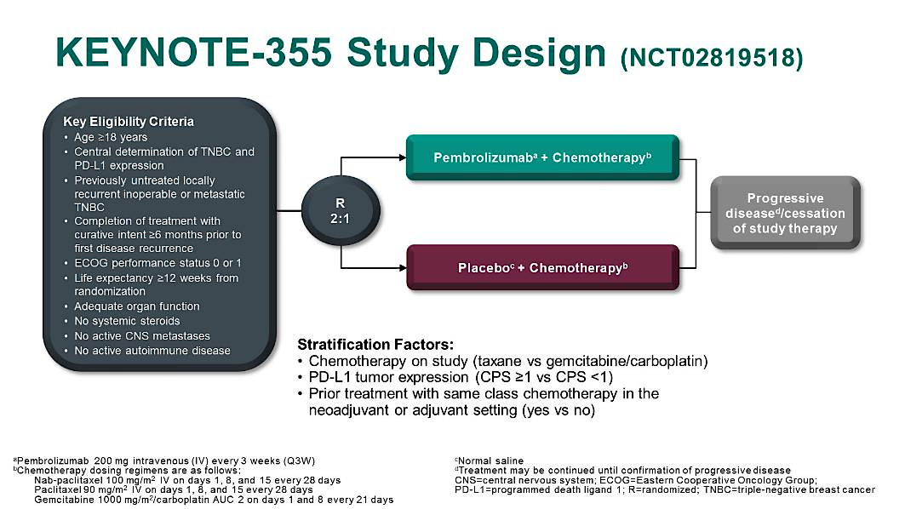
Phase 3 KEYNOTE-355: Design
Primary Endpoints:
PFS in PDL1+ (CPS≥10 and CPS≥1) and ITT
OS in same
Cortes J, et al. ASCO 2020. Abstract 1000. Cortes J, et al. Lancet. 2020;396:1817-1828.
Notes:
1 sided alpha at 2.5%
22% treated 6mo – 12mo from adjuvant therapy
~55% received gem/carbo;

Slide 4
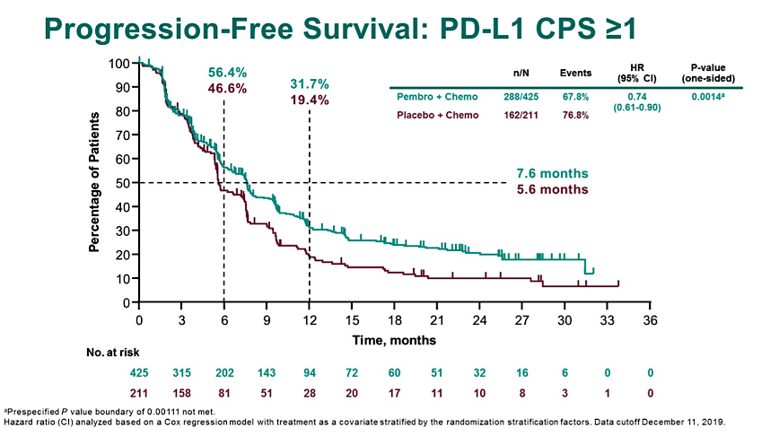
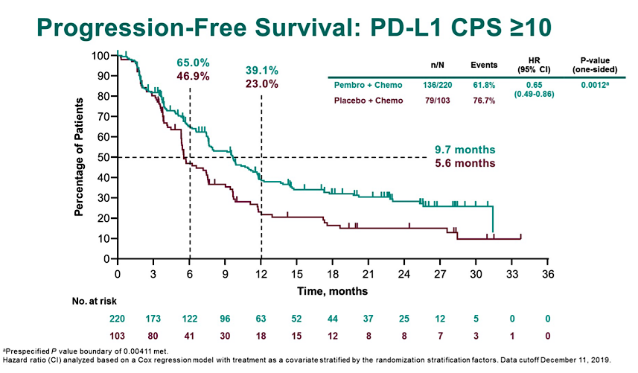
KEYNOTE-355 PFS by PD-L1 Expression
Cortes J et al. ASCO 2020. Abstract 1000.
Cortes J et al. Lancet. 2020;396(10265):1817-1828.

Slide 5
Median OS (mo)
Hazard Ratio
for Death
(95%)
Pembro +
Chemo
Placebo
+ Chemo
Subgroup
N
Overall
323
23.0
16.1
0.73 (0.55 to 0.95)
Age (years)
<65
257
21.8
16.8
0.78 (0.58 to 1.05)
≥65
66
28.3
12.6
0.51 (0.28 to 0.92)
Geographic region
N America/EU/ANZ
212
23.5
15.2
0.72 (0.52 to 1.00)
Asia
56
26.7
17.4
0.44 (0.23 to 0.84)
Rest of world
55
18.0
22.0
1.07 (0.57 to 1.98)
ECOG PS
0
196
26.4
19.8
0.70 (0.49 to 1.00)
1
127
17.7
10.6
0.70 (0.47 to 1.05)
On-study chemotherapy
Nab-paclitaxel
99
29.8
18.4
0.63 (0.39 to 1.03)
Paclitaxel
44
28.6
8.5
0.34 (0.16 to 0.72)
Gemcitabine-Carboplatin
180
19.1
16.2
0.88 (0.61 to 1.25)
Prior same-class chemotherapy
Yes
65
23.5
14.9
0.60 (0.32 to 1.09)
No
258
22.8
16.9
0.74 (0.55 to 1.00)
Prior (neo)adjuvant chemotherapy
Yes
193
20.3
17.1
0.86 (0.61 to 1.22)
No
130
28.3
13.0
0.53 (0.34 to 0.80)
Disease-free interval
de novo metastasis
104
26.4
12.5
0.54 (0.34 to 0.86)
<12 months
65
17.1
19.7
1.44 (0.73 to 2.82)
≥12 months
153
24.9
17.1
0.65 (0.45 to 0.96)
Number of metastatic sites
<3
184
32.1
18.8
0.63 (0.43 to 0.91)
≥3
138
13.2
10.5
0.75 (0.51 to 1.10)
0
1
2
3
Hazard Ratio (95% CI)
Favors
Pembro + Chemo
Favors
Placebo + Chemo
Rugo HS et al. ESMO 2021. Abstract LBA16.

Slide 6
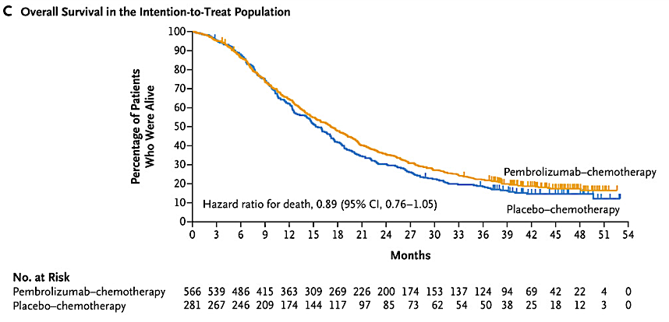
KN-355 Overall Survival in ITT
Cortes et al, N Engl J Med 2022;387:217-226, DOI: 10.1056/NEJMoa2202809, VOL. 387 NO. 3

Slide 7
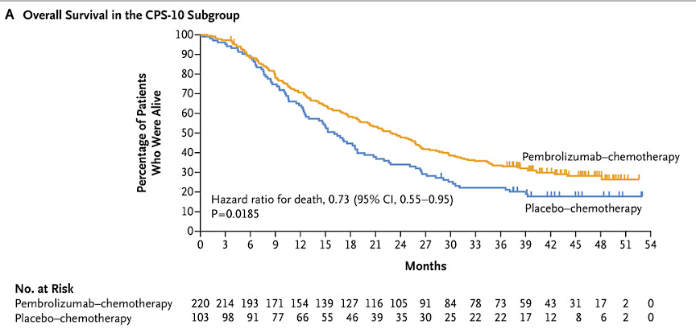
KN-355 Overall Survival in CPS>10
Cortes et al, N Engl J Med 2022;387:217-226, DOI: 10.1056/NEJMoa2202809, VOL. 387 NO. 3

Slide 8
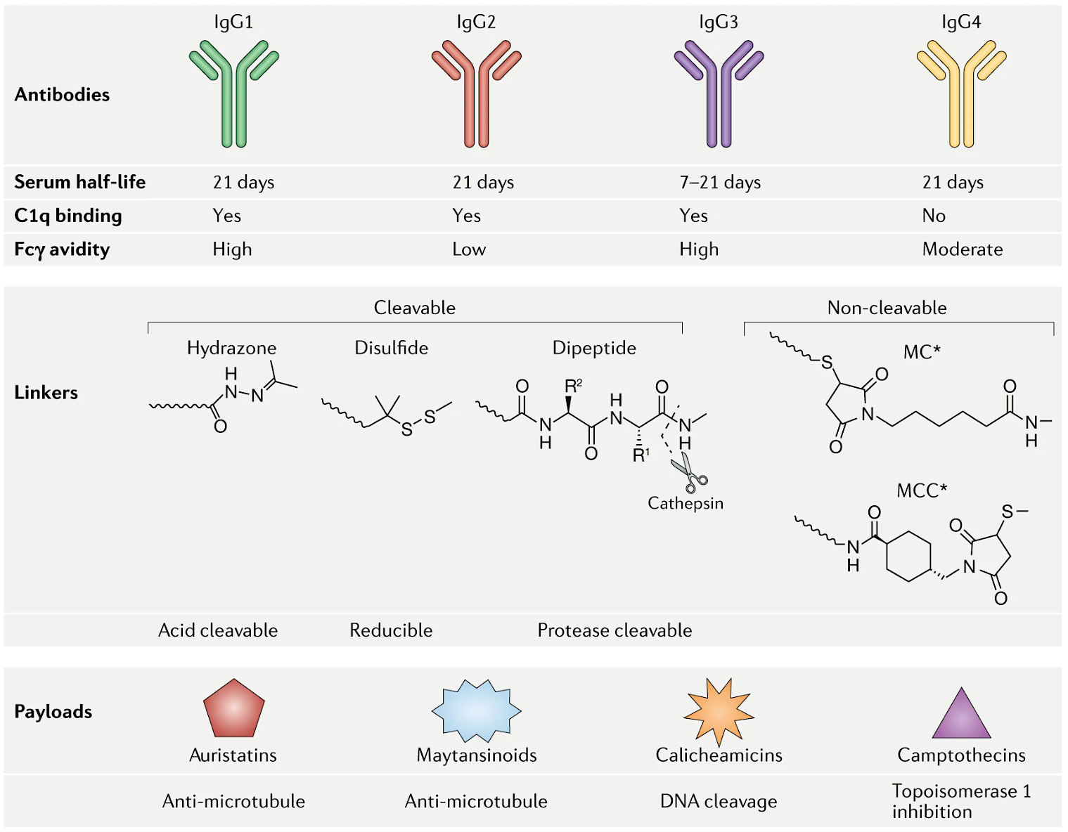
Sacituzumab: The first ADC in TNBC
Sacituzumab Govitecan
Anti-TROP2
SN-38
Drago JZ et al. Nat Rev Clin Oncol. 2021;18(6):327-344.

Slide 9
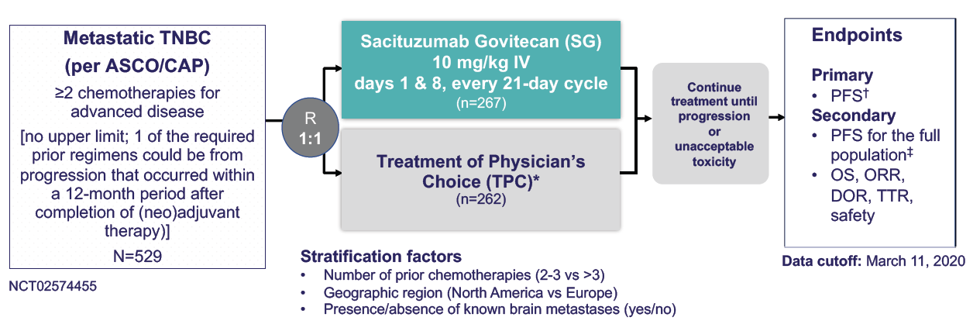
Randomized Phase 3 ASCENT Trial of Sacituzumab Govitecan vs TPC
* TPC options: capecitabine, eribulin, gemcitabine, vinorelbine
Bardia A, et al. N Engl J Med. 2021;384:1529-1541.
Notes:
≥2 priors, s/p taxane. No biomarker selection
mPFS 5.5 mo
mOS 12.7 mo
OR 34%

Slide 10
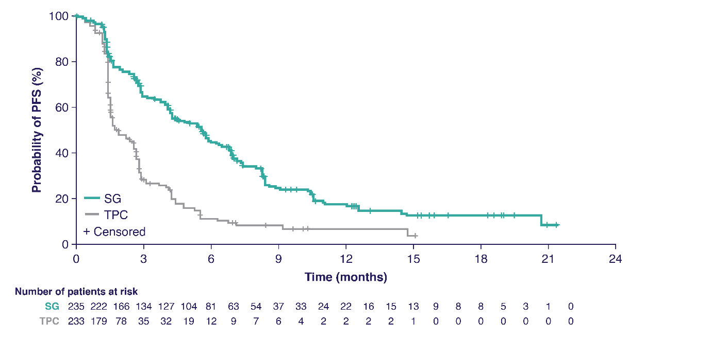
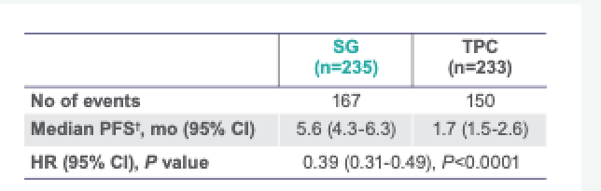
ASCENT: Sacituzumab Prolongs PFS by 60%
BICR Analysis | SG (n=235) | TPC (n=233)
No. of events | 166 | 150
Median PFS—mo (95% CI) | 5.6 (4.3-6.3) | 1.7 (1.5-2.6)
HR (95% CI), P-value | 0.41 (0.32-0.52), P<0.0001
Bardia A, et al. N Engl J Med. 2021;384:1529-1541; Bardia et al ASCO 2022

Slide 11
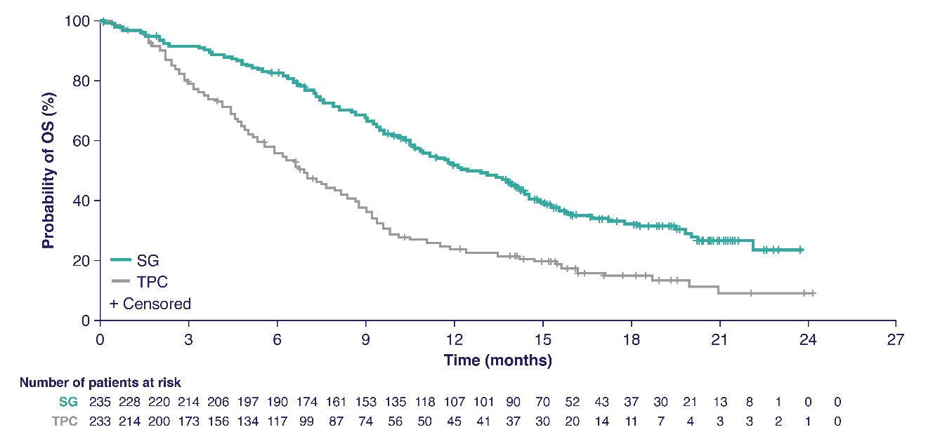
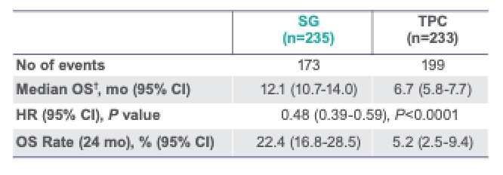
ASCENT: Sacituzumab Significantly Improves OS
 | SG (n=235) | TPC (n=233)
No. of events | 155 | 185
Median OS—mo (95% CI) | 12.1 (10.7-14.0) | 6.7 (5.8-7.7)
HR (95% CI), P-value | 0.48 (0.38-0.59), P<0.0001
Bardia et al. ESMO 2020. Abstract LBA17; Bardia et al ASCO 2022.

Slide 12
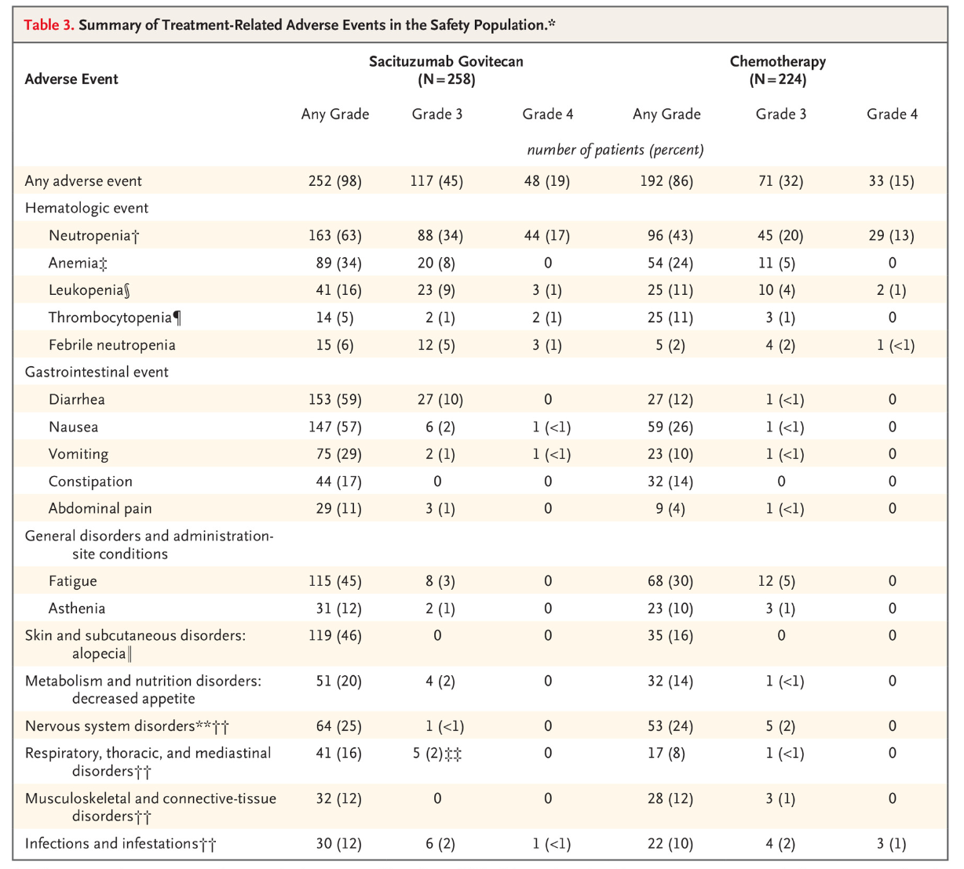
ASCENT: Sacituzumab
Govitecan Safety
Profile
Treatment-related discontinuation rates: Sacituzumab 4.7%,
TPC 5.4%
Bardia A, et al. N Engl J Med. 2021

Slide 13
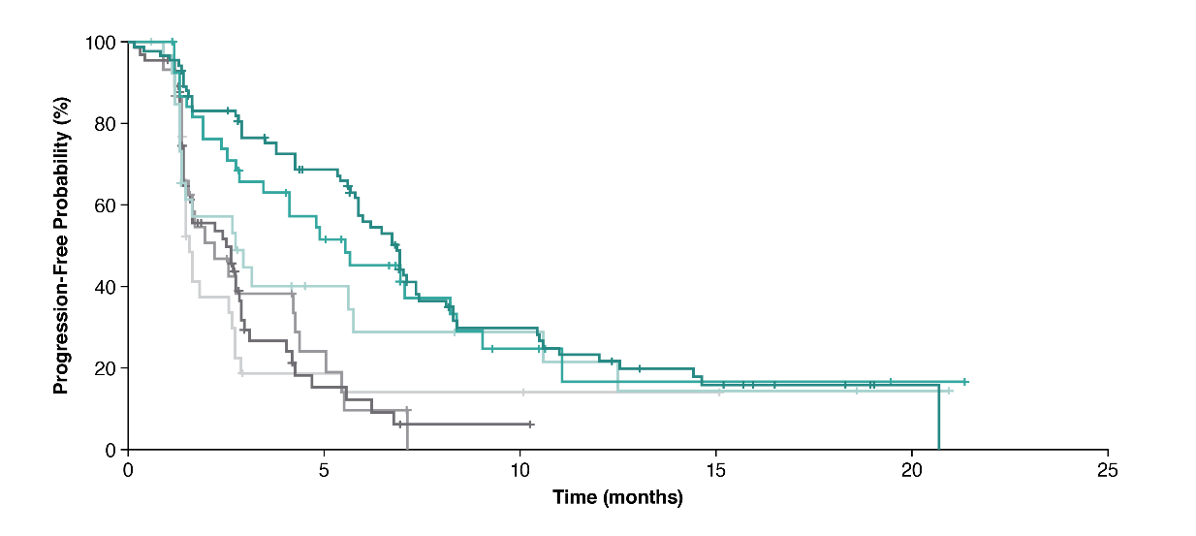
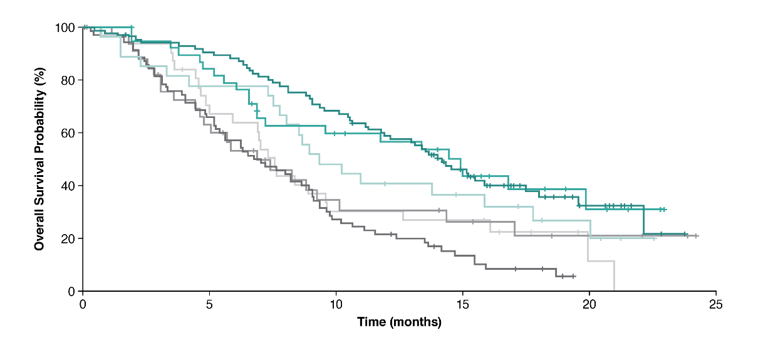
ASCENT: Efficacy by Trop-2 Expression
Progression Free Survival
Overall Survival
 | Events/Censored
SG – Trop-2 High | 60/25
SG – Trop-2 Medium | 26/13
SG – Trop-2 Low | 19/8
TPC – Trop-2 High | 47/25
TPC – Trop-2 Medium | 24/11
TPC – Trop-2 Low | 24/8
Bardia A, et al. Ann Oncol. 2021;32:1148-1156.
Notes:
Bardia A, et al. Ann Oncol. 2021;32:1148-1156.

Slide 14
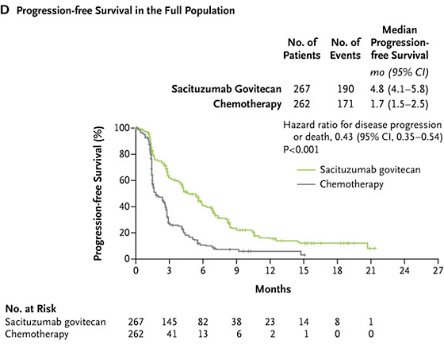
ASCENT: Efficacy Outcomes in Full Population (+ Brain Mets)
Bardia A, et al. N Engl J Med. 2021;384:1529-1541; Bardia et al. ESMO 2020. Abstract LBA17

Slide 15
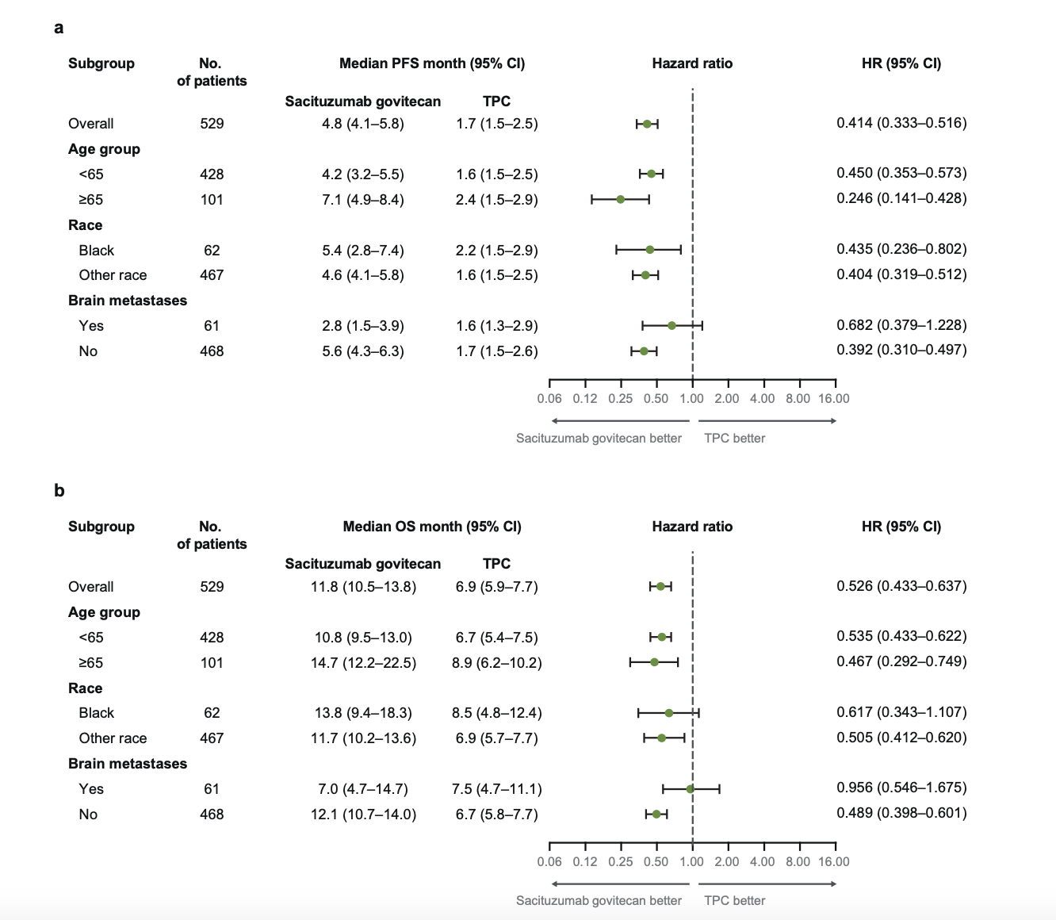
Brain met subset
(N=61; 12% of population)
mPFS 2.8mo for SG vs. 1.6m for TPC
mOS 6.8mo for SG vs. 7.5mo for TPC
ORR for SG vs. TPC 3% vs 0%
Safety profile similar to population without brain metastases for both study arms
Hurvitz et al npj Breast Cancer April 2024

Slide 16
Sacituzumab in mTNBC: Ongoing Trials
ASCENT-03
ASCENT-04
1st line metastatic TNBC
PD-L1 CPS <10 or PD-L1+ and prior immunotherapy
Randomized to SG vs. TPC (paclitaxel, nab-pac, gem/carbo)
Crossover permitted
Primary endpoint = PFS
1st line metastatic TNBC
PD-L1 CPS ≥ 10
Randomized to SG + pembrolizumab or TPC + pembrolizumab
Prior exposure to immunotherapy in early stage disease permitted
Crossover permitted
Primary endpoint = PFS
NCT05382299; NCT05382286

Slide 17
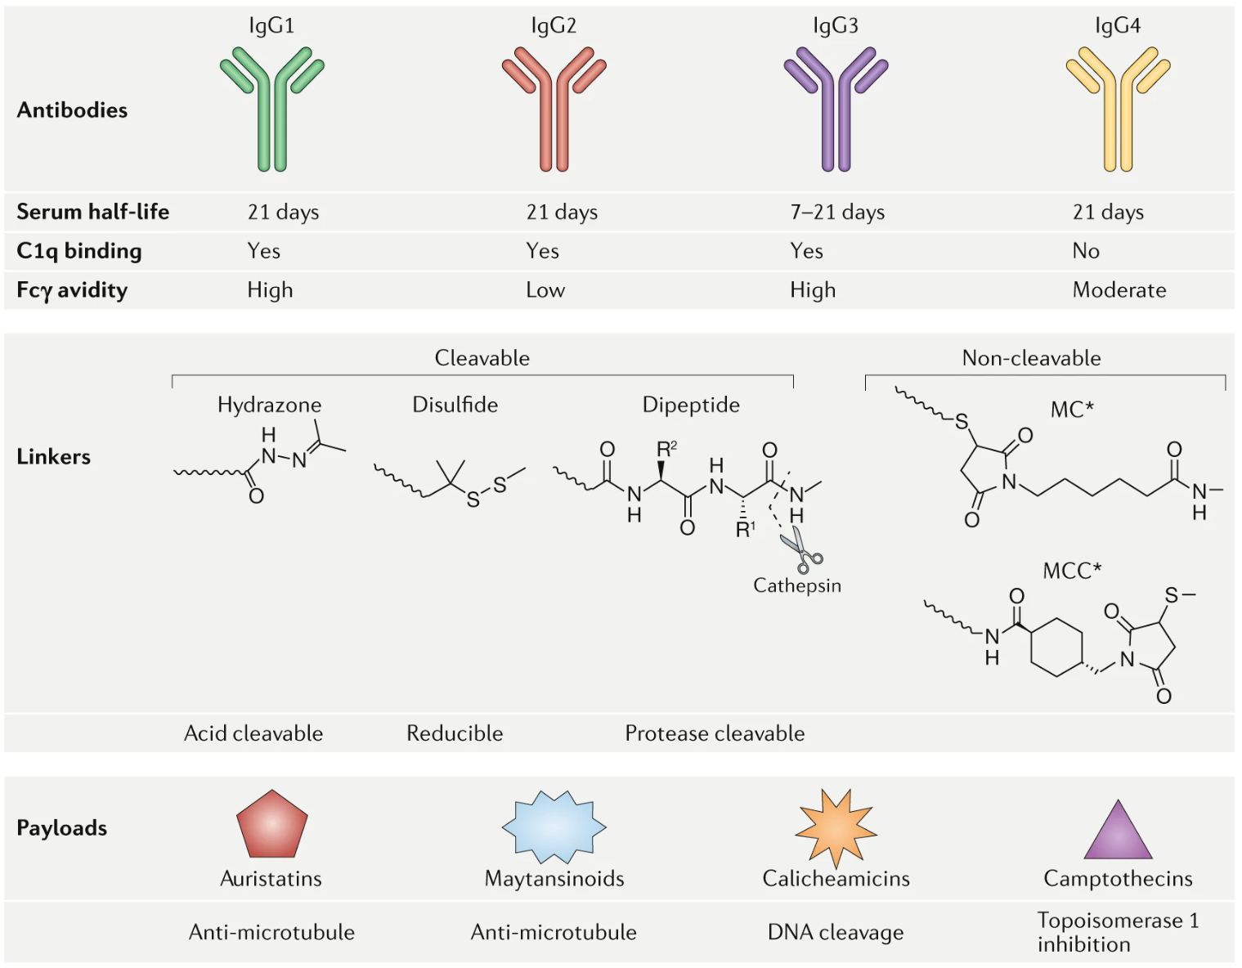
Trastuzumab deruxtecan in HER2-low BC
DXd
Drago JZ et al. Nat Rev Clin Oncol. 2021;18(6):327-344; Schettini ESMO Breast Virtual Meeting 2020 Abstr 23P
Notes:
High drug-to-antibody ratio: ~8
Stable linker-payload
Tumor-selectable cleavable linker
High potency, membrane-permeable payload with short systemic half-life
Bystander killing effect

Slide 18
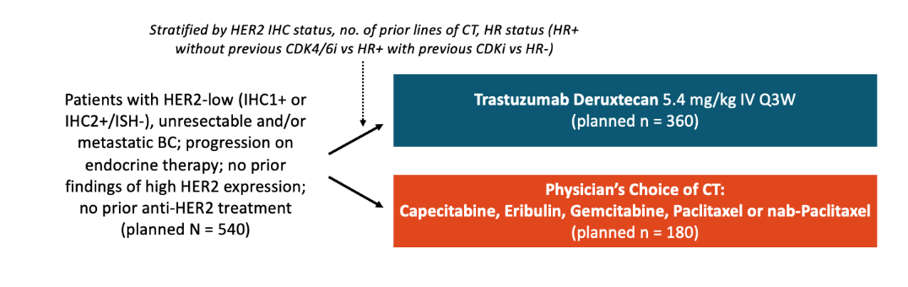
DESTINY-Breast04: T-DXd for HER2-Low MBC
Up to 2 prior lines in MBC
Key characteristics:
HER2 1+ 58%; HER2 2+ 42%
HR+ 89%, HR- 11%
Brain mets 5%
Prior CDK 64%, immunotherapy 6%
Median prior lines chemotherapy 1 (0-3)
Primary Endpoint: PFS in HR+
Secondary Endpoints:
PFS overall
OS in HR+
OS overall
Modi et al NEJM June 2022

Slide 19
DB04 Results
 | HR+ HER2-low N=494 | HR- HER2-low (”TNBC”) Exploratory (N=58)
PFS | Median 10.1m vs 5.4m HR 0.51 (0.40-0.64) P<0.001 | Median 8.5m vs 2.9m HR 0.46 (0.24-0.89)
OS | Median 23.9m vs 17.5m HR 0.64 (0.48-0.86) P=0.003 | Median 18.2m vs 8.3m HR 0.48 (0.24-0.95)
ORR | 52.6% vs 16.3% | 50% vs 16.7%
Modi et al NEJM June 2022

Slide 20
DESTINY-Breast04: PFS Updated Subgroup Analyses
No. of Events/No. of Patients
Median PFS (mo, 95% CI)ª
Hazard Ratio (95% CI)^{b}
T-DXd
TPC
T-DXd
TPC
Prior CDK4/6i use
Yes (n = 348)
149/233
74/115
10.0 (8.3-11.4)
5.4 (4.0-7.8)
0.55 (0.42-0.74)
(HR+ cohort)
No (n = 143)
60/96
35/47
11.7 (9.5-17.7)
5.9 (4.3-8.2)
0.42 (0.28-0.64)
Disease burden^{c}
Low (n = 235)
88/150
60/85
11.4 (9.8-16.2)
5.1 (3.1-7.3)
0.41 (0.30-0.58)
High (n = 322)
155/223
67/99
9.5 (7.5-10.1)
4.8 (2.9-6.9)
0.58 (0.43-0.78)
Rapid progression^{d}
Yes (n = 22)
9/14
6/8
8.2 (1.4-NE)
2.2 (0.6-NE)
0.38 (0.12-1.21)
No (n = 535)
234/359
121/176
9.9 (9.0-11.3)
5.3 (4.2-6.9)
0.51 (0.41-0.64)
HER2 IHC status
IHC 1+ (n = 321)
134/214
75/107
10.0 (8.6-12.3)
4.8 (3.0-7.0)
0.48 (0.36-0.63)
IHC 2+/ISH− (n = 236)
109/159
52/77
9.9 (8.0-11.5)
5.1 (2.9-7.1)
0.55 (0.39-0.76)
Prior lines of
1 (n = 321)
141/221
68/100
10.1 (8.4-12.2)
6.4 (4.3-7.8)
0.52 (0.39-0.70)
chemotherapy
2 (n = 234)
101/151
59/83
9.7 (8.1-11.4)
4.2 (3.0-5.4)
0.49 (0.35-0.68)
Age
<65 years (n = 426)
191/290
93/136
9.8 (8.4-11.1)
4.6 (2.9-5.9)
0.47 (0.37-0.61)
≥65 years (n = 131)
52/83
34/48
11.4 (8.3-13.3)
6.2 (4.3-10.8)
0.57 (0.36-0.89)
Baseline CNS
Yes (n = 32)
18/24
6/8
8.1 (4.0-11.3)
4.8 (0.6-11.0)
0.71 (0.28-1.80)
metastases
No (n = 525)
225/349
121/176
10.1 (9.5-11.5)
5.1 (4.2-6.8)
0.49 (0.39-0.62)
Prior anthracycline
Yes (n = 342)
155/239
81/113
9.8 (8.5-11.7)
5.3 (3.0-7.9
0.53 (0.40-0.70)
treatment^{e}
No (n = 205)
88/134
46/71
10.0 (7.2-12.5)
4.6 (3.0-6.8)
0.46 (0.32-0.66)
0.0
0.5
1.0
1.5
2.0
Hazard ratio (T-DXd vs TPC)
Favors T-DXd
Favors TPC
Harbeck N et al. Presented at: San Antonio Breast Cancer Symposium 2022; December 5-9, 2022; San Antonio, TX. Poster P1-11-0.

Slide 21
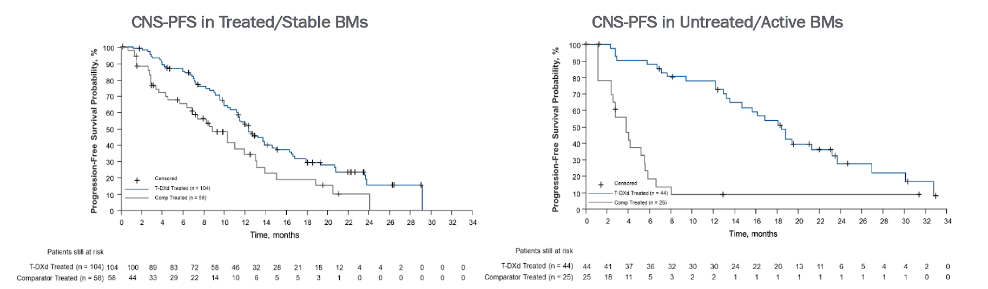
Pooled Analysis DB01, DB02, DB03: T-DXd in HER2+ Brain Mets
mCNS-PFS 12.3m vs 8.7m
HR 0.59 (0.39-0.89)
mCNS-PFS 18.5m vs 4.0m
HR 0.19 (0.11-0.35)
Hurvitz et al ESMO 2023 Abstr 3770

Slide 22
DESTINY-Breast04:
Adverse Events of Special Interest
FAS
Median duration of follow-up:
32 months
AESI | Trastuzumab Deruxtecan | Treatment of Physician Choice
 | n=373 | n=184
Grade >3 Adverse Events, Total % | 54.4% | 67.4%
All-Grade
Nausea | 76.0% | 30.2%
Vomiting | 40.7% | 13.4%
Decreased Neutrophil Count | 22.1% | 36.0%
ILD or Pneumonitis, n (%): Primary Data Cutoff: 01.11.2022 | 45 (12.1%) | 1 (0.6%)
ILD
All grade 12%
Gr 1 3.5%
Gr 2 6.5%
Gr 3 1.3%
Gr 5 0.8%
Median Treatment Duration
Trastuzumab deruxtecan: 8.2 months (range, 0.2-39.1 months)
Treatment of Physician Choice: 3.5 months (range, 0.3-19.7 months)
Modi S, et al. N Engl J Med. 2022;387:9-20.
Modi S, et al. ESMO 2023

Slide 23
DESTINY-Breast06: T-DXd in 1st Line
HR+ HER2-Ultralow Advanced/Metastatic Breast Cancer
Randomized, open-label phase III study
Stratified by: prior CDK4/6 inhibitor; HER2 IHC 2+ vs 1+ vs 0; prior taxane in non-metastatic setting.
Patients with advanced/metastatic breast cancer with progression on 2 previous endocrine therapy; restricted to HR+
Disease; HER2 IHC* 0+, 1+, or 2+ based on central IHC assessment at diagnosis of first metastatic disease or later
(N = 850)
T-DXd
(n = 425)
Until PD or toxicity
Chemotherapy
(n = 425)
*Investigator’s choice chemotherapy may consist of capecitabine, paclitaxel, or nab-paclitaxel.
Primary endpoint: PFS (per BICR) in HER2 IHC 1+/2+
Key secondary endpoints: OS in HER2 IHC 1+/2+ population, PFS and OS in ITT
Secondary endpoints: PFS (per INV) in HER2 1+/2+, ORR and DoR in HER2 1+/2+and ITT, safety and tolerability, symptoms, functioning and QoL
Exploratory: OS in HER2 IHC 1+/2+ population
*HER2 IHC 0+ defined by any IHC staining up to 10% of tumor cells. Futility analysis in HER2 IHC 0+ cohort will be done.
NCT04494425.
Notes:
BC, breast cancer; HR, hormone receptor positive; ITT, intention to treat;.

Slide 24
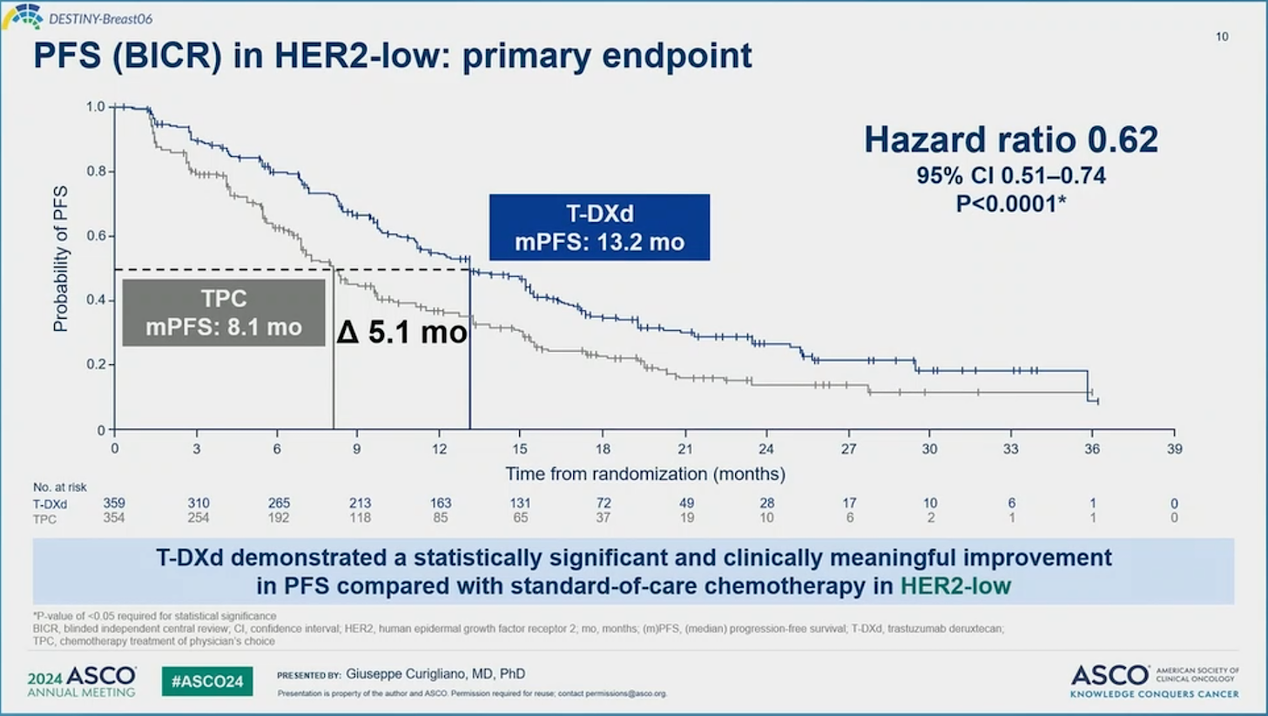

Slide 25
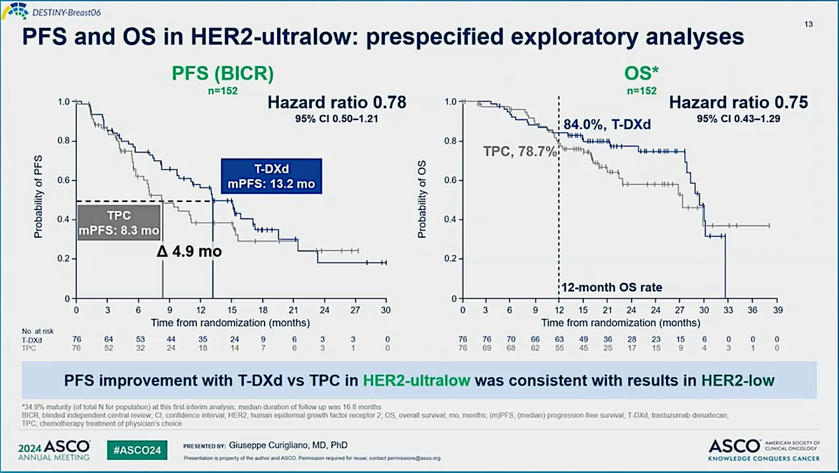
Notes:
Will this be duplicated in TNBC HER2 ultralow?

Slide 26
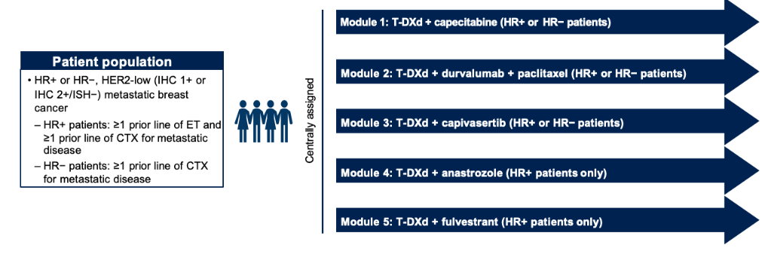
Phase 1b DESTINY-Breast08:
T-DXd Combinations in HER2-Low MBC
Part 1: Dose Finding
Jhaveri K, et al. SABCS 2020. Abs OT-03-05 (NCT04556773).

Slide 27
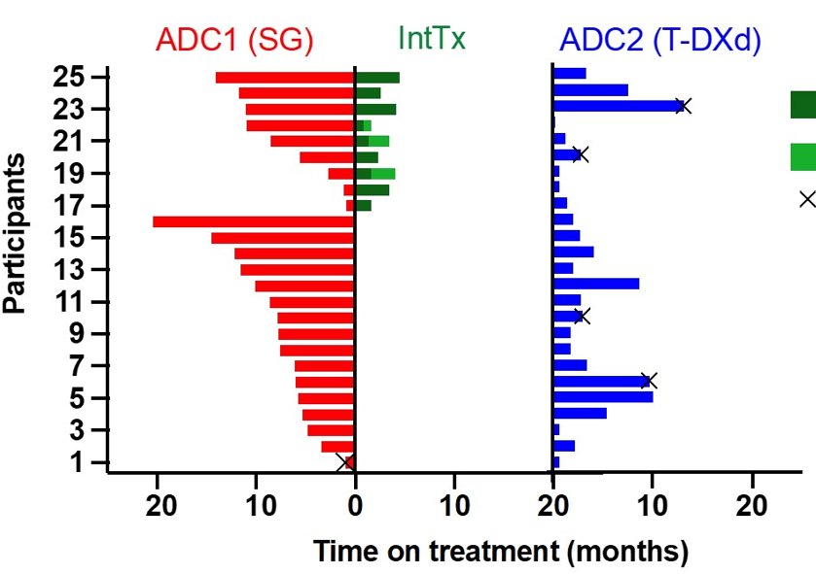
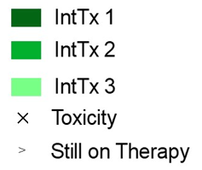
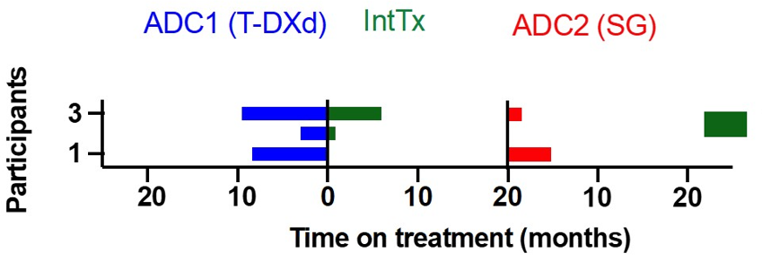
Retrospective Study of Sequential ADC Use in Patients With
HER2-Low MBC: Efficacy
HR–/HER2-Low (n=28)
SG→T-DXd (n=25)
T-DXd→SG (n=3)
n=25 | ADC1 (SG) | ADC2 (T-DXd)
mrwPFS, mo | 7.7 | 2.8
mrwOS, mo | 16.2 | 6.5
Huppert L, et al. ASCO 2024. Abstract 1083.

Slide 28









The BEGONIA Study (NCT03742102)
Rationale Study Design
Immune checkpoint inhibitors + chemotherapy is the standard of care for patients with PD-L1 positive a/mTNBC; still, most progress within a year (median PFS ~9–10 months)^{1,2}
BEGONIA is evaluating combinations of durvalumab (D), an anti−PD-L1 antibody, with other novel therapies in first-line a/mTNBC
Dato-DXd is a TROP2-directed ADC with a TOPO I inhibitor payload and a tumour- selective cleavable linker³
At median 7.2 months follow-up, ORR was 74% for patients treated with Dato-DXd + D in BEGONIA⁴
Eligibility criteria Treatment arms Part 1
Part 2 expansion
Females aged ≥18 years
Unresectable a/mTNBC
No prior treatment for Stage IV TNBC
≥12 months since prior
taxane therapy
ECOG PS 0-1
Adequate organ function
Measurable disease per RECIST v1.1
No prior treatment with checkpoint inhibitor
No prior treatment with TOPO I-based ADCª
Arm 1: Paclitaxel (P) + D (N=20)
Arm 2: Capivasertib + P + D (N=30)
Arm 5: Oleclumab + P + D (N=30) Arm 6: T-DXd + D (N=30)
Arm 7: Dato-DXd 6 mg/kg + D 1120 mg (N=30)
Q3W until PD
Safety run-in (up to
6 patients)
Simon
2-stage futility analysis for
Part 2 expansion^{c}
Arms that meet expansion criteria enroll additional 27 patients
Arm 8: Dato-DXd + D, PD-L1
positive (N=30)^{b}
1° endpoints: Safety and tolerability 2° endpoints: ORR, PFS, DoR, OS
1° endpoint: ORR
2° endpoints: PFS, DoR, PFS6, OS
ªADC-cohort-specific criteria. ^{b}Currently enrolling; a safety run-in will not occur for this arm as Dato-DXd + D was already evaluated and found to be tolerable with no dose-limiting toxicities reported. ^{c}Novel treatment combinations may enter Part 2 expansion if confirmed ORR is at least 57%.
1. Cortes J, et al. Lancet. 2020;396(10265):1817-1828. 2. Emens LA, et al. J Natl Cancer Inst. 2021;113(8):1005-1016. 3. Bardia A, et al. Presented at SABCS 2022. P6-10-03. 4. Schmid P, et al. Presented at SABCS 2022. PD11-09.
ADC, antibody-drug conjugate; a/mTNBC, advanced/metastatic triple-negative breast cancer; Dato-DXd, datopotamab deruxtecan; DoR, duration of response; D, durvalumab; ECOG PS, Eastern Cooperative Oncology Group performance status; ORR, objective response rate; OS, overall survival; PD, progressive disease; PD-L1, programmed death ligand-1; PFS, progression-free survival; PFS6, progression-free survival at 6 months; Q3W, every 3 weeks; RECIST, Response Evaluation Criteria In Solid Tumors; T-DXd, trastuzumab deruxtecan; TOPO I, topoisomerase I; TROP2, trophoblast cell-surface antigen 2.
Notes:
Eligibility criteria:
Metastatic TNBC
No prior treatment for MBC
> 12m DFI
Measurable disease
Normal organ function and no contraindication to IO
For TDxd cohort:
HER2 low
No pulmonary disorders

Slide 29
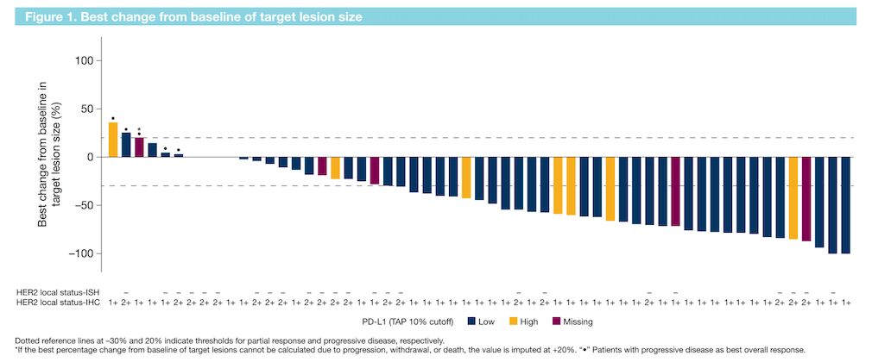
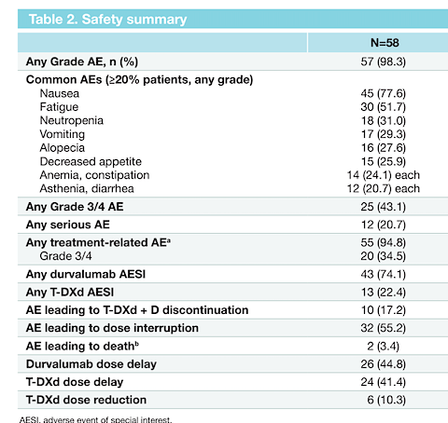
BEGONIA Cohort 6 – T-DXd + Durvalumab
ORR 57%
CR 1.7%
mPFS 12.6 months
Discontinuation rate 17%
T-DXd delay or reduction in 51%
* 8 cases of ILD (1 Gr 5)
N=56
T-DXd 5.4mg/kg q3 weeks +
Durva 1120mg IV q3 weeks
Schmidt et al SABCS Poster 2022
Notes:
Responses shown in both PDL1 low and high
And in HER2 1+ (~60%) 2+ (~40%)

Slide 30

Datopotamab Deruxtecan (Dato-DXd): TROP2 Antibody–Drug Conjugate
Dato-DXd ADC:
  A humanized anti- TROP2 IgG1 mAb
  Attached to topoisomerase I inhibitor payload (exatecan derivative)
  Tetrapeptide-based cleavable linker
Cysteine residue
Drug linker
O
H N
O
H N
O
H
N O
O
N
N
N H
NH
H
O
O
O
H _{O} H
O
N
O
H
O CH₃
H C
N
HO
Cleavable tetrapeptide-based linker
3
F
Payload (DXd)
Exatecan derivative
Heist. WCLC 2019. Abstract 3854. Krop. SABCS 2019 Abstr GS1-03.
Notes:
Targets TROP2
Lower DAR than TDxd

Slide 31
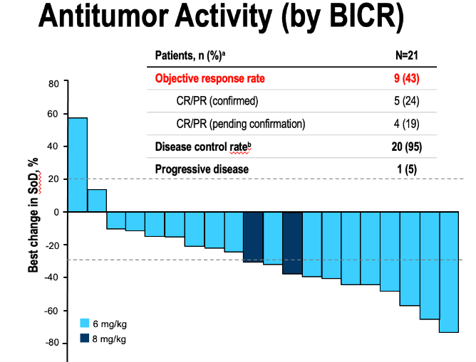
TROPION-PanTumor01
Dato-DXd Efficacy Signal
71% had ≥3 prior lines
8% had prior sacituzumab
Preferred Term, n (%)ª | N=24
 | Any grade | Grade ≥3
TEAEs | 24 (100) | 8 (33)
Stomatitis | 15 (63) | 3 (13)
Nausea | 15 (63) | 0
Fatigue | 10 (42) | 1 (4)
Vomiting | 10 (42) | 0
Alopecia | 6 (25) | –
Cough | 5 (21) | 0
Pruritus | 5 (21) | 0
Anemia | 4 (17) | 1 (4)
Headache | 4 (17) | 0
Constipation | 4 (17) | 0
Bardia A, et al. ESMO 2021. Ann Oncol. 2021;32 (suppl_2):S60-S78.
Notes:
ORR was 43% (9 PRs)
DCR was 95% (20/21 pts)
Dose reductions due to AEs occurred
in 6 patients (25%)
No grade ≥ 3 diarrhea or decreased neutrophil count/neutropenia
No cases of TX-related ILD (adjudicated) were observed

Slide 32
BEGONIA Arm 7: Dato-DXd + Durvalumab
Antitumour Responses in 1L a/mTNBC
Confirmed ORR was 79% (49/62; 95% CI, 66.8–88.3) with 6 CR and 43 PR
  Antitumour responses were observed regardless of PD-L1 expression level as assessed by 2 separate PD-L1 assays and scoring methods
100
50
*
Best change from baseline
in target lesion size (%)
0
–50
#
H High
L Low
U Unknown/Missing
–100
#
PD-L1
expression
SP263 PD-L1 TAP 10% cutoff
22C3 PD-L1 CPS 10 cutoff
L
L
L
L
L
L
H
H
L
L
L
L
L
L
L
L
H
H
L
L
L
L
H
H
H
H
L
L
L
L
L
L
L
L
L
L
U
U
L
L
L
L
L
L
L
L
L
L
L
L
L
L
L
L
H
H
L
L
L
L
L
L
L
L
L
L
L
L
L
L
L
L
L
L
H
H
L
L
L
H
L
L
L
L
L
L
L
L
L
L
L
L
L
L
L
L
L
L
L
L
L
L
L
L
L
L
L
L
L
L
L
L
L
L
L
H
L
L
H
H
L
L
L
L
Progressive disease
Stable disease
Not evaluable
Partial response
Complete response
Schmid et al. ESMO 2023
Notes:
Discontinuation due to AE = 6.6%
Common AEs of any grade include:
Nausea 57%
Mucositis 56%
Alopecia 45%

Slide 33
BEGONIA Arm 7: Dato-DXd + Durvalumab
Adverse Events
Most frequently reported adverse events (≥15%) (N=62)
  The most common AEs were gastrointestinal and generally of low grade (Table)
  Stomatitis was the most common AE leading to Dato-DXd dose reduction (11 patients)
  There were 3 (5%) adjudicated treatment-related ILD/pneumonitis events (2 grade 2 events, 1 grade 1 event)
  Limited rates of diarrhea (13% any grade, 1 grade 3 event) and neutropenia (5% any grade, 1 grade 3 event) were reported
  The most frequent AESIs for Arm 7 were stomatitis (65%), rash (32%), dry eye (21%), hypothyroidism (14.5%), and keratitis* (14.5%)
AE preferred term | Any grade, n (%) | Grade 3/4, n (%)
Nausea | 40 (65) | 0
Stomatitis | 40 (65) | 7 (11)
Alopecia | 31 (50) | 0
Constipation | 29 (47) | 1 (2)
Fatigue | 28 (45) | 1 (2)
Rash | 20 (32) | 0
Vomiting | 16 (26) | 1 (2)
Amylase increased | 13 (21) | 11 (18)
COVID-19 | 13 (21) | 0
Dry eye | 13 (21) | 0
Decreased appetite | 12 (19) | 1 (2)
Pruritus | 10 (16) | 0
Cough | 10 (16) | 0
*1 grade 1 event, 3 grade 2 events, 5 grade 3 events.
AE, adverse event; AESI, adverse event of special interest; ILD, interstitial lung disease.
Data cutoff: 02 Feb 2023

Slide 34
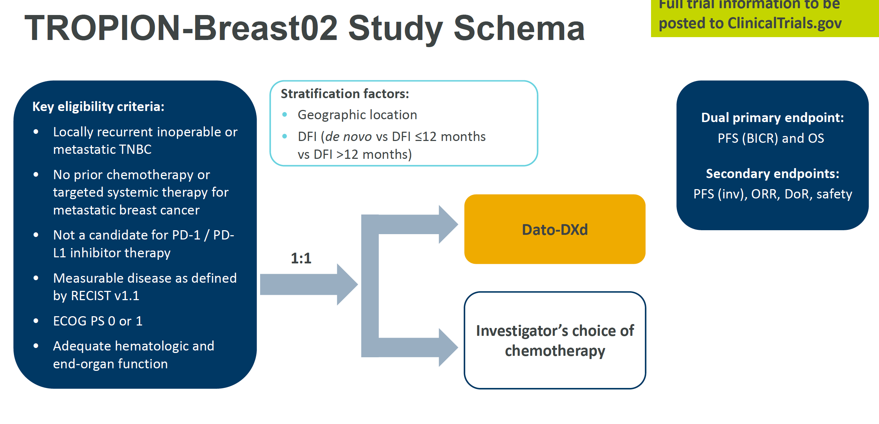
ER/PR <1%
Contraindication
Prior adjuvant IO
No access to drug
N=600
Requires central confirmation of PDL1
Paclitaxel
Nab-paclitaxel
Carboplatin
Capecitabine
Eribulin
If no prior taxane or taxane >12 mo prior
DFI <12 mo cohort closed
If prior taxane or <12mo DFI
PI: Tiffany A. Traina

Slide 35
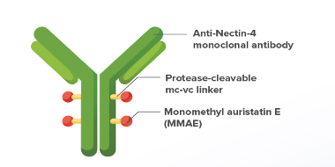
EV-202: Enfortumab vedotin
Patient Population
Locally advanced or metastatic BC
Prior taxanes or anthracyclines
≥ 1 standard-of-care cytotoxic regimen and ≤ 2 lines of cytotoxic therapy for locally advanced or metastatic BC
HR+/HER2- BC
Prior endocrine treatment with or without a CDK4/6 inhibitor
Endpoints
Primary: Investigator-assessed confirmed ORR per RECIST v1.1
Secondary: DOR, DCR, and PFS per RECIST v1.1, OS, safety / tolerability
Exploratory: Nectin-4 expressionª
EV 1.25 mg/kg IV on
Days 1, 8, 15 of each
28-day cycle
TNBC
Prior PD-1/L1 inhibitor based on PD-L1 expression
Treatment until disease progression or discontinuation criteria are met
Disease assessment was performed at screening/baseline and repeated every 8 weeks (56 days ± 7 days) from the first dose of study treatment throughout the study until the patient had radiologically-confirmed disease progression, initiated a new subsequent anticancer therapy, died, withdrew consent, was lost to follow-up, or the study closed, whichever came first. A confirmatory imaging scan was required 4 weeks (28 days + 7-day window) after the first response. After 1 year on study treatment, the frequency of response assessments was reduced to every 12 weeks (84 days ± 7 days). ªNectin-4 expression was not required for study enrollment but was assessed retrospectively.
Giordano A….Traina TA Abstract 1005 ASCO 2024
Notes:
Nectin-4 is a cell-adhesion molecule highly expressed in solid malignancies¹
Enfortumab vedotin (EV) is a Nectin-4–directed antibody–drug conjugate²
EV is indicated for the treatment of adult patients with locally advanced or metastatic urothelial carcinoma³
EV-202 (NCT04225117) is a multicenter, multicohort, open-label, phase 2 study evaluating EV in patients with locally advanced or metastatic solid tumors⁴
Here we present the results for the HR+/HER2− breast cancer and triple-negative breast cancer (TNBC) cohorts

Slide 36
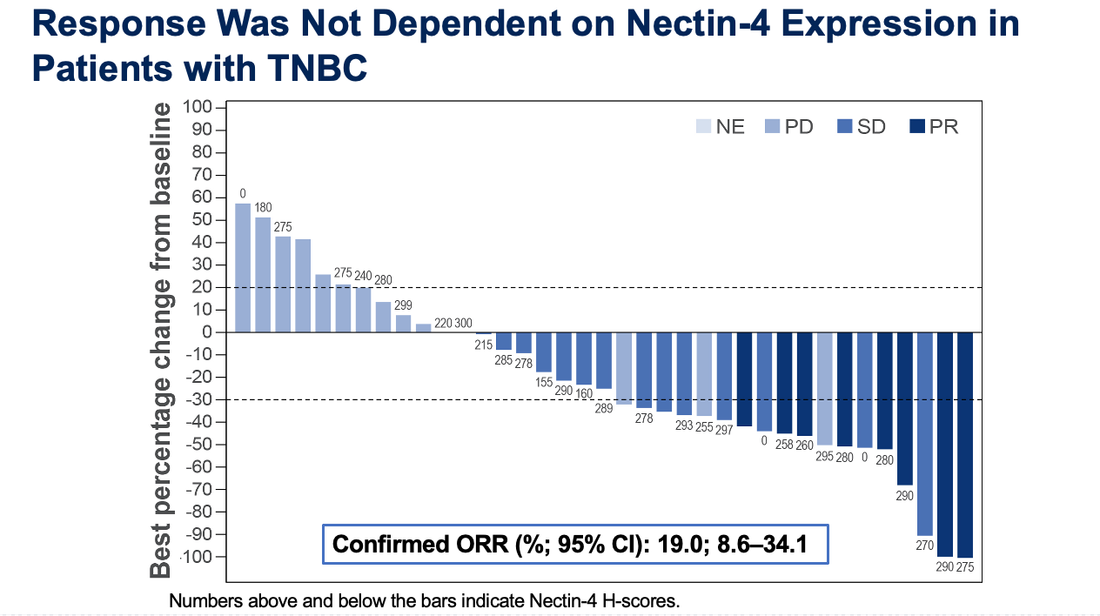
EV-202: Enfortumab vedotin in TNBC
N=42
Median 2 prior lines of chemotx
CBR 57%
Median PFS (months; 95% CI): 3.52; 2.10–4.63
Median OS (months; 95% CI): 12.91; 10.28–NE
Giordano A….Traina TA Abstract 1005 ASCO 2024

Slide 37
EV-202: Treatment-Related Adverse Events
Parameter | HR+/HER2- Breast Cancer n=45 |  | Triple-Negative Breast Cancer n=42
 | Any Grade | Grade ≥3 | Any Grade | Grade ≥3
TRAEs, overall, n (%) | 45 (100.0) | 20 (44.4) | 41 (97.6) | 12 (28.6)
TRAEs in ≥15% of participants for either cohort, n (%)
Fatigue | 20 (44.4) | 0 | 12 (28.6) | 0
Pruritis | 19 (42.2) | 3 (6.7) | 14 (33.3) | 1 (2.4)
Rash maculopapular | 18 (40.0) | 7 (15.6) | 13 (31.0) | 1 (2.4)
Nausea | 17 (37.8) | 1 (2.2) | 16 (38.1) | 1 (2.4)
Dysgeusia | 10 (22.2) | 0 | 13 (31.0) | 0
Diarrhea | 10 (22.2) | 1 (2.2) | 5 (11.9) | 0
Dry skin | 10 (22.2) | 0 | 11 (26.2) | 0
Alopecia | 9 (20.0) | 0 | 12 (28.6) | 0
AST increased | 8 (17.8) | 3 (6.7) | 10 (23.8) | 2 (4.8)
ALT increased | 8 (17.8) | 1 (2.2) | 9 (21.4) | 1 (2.4)
Decreased appetite | 7 (15.6) | 0 | 10 (23.8) | 0
Peripheral sensory neuropathy | 7 (15.6) | 1 (2.2) | 9 (21.4) | 0
Constipation | 7 (15.6) | 0 | 3 (7.1) | 0
Anemia | 4 (8.9) | 0 | 7 (16.7) | 0
Giordano A….Traina TA Abstract 1005 ASCO 2024
Notes:
Annotations:
[Any grade TRAE, HR+/HER2- column] [7465-CL-202 Primary Analysis Cohort 1_Final/Slide 35]
[Any grade TRAE, TNBC column] [7465-CL-202 Primary Analysis Cohort 2_Final/Slide 35]
[Any-grade TRAE, in ≥15 % of participants for either cohort, HR+/HER- BC column] [7465-CL-202 Primary Analysis Cohort 1_Final/Slide 36; for anemia, see 7465-cl-202_Cohort1_PA_Tables_16FEB2023_Linearized, pg 542]
[Any-grade TRAE, in ≥15 % of participants for either cohort, TNBC column] [7465-CL-202 Primary Analysis Cohort 2_Final/Slide 36; for diarrhea and constipation, see 7465-cl-202_Cohort2_7_PA_Tables_26MAY2023_Linearized, pg 596]
[Grade ≥ 3 TRAEs, HR+/HER- BC column] [7465-cl-202_Cohort1_PA_Tables_16FEB2023_Linearized, pg 873-878]
[Grade ≥ 3 TRAEs, overall, TNBC] [7465-cl-202_Cohort2_7_PA_Tables_26MAY2023_Linearized, pg 935-939]

Slide 38
TBCRC 048: “Olaparib expanded”
Benefit in gPALB2 + sBRCA
PALB2 N=26 | sBRCA1/2 N=30 | ATM & CHEK2 N=17
Germline: 18/24 ORR 75% CBR @ 18w 83% mPFS 9.6 mo Somatic: 0/2 – both SD* | 11/30 ORR 37% CBR 53% mPFS 5.6mo | 0/13 germline 0/4 somatic
Tung N, et al. Abstract 1021 ASCO 2024; ASCO 2020
Notes:
Stats required an ORR >30%
PALB2 3 were TNBC
BRCA 4 were TNBC

Slide 39
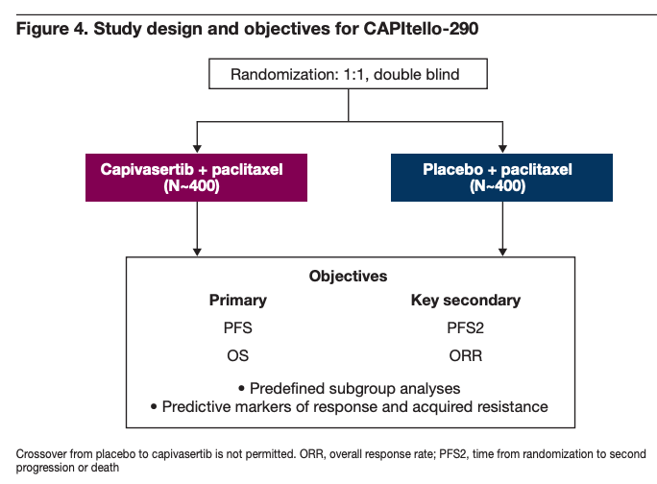
CAPItello-290: Capivasertib in mTNBC
June 18, 2024
AstraZeneca Press Release:
“The CAPItello-290 Phase III trial for capivasertib with paclitaxel….did not meet the dual primary endpoints of improvement in overall survival … in either the overall trial population or in a subgroup of patients with tumors harboring specific biomarker alterations (PIK3CA, AKT1, or PTEN).”

Slide 40
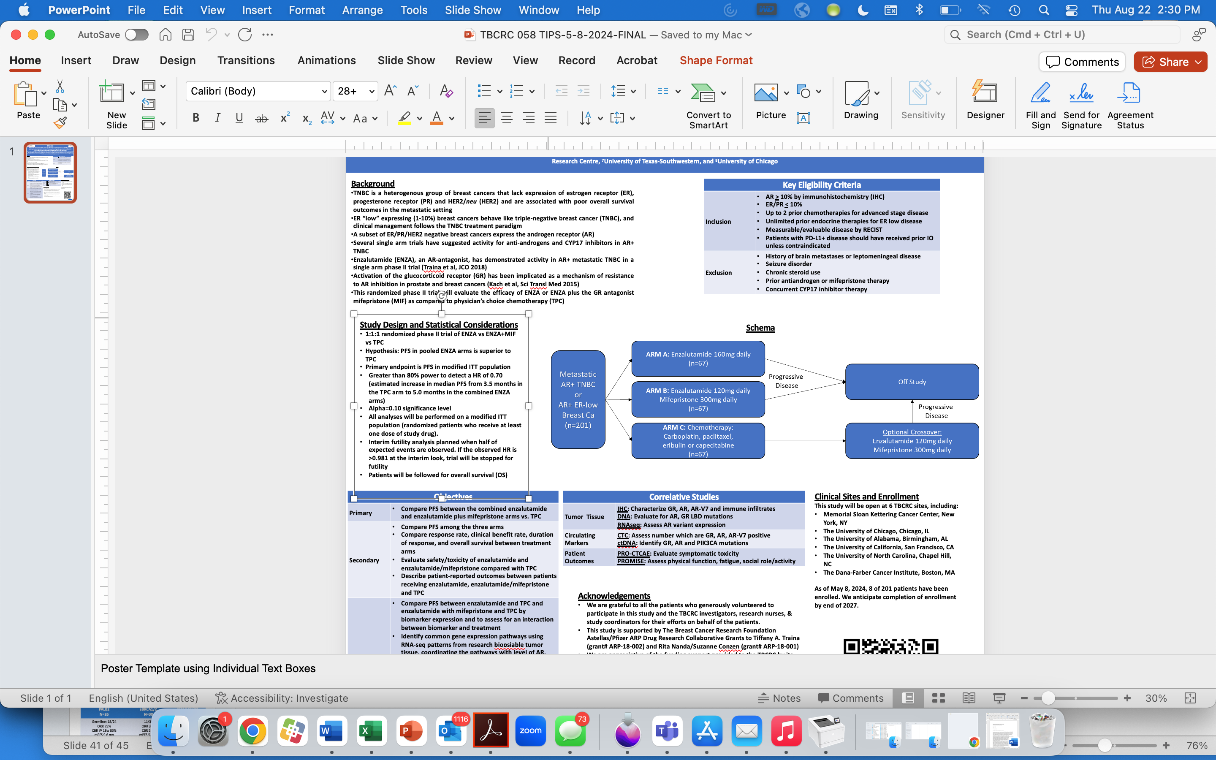
TBCRC 058:
Targeting AR in TNBC and ER-low MBC
Traina et al ASCO 2024

Slide 41
Cases

Slide 42
mTNBC 1L PD-L1+
62yo germline wildtype
2019 cT2N0 ER 30% HER2 neg BC
Neo weekly paclitaxel c/b allergy → changed to weekly nab-paclitaxel but had clinical progression after 5 doses
Changed to ddAC x4
6/2019 Left total mastectomy + SNB → IDC 2mm, mod diff, 0/2LN neg. ypT1aN0
Adjuvant Capecitabine x 6 months
November 2020
Elevated tumor markers prompted imaging with CT CAP: mediastinal lymphadenopathy ranging in size from 2.1 to 3.4 cm
12/2020 Endobronchial biopsy of LN = PD IDC TNBC PDL1 CPS>10
1/19/21 While in screening for 1st line clinical trial, MRI brain detected multiple CNS metastases with edema
s/p VP shunt insertion and WBXRT
2/23/21 Begin gemcitabine, carboplatin and pembrolizumab
CR on first set of scans!
8/26/21 Gemcitabine discontinued in setting of thrombocytopenias. Continued on Carboplatin q3 weeks and Pembro
12/2022 Carbo/Pembro dose held due to traumatic C1 and wrist fracture after a fall, requiring neurosurgery for spinal stabilization 12/26/22.
Resumed Carbo/Pembro Jan 2023 → Discontinued Carboplatin June 2023 due to cumulative toxicity and risk/benefit consideration.
August 2024 Remains NED on imaging! Continues on Pembrolizumab alone.
Notes:
AS

Slide 43
TNBC with short DFI
39yo who palpated right breast masses in November 2023 with nipple inversion.
Work up confirmed cT2N1 TNBC (HER2 0). No evidence of distant disease.
Germline genetic testing wildtype
Underwent fertility preservation
Jan 2024 started KN522 regimen.
  Clinical POD after 7 of 12 paclitaxel/carboplatin/pembro
  Changed to ddAC/pembro → brought to surgery after AC#3 due to clinical concern for progression.
May 2024 s/p bilateral mastectomies: RIGHT breast ypT2N1a (IDC, multifocal, largest tumor 3.8cm, grade III, foci 20-80% cellularity, 2/12 LN with macromet 6mm).
While planning for PMRT and screening for adjuvant trials, she was hospitalized with headaches and visual changes.
MRI brain with new CNS metastases, dominant mass causing shift. s/p Craniotomy with path consistent with her primary ER/PR 0% HER2 1+ AR 30% PDL1 <10
s/p Regional RT and CNS RT.
Began Sacituzumab in 1L setting

Slide 44
HR-negative HER2-low MBC
68yo practicing physician presented with palpable left breast mass 2019 → imaging with multifocal left breast masses and left axillary mass
Biopsy showing ER 50%, PR 0, HER2 2+ and ER 10% PR 0 HER2+ in the 2 biopsied lesions (FISH neg)
PET/CT negative for distant metastases
s/p neoadjuvant ddAC-T
Left total mastectomy & axillary lymph node dissection (>10 LN involved (ypT1N3): 2 foci identified
  ER 1-5%, PR 0, HER2 1+
  ER 20-30%, PR 0, HER2 1+
Anastrozole
PMRT
Adjuvant Capecitabine x6 mo (last 2020)

Slide 45
HR-negative HER2-low MBC (continued)
Summer 2022 Bone pains → PET/CT with suspicious bone lesions --> bx confirmed ER 0% HER2 1-2+ FISH not amplified
PDL1 negative CPS <10
Guardant with ERBB2 mutation; Tumor sequencing unremarkable
Began 1L carboplatin and denosumab
3 months later, PET/CT w overall increased extent of FDG uptake in multiple osseous lesions. Decreased in size and FDG uptake of two right axillary lymph nodes.
10/2022 Began T-DXd → POD bone only 11/2023
12/2023 Began neratinib, trastuzumab → POD bone 6/2024
7/2024 Began Sacituzumab

