Slide 1


Integrating Antibody-Drug Conjugates into the Management of HR-Positive and Triple-Negative Metastatic Breast Cancer
Sara A. Hurvitz, MD, FACP
Professor of Medicine
Head, Division of Hematology/Oncology,
University of Washington School of Medicine
Senior Vice President, Clinical Research Division,
Fred Hutchinson Cancer Center

Slide 2
Targeting Trop2
Sacituzumab govitecan (ASCENT, TROPiCS-02)
Datopotamab deruxtecan (TROPION-Breast01, TROPION-Breast 02)

Slide 3
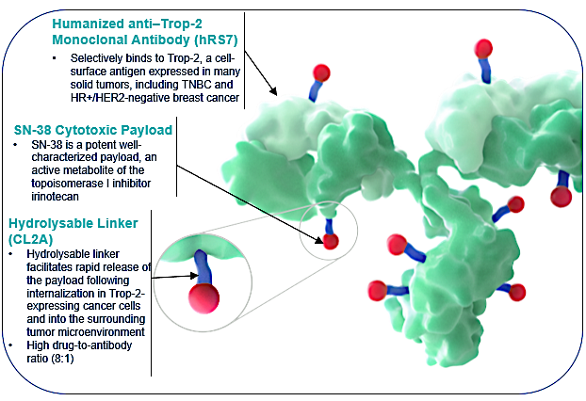
Sacituzumab Govitecan
Trop2-targeted ADC
Trop-2 is expressed in all subtypes of breast cancer and linked to poor prognosis^{1,2}
Sacituzumab Govitecan
  Antibody highly specific for Trop-2
  High drug-to-antibody ratio (7.6:1)
  Internalization and enzymatic cleavage by tumor cell not required for the liberation of
  SN-38 from the antibody
  Hydrolysis of the linker also releases the
  SN-38 cytotoxic extracellularly in the tumor microenvironment, providing a bystander effect
1. Vidula N et al. J Clin Oncol. 2017;35:15(suppl):Abstract 1075. 2. Ambrogi et al. PLoS One. 2014;9(5):e96993 Figure from Tolaney S et al. ASCO 2023

Slide 4
Case 1
48 yo woman diagnosed with stage II 3 cm, 1 LN+ TNBC, treated with neoadjuvant docetaxel/carboplatin x 6 cycles with pCR at surgery.
2 years later develops cough. CT scan shows solitary lung nodule 1.5 cm and rib metastasis.
Biopsy confirms TNBC (ER 0, PR 0, HER2 0)
Receives 1st line chemotherapy (PR x 15 months) then second line chemotherapy (SD x 10 months).
Progressive disease in lungs and liver.

Slide 5
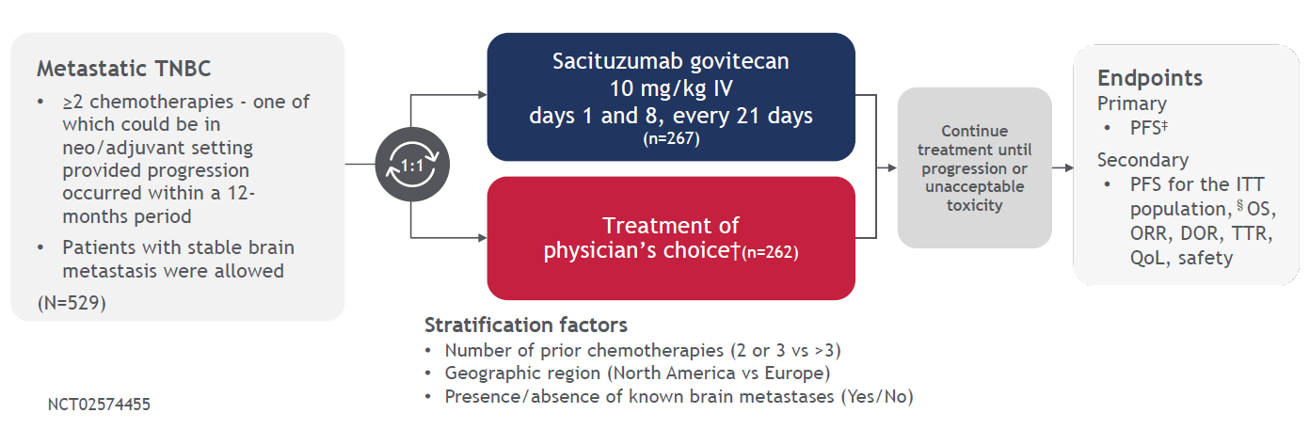
ASCENT: Phase 3 Trial Sacituzumab Govitecan in TNBC
month period
Bardia A et al. ESMO 2021; NEJM 2021

Slide 6
Phase 3 ASCENT in TNBC: Efficacy
Progression-free survival
Overall survival
BICR Analysis | SG (n=235) | TPC (n=233)
No. of events | 166 | 150
Median PFS, mo (95% CI) | 5.6 (4.3-6.3) | 1.7 (1.5-2.6)
HR (95% CI), P-value | 0.41 (0.32-0.52), P < 0.0001
 | SG (n=235) | TPC (n=233)
No. of events | 155 | 185
Median OS, mo (95% CI) | 12.1 (10.7-14.0) | 6.7 (5.8-7.7)
HR (95% CI), P-value | 0.48 (0.38-0.59), P < 0.0001
SG, sacituzumab govitecan; TPC, treatment of physician's choice.
Bardia A et al. N Engl J Med. 2021; 384:1529-1541; Bardia A et al. ASCO 2022;Abstract 1071.

Slide 7
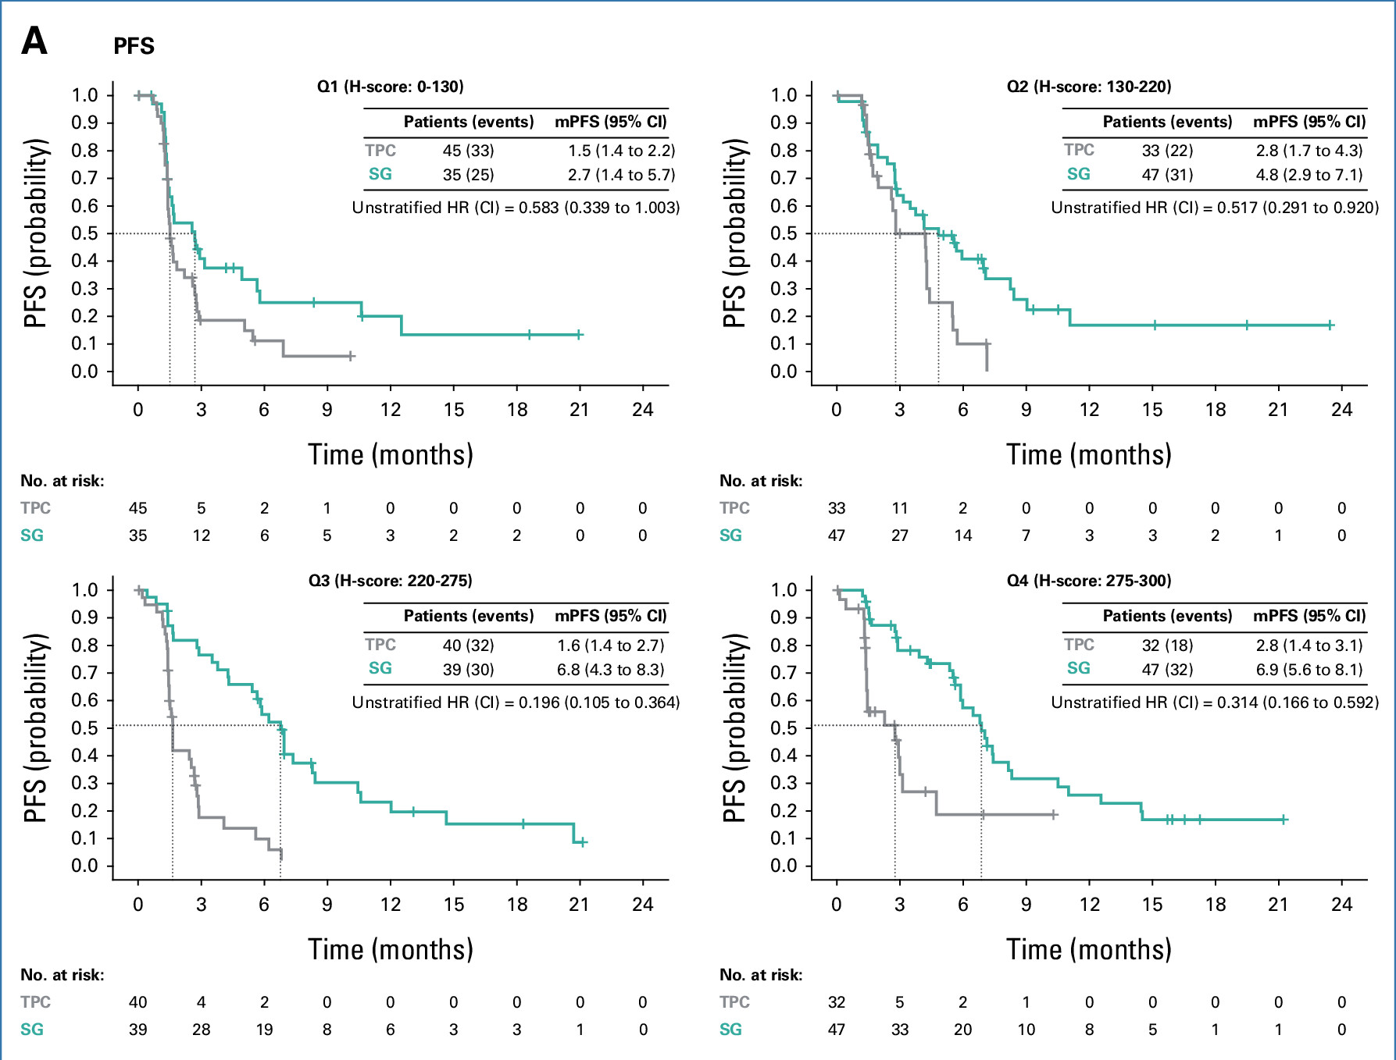
ASCENT: Clinical benefit irrespective of Trop-2 expression
Bardia A…Hurvitz S; Journal of Clinical Oncology 2024 DOI: 10.1200/JCO.23.01409

Slide 8
Phase 3 ASCENT in TNBC: Safety
 |  | SG (n=258) |  |  | TPC (n=224)
 | TRAE | All grade, % | Grade 3, % | Grade 4, % | All Grade, % | Grade 3, % | Grade 4, %
Hematologic | Neutropenia | 63 | 34 | 17 | 43 | 20 | 13
 | Anemia | 34 | 8 | 0 | 24 | 5 | 0
 | Leukopenia | 16 | 9 | 1 | 11 | 4 | 1
 | Febrile neutropenia | 6 | 5 | 1 | 2 | 2 | <1
Gastrointestinal | Diarrhea | 59 | 10 | 0 | 12 | <1 | 0
 | Nausea | 57 | 2 | <1 | 26 | <1 | 0
 | Vomiting | 29 | 1 | <1 | 10 | <1 | 0
Other | Fatigue | 45 | 3 | 0 | 30 | 5 | 0
 | Alopecia | 46 | 0 | 0 | 16 | 0 | 0
Key grade 3 TRAEs (SG vs TPC): neutropenia (34% vs 20%), diarrhea (10% vs < 1%), leukopenia (9% vs 4%), anemia (8% vs 5%), and febrile neutropenia (5% vs 2%)
SG, sacituzumab govitecan; TPC, treatment of physician's choice.
Bardia A, et al. N Engl J Med. 2021; 384:1529-1541; Bardia A et al. ASCO 2022;Abstract 1071.

Slide 9
Case 1 continued
Patient has TNBC, PD after 2 lines of chemotherapy
Receives sacituzumab govitecan.
Partial response (complete response in lung, PR in liver and SD bones)
Tolerates well for 2 years with disease control

Slide 10
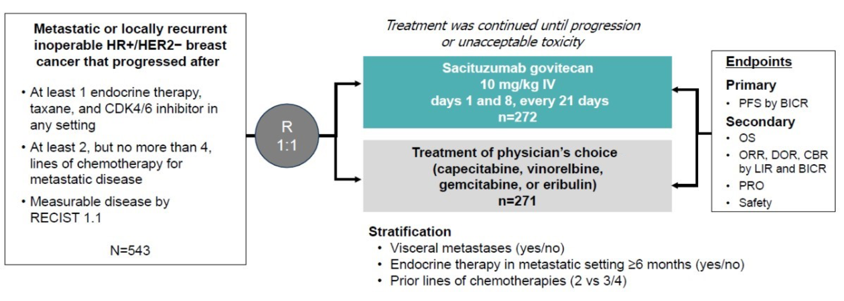
Sacituzumab Govitecan vs TPC in HR-Positive/HER2-Negative MBC
TROPiCS-02
BICR, blinded independent central review; LIR, local investigator review; IV, intravenous; PRO, patient-reported outcomes; RECIST, Response Evaluation Criteria in Solid Tumors.
Rugo HS, et al. Presented at: ASCO Annual Meeting 2022; Abs LBA1001.

Slide 11
Sacituzumab Govitecan vs TPC in HR-Positive/HER2-Negative MBC
TROPiCS-02
Rugo et al. ASCO 2022 Abs LBA 1001

Slide 12
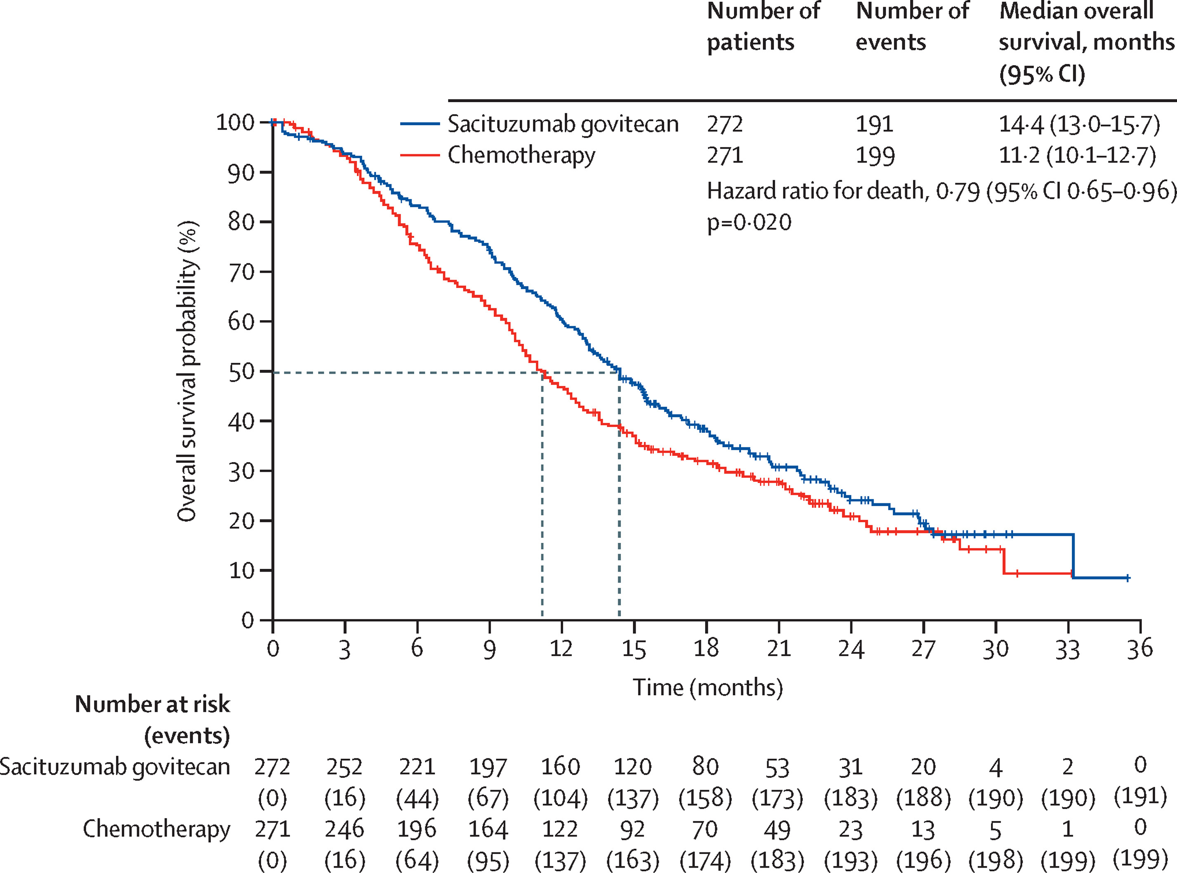
Phase 3 TROPiCS-02: Overall Survival of
Sacituzumab in HR+/HER2- MBC
Rugo et al. The Lancet 2023 4021423-1433DOI: (10.1016/S0140-6736(23)01245-X)
Notes:
Overall survival in the intention-to-treat population
This is the planned final analysis of overall survival in the intent-to-treat population of all randomly assigned patients. Vertical hash marks indicate censored data.

Slide 13
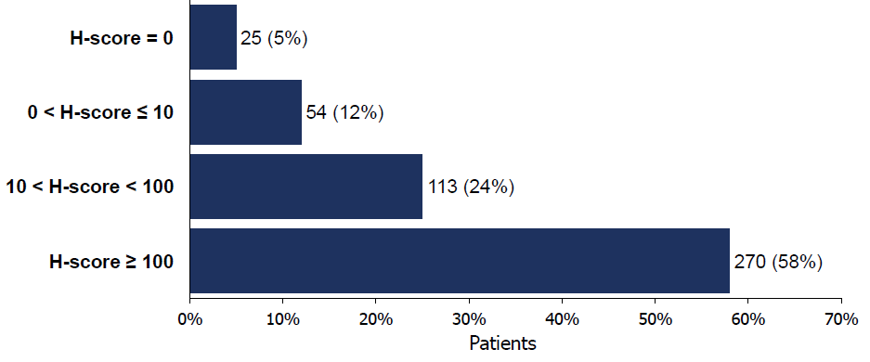
SG vs TPC in HR-Positive/HER2-Negative MBC by TROP-2 Expression
TROPiCS-02
TROP-2 Expression Observed in 95% of Evaluable Tissue Samples
TROP-2 H-Score
Cutoff 100
PFS: SG vs TPC
< 100: 5.3 vs 4.0 months;
hazard ratio 0.77
≥ 100: 6.4 vs 4.1 months;
hazard ratio 0.60
OS: SG vs TPC
< 100: 14.6 vs 11.3 months; hazard ratio 0.75
≥ 100: 14.4 vs 11.2 months; hazard ratio 0.83
PFS and OS benefit of SG over TPC was observed across TROP-2 subgroups (H-score < 100 and ≥ 100) and in tumors with very low TROP-2 expression, including H-score ≤ 10*
Rugo HS, et al. Presented at: San Antonio Breast Cancer Symposium (SABCS) 2022; December 6-10, 2022; San Antonio, TX. Presentation GS5-11.

Slide 14
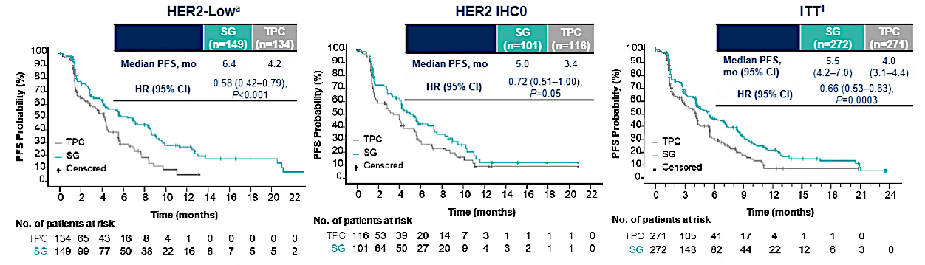
TROPiCS-02: Activity by HER2 IHC Score
Within the HER2-low population, median PFS with SG vs TPC for the IHC1+ and IHC2+ subgroups was 7.0 vs 4.3 (HR, 0.57) and 5.6 vs 4.0 (HR, 0.58) months, respectively
The HR for median PFS in a sensitivity analysis of the HER2-low subgroup (excluding ISH-unverified) was similar (HR, 0.53)
Schmid P, et al. Presented at: ESMO Congress 2022; September 9-13, 2022; Paris, France. Abstract 214MO.

Slide 15
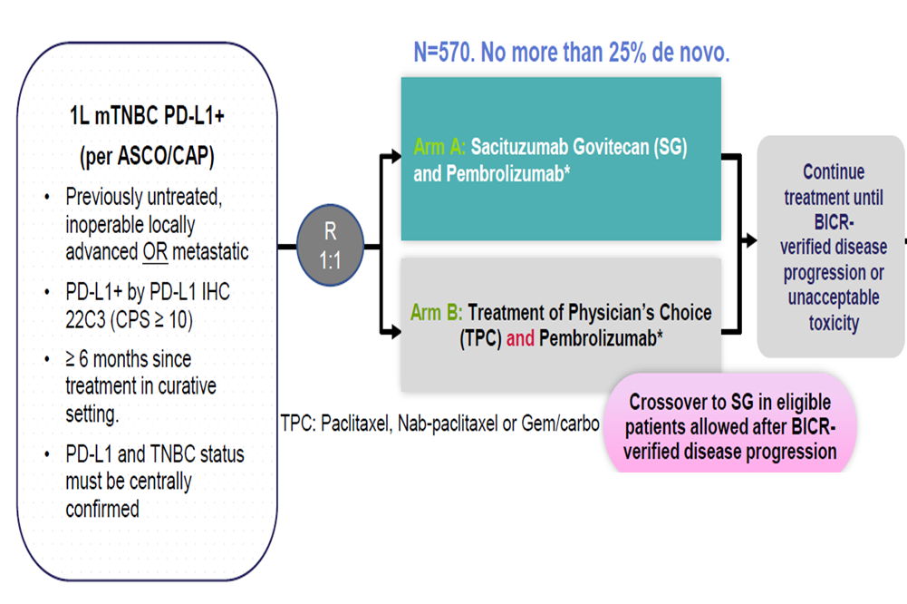
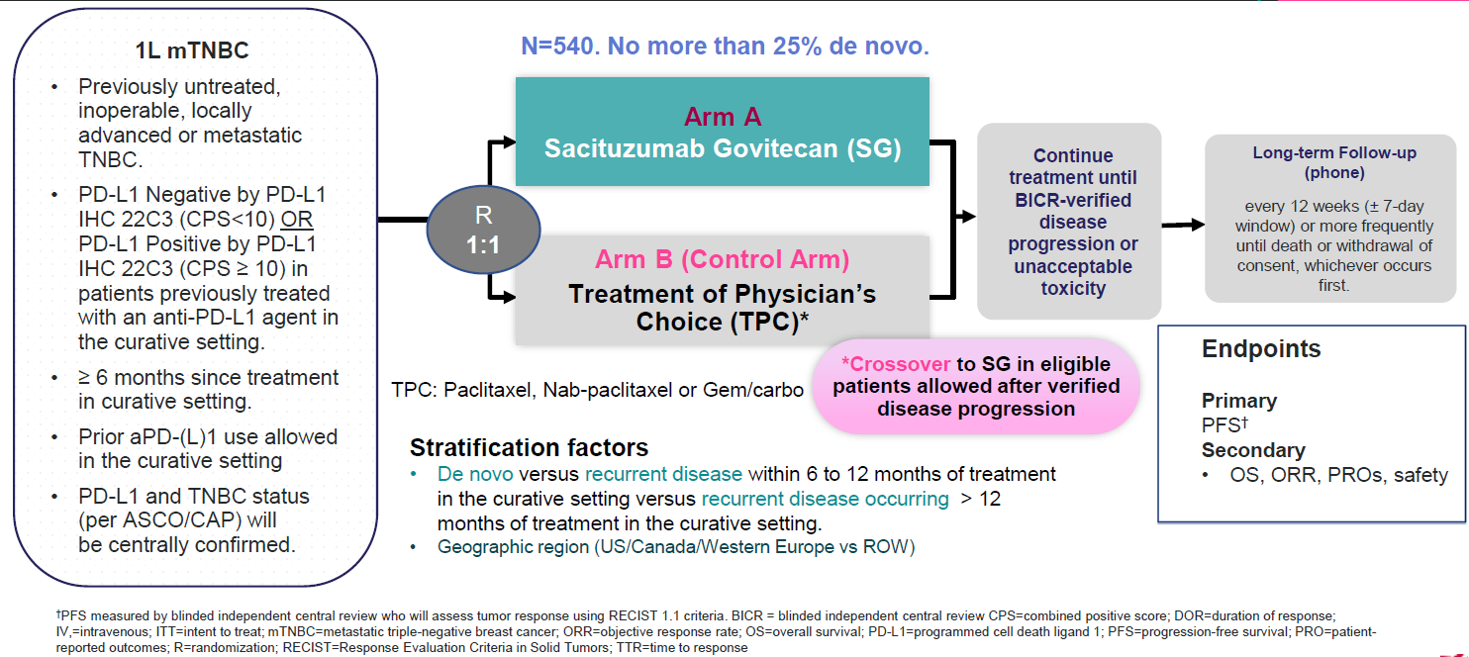
Ongoing Phase III Trials of SG in 1st Line TNBC
ASCENT-04
(PD-L1 positive)
ASCENT-03
(PD-L1 negative or PD-L1+ with IO for EBC)
Recruiting
NCT05382299
Recruiting
NCT05382286

Slide 16
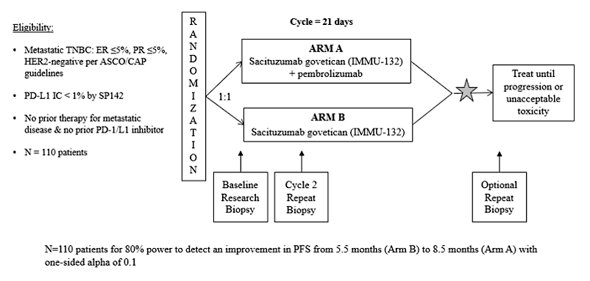
Saci-IO TNBC: Ph 2 trial with SG +/- pembrolizumab – 1L mTNBC in PD-L1 negative
Recruiting
NCT04468061

Slide 17
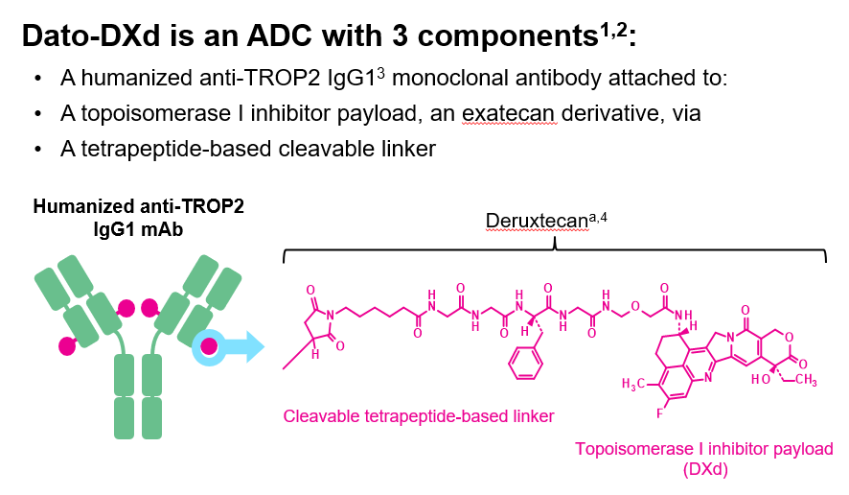
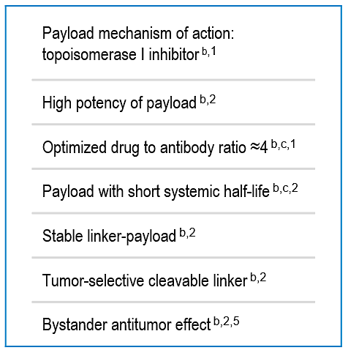
Dato-DXd: TROP2 targeting ADC
Bardia A et al. ASCO 2022
Notes:
Aditya Bardia et al.
ASCO 2022; Abstract 1071.

Slide 18
Ongoing TROPION-Breast02: Dato-DXd for 1L mTNBC
Dato-DXd
6mg/kg IV Q3 weeks
Metastatic TNBC
No prior systemic therapy for MBC
Not a candidate for PD-(L)1 therapy
Central testing to confirm PD-L1 status
Measurable disease per RECIST v1.1
N=600
1:1
Investigator choice of
Chemotherapy*
*If no prior taxane or DFI >12 months: paclitaxel or nab-paclitaxel
If prior taxane or DFI <12 months: Eribulin, Capecitabine, Carboplatin

Slide 19
TROPION-Breast01
SABCS 2023

Slide 20
TROPION-Breast01
Bardia A, et al. Oral Presentation at ESMO 2023; Abstract LBA11; Bardia A et al. SABCS 2023; Abstract GS02-01.

Slide 21
TROPION-Breast01: Adverse Events of Clinical Interest
SABCS 2023

Slide 22
Can HER2 be effectively targeted in
HER2 Low Expressing Disease?

Slide 23

Expression of HER2¹
HER2 is physiologically expressed on cell membranes of nearly all normal tissues in the body, including the breast, skin, lungs, GI system, placenta and urinary tract
Similarly, nearly all breast cancers exhibit some degree of HER2 expression on the cell membrane
The detectability of this expression depends on the type of tissue analyzed (paraffin-embedded vs frozen tissue) and the sensitivity of the HER2 assay used

Slide 24
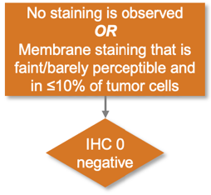
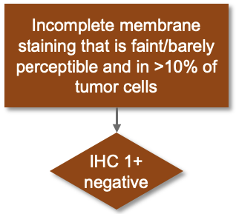
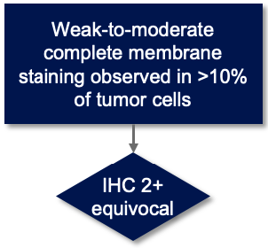
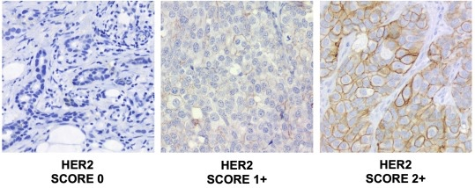
HER2 Negative¹
No approved
anti-HER2 agent between 2000
and 2021
10,000-1,000,000
HER2 receptors per cell
Could this group
benefit from
HER2 blockade?
/ ISH-

Slide 25
HER2-low: Is Not a Distinct Prognostic Entity
Study | N | Setting | HR+ | TNBC
Won et al. Breast Cancer Res. 2022 | 30,491 | Early
Tan et al. BMC Med. 2022 | 28, 280 | Early
Tarantino et al. JAMA Oncol. 2022 | 5,235 | Early
Horisawa et al. Breast Cancer. 2022 | 4,918 | Early
Denkert et al. Lancet Oncol. 2021 | 2,310 | Early
Gampenrieder et al. Breast Cancer Res. 2021 | 1,378 | Advanced
Schettini et al. Breast NPJ. 2021 | 1304 | Advanced
Hein et al. Eur J Cancer. 2021 | 1,022 | Advanced
De Moura Leite et al. Breast Cancer Res Treat. 2021 | 855 | Early
Agostinetto et al. Cancers (Basel). 2021 | 804 | Early
Mutai et al. Breast. 2021 | 608 | Early
Jacot et al. Cancers (Basel). 2021 | 296 | Early
Tarantino et al. Eur J Cancer. 2021 | 232 | Advanced
Viale et al, SABCS 2022 | 574 | Advanced
Peiffer et al, SABCS 2022 | 1,136,016 | Early/ Advanced
A multitude of studies conducted
to evaluate the prognostic role
of HER2-low expression
Most studies found no OS difference in HER2-low
vs HER2-zero BC when analyzed
by HR expression
Caution: retrospective studies, different populations, sample sizes, f/u duration, and most lack central pathology review
No OS difference
Significant OS difference
Not evaluated
Notes:
There have been several additional studies that have evaluated the prognostic role of HER2low expression as shown here and you can see that the vast majority of these studies found there was no difference seen in overall survival between HER2-low and HER20 tumors when looking at outcomes by HR status
Some lack of consistency in findings could be attributed to the fact that these are retrospective analyses with different sample sizes and different durations of f/u, and the majority of these lacked central pathology review
Which may account for some of these marginal differences in outcome that we are seeing

Slide 26
T-DXd MOA: Bystander Effect and Rationale for Targeting HER2-Low MBC¹⁻³

Slide 27
DESTINY-Breast04: T-DXd vs Chemotherapy for Previously Treated HER2-Low ABC
Multicenter, randomized, open-label, active-controlled phase III trial
Primary endpoint: PFS in HR+ patient population (by BICR)
Key secondary endpoints: PFS (all patients), OS in HR+ and in all patients, PFS by investigator, ORR, DoR, efficacy in HR- patient population
Stratified by HER2-low status (IHC1+ vs IHC2+ and ISH-),
no. of prior lines of CT for metastatic disease (1 vs 2), hormone receptor status (positive [with vs without previous CDK4/6 inhibitor] vs negative)
Patients with HER2-low (IHC1+ or IHC2+/ISH-) unresectable or metastatic BC; 1-2 lines of CT in the metastatic setting or recurrence ≤6 mo after adjuvant CT; ≥1 ET if HR+; treated, stable brain metastases eligible
(N = 557)
T-DXd 5.4 mg/kg Q3W
(n = 373)
2:1
CT*
(n = 184)
*Treatment of physician’s choice: capecitabine, eribulin, gemcitabine, paclitaxel, or nab-paclitaxel.
Modi. ASCO 2022. LBA3. Modi. NEJM. 2022;387:9.
Notes:
ABC, advanced breast cancer.

Slide 28
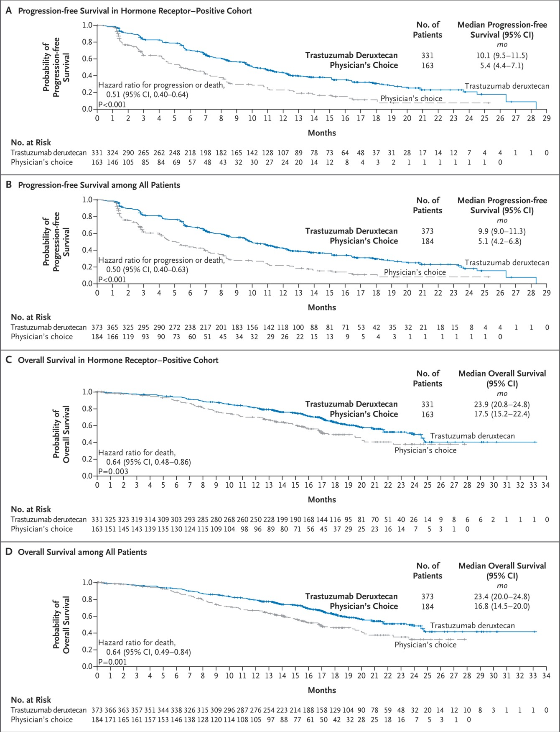
DESTINY-Breast04: T-DXd in HER2-low MBC
T-DXd approved by the FDA for treatment of MBC in the newly defined “HER2-low” subtype on August 5, 2022
Modi S et al. NEJM 2022;387:9-20.

Slide 29
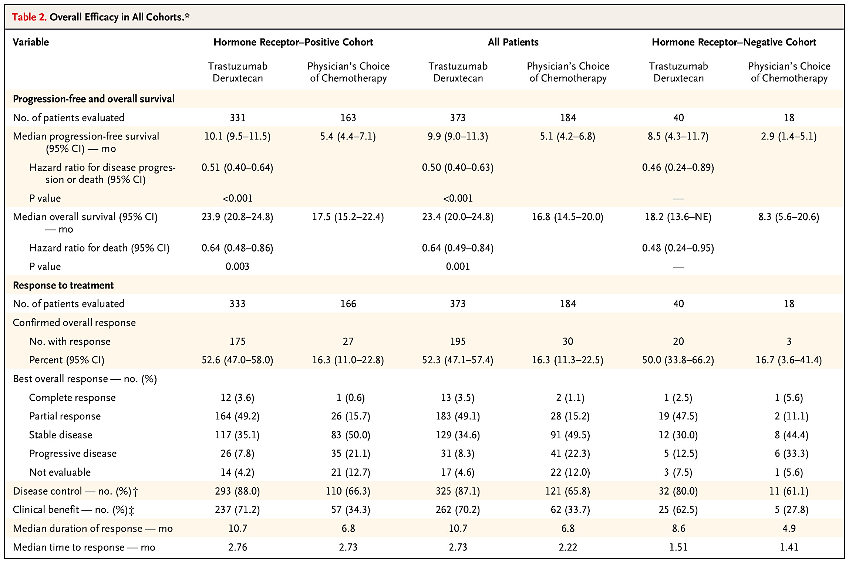
DESTINY-Breast04: T-DXd in HER2-low MBC
Modi S et al. NEJM 2022;387:9-20.

Slide 30
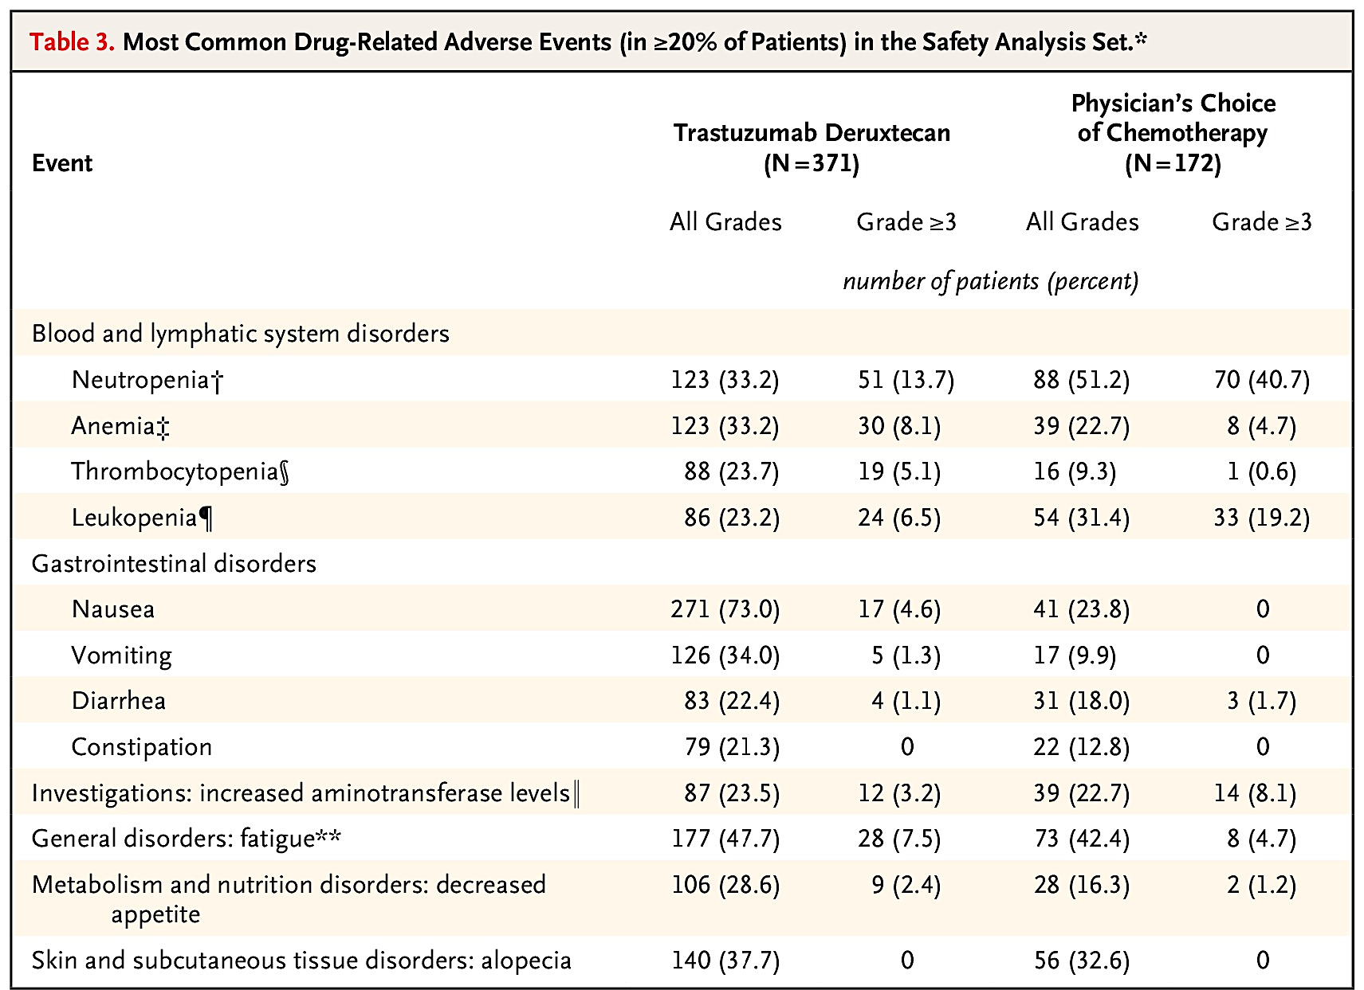
DESTINY-Breast04: Adverse events
Interstitial lung disease: (12.1%):
Grade 1: 13 (3.5%)
Grade 2: 24 (6.5%)
Grade 3: 5 (1.3%)
Grade 5: 3 (0.8%)
Modi S et al. NEJM 2022;387:9-20.

Slide 31
Is there a threshold of HER2 expression for activity of T-DXd?
Notes:
Formulate mitigation strategies for identifying and managing treatment-related adverse events

Slide 32
Case 2
53 yo woman diagnosed with stage I right breast ER+ PR+ HER2 0 low grade IDC, Oncotype RS 9. Treated with tamoxifen only.
18 months later developed fever of unknown origin. Workup by ID revealed left breast mass, liver lesions, bone lesions. Biopsy breast: ER ++ PR + HER2 1+ by IHC.
1st line CDK4/6i + ET with control x 15 months
PIK3CA mut detected: 2nd line fulvestrant/alpelisib x 1 year (poorly tolerated, switched to everolimus)
PD switched to capecitabine. Biopsy liver: ER+ PR – HER2 2+ by IHC, FISH HER2 copy number 4.3, ratio 2.1
Tempus and Foundation One testing twice: no HER2 amplification
Started T-DXd with response x 18 months.
At PD tried T-DM1 with progression after 3 doses.
Currently retesting HER2

Slide 33
Phase II DAISY Trial: Best Overall Response According to HER2 Expression Levels With T-DXd in Metastatic BC
Mosele MF et al ESMO Breast 2022. Abstract LBA1

Slide 34
HER2 Status Discordance
TN matched Core : Surgical : Met Bxs (N=35)
Pt #
1
2
3
4
5
6
7
8
9
10
11
12
13
14
15
16
17
18
19
20
21
22
23
24
25
26
27
28
29
30
31
32
33
34
35
Core Bx
Surgical Bx
Metastatic Bx
HER2 status
stable
Changed (49%)
stable
HER2-low
HER2-IHC 0
HER2-3+
HER2 status was changed for half of the pts throughout
the disease course

Slide 35
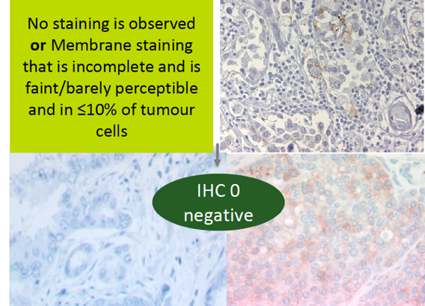
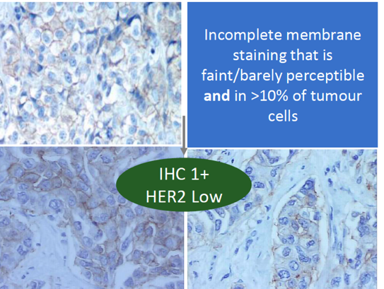
Low Concordance Among Pathologists¹
Among 18 experienced pathologists there was only 26% concordance between the diagnoses of HER2 0 and HER2 1+; current IHC assays were developed to identify overexpressing cases, and are unsuitable to distinguish HER2 0 from HER2 low
Importantly, HER2 0 does not mean absence of HER2, as it also includes tumors with “ultralow” expression
No staining is observed
or
Membrane staining
that is incomplete and faint/barely perceptible and in ≤10% of
tumor cells
Incomplete membrane staining that is faint/barely perceptible and in >10% of
tumor cells
IHC 0
HER2 negative
IHC 1+
HER2 low

Slide 36
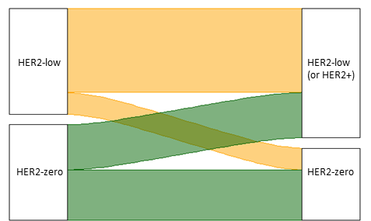
Defining whether a patient has HER2 low disease
Given the complexities of a HER2-low pathological definition and some suggestion of activity of T-DXd even in HER2 0 MBC, a practical definition of HER2 low is:
  HER2 nonamplified tumor that showed HER2-low expression on any prior specimen in the course of disease
Primary
Tumor
1st Metastatic
Biopsy
53%
44%
= 81% HER2 low according to the practical definition
The rate of HER2-low tumors increases progressively with each additional biopsy
21%
47%
16%

Slide 37
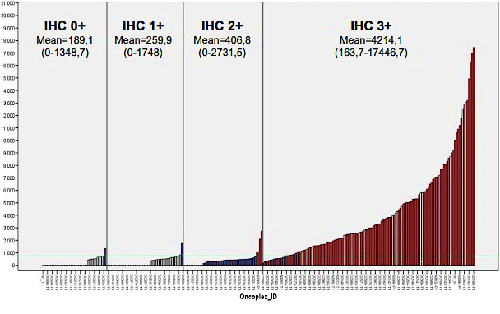
Alternate Methods of Measuring HER2 Expression
HER2 Expression by IHC and HER2 mRNA Levels³
Quantitative Measurement of HER2 Expression by Multiplexed Mass Spectrometry from FFPE Tissue^{1,2}
HER2 0
HER2-low
HER2+
HER2_FISH_DX_CL
IHC 0+
Mean=189.1
(0-1348.7)
IHC 1+
Mean=259.9
(0-1748)
IHC 2+
Mean=406.8
(0-2731.5)
IHC 3+
Mean=4214.1
(163.7-17446.7)
0
1
N/A
3
3
2
2
1
1
0
0
-1
-1
-2
-2
Red = amplified; blue = non-amplified; bland = N/A
-3
-3
HER2 0
HER2 1+
HER2 2+
HER2 3+
HER2 0
HER2-low
1. Nuciforo. Mol Oncol. 2016;10:138. 2. Nuciforo. AACR 2015;Abstr P4-11-29. 3. Schettini. Breast. 2021;59:339.
Notes:
FFPE, formalin-fixed parrafin-embedded; IHC, immunohistochemistry; mRNA, messenger RNA.

Slide 38
DESTINY-Breast06: T-DXd in Chemotherapy Naive and HER2-Ultralow Advanced/Metastatic Breast Cancer
Randomized, open-label phase III study
Stratified by: prior CDK4/6 inhibitor; HER2 IHC 2+ vs 1+ vs 0; prior taxane in non-metastatic setting.
Patients with advanced/metastatic breast cancer with progression on 2 previous endocrine therapy; restricted to HR+
Disease; HER2 low (IHC1+, or 2+) or HER2 ultralow (IHC* >0 <1+) based on central IHC assessment at diagnosis of first metastatic disease or later
(N = 850)
T-DXd
(n = 425)
Until PD or toxicity
Chemotherapy
(n = 425)
*Investigator’s choice chemotherapy may consist of capecitabine, paclitaxel, or nab-paclitaxel.
Primary endpoint: PFS (per BICR) in HER2 IHC 1+/2+
Key secondary endpoints: OS in HER2 IHC 1+/2+ population, PFS and OS in ITT
Secondary endpoints: PFS (per INV) in HER2 1+/2+, ORR and DoR in HER2 1+/2+and ITT, safety and tolerability, symptoms, functioning and QoL
Exploratory: OS in HER2 IHC 1+/2+ population
*HER2 IHC >0 defined by any IHC staining up to 10% of tumor cells. Futility analysis in HER2 IHC 0+ cohort will be done.
NCT04494425.
Notes:
BC, breast cancer; HR, hormone receptor positive; ITT, intention to treat.

Slide 39
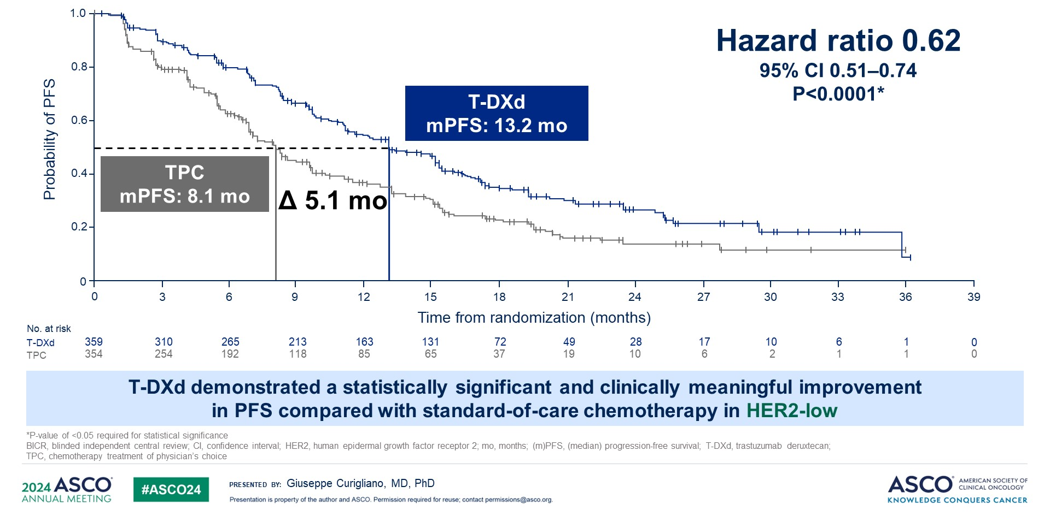
PFS (BICR) in HER2-low: primary endpoint
DESTINY-Breast06 PFS in HER2 low

Slide 40
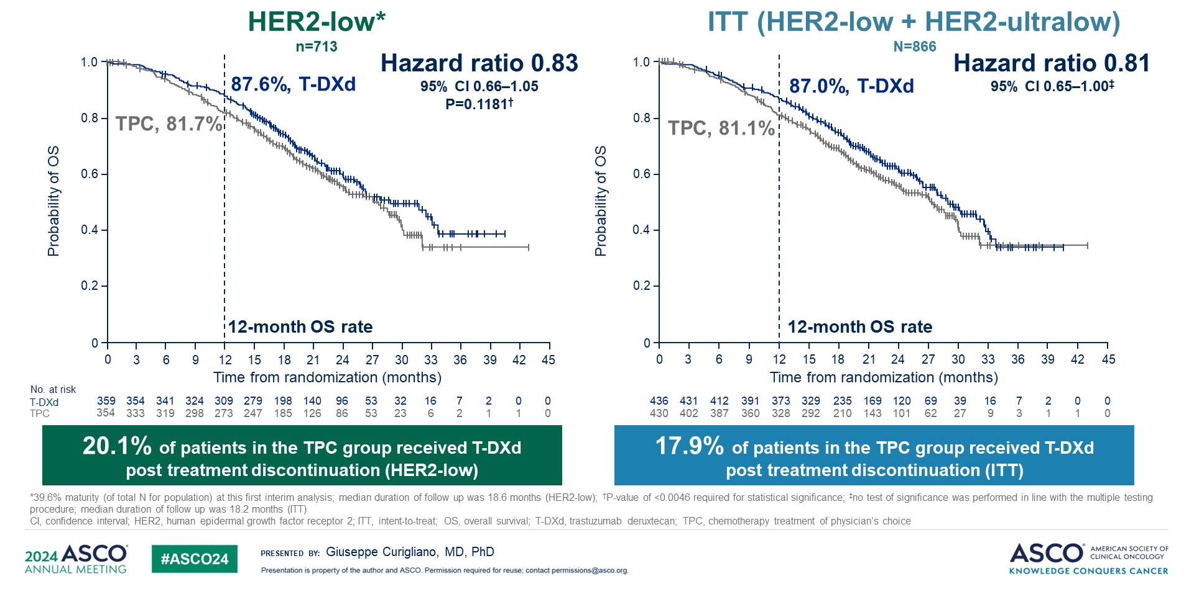
OS in HER2-low and ITT: key secondary endpoints (~40% maturity)
DESTINY-Breast06 Overall Survival

Slide 41
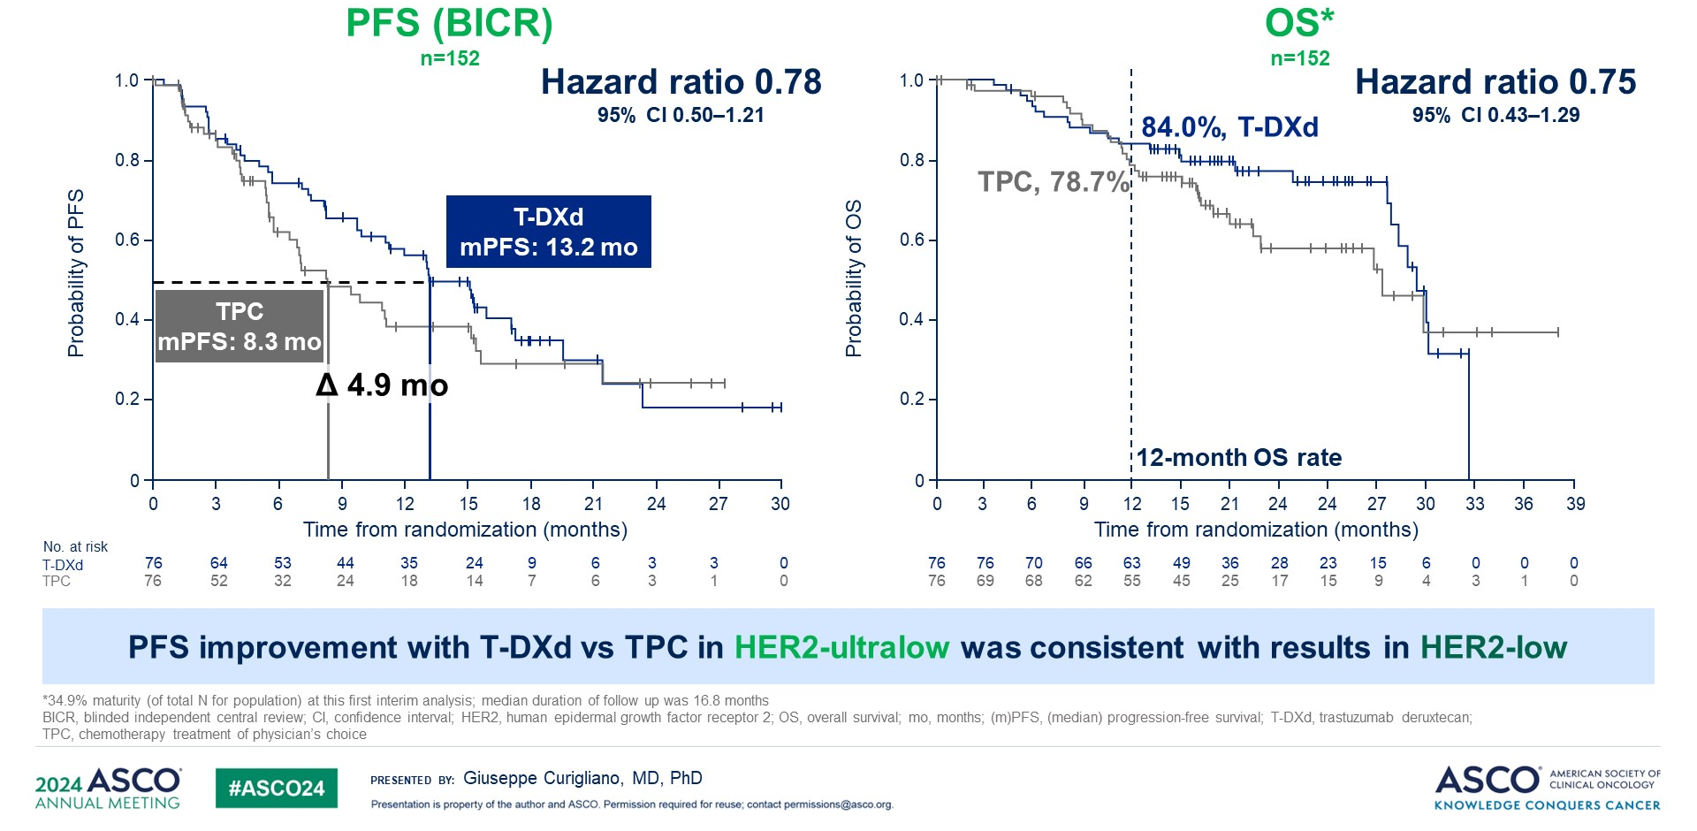
PFS and OS in HER2-ultralow: prespecified exploratory analyses
DESTINY-Breast06 PFS and OS in HER2 Ultralow

Slide 42
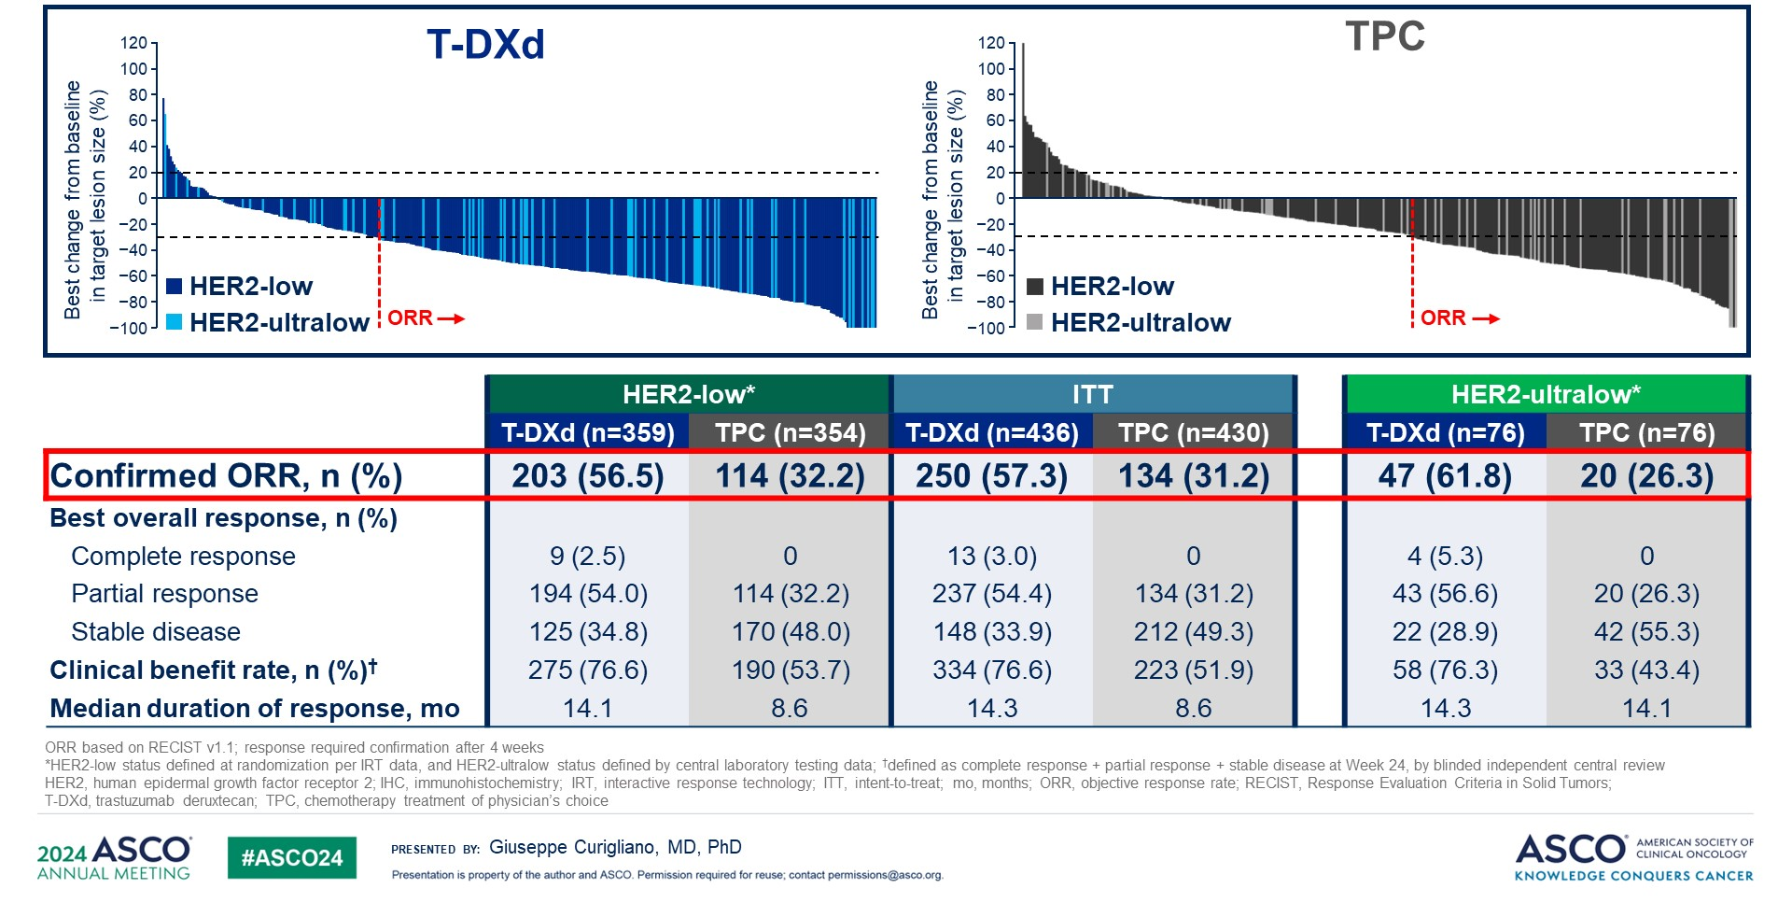
Antitumor activity
DESTINY-Breast06 ORR

Slide 43
Case 3
59 yo woman started T-DXd for HER2 low MBC to liver and lungs.
After 3 cycles, scan shows CR in lungs and liver but ground glass infiltrates in bilateral upper lung lobes
Patient is completely asymptomatic
O2 sat 96%, vitals signs all normal, exam unremarkable

Slide 44
Case 3
59 yo woman started T-DXd for HER2 low MBC to liver and lungs.
After 3 cycles, scan shows CR in lungs and liver but ground glass infiltrates in bilateral upper lung lobes
Patient is completely asymptomatic
O2 sat 96%, vitals signs all normal, exam unremarkable
T-DXd stopped. COVID testing negative.
Steroids initiated x 2 weeks.
CT scan repeated in 4 weeks showed complete resolution
Restarted T-DXd and patient continued with disease control for 15 more months.

Slide 45
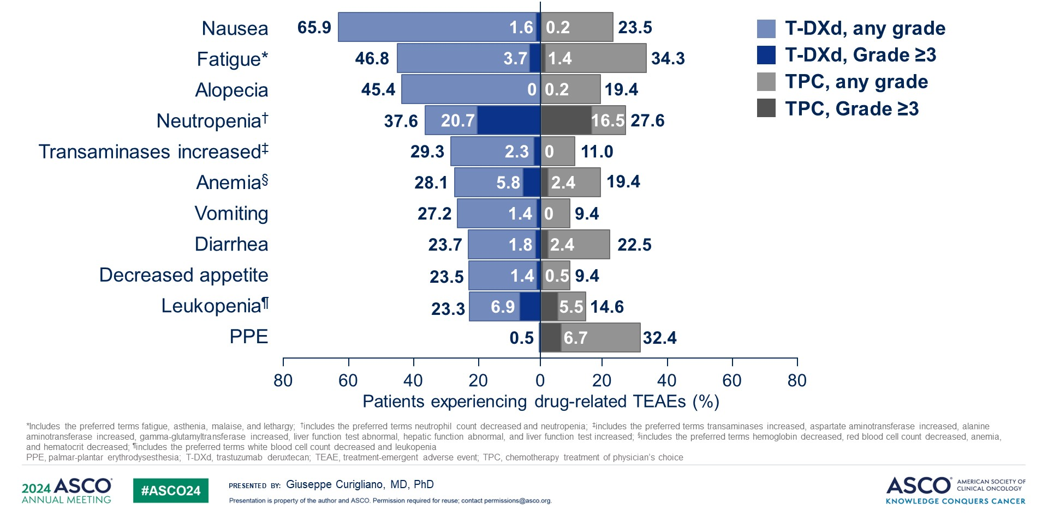
Drug-related TEAEs in ≥20% of patients (either treatment group)
DESTINY-Breast06 Drug-Related TEAEs

Slide 46
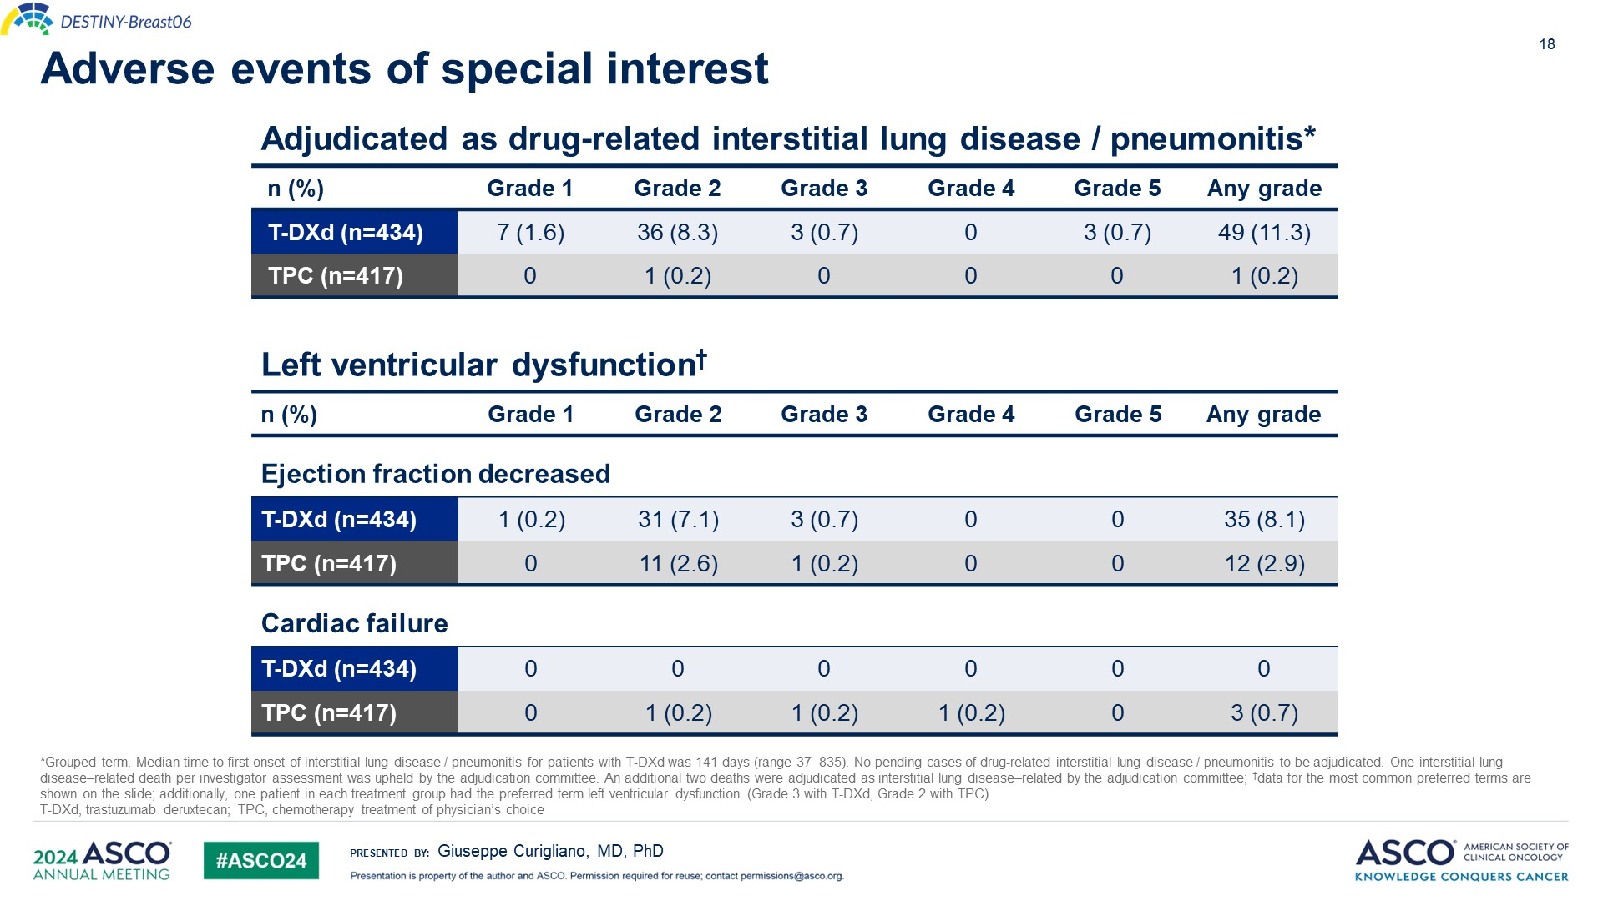
Adverse events of special interest

Slide 47
Novel ADC strategies being explored
Notes:
Formulate mitigation strategies for identifying and managing treatment-related adverse events

Slide 48
DESTINY-Breast08: T-DXd novel combinations in HER2 low
https://clinicaltrials.gov/ct2/show/NCT04556773.
Confirmed ORR T-DXd + anastrozole: 71.4%
Confirmed ORR T-DXd + fulvestrant: 40.0%
Jhaveri K et al. SABCS 2023;Abstract RF02-03.

Slide 49
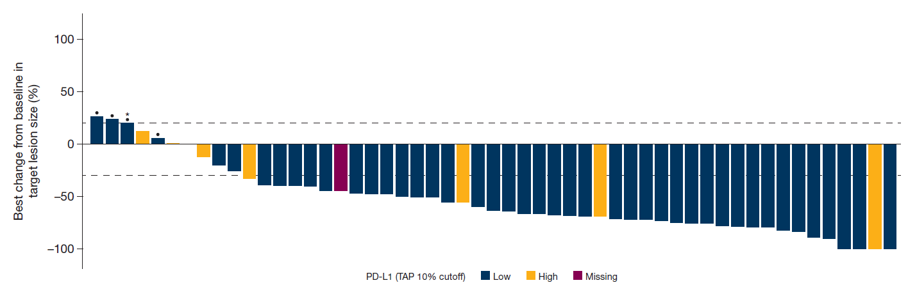
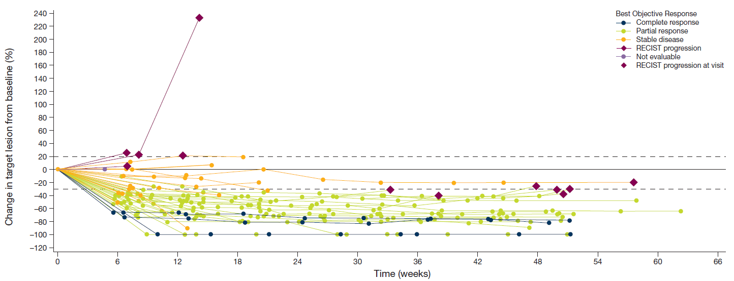
BEGONIA: Dato-DXd + durvalumab in 1L mTNBC
Best Change from Baseline of Target Lesion Size (n=53)
• Confirmed ORR= 39 (73.6%)
  CR = 4
  PR = 35
Change from baseline in sum of target lesions over time
Durable responses: 82% still on tx
(median f/u 7.2 months)
Responses seen in PD-L1 low and PD-L1 high tumors
Schmid P et al. SABCS 2022; PD11-09.
Notes:
Aditya Bardia et al.
ASCO 2022; Abstract 1071.

Slide 50
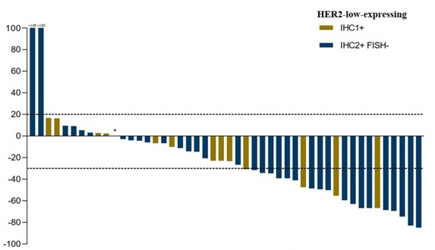
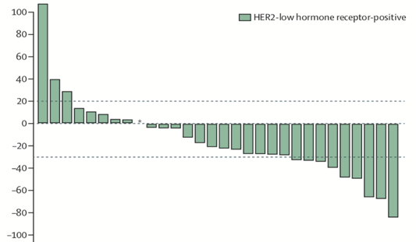
Novel Conjugates for HER2 Low
Trastuzumab Duocarmazine (SYD985)¹
Disitamab Vedotin (RC48-ADC)²
HER2 low
HER2 low, HR+
IHC 1+
IHC 2+ FISH-
Change From Baseline, %
Change From Baseline, %
49 HER2-low MBC patients: ORR 32%, mPFS 4 mo
48 HER2-low MBC patients: ORR 40%, mPFS 5.7 mo

Slide 51
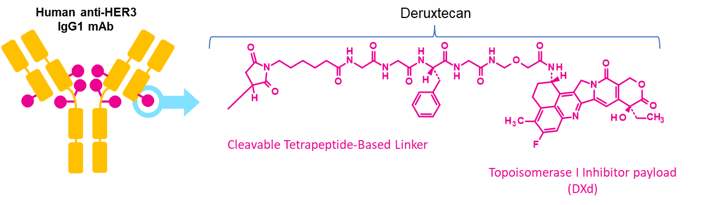
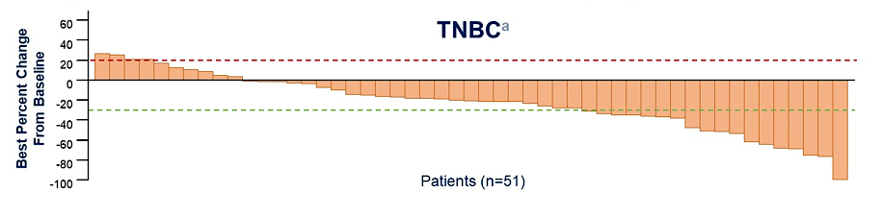
Patritumab-DXd: HER3 targeting ADC
Ph I/II study with patritumab deruxtecan in patients with heavily pretreated MBC demonstrated decreased tumor size irrespective of BC subtype and HER3 expression.
ORR = 22.6% in TNBC (regardless of HER3 expression)
Krop IA et al. ASCO 2022; Krop IA et al. J Clin Oncol 2023;41(36):5550-60.

Slide 52
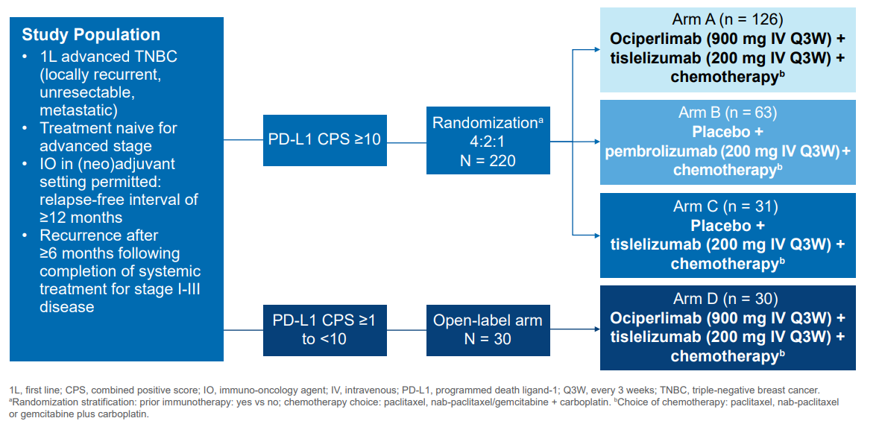
AdvanTIG-211: Ph 2 trial of anti-TIGIT + anti-PD-1+ chemo in 1L mTNBC
Ociperlimab inhibits TIGIT, a co-inhibitory immune checkpoint inhibitor
Preclinical data: Dual targeting with ociperlimab and tislelizumab (anti PD-1 antibody) produces
synergistic immune cell activation & enhanced antitumor activity
Not yet recruiting
NCT05809895

Slide 53
Zenocutuzumab in HER2-Low MBC
Zenocutuzumab: a bispecific antibody targeting HER2 and HER3 with ADCC
Trial (NCT#) | Phase | Target (N) | Patient population | Treatments
NCT03321981 | II | 101 | Cohort 1: HER2+/amplified Cohort 2: ER+/HER2-low | Cohort 1: Zenocutuzumab (MCLA128) + trastuzumab ± vinorelbine Cohort 2: Zenocutuzumab (MCLA128) + endocrine therapy
Notes:
ADCC, antibody-dependent cellular cytotoxicity

Slide 54
Appendix

Slide 55
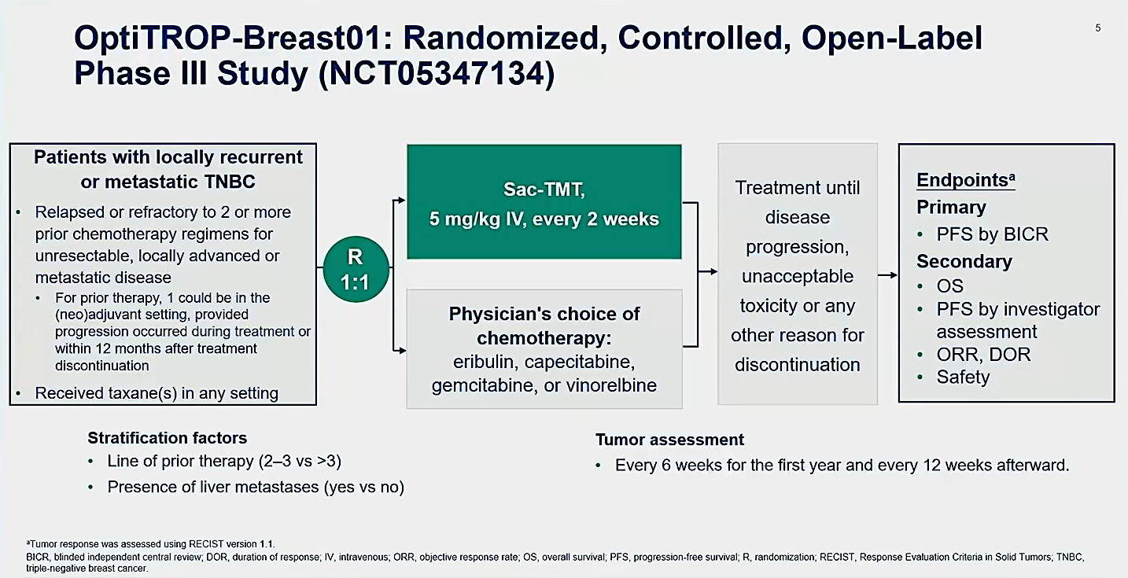
OptiTROP-Breast01: Phase III Trial Schema of Sacituzumab Tirumotecan for TNBC
Xu B et al. ASCO 2024;Abstract 104.

Slide 56
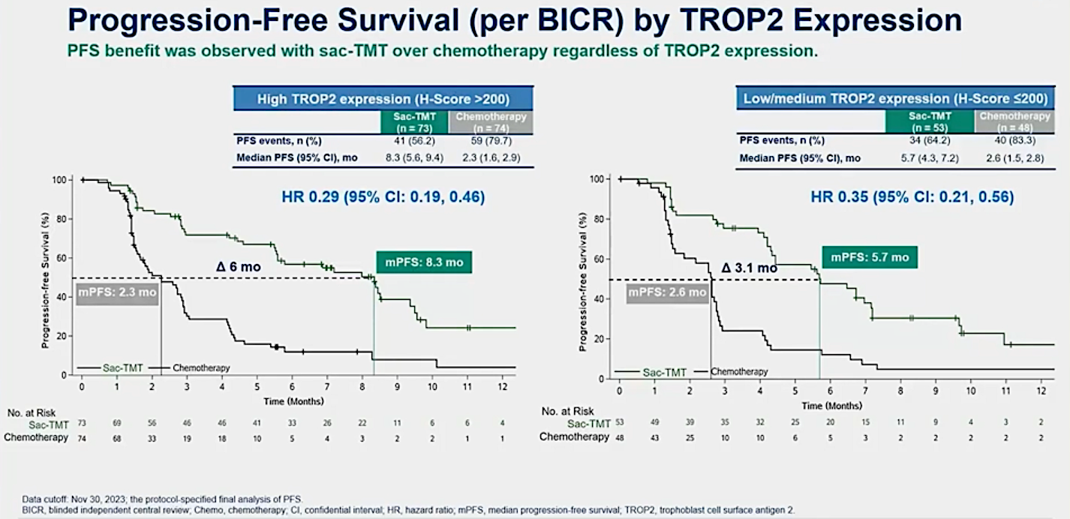
OptiTROP-Breast01: Sacituzumab Tirumotecan for Locally Recurrent or Metastatic TNBC
Xu B et al. ASCO 2024;Abstract 104.

Slide 57
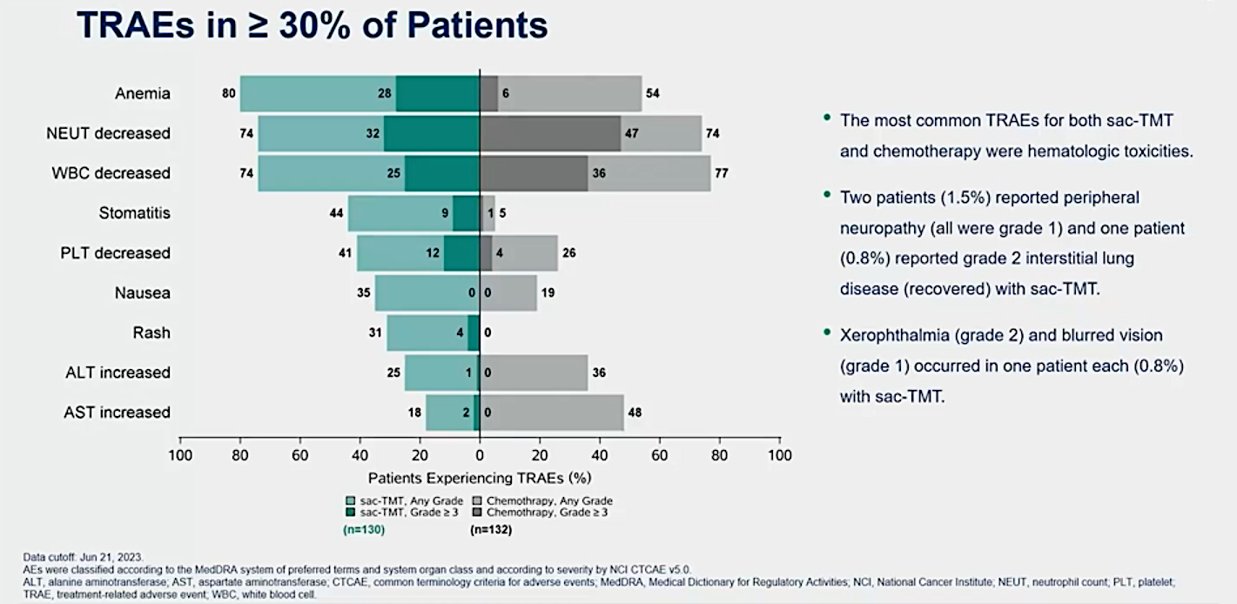
OptiTROP-Breast01: Treatment-Related Adverse Events with Sacituzumab Tirumotecan for Locally Recurrent or Metastatic TNBC
Chemotherapy, Any Grade
Chemotherapy, Grade ≥ 3
Xu B et al. ASCO 2024;Abstract 104.

Slide 58
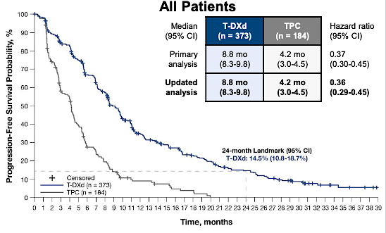
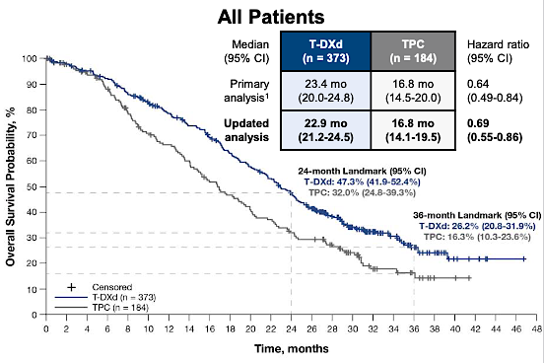
DESTINY-Breast04 Updated Survival Results: T-DXd for HER2-Low Breast Cancer
Modi S et al. ESMO 2023;Abstract 376O.

