Slide 1
Virtual Case Library:
Metastatic Triple-Negative Breast Cancer
Thursday, April 4, 2024
12:30 PM – 3:00 PM ET
Faculty
Case Presenters
Julia Foldi, MD, PhD
Laura Huppert, MD
Saba Shaikh, MD
Case Discussants
Rita Nanda, MD
Sara M Tolaney, MD, MPH
Moderator
Neil Love, MD

Slide 2






Faculty
CASE PRESENTERS
CASE DISCUSSANTS
Julia Foldi, MD, PhD
Assistant Professor of Medicine in Hematology and Oncology
University of Pittsburgh School of Medicine
Pittsburgh, Pennsylvania
Rita Nanda, MD
Director, Breast Oncology
Associate Professor of Medicine
Section of Hematology/Oncology
The University of Chicago
Chicago, Illinois
Laura Huppert, MD
Assistant Professor of Medicine
University of California
San Francisco, California
Sara M Tolaney, MD, MPH
Chief, Division of Breast Oncology
Associate Director, Susan F Smith Center for Women's Cancers
Senior Physician
Dana-Farber Cancer Institute
Associate Professor of Medicine
Harvard Medical School
Boston, Massachusetts
Saba Shaikh, MD
Assistant Professor
Division of Hematology/Oncology
Mays Cancer Center
UT Health San Antonio MD Anderson Cancer Center
San Antonio, Texas
MODERATOR
Neil Love, MD
Research To Practice
Miami, Florida

Slide 3
Agenda
Introduction: Overview of metastatic triple-negative breast cancer (mTNBC)
Module 1: First-line treatment of mTNBC – Chemotherapy with or without immunotherapy
Module 2: Antibody-drug conjugates in the management of mTNBC
Module 3: PARP inhibition for the treatment of mTNBC

Slide 4
Agenda
Introduction: Overview of metastatic triple-negative breast cancer (mTNBC)
Module 1: First-line treatment of mTNBC – Chemotherapy with or without immunotherapy
Module 2: Antibody-drug conjugates in the management of mTNBC
Module 3: PARP inhibition for the treatment of mTNBC

Slide 5
Key Data Sets
Introduction
Teli et al. Recent advances in triple-negative breast cancer. SABCS 2023;Abstract PL-02.
Avila J et al. Frequency of presentation and outcomes of stage IV breast cancer over the past decade: A population-based study. SABCS 2023;Abstract PO4-06-02.
Leone JP et al. Estimating mortality in women with triple-negative breast cancer: The 'ESTIMATE triple-negative' tool. Eur J Cancer 2023;189:112930.
Shaikh SS, Emens LA. Current and emerging biologic therapies for triple negative breast cancer. Expert Opin Biol Ther 2022;22(5):591-602.
Huppert LA et al. Emerging treatment strategies for metastatic triple-negative breast cancer. Ther Adv Med Oncol 2022;14:17588359221086916.
Foldi J, Geyer CE Jr. Precision medicine for metastatic TNBC: The FUTURE is now. Cell Res 2023;33(7):491-2.

Slide 6
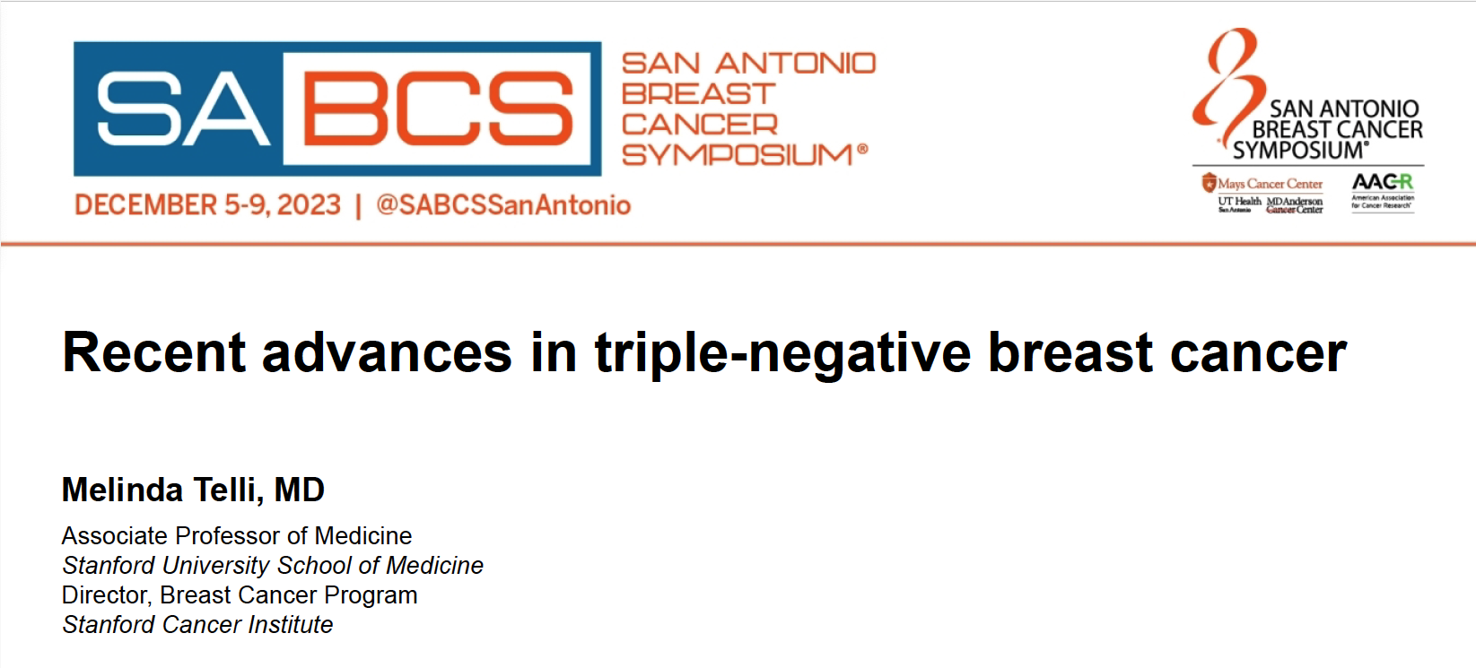

Slide 7
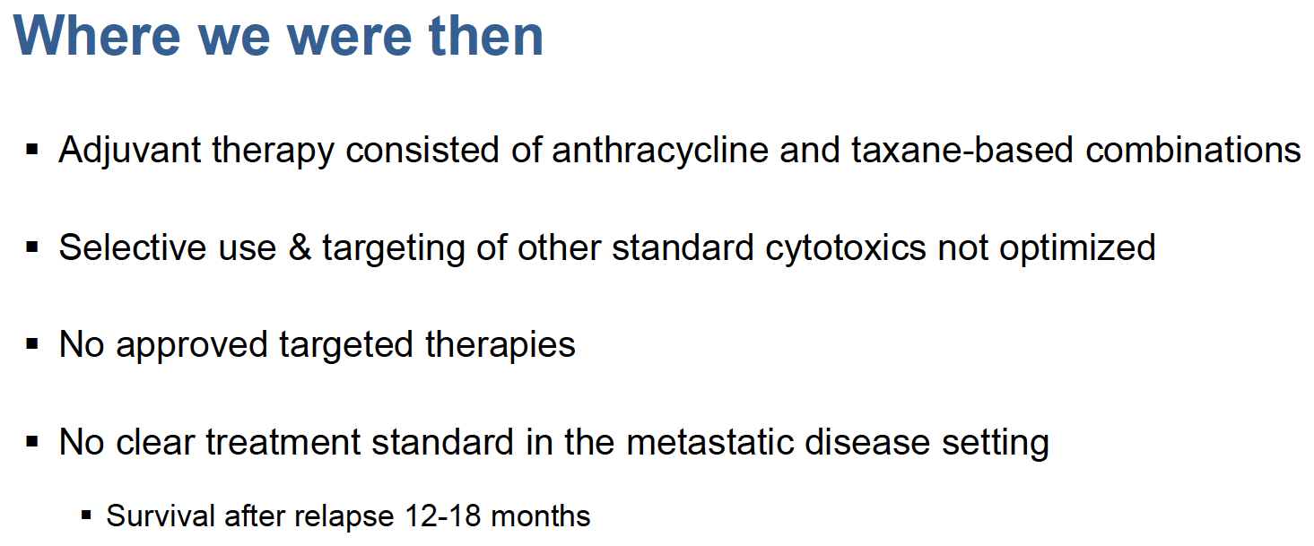
Telli M. SABCS 2023;Abstract PL-02.

Slide 8
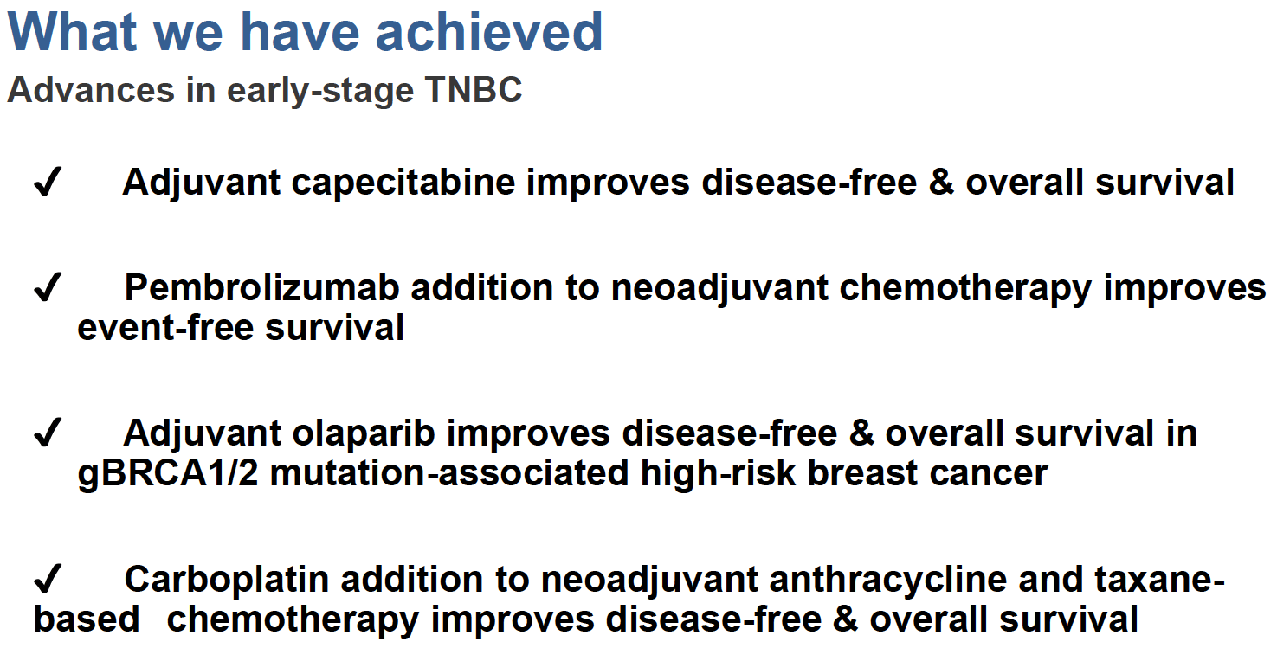
Telli M. SABCS 2023;Abstract PL-02.

Slide 9
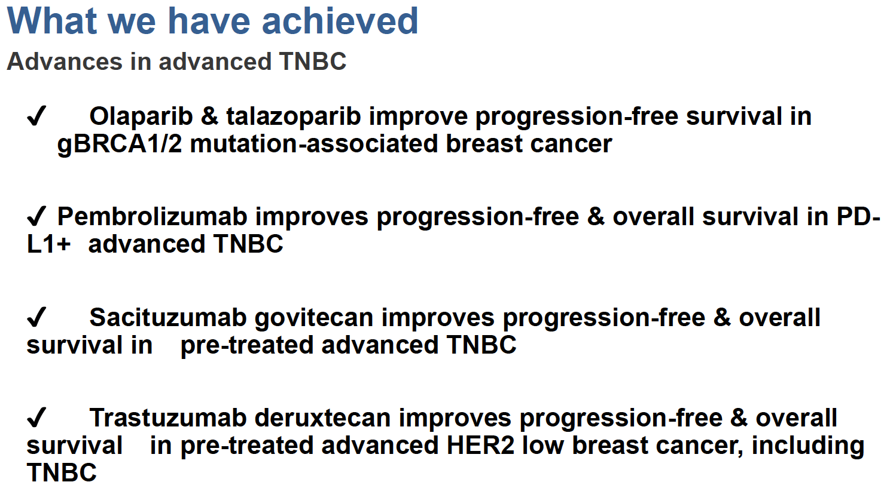
Telli M. SABCS 2023;Abstract PL-02.

Slide 10
Key Data Sets
Introduction
Teli et al. Recent advances in triple-negative breast cancer. SABCS 2023;Abstract PL-02.
Avila J et al. Frequency of presentation and outcomes of stage IV breast cancer over the past decade: A population-based study. SABCS 2023;Abstract PO4-06-02.
Leone JP et al. Estimating mortality in women with triple-negative breast cancer: The 'ESTIMATE triple-negative' tool. Eur J Cancer 2023;189:112930.
Shaikh SS, Emens LA. Current and emerging biologic therapies for triple negative breast cancer. Expert Opin Biol Ther 2022;22(5):591-602.
Huppert LA et al. Emerging treatment strategies for metastatic triple-negative breast cancer. Ther Adv Med Oncol 2022;14:17588359221086916.
Foldi J, Geyer CE Jr. Precision medicine for metastatic TNBC: The FUTURE is now. Cell Res 2023;33(7):491-2.

Slide 11
Roadmap: mTNBC
First line
Second line
Third line and Beyond
≥ 12mo from adj tx
or de novo mTNBC
Pembrolizumab + paclitaxel or nab-paclitaxel (KN355)
Sacituzumab govitecan (ASCENT)
PD-L1+
Pembrolizumab + gemcitabine/carboplatin (KN355)
<12mo from adj tx
2nd line option not previously used
Chemotherapy
T-DXd
(if HER2 low)
(DB04)
mTNBC
gBRCA WT
Chemotherapy
PARPi
(if gBRCA mutant and not previously used)
PD-L1-
PARPi (OlympiAD, EMBRACA)
gBRCA mutant
Clinical trials
Courtesy of Laura Huppert, MD

Slide 12
Agenda
Introduction: Overview of metastatic triple-negative breast cancer (mTNBC)
Module 1: First-line treatment of mTNBC – Chemotherapy with or without immunotherapy
Module 2: Antibody-drug conjugates in the management of mTNBC
Module 3: PARP inhibition for the treatment of mTNBC

Slide 13
Key Data Sets
Immunotherapy
Howard FM et al. The emerging role of immune checkpoint inhibitors for the treatment of breast cancer. Expert Opin Investig Drugs 2022;31(6):531-48.
Howard FM et al. Clinical trials of immunotherapy in triple-negative breast cancer. Breast Cancer Res Treat 2022;195(1):1-15.
Jacob SL et al. Role of immunotherapy in breast cancer. JCO Oncol Pract 2023;19(4):167-79.
Morganti S, Tolaney SM. Role of immunotherapy in early- and late-stage triple-negative breast cancer. Hematol Oncol Clin North Am 2023;37(1):133-50.
Cortes J et al; KEYNOTE-355 Investigators. Pembrolizumab plus chemotherapy in advanced triple-negative breast cancer. N Engl J Med 2022;387(3):217-26.

Slide 14
Key Data Sets
Immunotherapy
Brastianos PK et al. Pembrolizumab in brain metastases of diverse histologies: Phase 2 trial results. Nat Med 2023;29(7):1728-37.
Kim AE et al. Abnormal vascular structure and function within brain metastases is linked to pembrolizumab resistance. Neuro Oncol 2023 Dec 9;[Online ahead of print].

Slide 15
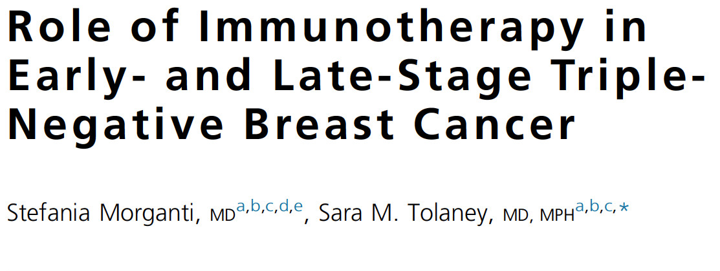
Hematol Oncol Clin North Am 2023 February;37(1):133-50.

Slide 16
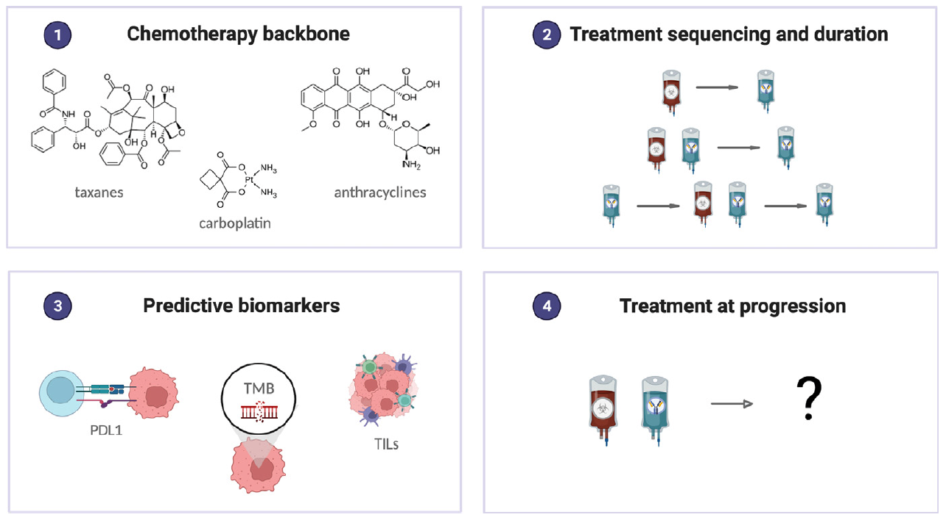
Immunotherapy in Triple-Negative Breast Cancer: Open Questions
Morganti S, Tolaney SM. Hematol Oncol Clin North Am 2023 February;37(1):133-50.

Slide 17
Dr Shaikh – A 60-year-old woman with a history of well-controlled HIV who is diagnosed with mTNBC
60-year-old woman with well-controlled HIV on HAART for several decades. She self-palpated a R breast mass noted to be 2.5 cm on mammogram with no associated axillary adenopathy. Biopsy of the breast mass noted invasive ductal carcinoma, ER 0, PR 0, HER2 0. She reported back pain that was new for her in the past few weeks to months so we obtained a PET scan at baseline. It did not identify any evidence of disease in the back, but she did have a pleural based mass that was FDG-avid. She underwent biopsy which was consistent with metastatic triple negative breast cancer, CPS 20. She started nab paclitaxel and pembrolizumab and after the first cycle felt the breast mass started to shrink and soon it was no longer palpable. Repeat scans at 3 months noted complete resolution of the pleural based nodule, significant decrease in the breast mass, and on other evidence of disease. We discussed her case at the multidisciplinary tumor board to discuss possibility of local therapy and the plan is to continue treatment for at least 6 months. If at that time she has ongoing response can consider surgery and radiation.

Slide 18
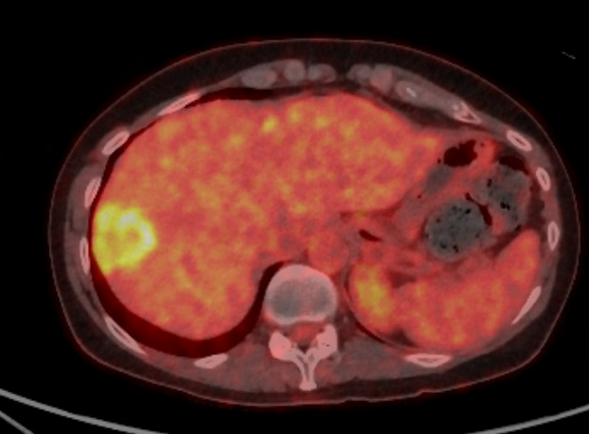
Dr Huppert – A 45-year-old woman with de novo mTNBC
45yoF with a new diagnosis of de novo mTNBC to liver (PD-L1 CPS 10, no germline genetic mutations) here to establish care.
De novo metastatic disease:
10/23: Developed right breast pain and swelling
11/18/23: MRI breast demonstrated large breast mass involving most of the right breast, at least 10cm in size. +Level I-III adenopathy
11/24/23: Right breast ultrasound-guided biopsy: Grade 3 IDC, ER neg, PR neg, HER2 neg (IHC 0), Ki67 80%
11/26/23: PET/CT: Right breast mass and axillary LAD. 5cm hypermetabolic liver mass c/f metastatic disease
12/4/23: Image-guided liver biopsy:
  Metastatic carcinoma c/w breast primary
  ER neg, PR neg, HER2 neg (IHC 0)
  NGS: MAP2K4 loss, TP53 N29fs*15; PD-L1 CPS 10
12/13/23: Started on weekly nab-paclitaxel 2 weeks on, 1 week off + pembrolizumab q3wk per KN355
1/3/24: Tbili 0.7, AST 255, ALT 255, AlkP 180.
  RUQ u/s with improved size of liver mass, no biliary ductal dilation
  Viral and autoimmune hepatitis serologies negative
  Suspected IRAE hepatitis – Held pembro, started 1mg/kg PO prednisone
  Continued nab-paclitaxel and held pembrolizumab for 8 weeks during steroid taper
Nov 2023:

Slide 19
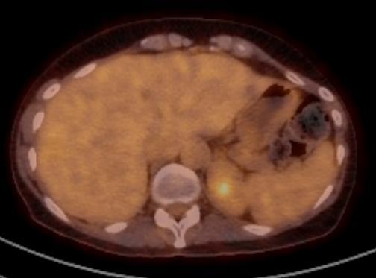
Dr Huppert – A 45-year-old woman with de novo mTNBC (continued)
2/14/24: Completed 6-week steroid taper
2/16/24: PET/CT: Significant improvement in size and hypermetabolism of solitary liver lesion, now 1.1cm in size on CT scan with minimal hypermetabolism above baseline
3/6/24: LFTs remained normal off of pembrolizumab. Discussed pros/cons of restarting pembro with hepatology and the patient. Counseled patient about 20-30% risk of recurrent IRAE hepatitis. Decision made to re-trial pembro.
3/6/24: Restarted pembrolizumab q3wk with ongoing nab-paclitaxel
  LFTs remain normal to date
  Plan for repeat scan in mid-May
Feb 2024:
Questions:
What is your chemotherapy partner of choice with pembrolizumab in patients with PD-L1 positive mTNBC?
In excellent responders, when do you consider dropping the chemotherapy and continuing pembrolizumab maintenance?
What is your approach to managing IRAE hepatitis? Have you re-trialed IO in these cases?
What are the most common IO toxicities you see and any tips for management?

Slide 20
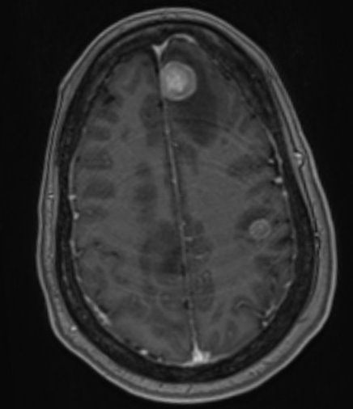
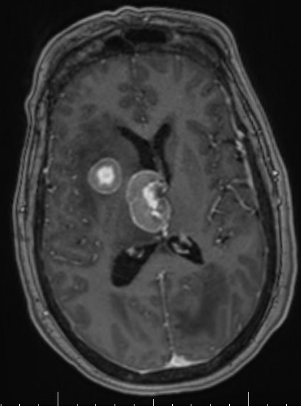
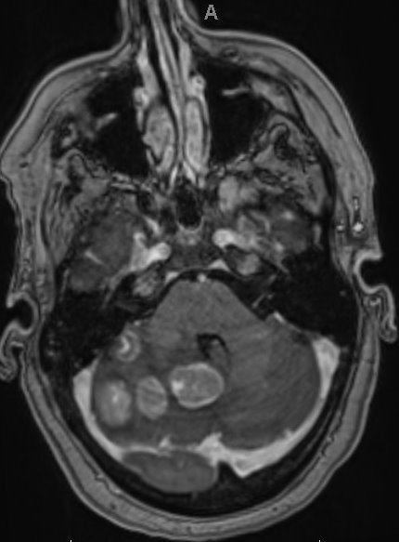
Dr Foldi – A 59-year-old woman with mTNBC who received up-front pembrolizumab/chemotherapy
59-year-old woman with history of a left-sided stage IA (pT1c pN0) ER/PR+, HER2- IDC diagnosed in 2016, MammaPrint low-risk, s/p partial mastectomy, adjuvant RT and endocrine therapy with an AI until summer 2023
August 2023 - Presented with headache and dizziness and seizure-like activity
MRI brain 8/7/2023:

Slide 21
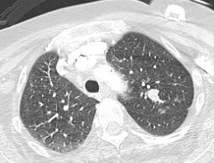
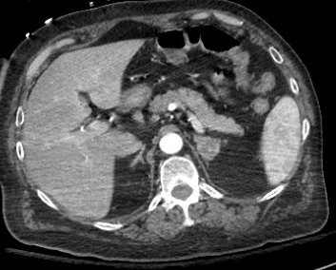
Dr Foldi – A 59-year-old woman with mTNBC who received up-front pembrolizumab/chemotherapy (continued)
CT CAP revealed a LUL lung nodule, mediastinal adenopathy and an adrenal nodule
Biopsy of the adrenal nodule was consistent with metastatic carcinoma:
  GATA3+ and Keratin-7+
  Keratin-20-, TTF-1-, napsin-A-, p40-, synaptophysin- and chromogranin-negative
  Ki-67 >90%
  ER<1%, PR<1%, HER2 0 on IHC
  PD-L1 negative
  TMB=18 mut/Mb

Slide 22
Dr Foldi – A 59-year-old woman with mTNBC who received up-front pembrolizumab/chemotherapy (continued)
CT CAP revealed a LUL lung nodule, mediastinal adenopathy and an adrenal nodule
Biopsy of the adrenal nodule was consistent with metastatic carcinoma:
  GATA3+ and Keratin-7+
  Keratin-20-, TTF-1-, napsin-A-, p40-, synaptophysin- and chromogranin-negative
  Ki-67 >90%
  ER<1%, PR<1%, HER2 0 on IHC
  PD-L1 negative
  TMB=18 mut/Mb
Overall consistent with metastatic carcinoma of breast origin, triple negative

Slide 23
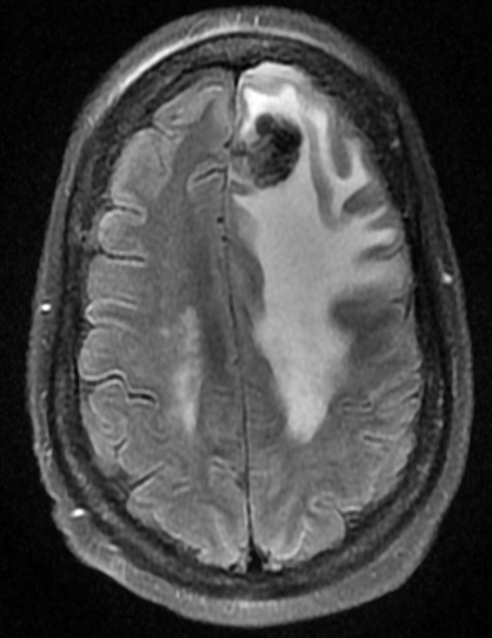
Dr Foldi – A 59-year-old woman with mTNBC who received up-front pembrolizumab/chemotherapy (continued)
Started on Nab-paclitaxel plus Pembrolizumab (based on high TMB)
PET-CT 3 months later showed response to therapy
4 months later, was found down at home and MRI brain was done in the ED:
Left frontal lobe mass resection:
  Metastatic carcinoma: GATA3+, CK7+, TRPS1 patchy, weak +
    TTF-1, CK20, Synaptophysin negative
    Ki-67 ~80%
    ER, PR neg, HER2 0
    Oncomine:
      RB1 mutation p.R556*
      TP53 mutation p.T155N
      5q region copy number LOSS
      7q region (BRAF) copy number GAIN (~5 copies)
      8p region copy number LOSS
      TMB = 19.2 mut/Mb

Slide 24
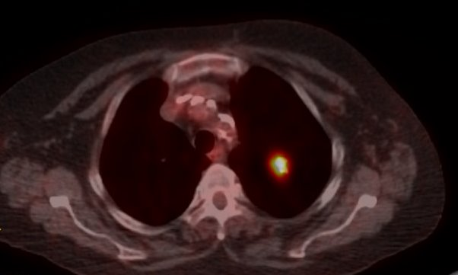
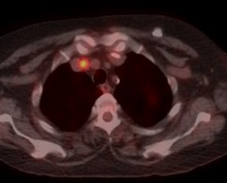
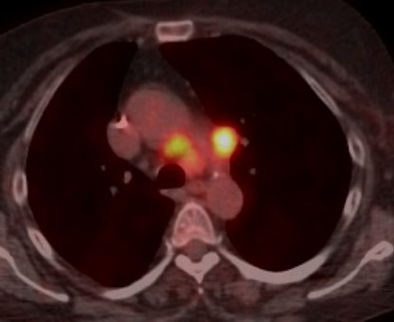
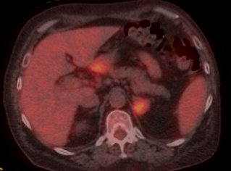
Dr Foldi – A 59-year-old woman with mTNBC who received up-front pembrolizumab/chemotherapy (continued)
Systemic restaging with a PET CT at the same time showed the following:
ECOG Performance status = 1 after 2 weeks in rehab

Slide 25
Dr Foldi – A 59-year-old woman with mTNBC who received up-front pembrolizumab/chemotherapy (continued)
Systemic restaging with a PET CT at the same time showed the following:
ECOG Performance status = 1 after 2 weeks in rehab
What is the next step in the management
of her mTNBC?

Slide 26
Agenda
Introduction: Overview of metastatic triple-negative breast cancer (mTNBC)
Module 1: First-line treatment of mTNBC – Chemotherapy with or without immunotherapy
Module 2: Antibody-drug conjugates in the management of mTNBC
Module 3: PARP inhibition for the treatment of mTNBC

Slide 27
Key Data Sets
Antibody-drug conjugates: Sacituzumab govitecan
Schlam I et al. Next-generation antibody-drug conjugates for breast cancer: Moving beyond HER2 and TROP2. Crit Rev Oncol Hematol 2023;190:104090.
Tarantino P et al. Optimizing the safety of antibody-drug conjugates for patients with solid tumours. Nat Rev Clin Oncol 2023;20(8):558-76.
Chen N et al. The evolving therapeutic landscape of antibody-drug conjugates in breast cancer. Expert Rev Anticancer Ther 2022;22(12):1325-31.
Schlam I et al. Managing adverse events of sacituzumab govitecan. Expert Opin Biol Ther 2023;23(11):1103-11.
Bardia A et al. Final results from the randomized phase III ASCENT clinical trial in metastatic triple-negative breast cancer and association of outcomes by human epidermal growth factor receptor 2 and trophoblast cell surface antigen 2 expression. J Clin Oncol 2024;[Online ahead of print].

Slide 28
Key Data Sets
Antibody-drug conjugates: Sacituzumab govitecan (continued)
Kalinsky K et al. Real-world (RW) use patterns, effectiveness, and tolerability of sacituzumab govitecan (SG) for second-line (2L) and later treatment of metastatic triple-negative breast cancer (mTNBC). ESMO 2023;Abstract 393P.
Bardia A et al. ASCENT-03: Phase III study of sacituzumab govitecan (SG) vs treatment of physician’s choice (TPC) in first-line (1L) metastatic triple-negative breast cancer (mTNBC). ESMO 2022;Abstract 275TiP.

Slide 29
Dr Shaikh – A 50-year-old woman with mTNBC treated with first-line chemotherapy/immune checkpoint inhibitor followed by sacituzumab govitecan
50-year-old woman with no known past medical history initially diagnosed with breast cancer in 2022 after presenting with 2 months of a growing breast mass that was becoming painful. Mammogram noted 6.8 x 5.7 cm mass, no suspicious axillary adenopathy was identified. Biopsy reported invasive ductal carcinoma, grade 3, ER 0, PR 0, HER2 0, Ki67 60%. Pt reported back pain and headaches, PET and MRI brain ordered. No evidence of brain mets on MRI brain. PET identified the breast mass, which measured about 7 cm with SUV 14, there was also a 3.5 cm right hepatic lobe mass SUV 15. She had a CT-guided liver biopsy which reported metastatic carcinoma, c/w breast primary. ER/PR/HER2 0. PD-L1 CPS 40. Germline genetic testing negative. She was started on paclitaxel/pembrolizumab. She overall tolerated treatment well. She experienced fatigue for a few days after her infusions, and mild neuropathy for which she was on gabapentin. Breast pain improved. Scans showed initial partial response which lasted for 9 months after which she developed progressive disease. That’s when she started on Sacituzumab Govitecan in the second line setting. Then developed grade 2 diarrhea with the first cycle that was controlled with loperamide. She has an ongoing response to treatment and continues on SG which she has been on for 9 months so far.

Slide 30
Dr Huppert – A 37-year-old woman with mTNBC treated with sacituzumab govitecan
37yoF with h/o right breast cancer dx in 2021 (3.0cm grade 3 IDC, ER+ 71-80%, PR+ 61-70%, HER2 neg (IHC 1+), 1/4 SLN, pT2N1a, Oncotype 29 s/p TC x 4, radiation, tamoxifen x 18mo stopped 9/21) now with a diagnosis of mTNBC (diagnosed 11/23) to liver, LN, bone, malignant effusions, PD-L1 negative, no germline genetic mutations)
Right breast cancer:
3/21: S/p Right lumpectomy and SLNB with 3.0 cm grade 3 IDC, ER+ 71-80%, PR+ 61-70%, HER2 neg (IHC 0), 1/4 SLN with 3mm deposit, no ECE pT2N1a. Oncotype 29.
3/21: Germline genetic testing: No pathogenic mutations
5/21: Adjuvant TC x 4
8/21: Adjuvant radiation to breast and LN
8/21: Started on OFS/AI but didn’t tolerate (joint pains, hot flashes)
9/21-9/23: Switched to tamoxifen. Stopped due to intolerance (hot flashes, mood changes) after 2 yrs.
Metastatic disease:
11/1/23: Developed abdominal pain; labs notable for Tbili 2.4. CT CAP with numerous liver lesions, osseous lesions, retroperitoneal LAD, large volume ascites. On exam, +fluid wave, weight 160lb (dry weight 125lb)
11/10/23: US-guided liver biopsy: Metastatic carcinoma c/w breast primary. ER neg, PR neg, HER2 neg (IHC 0), PD-L1 CPS 3.
11/11/23: Paracentesis - 2L fluid removed: +Malignant cells, ER neg, PR neg, HER2 neg (IHC 0)

Slide 31
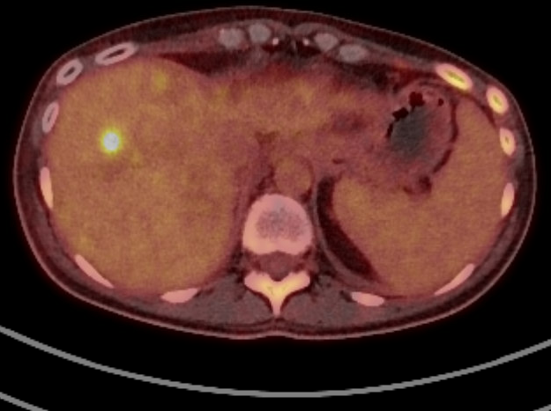
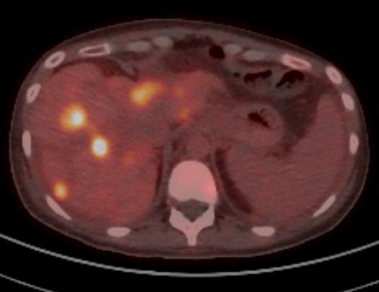
Dr Huppert – A 37-year-old woman with mTNBC treated with sacituzumab govitecan (continued)
Jan 2024:
11/16/23: Started on weekly paclitaxel 60mg/m²
  Overall LFTs improved – increased paclitaxel to 80mg/m²
  Malignant effusions improved; weight improved to 135lb
1/28/24: PET/CT: Lytic bone lesions now more sclerotic, liver lesions stable
  Continued weekly paclitaxel, 3 weeks on/1 week off.
  Requiring 2-3 doses of growth factor between weekly cycles.
3/20/24 PET/CT: New and increased hypermetabolic hepatic metastases. Additional foci of osseous hypermetabolism. Worsening right pleural effusions + moderate volume ascites.
3/27/24 C1D1 sacituzumab govitecan 10mg/kg per ASCENT
Questions:
This pt was IHC 1+ on early-stage biopsy. Do you typically use SG or T-DXd as the preferred 2nd line tx in pts with HER2-low mTNBC?
This patient had normal LFTs at SG start. There is limited data with SG in pts with elevated LFTs – what is your experience/practice?
What is your approach to management of neutropenia on SG: primary vs. secondary prophylaxis?
What is your approach to managing diarrhea on SG?
March 2024:

Slide 32
Dr Foldi – A 40-year-old woman with mTNBC treated with sacituzumab govitecan
40-year-old woman was diagnosed with a cT2N0 TNBC, grade 3, Ki-67 40%
Underwent neoadjuvant chemotherapy with the KEYNOTE-522 regimen
  completed carboplatin x5 after which it was discontinued due to toxicity, and weekly paclitaxel x12 along with every 3-week pembrolizumab, followed by AC x4 with continued pembrolizumab
  complicated by immune related hypopituitarism and secondary adrenal insufficiency requiring replacement hydrocortisone and levothyroxine, as well as a DVT requiring anticoagulation for 6 months
Underwent right segmental mastectomy for a final pathologic stage of ypT2N1mic with 2.5 cm residual tumor and 1/6 LN's with micrometastasis
She completed adjuvant RT in 30 fractions and Capecitabine x 6 cycles
2 months later, began to experience breast changes with development of skin nodules and skin discoloration and skin biopsy confirmed recurrent triple negative grade 3 IDC, Ki-67 50%
Taken for completion mastectomy with ALND - pathology showing multifocal tumor found in all four quadrants of the breast with chest wall extension and 1/1 positive LN.

Slide 33
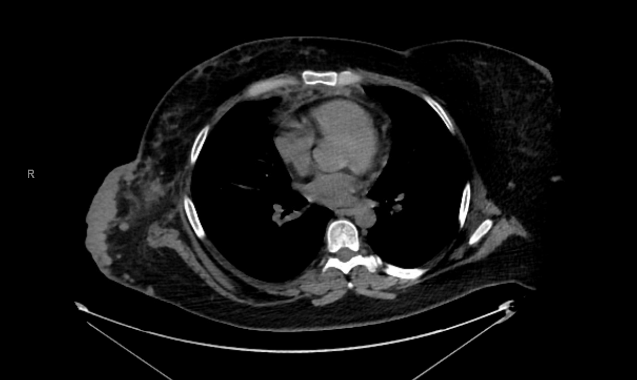
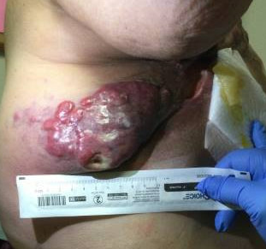
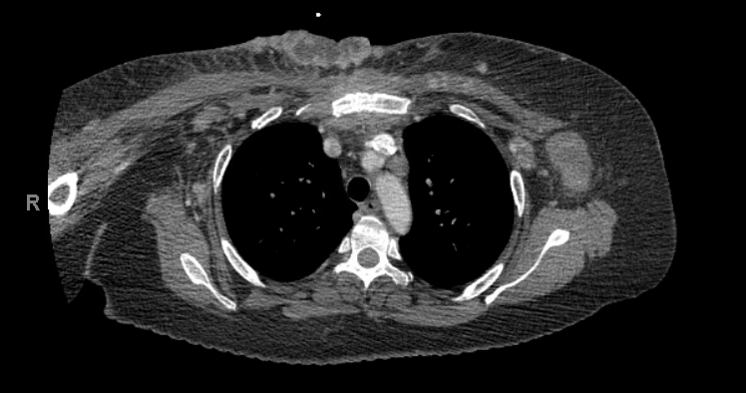
Dr Foldi – A 40-year-old woman with mTNBC treated with sacituzumab govitecan (continued)
Referred for a second opinion regarding systemic treatment options
Despite rapid local recurrence, was not systemically staged prior to completion mastectomy
Her exam on my first visit with her:
Given short interval recurrence after completing neoadjuvant/adjuvant chemotherapy, started Sacituzumab govitecan
  Complicated by grade 3 neutropenia despite receiving growth factor support with C1
  Chest wall disease progressed after 1 cycle of SG

Slide 34
Dr Foldi – A 40-year-old woman with mTNBC treated with sacituzumab govitecan (continued)
Referred for a second opinion regarding systemic treatment options
Despite rapid local recurrence, was not systemically staged prior to completion mastectomy
Her exam on my first visit with her:
Given short interval recurrence after completing neoadjuvant/adjuvant chemotherapy, started Sacituzumab govitecan
  Complicated by grade 3 neutropenia despite receiving growth factor support with C1
  Chest wall disease progressed after 1 cycle of SG
What is the next step in the management of her mTNBC?

Slide 35
Key Data Sets
Antibody-drug conjugates: Trastuzumab deruxtecan and datopotamab deruxtecan
Schlam I et al. How I treat HER2-low advanced breast cancer. Breast 2023;67:116-23.
Rugo HS et al. Real-world perspectives and practices for pneumonitis/interstitial lung disease associated with trastuzumab deruxtecan use in human epidermal growth factor receptor 2-expressing metastatic breast cancer. JCO Oncol Pract 2023;19(8):539-46.
  Tarantino P, Tolaney SM. Detecting and managing T-DXd-related interstitial lung disease: The five "S" rules. JCO Oncol Pract 2023;19(8):526-7.
Notini G et al. Management of trastuzumab deruxtecan-related nausea and vomiting in real-world practice. Front Oncol 2024;14:1374547.
Schreiber AR et al. The emergence of targeted therapy for HER2-low triple-negative breast cancer: A review of fam-trastuzumab deruxtecan. Expert Rev Anticancer Ther 2023;23(10):1061-9.
Schmid P et al. Datopotamab deruxtecan (DATO-DXd) + durvalumab (D) as first-line (1L) treatment for unresectable locally advanced/metastatic triple-negative breast cancer (a/m TNBC). ESMO 2023;Abstract 379MO.

Slide 36
Dr Shaikh – A 55-year-old woman with HER2-low mBC treated with T-DXd
55-year-old woman with germline BRCA1 mutation who had significant treatment history prior to transferring care. She was initially diagnosed with 3.3 cm breast cancer that was biopsied and noted to be invasive ductal carcinoma, ER 0, PR 0, HER2 0. She was treated with adjuvant AC-T and subsequently had a recurrence 2 years later that was triple negative breast cancer ER 0, PR 0, HER2 0, CPS 0. She had multiple lines of therapy including capecitabine, Olaparib, vinorelbine, Sacituzumab, an immune checkpoint inhibitor clinical trial, eribulin. She had a few lung nodules but she also had very extensive cutaneous metastases. A few which were very bothersome to her had been previously radiated. We biopsied a cutaneous met which noted triple negative breast cancer ER 0, PR 0, HER2 1+ and started treatment with T-DXd. She had a clinical response to T-DXd and noted shrinkage of the cutaneous metastases and has been on this for several months. She has nausea and fatigue. Her hair had previously thinned out with her prior therapies but she noted some additional hair loss on T-DXd.

Slide 37
Agenda
Introduction: Overview of metastatic triple-negative breast cancer (mTNBC)
Module 1: First-line treatment of mTNBC – Chemotherapy with or without immunotherapy
Module 2: Antibody-drug conjugates in the management of mTNBC
Module 3: PARP inhibition for the treatment of mTNBC

Slide 38
Key Data Sets
PARP inhibitors
Morganti S et al. Adjuvant olaparib for germline BRCA carriers with HER2-negative early breast cancer: Evidence and controversies. Oncologist 2023;28(7):565-74.
Senkus E et al. Olaparib efficacy in patients with germline BRCA-mutated, HER2-negative metastatic breast cancer: Subgroup analyses from the phase III OlympiAD trial. Int J Cancer 2023;153(4):803-14.

Slide 39
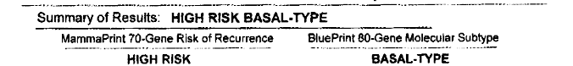
Dr Foldi – A 35-year-old woman with mTNBC treated with olaparib
35-year-old woman was found to have a right IDC, clinical stage cT4 cN1/N2 cM0
grade 3, Ki-67 96%, ER low positive (3%), PR<1% and HER2 0 on IHC
MammaPrint with BluePrint:
Genetic testing was negative for germline pathogenic variants
Underwent neoadjuvant dose dense AC x4 followed by weekly paclitaxel x12 concurrent with every 3-week carboplatin x4
Modified radical mastectomy → pathologic complete response in breast and axilla
Completed adjuvant XRT to chest wall
Was placed on adjuvant Tamoxifen given low ER expression but could not tolerate

Slide 40
Dr Foldi – A 35-year-old woman with mTNBC treated with olaparib (continued)
2 years after her initial diagnosis, she began to experience hoarseness and cough
CT CAP revealed enlarged mediastinal LN’s (do not have images available)
Biopsy of a LN confirmed poorly differentiated carcinoma, consistent with breast primary that was ER, low positive (H score 1), PR negative and Her-2/neu negative, 1+, PD-L1 negative (CPS 5)
Started on Capecitabine along with SBRT to mediastinal LN’s
Initially had some response and LN’s decreased in size, then developed new supraclavicular LN’s
Foundation One Liquid CDx: somatic BRCA1 E673* (pathogenic) mutation
Started Olaparib 300mg BID with ongoing response at 1 year

Slide 41
Dr Foldi – A 35-year-old woman with mTNBC treated with olaparib (continued)
2 years after her initial diagnosis, she began to experience hoarseness and cough
CT CAP revealed enlarged mediastinal LN’s (do not have images available)
Biopsy of a LN confirmed poorly differentiated carcinoma, consistent with breast primary that was ER, low positive (H score 1), PR negative and Her-2/neu negative, 1+, PD-L1 negative (CPS 5)
Started on Capecitabine along with SBRT to mediastinal LN’s
Initially had some response and LN’s decreased in size, then developed new supraclavicular LN’s
Foundation One Liquid CDx: somatic BRCA1 E673* (pathogenic) mutation
Started Olaparib 300mg BID with ongoing response at 1 year
What is the evidence for using Olaparib in patients whose tumors harbor somatic BRCAmut?

Slide 42
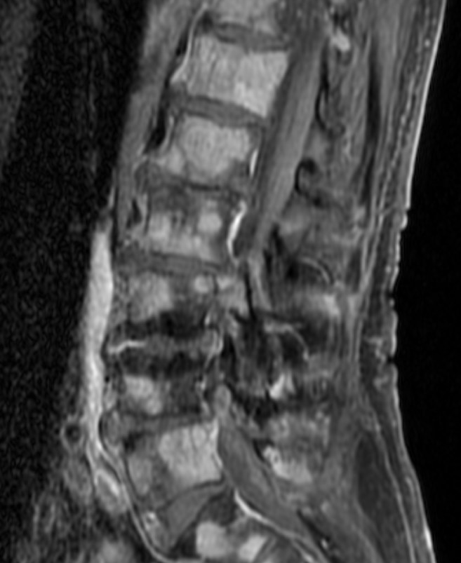
Dr Huppert – A 66-year-old woman with mTNBC who receives olaparib
66yoF with pathogenic BRCA1 mutation and h/o left breast cancer (s/p upfront lumpectomy and SLNB in Russia with 3.1cm grade 3 IDC, TNBC, 0/1 LN s/p adjuvant AC/T) now presenting with back pain.
Left breast cancer (initial care in Russia):
11/21: Self palpated a left breast mass
11/22: Mammogram demonstrated 3cm right breast mass
12/15/21: Left lumpectomy + SLNB: 3.1cm grade 3 IDC, ER neg, PR neg, HER2 neg (IHC 0), Ki67 90%, 1/3 LN with 3mm deposit
No germline genetic testing performed at that time despite strong family history of breast cancer
1/22/22: PET/CT non-contrast: No e/o metastatic disease
1/28/22-7/28/22: Adjuvant AC/T
8/22: Radiation to left breast and axillary LN
Jan 2023: Moved to the US
Feb 2023:
Metastatic disease:
Feb 2023: Presented to the ED with mid-back pain
3/4/23 MR total spine: New osseous lesions, including T4 compression fracture. No cord signal abnormality → Discussed with NGS, no surgery indicated. Radiation oncology recommended radiation.
3/5/23 CT CAP: Diffuse bone lesions, no other e/o metastatic lesions

Slide 43
Dr Huppert – A 66-year-old woman with mTNBC who receives olaparib (continued)
3/4/23 Germline genetic testing 94 gene panel confirmed pathogenic BRCA1 mutation (c.1961del pLys654Serfs*47), and VUS in DICER c1274A>G
3/9/23 CT-guided bone bx: Metastatic adenocarcinoma c/w breast primary. ER neg, PR neg, HER2 neg (IHC 0)
  NGS: MS stable, TMB 5 muts/mb, BRCA1 K654fs.47, MSH3 rearrangement exon 18, TP53 R196
  PD-L1 CPS 22C3 = 0
3/10/23-3/14/23: Radiation to T4
3/17/23: Started on olaparib 300mg BID per OlympiAD. Baseline Hg 10.7.
4/15/23: Hg 7.0, held olaparib and transfused 1u PRBC
4/20/23: Repeat Hg 9.2. Restarted olaparib 250mg BID
Moved back to Russia May 2023
  Per patient, had response to treatment on first staging scans in Russia and was on olaparib for ~11 mo
  Discussed options for next lines of therapy: SG, gemcitabine/carboplatin, other standard chemotherapies
Questions:
When do you consider using olaparib 1st line vs. 2nd line and beyond for mTNBC?
Germline genetic testing – which patients do you test?
This patient was treated adjuvantly for her initial early-stage TNBC, but we would have preferred to treat her neoadjuvantly with the KN522 regimen, with option to escalate adjuvant care if needed. If a patient gets adjuvant olaparib for early-stage disease, how does this impact your use of PARPi in the metastatic setting?

Slide 44
Dr Shaikh – A 45-year-old woman with mTNBC treated with olaparib
45-year-old woman with no significant past medical history presented with a painful R breast mass. Mammogram identified 2.5 cm R breast mass with associated abnormal axillary lymph nodes. She underwent a biopsy which showed invasive ductal carcinoma, ER 0, PR 0, HER2 0, Ki67 30%. R axillary node was biopsied and c/w metastatic carcinoma. She had genetic testing done and found to have BRCA1 germline mutation. No identification of metastatic disease on baseline scans. She completed neoadjuvant KN522 with carbo/paclitaxel/pembro followed by doxorubicin/cyclophosphamide/pembro with no significant issue. She underwent R modified radical mastectomy, R targeted axillary dissection and had a complete pathologic response. She completed 9 cycles of adjuvant pembrolizumab. 6 months after completing adjuvant pembrolizumab she presented with a severe headache and was found to have a 2.5 cm brain metastasis which was resected. Biopsy c/w triple negative breast cancer, ER 0, PR 0, HER2 0. CPS 5. She received radiation to the tumor bed. Systemic scans completed and no distant metastases. She was started on Olaparib 300 BID. She reports nausea which is controlled with ondansetron and is otherwise tolerating it well.

Slide 45
Feedback on New Programs for TNBC

Slide 46

https://www.mbcalliance.org/members/metastatic-breast-cancer-network/

Slide 47

https://tnbcfoundation.org

Slide 48
Appendix of Additional Cases

Slide 49
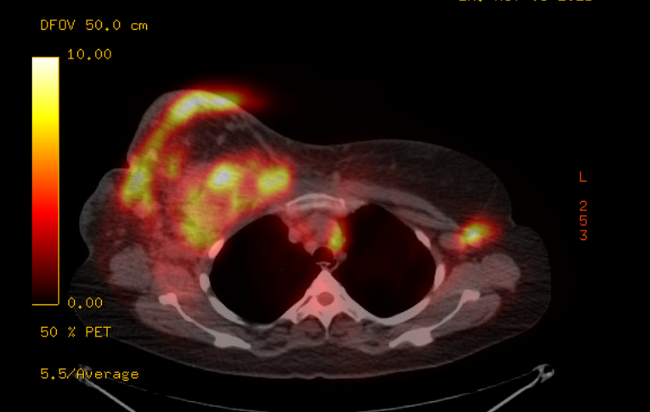
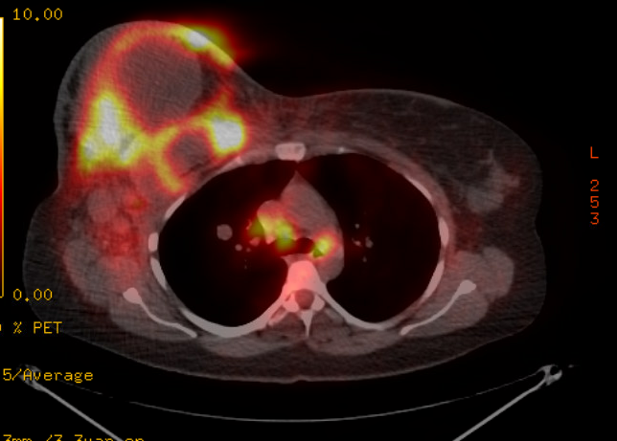
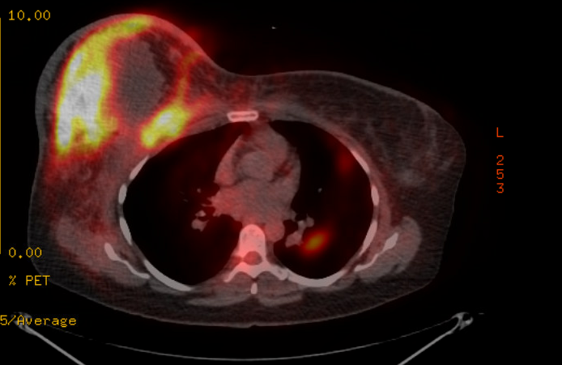
Dr Foldi – A 37-year-old woman with ER-negative, HER2-low mBC
37-year-old woman presented with a large right breast mass, and underwent biopsy and staging PET CT:
Pathology: Grade 3 IDC, Ki-67 95%
  ER: 0, PR: 0, HER2: 0 (IHC)
  PD-L1: CPS 0

Slide 50
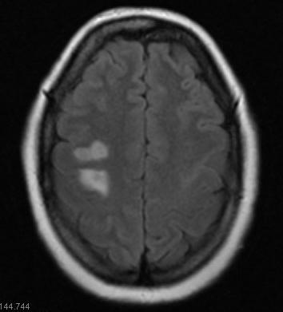
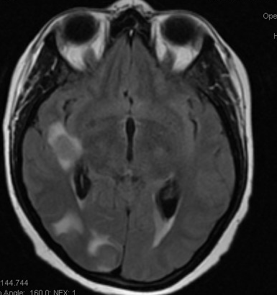
Dr Foldi – A 37-year-old woman with ER-negative, HER2-low mBC (continued)
Given de novo metastatic disease, started chemotherapy with Carboplatin + Nab paclitaxel x 6 months
Progression of disease in multiple left axillary and mediastinal LN’s. New brain metastases found (at least 27)
Underwent whole brain radiotherapy

Slide 51
Dr Foldi – A 37-year-old woman with ER-negative, HER2-low mBC (continued)
Underwent left axillary LN biopsy:
  Pathology: metastatic carcinoma of breast origin
    ER: 0, PR: 0, HER2: 1+ on IHC
Started 2nd line therapy with Sacituzumab govitecan x 5 months – progression in the chest and breast and new bone metastases
Started 3rd line therapy with Trastuzumab deruxtecan with the addition of zoledronic acid
  POD after only 2 months
Enrolled on clinical trial of B7-H4 Ab – POD after 3 months with development of leptomeningeal disease
Deceased shortly after

Slide 52
Dr Foldi – A 37-year-old woman with ER-negative, HER2-low mBC (continued)
Underwent left axillary LN biopsy:
  Pathology: metastatic carcinoma of breast origin
    ER: 0, PR: 0, HER2: 1+ on IHC
Started 2nd line therapy with Sacituzumab govitecan x 5 months – progression in the chest and breast and new bone metastases
Started 3rd line therapy with Trastuzumab deruxtecan with the addition of zoledronic acid
  POD after only 2 months
Enrolled on clinical trial of B7-H4 Ab – POD after 3 months with development of leptomeningeal disease
Deceased shortly after
How would you sequence ADC’s in mTNBC?
What, if any, is the evidence for efficacy of 2nd ADC after ADC?

Slide 53
Dr Huppert – A 36-year-old woman with de novo mTNBC
36yoF with de novo mTNBC (to chest wall, LN, lung)
De novo metastatic disease:
6/22: Developed swollen LN in her neck, changes in her left breast
9/4/22: CT CAP: Left breast with diffuse involvement of disease, Hypermetabolic LN in neck mediastinum, left axilla, right inguinal region and diffuse bone lesions
9/10/22: Left breast core needle biopsy: Grade 3 IDC, ER neg, PR neg, HER2 neg (IHC 1+), Ki67 90%.
  NGS: MSI normal, TP53 p.Y234* (pathogenic), TP53 p.H233_Y234insV.
  PD-L1 CPS 22C3 = 0
9/14/22: CT-guided bone biopsy: Adenocarcinoma c/w breast primary, ER neg, PR neg, HER2 neg (IHC 0)
9/14/22: Germline genetic testing- negative 87 gene panel
9/20/22-11/30/22: Weekly paclitaxel 80mg/m² 3 weeks on, 1 week off
9/20/22 Started on monthly denosumab
11/17/22: PET/CT: Interval increase in left breast primary disease along with increased hypermetabolic nodal, osseous, and soft tissue disease burden.

Slide 54
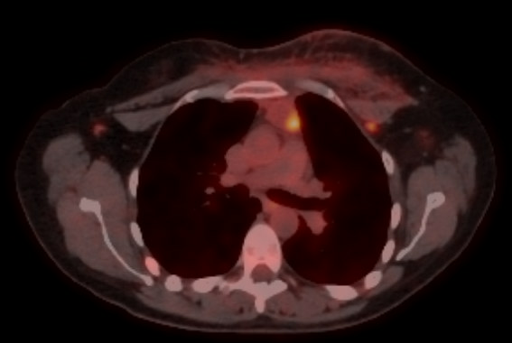
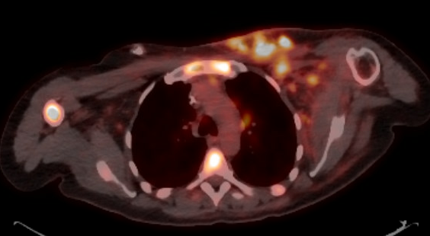
Dr Huppert – A 36-year-old woman with de novo mTNBC (continued)
Nov 2023:
11/30/23-2/15/24: Sacituzumab govitecan per ASCENT
  Initial clinical improvement in appearance of chest wall nodules C1-3
  However, then clinical progression of chest wall lesions during C4 with more pain and development of left arm weakness
2/17/24: PET/CT: Increased extent of confluent infiltrating hypermetabolic tumor in the left breast + chest wall and increased thoracic and cervical nodal metastases. Increased number and hypermetabolism of osseous metastases.
2/22/24: T-DXd per DESTINY-Breast04
2/27/24-3/10/24 Radiation to left chest wall (400 cGy) and scapular lesion
  Improvement in chest wall pain after starting T-DXd and with radiation
  Due for first restaging scan mid-April 2024
Questions:
In this patient with HER2-low mTNBC, which ADC do you typically use first – SG or T-DXd?
What is your practice regarding use of ADC-after-ADC? Do you sequence ADCs back-to-back?
This patient appears to have fairly resistant disease with early progression on both 1st line chemo, 2nd line SG. Thoughts?
What is your practice regarding monitoring for ILD in pts on T-DXd?
Feb 2024:

Slide 55
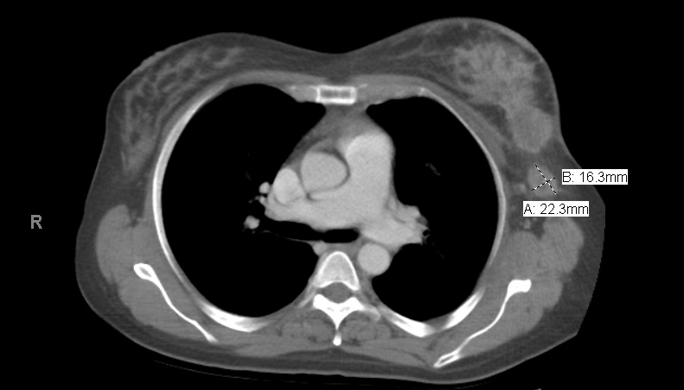
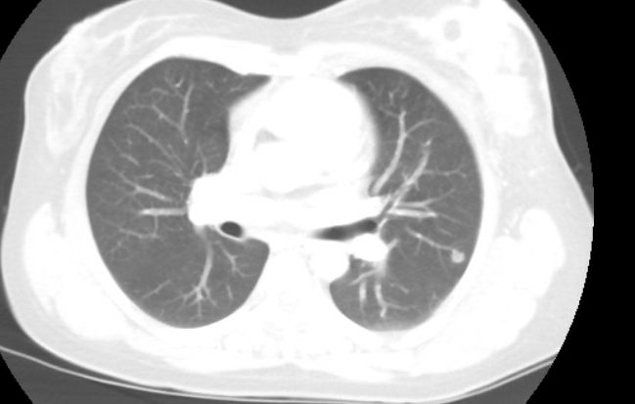
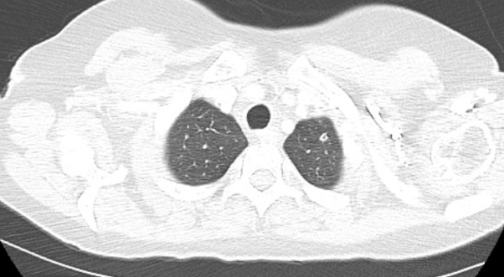
Dr Foldi – A 48-year-old woman with HER2-low mBC treated with atezolizumab plus nab paclitaxel
48-year-old woman presented with a large left breast mass that had been growing for about a year
Pathology: Grade 3 IDC, Ki-67 90%
  ER: 0, PR: 0, HER2: 1+ (IHC)
  PD-L1 (SP142): 1% on immune cells (+)

Slide 56
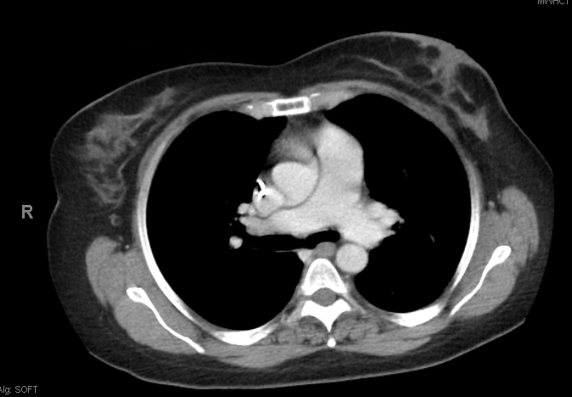
Dr Foldi – A 48-year-old woman with HER2-low mBC treated with atezolizumab plus nab paclitaxel (continued)
Given PD-L1+ as per IMpassion130 criteria, started on Nab paclitaxel + Atezolizumab
Baseline
After 20 cycles
Nab paclitaxel discontinued after 20 cycles given peripheral neuropathy and what appeared to be a complete response on imaging. Atezolizumab continued

Slide 57
Dr Foldi – A 48-year-old woman with HER2-low mBC treated with atezolizumab plus nab paclitaxel (continued)
Underwent bilateral mastectomy and L ALND → pathologic complete response in breast and LN’s
Continues on Atezolizumab indefinitely (currently cycle #41) with no evidence of disease
In a patient with a complete and persistent response to checkpoint inhibitor therapy, at what point would you trial off treatment?
If disease progresses/relapses after being off treatment, would re-trialing an ICI be reasonable?

Slide 58
Dr Huppert – A 45-year-old woman with ER/PR-negative, HER2-low BC initially treated with neoadjuvant pembrolizumab/chemotherapy
45yoF with h/o right breast cancer (6cm mass with level I-II adenopathy s/p neoadjuvant chemo/IO with KN522 regimen with pCR at time of surgery) now with recent diagnosis of brain metastases and LMD.
Right breast cancer:
12/22: Developed right breast pain and swelling
1/18/23: MRI breast demonstrated large right breast mass, at least 6cm in size. +Level I-III adenopathy
1/24/23: Right breast ultrasound-guided biopsy: Grade 3 IDC, ER neg, PR neg, HER2 neg (IHC 1+), Ki67 80%
1/26/23: PET/CT: Right breast mass and axillary LAD. No evidence of metastatic disease
1/26/23: Genetic testing: No pathogenic mutations
2/23/23-7/25/23: Neoadjuvant chemo/IO with KN522 regimen
8/28/23: Left mastectomy and ALND: No evidence of residual disease, 0/9 SLN.
Aug 2023: Adjuvant pembrolizumab to complete one year
Metastatic disease:
Late Dec 2023: Developed severe headaches while on adjuvant pembrolizumab
1/17/24: MRI brain: Extensive intracranial metastatic disease including both brain metastases and LMD
1/17/24: MRI spine: Abnormal leptomeningeal enhancement coating the entire spinal cord
1/18/24: PET/CT: +Osseous disease, 3cm liver lesion

Slide 59
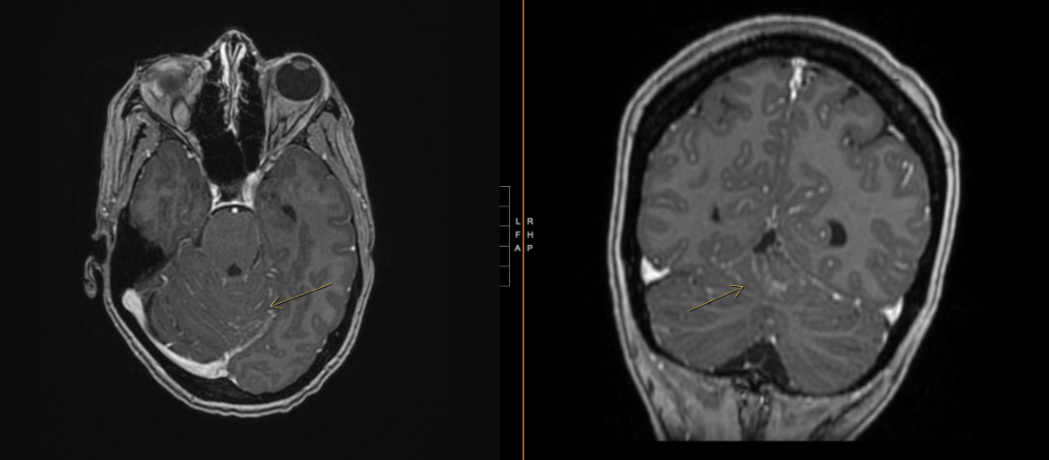
Dr Huppert – A 45-year-old woman with ER/PR-negative, HER2-low BC initially treated with neoadjuvant pembrolizumab/chemotherapy (continued)
Jan 2024:
1/19/24 Lumbar puncture: CSF positive for malignant cells. Insufficient cells for repeat receptor testing.
  On exam, ECOG 1. Alert and oriented. Able to speak in full sentences and answer questions, but somewhat more confused per her husband. Ongoing headaches. No focal neurologic deficits.
  Goals of care discussed at length with palliative care involvement; patient and her family clear they want to pursue cancer-directed therapy for now
1/20-1/31/24: Whole brain radiation therapy
2/8/24: Started on T-DXd per DESTINY-Breast04
  Improvement in mental status
  Plan for repeat MRI and cross-sectional first week of April
Questions:
What is your approach to management of brain metastases and LMD for patients with mTNBC?
For initial management of her LMD: We had considered T-DXd, SG, or IT MTX with IV chemo. We opted for T-DXd given most robust data for CNS penetration including case series of LMD. Do you agree with this rationale? What treatment would you consider next if PS remains good and she wants to continue therapy?

