Slide 1
Improving Outcomes with First-Line
Endocrine-Based Therapy for Patients with HR-Positive,
HER2-Negative Metastatic Breast Cancer
A CME/MOC-Accredited Live Webinar
Tuesday, October 8, 2024
5:00 PM – 6:00 PM ET
Faculty
Francois-Clement Bidard, MD, PhD
Kevin Kalinsky, MD, MS
Moderator
Neil Love, MD

Slide 2



Faculty
Francois-Clement Bidard, MD, PhD
Professor of Medical Oncology
Institut Curie
Versailles University
Paris, France
MODERATOR
Neil Love, MD
Research To Practice
Miami, Florida
Kevin Kalinsky, MD, MS
Professor
Department of Hematology and Medical Oncology
Emory University School of Medicine
Director, Division of Medical Oncology
Director, Glenn Family Breast Center
Winship Cancer Institute of Emory University
Atlanta, Georgia

Slide 3
Prof Bidard — Disclosures
Advisory Committees | AstraZeneca Pharmaceuticals LP, Daiichi Sankyo Inc, Exact Sciences Corporation, GE Healthcare, Gilead Sciences Inc, Inatherys, Lilly, Menarini Group, Novartis, Pfizer Inc, Roche Laboratories Inc, SAGA Diagnostics, Stemline Therapeutics Inc
Contracted Research | GE Healthcare, Menarini Silicon Biosystems, Merck KGaA, MSD, Novartis, Personalis, Pfizer Inc, ProLynx Inc, Roche Laboratories Inc, SAGA Diagnostics, Tempus
Speakers Bureaus | AstraZeneca Pharmaceuticals LP, Daiichi Sankyo Inc, Lilly, Menarini Group, Pfizer Inc, Stemline Therapeutics Inc
Travel Support | AstraZeneca Pharmaceuticals LP, Daiichi Sankyo Inc, Novartis, Pfizer Inc

Slide 4
Dr Kalinsky — Disclosures
Advisory Committees | AstraZeneca Pharmaceuticals LP, Biotheranostics Inc, Cullinan Therapeutics, Cyclacel Pharmaceuticals Inc, eFFECTOR Therapeutics Inc, Eisai Inc, Gilead Sciences Inc, Lilly, Merck, Novartis, Pfizer Inc, Prelude Therapeutics, RayzeBio, Regor Therapeutics Group, Seagen Inc
Data and Safety Monitoring Board/Committee | Merck
Stock Options/Stock — Public Companies | Grail Inc, Array BioPharma Inc, a subsidiary of Pfizer Inc, Pfizer Inc (spouse prior employment)

Slide 5
Dr Love — Disclosures
Dr Love is president and CEO of Research To Practice. Research To Practice receives funds in the form of educational grants to develop CME activities from the following companies: AbbVie Inc, Adaptive Biotechnologies Corporation, ADC Therapeutics, Agios Pharmaceuticals Inc, Alexion Pharmaceuticals, Amgen Inc, Array BioPharma Inc, a subsidiary of Pfizer Inc, Arvinas Operations Inc, Astellas, AstraZeneca Pharmaceuticals LP, Aveo Pharmaceuticals, Bayer HealthCare Pharmaceuticals, BeiGene Ltd, BeyondSpring Pharmaceuticals Inc, Black Diamond Therapeutics Inc, Blueprint Medicines, Boehringer Ingelheim Pharmaceuticals Inc, Bristol Myers Squibb, Celgene Corporation, Clovis Oncology, Coherus BioSciences, CTI BioPharma, a Sobi Company, Daiichi Sankyo Inc, Eisai Inc, Elevation Oncology Inc, EMD Serono Inc, Epizyme Inc, Exact Sciences Corporation, Exelixis Inc, Five Prime Therapeutics Inc, Foundation Medicine, G1 Therapeutics Inc, Genentech, a member of the Roche Group, Genmab US Inc, Geron Corporation, Gilead Sciences Inc, Grail Inc, GSK, Halozyme Inc, Helsinn Healthcare SA, Hologic Inc, ImmunoGen Inc, Incyte Corporation, Ipsen Biopharmaceuticals Inc, Janssen Biotech Inc, administered by Janssen Scientific Affairs LLC, Jazz Pharmaceuticals Inc, Karyopharm Therapeutics, Kite, A Gilead Company, Kronos Bio Inc, Legend Biotech, Lilly, Loxo Oncology Inc, a wholly owned subsidiary of Eli Lilly & Company, MEI Pharma Inc, Merck, Mersana Therapeutics Inc, Mirati Therapeutics Inc, Mural Oncology Inc, Natera Inc, Novartis, Novartis Pharmaceuticals Corporation on behalf of Advanced Accelerator Applications, Novocure Inc, Oncopeptides, Pfizer Inc, Pharmacyclics LLC, an AbbVie Company, Puma Biotechnology Inc, Regeneron Pharmaceuticals Inc, R-Pharm US, Sanofi, Seagen Inc, Servier Pharmaceuticals LLC, SpringWorks Therapeutics Inc, Stemline Therapeutics Inc, Sumitomo Dainippon Pharma Oncology Inc, Syndax Pharmaceuticals, Taiho Oncology Inc, Takeda Pharmaceuticals USA Inc, TerSeraTherapeutics LLC, Tesaro, A GSK Company, TG Therapeutics Inc, Turning Point Therapeutics Inc, Verastem Inc, and Zymeworks Inc.

Slide 6
Commercial Support
This activity is supported by an educational grant from AstraZeneca Pharmaceuticals LP.
Research To Practice CME Planning Committee Members,
Staff and Reviewers
Planners, scientific staff and independent reviewers for Research To Practice have no relevant conflicts of interest to disclose.

Slide 7
This educational activity contains discussion of
non-FDA-approved uses of agents and regimens. Please refer to official prescribing information for each product for approved indications.

Slide 8
Agenda
Introduction: Confronting Metastatic Breast Cancer (mBC)
Module 1: Mechanisms of Resistance to Endocrine Therapy in HR-Positive mBC; Use of Oral Selective Estrogen Receptor Degraders (SERDs) — Dr Kalinsky
Module 2: Ongoing Evaluation of Early Therapeutic Switching for HR-Positive mBC Harboring ESR1 Mutations — Prof Bidard
Module 3: Other Key Datasets and Ongoing Trials in HR-Positive Breast Cancer

Slide 9
Agenda
Introduction: Confronting Metastatic Breast Cancer (mBC)
Module 1: Mechanisms of Resistance to Endocrine Therapy in HR-Positive mBC; Use of Oral Selective Estrogen Receptor Degraders (SERDs) — Dr Kalinsky
Module 2: Ongoing Evaluation of Early Therapeutic Switching for HR-Positive mBC Harboring ESR1 Mutations — Prof Bidard
Module 3: Other Key Datasets and Ongoing Trials in HR-Positive Breast Cancer

Slide 10
NCCN Guidelines for Invasive Breast Cancer
HR-Positive, HER2-Negative mBC
HR-Positive, HER2-Negative mBC and Postmenopausal Patients or Premenopausal Patients Receiving Ovarian Ablation or Suppression
Setting | Preferred regimens | Other recommended regimens (first and subsequent lines)
First line | Aromatase inhibitor + CDK4/6 inhibitor Aromatase inhibitor + ribociclib (Category 1) Aromatase inhibitor + abemaciclib Aromatase inhibitor + palbociclib | Selective ER downregulator Fulvestrant Elacestrant for ESR1-mutated tumors Selective ER downregulator (fulvestrant, Category 1) + nonsteroidal aromatase inhibitor (anastrozole, letrozole) (Category 1) Nonsteroidal aromatase inhibitor Anastrozole Letrozole Selective ER modulator Tamoxifen Steroidal aromatase inactivator Exemestane
 | Fulvestrant + CDK4/6 inhibitor Fulvestrant + ribociclib (Category 1) Fulvestrant + abemaciclib (Category 1) Fulvestrant + palbociclib
Second line | Fulvestrant + CDK4/6 inhibitor if CDK4/6 inhibitor not previously used (Category 1)
 | Fulvestrant + capivasertib for PIK3CA-, AKT1-mutated or PTEN-altered tumors (Category 1)
 | Alpelisib + fulvestrant for PIK3CA-mutated tumors (Category 1)
 | Everolimus + endocrine therapy (exemestane, fulvestrant, tamoxifen)
NCCN Clinical Practice Guidelines in Oncology for Breast Cancer. v4.2024. Accessed October 2024.

Slide 11
Agenda
Introduction: Confronting Metastatic Breast Cancer (mBC)
Module 1: Mechanisms of Resistance to Endocrine Therapy in HR-Positive mBC; Use of Oral Selective Estrogen Receptor Degraders (SERDs) — Dr Kalinsky
Module 2: Ongoing Evaluation of Early Therapeutic Switching for HR-Positive mBC Harboring ESR1 Mutations — Prof Bidard
Module 3: Other Key Datasets and Ongoing Trials in HR-Positive Breast Cancer

Slide 12
Mechanisms of Resistance to Endocrine Therapy in Hormone Receptor (HR)-Positive Metastatic Breast Cancer (mBC) and Rationale for the Use of Oral Selective Estrogen Receptor Degraders (SERDs) in this Setting
Kevin Kalinsky, MD, MS
Professor of Medicine
Director, Glenn Family Breast Center
Director, Breast Medical Oncology
Louisa and Rand Glenn Family Chair in Breast Cancer Research

Slide 13
Endocrine resistance is associated with poor prognosis in HR+ BC
Patient-level data from four randomised clinical trials* (n = 493 with 1ER, 2ER or ES)†
 | Cohort
 | 1ER | 2ER | ES
Median OS, months | 27.2 | 38.4 | 43.2
IQR | 14.9–50.1 | 16.3–66.9 | 20.4–81.8
p = 0.03
100
80
60
OS (%)
40
20
0
Censored
0
12
24
36
48
60
72
84
96
108
120
Time (months)
* N = 9,058; n = 6,612 had HR+, HER2– BC and, of those, n = 493 had distant relapse as the first DFS event.
† Median follow-up from the occurrence of distant relapse was 3.8 years (IQR 1.6–7.5).
1ER, primary endocrine resistance; 2ER, secondary endocrine resistance; BC, breast cancer; DFS, disease-free survival; ES, endocrine sensitive; HR+, hormone receptor-positive;
IQR, interquartile range; OS, overall survival.
Lambertini M, et al. eClinicalMedicine 2023; 59:101931.

Slide 14
Results for Pivotal CDK 4/6 Inhibitor Trials
Trial | CDK Inhibitor | Line of Therapy (Endocrine Rx) | Menopausal Status | PFS HR | Statistical Significance | OS HR | Statistical Significance
PALOMA-2^{[1]} | Palbociclib | 1st Line/AI | Post | 0.56 | Yes | 0.96 | No
MONALEESA-2^{[2]} | Ribociclib | 1st Line/AI | Post | 0.57 | Yes | 0.76 | Yes
MONALEESA-7^{[3a]} | Ribociclib | 1st Line/AI or Tam | Pre/Peri | 0.55 | Yes | 0.70 | Yes
MONARCH-3^{[4]} | Abemaciclib | 1st Line/AI | Post | 0.54 | Yes | 0.75 | No (@IA2)
PALOMA-3^{[5]} | Palbociclib | 2nd Line/Fulv | Pre/Post | 0.46 | Yes | 0.81 | No
MONARCH-2^{[6]} | Abemaciclib | 2nd Line/Fulv | Pre/Post | 0.55 | Yes | 0.78 | Yes
MONALEESA-3^{[7]} | Ribociclib | 1st /2nd Line/Fulv | Pre/Post | 0.59 | Yes | 0.72 | Yes
a. Missing survival data (ie, pts who withdrew consent or were lost to follow-up) and were censored (assumed to be alive) at time of analysis: 13% in palbo+AI arm vs 21% in control arm.
b. 27% of patients in control arm went on to receive a CDK4/6i (24% received palbociclib).
c. PFS/OS data reported for approved AI subset.
AI indicates aromatase inhibitor; Fulv, fulvestrant; IA2, interim analysis 2; NR, not reported; Rx, therapy.
1. PALOMA-2: Finn R, et al. N Engl J Med. 2016;375:1925-1936; Rugo H, et al. Breast Cancer Res Treat. 2019;174:719-729. Finn R, et al. ASCO 2022. LBA1003. 2. MONALEESA-2: Hortobagyi G, et al. N Engl J Med. 2016;375:1738-1748; Hortobagyi G, et al. Ann Oncol. 2018;29:1541-1547; Hortobagyi G. et al. ESMO 2021. Abstract LBA17_PR. 3. MONALEESA-7: Tripathy D, et al. Lancet Oncol. 2018;19:904-915; Im S-A, et al. New Engl J Med. 2019;381:307-316. 4. MONARCH-3: Goetz M, et al. J Clin Oncol. 2017;35:3638-3646; Johnson S, et al. NPJ Breast Cancer. 2019;5:5. Goetz MP, et al. ESMO 2022. Abstract LBA 15. 5. PALOMA-3: Turner NC, et al. New Engl J Med. 2015;373:209-219; Cristofanilli M, et al. Lancet Oncol. 2016;17:425-439; Turner NC, et al. New Engl J Med. 2015;373:1672-1673. 6. MONARCH-2: Sledge G, et al. J Clin Oncol. 2017;35:2875-2884; Sledge G, et al. JAMA Oncol. 2020;6:116-124. 7. MONALEESA-3: Slamon D, et al. J Clin Oncol. 2018;36:2465-2472; Slamon D, et al. New Engl J Med. 2020;382:514-524.

Slide 15
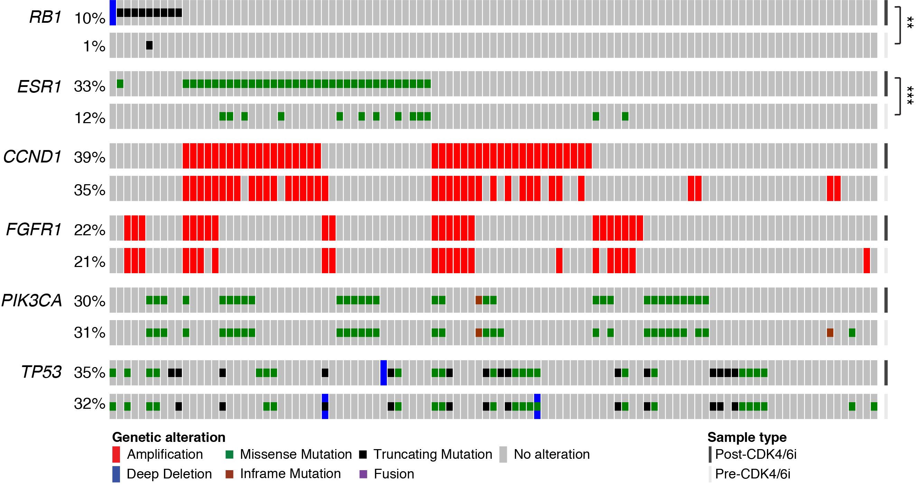
Comparison of Paired Post- vs Pre-CDK4/6i Breast Cancer Tumors
Razavi P et al. ASCO 2019. Abstract 1009.

Slide 16
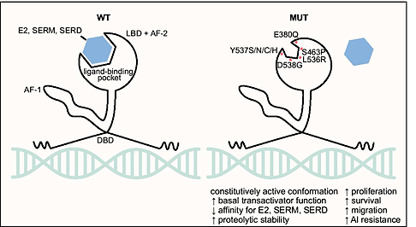
ESR1 mutations in Breast Cancer
Brett JO et al. Breast Cancer Res 2021;23,85

Slide 17
Prevalence of ESR1 Mutations in Untreated vs Treated ER+/HER2- mBC
Treatment Setting | ESR1 Mutation Prevalence¹⁻⁵
At Initiation of First-Line ET | ~5%
Second-Line | ~33%
Third-Line | Up to 40%
1. Jeselsohn R et al. Clin Cancer Res 2014;20:1757-1767; 2. Jeselsohn R et al. Cancer Cell 2018;33:173-186; 3. Allouchery V et al. Breast Cancer Res 2018;20:40; 4. Schiavon G et al. Sci Transl Med 2015;7(313):313ra182; 5. Brett JO et al. Breast Cancer Res 2021;23(1):85.

Slide 18
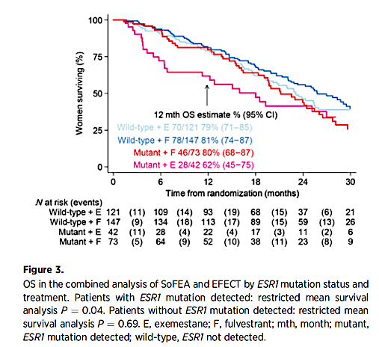
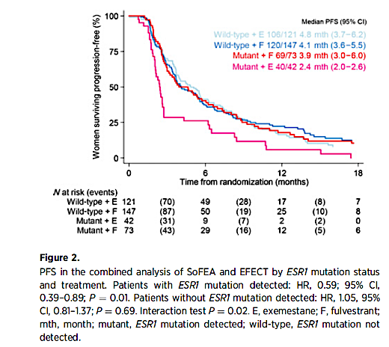
ESR1 Mutations and OS on Fulvestrant vs Exemestane in Advanced HR+ Breast Cancer: A Combined Analysis of the Phase III SoFEA and EFECT
PFS
OS
Turner N, et al. Clin Cancer Res 2020;26:5172–7

Slide 19
ESR1 Mutations
Trial | Study treatment | Patient population | Patients (n substudy/ total N on trial) | ESR1 mutation frequency
MONALEESA-2^{[1]} | Letrozole ± Ribociclib | 1st line ER+ MBC | 494/668 | 4.0%
BOLERO-2^{[2]} | Exemestane ± Everolimus | ER+ MBC after PD on ET | 541/724 | 28.8%
FERGI^{[3]} | Fulvestrant ± Pictilisib | ER+ MBC after PD on ET | 153/168 | 37.3%
PALOMA-3^{[4]} | Fulvestrant ± Palbociclib | ER+ MBC after PD on ET | 360/521 | 25.3%
1. Hortobagyi GN et al. Ann Oncol. 2018;29:1541-1547. 2. Chandarlapaty S et al. JAMA Oncol. 2016;2:1310-1315. 3. Spoerke JM et al. Nat Commun. 2016;7:11579. 4. Fribbens C et al. J Clin Oncol. 2016;34:2961-2968.

Slide 20
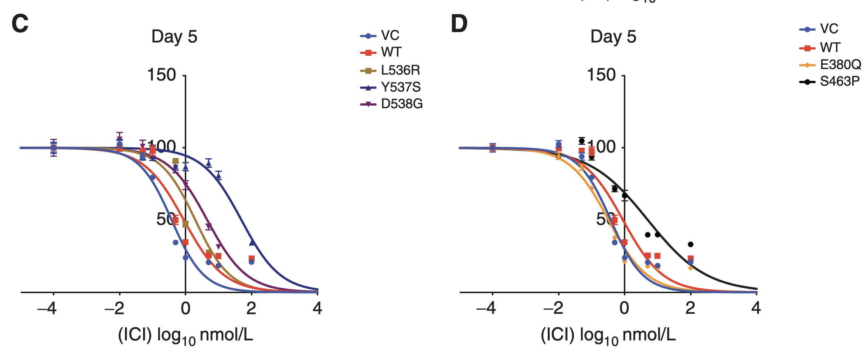
In Vivo Activity of Fulvestrant Against Different ESR1m
Y537S mutants required highest IC₅₀ (55-fold higher than WT)
Toy W, et al. Cancer Discov 2017;7:277-87

Slide 21
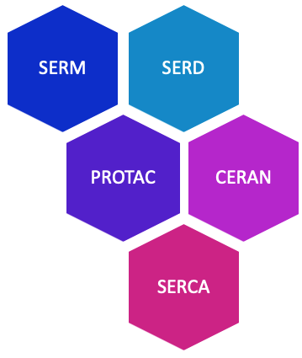
Novel endocrine therapies may address endocrine resistance in MBC
SERD: Mechanism of action
SERD
Estrogen
Competitive binding to ERα
Estrogen receptor α (ERα)
ERα degradation
Estrogen response element ERE
Key advantages
Oral formulation
Higher potency
Activity in ESR1 mutant MBC
Activity in post-ET and CDK4/6i treated pts
5’
3’
5’
3’
©WebMD Global, LLC
Estrogen responsive gene
Transcription
ERα antagonism
Hernando et al, Int J Mol Sci 2021; slide adapted from Erika Hamilton

Slide 22
EMERALD Phase 3 Study Design
Elacestrant
400 mg daily^{c}
Inclusion Criteria
Men and postmenopausal women with advanced/metastatic breast cancer
ER-positive,ª HER2-negative
Progressed or relapsed on or after 1 or 2 lines of endocrine therapy for advanced disease, one of which was given in combination with a CDK4/6i
≤1 line of chemotherapy for advanced disease
ECOG PS 0 or 1
Two Primary Endpoints:^{e}
PFS in all pts
PFS in ESR1-mut
PD or withdrawal criterion^{d}
R
Follow Up
1:1^{b}
Investigator’s choice (SOC):
Fulvestrant
Anastrozole
Letrozole
Exemestane
Stratification Factors:
ESR1-mutation status^{f}
Prior treatment with fulvestrant
Presence of visceral metastases
ªDocumentation of ER+ tumor with ≥ 1% staining by immunohistochemistry; ^{b}Recruitment from February 2019 to October 2020; ^{c}Protocol-defined dose reductions permitted; ^{d}Restaging CT scans every 8 weeks;
^{e}Blinded Independent Central Review; ^{f}ESR1-mutation status was determined by ctDNA analysis using the Guardant360 assay (Guardant Health, Redwood City, CA).
PFS, progression-free survival; Pts, patients; R, randomized; SOC, standard of care.

Slide 23
Patients with ESR1-mut Tumors: PFS by Duration of CDK4/6i
At least 6 mo CDK4/6i
At least 12 mo CDK4/6i
At least 18 mo CDK4/6i
100
100
100
80
80
80
60
60
60
Probability of PFS (%)
Probability of PFS (%)
Probability of PFS (%)
40
40
  40
20
20
20
Elacestrant
Standard of Care
Elacestrant
Standard of Care
0
Elacestrant
Standard of Care
0
0
0
5
10
15
20
25
30
0
5
10
15
20
25
30
0
5
10
15
20
25
30
Time (months)
Time (months)
Time (months)
Elacestrant
SOC
103
102
50
34
33
16
25
11
20
9
16
5
11
2
9
1
8
1
7
0
6
5
5
1
1
0
Elacestrant
SOC
78
81
42
26
31
12
24
10
20
9
16
5
11
2
9
1
8
1
7
0
6
5
5
1
1
0
Elacestrant
SOC
55
56
30
21
23
9
18
8
16
7
12
4
8
1
8
1
7
1
6
0
6
5
5
1
1
0
 | Elacestrant | SOC Hormonal Therapy
Median PFS, months (95% CI) | 4.14 (2.20 - 7.79) | 1.87 (1.87 - 3.29)
PFS rate at 12 months, % (95% CI) | 26.02 (15.12 - 36.92) | 6.45 (0.00 - 13.65)
Hazard ratio (95% CI) | 0.517 (0.361 - 0.738)
 | Elacestrant | SOC Hormonal Therapy
Median PFS, months (95% CI) | 8.61 (4.14 - 10.84) | 1.91 (1.87 - 3.68)
PFS rate at 12 months, % (95% CI) | 35.81 (21.84 - 49.78) | 8.39 (0.00 - 17.66)
Hazard ratio (95% CI) | 0.410 (0.262 - 0.634)
 | Elacestrant | SOC Hormonal Therapy
Median PFS, months (95% CI) | 8.61 (5.45 - 16.89) | 2.10 (1.87 - 3.75)
PFS rate at 12 months, % (95% CI) | 35.79 (19.54 - 52.05) | 7.73 (0.00 - 20.20)
Hazard ratio (95% CI) | 0.466 (0.270 - 0.791)

Slide 24
Various oral SERDs are being investigated on the horizon, pionERA is the only study addressing specific endocrine resistance and building on learnings from ESR1 mutation unmet need from previous studies
SERD | giredestrant | elacestrant | camizestrant | imlunestrant | amcenestrant* (discont.)
mBC
1L PhIII +CDKi | persevERA BC¹ gired vs. let (+palbo) pionERA BC† gired vs. fulv (+CDKi) in ET-resistant | -- | SERENA-4⁹ cami vs. ana (+palbo) SERENA-6¹⁰ cami vs. AI (+palbo/abema) in emerging ESR1m | -- | AMEERA-5¹⁷ amce vs. let (+palbo)
2L PhII–III | acelERA BC² PhII gired vs. PCE evERA BC³ PhIII gired vs. PCE (+evero) | EMERALD⁶ PhIII ela vs. PCE | SERENA-2¹¹ PhII cami (2 dose arms) vs. fulv | EMBER-3¹⁴ PhIII imlu vs. PCE vs imlu+abema | AMEERA-3¹⁸ amce vs. PCE
eBC
Neoadj / WoO PhI–II | coopERA BC⁴ PhII gired vs. ana (+palbo) | ELIPSE⁷ PhI ela single-arm | SERENA-3¹² PhII cami (3 dose arms) | EMBER-2¹⁵ PhI imlu (3 dose arms) | AMEERA-4¹⁹ PhII amce vs. let I-SPY EOP²⁰ PhII amce+/-abema
Adjuvant PhIII | lidERA BC⁵ gired vs. PCE, upfront | TREAT⁸ ela vs. PCE, switch in rising ctDNA | CAMBRIA-1¹³ cami vs PCE, switch | EMBER-4¹⁶ imlu vs. PCE, switch | AMEERA-6²¹ amce vs. tam, switch
* Discontinued clinical development of amcenestrant.
† Planned for 2023.
AI, aromatase inhibitor; amce, amcenestrant; ana, anastrozole; cami, camizestrant; CDKi, cyclin-dependent kinase inhibitor; ela, elacestrant; fulv, fulvestrant; gired, giredestrant; imlu, imlunestrant; let, letrozole; PCE: physician's choice endocrine therapy; tam, tamoxifen; WoO, window of opportunity. References in slide notes.

Slide 25
Questions?

Slide 26
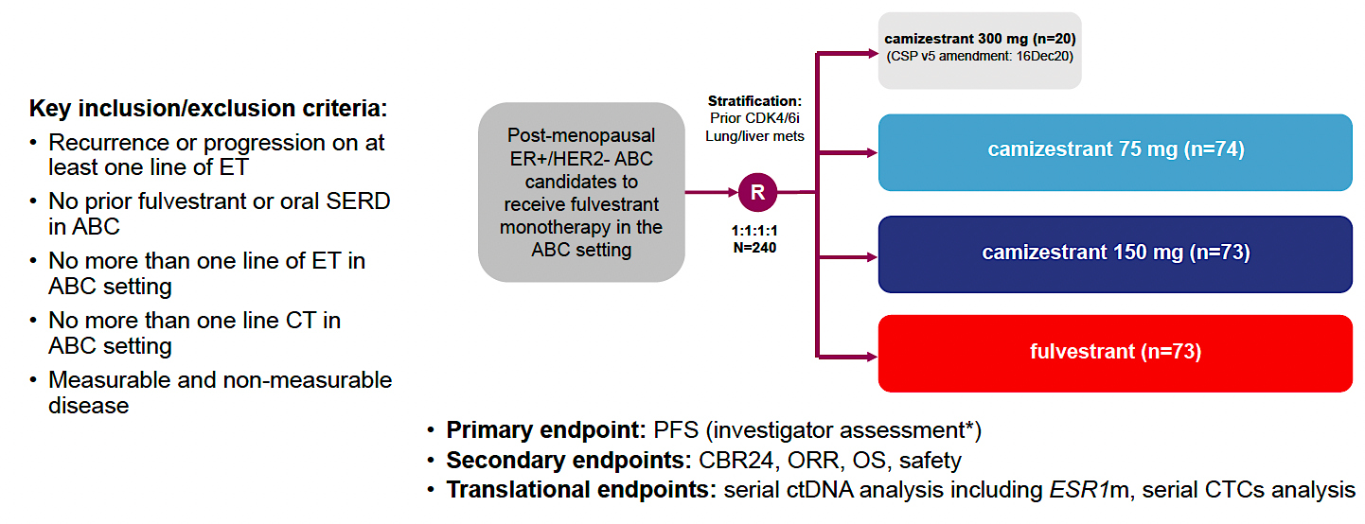
SERENA-2 Phase II Study Design
ET = endocrine therapy; ABC = advanced breast cancer; CT = chemotherapy; PFS = progression-free survival; CBR24 = clinical benefit rate at 24 weeks; ORR = objective response rate; OS = overall survival; ctDNA = circulating tumor DNA; CTCs = circulating tumor cells
Oliveira M et al. San Antonio Breast Cancer Symposium 2022;Abstract GS3-02.

Slide 27
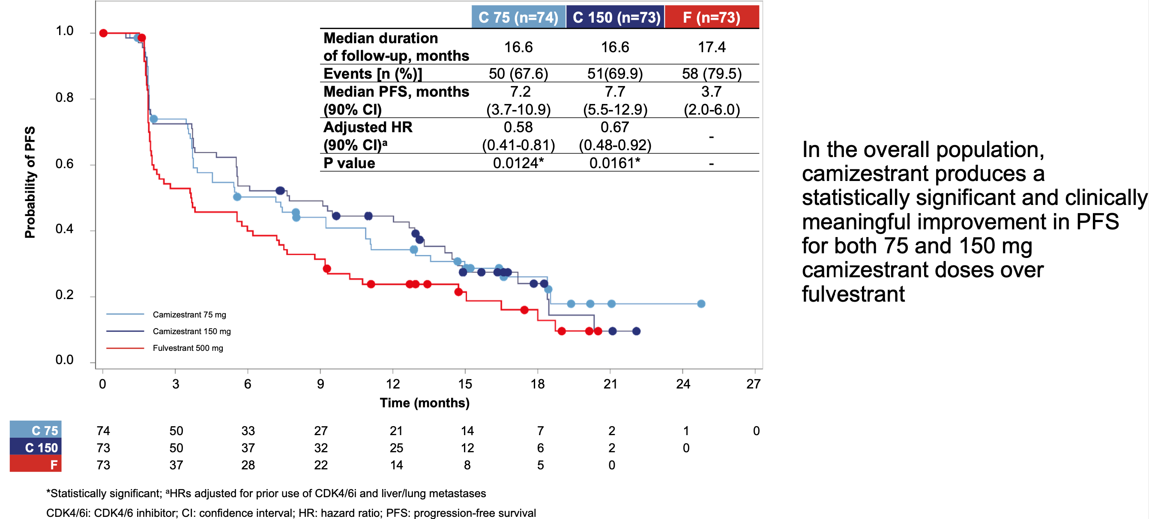
Phase II SERENA-2 Trial: PFS by Investigator Assessment (Primary Endpoint)
Oliveira M et al. San Antonio Breast Cancer Symposium 2022;Abstract GS3-02.

Slide 28
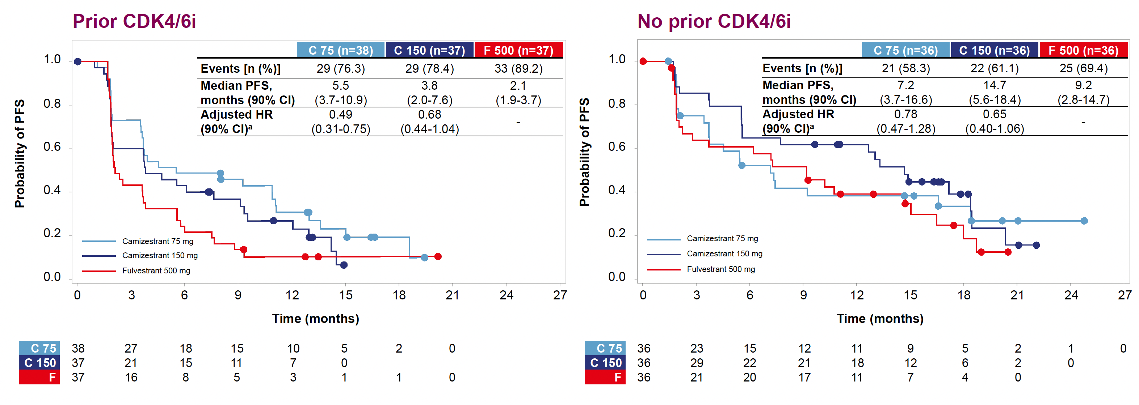
Phase II SERENA-2 Trial: PFS by Prior CDK4/6 Inhibitor (CDK4/6i)
Oliveira M et al. San Antonio Breast Cancer Symposium 2022;Abstract GS3-02.

Slide 29
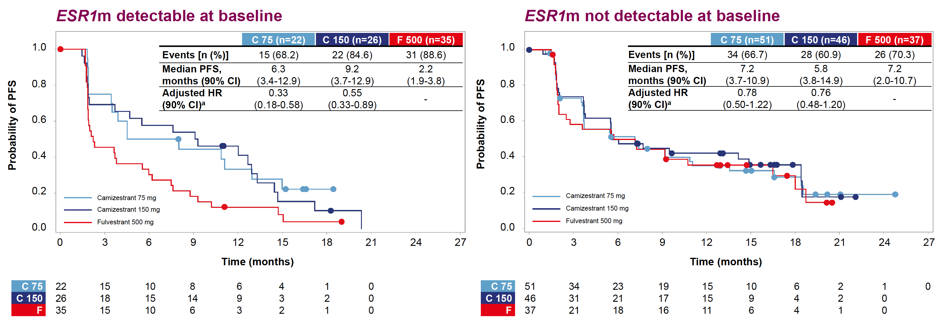
Phase II SERENA-2 Trial: PFS by Detectable ESR1
Oliveira M et al. San Antonio Breast Cancer Symposium 2022;Abstract GS3-02.

Slide 30
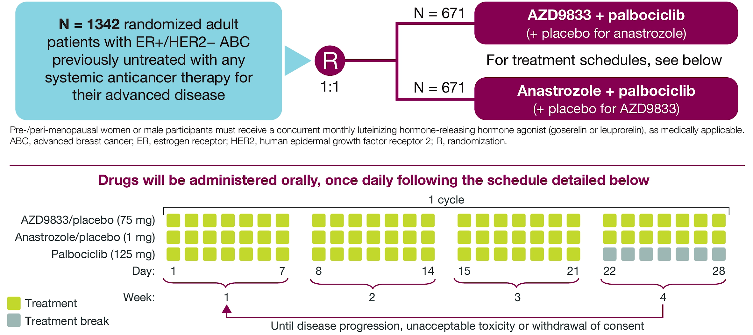
SERENA-4 Phase III Study Design
Camizestrant + palbociclib
(+ placebo for camizestrant)
Camizestrant/placebo (75 mg)
Im SA et al. ASCO 2021;Abstract TPS1101.

Slide 31
Rapid Recommendation Update
Recommendation
Routine testing for emergence of ESR1 mutations at recurrence or progression on ET (with or without CDK4/6 inhibitor) in pts
with ER-positive, HER2-negative MBC.
Testing with a CLIA-certified assay should be performed on blood or tissue obtained at the time of progression. Blood-based ctDNA is preferred owing to greater sensitivity.
Pts whose tumor or ctDNA tests remain ESR1 wildtype may warrant retesting at subsequent progression(s) to determine if an ESR1 mutation has arisen.
Evidence-based benefits outweigh harms
Evidence Quality |  | Strength of Recommendation
High |  | Strong
www.asco.org/breast-cancer-guidelines ©American Society of Clinical Oncology (ASCO) 2023. All rights reserved worldwide. For licensing opportunities, contact licensing@asco.org

Slide 32
INAVO120 study design
San Antonio Breast Cancer Symposium®, December 5–9, 2023
Key eligibility criteria
Enrichment of patients with poor prognosis:
PIK3CA-mutated, HR+, HER2- ABC by central ctDNA* or local tissue/ctDNA test
Measurable disease
Progression during/within 12 months of
adjuvant ET completion
No prior therapy for ABC
Fasting glucose <126 mg/dL and HbA_{1C} <6.0%
Enrolment period: December 2019 to September 2023
N=325
Inavolisib (9 mg QD PO)
+ palbociclib (125 mg PO QD D1–D21)
+ fulvestrant (500 mg C1D1/15 and Q4W)**
Until PD
or toxicity
R
1:1
SURVIVAL
FOLLOW-UP
Placebo (PO QD)
+ palbociclib (125 mg PO QD D1–D21)
+ fulvestrant (500 mg C1D1/15 and Q4W)**
Stratification factors:
Visceral Disease (Yes vs. No)
        Endocrine Resistance (Primary vs. Secondary)†
Region (North America/Western Europe; Asia; Other)
Endpoints
Primary: PFS by Investigator
Secondary: OS‡, ORR, BOR, CBR, DOR, PROs
* Central testing for PIK3CA mutations was done on ctDNA using FoundationOne®Liquid (Foundation Medicine). In China, the central ctDNA test was the PredicineCARE NGS assay (Huidu). † Defined per 4th European School of Oncology (ESO)–European Society for Medical Oncology (ESMO) International Consensus Guidelines for Advanced Breast Cancer.¹ Primary: relapse while on the first 2 years of adjuvant ET; Secondary: relapse while on adjuvant ET after at least 2 years or relapse within 12 months of completing adjuvant ET. ‡ OS testing only if PFS is positive; interim OS analysis at primary PFS analysis;
** Pre-menopausal women received ovarian suppression. ctDNA, circulating tumor DNA; R, randomized. 1. Cardoso F, et al. Ann Oncol 2018;29:1634–1657.

Slide 33
Primary endpoint: PFS (investigator-assessed)
San Antonio Breast Cancer Symposium®, December 5–9, 2023
6-month
12-month
18-month
 | Inavo+Palbo+Fulv (n=161) | Pbo+Palbo+Fulv (n=164)
No. of events, n (%) | 82 (50.9) | 113 (68.9)
Median (95% CI), mo | 15.0 (11.3, 20.5) | 7.3 (5.6, 9.3)
Stratified hazard ratio (95% CI) | 0.43 (0.32, 0.59) p<0.0001
100
82.9%
75
55.9%
55.9%
PFS (%)
46.2%
50
32.6%
Inavo+Palbo+Fulv
21.1%
25
Pbo+Palbo+Fulv
Censored
0
0
3
6
9
12
15
18
21
24
27
30
33
36
Time (mo)
Patients at risk:
Inavo+Palbo+Fulv | 161 | 134 | 111 | 92 | 66 | 48 | 41 | 31 | 22 | 13 | 11 | 5 | 1
Pbo+Palbo+Fulv | 164 | 113 | 77 | 59 | 40 | 23 | 19 | 16 | 12 | 6 | 3 | 3 | 1
Median follow-up: 21.3 months
CCOD: 29th September 2023
CI, confidence interval; Fulv, fulvestrant; Inavo, inavolisib; mo, months; Palbo, palbociclib; Pbo, placebo; PFS, progression-free survival.

Slide 34
Novel endocrine therapy, including oral SERDs, will continue to have important role in HR+ mBC

Slide 35
Case 1: Second-Line Treatment of
HR-Positive/HER2-Negative ESR1-Mutated Metastatic Breast Cancer

Slide 36

Dr Kalinsky – Case Presentation
Patient is a 42-yo premenopausal healthy female who is diagnosed with a right breast invasive ductal carcinoma, grade 2, ER+ 95% PR+ 80% HER2 1+
No prior breast imaging until it was T3N2
Staging and lung biopsy confirmed bone and lung metastases
Her performance status is excellent
She has moderate back pain from metastases
Hereditary Genetic Testing: no pathogenic variants

Slide 37
Dr Kalinsky – Case Presentation (Continued)
Patient undergoes TAH/BSO
She receives ribociclib plus AI
After 34 mo of therapy, the patient has progressive disease
She undergoes ctDNA testing: biomarker testing reveals a pathogenic ESR1 Y537S mutation

Slide 38
What therapy would you recommend next?
Alpelisib + fulvestrant
Chemotherapy
Capivasertib + fulvestrant
Elacestrant
Switch CDK4/6 inhibitor + AI combination
Trastuzumab Deruxtecan
Sacituzumab Govitecan

Slide 39
Dr Kalinsky – Case Presentation (Continued)
Pt started single agent elacestrant and is tolerating

Slide 40
Agenda
Introduction: Confronting Metastatic Breast Cancer (mBC)
Module 1: Mechanisms of Resistance to Endocrine Therapy in HR-Positive mBC; Use of Oral Selective Estrogen Receptor Degraders (SERDs) — Dr Kalinsky
Module 2: Ongoing Evaluation of Early Therapeutic Switching for HR-Positive mBC Harboring ESR1 Mutations — Prof Bidard
Module 3: Other Key Datasets and Ongoing Trials in HR-Positive Breast Cancer

Slide 41
Early Therapeutic Switching in Patients Found to Harbor ESR1 Mutations
Francois-Clement Bidard
Curie Institute & Versailles University, France
This presentation is the intellectual property of the presenter. Contact him at francois-clement.bidard@curie.fr for permission to reprint and/or distribute

Slide 42
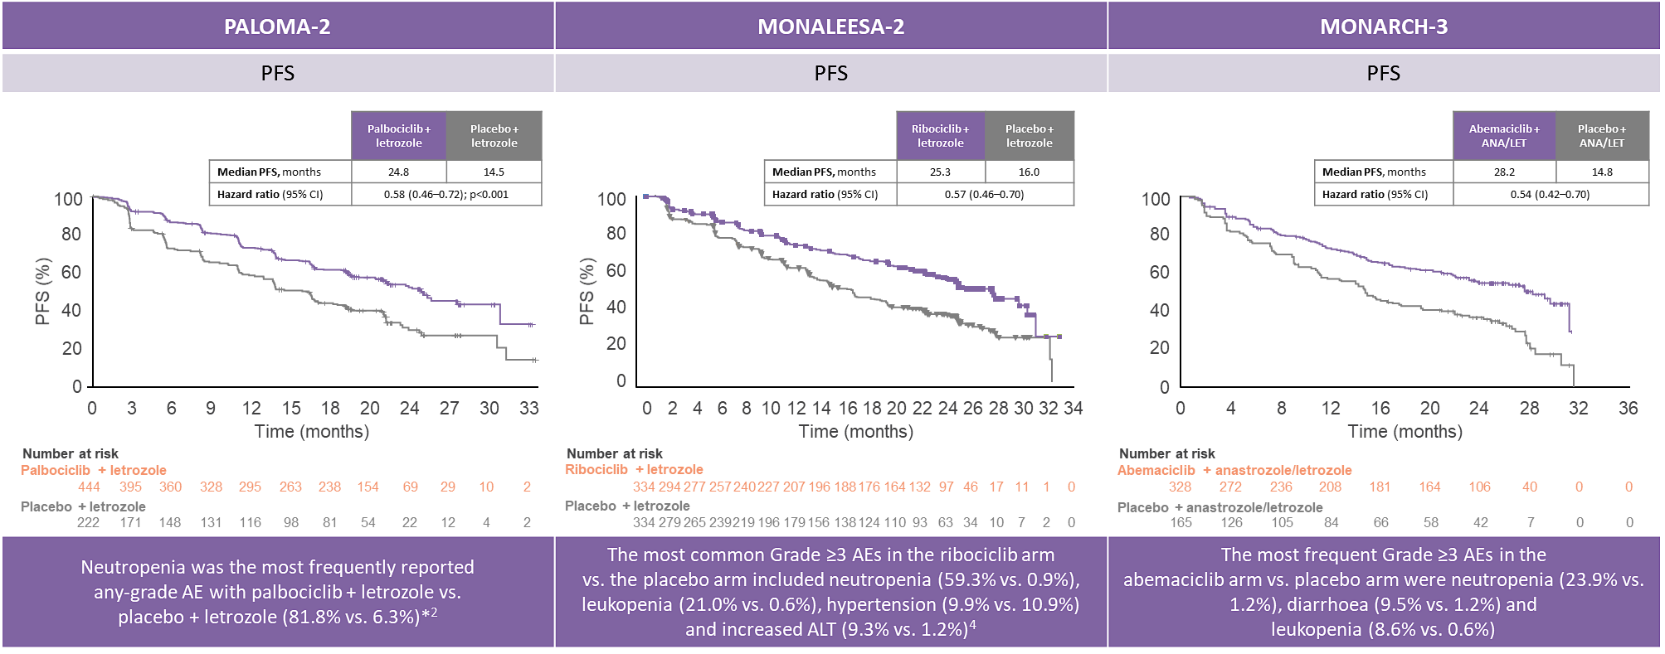
Extending the first line
In ER+ HER2- endocrine sensitive mBC, AI+CDK4/6i is the current standard of care in L1
Longest PFS ever observed in mBC (~ 24 months mPFS)
with an overall very good tolerability

Slide 43
Extending the first line
In ER+ HER2- endocrine sensitive mBC, AI+CDK4/6i is the current standard of care in L1
Longest PFS ever observed in mBC (~ 24 months mPFS)
but
Acquired resistance eventually appears in all patients ➔ disease progression
^{(a)} Andre, NEJM 2019 ; ^{(b)} Rugo, Lancet Oncol 2021

Slide 44
Extending the first line
In ER+ HER2- endocrine sensitive mBC, AI+CDK4/6i is the current standard of care in L1
Longest PFS ever observed in mBC (~ 24 months mPFS)
but
Acquired resistance eventually appears in all patients ➔ disease progression
PFS of subsequent lines of therapy shortened by the prior use of CDK4/6i
e.g. : fulvestrant + alpelisib in 2nd line
CDK4/6i-naïve mBC: 11months mPFS (SOLAR-1^{(a)})
CDK4/6i-pretreated mBC: 50.4% progression-free at 6 months, (BYLIEVE^{(b)})
^{(a)} Andre, NEJM 2019 ; ^{(b)} Rugo, Lancet Oncol 2021

Slide 45
Extending the first line
In ER+ HER2- endocrine sensitive mBC, AI+CDK4/6i is the current standard of care in L1
Longest PFS ever observed in mBC (~ 24 months mPFS)
but
Acquired resistance eventually appears in all patients ➔ disease progression
PFS of subsequent lines of therapy shortened by the prior use of CDK4/6i
Limited efficacy of the 2nd line after progression on CDK4/6i
mPFS
elacestrant 3.8 months ESR1_{mut} mBC 100% CDK4/6i (+/- chemo) pre-treated, EMERALD trial ^{(a)}
fulvestrant + abemaciclib 6 months All comers 100% CDK4/6i pre-treated, postMONARCH trial ^{(b)}
fulvestrant + capivasertib 7.3 months PIK3CA/AKT/PTEN_{mut} mBC 73% CDK4/6i pre-treated, CAPItello-291 trial ^{(c)}
^{(a)} Bidard, JCO 2022 ; ^{(b)} Kalinsky, ASCO 2024 ; ^{(c)} Turner, NEJM 2023

Slide 46
Extending the first line
In ER+ HER2- endocrine sensitive mBC, AI+CDK4/6i is the current standard of care in L1
Longest PFS ever observed in mBC (~ 24 months mPFS)
but
Acquired resistance eventually appears in all patients ➔ disease progression
PFS of subsequent lines of therapy shortened by the prior use of CDK4/6i
Limited efficacy of the 2nd line after progression on CDK4/6i
Extending the time on 1st line CDK4/6i is critical
Understanding acquired resistance mechanisms to CDK4/6i + AI

Slide 47
Extending the first line
In ER+ HER2- endocrine sensitive mBC, AI+CDK4/6i is the current standard of care in L1
Longest PFS ever observed in mBC (~ 24 months mPFS)
but
Acquired resistance eventually appears in all patients ➔ disease progression
PFS of subsequent lines of therapy shortened by the prior use of CDK4/6i
Limited efficacy of the 2nd line after progression on CDK4/6i
Extending the time on 1st line CDK4/6i is critical
Understanding acquired resistance mechanisms to CDK4/6i + AI
CDK4/6i ➔ known resistance mechanisms are rare and not (yet) targetable

Slide 48
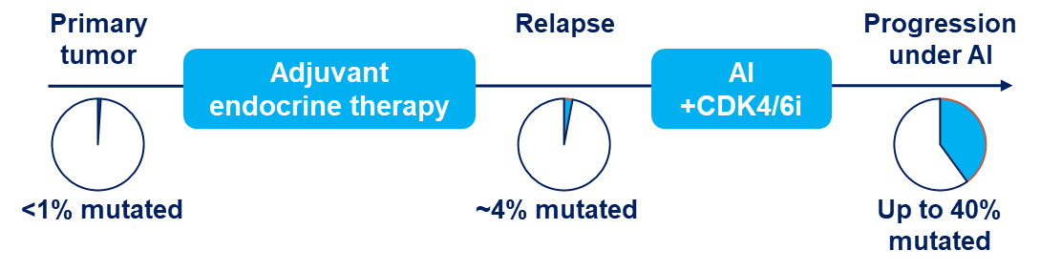
ESR1 mutations: a major opportunity… not to be missed !
ESR1_{mut} become detectable during AI + CDK4/6i
mutant clones rising in ctDNA
Tumor cells may still be sensitive to CDK4/6i
Figure adapted from Allouchery, BCR 2018; ^{(a)} Turner, CCR 2020; ^{(b)} Turner, Lancet Oncol 2020; ^{(c)} Bidard, JCO 2022

Slide 49
ESR1 mutations: a major opportunity… not to be missed !
ESR1_{mut} become detectable during AI + CDK4/6i
Mutant estrogen receptors are degradable by fulvestrant (SoFEA & EFECT trials^{(a)})
However, fulvestrant has no relevant efficacy after disease progression:
plasmaMATCH^{(b)} 2.2 months mPFS in ESR1_{mut} mBC
EMERALD^{(c)} 1.9 month mPFS in ESR1_{mut} mBC
Figure adapted from Allouchery, BCR 2018; ^{(a)} Turner, CCR 2020; ^{(b)} Turner, Lancet Oncol 2020; ^{(c)} Bidard, JCO 2022

Slide 50
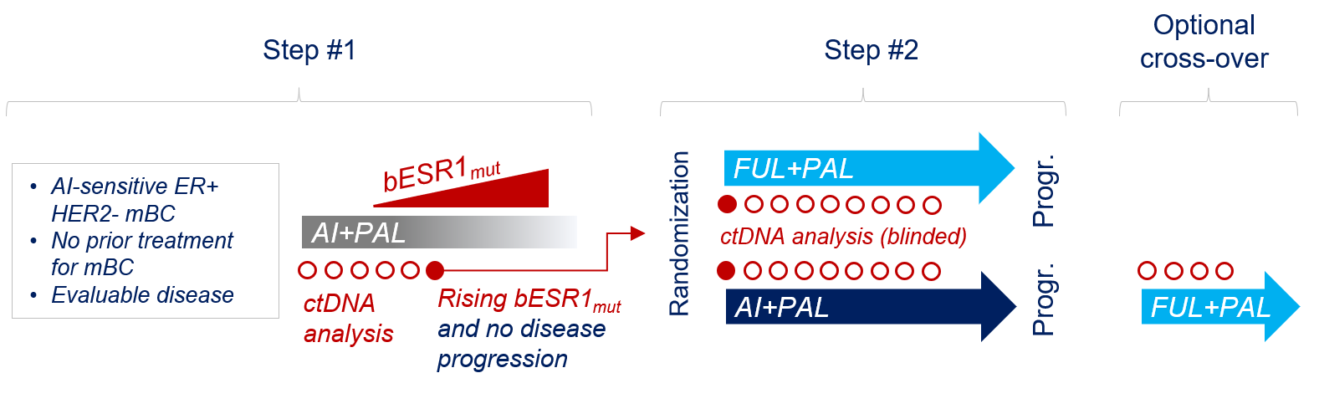

PADA-1, the academic proof-of-concept trial
Progr.

Slide 51
PADA-1, the academic proof-of-concept trial
Progr.
Delaying disease progression on CDK4/6i ?
Optimal use of SERD as a targeted therapy against ESR1_{mut} ?
Feasibility / acceptance ?

Slide 52
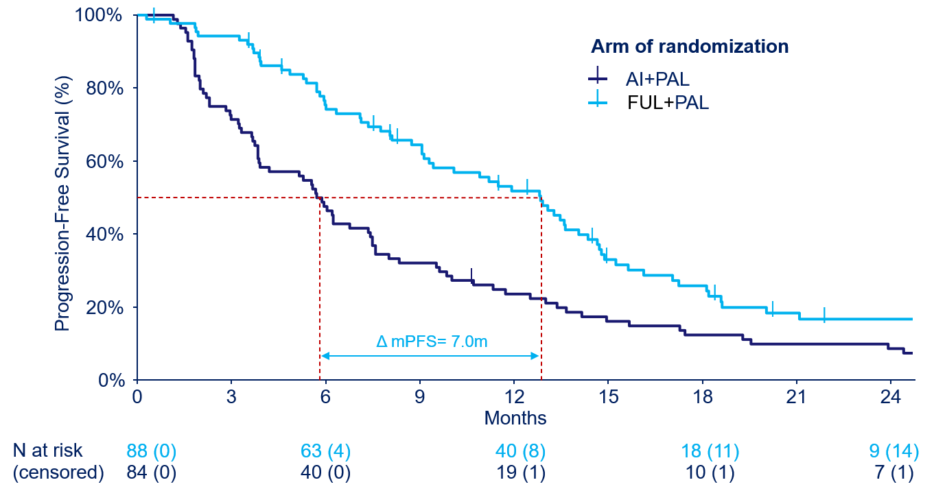
Updated PFS results – primary endpoint
N= 1,017 pts enrolled in step #1
N= 283 pts with a rising bESR1_{mut}
while the study was ongoing
N= 172 pts randomized
N= 88 pts allocated to FUL+PAL
N= 84 pts allocated to AI+PAL
Data cut-off: June 21, 2022 Median FU from randomization: 28.2 months; N= 152 PFS events (89% maturity)
Progression-Free Survival, from randomization
FUL+PAL mPFS: 12.8 months, 95%CI [9.3;14.7]
AI+PAL mPFS: 5.8 months, 95%CI [3.9;7.5]
PFS HR= 0.54 [0.38;0.75]
Optional cross-over (N=49 patients)
mPFS: 3.5 months, 95%CI [2.4;5.4]
Updated results presented at ASCO 2023; Primary results: Bidard, Lancet Oncol 2022

Slide 53
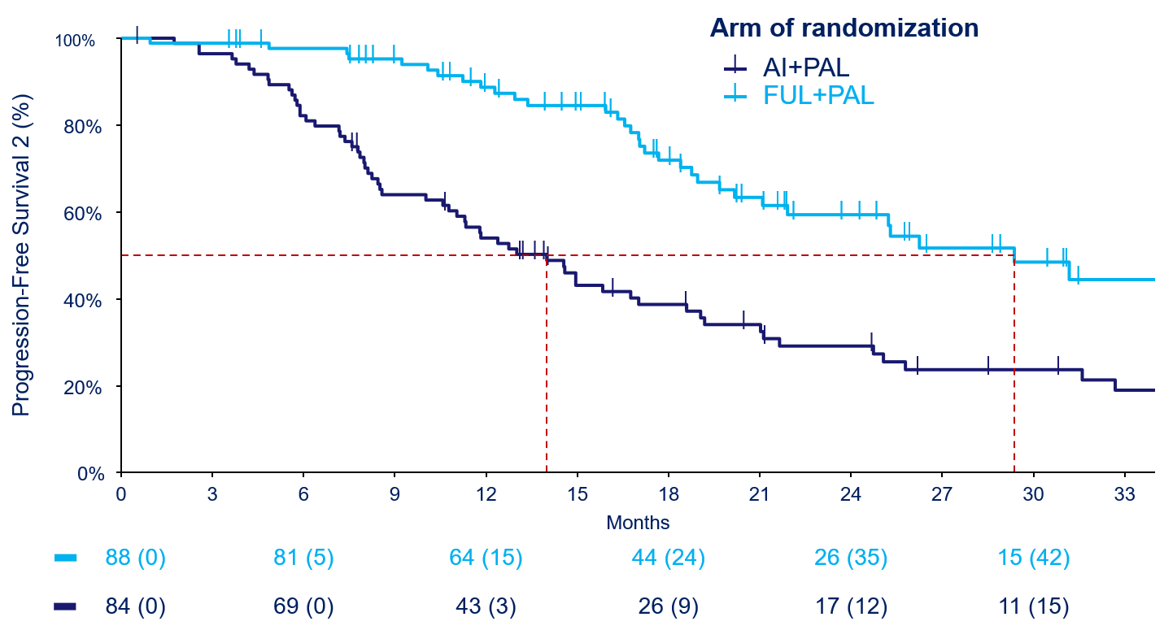
PFS2 results – secondary endpoint
Data cut-off: June 21, 2022 N= 93 PFS2 events (54% maturity)
Progression-Free Survival 2, from randomization
FUL+PAL mPFS2: 29.4 months, 95%CI [21.9;NR]
AI+PAL mPFS2: 14.0 months, 95%CI [11.0;18.6]
PFS2 HR= 0.37 [0.24;0.56]
Δ mPFS2= 15.4m
PFS2: time from randomization to 2nd progression or death in both arms
Updated results presented at ASCO 2023; Primary results: Bidard, Lancet Oncol 2022

Slide 54
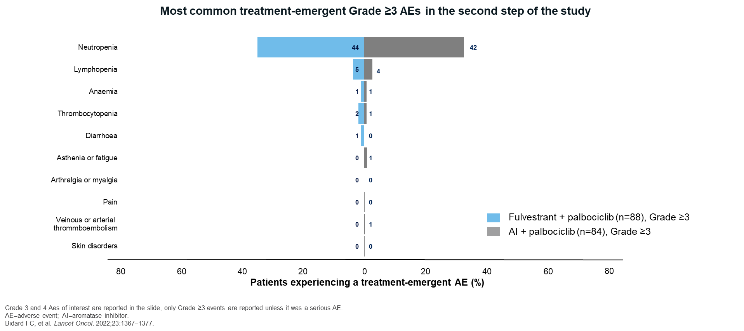
PADA-1 Safety– most frequent grade 3-4 AEs in step #2
Venous or arterial thromboembolism
AEs
AE=adverse event; AI=aromatase inhibitor.

Slide 55
Questions?

Slide 56

SERENA-6: the global trial with camizestrant (oral ngSERD)
Step 1: ESR1m detection
SERENA-6 is the only Phase III study assessing an ngSERD
in combination with all three approved CDK4/6i ^{1,2}
HR-positive,
HER2-negative
locally advanced (inoperable) or mBC^{1,2}
Currently receiving AI (anastrozole or letrozole) + CDK4/6i (palbociclib, abemaciclib or ribociclib) ± LHRH as 1L treatment for ≥6 months with no evidence of PD^{1,2*}
Continue 1L treatment with AI (anastrozole or letrozole)
+ CDK4/6i (palbociclib, abemaciclib or ribociclib) ± LHRH
ESR1m screening in plasma ctDNA (every 2–3 treatment cycles) and tumour imaging as per SoC
ESR1m positive ctDNA detected and no evidence
of PD†
ESR1m negative tumour
and no evidence of PD
Step 2: Randomised treatment (N=300)²
Primary endpoint²
PFS*
Key secondary endpoints²
PFS2, ORR, CBR₂₄, OS, PROs (TTD), time to ChT
Switch to camizestrant (75 mg QD)
+ maintain same CDK4/6i + placebo for AI
R
1:1
Continue on AI + maintain same CDK4/6i
+ placebo for camizestrant
*By investigator assessment; †Inclusion criteria for Step 2 include evaluable disease as per RECIST v1.1.²
1L=first-line; AI=aromatase inhibitor; CBR₂₄=clinical benefit rate at 24 weeks; CDK4/6i=cyclin-dependent kinase 4/6 inhibitor; ChT=chemotherapy; CI=confidence interval; ctDNA=circulating tumour DNA; ESR1m=oestrogen receptor alpha mutation; ET=endocrine therapy; HER2=human epidermal growth factor receptor 2; HR=hormone receptor; LHRH=luteinising hormone-releasing hormone; mBC=metastatic breast cancer; ngSERD=next-generation selective oestrogen receptor degrader; ORR=objective response rate; OS=overall survival; PD=disease progression; PFS=progression-free survival; PRO=patient reported outcome; QD=once daily; R=randomisation; RECIST=response evaluation criteria in solid tumors;
SoC=standard of care; TTD=time to deterioration.
1. NIH. SERENA-6. Available at: https://www.clinicaltrials.gov/study/NCT04964934 (Accessed September 2024); 2. Bidard F-C, et al. Presented at SABCS Annual Meeting 2021, December 7–10. San Antonio, Tx. Abstract #OT2-11-05.

Slide 57
SERENA-6: the global trial with camizestrant (oral ngSERD)
Step 1: ESR1m detection
SERENA-6 is the only Phase III study assessing an ngSERD
in combination with all three approved CDK4/6i ^{1,2}
HR-positive,
HER2-negative
locally advanced (inoperable) or mBC^{1,2}
Currently receiving AI (anastrozole or letrozole) + CDK4/6i (palbociclib, abemaciclib or ribociclib) ± LHRH as 1L treatment for ≥6 months with no evidence of PD^{1,2*}
Continue 1L treatment with AI (anastrozole or letrozole)
+ CDK4/6i (palbociclib, abemaciclib or ribociclib) ± LHRH
ESR1m screening in plasma ctDNA (every 2–3 treatment cycles) and tumour imaging as per SoC
ESR1m positive ctDNA detected and no evidence
of PD†
ESR1m negative tumour
and no evidence of PD
Step 2: Randomised treatment (N=300)²
Primary endpoint²
PFS*
Key secondary endpoints²
PFS2, ORR, CBR₂₄, OS, PROs (TTD), time to ChT
Switch to camizestrant (75 mg QD)
+ maintain same CDK4/6i + placebo for AI
R
1:1
Continue on AI + maintain same CDK4/6i
+ placebo for camizestrant
Enrollment completed in 07/2024, read-out expected in 2025
*By investigator assessment; †Inclusion criteria for Step 2 include evaluable disease as per RECIST v1.1.²
1L=first-line; AI=aromatase inhibitor; CBR₂₄=clinical benefit rate at 24 weeks; CDK4/6i=cyclin-dependent kinase 4/6 inhibitor; ChT=chemotherapy; CI=confidence interval; ctDNA=circulating tumour DNA; ESR1m=oestrogen receptor alpha mutation; ET=endocrine therapy; HER2=human epidermal growth factor receptor 2; HR=hormone receptor; LHRH=luteinising hormone-releasing hormone; mBC=metastatic breast cancer; ngSERD=next-generation selective oestrogen receptor degrader; ORR=objective response rate; OS=overall survival; PD=disease progression; PFS=progression-free survival; PRO=patient reported outcome; QD=once daily; R=randomisation; RECIST=response evaluation criteria in solid tumors;
SoC=standard of care; TTD=time to deterioration.
1. NIH. SERENA-6. Available at: https://www.clinicaltrials.gov/study/NCT04964934 (Accessed September 2024); 2. Bidard F-C, et al. Presented at SABCS Annual Meeting 2021, December 7–10. San Antonio, Tx. Abstract #OT2-11-05.

Slide 58
Potential benefits of intercepting ESR1_{mut}
Step 1
AI + palbociclib
Step 2
If bESR1_{mut} and no concomitant PD…
AI + PAL
PD
2nd line
PD
R
SERD + PAL
PD
Maximizing SERD efficacy: 6 mo absolute mPFS gain in PADA-1
vs ~2 mo mPFS if used after PD ^{[7,8]}
Targeting resistant subclones when they are still a minority ?
Results of a trial in EGFR_{mut} NSCLC also support the concept of early targeting ^{[9]}
Extending the length of CDK4/6i exposure
This presentation is the intellectual property of the presenter. Contact him at francois-clement.bidard@curie.fr for permission to reprint and/or distribute

Slide 59
Prof Bidard – Case Presentation
69 y.o. woman, retired seamstress
Family history: her sister had a breast cancer at age 50
Personal history: obesity (BMI=34), diabetes & hypertension
Diagnosed with de novo stage IV breast cancer, cT2N1 with many asymptomatic bone lesions, PS=0
Breast biopsy: ER+ 90%, PR+ 20%, HER2- (1+)
1st line treatment with letrozole and ribociclib has been initiated
Three months later, patient comes back to her planned consultation
Treatment is very well tolerated
CT scan shows stable bone lesions.
Clinical exam shows a clinical response of the breast mass and axillary lymph nodes.

Slide 60
Prof Bidard – Case Presentation (Continued)
You also received the results of
Somatic NGS testing (breast tumor tissue): PIK3CA_{mut}. No ESR1_{mut} detected.
Germline NGS testing (blood): no germline alteration.
Questions
Did you expect to find an ESR1_{mut} in the tumor tissue ?
The likelihood to develop an ESR1_{mut} during AI+CDK4/6i is ~40%
but how do patients with either somatic PIK3CA_{mut} or with gBRCA2_{mut} behave in that regard ?

Slide 61
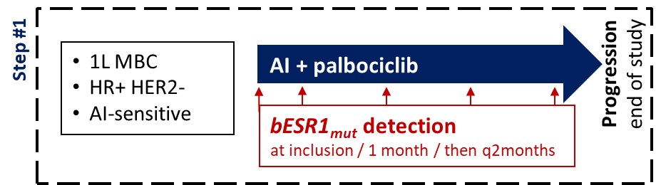
Prof Bidard – Case Presentation (Continued)
Did you expect to find an ESR1_{mut} in the tumor tissue ?
No -- ESR1_{mut} mostly appear after exposure to aromatase inhibitor, given for mBC
Prior to AI+PAL, N= 33 /1,017 pts (3.2%) were ESR1_{mut}-positive ^{[4]}
Factors associated with higher prevalence at mBC diagnosis
Bone mets: detection rate: 4.0%; OR=3.4
Menopause: 4.1%; OR=5.4
Prior exposure to AI: 7.1%; OR=3.0
^{[4]} Bidard et al, ASCO 2020, abstract 1010

Slide 62
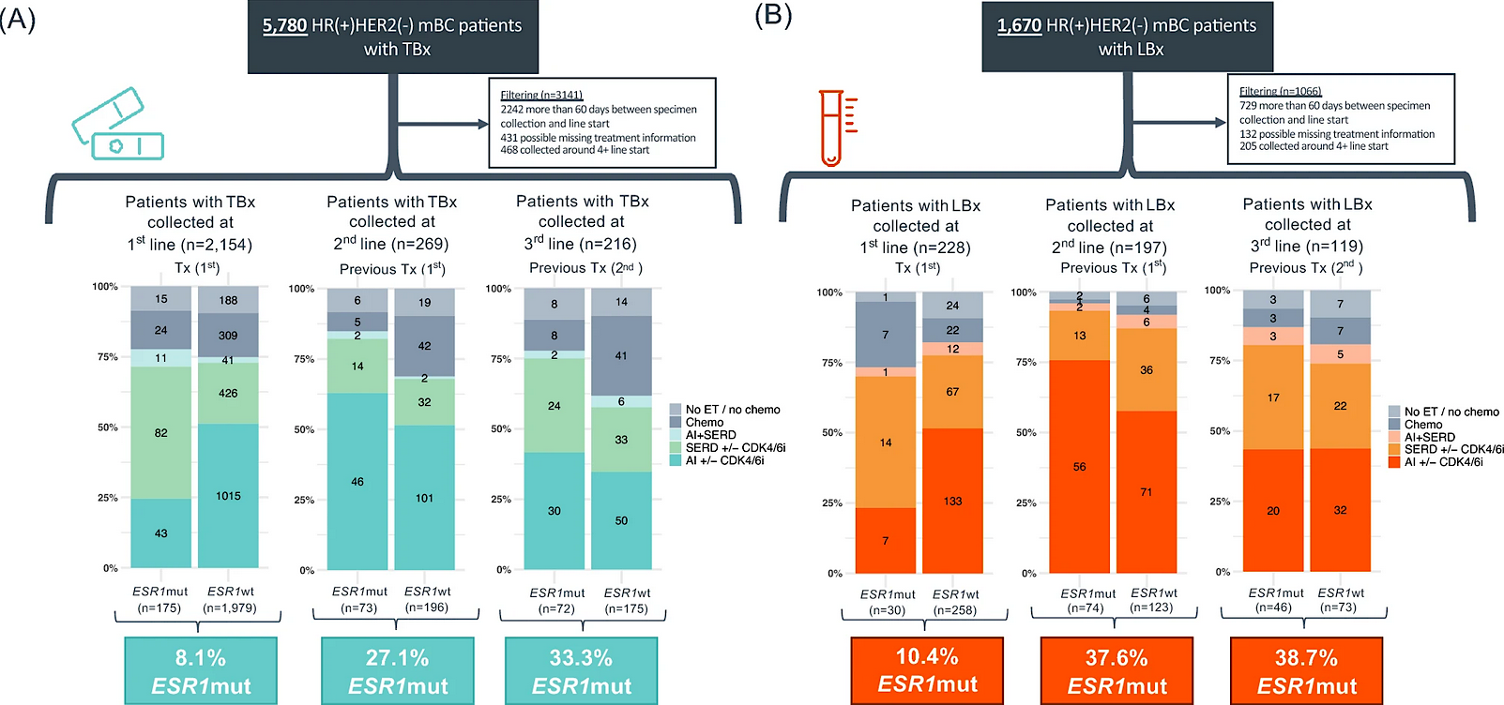
Prof Bidard – Case Presentation (Continued)
Prevalence of ESR1_{mut} in samples analyzed by CDx 2011-2023
Tissue
Blood
Bhave, BCRT 2024

Slide 63
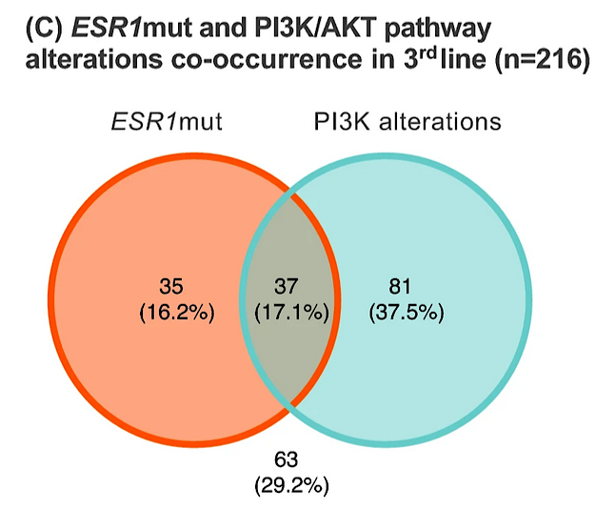
Prof Bidard – Case Presentation (Continued)
Does the presence of PIK3CA_{mut} or gBRCA2_{mut} influence the appearance of ESR1_{mut} ?
No PIK3CA_{mut} are detected in ~40% of BC
ESR1_{mut} incidence is independent of PIK3CA_{mut} status
15-20%
of mBC
~40% of mBC
~40% of mBC
Bhave, BCRT 2024

Slide 64
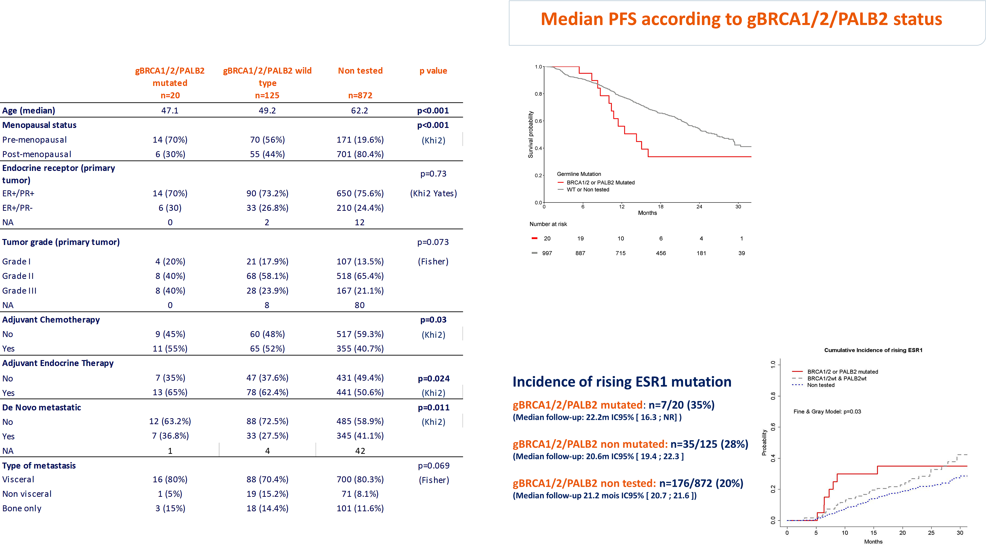
Prof Bidard – Case Presentation (Continued)
Does the presence of PIK3CA_{mut} or gBRCA2_{mut} influence the appearance of ESR1_{mut} ?
No
gBRCA2_{mut}
shortened PFS on AI+CDK4/6, due to a frequent co-loss of BRCA2 and RB1 in tumors ^{(a)}
PADA-1: no impact on the onset of ESR1_{mut} ^{(b)}
(Median follow-up 21.2m IC95% [20.7; 21.6])
^{[4]} Safonov, bioRxiv 2024; (b) Fresnel, ESMO 2020

Slide 65
Prof Bidard – Case Presentation (Continued)
You are telling the patient about the risk of ESR1_{mut} appearing during therapy.
What are the main talking points ?
She understands the benefits and is willing to begin non-invasive monitoring by serial ctDNA analyses.
… but when do you test, and at which frequency ?

Slide 66
Prof Bidard – Case Presentation (Continued)
Main talking points (suggestion)
Her mBC is very likely to develop a resistance to either therapy of the combination she is receiving
If the disease progresses, subsequent treatment lines may be more toxic and with limited efficacy
Part of her routine monitoring of the tumor response to therapy, serial blood draw can detect some form of tumor resistance in ~40% of patients.
It is possible to switch to the endocrine therapy if a resistance to the first endocrine therapy is detected, while continuing CDK4/6 inhibition, thus delaying the time of tumor progression
+ discuss the timing of blood analyses… when their results will be known (and if the patient should expect a call)
Imaging
Consultation
Blood draw
ctDNA results known

Slide 67
Prof Bidard – Case Presentation (Continued)
When do you test ? At which frequency ? (suggestions)
Not before 6 months on AI+CDK4/6i
few ESR1_{mut} detected before 6 months
mBC resistance within the first 6 months = endocrine-refractory; an ET switch unlikely to have any impact
^{(a)} Berger, BMJ Open 2022; ^{(b)} Turner, Future Oncol 2023

Slide 68
Prof Bidard – Case Presentation (Continued)
When do you test ? At which frequency ? (suggestions)
Not before 6 months on AI+CDK4/6i
few ESR1_{mut} detected before 6 months
mBC resistance within the first 6 months = endocrine-refractory; an ET switch unlikely to have any impact
At anytime thereafter
ESR1_{mut} screening can be initiated in any patient under AI+CDK4/6i, as long the disease has not yet progressed
Note that the first ctDNA analysis has a higher probability to be positive than the following (pts should be warned)

Slide 69
Prof Bidard – Case Presentation (Continued)
When do you test ? At which frequency ? (suggestions)
Not before 6 months on AI+CDK4/6i
few ESR1_{mut} detected before 6 months
mBC resistance within the first 6 months = endocrine-refractory; an ET switch unlikely to have any impact
At anytime thereafter
ESR1_{mut} screening can be initiated in any patient under AI+CDK4/6i, as long the disease has not yet progressed
Note that the first ctDNA analysis has a higher probability to be positive than the following (pts should be warned)
Frequency ?
    every 2 months in PADA-1 ^{(b)}
    every 3 months in SERENA-6 ^{(c)}
    Other, non-evidence based: longer interval ?
    tumor growth not reaching RECIST PD criteria ? Or other early sign of resistance ?
^{(a)} Berger, BMJ Open 2022; ^{(b)} Turner, Future Oncol 2023

Slide 70
Prof Bidard – Case Presentation: Same Patient, 2 Years Later
After 2 years on letrozole+ribociclib, ctDNA analysis reports an ESR1_{mut}.
The ctDNA report shows the ESR1_{mut} has been detected at a very low allelic fraction (0.5%), while PIK3CA_{mut} was found at 1.3%.
What is/are the best thing(s) to do ?
Wait until the next blood draw to confirm ESR1_{mut} positivity
Request a tumor evaluation
Discuss with patient an immediate switch from letrozole+ribociclib to SERD+ribociclib

Slide 71
Prof Bidard – Case Presentation: Same Patient, 2 Years Later (Continued)
After 2 years on letrozole+ribociclib, ctDNA analysis reports an ESR1_{mut}.
The ctDNA report shows the ESR1_{mut} has been detected at a very low allelic fraction (0.5%), while PIK3CA_{mut} was found at 1.3%.
What is/are the best thing(s) to do ?
Wait until the next blood draw
No need of a confirmation…
False positive results are exceptional with current ctDNA analyses
Subclonality is frequent for ESR1_{mut}

Slide 72
Prof Bidard – Case Presentation: Same Patient, 2 Years Later (Continued)
After 2 years on letrozole+ribociclib, ctDNA analysis reports an ESR1_{mut}.
The ctDNA report shows the ESR1_{mut} has been detected at a very low allelic fraction (0.5%), while PIK3CA_{mut} was found at 1.3%.
What is/are the best thing(s) to do ?
Wait until the next blood draw
No need of a confirmation…
False positive results are exceptional with current ctDNA analyses
Subclonality is frequent for ESR1_{mut}
Rising ESR1_{mut} detection made at the limit of detection (~0.1-0.5%)
Low allelic fraction is typical of the first detection of a rising ctDNA
PADA-1: median MAF = 0.8% ^{(a)}
ESR1_{mut} may be missed in a second sample
PADA-1: ESR1mut not detected in ~40% of pts at next blood draw ^{(a)}
Limit of detection
^{(a)} Bidard, ASCO 2023

Slide 73
Prof Bidard – Case Presentation: Same Patient, 2 Years Later (Continued)
After 2 years on letrozole+ribociclib, ctDNA analysis reports an ESR1_{mut}.
The ctDNA report shows the ESR1_{mut} has been detected at a very low allelic fraction (0.5%), while PIK3CA_{mut} was found at 1.3%.
What is/are the best thing(s) to do ?
Wait until the next blood draw
The next blood draw may be too late !
ctDNA in PADA-1 was detected by ddPCR:
~25% of patients with rising ESR1_{mut} had a synchronous progression
ctDNA in SERENA-6: NGS
Factors influencing the rate of patients with synchronous progression:
ctDNA test sensitivity
Interval between two tests
Biologic features

Slide 74
Prof Bidard – Case Presentation: Same Patient, 2 Years Later (Continued)
After 2 years on letrozole+ribociclib, ctDNA analysis reports an ESR1_{mut}.
The ctDNA report shows the ESR1_{mut} has been detected at a very low allelic fraction (0.5%), while PIK3CA_{mut} was found at 1.3%.
What is/are the best thing(s) to do ?
Request a tumor evaluation
Discuss with patient an immediate switch from letrozole+ribociclib to SERD+ribociclib
Benefit to extend the 1st line & limited toxicity ➔ attractive option
Not in current clinical guidelines -- as of October 2024
At the moment, relies only on PADA-1 results. SERENA-6 trial will read out in 2025
Only SERD available now: Fulvestrant (IM shots, etc).
Camizestrant may become the only ngSERD with a label for the switch, depending on SERENA-6 results

Slide 75
Prof Bidard – Case Presentation: Same Patient, 2 Years Later (Continued)
Patient has no synchronous disease progression and ESR1_{mut} in ctDNA triggered a switch to a SERD+ribociclib
How do you monitor the disease after the switch ? (ctDNA, imaging…)

Slide 76
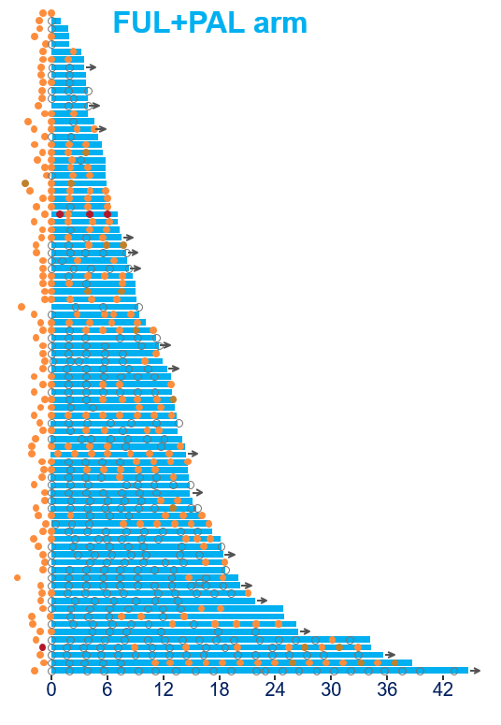
Prof Bidard – Case Presentation: Same Patient, 2 Years Later (Continued)
Patient has no synchronous disease progression and ESR1_{mut} in ctDNA triggered a switch to a SERD+ribociclib
How do you monitor the disease after the switch ? (ctDNA, imaging…)
There is NO data to support the utility ESR1_{mut} monitoring during SERD-based therapy
Clearance/decrease of ctDNA ➔longer PFS in several reports…
… but no threshold a timing validated / no benefit demonstrated
Rising ctDNA is an easy call (from negative to positive results)
and is clinically actionable
But, once switched, patients should rather discontinue ctDNA monitoring
(unless within a research program)
Bidard, ASCO 2023

Slide 77
Agenda
Introduction: Confronting Metastatic Breast Cancer (mBC)
Module 1: Mechanisms of Resistance to Endocrine Therapy in HR-Positive mBC; Use of Oral Selective Estrogen Receptor Degraders (SERDs) — Dr Kalinsky
Module 2: Ongoing Evaluation of Early Therapeutic Switching for HR-Positive mBC Harboring ESR1 Mutations — Prof Bidard
Module 3: Other Key Datasets and Ongoing Trials in HR-Positive Breast Cancer

Slide 78
Key Datasets and Ongoing Trials: Adjuvant Therapy
Ignatiadis M et al. EORTC-2129-BCG: Elacestrant for treating ER+/HER2- breast cancer patients with ctDNA relapse (TREAT ctDNA). ESMO 2024;Abstract 338TiP.
Hamilton E et al. A phase III randomised open-label study of extended adjuvant therapy with camizestrant vs standard endocrine therapy (ET) in patients with ER+/HER2– early breast cancer (BC) and an intermediate or high risk of recurrence (CAMBRIA-1) ESMO 2023;Abstract 354 TiP.
NCT05952557. An adjuvant endocrine-based therapy study of camizestrant (AZD9833) in ER+/HER2- early breast cancer (CAMBRIA-2).
Jhaveri K et al. EMBER-4: A phase 3 adjuvant trial of imlunestrant vs standard endocrine therapy (ET) in patients with ER+, HER2- early breast cancer (EBC) with an increased risk of recurrence who have previously received 2 to 5 years of adjuvant ET. SABCS 2022;Abstract OT1-01-02.
Geyer C et al. lidERA Breast Cancer (BC): Phase III adjuvant study of giredestrant vs physician’s choice of endocrine therapy (PCET) in patients (pts) with estrogen receptor-positive, HER2-negative early BC (ER+, HER2– eBC). ASCO 2023;Abstract TPS616.

Slide 79
Key Datasets and Ongoing Trials:
Neoadjuvant Therapy or Window of Opportunity
Vidal M et al. Solti-1905. Elacestrant in preoperative setting, a window of opportunity study (ELIPSE trial). SABCS 2022;Abstract PD13-01.
Robertson J et al. SERENA-3: A randomized pre-surgical window of opportunity study assessing dose and duration of camizestrant treatment in postmenopausal women with ER-positive, HER2-negative primary breast cancer. SABCS 2023;Abstract RF01-01.
Neven P et al. A preoperative window-of-opportunity (WOO) study of imlunestrant in ER+, HER2- early breast cancer (EBC): Final analysis from EMBER-2. ESMO 2023;Abstract 273P.
Hurvitz SA et al. Neoadjuvant palbociclib plus either giredestrant or anastrozole in oestrogen receptor-positive, HER2-negative, early breast cancer (coopERA Breast Cancer): An open-label, randomised, controlled, phase 2 study. Lancet Oncol 2023;24(9):1029-41.

Slide 80
Key Datasets and Ongoing Trials:
Proteolysis Targeting Chimeras (PROTACS)
Hamilton E et al. First-in-human safety and activity of ARV-471, a novel PROTAC estrogen receptor degrader, in ER+/HER2- locally advanced or metastatic breast cancer. SABCS 2021;Abstract PD13-08.
Hamilton E et al. Vepdegestrant, a proteolysis targeting chimera (PROTAC) estrogen receptor (ER) degrader, plus palbociclib (palbo) in ER+/human epidermal growth factor receptor 2 (HER2)- advanced breast cancer: Updated phase Ib cohort results. ESMO Breast 2024;Abstract 218P.
Hamilton E et al. VERITAC-2: A global, randomized phase 3 study of ARV-471, a PROteolysis TArgeting Chimera (PROTAC) estrogen receptor (ER) degrader, vs fulvestrant in ER+/human epidermal growth factor receptor 2 (HER2)- advanced breast cancer. ESMO Breast 2023;Abstract 257TiP.
Wander S et al. VERITAC-3: A randomized phase 3 study, with a lead-in, of first-line vepdegestrant + palbociclib vs letrozole + palbociclib in estrogen receptor–positive/human epidermal growth factor receptor 2–negative advanced breast cancer. SABCS 2023;Abstract PO2-20-03.
Hamilton E et al. AC699, a novel chimeric estrogen receptor degrader, in a phase I study in breast cancer. ESMO 2024;Abstract 637P.

Slide 81
Case 2: First-Line Treatment of HR-Positive/HER2-Negative
PIK3CA-Mutated Metastatic
Breast Cancer

Slide 82
Dr Kalinsky – Case Presentation
Patient is a 65-yo postmenopausal healthy female who is diagnosed with a right breast invasive ductal carcinoma, grade 2, ER+ 100% PR+ 100% HER2 0
She undergoes lumpectomy, SLNB: 3 cm, 2/3 lymph nodes in 4/21
Oncotype 20
No chemo. s/p XRT
Compliant with aromatase inhibitor. s/p 1 year of Abemaciclib – stopped in 6/22 due to intolerance
Develops new bone metastases in 5/24 while on an aromatase inhibitor
Her performance status is excellent
She has minimal pain from metastases
Hereditary Genetic Testing: no pathogenic variants

Slide 83
Dr Kalinsky – Case Presentation (Continued)
She undergoes ctDNA testing: biomarker testing reveals a pathogenic PIK3CA H1047R mutation

Slide 84
What therapy would you recommend next?
Alpelisib + fulvestrant
Chemotherapy
Capivasertib + fulvestrant
Ribociclib + fulvestrant
Trastuzumab Deruxtecan
Sacituzumab Govitecan

Slide 85
Dr Kalinsky – Case Presentation (Continued)
Pt started fulvestrant + ribociclib

