Slide 1

Second-generation ROS1 Inhibitors
2022: A Year in Review
Management of NSCLC with an EGFR, ALK or ROS1 Abnormality
Zosia Piotrowska, MD, MHS
Assistant Professor of Medicine
Harvard Medical School | Massachusetts General Hospital

Slide 2
Overview
EGFR: Early Stage Disease
Tsuboi M et al. Osimertinib as adjuvant therapy in patients with resected EGFR-mutated Stage IB-IIIA non-small cell lung cancer: Updated results from ADAURA. ESMO 2022;Abstract LBA47.
Wu YL et al. Postoperative chemotherapy use and outcomes from ADAURA: Osimertinib as adjuvant therapy for resected EGFR-mutated NSCLC. J Thorac Oncol 2022;17(3):423-33.
EGFR: Acquired Resistance
Piotrowska Z et al. ELIOS: A multicentre, molecular profiling study of patients with epidermal growth factor receptor-mutated advanced NSCLC treated with first-line osimertinib. ESMO 2022;Abstract LBA53.
Jänne PA et al. Efficacy and safety of patritumab deruxtecan (HER3-DXd) in EGFR inhibitor-resistant, EGFR-mutated NSCLC. Cancer Discov 2022;12(1):74-89.
Shu CA et al. Amivantamab and lazertinib in patients with EGFR-mutant NSCLC after progression on osimertinib and platinum-based chemotherapy: Updated results from CHRYSALIS-2. ASCO 2022;Abstract 9006.
EGFR: Exon 20 Insertions
Ramalingam SS et al. Phase I/II study of mobocertinib in EGFR exon 20 insertion+ metastatic NSCLC: Updated results from platinum-pretreated patients. ESMO 2022;Abstract 988P.
Park K et al. Amivantamab in EGFR exon 20 insertion-mutated NSCLC progressing on platinum chemotherapy: Initial results from the CHRYSALIS Phase I study. J Clin Oncol 2021;39(30):3391-402.
Yu HA et al. Phase (Ph) 1/2a study of CLN-081 in patients (pts) with NSCLC with EGFR exon 20 insertion mutations (Ins20). ASCO 2022;Abstract 9007.
Bazhenova L et al. Sunvozertinib in NSCLC Patients with EGFR Exon20 Insertion Mutations. 2022 North America Conference on Lung Cancer.
ALK-positive NSCLC
Hotta K et al. Final overall survival analysis from the Phase III J-ALEX study of alectinib versus crizotinib in ALK inhibitor-naïve Japanese patients with ALK-positive non-small-cell lung cancer. ESMO Open 2022;7(4):100527.
Camidge DR et al. Brigatinib versus crizotinib in ALK inhibitor-naïve advanced ALK-positive NSCLC: Final results of Phase III ALTA-1L trial. J Thorac Oncol 2021;16(12):2091-108.
Solomon BJ et al. Efficacy and safety of first-line lorlatinib versus crizotinib in patients with advanced, ALK-positive non-small-cell lung cancer: Updated analysis of data from the phase 3, randomised, open-label CROWN study. Lancet Respir Med 2022, Published Online December 16, 2022.
Solomon BJ et al. Post hoc analysis of lorlatinib intracranial efficacy and safety in patients with ALK-positive advanced non-small-cell lung cancer from the Phase III CROWN study. J Clin Oncol 2022;40(31):3593-602.
ROS1-positive NSCLC
Fan Y et al. Entrectinib in patients with ROS1 fusion-positive NSCLC: Updated efficacy and safety analysis. WCLC 2022;Abstract MA13.04.
Drilon A et al. NVL-520 is a selective, TRK-sparing, and brain-penetrant inhibitor of ROS1 fusions and secondary resistance mutations. Cancer Discovery 2022.

Slide 3
Background: Common EGFR Mutations
For common, sensitizing EGFR mutations (Exon 19 deletion and L858R), osimertinib (3rd gen EGFR TKI) remains the standard of care.
  mPFS 1L Osi: 18.9 months; mOS 39 mos
Treatment options for patients who progress on first-line osimertinib are needed.
In 2021, osimertinib became the first TKI approved in the adjuvant setting based on improved DFS seen in the ADAURA trial (3 yrs of adjuvant osimertinib vs. placebo)
 | Median PFS, mos | HR (95% CI)
Osimertinib | 18.9 (15.2, 21.4) | 0.46 (0.37, 0.57); p<0.001
Comparator EGFR-TKI | 10.2 (9.6, 11.1)
Ramalingam S et al. ESMO 2017. Abstract 4738.
Soria J-C et al. N Engl J Med. 2017;378-113-125.

Slide 4
EGFR: Early Stage Disease
Tsuboi M et al. Osimertinib as adjuvant therapy in patients with resected EGFR-mutated Stage IB-IIIA non-small cell lung cancer: Updated results from ADAURA. ESMO 2022;Abstract LBA47.
Wu YL et al. Postoperative chemotherapy use and outcomes from ADAURA: Osimertinib as adjuvant therapy for resected EGFR-mutated NSCLC. J Thorac Oncol 2022;17(3):423-33.

Slide 5
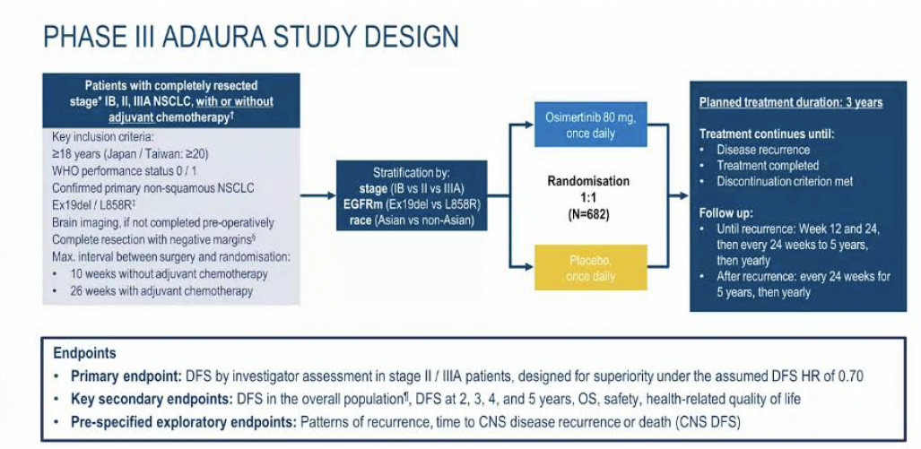
Updated results from ADAURA
Tsuboi M et al, ESMO 2022.

Slide 6
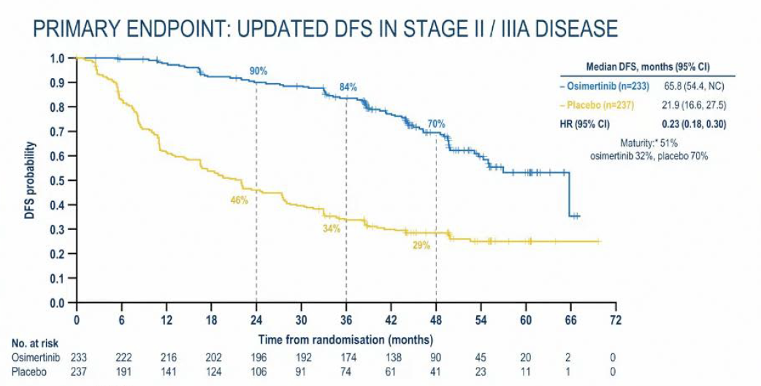
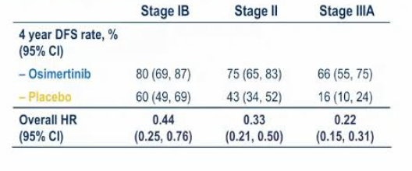
Updated results from ADAURA
Updated DFS by Stage (AJCC 8th Edition)
Tsuboi M et al, ESMO 2022.

Slide 7
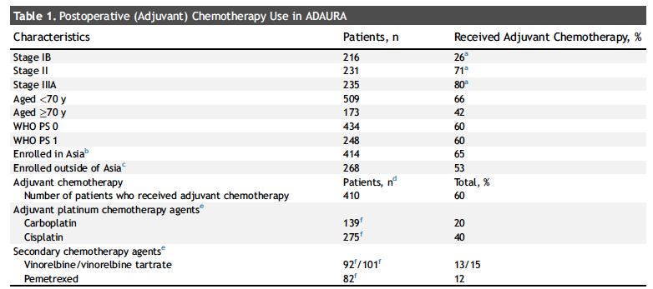
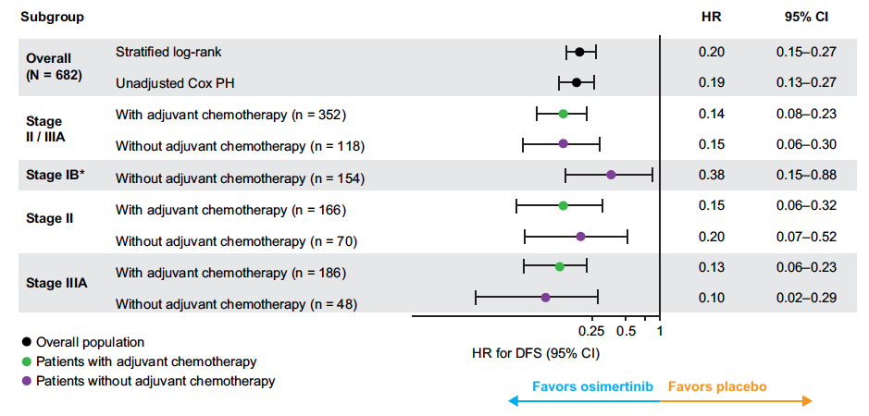
Postoperative chemo use and outcomes from ADAURA
Wu YL, J Thorac Oncol 2022;17(3):423-33.

Slide 8
Updated results from ADAURA
Clinical Implications:
The updated results of ADAURA continue to show a sustained improvement in DFS with 3 years of adjuvant osimertinib.
Adjuvant osimertinib is approved as adjuvant therapy after resection for patients with NSCLC harboring del19 and L858R mutation.
DFS benefit appears to be maintained regardless of prior chemotherapy use, thus osimertinib can be considered in both chemo-eligible and chemo-ineligible patients.
Future Directions:
OS Results from ADAURA are eagerly awaited.
There is a hint that curves may start to come together after 3 years of TKI therapy, a phenomenon that has also been observed in earlier TKI studies-- future studies will be required to determine the optimal duration of adjuvant TKIs.

Slide 9
EGFR: Osimertinib Resistance Mechanisms and Novel Agents
Piotrowska Z et al. ELIOS: A multicentre, molecular profiling study of patients with epidermal growth factor receptor-mutated advanced NSCLC treated with first-line osimertinib. ESMO 2022;Abstract LBA53.
Jänne PA et al. Efficacy and safety of patritumab deruxtecan (HER3-DXd) in EGFR inhibitor-resistant, EGFR-mutated NSCLC. Cancer Discov 2022;12(1):74-89.
Shu CA et al. Amivantamab and lazertinib in patients with EGFR-mutant NSCLC after progression on osimertinib and platinum-based chemotherapy: Updated results from CHRYSALIS-2. ASCO 2022;Abstract 9006.

Slide 10
ELIOS: Molecular Profiling Study of Resistance to 1L Osimertinib
Paired samples analysed by NGS and mass spectrometry
(mProbe; LiquidTissues assay)
Piotrowska Z, ESMO 2022

Slide 11
ELIOS: Molecular Profiling Study of Resistance to 1L Osimertinib
Paired samples analysed by NGS and mass spectrometry
(mProbe; LiquidTissues assay)
Piotrowska Z, ESMO 2022

Slide 12
ELIOS: Molecular Profiling Study of Resistance to 1L Osimertinib
Paired samples analysed by NGS and mass spectrometry
(mProbe; LiquidTissues assay)
Only 46/115 (39%) pts with PD provided an evaluable biopsy pair.
Most common reasons for failure:
Pt/anatomic factors limit bx feasibility
Technical failure of NGS on either baseline or PD biopsy
Piotrowska Z, ESMO 2022

Slide 13
ELIOS- A Prospective Study of First-line Osimertinib Resistance
Note: Histologic transformations were not assessed in this analysis.
Piotrowska Z, ESMO 2022

Slide 14
ELIOS
Clinical Implications:
Tissue biopsies are hard to obtain, even in a prospective clinical trial!
MET Amplification (17%) and EGFR C797S (15%) were the most common resistance mechanisms seen and may be targetable.
Histologic transformation was not assessed (but occurs in up to 15% of pts in other studies).
Important to try to get tissue biopsies after first-line osimertinib if possible.
Future Directions:
Can we develop non-invasive methods for comprehensive evaluation of resistance mechanisms?

Slide 15
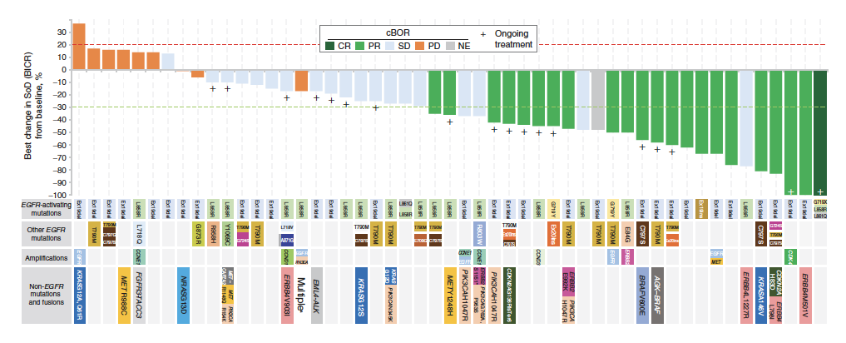
Patritumab Deruxtecan
(HER3-DXd; HER3 Antibody-Drug Conjugate)
 | All (n=57) | Prior PBC + Osi (n=44)
Confirmed ORR (BICR) | 39% | 39%
mDOR, mo (range) | 6.9 (3.1-NE) | 7.0 (3.1-NE)
mPFS, mo (range) | 8.2 (4.4-8.3) | 8.2 (4.0-NE)
Janne P et al. Cancer Discovery, 2021

Slide 16
Patritumab Deruxtecan- Adverse Events
Grade > 3 TEAEs in > 5% pts | 5.6 mg/kg (n=57)
Thrombocytopenia | 17 (30)
Neutropenia | 11 (19)
Fatigue | 8 (14)
Anemia | 5 (9)
Dyspnea | 5 (9)
Febrile neutropenia | 5 (9)
Hypoxia | 4 (7)
Leukopenia | 4 (7)
Hypokalemia | 3 (5)
Lymphopenia | 3 (5)
TEAEs | 5.6 mg/kg (n=57)
TEAEs associated with treatment discontinuation | 6 (11)
TEAEs associated with dose reduction | 12 (21)
TEAEs associated with dose interruption | 21 (37)
TEAEs associated with death * None treatment-related. | 4 (7)
Adjudicated treatment-related ILD: 7%
Janne P et al. Cancer Discovery, 2021

Slide 17
Patritumab Deruxtecan
Clinical Implications:
Patritumab deruxtecan is active in TKI- and chemo-resistant EGFR-mutant NSCLC, including patients with various resistance mechanisms (ORR 39%, mPFS 8.2 months)
Patritumab is not yet approved (has breakthrough therapy designation), but clinical trials are ongoing including osimertinib combinations in the first and second-line setting.
Future Directions:
Can we find biomarkers of Patritumab response?

Slide 18
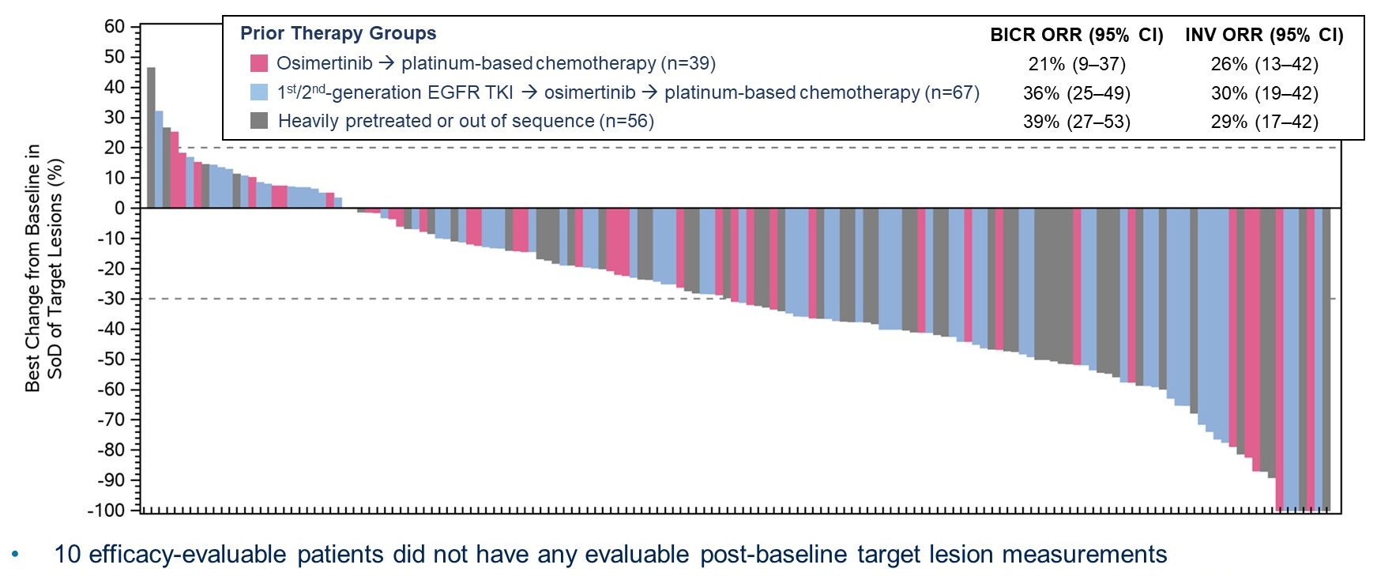
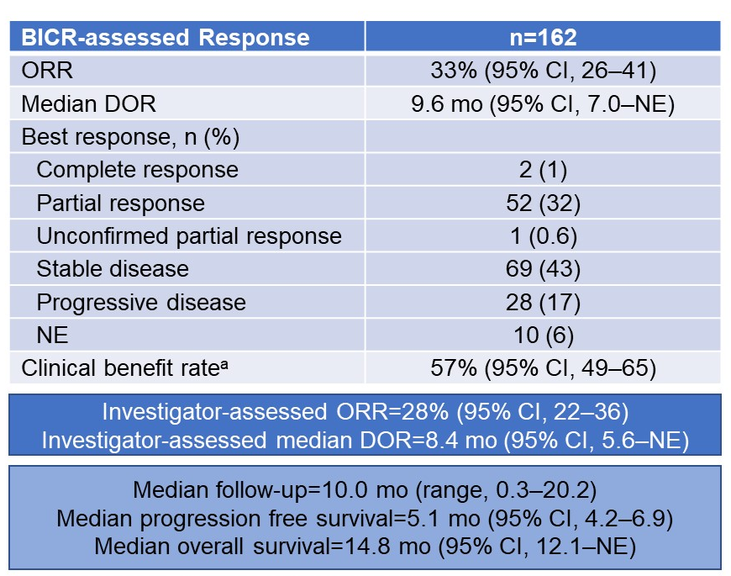
Amivantamab + Lazertinib
Amivantamab (bispecific MET/EGFR antibody) + Lazertinib (3rd gen EGFR TKI)
Most common TEAEs include: rash (cumulative 80% all grade, 10% gr > 3), paronychia (52%), stomatitis (39%), hypoalbuminemia (43%), edema (27%) and IRR (67% any grade, 8% grade > 3).
IRRs most commonly occur on C1D1 and do not recur.
Shu C, ASCO 2022

Slide 19
Amivantamab + Lazertinib – Biomarker selection?
Chul B et al. ASCO 2021.

Slide 20
Amivantamab + Lazertinib
Clinical Implications:
Ami/Lazer is another active combination in TKI-resistant EGFR-mutant NSCLC, with activity across various resistance mechanisms.
Amivantamab/Lazertinib is not yet approved as a combination in EGFR TKI resistance, but trials are ongoing.
Future Directions:
Again- biomarkers to select patients for treatment are needed!

Slide 21
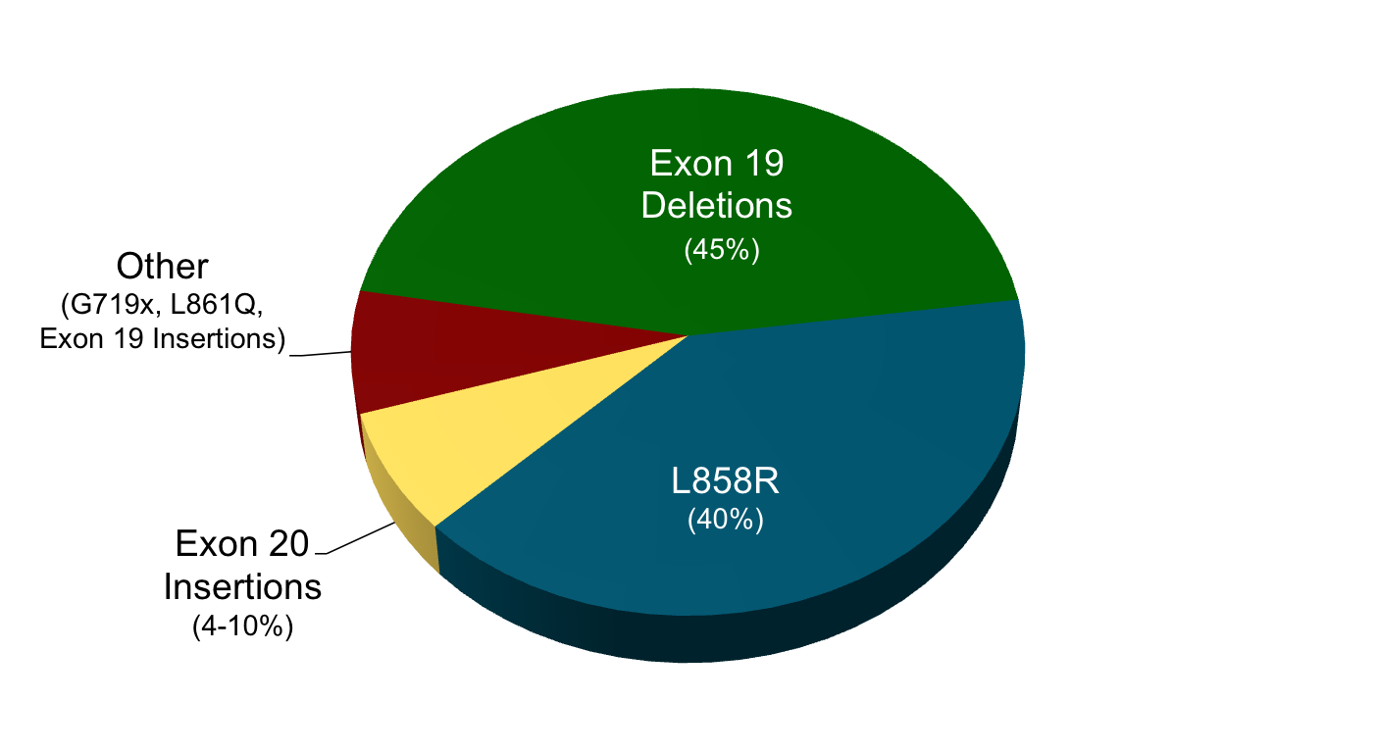
Background: EGFR Exon 20 Insertions in NSCLC
Common EGFR Mutations
Exon 19 Deletions (~45%)
Most commonly between AA L746 and E749: E746_A750del, L747_P753insS, L747_T751del, L747_A750insP, E746-S752insV, etc.
L858R point mutation (exon 21), (~40%)
Approved Therapies:
Osimertinib (preferred, 1L)
Erlotinib, Gefitinib, Afatinib, Dacomitinib
SENSITIZING
Atypical EGFR Mutations
L861Q, G719X, S768I, etc.
Others (TKI sensitivity varies)
Approved Therapies:
Afatinib
(Osimertinib may also have some activity)
Exon 20 Insertions (AA 761-775)
A767_V769dup
S768_D770dupSVD
V769_D770insASV
D770_N771ins…
D770_P772dup
N771_H773dup
N771_P772ins…
P772_H773dupPH
V774ins
Approved Therapies:
Mobocertinib (2L, post-platinum)
Amivantamab (2L, post-platinum)
RESISTANT to standard EGFR TKIs
Yasuda H et al. Lancet Oncol. 2012;13(1):e23-e31.
Yasuda H et al. Sci Transl Med. 2013;5(2216):216ra177.

Slide 22
EGFR Exon 20 Insertions
Ramalingam SS et al. Phase I/II study of mobocertinib in EGFR exon 20 insertion+ metastatic NSCLC: Updated results from platinum-pretreated patients. ESMO 2022; Abstract 988P.
Park K et al. Amivantamab in EGFR exon 20 insertion-mutated NSCLC progressing on platinum chemotherapy: Initial results from the CHRYSALIS Phase I study. J Clin Oncol 2021;39(30):3391-402.
Yu HA et al. Phase (Ph) 1/2a study of CLN-081 in patients (pts) with NSCLC with EGFR exon 20 insertion mutations (Ins20). ASCO 2022; Abstract 9007.
Bazhenova L et al. Sunvozertinib in NSCLC Patients with EGFR Exon20 Insertion Mutations. 2022 North America Conference on Lung Cancer.

Slide 23
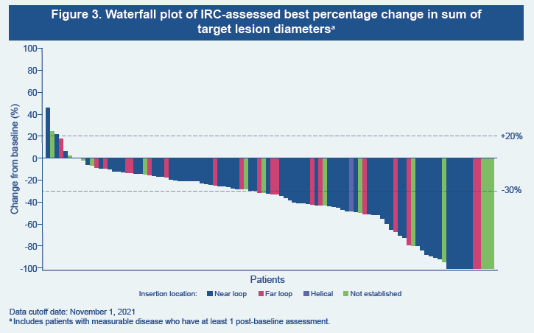
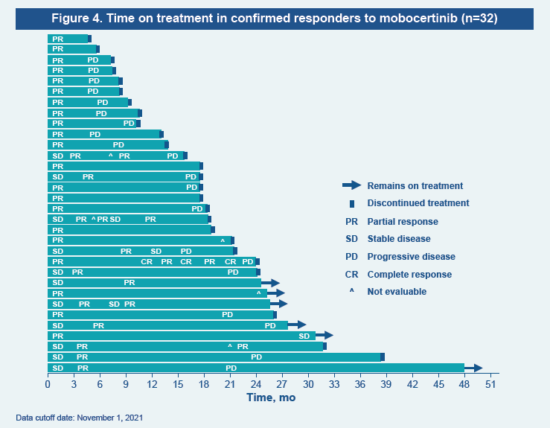
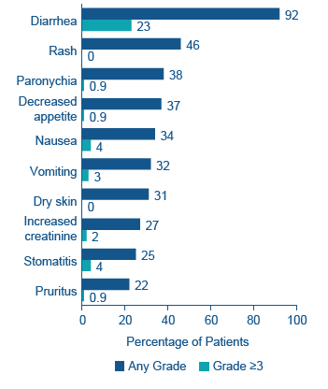
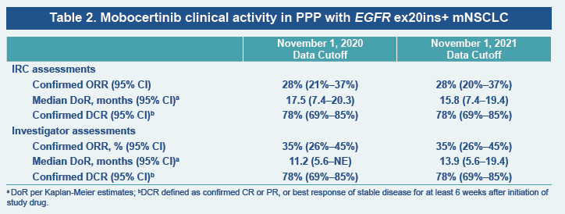
Mobocertinib: Updated Results from the PPP Cohort
PPP = 114 pts (from phase 1 + EXCLAIM cohorts)
> 1 prior line of therapy
Mobocertinib Toxicity
mPFS 7.3 mos
Ramalingam SS, ESMO 2022.

Slide 24
Mobocertinib: Updated Results from the PPP Cohort
Clinical Implications:
Efficacy of mobocertinib appears consistent with earlier reports and continues to support the use of osimertinib post-chemotherapy.
Rates of diarrhea remain high, with > 90% pts experiencing diarrhea.
Selection between mobocertinib and amivantamab should be made on a case-by-case basis, with the goal of most patients accessing both therapies during their disease course.
Future Directions:
Will mobocertinib move to the first-line setting?
Will novel agents improve efficacy, safety and CNS penetration?

Slide 25
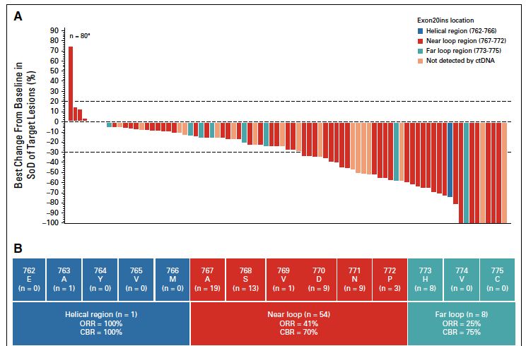
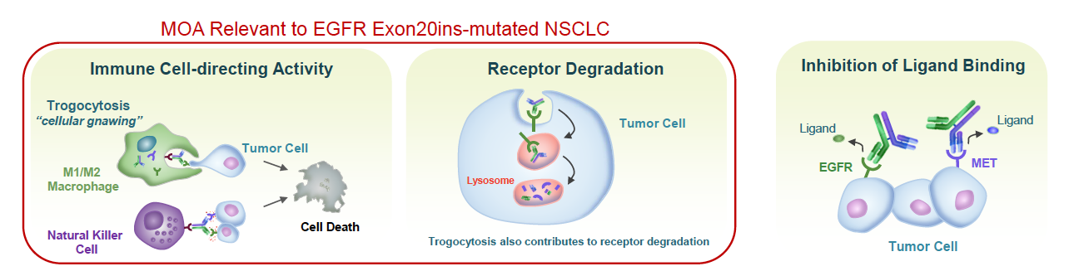
Amivantamab
 | Post-Platinum EGFR Ins20 N=81
ORR (IRC) | 40%
mDOR (IRC) | 11.1 months
mPFS (IRC) | 8.3 months
Park K et al. J Clin Oncol. 2021;39:3391-3402.
Sabari, J, WCLC 2020

Slide 26
Amivantamab Safety
Adverse Event | Total | Grade 1 | Grade 2 | Grade > 3
Rash | 86% | 38% | 45% | 4%
Infusion-related reaction | 66% | 8% | 55% | 3%
Paronychia | 45% | 25% | 19% | 1%
Hypoalbuminemia | 27% | 5% | 19% | 3%
Constipation | 24% | 16% | 8% | 0%
Nausea | 19% | 15% | 4% | 0%
Dyspnea | 19% | 11% | 7% | 2%
Stomatitis | 21% | 10% | 11% | 0%
Peripheral edema | 18% | 18% | 1% | 0%
Pruritus | 17% | 10% | 7% | 0%
Fatigue | 18% | 13% | 4% | 2%
Cough | 14% | 10% | 4% | 0%
Dry skin | 16% | 16% | 0% | 0%
Incr ALT | 15% | 13% | 1% | 1%
IRR Severity: 98% Gr 1-2; 2% Gr 3
Chills, SOB, nausea, flushing
Primarily limited to first infusion
Improves with split dosing (C1D1, C1D2)
Dose reduction: 13% | Dose discontinuation: 10%
Park K et al. J Clin Oncol. 2021;39:3391-3402.
Sabari, J, WCLC 2020

Slide 27
Amivantamab
Clinical Implications:
Amivantamab is an active therapy for patients with EGFR exon 20 insertions (ORR 40%, mPFS 8.3 months).
Key toxicities include skin rash and IRRs.
Selection between mobocertinib and amivantamab should be made on a case-by-case basis, with the goal of most patients accessing both therapies during their disease course.
Future Directions:
Amivantamab being tested first-line in combination with chemotherapy (PAPILLON)
More active, better tolerated and more CNS penetrant therapies are needed

Slide 28
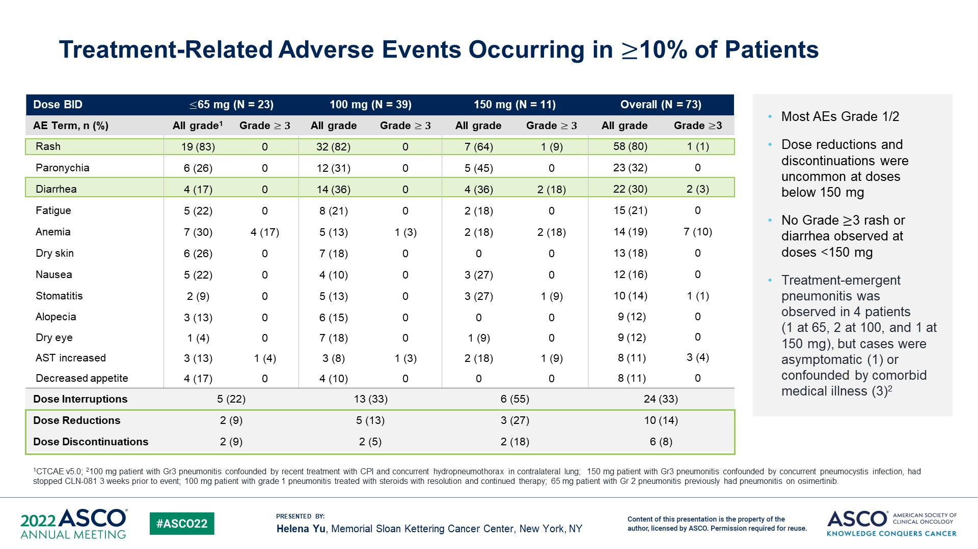
EGFR Exon 20: Novel Agents
CLN-081 (TAS6417)
Yu HA, ASCO 2022

Slide 29
EGFR Exon 20: Novel Agents
Sunvozertinib (DZD9008)
Most common TEAEs (all grades)
In a pooled analysis of pts treated at 300mg QD (n=84), the combined ORR was 52.4%
In the WU-KONG6 trial (ph 2, China), ORR (BICR) was 59.8%
Bazhenova L, NACLC 2022.

Slide 30
EGFR Exon 20: Novel Agents
Clinical Implications:
Still in clinical trials, but novel EGFR TKIs like Sunvozertinib and CLN-081 appear to have improved efficacy and safety profiles over currently-approved options.
Future Directions:
New drugs predicted to have CNS penetration (BLU-451, ORIC-114) are now entering the clinic.

Slide 31
Background: ALK + ROS1 alterations in NSCLC
ALK-positive NSCLC:
  In the US, crizotinib, ceritinib, alectinib, brigatinib and lorlatinib are all approved for front-line use in ALK-positive NSCLC.
  Randomized, phase 3 trials of second-generation (alectinib, brigatinib) and recently, third-generation (lorlatinib) ALK inhibitors have all shown superiority to crizotinib in the front line setting.
ROS1-positive NSCLC:
  In the United States, crizotinib and entrectinib are both approved in ROS1+ NSCLC
Shaw. NEJM. 2014;371:1963. Shaw. Ann Oncol. 2019;30:1121.

Slide 32
ALK+ NSCLC
Hotta K, et al. Final overall survival analysis from the Phase III J-ALEX study of alectinib versus crizotinib in ALK inhibitor-naïve Japanese patients with ALK-positive non-small-cell lung cancer. ESMO Open 2022;7(4):100527.
Camidge DR et al. Brigatinib versus crizotinib in ALK inhibitor-naïve advanced ALK-positive NSCLC: Final results of Phase III ALTA-1L trial. J Thorac Oncol 2021;16(12):2091-108.
Solomon BJ et al. Efficacy and safety of first-line lorlatinib versus crizotinib in patients with advanced, ALK-positive non-small-cell lung cancer: Updated analysis of data from the phase 3, randomised, open-label CROWN study. Lancet Respir Med 2022, Published Online December 16, 2022.
Solomon BJ et al. Post hoc analysis of lorlatinib intracranial efficacy and safety in patients with ALK-positive advanced non-small-cell lung cancer from the Phase III CROWN study. J Clin Oncol 2022;40(31):3593-602.

Slide 33
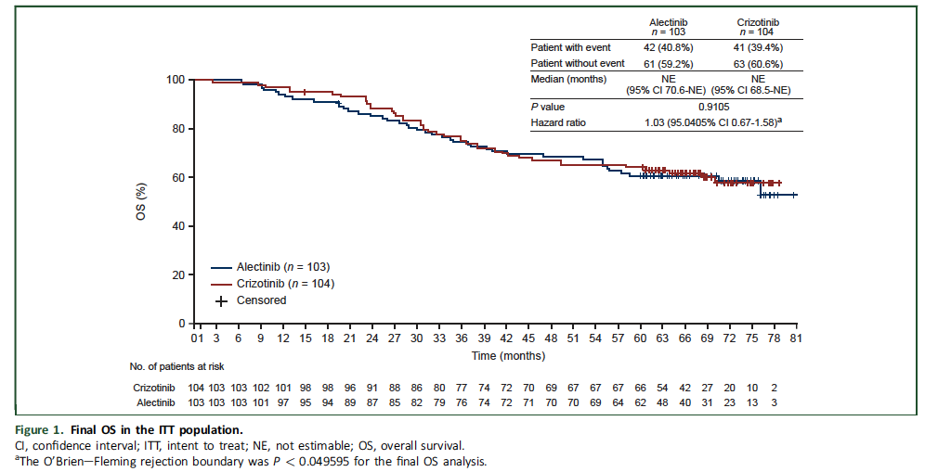
J-ALEX: Final OS Analysis
J-ALEX – 1L study of Alectinib vs. Crizotinib in Japan, prev showed improved PFS with Alectinib.
Final OS results with > 5 yrs follow up
Alectinib did not improve OS vs. Crizotinib: HR 1.03 [95% CI, 0.67-1.58].
5-yr OS: 60.9% Alectinib, 64.1% Crizotinib
Results likely confounded by high rate of crossover (79% of crizotinib pts received alectinib).
Hotta K, et al, ESMO Open 2022.

Slide 34
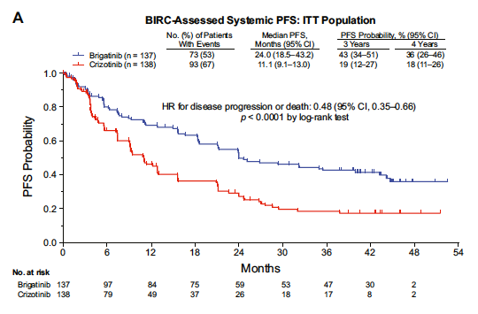
ALTA-1L: Final Results
ALTA-1L: Ph 3 study of first-line Brigatinib vs. Crizotinib, which previously showed improved PFS with brigatinib.
Final results (median f/u 40.4 mo on brigatinib arm) demonstrated continued benefit with first-line brigatinib.
Final PFS HR 0.48 [95% CI, 0.35-0.66]
  3yr PFS 43% (brigatinib) vs. 19% (crizotinib)
While there was no OS improvement in the overall population [HR 0.81], post-hoc analysis suggested an OS benefit in pts with baseline brain mets [HR 0.43, 95% CI 0.21-0.89]
Camidge DR, et al. J Thorac Oncol 2021;16(12):2091-108.

Slide 35
J-ALEX and ALTA-1L Updated Analyses
Clinical Implications:
With > 5 yrs follow up, no OS difference between first-line Alectinib and Crizotinib in J-ALEX. Not surprising that there was no difference in OS between the two treatment arms, given the widespread availability of alectinib and other next-generation ALK inhibitors and high rates of crossover.
In the final data from ALTA-1L, brigatinib maintained clear PFS advantage over crizotinib (HR 0.48), but also did not show OS difference.
Alectinib and brigatinib (both 2nd gen ALK TKIs) remain good first-line treatment options, though the selection of second vs. third-generation ALK inhibitors as first-line therapy remains an area of active debate given the impressive results of the CROWN study (first-line lorlatinib).
Future Directions:
Will we ever have a 2nd vs. 3rd gen ALK TKI first-line study?

Slide 36
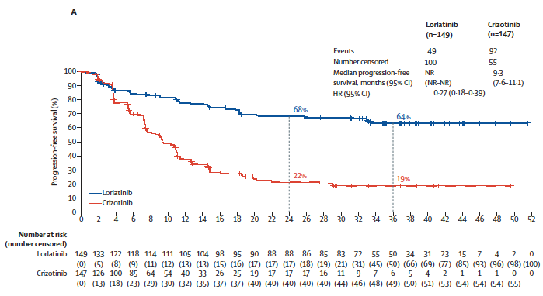
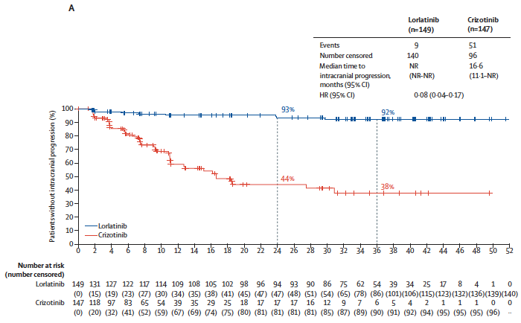
CROWN: Updated Analysis
CROWN: Phase III Study of First-line Lorlatinib vs. Crizotinib in ALK+ NSCLC
Unplanned interim analysis (median follow up 36.7 mos lorlatinib, 29.3 mos crizotinib)
Progression-Free Survival (BICR) - ITT
Time to Intracranial Progression (BICR) - ITT
Lorlatinib vs. Crizotinib
ORR: 77% vs. 59%
Intracranial ORR: 83% vs. 23%*
(*pts with measurable baseline brain mets)
Solomon B, et al. Lancet Respir Med 2022

Slide 37
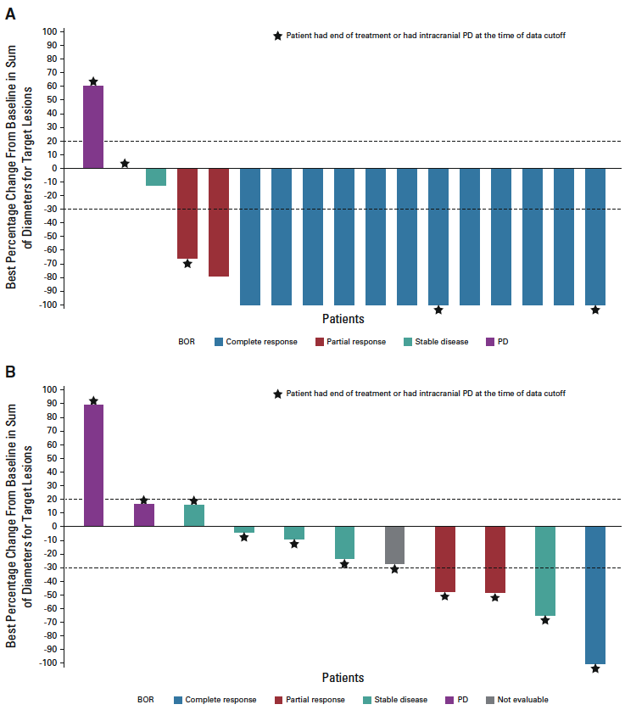
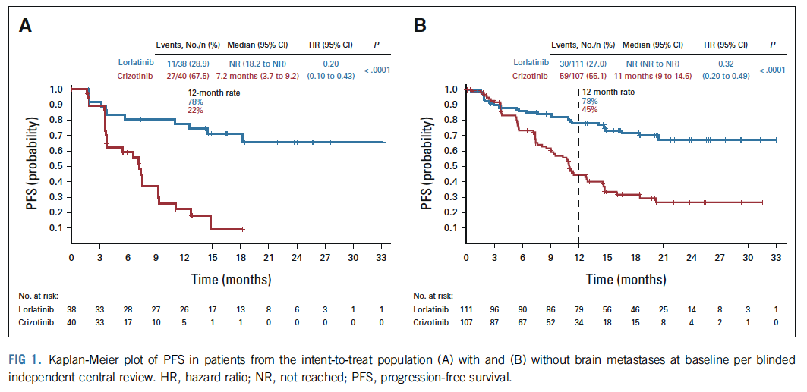
CROWN: CNS Outcomes
CNS outcomes from CROWN, including subgroup analyses in pts with and without brain mets, and data on incidence/ management of CNS AE’s.
With Baseline Brain Mets
Without Brain Mets
Complete CNS Responses: 61%
Complete CNS Responses: 15%
Solomon BJ et al, J Clin Oncol 2022;40(31):3593-602.

Slide 38
Lorlatinib: CNS Adverse Events
CNS AE’s overall: 35% Total, 3% Gr 3
Cognitive Effects (21%; 2% Gr 3)
  Memory impairment (9%), Disturbance in attention (5%), Confusion (4%), Amnesia (3%), Cognitive disorder (2%), Delirium (1%), Disorientation (1%), Mental impairment (1%)
Mood Effects (16%, 1% Gr 3)
  Anxiety (7%), Depression (4%), Affect lability (2%), Affective disorder, agitation, irritability, mood altered, anger, bipolar disorder, depression mood, depressive symptoms, euphoric mood, mood swings, stress (each 1%)
Speech Effects (5%, 1% Gr 3)
  Dysarthria (3%), Speech disorder (1%), Slow speech (1%)
Psychotic Effects (3%, 0% Gr 3)
  Hallucination (2%), visual hallucination (1%), auditory hallucination (1%), Delusion (1%)
Median time to first episode of any CNS AE: 57 days (1-533)
Dose modification: 23%
Landmark PFS analysis showed comparable efficacy in patients with or without dose reduction.
Solomon BJ et al, J Clin Oncol 2022;40(31):3593-602.

Slide 39
CROWN Trial
Clinical Implications:
Continued follow-up of the CROWN study and CNS-specific analyses continue to show impressive results with first-line lorlatinib, with 64% pts progression-free at 3 years. These results compare favorably with second-generation ALK TKIs in cross-trial comparisons.
Intracranial response rates are substantially higher with lorlatinib, which also significantly delays time to intracranial progression.
CNS Adverse events occurred in 35% pts overall, but dose modification (interruption or reduction) did not adversely impact PFS.
Lorlatinib is now a preferred first-line TKI for newly diagnosed ALK+ NSCLC, and is my preferred agent for patients with baseline brain mets.
Future Directions:
Better understanding of Resistance Mechanisms, high-risk subgroups

Slide 40
ROS1+ NSCLC
Fan Y, et al. Entrectinib in patients with ROS1 fusion-positive NSCLC: Updated efficacy and safety analysis. WCLC 2022; Abstract MA13.04.
Drilon A, et al. NVL-520 is a selective, TRK-sparing, and brain-penetrant inhibitor of ROS1 fusions and secondary resistance mutations. Cancer Discovery 2022.

Slide 41
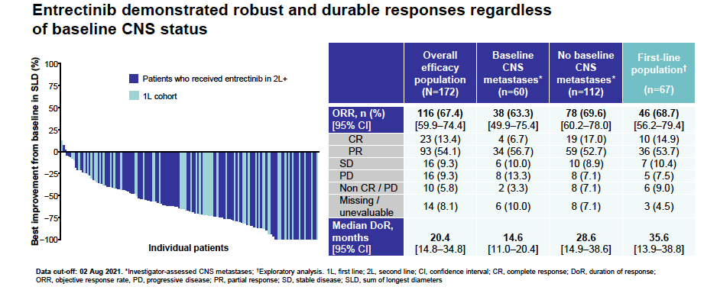
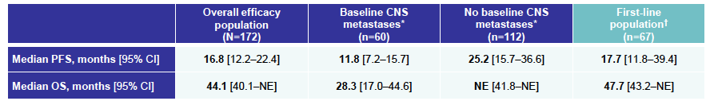
Entrectinib in patients with ROS1 fusion-positive NSCLC
Intracranial ORR:
Overall: 49%
First-line: 69%
Most Frequent AEs:
Dysgeusia (43%)
Weight increase (38%)
Dizziness (35%)
Constipation (32%)
Diarrhea (30%)
Fan Y, WCLC 2022

Slide 42
Entrectinib in patients with ROS1 fusion-positive NSCLC
Clinical Implications:
Entrectinib’s efficacy is maintained in this analysis and entrectinib remains a standard of care of patients with ROS1+ NSCLC.
High intracranial response rates make it my preferred first-line ROS1 TKI for patients with baseline brain metastases.
Future Directions:
Phase III trial of entrectinib vs. crizotinib in ROS1+ NSCLC is ongoing.

Slide 43
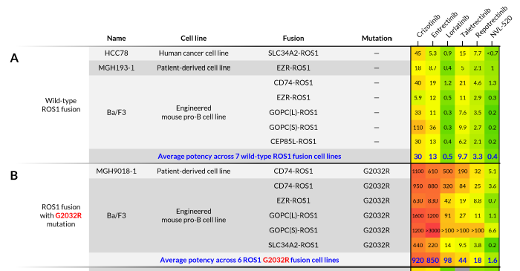
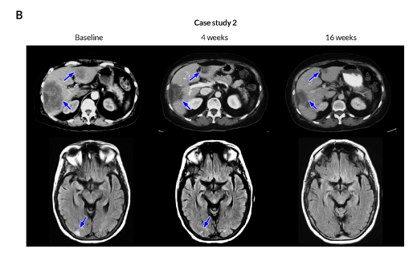
Overcoming ROS1 TKI Resistance: NVL-520
Treatment options for patients with resistance to available ROS1 TKIs are limited, particularly in cases of intracranial progression and pts with G2032R solvent front mutation.
NVL-520 is a novel, rationally designed ROS1 inhibitor with potent preclinical activity against ROS1 G2032R and predicted intracranial efficacy.
Clinical responses have been observed in 3 patients, including two with G2032R and one with intracranial progression.
Drilon A, et al. Cancer Discovery 2022.

Slide 44
Overcoming ROS1 TKI Resistance: NVL-520
Clinical Implications:
NVL-520 is a promising new agent for patients with ROS1+ NSCLC and acquired resistance to standard TKIs, with potent activity against the G2032R resistance mutation and CNS activity.
Phase 1 testing is ongoing.

