Slide 1
Striving for Consensus — Current and Future
Management of Metastatic Non-Small Cell Lung Cancer in Patients Who Experience Disease Progression on Immune Checkpoint Inhibitor Therapy
Friday, August 11, 2023
12:00 PM – 3:15 PM ET
Faculty
Corey J Langer, MD
Ticiana Leal, MD
Karen Reckamp, MD, MS
Jacob Sands, MD
Moderator
Neil Love, MD

Slide 2





Faculty
Corey J Langer, MD
Director of Thoracic Oncology
Abramson Cancer Center
Professor of Medicine
Perelman School of Medicine
University of Pennsylvania
Philadelphia, Pennsylvania
Jacob Sands, MD
Physician
Dana-Farber Cancer Institute
Assistant Professor
Harvard Medical School
Boston, Massachusetts
Ticiana Leal, MD
Associate Professor
Department of Hematology and Oncology
Director, Thoracic Medical Oncology
Winship Cancer Institute
Emory University
Atlanta, Georgia
MODERATOR
Neil Love, MD
Research To Practice
Miami, Florida
Karen Reckamp, MD, MS
Director, Division of Medical Oncology
Associate Director of Clinical Research
Clinical Professor, Department of Medicine
Cedars-Sinai Cancer
Los Angeles, California

Slide 3
Agenda
Introduction
Module 1: Case Discussions – Part 1
Module 2: Faculty Presentations
Current Management of Non-Small Cell Lung Cancer (NSCLC) After Disease Progression on Anti-PD-1/PD-L1-Containing Regimens – Dr Langer
Potential Role of Novel Immunotherapy-Based Combination Strategies in Progressive Advanced NSCLC – Dr Reckamp
Novel Antibody-Drug Conjugates (ADCs) Under Evaluation in NSCLC – Dr Sands
Other Promising Therapeutic Strategies for Patients with Progressive Metastatic NSCLC – Dr Leal
Module 3: Case Discussions – Part 2

Slide 4
Agenda
Introduction
Module 1: Case Discussions – Part 1
Module 2: Faculty Presentations
Current Management of Non-Small Cell Lung Cancer (NSCLC) After Disease Progression on Anti-PD-1/PD-L1-Containing Regimens – Dr Langer
Potential Role of Novel Immunotherapy-Based Combination Strategies in Progressive Advanced NSCLC – Dr Reckamp
Novel Antibody-Drug Conjugates (ADCs) Under Evaluation in NSCLC – Dr Sands
Other Promising Therapeutic Strategies for Patients with Progressive Metastatic NSCLC – Dr Leal
Module 3: Case Discussions – Part 2

Slide 5
Agenda
Introduction
Module 1: Case Discussions – Part 1
Module 2: Faculty Presentations
Current Management of Non-Small Cell Lung Cancer (NSCLC) After Disease Progression on Anti-PD-1/PD-L1-Containing Regimens – Dr Langer
Potential Role of Novel Immunotherapy-Based Combination Strategies in Progressive Advanced NSCLC – Dr Reckamp
Novel Antibody-Drug Conjugates (ADCs) Under Evaluation in NSCLC – Dr Sands
Other Promising Therapeutic Strategies for Patients with Progressive Metastatic NSCLC – Dr Leal
Module 3: Case Discussions – Part 2

Slide 6
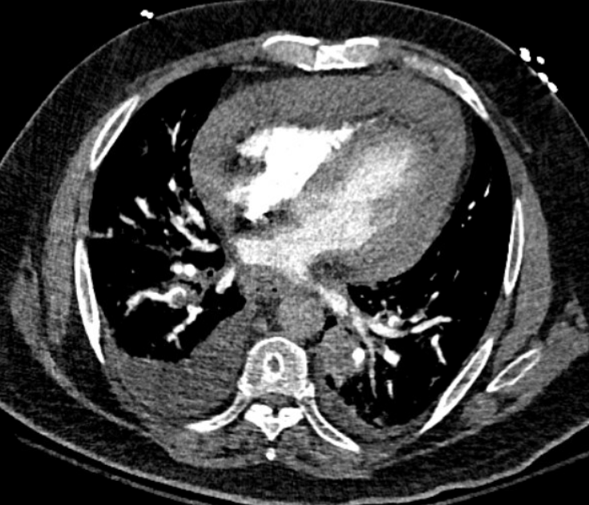
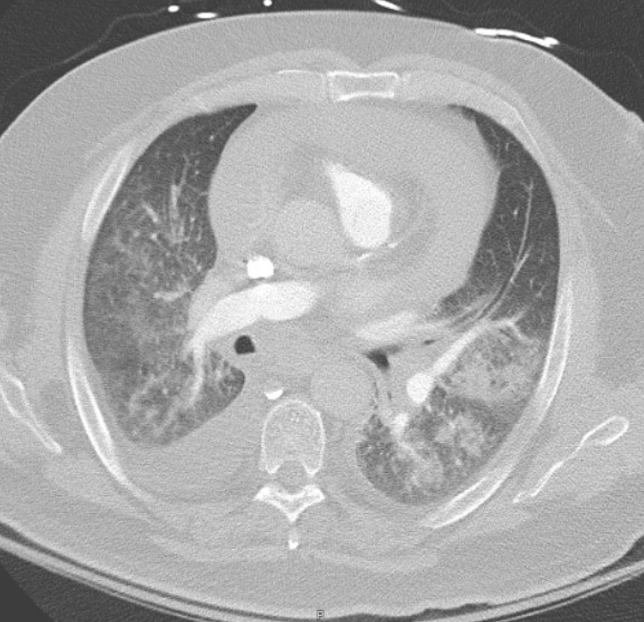


Case Presentation – Dr Sands
69 yr old man experienced worsening shortness of breath over 3 months leading to presentation to PCP. Diagnosed with pneumonia and treated without improvement.
Referred to cardiology and pulmonology. Diagnosed with restrictive/obstructive disease and prescribed steroids and albuterol inhaler with some relief.
About 1 month later, presented to PCP with worsening symptoms. CT scan showed bilateral pulmonary emboli, extensive infiltrates, “mass-like features”, and adenopathy. Wife drove him to BWH for worsening symptoms where he was admitted.
Lung adenocarcinoma diagnosed from EBUS nodes and pericardial fluid. No actionable alterations. PD-L1 = 20%

Slide 7

Case Presentation – Dr Sands (continued)
1L treatment: carboplatin, pemetrexed, and pembrolizumab and had partial response with total ~10 months disease control
2L treatment: Initiated DS-1062 on clinical trial
Tolerated treatment well with only significant toxicity being ocular. He did not like using eye drops and did not consistently start using until being told that if symptoms worsened, he might have to stop the treatment.
Not the actual patient

Slide 8
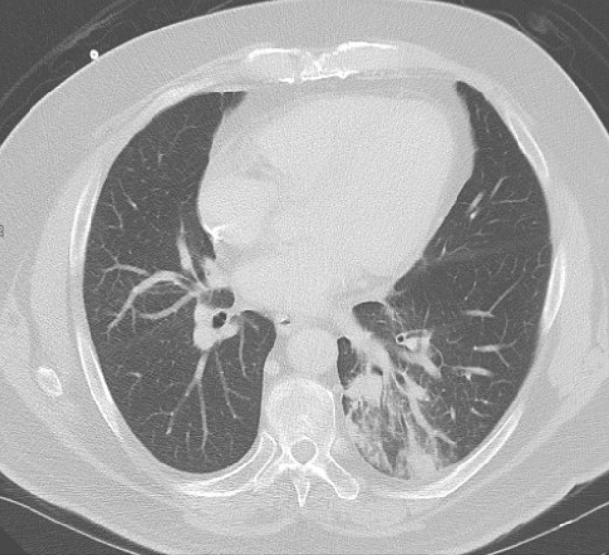
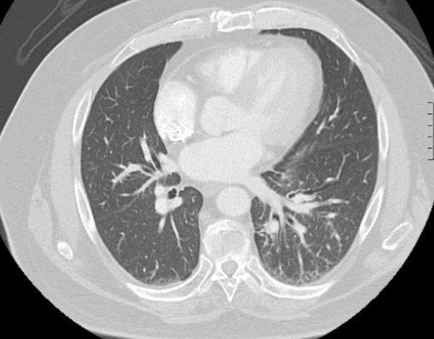
Case Presentation – Dr Sands (continued)
These scans show baseline to 9 months into treatment with a 72% reduction in measurable tumor volume.
Had partial response with disease control for ~21 months.
At progression, he was treated on docetaxel as next line therapy with early progression and then with gemcitabine with brief disease control.

Slide 9
Case Presentation – Dr Reckamp
72-year-old man with progressive cough and chest discomfort for 4 months
40 pack-year smoking history, quit 10 years ago
CT chest/abdomen/pelvis: LUL mass 9.5 x 6.5 x 6.4 cm mass extends into left hilum and abuts left superior aspect of pericardium. Extensive mediastinal and right hilar lymphadenopathy. Multiple bilateral rounded pulmonary masses up to 19 mm in diameter. Left adrenal gland mass 4.3 x 3.2 x 4.5 cm.
PET/CT: Dominant hypermetabolic mass in the left upper lobe with atelectasis, 7.9 x 10.7 cm with multiple bilateral lung nodules with FDG activity. Bulky right hilar adenopathy and mediastinal LN, largest 2.4 cm in the subcarinal region. Increased uptake in the left adrenal gland. Hypermetabolic bone metastases, prominent lesion in L3, left iliac bone and right sacrum.
MRI of the brain had no metastases

Slide 10
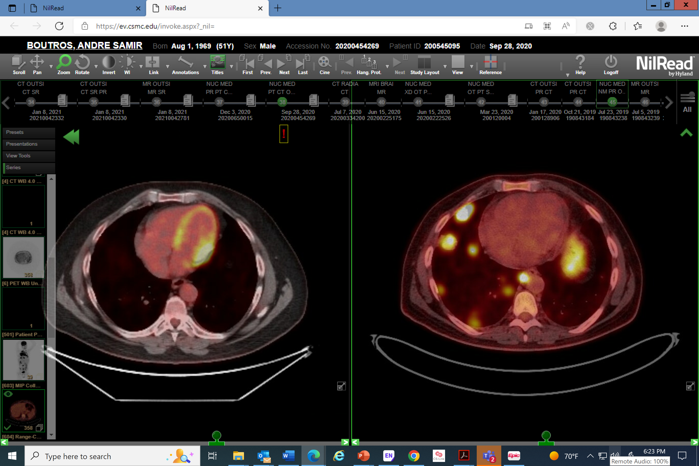
Case Presentation – Dr Reckamp (continued)
CT-guided biopsy of lung mass: squamous cell carcinoma; TTF1: negative; Napsin-A: negative; p40: positive.
Molecular testing—no alterations
PD-L1 TPS 30%
Stage cT4N3M1c
Normal CBC, liver and renal function
ECOG PS 1

Slide 11
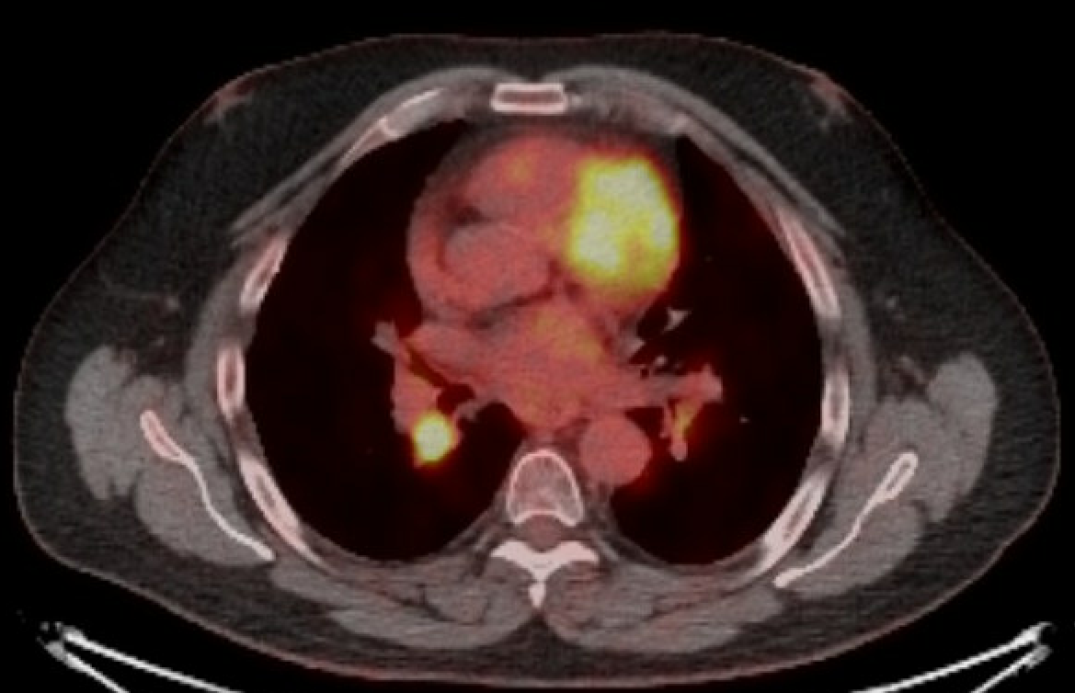
Case Presentation – Dr Reckamp
(continued)
He received carboplatin, nab-paclitaxel and pembrolizumab with response.
Maintenance pembrolizumab with response for 18 months
Progression in hilar LN and left adrenal gland

Slide 12
Case Presentation – Dr Reckamp (continued)
What is the next best therapy?
Afatinib
Docetaxel
Docetaxel/ramucirumab
Pembrolizumab/ramucirumab

Slide 13
Case Presentation – Dr Langer
65 M recent former smoker (20 pk yrs), Hx type 2 DM presented 12/24/18 with 3 mos of worsening cough and DOE.
Tx’d for pneumonia; found to have large R pleural effusion.
Admitted to the OSH ICU, requiring high-flow NC. Tx’d with 7 days of levofloxacin, methylprednisolone, and nebulizers.
Thoracentesis 12/25/18; 2.1L drained; pleural fluid (+) for adenocarcinoma (CK7, TTF1, and Napsin A [+]; CK20 p-40 [-]). Cytology QNS for PD-L1, NGS
2nd thoracentesis on 12/31/18: 1.7L drained; inadequate cellularity for molecular
Transferred to HUP. Stabilized, discharged on 2L NC.
Brain MRI (-)
PET (+) for
  Moderate R loculated pleural effusion; diffuse nodular hypermetabolic FDG activity along pleura
  Mildly FDG-avid R hilar and mediastinal LAD, deemed either metastatic or reactive in origin
VATS pleural biopsy 01/29/19 for PD-L1 and NGS; underwent intraoperative talc pleurodesis; c/b persistent air leak.
Discharged with R chest tube and Heimlich valve; ultimately stopped bubbling after 2 wk. Clamp trial successful
PD-L1 proved (+) 60%. NGS and fusion panel (-) for actionable molecular abnormalities

Slide 14
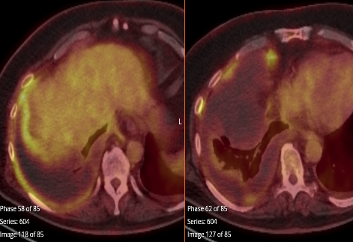
Case Presentation – Dr Langer (cont’d)
How would you manage this pt?
Single agent Pembro
KN189 – Pembro/Pemetrexed/Carbo
9LA: Ipi/Nivo + Pem/Carbo x 2
Enrollment on INSIGNA trial
Other
Pseudo-mesotheliomatous Adenoca of the Lung

Slide 15
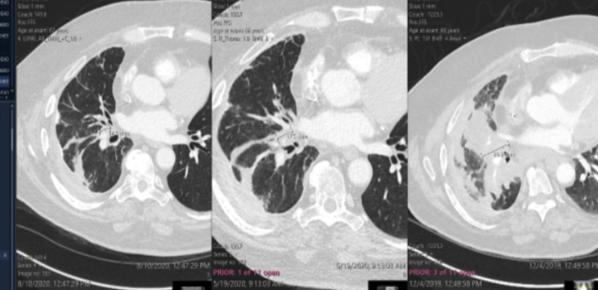
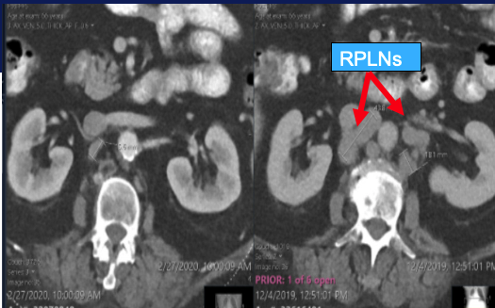
Case Presentation – Dr Langer (cont’d)
Pt was treated with single agent Pembro through 12/19, at which point he developed progression in the RLL and RPL LNs.
He continued Pembrolizumab and started full dose Pemetrexed 500 mg/m2 q 3 wks and carboplatin AUC 5 q 3 wks for 4 cycles, then shifted to Pembo/Pemetrexed maintenance
He stayed on maintenance Pem² for 42 cycles (01/20 through 01/23) with profound PR, but dev’d gradually worsening renal insufficiency, prompting suspension of pemetrexed in 12/21 when creat topped 2.0 mg/dL, then discontinuation of pembrolizumab 01/23 when creat rose to 3.0
RPLNs

Slide 16
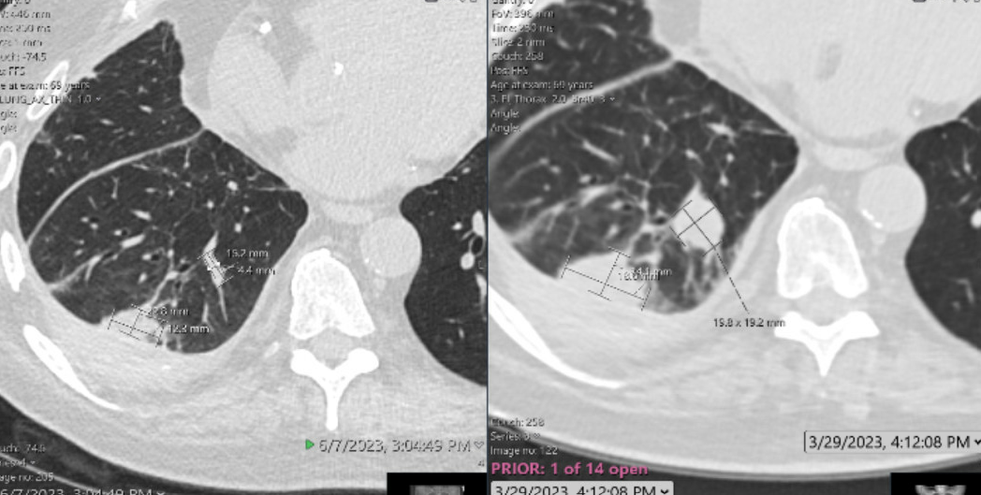
Case Presentation – Dr Langer (cont’d)
Pt observed off antineoplastics and placed on steroids for presumed IO-mediated nephritis with gradual improvement in Creat to 1.7 by 02/23
10/20 and 11/22: Underwent SRS for new CNS mets and stents for Sx coronary insufficiency
By 03/23, he had developed recurrent DOE, back on intermittent O2 with exercise; CT exhibited PD

Slide 17
Case Presentation – Dr Langer (cont’d)
What is the next step?
Resume Pembrolizumab +/- Pemetrexed
Resume Pembrolizumab, add Ramucirumab
Start Docetaxel
Start Docetaxel/Ramucirumab
Resume Carboplatin, add Taxane and either Bevacizumab or Ramucirumab
Other

Slide 18
Case Presentation – Dr Langer (cont’d)
What is the next step?
Resume Pemetrexed/Pembrolizumab
Resume Pembrolizumab, add Ramucirumab
Start Docetaxel
Start Docetaxel/Ramucirumab
Resume Carboplatin, add Taxane and either Bevacizumab or Ramucirumab
Other
Tx’d with Carbo AUC 5, Nab-pac 80 mg/m2 days 1and 8 q 3 wks and Bev 15mg/kg q 3 wks: 5 cycles to date
Pt breathing better, with exercise pulsox in the low 90s; resuming most ADLs
Due for f/u imaging mid August

Slide 19
Case Presentation – Dr Leal
H&P
72 yo male presented with intermittent hemoptysis.
Past medical history:
CAD sp PCI with stent x 1 (2015)
HTN
HLD
Past Surgical History
s/p appendectomy
s/p tonsillectomy

Slide 20
Case Presentation – Dr Leal (cont’d)
Physical exam
ECOG PS: 0
Physical exam: no significant findings

Slide 21
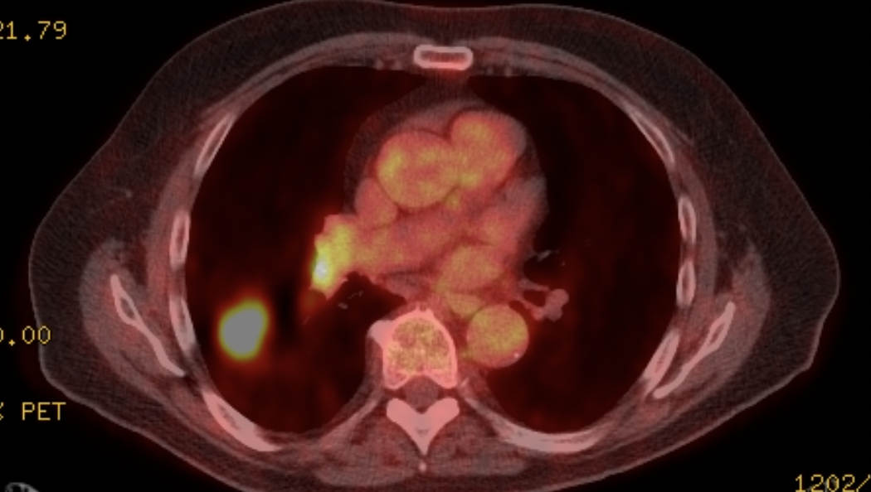
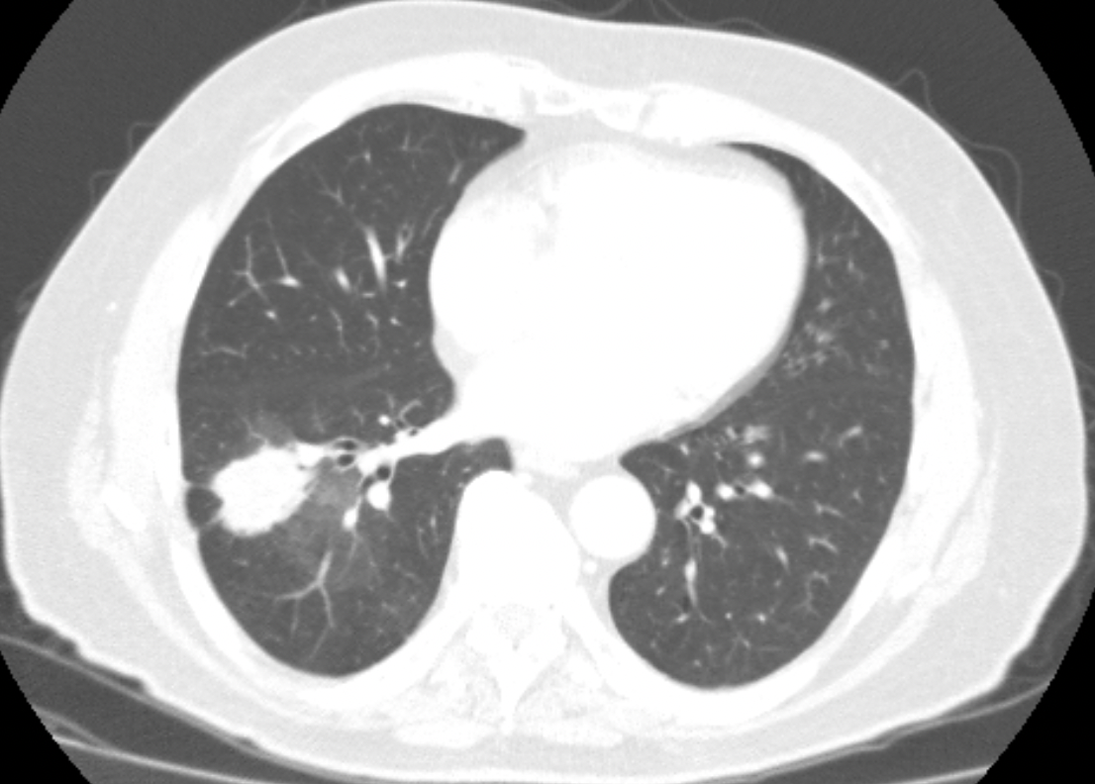
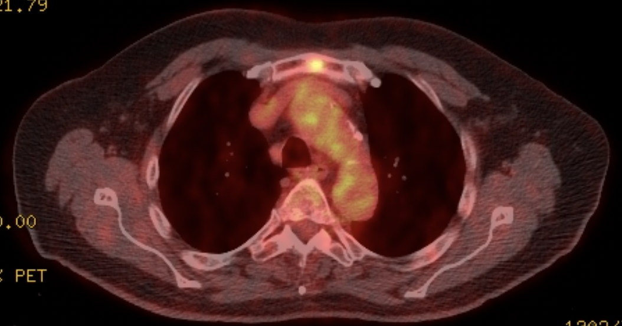
Case Presentation
– Dr Leal (cont’d)
Imaging
Notes:
CT: 3.5 cm RLL mass w/ extensive ground glass attenuation throughout inferior RLL, highly suspicious for adenocarcinoma w/ associated lepidic spread. Multiple b/l ground glass attenuation lesions may represent metastases.
PET/CT:
PET, 3.9 x 2.6 cm spiculated RLL mass w/ multiple pleural tags. Focal increased metabolic activity identified within R hilum. Focal area of subtle sclerosis and increased metabolic activity in sternum, only area of osseous uptake. Semisolid lesion appearing nodular opacity in LUL.

Slide 22
Case Presentation – Dr Leal (cont’d)
Clinical Course
RLL transbronchial biopsy w/ adenocarcinoma w/ lepidic growth pattern, c/w lung primary. R hilar LN w/ malignant cells present (TTF1, Napsin, CK7 positive, P40 negative). Subcarinal LN, R paratracheal LN, negative for malignant cells.
Biopsy of the hypermetabolic focus: negative for cancer
Brain MRI: negative
Planned bilobectomy, however several nodules seen on diaphragm and posterior parietal pleura. One pleural nodule was excised and demonstrated metastatic lung cancer. Path demonstrated R pleura nodule positive for metastatic adenocarcinoma. Level 7 LN positive for metastatic carcinoma. Level 8 LN negative for carcinoma.

Slide 23
Case Presentation – Dr Leal (cont’d)
Diagnosis
Stage IVA (T2aN2M1a) adenocarcinoma of RLL
Biomarkers: At initial diagnosis
Tumor NGS: KRAS G12D, PD-L1 20%, TMB low

Slide 24
Case Presentation – Dr Leal (cont’d)
Treatment course
Patient initiated treatment with carboplatin/pemetrexed/pembrolizumab and completed 2 years of therapy. He achieved PR as best response.
He stopped chemoimmunotherapy and did well for 7 months when he had progression of disease with new lung nodules and mediastinal adenopathy.
He then initiated therapy with pembrolizumab + TTFields.
He did well and achieved stable disease as his best response. He had no significant adverse events related to TTFields. He required start of hydrocortisone for immune-mediated adrenal insufficiency.

Slide 25
Agenda
Introduction
Module 1: Case Discussions – Part 1
Module 2: Faculty Presentations
Current Management of Non-Small Cell Lung Cancer (NSCLC) After Disease Progression on Anti-PD-1/PD-L1-Containing Regimens – Dr Langer
Potential Role of Novel Immunotherapy-Based Combination Strategies in Progressive Advanced NSCLC – Dr Reckamp
Novel Antibody-Drug Conjugates (ADCs) Under Evaluation in NSCLC – Dr Sands
Other Promising Therapeutic Strategies for Patients with Progressive Metastatic NSCLC – Dr Leal
Module 3: Case Discussions – Part 2

Slide 26
Langer’s Perspective on 2nd Line Therapy in NSCLC
Corey J. Langer, MD, FACP
Director of Thoracic Oncology
Abramson Cancer Center
Professor of Medicine
Perelman School of Medicine
University of Pennsylvania
Philadelphia, PA 19104

Slide 27
Langer’s Current Paradigm in wt NSCLC: August, 2023
(could change at any moment)
Tx Cohort | Non-Squamous | Squamous
PDL1 > 50% | Pembro > Pem/Carbo/Pembro | Pembro > Taxane/Carbo/Pembro
PDL1 1-50% | Pem/Carbo/Pembro > Pembro | Taxane/Carbo/Pembro > Pembro
PDL1 < 1% | Pem/Carbo/Pembro | Taxane/Carbo/Pembro
PDL1 < 1%, TMB > 10 | Pem/Carbo/Pembro vs Ipi/Nivo or 9LA* | Taxane/Carbo/Pembro vs Ipi/Nivo or 9LA*
TKI-Refractory | Pem/Carbo +/- Bev or Pac/Carbo/Bev/Atezo
Tissue QNS | Pem/Carbo/Pembro | Taxane/Carbo/Pembro
*Ipilimumab/Nivolumab +/- 2 cycles of histology-appropriate chemotherapy (9LA) or POSEIDON

Slide 28
INSIGNA: A Randomized, Phase III Study of Firstline Immunotherapy alone or in Combination with Chemotherapy in Induction/Maintenance or Post-progression in Advanced Nonsquamous Non-Small Cell Lung Cancer (NSCLC) with Immunobiomarker SIGNature-driven Analysis
1st Line Treatment
2nd Line Treatment
Pembrolizumab
Carbo/
Pemetrexed
≥1% TPS
positive
Randomization*
Arm B
Carbo/Pemetrexed/
Pembrolizumab
Pembrolizumab
Induction
Maintenance
Carbo/ Pemetrexed/ Pembrolizumab
Pemetrexed/
Pembrolizumab
Not Specified
SWOG-ECOG collaboration NCTN NCI network (A. Chiang, H. Borghaei)

Slide 29
What happens after first line therapy in mNSCLC?
In the era of CPIs, 5 yr OS rates on study are now ~ 30% in those with
PD-L1 > 50%
But a majority of those with advanced mNSCLC experience diease progression, even after CPIs +/- chemo, most within 6-12 mos of treatment initiation
Once PD manifests, death with rare exception is inevitable

Slide 30
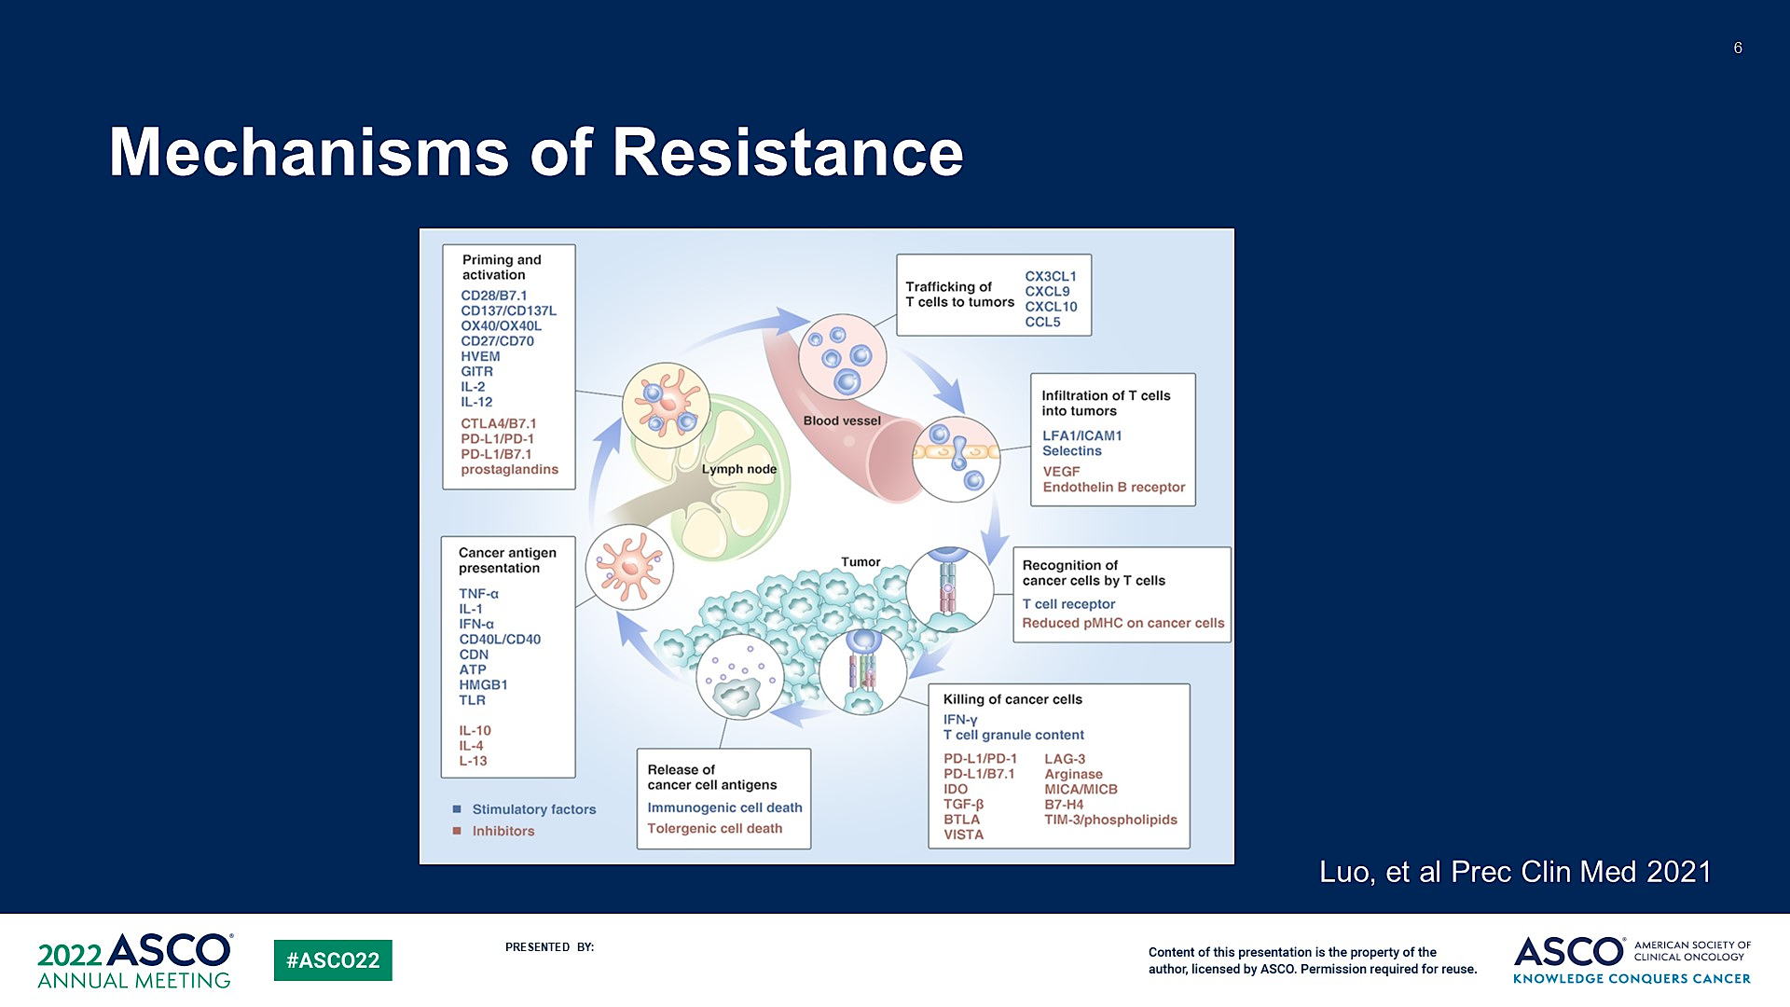
Mechanisms of Immune Checkpoint Inhibitor Resistance
Luo W et al. Precis Clin Med. 2021;4(4):258-270.

Slide 31
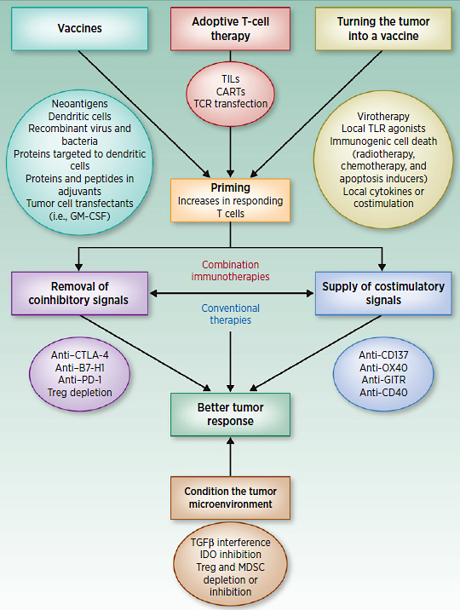
Potential Strategies to Overcome Resistance to ICIs
Whiteside et al CCR 2016

Slide 32
Potential Tx Strategies: 2nd Line mNSCLC (wt)
SOC: Docetaxel +/- Ramucirumab (after platinum-based chemo and ICIs)
Reviving Other Cytotoxics +/- Angiogenesis Inhibitors
Treatment Beyond Progression with CPIs +/- Angio-inhibitors
Managing Oligo-Progression and Oligo-Remnant Tumor with Local Ablative therapies
Immunotherapeutic Combinations with MAbs, vaccines, etc
Antibody-Drug Conjugates (ADCs)
Tumor Treating Fields with either Docetaxel or CPIs

Slide 33
REVEL: Study Design
1:1
Stage IV NSCLC after one platinum-based chemo +/- maintenance
Prior Bev allowed
All histologies
PS 0 or 1
R
A
N
D
O
M
I
S
E
Ramucirumab 10 mg/kg
+
Docetaxel 75 mg/m² q3w
N=628
Treatment until disease progression
or unacceptable toxicity
Placebo
+
Docetaxel 75 mg/m² q3w
N=625
Stratification factors:
ECOG PS 0 vs 1
Gender
Prior maintenance
East-Asia vs ROW
Primary endpoint: overall survival
Secondary endpoints:
PFS, ORR, safety, patient-reported outcomes
Garon EB et al. Lancet. 2014;384:655.

Slide 34
REVEL Study: Docetaxel With or Without Ramucirumab in Second-Line Treatment
Ramucirumab: fully human monoclonal antibody (IgG1) targeting VEGFR2.
Successful in gastric cancer, but failed in phase 3 breast cancer study¹
REVEL: Randomized, double-blind Phase 3 study (N = 1253)
2nd-line Tx of stage IV NSCLC following PD post one prior platinum-based Tx
Arm | Docetaxel + RAM | Docetaxel + PLACEBO | P-value | HR (95% CI)
No. | 628 | 625 | —
ORR% | 23 | 14 | <0.001
PFS (mos.) | 4.5 | 3.0 | <0.0001 | 0.762 (0.677–0.859)
OS (mos.) | 10.5 | 9.1 | 0.0236 | 0.857 (0.751–0.979)
First study in second-line NSCLC to show a survival benefit vs. docetaxel alone
First study to show a benefit for an angiogenesis inhibitor in SqCCa
Garon EB et al. Lancet. 2014;384:665-673.
Notes:
In this multicentre, double-blind, randomised phase 3 trial (REVEL), we enrolled patients with squamous or non-squamous NSCLC who had progressed during or after a first-line platinum-based chemotherapy regimen. Patients were randomly allocated (1:1) with a centralised, interactive voice-response system (stratified by sex, region, performance status, and previous maintenance therapy [yes vs no]) to receive docetaxel 75 mg/m2 and either ramucirumab (10 mg/kg) or placebo on day 1 of a 21 day cycle until disease progression, unacceptable toxicity, withdrawal, or death. The primary endpoint was overall survival in all patients allocated to treatment. We assessed adverse events according to treatment received. This study is registered with ClinicalTrials.gov, number NCT01168973.
Findings
Between Dec 3, 2010, and Jan 24, 2013, we screened 1825 patients, of whom 1253 patients were randomly allocated to treatment. Median overall survival was 10·5 months (IQR 5·1—21·2) for 628 patients allocated ramucirumab plus docetaxel and 9·1 months (4·2—18·0) for 625 patients who received placebo plus docetaxel (hazard ratio 0·86, 95% CI 0·75—0·98; p=0·023). Median progression-free survival was 4·5 months (IQR 2·3—8·3) for the ramucirumab group compared with 3·0 months (1·4—6·9) for the control group (0·76, 0·68—0·86; p<0·0001). We noted treatment-emergent adverse events in 613 (98%) of 627 patients in the ramucirumab safety population and 594 (95%) of 618 patients in the control safety population. The most common grade 3 or worse adverse events were neutropenia (306 patients [49%] in the ramucirumab group vs 246 [40%] in the control group), febrile neutropenia (100 [16%] vs 62 [10%]), fatigue (88 [14%] vs 65 [10%]), leucopenia (86 [14%] vs 77 [12%]), and hypertension (35 [6%] vs 13 [2%]). The numbers of deaths from adverse events (31 [5%] vs 35 [6%]) and grade 3 or worse pulmonary haemorrhage (eight [1%] vs eight [1%]) did not differ between groups. Toxicities were manageable with appropriate dose reductions and supportive care.

Slide 35
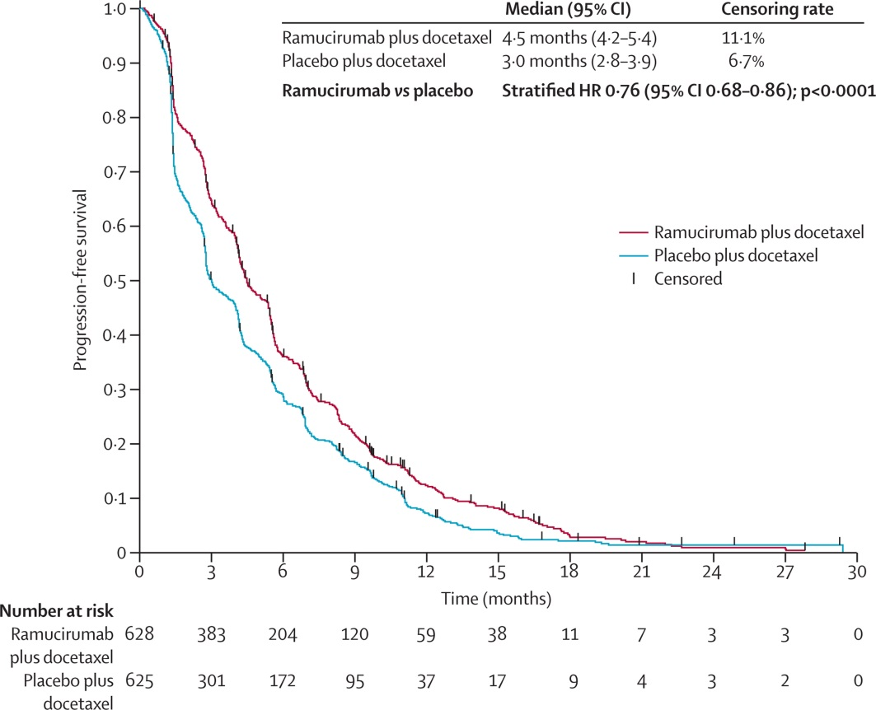
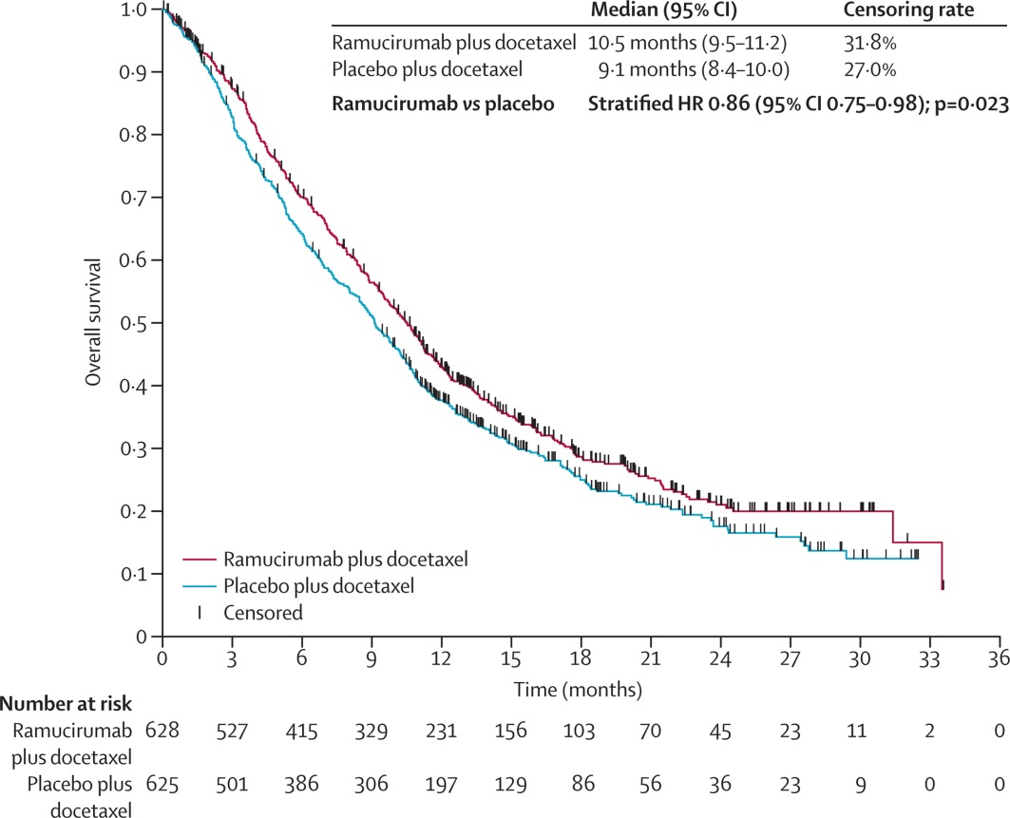
Ramucirumab: Survival Figures
Kaplan-Meier estimates of progression-free survival in the intention-to-treat population
HR=hazard ratio.
Kaplan-Meier estimates of overall survival in the intention-to-treat population
HR=hazard ratio.
Garon EB et al. Lancet, 2014

Slide 36
Docetaxel and Ramucirumab vs. Docetaxel and Placebo in Second-Line Treatment of Stage IV NSCLC: Safety
Adverse Event Grade ≥ 3 in > 5% of Patients, % | RAM + DOC n=628 | DOC n=625
Neutropenia | 34.9 | 28.0
Febrile neutropenia | 15.9 | 10.0
Fatigue | 11.3 | 8.1
Leukopenia | 8.5 | 7.6
Hypertension | 5.4 | 1.9
Pneumonia | 5.1 | 5.8
Grade 5 events | 5.4 | 5.8
Any grade pulmonary hemorrhage | 2.1 | 1.6
Any grade pulmonary hemorrhage occurred in 3.8% (RAM+DOC) vs 2.4% (DOC) of patients with squamous NSCLC
Perol et al. ASCO 2014. Abstract LBA8006 (data from abstract only).

Slide 37
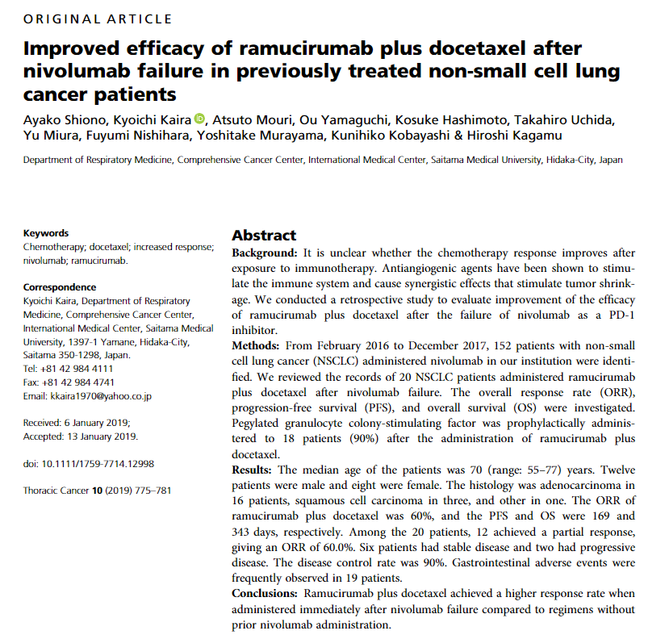
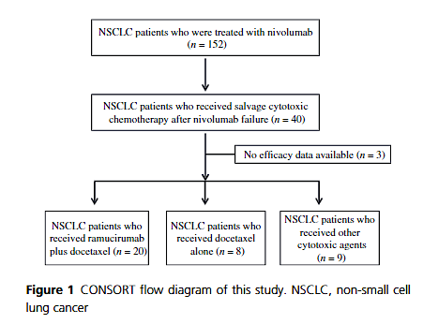

Slide 38
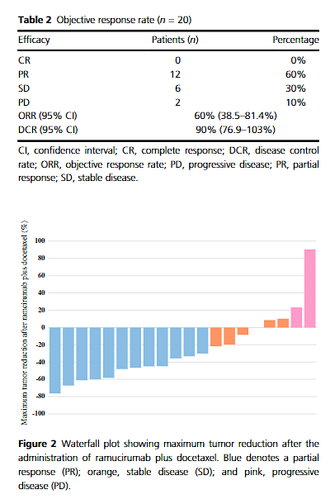
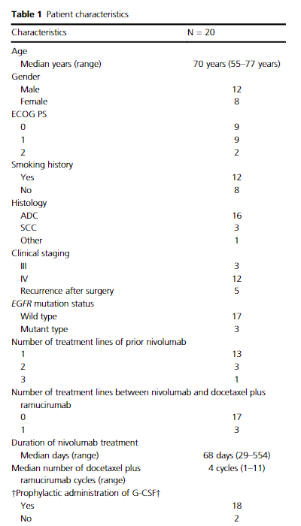
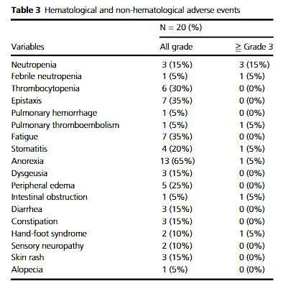

Slide 39
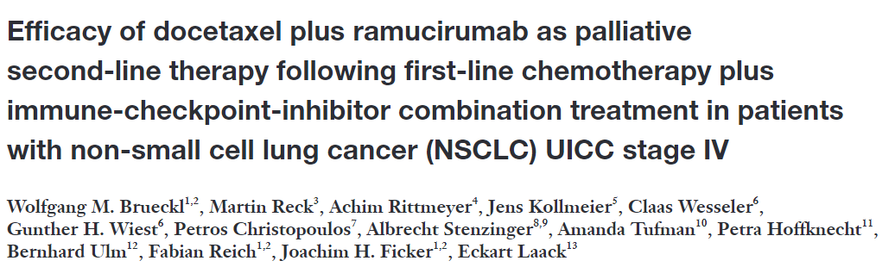
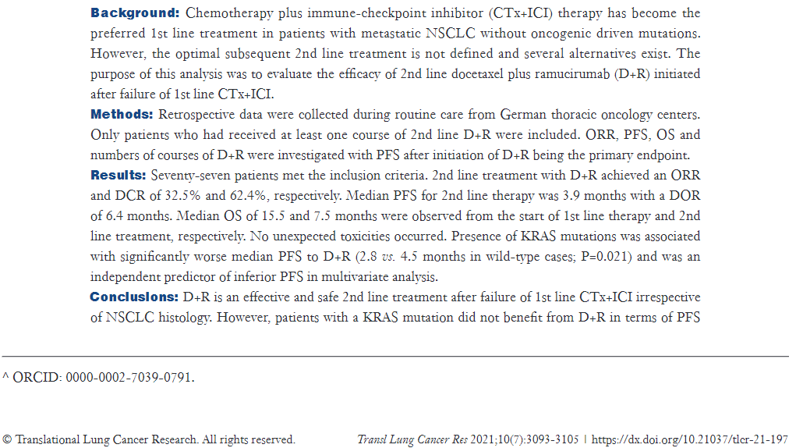
Summary:
N=77
ORR%: 32.5%
DCR%: 62.4%
mPFS: 3.9 mos
mOS: 7.5 mos
KRAS mt (+)
  poorer outcomes –
  PFS 2.8 mos vs 4.5 mos for KRAS wt (p=0..021)

Slide 40
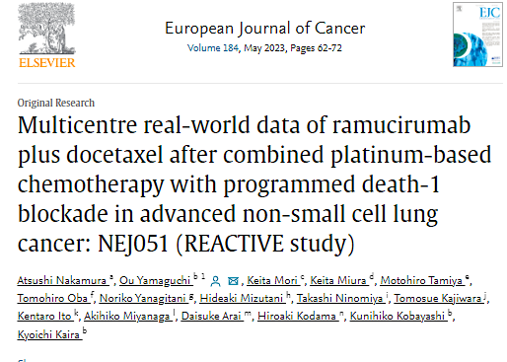
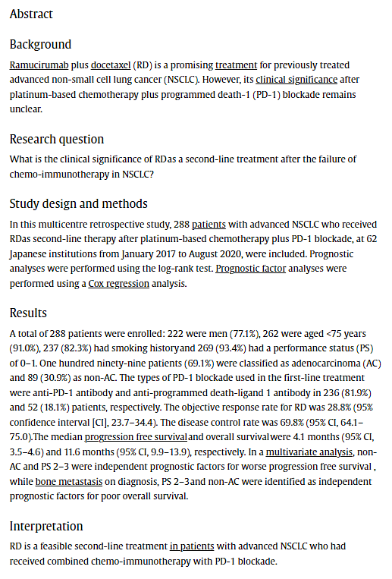

Slide 41
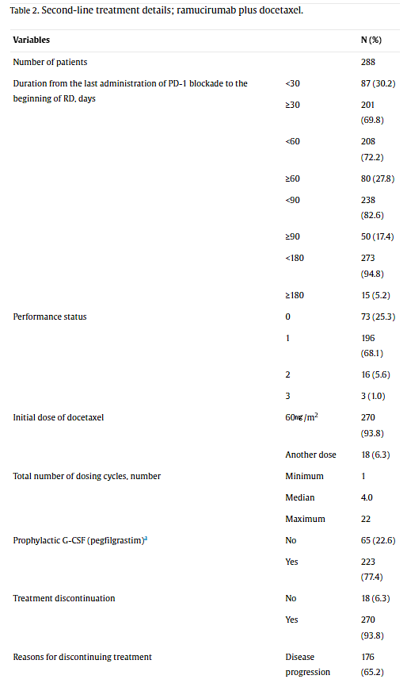
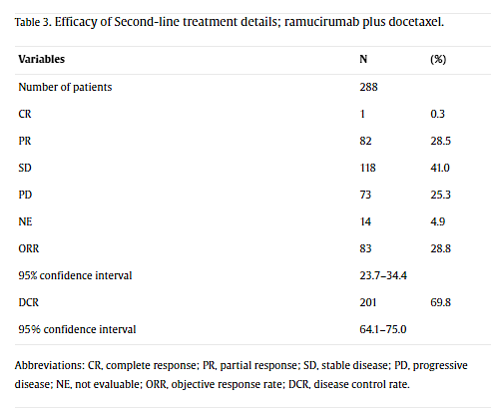
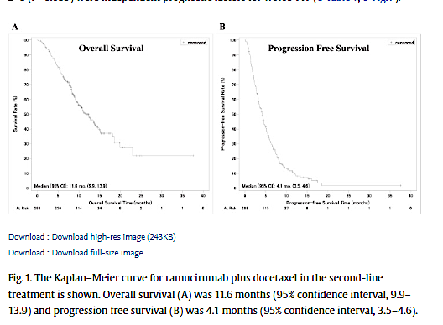
Demographics
Outcomes
mOS: 11.6 m
mPFS: 4.6 m
In multivariate analysis, Non-AC histology and PS 2-3 associated with poorer PFS and OS
Bone mets also associated with poorer OS

Slide 42
Other 2nd Line Strategies
AvaALL: Bevacizumab Beyond PD
LUX-Lung 8: Afatinib vs Erlotinib

Slide 43
Efficacy and safety results from AvaALL: open-label, randomized phase III trial of standard of care (SOC) with or without continuous bevacizumab (Bev) treatment beyond progression (PD) in patients (pts) with advanced non-small-cell lung cancer (NSCLC) progressing after first-line Bev and chemotherapy (chemo):
ASCO 2017
J Bennouna,¹ J de Castro Carpeno,² AM Dingemans,³ F Griesinger,⁴
F Grossi,⁵ C Langer,⁶ Y Ohe,⁷ K Syrigos,⁸ N Thatcher,⁹ A Das-Gupta,¹⁰
M Donica,¹⁰ V Smoljanovic,¹⁰ C Gridelli¹¹
1. Thoracic Oncology Unit, University Hospital, Nantes, France; 2. Translational Oncology Unit at Medical Oncology Division, Hospital Universitario La Paz, IdiPAZ, Madrid, Spain; 3. Department of Pulmonology, Maastricht University Medical Center, Maastricht, The Netherlands; 4. Department of Hematology and Oncology, University Department Internal Medicine-Oncology, Pius-Hospital, University of Oldenburg, Oldenburg, Germany; 5. Lung Cancer Unit, National Institute for Cancer Research, Genova, Italy; 6. Thoracic Oncology Unit, Abramson Cancer Center, University of Pennsylvania, Philadelphia, PA, USA; 7. National Cancer Center Hospital, Tokyo, Japan; 8. National & Kapodistrian University of Athens Medical School, Athens, Greece; 9. Christie Hospital NHS Trust, Manchester, UK; 10. F. Hoffmann-La Roche, Basel, Switzerland; 11. Division of Medical Oncology, S.G. Moscati Hospital, Avellino, Italy

Slide 44
AvaALL study design
Bev + platinum doublet therapy followed by Bev monotherapy at or prior to PD in advanced non-squamous NSCLC
(N=485)
Bev + SOC (7.5mg/kg or 15mg/kg i.v. on
Day 1 every 21 days)
Bev + SOC
Bev + SOC
PD1
Randomize 1:1
No crossover allowed
PD2
PD3
SOC (erlotinib, pemetrexed or docetaxel)
SOC
SOC
Primary endpoint | OS (time from randomization at PD1 to the date of death)
Secondary endpoints | OS rates at 6, 12 and 18 months post-PD1 PFS (from randomization at PD1 to second progression [PD2, PFS2] and from PD2 to third progression [PD3, PFS3]) Time to progression (TTP) (from randomization at PD1 to PD2 [TTP2] and from PD2 to PD3 [TTP3]) Objective response rate (ORR) Disease control rate (DCR) Safety
Stratification factors | Type of planned second-line treatment (erlotinib vs docetaxel vs pemetrexed) Number of cycles of Bev maintenance treatment prior to first PD (≤6 vs >6) Smoking status (never vs former vs current)

Slide 45
Primary endpoint: OS (ITT population)
1.0
Bev + SOC
SOC
0.9
0.8
0.7
0.6
Stratified HR 0.84 (90% CI 0.71–1.00)
Stratified logrank p=0.1044
0.5
Overall survival
0.4
0.3
0.2
0.1
Median OS 10.22
(95% CI: 8.61-11.93)
Median OS 11.86
(95% CI: 10.22-13.67)
0.0
0
2
4
6
8
10
12
14
16
18
20
22
24
26
28
30
32
34
36
38
40
42
44
46
48
50
52
54
Months
# at risk
Bev & Soc
Soc
245
240
226
217
206
186
181
147
157
126
129
108
109
94
97
83
88
73
74
63
68
55
48
44
38
36
32
31
28
25
22
22
20
20
13
14
11
10
10
7
8
4
4
3
4
2
3
2
2
1
2
1
1
1
0
0
Median duration of follow up: 9.4 months
Presented by: Prof. J Bennouna: ASCO 2017
JAMA Oncol 2018

Slide 46
Secondary endpoints: PFS2 and PFS3 (ITT population)
1.0
Bev + SOC
SOC
1.0
Bev + SOC
SOC
0.9
0.9
0.8
0.8
0.7
Median PFS 5.5
(95% CI: 4.21-5.68)
0.7
Median PFS 4.0
(95% CI: 2.86-4.47)
0.6
0.6
0.5
0.5
Progression-free survival
Median PFS 4.0
(95% CI: 3.38-4.30)
Progression-free survival
Median PFS 2.6
(95% CI: 2.33-2.92)
0.4
0.4
0.3
Stratified HR 0.83 (90% CI 0.70–0.98)
Stratified log-rank p=0.0573
0.3
Stratified HR 0.63 (90% CI 0.49–0.83)
Stratified log-rank p-value=0.0045
0.2
0.2
0.1
0.1
0.0
0.0
0
2
4
6
8
10
12
14
16
18
20
22
24
26
28
30
32
34
36
38
40
42
44
46
48
50
52
54
0
2
4
6
8
10
12
14
16
18
20
22
24
26
28
30
32
34
36
38
40
42
44
Months
Months
Median PFS2: Bev + SOC 5.5 months vs SOC 4.0 months
Median PFS3: Bev + SOC 4.0 months vs SOC 2.6 months
Presented by: Prof. J Bennouna: ASCO 2017
JAMA Oncol 2018

Slide 47
AvaALL: Conclusions
AvaALL was the first randomized phase III study to analyse the efficacy of Bev beyond progression in NSCLC
The primary endpoint of OS in the AvaALL study was not met despite improvement in PFS2 and significant increase in PFS3
  fewer OS events occurred in the study than were anticipated, and statistical significance was not reached
No new safety signals were identified
Future studies with antiangiogenics should define the optimal strategy for combination with immunotherapy or targeted therapy
Presented by: Prof. J Bennouna: ASCO 2017

Slide 48
Study Design: LUX-Lung 8
SqCC of the lung (stage IIIB/IV)
Progression after
≥4 cycles of a
first-line
platinum doublet
ECOG PS 0–1
Adequate organ function
Stratified by East Asian vs
non-East Asian
Key secondary
endpoint
OS
Other secondary
endpoints:
ORR, DCR,
tumour shrinkage,
PRO, safety
Afatinib
40 mgª qd
Primary
endpoint
PFS by
independent
review^{c}
1:1
Erlotinib
150 mg^{b} qd
ªDose escalation to 50 mg and dose reduction to 30 or 20 mg permitted.
^{b}Dose reduction to 100 or 50 mg permitted.
^{c}Tumour assessment at baseline and weeks 8, 12, and 16; every 8 weeks thereafter.
Soria et al. Lancet Oncol. 2015;16:897.

Slide 49
Demographics and Baseline Characteristics
 |  | Afatinib^{g} (n=398) | Erlotinib^{g} (n=397)
Median age, years |  | 65 | 64
Male, % |  | 84 | 83
Race, % | Asian | 24 | 24
 | East Asian | 22 | 22
 | White | 72 | 73
 | Other^{d} | 2 | 3
Smoking history, % | Never smoker | 7 | 5
 | Light ex-smoker^{e} | 3 | 3
 | Current and other ex-smoker^{f} | 91 | 92
ECOG,ª % | 0/1 | 32/68 | 34/66
Clinical stage,^{b} % | IIIB/IV | 12/88 | 12/87
Histology,^{c} % | Squamous | 96 | 96
 | Mixed | 4 | 4
Best response to first-line chemotherapy, % | CR/PR | 47 | 47
 | SD | 41 | 42
 | Unknown | 12 | 11
ª<1% were ECOG PS 2; ^{b}≤1% were stage IIIA; ^{c}<1% were undifferentiated (considered to be of squamous histology); ^{d}Includes black/African American and American Indian/Alaska native; ^{e}Fifteen pack-years and stopped >1 year before diagnosis; ^{f}Seventy-one (17.8%) and 85 (21.4%) patients were current smokers, respectively; ^{g}Percentages may not total 100 due to rounding.
Soria et al. Lancet Oncol. 2015;16:897.

Slide 50
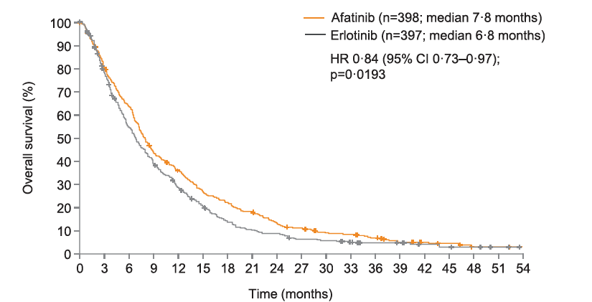
LUX-Lung 8: Final Analysis of Overall Survival
Goss GD et al. EClinicalMedicine 2021;37:100940.

Slide 51
PFS: Independent Review—
Updated With All Randomised Patients (N=795)
 | Afatinib (n=398) | Erlotinib (n=397)
Median PFS, months (95% CI) | 2.6 (2.0-2.9) | 1.9 (1.9-2.1)
HR (95% CI) | 0.81 (0.69-0.96)
P value | P=0.0103
1.0
0.9
0.8
0.7
0.6
0.5
Estimated PFS Probability
0.4
0.3
Afatinib
Erlotinib
0.2
0.1
0
0
3
6
9
12
15
18
21
24
27
No. at Risk
Months
Afatinib
139
30
14
10
5
2
2
0
398
50
Erlotinib
397
99
34
17
10
2
1
1
1
0
Data cut-off February 2, 2015.
Soria et al. Lancet Oncol. 2015;16:897.

Slide 52
Objective Response and Tumour Shrinkage
Afatinib
P=0.002
100
≥20% increase (n=62)
0–<20% increase (n=90)
>0–<30% decrease (n=81)
≥30% decrease (n=22)
Percent
Maximum Decrease From Baseline SLD (%)
80
60
40
20
0
–20
–40
–60
–80
P=0.055
–100
Patient Index Sorted by Maximum Decrease (%)
Erlotinib
Maximum Decrease From Baseline SLD (%)
100
≥20% increase (n=74)
0–<20% increase (n=101)
>0–<30% decrease (n=77)
≥30% decrease (n=13)
80
60
40
20
Duration of response was 7.29 months for
afatinib and 3.71 months for erlotinib
0
–20
–40
–60
–80
–100
Patient Index Sorted by Maximum Decrease (%)
Soria et al. Lancet Oncol. 2015;16:897.

Slide 53
Platinum-Rechallenge: Trial Design
Study Agents | Carboplatin AUC 5 IV every 3 wks Paclitaxel (Nab- or Sb-) 80 mg/m² IV days 1 and 8 every 3 weeks Ramucirumab 10 mg/kg IV every 3 weeks
Setting/Indication | PD post 6 cycles of maintenance Pemetrexed/Pembrolizumab
Duration of administration | 4-6 cycles of the above combination Indefinite maintenance therapy with combination Paclitaxel/Ramucirumab in the absence of untoward toxicity
Reference therapy | Comparison to historical controls in 2L Tx of mNSCLC
PI: Melina Marmarelis, MD

Slide 54
Agenda
Introduction
Module 1: Case Discussions – Part 1
Module 2: Faculty Presentations
Current Management of Non-Small Cell Lung Cancer (NSCLC) After Disease Progression on Anti-PD-1/PD-L1-Containing Regimens – Dr Langer
Potential Role of Novel Immunotherapy-Based Combination Strategies in Progressive Advanced NSCLC – Dr Reckamp
Novel Antibody-Drug Conjugates (ADCs) Under Evaluation in NSCLC – Dr Sands
Other Promising Therapeutic Strategies for Patients with Progressive Metastatic NSCLC – Dr Leal
Module 3: Case Discussions – Part 2

Slide 55
Potential Role of Novel Immunotherapy-Based Combination Strategies in Progressive Advanced NSCLC
Karen Reckamp, MD, MS
Director, Division of Medical Oncology
Associate Director of Clinical Research
Clinical Professor, Department of Medicine
Cedars-Sinai Cancer
Los Angeles, California

Slide 56
NSCLC therapy following platinum-doublet
Regimen | PFS (months) | OS (months)
Docetaxel | 3.0 | 9.1
Gemcitabine | na | 5.7
Pemetrexed | 2.9 | 8.3
Docetaxel and nintedanib | 3.4 | 10.1
Docetaxel and ramucirumab | 4.5 | 10.5
Shepherd J Clin Oncol 2000; Anderson BJC 2000; Hanna JCO 2004; Garon Lancet 2014; Reck Lancet Oncol 2014

Slide 57
Effects of angiogenesis-modulating factors on the immune system
VEGF is important in modulating the tumor immune microenvironment
  induces PD-L1 expression on dendritic cells and suppresses maturation
  impedes T cell extravasation
  inhibits the proliferation and cytotoxicity of cytotoxic T lymphocytes (CTLs)
  stimulates the proliferation of T regulatory (Treg) cells
  mediates effects on myeloid-derived suppressor cells (MDSCs)
Inhibition of VEGF restores many of these phenotypes
VEGFR2 inhibition decreases infiltration of suppressive immune cells while increasing mature dendritic cells
Combination blockade of PD1 (pembrolizumab) and VEGFR (ramucirumab) may overcome resistance by reducing tumor neovascularization with upregulation of proinflammatory cytokines
Ziogas AC, et al. Int J Cancer. 2012;130:857-64; Rivera et al. Trends Immunol. 2015; 36:240-9; Ko JS, et al. Clin Cancer Res 2009; 15: 2148-2157; Terme M, et al Oncoimmunol 2013; 2:e25156; Roland CL, et al. PLoS ONE 2009; 4(11): e7669; Yasuda S, et al. Clin Exp Immunol. 2013; 172:500-6

Slide 58
VEGF/R inhibition plus immune checkpoint inhibition in the clinic
Combination VEGF/R and PD-1/L1 therapy has demonstrated benefit in ICI-naïve patients in multiple tumor types with FDA approvals
  Renal cell carcinoma—axitinib/pembrolizumab¹; axitinib/avelumab²; cabozantinib/nivolumab³; lenvatinib/pembrolizumab⁴
  Endometrial carcinoma—lenvatinib/pembrolizumab⁵
  Hepatocellular carcinoma—bevacizumab/atezolizumab⁶
Pembrolizumab is an anti–programmed death 1 (PD-1) monoclonal antibody
Ramucirumab is a monoclonal antibody targeting the extracellular domain of vascular endothelial growth factor receptor 2 (VEGFR2)
Preliminary activity and safety with pembrolizumab and ramucirumab was demonstrated in a phase I trial with anti-tumor activity seen^{7,8}
1. Rini BI et al NEJM 2019; 2. Motzer RJ et al NEJM 2019; 3. Choueiri TK et al 2021; 4. Motzer RJ et al NEJM 2021; 5. Makker V et al NEJM 2022; 6. Finn RS et al NEJM 2020; 7. Herbst RS et al Lancet Oncol 2019; 8. Herbst RS et al J Thorac Oncol 2021

Slide 59
S1800A Schema—Randomized Phase II trial
NCT03971474
Primary endpoint: OS
Stratified by 1) PD-L1 expression, 2) histology, 3) intent to receive ramucirumab in standard of care arm
Secondary endpoints: RR, DCR, DoR, PFS, Toxicities
ARM A
Investigator’s Choice
Standard of Care
docetaxel + ramucirumab; docetaxel; gemcitabine; pemetrexed (nonSCC only)
Randomization
ARM B
Pembrolizumab
200 mg Q3W for
up to 35 cycles
+
Ramucirumab
10 mg/kg Q3W
R (1:1)
N= 130
Key eligibility: 1) Previously received PD-1 or PD-L1 inhibitor therapy with PD at least 84 days after initiation of ICI and platinum-based doublet therapy; 2) ECOG 0-1
Reckamp KL et al ASCO 2022; J Clin Oncol 2022

Slide 60

S1800A—Overall survival
Median OS for RP 14.5 months v. SOC 11.6 months
HR= 0.69; SLR p-value 0.05
Standard of care therapy received:
Docetaxel + Ramucirumab (n = 45)
Docetaxel (n = 3)
Gemcitabine (n = 12)
Pemetrexed (n = 1)
No treatment (n = 6)
Reckamp KL et al ASCO 2022; J Clin Oncol 2022

Slide 61
S1800A Overall survival—subgroup analysis
All subgroup HRs < 1
HRs by PD-L1 does not appear to vary
Pronounced benefit in SCC/mixed histology
Benefit seen with PS 0 and 1
Co-mutations did not affect OS improvement
Reckamp KL et al ASCO 2022; J Clin Oncol 2022

Slide 62
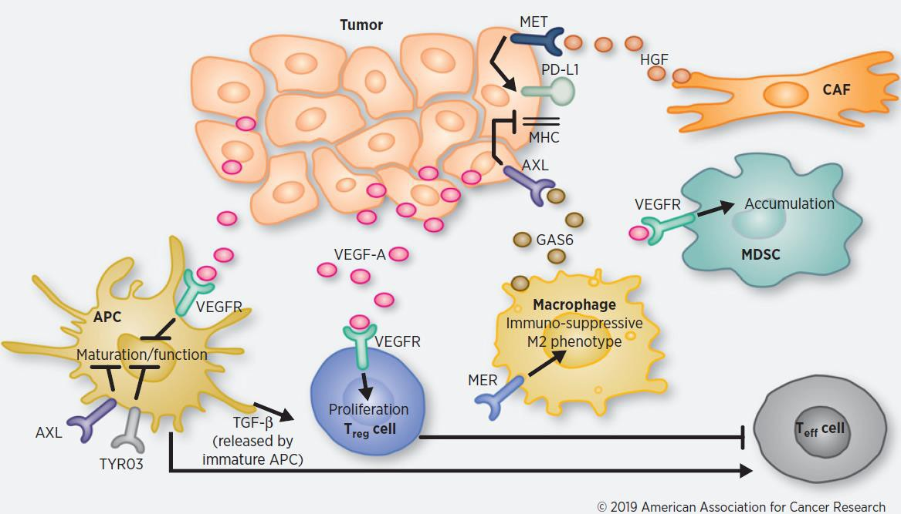
Immune-modification with receptor tyrosine kinase inhibitors—VEGFR, MET, AXL, MER, and TYRO3
Sitravatinib TAM (TYRO3, AXL, MER) and
Split-family Receptors (VEGR2)
Cabozantinib MET, VEGFR, RET, ROS1,
and TAM (TYRO3, AXL,
and MER)
Lenvatinib VEGFR 1-3, FGFR 1-4, PDGFRa, RET, KIT
Bemcentinib
Selective AXLi
Bergerot P et al. Mol Cancer Ther 2019

Slide 63
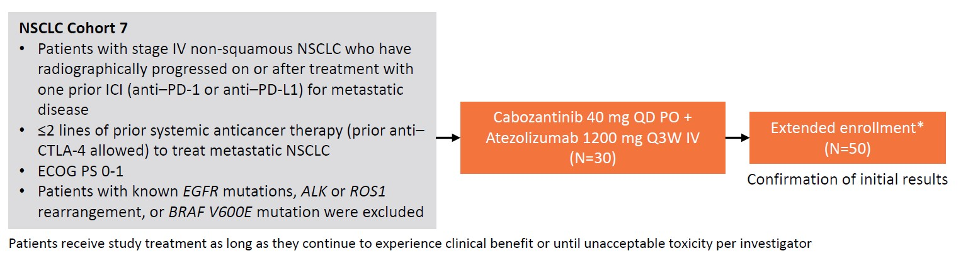
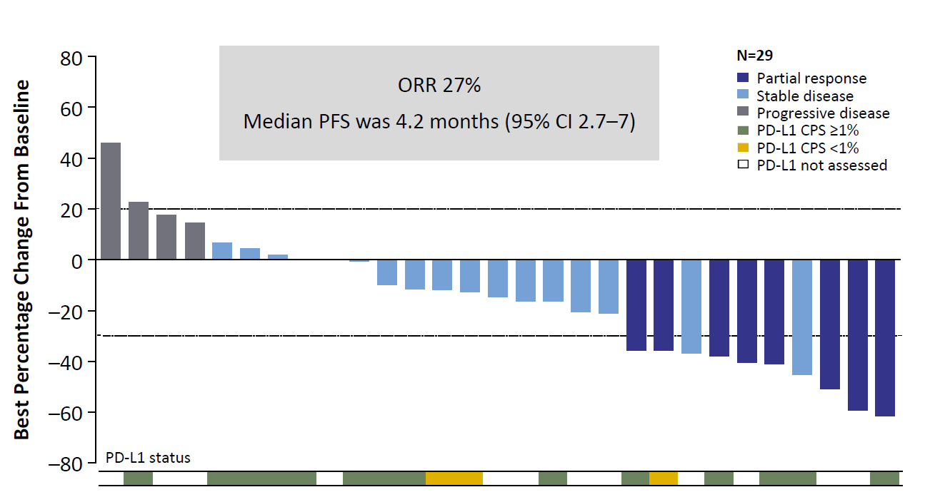
COSMIC-021: Cabozantinib + Atezolizumab
Neal JW, et al. ASCO 2020

Slide 64
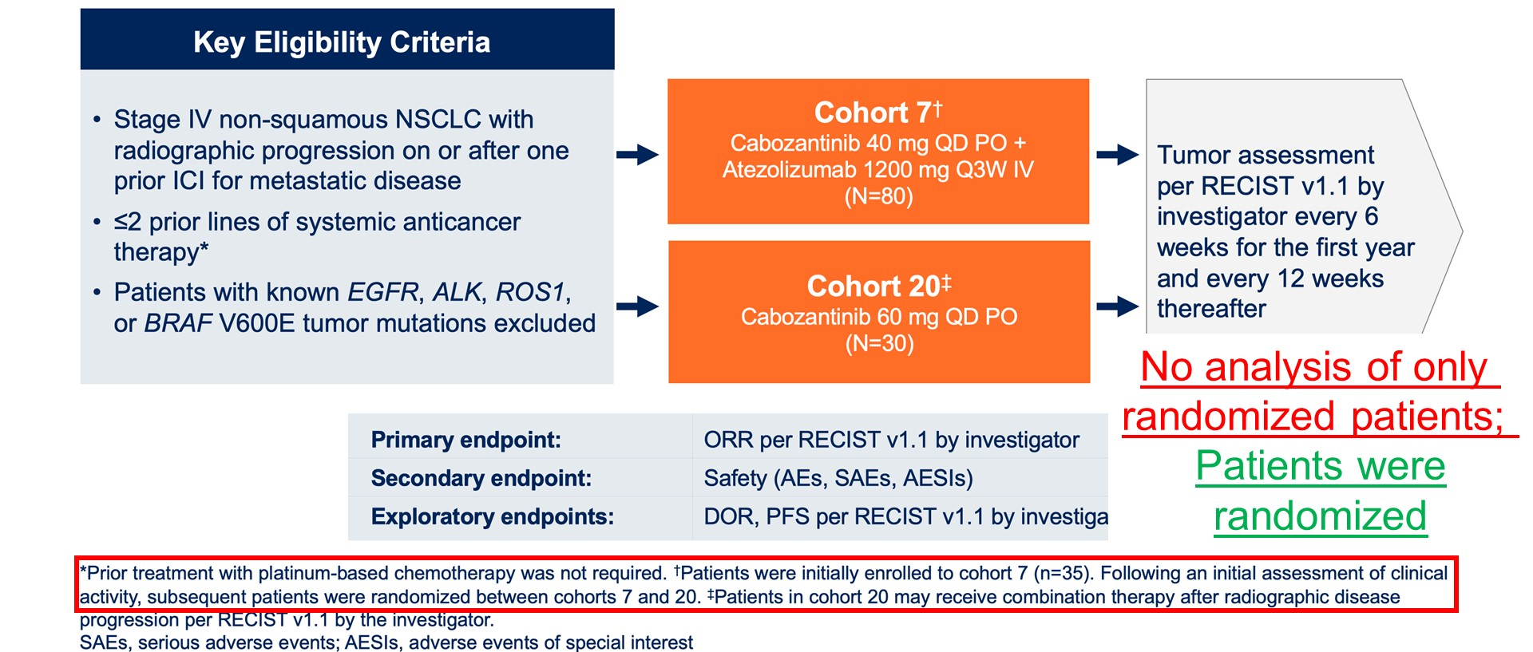
COSMIC-021 Study Design
Neal JW, et al. ASCO 2020

Slide 65
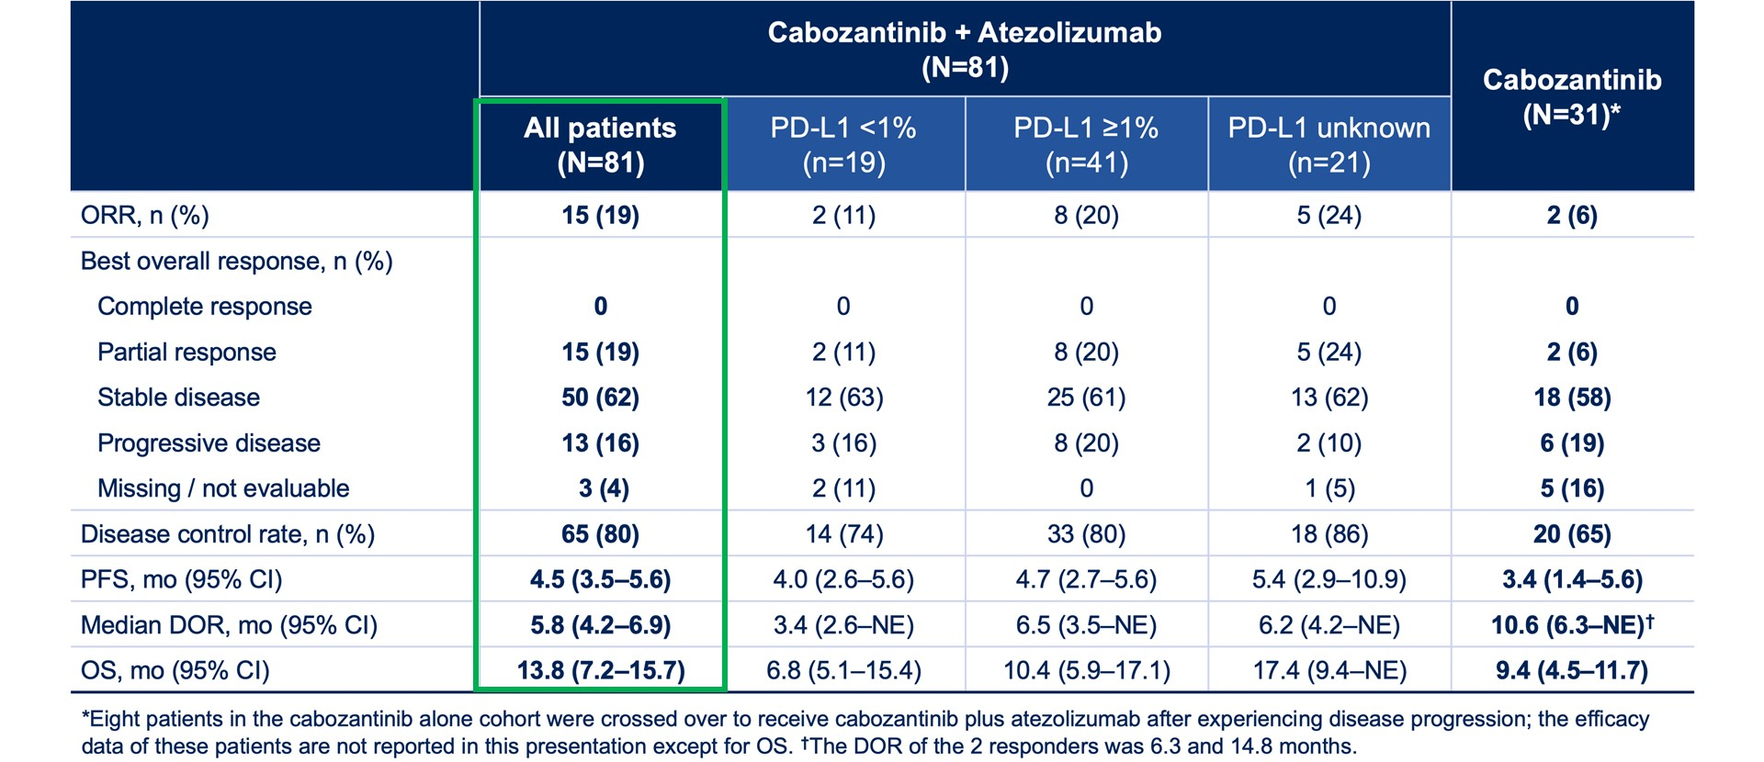
Slide 21
COSMIC-021 Efficacy
Neal JW, et al. ASCO 2020

Slide 66
Selected Trials: Cabozantinib + ICI in NSCLC
Study | Setting | Regimen | No. Patients
Phase III—CONTACT-01 NCT04471428 | Progression after platinum doublet + PD-(L)1 therapy | Cabozantinib + Atezo vs. Docetaxel | 366; Dec 2022 OS endpoint not met
Phase II EA5191; NCT04310007 | Progression after platinum doublet + PD-(L)1 therapy (Separate MET, RET, ROS1 cohort) | Cabozantinib vs Cabozantinib + Nivo vs. Standard chemotherapy | Recruiting

Slide 67
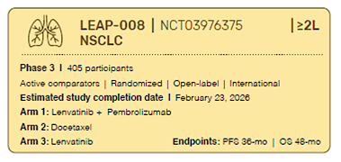
Pembrolizumab and Lenvatinib in previously treated NSCLC
Best overall response | irRECIST (N= 21) n (%)
Complete response | 1 (4.8)
Partial response | 6 (28.6)
Stable disease | 10 (47.6)
Progressive disease | 2 (9.5)
Unknown | 2 (9.5)
ORR | 7 (33.3)
95% CI | 14.6-57
Median DOR, mos (95% CI) | NE (2.4-NE)
Median PFS, mos (95% CI) | 7.4 (5.3-NE)
Brose M ASCO SITC 2019; Taylor Future Oncol 2020

Slide 68
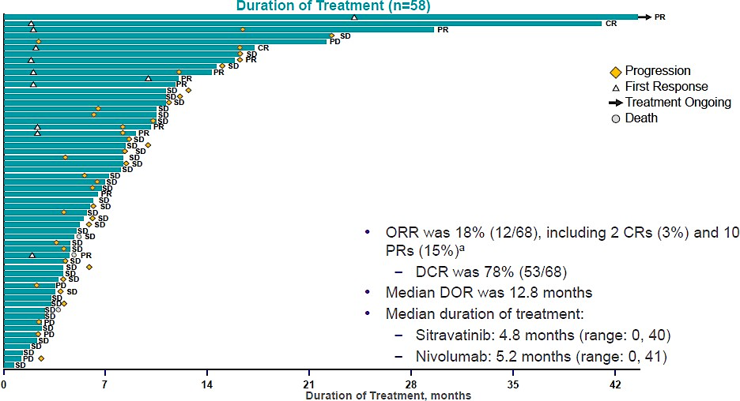
MRTX-500: PhII Sitravatinib + Nivo in Non-Sq NSCLC with prior ICI clinical benefit
mPFS 5.7 mos (4.9-7.6); mOS 14.9 mos (9.3-21.1)
Leal TA, et al. ESMO 2021; He K et al J Thorac Oncol 2023

Slide 69
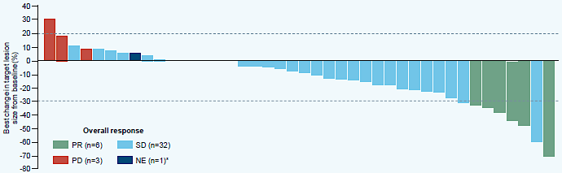
Phase Ib Sitravatinib + Tislelizumab in R/R Sq and non-Sq NSCLC
ORR 13.6% (5.2-27.4), DOR 6.9 (1-NE), PFS 5.2 months (4.1-5.9), OS 10.1 months (6.1-18.1)
Leal TA, et al. ESMO 2021; He K et al J Thorac Oncol 2023

Slide 70
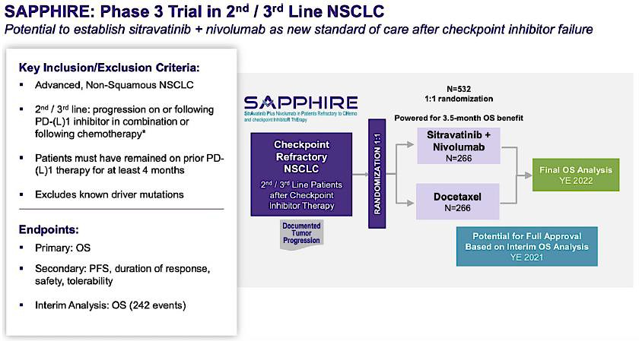
May 2023 OS primary endpoint not met
NCT03906071

Slide 71
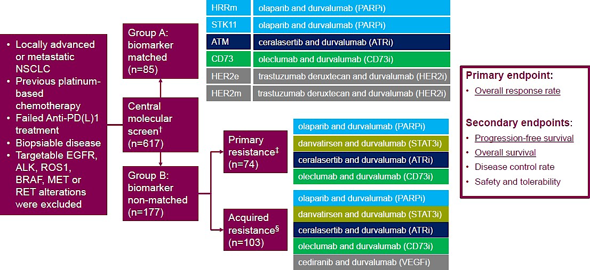
HUDSON: ICI Pretreated NSCLC
Besse, B et al. WCLC 2020

Slide 72
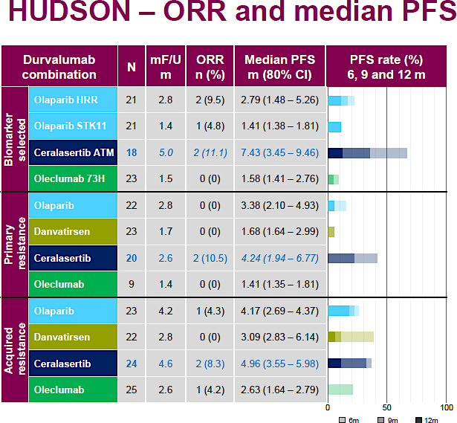
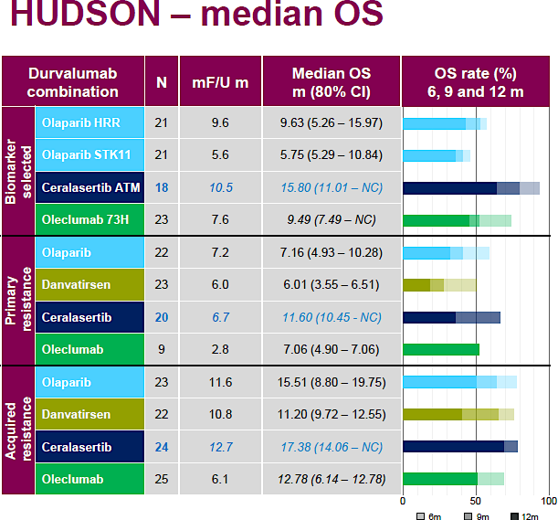
HUDSON: ICI Pretreated NSCLC Outcomes
Ceralasertib and durvalumab (acquired resistance): PFS 5 months; OS 17 months
decreased signatures associated with exhausted T-cells and, conversely,
increased interferon pathway activation
demonstrated expansion and maintenance of abundant T-cell clones
Phase III LATIFY trial ongoing
NCT05450692
Besse, B et al. WCLC 2020; Iyer S er al AACR 2023

Slide 73
S2302 Pragmatica-Lung
NCT05633602
A Prospective Randomized Study of Ramucirumab plus Pembrolizumab v Standard of Care for Participants Previously Treated with Immunotherapy for Stage IV or Recurrent NSCLC
Previously treated Stage IV or recurrent non-small cell lung cancer
Objectives
Primary study objective: To compare overall survival (OS) between participants previously treated with platinum-based chemotherapy and immunotherapy for Stage IV or recurrent NSCLC randomized to pembrolizumab and ramucirumab versus SOC.
Secondary study objective: To summarize reports of serious and unexpected high-grade (≥ Grade 3) treatment-related adverse events determined by the treating physician within each treatment arm.
Primary endpoint: Overall Survival
Accrual Goal: 700 participants
Randomization
Current Accrual: 39 participants
(6/14/23)
ARM A
Standard of Care (SoC)*
ARM B
Ramucirumab
+
Pembrolizumab
*SoC treatment is to be determined by the treating investigator and participant.
It is recommended that the choice of SoC drug(s) is based on NCCN guidelines for a “systemic therapy for advanced or metastatic disease-subsequent.”
Chair: Karen Reckamp, MD; Co-chair: Konstantin Dragnev, MD (Alliance); Statistical Chair: Mary Redman, PhD
Co-statisticians: Jieling Miao, MS, James Moon, MS Study Champion(s): Wade Iams, MD (ECOG), Brian Henick, MD (NRG); Lung community engagement subcommittee representative: Daniel Carrizosa, MD, MS
This is an FDA Registration Trial.

Slide 74
Pragmatic Design
Specifically, the goals of S2302 include:
  Empowerment of investigators to treat patients as would be done in real world practice.
  To decrease barriers to enrollment.
  To minimize the data collection burden.
  - Such trials are in the Pragmatic Design class of studies.
A pragmatic trial is designed to inform decision-makers on effectiveness, the comparative balance of benefits, burdens, and risks of a health intervention in clinical practice. In contrast to an “explanatory” trial that tests efficacy under ideal conditions, a pragmatic trial asks,
“Does this intervention work under usual conditions?”
The pragmatic design approach for registrational intent trials is novel and potentially paradigm-changing.

Slide 75
Pragmatic Design
Eligibility and study calendar
  PRAGMATIC
  Limited eligibility criteria
    Items focus on stage, prior therapy, PS and safety
  Enroll and treat patients as would be done in real world practice with institutional guidelines and investigator discretion.
  Minimal items on study calendar.
    No labs
    No imaging or RECIST
  .
STANDARD
Extensive, complex eligibility.
Specifics of treatment may vary from institutional standards.
Complicated study calendar with labs/imaging/biomarker testing.

Slide 76
Pragmatic Design
Data capture
  PRAGMATIC
  Minimize the data collection burden
    Reduced time points for data submitted
    Reduced number of forms
    Reduced number of data elements
  No protocol required disease assessment (CT, imaging)
  No protocol required lab tests
  No specimen collection
  Grade 5 and unexpected, related Grade 3-4 AE (~90% fewer AEs reported)
  No conmed collection
  Reduced data to monitor and audit
STANDARD
Extensive, complex electronic data capture
Collection of labs
Collection of RECIST and associated queries
Conmed collection and dates
Extensive study monitoring and auditing

Slide 77
Agenda
Introduction
Module 1: Case Discussions – Part 1
Module 2: Faculty Presentations
Current Management of Non-Small Cell Lung Cancer (NSCLC) After Disease Progression on Anti-PD-1/PD-L1-Containing Regimens – Dr Langer
Potential Role of Novel Immunotherapy-Based Combination Strategies in Progressive Advanced NSCLC – Dr Reckamp
Novel Antibody-Drug Conjugates (ADCs) Under Evaluation in NSCLC – Dr Sands
Other Promising Therapeutic Strategies for Patients with Progressive Metastatic NSCLC – Dr Leal
Module 3: Case Discussions – Part 2

Slide 78

TROP2 and Novel Antibody Drug Conjugates Under Evaluation in NSCLC
Jacob Sands, MD

Slide 79
Trophoblast-Cell Surface Antigen 2 (TROP 2)
Initially discovered in human trophoblast and choriocarcinoma cells
An intracellular calcium signal transducer overexpressed in various epithelial cancers
Associated with poor prognosis in some data sets
Not expressed in normal tissue
Encoded by TACSTD2
Role is not fully understood but thought to have a role in growth and proliferation of carcinoma cells
Thought to be an oncogene with a role in initiating signaling mechanisms that can increase tumorigenicity, aggressiveness, and metastasis
Basu A, et al. Int J Cancer. 1995
Lipinski M, et al. Proc Natl Acad Sci U S A. 1981
Shvartsur A, et al. Genes Cancer. 2015
Wang J, et al. Mol Cancer Ther. 2008
Ohmachi, et al. Clin Cancer Res. 2006;12:3057

Slide 80
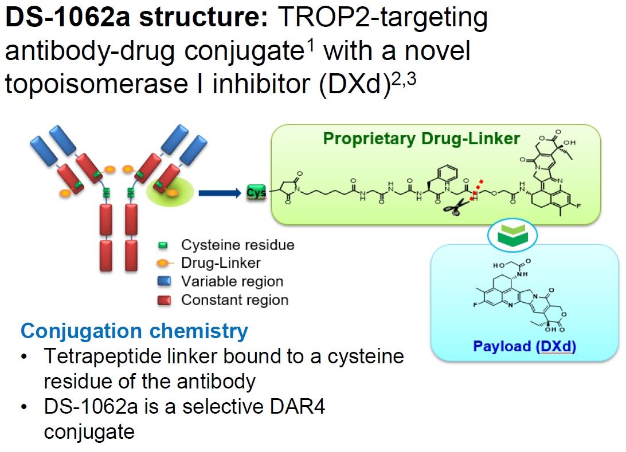
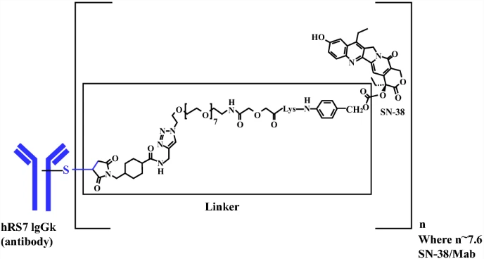
TROP 2 Targeting Strategies
Datopotamab Deruxtecan (DS-1062)
Sacituzumab govitecan
Sands et al. ASCO 2018

Slide 81
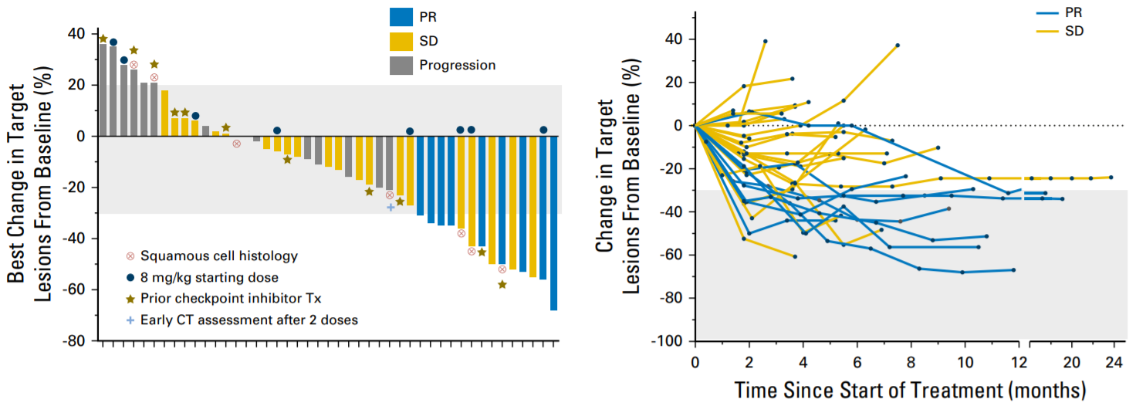
Sacituzumab Govitecan in NSCLC
ORR 19%
Median response duration 6 months
Clinical benefit rate 43%
Heist et al. JCO 2017; 35:2790-2797
Notes:
April 2020: FDA granted accelerated approval for treatment of metastatic triple-negative breast cancer after ≥2 prior therapies for metastatic disease²
ORR 33.3%
Median DOR 7.7 months

Slide 82
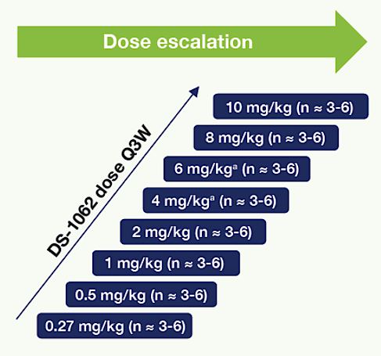
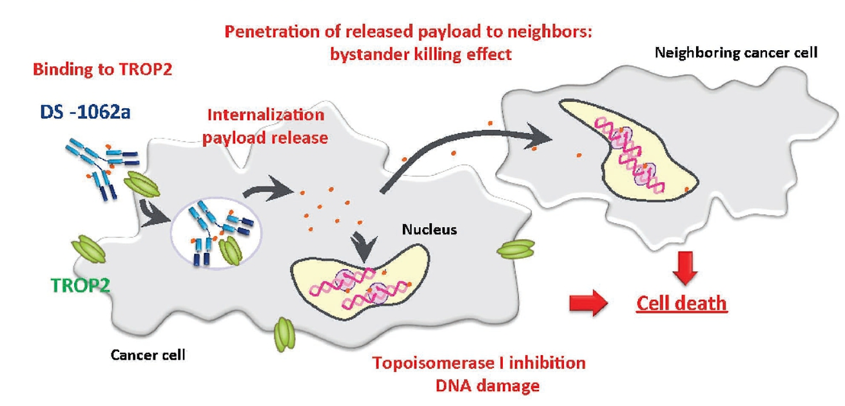
Datopotamab Deruxtecan
Lisberg et al. ASCO 2020

Slide 83
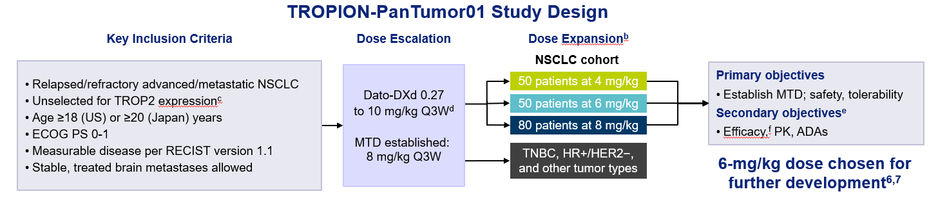
Datopotamab Deruxtecan
Dose expansion presented by Dr. Garon at WCLC 2021
Garon et al. WCLC 2021

Slide 84
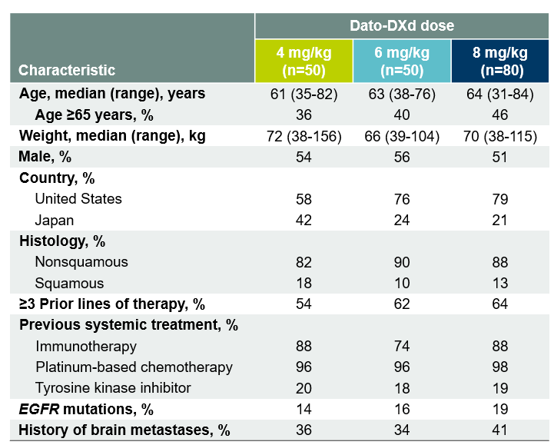
Datopotamab Deruxtecan
Baseline Characteristics
Garon et al. WCLC 2021

Slide 85
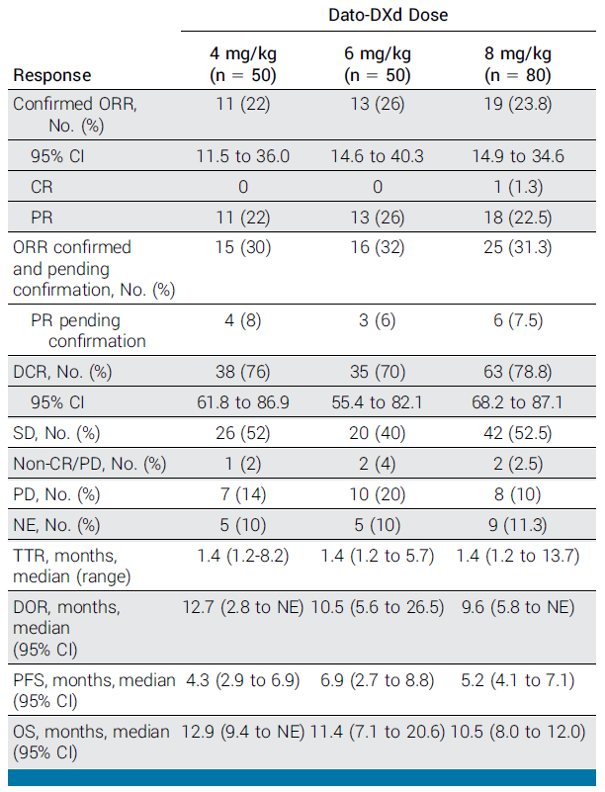


Datopotamab Deruxtecan
Shimizu et al. JCO 2023

Slide 86


Datopotamab Deruxtecan
Manageable safety profile
Shimizu et al. JCO 2023
Garon et al. WCLC 2021

Slide 87


Dato-DXd + Pembro
Preclinical data demonstrates greater activity with combination Dato-DXd and anti-PD-(L)1
TROPION-Lung02 (Phase Ib)
Goto et al. ASCO 2023

Slide 88


TROPION-Lung02
Goto et al. ASCO 2023

Slide 89

TROPION-Lung02
Goto et al. ASCO 2023

Slide 90

TROPION-Lung02
Goto et al. ASCO 2023

Slide 91


TEAEs of Dato-DXd & Pembro +/- chemo
Goto et al. ASCO 2023

Slide 92


Adverse Events of Special Interest
Goto et al. ASCO 2023
Shimizu et al. JCO 2023

Slide 93

Datopotamab Deruxtecan in NSCLC
Ongoing Trials
TROPION-Lung01: Dato-DXd vs docetaxel
TROPION-Lung02: Dato-DXd in combination with pembro +/- platinum chemo
TROPION-Lung04: Dato-DXd in combo with durva +/- carboplatin
TROPION-Lung05: Dato-DXd in NSCLC with actionable alteration
TROPION-Lung07: Dato-DXd in 1st line NSCLC, PD-L <50%:
TROPION-Lung08: Dato-DXd in 1st line NSCLC, Pembro +/- Dato-DXd

Slide 94
Positive High-Level Results from Phase III TROPION-Lung01 Study Announced
Press Release – July 3, 2023
“Positive high-level results from the TROPION-Lung01 Phase III trial showed datopotamab deruxtecan (Dato-DXd) demonstrated a statistically significant improvement for the dual primary endpoint of progression-free survival (PFS) compared to docetaxel, the current standard of care chemotherapy, in patients with locally advanced or metastatic non-small cell lung cancer (NSCLC) treated with at least one prior therapy.
For the dual primary endpoint of overall survival (OS), the data were not mature and an early trend was observed in favour of datopotamab deruxtecan versus docetaxel that did not meet the prespecified threshold for statistical significance at this interim analysis. The trial will continue as planned to assess OS with greater maturity. The investigators and participants will remain blinded to the results.
The safety profile of datopotamab deruxtecan was consistent with previous clinical trials with no new safety signals identified. All grade interstitial lung disease was generally consistent with prior clinical trials, with the majority being low grade. Some Grade 5 events were observed.
TROPION-Lung01 enrolled patients with and without actionable genomic alterations, such as EGFR and ALK. Patients with actionable genomic alterations were previously treated with platinum-based chemotherapy and an approved targeted therapy. Patients without actionable genomic alterations were previously treated, concurrently or sequentially, with platinum-based chemotherapy and a PD-1 or PD-L1 inhibitor. The data will be presented at a forthcoming medical meeting and shared with health authorities.”
https://www.astrazeneca.com/media-centre/press-releases/2023/datopotamab-deruxtecan-met-dual-primary-endpoint-of-progression-free-survival-in-patients-with-advanced-non-small-cell-lung-cancer.html

Slide 95
CEACAM5
Overexpressed on multiple solid tumors, including NSCLC (about 20% of lung adenocarcinoma), but not on normal lung tissue.
Impacts progression of NSCLC by stimulating proliferation and migration
Zhang X, et al. Journal Int Med Research 2020
Han ZW, et al. Invest New Drugs 2020

Slide 96

Tusamitamab Ravtansine (SAR408701)
ADC to CEACAM5 with an anti-tubulin payload
Study enrollment has required expression of CEACAM5

Slide 97


Tusamitamab Ravtansine (SAR408701)
Gazzah A et al. ASCO 2020. Abstract 9505.

Slide 98


Treatment-Emergent Adverse Events
Gazzah A et al. ASCO 2020. Abstract 9505.

Slide 99
Agenda
Introduction
Module 1: Case Discussions – Part 1
Module 2: Faculty Presentations
Current Management of Non-Small Cell Lung Cancer (NSCLC) After Disease Progression on Anti-PD-1/PD-L1-Containing Regimens – Dr Langer
Potential Role of Novel Immunotherapy-Based Combination Strategies in Progressive Advanced NSCLC – Dr Reckamp
Novel Antibody-Drug Conjugates (ADCs) Under Evaluation in NSCLC – Dr Sands
Other Promising Therapeutic Strategies for Patients with Progressive Metastatic NSCLC – Dr Leal
Module 3: Case Discussions – Part 2

Slide 100
Other Promising Therapeutic Strategies for Patients with Progressive Metastatic NSCLC
Ticiana Leal, MD
Associate Professor of Medicine
Director, Thoracic Medical Oncology Program
Winship Cancer Institute
Emory University

Slide 101
Learning Objectives
Review the mechanism of action of tumor treating fields (TTFields) and biologic rationale for their investigation in advanced NSCLC
Review the preclinical and early clinical activity observed with TTFields in NSCLC
Analyze the results of the Phase III LUNAR study assessing TTFields in combination with standard therapy for metastatic NSCLC after platinum failure
Compare the rates and severity of TTFields-associated skin toxicities versus standard of care
Consider practical considerations related to treatment with TTFields
Delineate other promising strategies in clinical development for patients with progressive metastatic NSCLC
Describe optimal timing of referral for palliative care for patients with advanced NSCLC; potential benefits of early integration of palliative care services

Slide 102




Tumor Treating Fields: A Platform Therapy Targeting Dividing Cancer Cells
INTERRUPT MITOTIC SPINDLE FORMATION
DISRUPT CANCER
CELL DIVISION
INDUCE DEATH IN AFFECTED CANCER CELLS
Tumor treating fields are alternating electric fields tuned to specific frequencies that disrupt cancer cell division (mitosis)
Arvind R, et al. Crit Rev Oncol Hematol 2021;168:103535.
© 2022 Novocure GmbH 102

Slide 103



TTFields Affect Multiple Phases of Mitosis: Metaphase
ACTIONS OF ELECTRIC FIELDS
IMPACT OF TTFIELDS ON METAPHASE
  Constant, uniform electric field
  Charges move in direction of opposite polarity
Charge
  Alternating electric fields (TTFields)
  Disrupt alignment of highly polarized tubulin subunits
  Disrupt microtubule spindle formation during mitosis and may ultimately lead to apoptosis
Dipole
  Alternating electric field
  Charges move back and forth; dipoles rotate
Gutin PH, Wong ET. Am Soc Clin Oncol Educ Book. 2012;32:126–131. Images used with permission
Swanson KD, et al Curr Neurol Neurosci Rep. 2016;16(1):8.

Slide 104


TTFields Affect Multiple Phases of Mitosis: Telophase
ACTIONS OF ELECTRIC FIELDS
IMPACT OF TTFIELDS ON TELOPHASE
  Nonuniform (converging) electric field
  Concentrated electric field intensity at smaller electrode
  Charges and dipoles move toward the area of highest electric field intensity (dielectrophoresis)
  Nonuniform electric field
  A change in cell shape during telophase causes a nonuniform electric field
  Polar components move to cleavage furrow
  Cell cannot divide properly, which may ultimately lead to apoptosis
Gutin PH, Wong ET. Am Soc Clin Oncol Educ Book. 2012;32:126-131.

Slide 105


Tumor Treating Fields
Tumor Treating Fields (TTFields) are electric fields tuned to specific frequencies that interfere with mitosis to continuously disrupt cancer cell division in solid tumors¹⁻⁴
TTFields therapy is delivered locoregionally and non-invasively through transducer arrays connected to a portable delivery system^{3,4}
FDA-approved and CE-marked for adults with:
  Newly diagnosed glioblastoma, concurrent with temozolomide^{3,5,}*
  Recurrent glioblastoma^{3,5,}*
  Malignant pleural mesothelioma^{4,6,}**
*Approved via the Premarket Approval (PMA) Pathway
**Approved via the Humanitarian Device Exemption (HDE) Pathway
.
1. Kirson ED, et al. Cancer Res. 2004;64(9):3288-3295. 2. Kirson ED, et al. Proc Natl Acad Sci U S A. 2007;104(24):10152-10157. 3. Optune [optune.com]. Accessed October 6, 2022. https://www.optune.com/hcp/instructions-for-use. 4. FDA [fda.access.gov]. Accessed October 6, 2022. https://www.accessdata.fda.gov/cdrh_docs/pdf18/H180002C.pdf. 5. Novocure. https://www.novocure.com/novocure-announces-ce-mark-and-first-patient-use-of-second-generation-optune-system/. Accessed October 6, 2022. 6. Novocure [novocure.com]. https://www.novocure.com/novocure-receives-ce-mark-for-novottf-100l-system/. Accessed October 6, 2022.

Slide 106







In Vitro Evidence: Mechanism of Action
TTFields Are Frequency Tuned to Cancer Cell Histologies
Optimal TTFields Frequency is Inversely Related to Cell Size^{1–8}
Uterine sarcoma
and other large cell types^{1,2}
Breast Cancer¹
Pancreatic Cancer³
NSCLC⁴
MPM^{5,6}
Ovarian Cancer⁷
GBM⁸
~ 100 kHz
150 kHz
150 kHz
150 kHz
150 kHz
200 kHz
200 kHz
Optimal frequency has been established for NSCLC and MPM at 150 kHz and for GBM at 200 kHz^{5,6,8}
Images used with permission from Steve Gschmeissner/Science Photo Library.
1. Lavi-Shahaf G, et al. Cancer Res. 2019;79(13 suppl): Abstract 1258. As presented at AACR; Mar 29-Apr 3, 2019; Atlanta,. 2. Kirson ED, et al. Proc Natl Acad Sci U S A. 2007;104(24):10152–10157 [appendix]. 3. Giladi M, et al. Pancreatology. 2014;14(1):54-63. 4. Giladi M, et al. Semin Oncol. 2014;41(suppl 6):S35–S41. 5. Munster M, et al. Int J Rad Oncol Biol Phys. 2019;105 (suppl 1):E679. Abstract 3582. As presented at the American Society for Radiation Oncology (ASTRO). September 15-18, 2019; Chicago,. 6. Giladi M, et al. Sci Rep. 2015;5:18046. 7. Voloshin T, et al. Int J Cancer. 2016;139(12):2850–2858. 8. Kirson ED, et al. Cancer Res. 2004;64(9):3288–3295.

Slide 107
TTFields Treatment-Induced Frequency-Dependent Reductions in Viability of NSCLC and MPM Cells In Vitro
Frequency-Dependent Effect of TTFields Treatment on Viability of NSCLC Cells¹
Frequency-Dependent Effect of TTFields Treatment on Viability of MPM Cells²
150
100
150 kHz
75
150 kHz
100
H1299
A549
Number of Cells
(% of Control)
Relative Cell Viability
(% of Control)
HCC827
50
HTB-182
50
LLC1
KLN-205
25
0
0
0
50
100
150
200
250
0
50
100
150
200
250
300
350
400
Frequency (kHz)
Frequency (kHz)
Adapted from Giladi M et al. 2014¹
Adapted from Mumblat H et al. 2021²
    150 kHz is the optimal effective frequency for NSCLC and MPM cell lines^{1,2}
*P < 0.05,**P < 0.01, ***P < 0.001 vs control group, Tukey range test.
A549, H1299, HCC827, and HTB-182, human NSCLC cell lines; KLN-205, murine lung squamous cell carcinoma cell line; LLC1, murine Lewis Lung Carcinoma cell line.
MPM, malignant pleural mesothelioma; NSCLC, non-small cell lung cancer.
1. Giladi M, et al. Semin Oncol. 2014;41(suppl 6):S35–S41. 2. Mumblat H, et al. Lung Cancer. 2021;160;99–110.
  TTFields are experimental for the treatment of patients with non-small cell lung cancer and have not been approved by the US Food and Drug Administration for this indication nor received a CE mark in Europe.

Slide 108
Addition of TTFields Treatment to Chemotherapy Demonstrated Increased Efficacy In NSCLC Cells In Vitro
Addition of TTFields treatment to paclitaxel led to a decrease in the number of viable cells for all tested concentrations, suggesting an additive effect in NSCLC cell lines.
H1299
LLC1
HTB-182
150
150
150
100
100
100
Relative Cell Viability (% of control)
Relative Cell Viability (% of control)
Relative Cell Viability (% of control)
50
50
50
0
0
0
0.1
1
10
100
0.01
0.1
1
10
100
0.1
1
10
Paclitaxel (nM)
Paclitaxel (nM)
Paclitaxel (nM)
Paclitaxel
Paclitaxel + TTFields
Adapted from Giladi M et al. 2014
H1299 and HTB-182, human NSCLC cell lines; LLC1, murine Lewis Lung Carcinoma cell line.
Giladi M, et al. Semin Oncol. 2014;41(suppl 6):S35–S41.
  TTFields are experimental for the treatment of patients with non-small cell lung cancer and have not been approved by the US Food and Drug Administration for this indication nor received a CE mark in Europe.

Slide 109
TTFields Treatment-Induced Immunogenic Cell Death and Apoptosis in LLC1 Cancer Cells
A
B
C
120
60
70
*
100
***
50
Annexin V+/ 7AAD+
Annexin V+/ 7AAD-
60
***
80
40
50
***
***
40
60
***
30
Number of Cells (% of Control)
Cells Expressing Markers (%)
HMGB1 (ng/10⁶ Cells)
*
30
40
20
20
20
10
10
0
0
0
0
24
48
72
0
24
48
72
0
24
48
72
Time (h)
TTFields (h)
TTFields (h)
Adapted from Voloshin T et al. 2020
  TTFields applied at optimal frequency (150 kHz) reduced cell counts by triggering apoptosis in LLC1 cells
*P < 0.05, ***P < 0.001, one-way ANOVA followed by Dunnett’s post-test.
LLC1, murine Lewis Lung Carcinoma cell line.
7AAD, 7-Aminoactinomycin D; ANOVA, Analysis of variance; HMGB1, high-mobility group box 1.
Voloshin T, et al. Cancer Immunol Immunother. 2020;69(7):1191–1204.
  TTFields are experimental for the treatment of patients with non-small cell lung cancer and have not been approved by the US Food and Drug Administration for this indication nor received a CE mark in Europe.

Slide 110

The Addition of TTFields Treatment to Anti-PD-1 Immunotherapy Enhances Antitumor Immunity and Tumor Control In Vivo
Adding TTFields treatment to anti-PD-1 led to decreased tumor volume and increased dendritic cell population (CD11c+/CD45+), suggesting therapeutic efficacy for the concomitant treatment of TTFields therapy with anti-PD-1
A
B
C
Dendritic Cells
300
***
40
**
*
TTFields
*
30
anti-PD-1 (250 µg/mouse, IP)
200
Tumor Volume (mm³)
20
CD11c⁺/CD45⁺ Cells (%)
100
0
6
7
10
13
15
10
LLC1; Orthotopic
Days after
tumor inoculation
0
0
Control +
Isotype
Control +
Anti-PD-1
TTFields +
Isotype
TTFields +
Anti-PD-1
Control +
Isotype
Control +
Anti-PD-1
TTFields +
Isotype
TTFields +
Anti-PD-1
Adapted from Voloshin T et al. 2020
*P < 0.05,**P < 0.01, ***P < 0.001, Figure B: Kruskal-Wallis test followed by Dunn’s post-test; Figure C: unpaired two-tailed t test.
LLC1, murine Lewis Lung Carcinoma cell line.
Anti-PD-1, anti-programmed cell death protein 1; CD45+, immune cells; IP, intraperitoneal.
Voloshin T, et al. Cancer Immunol Immunother. 2020;69(7):1191–1204.
  TTFields are experimental for the treatment of patients with non-small cell lung cancer and have not been approved by the US Food and Drug Administration for this indication nor received a CE mark in Europe.

Slide 111
EF-15: Phase 1/2 Trial Design^{1,2}
N = 42
P1
P2
Histologically or cytologically confirmed stage IIIB or IV NSCLC,
ECOG 0–2, pretreated
TTFields (150 kHz) therapy (≥ 18 h/day)
+
Pemetrexed 500 mg/m² IV Q3W for 9 weeks
N = 14
TTFields (150 kHz) therapy (≥ 18 h/day)
+
Pemetrexed
500 mg/m² IV Q3W
N = 42*
< 3 device related serious AEs
Clinical F/U Q3W (CT scan Q9W)
Systemic disease progression
Survival F/U
Start date: May 2008
Primary completion: July 2011
Study sites: 4 (Switzerland)
Primary endpoints:
Device related toxicity (P1), Time to in-field progression (P2)
Key secondary endpoints:
Safety, ORR, time to systemic progression, OS
*Includes the 14 patients in the phase 1 cohort.
1. NCT00749346 [clinicaltrials.gov]. Accessed October 6, 2022. https://clinicaltrials.gov/ct2/show/NCT00749346 2. Pless M, et al. Lung Cancer. 2013;81(3):445-450.
  TTFields are experimental for the treatment of patients with non-small cell lung cancer and have not been approved by the US Food and Drug Administration for this indication nor received a CE mark in Europe.

Slide 112
EF-15: Phase 2 Trial Results
Efficacy Endpoints | TTFields Therapy With Pemetrexed (N = 42)*
Median in-field TTP | 6.5 months
Median systemic PFS | 5.2 months
Median OS | 13.8 months
One-year survival rate | 57%
Overall response rate | 14.6%
Pless M, et al Lung Cancer. 2013;81(3):445-450.
  TTFields are experimental for the treatment of patients with non-small cell lung cancer and have not been approved by the US Food and Drug Administration for this indication nor received a CE mark in Europe.
Notes:
.

Slide 113

EF-15: Progression-Free and Overall Survival
Phase 1/2 single arm study of TTFields therapy (150 kHz) concomitant with pemetrexed (N = 42 pre-treated patients at 4 centers in Switzerland)^{1–3,}*
TTP
OS
1.0
1.0
0.9
TTFields Therapy + Pem Overall TTP
TTFields Therapy + Pem In-Field TTP
0.9
TTFields Therapy + Pem
0.8
0.8
0.7
0.7
0.6
0.6
0.5
0.5
Fraction of Patients
Fraction of Patients
0.4
0.4
0.3
0.3
0.2
0.2
0.1
0.1
0.0
0.0
0
20
40
60
80
100
0
2
4
6
8
10
12
14
16
18
20
22
24
Weeks
Months
Adapted from Pless M et al. 2013
*One out of the 42 patients enrolled was excluded from the analysis due to brain metastasis on screening.
1. NCT00749346 [clinicaltrials.gov]. Accessed October 6, 2022. https://clinicaltrials.gov/ct2/show/NCT00749346. 2. Pless M, et al. Lung Cancer. 2013;81(3):445-450. 3. Giladi M, et al. Semin Oncol. 2014;41(suppl 6):S35-S41.
  TTFields are experimental for the treatment of patients with non-small cell lung cancer and have not been approved by the US Food and Drug Administration for this indication nor received a CE mark in Europe.

Slide 114


Slide 115


Slide 116


Slide 117


Slide 118


Slide 119


Slide 120

Anadkat MJ et al. Front. Oncol. 2023;12:975473.
Lacouture ME et al. Front. Oncol. 2020;10:1045.

Slide 121

Company team generates a recommended personalized

Slide 122





Post-Progression: Immunotherapy Resistance
Immunotherapy treatment beyond progression (TBP) outcomes have been reported for multiple tumor types, including NSCLC showing that a subset of patients may derive benefit
Treatment with PD-1/PD-L1 blockade beyond progression is not a standard approach
Post-progression prolongation of survival has been observed with immunotherapy and further research is warranted
OAK Study
Post-PD OS
Necchi et al, 2017; George et al, 2016; Long et al, 2017; Gandara et al, 2018; Escudier et al, 2016.
Notes:
-The OAK study evaluated the efficacy and safety of atezolizumab versus docetaxel as second-line or third-line treatment for stage IIIb/IV non-small cell lung cancer. Post-progression prolongation of survival
(PPPS), a term implying continued benefit in OS after PD served as rationale for this analysis.
-Cancer immunotherapy may alter tumor biology such that treatment effects can extend beyond
radiographic progression.
-The post-PD analysis revealed that most patients experienced stability or a response in target
lesions after initial PD, and in rare cases durable responses were observed.
-Median post-PD OS was 12.7 months (95% confidence interval [CI]: 9.3–14.9) in
168 atezolizumab-arm patients continuing TBP, 8.8 months
(95% CI: 6.0–12.1) in 94 patients switching to nonprotocol
therapy, and 2.2 months (95% CI: 1.9–3.4) in 70 patients
receiving no further therapy. Of the atezolizumab TBP pa-
tients, 7% achieved a post-progression response in target le-
sions and 49% had stable target lesions. Atezolizumab TBP
was not associated with increased safety risks

Slide 123


Potential pathways contributing to sensitivity and resistance to PD‐(L)1 inhibitors in NSCLC
Villacruz L, Blumenschein G, Otterson G, Leal T. Cancer. 2023;129:1319–1350. 2022.

Slide 124

Early integration of palliative care services
Among patients with NSCLC, early palliative care led to significant improvements in both quality of life and mood.
As compared with patients receiving standard care, patients receiving early palliative care had less aggressive care at the end of life but longer survival.
Temel et al. N Engl J Med 2010;363:733-42

Slide 125
Conclusions
Immunotherapy resistance in the setting of recurrent or metastatic NSCLC is heterogeneous and better therapies are needed
TTFields therapy with SOC provided a statistically significant and clinically meaningful 3-month improvement in median OS vs SOC: HR:0.74, P=0.035) with no added systemic toxicities
Additional studies evaluating TTFields therapy with current SOC for first-line metastatic and locally advanced NSCLC are underway
Early palliative care led to longer survival

Slide 126
Agenda
Introduction
Module 1: Case Discussions – Part 1
Module 2: Faculty Presentations
Current Management of Non-Small Cell Lung Cancer (NSCLC) After Disease Progression on Anti-PD-1/PD-L1-Containing Regimens – Dr Langer
Potential Role of Novel Immunotherapy-Based Combination Strategies in Progressive Advanced NSCLC – Dr Reckamp
Novel Antibody-Drug Conjugates (ADCs) Under Evaluation in NSCLC – Dr Sands
Other Promising Therapeutic Strategies for Patients with Progressive Metastatic NSCLC – Dr Leal
Module 3: Case Discussions – Part 2

Slide 127

Case Presentation – Dr Langer
11/12- 11/16/19: 60 year old M retired police officer, PMH relevant for 30 pk-yr smoking history (quit 2004), CAD (s/p CABG in 2004, several stents most recently in 2012, history of MI), iliac artery aneurysm and mesenteric artery dissection, otherwise well until September 2019 when, while traveling, he developed URI Sx, and then felt increasingly unwell, with escalating cough, progressive DOE, worse when lying flat, progressive swelling in neck and upper arms, with night sweats, muscle cramps in back, generalized malaise, weakness and hoarseness.
Sx prompted CXR and f/u CT scan which showed a large mediastinal mass and mediastinal adenopathy
PE c/w SVC syndrome with palpable L SCN.
11/13/19: Left supraclavicular lymph node biopsy revealed ca, later deemed adenoca, TTF1 (+)
MR brain (+) 3mm area of discrete enhancement in the cerebellum concerning for metastasis, but too small to characterize.
PET (+) bulky R hilar and mediastinal LAD, liver and bone mets with small R pleural effusion
PD-L1 returned at 100%. NGS showed mutations in NF1 and TP53 p.D281Y c.841G>T, but no actionable markers

Slide 128

How would you treat this patient?
Local XRT, then systemic therapy with Pembrolizumab
Local XRT, then KN 189 with Pemetrexed, Carboplatin and Pembrolizumab
Pembrolizumab monotherapy
KN189 alone
IMP150: Atezolizumab/Bevacizumab and Carboplatin/Paclitaxel
9LA: Ipilumumab/Nivolumab + 2 cycles of Carboplatin/Pemetrexed

Slide 129


Case Presentation – Dr Langer (cont’d)
Pt was treated with Pembrolizumab monotherapy and did well until 10/20. Tx marked by mild fatigue.
Initial Sx, including cough, DOE, night sweats and muscle cramps resolved within 1 mo as did signs of SVC syndrome and L SCN. PS: “0”
F/U visits 03-09/20: excellent appetite; No N/V/D/C. On alprazolam for stress/anxiety, which helped him to relax and sleep

Slide 130

Case Presentation – Dr Langer (cont’d)
However, on PE in late 11/20, we palpated new, asymptomatic axillary LNs. PS remains “0”
CT and subsequent PET revealed bilateral axillary LN and upper RPLN
Bx L axillary LN (+) adenoca, PD-L1 (+) 60%
What is the next move?
Switch to Pemetrexed/Carboplatin/Bevacizumab
Add Pem/Carbo +/- Bevacizumab to Pembrolizumab
Switch to IMP150
Continue Pembro, radiate sites of “oligo-PD”

Slide 131
Case Presentation – Dr Langer (cont’d)
We opted to continue Pembrolizumab and radiate sites of “active” tumor in both axilla and celiac LN
He received 50 Gy/25 Fx to each site through 11/20
Pt tolerated Tx well x for mild nausea
Nodes resolved. No other sites progressed
He continued Pembrolizumab q 4 wks, and received 22 cycles through 01/27/22, when he developed bulky cervical and submandibular LN. Bx again showed adenoca, PDL1 (+).
What now?

Slide 132

Case Presentation – Dr Langer (cont’d)

Slide 133


Case Presentation – Dr Langer (cont’d)
We opted to continue Pembrolizumab and once more radiate sites of “active” tumor in the neck
He received 45 Gy/15 Fx to each site through 03/22
As of 07/23, he has received 40 cycles of Pembro and is now being dosed at 6 wk intervals
There has been no further progression since 03/22

Slide 134


Case Presentation – Dr Reckamp
66-year-old female with 35 pack-year smoking history
Pleuritic chest pain and dyspnea for 2 months
CXR with mediastinal and right hilar masses
CT chest, abdomen, pelvis with right lower lobe spiculated mass, 1.1 cm
Mediastinal and right hilar lymphadenopathy
  right paratracheal node 1.7 x 2.0 cm
  precarinal node 2.0 x 2.4 cm with mass effect on the superior vena cava
  right hilar lymphadenopathy 2.2 x 2.9 cm and a second 1.9 x 2.6 cm
  Liver metastases
PET/CT with uptake in the right lower lobe, lymph nodes and liver
MRI brain normal

Slide 135
Case Presentation – Dr Reckamp (cont’d)
She underwent bronchoscopy with EBUS and mediastinal biopsy
Pathology revealed 5 of 5 level 7 lymph nodes with metastatic poorly differentiated adenocarcinoma and right level 2 lymph node with metastatic poorly differentiated adenocarcinoma
IHC was positive for CK7, TTF1 and Napsin A
PD-L1 10%
NGS with KRAS G12V and TP53 mutation
Stage cT1bN3M1b
ECOG PS 1
Received carboplatin, pemetrexed and pembrolizumab with initial tumor response
Pemetrexed and pembrolizumab maintenance for 6 months
Diffuse progression in the liver and lymph nodes

Slide 136
Case Presentation – Dr Reckamp (cont’d)
What is the next best therapy?
Ipilimumab/nivolumab
Docetaxel
Docetaxel/ramucirumab
Pembrolizumab/ramucirumab

Slide 137


Case Presentation – Dr Sands
65 yr old man with metastatic adenocarcinoma lung, PD-L1 of 3%, no actionable alterations by ctDNA. Tumor biopsy unable to test genomics on multiple attempts.
Treated with carboplatin, pemetrexed, and pembro.
At progression, started treatment on DS-1062.
After 2+ months of DS-1062, scan showed stable disease but diffuse bilateral inflammatory changes, and patient had worsening respiratory status that required inpatient admission and transitioned to “comfort measures only”.
Autopsy showed extensive tumor involvement with lymphangitic spread peripherally in both lungs. There was organizing pneumonia/fibrin deposition with strong association with proximity to tumor, “strongly favor a tumor associated reaction.”

Slide 138
Clinical Presentation – Dr Leal
H&P
68 yo female presented with anorexia, 20 lb weight loss over the past 4 months, fatigue and shortness of breath on exertion associated with cough.
Past medical history:
HTN
HLD
Inflammatory bowel disease, flare 3 months before diagnosis

Slide 139
Case Presentation – Dr Leal (cont’d)
Physical exam
ECOG PS: 1
Physical exam: Notable for mild wheezing
At initial diagnosis, patient underwent liver biopsy that demonstrated squamous cell carcinoma.
Patient initiated treatment with carboplatin/paclitaxel x 4 cycles and then went on to observation. Imaging after 3 months showed progression. Inflammatory bowel disease had been well controlled without need for systemic immunosuppression for 8 months.

Slide 140


Case Presentatoin – Dr Leal (cont’d)
Imaging

Slide 141
Case Presentation– Dr Leal (cont’d)
Clinical course
PD-L1: 60%
She initiated therapy in second-line with atezolizumab + TTFields.
She did well and achieved PR. Main side effect was grade 2 rash, attributable to the TTFields therapy.
This was managed with holding TTFields for 1 week, topical steroids and skin care.

