Slide 1
Implications of Recent Data Sets for the Current and Future Management of Lung Cancer
Part 3 of a 3-Part Post-ESMO 2023 Congress CME/MOC-Accredited Live Webinar Series
Tuesday, November 14, 2023
5:00 PM – 6:30 PM ET
Faculty
Luis Paz-Ares, MD, PhD
Zofia Piotrowska, MD, MHS
David R Spigel, MD
Moderator
Neil Love, MD

Slide 2




Faculty
Luis Paz-Ares, MD, PhD
Chair of the Medical Oncology Department at the Hospital Universitario 12 de Octubre
Associate Professor at the Universidad Complutense
Head of the Lung Cancer Unit at the National Oncology Research Center
Madrid, Spain
David R Spigel, MD
Chief Scientific Officer
Sarah Cannon Research Institute
Nashville, Tennessee
Zofia Piotrowska, MD, MHS
Assistant Professor of Medicine
Harvard Medical School
Massachusetts General Hospital
Boston, Massachusetts
Moderator
Neil Love, MD
Research To Practice
Miami, Florida

Slide 3
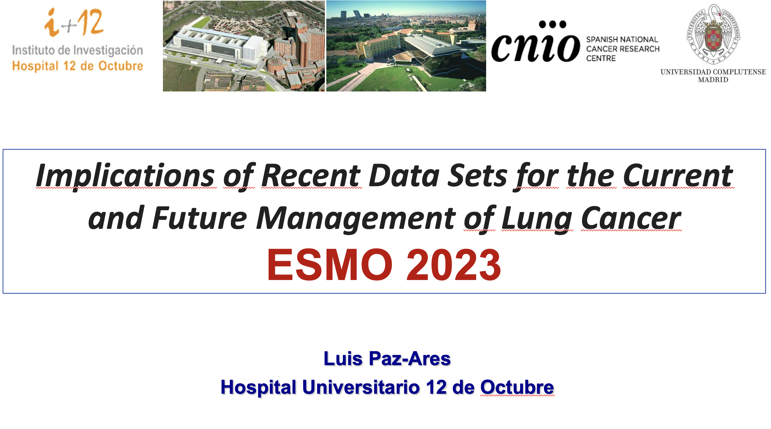
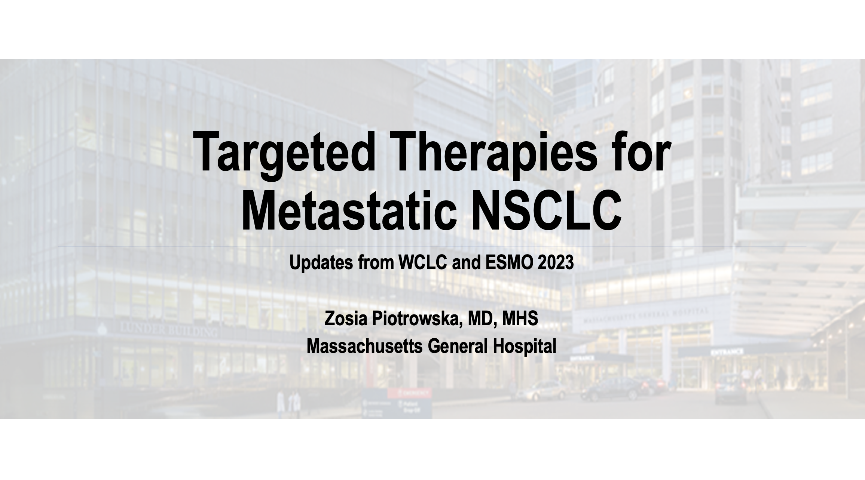
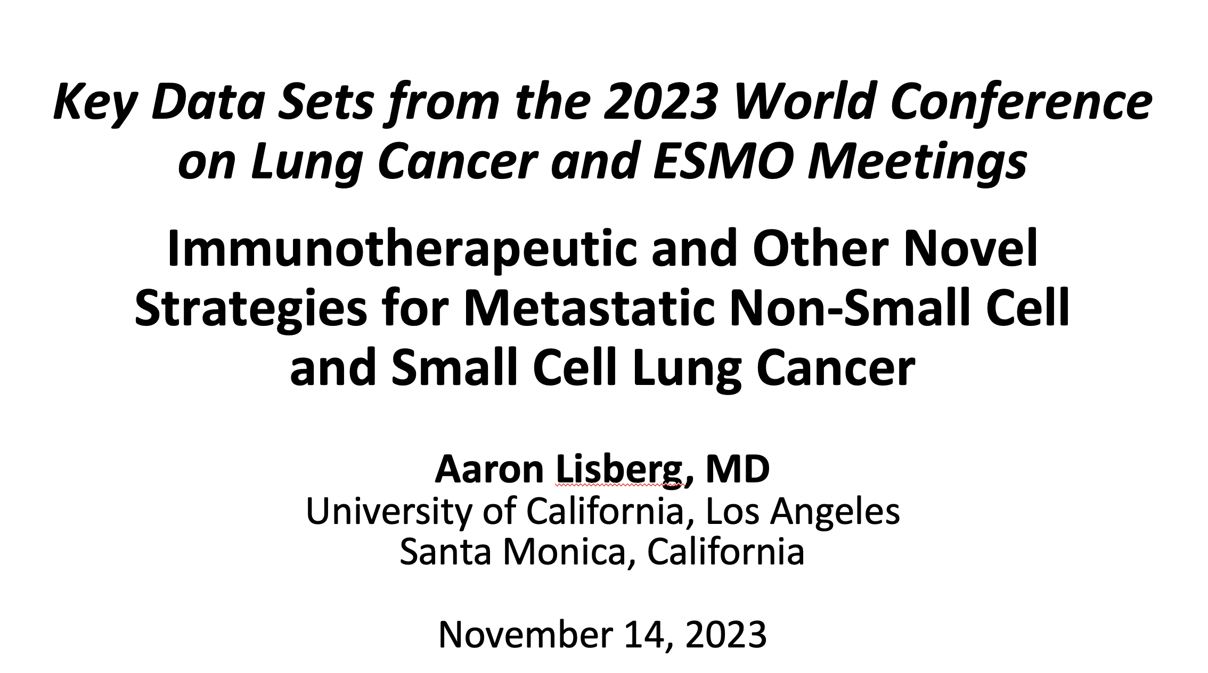

Slide 4
Commercial Support
This activity is supported by educational grants from AstraZeneca Pharmaceuticals LP, Daiichi Sankyo Inc, Janssen Biotech Inc, administered by Janssen Scientific Affairs LLC, Lilly, and Regeneron Pharmaceuticals Inc.
Research To Practice CME Planning Committee Members,
Staff and Reviewers
Planners, scientific staff and independent reviewers for Research To Practice have no relevant conflicts of interest to disclose.

Slide 5
Dr Paz-Ares — Disclosures
Advisory Committee | Amgen Inc, AstraZeneca Pharmaceuticals LP, Bayer HealthCare Pharmaceuticals, Bristol Myers Squibb, Daiichi Sankyo Inc, GSK, Janssen Biotech Inc, Lilly, Merck, Mirati Therapeutics Inc, MSD, Novartis, Pfizer Inc, PharmaMar, Roche Laboratories Inc, Sanofi, Servier Pharmaceuticals LLC, Takeda Pharmaceuticals USA Inc
Board of Directors | Altum Sequencing, STAb Therapeutics
Speakers Bureau | AstraZeneca Pharmaceuticals LP, Bristol Myers Squibb, GSK, Janssen Biotech Inc, Lilly, Mirati Therapeutics Inc, MSD, PharmaMar, Sanofi

Slide 6
Dr Piotrowska — Disclosures
Advisory Committee | AstraZeneca Pharmaceuticals LP, Bayer HealthCare Pharmaceuticals, Blueprint Medicines, Daiichi Sankyo Inc, Janssen Biotech Inc, Lilly, Merck, Sanofi, Taiho Oncology Inc, Takeda Pharmaceuticals USA Inc
Consulting Agreements | Blueprint Medicines, Daiichi Sankyo Inc
Contracted Research | AbbVie Inc, AstraZeneca Pharmaceuticals LP, Blueprint Medicines, Cullinan Oncology, Daiichi Sankyo Inc, Janssen Biotech Inc, Novartis, Spectrum Pharmaceuticals Inc, Takeda Pharmaceuticals USA Inc, Tesaro, A GSK Company
Travel Support | Janssen Biotech Inc

Slide 7
Dr Spigel — Disclosures
Consulting Agreements (Paid to Institution) | AbbVie Inc, Amgen Inc, AstraZeneca Pharmaceuticals LP, BeiGene Ltd, Bristol Myers Squibb, Genentech, a member of the Roche Group, GSK, Ipsen Biopharmaceuticals Inc, Jazz Pharmaceuticals Inc, Lilly, Lyell Immunopharma, Monte Rosa Therapeutics, Novartis, Novocure Inc, Regeneron Pharmaceuticals Inc, Sanofi
Contracted Research (Paid to Institution) | AbbVie Inc, Aeglea BioTherapeutics, Agios Pharmaceuticals Inc, Amgen Inc, AnHeart Therapeutics, Apollomics Inc, Arcus Biosciences, Arrys Therapeutics, a wholly owned subsidiary of Kyn Therapeutics, Ascendis Pharma, Asher Biotherapeutics, Astellas, AstraZeneca Pharmaceuticals LP, Bayer HealthCare Pharmaceuticals, BeiGene Ltd, BIND Therapeutics Inc, BioNTech SE, Blueprint Medicines, Boehringer Ingelheim Pharmaceuticals Inc, Bristol Myers Squibb, Calithera Biosciences, Celgene Corporation, Celldex Therapeutics, Clovis Oncology, Cyteir Therapeutics, Daiichi Sankyo Inc, Eisai Inc, Elevation Oncology, Ellipses Pharma, EMD Serono Inc, Endeavor BioMedicines, Erasca, Evelo Biosciences Inc, Faeth Therapeutics, Foundation Medicine, FUJIFILM Pharmaceuticals USA Inc, G1 Therapeutics Inc, Genentech, a member of the Roche Group, Gilead Sciences Inc, Grail Inc, GSK, Hutchison MediPharma, ImClone Systems, a wholly owned subsidiary of Eli Lilly and Company, ImmunoGen Inc, Incyte Corporation, Inspirna, Ipsen Biopharmaceuticals Inc, Janssen Biotech Inc, Janux Therapeutics, Jazz Pharmaceuticals Inc, Kronos Bio, Lilly, Loxo Oncology Inc, a wholly owned subsidiary of Eli Lilly & Company, Lyell Immunopharma, MacroGenics Inc, Merck, Moderna, Molecular Partners, Monte Rosa Therapeutics, Nektar, Novartis, Novocure Inc, OncXerna Therapeutics Inc, Peloton Therapeutics Inc, a wholly-owned subsidiary of Merck & Co Inc, Pfizer Inc, PTC Therapeutics, PureTech Health, Razor Genomics, Repare Therapeutics, Seagen Inc, Shenzhen Chipscreen Biosciences Co Ltd, Stemline Therapeutics Inc, Strata Oncology, Synthekine, Taiho Oncology Inc, Takeda Pharmaceuticals USA Inc, Tango Therapeutics, Tarveda Therapeutics, Tesaro, A GSK Company, Tizona Therapeutics Inc, Transgene, Verastem Inc, Zai Lab
Nonrelevant Financial Relationship | UT Southwestern Medical Center

Slide 8
Aaron Lisberg, MD, Video Interview
Participant — Disclosures
Advisory Committee and Consulting Agreements | Amgen Inc, AstraZeneca Pharmaceuticals LP, Bayer HealthCare Pharmaceuticals, Bristol Myers Squibb, Daiichi Sankyo Inc, G1 Therapeutics Inc, IQVIA, Janssen Biotech Inc, Jazz Pharmaceuticals Inc, Leica Biosystems, Lilly, Molecular Axiom, MorphoSys, Novartis, Novocure Inc, Oncocyte, Pfizer Inc, Regeneron Pharmaceuticals Inc, Sanofi
Contracted Research | AstraZeneca Pharmaceuticals LP, Calithera Biosciences, Daiichi Sankyo Inc, Dracen Pharmaceuticals, Duality Biologics, eFFECTOR Therapeutics Inc, WindMIL Therapeutics
Steering Committees | AstraZeneca Pharmaceuticals LP, Daiichi Sankyo Inc, Duality Biologics
Nonrelevant Financial Relationship | LUNGevity Foundation, National Institutes of Health (NIH)

Slide 9
This educational activity contains discussion of published and/or investigational uses of agents that are not indicated by the Food and Drug Administration. Research To Practice does not recommend the use of any agent outside of the labeled indications. Please refer to the official prescribing information for each product for discussion of approved indications, contraindications and warnings. The opinions expressed are those of the presenters and are not to be construed
as those of the publisher or grantors.

Slide 10
Key Data Sets
Luis Paz-Ares, MD, PhD
Herbst RS et al. Overall survival analysis from the ADAURA trial of adjuvant osimertinib in patients with resected EGFR‑mutated (EGFRm) stage IB–IIIA non-small cell lung cancer (NSCLC). ASCO 2023;Abstract LBA3.
Nassar AH et al. Consolidation EGFR-tyrosine kinase inhibitor (TKI) vs durvalumab vs observation in unresectable EGFR-mutant Stage III NSCLC. WCLC 2023;Abstract MA16.11.
Solomon BJ et al. ALINA: Efficacy and safety of adjuvant alectinib versus chemotherapy in patients with early-stage ALK+ non-small cell lung cancer (NSCLC). ESMO 2023;Abstract LBA2.
Pulla MP et al. Neoadjuvant nivolumab (N) + chemotherapy (C) in the phase 3 CheckMate 816 study: 3-y results by tumor PD-L1 expression. ESMO 2023;Abstract LBA57.
Awad MM et al. Neoadjuvant nivolumab (N) + ipilimumab (I) vs chemotherapy (C) in the phase 3 CheckMate 816 trial. ESMO 2023;Abstract 1261O.

Slide 11
Key Data Sets
Luis Paz-Ares, MD, PhD (continued)
Mitsudomi T et al. Surgical outcomes with neoadjuvant durvalumab + chemotherapy followed by adjuvant durvalumab in resectable NSCLC (AEGEAN). WCLC 2023;Abstract OA12.05.
Reck M et al. Associations of ctDNA clearance and pathological response with neoadjuvant treatment in patients with resectable NSCLC from the phase 3 AEGEAN trial. ESMO 2023;Abstract LBA59.
Spicer JD et al. Overall survival in the KEYNOTE-671 study of perioperative pembrolizumab for early-stage non-small-cell lung cancer (NSCLC). ESMO 2023;Abstract LBA56.
Cascone T et al. CheckMate 77T: Phase 3 study comparing neoadjuvant nivolumab (NIVO) plus chemotherapy (chemo) vs neoadjuvant placebo plus chemo followed by surgery and adjuvant NIVO or placebo for previously untreated, resectable stage II–IIIB NSCLC. ESMO 2023;Abstract LBA1.
Felip E et al. IMpower010: Exploratory analysis of tumour mutational burden and disease-free survival with adjuvant atezolizumab in NSCLC. WCLC 2023;Abstract MA11.08.

Slide 12
Key Data Sets
Luis Paz-Ares, MD, PhD (continued)
Altorki NK et al. IMpower010: Exploratory analysis of disease-free survival (DFS) by TGFβ cancer-associated fibroblast (CAF) gene signature expression in patients (pts) with resected NSCLC treated with atezolizumab (atezo) or best supportive care (BSC). ESMO 2023;Abstract 1264MO.
Peters S et al. Real-world outcomes with durvalumab after chemoradiotherapy in unresectable stage III EGFR-mutated NSCLC (PACIFIC-R). WCLC 2023;Abstract OA17.03.
Garassino MC et al. Durvalumab (durva) after sequential chemoradiotherapy (CRT) in patients (pts) with unresectable Stage III NSCLC: Final analysis from PACIFIC-6. ESMO 2023;Abstract LBA61.
Filippi ARR et al. Durvalumab after radiotherapy (RT) in patients with unresectable Stage III NSCLC ineligible for chemotherapy (CT): Primary results from the DUART study. ESMO 2023;Abstract LBA62.

Slide 13
Key Data Sets
Zofia Piotrowska, MD, MHS
Janne P et al. Osimertinib with/without platinum-based chemotherapy as first-line treatment in patients with EGFRm advanced NSCLC (FLAURA2). WCLC 2023;Abstract PL03.13.
Planchard D et al. FLAURA2: Safety and CNS outcomes of first-line (1L) osimertinib (osi) ± chemotherapy (CTx) in EGFRm advanced NSCLC. ESMO 2023;Abstract LBA68.
Le X et al. A multi-centre open-label randomized phase II study of osimertinib with and without ramucirumab in TKI-naïve EGFR-mutant metastatic NSCLC (RAMOSE trial interim analysis). ESMO 2023;Abstract LBA71.
Cho BC et al. Amivantamab plus lazertinib vs osimertinib as first-line treatment in patients with EGFR-mutated, advanced non-small cell lung cancer (NSCLC): Primary results from MARIPOSA, a phase 3, global, randomized, controlled trial. ESMO 2023;Abstract LBA14.

Slide 14
Key Data Sets
Zofia Piotrowska, MD, MHS (continued)
Passaro P et al. Amivantamab plus chemotherapy (with or without lazertinib) vs chemotherapy in EGFR-mutated advanced NSCLC after progression on osimertinib: MARIPOSA-2, a phase 3, global, randomized, controlled trial. ESMO 2023;Abstract LBA15.
Kim TM et al. Tepotinib + osimertinib in EGFR-mutant NSCLC with MET amplification following 1L osimertinib: INSIGHT 2 primary analysis. WCLC 2023;Abstract OA21.05.
Yu HA et al. Patritumab deruxtecan (HER3-DXd) in EGFR-mutated NSCLC following EGFR TKI and platinum-based chemotherapy: HERTHENA-Lung01. WCLC 2023;Abstract OA05.03.
Johnson M et al. Intracranial efficacy of HER3-DXd in patients with previously treated advanced EGFR-mutated NSCLC: Results from HERTHENA-Lung01. ESMO 2023;Abstract 1319MO.

Slide 15
Key Data Sets
Zofia Piotrowska, MD, MHS (continued)
Girard N et al. Amivantamab plus chemotherapy vs chemotherapy as first-line treatment in EGFR exon 20 insertion-mutated advanced non-small cell lung cancer (NSCLC): Primary results from PAPILLON, a randomized phase 3 global study. ESMO 2023;Abstract LBA5.
Loong HHF et al. Randomized phase 3 study of first-line selpercatinib versus chemotherapy and pembrolizumab in RET fusion-positive. ESMO 2023;Abstract LBA4.
Clarke JM et al. CodeBreaK 101: Safety and efficacy of sotorasib with carboplatin and pemetrexed in KRAS G12C-mutated advanced NSCLC. WCLC 2023;Abstract MA06.05.
Garassino MC et al. KRYSTAL-7: Efficacy and safety of adagrasib with pembrolizumab in patients with treatment-naïve, advanced non-small cell lung cancer (NSCLC) harboring a KRAS G12C mutation. ESMO 2023;Abstract LBA65.

Slide 16
Key Data Sets
Zofia Piotrowska, MD, MHS (continued)
Janne P et al. Trastuzumab deruxtecan in patients with HER2-mutant metastatic non-small cell lung cancer: Primary results of DESTINY-Lung02. WCLC 2023;Abstract MA13.10.
Planchard D et al. Trastuzumab deruxtecan (T-DXd) in patients (pts) with HER2 (ERBB2)-mutant (HER2m) metastatic non-small cell lung cancer (NSCLC) with and without brain metastases (BMs): Pooled analyses from DESTINY-Lung01 and DESTINY-Lung02. ESMO 2023;Abstract 1321MO.

Slide 17
Key Data Sets
Aaron Lisberg, MD
Gadgeel S et al. 5-year survival of pembrolizumab plus chemotherapy for metastatic NSCLC with PD-L1 tumor proportion score <1%. WCLC 2023;Abstract OA14.05.
Gandara DR et al. Predictive utility of patient-reported outcomes for survival in 1st-line treated patients with aNSCLC in EMPOWER-Lung 1 and 3. WCLC 2023;Abstract MA05.11.
Makharadze T et al. Cemiplimab for advanced non-small cell lung cancer: Squamous subgroup analysis for EMPOWER-Lung 1 and 3. ESMO 2023;Abstract 1438P.
Peters S et al. Overall survival from a phase II randomised double-blind trial (PERLA) of dostarlimab (dostar) + chemotherapy (CT) vs pembrolizumab (pembro) + CT in metastatic non-squamous NSCLC. ESMO 2023;Abstract LBA64.

Slide 18
Key Data Sets
Aaron Lisberg, MD (continued)
Cho BC et al. Durvalumab ± tremelimumab + chemotherapy in 1L metastatic NSCLC: Characterisation of patients with PFS ≥12 months in POSEIDON. WCLC 2023;Abstract P2.06-05.
Ramalingam SS et al. Six-year survival and HRQoL outcomes with 1L nivolumab + ipilimumab in patients with metastatic NSCLC from CheckMate227. WCLC 2023;Abstract OA14.03.
Cho BC et al. Sacituzumab govitecan + pembrolizumab in 1L metastatic non-small cell lung cancer: Preliminary results of the EVOKE-02 study. WCLC 2023;Abstract OA05.04.
Middleton G et al. A phase II trial of ceralasertib and durvalumab in advanced non-small cell lung cancer (NSCLC) with and without RAS mutations: Results of NLMT arm J. WCLC 2023;Abstract MA06.06.

Slide 19
Key Data Sets
Aaron Lisberg, MD (continued)
Lisberg AE et al. Datopotamab deruxtecan (Dato-DXd) vs docetaxel in previously treated advanced/metastatic (adv/met) non-small cell lung cancer (NSCLC): Results of the randomized phase 3 study TROPION-Lung01. ESMO 2023;Abstract LBA12.
Papadopoulos KP et al. Datopotamab deruxtecan (Dato-DXd) + durvalumab ± carboplatin in advanced/mNSCLC: Initial results from phase 1b TROPION-Lung04. WCLC 2023;Abstract OA05.06.
Leal T et al. TTFields and immune-checkpoint inhibitor in metastatic non-small cell lung cancer: PD-L1 subgroups in the phase 3 LUNAR study. WCLC 2023;Abstract OA22.05.
Ganti AK et al. The prognostic value of patient reported outcomes (PROs) and clinical/demographic variables in the CASPIAN study. ASCO 2023;Abstract 8516.

Slide 20
Key Data Sets
Aaron Lisberg, MD (continued)
Johnson M et al. Ifinatamab deruxtecan (I-DXd; DS-7300) in patients with refractory SCLC: A subgroup analysis of a phase 1/2 study. WCLC 2023;Abstract OA05.05.
Paz-Ares L et al. Tarlatamab for patients (pts) with previously treated small cell lung cancer (SCLC): Primary analysis of the phase 2 DeLLphi-301 study. ESMO 2023;Abstract LBA92.

Slide 21
Agenda
INTRODUCTION
MODULE 1: Localized Non-Small Cell Lung Cancer (NSCLC)
MODULE 2: EGFR-Mutated Metastatic NSCLC
MODULE 3: Other Targeted Treatment for Metastatic NSCLC
MODULE 4: Updates on Immunotherapy in Metastatic NSCLC
MODULE 5: Emerging Antibody-Drug Conjugates for Metastatic NSCLC
MODULE 6: Small Cell Lung Cancer

Slide 22
Agenda
INTRODUCTION
MODULE 1: Localized NSCLC
MODULE 2: EGFR-Mutated Metastatic NSCLC
MODULE 3: Other Targeted Treatment for Metastatic NSCLC
MODULE 4: Updates on Immunotherapy in Metastatic NSCLC
MODULE 5: Emerging Antibody-Drug Conjugates for Metastatic NSCLC
MODULE 6: Small Cell Lung Cancer

Slide 23
A 74-year-old Taiwanese non-smoking woman presented to a nearby hospital with shortness of breath and was found to have a large burden of metastatic disease on scans (I can include pictures). She had bulky masses in her lungs bilaterally.
Due to the large burden of pulmonary disease, was hypoxic and she required 6 L of oxygen in order to saturate around 90%. She had lost 30 pounds and had a severe cough. At this outside hospital, she was put on hospice without any tissue diagnosis. After a few months she had a family friend suggest she reach out and was seen at my office while still on hospice.
Obviously, my concern at this time was for a possible sensitizing mutation lung cancer.
She underwent tissue biopsy as well as liquid biopsy that showed a lung adenocarcinoma and she was positive for EGFR exon 19 deletion mutation.
She revoked her hospice and I immediately started her on osimertinib.
4 weeks later, she was completely off of oxygen and clinically doing great. She had the standard incredible response to osimertinib. However, about 4 weeks later, she started requiring oxygen again and became short of breath and had a cough. She ended up in the emergency room with hypoxia, cough, and new atrial fibrillation. Her imaging showed the previous sites of cancer had improved drastically, however she developed a new pneumonitis bilaterally. She required IV antibiotics and intravenous steroids and slowly improved.
My question:
Osimertinib induced pneumonitis or interstitial lung disease is relatively uncommon but a serious complication. We are used to dealing with this with immunotherapy.
In this case, for a patient that is frail, and her cancer is having a remarkable response to her EGFR targeted therapy, once the patient has improved, would experts rechallenge her? Would they use osimertinib again at a reduced dose? Would they leave on a small steroid dose in the beginning? Would they reach for another EGFR TKI?
Unfortunately she is not a great candidate for systemic chemotherapy and my understanding is these patients do not do as well on immunotherapy.
Happy to provide more details or info at request!
Thank you
Eric Fox, MD
Philadelphia, Pennsylvania

Slide 24
Agenda
INTRODUCTION
MODULE 1: Localized NSCLC
– Adjuvant Targeted Therapy
– Perioperative Immunotherapy
– Locally Advanced Unresectable NSCLC
MODULE 2: EGFR-Mutated Metastatic NSCLC
MODULE 3: Other Targeted Treatment for Metastatic NSCLC
MODULE 4: Updates on Immunotherapy in Metastatic NSCLC
MODULE 5: Emerging Antibody-Drug Conjugates for Metastatic NSCLC
MODULE 6: Small Cell Lung Cancer

Slide 25
Agenda
INTRODUCTION
MODULE 1: Localized NSCLC
– Adjuvant Targeted Therapy
– Perioperative Immunotherapy
– Locally Advanced Unresectable NSCLC
MODULE 2: EGFR-Mutated Metastatic NSCLC
MODULE 3: Other Targeted Treatment for Metastatic NSCLC
MODULE 4: Updates on Immunotherapy in Metastatic NSCLC
MODULE 5: Emerging Antibody-Drug Conjugates for Metastatic NSCLC
MODULE 6: Small Cell Lung Cancer

Slide 26
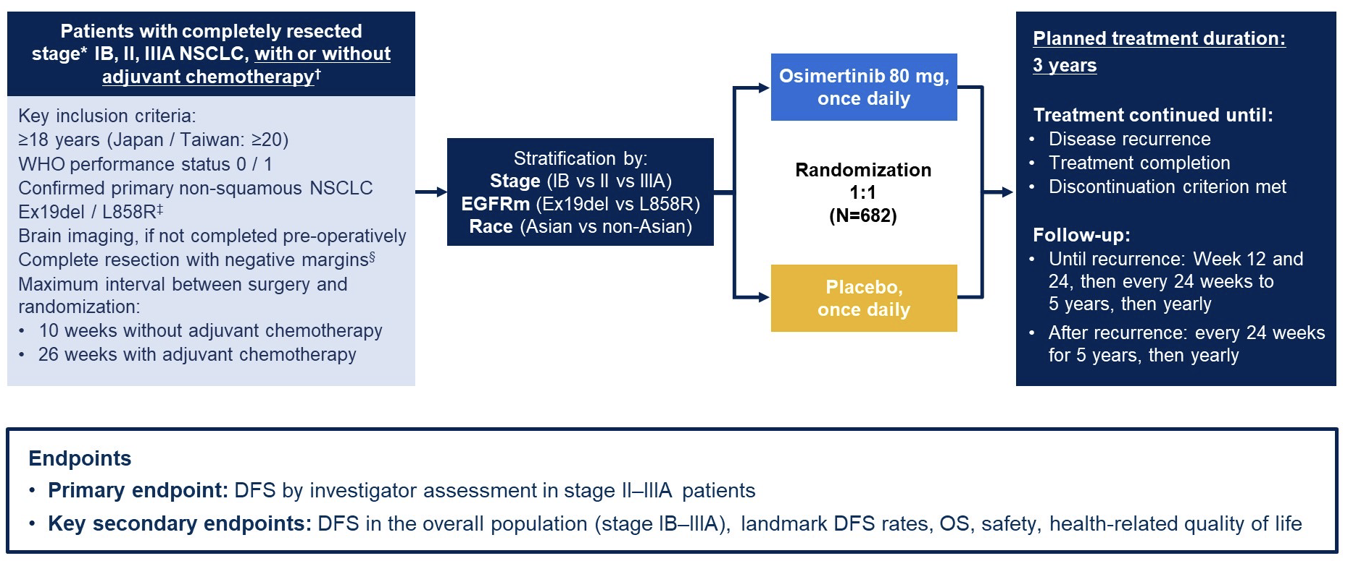
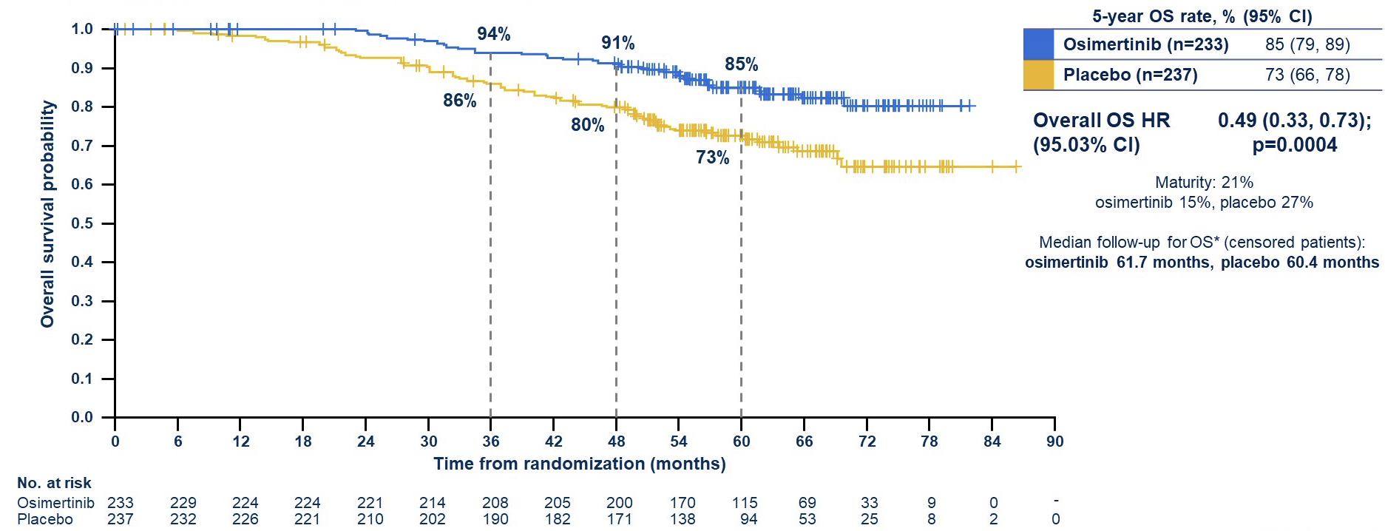
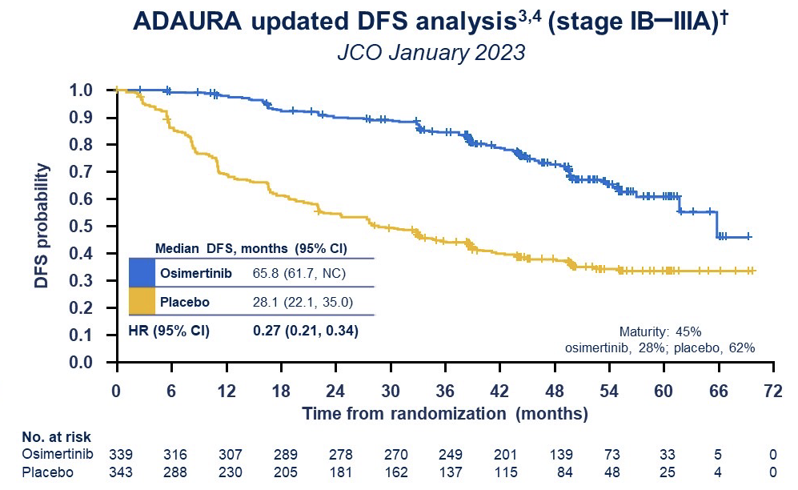
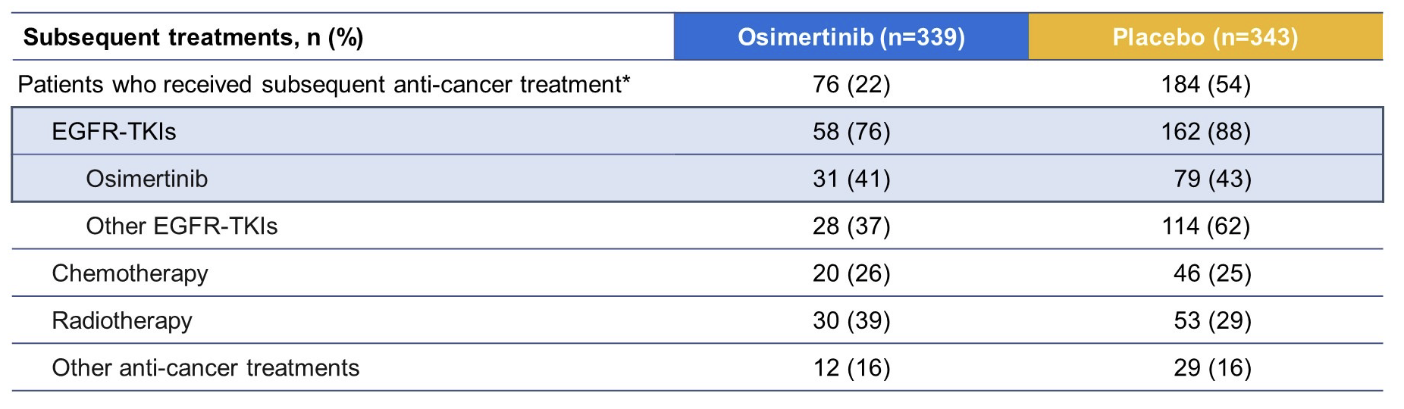
ADAURA trial: Overall Survival
Courtesy of Luis Paz-Ares, MD, PhD
Herbst et al. ESMO 2023

Slide 27
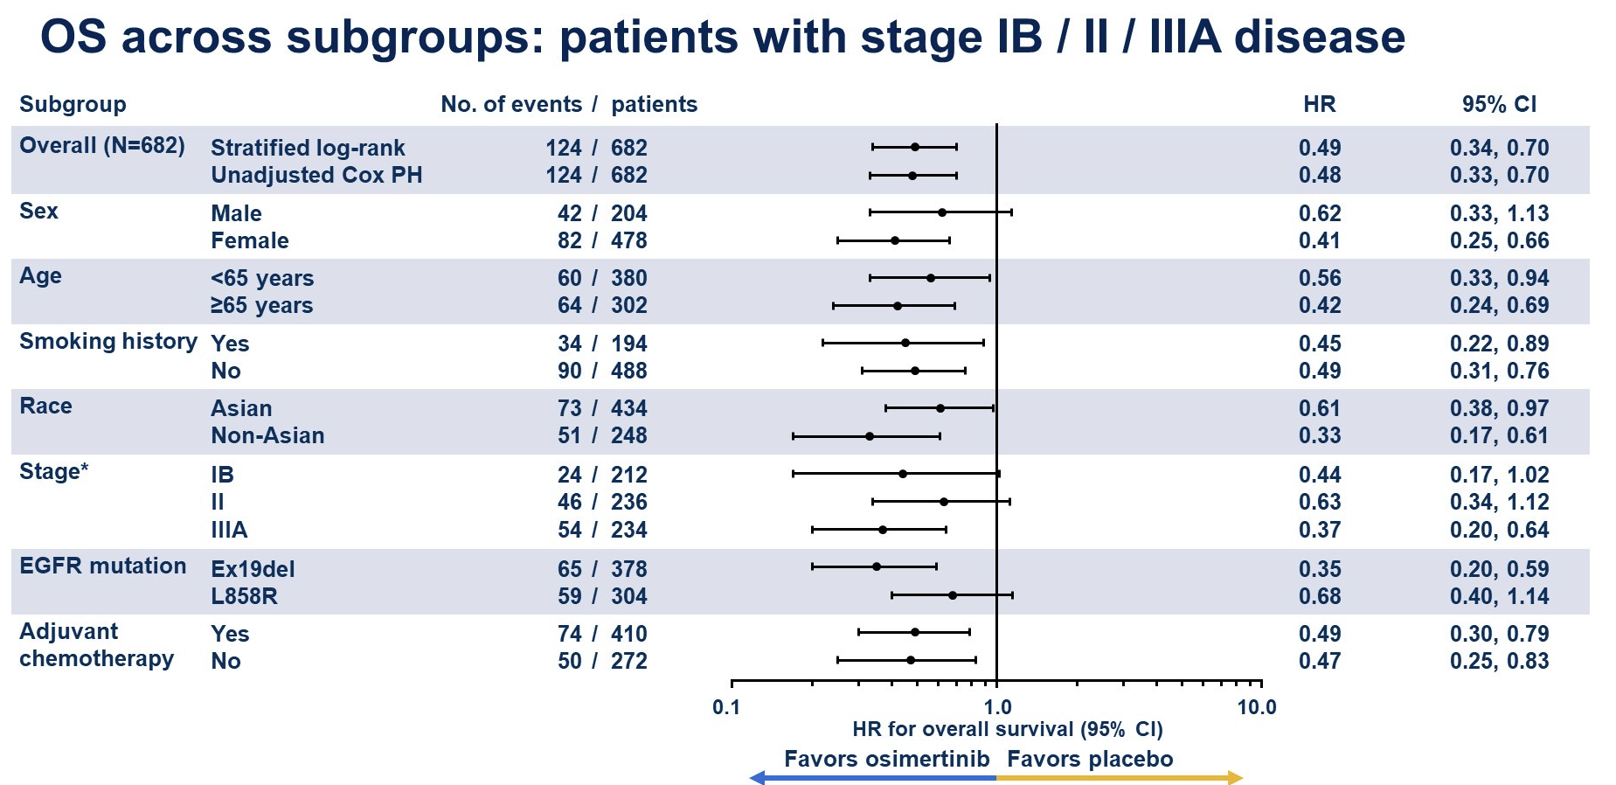
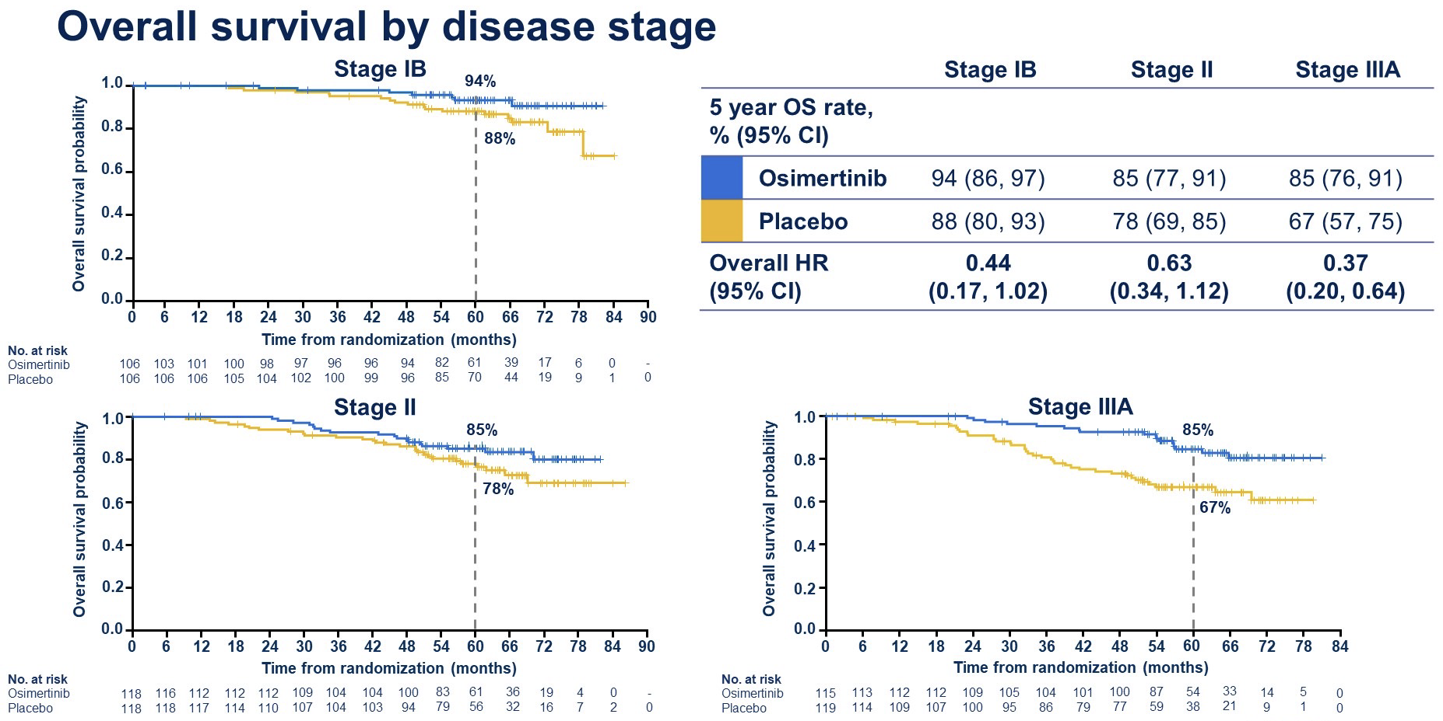
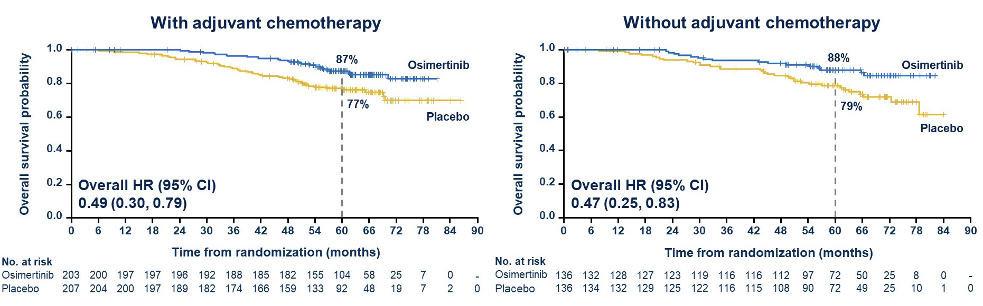
ADAURA trial: Overall Survival
Courtesy of Luis Paz-Ares, MD, PhD
Herbst et al. ESMO 2023

Slide 28
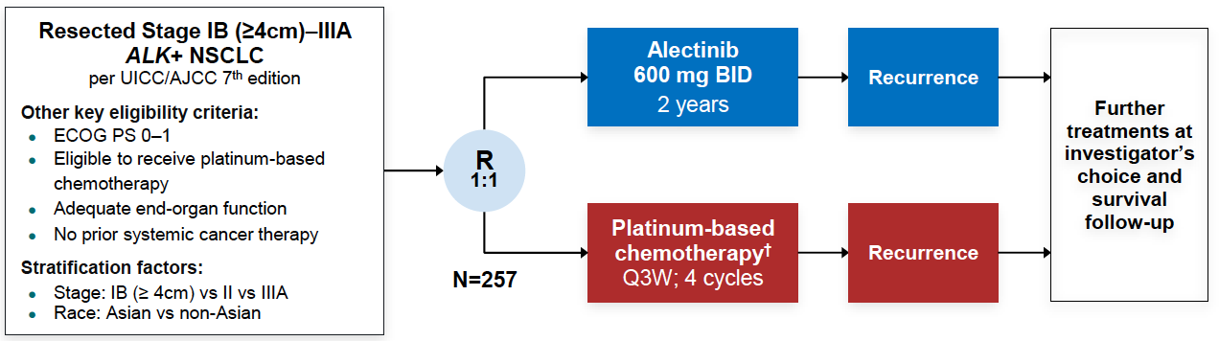
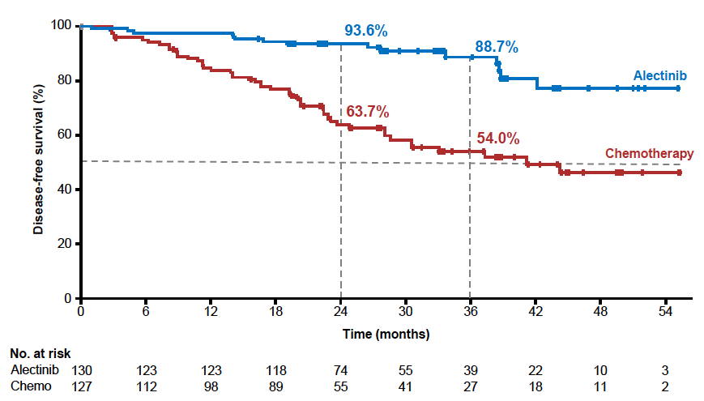


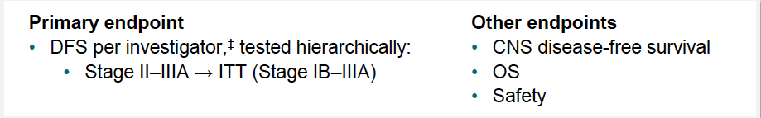
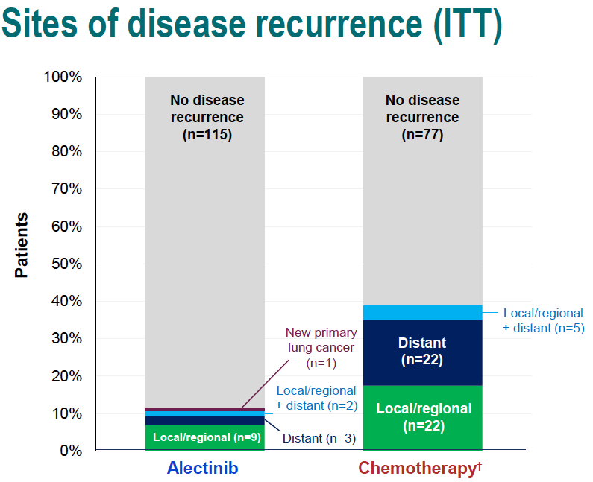
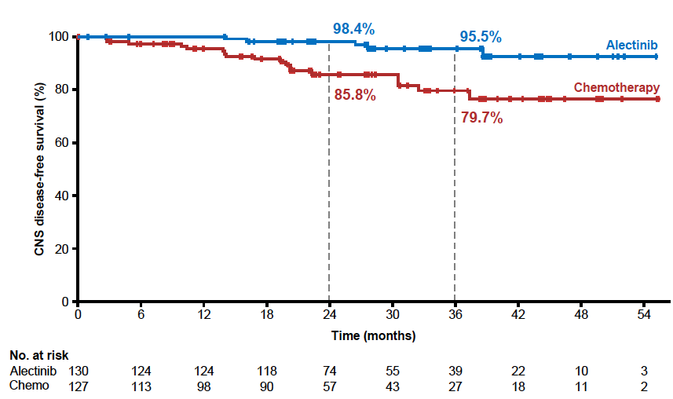
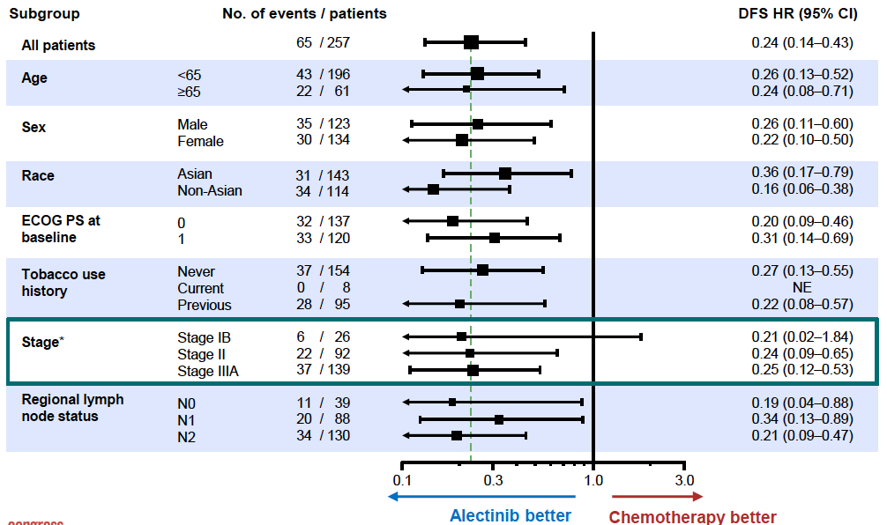
ALINA trial: Adjuvant Alectinib
Courtesy of Luis Paz-Ares, MD, PhD
Solomon et al. ESMO 2023

Slide 29
Agenda
INTRODUCTION
MODULE 1: Localized NSCLC
– Adjuvant Targeted Therapy
– Perioperative Immunotherapy
– Locally Advanced Unresectable NSCLC
MODULE 2: EGFR-Mutated Metastatic NSCLC
MODULE 3: Other Targeted Treatment for Metastatic NSCLC
MODULE 4: Updates on Immunotherapy in Metastatic NSCLC
MODULE 5: Emerging Antibody-Drug Conjugates for Metastatic NSCLC
MODULE 6: Small Cell Lung Cancer

Slide 30
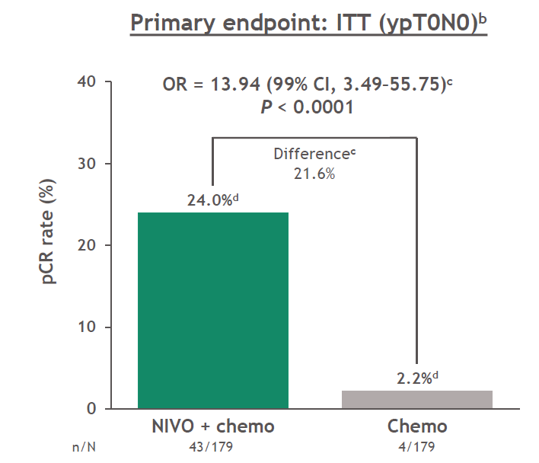
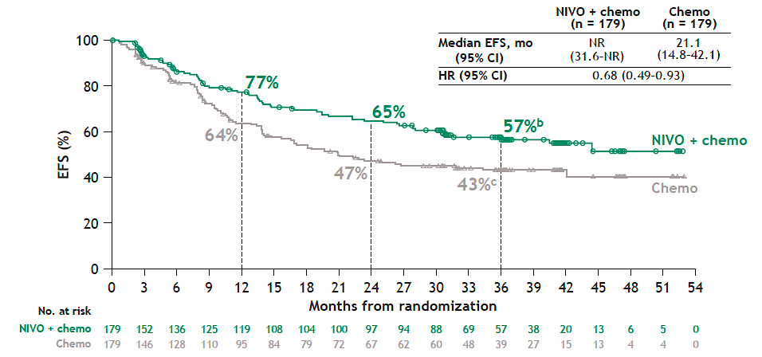
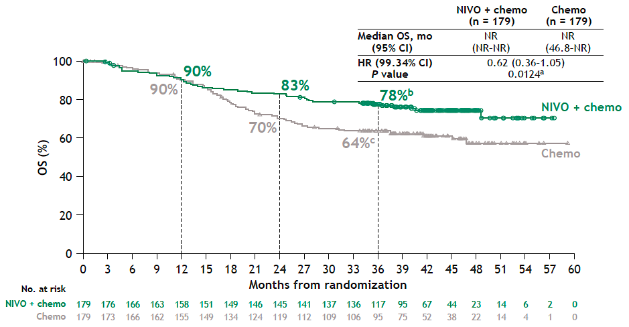
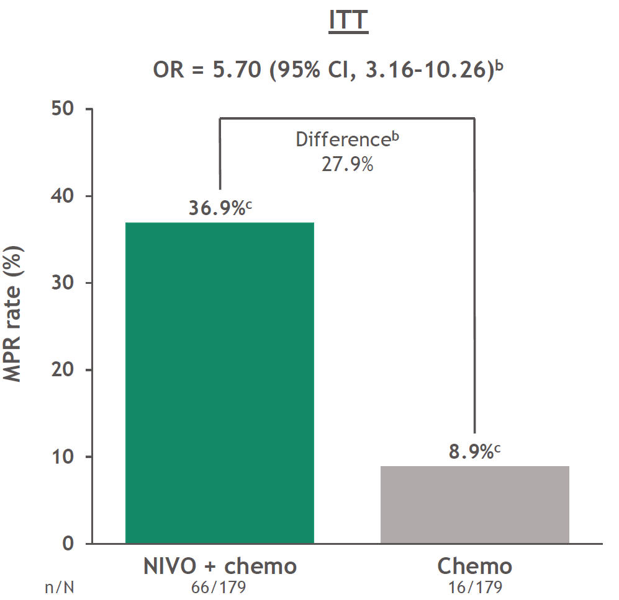
CheckMate 816: efficacy results with 3 years follow-up
Pathological outcomes
EFS and OS outcomes‡§
OR 13.94 (99% CI 3.49, 55.75)*
P<0.0001
Difference
21.8%
24.0%
2.2%
OR 5.70 (99% CI 3.16, 10.26)†
Difference
28.0%
36.9%
8.9%
Courtesy of Luis Paz-Ares, MD, PhD
Spicer J, et al. Oral presentation at ASCO 2021 (Abstract 8503); Girard N, et al. Oral presentation at AACR 2022 (Abstract CT012); Forde PM, et al. N Engl J Med 2022;386:1973–1985; Forde ELCC 2023

Slide 31
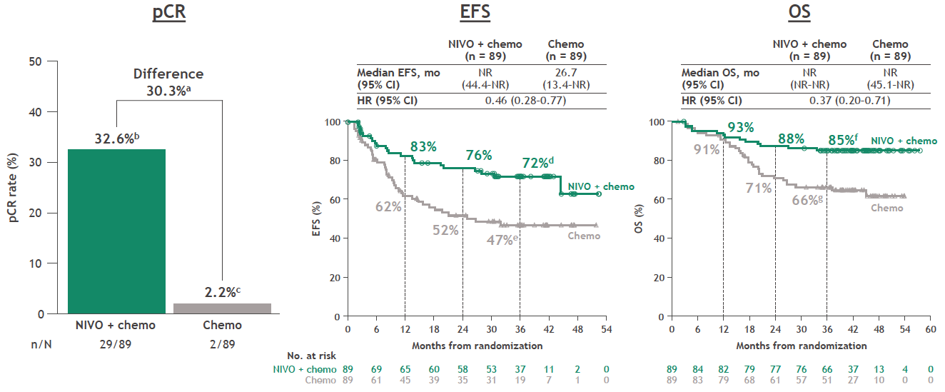
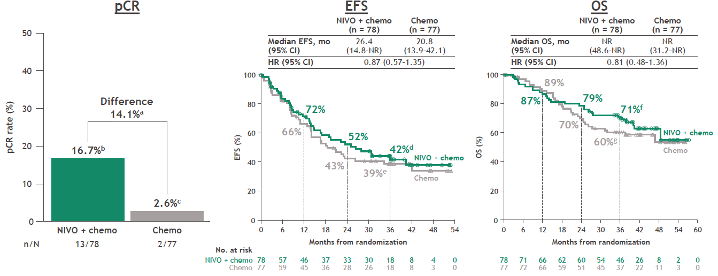
CheckMate 816 trial:
Neoadjuvant CT+Nivo by PD-L1 status
PD-L1 +
PD-L1 -
Courtesy of Luis Paz-Ares, MD, PhD
Pulla MP et al. ESMO 2023

Slide 32
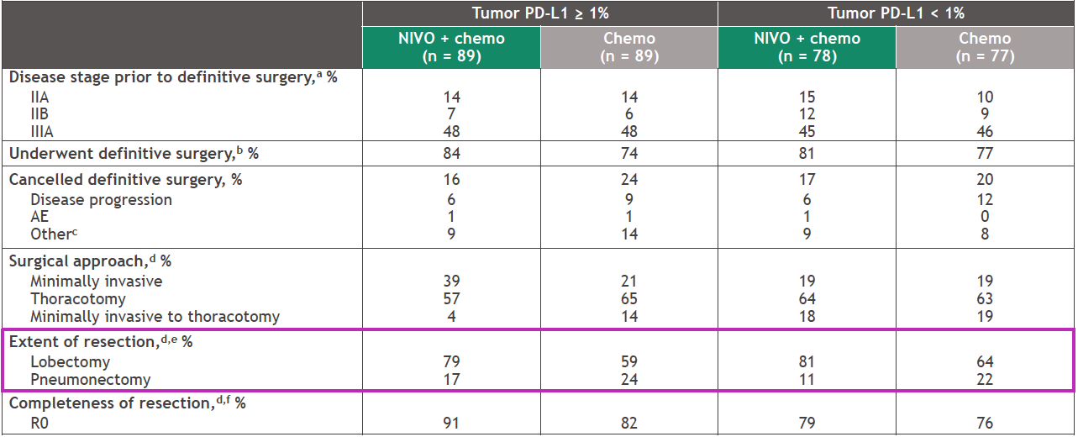
CheckMate 816 trial:
Neoadjuvant CT+Nivo by PD-L1 status
Courtesy of Luis Paz-Ares, MD, PhD
Pulla MP et al. ESMO 2023

Slide 33
Agenda
INTRODUCTION
MODULE 1: Localized NSCLC
– Adjuvant Targeted Therapy
– Perioperative Immunotherapy
– Locally Advanced Unresectable NSCLC
MODULE 2: EGFR-Mutated Metastatic NSCLC
MODULE 3: Other Targeted Treatment for Metastatic NSCLC
MODULE 4: Updates on Immunotherapy in Metastatic NSCLC
MODULE 5: Emerging Antibody-Drug Conjugates for Metastatic NSCLC
MODULE 6: Small Cell Lung Cancer

Slide 34
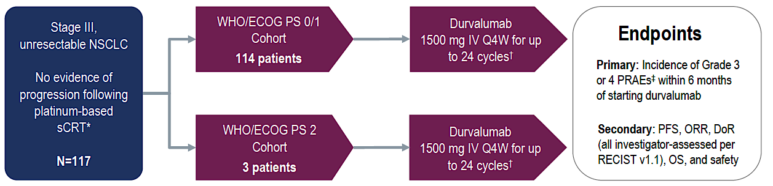
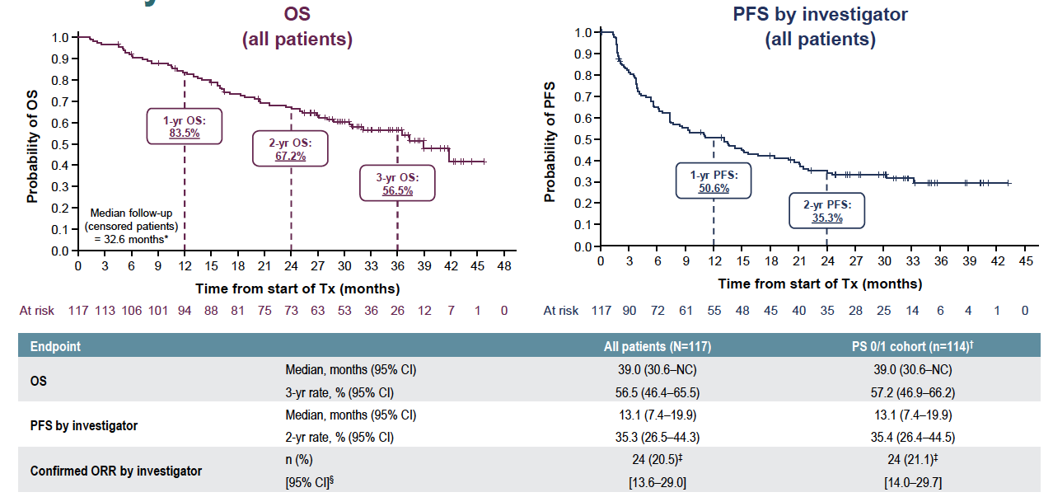
PACIFIC-6 trial – Durvalumab following sequential CT/RT
Courtesy of Luis Paz-Ares, MD, PhD
Garassino et al. ESMO 2023

Slide 35
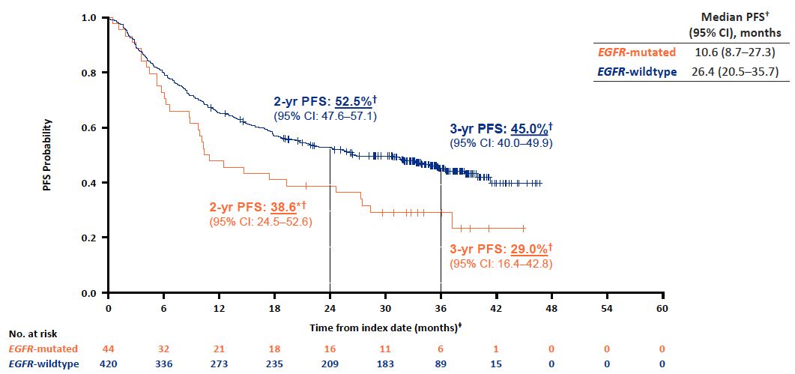
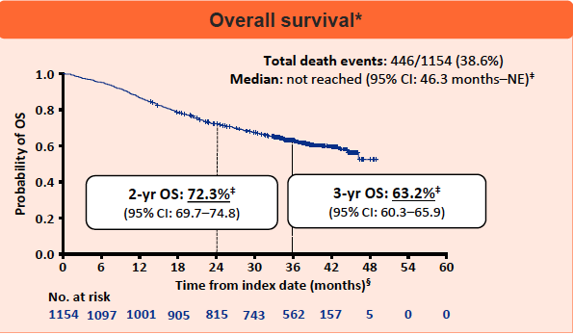
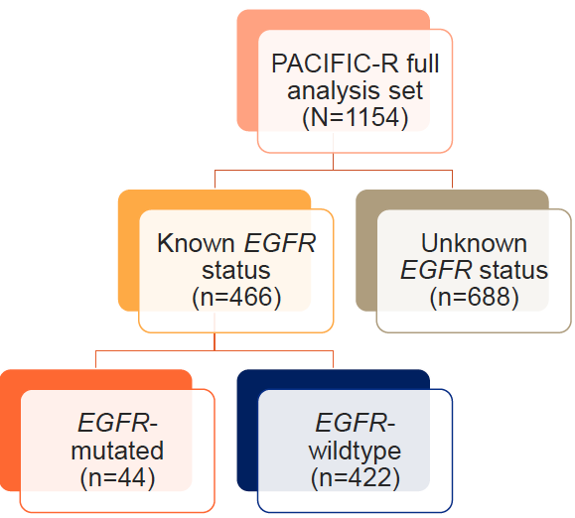
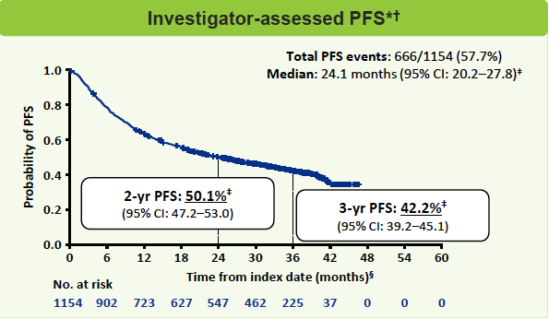
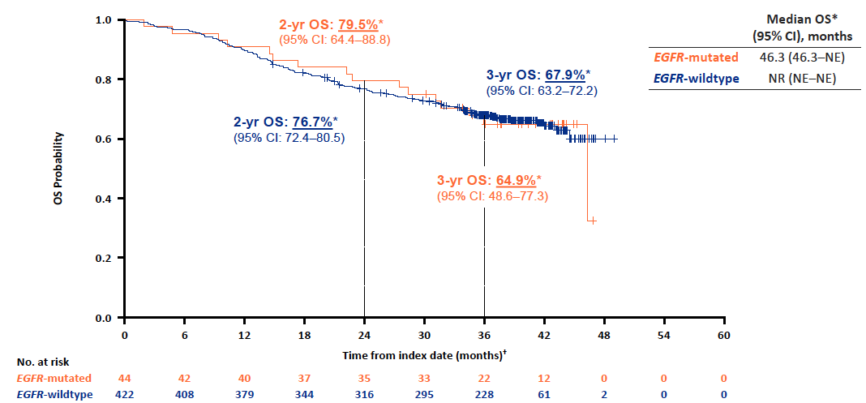
PACIFIC-R – Durvalumab following sequential CT/RT in
EGFR mutant stage III NSCLC
Courtesy of Luis Paz-Ares, MD, PhD
Peters et al. ESMO 2023

Slide 36
Earlier Use of Durvalumab with Chemoradiotherapy Fails in Lung Cancer Study
Press Release – November 14, 2023
“[The manufacturer] announced Tuesday that the Phase III PACIFIC-2 study of durvalumab in patients with unresectable, Stage III non-small-cell lung cancer (NSCLC) failed to meet its primary endpoint of progression-free survival (PFS). The trial investigated concurrent durvalumab administration with chemoradiotherapy (CRT), with the aim of addressing patients who progress or discontinue treatment during CRT.
Durvalumab sequentially administered after platinum-based CRT is the established, global standard of care for the treatment of unresectable, Stage III NSCLC based on results from the Phase III PACIFIC study. ‘Our goal with the PACIFIC-2 trial was to address a remaining unmet need for patients in this setting by introducing immunotherapy even earlier and concurrently administering durvalumab with chemoradiotherapy,’ remarked Susan Galbraith, executive vice president of oncology R&D.”
https://firstwordpharma.com/story/5800631?aid=5800631

Slide 37
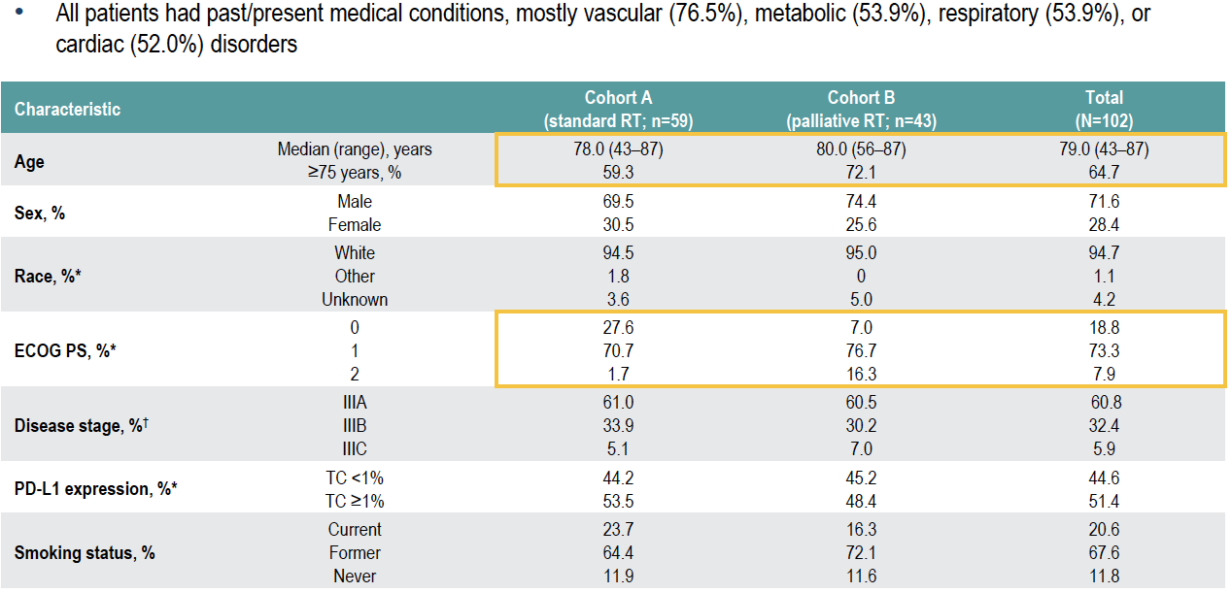
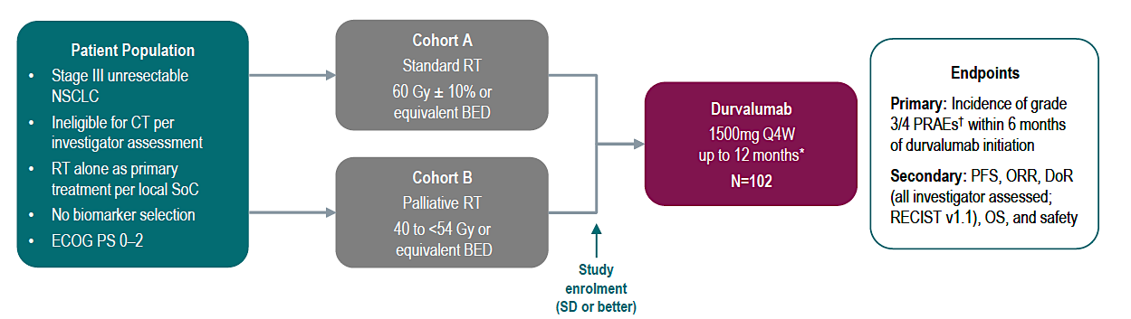
DUART Trial
Durva following RT in stage III NSCLC ineligible to CT
Courtesy of Luis Paz-Ares, MD, PhD
Filippi et al. WLCC 2023

Slide 38
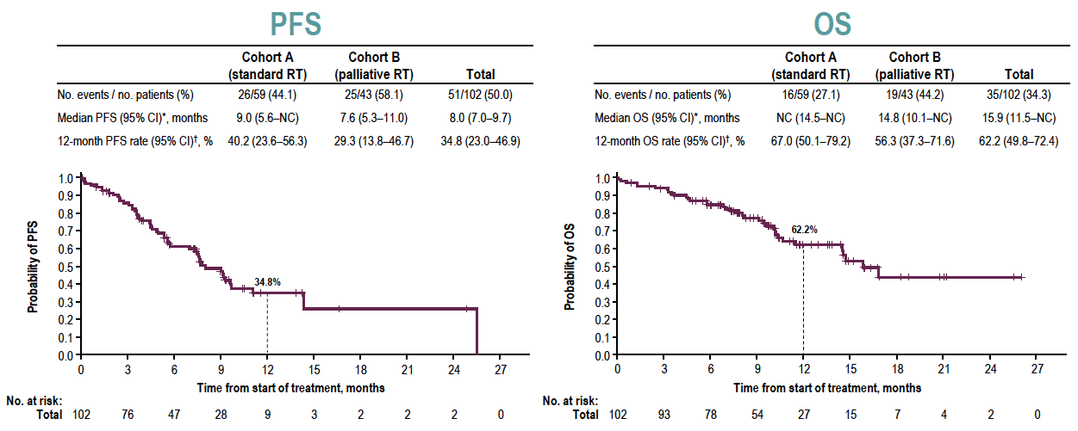
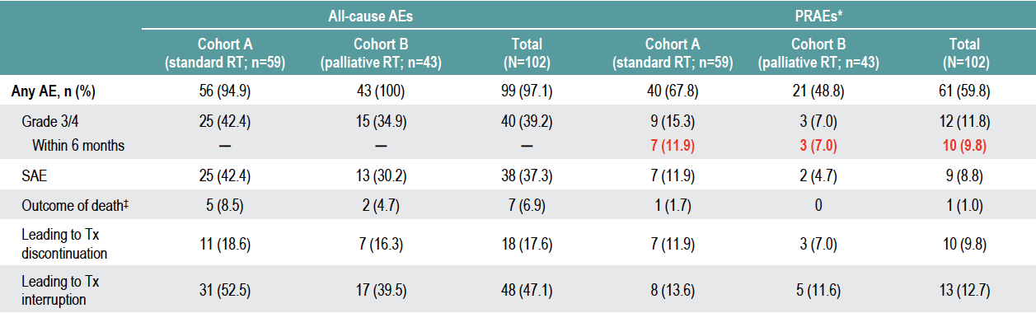
DUART Trial
Durva following RT in stage III NSCLC ineligible to CT
Courtesy of Luis Paz-Ares, MD, PhD
Filippi et al. WLCC 2023

Slide 39
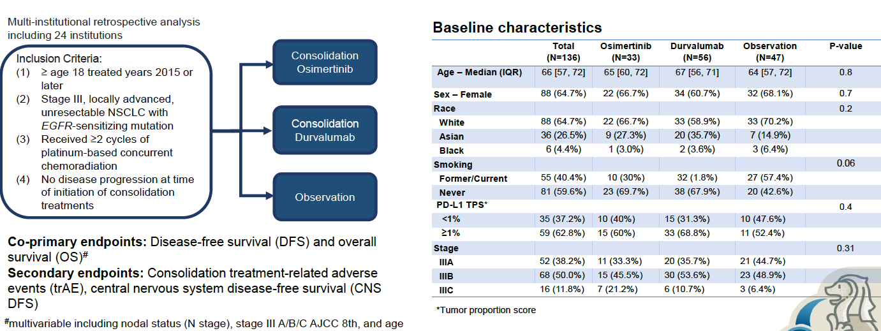
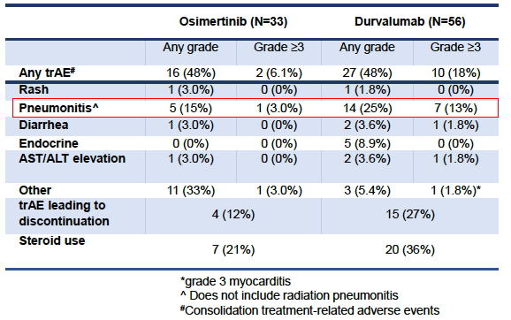
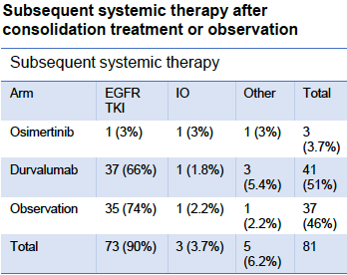
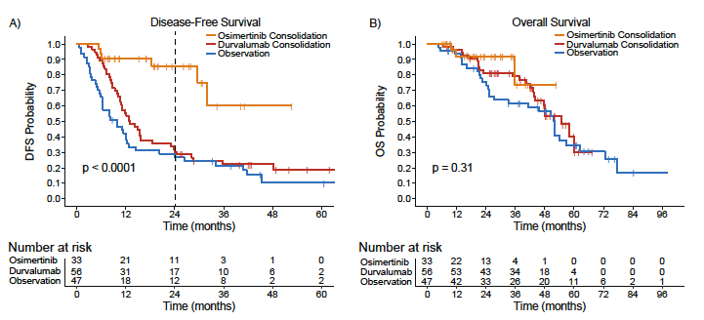
Osimertinib v Durvalumab v Observation following CT/RT in EGFR mutant stage III NSCLC
Courtesy of Luis Paz-Ares, MD, PhD
Nassar et al. WLCC 2023

Slide 40
Dr Paz-Ares: Clinical Case – Non-SCC NSCLC T1N3
42 yo male
Heavy smoker – 63 py
PMH
  Pneumothorax: right lung (1993 - drainage), bilateral (2013 – resection )
  Migraine
Current Problem
  March 2015: Right supraclavicular lymph node
  Diagnosed of RUL Squamous Cell Carcinoma T1N3M0
Courtesy of Luis Paz-Ares, MD, PhD

Slide 41
Dr Paz-Ares: Clinical Case – Non-SCC NSCLC T1N3
42 yo male
Heavy smoker – 63 py
PMH
  Pneumothorax: right lung (1993 - drainage), bilateral (2013 – resection )
  Migraine
Current Problem
  March 2015: Right supraclavicular lymph node
  Diagnosed of RUL Squamous Cell Carcinoma T1N3M0
  PD-L1 ??
Courtesy of Luis Paz-Ares, MD, PhD

Slide 42
Dr Paz-Ares: Clinical Case – Non-SCC NSCLC T1N3
42 yo male
Heavy smoker – 63 py
PMH
  Pneumothorax: right lung (1993 - drainage), bilateral (2013 – resection )
  Migraine
Current Problem
  March 2015: Right supraclavicular lymph node
  Diagnosed of RUL Squamous Cell Carcinoma T1N3M0
  PD-L1 + (5% of cells)
Courtesy of Luis Paz-Ares, MD, PhD

Slide 43
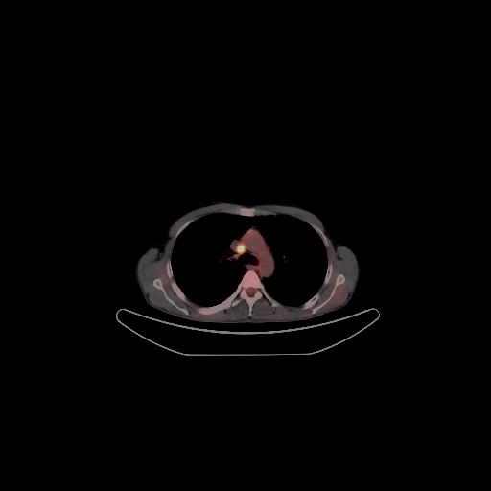
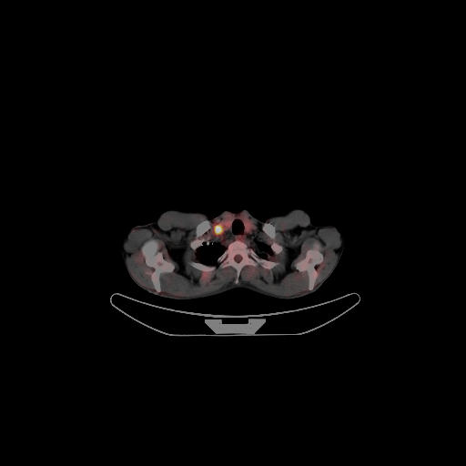
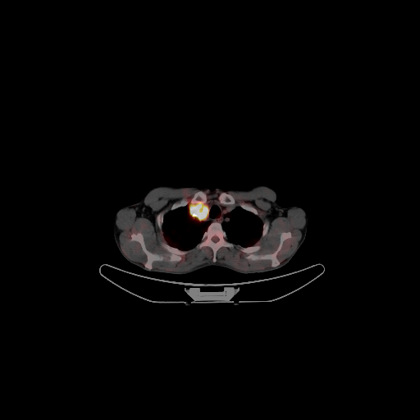
Baseline PET/TC
March 2015
Courtesy of Luis Paz-Ares, MD, PhD

Slide 44
Chemo/xRT Treatment
Cb-Pem x3/xRT (60Gy)
Courtesy of Luis Paz-Ares, MD, PhD

Slide 45
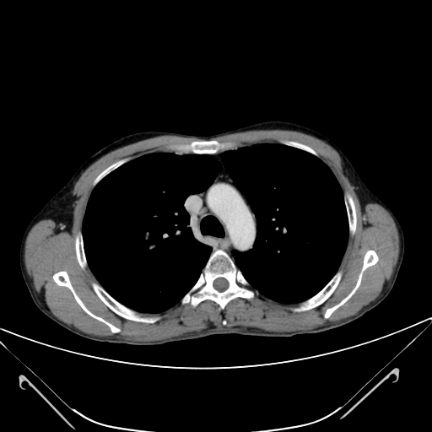
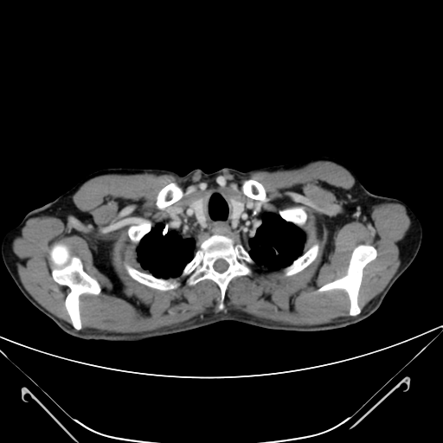
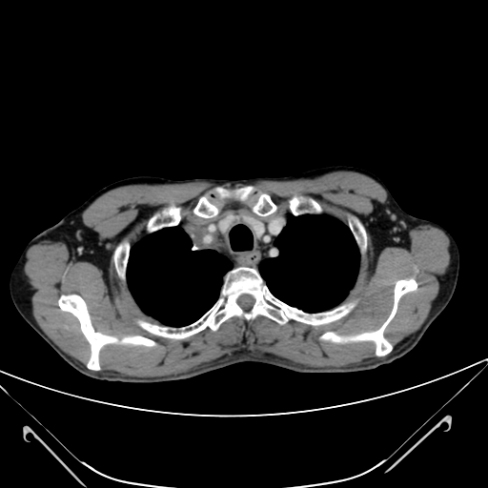
Chemo/xRT Treatment
Cb-Pem x3/xRT (60Gy)
Courtesy of Luis Paz-Ares, MD, PhD

Slide 46
EC PACIFIC
C1 Durvalumab 30/06/15
C5 Durvalumab 24/08/15
26/8/15 Admission due to GI bleeding
Courtesy of Luis Paz-Ares, MD, PhD

Slide 47
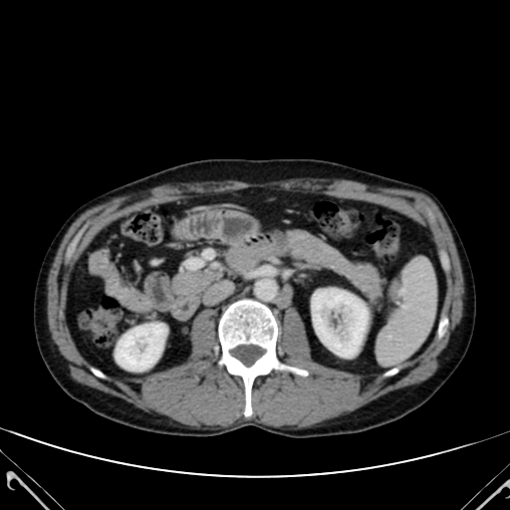
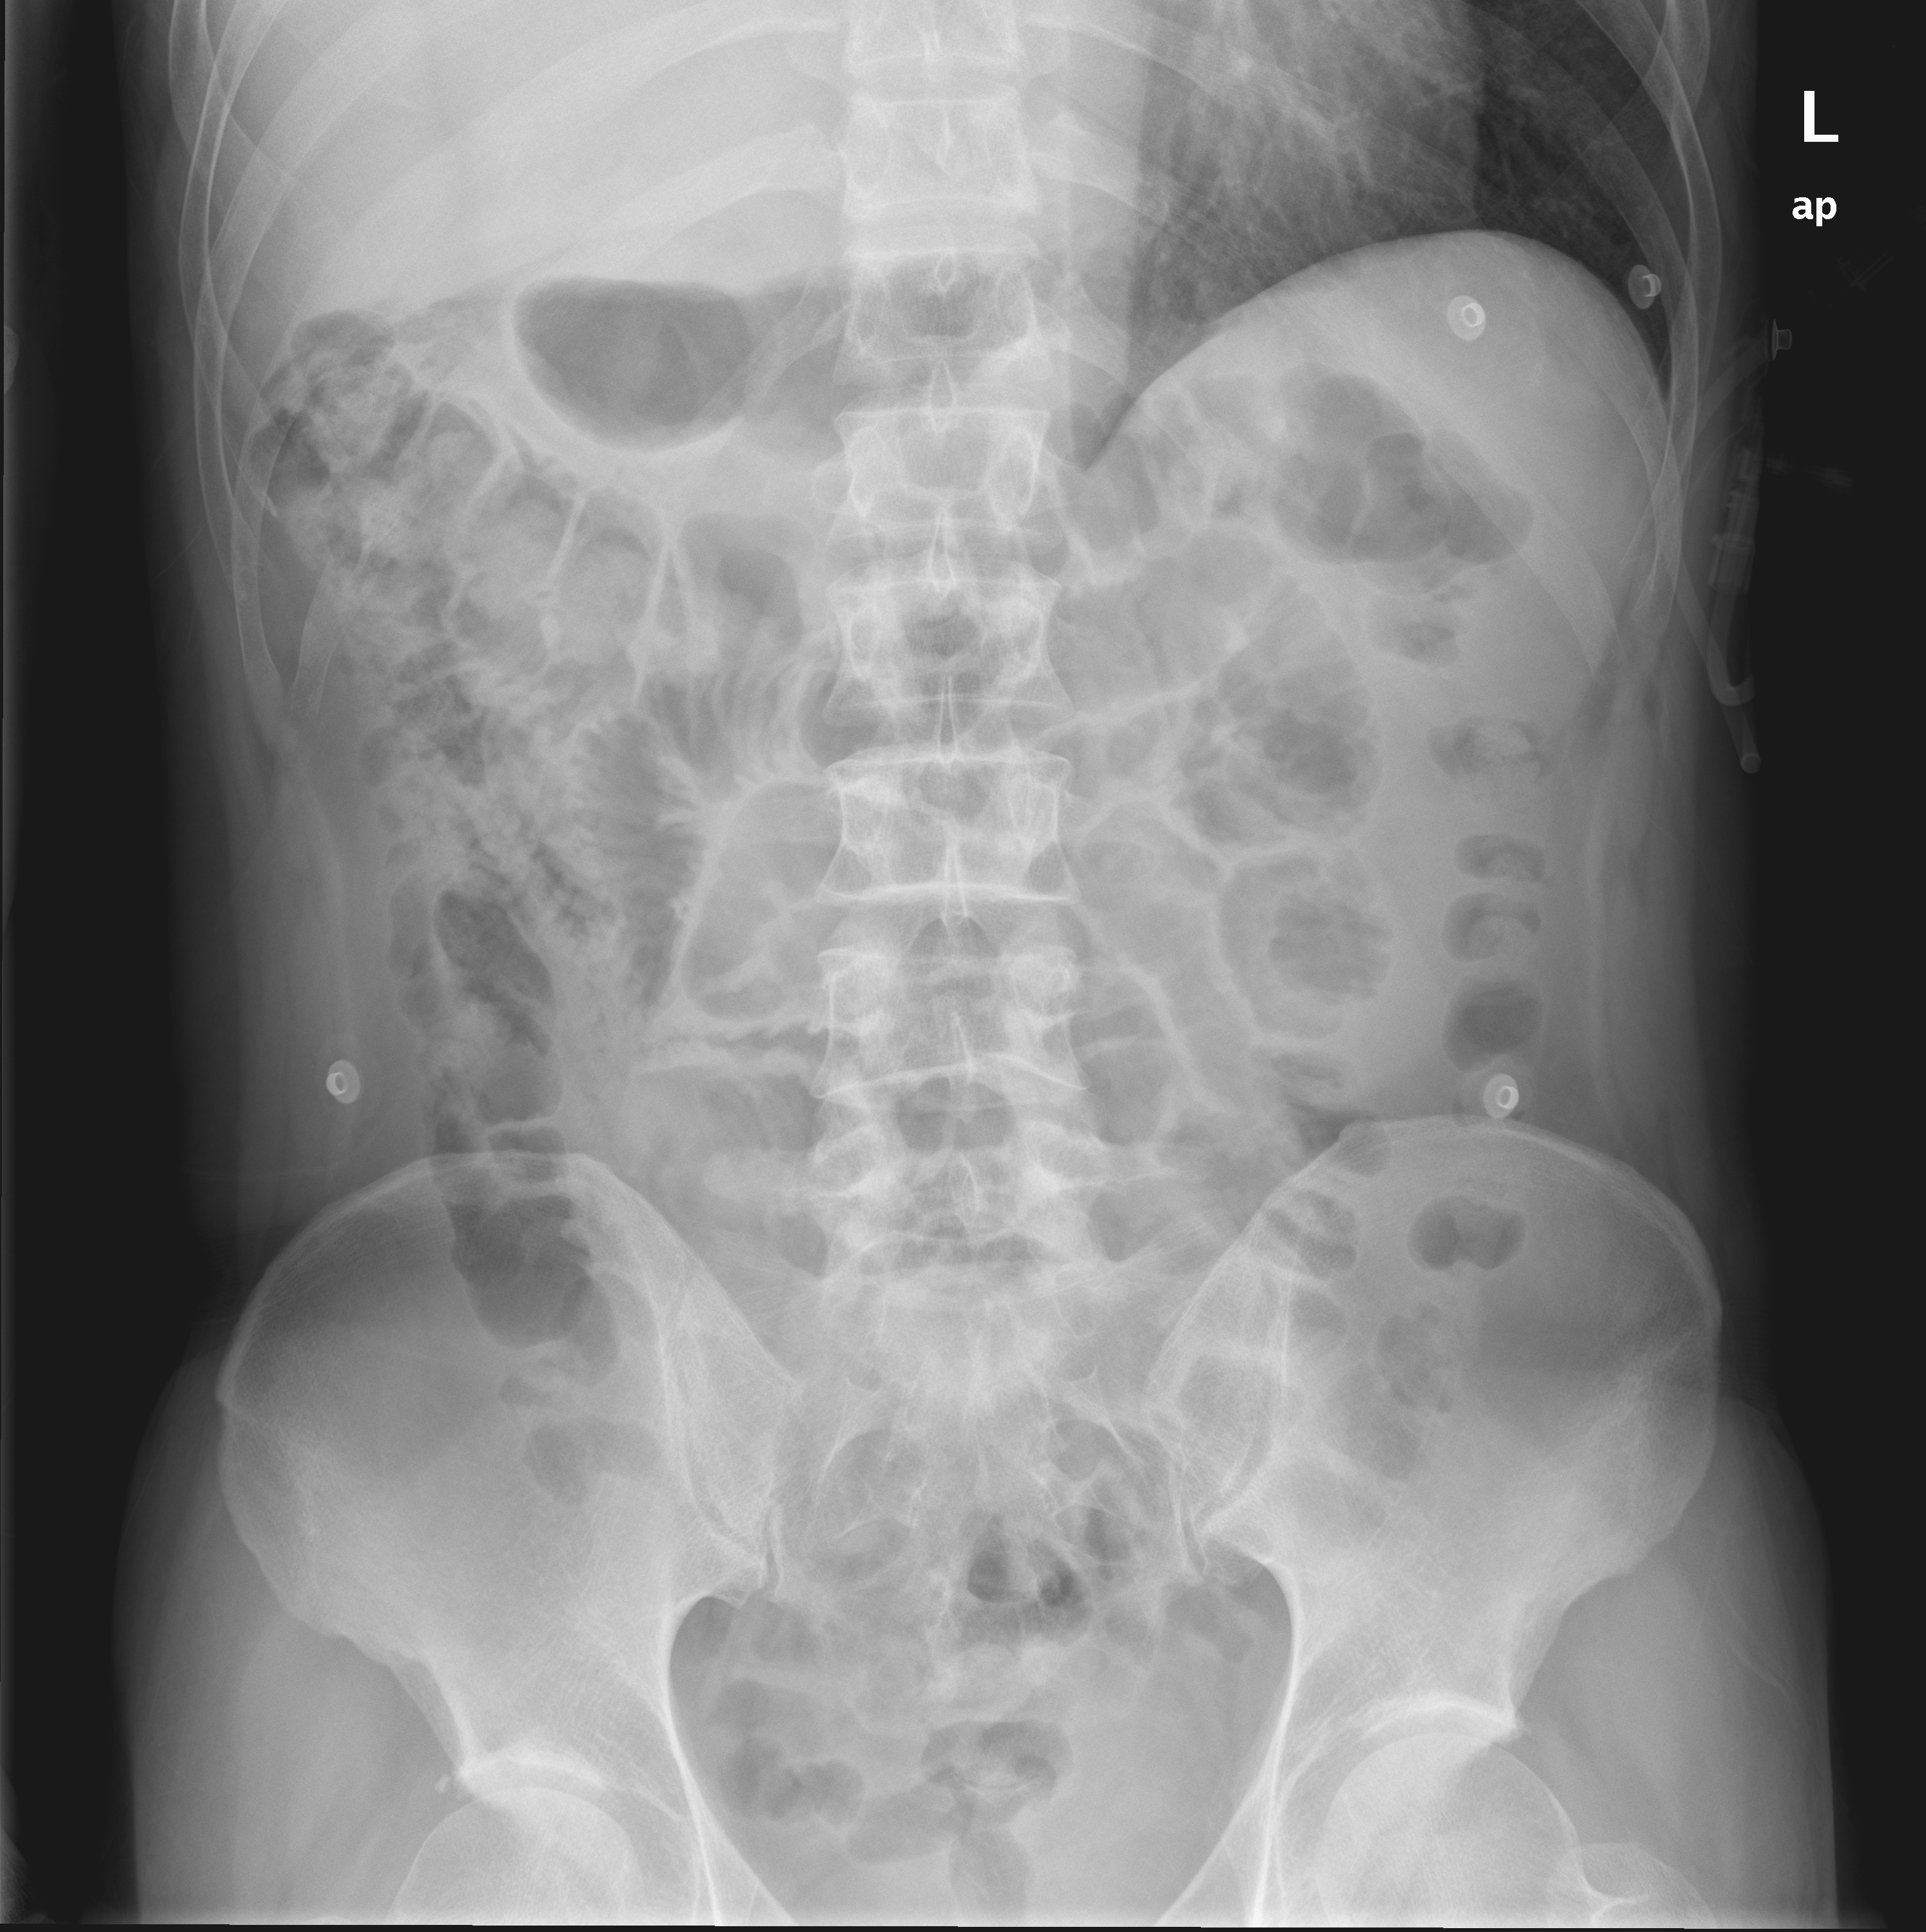
EC PACIFIC
C1 Durvalumab 30/06/15
C5 Durvalumab 24/08/15
26/8/15 Admission due to GI bleeding
Courtesy of Luis Paz-Ares, MD, PhD

Slide 48
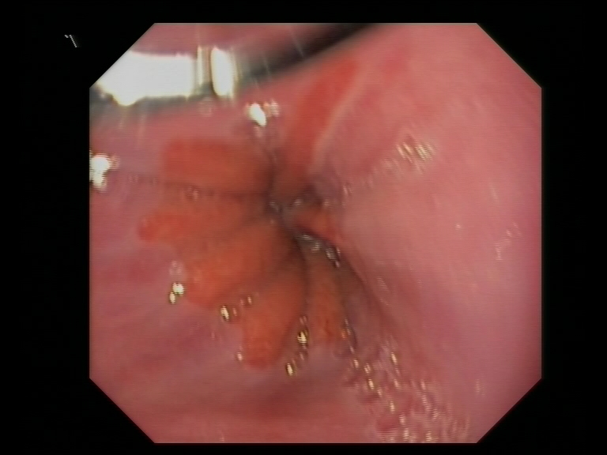
Grade III Jejunitis
Courtesy of Luis Paz-Ares, MD, PhD

Slide 49
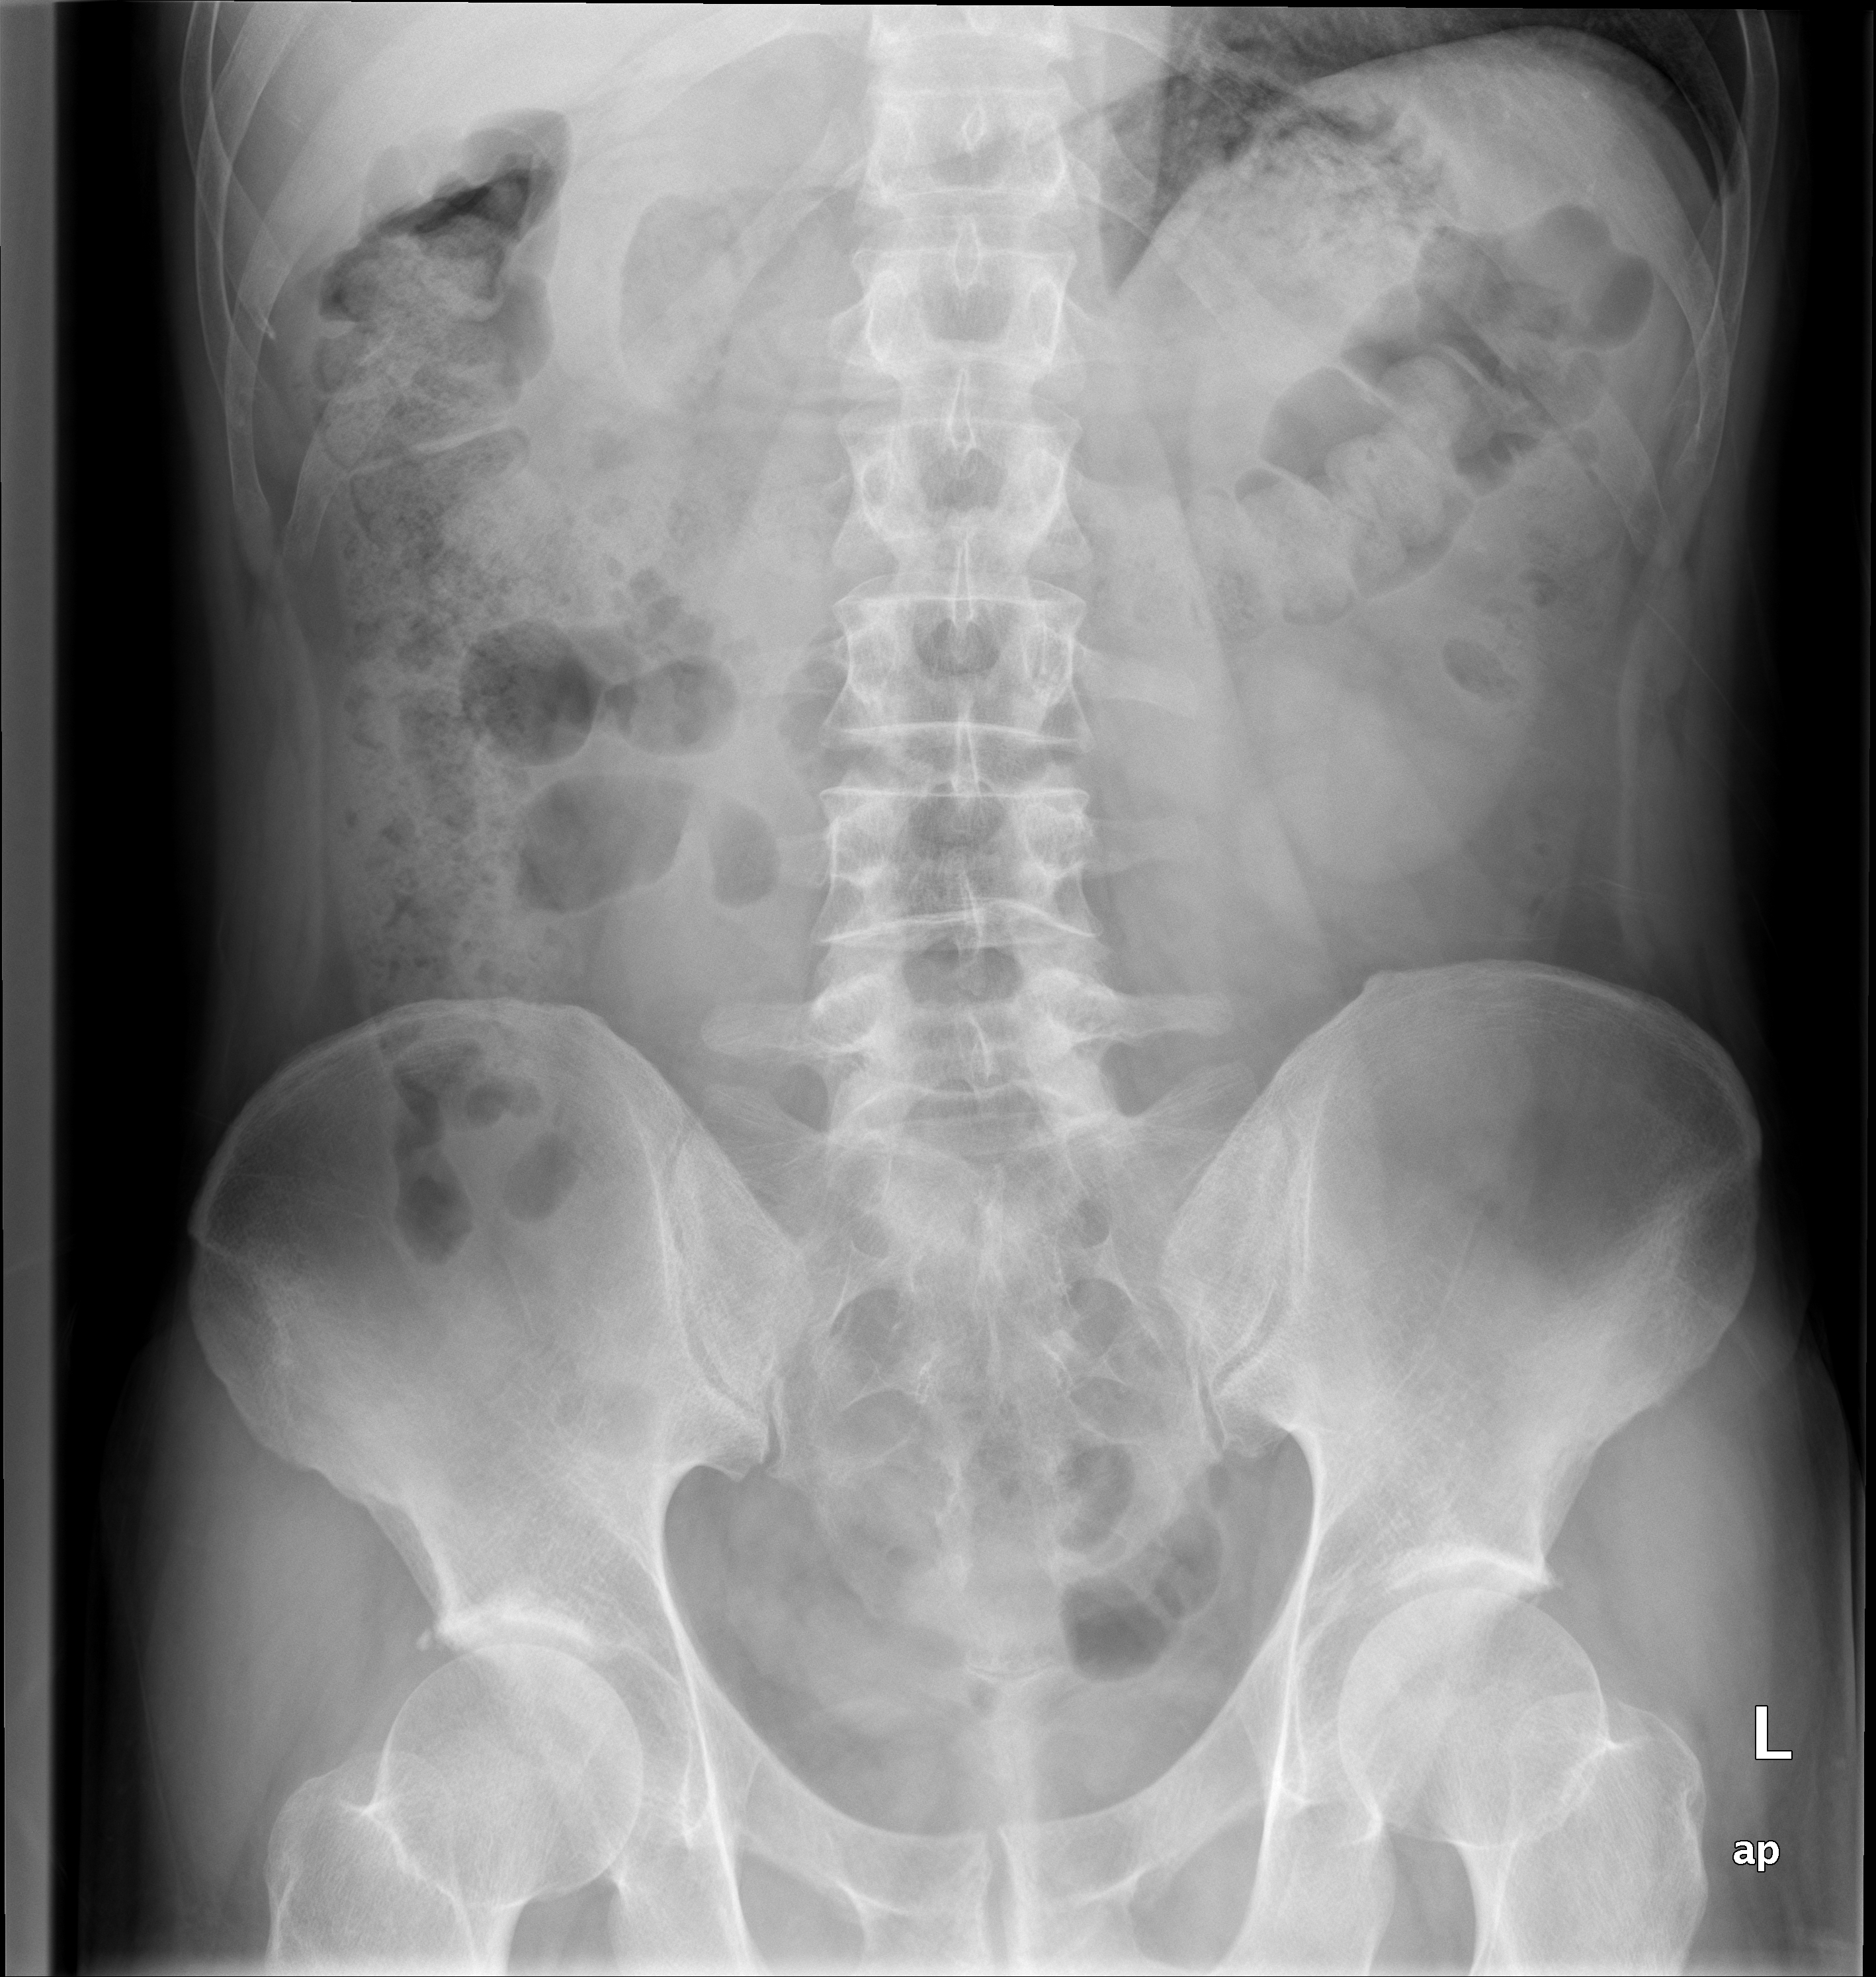
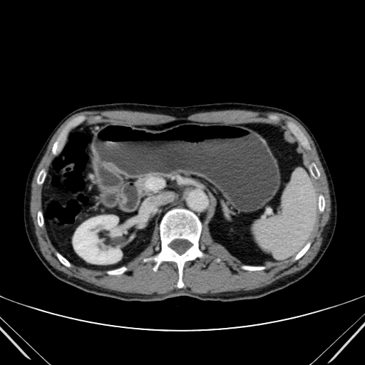
After Prednisolone 1mg/kg
At discharge on 10/9/19
Courtesy of Luis Paz-Ares, MD, PhD

Slide 50
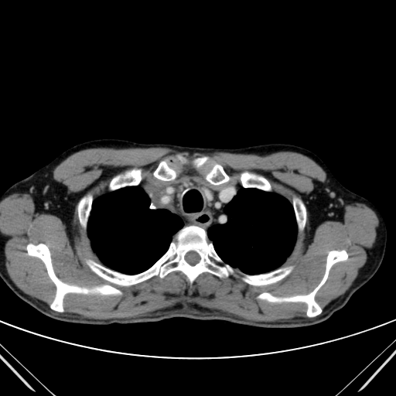


CT Scan in Sept 2015
Courtesy of Luis Paz-Ares, MD, PhD

Slide 51

No rechallenge to Durvalumab
After tapering steroids:
New episode of GI inflammation in Oct 2015
Courtesy of Luis Paz-Ares, MD, PhD

Slide 52



More than 8 years later…
CT Scan in June 3, 2023
Courtesy of Luis Paz-Ares, MD, PhD

Slide 53
Agenda
INTRODUCTION
MODULE 1: Localized NSCLC
MODULE 2: EGFR-Mutated Metastatic NSCLC
– First-Line Treatment
– Second- and Later-Line Treatment
MODULE 3: Other Targeted Treatment for Metastatic NSCLC
MODULE 4: Updates on Immunotherapy in Metastatic NSCLC
MODULE 5: Emerging Antibody-Drug Conjugates for Metastatic NSCLC
MODULE 6: Small Cell Lung Cancer

Slide 54
Agenda
INTRODUCTION
MODULE 1: Localized NSCLC
MODULE 2: EGFR-Mutated Metastatic NSCLC
– First-Line Treatment
– Second- and Later-Line Treatment
MODULE 3: Other Targeted Treatment for Metastatic NSCLC
MODULE 4: Updates on Immunotherapy in Metastatic NSCLC
MODULE 5: Emerging Antibody-Drug Conjugates for Metastatic NSCLC
MODULE 6: Small Cell Lung Cancer

Slide 55

Management of NSCLC with classical EGFR mutations
1st Line
Current
SOC
OSIMERTINIB¹
(mPFS 18.9 mo, oral therapy, well-tolerated)
TKI + Chemotherapy
Osimertinib + Carboplatin/Pemetrexed
FLAURA2
TKI + Bispecific Antibody
Lazertinib + Amivantamab
MARIPOSA
TKI + anti-VEGF therapy
Osimertinib + Ramucirumab
OSIRAM, RAMOSE
1. FLAURA Soria NEJM 2018
Courtesy of Zofia Piotrowska, MD, MHS

Slide 56
FLAURA2 – Outcomes in pts with baseline CNS mets
With CNS Mets
mPFS 13.8 vs. 24.9
HR 0.47 (0.33,0.66)
Time from randomization (months)
Without CNS Mets
mPFS 21 vs. 27.6
HR 0.75 (0.55, 1.03)
Probability of
progression-free survival
These exploratory analyses suggest that patients with baseline CNS metastases may have particular benefit from addition of chemotherapy to osimertinib.
Time from randomization (months)
Janne P, WCLC 2023 and Planchard D, ESMO 2023.
Courtesy of Zofia Piotrowska, MD, MHS

Slide 57
MARIPOSA
Overall Survival (Interim Analysis:)
HR 0.80 (95% CI, 0.61-1.05), p=0.11
Landmark 2-year survival: 74% vs 69%
Cho BC, ESMO 2023, Abstract LBA14.
Courtesy of Zofia Piotrowska, MD, MHS

Slide 58
MARIPOSA
Amivantamab/Lazertinib:
83% Interruption
59% Dose reduction (any agent)
35% Discontinuation (any agent)
Osimertinib:
39% Interruption
5% Dose reduction (any agent)
14% Discontinuation (any agent)
37% patients had VTE on Ami/Lazertinib (median onset 84 days)
Prophylactic anticoagulation is now recommended for the first 4 months of treatment with amivantamab + lazertinib
Cho BC, ESMO 2023, Abstract LBA14.
Courtesy of Zofia Piotrowska, MD, MHS

Slide 59
MARIPOSA
Clinical Implications:
Amivantamab + Lazertinib extends PFS (7.1 month PFS gain, HR 0.70) compared to osimertinib, but requires IV q2 week infusions and increases toxicities (dermatologic, IRRs, VTE).
If approved, Ami/Lazer will represent another first-line treatment option to be discussed with patients, but given toxicity concerns and lack of OS benefit with either MARIPOSA or FLAURA2 thus far, osimertinib monotherapy remains a reasonable first-line option.
Future Directions:
OS data are needed
Better biomarkers and risk stratification strategies are needed.
Courtesy of Zofia Piotrowska, MD, MHS

Slide 60
Agenda
INTRODUCTION
MODULE 1: Localized NSCLC
MODULE 2: EGFR-Mutated Metastatic NSCLC
– First-Line Treatment
– Second- and Later-Line Treatment
MODULE 3: Other Targeted Treatment for Metastatic NSCLC
MODULE 4: Updates on Immunotherapy in Metastatic NSCLC
MODULE 5: Emerging Antibody-Drug Conjugates for Metastatic NSCLC
MODULE 6: Small Cell Lung Cancer

Slide 61

Managing Progression on EGFR TKIs
Resistance Mechanisms to First-Line Osimertinib
Treatment Options for Patients with no Targetable Resistance Mechanisms:
MARIPOSA-2 (Chemo + Amivantamab +/- Lazertinib)
HERTHENA-Lung 01 - Patritumab Deruxtecan (HER23 ADC)
Treatment Options for Patients with MET Amp after Osimertinib
Tepotinib + Osimertinib (Final Analysis of INSIGHT-2)
N=129
Tissue Biopsies
Piotrowska Z, ASCO 2023 Abstract 9108
Courtesy of Zofia Piotrowska, MD, MHS

Slide 62
MARIPOSA-2 - Summary
Clinical Implications:
Adding Amivantamab or Ami/Lazertinib to Carbo/Pem post-TKIs improves ORR, mPFS and intracranial PFS, but also increases toxicities.
If approved, Amivantamab/Chemotherapy will be a post-TKI option, and will be particularly appealing for high risk patients (e.g., CNS mets, high disease burden)
Future Directions:
A delayed regimen with Lazertinib added after carboplatin is complete is being evaluated.
Biomarker analyses will be important for patient selection.
Courtesy of Zofia Piotrowska, MD, MHS

Slide 63


HERTHENA-Lung01: Patritumab Deruxtecan
Patritumab Deruxtecan: HER3-directed ADC with Topoisomerase I Inh payload
Prior EGFR TKI and PBC (n=225):
Confirmed ORR: 29.8% (23.9-36.2)
mPFS: 5.5 months (5.1-5.9)
Courtesy of Zofia Piotrowska, MD, MHS
Yu HA, WCLC 2023

Slide 64
HERTHENA-Lung01: CNS Outcomes
Patritumab Deruxtecan appears to have intracranial activity, with a CNS ORR 33%, and may delay intracranial progression.
Among 8 pts with CR, 8 had non-target lesions.
Courtesy of Zofia Piotrowska, MD, MHS
Johnson M, ESMO 2023

Slide 65
HERTHENA-Lung 01 - Summary
Clinical Implications:
Patritumab deruxtecan has broad activity in EGFRm NSCLC post-TKI and post-chemotherapy, including patients with various resistance mechanisms.
Intracranial responses have been observed, which will be important as post-osimertinib options with CNS activity are very limited.
If approved, this drug will represent a new post-TKI treatment option for EGFRm lung cancer.
Future Directions:
Combination studies of Patritumab +/- Osimertinib are ongoing in the first and second line.
Courtesy of Zofia Piotrowska, MD, MHS

Slide 66



INSIGHT 2
Outcomes were similar whether MET amp was detected by tissue testing (FISH) or ctDNA (NGS), with highest response rates observed in patients with high-level MET amp.
Osimertinib + Tepotinib – ORR 50%, mPFS 5.6 mos
Osimertinib + Tepotinib had intracranial activity
Tepotinib monotherapy– ORR 8% (n=12)
Courtesy of Zofia Piotrowska, MD, MHS
Kim TM, WCLC 2023, Abstract OA21.05

Slide 67
INSIGHT 2: Summary
Clinical Implications:
MET amplification is among the most commonly observed resistance mechanisms to first-line osimertinib (~15-20% patients) and can be detected by tissue and ctDNA (though ctDNA sensitivity is limited.)
The primary results of INSIGHT 2 are consistent with other studies (TATTON, SAVANNAH), demonstrating the efficacy of combined EGFR + MET inhibition for patients with acquired MET amp after osimertinib.
If approved, combined MET + EGFR will likely become the preferred treatment for patients with MET amp (off-label use can be considered in select patients.)
Future Directions:
Randomized studies of EGFR/MET inhibitors vs. Carboplatin/Pemetrexed are ongoing.
Courtesy of Zofia Piotrowska, MD, MHS

Slide 68



Dr Piotrowska: EGFR-mutated metastatic NSCLC
68yo F with no history of tobacco use, h/o mild anxiety, presented to a local ED with several weeks of progressive dyspnea on exertion. She was found to have a large pericardial effusion with tamponade physiology.
Underwent emergent pericardiocentesis.
  Pleural fluid cytology + for adenocarcinoma.
Full staging scans:
  PET/CT: FDG-avid, 3cm RUL mass, R hilar and mediastinal LAD, adrenal nodule.
  Brain MRI: 7mm occipital lesion, 9 mm R frontal lobe lesion.
ctDNA NGS: EGFR L858R, TP53 mutation.
She initiated first-line osimertinib with good systemic and CNS response.
After 14 months, she was noted to have progressive systemic disease with increased pericardial nodules. Brain MRI remained stable.

Slide 69

Dr Piotrowska: EGFR-mutated metastatic NSCLC, continued
Post-osimertinib ctDNA NGS: EGFR L858R, TP53 mutation and acquired EGFR L718Q, L718V mutations.
She initiated second-line carboplatin/pemetrexed, followed by pemetrexed maintenance (10 total cycles) with further disease progression in the thorax.
What treatment options should be considered now?
  Patritumab deruxtecan (if available)
  Amivantamab/Lazertinib (if available)
  Docetaxel
  Afatinib
ctDNA testing after first-line osimertinib

Slide 70
Agenda
INTRODUCTION
MODULE 1: Localized NSCLC
MODULE 2: EGFR-Mutated Metastatic NSCLC
MODULE 3: Other Targeted Treatment for Metastatic NSCLC
– EGFR Exon 20 Insertions
– HER2 Mutations
– RET Fusions
MODULE 4: Updates on Immunotherapy in Metastatic NSCLC
MODULE 5: Emerging Antibody-Drug Conjugates for Metastatic NSCLC
MODULE 6: Small Cell Lung Cancer

Slide 71
Agenda
INTRODUCTION
MODULE 1: Localized NSCLC
MODULE 2: EGFR-Mutated Metastatic NSCLC
MODULE 3: Other Targeted Treatment for Metastatic NSCLC
– EGFR Exon 20 Insertions
– HER2 Mutations
– RET Fusions
MODULE 4: Updates on Immunotherapy in Metastatic NSCLC
MODULE 5: Emerging Antibody-Drug Conjugates for Metastatic NSCLC
MODULE 6: Small Cell Lung Cancer

Slide 72
Management of EGFR Exon 20 Insertions
Management of EGFR exon 20 insertions pre-ESMO:
The current first-line standard of care for EGFR exon 20 insertions is platinum-pemetrexed chemo (+/- immunotherapy).
Amivantamab (bispecific EGFR/MET ab) has accelerated approval in the post-chemotherapy setting (ORR 40%, mPFS 8.3 mo¹)
Mobocertinib (oral EGFR inhibitor) is being voluntarily withdrawn from the US market after randomized first-line trial was stopped for futility².
Other new EGFR exon 20-directed TKIs are in clinical trials.
1. Park K, et al, JCO 2021; 2. https://www.takeda.com/newsroom/newsreleases/2023/Takeda-Provides-Update-on-EXKIVITY-mobocertinib/
Courtesy of Zofia Piotrowska, MD, MHS

Slide 73
PAPILLON: Amivantamab + Chemo for EGFR ex20ins
Girard N, ESMO 2023.
Courtesy of Zofia Piotrowska, MD, MHS

Slide 74
PAPILLON: Amivantamab + Chemo for EGFR ex20ins
ORR 73 vs 47%
Girard N, ESMO 2023.
Courtesy of Zofia Piotrowska, MD, MHS

Slide 75
PAPILLON Safety
Lazertinib adds dermatologic toxicities, edema, and increases risk of neutropenia vs. chemotherapy.
Dose reductions were required in 48% Ami/Chemo vs. 23% of Chemo pts.
24% pts on Ami/Chemo discontinued an agent, vs. 10% on chemo.
Girard N, ESMO 2023.
Courtesy of Zofia Piotrowska, MD, MHS

Slide 76
PAPILLON - Summary
Clinical Implications:
Adding Amivantamab to Chemotherapy significantly improved ORR and PFS for patients with EGFR exon 20 insertion+ NSCLC.
Testing for EGFR exon 20 is critical for selection of optimal therapy.
If approved, Chemo + Ami will likely become the preferred first-line treatment for patients (acknowledging increased toxicities)
Future Directions:
Multiple studies of novel, selective exon 20-specific TKIs are ongoing and may change our first-line standard of care in the future.
Courtesy of Zofia Piotrowska, MD, MHS

Slide 77
Agenda
INTRODUCTION
MODULE 1: Localized NSCLC
MODULE 2: EGFR-Mutated Metastatic NSCLC
MODULE 3: Other Targeted Treatment for Metastatic NSCLC
– EGFR Exon 20 Insertions
– HER2 Mutations
– RET Fusions
MODULE 4: Updates on Immunotherapy in Metastatic NSCLC
MODULE 5: Emerging Antibody-Drug Conjugates for Metastatic NSCLC
MODULE 6: Small Cell Lung Cancer

Slide 78


HER2-mutant NSCLC
DESTINY-Lung 01
HER2-mutated cohort (N=91):
  ORR 55% (95% CI, 44–65%)
  mPFS 8.2 mo (95% CI, 6.0–11.9 mo)
  mOS 17.8 mo (95% CI, 13.8–22.1 mo)
Adjudicated drug-related ILD occurred in 26% pts, with 2/91 deaths.
DESTINY-Lung02:
Study Design
Li B, et al, NEJM 2022
Courtesy of Zofia Piotrowska, MD, MHS
Janne P, WCLC 2023, Abstract MA13.20

Slide 79




DESTINY-Lung02
Janne P, WCLC 2023, Abstract MA13.20
 | 5.4mg/kg N=102 | 6.4mg/kg N=50
Conf ORR | 49% (39-59.1) | 56% (41.3-70)
mDOR | 16.8 mo (6.4-NE) | NE (8.3-NE)
Median PFS | 9.9 mo (7.4-NE) | 15.4 mo (8.3-NE)
Median F/U | 11.5 mo | 11.8mo
Safety in DL-02
8/11/22: US FDA granted accelerated approval to T-DXd for NSCLC with activating HER2 mutations, who have received a prior systemic therapy. The recommended dose is 5.4mg/kg IV q3 weeks.
Courtesy of Zofia Piotrowska, MD, MHS

Slide 80


CNS Outcomes with Trastuzumab Deruxtecan
 | 5.4mg/kg (DL02) No prior Rx N=6 | Pooled 6.4mg/kg (DL-01/DL-02) No prior Rx N=16
IC –cORR | 3/6 (50%) | 6/16 (37.5%)
IC- DoR, median | 9.5 mo | 5.6 mo
Planchard D, ESMO 2023
Courtesy of Zofia Piotrowska, MD, MHS

Slide 81

Trastuzumab Deruxtecan in HER2-mutant NSCLC
Clinical Implications:
DESTINY-Lung02 confirms efficacy of T-DXd in HER2m NSCLC at the approved dose of 5.4mg/kg IV q3 weeks, with lower rates of toxicities, especially ILD (12%).
T-DXd has CNS activity with an intracranial ORR of 50% (7/14 pts) including 3 CRs at 5.4mg/m2.
Future Directions:
DESTINY-Lung04
HER2-selective, EGFR-
sparing TKIs are also now
in clinical trials
Courtesy of Zofia Piotrowska, MD, MHS
Li B, J Clin Oncol 40, 2022 (suppl 16; abstr TPS9137)

Slide 82
Dr Piotrowska: HER2-mutated metastatic NSCLC
65 yo F with no history of tobacco use, history of hypothyroidism who presented with subacute cough and shortness of breath.
Scans showed a 4cm LUL lung mass with mediastinal adenopathy and a lytic lesion of T10. Brain MRI at diagnosis showed 3 subcentimeter metastases.
Bronchoscopy/EBUS and biopsy of level 4L LN: lung adenocarcinoma, PDL1 negative.
NGS– HER2 exon 20 insertion, A775_G776insYVMA, TP53 mutation
She received first-line Carboplatin/Pemetrexed/Pembrolizumab x 4 cycles, followed by 6 cycles of Pemetrexed/Pembrolizumab maintenance.
She developed progressive bone metastases, new CNS metastasis.

Slide 83

Dr Piotrowska: HER2-mutated metastatic NSCLC, continued
She received SRS to the new CNS metastasis.
She started second-line Trastuzumab Deruxtecan, 5.4mg/kg IV q3 weeks.
Restaging scans showed decrease in LUL mass, stable osseous and CNS metastases.
After 6 months on Trastuzumab Deruxtecan, she was noted to have new groundglass opacities in the RLL. She had no associated shortness of breath, cough or respiratory symptoms.
What is the most appropriate course of action at this point?

Slide 84
Agenda
INTRODUCTION
MODULE 1: Localized NSCLC
MODULE 2: EGFR-Mutated Metastatic NSCLC
MODULE 3: Other Targeted Treatment for Metastatic NSCLC
– EGFR Exon 20 Insertions
– HER2 Mutations
– RET Fusions
MODULE 4: Updates on Immunotherapy in Metastatic NSCLC
MODULE 5: Emerging Antibody-Drug Conjugates for Metastatic NSCLC
MODULE 6: Small Cell Lung Cancer

Slide 85




LIBRETTO-431
Courtesy of Zofia Piotrowska, MD, MHS
Loong H, ESMO 2023

Slide 86
LIBRETTO-431 Summary
Clinical Implications:
LIBRETTO-431 confirms our practice of using selective RET inhibitors as first-line therapy for patients with RET+ NSCLC.
Similar outcomes were observed in the control arm, regardless of whether pembro was given, highlighting the limited role of immunotherapy in RET+ patients.
Future Directions:
Unclear if confirmatory, randomized studies are needed for rare patient subgroups with highly-active TKIs.
Courtesy of Zofia Piotrowska, MD, MHS

Slide 87



Dr Piotrowska: Metastatic NSCLC with a RET Fusion
58yo M with 10 py history of tobacco use, HTN, s/p gastric bypass presented with neck discomfort.
CT neck/chest/abd/pelvis showed a 2.4cm LLL lung mass, extensive L hilar, mediastinal, supraclavicular, cervical lymphadenopathy and multiple hepatic metastases.
Brain MRI showed a 1cm temporal lobe metastasis.
Liver biopsy demonstrated adenocarcinoma.
DNA NGS was negative; RNA NGS showed a KIF5B-RET fusion.
He was started on first-line selpercatinib 160mg BID.

Slide 88

Dr Piotrowska: Metastatic NSCLC with a RET Fusion, continued
Best response to selpercatinib was stable disease, lasting 9 months.
He received SRS to the L temporal lesion.
After about 9 months on selpercatinib, he developed progressive low back pain.
Restaging CT scans showed progressive hepatic and LN metastases, new L5 metastasis. Brain MRI remained stable.
What treatment options should be considered now?
Pre-Selpercatinib
Post-PD

Slide 89
Agenda
INTRODUCTION
MODULE 1: Localized NSCLC
MODULE 2: EGFR-Mutated Metastatic NSCLC
MODULE 3: Other Targeted Treatment for Metastatic NSCLC
MODULE 4: Updates on Immunotherapy in Metastatic NSCLC
– EMPOWER-Lung 1 and 3
– POSEIDON
MODULE 5: Emerging Antibody-Drug Conjugates for Metastatic NSCLC
MODULE 6: Small Cell Lung Cancer

Slide 90
Agenda
INTRODUCTION
MODULE 1: Localized NSCLC
MODULE 2: EGFR-Mutated Metastatic NSCLC
MODULE 3: Other Targeted Treatment for Metastatic NSCLC
MODULE 4: Updates on Immunotherapy in Metastatic NSCLC
– EMPOWER-Lung 1 and 3
– POSEIDON
MODULE 5: Emerging Antibody-Drug Conjugates for Metastatic NSCLC
MODULE 6: Small Cell Lung Cancer

Slide 91


Slide 92

Predictive Utility of PROs for Survival in the EMPOWER-Lung 1 and 3 Trials: Overall Survival (OS) by Physical Function at Baseline
PROs = patient-reported outcomes
Gandara D et al. WCLC 2023;Abstract MA05.11.

Slide 93
Cemiplimab for Advanced Non-Small Cell Lung Cancer: Squamous Subgroup Analysis for EMPOWER-Lung 1 and 3
Makharadze T et al.
ESMO 2023;Abstract 1438P.

Slide 94

Subgroup Analysis for EMPOWER-Lung 1 and 3
EMPOWER-Lung1: OS
EMPOWER-Lung3 Part 2: OS
Median HR (95% CI)
Cemiplimab 22.7 months 0.51 (0.37, 0.69)
Chemotherapy 13.5 months
Median HR (95% CI)
Cemiplimab + chemo 22.3 months 0.61 (0.42, 0.87)
Placebo + chemo 13.8 months
EMPOWER-Lung1: PFS
EMPOWER-Lung3 Part 2: PFS
Median HR (95% CI)
Cemiplimab 8.3 months 0.44 (0.32, 0.59)
Chemotherapy 5.9 months
Median HR (95% CI)
Cemiplimab + chemo 8.2 months 0.56 (0.41, 0.78)
Placebo + chemo 4.9 months
Makharadze T et al. ESMO 2023;Abstract 1438P.

Slide 95
Agenda
INTRODUCTION
MODULE 1: Localized NSCLC
MODULE 2: EGFR-Mutated Metastatic NSCLC
MODULE 3: Other Targeted Treatment for Metastatic NSCLC
MODULE 4: Updates on Immunotherapy in Metastatic NSCLC
– EMPOWER-Lung 1 and 3
– POSEIDON
MODULE 5: Emerging Antibody-Drug Conjugates for Metastatic NSCLC
MODULE 6: Small Cell Lung Cancer

Slide 96
Durvalumab ± Tremelimumab + Chemotherapy in 1L Metastatic NSCLC: Characterization of Patients with PFS ≥12 Months in POSEIDON
Cho BC et al.
WCLC 2023;Abstract P2.06-05.

Slide 97


Patients with PFS ≥12 Months in the POSEIDON Trial
ORR in the PFS ≥12 and <12 months subgroups
Patients with PFS ≥12 months
T = tremelimumab; D = durvalumab; CT = chemotherapy; ORR = objective response rate
Cho BC et al. WCLC 2023;Abstract P2.06-05.

Slide 98
Agenda
INTRODUCTION
MODULE 1: Localized NSCLC
MODULE 2: EGFR-Mutated Metastatic NSCLC
MODULE 3: Other Targeted Treatment for Metastatic NSCLC
MODULE 4: Updates on Immunotherapy in Metastatic NSCLC
MODULE 5: Emerging Antibody-Drug Conjugates for Metastatic NSCLC
– Datopotamab Deruxtecan
– Sacituzumab Govitecan
MODULE 6: Small Cell Lung Cancer

Slide 99
Agenda
INTRODUCTION
MODULE 1: Localized NSCLC
MODULE 2: EGFR-Mutated Metastatic NSCLC
MODULE 3: Other Targeted Treatment for Metastatic NSCLC
MODULE 4: Updates on Immunotherapy in Metastatic NSCLC
MODULE 5: Emerging Antibody-Drug Conjugates for Metastatic NSCLC
– Datopotamab Deruxtecan
– Sacituzumab Govitecan
MODULE 6: Small Cell Lung Cancer

Slide 100
Abstract LBA12
Datopotamab deruxtecan (Dato-DXd) vs docetaxel in previously treated advanced/metastatic (adv/met) non-small cell lung cancer (NSCLC): Results of the randomized phase 3 study TROPION-Lung01
Myung-Ju Ahn,^{1,a} Aaron Lisberg,^{2,a,b} Luis Paz-Ares,³ Robin Cornelissen,⁴ Nicolas Girard,⁵ Elvire Pons-Tostivint,⁶ David Vicente Baz,⁷ Shunichi Sugawara,⁸ Manuel Angel Cobo Dols,⁹ Maurice Pérol,¹⁰ Céline Mascaux,¹¹ Elena Poddubskaya,¹² Satoru Kitazono,¹³ Hidetoshi Hayashi,¹⁴ Jacob Sands,¹⁵ Richard Hall,¹⁶ Yong Zhang,¹⁷ Hong Zebger-Gong,¹⁸ Deise Uema,¹⁷ Isamu Okamoto¹⁹
ªEqual contribution as first author. ^{b}Indicates presenting author.
¹Samsung Medical Center, Sungkyunkwan University School of Medicine, Seoul, South Korea; ²David Geffen School of Medicine at UCLA, Los Angeles, CA, USA; ³Hospital Universitario 12 de Octubre, CNIO-H12O Lung Cancer Unit, Universidad Complutense & CiberOnc, Madrid, Spain; ⁴Erasmus MC Cancer Institute, Rotterdam, The Netherlands; ⁵Institut Curie, Paris, France; ⁶Centre Hospitalier Universitaire de Nantes, Nantes, France; ⁷Hospital Universitario Virgen Macarena, Seville, Spain; ⁸Sendai Kousei Hospital, Sendai, Japan; ⁹FEA Oncología Médica, Medical Oncology Intercenter Unit, Regional and Virgen de la Victoria University Hospitals, IBIMA, Málaga, Spain; ¹⁰Centre Léon Bérard, Lyon, France; ¹¹Hôpitaux Universitaires de Strasbourg (CHRU), Strasbourg, France; ¹²Vitamed LLC, Moscow, Russia; ¹³The Cancer Institute Hospital of JFCR, Tokyo, Japan; ¹⁴Kindai University, Osaka, Japan; ¹⁵Dana-Farber Cancer Institute, Boston, MA, USA; ¹⁶University of Virginia Health System, Charlottesville, VA, USA; ¹⁷Daiichi Sankyo, Inc, Basking Ridge, NJ, USA; ¹⁸Daiichi Sankyo Europe GmbH, Munich, Germany; ¹⁹Kyushu University Hospital, Fukuoka, Japan

Slide 101
TROPION-Lung01 Study Design
Randomized, Phase 3, Open-Label, Global Study (NCT04656652)
Key Eligibility Criteria
NSCLC (stage IIIB, IIIC, or IV)
ECOG PS of 0 or 1
No prior docetaxel
Without actionable genomic alterationsª
1 or 2 prior lines, including platinum CT and
anti–PD-(L)1 mAb therapy
With actionable genomic alterations
Positive for EGFR, ALK, NTRK, BRAF, ROS1,
MET exon 14 skipping, or RET
1 or 2 prior approved targeted therapies + platinum-based CT, and ≤1 anti–PD-(L)1 mAb
Dato-DXd
6 mg/kg Q3W
(N=299)
Dual Primary Endpoints
PFS by BICR
OS
Secondary Endpoints
ORR by BICR
DOR by BICR
Safety
R 1:1
Docetaxel
75 mg/m² Q3W
(N=305)
Stratified by: histology,^{b} actionable genomic alteration,^{c}
anti–PD-(L)1 mAb included in most recent prior therapy, geography^{d}
Enrollment period: 19 February 2021 to 7 November 2022.
BICR, blinded independent central review; CT, chemotherapy; DOR, duration of response; ECOG PS, Eastern Cooperative Oncology Group performance status; mAb, monoclonal antibody; NSCLC, non-small cell lung cancer; ORR, objective response rate; OS, overall survival; PD-(L)1, programmed cell death 1 (ligand 1); PFS, progression-free survival; Q3W, every 3 weeks; R, randomized.
ªPatients with KRAS mutations in the absence of known actionable genomic alterations are eligible; must meet prior therapy requirements for patients without actionable genomic alterations. ^{b}Squamous vs non-squamous. ^{c}Presence vs absence. ^{d}United States/Japan/Western Europe vs rest of world.
Aaron Lisberg
Abstract LBA12.

Slide 102
Progression-Free Survival: ITT
100
Median (95% CI), monthsª | Dato-DXd | Docetaxel
 | 4.4 (4.2-5.6) | 3.7 (2.9-4.2)
HR | 0.75 (0.62-0.91)
P-value | 0.004 | 12.8
Prespecified boundary (2-sided) | 0.008 | 5.6
80
60
40.8
PFS probability, %
40
30.1
28.2
20
17.8
0
+ Censored
0
2
4
6
8
10
12
14
16
18
No. at risk:
Time since randomization, months
Dato-DXd
299
216
156
96
74
46
24
10
2
0
Docetaxel
305
186
 | Dato-DXd | Docetaxel
ORR (95% CI), %^{b} | 26.4 (21.5-31.8) | 12.8 (9.3-17.1)
DOR (95% CI), mo | 7.1 (5.6-10.9) | 5.6 (5.4-8.1)
120
63
42
19
14
7
0
0
CR, complete response; DOR, duration of response; HR, hazard ratio; ITT, intention to treat; ORR, objective response rate; PFS, progression-free survival; PR, partial response.
ªMedian PFS follow-up was 10.9 (95% CI, 9.8-12.5) and 9.6 (95% CI, 8.2-11.9) months for Dato-DXd and docetaxel, respectively. ^{b}Included 4 CRs and 75 PRs for Dato-DXd and 39 PRs for docetaxel.
Aaron Lisberg
Abstract LBA12.

Slide 103
Interim Overall Survival: ITT
100
Median (95% CI), monthsª | Dato-DXd | Docetaxel
 | 12.4 (10.8-14.8) | 11.0 (9.8-12.5)
HR | 0.90 (0.72-1.13)
80
60
OS probability, %
40
20
Information fraction at interim analysis (events/total events required): 74%.
+ Censored
0
0
2
4
6
8
10
12
14
16
18
20
22
No. at risk
Time since randomization, months
Dato-DXd
299
273
243
201
166
121
85
56
33
14
6
1
Docetaxel
305
273
239
193
156
115
76
42
29
13
4
1
Non-squamous HR (95% CI): 0.77 (0.59-1.01); Squamous HR (95% CI): 1.32 (0.87-2.00)
Trial is continuing to final OS analysis
HR, hazard ratio; ITT, intention to treat; OS, overall survival.
ªMedian OS follow-up was 11.8 (95% CI, 11.3-12.7) and 11.7 (95% CI, 10.9-12.9) months for Dato-DXd and docetaxel, respectively.
Aaron Lisberg
Abstract LBA12.

Slide 104
Adverse Events of Special Interest
AESI, n (%) | Dato-DXd N=297 | Docetaxel N=290
Stomatitis/oral mucositisª
All grades | 160 (54) | 59 (20)
Grade ≥3 | 19 (6) | 4 (1)
Ocular events^{b}
All grades | 57 (19) | 27 (9)
Grade ≥3 | 5 (2)^{c} | 0
Adjudicated drug-related ILD^{d}
All grades | 25 (8) | 12 (4)
Grade ≥3 | 10 (3) | 4 (1)
Grade 5 | 7 (2) | 1 (0.3)
Stomatitis/oral mucositis associated with Dato-DXd resulted in a low rate of discontinuation (0.7%)
Dry eye was the most common ocular event seen with Dato-DXd (6.1%; primarily grade ≤2), followed by increased lacrimation (5.4%)
Seven adjudicated drug-related grade 5 ILD events
Primary cause of death in 4 out of 7 was attributed to disease progression by investigator
          Non-squamous: 4 of 232 patients (1.7%); Squamous: 3 of 65 patients (4.6%)^{e}
IRRs were observed in 8% of patients in each arm, all were grade ≤2 with the exception of 1 grade 3 event with Dato-DXd
AESI, adverse event of special interest; ILD, interstitial lung disease; IRR, infusion-related reaction; MedDRA, Medical Dictionary for Regulatory Activities; PT, preferred term; SMQ, standardized MedDRA query; SOC, system organ class. AESIs listed in this slide are treatment emergent and include all PTs that define the medical concept.
ªEvents included the selected PTs oral mucositis/stomatitis, oropharyngeal pain, mouth ulceration, odynophagia, dysphagia, oral pain, glossitis, pharyngeal inflammation, aphthous ulcer, and oral mucosa erosion. ^{b}Ocular events included selected PTs from the corneal disorder SMQ and selected relevant PTs from the eye disorder SOC. ^{c}Included 4 cases of keratitis and 1 case of ulcerative keratitis. ^{d}ILD includes events that were adjudicated as ILD and related to use of Dato-DXd or docetaxel (includes cases of potential ILD/pneumonitis based on MedDRA v26.0 for the narrow ILD SMQ, selected terms from the broad ILD SMQ, and PTs of respiratory failure and acute respiratory failure). ^{e}Among treated patients, histology information per the case report form.
Aaron Lisberg
Abstract LBA12.

Slide 105


Slide 106

TROPION-Lung04 Design: A Phase Ib, Multicenter,
Open-Label, Dose Escalation/Confirmation and Expansion Study
Papadopoulos KP et al. WCLC 2023;Abstract OA05.06.

Slide 107

TROPION-Lung04: TEAEs in ≥15% of Patients
Papadopoulos KP et al. WCLC 2023;Abstract OA05.06.

Slide 108

TROPION-Lung04: Antitumor Activity
Papadopoulos KP et al. WCLC 2023;Abstract OA05.06.

Slide 109
Agenda
INTRODUCTION
MODULE 1: Localized NSCLC
MODULE 2: EGFR-Mutated Metastatic NSCLC
MODULE 3: Other Targeted Treatment for Metastatic NSCLC
MODULE 4: Updates on Immunotherapy in Metastatic NSCLC
MODULE 5: Emerging Antibody-Drug Conjugates for Metastatic NSCLC
– Datopotamab Deruxtecan
– Sacituzumab Govitecan
MODULE 6: Small Cell Lung Cancer

Slide 110


Slide 111


EVOKE-02: Efficacy by Investigator Assessment
SG = sacituzumab govitecan; Pembro = pembrolizumab; ORR = objective response rate; DCR = disease control rate
Cho BC et al. WCLC 2023;Abstract OA05.04.

Slide 112

EVOKE-02: Safety Profile of Sacituzumab Govitecan/Pembrolizumab
TEAEs = treatment-emergent adverse events
Cho BC et al. WCLC 2023;Abstract OA05.04.

Slide 113
Agenda
INTRODUCTION
MODULE 1: Localized NSCLC
MODULE 2: EGFR-Mutated Metastatic NSCLC
MODULE 3: Other Targeted Treatment for Metastatic NSCLC
MODULE 4: Updates on Immunotherapy in Metastatic NSCLC
MODULE 5: Emerging Antibody-Drug Conjugates for Metastatic NSCLC
MODULE 6: Small Cell Lung Cancer
– Immunotherapy
– Novel Agents

Slide 114
Agenda
INTRODUCTION
MODULE 1: Localized NSCLC
MODULE 2: EGFR-Mutated Metastatic NSCLC
MODULE 3: Other Targeted Treatment for Metastatic NSCLC
MODULE 4: Updates on Immunotherapy in Metastatic NSCLC
MODULE 5: Emerging Antibody-Drug Conjugates for Metastatic NSCLC
MODULE 6: Small Cell Lung Cancer
– Immunotherapy
– Novel Agents

Slide 115
The Prognostic Value of Patient Reported Outcomes (PROs) and Clinical/Demographic Variables in the CASPIAN Study
Ganti AK et al.
ASCO 2023;Abstract 8516.

Slide 116

CASPIAN: Prognostic Value of PROs and Clinical/Demographic Variables
ES-SCLC = extensive-stage small cell lung cancer; Durva = durvalumab; EP = platinum-etoposide; QoL = quality of life
Ganti AK et al. ASCO 2023;Abstract 8516.

Slide 117

CASPIAN: Prognostic Value of PROs and Clinical/Demographic Variables
Ganti AK et al. ASCO 2023;Abstract 8516.

Slide 118
Agenda
INTRODUCTION
MODULE 1: Localized NSCLC
MODULE 2: EGFR-Mutated Metastatic NSCLC
MODULE 3: Other Targeted Treatment for Metastatic NSCLC
MODULE 4: Updates on Immunotherapy in Metastatic NSCLC
MODULE 5: Emerging Antibody-Drug Conjugates for Metastatic NSCLC
MODULE 6: Small Cell Lung Cancer
– Immunotherapy
– Novel Agents

Slide 119


Slide 120

Ifinatamab Deruxtecan
ADC = antibody-drug conjugate
Johnson M et al. WCLC 2023;Abstract OA05.05.

Slide 121

DS7300-A-J101 (NCT04145622) Study Design
Johnson M et al. WCLC 2023;Abstract OA05.05.

Slide 122


DS7300-A-J101: Ifinatamab Deruxtecan Antitumor Activity
Nearly all patients with post-baseline scans had a reduction in target lesions
Median time to response was 1.2 months (95% CI, 1.2-1.4)
Median duration of response was 5.9 months (95% CI, 2.8-7.5); two patients remain on treatment
Median follow-up was 11.7 months (95% CI, 4.63-12.88)
Data cutoff: January 31, 2023.
Johnson M et al. WCLC 2023;Abstract OA05.05.

Slide 123

DS7300-A-J101: Ifinatamab Deruxtecan – Most Common (≥10%) All-Grade TEAEs Regardless of Causality
A total of 3 patients (13.6%) experienced an interstitial lung disease (ILD) or pneumonitis event (two Grade 1, one Grade 2).
  All events were adjudicated by the ILD adjudication committee, of which one was adjudicated as drug-related ILD (Grade 2,
  8.0 mg/kg), and treatment was discontinued per protocol.ª
Prophylactic premedication for nausea, vomiting and IRR (infusion-related reaction) were not permitted for primary prophylaxis during cycle 1 of dose escalation.
Johnson M et al. WCLC 2023;Abstract OA05.05.
Data cutoff: January 31, 2023. ª Outcome was reported as “not recovered” for 2 events (Gr 1, Gr2) and ”recovered” for 1 event (Gr 1).

Slide 124
Tarlatamab for Patients (pts) with Previously Treated Small Cell Lung Cancer (SCLC): Primary Analysis of the Phase 2 DeLLphi-301 Study
Paz-Ares L et al.
ESMO 2023;Abstract LBA92.

Slide 125

DeLLphi-301: Efficacy Analysis Set per ITT Analysis
ITT = intent to treat; ORR = objective response rate
Paz-Ares L et al. ESMO 2023;Abstract LBA92.

