Slide 1

Optimizing the Current Management of Multiple Myeloma
Research To Practice Year End
December 2022
Joseph Mikhael, MD, MEd, FRCPC
Chief Medical Officer, International Myeloma Foundation
Professor, Translational Genomics Research Institute (TGen)
City of Hope Cancer Center

Slide 2
Richardson PG et al. Triplet therapy, transplantation, and maintenance until progression in myeloma. N Engl J Med 2022;387(2):132-47.

Slide 3
DETERMINATION: study design and patient disposition
DETERMINATION: Delayed vs Early Transplant with Revlimid Maintenance and Antimyeloma Triple Therapy
RVd cycle 1 (N=729)
Arm A:
RVd-alone
(N=357)
RVd cycles 2-3
Stem cell collection
RVd cycles 4-8
R maintenance (N=291)
Randomization
(N=722)
Stratified by:
ISS disease stage
Cytogenetic risk
Arm B: RVd+ASCT
(N=365)
RVd cycles 2-3
Stem cell collection
Melphalan 200 mg/m² + ASCT (N=310)
RVd cycles 4-5
R maintenance (N=289)
Each RVd cycle (21 days):
R 25 mg/day PO, days 1-14
V 1.3 mg/m² IV/SC, days 1, 4, 8, 11
Dex 20/10 mg PO, days 1, 2, 4, 5, 8, 9, 11, 12
Induction ± ASCT + consolidation treatment duration = ~6 months
Lenalidomide maintenance
Months 1-3: 10 mg/day
Month 4 onwards: 15 mg/day
Primary endpoint: PFS
Secondary endpoints: response rates; DOR; TTP; OS; QoL; safety
d/Dex, dexamethasone; DOR, duration of response; ISS, International Staging System; IV, intravenous; PO, orally; R, lenalidomide; SC, subcutaneous; TTP, time to progression; V, bortezomib
Paul G. Richardson, MD

Slide 4
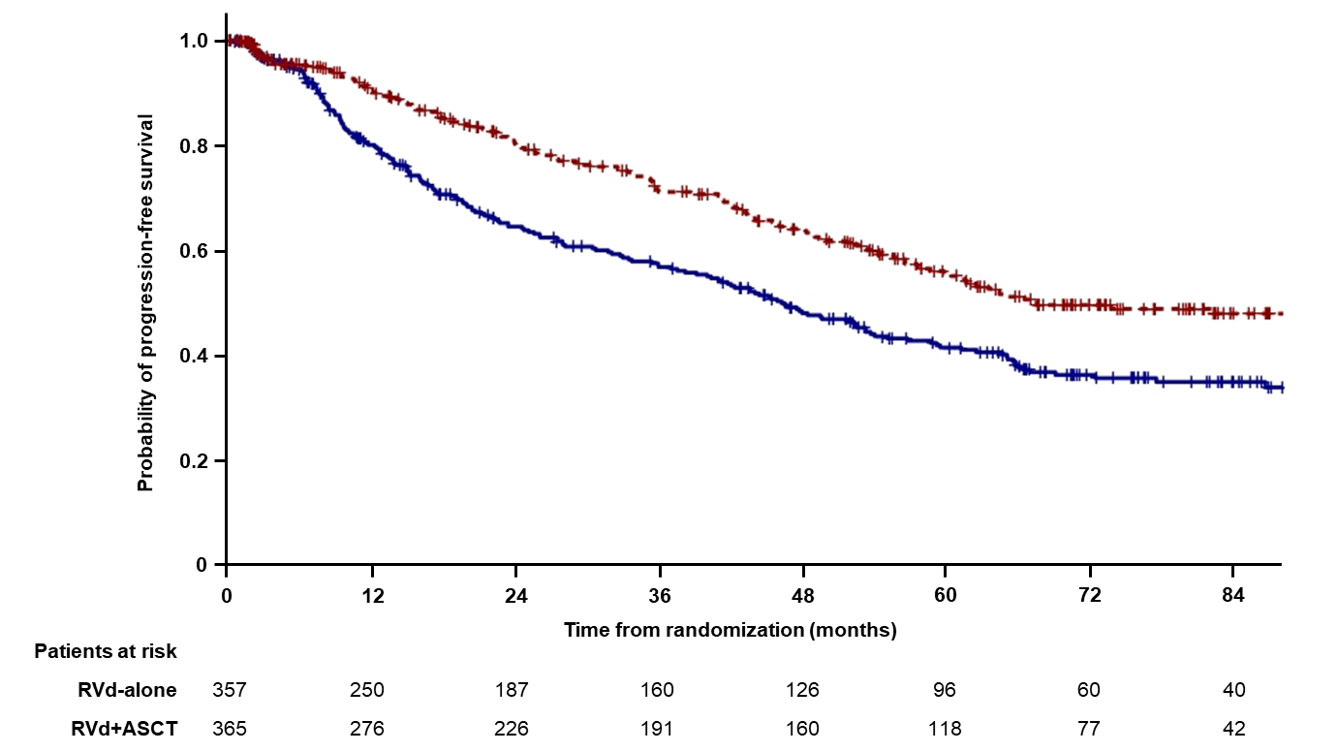
Primary endpoint: Progression-free survival (PFS)
 | Events – no. (%) | Median PFS, months (95% CI) | 5-year PFS, % (95% CI)
RVd-alone | 189 (52.9%) | 46.2 (38.1–53.7) | 41.5 (35.7–47.2)
RVd+ASCT | 139 (38.1%) | 67.5 (58.6–NR) | 55.6 (49.4–61.3)
 |  | HR 1.53 (1.23–1.91), p<0.0001
CI, confidence interval; HR, hazard ratio; Data cut off: 12/12/21
Paul G. Richardson, MD

Slide 5
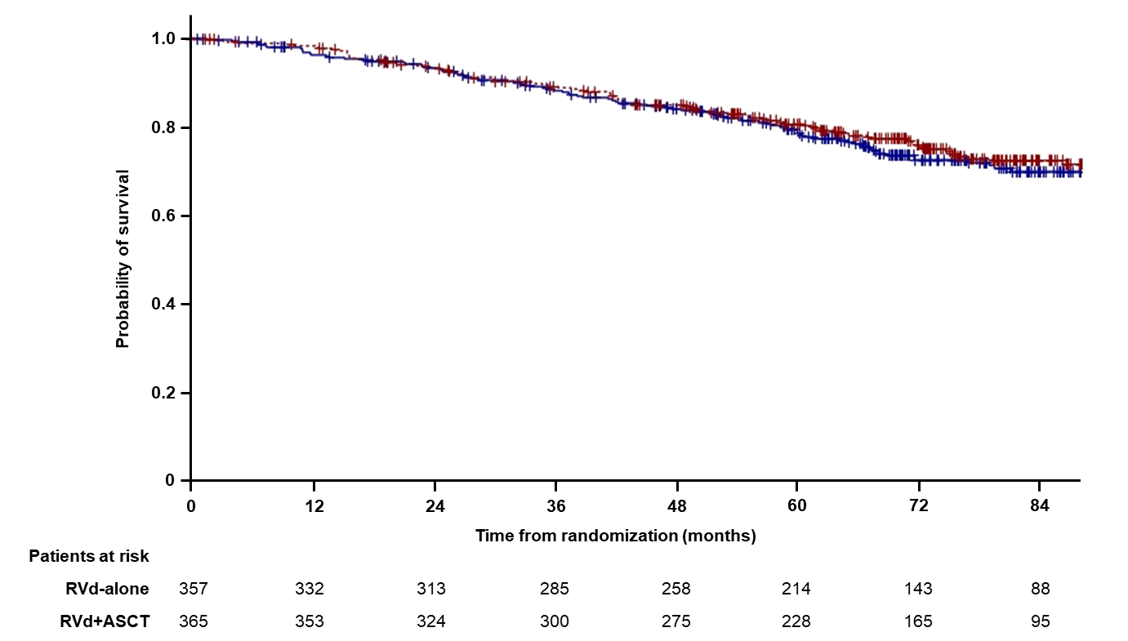
Key secondary endpoint: Overall survival (OS)
Median follow-up 76 months
 | Events – no. (%) | 5-year OS, % | HR (95% CI)
RVd-alone | 90 (25.2%) | 79.2 | 1.10 (0.73 – 1.65) p=0.99*
RVd+ASCT | 88 (24.1%) | 80.7
*p-value adjusted using Bonferroni’s correction to control overall family-wise error rate for secondary outcomes
Data cut off:12/12/21
Paul G. Richardson, MD

Slide 6
DETERMINATION: The debate of To Transplant or Not to Transplant continues:
YES to ASCT
1. The sheer magnitude of the PFS benefit here is staggering – OVER 21 months (And please remember, your honor, that PFS was the PRIMARY endpoint of the trial)
2. Prolonged maintenance (intended until PD) did NOT catch up the PFS benefit
3. We “don’t save the best for last” anymore in MM – early Rx has downstream effect
4. This builds on prior studies and ongoing studies like FORTE
5. You may lose the chance for ASCT if you don’t use it upfront
NO to ASCT
1. OS was not improved, despite only 28% of patients in the non ASCT arm receiving ASCT at relapse – unlike the IFM study where 79% had ASCT at relapse
2. Both IFM and DETERMINATION restricted entry to patients 65 years old and younger – is this really reflective of the ASCT population?
3. The toxicity of ASCT is real - it costs patients 3 months of QOL at minimum
4. The long term toxicity of ASCT is real – the SPM signal is concerning for MDS/AML
5. With even more enhanced induction options coming (including quadruplets) ASCT may no longer be necessary…
Bottom Line – ASCT remains a standard of care, but ok to delay until 1st relapse

Slide 7
Daratumumab (DARA) + Lenalidomide, Bortezomib, and Dexamethasone (RVd) in Patients With Transplant-eligible Newly Diagnosed Multiple Myeloma (NDMM): Final Analysis of GRIFFIN
Douglas W. Sborov,¹ Jacob Laubach,² Jonathan L. Kaufman,³ Brandi Reeves,⁴ Cesar Rodriguez,⁵
Ajai Chari,⁵ Rebecca Silbermann,⁶ Luciano J. Costa,⁷ Larry D. Anderson Jr.,⁸ Nitya Nathwani,⁹
Nina Shah,¹⁰ Naresh Bumma,¹¹ Sarah A. Holstein,¹² Caitlin Costello,¹³ Andrzej Jakubowiak,¹⁴
Robert Z. Orlowski,¹⁵ Kenneth H. Shain,¹⁶ Andrew J. Cowan,¹⁷ Huiling Pei,¹⁸ Annelore Cortoos,¹⁹ Sharmila Patel,¹⁹ Thomas S. Lin,¹⁹ Paul Richardson,² Saad Z. Usmani,²⁰ Peter M. Voorhees²¹
¹Huntsman Cancer Institute, University of Utah School of Medicine, Salt Lake City, UT, USA; ²Dana-Farber Cancer Institute, Harvard Medical School, Boston, MA, USA; ³Winship Cancer Institute, Emory University, Atlanta, GA, USA; ⁴University of North Carolina – Chapel Hill, Chapel Hill, NC, USA; ⁵Icahn School of Medicine at Mount Sinai, New York, NY, USA; ⁶Knight Cancer Institute, Oregon Health & Science University, Portland, OR, USA; ⁷University of Alabama at Birmingham, Birmingham, AL, USA; ⁸Department of Internal Medicine, Division of Hematology/Oncology, UT Southwestern Medical Center, Dallas, TX, USA; ⁹Judy and Bernard Briskin Center for Multiple Myeloma Research, City of Hope Comprehensive Cancer Center, Duarte, CA, USA; ¹⁰Department of Medicine, University of California San Francisco, San Francisco, CA, USA; ¹¹Division of Hematology, The Ohio State University Comprehensive Cancer Center, Columbus, OH, USA; ¹²University of Nebraska Medical Center, Division of Oncology and Hematology Department of Internal Medicine, Omaha, NE, USA; ¹³Moores Cancer Center, University of California San Diego, La Jolla, CA, USA; ¹⁴University of Chicago Medical Center, Chicago, IL, USA; ¹⁵Department of Lymphoma/Myeloma, The University of Texas MD Anderson Cancer Center, Houston, TX, USA; ¹⁶Department of Malignant Hematology, H. Lee Moffitt Cancer Center, Tampa, FL, USA; ¹⁷Division of Medical Oncology, University of Washington, Seattle, WA, USA; ¹⁸Janssen Research & Development, LLC, Titusville, NJ, USA; ¹⁹Janssen Scientific Affairs, LLC, Horsham, PA, USA; ²⁰Memorial Sloan Kettering Cancer Center, New York, NY, USA; ²¹Levine Cancer Institute, Atrium Health, Charlotte, NC, USA
Presented at the 19th International Myeloma Society (IMS) Annual Meeting; August 25-27, 2022; Los Angeles, CA, USA.

Slide 8
GRIFFIN: Responses Deepened Over Time
sCR, P = 0.0079ª
≥CR, P = 0.0005ª
≥CR:
19%
≥CR:
13%
≥CR:
52%
≥CR:
42%
≥CR:
59%
≥CR:
60%
≥CR:
81%
≥CR:
83%
End of
induction^{b}
End of
consolidation^{b}
At 1 year of
maintenance^{c}
End of
study^{c}
End of
induction^{b}
End of
consolidation^{b}
At 1 year of
maintenance^{c}
End of
study^{c}
D-RVd
RVd
sCR CR VGPR PR SD/PD/NE
sCR CR VGPR PR SD/PD/NE
  Rates of ≥CR improved over time and the deepest responses occurred at the end of study maintenance
  At all timepoints, response rates for D-RVd were consistently higher versus RVd

Slide 9
GRIFFIN: PFS in the ITT Population
  Median follow-up: 49.6 months
  Median PFS was not reached in either group
  PFS was longer for D-RVd/D-R versus RVd/R, with a clinically meaningful 55% reduction in the risk of disease progression or death
  The separation of the PFS curves occurred beyond 1 year of maintenance
3-year
PFS rate
4-year
PFS rate
89.0%
87.2%
D-RVd
80.7%
RVd
70.0%
HR, 0.45 (95% CI, 0.21-0.95)
P = 0.0324
No. at risk:
RVd | 103 | 93 | 77 | 72 | 70 | 68 | 63 | 61 | 59 | 53 | 51 | 46 | 42 | 39 | 35 | 33 | 25 | 12 | 3 | 3 | 0
D-RVd | 104 | 98 | 94 | 90 | 90 | 89 | 86 | 85 | 81 | 81 | 79 | 68 | 59 | 58 | 56 | 54 | 45 | 23 | 12 | 3 | 0

Slide 10
Dr. Joe’s Take on GRIFFIN
Quadruplet therapy is becoming the standard of care
D-VRD already listed in NCCN
The deeper responses justify 4 drugs as induction and consolidation post ASCT
But still unclear if D is needed for maintenance therapy – that will take a phase 3 trial to demonstrate
Other quads will come using carfilzomib instead of bortezomib and isatuximab instead of daratumumab

Slide 11
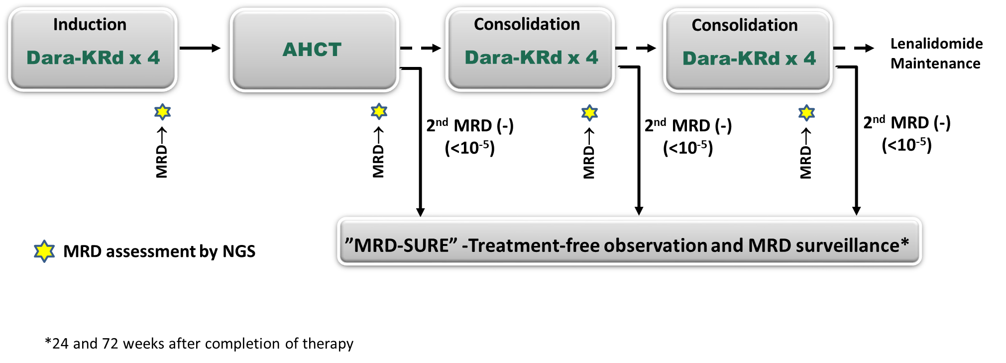
MRD-Guided Treatment Augmentation and Cessation- MASTER Trial
Costa et al. JCO 2022 (Epub ahead of print)

Slide 12
MRD-Guided Treatment Augmentation and Cessation- MASTER Trial
PFS – All Patients (N=123)
PFS – Patients in MRD-SURE (N=84)
Months from Onset of Treatment
HRCA = gain/amp 1q, t(4;14), t(14;16), t(14;20), del(17p)
Median follow up 34.1 mo.
Unpublished update

Slide 13
Dr. Joe’s Take on MASTER
This is a critical first step in moving us to STOP therapy
This is also a first step in using MRD status to guide therapy
MRD “sure” is more important than one MRD test – the length of the interval, though, is still to be determined (maybe 3 months is too little)
With this quad approach, one high risk feature is nearly “overcome”
It may be reasonable to consider stopping in low risk pts
The highest risk patients clearly need more and cannot stop therapy with MRD sure

Slide 14

MAIA
Patients were enrolled in MAIA from March 2015 through January 2017
D-Rd
D: 16 mg/kg IV
QW Cycles 1-2, Q2W Cycles 3-6,
then Q4W thereafter until PD
R: 25 mg PO
Days 1-21 until PD
dª: 40 mg^{b} PO or IV
Days 1, 8, 15, 22 until PD
Primary
endpoint
PFS
Key secondary
endpoints
OS
PFS2
ORR
CR/sCR rate
MRD (NGS; 10^{–5})
Key eligibility
criteria
TIE NDMM
ECOG PS
score 0-2
CrCl
≥30 mL/min
End-of-
treatment
visit
(30 days
after last
dose)
Long-
term
follow-up
1:1 randomisation
Rd
R: 25 mg PO Days 1-21 until PD
d: 40 mg PO
Days 1, 8, 15, 22 until PD
Cycles: 28 days
MAIA is a multicentre, randomised, open-label, active-controlled, phase 3 study of
D-Rd versus Rd alone in patients with NDMM who are transplant ineligible
TIE, transplant-ineligible; ECOG PS, Eastern Cooperative Oncology Group performance status; CrCl, creatinine clearance; IV, intravenous; QW, once weekly; Q2W, once every 2 weeks; Q4W, once every 4 weeks; PD, progressive disease; PO, oral; ORR, overall response rate; CR, complete response; sCR, stringent complete response; MRD, minimal residual disease; NGS, next-generation sequencing; BMI, body mass index.
ªOn days when DARA is administered, dexamethasone will be administered to patients in the D-Rd arm and will serve as the treatment dose of steroid for that day, as well as the required pre-infusion medication. ^{b}For patients >75 years of age or with BMI <18.5 kg/m², dexamethasone was administered at a dose of 20 mg QW.

Slide 15
Updated PFS in 2021
60-month PFS rate
100
80
52.5%
60
% surviving without progression
D-Rd: median, NR
40
28.7%
Rd: median, 34.4 months
20
HR, 0.53; 95% CI, 0.43-0.66;
P <0.0001
0
0
3
6
9
12
15
18
21
24
27
30
33
36
39
42
45
48
51
54
57
60
63
66
69
Months
No. at risk
Rd
369
333
307
280
255
237
220
205
196
179
172
155
146
133
123
113
105
94
63
36
12
4
2
0
D-Rd
368
347
335
320
309
300
290
276
266
256
246
237
232
222
210
199
195
170
123
87
51
17
5
0
D-Rd continued to demonstrate a significant PFS benefit, with median PFS not reached with D-Rd
These data provide a new PFS benchmark in patients with NDMM who are transplant ineligible
NR, not reached; CI, confidence interval.

Slide 16
OS
60-month OS rate
100
80
66.3%
53.1%
D-Rd: median, NR
60
Rd: median, NR
% surviving
40
20
HR, 0.68; 95% CI, 0.53-0.86;
P = 0.0013
0
0
3
6
9
12
15
18
21
24
27
30
33
36
39
42
45
48
51
54
57
60
63
66
69
72
Months
No. at risk
Rd
369
351
343
336
324
317
308
300
294
281
270
258
251
241
232
223
213
183
134
85
42
14
5
1
0
D-Rd
368
350
346
344
338
334
328
316
305
302
297
286
280
273
266
255
249
228
170
118
63
22
6
1
0
D-Rd demonstrated a significant benefit in OS, with a 32% reduction in the risk of death, in patients with NDMM who are transplant ineligible

Slide 17
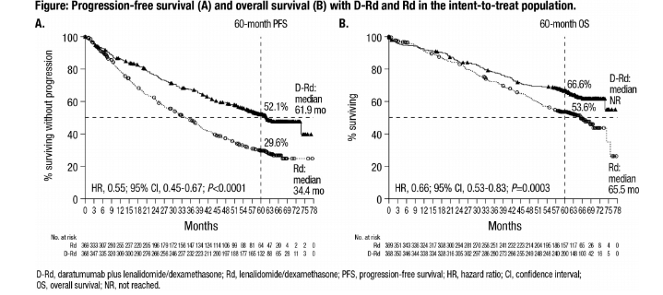
Updated results ASH 2022

Slide 18
Kumar Update on MAIA
MAIA is a critical study that has set the new standard of care in pts not going to ASCT
5 year PFS (52%) and OS (66%) is remarkable
DRD is now generally favored over VRD – less toxicity, better outcomes
Updated results very similar – more information on depth of response with 4 fold increase in MRD negativity with DRD

Slide 19

The first phase 3 study evaluating Isa + RVd for induction and maintenance in Te NDMM patients
HD7
NDMM
N=662
Induction phase (3 x 6-week cycles)
Maintenance phase (4-week cycles)
3 years or PD
Isa + RVd
HDT + ASCT
Isa + R
Randomization 1:1
Randomization
Key eligibility criteria¹:
Age 18–70 years
NDMM and eligible for
HDT and ASCT
RVd
R
Week 1
Week 2
Week 3
Week 4
Week 5
Week 6
Week 1
Week 2
Week 3
Week 4
↑
D1
↑
D8
↑
D15
↑
D22
↑
D29
↑
D1
↑
D8
↑
D15
↑
D22
Isa (IV) 10 mg/kg Cycle 1
Cycle 2–3
Isa (IV) 10 mg/kg: Cycle 1
Cycle 2–3
Cycle 4+
↑
D1
↑
D15
↑
D29
↑
D1
↑
D15
↑
D1
↑
D4
↑
D8
↑
D11
↑
D22
↑
D25
↑
D29
↑
D32
↑
D1
Bor (SC) 1.3 mg/m²
Len (PO) 25 mg
Days 1–14
Days 22–35
Len (PO) 10 mg
increased to 15 mg after 3 months
Days 1–28
↑
D1
↑
D1
↑
D8
↑
D15
↑
D22
↑
2
↑
4
↑
5
↑
8
↑
9
↑
11
↑
12
↑
15
↑
22
↑
23
↑
25
↑
26
↑
29
↑
30
↑
32
Dex (PO) 20 mg
↑
33
Dex (PO) 20 mg: first cycle
ASCT, autologous stem cell transplant; D, day; d/Dex, dexamethasone; HDT, high-dose therapy; Isa, isatuximab; IV, intravenous; NDMM, newly diagnosed multiple myeloma; PD, progressive disease; PO, oral; R/Len, lenalidomide; SC, subcutaneous; Te, transplant eligible; V/Bor, bortezomib; RVd is off label use in some countries according to the lenalidomide summary of product characteristics.
1. ClinicalTrials.gov: NCT03617731
19

Slide 20
First primary endpoint, end of induction MRD negativity by NGF (10⁻⁵), was met in ITT analysis
HD7
Patients with MRD negativity at the end of induction therapy
OR 1.83 (95% CI 1.34–2.51)
P<0.001*
Low number of not assessable/missing† MRD status: Isa-RVd (10.6%) and RVd (15.2%)
Isa-RVd is the first regimen to demonstrate a rapid and statistically significant benefit from treatment by reaching a MRD negativity of 50.1% at the end of induction and to show superiority vs. RVd in a Phase 3 trial
*P value derived from stratified conditional logistic regression analysis
†Missing NGF-MRD values were due to either patients’ loss to follow-up during induction therapy or to missing bone marrow samples or technical failures in measurement counted as non-responders, i.e. NGF-MRD positive
CI, confidence interval; d, dexamethasone; Isa, isatuximab; ITT, intent-to-treat; MRD, minimal residual disease; NGF, next-generation flow;
OR, odds ratio; R, lenalidomide; V, bortezomib

Slide 21
Dr. Joe’s Take on Isa-VRD
First phase 3 trial of quad we have seen data for
First study where MRD is primary endpoint
Very impressive primary endpoint results with 50% MRD neg after only 18 weeks of therapy
  Significantly better than VRD
There seems to be no problem collecting stem cells (that is a problem with DVRD)
Will be important to see the impact of ASCT after induction
Further evidence we are moving to quads

Slide 22
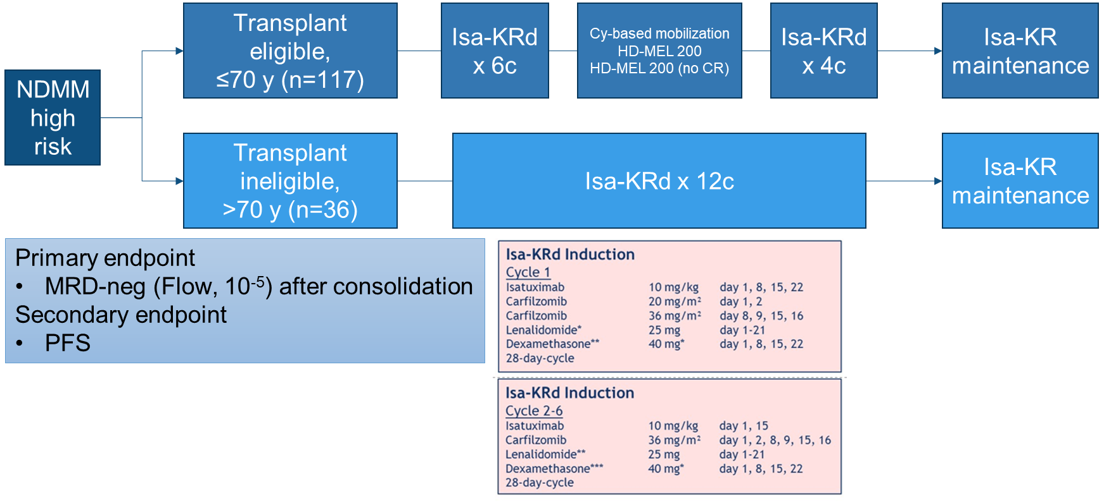
GMMG CONCEPT: Phase 2, Isatuximab-KRd
*Cy-based mobilization was moved in an amendment to the time after 3 induction cycles.
**Dose adaption of lenalidomide according to renal function.
***20 mg in patients aged ≥75 years.
Leypoldt LB, et al. Leukemia. 2022;36(3):885-888 [Epub ahead of print].

Slide 23
Dr. Joe’s Take
We need better options for high risk patients
quads very much preferred in this group
Carfilzomib is preferred over bortezomib
This concept trial demonstrates the feasibility of this quad, even in transplant ineligible patients
It would require a phase 3 for full proof

Slide 24
Touzeau C et al. All-oral triplet combination of ixazomib, lenalidomide, and dexamethasone in newly diagnosed transplant-eligible multiple myeloma patients: Final results of the phase II IFM 2013-06 study. Haematologica 2022;107(7):1693-7.

Slide 25
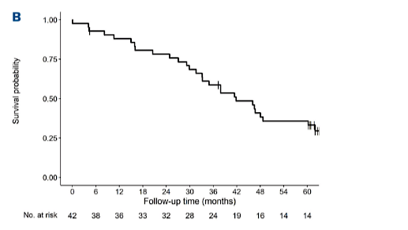
Key Results
ORR 92% - 44% CR or greater
Median PFS 41.8 months
3 year OS 92%

Slide 26
Dr. Joe’s Take on Ixa-Len-Dex
Attractive to use an all oral combination
Only 42 patients
Unusual to only have 1 year of maintenance Ixa
Toxicities are predictable and mangeable
However, the outcomes are clearly inferior to VRD and DRD
Ixazomib has consistently not performed well in frontline and maintenance therapy

Slide 27

Study design
ICARIA-MM
Isa-Pd
n=154
Disease progression,
unacceptable toxicities,
patient request
RRMM
Randomization
Pd
n=153
1:1
Cycle 1
Week 1
Week 2
Week 3
Week 4
Subsequent cycles
Week 1
Week 2
Week 3
Week 4
↑
D1
↑
D8
↑
D15
↑
D22
↑
D1
↑
D15
Isatuximab 10 mg/kg
Isatuximab 10 mg/kg
Pomalidomide 4 mg
Days 1–21
Pomalidomide 4 mg
Days 1–21
↑
D1
↑
D8
↑
D15
↑
D22
↑
D1
↑
D8
↑
D15
↑
D22
Dexamethasone 40 mg
Dexamethasone 40 mg

Slide 28
Final OS analysis
ICARIA-MM
220 OS events: 106 (68.8%) in Isa-Pd; 114 (74.5%) in Pd*
100
Isa-Pd
Pd
Censor
90
80
70
Isa-Pd:
mOS: 24.57 months
(95% CI: 20.304–31.310)
60
50
Overall survival (%)
40
Pd:
mOS: 17.71 months
(95% CI: 14.390–26.218)
30
20
10
0
HR = 0.776 (95% CI: 0.594–1.1015); log-rank p=0.0319†
0
3
6
9
12
15
18
21
24
27
30
33
36
39
42
45
48
51
54
Time (Months)
Number at Risk
Isa-Pd
154
145
127
119
109
102
91
84
75
68
63
61
54
50
48
45
44
23
8
Pd
153
137
116
103
93
82
72
66
65
58
49
44
42
39
36
36
33
18
3
Clinically meaningful OS benefit, with 6.9-month improvement in median OS

Slide 29
Dr. Joe’s Take on ICARIA
Good to see an OS advantage in later relapse MM
7 month improvement is clinically significant
No unusual long term safety signals
We still have a lot to learn about the potential of switching CD38 Abs or re-using them

Slide 30

Updated Progression-free Survival (PFS) and Depth of Response in IKEMA, a Randomized Phase 3 Trial of Isatuximab, Carfilzomib and Dexamethasone
(Isa-Kd) vs Kd in Relapsed Multiple Myeloma (MM)
Joseph Mikhael, MD, MEd, FRCPC, FACP
Translational Genomics Research Institute, City of Hope Cancer Center, Phoenix, AZ, USA
Joseph Mikhael¹, Philippe Moreau^{2*}, Meletios-Athanasios Dimopoulos³, Kwee Yong⁴, Marcelo Capra⁵, Thierry Facon⁶, Roman Hajek⁷, Ivan Špička⁸, France Casca⁹, Sandrine Macé¹⁰, Marie-Laure Risse¹¹ & Thomas Martin^{12*} on behalf of the IKEMA study group.
*Co-primary investigators; ¹Translational Genomics Research Institute, City of Hope Cancer Center, Phoenix, AZ, USA; ²Department of Hematology, University Hospital Hôtel-Dieu, Nantes, Pays de la Loire, France; ³Department of Clinical Therapeutics, The National and Kapodistrian University of Athens, Athens, Greece; ⁴Department of Hematology, University College Hospital, London, UK; ⁵Centro Integrado de Hematologia e Oncologia, Hospital Mãe de Deus, Porto Alegre, Rio Grande do Sul, Brazil; ⁶Department of Hematology, Lille University Hospital, Lille, Hauts-de-France, France; ⁷Department of Hemato-Oncology, University Hospital Ostrava and Faculty of Medicine, University of Ostrava, Ostrava, Czech Republic; ⁸1st Department of Medicine, Department of Hematology, 1st Faculty of Medicine, Charles University and General Hospital, Prague, Czech Republic; ⁹Ividata Life Science, Levallois-Perret, Ile-de-France, France, contracted by Sanofi; ¹⁰Sanofi, R&D Translational Medicine, Chilly-Mazarin, Ile-de-France, France; ¹¹Sanofi, R&D, Vitry-sur-Seine, France; ¹²Department of Hematology, University of California at San Francisco, San Francisco, CA, USA.

Slide 31
Updated PFS (primary endpoint) – IRC assessment (Original ITT population)
1.0
0.9
Isa-Kd
Kd
0.8
Censor
0.7
0.6
Isa-Kd
mPFS: 35.7 months
(95% CI: 25.8–44.0)
Kaplan-Meier estimate
0.5
0.4
0.3
Kd
mPFS: 19.2 months
(95% CI: 15.8–25.0)
0.2
HR 0.58 (95.4% CI: 0.42–0.79)
0.1
0.0
0
3
6
9
12
15
18
21
24
27
30
33
36
39
42
45
48
Time (Months)
Number at Risk
Isa-Kd
179
164
151
136
127
1
14
108
95
88
81
75
72
64
62
50
18
1
Kd
123
108
99
85
73
63
53
43
39
32
29
23
21
16
10
3
2
With 2 additional years of follow-up, Isa-Kd showed the longest PFS on a PI-based backbone in the relapsed MM setting, with 42% reduction vs Kd in the risk of progression or death
CI, confidence interval; d, dexamethasone; HR, hazard ratio; IRC, Independent Review Committee; Isa, isatuximab; ITT, intent to treat; K, carfilzomib; m, median;
MM, multiple myeloma; PFS, progression-free survival; PI, proteasome inhibitor.

Slide 32
Depth of response (Original ITT population)
Best Overall Survival
MRD neg Rate (NGS 10⁻⁵)
Odds ratio Isa-Kd vs Kd (95% CI)
2.09 (1.26–3.48)
Odds ratio Isa-Kd vs Kd (95% CI)
2.78 (1.55–4.99)
Odds ratio Isa-Kd vs Kd (95% CI)
2.57 (1.35–4.88)
Deeper responses were seen with Isa-Kd vs Kd
MRD negativity rate with Isa-Kd in the ITT population was 33.5% (29.6% at IA)
MRD negativity and CR rate with Isa-Kd in the ITT population was 26.3% (20.1% at IA)
CI, confidence interval; CR, complete response; d, dexamethasone; IA, interim analysis; ITT, intent to treat; Isa, isatuximab; K, carfilzomib; MRD, minimal residual disease;
neg, negative; NGS, next generation sequencing; ORR, overall response rate; sCR, stringent complete response; VGPR, very good partial response.

Slide 33
Dr. Joe’s Take on IKEMA
3 year PFS in relapsed MM is unprecedented
Carfilzomib is a very attractive partner in early relapse
  Giving it indefinitely is key to benefit
The depth of response, especially MRD, is important in relapsed MM
The PFS2 was also improved in the intervention arm, so bridges are not being burned

Slide 34
COLUMBA Study Design
Phase 3 non-inferiority study of DARA SC versus DARA IV in RRMM (N = 522)
Key eligibility
criteria:
RRMM
≥3 prior lines including a PI and an IMiD or
Refractory to both a PI and an IMiD
DARA SC 1,800 mg (n = 263)
QW Cycles 1-2, Q2W Cycles 3-6, Q4W Cycles 7+ until PD
Co-primary endpoints:
ORR
Maximum C_{trough}ª
Key secondary endpoints:
IRR rate
PFS
≥VGPR, ≥CR
Time to next therapy
OS
PROs
1:1 Randomization
DARA IV 16 mg/kg (n = 259)
QW Cycles 1-2, Q2W Cycles 3-6, Q4W Cycles 7+ until PD
Stratification factors:
Baseline body weight (≤65 kg, 66 kg to 85 kg, >85 kg)
Prior lines of therapy (≤4 prior lines vs >4 prior lines)
Myeloma subtype (IgG vs non-IgG)
Treatment cycle: 28-days
ªSerum pre-dose DARA concentration on Cycle 3 Day 1.
PI, proteasome inhibitor; IMiD, immunomodulatory drug; QW, every week; Q2W, every 2 weeks; Q4W, every 4 weeks; PD, progressive disease; ORR, overall response rate; C_{trough}, trough concentration; PFS, progression-free survival; VGPR, very good partial response; CR, complete response; OS, overall survival; PROs, patient-reported outcomes.

Slide 35
Non-inferiority Comparisons for Co-primary Endpoints
ORR
  Non-inferiority of DARA SC relative to DARA IV was defined using 60% retention of ORR¹
    Non-inferiority test for non-unity null according to Farrington and Manning²
    Non-inferiority of DARA SC to DARA IV if lower bound of 95% CI ≥60%
    Superiority of DARA SC to DARA IV if non-inferiority was established and the lower limit of the 95% CI of relative risk was ≥100%
  480 patients required for non-inferiority with 80% power and one sided α = 0.025, assuming the same true ORR in both arms
Maximum C_{trough}ª
  Non-inferiority of DARA SC to DARA IV if the lower bound of 90% CI for ratio of geometric means of C_{trough} on Cycle 3 Day 1 was ≥80%
CI, confidence interval.
ªPre-dose on Cycle 3 Day 1.
1. Lonial S, et al. Lancet. 2016;387(10027):1551-60. 2. Farrington CP and Manning G. Stat Med. 1990;9:1447-1454.

Slide 36

Co-primary Endpoint: Overall Response Rateª
Median (range) follow-up: 7.46 (0.03-13.86) months^{b}
Relative risk (95% CI): 1.11 (0.89 – 1.37)^{c}
P <0.0001^{d}
ORR = 41.1%
ORR = 37.1%
≥CR:
1.9%
≥CR:
2.7%
≥VGPR:
17.0%
≥VGPR:
19.0%
DARA SC non-inferior to DARA IV
≥VGPR and ≥CR rates comparable between DARA SC and DARA IV
PR, partial response; sCR, stringent complete response.
ªITT population. ^{b}Based on Kaplan-Meier product limit estimate. ^{c}Farrington-Manning estimates of the relative risk of DARA SC over DARA IV. ^{d}P-value from Farrington-Manning test for non-inferiority hypothesis that DARA SC retains ≥60% of ORR in DARA IV.

Slide 37
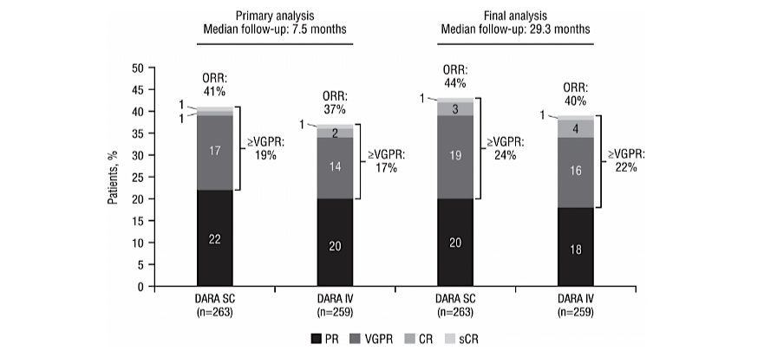
Updated Final Analysis

Slide 38
Co-primary Endpoint: Maximum C_{trough} at C3D1^{a,b}
2000
1500
Maximum C_{trough} concentration:
  Ratio of DARA SC/DARA IV
    107.93% (90% CI, 95.74%-121.67%)
    Lower limit of 90% CI (95.74%) >80%, meeting PK non-inferiority criterion
DARA concentration (µg/mL)
1000
500
0
DARA IV
(n = 146)
DARA SC
(n = 149)
Co-primary endpoint of C_{trough} at Cycle 3 Day 1 met the non-inferiority criterion
ªPre-dose on Cycle 3, Day 1. ^{b}Pharmacokinetic-evaluable population.
Notes:
The lower limit of the 90% CI was >80%, meeting the PK non-inferiority criteria

Slide 39
Dr. Joe’s Take on COLUMBA
This was a critical trial to move us from IV to SC dara
Impressive that ORR same if not better
Important caveats
  Single vial dosing is easier and more efficient
  Can be given in nearly all patients independent of weight
The shortened time of administration is outstanding for patients
  Has literally gone from hours to minutes
Infusion reactions with SC are down from 30-40% to 10-15%
Nearly all patients are now shifting to SC dara

Slide 40
Quach H et al. Subcutaneous isatuximab administration by an on-body delivery system (OBDS) in combination with pomalidomide and dexamethasone in patients with relapsed/refractory multiple myeloma: Phase 1b expansion study results. ASH 2022;Abstract 1923.
The on-body delivery system (OBDS), a wearable bolus injector applied to the abdomen by a healthcare professional, is administered SC

Slide 41
Key Results
A total of 56 pts were randomized and treated: 12 with Isa IV, 12 with Isa IP1000, 10 with Isa IP1400, and 22 with IsaOBDS
Isa administration was well tolerated, with infrequent infusion reactions (IRs) (≤10% in each cohort, all G2), only at first administration, and none in the OBDS cohort.
The median duration of OBDS injections was 10 min, and all injections were successfully completed with no interruption. There was good local tolerability: 5 (22.7%) pts experienced 7 injection site reactions, all G1, out of 404 administrations (1.73%), including 5 injection site erythemas, 1 injection site hemorrhage, and 1injection site induration.

Slide 42
Dr. Joe’s Take on SC Isatuximab
We have been waiting for this
It is highly desirable to provide this agent SC – quicker, less reactions, single dose vial, not weight based
Results of efficacy similar to IV
Very well tolerated with minimal complications
Delivery system is unique
Will facilitate the use of Isatuximab

Slide 43
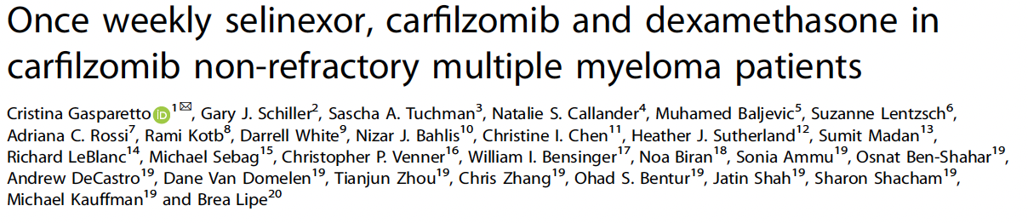
Gasparetto C, et al. British Jour of Cancer. 2022 126:718-725
Notes:
Welcome to this Cancer Network Between the Lines program. Today’s featured article is “Once weekly selinexor, carfilzomib and dexamethasone in carfilzomib non-refractory multiple myeloma patients.” I’m Dr Joseph Mikeal. I’ll be discussing this publication with my colleague Dr Hakan Kaya.

Slide 44
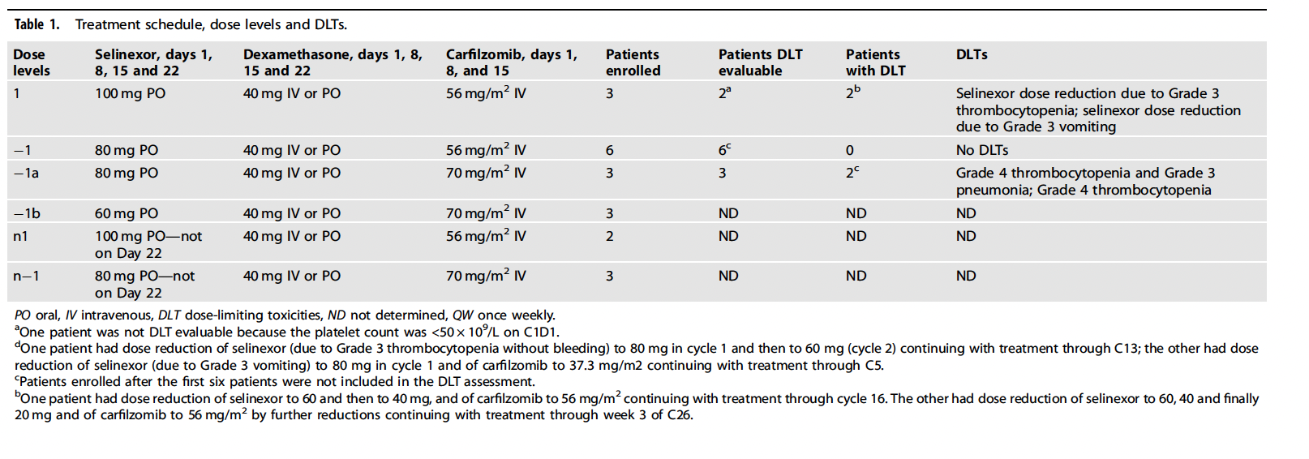
Treatment Schedule
Gasparetto C, et al. British Jour of Cancer. 2022 126:718-725
MTD and RP2D were identified as selinexor 80 mg, carfilzomib 56 mg/m2, and dexamethasone 40 mg, all QW.

Slide 45
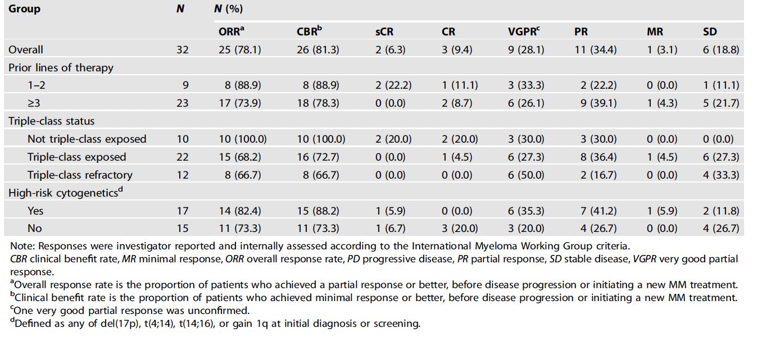
Efficacy Data: Response Rates
Gasparetto C, et al. British Jour of Cancer. 2022 126:718-725

Slide 46
Efficacy Data: Duration of Response and PFS
Outcome Parameter | Month (95% CI)
Median Duration of Response | 22.7 (11.8-NE)
Median Progression Free Survival | 15 (12.0- NE)
Gasparetto C, et al. British Jour of Cancer. 2022 126:718-725

Slide 47
Dr. Joe’s Take on Weekly Selinexor and Carfilzomib
Critical to the evolution of seli to be paired with multiple other agents
Seli is MUCH better tolerated now with weekly dosing and prophylaxis
This is my favorite combo with seli – highly active
The 15 month PFS is impressive in this group
Particularly attractive in high risk patients

Slide 48

BOSTON: A Phase 3, Global, Randomized, Open Label, Controlled Study in Patients with Multiple Myeloma who Had Received 1-3 Prior Therapies
Primary endpoint: PFS
Key secondary endpoints
ORR
≥VGPR
Grade ≥2 PN
Secondary endpoints:
OS
DoR
TTNT
Safety
1:1
Randomization
XVd
N=195
35-day
cycles
SEL: 100 mg PO on days 1, 8, 15, 22, 29
BOR: 1.3 mg/m² SC on days 1, 8, 15, 22
DEX: 20 mg PO on days 1, 2, 8, 9, 15, 16, 22, 23, 29, 30
N=402
5HT-3 prophylactic recommended
Vd
N=207
21-day
cycles
BOR: 1.3 mg/m² SC on days 1, 4, 8, 11
DEX: 20 mg PO on days 1, 2, 4, 5, 8, 9, 11, 12
XVd
Pts with prior Vd allowed on trial
Patients with IRC confirmed PD on Vd could crossover to XVd
The XVd regimen requires approximately 40% less bortezomib than Vd which entails 37% fewer clinic visits over the first 6 months of treatment
Grosicki S, et al. Lancet. 2020;396:1563-1573
Notes:
1:1 Randomization will be performed prior to dosing. Allocation between treatment arms (SVd, Vd) within each of the stratification categories:
Prior PI therapies (Yes or No)
Number of prior anti-MM regimens (1 versus >1)
R-ISS stage at original MM diagnosis (R-ISS Stage III versus R-ISS Stage I or II; Palumbo 2015;).
If data for chromosomal abnormalities and serum LDH required for R-ISS staging are not available, patients will be assigned to the R-ISS category corresponding to their ISS stage
The following process will be used in order to prevent premature crossover:
Investigators will assess PD according to IMWG criteria including repeat testing if PD is based on serum and/or urine M-protein, IgA, or FLC. PD may also be based on new or enlarging plasmacytoma(s) or bone lesion(s)
All cases of PD must be confirmed by the IRC prior to crossover
Crossover will not be permitted based purely on clinical progression
Crossover will not be permitted if dosing of bortezomib is terminated before PD is confirmed by the IRC
Putative PD events that are not confirmed by the IRC will have their PFS censored at the time of treatment discontinuation
Data on File, Karyopharm Therapeutics, Inc.
Karyopharm Corporate Presentation/Oct2018/p13
NCT03110562/p2/Arms
NCT03110562/p1/Brief Summary
DOF

Slide 49
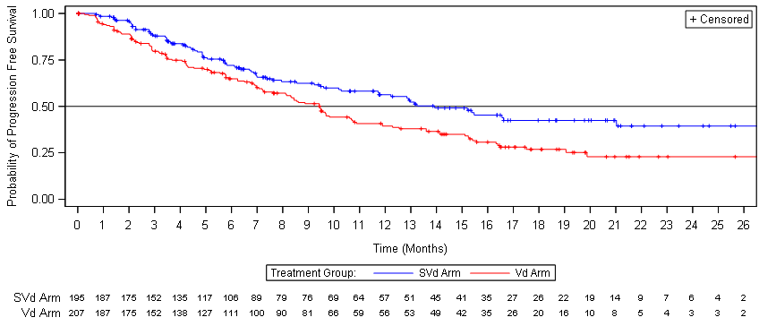
Primary Endpoint - PFS With XVd vs Vd
 | XVd (n=195) | Vd (n=207)
Median PFS, mos (95% CI) | 13.93 (11.73, NE) | 9.46 (8.11, 10.78)
HR=0.7020 (95% CI: 0.5279, 0.9335); one-sided P=0.0075
This data represents:
An increase of 4.47 months in median PFS
A 30% reduction in the risk of disease progression or death
XVd Arm
Grosicki S, et al. Lancet. 2020;396:1563-1573

Slide 50
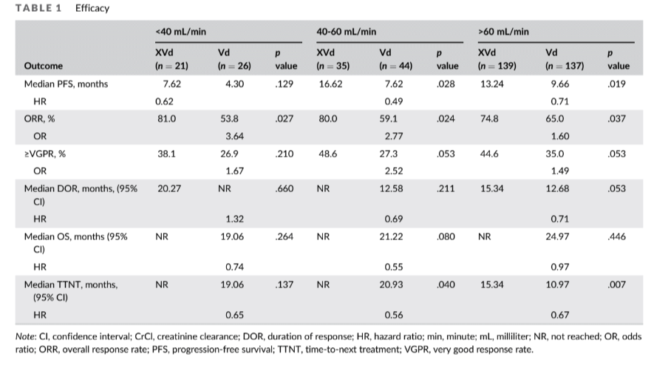
Analysis of Patients based on Renal Impairment
Delimpasi S, et al. Am J Hematol. 2022;97(3):E83-E86.

Slide 51
Dr. Joe’s Take on BOSTON subgroup renal analysis
It is expected to see less efficacious results in patients with reduced renal function
  There is always reduced efficacy in these patients
This is a feasible regimen as we use both agents in renally impaired patients
The similarity in AEs in patients independent of renal function is encouraging
This is a preferred regimen in patients with renal insufficiency

Slide 52
THANK YOU!
Joseph Mikhael, MD, MEd, FRCPC
Professor, Translational Genomics Research Institute (TGen)
City of Hope Cancer Center
Chief Medical Officer, International Myeloma Foundation
Director of Myeloma Research and Consultant Hematologist, HonorHealth Research Institute
jmikhael@myeloma.org

