Slide 1
Treatment of Relapsed/Refractory CLL; Novel and Investigational Strategies Deborah Stephens, DO

Slide 2
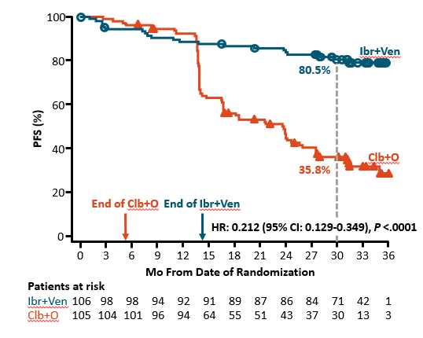
GLOW
Median Follow-up = 27.7 months
Ibrutinib + Venetoclax x 12 months
Ibrutinib x 3 months
GLOW
-TN CLL
->65 years
-No del17p
N=106
Obinutuzumab + Chlorambucil (6m)
N=105
Kater, NEJM Evid 2022

Slide 3
GLOW
Ibr-Ven Reduces High TLS Risk:
Prior to ibrutinib lead-in = 25%
After ibrutinib lead-in = 2%
Notable Toxicity with Ibr-Ven:
Diarrhea
Neutropenia
Atrial Fibrillation
Cardiac Deaths
All with prior risk factors
Adverse Events | Ibr- Ven (%) | Chl-Obin (%)
TLS Cases | 0 | 6
Diarrhea (Any Grade) | 51 | 12
Neutropenia (Any Grade) | 42 | 58
Infusion Rx | 0 | 30
Atrial Fibrillation | 14 | 2
On-Treatment Cardiac Death | 4 | 0
Grade 3+ AEs | 76 | 70
Kater, NEJM Evid 2022

Slide 4
GLOW- Takeaway
Ibrutinib + Venetoclax ↑ PFS –
Approved for TN CLL patients in Europe
PROS
CONS
Ibrutinib (15m) + Venetoclax (12m)
Limits risk of TLS with venetoclax
Allows for a time-limited frontline BTKi treatment
Evidence of responses to ibrutinib following relapse
Toxicity (better with acala?)
Cost/insurance coverage
Unclear which population may benefit most
As of yet, no clear evidence of functional cure
GLOW
-TN CLL
->65 years
Obinutuzumab + Chlorambucil (12m)
Where to use? Young? High-risk? High Tumor Burden?
Kater, NEJM Evid 2022

Slide 5
FLAIR
Primary Endpoint: MRD eradication
Analysis of MRD within 2 yrs of therapy
Ibrutinib + Venetoclax x Up to 6 yrs*
Ibrutinib x 2 months
FLAIR
-<75 yrs
-TN CLL
-No TP53m
N=136
Ibrutinib x
Up to 6 yrs*
N=138
*Therapy stopped after MRD undetectable (flow < 10⁻⁴) x 3 mos
Munir, ASH 2022

Slide 6
FLAIR-MRDu - Takeaway
In frontline CLL treatment with Ibr+Ven:
patients with IGHV unmutated status were more likely to achieve MRDu and achieved it at a faster pace than those with IGHV mutated status.
83% of patients with Del(11q) and 55% of patients with del(13q) achieved MRDu within 2 years of treatment
Unmutated IGHV and del(11q) CLL may be particularly responsive to the Ibr + Ven regimen.
These subtypes may be more dependent on B-cell signaling.
Longer follow-up will determine if difference in timing and achievement of MRDu will have on PFS and OS
Munir, ASH 2022

Slide 7
Venetoclax Consolidation
Median follow-up = 37.5 mos
Best cumulative rate of MRDu = 73%
Best rate of CR/Cri = 57%
Discontinued ibrutinib and venetoclax = 49%
Patients with progression = 4/45 (9%)
1 – during combination
3 – during ibrutinib maintenance
1 – Richter’s transformation
Venetoclax-Consolidation
-CLL/SLL w del17p, complex karyotype, del11q, ↑B2M
-1+ Yr of Ibrutinib wo CR +MRDu
Venetoclax 400mg PO QD x 24 mos (max)*
N = 45
*Venetoclax stopped after CR and BM MRDu (flow < 10⁻⁴) x 6 mos;
Ibrutinib could be discontinued at physician discretion
Thompson, ASH 2022

Slide 8
Venetoclax Consolidation - Takeaway
Consolidation resulted in high rate of MRDu (73%) and CR/Cri (57%)
Most patients with MRDu at end of venetoclax remain in MRDu
Effective consolidation strategy
Future directions: High risk cohort (del17p and complex karyotype), on treatment with acalabrutinib.
Is consolidation with venetoclax better than sequential therapy with venetoclax?

Slide 9
AVO for Frontline CLL
 | TP53 WT (%) | TP53 MUT (%)
BM MRDu at C16 | 89 | 83
D/c acala + venetoclax = 63% (43/68)
Median time off therapy = 19 mos (range=0-30)
Patients with progression after D/c tx = 4/43 (9%)
3 – MRD recurrence only
1 – CLL progression
Overall patients with PD or death = 5/68 (7%)
1 – CLL progression
3 – Transformation events
1 – COVID-related death
PFS at 35 months = 93%
Acalabrutinib 100mg PO BID (starting C1)* + Obinutuzumab IV (C2-7) +
Venetoclax 400mg PO QD x (starting C4)*
AVO:
-TN
-All comer cohort: N=37
-TP53 or del(17p) mut cohort: N=31
*Venetoclax and acalabrutinib stopped at
C16 or C25 if MRDu (flow < 10⁻⁴)
Ryan, ASH 2022

Slide 10
AVO for Frontline CLL - Takeaway
High MRDu rates (>80%) regardless of TP53 mutation status
Durable responses after d/c therapy – supporting time limited therapy option, even for high-risk disease
Future directions: Ongoing AMPLIFY trial = AVO vs AV vs CIT
Will durability of response maintain in high-risk group with longer follow-up?
Ryan, ASH 2022

Slide 11
MRD Kinetics Following Ven + R (MURANO)
Median follow-up = 5 years
VenR maintained OS benefit over BR (5yr OS) = 82% vs 62%
3 years after VenR End of Therapy (EOT) PFS = 38%
In patients MRDu at EOT, median time to MRD conversion = 19 mos
Of 47 patients with MRD conversion:
Clinical PD = 19 patients
Median time from MRD conversion to clinical PD = 25 mos
Rituximab
x 6 cycles + Venetoclax x 24 mos
MURANO
-R/R CLL
(1-3 prior treatments)
BR x 6 cycles
N = 389
Seymour, Blood 2022

Slide 12
MRD Kinetics Following Ven + R - Takeaway
Fixed Duration VenR – maintained OS benefit over BR in R/R CLL
MRD was detectable at a median of 1.5 years, but clinical PD did not occur for another 2 years after MRD was detected
Would early intervention on MRD be better?
Or best to leave patients alone until clinical PD?
Seymour, Blood 2022

Slide 13
ASCEND
Median follow-up = 47 mos
Acalabrutinib maintained PFS benefit over IdR/BR (42mo PFS) = 62% vs 19%
Acalabrutinib prolonged PFS in high risk subgroups: del(17p) and unmutated IGHV
Acalabrutinib AEs of Interest (all grade):
Atrial Fibrillation = 8%
HTN = 8%
Acalabrutinib 100mg PO BID
ASCEND
-R/R CLL
R (x8) + Idelalisib PO
OR
BR x 6 cycles
N = 310
Jurczak, ASCO 2022

Slide 14
ASCEND- Takeaway
With 4 years of follow-up, acalabrutinib maintained PFS benefit over IdR/BR in R/R CLL.
No new safety signals identified.
Another study in strong support of avoiding standard CIT in R/R CLL
Jurczak, ASCO 2022

Slide 15
BRUIN Phase 1/2 - Prior BTKi
Pirtobrutinib = Noncovalent BTKi; binds in C418-independent manner
Most common AEs (mostly Grade 1-2):
Fatigue, diarrhea, neutropenia, contusion
Grade 3+ AEs: rare
Atrial fibrillation: 3%
Pirtobrutinib 25-300mg PO QD
RP2D 200mg
BRUIN
-CLL/SLL – Prior BTKi
N =247
 | Prior BTKi (n=247) | Prior BTKi and BCL2i (n=100)
Best ORR (%) | 82 | 79
Mato, ASH 2022

Slide 16
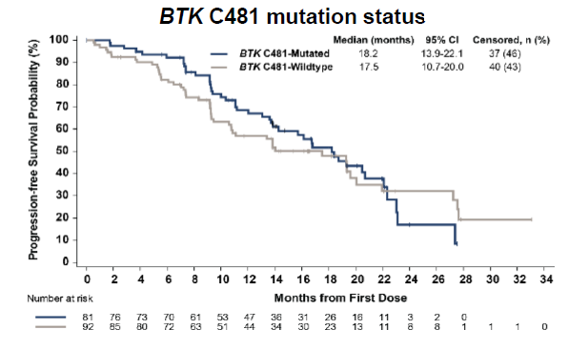
BRUIN Phase 1/2 – Prior BTKi
Median follow-up = 19 mos
Median follow-up = 19 mos
Median PFS
All Prior BTKi (median 3 prior Rx; n=247) = 20 mos
Prior BTKi and BCL2i (median 5 prior Rx; n=100) = 17 mos
No difference in PFS curves for:
C481 Mut vs WT
Age < vs > 75 years
Del(17p) and/or TP53 Mut vs WT
Mato, ASH 2022

Slide 17
BRUIN- Takeaway
With 1.5 years of follow-up, pirtobrutinib shows efficacy in heavily pretreated and high-risk (C481S and TP53 Mut) CLL.
Toxicity profile continues to be very well-tolerated.
CLL with prior BTKi and BCL2i is still an area of un-met need.
Mato, ASH 2022

Slide 18
Resistance to Pirtobrutinib
7 of 9 Patients Analyzed Developed New BTK mutation
Wang, NEJM 2022

Slide 19
Pirtobrutinib Resistance- Takeaway
In a small sample of 9 patients, CLL resistance to pirtobrutinib has now been described.
7/9 developed new BTK mutations.
All BTKi tested had different abilities to inhibit the described mutations.
Caution should be used in moving pirtobrutinib to front-line setting unless very durable remissions are seen in this setting.
CLL with prior BTKi and BCL2i is still an area of un-met need.
Mato, ASH 2022

Slide 20
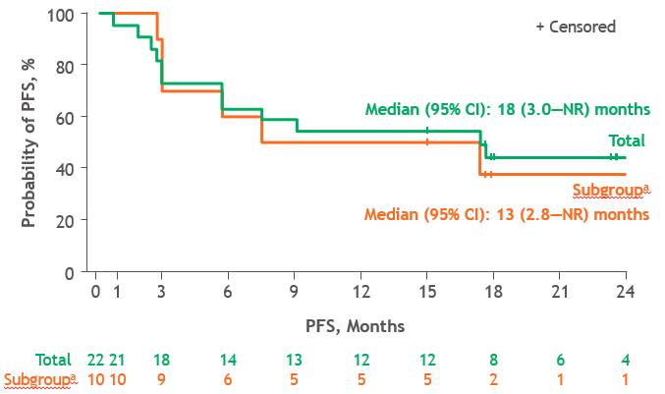
TRANSCEND
Lisocabtagene maraleucel = CD19-directed, defined T-cell composition CART product
Phase 1/2 Study = 23 R/R CLL
11 with prior BTKi and BCL2i
ORR = 82% (CR = 46%, MRDu = 75%)
PFS was similar between double refractory vs not group
Important Toxicities
Cytokine release syndrome
All grade = 74%; Grade 3+ = 9%
Neurotoxicity
All grade = 29%; Grade 3+ = 21%
Median Follow-up 24 months
Siddiqi, Blood 2022

Slide 21
TRANSCEND- Takeaway
In a high-risk R/R CLL population, Liso-cel led to deep remissions (75% MRDu).
However, especially in patients previously treated with BTKi and BCL2, PFS is similar to what was seen with pirtobrutinib and has more toxicity (and cost) than pirtobrutinib.
Toxicity may limit the population that can receive CART.
Should we use CART as a bridge to more definitive therapy?
CLL with prior BTKi and BCL2i is still an area of un-met need.
Mato, ASH 2022

Slide 22
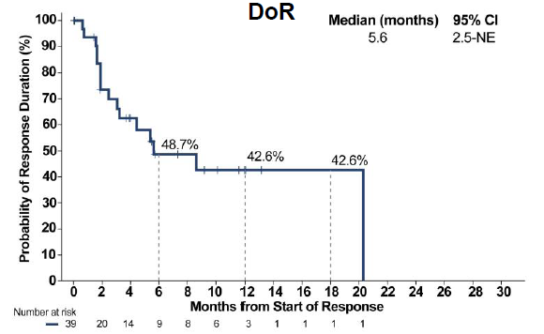
BRUIN Phase 1/2 – Richter’s Syndrome
Pirtobrutinib 25-300mg PO QD
RP2D 200mg
 | ORR | CRR
Responders, n (%) | 39/75 (52) | 10 (13)
BRUIN
-Richter’s Syndrome
Median PFS = 3.7 mos
Median OS = 13.1 mos
N =82
Heavily Pretreated:
Median Prior CLL and RT Rx = 4 (0-13)
Prior BTKi = 34%
Prior BCL2i = 38%
Prior CART = 11%
Wierda, ASH 2022

Slide 23
BRUIN- Richter’s Takeaway
Pirtobrutinib led to responses in heavily pretreated patients, including 13% complete responses.
PFS and OS are still short for these patients.
6 patients were able to proceed to curative intent allogeneic stem cell transplant.
Should we use pirtobrutinib as a bridge to more definitive therapy?
Richter’s Syndrome remains an area of un-met need.
Wierda, ASH 2022

Slide 24
EPCORE– Richter’s Syndrome
 | ORR | CRR
Responders, n (%) | 6/10 (60) | 5/10 (50)
Epcoritamab SC
C1-3: QW
C4-9: Q2W
C10+: Q4W
EPCORE
Richter’s Syndrome
0-1 prior Rx
Cytokine Release Syndrome: n = 90% (all grade 1/2)
First full dose given C1D15
Median time from first full dose to CRS = 13 hrs
Median time to resolution = 3 (2-9) days
Neurotoxicity = 0%
N =10
Bispecific Antibody to CD3/CD20
Median Prior CLL Rx = 3 (0-7)
Kater, ASH 2022

Slide 25
EPCORE- Richter’s Takeaway
In a small study of 10 patients with Richter’s Syndrome, epcoritamab delivered a 60% ORR and 50% CRR.
Good toxicity profile with low-grade CRS.
Follow-up is short and more information is needed about duration of response.
Should we use epcoritamab as a bridge to more definitive therapy?
Richter’s Syndrome remains an area of un-met need.
Kater, ASH 2022

Slide 26
THANK YOU
Twitter: @Debbiemstephens

