Slide 1



Optimizing First-Line Management for Newly Diagnosed CLL
Jennifer R. Brown, M.D., Ph.D.
Director, CLL Center, and Institute Physician
Dana-Farber Cancer Institute
Worthington and Margaret Collette Professor of Medicine
In the Field of Hematologic Oncology
Harvard Medical School

Slide 2
CLL14
Ven-Obi: Progression-Free Survival
Median observation time 65.4 months
Median PFS
Ven-Obi: not reached
Clb-Obi: 36.4 months
5-year PFS rate
Ven-Obi: 62.6%
Clb-Obi: 27.0%
HR 0.35, 95% CI [0.26-0.46]
P<0.0001
Cum Survival
End of treatment
Time to Event [PFS] from Randomization (months)
Al-Sawaf O et al EHA 2022;Abstract S148

Slide 3
CLL14 PFS after Ven-Obi by MRD Status
End of treatment MRD status in peripheral blood, by NGS
Depth of remission beyond 10⁻⁴ correlates with long-term PFS, indicating the value of ultra-sensitive MRD assessments.
Cum Survival
MRD < 10⁻⁶
MRD ≥ 10⁻⁶ and < 10⁻⁵
MRD ≥ 10⁻⁵ and < 10⁻⁴
MRD ≥ 10⁻⁴
Time to Event [PFS] from Last Treatment Exposure (months)
Al-Sawaf O et al EHA 2022;Abstract S148

Slide 4
CLL14 OS After VEN-Obi According to MRD Status
End of treatment MRD status in peripheral blood, by NGS
Patients with MRD ≥10⁻⁴ after Ven-Obi have a shorter OS than patients with MRD <10⁻⁴, highlighting the need for dedicated MRD-guided approaches.
MRD < 10⁻⁴
MRD ≥ 10⁻⁴
Al-Sawaf O et al EHA 2022;Abstract S148

Slide 5
Conclusions: CLL14
One year time limited therapy
Highly active, median PFS > 5 yrs
Depth of MRD strongly associated with PFS and now also with OS
Duration of remission depends on prognostic factors
Potential to re-treat but limited data as yet

Slide 6
CLL13 / GAIA: uMRD (< 10⁻⁴) at Mo15 in PB by 4-Colour-Flow
ITT analysis: 63 pts (34 CIT, 15 RVe, 10 GVe, 4 GIVe) with missing samples (6.8%) were counted as MRD positive
GIVe vs CIT: 92.2% versus 52.0%: p < 0.0001
GVe vs CIT : 86.5% versus 52.0%: p < 0.0001
RVe vs CIT: 57.0% versus 52.0%: p = 0.317
 | uMRD% | 97.5% CI
GIVe | 92.2 | 87.3 – 95.7
GVe | 86.5 | 80.6 – 91.1
RVe | 57.0 | 49.5 – 64.2
CIT | 52.0 | 44.4 – 59.5
n = 229
n = 237
n = 229
n = 231
Eichhorst B et al. EHA 2022;Abstract LB2365

Slide 7
CLL13 / GAIA: Results of the Coprimary Endpoint
Progression-Free Survival (PFS)
Median FU 38.8 months (range: 0.0 – 59.2)
1.0
0.8
PFS | Median months | 3y PFS (%)
CIT | 52.0 | 75.5
RV | 52.3 | 80.8
GV | Not reached | 87.7
GIV | Not reached | 90.5
0.6
Cum Survival
0.4
0.2
GIV vs CIT: HR 0.32, 97.5% CI 0.19-0.54, p<0.000001
GV vs CIT: HR 0.42, 97.5% CI 0.26-0.68, p<0.0001
0.0
RV vs CIT: HR 0.79, 97.5% CI 0.53-1.18, p=0.183
0
12
24
36
48
60
Time to Event [PFS] (months)
Eichhorst B et al. EHA 2022;Abstract LB2365

Slide 8
Conclusions: CLL13
One year time limited therapy in fit patients
Obinutuzumab containing regimens have the highest uMRD and best PFS (3 yr 88-91%)
VenR not better than CIT
FCR in patients < 65 has similar 3 yr PFS to the obinutuzumab containing regimens

Slide 9
Venetoclax PK in CLL14
No significant effect of obinutuzumab on venetoclax PK relative to single agent venetoclax
Fixed dosing regimen is appropriate; no relation of baseline characteristics with PK
  Including no effect of mild-moderate hepatic or renal impairment
Strong and moderate CYP3A4 inhibitors decrease clearance by about 82% and 14%, respectively
  Limited numbers evaluated, supports current label

Slide 10
Venetoclax PK in CLL14
No association of ven exposure in CLL14 with SAEs, neutropenia, thrombocytopenia or infection
  “Lowering the dose not likely to impact these toxicities”
No statistically significant relationship between venetoclax exposure and PFS in CLL14
  “No evidence that higher doses would increase efficacy”

Slide 11
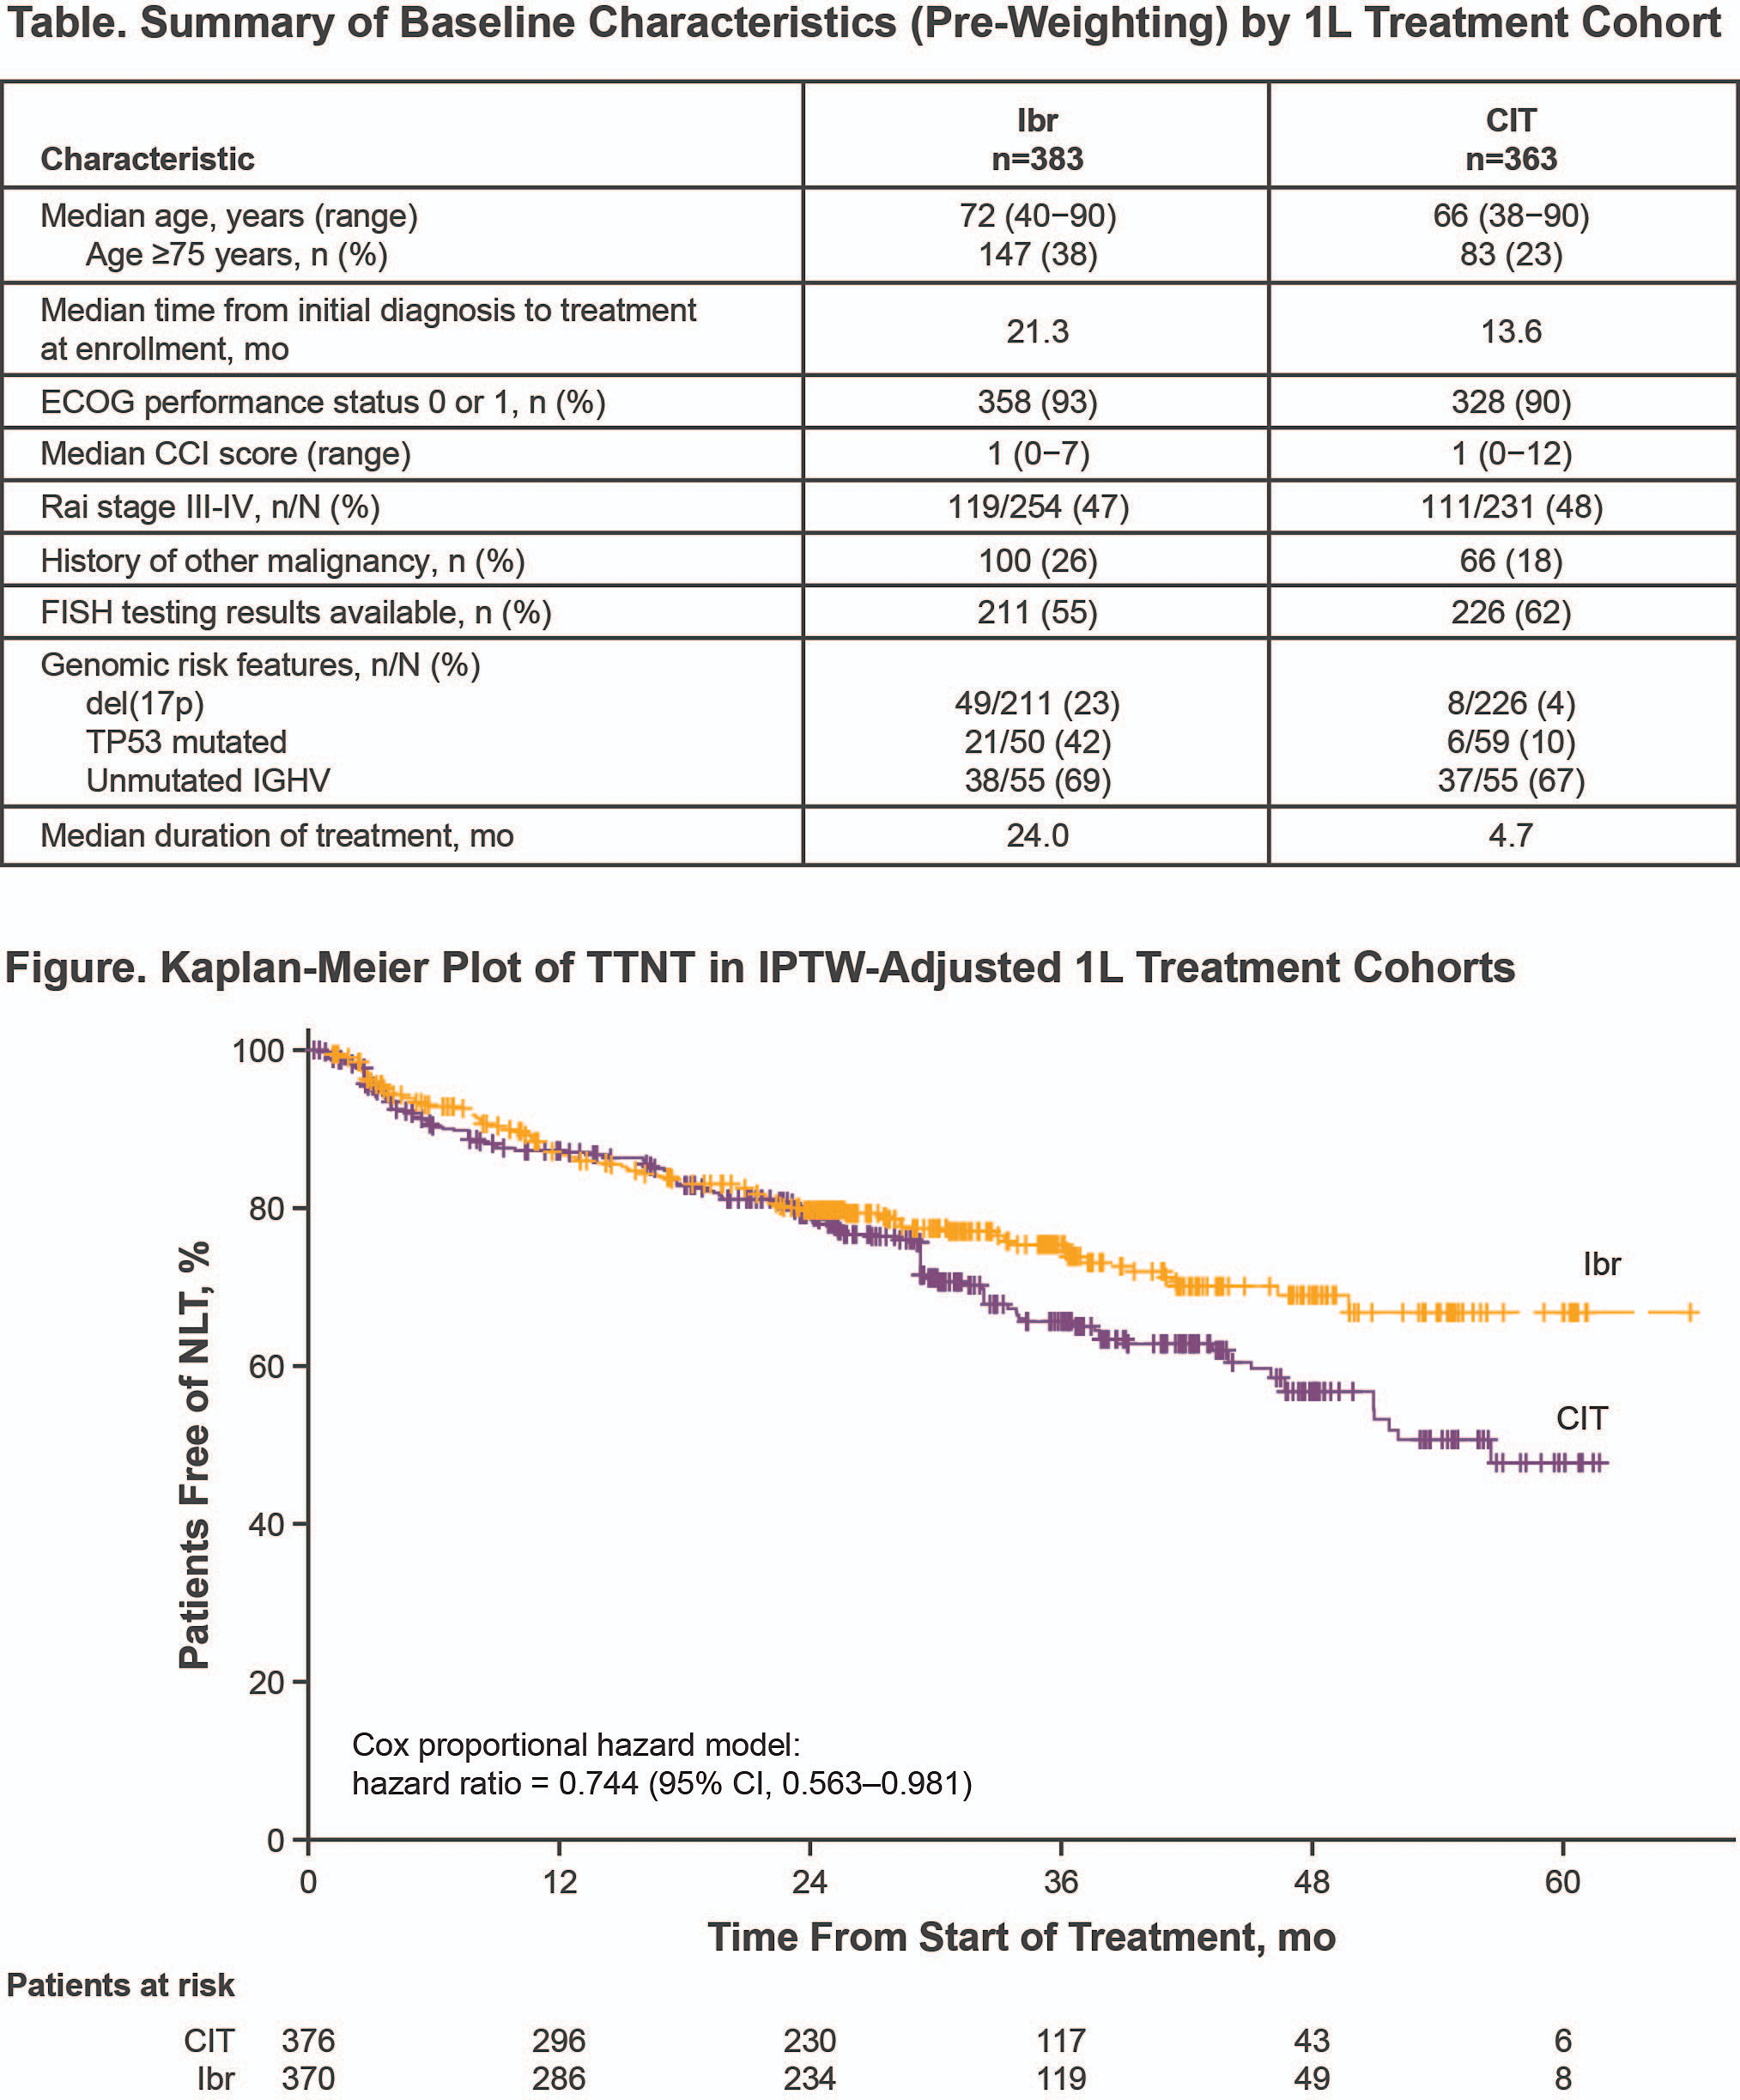
Real World Analysis Ibr vs CIT:
Final Analysis of the Inform Registry
Ghosh N et al ASH 2022;Abstract 3132

Slide 12
Ibrutinib vs CIT
Time to next treatment was longer with ibrutinib than CIT
SAEs and AEs leading to discontinuation were more common with ibrutinib overall --- but if corrected for time on therapy were less common

Slide 13
ELEVATE-TN: 5 Yr Investigator-Assessed PFS
Progression-Free Survival (%)
100
84%
Median PFS=NR
80
A+O vs O+Clb
HR (95% CI): 0.11 (0.07, 0.16)
P<0.0001
A vs O+Clb
HR (95% CI): 0.21 (0.15, 0.30)
P<0.0001
A+O vs A
HR (95% CI): 0.51 (0.32, 0.81)
P=0.0259
72%
60
Median PFS=NR
40
20
A + O
21%
A
Median PFS=27.8 mo
O + Clb
0
0
3
6
9
12
15
18
21
24
27
30
33
36
39
42
45
48
51
54
57
60
63
66
69
72
Months
Sharman et. al. ASCO 2022, Poster 7539
Notes:
ªHazard ratio based on Cox proportional-hazard model stratified by 17p deletion status (yes vs no based on interactive voice/web response system). ^{b}P-value based on log-rank test stratified by 17p deletion status (yes vs no based on interactive voice/web response system).

Slide 14
ELEVATE-TN: Investigator-Assessed ORR
100
2.2
3.9
6.8
0.6
1.7
90
1.7
8.5
0.6
2.2
80
Patients (%)
70
64.2
60
77.7
ORR: 96.1%
(95% CI: 92.1,
98.1; P<0.0001)
ORR: 89.9%
(95% CI: 84.7,
93.5; P=0.0499)
69.5
50
ORR: 83.1%
(95% CI: 76.8,
87.9)
40
30
20
32.4
10
14.5
13.6
0
A+O (n=179)
A (n=179)
O+Clb (n=177)
CR
PR
SD
PD
Missing
Sharman et. al. ASCO 2022, Poster 7539
Notes:
ªORR is defined as achieving CR, CRi, nPR, or PR per the investigator per iwCLL 2008 criteria⁹ at or before initiation of subsequent anticancer therapy. ORR = CR + CRi + PR + nPR. ORR does not include PRL.
^{b}Based on Cochran-Mantel-Haenzel test with adjustment for 17p deletion status (yes vs no) vs O+Clb.
^{c}Includes CR and CRi.
^{d}Includes PR, nPR, and PRL.
A, acalabrutinib; CI, confidence interval; Clb, chlorambucil; CR, complete response; CRi, complete response with incomplete blood count recovery; IRC, independent review committee; iwCLL, International Workshop on Chronic Lymphocytic Leukemia; nPR, nodular partial response; O, obinutuzumab; ORR, overall response rate; OS, overall survival; PD, progressive disease; PR, partial response; PRL, partial response with lymphocytosis; SD, stable disease.

Slide 15
Conclusions: ELEVATE-TN
Addition of obinutuzumab to acalabrutinib improves
5 yr PFS by 12%
Obinutuzumab led to higher CR rate and higher uMRD
Has not been widely adopted – but perhaps should be

Slide 16
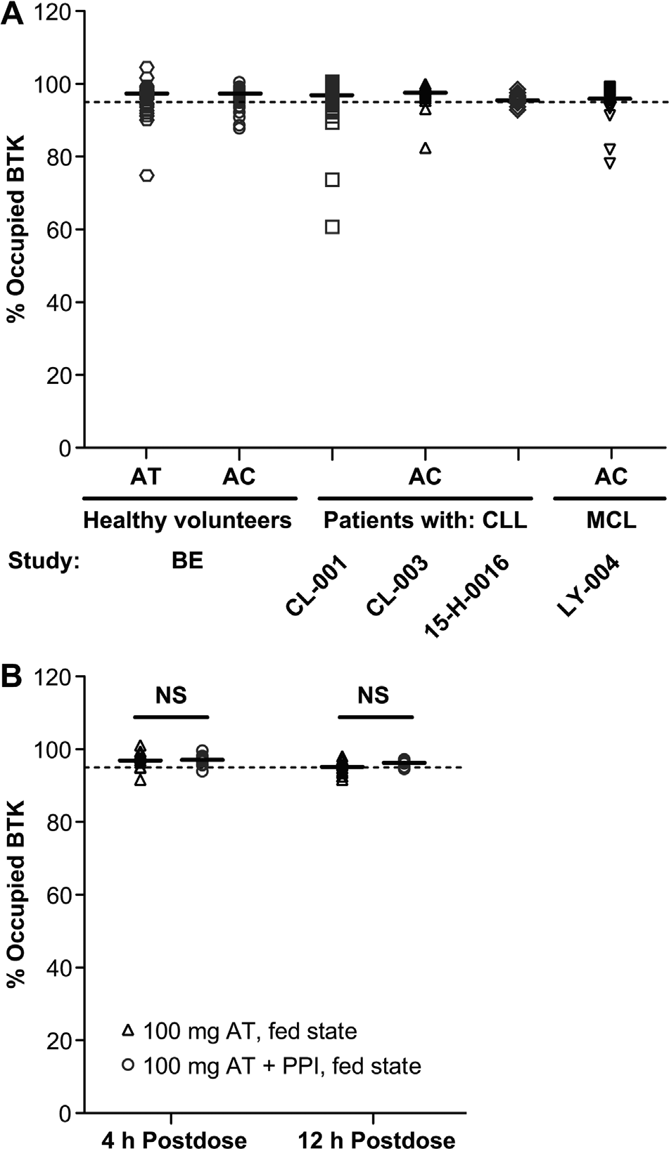
Pharmacodynamics of BTK Receptor Occupancy
Following Administration of Acalabrutinib:
Comparison of AT to AC (Across Several Studies)
Following Administration of Acalabrutinib (Fed State)
in the Absence or Presence of a PPI (Study 1)
Sharma et. al. Clin. Pharmacol Drug Dev. 2022, 11(11) 1294–1307.
Notes:
Figure 3. (A) Pharmacodynamics of BTK receptor occupancy following administration of acalabrutinib: comparison of AT to AC (across several studies). Shown horizontal error bar indicates median for each data set. Dotted line indicates 95% BTK-TO. (B) Pharmacodynamics of BTK receptor occupancy following admin- istration of acalabrutinib (fed state) in the absence or presence of a PPI (study 1). Dots represent patient samples; solid horizon- tal lines represent median values. Significance was determined using an unpaired, two-tailed t-test. AC, acalabrutinib capsule; AT, acalabrutinib maleate tablet; BTK, Bruton tyrosine kinase; CLL, chronic lymphocytic leukemia; MCL, mantle cell lymphoma; NS, not significant; PPI, proton pump inhibitor.

Slide 17
Conclusions: Acala Tablet
Characterization of the acalabrutinib tablet formulation shows similarity to the capsule
Absorption similar regardless of stomach acidity so tablet can be used with PPIs

Slide 18
SEQUOIA (BGB-3111-304)
Study Design
Arm A: Zanubrutinib
160 mg bid until PD, intolerable
toxicity, or end of study
Cohort 1
without del(17p) by central FISH
planned n ~450
open-label
Key Eligibility Criteria
Untreated CLL/SLL
Met iwCLL criteria for treatment
≥65 y of age OR unsuitable for treatment with FCRª
Anticoagulation and CYP3A inhibitors allowed
R 1:1
Arm B:
Bendamustine (90 mg/m² D1 & D2)
+ Rituximab (375 mg/m² C1, then 500 mg/m² C2-C6)
x 6 cycles
Stratification Factors
Age, Binet stage,
IGHV status, geographic region
Cohort 2
with del(17p)
planned n ~100
Arm C: Zanubrutinib
ClinicalTrials.gov: NCT03336333
Cohort 3¹
with del(17p)
planned n ~80
Arm D: Zanubrutinib + Venetoclax
Tam et al. Lancet Oncology 2022
Notes:
ªDefined as Cumulative Illness Rating Scale >6, creatinine clearance <70 mL/min, or a history of previous severe infection or multiple infections within the last 2 years.
C, cycle; CLL/SLL, chronic lymphocytic leukemia/small lymphocytic lymphoma; CYP3A, cytochrome P450, family 3, subfamily A; D, day; del(17p), chromosome 17p deletion; FCR, fludarabine, cyclophosphamide, and rituximab; FISH, fluorescence in-situ hybridization; IRC, independent review committee; IGHV, gene encoding the immunoglobulin heavy chain variable region; iwCLL, International Workshop on CLL; ORR, overall response rate; PD, progressive disease; R, randomized.

Slide 19
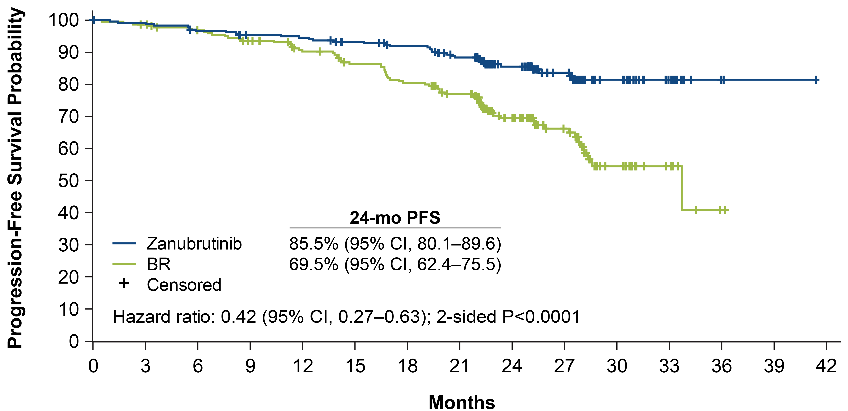
SEQUOIA: Progression-Free Survival Per IRC Assessment
Tam et al. Lancet Oncology 2022
Notes:
BR, bendamustine + rituximab; IRC, independent review committee; PFS, progression-free survival.

Slide 20
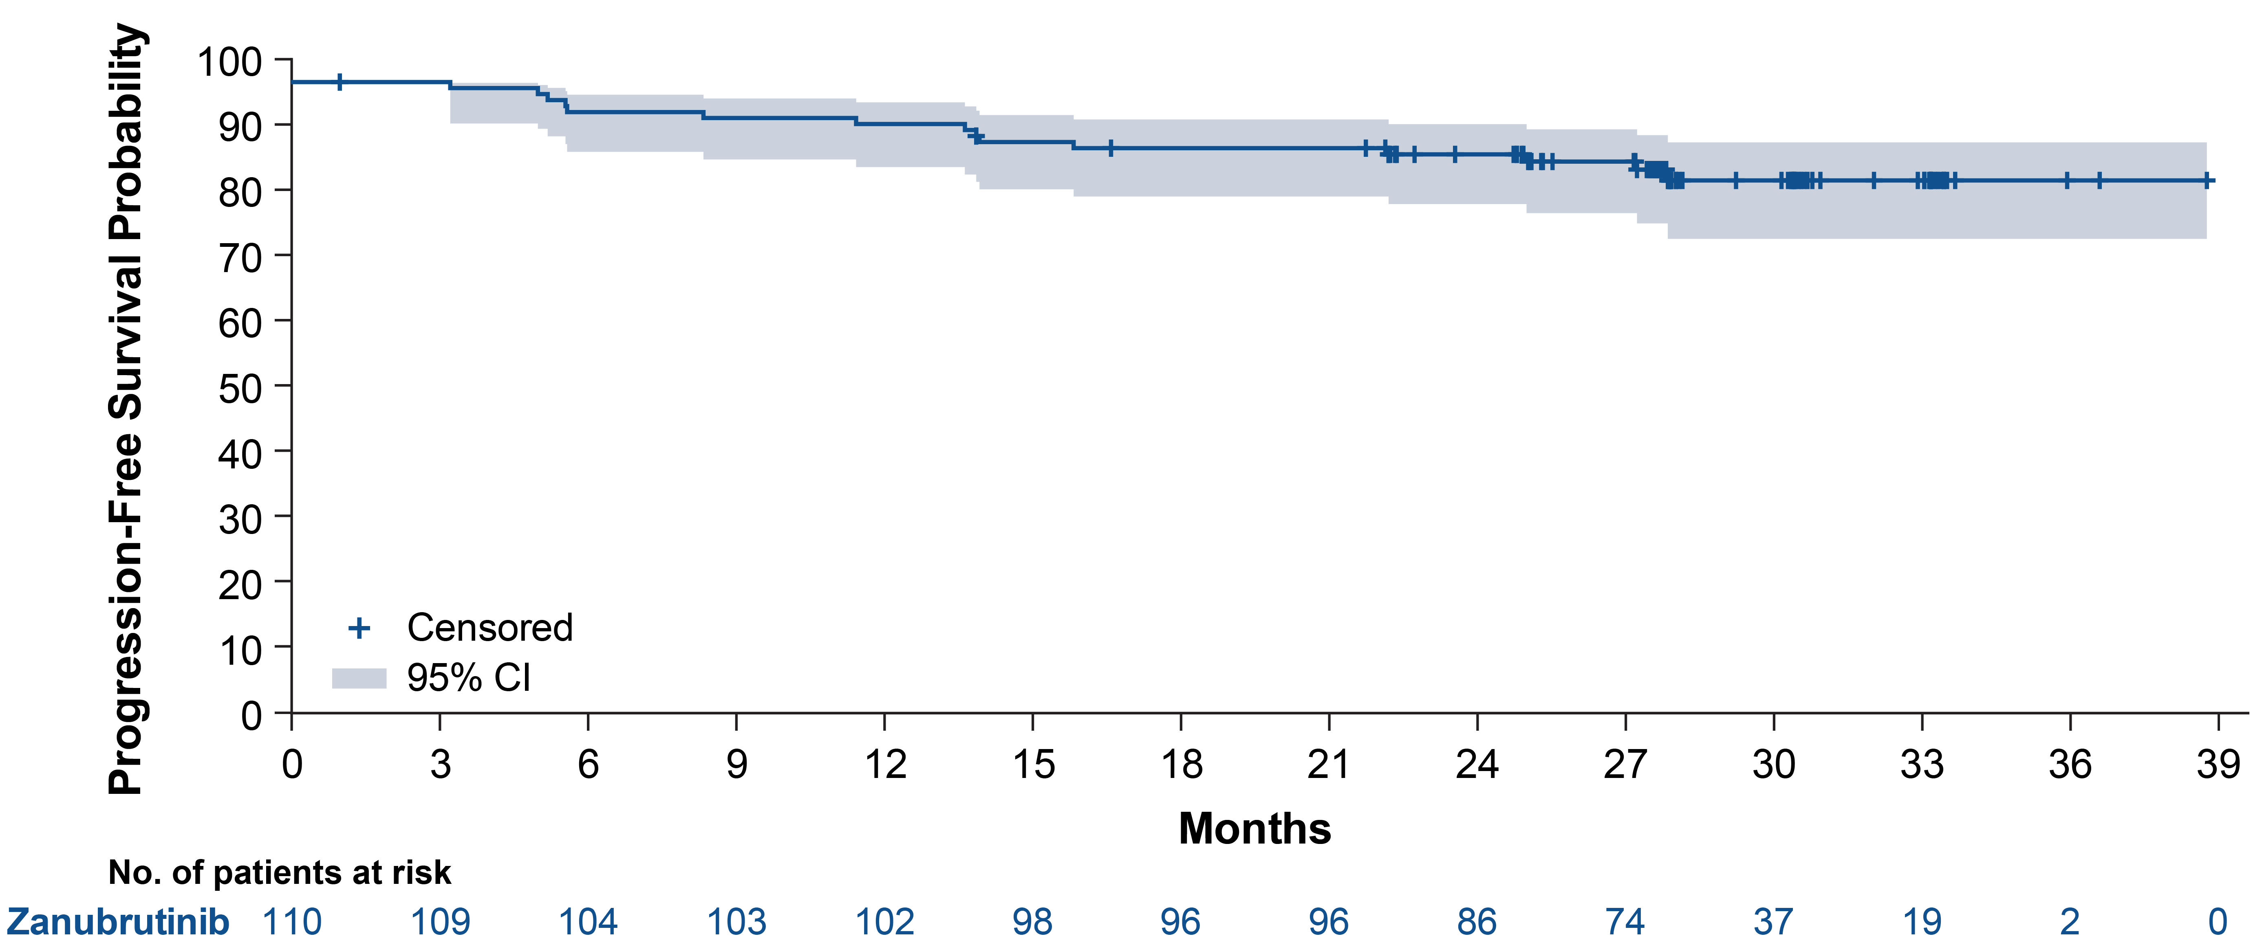
SEQUOIA Cohort 2: PFS Per IRC Assessment in
Patients With Del(17p)
Median follow-up: 30.5 mo
24-mo PFS: 88.9% (95% CI, 81.3–93.6)
Tam et al. Lancet Oncology 2022
Notes:
Del(17p), chromosome 17p deletion; IRC, independent review committee; PFS, progression-free survival.

Slide 21
Conclusions: SEQUOIA
Frontline registration trial for zanubrutinib
2 yr PFS 86%
Includes largest dedicated prospective cohort of patients with 17p deletion – 89% 2 yr PFS
Ongoing cohort of zanu ven

Slide 22
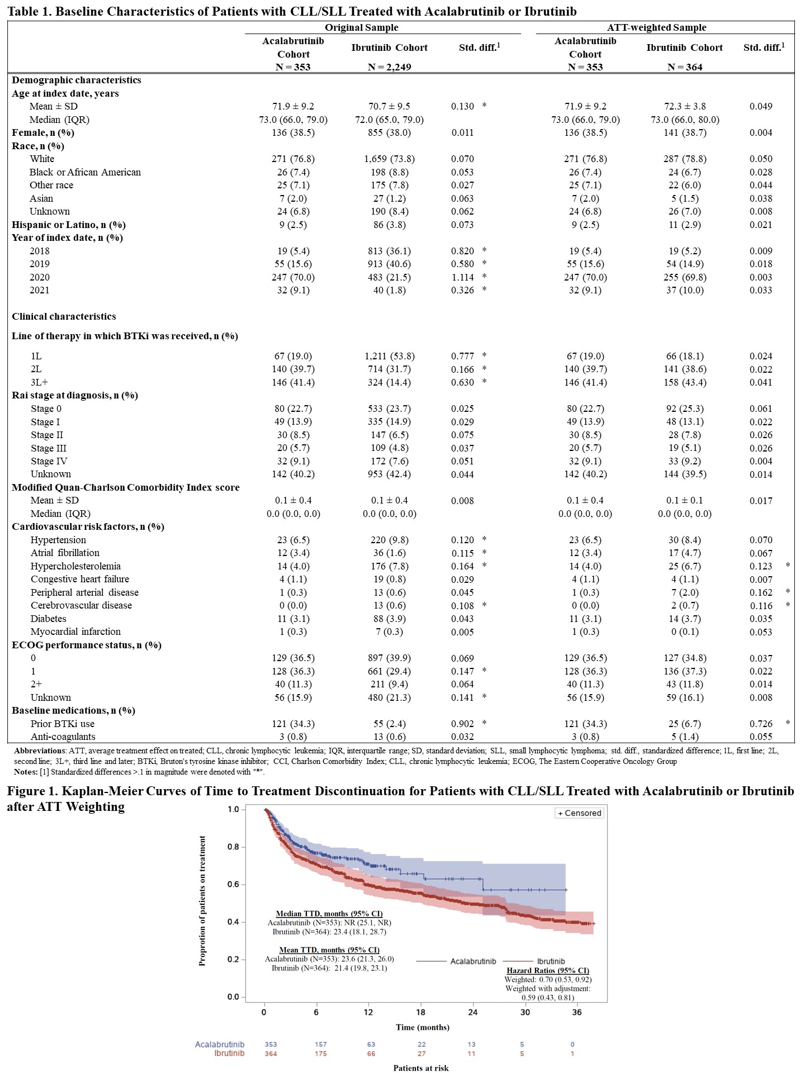
Real World Data: 2509 pts, Acala vs Ibrut
Time to Treatment Discontinuation for Patients with CLL/SLL Treated with Acalabrutinib or Ibrutinib
Proportion of patients on treatment
Roeker L et al ASH 2022;Abstract 1808

Slide 23
Conclusions: Real World Acala v Ibrut
Largest cohort to date
Baseline populations are not balanced (many on acala had prior BTKi; ibrutinib patients were much more likely to be frontline)
No significant difference without weighting – but using weighting to account for population differences, or just looking at first-line patients only, both showed a significant benefit for acala in staying on therapy

Slide 24



Assessing the burden of adverse events of acalabrutinib versus ibrutinib in previously treated CLL
Seymour JF, et al. ASH 2022 Poster Presentation #3133
AE burden score (post hoc analysis)
Considers AE duration and recurrence and grade weighting of the AE in a single score
Randomized 1:1
Acalabrutinib
PO 100 mg BID
Ibrutinib
PO 420 mg QD
OR
Patients Previously treated CLL (N=533)
n=268
n=265
Median time on study
40.9 months
Summary of AE Burden Score by Treatment Group and Patient Subgroups for Grade 1–4 AEs
AE Burden Score by Time Interval (Grade 1–4)
Acala Ibr
Event incidence and AE burden score for afib/flutter, hypertension, and hemorrhage were higher with ibrutinib
All patients
Age group: <65 years Age group: ≥65 years
P=0.0162 P=0.0454
Prior therapies: 1–3
Prior therapies: ≥4
10
9
8
7
6
5
4
3
2
1
0
AE Burden Score (Grade 1–4)
80
P=0.0016
P=0.0065
P=0.0875
8.18
AE burden score for diarrhea was higher with acalabrutinib, while event incidence was higher with ibrutinib
Mean AE Burden Score
*
60
*
6.01
6.29
Mean values
*
4.94
4.52
40
3.86
5.14
2.84
4.05
4.76
6.07
3.90
5.19
3.53
4.73
*
3.69
3.62
Event incidence and AE burden score for headache was higher with acalabrutinib
2.81
2.21
2.76
20
0
1 2
3
Year
4
5
Event incidence for musculoskeletal pain was similar between both arms; however, AE burden score was higher with ibrutinib
Acala Ibr
Acala Ibr
:
Acala Ibr
Acala Ibr
Acala Ibr
No. of patients with AE burden score:
No. of patients with AE burden score |  |  |  |  |  |  |  |  | Acala 266 | 232 | 194 | 151 | 39
265 263 | 124 | 121 | 141 | 142 | 237 | 236 | 28 | 27 | Ibr 263 | 206 | 166 | 130 | 40
Acala, acalabrutinib; AE, adverse event; Afib/flutter, atrial fibrillation/atrial flutter; BID, twice daily; CLL, chronic lymphocytic leukemia; Ibru, ibrutinib; PO, orally; QD, daily.
Conclusions
Considering all AEs, the AE burden score was lower with acalabrutinib regardless of age and number of lines of previous therapy and by yearly interval through year 4
AE burden score was lower with acalabrutinib vs ibrutinib overall and for afib/flutter, hypertension, hemorrhage, and musculoskeletal events
AE burden score was greater with acalabrutinib for diarrhea and headache
Seymour J et al ASH 2022;Abstract 3133

Slide 25
Conclusions: AE Burden Score ELEVATE-RR
Acala better overall, and for AF, hypertension, hemorrhage and musculoskeletal events
Acala worse for headache and diarrhea
Hard to directly translate AE burden score into how a given patient feels…..

Slide 26
ALPINE: Phase 3, Randomized Study of Zanubrutinib vs Ibrutinib in Patients With Relapsed/Refractory CLL or SLL
R/R CLL/SLL with ≥ 1 prior treatment (Planned N=600, Actual N=652)
Key Inclusion Criteria
R/R to ≥1 prior systemic therapy for CLL/SLL
Measurable lymphadenopathy by CT or MRI
Key Exclusion Criteria
Current or past Richter’s transformation
Prior BTK inhibitor therapy
Treatment with warfarin or other vitamin K antagonists
Arm A
Zanubrutinib 160 mg BID
R
1:1
Arm B
Ibrutinib 420 mg QD
Stratification Factors
Age
Geographic region
Refractory status
Del(17p)/TP53 mutation status
ALPINE study. Hillmen et al. LB1900 EHA 2021.
Notes:
Other Key Inclusion Criteria: Age 18 years or older, ECOG performance status 0-2, Adequate bone marrow function, Adequate organ function.
Other Key Exclusion Criteria: History of severe bleeding, Known infection with HIV, Active hepatitis B or C, Clinically significant cardiovascular disease

Slide 27
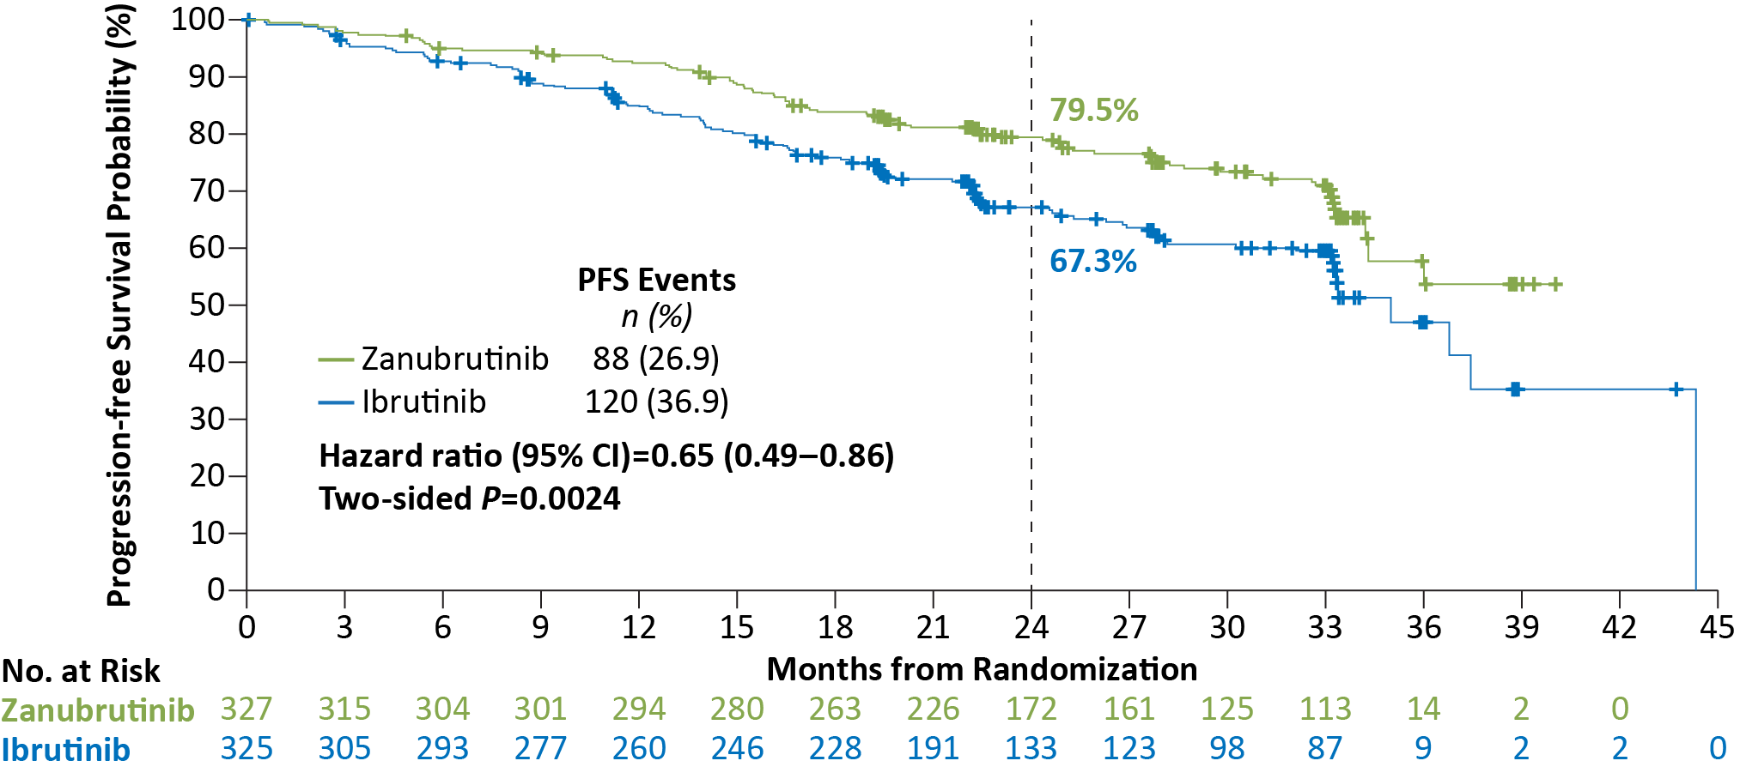
Zanubrutinib PFS by IRC Significantly Superior to Ibrutinib
Median study follow-up of 29.6 months
Brown JR et al ASH 2022;Abstract LBA-6
Data cutoff: 8 Aug 2022

Slide 28
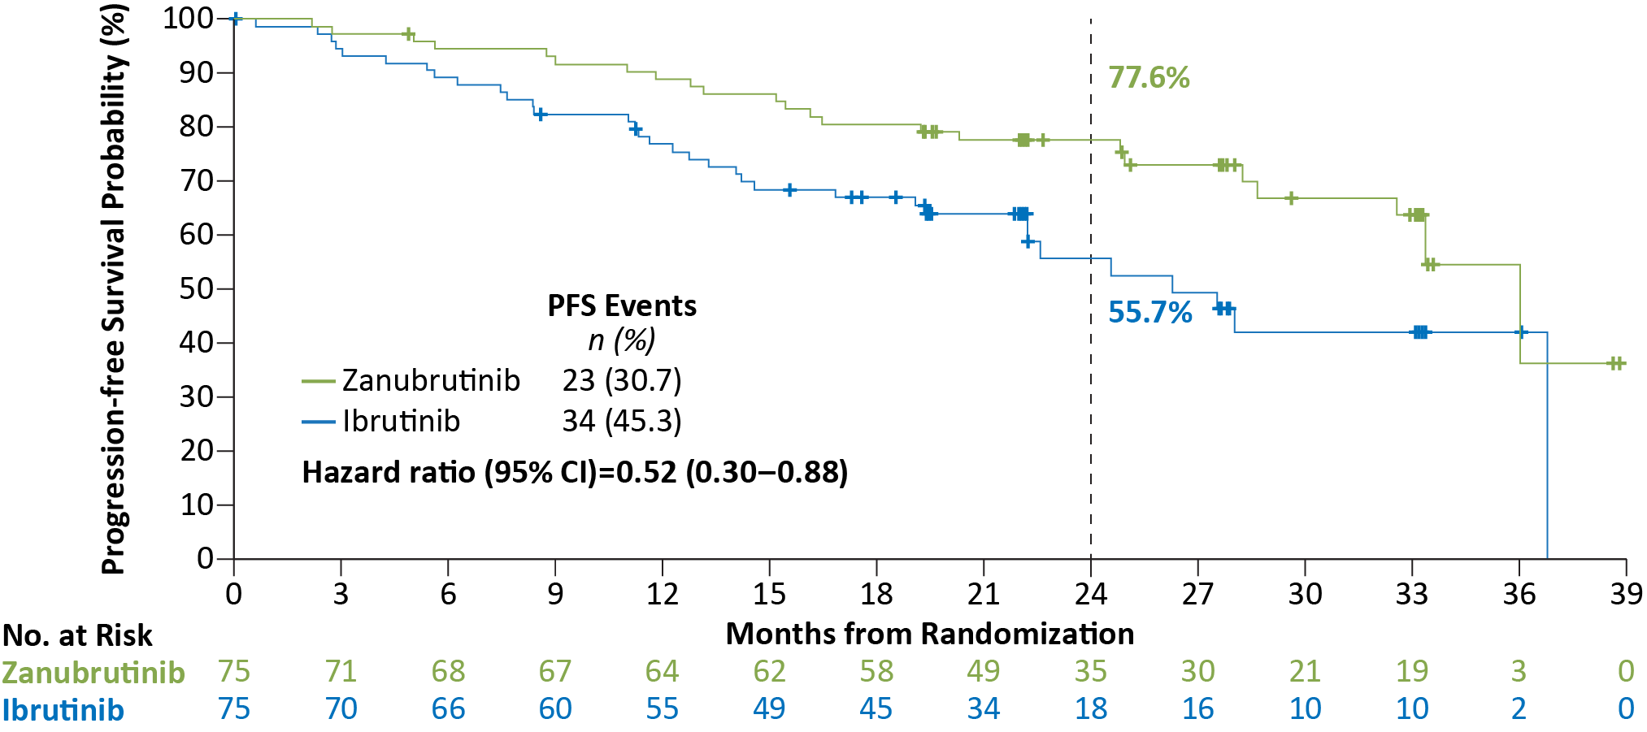
Zanubrutinib Improved PFS in Patients with del(17p)/TP53^{mut}
Nominal, 2-sided P=.0134
PFS data assessed by IRC
Brown JR et al ASH 2022;Abstract LBA-6
Data cutoff: 8 Aug 2022
Notes:
In a predefined subgroup of patients with del(17p)/TP53 mutation, longer PFS was demonstrated with zanubrutinib than ibrutinib regardless of IRC or INV assessment

Slide 29
Conclusions: ALPINE
First demonstrated efficacy benefit in head-to-head comparison of BTK inhibitors
2 yr PFS improved 12% by zanubrutinib in entire population, 22% in the del17p/TP53 aberrant population
Zanubrutinib also safer: fewer drug holds/ interruptions/ discontinuations
Cardiac safety much better: 1 discontinuation vs 14 with ibrutinib; 0 deaths vs 6 with ibrutinib

