Slide 1
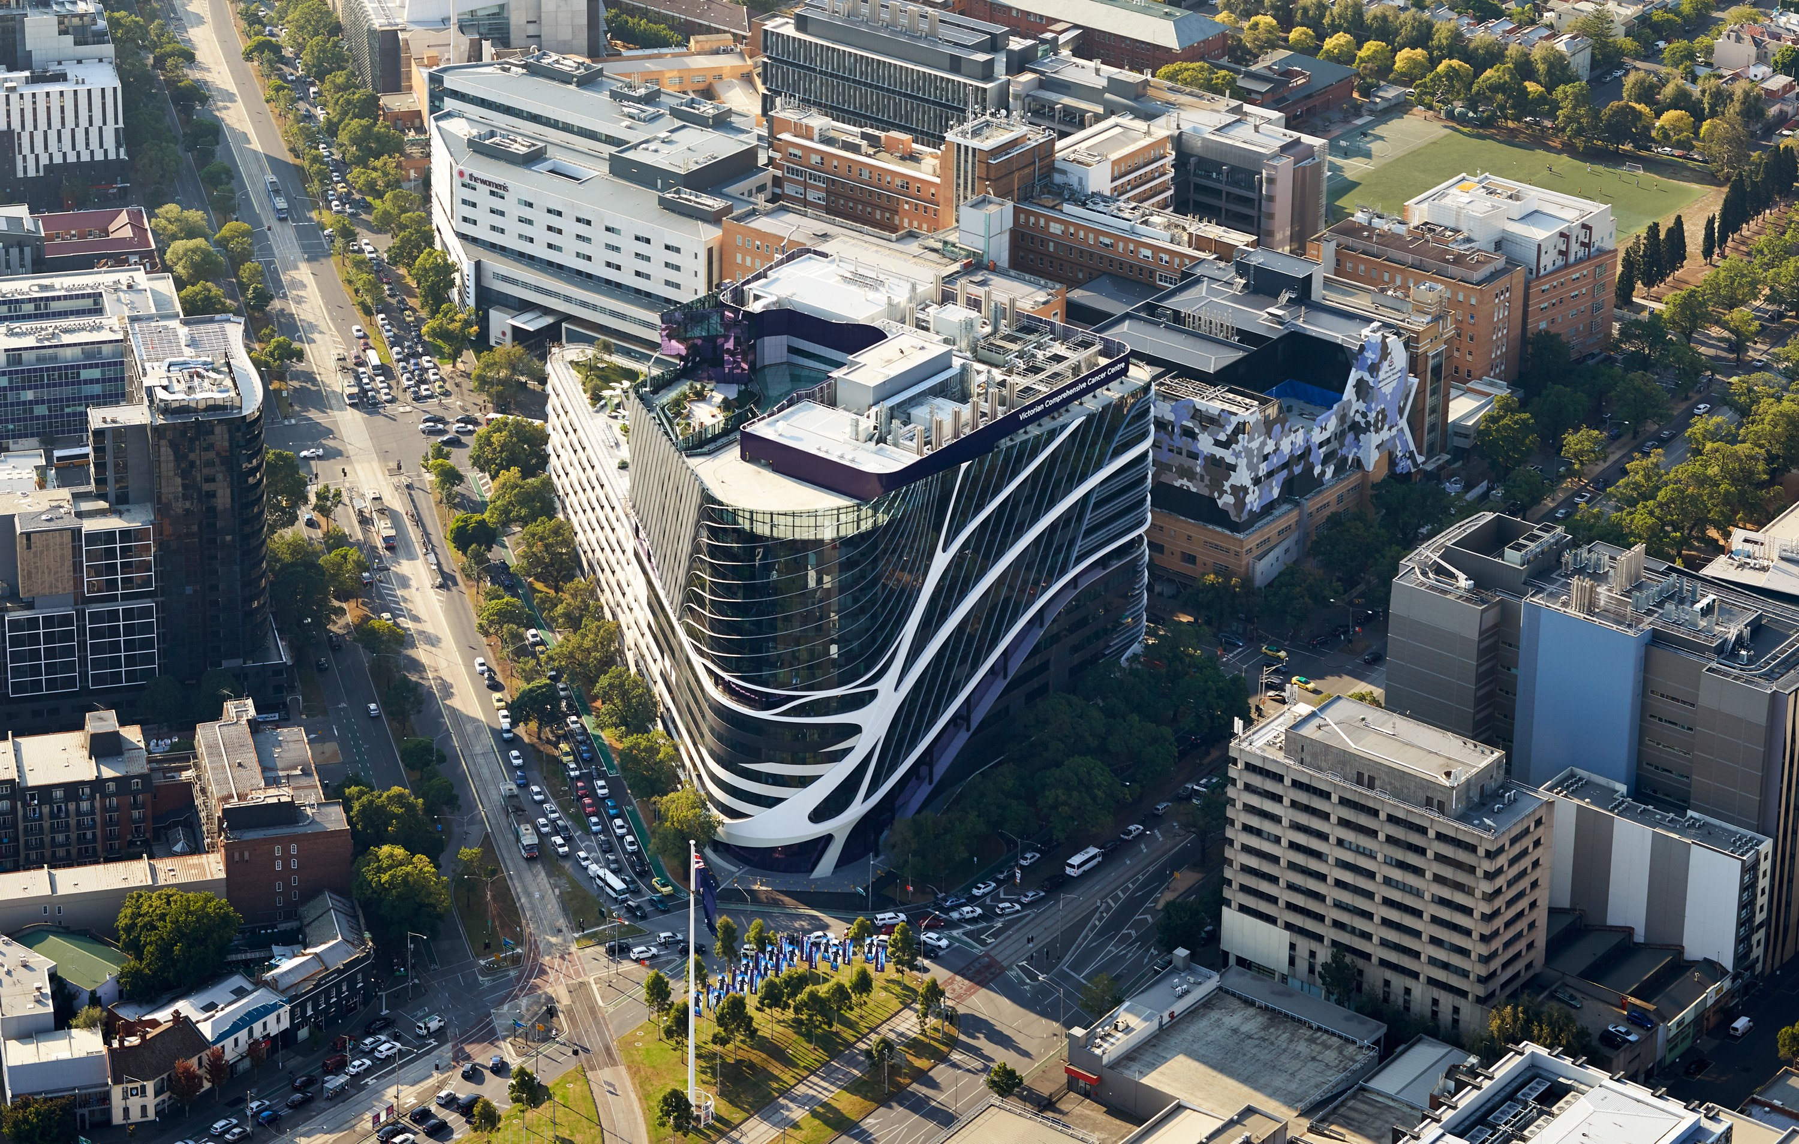


AML update
Andrew Wei
Peter MacCallum Cancer Centre
Royal Melbourne Hospital
Melbourne, Australia

Slide 2
First line
Salvage
Current landscape in AML
Fit for intensive chemo
FLT3^{MUT}
7+3 + Midostaurin
Post-remission therapy
HCT or
IDAC consol. or
oral AZA
Fit for intensive chemo
FLT3 mut
Gilteritinib
1
FLT3-ITD
7+3 + Quizartinib
Non-targeted
FLAG-IDA +/- VEN
sAML, tAML, MR-AML
CPX-351
Non-adverse CG
7+3 + GO
Adverse risk
Clinical trial
Unfit for chemo
IDH1 mut
IVO + AZA
Unfit for chemo
IDH1 mut
Ivosidenib
Other
VEN + AZA
IDH2 mut
Enasidenib
FLT3 mut
Gilteritinib

Slide 3
Targeted options for 1L therapy of FLT3-ITD AML
 | RATIFY | QuANTUM-First
Median Age | 47 | 56
≥ 60 y | 0% | 40%
FLT3-ITD | 78% | 100%
CR | 59% | 55%
Duration of CR | 27m | 39m
30-day death (vs PBO) | 4.5% (3.1%) | 5.7% (3.4%)
Maint 12 m
Maint 36 m + post HCT Quiz
Gr 3+ Rash 14%
Gr 3+ QTc inc 13.6%
100
HR=0.78
(95% CI=0.63–0.96)
p=0.009 (one-sided)
80
Midostaurin, n=360
Median OS, 74.7 months (95% CI=31.5–NR)
60
Survival (%)¹
40
Placebo, n=357
Median OS, 25.6 months (95% CI=18.6–42.9)
20
Benefit >60?
Neutrophil recovery?
0
0
12
24
36
48
60
72
84
90
Months
Months
Stone RM, et al. N Engl J Med 2017; 377:454–464
Harry Erba, EHA 2022; Abstract S100, Levis ASH 2022; Abstract 225

Slide 4
First line
Salvage
Current landscape in AML
Fit for intensive chemo
FLT3^{MUT}
7+3 + Midostaurin
Post-remission therapy
HCT or
IDAC consol. or
oral AZA
Fit for intensive chemo
FLT3 mut
Gilteritinib
1
FLT3-ITD
7+3 + Quizartinib
Non-targeted
FLAG-IDA +/- VEN
sAML, tAML, MR-AML
CPX-351
Non-adverse CG
7+3 + GO
Adverse risk
Clinical trial
Unfit for chemo
IDH1 mut
IVO + AZA
Unfit for chemo
IDH1 mut
Ivosidenib
Other
VEN + AZA
IDH2 mut
Enasidenib
FLT3 mut
Gilteritinib

Slide 5
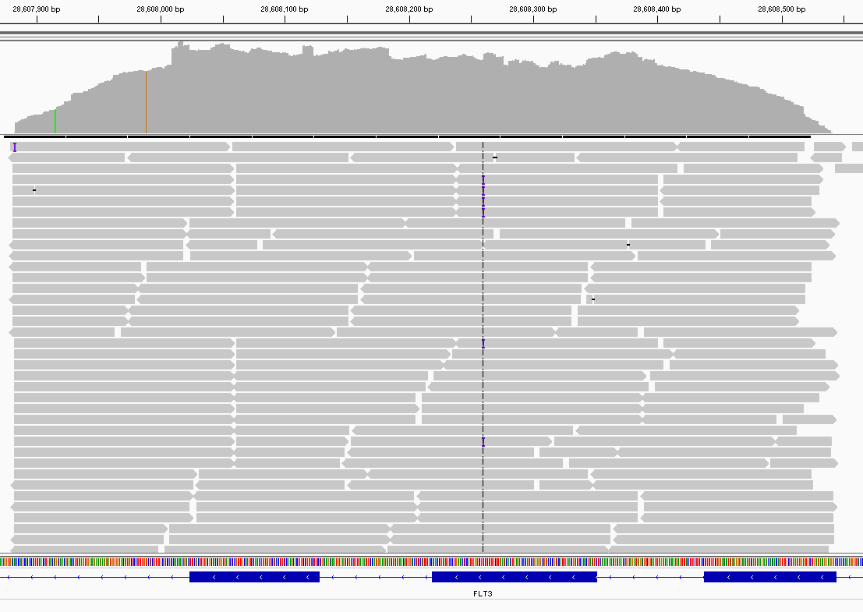
MRD assay for FLT3-ITD mutations:
PCR followed by NGS
5’
Forward
ITD
3’
Reverse
Reads matching wild type sequence
Reads containing unique ITD sequence
Reads matching wild type sequence
Ultra-deep sequencing of the region
(Illumina SBS)
Detects FLT3-ITD mutations with sensitivity of ~2 x 10⁻⁶
ITD identified by bioinformatics pipeline and
allelic frequency is calculated
Diverse reads aligned to FLT3 genomic sequence
Relevant FLT3 region (exon 14-15) targeted
Exon 15 Exon 14 Exon 13
Blood. 2020. 135:75-78

Slide 6
PCR-NGS MRD assay results pre-transplant predict outcomes
Pre-transplant MRD
PCR: Polymerase chain reaction
NGS: Next-generation sequencing
MRD: Measurable residual disease
VAF: variant allele frequency
Loo et al. Blood 2022 Epub

Slide 7
First line
Salvage
Current landscape in AML
Fit for intensive chemo
FLT3^{MUT}
7+3 + Midostaurin
Post-remission therapy
HCT or
IDAC consol. or
oral AZA
Fit for intensive chemo
FLT3 mut
Gilteritinib
FLT3-ITD
7+3 + Quizartinib
Non-targeted
FLAG-IDA +/- VEN
sAML, tAML, MR-AML
CPX-351
2
Non-adverse CG
7+3 + GO
Other
7+3
Unfit for chemo
IDH1 mut
IVO + AZA
Unfit for chemo
IDH1 mut
Ivosidenib
Other
VEN + AZA
IDH2 mut
Enasidenib
FLT3 mut
Gilteritinib

Slide 8
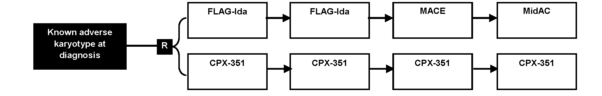
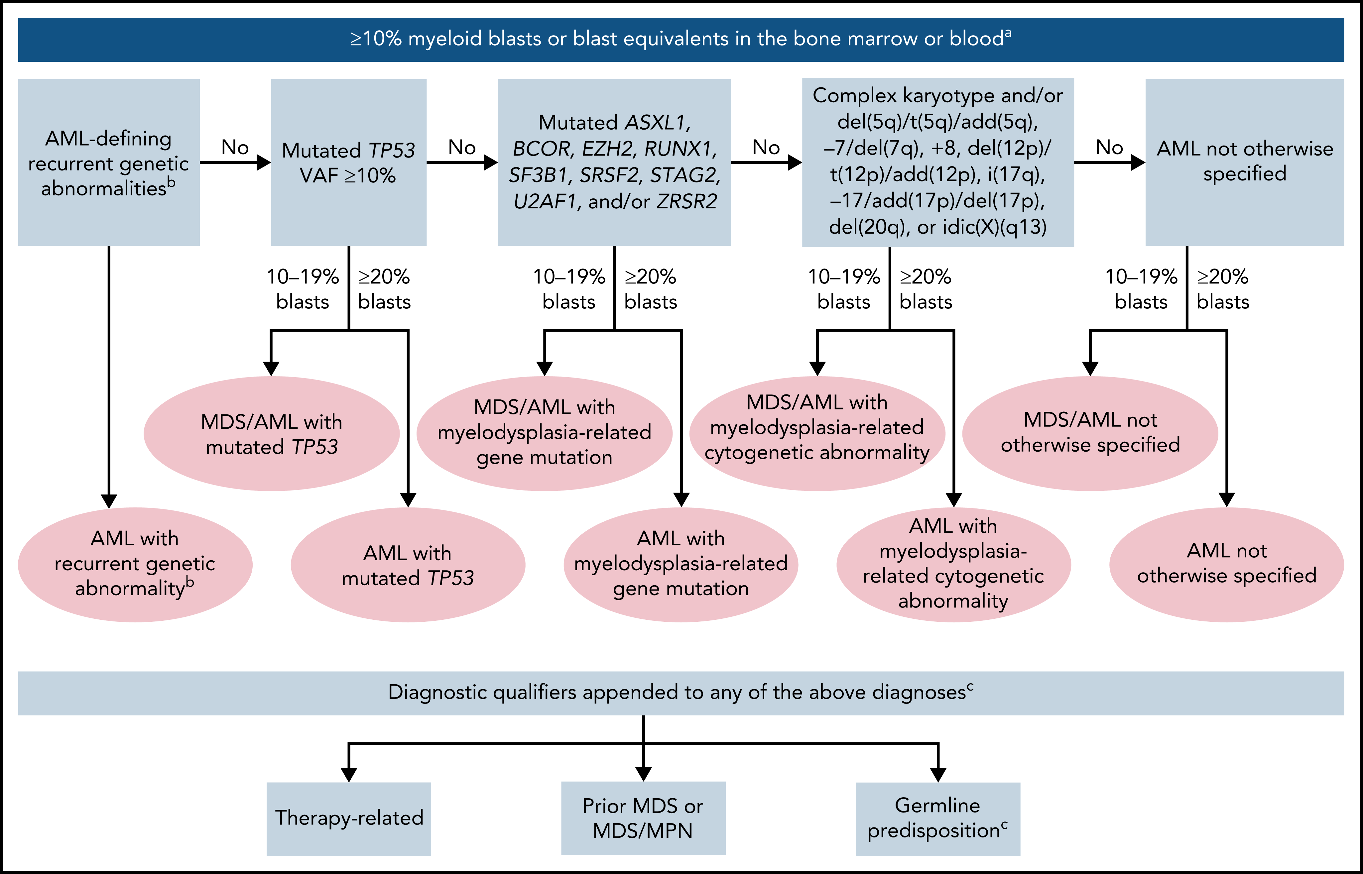
Genomic Correlates of Outcome in a Randomised Comparison Of CPX-351 and FLAG-Ida in High-Risk Acute Myeloid Leukaemia and Myelodysplastic Syndrome:
Results From the UK NCRI AML19 Trial
n=82
n=78
n=54
n=1
n=0
n=105
100 u/m²
D 1, 3, 5
100 u/m²
D 1, 3
65 u/m²
D 1, 3
65 u/m²
D 1, 3
>10% blasts
n=101
n=59
n=19
n=5
J Othman, ASH 2022
Döhner H et al, Blood. 2022
Notes:
FLAG-Ida Ara-C dose reduced from 2 to 1 if >60
MACE – amsacrine 100, cytarabine 200, etoposide 100 (all days 1-5)
MiDAC – mitoxantrone 10 d1-5, cytarabine 1 bd d1-3

Slide 9
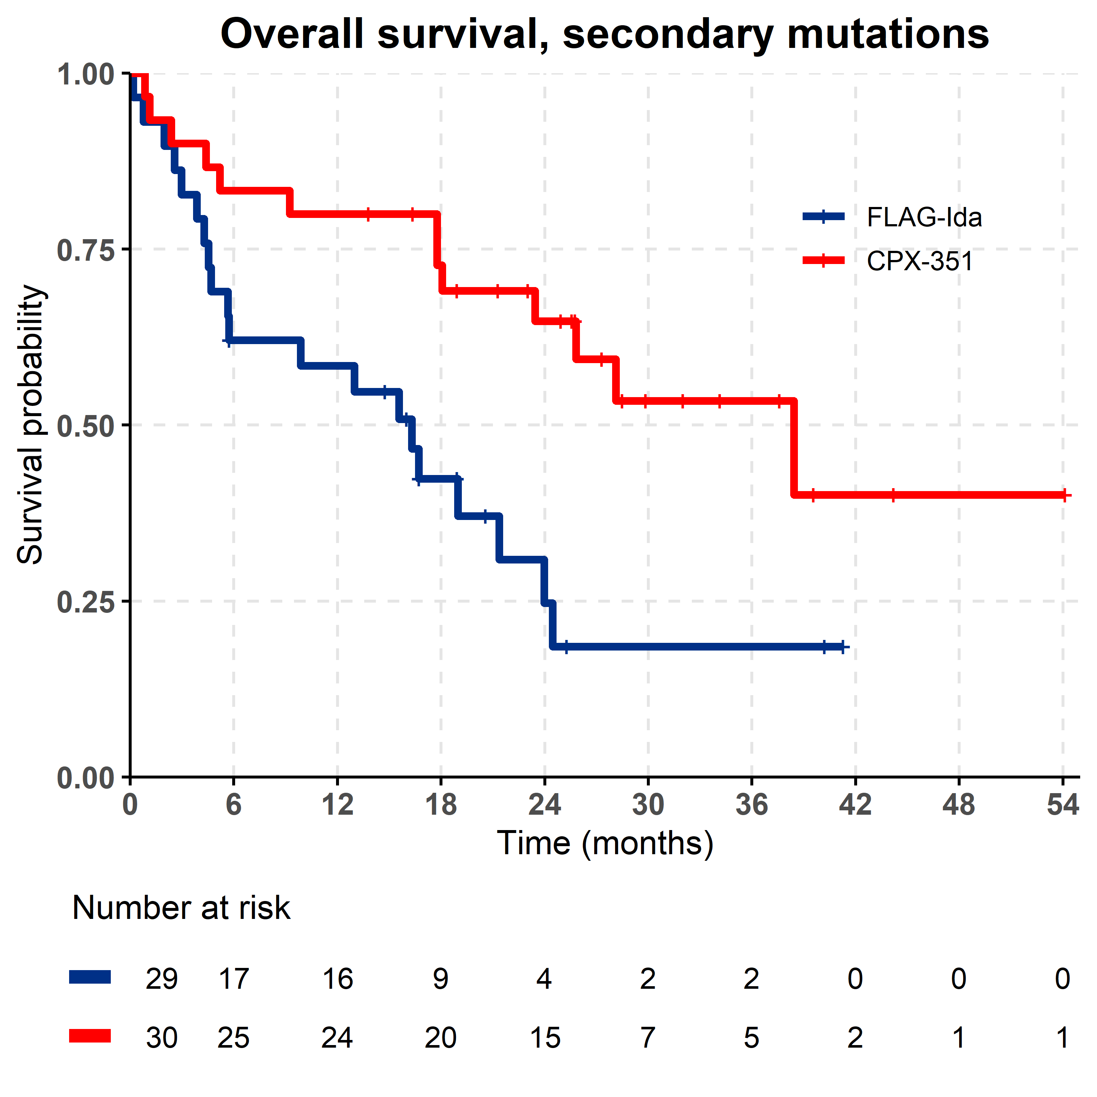
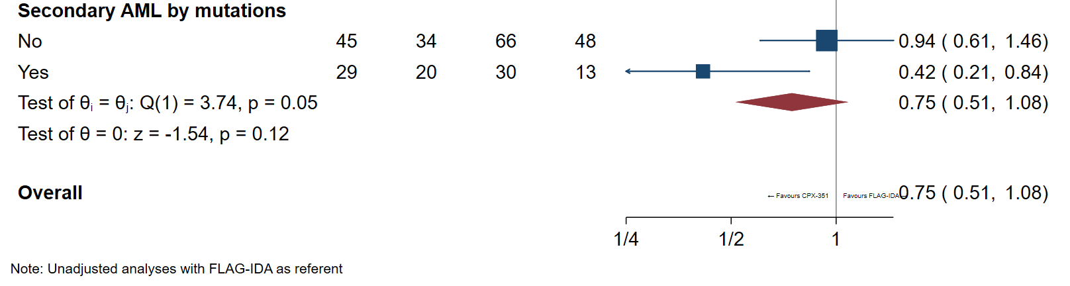
CPX-351 shows benefit in MR-AML
In patients with myelodysplasia-related gene mutations, there was an OS advantage with CPX-351
Favours CPX-351 Favours FLAG-Ida
J Othman, ASH 2022

Slide 10
First line
Salvage
Current landscape in AML
Fit for intensive chemo
FLT3^{MUT}
7+3 + Midostaurin
Post-remission therapy
HCT or
IDAC consol. or
oral AZA
Fit for intensive chemo
FLT3 mut
Gilteritinib
FLT3-ITD
7+3 + Quizartinib
Non-targeted
FLAG-IDA +/- VEN
sAML, tAML, MR-AML
CPX-351
Non-adverse CG
7+3 + GO
Other
3
7+3
Unfit for chemo
IDH1 mut
IVO + AZA
Unfit for chemo
IDH1 mut
Ivosidenib
Other
VEN + AZA
IDH2 mut
Enasidenib
FLT3 mut
Gilteritinib

Slide 11

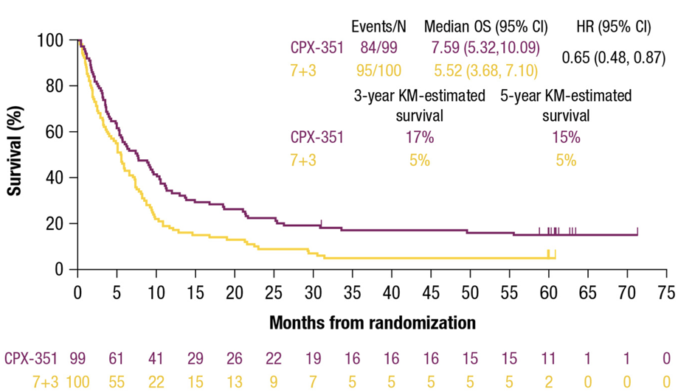
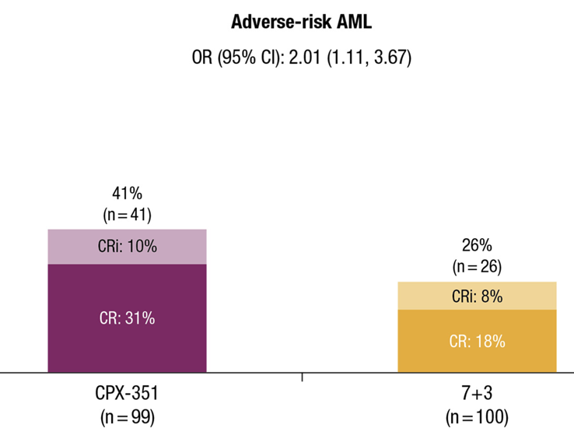
CPX-351 vs 7+3 in adverse risk AML
Cortes et al, Journal of Hematology & Oncology 2022

Slide 12
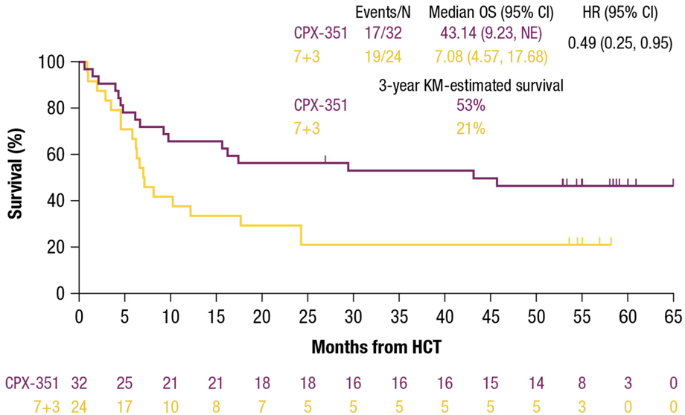
CPX-351 vs 7+3 in adverse risk AML
Cortes et al, Journal of Hematology & Oncology 2022

Slide 13
First line
Salvage
Current landscape in AML
Fit for intensive chemo
FLT3^{MUT}
7+3 + Midostaurin
Post-remission therapy
HCT or
IDAC consol. or
oral AZA
Fit for intensive chemo
FLT3 mut
Gilteritinib
FLT3-ITD
7+3 + Quizartinib
Non-targeted
FLAG-IDA +/- VEN
sAML, tAML, MR-AML
CPX-351
Non-adverse CG
7+3 + GO
Other
7+3
Unfit for chemo
IDH1 mut
IVO + AZA
Unfit for chemo
IDH1 mut
Ivosidenib
4
Other
VEN + AZA
IDH2 mut
Enasidenib
FLT3 mut
Gilteritinib

Slide 14
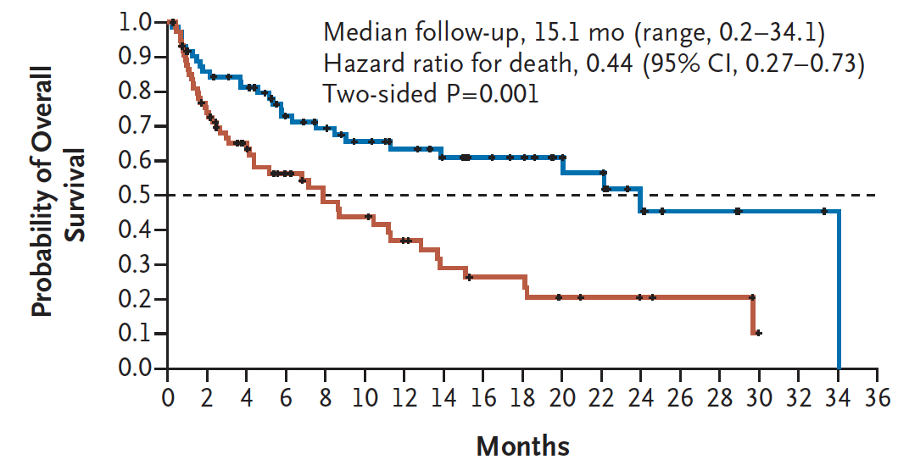
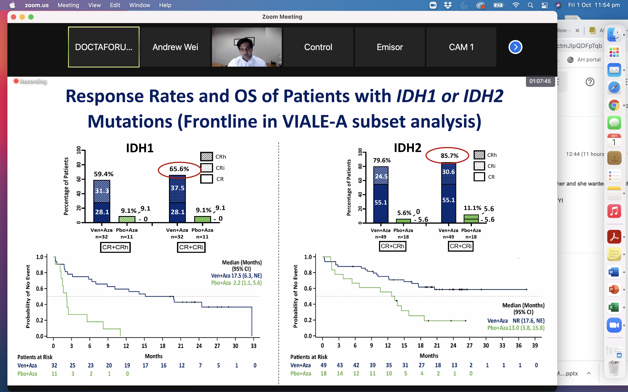
IVO-AZA or VEN-AZA for IDH1 mut AML?
IDH1m | IVO + AZA | AZA | VEN-AZA | AZA
N | 72 | 74 | 32 | 11
Median age | 76 | 76 | 76 | 76
ORR (CR/CRi) | 54% | 16% | 66% | 9%
CR | 47% | 15% | 28% | 0%
Median time to CR/CRi | 4.3 m | 3.8 m | 1.1 m | 3.4 m
Median OS | 24 m | 7.9 m | 17.5 m | 2.2 m
IVO + AZA
Pbo + AZA
Montesinos et al, NEJM 2022, 386; 1519-31
Pollyea, et al, Clin Cancer Res 2022;28:2753–61
Notes:
IDH1 mut clearance 52% 30%

Slide 15
First line
Salvage
Current landscape in AML
Fit for intensive chemo
FLT3^{MUT}
7+3 + Midostaurin
Post-remission therapy
HCT or
IDAC consol. or
oral AZA
Fit for intensive chemo
FLT3 mut
Gilteritinib
FLT3-ITD
7+3 + Quizartinib
Non-targeted
FLAG-IDA +/- VEN
sAML, tAML, MR-AML
CPX-351
Non-adverse CG
7+3 + GO
Other
7+3
Unfit for chemo
IDH1 mut
IVO + AZA
Unfit for chemo
IDH1 mut
Ivosidenib
Other
VEN + AZA
IDH2 mut
Enasidenib
5
FLT3 mut
Gilteritinib

Slide 16
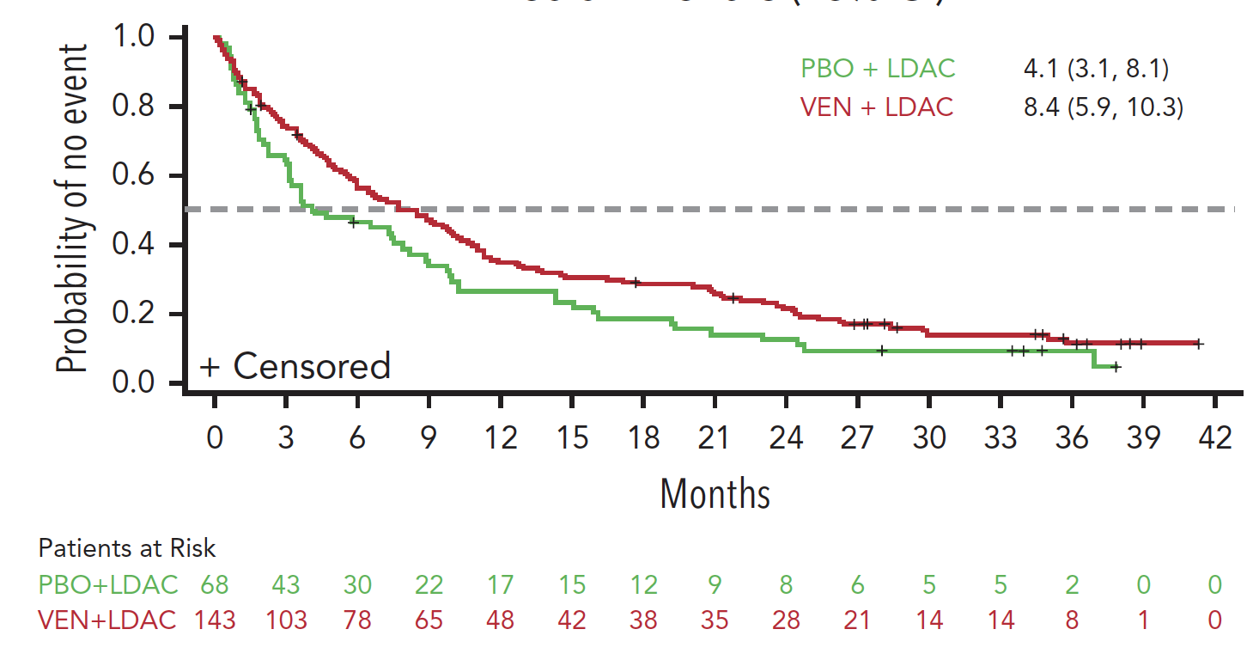
Long-term outcome after low-intensity therapies for AML
AZA-VEN
LDAC-VEN
14.7 m
9.6 m
Probability of no event
Median follow-up:
37.4 months
Median follow-up:
43.2 months
0
3
6
9
12
15
18
21
24
27
30
33
36
39
42
45
48
51
54
Months
Which sub-groups benefit most?
Pratz KW, et al. Oral 219. 64th ASH. Dec 10-13, 2022. New Orleans, LA.
Wei et al, Blood (2022) 140 (25): 2754–2756

Slide 17
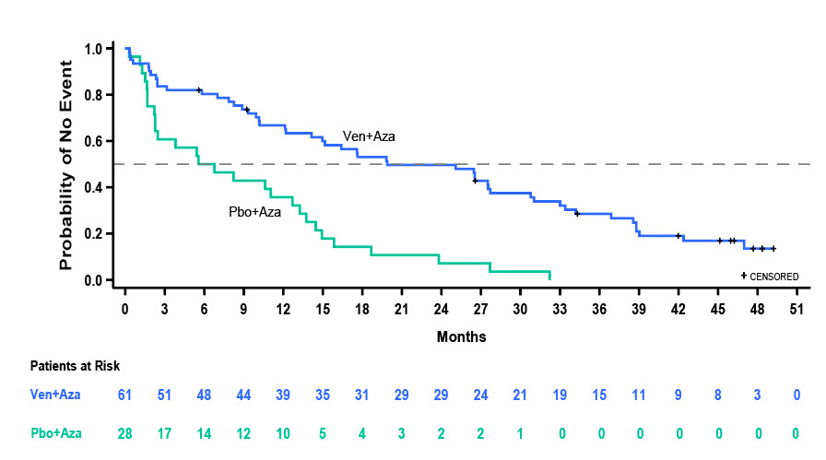
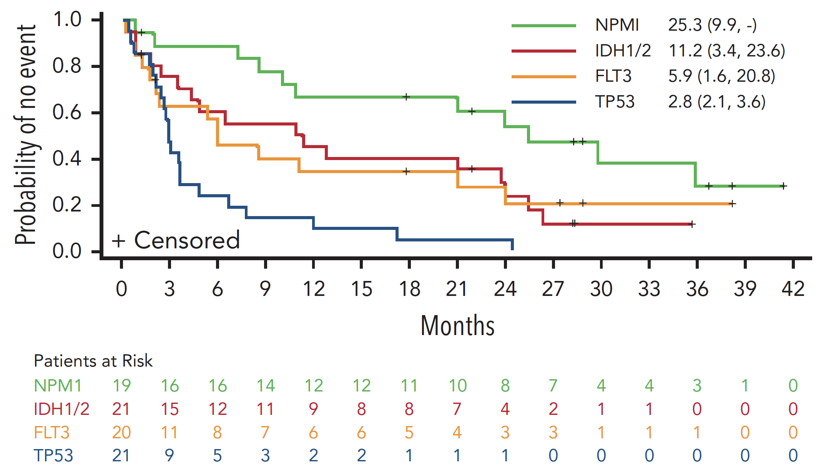
Long-term outcomes for selected molecular sub-groups
AZA-VEN
IDHm
LDAC-VEN
Various molecular
 | OS (months) median (95% CI)
Ven+Aza | 19.9 (12.2, 27.7)
Pbo+Aza | 6.2 (2.3, 12.7)
Probability of Overall Survival
Pratz KW, et al. Oral 219. 64th ASH. Dec 10-13, 2022. New Orleans, LA.
Wei et al, Blood (2022) 140 (25): 2754–2756

Slide 18
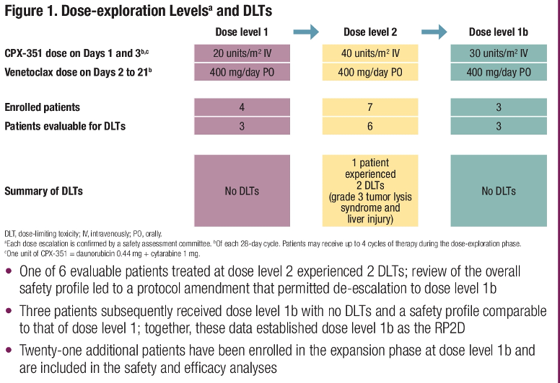
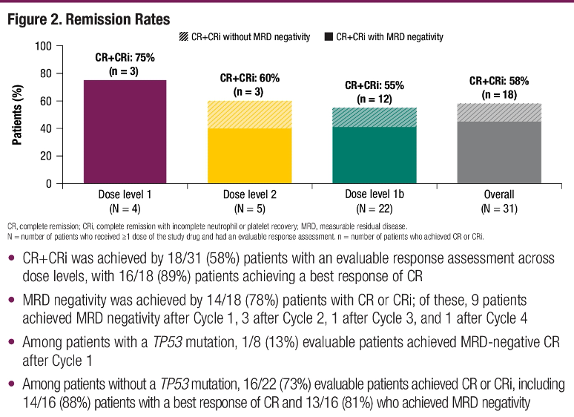
Lower-Intensity CPX-351 with Venetoclax for Patients with Newly Diagnosed AML Not Eligible for Intensive Chemotherapy
Uy. ASCO 2022;Abstract 7031.

Slide 19
First line
Salvage
Current landscape in AML
Fit for intensive chemo
FLT3^{MUT}
7+3 + Midostaurin
Post-remission therapy
HCT or
IDAC consol. or
oral AZA
Fit for intensive chemo
FLT3 mut
Gilteritinib
FLT3-ITD
7+3 + Quizartinib
Non-targeted
FLAG-IDA +/- VEN
sAML, tAML, MR-AML
CPX-351
Non-adverse CG
7+3 + GO
6
Other
7+3
Unfit for chemo
IDH1 mut
IVO + AZA
Unfit for chemo
IDH1 mut
Ivosidenib
Other
VEN + AZA
IDH2 mut
Enasidenib
FLT3 mut
Gilteritinib

Slide 20
Venetoclax in combination with intensive chemotherapy in newly diagnosed AML
Reference | Regimen | Median age, years (range) | N | CR+CRi | Median follow up | Median OS
2020 Chua et al, JCO | 5+2 plus VEN (CAVEAT) | 72 (63-80) | 51 | 72% | 22.9 mo | 11.2 mo
2021 DiNardo et al, JCO | FLAG-Ida plus VEN | 46 (20-63) | 29 | 72% | 12 mo | Not reached
2021 Kadia et al, Lancet Haematol | CLIA plus VEN | 48 (37-56) | 46 | 94% | 14 mo | Not reached
2022 Wang et al, Lancet Haematol | 7+3 plus VEN | 40 (18-60) | 33 | 91% | 11 mo | Not reached
2019 Stone et al, ASH | 7+3 plus VEN | Study amended to ≤60y due to early deaths | 9 | NA | NA | NA
Mo: months; CAVEAT, chemotherapy and venetoclax in elderly AML trial
Chua et al, ASH 2022

Slide 21
CAVEAT: Chemotherapy and Venetoclax in Elderly AML Trial
Median age 72
Median follow up 37.0 months
Median months (95% CI)
NPM1
IDH2
5+2+venetoclax (>65 yo)
Others
TP53
 | N | ORR (CR+CRi) | CR | Median OS (months) | 2-year OS | 3-year OS
Molecular abnormality NPM1 FLT3-ITD IDH1 IDH2 TP53 | 17 5 8 13 12 | 76% 80% 63% 85% 33% | 59% 60% 38% 85% 0% | 43.9 5.5 9.4 43.9 3.6 | 59% 40% 33% 69% - | 52% - 33% 58% -
Chua et al, ASH 2022

Slide 22
How to use FLAG-IDA-VEN
 | DiNardo | Shahswar | Modified
Fludarabine | 30mg/m² D2-6 | 30mg/m² D1-5 If >60 yo 20mg/m² | 30mg/m² D2-6 If >60 yo 20mg/m²
Ara-C | 1.5g/m² IV D2-6 | 1.5g/m² IV daily D1-5 If >60 yo Ara-C 500mg/m² | 1.5g/m² IV D2-6 If >60 yo Ara-C 500mg/m²
G-CSF | 5mcg/kg D1-7 | PEG-GCSF 6mg D6 | PEG-GCSF 6mg D6
Idarubicin | 6 mg/m² D4,5 | 10 mg/m² D1-3 If >60 yo 8 mg/m² D4,5 | 6 mg/m² D5,6
Venetoclax | 400mg PO D1-14 | 100mg PO D1-7 | 100mg PO D1-7
 |  | Posaconazole D1+ | Posaconazole D2+
Ensure an HCT donor is planned
Aim to give one cycle of therapy
Mainly use in patients <60 years
Avoid in situations where 7+3 is sufficient
DiNardo, J Clin Oncol 2021, 39:2768-2778
Am J Hematol 2022;97(8):1035-43
Shahswar et al, Br J Haematol. 2020 February 01; 188(3): e11–e15

Slide 23
First line
Salvage
Current landscape in AML
Fit for intensive chemo
FLT3^{MUT}
7+3 + Midostaurin
Post-remission therapy
HCT or
IDAC consol. or
oral AZA
Fit for intensive chemo
FLT3 mut
Gilteritinib
FLT3-ITD
7+3 + Quizartinib
Non-targeted
FLAG-IDA +/- VEN
sAML, tAML, MR-AML
CPX-351
Non-adverse CG
7+3 + GO
Other
7+3
7
Ivosidenib
Unfit for chemo
IDH1 mut
IVO + AZA
Unfit for chemo
IDH1 mut
Other
VEN + AZA
IDH2 mut
Enasidenib
FLT3 mut
Gilteritinib

Slide 24
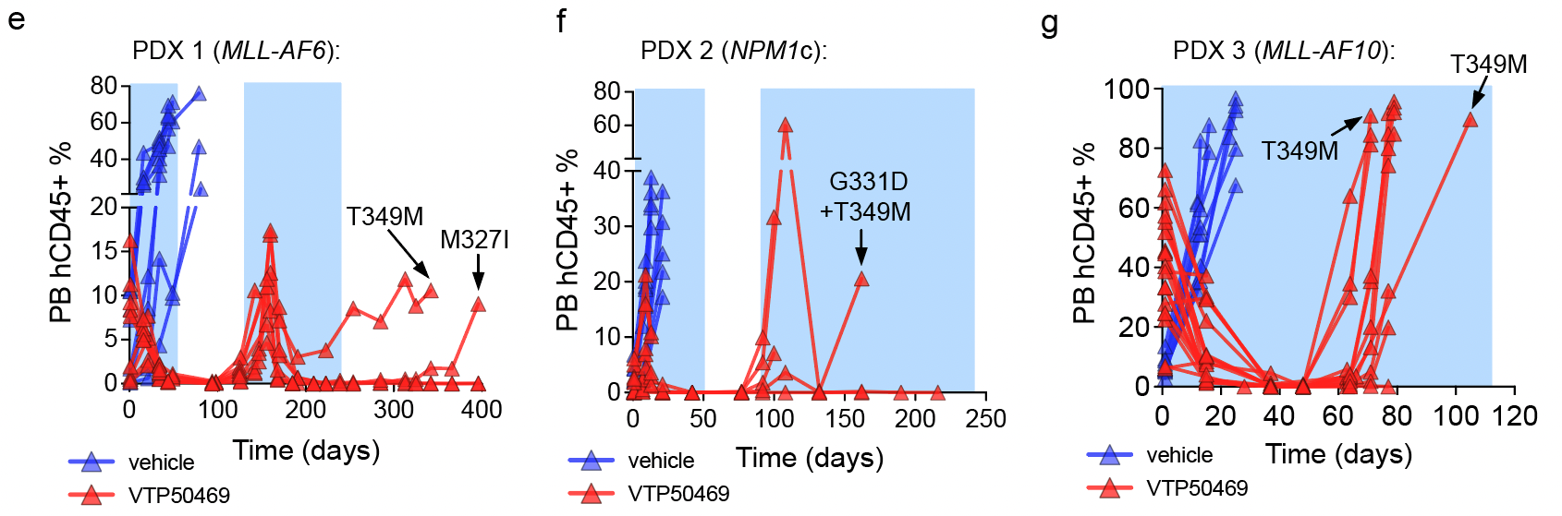
AUGMENT-101: SNDX-5613 (revumenib)
46 had KMT2Ar, 14 had mNPM1
Differentiation syndrome, all grade 2, in 11 pts (16%)
KMT2Ar: ORR 59% (27/46 pts)
mNPM1: ORR 36% (5/14 pts)
Median duration of response 9.1 months (95% CI: 2.7-NR)
Issa et al, Nature 2023
Perner et al, Nature 2023

Slide 25
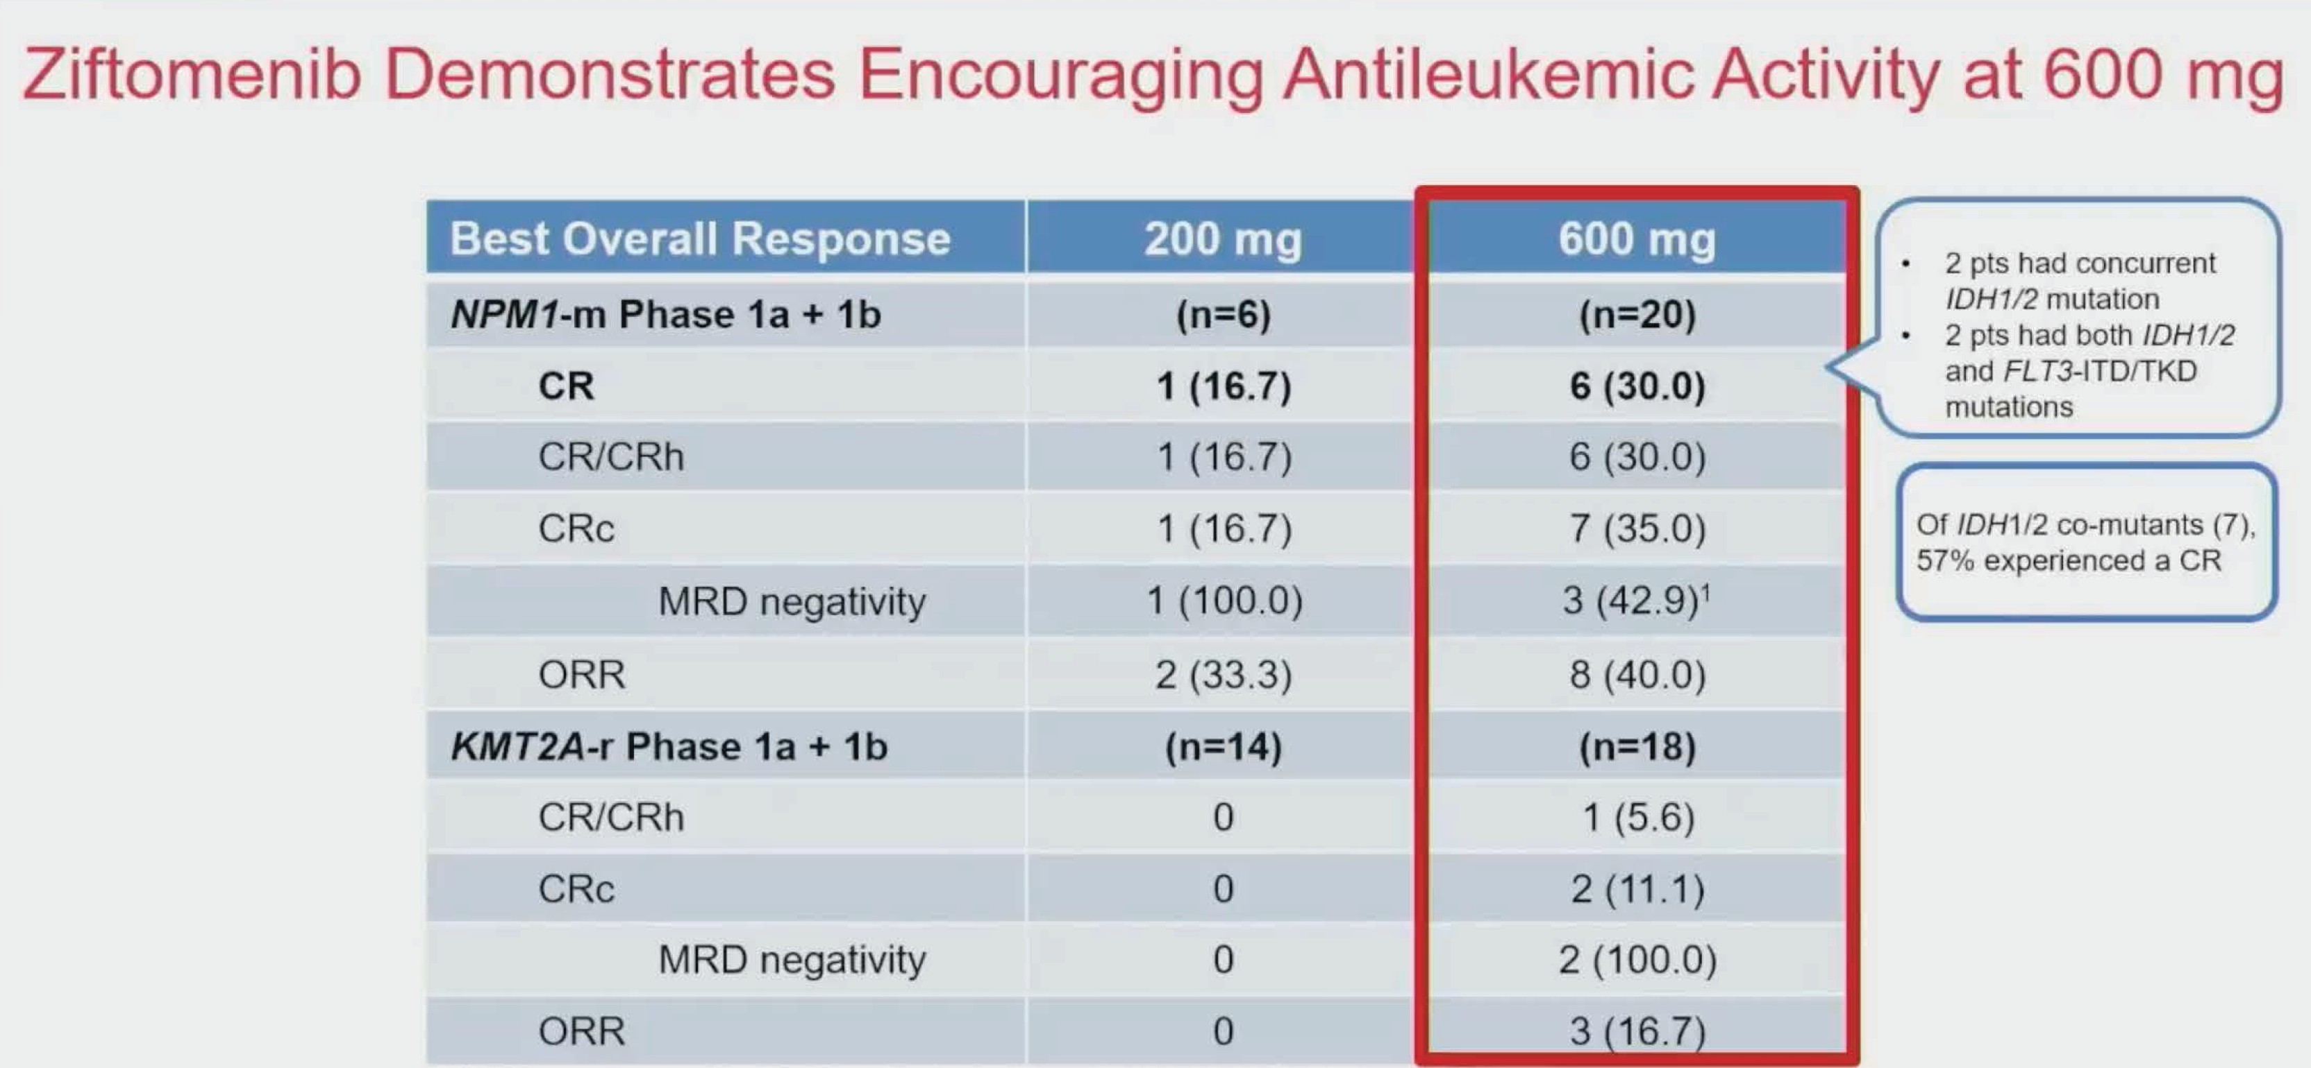
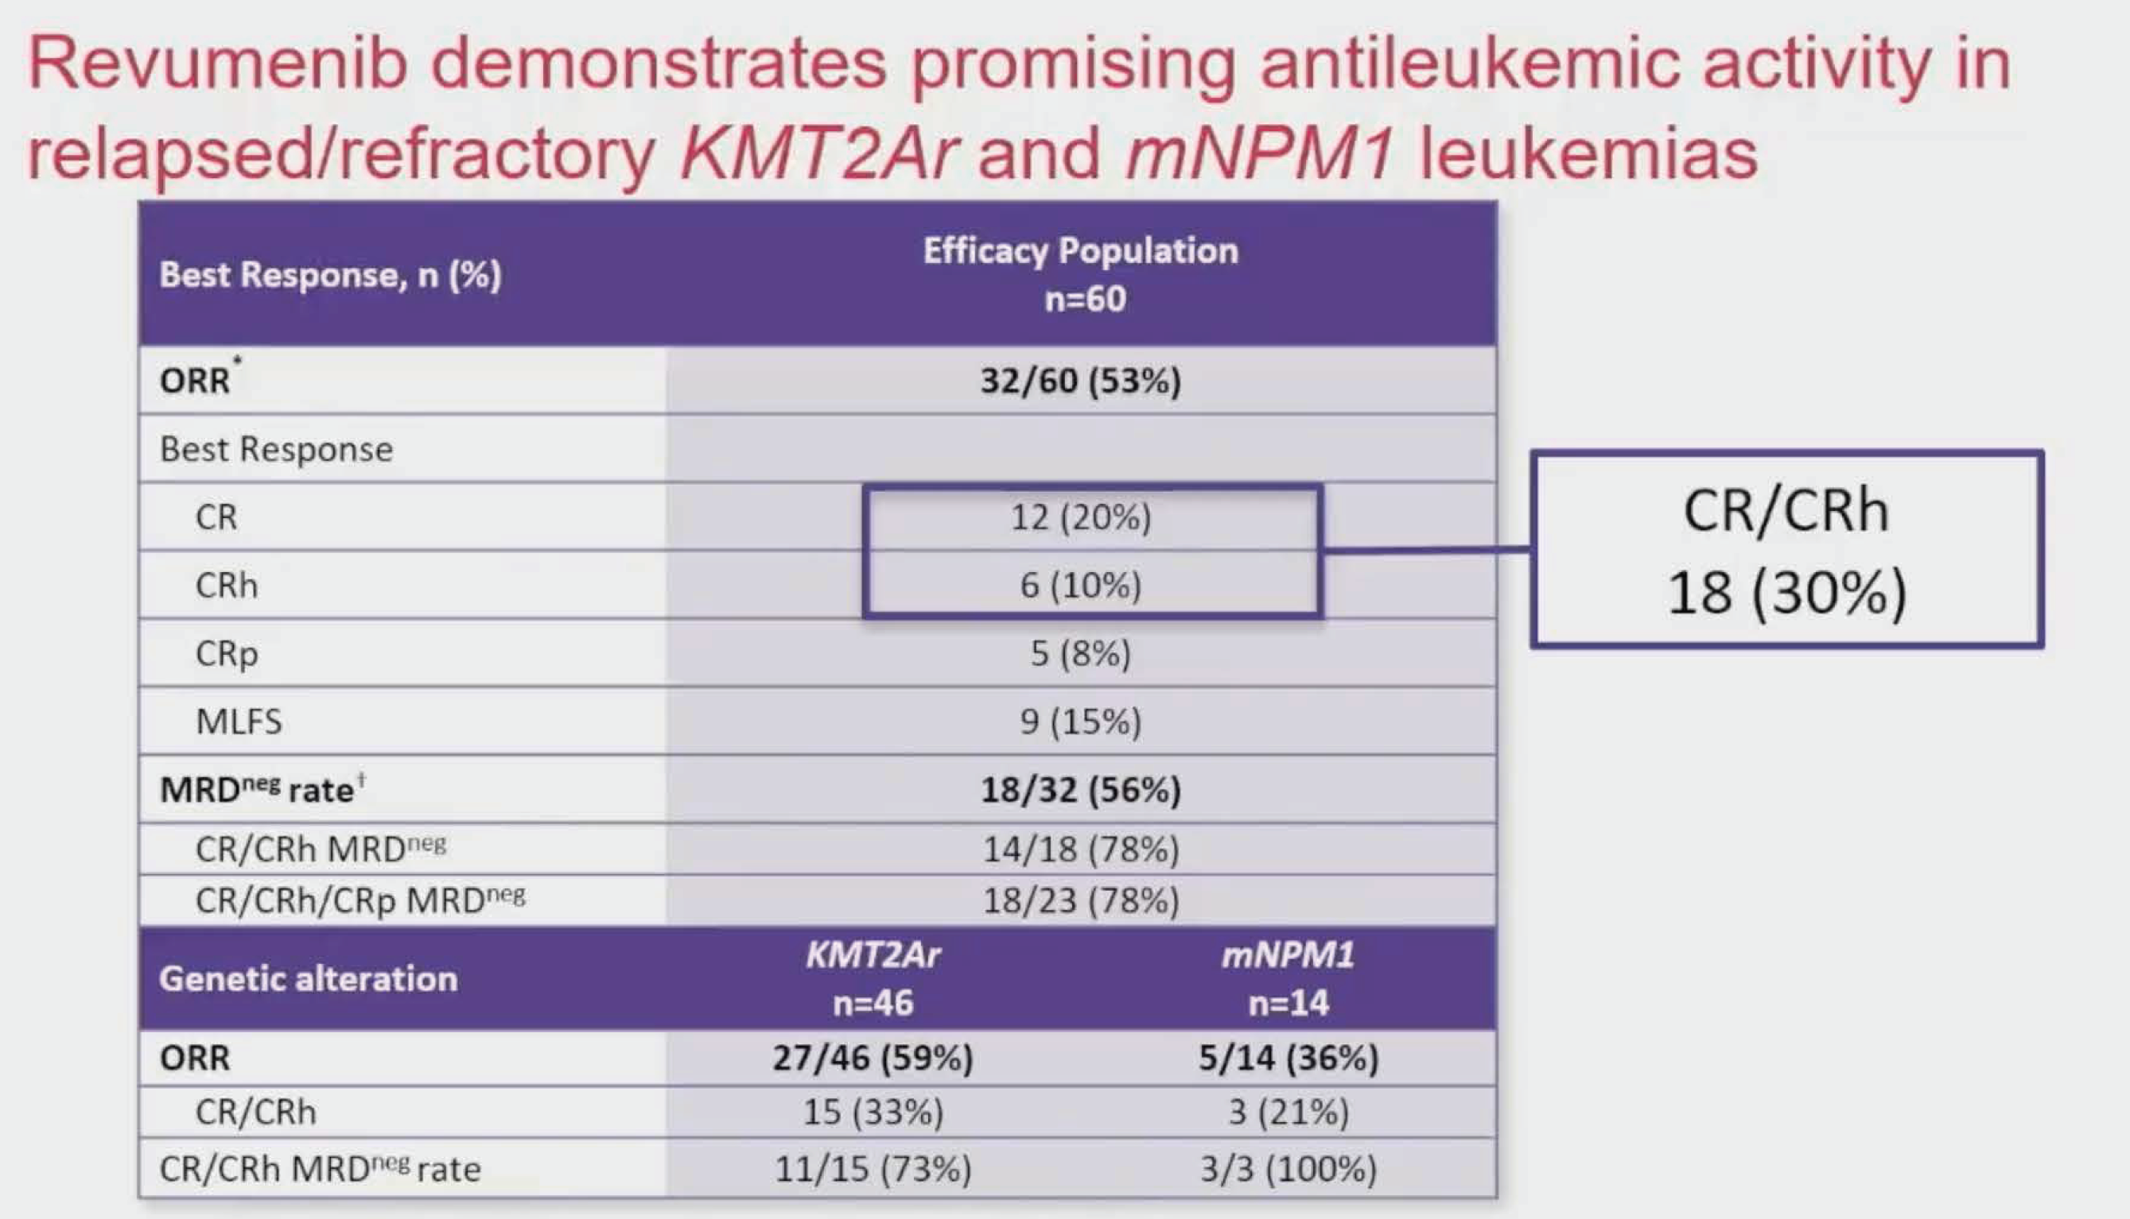
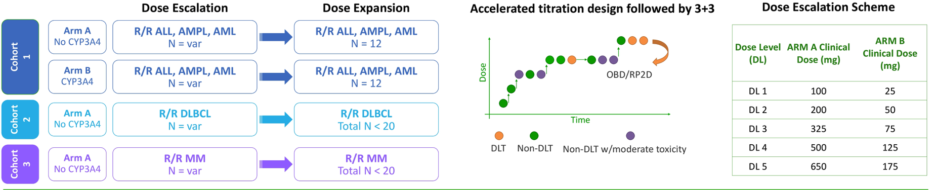
Menin Inhibitors
a.
b.
c.
a. Erba. ASH 2022;Abstract 64. b. Issa. ASH 2022; Abstract 63.
c. Ravandi. ASCO 2022;Abstract TPS7064.

Slide 26
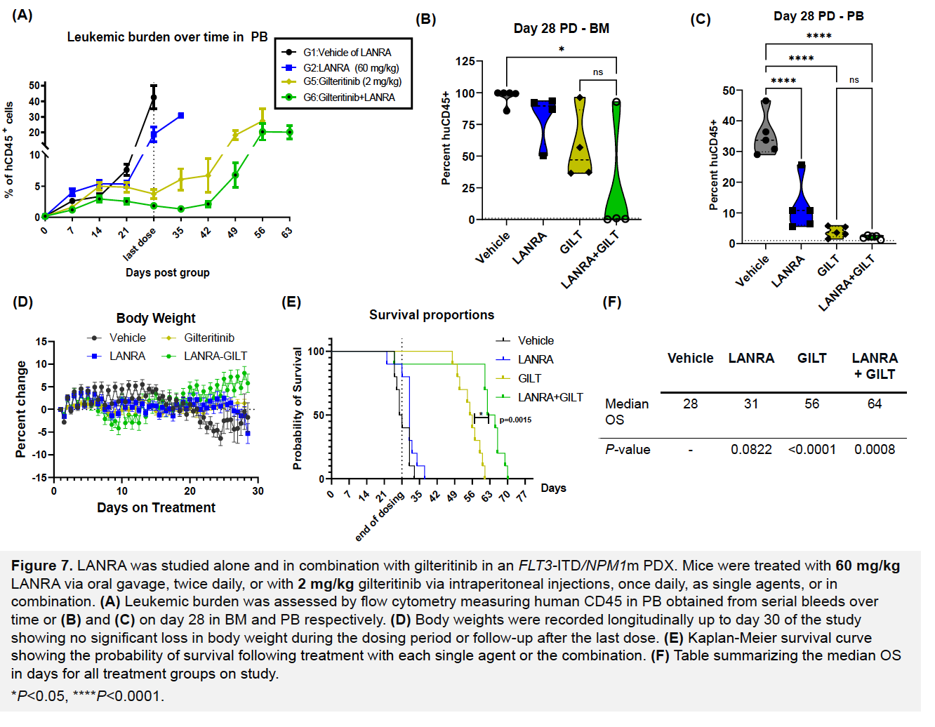
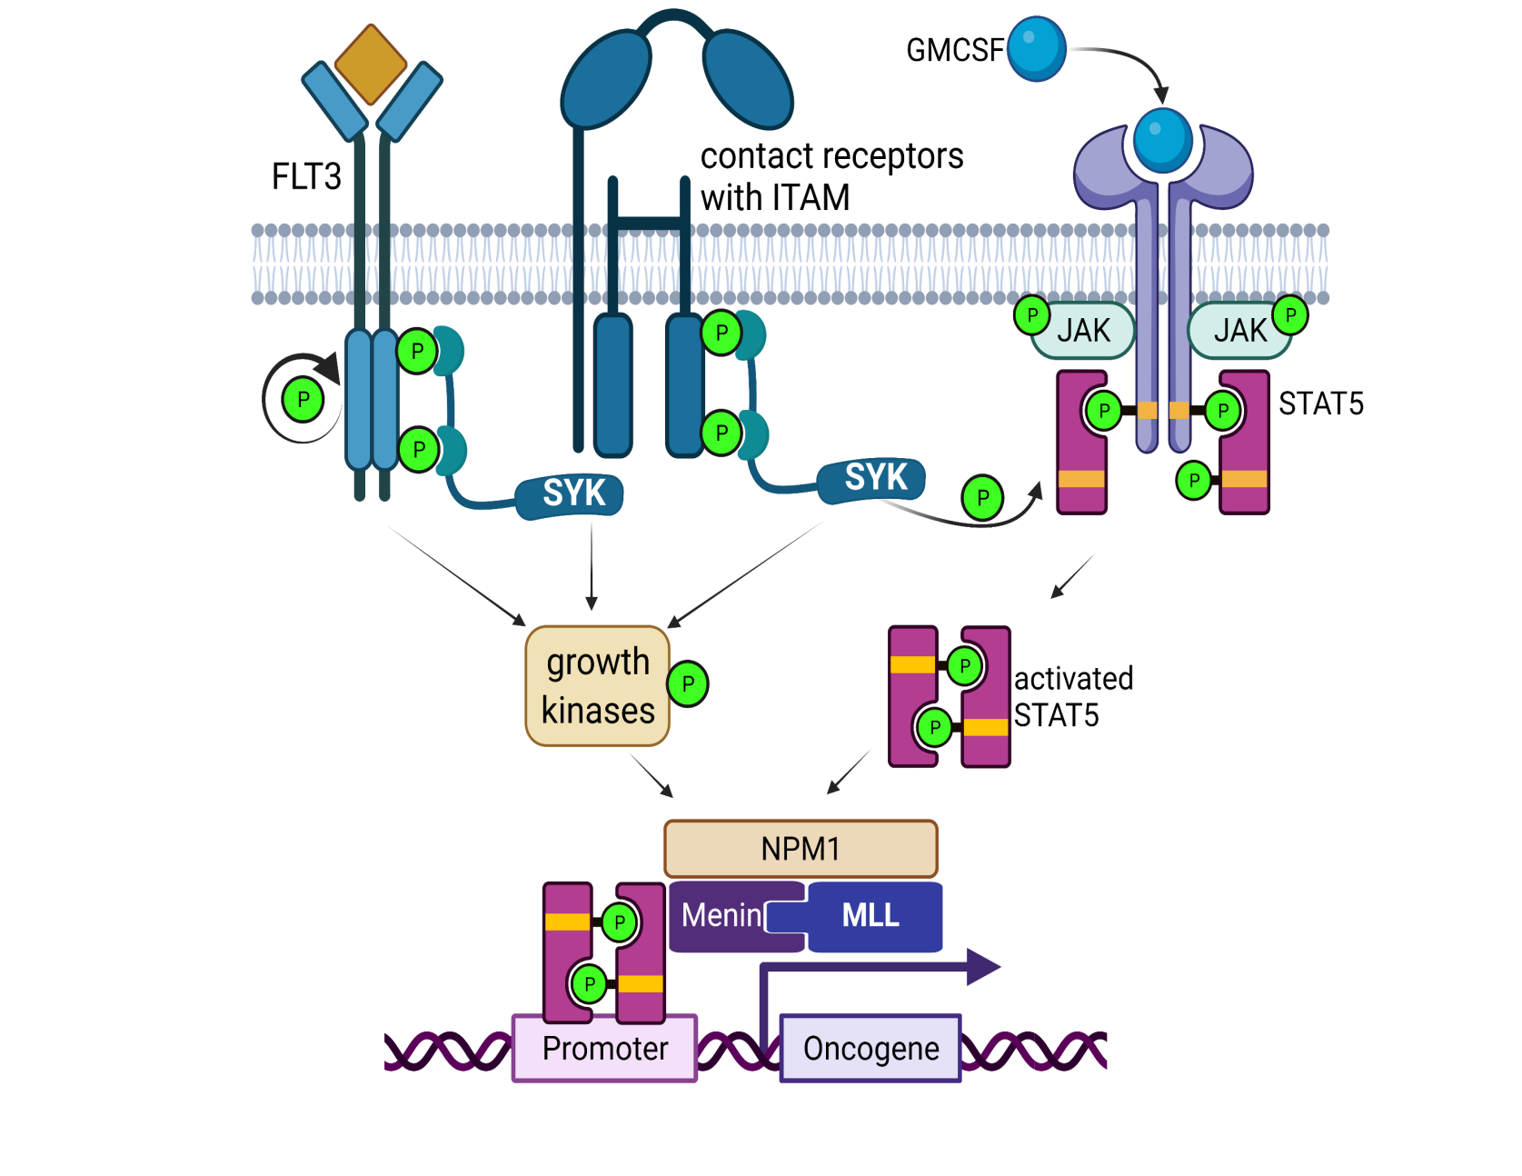
SYK Inhibitors Entospletinib and Lanraplenib
SYK Mechanistic Model in AML
Carvajal. ASH 2022;Abstract 2639.

Slide 27
First line
Salvage
Current landscape in AML
Fit for intensive chemo
FLT3^{MUT}
7+3 + Midostaurin
Post-remission therapy
HCT or
IDAC consol. or
oral AZA
Fit for intensive chemo
8
FLT3 mut
Gilteritinib
FLT3-ITD
7+3 + Quizartinib
Non-targeted
FLAG-IDA +/- VEN
sAML, tAML, MR-AML
CPX-351
Non-adverse CG
7+3 + GO
Other
7+3
Unfit for chemo
IDH1 mut
IVO + AZA
Unfit for chemo
IDH1 mut
Ivosidenib
Other
VEN + AZA
IDH2 mut
Enasidenib
FLT3 mut
Gilteritinib

Slide 28
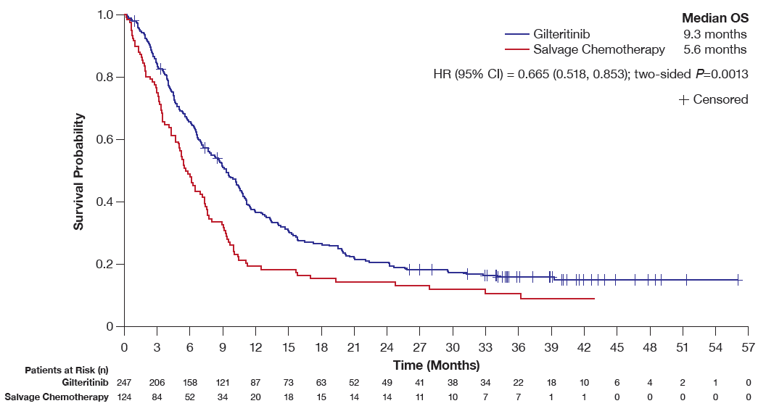
Longer overall survival follow up for ADMIRAL patients
Perl et al. Blood. 2022 139:3366

Slide 29
Aza+Ven+Gilteritinib in FLT3-mutated AML
Induction
Consolidation (up to 24 cycles)
Azacitidine
75 mg/m² IV/SC on D1-7
Venetoclax R/U then 400mg D3-28
Gilteritinib
120 mg on D1-28
(if blasts <5% on D14, hold both GV)
Azacitidine 75 mg/m² IV/SC on D1-5
Venetoclax 400mg on D1-7
Gilteritinib 80 mg on D1-28
1L AML
CR 92%
CRi 4%
R/R AML
FLT3-ITD
* FLT3-ITD or FLT3 D835 mutations allowed
N≥0.5 37d
Plt ≥50 25d
Short et al, ASH 2022

Slide 30
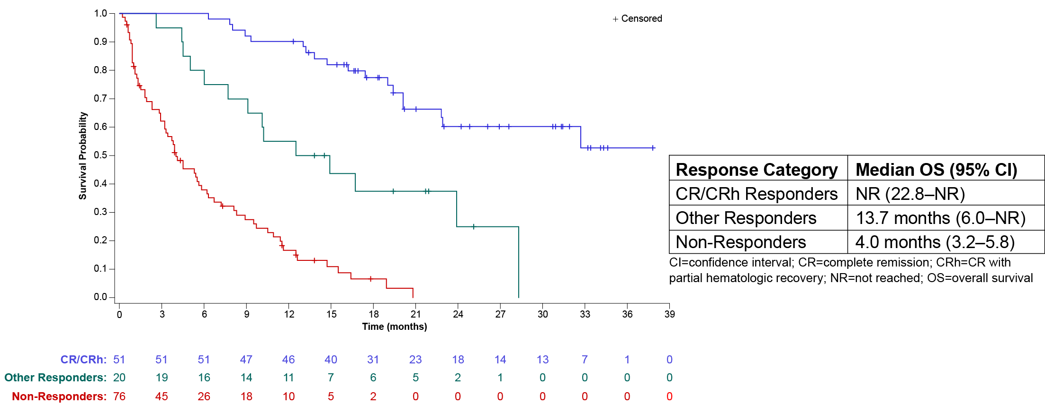
Olutasidenib (FT-2102) in Relapsed/Refractory mIDH1 AML
Response Rates, n (%) | Efficacy Evaluable Cohort (N = 147)
ORR | 71 (48)
CR | 47 (32)
CRh | 4 (3)
CRi | 15 (10)
PR | 3 (2)
MLFS | 2 (1)
Cortes et al, ASH 2022

Slide 31
First line
Salvage
Current landscape in AML
Fit for intensive chemo
FLT3^{MUT}
7+3 + Midostaurin
Post-remission therapy
HCT or
IDAC consol. or
oral AZA
Fit for intensive chemo
FLT3 mut
Gilteritinib
FLT3-ITD
7+3 + Quizartinib
Non-targeted
FLAG-IDA +/- VEN
sAML, tAML, MR-AML
CPX-351
Non-adverse CG
7+3 + GO
Other
7+3
Unfit for chemo
IDH1 mut
IVO + AZA
Unfit for chemo
IDH1 mut
Ivosidenib
Other
VEN + AZA
9
IDH2 mut
Enasidenib
FLT3 mut
Gilteritinib

Slide 32
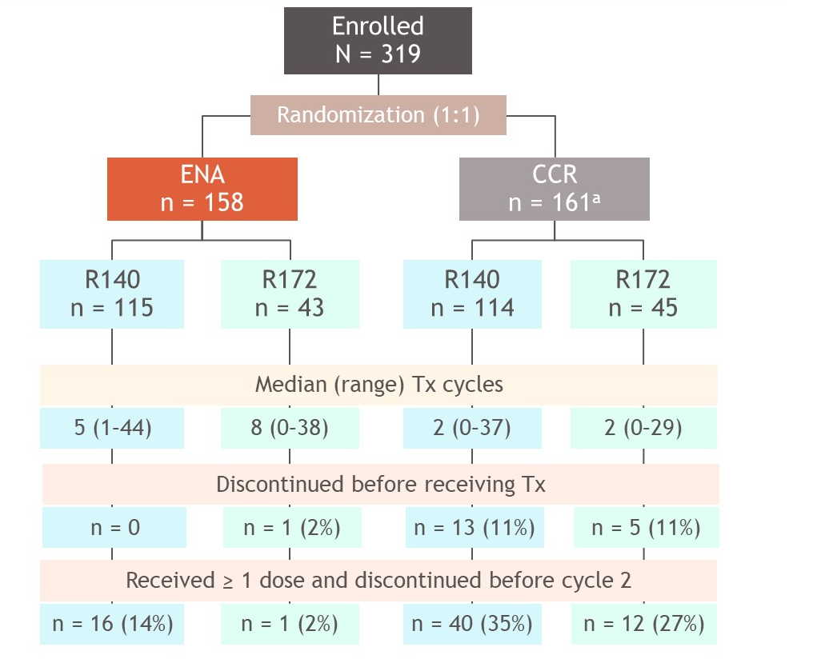
Enasidenib vs conventional care in R/R IDH2 mutated AML
 | R140 (72%) | R172 (28%)
ORR (%) | ENA 41% vs CCR 10%
mOS (m) | ENA 6.5 vs CCR 6.2
FLT3-ITD FLT3-TKD | 17% 17% | 1% 4%
TP53 | 11% | 21%
NRAS | 17% | 7%
ORR (%) ENA | 37% | 51%
mOS (m) ENA | 5.7m | 14.6m
DeBotton, ASCO 2022

Slide 33
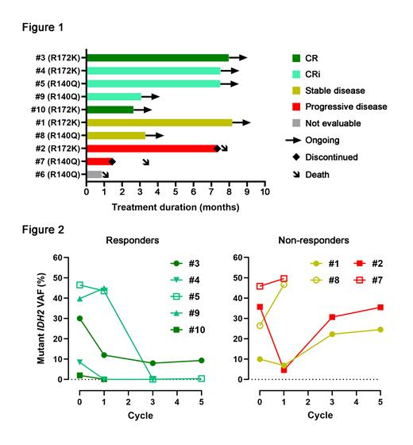
Enasidenib + venetoclax in IDH2 mutant AML
Ven 100 mg D1
Ven 200 mg D2
Ven 400 mg D3-28
Enasidenib 100 mg D15-28
N=11
10 R/R AML
6 R140Q, 5 R172K
Median age 72
CR – 2 pts
CRi- 3 pts
All still in remission (3-8 cycles)
Steve Chan ASH 2021
Notes:
Enasidenib in Combination with Venetoclax in IDH2-Mutated Myeloid Malignancies: Preliminary Results of the Phase Ib/II Enaven-AML Trial
Steven M Chan,
Blood (2021) 138 (Supplement 1): 1263.
RESULTS: The study opened to recruitment in November of 2020. As of July 28, 2021 (data cutoff), 11 patients were enrolled on study; 10 with R/R AML and 1 with very-high risk MDS by IPSS-R. Six patients had a R140Q mutation, and 5 had a R172K mutation. Median age was 72 years (range: 32 - 80); 6 patients were male. Participants had received a median of 2 prior lines of therapies (range: 1 - 4). Six of 10 AML patients had primary refractory disease. The MDS patient experienced secondary azacitidine failure.
Key treatment emergent grade ≥ 3 AEs regardless of attribution were: febrile neutropenia (n=3), intracranial hemorrhage (n=3), lung infection (n=2), other infection (n=2), elevated AST/ALT (n=2), sepsis (n=1), leukocytosis (n=1), TRALI (n=1), and small bowel obstruction (n=1). No cases of differentiation or tumor lysis syndrome were observed. No patients discontinued the study due to AEs. The addition of ENA, a known inhibitor of CYP3A4, did not significantly affect the PK profiles of VEN.
Nine of the AML patients completed at least 1 cycle of treatment and are considered evaluable for efficacy. One AML patient died from intracranial hemorrhage prior to completion of cycle 1. Median duration of observation is 3.5 months. Of the evaluable patients, CR was achieved in 2 patients (22%) and CRi in 3 patients (33%) for an ORR of 55% (Fig. 1). Median number of cycles to response was 3. All responders remain in remission and on study with a median of 6 cycles received to date (range: 3 - 8). Of the remaining 4 patients, 2 patients (22%) remain on study with stable disease, and 2 patients (22%) experienced progressive disease and died (one after 7 cycles and the other after 1 cycle). Median OS for the entire cohort has not been reached. A sustained reduction in mutant IDH2 allele frequency in bone marrow correlated with response (Fig. 2). For the MDS patient, no response was observed after 1 cycle of treatment.
CONCLUSIONS: VEN in combination with ENA is a well-tolerated regimen with no dose-limiting toxicities observed at the current dose level. The preliminary efficacy of this combination is encouraging with an ORR of 55% in evaluable R/R AML patients, with some responders achieving deep molecular remissions. Patient enrollment in dose-escalation cohorts is ongoing.

Slide 34

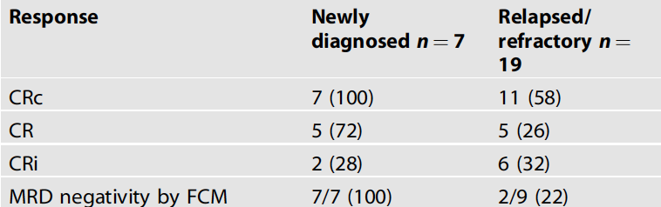
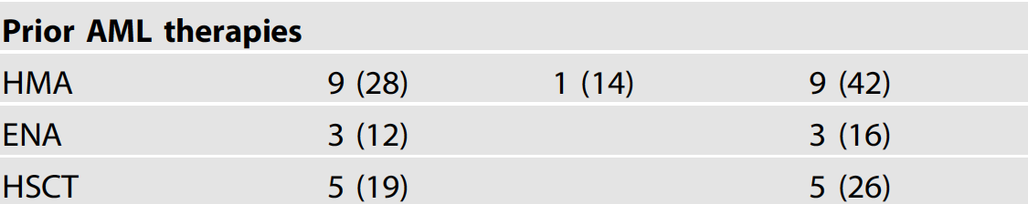
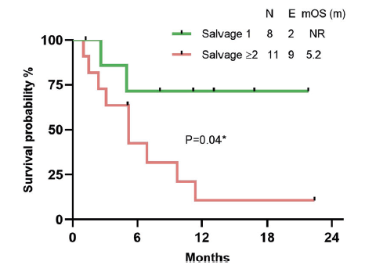
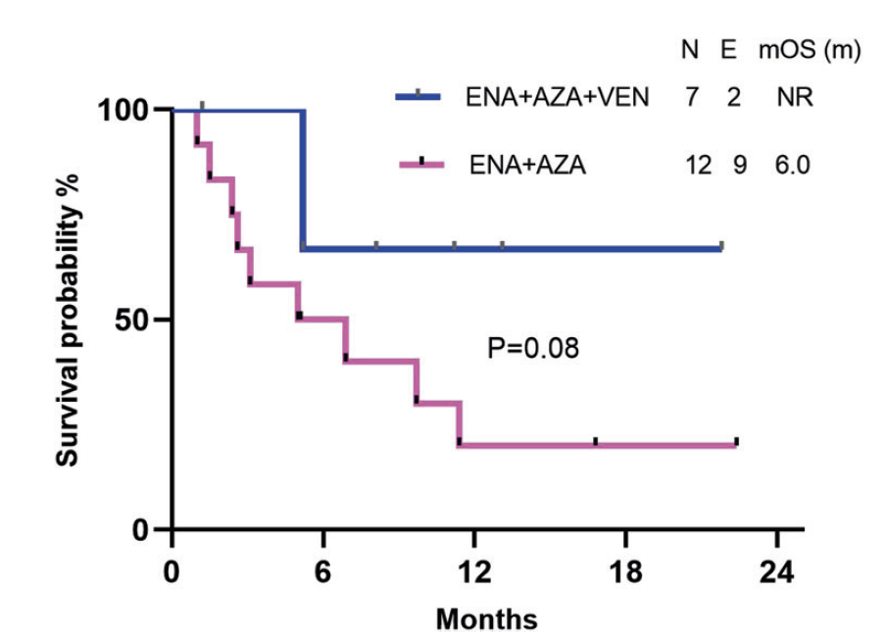
Azacitidine + enasidenib + venetoclax
Venugopal et al, Blood Cancer Journal 2022

Slide 35
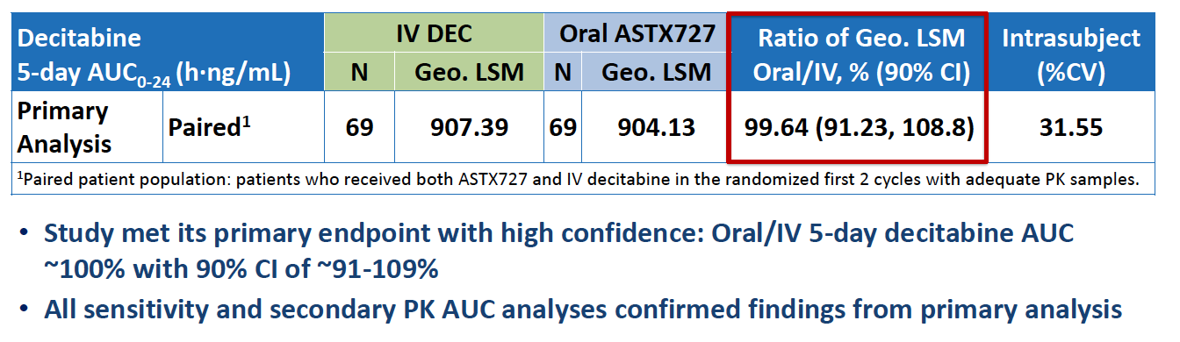
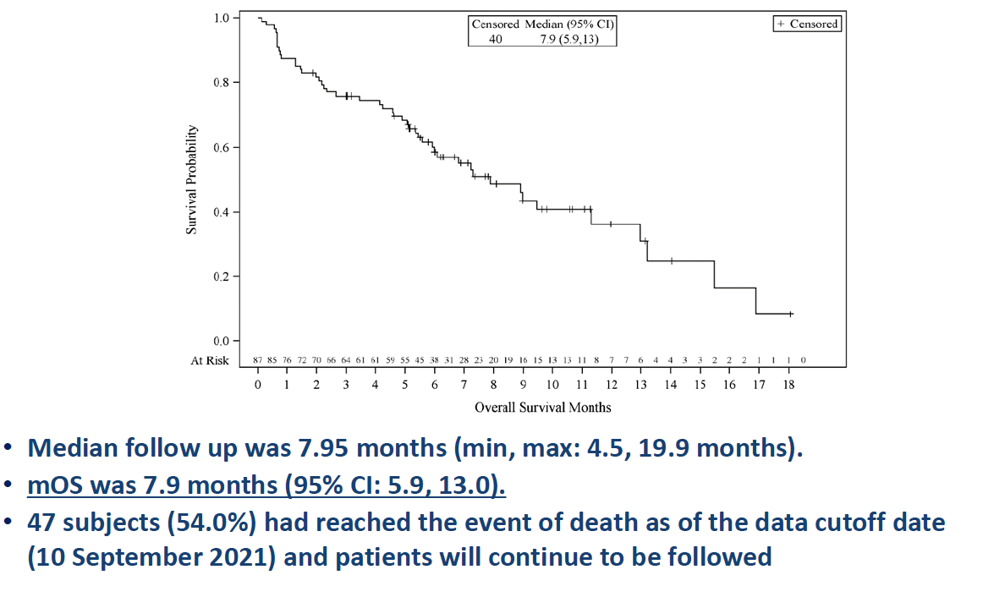
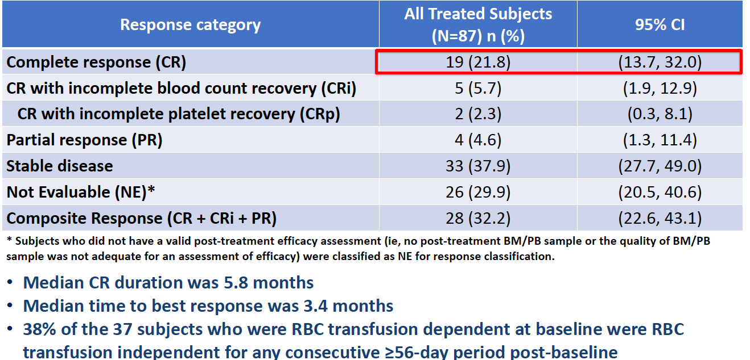
Phase III Study of an Oral Hypomethylating Agent, ASTX727 (DEC-C), Compared to IV Decitabine for AML
Primary Endpoint: 5-Day Decitabine AUC Equivalence
Kaplan-Meier Plot of Overall Survival
Preliminary Efficacy Response (ITT)
Geissler. EHA 2022;Abstract P573.

