Slide 1
Research To Practice
MDS
Dr. Uma Borate

Slide 2
Original Article
Molecular International Prognostic Scoring System for Myelodysplastic Syndromes
Elsa Bernard, Ph.D., Heinz Tuechler, Peter L. Greenberg, M.D., Robert P. Hasserjian, M.D., Juan E. Arango Ossa, M.S., Yasuhito Nannya, M.D., Ph.D., Sean M. Devlin, Ph.D., Maria Creignou, M.D., Philippe Pinel, M.S., Lily Monnier, M.S., Gunes Gundem, Ph.D., Juan S. Medina-Martinez, M.S., Dylan Domenico, B.S., Martin Jädersten, M.D., Ph.D., Ulrich Germing, M.D., Guillermo Sanz, M.D., Ph.D., Arjan A. van de Loosdrecht, M.D., Ph.D., Olivier Kosmider, M.D., Ph.D., Matilde Y. Follo, Ph.D., Felicitas Thol, M.D., Lurdes Zamora, Ph.D., Ronald F. Pinheiro, Ph.D., Andrea Pellagatti, Ph.D., Harold K. Elias, M.D., Detlef Haase, M.D., Ph.D., Christina Ganster, Ph.D., Lionel Ades, M.D., Ph.D., Magnus Tobiasson, M.D., Ph.D., Laura Palomo, Ph.D., Matteo Giovanni Della Porta, M.D., Akifumi Takaori-Kondo, M.D., Ph.D., Takayuki Ishikawa, M.D., Ph.D., Shigeru Chiba, M.D., Ph.D., Senji Kasahara, M.D., Ph.D., Yasushi Miyazaki, M.D., Ph.D., Agnes Viale, Ph.D., Kety Huberman, B.S., Pierre Fenaux, M.D., Ph.D., Monika Belickova, Ph.D., Michael R. Savona, M.D., Virginia M. Klimek, M.D., Fabio P. S. Santos, M.D., Ph.D., Jacqueline Boultwood, Ph.D., Ioannis Kotsianidis, M.D., Ph.D., Valeria Santini, M.D., Francesc Solé, Ph.D., Uwe Platzbecker, M.D., Michael Heuser, M.D., Peter Valent, M.D., Kazuma Ohyashiki, M.D., Ph.D., Carlo Finelli, M.D., Maria Teresa Voso, M.D., Lee-Yung Shih, M.S., Michaela Fontenay, M.D., Ph.D., Joop H. Jansen, Ph.D., José Cervera, M.D., Ph.D., Norbert Gattermann, M.D., Benjamin L. Ebert, M.D., Ph.D., Rafael Bejar, M.D., Ph.D., Luca Malcovati, M.D., Mario Cazzola, M.D., Seishi Ogawa, M.D., Ph.D., Eva Hellström-Lindberg, M.D., Ph.D., and Elli Papaemmanuil, Ph.D.
NEJM Evid
Volume 1(7):EVIDoa2200008
June 28, 2022

Slide 3
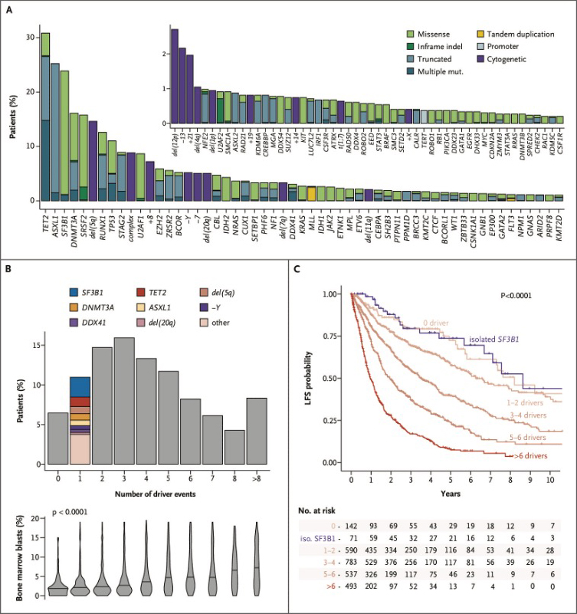
International Working Group for Prognosis in Myelodysplastic Syndromes Cohort Molecular Characteristics.
Bernard E et al. NEJM Evid2022;1:EVIDoa2200008
Bernard E et al. NEJM Evid 2022;1:EVIDoa2200008
Notes:
Figure 1 International Working Group for Prognosis in Myelodysplastic Syndromes Cohort Molecular Characteristics. In Panel A, the frequency of mutated genes and cytogenetic alterations in the 2957 myelodysplastic syndrome samples is shown. Lesions observed in more than five patients are shown. Colors represent the type of lesions. In Panel B, a histogram of the total number of oncogenic alterations (gene mutations and cytogenetic abnormalities) per patient (top) and violin plots representing the associated distribution of percentage of bone marrow blasts (bottom) are shown. P-value is from the Kruskal–Wallis test. In Panel C, Kaplan–Meier probability estimates of leukemia-free survival (LFS) across numbers of oncogenic alterations per patient (gene mutations and cytogenetic abnormalities) are shown. Isolated SF3B1 mutations are shown separately in purple. P-value is from the log-rank test.

Slide 4
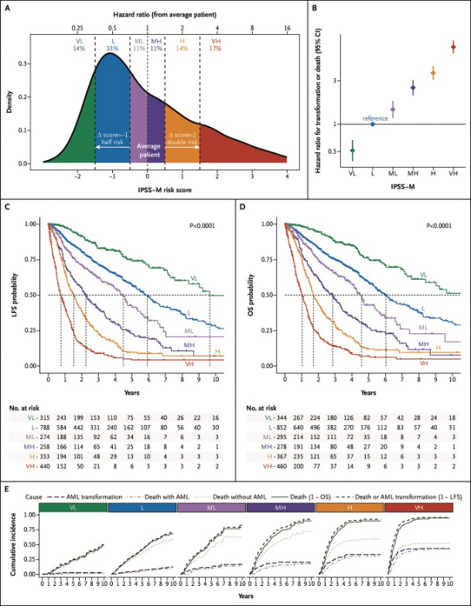

International Prognostic Scoring System–Molecular Risk Score and Risk Categories.
Bernard E et al. NEJM Evid 2022;1:EVIDoa2200008
Notes:
Figure 2 International Prognostic Scoring System–Molecular Risk Score and Risk Categories. In Panel A, the density plot shows the International Prognostic Scoring System–Molecular (IPSS-M) risk score calculated for 2701 patients from the International Working Group for Prognosis in Myelodysplastic Syndromes cohort with available data for hemoglobin, platelets, marrow blasts, cytogenetic, and gene mutations. The bottom x-axis shows the IPSS-M score and the top x-axis shows the corresponding hazard ratio from the hypothetical average patient. Vertical dashed lines represent cutoffs that are applied to the score to define the six IPSS-M risk categories. In Panel B, hazard ratios are provided for the risk of death or transformation of the IPSS-M risk categories, in which the low category corresponds to the reference. In Panels C and D, Kaplan–Meier probability estimates of leukemia-free survival (LFS) and overall survival (OS) are presented across IPSS-M risk categories, respectively. Dashed lines highlight the median values. P-values are from the log-rank test. In Panel E, cause-specific cumulative incidences are shown for the rate of acute myeloid leukemia (AML) transformation (long-dashed line), death with AML (dot-dashed lines), death without AML (dotted line), overall death (solid line), and death or transformation (short-dashed line). In the latter two cases, the curves are equivalent to 1 − Kaplan–Meier estimates for OS and LFS. CI denotes confidence interval, H high, L low, MH moderate high, ML moderate low, VH very high, and VL very low.

Slide 5
Summary slide
Samples from over 2500 patients with MDS were profiled for gene mutations and used to develop the International Prognostic Scoring System–Molecular (IPSS-M).
TP53^{multihit}, FLT3 mutations, and MLL^{PTD} were identified as top genetic predictors of adverse outcomes.
IPSS-M improves prognostic discrimination across all clinical end points versus prior versions
Combining genomic profiling with hematologic and cytogenetic parameters, the IPSS-M improves the risk stratification of patients with MDS and represents a valuable tool for clinical decision-making

Slide 6
Lower risk MDS-do our interventions impact patient outcomes ?
ESAs, luspatercept and lenalidomide data review

Slide 7
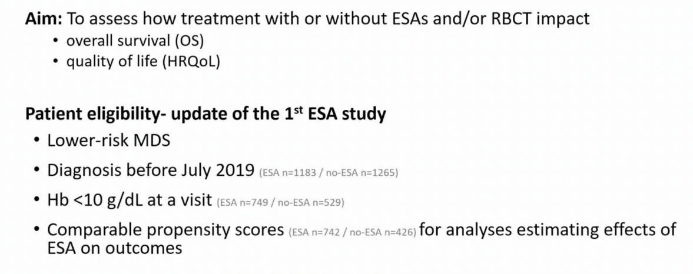
Garelius H et al addressed key questions about ESA use at EHA 2022 presentation
When is it the optimal time to start ESA’s –based on Hgb threshold and need for transfusions
OR
Before the patient is transfusion dependent ?
Garelius EHA 2022; Abstract S168

Slide 8
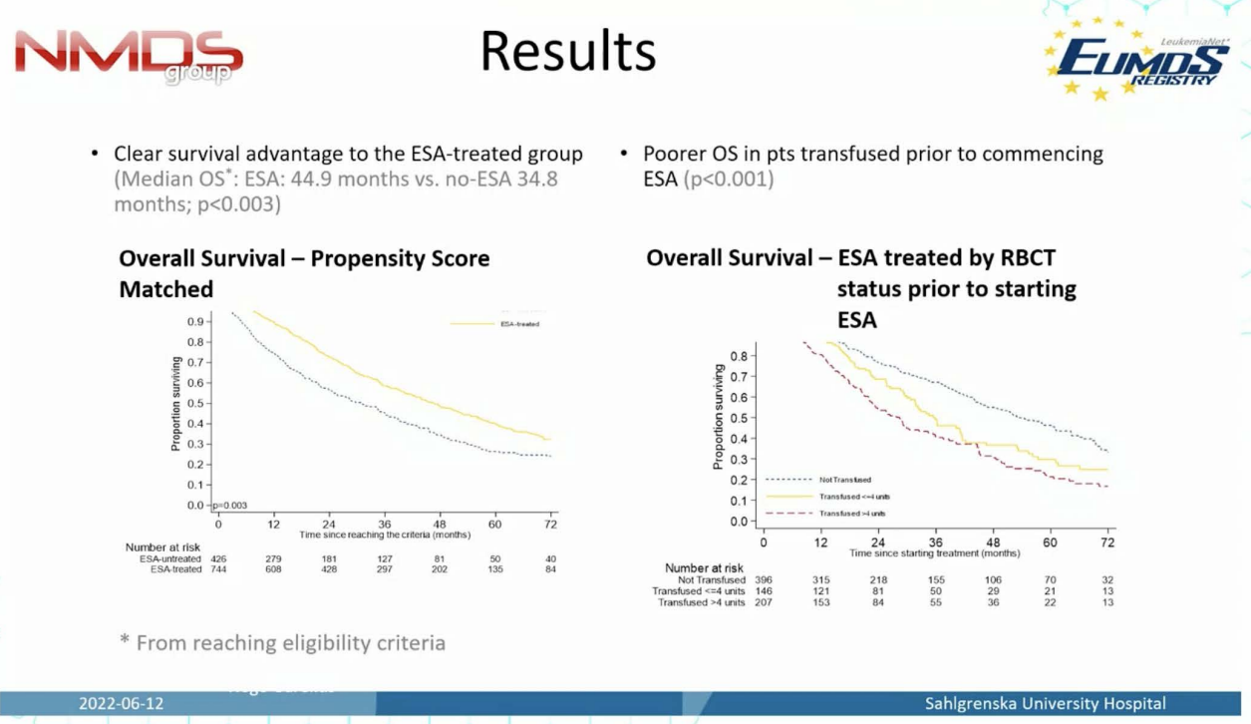
Results show ESA Rx is beneficial BEFORE transfusion dependence as is QOL
Garelius EHA 2022; Abstract S168

Slide 9
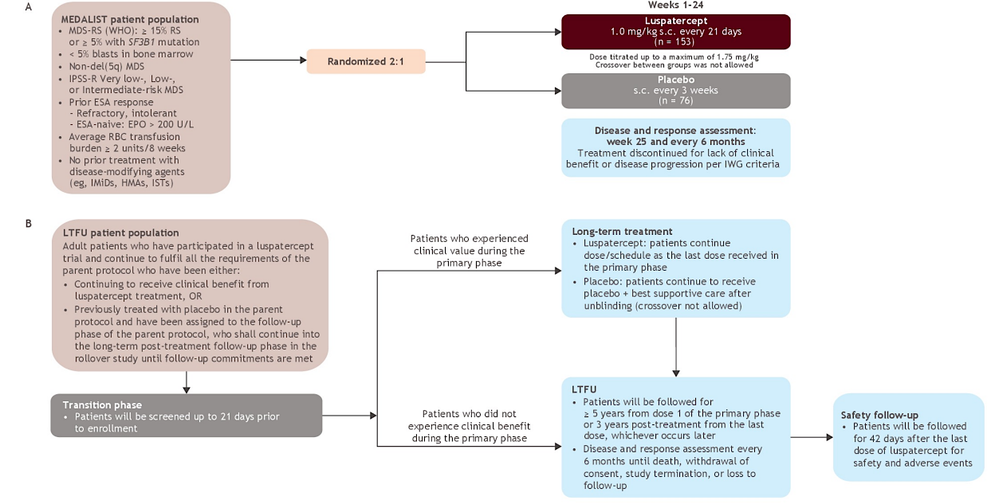
Fenaux ASCO 2022; Abstract 7056

Slide 10
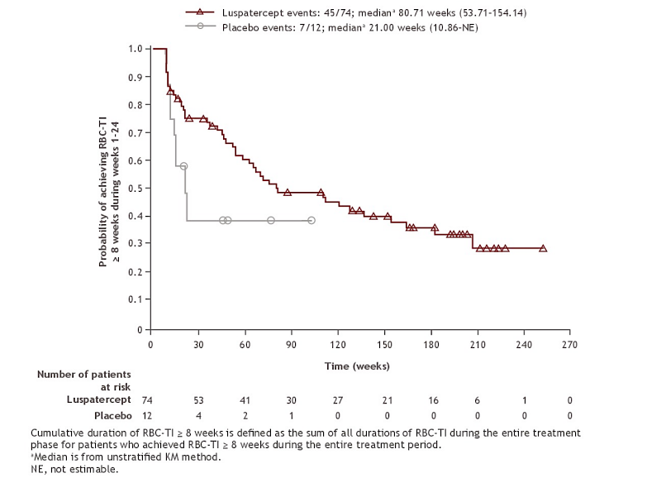
Cumulative duration of RBC-TI>=8 wks during the entire treatment period for patients who achieved RBC-TI>=8 wks during the entire treatment period
Fenaux ASCO 2022; Abstract 7056

Slide 11
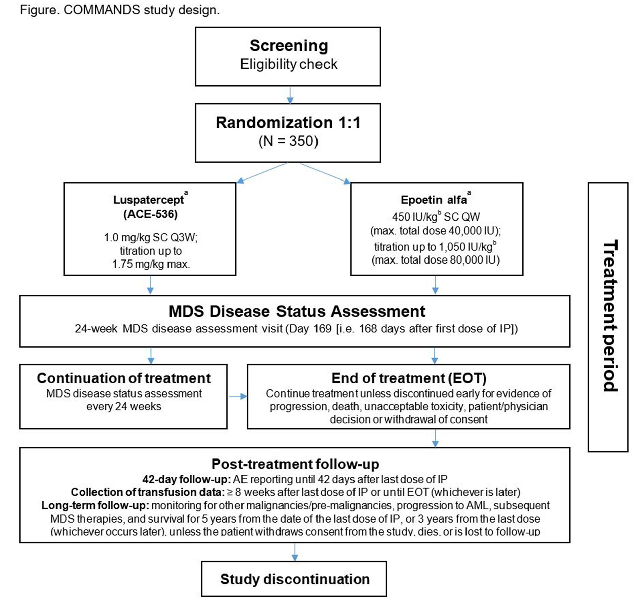
Positive topline results of Phase 3 COMMANDS trial announced:
Press release – October 31, 2022
The study met its primary endpoint, demonstrating a highly statistically significant and clinically meaningful improvement in red blood cell transfusion independence (RBC-TI) with concurrent hemoglobin (Hb) increase in the first-line treatment of adult patients with very low-, low- or intermediate-risk myelodysplastic syndromes (MDS) who require RBC transfusions.
This result was based on a pre-specified interim analysis conducted through an independent review committee. Safety results in the trial were consistent with the safety profile of Luspatercept previously demonstrated in the MEDALIST study (NCT02631070), and no new safety signals were reported

Slide 12
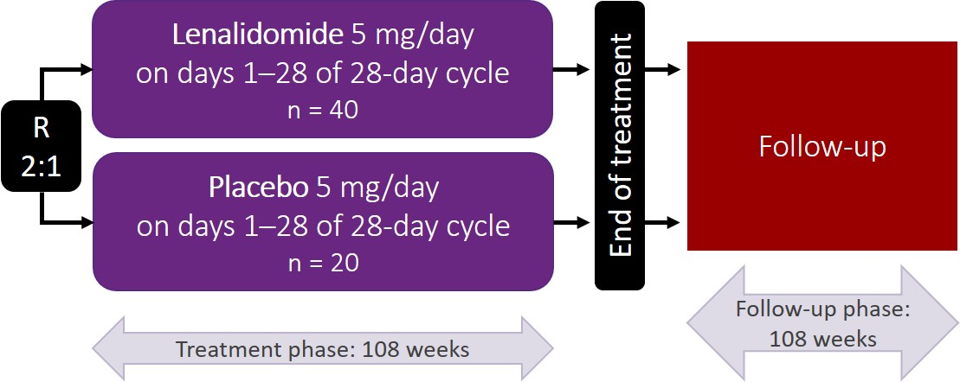
Evaluation of lenalidomide (LEN) vs placebo in non-transfusion dependent low risk del(5q) MDS patients. Final results of Sintra-REV Phase III international multicenter clinical trial.
Low dose Len improves TD, AML transformation and OS in LR-MDS del 5 patients that respond to therapy.
TI > 60% and CyR approximately 50-70%
Question asked by the study: Can low dose Len started early, prolong time to TD and improve outcomes?
López Cadenas F et al, ASH 2022, abstract 640.

Slide 13
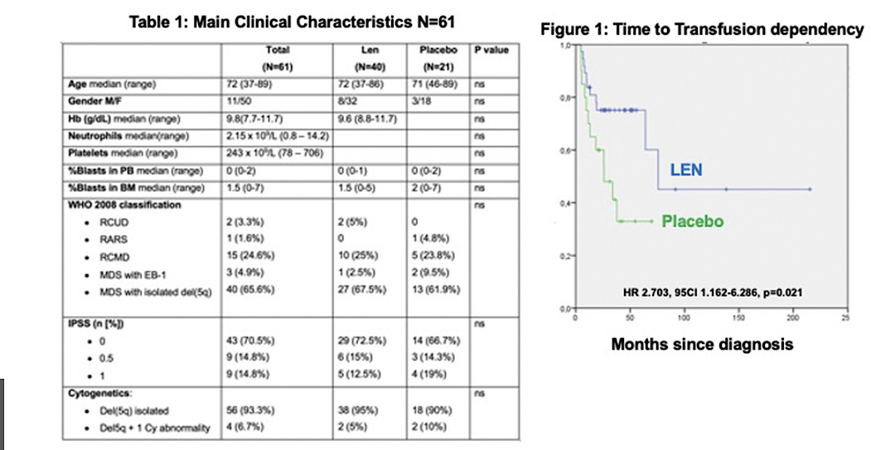
Results
Len decreased risk of TD in approx. 70% of pts,
Achieved erythroid and cytogenetic responses,
No signs of clonal evolution
Caused clinically non-significant neutropenia
LTFU still waited
López Cadenas F et al, ASH 2022, abstract 640.

Slide 14
Summary of LR-MDS supportive care intervention studies
Early initiation of ESAs appears to be more beneficial then waiting until emergence of transfusion dependence for outcomes and QOL of LR-MDS patients
LR-MDS patients that respond to Luspatercept continue to have a sustained response but typically need the full dose to achieve that response.
Early initiation of low dose Len in del 5q patients appears to be beneficial with no clonal evolution but LTFU awaited.
Can these be considered disease modifying therapies vs supportive care only?

Slide 15
HMA use in LR-MDS

Slide 16
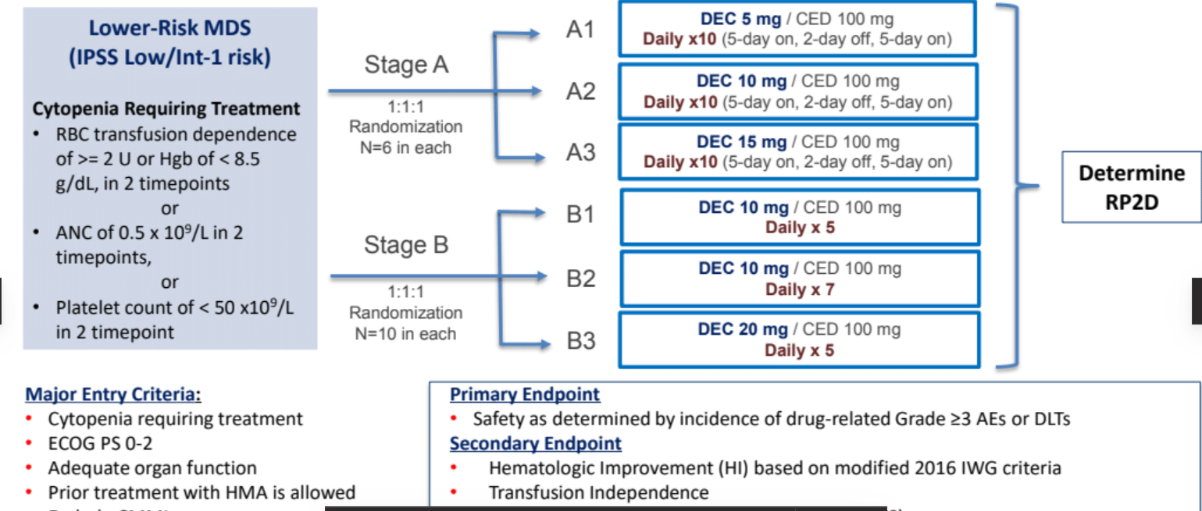
ASTX727-03: Phase 1 study evaluating oral decitabine/cedazuridine (ASTX727) low-dose (LD) in lower-risk myelodysplastic syndromes (LR-MDS) patients
Benefit of HMAs in LR-MDS is not clear and optimizing the dose in order to balance risk of cytopenias with clinical benefit is a key challenge
Secondary Endpoints

Slide 17
Results and conclusions
All DLTs were due to Grade 4 neutropenia which in turn was dose dependent (intensity & no of days).
Patients showed evidence of response with HI and transfusion independence.
The 5day schedule (10mg DEC/100mg CED/Cohort B1) was identified to move forward as the RP2D in a Phase 2 randomized study comparing it to a 3day (35mg DEC/100mg CED) schedule. (NCT03502668).

Slide 18
High risk MDS
( HR-MDS) therapeutic advances

Slide 19
Azacitidine and venetoclax combination studies in HR-MDS and CMML

Slide 20
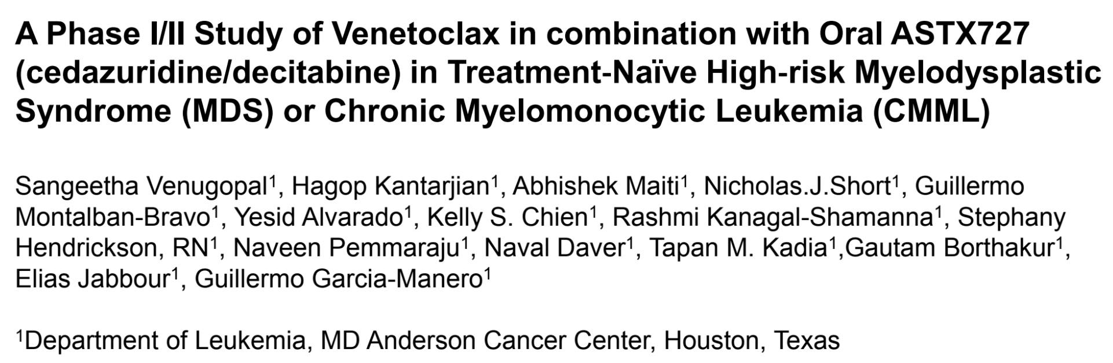
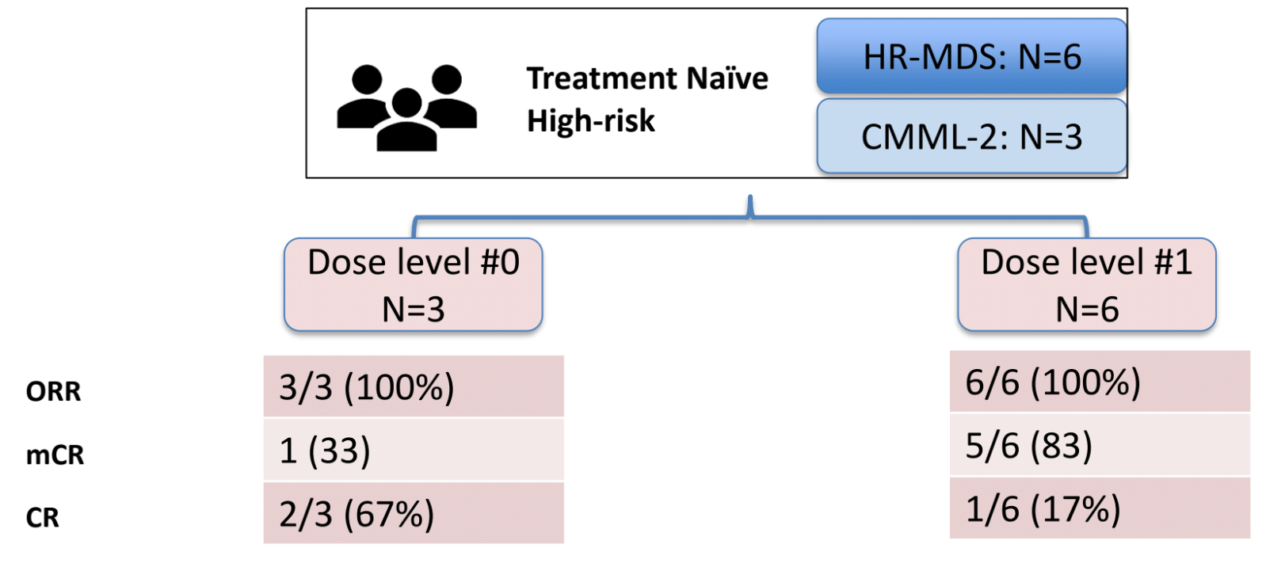
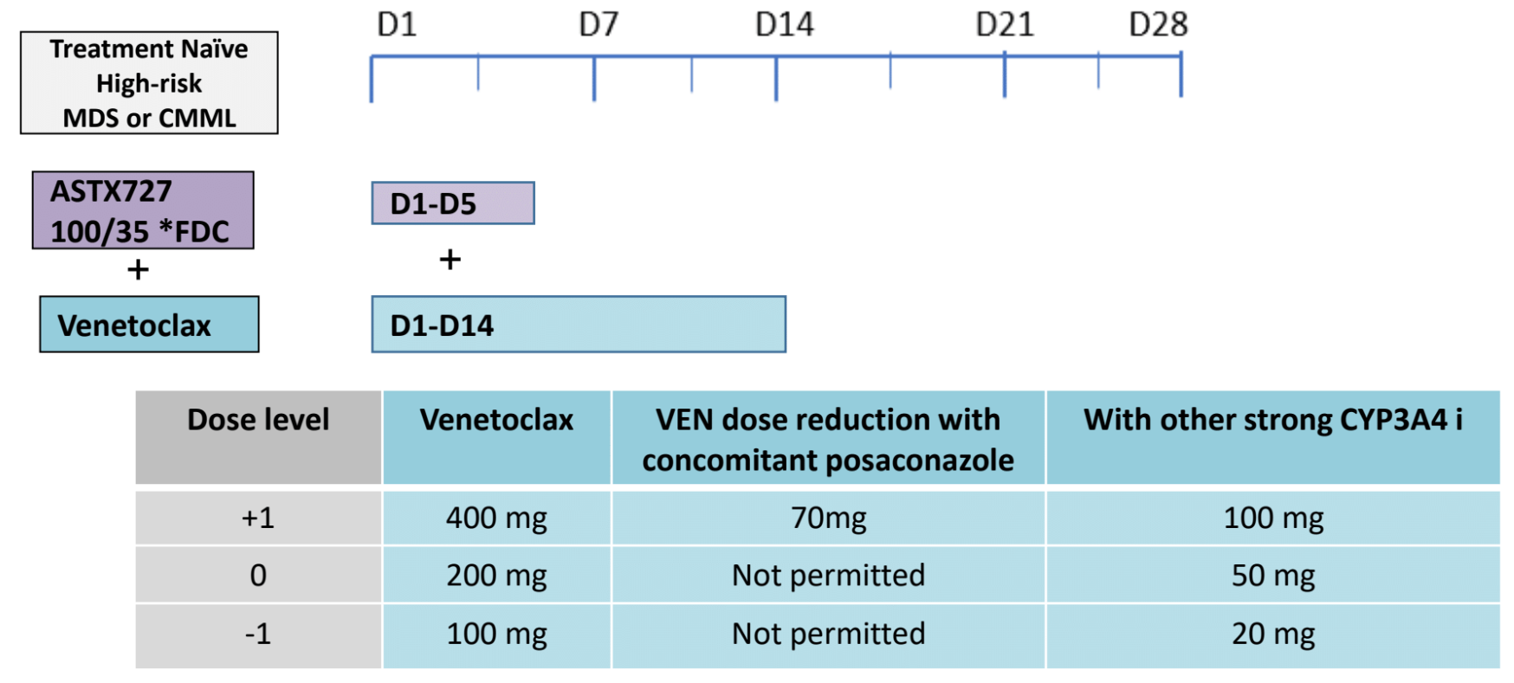
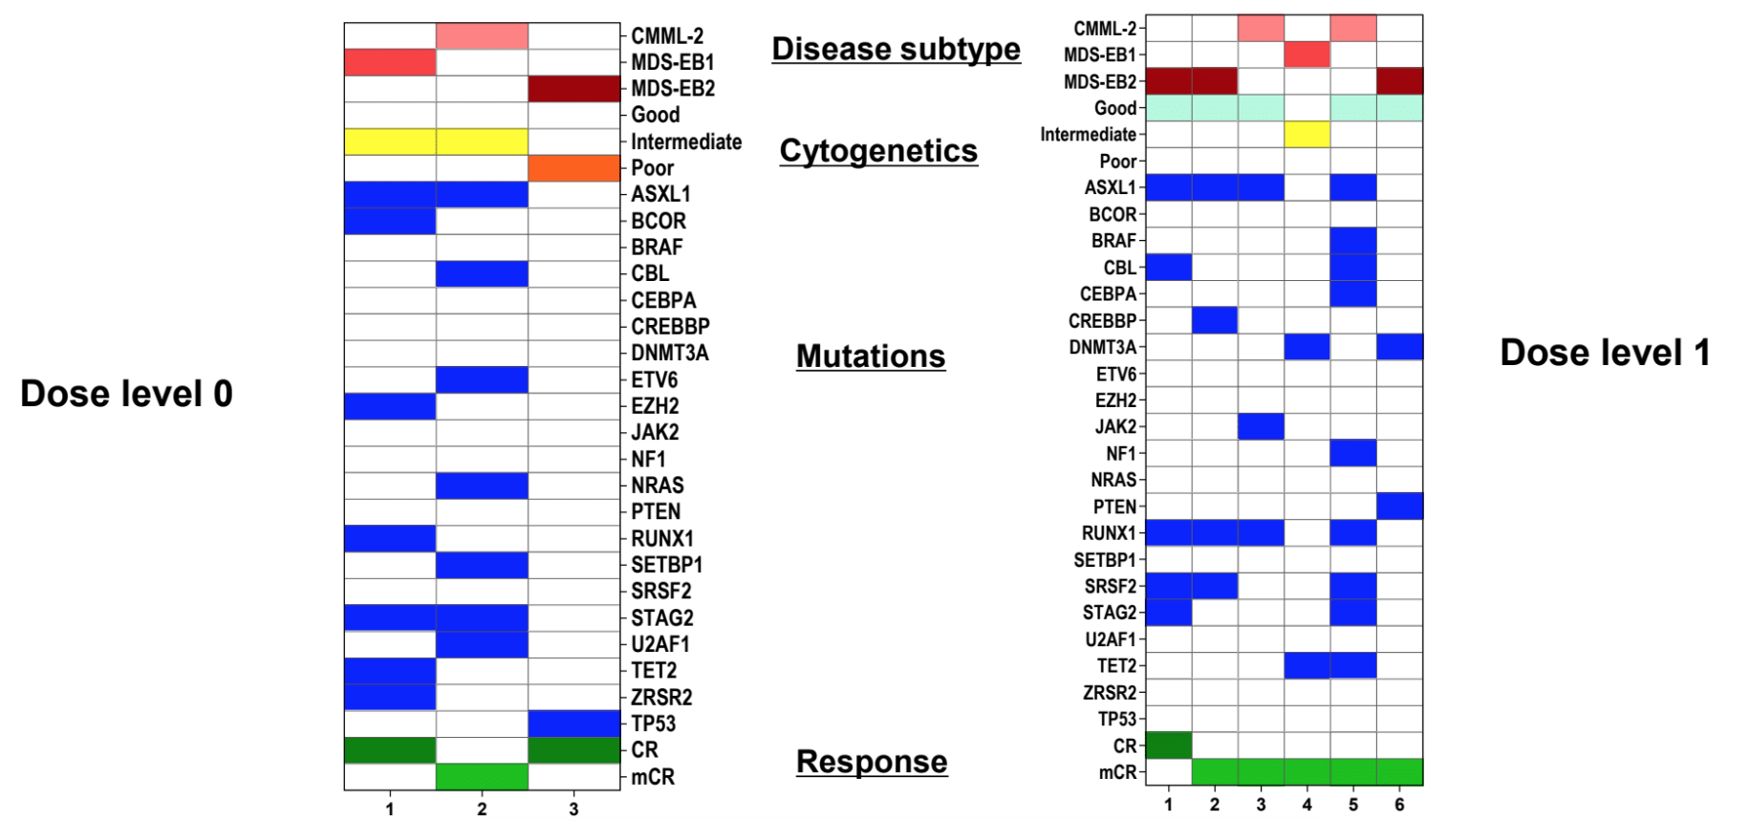
9 Enrolled
Dose Level 0: 3
Dose Level 1: 6
N/V of any grade was not observed

Slide 21
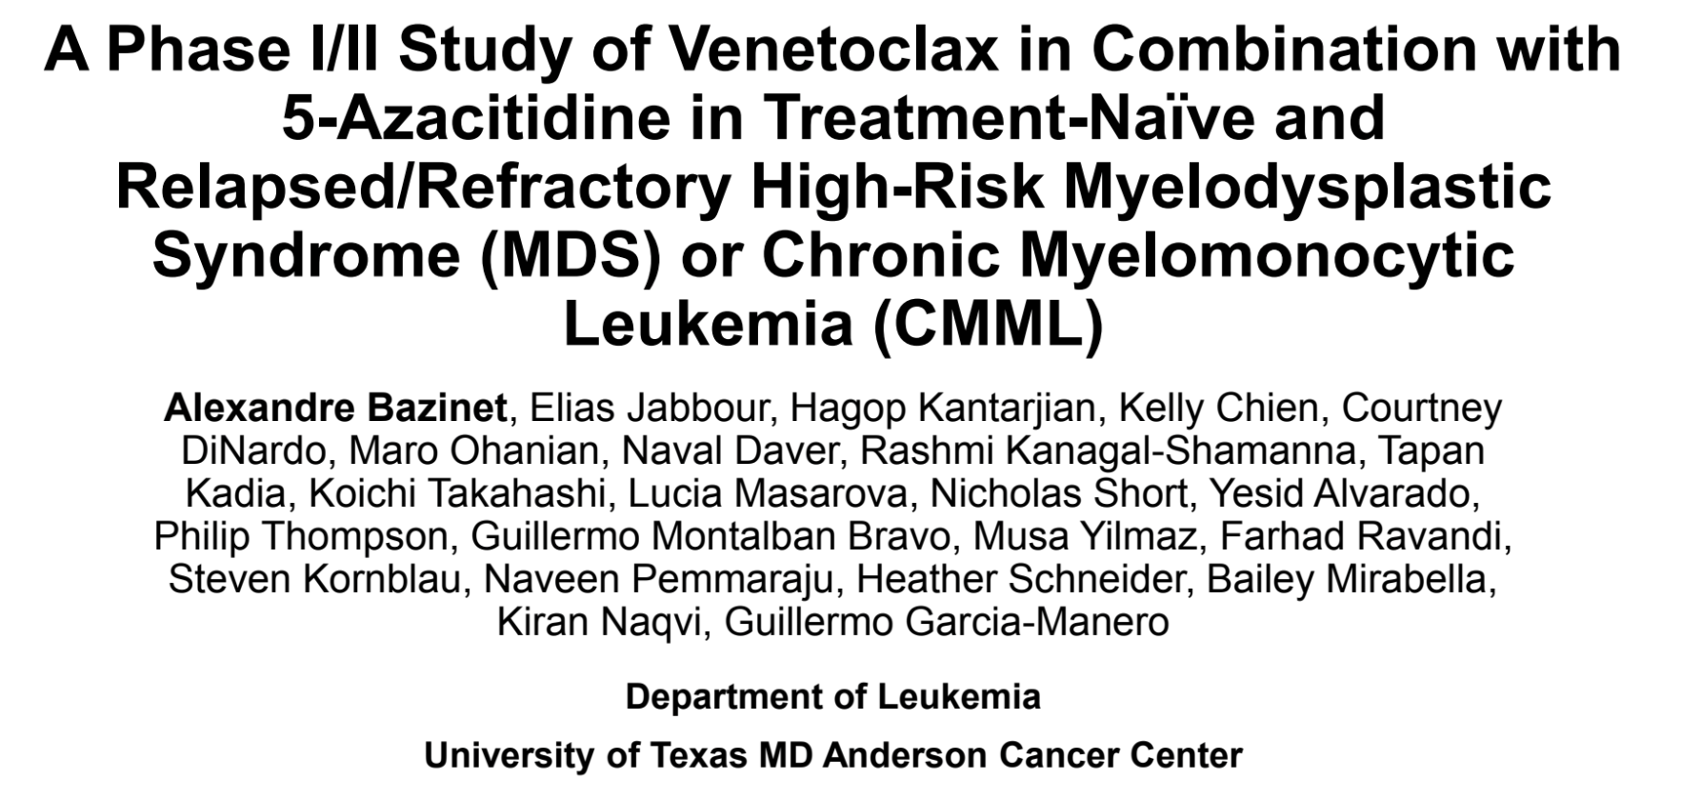
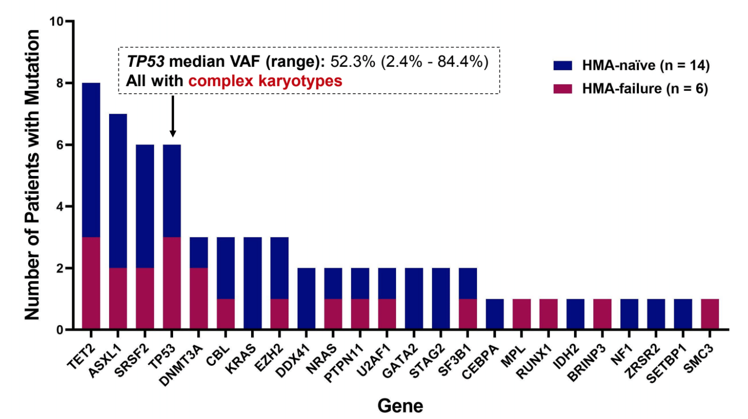
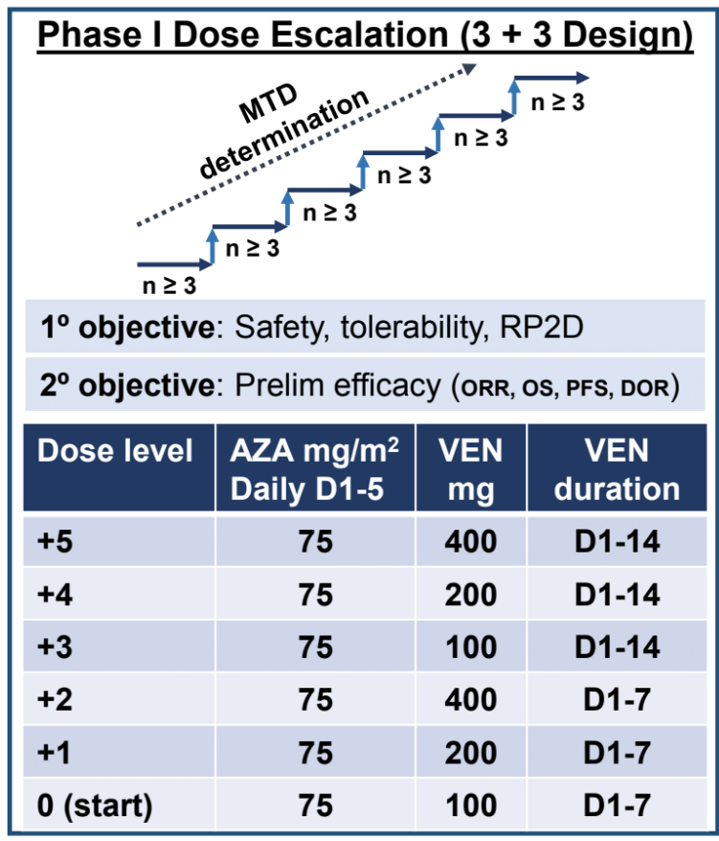
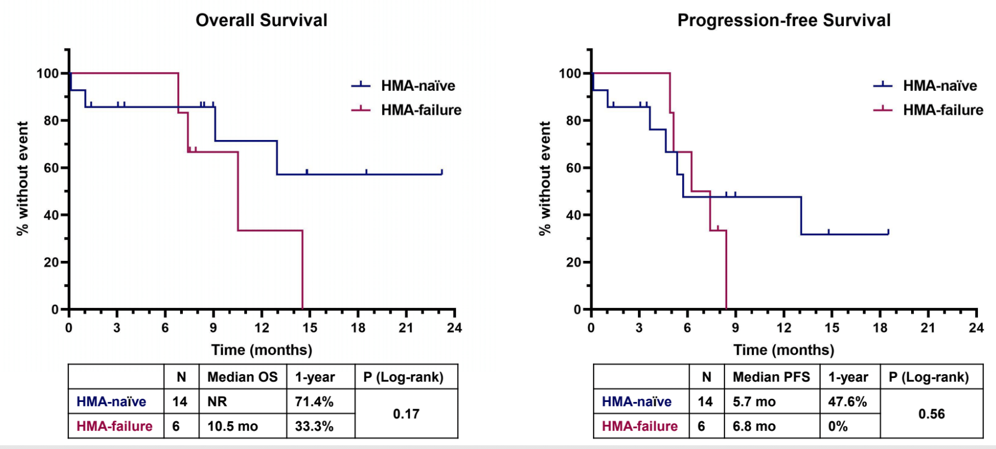
23 Patients Enrolled
Count Recoveries can be delayed given high rates of myelosuppression
Most responses are mCR

Slide 22
Phase I study of Aza+Ven in high risk MDS and CMML
23 patients with R/R or treatment naïve MDS & CMML were treated with intravenous or subcutaneous aza (75 mg/m²) for 5 days and oral venetoclax (100–400 mg) for 7–14 days.
The maximum tolerated dose was not reached and the recommended phase 2 dose was established as azacitidine 75 mg/m² for 5 days plus venetoclax 400 mg for 14 days.
The most common grade 3 &4 treatment-emergent adverse events were neutropenia (39%), thrombocytopenia (39%),lung infection (30%, and febrile neutropenia (four [17%]).Three deaths due to sepsis, which were not deemed treatment-related, occurred on the study drugs.
The overall response rate was 87% (95% CI 66–97; 20 of 23 patients).Most of these were marrow CR with dec blasts.
Bazinet et al, Lancet Haematol 2022;9(10):e756-e765

Slide 23
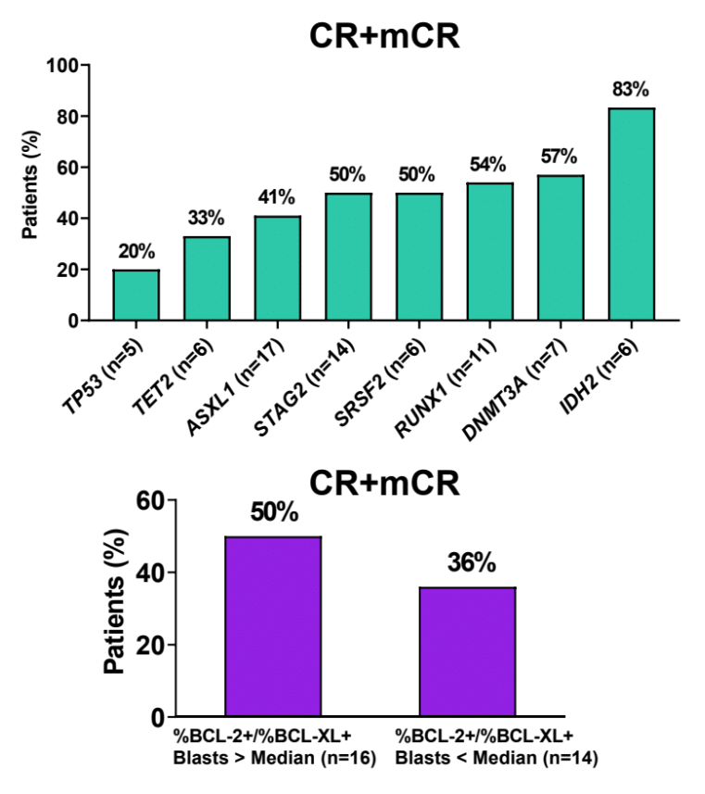
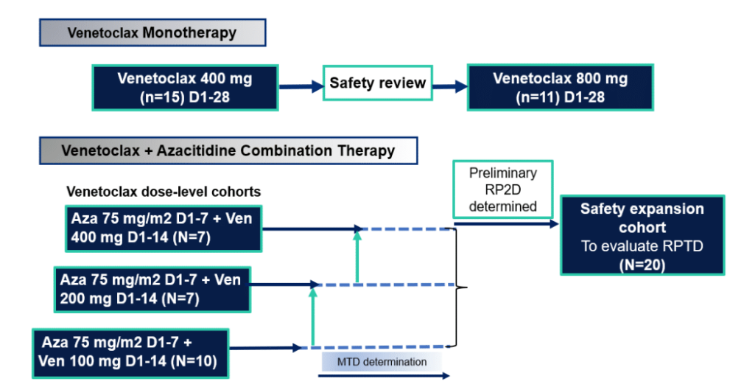
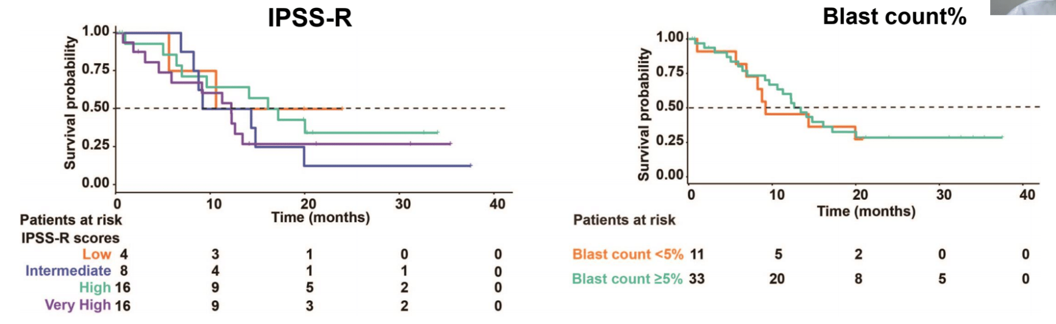
A Phase 1b study of venetoclax and azacitidine combination in patients with relapsed or refractory myelodysplastic syndromes.
Zeidan AM et al. Am J Hematol 2023;98(2):272-81
Notes:
NCCN Guidelines
Introstudies for each slide

Slide 24
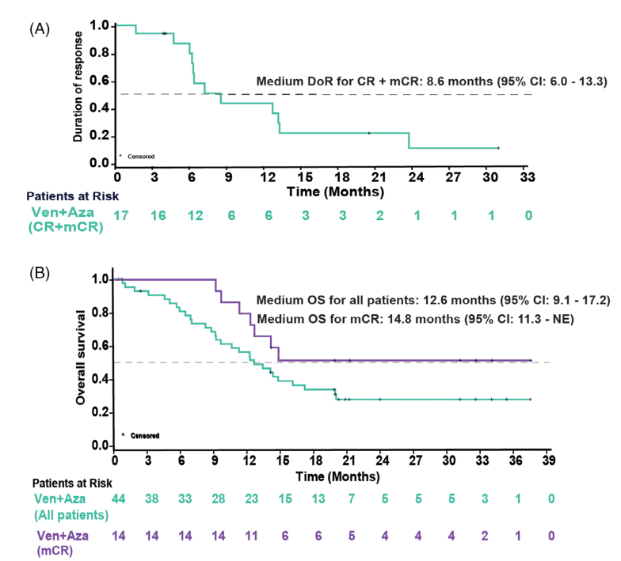
A Phase 1b study of venetoclax and azacitidine combination in patients with relapsed or refractory myelodysplastic syndromes.
The study demonstrated marrow responses including 7% CR (3/44) and 32% mCR (14/44).
While the value of mCR as a response in MDS patients is debated, 6 of the 14 patients who achieved mCR also achieved HI, which is clinically meaningful and has been consistently associated with OS benefits in prior analyses.
Nine patients who achieved less than 5% blasts were able to proceed to allogeneic BM transplant, which is often an important goal in managing R/R MDS as allogeneic transplant is potentially the only curative therapy

Slide 25
Summary
HMA (Azacitidine and Oral decitabine) and venetoclax combinations are being studied in HR-MDS with emerging data on the optimal dose & duration of both HMA and venetoclax to maximize response and minimize toxicities namely severe, prolonged cytopenias
These combinations appear potent in terms of decreasing blast counts but long term benefit remains to be seen.

Slide 26
Novel combination therapies in HR-MDS

Slide 27
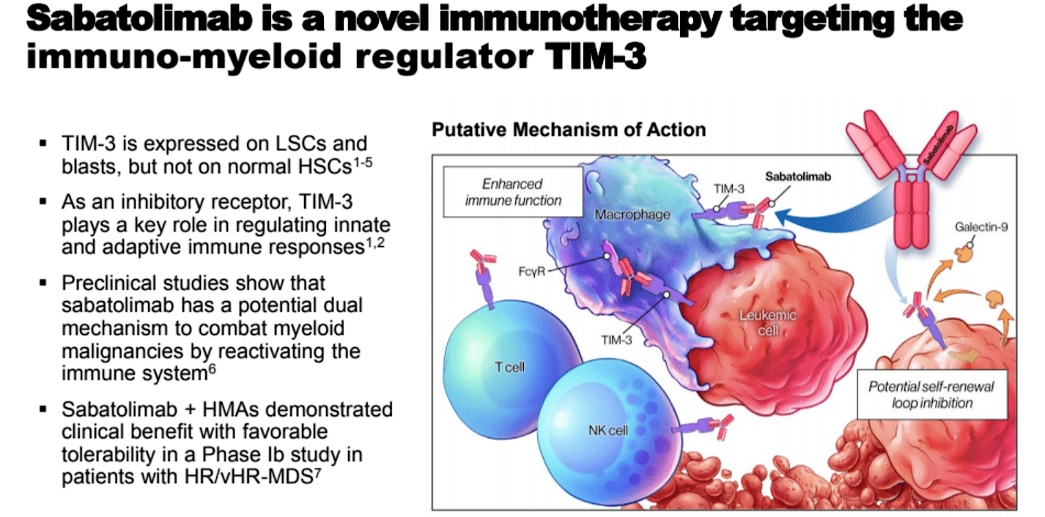
Primary results of Stimulus-MDS1: A randomized, double-blind, placebo-controlled Phase II study of TIM-3 inhibition with sabatolimab added to hypomethylating agents (HMAs) in HR-MDS
Zeidan AM et al. ASH 2022; Abstract 853

Slide 28
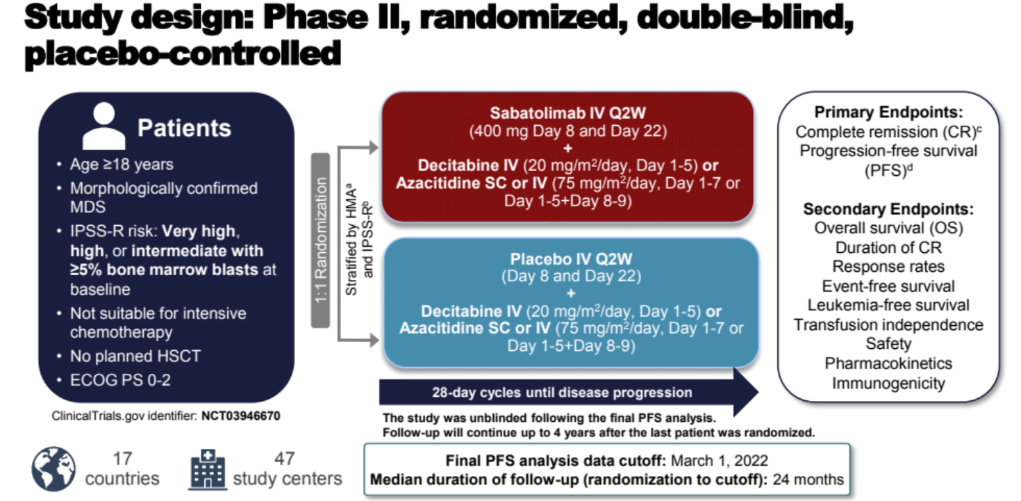
Zeidan AM et al. ASH 2022; Abstract 853

Slide 29
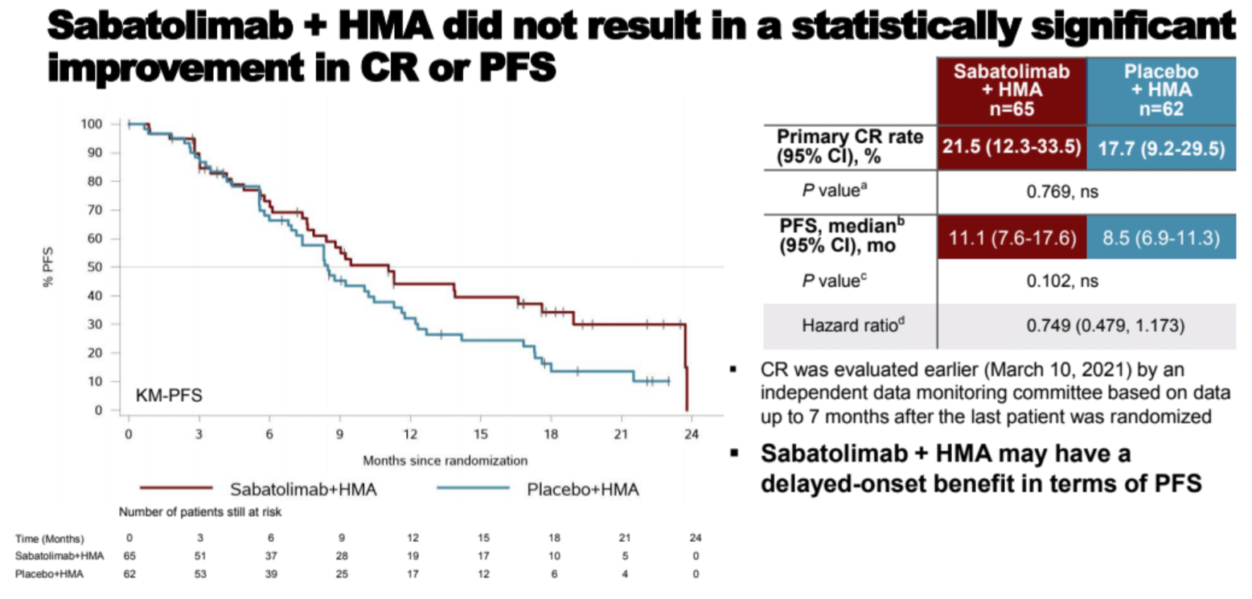
Phase III randomized placebo controlled trial is ongoing (STIMULUS-2)
Zeidan AM et al. ASH 2022; Abstract 853

Slide 30
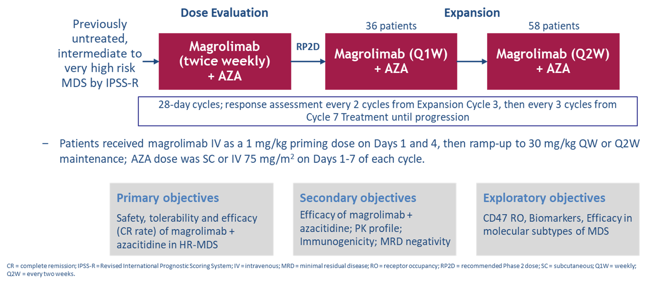
Magrolimab, a First-in-Class Macrophage Immune Checkpoint Inhibitor Targeting CD47-Magrolimab in Combination With Azacitidine in Patients With Higher-Risk Myelodysplastic Syndromes: Final Results of a Phase Ib Study
Magrolimab
CD47 is a “don’t eat me” signal that is overexpressed in multiple cancers, including MDS, leading to macrophage immune evasion.^{1,2}
Magrolimab, an IgG4 anti-CD47 monoclonal antibody, eliminates tumor cells through macrophage phagocytosis.¹
1. Liu J, et al. PLoS One. 2015;10(9):e0137345. 2. Chao MP, et al. Front Oncol. 2020;9:1380.
Sallman ASCO 2022; Abstract 7017

Slide 31
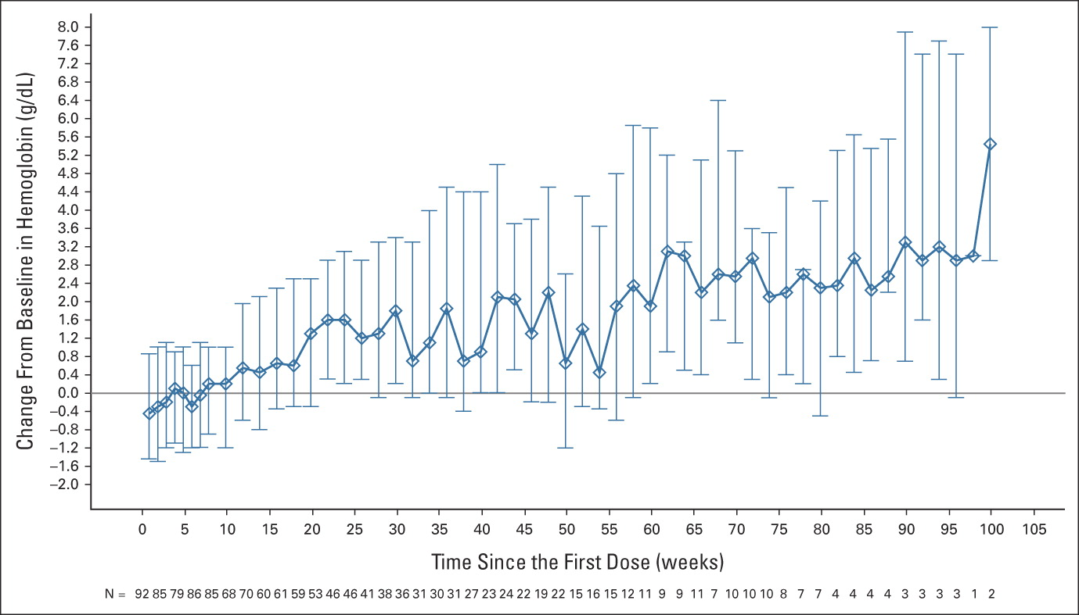
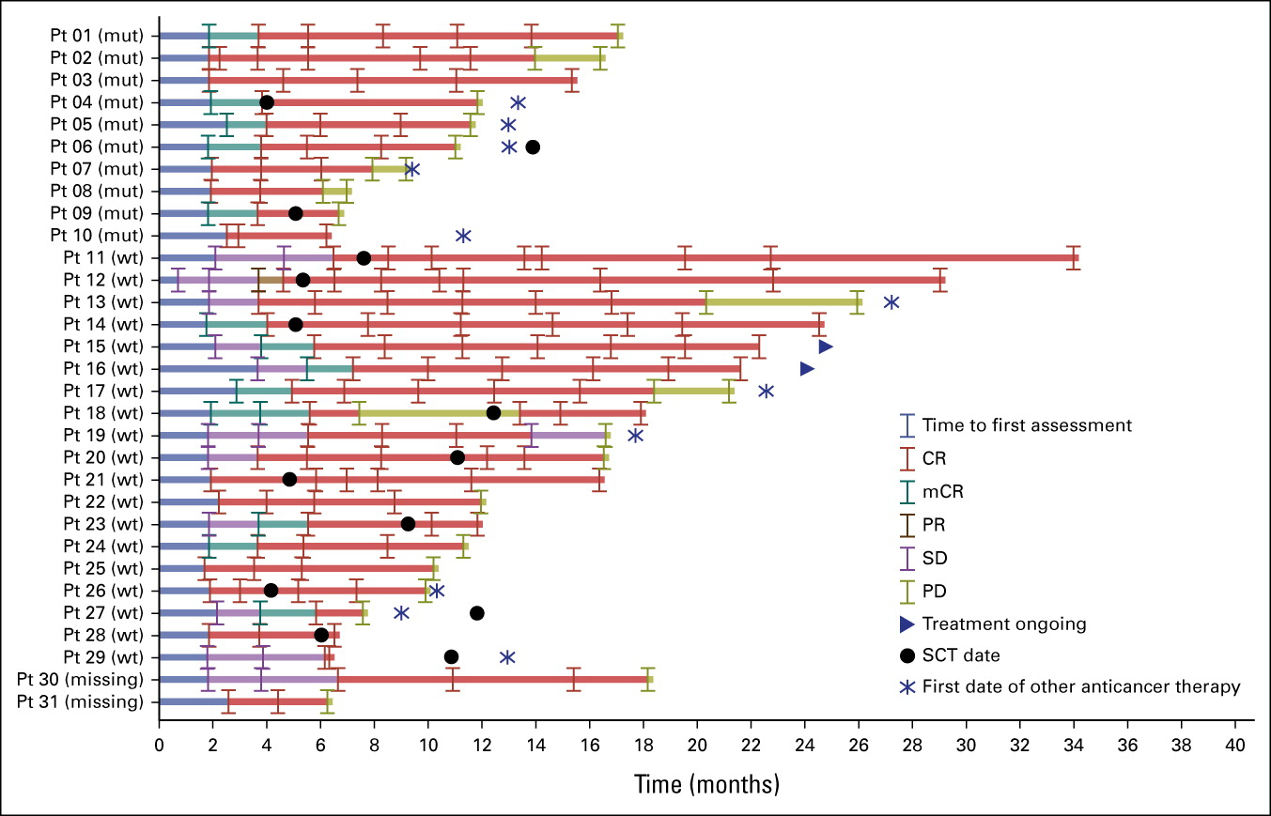
Magrolimab in Combination With Azacitidine in Patients With Higher-Risk Myelodysplastic Syndromes: Final Results of a Phase Ib Study
Hemoglobin changes from baseline over time on treatment with magrolimab + azacitidine in patients with HR-MDS (N = 95). Data shown are median (Q1, Q3) change in blood samples drawn before each magrolimab dose. Analysis includes all patients who received at least one dose of magrolimab. HR-MDS, higher-risk myelodysplastic syndrome; Q1, first quartile; Q3, third quartile.
Published in: David A. Sallman; Monzr M. Al Malki; Adam S. Asch; Eunice S. Wang; Joseph G. Jurcic; Terrence J. Bradley; Ian W. Flinn; Daniel A. Pollyea; Suman Kambhampati; Tiffany N. Tanaka; Joshua F. Zeidner; Guillermo Garcia-Manero; Deepa Jeyakumar; Rami Komrokji; Jeffrey Lancet; Hagop M. Kantarjian; Lin Gu; Yajia Zhang; Anderson Tan; Mark Chao; Carol O'Hear; Giridharan Ramsingh; Indu Lal; Paresh Vyas; Naval G. Daver; Journal of Clinical Oncology Ahead of Print
DOI: 10.1200/JCO.22.01794
Copyright © 2023 American Society of Clinical Oncology
Sallman ASCO 2022; Abstract 7017

Slide 32
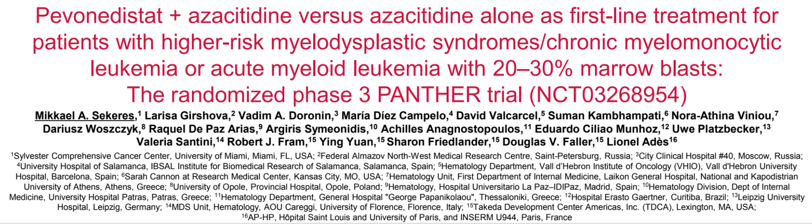
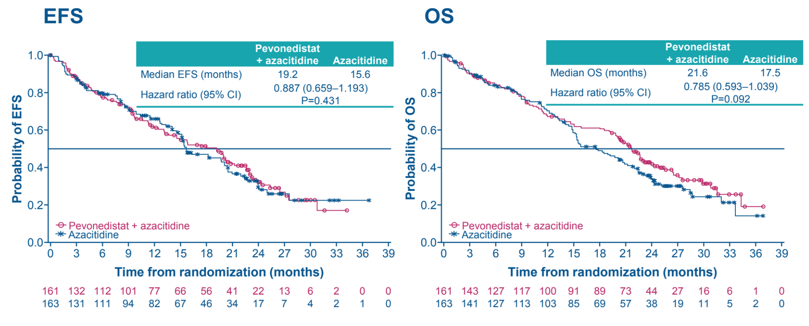
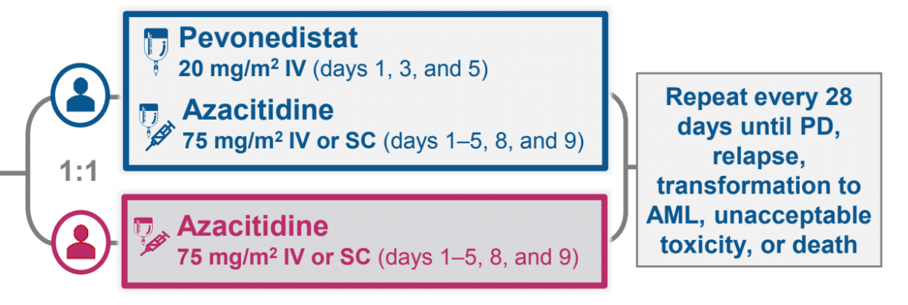
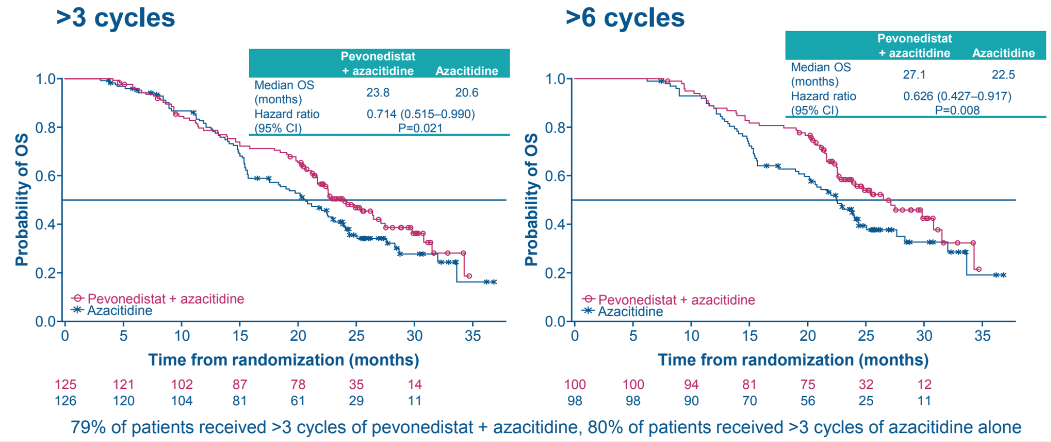
324 MDS Enrolled
Balanced distribution of poor prognostic and frequently mutated genes
Did not meet primary endpoint for EFS
Greater OS benefit for >6 cycles
Ades V et al. Blood Adv 2022;6(17):5132-45

Slide 33
Summary
Several novel combinations are being explored in combination with HMAs (mostly azacitidine) in large Phase 3 studies
Preliminary data show tolerability and benefit in HR-MDS, although OS benefit in confirmatory studies is awaited
Several learnings in large randomized studies where the azacitidine control arm also performed very well, giving us clues that we can continue to optimize standard of care azacitidine therapy in our MDS patients in the community

Slide 34

Precision Medicine in MDS?

Slide 35
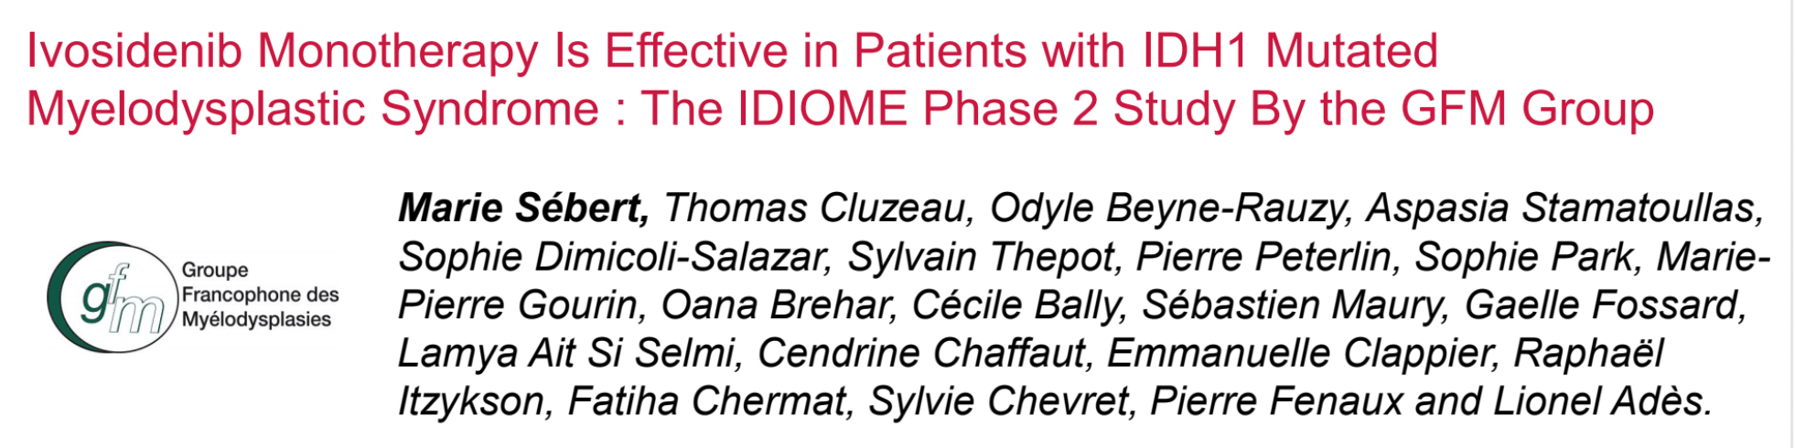
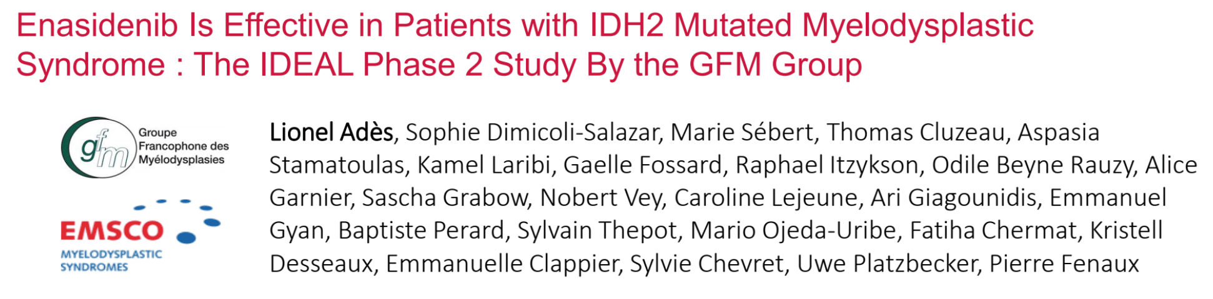

Slide 36
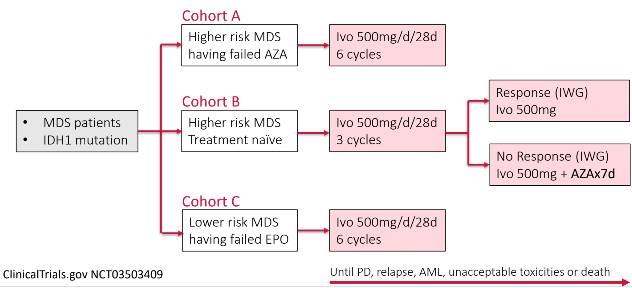
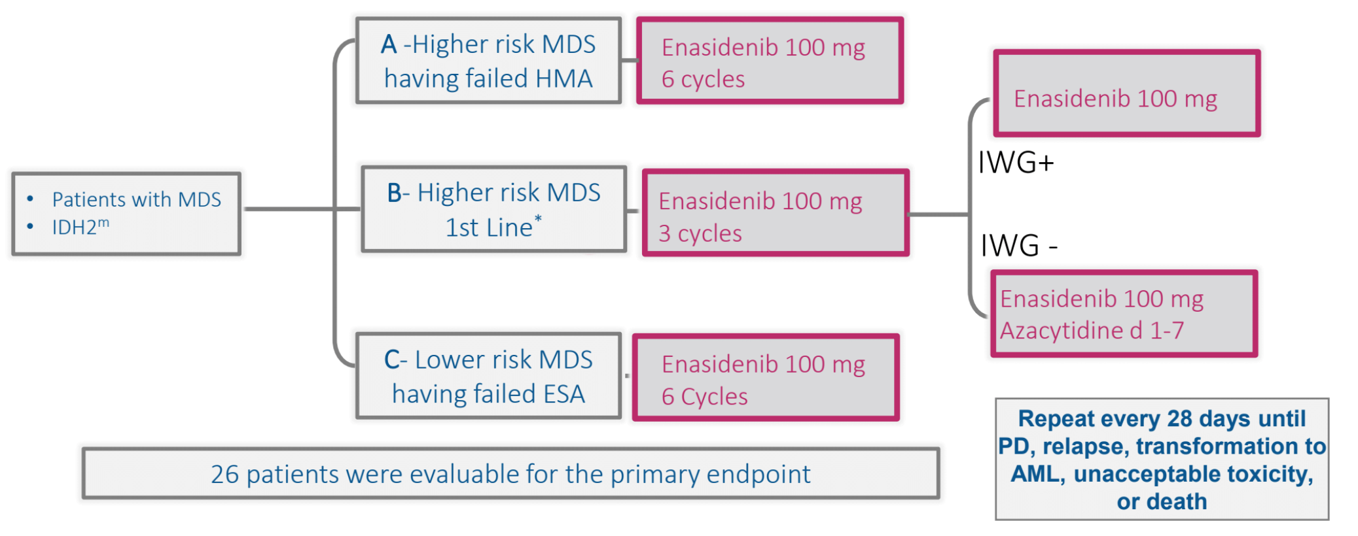
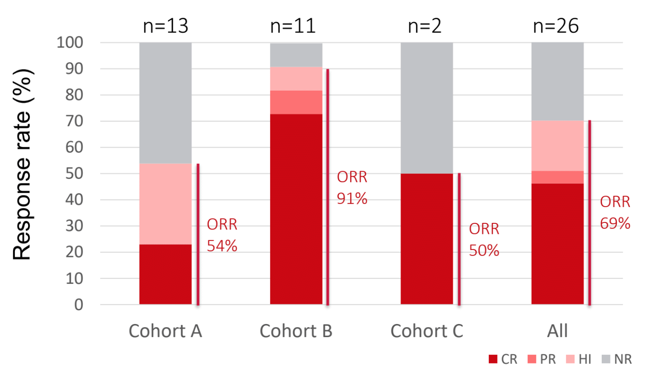
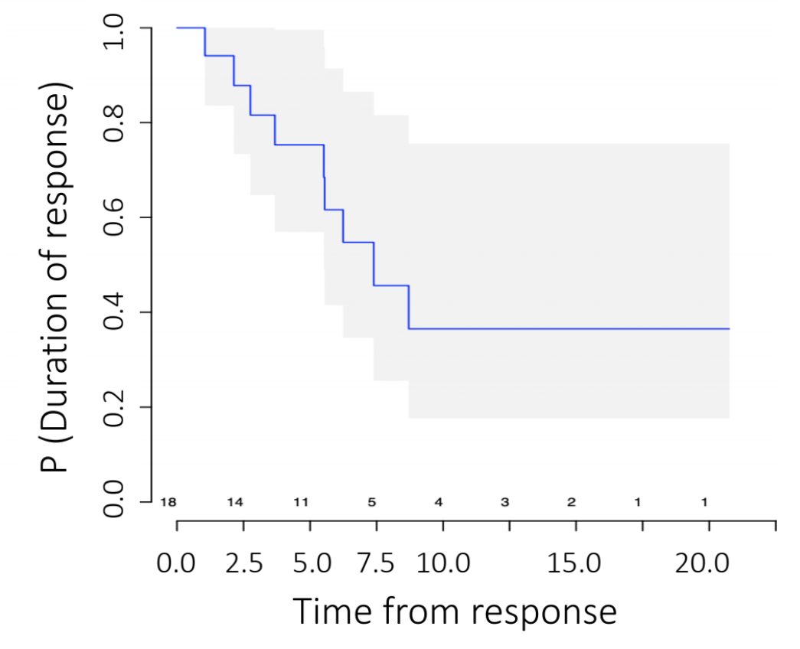
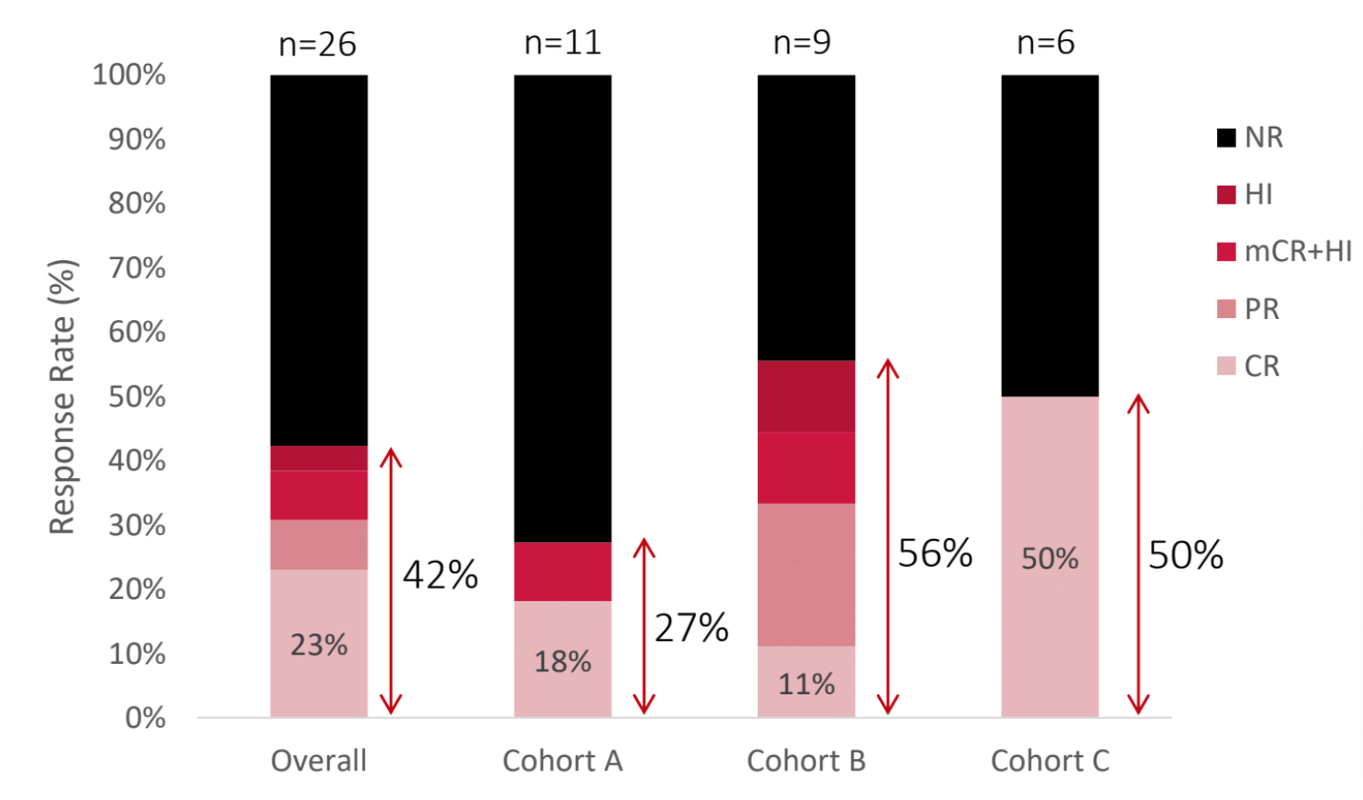
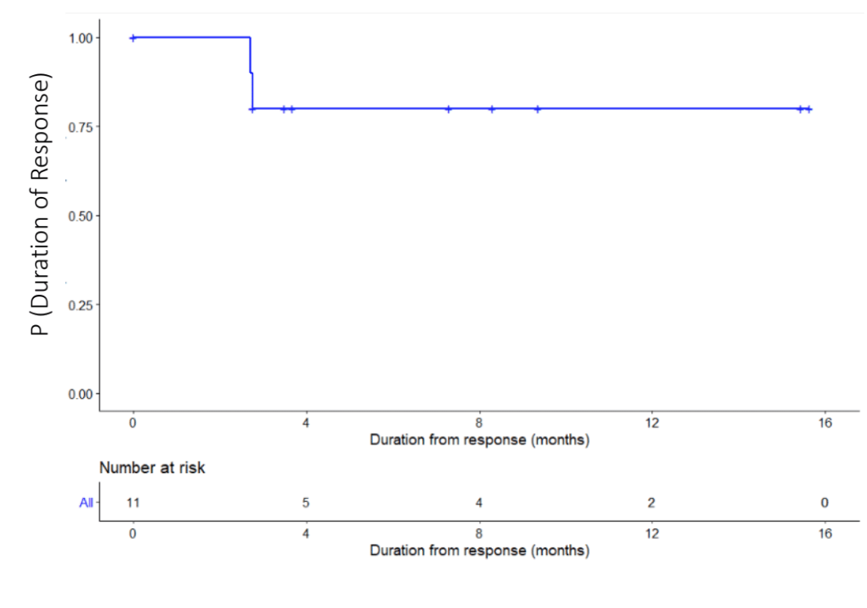
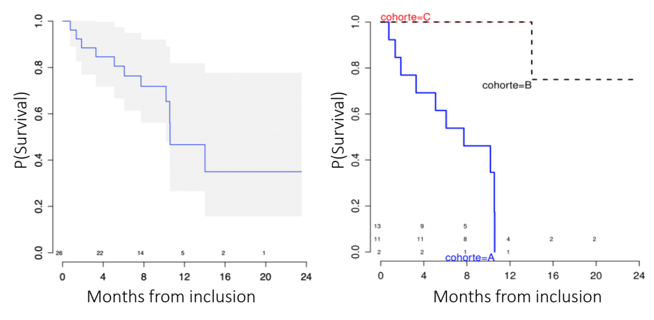
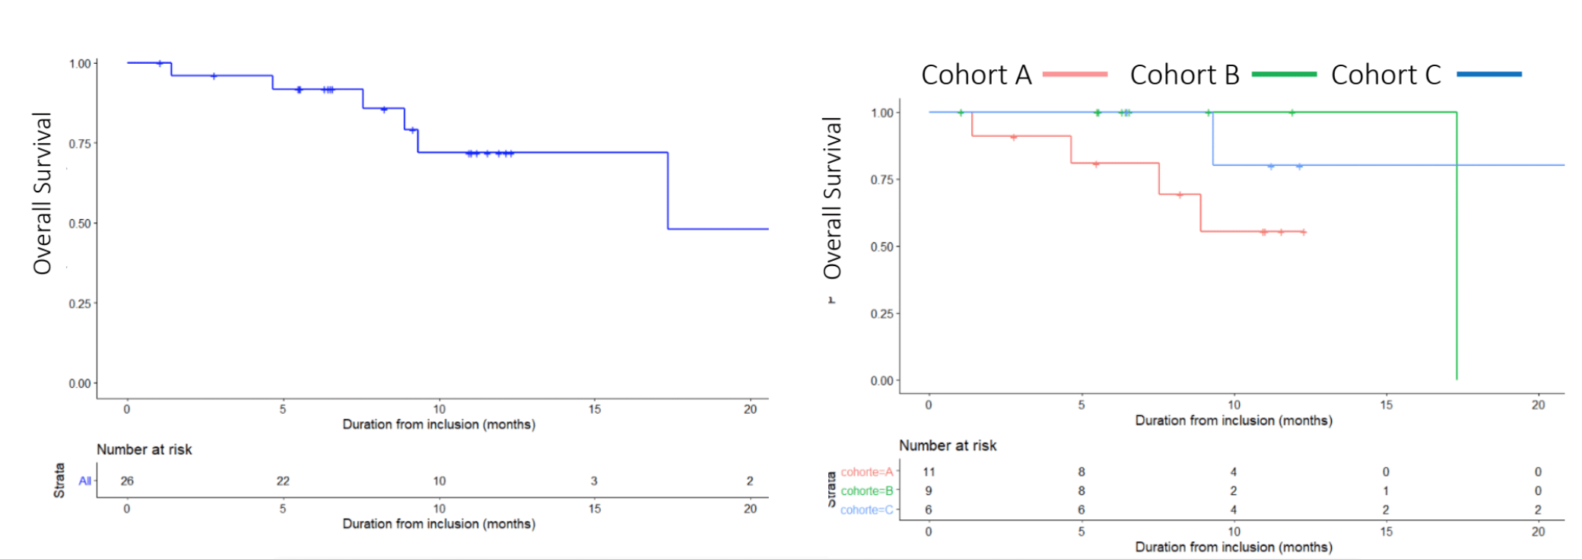
Enasidenib 100 mg
Azacitidine d 1-7
Sébert M et al ASH 2021; Abstract 62, Adès ASH 2021; Abstract 63

Slide 37
Summary of IDH directed therapy in MDS
The phase II IDIOME and IDEAL trials, conducted in France and Germany, indicate that for patients with myelodysplastic syndrome harboring IDH1 or IDH2 mutations, the IDH inhibitors ivosidenib and enosidenib, respectively, may be promising treatments.
Response rates in various cohorts of patients ranged from 42% to 69%, and the median overall survival ranged from 14 to 17 months.
The drugs were reported to be well tolerated.

Slide 38
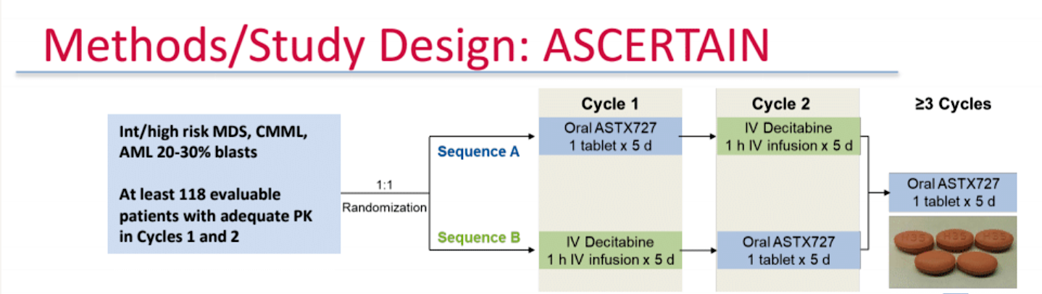
What do we do about TP53 mutated MDS?
TP53 mutations are associated with poor overall survival despite similar response rates in MDS (9.4 vs. 20.7 months in TP53mut vs.TP53wt)
Garcia-Manero ASH 2022; Abstract 854

Slide 39
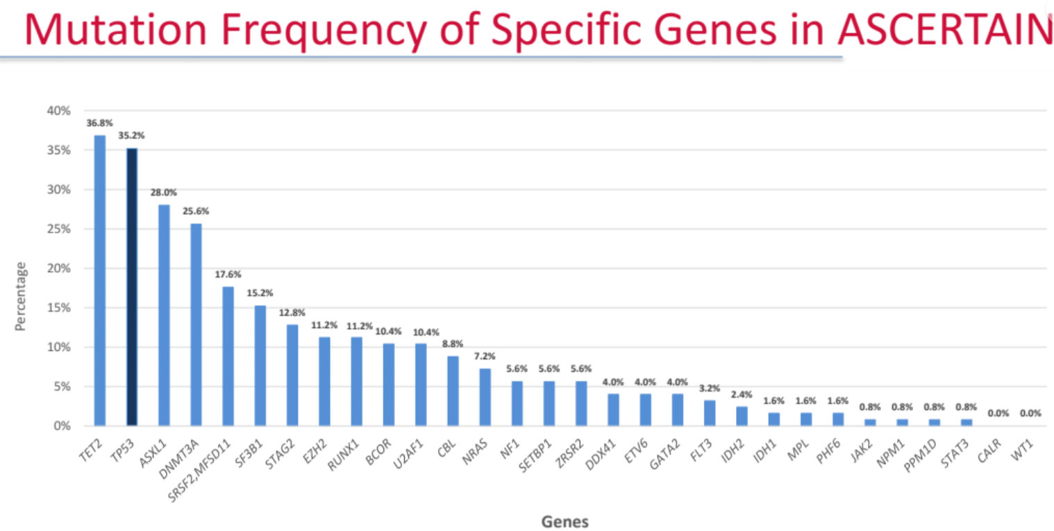
TP53 mutations in ASCERTAIN study
The TP53mut population was analyzed by allelic status:
Biallelic if more than one TP53 copy OR 17p deletion and at least one TP53 mutation (*LOH analyses were not conducted).
TP53mut: 30 monoallelic,
14 biallelic (by this definition)
Garcia-Manero ASH 2022; Abstract 854

Slide 40
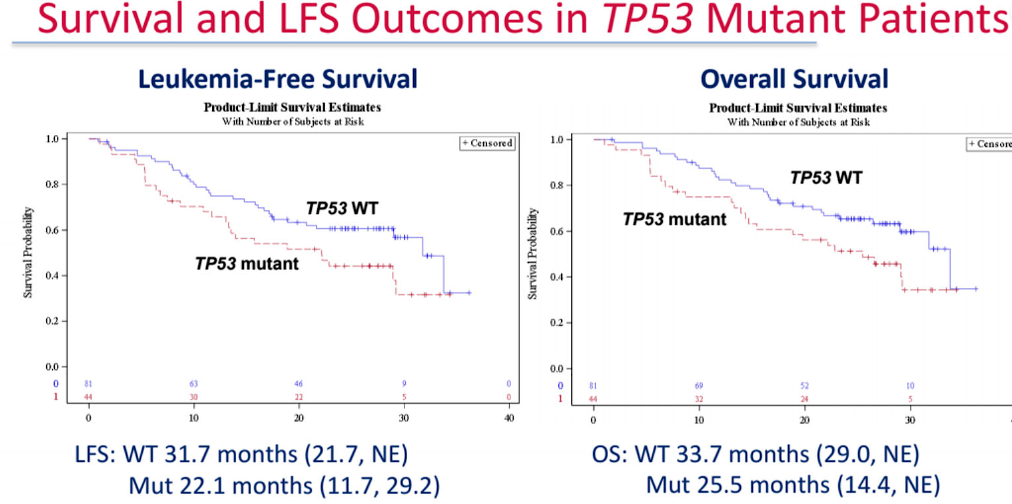
+ Censored
Garcia-Manero ASH 2022; Abstract 854

Slide 41
Summary
Several new therapies being explored in TP53 mutant MDS including the optimal HMA alone or in combination with novel therapies such as the anti-CD74 antibody magrolimab.
Overall this subset of MDS has poor outcomes especially if mutations are biallelic.
Allogeneic stem cell transplant remains the only curative option for HR-MDS.

Slide 42
Will the IPSS-M affect how we treat our patients and clinical trial eligibility ?

Slide 43
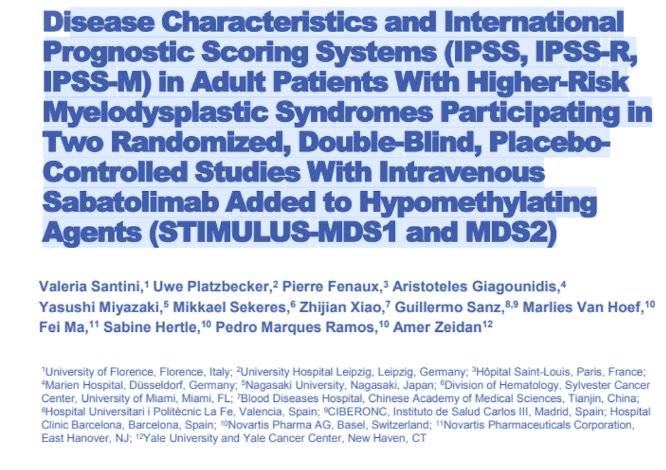

Slide 44
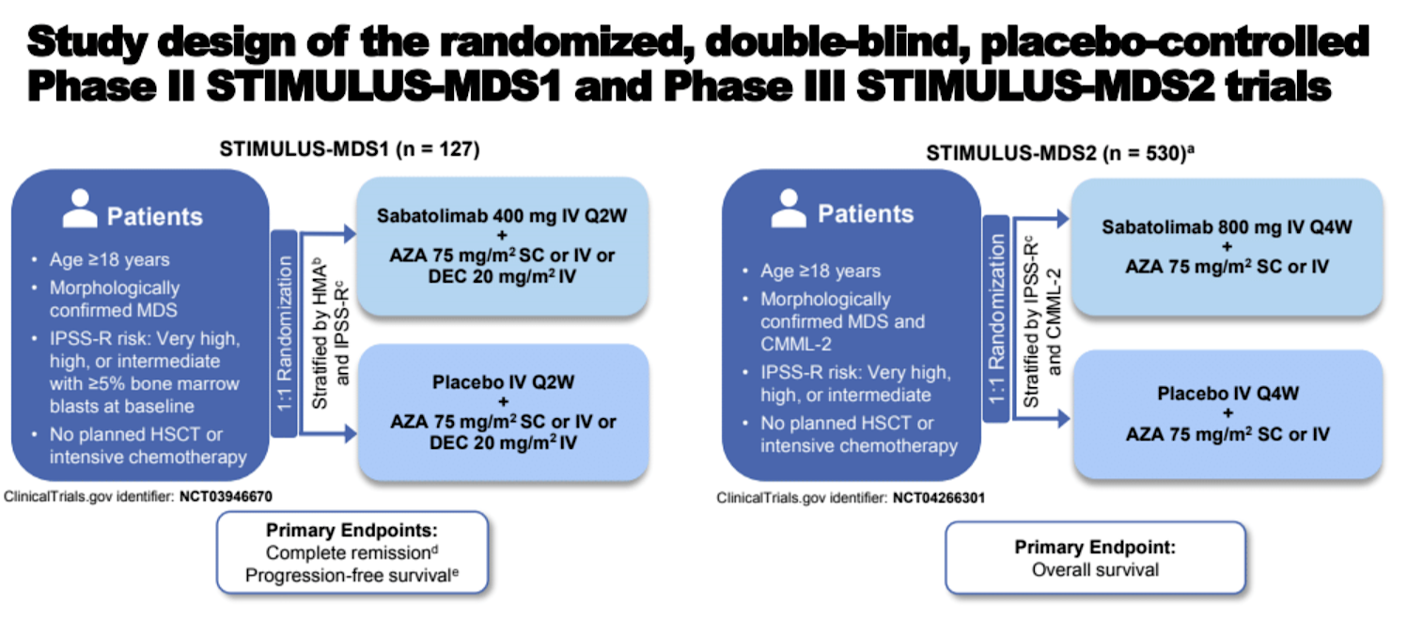
Comparing study populations using different scoring systems
Santini V et al. ASH 2022; Abstract 559

Slide 45
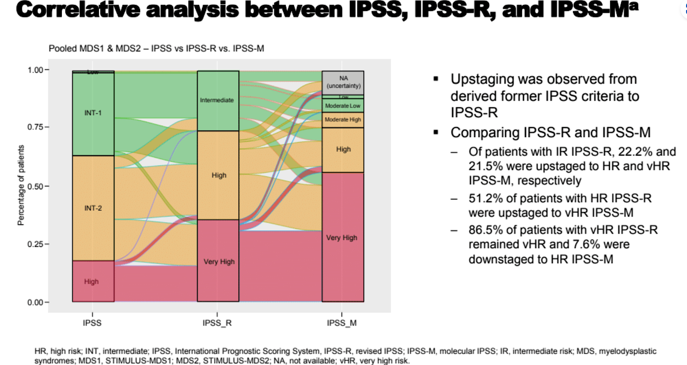
Santini V et al. ASH 2022; Abstract 559

Slide 46
Summary
As the IPSS-M becomes more utilized in clinical practice, we are incorporating more mutational data to risk stratify MDS patients.
This may change how to counsel and treat our patients as more therapies become available for both LR and HR-MDS patients in the future.

