Slide 1
Year in Review
Clinical Investigator Perspectives
Gynecologic Oncology Edition
Krishnansu S. Tewari, MD, FACOG, FACS, FRSM
Professor-with-Tenure & Division Director
The Philip J. DiSaia, MD Endowed Chair
in Gynecologic Oncology
University of California, Irvine

Slide 2
ENDOMETRIAL
CANCER

Slide 3
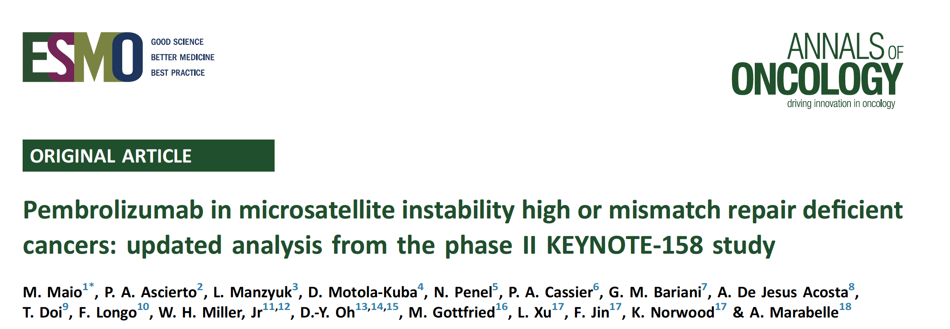

Slide 4
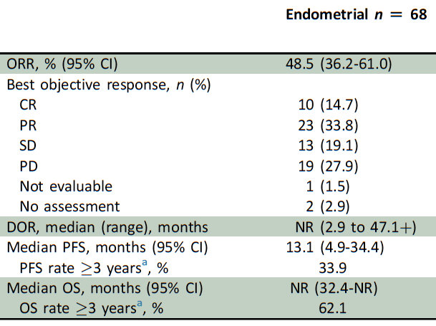
Maio M et al. Ann Oncol 2022;33(9):929-38.

Slide 5
Conclusions
Pembrolizumab Phase II KEYNOTE-158 Update
ORR 30.8%
Median DOR 47.5m
Manageable safety across a range of heavily pre-treated, advanced MSI-H/dMMR non-colorectal cancers

Slide 7
Oaknin A et al. ASCO 2022;Abstract 5509.

Slide 8
Conclusions
Dostarlimab demonstated durable antitumor activity in both dMMR/MSI-H and MMRp/MSS advanced/recurrent EC
Median follow-up 27.6m (dMMR/MSI-H) and 33.0m (MMRp/MSS)
The probability of remaining in response at 24m was 83.7% (dMMR/MSI-H)
Dostarlimab is the only PD-1 therapy tested q6wk dosing for EC
Safety profile was manageable

Slide 9
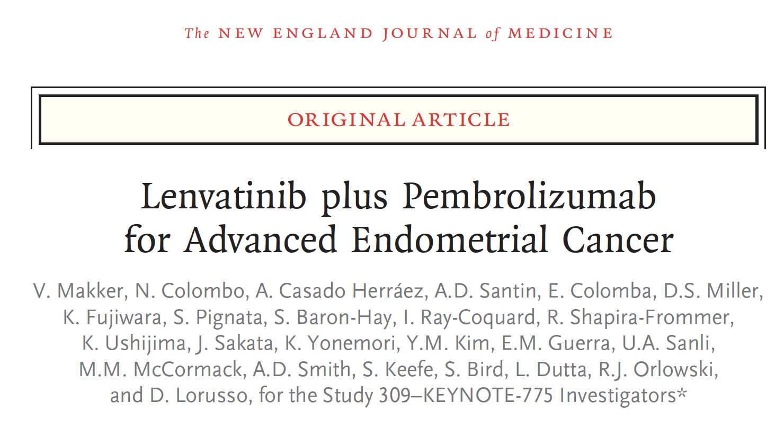

Slide 10
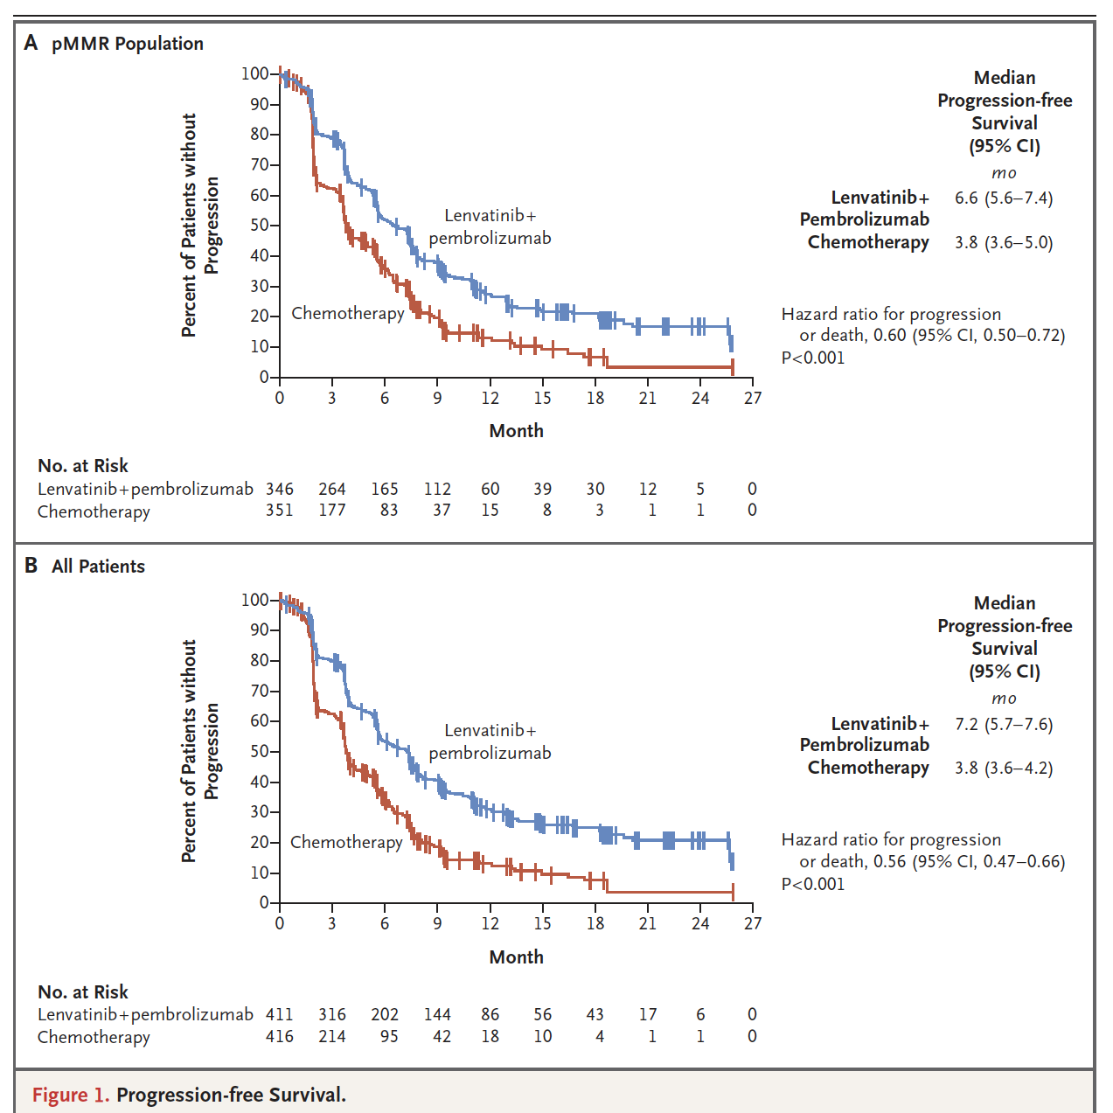
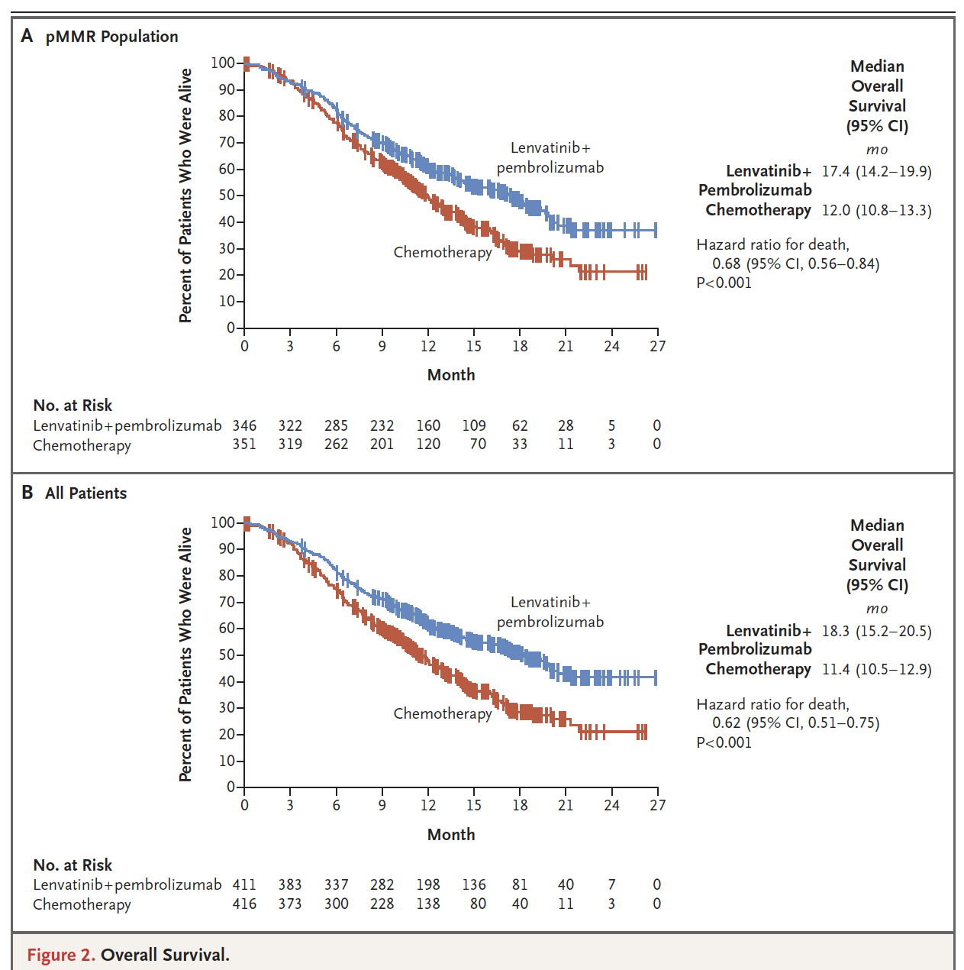
Makker V et al. N Engl J Med 2022;386(5):437-48.

Slide 11
Conclusions
The non-chemotherapy doublet of pembrolizumab plus Lenvatinib led to significantly longer PFS and OS than chemotherapy among patients with advanced EC

Slide 13
Makker V et al. ESMO 2022;Abstract 525MO.

Slide 14
Conclusions
The KEYNOTE-775 Update remains consistent with the primary analysis
Continued demonstration of clinically meaningful improvement in PFS, OS, and ORR (Lev+Pembro vs Doxorubicin+Paclitaxel) among patients with advanced EC (all-comers and MMRp) who received prior platinum therapy

Slide 16
Press Release: December 2, 2022
RUBY Phase III trial evaluating dostarlimab-gxly plus standard-of-care chemotherapy (carboplatin-paclitaxel) followed by dostarlimab compared to chemotherapy plus placebo followed by placebo in patients with primary advanced or recurrent endometrial cancer meets its primary endpoint in a planned interim analysis

Slide 17
Conclusions
RUBY demonstrated a statistically significant and clinically meaningful improvement in investigator-assessed PFS
RUBY is the only first-line trial to show improved PFS for an immuno-oncology therapy in combination with standard-of-care chemotherapy in primary advanced/recurrent EC

Slide 18
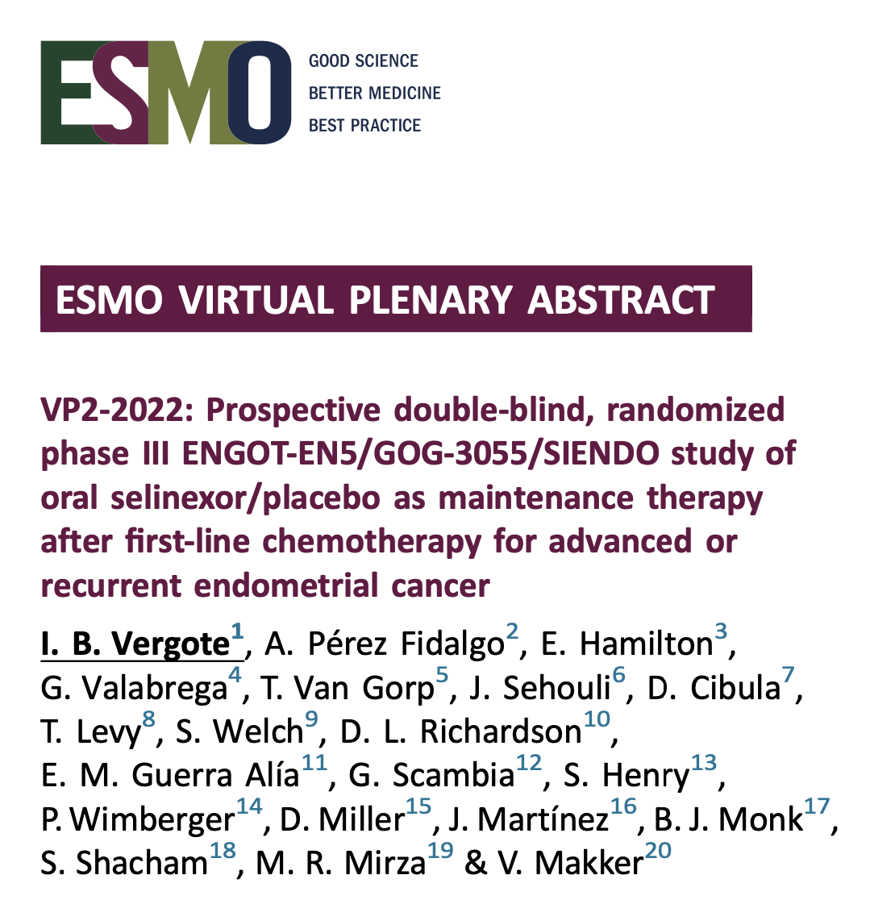

Slide 19
Vergote IB et al. ESMO Virtual Plenary 2022;Abstract VP2-2022.

Slide 20
Conclusions
Selinexor: 30% reduction in risk of progression and/or death
p53 wild-type subgroup: 62% risk of progression and/or death
Endometrioid histology: median PFS 9.2m v 3.2m [HR 0.57; 95% CI, 0.35-0.94; p=0.014]
AEs manageable with supportive care and dose reductions

Slide 22
Makker V et al. ASCO 2022;Abstract 5511.

Slide 23
Conclusions
Potential benefit may be observed for Selinexor over placebo in patients with p53 wild-type including MSS and Copy Number Low EC
Note: No benefit among patients with p53 mutant/aberrant tumors

Slide 25
Phase 1
Median age 69 yrs
>50% had received 4 lines of prior therapy
Primary Endpoints: Safety, DLTs, TRAEs
10% TRAEs
G3/4 Asthenia/Fatigue (12.9%)
G3/4 Lymphopenia (32.3%)
G3/4 Neutropenia (16.1%)
G3/4 Thrombocytopenia (6.5%)
Recommended Phase 2 Dose:
Olaparib 300 mg bid
+ 50 mg Metronomic Cyclophosphamide qd
+ Metformin 500 mg TID
You B et al. AACR 2022;Abstract CT005.

Slide 26
Phase 2
Median PFS 5.1m (95% CI, 3.7-8.1)
Endometrioid: Median PFS 7.5m (95% CI, 5.1-8.9)
Serous: Median PFS 4.3m (95% Ci, 2.7-5.8)
Compared favorably to KEYNOTE-775 (LEN+PEMBRO) which was a younger and less heavily pretreated population
Endometrioid, median PFS 7.6m
Serous, median PFS 5.7m
You B et al. AACR 2022;Abstract CT005.

Slide 28
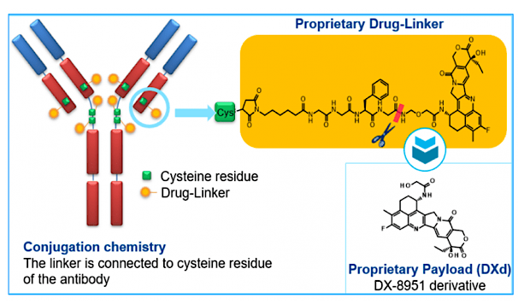
Mauricio D et al. SGO 2022;Abstract 46.

Slide 29
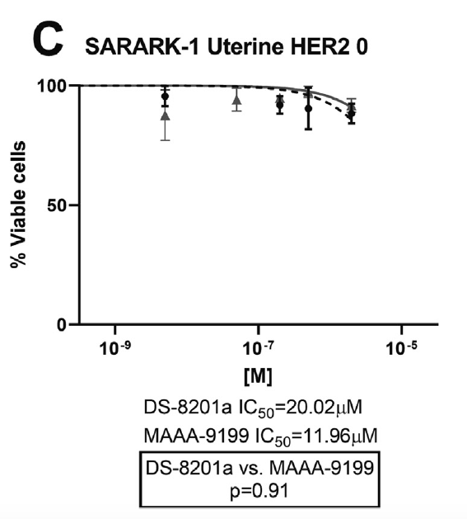
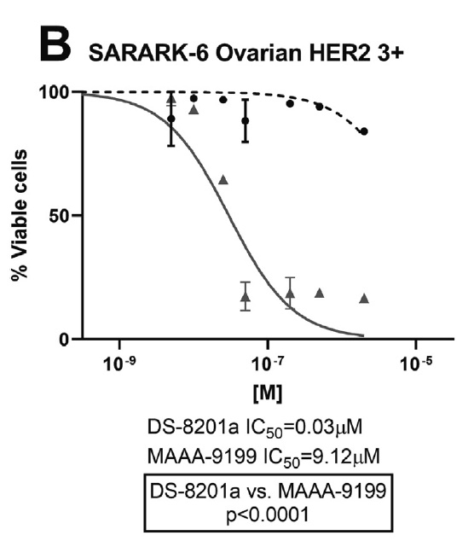
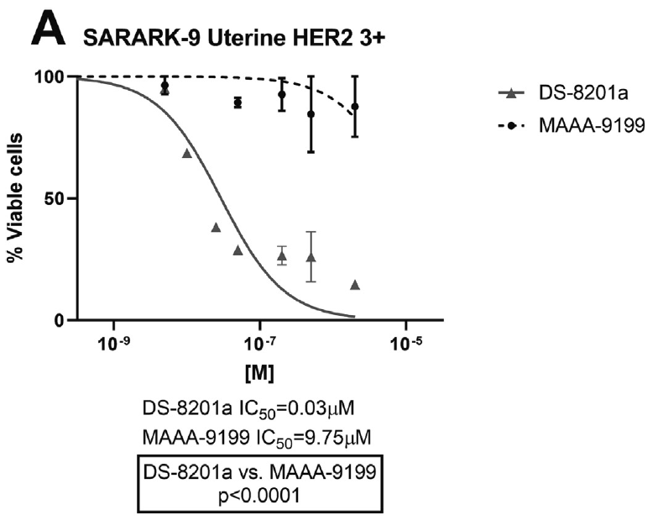
Mauricio D et al. SGO 2022;Abstract 46.

Slide 30
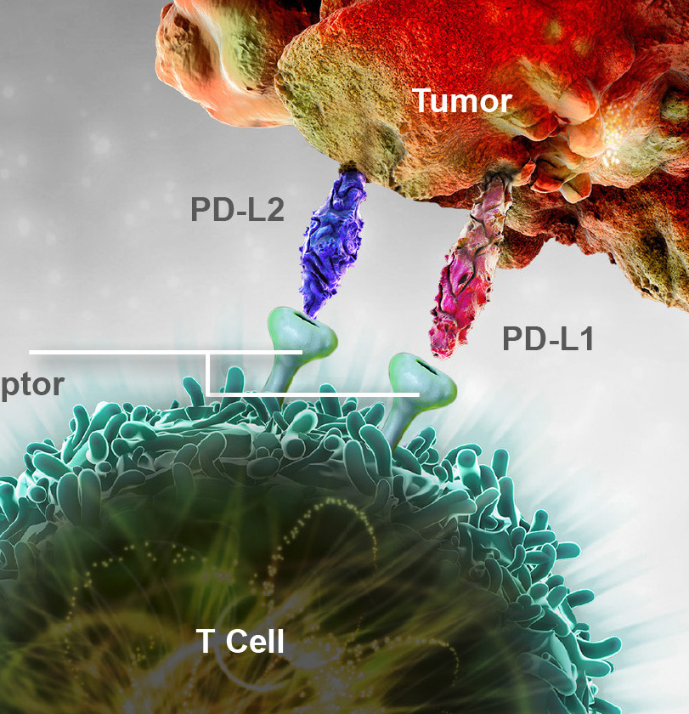
CERVICAL
CANCER

Slide 32
Tewari KS et al. ASCO 2022;Abstract 5506.

Slide 33
Tewari KS et al. ASCO 2022;Abstract 5506.

Slide 34
Conclusions
The benefit of pembrolizumab was generally consistent across a broad selection of key patient subgroups, including those defined by histology, platinum use, bevacizumab use, and prior CRT exposure only
“Real World Experience”: These results provide further support for pembrolizumab plus chemotherapy, with or without bevacizumab, as a new standard of care for women with persistent, recurrent, or metastatic cervical cancer

Slide 36
Monk B et al. SGO 2022;Abstract 23.

Slide 37
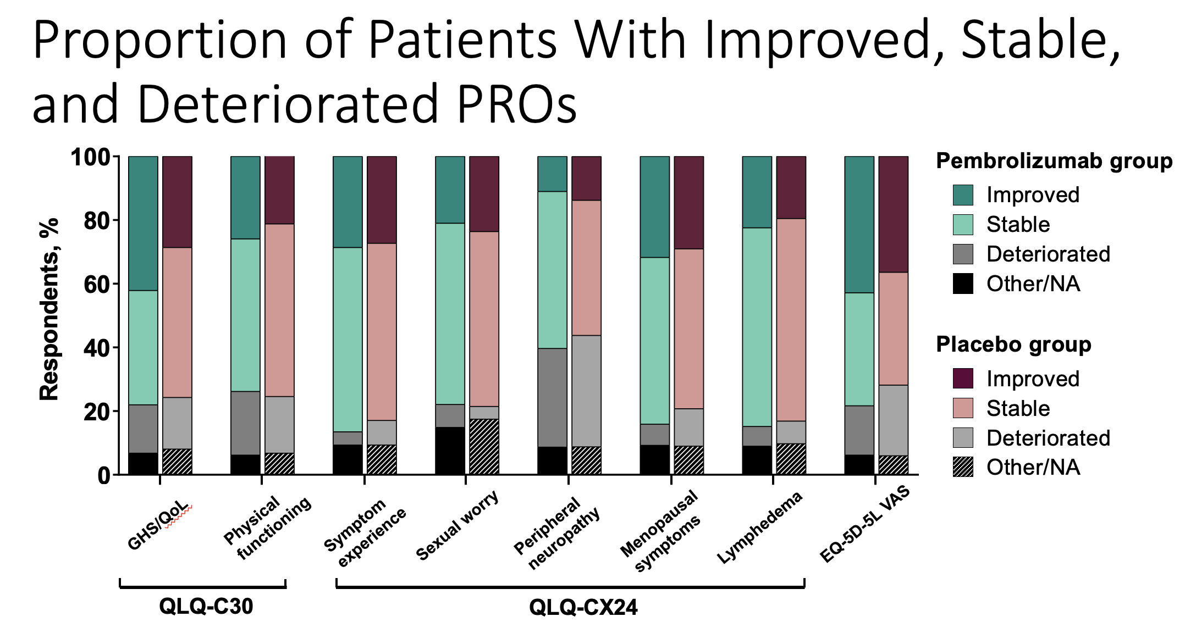
Monk B et al. SGO 2022;Abstract 23.

Slide 38
Conclusions
Improved OS and PFS were not accompanied by any substantial deterioration in HRQoL
There were improvements in the pembrolizumab group vs the placebo group for some PRO instruments
PRO data support a favorable benefit-risk ratio for pembrolizumab + chemotherapy ± bevacizumab in patients with persistent, recurrent, or metastatic cervical cancer

Slide 39
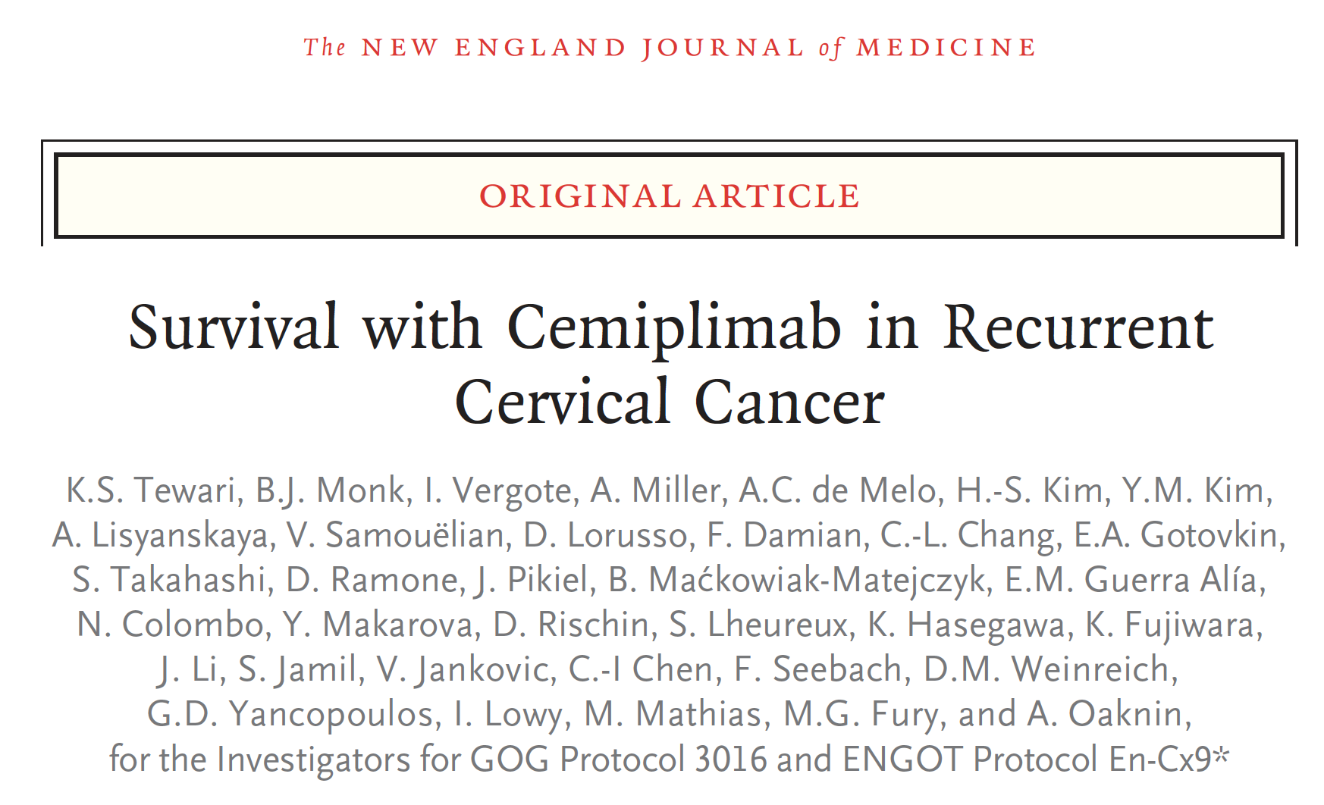

Slide 40
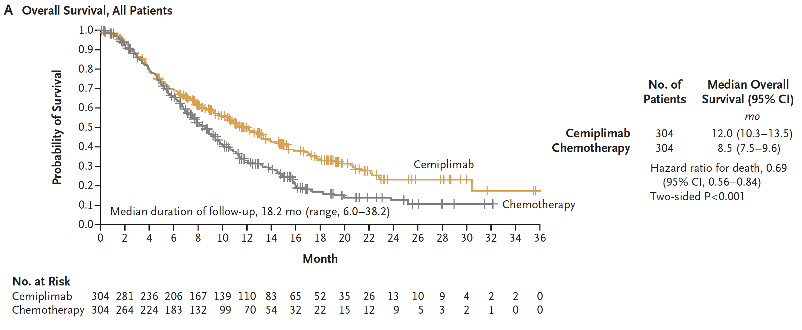
Tewari KS et al. N Engl J Med 2022;386(6):544-55.

Slide 41
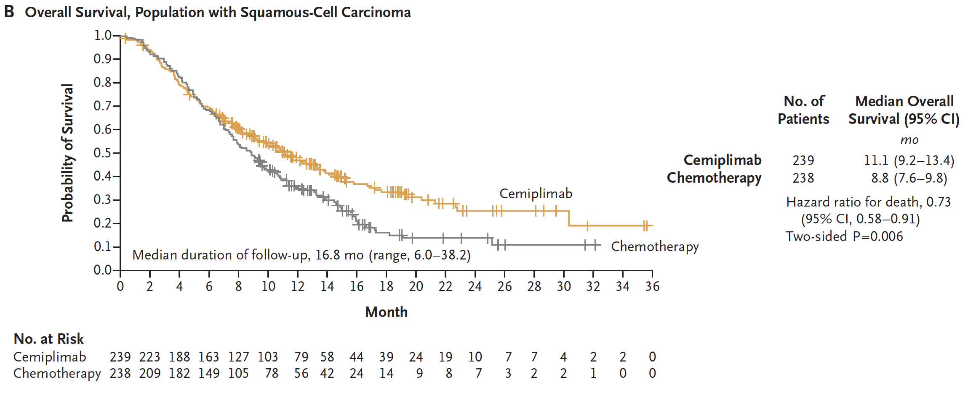
Tewari KS et al. N Engl J Med 2022;386(6):544-55.

Slide 42
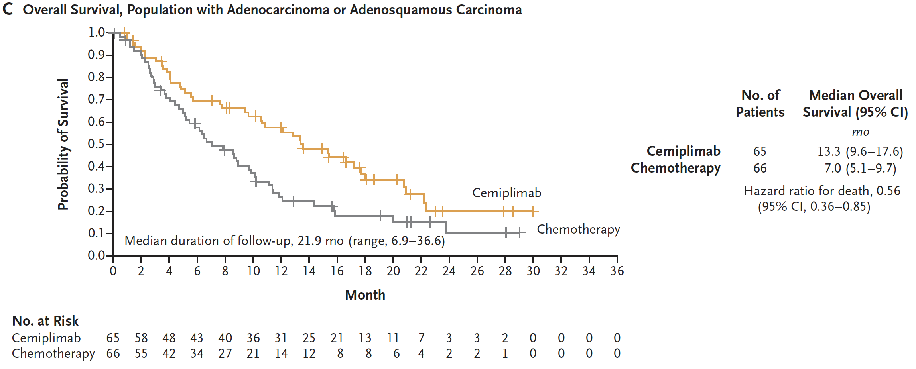
Tewari KS et al. N Engl J Med 2022;386(6):544-55.

Slide 43
Conclusions
In the largest randomised study conducted to date in this population, cemiplimab is the first immunotherapy to demonstrate a statistically significant and clinically meaningful survival benefit in R/M cervical carcinoma following progression after 1L platinum-containing chemotherapy
In SCC: Median OS 11.1 vs 8.8 months with IC chemotherapy; HR 0.73; 95% CI, 0.58–0.91; one-sided P=0.00306
Survival and ORR benefits observed in Overall and AC populations
Patients were enrolled regardless of PD-L1 status
Overall mean change from baseline GHS/QoL favored cemiplimab in overall population (1-sided p<0.001)
No new safety signals identified

Slide 44
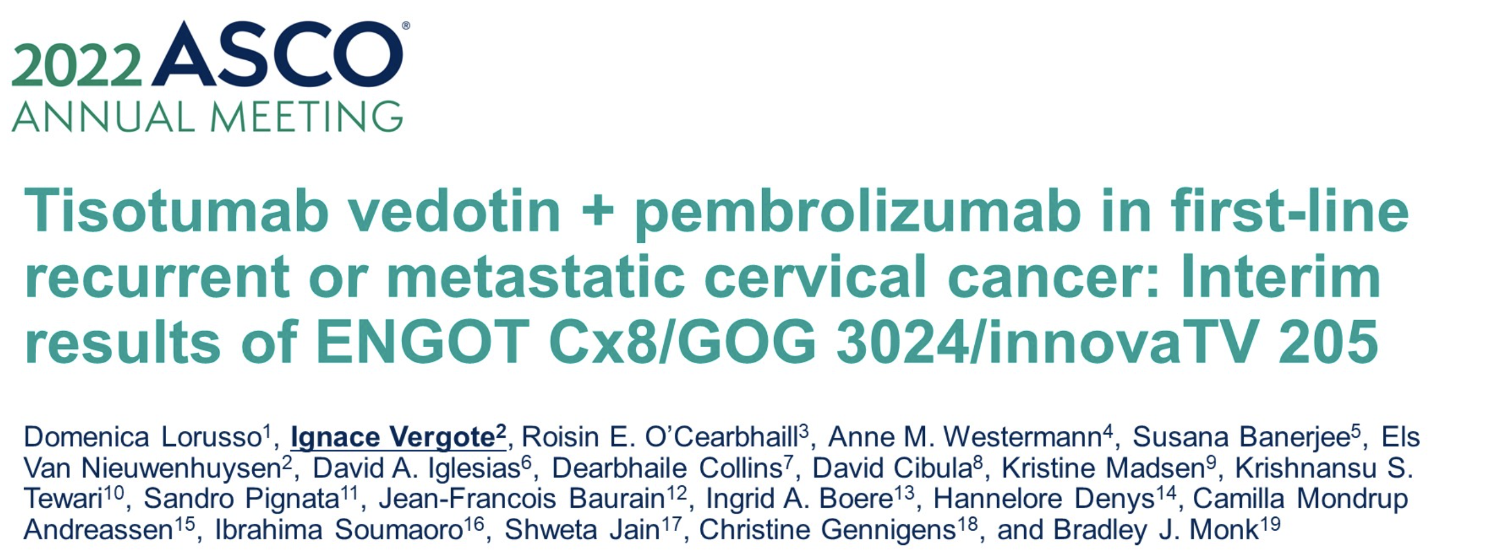

Slide 45
Lorusso D et al. ASCO 2022;Abstract 5507.

Slide 46
Lorusso D et al. ASCO 2022;Abstract 5507.

Slide 47
Lorusso D et al. ASCO 2022;Abstract 5507.

Slide 48
Conclusions
1L TV + Pembro: 41% ORR (16% CR); median DOR not reached at 19m median f/u
2L/3L TV + Pembro: 38% ORR
1L TV + Carbo: 55% ORR

Slide 50
Kim SK et al. Gynecol Oncol 2022;165(2):385-92.

Slide 51
Kim SK et al. Gynecol Oncol 2022;165(2):385-92.

Slide 52
Mitigation Strategy
Kim SK et al. Gynecol Oncol 2022;165(2):385-92.

Slide 53
Kim SK et al. Gynecol Oncol 2022;165(2):385-92.

