Slide 1


Update in management of advanced urothelial carcinoma after platinum chemotherapy and IO: Focus on FGFR-targeting and antibody-drug conjugates
Scott T. Tagawa, MD, MS, FACP
Professor of Medicine & Urology
Co-Leader, Experimental Therapeutics Program
weillcornellgucancer.org
@DrScottTagawa

Slide 2
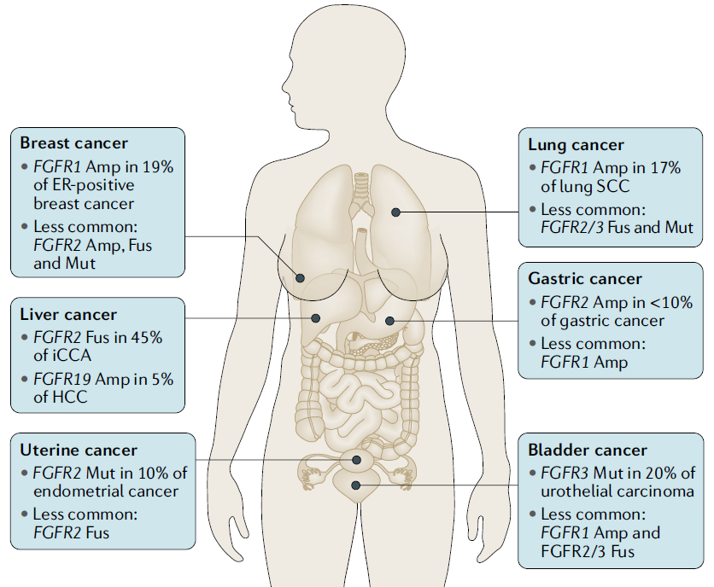
Landscape of Oncogenic FGFR Alterations
Distribution of common FGFR-mutant cancers
% of FGFR3 alteration
Bladder¹⁾
Urothelial Carcinoma²⁾
Katoh et al. Nature Reviews Clinical Oncol 2019
Tomlinson DC, et al. J Pathol. 2007
Knowles MA, et al. Nat Rev Cancer. 2015

Slide 3
Selective FGFR Inhibitors
IC50 (nM) | FGFR1 | FGFR2 | FGFR3 | FGFR4 | VEGFR2
Erdafitinib¹ | 1.2 | 2.5 | 3.0 | 5.7 | 36.8
Infigratinib (BGJ398)² | 0.9 | 1.4 | 1.0 | 60 | 180
ARQ087³ | 4.5 | 1.8 | 4.5 | 34 | 21
Pemigatinib (INCB54828)⁴ | 0.4 | 0.5 | 1.2 | 30 | 71
TAS-120⁵ | 3.9 | 1.3 | 1.6 | 8.3 | N/A
<10 nM
10-30 nM
>30 nM
Perera TPS, et al. Mol Cancer Ther. 2017;16:1010-1020.
Guagnano et al (2011) J Med Chem.
Hall TG, et al. PLoS One. 2016 Sep 14;11(9):e0162594.
Investor & Analyst Event Presentation, June 21, 2018.
Babina & Turner (2017), Nature Rev Cancer.

Slide 4
BLC2001: Phase 2 Trial of Erdafitinib
BLC2001: Phase 2 Trial of Erdafitinib in Patients with Metastatic or Surgically Unresectable Urothelial Carcinoma and Specific FGFR Mutations or Fusions
R
A
N
D
O
M
I
Z
A
T
I
O
N
Regimen 3ª: 8 mg QD with PD up titration to 9 mg QD n=99
Primary end point
ORR
Secondary end points
PFS, DoR, OS, safety, predictive biomarker evaluation, and PK
Patients with metastatic or surgically unresectable
locally advanced UC
Screening for FGFR fusions/ mutations on tissue by central lab
Regimen 1: 10 mg/d for 7 days on/7 days off
Regimen 2: 6 mg QD
Patients
Progression on ≥1 line prior systemic chemo or within 12 months of (neo)adjuvant chemo OR Chemo-naïve: cisplatin-ineligible per protocol criteria^{b}
Prior immunotherapy was allowed
Primary hypothesis:
ORR in regimen 3 is >25%
One-sided α=0.025
85% power
ªDose uptitration if ≥5.5 mg/dL target serum phosphate not reached by Day 14 and if no TRAEs. ^{b}Ineligibility for cisplatin: impaired renal function or peripheral neuropathy.
Siefker-Radtke A, et al. Presented at the ASCO Annual Meeting. June 1-5, 2018, Chicago, IL. Abstract 4503.
Notes:
Key point: This phase 2, multicenter, open-label study is being conducted in patients with metastatic or surgically unresectable UC and specific FGFR mutations or fusions as detected by a central lab assay.
Patients had progressed during or following at least 1 line of prior systemic chemotherapy or less than 12 months of receiving neoadjuvant or adjuvant chemotherapy or were cisplatin-ineligible, chemotherapy-naïve
The primary end point was ORR, and the primary hypothesis was that the ORR in the selected regimen would be >25%
Abbreviations: DoR, duration of response; ORR, objective response rate; PFS, progression-free survival; PK, pharmacokinetics; QD, daily; TRAEs, treatment-related adverse events; UC, urothelial carcinoma.

Slide 5
BLC2001: Baseline Demographic and Clinical Characteristics
Characteristic | All Patients (N=99)
Median age, year (range) | 68 (36–87)
ECOG PS, n (%) 0 1 2 | 50 (51) 42 (42) 7 (7)
Treatment history, n (%) Progression or relapse after CT No previous CT Progression or relapse after IO | 87 (88) 12 (12) 22 (22)
Number of previous treatments, n (%) 0 1 ≥2 | 11 (11) 45 (45) 43 (43)
Visceral metastasis present, n (%) | 78 (79)
Creatinine clearance <60 mL/min, n (%) | 52 (53)
Loriot Y, et al. N Engl J Med. 2019:381:338-348.
Notes:
Key point: The baseline demographic and clinical characteristics of the 99 patients treated with regimen #3 are shown in the table above.
Abbreviations: CT, chemotherapy; ECOG PS, Eastern Cooperative Oncology Group performance status; IO, immuno-oncology.

Slide 6
TRAEs of Clinical Importance or Special Interest
 | 8-mg continuous dose (n = 99)
Patients with AEs, n (%)¹ | Any grade | Grade ≥3
Hyperphosphatemia | 72 (73) | 2 (2)
Skin events | 48 (49) | 6 (6)
Dry skin Hand-foot syndrome | 32 (32) 22 (22) | 0 (0) 5 (5)
Nail events | 51 (52) | 14 (14)
Onycholysis Paronychia Nail dystrophy | 16 (16) 14 (14) 16 (16) | 2 (2) 3 (3) 6 (6)
Central serous retinopathy (CSR) Non-CSR ocular eventsª | 21 (21) 51 (52) | 3 (3) 5 (5)
ªMost common non-CSR ocular events included dry eye (19%), blurry vision (16%), increased lacrimation (11%), and conjunctivitis (9%).
Majority of events were grade 1/2
Few patients (n=7) discontinued because of AEs of special interest
All AEs of special interest were managed with supportive therapies, dose interruption, and/or modification
CSR is a known class effect of inhibitors of the MAPK pathway^{2,3}
Patients were routinely monitored
CSR rarely led to discontinuation (n=3), and no patient had retinal vein or artery occlusion
There were no treatment-related deaths on-study¹
Loriot Y, et al. N Engl J Med. 2019:381:338-348.
Siefker-Radtke A, et al. Presented at the ASCO Annual Meeting. June 1-5, 2018, Chicago, IL. Abstract 4503.
Renouf DJ, et al. J Clin Oncol. 2012;30:3277-3286
Stjepanovic N, et al. Ann Oncol. 2016;27:998-1005.
Notes:
Key point: All AEs of special interest were managed with supportive therapies, dose interruption, and/or modification
Abbreviations: AEs, adverse events; CSR, central serous retinopathy; MAPK, mitogen activated protein kinase; TRAEs, treatment-related adverse events.

Slide 7
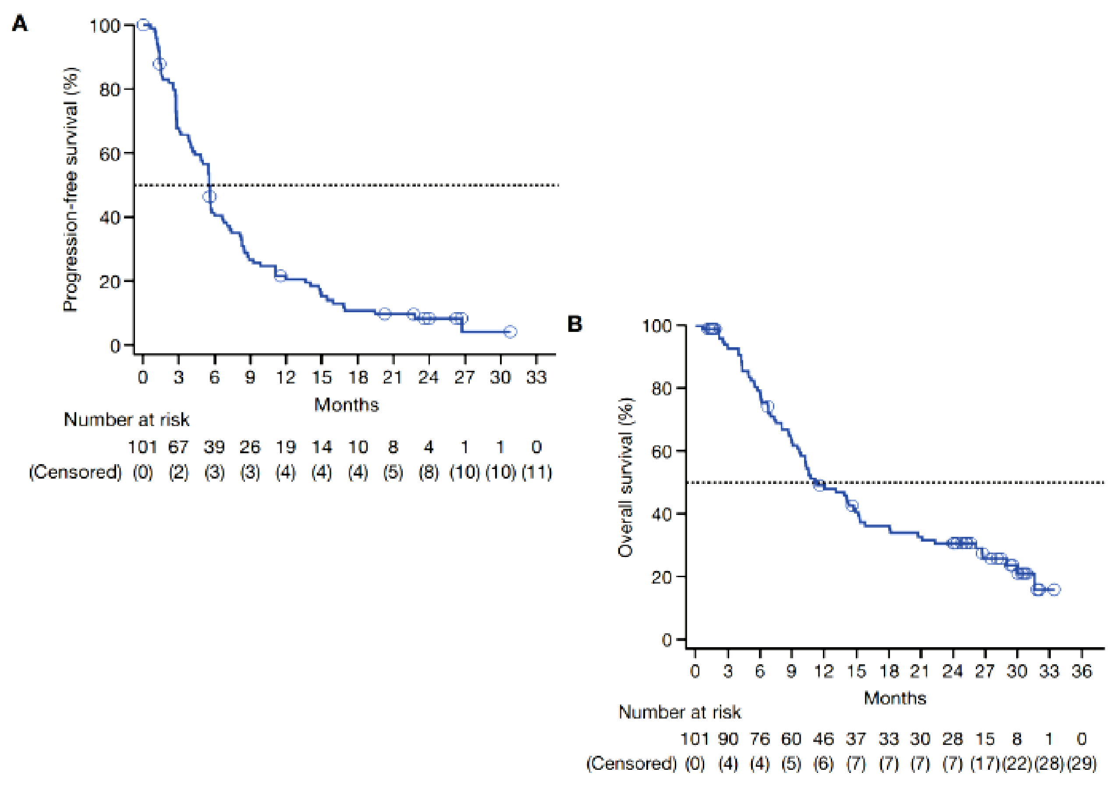
BLC2001 Long-term Follow up
mPFS 5.5 mo
[4.3 – 6.0]
ORR: 40%
Median DoR: 6.0 months
mOS 11.3 mo
[9.7 – 15.2]
Siefker-Radtke et al. Lancet Oncol 2022 23(2) 248-258

Slide 8


Serum Phosphate Levels Are a Proxy for FGFR Target Engagement by Erdafitinib
Erdafitinib induces dose-dependent hyperphosphatemia via inhibition of phosphate excretion¹
PO₄
Hyperphosphatemia is expected in all patients, is transient, and normalizes by Cycle 5 of erdafitinib treatment¹
Phase 1 data and PK/PD modeling identified a serum phosphate level of ≥5.5 mg/dL as a PD target with acceptable tolerability²
1. Loriot Y, et al. N Engl J Med. 2019;381(4):338-348. 2. Tagawa S, et al. Ann Oncol. 2019; 3206 [abstract].

Slide 9
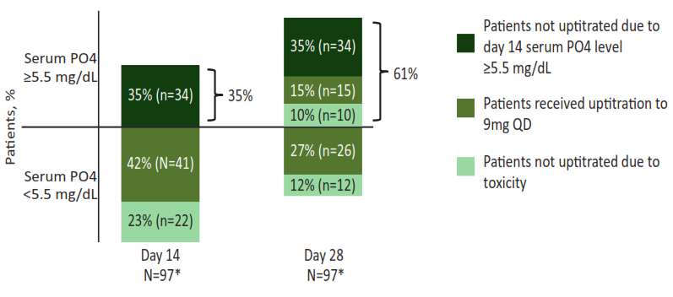
Patients Achieving Target Serum Phosphate Levels During Erdafitinib Treatment on the BLC2001 Trial
Proportion of Patients Achieving Target Serum PO4 Level on
Day 14 and Day 28 on BLC2001 Trial
Outcomes of Patients According to Maximum Serum PO4 Within First 3 Months of Treatment and Uptitration
Outcome | Max PO4 <5.5 mg/dL, no uptitration (n=9) | Max PO4 ≥5.5 mg/dL, no uptitration (n=48) | Patients uptitrated to 9 mg QD (n=41)
ORR, n (%) | 2 (22.2) | 18 (37.5) | 20 (48.8)
Median DOR, months (95% CI) | 4.1 (2.8, 5.4) | 6.0 (4.4, NE) | 6.0 (4.2 (13.4)
*1 patient with a baseline PO4 measurement did not have a Day 14 or Day 28 measurement; 1 patient with a baseline PO4 measurement did not have a Day 28 measurement. Neither patient received uptitration.
Tagawa ST, et al. Abstract presented at the 2019 ESMO Congress; Barcelona, Spain. September 27-October 1, 2019. Abstract 932P..
Notes:
Key point: Patients achieving higher maximum P04 levels within the first 3 months of erdafitinib treatment have higher ORR and DOR.
Abbreviations: DOR, duration of response; ORR, objective response rate; PO4, phosphate.

Slide 10
Phosphate Levels Are Associated With Improved Survival for Patients Treated With Erdafitinib on the BLC2001 Trial
Survival | Max Serum PO4 in First 3 Months <5.5 mg/dL (n=26) | Max serum PO4 first 3 months ≥5.5 mg/dL (n=72) | Max Serum PO4 First 3 Months ≥5.5 mg/dL (n=72)
Median PFS, months | 4.0 | 5.6 | 5.6
HR (95% CI) | 0.66 (0.40, 1.10)
HRª [95% CI; (P value)] | 0.78 [0.63, 0.96 (0.021)]
Predicted HR for uptitration^{b} (95% CI) | 0.90 (0.82, 0.98)
Median OS | 7.5 | NR
HR (95% CI) | 0.41 (0.21, 0.77)
HRª [95% CI; (P value)] | 0.58 [0.43, 0.80 (0.001)]
Predicted HR for uptitration^{b} (95% CI) | 0.79 (0.70, 0.91)
ªPer 1 mg/dL increase in maximum PO4. ^{b}Predicted HR based on simulation from 8-mg to 9-mg dose uptitration.
Tagawa ST, et al. Abstract presented at the 2019 ESMO Congress; Barcelona, Spain. September 27-October 1, 2019. Abstract 932P.
Notes:
Key point: The maximum PO4 level within 3 months of erdafitinib treatment positively correlates with improvement in PFS and OS.
Abbreviations: CI, confidence interval; HR, hazard ratio; NR, not reached; OS, overall survival; PFS, progression-free survival; PO4, phosphate.

Slide 11
Serum PO4 Levels Correlate With Grade ≥3 TEAEs
Patients With Grade ≥3 TEAEs, n (%) | Max Serum PO4 in First 3 Months <5.5 mg/dL (n=26) | Max Serum PO4 First 3 Months ≥5.5 mg/dL (n=72)
Hyperphosphatemia | 0 | 2 (2.8)
Nail events | 3 (11.5) | 11 (15.3)
Skin events | 1 (3.8) | 6 (8.3)
Central serous retinopathy (CSR) | 0 | 3 (4.2)
Non-CSR ocular events | 1 (3.8) | 5 (6.9)
Tagawa ST, et al. Abstract presented at the 2019 ESMO Congress; Barcelona, Spain. September 27-October 1, 2019. Abstract 932P.
Notes:
Key point: Higher serum PO4 levels are associated with a higher rate of grade ≥3 TEAEs.
Abbreviations: CSR, central serous retinopathy; PO4, phosphate; TEAEs, treatment-emergent adverse events.

Slide 12
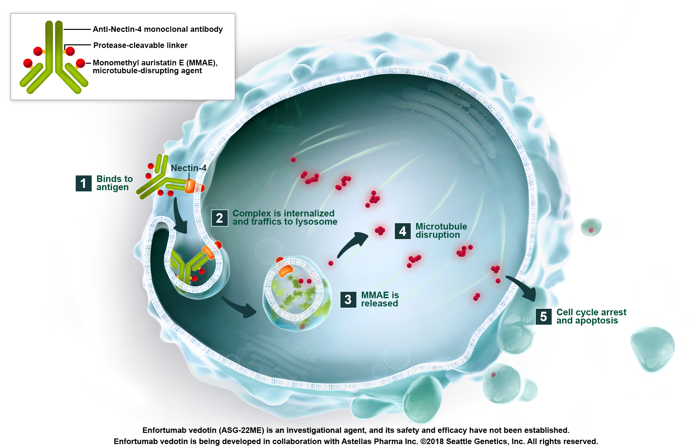
Enfortumab Vedotin (ASG-22ME → EV) Proposed Mechanism of Action
Nectin-4
Transmembrane adhesion molecule expressed on skin, urothelium, salivary gland ducts, esophagus, breast, and stomach
Expressed in 83% of UC TMA samples
Protease-cleavable linker
Conjugated to monomethyl auristatin-E (MMAE)
Scott T. Tagawa, MD, MS, FACP

Slide 13
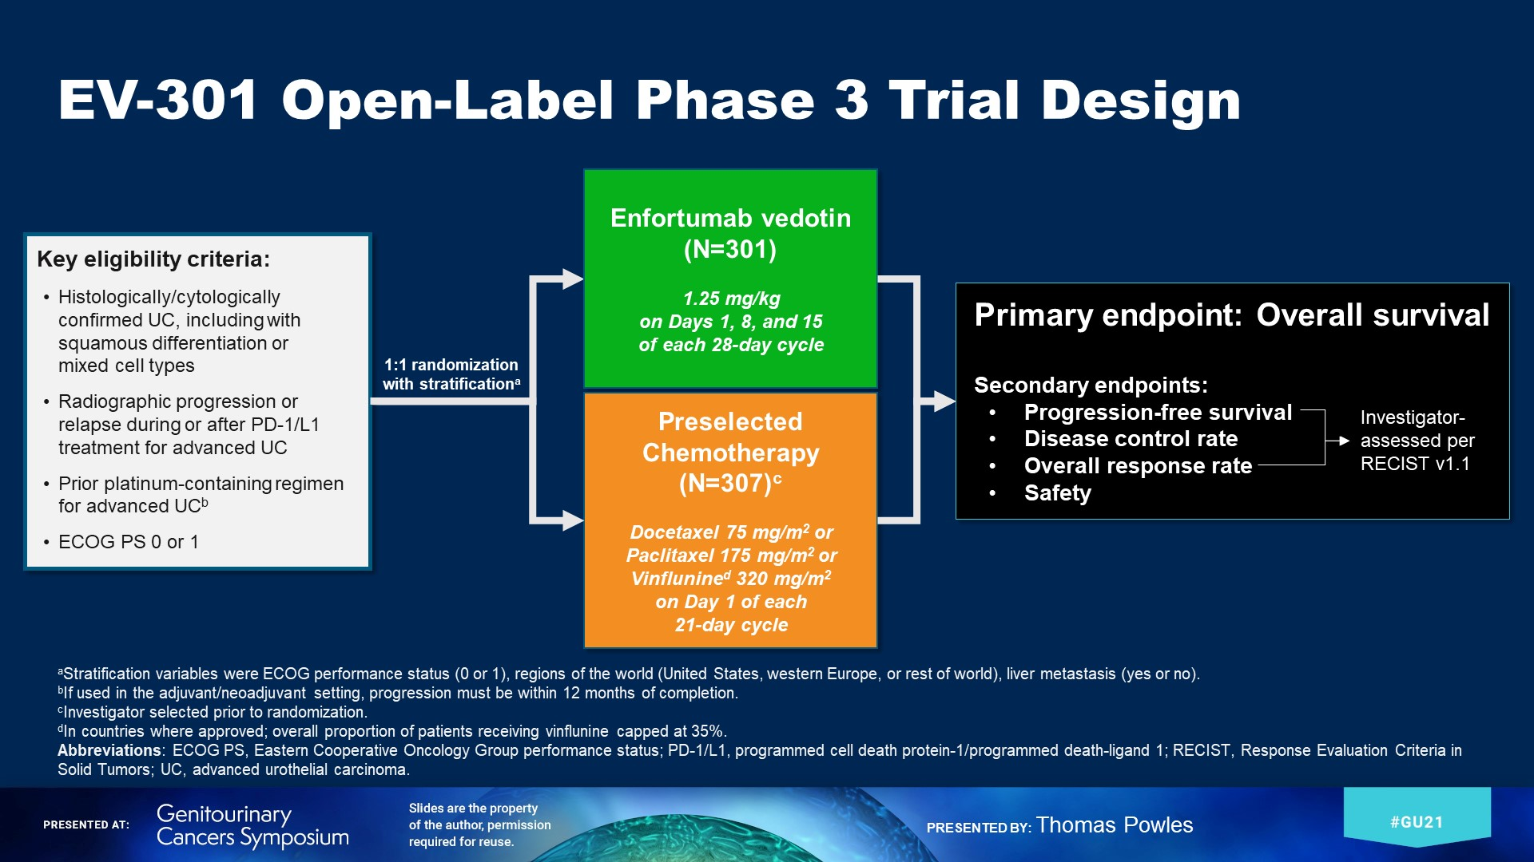
Scott T. Tagawa, MD, MS, FACP

Slide 14
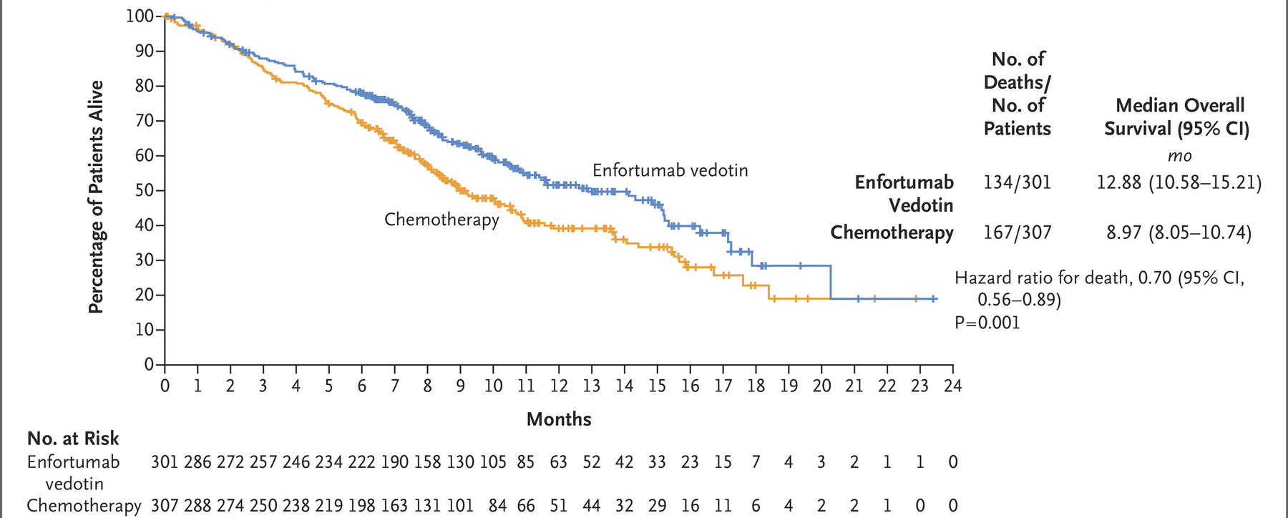
Progression free survival = 5.55 mo vs 3.71 mo; HR 0.62 [95%CI 0.51 – 0.75, p<0.001]
Overall response rate = 40.6% vs 17.9%, p<0.001 (CR in 4.9% vs 2.7%)
Disease control in 71.9% vs 53.4%, p<0.001
Powles et al, N Engl J Med 2021
Scott T. Tagawa, MD, MS, FACP

Slide 15
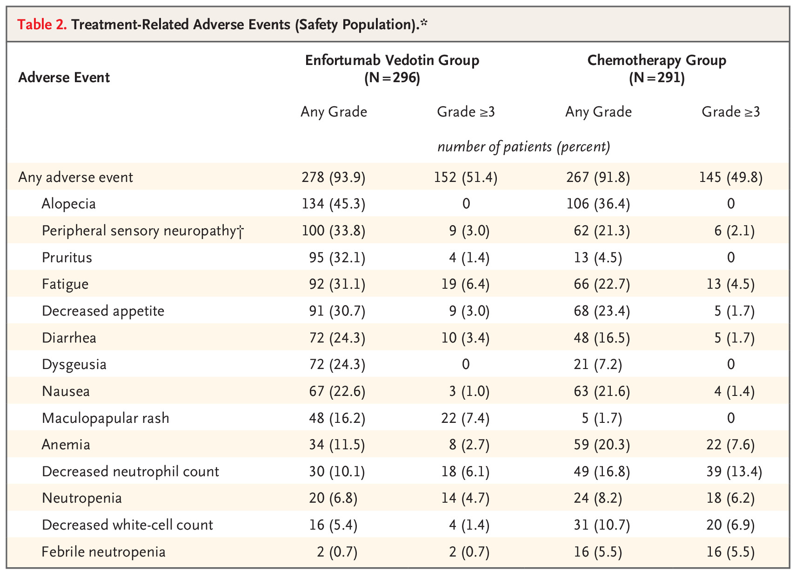
EV-301:
EV vs taxane/vinflunine
Rash in 43.9% (9.6% on control)
Gr 3/4 in 14.5%
Led to dose reduction in 4.4%
Dose interruption in 4.4%
No dose withdrawal
Neuropathy in 46.3% (30.6% on control)
Gr 3 in 3.7%
Led to dose reduction in 7.1%
Dose interruption in 15.5%
Dose withdrawal in 2.4%
Hyperglycemia in 6.4% (0.3% on control)
11 Gr 3, 1 Gr 5
More neutropenia (including FN) and
anemia with taxane/vinflunine
Powles et al, N Engl J Med 2021
Scott T. Tagawa, MD, MS, FACP

Slide 16
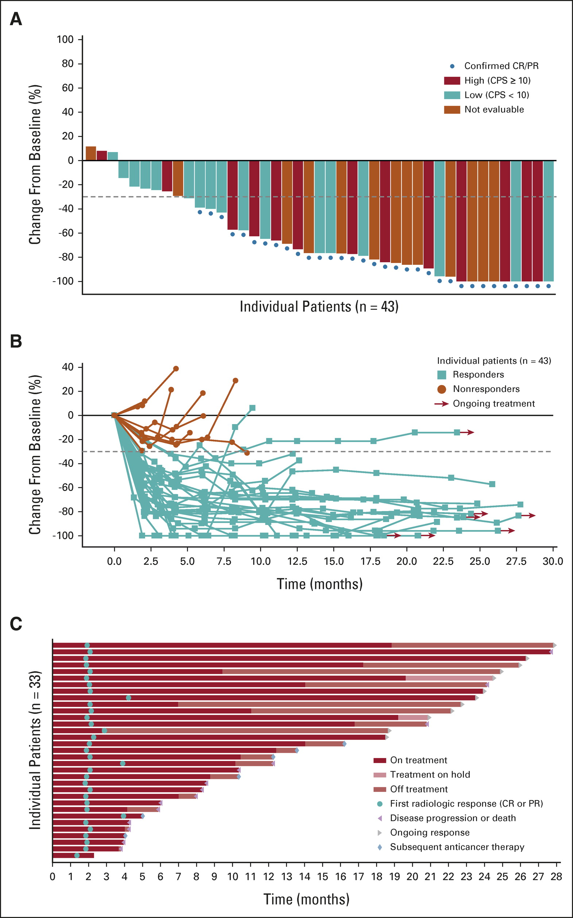
EV-103 Cohort A: EV + pembro in Cisplatin Unfit 1st Line mUC
Confirmed ORR 95% CI | 73.3% (33/45) (58.1, 85.4)
Complete response | 15.6% (7/45)
Partial response | 57.8% (26/45)
Best Overall Response Per RECIST v 1.1 by investigator (N=45)
Median duration of response: 25.6 mo
Median PFS 12.3 mo
Median OS 26.1 mo
Hoimes et al, JCO 2022
Scott T. Tagawa, MD, MS, FACP
Jonathan E. Rosenberg

Slide 17
EV-103 Cohort K
Part of an open-label, multiple cohort, phase 1b/2 study in patients with urothelial carcinoma
Cohort K
1:1 Randomization
enfortumab vedotin + pembrolizumab
or
enfortumab vedotin
Cisplatin-ineligible
1L
(N=151)
Dosing: EV 1.25 mg/kg IV on days 1 and 8, and P 200 mg IV on day 1 of every 3-week cycle
Primary endpoint: confirmed ORR by RECIST v1.1 per BICR
Key secondary endpoints: confirmed ORR per RECIST v1.1 by investigator, DOR, DCR, PFS, OS, safety/ tolerability, and lab abnormalities
Statistical considerations
The sample size was based on precision of the estimate for ORR characterized by 95%CIs
No formal statistical comparisons between the 2 treatment arms
Patient Population
Locally Advanced
or
Metastatic Urothelial Carcinoma
(la/mUC)
Dose Escalation
enfortumab vedotin + pembrolizumab
Cisplatin-ineligible
1L
(n=5)
Expansion Cohort A
enfortumab vedotin + pembrolizumab
Cisplatin-ineligible
1L
(n=40)
Stratification factors: Liver metastases (present/absent) and ECOG PS (0 or 1/2); Exploratory endpoints: pharmacokinetics, antitherapeutic antibody, biomarkers of activity including baseline PD-L1 status and Nectin-4 expression, progression-free survival on subsequent therapy by investigator, patient reported outcomes; Cohort K completed enrollment on 11 Oct 2021; Data cutoff was 10 Jun 2022
Jonathan E. Rosenberg, MD

Slide 18
Overall Response Rate by BICR
EV+P: 64.5% confirmed ORR with rapid responses
 | EV+P (N=76) | EV Mono (N=73)
Confirmed ORR, n (% ) (95% CI) | 49 (64.5) (52.7, 75.1) | 33 (45.2) (33.5, 57.3)
Best overall response, n (%)
Complete Response | 8 (10.5) | 3 (4.1)
Partial Response | 41 (53.9) | 30 (41.1)
Stable Disease | 17 (22.4) | 25 (34.2)
Progressive Disease | 6 (7.9) | 7 (9.6)
Not Evaluable | 3 (3.9) | 5 (6.8)
No Assessment | 1 (1.3) | 3 (4.1)
Median time to objective response (range), mos | 2.07 (1.1, 6.6) | 2.07 (1.9, 15.4)
Median number of treatment cycles (range) | 11.0 (1, 29) | 8.0 (1, 33)
EV+P
41/49 (85.7%) of responses observed at first assessment (week 9±1 wk)
cORRs were consistent across all pre-specified subgroups
7/13 (53.8%) cORR observed in patients with liver metastases
EV monotherapy
Activity is consistent with prior results in 2L+ la/mUC
Data cutoff: 10Jun2022
BICR: Blinded Independent Central Review; cORR: Confirmed Objective Response Rate; NR: Not Reached
Jonathan E. Rosenberg, MD

Slide 19
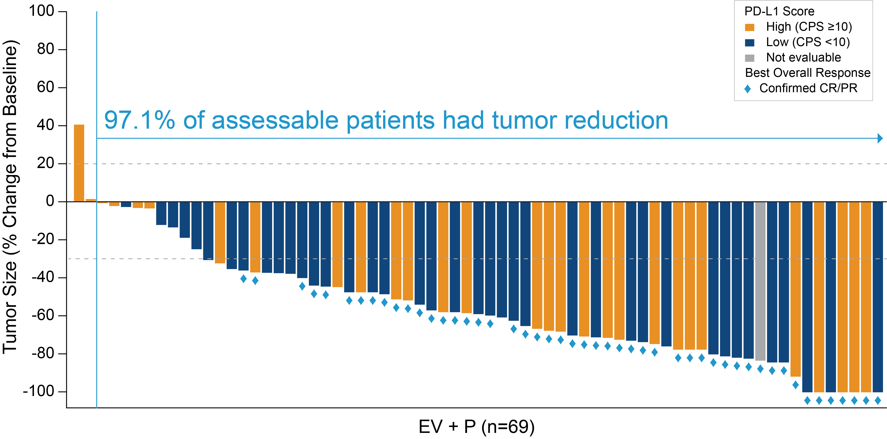
EV+P: Maximum Percent Reduction from Baseline of Target Lesion by BICR
Activity seen regardless of PD-L1 status
27/44 (61.4%) cORR in CPS<10
21/31 (67.7%) cORR in CPS≥10
BICR: Blinded Independent Central Review; CPS: Combined Positive Score; CR: Complete Response; PD-L1: Programmed Death-Ligand 1 PR: Partial Response
Jonathan E. Rosenberg, MD

Slide 20
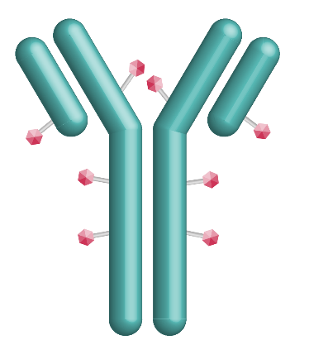

Sacituzumab Govitecan (SG) is a Trop-2–Directed Antibody-Drug Conjugate (ADC)
Trop-2 is an epithelial cell surface antigen highly expressed in UC¹
SG is distinct from other ADCs²⁻⁶:
High drug-to-antibody ratio⁵
Bystander effect due to hydrolyzable linker hydrolysis^{6a}
Significant activity across tumors^{3,7-11}
mTNBC, ER/PR+ BC
Phase 3 trial in UC ongoing
Linker for SN-38
Hydrolyzable linker for payload release
High drug-to-antibody ratio (7.6:1)⁵
Humanized anti‒Trop-2 antibody
Directed toward Trop-2, an epithelial antigen expressed on many solid cancers
SN-38 payload
SN-38 more potent than parent compound, irinotecan
Scott T. Tagawa, MD, MS, FACP

Slide 21
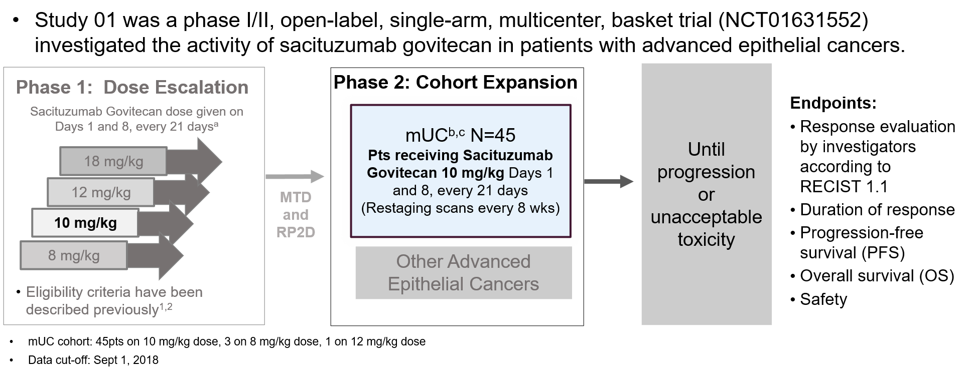
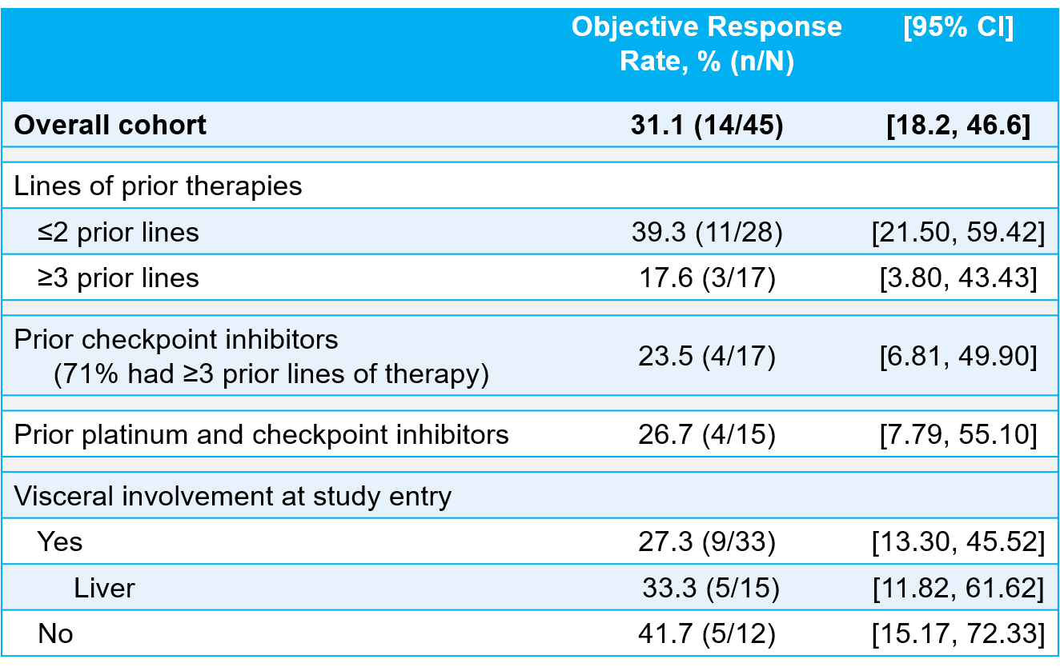
Sacituzumab govitecan: Ph I/II basket trial urothelial cohort³
2019 Genitourinary Cancers Symposium
¹Starodub AN, et al. Clin Cancer Res. 2015;21:3870-8; ²Faltas B, et al. Clin Genitourin Cancer. 2016;14:e75-79; ³Genitourinary Cancers Symposium 2019.
MTD, maximum tolerated dose; mUC, metastatic urothelial cancer; RP2D, recommended phase 2 dose. clinicaltrials.gov: NCT01631552
Scott T. Tagawa, MD, MS, FACP

Slide 22
TROPHY-U-01 Study Design
Clinicaltrials.gov NCT03547973
Cohort 1 (100 patients): patients with mUC who progressed after prior platinum-based and CPI-based therapies
SG 10 mg/kg
Days 1 and 8, every 21 days
Continue treatment in the absence of unacceptable toxicity or disease progression
Cohort 2 (40 patients): patients with mUC ineligible for platinum-based therapy and who progressed after prior CPI-based therapies
SG 10 mg/kg
Days 1 and 8, every 21 days
SG 10 mg/kg
Days 1 and 8, every 21 days
Cohort 3ª (up to 61 patients): mUC CPI naïve patients who progressed after prior platinum-based therapies
Pembrolizumab 200 mg
day 1 every 21 days
SG
Days 1 and 8, every 21 days
Continue until a maximum of 6 cycles have been completed^{d}, disease progression, lack of clinical benefit, toxicity, or withdrawal of consent
Cohort 4 (up to 60 patients): mUC platinum-naïve patients
Maintenance avelumab (800 mg every 2 weeks) with SG (Days 1 and 8 every 21 days) for those without disease progression
Cisplatin^{b}
Cohort 5 (up to 60 patients): mUC platinum-naïve patients
SG
Days 1 and 8, every 21 days
Cisplatin^{c} Avelumab 800 mg every 2 weeks
Primary Objective: ORR Secondary Objectives: Safety/tolerability, DOR, PFS, Overall survival (OS)
Key Inclusion Criteria: ECOG of 0 or 1; Creatinine clearance ≥30 mL/min; adequate organ function and stable brain metastases
Key Exclusion Criteria: Immunodeficiency, active Hep B or C, active secondary malignancy
ª Excluded for cohort 3 only: active autoimmune disease or history of interstitial lung disease. ^{b} In patients with creatinine clearance ≥60. ^{c} In patients with creatinine clearance 50–60 mL/min. ^{d} For patients who have not progressed, maintenance therapy will begin with infusions of avelumab (800 mg every 2 weeks beginning cycle 1, day 1 and every 2 weeks thereafter) followed by SG on days 1 and 8 every 21 day.
CBR, clinical benefit rate; CPI, checkpoint inhibitor; CrCl, creatinine clearance; DOR, duration of response; mUC, metastatic urothelial cancer; NR, not reached; ORR, objective response rate; OS, overall survival; PFS, progression-free survival; RECIST, Response evaluation criteria in solid tumors; SG, Sacituzumab Govitecan.
Scott T. Tagawa, MD, MS, FACP

Slide 23
TROPHY-U-01 Cohort 1: Baseline Characteristics
 | (n=113)
Median age (range), years | 66 (33-90)
Male, n (%) | 88 (78)
ECOG PS, n (%) 0 1 | 32 (28) 81 (72)
Visceral metastatic sites, n (%)ª Lung/pleura Liver Other | 75 (66) 49 (43) 38 (34) 15 (13)
Bellmunt risk factors, n (%)^{b} 0 1 2 3 | 18 (16) 54 (48) 32 (28) 9 (8)
 | (n=113)
Median number of prior anticancer regimens (range), months 1 prior line of metastatic therapy, n (%) 2 prior lines of metastatic therapy, n (%) ≥3 prior lines of metastatic therapy, n (%) | 3.0 (1-8) 22 (20) 30 (27) 56 (50)
Prior checkpoint inhibitors, n (%) | 112 (99)
Prior platinum anticancer therapy, n (%) Cisplatin Carboplatin | 113 (100) 89 (79) 24 (21)
Prior enfortumab vedotin, n (%) | 10 (8.8)
Prior erdafitinib, n (%) | 2 (1.8)
UGT1A1 status, n (%) Wild-type *1/*1 Heterozygous *1/*28 Homozygous *28/*28 | 45 (39.8) 47 (41.6) 13 (11.5)
ª Visceral metastases included only target and nontarget lesions. (Metastatic sites are not mutually exclusive.)
^{b} Risk factors are ECOG PS >0, presence of liver metastases, and hemoglobin <10 g/dL.
ECOG, Eastern Cooperative Oncology Group; PS, performance status.
J Clin Oncol 2021 Apr 30: JCO2003489. doi: 10.1200/JCO.20.03489. Online ahead of print.
Scott T. Tagawa, MD, MS, FACP

Slide 24
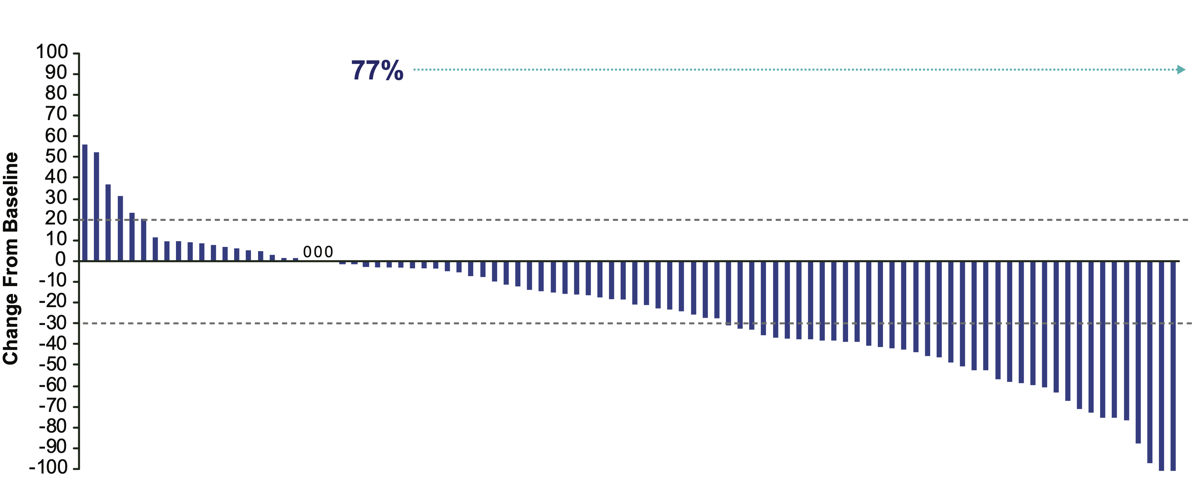
TROPHY-U-01 Cohort 1: Response Assessmentsª
 | (n=113)
Overall Response Rate
ORR, n (%) [95% CI] | 31 (27.4) [19.5, 36.6]
CR, n (%) PR, n (%) | 6 (5.3) 25 (22.1)
Response duration
mDOR, months 95% CI Range | 7.2 4.7-8.6 1.4-13.7
Subjects with visceral metastasis involving the liver had an ORR of 31.6%
compared with 25.3% in those without liver involvement
Subjects with prior EV had ORR 30%
ª Assessments were per blinded independent review assessment, RECIST v1.1.
CR, complete response; mDOR, median duration of response; ORR, objective response rate; PR, partial response;
RECIST v1.1, Response Evaluation Criteria in Solid Tumors version 1.1.
J Clin Oncol 2021 Apr 30: JCO2003489. doi: 10.1200/JCO.20.03489. Online ahead of print.
Scott T. Tagawa, MD, MS, FACP

Slide 25
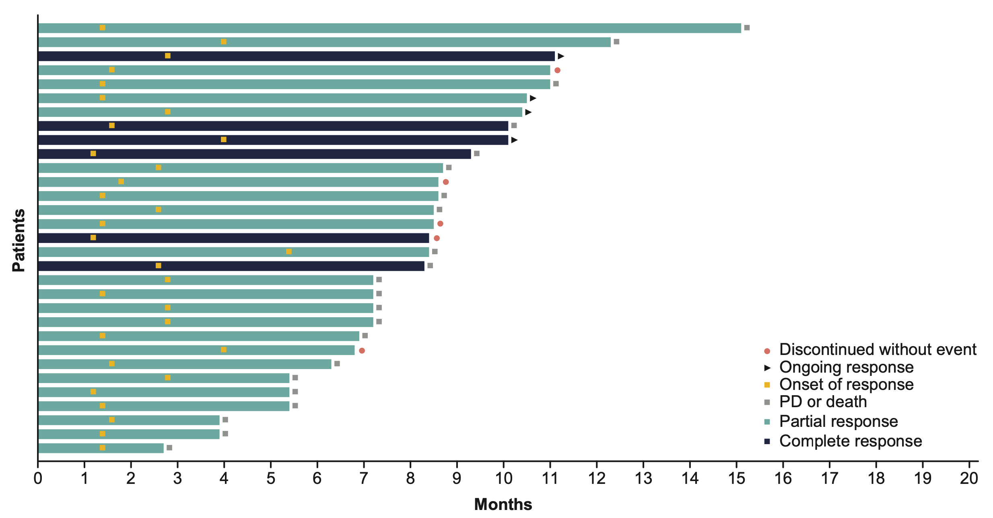
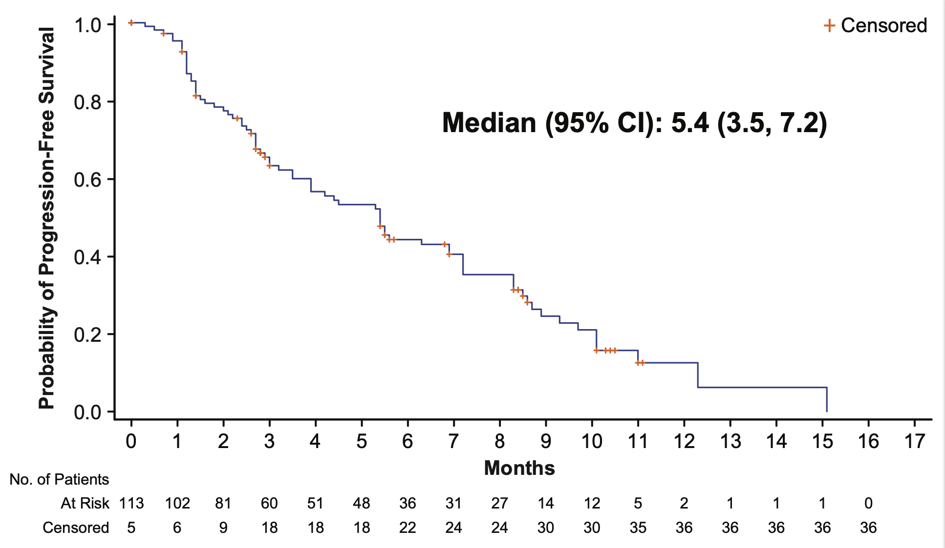
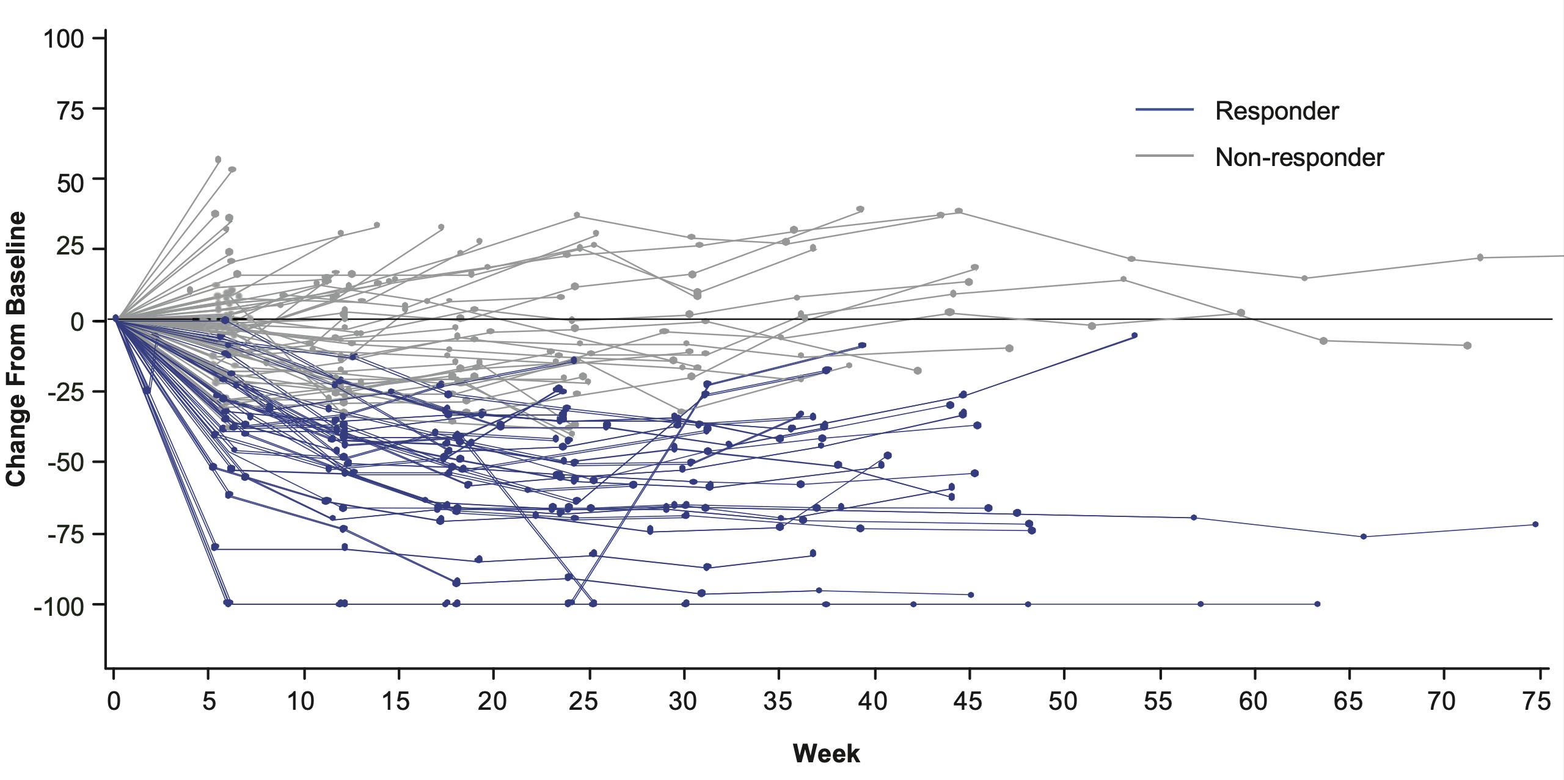
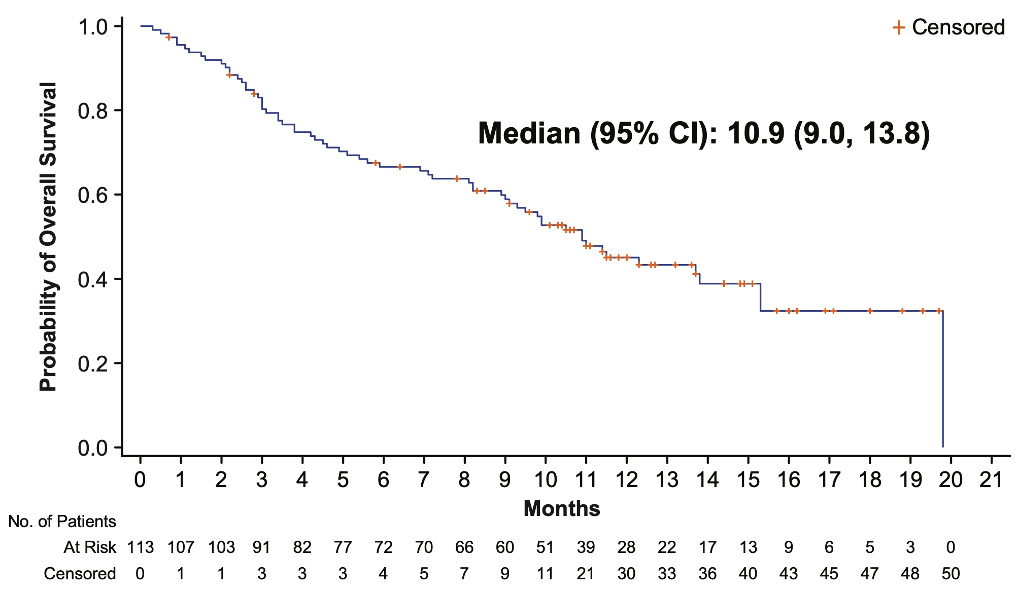
TROPHY-U-01 Cohort 1: Efficacyª
PFS
OS
ª Median follow-up time was 6.3 months, defined as time from informed consent date to death date, end of study date or data cutoff date, whichever occurs first.
J Clin Oncol 2021 Apr 30: JCO2003489. doi: 10.1200/JCO.20.03489. Online ahead of print.
Scott T. Tagawa, MD, MS, FACP

Slide 26
TROPHY-U-01 Cohort 1: Treatment-Related AEs (≥20% Any Grade or ≥5% Grade ≥3 [n=113])
Neutropenia 46%
Gr 3/4 in 34% (FN 10%)
Diarrhea 65%
Gr 3/4 in 10%
6% (n=7) of patients discontinued SG due to adverse events
4 patients discontinued due to neutropenia
30.1% G-CSF usage
One treatment-related death (febrile neutropenia)
Category | Event | All Grades (%) | Grade 3 (%) | Grade 4 (%)
Hematologicª | Neutropenia | 46 | 22 | 12
 | Leukopenia | 25 | 12 | 5
 | Anemia | 33 | 14 | 0
 | Lymphopenia | 11 | 5 | 2
 | Febrile neutropenia | 10 | 7 | 3
Gastrointestinal | Diarrhea^{b} | 65 | 9 | 1
 | Nausea | 60 | 4 | 0
 | Vomiting | 30 | 1 | 0
General disorders & administrative site conditions | Fatigue | 52 | 4 | 0
Skin & subcutaneous tissue | Alopecia | 47 | 0 | 0
Metabolism & nutrition | Decreased appetite | 36 | 3 | 0
Infections & infestations | Urinary tract infection | 8 | 6 | 0
ª “Neutrophil count decreased,” “white blood cell count decreased,” “lymphocyte count decreased,” and “hemoglobin decreased” have been recoded to “neutropenia,” “leukopenia,” “lymphopenia,” and “anemia,” respectively, for summary purposes. ^{b} Fifteen percent of patients treated with sacituzumab govitecan experienced grade 2 treatment-related diarrhea.
AE, adverse event; G-CSF, granulocyte colony-stimulating factor; TRAE, treatment-related adverse event.
J Clin Oncol 2021 Apr 30: JCO2003489. doi: 10.1200/JCO.20.03489. Online ahead of print.
Scott T. Tagawa, MD, MS, FACP

Slide 27
TROPiCS-04: A Randomized, Open-Label, Phase 3 Study of Sacituzumab Govitecan Versus Treatment of Physician’s Choice in Patients With mUC
Study Population
Locally advanced unresectable or metastatic UC
Upper/lower tract tumors
Mixed histologic types are allowed if UC is predominant
Progression after platinum-based and CPI therapy
OR
Cisplatin in neo-adjuvant/adjuvant setting if progression within 12 months and subsequent CPI
Sacituzumab govitecan
SG 10 mg/kg on days 1 and 8 of 21-day cycles
Continue treatment until loss of clinical benefit or toxicity
Endpoints
Primary endpoint:
OS
Secondary endpoints:
PFS by PI assessment and BICR using RECIST v1.1
ORR, DOR, and CBR by PI assessment and BICR using RECIST v1.1
EORTC QLQ C30 score and EuroQoL EQ-5D-5L QOL score
Safety and tolerability
N = 600
Treatment of physician’s Choice
Docetaxel 75 mg/m²
OR
Paclitaxel 175 mg/m²
OR
Vinflunine 320 mg/m²
Day 1 of 21-day cycles
1:1 randomization
BICR, blinded independent central review; CBR, clinical benefit rate; CPI, checkpoint inhibitor; DOR, duration of response; EuroQoL EQ-5D-5L, European Quality of Life 5-Dimension 5-Level instrument; EORTC QC-30, European Organization for Research and Treatment of Cancer Quality of Life Questionnaire Core 30; HR, hazard ratio; ORR, objective response rate; OS, overall survival; PD-1, programmed cell death protein 1; PD-L1, programmed death ligand 1; PFS, progression-free survival; PI, principal investigator; RECIST, Response Evaluation Criteria in Solid Tumors version 1.1; TPC, treatment of physician’s choice; UC, urothelial carcinoma. Vulsteke, et al. 2022 ASCO GU; February 17-19, 2022.
Clinicaltrials.gov NCT04527991
Scott T. Tagawa, MD, MS, FACP

Slide 28
TROPHY-U-01 Is a Registrational, Open-Label, Multicohort Phase 2 Trial in Patients With mUC
Cohort 1* (~100 patients): patients with mUC who progressed after prior platinum-based and CPI-based therapies
SG 10 mg/kg
Days 1 and 8, every 21 days
Continue treatment in the absence of unacceptable toxicity or disease progression
Primary Endpoint: Objective response rate by central review
Key Secondary Endpoints: Safety/tolerability, DOR, PFS, OS
Cohort 2 (~40 patients): patients with mUC ineligible for platinum-based therapy and who progressed after prior CPI-based therapies
SG 10 mg/kg
Days 1 and 8, every 21 days
Cohort 3ª (up to 61 patients): mUC CPI naïve patients who progressed after prior platinum-based therapies
SG 10 mg/kg
Days 1 and 8, every 21 days
Pembrolizumab 200 mg
day 1 every 21 days
SG
Days 1 and 8, every 21 days
Cohort 4 (up to 60 patients): mUC platinum-naïve patients
Continue until a maximum of 6 cycles has been completed,^{d} disease progression, lack of clinical benefit, toxicity, or withdrawal of consent
Maintenance avelumab (800 mg every 2 weeks) with SG (Days 1 and 8 every 21 days) for those without disease progression
Cisplatin^{b}
Cohort 5 (up to 60 patients): mUC platinum-naïve patients
SG
Days 1 and 8, every 21 days
Cisplatin^{c} Avelumab 800 mg every 2 weeks
Cohort 3 design:
Initial 10 patient safety lead in followed by Simon 2-stage phase 2 trial
Initial stage: if >5 responses in first 21, then move to 2nd stage (additional 20 pts)
Overall: 90% power to exclude null hypothesis of ORR <20%
If >13 responses in 41 pts, then reject null
Grivas et al

Slide 29
 | Cohort 3 (N=41)
Male, n (%) | 34 (83)
Median age, y (range) | 67 (46–86)
Race, n (%)
White | 22 (54)
Other or not reported | 19 (46)
ECOG PS 1, n (%) | 25 (61)
Baseline Hgb <10 g/dl | 5 (12)
Tumor stage at screening, n (%)
Loco-regional only | 9 (22)
Distant metastasis | 31 (76)
Missing | 1 (2)
Site of disease at baseline
Visceral | 28 (68)
Liver metastasis at baseline, n (%) | 12 (29)
Non-visceral | 13 (32)
Median prior chemotherapy regimens, (range) | 1 (1-2)
Number of prior chemotherapy regimen, n (%)
≤2 | 41 (100)
Prior platinum chemotherapy, n (%)
Cisplatin | 28 (68)
Carboplatin | 12 (29)
 | Cohort 3 (N=41)
Bellmunt risk factor
0 | 10 (24)
1 | 20 (50)
2 | 11 (27)
Setting of prior systemic therapy, n (%)
(Neo)adjuvant | 18 (44)
Median TTP on prior therapy, mo | 8.5
Metastatic | 23 (56)
Median TTP on prior therapy, mo | 2
Best response to prior therapy, n (%)
Complete response | 1 (2)
Partial response | 3 (7)
Stable disease | 13 (32)
Disease progression | 7 (17)
Not reported / not applicable | 17 (42)
ECOG PS, Eastern Cooperative Oncology Group performance status; Hgb, hemoglobin.
Grivas et al

Slide 30
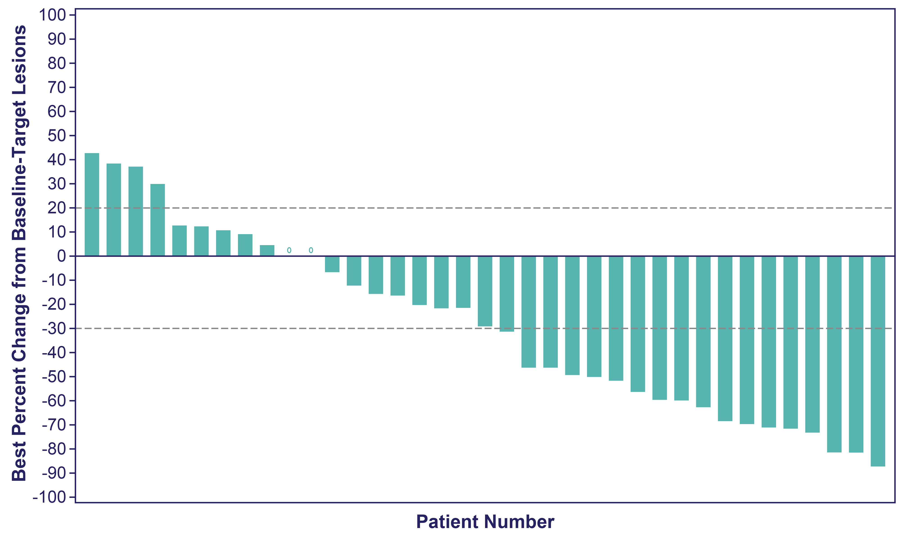
Overall Response and Best % Change From Baseline in Tumor Size
Median follow-up: 5.8 months (data cutoff date: 2021-09-24)
Median time to response: 2 months (1.3–2.8; n=14)
Median DOR not yet reached: N/A (2.80-N/A)
 | Cohort 3ª (N=41)
Objective response rate (CR + PR), n (%) [95%CI] | 14 (34) [20.1-50.6]
Objective response rate (CR + PR), evaluable patients, n (%) | 14 (38)
Best overall response, n (%)
CR | 1 (2)
PR | 13 (32)
SD | 11 (27)
SD ≥ 6 months | 4 (10)
PD | 12 (29)
Not assessed | 4 (10)
Clinical Benefit Rate (CR + PR + SD), n (%) [95%CI] | 25 (61) [44.5-75.8]
63% of patients with tumor shrinking^{a,b}
ªResponses assessed by investigator in the intent-to-treat population. ^{b}Patients without post-baseline assessments are not shown here.
CR, complete response; DOR, duration of response; ORR, objective response rate; PD, progressive disease; PR, partial response; SD, stable disease
Grivas et al

Slide 31
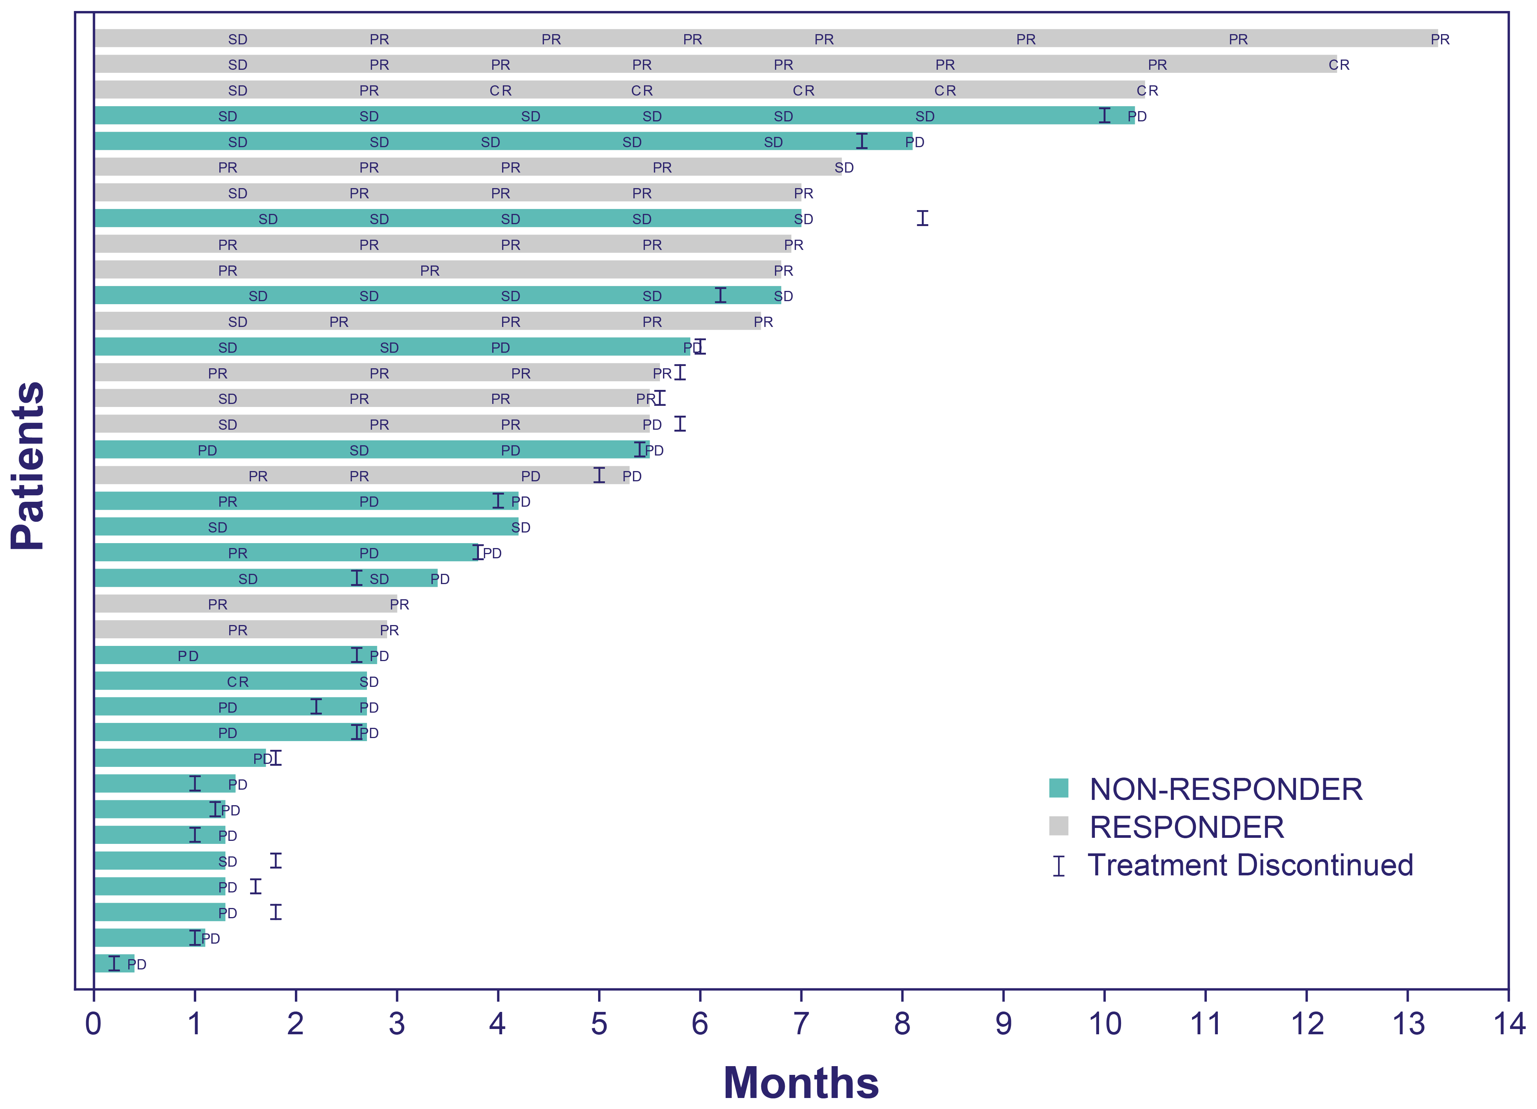
ORR by Subgroup and Individual Response Assessment
Subgroupª | n/N | Objective response rate, % (95% CI)
Overall | 14/41 | 34.1 (20.08–50.59)
Age
<50 Years | 0/1 | N/A (N/A–N/A)
50 to 64 Years | 6/14 | 42.9 (17.66–71.14)
≥65 Years | 8/26 | 30.8 (14.33–51.79)
Race
White | 8/22 | 36.4 (17.20–59.34)
Other | 1/1 | 100.0 (2.50–100.00)
Not reported | 5/18 | 27.8 (9.69–53.48)
Ethnicity
Hispanic or Latino | 2/2 | 100.0 (15.81–100.00)
Not Hispanic or Latino | 8/22 | 36.4 (17.20–59.34)
Not reported | 4/16 | 25.0 (7.27–52.38)
Missing | 0/1 | N/A (N/A–N/A)
ECOG PS
Grade 0 | 7/16 | 43.8 (19.75–70.12)
Grade 1 | 7/25 | 28.0 (12.07–49.39)
Baseline visceral metastasis involvement
Yes | 10/28 | 35.7 (18.64–55.93)
No | 4/13 | 30.8 (9.09–61.43)
Baseline visceral metastasis, involvement of liver
Yes | 5/12 | 41.7 (15.17–72.33)
No | 9/29 | 31.0 (15.28–50.83)
Bellmunt risk factor groups
0 | 4/10 | 40.0 (12.16–73.76)
1 | 7/20 | 35.0 (15.39–59.22)
2 | 3/11 | 27.3 (6.02–60.97)
Patient Response Assessment from Start of Treatment to Progression^{a,b}
ªResponses assessed by investigator in the intent-to-treat population; ^{b}Only evaluable patients were included.
ECOG PS, Eastern Cooperative Oncology Group performance status; N/A, not available.

Slide 32
Most Common Treatment-Related Adverse Events for All Patients
 | Cohort 3 (N=41)
TRAEs Occurring in >20% of Patients, n (%) | All Grade
Diarrhea | 29 (71)
Nausea | 22 (54)
Vomiting | 10 (24)
Neutropenia | 18 (44)
Anemia | 17 (41)
Leukopenia | 12 (29)
Fatigue | 12 (29)
Asthenia | 16 (39)
Alopecia | 14 (34)
Decreased appetite | 11 (27)
Pruritus | 9 (22)
Treatment-related Gr ≥3 AEs occurred in 59% of patients
16 (39%) patients had SG dose reductions due to TRAEs
No treatment-related death occurred
10 (25%) patients received steroids for iRAEª
Topical: 6 (15%) patients
Systemic: 4 (10%) patients
diarrhea (2 patients)
nausea (1 patient)
rash maculopapular (1 patient)
12 (29%) patients received concomitant G-CSFª
ªConcomitant medications are defined as medications that were taken at any time during study treatment, including medications that were started before first dose of study therapy but were ongoing at the time of first dose of study drug or that were initiated on or after first dose but prior to after 30 days of last dose. G-CSF, granulocyte colony stimulating factor; iRAE, immune-related adverse event; TEAE, treatment-emergent adverse event.
.

Slide 33
ADC’s for UC Summary
Enfortumab vedotin with initial approval in post-platinum, post-IO space
Full FDA approval (expanding worldwide), ongoing combo studies and investigation into earlier disease states
Neuropathy and rash in approx. 50%
Sacituzumab govitecan with promising data
Accelerated approval post-platinum/IO
1/3 with Gr 3/4 neutropenia (10% FN) and 2/3 low grade diarrhea
Other ADC’s being investigated
Including anti-HER2 ADC’s (disitamab vedotin with breakthrough designation) and oportuzumab monatox (anti-EpCAM for NMIBC)
Scott T. Tagawa, MD, MS, FACP

Slide 34
Systemic therapy for advanced UC: Summary
Cisplatin-based combo therapy may lead to long-term survival
Immune checkpoint inhibition has survival advantage in post-platinum maintenance and 2nd line settings
Enfortumab vedotin with level-1 OS data after platinum/IO
Rash and neuropathy
Sacituzumab govitecan with accelerated approval
Neutropenia and diarrhea
Erdafitinib with accelerated approval for treatment-refractory advanced UC with activating FGFR alterations
Need to check genomics; titrate for PD and AE’s

Slide 35
Retired detective with hematuria at age 79
Right nephroureterectomy for renal pelvis urothelial carcinoma
2 yrs later, developed multiple lung and lymph node metastases
Enrolled in EV-103, treated with carboplatin, enfortumab vedotin, pembrolizumab
Stopped carbo and then EV, continued pembro maintenance
Following progression (10 mo), started erdafitinib
Held during diagnosis and surgery for melanoma, then re-start erda
Following progression (6 mo), started sacituzumab govitecan
Response, then slow progression 18 mo later

Slide 36
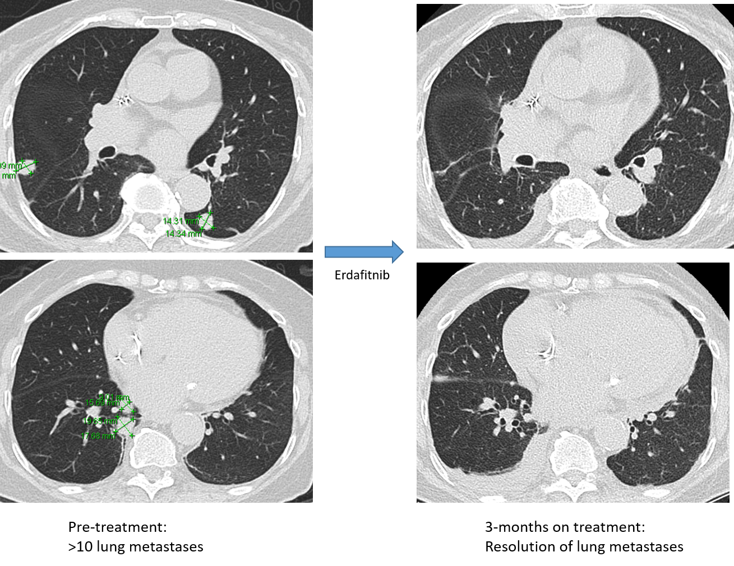
85 y.o. woman with microscopic hematuria
CT with 1.3 cm soft tissue mass obliterating renal calix mid right kidney
Biopsy = high grade papillary UC
Dec 2018 right nephroureterectomy
Pathology: high grade UC invading into renal parenchyma
Declined adjuvant immunotherapy trial
Aug 2019 multiple pulmonary nodules
Biopsy = metastatic UC
FGFR3 (c746C>G, p.Ser249Cys); PIK3CA (c.1357G>A, p.Glu453Lys)
Oct 2019 progressive disease, initiate erdafitinib
Erdafitinib

Slide 37
Initiate erdafitinib at 8 mg daily
Developed Gr 3 painful nails
Also Gr 1 stomatitis, fatigue, dry skin, hand/foot
Serum phos 5.1
What do you recommend?
A) Increase dose of erdafitinib to 9 mg
B) Permanently discontinue erdafitinib
C) Hold dosing of erdafitinib and re-evaluate with potential to resume with dose adjustment
D) Continue erdafitinib and add pembrolizumab

Slide 38
Initiated erdafitinib at 8 mg daily
Developed Gr 3 painful nails (also Gr1 stomatitis, fatigue, dry skin, hand/foot)
Held drug, course of cefadroxil with improvement
Decreased erda to 6 mg (temporary 4 mg)
Developed recurrent stomatitis and nail changes interfering with function
Held drug, initiate dexamethasone rinse
Resume at 5 mg after improvement
Developed recurrent stomatitis and nail changes interfering with function
Held dosing, resume at 4 mg after improvement
Developed recurrent stomatitis and nail changes interfering with function
Held dosing, instituted intermittent dosing, then discontinued
Baseline blurred vision determined to be due to cataracts
Complained of intermittent eye problems, determined to be non-specific
Remained off therapy for 6 months, slowly progressive lung metastases

Slide 39
66 y.o. developed hematuria, diagnosed with UTI, later found to have right mid-ureteral high grade urothelial carcinoma, underwent nephroureterectomy (pT1N0)
The following year with high grade non-invasive UC of bladder (Ta)
2 years after initial diagnosis with multifocal metastases to lymph nodes, with FGFR3 activating mutation on targeted genomics
Treated with gemcitabine and cisplatin x6 (with near CR) followed by avelumab maintenance
2 months later with bone metastases, stable LN’s and pulmonary nodules
Start erdafitinib 8 mg daily
Titrated up to 9 mg, developed mucositis
Titrated back to 8 mg and eventually 6 mg
6 mo later with progression of disease, start EV and denosumab
Progression in LN and bone plus Gr 2 neuropathy at 6 mo
Enrolled in TROPiCS-04, randomized to SG
Progression after 6 mo
Enroll in phase I study

