Slide 1
Year in Review: Clinical Investigator Perspectives on the Most Relevant New Data Sets and Advances in Oncology Hepatobiliary Cancers Thursday, May 4, 2023 5:00 PM – 6:00 PM ET
Faculty
Ghassan Abou-Alfa, MD, MBA
Richard S Finn, MD
Moderator
Neil Love, MD

Slide 2
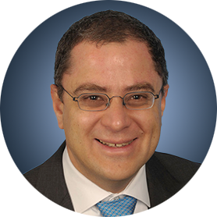


Faculty
Ghassan Abou-Alfa, MD, MBA
Professor
Memorial Sloan Kettering Cancer Center
New York, New York
MODERATOR
Neil Love, MD Research To Practice Miami, Florida
Richard S Finn, MD
Professor, Department of Medicine, Division
of Hematology/Oncology
David Geffen School of Medicine at UCLA
Director, Signal Transduction and Therapeutics Program
Jonsson Comprehensive Cancer Center at UCLA
Los Angeles, California

Slide 3
Commercial Support
This activity is supported by educational grants from Elevation Oncology Inc, Exelixis Inc, Incyte Corporation, and Taiho Oncology Inc.
Research To Practice CME Planning Committee Members, Staff and Reviewers
Planners, scientific staff and independent reviewers for Research To Practice have no relevant conflicts of interest to disclose.

Slide 4
Dr Abou-Alfa — Disclosures
Consulting Agreements | Astellas, AstraZeneca Pharmaceuticals LP, Autem Medical, Berry Genomics, BioNTech SE, Boehringer Ingelheim Pharmaceuticals Inc, Bristol Myers Squibb, Eisai Inc, Exelixis Inc, FibroGen Inc, Genentech, a member of the Roche Group, Helio Health, Incyte Corporation, Ipsen Biopharmaceuticals Inc, Merck, Merus BV, Neogene Therapeutics, NewBridge Pharmaceuticals, Novartis, QED Therapeutics, Servier Pharmaceuticals LLC, Tempus, Thetis Pharmaceuticals, Vector Pharma, Yiviva
Contracted Research | Agenus Inc, Arcus Biosciences, AstraZeneca Pharmaceuticals LP, BioNTech SE, Bristol Myers Squibb, Digestive Care Inc, Elicio Therapeutics, Genentech, a member of the Roche Group, Helsinn Healthcare SA, Puma Biotechnology Inc, QED Therapeutics, Yiviva
Nonrelevant Financial Relationship | Parker Institute for Cancer Immunotherapy

Slide 5
Dr Finn — Disclosures
Advisory Committee | CStone Pharmaceuticals
Consulting Agreements | AstraZeneca Pharmaceuticals LP, Bayer HealthCare Pharmaceuticals, Bristol Myers Squibb, CStone Pharmaceuticals, Eisai Inc, Exelixis Inc, Genentech, a member of the Roche Group, Hengrui Therapeutics Inc, Lilly, Merck, Pfizer Inc
Contracted Research (paid to UCLA) | Adaptimmune, Bayer HealthCare Pharmaceuticals, Bristol Myers Squibb, Eisai Inc, Lilly, Merck, Pfizer Inc, Roche Laboratories Inc
Data and Safety Monitoring Board/Committee | AstraZeneca Pharmaceuticals LP
Speakers Bureau | Genentech, a member of the Roche Group

Slide 6
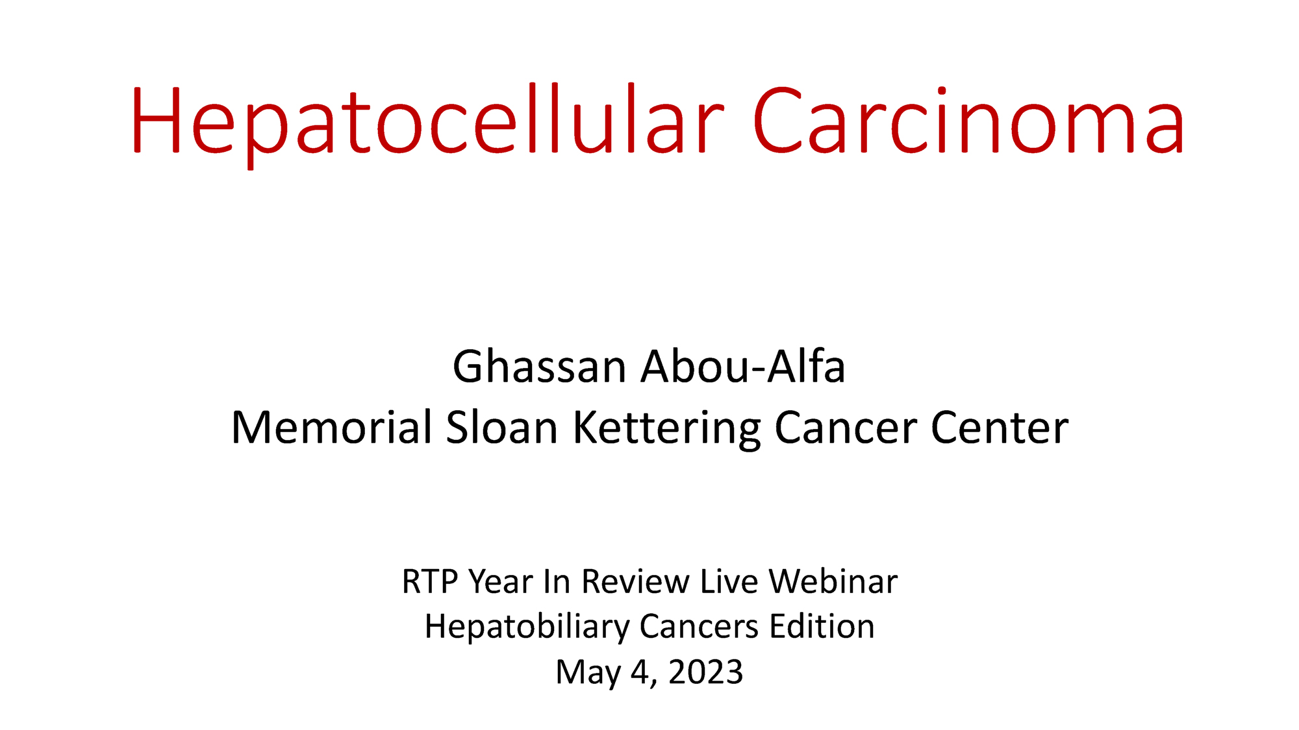
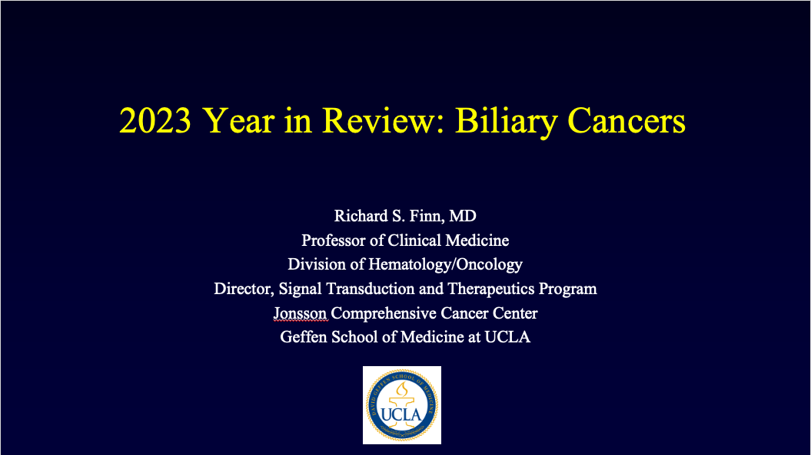

Slide 7
Key Data Sets
Ghassan Abou-Alfa, MD, MBA
Chow et al. IMbrave050: Phase 3 study of adjuvant atezolizumab + bevacizumab versus active surveillance in patients with hepatocellular carcinoma (HCC) at high risk of disease recurrence following resection or ablation. AACR 2023;Abstract CT003.
Reig M et al. BCLC strategy for prognosis prediction and treatment recommendation: The 2022 update. J Hepatol 2022;76(3):681-93.
Fulgenzi CAM et al. Effect of early antibiotic exposure on survival of patients receiving atezolizumab plus bevacizumab but not sorafenib for unresectable HCC: A sub-analysis of the phase III IMbrave150 study. Gastrointestinal Cancers Symposium 2023;Abstract 597.
Cheng A-L et al. Updated efficacy and safety data from IMbrave150: Atezolizumab plus bevacizumab vs sorafenib for unresectable hepatocellular carcinoma. J Hepatol 2022;76(4):862-73.
Abou-Alfa GK et al. Tremelimumab plus durvalumab in unresectable hepatocellular carcinoma. NEJM Evid 2022;1(8).
Qin S et al. Final analysis of RATIONALE-301: Randomized, phase III study of tislelizumab versus sorafenib as first-line treatment for unresectable hepatocellular carcinoma. ESMO 2022;Abstract LBA36.

Slide 8
Key Data Sets
Ghassan Abou-Alfa, MD, MBA (Continued)
Kelley RK et al. Cabozantinib plus atezolizumab versus sorafenib for advanced hepatocellular carcinoma (COSMIC-312): A multicentre, open-label, randomised, phase 3 trial. Lancet Oncol 2022;23(8):995-1008.
Finn RS et al. Primary results from the phase III LEAP-002 study: Lenvatinib plus pembrolizumab versus lenvatinib as first-line (1L) therapy for advanced hepatocellular carcinoma (aHCC). ESMO 2022;Abstract LBA34.
Rimini M et al. Atezolizumab plus bevacizumab versus lenvatinib or sorafenib in non-viral unresectable hepatocellular carcinoma: An international propensity score matching analysis. ESMO Open 2022;7(6):100591.
El-Khoueiry AB et al. Safety and efficacy of cabozantinib for patients with advanced hepatocellular carcinoma who advanced to Child-Pugh B liver function at study week 8: A retrospective analysis of the CELESTIAL randomised controlled trial. BMC Cancer 2022;22(1):377.
Freemantle N et al. Quality of life assessment of cabozantinib in patients with advanced hepatocellular carcinoma in the CELESTIAL trial. Eur J Cancer 2022;168:91-8.

Slide 9
Key Data Sets
Ghassan Abou-Alfa, MD, MBA (Continued)
Qin S et al. Pembrolizumab versus placebo as second-line therapy in patients from Asia with advanced hepatocellular carcinoma: A randomized, double-blind, phase III trial. J Clin Oncol 2023;41(7):1434-43.
Melero I et al. Nivolumab (NIVO) plus ipilimumab (IPI) combination therapy in patients with advanced hepatocellular carcinoma (aHCC): 5-year results from CheckMate 040. ESMO World Congress on Gastrointestinal Cancer 2022;Abstract SO-12.
Yau T et al. Nivolumab plus cabozantinib with or without ipilimumab for advanced hepatocellular carcinoma: Results from cohort 6 of the CheckMate 040 trial. J Clin Oncol 2023;41(9):1747-57.
Qin S et al. Camrelizumab (C) plus rivoceranib (R) vs. sorafenib (S) as first-line therapy for unresectable hepatocellular carcinoma (uHCC): A randomized, phase III trial. ESMO 2022; Abstract LBA35.
NCT05301842: A phase III, randomized, open-label, sponsor-blinded, multicenter study of durvalumab in combination with tremelimumab ± lenvatinib given concurrently with TACE compared to TACE alone in patients with locoregional hepatocellular carcinoma (EMERALD-3)

Slide 10
Key Data Sets
Richard S Finn, MD
Oh D-Y et al. Durvalumab plus gemcitabine and cisplatin in advanced biliary tract cancer. NEJM Evid 2022;1(8).
Oh D et al. Updated overall survival (OS) from the phase III TOPAZ-1 study of durvalumab (D) or placebo (PBO) plus gemcitabine and cisplatin (+ GC) in patients (pts) with advanced biliary tract cancer (BTC). ESMO 2022;Abstract 56P.
He AR et al. Outcomes by primary tumour location in patients with advanced biliary tract cancer treated with durvalumab or placebo plus gemcitabine and cisplatin in the phase 3 TOPAZ-1 study. ESMO World Congress on Gastrointestinal Cancer 2022;Abstract O-1.
Kelley RK et al. Pembrolizumab in combination with gemcitabine and cisplatin compared with gemcitabine and cisplatin alone for patients with advanced biliary tract cancer (KEYNOTE-966): a randomised, double-blind, placebo-controlled, phase 3 trial. Lancet 2023 April 16;[Online ahead of print].
Vogel A et al. Pemigatinib for previously treated locally advanced or metastatic cholangiocarcinoma: Final results from FIGHT-202. ESMO World Congress on Gastrointestinal Cancer 2022;Abstract O-2.

Slide 11
Key Data Sets
Richard S Finn, MD (Continued)
Bibeau K et al. Progression-free survival in patients with cholangiocarcinoma with or without FGF/FGFR alterations: A FIGHT-202 post hoc analysis of prior systemic therapy response. JCO Precis Oncol 2022;6:e2100414.
Goyal L et al. Futibatinib for FGFR2-rearranged intrahepatic cholangiocarcinoma. N Engl J Med 2023;388(3):228-39.
Goyal L et al. Updated results of the FOENIX-CCA2 trial: Efficacy and safety of futibatinib in intrahepatic cholangiocarcinoma (iCCA) harboring FGFR2 fusions/rearrangements. ASCO 2022;Abstract 4009.
Zymeworks announces positive topline data in the pivotal HERIZON-BTC-01 trial of zanidatamab [press release]. December 19, 2022. Available at https://ir.zymeworks.com/news-releases/news-release-details/zymeworks-announces-positive-topline-data-pivotal- herizon-btc-01.
Ohba A et al. Trastuzumab deruxtecan (T-DXd; DS-8201) in patients (pts) with HER2-expressing unresectable or recurrent biliary tract cancer (BTC): An investigator-initiated multicenter phase 2 study (HERB trial). ASCO 2022;Abstract 4006.

Slide 12
Key Data Sets
Richard S Finn, MD (Continued)
Carrizosa DR et al. CRESTONE: Initial efficacy and safety of seribantumab in solid tumors harboring NRG1 fusions. ASCO 2022;Abstract 3006.
El-Khoueiry AB et al. IMbrave151: A phase 2, randomized, double-blind, placebo-controlled study of atezolizumab with or without bevacizumab in combination with cisplatin plus gemcitabine in patients with untreated, advanced biliary tract cancer. Gastrointestinal Cancers Symposium 2023;Abstract 491.
Yoo C et al. Final results from the NIFTY trial, a phase IIb, randomized, open-label study of liposomal irinotecan (nal-IRI) plus fluorouracil (5-FU)/leucovorin (LV) in patients (pts) with previously treated metastatic biliary tract cancer (BTC). ESMO 2022;Abstract 55P.

Slide 13
Agenda
Prologue: Last Week
MODULE 1: Hepatocellular Carcinoma
MODULE 2: Biliary Tract Cancers
MODULE 3: Appendix

Slide 14
Agenda
Prologue: Last Week
MODULE 1: Hepatocellular Carcinoma
MODULE 2: Biliary Tract Cancers
MODULE 3: Appendix

Slide 15
Agenda
Prologue: Last Week
MODULE 1: Hepatocellular Carcinoma
IMbrave050: Adjuvant atezolizumab/bevacizumab; BCLC revisions
Immuno-oncology combinations as first-line systemic treatment for advanced hepatocellular carcinoma (HCC)
Safety and efficacy of cabozantinib in HCC
MODULE 2: Biliary Tract Cancers
MODULE 3: Appendix

Slide 16
IMbrave050: Adjuvant Atezolizumab/Bevacizumab; BCLC Revisions
Chow et al. IMbrave050: Phase 3 study of adjuvant atezolizumab + bevacizumab versus active surveillance in patients with hepatocellular carcinoma (HCC) at high risk of disease recurrence following resection or ablation. AACR 2023;Abstract CT003.
Reig M et al. BCLC strategy for prognosis prediction and treatment recommendation: The 2022 update. J Hepatol 2022;76(3):681-93.
Fulgenzi CAM et al. Effect of early antibiotic exposure on survival of patients receiving atezolizumab plus bevacizumab but not sorafenib for unresectable HCC: A sub-analysis of the phase III IMbrave150 study. Gastrointestinal Cancers Symposium 2023;Abstract 597.

Slide 17
Hepatocellular Carcinoma
Ghassan Abou-Alfa
Memorial Sloan Kettering Cancer Center
RTP Year In Review Live Webinar
Hepatobiliary Cancers Edition May 4, 2023

Slide 18
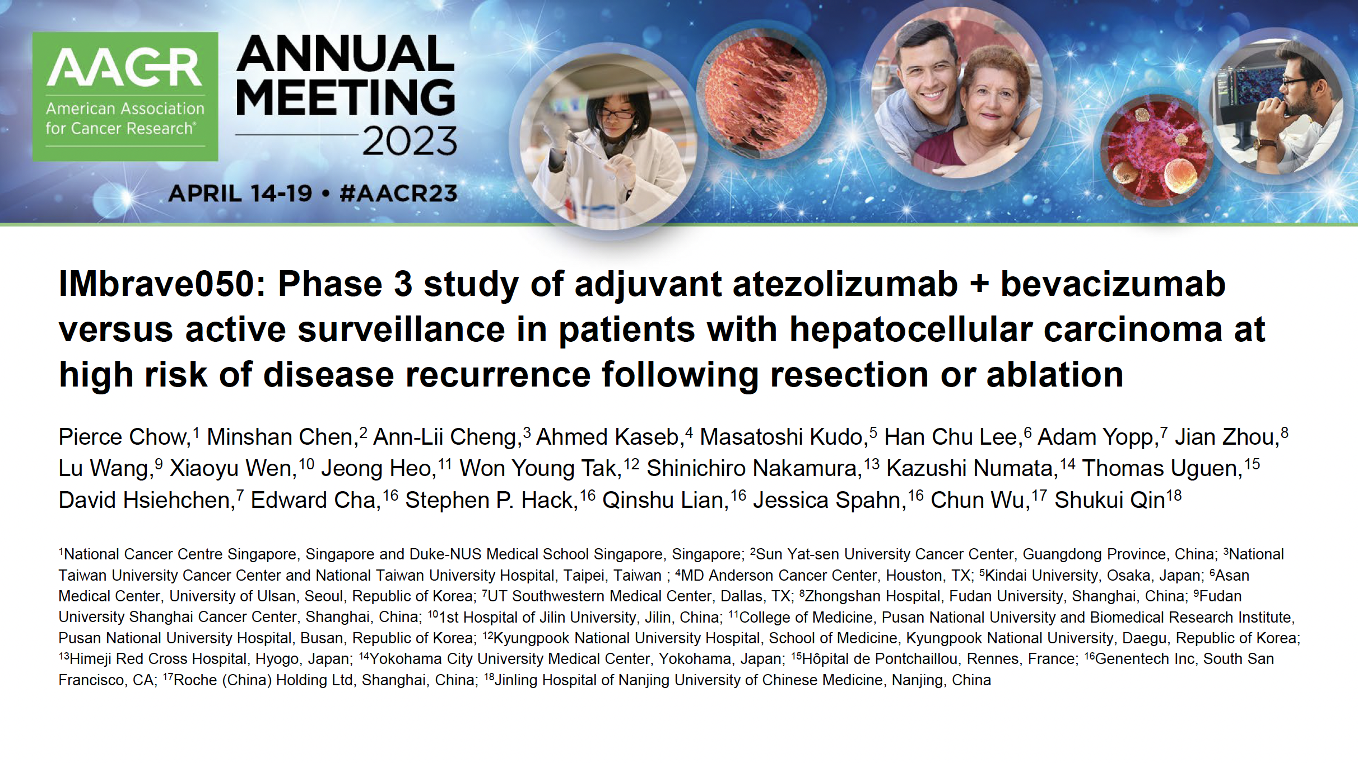

Slide 19
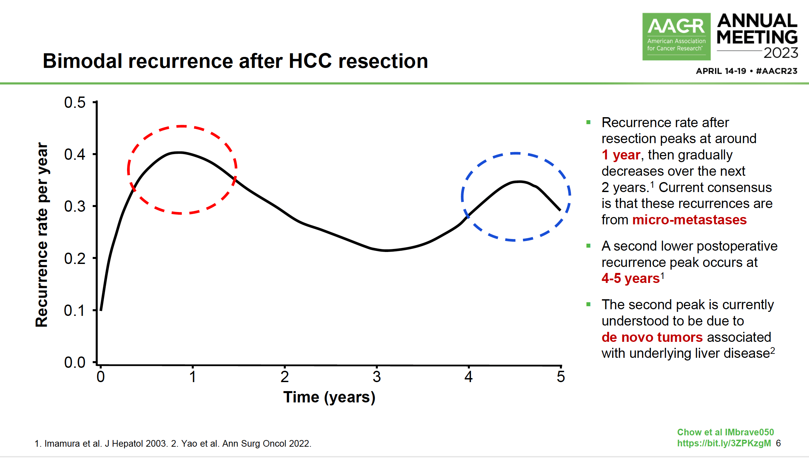

Slide 20
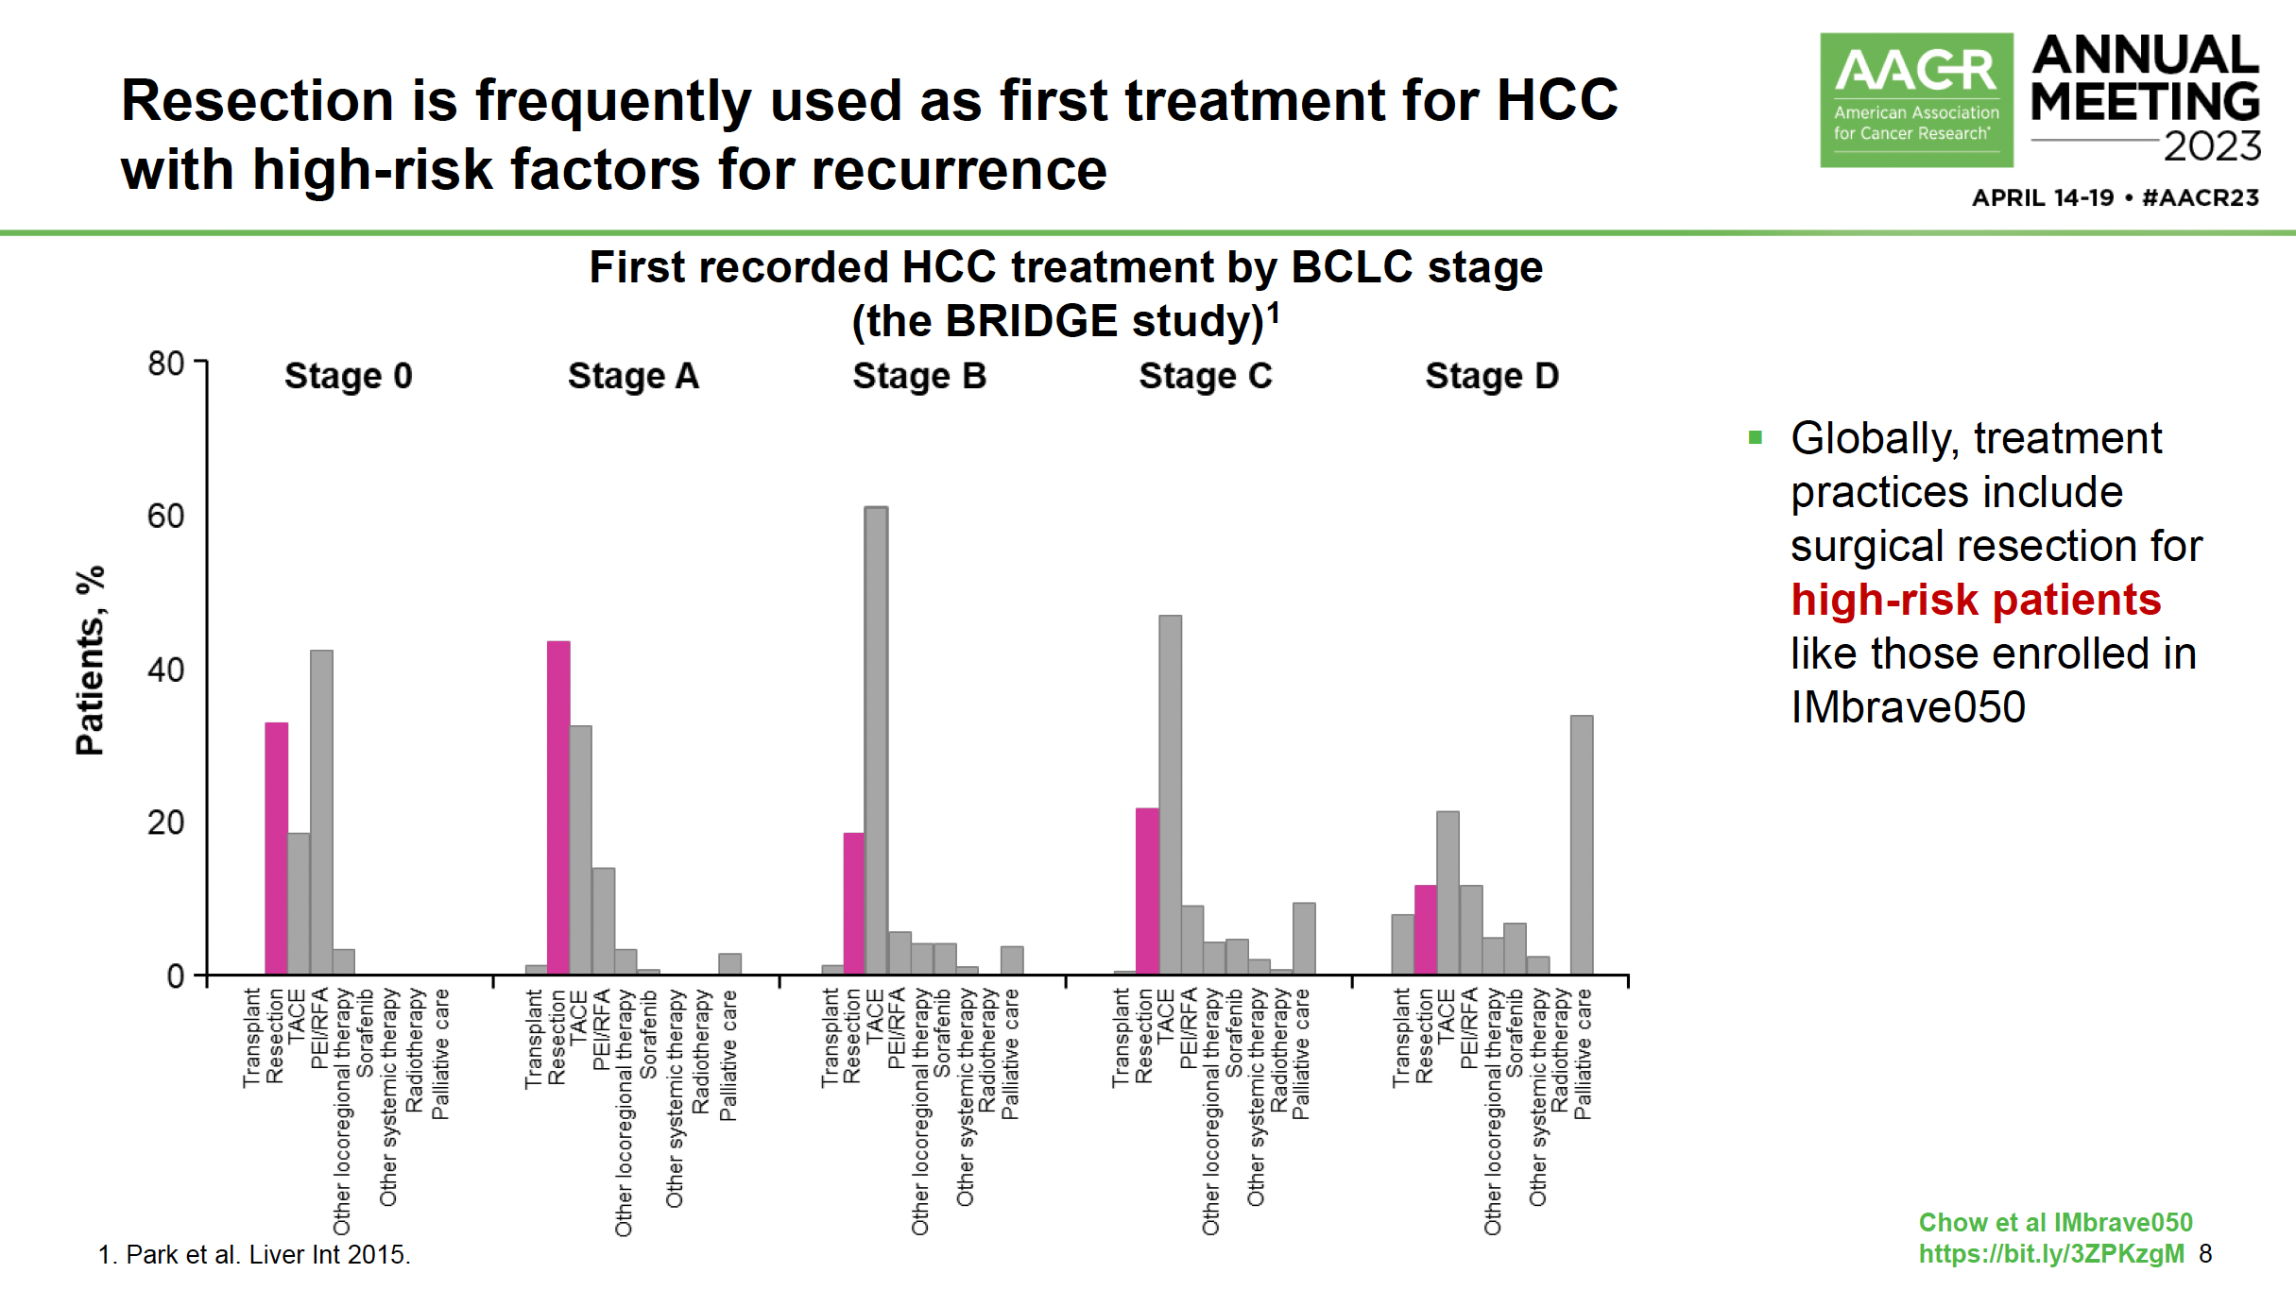

Slide 21
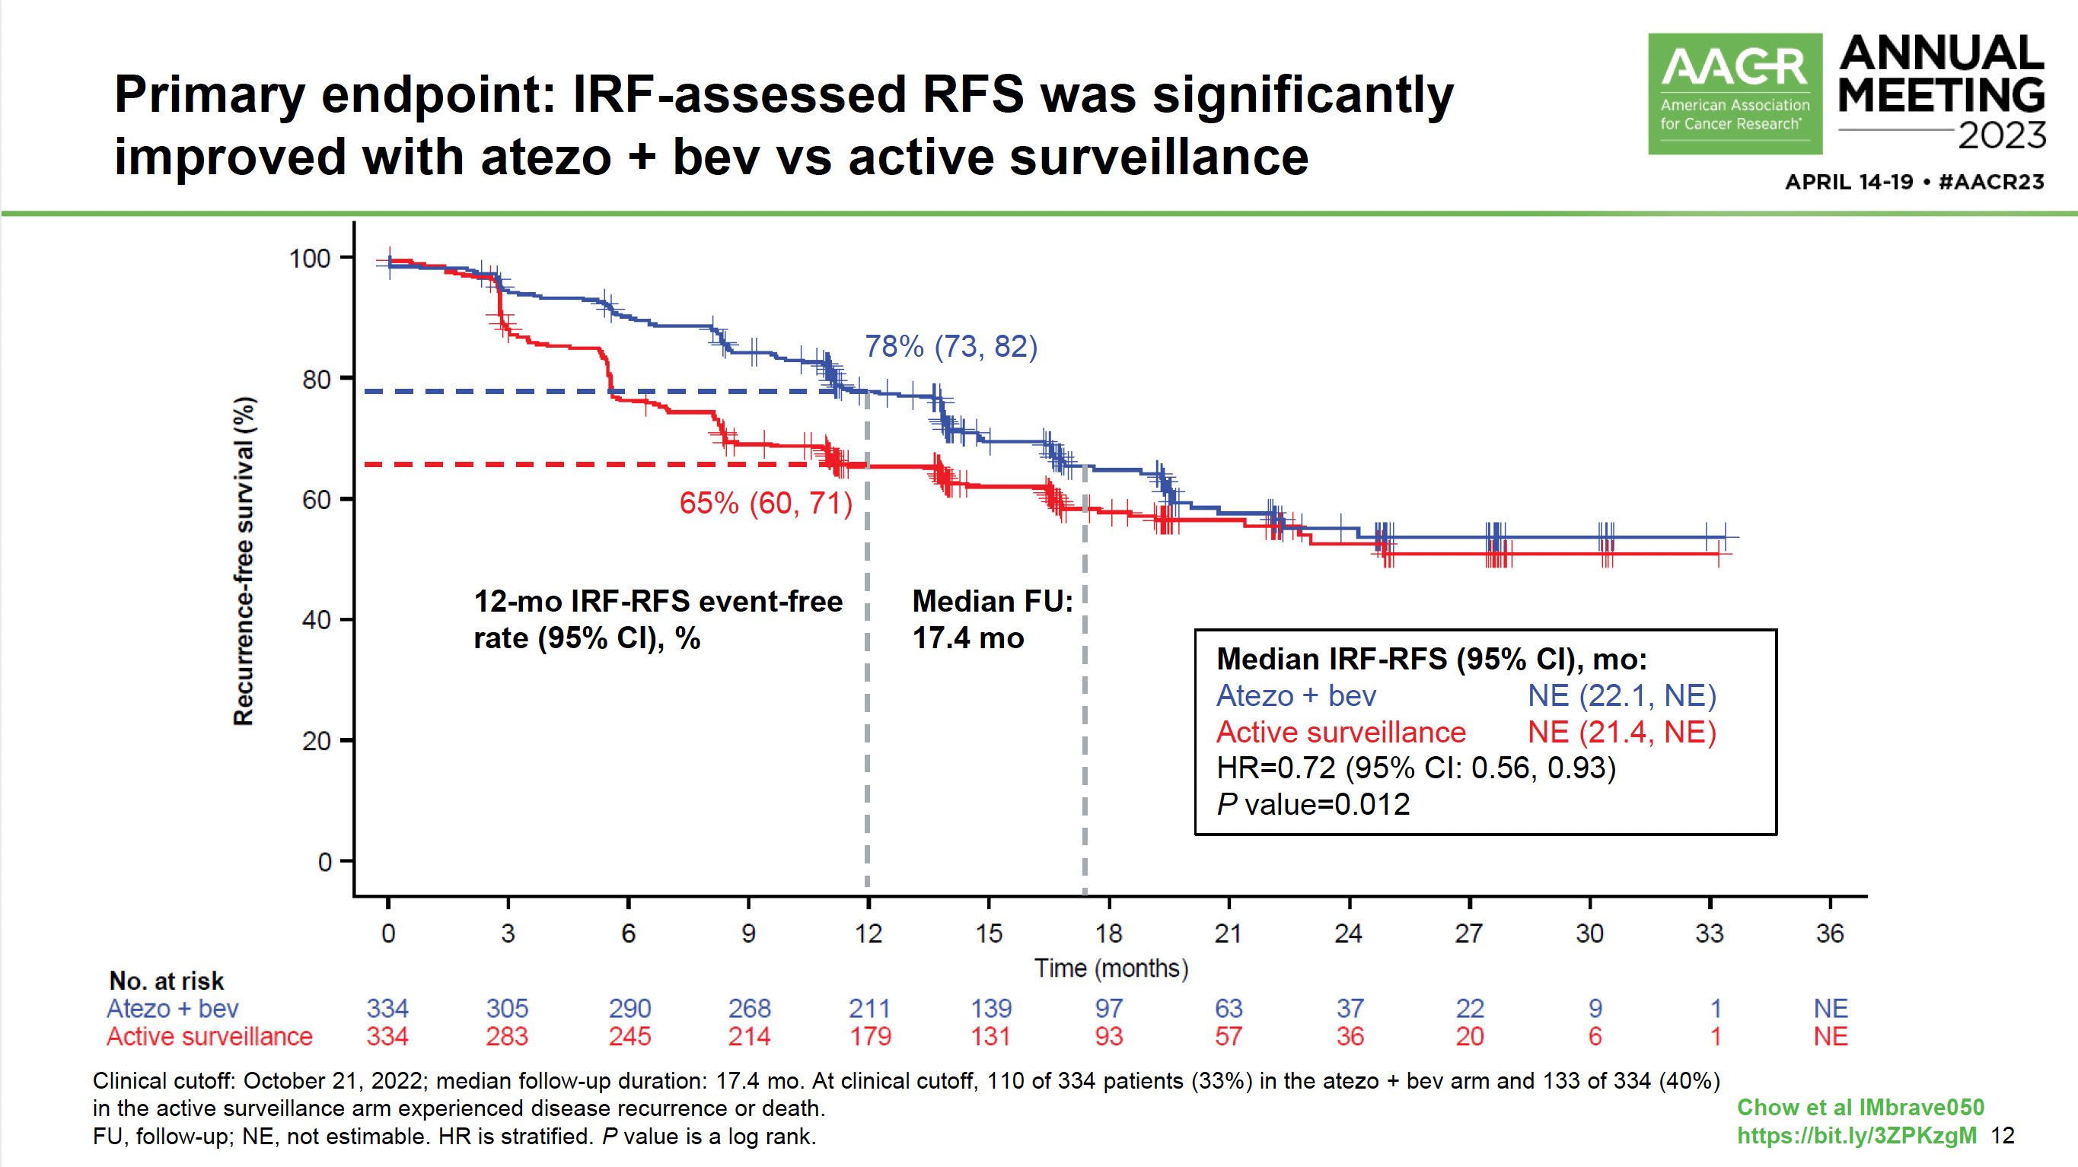

Slide 22
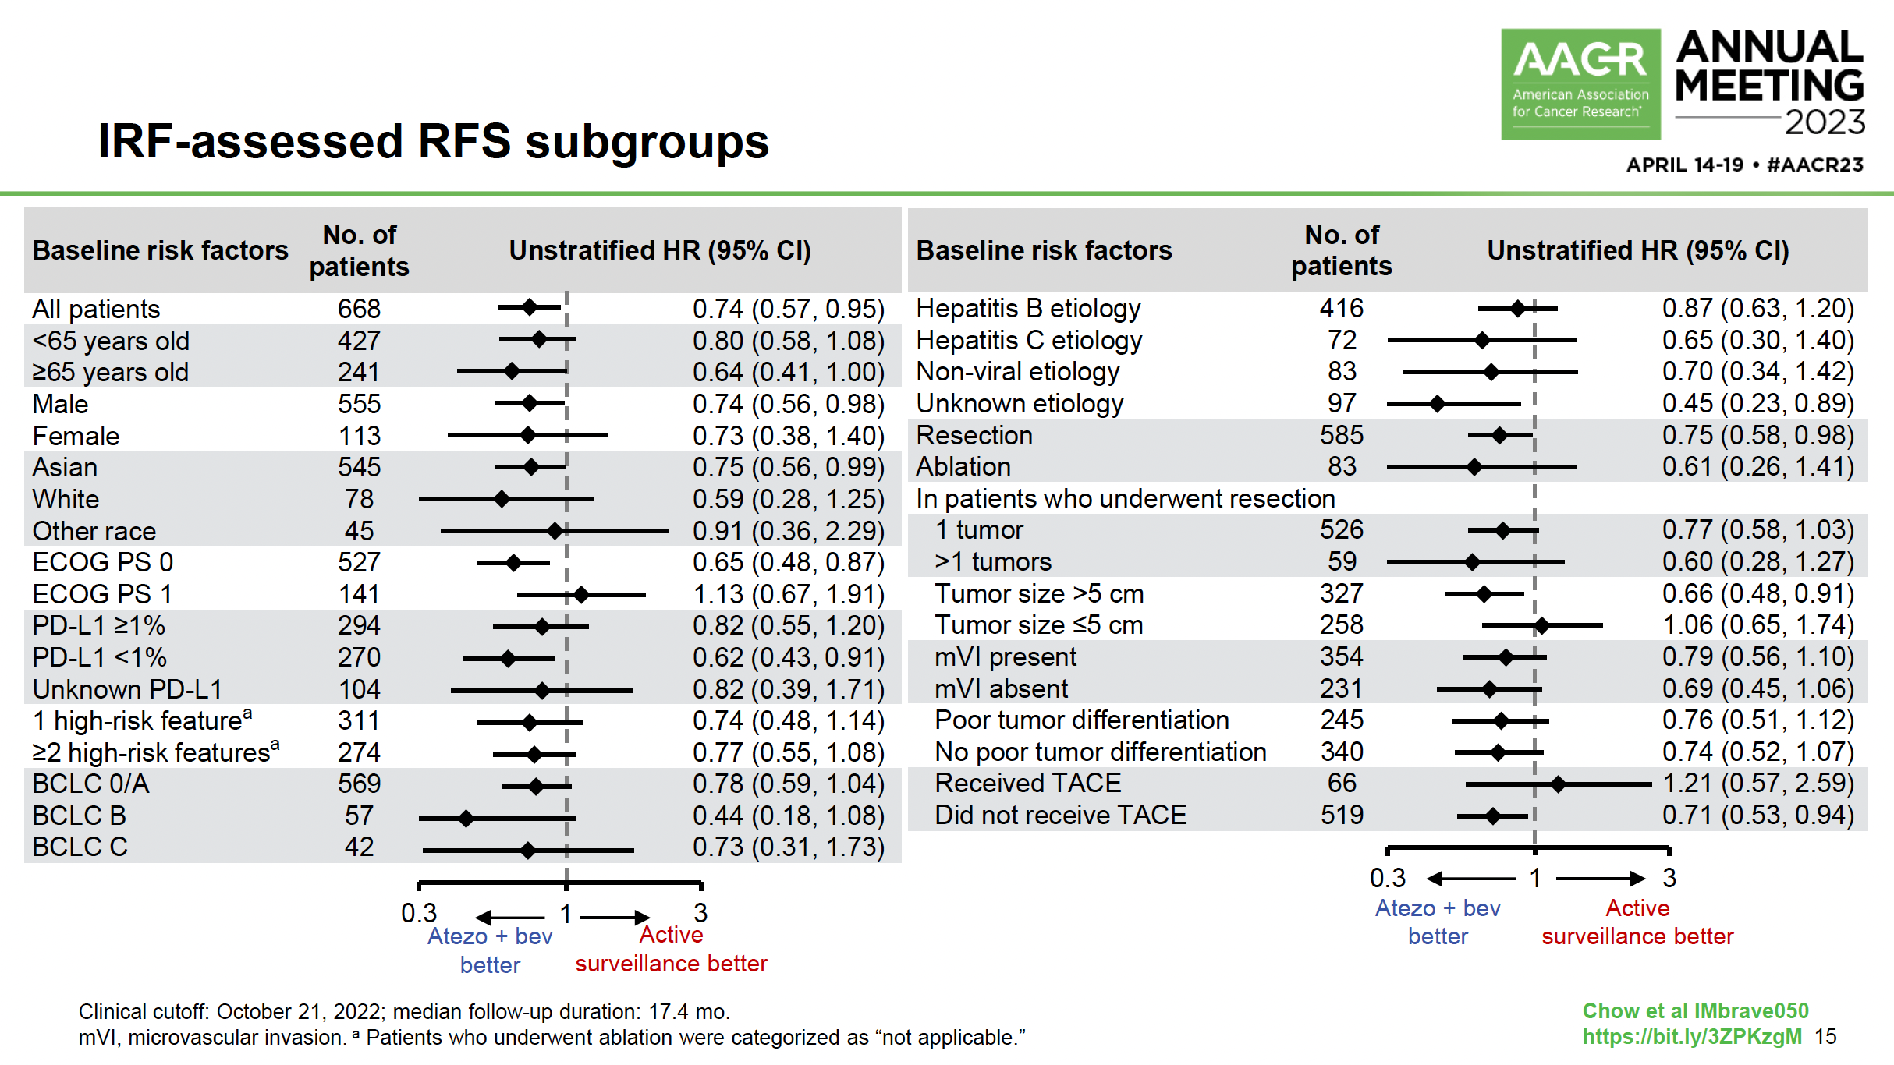
IRF = independent review facility; RFS = relapse-free survival

Slide 23
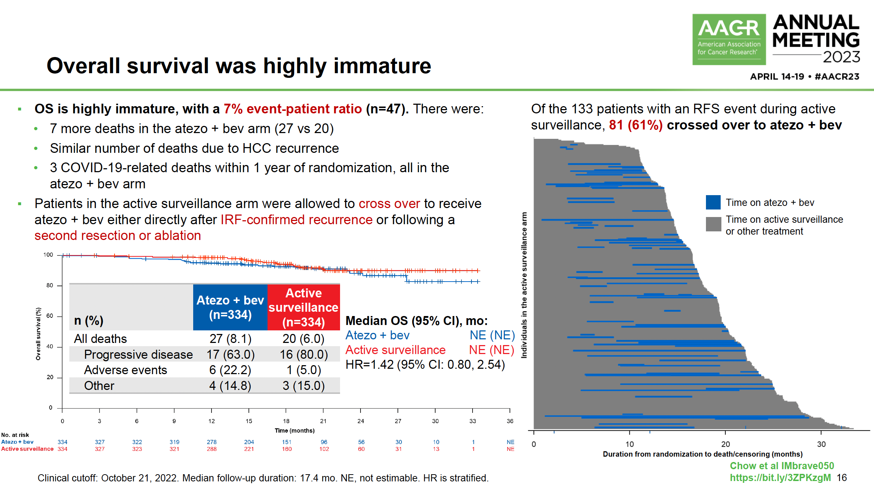

Slide 24
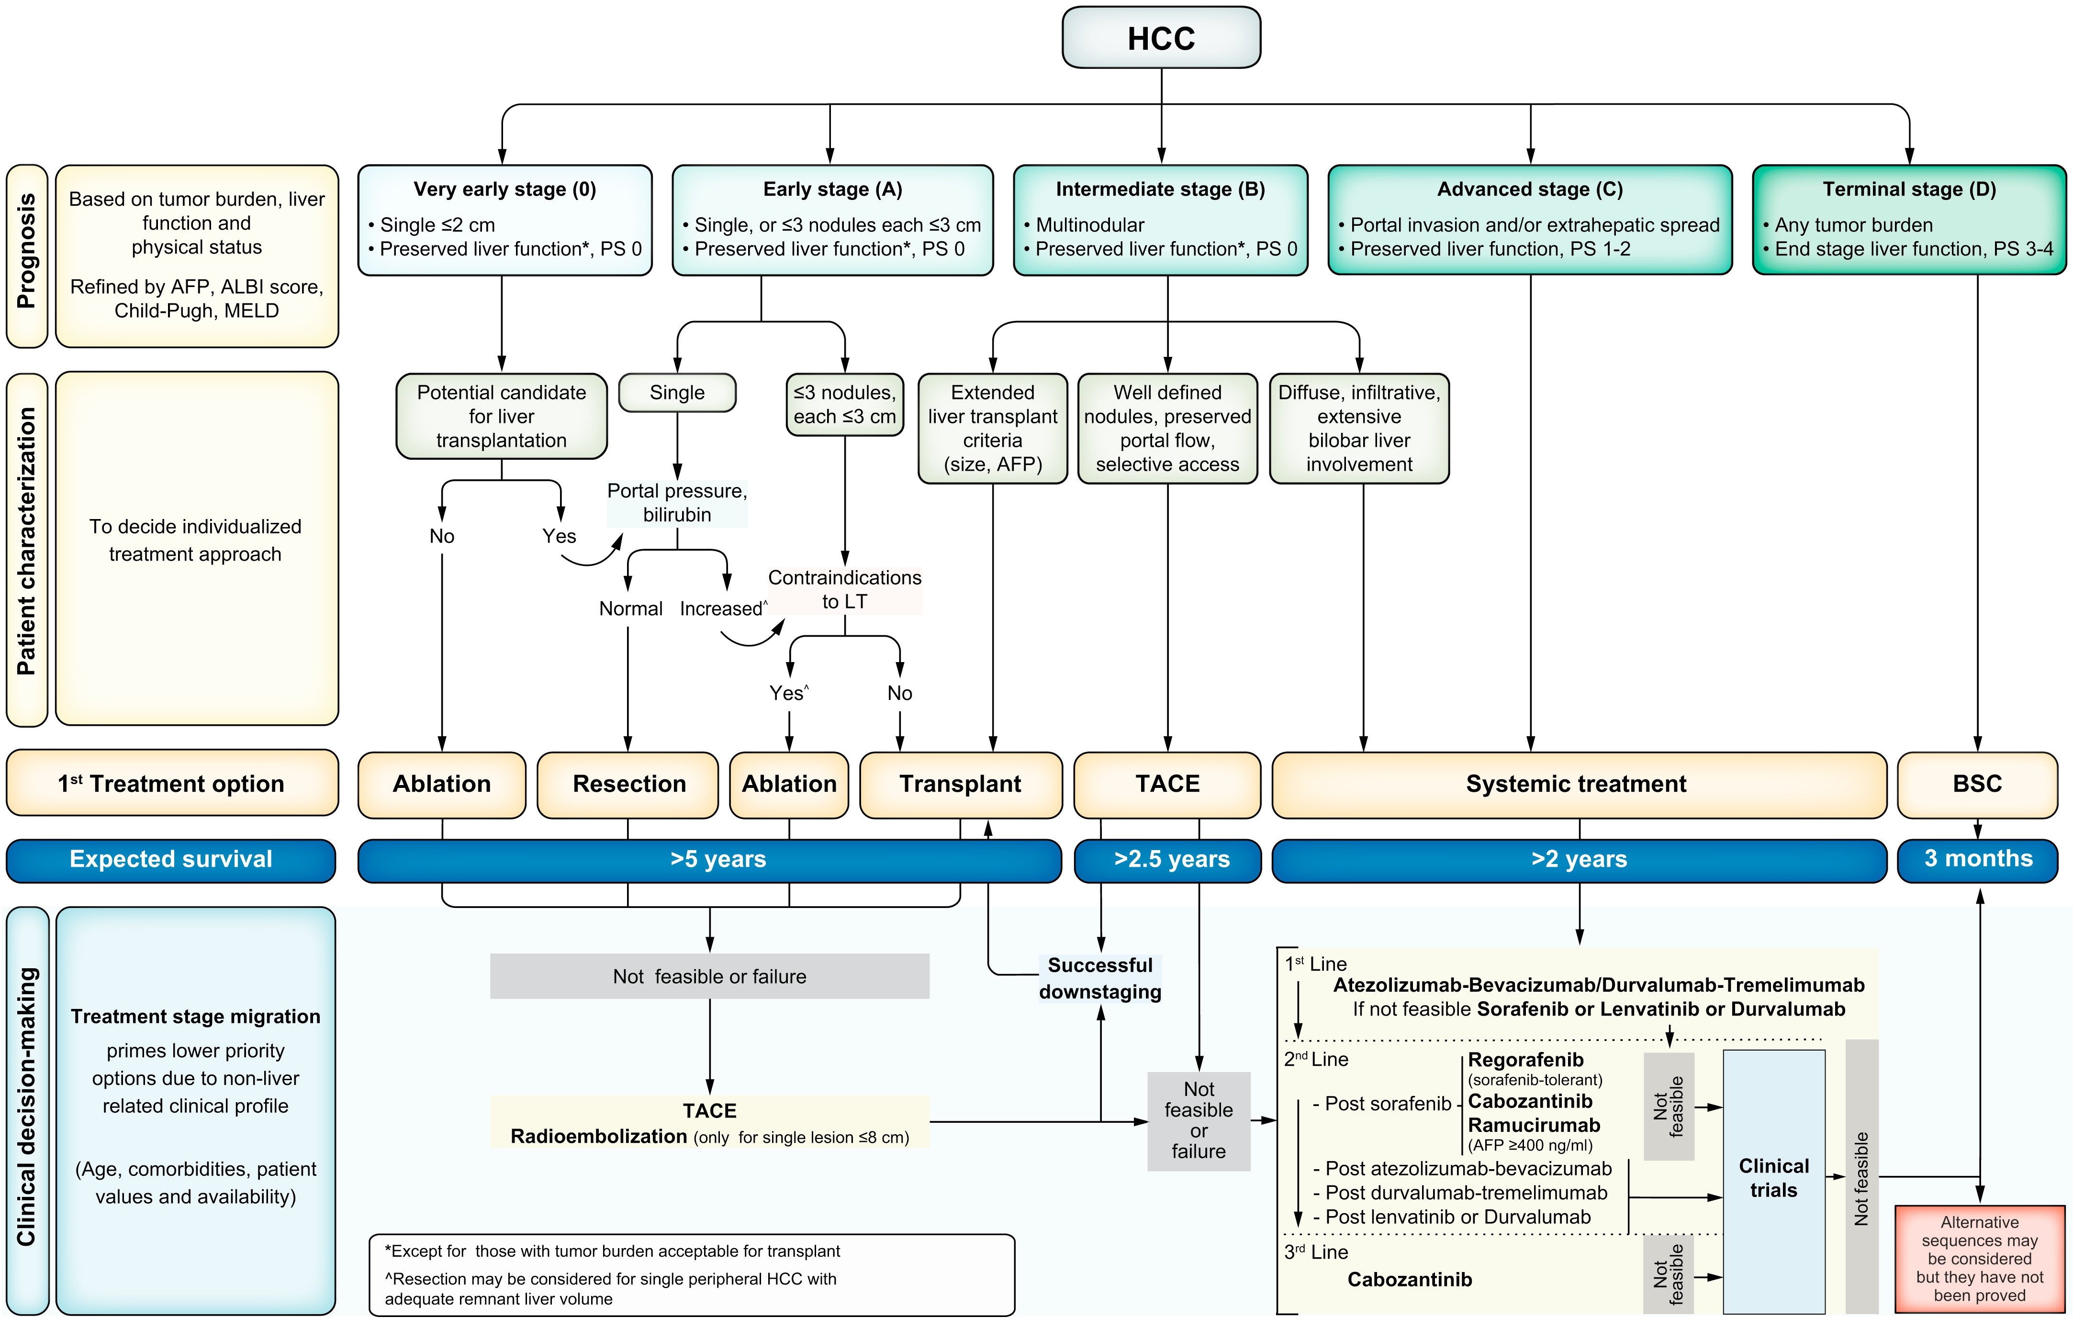
BCLC Revised
Fig. 1
Reig M et al. J Hepatol 2022;76(3):681-93.
Courtesy of Ghassan Abou-Alfa, MD, MBA

Slide 25
“Prospective translational studies should evaluate the role of ATB-mediated gut dysbiosis as a proposed mechanism underlying the adverse outcome in immunotherapy recipients.”
Fulgenzi CAM et al. Gastrointestinal Cancers Symposium 2023;Abstract 597.

Slide 26
Immuno-Oncology Combinations as First-Line Systemic Treatment for Advanced HCC
Cheng A-L et al. Updated efficacy and safety data from IMbrave150: Atezolizumab plus bevacizumab vs sorafenib for unresectable hepatocellular carcinoma. J Hepatol 2022;76(4):862-73.
Abou-Alfa GK et al. Tremelimumab plus durvalumab in unresectable hepatocellular carcinoma. NEJM Evid 2022;1(8).
Qin S et al. Final analysis of RATIONALE-301: Randomized, phase III study of tislelizumab versus sorafenib as first-line treatment for unresectable hepatocellular carcinoma. ESMO 2022;Abstract LBA36.
Kelley RK et al. Cabozantinib plus atezolizumab versus sorafenib for advanced hepatocellular carcinoma (COSMIC-312): A multicentre, open-label, randomised, phase 3 trial. Lancet Oncol 2022;23(8):995-1008.
Finn RS et al. Primary results from the phase III LEAP-002 study: Lenvatinib plus pembrolizumab versus lenvatinib as first-line (1L) therapy for advanced hepatocellular carcinoma (aHCC). ESMO 2022;Abstract LBA34.
Rimini M et al. Atezolizumab plus bevacizumab versus lenvatinib or sorafenib in non-viral unresectable hepatocellular carcinoma: An international propensity score matching analysis. ESMO Open 2022;7(6):100591.

Slide 27
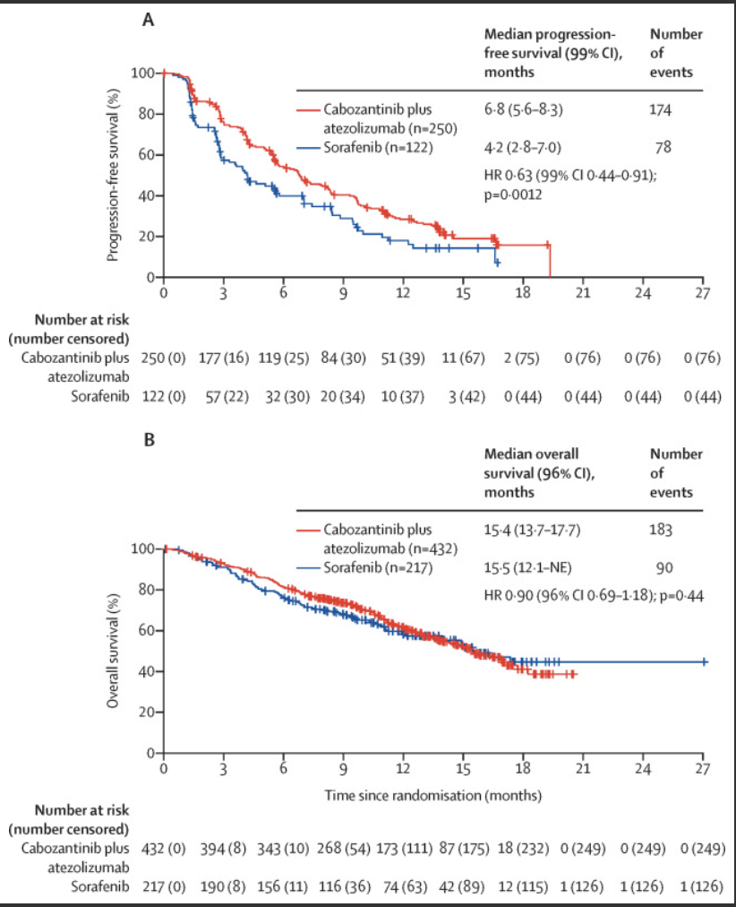
Kelley RK et al. Lancet Oncol 2022;23(8):995-1008.
Cabozantinib plus Atezolizumab
versus Sorafenib
Courtesy of Ghassan Abou-Alfa, MD, MBA

Slide 28
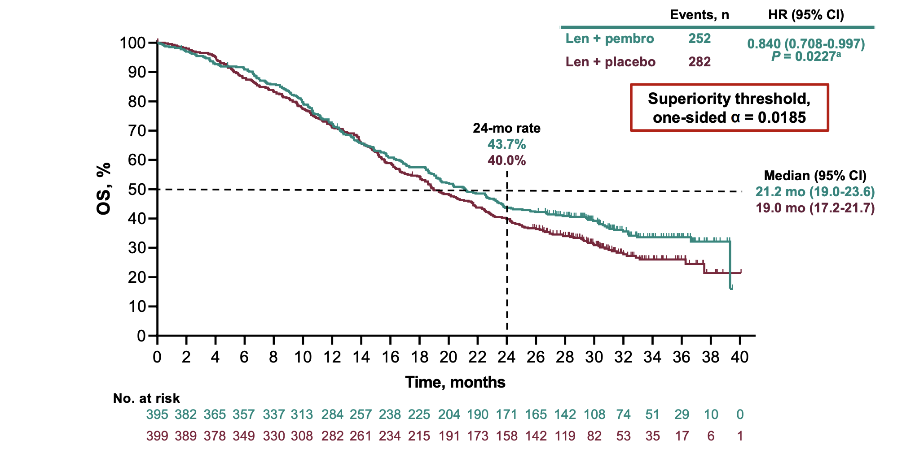
LEAP-002
Finn RS et al. ESMO 2022;Abstract LBA34.
Courtesy of Ghassan Abou-Alfa, MD, MBA

Slide 29
Safety and Efficacy of Cabozantinib in HCC
El-Khoueiry AB et al. Safety and efficacy of cabozantinib for patients with advanced hepatocellular carcinoma who advanced to Child-Pugh B liver function at study week 8: A retrospective analysis of the CELESTIAL randomised controlled trial. BMC Cancer 2022;22(1):377.
Freemantle N et al. Quality of life assessment of cabozantinib in patients with advanced hepatocellular carcinoma in the CELESTIAL trial. Eur J Cancer 2022;168:91-8.

Slide 30
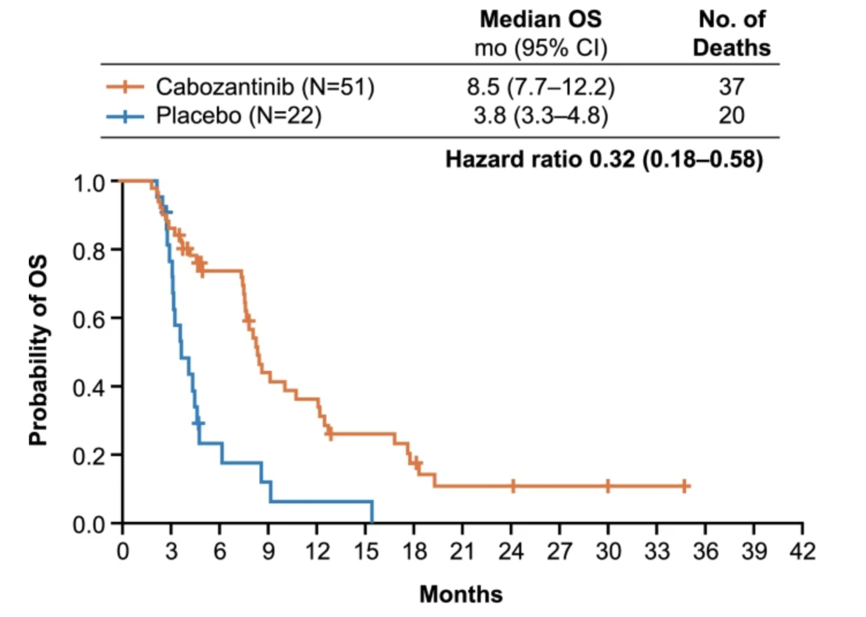
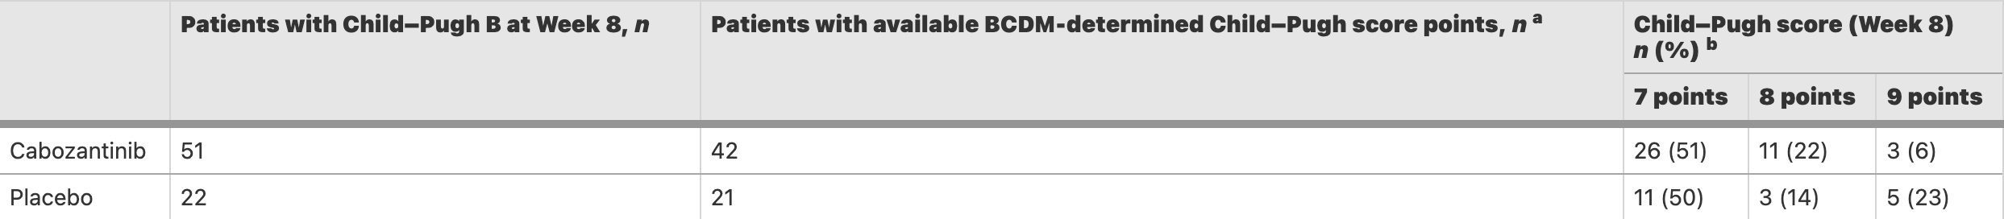
Cabozantinib and Worsening Child Pugh Score
El-Khoueiry AB et al. BMC Cancer 2022;22(1):377.
Courtesy of Ghassan Abou-Alfa, MD, MBA

Slide 31
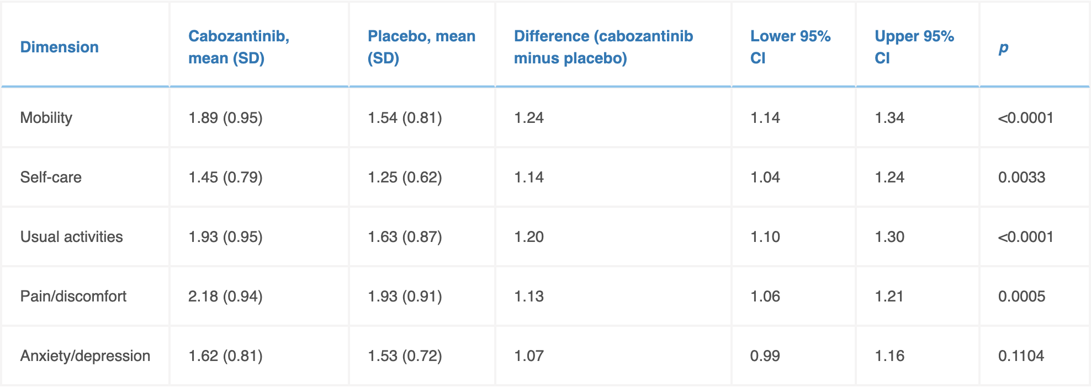
Cabozantinib and Quality of life in Patients with Advanced HCC
Freemantle N et al. Eur J Cancer 2022;168:91-8.
Courtesy of Ghassan Abou-Alfa, MD, MBA

Slide 32
Other Important Papers
Qin S et al. Pembrolizumab versus placebo as second-line therapy in patients from Asia with advanced hepatocellular carcinoma: A randomized, double-blind, phase III trial. J Clin Oncol 2023;41(7):1434-43.
Melero I et al. Nivolumab (NIVO) plus ipilimumab (IPI) combination therapy in patients with advanced hepatocellular carcinoma (aHCC): 5-year results from CheckMate 040. ESMO World Congress on Gastrointestinal Cancer 2022;Abstract SO-12.
Yau T et al. Nivolumab plus cabozantinib with or without ipilimumab for advanced hepatocellular carcinoma: Results from cohort 6 of the CheckMate 040 trial. J Clin Oncol 2023;41(9):1747-57.
Qin S et al. Camrelizumab (C) plus rivoceranib (R) vs. sorafenib (S) as first-line therapy for unresectable hepatocellular carcinoma (uHCC): A randomized, phase III trial. ESMO 2022; Abstract LBA35.
NCT05301842: A phase III, randomized, open-label, sponsor-blinded, multicenter study of durvalumab in combination with tremelimumab ± lenvatinib given concurrently with TACE compared to TACE alone in patients with locoregional hepatocellular carcinoma (EMERALD-3)

Slide 33
Agenda
Prologue: Last Week
MODULE 1: Hepatocellular Carcinoma
MODULE 2: Biliary Tract Cancers
Prologue: Anatomic biology of biliary tract cancers (BTC)
IOs with chemotherapy as first-line systemic treatment for metastatic BTC
Overview of targeted therapies for BTC
FGFR inhibitors in BTC
Other targeted therapies
Anti-HER2 therapies in BTC
Seribantumab
MODULE 3: Appendix

Slide 34
Agenda
Prologue: Last Week
MODULE 1: Hepatocellular Carcinoma
MODULE 2: Biliary Tract Cancers
Prologue: Anatomic biology of BTC
IOs with chemotherapy as first-line systemic treatment for metastatic BTC
Overview of targeted therapies for BTC
FGFR inhibitors in BTC
Other targeted therapies
Anti-HER2 therapies in BTC
Seribantumab
MODULE 3: Appendix

Slide 35
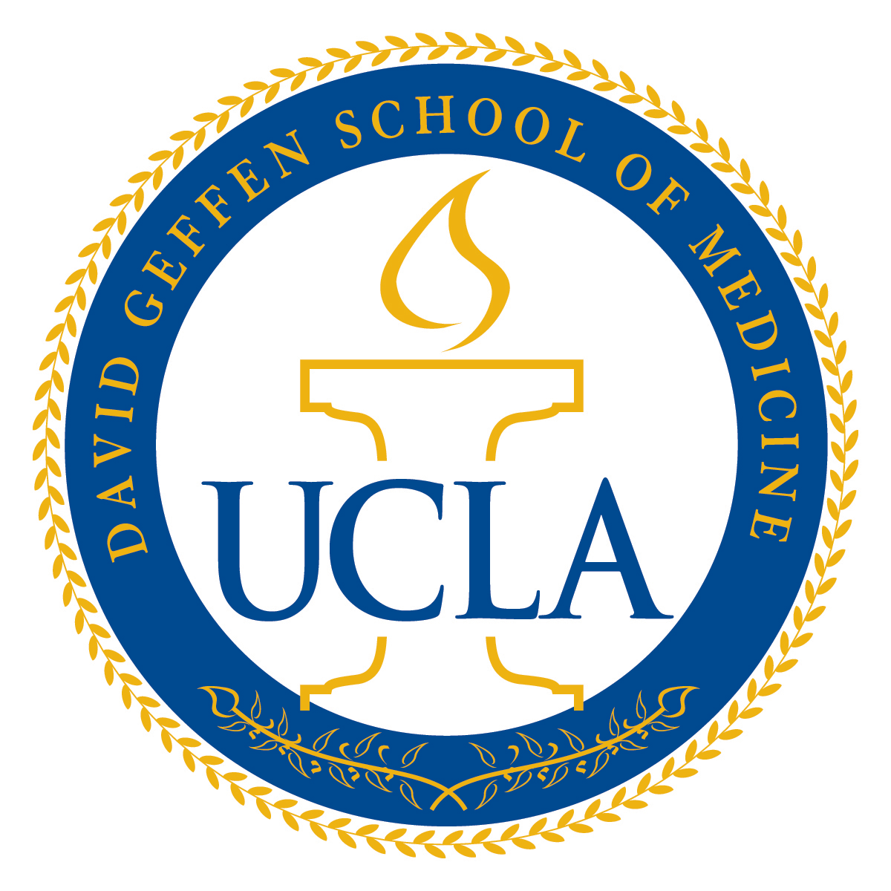
2023 Year in Review: Biliary Cancers
Richard S. Finn, MD
Professor of Clinical Medicine
Division of Hematology/Oncology
Director, Signal Transduction and Therapeutics Program
Jonsson Comprehensive Cancer Center
Geffen School of Medicine at UCLA

Slide 36
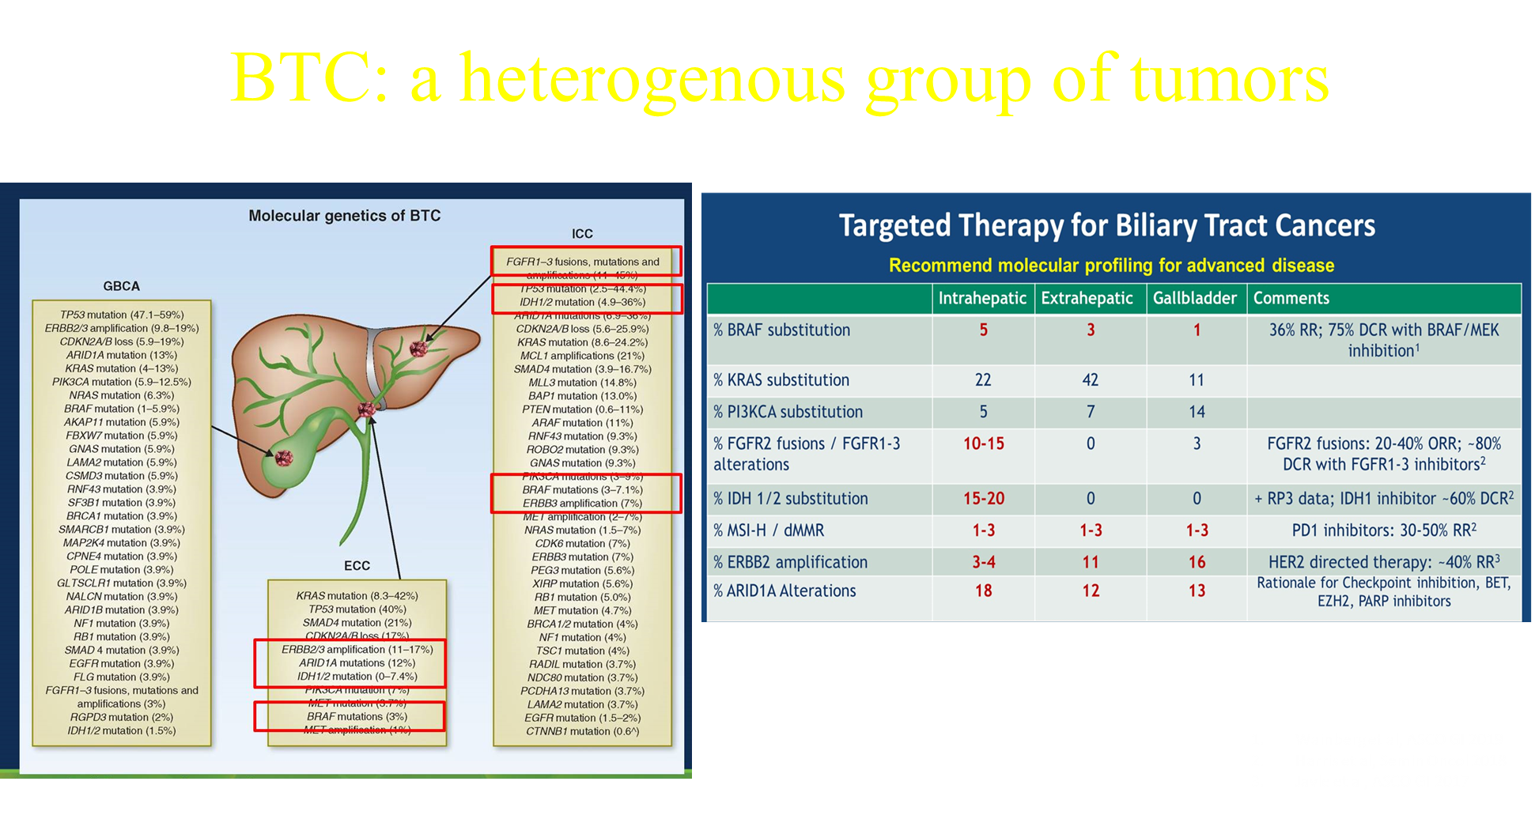
Courtesy of Richard S Finn, MD

Slide 37
IOs with Chemotherapy as First-Line Treatment for Metastatic BTC
Oh D-Y et al. Durvalumab plus gemcitabine and cisplatin in advanced biliary tract cancer. NEJM Evid 2022;1(8).
Oh D et al. Updated overall survival (OS) from the phase III TOPAZ-1 study of durvalumab (D) or placebo (PBO) plus gemcitabine and cisplatin (+ GC) in patients (pts) with advanced biliary tract cancer (BTC). ESMO 2022;Abstract 56P.
He AR et al. Outcomes by primary tumour location in patients with advanced biliary tract cancer treated with durvalumab or placebo plus gemcitabine and cisplatin in the phase 3 TOPAZ-1 study. ESMO World Congress on Gastrointestinal Cancer 2022;Abstract O-1.
Kelley RK et al. Pembrolizumab in combination with gemcitabine and cisplatin compared with gemcitabine and cisplatin alone for patients with advanced biliary tract cancer (KEYNOTE-966): a randomised, double-blind, placebo-controlled, phase 3 trial. Lancet 2023 April 16:[Online ahead of print].

Slide 38
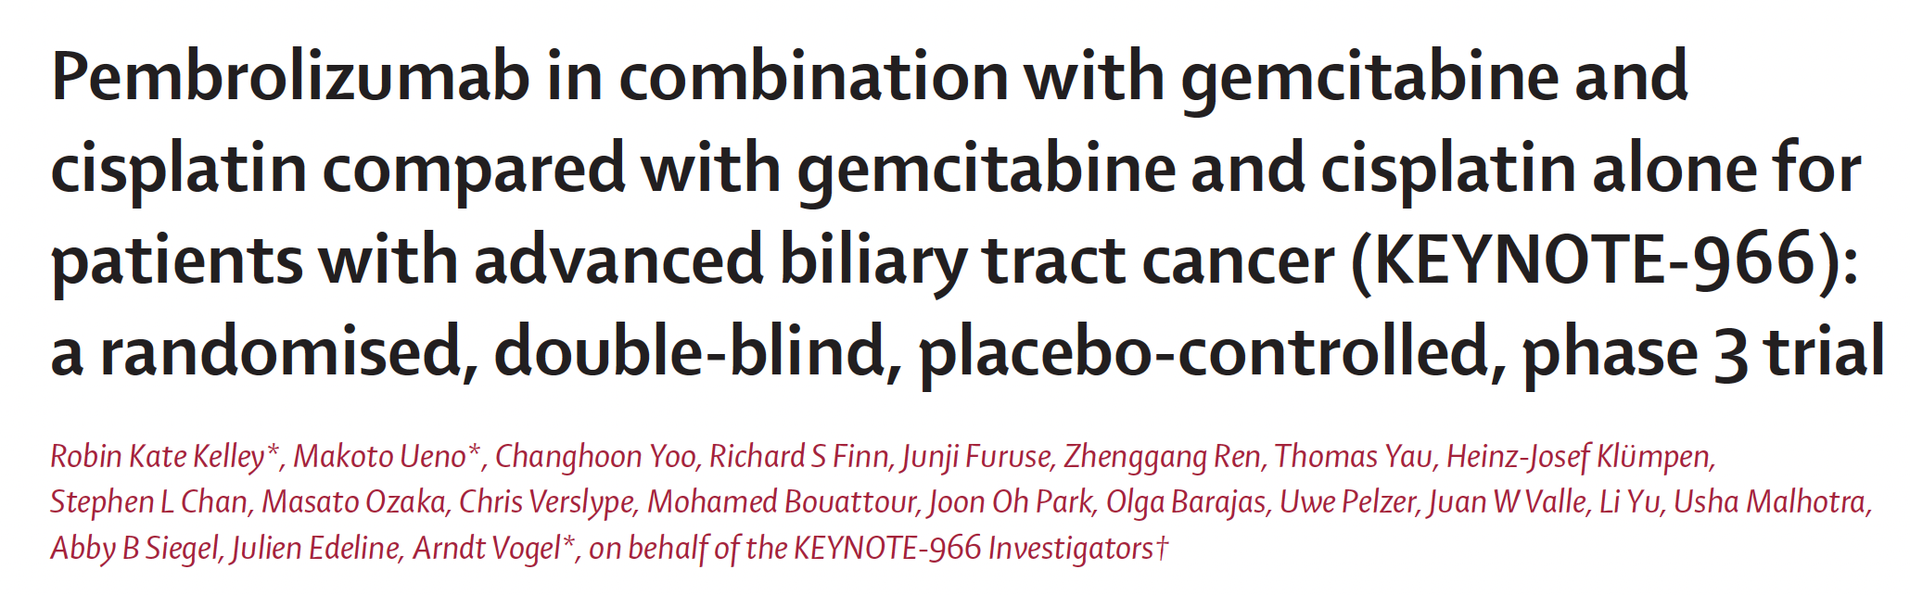
Lancet 2023;[Online ahead of print].

Slide 39
KEYNOTE-966
Added value of this study
“To our knowledge, KEYNOTE-966 is the first placebo-controlled study of a PD-1 inhibitor and the second study of a PD-1 or PD-L1 checkpoint inhibitor to show a statistically significant improvement in overall survival and a manageable safety profile in patients with advanced biliary tract cancer. KEYNOTE-966 offers key findings beyond those of TOPAZ-1, owing to its larger population, enrolment of a greater proportion of participants outside of Asia, the continuation of gemcitabine until disease progression, and more complete ascertainment of important clinical biomarkers such as hepatitis B and C viral status, all of which might affect the generalizability of outcomes to a global patient population.”

Slide 40
KEYNOTE-966 (continued)
Implications of all the available evidence
“Results of KEYNOTE-966 add to the body of evidence supporting the efficacy and safety of adding immune checkpoint inhibitors targeting PD-1 and PD-L1 to standard-of-care chemotherapy in the treatment of patients with biliary tract cancer. The statistically significant, clinically meaningful overall survival benefit observed in the absence of new safety signals supports the combination of pembrolizumab, gemcitabine, and cisplatin as a potential new first-line treatment option for patients with unresectable locally advanced or metastatic biliary tract cancer.”

Slide 41
FGFR Inhibitors in BTC
Vogel A et al. Pemigatinib for previously treated locally advanced or metastatic cholangiocarcinoma: Final results from FIGHT-202. ESMO World Congress on Gastrointestinal Cancer 2022;Abstract O-2.
Bibeau K et al. Progression-free survival in patients with cholangiocarcinoma with or without FGF/FGFR alterations: A FIGHT-202 post hoc analysis of prior systemic therapy response. JCO Precis Oncol 2022;6:e2100414.
Goyal L et al. Futibatinib for FGFR2-rearranged intrahepatic cholangiocarcinoma. N Engl J Med 2023;388(3):228-39.
Goyal L et al. Updated results of the FOENIX-CCA2 trial: Efficacy and safety of futibatinib in intrahepatic cholangiocarcinoma (iCCA) harboring FGFR2 fusions/rearrangements. ASCO 2022;Abstract 4009.

Slide 42
FIGHT-202
Pemigatinib oral selective FGFR 1,2,3 inhibitor
13.5 mg qD, 2 weeks on 1 off
FIGHT-202 open label single arm Phase 2 study in previously treated CCA, primary endpoint ORR
ORR 37% in patients with FGFR2 fusions/gene rearrangements (n=108)
DOR 9.1 months
PFS 7.0 mos, OS 17.5 mos
TEAEs- hyperphosphatemia, alopecia, diarrhea, fatigue
Exploratory analysis for this 108 patients, PFS to front-line was 5.5 mos (less than second-line pemigatinib)
Vogel A et al. ESMO GI 2022; Abstract O-2.
Courtesy of Richard S Finn, MD

Slide 43
Futibatinib
Highly selective FGFR 1-4 inhibitor, irreversible, 20 mg daily
FOENIX-CCA2 study, single arm phase 2 in patients with FGFR2 fusions/ rearrangements (n=103)
ORR 41.7 %, mDOR 9.5 mos, mPFS 8.9 mos
Mature mOS 20.0 mos
TEAEs- hyperphosphatemia, alopecia, dry mouth, diarrhea
Goyal L et al. ASCO 2022;Abstract 4009.
Courtesy of Richard S Finn, MD

Slide 44
Anti-HER2 Therapies in BTC
Zymeworks announces positive topline data in the pivotal HERIZON-BTC-01 trial of zanidatamab [press release]. December 19, 2022. Available at https://ir.zymeworks.com/news-releases/news-release-details/zymeworks-announces-positive-topline-data-pivotal- herizon-btc-01.
Ohba A et al. Trastuzumab deruxtecan (T-DXd; DS-8201) in patients (pts) with HER2-expressing unresectable or recurrent biliary tract cancer (BTC): An investigator-initiated multicenter phase 2 study (HERB trial). ASCO 2022;Abstract 4006.

Slide 45
HER2 Targeting: second line studies
HERIZON-BTC-01 trial, phase 2b (n~87), single agent
Zanidatamab, HER2 bispecific antibody against 2 different domains of HER2
ORR 41.3%, mDOR 12.9 mos in second line
Amplified or IHC 2 and 3+
No new safety signals (GI and infusion reactions)
HERB trial, phase 2, single arm, trastuzumab deruxtecan
30 pts (22 HER2 positive, 8 HER2 low)
ORR HER2 + 36.4 %, HER2 low 12.5%, All 30%
PFS HER2+ 5.1 mos, HER2 low 3.5 mos
TEAEs – hematologic, pneumonitis
HERIZON-BTC-01 press release, December 19, 2022; Ohba A et al.ASCO 2022;Abstract 4006.
Courtesy of Richard S Finn, MD

Slide 46
Seribantumab
Carrizosa DR et al. CRESTONE: Initial efficacy and safety of seribantumab in solid tumors harboring NRG1 fusions. ASCO 2022;Abstract 3006.

Slide 47
Seribantumab
Fully human anti-HER3 mAb, IV q3weeks
Competes with NRG-1 to bind to HER3
NRG fusions, rare, 0.2% of solid tumors
CRESTONE: ph2 study in solid tumors with NRG fusions, n=35
Included 2 patients with CCA
ORR overall study 33%, 36% in NSCLC, mDOR not reached
Carrizosa DR et al. ASCO 2022;Abstract 3006.
Courtesy of Richard S Finn, MD

Slide 48
Other Important Papers
El-Khoueiry AB et al. IMbrave151: A phase 2, randomized, double-blind, placebo-controlled study of atezolizumab with or without bevacizumab in combination with cisplatin plus gemcitabine in patients with untreated, advanced biliary tract cancer. Gastrointestinal Cancers Symposium 2023;Abstract 491.
Yoo C et al. Final results from the NIFTY trial, a phase IIb, randomized, open-label study of liposomal irinotecan (nal-IRI) plus fluorouracil (5-FU)/leucovorin (LV) in patients (pts) with previously treated metastatic biliary tract cancer (BTC). ESMO 2022;Abstract 55P.

Slide 49
Agenda
Prologue: Last Week
MODULE 1: Hepatocellular Carcinoma
MODULE 2: Biliary Tract Cancers
MODULE 3: Appendix

Slide 50
Hepatocellular Carcinoma

Slide 51
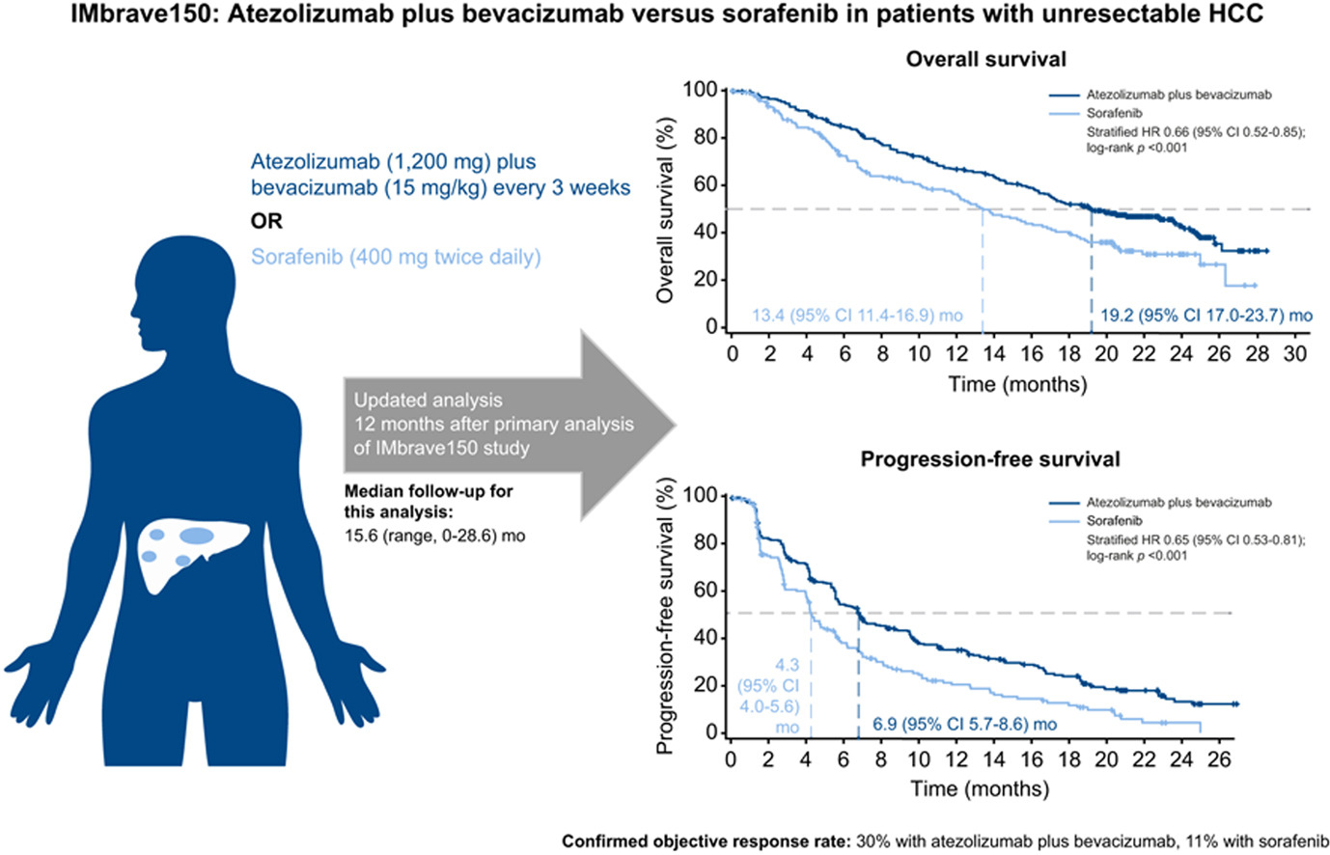
IMbrave150 One Year Update
Cheng A-L et al. J Hepatol 2022;76(4):862-73.
Courtesy of Ghassan Abou-Alfa, MD, MBA

Slide 52
IMbrave050
Phase III global, multicenter, open-label, randomized study evaluating the efficacy and safety of adjuvant atezolizumab plus bevacizumab, compared with active surveillance, in people with HCC at high risk of recurrence (determined by the size and number of cancerous lesions and the histopathology results, if available) after surgical resection or ablation with curative intent.
Overall survival data were immature at the time of interim analysis and follow-up will continue to the next analysis. Safety was consistent with the known safety profile of each therapeutic agent and with the underlying disease.
Results from the IMbrave050 study will be discussed with health authorities, including the U.S. Food and Drug Administration and the European Medicines Agency, and presented at an upcoming medical meeting.
https://www.gene.com/media/press-releases/14981/2023-01-18/genentechs-tecentriq-plus-avastin-is-the
Courtesy of Ghassan Abou-Alfa, MD, MBA

Slide 53
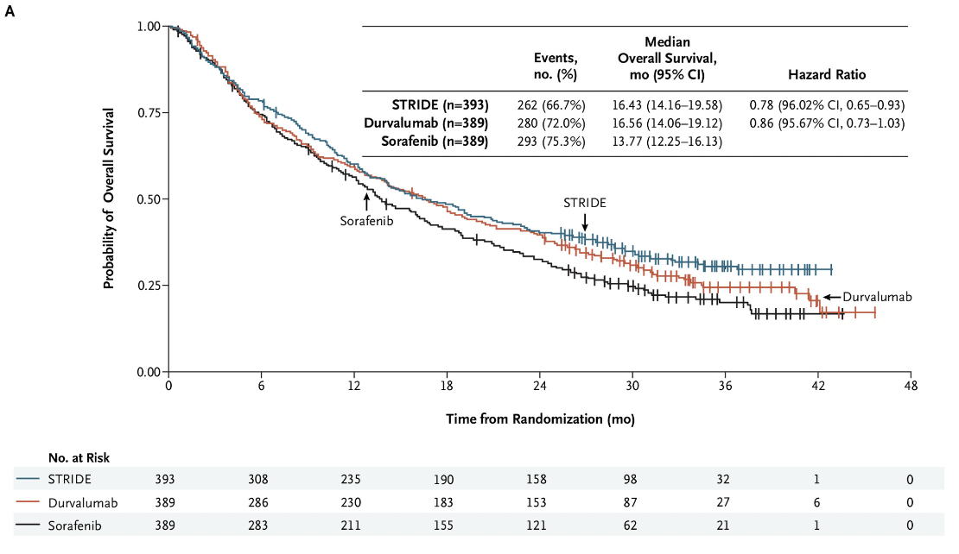
HIMALAYA OS for Durvalumab + Tremelimumab 300 mg vs Sorafenib
and Durvalumab vs Sorafenib
Abou-Alfa GK et al. NEJM Evidence. Published June 6, 2022. DOI:https://doi.org/10.1056/EVIDoa2100070
Courtesy of Ghassan Abou-Alfa, MD, MBA

Slide 54
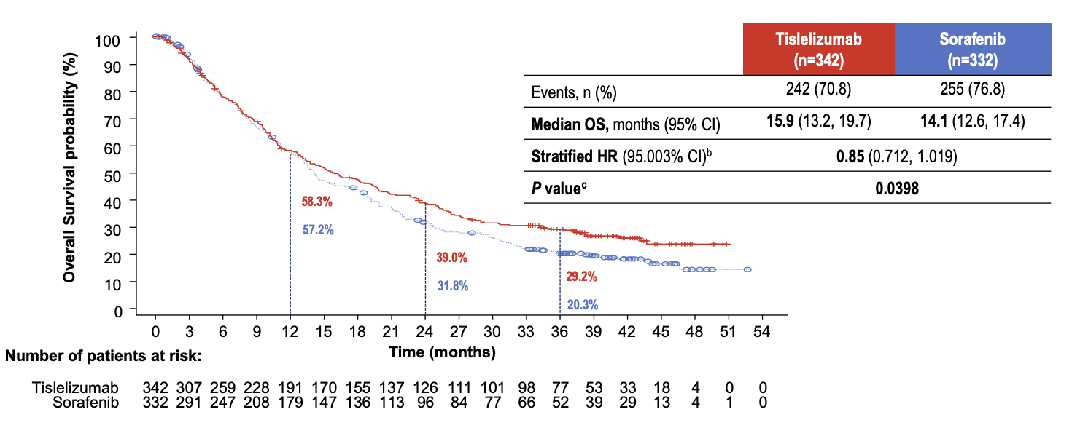
Tislelizumab vs Sorafenib Primary Endpoint: OS
Qin S et al. ESMO 2022;Abstract LBA36.
Courtesy of Ghassan Abou-Alfa, MD, MBA

Slide 55
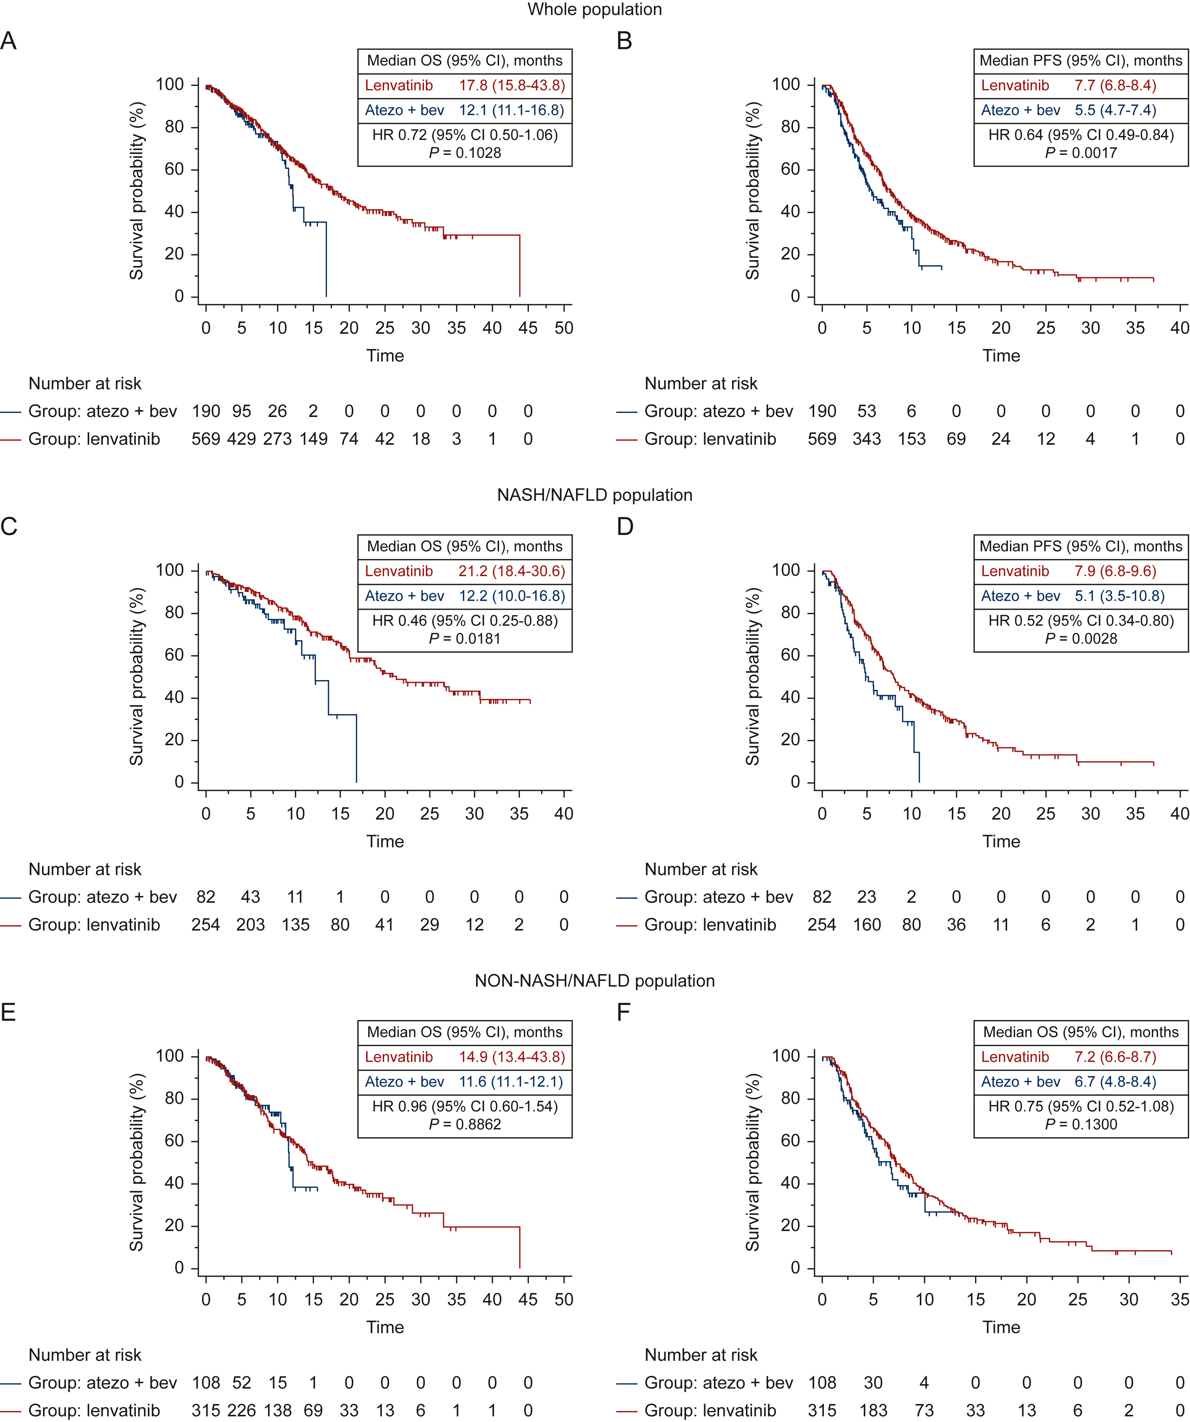
Atezolizumab plus Bevacizumab versus Lenvatinib or Sorafenib
Rimini M et al. ESMO Open 2022;7(6):100591.
Courtesy of Ghassan Abou-Alfa, MD, MBA

Slide 56
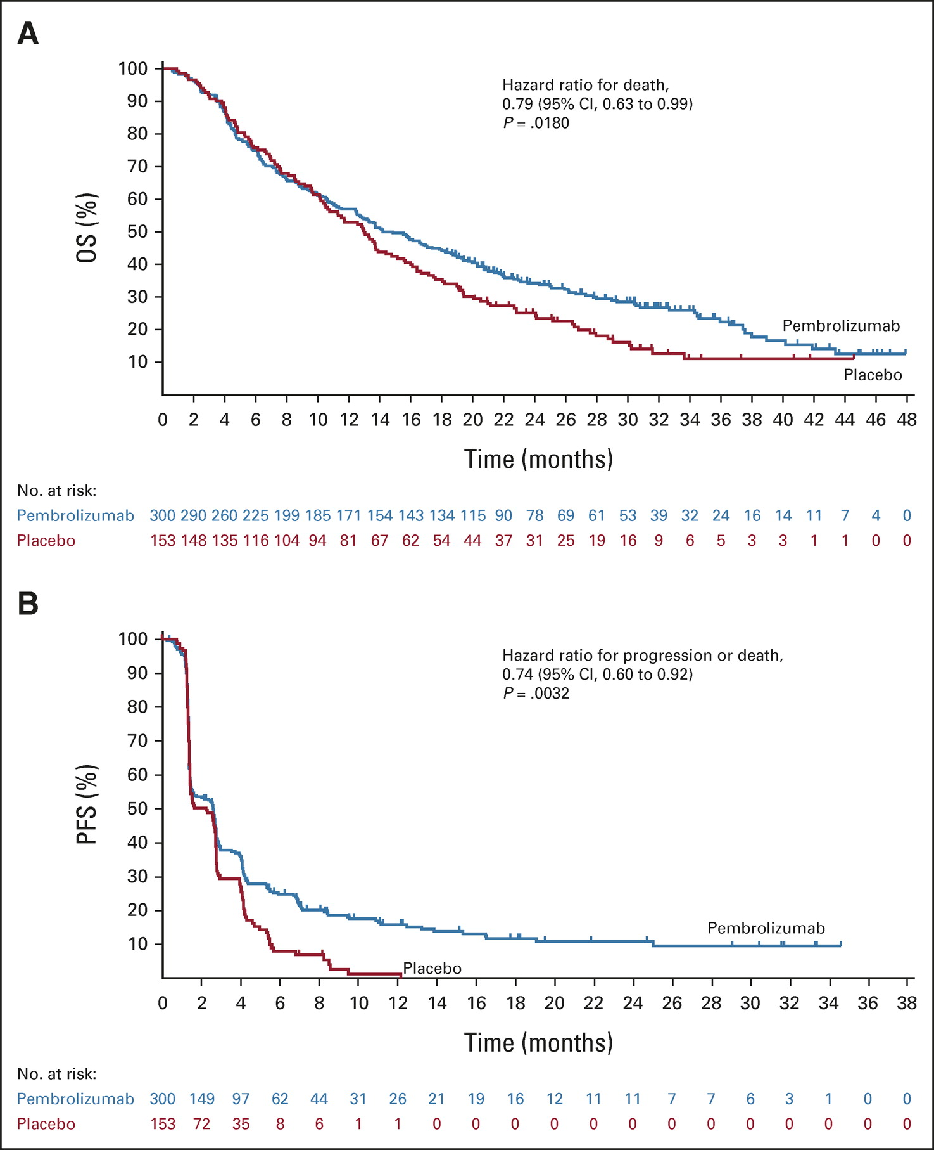
Second-line Pembrolizumab versus Placebo in Patients from Asia with Advanced HCC
Qin S et al. J Clin Oncol 2023;41(7):1434-43.
Courtesy of Ghassan Abou-Alfa, MD, MBA

Slide 57
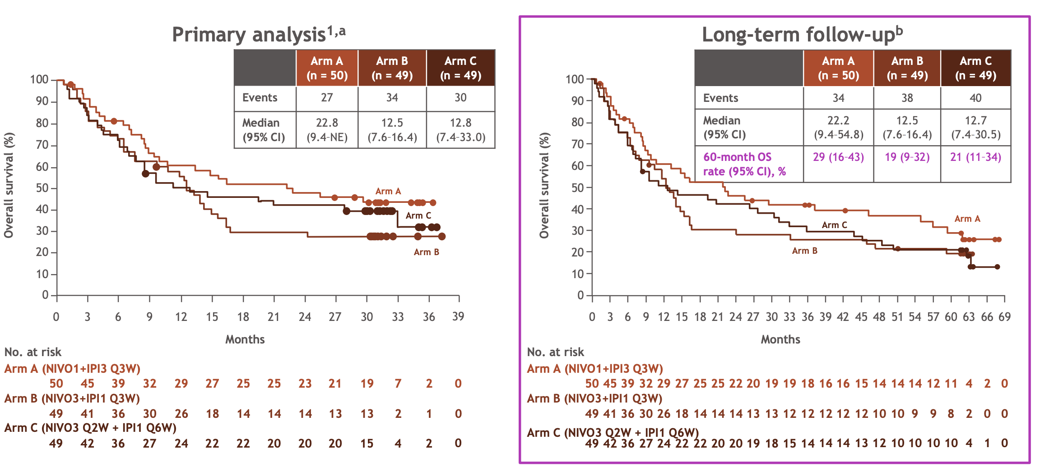
NIVO 1 mg/kg + IPI 3 mg/kg Q3W (4 doses) 5 years Follow-Up
Melero I et al. ESMO World Congress on Gastrointestinal Cancer 2022;Abstract SO-12.
Courtesy of Ghassan Abou-Alfa, MD, MBA

Slide 58
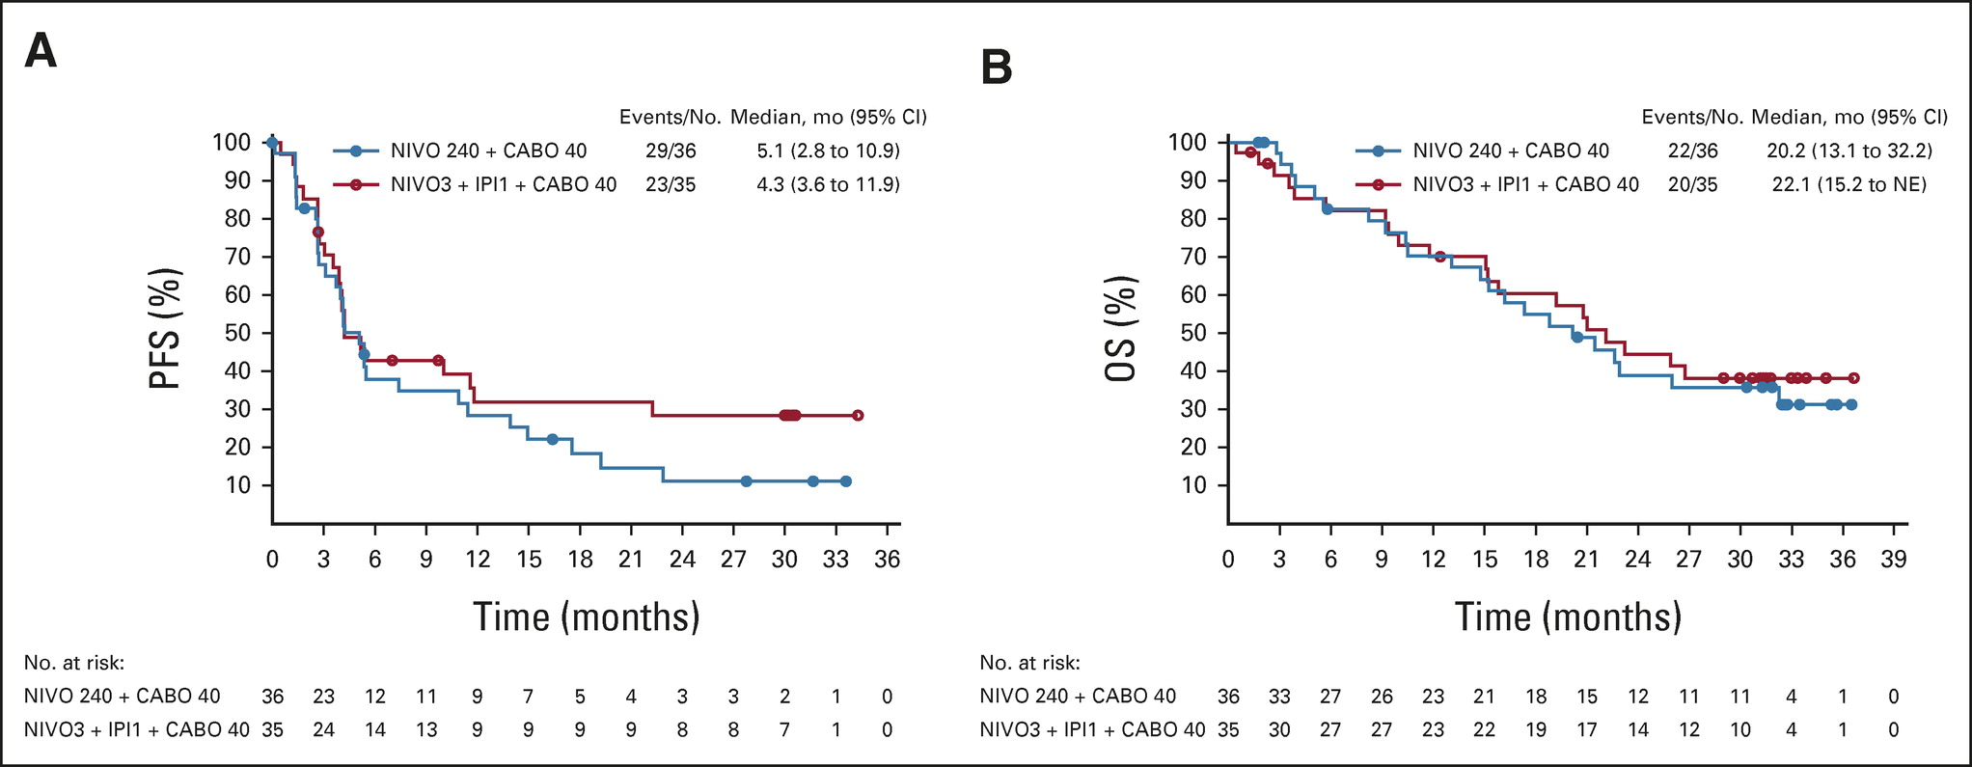
Nivolumab plus Cabozantinib +/- Ipilimumab
Yau T et al. J Clin Oncol 2023;41(9):1747-57.
Courtesy of Ghassan Abou-Alfa, MD, MBA

Slide 59
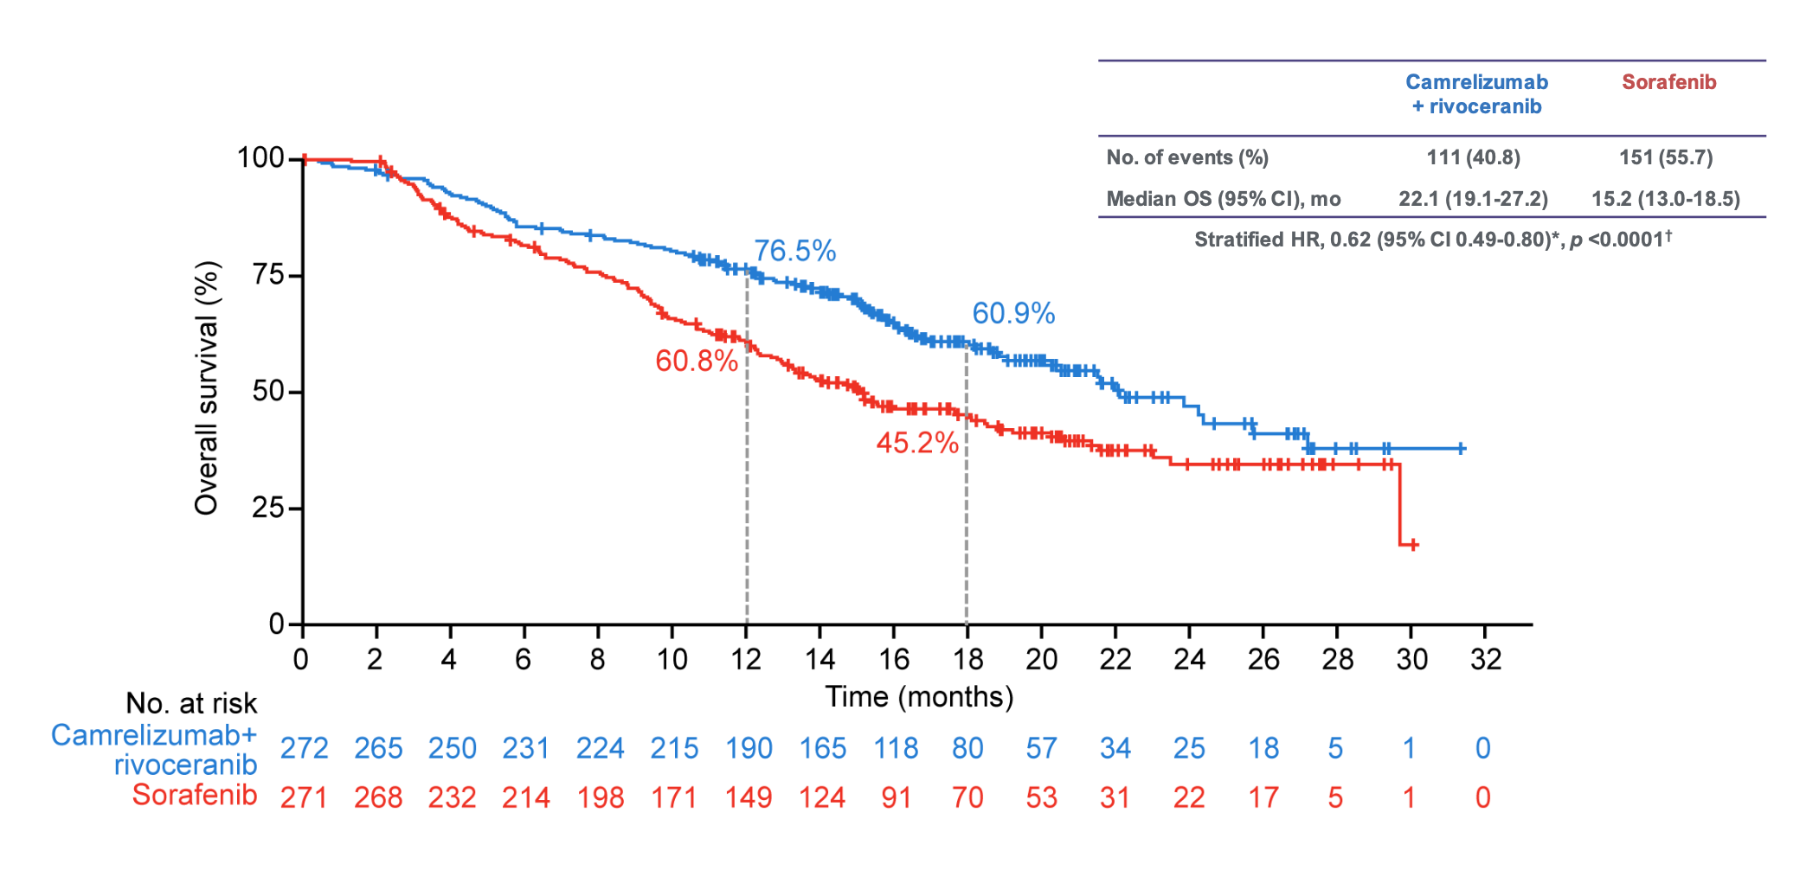
Camrelizumab plus Rivoceranib v Sorafenib
Qin S, et al., ESMO Paris 2022
Courtesy of Ghassan Abou-Alfa, MD, MBA

Slide 60
First Line Systemic Therapy
Regions | n | Sorafenib | Lenvatinib | Atezolizumab plus bevacizumab | Doxorubicin | FOLFOX | Don’t use any (availability, cost)
North South | 167 | 84% | 11% | 11% | 5% | 2% | 3%
East West | 127 | 66% | 2% | 4% | 13% | 1% | 8%
Central | 30 | 27% | 0 | 7% | 10% | 10% | 47%
Abou-Alfa, GK , et al. AORTIC, Senegal, Dakkar, Nov 7, 2021
Courtesy of Ghassan Abou-Alfa, MD, MBA

Slide 61
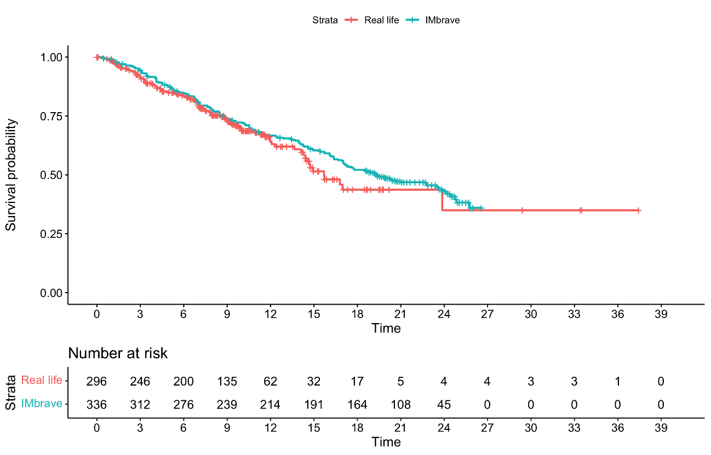
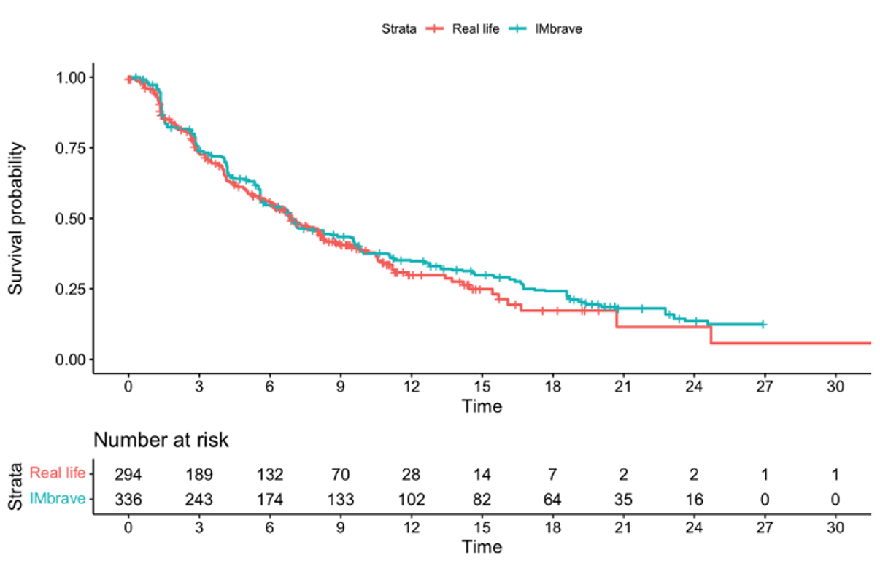
Atezolizumab plus Bevacizumab AB-Real International Study
AB-Real | IMbrave150
mOS: 15.74 months (95%CI: 14.4-NA) | mOS: 19.20 months (95%CI: 17.0-23.7)
HR: 0.87 (95%CI: 0.67-1.13; p=0.3)
AB-Real | IMbrave150
mPFS: 6.91 (95%CI: 6.1-8.3) | mPFS: 6.91 months (95%CI: 5.7- 8.6)
HR: 0.90 (95%CI: 0.74-1.10; p=0.3)
Fulgenzi C, et al. ILCA Madrid September 4, 2022
Courtesy of Ghassan Abou-Alfa, MD, MBA

Slide 62
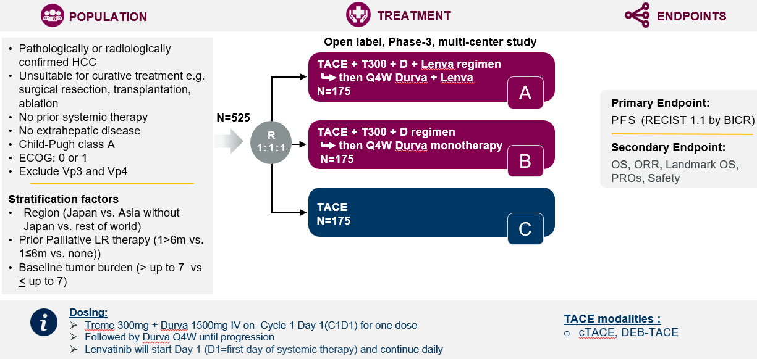
EMERALD-3
Secondary Endpoints:
Courtesy of Ghassan Abou-Alfa, MD, MBA

Slide 63
Biliary Tract Cancers

Slide 64
Overview
IO
Practice changing: TOPAZ and KEYNOTE-966
Of interest: IMbrave151
Molecular Targeted Therapy
FGFR2 targeting: FIGHT-202, Futibatinib
HER2 targeting: HERIZON-BTC-01, Trastuzumab deruxtecan
NRG1 fusions
Second line chemotherapy update: NIFTY trial
Courtesy of Richard S Finn, MD

Slide 65
Gemcitabine and cisplatin the SOC for >10 years
OS: 11.7 v 8.1 mos
PFS: 8.0 v 5.0 mos
ORR: 26.1% v 15.5%
Valle NEJM 2010
Courtesy of Richard S Finn, MD

Slide 66
TOPAZ-1:
Randomized placebo-controlled Phase 3 study:
Gem cis durvalumab vs gem cis placebo (n=685)
Primary endpoint: Improved OS: 11.5 to 12.8 mos (HR: 0.80)
Secondary endpoints: PFS 5.7 to 7.2 mos (HR: 0.75)
ORR 26.7% vs 18.7%, mDOR similar (6.6 v 6.2 mos) but tail
No new AEs
Max chemo cycles of 8, mostly Asian population
Updates: at 24 mos: 23.6 % alive vs 11.5%, benefit regardless of ORR, primary tumor location
Oh D et al. NEJM Evid 2022;1(8); Oh D et al. ESMO 2022; Abstract 56P; He AR at al. ESMO GI Abstract 0-1.
Courtesy of Richard S Finn, MD

Slide 67
KEYNOTE-966
Randomized placebo-controlled Phase 3 study:
Gem cis pembro vs gem cis placebo (n>1000)
Primary endpoint: Improved OS: 10.9 to 12.7 mos (HR 0.83)
Secondary endpoints: PFS 5.6 to 6.5 (HR 0.86 NS)
ORR 28% and 29%, DOR longer with pembro 6.8 to 8.3 mos with tail
No new AEs
Max number of cycles cis 8, pembro 35, gem up to MD
Asian 45%, non-Asian 55%
Kelley RK et al. Lancet 2023;Apr 16 [epub ahead of print].
Courtesy of Richard S Finn, MD

Slide 68
IMbrave151
Placebo controlled, blinded, randomized phase 2
Atezo bev + gem cis vs Atezo-placebo +gem cis
Primary endpoint: PFS 7.9 to 8.3 mos HR 0.76 NS
Secondary endpoints: ORR 24.1 vs 25.3
DOR longer with atezo-bev NE vs 5.8 mos HR 0.22
mOS NE vs 11.4 HR 0.74 NS
No new safety signals
El-Khoueiry A et al. ASCO GI 2023; Abstract 491.
Courtesy of Richard S Finn, MD

Slide 69
NIFTY trial: Phase 2b open-label study
Liposomal irinotecan (nal-IRI) plus 5FU/LV vs 5fu lv alone after cis-gem (second line)
Primary endpoint: PFS BICR 1.7 to 4.2 mos HR 0.61
ORR: 2.3% vs 19.3%
mOS 5.3 to 8.6 mos HR 0.68
Typical chemotherapy AEs
Yoo C et al. ESMO 2022 Abstract 55P.
Courtesy of Richard S Finn, MD

Slide 70
Conclusions
Front-line gem-cis +IO is standard of care based on 2 phase 3 studies (durva or pembro)
Molecular profiling is a must for all patients
FDA approved agents for FGFR2 alterations, IDH mutations, and BRAF mutations
Early signals of activity for new HER2 directed therapies
For patients without genomic alterations, second-line chemotherapy appropriate
FOLFOX or nal-IRI
Courtesy of Richard S Finn, MD

Slide 71
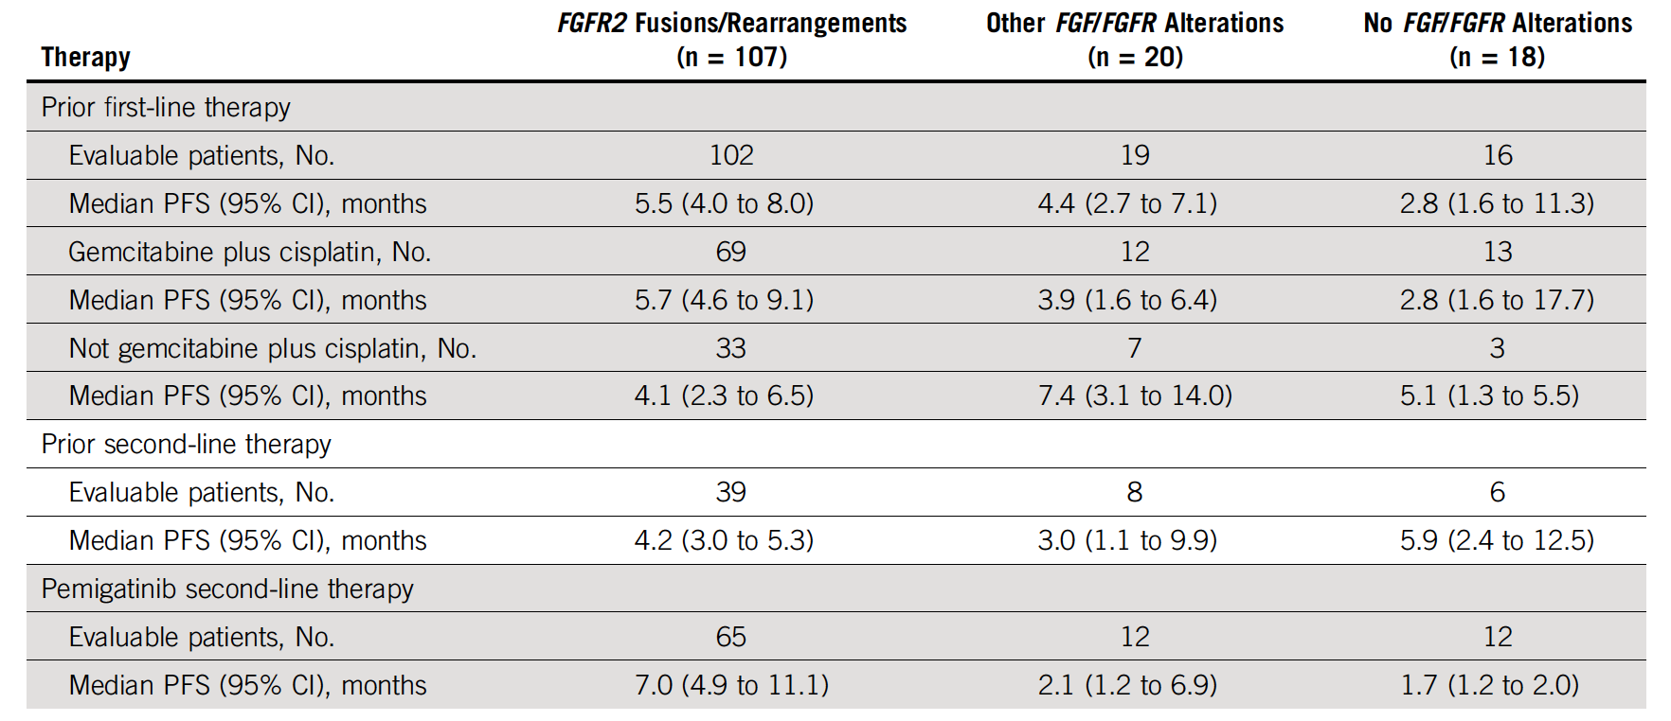
FIGHT-202: A Post Hoc Analysis of PFS in Patients with Cholangiocarcinoma with or without FGF or FGFR Alterations
Bibeau K et al. JCO Precis Oncol 2022;6:e2100414.

Slide 72
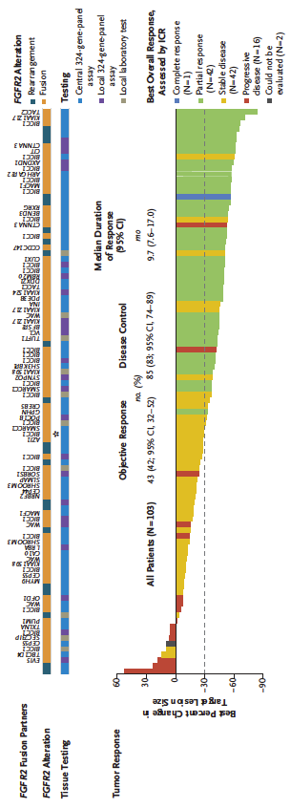
FOENIX-CCA2: A Phase II Study of Futibatinib for Intrahepatic Cholangiocarcinoma with FGFR2 Fusions or Rearrangements
Median PFS: 9.0 mo
Median OS: 21.7 mo
Goyal L et al. N Engl J Med 2023;388(3):228-39.

Slide 73
FOENIX-CCA2: Select Treatment-Related Adverse Events with Futibatinib for Intrahepatic Cholangiocarcinoma
Event (%) | All patients (N = 103)
Event (%) | Any grade | Grade 1 | Grade 2 | Grade 3 | Grade 4
Any adverse event | 99 | 8 | 34 | 56 | 1
Hyperphosphatemia | 85 | 10 | 46 | 30 | 0
Dry mouth | 30 | 27 | 3 | 0 | 0
Palmar-plantar erythrodysesthesia syndrome | 21 | 3 | 14 | 5 | 0
Increased aspartate aminotransferase level | 18 | 11 | 1 | 7 | 0
Increased alanine aminotransferase level | 15 | 5 | 5 | 4 | 1
Goyal L et al. N Engl J Med 2023;388(3):228-39.

