Slide 1

2023 Year in Review: Biliary Cancers
Richard S. Finn, MD
Professor of Clinical Medicine
Division of Hematology/Oncology
Director, Signal Transduction and Therapeutics Program
Jonsson Comprehensive Cancer Center
Geffen School of Medicine at UCLA

Slide 2
Overview
IO
  Practice changing: TOPAZ and KEYNOTE-966
  Of interest: IMbrave151
Molecular Targeted Therapy
  FGFR2 targeting: FIGHT-202, Futibatinib
  HER2 targeting: HERIZON-BTC-01, Trastuzumab deruxtecan
  NRG1 fusions
Second line chemotherapy update: NIFTY trial

Slide 3
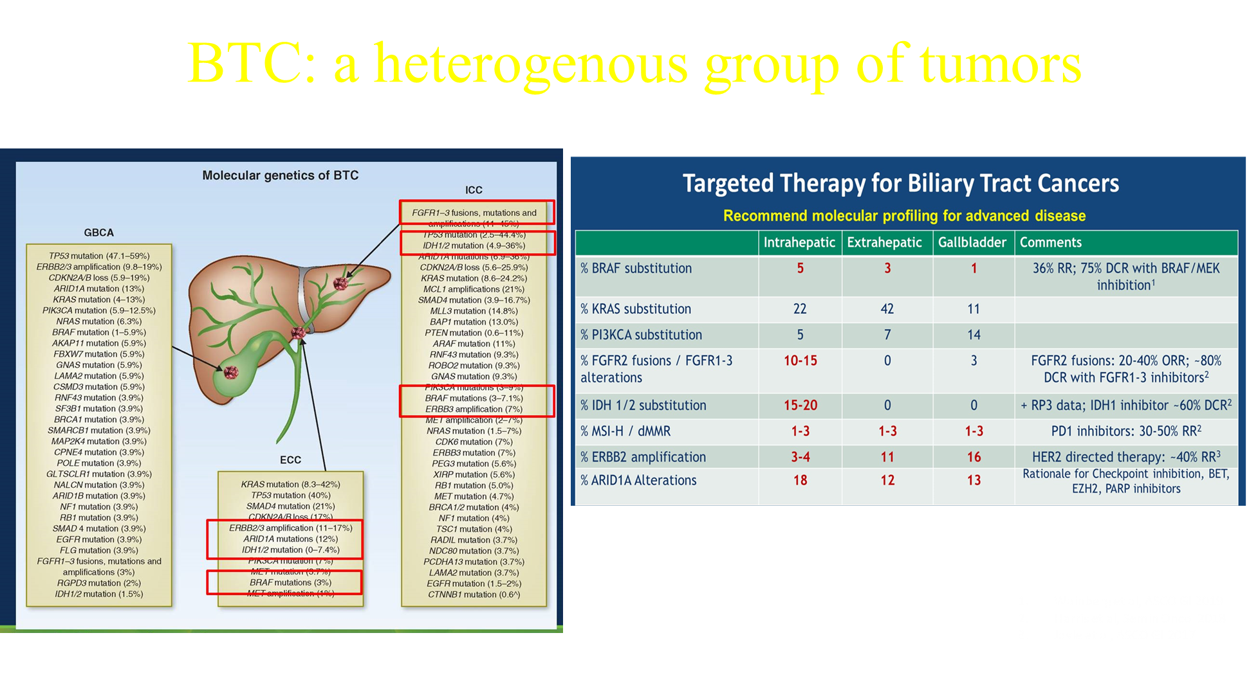

Slide 4
Gemcitabine and cisplatin the SOC for >10 years
OS: 11.7 v 8.1 mos
PFS: 8.0 v 5.0 mos
ORR: 26.1% v 15.5%
Valle NEJM 2010

Slide 5
TOPAZ-1:
Randomized placebo controlled Phase 3 study:
  Gem cis durvalumab vs gem cis placebo (n=685)
  Primary endpoint: Improved OS: 11.5 to 12.8 mos (HR: 0.80)
  Secondary endpoints: PFS 5.7 to 7.2 mos (HR: 0.75)
  ORR 26.7% vs 18.7%, mDOR similar (6.6 v 6.2 mos) but tail
  No new AEs
  Max chemo cycles of 8, mostly Asian population
  Updates: at 24 mos: 23.6 % alive vs 11.5%, benefit regardless of ORR, primary tumor location
Oh D et al. NEJM Evid 2022;1(8); Oh D et al. ESMO 2022; Abstract 56P; He AR at al. ESMO GI Abstract 0-1.

Slide 6
KEYNOTE-966
Randomized placebo controlled Phase 3 study:
  Gem cis pembro vs gem cis placebo (n>1000)
  Primary endpoint: Improved OS: 10.9 to 12.7 mos (HR 0.83)
  Secondary endpoints: PFS 5.6 to 6.5 (HR 0.86 NS)
  ORR 28% and 29%, DOR longer with pembro 6.8 to 8.3 mos with tail
  No new AEs
  Max number of cycles cis 8, pembro 35, gem up to MD
  Asian 45%, non-Asian 55%
Kelley RK et al. Lancet 2023;Apr 16 [epub ahead of print].

Slide 7
IMbrave151
Placebo controlled, blinded, randomized phase 2
  Atezo bev +gem cis vs Atezo-placebo +gem cis
  Primary endpoint: PFS 7.9 to 8.3 mos HR 0.76 NS
  Secondary endpoints: ORR 24.1 vs 25.3
  DOR longer with atezo-bev NE vs 5.8 mos HR 0.22
  mOS NE vs 11.4 HR 0.74 NS
  No new safety signals
El-Khoueiry A et al. ASCO GI 2023; Abstract 491.

Slide 8
FIGHT-202
Pemigatinib oral selective FGFR 1,2,3 inhibitor
13.5 mg qD, 2 weeks on 1 off
FIGHT-202 open label single arm Phase 2 study in previously treated CCA, primary endpoint ORR
ORR 37% in patients with FGFR2 fusions/gene rearrangements (n=108)
  DOR 9.1 months
  PFS 7.0 mos, OS 17.5 mos
TEAEs- hyperphosphatemia, alopecia, diarrhea, fatigue
Exploratory analysis for this 108 patients, PFS to front-line was 5.5 mos (less than second-line pemigatinib)
Vogel A et al. ESMO GI 2022; Abstract O-2.

Slide 9
Futibatinib
Highly selective FGFR 1-4 inhibitor, irreversible, 20 mg daily
FOENIX-CCA2 study, single arm phase 2 in patients with FGFR2 fusions/ rearrangements (n=103)
ORR 41.7 %, mDOR 9.5 mos, mPFS 8.9 mos
Mature mOS 20.0 mos
TEAEs- hyperphosphatemia, alopecia, dry mouth, diarrhea
Goyal L et al. ASCO 2022;Abstract 4009.

Slide 10
HER2 Targeting: second line studies
HERIZON-BTC-01 trial, phase 2b (n~87), single agent
  Zanidatamab, HER2 bispecific antibody against 2 different domains of HER2
  ORR 41.3%, mDOR 12.9 mos in second line
  Amplified or IHC 2 and 3+
  No new safety signals (GI and infusion reactions)
HERB trial, phase 2, single arm, trastuzumab deruxtecan
  30 pts (22 HER2 positive, 8 HER2 low)
  ORR HER2 + 36.4 %, HER2 low 12.5%, All 30%
  PFS HER2+ 5.1 mos, HER2 low 3.5 mos
  TEAEs – hematologic, pneumonitis
HERIZON-BTC-01 press release, December 19, 2022; Ohba A et al.ASCO 2022;Abstract 4006.

Slide 11
Seribantumab
Fully human anti-HER3 mAb, IV q3weeks
Competes with NRG-1 to bind to HER3
NRG fusions, rare, 0.2% of solid tumors
CRESTONE: ph2 study in solid tumors with NRG fusions, n=35
Included 2 patients with CCA
ORR overall study 33%, 36% in NSCLC, mDOR not reached
Carrizosa DR et al. ASCO 2022;Abstract 3006.

Slide 12
NIFTY trial: Phase 2b open-label study
Liposomal irinotecan (nal-IRI) plus 5FU/LV vs 5fu lv alone after cis-gem (second line)
Primary endpoint: PFS BICR 1.7 to 4.2 mos HR 0.61
ORR: 2.3% vs 19.3%
mOS 5.3 to 8.6 mos HR 0.68
Typical chemotherapy AEs
Yoo C et al. ESMO 2022 Abstract 55P.

Slide 13
Conclusions
Front-line gem-cis +IO is standard of care based on 2 phase 3 studies (durva or pembro)
Molecular profiling is a must for all patients
  FDA approved agents for FGFR2 alterations, IDH mutations, and BRAF mutations
  Early signals of activity for new HER2 directed therapies
For patients without genomic alterations, second-line chemotherapy appropriate
  FOLFOX or nal-IRI

Slide 14
APPENDIX

Slide 15
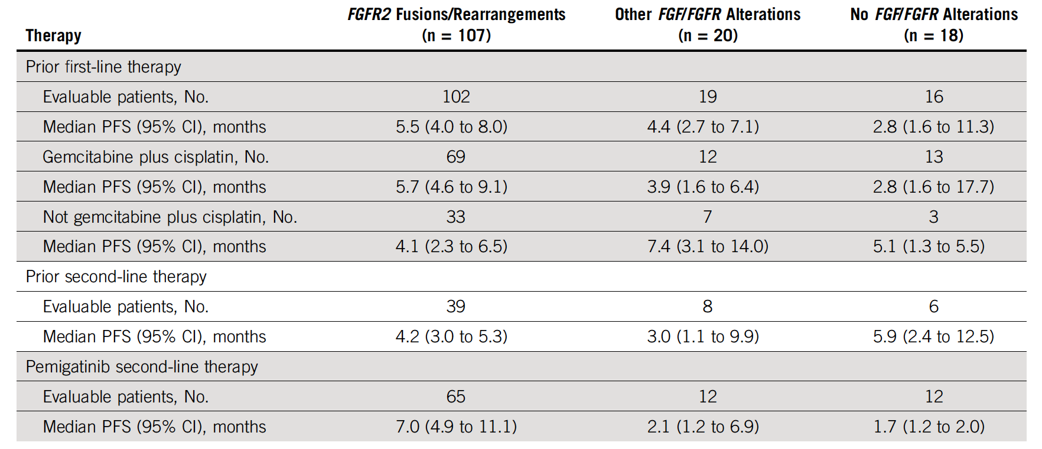
FIGHT-202: Post-hoc Analysis of PFS for Patients with Cholangiocarcinoma with or without FGF or FGFR Alterations
Bibeau K et al. JCO Precis Oncol 2022;6:e2100414.

Slide 16
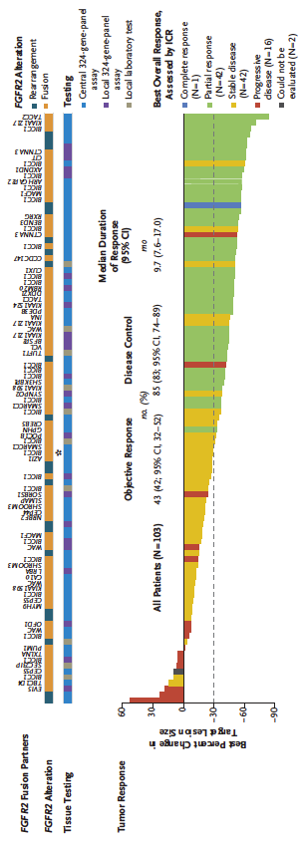
FOENIX-CCA2: A Phase II Study of Futibatinib for Intrahepatic Cholangiocarcinoma with FGFR2 Fusions/Rearrangements
Median PFS: 9.0 mo
Median OS: 21.7 mo
Goyal L et al. N Engl J Med 2023;388;228-39.

Slide 17
FOENIX-CCA2: Select Treatment-Related Adverse Events with Futibatinib for Intrahepatic Cholangiocarcinoma
Event (%) | All patients (N = 103)
Event (%) | Any grade | Grade 1 | Grade 2 | Grade 3 | Grade 4
Any adverse event | 99 | 8 | 34 | 56 | 1
Hyperphosphatemia | 85 | 10 | 46 | 30 | 0
Dry mouth | 30 | 27 | 3 | 0 | 0
Palmar-plantar erythrodysesthesia syndrome | 21 | 3 | 14 | 5 | 0
Increased aspartate aminotransferase level | 18 | 11 | 1 | 7 | 0
Increased alanine aminotransferase level | 15 | 5 | 5 | 4 | 1
Goyal L et al. N Engl J Med 2023;388;228-39.

