Slide 1
Hepatocellular Carcinoma
Ghassan Abou-Alfa
Memorial Sloan Kettering Cancer Center
RTP Year In Review Live Webinar
Hepatobiliary Cancers Edition
May 4, 2023

Slide 2
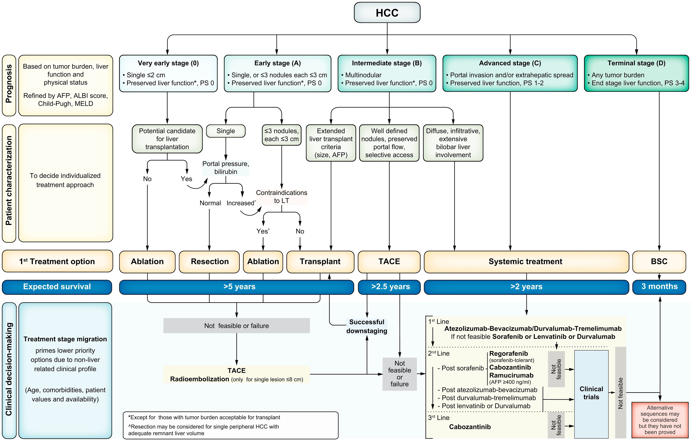
BCLC Revised
Fig. 1
Reig M et al. J Hepatol 2022;76(3):681-93.
CC Ghassan Abou-Alfa, MD, MBA
Notes:
BCLC staging and treatment strategy in 2022.
The BCLC system establishes a prognosis in accordance with the 5 stages that are linked to first-line treatment recommendation. The expected outcome is expressed as median survival of each tumour stage according to the available scientific evidence. Individualised clinical decision-making, according to the available data on November 15, 2021, is defined by teams responsible for integrating all available data with the individual patient’s medical profile. Note that liver function should be evaluated beyond the conventional Child-Pugh staging. AFP, alpha-fetoprotein; ALBI, albumin-bilirubin; BCLC, Barcelona Clinic Liver Cancer; BSC, best supportive care; ECOG-PS, Eastern Cooperative Oncology Group-performance status; LT, liver transplantation; MELD, model of end-stage liver disease; TACE, transarterial chemoembolisation.

Slide 3
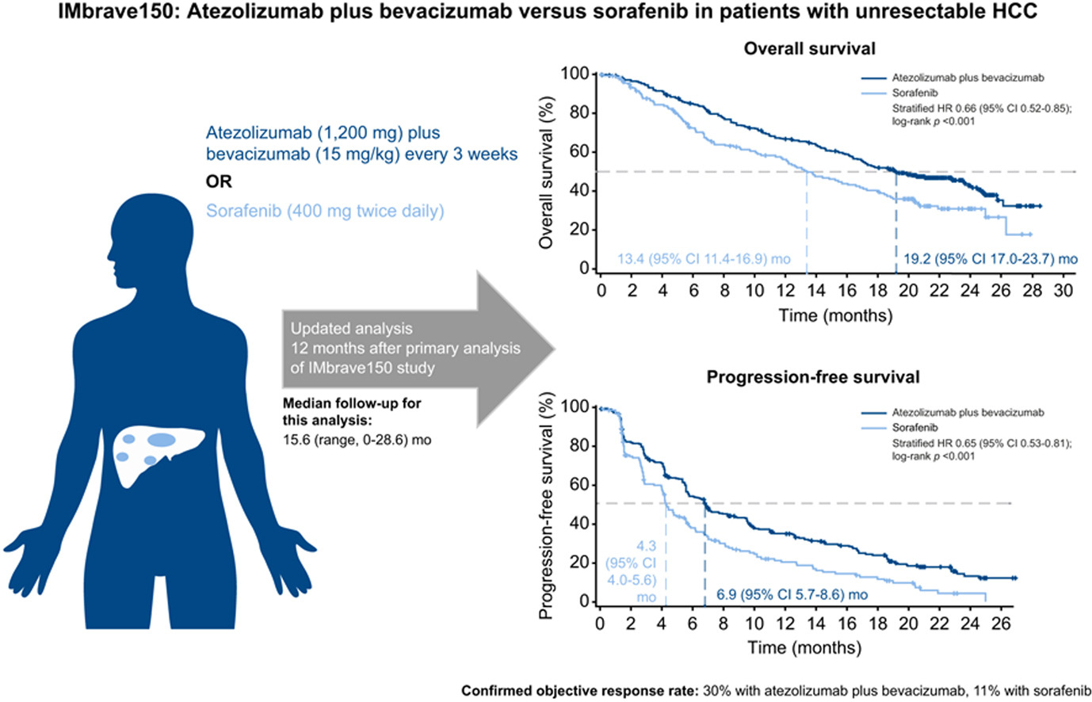
IMbrave150 One Year Update
Cheng A-L et al. J Hepatol 2022;76(4):862-73.
CC Ghassan Abou-Alfa, MD, MBA
Notes:
Figure 1. Summary of Mortality from Cancer According to Body-Mass Index for U.S. Men in the Cancer Prevention Study II, 1982 through 1998. For each relative risk, the comparison was between men in the highest body-mass-index (BMI) category (indicated in parentheses) and men in the reference category (body-mass index normal, 18.5 to 24.9). Asterisks indicate relative risks for men who never smoked. Results of the linear test for trend were significant (P<=0.05) for all cancer sites.

Slide 4
IMbrave050
Phase III global, multicenter, open-label, randomized study evaluating the efficacy and safety of adjuvant atezolizumab plus bevacizumab, compared with active surveillance, in people with HCC at high risk of recurrence (determined by the size and number of cancerous lesions and the histopathology results, if available) after surgical resection or ablation with curative intent.
Overall survival data were immature at the time of interim analysis and follow-up will continue to the next analysis. Safety was consistent with the known safety profile of each therapeutic agent and with the underlying disease.
Results from the IMbrave050 study will be discussed with health authorities, including the U.S. Food and Drug Administration and the European Medicines Agency, and presented at an upcoming medical meeting.
https://www.gene.com/media/press-releases/14981/2023-01-18/genentechs-tecentriq-plus-avastin-is-the
CC Ghassan Abou-Alfa, MD, MBA

Slide 5
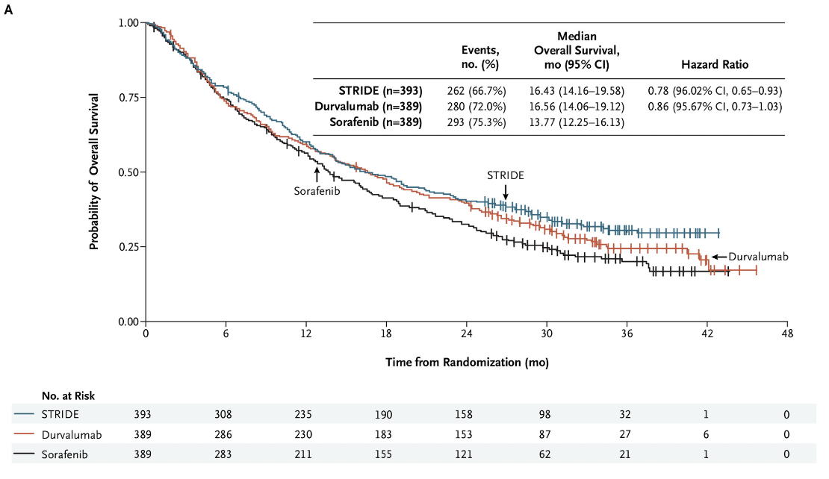
HIMALYA OS for Durvalumab + Tremelimumab 300 mg vs Sorafenib
and Durvalumab vs Sorafenib
CC Ghassan Abou-Alfa, MD, MBA
Abou-Alfa GK et al. NEJM Evidence. Published June 6, 2022. DOI:https://doi.org/10.1056/EVIDoa2100070

Slide 6
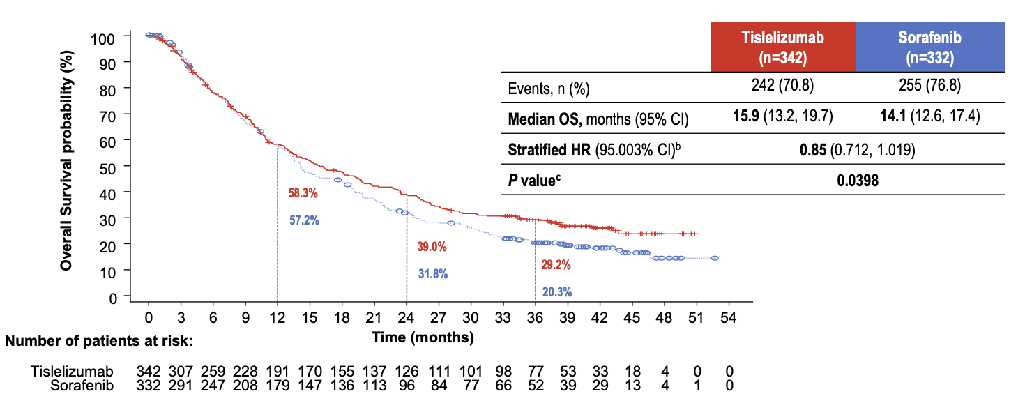
Tislelizumab vs Sorafenib Primary Endpoint: OS
Qin S et al. ESMO 2022;Abstract LBA36.
CC Ghassan Abou-Alfa, MD, MBA
Notes:
No difference OS
Met pre-specified NI margin of 95% CI upper limit being <1.08

Slide 7
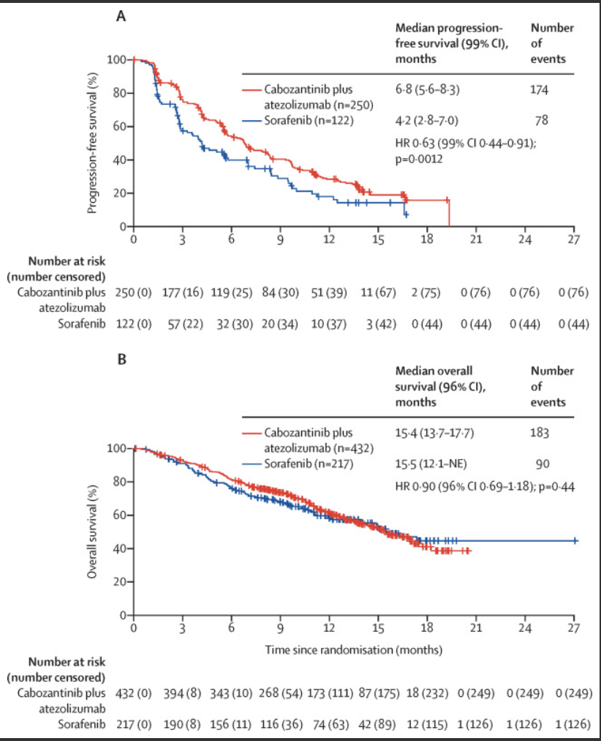
Kelley RK et al. Lancet Oncol 2022;23(8):995-1008.
Cabozantinib plus Atezolizumab
versus Sorafenib
CC Ghassan Abou-Alfa, MD, MBA
Notes:
No difference OS
Met pre-specified NI margin of 95% CI upper limit being <1.08

Slide 8
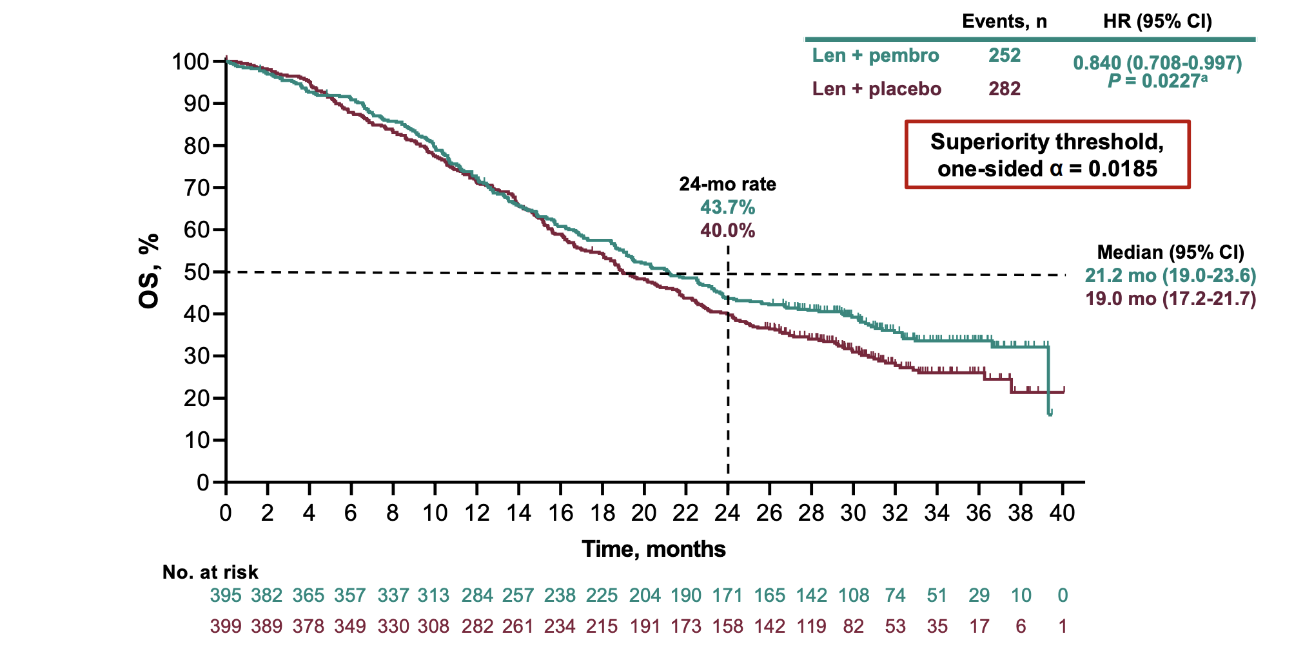
LEAP-002
Finn RS et al. ESMO 2022;Abstract LBA34.
CC Ghassan Abou-Alfa, MD, MBA

Slide 9
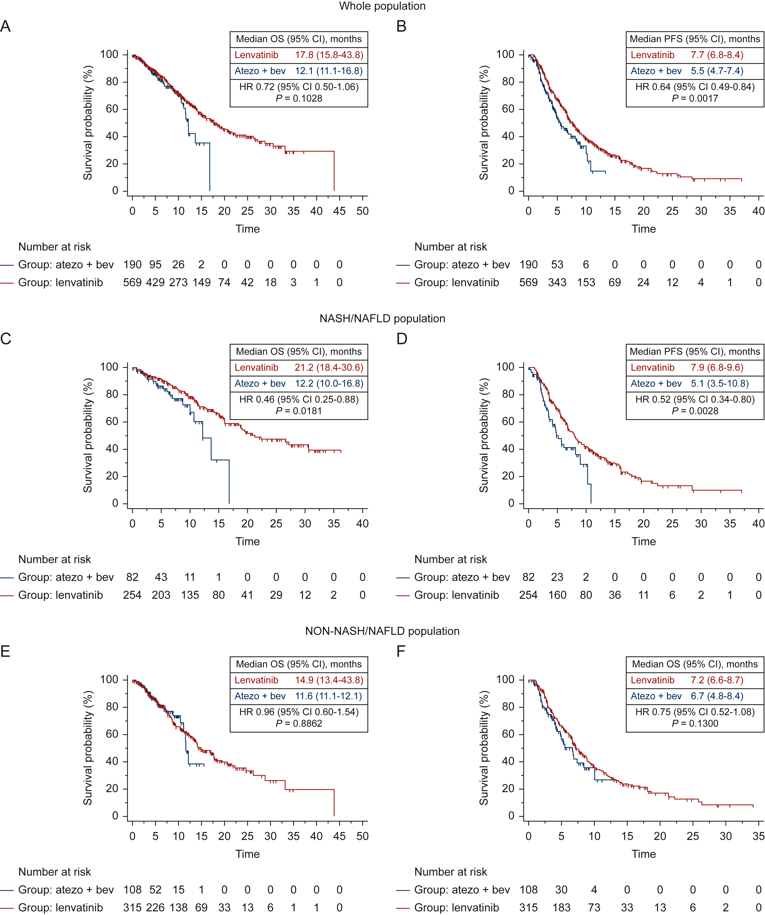
Atezolizumab plus Bevacizumab versus Lenvatinib or Sorafenib
Rimini M et al. ESMO Open 2022;7(6):100591.
CC Ghassan Abou-Alfa, MD, MBA
Notes:
Propensity score matching (PSM) is a quasi-experimental method in which the researcher uses statistical techniques to construct an artificial control group by matching each treated unit with a non-treated unit of similar characteristics. Using these matches, the researcher can estimate the impact of an intervention.

Slide 10
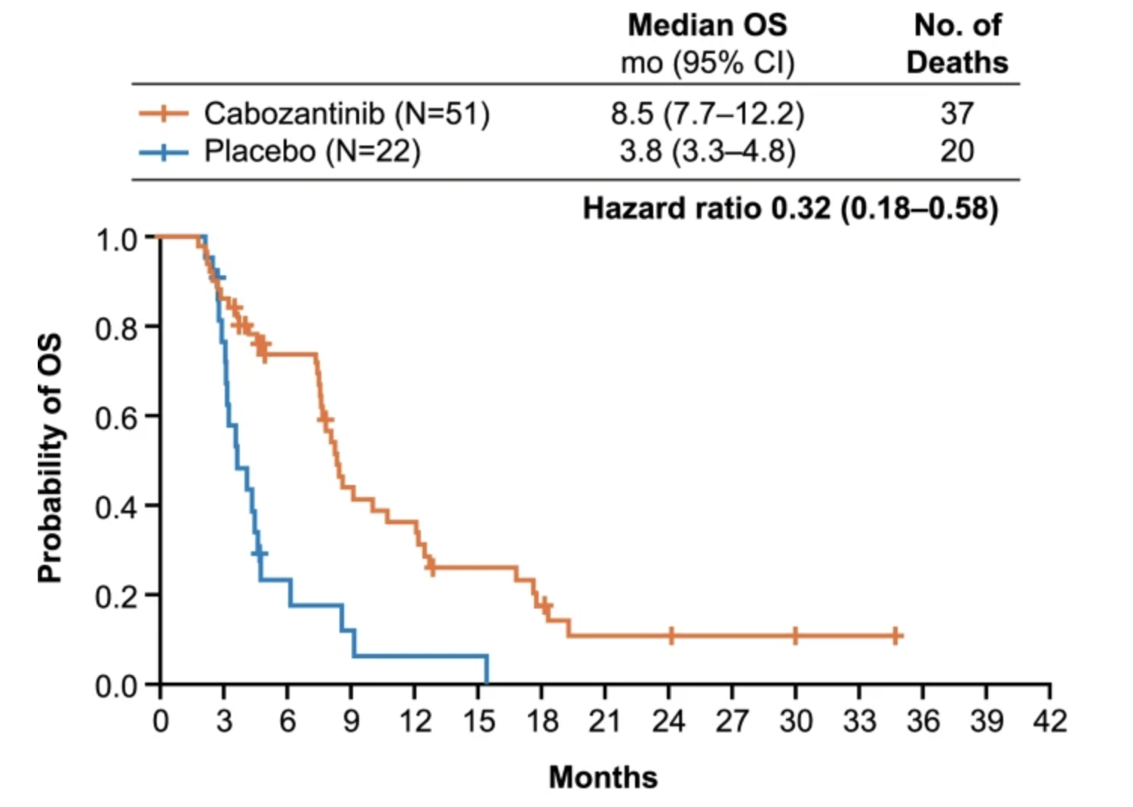
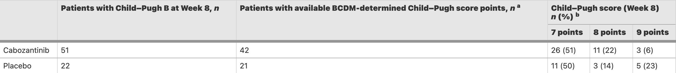
Cabozantinib and Worsening Child Pugh Score
El-Khoueiry AB et al. BMC Cancer 2022;22(1):377.
CC Ghassan Abou-Alfa, MD, MBA
Notes:
Propensity score matching (PSM) is a quasi-experimental method in which the researcher uses statistical techniques to construct an artificial control group by matching each treated unit with a non-treated unit of similar characteristics. Using these matches, the researcher can estimate the impact of an intervention.

Slide 11
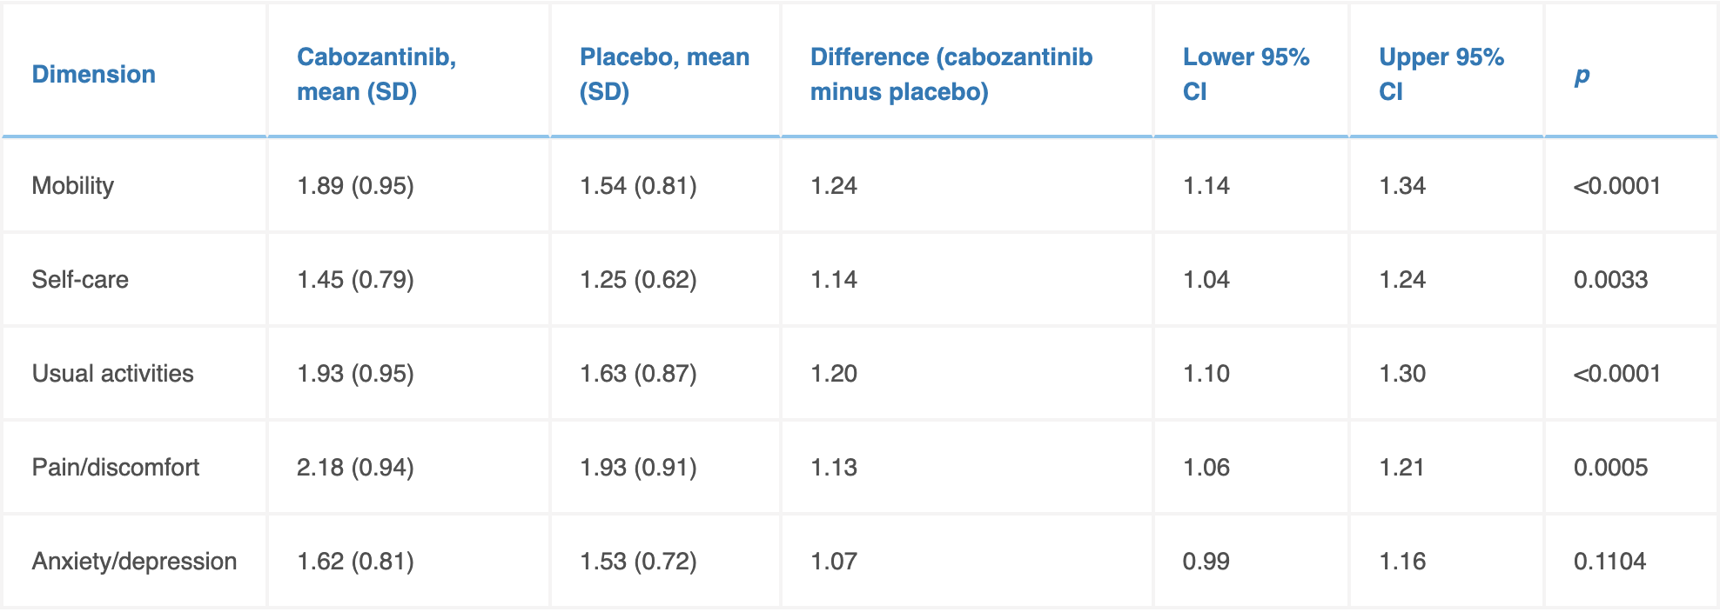
Cabozantinib and Quality of life in Patients with Advanced HCC
Freemantle N et al. Eur J Cancer 2022;168:91-8.
CC Ghassan Abou-Alfa, MD, MBA
Notes:
Propensity score matching (PSM) is a quasi-experimental method in which the researcher uses statistical techniques to construct an artificial control group by matching each treated unit with a non-treated unit of similar characteristics. Using these matches, the researcher can estimate the impact of an intervention.

Slide 12
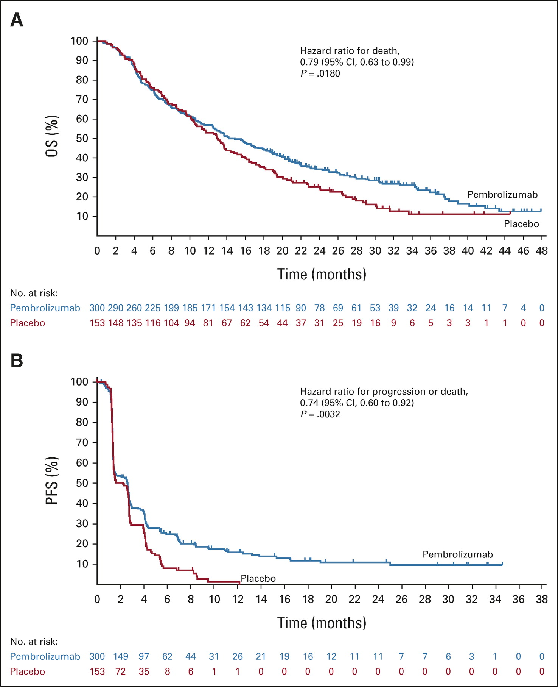
Second-line Pembrolizumab versus Placebo in Patients from Asia with Advanced HCC
Qin S et al. J Clin Oncol 2023;41(7):1434-43.
CC Ghassan Abou-Alfa, MD, MBA

Slide 13
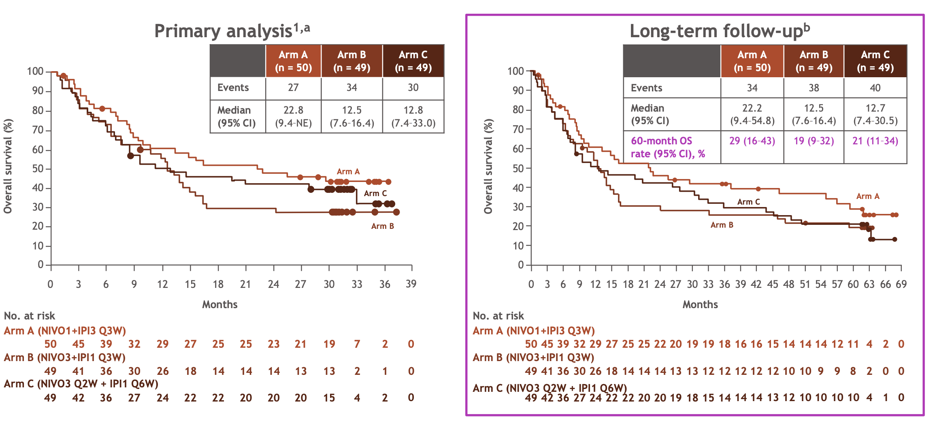
NIVO 1 mg/kg + IPI 3 mg/kg Q3W (4 doses) 5 years Follow-Up
Melero I et al. ESMO World Congress on Gastrointestinal Cancer 2022;Abstract SO-12.
CC Ghassan Abou-Alfa, MD, MBA

Slide 14
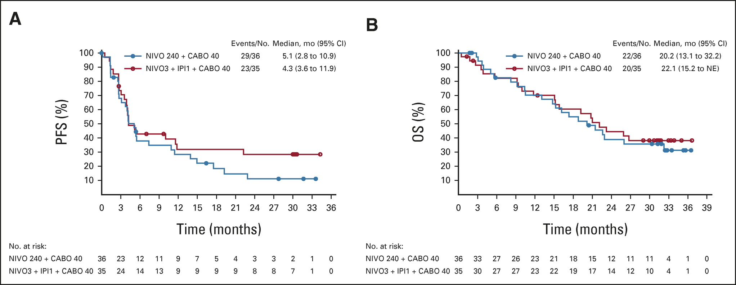
Nivolumab plus Cabozantinib +/- Ipilimumab
Yau T et al. J Clin Oncol 2023;41(9):1747-57.
CC Ghassan Abou-Alfa, MD, MBA

Slide 15
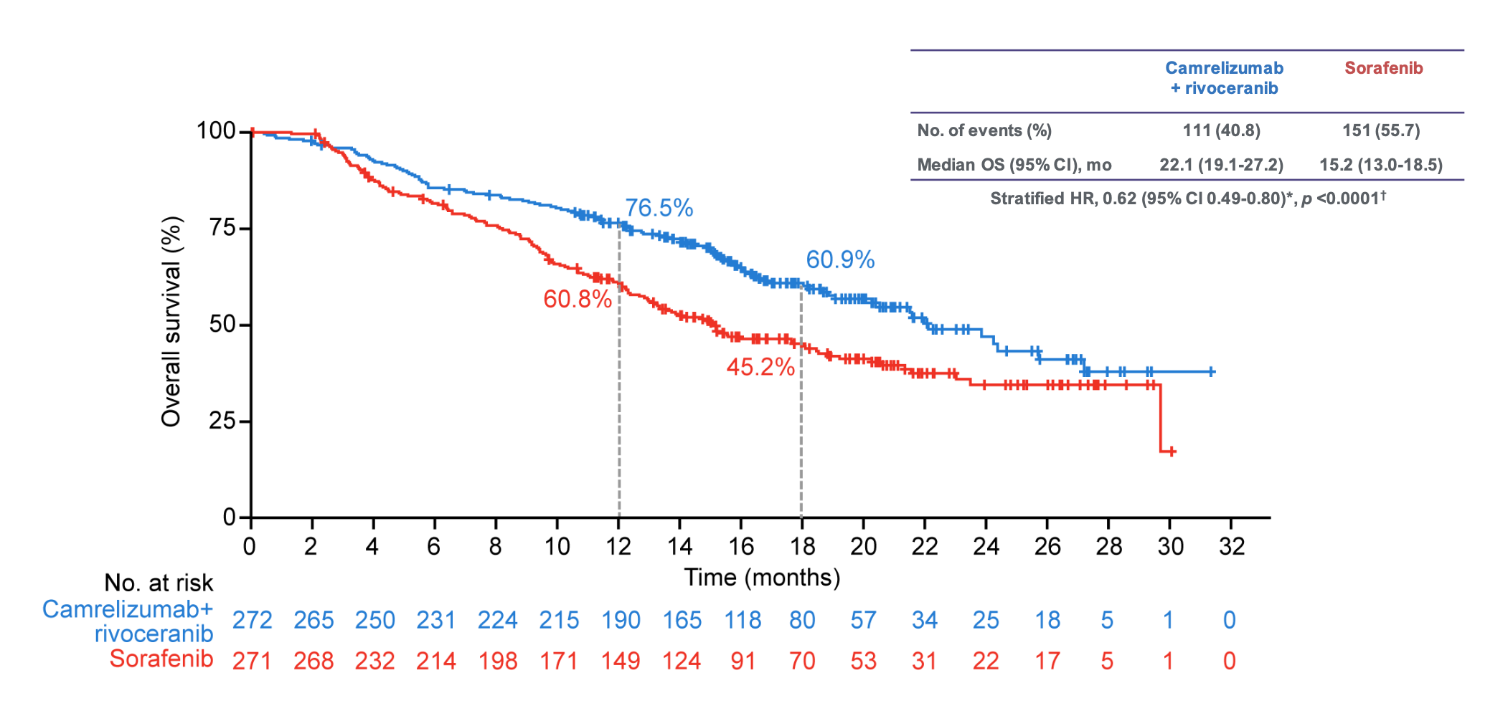
Camrelizumab plus Rivoceranib v Sorafenib
Qin S, et al., ESMO Paris 2022
CC Ghassan Abou-Alfa, MD, MBA

Slide 16
First Line Systemic Therapy
Regions | n | Sorafenib | Lenvatinib | Atezolizumab plus bevacizumab | Doxorubicin | FOLFOX | Don’t use any (availability, cost)
North South | 167 | 84% | 11% | 11% | 5% | 2% | 3%
East West | 127 | 66% | 2% | 4% | 13% | 1% | 8%
Central | 30 | 27% | 0 | 7% | 10% | 10% | 47%
Abou-Alfa, GK , et al. AORTIC, Senegal, Dakkar, Nov 7, 2021
CC Ghassan Abou-Alfa, MD, MBA

Slide 17
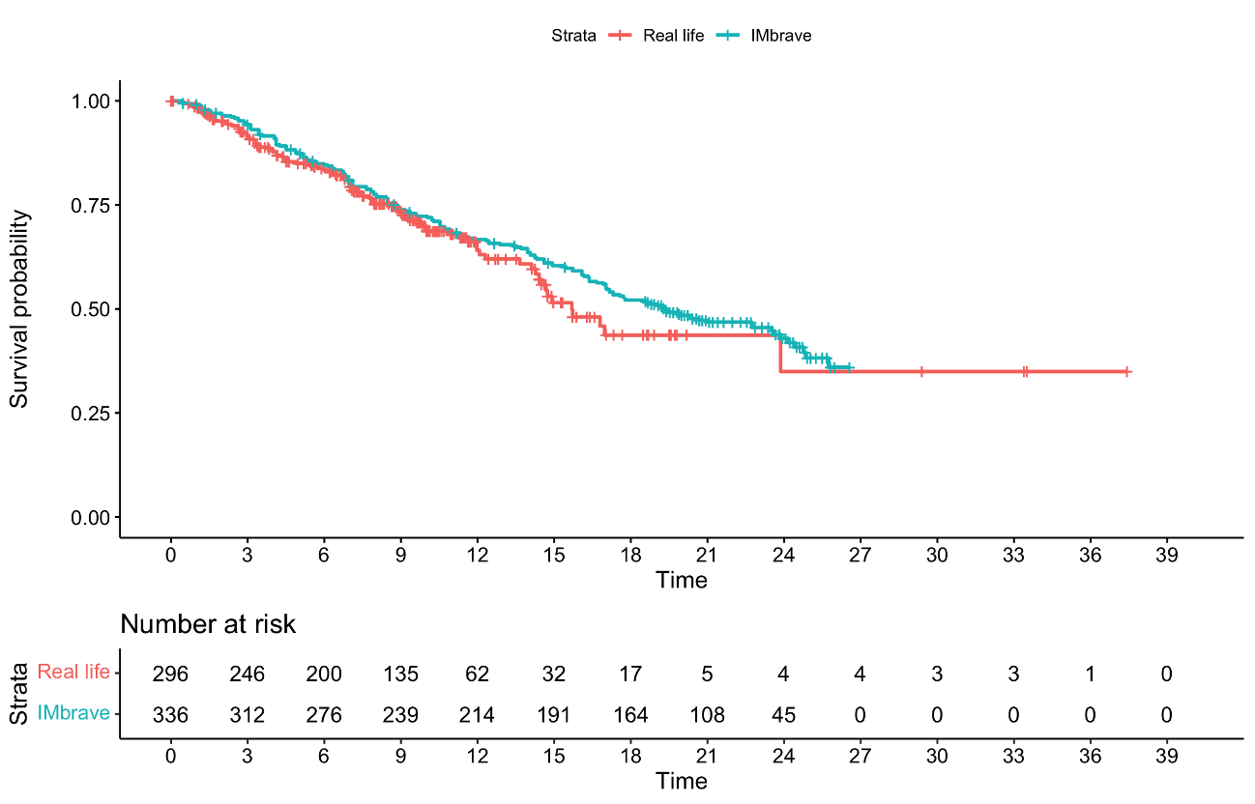
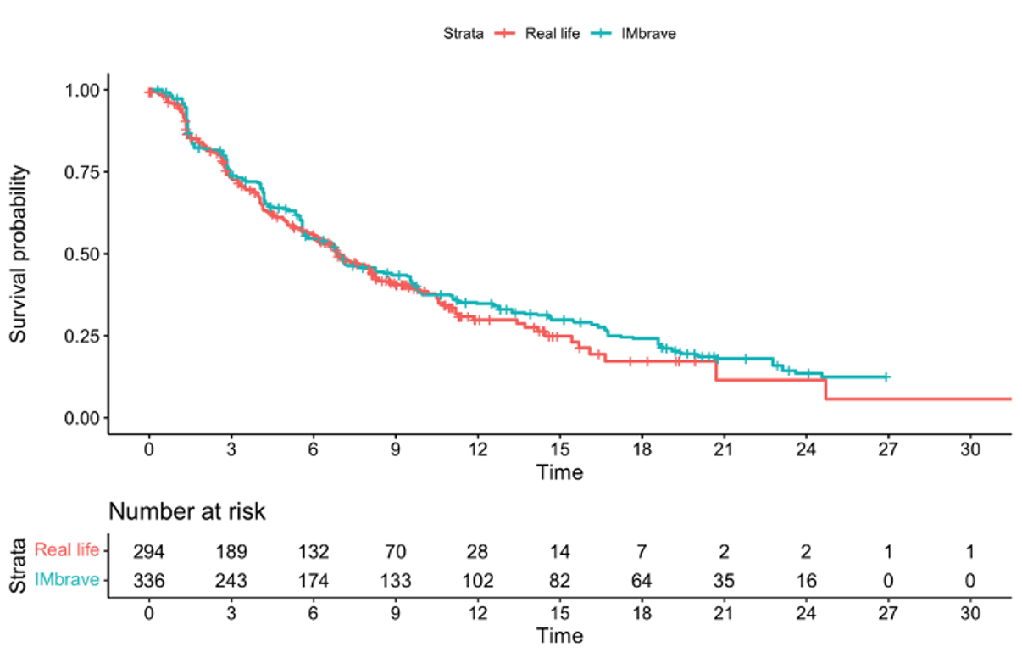
Atezolizumab plus Bevacizumab AB-Real International Study
AB-Real | IMbrave150
mOS: 15.74 months (95%CI: 14.4-NA) | mOS: 19.20 months (95%CI: 17.0-23.7)
HR: 0.87 (95%CI: 0.67-1.13; p=0.3)
AB-Real | IMbrave150
mPFS: 6.91 (95%CI: 6.1-8.3) | mPFS: 6.91 months (95%CI: 5.7- 8.6)
HR: 0.90 (95%CI: 0.74-1.10; p=0.3)
Fulgenzi C, et al. ILCA Madrid September 4, 2022
CC Ghassan Abou-Alfa, MD, MBA

Slide 18
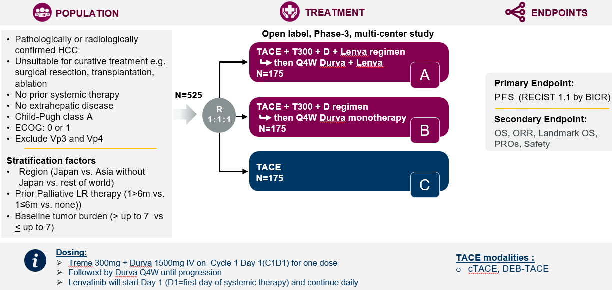
EMERALD-3
Secondary Endpoints:
CC Ghassan Abou-Alfa, MD, MBA

