Slide 1
Cases from the Community: Investigators
Discuss Available Research Guiding the Care of Patients with Hepatobiliary Cancers
Part 3 of a 3-Part CME Symposium Series Held in Conjunction
with the 2023 ASCO Gastrointestinal Cancers Symposium
Friday, January 20, 2023
6:00 PM – 7:30 PM PT
Faculty
Richard S Finn, MD
Lipika Goyal, MD, MPhil
Professor Arndt Vogel, MD
Moderator
Robin K (Katie) Kelley, MD

Slide 2




Faculty
Richard S Finn, MD
Professor, Department of Medicine
Division of Hematology/Oncology
David Geffen School of Medicine at UCLA
Director, Signal Transduction and Therapeutics Program
Jonsson Comprehensive Cancer Center at UCLA
Los Angeles, California
Professor Arndt Vogel, MD
Managing Senior Consultant
Department of Gastroenterology,
Hepatology and Endocrinology
Hannover Medical School
Hannover, Germany
Lipika Goyal, MD, MPhil
Director of Gastrointestinal Oncology
Stanford Cancer Center
Associate Professor
Stanford University School of Medicine
Palo Alto, California
Moderator
Robin K (Katie) Kelley, MD
Professor of Clinical Medicine
Division of Hematology/Oncology
Helen Diller Family Comprehensive
Cancer Center
University of California, San Francisco (UCSF)
San Francisco, California

Slide 3
Commercial Support
This activity is supported by educational grants from AstraZeneca Pharmaceuticals LP, Bayer HealthCare Pharmaceuticals, Eisai Inc, Exelixis Inc, Genentech, a member of the Roche Group, Incyte Corporation, and Merck.
Research To Practice CME Planning Committee Members,
Staff and Reviewers
Planners, scientific staff and independent reviewers for Research To Practice have no relevant conflicts of interest to disclose.

Slide 4
Richard S Finn, MD — Disclosures
Faculty
Advisory Committee | CStone Pharmaceuticals
Consulting Agreements | AstraZeneca Pharmaceuticals LP, Bayer HealthCare Pharmaceuticals, Bristol-Myers Squibb Company, Eisai Inc, Exelixis Inc, Genentech, a member of the Roche Group, Hengrui Therapeutics Inc, Lilly, Merck, Pfizer Inc
Contracted Research (to Institution) | Adaptimmune, Bayer HealthCare Pharmaceuticals, Bristol-Myers Squibb Company, Eisai Inc, Genentech, a member of the Roche Group, Lilly, Merck, Pfizer Inc
Data and Safety Monitoring Board/Committee | AstraZeneca Pharmaceuticals LP, Hengrui Therapeutics Inc
Speakers Bureau | Genentech, a member of the Roche Group

Slide 5
Lipika Goyal, MD, MPhil — Disclosures
Faculty
Advisory Board and Consulting Agreements | Alentis Therapeutics AG, Black Diamond Therapeutics Inc, Exelixis Inc, Genentech, a member of the Roche Group, H3 Biomedicine, Incyte Corporation, Kinnate Biopharma, Merck, QED Therapeutics, Servier Pharmaceuticals LLC, Sirtex Medical Ltd, Surface Oncology, Taiho Oncology Inc, TransThera Biosciences, Tyra Biosciences
Data and Safety Monitoring Board/Committee | AstraZeneca Pharmaceuticals LP

Slide 6
Professor Arndt Vogel, MD — Disclosures
Faculty
Consulting Agreements | Amgen Inc, AstraZeneca Pharmaceuticals LP, BeiGene Ltd, Böhringer Mannheim, Bristol-Myers Squibb Company, BTG, Daiichi Sankyo Inc, Eisai Inc, Incyte Corporation, Ipsen Biopharmaceuticals Inc, Merck Sharp & Dohme LLC, Pierre Fabre, Roche Laboratories Inc, Servier Pharmaceuticals LLC, Sirtex Medical Ltd, Taiho Oncology Inc, Terumo Medical Corporation
Speaker | Advanced Accelerator Applications, Amgen Inc, AstraZeneca Pharmaceuticals LP, BeiGene Ltd, Böhringer Mannheim, Bristol-Myers Squibb Company, BTG, Daiichi Sankyo Inc, Eisai Inc, GlaxoSmithKline, Incyte Corporation, Ipsen Biopharmaceuticals Inc, Jiangsu Hengrui Medicine Co Ltd, Merck Sharp & Dohme LLC, Pierre Fabre, Roche Laboratories Inc, Servier Pharmaceuticals LLC, Sirtex Medical Ltd, Taiho Oncology Inc, Terumo Medical Corporation

Slide 7
Robin K Kelley, MD — Disclosures
Moderator
Advisory Board | Kinnate Biopharma
Advisory Board or Steering Committee (to Institution) | Agios Pharmaceuticals Inc, AstraZeneca Pharmaceuticals LP, Exelixis Inc, Ipsen Biopharmaceuticals Inc, Merck
Advisory Committee | Agios Pharmaceuticals Inc, AstraZeneca Pharmaceuticals LP, Exelixis Inc, Ipsen Biopharmaceuticals Inc, Kinnate Biopharma, Merck
Research Funding to Institution | Agios Pharmaceuticals Inc, AstraZeneca Pharmaceuticals LP, Bayer HealthCare Pharmaceuticals, Bristol-Myers Squibb Company, EMD Serono Inc, Exelixis Inc, Genentech, a member of the Roche Group, Lilly, Loxo Oncology Inc, a wholly owned subsidiary of Eli Lilly & Company, Merck, Novartis, Partner Therapeutics, QED Therapeutics, Relay Therapeutics, Surface Oncology, Taiho Oncology Inc
Uncompensated Service on IDMC | Genentech, a member of the Roche Group, Merck

Slide 8
Agenda
Module 1: First-Line Treatment for Advanced Hepatocellular Carcinoma (HCC) — Dr Finn
Module 2: Selection and Sequencing of Therapies for Relapsed/Refractory HCC — Dr Kelley
Module 3: Current and Future Role of Immunotherapy in the Treatment
of Advanced Biliary Tract Cancers (BTCs) — Prof Vogel
Module 4: Integration of Targeted Therapy into the Management of Advanced BTCs — Dr Goyal

Slide 9
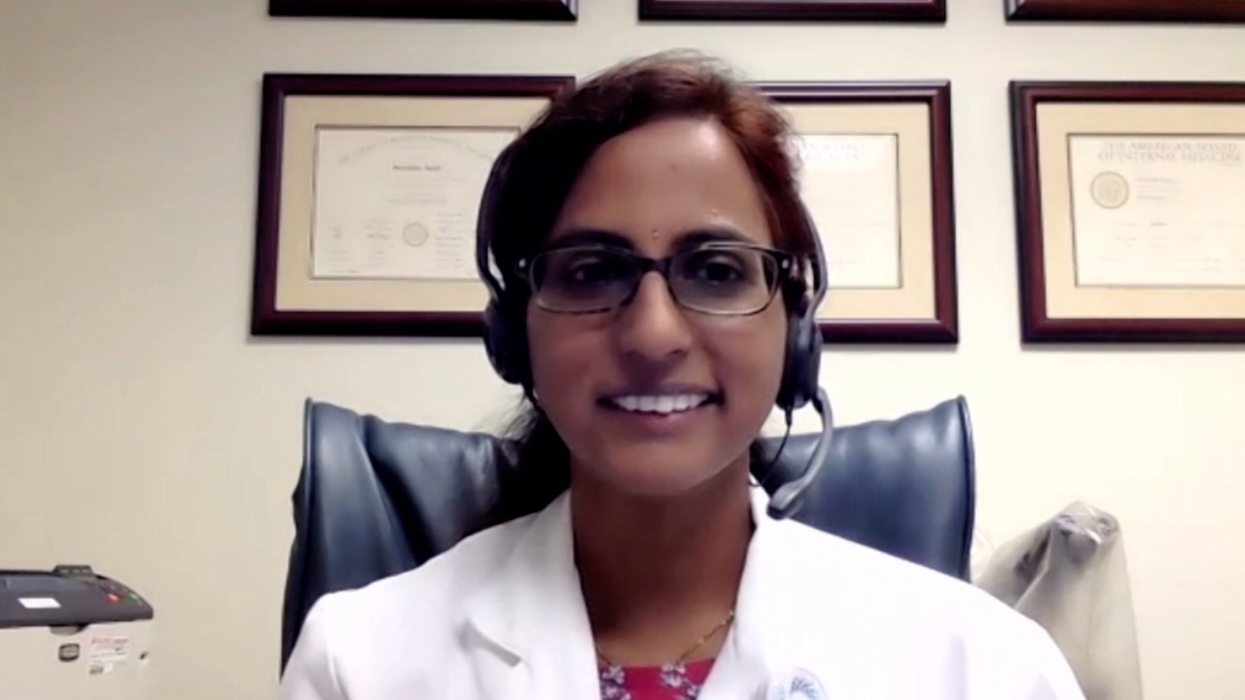

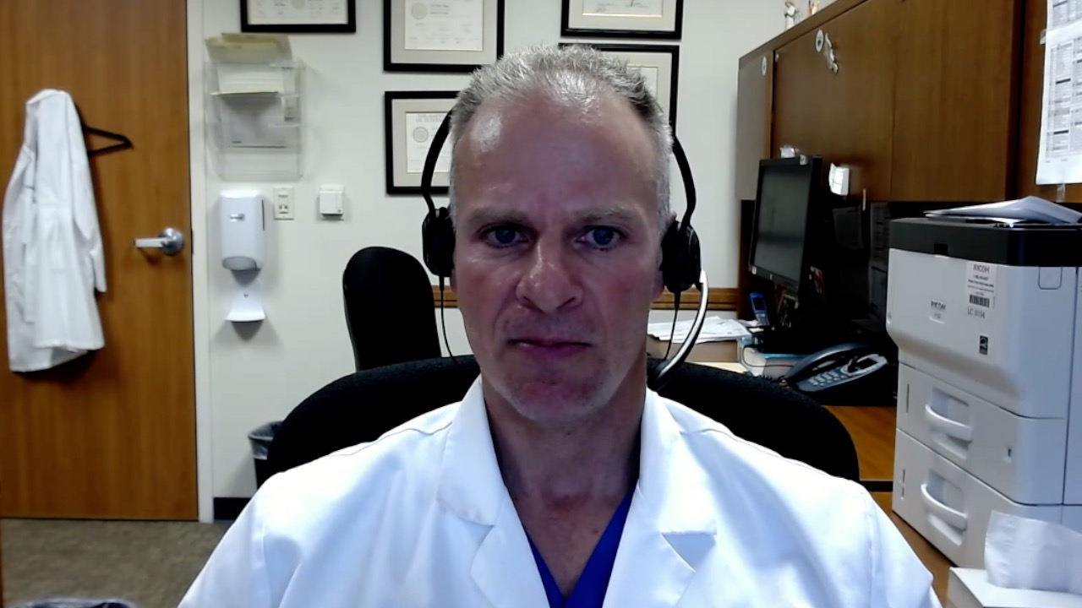

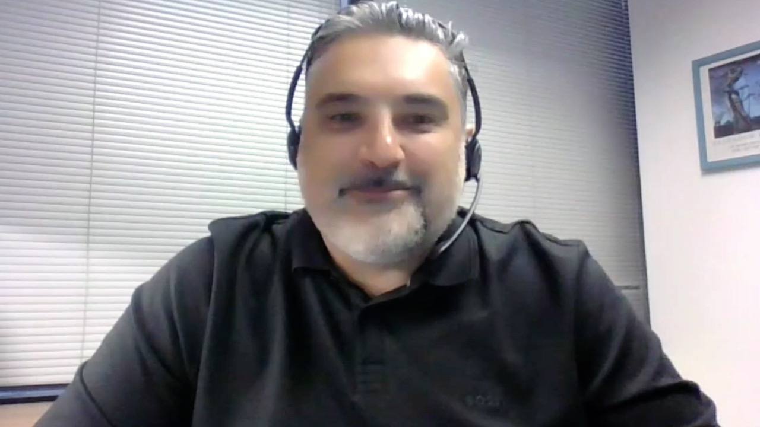
Susmitha Apuri, MD
Florida Cancer Specialists
Lutz, Florida
Lionel A Kankeu Fonkoua, MD
Mayo Clinic
Rochester, Minnesota
Warren S Brenner, MD
Lynn Cancer Institute
Boca Raton, Florida
Jeremy Lorber, MD
Cedars-Sinai Medical Center
Beverly Hills, California
Farshid Dayyani, MD, PhD
Stern Center for Cancer Clinical Trials and Research
Orange, California

Slide 10
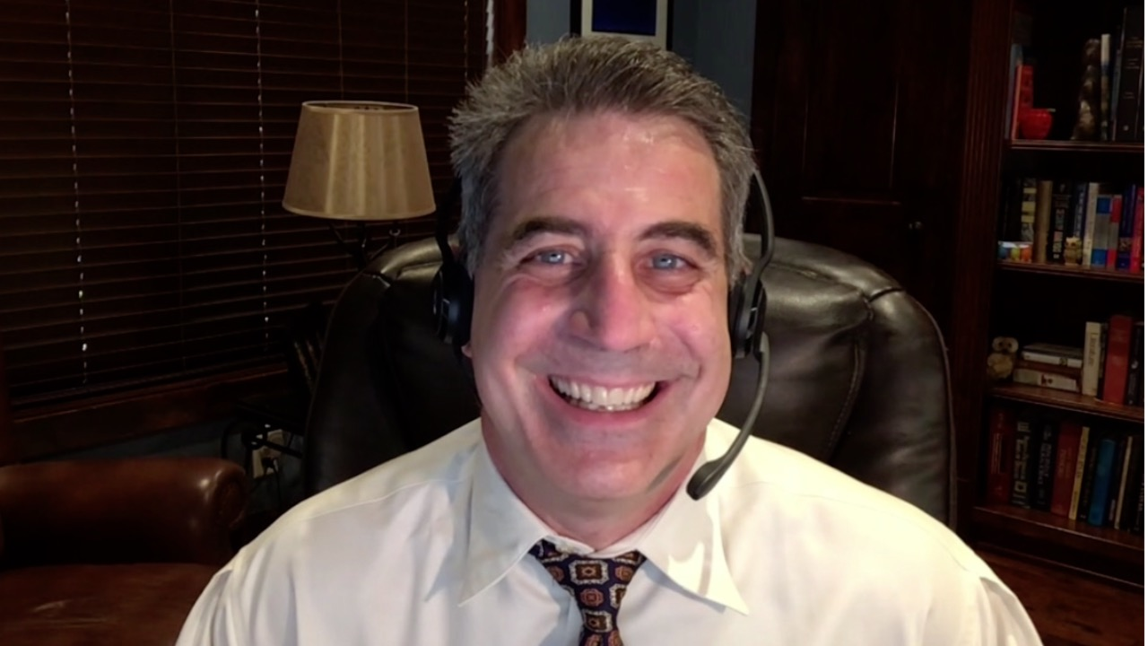

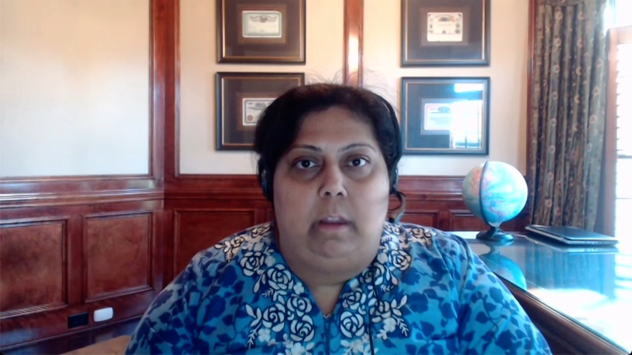
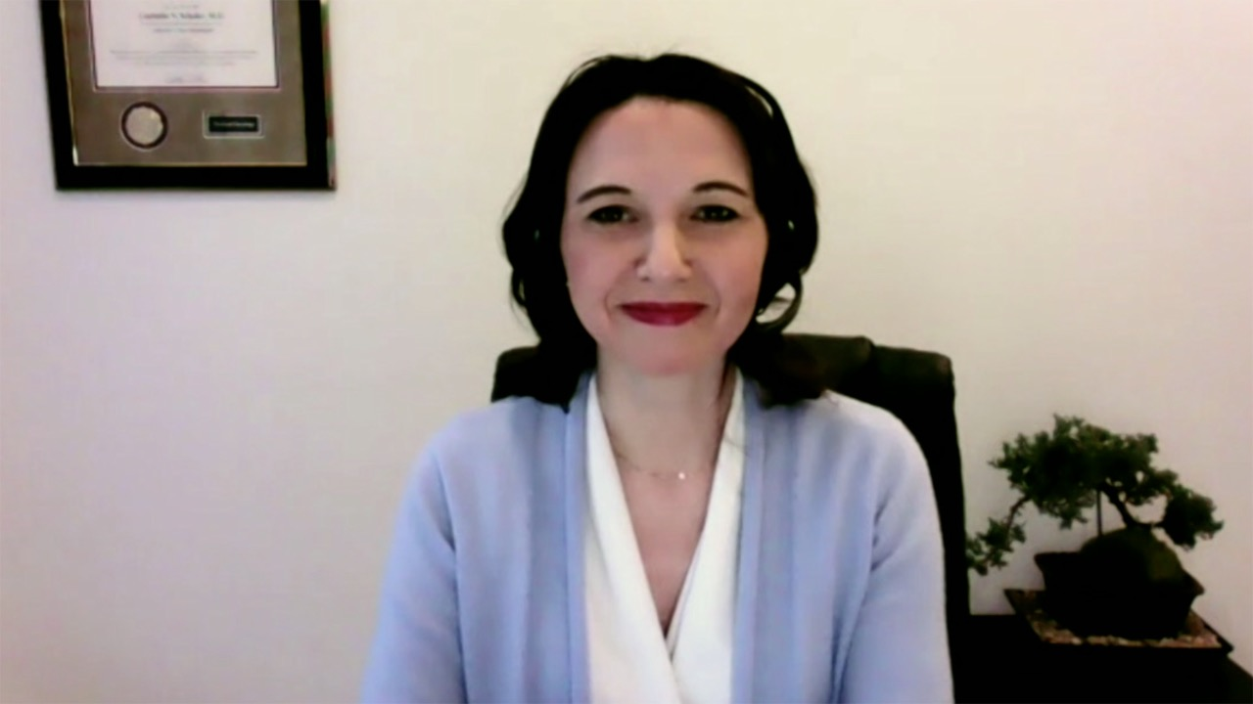
Joseph Martins, MD
UT Health Science Center
Tyler, Texas
Priya Rudolph, MD
Georgia Cancer Specialists
Athens, Georgia
Niyati A Nathwani, MD
Carolina Blood and Cancer Care Associates
Charlotte, North Carolina
Liudmila N Schafer, MD
Saint Luke’s Cancer Institute
Kansas City, Missouri

Slide 11
MODULE 1: First-Line Treatment for Advanced Hepatocellular Carcinoma (HCC) — Dr Finn

Slide 12
Case Presentation: 70-year-old man with newly diagnosed metastatic HCC receives atezolizumab/bevacizumab
Dr Warren Brenner (Boca Raton, Florida)

Slide 13
QUESTIONS FOR THE FACULTY
“My questions for the investigators are…
Is there a role for genetic profiling in patients with HCC? Is a biopsy really necessary in patients with clinical HCC and high alpha-fetoprotein (greater than 400)?
Warren S Brenner, MD
How are the investigators choosing between atezolizumab and bevacizumab and dual checkpoint inhibitor therapy based on the HIMALAYA trial?
Are there any clinical parameters to decide between the two regimens? Are patients with hepatitis-associated HCC more likely to respond to one regimen versus another?
Do all patients with HCC receiving bevacizumab require upper endoscopy prior to initiating therapy?”

Slide 14
Case Presentation: 59-year-old woman with a history of hepatitis C and chronic kidney disease on dialysis with localized HCC s/p surgical resection — the patient developed metastatic disease 10 months later
Dr Liudmila Schafer (Kansas City, Missouri)

Slide 15
QUESTIONS FOR THE FACULTY
“For most of the patients we see after primary surgery we follow up with surveillance, but is there a role for adjuvant systemic therapy, including immunotherapy?
This patient developed metastatic disease to the liver and nodes within 10 months of surgery but otherwise has a good performance status, although she is on dialysis. What treatment would you recommend?”
Liudmila N Schafer, MD

Slide 16

Current Role of Systemic Therapy
in Front-line HCC
Richard S. Finn, MD
Professor of Clinical Medicine
Division of Hematology/Oncology
Director, Signal Transduction and Therapeutics Program
Jonsson Comprehensive Cancer Center
Geffen School of Medicine at UCLA

Slide 17
Front-line

Slide 18
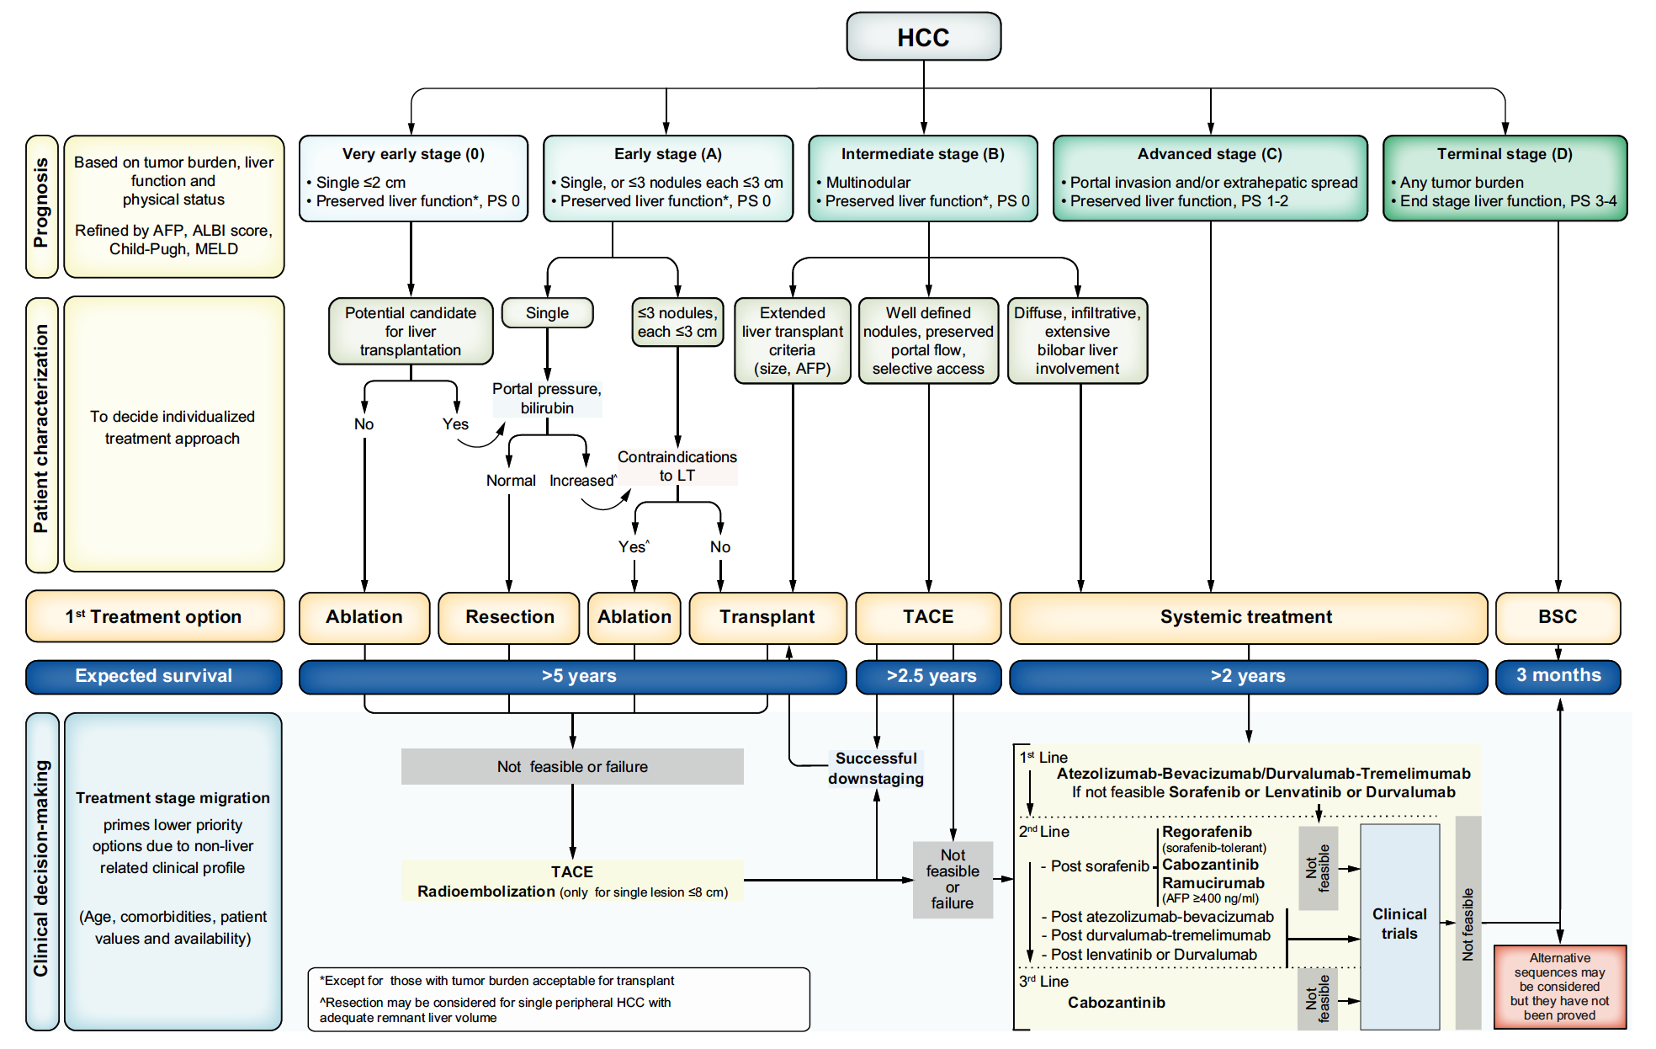
BCLC management of HCC-2022: Where to use Systemic Therapy
Reig M et al J Hep 2022
Notes:
18
5
5

Slide 19
IMbrave150 Study Design
Finn et al. New Engl J Med. 2020
Key eligibility
Locally advanced or metastatic and/or unresectable HCC
No prior systemic therapy
ECOG PS 0-1
Child-Pugh class A liver function
Stratification
  Region (Asia excluding Japanª/Rest of world)
  ECOG (0/1)
  Macrovascular invasion and/or extrahepatic spread (Presence/Absence)
  Baseline AFP
  (<400/≥400 ng/mL)
Atezolizumab
1200 mg IV q3w
+
Bevacizumab
15 mg/kg q3w
Until loss of clinical benefit or un-acceptable toxicity^{b}
Survival follow-up
R
2:1
N = 501
Sorafenib 400 mg bid
(open-label)
Co-primary endpoints
OS
IRF-assessed PFS per RECIST 1.1
Secondary endpoints included:
IRF-assessed ORR, DOR per RECIST 1.1 and HCC mRECIST^{b}
PROs: TTD^{c} of QOL, physical and role functioning (EORTC QLQ-C30)
Safety and tolerability assessed based on the nature, frequency and severity of AEs per NCI CTCAE version 4.0
No exclusion for main PVT
ª Japan is included in rest of world. ^{b} Tumor assessment by computed tomography or magnetic resonance imaging was done at baseline and every 6 weeks until 54 weeks, then every 9 weeks thereafter.
^{c} Time from randomization to first decrease from baseline of ≥ 10 points maintained for 2 consecutive assessments or 1 assessment followed by death from any cause within 3 weeks.
AFP, α-fetoprotein; CTCAE, Common Terminology Criteria for Adverse Events; ECOG PS, Eastern Cooperative Oncology Group Performance Status; EORTC QLQ-C30, European Organization for Research and Treatment of Cancer quality-of-life questionnaire for cancer; IRF, independent review facility; mRECIST, modified RECIST; NCI, National Cancer Institute; PRO, patient-reported outcomes; QOL, quality of life; TTD, time to deterioration.

Slide 20
Baseline patient characteristics (ITT)ª
n (%) | Atezo + Bev (n = 336) | Sorafenib (n = 165)
Median age (range), years | 64 (26-88) | 66 (33-87)
Male | 277 (82) | 137 (83)
Asia excluding Japan│rest of world^{b} | 133 (40) │203 (60) | 68 (41) │97 (59)
ECOG PS 0 │1 | 209 (62) │127 (38) | 103 (62) │62 (38)
Child-Pugh score A5│A6 | 239 (72) │94 (28) | 121 (73) │44 (27)
Barcelona Clinic Liver Cancer stage B│C | 52 (15) │276 (82) | 26 (16) │133 (81)
AFP at baseline ≥ 400 ng/mL | 126 (38) | 61 (37)
MVI present | 129 (38) | 71 (43)
EHS present | 212 (63) | 93 (56)
MVI and/or EHS present | 258 (77) | 120 (73)
Varices at baseline | 88 (26) | 43 (26)
Varices treated at baseline | 36 (11) | 23 (14)
HCC etiology
Hepatitis B | 164 (49) | 76 (46)
Hepatitis C | 72 (21) | 36 (22)
Non-viral^{c} | 100 (30) | 53 (32)
EHS, extrahepatic spread; ITT, intention to treat, MVI, macrovascular invasion. ª All randomised patients. ^{b} Includes United States, Australia, New Zealand, and Japan. ^{c} Includes alcohol, other and unknown non–hepatitis B and C causes.
Finn, N Engl J Med 2020.

Slide 21
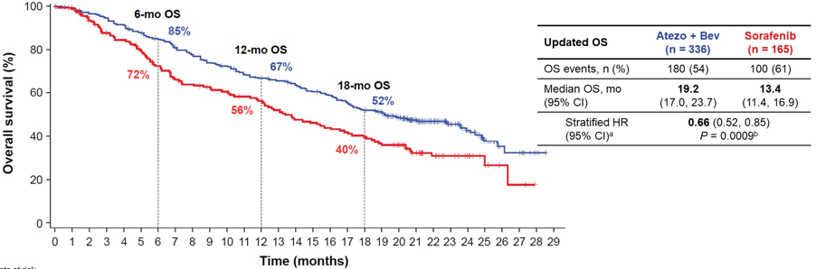
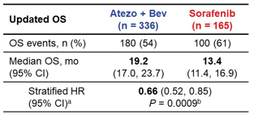
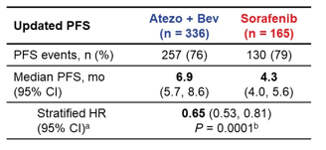
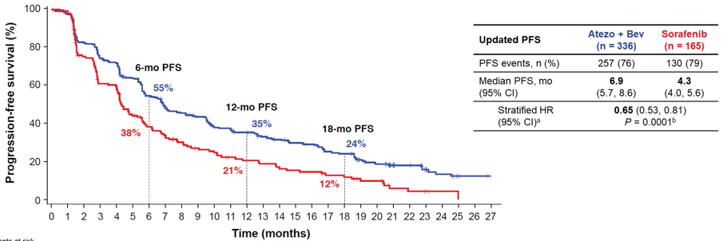
IMbrave150 Trial
Key Efficacy Data: Updated OS and PFS
  Primary analysis OS/PFS HR: 0.58/0.59 (median follow-up: 8.6 mo)
  Median follow-up: 15.6 mo
Finn RS et al NEJM 2020, Finn RS et al ASCO GI 2021, Cheng AL J Hep 2022

Slide 22
Updated response and duration of response
 | Updated analysisª
 | RECIST 1.1 |  | HCC mRECIST
 | Atezo + Bev (n = 326) | Sorafenib (n = 159) | Atezo + Bev (n = 325) | Sorafenib (n = 158)
Confirmed ORR (95% CI), % | 30 (25, 35) | 11 (7, 17) | 35 (30, 41) | 14 (9, 20)
CR, n (%) | 25 (8) | 1 (< 1) | 39 (12) | 4 (3)
PR, n (%) | 72 (22) | 17 (11) | 76 (23) | 18 (11)
SD, n (%) | 144 (44) | 69 (43) | 121 (37) | 65 (41)
DCR, n (%) | 241 (74) | 87 (55) | 236 (73) | 87 (55)
PD, n (%) | 63 (19) | 40 (25) | 65 (20) | 40 (25)
Ongoing response, n (%) | 54 (56) | 5 (28) | 58 (50) | 6 (27)
Median DOR (95% CI), mo^{b} | 18.1 (14.6, NE) | 14.9 (4.9, 17.0) | 16.3 (13.1, 21.4) | 12.6 (6.1, 17.7)
Cheng AL J Hep 2022
Clinical cutoff: August 31, 2020; median follow-up: 15.6 mo. DCR, disease control rate.
ª Only patients with measurable disease at baseline were included in the analysis of ORR.
^{b} Only confirmed responders were included in the analysis of ORR and DOR.

Slide 23
TRAEs: ≥ 10% any grade in either arm
Atezo + Bev (n = 329)
Sorafenib (n = 156)
Hypertension
Proteinuria
Fatigue
AST increase
Pruritus
Infusion-related reaction
Diarrhoea
ALT increase
Decreased appetite
Rash
All-grade AEs
All-grade AEs
Nausea
Grade 3-4 AEs
Grade 3-4 AEs
Asthenia
Alopecia
Palmar-plantar erythrodysesthesia
50%
40%
30%
20%
10%
0
10%
20%
30%
40%
50%
Finn et al , N Engl J Med 2020.

Slide 24
HIMALAYA study design
HIMALAYA was an open-label, multicenter, global, Phase 3 trial
Study population
Patients with confirmed uHCC
BCLC B (not eligible for locoregional therapy) and C
No prior systemic therapy
ECOG PS 0–1
Child-Pugh A
No main portal vein thrombosis
EGD was not required
Stratification factors
Macrovascular invasion: Y / N
Etiology of liver disease: HBV / HCV / others
Performance status: ECOG 0 / 1
Primary objective
OS for T300+D vs sorafenib
Key secondary objective
OS for durvalumab vs sorafenib
Additional secondary objectives
PFS, ORR, and DoR as assessed by investigator per RECIST v1.1
Safety
Multiple testing procedure
T300+D (n=393):
Tremelimumab 300 mg × 1 dose + durvalumab 1500 mg Q4W*
OS superiority for T300+D vs sorafenib
Durvalumab (n=389):
Durvalumab monotherapy
1500 mg Q4W*
OS noninferiority for durvalumab vs sorafenib
Noninferiority margin: 1.08
R
N=1324
Sorafenib (n=389):
Sorafenib 400 mg BID*
OS superiority for durvalumab vs sorafenib
T75+D (n=153): arm closed †
Tremelimumab 75 mg Q4W
× 4 doses + durvalumab Q4W*
*Treatment continued until disease progression. Patients with progressive disease who, in the investigator’s opinion, continued to benefit from treatment and met the criteria for treatment in the setting of progressive disease could continue treatment. †The T75+D arm was closed following a preplanned analysis of a Phase 2 study. Patients randomized to this arm (n=153) could continue treatment following arm closure. Results from this arm are not reported in this presentation.
BID, twice a day; EGD, esophagogastroduodenoscopy; Q4W, every 4 weeks.
Ghassan K Abou-Alfa, MD, MBA NEJM Evidence 2022

Slide 25
Baseline characteristics
Characteristic | T300+D (n=393) | Durvalumab (n=389) | Sorafenib (n=389)
Male sex, n (%) | 327 (83.2) | 323 (83.0) | 337 (86.6)
Median age (range), years | 65.0 (22–86) | 64.0 (20–86) | 64.0 (18–88)
Region, n (%) Asia (excluding Japan) Rest of world (including Japan) | 156 (39.7) 237 (60.3) | 167 (42.9) 222 (57.1) | 156 (40.1) 233 (59.9)
Viral etiology,*,† n (%) HBV HCV Nonviral | 122 (31.0) 110 (28.0) 161 (41.0) | 119 (30.6) 107 (27.5) 163 (41.9) | 119 (30.6) 104 (26.7) 166 (42.7)
ECOG PS, n (%) 0 1 | 244 (62.1) 148 (37.7) | 237 (60.9) 150 (38.6) | 241 (62.0) 147 (37.8)
BCLC,† n (%) B C | 77 (19.6) 316 (80.4) | 80 (20.6) 309 (79.4) | 66 (17.0) 323 (83.0)
Characteristic | T300+D (n=393) | Durvalumab (n=389) | Sorafenib (n=389)
Child-Pugh classification,† n (%) A B Missing | 392 (99.7) 0 1 (0.3) | 388 (99.7) 1 (0.3) 0 | 386 (99.2) 3 (0.8) 0
ALBI grade, n (%) 1 2 3 | 217 (55.2) 174 (44.3) 1 (0.3) | 198 (50.9) 189 (48.6) 2 (0.5) | 203 (52.2) 185 (47.6) 1 (0.3)
MVI,† n (%) | 103 (26.2) | 94 (24.2) | 100 (25.7)
EHS,† n (%) | 209 (53.2) | 212 (54.5) | 203 (52.2)
PD-L1 positive,‡ n (%) | 148 (37.7) | 154 (39.6) | 148 (38.0)
AFP ≥400 ng/ml,† n (%) | 145 (36.9) | 137 (35.2) | 124 (31.9)
*HBV: patients who tested positive for HBsAg or anti-HBc with detectable HBV DNA; HCV: patients who tested positive for HCV or had history of HCV infection; Nonviral: no active viral hepatitis identified. †Determined at screening. ‡Defined as tumor area positivity score ≥1%.
T300+D, tremelimumab 300 mg × 1 dose + durvalumab 1500 mg Q4W.
Ghassan K Abou-Alfa, MD, MBA

Slide 26
Primary objective: overall survival for T300+D vs sorafenib
 | T300+D (n=393) | Sorafenib (n=389)
OS events, n (%) | 262 (66.7) | 293 (75.3)
Median OS (95% CI), months | 16.4 (14.2–19.6) | 13.8 (12.3–16.1)
HR (96.02% CI) | 0.78 (0.65–0.92)
p-value (2-sided) | 0.0035
1.0
0.9
0.8
0.7
0.6
0.5
Probability of overall survival
0.4
HR for time up to 9 months (95% CI)
0.87 (0.68–1.11)
HR for time after 9 months (95% CI)
0.70 (0.56–0.89)
0.3
0.2
0.1
T300+D
0.0
Sorafenib
0
6
12
18
24
30
36
42
48
No. at risk
Time from randomization (months)
T300+D
393
308
235
190
158
98
32
1
0
Sorafenib
389
283
211
155
121
62
21
1
0
Data cut-off: August 27, 2021. Median duration of follow-up was 33.18 (95% CI, 31.74–34.53) months for T300+D and 32.23 (95% CI, 30.42–33.71) months for sorafenib.
CI, confidence interval; HR, hazard ratio; OS, overall survival; T300+D, tremelimumab 300 mg × 1 dose + durvalumab 1500 mg Q4W.
Ghassan K Abou-Alfa, MD, MBA NEJM Evidence 2022

Slide 27
Secondary objective: overall survival for durvalumab vs sorafenib
 | Durvalumab (n=389) | Sorafenib (n=389)
OS events, n (%) | 280 (72.0) | 293 (75.3)
Median OS (95% CI), months | 16.6 (14.1–19.1) | 13.8 (12.3–16.1)
HR (95.67% CI) | 0.86 (0.73–1.03)
1.0
0.9
0.8
Noninferiority margin=1.08
0.7
0.6
0.5
Probability of overall survival
0.4
HR for time up to 9 months (95% CI)
0.98 (0.77–1.24)
HR for time after 9 months (95% CI)
0.77 (0.61–0.97)
0.3
0.2
0.1
Durvalumab
Sorafenib
0.0
0
6
12
18
24
30
36
42
48
No. at risk
Time from randomization (months)
389
286
230
183
153
87
27
6
0
Durvalumab
Sorafenib
389
283
211
155
121
62
21
1
0
Data cut-off: August 27, 2021. Median duration of follow-up was 32.56 (95% CI, 31.57–33.71) months for durvalumab and 32.23 (95% CI, 30.42–33.71) months for sorafenib.
CI, confidence interval; HR, hazard ratio; NI, noninferiority; OS, overall survival.
Ghassan K Abou-Alfa, MD, MBA NEJM Evidence 2022

Slide 28
Progression-free survival
PFS for T300+D vs sorafenib
1.0
 | T300+D (n=393) | Durvalumab (n=389) | Sorafenib (n=389)
PFS events, n (%) | 335 (85.2) | 345 (88.7) | 327 (84.1)
Median PFS (95% CI), months | 3.78 (3.68–5.32) | 3.65 (3.19–3.75) | 4.07 (3.75–5.49)
PFS HR* (95% CI) | 0.90 (0.77–1.05) | 1.02 (0.88–1.19) | –
Progression-free at DCO, n (%) | 49 (12.5) | 32 (8.2) | 19 (4.9)
Median TTP (95% CI), months | 5.42 (3.81–5.62) | 3.75 (3.68–5.42) | 5.55 (5.13–5.75)
Treated ≥1 cycle beyond progression, n (%)† | 182 (46.9) | 188 (48.5) | 134 (34.4)
0.8
0.6
Probability of progression-free survival
0.4
0.2
T300+D
Sorafenib
0.0
0
6
12
18
24
30
36
42
48
No. at risk
T300+D
Sorafenib
Time from randomization (months)
393
389
135
118
81
53
55
31
43
18
26
6
7
0
0
0
0
0
*Versus sorafenib. †Percent calculated from total patients in the safety analysis set: T300+D, N=388; durvalumab, N=388, sorafenib, n=374.
CI, confidence interval; DCO, data cutoff; HR, hazard ratio; PFS, progression-free survival; T300+D, tremelimumab 300 mg × 1 dose + durvalumab 1500 mg Q4W; TTP, time to progression.
Ghassan K Abou-Alfa, MD, MBA NEJM Evidence 2022

Slide 29
Tumor response
 | T300+D (n=393) | Durvalumab (n=389) | Sorafenib (n=389)
ORR,* n (%) | 79 (20.1) | 66 (17.0) | 20 (5.1)
CR, n (%) | 12 (3.1) | 6 (1.5) | 0
PR, n (%) | 67 (17.0) | 60 (15.4) | 20 (5.1)
SD,† n (%) | 157 (39.9) | 147 (37.8) | 216 (55.5)
PD, n (%) | 157 (39.9) | 176 (45.2) | 153 (39.3)
DCR, % | 60.1 | 54.8 | 60.7
Median DoR,‡ months 25th percentile 75th percentile | 22.34 8.54 NR | 16.82 7.43 NR | 18.43 6.51 25.99
Median TTR (95% CI), months | 2.17 (1.84–3.98) | 2.09 (1.87–3.98) | 3.78 (1.89–8.44)
Remaining in response,‡ % 6 months 12 months | 82.3 65.8 | 81.8 57.8 | 78.9 63.2
*By investigator assessment according to RECIST v1.1. Responses are confirmed. †Defined as neither sufficient decrease in sum of diameters to qualify for PR nor sufficient increase to qualify for PD. ‡Calculated using Kaplan-Meier technique.
CI, confidence interval; CR, complete response; DCR, disease control rate; DoR, duration of response; NR, not reached; ORR, objective response rate; PD, progressive disease; PR, partial response; RECIST v1.1, Response Evaluation Criteria in Solid Tumors version 1.1; SD, stable disease; T300+D, tremelimumab 300 mg × 1 dose + durvalumab 1500 mg Q4W; TTR, time to response.
Ghassan K Abou-Alfa, MD, MBA NEJM Evidence 2022

Slide 30
Safety and tolerability
Event, n (%) | T300+D (n=388) | Durvalumab (n=388) | Sorafenib (n=374)
Any AE | 378 (97.4) | 345 (88.9) | 357 (95.5)
Any TRAE* | 294 (75.8) | 202 (52.1) | 317 (84.8)
Any grade 3/4 AE | 196 (50.5) | 144 (37.1) | 196 (52.4)
Any grade 3/4 TRAE | 100 (25.8) | 50 (12.9) | 138 (36.9)
Any serious TRAE | 68 (17.5) | 32 (8.2) | 35 (9.4)
Any TRAE leading to death | 9 (2.3)† | 0 | 3 (0.8)‡
Any TRAE leading to discontinuation | 32 (8.2) | 16 (4.1) | 41 (11.0)
Includes AEs with onset or increase in severity on or after the date of the first dose through 90 days following the date of the last dose or the date of initiation of the first subsequent therapy.
*Treatment-related was as assessed by investigator. †Nervous system disorder (n=1), acute respiratory distress syndrome (n=1), hepatitis (n=1), myocarditis (n=1), immune-mediated hepatitis (n=2), pneumonitis (n=1), hepatic failure (n=1), myasthenia gravis (n=1). ‡Hematuria (n=1), cerebral hematoma (n=1), hepatic failure (n=1).
AE, adverse event; SMQ, Standardized MedDRA Query; T300+D, tremelimumab 300 mg × 1 dose + durvalumab 1500 mg Q4W; TRAE, treatment-related adverse event.
Ghassan K Abou-Alfa, MD, MBA

Slide 31
Immune-mediated adverse events
Event, n (%) | T300+D (n=388) |  |  |  | Durvalumab (n=388)
 | All grades | Grade 3 or 4 | Received high-dose steroids | Leading to discontinuation | All grades | Grade 3 or 4 | Received high-dose steroids | Leading to discontinuation
Patients with immune-mediated event | 139 (35.8) | 49 (12.6) | 78 (20.1) | 22 (5.7) | 64 (16.5) | 25 (6.4) | 37 (9.5) | 10 (2.6)
Hepatic events | 29 (7.5) | 16 (4.1) | 29 (7.5) | 9 (2.3) | 26 (6.7) | 17 (4.4) | 25 (6.4) | 5 (1.3)
Diarrhea/colitis | 23 (5.9) | 14 (3.6) | 20 (5.2) | 5 (1.3) | 3 (0.8) | 1 (0.3) | 2 (0.5) | 1 (0.3)
Dermatitis/rash | 19 (4.9) | 7 (1.8) | 12 (3.1) | 2 (0.5) | 3 (0.8) | 1 (0.3) | 3 (0.8) | 1 (0.3)
Pancreatic events | 9 (2.3) | 7 (1.8) | 7 (1.8) | 0 | 2 (0.5) | 1 (0.3) | 2 (0.5) | 0
Adrenal insufficiency | 6 (1.5) | 1 (0.3) | 1 (0.3) | 0 | 6 (1.5) | 3 (0.8) | 3 (0.8) | 0
Hyperthyroid events | 18 (4.6) | 1 (0.3) | 2 (0.5) | 0 | 4 (1.0) | 0 | 0 | 0
Hypothyroid events | 42 (10.8) | 0 | 1 (0.3) | 0 | 19 (4.9) | 0 | 0 | 0
Pneumonitis | 5 (1.3) | 0 | 4 (1.0) | 1 (0.3) | 3 (0.8) | 1 (0.3) | 3 (0.8) | 2 (0.5)
Renal events | 4 (1.0) | 2 (0.5) | 3 (0.8) | 2 (0.5) | 0 | 0 | 0 | 0
Includes adverse events with onset or increase in severity on or after the date of the first dose through 90 days following the date of the last dose or the date of initiation of the first subsequent therapy. Patients may have had >1 event. Events include those that occurred in ≥1% of patients in either treatment arm.
T300+D, tremelimumab 300 mg × 1 dose + durvalumab 1500 mg Q4W.
Ghassan K Abou-Alfa, MD, MBA

Slide 32
Tislelizumab
Tislelizumab, a monoclonal antibody with high binding affinity for PD-1, was specifically engineered to minimize Fcγ receptor binding on macrophages

Slide 33
RATIONALE-301: Study Design
Randomized, open-label, multicenter, multiregional phase 3 study
Key eligibility criteria:
Histologically confirmed HCC
Systemic therapy-naïve
BCLC stage C or B disease not amenable to or progressed after loco-regional therapy
Child-Pugh class A
≥1 measurable lesion per RECIST v1.1
ECOG PS ≤1
No tumor thrombus involving main trunk of portal vein or inferior vena cava
Tislelizumab
200 mg IV Q3W
Treatment until disease progression or intolerable toxicity
R
1:1
Sorafenib
400 mg PO BID
Primary endpoint: OS in the ITT population
Key secondary endpoints: ORR, PFS, and DoR by BIRC per RECIST v1.1, and safety
Stratification factors: Macrovascular invasion (present vs absent), extrahepatic spread (present vs absent), ECOG PS (0 vs 1), etiology (HCV vs otherª),
geography (Asia [excluding Japan], vs Japan vs rest of world)
ªIncludes HBV. Abbreviations: BCLC, Barcelona Clinic Liver Cancer; BID, twice daily; BIRC, blinded independent review committee; DoR, duration of response; ECOG PS, European Cooperative Oncology Group performance status; HBV, hepatitis B virus; HCC, hepatocellular carcinoma; HCV, hepatitis C virus; ITT, intent-to-treat; IV, intravenous; ORR, objective response rate; OS, overall survival;
PFS, progression-free survival; PO, oral; Q3W, once every 3 weeks; RECIST, Response Evaluation Criteria In Solid Tumors.
Abstract LBA36
Masatoshi Kudo

Slide 34
RATIONALE-301: Overall Survival
Tislelizumab demonstrated OS noninferiorityª vs sorafenib; OS superiority vs sorafenib was not met
100
 | Tislelizumab (n=342) | Sorafenib (n=332)
Events, n (%) | 242 (70.8) | 255 (76.8)
Median OS, months (95% CI) | 15.9 (13.2, 19.7) | 14.1 (12.6, 17.4)
Stratified HR (95.003% CI)^{b} | 0.85 (0.712, 1.019)
P value^{c} | 0.0398
90
80
70
60
Overall Survival probability (%)
50
40
58.3%
30
57.2%
20
39.0%
10
31.8%
29.2%
0
20.3%
0
3
6
9
12
15
18
21
24
27
30
33
36
39
42
45
48
51
54
Number of patients at risk:
Time (months)
T
islelizumab
342
307
259
228
191
170
155
137
126
11
Sorafenib
332
291
247
208
179
147
136
113
96
1
101
98
77
53
33
18
4
0
0
84
77
66
52
39
29
13
4
1
0
Data cutoff: July 11, 2022. OS was assessed in the ITT population. ªPrespecified boundary of NI: upper bound of 95.003% CI of stratified HR <1.08; pre-specified boundary of superiority: one-sided P value <0.0223 (approximate HR <0.8352). ^{b}HR was based on a Cox proportional hazard model including treatment as a covariate, geography (Asia [including Japan] vs rest of world [EU/US]), macrovascular invasion and/or extrahepatic spread (present vs absent), etiology (HCV vs other), and ECOG PS (0 vs 1) as stratification factors. ^{c}One-sided stratified log-rank test. Abbreviations: CI, confidence interval; ECOG PS, European Cooperative Oncology Group performance status; HCV, hepatitis C virus; HR, hazard ratio; ITT, intent-to-treat; NI, non-inferiority; OS, overall survival.
Abstract LBA36
Masatoshi Kudo

Slide 35
RATIONALE-301: Overall Response Rate by IRC
Tislelizumab was associated with a higher ORR and more durable responses vs sorafenib
 | Tislelizumab (n=342) | Sorafenib (n=332)
ORR, n (%) [95% CI]ª | 49 (14.3) [10.8, 18.5] | 18 (5.4) [3.2, 8.4]
Best overall response, n (%)ª
CR | 10 (2.9) | 1 (0.3)
PR | 39 (11.4) | 17 (5.1)
SD | 94 (27.5) | 137 (41.3)
PD | 166 (48.5) | 117 (35.2)
Undetermined^{b} | 26 (7.6) | 50 (15.1)
Non-CR/non-PD^{c} | 7 (2.0) | 10 (3.0)
Responders | Tislelizumab (n=49) | Sorafenib (n=18)
Median DoR, months (95% CI) | 36.1 (16.8, NE) | 11.0 (6.2, 14.7)
Patients with ongoing response, n (%)^{d} | 20/28 (71.4) | 2/5 (40.0)
Duration of response
100
Tislelizumab
90
Sorafenib
80
70
60
Patients (%)
50
40
30
20
10
0
0
3
6
9
12
15
18
21
24
27
30
33
36
39
42
44
Number of patients at risk:
Time (months)
Tislelizumab
49
44
37
32
28
27
25
21
19
17
16
14
11
6
5
2
Sorafenib
18
18
14
11
7
3
3
2
2
2
2
0
0
0
0
Data cutoff: July 11, 2022. ORR was assessed in the ITT population. ªConfirmed responses; ^{b}Patients with no postbaseline tumor assessment (not assessable) or a nonevaluable tumor assessment. ^{c}Patients were assessed as non-CR/non-PD if the IRC was not able to identify the target lesions at screening. Patients with no target lesions were evaluated based on the assessment of nontarget lesions or the presence of new lesions. ^{d}Patients who had PD or died were excluded from this analysis. Abbreviations: CI, confidence interval; CR, complete response; DoR, duration of response; IRC, independent review committee; ITT, intent-to-treat; NE, not evaluable; ORR, objective response rate; PD, progressive disease; PR, partial response; SD, stable disease.
Abstract LBA36
Masatoshi Kudo

Slide 36
RATIONALE-301: Progression-Free Survival by IRC
The median PFS was longer with sorafenib versus tislelizumab
100
90
 | Tislelizumab (n=342) | Sorafenib (n=332)
Events, n (%) | 273 (79.8) | 220 (66.3)
Median PFS, months (95% CI) | 2.2 (2.1, 3.5) | 3.6 (2.2, 4.1)
Stratified HR (95% CI)ª | 1.10 (0.92, 1.33)
80
70
60
Progression-free survival
probability (%)
50
40
29.0%
36.2%
30
19.1%
14.0%
20
18.1%
6.1%
10
0
0
3
6
9
12
15
18
21
24
27
30
33
36
39
42
45
Number of patients at risk:
Time (months)
342
145
79
54
47
41
38
32
30
25
22
19
16
1
Tislelizumab
332
124
79
38
26
17
12
7
6
5
4
1
0
1
7
4
Sorafenib
0
0
0
Data cutoff: July 11, 2022. PFS was assessed in the ITT population. ªHR was based on a Cox proportional hazard model including treatment as a covariate, geography (Asia [including Japan] vs rest of world [EU/US]), macrovascular invasion and/or extrahepatic spread (present vs absent), etiology (HCV vs other), and ECOG PS (0 vs 1) as stratification factors. Abbreviations: CI, confidence interval; ECOG PS, European Cooperative Oncology Group performance status; HCV, hepatitis C virus; HR, hazard ratio; IRC, independent review committee; ITT, intent-to-treat; PFS, progression-free survival.
Abstract LBA36
Masatoshi Kudo

Slide 37
RATIONALE-301: Safety Summary
TEAEs and treatment-related TEAEs at grade ≥3 were less frequent with tislelizumab and treatment with tislelizumab led to fewer discontinuations/dose modifications vs sorafenib
Patients | Tislelizumab (n=338) | Sorafenib (n=324)
Safety, n (%)
Any TEAE Treatment-related | 325 (96.2) 259 (76.6) | 324 (100.0) 311 (96.0)
TEAE at ≥grade 3 Treatment-related | 163 (48.2) 75 (22.2) | 212 (65.4) 173 (53.4)
Serious TEAE Treatment-related | 101 (29.9) 40 (11.8) | 91 (28.1) 33 (10.2)
TEAE leading to discontinuation Treatment-related | 37 (10.9) 21 (6.2) | 60 (18.5) 33 (10.2)
TEAE leading to drug modificationª Treatment-related | 105 (31.1) 68 (20.1) | 210 (64.8) 187 (57.7)
TEAE leading to death Treatment-related | 15 (4.4) 3 (0.9) | 17 (5.2) 2 (0.6)
Immune-mediated AEs | 58 (17.2) | 10 (3.1)
Immune-mediated AEs treated with systemic corticosteroids | 43 (12.7) | 10 (3.1)
Immune-mediated AEs in ≥5% of patients Hepatitis Hypothyroidism | 18 (5.3) 18 (5.3) | 1 (0.3) 0 (0)
Treatment
Median duration of treatment, months | 4.1 | 2.7
Safety was assessed in the safety population. Data cutoff: July 11, 2022. ªDrug modification included an interrupted/held or reduced dose. Abbreviations: AE, adverse event; TEAE, treatment-emergent adverse event.
Abstract LBA36
Masatoshi Kudo

Slide 38
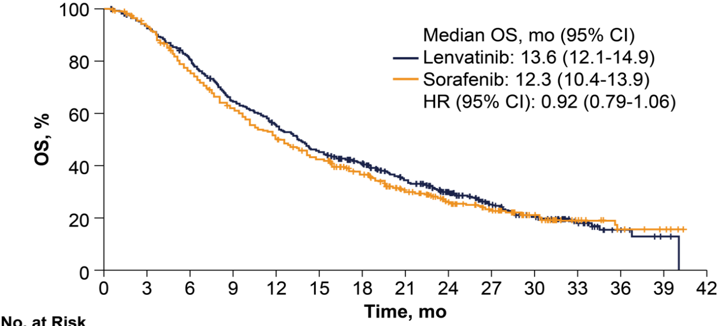
Alternative First-Line TKI Options
Phase 3 SHARP Trial¹
Phase 3 SHARP Trial¹
Phase 3 SHARP Trial¹
Phase 3 REFLECT Trial²
Probability of Survival
1.0
Lenvatinib
Sorafenib
Sorafenib
P < .001
Placebo
Time Since Randomization, mo
Sorafenib OS: 10.7 months
Placebo OS: 7.9 months
Lenvatinib OS: 13.6 months
Sorafenib OS: 12.3 months

Slide 39
LEAP-002: Overall Survival, ITT, FA
 | Events | HR (95% CI)
Len + pembro | 63.8% | 0.840 (0.708-0.997) P=0.0227ª
Len + placebo | 70.7%
Superiority threshold, one-sided α = 0.0185
24-mo rate
43.7%
40.0%
Median (95% CI)
21.2 mo (19.0-23.6)
19.0 mo (17.2-21.7)
Excluded main PVT

Slide 40
Conclusions:
We have made tremendous progress in improving the survival of patients with advanced HCC
The introduction of IO in the front-line setting is practice changing
  No clear biomarker or patient population to serve as predictive markers of benefit
Not every patient will be a candidate for IO combinations
  Consider TKIs or single agent IO
Studies evaluating the role of IO in earlier stage disease are ongoing

Slide 41
Atezolizumab Plus Bevacizumab is the First Treatment Combination to Reduce the Risk of Liver Cancer Returning in Early-Stage HCC
Press Release: January 18, 2023
The Phase III IMbrave050 study met its primary endpoint of recurrence-free survival (RFS) at the prespecified interim analysis. The study is evaluating atezolizumab in combination with bevacizumab as adjuvant treatment following surgery for people with early-stage hepatocellular carcinoma (HCC) at high risk of disease recurrence. The atezolizumab combination showed a statistically significant improvement in RFS in the intention-to-treat population of HCC patients who have an increased risk of recurrence following resection or ablation with curative intent, compared with active surveillance.
Overall survival data were immature at the time of interim analysis and follow-up will continue to the next analysis. Safety for atezolizumab and bevacizumab was consistent with the known safety profile of each therapeutic agent and with the underlying disease.
https://www.gene.com/media/press-releases/14981/2023-01-18/genentechs-tecentriq-plus-avastin-is-the

Slide 42
MODULE 2: Selection and Sequencing of Therapies for Relapsed/Refractory HCC — Dr Kelley

Slide 43
Case Presentation: 65-year-old man with metastatic HCC and a past medical history of hepatitis C develops ILD on atezolizumab/bevacizumab
Dr Priya Rudolph (Athens, Georgia)

Slide 44
QUESTIONS FOR THE FACULTY
“The patient developed dyspnea on exertion. CT scan showed ground-glass opacities. He was COVID-negative, but he had been cleaning his boat and possibly inhaled some strong chemicals. We held treatment and put him on a steroid taper. Are there any data to suggest that continuing single-agent bevacizumab has any efficacy, and can we just continue that for a while?
Priya Rudolph, MD, PhD
What would you recommend as his next systemic therapy?”
What is your usual next systemic therapy after atezolizumab/bevacizumab, and what factors do you consider in this decision?
What is your usual first-line systemic therapy for a patient with a contraindication to immunotherapy such as a major autoimmune disorder?

Slide 45
68-year-old man with post-transplant recurrence develops metastatic HCC and receives lenvatinib followed by cabozantinib followed by regorafenib
Dr Lionel Kankeu Fonkoua (Rochester, Minnesota)
79-year-old man with metastatic HCC who is s/p treatment with atezolizumab/bevacizumab, lenvatinib and currently cabozantinib
Dr Susmitha Apuri
(Lutz, Florida)

Slide 46
QUESTIONS FOR THE FACULTY
“The patient had a transplant years ago for multifocal HCC in the background of alcoholic cirrhosis and was doing fine on immunosuppressive therapy but had a post-transplant recurrence. He started on lenvatinib and then eventually progressed, switched to cabozantinib and then progressed and was placed on regorafenib. In a patient like this, would you consider atezolizumab/bevacizumab?
Lionel A Kankeu Fonkoua, MD
The patient wanted to remain aggressive, but I just didn’t feel comfortable knowing the graft failure rate is about 30% to 40% in this patient population.
The second question is, there have been some data suggesting that activating mutations in β-catenin actually confer resistance to immune checkpoint inhibition. Would that be a factor in this setting — in a patient who you already have reservations?”

Slide 47
QUESTIONS FOR THE FACULTY
“He’s on cabozantinib right now with an ECOG PS of 0. He’s back to his woodworking. He has a PIK3CA somatic mutation. Would an agent like alpelisib be helpful? Would he be a candidate for ipilimumab/nivolumab.”
Susmitha Apuri, MD

Slide 48
Selection and Sequencing of Therapies for Advanced HCC:
Second-Line and Beyond
Katie Kelley, MD
Helen Diller Family Comprehensive Cancer Center
University of California, San Francisco

Slide 49
Outline
Increasing utilization of subsequent lines of therapies in HCC
Currently available 2nd line therapies
  Agents with FDA approval after progression on sorafenib
  Role for sorafenib, lenvatinib, or other multikinase tyrosine kinase inhibitors (TKI) after 1st line immune checkpoint inhibitor (ICI)-based combinations?
  Role for anti-PD-(L)1 and anti-CTLA-4 combination regimens after prior ICI-based combinations?
Factors in selection and sequencing of ≥ 2nd line treatment options
Other promising agents and strategies under investigation as subsequent lines of therapy

Slide 50
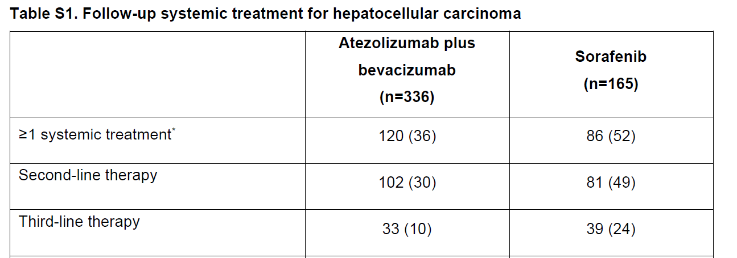
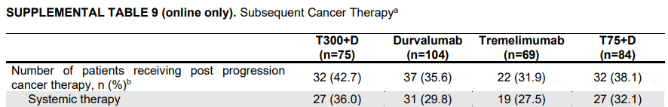
Increasing Uptake of Subsequent Lines of Therapy
A meaningful number of patients receive ≥ 2nd line therapies
Increase may be due to:
  More efficacious 1st line options?
  Better supportive care?
  Stage migration?
Incidence of ≥2nd line therapy in IMbrave150:
Cheng et al. J Hepatol 2022;76:862-73
Incidence of subsequent therapies post 2nd line durva/treme in Study 22:
Kelley et al. J Clin Oncol 2021; epub 22Jul21

Slide 51
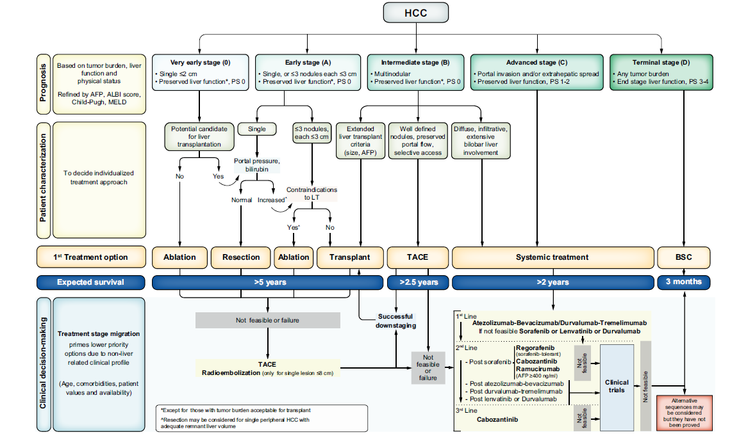
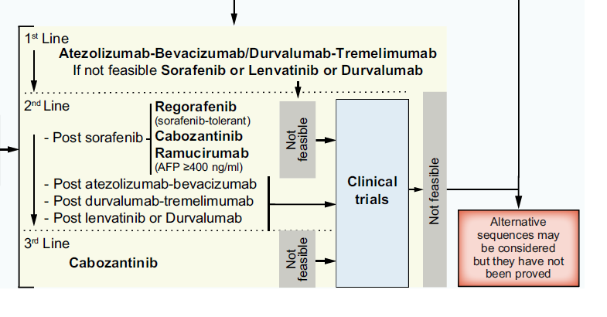
Updated BCLC Algorithm 2022
Reig et al. J Hepatol. 2022

Slide 52
Beyond 1st Line:
Currently Approved 2nd Line Therapies for HCC
Antiangiogenic therapies with USFDA approval and level 1 evidence:
  Regorafenib: Multikinase inhibitor, similar to sorafenib including VEGFR1-3, BRAF, PDGFR, RET
  Cabozantinib: Multikinase inhibitor with targets including VEGFR1-3, MET, AXL
  Ramucirumab (serum AFP ≥400 ng/mL): Monoclonal antibody targeting VEGFR2
ICI with USFDA accelerated approval based upon phase 1/2 studies:
  Pembrolizumab: Anti-PD-1 ICI
  Nivolumab + ipilimumab: Anti-PD-1 plus anti-CTLA-4 ICI combinations
All of these 2nd line treatments have been studied after sorafenib as 1st line treatment.

Slide 53
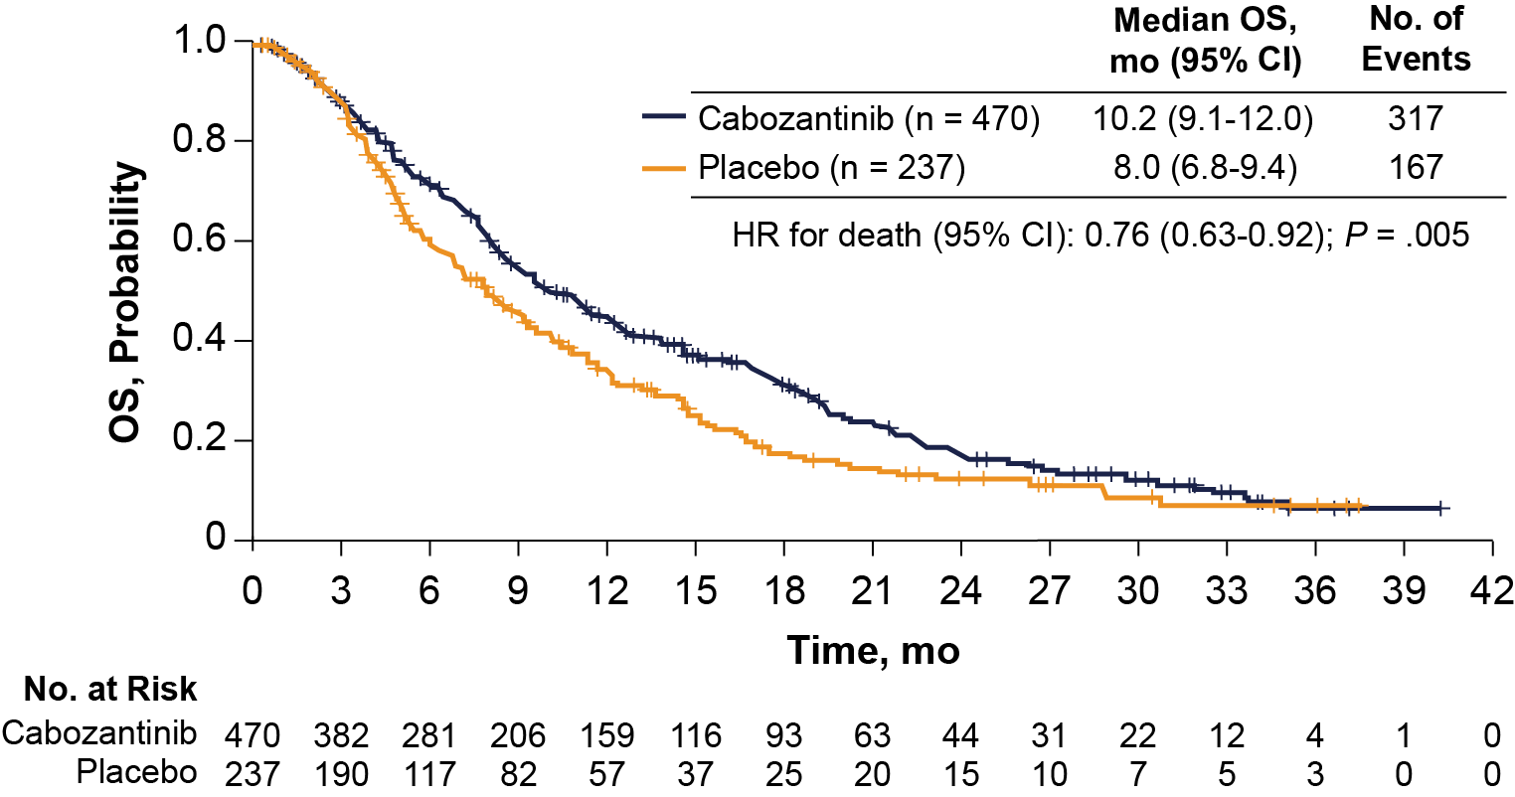
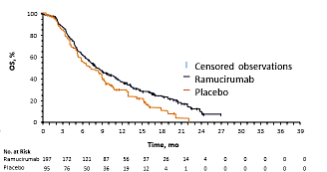
2nd Line Systemic Therapies
With Level 1 Evidence
Regorafenib vs. Placebo
HR 0.63
Regorafenib improved OS as 2nd line therapy after progression on sorafenib in patients who tolerated sorafenib¹
Cabozantinib improved OS as 2nd or 3rd line of therapy after sorafenib²
Ramucirumab improved OS as 2nd line therapy after sorafenib in patients with AFP ≥ 400 ng/mL³
  First biomarker-selected therapy in HCC
Cabozantinib vs. Placebo
HR 0.76
Ramucirumab vs. Placebo
HR 0.71
Bruix J, et al. Lancet. 2017;389(10064):56-66
Abou-Alfa G, et al. N Engl J Med. 2018;379(1):54-63
Zhu AX et al. Lancet Oncol. 2019;20(2):282-96

Slide 54
Role for Multikinase Inhibitors After 1st Line ICI-Based Therapy
There is limited prospective data for treatment selection after 1st line ICI-based therapies; multikinase inhibition has biologic rationale
Retrospective analysis of 71 patients treated with 2nd line TKI (sorafenib or lenvatinib) after 1st line atezo+beva reported median PFS 3.4 months, median OS 14.7 months¹
  Median PFS was longest for lenvatinib-treated patients: 6.1 vs 2.5 months (p=0.004)
A systematic literature review of cabozantinib treatment after prior ICI therapies showed benefit across range of tumor types including HCC²

Slide 55
Beyond 1st Line:
Currently Approved 2nd Line Therapies for HCC
Antiangiogenic therapies with USFDA approval and level 1 evidence:
  Regorafenib: Multikinase inhibitor, similar to sorafenib including VEGFR1-3, BRAF, PDGFR, RET
  Cabozantinib: Multikinase inhibitor with targets including VEGFR1-3, MET, AXL
  Ramucirumab (serum AFP ≥400 ng/mL): Monoclonal antibody targeting VEGFR2
ICI with USFDA accelerated approval based upon phase 1/2 studies:
  Pembrolizumab: Anti-PD-1 ICI
  Nivolumab + ipilimumab: Anti-PD-1 plus anti-CTLA-4 ICI combinations
All of these 2nd line treatments have been studied after sorafenib as 1st line treatment.

Slide 56
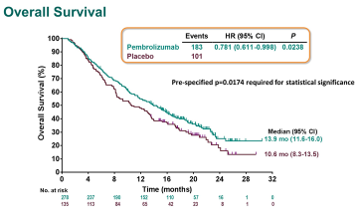
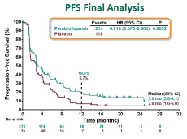
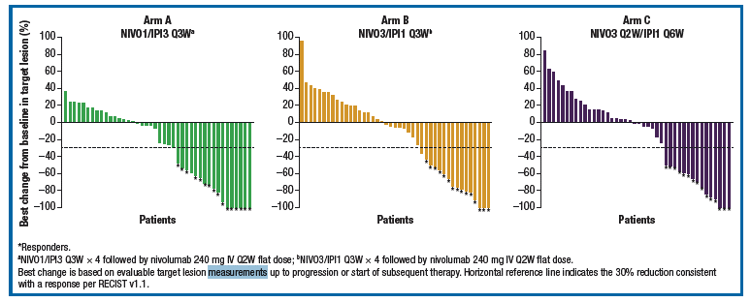
2nd Line ICI Therapies with Accelerated Approvals
KEYNOTE 240: Pembrolizumab vs. Placebo¹
Pembrolizumab
  KEYNOTE 240¹ did not improve OS but showed durable ORR 18.3%; KEYNOTE-394² improved OS, PFS, and ORR compared to placebo
Nivolumab + Ipilimumab³
  Deep and durable responses in ~30% by RECIST 1.1
  Median DOR > ~17 months
  Steroids required ~25-50%
CheckMate-040: Nivolumab + Ipilimumab Cohort³
ORR 32%
ORR 31%
ORR 31%
Finn RS, et al. J Clin Oncol. 2020;38(3):193-202
Clinicaltrials.gov, NCT03062358; Qin et al. GI ASCO 2022
Yau T, et al. JAMA Oncol. 2020;6(11):e204564

Slide 57
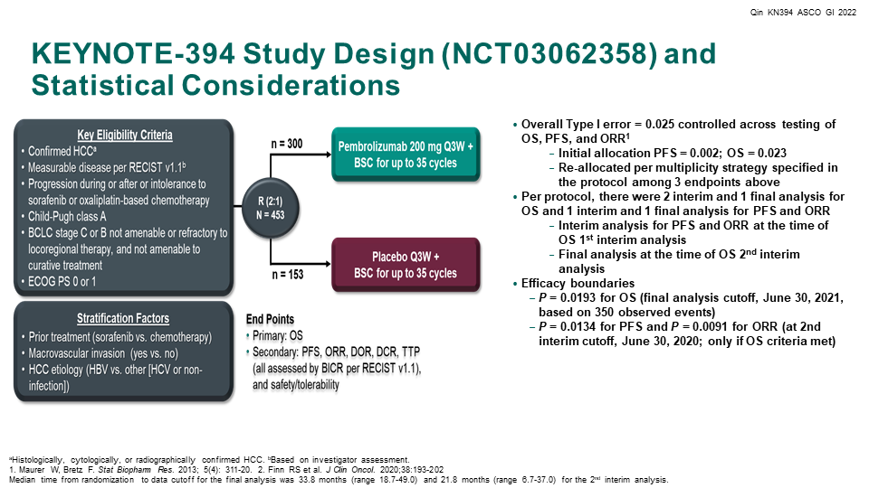

Slide 58
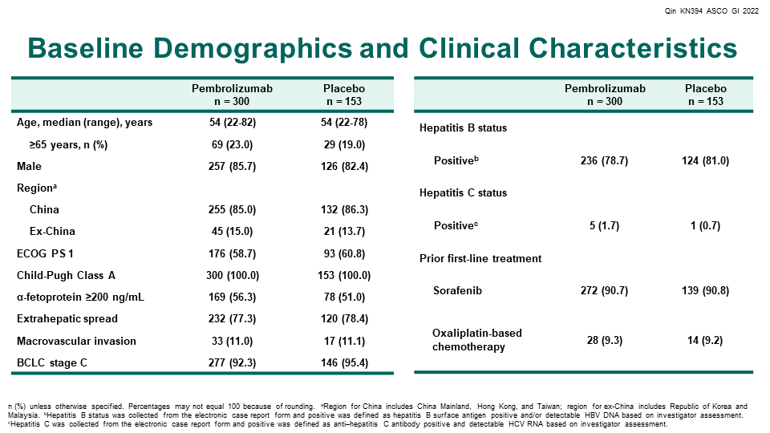

Slide 59
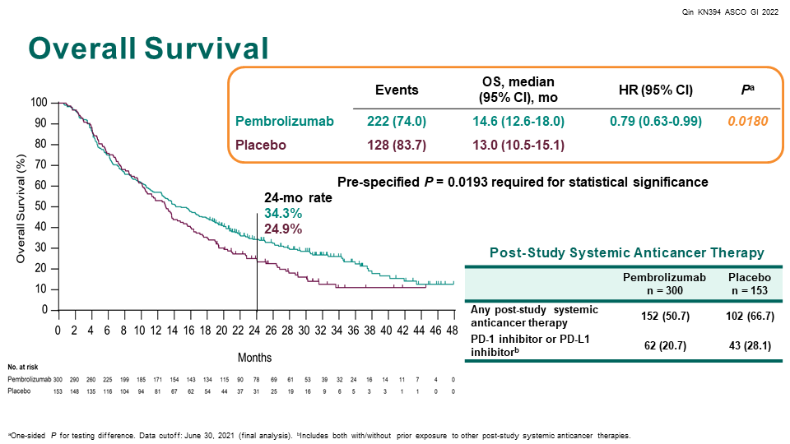

Slide 60
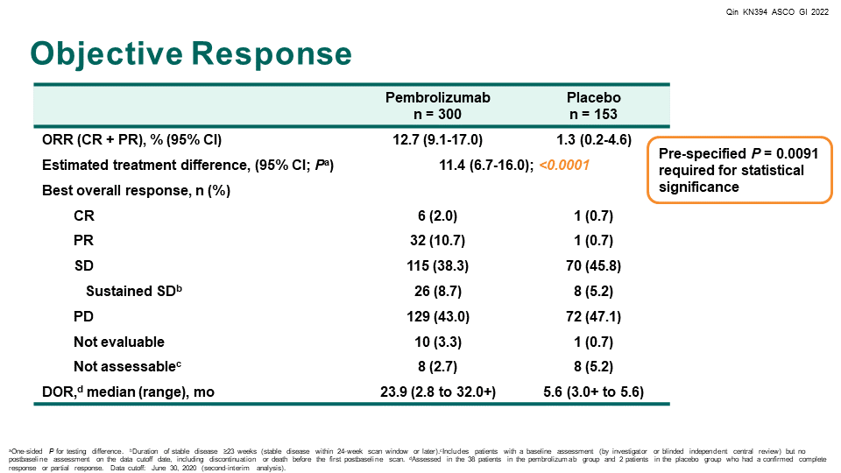

Slide 61
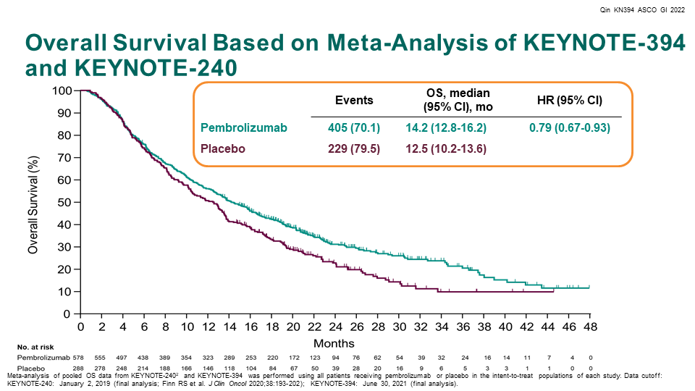

Slide 62
Role of Anti-PD-(L)1 and Anti-CTLA-4 Therapies After Prior ICI-based Combinations
There is no established role for ICI monotherapy after receipt of prior ICI monotherapy or in combination
Combination of anti-PD-(L)1 + anti-CTLA-4 has shown potential for eliciting responses after progression on anti-PD-(L)1 monotherapy in multiple tumor types^{1,2}
A retrospective analysis of patients treated with nivolumab plus ipilimumab after 1st line atezo+beva reported objective responses in 3 of 10 (30%) patients treated³

Slide 63
Selection and Sequencing of ≥ 2nd Line Treatments
Factors to consider:
Which 1st line therapy was received?
  What was response and duration?
  What was AE profile?
Contraindication to ICI?
  E.g. transplant, prior high-grade immune-related toxicity, significant autoimmune disease
Contraindication to anti-angiogenic therapies?
  E.g. significant vascular disease, severe proteinuria, non-healing wounds, high risk for bleeding
AFP
Liver function
Current consensus strategies:
Progressed on 1st line ICI-based combination → 2nd line TKI
Progressed on 1st line TKI → 2nd line ICI or ICI combination
Contraindication to ICI → TKI or ramucirumab if AFP
≥ 400 ng/mL
Contraindication to anti-angiogenic therapy → pembrolizumab, nivolumab + ipilimumab
Discontinued 1st line therapy for reasons other than progression → individualized treatment decision
Child Pugh B liver function → limited data; ICI monotherapy has shown acceptable safety in small studies in Child Pugh B HCC; consider empiric TKI dose reduction
Clinical trials are needed!

Slide 64
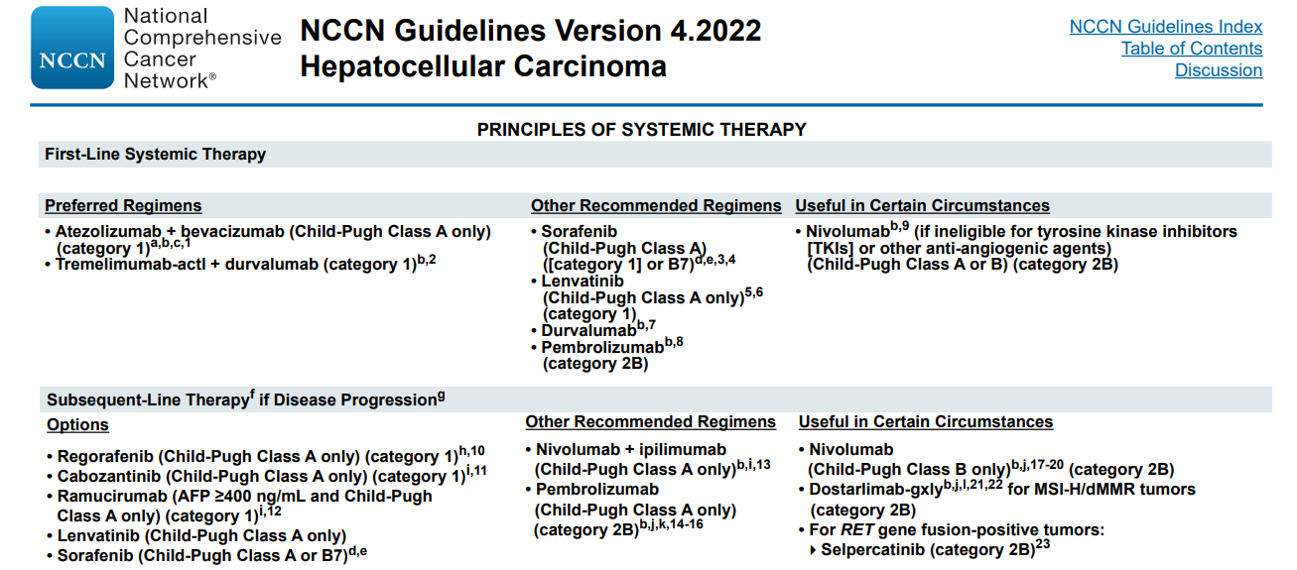
NCCN.org

Slide 65
Current Summary of ≥ 2nd Line HCC Therapy
2nd line treatment options:
  Anti-angiogenic: Regorafenib, cabozantinib, ramucirumab (if AFP ≥ 400 ng/mL)
    Lenvatinib, sorafenib also reasonable options
  Immunotherapy: Pembrolizumab, nivolumab + ipilimumab
All current FDA-approved treatments have been studied after 1st line sorafenib (or as
1st line)
Current selection of 2nd line treatment is based upon 1st line therapy received plus comorbidity profile
Need ≥ 2nd line clinical trials to inform choice of treatment after ICI-based 1st line therapy
  Phase 3 IMbrave251 trial ongoing of 2nd line sorafenib or lenvatinib ± atezolizumab (NCT04770896)
New immuno-oncology strategies and combinations are being studied in early-phase trials

Slide 66
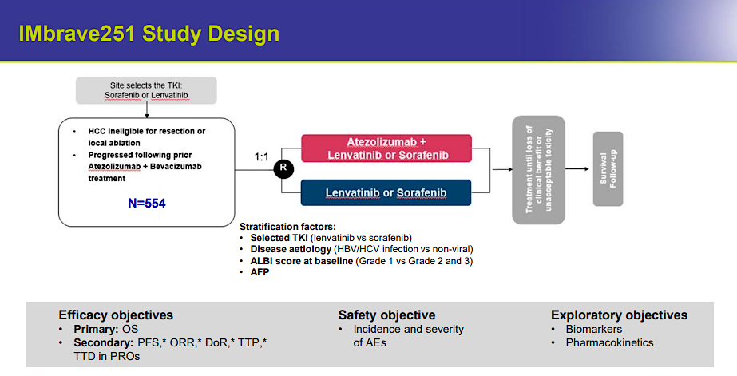
NCT04770896

Slide 67
New Agents and Strategies Under Investigation for Subsequent HCC Therapy
ICI combinations with targeted therapies
ICI combinations with complementary immune checkpoint pathways
  LAG-3, TIGIT, others
Inhibition of immunosuppressive myeloid pathways
Promoting/boosting tumor immunogenicity
  Locoregional therapy combinations, oncolytic viruses, cellular therapies targeting tumor antigens
Many others!

Slide 68
MODULE 3: Current and Future Role of Immunotherapy in the Treatment of Advanced
Biliary Tract Cancers (BTCs) — Prof Vogel

Slide 69
Case Presentation: 75-year-old woman with metastatic cholangiocarcinoma who received first-line gemcitabine/ cisplatin with durvalumab
Dr Warren Brenner (Boca Raton, Florida)

Slide 70
QUESTIONS FOR THE FACULTY
“My questions for the investigators are…
Are there subtypes, such as gallbladder cancer versus intrahepatic versus extrahepatic cholangiocarcinoma, that may respond differently to these agents, particularly checkpoint inhibitors?
Warren S Brenner, MD
Is there any differential effect based on PD-L1 and tumor mutational burden? And what are the management options for patients with progressive disease who have no targetable mutations?
Another question for the investigators is, there are a lot of liquid biopsies with high tumor mutational burden readings. I think the original pembrolizumab pan-tumor approval was based on the Foundation TMB. Do they use tumor mutational burden reported on liquid biopsies?”

Slide 71
Case Presentation: 72-year-old man with localized cholangiocarcinoma deemed potentially resectable with tumor response
Dr Jeremy Lorber (Beverly Hills, California)

Slide 72
QUESTIONS FOR THE FACULTY
“The surgeon deemed him not a surgical candidate for the time being but potentially in the future. He’s thus far had a partial response to durvalumab, gemcitabine and cisplatin. He’s tolerated it very well. He’s still not a perfect surgical candidate, and the surgeon ideally would like further response before considering resection. Any suggestions? Would you consider radiation therapy?”
Jeremy Lorber, MD

Slide 73
Current and Future Role of Immunotherapy in the
Treatment of Advanced Biliary Tract Cancers (BTCs)
Arndt Vogel

Slide 74
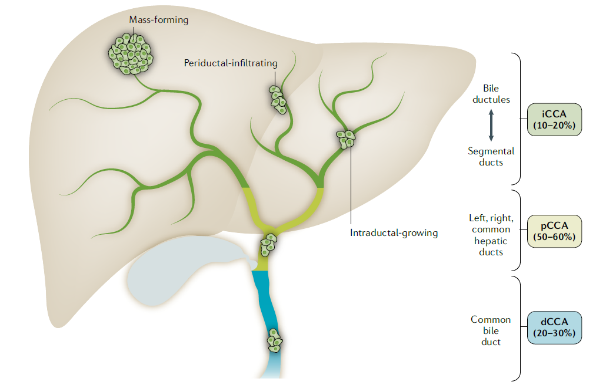
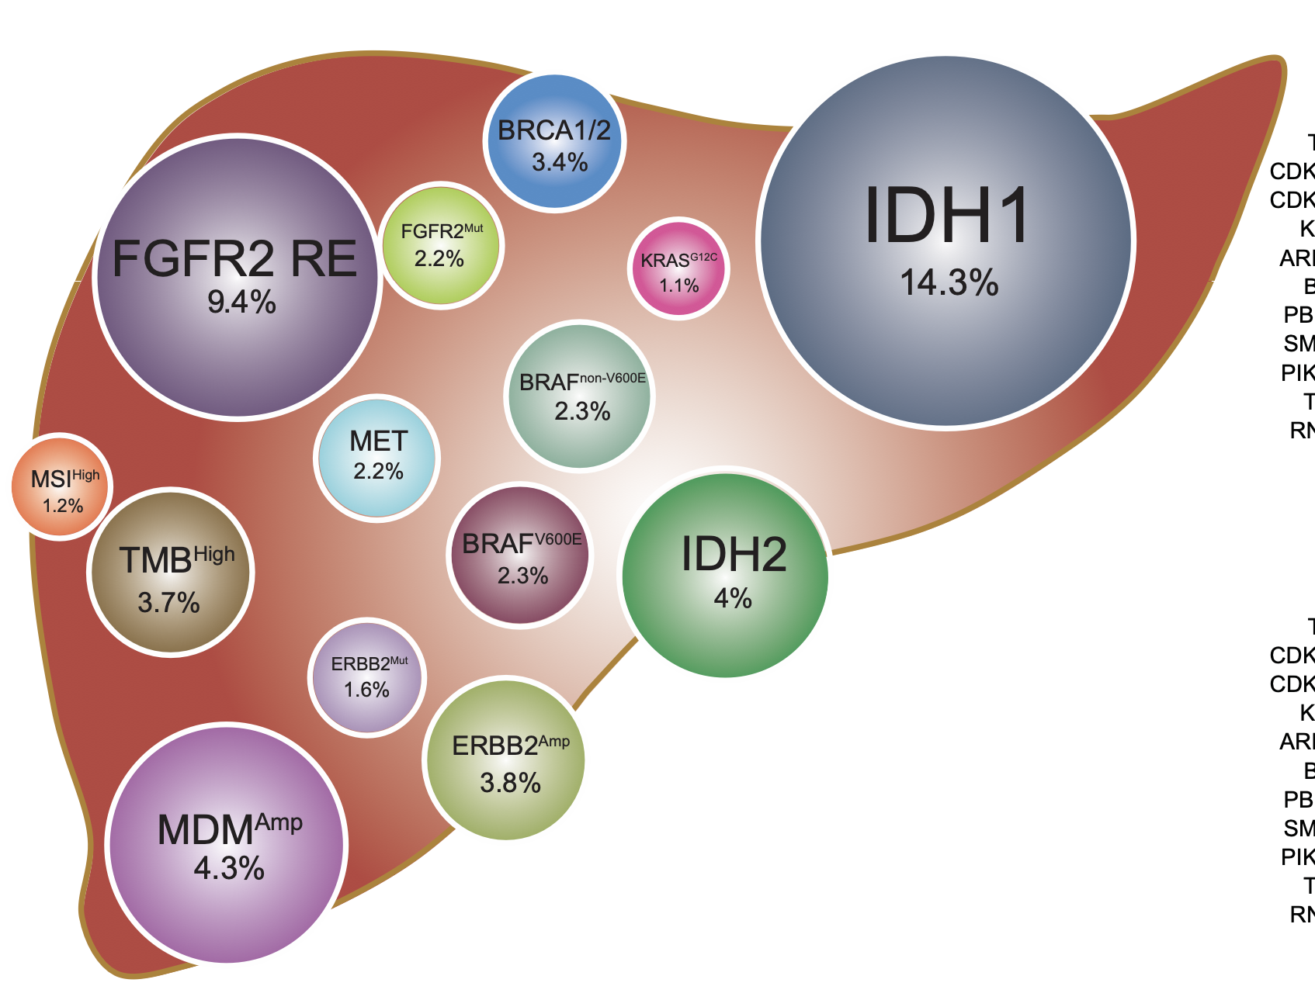
Biliary Tract Cancers: a heterogeneous disease entity
Anatomic heterogeneity
Genetic heterogeneity
Gallbladder cancer
Banales et al. Nat Rev Gastroent Hepatol 2020
Vogel/Saborowski Journal of Hepatology, 2022

Slide 75
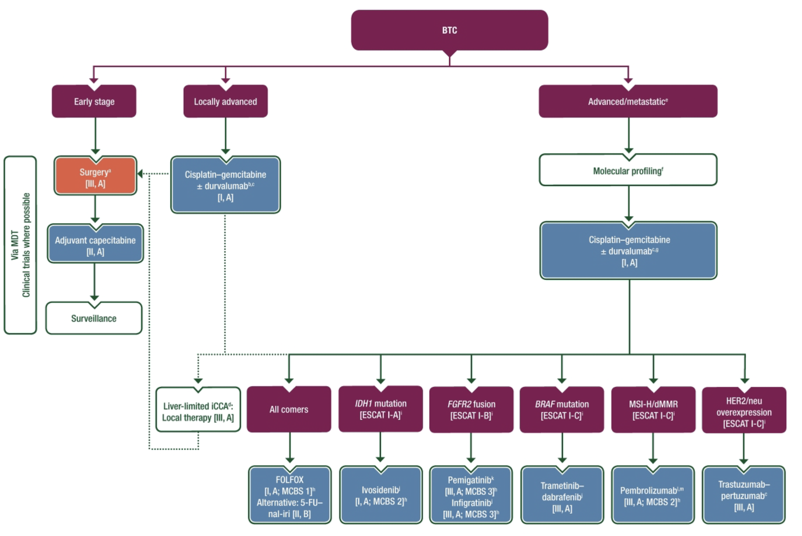
Diagnosis and Management of Biliary Tract Cancer
Vogel A et al. Annals of Oncology 2022

Slide 76
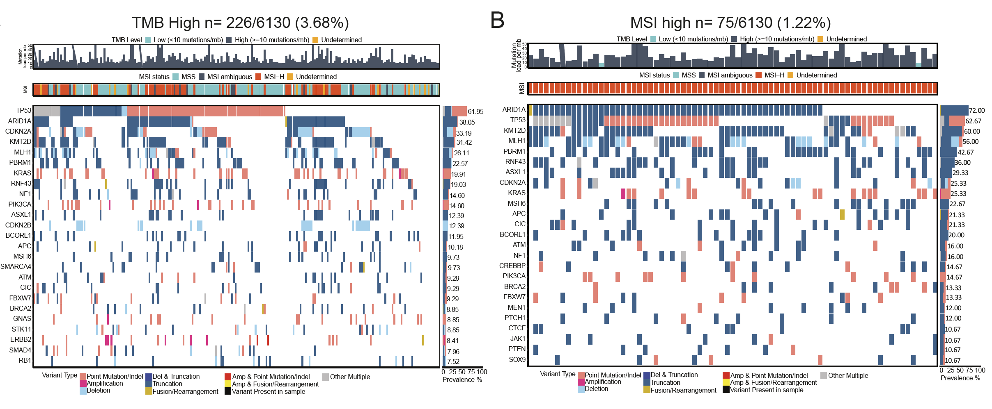
BTC: low prevalence of established IO biomarkers
TMB^{high} 226/6130 iCCAs (3.7%)
MSI^{high} 75/6130 iCCAs (1.2%)
ARID1A
KMT2D
MLH1
RNF43
Vogel/Saborowski Journal of Hepatology 2002

Slide 77
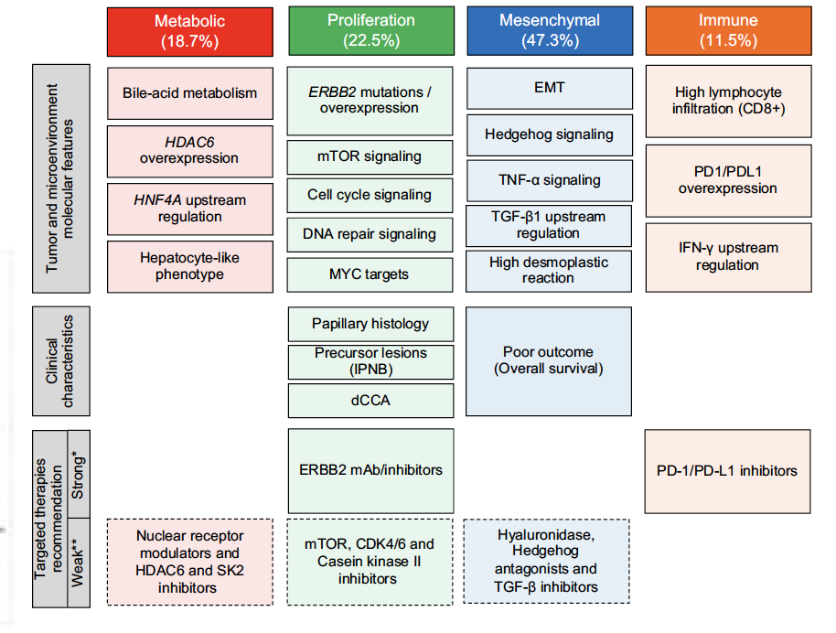
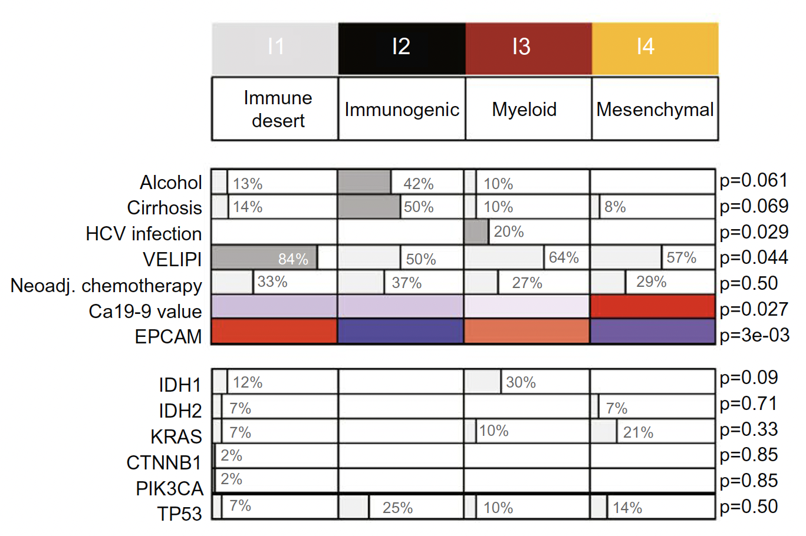
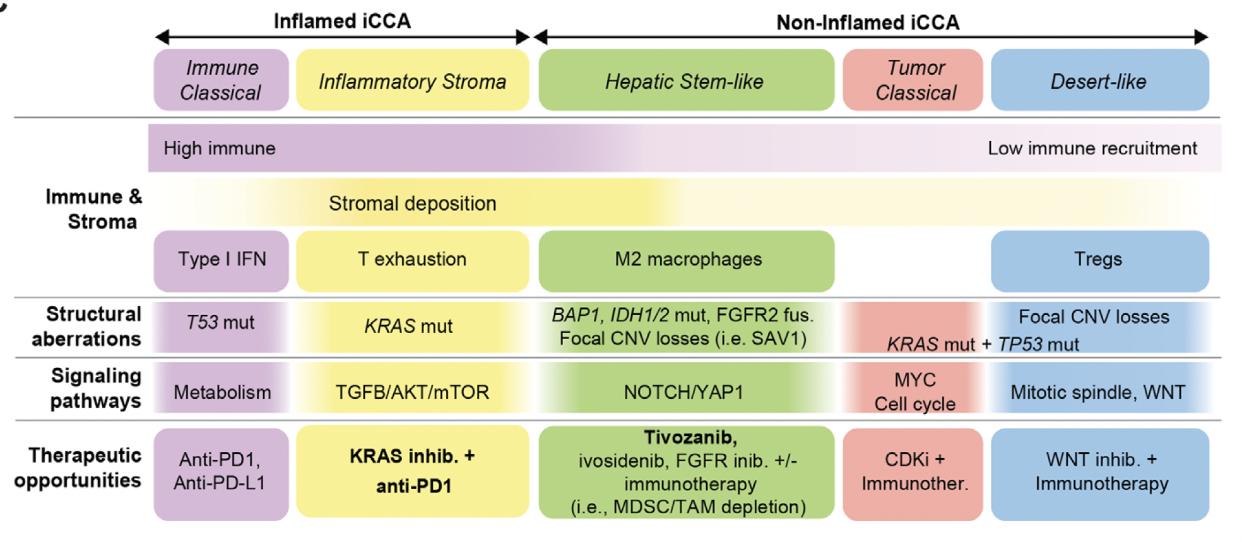
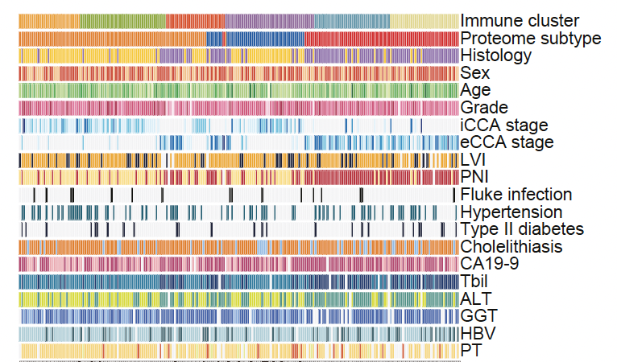
Biliary Tract Cancers: 10-30% with “immunogenic” phenotype according to “multi-omic” classification
Extrahepatic CCA, n=189; → 11% immune subclass
Intrahepatic, n=566 → 13% immunogenic
Montal et al, J. Hepatol 2020
Job et al. Hepatology 2020
Intrahepatic CCA, n=900 → 10% immune classical
Intra- and extrahepatic, n=217 → 30% „immun-responsive“
Martin-Serrano et al, GUT 2022
Deng et al, Hepatology 2022

Slide 78
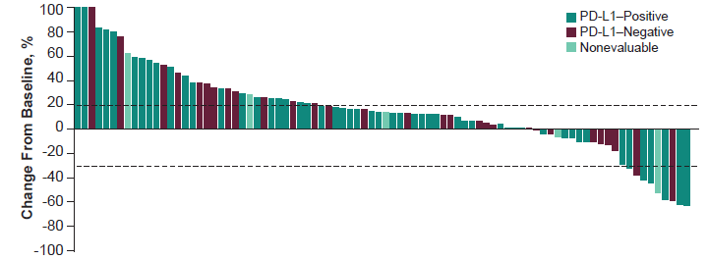
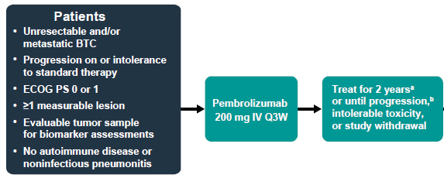
Pembrolizumab in Advanced BTC with Proficient MMR/MSS:
KEYNOTE-158
N=104, multicenter basket trial biliary tract cancer (BTC) cohort with planned biomarker analyses
  ≥1 prior line of therapy, median 2
  ICC, ECC, GBC % not reported
  PD-L1+ (CPS ≥1, 22C3) 59%
  99 with proficient mismatch repair (pMMR), 5 unknown
Treatment-related AE Grade 3-5 in 13.5%
Confirmed PR (central) in 5.8% overall
  6.6% for PD-L1+
  2.9% PD-L1-
mPFS 2.0 months
mOS 7.4 months
Piha-Paul et al. Int J Cancer 2020;147(8):2190-8

Slide 79
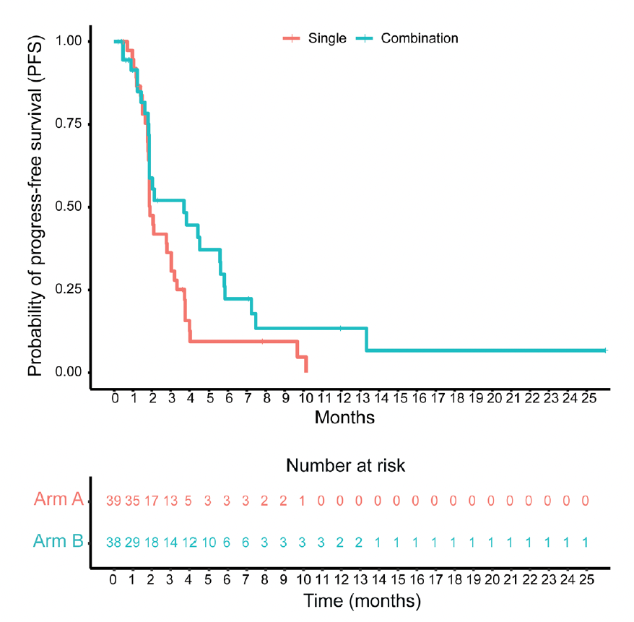
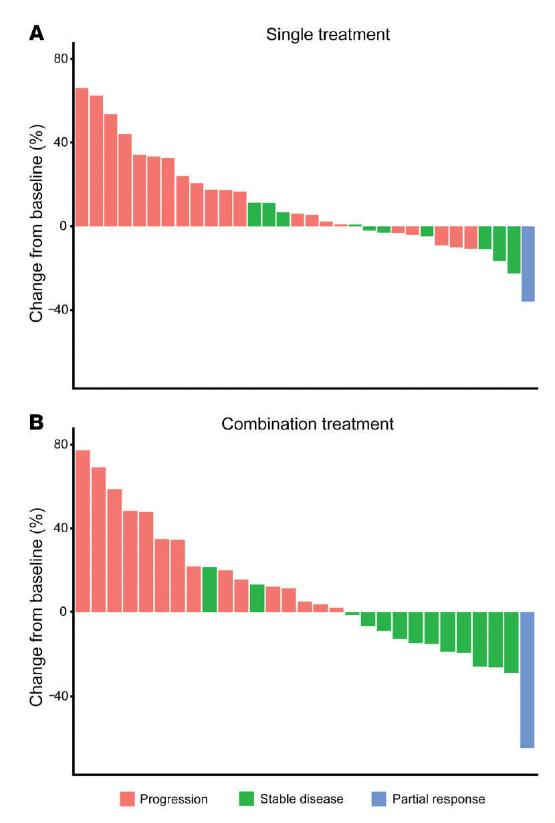
Chemo-free approaches: IO +/- MEK in BTC:
Atezolizumab (PD-L1) + Cobimetinib (MEK)
Rationale:
MEK inhibition enhances MHC1 expression, PD-L1 expression,
and CD8+ T cell infiltration
Single: mPFS 3.65
Combi: mPFS 1.87
Atezo
HR 0.58,
90% CI 0.35–0.93), P = 0.027
39
1-2 prior
therapies
38
Atezo
+
Cobimetinib
Atezo
+
Atezo
Cobimetinib
Formally positive (primary EP PFS)
Low ORR
ORR: 2.8%
ORR: 3.3%
Yarchoan et al, JCI 2021

Slide 80
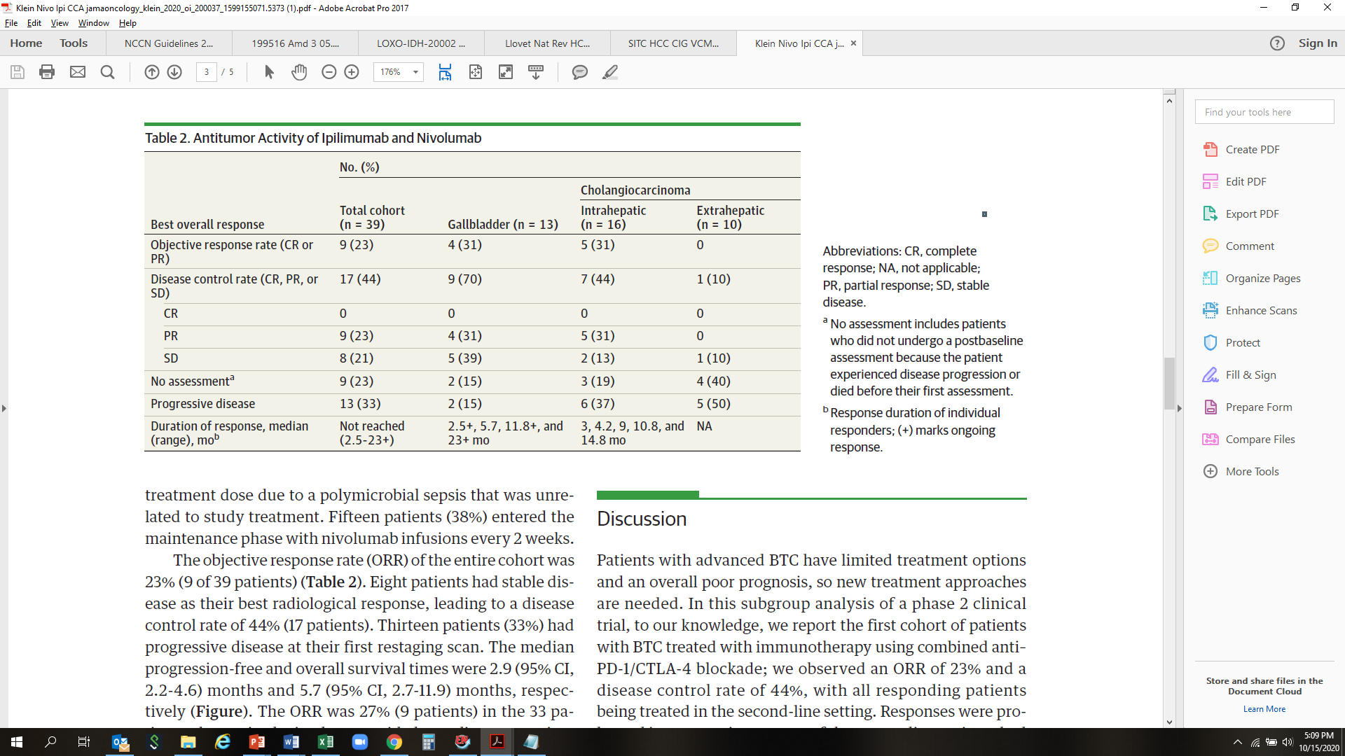
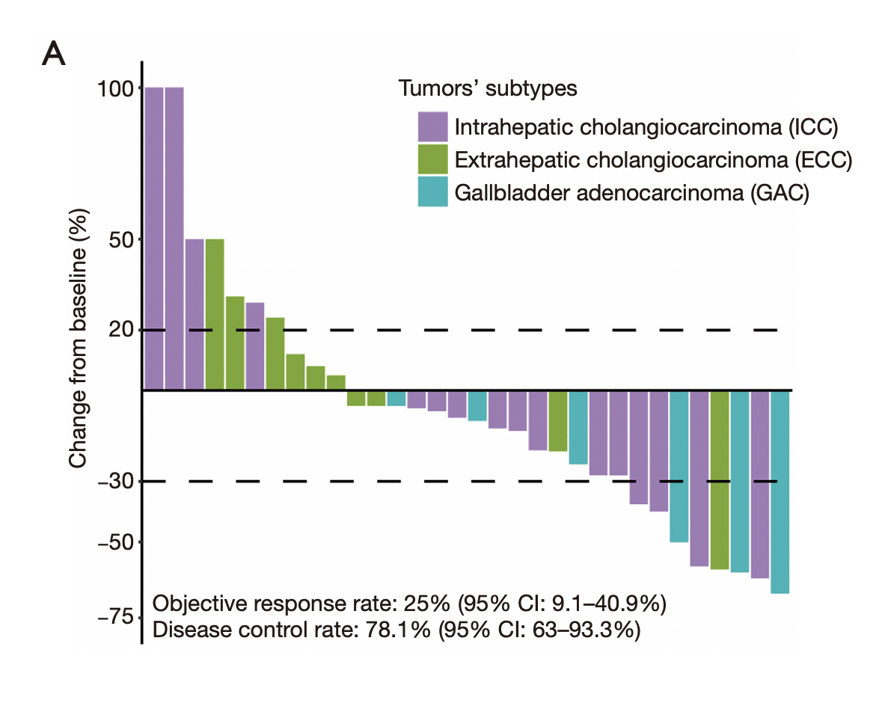
IO + anti-angiogenic
Pembrolizumab/Lenvatinib
IO + IO (BTC subgroup CA209-538)
Nivolumab/Ipilimumab
N= 32
PFS 4.9 mo
OS: 11.0 mo
ORR: 25%
N= 39
PFS: 2.9 mo
OS: 5.7 mo
ORR: 23%
AE 3/4: 62%
IR-AE: 49% (15% >= 3°)
Lin J, et al. Hepatobiliary Surg Nutr. 2020
Klein et al, JAMA Oncol 2020

Slide 81
MediTreme Study: Best Objective Response
Biomarker Cohort
100
GemCis + D
100
GemCis + D + T
100
80
80
80
60
PD
SD
PR
CR
60
SD
PR
CR
60
PD
SD
PR
CR
40
40
40
20
20
20
% Change from baseline
0
0
0
% Change from baseline
% Change from baseline
-20
-20
-20
-40
-40
-40
-60
-60
-60
-80
-80
-80
-100
-100
-100
Objective response rates were similar in the GemCis + D cohort and GemCis + D + T cohort, and were higher compared with the BMC.
Complete response rates were lower in GemCis + D + T cohort, whereas BMC and GemCis + D cohorts exhibited similar CR rates.
GemCis + D + T cohort had the highest partial response rate among the three cohorts.
The Biomarker cohort had the highest rate of stable disease among the three cohorts.
Disease progression was not observed in the GemCis + D cohort.
CR = complete response; D = durvalumab; GemCis = gemcitabine/cisplatin; OS = median overall survival; RR = response rates; PD = progressive disease; PR = partial response; SD = stable disease;
T = tremelimumab.
Oh D-Y et al. Poster presented at ASCO Virtual Annual Meeting; May 29-31, 2020.
Notes:
Oh et al ASCO 2020 poster abstract 4520/col3/Fig 2A
Oh et al ASCO 2020 poster abstract 4520/col2- bullets 2-3/col2 –table 2/col3- bullets 1-3

Slide 82
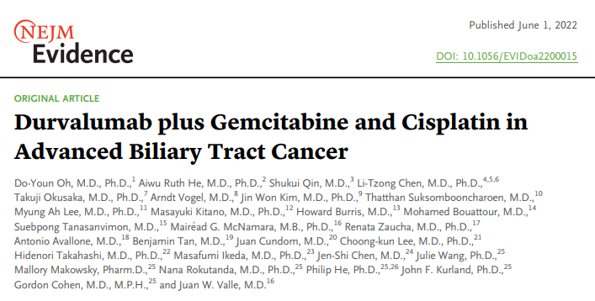
IO-Phase-III studies in BTC: TOPAZ-1 & KEYNOTE-966
Study population:
Adults with locally advanced or metastatic BTC*
Recurrent disease >6 months after curative surgery or adjuvant therapy completion†
Measurable lesion(s) by RECIST v1.1
ECOG PS 0 or 1
Durvalumab 1500 mg on day 1 Q3W
+ gemcitabine 1000 mg/m², and
cisplatin 25 mg/m² on days 1 and 8 Q3W [up to 8 cycles]¹
Durvalumab 1500 mg Q4W until PD, unacceptable toxicity or study withdrawal
R 1:1
N=685¹
TOPAZ-1^{1,2}
Placebo on day 1 Q3W
+ gemcitabine 1000 mg/m², and
cisplatin 25 mg/m² on days 1 and 8 Q3W [up to 8 cycles]¹
Placebo Q4W until PD, unacceptable toxicity or study withdrawal
Study population:
Adults with metastatic and/or unresectable (locally advanced) BTC
Measurable disease by RECIST v1.1
ECOG PS 0 or 1
No prior systemic therapy for advanced BTC
Pembrolizumab 200 mg on day 1 Q3W
+ gemcitabine 1000 mg/m², and
cisplatin 25 mg/m² on days 1 and 8 Q3W^{3,4}
Treatment to continue until:
PD, unacceptable toxicity or study withdrawal [for pembrolizumab and gemcitabine]
Up to 35 cycles [for pembrolizumab]
Up to 8 cycles [for cisplatin]
R 1:1
N=788³
KEYNOTE-966^{3–6}
Placebo on day 1 Q3W
+ gemcitabine 1000 mg/m², and
cisplatin 25 mg/m² on days 1 and 8 Q3W^{3,4}

Slide 83
TOPAZ-1: Durvalumab + GemCis Improved OS vs. GemCis
 | Median OS, months (95% CI) | Hazard ratio (95% CI) | p-value
Durvalumab + GemCisª (n=341) | 12.8 (11.1–14.0) | 0.80 (0.66–0.97) | 0.021
Placebo + GemCisª (n=344) | 11.5 (10.1–12.5) | 168 (48.8)
1.0
0.9
0.8
12-mo OS:
54.1%
48.0%
18-mo OS:
35.1%
25.6%
24-mo OS:
24.9%
10.4%
0.7
0.6
0.5
HR for time up to
6 months (95% CI)
0.91 (0.66–1.26)
Probability of overall survival
0.4
HR for time after
6 months (95% CI)
0.74 (0.58–0.94)
0.3
0.2
0.1
0.0
0
3
6
9
12
15
18
21
24
27
30
Number of subjects at risk
Time from randomization (months)
Durvalumab + GemCis
341
309
268
208
135
79
49
24
9
1
Placebo + GemCis
344
317
261
183
125
65
29
10
4
0
Oh D-Y, et al. @ ASCO GI
Arndt Vogel

Slide 84
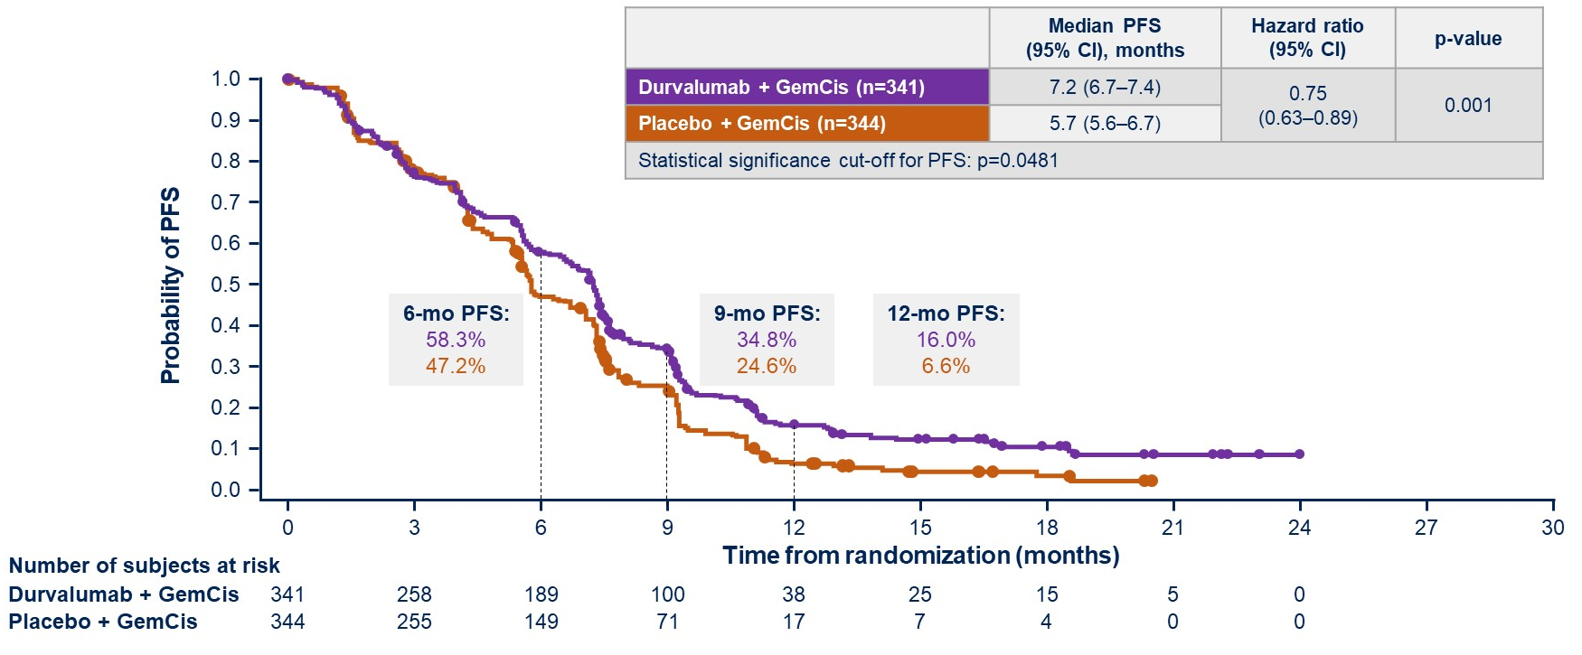
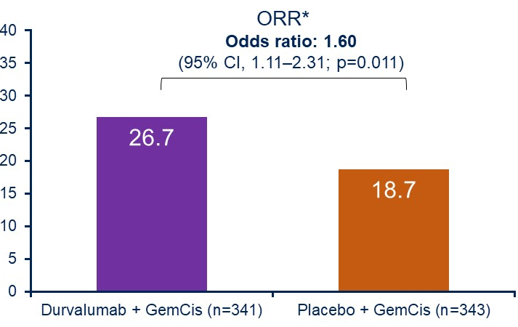
Secondary endpoint: PFS
IO + Chemo in BTC 1st line: TOPAZ-1 Phase 3
Efficacy data 2ndary objectives: PFS and ORR
Content of this presentation is the property of the author, licensed by ASCO. Permission required for reuse.
Oh D-Y et al. Gastrointestinal Cancers Symposium 2022.

Slide 85
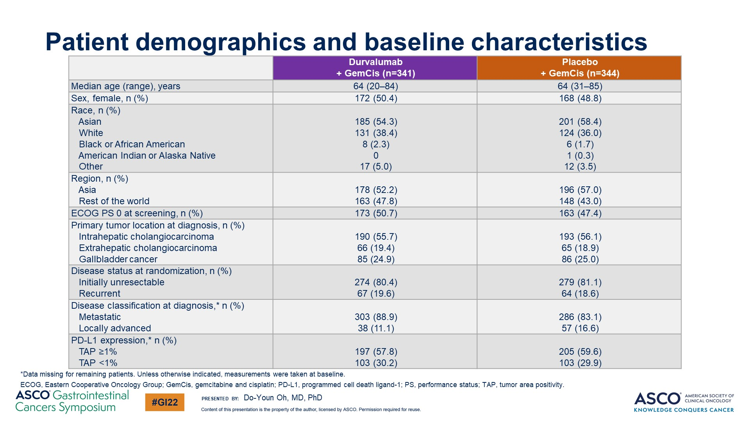
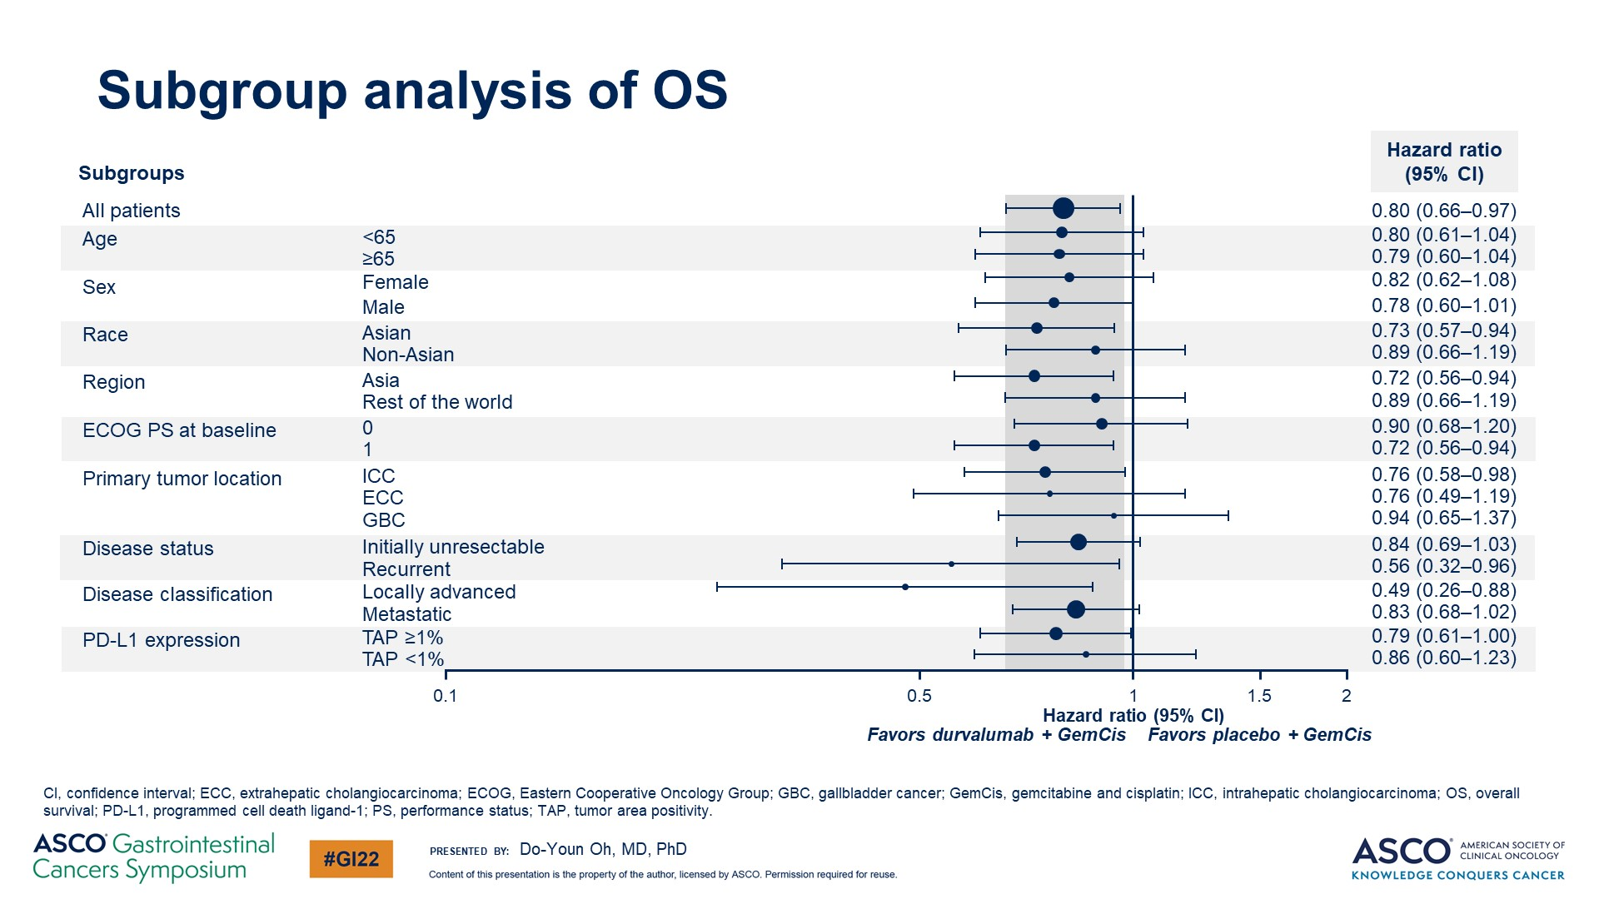
IO + Chemo in BTC 1st line: TOPAZ-1 Phase 3
Relevant Subgroups: “RACE”
Oh D-Y et al. Gastrointestinal Cancers Symposium 2022.
ORR MEDITREME (Chemo + Durva, all Asian): 73%
ORR Topaz: 26%

Slide 86
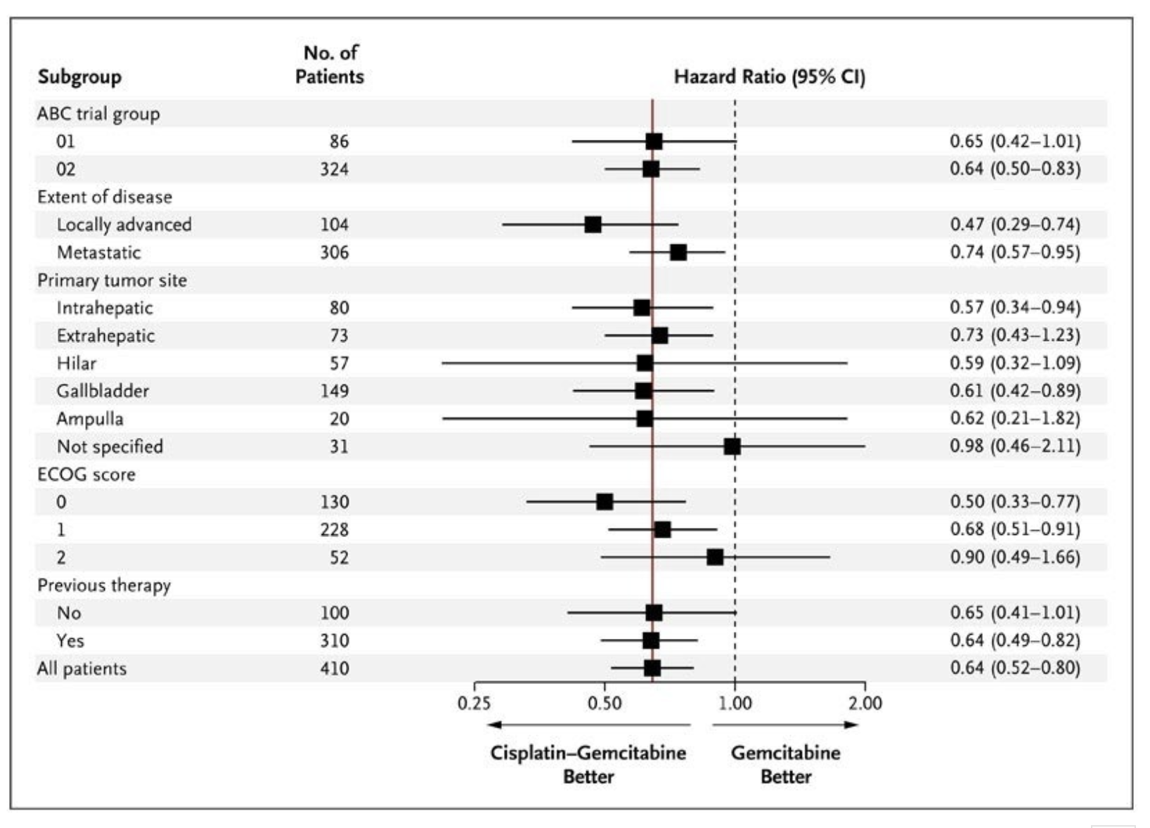
IO + Chemo in BTC 1st line: TOPAZ-1 Phase 3
Relevant Subgroups: “anatomic location”
Oh D-Y et al. Gastrointestinal Cancers Symposium 2022.
Valle et al, NEJM 2010

Slide 87
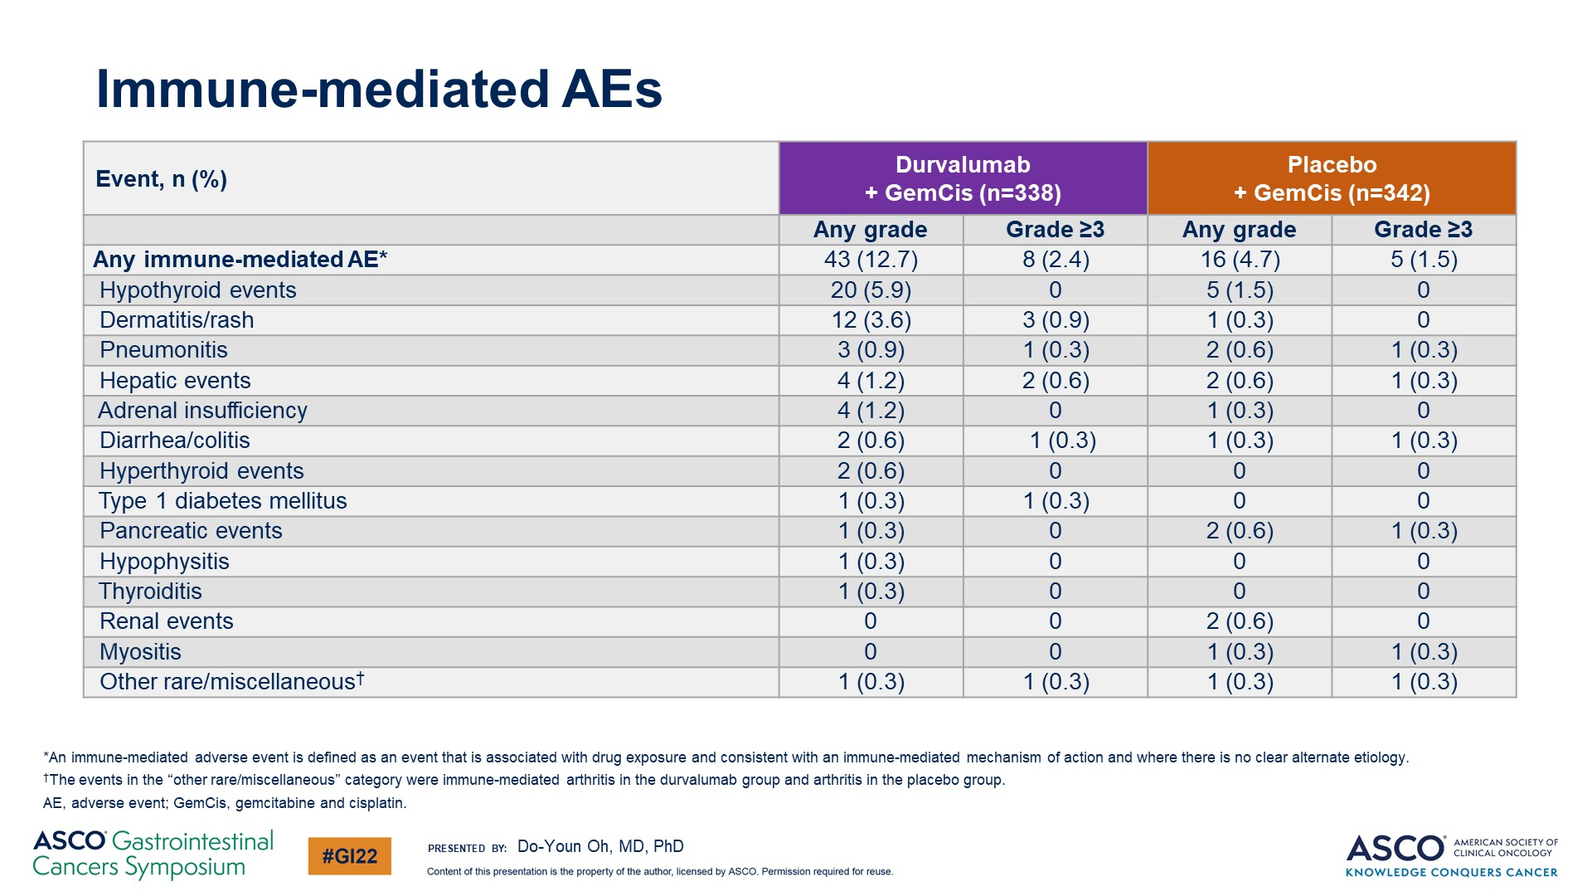
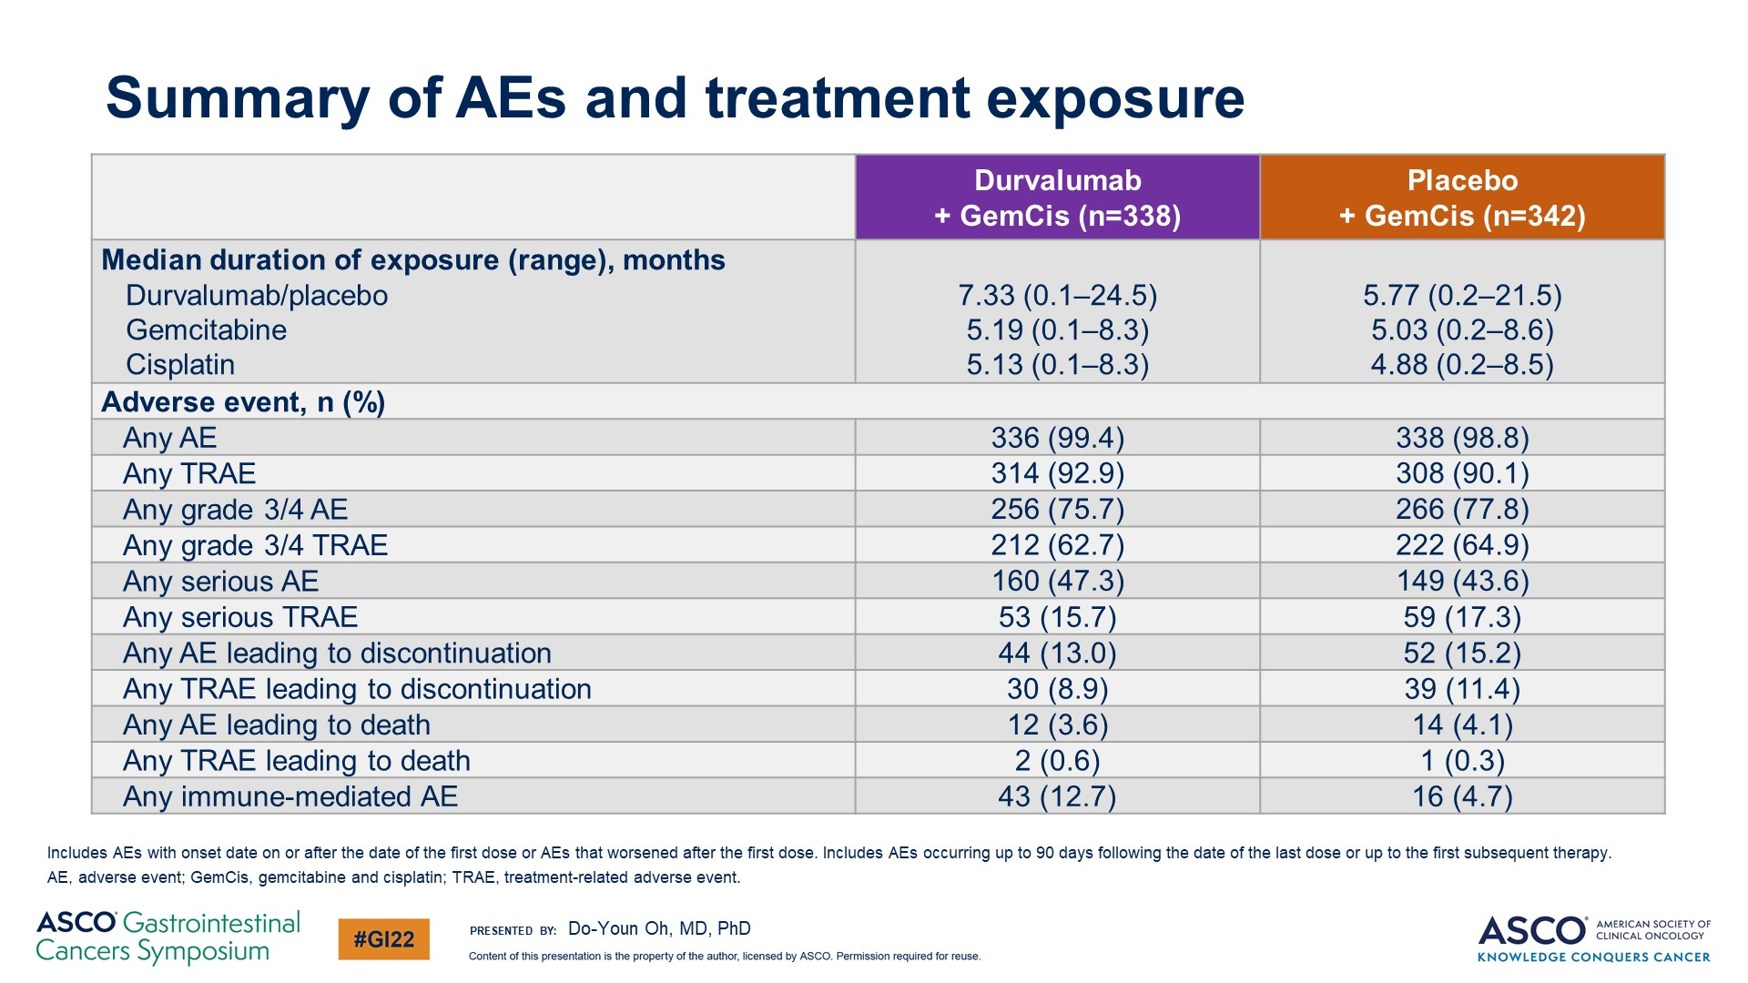
IO + Chemo in BTC 1st line: TOPAZ-1 Phase 3
Adverse events profile
No added Durvalumab-associated toxicity
irAE: 12.7%
9.5% Hypothyroid events or Dermatitis
Oh D-Y et al. Gastrointestinal Cancers Symposium 2022.

Slide 88



TOPAZ update @ ESMO 2022
Responders: late separation, but strong long-term effect
SD: early & continuous separation
PD: no separation
Speculation: „initial 6 mo“ of responses influenced
by „lifting“ of selected SD pts
Do-Youn Oh et al, ESMO 2022 poster 56P

Slide 89

OS in subgroups by PD-L1 expression
IO + Chemo in BTC 1st line: TOPAZ-1 Phase 3
OS in subgroups by PD-L1 expression

Slide 90

IMMUCHEC: an exploratory IO trial in BTC
Aim: identify early „signal of activity“ for different IO combinations

Slide 91


IMMUCHEC: an exploratory IO trial in BTC
What did we learn?
Addition of IO to chemo did not improve ORR (negative trial)
  compared to TOPAZ: small cohort?
  compared to TOPAZ: non-Asian cohort
mOS in control arm longer than in previous phase 2 and 3 trials
  small cohort
  overall improved post progression care in participating institutions?
Omitting Platinum cannot be compensated for by IO
Trend for improved OS in ArmD (Gem/Cis + Durva + single dose Tremelimumab)

Slide 92


Rationale ADVANCE:
Molecular Subclasses of iCCA
Derazantinib „sensitizes“ to IO
Martin-Serrano et al, GUT 2022
Derazantinib targets:
Atezolizumab:
Reprogram suppressive M2 macrophages
Restore T-cell activity
Improve susceptibility to IO
FGFR1
FGFR2
FGFR3
PD-L1
CSF1-R
VEGF-R2

Slide 93
Ongoing Trials IO + Chemo 1st line
 | Arm A | Arm B | Primary EP | Population
KEYNOTE-966 * Phase 3 NCT04003636 | Gem/Cis | Gem/Cis/Pembro | OS | 1st line N = 1048
IMbrave151 Phase 2 * NCT04677504 | Gem/Cis/Atezo | Gem/Cis/Atezo/Bev | PFS | 1st line N = 150
* RESULTS EXPECTED EARLY 2023

Slide 94
Ongoing IO + Locoregional Therapy (LRT) Combinations in Advanced BTC
Combination Targets | Agents | Trial Design: Phase, Population | Sample Size | NCT
ICI + LRT | Durvalumab ± tremelimumab + ablation | Phase 2, advanced HCC or BTC | 90 | NCT02821754
 | Durvalumab + tremelimumab + RT | Phase 2, advanced >1L HCC or BTC | 70 | NCT03482102
 | Durvalumab ± tremelimumab + Y90 SIRT | Phase 2, locally-advanced ICC | 50 | NCT04238637
 | Nivolumab + RT ± ipilimumab | RP2, advanced BTC or pancreas cancer | 160 | NCT02866383
Key: 1L=1st line; 2L=2nd line; RP2, RP3=randomized phase 2 or 3 trial; LRT=locoregional therapy; RT=radiation therapy; SIRT=selective internal radiation therapy

Slide 95
TAKE HOME: Immunotherapy in BTC
TOPAZ-1: Positive Phase III data and FDA approval for Gem/Cis + Durvalumab (vs Gem/Cis)
FDA & EMA approved
subgroup analysis:
  no significant difference depending on region/ethnicity and tumor location (trends?)
No established biomarker to select for patients who benefit from IO
→ personal opinion: there will not be a “single” marker
Data expected in the near future:
KN-966 (Gem/Cis +- Pembro)
Combination of IO+ locoregional therapies
Combination of IO+ targeted therapies

Slide 96
MODULE 4: Integration of Targeted Therapy into the Management of Advanced BTCs — Dr Goyal

Slide 97
77-year-old woman with intrahepatic cholangiocarcinoma considered unresectable — an FGFR2-KIAA1598 fusion was detected on NGS
Dr Lionel Kankeu Fonkoua (Rochester, Minnesota)
60-year-old man with metastatic cholangiocarcinoma with severe muscle pain on pemigatinib
Dr Joseph Martins
(Tyler, Texas)

Slide 98
QUESTIONS FOR THE FACULTY
“She wanted to preserve her quality of life and was very reluctant to try chemotherapy, so we started pemigatinib. She has mild hyperphosphatemia, which we managed with dietary changes. Otherwise, she tolerated it well. Her 6-month PET restaging demonstrated that the avidity had resolved, so very impressive response with just pemigatinib.
Lionel A Kankeu Fonkoua, MD
We had her evaluated by a surgeon, and she was taken for a left hepatectomy and now is under surveillance. Is there any role for using cfDNA as part of the surveillance strategy but also to pick up potential clonal mutations that may evolve?”

Slide 99
QUESTIONS FOR THE FACULTY
“We were thinking of hospice for him, but the next-generation sequencing showed an FGFR fusion, so we started pemigatinib.
Immediately, his tumor markers started coming down, his liver pain got better and now he's doing great. However, he’s having a lot of bone and muscle pain, which is a listed side effect of that drug.
Joseph Martins, MD
Have they seen muscle aches and muscle pain bad enough to cause a need for hydrocodone? What other side effects are seen? How do they deal with hyperphosphatemia?”

Slide 100
53-year-old man with recurrent metastatic cholangiocarcinoma with a BRAF V600E mutation treated with dabrafenib/trametinib
Dr Farshid Dayyani
(Orange, California)
64-year-old woman with cholangiocarcinoma
with an IDH1 mutation is treated with ivosidenib
Dr Niyati Nathwani
(Charlotte, North Carolina)

Slide 101
QUESTIONS FOR THE FACULTY
“He had a great quick response. Within 4 weeks, his CA19-9 normalized, and the MRD assay turned negative. He trucked along for about a year, but more recently his Signatera has slowly gone up. I repeated his liquid biopsy, and the BRAF clone is gone and his original p53-mutant clone is taking over. The question is, do you continue dabrafenib/trametinib or switch to another regimen?”
Farshid Dayyani, MD, PhD

Slide 102
QUESTIONS FOR THE FACULTY
“She’s currently getting concurrent treatment with radiation and capecitabine. We also did biomarker testing, which did show an IDH1 mutation. Should we use ivosidenib after completing concurrent chemoradiation? I’m guessing there’s no differentiation syndrome with this agent in cholangiocarcinoma, but what is their experience with this?”
Niyati A Nathwani, MD

Slide 103
Integration of Targeted Therapy into the Management of Advanced BTCs
Lipika Goyal, MD, Mphil
Associate Professor
Director of Gastrointestinal Oncology
Stanford School of Medicine
Research to Practice CME
2023 ASCO Gastrointestinal Cancers Symposium
January 20, 2023

Slide 104
Systemic Therapy for Cholangiocarcinoma
Cytotoxic Chemotherapy
Targeted
Therapy
Immunotherapy
Gemcitabine/
Cisplatin
(± Durvalumab)
FOLFOX
Nal-IRI/5-FU
Pembrolizumab
for MSI-H
Durvalumab+
Gemcitabine/
Cisplatin
FGFR2, IDH1,
BRAF, HER2
NTRK, RET
and more
BRAF, v-raf murine sarcoma viral oncogene homolog B; CAR, chimeric antigen receptor; FGFR2, fibroblast growth factor receptor 2; FOLFOX, folinic acid, fluorouracil and oxaliplatin; HER2, human epidermal growth factor receptor; IDH, isocitrate dehydrogenase; MAPK, mitogen-activated protein kinase; NTRK, neurotrophic tyrosine kinase; PI3K, phosphatidylinositol-3-kinase; RET, rearranged during transfection.
Image credit: Clipart Panda.

Slide 105

Anatomic Classification of Biliary Tract Cancer
Goyal L, et al. N Engl J Med, 2022

Slide 106

Biliary Tract Cancer: Frequent Actionable Alterations
ECC
ICC
FGFR1-3 alterations (11%–17%)
IDH1/2 mutation (5%–36%)
RNF43 mutation (9%)
PIK3CA mutations (3%–9%)
BRAF mutations (3%–7%)
HER2 amplification/mutation (7%)
MET amplification (2%–7%)
MET mutation (5%)
EGFR mutation (1%–2%)
RET-fusion (<1%)
PIK3CA mutation (7%)
HER2 amplification/mutation
(5%–10%)
IDH1/2 mutation (0%–7%)
MET mutation (4%)
BRAF mutations (3%)
MET amplification (1%)
GBCA
Biomarkers Matter
HER2 amplification/mutation (10%–19%)
PIK3CA mutation (6%–13%)
BRAF mutation (1–6%)
RNF43 mutation (4%)
MAP2K4 mutation (4%)
EGFR mutation (4%)
FGFR1-3 fusions, mutations, and amplifications (3%)
IDH1/2 mutation (2%)
BRAF, v-raf murine sarcoma viral oncogene homolog B; ECC, extrahepatic cholangiocarcinoma; EGFR, epidermal growth factor receptor; FGFR, fibroblast growth factor receptor; GBCA, gallbladder carcinoma; HER2, human epidermal growth factor receptor 2; ICC, intrahepatic cholangiocarcinoma; IDH, isocitrate dehydrogenase; MAP, mitogen-activated protein kinase; MET, mesenchymal to epithelial transition; PIK3CA, phosphatidylinositol 3-kinase catalytic alpha polypeptide; RET, rearranged during transfection; RNF43, ring finger protein 43.
Adapted from Valle JW, et al. Cancer Discov 2017;7(9):943–962.

Slide 107



Role for Liquid Biopsy in Biliary Tract Cancer?
44% of patients with actionable alteration
87% detection for
IDH1 mutations
18% detection for
FGFR2 fusions
Berchuck, etal, Annals of Onc, 2022

Slide 108



Evaluating Targeted Therapy in an
Uncommon Cancer: Approaches
Target-Specific Cholangiocarcinoma Trial
Target-Specific All Comer Basket Trial
Biliary Umbrella Trial With Target-Specific Arms
IDH1
HER2
BRAF
FGF2
BRAF V600E
mutations
4%–5%
RET-fusion
<1%
FGFR2
fusions
10%–15%
IDH1
mutations
15%–20%
NTRK-fusion
<1%
ABC10
HER2 amplification
5-15%
MSI-high
1%–2%
ABC10, ABC transporter 10; BRAF, v-raf murine sarcoma viral oncogene homolog B; FGFR2, fibroblast growth factor receptor 2; HER2, human epidermal growth factor 2;
IDH, isocitrate dehydrogenase; MSI, microsatellite instability; NTRK, neurotrophic tyrosine receptor kinase; RET, rearranged during transfection.
Valle JW, et al. Cancer Discov 2017;7(9):943–962.

Slide 109


Selective FGFR Inhibitors for FGFR2 Fusions or Rearrangement Positive Cholangiocarcinoma^{1–4}
Pemigatinib
ATP-competitive
FGFR1–3 inhibitor
Infigratinib
ATP-competitive
FGFR1–3 inhibitor
ORR: 35.5% (updated: 37.0%)
DCR: 82.2% (updated 82.4%)
PFS (updated): 7.0 months
ORR: 18.8% (updated: 23.1%)
DCR: 83.3% (updated: 84.3%)
PFS (updated): 7.3 months
ATP, adenosine triphosphate; DCR, disease control rate; FGFR, fibroblast growth factor receptor; ORR, overall response rate; PFS, progression-free survival.
1. Javle M, et al. J Clin Oncol 2018;36(3):276–282; 2. Javle M, et al. ASCO Gastrointestinal (GI) Cancers Symposium, 2021;
3. Abou-Alfa GK, et al. Lancet Oncol 2020;21(5):671–684; 4. Abou-Alfa GK et al. ASCO 2021;Abstract 4086.

Slide 110

FOENIX-CCA2 Study of Futibatinib for FGFR2-Rearranged
Intrahepatic Cholangiocarcinoma
ORR: 42%
Median duration of response: 9.7 months
PFS: 9.0 months
Goyal L et al. N Engl J Med 2023;388(3):228-39.

Slide 111

RLY-4008, FGFR2-specific inhibitor, in FGFR2-fusion or Rearrangement+ Cholangiocarcinoma
Radiographic tumor regression and response per RECIST 1.1 across all doses
RLY-4008
ORR 82.4% @ 70mg QD (RP2D)
in FGFR2 fusion+ cholangio
(preliminary results)
Resection with curative intent
BID, twice daily; BOR, best overall response; CCA, cholangiocarcinoma; DoR, duration of response; FGFR, fibroblast growth factor receptors; FGFRi, fibroblast growth factor receptor inhibitor; ORR, objective response rate; PD, progressive disease; PR, partial response; QD, once daily; QDi once daily on an intermittent schedule; RP2D, recommended phase 2 dose; SD, stable disease; uPR, unconfirmed partial response.
Hollebecque A, et al. Ann Onc 2022;33(suppl_7):S808-S869.

Slide 112

A Phase II Study Of FGFR1-3 Inhibitor Tinengotinib As Monotherapy In Patients With Advanced Or Metastatic Cholangiocarcinoma :Interim Analysis
Oral tinengotinib
10 mg once daily
28-day cycles
Until progression or toxicity
F/R: FGFR2 fusion or rearrangement.
Subject 02-040, 01-037, 01-044 no baseline cfDNA NGS data was detected, only historical FGFR data available.

Slide 113

RAGNAR Trial of Erdafitinib for Cholangiocarcinoma with Prespecified FGFR Alterations: Expansion Cohort Results
Pant S et al. Gastrointestinal Cancers Symposium 2023;Abstract 610.

Slide 114
Ivosidenib in IDH-Mutant Cholangiocarcinoma
Randomized, double-blind, placebo-controlled, multicenter phase 3 trial
Key eligibility criteria
≥18 years of age
Histologically confirmed diagnosis of cholangiocarcinoma
Centrally confirmed IDH1 mutation status by next-generation sequencing
ECOG performance status score 0 or 1
1–2 prior therapies (at least 1 gemcitabine- or 5-fluorouracil-containing regimen)
Measurable lesion as defined by RECIST v1.1
Adequate hematologic, hepatic and renal function
Ivosidenib 500 mg QD orally in continuous 28-day (±2 days) cycles (n=124)
2:1 double-blind randomization (n=185)
Crossover permitted at radiographic disease progression
Pre-screening for IDH1 mutation
Stratified by number of prior therapies
Placebo (n=61)
An independent data monitoring committee monitored the safety data throughout the study
Primary end point: PFS
Secondary end points: OS, ORR, safety, QOL
ECOG, Eastern Cooperative Oncology Group; IDH, isocitrate dehydrogenase; ORR, objective response rate; OS, overall survival; PFS, progression-free survival; QD, once daily; QOL, quality of life; RECIST, Response Evaluation Criteria in Solid Tumors.
Abou-Alfa GK, et al. Lancet Oncol 2020;21:796–807; NCT02989857.

Slide 115

Ivosidenib in IDH-Mutant Cholangiocarcinoma (Contd.)
 | Ivosidenib | Placebo
PFS
Median, months | 2.7 | 1.4
6-month rate | 32% | NE
12-month rate | 22% | NE
Primary end point: PFS
Secondary end points: OS, ORR, safety, QOL
CI, confidence interval; HR, hazard ratio; IDH1, isocitrate dehydrogenase 1; PFS, progression-free survival.
Abou-Alfa GK, et al. Lancet Oncol 2020;21:796–807.

Slide 116
Evaluating Targeted Therapy in an
Uncommon Cancer: Approaches
Target-Specific Cholangiocarcinoma Trial
Target-Specific All Comer Basket Trial
Biliary Umbrella Trial With Target-Specific Arms
IDH1
HER2
BRAF
FGF2
BRAF V600E
mutations
4%–5%
RET-fusion
<1%
FGFR2
fusions
10%–15%
IDH1
mutations
15%–20%
NTRK-fusion
<1%
ABC10
HER2 amplification
5-15%
MSI-high
1%–2%
ABC10, ABC transporter 10; BRAF, v-raf murine sarcoma viral oncogene homolog B; FGFR2, fibroblast growth factor receptor 2; HER2, human epidermal growth factor 2;
IDH, isocitrate dehydrogenase; MSI, microsatellite instability; NTRK, neurotrophic tyrosine receptor kinase; RET, rearranged during transfection.
Valle JW, et al. Cancer Discov 2017;7(9):943–962.

Slide 117
Dabrafenib/Trametinib: ROAR
Phase 2 Study: BRAF V600E–Mutant Advanced Solid Tumors
Anaplastic thyroid cancer
Patients with BTC
(N=33)
BTC
Gastrointestinal stromal tumor
Dose
End of treatment
Patients with BRAF V600E–mutated cancers
Germ cell tumor
Dabrafenib (150 mg BID)
+
Trametinib (2 mg QD)
Disease progression, death, or unacceptable toxicity
WHO grade I or II glioma
WHO grade III or IV glioma
Hairy cell leukemia
Primary end point: investigator-assessed ORR by RECIST v1.1
Secondary end points: PFS, DOR, OS, and safety
Multiple myeloma
Enrollment: March 2014 to April 2018
Adenocarcinoma of the small intestine
BID, twice daily; BRAF, v-raf murine sarcoma viral oncogene homolog B; BTC, biliary tract cancer; BID, twice daily; DOR, duration of response; ORR, objective response rate; OS, overall survival; PFS, progression-free survival; QD, once daily; RECIST, Response Evaluation Criteria in Solid Tumors; WHO, World Health Organization.
Wainberg ZA, et al,. J Clin Onc 2019 37:4(Suppl):187–187.

Slide 118

Dabrafenib/Trametinib: ROAR
Biliary Tract Cancer Cohort (n=43)
Primary end point:
ORR: 51% (95% CI: 36–67)
by investigator assessment
ORR: 47% (95% CI: 31–62)
by independent review
Secondary end points:
Median DOR:
9 months (95% CI: 6–14)
by investigator assessment
Median PFS: 9 months
(95% CI: 5–10)
by investigator assessment
Median OS: 14 months
(95% CI: 10–33)
CI, confidence interval; DOR, duration of response; ORR, objective response rate; OS, overall survival; PFS, progression-free survival.
Subbiah V, et al. Lancet Oncol 2020; 21:1234–43.

Slide 119



Targeting HER2 overexpression/amplification
Trastuzumab/Pertuzumab
MyPathway
Trastuzumab deruxtecan
Zanidatamab
ORR 23%
Median DOR 10.8 months (0.7-25.4)
N=39 patients
ORR 36.4%
Median DOR 7.4 months (n=22)
ORR 40%
Median DOR 7.4 months (3.2-NE)
(n=20)
DOR, duration of response; HER2, human epidermal growth factor receptor 2; ORR, objective response rate
Javle M et al. Lancet Oncol 2021;22(9):1290-1300; Ohba A et al. ASCO 2022;Abstract 4006; Meric-Bernstam F et al. Gastrointestinal Cancers Symposium 2021;Abstract 299.

Slide 120




Targeting NTRK and RET Fusions
Larotrectinib in TRK Fusion–Positive Cancers
Pralsetinib in RET Fusion–positive Solid Tumors
ORR 75%
ORR 57%
Entrectinib in NTRK Fusion-positive Solid Tumors
ORR 57%
Selpercatinib in RET Fusion–positive Solid Tumors
ORR 44%
Drilon A, et al, N Engl J Med 2018;378:731–9; Doebele RC, et al. Lancet Oncol. 2020;21(2):271–282; Subbiah V, et al, 2022 Nat Med 2022;28:1640–1645; Subbiah V, et al. Lancet Oncol 2022;12:S1470-2045(22)00541–1

Slide 121
Other Actionable Signatures in Cholangiocarcinoma^{1,2}
KRAS G12C mutations
BRCA 1/2 and DNA damage repair mutations
PIK3CA/Akt mutations
RSPO fusions and RNF43 mutations
BRCA, breast cancer gene; DNA, deoxyribonucleic acid; KRAS, Kirsten rat sarcoma viral oncogene homolog; PIK3CA, phosphatidylinositol-4,5-biphosphate 3-kinase catalyic alpha polypeptide; RNF43, ring finger protein 43; RSPO, recurrent R-spondin.
1. Valle JW, et al. Cancer Discov 2017;7(9):943–962; 2. Le DT, et al. Science 2017;357(6349):409–413.

Slide 122


Slide 123
Conclusions
Precision Oncology is Key for Management of Advanced Cholangiocarcinoma
TOPAZ-1:
Gem/Cisplatin/Durvalumab now a first line preferred regimen
ABC-06: 2L FOLFOX becomes standard of care
ABC-02: Gem/Cis becomes the standard of care
FDA approval of pemigatinib, infigratinib, and futibatinib for FGFR2 fusion/rearrangement–positive and ivosidenib for IDH1-positive cholangiocarcinoma
Biliary Tract Cancer
2009
2010
2011
2012
2013
2014
2015
2016
2017
2018
2019
2020
2021
2022
2023
Tissue agnostic
FDA approval of dabrafenib/trametinib BRAF V600E mutation-positive
and
selpercatinib for
RET-positive
advanced solid tumors
Tumor molecular profiling is now the standard of care in cholangiocarcinoma
Consider referral for clinical trials to hasten the path to FDA approval for effective drugs
Pembrolizumab for MSI-high advanced solid tumors
Larotrectinib and entrectinib for NTRK fusion–positive advanced solid tumors
2L, second line; BRAF, v-raf murine sarcoma viral oncogene homolog B; FDA, US Food and Drug Administration; FGFR, fibroblast growth factor receptor; FOLFOX, folinic acid, fluorouracil and oxaliplatin; Gem/Cis, gemcitabine/ cisplatin; IDH, isocitrate dehydrogenase; MEK, mitogen-activated protein kinase kinase; MSI, microsatellite instability; NTRK, neurotrophic tyrosine kinase.
Valle JW, et al. Cancer Discov 2017;7(9):943–962; Goyal L, et al. Cancer Treat Rev 2021;95:102170; National Comprehensive Cancer Network (2021). Hepatobiliary cancers: NCCN evidence blocks. Version 1.2021. Available at: https://www.nccn.org/professionals/physician_gls/pdf/hepatobiliary_blocks.pdf; Abou-Alfa GK, et al (2019). Ann Oncol (ESMO Congress Abstracts), 30(suppl_5). Abstract 1867; Subbiah V, et al. Lancet 2020;21(9):1234–1243.

