Slide 1
Localized Melanoma and Other Types of Skin Cancer
Evan J Lipson, MD Associate Professor, Medical Oncology Bloomberg-Kimmel Institute for Cancer Immunotherapy Johns Hopkins School of Medicine The Sidney Kimmel Comprehensive Cancer Center Baltimore, Maryland

Slide 2
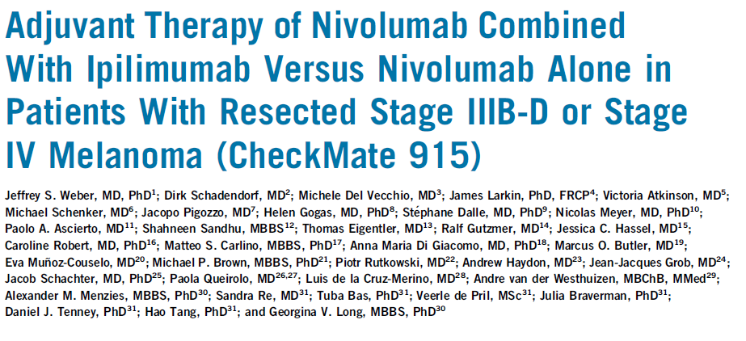
Weber JS et al. J Clin Oncol 2023;41(3):517-27.

Slide 3
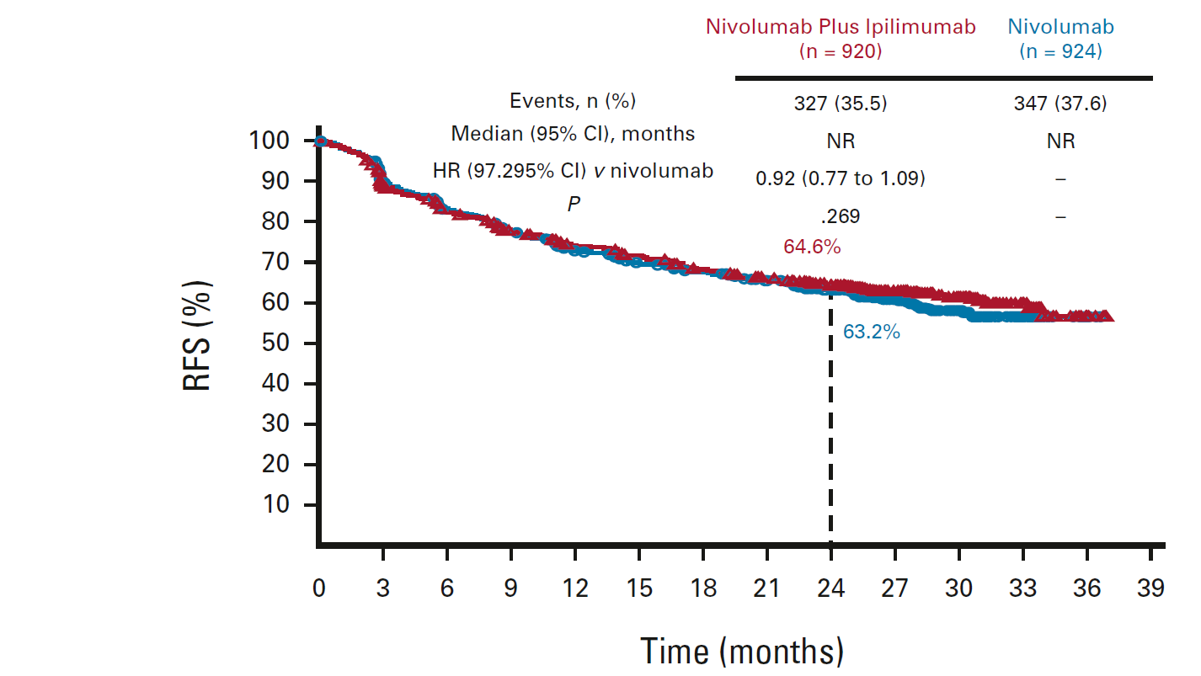
No difference in recurrence-free survival (RFS) among ~1800 patients with resected stage IIIB-D or IV melanoma randomized to nivolumab + ipilimumab 1mg/kg q6W vs nivolumab alone
Weber JS et al. J Clin Oncol 2023;41(3):517-27.

Slide 4
Conclusions
Critical finding(s): No difference in recurrence-free survival among ~1800 patients with resected stage IIIB-D or IV melanoma randomized to nivolumab + ipilimumab 1mg/kg q6W vs nivolumab alone, regardless of PD-L1 status.
Treatment-related grade 3-4 adverse events were reported in 32.6% of patients in the combination group and 12.8% in the nivolumab group. Treatment-related deaths were reported in 0.4% of patients in the combination group and in no nivolumab-treated patients.
Clinical implication(s): These results support administration of adjuvant anti-PD-1 monotherapy for patients with high-risk resected melanoma.
Research relevance: Could other combinations (e.g., anti-PD-1 + anti-LAG-3) provide benefit over anti-PD-1 alone in this patient population?

Slide 5
Pembrolizumab Versus Placebo as Adjuvant Therapy in Stage IIB or IIC Melanoma: Final Distant Metastasis-Free Survival Analysis in the Phase 3 KEYNOTE-716 Study
Luke JJ et al. ASCO 2023;Abstract LBA9505.

Slide 6
In patients with resected stage IIB/C melanoma, distant metastasis-free survival improved with adjuvant pembrolizumab vs. placebo.
Luke JJ et al. ASCO 2023;Abstract LBA9505.

Slide 7
Conclusions
Critical finding(s): Among ~1000 patients with resected stage IIB/C melanoma, at a median follow-up of 39.4 months, adjuvant pembrolizumab continued to demonstrate improved distant metastasis-free and recurrence-free survival compared with placebo.
Clinical implication(s): These results support adjuvant pembrolizumab monotherapy for patients with resected stage IIB/C melanoma.
Research relevance: Could other combinations (e.g., anti-PD-1 + anti-LAG-3) provide benefit over anti-PD-1 alone in this patient population?

Slide 8
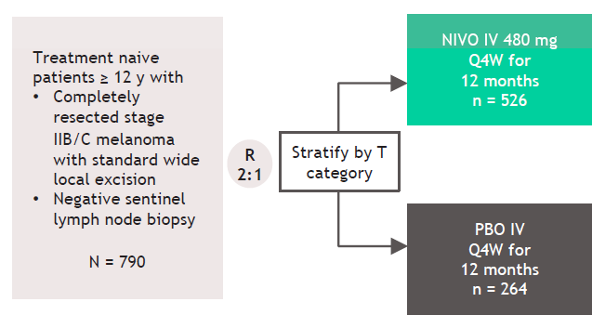
Long G et al. Society for Melanoma Research 2022.

Slide 9
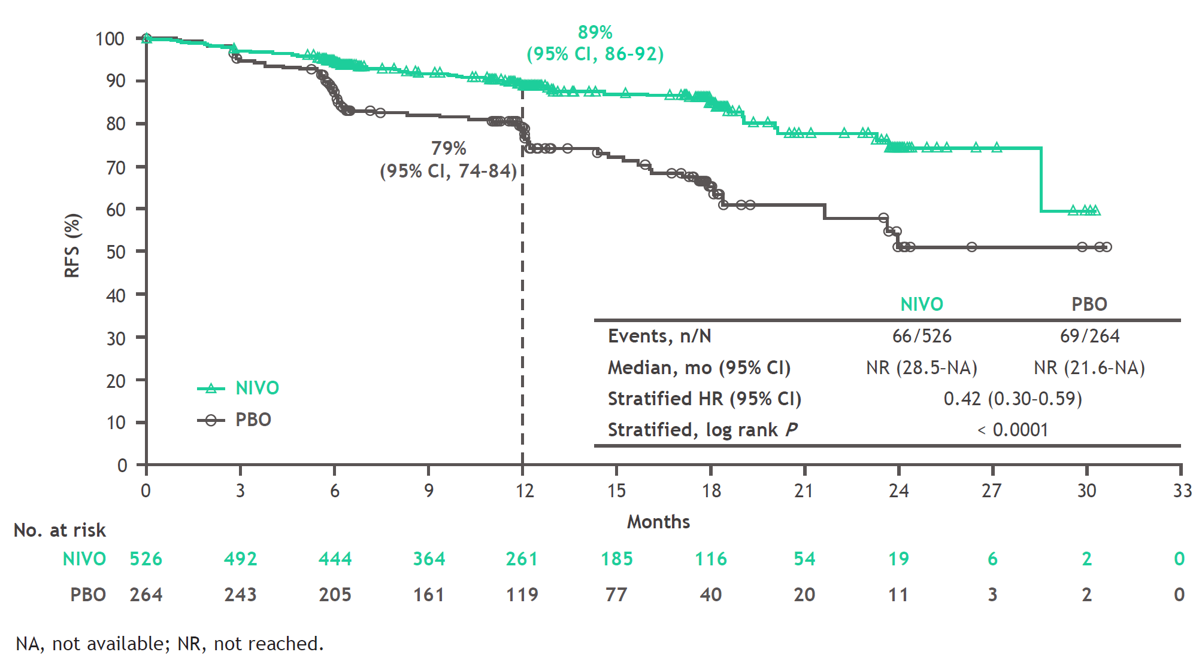
In patients with resected stage IIB/C melanoma, recurrence-free survival (RFS) improved with adjuvant nivolumab (NIVO) vs. placebo (PBO)
Long G et al. Society for Melanoma Research 2022.

Slide 10
Conclusions
Critical finding(s): Among ~800 patients with resected stage IIB or IIC melanoma, nivolumab significantly reduced the risk of recurrence by 58% compared with placebo
Clinical implication(s): These results demonstrate the benefit of adjuvant nivolumab for patients with resected stage IIB/C melanoma.
Research relevance: Could other combinations (e.g., anti-PD-1 + anti-LAG-3) provide benefit over anti-PD-1 alone in this patient population?

Slide 11
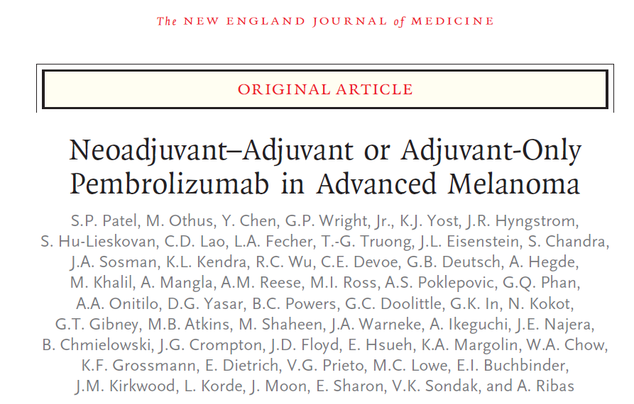
Patel SP et al. N Engl J Med 2023;388(9):813-23.

Slide 12
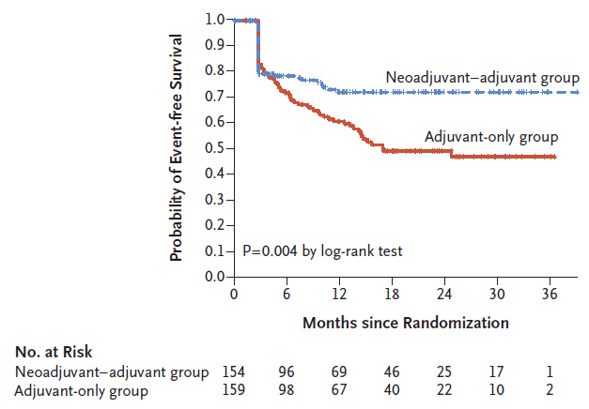
In patients with resectable stage III/IV melanoma, event-free survival (EFS) improved with neoadjuvant + adjuvant pembrolizumab vs. adjuvant-only.
Patel SP et al. N Engl J Med 2023;388(9):813-23.

Slide 13
Conclusions
Critical finding(s): Among ~150 patients with clinically detectable, measurable, surgically resectable, stage IIIB to IVC melanoma, event-free survival (EFS) improved with neoadjuvant + adjuvant pembrolizumab vs. adjuvant-only. Events were defined as:
disease progression or toxic effects that precluded surgery
inability to resect all gross disease
disease progression, surgical complications, or toxic effects of treatment that precluded the initiation of adjuvant therapy within 84 days after surgery
recurrence of melanoma after surgery
death from any cause
Clinical implication(s): Neoadjuvant immunotherapy is becoming standard-of-care for patients with resectable, stage IIIB to IV melanoma.
Research relevance: Which regimen is best, for how long, and is adjuvant therapy needed, especially in the setting of a pathologic complete response?

Slide 14
Distant Metastasis-Free Survival Results From <br />the Randomized, Phase 2 mRNA-4157-P201/<br />KEYNOTE-942 Trial
Khattak MA et al. ASCO 2023;Abstract LBA9503.

Slide 15
mRNA-4157-P201/KEYNOTE-942 (NCT03897881) Study Design
Khattak MA et al. ASCO 2023;Abstract LBA9503.

Slide 16
Recurrence-free survival among patients with resected stage IIIB-IV melanoma who received adjuvant pembrolizumab alone or mRNA-4157 (V940) + pembrolizumab.
Khattak MA et al. ASCO 2023;Abstract LBA9503.

Slide 17
Conclusions
Critical finding(s): Compared to pembrolizumab alone, mRNA-4157 (V940) + pembrolizumab led to a 44% reduction in the risk of recurrence or death and a 65% reduction in the risk of distant metastasis or death among patients with resected stage IIIB-IV melanoma.
Clinical implication(s): Further testing needed. Sample size was relatively small and statistical outcomes are borderline, requiring additional investigation.
Research relevance: Phase 3 trial opening soon.

Slide 18
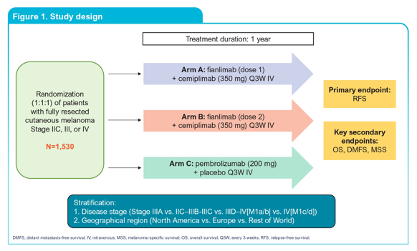
Panella TJ et al. ASCO 2023;Abstract TPS9598.

Slide 19
Conclusions
Critical finding(s): This is a phase 3 trial comparing recurrence-free survival among patients with resected stage IIC, III or IV melanoma who receive pembrolizumab or cemiplimab+fianlimab (anti-PD-1 + anti-LAG-3).
Clinical implication(s): If successful, this trial could introduce a combination adjuvant immunotherapy option for patients with resected high-risk melanoma.
Research relevance: Phase 3 trial in progress.

Slide 20
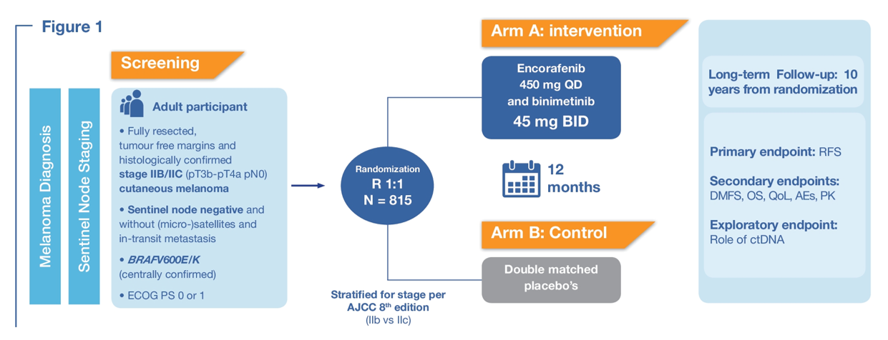
Van Akkooi ACJ et al. ASCO 2023;Abstract TPS9601.

Slide 21
Conclusions
Critical finding(s): This phase 3 study will evaluate whether encorafenib (BRAF inhibitor) plus binimetinib (MEK inhibitor) can decrease the risk of recurrence and improve distant metastasis-free survival and overall survival versus placebo in patients with resected stage IIB/C BRAF V600E/K-mutant melanoma.
Clinical implication(s): If successful, this trial could introduce a combination adjuvant targeted therapy option for patients with resected stage IIB/C BRAF V600E/K-mutant melanoma.
Research relevance: Phase 3 trial in progress.

Slide 22
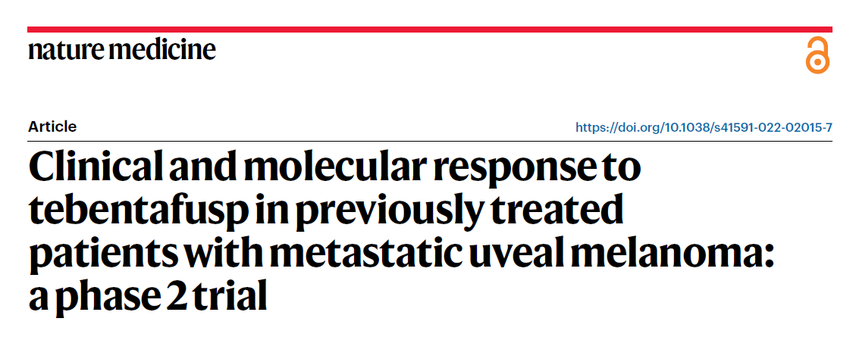
Carvajal RD et al. Nat Med 2022;28(11):2364-73.

Slide 23
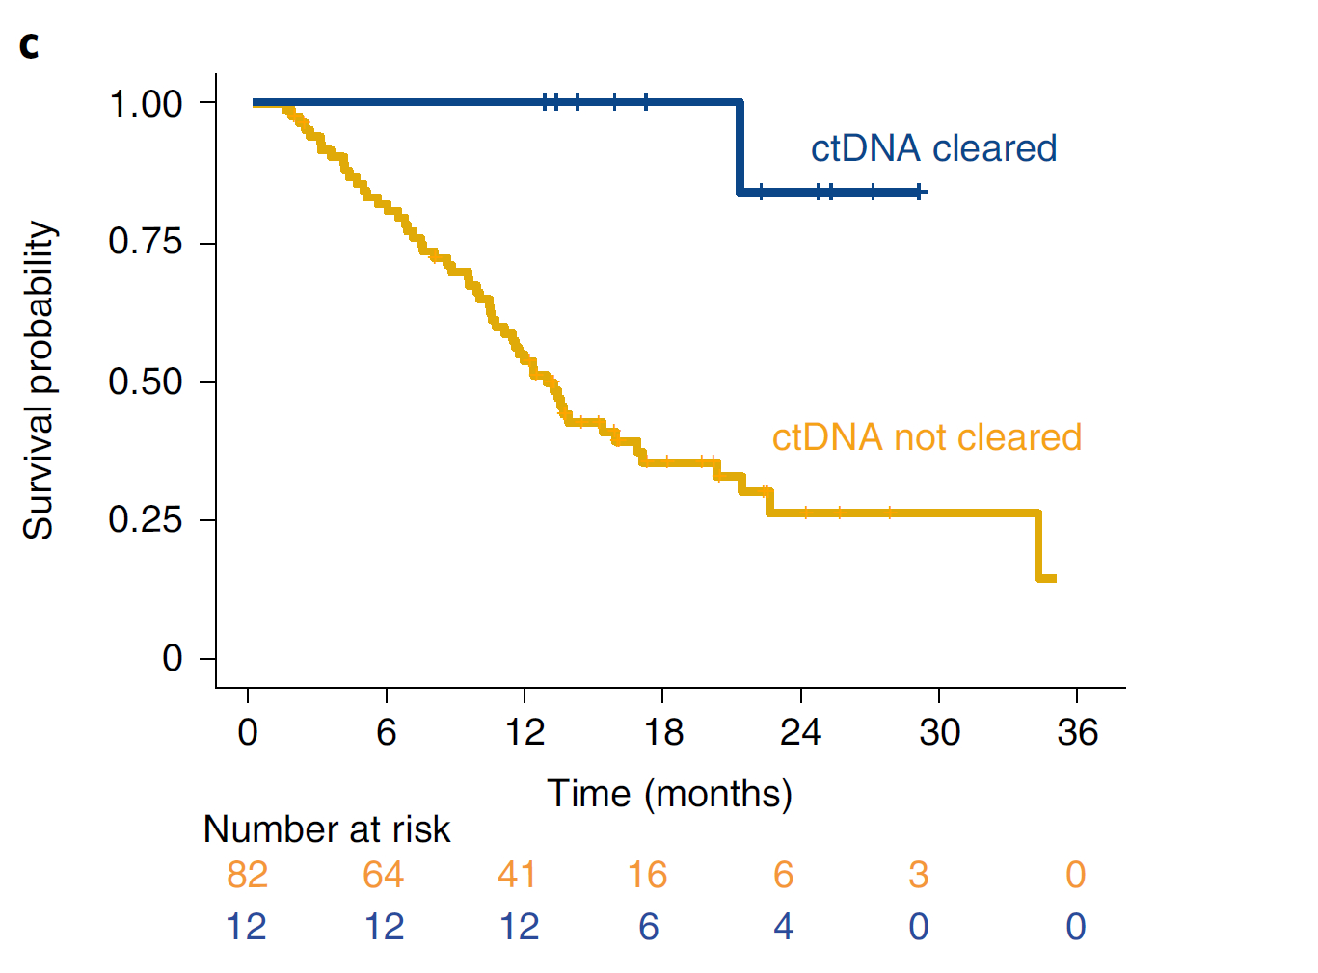
Tebentafusp may improve OS compared to historical controls. Early on-treatment reduction in circulating tumor DNA was associated with overall survival, even in patients with radiographic progression.
 | Historical controls | Tebentafusp
1-year OS rate (%) | 37 | 62
Median OS (mos) | 7.8 | 16.8
Carvajal RD et al. Nat Med 2022;28(11):2364-73.

Slide 24
Conclusions
Critical finding(s): 127 patients with previously treated metastatic uveal melanoma received tebentafusp (T cell receptor bispecific (gp100×CD3))
Despite an overall response rate of only 5%, 1-year overall survival rate was 62% and median overall survival was 16.8 months, suggesting benefit beyond traditional imaging-based response criteria.
In an exploratory analysis, early on-treatment reduction in circulating tumor DNA was strongly associated with overall survival, even in patients with radiographic progression.
Clinical implication(s): In patients with metastatic uveal melanoma who had previously received immunotherapy, chemotherapy, targeted therapy, radiotherapy, liver-directed therapy, and/or surgery, tebentafusp demonstrated promising clinical activity. ctDNA appears to be an early indicator of clinical benefit.
Research relevance: The findings above need validation in a randomized trial.

Slide 25
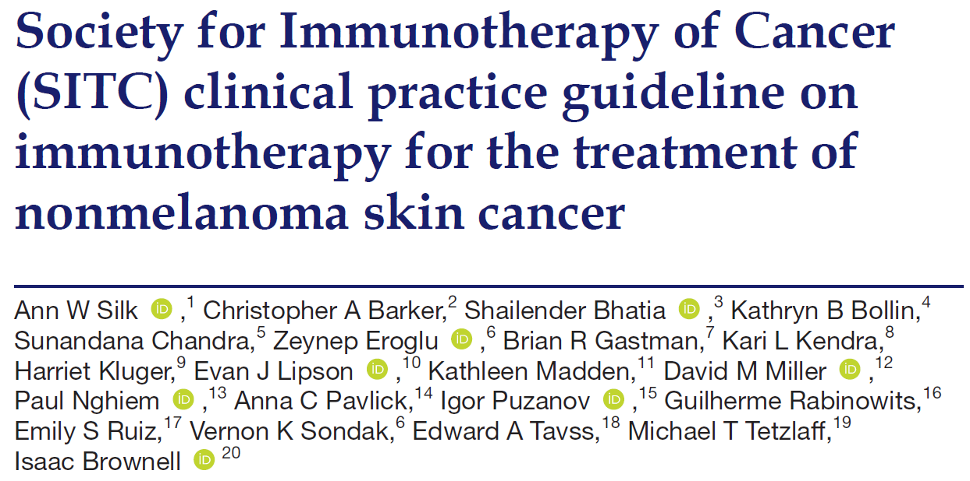
Silk AW et al. J Immunother Cancer 2022;10(7):e004434.

Slide 26
Conclusions
Critical finding(s): With the goal of improving patient care by providing expert guidance to the oncology community, the Society for Immunotherapy of Cancer (SITC) convened a multidisciplinary panel of experts to develop a clinical practice guideline for treating patients with basal, cutaneous squamous and Merkel cell carcinomas.
The expert panel drew on the published literature as well as their own clinical experience to develop recommendations for healthcare professionals on important aspects of immunotherapeutic treatment for these patients, including staging, biomarker testing, patient selection, therapy selection, post-treatment response evaluation and surveillance, and patient quality of life considerations.
Clinical implication(s): The evidence- and consensus-based recommendations in this clinical practice guideline are intended to provide guidance to cancer care professionals treating patients with non-melanoma skin cancers.
Research relevance: Some of the evidence- and consensus-based recommendations included in the clinical practice guideline are undergoing formal testing in clinical trials.

Slide 27
Non-comparative, open-label, international, multicenter <br />phase 1/2 study of nivolumab (NIVO) ± ipilimumab (IPI) <br />in patients (pts) with recurrent/metastatic Merkel cell carcinoma (MCC) (CheckMate 358)
Bhatia S et al. ASCO 2023;Abstract 9506.

Slide 28
Efficacy: all treated patients
Bhatia S et al. ASCO 2023;Abstract 9506.

Slide 29
Conclusions
Critical finding(s): This multicenter, international phase 1 /2 study investigated NIVO ± IPI 1 mg/kg Q6W in patients with advanced MCC, some treatment-naïve, some previously treated.
Both NIVO and NIVO + low-dose IPI were associated with frequent and durable responses.
While the non-randomized trial design limits comparisons between cohorts, results do not suggest additional efficacy (ORR, PFS, OS) in the combination arm.
Clinical implication(s): Although this study does not support administration of IPI+NIVO to patients with advanced Merkel cell carcinoma, reports from other groups suggest some benefit associated with this combination. For now, anti-PD-(L)1 monotherapy remains the standard of care for this patient population, though the addition of ipilimumab might be considered in patients with refractory MCC.
Research relevance: Further research is needed to assess a potential role for combination immune checkpoint inhibitor therapy in this patient population.

Slide 30
Towards organ preservation and cure <br />via two infusions of immunotherapy only, <br />in patients normally undergoing extensive and mutilating curative surgery for <br />cutaneous squamous cell carcinoma (CSCC)
Zuur CL et al. ASCO 2023;Abstract 9507.

Slide 31
MATISSE: Included patients
Zuur CL et al. ASCO 2023;Abstract 9507.

Slide 32
MATISSE, RFS:
Excellent clinical outcome in patients with an MPR or CCR, at an overall median Follow-Up of 14 months.
Zuur CL et al. ASCO 2023;Abstract 9507.

Slide 33
Conclusions
Critical finding(s): Among 40 patients with locally-advanced cutaneous squamous cell carcinoma who received NIVO or IPI+NIVO, major pathologic response rates were 40% and 53%, respectively.
9 pts declined surgery because of self-reported substantial clinical remission upon neoadjuvant immunotherapy. These clinical responses were confirmed via FDG-PET evaluation in week 4. All 9 pts were “cancer free” at median follow-up of 12 months (range 4 to 27) with superior quality-of-life compared to MATISSE pts undergoing standard of care surgery.
Clinical implication(s): Neoadjuvant immunotherapy is becoming standard-of-care for patients with locally-advanced resectable CSCC. In the setting of substantial tumor regression, it remains unclear whether surgical resection is necessary.
Research relevance: Which regimen is best, for how long, and are surgery and/or adjuvant therapy needed, particularly in the setting of substantial tumor regression or a pathologic complete response?

Slide 34
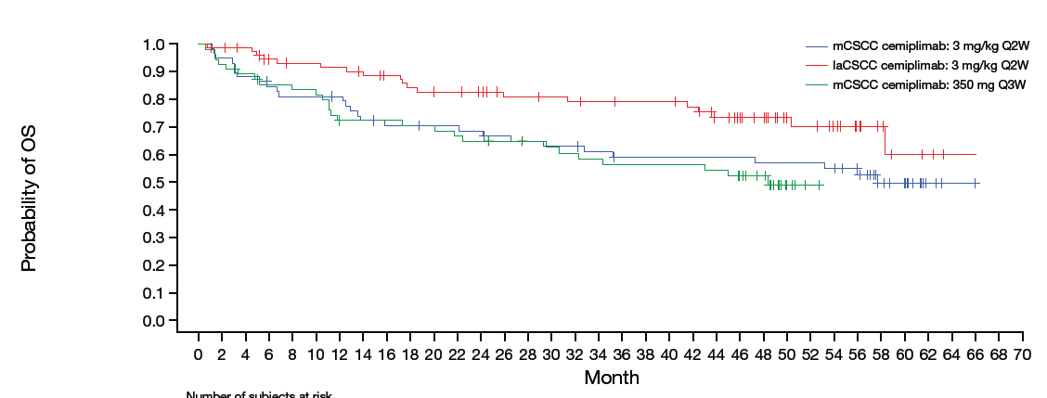
Migden MR et al. ESMO 2022;Abstract 814P.

Slide 35
Conclusions
Critical finding(s): 193 patients with advanced cutaneous squamous cell carcinoma received cemiplimab. Median duration of follow up was 15.7 months.
Median PFS = 22.1 months
Median duration of response = 41.3 months
Median OS not reached; Kaplan–Meier estimated probability of OS at 48 months was 61.8%
Clinical implication(s): This study confirms the efficacy, durability, and safety profile of cemiplimab in patients with advanced CSCC.
Research relevance: Could other combinations (e.g., anti-PD-1 + anti-LAG-3) provide benefit over anti-PD-1 alone in this patient population?

Slide 36
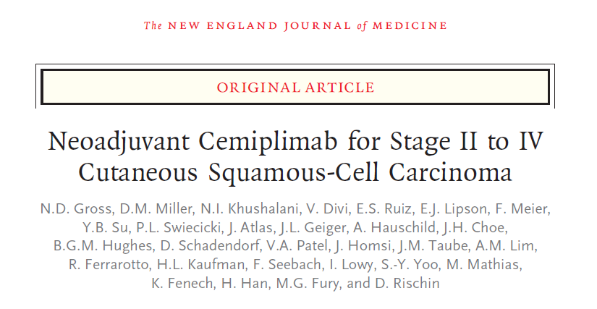
Gross ND et al. N Engl J Med 2022;387(17):1557-68.

Slide 37
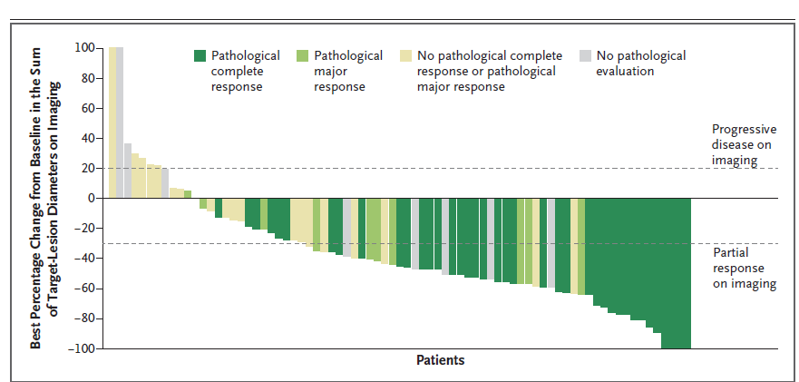
Among 79 patients with advanced CSCC who received neoadjuvant cemiplimab, complete or major pathological response was observed in 64%. Objective response on imaging was observed in 68%.
Gross ND et al. N Engl J Med 2022;387(17):1557-68.

Slide 38
Conclusions
Critical finding(s): Among 79 patients with resectable stage II, III, or IV (M0) CSCC who received neoadjuvant cemiplimab x 12 weeks, complete or major pathological response was observed in 64%. Objective response on imaging was observed in 68%.
Clinical implication(s): Neoadjuvant immunotherapy is becoming standard-of-care for patients with locally-advanced resectable CSCC.
Research relevance: Which regimen is best, for how long, and are surgery and/or adjuvant therapy needed, particularly in the setting of substantial tumor regression or a pathologic complete response? Larger trials addressing these questions are in process.

Slide 39
Lewis KD et al. EADO 2023;Abstract HSR23-097.

Slide 40
Phase 2 Trial of Cemiplimab in patients with metastatic basal cell carcinoma who progressed on or were intolerant to hedgehog inhibitor (HHI) treatment
Objective response rate = 24.1%
This analysis evaluated health-related quality of life data using validated questionnaires (European Organisation for Research and Treatment of Cancer Quality of Life-Core 30 and Skindex-16).
Baseline scores showed moderate to high levels of functioning and low symptom burden. Responder analysis showed clinically meaningful improvement or maintenance of functioning and symptoms in 76–88% of patients at week 3 that were generally maintained at ~6 months.
Lewis KD et al. EADO 2023;Abstract HSR23-097.

Slide 41
Conclusions
Critical finding(s): Most patients with metastatic BCC treated with cemiplimab reported maintenance in global health status/quality of life and functioning while maintaining low symptom burden.
Clinical implication(s): Cemiplimab remains a standard-of-care therapy for patients with metastatic basal cell carcinoma who previously received a hedgehog inhibitor (HHI) or for whom a HHI is not appropriate.
Research relevance: Response rates of BCC to anti-PD-1 after HHI seem low compared to tumors with similar tumor mutation burdens (CSCC, Merkel cell). An ongoing front-line anti-PD-1 study reports response rates of ~50% in patients with treatment-naïve BCC.

Slide 42
Hanna et al. ASCO 2023

Slide 43
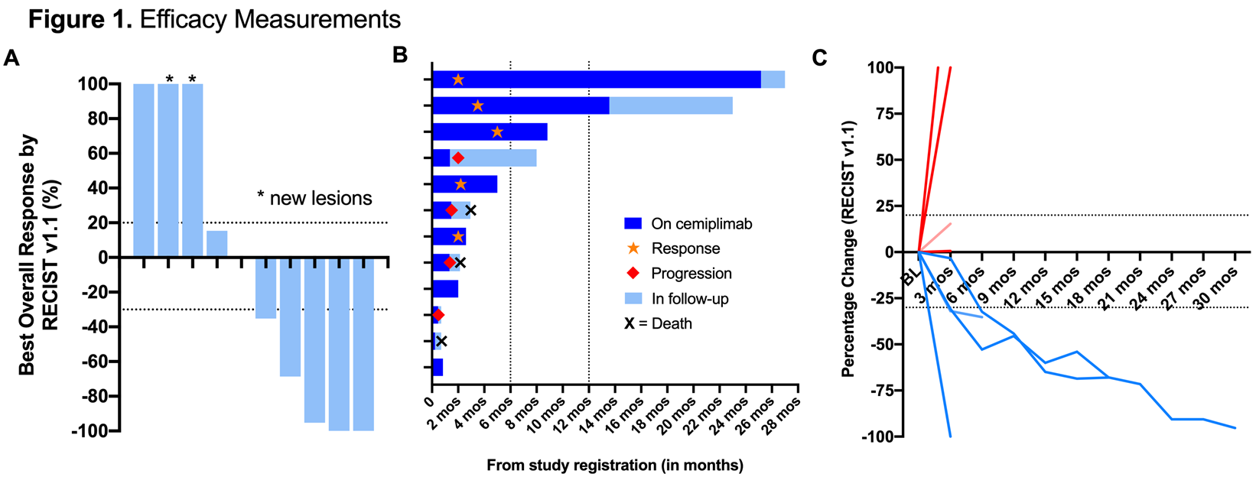
Hanna et al. ASCO 2023

Slide 44
Conclusions
Critical finding(s): Among 12 patients, no kidney rejection observed. ORR= 50% (5/10 patients); some responses were durable (>2 years in 2/10 patients)
Clinical implication(s): To date, mTor inhibition + pulsed prednisone is the regimen associated with the lowest risk of organ rejection that does not preclude responses to Cemiplimab in kidney transplant recipients with cutaneous squamous cell carcinoma.
Research relevance: Larger trials are planned to further test combinatorial regimens that can activate anti-tumor immunity and maintain allograft tolerance.

