Slide 1


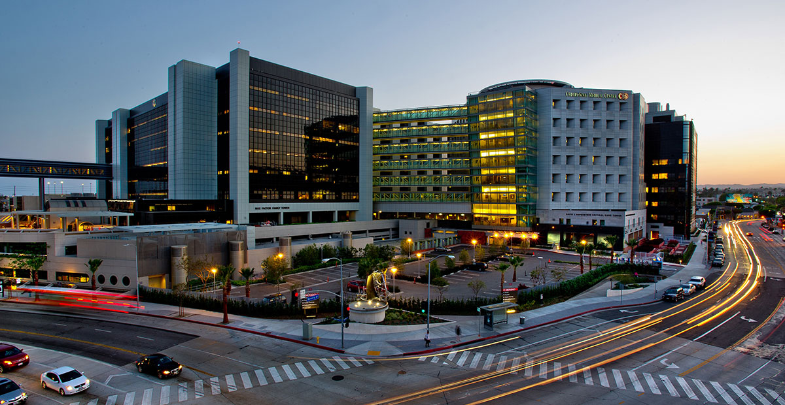


Research To Practice
Omid Hamid MD
Chief, Translational Research/Immuno-Oncology, Co-Director, Cutaneous Malignancies,
The Angeles Clinic & Research Institute, A Cedars Sinai Affiliate
@OmidHamidMD • ohamid@theangelesclinic.org

Slide 2
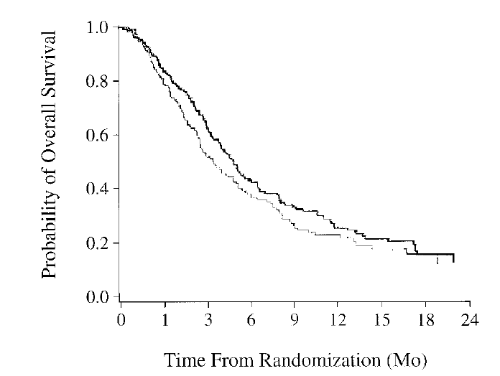
The Moving Overall Survival Bar for Metastatic Melanoma
Pre-Checkpoint Blockade/
BRAF-Targeted Therapy: Chemotherapy
PD-1 +/- CTLA-4 Inhibition
 | NIVO + IPI (n = 314) | NIVO (n = 316) | IPI (n = 315)
Median (95% CI), mo | 72.1 (38.2–NR) | 36.9 (28.2–58.7) | 19.9 (16.8–24.6)
HR (95% CI) vs IPI | 0.52 (0.43–0.64) | 0.63 (0.52–0.76) | –
HR (95% CI) vs NIVOª | 0.84 (0.67–1.04) | – | –
100
90
80
70
ªDescriptive analysis.
Median OS:
6.4 mos (dacarbazine)
60
52%
50%
49%
OS (%)
50
40
44%
43%
42%
30
Temozolomide
Dacarbazine
20
NIVO + IPI
26%
23%
23%
10
NIVO
IPI
0
0
3
6
9
12
15
18
21
24
27
30
33
36
39
42
45
48
51
54
57
60
63
66
69
72
75
78
81
84
87
No. at risk
Months
NIVO + IPI
314
292
265
248
227
222
210
201
199
193
187
181
179
172
169
164
163
159
158
157
156
154
153
150
147
145
138
66
10
0
NIVO
316
292
266
245
231
214
201
191
181
175
171
164
158
150
145
142
141
139
137
137
134
132
130
128
126
124
117
59
3
0
IPI
315
285
253
227
203
181
163
148
135
128
113
107
100
95
94
91
87
84
81
77
75
70
68
64
64
63
61
32
7
0
(Middleton MR et al. J Clin Oncol 2000)
(Wolchok et al. ASCO 2021)

Slide 3
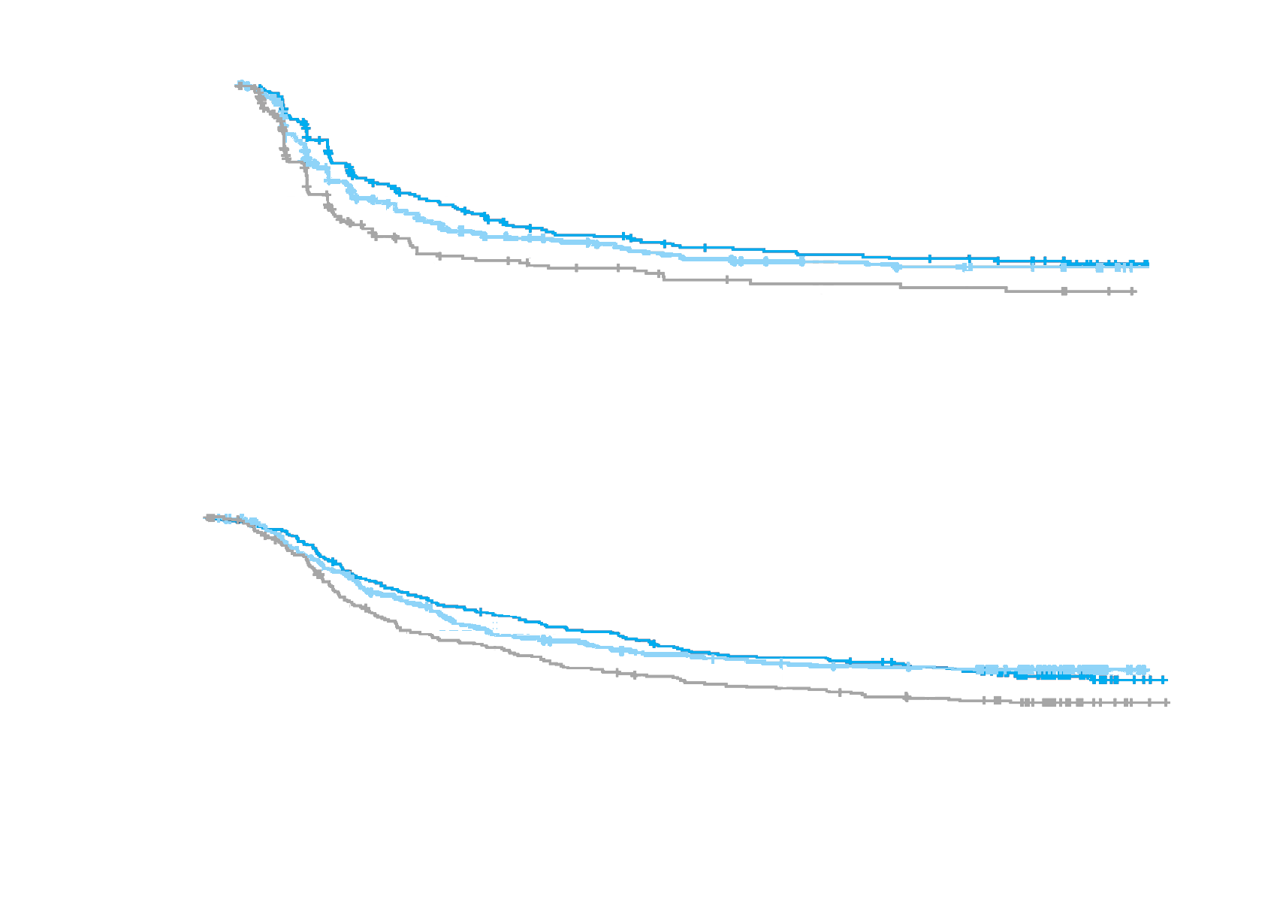
COLUMBUS Part 1: 5-Year PFS, OS, and ORR
Columbus Part 1
PFS rate, %
Enco + Bin
Enco
Vemu
Year 1
56.2
48.4
32.8
Year 2
36.5
32.0
20.0
Year 3
28.8
24.6
13.6
Year 4
24.6
21.7
11.9
Year 5
22.9
19.3
10.2
Randomized 1:1:1
100
Progression-Free Survival
PFS | Events n (%) | mPFS, mos (95% CI)
ENCO + BIN | 122 (63.5) | 14.9 (11.0–20.2)
ENCO | 120 (62.8) | 7.3 (5.6–7.9)
VEMU | 116 (59.8) | 9.6 (7.4–14.8)
ENCO + BIN vs VEMU: HR = 0.51 (95% CI, 0.40–0.67)
80
Encorafenib (ENCO) 450 mg QD + Binimetinib (BIN)
45 mg BID
n = 192
Vemurafenib (VEMU)
960 mg BID
n = 191
ENCO
300 mg QD
n = 194
60
Probability (%)
40
20
0
0
4
8
12
16
20
24
28
32
36
40
44
48
52
56
60
64
68
72
76
80
Time (mos)
No. at risk
Enco + Bin 192 151 108 87 73 63 50 45 43 35 33 31 29 28 27
Enco 194 125 84 68 53 43 37 34 29 26 24 19 18 17 15
Vemu 191 98 55 36 26 22 18 16 15 10 10 7 7 7 6
26 23 19 9 2 0
14 13 11 6 2 0
6 5 3 1 0 0
Overall response rate
 | ENCO + BIN (n = 192) | VEMU (n = 191) | ENCO (n = 194)
ORR | 64.1% | 40.8% | 51.5%
95% CI | 56.8–70.8 | 33.8–48.2 | 44.3–58.8
Encorafenib + binimetinib Encorafenib Vemurafenib
OS rate, %
Enco + Bin
Enco
Vemu
Year 1
75.5
74.6
63.1
Year 2
57.7
49.1
43.2
Year 3
46.5
40.9
31.4
Year 4
39.1
36.8
25.6
Year 5
34.7
34.9
21.4
OS | Events n (%) | mPFS, mos (95% CI)
ENCO + BIN | 131 (68.2) | 33.6 (24.4–39.2)
ENCO | 145 (75.9) | 16.9 (14.0–24.5)
VEMU | 117 (60.3) | 23.5 (19.6–33.6)
ENCO + BIN vs VEMU: HR = 0.64 (95% CI, 0.50–0.81)
Overall Survival
100
80
60
Probability (%)
40
Median follow-up for all patients
PFS = 40.8 mos; OS = 70.4 mos
20
0
0
3
6
9
12
15
18
21
24
27
30
33
36
39
42
45
48
51
54
57
60
63
66
69
72
75
78
80
Time (mos)
No. at risk
Enco + Bin 192 182 144 124 109 96 88 76 73 68 62 53 22 3 0
Enco 194 168 133 109 86 79 69 65 60 57 55 44 24 0 0
Vemu 191 166 115 89 77 62 54 47 44 39 34 29 13 2 0
BID = twice daily; QD = once daily.
Dummer R, et al. J Clin Oncol. 2022;40:4178-4188. Dummer R, et al. ESMO 2021; abstract 9507.
*Experimental arms not FDA-approved for the treatment of melanoma.

Slide 4
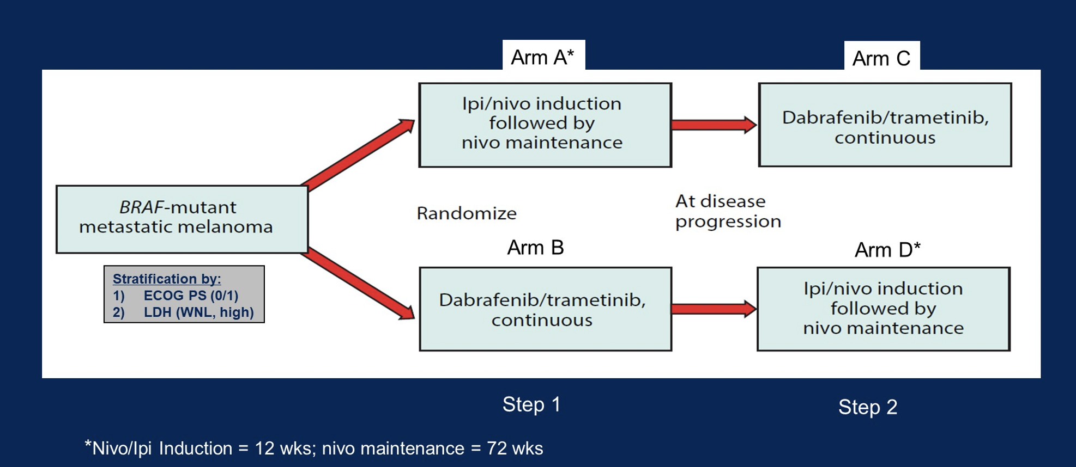
DREAMseq: Sequencing Immune Checkpoint Inhibitors and BRAF-Targeted Therapies in BRAF-Mutant Advanced Melanoma
Atkins MB. ASCO 2022

Slide 5
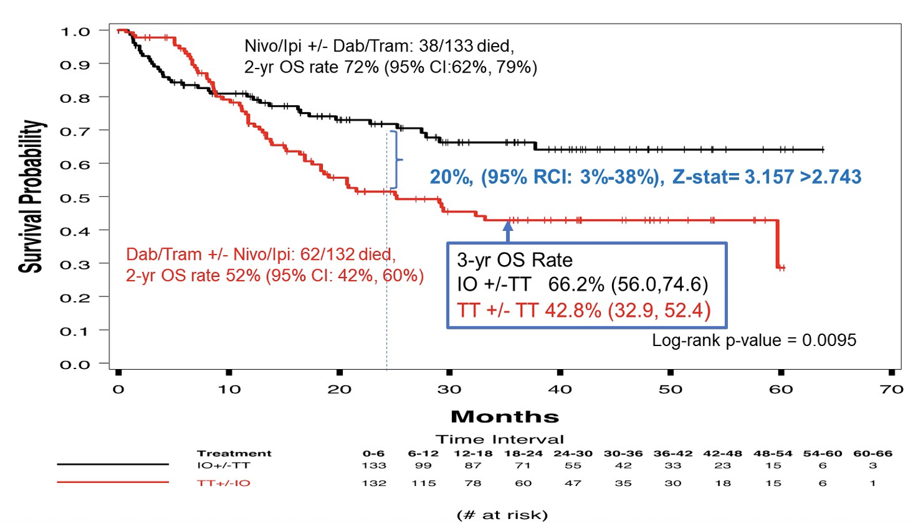
DREAMseq: Overall Survival
Atkins MB. ASCO 2022; Atkins J Clin Oncol 2022

Slide 6
DREAMseq: Response by Treatment Arm
Median PFS Mos (95% CI)
Arm A (n=133) | 11.8 (5.9, 33.5)
Arm B (n=132) | 8.5 (6.5, 11.3)
Arm C (n=27) | 9.9 (8.3, 20.8)
Arm D (n=46) | 2.9 (2.6, 8.9)
Step 1
Step 2
Atkins J Clin Oncol 2022

Slide 7
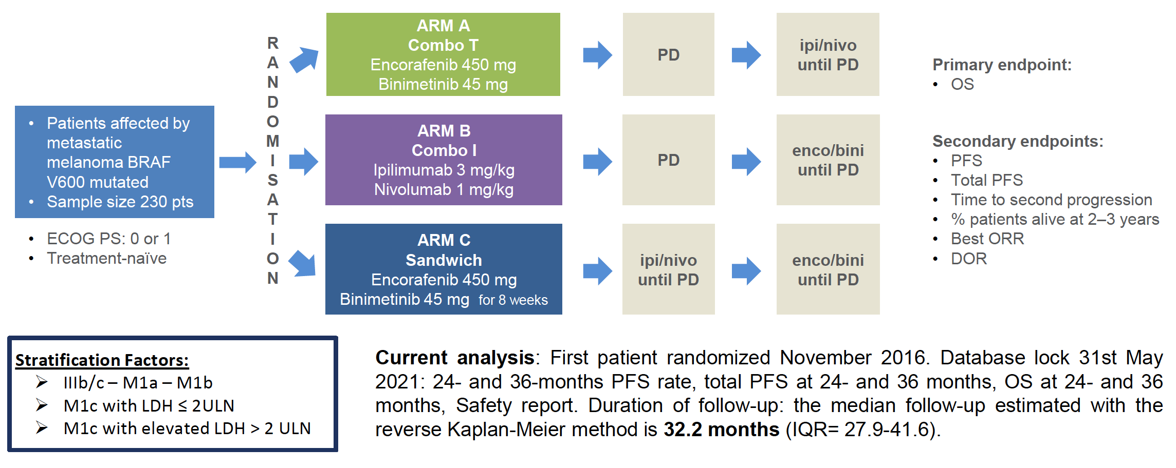
SECOMBIT Phase II Study: Sequencing Immunotherapy in BRAF-Mutant Advanced Melanoma
Ascierto PA et al. ESMO 2021;Abstract LBA1997.

Slide 8
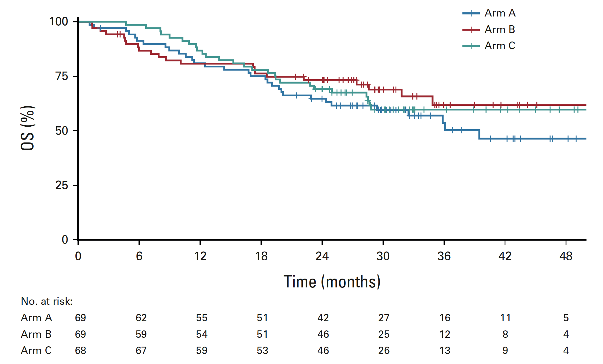
SECOMBIT: Survival by Treatment Arm
2-yr OS 3-yr OS
65% 54%
73% 62%
69% 60%
Enco/Bini→Ipi/Nivo
Ipi/Nivo→Enco/Bini
Enco/Bini→Ipi/Nivo→Enco/Bini
Ascierto PA et al. J Clin Oncol 2023 Jan;41(2):212-221.

Slide 9
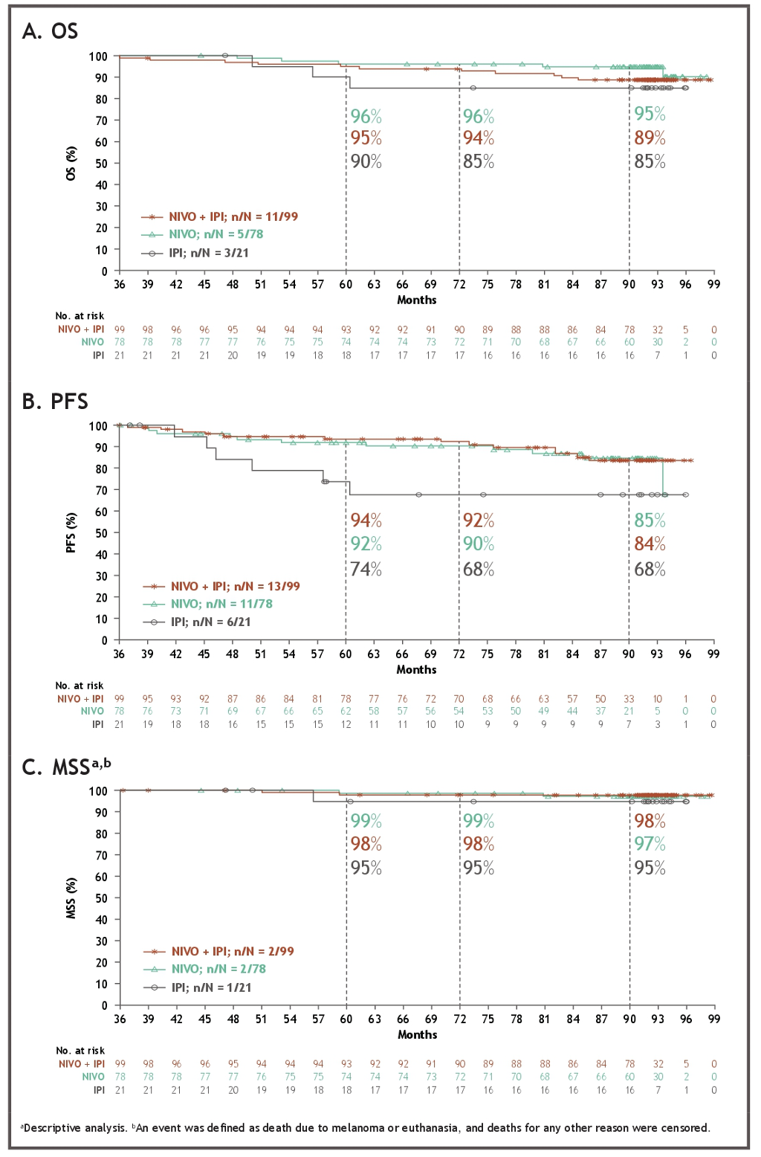
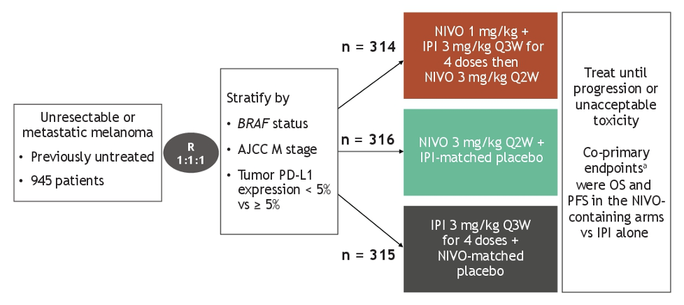
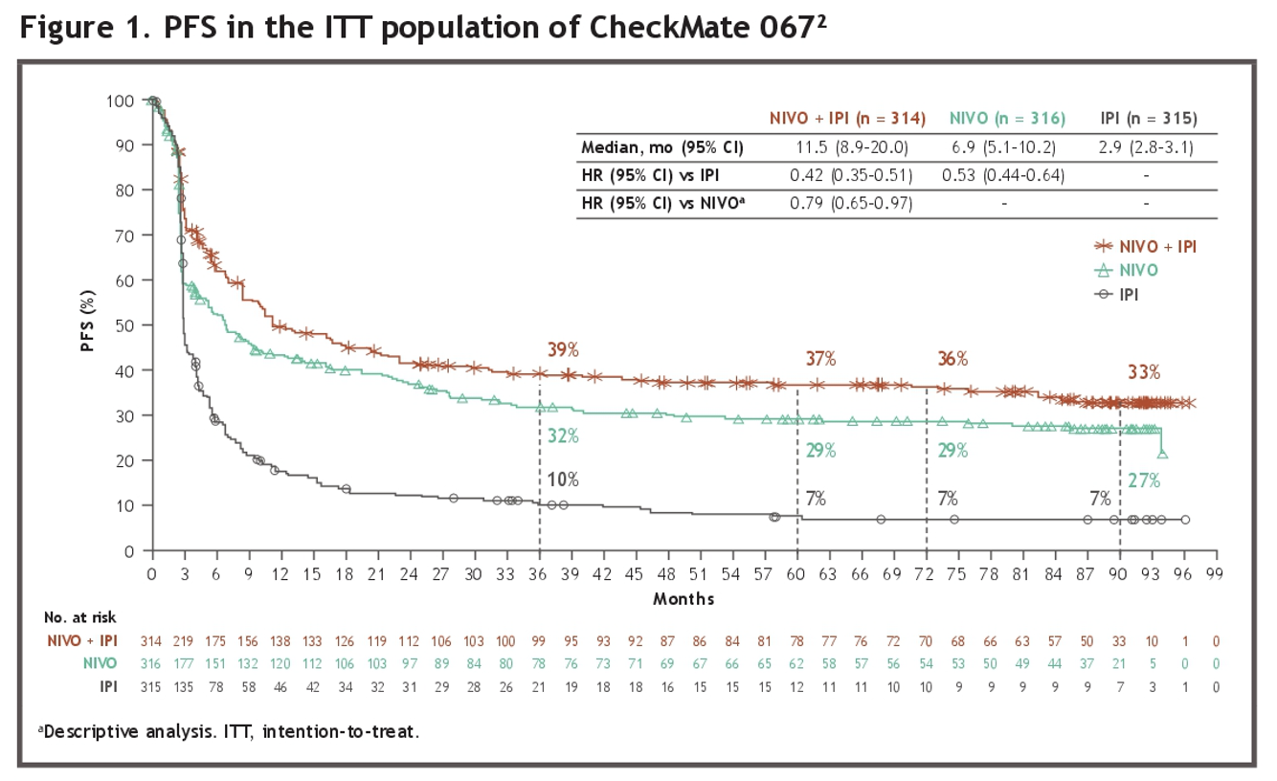
Wolchok ASCO 2023;
Abstract 9542

Slide 10
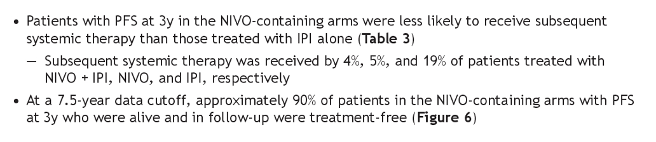
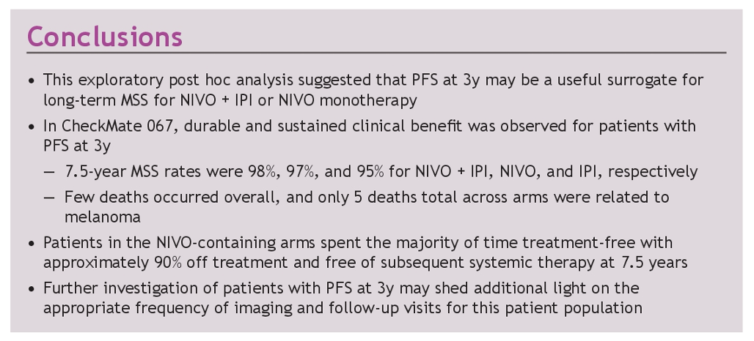
Wolchok ASCO 2023;
Abstract 9542

Slide 11

Nivolumab (NIVO) plus relatlimab (RELA) vs NIVO in previously untreated metastatic or unresectable melanoma: 2-year results from RELATIVITY-047
Hussein A. Tawbi,¹ F. Stephen Hodi,² Evan J. Lipson,³ Dirk Schadendorf,⁴ Paolo Antonio Ascierto,⁵ Luis Matamala,⁶ Erika Castillo Gutiérrez,⁷ Piotr Rutkowski,⁸ Helen Gogas,⁹ Christopher D. Lao,¹⁰ Juliana Janoski De Menezes,¹¹ Stéphane Dalle,¹² Ana Maria Arance,¹³ Jean-Jacques Grob,¹⁴
Barbara Ratto,¹⁵ Saima Rodriguez,¹⁵ Yuanfang Xu,¹⁵ Peter Wang,¹⁵ Sonia Dolfi,¹⁵ Georgina V. Long¹⁶
¹The University of Texas MD Anderson Cancer Center, Houston, TX; ²Dana-Farber Cancer Institute, Boston, MA; ³Bloomberg-Kimmel Institute for Cancer Immunotherapy, Johns Hopkins Sidney Kimmel Comprehensive Cancer Center, Baltimore, MD; ⁴University of Essen and the German Cancer Consortium, Essen, Germany; ⁵Istituto Nazionale dei Tumori IRCCS "Fondazione G. Pascale", Naples, Italy; ⁶Instituto Oncológico Fundación Arturo López Pérez and Department of Oncology, Instituto Nacional del Cáncer, Santiago, Chile; ⁷FAICIC Clinical Research, Veracruz, Mexico; ⁸Maria Skłodowska-Curie National Research Institute of Oncology, Warsaw, Poland; ⁹National and Kapodistrian University of Athens, Athens, Greece; ¹⁰Michigan Medicine, Rogel Cancer Center, University of Michigan, Ann Arbor, MI; ¹¹Hospital Nossa Senhora da Conceição, Porto Alegre, Brazil; ¹²Hospices Civils de Lyon, Cancer Research Center of Lyon, Pierre-Bénite, France; ¹³Hospital Clinic Barcelona and IDIBAPS, Barcelona, Spain; ¹⁴Aix-Marseille University, CHU Timone, Marseille, France; ¹⁵Bristol Myers Squibb, Princeton, NJ; ¹⁶Melanoma Institute Australia, The University of Sydney, Royal North Shore and Mater Hospitals, Sydney, NSW, Australia
Abstract number 9502

Slide 12
Study design
  RELATIVITY-047 is a global, randomized, double-blind, phase 2/3 study
Key eligibility criteria
Previously untreated, unresectable, or
metastatic melanoma
ECOG PS 0–1
Primary endpoint
PFS by BICRª
Secondary endpoints
OS^{b}
ORR by BICR^{c}
NIVO 480 mg + RELA 160 mg
FDC IV Q4W
R
1:1
NIVO 480 mg IV Q4W
Stratified by: LAG-3,^{d} PD-L1,^{e} BRAF, and AJCC v8 M stage
Endpoints were tested in hierarchy: PFS → OS → ORR
Database lock | March 9, 2021 | October 28, 2021 | October 27, 2022
Min. follow-up^{f} | 1.3 months | 8.7 months | 21.0 months
Median follow-up | 13.2 months | 19.3 months | 25.3 months
Endpoint(s) | PFS per BICR | OS, ORR per BICR, and updated PFS per BICR | Updated PFS per BICR, OS, and ORR per BICR
RELATIVITY-047 (NCT03470922).
ªFirst tumor assessment (RECIST v1.1) was performed 12 weeks after randomization, every 8 weeks up to 52 weeks, and then every 12 weeks. ^{b}OS boundary for statistical significance was
P < 0.04302 (2-sided) analyzed at 69% power; target HR, 0.75. ^{c}ORR could not be formally tested and was descriptively analyzed. ^{d}LAG-3 expression on immune cells (1%) was determined by an analytically validated IHC assay (Labcorp, Burlington, NC, USA). ^{e}PD-L1 expression on tumor cells (1%) was determined by a validated Agilent Dako PD-L1 IHC 28-8 pharmDx test (Agilent, Santa Clara, CA, USA). ^{f}Minimum potential follow-up was defined as the time from last patient randomized to last patient, last visit.
Tawbi ASCO 2023;Abstract 9502

Slide 13
Best overall response per BICR
Updated secondary endpoint
44%
(95% CI, 38–49)
42%
(n = 150)
31%
(n = 109)
34%
(95% CI, 29–39)
CR: 18%
(n = 64)
16%
(n = 57)
CR: 18%
(n = 63)
16%
(n = 57)
PR: 26%
(n = 91)
PR: 16%
(n = 58)
  NIVO + RELA vs NIVO ORR difference of 9.8% (95% CI, 2.8–16.8)
  Median duration of response was not reached in both the NIVO + RELA (NR [95% CI, 39.4–NA]) and NIVO (NR [95% CI, 39.8–NA]) arms
RELATIVITY-047 (NCT03470922). Median follow-up: 25.3 months.
Descriptive analysis. 26 patients (7.3%) in the NIVO + RELA arm and 26 patients (7.2%) in the NIVO arm were classified as unable to determine.
Tawbi ASCO 2023;Abstract 9502

Slide 14
PFS by BICR
Updated primary endpoint
 | NIVO + RELA (n = 355) | NIVO (n = 359)
mPFS, mo | 10.2 | 4.6
(95% CI) | (6.5–14.8) | (3.5–6.5)
HR (95% CI) | 0.81 (0.67–0.97)
100
80
60
48%
(95% CI, 43–53)
PFS (%)
38%
(95% CI, 33–44)
40
31%
(95% CI, 25–36)
NIVO + RELA
37%
(95% CI, 32–42)
20
31%
(95% CI, 26–36)
27%
(95% CI, 22–32)
NIVO
0
0
3
6
9
12
15
18
21
24
27
30
33
36
39
42
45
48
51
No. at risk
Months
NIVO + RELA
355
221
188
165
144
130
123
108
92
82
70
53
49
49
43
23
3
0
NIVO
359
194
152
128
116
109
101
89
76
68
56
44
41
39
35
17
3
0
RELATIVITY-047 (NCT03470922). Median follow-up: 25.3 months.
Descriptive analysis. Statistical model for HR: stratified Cox proportional hazard model. Stratified by LAG-3, BRAF mutation status, and AJCC M stage. PD-L1 was removed from stratification because it led to subgroups with < 10 patients.
Tawbi ASCO 2023;Abstract 9502

Slide 15
OS
Updated secondary endpoint
 | NIVO + RELA (n = 355) | NIVO (n = 359)
mOS, mo | NR | 33.2
(95% CI) | (31.5–NA) | (25.2–45.8)
HR (95% CI) | 0.82 (0.67–1.02)
100
77%
(95% CI, 72–81)
80
62%
(95% CI, 56–67)
54%
(95% CI, 49–59)
NIVO + RELA
60
52%
(95% CI, 46–57)
OS (%)
72%
(95% CI, 67–76)
40
58%
(95% CI, 53–63)
NIVO
48%
(95% CI, 43–54)
42%
(95% CI, 36–49)
20
0
0
3
6
9
12
15
18
21
24
27
30
33
36
39
42
45
48
51
No. at risk
Months
NIVO + RELA
355
334
305
287
270
258
241
226
197
179
160
136
128
122
120
78
26
2
NIVO
359
329
301
278
253
238
224
211
185
162
144
118
106
104
100
64
17
0
RELATIVITY-047 (NCT03470922). Median follow-up: 25.3 months.
Descriptive analysis. Statistical model for HR: stratified Cox proportional hazard model. Stratified by LAG-3, BRAF mutation status, and AJCC M stage. PD-L1 was removed from stratification because it led to subgroups with < 10 patients.
Tawbi ASCO 2023;Abstract 9502

Slide 16
Progression-free survival 2 (PFS2)
Investigator assessed
 | NIVO + RELA (n = 355) | NIVO (n = 359)
mPFS2, mo | 28.4 | 20.1
(95% CI) | (22.3–37.1) | (16.1–24.7)
HR (95% CI) | 0.79 (0.65–0.96)
100
80
71%
(95% CI, 66–75)
60
54%
(95% CI, 48–59)
46%
(95% CI, 40–51)
NIVO + RELA
PFS2 (%)
42%
(95% CI, 37–48)
62%
(95% CI, 57–67)
40
NIVO
46%
(95% CI, 40–51)
36%
(95% CI, 31–42)
35%
(95% CI, 29–40)
20
0
0
3
6
9
12
15
18
21
24
27
30
33
36
39
42
45
48
51
No. at risk
Months
NIVO + RELA
355
332
293
270
249
230
209
196
172
154
136
114
106
99
96
62
19
2
NIVO
359
329
291
246
219
202
187
173
144
122
105
87
77
75
73
49
13
0
RELATIVITY-047 (NCT03470922). Median follow-up: 25.3 months.
Progression-free survival 2 (PFS2) was an exploratory analysis and defined as the time from randomization to progression date after the next line of therapy, per investigator assessment, or to death from any cause.
Tawbi ASCO 2023;Abstract 9502

Slide 17
RELATIVITY-047: Subgroup Comparisons HR vs Nivolumab monotherapy
CM 067 |  | Rela 047
PFS Nivo Ipi vs Nivo HR | PFS Nivo Ipi vs Nivo HR | PFS Nivo Rela vs Nivo HR | PFS Nivo Rela vs Nivo HR
BRAF Mutant Wild Type | 0.59 0.89 | BRAF Mutant Wild Type | 0.77 0.78
PDL-1. ≥ 1% ≤ 1% | 0.90 0.67 | PDL-1. ≥ 1% ≤ 1% | 0.96 0.68
a,b
a. Tawbi HA, et al. N Engl J Med 2022;386:24–34. b: Long GV et al. NEJM Evid 2023;2(4)

Slide 19
OS by best overall response, 12-month landmark analysisª
NIVO + IPI
NIVO
IPI
100
100
CR 87%
100
90
CR 88%
90
90
80
PR 79%
80
80
70
70
PR 75%
70
PR 66%
60
60
60
CR 63%
OS (%)
OS (%)
SD 46%
OS (%)
50
SD 38%
50
50
40
40
40
SD 38%
30
PD 39%
30
PD 28%
30
20
20
20
PD 22%
10
10
10
0
0
6
12
18
24
30
36
42
48
54
60
66
72
78
84
0
0
6
12
18
24
30
36
42
48
54
60
66
72
78
84
0
0
6
12
18
24
30
36
42
48
54
60
66
72
78
84
Months
Months
Months
CR
PR
SD
PD
34
134
29
25
34
134
29
25
34
134
29
25
33
127
27
18
33
121
22
18
32
117
19
14
31
116
15
13
30
109
14
12
30
108
12
9
30
105
11
8
29
104
11
8
27
104
11
7
27
99
11
7
26
92
11
7
1
9
0
0
CR
PR
SD
PD
31
104
35
57
31
104
35
57
31
104
35
57
31
97
31
41
31
95
23
32
31
93
20
27
30
88
17
23
29
85
15
16
29
81
15
16
27
79
15
16
27
77
15
15
27
74
15
14
25
73
15
13
24
65
15
13
0
3
0
0
CR
PR
SD
PD
8
50
61
80
8
50
61
80
8
50
61
80
7
46
54
54
6
40
48
39
6
38
38
29
6
35
33
24
5
34
31
22
5
32
27
21
5
31
25
18
5
30
21
17
4
29
16
17
4
28
14
16
3
27
13
16
1
4
1
1
Patients with a best overall response of a CR, PR, SD, or PD at 12 months were followed for OS
ªTo address guarantee-time bias, landmark analysis excluded patients who had an event during the first 12 months.
PD, progressive disease.
Wolchok ASCO 2021;Abstract 9506

Slide 20
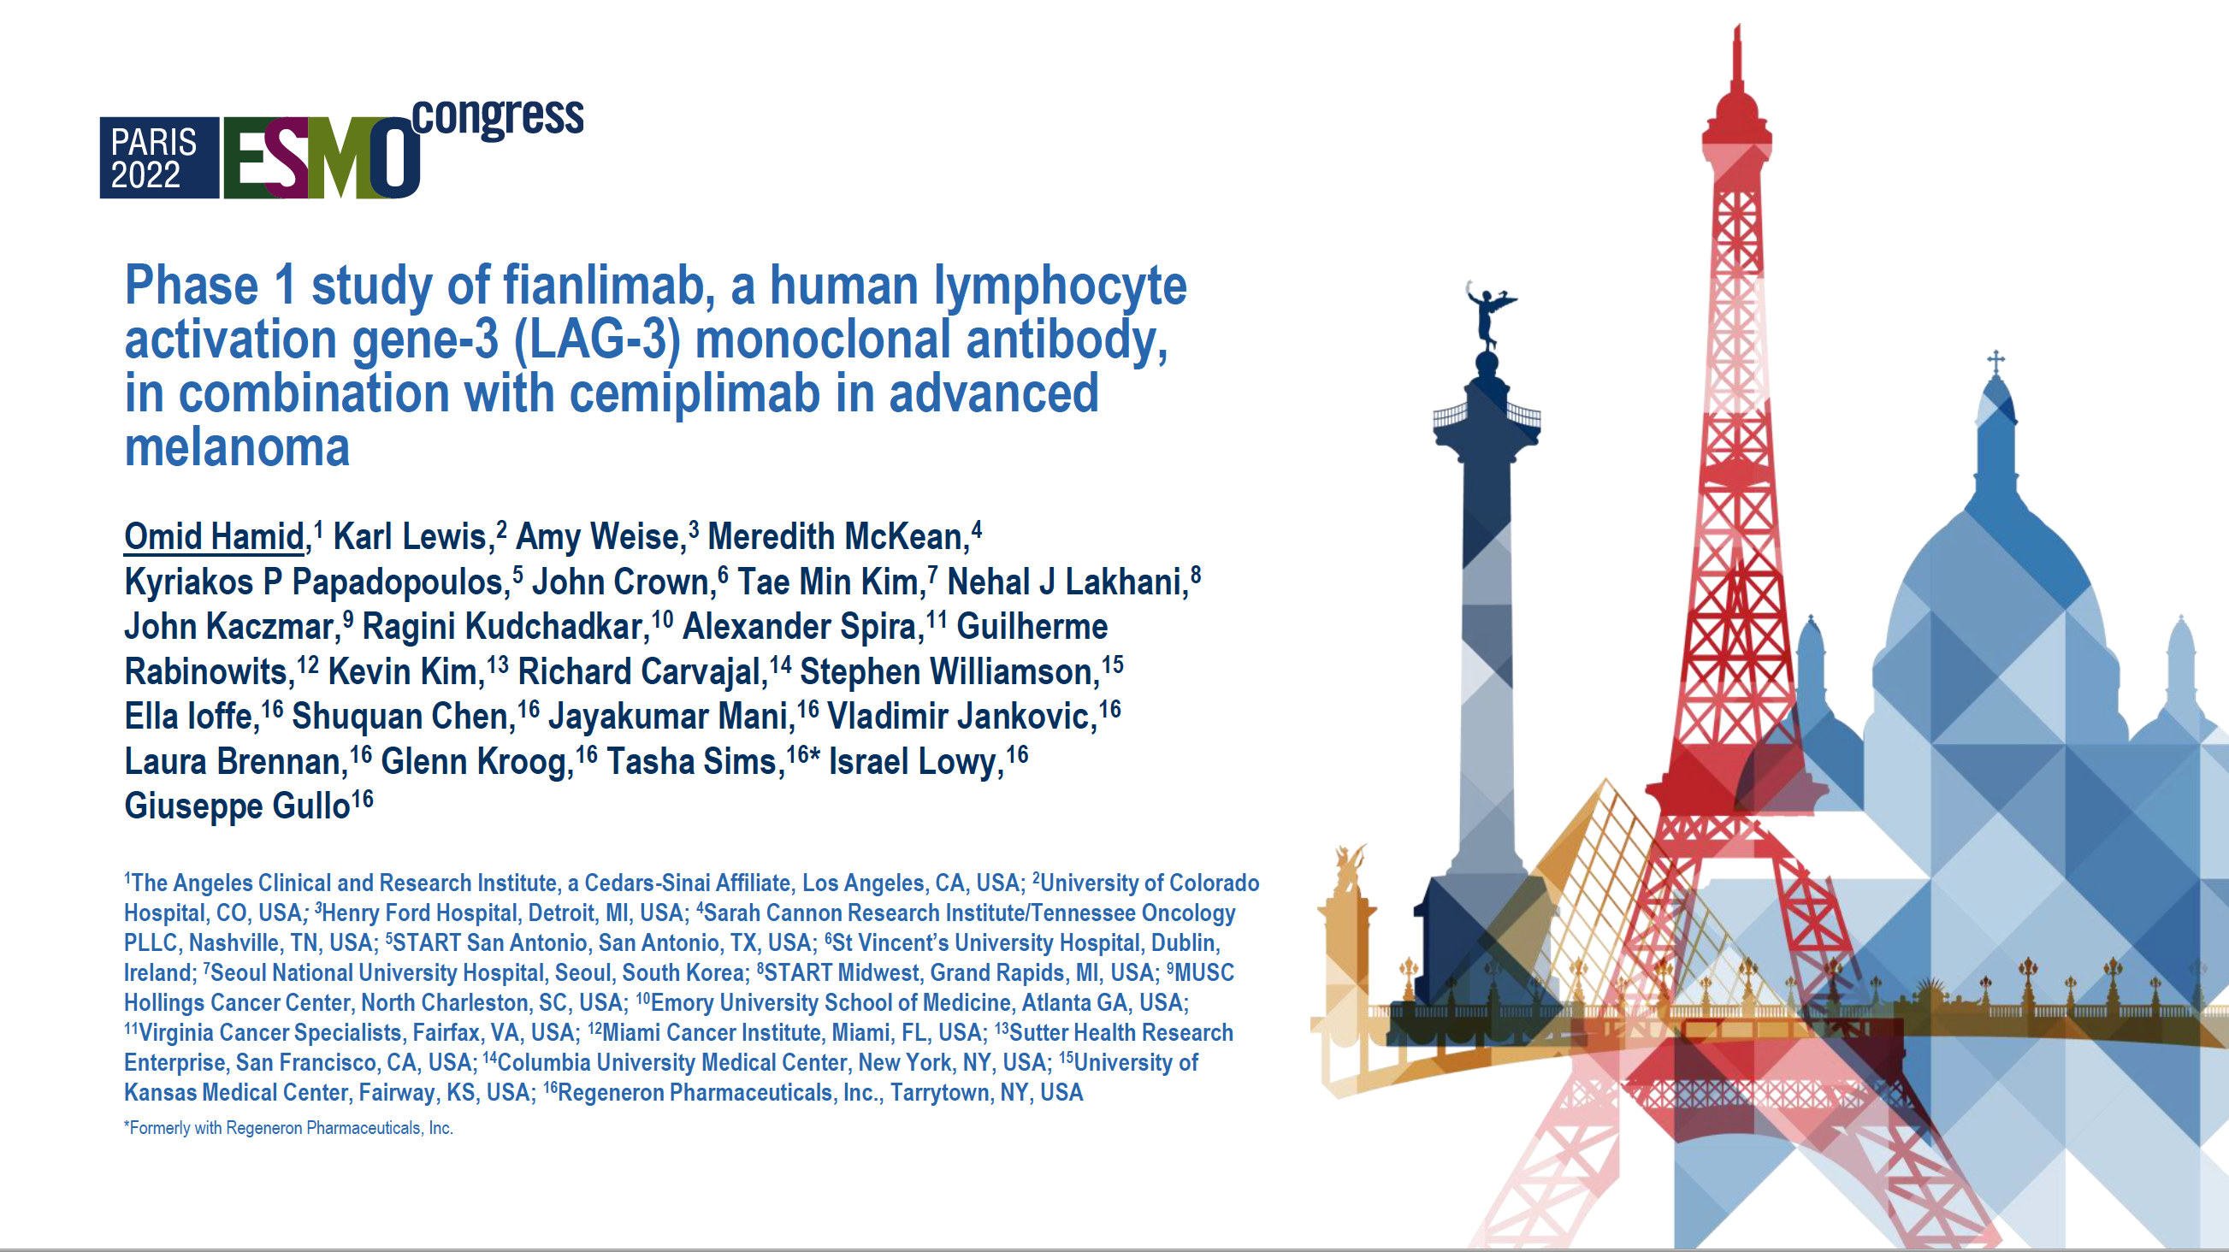
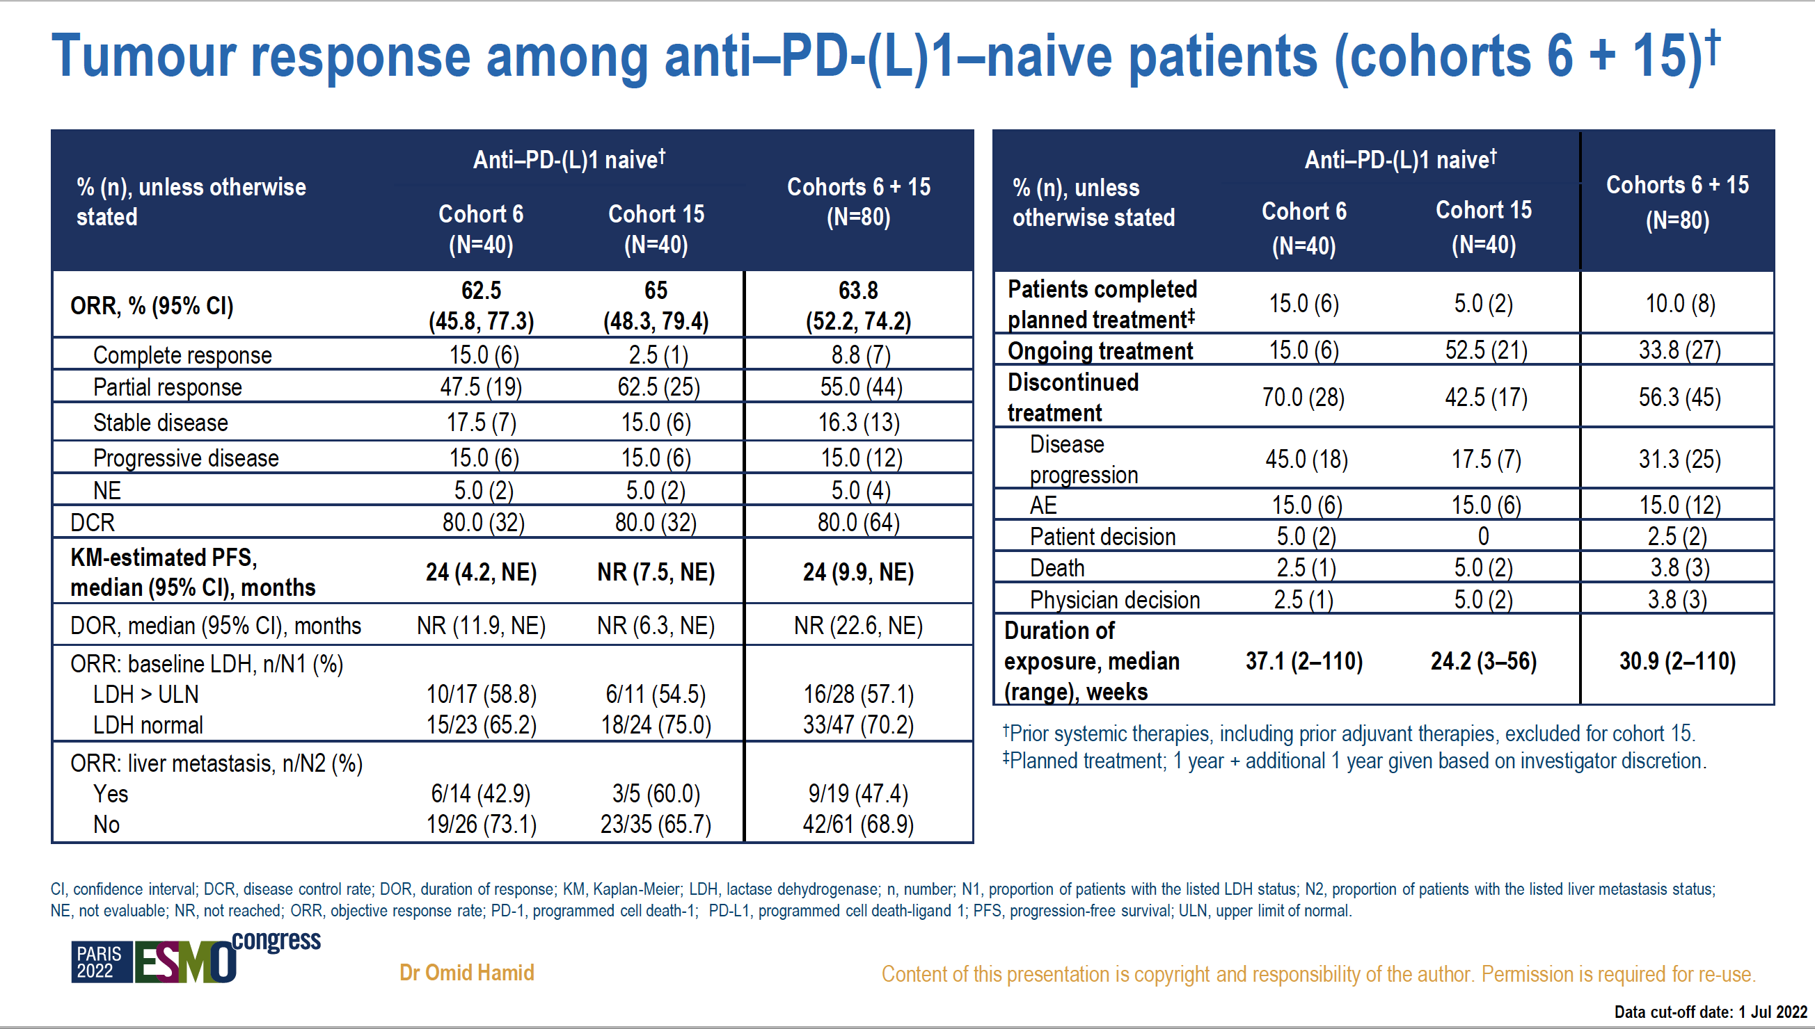
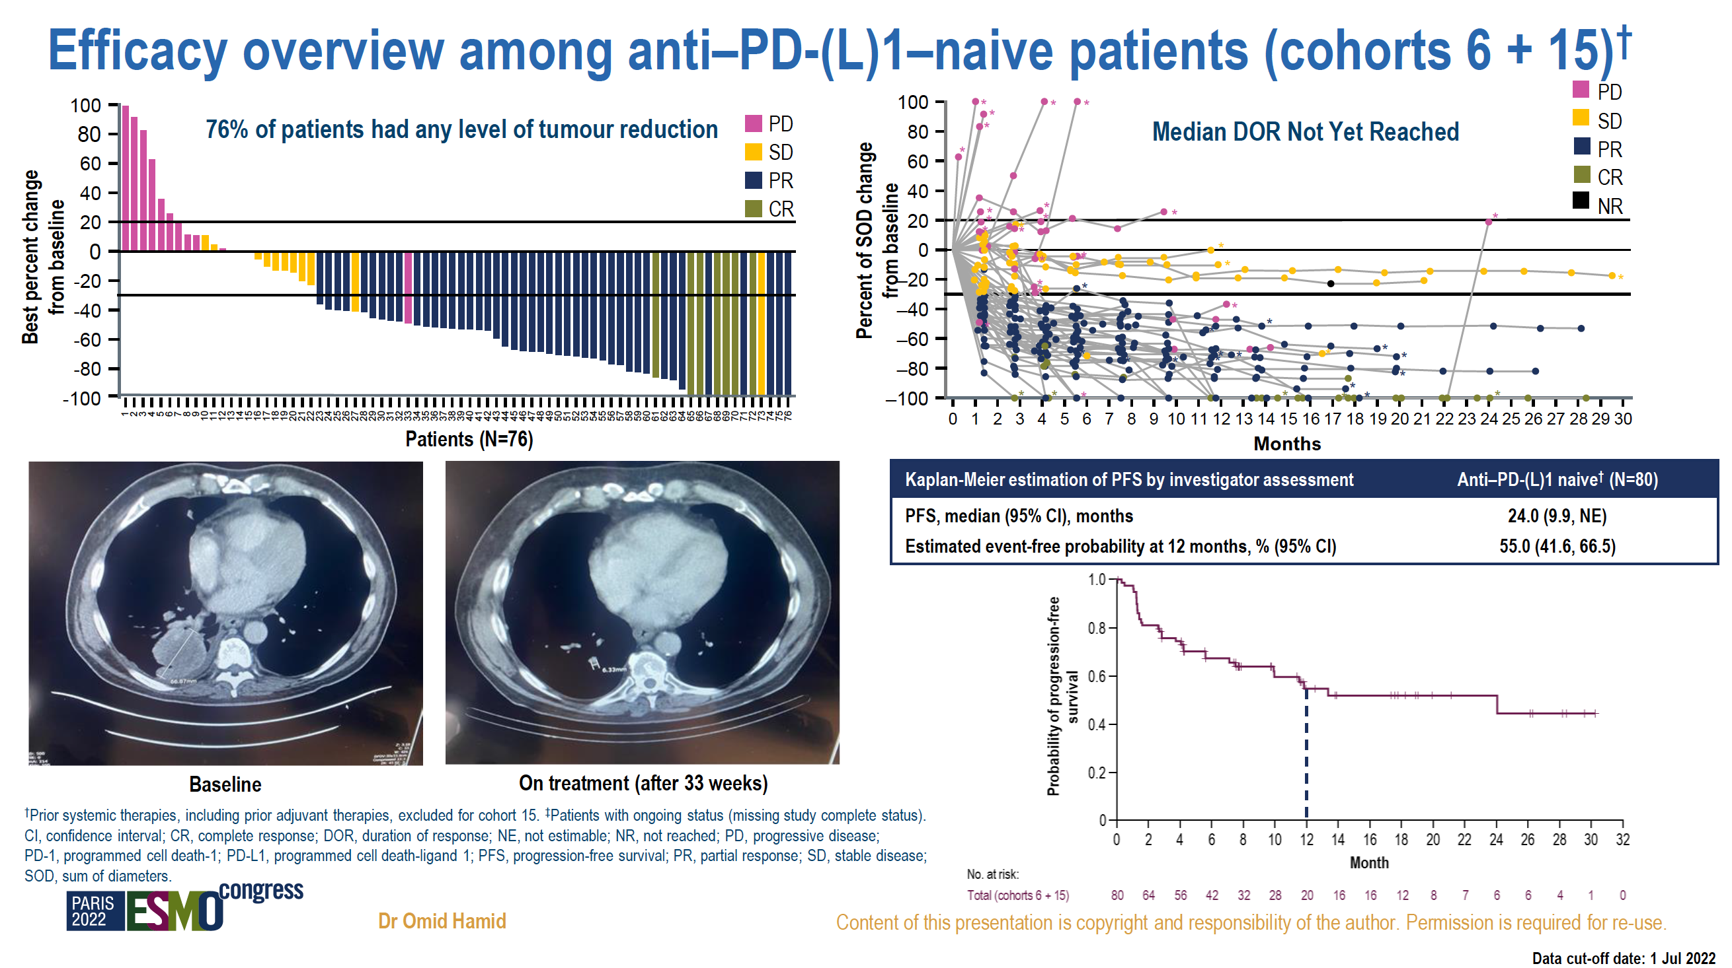
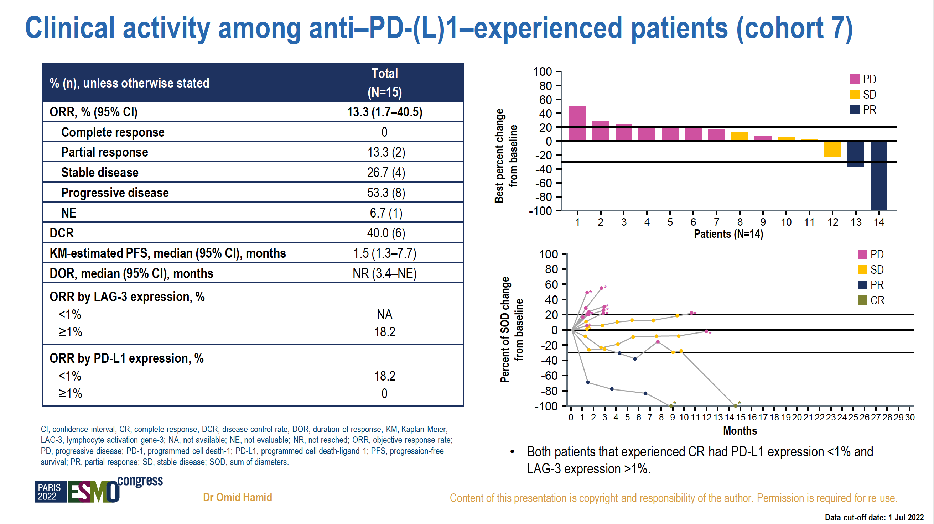

Slide 21

Significant durable response with fianlimab
(anti-LAG-3) and cemiplimab (anti-PD-1) in advanced melanoma: post adjuvant PD-1 analysis
Scan the QR code for a copy of these slides, and related educational materials.
Copies of these slides are for personal use only and may not be reproduced without permission from ASCO® or the authors of these slides
Omid Hamid,¹ Karl D Lewis,² Amy Weise,³ Meredith McKean,⁴ Kyriakos P Papadopoulos,⁵ John Crown,⁶ Sajeve S Thomas,⁷ Eugenia Girda,⁸ John Kaczmar,⁹ Kevin B Kim,¹⁰ Nehal J Lakhani,¹¹ Melinda Yushak,¹² Tae Min Kim,¹³ Guilherme Rabinowits,¹⁴ Alexander Spira,¹⁵ Jayakumar Mani,¹⁶ Fang Fang,¹⁶ Shuquan Chen,¹⁶ JuAn Wang,¹⁶ Laura Brennan,¹⁶ Vladimir Jankovic,¹⁶ Anne Paccaly,¹⁶ Sheila Masinde,¹⁶ Mark Salvati,¹⁶ Matthew G Fury,¹⁶
Israel Lowy,¹⁶ Giuseppe Gullo¹⁶
¹The Angeles Clinical and Research Institute, a Cedars-Sinai Affiliate, Los Angeles, CA, USA; ²University of Colorado Cancer Center, Aurora, CO, USA; ³Henry Ford Hospital, Detroit, MI, USA; ⁴Sarah Cannon Research Institute/Tennessee Oncology PLLC, Nashville, TN, USA; ⁵START, San Antonio, TX, USA; ⁶St Vincent’s University Hospital, Dublin, Ireland; ⁷University of Florida Health Cancer Center at Orlando Health, Orlando, FL; ⁸Rutgers Cancer Institute of New Jersey, New Brunswick, NJ, USA; ⁹MUSC Hollings Cancer Center, North Charleston, SC, USA; ¹⁰Center for Melanoma Research and Treatment, California Pacific Medical Center Research Institute, San Francisco, CA, USA; ¹¹START Midwest, Grand Rapids, MI, USA; ¹²Department of Hematology and Medical Oncology at Emory University School of Medicine, Atlanta, GA, USA; ¹³Seoul National University Hospital, Seoul, South Korea; ¹⁴Department of Hematology and Oncology, Miami Cancer Institute/Baptist Health South Florida, Miami, FL, USA; ¹⁵Virginia Cancer Specialists and US Oncology Research, Fairfax, VA, USA; ¹⁶Regeneron Pharmaceuticals, Inc., Tarrytown, NY, USA
Dr Omid Hamid

Slide 22
Study design: three serial expansion cohorts in advanced melanoma setting
Treatment:
Fianlimab 1600 mg + cemiplimab 350 mg IV every 3 weeks, for up to 51 weeks*
Key inclusion criteria
3
Metastatic or inoperable locally advanced non-uveal melanoma
≥18 years of age
ECOG PS of 0 or 1
At least one lesion measurable by RECIST 1.1
Initial cohort MM1# (n=40)
1L or 2L advanced melanoma patients who have never received anti-PD-(L)1
Primary endpoint
ORR per RECIST 1.1 criteria
Secondary endpoints
PFS
DoR
DCR
Safety
PK
Primary Endpoint
Confirmatory cohort MM2# (n=40)
1L advanced melanoma patients
who have never received anti-PD-(L)1
Key exclusion criteria
Uveal melanoma
Prior treatment with a LAG-3 targeting agent
Radiation therapy within
2 weeks prior to enrollment
PD-1 experienced cohort MM3# (n=18)
1L advanced melanoma patients with prior (neo)adjuvant systemic therapy‡, including 13/18 patients who received anti-PD-1
‡: Prior exposure to (neo)adjuvant systemic treatment (including anti-PD-1) with recurrence >6 months after adjuvant therapy
MM1#, Cohort 6; MM2#, Cohort 15; MM3#, Cohort 16. *With an option for an additional 51 weeks.
1L, first-line; 2L, second-line; DCR, disease control rate; DoR, duration of response; ECOG PS, Eastern Cooperative Oncology Group performance score; IV, intravenous; LAG-3, lymphocyte activation gene-3; MM, metastatic melanoma; NHL, non-Hodgkin lymphoma; ORR, objective response rate; PD-(L)1, programmed cell death-(ligand)1; PFS, progression-free survival; PK, pharmacokinetics; RECIST 1.1, Response Evaluation Criteria in Solid Tumors version 1.1.
Dr Omid Hamid

Slide 23
Tumor response by cohort
Response endpoints | Initial cohort MM1# (n=40) | Confirmatory cohort MM2# (n=40)
Median follow-up (IQR), months | 20.8 (11.2–30.8) | 11.5 (8.9–13.9)
Treatment exposure, median (IQR), weeks | 37 (20–81) | 35 (15–51)
ORR, (n) | 63% (25) | 63% (25)
95% CI for ORR | (46–77) | (46–77)
DoR, median (95% CI), months | NR (12–NE) | NR (NE–NE)
DCR, (n) | 80% (32) | 80% (32)
95% CI for DCR | (64–91) | (64–91)
Best overall response, (n)
CR | 15% (6) | 13% (5)
PR | 48% (19) | 50% (20)
SD | 18% (7) | 18% (7)
PD | 15% (6) | 15% (6)
NE | 5% (2) | 5% (2)
KM-estimated PFS, median (95% CI), months | 24 (4–NE) | 15 (7–NE)
Response endpoints | Initial cohort MM1# (n=40) | Confirmatory cohort MM2# (n=40) | PD-1 experienced cohort MM3# (n=18)*
Median follow-up (IQR), months | 20.8 (11.2–30.8) | 11.5 (8.9–13.9) | 9.7 (4.8–14.1)
Treatment exposure, median (IQR), weeks | 37 (20–81) | 35 (15–51) | 23 (12–37)
ORR, (n) | 63% (25) | 63% (25) | 56% (10)
95% CI for ORR | (46–77) | (46–77) | (31–79)
DoR, median (95% CI), months | NR (12–NE) | NR (NE–NE) | NR (6–NE)
DCR, (n) | 80% (32) | 80% (32) | 67% (12)
95% CI for DCR | (64–91) | (64–91) | (41–87)
Best overall response, (n)
CR | 15% (6) | 13% (5) | 6% (1)
PR | 48% (19) | 50% (20) | 50% (9)
SD | 18% (7) | 18% (7) | 11% (2)
PD | 15% (6) | 15% (6) | 28% (5)
NE | 5% (2) | 5% (2) | 6% (1)
KM-estimated PFS, median (95% CI), months | 24 (4–NE) | 15 (7–NE) | 12 (1–NE)
MM1#, Cohort 6; MM2#, Cohort 15; MM3#, Cohort 16. *17 patients in cohort MM3 received prior adjuvant therapy and 1 patient in cohort MM3 received prior neoadjuvant and adjuvant therapy.
CI, confidence interval; CR, complete response; DCR, disease control rate; DoR, duration of response; IQR, interquartile range; KM, Kaplan-Meier; n, number; MM, metastatic melanoma; NE, not estimated; NR, not reached; ORR, objective response rate; PD, progressive disease;
PR, partial response;
Dr Omid Hamid

Slide 24
Tumor responses compared with historical controls
Response endpoints | Cohorts MM1# + MM2# + MM3# Advanced Melanoma (N=98) | Nivo Relativity-047¹ (N=359) | Nivo + Rela Relativity-047¹ (N=355) | Ipi + Nivo CheckMate-067^{2,3} (N=314)
Median follow-up, months | 12.6 | 19.3 | 19.3 | 57.5
ORR, (95% CI) | 61% (51–71) | 33% (28–38) | 43% (38–48) | 58% (53–64)
DCR | 78% | 51% | 63% | 71%
DoR, median (95% CI), months | NR (23–NE) | NR (30–NR) | NR (30–NR) | NR (62–NR)
KM-estimated PFS, median (95% CI), months | 15 (9–NE) | 5 (3–6) | 10 (7–15) | 12 (9–19)
Response endpoints | Cohorts MM1# + MM2# + MM3# Advanced Melanoma (N=98) | Nivo Relativity-047¹ (N=359) | Nivo + Rela Relativity-047¹ (N=355) | Ipi + Nivo CheckMate-067^{2,3} (N=314)
Median follow-up, months | 12.6 | 19.3 | 19.3 | 57.5
ORR, (95% CI) | 61% (51–71) | 33% (28–38) | 43% (38–48) | 58% (53–64)
Response endpoints | Cohorts MM1# + MM2# + MM3# Advanced Melanoma (N=98)
Median follow-up, months | 12.6
Objective Response Rate (ORR), (95% CI) | 61% (51–71)
MM1#, Cohort 6; MM2#, Cohort 15; MM3#, Cohort 16. CI, confidence interval; DCR, disease control rate; DoR, duration of response; Ipi, ipilimumab; KM, Kaplan-Meier; MM, metastatic melanoma; n, number; Nivo, nivolumab; ORR, objective response rate;
PFS, progression-free survival; Rela, relatlimab.
1. Long G et al. NEJM Evid 2023; 2 (4). 2. Larkin J et al. N Engl J Med 2019;381(16):1535–1546. 3. Wolchok JD et al. J Clin Oncol 2022 ;40(2):127-137
Dr Omid Hamid

Slide 25
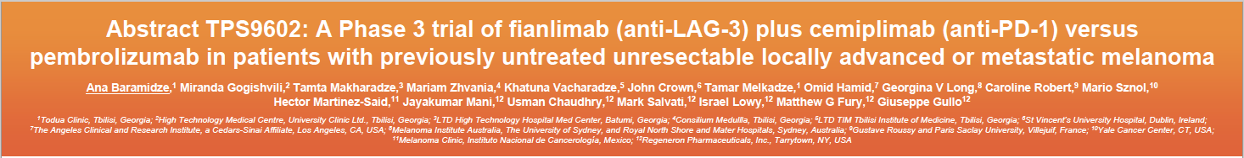
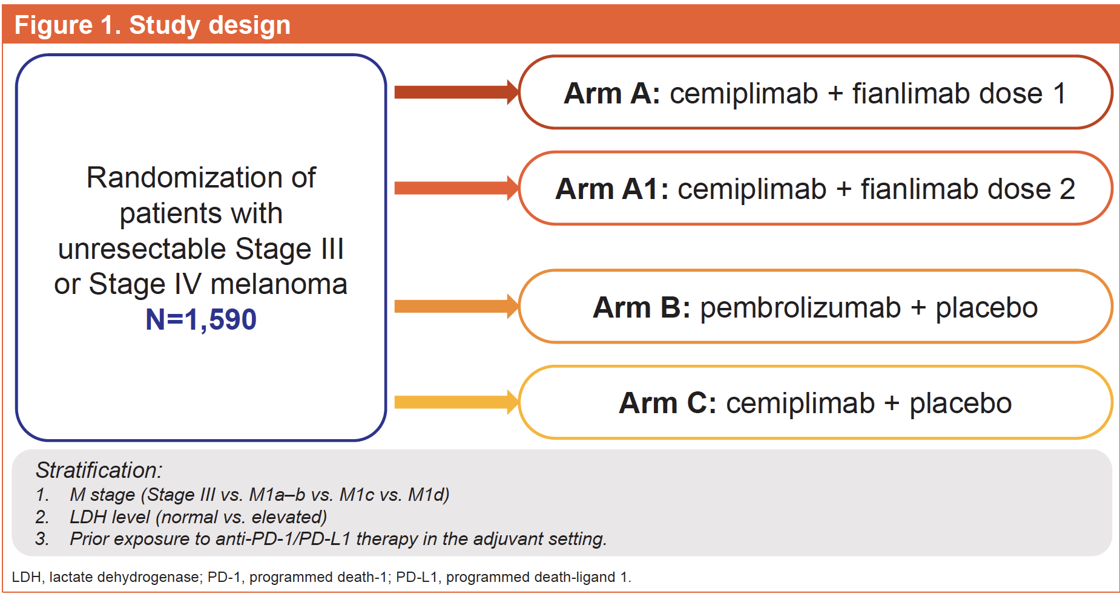

Slide 26
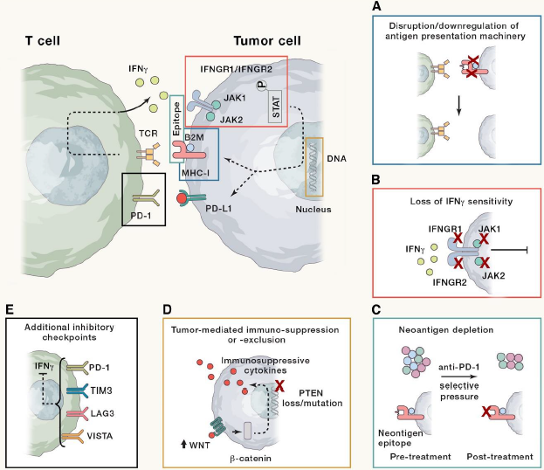
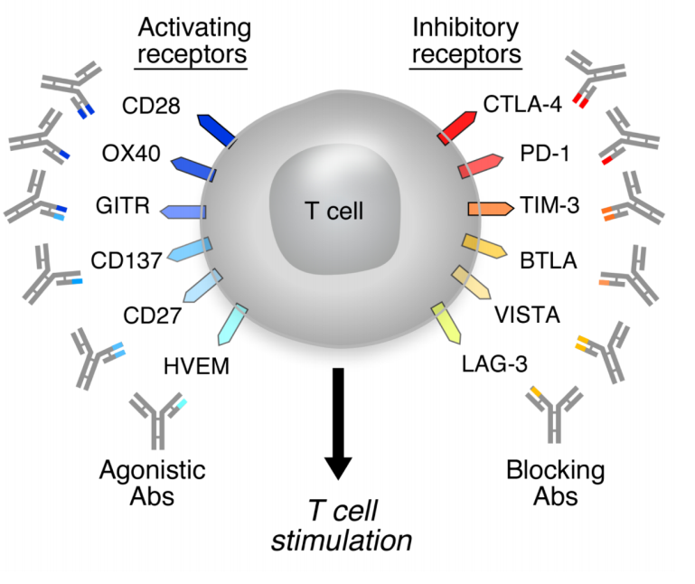
Loss of T-Cell Function Associated With
Progressive Expression of Checkpoint Molecules
Mechanisms of Resistance^{[a]}
Activating Receptors/Costimulatory Molecules^{[b]}
a. Schoenfeld AJ, et al. Cancer Cell. 2020;37:443-455; b. Mellman I, et al. Nature. 2011;480:480-489.
Wherry EJ. Nat Immunol. 2011;12:492-499; Wherry EJ, et al. Nat Immunol. 2011;12:492-499; Blackburn SD, et al. Nat Immunol. 2009;10:29-37; Paley MA, et al. Science. 2012;338:1220-1225.

Slide 27

NYU S22-00325
A Phase II Study of the Interleukin-6 Receptor Blocking Antibody Sarilumab in Combination with Ipilimumab, Nivolumab and Relatlimab in Patients with Unresectable Stage III or Stage IV Melanoma
Perlmutter Cancer Center
Maintenance cycle 1-2:
8 weeks
clinicaltrials.gov/NCT05428007

Slide 28
clinicaltrials.gov/NCT04370704

Slide 29
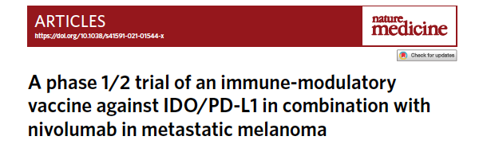
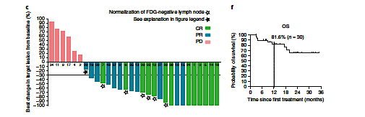
Kjeldsen JW et al. Nat Med. 2021;27(12):2212-2223.

Slide 30
C-144-01 Study Design
Phase 2, multicenter study to assess the efficacy and safety of autologous TIL (lifileucel) for treatment of patients with metastatic melanoma progressing on ICI and TC therapy (NCT02360579)
Cohort 1 Noncryopreserved TIL product (Gen 1)
n=30
Closed to enrollment
Key Endpoints
Primary: ORR (IRC-assessed using RECIST v1.1)
Secondary: DOR, PFS, OS, TEAE incidence and severity
Patient Population
Unresectable or metastatic melanoma treated with ≥1 prior systemic therapy including a PD-1– blocking antibody and, if BRAF V600 mutation positive, a BRAF inhibitor ± MEK inhibitor
Key Eligibility Criteria
≥1 tumor lesion resectable for TIL generation (≥1.5 cm in diameter)
Cohort 2 Cryopreserved lifileucel (Gen 2)
n=66
Enrollment:
Apr 2017 to Jan 2019
and ≥1 target tumor lesion for response assessment
Age ≥18 years at time of consent
ECOG performance status 0–1
No limit on number of prior therapies
Cohort 3
Lifileucel
re-treatment
n≈10
Treatment Regimen
Lifileucel, a cryopreserved TIL cell therapy product, was used in Cohorts 2 and 4 and manufactured using the same 22-day
Cohort 4 Cryopreserved lifileucel (Gen 2)
n=75*
Enrollment:
Feb 2019 to Dec 2019
Gen 2 process
All patients received NMA-LD, a single lifileucel infusion, and up to 6 doses of high-dose IL-2
Data cutoff date: 15 July 2022
*The planned sample size for Cohort 4 was 75 per statistical plan, but the Full Analysis Set, defined as patients who received lifileucel that met specification, consisted of 87 patients due to rapid enrollment.
DOR, duration of response; ECOG, Eastern Cooperative Oncology Group; IL-2, interleukin 2; IRC, Independent Review Committee; NMA-LD, nonmyeloablative lymphodepletion; ORR, objective response rate; OS, overall survival; PD-1, programmed cell death protein 1; RECIST, Response evaluation Criteria in Solid Tumors; TEAE, treatment-emergent adverse events; TIL, tumor-infiltrating lymphocytes.
Sarnaik A. et al, SITC 2022
Igor Puzanov, M.D.

Slide 31
Objective Response Rate (IRC-assessed)
 | Cohort 2 (n=66) | Cohort 4 (n=87) | Cohort 2+4 (N=153)
ORR, n (%) | 23 (34.8) | 25 (28.7) | 48 (31.4)
(95% CI) | (23.5, 47.6) | (19.5, 39.4) | (24.1, 39.4)
Best overall response, n (%)
CR | 5 (7.6) | 4 (4.6) | 9 (5.9)
PR | 18 (27.3) | 21 (24.1) | 39 (25.5)
SD | 24 (36.4) | 47 (54.0) | 71 (46.4)
Non-CR/Non-PD* | 1 (1.5) | 0 | 1 (0.7)
PD | 15 (22.7) | 12 (13.8) | 27 (17.6)
Nonevaluable† | 3 (4.5) | 3 (3.4) | 6 (3.9)
IRC-assessed ORR was 31.4%
The concordance rate between IRC- and investigator-assessed ORR was 91%
Median number of TIL cells infused was 21.1 × 10⁹
(range, 1.2 × 10⁹ to 99.5 × 10⁹)
Lifileucel was manufactured within specification in 94.7% of patients
Median time from resection to lifileucel infusion was 33 days
Igor Puzanov, M.D.

Slide 32
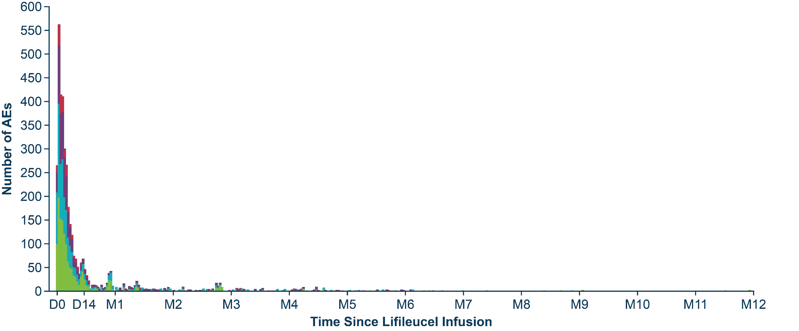
Safety
Grade 3/4 Hematologic Lab Abnormalities*
Non-Hematologic TEAEs in ≥30% of Patients*,†
Preferred Term, n (%) | Any Grade | Grade 3/4
Chills | 117 (75.0) | 8 (5.1)
Pyrexia | 81 (51.9) | 17 (10.9)
Febrile neutropenia | 65 (41.7) | 65 (41.7)
Hypophosphatemia | 58 (37.2) | 41 (26.3)
Hypotension | 52 (33.3) | 17 (10.9)
Fatigue | 51 (32.7) | 6 (3.8)
Diarrhea | 48 (30.8) | 2 (1.3)
Preferred Term, n (%) | Grade 3/4
Leukopenia | 156 (100.0)
Lymphopenia | 156 (100.0)
Neutropenia | 156 (100.0)
Thrombocytopenia | 147 (94.2)
Anemia | 111 (71.2)
Grade 1
2
3
4
5
Igor Puzanov, M.D.
Median number of IL-2 doses administered was 6
All patients experienced ≥1 TEAE (any grade); 94.9% experienced ≥1 Grade 3/4 TEAE
TEAEs were consistent with known safety profiles of NMA‐LD and IL-2 and in line with previous reports
Incidence of TEAEs decreased rapidly within the first 2 weeks after lifileucel infusion
*Per CTCAE v4.03; Safety Analysis Set (N=156).
†Grade 5 TEAEs included pneumonia (n=1), acute respiratory failure (n=1), arrhythmia (n=1), and intra-abdominal hemorrhage (n=1).
All occurrences of AEs were counted if a patient experienced a new onset of the same AE at different timepoints. If
multiple records were reported on the electronic case report form because of toxicity grade decrease of the same AE that had not resolved, then the event was counted once with the highest grade reported.
15 events were reported after Month 12 (Grade 1, n=7; Grade 2, n=6; Grade 3, n=1; Grade 5, n=1).
AE, adverse event; D, day; IL-2, interleukin 2; M, month; NMA-LD, nonmyeloablative lymphodepletion; TEAE, treatment-emergent adverse event.
Igor Puzanov, M.D.

Slide 33
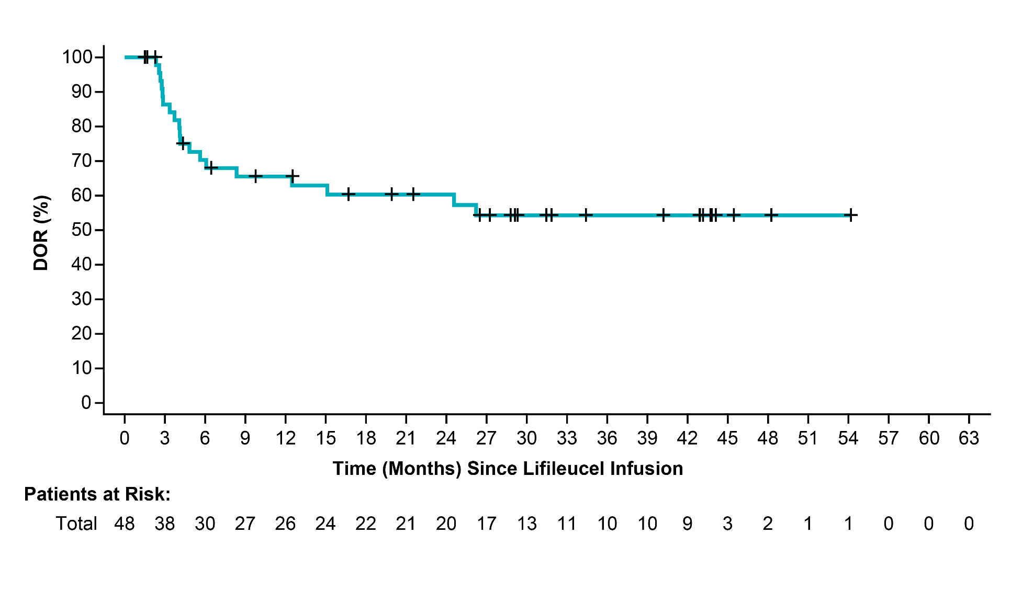
Duration of Response
 | Cohort 2 (n=23) | Cohort 4 (n=25) | Cohort 2+4 (N=48)
Median DOR*, months | NR | 10.4 | NR
95% CI | (NR, NR) | (4.1, NR) | (8.3, NR)
Min, max (months) | 1.4+, 54.1+ | 1.4+, 34.3+ | 1.4+, 54.1+
At a median study follow up of 36.5 months, median DOR was not reached
41.7% of responses were maintained ≥24 months
Igor Puzanov, M.D.

Slide 35


Tumor-infiltrating lymphocytes (TIL)
Preparation and treatment
Single infusion of TIL
Administration of high-dose IL-2
Cy Flu
Surgical removal of melanoma lesion
Non-myeloablative, lymphodepleting chemotherapy prior to TIL infusion
IL-2
Addition of:
Anti-CD3
Feeder cells
IL-2
Addition of interleukin -2 (IL-2)
Tumor digest/fragments
put into culture plates
Initial outgrowth
Rapid expansion protocol (“REP”)
Expanded TIL
pooled in one infusion bag
Haanen, JBAG et al ESMO 2022

Slide 38
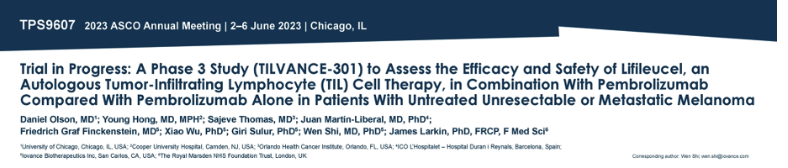
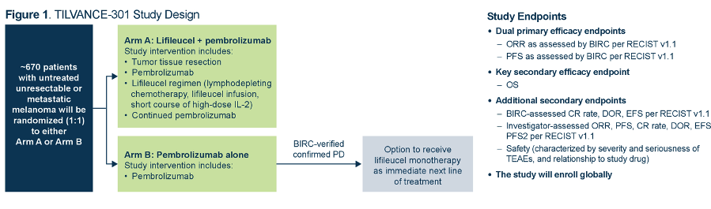

Slide 39
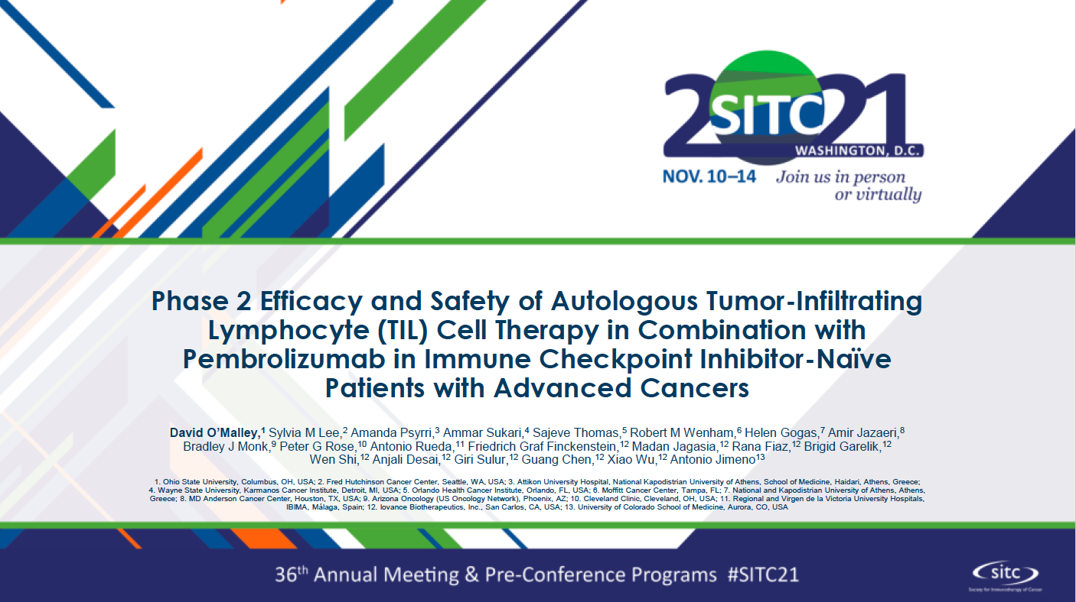
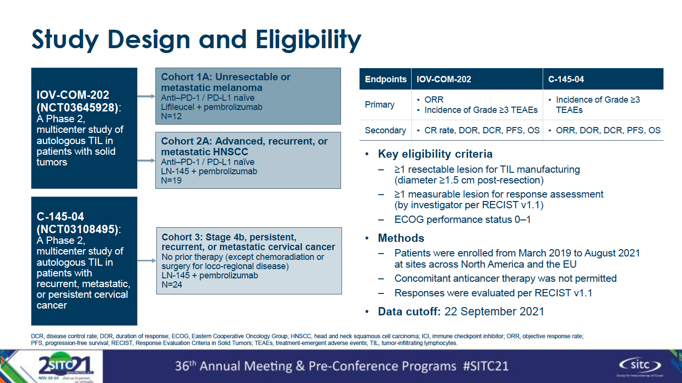

Slide 40
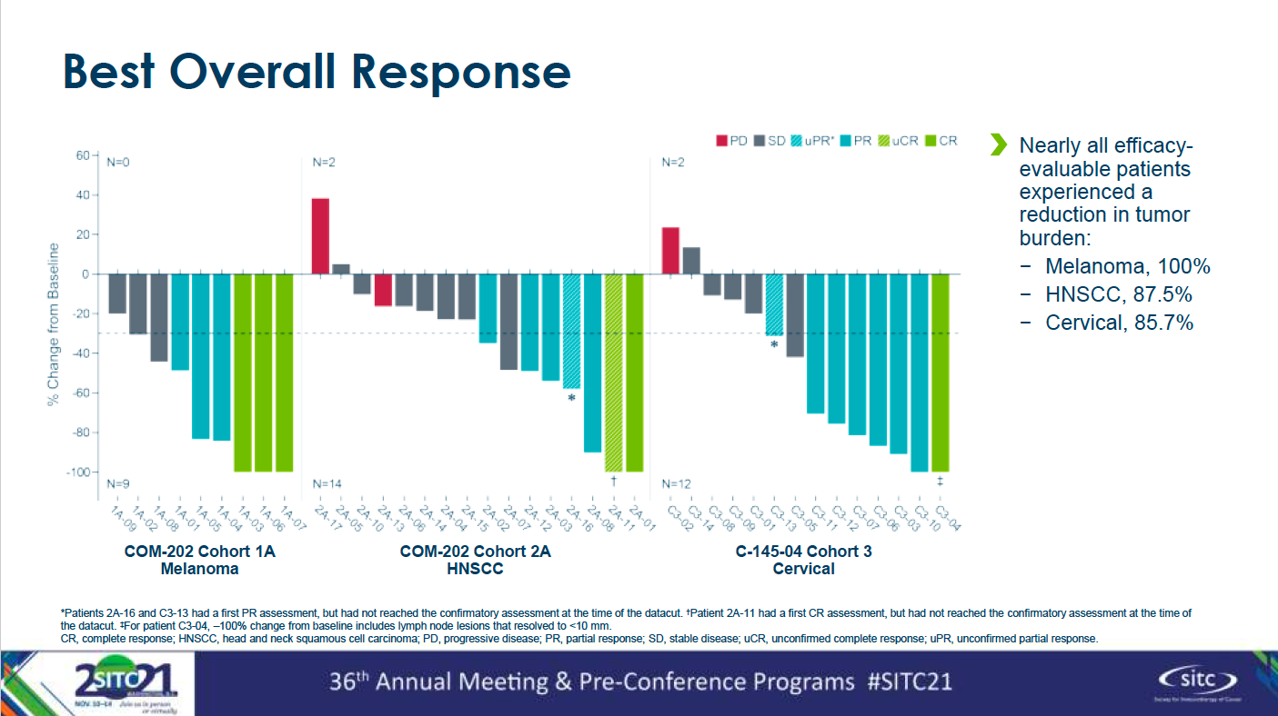

Slide 41
IOV-4001 First-in-Human Study: IOV-GM1-201
Phase 1/2, Open-label Study of PD-1 Knockout Tumor-infiltrating Lymphocytes (IOV-4001) in Participants With Unresectable or Metastatic Melanoma or Stage III or IV Non-small-cell Lung Cancer (NCT05361174)
Phase 1 / 2 study to investigate the efficacy and safety of an infusion of IOV-4001 in adult participants with unresectable or metastatic melanoma or advanced non-small-cell lung cancer (NSCLC).
N=53
Cohort 1: Unresectable or metastatic melanoma
Post-anti-PD-1/L1, post-BRAF/MEK inhibitor in patients with BRAF mutations
Endpoints
Phase I: Safety
Phase 2: Objective Response Rate (ORR) per RECIST v1.1 as assessed by the investigator
Secondary endpoints include complete response (CR) rate, duration of response (DOR), disease control rate (DCR), progression free survival (PFS), overall survival (OS), safety and tolerability, feasibility
Study Updates
Investigational New Drug (IND) Allowance March 2022
Cohort 2: Stage III or IV non-small-cell lung cancer
Post -anti-PD-1/L1 or
Post targeted therapy and either chemotherapy or anti-PD-1/L1
clinicaltrials.gov/NCT05361174

Slide 42
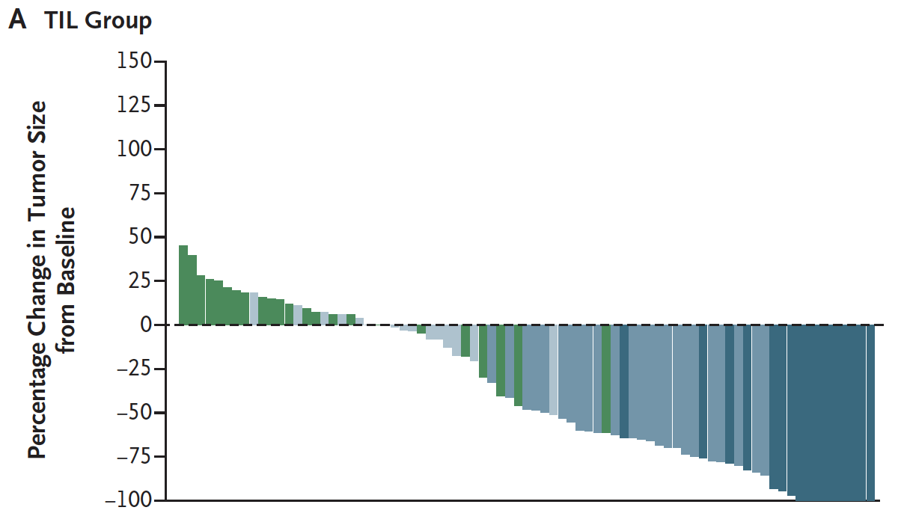
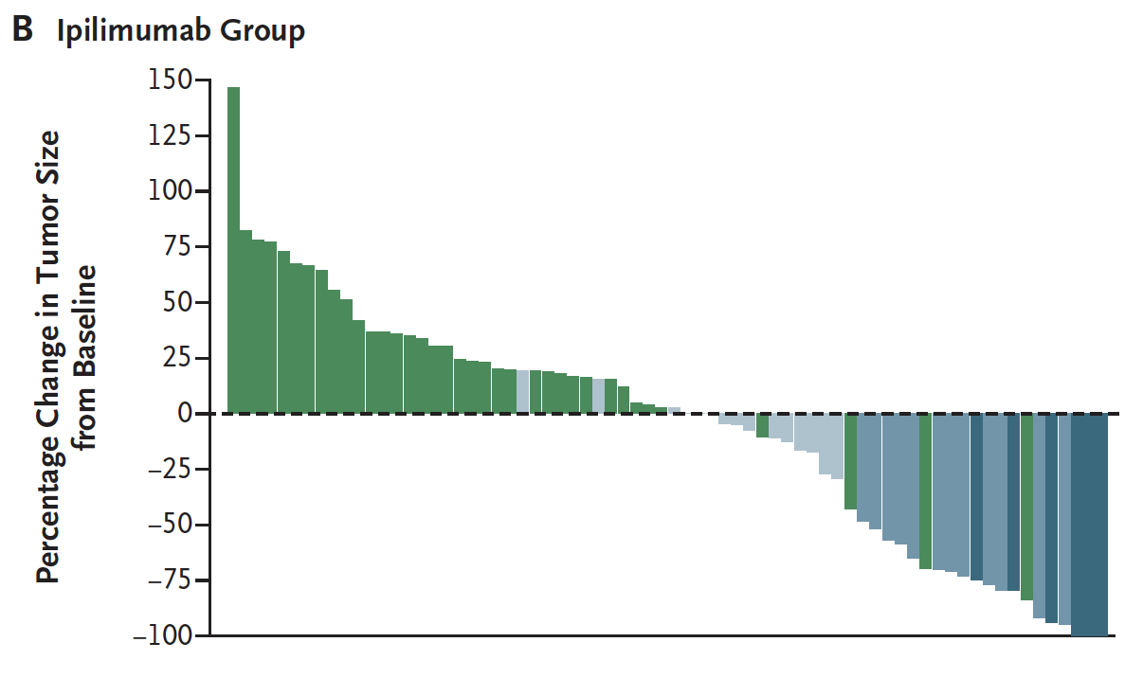
TIL Versus Ipilimumab
Phase III trial in patients (PS 0-1) with unresectable or metastatic melanoma
At least 1 prior line of systemic therapy, excluding ipilimumab
ORR: 49%
ORR: 21%
Rohaan MW et al. N Engl J Med 2022;387(23):2113-25.

Slide 43
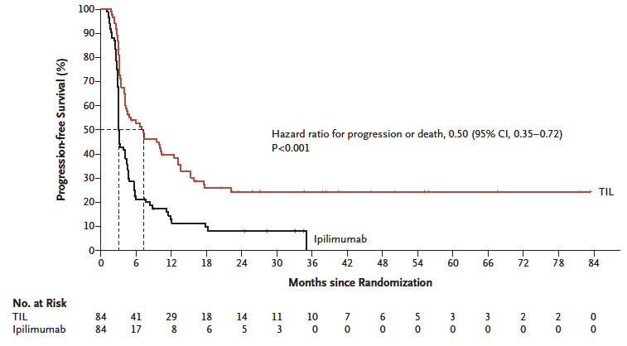
TIL Versus Ipilimumab
Phase III trial in patients (PS 0-1) with unresectable or metastatic melanoma
At least 1 prior line of systemic therapy, excluding ipilimumab
PFS @ 6 months
TIL 52.7%
Ipilimumab 21.4%
Median OS
TIL 25.8 months
Ipilimumab 18.9 months
HR 0.82
2-year OS
TIL 54.3%
Ipilimumab 44.1%
Median 7.2 months
Median 3.1 months
Rohaan MW et al. N Engl J Med 2022;387(23):2113-25.

Slide 44

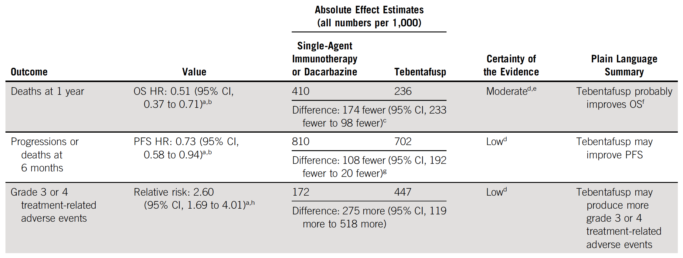

Slide 45
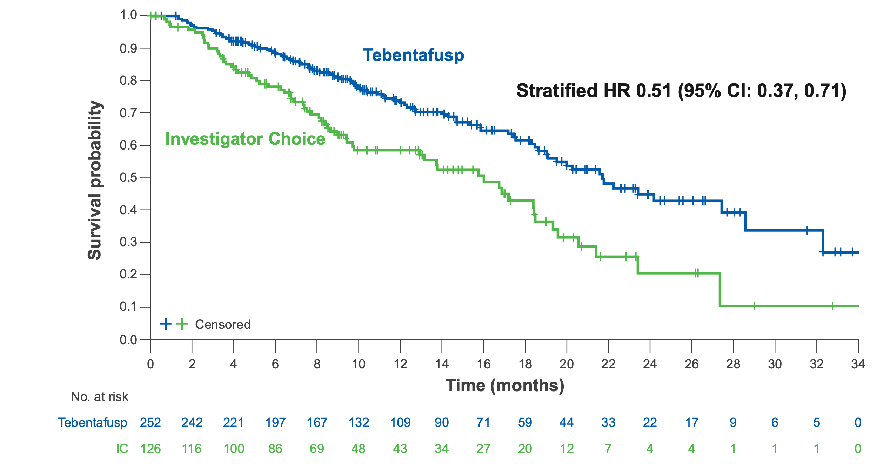
OS best captures benefit from tebentafusp (uveal melanoma)
Phase 3, first-line study (IMCgp100-202)¹
RECIST response rate and PFS underestimate OS
Statistically and clinically significant OS benefit
 | Tebentafusp vs Investigator Choice (IC)
RECIST response rate | 9% vs 5%
Tumor shrinkage* | 39% vs 24%
PFS (HR) | 0.73 (95% CI: 0.58, 0.94)
* In phase 2, any tumor shrinkage (44%)² and ctDNA reduction (70%)³ were associated with OS
1. Nathan P, et al. N Engl J Med 2021;385:1196-206; 2. Sacco JJ, et al. Ann Oncol 2020;31:S1442–43; 3. Shoushtari A et al. Ann Oncol 2021;32:S1210
Professor M.R. Middleton
Middleton MR et al. ASCO 2022;Abstract 104

Slide 46
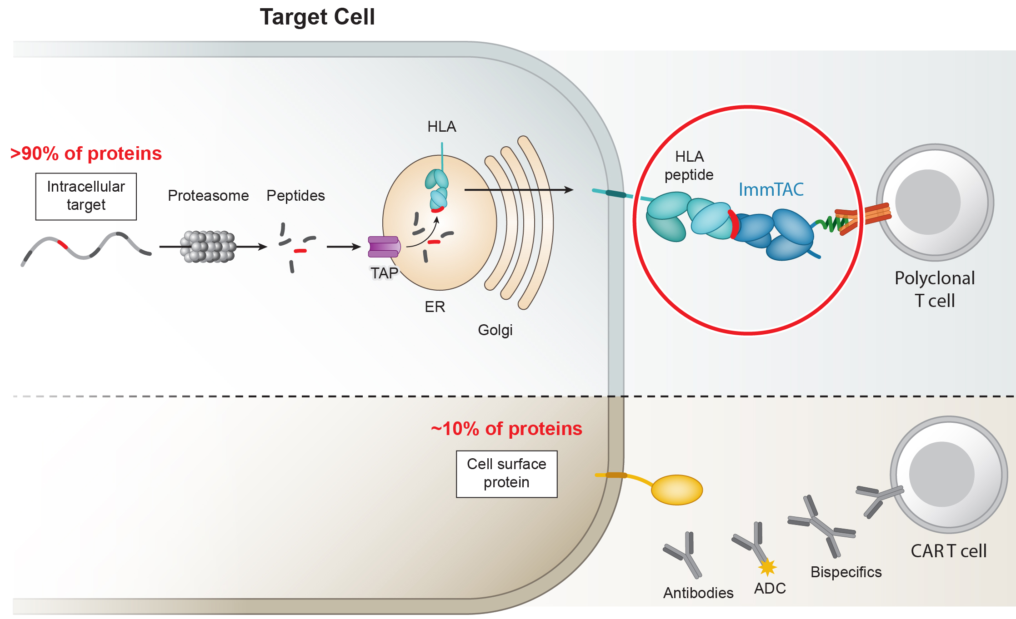
ImmTAC: T cell receptor (TCR) bispecifics target intracellular proteins
ImmTAC target >90% of proteome via soluble TCR
ImmTAX
Antibody bispecifics target 10% of proteome
Professor M.R. Middleton
Middleton MR et al. ASCO 2022;Abstract 104
Notes:
Key Points
While antibody-based therapeutics can only target proteins expressed on the cell surface which represents ~10% of the proteome
TCR based therapeutics, such as the soluble TCR bispecific, tebentafusp, can target any intra-cellular protein that is processed and presented by HLA molecules.
This represent >90% of the proteome.
Reason this is important is that most solid tumor specific proteins are only found inside the cell

Slide 47
Updated overall survival (OS) data from Phase 1b study of tebentafusp (tebe) as monotherapy or combination therapy with durvalumab (durva) and/or tremelimumab (treme) in metastatic cutaneous melanoma (mCM)
Authors: M.R. Middleton¹, O. Hamid², A.N. Shoushtari³, F.E. Meier⁴, T.M. Bauer⁵, A.K.S. Salama⁶, J.M. Kirkwood⁷, P.A. Ascierto⁸, P. Lorigan⁹, C. Mauch¹⁰, M.M. Orloff¹¹, T. R.J Evans¹², S.E. Abdullah¹³, Y. Yuan¹³, J. Mitchell¹³, J.C. Hassel¹⁴
¹University of Oxford, Oxford, UK; ²The Angeles Clinic and Research Institute, A Cedars-Sinai Affiliate, Los Angeles, CA, USA; ³Memorial Sloan-Kettering Cancer Center, New York, NY, USA; ⁴University Hospital Carl Gustav Carus at the TU Dresden, Germany; ⁵Tenessee Oncology, Nashville, TN, USA; ⁶Duke University, Durham, NC, USA; ⁷University of Pittsburgh Medical Center, Pittsburgh, PA, USA; ⁸IRCCS National Cancer Institute Pascale Foundation, Naples, Italy; ⁹The Christie NHS Foundation Trust, Manchester, UK; ¹⁰University of Cologne, Cologne, Germany; ¹¹Thomas Jefferson University Hospitals, Philadelphia, PA, US; ¹²Beatson West of Scotland Cancer Centre, Glasgow, UK; ¹³Immunocore Ltd, Abingdon, UK; ¹⁴Heidelberg University Hospital, Heidelberg, German
Abstract #104
Professor M.R. Middleton

Slide 48
Similar associations with OS between mUM and mCM
 | IMCgp100-201 | IMCgp100-202
Population | Previously treated mCM (n=52) | Previously untreated mUM (n=230)†
Treatment | Tebentafusp + durvalumab | Tebentafusp
RECIST response rate (%) | 10% | 12%
Patients with tumor decrease (%) | 37%* | 40%*
Alive at 1 yr (%) | 89% | 85%
Patients with tumor increase (%) | 60%* | 54%*
Alive at 1 yr (%) | 58% | 64%
* 3% and 6% of patients in Study 201 and Study 202, respectively, had no change in tumor size
† April 2022 data cut off for survival data. Tumor shrinkage and increase for IMCgp100-202 (N=230)
Middleton MR et al. ASCO 2022;Abstract 104

Slide 50
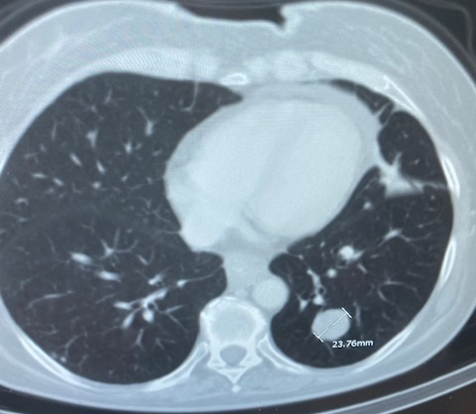
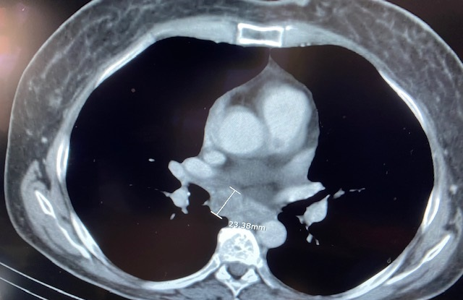
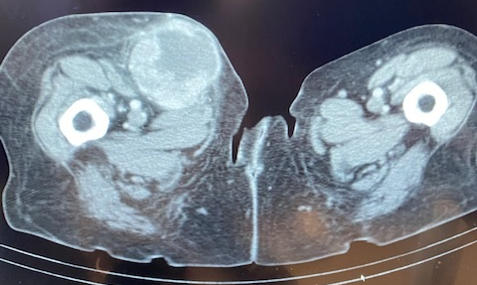
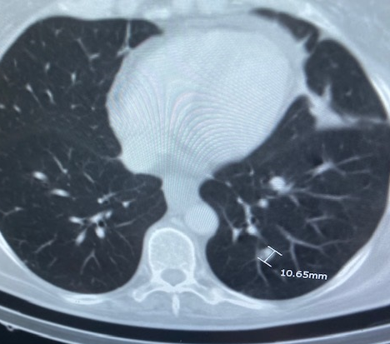
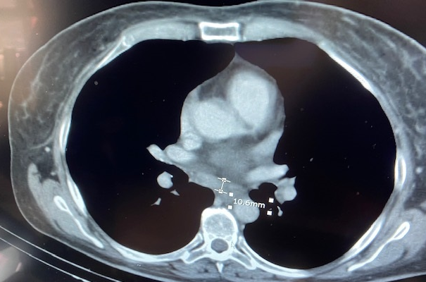
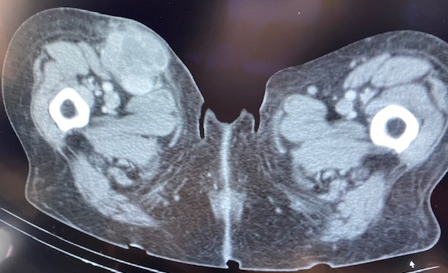
Single Agent: cutaneous melanoma
Prior anti-CTLA4, multiple anti-PD1s and oncolytic virus
Baseline
23 mm
63 mm
24 mm
Confirmed PR
ongoing treatment 5+ months
11 mm
47 mm
11 mm
Week 9
Week 9
Week 9
Images courtesy of Dr. Omid Hamid (Angeles Clinic)

Slide 51
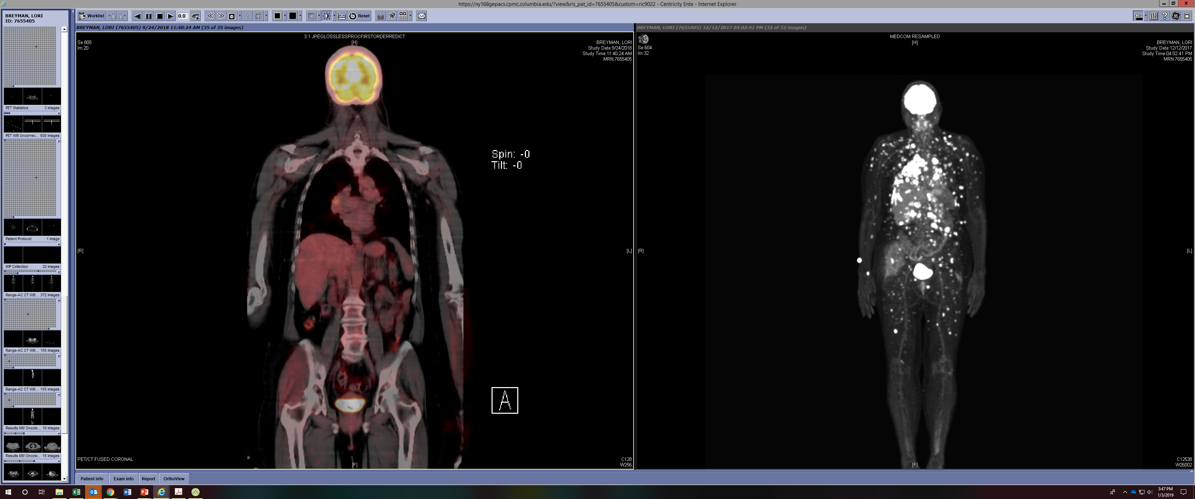
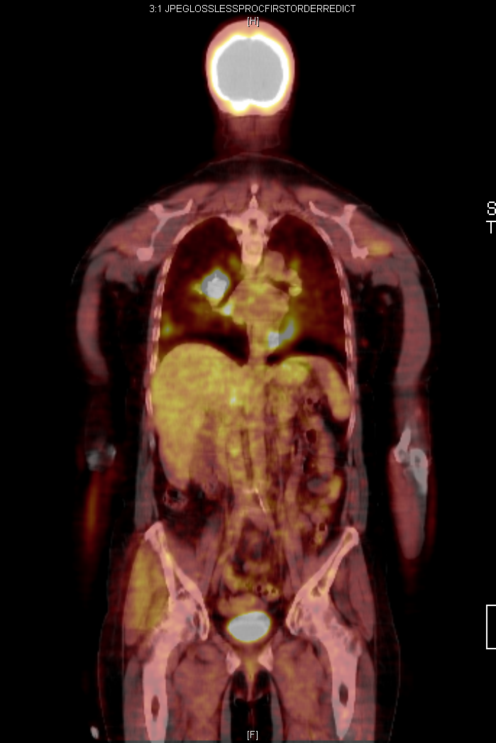
Response to Combined Checkpoint Blockade
52 year old female with Decision DX Class 2, GNA11 Q209L mutant, right ciliary body melanoma s/p enucleation with the development of metastatic disease 26 months later to the liver, lung, bone and soft tissue
Prior Therapies:
Ipilimumab
Pembrolizumab + radioembolization x 7 months
IMCgp100 x 20 months
Ipi/Nivo
Ipi/Nivo
Observation
12/2017
03/2018
09/2018
Courtesy of Dr. Richard Carvajal

Slide 53
Schadendorf D et al. ESMO 2022;Abstract 7840

Slide 54
Schadendorf D et al. ESMO 2022;Abstract 7840

Slide 55
Schadendorf D et al. ESMO 2022;Abstract 7840

Slide 56
Conclusions:
Checkpoint therapy has changed the outcome of advanced melanoma
Standard therapy includes first-line PD1 based single agent or combinations
Newer checkpoint combinations seek to overcome resistant mechanisms
Adoptive T cell therapies will allow further improvements in outcomes
Second- and third-line options are upcoming. Triplet, quadruplet, and more are coming
Tumor Infiltrating Lymphocyte (TIL therapy) is at FDA for approval
Clinical trials, clinical trials, clinical trials ….
Complete response …

Slide 57
APPENDIX

Slide 58
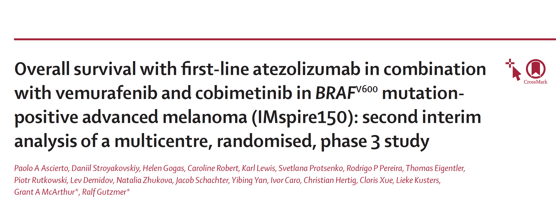
Lancet Oncol 2023;24:33-44

Slide 59
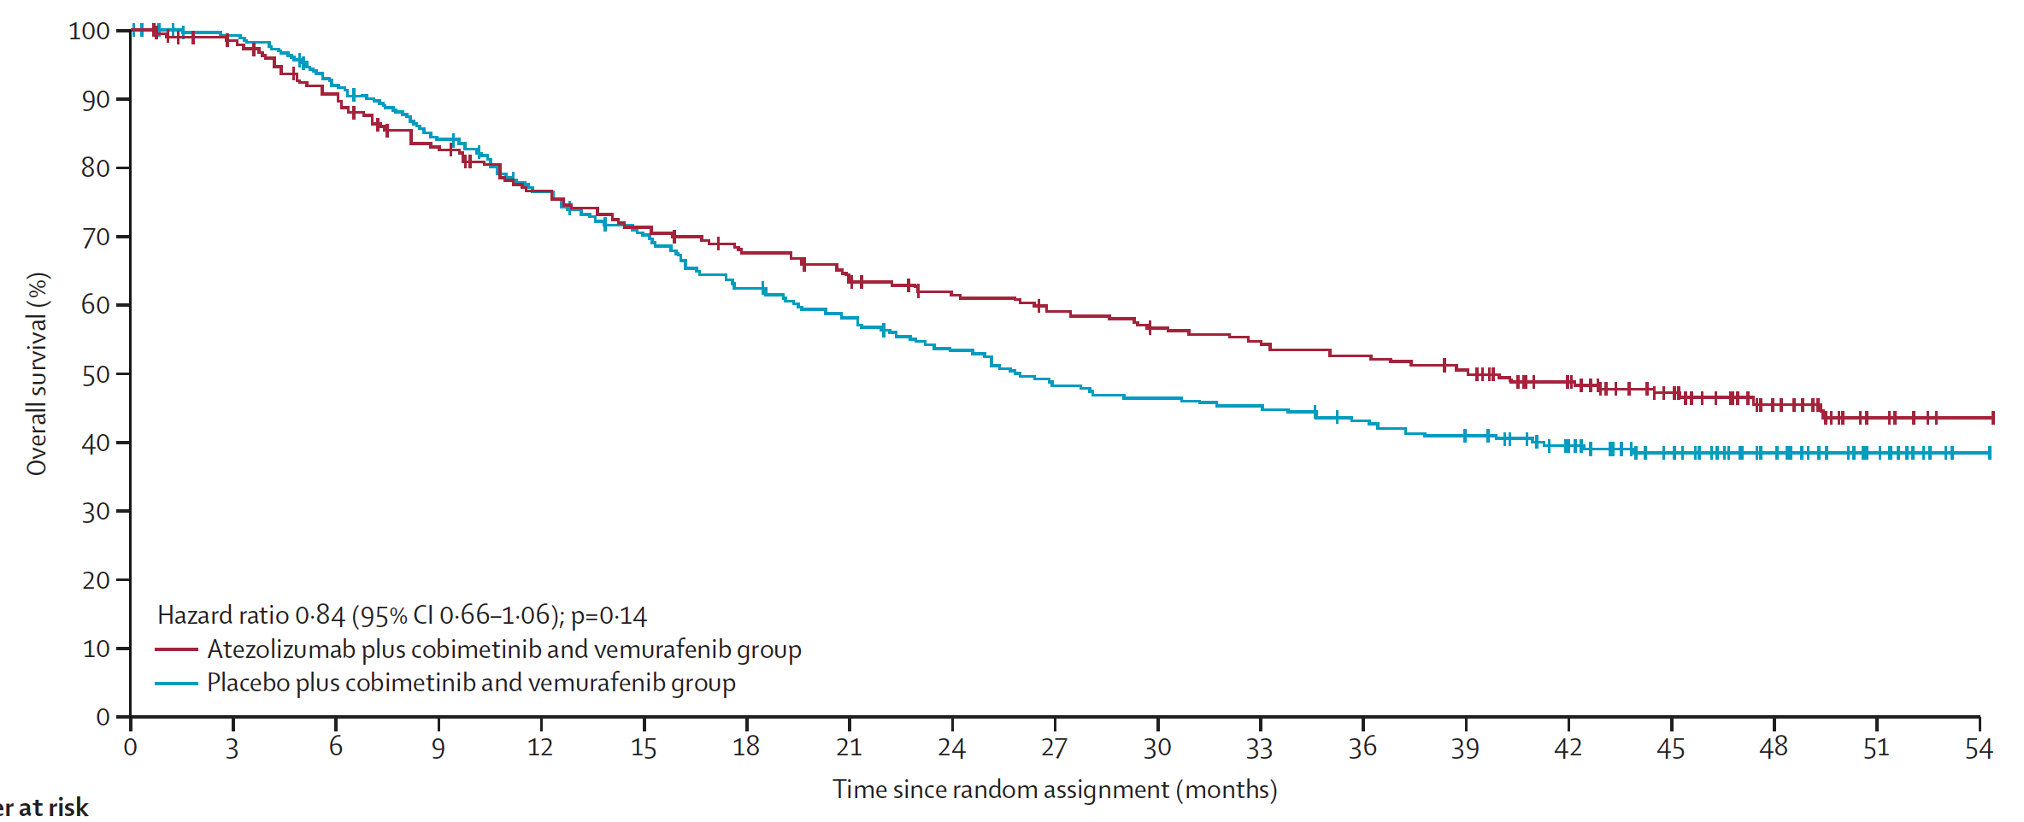
IMspire150: Overall Survival with First-Line Atezolizumab and Cobimetinib for BRAFV600 Mutation-Positive Advanced Melanoma
Second Interim Analysis
Median: 39.0 months
Median: 25.8 months
Ascierto PA et al. Lancet Oncol 2023;24:33-44.

Slide 60
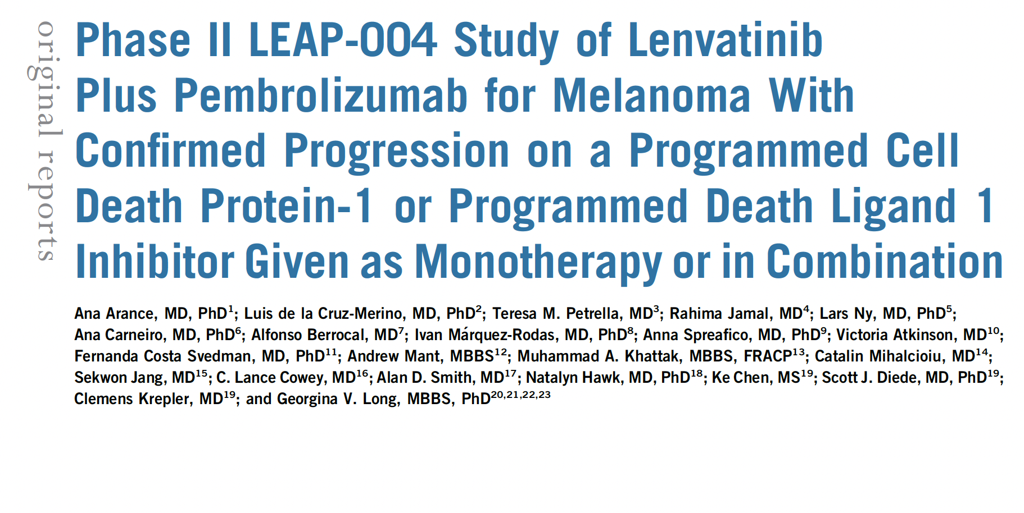
J Clin Oncol 2023;41(1):75-85

Slide 61
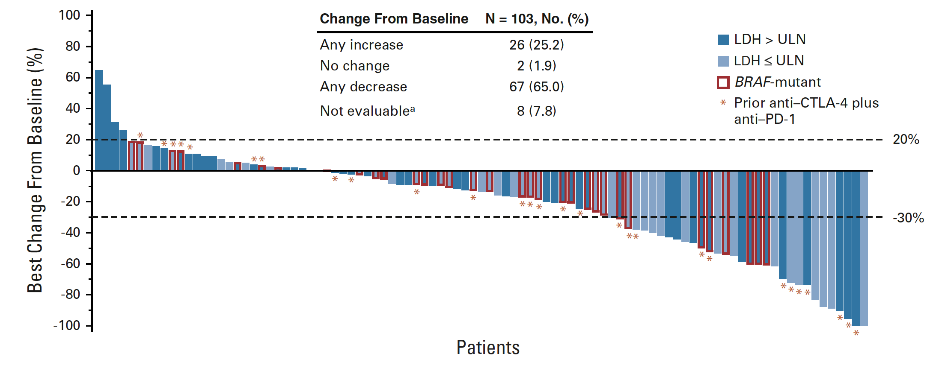
LEAP-004 Primary Endpoint: ORR by Independent Central Review
ORR: 21.4%
ORR = objective response rate
Arance A et al. J Clin Oncol 2023;41(1):75-85.

Slide 62
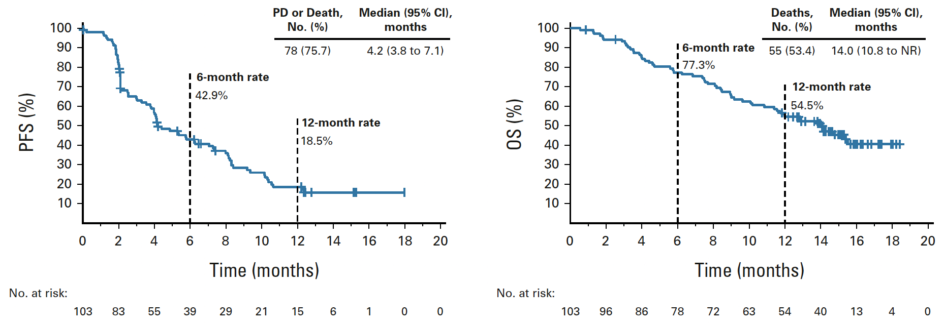
LEAP-004: PFS and OS
PFS = progression-free survival; OS = overall survival
Arance A et al. J Clin Oncol 2023;41(1):75-85.

Slide 63
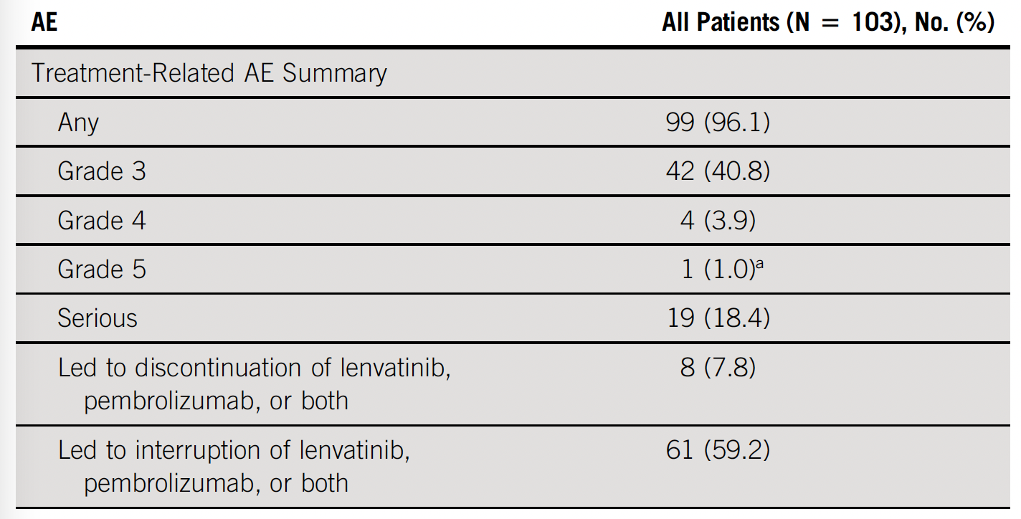
LEAP-004: Treatment-Related AE summary
AE = adverse event
Arance A et al. J Clin Oncol 2023;41(1):75-85.

Slide 64
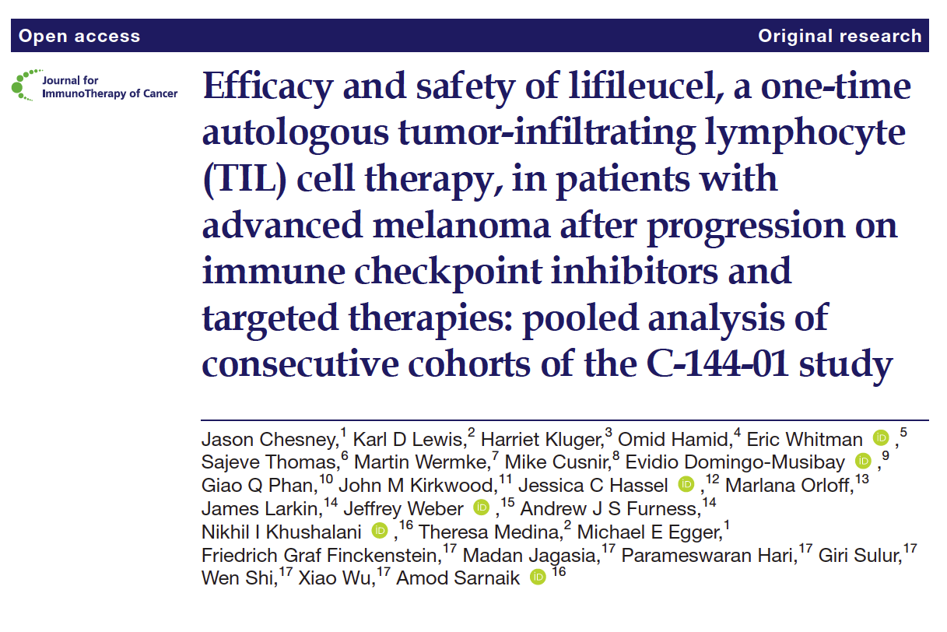
J Immunother Cancer 2022;10(12):e005755.

Slide 65

Pooled Analysis of Patients Treated with Lifileucel in the
Phase II C-144-01 Study
IRC assessment for Cohorts 2 and 4 and pooled Cohorts 2 and 4 (full analysis set)
Chesney J et al. J Immunother Cancer 2022;10(12):e005755.

