Slide 1

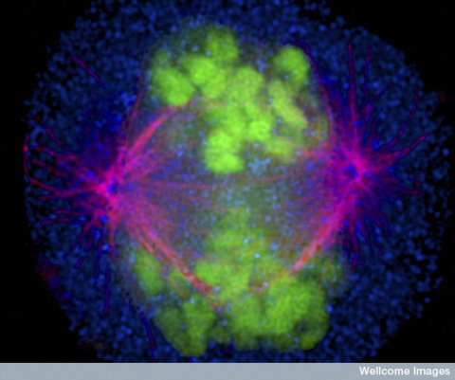

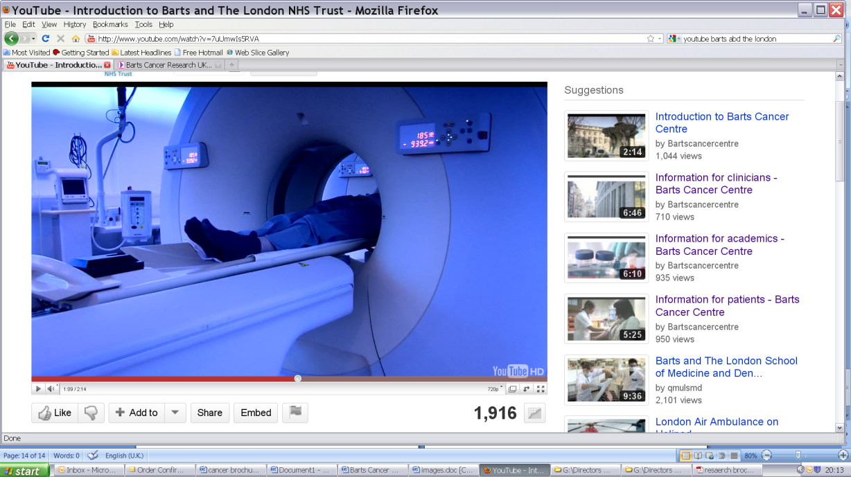



Breast Cancer:
Highlights of the year 2022
Professor Peter Schmid, MD PhD FRCP
Lead, Centre for Experimental Cancer Medicine
Barts Cancer Institute, St Bartholomew’s Hospital
Queen Mary University of London

Slide 2
Key Data Sets
Localized ER-Positive Breast Cancer
Abdou Y et al. Race and clinical outcomes in the RxPONDER trial (SWOG S1007). San Antonio Breast Cancer Symposium 2022;Abstract GS1-01.
Nitz UA et al. Endocrine therapy response and 21-gene expression assay for therapy guidance in HR+/HER2- early breast cancer. J Clin Oncol 2022;40(23):2557-67.
Sparano J et al. Trial Assigning Individualized Options for Treatment (TAILORx): An update including 12-year event rates. San Antonio Breast Cancer Symposium 2022;Abstract GS1-05.
Andre F et al. Biomarkers for adjuvant endocrine and chemotherapy in early-stage breast cancer: ASCO guideline update. J Clin Oncol 2022;40(16):1816-37.
Johnston S et al. Abemaciclib plus endocrine therapy for HR+, HER2-, node-positive, high-risk
early breast cancer: Results from a pre-planned monarchE overall survival interim analysis, including 4-year efficacy outcomes. San Antonio Breast Cancer Symposium 2022;Abstract GS1-09.

Slide 3
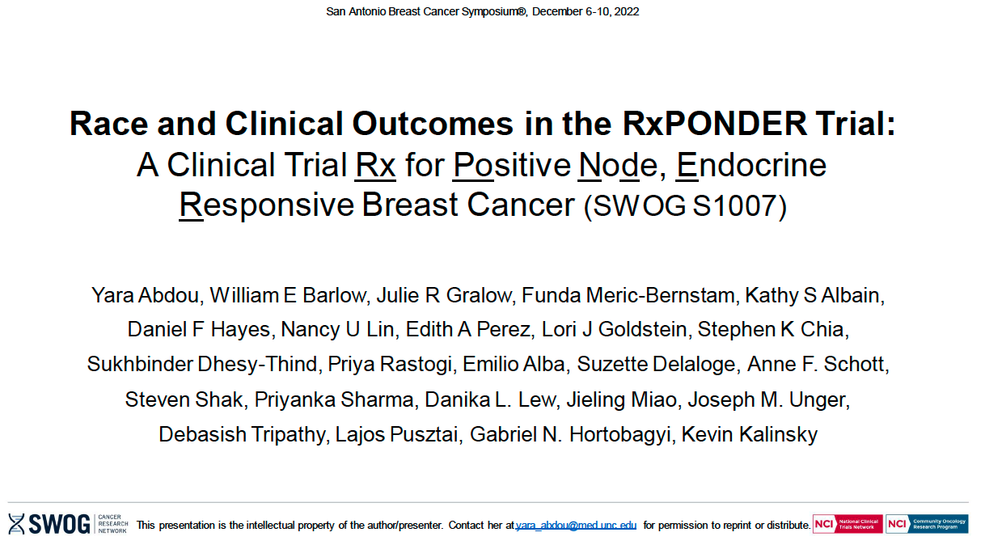
Abstract GS1-01

Slide 4
Ethnicity and Outcomes in RxPONDER and TAILORx
Ethnicity in RxPONDER
IRFS by Ethnicity (multivariate analysis
DRFS By Ethnicity
DRFS by Ethnicity – Role of BMI in multivar. analysis
TAILORx: Outcomes by Time Period and Ethnicity
Abou Y et al, SABCS 2022, Sparano S, et al, SABCS 2022

Slide 5
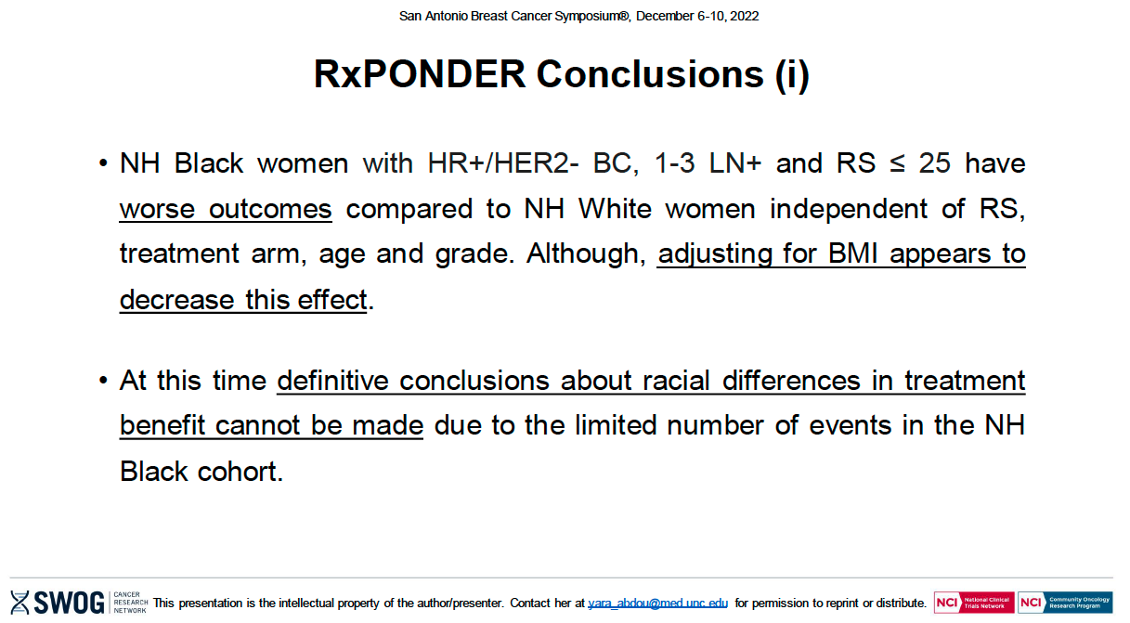
Abstract GS1-01
Abou Y et al. SABCS 2022;Abstract GS1-01.

Slide 6
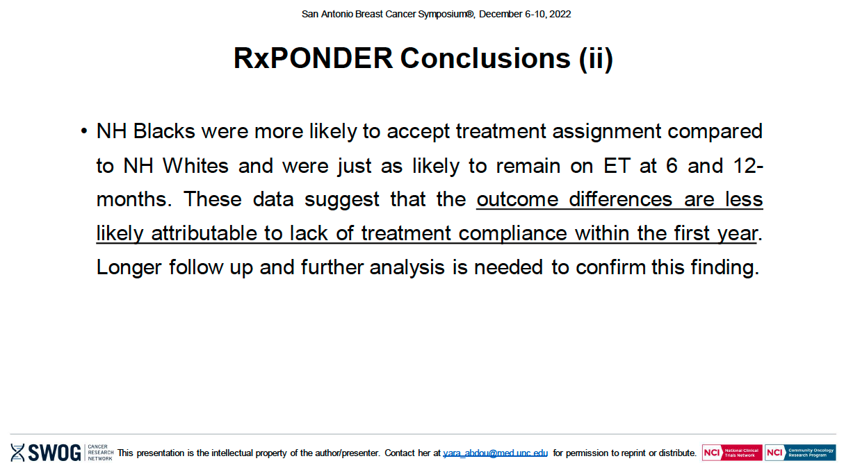
Abou Y et al. SABCS 2022;Abstract GS1-01.

Slide 7
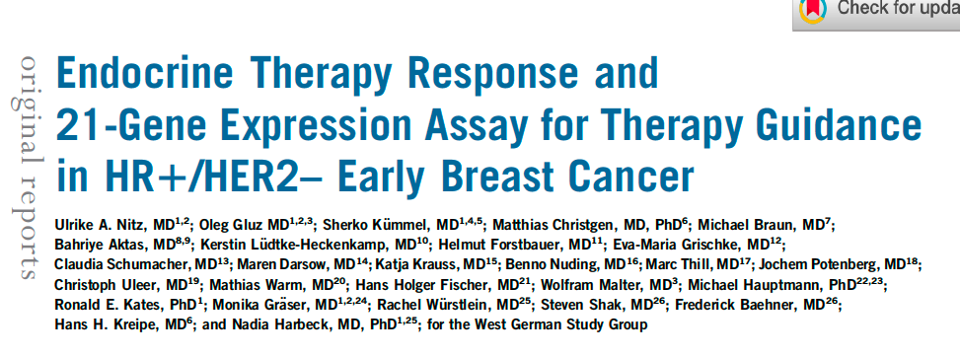
J Clin Oncol 2022;40(23):2557-67.

Slide 8
ER+ EBC: Who benefits from chemotherapy?
Treatment decisions based on Oncotype DX
 | N0 |  |  | N+ 1-3LN |  |  | N ≥4LN
Premenopausal | 0-10 | 11-25 | >25 | 0-10 | 11-25 | >25 | CET
 | ET | ET/CET | CET | ET | CET | CET
Postmenopausal | 0-10 | 11-25 | >25 | 0-10 | 11-25 | >25 | CET
 | ET | ET | CET | ET | ET | CET

Slide 9
ER+ EBC: Who benefits from chemotherapy?
Combining Oncotype with functional endocrine sensitivity test (3/52 WOO therapy)
HR+ N0/1 EBC
RS 0-11
RS12-25
RS >25
Significantly higher ET response with OFS
20.3%
55.5%
24.2%
ET Response
No ET Response
62.2%
3/52
preOP ET
37.8%
ET
ET
CET
CET
N=868
N=1422
N=694
iDFS in ET groups
dDFS in RS0-11 and RS12-25 groups
Nitz et al, JCO 2022; Gluz et al, ESMO 2022

Slide 10
Conclusion: WSG-ADAPT HR+/HER2-
“WSG-ADAPT-HR1/HER2– demonstrates that guiding systemic treatment by both RS and ET response is feasible in clinical routine and spares CT in pre- and postmenopausal patients with
≤ 3 involved lymph nodes.”
Nitz UA et al. J Clin Oncol 2022;40(23):2557-67.

Slide 11
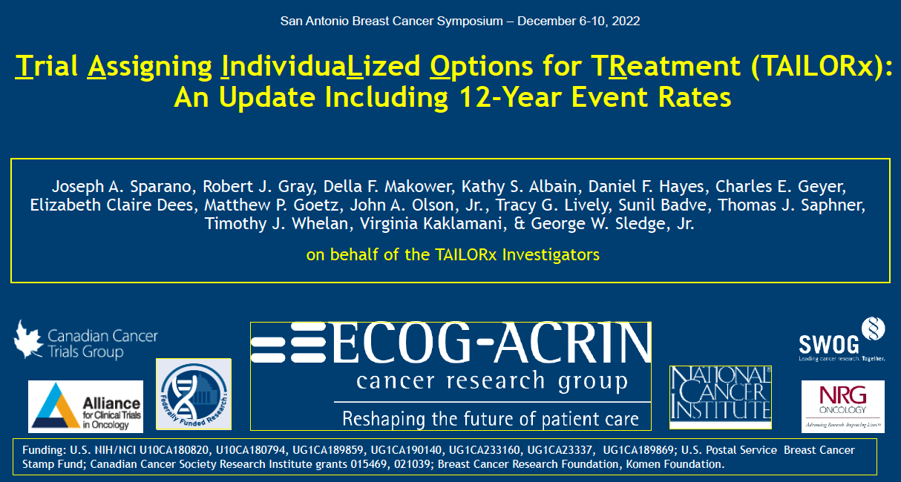
Abstract GS1-05

Slide 12
TAILORx Trial in ER+ N0 EBC – Updated results (12a event rates)
RFS across all Arms
RA 11-25 and Age <50a
RS <11 ET
RS 11-25 ET vs CET
RS ≥25 CET
RA 11-25 and Age <50a
Sparano et al, SABCS 2022

Slide 13
ER+ EBC: Who benefits from chemotherapy?
Treatment decisions based on Oncotype DX after SABCS 2022
 | N0 |  |  |  |  |  | N+ 1-3LN |  |  | N ≥4LN
Premenopausal | 0-10 | 11-25 |  |  |  | >25 | 0-10 | 11-25 | >25 | CET
 | ET | 11-15 | 16-20 |  | 21-25 | CET | ET | CET | CET
 |  | ET | ET low risk |  | CET
 |  |  |  | CET high risk
Postmenopausal | 0-10 | 11-25 |  |  |  | >25 | 0-10 | 11-25 | >25 | CET
 | ET | ET |  |  |  | CET | ET | ET | CET

Slide 14
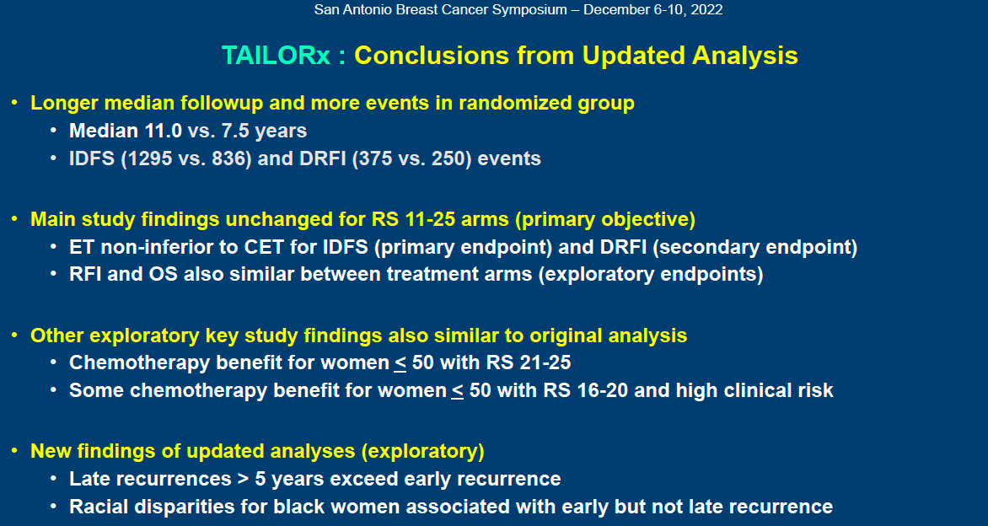
Sparano S et al. SABCS 2022;Abstract GS1-05.

Slide 15
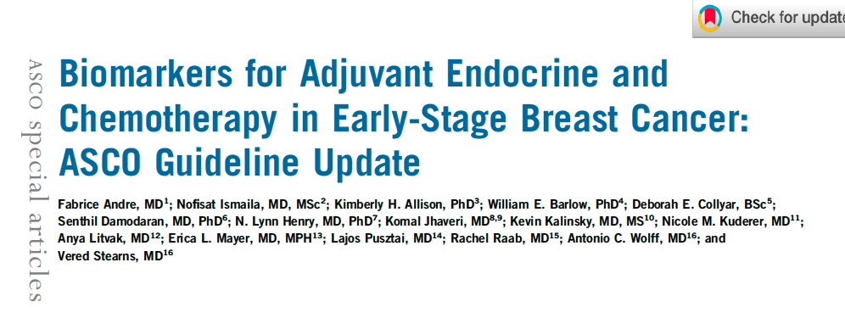
J Clin Oncol 2022;40(16):1816-37.

Slide 16
2022 RECOMMENDATIONS
“Clinicians may use Oncotype DX, MammaPrint, Breast Cancer Index (BCI), and Endo-Predict to guide adjuvant endocrine and chemotherapy in patients who are postmenopausal or age > 50 years with early-stage estrogen receptor (ER)–positive, human epidermal growth factor receptor 2 (HER2)–negative (ER1 and HER2–) breast cancer that is node-negative or with 1-3 positive nodes. Prosigna and BCI may be used in postmenopausal patients with node-negative ER1 and HER2– breast cancer.
In premenopausal patients, clinicians may use Oncotype in patients with node-negative ER1 and HER2– breast cancer. Current data suggest that premenopausal patients with 1-3 positive nodes benefit from chemotherapy regardless of genomic assay result.
There are no data on use of genomic tests to guide adjuvant chemotherapy in patients with > 4 positive nodes. Ki67 combined with other parameters or immunohistochemistry 4 score may be used in postmenopausal patients without access to genomic tests to guide adjuvant therapy decisions. BCI may be offered to patients with 0-3 positive nodes who received 5 years of endocrine therapy without evidence of recurrence to guide decisions about extended endocrine therapy. None of the assays are recommended for treatment guidance in individuals with HER2-positive or triple-negative breast cancer. Treatment decisions should also consider disease stage, comorbidities, and patient preferences.”
Andre F et al. J Clin Oncol 2022;40(16):1816-37.

Slide 17
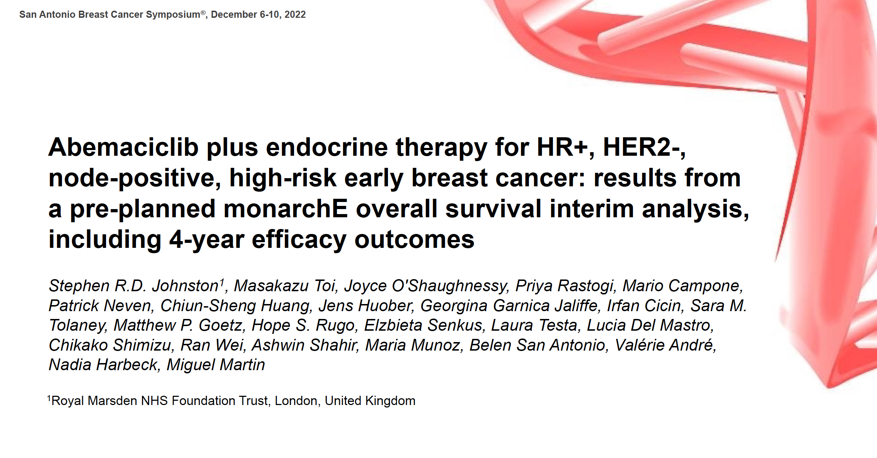
Abstract GS1-09

Slide 18
monarchE Study Design (NCT03155997)
ET plus CDK4/6 inhibitors in high-risk HR+/HER2- EBC
Cohort 1: High risk based on clinical pathological features
≥4 ALN OR
1-3 ALN and at least 1 of the below:
Grade 3 disease
Tumor size ≥5 cm
On-study treatment period
2 years
HR+, HER2-, node positive high-risk EBC
Women or men
Pre-/postmenopausal
With or without prior neo- and/or adjuvant chemotherapy
No metastatic disease
Maximum of 16 months from surgery to randomization and 12 weeks of ET following the last non-ET
Abemaciclib
(150mg twice daily) +
Endocrine Therapy: AI or tamoxifen
Follow-up period
Endocrine Therapy
3-8 years as clinically indicated
R 1:1
N = 5637
Cohort 2: High risk based
on Ki-67
1-3 ALN and
Ki-67 ≥20% and
Grade 1-2 and tumor size <5 cm
Endocrine Therapy: AI or tamoxifen
Primary Objective: IDFS
Secondary Objectives: IDFS in high Ki-67 populations, DRFS, OS, Safety, PK, PRO
Stratified for:
Prior chemotherapy
Menopausal status
Region
Johnston et al, SABCS 2022

Slide 19
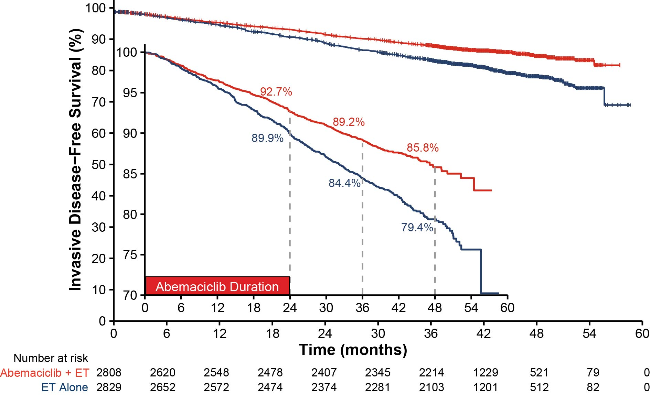
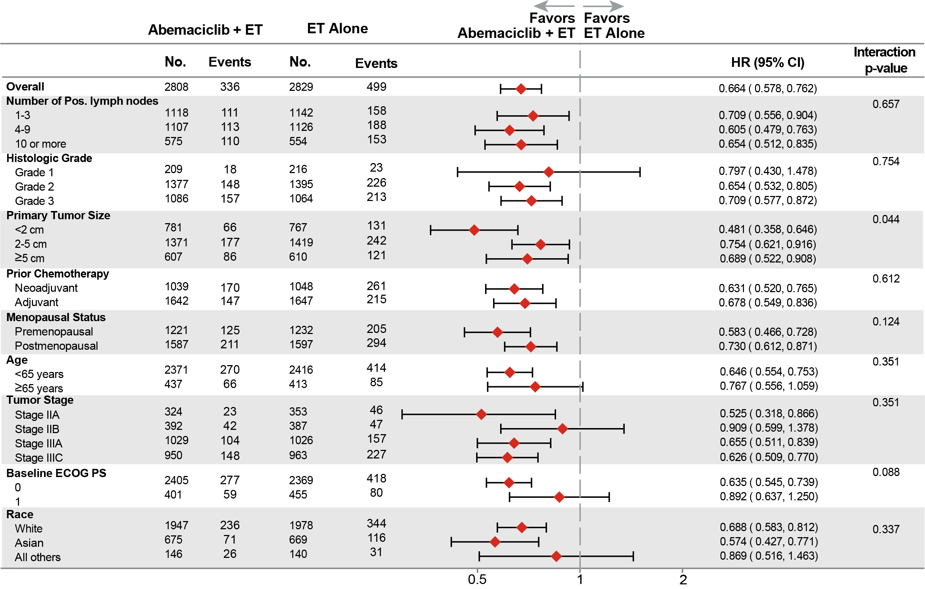
IDFS Benefit in ITT Persists Beyond Completion of Abemaciclib
Monarch-E: IDFS @42 months
Consistent IDFS benefit across subgroups
Number of IDFS events
Abemac + ET | ET Alone
336 | 499
HR: 0.664 (0.578, 0.762) Nominal p < 0.0001
33.6% reduction in the risk of developing an IDFS event with an increase in absolute
benefit in IDFS 4-year rates (6.4%) compared to 2- and 3-year IDFS rates (2.8% and 4.8% respectively)
Johnston et al, SABCS 2022

Slide 20
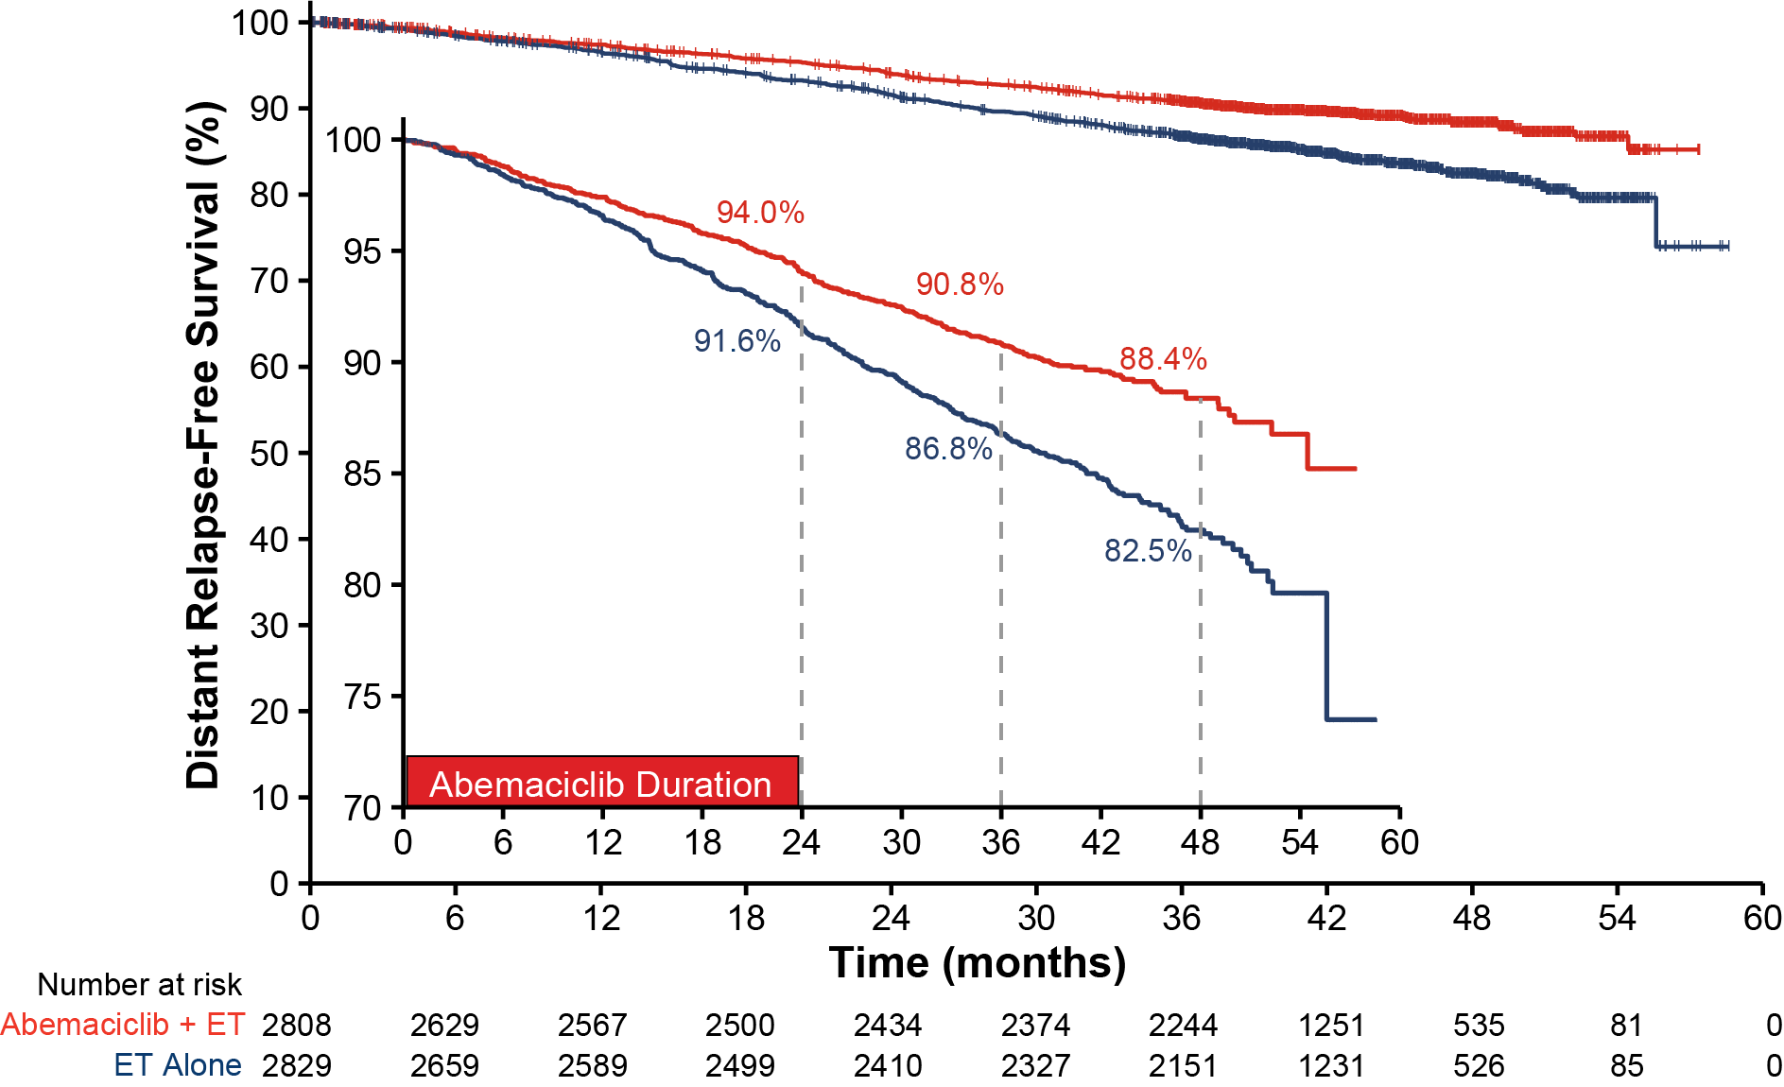
DRFS Benefit in ITT Persists Beyond Completion of Abemaciclib
Abemaciclib Treatment Benefit Deepened Over Time
DRFS @42 months
Analysis landmark | IDFS | DRFS
 | Piecewise HRª (95% CI^{b}) | Piecewise HRª (95% CI^{b})
Year 0-1 | 0.782 (0.583, 1.018) | 0.725 (0.519, 0.983)
Year 1-2 | 0.674 (0.521, 0.858) | 0.691 (0.521, 0.887)
Year 2-3 | 0.618 (0.477, 0.788) | 0.651 (0.497, 0.851)
Year 3+ | 0.602 (0.428, 0.803) | 0.581 (0.391, 0.818)
Number of DRFS events
Abema + ET | ET Alone
281 | 421
HR: 0.659 (0.567, 0.767) Nominal p < 0.0001
34.1% reduction in the risk of developing a DRFS event with an increase in absolute
benefit in DRFS 4-year rates (5.9%), compared to 2- and 3-year rates (2.5% and 4.1%, respectively)
Johnston et al, SABCS 2022

Slide 21
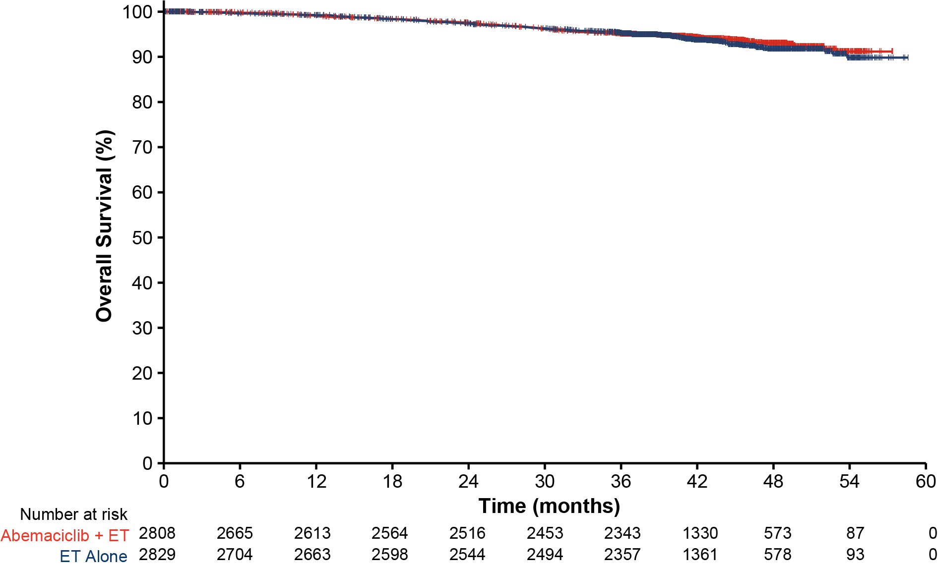
MonarchE – Preliminary Survival Data
Monarch-E: OS @42 months
Number of OS events
Abemaciclib + ET | ET Alone
157 | 173
HR (95% CI): 0.929 (0.748, 1.153) Log-rank P = 0.5027
Fewer deaths (157 vs 173) were observed in the abemaciclib plus ET group versus the ET group
Johnston et al, SABCS 2022

Slide 22
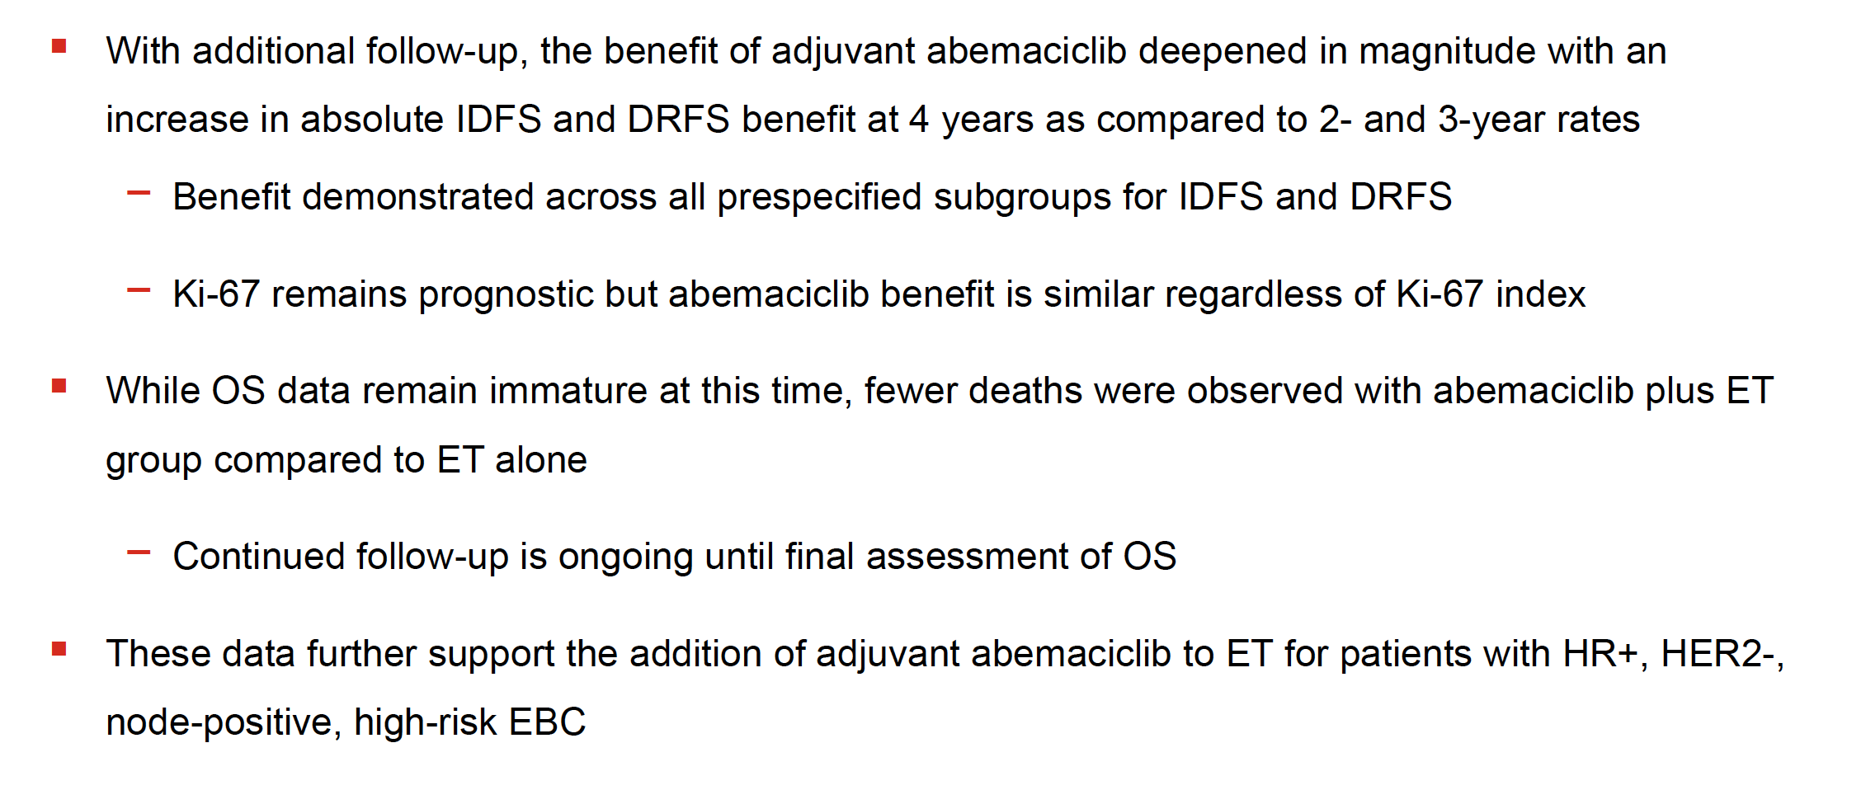
monarchE: Conclusions
Johnston S et al. SABCS 2022;Abstract GS1-09.

Slide 23
Key Data Sets
Localized Triple-Negative Breast Cancer
Tutt ANJ et al. Pre-specified event driven analysis of overall survival (OS) in the OlympiA phase III trial of adjuvant olaparib (OL) in germline BRCA1/2 mutation (gBRCAm) associated breast cancer. ESMO Virtual Plenary 2022;Abstract VP1-2022.
Schmid P et al. Event-free survival with pembrolizumab in early triple-negative breast cancer.
N Engl J Med 2022;386(6):556-67.
Pusztai L et al. Event-free survival by residual cancer burden after neoadjuvant pembrolizumab + chemotherapy versus placebo + chemotherapy for early TNBC: Exploratory analysis from
KEYNOTE-522. ASCO 2022;Abstract 503.
Korde LA et al. Use of immune checkpoint inhibitor pembrolizumab in the treatment of high-risk, early-stage triple-negative breast cancer: ASCO guideline rapid recommendation update. J Clin Oncol 2022;40(15):1696-8.
Joensuu H et al. Adjuvant capecitabine for early breast cancer: 15-year overall survival results
from a randomized trial. J Clin Oncol 2022;40(10):1051-8.

Slide 24
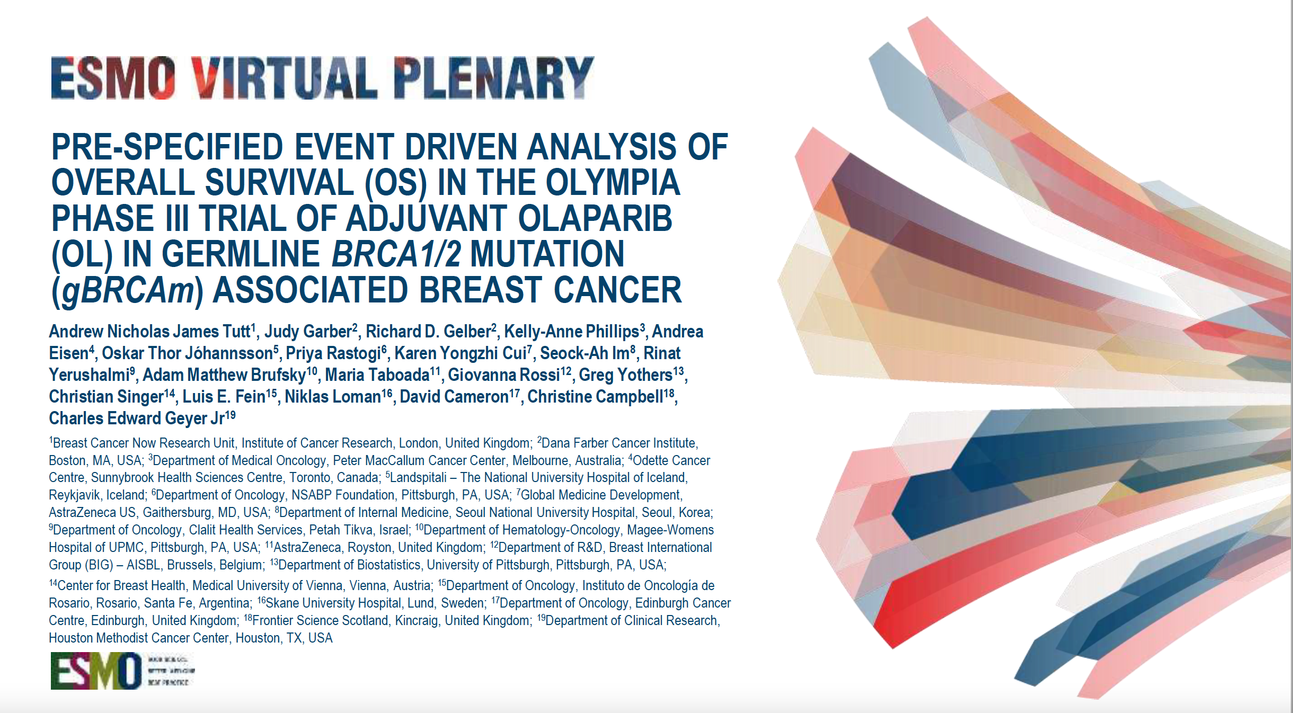
Abstract VP1-2022.

Slide 25
Can adjuvant therapy improve outcomes in patients with residual disease after NACT?
Yes, in patients with gBRCA1/2 mutations
Stage I–IIIB breast cancer
NACT
Non pathCR
Olaparib
(1 year)
OlympiA trial
Adjuvant
(T2 or N+)
Placebo
(1 year)
Distant Disease-free Survival
Overall Survival
Overall Survival benefit in subgroups
Tutt ANJ et al. ESMO Virtual Plenary 2022;Abstract VP1-2022.
This presentation is the intellectual property of the presenter. Contact p.Schmid@qmul.ac.uk for permission to reprint and/or distribute

Slide 26
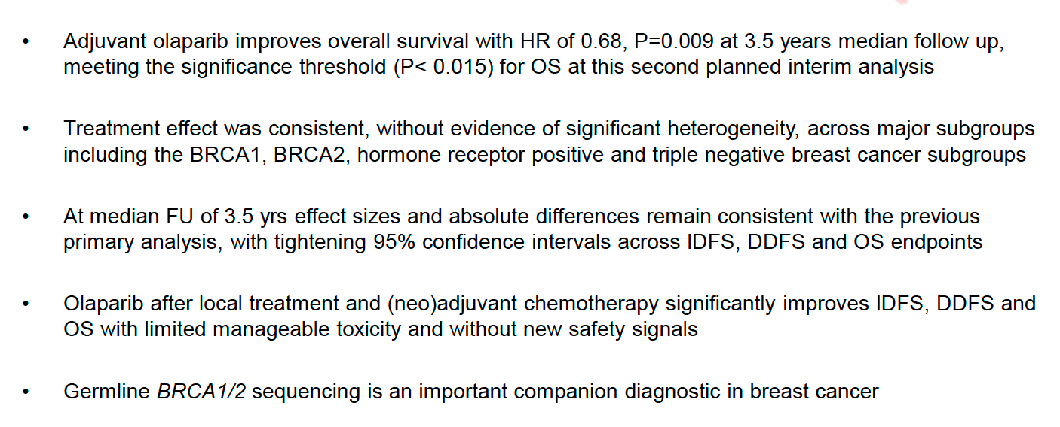
OlympiA: Conclusions
Tutt ANJ et al. ESMO Virtual Plenary 2022;Abstract VP1-2022.

Slide 27
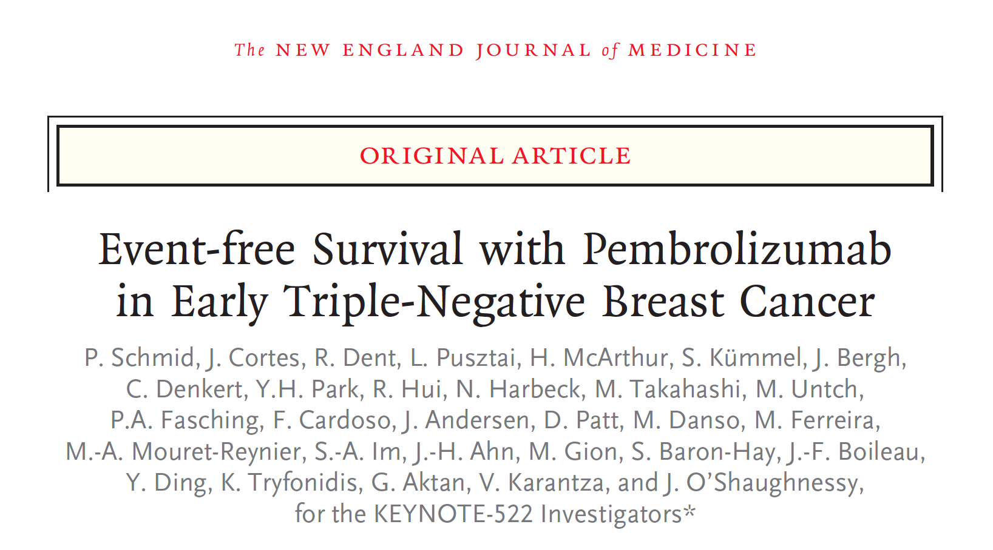
N Engl J Med 2022;386(6):556-67.

Slide 28
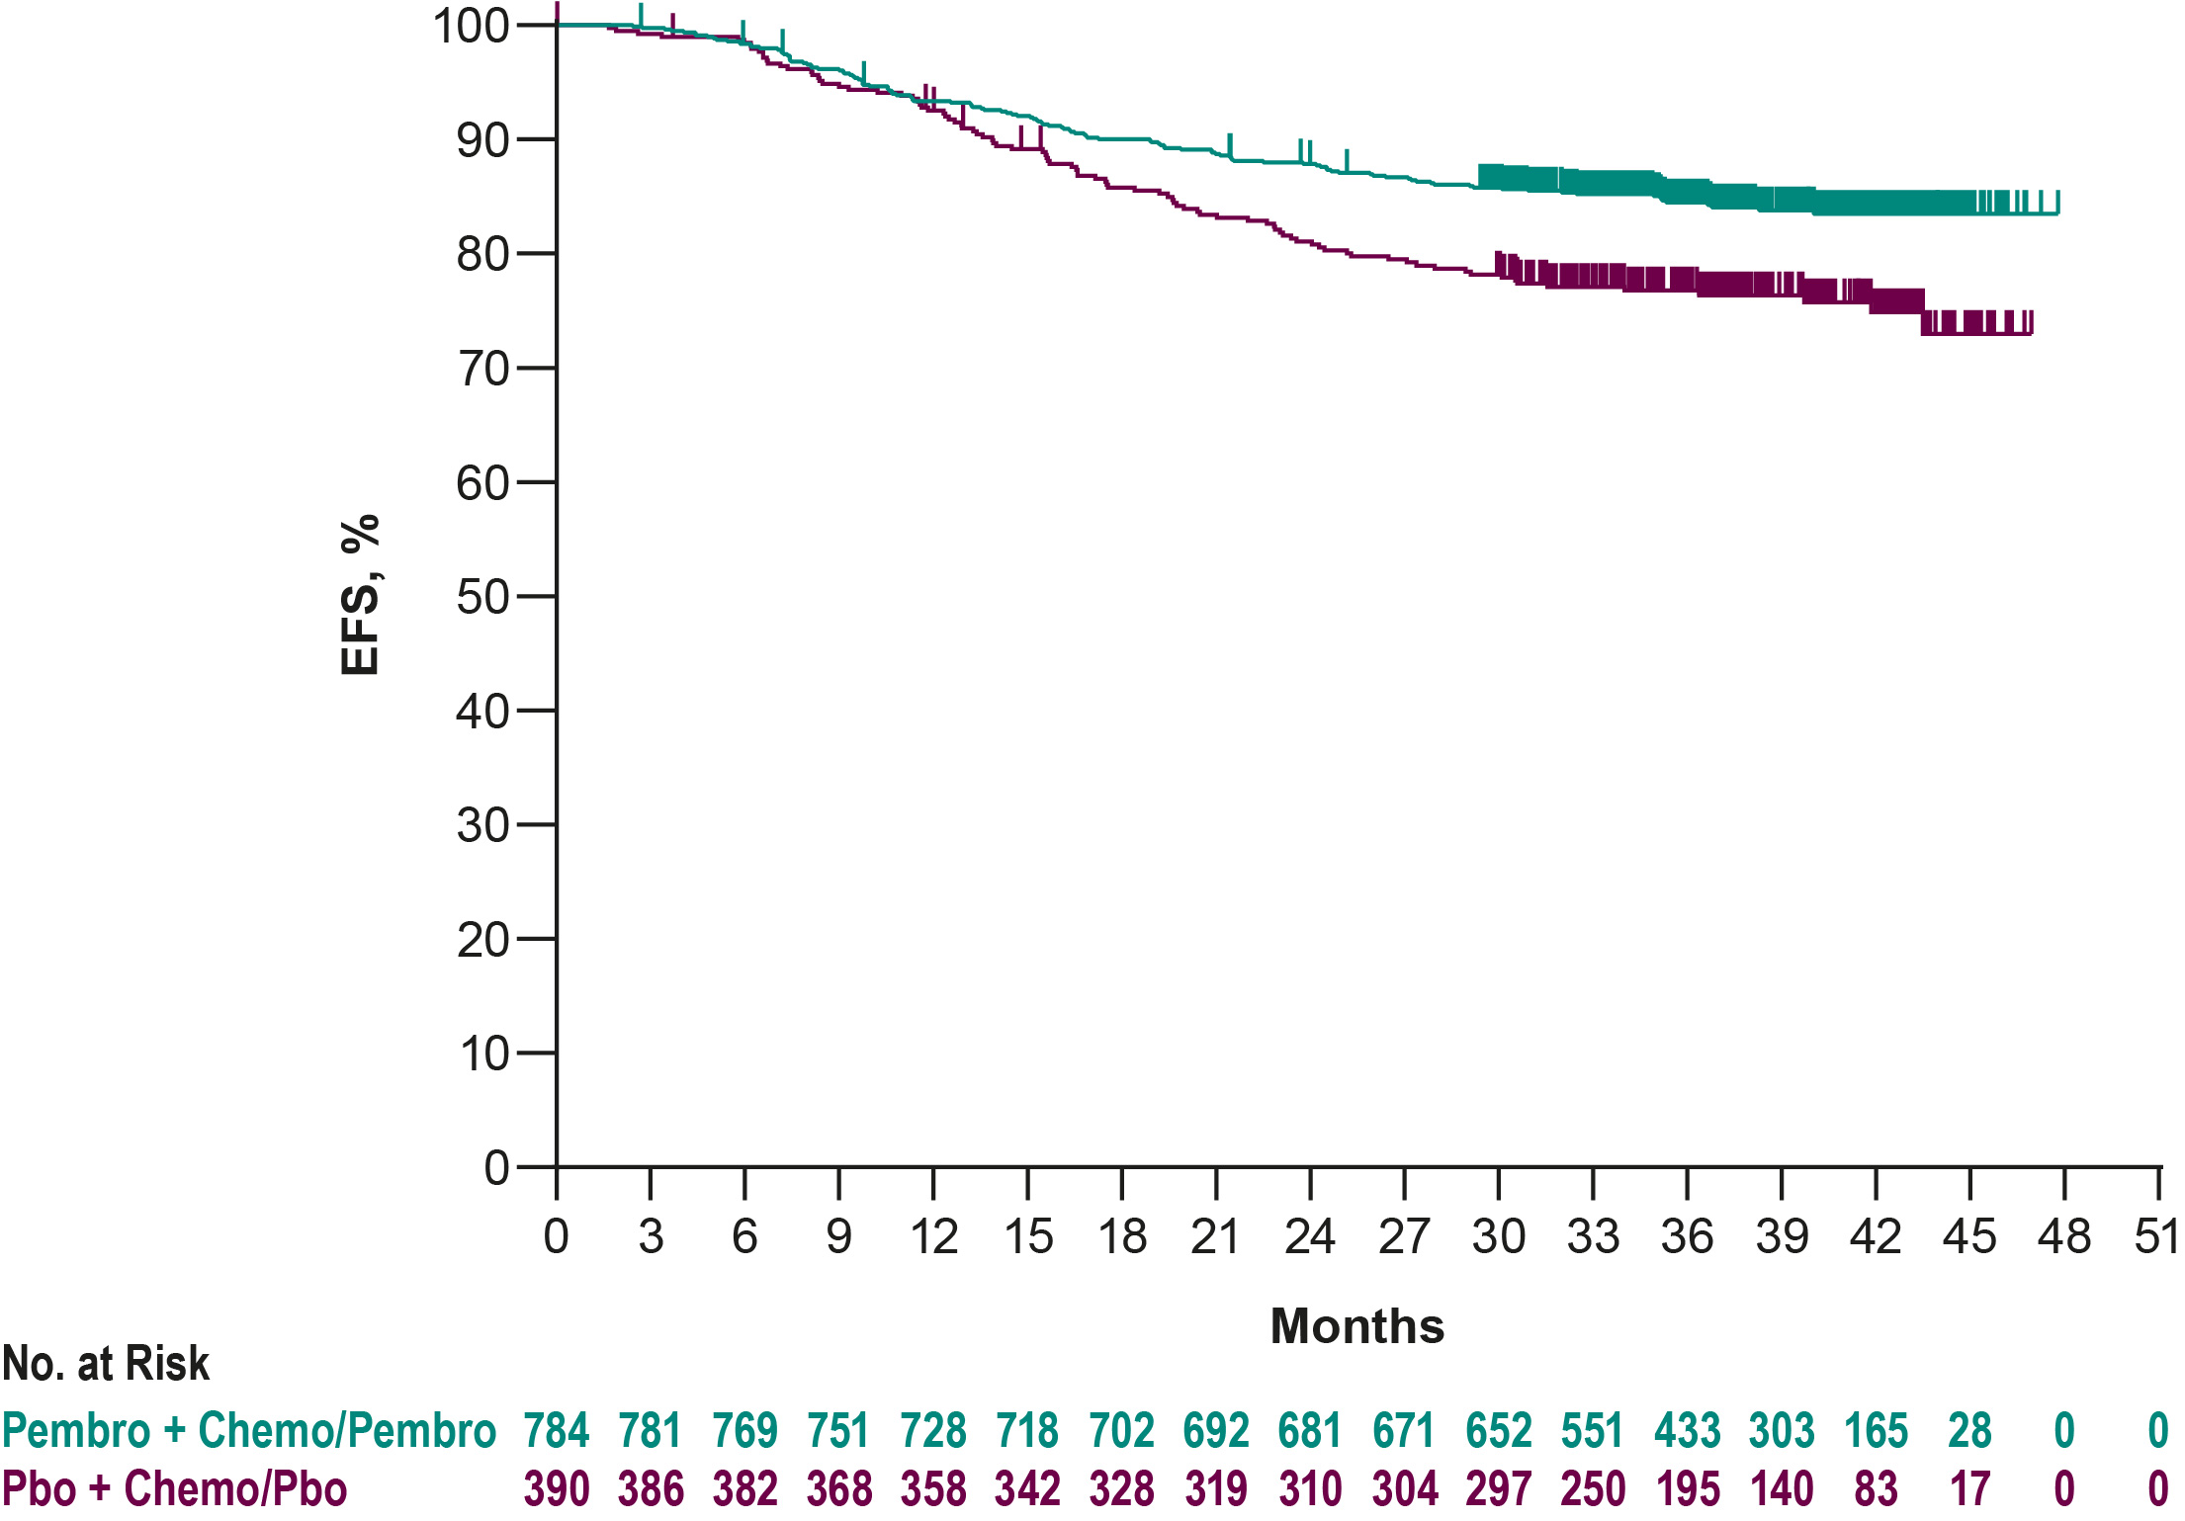
Neoadjuvant Immunotherapy in early TNBC
pCR Rates
Event-free Survival
84.5%
76.8%
 | Events | HR | P-value
Pembro + Chemo/Pembro | 15.7% | 0.63ª | 0.00031^{b}
Pbo + Chemo/Pbo | 23.8% |  | 23.8%
Median follow-up^{c}: 39.1 mo
Schmid P, et al. N EJM 2022, Schmid, et al NEJM 2020
This presentation is the intellectual property of the presenter. Contact p.Schmid@qmul.ac.uk for permission to reprint and/or distribute
This presentation is the intellectual property of the presenter. Contact p.Schmid@qmul.ac.uk for permission to reprint and/or distribute

Slide 29
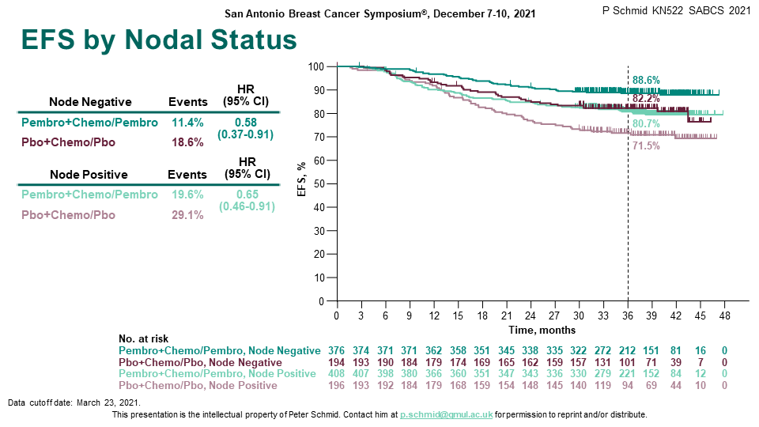
Nodal Status and Benefit from Immunotherapy
N0 and N+ patients have similar pCR and EFS Benefit when treated with CIT
pCR by Nodal Status
EFS by Nodal Status
100
90
80
Δ 6.3%
Δ 20.6%
07
60
64.9%
64.8%
pCR, % (95% CI)
58.6%
50
40
44.1%
30
20
10
0
Negative
Positive
Schmid, et al NEJM 2020, Schmid et al, ESMO 2021, Schmid et al, NEJM 2022
This presentation is the intellectual property of the presenter. Contact p.Schmid@qmul.ac.uk for permission to reprint and/or distribute

Slide 30
PD-L1 Status and Benefit from Immunotherapy
PD-L1+ and PD-L1- patients have similar EFS and pCR Benefit when treated with CIT
pCR by PD-L1 Score
EFS in Subgroups
100
90
Δ 17.5%
Δ 14.2%
80
70
77.9%
Δ 18.3%
68.9%
60
pCR, % (95% CI)
59.8%
50
54.9%
40
45.3%
30
30.3%
20
10
0
CPS <1
CPS ≥1
CPS ≥10
Schmid, et al NEJM 2020, Schmid et al, ESMO 2021, Schmid et al, NEJM 2022
This presentation is the intellectual property of the presenter. Contact p.Schmid@qmul.ac.uk for permission to reprint and/or distribute

Slide 31
KEYNOTE-522: Results Summary
The median follow-up at this fourth planned interim analysis was 39.1 months.
The estimated event-free survival at 36 months was 84.5% in the pembrolizumab-chemotherapy group, as compared with 76.8% in the placebo-chemotherapy group (HR for event or death, 0.63).
Adverse events occurred predominantly during the neoadjuvant phase and were consistent with the established safety profiles of pembrolizumab and chemotherapy.
In patients with early triple-negative breast cancer, neoadjuvant pembrolizumab plus chemotherapy, followed by adjuvant pembrolizumab after surgery, resulted in significantly longer event-free survival than neoadjuvant chemotherapy alone.
Schmid P et al. N Engl J Med 2022;386(6):556-67.

Slide 32
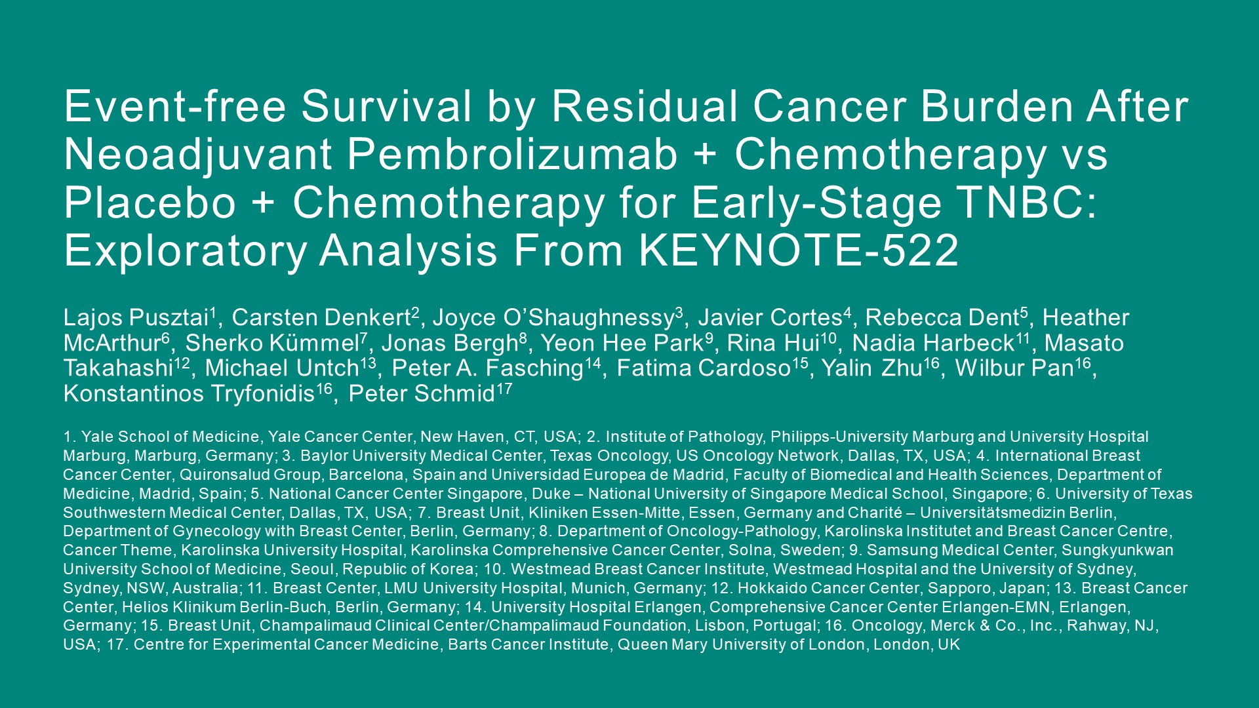
ASCO 2022;Abstract 503

Slide 33
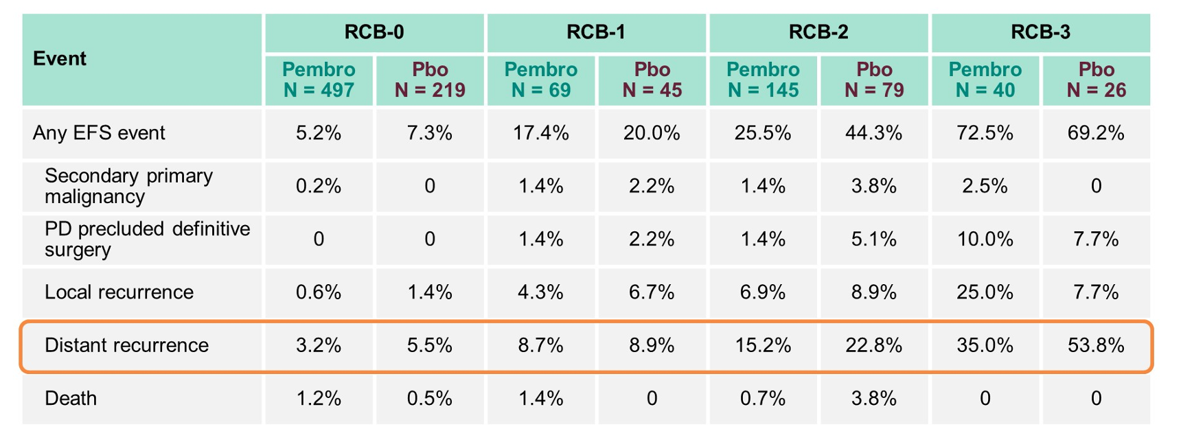
KEYNOTE-522: Summary of First EFS Events by RCB Category
RCB = residual cancer burden
Pusztai L al. ASCO 2022;Abstract 503.

Slide 34
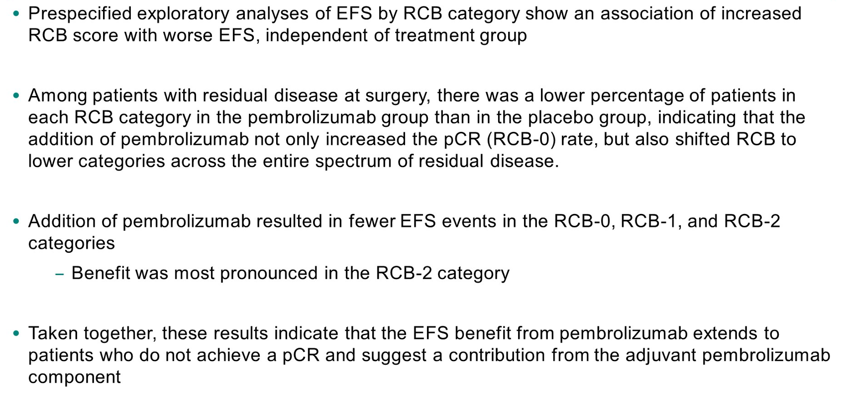
KEYNOTE-522 Exploratory Analysis: Conclusions
Pusztai L al. ASCO 2022;Abstract 503.

Slide 35
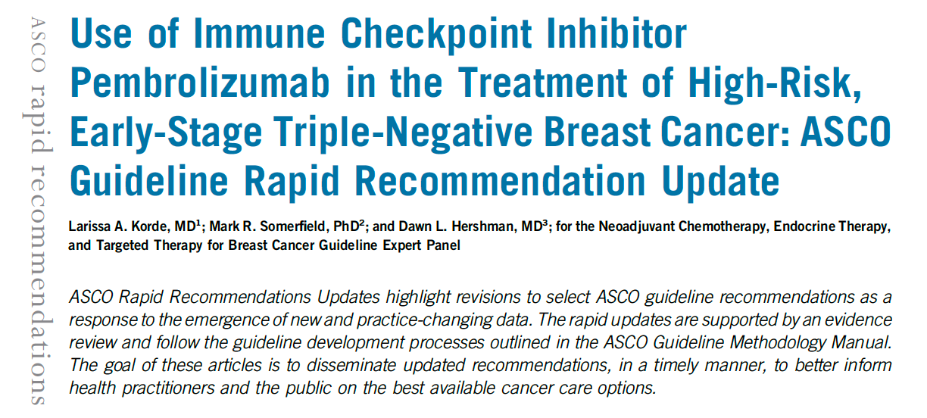
J Clin Oncol 2022;40(15):1696-8.

Slide 36
2022 UPDATED RECOMMENDATION
“For patients with T1cN1-2 or T2-4N0 (stage II or III), early-stage TNBC, the Panel recommends use of pembrolizumab (200 mg once every 3 weeks or 400 mg once every 6 weeks) in combination with neoadjuvant chemotherapy, followed by adjuvant pembrolizumab after surgery. Adjuvant pembrolizumab may be given either concurrent with or after completion of radiation therapy. Given that irAEs associated with pembrolizumab therapy can be severe and permanent, careful screening for and management of common toxicities are required. The ASCO guideline for management of irAEs in patients treated with immune checkpoint inhibitor therapy offers detailed practice recommendations and should be consulted by clinicians who prescribe pembrolizumab for patients with early-stage TNBC, https://ascopubs.org/doi/full/10.1200/JCO.21.01440
(Type: Evidence based, benefits outweigh harms; Evidence quality: Intermediate; Strength of recommendation: Moderate).”
Korde LA et al. J Clin Oncol 2022;40(15):1696-8.

Slide 37
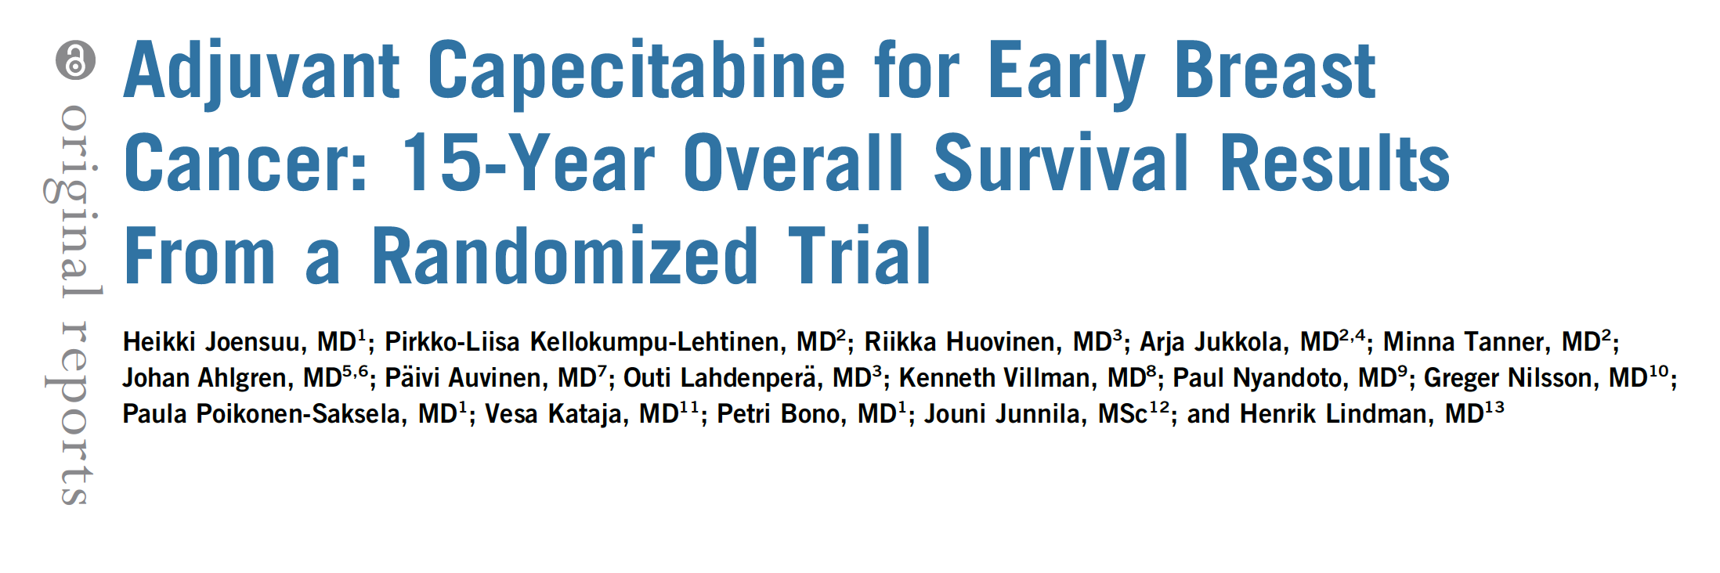
J Clin Oncol 2022;40(10):1051-8.

Slide 38
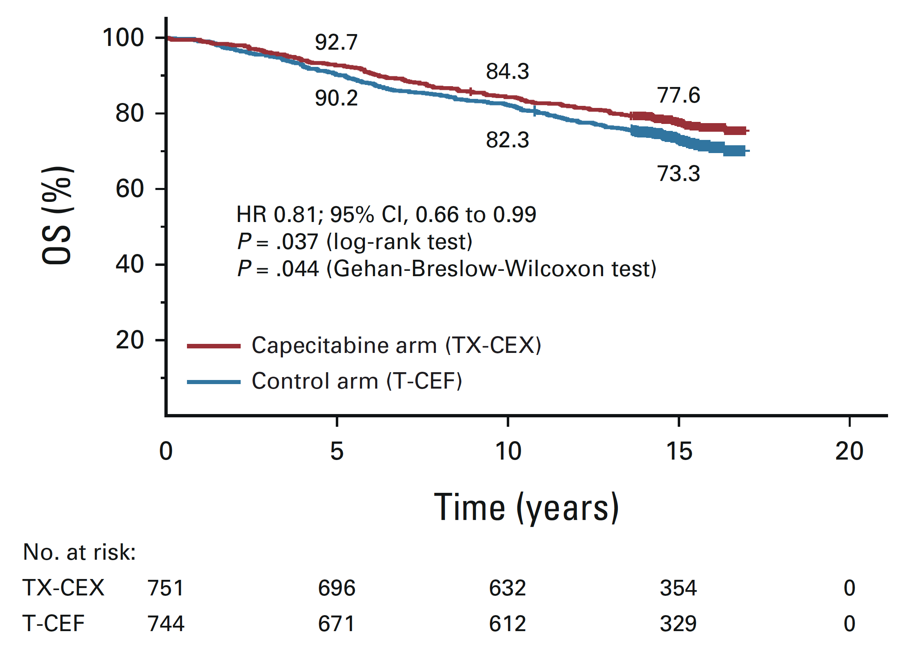
Overall Survival
Joensuu H et al. J Clin Oncol 2022;40(10):1051-8.

Slide 39
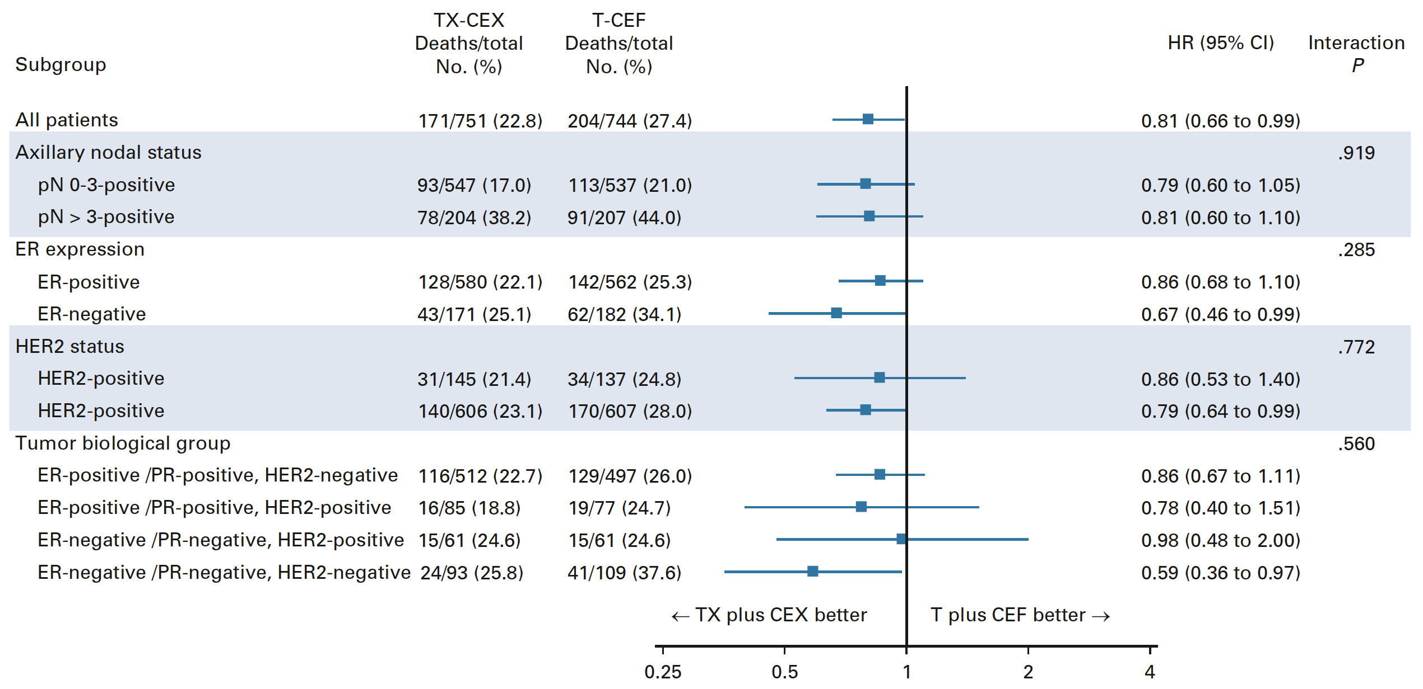
Exploratory Analyses of Overall Survival in Subgroups
Joensuu H et al. J Clin Oncol 2022;40(10):1051-8.

Slide 40
Conclusions
“We found that addition of capecitabine to a taxane-anthracycline chemotherapy backbone improved OS during a median follow-up of the patients for approximately 15 years after the date of random assignment.
The improvement in OS was statistically significant, but modest (19%).
In predefined subgroup analyses, patients with ER-negative cancer, HER2-negative cancer, and TNBC tended to benefit most from capecitabine-containing chemotherapy, but the subgroup analyses need to be interpreted with caution.”
Joensuu H et al. J Clin Oncol 2022;40(10):1051-8.

Slide 41
Key Data Sets
Localized HER2-Positive Breast Cancer
Loibl S et al. Adjuvant pertuzumab and trastuzumab in patients with early HER-2 positive breast cancer in APHINITY: 8.4 years' follow-up. ESMO Virtual Plenary 2022;Abstract VP6-2022.
Hurvitz SA et al. TRIO-US B-12 TALENT: Neoadjuvant trastuzumab deruxtecan with or without anastrozole for HER2-low, HR+ early stage breast cancer. San Antonio Breast Cancer Symposium 2022;Abstract GS2-03.

Slide 42
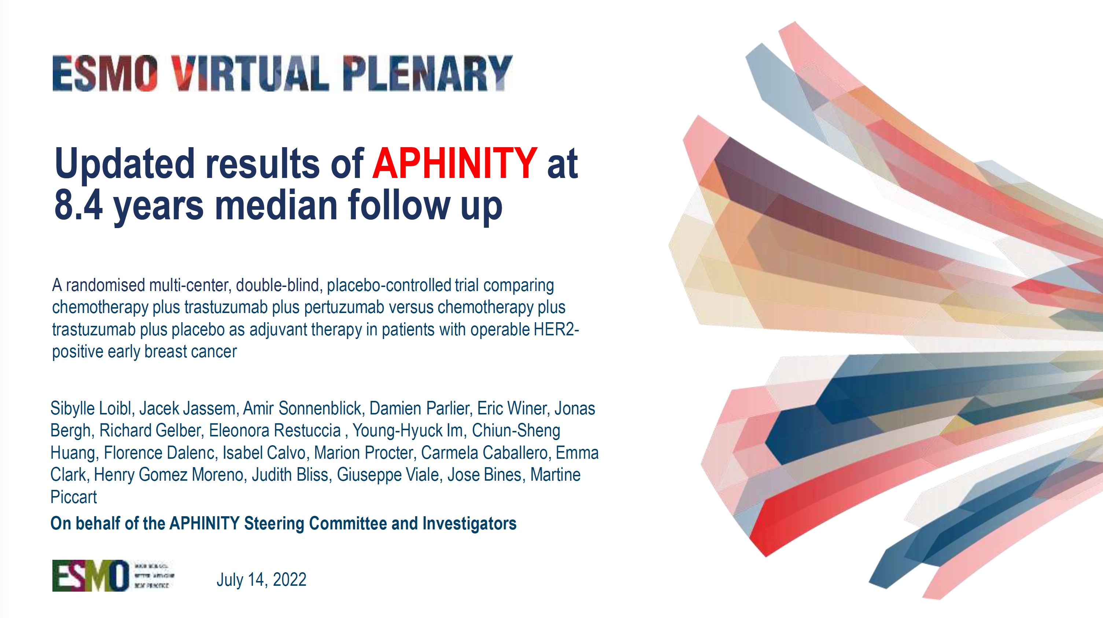
Abstract VP6-2022

Slide 43
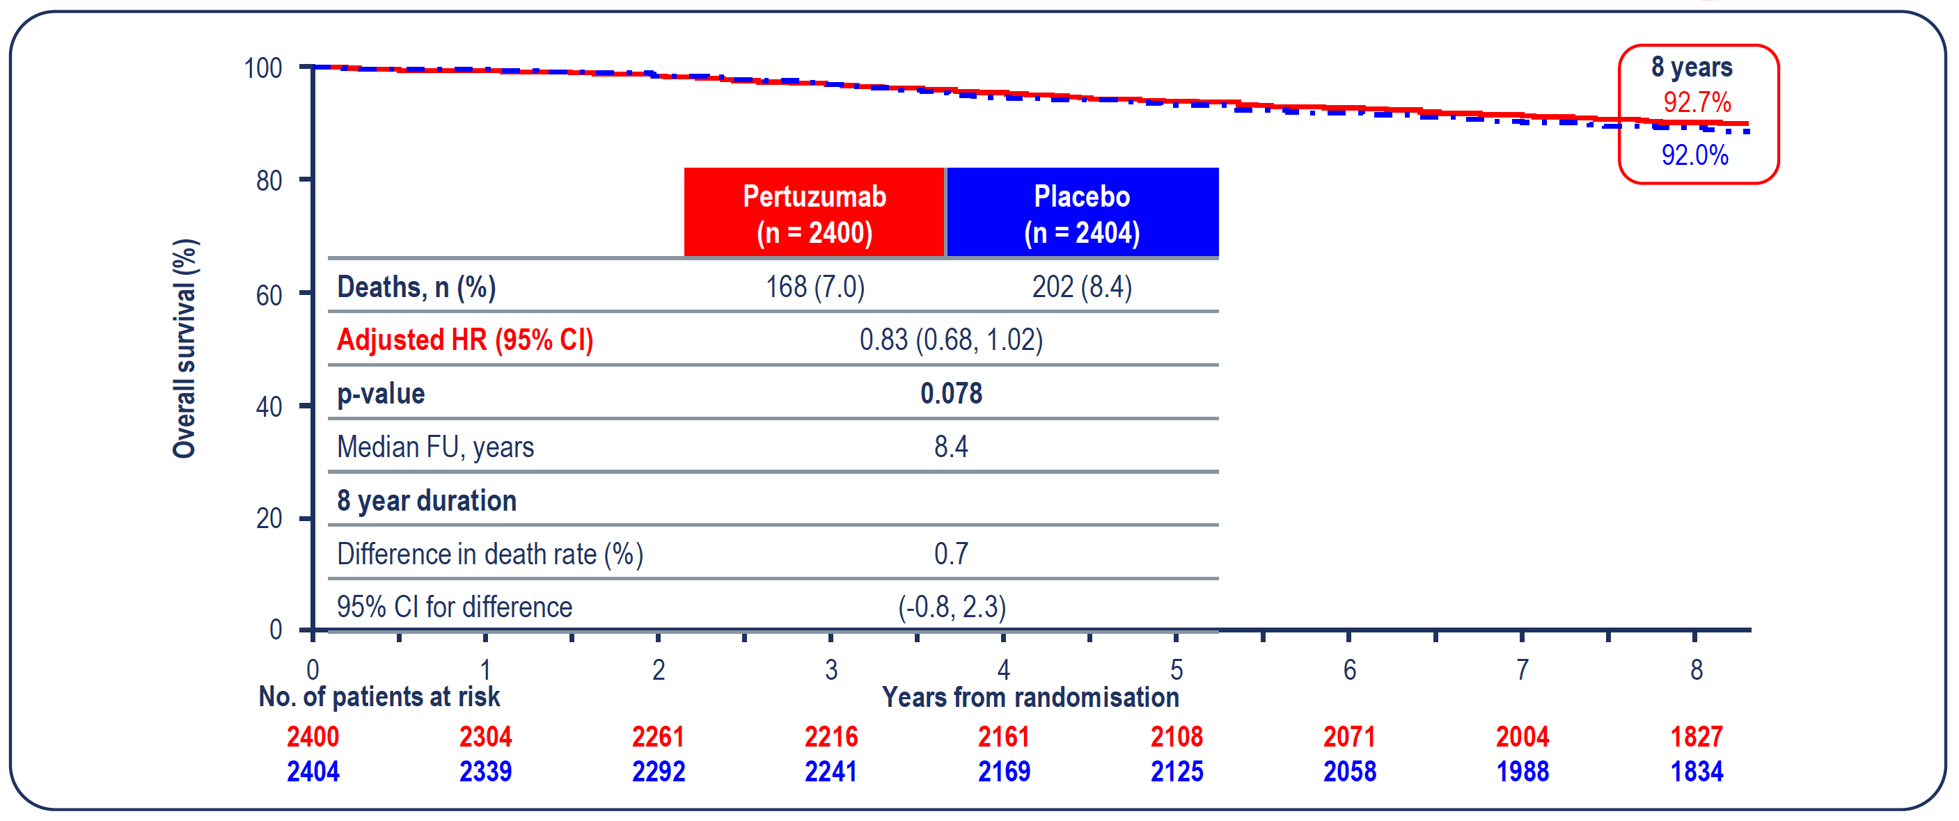
APHINITY: Interim Overall Survival at 8.4 Years Median Follow-Up (ITT)
Loibl S et al. ESMO Virtual Plenary 2022;Abstract VP6-2022.

Slide 44
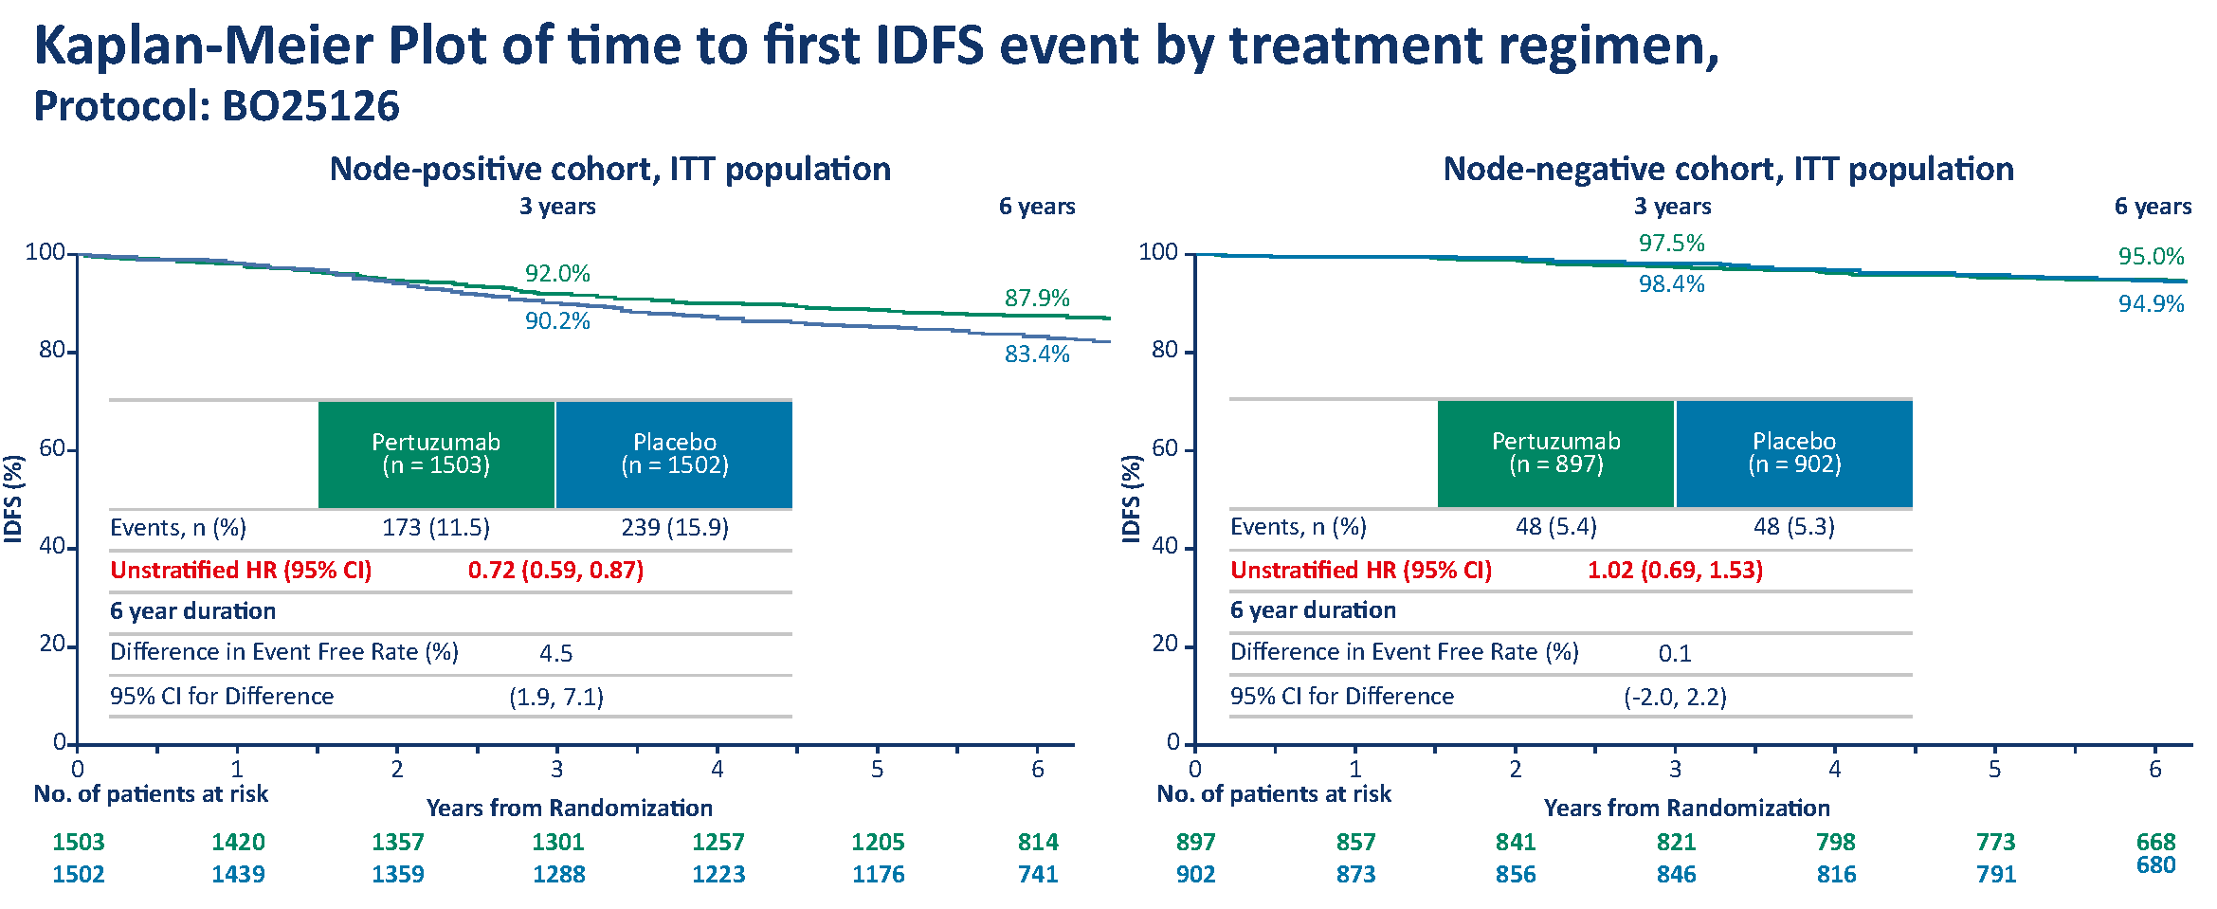
Adjuvant single vs doublet HER2-Blockade (APHINITY)
Interim OS analysis at 8.4 years
Overall Survival in N+
IDFS
Loibl et al. ESMO Virtual Plenary 2022
Piccart et al. SABCS 2019

Slide 45
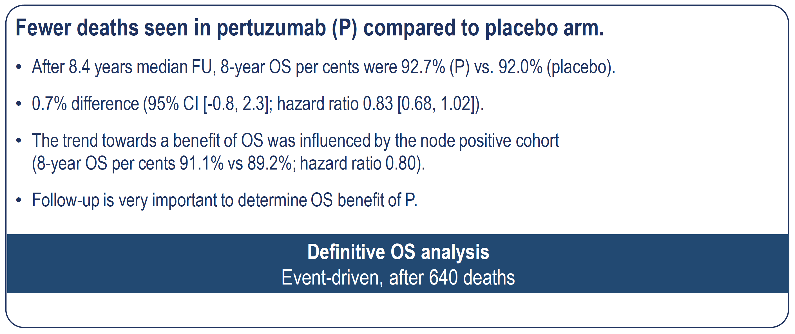
APHINITY Third Interim Analysis of Overall Survival
percents
percents
Loibl S et al. ESMO Virtual Plenary 2022;Abstract VP6-2022.

Slide 46
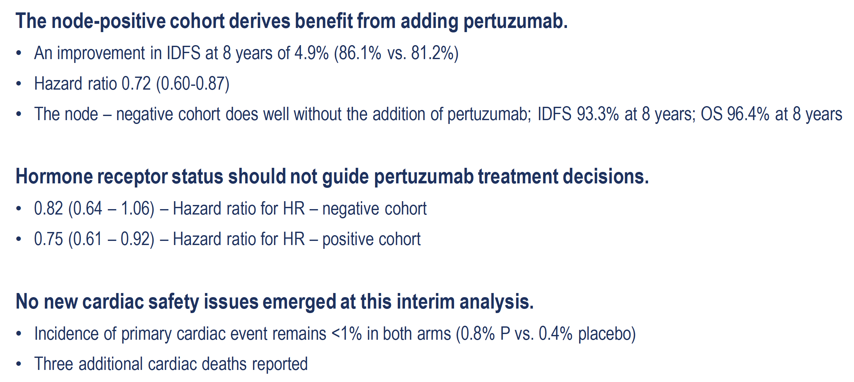
APHINITY Updated Descriptive Analysis of IDFS and Safety
Loibl S et al. ESMO Virtual Plenary 2022;Abstract VP6-2022.

Slide 47
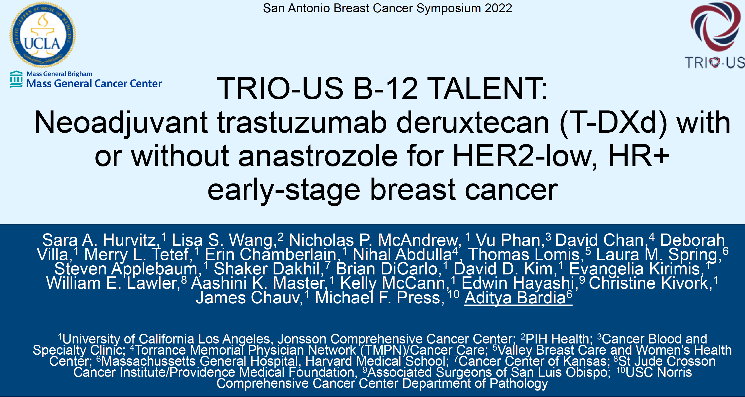
Abstract GS2-03.

Slide 48
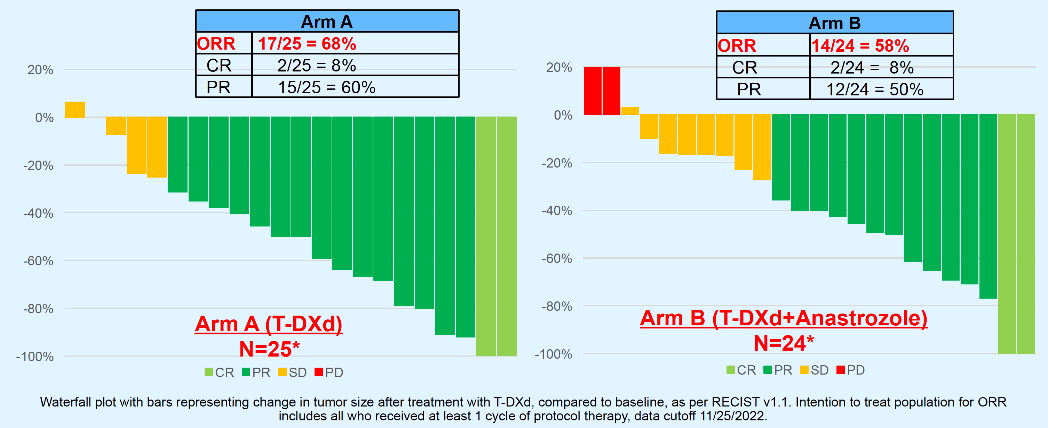
TRIO-US B-12 TALENT: Objective Response Rate (Based on Imaging)
Hurvitz SA et al. SABCS 2022;Abstract GS2-03.

Slide 49
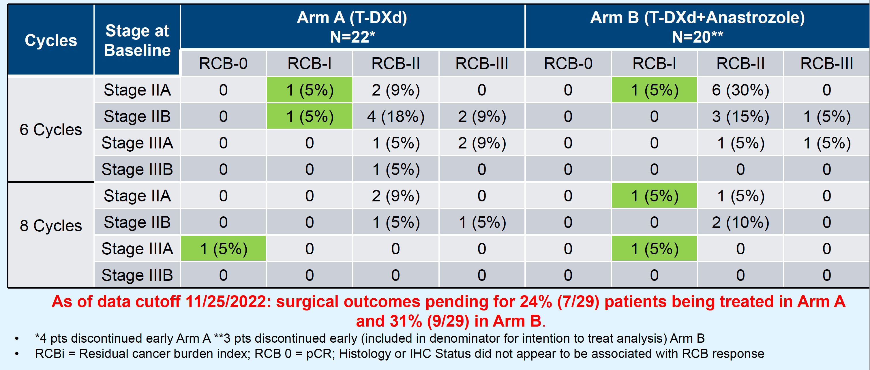
TRIO-US B-12 TALENT: Residual Cancer Burden After T-DXd
(by Arm, Cycles and Stage)
Hurvitz SA et al. SABCS 2022;Abstract GS2-03.

Slide 50
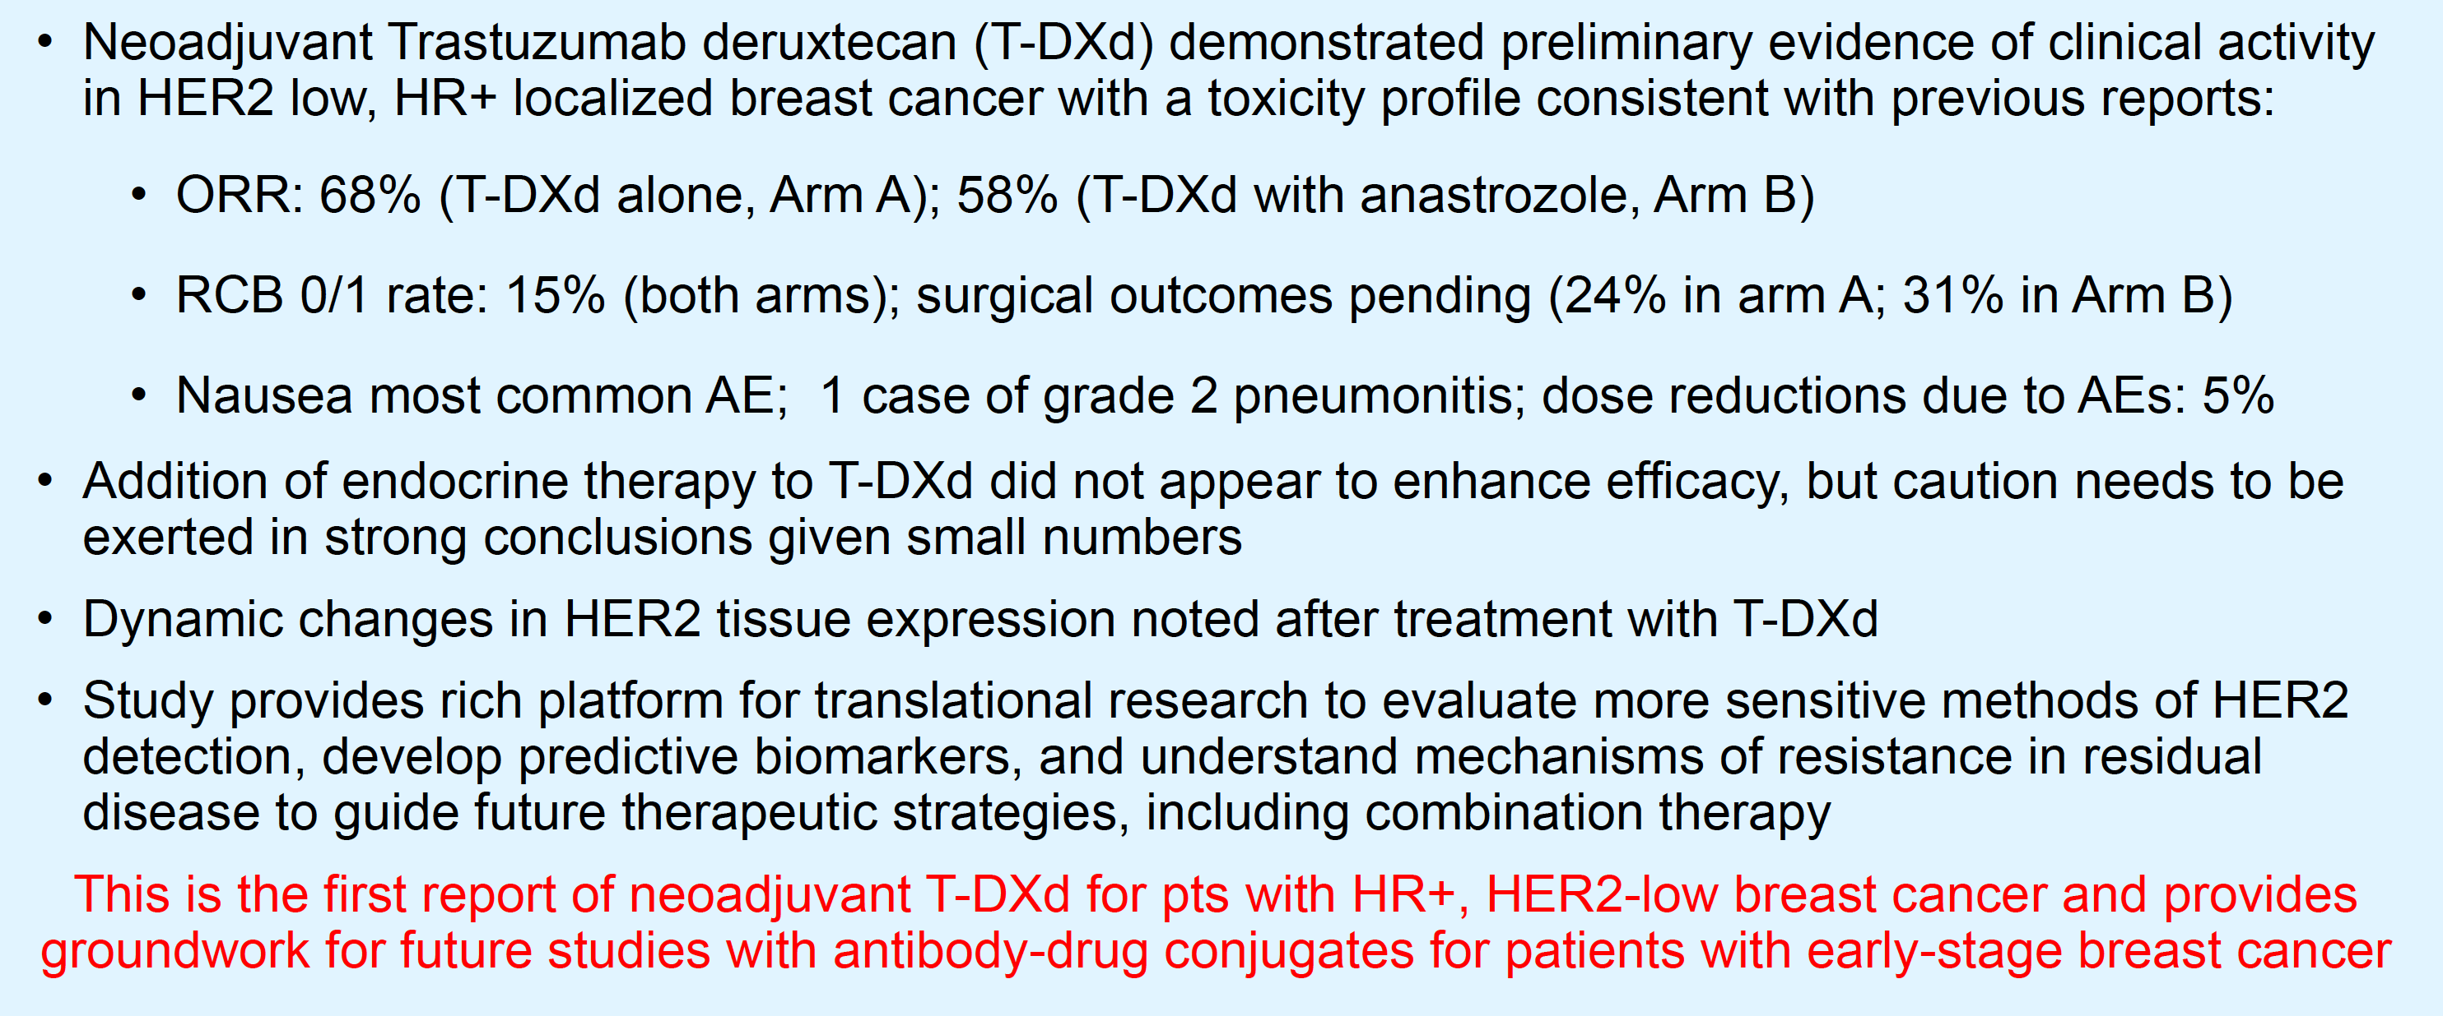
TRIO-US B-12 TALENT: Conclusions
Hurvitz SA et al. SABCS 2022;Abstract GS2-03.

Slide 51
Breast Cancer:
Highlights of the year 2022
Professor Peter Schmid, MD PhD FRCP
Lead, Centre for Experimental Cancer Medicine
Barts Cancer Institute, St Bartholomew’s Hospital
Queen Mary University of London

