Slide 1
Year in Review 2022
Metastatic Breast Cancer
Joyce O’Shaughnessy, MD
Baylor University Medical Center
Texas Oncology
US Oncology
Dallas TX

Slide 2
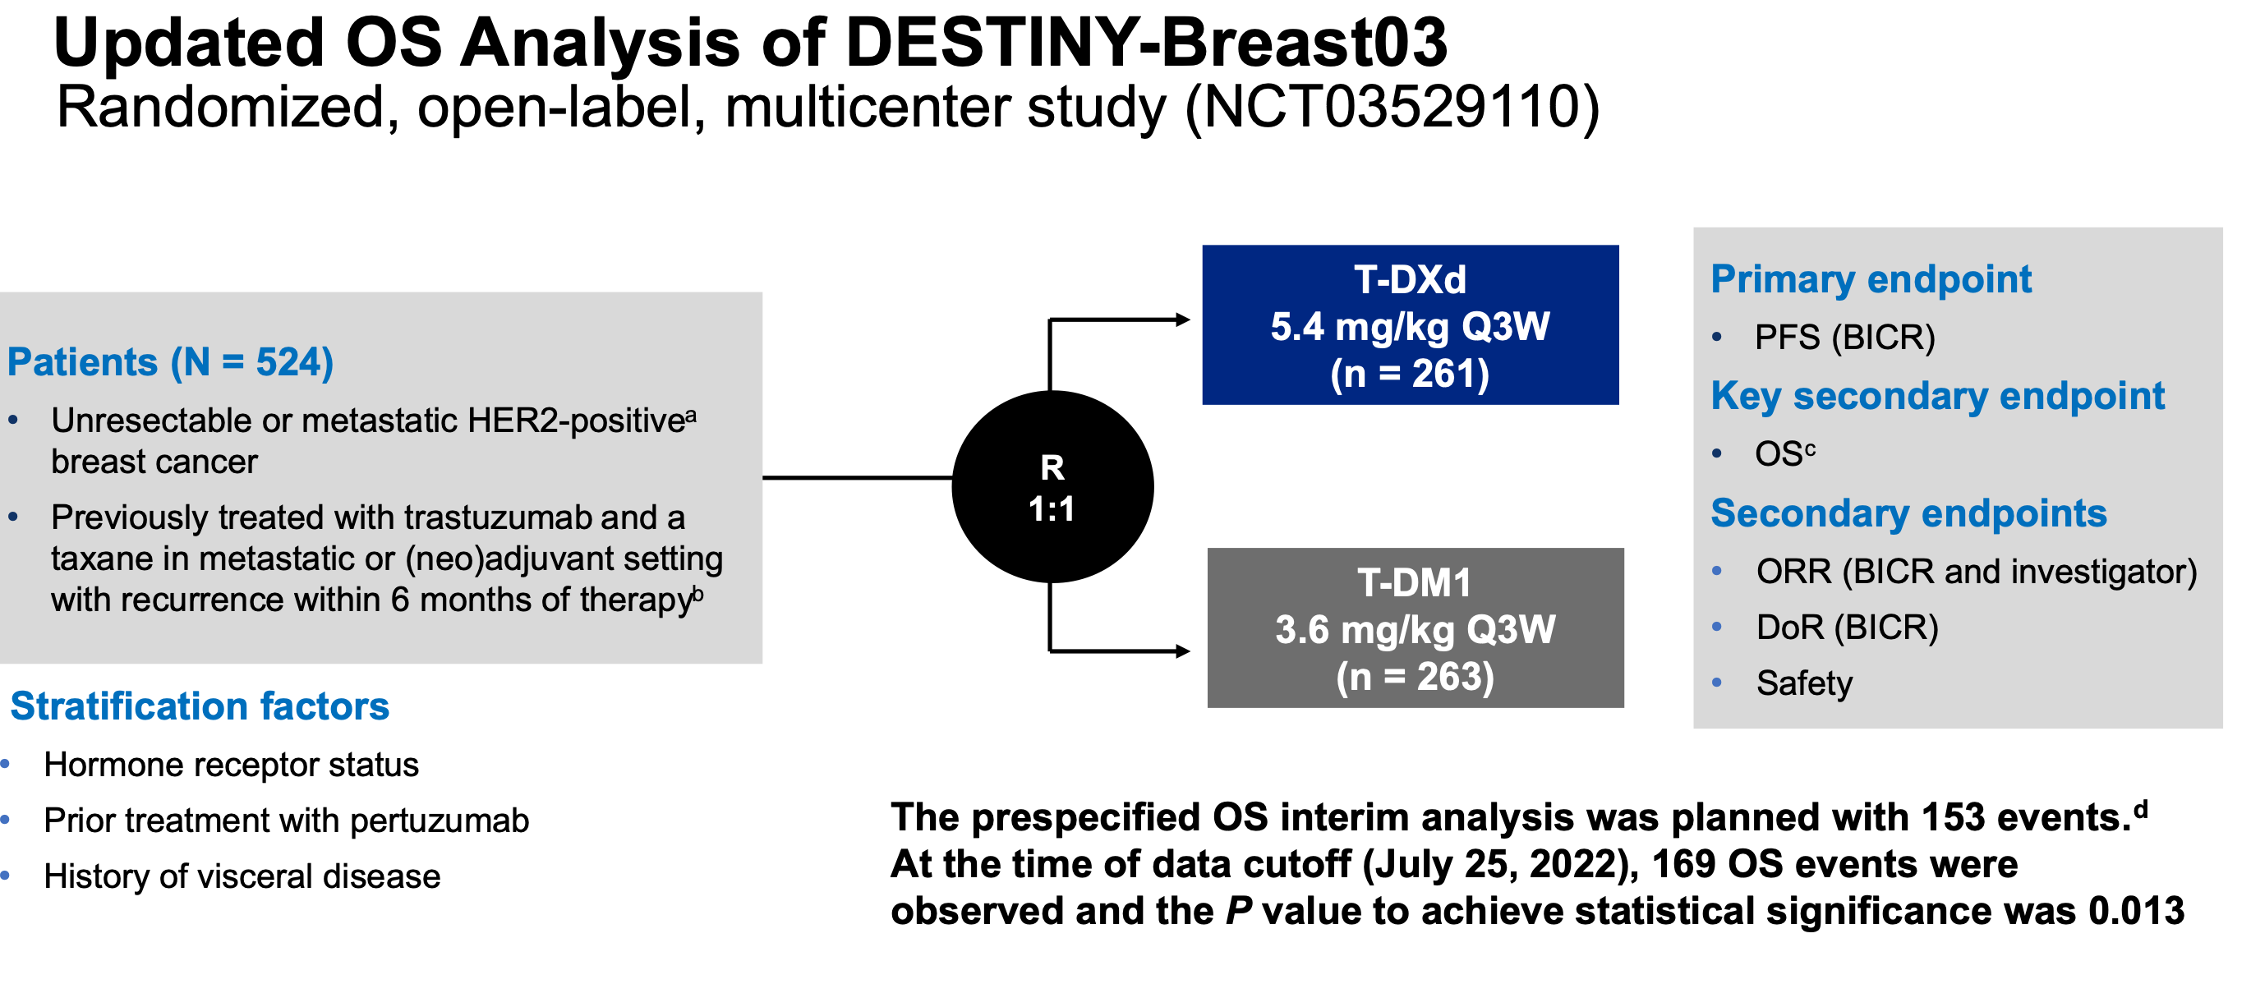
Hurvitz SA et al SABCS 2022; Abstract GS2-02

Slide 3
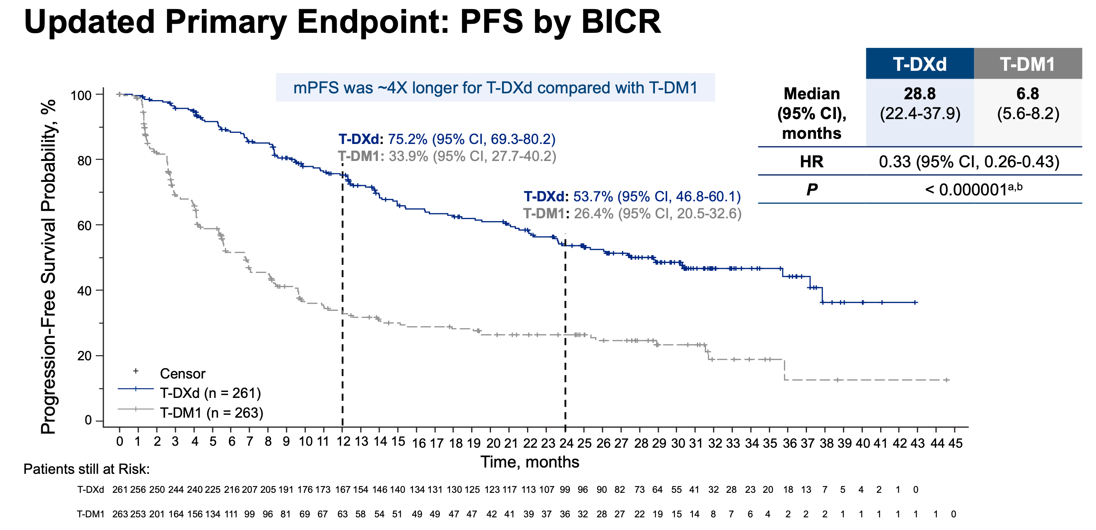
Hurvitz SA et al SABCS 2022; Abstract GS2-02

Slide 4
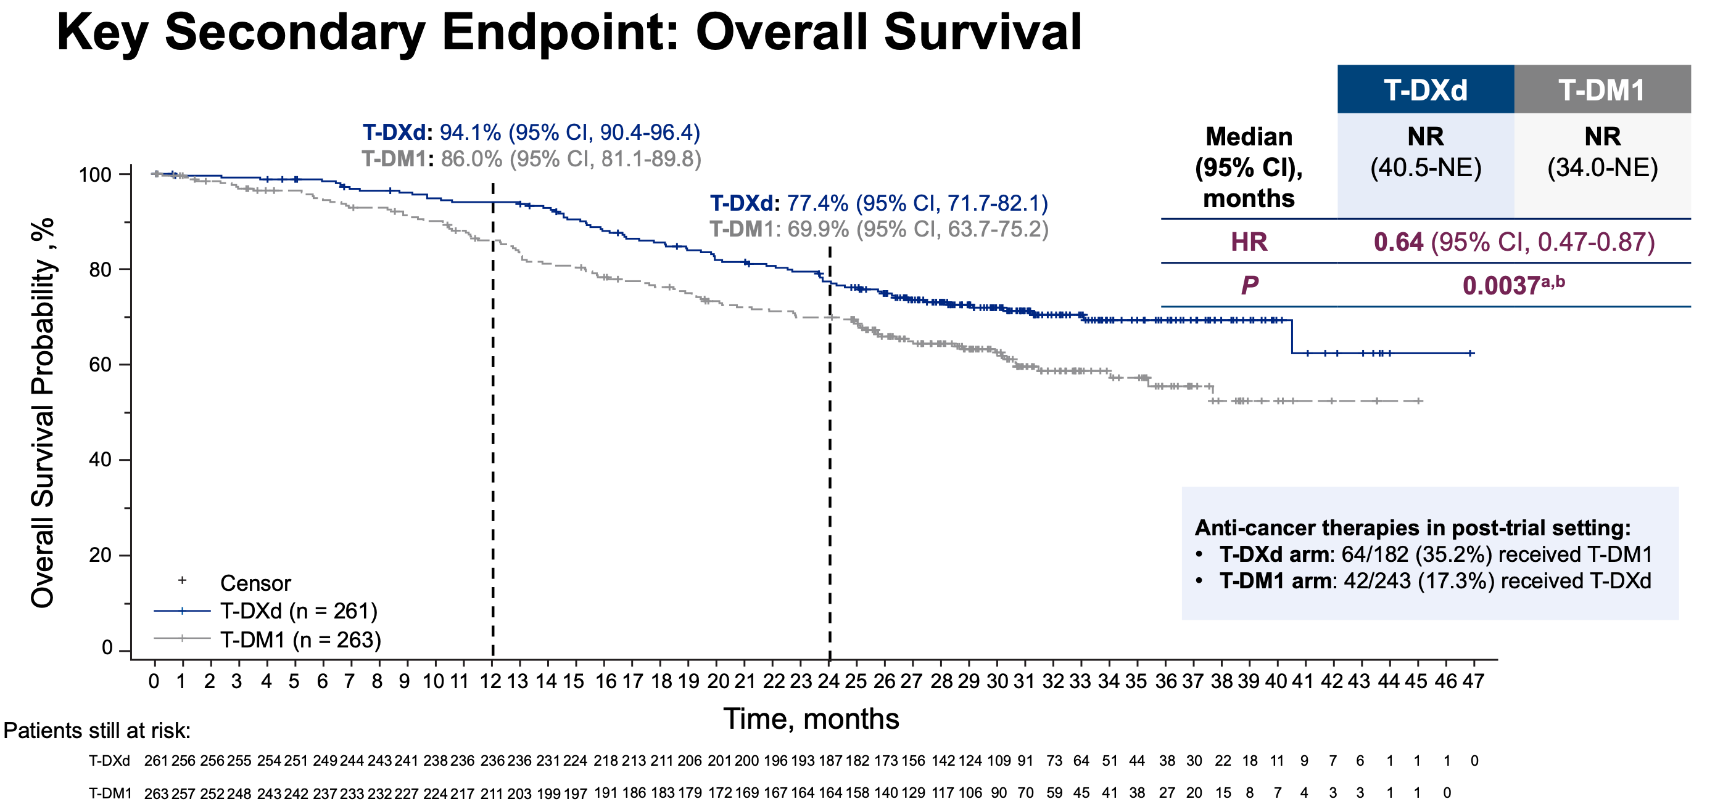
Hurvitz SA et al SABCS 2022; Abstract GS2-02

Slide 5
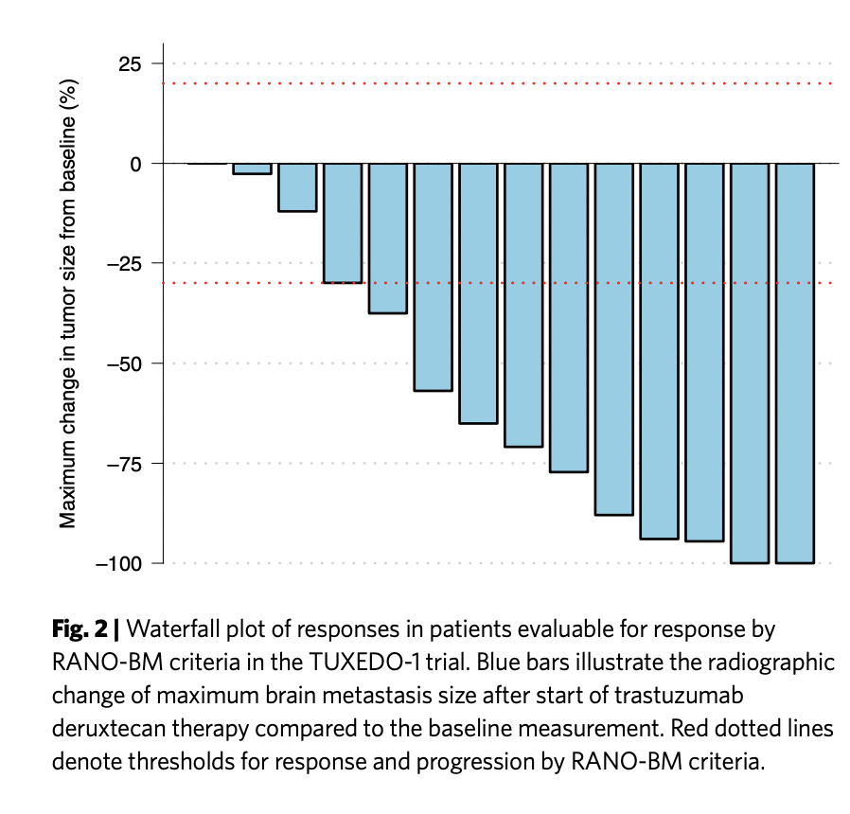
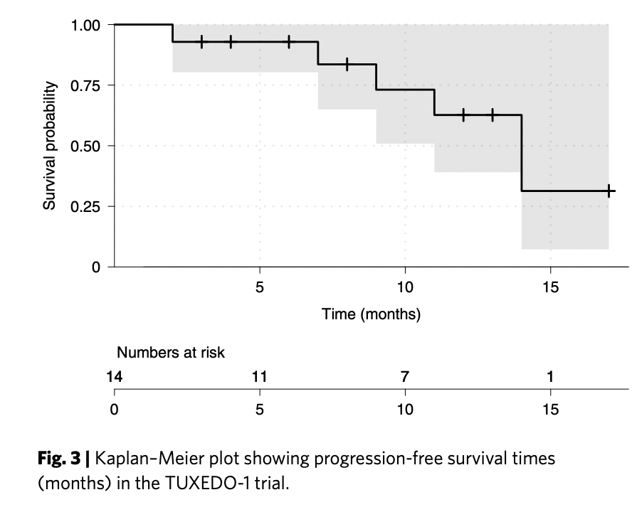
TUXEDO Trial: T-DXd in Active HER2+ Brain Metastases
Bartsch R et al Nature Med 2022

Slide 6
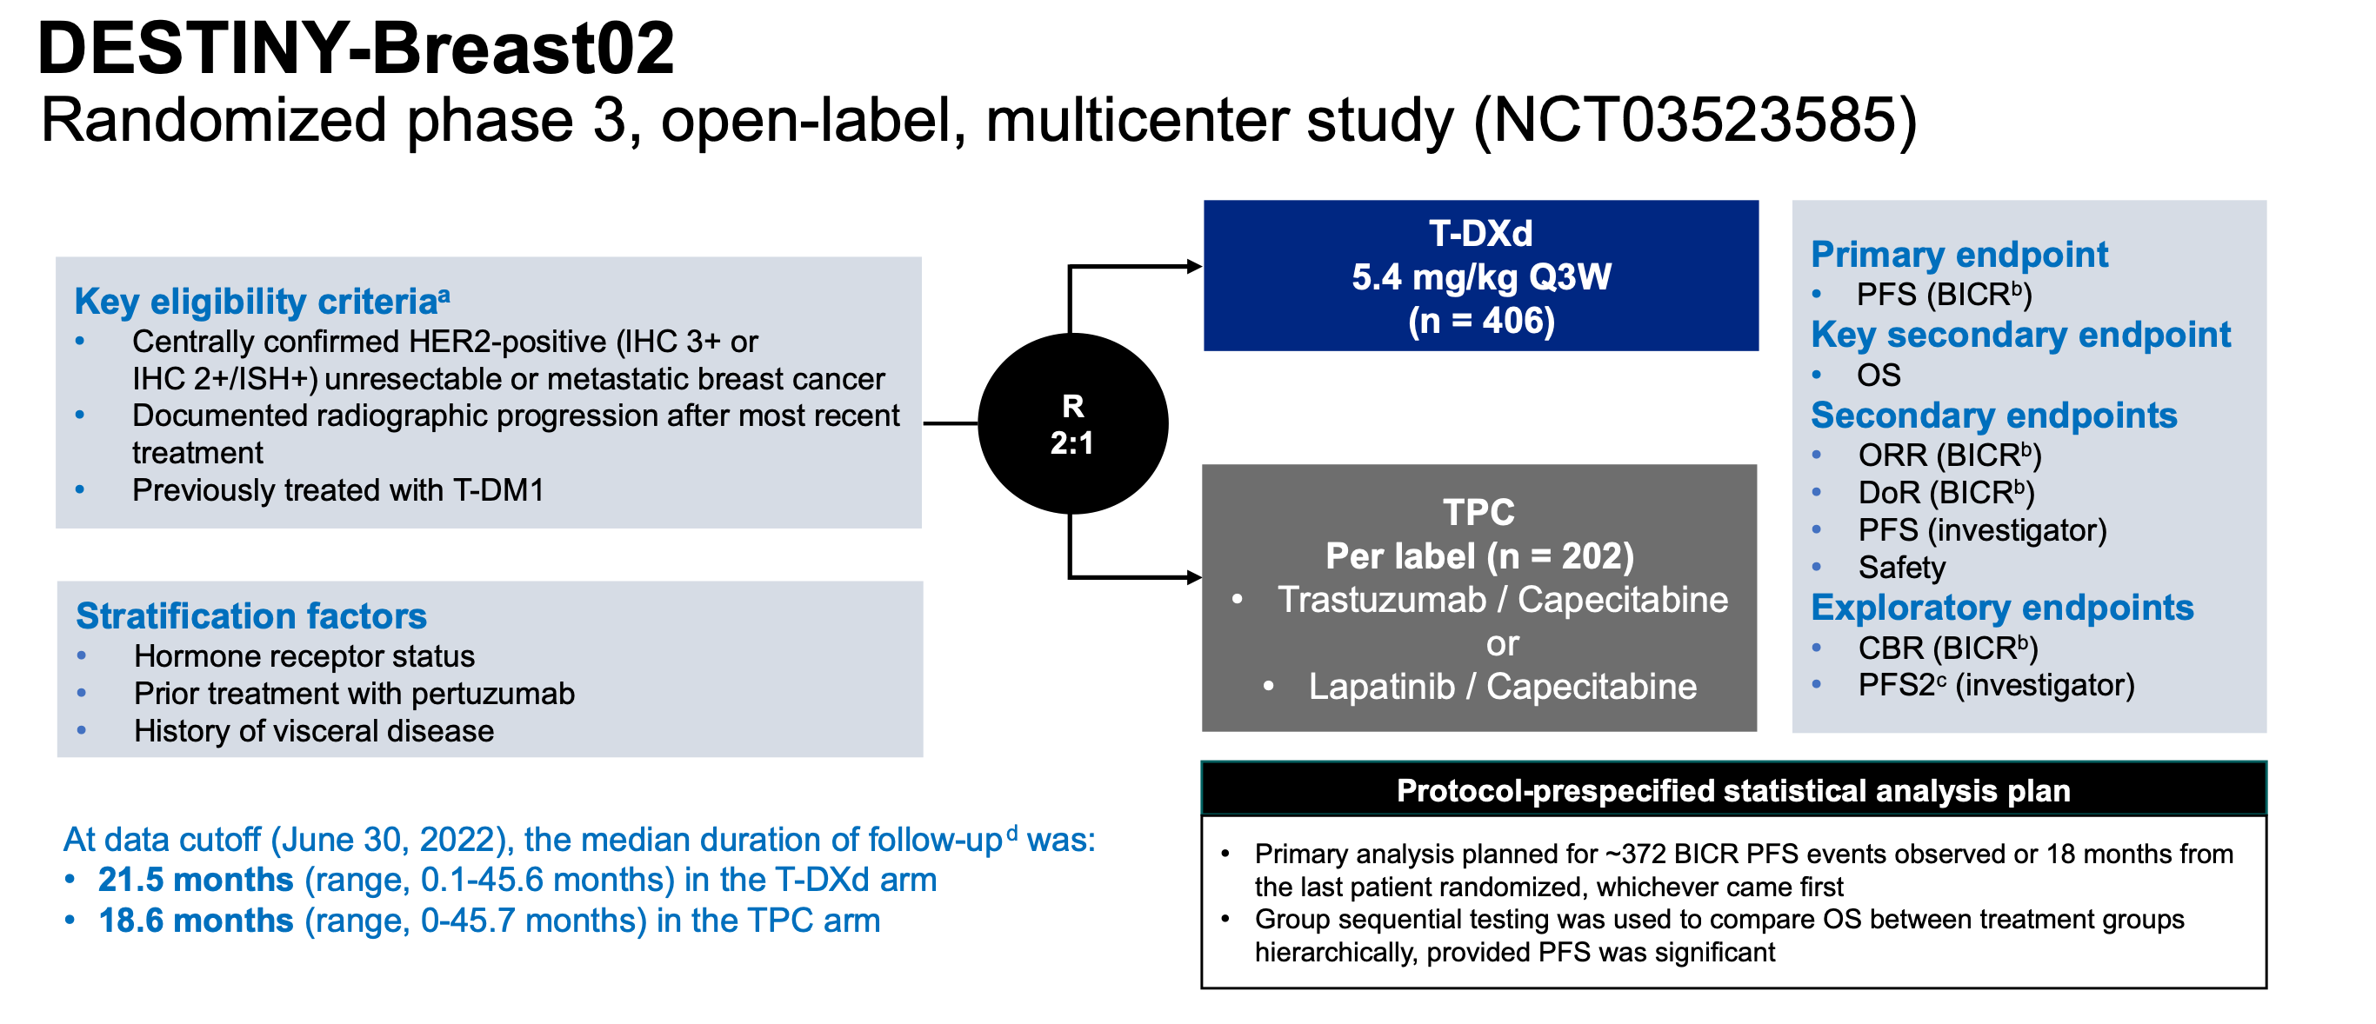
Krop I et al SABCS 2022 Abstract GS2-01

Slide 7
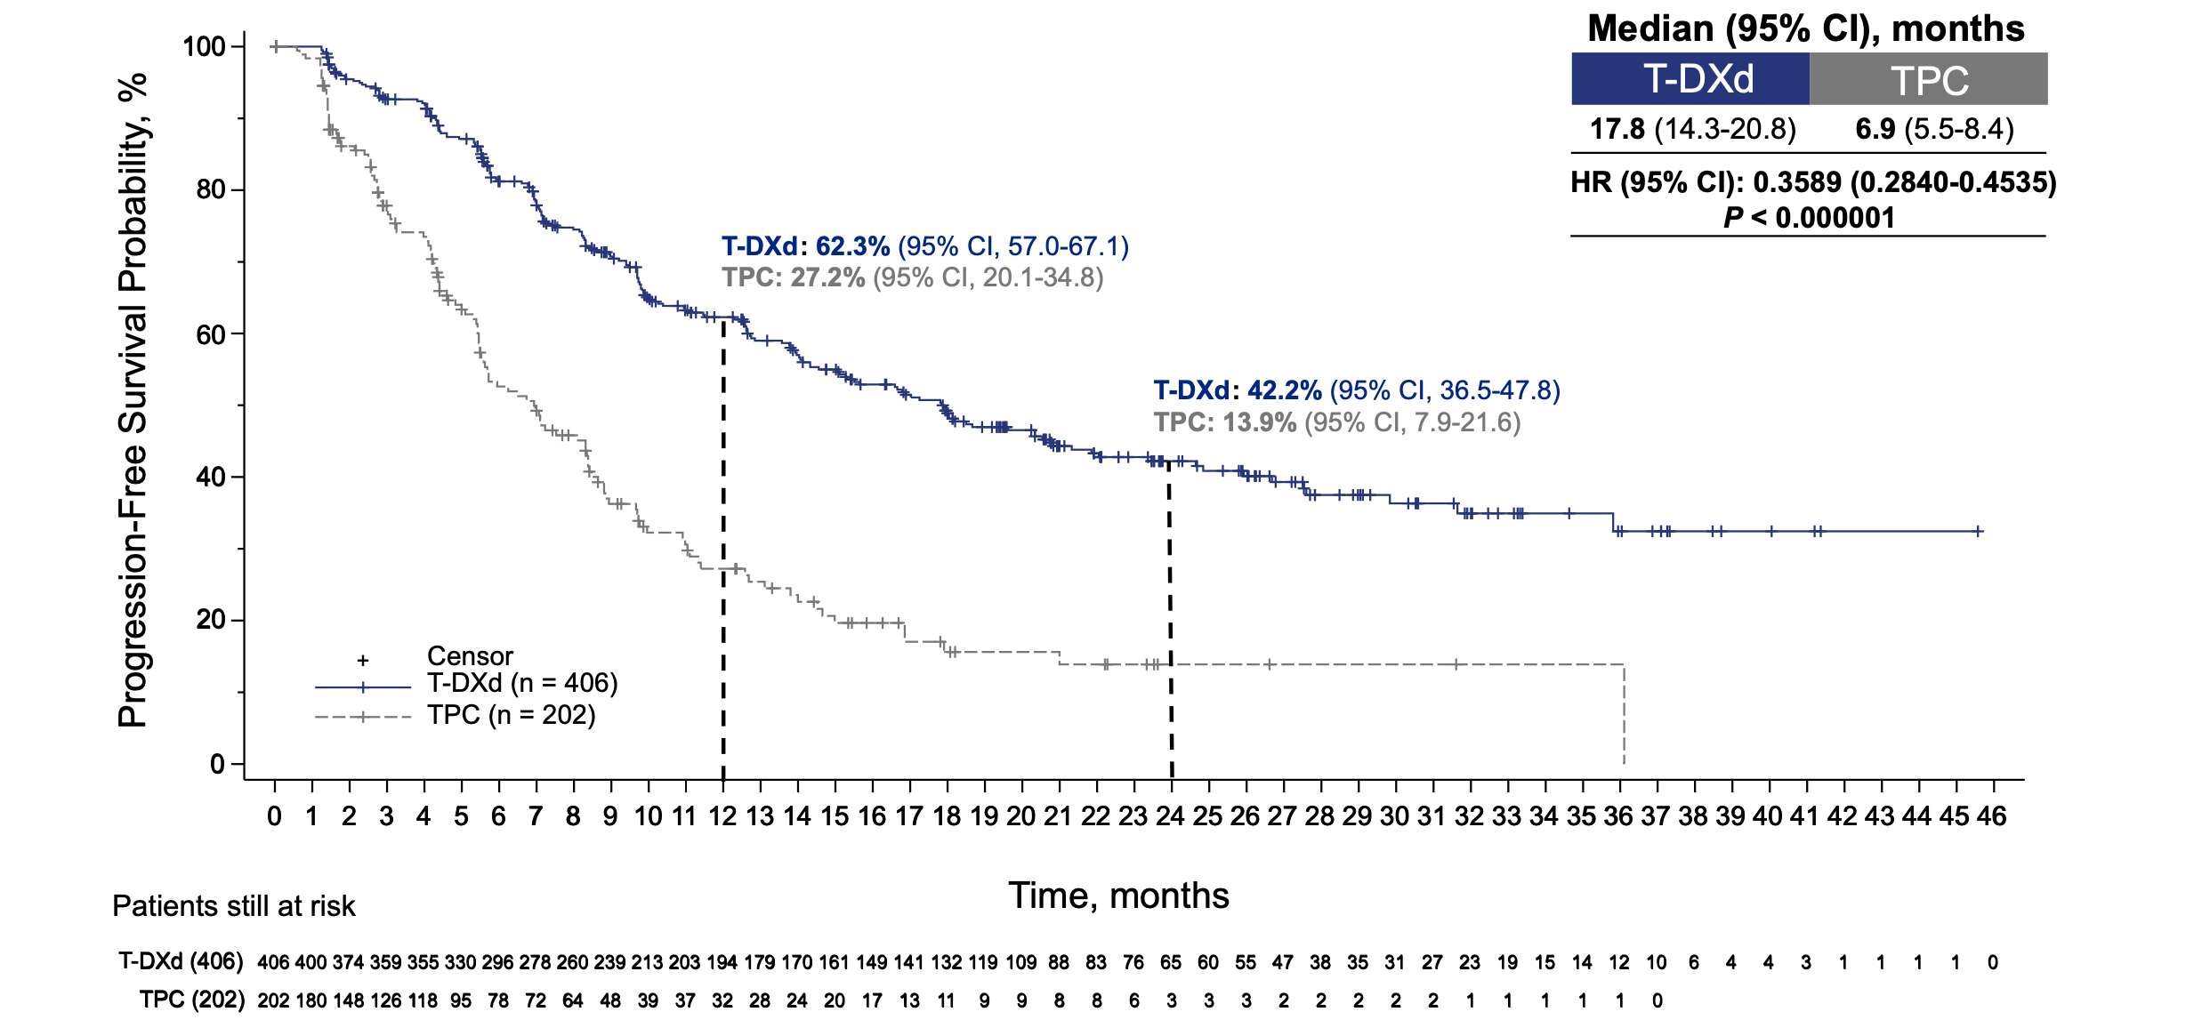
DESTINY-Breast02: PFS
Krop I et al SABCS 2022 Abstract GS2-01

Slide 8
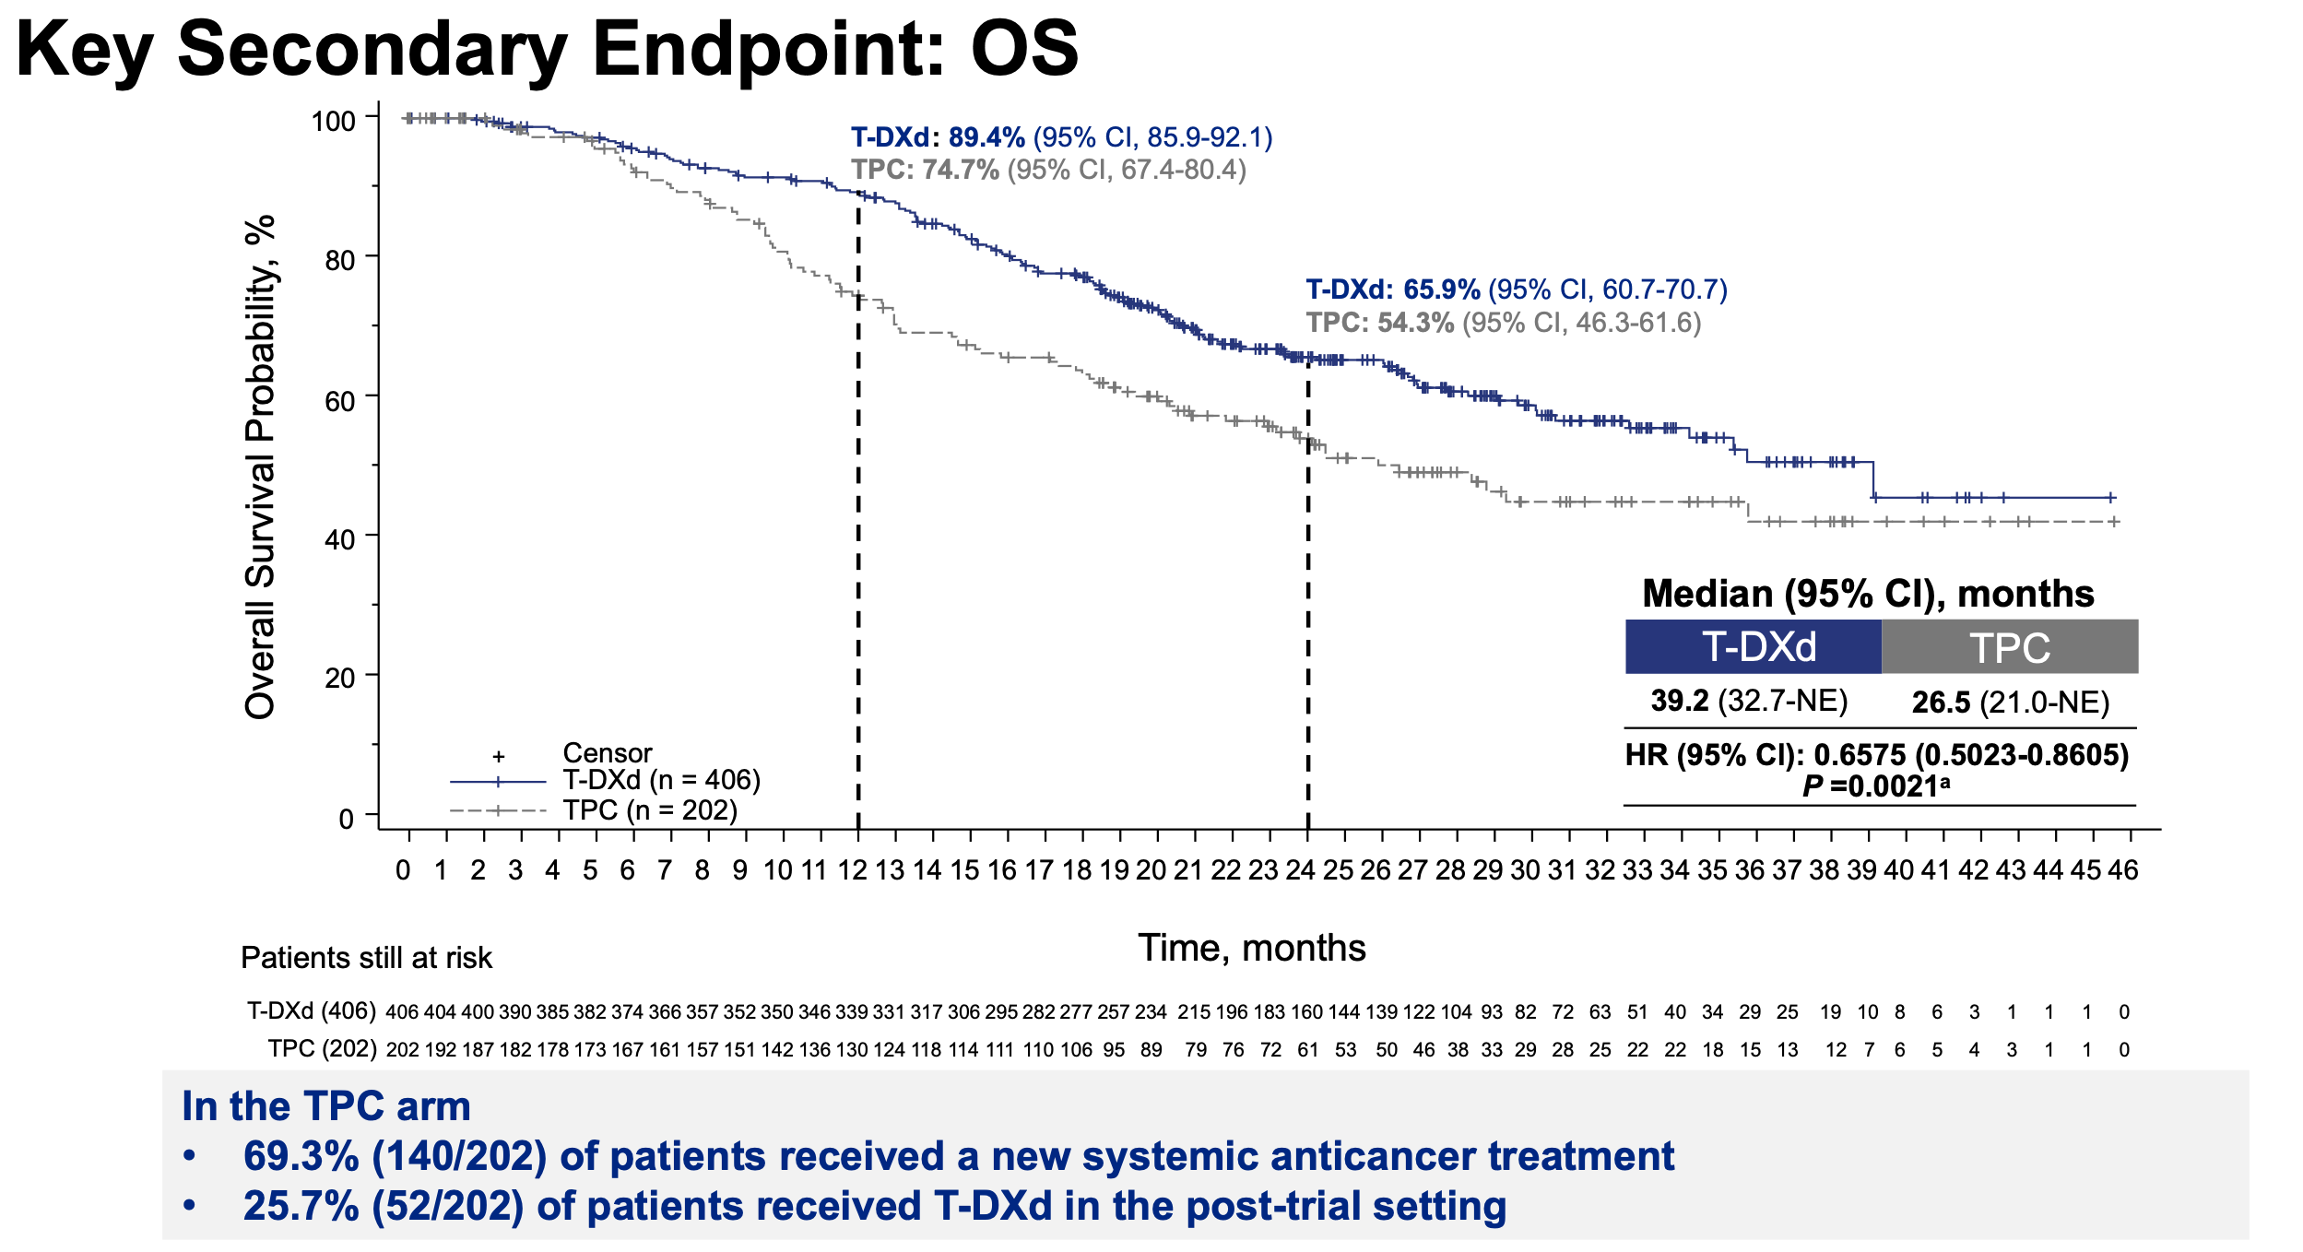
Krop I et al SABCS 2022 Abstract GS2-01

Slide 9
Conclusions
T-DXd improves OS and dramatically improves PFS no matter where it is used in HER2+ MBC
T-DXd has activity against active, untreated HER2+ brain metastases
T-DXd is definitive 2L SOC for HER2+ MBC – less ILD and no fatal ILD in 2L – but incidence increased with further f/u, ie, longer exposure
ILD mainly occurs in first 12 mos but can occur at any time
Key to avoiding serious ILD is to not treat through symptoms
T-DXd currently in 1L DB-09 trial +/- pertuzumab versus std 1L THP

Slide 10
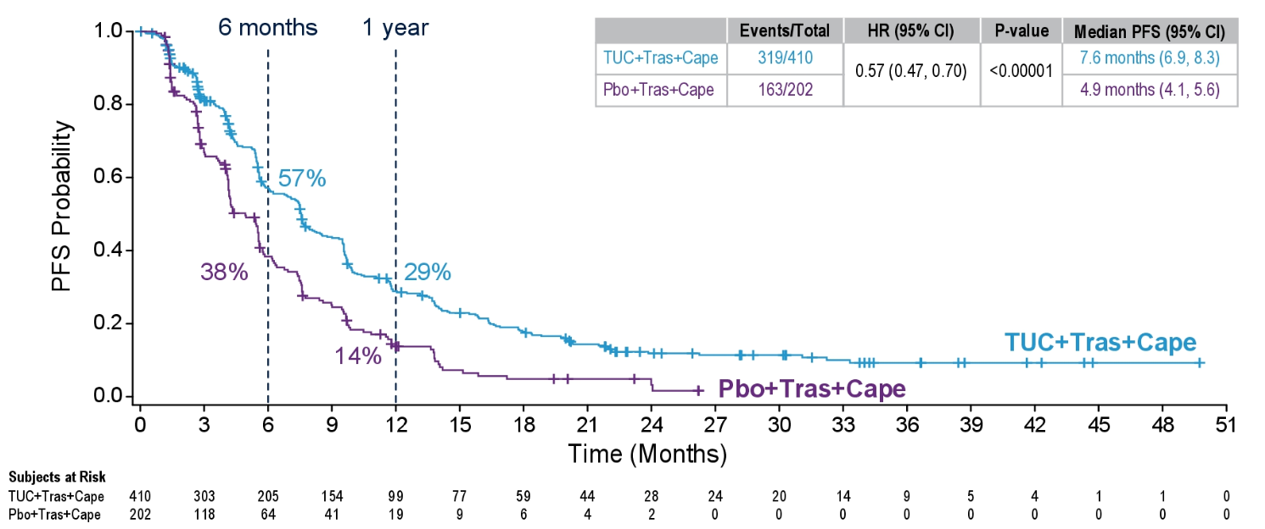
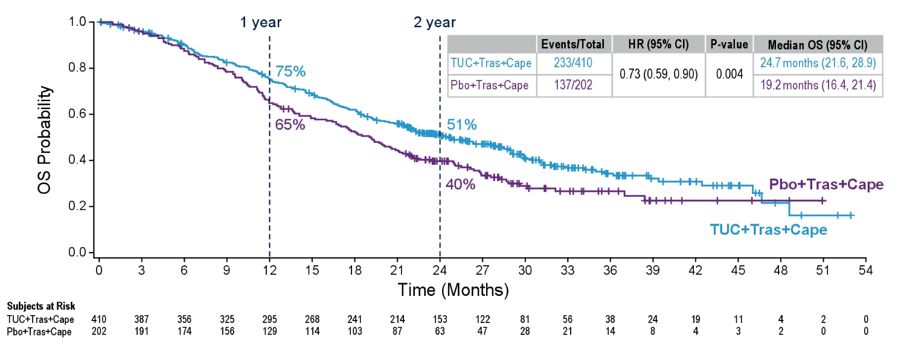
Tucatinib vs Placebo in HER2+ MBC, Results From the Randomized Phase 3 HER2CLIMB Study: PFS and OS
Median follow-up: 29.6 months
Progression-Free Survival
Overall Survival
 | Median PFS | HR (95% CI) | P value
Tucatinib | 7.6 months | 0.57 (0.47-0.70) | <0.00001
Placebo | 4.9 months
2 year
 | Median OS | HR (95% CI) | P value
Tucatinib | 24.7 months | 0.73 (0.59-0.90) | 0.004
Placebo | 19.2 months
Overall Survival in an Exploratory Analysis in Patients With and Without Visceral Metastases
 | Patients With Visceral Metastases (n=455) |  |  | Patients Without Visceral Metastases (n=157)
 | HR (95% CI) | P value | Median OS | HR (95% CI) | P value | Median OS
Tucatinib | 0.70 (0.55-0.89) | 0.004 | 21.6 months | 0.80 (0.48-1.3) | 0.36 | 32.9 months
Placebo |  |  | 16.9 months |  |  | 26.9 months
Curigliano G, et al. ASCO 2021. Abstract 1043; Annals Oncol 2022
10

Slide 11
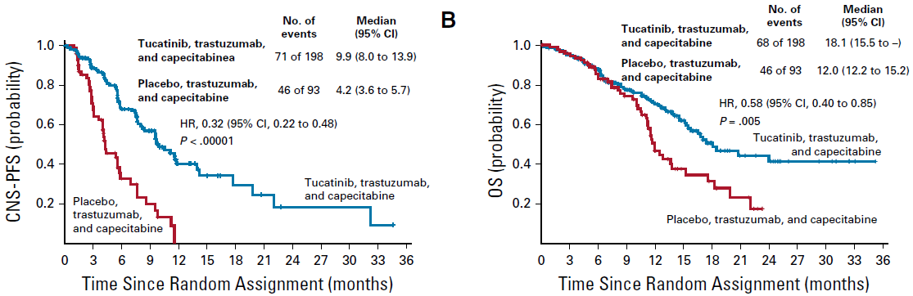
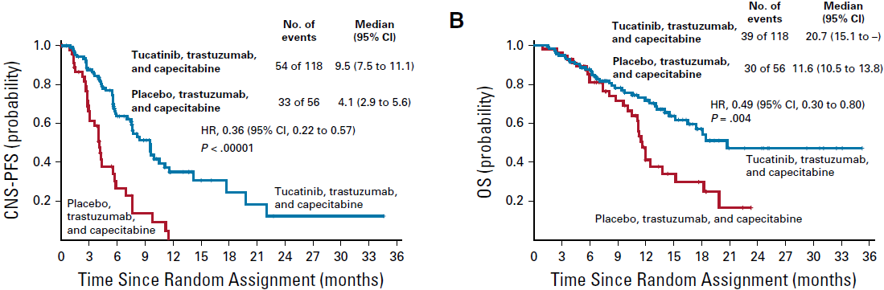
Intracranial CNS-Specific Outcomes: HER2CLIMB Study Results
Patient with Brain Metastases (active or treated/stable)
Intra-Cranial CNS Response (RECIST) N=75 | Tucatinib N=55 N (%) | Placebo N=20 N (%)
CR | 3 (5.5) | 1 (5.0)
PR | 23 (41.8) | 3 (15.0)
SD | 24 (43.6) | 16 (80.0)
PD | 2 (3.6) | 0
Not Available | 3 (5.5) | 0
Confirmed ORR | 26 (47.3) | 4 (20.0)
95% CI | 33.7-61.2% | 5.7-43.7%
Stratified p-value | 0.03
DOR (months) | 6.8 | 3.0
capecitabine
12.0 (11.2 to 15.2)
Patient with Brain Metastases (active)
Lin NU, et al. J Clin Oncol. 2020;38(23):2610-2619.

Slide 12
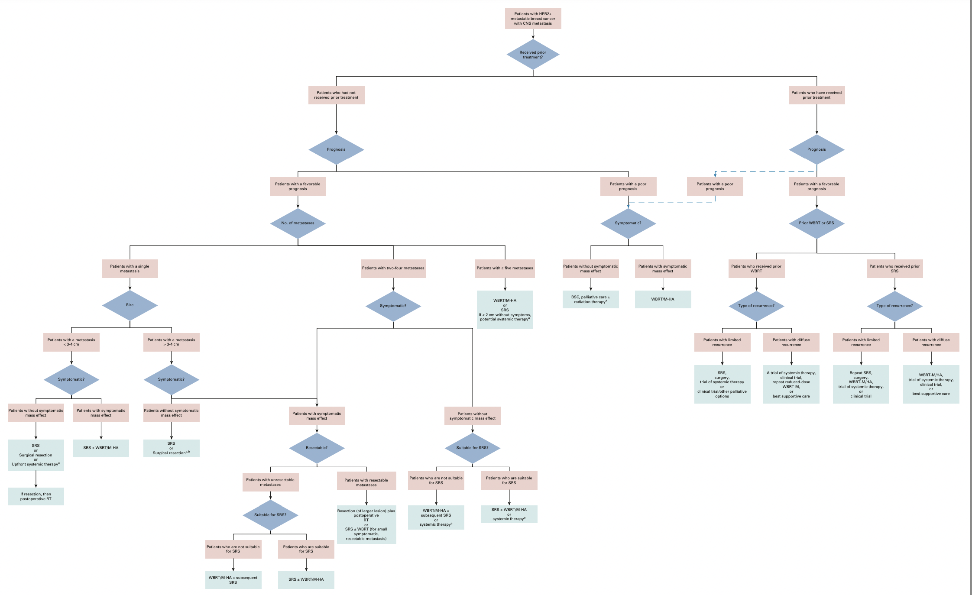
2022 ASCO Guidelines
Treatment of HER2+
Brain Metastases
Ramakrishna N et al. J Clin Oncol 2022

Slide 13
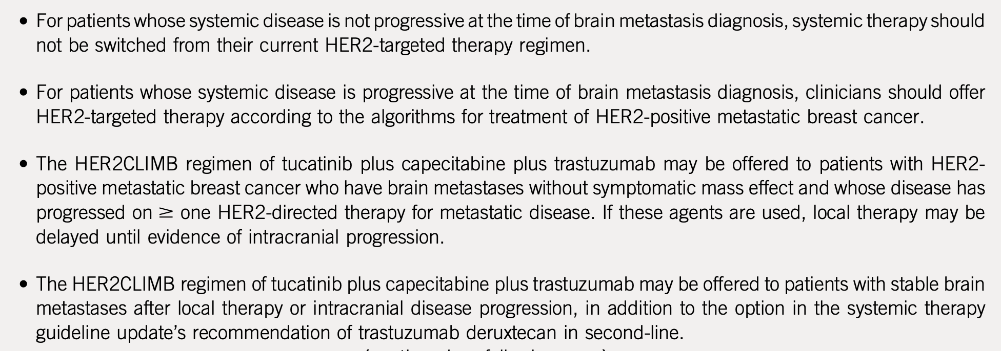
2022 ASCO Guidelines
Treatment of HER2+
Brain Metastases
Ramakrishna N et al. J Clin Oncol 2022

Slide 14
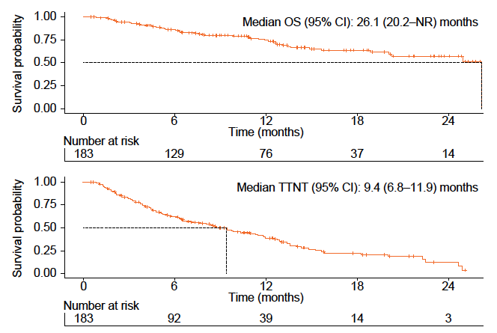
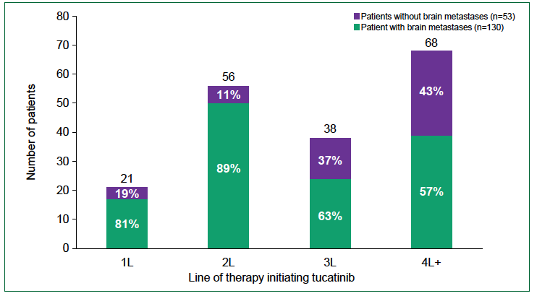
Tucatinib in Metastatic HER2+ BC: Flatiron Analysis
Patients with brain metastases (n=130)
Proportion not on new therapy
Kaufman P et al, SABCS 2022

Slide 15
Conclusions
Tucatinib improves OS when added to capecitabine/trastuzumab as 2L+ therapy, including in pts with active, untreated brain metastases
ASCO 2022 HER2+ Brain Metastases Guidelines endorse tucatinib triplet in pts with asymptomatic active, untreated brain mets, delaying local therapy
Real world evidence shows tucatinib triplet is the 2L therapy choice in patients with brain metastases
Phase III of HER2CLIMB-02 with T-DM1 + tucatinib vs T-DM1 underway

Slide 16
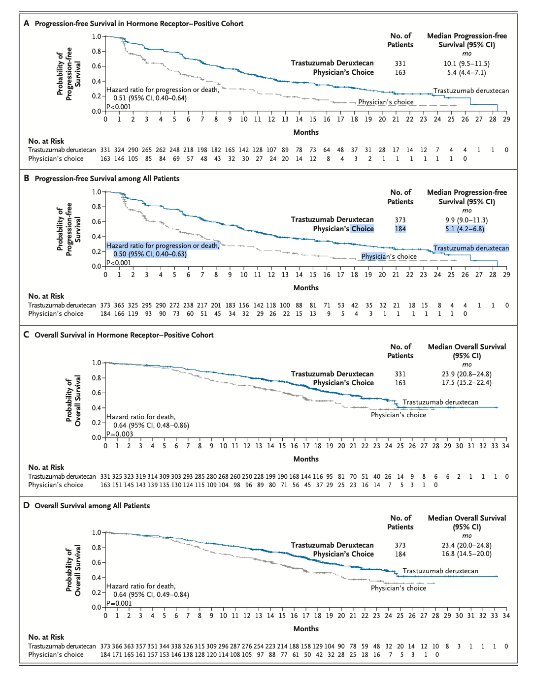
Destiny-Breast04
Improved PFS and OS with T-DXd vs TPC in HER2 Low MBC Pts
Modi S et al NEJM 2022

Slide 17
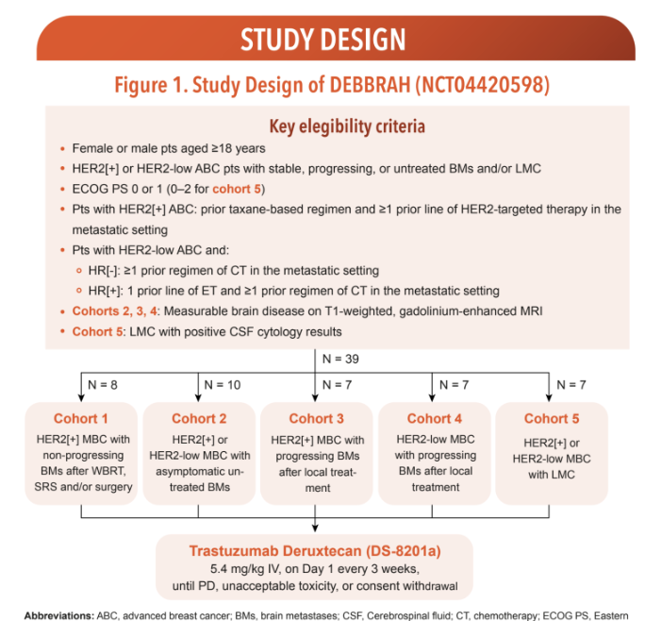
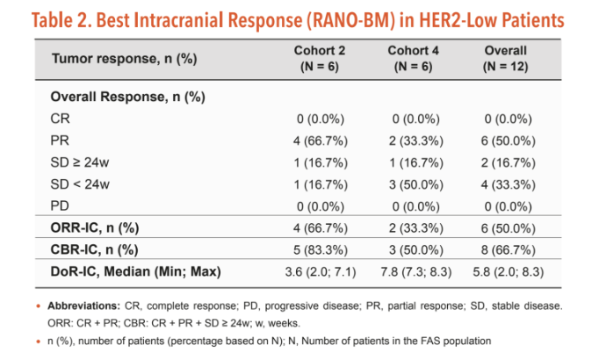
DEBBRAH: T-DXd for HER2-low Brain Mets
Perez-Garcia JM et al, SABCS 2022; Abstract PD7-02

Slide 18
Conclusions
T-DXd is superior to single agent chemotherapy regarding PFS and OS as 2L+ therapy for HER2-low MBC (both HR+ and TN)
T-DXd is 2L SOC, following progression on ET and 1L chemotherapy
T-DXd has activity against active, untreated or treated and progressing HER2-low brain metastases
Olanzapine 2.5mg at bedtime highly effective in eradicating chronic nausea
T-DXd is being evaluated as preoperative therapy in HR+ HER2 low EBC – preliminary data from TALENT trial at SABCS 2022 are promising

Slide 19
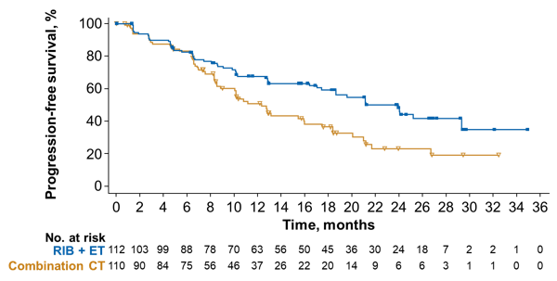
The Phase II Right Choice Trial
Demographics
Median age: 44
Denovo MBC: 65%
Visceral mets: 78%
Visceral crisis: 52%
Symptomatic visceral mets: ~67%
Lu et al, SABCS 2022; Abstract GS1-10

Slide 20
Conclusions
ET + ribociclib is more effective than combination chemotherapy as 1L treatment for patients with rapidly progressive, symptomatic MBC and doubles median PFS from 12 to 24 mos
The tempo of response to ET + ribociclib is similar to that seen with combination chemotherapy
Chemotherapy should only be used as 1L therapy in patients with significant organ dysfunction, eg, impending liver or respiratory failure, and all other patients should receive 1L ET + CDK 4/6 inhibitor

Slide 21
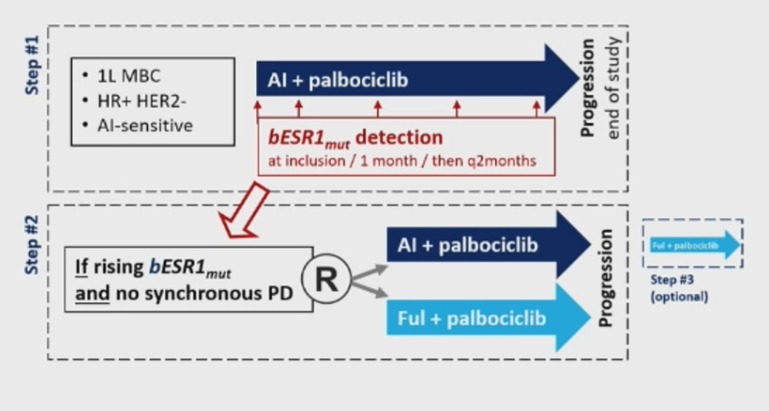
ctDNA Monitoring and
Therapy Switch with ESR1 Mutation (PADA-1)
Key Eligibility:
ER+ (>10%), HER2 neg
No prior tx for MBC
No relapse <12m on adjuvant ET
Postmeno or receiving LHRH
Bidard et al, SABCS 2021 Abstract GS3-05
Notes:
To prevent or delay tumor POD in patients receiveing 1L AI/P by targeting ESR1m with a switch to fulvestrant/P as soon as ESR1 becomes detectable

Slide 22
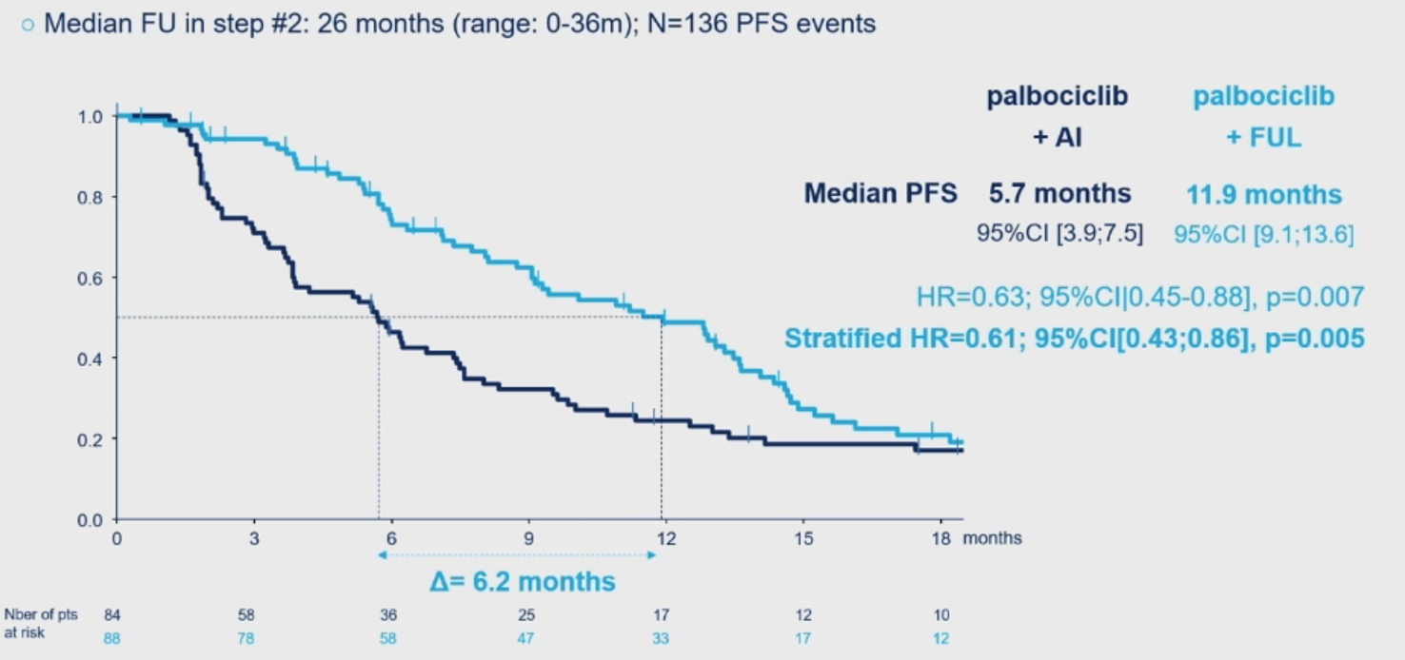
ctDNA Monitoring and
Therapy Switch (PADA-1)
Step #2: mPFS ~40% longer with switch to F+P
Bidard et al, SABCS 2021 Abstract GS3-05

Slide 23
Conclusions
Development of ESR1 mutation is found in 50% of pts whose HR+ HER2- MBC has progressed on CDK 4/6 inhibitor
PADA-1 trial shows PFS is prolonged switching endocrine therapy from AI to fulvestrant, and continuing palbociclib, compared with continuing the AI plus palbociclib, in pts with ctDNA-detected ESR1 mutation without imaging/clinical evidence of progression
Use of ctDNA in MBC to detect targetable mutations arising in resistant disease, prior to clinical progression, may evolve as new management paradigm – will this improve OS?
SERENA-6 trial is evaluating switching to oral SERD camizestrant in pts with ctDNA-detected ESR1 mutations

Slide 24
PACE: Ph2 Palbociclib after CDK and Endocrine Therapy
ITT PFS
Demographics
81% Post menopausal
40% de novo MBC
60% visceral disease
68% measurable disease
Other endpoints
ORR (n=149): 10.8 v 13.7 v 17.9%
Med OS: 27.5 v 24.6 v 42.5 mo
Rare immune-related AEs
Suggestion of improved efficacy of FP over F in ESR1 and PIK3CA mutations
91% prior Palbociclib
76% prior ET>12 months
77% second line
Mayer et al, SABCS 2022; Abstract GS3-06

Slide 25
PACE: Exploratory Endpoints and Conclusions
ESR1 WT
ESR1 altered
Continuing palbociclib beyond progression on prior CDK4/6i did not significantly improve PFS
  Is change in the CDKi important?
  Variations in the patient population in phase II studies may be important
  Await data from Ph III studies (post-MONARCH)
The longer PFS with the addition of a PD-L1 inhibitor is intriguing, further study is needed
  Greater toxicity with PD-L combinations have been seen
  In this study, increased immune toxicity was not seen
Baseline ctDNA analyses are also of interest and suggest differential impact in tumors with ESR1 and PIK3CA mutations
Evaluation of serial ctDNA and CTC samples is ongoing
PIK3CA WT
PIK3CA altered
Mayer et al, SABCS 2022; Abstract GS3-06

Slide 26
CDK 4/6 inhibitor after 1st line CDK 4/6 inhibitor
MAINTAIN: Phase II trial of switching ET+/- Ribociclib for HR+ MBC after failure of previous ET+ CDK4/6i
Adults with ER and/or PR ≥1%, HER2- MBC and progression on ET and CDK4/6i;
≤1 CT line for MBC;
ECOG PS 0 or 1;
Postmenopausal (or premenopausal with GnRH agonist);
Stable brain metastases allowed
(N = 120)
Ribociclib
600 mg QD 3 wk on, 1 wk off
+ Switch ET*
(n = 60)
ET + CDK4/6 inhibitor is preferred treatment for HR+/HER2- MBC
Ribociclib + ET shown to extend PFS and OS in HR+/HER2- MBC
This trial aims to compare continuing ribociclib and
switching ET vs switching ET only in patients with HR+ MBC
Placebo + Switch ET*
(n = 59)
*Patients with progression on AI for MBC and no prior fulvestrant received fulvestrant.
After protocol amendment, patients who progressed on prior fulvestrant received exemestane.
*P = .035.
Primary endpoint: PFS (locally assessed per RECIST v1.1)
Key secondary endpoints: ORR, CBR, safety, tumor response
Kalinsky K et al. ASCO 2022. LBA1004.
Notes:
ET + CDK4/6 inhibitor is preferred treatment for HR+/HER2- recurrent unresectable or metastatic breast cancer
Ribociclib + ET shown to extend PFS and OS in HR+/HER2- advanced breast cancer in phase III study
This trial was designed to study the efficacy of continuing ribociclib and
switching ET in patients with unresectable or metastatic HR+/HER2- breast cancer

Slide 27
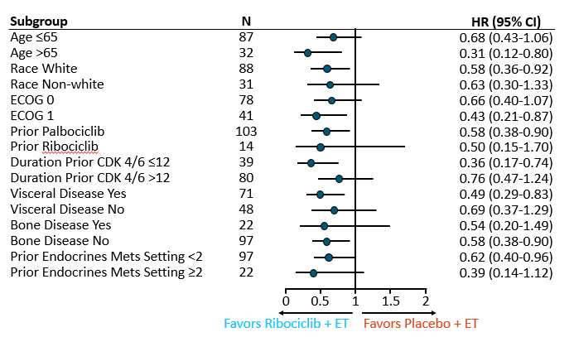
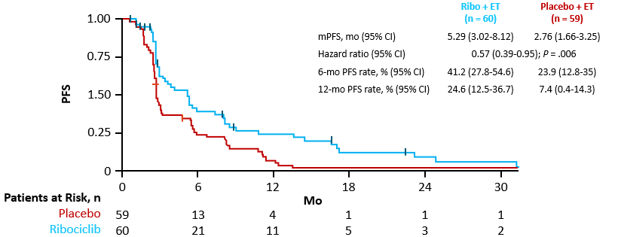
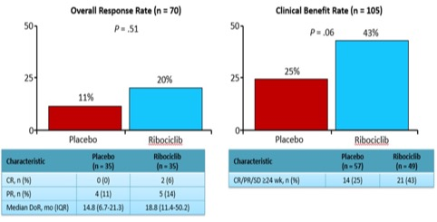
MAINTAIN: PFS
Ribociclib and switching ET improved PFS compared with ET alone in patients who progressed on ET with a previous CDK4/6 inhibitor: mPFS: 5.29 vs 2.76 mo (HR: 0.57; 95% CI: 0.39-0.95; P = .006)
Kalinsky K et al. ASCO 2022. LBA1004.

Slide 28
Conclusions
Switching endocrine therapy and continuing palbociclib post-progression on palbociclib is not more effective than ET alone
Switching both endocrine therapy and the CDK 4/6 inhibitor (from palbociclib to ribociclib) prolongs PFS (modestly) vs ET switch alone – clinical relevance now that ribociclib is 1L therapy of choice?
Can ctDNA post-progression on palbociclib identify pts who may benefit from switching CDK 4/6 inhibitors, ie, lack of LOF Rb mutation?
Adding the PDL1 inhibitor avelumab to palbociclib + ET is safe and appears promising post-progression on palbociclib – further trials would be of interest
Abemaciclib is being evaluated in 2 phase III trials post-progression on palbociclib/ribociclib (EMBER-3 and post-MONARCH)

Slide 29
CAPItello-291: Phase III, randomized, double-blind, placebo-controlled study
Summary of Demographics
Median age ~59
Asian 26%, Black 1%
Primary ET resistance ~38%
Visceral mets ~68%
One line of prior ET for MBC ~75%
Prior CDK4/6i for MBC ~70%
Chemotherapy for ABC ~18%
Turner et al, SABCS 2022; Abstract GS3-04

Slide 30
Turner et al, SABCS 2022; Abstract GS3-04

Slide 31
Additional Analyses
Investigator-assessed PFS by subgroup: Overall population
Exploratory analysis: Investigator-assessed PFS in the non-altered population (including unknown†)
Response per investigator assessment
Excluding unknowns (58 v 48):
HR 0.79 (95% CI 0.61, 1.02)
Turner et al, SABCS 2022; Abstract GS3-04

Slide 32
Conclusions
Capivasertib/fulvestrant improved PFS over fulvestrant post-progression on AI +/- CDK 4/6 inhibitor - in overall population and in patients with PI3K/AKT pathway-altered cancers
Efficacy in the subset of patients with non-altered tumors uncertain
GI toxicity, primarily lower grade diarrhea, is manageable with 4 days on/3 days off schedule – much less hyperglycemia than alpelisib with HgbA1c up to 8% allowed
Capivasertib may be PI3K/AKT pathway inhibitor of choice following progression on CDK 4/6 inhibitor once FDA-approved
Data to be considered for FDA approval

Slide 33
EMERALD Phase 3 Study Design
Elacestrant
400 mg daily^{c}
Co-Primary Endpoints:^{d}
PFS in all pts
PFS in mESR1
Key Secondary Endpoint:
Overall Survival
Inclusion Criteria
Men and postmenopausal women with advanced/metastatic breast cancer
ER-positive,ª HER2-negative
Progressed or relapsed on or after 1 or 2 lines of endocrine therapy for advanced disease, one of which was given in combination with a CDK4/6i
≤1 line of chemotherapy for advanced disease
ECOG PS 0 or 1
N = 477^{b}
PD or withdrawal criterion^{f}
R
Follow Up
1:1
Investigator’s choice (SOC):
Fulvestrant
Anastrozole
Letrozole
Exemestane
Stratification Factors:
ESR1-mutation status^{e}
Prior treatment with fulvestrant
Presence of visceral metastases
ªDocumentation of ER+ tumor with ≥ 1% staining by immunohistochemistry; ^{b}Recruitment from February 2019 to October 2020; ^{c}Protocol-defined dose reductions permitted;
^{d}Blinded Independent Central Review. ^{e}ESR1-mutation status was determined by ctDNA analysis using the Guardant360 assay. ^{f}Restaging CT scans every 8 weeks.
CBR, clinical benefit rate; DOR, duration of response; ECOG PS, Eastern Cooperative Oncology Group performance status; ORR, objective response rate; OS, overall survival, PD, progressive disease; PFS: progression-free survival; Pts, patients; R, randomized. SOC, standard of care.
Bidard FC et al. J Clin Oncol, 2022

Slide 34
PFS: Elacestrant vs Fulvestrant (All Patients and mESR1 Group)
All Patients
Patients With Tumors Harboring mESR1
100
 | Elacestrant | Fulvestrant
N | 239 | 165
Event (%) | 144 (60.3) | 109 (66.1)
Median PFS, months (95% CI) | 2.79 (1.94-3.78) | 1.94 (1.87-2.10)
P value | 0.0049
Hazard ratio (95% CI) | 0.684 (0.521-0.897)
100
 | Elacestrant | Fulvestrant
N | 115 | 83
Event (%) | 62 (53.9) | 59 (71.1)
Median PFS, months (95% CI) | 3.78 (2.17-7.26) | 1.87 (1.84-2.10)
P value | 0.0005
Hazard ratio (95% CI) | 0.504 (0.341-0.741)
90
90
80
80
70
70
60
60
50
50
Probability of PFS (%)
Probability of PFS (%)
40
40
30
30
20
+
20
+
10
+
Elacestrant
10
+
Elacestrant
0
Fulvestrant
0
Fulvestrant
0
1
2
3
4
5
6
7
8
9
10
11
12
13
14
15
16
17
18
19
20
21
22
23
24
25
0
1
2
3
4
5
6
7
8
9
10
11
12
13
14
15
16
17
18
19
20
21
22
23
24
25
Time (months)
Time (months)
Elacestrant
Fulvestrant
239
165
106
62
60
33
42
21
34
14
27
5
19
2
11
1
7
0
6
2
2
0
Elacestrant
Fulvestrant
115
83
54
29
35
16
26
10
21
8
16
3
11
1
7
0
5
4
1
1
0
Elacestrant demonstrated a statistically significant and clinically meaningful PFS improvement versus Fulvestrant as SOC in patients with ER+/HER2- advanced/metastatic breast cancer and mESR1 following CDK4/6i therapy
Bidard FC et al. J Clin Oncol, 2022
Notes:
Exploratory Add to speaker notes. As this was additional analysis

Slide 35
A significant PFS benefit was seen in the ESR1-mutated population of EMERALD; a benefit trend was observed in acelERA BC and AMEERA-3
acelERA BC¹
2° EP: PFS (ESR1mut)
AMEERA-3*^{,2}
2° EP: PFS (ESR1mut)
EMERALD³
Co-1° EP: PFS (ESR1mut)
100
100
100
90
90
90
80
Hazard ratio: 0.60
mPFS 5.3 vs. 3.5 mo (Δ: 1.8 mo)
80
Hazard ratio: 0.90
mPFS 3.7 vs. 2.0 mo (Δ: 1.7 mo)
80
Hazard ratio: 0.55
mPFS 3.8 vs. 1.9 mo (Δ: 1.9 mo)
70
70
70
60
60
60
PFS (%)
PFS (%)
PFS (%)
50
50
50
40
Giredestrant
40
40
Elacestrant
30
30
Amcenestrant
30
20
PCET
20
20
PCET
10
10
PCET
10
0
0
0
0
2
4
6
8
10
12
14
0
2
4
6
8
10
12
14
16
18
20
0
2
4
6
8
10
12
14
16
18
20
22
24
Months
Months
Months
  Giredestrant and elacestrant had comparable PFS hazard ratios vs. PCET in ESR1-mutated subpopulations; the HR for amcenestrant was notably higher
It was announced in August 2022 that the amcenestrant clinical development programme will be discontinued.⁴
1° primary; 2°, secondary; BC, breast cancer; EP, endpoint; mo, months; mPFS, median progression-free survival; PCET, physician’s choice of endocrine therapy; PFS, progression-free survival; SERD, selective oestrogen receptor degrader.
1. Martin M, et al. ESMO 2022 (Abstract 211MO; mini oral presentation); 2. Tolaney SM, et al. ESMO 2022 (Abstract 212MO; mini oral presentation); 3. Bidard F-C, et al. J Clin Oncol 2022; 4. https://www.sanofi.com/en/media-room/press-releases/2022/2022-08-17-05-30-00-2499668 (accessed August 2022).

Slide 36
EMERALD Phase 3 Trial: Elacestrant vs SOC ET
PFS by Duration of CDK4/6i: All Patients
PFS by Duration of CDK4/6i: ESR1 mutant
Bardia, Bidard …… and Kaklamani; SABCS 2022

Slide 37
Conclusions
Elacestrant is effective post-progression on CDK 4/6 inhibitor in patients with endocrine therapy-sensitive disease
Hazard ratios for improved PFS (vs fulvestrant or AI) are similar in pts who received >6 months prior CDK4/6i or longer, ie, not primary-resistant to CDK 4/6 inhibitor
Benefit of elacestrant more marked in the ESR1 mutant population, especially those who had at least 12 mos of prior CDK 4/6 inhibitor therapy
Next steps: combinations with other targeted agents in HR+ HER2- MBC (ELEVATE trial) and adjuvant trial is planned

Slide 38
SERENA-2 Phase 2 Trial: Camizestrant plus Fulvestrant
Primary endpoint: PFS by investigator assessment
Primary endpt: Inv assessed PFS of each C arm to F
Demographics
90-95% white
Imbalance in liver (not visceral) mets: 31 v 41 vs 48%
Imbalance in ESR1m: 30 v 36 v 48%
77% one line ET, 63% prior AI; 50% prior CDK4/6i
Prior chemo for MBC: 22 v 12 v 26%
*Statistically significant; ªHRs adjusted for prior use of CDK4/6i and liver/lung metastases
PFS by BICR: Significant discordance with inv PFS for 150 mg
 | C 75 (n=74) | C 150 (n=73) | F (n=73)
Events [n (%)] | 39 (52.7) | 33 (45.2) | 53 (72.6)
Median PFS, months (90% CI)​ | 7.4 (4.5-10.9) | 12.7 (9.3-18.4) | 3.7 (2.0-3.8)
Adjusted HR (90% CI)ª | 0.56 (0.39-0.80) | 0.47 (0.33-0.68) | -
P value | 0.0079* | 0.0004* | -
Oliveira et al, SABCS 2022

Slide 39
Biomarkers
Camizestrant reduced ESR1 ctDNA to near zero by C2D1
Safety
Very low rate discontinuation
Interruption TRAEs ~med 7 days: ~10%
Very low rate of grade 3 AEs
All grade AEs (low-high dose):
  Photopsia: 12-25%
  Sinus bradycardia: 5-26%
  More fatigue, arthralgia, AST/ALT elevation at higher dose
YES
NO
​ | C 75 ​(n=43)​ | C​ 150 ​(n=43)​ | F 500 ​(n=43)​
Events [n (%)]​ | 31 (72.1) | 32 (74.4) | 39 (90.7)
Median PFS, months (90% CI)​ | 7.2 (3.6-11.1) | 5.6 (3.7-9.1) | 2.0 (1.9-3.6)
Adjusted HR (90% CI)ª​ | 0.43 (0.28-0.65) | 0.55 (0.37-0.82) | -​
​ | C 75 ​(n=31)​ | C​ 150 ​(n=30)​ | F 500 ​(n=30)​
Events [n (%)]​ | 19 (61.3) | 19 (63.3) | 19 (63.3)
Median PFS, months (90% CI)​ | 5.5 (3.7-15.0) | 14.5 (5.6-17.2) | 9.2 (3.7-18.7)
Adjusted HR (90% CI)ª​ | 0.99 (0.57-1.69) | 0.91 (0.53-1.56) | -​
Liver and/or lung mets
Oliveira et al, SABCS 2022

Slide 40
Conclusions
Oral SERD camizestrant has improved PFS over fulvestrant, including in pts post-progression on CDK 4/6 inhibitor
More data needed on efficacy of camizestrant in ESR1 WT pts
At chosen phase III dose of 75mg low incidence of sinus bradycardia and photopsia (flashes of light)
1L trial SERENA-4 underway (with CDK 4/6 inhibitor) and adjuvant trial planned

Slide 41
Phase III TROPiCS: Sacituzumab govitecan in HR+/HER2neg MBC
Demographics
95% visceral mets
100% prior CDKi
Median 3 lines of chemo for MBC
TROP2 expression in 95%
H score >100 in 58%
7.7 mo median time from tissue collection to randomization
No Impact of TROP2 expression on efficacy
ASCENT-07
Improved OS by a median of 3.2 months as late line Rx
TTD of Physical functioning
Rugo et al, JCO 2022, ESMO 2022, SABCS 2022

Slide 42
Phase 1 TROPION-PanTumor01:
Datopotamab deruxtecan in HR+/HER2neg MBC
N=41
  Median of 2 prior chemo for MBC (Range: 1-6)
  95% prior CDKi
Efficacy:
  ORR (all PR): 27%
  CBR: 44%
  Med PFS 8.3 mo
  59% alive for >1 year
Safety (all Gr/>Gr 3):
  Stomatitis: 83/10%
  Nausea: 56/0%
  Alopecia: 37%
  Pneumonitis: Gr 2 and 3 (2 pts)
inoperable/metastatic breast cancer
Ongoing TROPION-Breast01 in 2nd-3rd line HR+ MBC
Meric-Bernstam et al, SABCS 2022; Abstract PD13-08

Slide 43
Conclusions
Sacituzumab govitecan improved OS compared with chemotherapy as late-line therapy for HR+ HER2- MBC post-progression on CDK 4/6 inhibitor
Category 2A, preferred therapy on NCCN guidelines following progression on 2 prior cytotoxic regimens (awaiting FDA approval)
ASCENT-07 underway of sacituzumab as 1L cytotoxic therapy in HR+ MBC
Datopotamab, anti-TROP2 ADC, is active as late-line therapy for HR+ MBC, with stomatitis most common toxicity (steroid mouth rinse ameliorates)

Slide 44
OS:
6.9 month increase in OS
PFS:
Cortes et al, Lancet 2020; Rugo et al , ESMO 2021
Cortes et al N Engl J Med 2022

Slide 45
Impact of PD-L1 CPS Subgroups on OS and PFS
Overall Survival
Progression Free Survival
For pembrolizumab + chemotherapy in mTNBC, CPS ≥10 is the best cut-off to define those expected to benefit
Pembrolizumab + chemotherapy is a new standard of care for the treatment of mTNBC with CPS >10

Slide 46
Conclusions
1L Pembrolizumab plus chemotherapy improves OS in patients with metastatic TNBC with CPS > 10 – established SOC
Pembrolizumab does not improve OS if TNBC has CPS < 10
Unknown whether 1L pembrolizumab improves OS in metastatic TNBC pts who received pembrolizumab as neo/adjuvant therapy

Slide 47
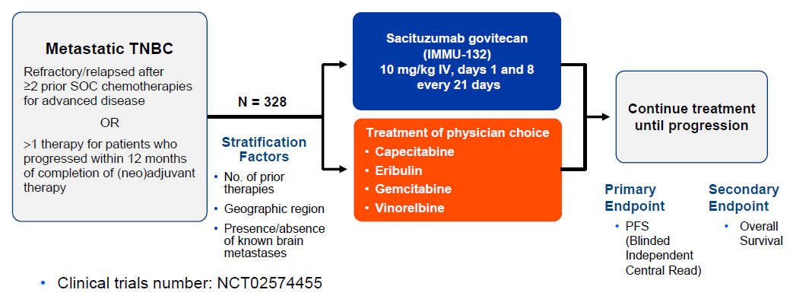
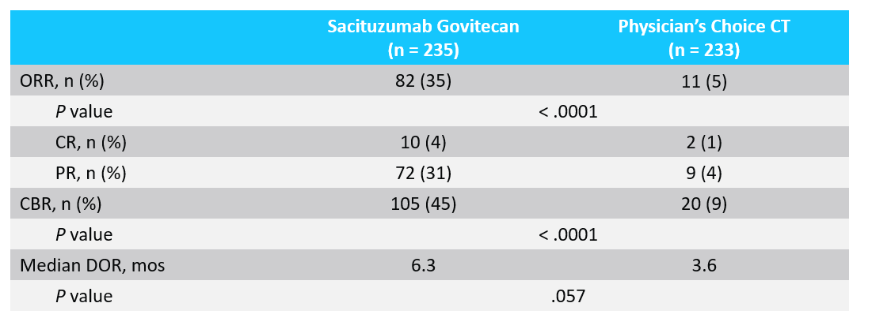
Phase III ASCENT Trial
Bardia et al ESMO 2020; Abstract LBA17

Slide 48
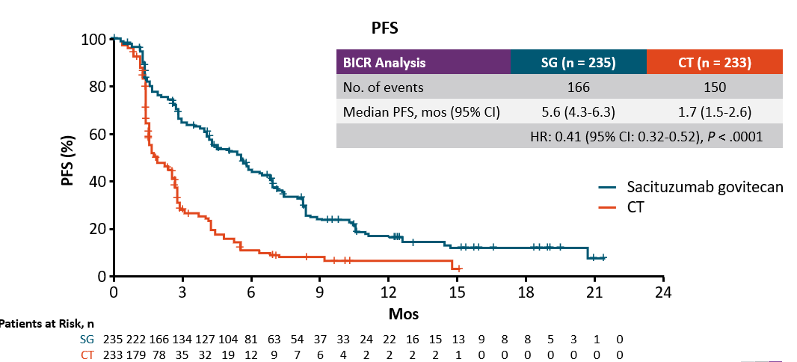
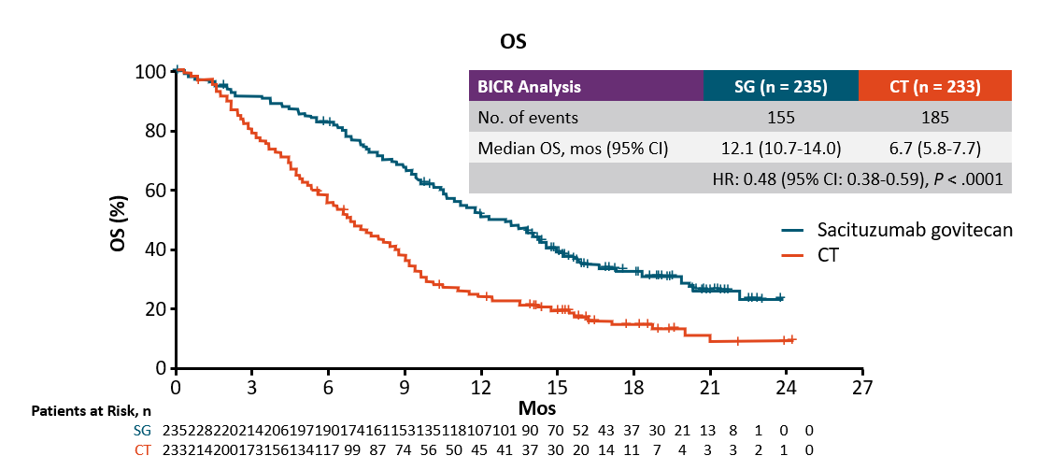
Phase III ASCENT Trial
PFS was 5.6 months (95% confidence interval [CI], 4.3 to 6.3; 166 events) with sacituzumab govitecan and 1.7 months with chemo.
The median overall survival was 12.1 months (95% CI, 10.7 to 14.0) with sacituzumab govitecan and 6.7 months (95% CI, 5.8 to 7.7) with chemotherapy (hazard ratio for death, 0.48; 95% CI, 0.38 to 0.59; P<0.001).
Bardia et al ESMO 2020; Abstract LBA17

Slide 49
Conclusions
Sacituzumab govitecan improves OS as 2L+ therapy for metastatic TNBC
Category 1, preferred regimen NCCN guidelines 2L+ therapy for metastatic TNBC
Treatment-limiting toxicities of myelosuppression and diarrhea manageable with dose reduction – start with lower dose in pts who are heavily pretreated or have impaired hepatic function or co-morbidities
Sacituzumab being evaluated as 1L metTNBC therapy with or without pembrolizumab (ASCENT-03 and ASCENT-04)

Slide 50
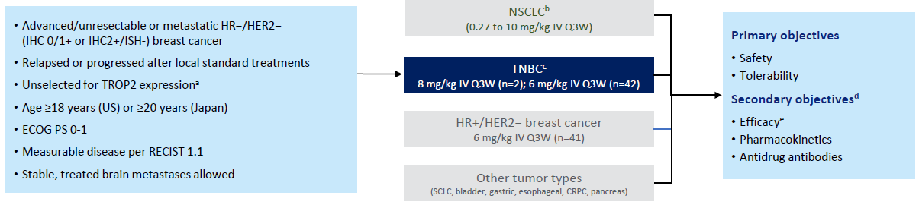
Dato-DXd in Advanced TNBC
TROPION-PanTumor01 Study
Study Design
Bardia A, et al. SABCS 2022. Poster Presentation P6-10-03.

Slide 51
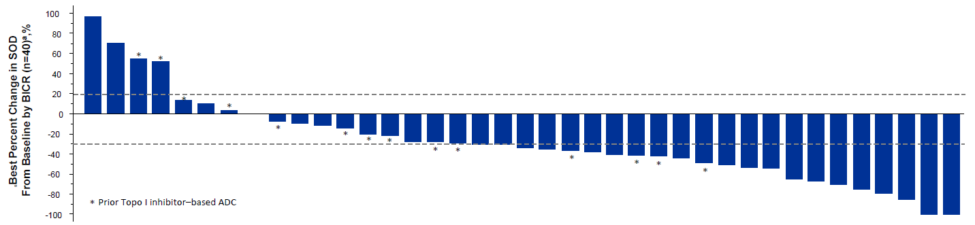
TROPION-PanTumor01 Study: Dato-DXd
Efficacy
Antitumor Tumor Responses by BICR
ORR by BICR:
All patients: 32%
Topo I inhibitor-naive patients: 44%
mDOR: 16.8 months in both groups
mPFS:
All patients: 4.4 months
Topo I inhibitor-naive patients: 7.3 months
mOS:
All patients: 13.5 months
Topo I inhibitor-naive patients: 14.3 months
AEs: Most common TEAEs: stomatitis (73%), nausea (66%), vomiting (39%)
Bardia A, et al. SABCS 2022. Poster Presentation P6-10-03.

Slide 52
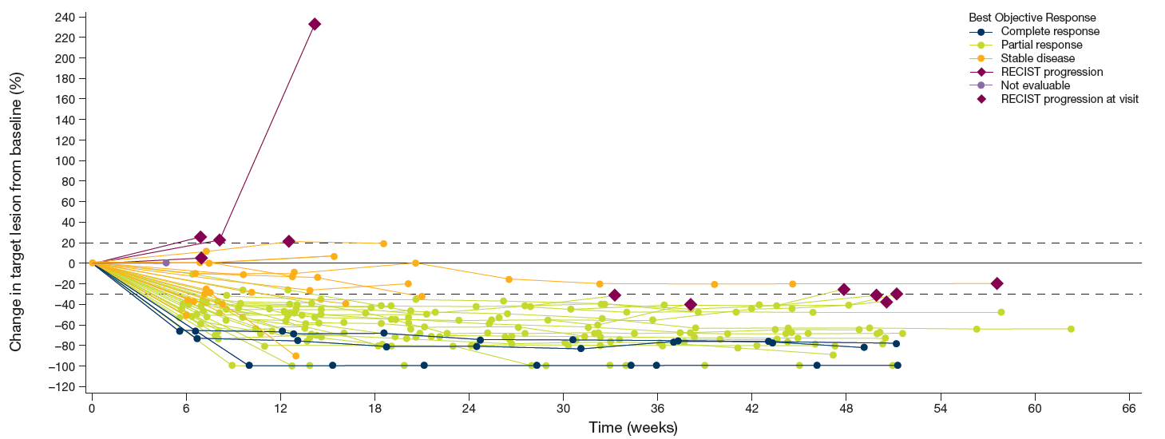
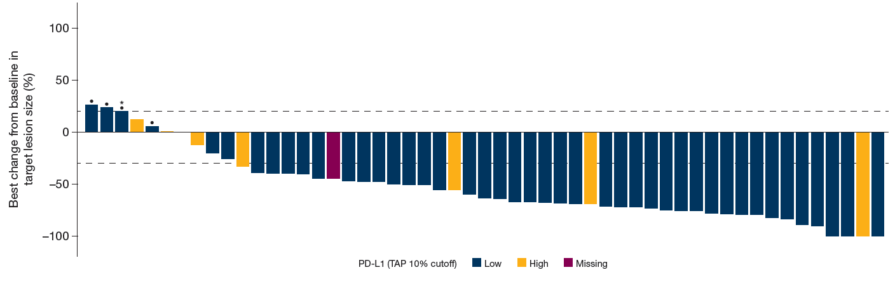
BEGONIA: Dato-DXd + Durvalumab 1L Metastatic TNBC
Efficacy
Change from Baseline in Sum of Target Lesions Over Time
Confirmed ORR: 39/61 (73.6%)
Responses were durable
  82% of patients remaining in response at data cutoff
Responses were observed in PD-L1 low and PD-L1 high tumors
Best Change from Baseline of Target Lesion Size
Schmid P, et al. SABCS 2022. Poster Presentation PD11-09.

Slide 53
Conclusions
Dato-DXd promising activity late-line single agent and 1L with durvalumab in metastatic TNBC (regardless of PDL1 expression)
Every 3-weekly dosing convenient with less neutropenia and diarrhea than sacituzumab, but with stomatitis
Dato-DXd being evaluated as 1L therapy in metTNBC with or without checkpoint inhibitor
Dato-DXd will be evaluated as adjuvant therapy for residual TNBC following neoadjuvant therapy, and as preoperative therapy in TNBC

Slide 54
Appendix

Slide 55
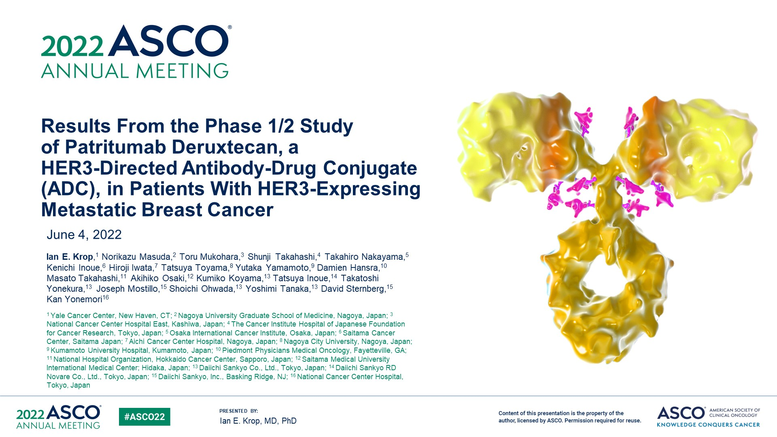
Results From the Phase 1/2 Study <br />of Patritumab Deruxtecan, a <br />HER3-Directed Antibody-Drug Conjugate (ADC), in Patients With HER3-Expressing Metastatic Breast Cancer
Abstract 1002

Slide 56
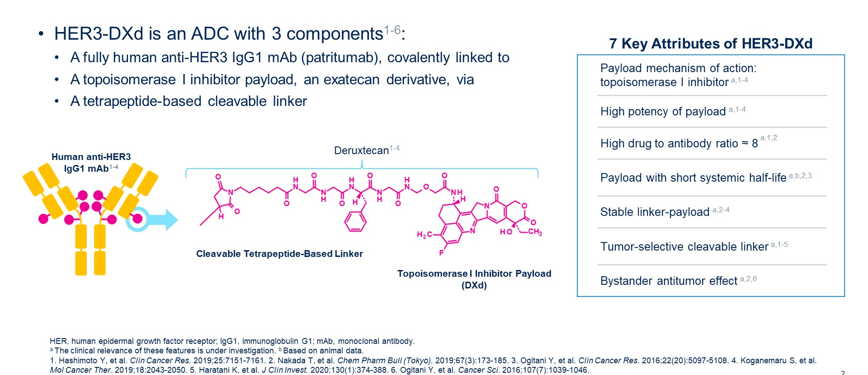
Patritumab Deruxtecan (HER3-DXd)
Krop IE et al. ASCO 2022;Abstract 1002.

Slide 57
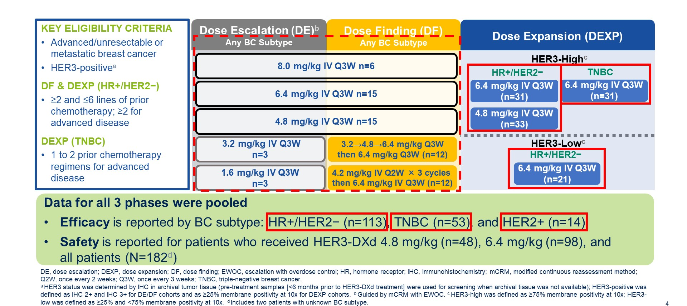
U31402-A-J101: Study Design
Krop IE et al. ASCO 2022;Abstract 1002.

Slide 58
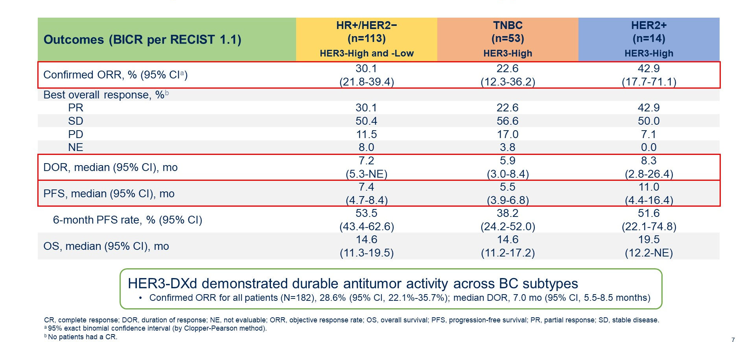
Clinical Activity of HER3-DXd Across Breast Cancer Subtypes
Krop IE et al. ASCO 2022;Abstract 1002.

Slide 59
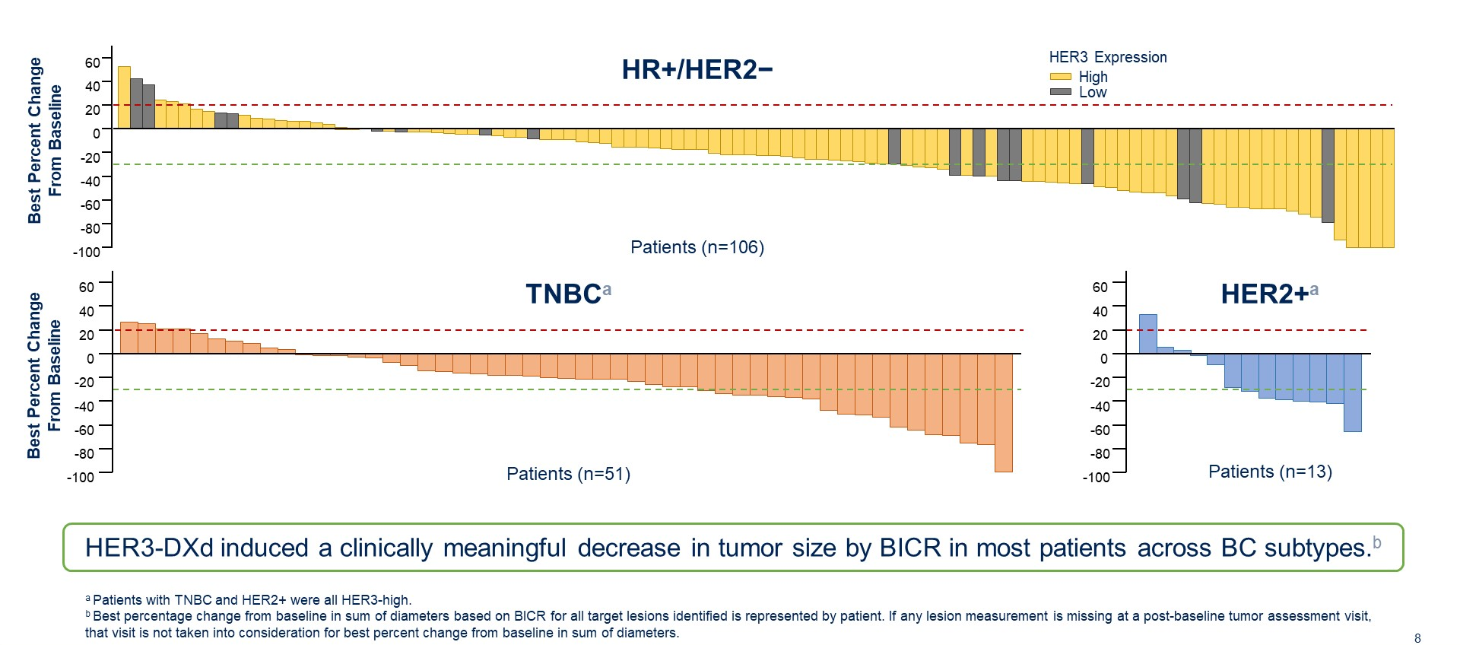
Change in Tumor Size from Baseline
Krop IE et al. ASCO 2022;Abstract 1002.

Slide 60
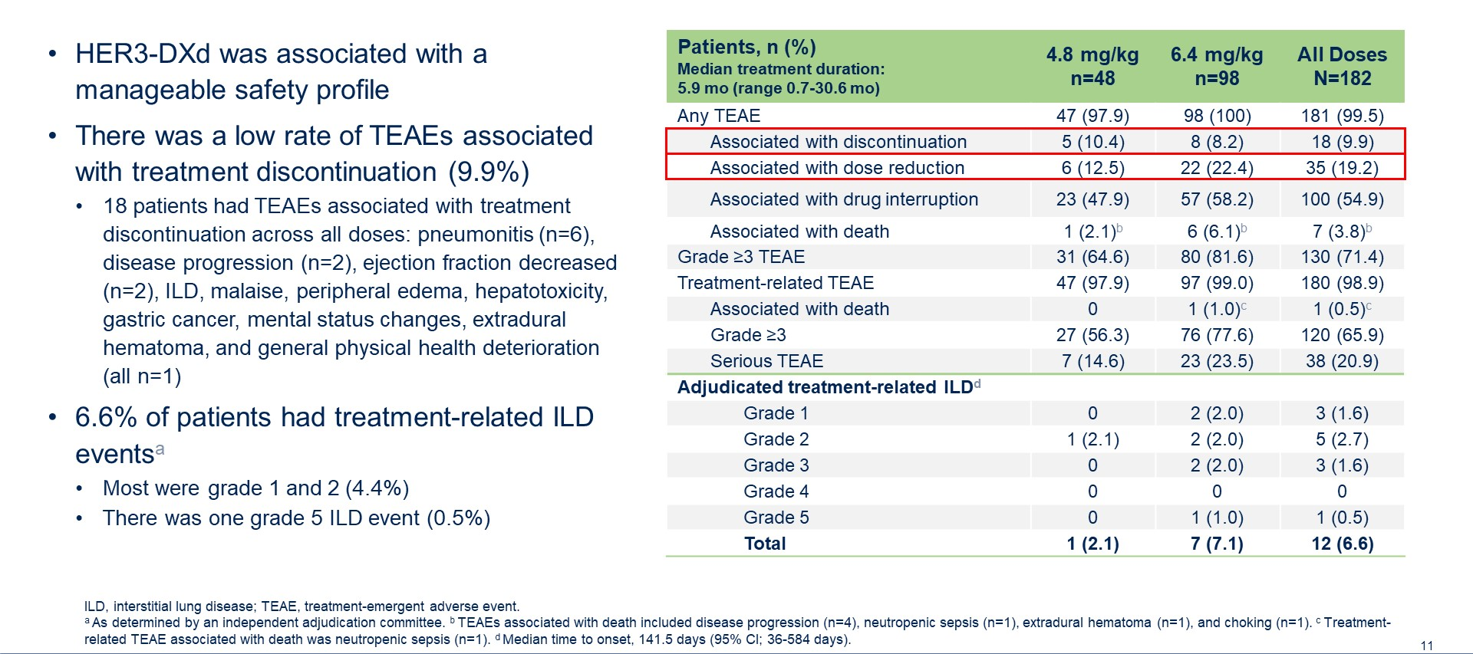
Overall Safety Profile of HER3-DXd
Krop IE et al. ASCO 2022;Abstract 1002.

