Slide 1
Beyond the Guidelines: Clinical Investigator
Perspectives on the Management of
HER2-Low Breast Cancer
Part 3 of a 3-Part CME Satellite Symposium Series in Partnership with
the 2023 San Antonio Breast Cancer Symposium®
Thursday, December 7, 2023
7:15 PM – 8:45 PM CT (8:15 PM – 9:45 PM ET)
Faculty
Aditya Bardia, MD, MPH
Lisa A Carey, MD, ScM, FASCO
Shanu Modi, MD
Professor Peter Schmid, FRCP, MD, PhD
Moderator
Neil Love, MD

Slide 2





Faculty
Aditya Bardia, MD, MPH
Director
Breast Cancer Research Program
Associate Professor
Harvard Medical School
Attending Physician
Massachusetts General Hospital
Boston, Massachusetts
Professor Peter Schmid, FRCP, MD, PhD
Lead, Centre of Experimental
Cancer Medicine
Barts Cancer Institute
London, United Kingdom
Lisa A Carey, MD, ScM, FASCO
L Richardson and Marilyn Jacobs Preyer Distinguished Professor for Breast Cancer Research
Deputy Director for Clinical Sciences
Lineberger Comprehensive Cancer Center
University of North Carolina
Chapel Hill, North Carolina
Moderator
Neil Love, MD
Research To Practice
Miami, Florida
Shanu Modi, MD
Member and Attending
Breast Medicine Service
Memorial Sloan Kettering Cancer Center
Professor of Medicine
Weill Cornell Medical College
New York, New York

Slide 3
Dr Bardia — Disclosures
Consulting Agreements and Contracted Research | AstraZeneca Pharmaceuticals LP, Daiichi Sankyo Inc, Genentech, a member of the Roche Group, Gilead Sciences Inc, Lilly, Menarini Group, Merck, Novartis, Pfizer Inc, Radius Health Inc, Sanofi

Slide 4
Dr Carey — Disclosures
No relevant conflicts of interest to disclose

Slide 5
Dr Modi — Disclosures
Advisory Committee and Consulting Agreements | AstraZeneca Pharmaceuticals LP, Daiichi Sankyo Inc, Genentech, a member of the Roche Group, Gilead Sciences Inc, Seagen Inc
Contracted Research | AstraZeneca Pharmaceuticals LP, Daiichi Sankyo Inc, Genentech, a member of the Roche Group, Seagen Inc

Slide 6
Prof Schmid — Disclosures
Consulting Agreements | AstraZeneca Pharmaceuticals LP, Bayer HealthCare Pharmaceuticals, Boehringer Ingelheim Pharmaceuticals Inc, Celgene Corporation, Daiichi Sankyo Inc, Eisai Inc, Gilead Sciences Inc, Lilly, Merck, Novartis, Pfizer Inc, Puma Biotechnology Inc, Roche Laboratories Inc
Contracted Research | Astellas, AstraZeneca Pharmaceuticals LP, Genentech, a member of the Roche Group, Medivation Inc, a Pfizer Company, Novartis, OncoGenex Pharmaceuticals Inc, Roche Laboratories Inc

Slide 7
Commercial Support
This symposium is sponsored by Research To Practice and supported by grants from AstraZeneca Pharmaceuticals LP and Daiichi Sankyo Inc. This is not an official program of the San Antonio Breast Cancer Symposium®.
Research To Practice CME Planning Committee Members,
Staff and Reviewers
Planners, scientific staff and independent reviewers for Research To Practice have no relevant conflicts of interest to disclose.

Slide 8
This educational activity contains discussion of published and/or investigational uses of agents that are not indicated by the Food and Drug Administration. Research To Practice does not recommend the use of any agent outside of the labeled indications. Please refer to the official prescribing information for each product for discussion of approved indications, contraindications and warnings. The opinions expressed are those of the presenters and are not to be construed
as those of the publisher or grantors.

Slide 9
Agenda
Module 1: Optimal Approaches to HER2 Testing for the Identification of
HER2-Low Breast Cancer — Dr Carey
Module 2: Available Data with and Current Role of HER2-Targeted Therapy
for HER2-Low Disease — Dr Modi
Module 3: Identification and Management of Toxicities with Trastuzumab Deruxtecan — Prof Schmid
Module 4: Future Directions in the Management of HER2-Low Breast Cancer
— Dr Bardia

Slide 10
Breast Cancer Survey Respondents
Aditya Bardia, MD, MPH
François-Clément Bidard, MD, PhD
Adam Brufsky, MD, PhD
Harold J Burstein, MD, PhD
Lisa A Carey, MD, ScM, FASCO
Matthew P Goetz, MD
Erika Hamilton, MD
Sara A Hurvitz, MD, FACP
Komal Jhaveri, MD, FACP
Virginia Kaklamani, MD, DSc
Jane Lowe Meisel, MD
Shanu Modi, MD
Joyce O’Shaughnessy, MD
Mark Pegram, MD
Lajos Pusztai, MD, DPhil, FASCO
Hope S Rugo, MD
Paolo Tarantino, MD
Prof Peter Schmid, FRCP, MD, PhD
Priyanka Sharma, MD
Eric P Winer, MD

Slide 11

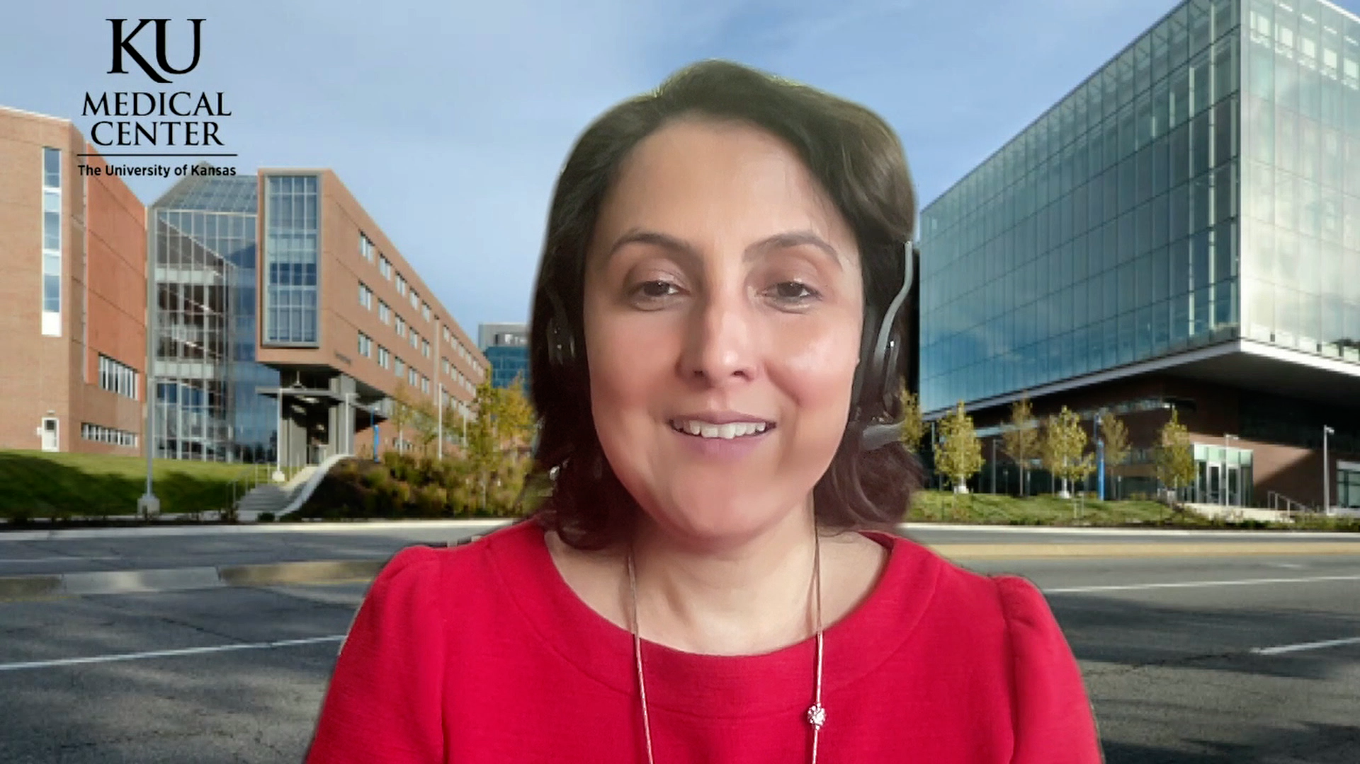
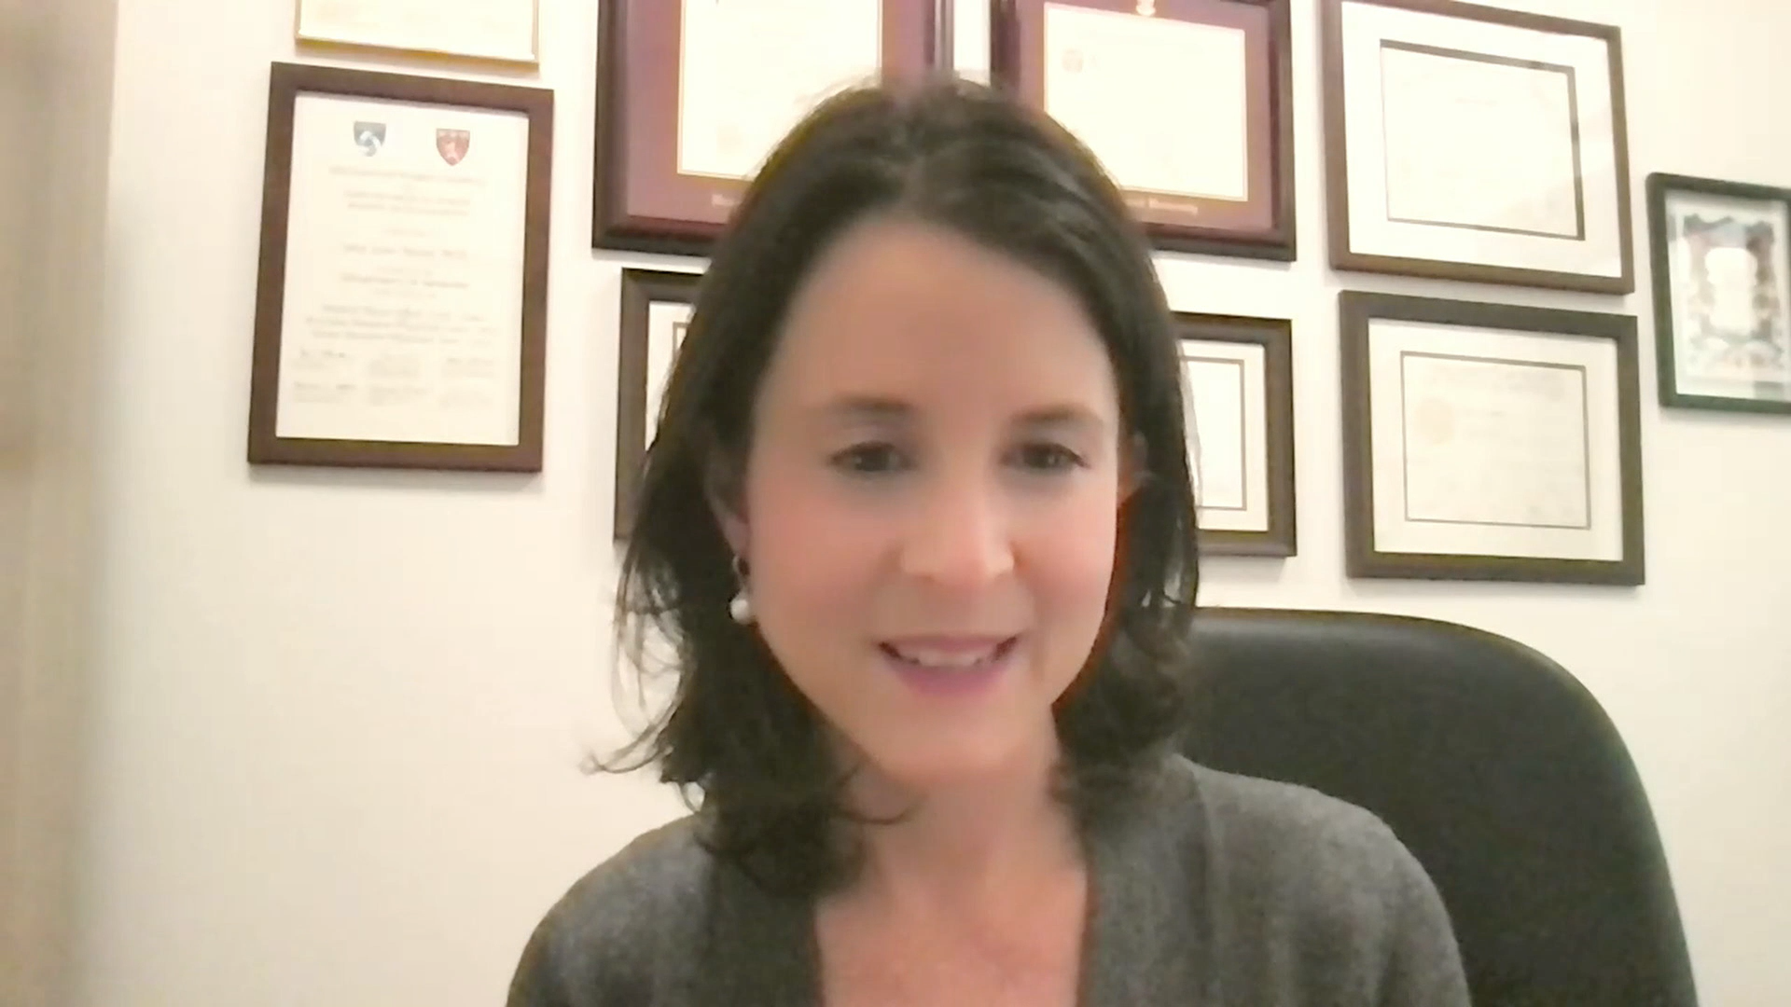


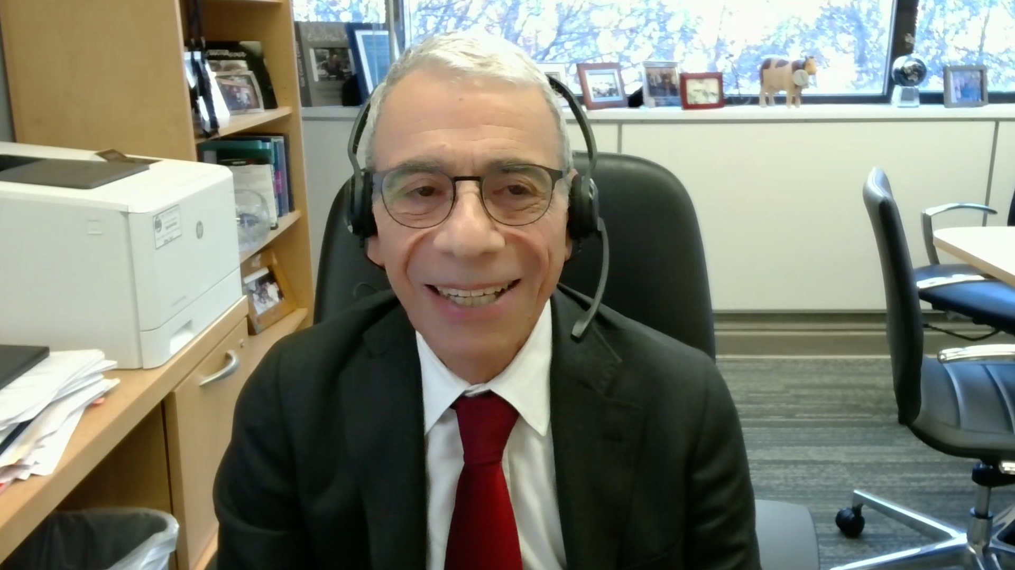
Consulting Faculty
Adam M Brufsky, MD, PhD
Professor of Medicine
Co-Director, Comprehensive Breast Cancer Center
UPMC Hillman Cancer Center
Department of Medicine
University of Pittsburgh
Pittsburgh, Pennsylvania
Priyanka Sharma, MD
Frank B Tyler Professor in Cancer Research
Division of Medical Oncology Department of Internal Medicine
The University of Kansas Cancer Center
Westwood, Kansas
Jane Lowe Meisel, MD
Associate Professor of Hematology
and Medical Oncology
Associate Vice Chair of Faculty Development and Promotions
Winship Cancer Institute of Emory University
Atlanta, Georgia
Paolo Tarantino, MD
Medical Oncologist
Advanced Research Fellow
Dana-Farber Cancer Institute
Harvard Medical School
Boston, Massachusetts
Mark D Pegram, MD
Susy Yuan-Huey Hung Endowed Professor
of Oncology
Director, Clinical and Translational
Research Unit
Associate Director for Clinical Research
Stanford Comprehensive Cancer Institute
Stanford, California
Eric P Winer, MD
Alfred Gilman Professor of Medicine and Pharmacology
Director, Yale Cancer Center
President and Physician-in-Chief Smilow Cancer Hospital
New Haven, Connecticut

Slide 12
Agenda
Module 1: Optimal Approaches to HER2 Testing for the Identification of
HER2-Low Breast Cancer — Dr Carey
Module 2: Available Data with and Current Role of HER2-Targeted Therapy
for HER2-Low Disease — Dr Modi
Module 3: Identification and Management of Toxicities with Trastuzumab Deruxtecan — Prof Schmid
Module 4: Future Directions in the Management of HER2-Low Breast Cancer
— Dr Bardia

Slide 13
Approximately what proportion of patients with metastatic breast cancer have tumors that are HER2-negative or HER2-low based on ER status? (Median; range)
 | ER-positive | ER-negative
HER2 IHC 0 | 30% (20% - 50%) | 58% (20% - 80%)
HER2 IHC 1+ or 2+ | 67% (50% - 80%) | 35% (20% - 70%

Slide 14


Based on available data, do you believe that trastuzumab deruxtecan has shown efficacy in HER2-low tumors other than breast cancer?
Yes
12
No
8

Slide 15
Do you believe that trastuzumab deruxtecan (T-DXd) should receive a tumor-agnostic FDA approval?
Yes
12
No
8
HER2 gene amplification occurs in many tumor types (salivary, endometrial, ovarian, biliary, gastric, etc.). It is likely that T-DXd will have activity in all these HER2+ diseases.
It seems to work for almost all HER2+ cancers and better to give people the option given its excellent efficacy compared to most chemo and very quick (most of the time) impact.
T-DXd is clearly effective in many settings but I don’t think there is enough data to use HER2-low in any tumor. I suspect there will be more data soon that might support this approach.
For HER2 amplified tumors, I would be supportive of a tumor-agnostic label.
But, for HER2 low tumors, the MoA is different and the concept of a universal sensitivity of tumors to vectorized TOPO1 inhibitor is not proven. Thresholds may also be different across tumor types.

Slide 16
Regulatory and reimbursement issues aside, would you offer trastuzumab deruxtecan to a patient with HER2 IHC 0 metastatic breast cancer with a HER2 mutation?
Yes
14
No
6

Slide 17
HER2 IHC levels and selection of patients for treatment with trastuzumab deruxtecan
Adam M Brufsky, MD, PhD
Jane Lowe Meisel, MD

Slide 18
HER2 IHC 0 breast cancer and potential role for trastuzumab deruxtecan
Paolo Tarantino, MD
Eric P Winer, MD

Slide 19
Optimal Approaches to HER2 Testing to Identify HER2-Low Breast Cancer (BC)
Lisa A. Carey MD, ScM
December, 2023

Slide 20
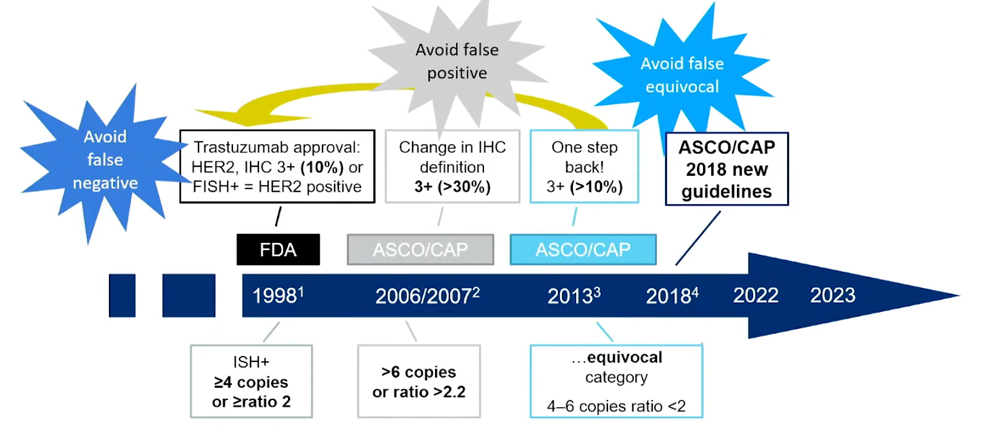
History of HER2 Testing
Purpose: to optimize use of anti-HER2 drugs
Courtesy F. Penault-Llorca, ABC7
Jorgensen JT et al, Front Oncol 2021; Wolff AC et al, JCO 2007;
Wolff AC et al, JCO 2013; Wolff AC et al, JCO 2018

Slide 21
History of HER2 Testing
Purpose:
Optimize anti-HER2 drugs
Identify “HER2-Low”
DB04
Courtesy F. Penault-Llorca, ABC7
Jorgensen JT et al, Front Oncol 2021; Wolff AC et al, JCO 2007;
Wolff AC et al, JCO 2013; Wolff AC et al, JCO 2018

Slide 22
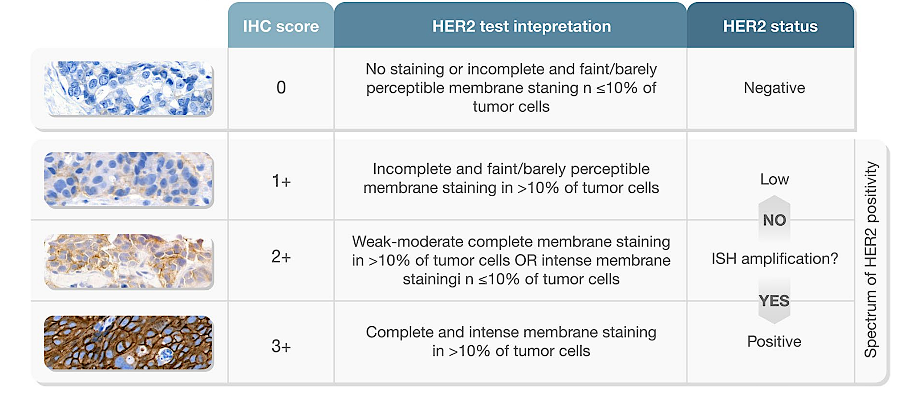
Immunostains (IHC) for HER2
staining in ≤10% of
staining in
Wolff A et al, Arch Path Lab Med 2023

Slide 23
Immunostains (IHC) for HER2: Focus was on ”HER2-Positive”
staining in ≤10% of
staining in
HER2+
Focus 1998-2020
Defining where inhibitory antibodies would work
Wolff A et al, Arch Path Lab Med 2023

Slide 24
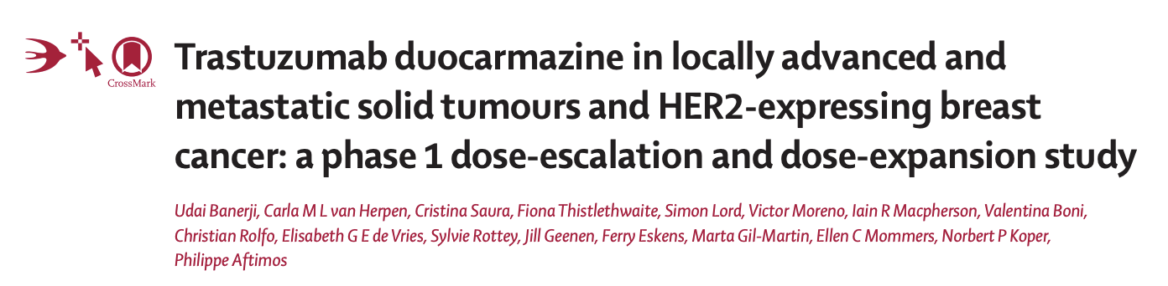
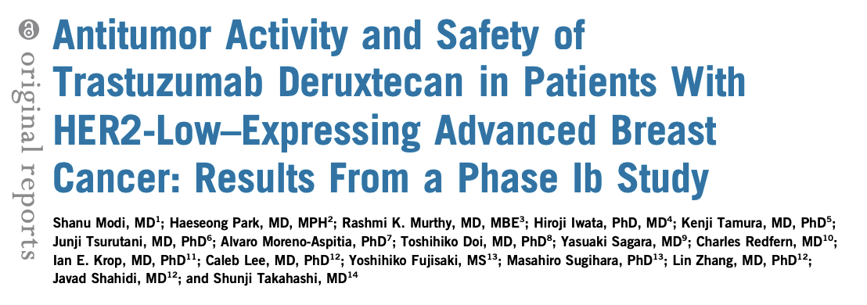
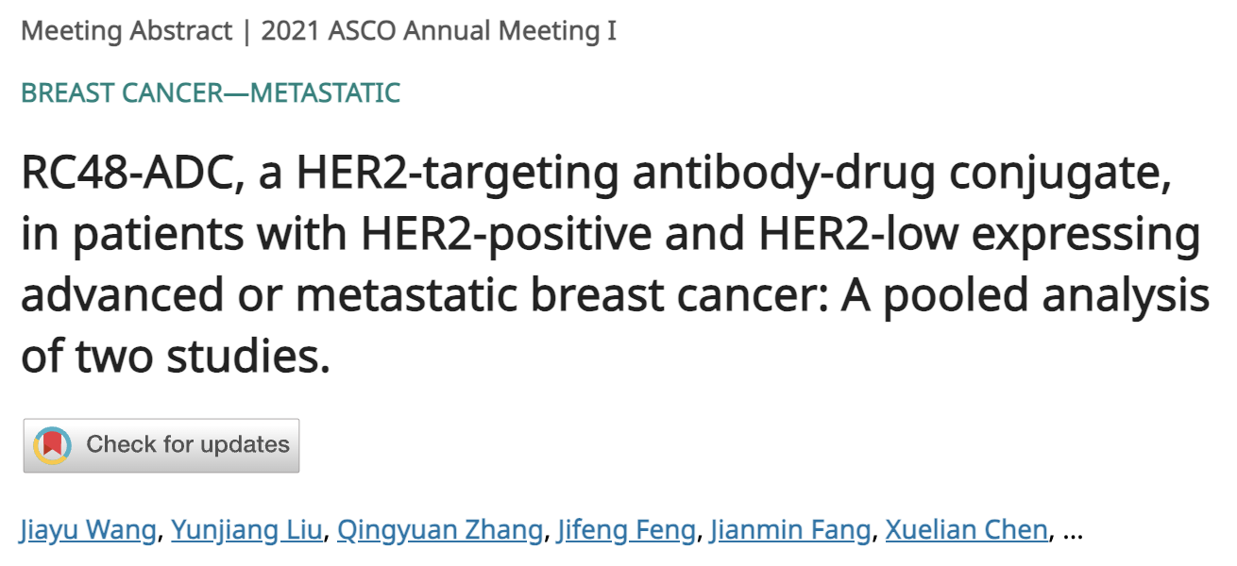
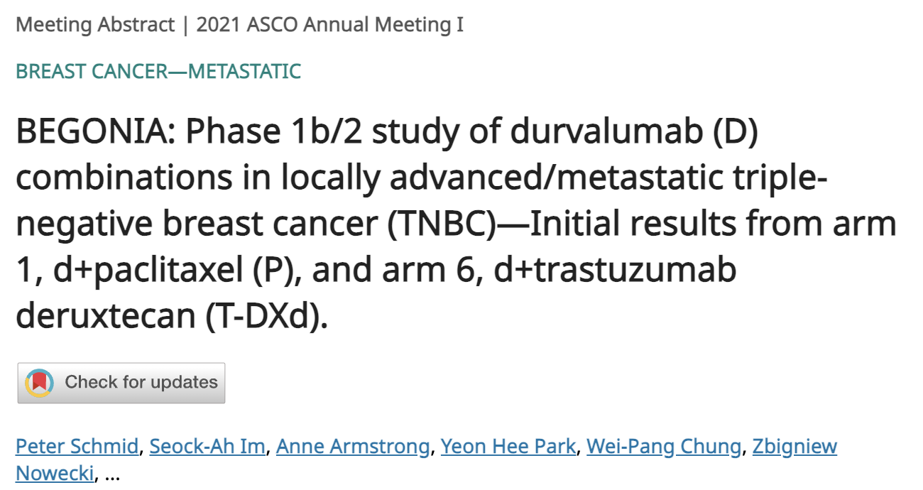
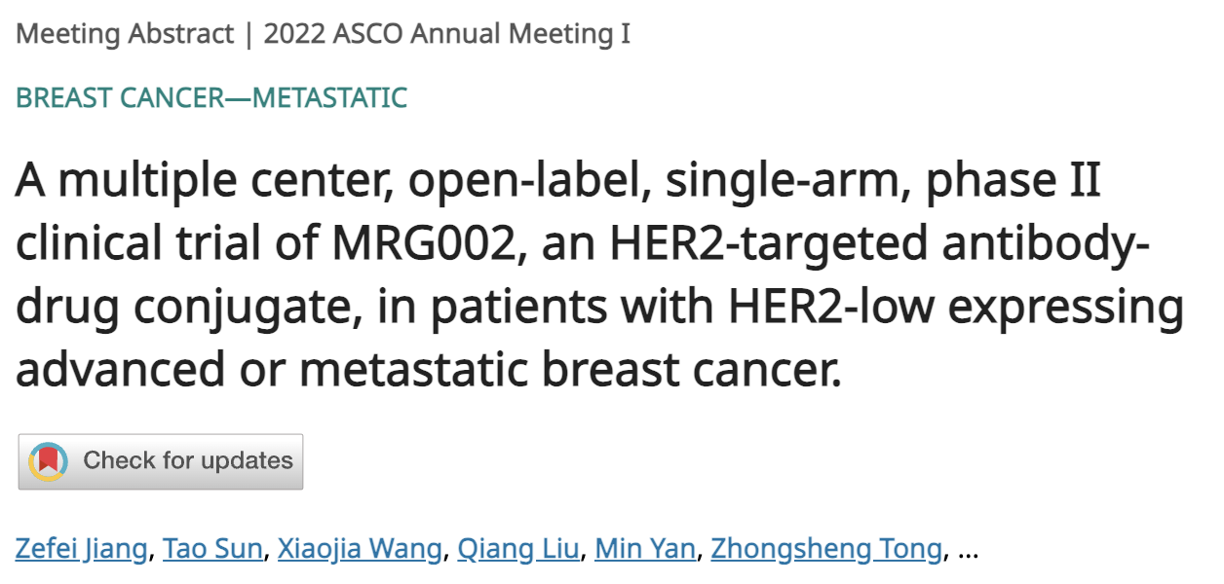

Then Came The Anti-HER2 ADCs…

Slide 25
Immunostains (IHC) for HER2: “HER2-Low”
staining in ≤10% of
HER2-low
staining in
New focus!
Defined in NSABP B-47, used in ADC trials
(Below threshold where “naked” HER2 Ab alone would work)
Wolff A et al, Arch Path Lab Med 2023

Slide 26
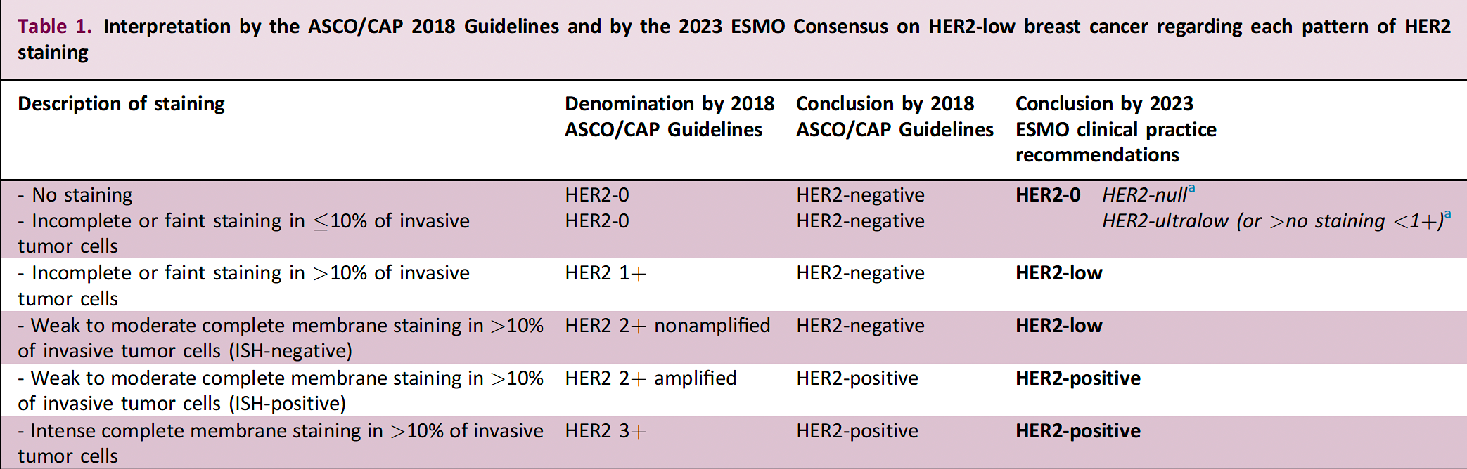
HER2-Low: Defining Immunostains in the Lower Register
How low do you go?
“HER2-ultralow” (vs “-null”)
Included in DB06
(T-DXd vs TPC chemo in HR+ HER2-low)
Unknown if clinically valid
Tarantino et al, Ann Oncol 2023

Slide 27

Testing Biomarkers for Clinical Use
Key elements of assay development:
  Analytical validity
  (reproducible and accurate?)
  Clinical validity
  (differentiate cancers?)
  Clinical utility
  (assay = better decisions?)
Adapted from Simon R, JNCI 2009

Slide 28
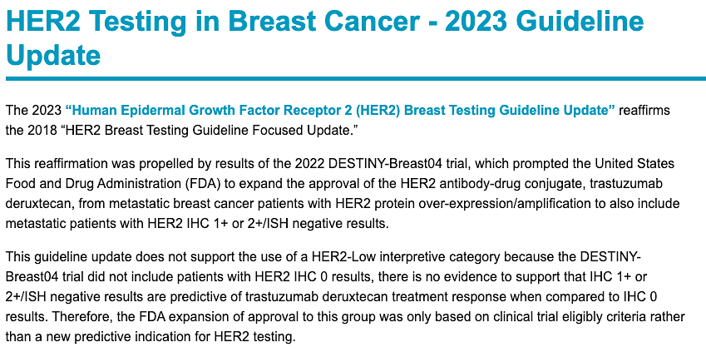
College of American Pathologists Is Not Happy…
https://www.cap.org/protocols-and-guidelines/cap-guidelines/current-cap-guidelines/recommendations-for-human-epidermal-growth-factor-2-testing-in-breast-cancer

Slide 29
General Comments about Defining HER2-Low
HER2 testing was designed to differentiate HER2+ (HER2-driven, HER2-addicted, etc) from not-that. They were not validated for score 0 vs 1+.
HER2-low was not a priori defined as a biologically distinct entity (it was a byproduct of the DESTINY-Breast04 and similar ADC trials).
It is biologically plausible that some HER2 expression is needed for the ”T” part of T-DXd and other HER2-directed ADCs to work.
How much HER2 expression is needed is unclear.

Slide 30
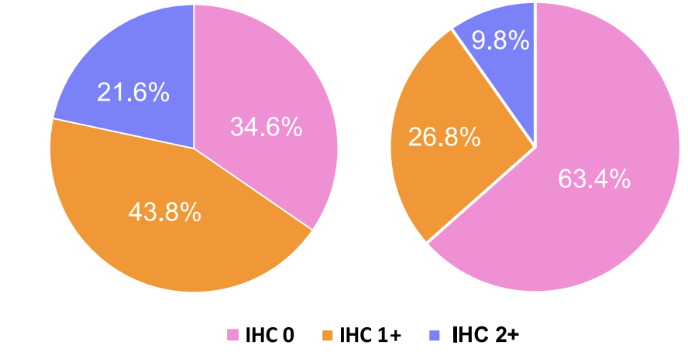
Clinical Characteristics of HER2-Low
1.1M patients, NCDB 2010-2019
ER+ (65%)
ER- (36%)
All P<0.001: | HER2-0 | HER2-Low
ER+ PR+ | 69% | 79%
TNBC | 20% | 10%
< 50 | 23% | 18%
Male | 0.7% | 1.0%
Black | 12% | 11%
Grade 3 | 31% | 24%
T1 | 64% | 66%
N0 | 73% | 72%
Ductal | 75% | 79%
Lobular | 12% | 11%
Metaplastic | 1.0% | 0.3%
Mucinous | 2.7% | 1.6%
From 3700 incident BC (70% primary)
Mixed MBC/EBC
Schettini et al, NPJ Breast 2021; Peiffer DS et al, JAMA Oncol 2023

Slide 31
Clinical Characteristics of HER2-Low
Beyond HR, other clinical differences are subtle
ER+ (65%)
ER- (36%)
All P<0.001: | HER2-0 | HER2-Low
ER+ PR+ | 69% | 79%
TNBC | 20% | 10%
< 50 | 23% | 18%
Male | 0.7% | 1.0%
Black | 12% | 11%
Grade 3 | 31% | 24%
T1 | 64% | 66%
N0 | 73% | 72%
Ductal | 75% | 79%
Lobular | 12% | 11%
Metaplastic | 1.0% | 0.3%
Mucinous | 2.7% | 1.6%
From 3700 incident BC (70% primary)
Mixed MBC/EBC
Schettini et al, NPJ Breast 2021; Peiffer DS et al, JAMA Oncol 2023

Slide 32
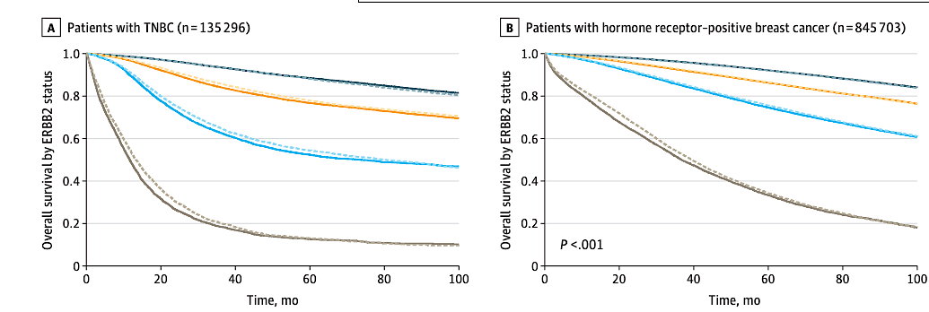
Prognosis by HER2-Low Status
After correcting for HR status, similar outcomes
With conventional therapies….
HER2-based Rx not represented
Peiffer DS et al, JAMA Oncol 2023

Slide 33
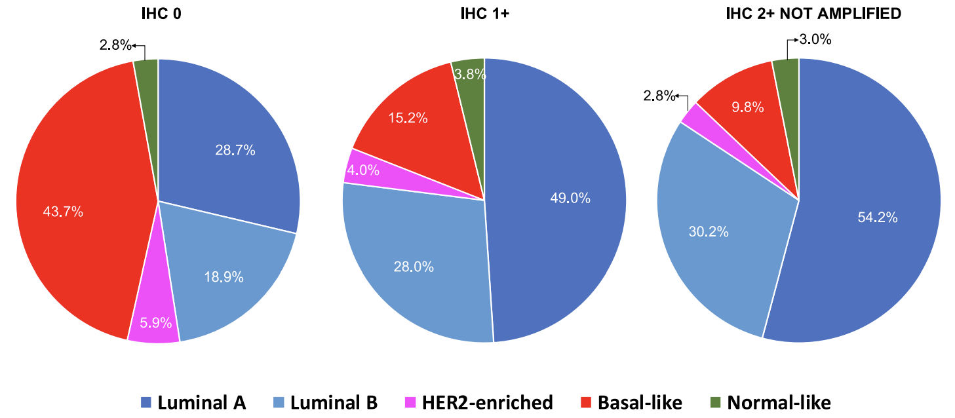
Molecular Subtypes
From 3700 incident BC (70% primary)
Mixed MBC/EBC
 | ER+ |  | TNBC
Intrinsic Subtype | HER2-0 | HER2-Low | HER2-0 | HER2-Low
Luminal A | 52% | 59% | 2% | 2%
Luminal B | 35% | 33% | 0 | 0
HER2-Enriched | 3% | 3% | 9% | 7%
Basal-like | 8% | 2% | 85% | 83%
Normal-like | 2% | 3% | 4% | 8%
Schettini et al, NPJ Breast 2021

Slide 34
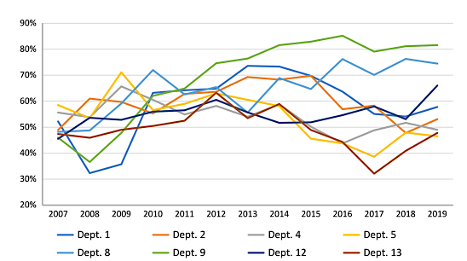
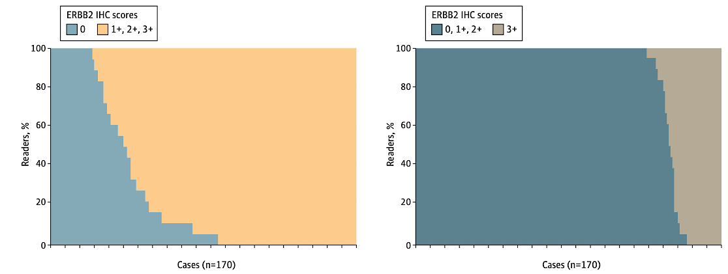
Precision of HER2-Low Testing
“HER2-Low” by IHC
8 Danish Pathology Depts with > 3000 BC patients
Agreement among 18 board-certified pathologists
26% for
HER2-0
vs > 0
58% for
HER2-3+
vs < 3+
High inter-observer variability in calling HER2-Low.
Not seen in calling HER2 3+
Nielsen K et al, Breast Cancer Res 2023; Fernandez A et al, JAMA Oncol 2022

Slide 35
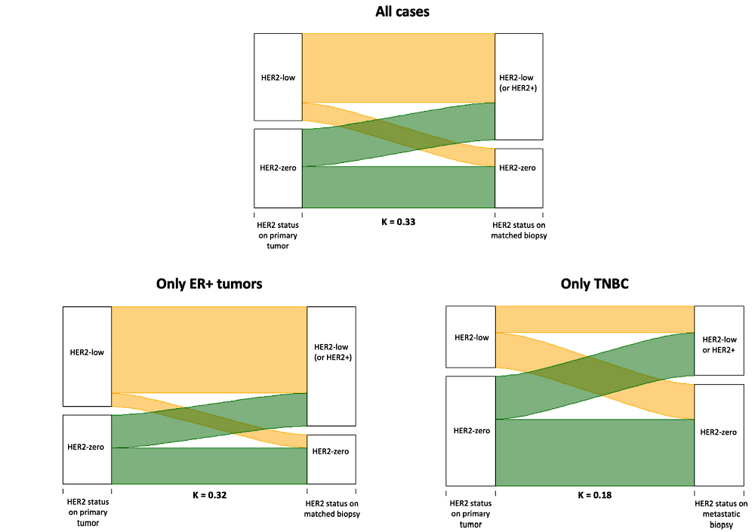
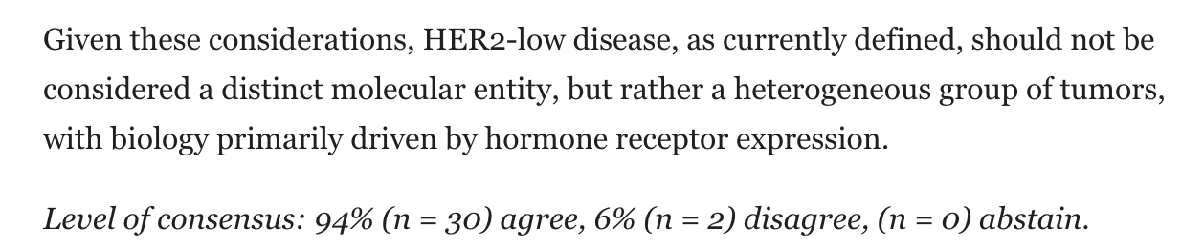
HER2-Low as a Biomarker: Sources of Heterogeneity
Analytic (fixation, Ag retrieval…)
Histologic and spatial heterogeneity
Primary / metastasis variation (38%)
Others…
T-DXd active across HER2 IHC:
(N=182)
(N=50)
 | RR | PFS
HER2+ | 71% | 11.1m
HER2-Low | 38% | 6.7m
HER2-0 | 30% | 4.2m
2023 ESMO Expert Consensus Statement
Miglietta F et al, NPJ Breast 2021; Tarantino P et al, Eur J Cancer 2022; Tarantino et al, Ann Oncol 2023

Slide 36
Training for HER2-Low Interpretation
787 tumors from MBC patients rescored locally after formal retraining in reading low-level HER2 immunostains (2018 ASCO/CAP).
  13 labs, 10 countries, multiple Abs (Ventana 4B5, HercepTest, Bond Oracle HER2,…)
  = 67% HER2-Low (no difference among IHC antibodies)
  71% HR+, 53% HR-
  68% primary, 67% metastasis
~ 80% concordance between original and rescore.
30% rescored from HER2-0 to -low (< 10% rescored from HER2-Low to -0)
Among 74 pathologists across the globe
HER2-0 concordance ↑ from 75% to 89% after 4h training
Viale G et al, JCO 2023; Ruschoff J et al, AACR 2023

Slide 37
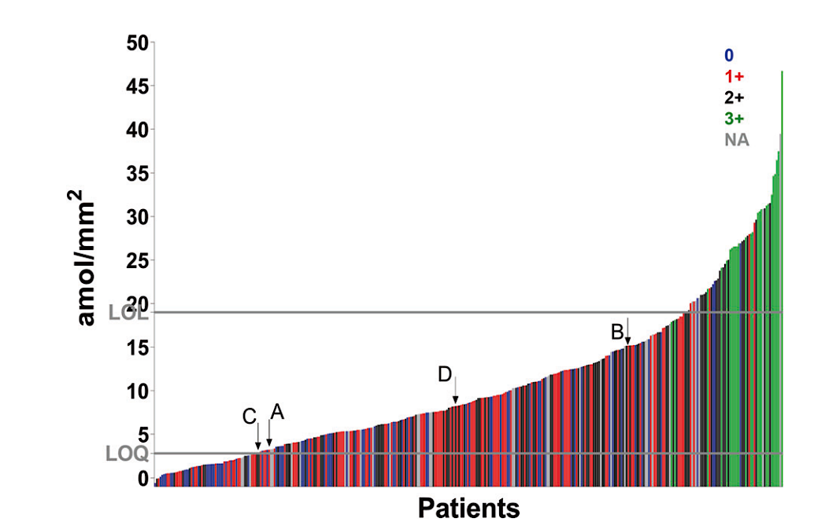
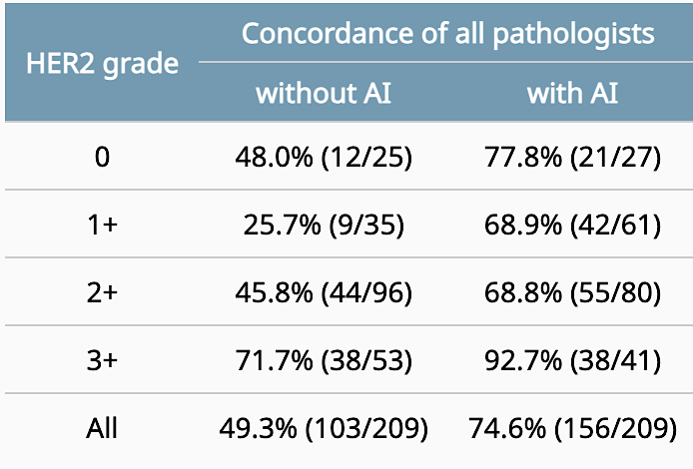
Novel Quantitative Approaches Are Coming…
Newer methods
e.g. AQUA – quantitative fluorescence
↑ discrimination in lower HER2 expression
And/Or: Machine learning-based image analysis to reduce interobserver variability
Moutafi M et al, Lab Invest 2022; Jung M et al, ASCO 2022

Slide 38
Summary
Little evidence that HER2-Low represents a biologically distinct entity, but (despite CAP skepticism) it is clinically actionable
Any HER2-Low test result counts!
Conventional IHC definition is improving but may be suboptimal for technical and biologic reasons.
Newer methodologies may provide more clinical validity and utility; HER2 threshold for clinical activity of HER2-directed ADCs currently unknown.

Slide 39
Agenda
Module 1: Optimal Approaches to HER2 Testing for the Identification of
HER2-Low Breast Cancer — Dr Carey
Module 2: Available Data with and Current Role of HER2-Targeted Therapy
for HER2-Low Disease — Dr Modi
Module 3: Identification and Management of Toxicities with Trastuzumab Deruxtecan — Prof Schmid
Module 4: Future Directions in the Management of HER2-Low Breast Cancer
— Dr Bardia

Slide 40


Regulatory and reimbursement issues aside, for a patient with metastatic breast cancer, at what point would you like to use trastuzumab deruxtecan?
ER-Positive
HER2-Low
After 1 line of endocrine therapy
1
After 1 line of chemotherapy
18
After 2 lines of endocrine therapy
1

Slide 41
Regulatory and reimbursement issues aside, for a patient with metastatic breast cancer, at what point would you like to use trastuzumab deruxtecan?
ER-Negative
HER2-Low
After 1 line of chemotherapy
11
After 2 lines of chemotherapy
8
After more than 2 lines
of chemotherapy
1

Slide 42
How do you generally sequence the following agents for a patient with HER2-low metastatic breast cancer who is eligible to receive both?
ER-Positive
Trastuzumab deruxtecan → sacituzumab govitecan
19
Sacituzumab govitecan → trastuzumab deruxtecan
1
ER-Negative
18
Sacituzumab govitecan → trastuzumab deruxtecan
Trastuzumab deruxtecan → sacituzumab govitecan
2

Slide 43
What is your global view on the antitumor efficacy of trastuzumab deruxtecan in patients with HER2-low breast cancer? (Eg, approximate proportion of patients who experience a clinical response; general duration of response)
75% respond; duration 6-12 months (in my practice)
3/4 of patients will either have a response or a PFS >6 months
Most pts respond -- probably around two-thirds -- but duration is relatively short at 5-6 months (all pts would be pretreated with 1-2 lines of chemotherapy for MBC)
60% response rate, 10-12 month PFS
Approximately half of the patients respond, duration is generally short (4-5 months)
40% response, duration of response 5-6 months
30-40% with partial/complete response; duration 8-10 months
About 30-40% experience a response. In clinic I am not seeing the very long duration of responses in many patients
Much better than chemotherapy, duration longer than just 2 months
Hard to know, I usually give sacituzumab first and most rapid relapsing patients with TNBC are HER2 IHC 0
Depends on prior lines of chemotherapy but response rate in 2L setting would be around 35% with median duration 4-6 months

Slide 44
Integration of antibody-drug conjugates in the management of recurrent metastatic HER2-low breast cancer
Priyanka Sharma, MD

Slide 45
Sequencing therapy for recurrent metastatic triple-negative breast cancer
Adam M Brufsky, MD, PhD

Slide 46
Therapy options for patients with HER2-low metastatic breast cancer after capecitabine
Eric P Winer, MD

Slide 47
HER2 Targeted Therapy for HER2 LOW MBC
Shanu Modi, MD
Attending, Section Head HER2 Breast Program
Memorial Sloan Kettering Cancer Center
Dec 7, 2023

Slide 48
HER2 Expressing Breast Cancer: Positive, Negative, and HER2-Low
Historical MBC paradigm
HER2+
IHC 3+, 2+/ISH+
HER2+
15-20%
HR+/HER2−
IHC 0, 1+, 2+/ISH−
HER2-low:
IHC 1+ or IHC 2+/ISH-
HER2−
~65%
HR−/HER2− (TNBC)
~15%
Aogi K, et al. Ann Oncol. 2012;23:1441-8.; Eiger D, et al. Cancers (Basel). 2021;13(5):1015. ; Fehrenbacher L, et al. J Clin Oncol. 2019;38(5):444-453.; Mo H, et al. Clin Breast Cancer. 2022;22:143-8. ; Kaufman et al. J Clin Oncol. 2015;33:594-601.; Schettini F, et al. NPJ Breast Cancer. 2021;4;7(1):1.; Tarantino P, et al. J Clin Oncol. 2020;38(17):1951-19622.;

Slide 49
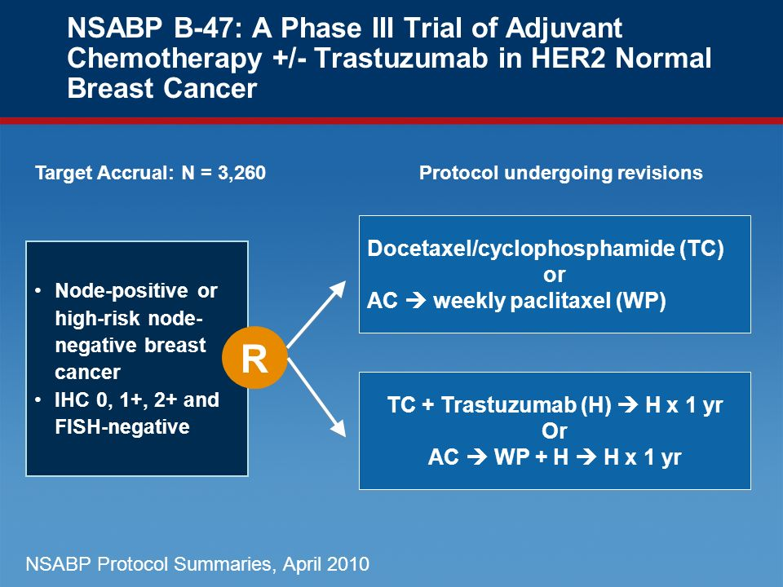
NSABP B-47
A phase 3 trial was conducted to understand if adjuvant trastuzumab was beneficial for patients with HER2-low breast cancer
3,270 HER2-low EBC patients randomized
57% HER2 1+, 43% HER2 2+
20% N-, 80% N+
17% TNBC, 83% HR+
56% received AC-T, 44% received TC
=
Fehrenbacher L, et al. J Clin Oncol. 2020;38(5):444-453.

Slide 50
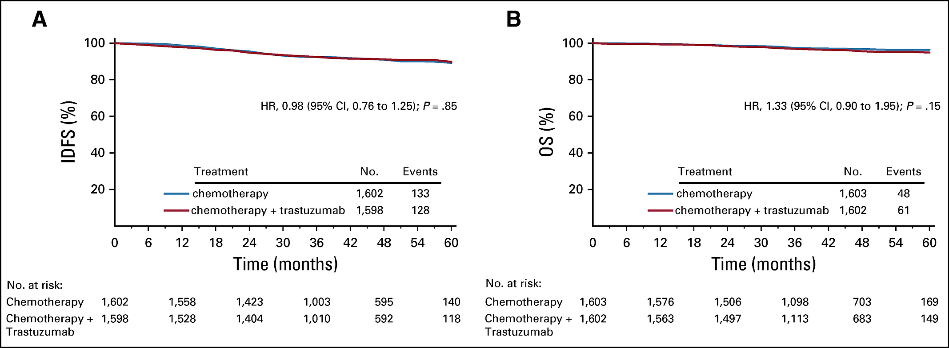
NSABP B-47: Efficacy Results
NO BENEFIT of adjuvant trastuzumab for HER2-low Breast Cancer
Fehrenbacher L, et al. J Clin Oncol. 2020;38(5):444-453.

Slide 51
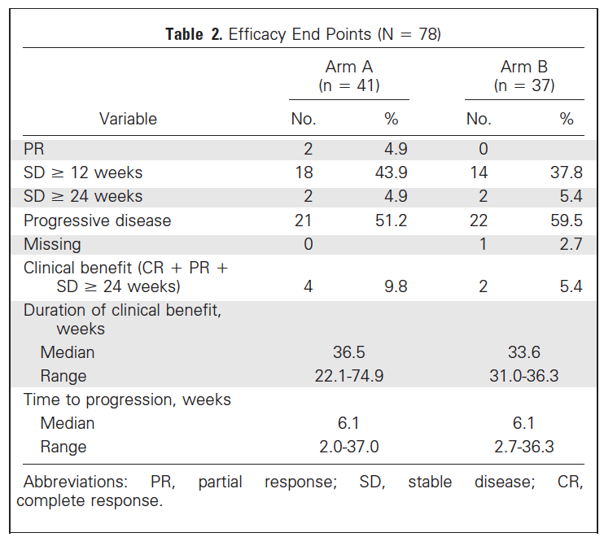
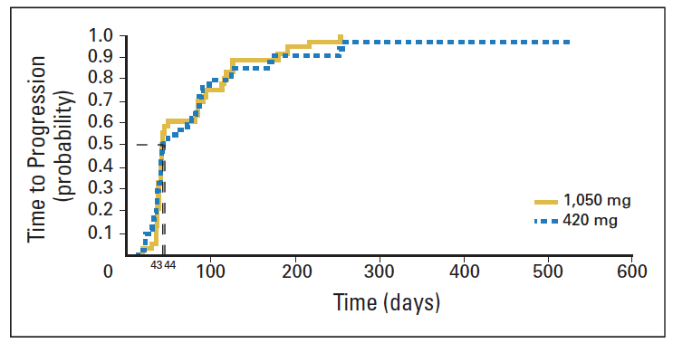
Pertuzumab for HER2-low MBC
Similar results were observed in the metastatic setting
In a population of largely (90%) HER2-low MBC patients, treatment with pertuzumab led to an ORR of 4.9% and a median time to progression of 1.5 months
NO CLINICAL BENEFIT WITH THE BLOCKADE OF THE HER2 PATHWAY IN HER2-LOW BREAST CANCER
Gianni L et al. J Clin Oncol. 2010;28(7):1131-1137.

Slide 52
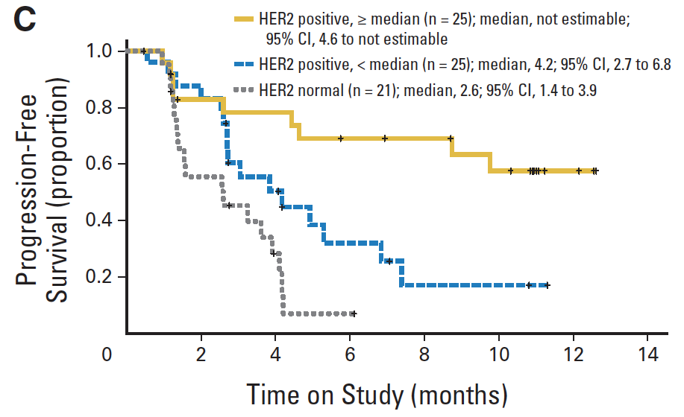
T-DM1 for HER2-low MBC
Retrospective evaluation of T-DM1 in 21 cases of HER2-non-amplified MBC
Only 1 response (ORR 4.8%) and mPFS 2.6 months
LITTLE ACTIVITY OF T-DM1 IN HER2-NEGATIVE mBC
Burris HA, et al. J Clin Oncol. 2011;29(4):398–405.

Slide 53
Trastuzumab Deruxtecan (T-DXd): Next Generation HER2 ADC
Characteristic Differences Between T-DXd and T-DM1
HER2 Targeting ADCs with similar mAB Backbone
Trastuzumab deruxtecan
(T-DXd)
T-DXd | ADC Attributes | T-DM1
Topoisomerase I inhibitor | Payload MoA | Anti-microtubule
~8:1 | Drug-to-antibody ratio | ~3.5:1
Yes | Tumor-selective cleavable linker? | No
Yes | Evidence of bystander anti-tumor effect? | No
Trastuzumab emtansine
(T-DM1)
1. Nakada T et al. Chem Pharm Bull (Tokyo). 2019;67:173-85. 2. Ogitani Y et al. Clin Cancer Res. 2016;22:5097-108. 3. Trail PA et al. Pharmacol Ther. 2018;181:126-42.
4. Ogitani Y et al. Cancer Sci. 2016;107:1039-46. 5. LoRusso PM et al. Clin Cancer Res. 2011;17:6437-47.
Cortes, J et al. ESMO 2021

Slide 54
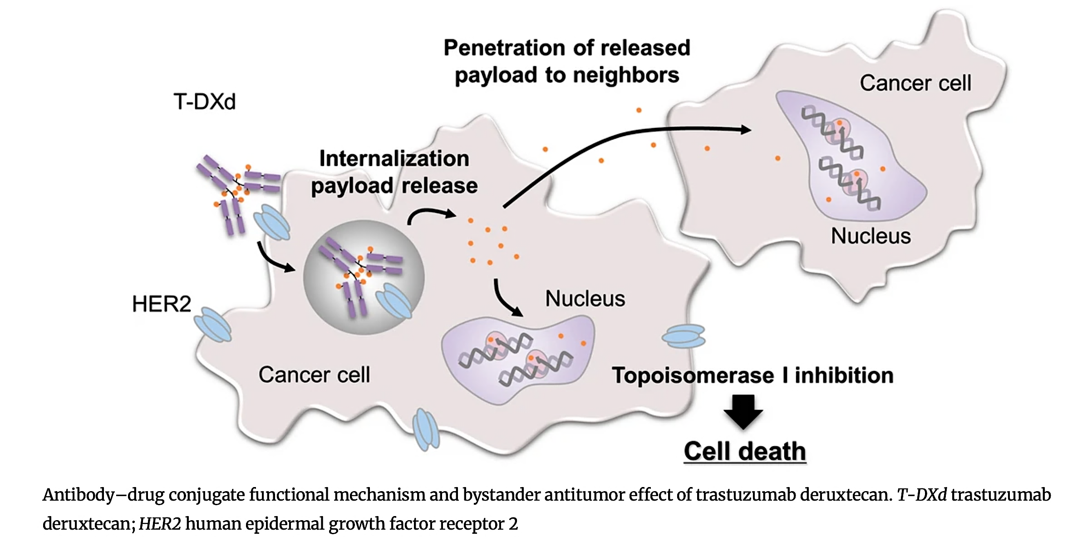
T-DXd: Bystander Effect and Rationale for Targeting HER2 Heterogeneity
Shitara K et al. Gastric Cancer 2021;24(4):780-89.

Slide 55
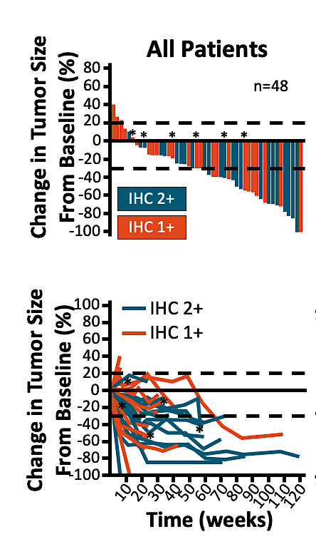
T-DXd in HER2-Low MBC: Robust and Durable Antitumor Activity
Phase 1 Trial
Heavily pretreated HER2 Low MBC
Median prior lines: 7.5
ORR = 37%
mDOR = 10.4 mo
mPFS = 11 mo
Modi S, JCO. 2020;38:1887.

Slide 56
DESTINY-Breast04: Phase 3 Study of T-DXd for HER2-low mBC
An open-label, multicenter study (NCT03734029)
T-DXd
5.4 mg/kg Q3W
(n = 373)
Centrally HER2 Low MBC (IHC 1+ or IHC 2+/ISH−)
1-2 prior lines of chemo
        or relapse <6mo of adj CTx
HR+ disease considered endocrine refractory
Primary endpoint
PFS by BICR (HR+)
Key secondary endpoints^{d}
PFS by BICR (all patients)
OS (HR+ and all patients)
R
2:1
HR+ ≈ 480
HR− ≈ 60
TPC
Capecitabine, eribulin, gemcitabine, paclitaxel, nab-paclitaxel^{c}
(n = 184)
Stratification factors
Centrally assessed HER2 status^{b} (IHC 1+ vs IHC 2+/ISH−)
1 vs 2 prior lines of chemotherapy
HR+ (with vs without prior treatment with CDK4/6 inhibitor) vs HR−
BICR, blinded independent central review; CDK, cyclin-dependent kinase; HER2, human epidermal growth factor receptor 2; HR, hormone receptor; IHC, immunohistochemistry; ISH, in situ hybridization; mBC, metastatic breast cancer; OS, overall survival; PFS, progression-free survival; Q3W, every three weeks; T-DXd, trastuzumab deruxtecan; TPC, treatment of physician’s choice.
ªIf patients had HR+ mBC, prior endocrine therapy was required. ^{b}Performed on adequate archived or recent tumor biopsy per ASCO/CAP guidelines using the VENTANA HER2/neu (4B5) investigational use only [IUO] Assay system. ^{c}TPC was administered accordingly to the label. ^{d}Other secondary endpoints included ORR (BICR and investigator), DOR (BICR), PFS (investigator), and safety; efficacy in the HR− cohort was an exploratory endpoint.
Modi S, et al. N Engl J Med. 2022 Jul 7;387(1):9-20.

Slide 57
DB-04: Prior Therapies
 | Hormone receptor-positive | Full analysis set | All patients
 | T-DXd (n = 331) | TPC (n = 163) | T-DXd (n = 373) | TPC (n = 184)
Lines of systemic therapy (metastatic setting)
Median number of lines (range) | 3 (1-9) | 3 (1-8) | 3 (1-9) | 3 (1-8)
Number of lines, n (%)
1 | 23 (7) | 14 (9) | 39 (10) | 19 (10)
2 | 85 (26) | 41 (25) | 100 (27) | 53 (29)
≥3 | 223 (67) | 108 (66) | 234 (63) | 112 (61)
Lines of chemotherapy (metastatic setting)
Median number of lines (range) | 1 (0-3) | 1 (0-2) | 1 (0-3) | 1 (0-2)
Number of lines, n (%)
0 | 1 (0.3) | 1 (0.6) | 1 (0.3) | 1 (0.5)
1 | 203 (61.3) | 93 (57.1) | 221 (59.2) | 100 (54.3)
2 | 124 (37.5) | 69 (42.3) | 145 (38.9) | 83 (45.1)
≥3 | 3 (0.9) | 0 | 6 (1.6) | 0
Lines of endocrine therapy (metastatic setting)
Median number of lines (range) | 2 (0-7) | 2 (0-6) | 2 (0-7) | 2 (0-6)
Number of lines, n (%)
0 | 28 (8) | 17 (10) | 60 (16) | 34 (18)
1 | 105 (32) | 49 (30) | 108 (29) | 51 (28)
2 | 110 (33) | 53 (33) | 115 (31) | 54 (29)
≥3 | 88 (27) | 44 (27) | 90 (24) | 45 (24)
Prior targeted cancer therapy, n (%) Targeted therapy | 259 (78) | 132 (81) | 279 (75) | 140 (76)
CDK4/6 inhibitor | 233 (70) | 115 (71) | 239 (64) | 119 (65)
HER2 status (IHC), n (%)
1+ | 193 (58) | 95 (58) | 215 (58) | 106 (58)
2+/ISH− | 138 (42) | 68 (42) | 158 (42) | 78 (42)

Slide 58
DB-04 Primary Analysis: PFS in HR+ and All Patients
Hormone receptor-positive
All patients
100
Hazard ratio: 0.51
95% CI, 0.40-0.64
P <0.0001
100
Hazard ratio: 0.50
95% CI, 0.40-0.63
P <0.0001
80
80
T-DXd
mPFS: 10.1 mo
T-DXd
mPFS: 9.9 mo
60
60
Progression-Free Survival Probability (%)
Δ 4.7 mo
Progression-Free Survival Probability (%)
Δ 4.8 mo
40
TPC
mPFS: 5.4 mo
40
TPC
mPFS: 5.1 mo
20
20
0
0
0
1
2
3
4
5
6
7
8
9
10
11
12
13
14
15
16
17
18
19
20
21
22
23
24
25
26
27
28
29
0
1
2
3
4
5
6
7
8
9
10
11
12
13
14
15
16
17
18
19
20
21
22
23
24
25
26
27
28
29
No. at Risk
Months
No. at Risk
Months
T-DXd (n=331):
T-DXd (n=373):
373
365
325
295
290
272
238
217
201
183
156
142
118
100
331
324
290
265
262
248
218
198
182
165
142
128
107
89
78
73
64
48
37
31
28
17
14
12
7
4
4
1
1
0
TPC (n=184):
184
166
119
88
81
71
53
42
35
32
21
18
15
8
4
4
1
1
0
TPC (n=163):
163
146
105
85
84
69
57
48
43
32
30
27
24
20
14
12
8
4
3
2
1
1
1
1
1
1
0
93
90
73
60
51
45
34
32
29
26
22
15
13
9
5
4
3
1
1
1
1
1
1
0
PFS by blinded independent central review.
HR, hormone receptor; PFS, progression-free survival; T-DXd, trastuzumab deruxtecan; TPC, treatment of physician’s choice.
Modi S, et al. N Engl J Med. 2022 Jul 7;387(1):9-20.

Slide 59
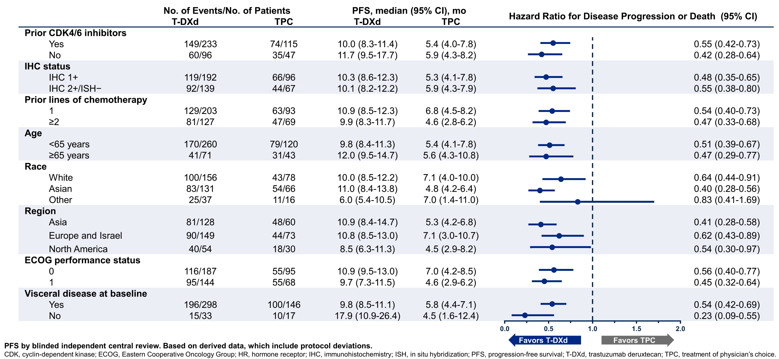
DB-04 Subgroup Analysis: PFS in HR+ HER2-low MBC
Modi S et al., N Engl J Med 2022; 387:9-20, DOI: 10.1056/NEJMoa2203690

Slide 60
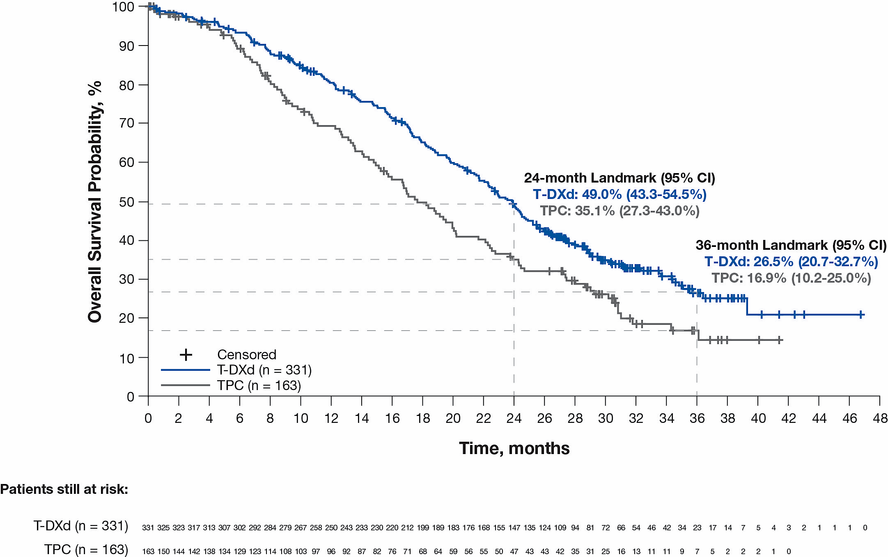
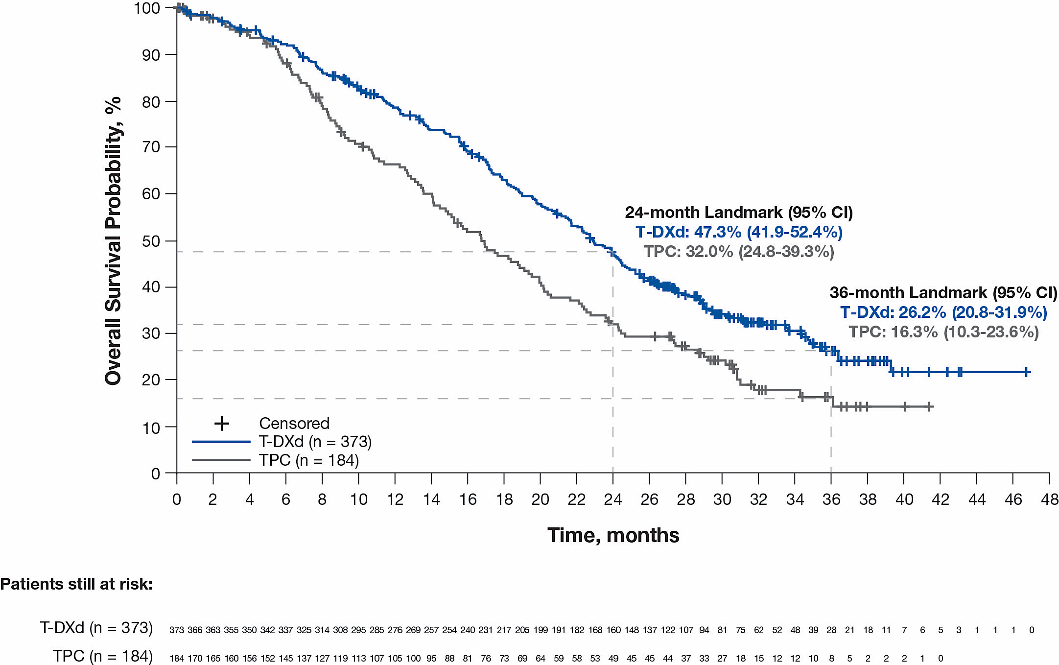
DB-04: Updated Overall Survival (med 32 mo f/u)
HR+ Cohort
All Patients
Median (95% CI) | T-DXd (n = 331) | TPC (n = 163) | Hazard ratio (95% CI)
Primary analysis¹ | 23.9 mo (20.8-24.8) | 17.5 mo (15.2-22.4) | 0.64 (0.48-0.86)
Updated analysis | 23.9 mo (21.7-25.2) | 17.6 mo (15.1-20.2) | 0.69 (0.55-0.87)
Median (95% CI) | T-DXd (n = 373) | TPC (n = 184) | Hazard ratio (95% CI)
Primary analysis¹ | 23.4 mo (20.0-24.8) | 16.8 mo (14.5-20.0) | 0.64 (0.49-0.84)
Updated analysis | 22.9 mo (21.2-24.5) | 16.8 mo (14.1-19.5) | 0.69 (0.55-0.86)
In the HR+ cohort and all patients, median OS was consistent with results from the primary analysis,¹ showing a 31% reduction in risk of death for patients receiving T-DXd compared with those receiving TPC
HR, hormone receptor; mo, month; OS, overall survival; T-DXd, trastuzumab deruxtecan; TPC, treatment of physician’s choice.
1. Modi S et al. N Engl J Med. 2022;387:9-20.
Modi S, ESMO 2023

Slide 61
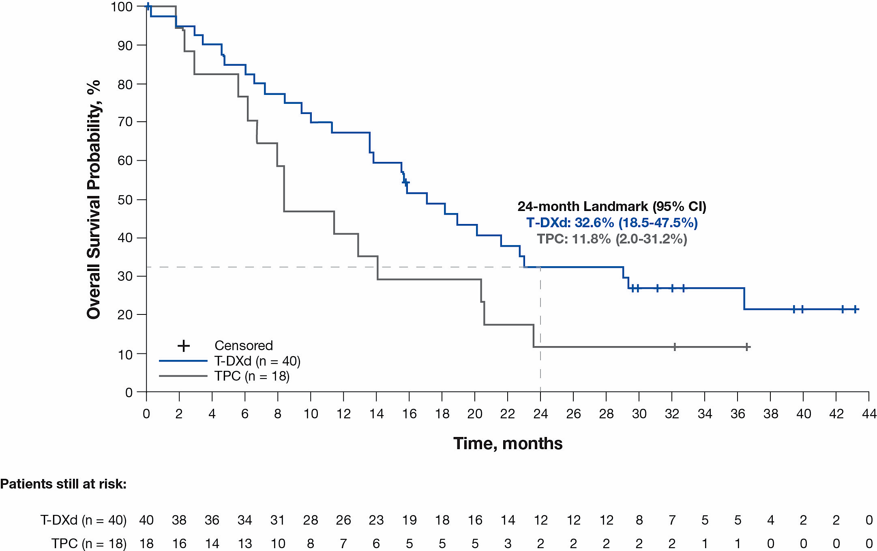
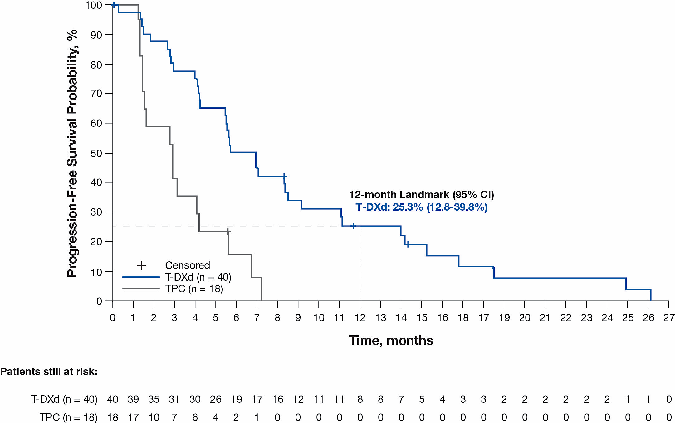
Updated Efficacy in the HR− Cohort (Exploratory Analyses)
Med 32 mo followup
Overall Survival
Progression-Free Survival (by Investigator)
Median (95% CI) | T-DXd (n = 40) | TPC (n = 18) | Hazard ratio (95% CI)
Primary analysis¹ | 18.2 mo (13.6-NE) | 8.3 mo (5.6-20.6) | 0.48 (0.24-0.95)
Updated analysis | 17.1 mo (13.6-23.0) | 8.3 mo (5.6-20.4) | 0.58 (0.31-1.08)
Median (95% CI) | T-DXd (n = 40) | TPC (n = 18) | Hazard ratio (95% CI)
Primary analysis (by BICRª)¹ | 8.5 mo (4.3-11.7) | 2.9 mo (1.4-5.1) | 0.46 (0.24-0.89)
Updated analysis (by investigator) | 6.3 mo (4.2-8.5) | 2.9 mo (1.4-4.2) | 0.29 (0.15-0.57)
ªPFS by investigator was not analyzed for the HR− cohort at the time of the primary analysis.
There was a 42% reduction in risk of death and 71% reduction in risk of disease progression or death for HR− patients receiving T-DXd compared with TPC
BICR, blinded independent central review; HR, hormone receptor; mo, month; NE, not evaluable; OS, overall survival; T-DXd, trastuzumab deruxtecan; TPC, treatment of physician’s choice.
1. Modi S et al. N Engl J Med. 2022;387:9-20.
Modi S, ESMO 2023

Slide 62
DB-04: Exploratory Efficacy in ER-Low Cohort (IHC: 1-10%)
Progression Free Survival
Overall Survival
T-DXd
CT
T-DXd
CT
mPFS
(95% CI)
8.4
(5.6-12.2)
2.6
(1.2-4.6)
mOS
(95% CI)
20.0
(13.5-NE)
10.2
(7.8-14.5)
1.0
1.0
+
+
+
HR (95% CI): 0.2402 (0.1194-0.4829)
HR (95% CI): 0.3461 (0.1608-0.7451)
0.8
0.8
+
+
+
+
+
+
+
+
+
+
+
+
0.6
0.6
+
+
+
+
+
+
+
Progression-free survival
+
Overall survival
+
+
+
0.4
+
0.4
+
+
+
Censor:
T-DXd (n = 35)
CT (n = 17)
Censor:
T-DXd (n = 35)
TPC (n = 17)
0.2
0.2
+
+
0
0
0
2
4
6
8
10
12
14
16
18
20
22
24
26
28
30
0
2
4
6
8
10
12
14
16
18
20
22
24
26
28
30
Time, months
Time, months
T-DXd significantly improved PFS and OS compared with CT in patients with ER-low advanced BC
Cameron. ESMO 2023. Abstr 192MO.

Slide 63
DB-04: PFS2 and Post-Study Anticancer Therapies
 | HR+ Cohort |  | All Patients
 | T-DXd (n = 331) | TPC (n = 163) | T-DXd (n = 373) | TPC (n = 184)
Median PFS2 by investigator, mo (95% CI) | 15.5 (13.8-17.2) | 10.5 (8.3-11.4) | 15.4 (13.6-16.5) | 9.7 (8.3-10.8)
Hazard ratio (95% CI) | 0.51 (0.40-0.64) |  | 0.51 (0.41-0.64)
Post-study anticancer therapies
Systemic treatment, n (%) | 247 (74.6) | 126 (77.3) | 282 (75.6) | 144 (78.3)
Targeted therapy^{c} | 119 (36.0) | 70 (42.9) | 134 (35.9) | 75 (40.8)
CDK4/6 inhibitors | 47 (14.2) | 27 (16.6) | 48 (12.9) | 27 (14.7)
ADC | 16 (4.8) | 15 (9.2) | 18 (4.8) | 15 (8.2)
T-DXd | 2 (0.6) | 4 (2.5) | 2 (0.5) | 4 (2.2)
Sacituzumab govitecan | 9 (2.7) | 5 (3.1) | 11 (2.9) | 5 (2.7)
Endocrine therapy | 102 (30.8) | 56 (34.4) | 103 (27.6) | 57 (31.0)
Chemotherapy | 222 (67.1) | 109 (66.9) | 257 (68.9) | 126 (68.5)
Radiation, n (%) | 32 (9.7) | 25 (15.3) | 37 (9.9) | 29 (15.8)
Surgery, n (%) | 3 (0.9) | 1 (0.6) | 5 (1.3) | 1 (0.5)
ADC, antibody drug conjugate; CDK, cyclin-dependent kinase; HR, hormone receptor; PFS, progression-free survival; T-DXd, trastuzumab deruxtecan; TPC, treatment of physician’s choice.
ªDefined as the time from date of randomization to the first documented progression per investigator assessment on next-line of systemic therapy or death due to any cause, whichever occurs first.
^{b}Participants may have been treated with more than 1 type of post-study anticancer therapy. ^{c}Class includes CDK4/6 inhibitor, immunotherapy, antibody drug conjugates, or no subclass specified.
Modi S, ESMO 2023

Slide 64
DESTINY-Breast04: Summary and Impact
The new mBC paradigm
HER2+
IHC 3+
IHC2+/ISH+
T-DXd is the first HER2-targeted therapy to demonstrate improved efficacy in HER2-low MBC
DESTINY-Breast04 establishes T-DXd as the new standard of care for HER2-low MBC
Potential improvement for ~50% of all patients with MBC in this setting
HER2-low
IHC 1+
IHC2+/ISH-
~50%
HER2-
IHC <1
The FDA approved T-DXd for patients with unresectable or metastatic HER2-low BC who have received a prior CT in the metastatic setting or developed disease recurrence ≤6 mo of completing adjuvant CT.
Endorsed by the International and NCCN Guidelines
Modi. ASCO 2022. Abstr LBA3. Modi. NEJM. 2022;387:9.

Slide 65
Approach to Sequencing Therapy in HR+ HER2 Low MBC
1-3 Lines of Endocrine-Based Targeted Therapy
Endocrine Refractory Disease
Single Agent Chemotherapy
Trastuzumab Deruxtecan
?
Sacituzumab Govitecan
Single Agent Chemotherapy

Slide 66
Approach to Sequencing Therapy in HR- HER2 Low MBC
PDL1 Status/gBRCA status
+
-
Pembrolizumab +Chemotherapy
Single Agent Chemotherapy
Olaparib / Talazoparib
Sacituzumab Govitecan
Trastuzumab Deruxtecan
Both OS benefit
T-DXd smaller cohort experience
Toxicity profile & Patient characteristics
to individualize Rx
?
Cross-over
New ADCs
Clinical Trials
Single Agent Chemotherapy

Slide 67
Agenda
Module 1: Optimal Approaches to HER2 Testing for the Identification of
HER2-Low Breast Cancer — Dr Carey
Module 2: Available Data with and Current Role of HER2-Targeted Therapy
for HER2-Low Disease — Dr Modi
Module 3: Identification and Management of Toxicities with Trastuzumab Deruxtecan — Prof Schmid
Module 4: Future Directions in the Management of HER2-Low Breast Cancer
— Dr Bardia

Slide 68
Have you readministered or would you readminister trastuzumab deruxtecan to a patient who developed Grade 2 interstitial lung disease (ILD)?
Yes
4
No
16
What grade of ILD would lead you to permanently discontinue treatment with trastuzumab deruxtecan?
Grade 2
18
Grade 3
2

Slide 69
How would you characterize the degree of alopecia observed with trastuzumab deruxtecan?
Moderate alopecia as
observed with platinum agents
13
Less alopecia than that
observed with platinum agents
6
Complete alopecia as
observed with anthracyclines
1

Slide 70
How would you describe the “chemotherapy-like” side-effect profile (fatigue, GI symptoms) of trastuzumab deruxtecan?
Similar to but less concerning than the profile of anthracyclines and platinum agents
11
Similar to the profile of anthracyclines and platinum agents
5
Similar to but much less concerning than the profile of anthracyclines and platinum agents
4

Slide 71
Do you use chest imaging to monitor a patient receiving trastuzumab deruxtecan who otherwise does not require chest imaging?
No
4
Yes
13
How often would you order imaging if the patient remained asymptomatic?
Every 6 weeks
1
Every 9 weeks
11
Every 12 weeks
5

Slide 72
Do you perform pulmonary function tests?
Yes
3
No
17
Do you use self-reporting apps, at-home oxygen saturation devices or other electronic means to pick up pulmonary symptoms particularly related to exercise?
Yes
1
19
No

Slide 73
Do you believe that the incidence of ILD is higher among Asian people who have immigrated to the United States than in non-Asian US populations?
Yes
9
No
11

Slide 74
Strategies to manage chemotherapy-related side effects associated with trastuzumab deruxtecan
Paolo Tarantino, MD

Slide 75
Approach to patients responding to trastuzumab deruxtecan who have abnormal chest imaging
Adam M Brufsky, MD, PhD

Slide 76
Monitoring for trastuzumab deruxtecan-associated ILD/pneumonitis; trastuzumab deruxtecan in patients with prior ILD
Jane Lowe Meisel, MD
Priyanka Sharma, MD

Slide 77

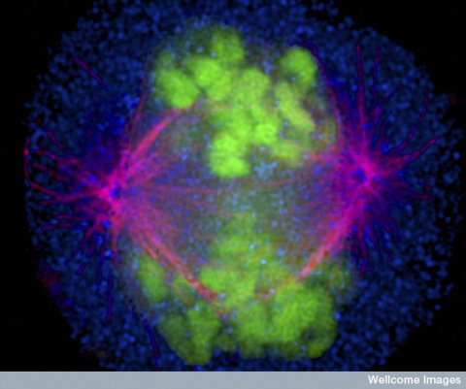

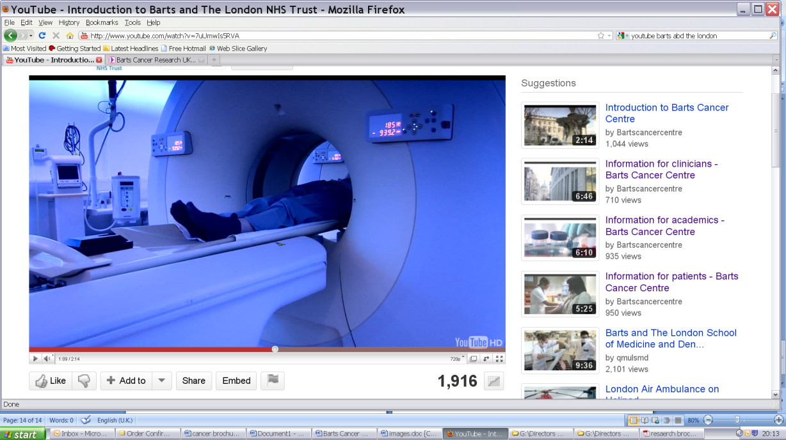



Immunotherapeutic approaches in the treatment of breast cancer
Identification and Management
of Toxicities with T-DXd
Professor Peter Schmid, MD PhD FRCP
Lead, Centre for Experimental Cancer Medicine
Barts Cancer Institute, St Bartholomew’s Hospital
Queen Mary University of London

Slide 78
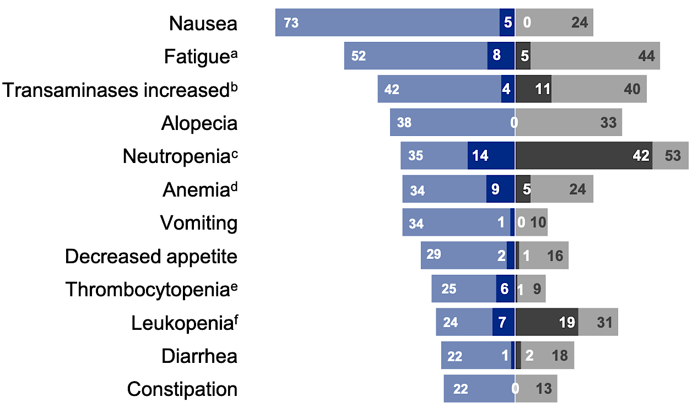

Trastuzumab Deruxtecan (T-DXd) in HER2_{low} MBC
Drug related TEAEs in ≥20% of patients
Most common TEAEs associated with:
T-DXD
TPC
 | T-DXd | TPC
Treatment discontinuation | 10.2% ILD/pneumonitis | 2.3% peripheral sensory neuropathy
Dose reduction | 4.6% nausea and 3% decreased platelets | 10.5% neutropenia
Total on-treatment deaths§ | 3.8% | 4.7%
 | Grade 1 |  | Grade 2 |  | Grade 3 |  | Grade 4 |  | Grade 5 |  | Any Grade
 | T-DXd (n=371) | TPC (n=172) | T-DXd (n=371) | TPC (n=172) | T-DXd (n=371) | TPC (n=172) | T-DXd (n=371) | TPC (n=172) | T-DXd (n=371) | TPC (n=172) | T-DXd (n=371) | TPC (n=172)
ILD/pneumonitis* | 13 (3.5) | 1 (0.6) | 24 (6.5) | 0 | 4 (1.1) | 0 | 0 | 0 | 4 (1.1) | 0 | 45 (12.1) | 1 (0.6)
Left ventricular dysfunction†
LVEF decreased | 2 (0.5) | 0 | 15 (4.0) | 0 | 1 (0.3) | 0 | 0 | 0 | 0 | 0 | 18 (4.9) | 0
Cardiac failure‡ | 0 | 0 | 1 (0.3) | 0 | 1 (0.3) | 0 | 0 | 0 | 0 | 0 | 2 (0.5) | 0
AEs of special interest
Modi S, et al. ESMO 2023; Abstract 376O.

Slide 79
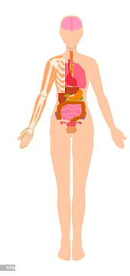
Side effects of ADCs
T-DM1
T-DXd
Fatigue 22-35%
Fatigue 48%
Determinants of ADC Toxicity
Target (tissue distribution)
Payload
Linker
Antibody effects (on target or immune)
Patient factors
Interstitial lung disease 0.5%
Interstitial lung disease 12%
LVEF 2.2%
LVEF 4%
Thrombocytopenia 25%
Thrombocytopenia 24%
Haemorrhage 35%
Neutropenia 33%
LFTs 24%
LFTs 24%
Diarrhoea 10-25%
Diarrhoea 22%
Nausea 39-47%
Nausea 73%
Peripheral Neuropathy 32%
Modi, et al NEJM 2022; Hackshaw BCRT 2022; Powell, ESMO Open 2022; Abuhelwa, Drugs 2022

Slide 80
T-DXd: Management of Nausea and Vomiting
T-DXd is moderately emetogenic
Nausea can be effectively managed with appropriate anti-emetic prophylaxis and treatment
Consider slightly longer breakthrough medication compared to standard chemotherapy
Prophylactic/Acute N/V
Delayed N/V (d2 & 3)
Breakthrough N/V
Moderately emetogenic
  5-HT3 + Dexamethasone
Highly emetogenic
  5-HT3 + Dexamethasone
  NK1R Antagonist
  5-HT3
  Dexamethasone (8mg BD)
  Olanzapine
  Ondansetron
  Prochlorperazine
  Cyclizine
  Olanzapine
  Dexamethasone
5-HT3 receptor antagonist
Dolasetron 100 mg PO once.
Granisetron 10 mg SC or 2 mg PO or 0.01 mg/kg (max. 1 mg) IV once.
Ondansetron 16 mg to 24 mg PO once or 8 mg to 16 mg IV once.
Palonosetron 0.25 mg IV once.
NK1R antagonist
Aprepitant 125 mg PO once or emulsion 130 mg IV.
Fosaprepitant 150 mg IV once.
Netupitant 300 mg/palonosetron 0.5 mg PO once.
Fosnetupitant 235 mg/palonosetron 0.25 mg once.
Rolapitant 180 mg PO once on days 2 and 3.
Breakthrough
Ondansetron 8 mg PO BD or TDS.
Prochlorperazine 10 mg IV/PO Q6H PRN for N/V.
Cyclizine 50 mg PD BD or TDS.
Dexamethasone 4 mg to 8 mg BID.
Olanzapine 2.5 mg to 10 mg PO daily.

Slide 81
T-DXd: Management of Neutro- and Thrombocytopenia
Routine Monitoring
 | T-DXd dose
Starting dose | 5.4 mg/kg
1st reduction | 4.4 mg/kg
2nd reduction | 3.2 mg/kg
Further reduction required | Discontinue
Prior to D1 of each cycle ANC ≥1 and Plt ≥75
Nadir control not required
Primary G-CSF prophylaxis only in risk groups
Secondary G-CSF as indicated
 | Grade 1 | Grade 2 | Grade 3 | Grade 4 | Febrile Neutropenia
Description | ANC 1.5 - <2 | ANC 1 - <1.5 | ANC 0.5 - <1 | ANC <0.5 | ANC <1 & T >38.3
T-DXd | Continue | Continue | Hold until ≥1 | Hold until ≥1 | Hold until resolved
Dose reduction | N/A | N/A | N/A | Reduce by 1 level | Reduce by 1 level
G-CSF | No primary prophylaxis (unless risk group) |  | Consider G-CSF | Consider G-CSF | Consider G-CSF
Neutropenia
Thrombocytopenia:
Hold if Platelets <50, until ≥75
Reduce by 1 level if Platelet nadir <25

Slide 82
T-DXd: Management of LVEF changes
Routine Monitoring
LVEF assessment at baseline
Repeat LVEF every 3 months
 | LVEF >45% | LVEF 40-45% | LVEF <40%
Decrease from BL <10% | Continue. | Continue. Repeat LVEF after 3 weeks. | Hold T-DXd. Repeat LVEF after 3 weeks. If confirmed, discontinue.
Decrease from BL 10-20% | Continue. | Hold T-DXd. Repeat LVEF after 3 weeks. If not recovered to within 10% from BL, discontinue. If recovered, resume at same dose.
Decrease from BL >20% | Hold T-DXd. Repeat LVEF after 3 weeks. If confirmed, discontinue.
Discontinue if symptomatic congestive heart failure

Slide 83
What is ILD?
ILD (Interstitial Lung Disease) is a broad term for a group of diffuse,
parenchymal lung disorders including some types of pneumonitits
Symptoms
Clinical signs
Risk factors
Inflammation or scarring of the lung interstitium²
Chest radiographic abnormalities¹
Changes in pulmonary function tests reflecting decreased lung volume¹
Microscopic patterns of inflammation and fibrosis²
Patient history of ILD/pneumonitis or lung disease^{4,5}
Smoking status^{4,5}
Age >70 years⁵
Male⁵
Use of anticancer agents
Nonspecific cough^{1,2}
Fever³
Shortness of breath (dyspnoea)²
Pneumonitis and idiopathic pulmonary fibrosis⁴

Slide 84
Incidence and time course of ILD with T-DXd
Cumulative probability of developing ILD for patients treated with T-DXd
Incidence of ILD
Severity of ILD
0% Grade 4
G5
G3
Grade 1
Median Time to onset 5.4 months
Median Time to G3 3.2 months
Grade 2
ILD does not appear to be directly associated with cumulative exposure to T-DXd
Powell, et al. ESMO OPEN 2022; Modi S, et al. N Engl J Med. 2022;387(1):9–20

Slide 85
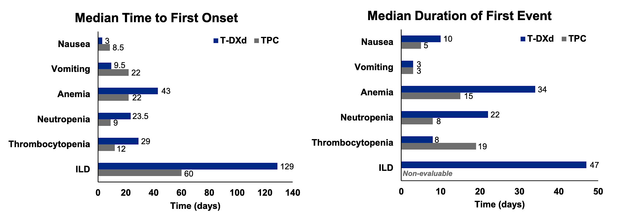
DESTINY-Breast04: Detailed Safety Summary
Rugo HS et al. ESMO Breast 2023;Abstract 185O.

Slide 86
Diagnostic if ILD suspected
T-DXd: Management of ILD
Routine Monitoring
Monitor for symptoms (cough, dyspnea, pyrexia)
Review every 4-6 weeks
Monitor SpO2 (examine if drops by 2-4% for 1-3d)
CT scans every 9-12 weeks
Lung function test
CT chest scan (ideally high-resolution CT)
Possibly Bronchoscopy
Bloods, blood and sputum cultures
 | Grade 1 | Grade 2 | Grade 3/4
Description | Asymptomatic (diagnostic observations only) | Symptomatic; limiting instrumental ADL | Severe symptoms; limiting self-care ADL; oxygen (G3); Life-threatening (G4)
T-DXd | Hold (restart if resolved within 49 days, otherwise discontinue) | Discontinue | Discontinue
Dose reduction | Same dose if ≤28d, lower dose if > 28d | N/A | N/A
Steroids | 0.5 mg/kg/day | ≥1 mg/kg/day | Methylprednisolone i.v. 500-1000 mg/d for 3d, followed by ≥1 mg/kg/d prednisolone for 14d
Escalation | If worsens despite initiation of steroids, follow Grade 2 guidelines | If not better within 5d: Increase dose or switch to IV | If not better within 5d: Infliximab, IVIG or MMF
Duration | Until improvement, followed by gradual taper over ≥4 weeks | For at least 14d or until complete resolution of clinical and chest CT findings then gradually taper (for at least 4wks)

Slide 87
Agenda
Module 1: Optimal Approaches to HER2 Testing for the Identification of
HER2-Low Breast Cancer — Dr Carey
Module 2: Available Data with and Current Role of HER2-Targeted Therapy
for HER2-Low Disease — Dr Modi
Module 3: Identification and Management of Toxicities with Trastuzumab Deruxtecan — Prof Schmid
Module 4: Future Directions in the Management of HER2-Low Breast Cancer
— Dr Bardia

Slide 88
Please describe the last patient with HER2-low metastatic breast cancer in your practice who received trastuzumab deruxtecan.
Patient age: 57 (median; range 30-77)
ER status:
ER-positive
14
ER-low (1-2%)
1
ER-negative
1
HER2 IHC:
IHC 1+
11
IHC 2+
5

Slide 89


Please describe the last patient with HER2-low metastatic breast cancer in your practice who received trastuzumab deruxtecan.
Patient’s tolerance of therapy:
Patient’s response to therapy:
Complete response
4
Very well tolerated
6
Partial response
7
Nausea
6
Stable disease
4
Alopecia
1
1
Minor respiratory issues
1
Disease progression
Grade 3 ILD
1
Required dose reduction
1

Slide 90
Antibody-drug conjugate technology and novel cytotoxic payloads
Mark D Pegram, MD

Slide 91
Perspectives on the future management of HER2-positive breast cancer
Mark D Pegram, MD

Slide 92


Future Directions in the
Management of HER2-Low BC
Aditya Bardia, MD, MPH, FASCO
Director, Breast Cancer Research
Massachusetts General Hospital, Harvard Medical School

Slide 93
Objectives
Understand HER2 ultra-low breast cancer and biologic rationale for T-DXd
Review clinical data of activity of T-DXd in HER2 ultra-low breast cancer
Review ongoing and upcoming clinical trials in metastatic and localized breast cancer
Understand research efforts combining T-DXd with other systemic therapies
Review other novel HER2-targeted agents in HER2-low breast cancer

Slide 94
HER2-Low and Ultra-low
Breast Cancer
HER 2 testing by validated IHC assay
Circumferential membrane staining that is complete, intense, and in >10% of tumor cells ➔ (IHC 3+)
Weak to moderate complete membrane staining in >10% of tumor cells ➔ (IHC 2+)
Incomplete membrane staining that is faint/barely perceptible and in >10% of tumor cells ➔ (IHC 1+)
No staining is observed
HER2-null or membrane staining that is incomplete and is faint/barely perceptible and in ≤10% tumor cells ➔ (IHC 0)
HER2-Positive
Reflex ISH test Positive
Reflex ISH test Negative
HER2-Low
HER2-Negative/
ultra-low
IHC, immunohistochemistry; ISH, in-situ hybridisation. Wolff AC, et al. Arch Pathol Lab Med. 2018.

Slide 95
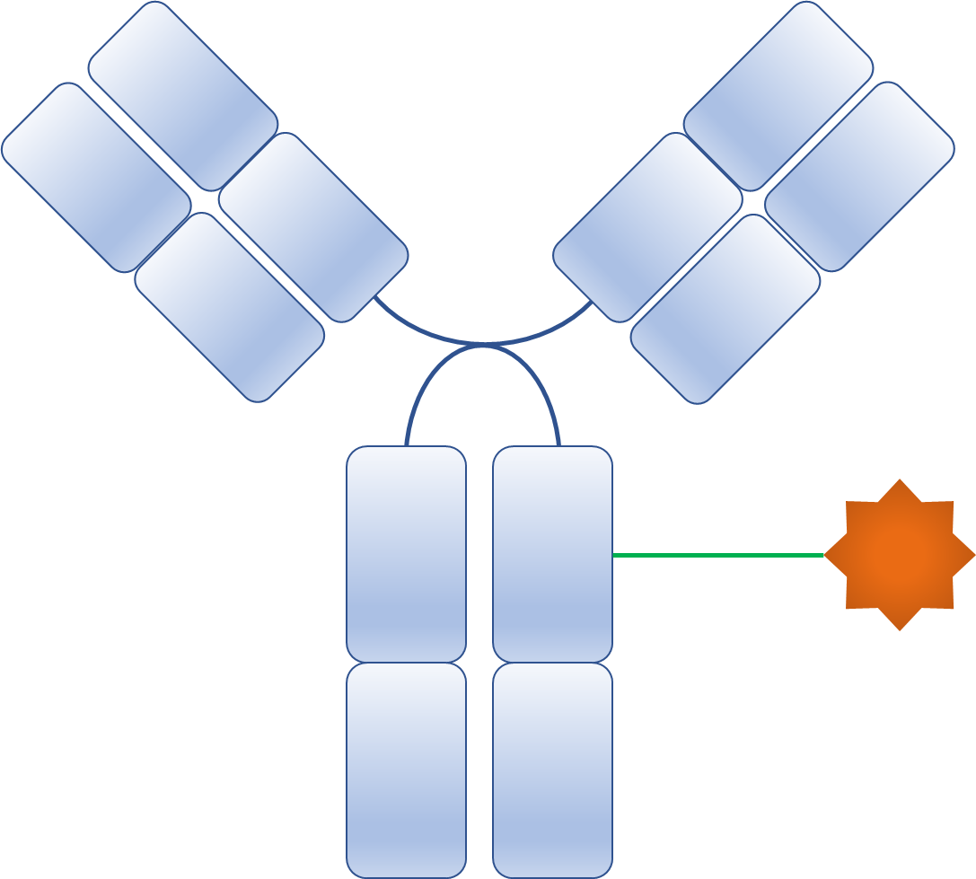

ADC:
Selective delivery of toxic payload
6. Bystander Effect
1. Binding of an ADC to antigen
2. Internalization to the early endosome
HER-2
HER-2
Clathrin
5. Apoptosis of the cancer cell
H⁺
Lysosomes
H⁺
3. Degradation of ADCs in the lysosome
4. Release and action of payload
Nagayama, A, Ellisen L, Chabner B, Bardia A. Target Oncol. 2017

Slide 96
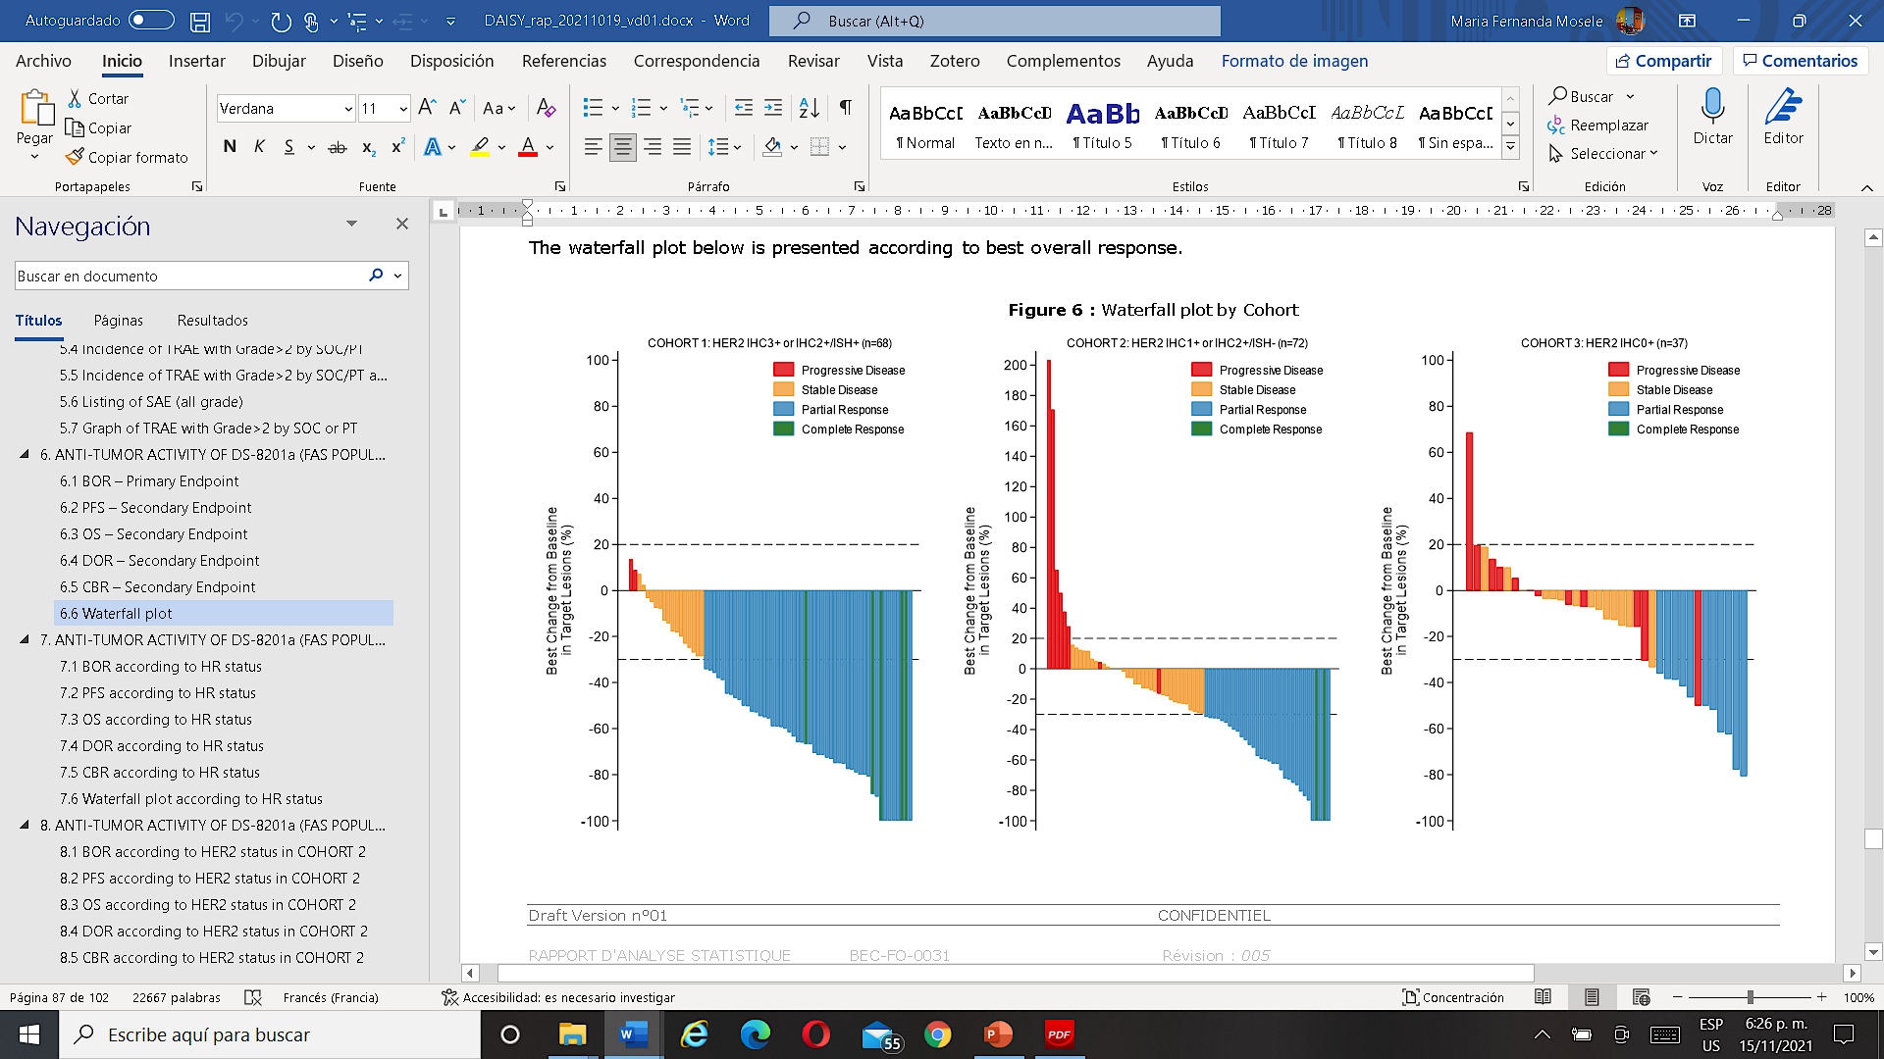
DAISY: Response Rate
according to HER2 expression
BOR: 71%
95% CI [58.3-81]
BOR: 37.5%
95% CI [26.4-50]
BOR: 30%
95% CI [16-47]
Data cut-off: Oct 19, 2021
Mosele F et al. Nature Medicine 2023

Slide 97
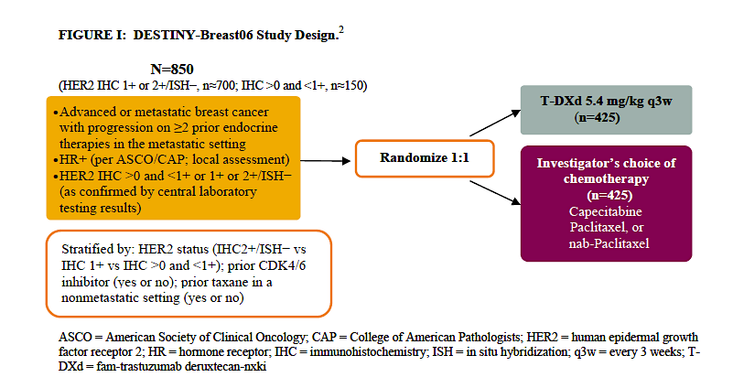
DESTINY-Breast06:
T-DXd vs ICC for HER2 low and ultra-low BC
²Bardia A et al. SABCS 2020

Slide 98
How about early breast cancer?

Slide 99
TRIO-US B-12 TALENT:
Study Design
Study Population:
Hormone Receptor +
HER2-low (by local and/or central review)
Stage II-III operable
Men or Pre-/Post-menopausal women
Arm A (N=29):
T-DXd 5.4mg/kg
Treatment: 6 or 8 cycles* + EOT
Surgery
Arm B (N=29):
T-DXd 5.4mg/kg + anastrozole (+GnRH analog for men/premenopausal women)
Stratified by HER2 expression level (1+ or 2+ by IHC) and menopausal status (pre or post)
Tissue acquisition from archival tissue or biopsy at baseline and biopsy between
C1D17-C1D21, and tissue at time of surgical resection
All tissue collected for study: pathology centrally reviewed
* Originally, 6 cycles of treatment were given but in 02/2022, an amendment increased the number of treatment cycles from 6 to 8 for newly enrolled participants, or those who had not yet had surgery. EOT 21-28 days after last dose of T-DXd.

Slide 100
Objective Response Rate with T-DXd (based on imaging)
Arm A
ORR | 17/25 = 68%
CR | 2/25 = 8%
PR | 15/25 = 60%
Arm B
ORR | 14/24 = 58%
CR | 2/24 = 8%
PR | 12/24 = 50%
Waterfall plot with bars representing change in tumor size after treatment with T-DXd, compared to baseline, as per RECIST v1.1. Intention to treat population for ORR includes all who received at least 1 cycle of protocol therapy, data cutoff 11/25/2022.
* 4 patients still on treatment; 3 patients did have imaging (treatment discontinued prematurely), but included in intention to treat (ITT) denominator for ORR analysis per protocol
* 5 patients still on treatment

Slide 101
HER2 IHC Change from Baseline to Surgery with T-DXd (central review)
Baseline
(before T-DXd)
Surgery
(after T-DXd)
48.6% (17/35) had change in HER2 IHC expression after
T-DXd treatment
Of those who had change, majority (88.2%) had decrease in HER2 expression
Green: IHC staining of HER2 decreased from baseline to surgery
Gray: IHC staining of HER2 remained stable from baseline to surgery
Red: IHC staining of HER2 increased from baseline to surgery
Note: The observed change in IHC immunostaining may not accurately reflect changes in HER2 protein expression in carcinoma cells

Slide 102
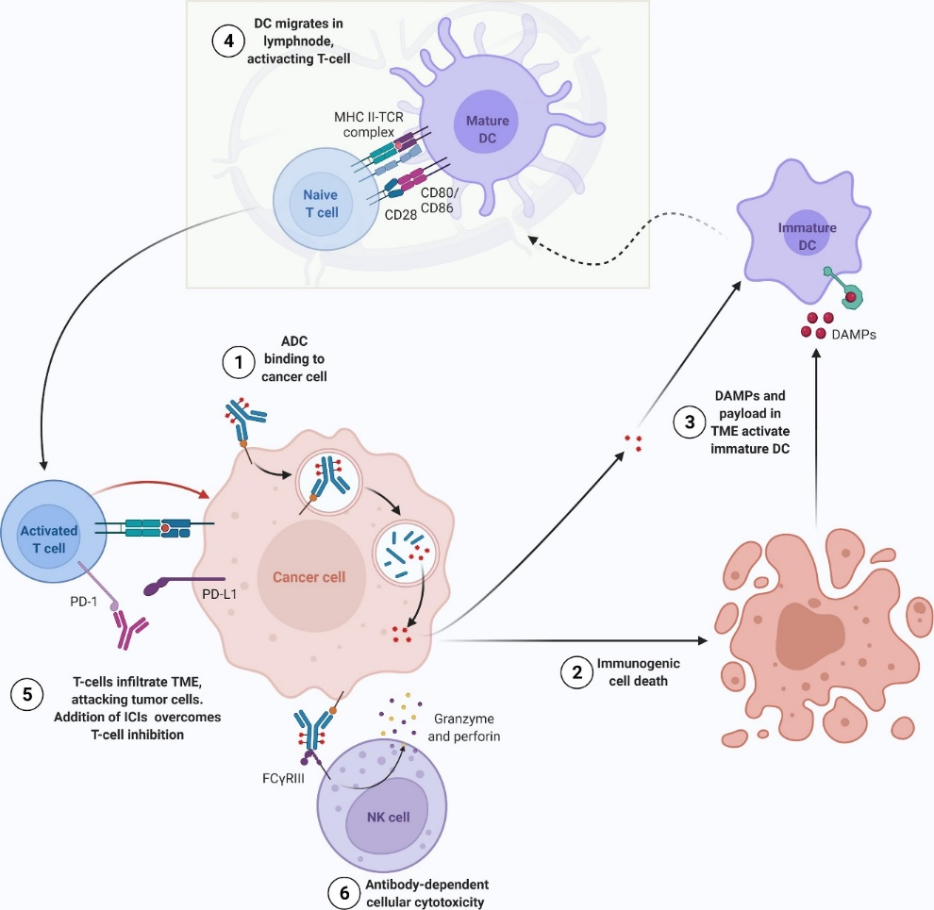
Antibody-Drug Conjugates:
Combination with immunotherapy
DC migrates in
lymphnode,
activating T-cell
6. Bystander Effect
1. Binding of an ADC to antigen
2. Internalization to the early endosome
Trop-2
Trop-2
5. Apoptosis of the cancer cell
Lysosomes
3. Degradation of ADCs in the lysosome
4. Release and action of payload
Nicolo et al. CTR. 2022

Slide 103
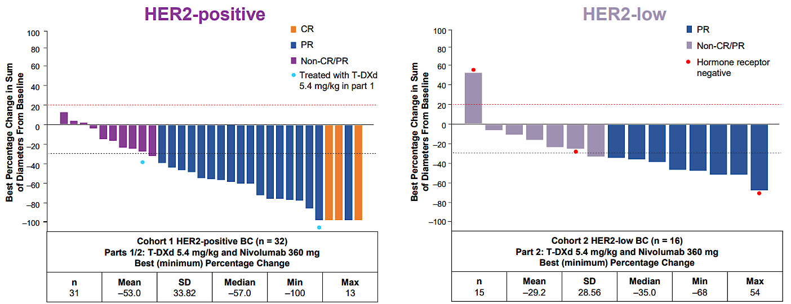
Combination with immunotherapy:
T-DXd and Nivolumab (U105)
Does immunotherapy add to efficacy of ADC?
Setting might matter.
Hamilton E. et al. ESMO Breast. 2022.

Slide 104
What about other ADCs?

Slide 105
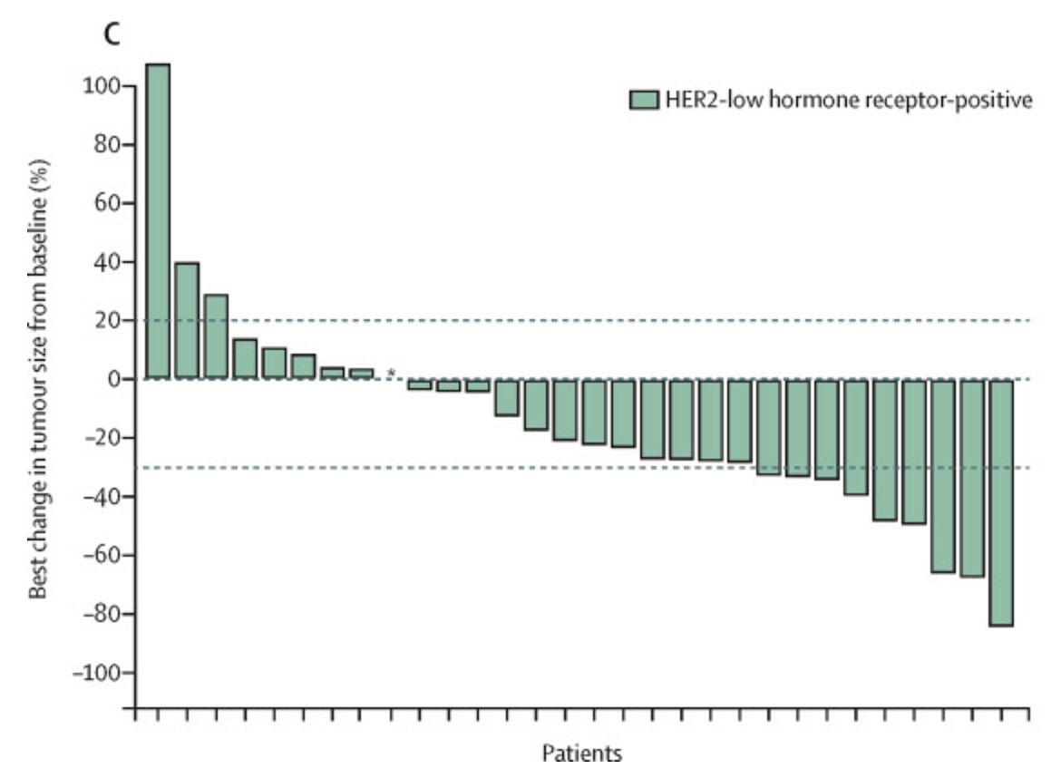
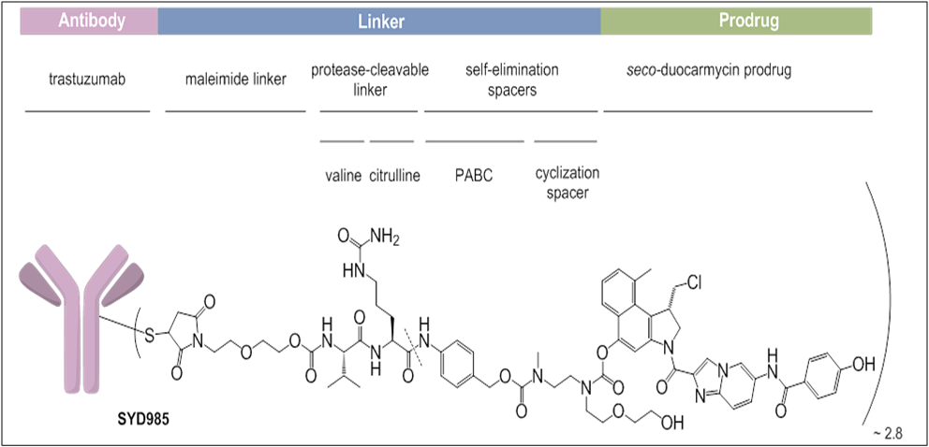
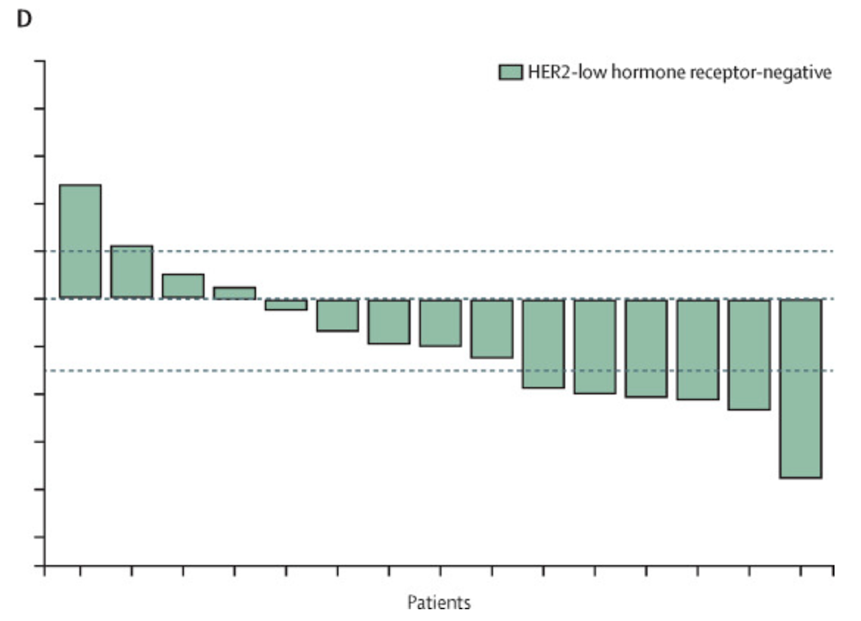
SYD985: HER2-targeting ADC
Trastuzumab duocarmazine
HER2-low, HR+
ORR (N=32): 28%
Antibody-drug conjugate
HER2 antibody
Cleavage of linker in tumor environment by proteases leads to activation
Active toxin (DUBA) alkylates DNA, kills dividing and non-dividing cells
HER2-low, HR-
ORR (N=15): 40%
Dokter W et al. Mol Cancer Ther. 2014;13(11):2618-2629. Banjeri U et al. Lancet Oncol. 2019;20(8):1124-1135

Slide 106
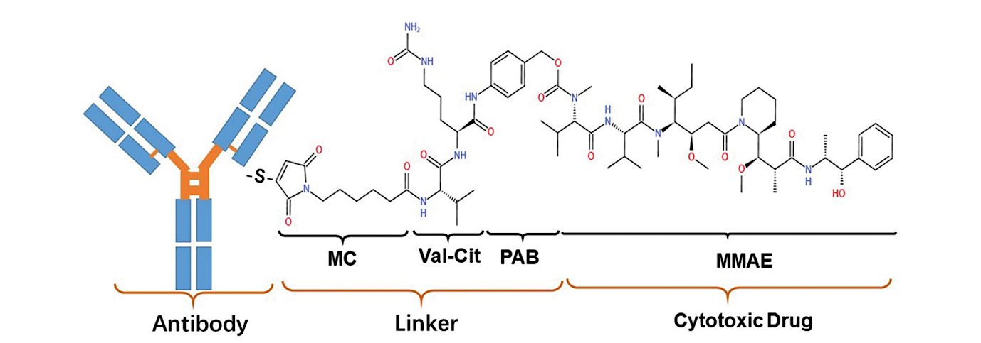
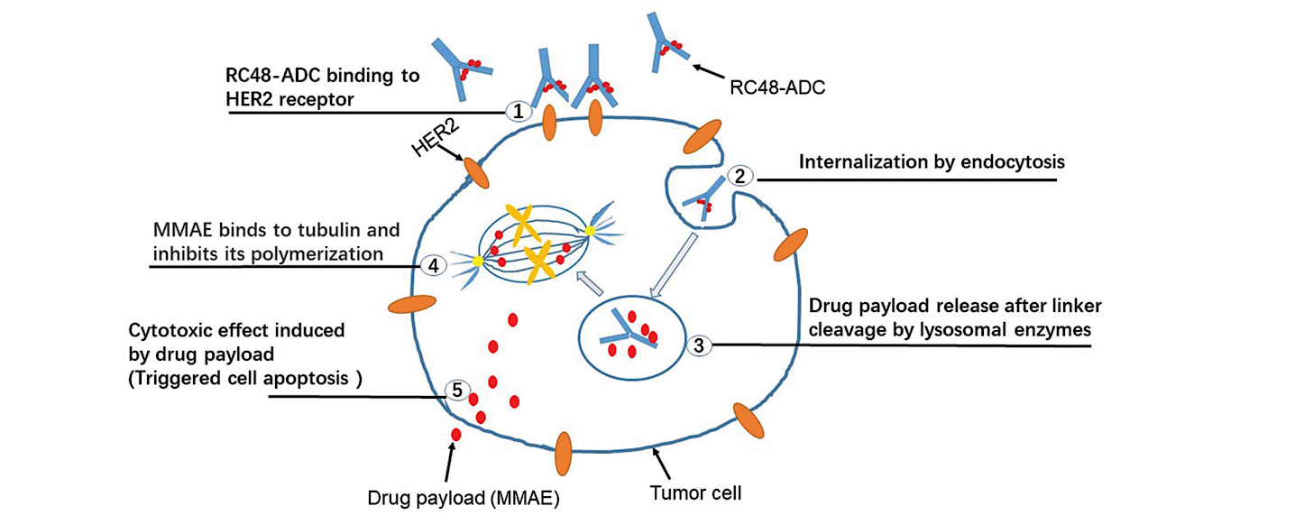
RC48-ADC: HER2-targeting ADC
Disitamab vedotin
Shi F et al. Drug Deliv. 2022;29(1):1335-1344.

Slide 107
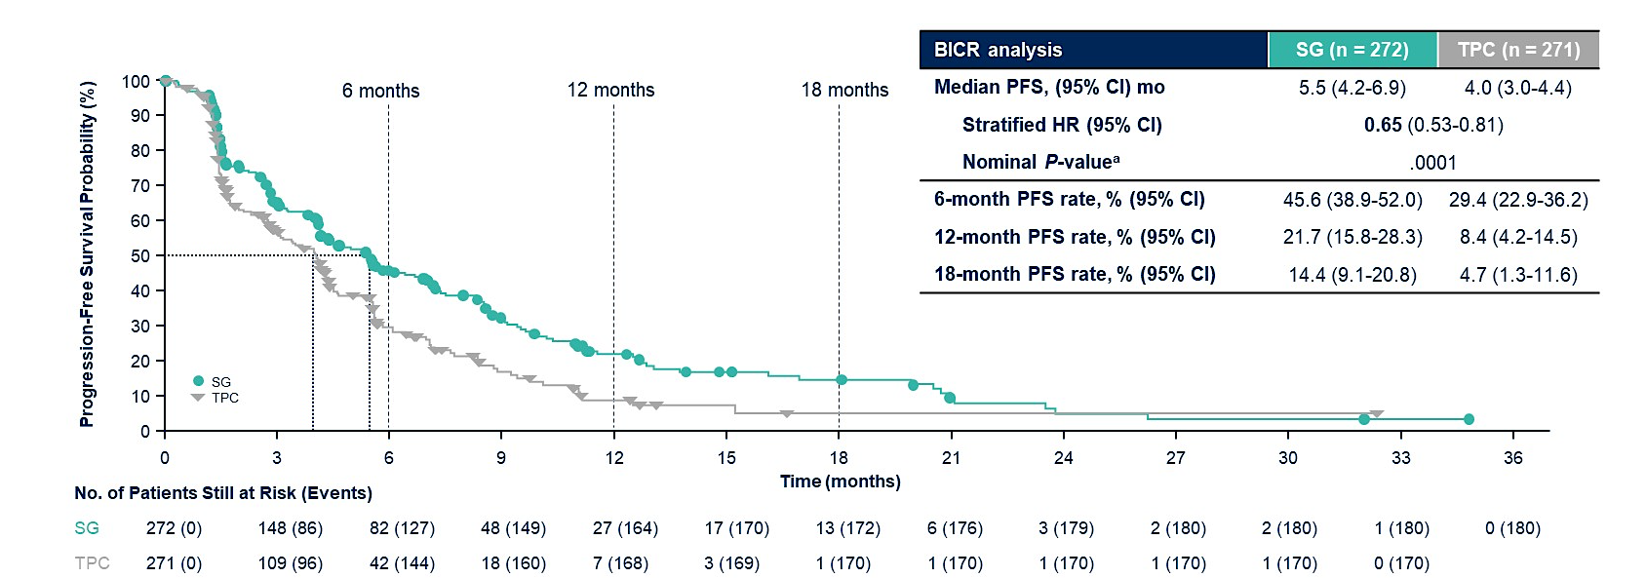
Sacituzumab Govitecan vs TPC:
Efficacy by HER2 status (TROPiCS-02)
ITT Population
Tolaney SM et al. ASCO 2023; Abstract 1003.

Slide 108
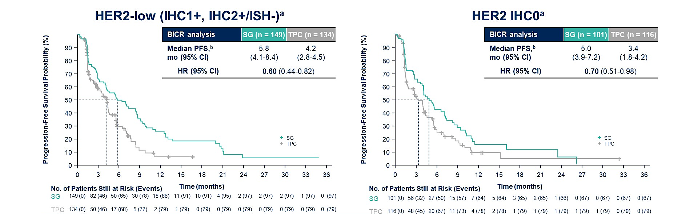
Sacituzumab Govitecan vs TPC:
Efficacy by HER2 status (TROPiCS-02)
HER2-low (IHC1+, IHC2+/ISH-)
HER2 IHC0
Within the HER2-Low population, median PFS with SG vs TPC for the IHC1+ and IHC2+ subgroups was 7.0 vs 4.3 (HR, 0.57) and
5.6 vs 4.0 (HR, 0.58) months, respectively
The hazard ratio for median PFS in a sensitivity analysis of the HER2-Low subgroup (excluding ISH-unverified) was similar (HR, 0.53)
Schmid P et al. ESMO 2022; Abstract 214MO. Tolaney SM et al. ASCO 2023; Abstract 1003.

Slide 109
ADCs to target MBC:
Multiple Agents in Development
Antibody-Drug Conjugate | Target
Trastuzumab deruxtecan (DS-8201a) | HER2
Sacituzumab govitecan (IMMU-132) | Trop-2
Datopotamab deruxtecan (DS-1062) | Trop-2
Ladiratuzumab vedotin (SGN-LIV1a) | LIV-1
Patritumab deruxtecan (U3-1402) | HER3
Trastuzumab duocarmazine | HER2
Disitamab vedotin | HER2
Payload
Topo-1 inhibitor
Topo-1 inhibitor
Topo-1 inhibitor
Microtubule inhibitor
Topo-1 inhibitor
Alkylating agent
Microtubule inhibitor
Both target and payload important considerations for efficacy/toxicity profile and ADC sequencing

Slide 110
Implications of resistance mechanisms for ADC sequencing
Same Ab-based
ADC
Antibody
resistance
No Response
Different Ab-
targeted ADC
Response
Same Payload
ADC
Payload
resistance
No Response
Different
payload ADC
Response
Altered
Coates, Sun et al Cancer Discovery 2021.

Slide 111
Summary
Even HER2 IHC 0 has some HER2 expression which can be leveraged as target for ADCs with bystander effect.
Trastuzumab deruxtecan: approved for HER2 low MBC (both HR+ and TNBC). Ongoing studies in HER2 ultra-low breast cancer as well as early breast cancer.
ADC combination with immunotherapy has demonstrated impressive clinical activity in mTNBC. However, additional contribution of immunotherapy currently remains undefined and will be clarified in various ongoing studies.
There are multiple other HER2 ADCs in development for HER2 low breast cancer. Understanding mechanism of resistance, antibody vs payload, could help guide therapeutic sequencing and optimal therapeutic management of patients with breast cancer.

