Slide 1
What Clinicians Want to Know: Addressing
Current Questions and Controversies in the
Management of ER-Positive Breast Cancer
Part 2 of a 2-Part CME Satellite Symposium Series Held in Conjunction
with the 2022 San Antonio Breast Cancer Symposium®
Thursday, December 8, 2022
7:15 PM – 9:15 PM CT
Faculty
Aditya Bardia, MD, MPH
Matthew P Goetz, MD
Virginia Kaklamani, MD, DSc
Kevin Kalinsky, MD, MS
Hope S Rugo, MD
Moderator
Neil Love, MD

Slide 2





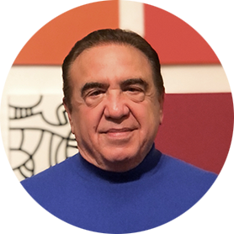
Faculty
Aditya Bardia, MD, MPH
Director, Breast Cancer Research Program
Associate Professor
Harvard Medical School
Attending Physician
Massachusetts General Hospital
Boston, Massachusetts
Kevin Kalinsky, MD, MS
Associate Professor
Department of Hematology and Medical Oncology
Emory University School of Medicine
Director, Glenn Family Breast Center
Director, Breast Medical Oncology
Winship Cancer Institute of Emory University
Atlanta, Georgia
Matthew P Goetz, MD
Erivan K Haub Family Professor of Cancer Research Honoring Richard F Emslander, MD
Professor of Oncology and Pharmacology
Enterprise Deputy Director, Translational Research
Director, Mayo Clinic Breast Cancer SPORE
Mayo Clinic
Rochester, Minnesota
Hope S Rugo, MD
Professor of Medicine
Director, Breast Oncology and Clinical
Trials Education
University of California, San Francisco
Helen Diller Family Comprehensive
Cancer Center
San Francisco, California
Virginia Kaklamani, MD, DSc
Professor of Medicine
Ruth McLean Bowman Bowers Chair in Breast Cancer Research and Treatment
AB Alexander Distinguished Chair in Oncology
Associate Director for Clinical Research
Leader of the Breast Cancer Program
UT Health San Antonio
The University of Texas MD Anderson Cancer Center
San Antonio, Texas
Moderator
Neil Love, MD
Research To Practice

Slide 3
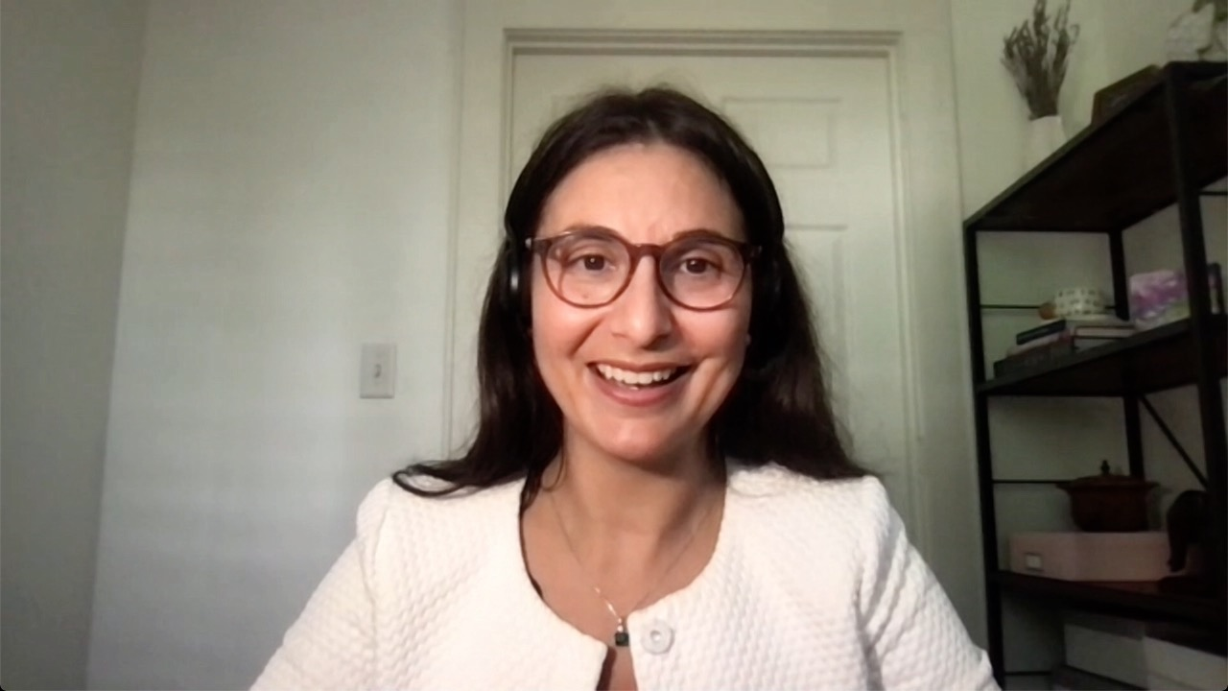
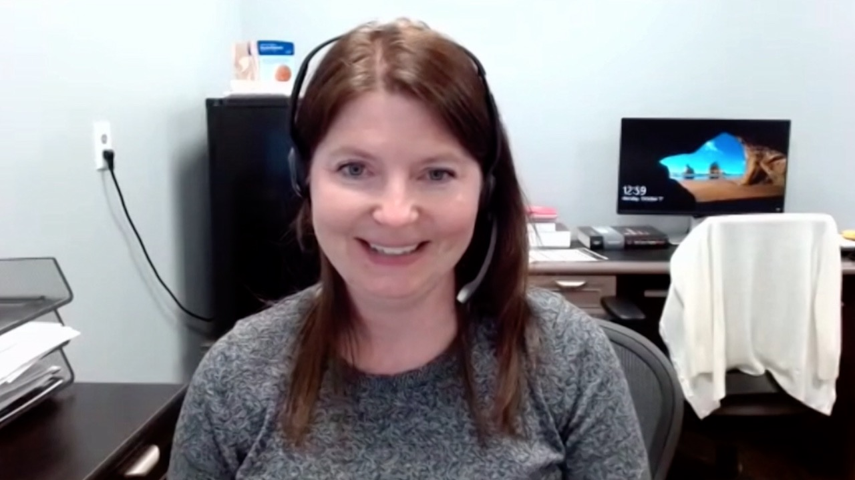
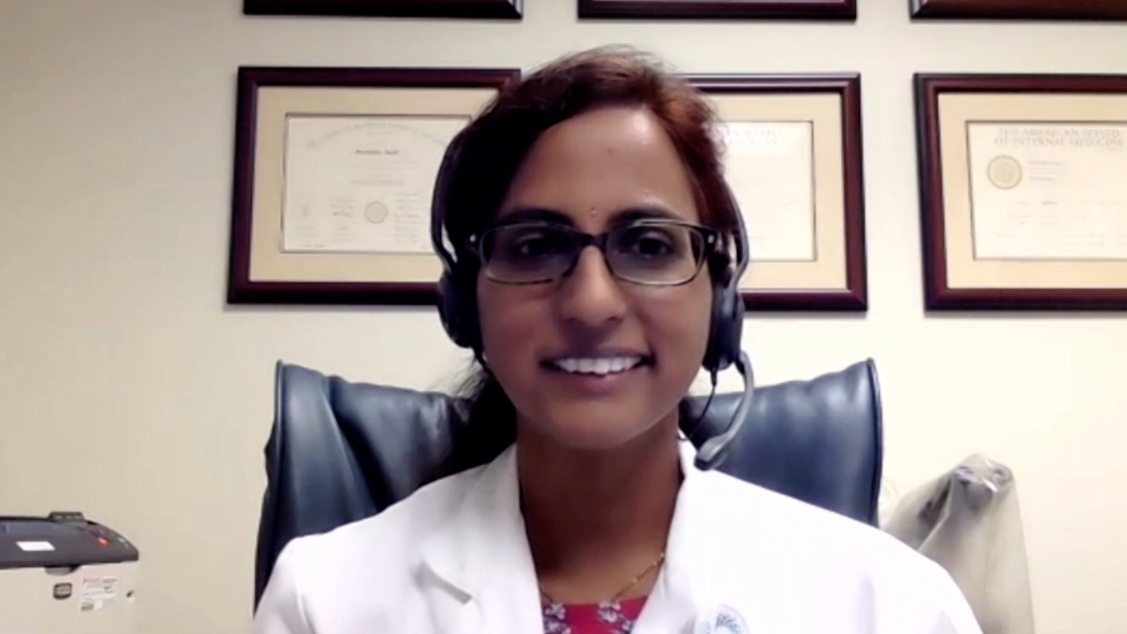

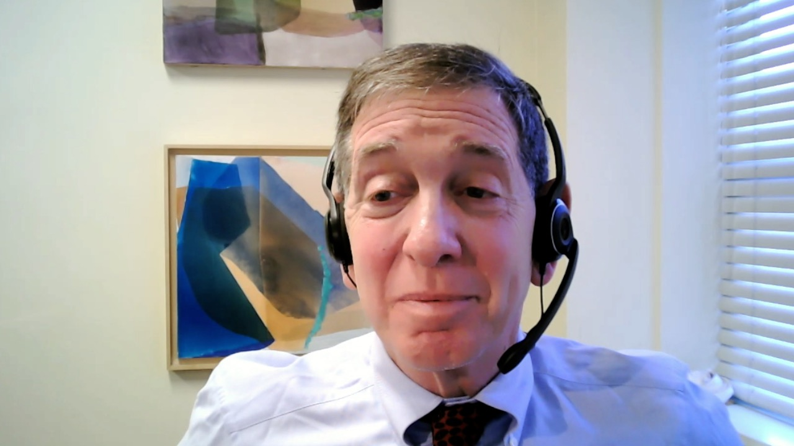
Laila Agrawal, MD
Norton Cancer Institute
Louisville, Kentucky
Jennifer L Dallas, MD
Oncology Specialists of Charlotte
Charlotte, North Carolina
Susmitha Apuri, MD
Florida Cancer Specialists
Lutz, Florida
Kapisthalam (KS) Kumar, MD Florida Cancer Specialists
Trinity, Florida
Alan B Astrow, MD
Weill Cornell Medicine
Brooklyn, New York

Slide 4
Commercial Support
This activity is supported by educational grants from AstraZeneca Pharmaceuticals LP, Daiichi Sankyo Inc, Exact Sciences Corporation, Lilly, Novartis, Sanofi, and TerSera Therapeutics LLC.
Research To Practice CME Planning Committee Members,
Staff and Reviewers
Planners, scientific staff and independent reviewers for Research To Practice have no relevant conflicts of interest to disclose.

Slide 5
Dr Love — Disclosures
Dr Love is president and CEO of Research To Practice. Research To Practice receives funds in the form of educational grants to develop CME activities from the following companies: AbbVie Inc, Adaptive Biotechnologies Corporation, ADC Therapeutics, Agios Pharmaceuticals Inc, Alexion Pharmaceuticals, Amgen Inc, Array BioPharma Inc, a subsidiary of Pfizer Inc, Astellas, AstraZeneca Pharmaceuticals LP, Aveo Pharmaceuticals, Bayer HealthCare Pharmaceuticals, BeiGene Ltd, BeyondSpring Pharmaceuticals Inc, Blueprint Medicines, Boehringer Ingelheim Pharmaceuticals Inc, Bristol-Myers Squibb Company, Celgene Corporation, Clovis Oncology, Coherus BioSciences, CTI BioPharma Corp, Daiichi Sankyo Inc, Eisai Inc, Elevation Oncology Inc, EMD Serono Inc, Epizyme Inc, Exact Sciences Corporation, Exelixis Inc, Five Prime Therapeutics Inc, Foundation Medicine, G1 Therapeutics Inc, Genentech, a member of the Roche Group, Genmab, Gilead Sciences Inc, GlaxoSmithKline, Grail Inc, Halozyme Inc, Helsinn Healthcare SA, ImmunoGen Inc, Incyte Corporation, Ipsen Biopharmaceuticals Inc, Janssen Biotech Inc, administered by Janssen Scientific Affairs LLC, Jazz Pharmaceuticals Inc, Karyopharm Therapeutics, Kite, A Gilead Company, Kronos Bio Inc, Lilly, Loxo Oncology Inc, a wholly owned subsidiary of Eli Lilly & Company, MEI Pharma Inc, Merck, Mersana Therapeutics Inc, Mirati Therapeutics Inc, Natera Inc, Novartis, Novartis Pharmaceuticals Corporation on behalf of Advanced Accelerator Applications, Novocure Inc, Oncopeptides, Pfizer Inc, Pharmacyclics LLC, an AbbVie Company, Puma Biotechnology Inc, Regeneron Pharmaceuticals Inc, Sanofi, Seagen Inc, Servier Pharmaceuticals LLC, SpringWorks Therapeutics Inc, Sumitomo Dainippon Pharma Oncology Inc, Taiho Oncology Inc, Takeda Pharmaceuticals USA Inc, TerSera Therapeutics LLC, Tesaro, A GSK Company, TG Therapeutics Inc, Turning Point Therapeutics Inc, Verastem Inc and Zymeworks Inc.

Slide 6
Dr Bardia — Disclosures
Consulting Agreements | AstraZeneca Pharmaceuticals LP, Daiichi Sankyo Inc, Foundation Medicine, Genentech, a member of the Roche Group, Gilead Sciences Inc, Lilly, Merck, Novartis, Pfizer Inc, Phillips HealthCare Services Ltd, Radius Health Inc, Sanofi
Contracted Research | AstraZeneca Pharmaceuticals LP, Daiichi Sankyo Inc, Genentech, a member of the Roche Group, Gilead Sciences Inc, Lilly, Merck, Novartis, Pfizer Inc, Radius Health Inc, Sanofi

Slide 7
Dr Goetz — Disclosures
Advisory Committee | ARC Therapeutics, Biotheranostics Inc, Blueprint Medicines, Sanofi
Consulting Agreements | AstraZeneca Pharmaceuticals LP, Biovica, Context Therapeutics, Eagle Pharmaceuticals, Lilly, Novartis, Pfizer Inc
Contracted Research | Lilly, Pfizer Inc, Sermonix Pharmaceuticals
Nonrelevant Financial Relationship (CME Presentation Fees) | Clinical Education Alliance, Medscape, MJH Life Sciences
Nonrelevant Financial Relationship (Panelist) | Total Health Conferencing

Slide 8
Dr Kaklamani — Disclosures
Advisory Committee and Consulting Agreements | AstraZeneca Pharmaceuticals LP, Athenex, Gilead Sciences Inc, Puma Biotechnology Inc
Contracted Research | Eisai Inc
Data and Safety Monitoring Board/Committee | Sanofi
Speakers Bureau | AstraZeneca Pharmaceuticals LP, Daiichi Sankyo Inc, Exact Sciences Corporation, Genentech, a member of the Roche Group, Gilead Sciences Inc, Novartis, Pfizer Inc, Seagen Inc

Slide 9
Dr Kalinsky — Disclosures
Advisory Committee | D Pharma PLC, AstraZeneca Pharmaceuticals LP, Daiichi Sankyo Inc, Gilead Sciences Inc, Lilly, Menarini Silicon Biosystems, Merck, Mersana Therapeutics Inc, Myovant Sciences, Novartis, OncoSec Medical, Pfizer Inc, Puma Biotechnology Inc, Seagen Inc, Takeda Phamraceuticals USA Inc
Contracted Research | Ascentage Pharma, AstraZeneca Pharmaceuticals LP, Daiichi Sankyo Inc, Genentech, a member of the Roche Group, Lilly, Novartis
Data and Safety Monitoring Board/Committee | Merck

Slide 10
Dr Rugo — Disclosures
Consultancy/Advisory Support | Blueprint Medicines, Napo Pharmaceuticals Inc, Puma Biotechnology Inc
Contracted Research | Ambrx, Astellas, AstraZeneca Pharmaceuticals LP, Daiichi Sankyo Inc, Genentech, a member of the Roche Group, Gilead Sciences Inc, GlaxoSmithKline, Lilly, Merck, Novartis, OBI Pharma Inc, Pfizer Inc, Pionyr Immunotherapeutics, Seagen Inc, Sermonix Pharmaceuticals, Taiho Oncology Inc, Veru Inc
Travel Support to Academic Meetings | AstraZeneca Pharmaceuticals LP, Gilead Sciences Inc, Merck.

Slide 11
Agenda
Module 1: Current Role of Genomic Assays for Hormone Receptor (HR)-Positive Localized Breast Cancer — Dr Goetz
Module 2: Optimizing the Management of Localized ER-Positive Breast Cancer — Dr Kaklamani
Module 3: Selection and Sequencing of Therapy for Patients with ER-Positive Metastatic Breast Cancer (mBC) — Dr Kalinsky
Module 4: Recent Appreciation of HER2 Low as a Unique Subset of HR-Positive Breast Cancer — Dr Bardia
Module 5: Novel Strategies Under Investigation for Patients with HR-Positive mBC — Dr Rugo

Slide 12
Agenda
Module 1: Current Role of Genomic Assays for Hormone Receptor (HR)-Positive Localized Breast Cancer — Dr Goetz
► Real World Cases and Questions—
Module 2: Optimizing the Management of Localized ER-Positive Breast Cancer — Dr Kaklamani
► Real World Cases and Questions—
Module 3: Selection and Sequencing of Therapy for Patients with ER-Positive Metastatic Breast Cancer (mBC) — Dr Kalinsky
► Real World Cases and Questions—
Module 4: Recent Appreciation of HER2 Low as a Unique Subset of HR-Positive Breast Cancer — Dr Bardia
► Real World Cases and Questions—
Module 5: Novel Strategies Under Investigation for Patients with HR-Positive mBC — Dr Rugo
► Real World Cases and Questions—

Slide 13
MODULE 1: Current Role of Genomic Assays for Hormone Receptor (HR)-Positive Localized
Breast Cancer — Dr Goetz

Slide 14
Case Presentation: 42-year-old premenopausal woman with 9-mm, Grade III, ER/PR-positive, HER2-negative, node-negative IDC – 21-gene RS: 22
Dr Alan Astrow (Brooklyn, New York)

Slide 15
Case Presentation: 35-year-old premenopausal woman with 3.6-cm, ER/PR-positive, HER2-low (IHC 1+), sentinel node- positive (4/4) multifocal IDC, s/p bilateral mastectomies, adjuvant T → AC and OFS/AI — Ki67: 50%
Dr Laila Agrawal (Louisville, Kentucky)

Slide 16
Current Role of Genomic Assays for Hormone Receptor (HR)-Positive Localized Breast Cancer
Matthew Goetz, M.D.
Erivan K. Haub Family Professor of Cancer Research
Honoring Richard F. Emslander, M.D.
Professor of Oncology and Pharmacology
Division of Medical Oncology, Department of Oncology
Mayo Clinic in Rochester, MN
CP1229323-1

Slide 17
Outline
Phase III RxPONDER trial evaluating the role of chemotherapy for patients with ER-positive, HER2-negative localized breast cancer with 1 to 3 positive lymph nodes and a 21-gene Recurrence Score (RS) of ≤25
Updated findings, including 12-year event rates, from the Phase III TAILORx study
21-gene RS and neoadjuvant chemotherapy decision making
Insight regarding poor correlation between the RS and chemotherapy response in premenopausal patients

Slide 18
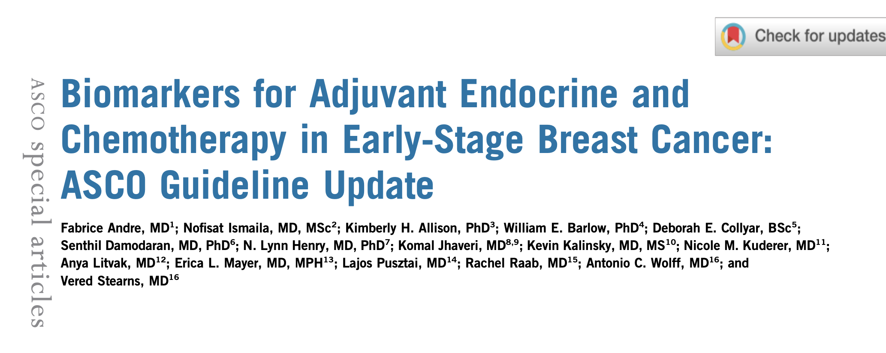
J Clin Oncol 2022;40(16):1816-37.

Slide 19
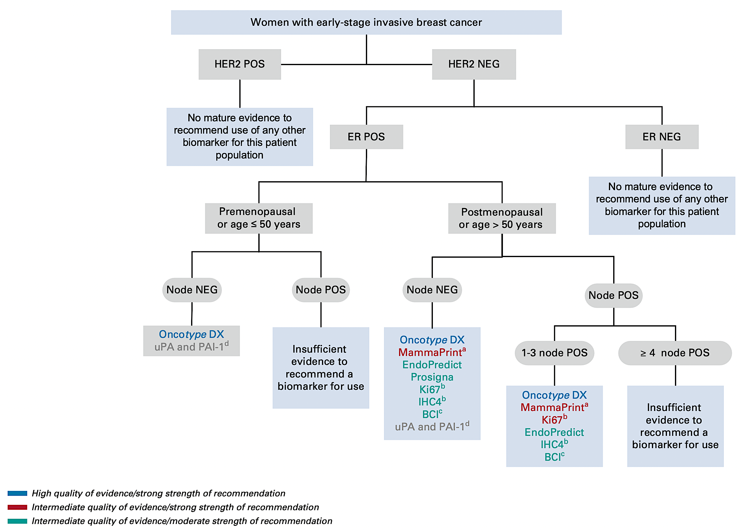
Biomarkers for Adjuvant Endocrine and Chemotherapy in Localized Breast Cancer: ASCO Guideline Update
Andre F et al. J Clin Oncol 2022;40(16):1816-37.

Slide 20
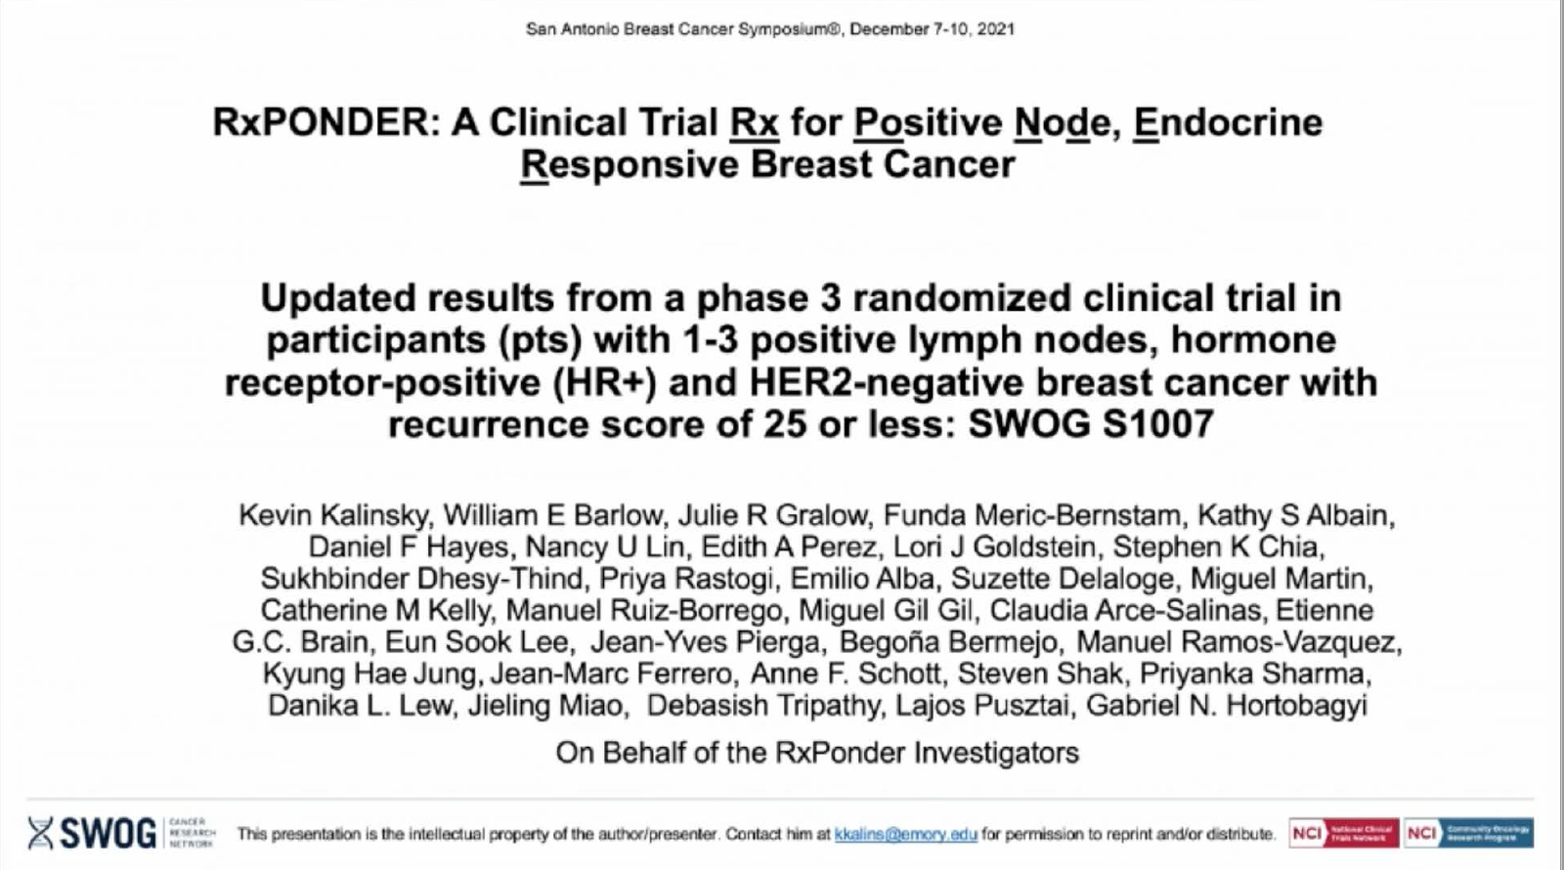
SABCS 2021;Abstract GS2-07.

Slide 21
RxPONDER Trial Schema
Key Entry Criteria
Women age ≥18
ER and/or PR ≥1%, HER2-negative breast cancer with 1*-3 positive LN without distant metastasis
Able to receive adjuvant taxane and/or anthracycline-based chemotherapy†
Axillary staging by SLNB or ALND
R
E
G
I
S
T
R
A
T
I
O
N
R
A
N
D
O
M
I
Z
A
T
I
O
N
Arm 1:
Chemotherapy followed by endocrine therapy
Recurrence Score
0-25
Arm 2:
Endocrine therapy alone
Recurrence Score
>25
N = 5,000 pts
Stratification Factors
Recurrence Score: 0-13 vs 14-25
Menopausal status: pre vs post
Axillary surgery: ALND vs SLNB
Off study
chemotherapy followed by
endocrine therapy recommended
  * After randomization of 2,493 pts, the protocol was amended to exclude enrollment of pts with pN1mic as only nodal disease.
  † Approved chemotherapy regimens included TC, FAC (or FEC), AC/T (or EC/T), FAC/T (or FEC/T). AC alone or CMF not allowed.
  LN = lymph node; SLNB = sentinel lymph node biopsy; ALND = axillary lymph node dissection; pts = patients
Kalinsky K et al. SABCS 2020;Abstract GS3-00.

Slide 22
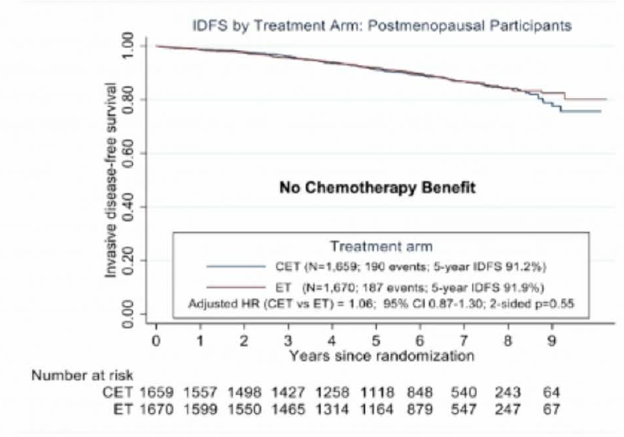
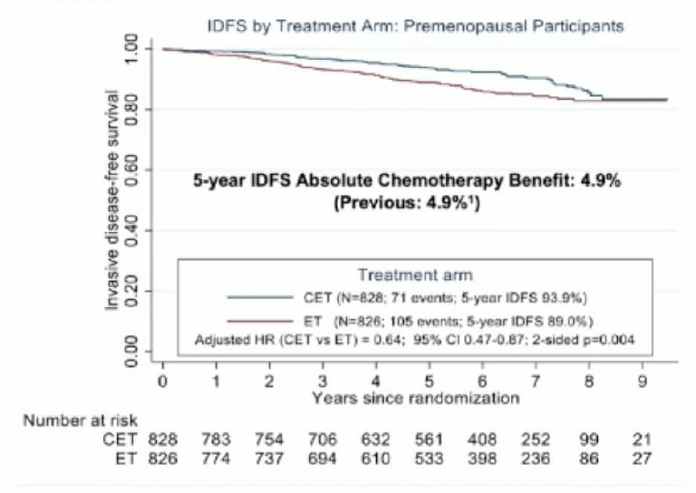
RxPONDER Updated Analysis: IDFS Stratified by Menopausal Status
Postmenopausal
Premenopausal
IDFS = invasive disease-free survival
Kalinsky K et al. SABCS 2021;Abstract GS2-07.

Slide 23
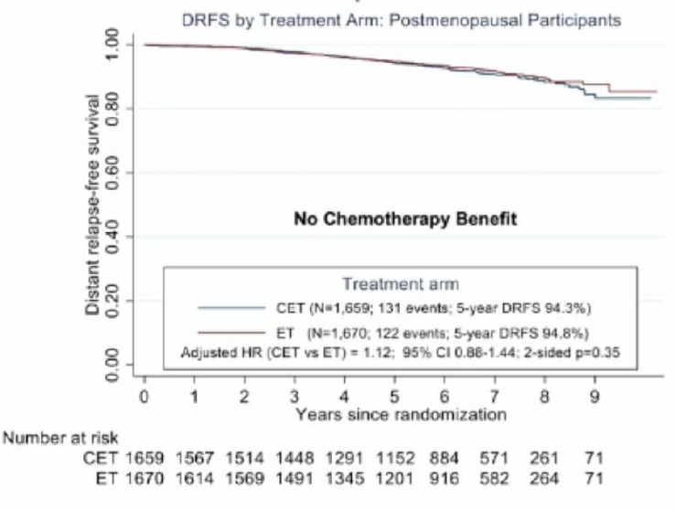
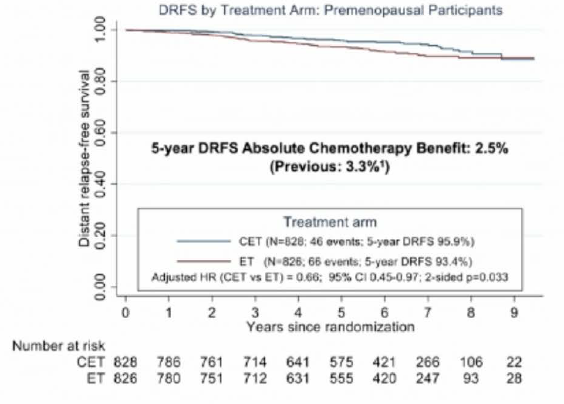
RxPONDER Updated Analysis: DRFS Stratified by Menopausal Status
Postmenopausal
Premenopausal
DRFS = distant recurrence-free survival
Kalinsky K et al. SABCS 2021;Abstract GS2-07.

Slide 24
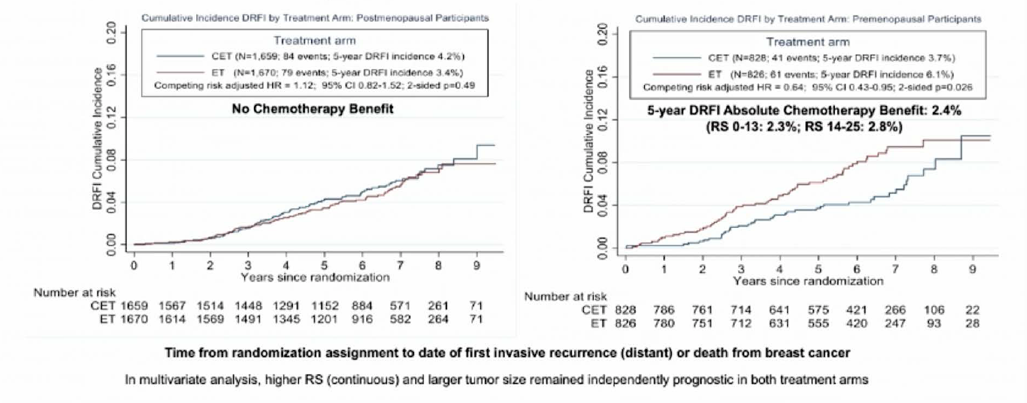
RxPONDER New Analysis: DRFI Stratified by Menopausal Status
Postmenopausal
Premenopausal
DRFI = distant recurrence-free interval
Kalinsky K et al. SABCS 2021;Abstract GS2-07.

Slide 25







San Antonio Breast Cancer Symposium – December 6-10, 2022
Trial Assigning IndividuaLized Options for TReatment (TAILORx):
An Update Including 12-Year Event Rates
Joseph A. Sparano, Robert J. Gray, Della F. Makower, Kathy S. Albain, Daniel F. Hayes, Charles E. Geyer, Elizabeth Claire Dees, Matthew P. Goetz, John A. Olson, Jr., Tracy G. Lively, Sunil Badve, Thomas J. Saphner, Timothy J. Whelan, Virginia Kaklamani, & George W. Sledge, Jr.
on behalf of the TAILORx Investigators
Funding: U.S. NIH/NCI U10CA180820, U10CA180794, UG1CA189859, UG1CA190140, UG1CA233160, UG1CA23337, UG1CA189869; U.S. Postal Service Breast Cancer Stamp Fund; Canadian Cancer Society Research Institute grants 015469, 021039; Breast Cancer Research Foundation, Komen Foundation.

Slide 26
San Antonio Breast Cancer Symposium – December 6-10, 2022
TAILORx Study Design: Treatment Assignment & Randomization
Accrued Between April 2006 – October 2010
Key Eligibility Criteria
Node-negative
ER-pos, HER2-neg
T1c-T2 (high-risk T1b)
Statistical Design
Non-inferiority - IDFS
HR 1.332 (90 vs. 87% 5-yr DFS)
Type I 10%, type II 5%
Full info– 835 IDFS events
ARM A: Low RS 0-10
(N=1619 evaluable)
ASSIGN
Endocrine Therapy (ET)
ARM D: High RS 26-100
(N=1389 evaluable)
ASSIGN
ET + Chemo
Mid-Range RS 11-25
(N=6711 evaluable)
RANDOMIZE
Stratification Factors:
Menopausal Status, Planned Chemotherapy, Planned Radiation, and RS 11-15, 16-20, 21-25
ARM B: Experimental Arm
(N=3399)
ET Alone
ARM C: Standard Arm
(N=3312)
ET + Chemo
Preregister – Oncotype DX RS (N=11,232)
Register (N=10,273)
Sparano et al. NEJM 2018
(PMID: 31157962)

Slide 27
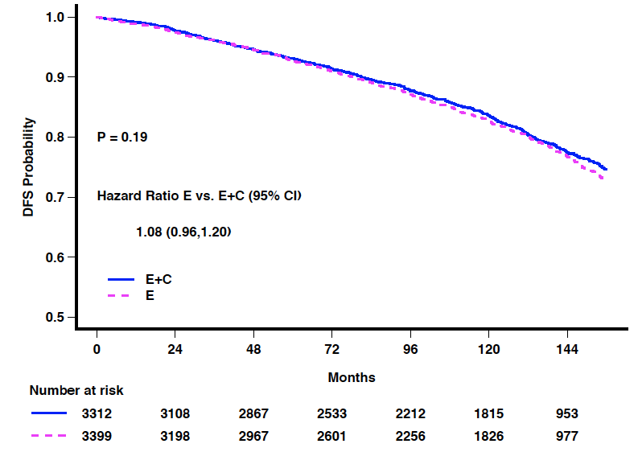
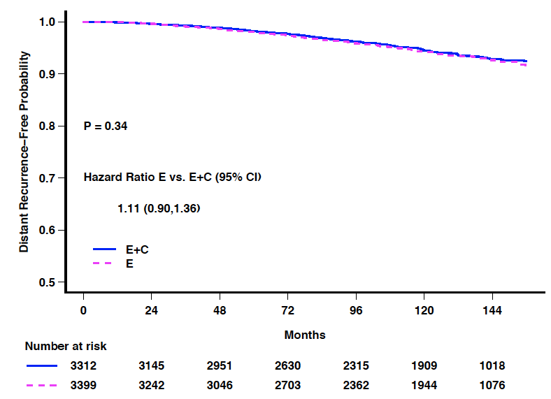
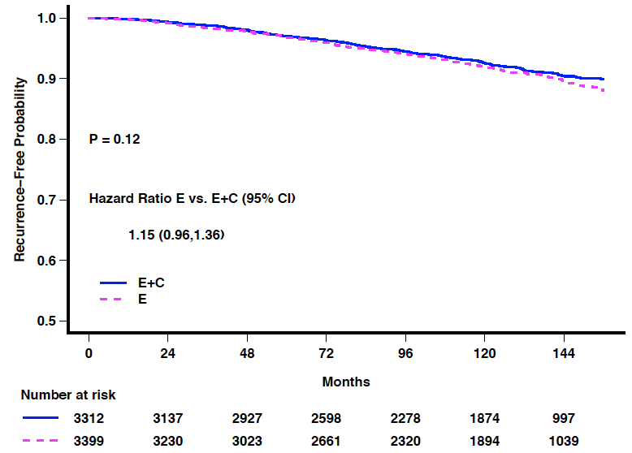
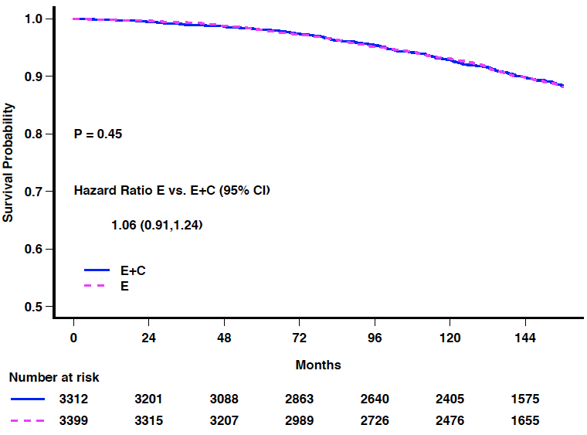
San Antonio Breast Cancer Symposium – December 6-10, 2022
TAILORx: Updated Analysis - Kaplan-Meier Curves in RS 11-25 Arms (ITT population)
Primary trial conclusions unchanged: ET non-inferior to CET (N=6711)
IDFS
P=0.19
DRFI
P=0.34
Event | Hazard Ratio: Arm B vs. C (95% CI)
IDFS | Primary analysis: 1.08 (0.94, 1.24, p=0.26)
 | Updated analysis: 1.08 (0.96, 1.20)
DRFI | Primary analysis: 1.10 (0.85,1.41, p=0.48)
 | Updated analysis: 1.11 (0.90, 1.36)
RFI | Primary analysis: 1.11 (0.90, 1.37, p=0.33)
 | Updated analysis: 1.15 (0.96, 1.36)
OS | Primary analysis: 0.99 (0.79, 1.22, p=0.89)
 | Updated analysis: 1.06 (0.91, 1.24)
RFI
P=0.12
OS
P=0.46
RFI

Slide 28
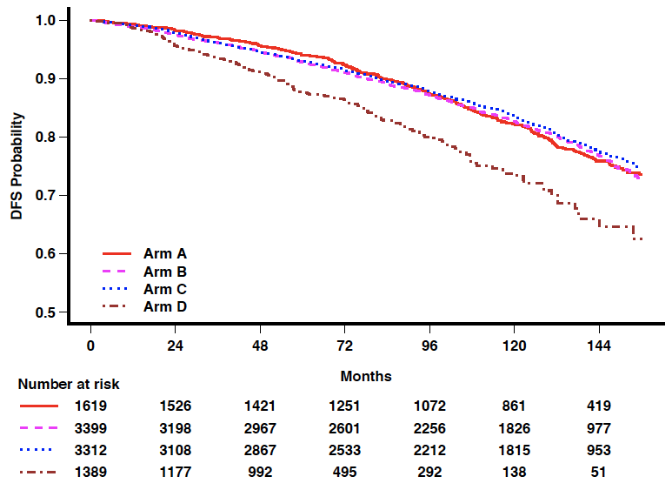
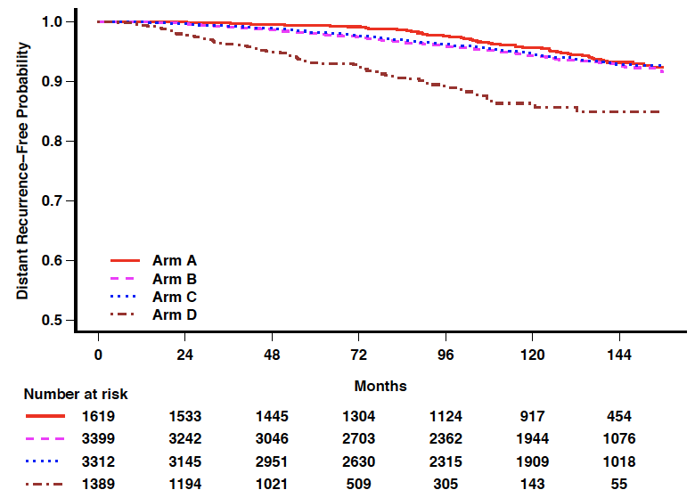
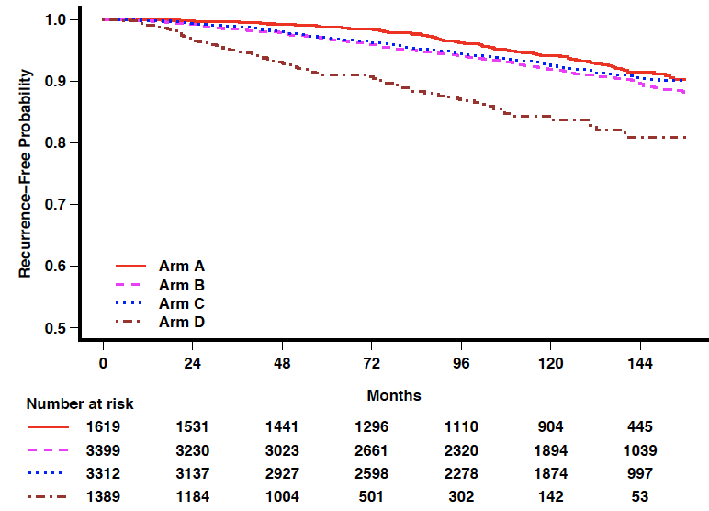
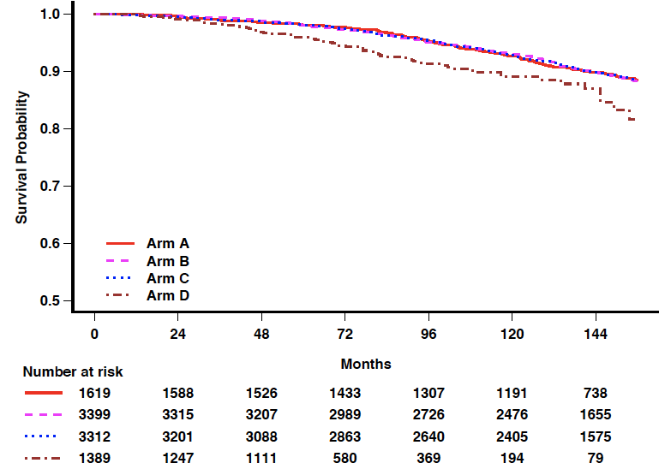
San Antonio Breast Cancer Symposium – December 6-10, 2022
TAILORx: Updated Analysis- Kaplan-Meier Curves in All Arms (ITT population)
12-Year Event Rates (N=9719)
RS prognostic for all endpoints
RS 0-10 (Arm A) – ET Alone
  DFRI rate: 93.2% (SE 0.8)
  RFI rate: 91.4% (SE 0.9)
RS 11-25 (Arms B & C) – ET vs. CET
  < 1 % difference for all endpoints
    IDFS: 76.8 vs. 77.4%
    DRFI: 92.6 vs. 92.8%
    RFI: 89.6 vs. 90.4%
    OS: 89.8 vs. 89.8%
RS 26-100 (Arm D) – CET
  DFRI rate: 84.8% (SE 1.8)
  RFI rate: 80.9 (SE 2.2)
IDFS p<0.001
DRFI p<0.001
RFI p<0.001
OS p<0.001

Slide 29
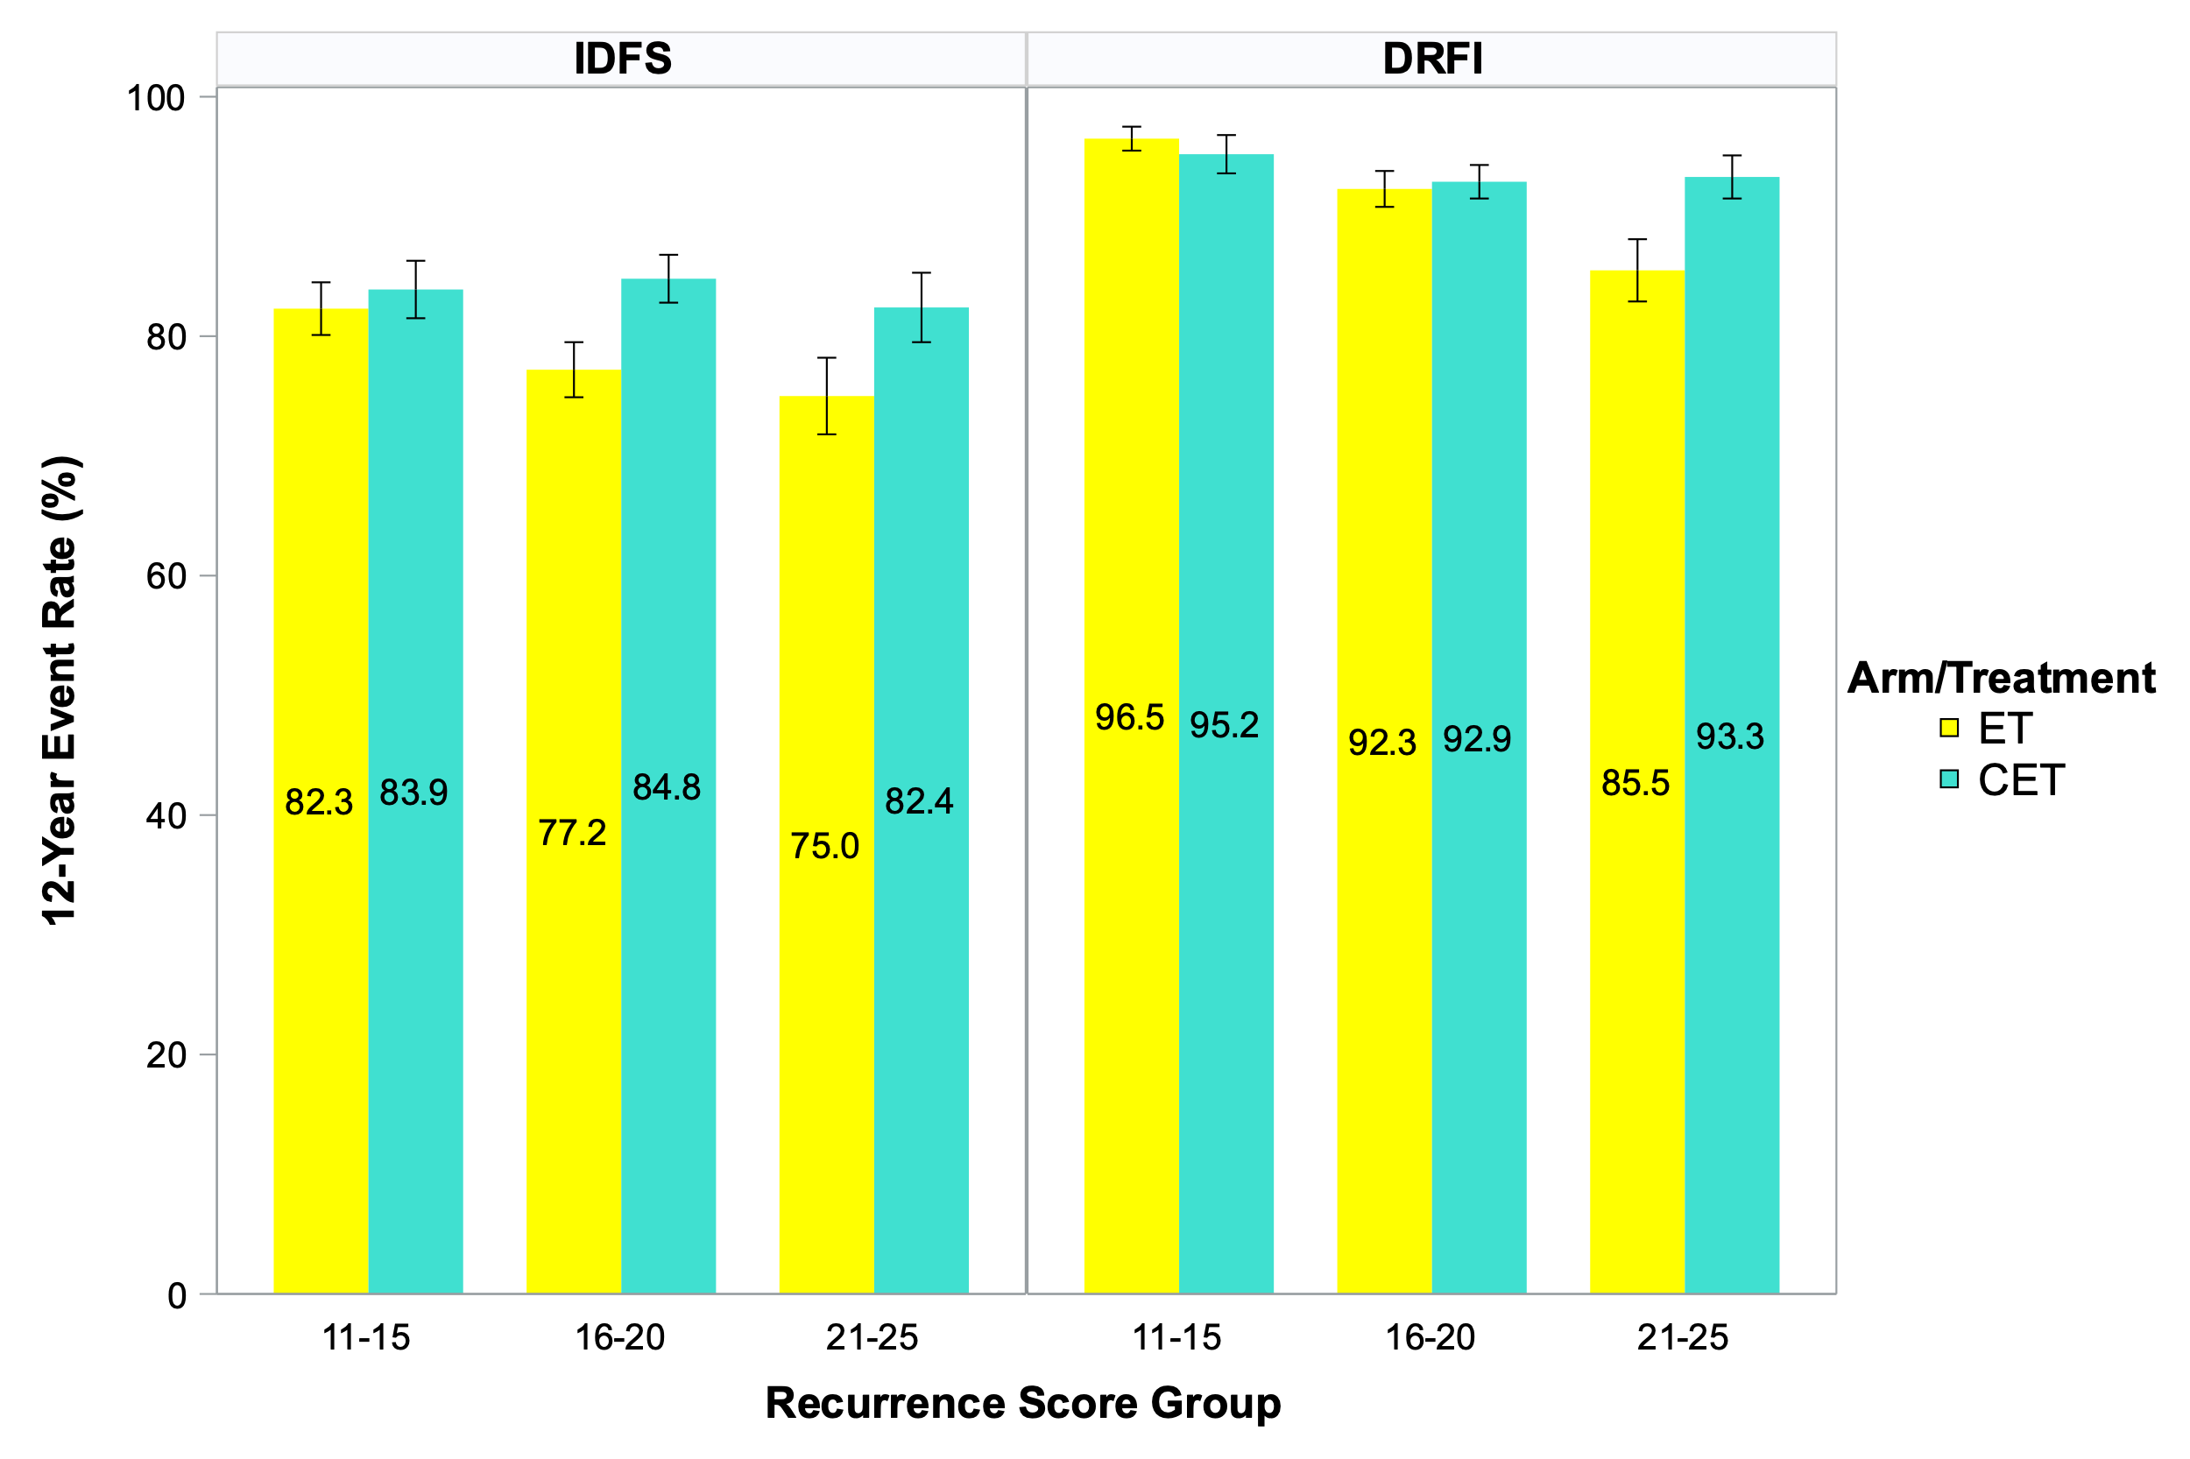
TAILORx: Updated Analysis – Event Rates in RS
11-25 Arms and < 50 Years (ITT Population)
San Antonio Breast Cancer Symposium – December 6-10, 2022

Slide 30
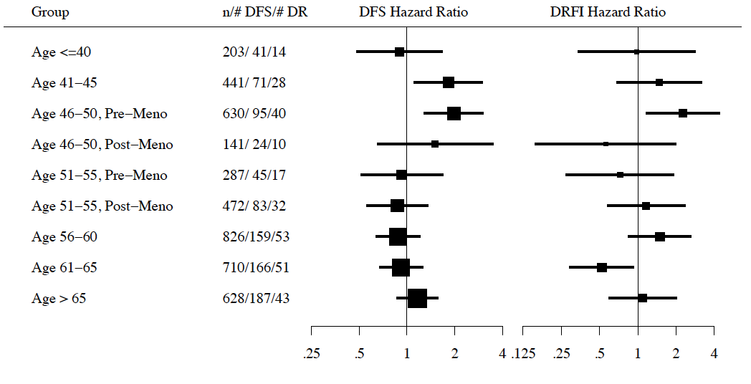
TAILORx: Updated Analysis - Effect of Age, RS, and Clinical
Risk on Chemotherapy Benefit (ITT Population)
San Antonio Breast Cancer Symposium – December 6-10, 2022
Grouped by Age &
Menopausal Status
Total #/#IDFS/DR events
IDFS Hazard Ratio
DRFI Hazard Ratio
12-Year DRFI Rates in Age < 50 Years & RS 16-25
 | Estimated Absolute Chemo Benefit Not Stratified by Clinical Risk | Clinical Risk | No. | Estimated Absolute Chemo Benefit Stratified by Clinical Risk
RS 16-20 (N=886) | ∆ +0.4% (+SE 2.1%) | Low | 671 (76%) | ∆ -0.5% (+SE 2.2%)
 |  | High | 215 (24%) | ∆ +3.1% (+SE 5.4%)
RS 21-25 (N=476) | ∆ +7.8% (+SE 3.4%) | Low | 319 (67%) | ∆ +5.9% (+SE 3.4%)
 |  | High | 157 (33%) | ∆ +11.7% (+SE 7.2%)
3-way treatment interaction test
IDFS
  Chemo-Age-RS (p=0.007)
  Chemo-Menopause-RS (p=0.06)
DRFI
  Chemo-Age-RS (p=0.43)
  Chemo-Menopause-RS (p=0.26)
Chemo
better
Chemo
better

Slide 31
Conclusion
Adjuvant chemotherapy provides no benefit in postmenopausal ER+/HER2- node negative patients (RS 11-25) and postmenopausal ER+/HER2-, 1-3 + LN (RS 0-25).
Why did chemotherapy provide benefit in TailoRx and RxPonder premenopausal patients?
  Endocrine Hypothesis:
    Endocrine only arm: Inadequate endocrine therapy delivered (mostly tamoxifen and without OFS)
    Chemotherapy treatment resulted in ovarian suppression not measured adequately
  Cytotoxic hypothesis: chemotherapy eliminates micro-metastatic disease, independent of endocrine effects¹
Early Breast Cancer Trialists’ Collaborative Group (EBCTCG): Effects of chemotherapy and hormonal therapy for early breast cancer on recurrence and 15-year survival: An overview of the randomised trials. Lancet 365:1687-1717, 2005

Slide 32
TEXT and SOFT Designs
SOFT and TEXT
TEXT (N=2672)
Enrolled: Nov’03-Apr’11
R
A
N
D
O
M
I
Z
E
Premenopausal HR+
≤12 wks after surgery
Planned OFS
No planned chemo (N=1053)
OR planned chemo (N=1607)
Tamoxifen+OFS x 5y
Exemestane+OFS x 5y
AI Question
(N=4690)
Tamoxifen+OFS x 5y
Exemestane+OFS x 5y
SOFT (N=3066)
R
A
N
D
O
M
I
Z
E
Premenopausal HR+
≤12 wks after surgery
No chemo (N=1419)
OR
Remain premenopausal ≤8 mos after chemo (N=1628)
Tamoxifen x 5y
Tamoxifen+OFS x 5y
Exemestane+OFS x 5y
Median follow-up 13 years
OFS=ovarian function suppression, by GnRH analogue triptorelin or oophorectomy
Pagani et al. NEJM 2014; Francis et al. NEJM 2014, Regan SABCS 2021

Slide 33
AI Question: SOFT+TEXT Overall Populations
13 years median follow-up
Distant Recurrence-free Interval
Overall Survival
5-yr:
93.7
92.2
12-yr:
88.4 (+1.8%)
86.6
5-yr:
96.0
97.0
12-yr:
90.1 (+1.0%)
89.1
Distant recurrence-free (%)
Surviving (%)
 | Distant Recur | HR (95%CI) | P
E+OFS | 249 | 0.83 (0.70-0.98) | 0.03
T+OFS | 295 | . | .
 | Death | HR (95%CI) | P
E+OFS | 228 | 0.93 (0.78-1.11) | 0.43
T+OFS | 245 | . | .
0 5 12
0 5 12
Years since randomization
Years since randomization
 |  | 0-5 years |  | >5 years
 | Recur | HR (95% CI) | Recur | HR (95% CI)
E+OFS: | 139 | 0.78 (0.63-0.98) | 110 | 0.90 (0.70-1.17)
T+OFS: | 175 | . | 120 | .
. | . | . | . | .
At risk: | 4690 pts | 21535 pyfu | 3947 pts | 26891 pyfu
 |  | 0-5 years |  | >5 years
 | Deaths | HR (95% CI) | Deaths | HR (95% CI)
E+OFS: | 91 | 1.34 (0.98-1.84) | 137 | 0.77 (0.62-0.97)
T+OFS: | 68 | . | 177 | .
. | . | . | . | .
At risk: | 4690 pts | 22467 pyfu | 4283 pts | 30294 pyfu
E+OFS vs T+OFS: absolute reduction in distant recurrence, 1.8% at 12 years
absolute reduction in death, 1.0% at 12 years
pyfu=person-years follow-up
Regan SABCS 2021 and J Clin Oncol (in press)

Slide 34
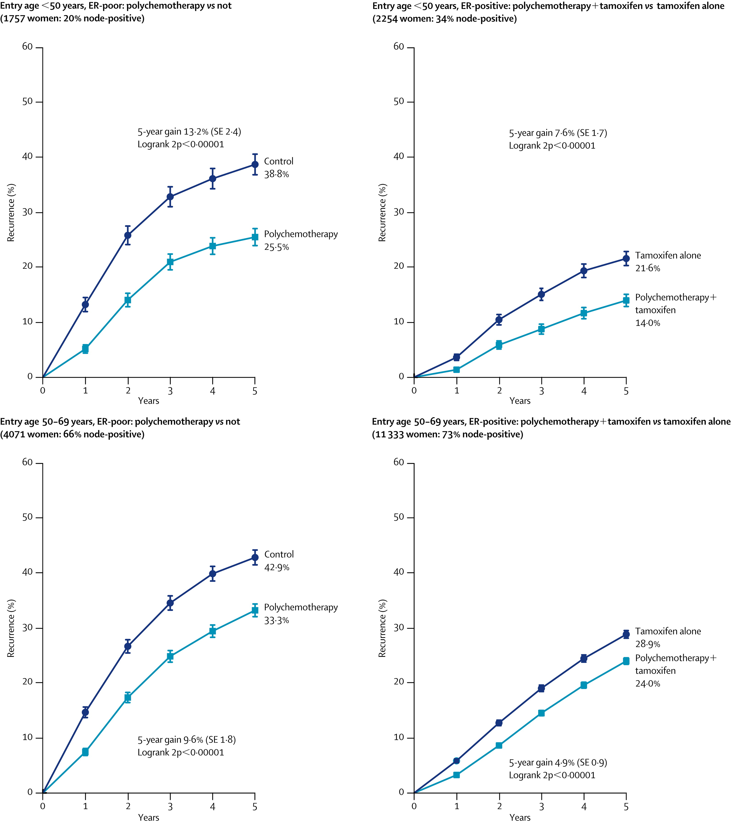
Polychemotherapy versus not, by entry age <50 or 50-69 years and ER status
(Oxford Overview)
Age < 50: Enriched with tumors that harbor deficiencies in DNA repair?
Proportional risk reductions are a bit smaller, but clearly still evident
Early Breast Cancer Trialists' Collaborative Group (EBCTCG): Lancet 2005

Slide 35
BR009: Schema (slide courtesy of Terry Mamounas)
Premenopausal; HR+/HER2- BC
pN0 with RS 16-20 (high clinical risk) or RS 21-25
pN1 with RS 0-25
Stratification
Nodal Status (pN0 vs. pN1)
RS (0-15 vs. 16-25)
Randomization
Chemotherapy +
Ovarian Function Suppression +
Aromatase Inhibitor*
X 5 Years
Ovarian Function Suppression +
Aromatase Inhibitor*
X 5 Years
* Tamoxifen can be used if AI is not tolerated

Slide 36
Outline
Phase III RxPONDER trial evaluating the role of chemotherapy for patients with ER-positive, HER2-negative localized breast cancer with 1 to 3 positive lymph nodes and a 21-gene Recurrence Score (RS) of ≤25
Updated findings, including 12-year event rates, from the Phase III TAILORx study
21-gene RS and neoadjuvant chemotherapy decision making
Insight regarding poor correlation between the RS and chemotherapy response in premenopausal patients

Slide 37
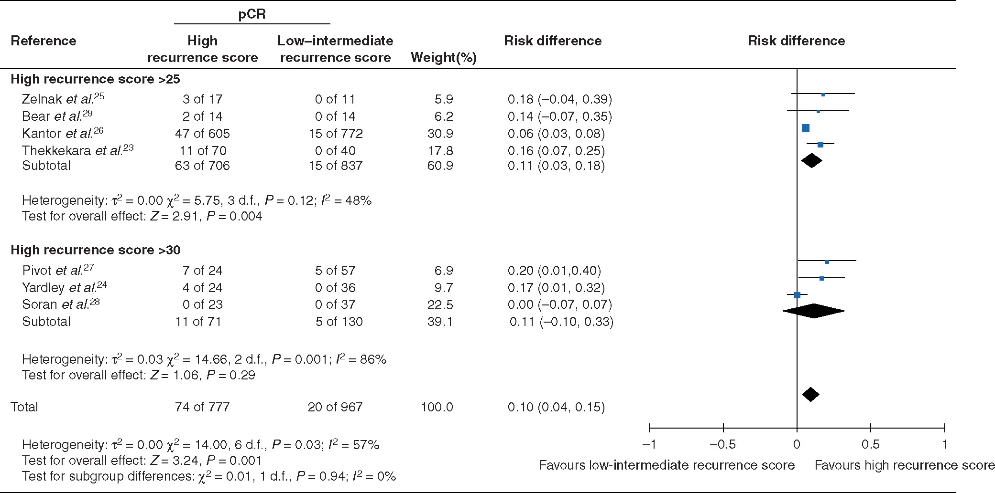
Meta-analysis: pCR rates in Breast Cancer Patients Receiving Neoadjuvant Chemotherapy stratified based on
21-gene expression assay at diagnosis.
Is pCR the best endpoint to determine chemotherapy benefit?
Boland et al. British Journal of Surgery, 2021

Slide 38
ER+/HER2- Breast Cancer Treated with Neoadjvuant Chemotherapy: Total pCR vs nodal pCR
NCDB: 2010-2018, 20,084 cN+ ER+/HER2- BC pts treated with NAC.
7.4% had total pCR
14.3% had nodal-only pCR
Nodal pCR is highly prognostic for survival in ER+/HER2- Breast Cancer
NCDB: Nodal pCR more likely in a) premenopausal pts and b) high Ki-67.
RxPONDER inclusion criteria (cT1-3, N1, Grade I or II, ER+/PR+/Her2-​)
Nodal pCR varied by age: 17.5% in age < 50 ​ vs 13.6% in age ≥ 50, p<0.001​
Nodal pCR also varied by Ki-67: 16.8% in Ki-67 ≥ 20% ​vs 7.9% in Ki-67 < 20%, p<0.001
Moldovenau et al. SABCS 2022

Slide 39
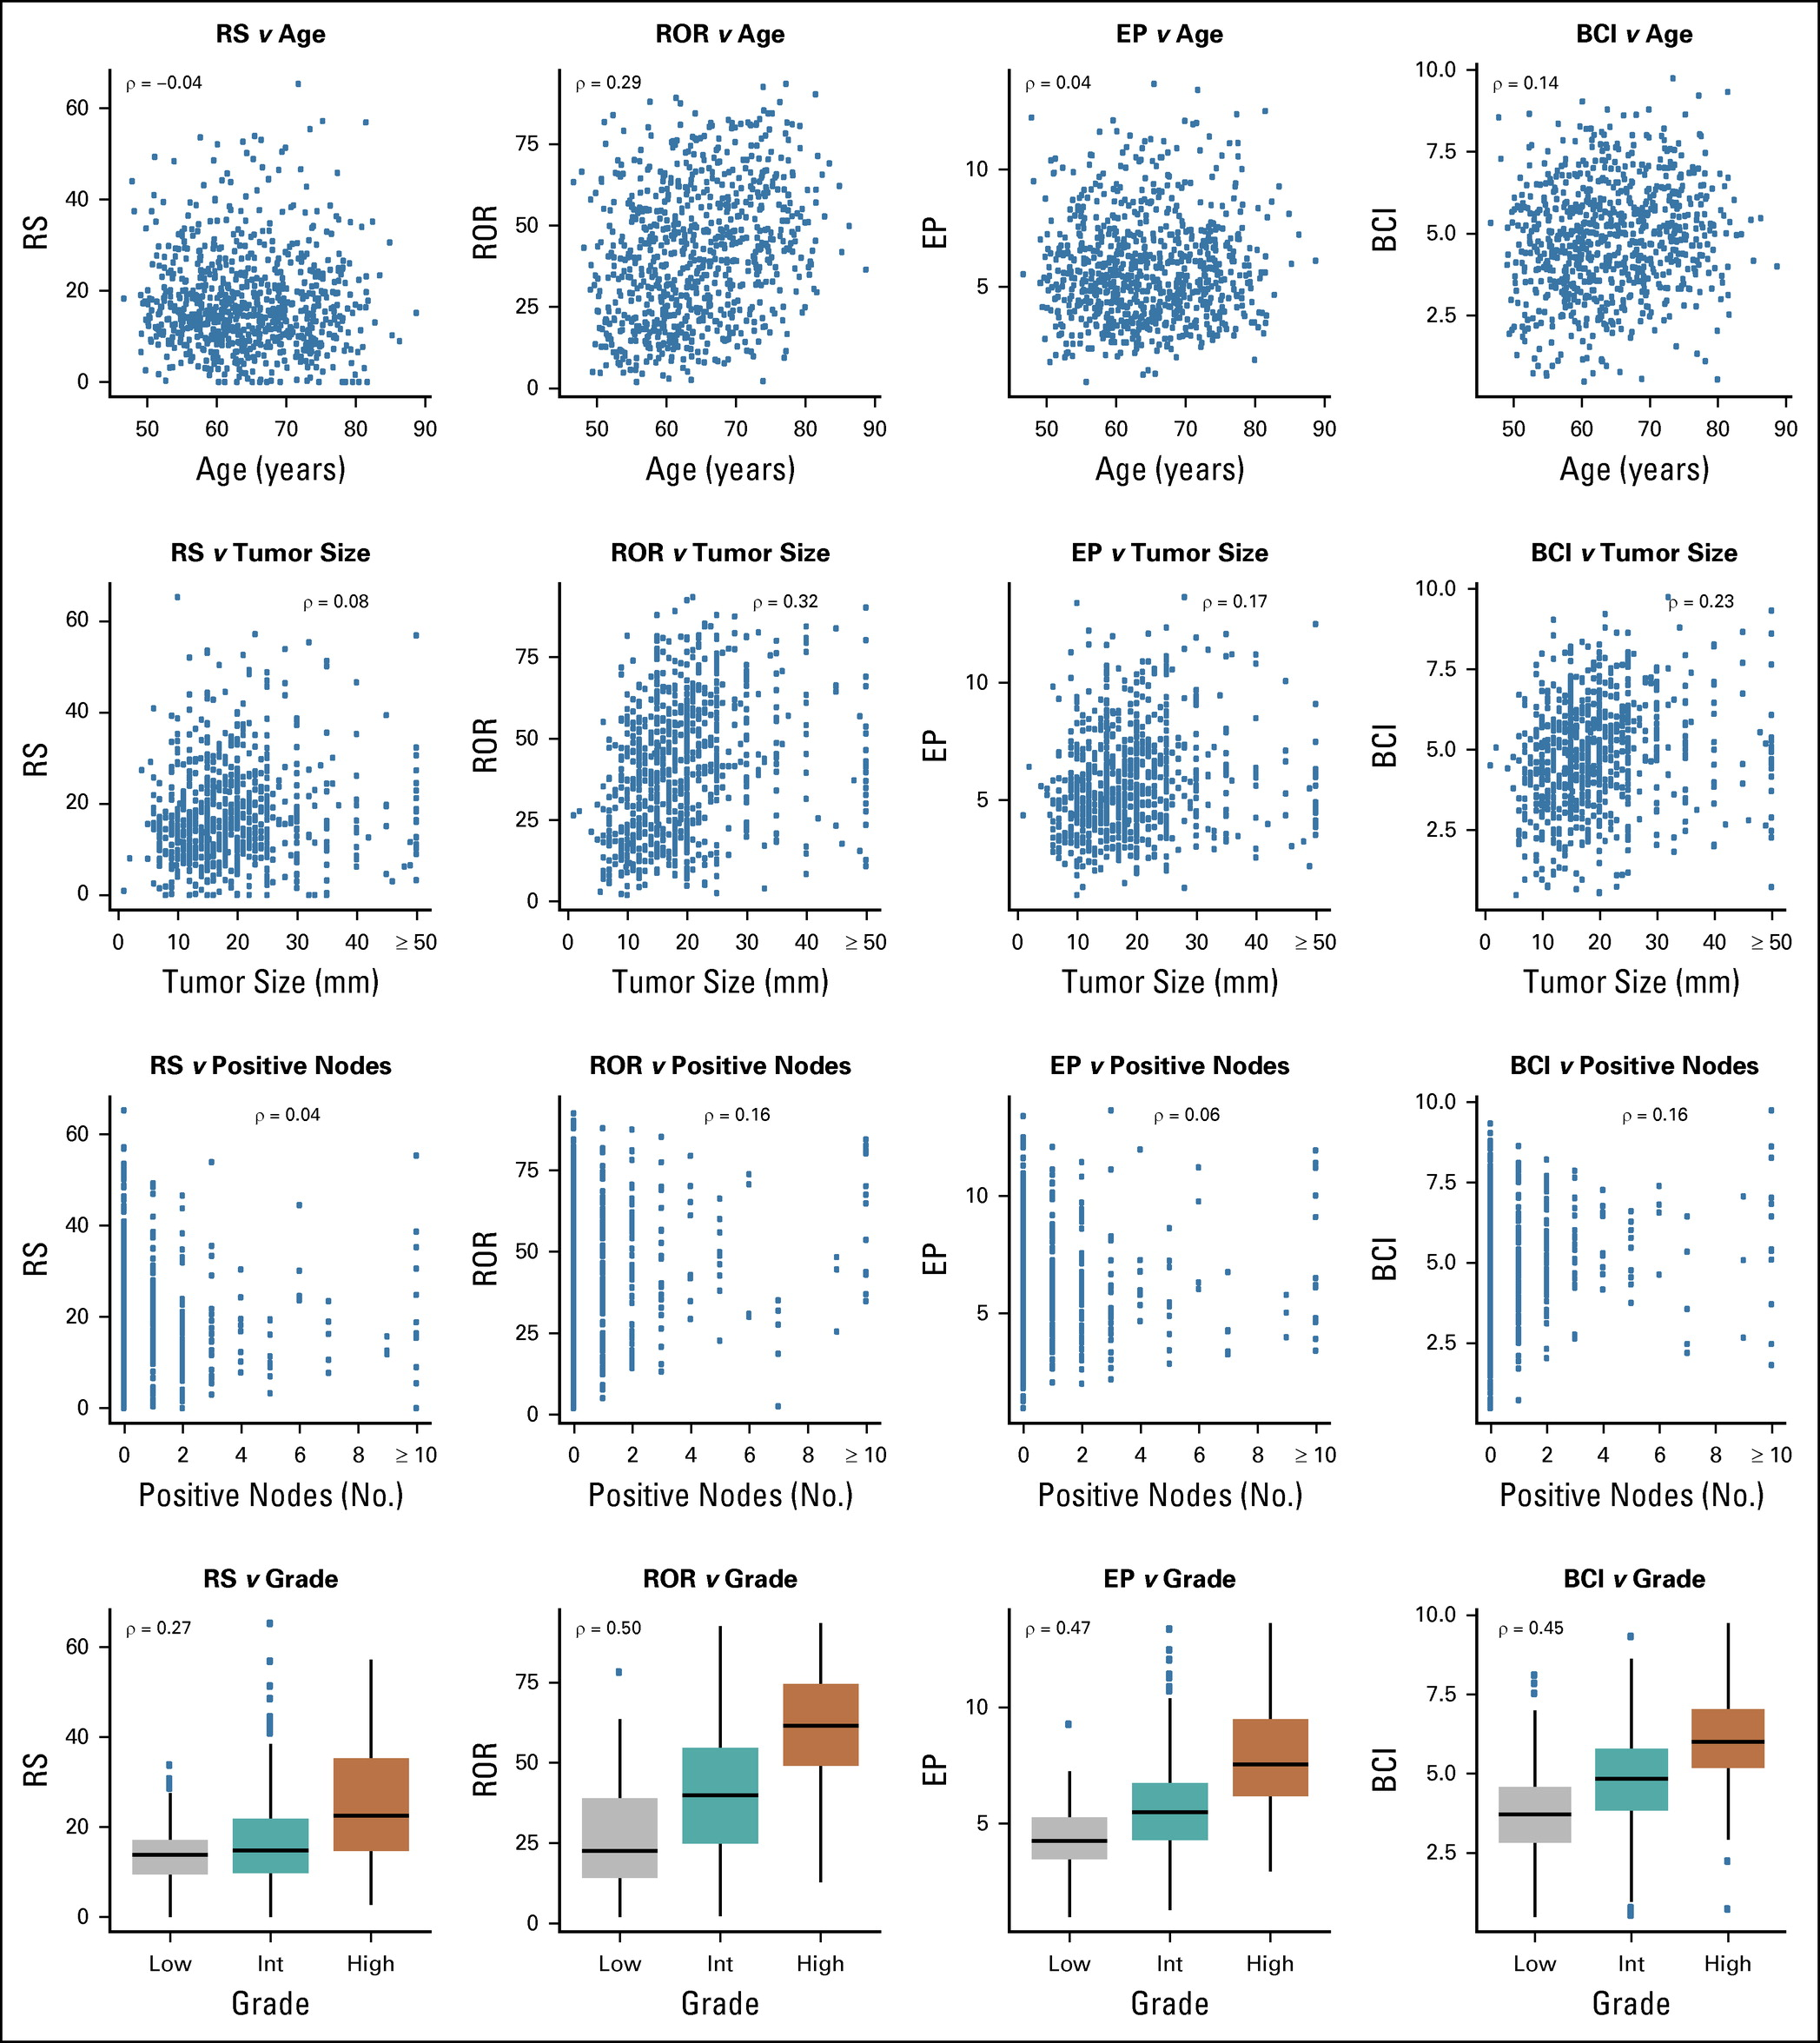
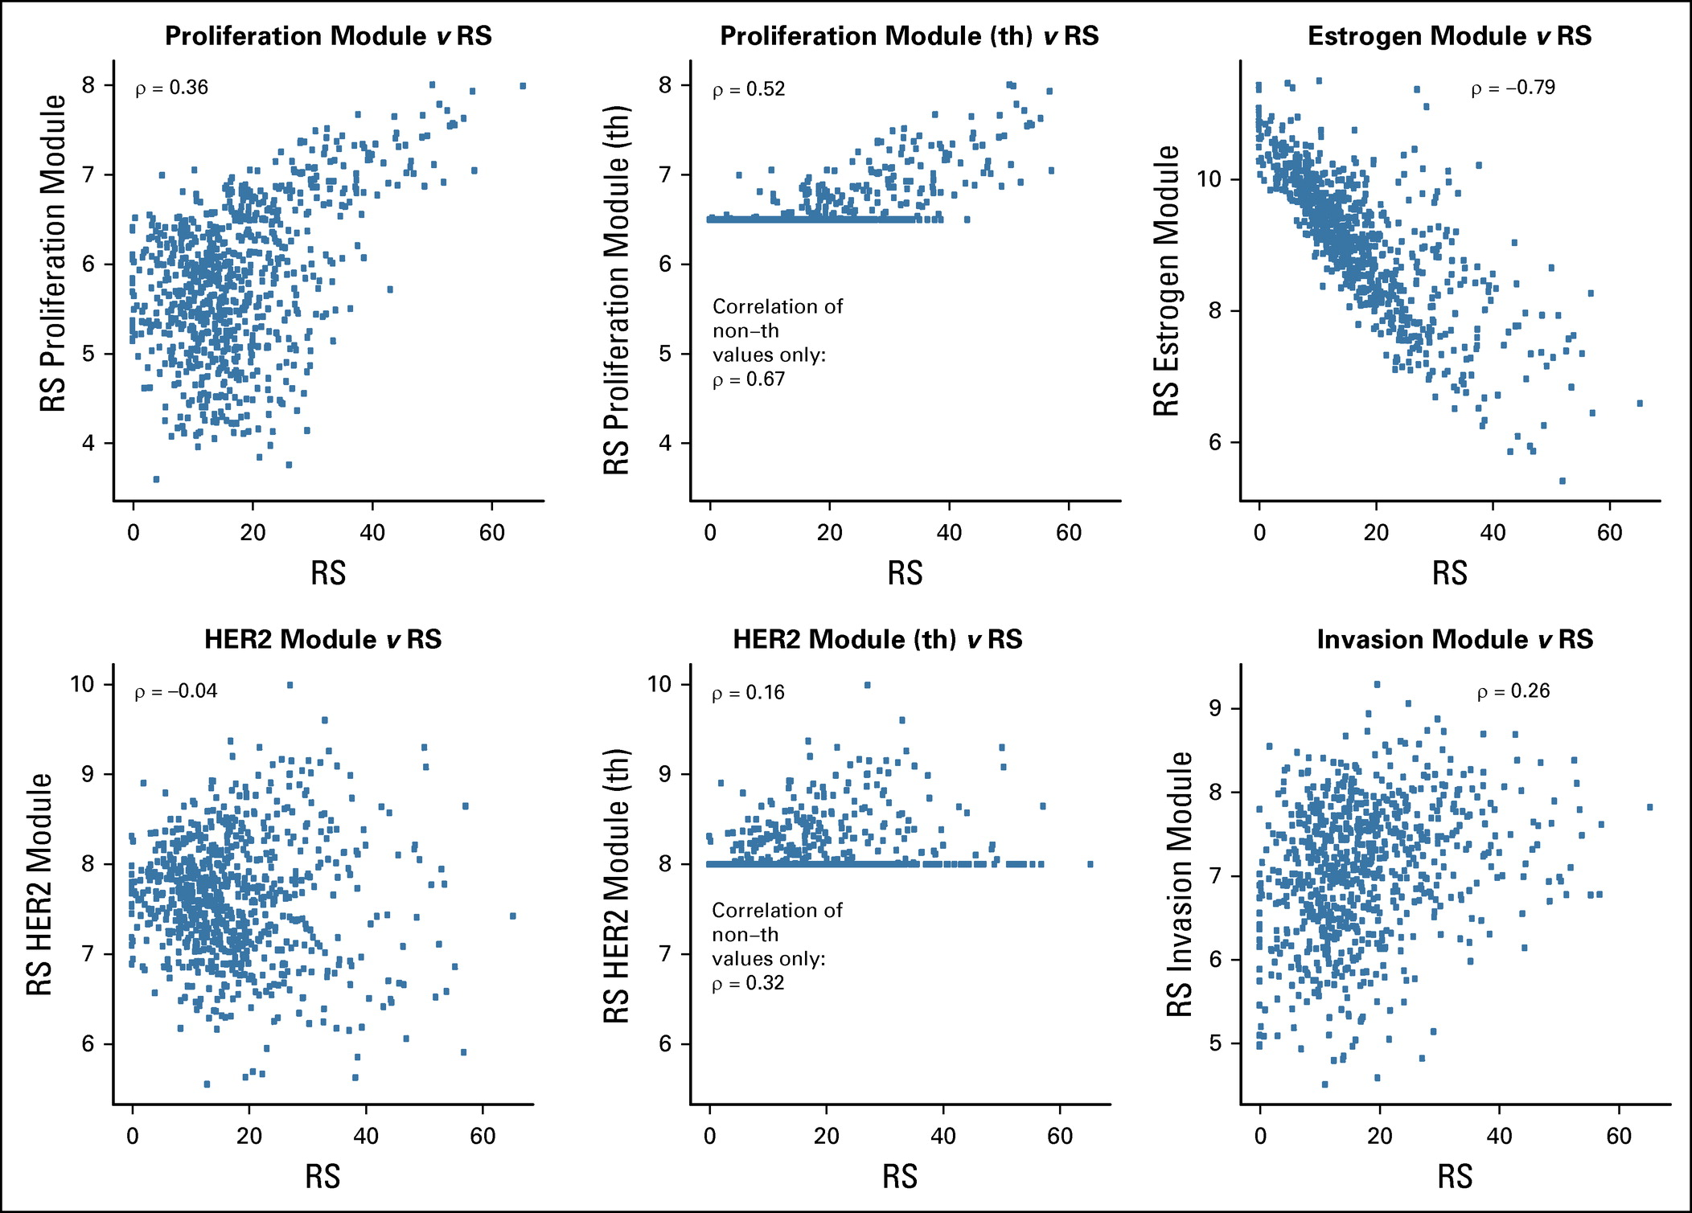
Molecular Drivers of Oncotype DX, A TransATAC Study: The RS is mainly driven by the Estrogen Module
The estrogen module explained more than half of RS’s variance (59.1%), while the proliferation module accounted for approximately a fifth of RS’s information (19.4%)
Buus et al. J Clin Oncol 2021

Slide 40
Conclusion
TAILORx and RxPONDER have provided prospective evidence for lack of adjuvant chemotherapy benefit in postmenopausal patients with RS <25
In contrast, the RS may not be predictive of chemotherapy benefit in age <50 patients
  NRG BR009 will provide the definitive answer to this question
The RS is poorly correlated with the proliferation module but highly correlated with ER
Additional clinical and pathological biomarkers may provide additional insight into those patients that derive benefit from chemotherapy.
Early Breast Cancer Trialists’ Collaborative Group (EBCTCG): Effects of chemotherapy and hormonal therapy for early breast cancer on recurrence and 15-year survival: An overview of the randomised trials. Lancet 365:1687-1717, 2005

Slide 41
MODULE 2: Optimizing the Management of Localized ER-Positive Breast Cancer — Dr Kaklamani

Slide 42
Case Presentation: 40-year-old woman with 5.5-cm, ER/
PR-positive, HER2-negative, node-positive (20/21) IDC, s/p bilateral mastectomies, BSO, adjuvant AC-T and initiation of letrozole/abemaciclib – Ki-67: 3%
Dr Susmitha Apuri (Lutz, Florida)

Slide 43
Case Presentation: 56-year-old woman with de novo
ER-positive, PR-negative, HER2-negative ulcerated BC with pulmonary and extensive spinal metastases
Dr Jennifer Dallas (Charlotte, North Carolina)

Slide 44
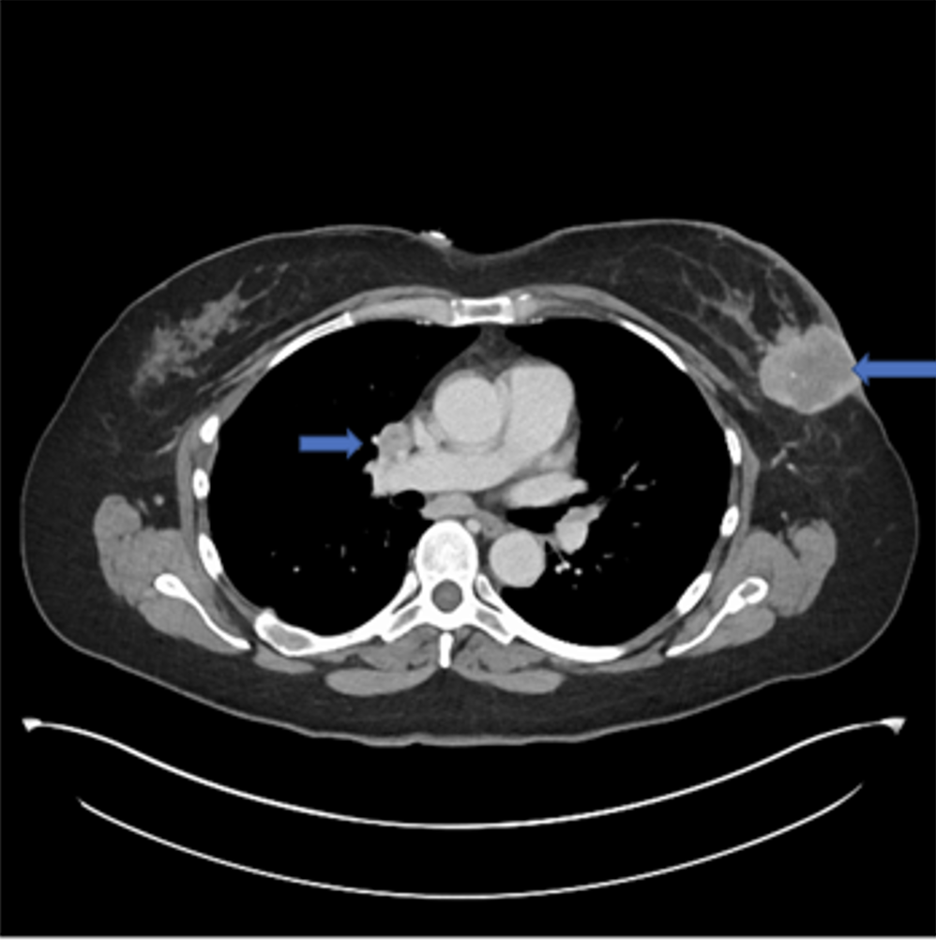
2-26-2022
Notes:
Dallas 56 yo F

Slide 45
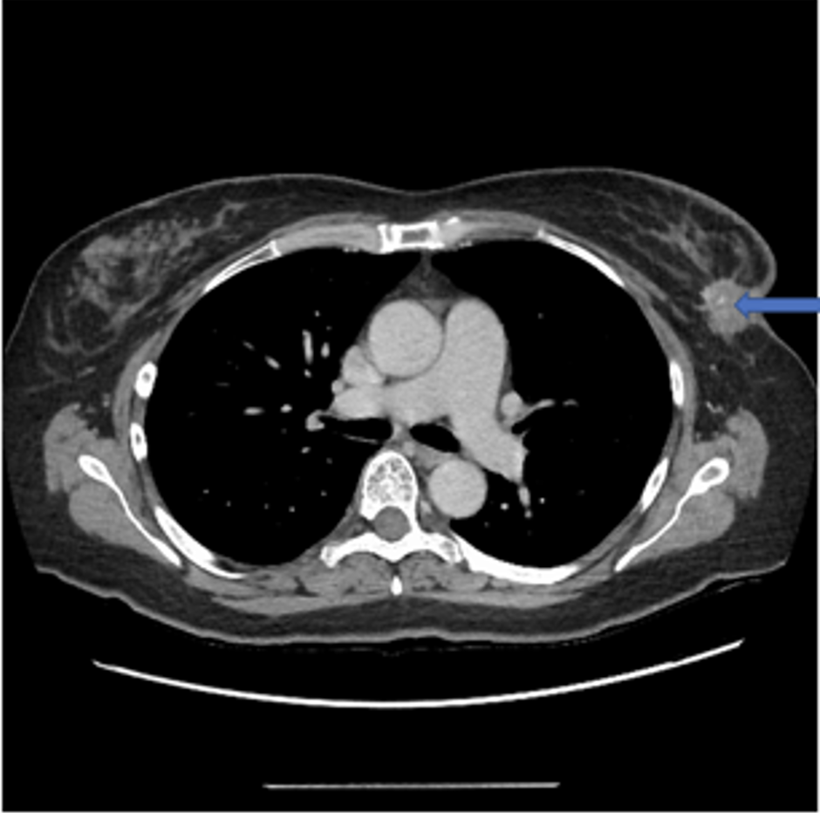
8-10-2022

Slide 46
Optimizing the Management of Localized ER-Positive Breast Cancer
Virginia Kaklamani, MD DSc
Professor of Medicine
Leader, Breast Oncology Program

Slide 47
Optimal duration of ET
Role of OFS in preserving oncofertility and improving outcomes
CDK4/6 inhibition in EBC
PARPi in EBC

Slide 48
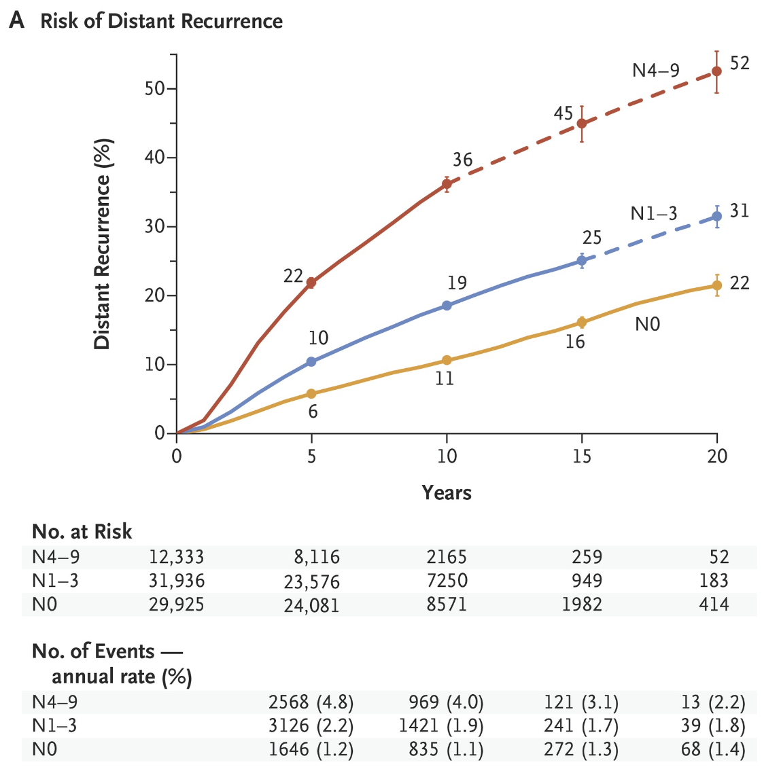
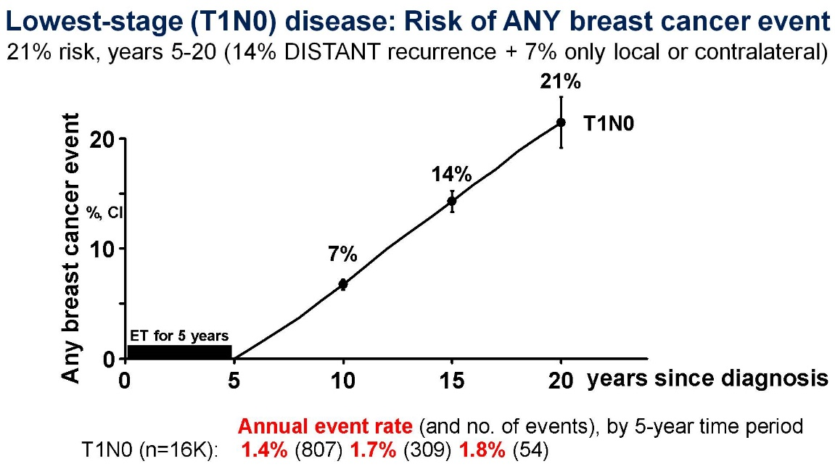
EBCTCG Meta-analysis of 62,923 women with ER+ BC
Factors associated with risk of late recurrence:
LN status
Tumor size
Tumor grade
PR and HER2 not predictive
N Engl J Med 2017; 377:1836-1846

Slide 49
Clinical trials of Extended Endocrine Therapy
Trial | Therapy | n | Absolute Benefit in DFS
ATLAS | Tam x 5 yr | 6846 | 3%*
aTTom | Tam x 5 yr | 6953 | 3%*
MA.17 | AI x 5 yr | 5187 | 4.6%*
MA.17R | AI x 5 yr | 1918 | 4%*
B14 | Tam x 5 yr | 1172 | 6%*
B33 | AI x 5 yr | 1598 | 2%
B42 | AI x 5 yr | 3966 | 3%
DATA | AI x 3 yr | 1912 | 4%
IDEAL | AI x 2.5 yr | 1824 | 3%
ABCSG-6a | AI x 3 yr | 856 | 4.7%
ABCSG16 | AI x 3 yr | 3484 | -0.8%
SOLE | AI cont vs intermittent | 4884 | 1.7%

Slide 50
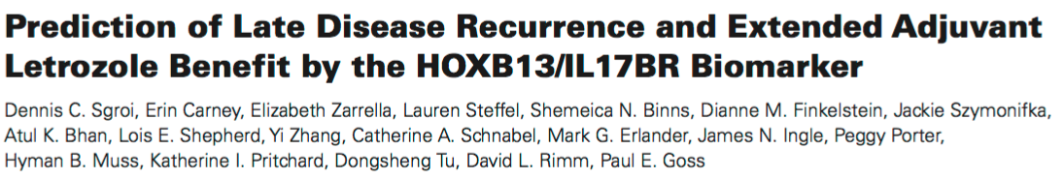
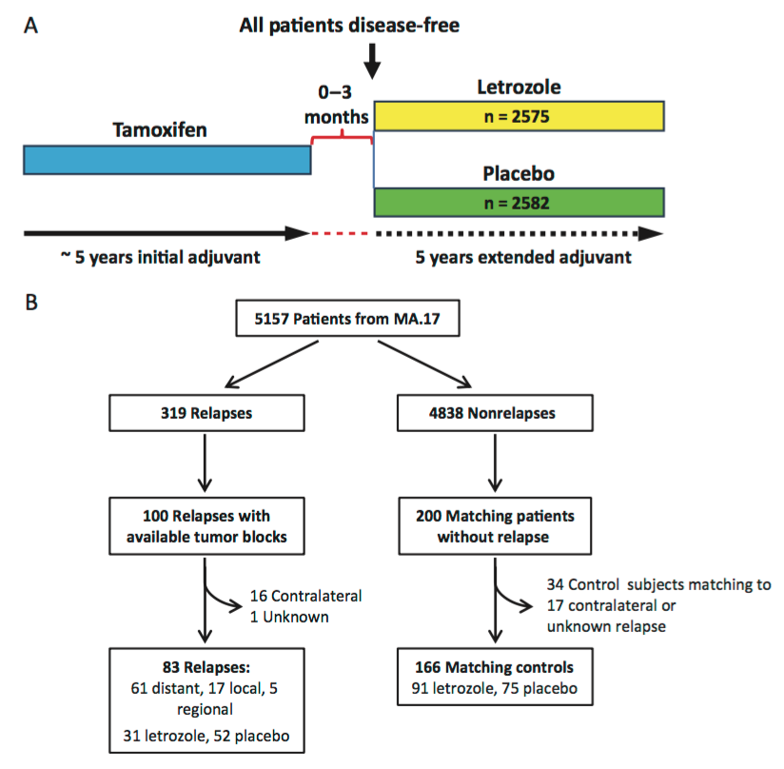
High H/I significantly associated with decreased recurrence in letrozole arm
OR=0.35, p=0.007
Interaction between H/I and letrozole, p=0.03
16.5%
absolute benefit
Lancet Oncol. 2013,14:1067-76.

Slide 51
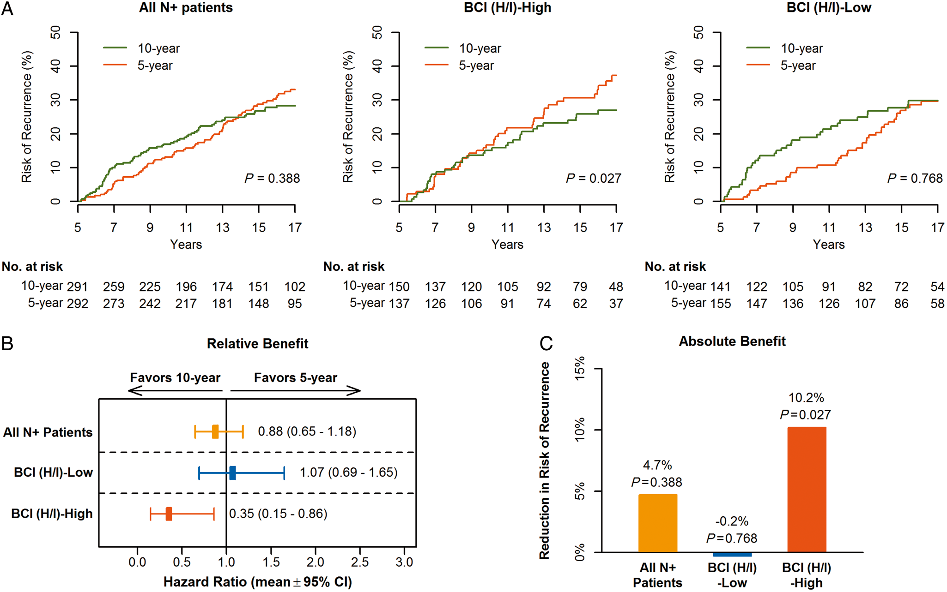

aTTom: Predictive performance by BCI (H/I) groups based on RFI in HR+ N+ patients (n = 583).
51% of patients identified as low

Slide 52
Factors Affecting Late Recurrence and Benefit from Extended Endocrine Therapy
Tolerability
LN status
Tumor Size
Tumor Grade
Prior Chemotherapy
Switching from TAM to AI
Genomic Assays
Bone Fractures
Osteoporosis
Bone Pain
Uterine ca
VTEs

Slide 53
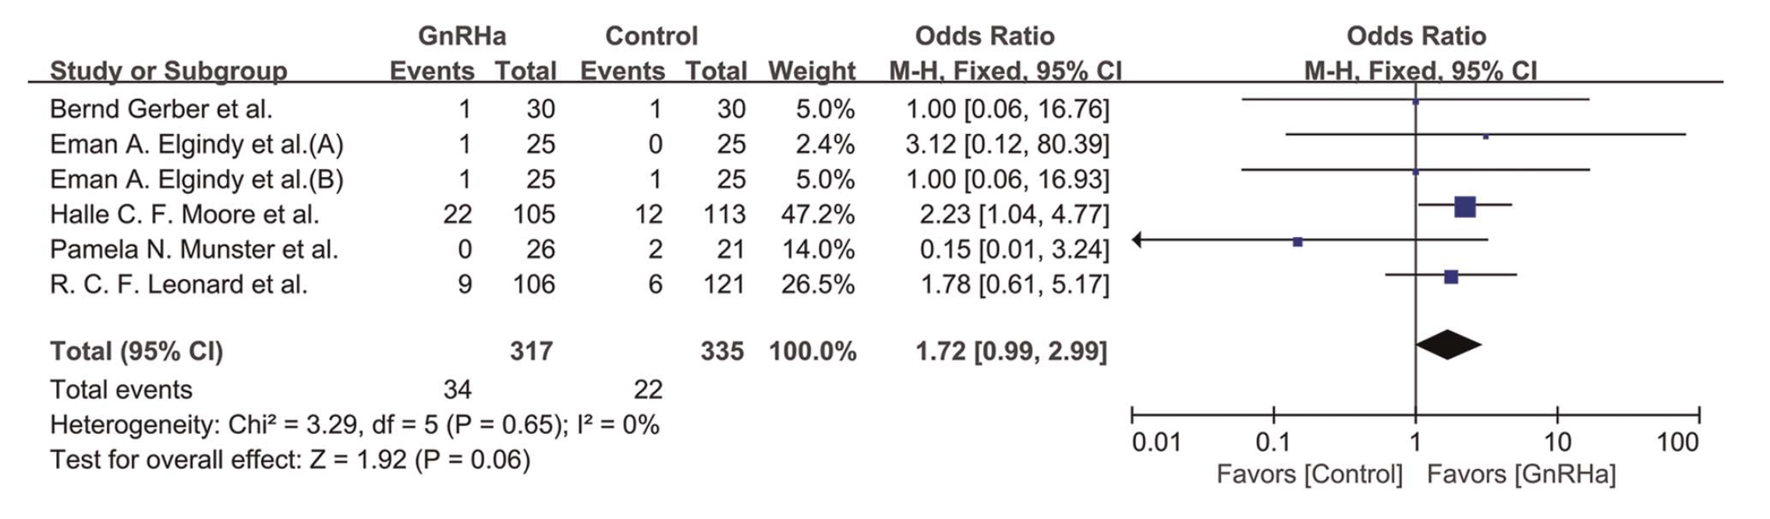
Forest Plot of the Rate of Spontaneous Pregnancy Achieved with GnRHa and Chemotherapy versus Chemotherapy Alone: All Patients
STAY TUNED FOR POSITIVE TRIAL
Li Z-Y et al. Menopause 2022;29(9):1093-100.

Slide 54
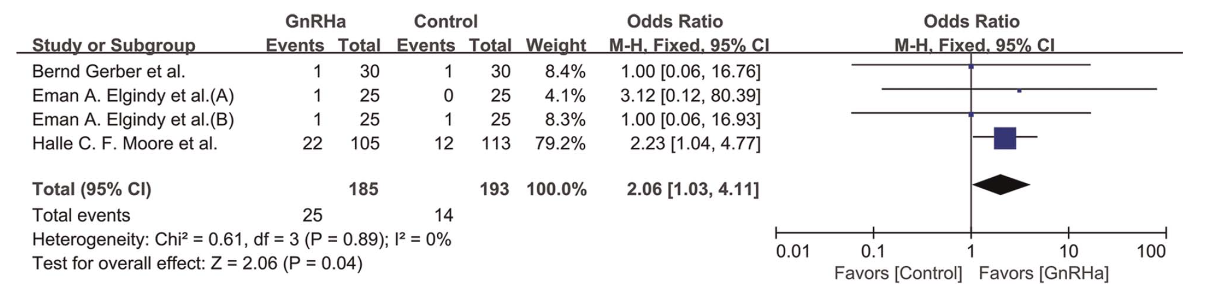
Forest Plot of the Rate of Spontaneous Pregnancy Achieved with GnRHa and Chemotherapy versus Chemotherapy Alone: HR-Negative Disease
Li Z-Y et al. Menopause 2022;29(9):1093-100.

Slide 55
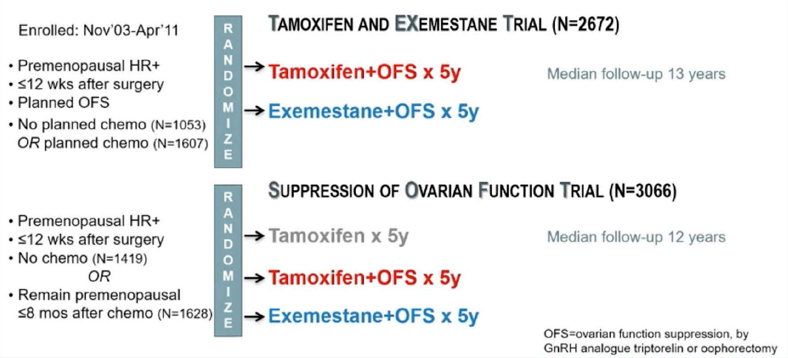
TEXT and SOFT Trial Designs
Regan MM et al. SABCS 2021;Abstract GS2-05.

Slide 56
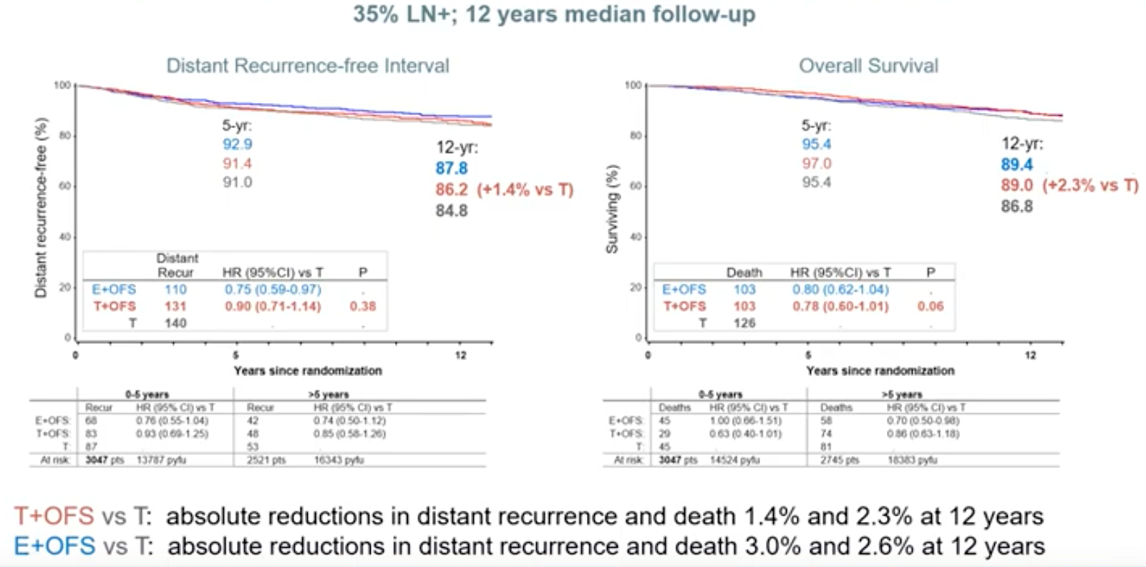
OFS Question: SOFT Overall Population
Regan MM et al. SABCS 2021;Abstract GS2-05.

Slide 57
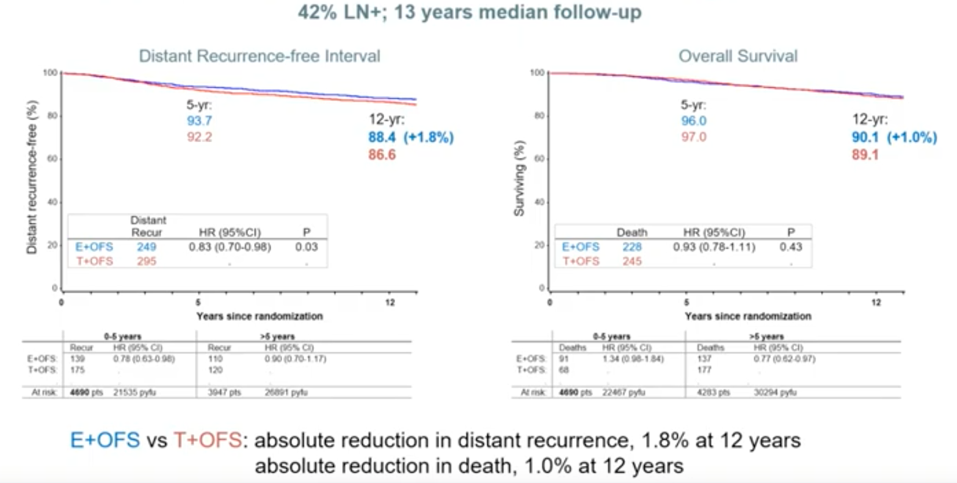
AI Question: SOFT and TEXT Overall Populations
Regan MM et al. SABCS 2021;Abstract GS2-05.

Slide 58
SOFT+TEXT Chemotherapy Cohorts
57% & 66% LN+; 13 years median follow-up
Distant Recurrence-free Interval
Overall Survival
5-yr:
91.8
88.9
87.6 85.2
5-yr:
94.5
95.0
92.4
95.0
12-yr:
87.0 (+2.6%)
84.4
82.9 (-0.7%)
83.6
12-yr:
84.7 (+2.4%)
82.3
79.6 (+1.9%) 77.7
TEXT
SOFT
TEXT
SOFT
Distant recurrence-free (%)
Surviving (%)
 | Distant Recur | HR (95%CI)
E+OFS | 99 | 0.86 (0.66-1.13) | SOFT
T+OFS | 114 | .
E+OFS | 118 | 0.86 (0.67-1.11) | TEXT
T+OFS | 132 | .
 | Death | HR (95%CI)
E+OFS | 88 | 1.06 (0.79-1.43) | SOFT
T+OFS | 85 | .
E+OFS | 103 | 0.85 (0.65-1.11) | TEXT
T+OFS | 118 | .
0 5 12
0 5 12
Years since randomization
Years since randomization
SOFT
TEXT
 |  | 0-5 years |  | >5 years
 | Recur | HR (95% CI) | Recur | HR (95% CI)
E+OFS: | 65 | 0.85 (0.61-1.19) | 34 | 0.88 (0.56-1.41)
T+OFS: | 76 | . | 38 | .
E+OFS: | 62 | 0.73 (0.52-1.01) | 56 | 1.10 (0.75-1.61)
T+OFS: | 83 | . | 49 | .
At risk: | 2694 pts | 12086 pyfu | 2166 pts | 14702 pyfu
SOFT
TEXT
 |  | 0-5 years |  | >5 years
 | Deaths | HR (95% CI) | Deaths | HR (95% CI)
E+OFS: | 40 | 1.57 (0.96-2.57) | 48 | 0.84 (0.57-1.22)
T+OFS: | 26 | . | 59 | .
E+OFS: | 42 | 1.10 (0.71-1.70) | 61 | 0.74 (0.53-1.03)
T+OFS: | 38 | . | 80 | .
At risk: | 2694 pts | 12774 pyfu | 2395 pts | 16928 pyfu
E+OFS vs T+OFS: reductions in distant recurrence 1.9% SOFT and 2.4% TEXT at 12 years
overall survival, -0.7% SOFT and +2.6% TEXT at 12 years
pyfu=person-years follow-up
Notes:
*And looking together at both the SOFT and TEXT chemotherapy cohorts … with TEXT again in dashed lines appended to solid lines of SOFT …
*In the 2 trials, there remained overall, moderate relative reductions in DR with E+OFS compared to T+OFS …
*which resulted in abs reductions in DR at 12 yrs of 1.9% in SOFT and 2.4% in the TEXT cohort.
*Survival was not consistently improved…
*It was without improvement in SOFT at 12 yrs, and with a later-emergent improvement in survival of 2.6% at 12 yrs in TEXT.
*86% of deaths were after a BC event in these cohorts.

Slide 59
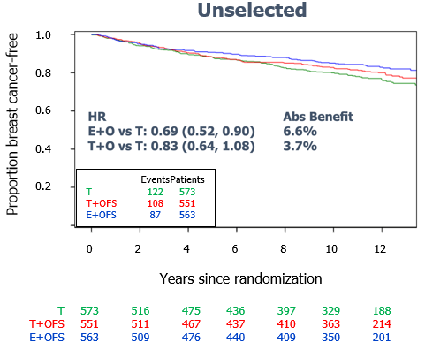
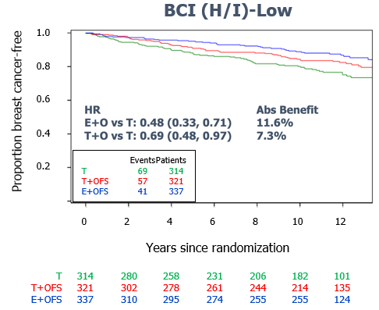
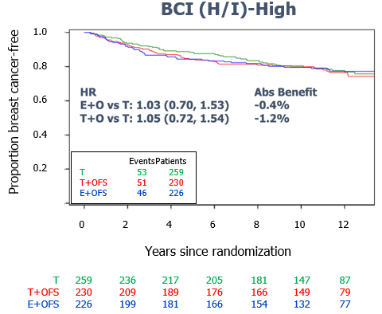
BCI (H/I) Predictive Results for BCFI – Overall HR+ Cohort
HR
E+O vs T: 1.03 (0.70, 1.53)
T+O vs T: 1.05 (0.72, 1.54)
HR
E+O vs T: 0.69 (0.52, 0.90)
T+O vs T: 0.83 (0.64, 1.08)
12y Abs Benefit
6.6%
3.7%
HR
E+O vs T: 0.48 (0.33, 0.71)
T+O vs T: 0.69 (0.48, 0.97)
12y Abs Benefit
11.6%
7.3%
12y Abs Benefit
-0.4%
-1.2%
58% of cancers were BCI (H/I)-Low and 42% were BCI (H/I)-High
Significant treatment by biomarker interaction for EXE+OFS vs TAM (P<0.01 in adjusted analysis); less so for TAM+OFS vs TAM (P=0.16)

Slide 60
Guidelines for OFS
ASCO:
  Offer in women receiving chemotherapy
  Offer to higher risk women: larger tumors, younger age, higher grade, pos LN
St Gallen:
  Offer in women who are less than 35yo, received chemotherapy, have 4+LN

Slide 61
monarchE Study Design (NCT03155997) (4y efficacy)
Cohort 1: High risk based on clinical pathological features
≥4 ALN OR
1-3 ALN and at least 1 of the below:
Grade 3 disease
Tumor size ≥5 cm
On-study treatment period
2 years
HR+, HER2-, node positive high-risk EBC
Women or men
Pre-/postmenopausal
With or without prior neo- and/or adjuvant chemotherapy
No metastatic disease
Maximum of 16 months from surgery to randomization and 12 weeks of ET following the last non-ET
Abemaciclib
(150mg twice daily)
+
Endocrine Therapy: AI or tamoxifen
Follow-up period
Endocrine Therapy
3-8 years as clinically indicated
R 1:1
N = 5637
Cohort 2: High risk based
on Ki-67
1-3 ALN and
Ki-67 ≥20% and
Grade 1-2 and tumor size <5 cm
Endocrine Therapy: AI or tamoxifen
Primary Objective: IDFS
Secondary Objectives: IDFS in high Ki-67 populations, DRFS, OS, Safety, PK, PRO
Stratified for:
Prior chemotherapy
Menopausal status
Region

Slide 62
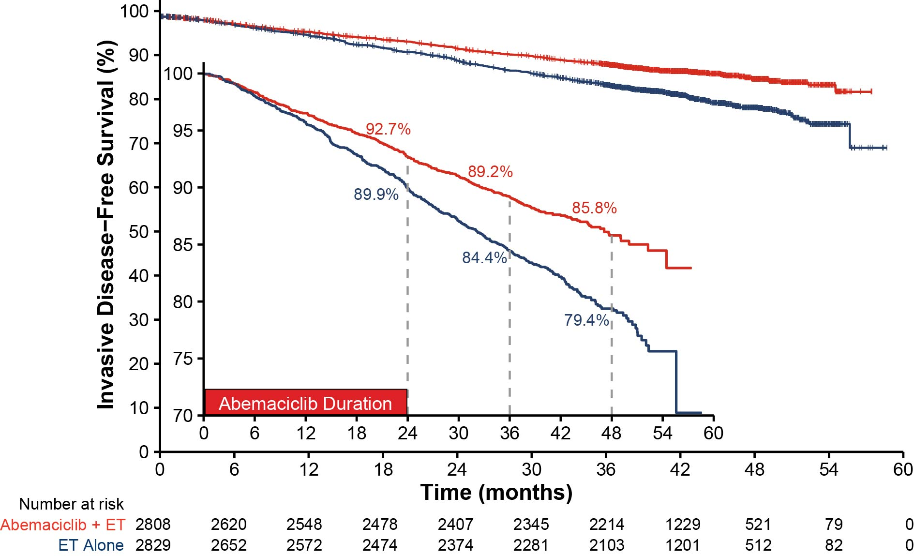
IDFS Benefit in ITT Persists Beyond Completion of Abemaciclib
Number of IDFS events
Abemaciclib + ET | ET Alone
336 | 499
HR (95% CI): 0.664 (0.578, 0.762) Nominal p < 0.0001
33.6% reduction in the risk of developing an IDFS event with an increase in absolute
benefit in IDFS 4-year rates (6.4%) compared to 2-and 3-year IDFS rates (2.8% and 4.8% respectively)

Slide 63
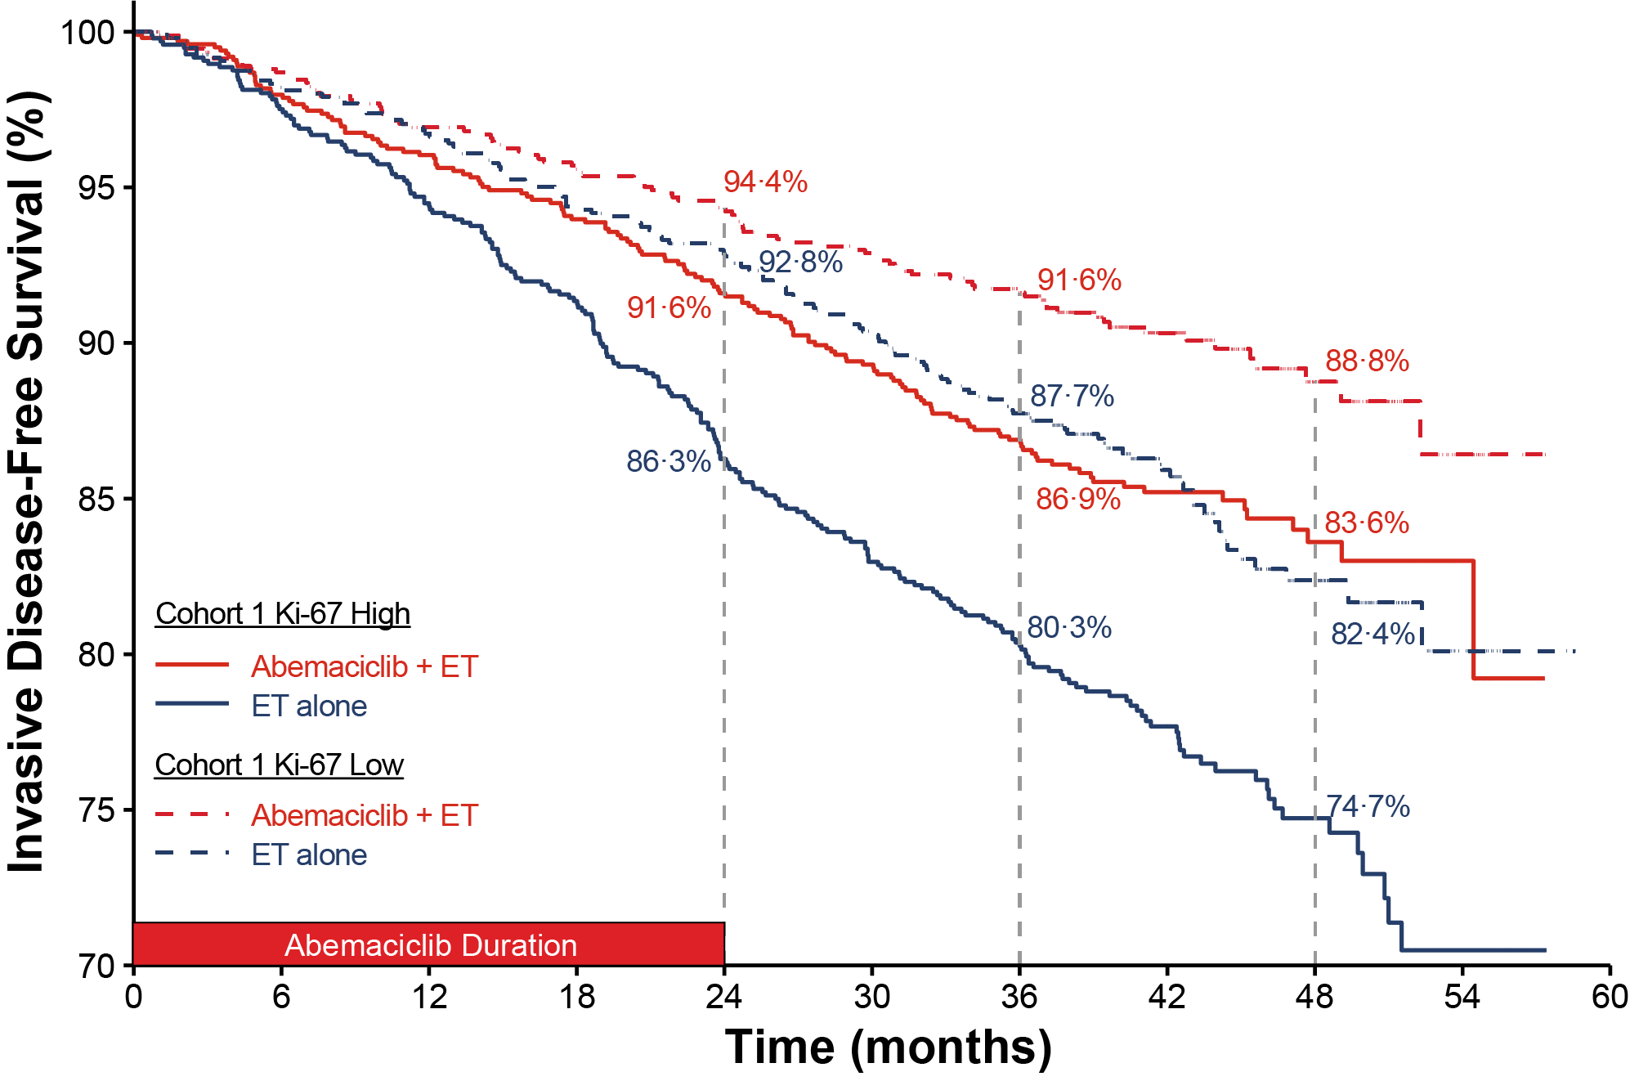
Ki-67 is Prognostic, but Not Predictive of Abemaciclib Benefit
 | Cohort 1*
 | C1 Ki-67 High |  |  | C1 Ki-67 Low
 | Abemaciclib + ET N=1017 | ET alone N=986 | ET alone N=986 | Abemaciclib + ET N=946 | ET alone N=968 | ET alone N=968
IDFS
Number of events, n | 147 | 224 |  | 91 | 141
HR (95% CI) | 0.618 (0.501, 0.762) |  |  | 0.624 (0.478, 0.814)
DRFS
Number of events, n | 126 | 193 |  | 74 | 119
HR (95% CI) | 0.612 (0.488, 0.767) |  |  | 0.613 (0.458, 0.821)
OS (Immature)
Number of events, n | 68 | 88 |  | 39 | 50
HR (95% CI) | 0.733 (0.533, 1.007) |  |  | 0.772 (0.506, 1.175)
*Ki-67 value was missing in 1203 (23.5%) patients
Within Cohort 1, similar abemaciclib treatment effects were observed regardless of Ki-67 index

Slide 64
Adjuvant CDK4/6i Reported Trials
 | PALLAS | PENELOPE-B | MONARCH-E
N | 5600 | 1250 | 5637
Length of CDK4/6i | 2 year | 1 year | 2 year
Prior chemotherapy | 82% | 100% | 95%
Tamoxifen use | 32% | 50% | 30%
Grade 3 | 29% | 47% | 38%
Node negative | 13% | Unknown | 0.2%
N1 | 49% | Unknown | 40%
>N2 | 37% | 50% (after NAC) | 60%
Discontinued IP prematurely | 42% | 19.5% | 28% (at 19 mos f/u)
Still on therapy | 26% | 0 | 10%
Median follow up | 24 mos | 42.8 mos | 27.1 mos
2-year iDFS |  | 88.3% vs 84% △4.3% | 92.7% vs 90.0% △2.7%
3-year iDFS | 88.2% vs. 88.5% △-0.3% | 81.2% vs. 77.7% △3.5% | 88.8% vs 83.4% △5.4%, HR 0.696, P<0.0001

Slide 65
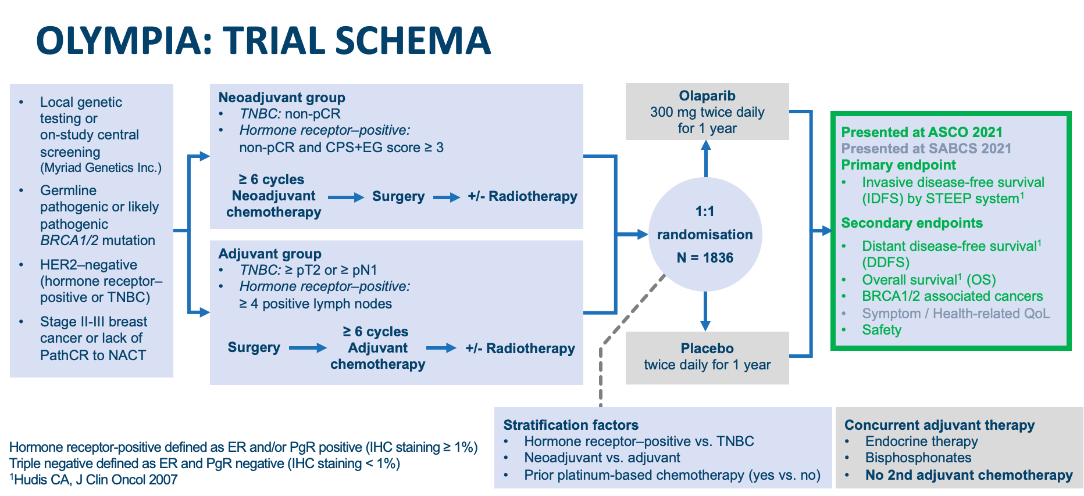

Slide 66
Comments on study population
Very young (median 42-43, 25% > 50)
72.3% gBRCA1m
82.2% TNBC, no HER2+ (by design)
74.7% treated with mastectomy (46.5% bilateral)
RRSO in ~60%
CPS+EG score unfamiliar to many
  http://www3.mdanderson.org/app/medcalc/index.cfm?pagename=bcnt
  Remember to use nuclear grade, not histologic or overall

Slide 67
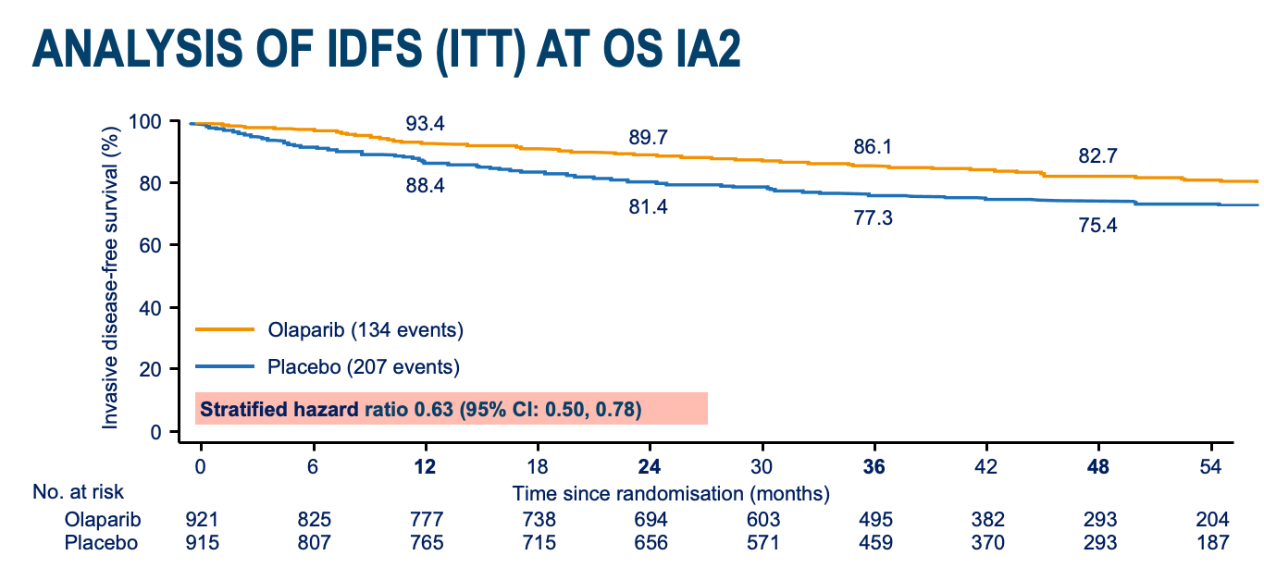

Tutt et al, ESMO Virtual Plenary March 2022

Slide 68
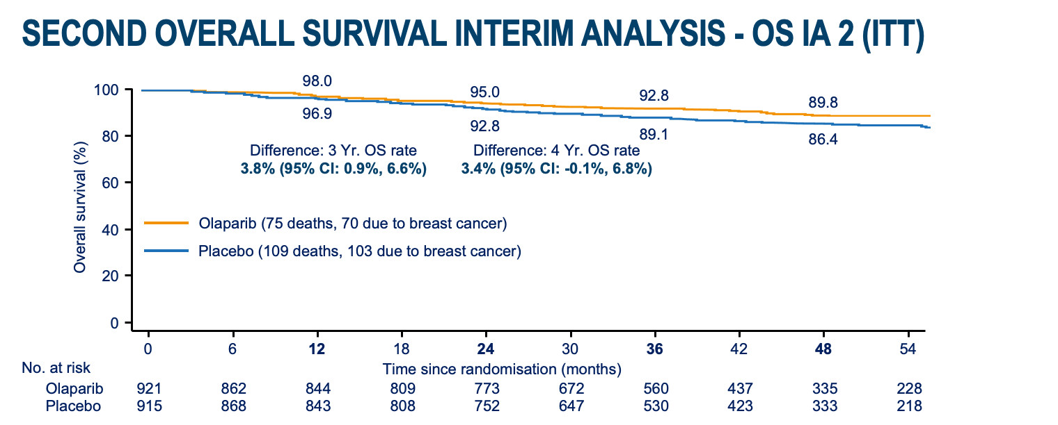
Tutt et al, ESMO Virtual Plenary March 2022

Slide 69
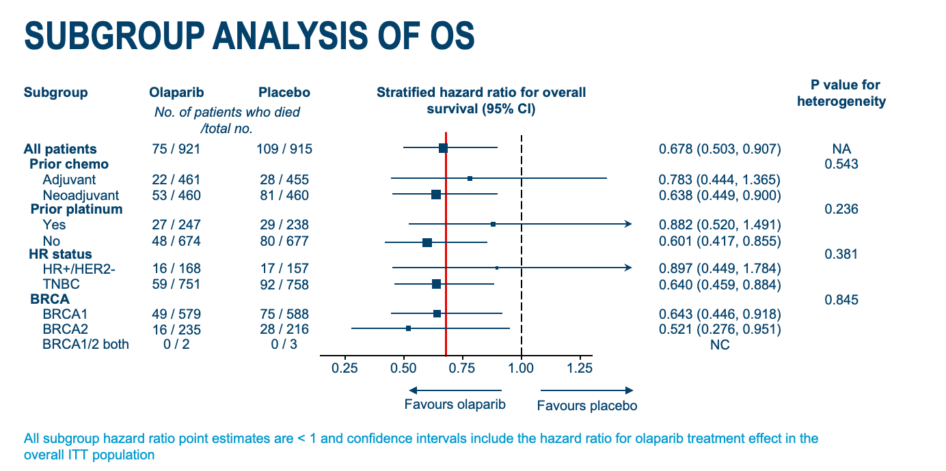
Tutt et al, ESMO Virtual Plenary March 2022

Slide 70
Olaparib
Placebo
Nausea
57%
23%
Fatigue
40%
27%
Anemia
23%
4%
Vomiting
23%
8%
Headache
20%
17%
Diarrhea
18%
14%
Neutropenia
16%
7%
Leukopenia
16%
6%
Grade 1
Decreased appetite
13%
6%
Grade 2
4%
Grade ≥ 3
Dysgeusia
12%
Dizziness
11%
7%
Arthralgia
9%
12%
60
40
20
0
20
40
60
Adverse events, %

Slide 71
Conclusions
EET benefits few and adds to AEs
OFS during chemo can preserve ovarian function
OFS to high risk women. Can it replace chemo?
CDK4/6i for high risk. Do we trust Ki67?
PARPi for high risk. Do we perform CPS?

Slide 72
MODULE 3: Selection and Sequencing of Therapy for Patients with ER-Positive Metastatic Breast Cancer (mBC) — Dr Kalinsky

Slide 73
Case Presentation: 53-year-old woman with ER/PR-positive, HER2-low, PI3KCA-mutated mBC who experiences a dramatic response to rechallenge with fulvestrant and a CDK4/6i (abemaciclib); now with progression and cytopenias
Dr KS Kumar (Trinity, Florida)

Slide 74
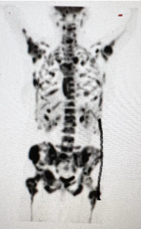
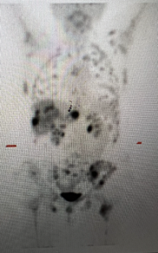
Before abemaciclib/fulvestrant
After abemaciclib/fulvestrant

Slide 75
Selection and Sequencing of Therapy for Patients with
ER-Positive Metastatic Breast Cancer
Kevin Kalinsky, MD, MS
Associate Professor of Medicine
Director, Glenn Family Breast Center
Director, Breast Medical Oncology
Louisa and Rand Glenn Family Chair in Breast Cancer Research

Slide 76
Results for Pivotal CDK 4/6 Inhibitor Trials
Trial | CDK Inhibitor | Line of Therapy (Endocrine Rx) | Menopausal Status | PFS HR | Statistical Significance | OS HR | Statistical Significance
PALOMA-2^{[1]} | Palbociclib | 1st Line/AI | Post | 0.56 | Yes | 0.96 | No
MONALEESA-2^{[2]} | Ribociclib | 1st Line/AI | Post | 0.57 | Yes | 0.76 | Yes
MONALEESA-7^{[3a]} | Ribociclib | 1st Line/AI or Tam | Pre/Peri | 0.55 | Yes | 0.70 | Yes
MONARCH-3^{[4]} | Abemaciclib | 1st Line/AI | Post | 0.54 | Yes | 0.75 | No (@IA2)
PALOMA-3^{[5]} | Palbociclib | 2nd Line/Fulv | Pre/Post | 0.46 | Yes | 0.81 | No
MONARCH-2^{[6]} | Abemaciclib | 2nd Line/Fulv | Pre/Post | 0.55 | Yes | 0.78 | Yes
MONALEESA-3^{[7]} | Ribociclib | 1st /2nd Line/Fulv | Pre/Post | 0.59 | Yes | 0.72 | Yes
a. Missing survival data (ie, pts who withdrew consent or were lost to follow-up) and were censored (assumed to be alive) at time of analysis: 13% in palbo+AI arm vs 21% in control arm.
b. 27% of patients in control arm went on to receive a CDK4/6i (24% received palbociclib).
c. PFS/OS data reported for approved AI subset.
AI indicates aromatase inhibitor; Fulv, fulvestrant; IA2, interim analysis 2; NR, not reported; Rx, therapy.
1. PALOMA-2: Finn R, et al. N Engl J Med. 2016;375:1925-1936; Rugo H, et al. Breast Cancer Res Treat. 2019;174:719-729. Finn R, et al. ASCO 2022. LBA1003. 2. MONALEESA-2: Hortobagyi G, et al. N Engl J Med. 2016;375:1738-1748; Hortobagyi G, et al. Ann Oncol. 2018;29:1541-1547; Hortobagyi G. et al. ESMO 2021. Abstract LBA17_PR. 3. MONALEESA-7: Tripathy D, et al. Lancet Oncol. 2018;19:904-915; Im S-A, et al. New Engl J Med. 2019;381:307-316. 4. MONARCH-3: Goetz M, et al. J Clin Oncol. 2017;35:3638-3646; Johnson S, et al. NPJ Breast Cancer. 2019;5:5. Goetz MP, et al. ESMO 2022. Abstract LBA 15. 5. PALOMA-3: Turner NC, et al. New Engl J Med. 2015;373:209-219; Cristofanilli M, et al. Lancet Oncol. 2016;17:425-439; Turner NC, et al. New Engl J Med. 2015;373:1672-1673. 6. MONARCH-2: Sledge G, et al. J Clin Oncol. 2017;35:2875-2884; Sledge G, et al. JAMA Oncol. 2020;6:116-124. 7. MONALEESA-3: Slamon D, et al. J Clin Oncol. 2018;36:2465-2472; Slamon D, et al. New Engl J Med. 2020;382:514-524.

Slide 77

MONALEESA-7: Overall Survival
≈ 29% relative reduction in risk of death
The P value of .00973 crossed the prespecified boundary to claim superior efficacy
Landmark Analysis
 | Ribociclib + ET | Placebo + ET
Events/N | 83/335 | 109/337
Median OS, mo | Not reached | 40.9
HR (95% CI) | 0.712 (0.535-0.948)
P value | .00973
Kaplan-Meier Estimate | Ribociclib + ET | Placebo + ET
36 mo | 71.9% | 64.9%
42 mo | 70.2% | 46.0%
Protocol-specified key secondary end point.
Im S-A, et al. New Engl J Med. 2019;381:307-316.
Notes:
Added comma after “0.77”
Changed en dash to hyphen
Changed “overall survival” to “OS”

Slide 78

MONALEESA-2: Letrozole ± Ribociclib – Overall Survival
Final Analysis at 400 death events: Improvement in median OS of 12.5 mo
 | RIB + LET | PBO + LET
Events/n | 181/334 | 219/334
Median OS, mo | 63.9 | 51.4
HR (95% CI), P value | 0.76 (0.63-0.93), .004
63.9 mo. (5.3 y)
51.4 mo. (4.3 y)
Key secondary end point.
Hortobagyi G. et al. ESMO 2021. Abstract LBA17_PR.

Slide 79

Why are there OS differences between the studies?
*
Paloma-2: Missing survival data and were censored at time of analysis: 13% in palbo+AI arm vs 21% in control arm. 27% of pts in control arm went on to receive a CDK4/6i (24% received palbo).
Adopted from Claudine Isaacs

Slide 80
MONARCH-3: NSAI ± Abemaciclib – Overall Survival
Key secondary end point.
Goetz M. et al. ESMO 2022. Abstract LBA15

Slide 81
Schema
Key Entry Criteria
Men or Women age > 18 yrs
ER and/or PR > 1%, HER2- MBC
Progression on ET + any CDK 4/6 inhibitor
< 1 line of chemotherapy for MBC
Measurable or non-measurable
PS 0 or 1
Postmenopausal
  GnRH agonist allowed if premenopausal
Stable brain metastases allowed
Primary Endpoint
Progression free survival
  Locally assessed per RECIST 1.1
Secondary Endpoints
Overall response rate
Clinical benefit rate
Safety
Tumor and blood markers, including circulating tumor DNA
Arm 1
Ribociclib + Switch Endocrine Therapy*
1:1
Arm 2
Placebo + Switch
Endocrine Therapy*
N=120
  Fulvestrant as endocrine therapy in pts with progression on a prior aromatase inhibitor for MBC and no prior fulvestrant; Protocol amended to allow exemestane as endocrine therapy if progression on prior fulvestrant (September 2018); Ribociclib 600 mg administered 3 weeks on/1 week off
Kevin Kalinsky, MD, MS

Slide 82
Patient Characteristics and Prior Treatment
 | Placebo (n=59) | Ribociclib (n=60)
Female - no. (%) | 58 (99%) | 60 (100%)
Median age – years (IQR) | 59 (52-65) | 55 (48-67)
Race or ethnic group – no. (%)
White | 42 (71%) | 46 (77%)
Black | 8 (14%) | 5 (8%)
Asian | 2 (3%) | 5 (8%)
Other or not specified | 7 (12%) | 4 (7%)
ECOG PS – no. (%)
0 | 38 (64%) | 40 (67%)
1 | 21 (36%) | 20 (33%)
De Novo Metastasis at Dx - no. (%)*** | 32 (54%) | 21 (35%)
Visceral Metastasis – no. (%) | 35 (59%) | 36 (60%)
Bone-Only Disease – no. (%) | 9 (15%) | 13 (22%)
> 2 prior ET for MBC – no. (%) | 11 (19%) | 11 (18%)
Chemotherapy for MBC – no. (%) | 7 (12%) | 4 (7%)
 | Placebo (n=59) | Ribociclib (n=60)
Prior CDK 4/6 inhibitor – no. (%)
Palbociclib* | 51 (86%) | 52 (87%)
Ribociclib** | 8 (14%) | 6 (10%)
Abemaciclib | 0 (0%) | 2 (3%)
Median duration of prior CDK 4/6 inhibitor - months (IQR) | 17 (11-23.5) | 15.5 (12-21)
Prior CDK 4/6 inhibitor duration– no. (%)****
< 12 months | 21 (36%) | 18 (30%)
> 12 months | 38 (64%) | 42 (70%)
Prior CDK 4/6 inhibitor in metastatic setting - no. (%) | 59 (100%) | 60 (100%)
Intervening treatment after progression on prior CDK 4/6 inhibitor - no. (%) | 6 (10%) | 1 (2%)
* Includes 1 pt who did not tolerate prior abemaciclib and 2 pts with insurance issues with ribociclib; ** Includes 1 pt who did not tolerate prior palbociclib;
***p=0.035; **** 10 pts (17%) in placebo arm and 7 pts (12%) in ribociclib arm on prior CDK4/6 inhibitor < 6 months; IQR = interquartile range
Kevin Kalinsky, MD, MS

Slide 83


Progression Free Survival
 | Placebo + ET (n=59) | Ribociclib + ET (n=60)
Median: 95% CI (months) | 2.76 (2.66-3.25) | 5.29 (3.02-8.12)
PFS rate at 6 months (95% CI) | 23.9% (12.8%-35%) | 41.2% (27.8%-54.6%)
PFS rate at 12 months (95% CI) | 7.4% (0.4%-14.3%) | 24.6% (12.5%-36.7%)
Median PFS:
HR=0.57 (95% CI: 0.39-0.95), p=0.006
Kevin Kalinsky, MD, MS

Slide 84

Progression Free Survival by Subgroup
Kevin Kalinsky, MD, MS

Slide 85
PACE Trial: Schema
RANDOMI
Z
E
Eligibility Criteria
HR+/HER2- MBC
Progression on CDK4/6i and ET, with >6mo SD on prior regimen
<2 prior lines ET for MBC
No prior fulvestrant
0-1 prior chemo for MBC
Fulvestrant: 500 mg IM C1D1,15, then q28d
1:2:1 randomization; stratified by exposure to chemo between CDK4/6i and entry onto trial
Fulvestrant: 500 mg IM C1D1,15, then q28d
Palbociclib: 125 mg PO qd 1-21d in a 28d cycle (or lower starting dose to match prior treatment)
Fulvestrant: 500 mg IM C1D1,15, then q28d
Palbociclib: 125 mg PO qd 1-21d in a 28d cycle
Avelumab: 10 mg/kg IV q14d
N=220
Baseline archival tissue
Baseline ctDNA, CTC
ctDNA
ctDNA, CTC
ctDNA
ctDNA
Primary objective: To compare PFS (RECIST-confirmed) for fulvestrant+palbociclib vs. fulvestrant alone
Secondary objectives: To compare PFS for fulvestrant+palbociclib+avelumab vs fulvestrant alone, response endpoints, safety, outcomes in predefined molecular subgroups including ESR1, PIK3CA, and Rb.
Notes:
.

Slide 86
PACE Trial: Patient Demographics
 | Fulvestrant (n=55) |  | Fulvestrant + Palbociclib (N=111) |  | Fulvestrant + Palbociclib + Avelumab (N=54) |  | Overall (n = 220)
 | N | % | N | % | N | % | N | %
Female | 55 | 100.0 | 109 | 98.2 | 54 | 100.0 | 218 | 99.0
Age (median, range) | 58 (36-77) |  | 55 (28-77) |  | 58 (25-83) |  | 57 (25-83)
Race White Black Asian Other | 47 3 0 5 | 85.5 5.5 0 9.1 | 88 13 4 6 | 79.3 11.7 3.6 5.4 | 44 4 3 3 | 81.5 7.4 5.6 5.6 | 179 20 7 14 | 81.4 9.1 3.2 6.4
Post-menopausal | 47 | 85.5 | 87 | 78.4 | 44 | 81.5 | 178 | 80.9
De novo MBC | 28 | 50.9 | 40 | 36.0 | 20 | 37.0 | 88 | 40.0
Visceral disease | 29 | 52.7 | 70 | 63.1 | 33 | 61.1 | 132 | 60.0
Bone only disease | 4 | 7.3 | 18 | 16.2 | 8 | 14.8 | 30 | 13.6
Measurable disease | 37 | 67.3 | 73 | 65.8 | 39 | 72.2 | 149 | 67.7
Unknown values are omitted from the table.

Slide 87
PACE: Prior Treatment Characteristics
 | Fulvestrant (n=55) |  | Fulvestrant + Palbociclib (N=111) |  | Fulvestrant + Palbociclib + Avelumab (N=54) |  | Overall (n = 220)
 | N | % | N | % | N | % | N | %
Prior adjuvant endocrine exposure* Endocrine resistant Endocrine sensitive | 10 45 | 18.2 81.8 | 32 78 | 28.8 70.3 | 16 37 | 29.6 68.5 | 58 160 | 26.4 72.7
Prior CDK4/6i Palbociclib Ribociclib Abemaciclib | 52 1 2 | 94.5 1.8 3.6 | 102 5 3 | 91.9 4.5 2.7 | 46 4 4 | 85.2 7.4 7.4 | 200 10 9 | 90.9 4.5 4.1
Duration of prior CDK4/6i + ET 6-12 months > 12 months | 10 45 | 18.2 81.8 | 26 84 | 23.4 75.7 | 16 38 | 29.6 70.4 | 52 167 | 23.6 75.9
Prior chemotherapy for MBC | 11 | 20.0 | 16 | 14.4 | 9 | 16.7 | 36 | 16.4
Line of MBC therapy initiated in PACE First Line Second Line > Second Line | 3 42 10 | 5.5 76.4 18.2 | 5 83 21 | 4.5 74.8 18.9 | 2 44 7 | 3.7 81.5 13.0 | 10 169 38 | 4.5 76.8 17.3
Any systemic therapy between prior CDK4/6i and randomization | 5 | 9.1 | 16 | 14.4 | 5 | 9.3 | 26 | 11.8
Unknown values are omitted from the table.
*Endocrine resistant: recur <1y of adj ET. Endocrine sensitive: de novo MBC, or no adj ET, or recur >1y after adj ET. Adapted from ESO-ESMO guidelines, Ann Oncol 2020

Slide 88
PACE: Progression Free Survival ITT
 | Pts | PFS Events | Median PFS, mo (90% CI) | HR vs F (90% CI) | P-value
F | 55 | 34 | 4.8 (2.1, 8.2) | -- | --
F+P | 111 | 79 | 4.6 (3.6, 5.9) | 1.11 (0.74-1.66) | P=0.62
6-month PFS:
F: 42.9%
F+P: 40.0%
12-month PFS:
F: 17.5%
F+P: 13.1%
Numbers at risk:
F | 55 | 31 | 20 | 14 | 12 | 9 | 4 | 3 | 3 | 3
F+P | 111 | 73 | 48 | 32 | 28 | 16 | 7 | 5 | 4 | 4
F+P+A | 54 | 38 | 25 | 20 | 20 | 15 | 12 | 10 | 9 | 7

Slide 89
PACE: Progression Free Survival ITT
 | Pts | PFS Events | Median PFS, mo (90% CI) | HR vs F (90% CI) | P-value
F | 55 | 34 | 4.8 (2.1, 8.2) | -- | --
F+P | 111 | 79 | 4.6 (3.6, 5.9) | 1.11 (0.74-1.66) | P=0.62
F+P+A | 54 | 35 | 8.1 (3.2, 10.7) | 0.75 (0.47-1.20) | P=0.23
6-month PFS:
F: 42.9%
F+P: 40.0%
F+P+A: 50.8%
12-month PFS:
F: 17.5%
F+P: 13.1%
F+P+A: 35.6%
Numbers at risk:
F | 55 | 31 | 20 | 14 | 12 | 9 | 4 | 3 | 3 | 3
F+P | 111 | 73 | 48 | 32 | 28 | 16 | 7 | 5 | 4 | 4
F+P+A | 54 | 38 | 25 | 20 | 20 | 15 | 12 | 10 | 9 | 7

Slide 90


BYLieve: A Phase 2, Open-Label, 3-Cohort,
Noncomparative Trial
Rugo HS, et al. Lancet Oncol. 2021;22:489-498; Rugo HS, et al. ASCO 2020. Abstract 1006.

Slide 91

BYLieve Study of Alpelisib After CDK4/6i: Efficacy
Endpoint | BYLieve Trial^{a,b}
 | Cohort Aª ^{Prior AI} | Cohort B^{b} ^{Prior FULV}
N | 121 | 115
Alive, no PD @ 6 mo | 50.4% met endpoint | 46.1% met endpoint
Median PFS (mo) | 7.3 mo | 5.7 mo
ORR | 21.0% | 17.8%
CBR | 42.0% | 31.7%
a. Rugo HR, et al. ASCO 2020. Abstract 1040; b. Rugo HR, et al. SABCS 2020. Abstract PD2-07.

Slide 92
Summary of Selected Outcomes: BYLieve And SOLAR-1
Endpoint | SOLAR-1 Trial Prior CDKiª |  | BYLieve Trial^{b,c}
 | FULV + PBO | FULV + Alpelisib | Cohort A^{b} | Cohort B^{c}
N | 11 | 9 | 121 | 115
Alive, no PD @ 6 mo | ≈ 20% | 44.4% | 50.4% | 46.1%
Median PFS (mo) | 1.8 mo | 5.5 mo | 7.3 mo | 5.7 mo
ORR | NR | NR | 21.0% | 17.8%
CBR | NR | NR | 42.0% | 31.7%
a. André F, et al. N Engl J Med. 2019;380:1929-1940; b. Rugo HR, et al. ASCO 2020. Abstract 1040; c. Rugo HR, et al. SABCS 2020. Abstract PD2-07.

Slide 93


PARP Inhibitors
OlympiAD
EMBRACA
Litton JK, et al. N Engl J Med 2018;379:753-763. Robson M, et al. N Engl J Med 2017;377:523-533.

Slide 94



Progression-Free Survival
OlympiAD
EMBRACA
Litton JK, et al. N Engl J Med 2018;379:753-763. Robson M, et al. N Engl J Med 2017;377:523-533.

Slide 95
EMBRACA: Final OS
100
Talazoparib
Median OS, 19.3 months
95% CI, 16.6-22.5
Chemotherapy
Median OS, 19.5 months
95% CI, 17.4-22.4
Hazard ratio, 0.848
95% CI, 0.670-1.073
P = 0.17
Survival probability | Talazoparib | Chemotherapy
At Month 12 (95% CI) | 0.71 (0.66-0.76) | 0.74 (0.66-0.81)
At Month 24 (95% CI) | 0.42 (0.36-0.47) | 0.38 (0.30-0.47)
At Month 36 (95% CI) | 0.27 (0.22-0.33) | 0.21 (0.14-0.29)
At Month 48 (95% CI) | 0.19 (0.14-0.25) | 0.07 (0.02-0.15)
90
80
70
60
50
OS probability (%)
40
30
20
10
0
0
3
6
9
12
15
18
21
24
27
30
33
36
39
42
45
48
51
54
57
60
Time (months)
Number of patients at risk
Talazoparib
Chemotherapy
287
144
280
125
264
116
232
105
199
96
163
86
143
71
128
58
113
48
101
44
85
34
68
25
54
18
41
8
35
7
27
4
20
2
15
2
9
2
6
1
2
0
*ITT population
7
Litton JK, et al. AACR 2020. Abstract CT017.

Slide 96
OlympiAD: Extended OS Follow-Up
No statistically significant differences in survival curves in tissue receptor subtype
No new safety signal –No AML/MDS
Robson M et al. N Engl J Med 2017;377:523-533
Robson M, et al. SABCS 2019.
PD4-03.

Slide 97

Current Approach: Treatment of HR+/HER2- mBC
? AKT inh
? CKD 4/6 inh
Adopted from Claudine Isaacs

Slide 98
MODULE 4: Recent Appreciation of HER2 Low as a Unique Subset of HR-Positive Breast Cancer —
Dr Bardia

Slide 99
Case Presentation: 39-year-old premenopausal woman with ER/PR-positive, HER2-low (IHC 1+) IDC, s/p adjuvant tamoxifen and OFS x 5 years, now with bone and liver metastases
Dr Laila Agrawal (Louisville, Kentucky)

Slide 100
Case Presentation: 39-year-old premenopausal woman with ER/PR-positive, HER2-low (IHC 1+) IDC, s/p adjuvant tamoxifen and OFS x 5 years, now with bone and liver metastases (continued)
Dr Laila Agrawal (Louisville, Kentucky)

Slide 101


HER2 low Breast Cancer
Aditya Bardia, MD, MPH
Director, Breast Cancer Research,
Attending Physician, Mass General Hospital,
Associate Professor, Harvard Medical School

Slide 102
Objectives
Understand rationale of ADCs for HER2 low breast cancer
Gain knowledge related to HER2 ADC, trastuzumab deruxtecan, including efficacy and toxicity
Review upcoming therapies for HER2 low breast cancer

Slide 103
HER2-Low Breast Cancer:
Current Definition
HER 2 testing by validated IHC assay
Circumferential membrane staining that is complete, intense, and in >10% of tumor cells ➔ (IHC 3+)
Weak to moderate complete membrane staining in >10% of tumor cells ➔ (IHC 2+)
Incomplete membrane staining that is faint/barely perceptible and in >10% of tumor cells ➔ (IHC 1+)
No staining is overserved HER2-null or membrane staining that is incomplete and is faint/barely perceptible and in <10% tumor cells ➔ (IHC 0)
HER2-Positive
(15%)
Reflex ISH test Positive
Reflex ISH test Negative
HER2-Low
(45-65%)
HER2-Negative/null
(30-40%)
Notes:
Change figure. Pie chart. Mention 2/3 of. Recreate figure so the font is more clear
https://www.nature.com/articles/s41379-022-01019-5.pdf?proof=t ➔ Figure 1
Dr. Bardia:
The % appears low (for both HER2+, and HER2-low). We can discuss during meeting.
Hurvitz, Sara A.
Yes and what does “over served” mean on far right?
These data are taken from one institution and may not reflect that actual percentages seen in practice. I recommend we use the next slide which comes from Paolo Tarantino’s article. https://ascopubs.org/doi/figure/10.1200/JCO.19.02488

Slide 104

Trastuzumab Deruxtecan (T-DXd):
Selective delivery of toxic payload
Nagayama, A, et al. Target Oncol. 2017
Modi S, et al. ASCO 2022.

Slide 105

Trastuzumab Deruxtecan (T-DXd):
HER2 Low Tumors
Modi S et al. J Clin Oncol. 2020.

Slide 106

Slide 5
Trastuzumab Deruxtecan vs TPC:
Study Design (DESTINY-B04)
Content of this presentation is the property of the author, licensed by ASCO. Permission required for reuse.

Slide 107


Slide 10
Trastuzumab Deruxtecan vs TPC:
PFS (HR+/HER2 Low BC)
Progression-Free Survival
Overall Survival
Content of this presentation is the property of the author, licensed by ASCO. Permission required for reuse.

Slide 108


Trastuzumab Deruxtecan:
Efficacy in HER2-low mTNBC
Exploratory Endpoint
Progression-Free Survival
Overall Survival
 | T-DXd (n=40) | TPC (n=18)
Median PFS (95% CI) | 8.5 (4.3-11.7) | 2.9 (1.4-5.1)
HR (95% CI), P-value | 0.46 (0.24-0.89)
 | T-DXd (n=40) | TPC (n=18)
Median OS (95% CI) | 18.2 (13.6-NE) | 8.3 (5.6-20.6)
HR (95% CI), P-value | 0.48 (0.24-0.95)
Modi S et al. NEJM. 2022.

Slide 109
What about activity of other ADCs for HER2 low MBC?

Slide 110



Trop2 ADC for HR+ MBC:
Sacituzumab Govitecan
Confirmed ORR = 31.5%
Kalinsky K et al. Ann Oncol. 2020

Slide 111



Sacituzumab Govitecan vs TPC:
Efficacy by HER2 status (TROPiCS-02)
HER2-Lowª
HER2 IHC0
ITT¹
 | SG (n=149) | TPC (n=134)
Median PFS, mo | 6.4 | 4.2
HR (95% CI) | 0.58 (0.42–0.79), P<0.001
 | SG (n=101) | TPC (n=116)
Median PFS, mo | 5.0 | 3.4
HR (95% CI) | 0.72 (0.51–1.00), P=0.05
 | SG (n=272) | TPC (n=271)
Median PFS, mo (95% CI) | 5.5 (4.2–7.0) | 4.0 (3.1–4.4)
HR (95% CI) | 0.66 (0.53–0.83), P=0.0003
Within the HER2-Low population, median PFS with SG vs TPC for the IHC1+ and IHC2+ subgroups was 7.0 vs 4.3 (HR, 0.57) and
5.6 vs 4.0 (HR, 0.58) months, respectively
The hazard ratio for median PFS in a sensitivity analysis of the HER2-Low subgroup (excluding ISH-unverified^{b}) was similar (HR, 0.53)
ªHER2-Low defined as IHC1+, or IHC2+ and ISH-negative/unverified.
^{b}39 patients with HER2 IHC2+ did not have ISH data documentation available for verification and were presumed to be HER2-low, consistent with the trial eligibility criteria to enroll HER2-negative patients.
HER2, human epidermal growth factor receptor 2; IHC, immunohistochemistry; ISH, in situ hybridization; PFS, progression-free survival; SG, sacituzumab govitecan; TPC, treatment of physician’s choice.
1. Rugo HS, et al. J Clin Oncol. 2022. doi: 10.1200/JCO.22.01002. (epub ahead of print). Adapted from Rugo HS, et al. Sacituzumab govitecan in hormone receptor-positive/human epidermal growth factor receptor 2-negative metastatic breast cancer. J Clin Oncol. 2022. doi: 10.1200/JCO.22.01002. Reprinted with permission from American Society of Clinical Oncology.
Presented by: Dr. Frederik Marmé

Slide 112
Phase III Study of Sacituzumab Govitecan vs TPC: ASCENT
Metastatic TNBC
(per ASCO/CAP)
≥2 chemotherapies for advanced disease
[no upper limit; 1 of the required prior regimens could be from progression that occurred within a 12-month period after completion of (neo)adjuvant therapy)]
N=529
Sacituzumab Govitecan (SG)
10 mg/kg IV days 1 & 8, every 21-day cycle
(n=267)
Endpoints
Primary
PFS†
Secondary
PFS for the full population‡
OS, ORR, DOR, TTR, safety
Continue treatment until progression or unacceptable toxicity
R 1:1
Treatment of Physician’s Choice (TPC)*
(n=262)
Stratification factors
Number of prior chemotherapies (2-3 vs >3)
Geographic region (North America vs Europe)
Presence/absence of known brain metastases (yes/no)
Data cutoff: March 11, 2020
NCT02574455
ASCENT was halted early due to compelling evidence of efficacy per unanimous DSMC recommendation.
*TPC: eribulin, vinorelbine, gemcitabine, or capecitabine. †PFS measured by an independent, centralized, and blinded group of radiology experts who assessed tumor response using RECIST 1.1 criteria in patients without brain metastasis. ‡The full population includes all randomized patients (with and without brain metastases). Baseline brain MRI only required for patients with known brain metastasis.
ASCO/CAP, American Society of Clinical Oncology/College of American Pathologists; DOR, duration of response; DSMC, Data Safety Monitoring Committee; IV, intravenous; mTNBC, metastatic triple-negative breast cancer; ORR, objective response rate; OS, overall survival; PFS, progression-free survival; R, randomization; RECIST, Response Evaluation Criteria in Solid Tumors; TTR, time to response.
National Institutes of Health. https://clinicaltrials.gov/ct2/show/NCT02574455.
1Bardia A et al. NEJM. 2021

Slide 113


Sacituzumab Govitecan vs TPC:
Efficacy in HER2 low mTNBC (ASCENT)
A
HER2 IHC0
B
HER-Low
 | HER2 IHC0
 | SG | TPC
Events, n | 149 | 144
Median OS, mo. | 11.3 | 5.9
HR (95% CI) | 0.51 (0.39-0.66), P<0.001
 | HER2-Low*
 | SG | TPC
Events, n | 63 | 60
Median OS, mo. | 14.0 | 8.7
HR (95% CI) | 0.43 (0.28-0.67), P<0.001
Overall Survival Probability (%)
Overall Survival Probability (%)
Time (months)
Time (months)
No. of Patients Still at Risk
No. of Patients Still at Risk
SG, HER2 IHC0 TPC, HER2 IHC0
SG, HER2 IHC0 TPC, HER2 IHC0
*HER2-Low defined as IHC1+ or ICH2+ and ISH-negative.
HER2, human epidermal growth factor receptor 2; IHC, immunohistochemistry; ISH, in situ hybridization; OS, overall survival; SG, sacituzumab govitecan; TPC, treatment of physician’s choice.
Hurvitz S et al. ESMO Breast. 2022

Slide 114
How to sequence the different ADCs?

Slide 115

Mechanism Governing Resistance:
Trastuzumab Deruxtecan (DAISY)

Slide 116
Mechanism Governing Resistance:
Antibody vs Payload
Coates, Sun et al Cancer Discovery 2021.

Slide 117
Implications of resistance mechanisms for ADC sequencing
Same Ab-based
ADC
No Response
Antibody
mutation
Different Ab-
targeted ADC
Response
Same Payload
ADC
Payload
mutation
No Response
Different
payload ADC
Response
Coates, Sun et al Cancer Discovery 2021.

Slide 118
ADCs to target MBC:
Multiple Agents in Development
Antibody Drug Conjugate | Target
Trastuzumab deruxtecan (DS-8201a) | HER2
Sacituzumab govitecan (IMMU-132) | Trop-2
Datopotamab deruxtecan (DS-1062) | Trop-2
Ladiratuzumab vedotin (SGN-LIV1a) | LIV-1
Patritumab deruxtecan (U3-1402) | HER3
Trastuzumab duocarmazine | HER2
Disitamab vedotin | HER2
Payload
Topo-1 inhibitor
Topo-1 inhibitor
Topo-1 inhibitor
Microtubule inhibitor
Topo-1 inhibitor
Alkylating agent
Microtubule inhibitor
Both target and payload important considerations for efficacy/toxicity profile and ADC sequencing

Slide 119
How about Early Breast Cancer?

Slide 120
TRIO-US B-12 (TALENT):
Study Design
Study Population:
HR+
HER2-low (by local and/or central review)
Stage II-III operable
Men or Pre-/Post-menopausal women
Arm A (N=29):
T-DXd 5.4mg/kg
Treatment: 6 or 8 cycles* + EOT
Surgery
Arm B (N=29):
T-DXd 5.4mg/kg + anastrozole (+GnRH analog for men/premenopausal women)
Tissue acquisition from archival tissue or biopsy at baseline and biopsy between C1D17-C1D21, and tissue at time of surgical resection
All tissue collected for study: pathology centrally reviewed HER2 and Ki67
* Originally, 6 cycles of treatment were given but in 02/2022, an amendment increased the number of treatment cycles from 6 to 8 for newly enrolled participants, or those who had not yet had surgery. EOT 21-28 days after last dose of T-DXd.

Slide 121


Slide 122


Slide 123


Slide 124


Slide 125
Summary
Trastuzumab deruxtecan has demonstrated impressive activity in HER2 low metastatic breast cancer, both HR+ and HR-, and approved in 2nd line (and plus) MBC setting.
Sacituzumab govitecan approved for mTNBC, regardless of HER2 expression (not surprising). Activity also seen in HR+ metastatic breast cancer.
There are multiple ADCs in development to target antigens overexpressed in MBC.
Understanding mechanism of resistance, antibody vs payload, could help guide therapeutic sequencing of ADCs.
Additional studies evaluating different ADCs targeting different antigens could redefine the current receptor-based classification of breast cancer.

Slide 126
MODULE 5: Novel Strategies Under Investigation for Patients with HR-Positive mBC — Dr Rugo

Slide 127
Case Presentation: 90-year-old woman with ER/PR-positive, HER2-low (IHC 1+) mBC and PD on multiple lines of endocrine and chemotherapy receives T-DXd
Dr Alan Astrow (Brooklyn, New York)

Slide 128
Case Presentation: 45-year-old woman with ER/PR-positive, HER2-low (IHC 2+) mBC, s/p fulvestrant/abemaciclib and now receiving exemestane/everolimus – ESR1 and PIK3CA mutations
Dr Jennifer Dallas (Charlotte, North Carolina)

Slide 129



Slide 130


Novel Strategies Under Investigation for Patients with HR-Positive Metastatic Breast Cancer
Hope S. Rugo, MD
Professor of Medicine
Director, Breast Oncology and Clinical Trials Education
University of California San Francisco Comprehensive Cancer Center

Slide 131


Resistance to ET + CDK4/6i: Now a High Unmet Need
ER dependent and independent mechanism of resistance
Major Mechanisms of Resistance to CDK4/6 Inhibitors

Slide 132
Inhibiting AKT
Phase II FAKTION Trial
Adding Capi to Fulv in PM women with AI resistant HR+ MBC (no prior CDKi) improved PFS and OS, with most benefit in altered population
AKT pathway activation occurs in many HR+/HER2– ABC through alterations in PIK3CA, AKT1 and PTEN
  May also occur in cancers without these genetic alterations
  AKT signalling implicated in development of ET resistance
Capivasertib is a potent, selective inhibitor of all three AKT isoforms (AKT1/2/3)
Turner et al, SABCS 2022; Jones RH, et al. Lancet Oncol 2020; Howell et al, Lancet Oncology 2022

Slide 133
CAPItello-291: Phase III, randomized, double-blind, placebo-controlled study
Summary of Demographics
Median age ~59
Asian 26%, Black 1%
Primary ET resistance ~38%
Visceral mets ~68%
One line of prior ET for MBC ~75%
Prior CDK4/6i for MBC ~70%
Chemotherapy for ABC ~18%
Turner et al, SABCS 2022

Slide 134
AKT Pathway Alterations
AKT pathway alteration status was determined centrally using next-generation sequencing in tumor tissue with the FoundationOne®CDx assay (and Burning Rock assay in China)
Turner et al, SABCS 2022

Slide 135
Turner et al, SABCS 2022

Slide 136
Additional Analyses
Investigator-assessed PFS by subgroup: Overall population
Exploratory analysis: Investigator-assessed PFS in the non-altered population (including unknown†)
Response per investigator assessment
Excluding unknowns (58 v 48):
HR 0.79 (95% CI 0.61, 1.02)
Turner et al, SABCS 2022

Slide 137
Overall Survival
Safety
Overall survival immature at just 28% maturity
  Less events in the Capi arm
Overall population
Rash (all terms)
38% all grade
12% grade 3
AKT pathway-altered population
AEs leading to:
  Discontinuation capi/pla: 9.3 vs 0.6%
  Interruption capi/pla: 34.9 vs 10.3%
  Dose reduction capi/pla: 19.7 vs 1.7%
Turner et al, SABCS 2022

Slide 138
Conclusions and Next Steps
Capivasertib/fulvestrant vs Pla/fulvestrant improved PFS in the overall population and in patients with tumor PIK3CA altered population; overall survival immature
Efficacy in the subset of patients with non-altered tumors uncertain
  Trial was not powered to look at this subgroup; small group with unknown mutation profile hard to take into account
Benefit seen across subgroups including those with prior CDK4/6i and with visceral metastases
Safety: GI toxicity, primarily lower grade resulted in modestly more discontinuations, dose holds and dose reductions of capivasertib
  All/Grade 3 diarrhea 72/9%, rash 38/12%, hyperglycemia 16/2.3%, nausea 35/0.8%
Data to be considered for regulatory approval
Additional studies
  CAPItello-292 (NCT04862663): Fulvestrant/Palbociclib +/- Capi
  Additional studies with ipatasertib with similar designs
  New PIK3CA inhibitors: Inavolisib, LOX783 and more!

Slide 139




Mechanism of Action of New Endocrine Agents
Targeting the ER Domain
CERANs

Slide 140
Oral SERDS: Randomized Trials in the Post-CDK4/6 Inhibitor Setting
 | EMERALD (NCT03778931) | AMEERA-3 (NCT04059484) | acelERA (NCT04576455) | SERENA-2 (NCT04214288) | EMBER-3 (NCT04975348)
N | 477 | 282 | 303 | 288 | 830
Patient Population | ER+/HER2- ABC | ER+/HER2- ABC (ET sensitivity required) | ER+/HER2- ABC Measurable disease | ER+/HER2- MBC | ER+/HER2- MBC
Number of Prior Therapies | 1-2 | 0-2 | 0-2 | 0-2 | 1 (AI + CDK4/6i)
Prior Chemotherapy | 20% had 1 line | Allowed (≤1) or CDK | Allowed (≤1) | Allowed (≤1) | Not allowed
Prior Fulvestrant | 30% | Allowed | Allowed | Not allowed | Not allowed
Prior CDK 4/6i | 100% | 80% | Allowed | Allowed | Allowed
Treatment Arms | Elacestrant vs ET (AI or Fulvestrant) | Amcenestrant vs ET (AI, Tamoxifen or Fulvestrant) | Giredestrant vs ET (AI or Fulvestrant) | Camizestrant (various doses) vs Fulvestrant | Imlunestrant (N~370) vs ET (AI or Fulv) (N=280) vs Imlunestrant + Abemaciclib (N= 180)
Primary Endpoint | PFS in ITT and ESR1 mutant | PFS | PFS | PFS | PFS
Results | Positive IIT: 2.79 vs 1.891 HR 0.7 ESR1m: 3.78 vs 1.87 HR 0.55 | Did not meet primary EP | Did not meet primary EP | Positive (SABCS 2022) 3.7 vs 7.2 (75mg) HR 0.58 3.7 vs 7.7(150mg) HR 0.67 | Not yet reported
Modified from Jhaveri

Slide 141
A significant PFS benefit was seen in the ESR1-mutated population of EMERALD; a benefit trend was observed in acelERA BC and AMEERA-3
acelERA BC¹
2° EP: PFS (ESR1mut)
AMEERA-3*^{,2}
2° EP: PFS (ESR1mut)
EMERALD³
Co-1° EP: PFS (ESR1mut)
100
100
100
90
90
90
80
Hazard ratio: 0.60
mPFS 5.3 vs. 3.5 mo (Δ: 1.8 mo)
80
Hazard ratio: 0.90
mPFS 3.7 vs. 2.0 mo (Δ: 1.7 mo)
80
Hazard ratio: 0.55
mPFS 3.8 vs. 1.9 mo (Δ: 1.9 mo)
70
70
70
60
60
60
PFS (%)
PFS (%)
PFS (%)
50
50
50
40
Giredestrant
40
40
Elacestrant
30
30
Amcenestrant
30
20
PCET
20
20
PCET
10
10
PCET
10
0
0
0
0
2
4
6
8
10
12
14
0
2
4
6
8
10
12
14
16
18
20
0
2
4
6
8
10
12
14
16
18
20
22
24
Months
Months
Months
  Giredestrant and elacestrant had comparable PFS hazard ratios vs. PCET in ESR1-mutated subpopulations; the HR for amcenestrant was notably higher
It was announced in August 2022 that the amcenestrant clinical development programme will be discontinued.⁴
1° primary; 2°, secondary; BC, breast cancer; EP, endpoint; mo, months; mPFS, median progression-free survival; PCET, physician’s choice of endocrine therapy; PFS, progression-free survival; SERD, selective oestrogen receptor degrader.
1. Martin M, et al. ESMO 2022 (Abstract 211MO; mini oral presentation); 2. Tolaney SM, et al. ESMO 2022 (Abstract 212MO; mini oral presentation); 3. Bidard F-C, et al. J Clin Oncol 2022; 4. https://www.sanofi.com/en/media-room/press-releases/2022/2022-08-17-05-30-00-2499668 (accessed August 2022).

Slide 142
EMERALD Phase 3 Trial: Elacestrant vs SOC ET
PFS by Duration of CDK4/6i: All Patients
Demographics
~70% visceral mets
~40% 2 lines prior ET for MBC
~24% one line of chemotherapy
100% prior CDK4/6i
PFS by Duration of CDK4/6i: ESR1 mutant
Conclusions
Hazard ratios are relatively similar in pts who received >6 months prior CDK4/6i or longer
Pts with endocrine sensitive disease had remarkable PFS with elacestrant alone
Benefit was more marked in the ESR1 mutant population
Next steps: combinations with targeted agents (ELEVATE)
Bardia, Bidard …… and Kaklamani; SABCS 2022

Slide 143
SERENA-2 Phase 2 Trial: Camizestrant plus Fulvestrant
Primary endpoint: PFS by investigator assessment
Primary endpt: Inv assessed PFS of each C arm to F
Demographics
90-95% white
Imbalance in liver (not visceral) mets: 31 v 41 vs 48%
Imbalance in ESR1m: 30 v 36 v 48%
77% one line ET, 63% prior AI; 50% prior CDK4/6i
Prior chemo for MBC: 22 v 12 v 26%
*Statistically significant; ªHRs adjusted for prior use of CDK4/6i and liver/lung metastases
PFS by BICR: Significant discordance with inv PFS for 150 mg
 | C 75 (n=74) | C 150 (n=73) | F (n=73)
Events [n (%)] | 39 (52.7) | 33 (45.2) | 53 (72.6)
Median PFS, months (90% CI)​ | 7.4 (4.5-10.9) | 12.7 (9.3-18.4) | 3.7 (2.0-3.8)
Adjusted HR (90% CI)ª | 0.56 (0.39-0.80) | 0.47 (0.33-0.68) | -
P value | 0.0079* | 0.0004* | -
Oliveira et al, SABCS 2022

Slide 144
Biomarkers
Camizestrant reduced ESR1 ctDNA to near zero by C2D1
Safety
Very low rate discontinuation
Interruption TRAEs ~med 7 days: ~10%
Very low rate of grade 3 AEs
All grade AEs (low-high dose):
  Photopsia: 12-25%
  Sinus bradycardia: 5-26%
  More fatigue, arthralgia, AST/ALT elevation at higher dose
Conclusion
  Met its primary endpoint
  No comment about dosing or imbalance in specific factors
    Ph 3 trials ongoing
    Dose: 75 mg
YES
NO
​ | C 75 ​(n=43)​ | C​ 150 ​(n=43)​ | F 500 ​(n=43)​
Events [n (%)]​ | 31 (72.1) | 32 (74.4) | 39 (90.7)
Median PFS, months (90% CI)​ | 7.2 (3.6-11.1) | 5.6 (3.7-9.1) | 2.0 (1.9-3.6)
Adjusted HR (90% CI)ª​ | 0.43 (0.28-0.65) | 0.55 (0.37-0.82) | -​
​ | C 75 ​(n=31)​ | C​ 150 ​(n=30)​ | F 500 ​(n=30)​
Events [n (%)]​ | 19 (61.3) | 19 (63.3) | 19 (63.3)
Median PFS, months (90% CI)​ | 5.5 (3.7-15.0) | 14.5 (5.6-17.2) | 9.2 (3.7-18.7)
Adjusted HR (90% CI)ª​ | 0.99 (0.57-1.69) | 0.91 (0.53-1.56) | -​
Liver and/or lung mets
Oliveira et al, SABCS 2022

Slide 145


Imlunestrant: Phase Ia/b Trial
N=42
N=43
<1 prior therapy for MBC, no prior CDK4/6i
ET sensitive disease (>24 weeks on ET)
Demographics
ESR1m: 7 v 10%
Visceral mets: 50 v 65%
De novo: 19 v 33%
Measurable dse: 67 v 79%
70% Rxd in first line; 10% prior chemo
Recurrence <12 mo adj Rx: 67 v 44%
RP2D Imlunestrant combined with abemaciclib
150 mg BID
Safety (all/gr3, averaged)
Diarrhea: 92/10%
Nausea: 59/0%
Neutropenia: 41/14%
D/C for TRAE: 1%
Dose reduction for AE:
Both: 6%
Abema: 29%
PFS: small number of events; 80% prog free at 12 mos
ctDNA: ORR/PFS assoc with decline
No PK drug interaction with abemaciclib
Phase III trials ongoing in metastatic and adjuvant settings
Jhaveri et al, SABCS 2022

Slide 146

Additional Phase III SERD Trials for MBC: Examples
EMBER-3
SERENA-6

Slide 147
ARV-471 (PROTAC ER Degrader): VERITAC Phase II Expansion Trial
ARV-471 directly binds an E3 ubiquitin ligase and ER to trigger ubiquitination of ER then proteasomal degradation
>1 ET for MBC, a CDK4/6i
  35 pts at 200mg/d; 36 pts at 500 mg/d
  58% ESR1 mutations; 79% prior fulvestrant, 45% liver mets
Primary toxicities: fatigue, nausea, but <grade 2
PFS
Median ER degradation was 69% (range: 28%–95%)
Phase 3 VERITAC-2 Trial
Fulvestrant vs ARV471 200 mg/d
Hurvitz, Schott et al, SABCS 2022

Slide 148
Newer ER Targeted Agents
Other agents
  SERCA: serum ER covalent antagonist, H3B-6546 (n=94)
    ORR 16%, CVR 40%, mPFS 3.8 mo but 7.3 mo with ESR1Y537S in phase I
    Phase 1 trial of H3B6545 with Palbociclib is ongoing (NCT04288089)
  CERAN: complete ER antagonist, OP-1250 (n=40)
    ORR 18%, CBR 38%
    Phase I trial OP-1250 + Palbociclib (NCT05266105)
Hamilton et al, SABCS 2021; Patel MR et al. SABCS 2021; Burke et al, Front Cell Dev Biol; 2022

Slide 149
And more……
More oral SERDS in development
SARM: selective androgen receptor modulator
  Enobosarm: ORR 48%, CBR 80%, and median PFS 5.5 months in AR+++ (n=24); Phase III ARTEST trial in 3rd line metastatic setting
  Fast track designation by FDA
SERM: Lasofoxifene
  Elaine 2: n=29 with abemaciclib: CBR 69% at 24 wks (ORR 50%), PFS 13 months
    DVT 6.9% (n=2), one with risks (knee surgery etc)
  Elaine 1: Phase II in ESR1 mut v fulvestrant
Palmieri ASCO 2021; Barroso-Sousa et al, SABCS 2021; Jhaveri et al, SABCS 2021; Damodaran et al, ASCO 2022

Slide 150
ADCs in HR+ MBC (not including HER2 low)
Phase III TROPiCS: Sacituzumab govitecan
in HR+/HER2neg MBC
Phase 1 TROPION-PanTumor01: Datopotomab deruxtecan in HR+/HER2neg MBC
N=40
Median 2 prior chemo for MBC (1-6)
Efficacy: ORR (all PR): 27%; CBR: 44%; med PFS 8.3 mo.
Safety: stomatitis (Gr 3 10%); ILD Gr 2 and 3 (2 pts)
Improved OS by median of 3.2 months as late line Rx
No Impact of TROP2 expression on efficacy
Ascent-07
Targeting HER3: Patritumab deruxtecan; ORR 30%
Krop et al, ASCO 2022
Rugo et al, JCO 2022, ESMO 2022, SABCS 2022
Meric-Bernstam et al, SABCS 2022

Slide 151
Summary and Conclusions
Exciting new data with novel approaches to the treatment of HR+ MBC
Capivasertib
  Improved PFS added to fulvestrant with better safety profile than existing PIK3CA inhibitors
  Benefit in pathway non-altered population still unclear
  Next step in combination with CDK4/6i, early stage?
Oral SERDs
  We are finally making progress!
  Benefit clearer in ESR1m population
  Multiple phase III trials in metastatic and early stage disease ongoing
ADCs
  Very encouraging efficacy in HR+/HER2 negative (and HER2 low disease)
  Sequencing is the most important next question along with efficacy in earlier lines

