Slide 1
Oncology Today with Dr Neil Love Key Presentations from the 2023 ASCO Annual Meeting — Breast Cancer Issue
Heather McArthur, MD, MPH
Associate Professor, Department of Internal Medicine
Clinical Director, Breast Cancer Program
Komen Distinguished Chair in Clinical Breast Cancer Research
UT Southwestern Medical Center
Dallas, Texas
July 21, 2023

Slide 2
Cortes J et al. ASCO 2023;Abstract LBA506.

Slide 3
Slide 4
Cortes J et al. ASCO 2023;Abstract LBA506.

Slide 4
PHERGain: Primary Endpoints
pCR in F-FDG-PET responders in group B
3-year iDFS events in group B (ITT Population)
3-year iDFS rate in group B (ITT Population)
Cortes J et al. ASCO 2023;Abstract LBA506.

Slide 5
PHERGain: Safety Analysis – TEAEs Occurring in More Than 20% of Patients
Cortes J et al. ASCO 2023;Abstract LBA506.

Slide 6
A Phase II Single-Arm, Open-Label Trial of T-DM1 (Ado-Trastuzumab Emtansine) and Neratinib for HER2-Positive Breast Cancer with Molecular Residual Disease (KAN-HER2 MRD)
Elliot M et al.
ASCO 2023;Abstract TPS620.

Slide 7
KAN-HER2 MRD: Study Design
Primary objective:
Evaluate clearance of ctDNA at week 12 with the addition of neratinib to T-DM1
Secondary objectives:
Identify correlates of ctDNA MRD+* in the screened population
Characterize changes in ctDNA detected post-operatively, upon switch to T-DM1
Describe clinical outcomes for MRD+* patients treated with escalated strategy, including invasive disease free survival (iDFS)
Describe clinical outcomes, including, iDFS for non-pCR patients without detectable MRD+*
Describe the toxicities of the combination of neratinib and T-DM1 in the study population
Elliot M et al. ASCO 2023;Abstract TPS620.

Slide 8
An Age-Specific Pooled Analysis of Trastuzumab Deruxtecan (T-DXd) in Patients With HER2-Positive Metastatic Breast Cancer (mBC) From DESTINY-Breast01, -02, and -03
Krop I et al. ASCO 2023;Abstract 1006.

Slide 9
Age-Specific Analysis of DESTINY-Breast01/02/03: Study Design
Krop I et al. ASCO 2023;Abstract 1006.

Slide 10
DESTINY-Breast01/02/03: Descriptive Efficacy According to Age for T-DXd
Krop I et al. ASCO 2023;Abstract 1006.

Slide 11
DESTINY-Breast01/02/03: Confirmed ORR by BICR with T-DXd
Krop I et al. ASCO 2023;Abstract 1006.

Slide 12
DESTINY-Breast01/02/03: Adjudicated Drug-Related ILD/Pneumonitis
ILD = interstitial lung disease
Krop I et al. ASCO 2023;Abstract 1006.

Slide 13
ECOG-ACRIN E2197: Comparison of HER2 Gene Expression by RT-PCR Across All HER2 Immunohistochemistry Groups with Recurrence Analysis
Can T et al.
ASCO 2023;Abstract 515.

Slide 14
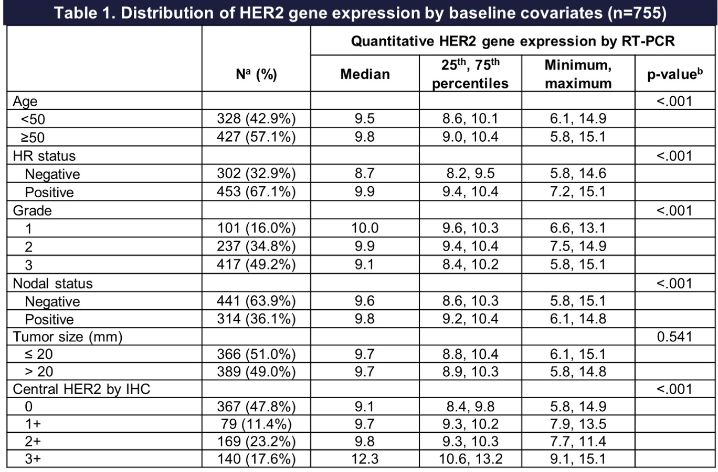
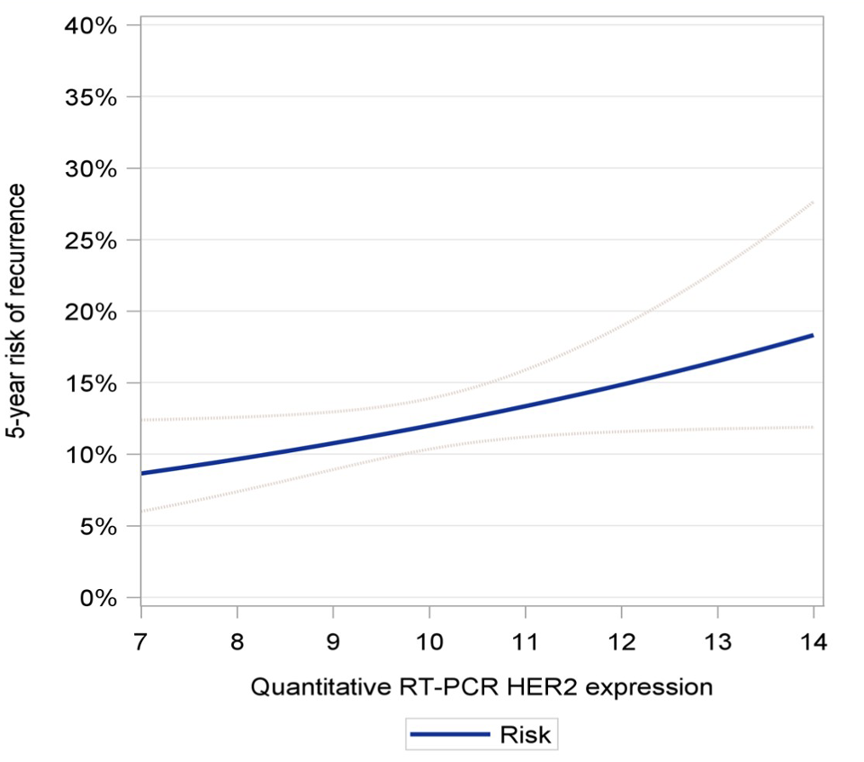
ECOG-ACRIN E2197: Results
Five-year risk of recurrence as a continuous function of quantitative HER2 by RT-PCR with 95% confidence interval (dashed curves) n=755
Can T et al. ASCO 2023;Abstract 515.

Slide 15
Gill J et al. ASCO 2023;Abstract 511.

Slide 16
Racial/Ethnic Differences in 21-Gene Recurrence Score® and Survival Among Patients with ER-Positive Breast Cancer: Methods
Gill J et al. ASCO 2023;Abstract 511.

Slide 17
Racial/Ethnic Differences in 21-Gene Recurrence Score and Survival Among Patients with ER-Positive Breast Cancer: Results
Gill J et al. ASCO 2023;Abstract 511.

Slide 18
Racial/Ethnic Differences in 21-Gene Recurrence Score and Survival Among Patients with ER-Positive Breast Cancer: Overall Mortality
Gill J et al. ASCO 2023;Abstract 511.

Slide 19
Gray R et al. ASCO 2023;Abstract 503.

Slide 20
Randomized Trials of Ovarian Ablation/Suppression
Meta-analysis of individual patient data from trials of ovarian ablation (by surgery or irradiation) or ovarian suppression (usually GnRH agonists) versus not (with all other treatments the same in each group)
Premenopausal women with ER-positive, or unknown status, early-stage breast cancer
Primary outcomes: recurrence and cause-specific mortality analyzed by standard EBCTCG* methods
* EBCTCG OUP 1990, Lancet 2011, 2012
Gray R et al. ASCO 2023;Abstract 503.

Slide 21
Ovarian Ablation/Suppression versus Not: Mortality — No Chemotherapy or Premenopausal After
Gray R et al. ASCO 2023;Abstract 503.

Slide 22
Ovarian Ablation/Suppression versus Not: Recurrence by Tamoxifen Use — No Chemotherapy or Premenopausal After
Gray R et al. ASCO 2023;Abstract 503.

Slide 23
Hamilton E et al. ASCO 2023;Abstract 501.

Slide 24
monarchE: Study Design and Age Subgroup Analyses
Hamilton E et al. ASCO 2023;Abstract 501.

Slide 25
monarchE: Older Patients Derived Similar Abemaciclib Benefit to ITT Population
Hamilton E et al. ASCO 2023;Abstract 501.

Slide 26
monarchE: Abemaciclib Benefit Is Maintained When Dose Modifications Are Undertaken to Manage Adverse Events
Hamilton E et al. ASCO 2023;Abstract 501.

Slide 27
Slamon D et al. ASCO 2023;Abstract LBA500.

Slide 28
NATALEE: Study Design – Unique Features
Slamon D et al. ASCO 2023;Abstract LBA500.

Slide 29
NATALEE: Consistent Improvement in DDFS with Ribociclib
Slamon D et al. ASCO 2023;Abstract LBA500.

Slide 30
NATALEE: Trend for Improved OS with Ribociclib
Slamon D et al. ASCO 2023;Abstract LBA500.

Slide 31
NATALEE: Favorable Safety Profile with 400 mg versus 600 mg of Ribociclib
Slamon D et al. ASCO 2023;Abstract LBA500.

Slide 32
Turner N et al. ASCO 2023;Abstract 502.

Slide 33
PENELOPE-B: Background
Turner N et al. ASCO 2023;Abstract 502.

Slide 34
PENELOPE-B: Results – Baseline ctDNA Detection
Turner N et al. ASCO 2023;Abstract 502.

Slide 35
PENELOPE-B: Results – ctDNA Dynamics
Turner N et al. ASCO 2023;Abstract 502.

Slide 36
Outcomes with First-Line (1L) Ribociclib (RIB) + Endocrine Therapy (ET) vs Physician’s Choice Combination Chemotherapy (Combo CT) by Age in Pre/Perimenopausal Patients (pts) with Aggressive HR+/HER2− Advanced Breast Cancer (ABC): A Subgroup Analysis of the RIGHT Choice Trial
El Saghir NS et al.
ASCO 2023;Abstract 1063.

Slide 37
RIGHT Choice: Progression-Free Survival (PFS) by Age
El Saghir NS et al. ASCO 2023;Abstract 1063.

Slide 38
RIGHT Choice: Adverse Events (AEs) in ≥20% Irrespective of Causality in Either Treatment Arm in Both Age Groups
El Saghir NS et al. ASCO 2023;Abstract 1063.

Slide 39
Sonke G et al. ASCO 2023;Abstract 1000.

Slide 40
SONIA: Trial Design
Sonke G et al. ASCO 2023;Abstract 1000.

Slide 41
SONIA: PFS2
Sonke G et al. ASCO 2023;Abstract 1000.

Slide 42
SONIA: Overall Survival
Sonke G et al. ASCO 2023;Abstract 1000.

Slide 43
SONIA: Safety Summary
Sonke G et al. ASCO 2023;Abstract 1000.

Slide 44
Llombart-Cussac A et al. ASCO 2023;Abstract 1001.

Slide 45
PALMIRA: Study Design
Llombart-Cussac A et al. ASCO 2023;Abstract 1001.

Slide 46
PALMIRA: Investigator-Assessed PFS (ITT Population)
Llombart-Cussac A et al. ASCO 2023;Abstract 1001.

Slide 47
PALMIRA: Overall Survival (ITT Population)
Llombart-Cussac A et al. ASCO 2023;Abstract 1001.

Slide 48
PALMIRA: TEAEs by Maximum Severity Affecting at Least 10% or of Grade 4-5 (Safety Analysis)
TEAE = treatment-emergent adverse event
Llombart-Cussac A et al. ASCO 2023;Abstract 1001.

Slide 49
Alpelisib + Endocrine Therapy in Patients with PIK3CA-Mutated, Hormone Receptor-Positive, Human Epidermal Growth Factor Receptor 2-Negative, Advanced Breast Cancer: Analysis of All 3 Cohorts of the BYLieve Study
Chia S et al.
ASCO 2023;Abstract 1078.

Slide 50
BYLieve: Study Design
Chia S et al. ASCO 2023;Abstract 1078.

Slide 51
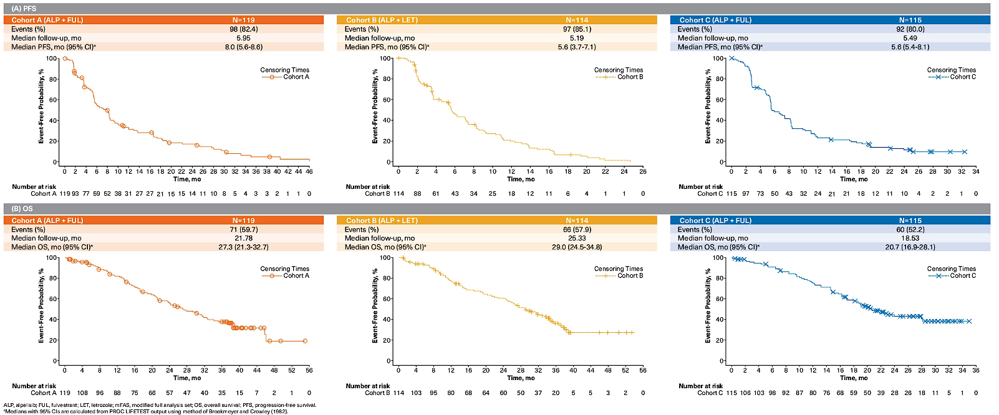
BYLieve: PFS and OS by Investigator
Chia S et al. ASCO 2023;Abstract 1078.

Slide 52
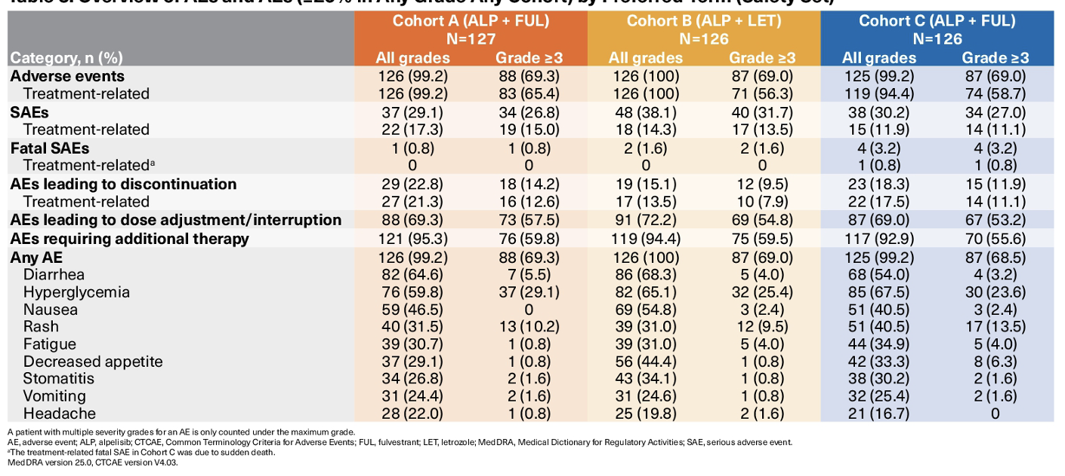
BYLieve: Overview of AEs and AEs (≥20% in Any Grade Any Cohort) by Preferred Term (Safety Set)
Chia S et al. ASCO 2023;Abstract 1078.

Slide 53
Tolaney SM et al. ASCO 2023;Abstract 1003.

Slide 54
TROPiCS-02: A Phase III Study of Sacituzumab Govitecan for Patients with HR-Positive, HER2-Negative mBC
Tolaney SM et al. ASCO 2023;Abstract 1003.

Slide 55
TROPiCS-02: PFS
Tolaney SM et al. ASCO 2023;Abstract 1003.

Slide 56
TROPiCS-02: Overall Survival
Tolaney SM et al. ASCO 2023;Abstract 1003.

Slide 57
TROPiCS-02: Overall Survival by TROP2 Expression Level
Tolaney SM et al. ASCO 2023;Abstract 1003.

Slide 58
TROPiCS-02: Overall Survival by HER2 IHC Status
Tolaney SM et al. ASCO 2023;Abstract 1003.

Slide 59
Trop-2 mRNA Expression and Association with Clinical Outcomes with Sacituzumab Govitecan (SG) in Patients with HR+/HER2– Metastatic Breast Cancer (mBC): Biomarker Results from the Phase 3 TROPiCS-02 Study
Bardia A et al.
ASCO 2023;Abstract 1082.

Slide 60
TROPiCS-02: PFS and OS by TACSTD2 mRNA Expression
PFS
OS
Bardia A et al. ASCO 2023;Abstract 1082.

Slide 61
TROPiCS-02: PFS and OS by TROP2 and HER2 IHC Subgroup
Bardia A et al. ASCO 2023;Abstract 1082.

Slide 62
Hamilton EP et al. ASCO 2023;Abstract 1004.

Slide 63
Phase II Study of Patritumab Deruxtecan: Study Design
Hamilton EP et al. ASCO 2023;Abstract 1004.

Slide 64
Phase II Study of Patritumab Deruxtecan: Response – Investigator Assessment
Hamilton EP et al. ASCO 2023;Abstract 1004.

Slide 65
Phase II Study of Patritumab Deruxtecan: Safety
Hamilton EP et al. ASCO 2023;Abstract 1004.

