Slide 1


HER2 positive metastatic breast cancer
Giuseppe Curigliano, MD, PhD
University of Milano and Istituto Europeo di Oncologia, IRCCS
Milano, Italia

Slide 2
HER2-positive stage IV breast cancer
First-line treatment
Second-line treatment
HR positive
HR negative
Active brain metastases
No, unknown or stable brain metastases
ChT contraindicated
No ChT contraindications
ChT contraindicated
No ChT contraindications
Local intervention indicated^{e}
Local intervention not indicated
Trastuzumab (± pertuzumab) + ET
[II, B]
Docetaxel [or paclitaxel (II, A)] + trastuzumab/ pertuzumab ≥6 cycles [I, A; MCBS 4; ESCAT I-A]^{a,b} followed by trastuzumab/ pertuzumab/ET until progression
[I, A]
Trastuzumab/ pertuzumab until progression
[II, B]
Docetaxel [or paclitaxel (II, A)] + trastuzumab/ pertuzumab ≥6 cycles [I, A; MCBS 4; ESCAT I-A]^{a,b} followed by pertuzumab/ trastuzumab until progression
[I, A]
1-10 BMs, favourable prognostic factors
>10 BMs, unfavourable prognostic factors
Tucatinib/ capecitabine/ trastuzumab
[II, A; MCBS 3; ESCAT I-A]^{a-c}
(preferred)
or
Trastuzumab deruxtecan [II, A; ESCAT I-A]^{b,d}
Trastuzumab deruxtecan [I, A; ESCAT I-A]^{b,d}
or
Tucatinib/ capecitabine/ trastuzumab
[II, A; MCBS 3; ESCAT I-A]^{a-c}
Resection
[II, B]
SRT
For 1-4 BMs [I, A]
For 5-10 BMs [II, B]
SRT
[II, B]
WBRT
[III, B]

Slide 3
HER2-positive stage IV breast cancer
Third-line treatment and beyond
Active brain metastases
No, unknown or stable brain metastases
Local intervention indicated^{f}
Local intervention not indicated
Tucatinib/ capecitabine/ trastuzumab [I, A; MCBS 3; ESCAT I-A]^{b-d}
Or
Trastuzumab deruxtecan [III, A; MCBS 2; ESCAT I-A]^{b,c,e}
Or
T-DM1 [I, A; MCBS 4; ESCAT I-A]^{b,c,e}
1-10 BMs, favourable prognostic factors
>10 BMs, unfavourable prognostic factors
Tucatinib/ capecitabine/ trastuzumab
[II, A; MCBS 3; ESCAT I-A]^{b-d}
Resection
[II, B]
SRT
For 1-4 BMs [I, A]
For 5-10 BMs [II, B]
WBRT
[III, B]
Lapatinib/trastuzumab [I, B; MCBS 4; ESCAT I-A]^{a-c}
Trastuzumab/ChT [III, A; ESCAT I-A]^{a,c}
Margetuximab/ChT [I, B; MCBS 2; ESCAT I-A]^{a-d}
Neratinib/ChT [I, C; MCBS 1; ESCAT I-A]^{a-d}
Trastuzumab deruxtecan
[II, A; MCBS 2; ESCAT I-A]^{b-d,g}
SRT
[II, B]

Slide 4
DESTINY-Breast02 (Phase 3): T-DXd vs TPC for HER2+ unresectable and/or trastuzumab emtansine treated metastatic BC
Key eligibility
Centrally confirmed HER2+ (IHC 3+ or IHC 2+/ISH+) unresectable or metastatic breast cancer
Documented radiographic progression after most recent treatment
Previously treated with T-DM1
T-DXd 5.4 mg/kg Q3W (n=406)
Primary endpoint:
PFS (BICR)
Key secondary endpoint:
OS
Secondary endpoints:
ORR (BICR)
DOR (BICR)
PFS (investigator)
Safety
Exploratory endpoints:
CBR (BICR)
PFS2 (investigator)
R
2:1
TPC (n=202)
Trastuzumab/capecitabine or lapatinib/capecitabine
N=608
Stratification factors
HR status
Prior pertuzumab treatment
History of visceral disease
Median (range) follow-up duration at data cutoff (June 30, 2022):
T-DXd: 21.5 months (range, 0.1–45.6 months)
TPC: 18.6 months (range, 0–45.7 months)
Protocol-prespecified statistical analysis plan:
Primary analysis planned for ~372 BICR PFS events observed or 18 months from the last patient randomized (whichever came first)
Group sequential testing used to compare OS between treatment groups hierarchically, provided PFS was significant
BICR, blinded independent central review; CBR, clinical benefit rate; DOR, duration of response; ORR, objective response rate; T-DXd, trastuzumab deruxtecan; T-DM1, trastuzumab emtansine; TPC, treatment of physician’s choice.
Krop I, et al. SABCS 2022. Abstract GS2-01

Slide 5
DESTINY-Breast02 (Phase 3): Patient baseline characteristics
 | T-DXd (n=406) | TPC (n=202)
Age, median, years (range) ≥65, n(%) | 54 (22–89) 85 (21) | 55 (25–87) 38 (19)
Female, n (%) | 403 (99) | 200 (99)
Region, n (%) Asia Europe North America Rest of world | 112 (28) 152 (37) 41 (10) 101 (25) | 52 (26) 78 (39) 23 (11) 49 (24)
HER2 status (IHC), n (%) 3+ 2+ (ISH+) 2+ (ISH– or non evaluable) 1+ (ISH+) | 326 (80) 79 (20) 1 (0.2) 0 | 159 (79) 41 (21) 1 (1) 1 (1)
ECOG PS, n (%) 0 1 2 | 228 (56) 177 (44) 1 (0.2) | 121 (60) 81 (40) 0
n (%) | T-DXd (n=406) | TPC (n=202)
HR+ HR– | 238 (59) 165 (41) | 118 (58) 83 (41)
Brain metastases at baseline | 74 (18) | 36 (18)
Visceral disease | 316 (78) | 160 (79)
Prior treatment for BC | 406 (100) | 202 (100)
Prior lines of therapy in the metastatic setting 0 1 2 3 4 ≥5 | 2 (1) 18 (4) 192 (47) 123 (30) 42 (10) 29 (7) | 0 12 (6) 92 (46) 63 (31) 13 (6) 22 (11)
ECOG PS, European Cooperative Oncology Group Performance Status; T-DXd, trastuzumab deruxtecan; TPC, treatment of physician’s choice.
Krop I, et al. SABCS 2022. Abstract GS2-01

Slide 6
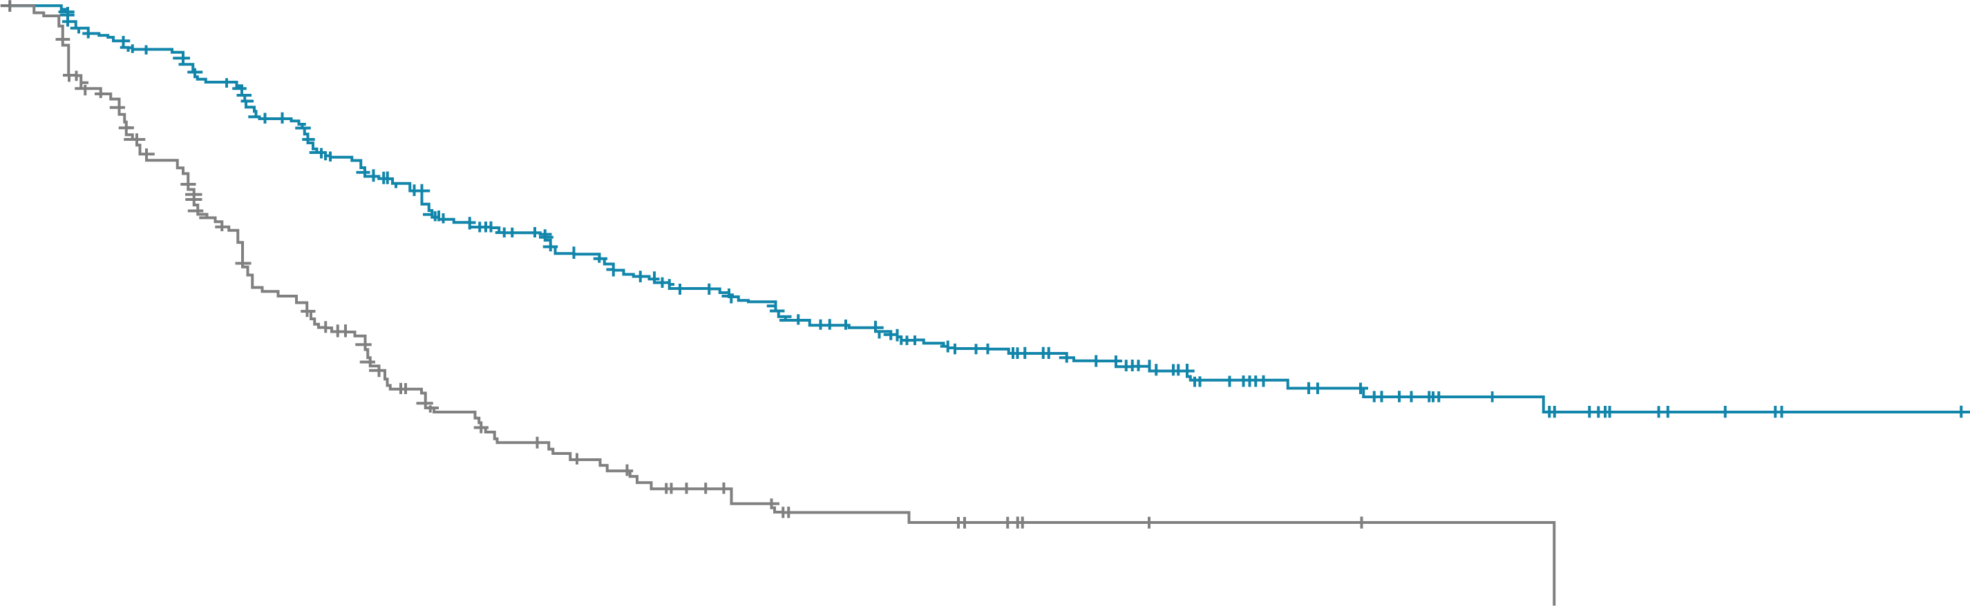
DESTINY-Breast02 (Phase 3): PFS with T-DXd vs TPC for HER2+ unresectable and/or trastuzumab emtansine treated metastatic BC
PFSª (primary endpoint)
100
 | T-DXd | TPC
mPFS (95% CI) months | 17.8 (14.3, 20.8) | 6.9 (5.5, 8.4)
HR (95% CI); P-value | 0.3589 (0.2840, 0.4535); <0.000001
90
80
T-DXd: 62.3% (95% CI, 57.0, 67.1)
70
TPC: 27.2% (95% CI, 20.1, 34.8)
60
T-DXd: 42.2% (95% CI, 36.5, 47.8)
PFS probability (%)
50
TPC: 13.9% (95% CI, 7.9, 21.6)
40
30
T-DXd (n = 406)
20
10
TPC (n = 202)
Censor
0
0
2
4
6
8
10
12
14
16
18
20
22
24
26
28
30
32
34
36
38
40
42
44
46
Patients still at risk
Time (months)
T-DXd
406
374
355
296
260
213
194
170
149
132
109
83
65
55
38
31
23
15
12
6
4
1
1
0
TPC
202
148
118
78
64
39
32
24
17
11
9
8
3
3
2
2
1
1
1
ªBy BICR
T-DXd, trastuzumab deruxtecan; TPC, treatment of physician’s choice.
Krop I, et al. SABCS 2022. Abstract GS2-01

Slide 7
DESTINY-Breast02 (Phase 3): PFS subgroup analysis
Events, n/N
Median PFS, months (95% CI)
Subgroup | T-DXd | TPC | T-DXd | TPC | HR (95% CI)
All patients | 200/406 | 125/202 | 17.8 (14.3, 20.8) | 6.9 (5.5, 8.4) |  | 0.36 (0.28, 0.45)
<65 | 160/321 | 101/164 | 17.9 (14.1, 20.8) | 7.1 (5.5, 8.6) |  | 0.37 (0.29, 0.48)
≥65 | 40/85 | 24/38 | 16.8 (12.7, NE) | 6.7 (4.3, 8.4) |  | 0.39 (0.23, 0.65)
Positive | 115/238 | 71/118 | 18.0 (15.1 21.3) | 8.5 (6.5, 10.0) |  | 0.42 (0.31, 0.57)
Negative | 84/165 | 53/83 | 17.0 (12.3, 24.6) | 5.3 (4.3, 6.7) |  | 0.31 (0.22, 0.45)
Yes | 155/318 | 95/156 | 17.8 (14.0, 20.8) | 6.2 (5.0, 8.4) |  | 0.38 (0.29, 0.49)
No | 45/88 | 30/46 | 18.0 (13.9, 26.7) | 8.3 (5.5, 12.6) |  | 0.37 (0.23, 0.60)
Yes | 164/316 | 98/160 | 15.6 (12.8, 20.3) | 5.7 (5.3, 7.2) |  | 0.36 (0.28, 0.46)
No | 36/90 | 27/42 | 29.8 (16.8, NE) | 9.8 (6.2, 12.6) |  | 0.39 (0.23, 0.64)
Yes | 44/74 | 20/36 | 13.9 (11.1, 18.0) | 5.6 (3.3, 8.1) |  | 0.35 (0.20, 0.61)
No | 156/332 | 105/166 | 18.7 (15.1, 24.8) | 7.1 (5.5, 8.6) |  | 0.38 (0.29, 0.48)
<3 | 105/212 | 66/104 | 16.6 (13.8, 24.6) | 7.0 (4.6, 8.6) |  | 0.35 (0.26, 0.49)
≥3 | 95/194 | 59/98 | 18.2 (14.3, 22.0) | 6.9 (5.5, 8.8) |  | 0.41 (0.29, 0.57)
0 | 101/228 | 75/121 | 24.6 (15.3, 31.6) | 8.1 (5.7, 9.7) |  | 0.36 (0.27, 0.50)
1 | 98/177 | 50/81 | 15.1 (11.5, 18.0) | 5.4 (4.3, 7.5) |  | 0.37 (0.26, 0.53)
Age
HR status
Prior
pertuzumab
Visceral
disease
Baseline brain
metastases
Prior therapy
lines
ECOG PS
ECOG PS, European Cooperative Oncology Group Performance Status;
T-DXd, trastuzumab deruxtecan; TPC, treatment of physician’s choice
Krop I, et al. SABCS 2022. Abstract GS2-01
T-DXd better
TPC better
HR (95% CI, log scale)

Slide 8
DESTINY-Breast02 (Phase 3): Secondary endpoints
OS
Treatment response
T-DXd: 89.4% (95% CI, 85.9, 92.1)
Data are n (%) or months (95% CI) | T-DXd (n=406) |  | TPC (n=202)
Confirmed ORR by BICR [95% CI] | 283 (69.7) [65.0, 74.1] |  | 59 (29.2) [23.0, 36.0]
 | P <0.0001
Confirmed best overall response CR PR SD PD Not evaluable | 57 (14.0) 226 (55.7) 95 (23.4) 19 (4.7) 9 (2.2) | 10 (5.0) 49 (24.3) 94 (46.5) 26 (12.9) 23 (11.4) | 10 (5.0) 49 (24.3) 94 (46.5) 26 (12.9) 23 (11.4)
mDOR by BICR, months | 19.6 (15.9, NE) | 8.3 (5.8, 9.5) | 8.3 (5.8, 9.5)
CBR by BICR | 82.3 (78.2, 85.9) | 46.0 (39.0, 53.2) | 46.0 (39.0, 53.2)
mPFS by investigator, months | 16.7 (14.3, 19.6) | 5.5 (4.4, 7.0) | 5.5 (4.4, 7.0)
mPFS, months | 35.8 (28.4, NE) | 15.8 (13.5, 21.0) | 15.8 (13.5, 21.0)
100
TPC: 74.7% (95% CI, 67.4, 80.4)
80
T-DXd: 65.9% (95% CI, 60.7, 70.7)
TPC: 54.3% (95% CI, 46.3, 61.6)
60
Progression-Free-Survival Probability (%)
40
 | T-DXd | TPC
Median OS (95% CI), months | 39.2 (32.7, NE) | 26.5 (21.0, NE)
HR (95% CI); P-value | 0.658 (0.502, 0.861): 0.0021
20
+ Censor
T-DXd (n=406)
TPC (n=202)
0
0
2
4
6
8
10
12
14
16
18
20
22
24
26
28
30
32
34
36
38
40
42
44
46
Time (months)
Patients still at risk
T-DXd (406)
406
400
385
374
357
350
339
317
295
277
234
196
160
139
104
82
63
40
29
19
8
3
1
0
TPC (202)
202
187
178
167
157
142
130
118
111
106
89
76
61
50
38
29
25
22
15
12
6
4
1
0
In the TPC arm:
69.3% of patients received a new systemic therapy
25.7% of patients received T-DXd in the post-trial setting
CR, complete response; DOR, duration of response; ORR, objective response rate;
PD, progressive disease; PR, partial response; SD, stable disease;
T-DXd, trastuzumab deruxtecan; TPC, treatment of physician’s choice
Krop I, et al. SABCS 2022. Abstract GS2-01

Slide 9
DESTINY-Breast02 (Phase 3): T-DXd safety
 | Adjudicated as drug-related ILD
 | Grade 1 | Grade 2 | Grade 3 | Grade 4 | Grade 5 | Any Grade
T-DXd (n=404) | 11 (2.7) | 26 (6.4) | 3 (0.7) | 0 | 2 (0.5) | 42 (10.4)
TPC (n=195) | 0 | 0 | 1 (0.5) | 0 | 0 | 1 (0.5)
Median time to onset of adjudicated drug-related ILD was 209.5 days (41–628 days) with T-DXd
LV dysfunction
T-DXd arm, 18 (4.5%) patients experienced an LV dysfunction event
  2 (0.5%) patients had a Grade ≥3 event
TPC arm, 3 (1.5%) patients experienced an LV dysfunction event
  1 (0.5%) patient had a Grade ≥3 event
Profound and early separation of PFS curves (HR 0.35 unprecedented favouring T-DXd) establishes this compound for HER2+ metastatic breast cancer
Overall well tolerated but still no biomarker to identify patients at risk for ILD and how best to monitor for pulmonary toxicity
Given these results, ongoing trials incorporating into the early breast cancer setting are highly anticipated to change natural history of the disease
T-DXd, trastuzumab deruxtecan; TPC, treatment of physician’s choice.
Krop I, et al. SABCS 2022. Abstract GS2-01

Slide 10
DESTINY-Breast03 (Phase 3): Updated efficacy of T-DXd vs
T-DM1 for patients with HER2+ metastatic BC
Key eligibility
Unresectable or metastatic HER2+ BC
Previous treatment with trastuzumab and a taxane in metastatic or (neo)adjuvant setting with recurrence <6 months’ treatment
Patient disposition
T-DXd 5.4 mg/kg Q3W
(n=261)
OS interim analysis planned with 153 eventsª
n (%) | T-DXd (n=261) | T-DM1 (n=263)
Randomized but not treated | 4 (2) | 2 (10
Treatment status Ongoing Discontinued | 75 (29) 182 (71) | 18 (7) 243 (93)
Primary reason for discontinuation PD AE Clinical progression Death Patient withdrawal Physician discretion Other | 94 (37) 54 (21) 5 (2) 4 (2) 17 (7) 2 (1) 6 (2) | 178 (68) 21 (8) 14 (5) 4 (2) 12 (5) 8 (3) 6 (2)
R
1:1
T-DM1 3.6 mg/kg Q3W
(n=263)
N=524
Primary endpoint:
PFS (BICR)
Key secondary endpoint:
OS
Secondary endpoints:
ORR (BICR and investigator)
DOR (BICR)
Safety
Stratification factors
HR status
Prior pertuzumab treatment
History of visceral disease
ªAt data cutoff (July 2022), 169 OS events had been observed and p-value for statistical significance was 0.013.
BICR, blinded independent central review; DOR, duration of response; PD, progressive disease; T-DXd, trastuzumab deruxtecan; T-DM1, ado-trastuzumab emtansine.
Hurvitz SA, et al. SABCS 2022. Abstract GS2-02

Slide 11

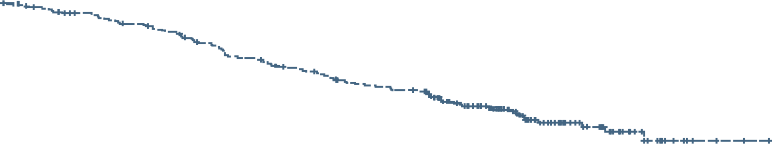
DESTINY-Breast03 (Phase 3): Updated OS (secondary endpoint) with T-DXd vs T-DM1 for patients with HER2+ metastatic BC
T-DXd: 77.4% (95% CI, 71.7, 82.1)
T-DM1: 69.9% (95% CI, 63.7, 75.2)
T-DXd: 94.1% (95% CI, 90.4, 96.4)
T-DM1: 86.0% (95% CI, 81.1, 89.8)
100
OS probability (%)
80
 | T-DXd | T-DM1
Median OS (95% CI), months | NR (40.5, NE) | NR (34.0, NE)
HR (95% CI); P-value | 0.64 (0.47, 0.87): 0.0037
60
40
Censor
T-DXd (n=261)
T-DM1 (n=263)
All anti-cancer therapies in post-trial setting
T-DXd arm: 64/182 (35.2%) received T-DM1
T-DM1 arm: 42/243 (17.3%) received T-DXd
20
+
0
Time (months)
Subgroup OS analysis
0
2
4
6
8
10
12
14
16
18
20
22
24
26
28
30
32
34
36
38
40
42
44
46
 |  | Events, n/N |  | Median OS, months (95% CI) |  | HR (95% CI)
 |  | T-DXd | T-DM1 | T-DXd | T-DM1
All patients |  | 72/261 | 97/263 | NR (40.5, NE) | NR (34.0, NE) |  | 0.64 (0.47, 0.87)
HR status | + (n=272) − (n=248) | 42/133 30/126 | 51/139 45/122 | NR (NE, NE) NR (40.5, NE) | 37.7 (34.0, NE) NR (28.5, NE) |  | 0.76 (0.50, 1.14) 0.55 (0.35, 0.87)
Prior pertuzumab | Yes (n=320) No (n=204) | 41/162 31/99 | 50/158 47/105 | NR (40.5, NE) NR (NE, NE) | NR (37.7, NE) 31.5 (22.7, NE) |  | 0.70 (0.46, 1.06) 0.59 (0.38, 0.93)
Baseline visceral disease | Yes (n=384) No (n=140) | 64/195 8/66 | 80/189 17/74 | NR (40.5, NE) NR (NE, NE) | 35.4 (29.9, NE) NR (NE, NE) |  | 0.68 (0.49, 0.95) 0.44 (0.19, 1.02)
Prior lines of systemic therapy | <3 (n=379) ≥3 (n=145) | 44/188 28/73 | 57/191 40/72 | NR (40.5, NE) NR (27.4, NE) | NR (37.7, NE) 22.8 (16.1, 31.5) |  | 0.70 (0.47, 1.04) 0.55 (0.34, 0.89)
Baseline brain metastases | Yes (n=82) No (n=442) | 17/43 55/218 | 22/39 75/224 | NR (23.8, NE NR (40.5, NE) | 25.1 (12.6, NE) NR (37.7, NE) |  | 0.54 (0.29, 1.03) 0.66 (0.47, 0.94)
Median study follow-up:
T-DXd: 28.4 months (range, 0.1–46.9)
T-DM1: 26.5 months( range, 0.0–45.0)
Prespecified OS interim analysis was planned with 153 events
At data cutoff (July 2022), 169 OS events had occurred
T-DXd, trastuzumab deruxtecan; T-DM1, ado-trastuzumab emtansine.
Hurvitz SA, et al. SABCS 2022. Abstract GS2-02
1
2
0.1
T-DXd better
T-DM1 better

Slide 12
DESTINY-Breast03 (Phase 3): Updated PFSª (primary endpoint) and response with T-DXd vs T-DM1 for patients with HER2+ metastatic BC
T-DXd: 75.2% (95% CI, 69.3, 80.2)
T-DM1: 33.9 % (95% CI, 27.7, 40.2)
T-DXd: 53.7% (95% CI, 46.8, 60.1)
T-DM1: 26.4 % (95% CI, 20.5, 32.6)
PFSª
PFS probability, %
100
+
+
+
+
+
+
+
+
+
+
+
+
+
+
+
+
+
+
80
+
+
+
+
+
+
 | T-DXd | T-DM1
Median PFS (95% CI), months | 28.8 (22.4, 37.9) | 6.8 (5.6, 8.2)
HR (95% CI); P-value | 0.33 (0.26, 0.43): <0.000001
+
+
+
+
+
+
+
+
+
+
+
+
+
+
+
+
+
+
+
+
+
+
+
+
+
+
60
+
+
+
+
+
+
+
+
+
+
+
+
+
+
+
+
+
+
+
+
+
+
+
+
+
+
+
+
+
+
+
+
+
+
+
+
+
+
+
+
+
+
+
+
+
+
+
+
+
+
+
+
+
+
+
+
+
+
+
+
+
40
+
+
+
+
+
+
+
+
+
+
+
+
+
+
+
+
+
+
+
+
Censor
T-DXd (n=261)
T-DM1 (n=263)
+
+
+
+
+
+
+
+
+
+
+
+
+
+
+
+
+
+
+
+
+
+
+
+
+
+
+
+
+
+
+
+
20
+
+
+
+
+
+
+
+
+
+
mPFS was x4 longer for T-DXd compared with T-DM1
+
+
+
0
Time (months)
0
2
4
6
8
10
12
14
16
18
20
22
24
26
28
30
32
34
36
38
40
42
44
Treatment response
 | T-DXd (n=261)^{b} | T-DM1 (n=263)^{b}
ORRª, n (%) [95% CI]; nominal P-value CR, n (%) PR, n (%) SD, n (%) PD, n (%) NE, n (%) | 205 (78.5) [73.1, 83.4]; <0.0001 55 (21.1) 150 (57.5) 47 (18.0) 3 (1.1) 6 (2.3) | 92 (35.0) [29.2, 41.1] 25 (9.5) 67 (25.5) 110 (41.8) 47 (17.9) 14 (5.3)
CBR, n (%) [95% CI]; nominal P-value | 233 (89.3) [84.9, 92.8]; <0.0001 | 122 (46.4) [40.2, 52.6]
mDORª, months [95% CI] | 36.6 (2.4, NE) | 23.8 (12.6, 34.7)
ªBy BICR. ^{b}Only patients with measurable disease at baseline and ≥1 postbaseline target lesion assessment were included. CBR, clinical benefit rate; CR, complete response; DOR, duration of response; ORR, objective response rate; NE, not evaluable. PD, progressive disease; PR, partial response. T-DXd, trastuzumab deruxtecan; T-DM1, ado-trastuzumab emtansine; SD, stable disease. Hurvitz SA, et al. SABCS 2022. Abstract GS2-02

Slide 13
DESTINY-Breast03 (Phase 3): T-DXd vs T-DM1 safety
Most common TEAEs (in ≥20% of patients)
n (%) | T-DXd (n=261) |  | T-DM1 (n=263)
 | Any grade | Grade ≥3 | Any grade | Grade ≥3
Any TEAE Drug related | 256 (99.6) 252 (98.1) | 145 (56.4) 121 (47.1) | 249 (95.4) 228 (87.4) | 135 (51.7) 110 (42.1)
Blood/lymphatic Anemia Platelets decrease WBC count decrease | 95 (37) 64 (25) 60 (23) | 24 (9) 20 (8) 16 (6) | 51 (20) 114 (44) 16 (6) | 17 (7) 52 (20) 2 (1)
GI Nausea Vomiting Constipation Diarrhea | 198 (77) 133 (52) 96 (37) 83 (32) | 18 (7) 4 (2) 0 3 (1) | 79 (30) 28 (11) 51 (20) 21 (8) | 1 (0.4) 2 (1) 0 2 (1)
General Fatigue Headache | 79 (31) 61 (24) | 15 (6) 1 (0.4) | 53 (20) 40 (15) | 2 (1) 0
Investigations Neutrophil count decrease AST increase ALT increase | 79 (31) 72 (28) 59 (23) | 41 (16) 2 (1) 4 (2) | 30 (12) 108 (41) 83 (32) | 8 (3) 14 (5) 12 (5)
Metabolism/nutrition Decreased appetite Weight decrease | 78 (30) 58 (23) | 4 (2) 6 (2) | 46 (18) 23 (9) | 1 (0.4) 2 (1)
Skin/subcutaneous tissue Alopecia | 102 (40) | 1 (0.4) | 9 (3) | 0
Adjudicated drug-related interstitial lung disease/pneumonitis
n (%) | T-DXd (n=257) | T-DM1 (n=261)
Grade 1 | 11 (4) | 4 (2)
Grade 2 | 26 (10) | 3 (1)
Grade 3 | 2 (1) | 1 (0.4)
Grade 4 | 0 | 0
Grade 5 | 0 | 0
With longer treatment exposure and follow-up, rates increased from 10.5% in the PFS interim analysis to 15.2%
(4 additional Grade 1, 8 additional Grade 2)
T-DXd is highly effective, established SOC for second-line HER2+ metastatic BC
Significant improvement in OS compared with T-DM1
ILD rate increased with longer follow-up and treatment exposure
Don’t treat through symptoms – stop, and evaluate – to avoid serious ILD
Median treatment duration, T-DXd=18.2 months (range 0.7–44.0), T-DM1=6.9 months (range 0.7–39.3)WBC, white blood cell. T-DXd, trastuzumab deruxtecan; T-DM1, ado-trastuzumab emtansine.
Hurvitz SA, et al. SABCS 2022. Abstract GS2-02

Slide 14
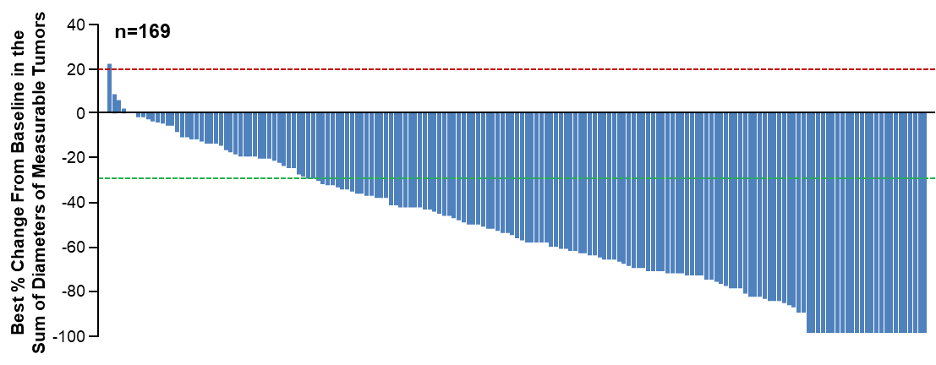
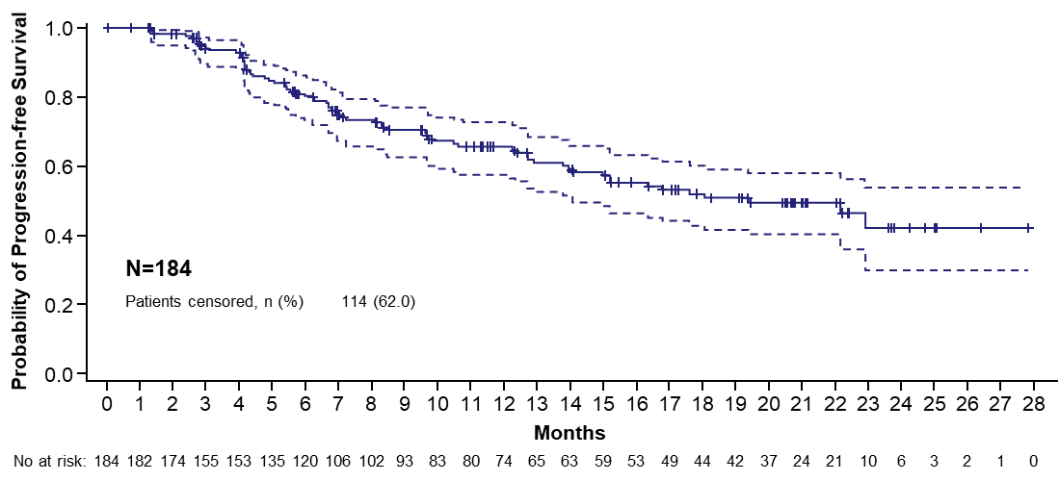
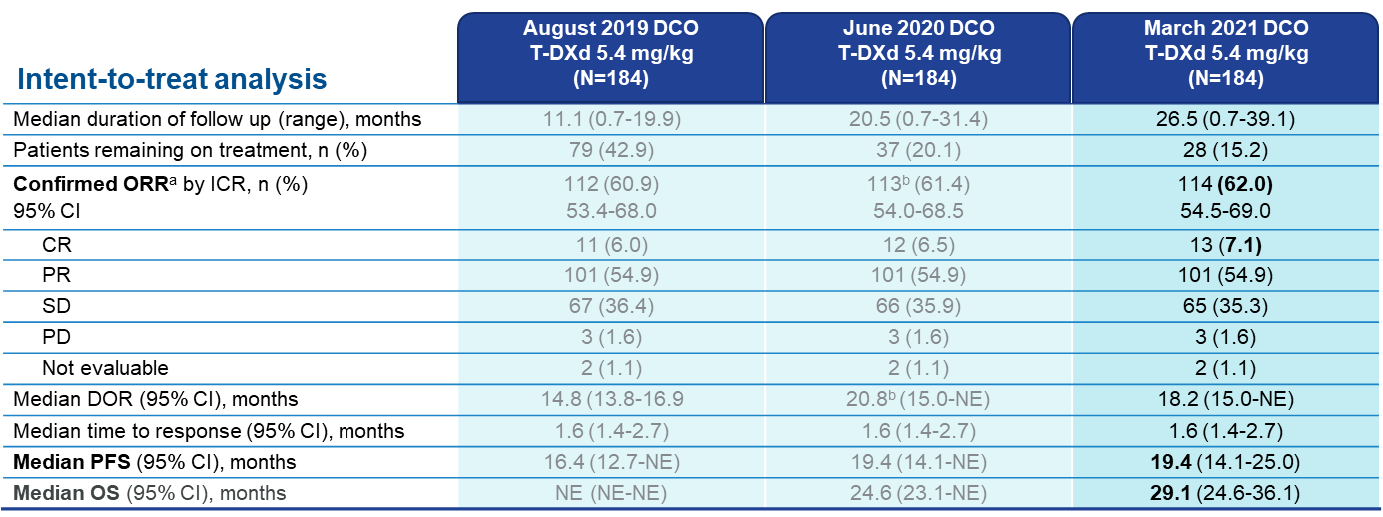
Trastuzumab-Deruxtecan: DB01 Phase II study
ORR
mPFS: 19.4 months
mOS: 29.1 months
Modi S, NEJM 2019; Modi S, et al. SABCS 2020; Saura C, et al. ESMO 2021

Slide 15
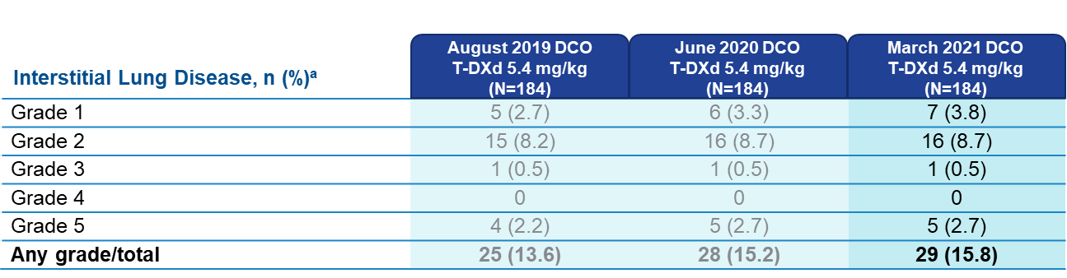
Adverse Events of Special Interest: Interstitial Lung Disease
  Median time from the first infusion of T-DXd to onset of ILD was 27.6 weeks (range, 6-76 weeks)
Modi S et al. SABCS 2020. Abstract PD3-06; Saura C, et al. ESMO 2021

Slide 16
New 3L Therapies for HER2+ MBC: Cross-Trial Comparisons
mOS
57.1
CLEOPATRA
Pertuzumab + trastuzumab + docetaxel (n=402)¹
1L
40.8
Placebo + trastuzumab + docetaxel (n=406)¹
EMILIA
T-DM1 (n=495)²
29.9
39% >1 prior therapy
2L
25.9
Lapatinib + capecitabine (n=496)²
39% >1 prior therapy
NALA
Neratinib + capecitabine (n=181)*³
5.6mo
23.0
30.0% ≥3 prior therapies†
Lapatinib + capecitabine (n=186)*³
21.8
31.5% ≥3 prior therapies†
HER2CLIMB
Tucatinib + trastuzumab + capecitabine (n=320)⁴
24.7
Median (range): 4 (2–14)
3L
Trastuzumab + capecitabine (n=160)⁴
19.2
Median (range): 4 (2–17)
TH3RESA
T-DM1 (n=404)⁵
NE
Median (range): 4 (1–14)
PC (n=198)⁵
14.9
Median (range): 4 (1–19)
SOPHIA
Margetuximab + chemo‡ (n=266)⁶
18.9
17.2
34% ≥2 prior therapies
Trastuzumab + chemo‡ (n=270)⁶
33% ≥2 prior therapies
DB01
T-DXd (n=184)^{7,8}
29.1
Median (range): 6 (2–27)
mPFS (months)
Prior treatment
Swain S, et al. Presented at ASCO, 31–4 June 2019, Chicago US. Abstract #1020; Diéras V, et al. Lancet Oncol. 2017;18(6):732–742; Saura C, et al. J Clin Oncol. 2020;38:3138–3149; Murthy RK, et al. N Engl J Med. 2020;382(7):597–609; Krop IE, et al. Lancet Oncol. 2014;15(7)689–699; Rugo HS, et al. Presented at ASCO 2019. Abstract 1000; Saura C et al. Presented at ESMO Congress 2021.

Slide 17
HER2CLIMB Analysis of Patients with Brain Metastases
All Patients with Brain Metastases
N=291
Brain MRI at baseline for all patients
Brain MRI for brain metastases patients every 6 weeks in first 24 weeks, every 9 weeks thereafter
Eligible brain metastases patients:
  Not requiring immediate
  local therapy
  Requiring local therapy during screening could be eligible after washout*
Active
Brain Metastases
N=174
Treated Stable
Brain Metastases†
N=117
Previously treated and no evidence of progression at baseline
Treated Progressing
N=108
Previously treated but progression of existing lesions, new lesions or untreated lesions at baseline
Untreated
N=66
  †Includes patients requiring immediate local therapy before enrollment. These patients were not considered evaluable for intracranial response.
  *These patients were included in the Treated Stable group for analysis.
Murthy R, et al. NEJM 2020

Slide 18
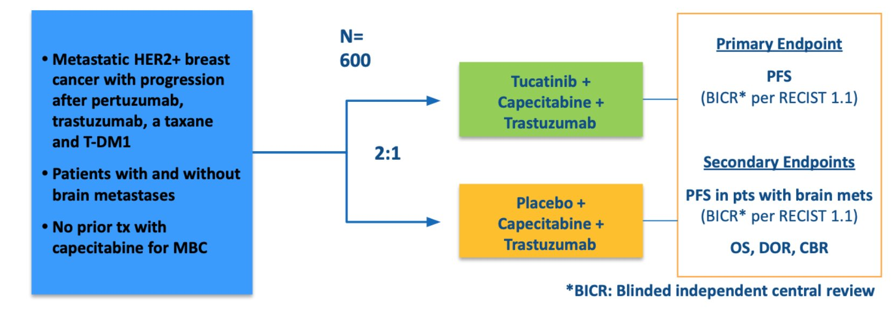
HER2CLIMB trial: tucatinib, trastuzumab, capecitabine
Curigliano G, et al. Ann Oncol. 2022 Mar;33(3):321-329
Giuseppe Curigliano, MD PhD

Slide 19
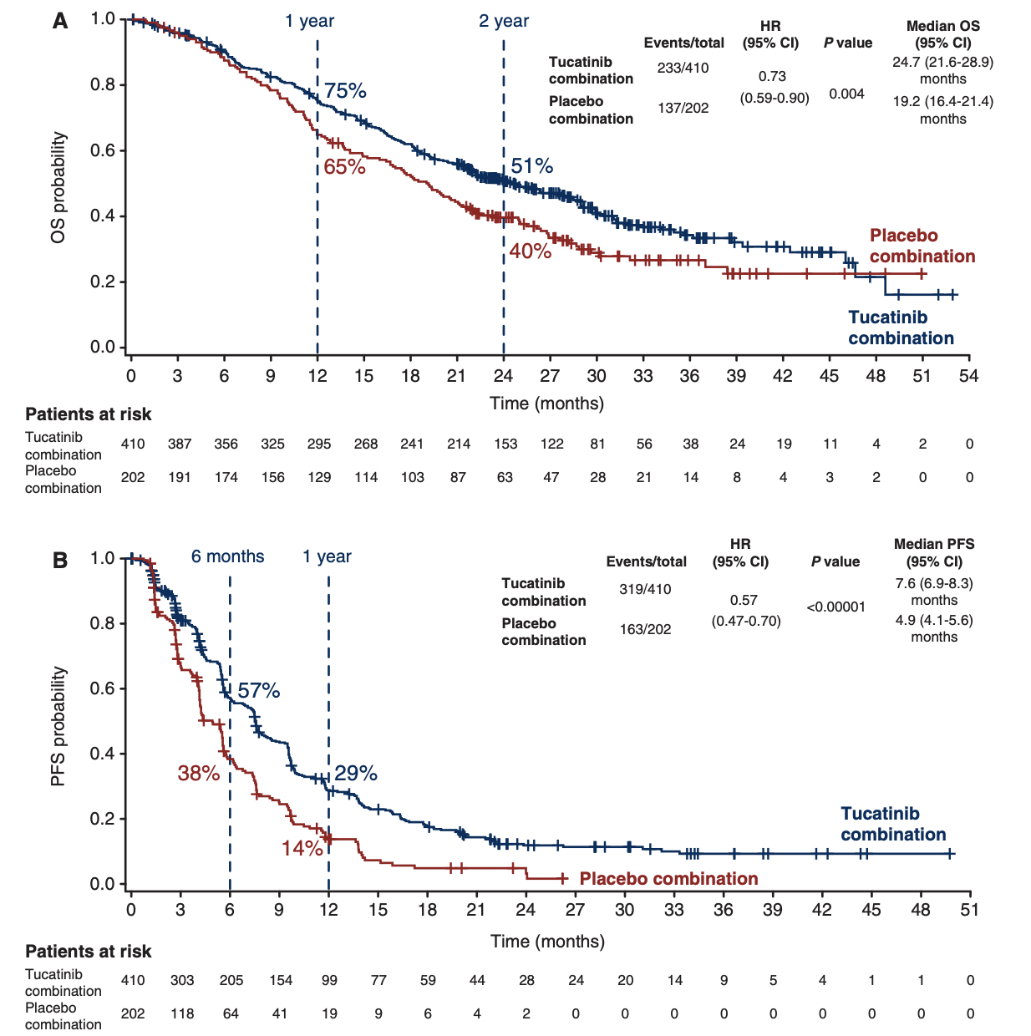
HER2CLIMB trial: tucatinib, trastuzumab, capecitabine
Improved PFS at 1 year: 29% vs 14%
(HR, 0.54; P<0.001)
Improved OS at 2 years: 51% vs 40%
(HR, 0.73, p=0.004)
Giuseppe Curigliano, MD PhD
Curigliano G, et al. Ann Oncol. 2022 Mar;33(3):321-329

Slide 20
HER2CLIMB trial: relevant intracranial activity
Median CNS PFS (95% CI)
9.5 mo (7.5-11.1) vs 4.1 mo (2.9-5.6)
Confirmed ORR (RECIST 1.1)
Confirmed ORR (RECIST 1.1)
Tuc + tras + cape
P = .03
Placebo + tras + cape
Probability of CNS PFS
Median
P = .03
35%
ORR-IC, % (95% Cl)
47%
(33.7-61.2)
0%
20%
(5.7-43.7)
Time Since Randomization, mo
Median OS (95% CI)
20.7 mo (15.1-NE) vs 11.6 mo (10.5-13.8)
71.7%
Tuc + tras + cape
Placebo + tras + cape
Tuc + Tras + Cape
N = 55
Placebo + Tras + Cape
N = 20
Probability of OS
Median
41.1%
Time Since Randomization, mo
Giuseppe Curigliano, MD PhD

Slide 21
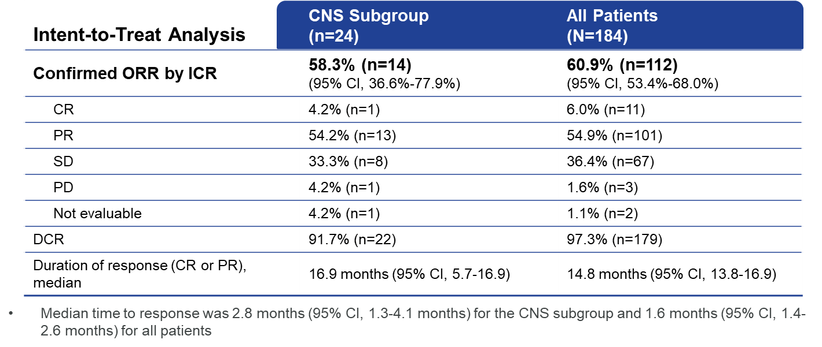
DESTINY-Breast01: CNS Subgroup
DB01 Phase II study: ORR
Jerusalem G, et al. ESMO Breast Cancer 2020.
Notes:
Key Takeaways
The efficacy of T-DXd treatment in the CNS subgroup was similar to that observed in the overall patient population
The confirmed ORR in the CNS subgroup was 58.3% (95% CI 36.6%-77.9%) based on independent central review and the DCR was 91.7%
Compared to the overall population, the duration of response was longer in the CNS subgroup (16.9 mo vs 14.8 mo)

Slide 22
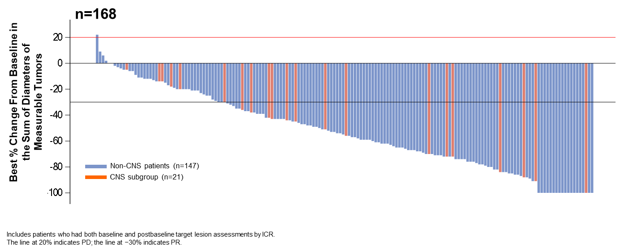
DESTINY-Breast01: CNS Subgroup
Best Change in Tumor Size
Jerusalem G, et al. ESMO Breast Cancer 2020.
Notes:
Key Takeaways
A majority of patients in the CNS subgroup had a reduction in tumor burden

Slide 23
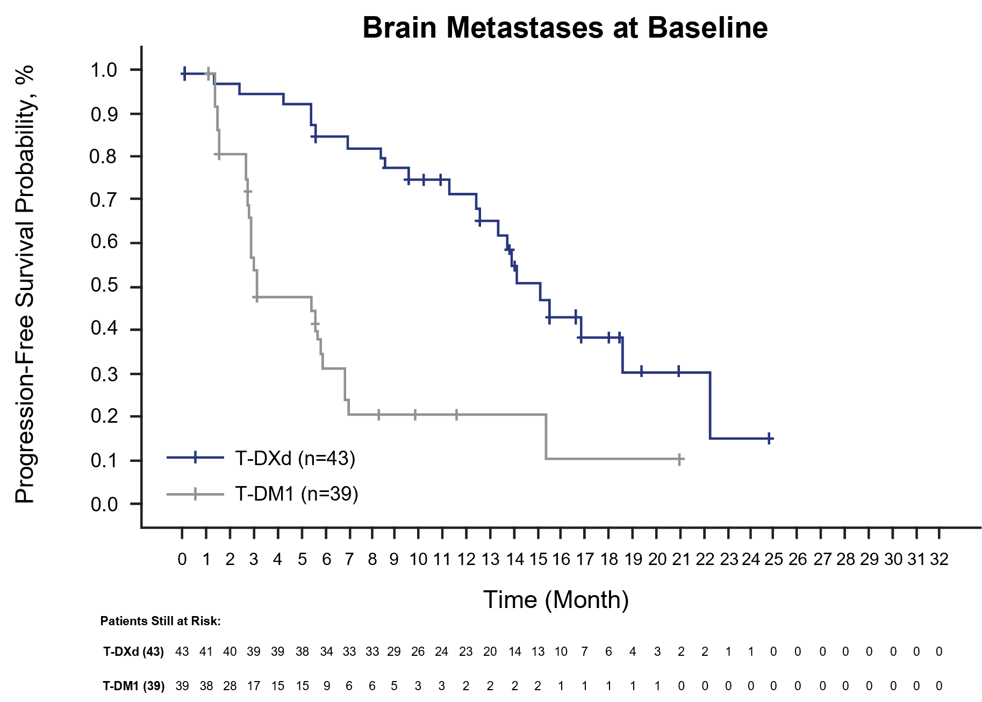
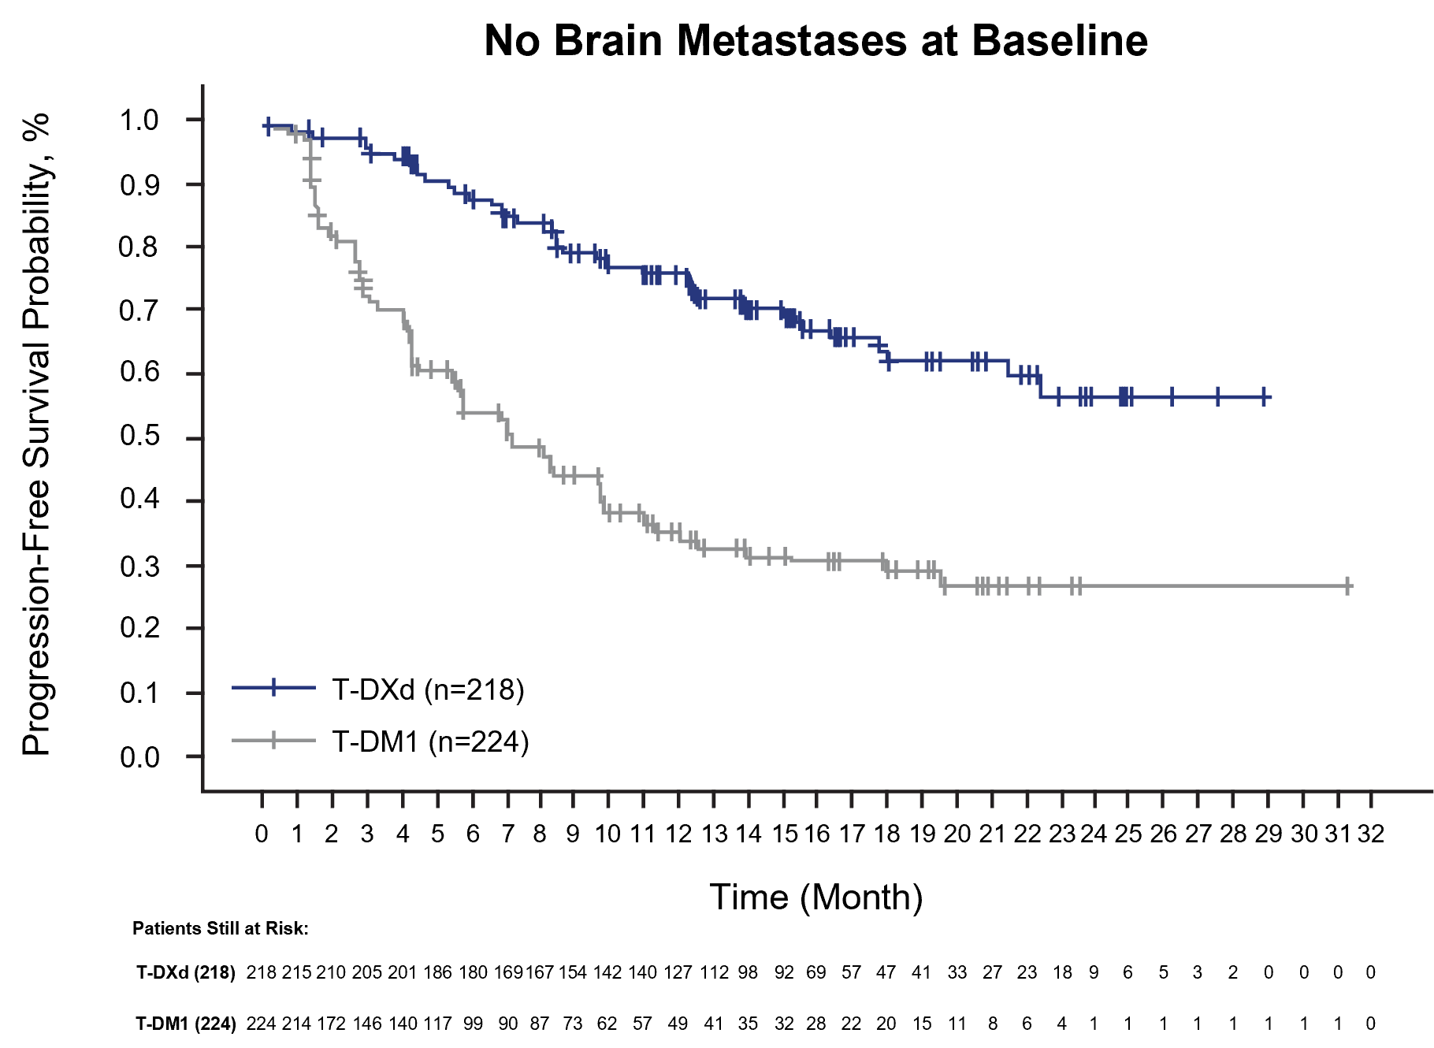
DB03: PFS KM Curves for Patients With and Without BM
Brain Metastases at Baseline
No Brain Metastases at Baseline
 | T-DXd | T-DM1
mPFS, mo (95% CI) | 15.0 (12.5-22.2) | 3.0 (2.8-5.8)
12-mo PFS rate, % (95% CI) | 72.0 (55.0-83.5) | 20.9 (8.7-36.6)
HR (95% CI) | 0.25 (0.13-0.45) | XX.X
 | T-DXd | T-DM1
mPFS, mo (95% CI) | NE (22.2-NE) | 7.1 (5.6-9.7)
12-mo PFS rate, % (95% CI) | 76.5 (70.0-81.8) | 36.4 (29.4-43.4)
HR (95% CI) | 0.30 (0.22-0.40) | XX.X
In patients with BM at baseline, PD was observed:
In 48.8% (21/43) treated with T-DXd versus 69.2% (27/39) with T-DM1
In the brain in 42.9% (9/21) treated with T-DXd versus 40.7% (11/27) with T-DM1
In patients without BM at baseline, PD was observed:
In 28.9% (63/218) treated with T-DXd versus 57.1% (128/224) with T-DM1
In the brain in 6.3% (4/63) treated with T-DXd versus 0.8% (1/128) with T-DM1
Hurvitz S, et al. SABCS 2021

Slide 24
Intracranial Response per BICR using RECIST 1.1
100
T-DXd (n = 21)
80
60
 | T-DXd (n = 36) | T-DM1 (n = 36)
Best Overall Response, n (%)ª
CR | 10 (27.8) | 1 (2.8)
PR | 13 (36.1) | 11 (30.6)
Non-CR/non-PD | 6 (16.7) | 7 (19.4)
SD | 4 (11.1) | 7 (19.4)
PD | 1 (2.8) | 8 (22.2)
Not evaluable | 0 | 1 (2.8)
Missing | 2 (5.6) | 1 (2.8)
40
20
0
-20
-40
-60
-80
-100
Best % Change in Sum of Diameters from Baseline
100
T-DM1 (n = 23)
80
60
40
20
0
-20
-40
-60
-80
CR, complete response; DCR, disease control rate; mDOR, median duration of response; PD, progressive disease; PR, partial response; SD, stable disease; T-DM1, trastuzumab emtansine; T-DXd, trastuzumab deruxtecan.
Table includes target and non-target lesions. Only patients with target lesion assessments are eligible for inclusion in waterfall.
Red line at 20% indicates progressive disease; black line at -30% indicates partial response.
ªDenominator for percentages is the number of subjects in the full analysis set with brain metastases tumor assessment
-100
Hurvitz S, et al. SABCS 2021
Notes:
Table includes target and non-target lesions. Only patients with target lesion assessments are eligible for inclusion in waterfall plot.

Slide 25
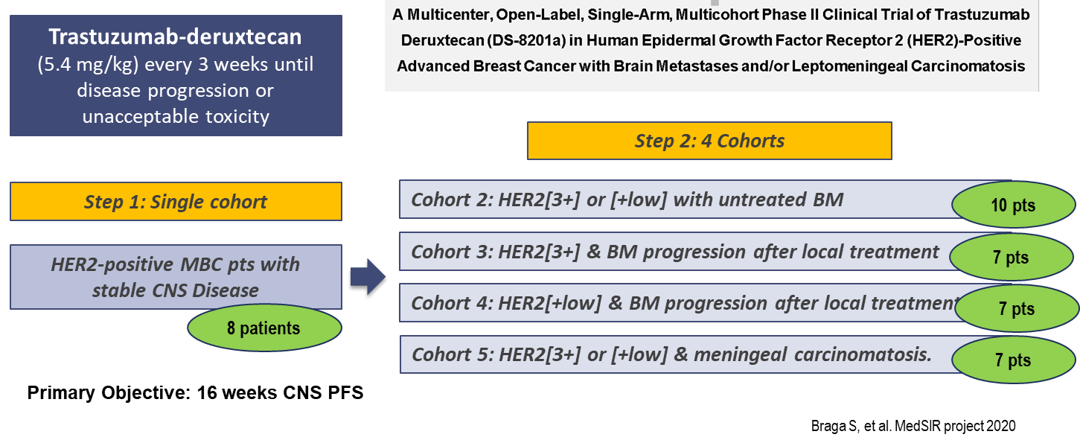
DS8201- DEBBRAH study
Braga S, et al. SABCS 2021

Slide 26
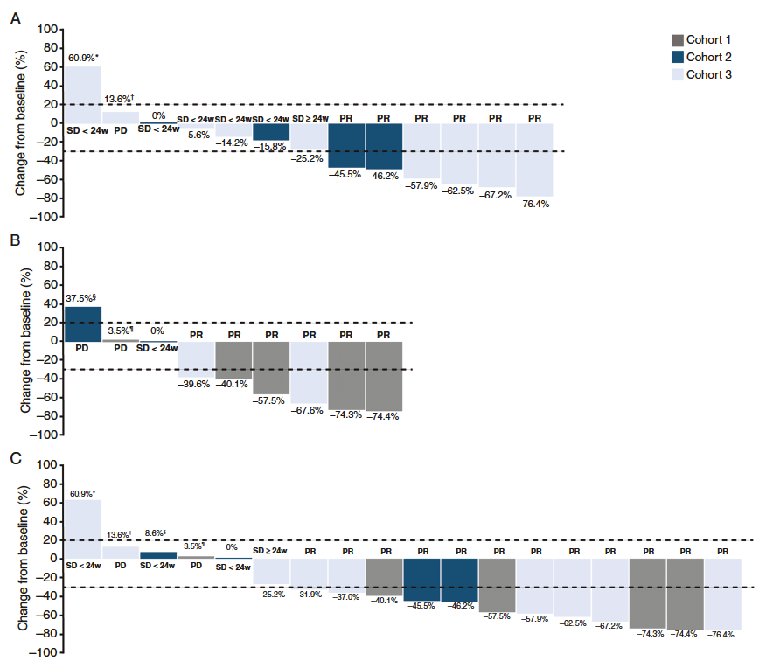
DEBBRAH: Best Responses in Cohorts 1 - 3
Intracranial Lesions by RANO-BM
Extracranial Lesions by RECIST v1.1
Overall Lesions by RECIST v1.1
Pérez-García JM et al. Neuro Oncol 2022;May 26 [online ahead of print].

Slide 27
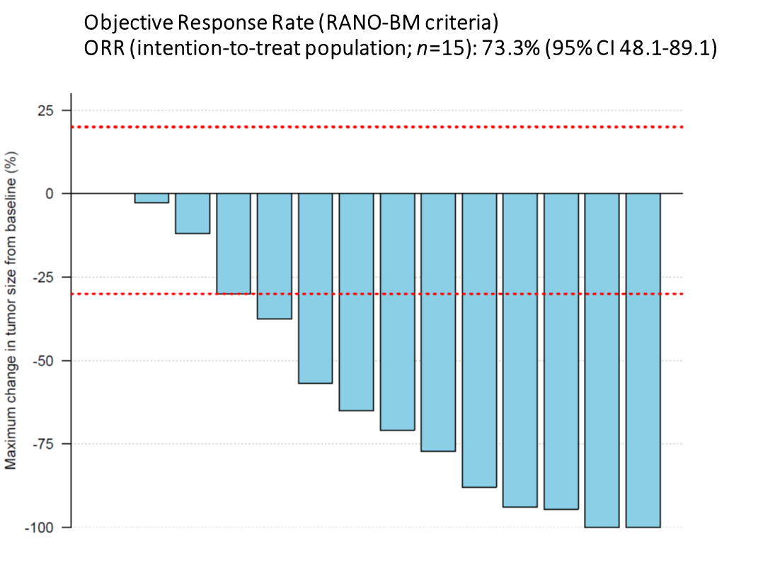
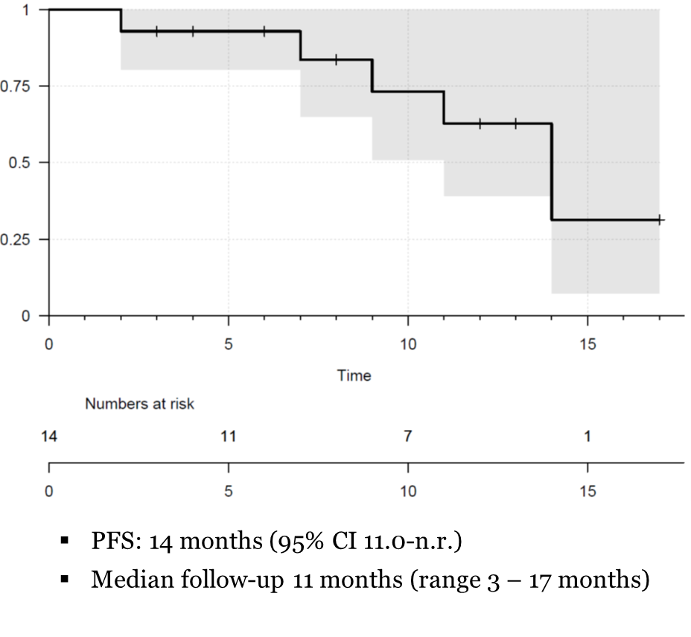
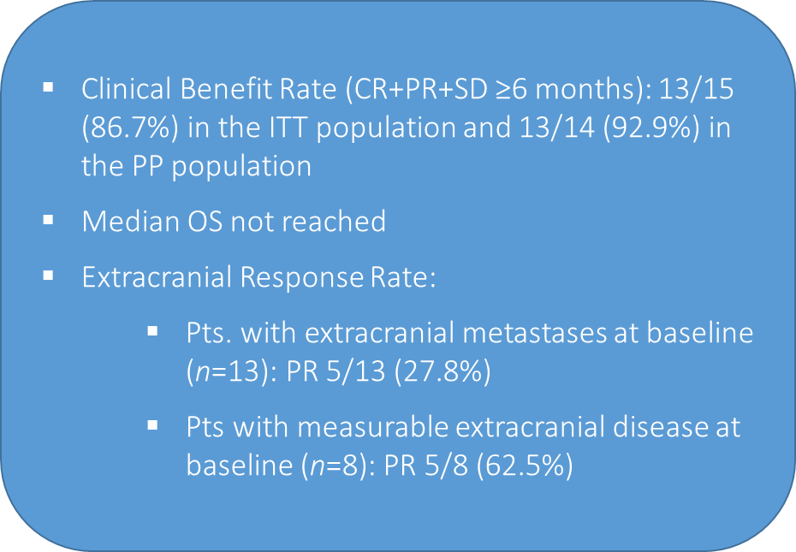
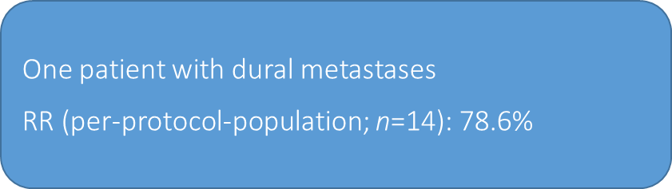
TUXEDO-1 study
Bartsch R, et al. ESMO Breast 2022

Slide 28
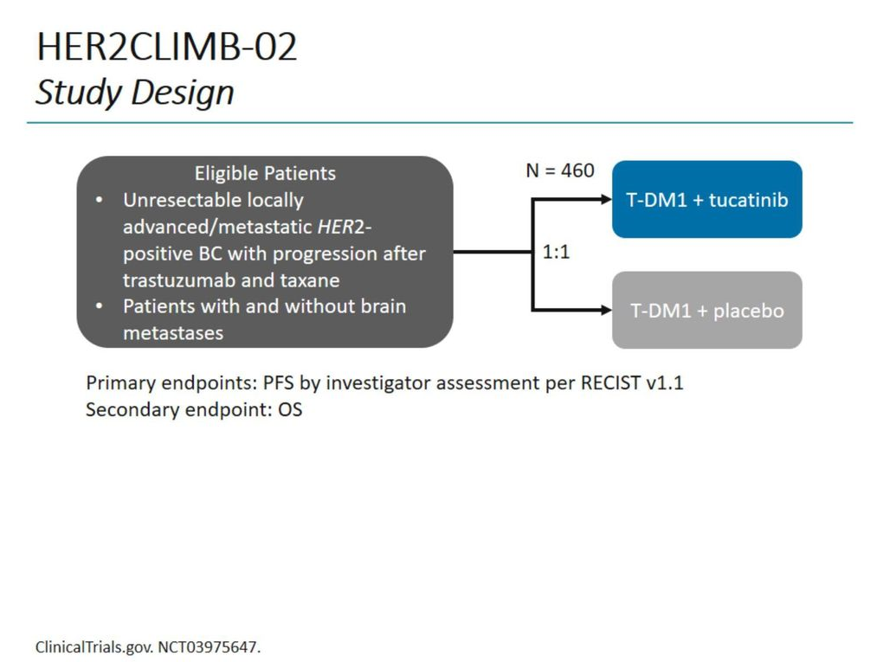
Primary endpoint: PFS by investigator assessment per RECIST v1.1
Secondary endpoint: OS

Slide 29
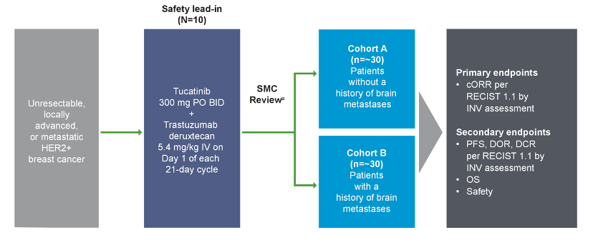
HER2CLIMB-04 Study Design
Primary endpoint
ªIf there are no safety signals in the safety lead-in (≥1 cycle), 50 additional patients will be enrolled in the post-safety lead-in.

Slide 30
HER2CLIMB-05 (NCT05132582) is a phase 3, randomized, double-blind study evaluating tucatinib plus T+P as maintenance therapy for HER2+ MBC. Approximately 650 pts will be enrolled.
DESTINY-Breast07 will investigate the safety, tolerability, and anti-tumour activity of trastuzumab deruxtecan (T-DXd) in combination with other anti-cancer agents in patients with HER2-positive Metastatic Breast Cancer. The study will assign patients to different treatment combinations.
Phase III Study of Trastuzumab Deruxtecan (T-DXd) With or Without Pertuzumab Versus Taxane, Trastuzumab and Pertuzumab in HER2-positive, First-line Metastatic Breast Cancer (DESTINY-Breast09)
DESTINY-Breast12 is a Phase IIIb/IV study seeking to better understand the treatment benefit of trastuzumab deruxtecan (T-DXd) in adult patients with or without brain metastases who have unresectable/advanced or metastatic HER2-positive breast cancer.

Slide 31
Case 1

Slide 32
Case 1. Clinical presentation, diagnosis, staging
Patient
  45 yo woman, premenopausal
  Comorbidities: none
  Family history: mother with BC (55 yo) and upper limb STS
Presentation
  Detection of lump in the right breast and right axillary adenopathy at self-examination
Physical examination
  Lesion of 70 mm in the right LIQ/LOQ
  Hard right axillary lymphadenopathy of 25 mm
  Abdominal PE: negative.
Work-up
  Mammography + breast and axillary US + breast MRI: right breast lesion of 75x53 mm, multiple right axillary lymphadenopathy
  PET-CT scan and CT scan: multiple hepatic metastasis ⁽¹⁾
Breast US-guided biopsy
  Invasive carcinoma NOS
    ER: 90%; PgR: 35%; HER2: 0; Ki67: 25%
Genetic testing
  Pathogenic BRCA2 variant c.6405_6409 (p_Asn2135fs)
Notes:
This is a case of a young woman, 45 yo, premenopausal without comorbidities.
Her mother was diagnosed with BC at the age of 55
She came to our attention after the self detection of a lump in her right breast and a right axillary adenopathy, confirmed at the PE that was negative for the rest
We then started the work up with a mammography and breast ultrasound which confirmed a lesion of 75 by 53 millimiters in the right breast and multiple homolateral axillary adenopathies
We performed a PET CT scanc and a CT scan which unfortunately confirmed multiple hepatica mets.
The US guided breast biopsy confirmd and invasive carcinoma NOS, ER 90% PgR 35% HER2 0 with a Ki67 of 25%
Given the young age at the diagnosis we addressed our pt to a genetic counseling and the gentic test revealed a pth variant of BRCA2

Slide 33
1. Clinical presentation, diagnosis, staging
Patient
45 yo woman, premenopausal
Comorbidities: none
Genetic testing
Pathogenic BRCA2 variant c.6405_6409 (p_Asn2135fs)
Presentation
Detection of lump in the right breast and right axillary adenopathy at self-examination
Family history: mother with BC (55 yo) and upper limb STS
Breast US-guided biopsy
Invasive carcinoma NOS
Physical examination
Lesion of 70 mm in the right LIQ/LOQ
Hard right axillary lymphadenopathy of 25 mm
Abdominal PE: negative.
ER: 90%; PgR: 35%; HER2: 0; Ki67: 25%
Work-up
Mammography + breast and axillary US + breast MRI: confirmed right breast lesion of 75x53 mm, multiple right axillary lymphadenopathy
PET-CT scan and CT scan: multiple hepatic metastasis ⁽¹⁾
De novo mBC
ER-positive/HER2-negative
gBRCA mut
Notes:
To sum up we were in front of a de novo metastatic ER positive HER2 neg met BC with germ line mut of BRACA

Slide 34
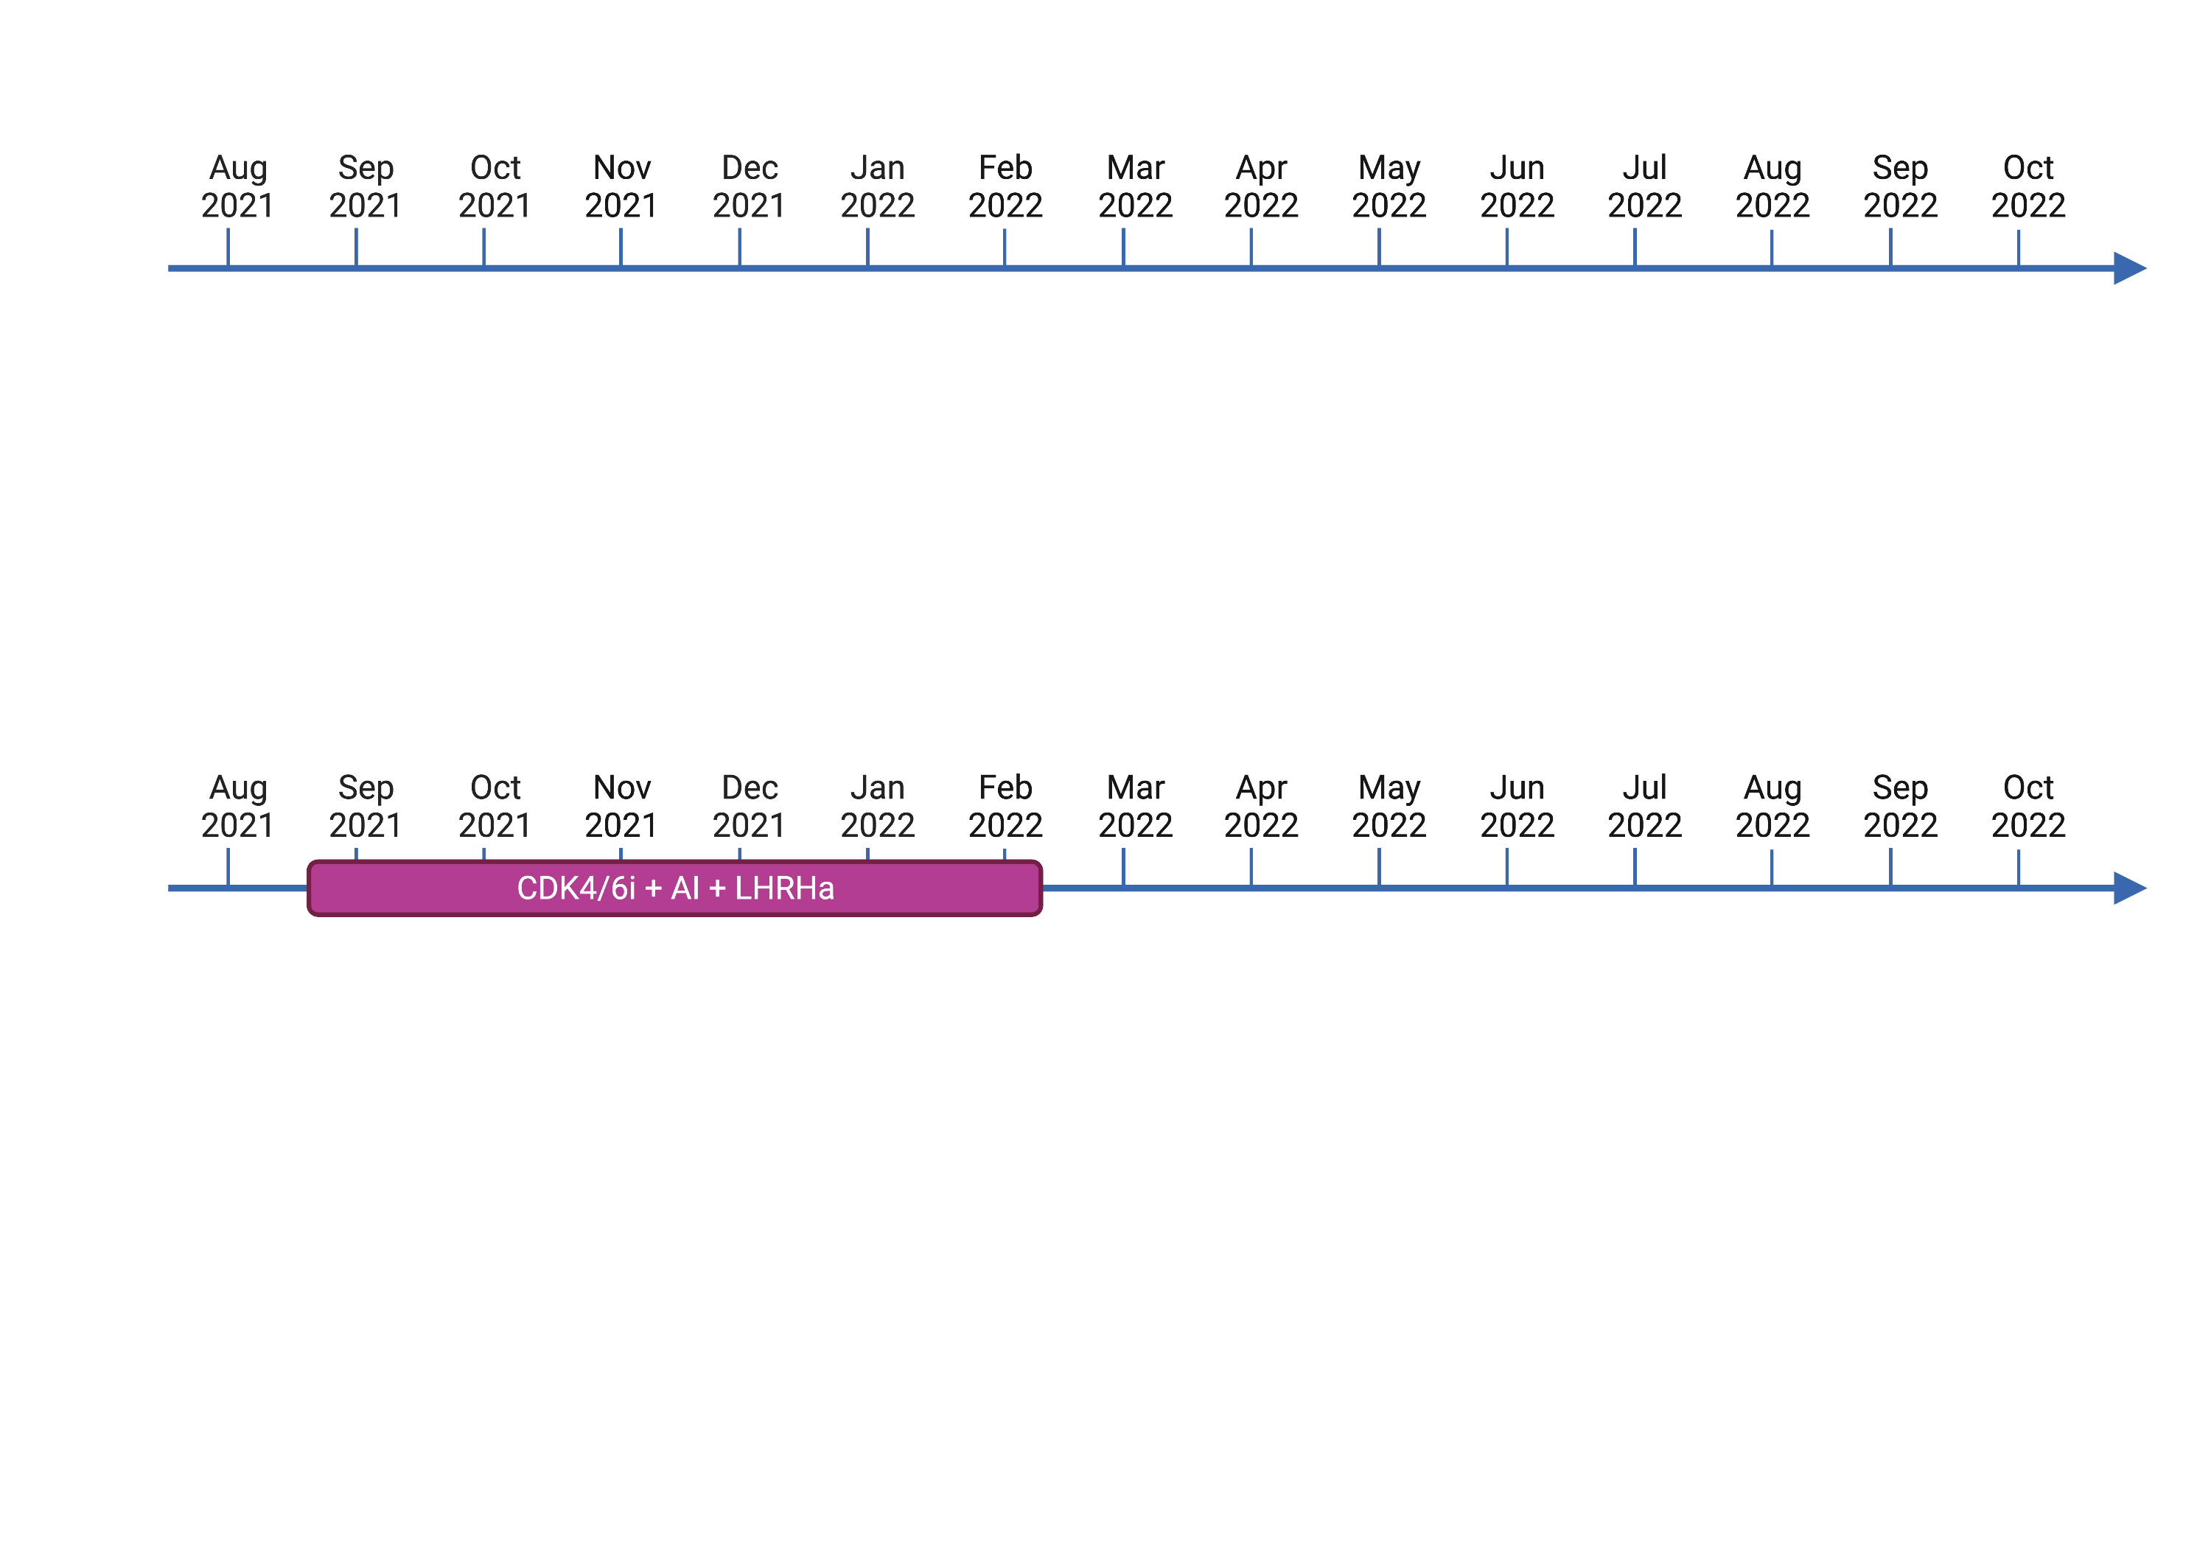
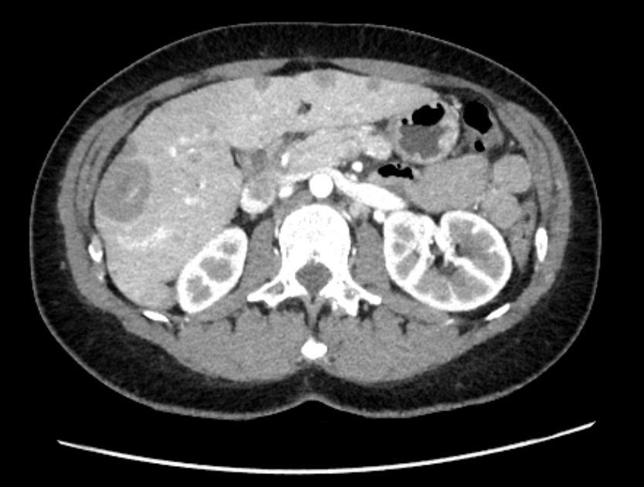
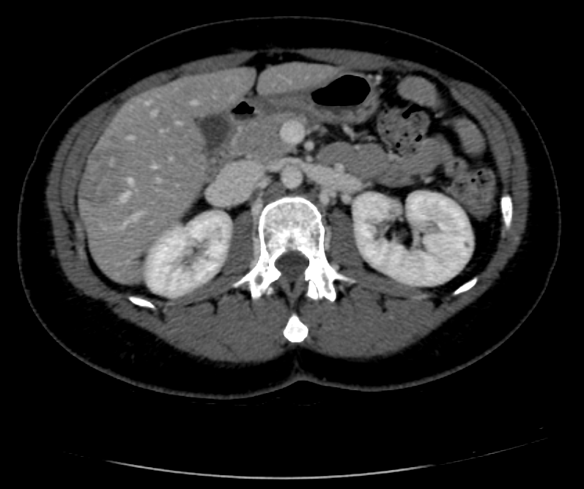
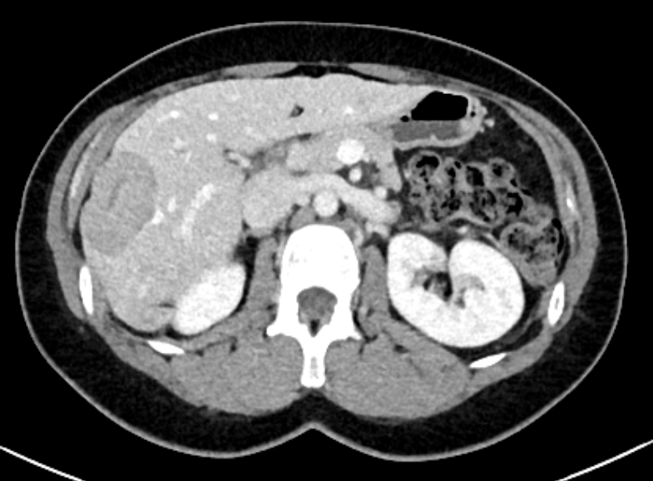



2. First line
August 20th
November 11th
February 7th
Ribociclib 600 mg 1-21 q28
Letrozole 2,5 mg qd
Triptorelin 3,75 mg q28
MONALEESA-7
CT scan: PR ⁽²⁾
CT scan: hepatic PD ⁽³⁾
Liver biopsy
Invasive adenocarcinoma consistent with breast adenocarcinoma
ER: <95%; PgR: 0%; Ki67: 3%; HER2: 1+/PIK3CA wt
(1)
(2)
(3)
Fulvestrant +/- everolimus
vs
Single agent chemotherapy
(capecitabine/taxane/anthracycline/platin)
PARP inhibitor in SHARP trial
EudraCT Number: 2017-003216-39
gBRCA
DESTINY-Breast06
NCT04494425
HER2-low
Notes:
As per Monaleesa7 trial we started a first line with ribociclib, letrozole and ovarian suppression. At the first evaluation we observer a partial response as we can see in this scan.
Unfortunatley, already at the second re evaluation, which means within 6 months to the start of the first line, pt experienced an hepatic progression disease.
In order to re assess the biology of the disease, we performed a liver biopsy that confirmed a metastasis of breast adenocarcinoma, ER positive but this thime HER 1+ at IHC, PIK3Ca was wild type.
At this point we were in front of different options:
First given the endocrine resistance, switch hormone therapy with fulvestrant optionally in association with everolimus or start a single agent chemotherapy
include our patient in the SHARP trial, a precision medicine trial recruiting at our institution which coulv have offered the patient Olaparib given the BRACA mutation
Our third option was to include her in destiny breast 06, a randomized ph3 trial in which HER2low ER positive patients are randomized to receive either Trastuzumab deruxtecan or investigator choice chemo in patients chemo naïve after at at least 2 line of endocrine therapy or progressed within 6 month of a first line with a cdk4/6 inhibitor, which was the case of our pt.

Slide 35
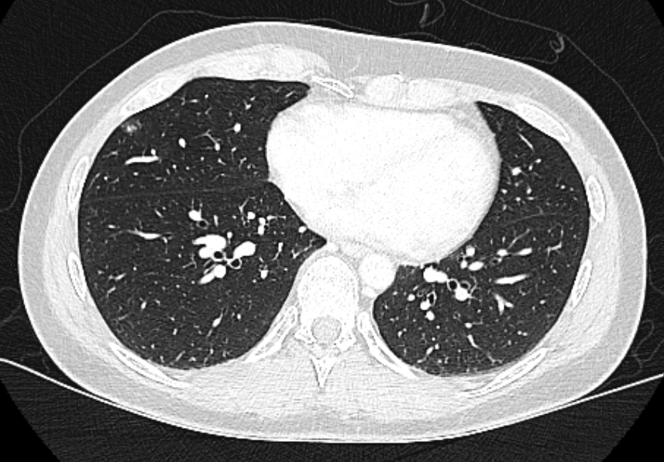
3. Second line
PFS<6 mo
April 5th
May 13th
June 21th
August 3rd
September 10th
Trastuzumab-deruxtecan
5,4 mg/Kg
CT scan after C2:
PR
CT scan after C4:
further response
+
Inflammatory micronodules in the ML and RLL ⁽⁴⁾
CT scan after C5:
further response
CT scan after C7:
further response
Toxicity at C1:
Nausea G2
Vomiting G1
(4)
ILD G1
T-DXd withdrawn
PFTs and pneumo consultation: neg.
Thoracic CT scan after 2 weeks: micronodules resolved
Anti-emetic premedication implemented with
5-HT3 receptor antagonist +
NK1 receptor antagonist +
dexamethasone
T-DXd re-started
Notes:
And the pt was randomized to Tdxd arm and she received the first cycle on April the fifth. After the first administration she experienced nausea G2 and vomiting G1 for which we implemented the antiemetic premedication as shown with benefit.
At the first evaluation we observed a partial response which was maintained ath the second evaluation after 4 cycles as well. At this time point, CT scan revealed also inflammatory micronodules in the middle lobe and right lower lobe, pt was asymptomatic. In the strong suspicion of grade 1 ILD we stopped the treatment, addressed patients to a pneumo concusltation and pulmonary function testa which didn’t show any significant clinical alterations and we repeated a CT scan after 2 week which showe a resolution of inflammatory micronodules which enabled to resume the treatment.
The two subsequent evalutaions after 5 and 7 cycles respectively confirmed a maintened PR to tdxd that our patient is currently still receiveing.

Slide 36
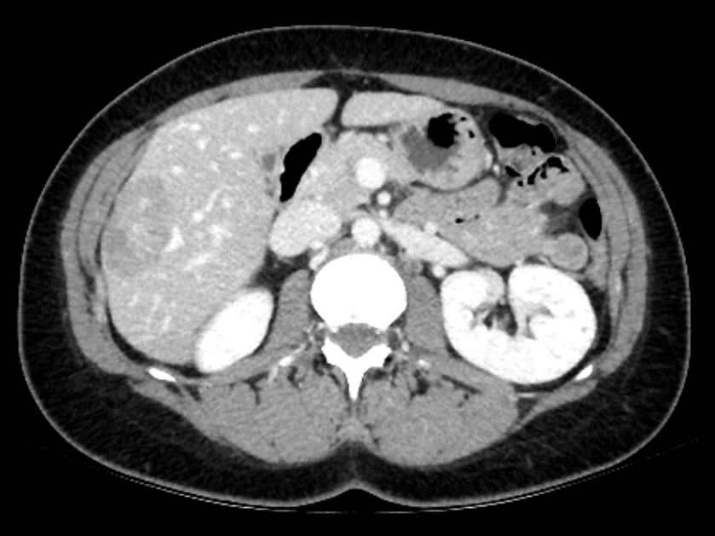
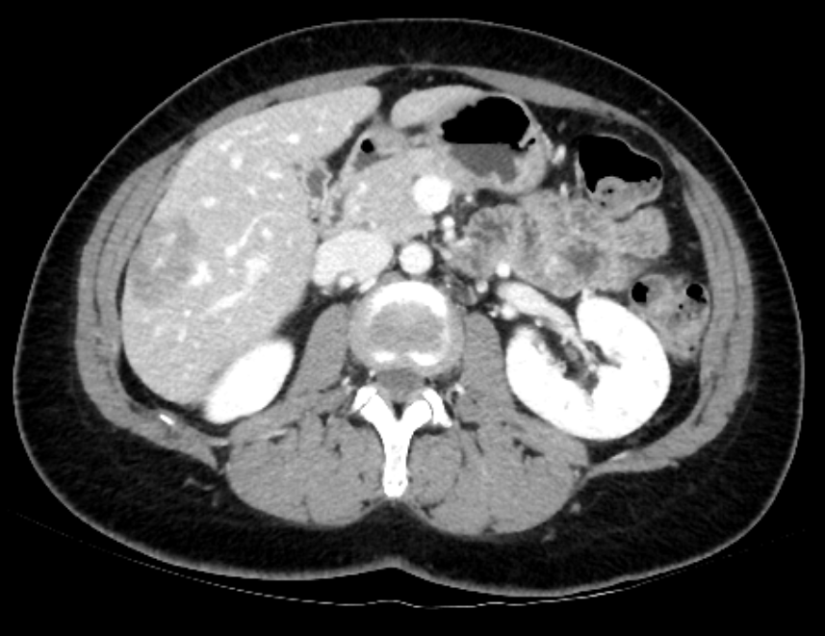
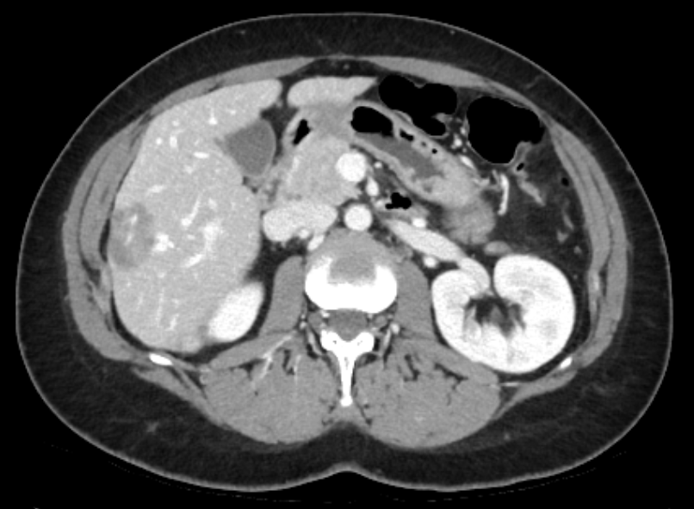
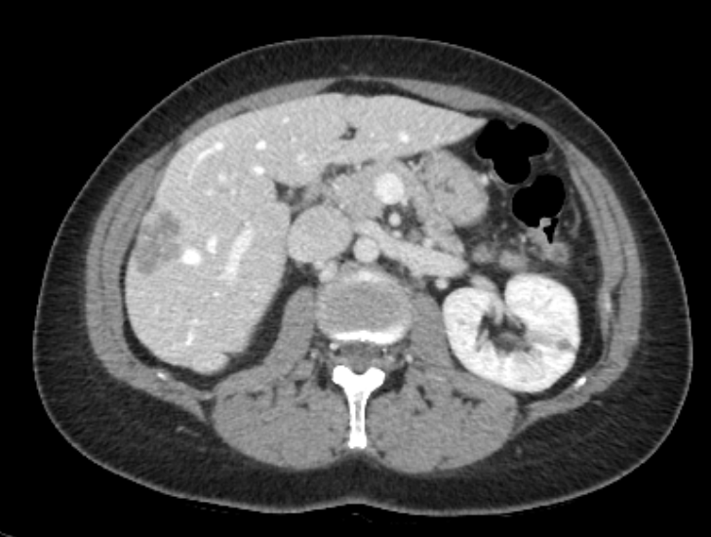
3. Second line
PFS<6 mo
April 5th
May 13th
June 21th
August 3rd
September 10th
Trastuzumab-deruxtecan
5,4 mg/Kg
CT scan after C2:
PR ⁽⁵⁾
CT scan after C4:
PR ⁽⁶⁾ + ILD G1 ⁽⁴⁾
CT scan after C5:
PR ⁽⁷⁾
CT scan after C7:
PR ⁽⁸⁾
(5)
(6)
(7)
(8)
Notes:
In these scans we cas see the evolution of one of the hepatic target lesions at every evaluation thus far.

Slide 37
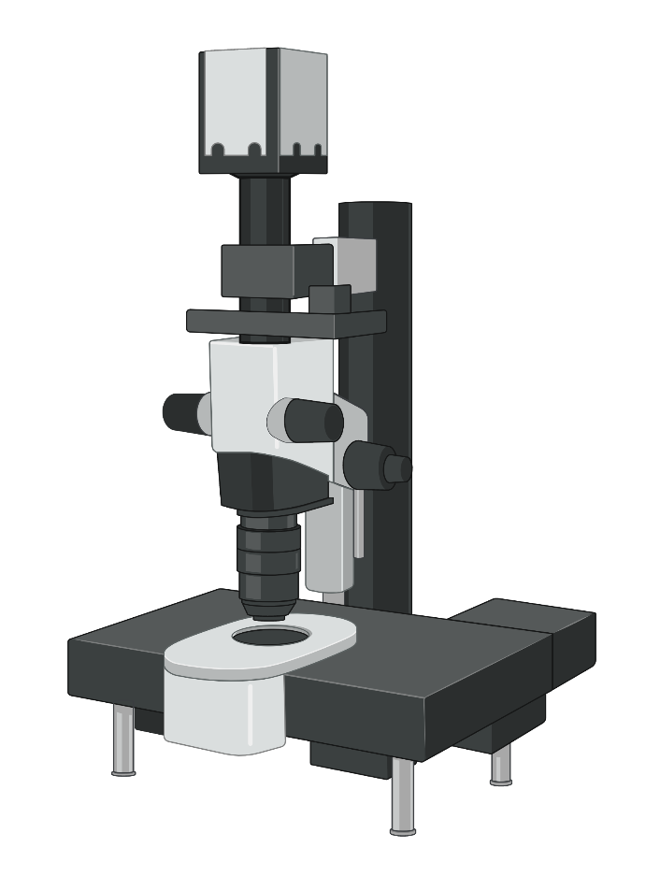


4. Points of discussion
What is the target to hit first between HER2 and BRCA?
HER2 status assessment: are we doing it correctly?
Same drug, different treatment’s line: is the toxicity profile the same?
How to sequence treatments in such evolving drugs’ landscape?
ET / chemotherapy / PARPi / T-DXd / sacituzumab govitecan
Notes:
To conclude here some hints for the discussion:
First: is it sufficiently correct how we assess HER2 status? This is becoming the more and more crucial since novel antiHER2 targeted therapies, such as Tdxd, have shown significant clinical benefit in patients historically considered HER2negative, namely HER2low. But also, in such evolving ttt landscape with several emerging new compounds, such as ADCs, what will be the right sequence?
Then, although BC occurring in gBRCA mutatnt patient are rarely HER2 positive, with the emergence of HER2 low status like the case I just presented, what is the target to hir first between BRCA and HER2?
Lastly, but as important, are we expecting the same the toxicity profile of a drug such as Tdxd used in across different lines? And this also important in the context of ttt sequencing since we have to know the rght timing to offer a ttt to our pts also conisedering the toxicity profile.
---------------------------------------------------------
HOW and WHEN to assess HER2 status
We need a better tool to asses HER2 status. Immunoistochemistry has few issues, reproducibility is one of them
Genomic tools/image-based tools/expression of ERBB2 mRNA level
Dynamic changes --> from primary to metastatic
Also the intrinsic biology changes from primary to metastatic and from early to late lines of treatment.
----------------------------------------------------------------
0% to 13% of HER2+ in BRCA2 mut.
OlimpiaD and EMBRACA → HER2 negative
OPHELIA trial → Olaparib+trastuzumab in HER2+ with gene alteration in HRR
Phase I currentlyrecruiting exploring Olaparib+tdxd in HER2+ malignancies in order to evaluate safety and tolerability
-----------------------------------------------------------------
In DB-04 70% dei pz avevano ricevuto CDK4/6i
In DB04 nearly 60% were IHC 1+
PFS 10.1 month → doubled
OS 23.9 months
TROPICS-02 → ER+/HER2neg Sacituzumab govitecan, at least 2 lines of chemo→ benefit in PFS and OS presented at ESMO 2022
Novel ADC such as TRASTUZUMAB DUOCARMAZINE AND DISITIMAB VEDOTIN have shown promising ORR of 32-40% also in HER2low BC
---------------------------------------------------------------------
ILD → in DB04 12% any grade, 3.5% G1

Slide 38
Case 2

Slide 39





Case presentation
42-year-old woman
ECOG PS 0
Personal medical history:
Hyperthyroidism treated by I-131
Excision of benign microcalcifications in the right breast (1995)
Family history:
Brother with leukemia (38y)
cousin with breast cancer (at >50y)
No germline mutations in BRCA1/2, PALB2, CHEK2, TP53
Primary tumor and treatment:
June 1999
Microcalcifications of the right breast
Breast conservative surgery + LND
invasive carcinoma NST
tumor grade II, ER+, pT1aN0
Adjuvant RT and ET (tamoxifen) for 5 years
March 2009
T4d of the right breast
Neo-adjuvant ChT 3 FEC + 3 Docetaxel-Trastuzumab -> right mastectomy
invasive carcinoma, tumor grade II, ki67 15%, ER+, PR+, HER2+
ypT3N0M0
Adjuvant trastuzumab (1 year) and anastrozole

Slide 40
Metastatic disease:
Sep 2010
Cutaneous (right chest wall) and left axillary metastases
Excision and left LND
Tamoxifen
July 2011
Cutaneous (right chest wall) recurrence
Extended excision and EBRT
Trastuzumab and Exemestane
Feb 2013
Retropectoral lymph nodes recurrence
T-DM1 (KAMILLA trial)
Nov 2015
Complete response but hepatic toxicity of T-DM1
Trastuzumab sc
April 2017
Retropectoral and spinal lymph nodes recurrence
T-DM1

Slide 41
Nov 2017
Quasi-complete response
Lymph nodes excision
Trastuzumab sc
March 2018
Supraclavicular lymph nodes recurrence
T-DM1 3 cycles
(no response)
Lapatinib-Capecitabine
(no response)
Lymph nodes excision and EBRT
Trastuzumab sc
May 2019
Mediastinal and hilar lymph nodes metastases
SYD985 (trastuzumab-duocarmazine, TULIP trial)
Oct 2019
Interstitital pulmonary disease – toxicity or post-RT? => excluded from the trial
No treatment
May 2020
PD (lymph nodes)
Trastuzumab - Eribulin

Slide 42
Dec 2020
PD (lymph nodes)
Trastuzumab – Lapatinib and Letrozole
May 2021
PD (lymph nodes)
Trastuzumab – Pertuzumab - Docetaxel
Nov 2021
PD (lymph nodes and bone)
Trastuzumab – Tucatinib - Capecitabine
PD (supradiaphragmatic and abdominal LN, bone, hepatic, lung adrenal, subcutaneous)
Feb 2022
Carboplatin – Gemcitabine - Trastuzumab
June 2022
PD on bone and PR in LN, liver, lung, adrenal, subcutaneous
Cyclophosphamide (oral) – Trastuzumab and Denosumab

Slide 43
Particularities of the case
>10 years from the onset of metastatic disease of exclusively regional evolution (particularly lymph nodes)
almost 10 years of oligometastatic evolution that could be treated with local therapies and chemotherapy-free regimens
No great response until present on chemotherapy regimens (a few cycles with Capecitabine-Lapatinib in 2018 with no response, Eribulin-Trastuzumab in 2020 with 6 mo of PFS etc)
in HER2+ BC
The double HER2-blockade, Trastuzumab-Pertuzumab, given after 2 ADC, with no great response

Slide 44
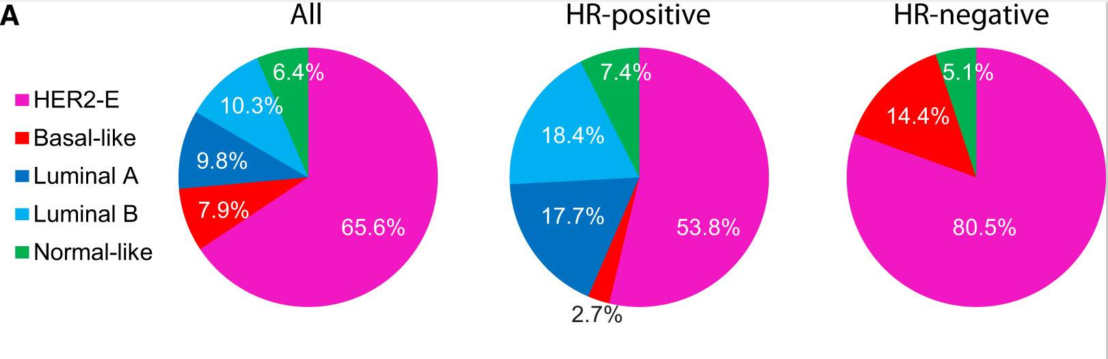

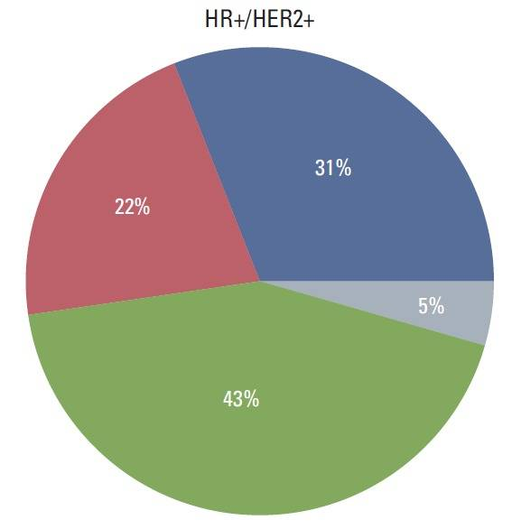
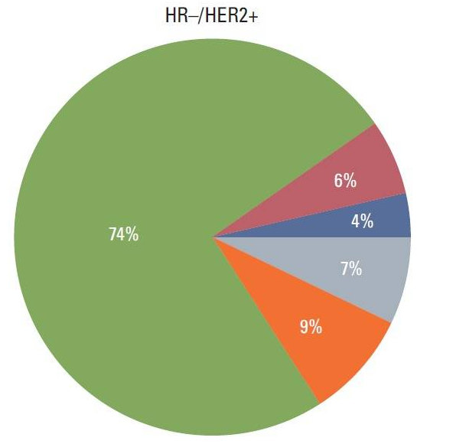
However, HR+/HER2+ BC (vs HR-):
Has more favorable biological and clinical features
Tends to have fewer visceral metastases
Has better prognosis¹
Worse response to neoadjuvant chemotherapy + HER2-targeted therapy,² although similar benefit in the metastatic setting from trastuzumab-pertuzumab-taxane or T-DM1
Prat, A et al. “HER2-Enriched Subtype and ERBB2 Expression in HER2-Positive Breast Cancer Treated with Dual HER2 Blockade”, J Natl Cancer Inst. 2020
¹Cobleigh, M et al. Clin Cancer Res. 2020;
2Cortazar, P et al. The Lancet. 2014.
Kim, HK et al. “Discordance of the PAM50 Intrinsic Subtypes Compared with Immunohistochemistry-Based Surrogate in Breast Cancer Patients: Potential Implication of Genomic Alterations of Discordance”, Cancer Res Treat. 2019

Slide 45
In conclusion
The biology and, hence, the behavior of HER2+ breast cancer are heterogeneous
We presented the case of a patient who, for the first 10 years of her triple-positive metastatic breast cancer evolution, had oligometastatic disease (cutaneous or lymph nodes), treated mainly with local therapy and chemotherapy-free systemic therapy
The best response was achieved with ADCs (CR and 4y of PFS for T-DM1 and 1y of PFS for trastuzumab-duocarmazine), which is encouraging for the next line of systemic therapy – T-DXd

Slide 46
Case 3

Slide 47
The patient
PS ECOG 0, 43 kg, 155 cm
Familiarity: aunt (mother-side), aunt (father-side) with breast cancer
Former smoker, no comorbidities; previous fibroadenoma of left breast
MDP, 24 yrs old (pre-menopausal)

Slide 48
Diagnosis
March 2022
Self examination of left breast: lump detected
01.03.22 Mammography + ultrasonography: lump of 13 mm
21.03.22 Core biopsy of left breast:
ductal infiltrating carcinoma, multifocal, ER: 70%; PgR: 40%; Ki67:30%; HER2+: 3+
26.03.22: CT scan:
bilateral lung lesions; nodes in the left axilla (30 mm); multiple hepatic lesions (max 20 mm)
29.03.22 breast MRI:
Left breast: 20 and 15 mm with many foci;
left axilla: multiple nodes of 33 mm and 25 mm
31.03.22 PET FDG:
uptake in left breast, left axilla, internal mammary nodes, liver lesions
Genetic counselling:
BRCA1-2 WT, TP53 WT, PALB2 WT

Slide 49
First line
15.04.22 signed informed consent to DESTINY-Breast07
22.04.22 Core biopsy left breast: ductal infiltrating carcinoma,
ER: 90%; PgR: 0%; HER2: 3+
11.05.22 start Triptorelin 3.75 mg q4w
10.05.22 start Trastuzumab-Deruxtecan 5.4 mg/kg + Pertuzumab q3w

Slide 50
Evaluation of response
 | Left axilla (nodal) | Left breast lump | Liver (S4/S8) | Liver (S4) | Lung lesions (NT)
20.04.22 | 19 | 24 | 12 | 24 | Present
16.06.22 | 9 | 13 | 7 | 9 | Present
27.07.22 | 7 | Not detectable | 5 | 7 | Present
31.05.22
C2
21.06.22
C3
12.07.22
C4
02.08.22
C5
10.05.22
C1

Slide 51
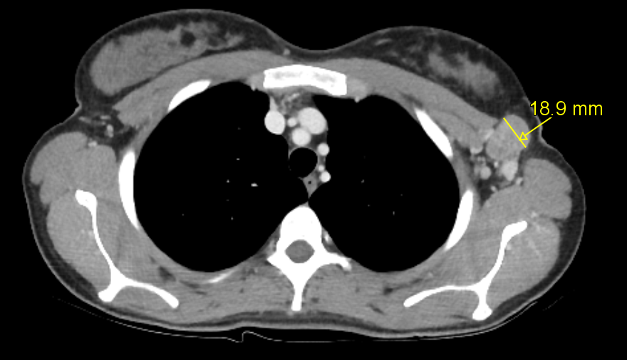
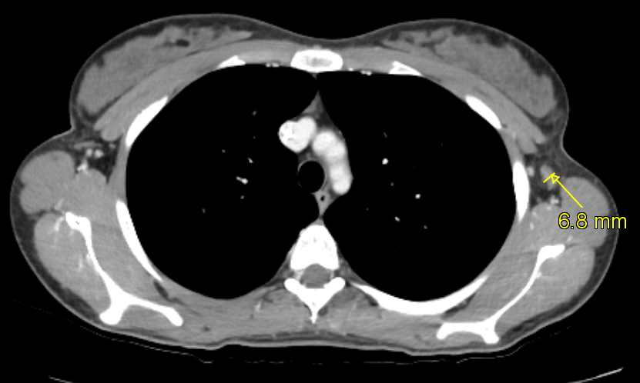
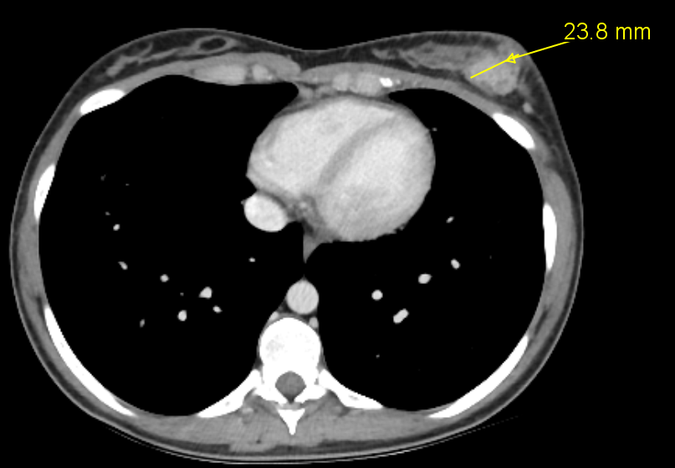
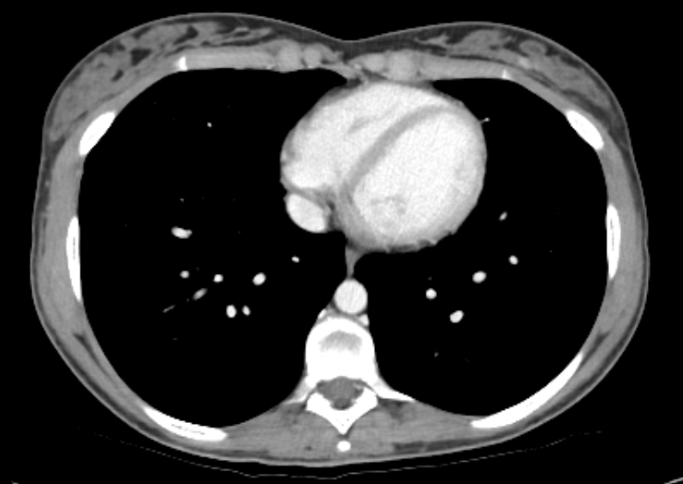
20.04.22
27.07.22

Slide 52
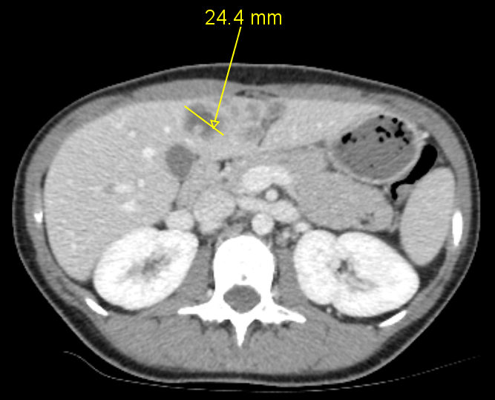
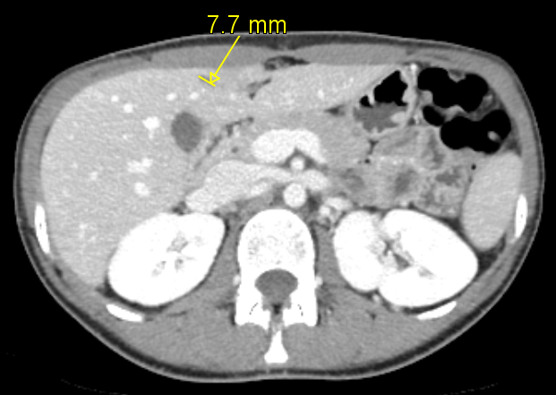
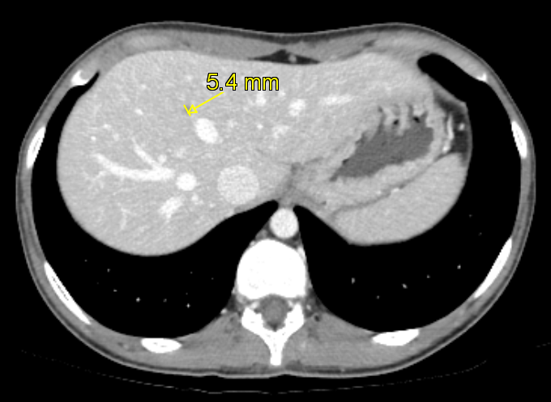
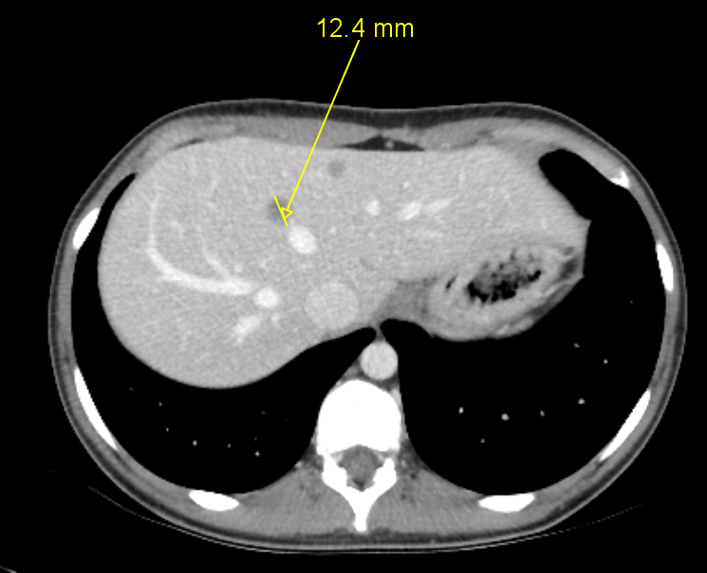
20.04.22
27.07.22

Slide 53
Evaluation of response
The patient is currently on treatment, with partial response for RECIST 1.1 criteria
T-DXd + pertuzumab is well tolerated with only G1 AEs (anemia, leukopenia, neutropenia, alopecia)

Slide 54
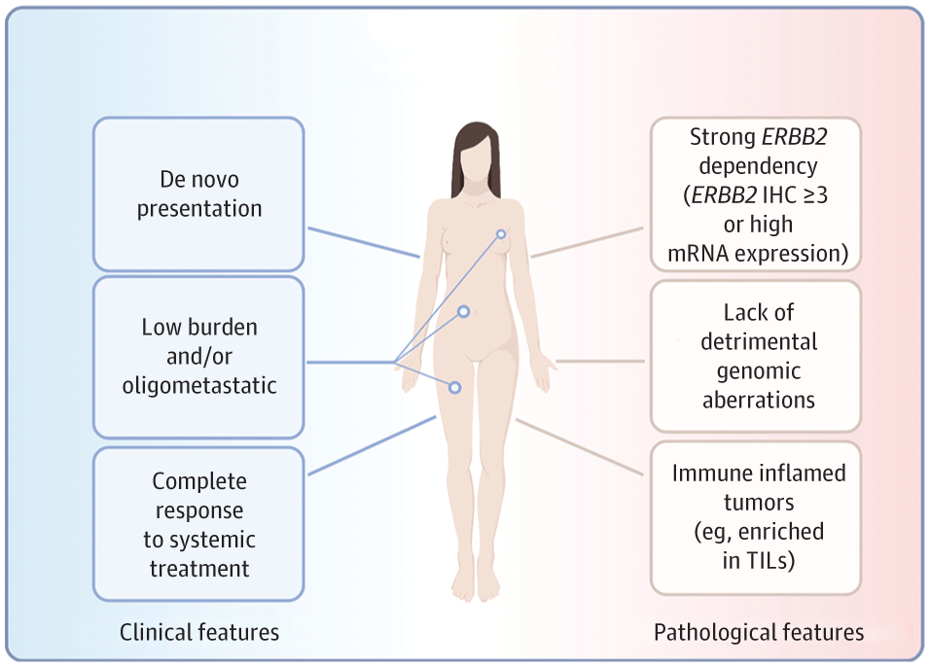
Discussion
Clinical and pathologic features could identify patients with HER2+ MBC who are more likely to experience a long-lasting response to systemic treatment.
This population may potentially derive benefit from a tailored escalation of frontline treatment with novel anti-HER2 drugs.
The phase III DESTINY-Breast09 trial is currently testing T-DXd +/- pertuzumab vs standard of care (taxane, trastuzumab and pertuzumab)
Tarantino et al, JAMA 2022

Slide 55

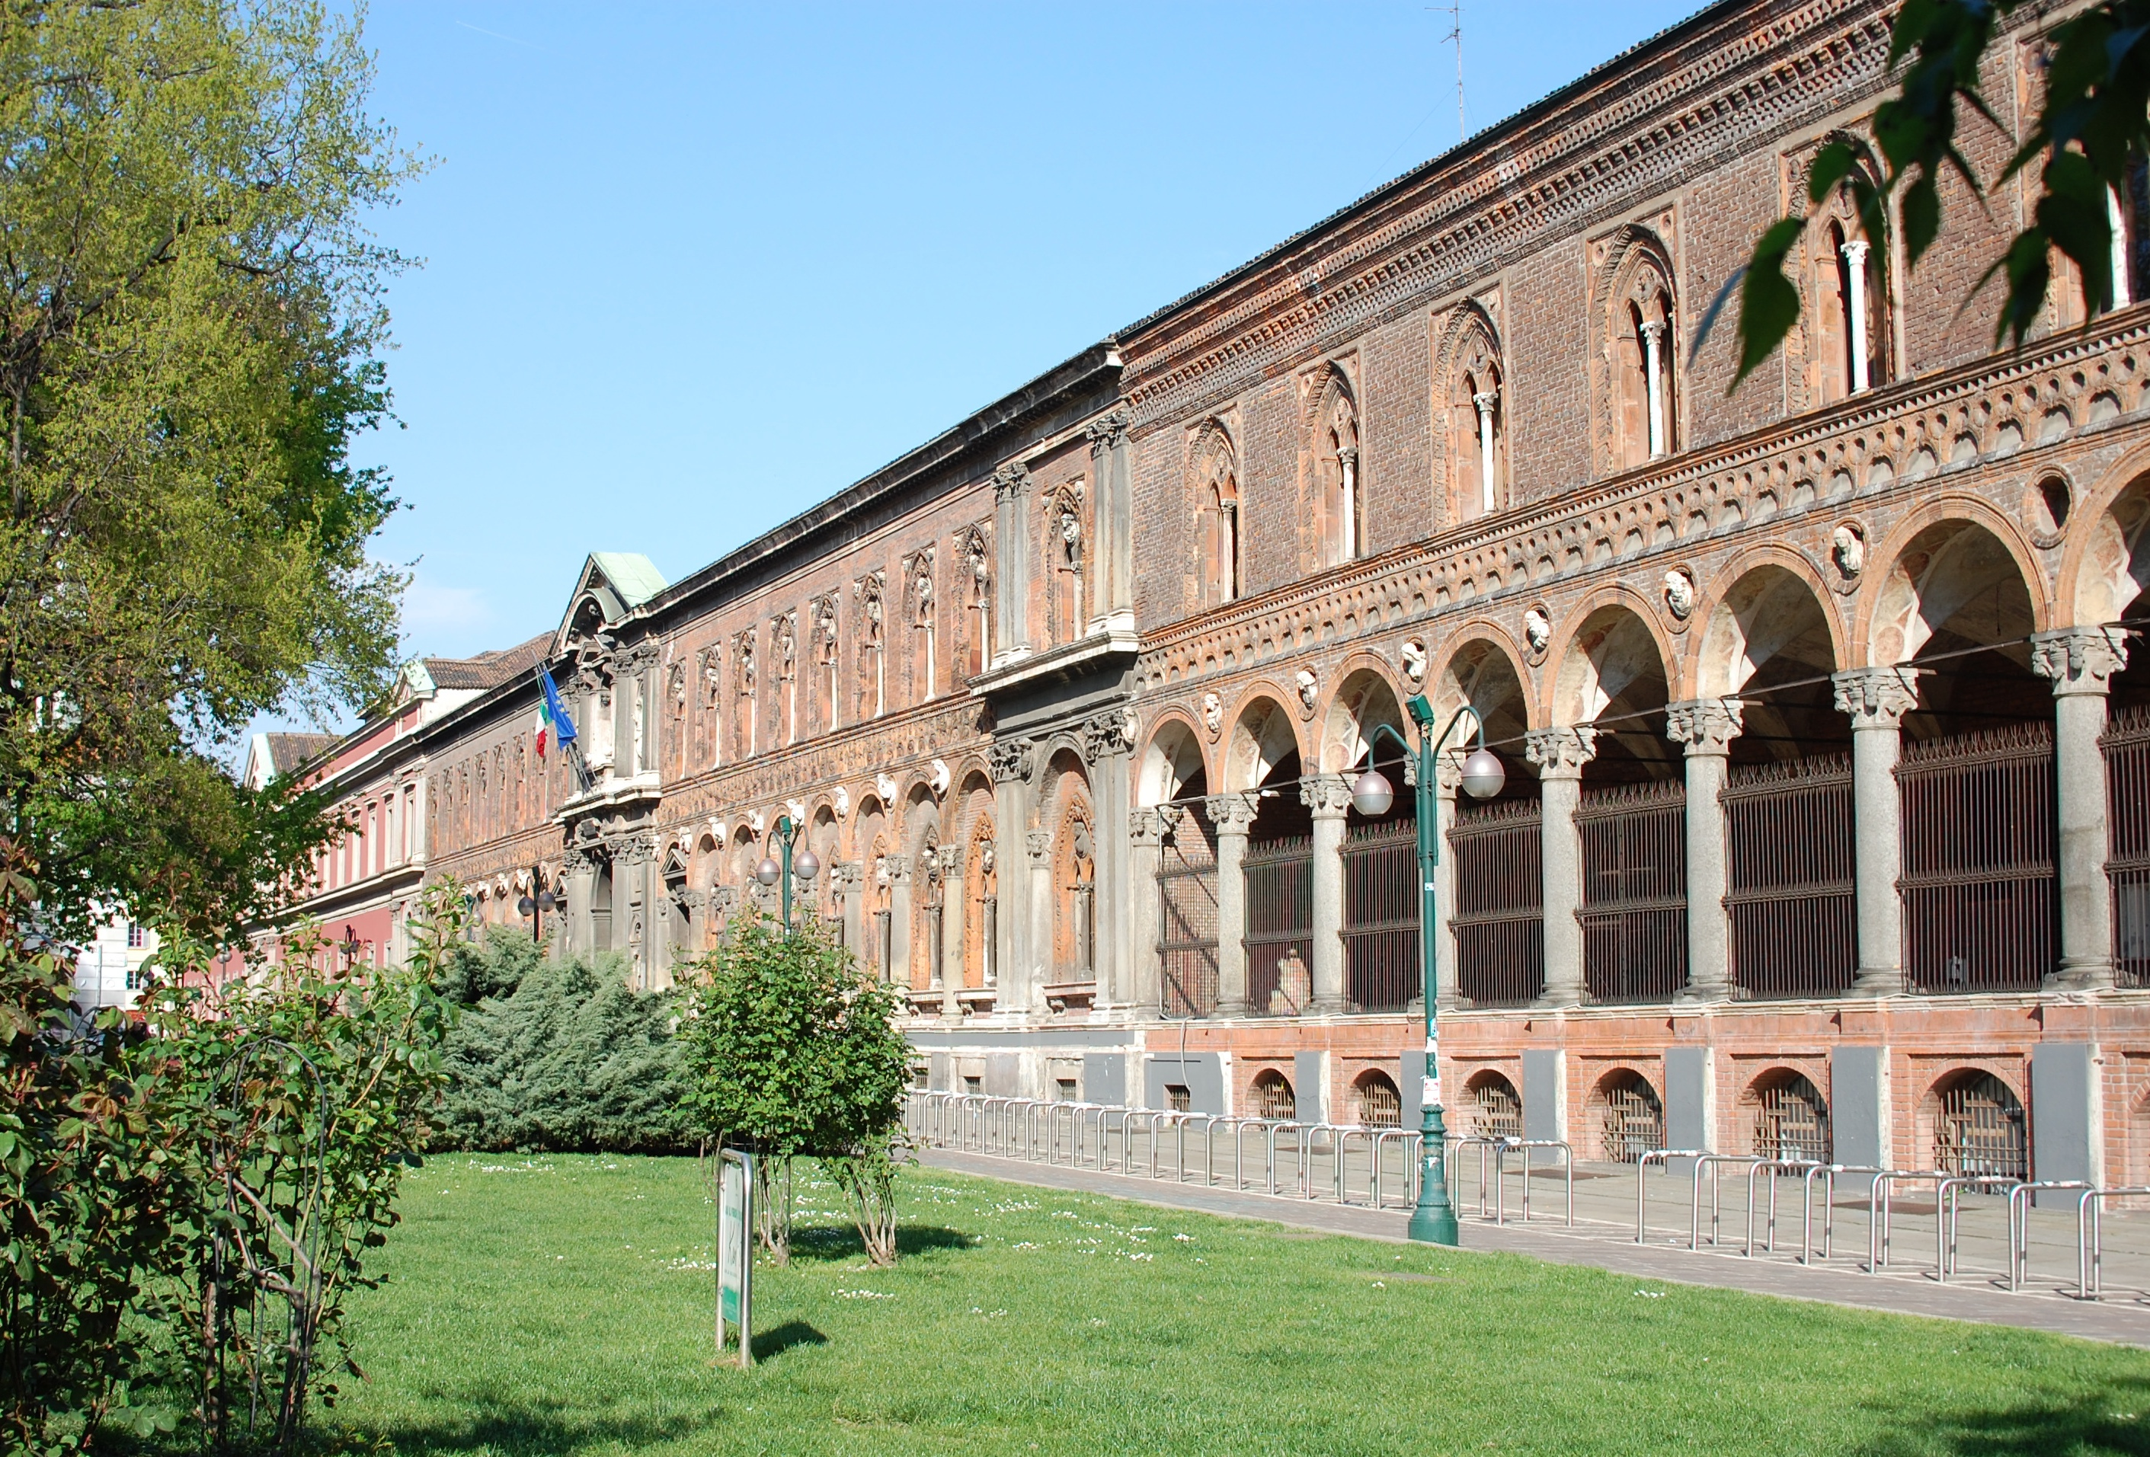
Thank You
Giuseppe Curigliano MD, PhD
giuseppe.curigliano@ieo.it
Notes:
Anna snaveley working on a) adaptive trial design illustration, b) example of a trial designed to detect an interaction b/w biomarker and drug effect and impact of < 100% tumor acquisition or less-than-optimal marker misclassification rates.

