Slide 1
Oncology Today with Dr Neil Love: Special Edition — Management of ER-Positive Breast Cancer
Friday, January 20, 2023 9:15 AM – 11:00 AM ET
Faculty
Erica Mayer, MD, MPH
Ruth O’Regan, MD
Moderator
Neil Love, MD

Slide 2
Faculty
Erica Mayer, MD, MPH
Director of Breast Cancer Clinical Research
Breast Oncology Center
Dana-Farber Cancer Institute
Associate Professor of Medicine
Harvard Medical School
Boston, Massachusetts
MODERATOR
Neil Love, MD Research To Practice Miami, Florida
Ruth O’Regan, MD
Chair, Department of Medicine
Charles A Dewey Professor of Medicine
University of Rochester
Rochester, New York

Slide 3
Agenda
Module 1: Pregnancy during adjuvant endocrine therapy; fertility issues
Module 2: Genomic biomarkers in the adjuvant setting
Module 3: CDK4/6 inhibitors in metastatic disease
Module 4: Adjuvant use of CDK4/6 inhibitors
Module 5: Novel agents in metastatic disease
Module 6: Challenging cases

Slide 4
Agenda
Module 1: Pregnancy during adjuvant endocrine therapy; fertility issues
Module 2: Genomic biomarkers in the adjuvant setting
Module 3: CDK4/6 inhibitors in metastatic disease
Module 4: Adjuvant use of CDK4/6 inhibitors
Module 5: Novel agents in metastatic disease
Module 6: Challenging cases

Slide 5
Dr Mayer – Case 4
38 year old premenopausal woman was diagnosed with breast cancer 3 years ago.
She presented with a breast mass, and at surgery was found to have 2.2 cm of disease with 1 of 2 involved sentinel lymph nodes, ER+/HER2-.
She received adjuvant TC x 4 chemotherapy with concurrent LHRH agonist for ovarian protection, and then initiated tamoxifen and OS.
Germline genetic testing was negative.
She has now completed 2 years of adjuvant endocrine therapy with tamoxifen and OS. She is interested in starting a family.

Slide 6
Agenda
Module 1: Pregnancy during adjuvant endocrine therapy; fertility issues
Module 2: Genomic biomarkers in the adjuvant setting
Module 3: CDK4/6 inhibitors in metastatic disease
Module 4: Adjuvant use of CDK4/6 inhibitors
Module 5: Novel agents in metastatic disease
Module 6: Challenging cases

Slide 7
Dr Mayer – Case 1
67 year old healthy woman presents with a right mammographic abnormality.
A core biopsy shows invasive ductal carcinoma, grade 1, ER > 95% positive, PR > 90% positive, HER2 0.
Clinical exam suggests a 4 cm mass with a palpable axillary lymph node. Axillary biopsy is positive.
She moves forward with an upfront mastectomy and axillary lymph node dissection.
Pathology demonstrates a 4.5 cm tumor with 3 of 11 nodes involved.
OncotypeDx is sent on the surgical specimen and returns with a score of 6.

Slide 8
Dr Mayer – Case 2
43 year old premenopausal woman presents with a right mammographic abnormality.
A core biopsy shows invasive ductal carcinoma, grade 2, ER > 80% positive, PR > 80% positive, HER2 0.
Clinical exam suggests a 2 cm mass with a clinically negative axilla.
She moves forward with upfront breast conserving surgery and sentinel lymph node biopsy.
Pathology demonstrates a 1.9 cm tumor; 1 of 2 sentinel lymph nodes has a macrometastasis.
OncotypeDx is sent on the surgical specimen and returns with a score of 11.
Adjuvant radiotherapy is planned.

Slide 9
Agenda
Module 1: Pregnancy during adjuvant endocrine therapy; fertility issues
Module 2: Genomic biomarkers in the adjuvant setting
Module 3: CDK4/6 inhibitors in metastatic disease
Module 4: Adjuvant use of CDK4/6 inhibitors
Module 5: Novel agents in metastatic disease
Module 6: Challenging cases

Slide 10
Differential activity of CDK4/6 inhibitors in the adjuvant and metastatic settings
Erica L. Mayer MD MPH
Dana-Farber Cancer Institute
Boston, MA
January 2023

Slide 11
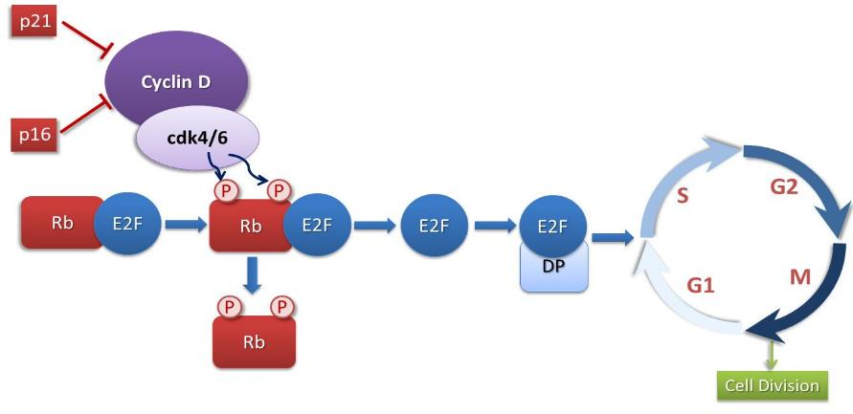
CDK4/6 Regulates G1->S Cell Cycle Progression
ER+ breast cancer preferentially overexpress Cyclin D or have loss of p16, with subsequent loss of control of the cell cycle
Palbociclib
Abemaciclib
Ribociclib
M, mitosis; Rb, retinoblastoma.
Adapted from Finn et al, 2016.

Slide 12
CDK4/6 Inhibitors + Endocrine Therapy Improve PFS in the 1st/2nd line MBC Setting
Study/Arms | ¹Paloma 1 | ²Paloma 2 | ³Monaleesa 2 | ⁴Monarch 3 | ⁵Monaleesa 7 | ⁶Paloma 3 | ⁷Monarch 2 | ⁸Monaleesa 3
Phase | 2 | 3 | 3 | 3 | 3 | 3 | 3 | 3
CDK4/6i ET partner | Palbo AI | Palbo AI | Ribo AI | Abema AI | Ribo AI/Tam + OS | Palbo Fulvestrant | Abema Fulvestrant | Ribo Fulvestrant
N | 165 | 666 | 668 | 493 | 642 | 521 | 669 | 726
Median PFS (months) Placebo | 10.2 | 14.5 | 16 | 14.7 | 13.0 | 4.6 | 9.3 | 12.8
Median PFS (months) CDK 4/6i | 20.2 | 27.6 | 25.3 | 28.1 | 23.8 | 11.2 | 16.4 | 20.5
HR 95% CI | 0.48 0.31-0.74 | 0.56 0.46-0.69 | 0.54 0.41-0.69 | 0.55 0.44-0.69 | 0.55 0.44-0.69 | 0.50 0.40-0.62 | 0.553 0.45-0.68 | 0.593 0.480-0.732
P value | <0.01 | <0.01 | <0.01 | <0.01 | <0.01 | <0.01 | <0.01 | <0.01
¹Finn R, et al. Lancet Oncol. 2015; 16:25-35; ²Rugo H, et al, et al. SABCS. 2017; ³Hortobagyi GN, et al. ASCO; ⁴Goetz MP, et al. J Clin Oncol. 2017 Nov 10;35(32):3638-3646; ⁵Tripathy D, et al. Lancet Oncol. 2018 Jul;19(7):904-915. ⁶Turner NC, et al. N Engl J Med. 2015;373:209-219; ⁷Sledge GW, et al. JCO. 2017;35:2875-2884; ⁸Slamon DJ, et al. J Clin Oncol. 2018 Aug 20;36(24):2465-2472.

Slide 13
Key AEs With CDK4/6 Inhibitors: Monitoring and Prevention
Diarrhea
Abemaciclib (more)
Palbociclib
Ribociclib
Hepatobiliary Toxicity
Abemaciclib
Ribociclib
QT Prolongation
Ribociclib
Neutropenia
Abemaciclib (less)
Palbociclib
Ribociclib
VTE
Abemaciclib
ILD/ Pneumonitis
Abemaciclib
Palbociclib
Ribociclib
Antidiarrheal therapy
Increase oral hydration
Notify HCP
LFTs before starting tx, Q2W x 2 mos, then:
abemaciclib, as indicated
ribociclib, at start of cycle x 4 cycles
EKG before cycle 1, Day 14 of cycle 1, start of cycle 2, then as indicated
Electrolytes at start of cycle x 6 cycles, then as indicated
CBC before starting tx, then:
abemaciclib, Q2W x 2 mos, QM x 2 mos, then as indicated
palbociclib, Days 1 and 15 of cycles 1-2, then as indicated
ribociclib, Q2W x 2 cycles, start of next 4 cycles, then as indicated
Monitor for signs and symptoms of thrombosis or pulmonary embolism
Monitor for pulmonary symptoms indicative of ILD or pneumonitis (eg, hypoxia, cough, dyspnea)

Slide 14
Phase III MONALEESA-2: First-Line AI ± Ribociclib in HR+/HER2- MBC
Ribociclib 600 mg PO QD on Days 1-21 + Letrozole 2.5 mg/day on 28-day cycles
(n = 335)
Pre/perimenopausal women with HR+/HER2- advanced breast cancer; ECOG PS ≤ 1; ≤1 line of prior CT for advanced disease; no prior ET for advanced disease and no prior CDK4/6 inhibitor; (neo)adjuvant ET permitted
(N = 672)
Placebo +
Letrozole 2.5 mg/day on 28-day cycles
(n = 335)
100
Overall Survival
90
80
70
60
50
Median OS, Mo (95% CI)
Ribociclib
OS, %
40
Ribociclib (n = 334) 63.9
Placebo (n = 331) 51.4
30
20
HR: 0.76 (95% CI: 0.63-0.93) P = .008
Placebo
10
0
0
4
8
12
16
20
24
28
32
36
40
44
48
52
56
60
64
68
72
76
80
84
88
Months
Hortobagyi. N Engl J Med. 2022;386:942.
Notes:
Hortobagyi ESMO 2021/slide 9 (screenshot)
Hortobagyi ESMO 2021/slide 7 (screenshot)

Slide 15
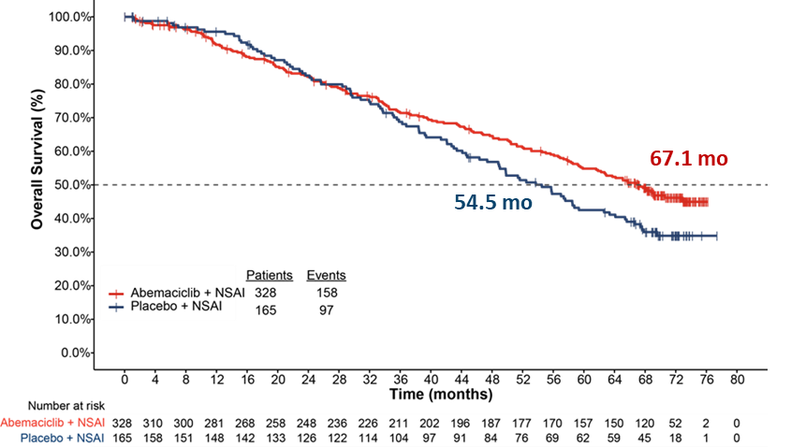
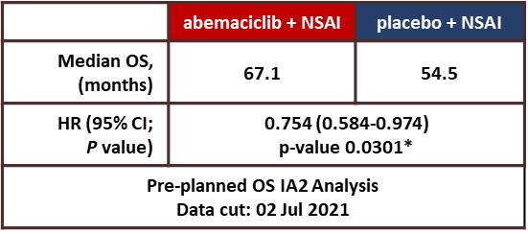
MONARCH-3: First-line AI +/- abemaciclib ITT OS at IA2
*p-value did not reach threshold for statistical significance at this interim
CDK; cyclin dependent kinase; CI, confidence interval; HR, hazard ratio; IA2, interim analysis 2; mo, months; ITT, intent to treat; NSAI, nonsteroidal aromatase inhibitor; OS, overall survival.
Goetz et al, ESMO 2022

Slide 16
PALOMA-2 First-line Letrozole +/- Palbociclib: OS Analysis
Median f/u 7.5 years
Missing survival data: 13% pal + let, 21% control
More crossover to CDK4/6i in the control arm, 27% vs 12%
10% of patients continue on pal and let at 7.5y f/u
Finn et al, ASCO 2022

Slide 17
Overall Survival in patients treated with CDK4/6i for Metastatic Disease
 | Treatment arm: OS, median, mo | Placebo arm: OS, median, mo | Hazard ratio | Hazard ratio (95% CI) | P value | Significance reached vs placeboª
PALOMA-2¹ Palbociclib + letrozole | 53.9 | 51.2 |  | 0.956 (0.777-1.177) | 0.3378 | ✗
PALOMA-3² Palbociclib + fulvestrant | 34.9 | 28.0 |  | 0.81 (0.64-1.03) | .09 | ✗
MONARCH 2³ Abemaciclib + fulvestrant | 46.7 | 37.3 |  | 0.76 (0.61-0.95) | .01 | ✓
MONARCH 3 Abemaciclib + NSAI | Not yet reported
MONALEESA-2^{4,5} Ribociclib + letrozole | 63.9 | 51.4 |  | 0.76 (0.63-0.93) | .004 | ✓
MONALEESA-7⁶ Ribociclib + goserelin + tamoxifen/NSAI | NR | 40.9 |  | 0.71 (0.54-0.95) | .00973 | ✓
MONALEESA-3⁷ Ribociclilb + fulvestrant | NR | 40.0 |  | 0.72 (0.57-0.92) | .00455 | ✓
PAL
ABE
RIBO
0.4
0.6
0.8
1.0
1.2
Favors CDK4/6i
Favors PBO
ª The red × denotes trials that did not report significant median OS compared with placebo. ABC, advanced breast cancer; ABE, abemaciclib; NR, not reached; NSAI, non-steroidal aromatase inhibitor; OS, overall survival; RIBO, ribociclib; PAL, palbociclib.
1. Finn RS, et al. J Clin Oncol. 2022; 40 (suppl 17; abstr LBA1003). 2. Turner NC, et al. N Engl J Med. 2018;379:1926-1936. 3. Sledge GW, et al. JAMA Oncol. 2020;6:116-124. 4. Hortobagyi GN, et al. N Engl J Med. 2022;386:942-950. 5. Hortobagyi GN, et al. ESMO 2021. Oral LBA17_PR. 6. Im SA, et al. N Engl J Med. 2019;381:307-316. 7. Slamon DJ, et al. N Engl J Med. 2020;382:514-524.

Slide 18
CDK4/6 Inhibitors for Advanced HR+ Breast Cancer
The three available CDK4/6 inhibitors in combination with endocrine therapy broadly improve PFS in the first-line and pre-treated settings. These agents should be considered SOC in almost all patients presenting with MBC.
Despite uniformity of PFS outcomes, updated survival data suggest efficacy differences among the agents, albeit with the caveat of cross trial comparisons.
Based on most recent results, practice patterns may be evolving away from palbociclib and towards the other two agents, with selection often based on toxicity profile.
But many questions….
Which agent should be the ”preferred” agent at this time?
What is best therapy post-CDK4/6 progression? Is there benefit to continuation of CDK4/6i or change in therapy?
Will role of CDK4/6i change with future introduction of SERDs, AKT inhibitors, ADC?

Slide 19
Agenda
Module 1: Pregnancy during adjuvant endocrine therapy; fertility issues
Module 2: Genomic biomarkers in the adjuvant setting
Module 3: CDK4/6 inhibitors in metastatic disease
Module 4: Adjuvant use of CDK4/6 inhibitors
Module 5: Novel agents in metastatic disease
Module 6: Challenging cases

Slide 20
Adjuvant eBC Trials With CDK4/6 Inhibitors
 | PALLAS^{1,2} | monarchE^{3,4} | PENELOPE-B^{5,6} | NATALEE⁷
CDK4/6 inhibitor | Palbociclib | Abemaciclib | Palbociclib | Ribociclib
Sample size/sites | 5760/406 | 4580/612 | 1250/267 | Projected 5000/395
Design | Phase 3 randomized open label | Phase 3 randomized open label | Phase 3 randomized placebo-controlled | Phase 3 randomized open label
Patient population | Stage II-III (Stage IIA capped 1000 pts) | High-risk N+ plus one other risk factor (size, grade, Ki67) | Very high-risk with residual disease after neoadjuvant chemo (CPS-EG score ≥ 3 or 2 and N+) | Stage II-III
Duration of CDK4/6 therapy | 2 years (26 cycles) | 2 years (26 cycles) | 1 year (13 cycles) | 3 years (39 cycles)
Primary endpoint | iDFS | iDFS | iDFS | iDFS
Median duration of follow-up | 31 months | 42 months | 43 months | NA
This information is not presented to compare the efficacy or safety profile of the discussed products. No implication of superiority or inferiority is intended or should be inferred. Cross-trial comparisons are unreliable as they are likely to be confounded due to differences in study design and patient population.
AFT=Alliance Foundation Trials, LLC; AGO=German Gynecological Oncology Working Group; BIG=Breast International Group; GBG=German Breast Group; iDFS=invasive disease-free survival; NSABP=National Surgical Adjuvant Breast and Bowel Project; TRIO=Translation Research in Oncology. 1. ClinicalTrials.gov. https://clinicaltrials.gov/ct2/show/NCT02513394. Accessed October 7, 2020. 2. Mayer EL, et al. LBA12. ESMO 2020. 3. ClinicalTrials.gov. https://clinicaltrials.gov/ct2/show/NCT03155997. Accessed October 7, 2020. 4. Rastogi P, et al. GS1-01. SABCS 2020. 5. ClinicalTrials.gov. https://clinicaltrials.gov/ct2/show/NCT01864746. Accessed October 7, 2020. 6. Loibl S, et al. SABCS 2020. 7. ClinicalTrials.gov. https://clinicaltrials.gov/ct2/show/NCT03701334. Accessed December 9, 2020.

Slide 21
monarchE Study Design (NCT03155997)
Cohort 1: High risk based on clinical pathological features
≥4 ALN OR
1-3 ALN and at least 1 of the below:
Grade 3 disease
Tumor size ≥5 cm
On-study treatment period
2 years
HR+, HER2-, node positive high-risk EBC
Women or men
Pre-/postmenopausal
With or without prior neo- and/or adjuvant chemotherapy
No metastatic disease
Maximum of 16 months from surgery to randomization and 12 weeks of ET following the last non-ET
Abemaciclib
(150mg twice daily)
+
Endocrine Therapy: AI or tamoxifen
Follow-up period
Endocrine Therapy
3-8 years as clinically indicated
R 1:1
N = 5637
Cohort 2: High risk based
on Ki-67
1-3 ALN and
Ki-67 ≥20% and
Grade 1-2 and tumor size <5 cm
Endocrine Therapy: AI or tamoxifen
Primary Objective: IDFS
Secondary Objectives: IDFS in high Ki-67 populations, DRFS, OS, Safety, PK, PRO
Stratified for:
Prior chemotherapy
Menopausal status
Region
Most recent data presentation at SABCS 2022 42 mo median f/u

Slide 22
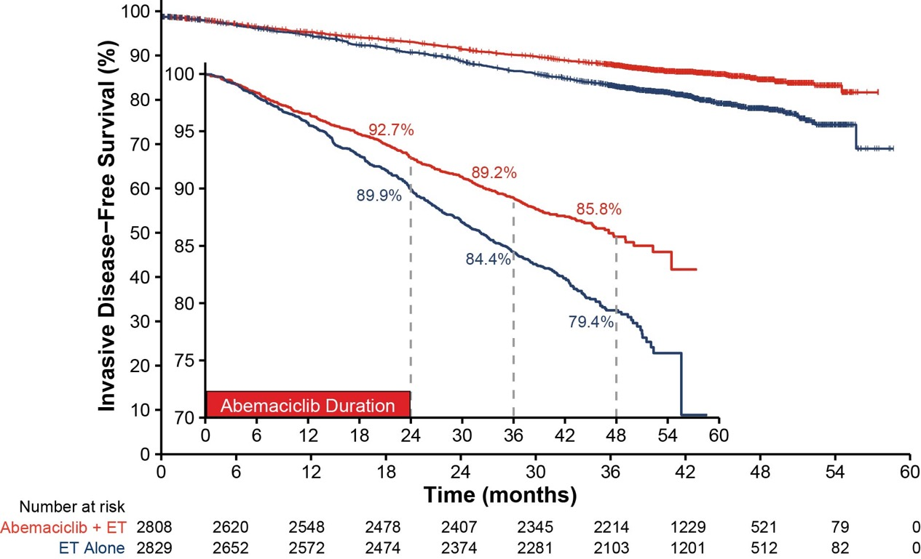
IDFS Benefit in ITT Persists Beyond Completion of Abemaciclib
Number of IDFS events
Abemaciclib + ET | ET Alone
336 | 499
HR (95% CI): 0.664 (0.578, 0.762) Nominal p < 0.0001
33.6% reduction in the risk of developing an IDFS event with an increase in absolute
benefit in IDFS 4-year rates (6.4%) compared to 2-and 3-year IDFS rates (2.8% and 4.8% respectively)
Johnston et al, Lancet Oncol 2022

Slide 23
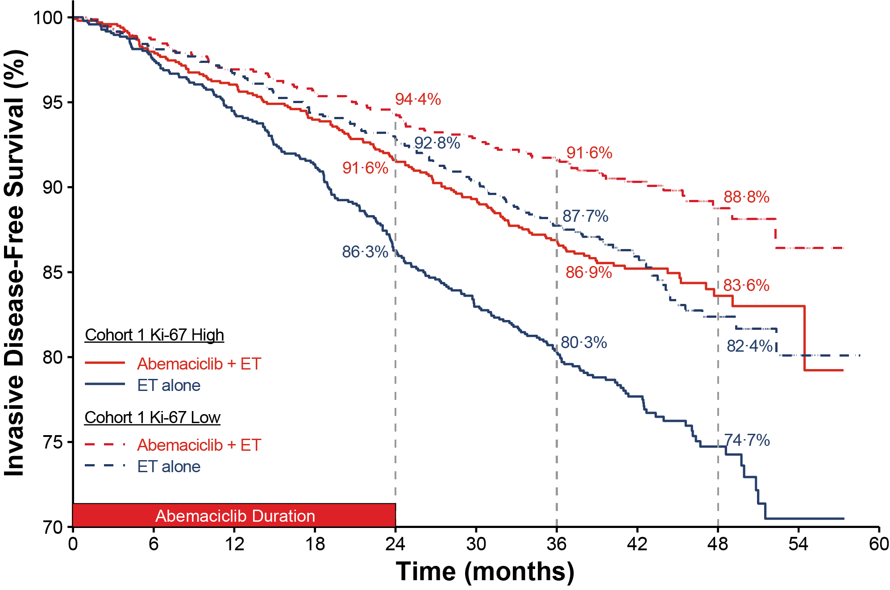
Ki-67 is Prognostic, but Not Predictive of Abemaciclib Benefit
 | Cohort 1*
 | C1 Ki-67 High |  |  | C1 Ki-67 Low
 | Abemaciclib + ET N=1017 | ET alone N=986 | ET alone N=986 | Abemaciclib + ET N=946 | ET alone N=968 | ET alone N=968
IDFS
Number of events, n | 147 | 224 |  | 91 | 141
HR (95% CI) | 0.618 (0.501, 0.762) |  |  | 0.624 (0.478, 0.814)
DRFS
Number of events, n | 126 | 193 |  | 74 | 119
HR (95% CI) | 0.612 (0.488, 0.767) |  |  | 0.613 (0.458, 0.821)
OS (Immature)
Number of events, n | 68 | 88 |  | 39 | 50
HR (95% CI) | 0.733 (0.533, 1.007) |  |  | 0.772 (0.506, 1.175)
*Ki-67 value was missing in 1203 (23.5%) patients
Within Cohort 1, similar abemaciclib treatment effects were observed regardless of Ki-67 index

Slide 24
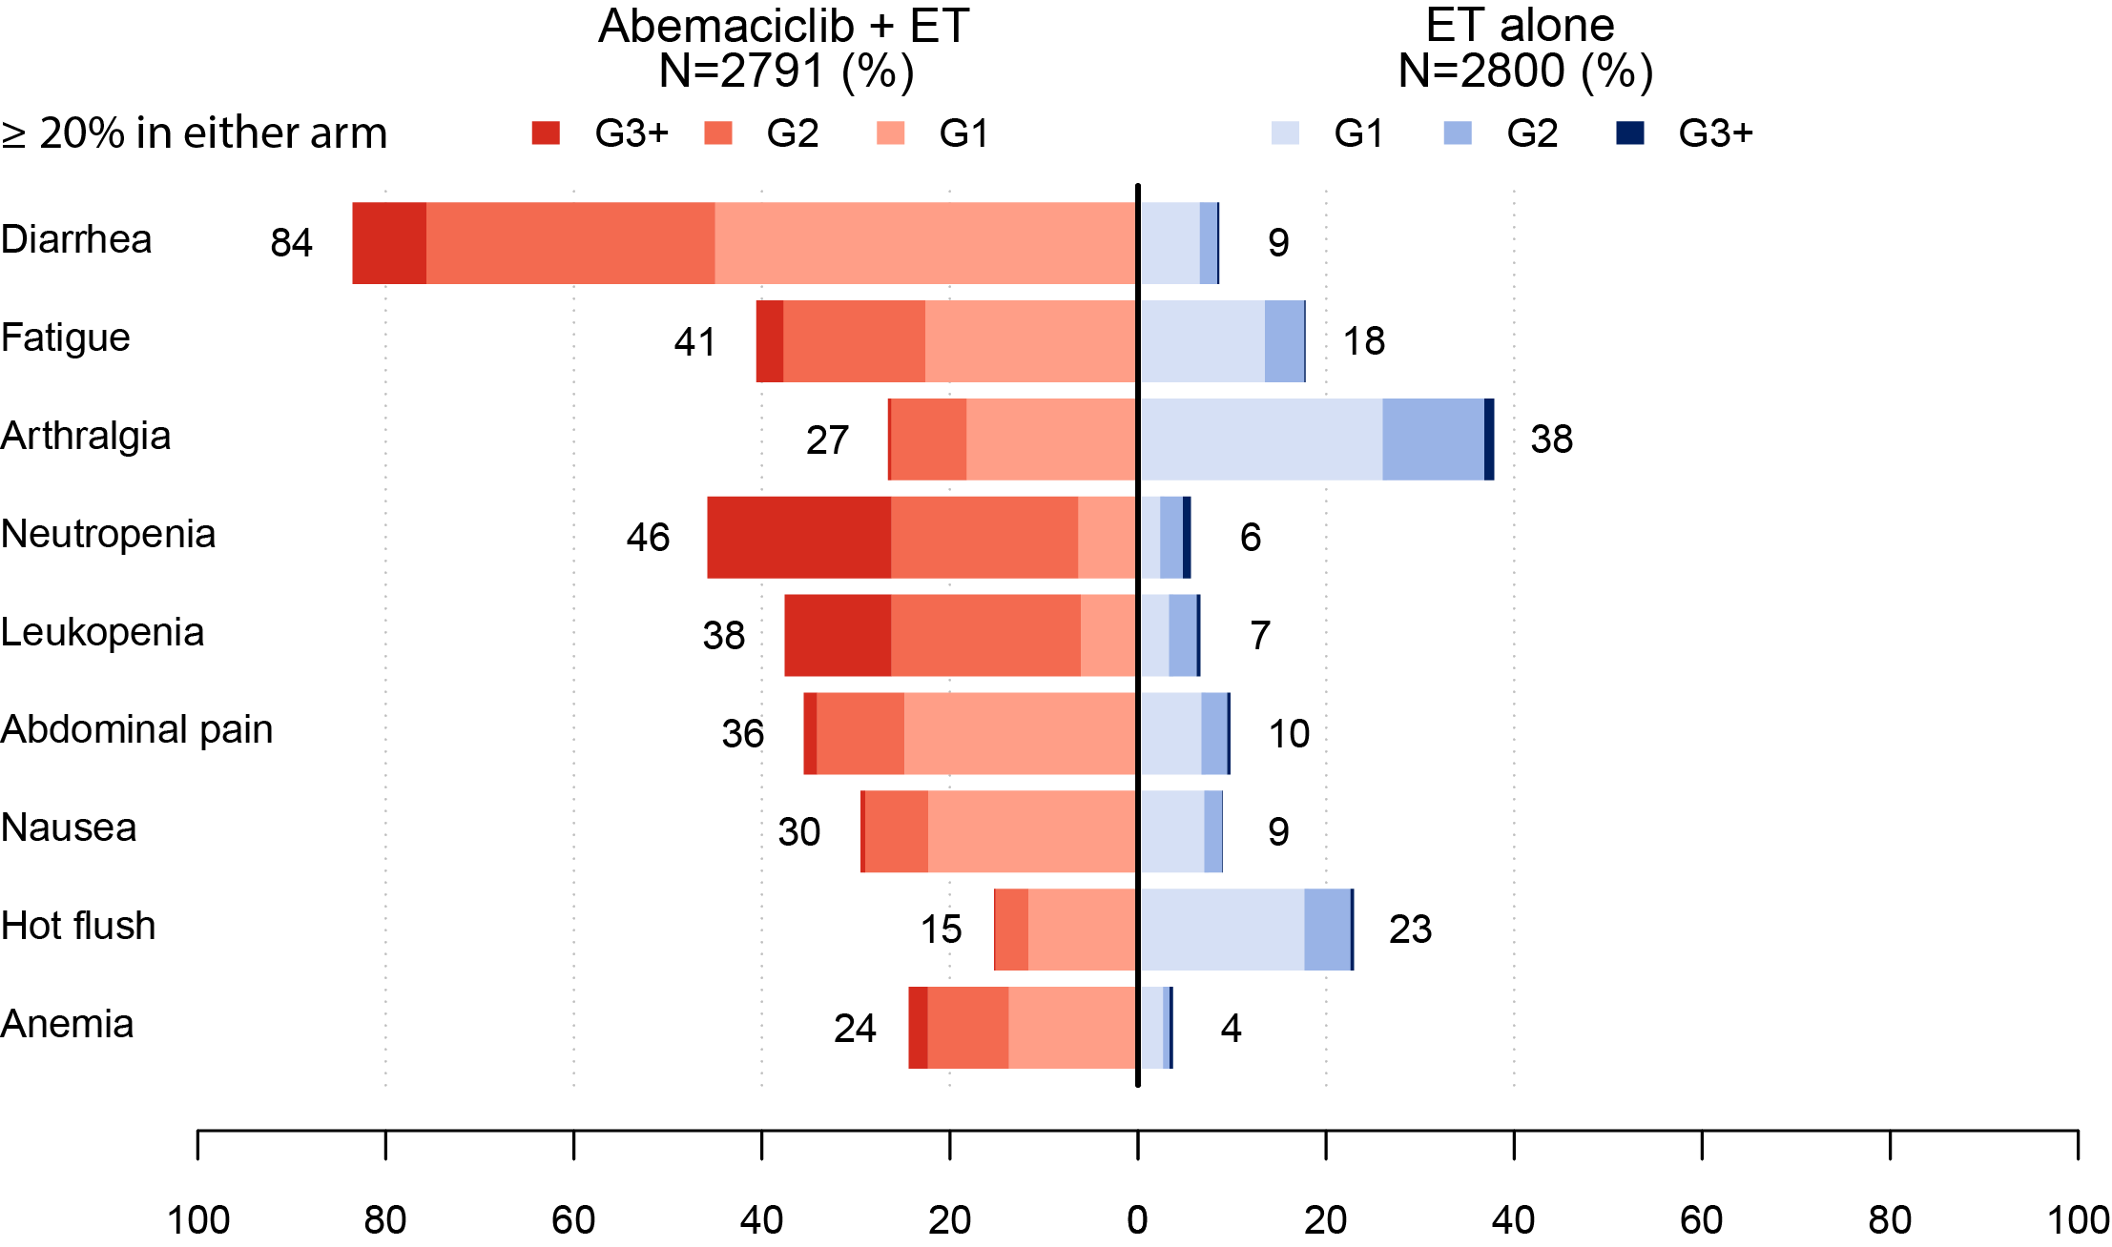
monarchE: Toxicity
Median duration of abemaciclib: 23.7 mo
Other events of interest, any grade | Abemaciclib + ET N = 2791, % | ET Alone N = 2800, %
VTE | 2.5 | 0.6
PE | 1.0 | 0.1
ILD | 3.2 | 1.3
Abbreviations: VTE = venous thromboembolic event; PE = pulmonary embolism; ILD = Interstitial lung disease

Slide 26
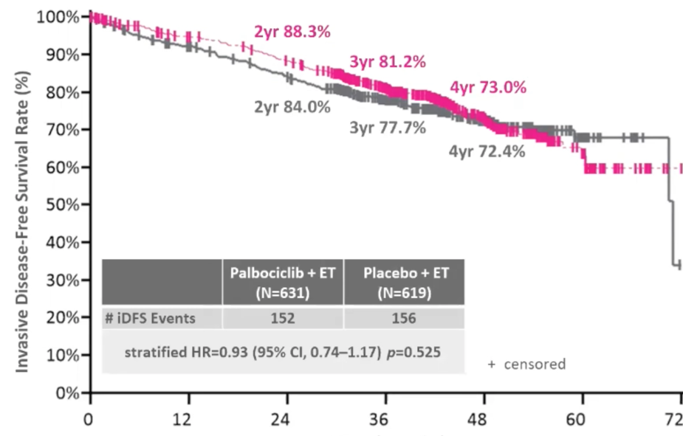
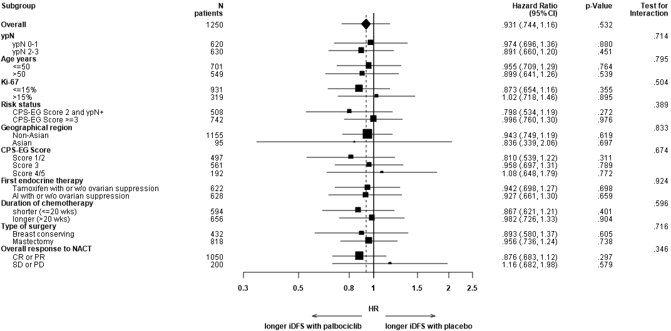
PENELOPE-B Efficacy
Loibl et al. JCO 2021

Slide 27
CDK4/6 Inhibitors for Early HR+ Breast Cancer
The addition of 2 years of abemaciclib to adjuvant endocrine therapy is appropriate for high-risk node-positive patients with HR+/HER2- disease, with a 30% reduction in risk of disease recurrence seen in monarchE. US national guidelines (NCCN, ASCO) have endorsed use of abemaciclib in high-risk patients identified without use of Ki-67.
Best candidates for abemaciclib not only have appropriate disease characteristics and risk, but are also motivated to take 2 years of an extra medicine with potential side effects in addition to their ongoing endocrine therapy.
But many questions….
How will recurrence on/soon after adjuvant CDK4/6i be managed?
Is there a role for adjuvant CDK4/6i for high-risk node negative tumors?
Is abemaciclib the only CDK4/6 option? Await results from NATALEE.
How to balance abemaciclib and olaparib in patients with BRCA-mutated high-risk breast cancer?

Slide 28
Dr O’Regan – Case history
45-year-old female presented 3 years ago with a right breast mass.
Imaging confirms 4cm mass in the right breast with suspicious nodes
Biopsy of the breast mass revealed IDC, grade 2, ER-positive, PR-negative, HER2-negative, Ki67 25% and biopsy of node is positive for cancer
She receives pre-operative chemotherapy with AC followed by paclitaxel
Undergoes right mastectomy with ALND: final pathology ypT2 (3cm), N2
Receives ovarian suppression with an aromatase inhibitor and starts adjuvant abemaciclib
18 months later presents with back pain.
Found to have bone metastases, bone biopsy adenocarcinoma ER-positive

Slide 29
Agenda
Module 1: Pregnancy during adjuvant endocrine therapy; fertility issues
Module 2: Genomic biomarkers in the adjuvant setting
Module 3: CDK4/6 inhibitors in metastatic disease
Module 4: Adjuvant use of CDK4/6 inhibitors
Module 5: Novel agents in metastatic disease
Module 6: Challenging cases

Slide 30
Emerging Therapies for ER-positive metastatic cancer: Capivasertib and SERDs
Ruth O’Regan, MD
University of Rochester
Rochester, New York

Slide 31
MAINTAIN

Slide 32
Andre et al ESMO 2018; NEJM 2019

Slide 34
FAKTION: updated PFS in the ITT population<br />

Slide 35
FAKTION: mature OS in the ITT population<br />

Slide 36
CAPItello-291: Study overview
Capivasertib
Patients with HR+/HER2– ABC
400 mg twice daily,
4 days on, 3 days off
Dual primary endpoints
Fulvestrant
PFS by investigator assessment
Overall
AKT pathway-altered tumors (≥1 qualifying PIK3CA, AKT1, or PTEN alteration)
Men and pre-/post-menopausal women
Recurrence while on or <12 months from end of adjuvant AI, or progression while on prior AI for ABC
≤2 lines of prior endocrine therapy for ABC
≤1 line of chemotherapy for ABC
Prior CDK4/6 inhibitors allowed (at least 51% required)
No prior SERD, mTOR inhibitor, PI3K inhibitor, or AKT inhibitor
HbA1c <8.0% (63.9 mmol/mol) and diabetes not requiring insulin allowed
FFPE tumor sample from the primary/recurrent cancer available for retrospective central molecular testing
500 mg: cycle 1, days 1 & 15; then every 4 weeks
R1:1 (N=708)
Stratification factors:
Liver metastases (yes/no)
Prior CDK4/6 inhibitor (yes/no)
Region*
Placebo
Key secondary endpoints
Overall survival
Overall
AKT pathway-altered tumors
Objective response rate
Overall
AKT pathway-altered tumors
Twice daily,
4 days on, 3 days off
Fulvestrant
500 mg: cycle 1, days 1 & 15; then every 4 weeks

Slide 37
Dual-primary endpoint: Investigator-assessed PFS in the overall population
100
 | Capivasertib + fulvestrant (N=355) | Placebo + fulvestrant (N=353)
PFS events | 258 | 293
Median PFS (95% CI); months | 7.2 (5.5–7.4) | 3.6 (2.8–3.7)
Adjusted HR (95% CI): | 0.60 (0.51, 0.71); two-sided p-value <0.001
90
80
70
60
Progression-free survival (%)
50
40
30
20
10
0
 | 0 | 1 | 2 | 3 | 4 | 5 | 6 | 7 | 8 | 9 | 10 | 11 | 12 | 13 | 14 | 15 | 16 | 17 | 18 | 19 | 20 | 21 | 22 | 23 | 24 | 25 | 26
 | Time from randomization (months)
Number of patients at risk
Capivasertib + fulvestrant | 355 | 330 | 266 | 252 | 207 | 199 | 172 | 166 | 138 | 133 | 115 | 98 | 78 | 64 | 55 | 44 | 43 | 25 | 25 | 21 | 8 | 8 | 5 | 2 | 2 | 1 | 0
Placebo + fulvestrant | 353 | 329 | 207 | 182 | 142 | 136 | 106 | 100 | 83 | 81 | 66 | 59 | 51 | 41 | 33 | 24 | 23 | 12 | 11 | 10 | 4 | 4 | 3 | 1 | 1 | 0 | 0

Slide 38
Dual-primary endpoint: Investigator-assessed PFS in the AKT pathway-altered population
 | Capivasertib + fulvestrant (N=155) | Placebo + fulvestrant (N=134)
PFS events | 121 | 115
Median PFS (95% CI); months | 7.3 (5.5–9.0) | 3.1 (2.0–3.7)
Adjusted HR (95% CI): | 0.50 (0.38, 0.65); two-sided p-value <0.001
100
90
80
70
60
Progression-free survival (%)
50
40
30
20
10
0
 | 0 | 1 | 2 | 3 | 4 | 5 | 6 | 7 | 8 | 9 | 10 | 11 | 12 | 13 | 14 | 15 | 16 | 17 | 18 | 19 | 20 | 21 | 22 | 23 | 24 | 25 | 26
 | Time from randomization (months)
Number of patients at risk
Capivasertib + fulvestrant | 155 | 150 | 127 | 121 | 99 | 97 | 80 | 76 | 65 | 62 | 54 | 49 | 38 | 31 | 26 | 22 | 21 | 12 | 12 | 9 | 3 | 3 | 2 | 1 | 1 | 0 | 0
Placebo + fulvestrant | 134 | 124 | 77 | 64 | 48 | 47 | 37 | 35 | 28 | 27 | 24 | 20 | 17 | 14 | 11 | 6 | 6 | 2 | 2 | 2 | 1 | 1 | 1 | 0 | 0 | 0 | 0

Slide 39
Randomized trials with oral SERDs
Trial | EMERALD |  | AcelERA |  | AMEERA-3
Agents | ELAC | FULV | GIRE | SAET | AMCE | SAET
n ITT | 239 | 238 | 143 | 147 | 151 | 152
ESR1 mutation | 115 | 113 | 65 | 55 | 44 | 34
Prior CDKi | 100% | 100% | 80% | 78% | 43% | 41%
PFS (mos.) | 2.79* | 1.91 | 3.6 | 3.7 | 5.6 | 5.4
PFS in ESR1 mutant (mos.) | 3.78** | 1.87 | 3.7 | 2.0 | 5.3 | 3.5
ELAC = Elacestrant; GIRE = Giredestant; AMCE = Amcenestrant; FULV = Fulvestrant; SAET = Single-agent endocrine therapy
* 0.0018; **0.0005
Jimenez et al ESMO 2022; Tolaney et al ESMO 2022; Bidard et al J Clin Oncol 2022.

Slide 40
EMERALD: PFS by Duration of CDK4/6i
At least 6 mo CDK4/6i
At least 12 mo CDK4/6i
At least 18 mo CDK4/6i
100
100
100
80
80
80
Probability of PFS (%)
Probability of PFS (%)
Probability of PFS (%)
60
60
60
40
40
40
20
20
20
0
Elacestrant
Standard of Care
Elacestrant
Standard of Care
0
Elacestrant
Standard of Care
0
0
5
10
15
20
25
30
0
5
10
15
20
25
30
0
5
10
15
20
25
30
Time (months)
Time (months)
Time (months)
Elacestrant
SOC
202
205
90
71
53
32
37
20
29
13
24
6
16
3
12
2
10
2
9
1
8
1
7
0
6
1
1
0
Elacestrant
SOC
150
160
76
55
48
26
35
18
28
13
23
6
15
3
11
2
9
2
8
1
7
1
6
0
6
1
1
0
Elacestrant
SOC
98
119
51
47
35
22
26
15
23
10
18
5
11
2
10
2
8
2
7
1
7
1
6
0
6
1
1
0
 | Elacestrant | SOC Hormonal Therapy
Median PFS, months (95% CI) | 2.79 (1.94 - 3.78) | 1.91 (1.87 - 2.14)
PFS rate at 12 months, % (95% CI) | 21.00 (13.57 - 28.43) | 6.42 (0.75 - 12.09)
Hazard ratio (95% CI) | 0.688 (0.535 - 0.884)
 | Elacestrant | SOC Hormonal Therapy
Median PFS, months (95% CI) | 3.78 (2.33 - 6.51) | 1.91 (1.87 - 3.58)
PFS rate at 12 months, % (95% CI) | 25.64 (16.49 - 34.80) | 7.38 (0.82 - 13.94)
Hazard ratio (95% CI) | 0.613 (0.453 - 0.828)
 | Elacestrant | SOC Hormonal Therapy
Median PFS, months (95% CI) | 5.45 (2.33 - 8.61) | 3.29 (1.87 - 3.71)
PFS rate at 12 months, % (95% CI) | 26.70 (15.61 - 37.80) | 8.23 (0.00 - 17.07)
Hazard ratio (95% CI) | 0.703 (0.482 - 1.019)
Kaklamani et al SABCS 2022

Slide 41
Patients with ESR1-mut Tumors: PFS by Duration of CDK4/6i
At least 6 mo CDK4/6i
At least 12 mo CDK4/6i
At least 18 mo CDK4/6i
100
100
100
80
80
80
60
60
60
Probability of PFS (%)
Probability of PFS (%)
Probability of PFS (%)
40
40
40
20
20
20
Elacestrant
Standard of Care
Elacestrant
Standard of Care
0
Elacestrant
Standard of Care
0
0
0
5
10
15
20
25
30
0
5
10
15
20
25
30
0
5
10
15
20
25
30
Time (months)
Time (months)
Time (months)
Elacestrant
SOC
103
102
50
34
33
16
25
11
20
9
16
5
11
2
9
1
8
1
7
0
6
5
5
1
1
0
Elacestrant
SOC
78
81
42
26
31
12
24
10
20
9
16
5
11
2
9
1
8
1
7
0
6
5
5
1
1
0
Elacestrant
SOC
55
56
30
21
23
9
18
8
16
7
12
4
8
1
8
1
7
1
6
0
6
5
5
1
1
0
 | Elacestrant | SOC Hormonal Therapy
Median PFS, months (95% CI) | 4.14 (2.20 - 7.79) | 1.87 (1.87 - 3.29)
PFS rate at 12 months, % (95% CI) | 26.02 (15.12 - 36.92) | 6.45 (0.00 - 13.65)
Hazard ratio (95% CI) | 0.517 (0.361 - 0.738)
 | Elacestrant | SOC Hormonal Therapy
Median PFS, months (95% CI) | 8.61 (4.14 - 10.84) | 1.91 (1.87 - 3.68)
PFS rate at 12 months, % (95% CI) | 35.81 (21.84 - 49.78) | 8.39 (0.00 - 17.66)
Hazard ratio (95% CI) | 0.410 (0.262 - 0.634)
 | Elacestrant | SOC Hormonal Therapy
Median PFS, months (95% CI) | 8.61 (5.45 - 16.89) | 2.10 (1.87 - 3.75)
PFS rate at 12 months, % (95% CI) | 35.79 (19.54 - 52.05) | 7.73 (0.00 - 20.20)
Hazard ratio (95% CI) | 0.466 (0.270 - 0.791)
Kaklamani et al SABCS 2022

Slide 42
Dr O’Regan – Case history
59-year-old presents to review systemic imaging
Diagnosed with breast cancer, ER-positive, PR-negative, HER2-negative 8 years ago when she received adjuvant chemotherapy and anastrozole
Found to have metastatic disease 4 years ago to bone and liver when she presented with bone pain.
Liver biopsy: adenocarcinoma, ER-positive, PR-negative, HER2 1+ by IHC
Stable disease for 2 years on fulvestrant and Palbociclib
Switched to everolimus with exemestane with progression disease after 6 months and then capecitabine with disease progression at 9 months
Switched to trastuzumab deruxtecan 6 months ago
Imaging shows disease progression in her liver and bones

Slide 43
Abstract GS3-02

Slide 44
SERENA-2 Phase II Study Design
Serial
Oliveira M et al. San Antonio Breast Cancer Symposium 2022;Abstract GS3-02.

Slide 45
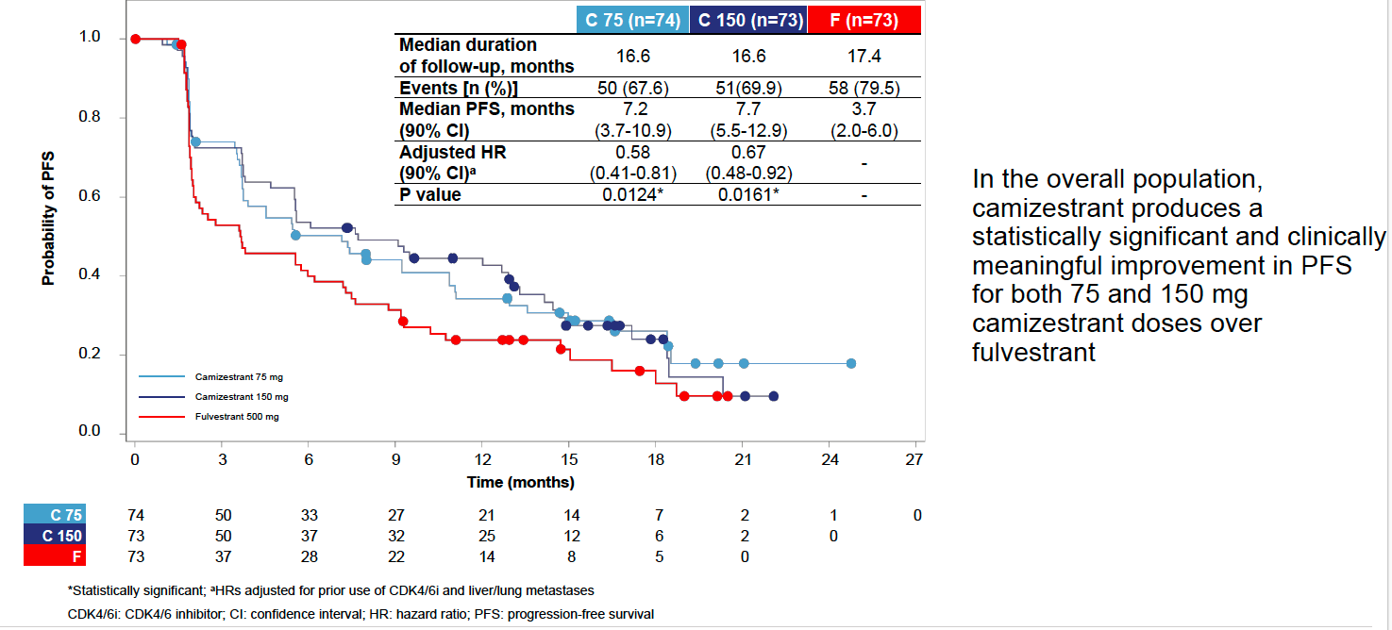
SERENA-2 Primary Endpoint: PFS by Investigator Assessment
C = camizestrant; F = fulvestrant
Oliveira M et al. San Antonio Breast Cancer Symposium 2022;Abstract GS3-02.

Slide 46
Agenda
Module 1: Pregnancy during adjuvant endocrine therapy; fertility issues
Module 2: Genomic biomarkers in the adjuvant setting
Module 3: CDK4/6 inhibitors in metastatic disease
Module 4: Adjuvant use of CDK4/6 inhibitors
Module 5: Novel agents in metastatic disease
Module 6: Challenging cases

Slide 47
Dr Mayer – Case 3
35 year old healthy premenopausal woman presented with a right breast mass. Imaging suggested a 4.5 cm mass with abnormal appearing ipsilateral lymph nodes.
A core biopsy showed invasive ductal carcinoma, grade 3, ER 60% positive, PR negative, HER2 1+. An axillary biopsy was positive for involvement. Staging studies showed no definitive evidence of distant metastatic disease.
She moves forward with preoperative dose dense AC + T chemotherapy, followed by bilateral mastectomy and right axillary lymph node dissection.
She will receive adjuvant endocrine therapy.
Pathology demonstrates residual 2.5 cm invasive disease; 2 of 12 axillary lymph nodes are involved, with treatment effect in an additional 2 nodes. CPS-EG score is 3.
Germline genetic testing has disclosed a pathogenic BRCA 1 mutation.
Question:
Administer adjuvant olaparib or not?

Slide 48
Dr O’Regan – Case history
60-year-old presents for follow-up for hormone receptor-positive breast cancer metastatic to bones
Initially diagnosed with de novo metastatic breast cancer 3-years ago
Bone biopsy positive for adenocarcinoma ER-positive, PR-positive, HER2-negative
Started anastrozole and Palbociclib with stable disease for approximately 2 years
Found to have PI3-kinase and an ESR1 mutation in liquid biopsy
Started fulvestrant plus alpelisib
Scans after 9 months of treatment demonstrate progressive disease in her bones

Slide 49
Elacestrant FDA Approval
Subsequent to this recording on January 27, 2023, the Food and Drug Administration (FDA) approved elacestrant for postmenopausal women or adult men with ER-positive, HER2-negative, ESR1-mutated advanced or metastatic breast cancer who experience disease progression following at least one line of endocrine therapy. The FDA also approved the Guardant360® CDx assay as a companion diagnostic tool to identify patients with breast cancer for treatment with elacestrant.
Efficacy was evaluated in EMERALD (NCT03778931), a randomized, open-label, active-controlled, multicenter trial that had enrolled 478 postmenopausal women and men with ER-positive, HER2-negative advanced or metastatic breast cancer. Of the 478 enrollees, 228 patients (48%) had ESR1 mutations.
The major efficacy outcome measure was progression-free survival (PFS), assessed by a blinded imaging review committee. A statistically significant difference in PFS was observed in the intention-to-treat (ITT) population and in the subgroup of patients with ESR1 mutations. In the 228 patients with ESR1 mutations, median PFS was 3.8 months in the elacestrant arm and 1.9 months in the fulvestrant or aromatase inhibitor arm (hazard ratio of 0.55, 2-sided p-value = 0.0005).
https://www.fda.gov/drugs/resources-information-approved-drugs/fda-approves-elacestrant-er-positive-her2-negative-esr1-mutated-advanced-or-metastatic-breast-cancer

Slide 50
Appendix

Slide 51
Differential activity of CDK4/6 inhibitors in the adjuvant and metastatic settings
Erica L. Mayer MD MPH
Dana-Farber Cancer Institute
Boston, MA
January 2023

Slide 52
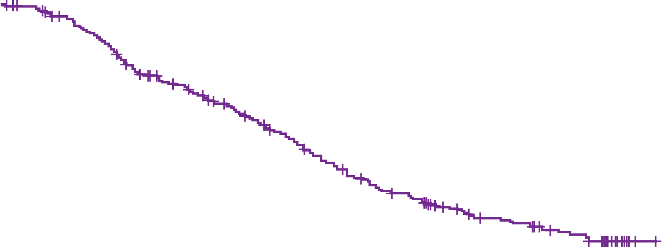
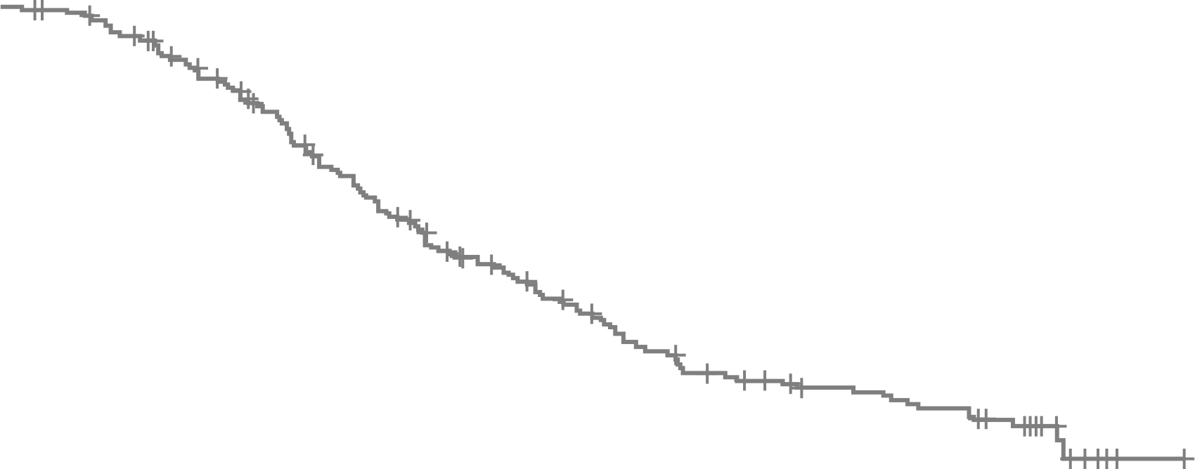
PALOMA-2: AI +/- palbociclib Final ITT OS Analysis
Median Follow-up 90 months | Palbociclib + Letrozole (N=444) | Placebo + Letrozole (N=222)
Median OS, months (95% CI) | 53.9 (49.8, 60.8) | 51.2 (43.7, 58.9)
Stratified HR (95% CI) | 0.956 (0.777, 1.177) | 7.0 (4.5, 8.3)
1-sided P value | 0.3378
100
90
80
70
60
Overall Survival Probability , %
50
40
30
20
10
0
0
12
24
36
48
60
72
84
96
108
No. at risk
Time, months
Palbociclib + letrozole
444
400
325
280
222
174
145
128
13
0
Placebo + letrozole
222
203
168
126
95
72
60
53
4
0
Finn et al, ASCO 2022

Slide 53
October 2022

Slide 54
DeMichelle A et al. ASCO Plenary Series October 2022.

