Slide 1
Breast Cancer
Wednesday, April 26, 2023
6:00 PM – 8:00 PM
What I Tell My Patients:
Faculty Physicians and Nurses Discuss Patient Education
About New Treatments and Clinical Trials
Fifteenth Annual RTP Symposium Series Held During the Annual ONS Congress
Faculty
Jamie Carroll, APRN, MSN, CNP
Virginia Kaklamani, MD, DSc
Joyce O’Shaughnessy, MD
Ronald Stein, JD, MSN, NP-C, AOCNP
Moderator
Neil Love, MD

Slide 2





Faculty
Jamie Carroll, APRN, MSN, CNP
Mayo Clinic
Rochester, Minnesota
Ronald Stein, JD, MSN, NP-C, AOCNP
Clinical Instructor of Medicine
USC Norris Comprehensive Cancer Center
Los Angeles, California
Virginia Kaklamani, MD, DSc
Professor of Medicine
Ruth McLean Bowman Bowers Chair in Breast Cancer Research and Treatment
AB Alexander Distinguished Chair in Oncology
Leader, Breast Oncology Program
UT Health San Antonio
MD Anderson Cancer Center
San Antonio, Texas
Moderator
Neil Love, MD
Research To Practice
Miami, Florida
Joyce O’Shaughnessy, MD
Celebrating Women Chair in Breast Cancer Research
Baylor University Medical Center
Director, Breast Cancer Research Program
Texas Oncology
US Oncology
Dallas, Texas

Slide 3
Ms Carroll — Disclosures
Advisory Committee | Lilly, Pfizer Inc, Sanofi, Sermonix Pharmaceuticals

Slide 4
Dr Kaklamani — Disclosures
Consulting Agreements | AstraZeneca Pharmaceuticals LP, Gilead Sciences Inc, Puma Biotechnology Inc, TerSera Therapeutics LLC
Contracted Research | Eisai Inc
Data and Safety Monitoring Board/Committee | Bristol-Myers Squibb Company
Speakers Bureau | AstraZeneca Pharmaceuticals LP, Daiichi Sankyo Inc, Exact Sciences Corporation, Genentech, a member of the Roche Group, Gilead Sciences Inc, Novartis, Pfizer Inc, Seagen Inc

Slide 5
Dr O’Shaughnessy — Disclosures
Advisory Committee and Consulting Agreements | AbbVie Inc, Agendia Inc, Amgen Inc, Aptitude Health, AstraZeneca Pharmaceuticals LP, Bayer HealthCare Pharmaceuticals, Bristol-Myers Squibb Company, Carrick Therapeutics, Celgene Corporation, Daiichi Sankyo Inc, Eisai Inc, Fishawack Health, G1 Therapeutics Inc, Genentech, a member of the Roche Group, Genzyme Corporation, Gilead Sciences Inc, GSK, Incyte Corporation, Lilly, Loxo Oncology Inc, a wholly owned subsidiary of Eli Lilly & Company, Merck, Novartis, Ontada, Pfizer Inc, Pharmacyclics LLC, an AbbVie Company, Pierre Fabre, Puma Biotechnology Inc, Roche Laboratories Inc, Samsung Bioepis, Sanofi, Seagen Inc, Stemline Therapeutics Inc, Synthon, Theralink, Veru
Nonrelevant Financial Relationship | prIME Oncology

Slide 6
Mr Stein — Disclosures
Advisory Committee | AstraZeneca Pharmaceuticals LP

Slide 7
Commercial Support
This activity is supported by educational grants from AstraZeneca Pharmaceuticals LP, Exact Sciences Corporation, Lilly, Merck, Puma Biotechnology Inc, Seagen Inc, and TerSera Therapeutics LLC.
Research To Practice NCPD Planning Committee Members,
Staff and Reviewers
Planners, scientific staff and independent reviewers for Research To Practice have no relevant conflicts of interest to disclose.

Slide 8
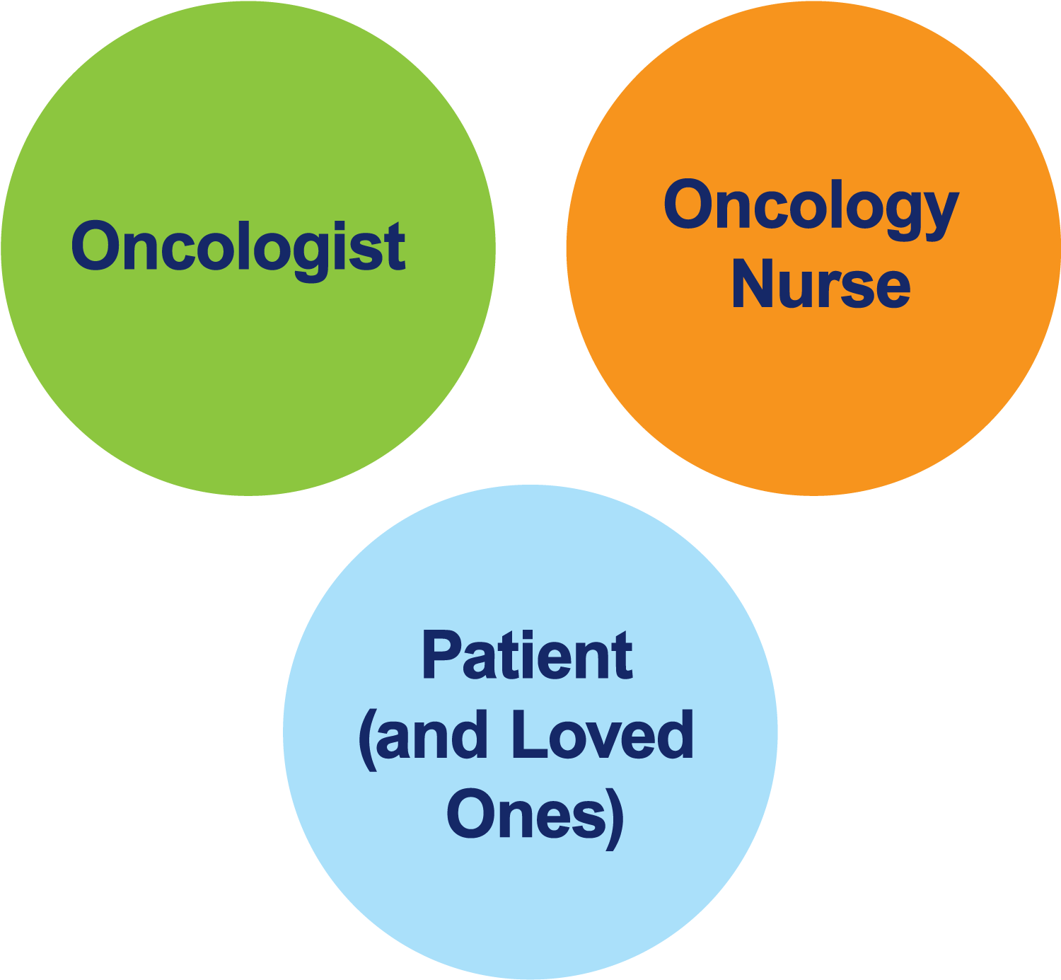
The Core Oncology Triad
Developing an Individualized Oncology Strategy

Slide 9
What I Tell My Patients
2023 ONS Congress
San Antonio, Texas
Symposia Themes
New agents and therapies; ongoing trials related to
specific clinical scenarios
Patient education: Preparing to receive new therapies
The bond that heals
THANKS! (Great job)
Notes:
9
9
9
9
9

Slide 10
Agenda
Module 1: ER-Positive, HER2-Negative Localized Breast Cancer — PART 1
Module 2: ER-Positive, HER2-Negative Localized Breast Cancer — PART 2
Module 3: ER-Positive Metastatic Breast Cancer
Module 4: Localized HER2-Positive Breast Cancer
Module 5: HER2-Positive and HER2-Low Metastatic Breast Cancer — PART 1
Module 6: HER2-Positive and HER2-Low Metastatic Breast Cancer — PART 2
Module 7: PARP Inhibitors
Module 8: Immune Checkpoint Inhibitors

Slide 11
Agenda
Module 1: ER-Positive, HER2-Negative Localized Breast Cancer — PART 1
Module 2: ER-Positive, HER2-Negative Localized Breast Cancer — PART 2
Module 3: ER-Positive Metastatic Breast Cancer
Module 4: Localized HER2-Positive Breast Cancer
Module 5: HER2-Positive and HER2-Low Metastatic Breast Cancer — PART 1
Module 6: HER2-Positive and HER2-Low Metastatic Breast Cancer — PART 2
Module 7: PARP Inhibitors
Module 8: Immune Checkpoint Inhibitors

Slide 12
Jamie Carroll, APRN, MSN, CNP
40-year-old premenopausal woman with a 6-cm node-negative, ER-positive, HER2-negative localized IDC and an Oncotype DX®
Recurrence Score® of 29

Slide 13
Clinical Research Background
Dr Kaklamani
San Antonio, Texas
Dr O’Shaughnessy
Dallas, Texas
Current role of the 21-gene Recurrence Score (node-positive); other genomic assays
Adjuvant ovarian suppression/ablation
LHRH agonist for fertility and ovarian function preservation
Adjuvant CDK4/6 inhibitors

Slide 14
Agenda
Module 1: ER-Positive, HER2-Negative Localized Breast Cancer — PART 1
Module 2: ER-Positive, HER2-Negative Localized Breast Cancer — PART 2
Module 3: ER-Positive Metastatic Breast Cancer
Module 4: Localized HER2-Positive Breast Cancer
Module 5: HER2-Positive and HER2-Low Metastatic Breast Cancer — PART 1
Module 6: HER2-Positive and HER2-Low Metastatic Breast Cancer — PART 2
Module 7: PARP Inhibitors
Module 8: Immune Checkpoint Inhibitors

Slide 15
Ronald Stein, JD, MSN, NP-C, AOCNP
47-year-old woman with a node-positive, ER-positive,
HER2-negative localized IDC who received adjuvant abemaciclib

Slide 16
Clinical Research Background
Dr Kaklamani
San Antonio, Texas
Dr O’Shaughnessy
Dallas, Texas
Current role of the 21-gene Recurrence Score (node-positive); other genomic assays
Adjuvant ovarian suppression/ablation
LHRH for fertility and ovarian function preservation
Adjuvant CDK4/6 inhibitors

Slide 17
Genomic Assays
Available assays
Oncotype DX
MammaPrint
Prosigna
PAM50
Breast Cancer Index
Key issues
Benefit of adding chemotherapy to endocrine therapy for premenopausal and postmenopausal patients

Slide 18
Ovarian Function Suppression
Available agents
Goserelin (FDA-approved)
Leuprolide
Triptorelin
Mechanism of action
Prevents the ovaries from producing estrogen
Key Issues
Adjuvant treatment for pre- and perimenopausal women
Timing of initiation (At least one week prior to chemotherapy)
Duration of therapy

Slide 19
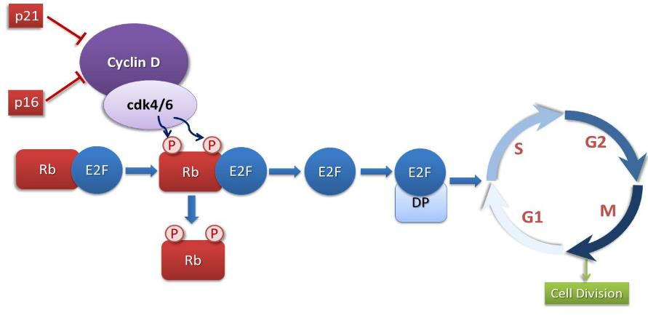
CDK4/6 Regulates Cell Cycle Progression
ER+ breast cancer may overexpress Cyclin D with subsequent loss of control of the cell cycle
Palbociclib
Abemaciclib
Ribociclib
Adapted from Finn et al, 2016.

Slide 20
CDK4/6 Inhibitors
Agent | Current indications and usage in ER-positive, HER2-negative BC
Palbociclib | With an AI as initial endocrine-based therapy for metastatic disease With fulvestrant after disease progression on ET for metastatic disease
Ribociclib | With an AI as initial endocrine-based therapy for metastatic disease With fulvestrant as initial endocrine-based therapy or after disease progression on ET for postmenopausal women or men with metastatic disease
Abemaciclib | With ET as adjuvant treatment for node-positive, early breast cancer at high risk of recurrence As monotherapy for metastatic disease with progression following ET and chemotherapy in the metastatic setting With fulvestrant after disease progression on ET for metastatic disease With an AI as initial endocrine-based therapy for metastatic disease

Slide 21
FDA Expands Early Breast Cancer Indication for Abemaciclib with Endocrine Therapy
Press Release – March 3, 2023
“The Food and Drug Administration (FDA) approved abemaciclib with endocrine therapy (tamoxifen or an aromatase inhibitor) for the adjuvant treatment of adult patients with hormone receptor (HR)-positive, human epidermal growth factor receptor 2 (HER2)-negative, node-positive, early breast cancer at high risk of recurrence.
Patients defined as high risk included those having either ≥4 pALN (pathologic axillary lymph nodes) or 1-3 pALN and either tumor grade 3 or a tumor size ≥50 mm.
Abemaciclib was previously approved for the above high-risk population with the additional requirement of having a Ki-67 score ≥20%. Today’s approval removes the Ki-67 testing requirement.”
https://www.fda.gov/drugs/resources-information-approved-drugs/fda-expands-early-breast-cancer-indication-abemaciclib-endocrine-therapy

Slide 22
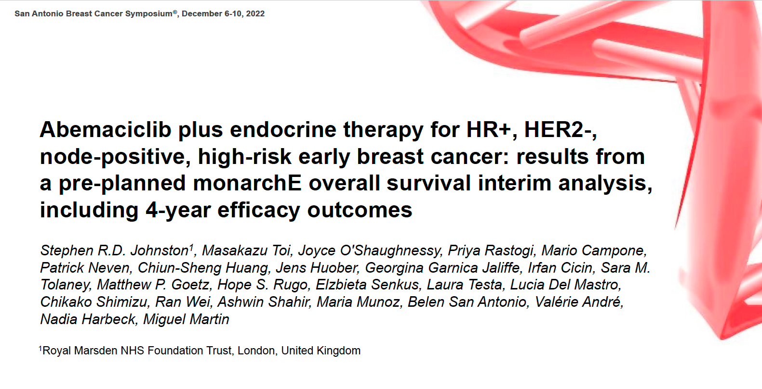
Abstract GS1-09

Slide 23
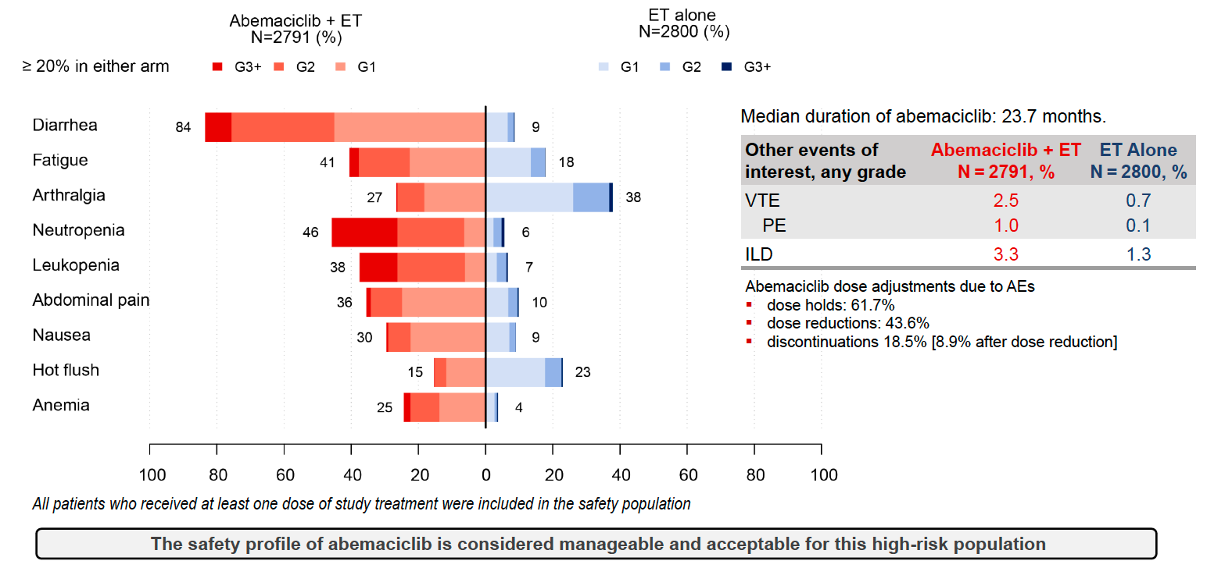
monarchE: Safety
VTE = venous thromboembolic events; PE = pulmonary embolism; ILD = interstitial lung disease
Johnston SRD et al. SABCS 2022;Abstract GS1-09.

Slide 24
Ribociclib Phase III NATALEE Trial Meets Primary Endpoint at Interim Analysis Demonstrating Clinically Meaningful Benefit in Broad Population of Patients with Early Breast Cancer
Press Release: March 27, 2023
“• NATALEE is the first and only positive Phase III study of a CDK4/6 inhibitor demonstrating consistent benefit in a broad population of patients with Stage II and III HR+/HER2- early breast cancer (EBC) at risk of recurrence, including those with no nodal involvement
• Approximately 30% to 60% of people with HR+/HER2- Stage II and III EBC treated with ET only remain at risk of breast cancer recurrence
Positive topline results [were announced] from an interim analysis of NATALEE, a Phase III trial evaluating ribociclib plus endocrine therapy (ET) in a broad population of patients with hormone receptor-positive/human epidermal growth factor receptor 2-negative (HR+/HER2-) early breast cancer (EBC) at risk of recurrence. The Independent Data Monitoring Committee recommended stopping the trial early as the primary endpoint of invasive disease-free survival (iDFS) has been met. Ribociclib plus ET significantly reduced the risk of disease recurrence, compared to standard adjuvant ET alone, with consistent benefit in patients with stage II and stage III EBC regardless of nodal involvement.”
https://www.novartis.com/news/media-releases/novartis-kisqali-phase-iii-natalee-trial-meets-primary-endpoint-interim-analysis-demonstrating-clinically-meaningful-benefit-broad-population-patients-early-breast-cancer

Slide 25
Agenda
Module 1: ER-Positive, HER2-Negative Localized Breast Cancer — PART 1
Module 2: ER-Positive, HER2-Negative Localized Breast Cancer — PART 2
Module 3: ER-Positive Metastatic Breast Cancer
Module 4: Localized HER2-Positive Breast Cancer
Module 5: HER2-Positive and HER2-Low Metastatic Breast Cancer — PART 1
Module 6: HER2-Positive and HER2-Low Metastatic Breast Cancer — PART 2
Module 7: PARP Inhibitors
Module 8: Immune Checkpoint Inhibitors

Slide 26
Jamie Carroll, APRN, MSN, CNP
67-year-old woman with ER-positive, HER2-negative metastatic breast cancer with an ESR1 mutation who received elacestrant

Slide 27
Clinical Research Background
Dr Kaklamani
San Antonio, Texas
Dr O’Shaughnessy
Dallas, Texas
Choice of first-line CDK4/6 inhibitor
Approved and investigational oral SERDs
ESR1 mutations
Capivasertib

Slide 28
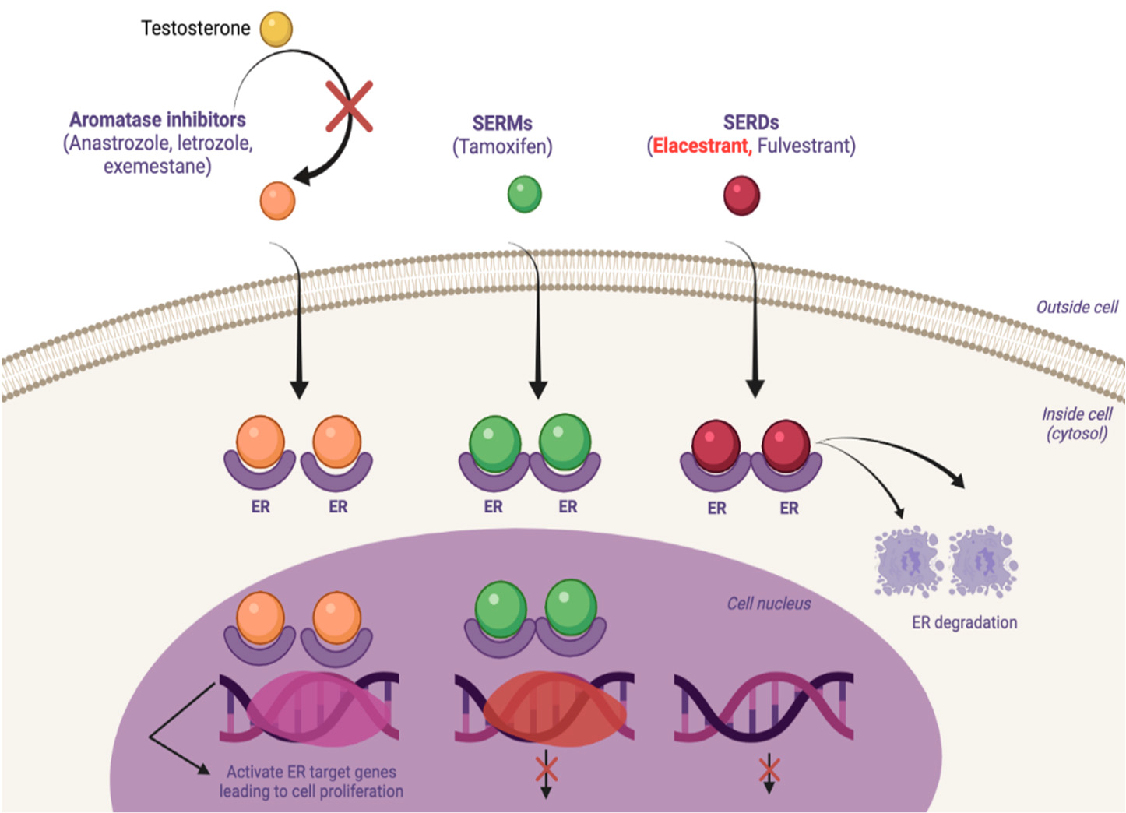
Mechanism of Action of Different Endocrine Therapies
(Eg, fulvestrant, elacestrant, camizestrant)
Hernando C et al. Int J Mol Sci 2021;22:7812.

Slide 29
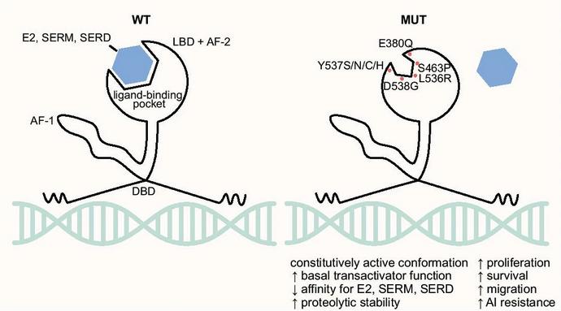
ESR1 Mutations and Resistance to Endocrine Therapies
Mutations in the ligand binding domain (LBD) of the ESR1 gene were shown to be present in ∼18% of endocrine-resistant hormone receptor-positive breast cancer cases.
ESR1 LBD mutations result in estrogen-independent activation of estrogen receptors and lead to resistance to AIs.
Brett JO et al. Breast Cancer Res 2021;23(1):85; Schiavon G et al. Sci Transl Med 2015;7(313):313ra182; Droste A and Schmidt M. J Cancer Metastasis Treat 2023;9:2.

Slide 30
Elacestrant
Mechanism of action
Oral SERD (selective estrogen receptor degrader)
Indication
For postmenopausal women or adult men with ER-positive, HER2-negative, ESR1-mutated advanced or metastatic breast cancer with disease progression after at least 1 line of endocrine therapy
Recommended dose
One 345 mg tablet po qd, with food
Elacestrant package insert, 1/2023.

Slide 31
Camizestrant
Mechanism of action
Oral SERD
Indication
Investigational
Key clinical trial
Phase II SERENA-2 trial evaluating camizestrant in postmenopausal women with locally advanced or metastatic ER-positive, HER2-negative breast cancer previously treated with endocrine therapy
Oliveira M et al. SABCS 2022;Abstract GS3-02.

Slide 32
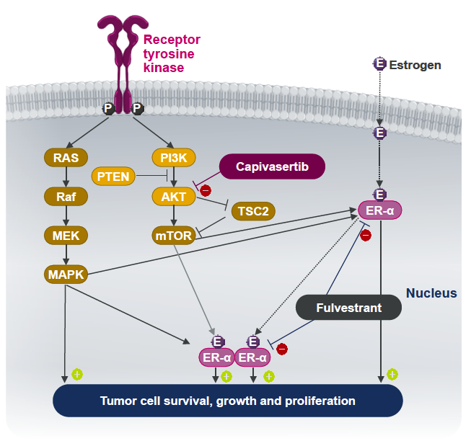
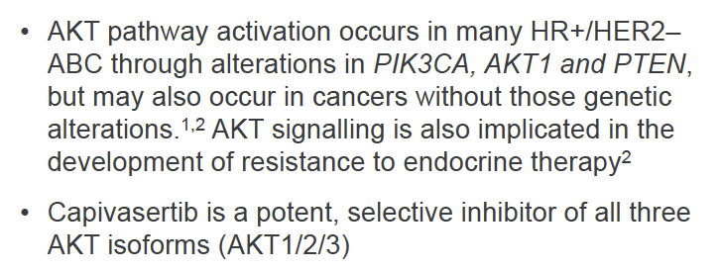
Capivasertib Mechanism of Action
Turner NC et al. SABCS 2022;Abstract GS3-04.

Slide 33
Capivasertib
Mechanism of action
AKT inhibitor
Indication
Investigational
Pivotal clinical data
Phase III CAPItello-291 trial evaluating capivasertib with fulvestrant for locally advanced or metastatic hormone receptor-positive,
HER2-negative breast cancer after recurrence or disease progression on or after treatment with an aromatase inhibitor
Turner NC et al. SABCS 2022;Abstract GS3-04.

Slide 34
Agenda
Module 1: ER-Positive, HER2-Negative Localized Breast Cancer — PART 1
Module 2: ER-Positive, HER2-Negative Localized Breast Cancer — PART 2
Module 3: ER-Positive Metastatic Breast Cancer
Module 4: Localized HER2-Positive Breast Cancer
Module 5: HER2-Positive and HER2-Low Metastatic Breast Cancer — PART 1
Module 6: HER2-Positive and HER2-Low Metastatic Breast Cancer — PART 2
Module 7: PARP Inhibitors
Module 8: Immune Checkpoint Inhibitors

Slide 35
Jamie Carroll, APRN, MSN, CNP
26-year-old premenopausal woman with a HER2-positive localized IDC who received postadjuvant neratinib

Slide 36
Clinical Research Background
Dr Kaklamani
San Antonio, Texas
Dr O’Shaughnessy
Dallas, Texas
Postadjuvant neratinib
  Role of ER status in patient selection
  Prevention and management of diarrhea

Slide 37
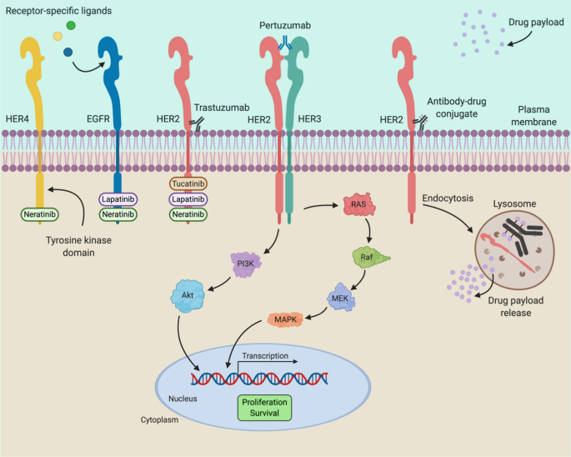
Pertuzumab
T-DM1,
Trastuzumab deruxtecan
Trastuzumab
Tucatinib – HER2
Lapatinib – HER2, HER3
Neratinib – HER2, HER3, HER4
Panoply of HER2-Targeted Agents
Tesch ME, Gelmon KA. Drugs 2020;80:1811-30.

Slide 38
CONTROL Trial: Strategies to Improve Neratinib Tolerability
Background: Neratinib is approved for extended-adjuvant therapy in HER2-positive breast cancer
Neratinib was poorly tolerated in the ExteNET trial:
  Discontinuation rate 17%
  Grade 3 diarrhea 40%
Objective: Improve GI tolerability of neratinib
Methods: Sequential single-arm interventions for patients who receive adjuvant therapy
Cohort 1 (L): Loperamide (n = 137)
Cohort 2 (BL): Budesonide + loperamide (n = 64)
Cohort 3 (CL or CL-PRN): Colestipol + loperamide (n = 136) or colestipol + as-needed loperamide (n = 104)
Cohort 4 (DE): Neratinib dose escalation; ongoing (n = 60)
Barcenas CH et al. Ann Oncol 2020;31(9):1223-30.

Slide 39
Agenda
Module 1: ER-Positive, HER2-Negative Localized Breast Cancer — PART 1
Module 2: ER-Positive, HER2-Negative Localized Breast Cancer — PART 2
Module 3: ER-Positive Metastatic Breast Cancer
Module 4: Localized HER2-Positive Breast Cancer
Module 5: HER2-Positive and HER2-Low Metastatic Breast Cancer — PART 1
Module 6: HER2-Positive and HER2-Low Metastatic Breast Cancer — PART 2
Module 7: PARP Inhibitors
Module 8: Immune Checkpoint Inhibitors

Slide 40
Ronald Stein, JD, MSN, NP-C, AOCNP
49-year-old woman with recurrent HER2-positive metastatic breast cancer who received T-DXd

Slide 41
Clinical Research Background
Dr Kaklamani
San Antonio, Texas
Dr O’Shaughnessy
Dallas, Texas
Sequencing of therapies for HER2-positive breast cancer
  Tucatinib
  Trastuzumab deruxtecan (T-DXd)
Management of HER2-positive brain metastases

Slide 42
HER2-Targeting Antibody-Drug Conjugates (ADCs)
mAb targets tumour-specific antigens
ADC Attributes | T-DM1 | T-DXd
Payload MoA | Antimicrotubule | Topoisomerase I inhibitor
Drug-to-antibody ratio | ~3.5:1 | ~8:1
Tumor-selective cleavable linker? | No | Yes
Evidence of bystander antitumor effect? | No | Yes
Tumour antigen internalised upon ADC binding
Potent
cytotoxic payload
Stable linker releases payload only in target cell
Bystander effect due to
payload release before internalisation or membrane permeability
Schmid P et al. SABCS 2021.

Slide 43
Trastuzumab Deruxtecan
Mechanism of action
Antibody-drug conjugate directed against HER2
Indication
For patients with unresectable or metastatic HER2-positive breast cancer who have
received a prior anti-HER2-based regimen either in the metastatic setting or in the (neo)adjuvant setting and have experienced disease recurrence during or within 6 months of completing therapy
For patients with unresectable or metastatic HER2-low (IHC 1+ or IHC 2+/ISH-) breast cancer who have received a prior chemotherapy in the metastatic setting or developed disease recurrence during or within 6 months of completing adjuvant chemotherapy
Recommended dose
5.4 mg/kg IV infusion q3wk until disease progression or unacceptable toxicity
Trastuzumab deruxtecan package insert, 11/2022.

Slide 44
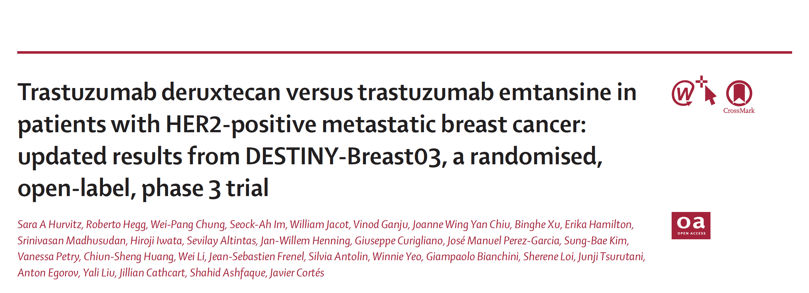
Lancet 2023 January 14;401:105-17.

Slide 45
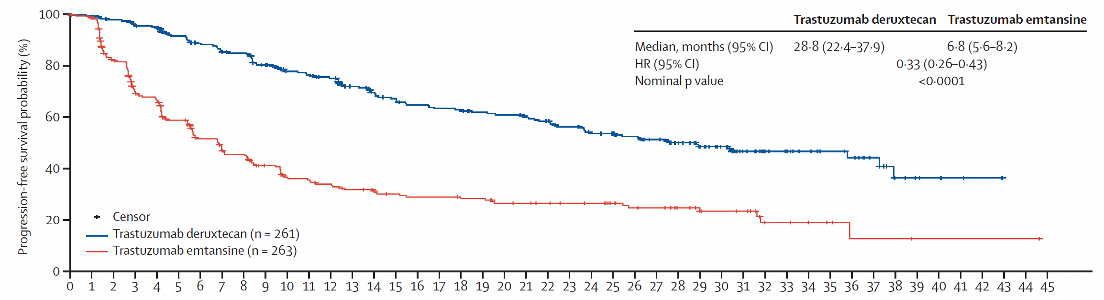
DESTINY-Breast03: Progression-Free Survival
Time since Randomization (months)
Hurvitz SA et al. Lancet 2023;401:105-17.

Slide 46
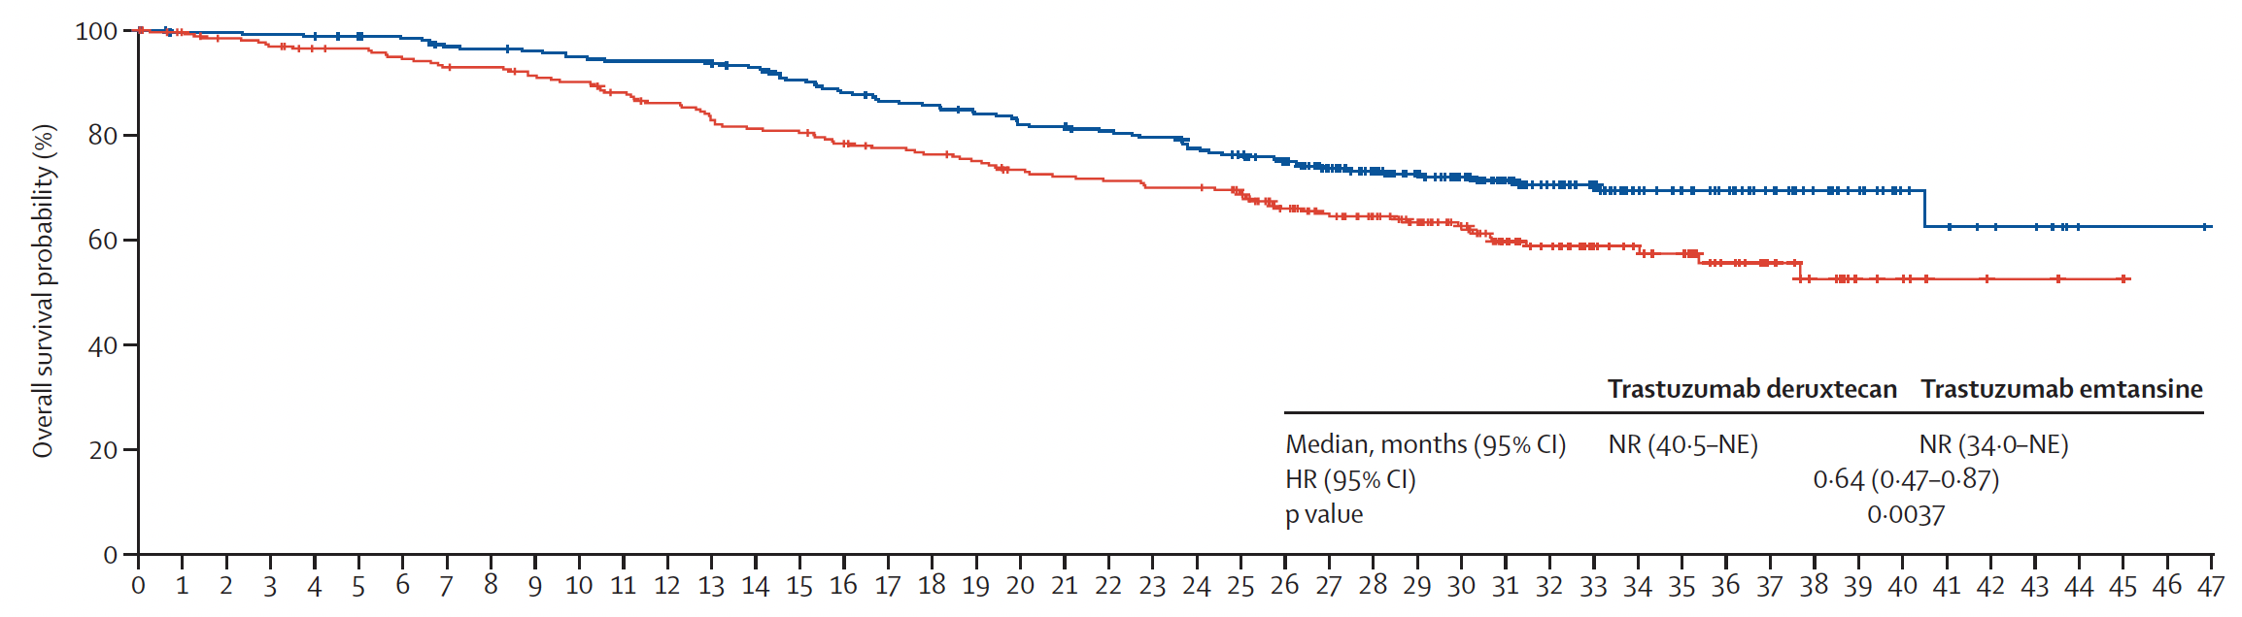
DESTINY-Breast03: Overall Survival
Time since randomization (months)
Hurvitz SA et al. Lancet 2023;401:105-17.

Slide 47
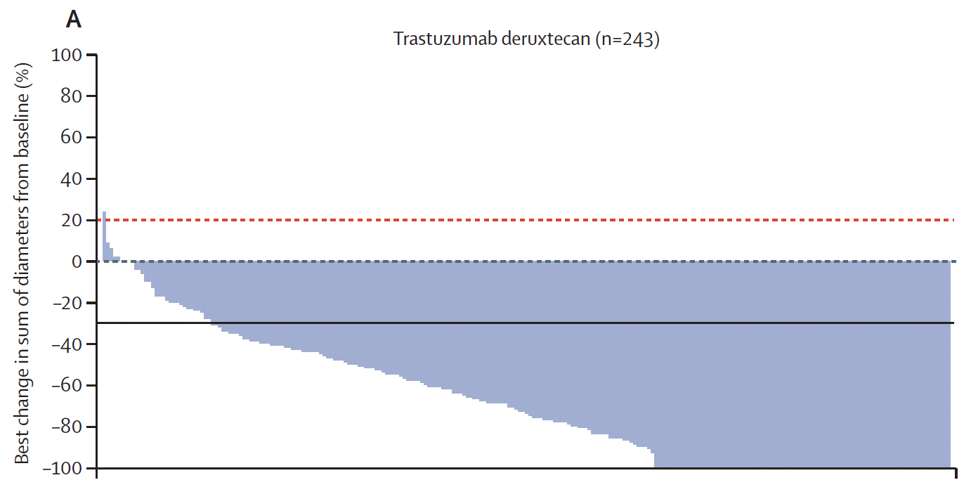
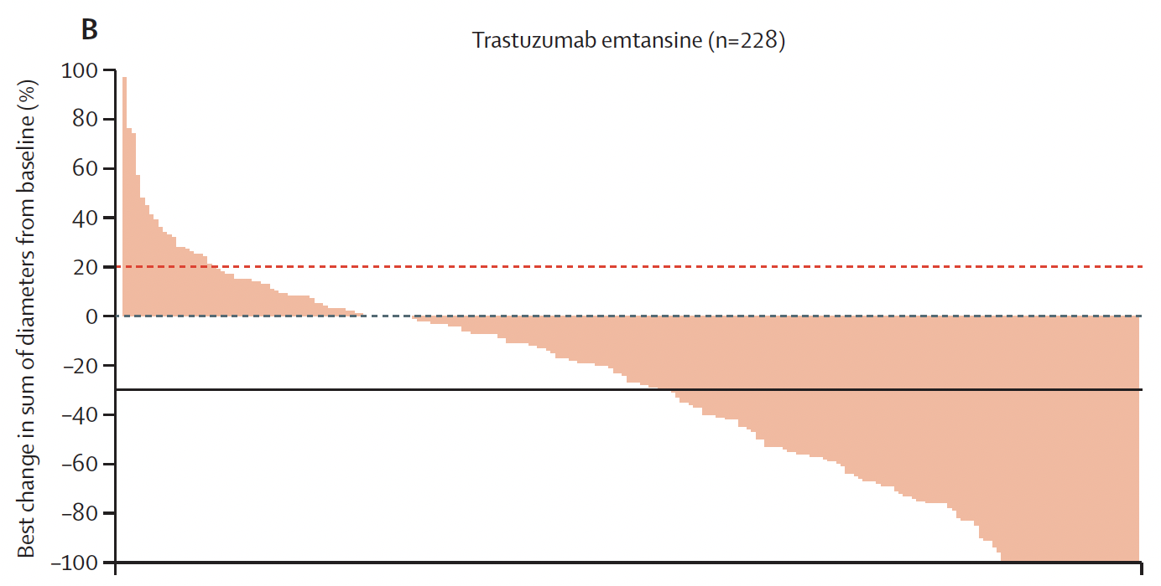
DESTINY-Breast03: Antitumor Activity
Trastuzumab deruxtecan (n = 243)
Trastuzumab emtansine (n = 228)
Confirmed ORR: 79%
Confirmed ORR: 35%
Patients
Patients
Hurvitz SA et al. Lancet 2023;401:105-17.

Slide 48
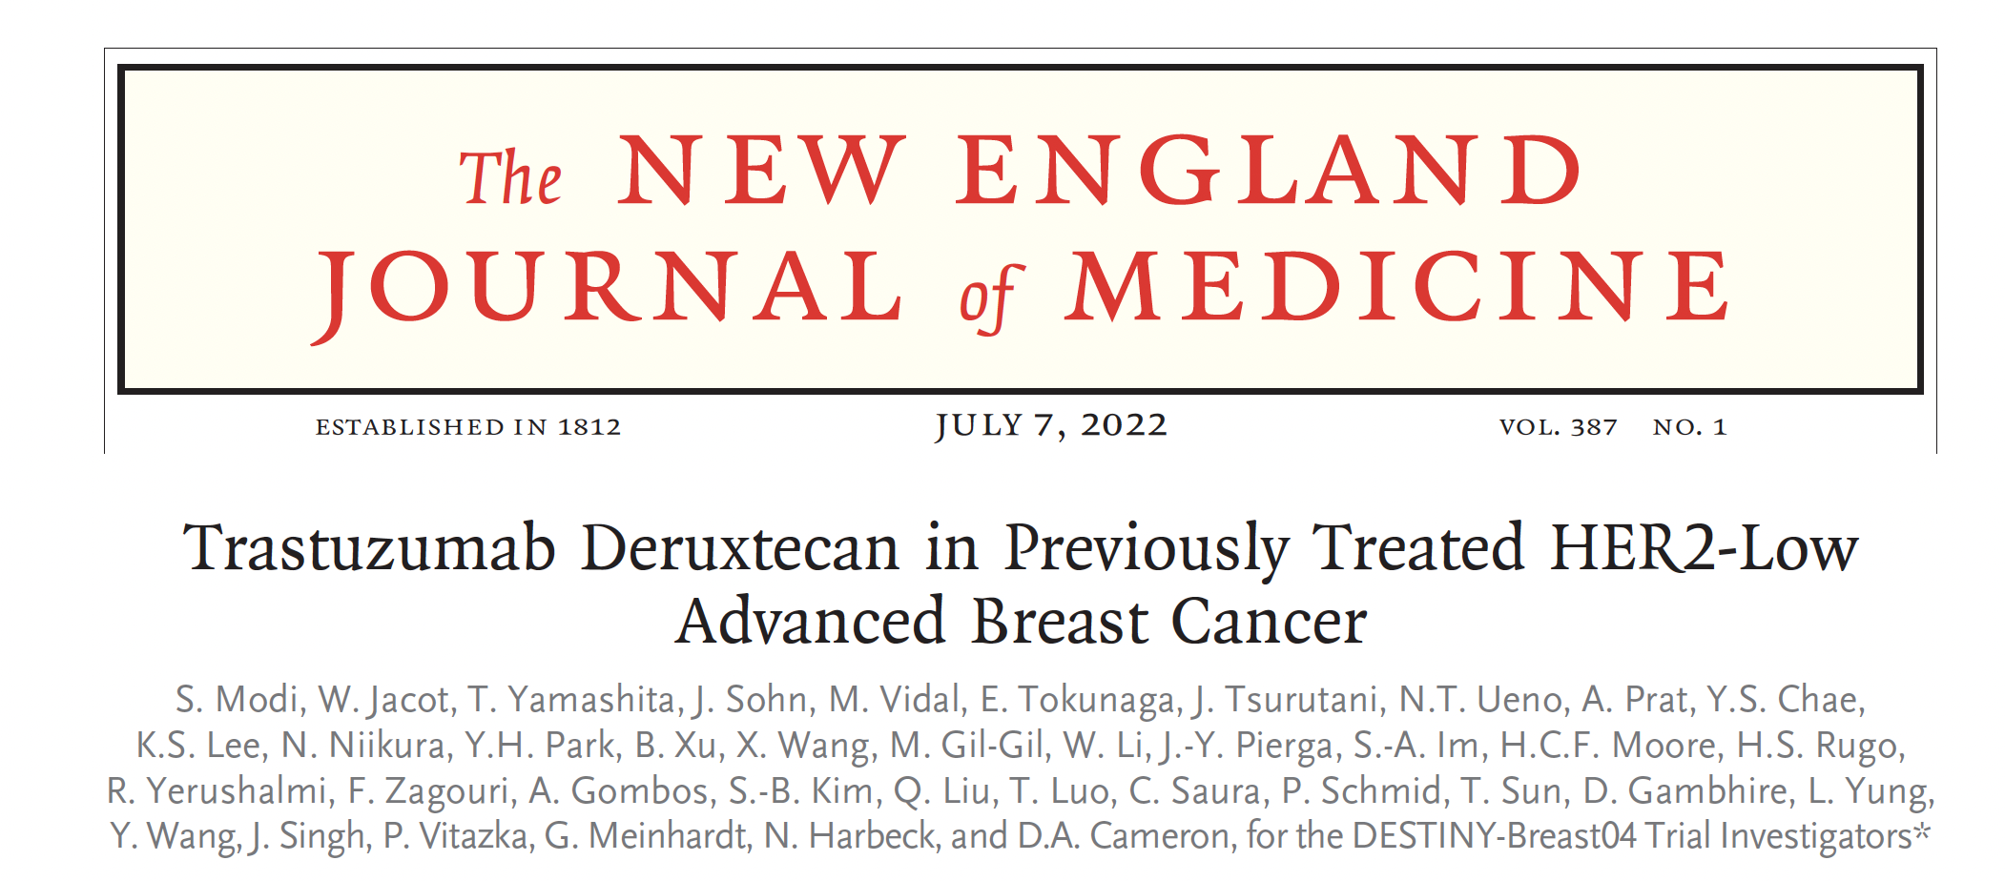
N Engl J Med. 2022;387(1):9-20.

Slide 49
Agenda
Module 1: ER-Positive, HER2-Negative Localized Breast Cancer — PART 1
Module 2: ER-Positive, HER2-Negative Localized Breast Cancer — PART 2
Module 3: ER-Positive Metastatic Breast Cancer
Module 4: Localized HER2-Positive Breast Cancer
Module 5: HER2-Positive and HER2-Low Metastatic Breast Cancer — PART 1
Module 6: HER2-Positive and HER2-Low Metastatic Breast Cancer — PART 2
Module 7: PARP Inhibitors
Module 8: Immune Checkpoint Inhibitors

Slide 50
Jamie Carroll, APRN, MSN, CNP
57-year-old woman with HER2-positive breast cancer and brain metastases who received tucatinib/trastuzumab/capecitabine

Slide 51
Clinical Research Background
Dr Kaklamani
San Antonio, Texas
Dr O’Shaughnessy
Dallas, Texas
Sequencing of therapies for HER2-positive breast cancer
  Tucatinib
  Trastuzumab deruxtecan (T-DXd)
Management of HER2-positive brain metastases

Slide 52
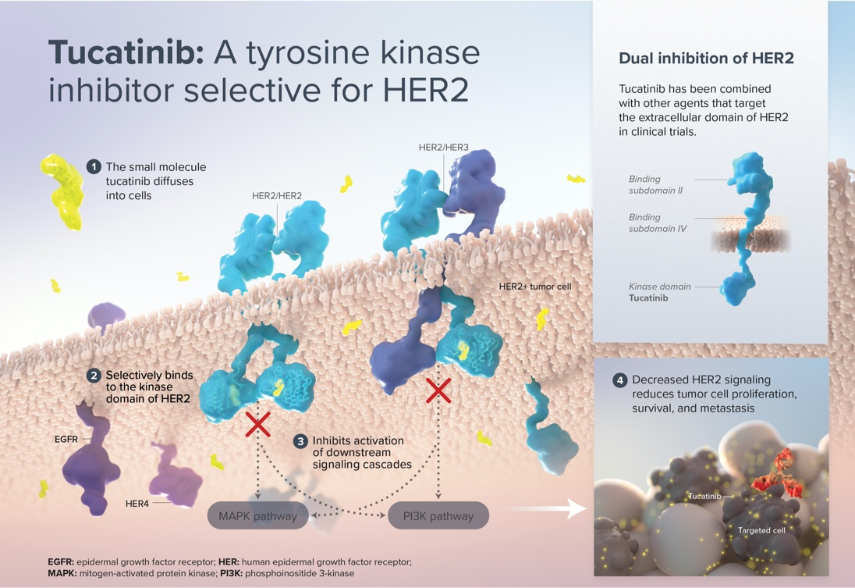
Tucatinib Mechanism of Action
Catenacci DV et al. ESMO 2021;Abstract 1434TiP.

Slide 53
Tucatinib
Mechanism of action
HER2 tyrosine kinase inhibitor
Indication
In combination with trastuzumab and capecitabine for patients with advanced unresectable or metastatic HER2-positive breast cancer who have received 1 or more prior anti-HER2-based regimens in the metastatic setting
Recommended dose
300 mg po BID with or without food
Tucatinib package insert, 1/2023.

Slide 54
Agenda
Module 1: ER-Positive, HER2-Negative Localized Breast Cancer — PART 1
Module 2: ER-Positive, HER2-Negative Localized Breast Cancer — PART 2
Module 3: ER-Positive Metastatic Breast Cancer
Module 4: Localized HER2-Positive Breast Cancer
Module 5: HER2-Positive and HER2-Low Metastatic Breast Cancer — PART 1
Module 6: HER2-Positive and HER2-Low Metastatic Breast Cancer — PART 2
Module 7: PARP Inhibitors
Module 8: Immune Checkpoint Inhibitors

Slide 55
Ronald Stein, JD, MSN, NP-C, AOCNP
49-year-old woman with a germline BRCA1 mutation and localized TNBC who received adjuvant olaparib

Slide 56
Clinical Research Background
Dr Kaklamani
San Antonio, Texas
Dr O’Shaughnessy
Dallas, Texas
Spectrum of somatic and germline mutations
Clinical use of PARP inhibitors in the adjuvant and metastatic settings
Tolerability/toxicity of PARP inhibitors

Slide 57








PARPi Exploits the Baseline Vulnerability of Cells with Inherent DNA Repair Deficiency
PARP inhibitor
PARP inhibitor
PARP
Increase in double-strand breaks in replicating cells
PARP
Trapped PARP on single-strand breaks
Double-strand breaks
HRR-deficient cancer cell
Normal cell

Reliance on error prone pathways leads to DNA damage accumulation and cell death
Repair of double-strand breaks via the HRR pathway and cell survival
✓
O’Connor MJ. Mol Cell. 2015.

Slide 58
PARP Inhibitors
Olaparib
Indications:
  Adjuvant treatment for patients with gBRCAm, HER2-negative high-risk localized breast cancer who have been treated with neoadjuvant or adjuvant chemotherapy; administered for 1 year
  Treatment for patients with gBRCAm, HER2-negative mBC who have been treated with chemotherapy in the neoadjuvant, adjuvant or metastatic setting. Patients with HR-positive breast cancer should have been treated with prior endocrine therapy or be considered inappropriate for
  endocrine therapy
Talazoparib
Indication:
  Treatment for patients with gBRCAm HER2-negative locally advanced or metastatic breast cancer

Slide 59
Agenda
Module 1: ER-Positive, HER2-Negative Localized Breast Cancer — PART 1
Module 2: ER-Positive, HER2-Negative Localized Breast Cancer — PART 2
Module 3: ER-Positive Metastatic Breast Cancer
Module 4: Localized HER2-Positive Breast Cancer
Module 5: HER2-Positive and HER2-Low Metastatic Breast Cancer — PART 1
Module 6: HER2-Positive and HER2-Low Metastatic Breast Cancer — PART 2
Module 7: PARP Inhibitors
Module 8: Immune Checkpoint Inhibitors

Slide 60
Ronald Stein, JD, MSN, NP-C, AOCNP
42-year-old woman with localized TNBC who received neoadjuvant chemotherapy/pembrolizumab followed by adjuvant pembrolizumab

Slide 61
Clinical Research Background
Dr Kaklamani
San Antonio, Texas
Dr O’Shaughnessy
Dallas, Texas
KEYNOTE-522
KEYNOTE-355: Relevance of PD-L1 expression
Immune-mediated toxicities associated with immunotherapy

Slide 62
Pembrolizumab
Mechanism of action
PD-1 inhibitor
Indication
In combination with chemotherapy as neoadjuvant treatment and continued as single agent after surgery for high-risk early-stage TNBC
In combination with chemotherapy for patients with advanced/metastatic TNBC whose tumors express PD-L1 (CPS ≥ 10)
Recommended dose
200 mg every 3 weeks or 400 mg every 6 weeks
Pembrolizumab package insert, 4/2023.

Slide 63
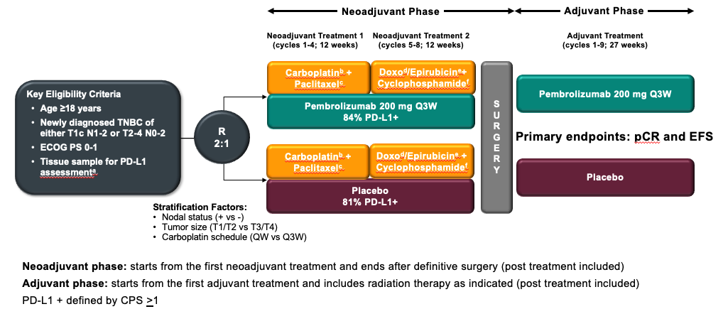
KEYNOTE-522: Phase III Trial Schema
Schmid P et al. N Engl J Med 2020;382:810-21.

Slide 64
APPENDIX

Slide 65
ER-Positive, HER2-Negative Localized
Breast Cancer

Slide 66
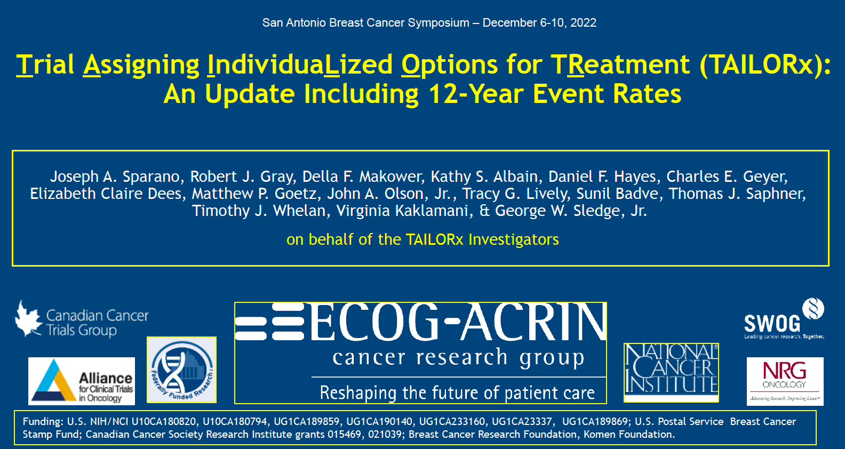
Abstract GS1-05

Slide 67
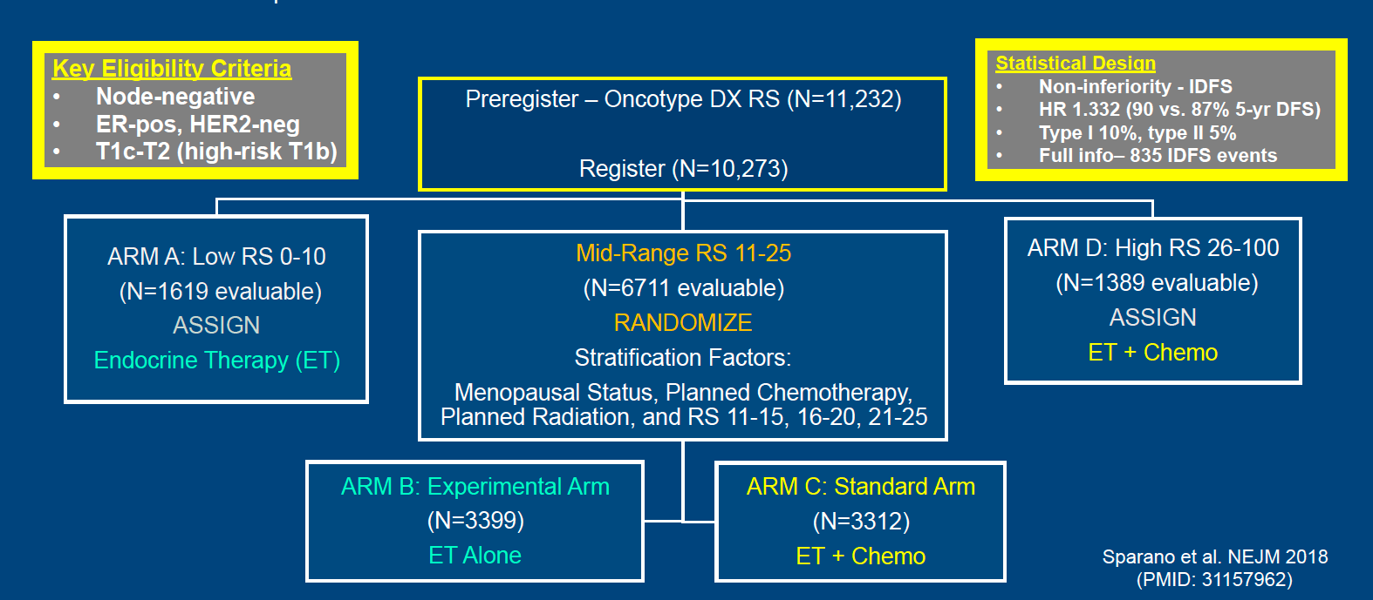
TAILORx Study Design: Treatment Assignment and Randomization
RS = Recurrence Score
Sparano JA et al. SABCS 2022;Abstract GS1-05.

Slide 68
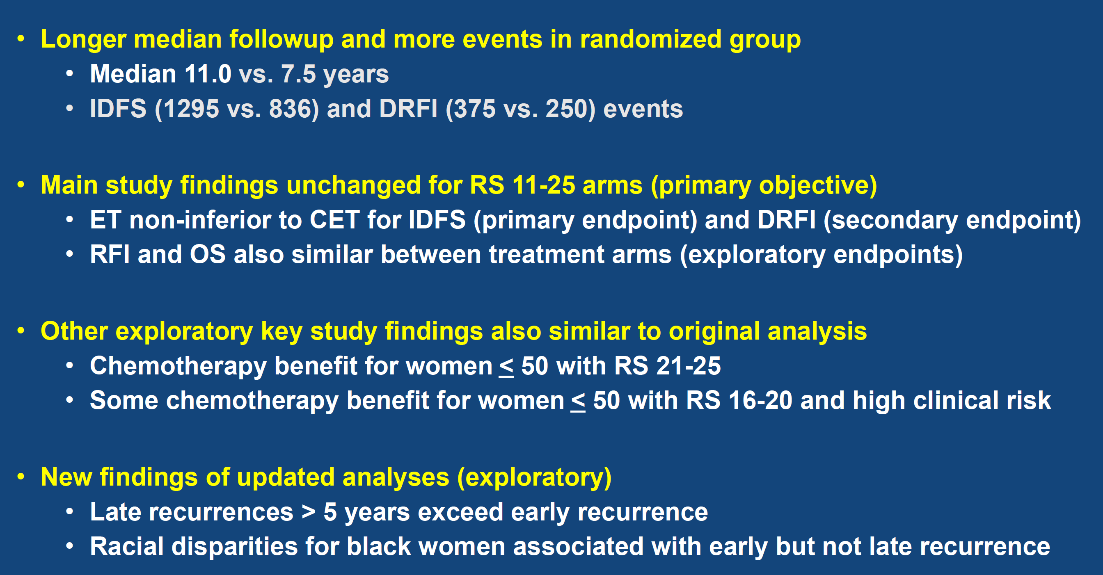
TAILORx Updated Analysis: Conclusions
Sparano JA et al. SABCS 2022;Abstract GS1-05.

Slide 69
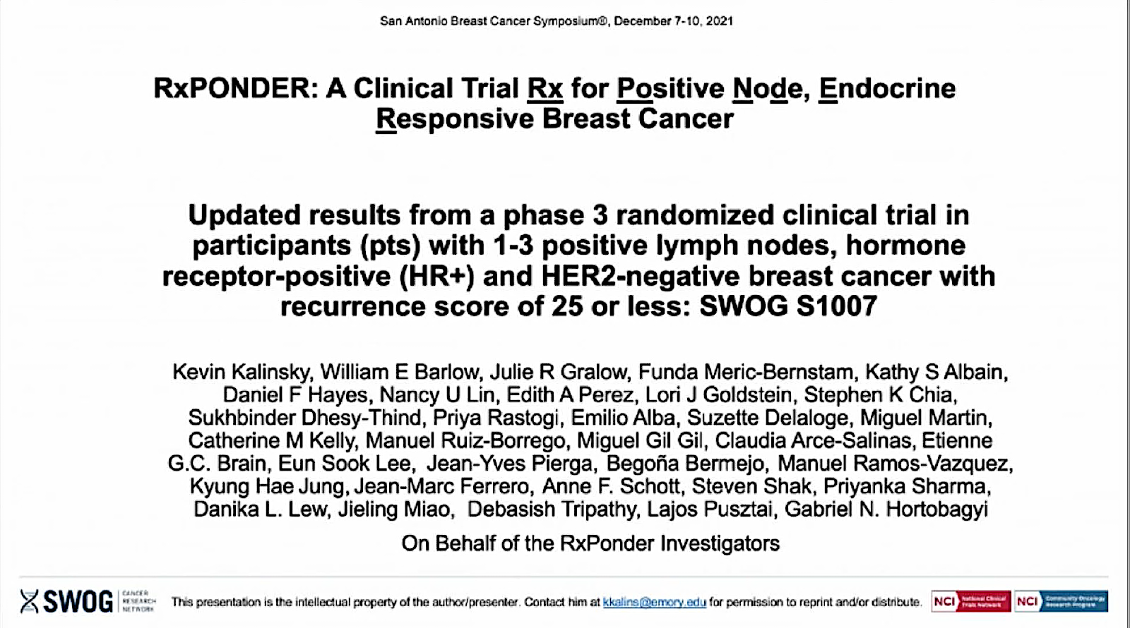
Abstract GS2-07

Slide 70
RxPONDER Trial Schema
Key Entry Criteria
Women age ≥18
ER and/or PR ≥1%, HER2-negative breast cancer with 1*-3 positive LN without distant metastasis
Able to receive adjuvant taxane and/or anthracycline-based chemotherapy†
Axillary staging by SLNB or ALND
R
E
G
I
S
T
R
A
T
I
O
N
R
A
N
D
O
M
I
Z
A
T
I
O
N
Arm 1
Chemotherapy followed by endocrine therapy
Recurrence Score®
0-25
Arm 2
Endocrine therapy alone
Recurrence Score
>25
N = 5,000 pts
Stratification factors
Recurrence Score: 0-13 vs 14-25
Menopausal status: pre vs post
Axillary surgery: ALND vs SLNB
Off-study
chemotherapy followed by
endocrine therapy recommended
LN = lymph nodes; SLNB = sentinel lymph node biopsy; ALND = axillary lymph node dissection
  * After randomization of 2,493 pts, the protocol was amended to exclude enrollment of pts with pN1mic as only nodal disease.
  † Approved chemotherapy regimens included TC, FAC (or FEC), AC/T (or EC/T), FAC/T (or FEC/T). AC alone or CMF not allowed.
Kalinsky K et al. SABCS 2020;Abstract GS3-00.

Slide 71
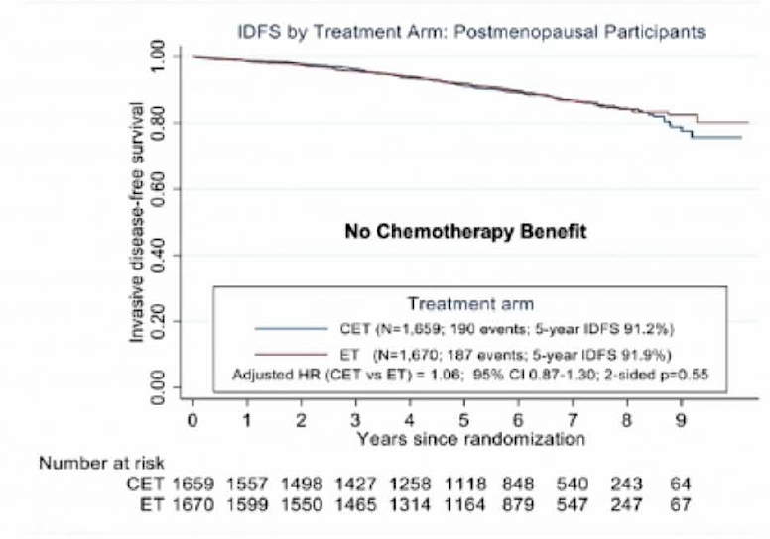
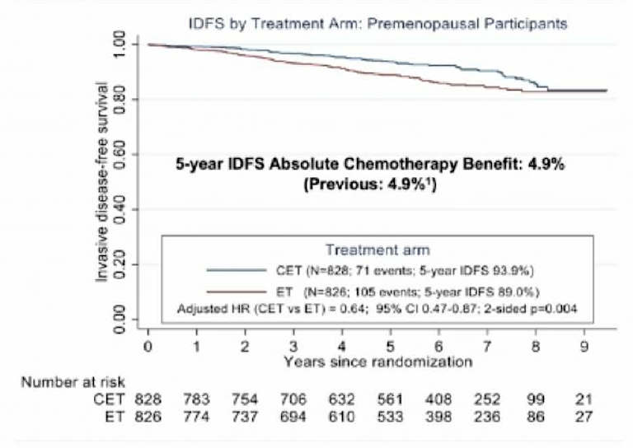
RxPONDER Updated Analysis: IDFS Stratified by Menopausal Status
Postmenopausal
Premenopausal
IDFS = invasive disease-free survival; CET = chemotherapy followed by endocrine therapy; ET = endocrine therapy
Kalinsky K et al. SABCS 2021;Abstract GS2-07.

Slide 72
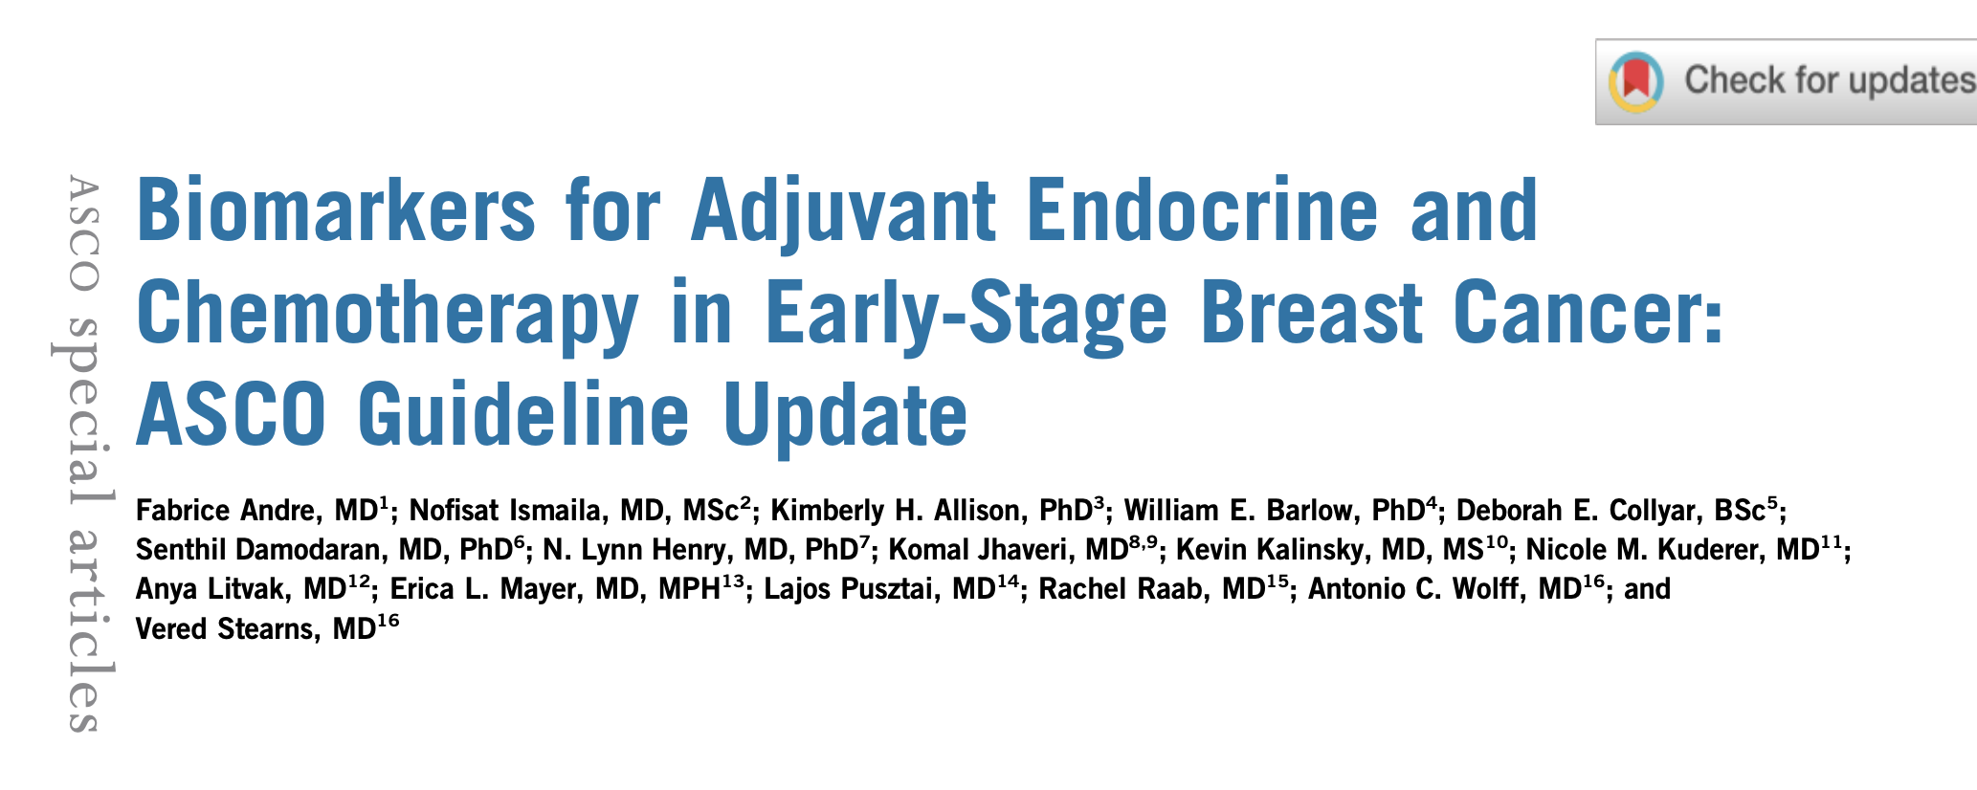
J Clin Oncol 2022;40(16):1816-37.

Slide 73
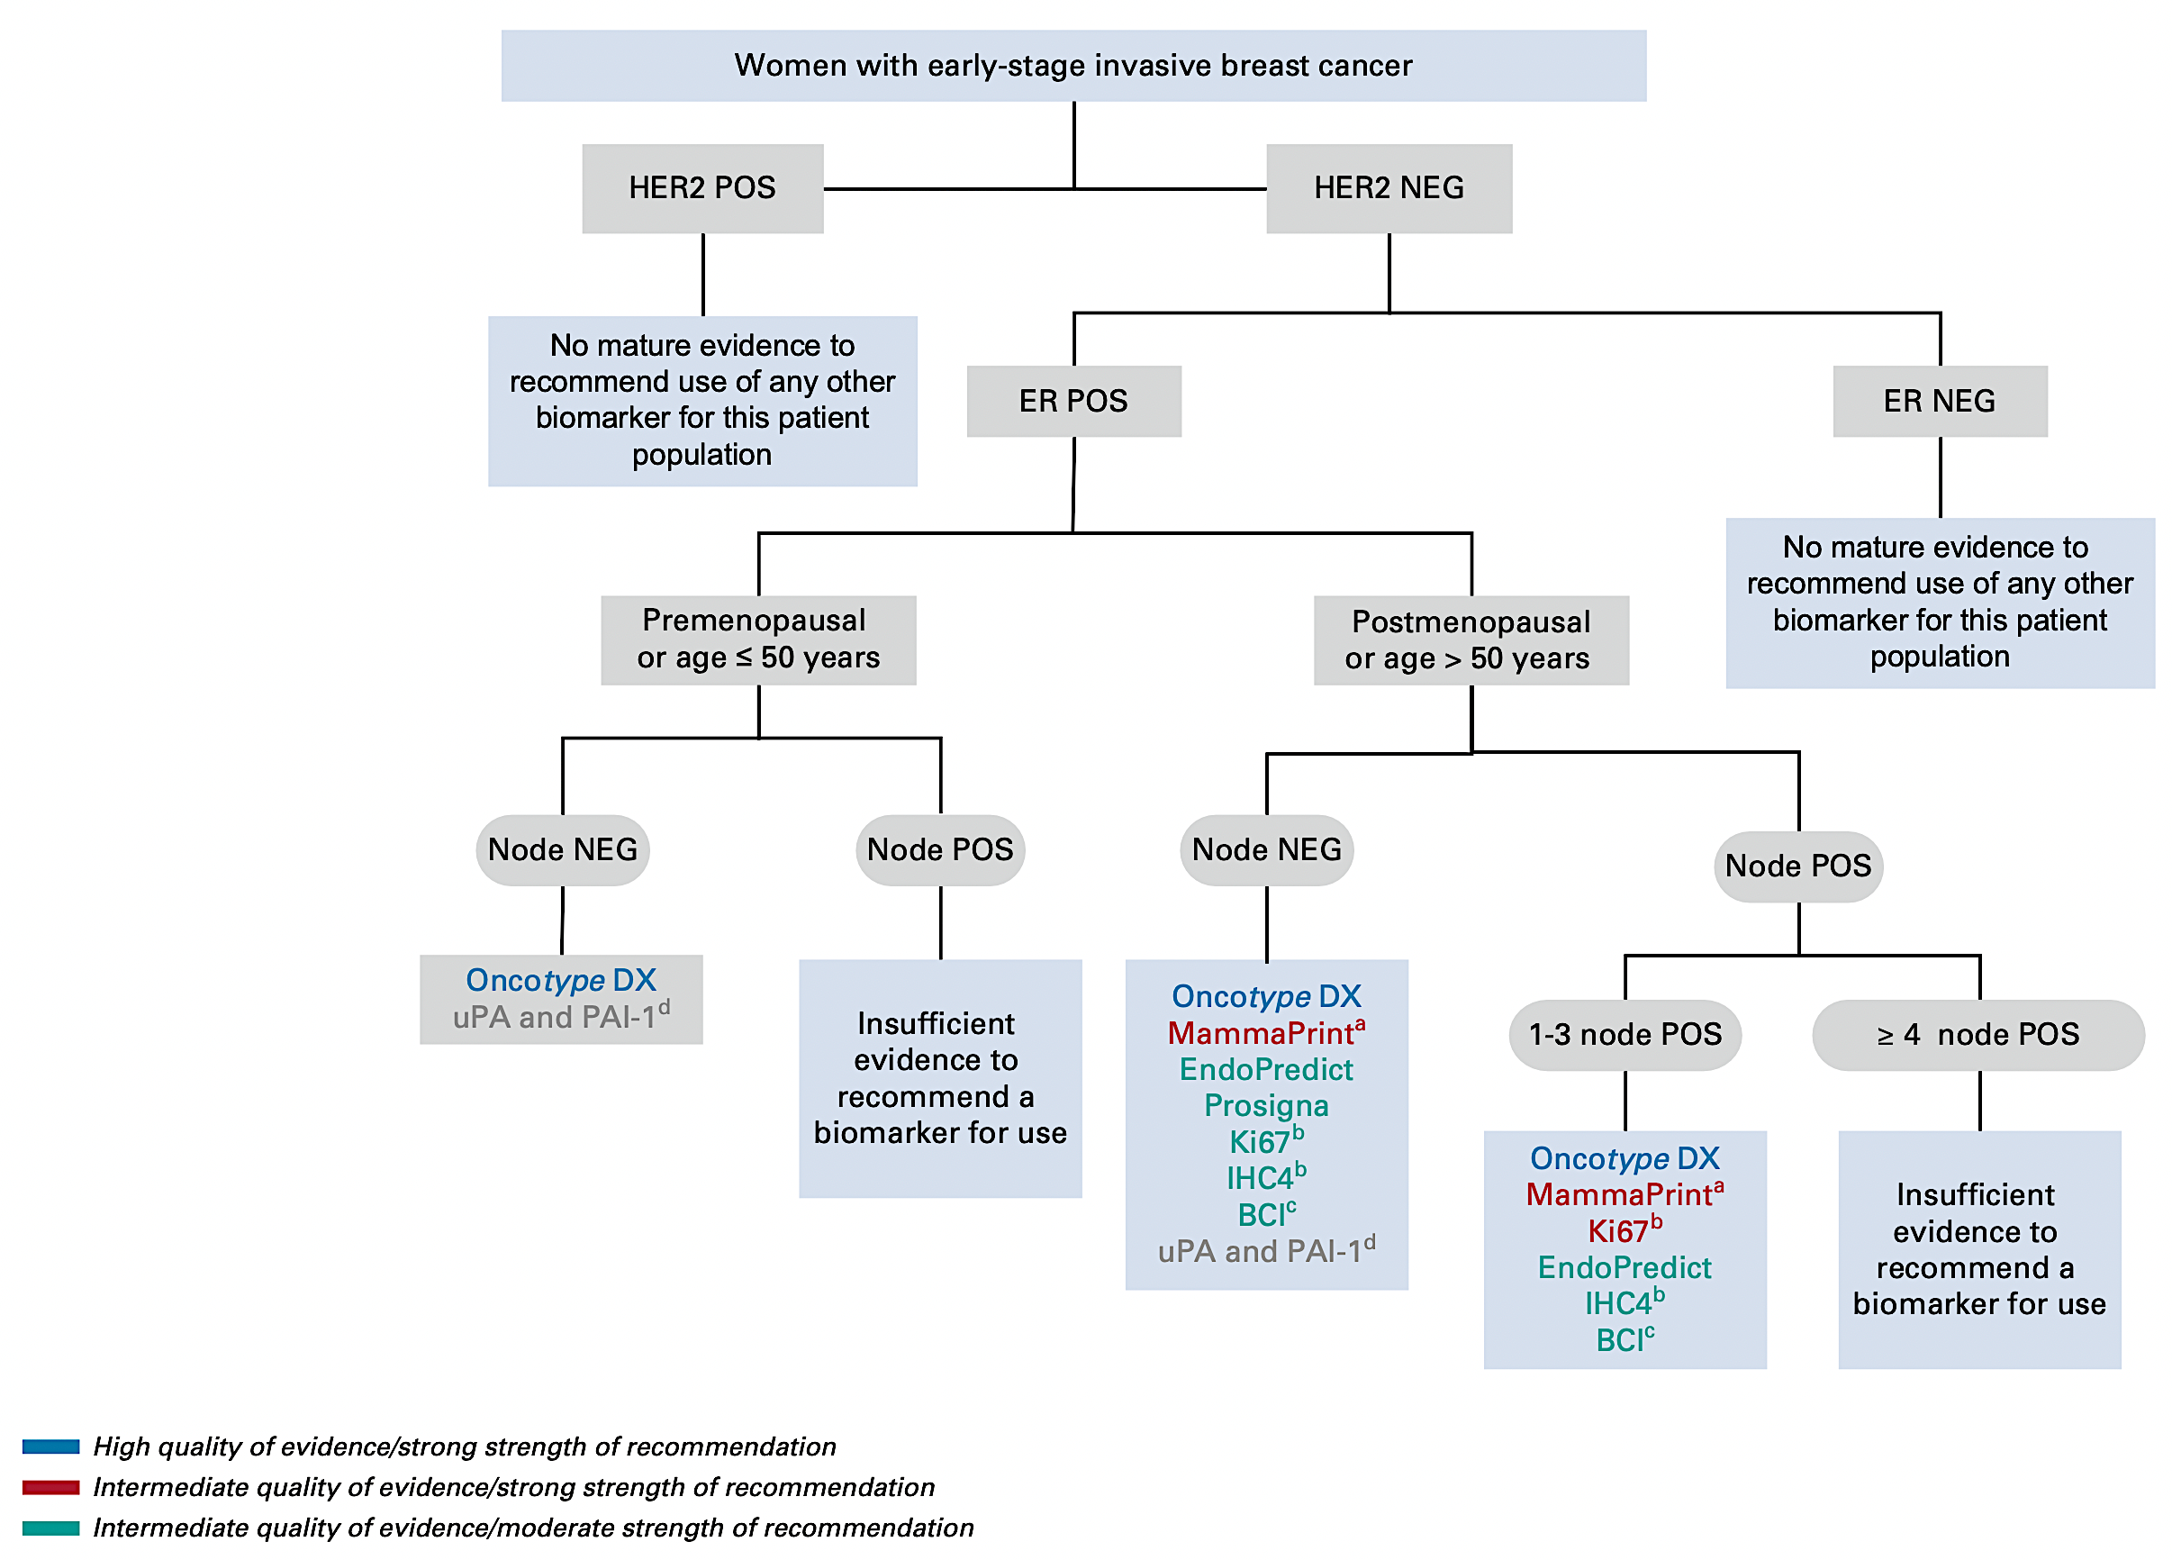
Biomarkers for Adjuvant Endocrine Therapy and Chemotherapy in Localized Breast Cancer: ASCO Guideline Update
Andre F et al. J Clin Oncol 2022;40(16):1816-37.

Slide 74
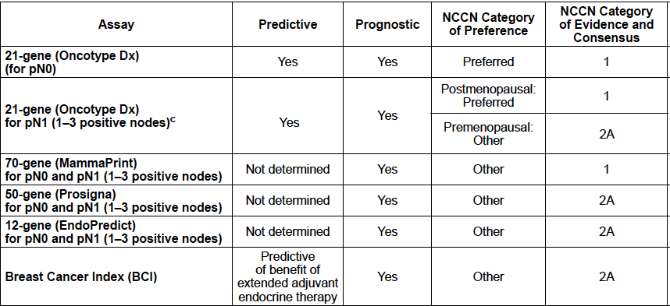
NCCN Guidelines: Gene Expression Assays for
Consideration of Adjuvant Systemic Therapy
21-gene (Oncotype DX®)
21-gene (Oncotype DX®)
70-gene (MammaPrint®)
50-gene (Prosigna®)
12-gene (EndoPredict®)
Breast Cancer Index® (BCI)
National Comprehensive Cancer Network (NCCN®). NCCN clinical practice guidelines in oncology. Breast cancer — Version 4.2022. https://www.nccn.org/professionals/physician_gls/pdf/breast.pdf. Accessed August 2022.

Slide 75
FDA Expands Early Breast Cancer Indication for Abemaciclib with Endocrine Therapy
Press Release – March 3, 2023
“The Food and Drug Administration (FDA) approved abemaciclib with endocrine therapy (tamoxifen or an aromatase inhibitor) for the adjuvant treatment of adult patients with hormone receptor (HR)-positive, human epidermal growth factor receptor 2 (HER2)-negative, node-positive, early breast cancer at high risk of recurrence.
Patients defined as high risk included those having either ≥4 pALN (pathologic axillary lymph nodes) or 1-3 pALN and either tumor grade 3 or a tumor size ≥50 mm.
Abemaciclib was previously approved for the above high-risk population with the additional requirement of having a Ki-67 score ≥20%. Today’s approval removes the Ki-67 testing requirement.”
https://www.fda.gov/drugs/resources-information-approved-drugs/fda-expands-early-breast-cancer-indication-abemaciclib-endocrine-therapy

Slide 76
Abstract GS1-09

Slide 77
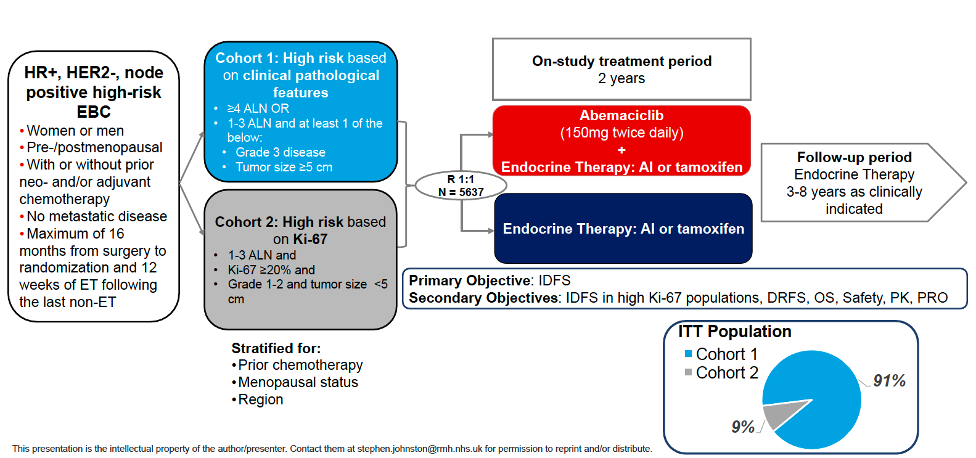
monarchE Phase III Study Design
EBC = early breast cancer; ET = endocrine therapy; IDFS = invasive disease-free survival; DRFS = distant relapse-free survival; OS = overall survival; PK = pharmacokinetics; PRO = patient-reported outcomes
Johnston SRD et al. SABCS 2022;Abstract GS1-09.

Slide 78
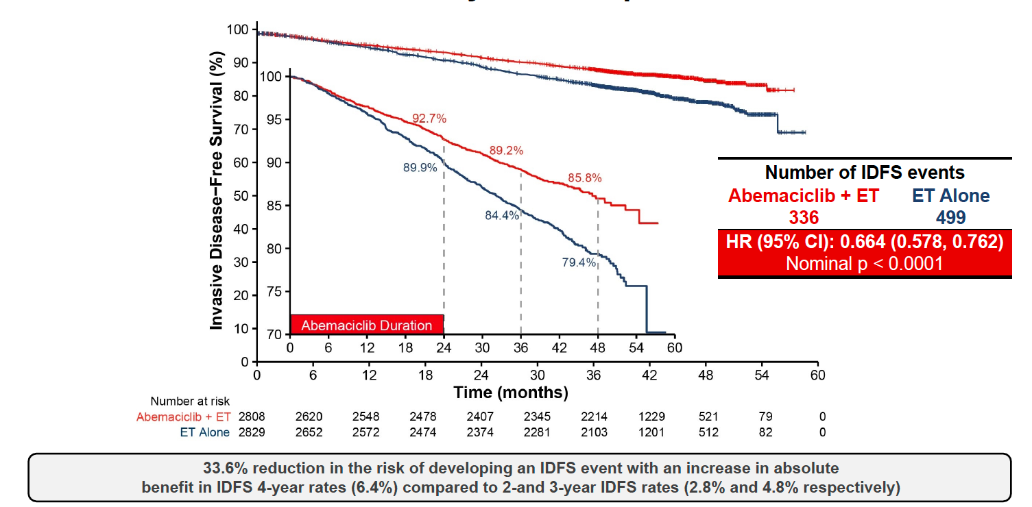
monarchE: IDFS (ITT Population)
Abemaciclib treatment benefit deepened over time
Ki-67 is prognostic, but not predictive of abemaciclib benefit
Johnston SRD et al. SABCS 2022;Abstract GS1-09.

Slide 79
monarchE: Safety
VTE = venous thromboembolic events; PE = pulmonary embolism; ILD = interstitial lung disease
Johnston SRD et al. SABCS 2022;Abstract GS1-09.

Slide 80

2022;[Online ahead of print]

Slide 81
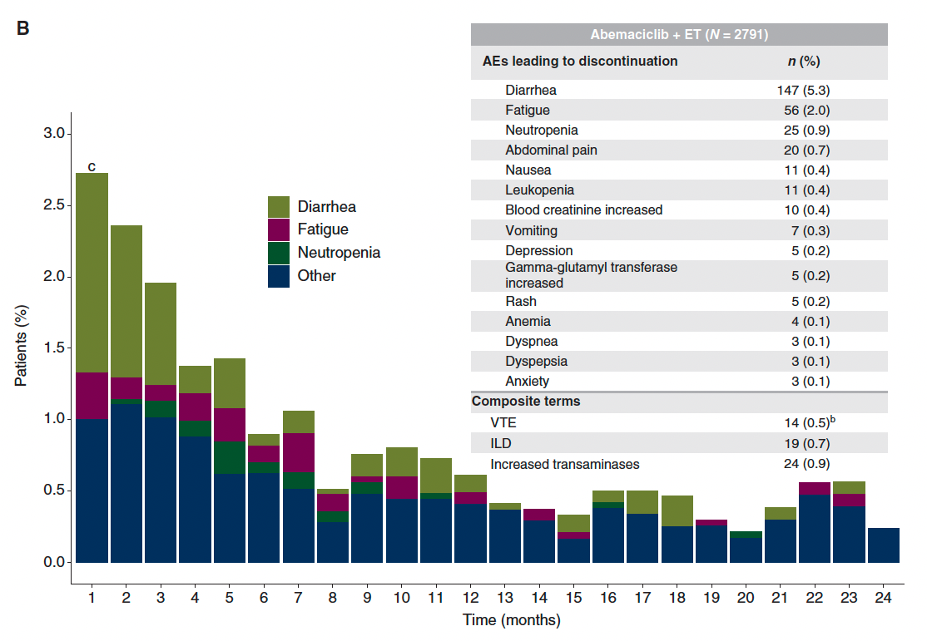
monarchE: Discontinuations Due to Adverse Events (AEs) on the Abemaciclib Arm
Rugo HS et al. Ann Oncol 2022;[Online ahead of print].

Slide 82
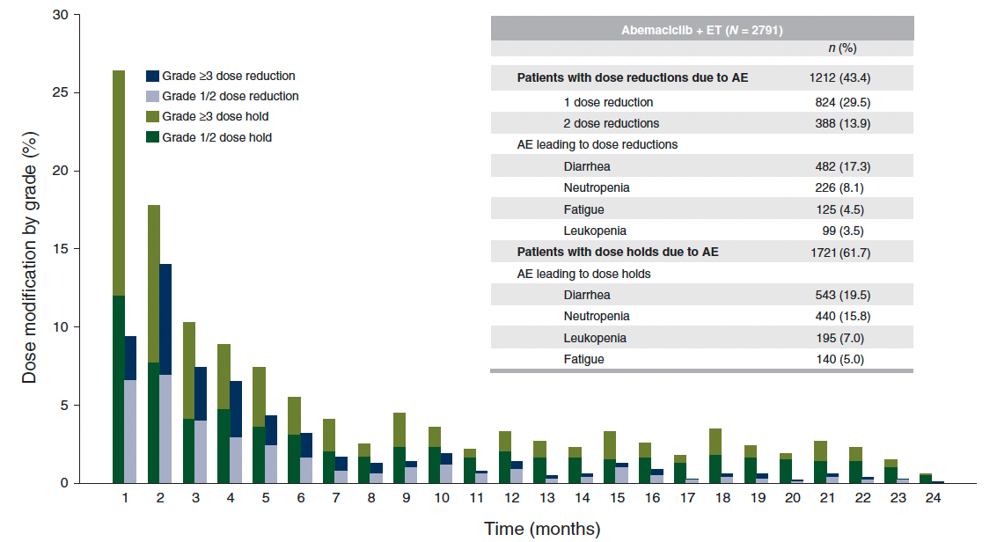
monarchE: Abemaciclib Dose Modifications
Rugo HS et al. Ann Oncol 2022;[Online ahead of print].

Slide 83
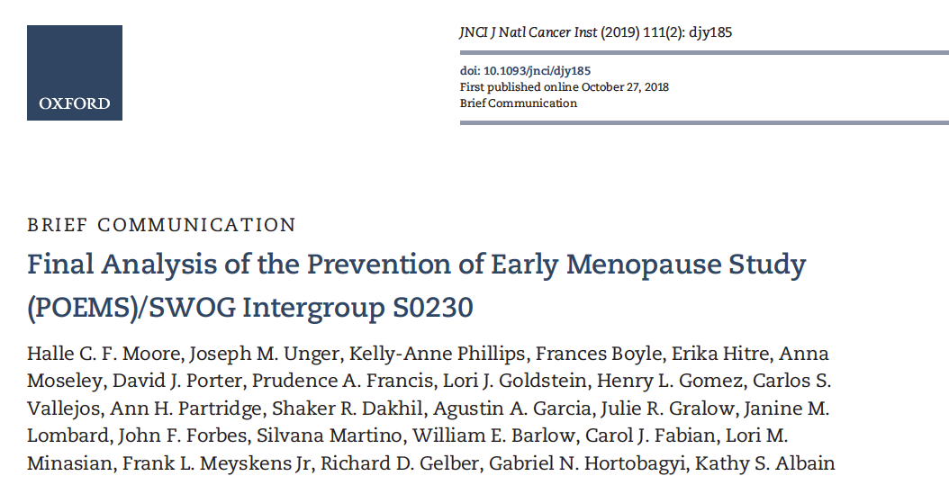

Slide 84
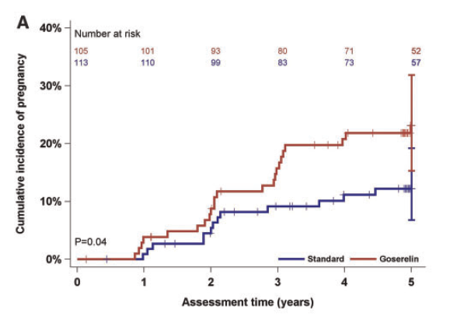
POEMS Final Analysis: Incidence of Pregnancy with Goserelin and Chemotherapy versus Standard Chemotherapy Alone for Premenopausal Women with Stage I to IIIA ER/PR-Negative Breast Cancer
Moore HCF et al. J Natl Cancer Inst 2019;111(2):210-13.

Slide 85
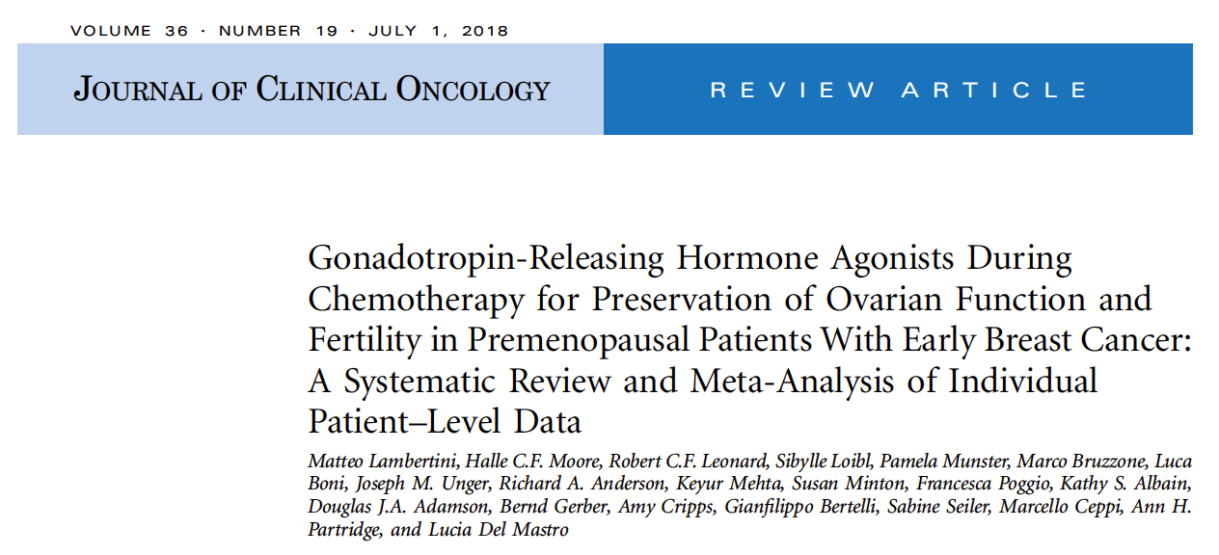

Slide 86
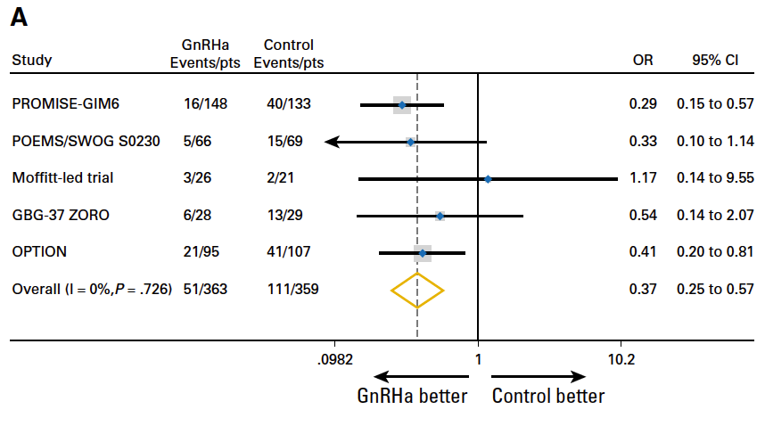
Meta-analysis of Gonadotropin-Releasing Hormone Analogues During Chemotherapy for Localized Breast Cancer: Premature Ovarian Insufficiency by Trial
873 randomized patients from 5 major trials were included in the meta-analysis
Lambertini M et al. J Clin Oncol 2018;36(19):1981-90.

Slide 87
ER-Positive Metastatic Breast Cancer

Slide 88
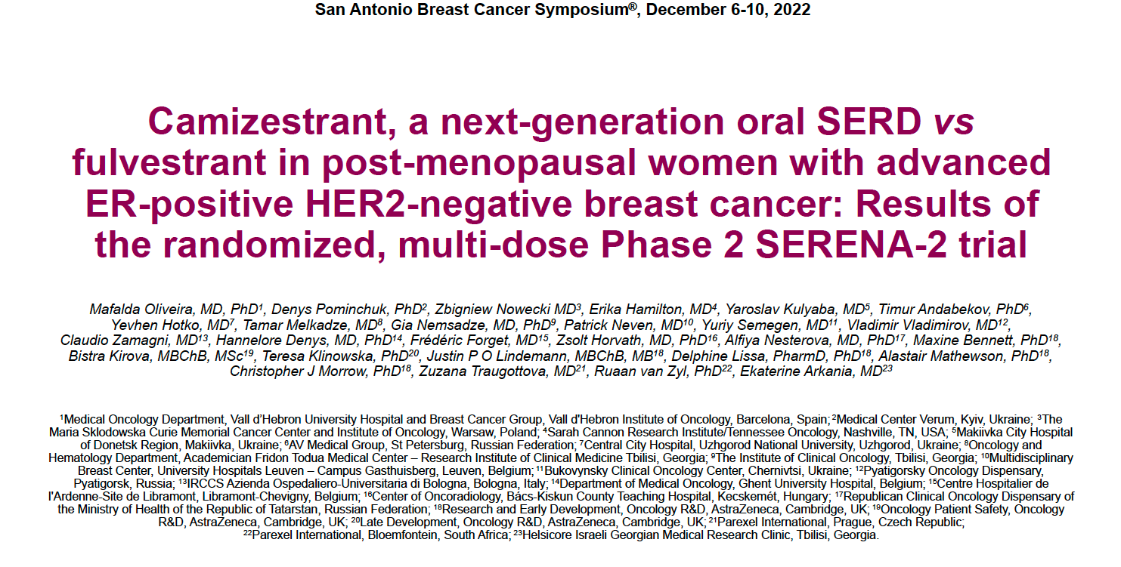
Abstract GS3-02

Slide 89
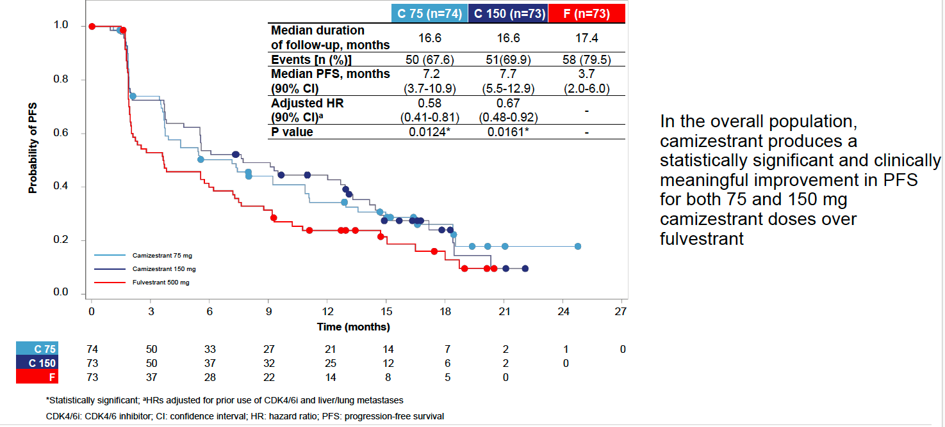
SERENA-2 Primary Endpoint: Progression-Free Survival (PFS) by Investigator Assessment
Oliveira M et al. SABCS 2022;Abstract GS3-02.

Slide 90
EMERALD: PFS Analyses by CDK4/6 Inhibitor Duration
Duration of CDK4/6i | <6 months |  | 6-12 months |  | 12-18 months |  | ≥18 months
All patients | Elacestrant (n = 29) | SOC ET (n = 29) | Elacestrant (n = 52) | SOC ET (n = 46) | Elacestrant (n = 52) | SOC ET (n = 40) | Elacestrant (n = 98) | SOC ET (n = 119)
Median PFS | 3.6 mo | 1.9 mo | 1.9 mo | 1.9 mo | 3.5 mo | 1.8 mo | 5.5 mo | 3.3 mo
Patients with ESR1 mutations | Elacestrant (n = 9) | SOC ET (n = 8) | Elacestrant (n = 25) | SOC ET (n = 21) | Elacestrant (n = 23) | SOC ET (n = 25) | Elacestrant (n = 55) | SOC ET (n = 56)
Median PFS | 1.9 mo | 1.9 mo | 1.9 mo | 1.8 mo | 5.5 mo | 1.8 mo | 8.6 mo | 2.1 mo
SOC ET = standard endocrine therapy
Bardia A et al. SABCS 2022;Abstract GS3-01.

Slide 91
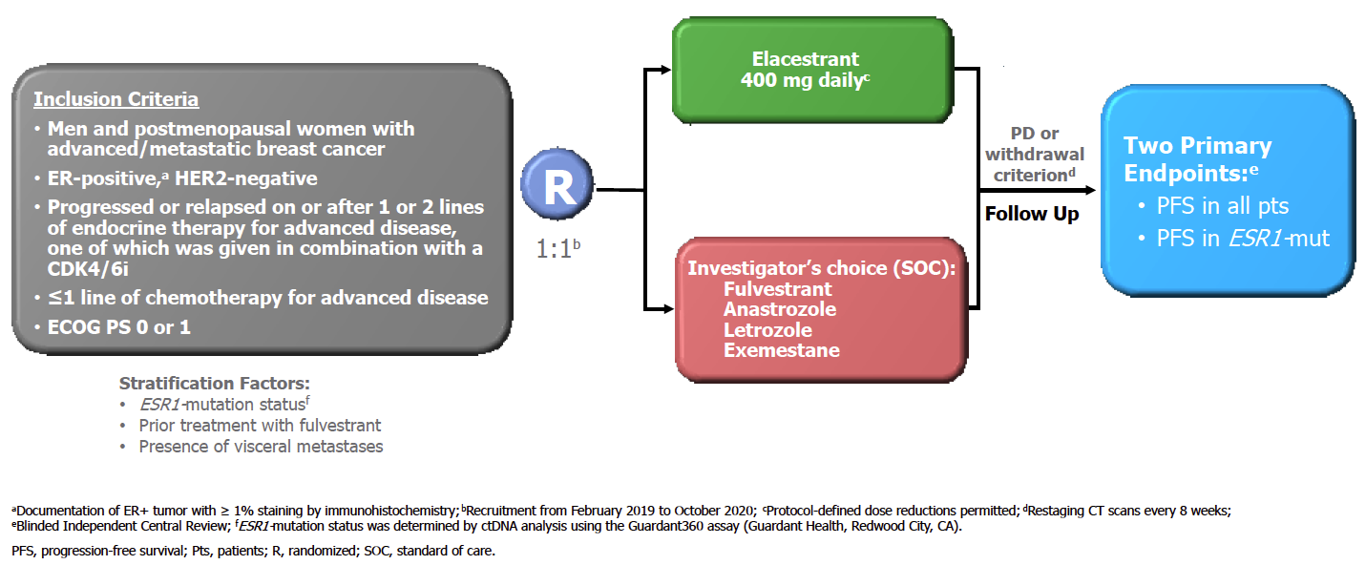
EMERALD Phase III Trial Design
Bardia A et al. SABCS 2022;Abstract GS3-01.

Slide 92
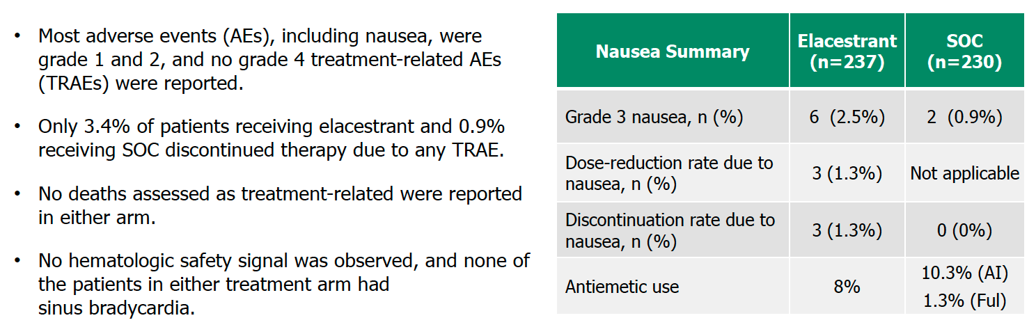
EMERALD: Safety Summary
Bardia A et al. SABCS 2022;Abstract GS3-01.

Slide 93
Select Ongoing Phase III Trials of Oral SERDs in Development for HR-Positive Advanced Breast Cancer (ABC)
Trial | N | Randomization | Setting | Est primary completion
SERENA-4 | 1,342 | Camizestrant + palbociclib Anastrozole + palbociclib | Untreated ABC | August 2026
persevERA | 978 | Giredestrant + palbociclib Letrozole + palbociclib | Untreated ABC | April 2024
SERENA-6 | 302 | Camizestrant + (palbociclib or abemaciclib) (Anastrozole or letrozole) + (palbociclib or abemaciclib) | Detectable ESR1 mutation w/o PD during first-line AI + CDK4/6i | September 2023
EMBER-3 | 860 | Imlunestrant Imlunestrant + abemaciclib Investigator’s choice of ET | ABC previously treated with ET + CDK4/6i | April 2024
evERA | 320 | Giredestrant + everolimus Exemestane + everolimus | ABC previously treated with ET + CDK4/6i | July 2024
heredERA | 812 | Giredestrant + pertuzumab/trastuzumab/hyaluronidase-zzxf Pertuzumab/trastuzumab/hyaluronidase-zzxf | Untreated ER+, HER2+ ABC after first-line pertuzumab/trastuzumab/ hyaluronidase-zzxf + taxane | August 2026
SERD = selective ER degrader
www.clinicaltrials.gov. Accessed November 2022.

Slide 94
Capivasertib and Fulvestrant for Patients with Aromatase Inhibitor-Resistant Hormone Receptor-Positive/Human Epidermal Growth Factor
Receptor 2-Negative Advanced Breast Cancer: Results from the Phase III CAPItello-291 Trial
Turner NC et al.
SABCS 2022;Abstract GS3-04.

Slide 95
CAPItello-291 Phase III Study Design
Secondary endpoints
Summary of Demographics
Median age ∼59
Asian 26%, Black 1%
Primary ET resistance ∼38%
Visceral metastases ∼68%
One line of prior ET for mBC ∼75%
Prior CDK4/6i for mBC ∼70%
Chemotherapy for ABC ∼18%
Turner NC et al. SABCS 2022;Abstract GS3-04.

Slide 96
CAPItello-291 Dual-Primary Endpoint: Investigator-Assessed PFS in the Overall Population
Turner NC et al. SABCS 2022;Abstract GS3-04.

Slide 97
CAPItello-291: Safety
Turner NC et al. SABCS 2022;Abstract GS3-04.

Slide 98
HER2-Positive Localized Breast Cancer

Slide 99
FDA-Approved Agents for Localized HER2-Positive Breast Cancer
Agent | Setting | Pivotal trials | Regimens | Year approved
Trastuzumab | Adjuvant, HER2-positive localized breast cancer (LBC), first line | NSABP B-31 N9831 BCIRG 006 HERA | AC-T-placebo vs AC-T-H AC-T vs AC-H vs AC-T-H ACT vs ACT-H vs TC-H Observation vs trastuzumab | 2006
Pertuzumab | Neoadjuvant, HER2-positive LBC | NEOSPHERE | TD vs PTD vs PT vs PD | 2013
Pertuzumab | Adjuvant, HER2-positive LBC | APHINITY | Chemotherapy + trastuzumab + pertuzumab vs placebo | 2017
Neratinib | Extended adjuvant, HER2-positive LBC | ExteNET | Placebo vs neratinib | 2017
T-DM1 | Adjuvant, HER2-positive LBC with residual disease after neoadjuvant taxane and trastuzumab-based treatment | KATHERINE | Trastuzumab vs T-DM1 | 2019
AC-T = doxorubicin, cyclophosphamide and paclitaxel; AC-T-H = doxorubicin, cyclophosphamide, paclitaxel and trastuzumab; AC-H = doxorubicin, cyclophosphamide, and trastuzumab; TC-H = docetaxel, cyclophosphamide and trastuzumab; TD = trastuzumab and docetaxel; PTD = pertuzumab, trastuzumab and docetaxel; PT = trastuzumab and pertuzumab; PD = pertuzumab and docetaxel
Choong GM et al. CA Cancer J Clin 2020;70(5):355-74.

Slide 100
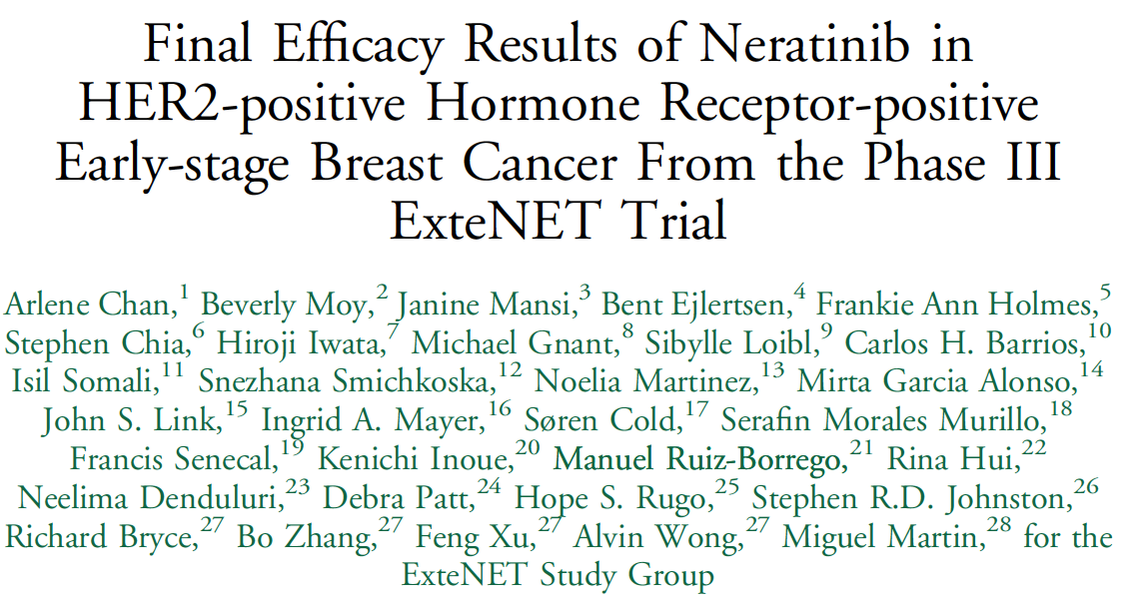
Clin Breast Cancer 2021;21(1):80-91.

Slide 101
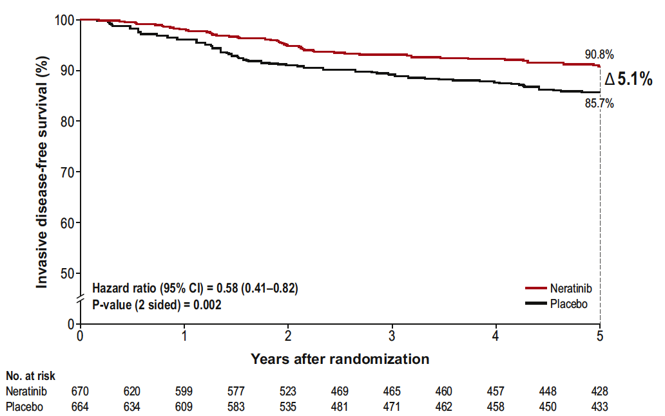
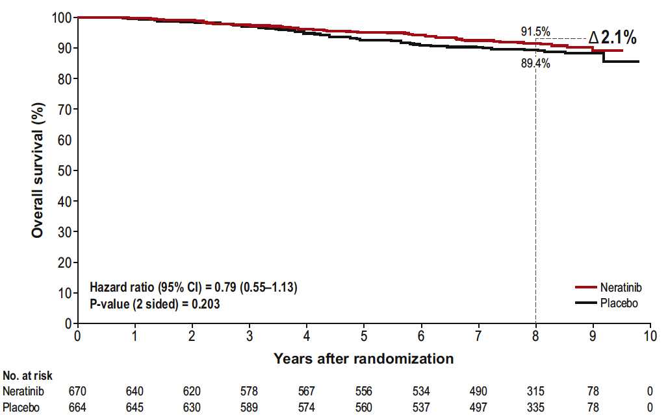
ExteNET: Final Analysis with Neratinib for HER2-Positive Localized
Breast Cancer (HR+/≤ 1-Year Population)
Invasive disease-free survival at 5 years
Overall survival at 8 years
Chan A et al. Clin Breast Cancer 2021;21(1):80-91.

Slide 102
ExteNET: Cumulative Incidence of CNS Recurrence
Population or subgroup | Events, n |  | Cumulative incidence of CNS recurrence
 | Neratinib | Placebo | Neratinib | Placebo
Intention-to-treat population (n = 2,840) | 16 | 23 | 1.3% | 1.8%
HR-positive/≤1-year population (EU indication) (n = 1,334) | 4 | 12 | 0.7% | 2.1%
Adjuvant or neoadjuvant therapy (n = 1,334) Adjuvant (n = 980) Neoadjuvant (n = 354) | 3 1 | 6 6 | 0.7% 0.7% | 1.5% 3.7%
pCR status (n = 354) No (n = 295) Yes (n = 38) | 1 0 | 5 1 | 0.8% 0 | 3.6% 5.0%
Chan A et al. Clin Breast Cancer 2021;21(1):80-91; Holmes FA et al. San Antonio Breast Cancer Symposium 2020;Abstract PD3-03.

Slide 103
Effect of Diarrheal Prophylaxis or Dose Escalation on Neratinib-Associated Diarrhea and Tolerability in Patients with HER2+ Early-Stage Breast Cancer: Final Findings from the CONTROL Trial
Chan A et al.
ESMO Breast 2022;Abstract 73P.

Slide 104
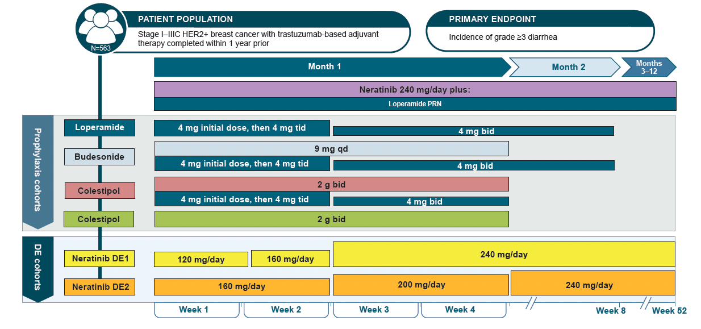
CONTROL Trial Cohorts: Study Schema
Chan A et al. ESMO Breast 2022;Abstract P73.

Slide 105
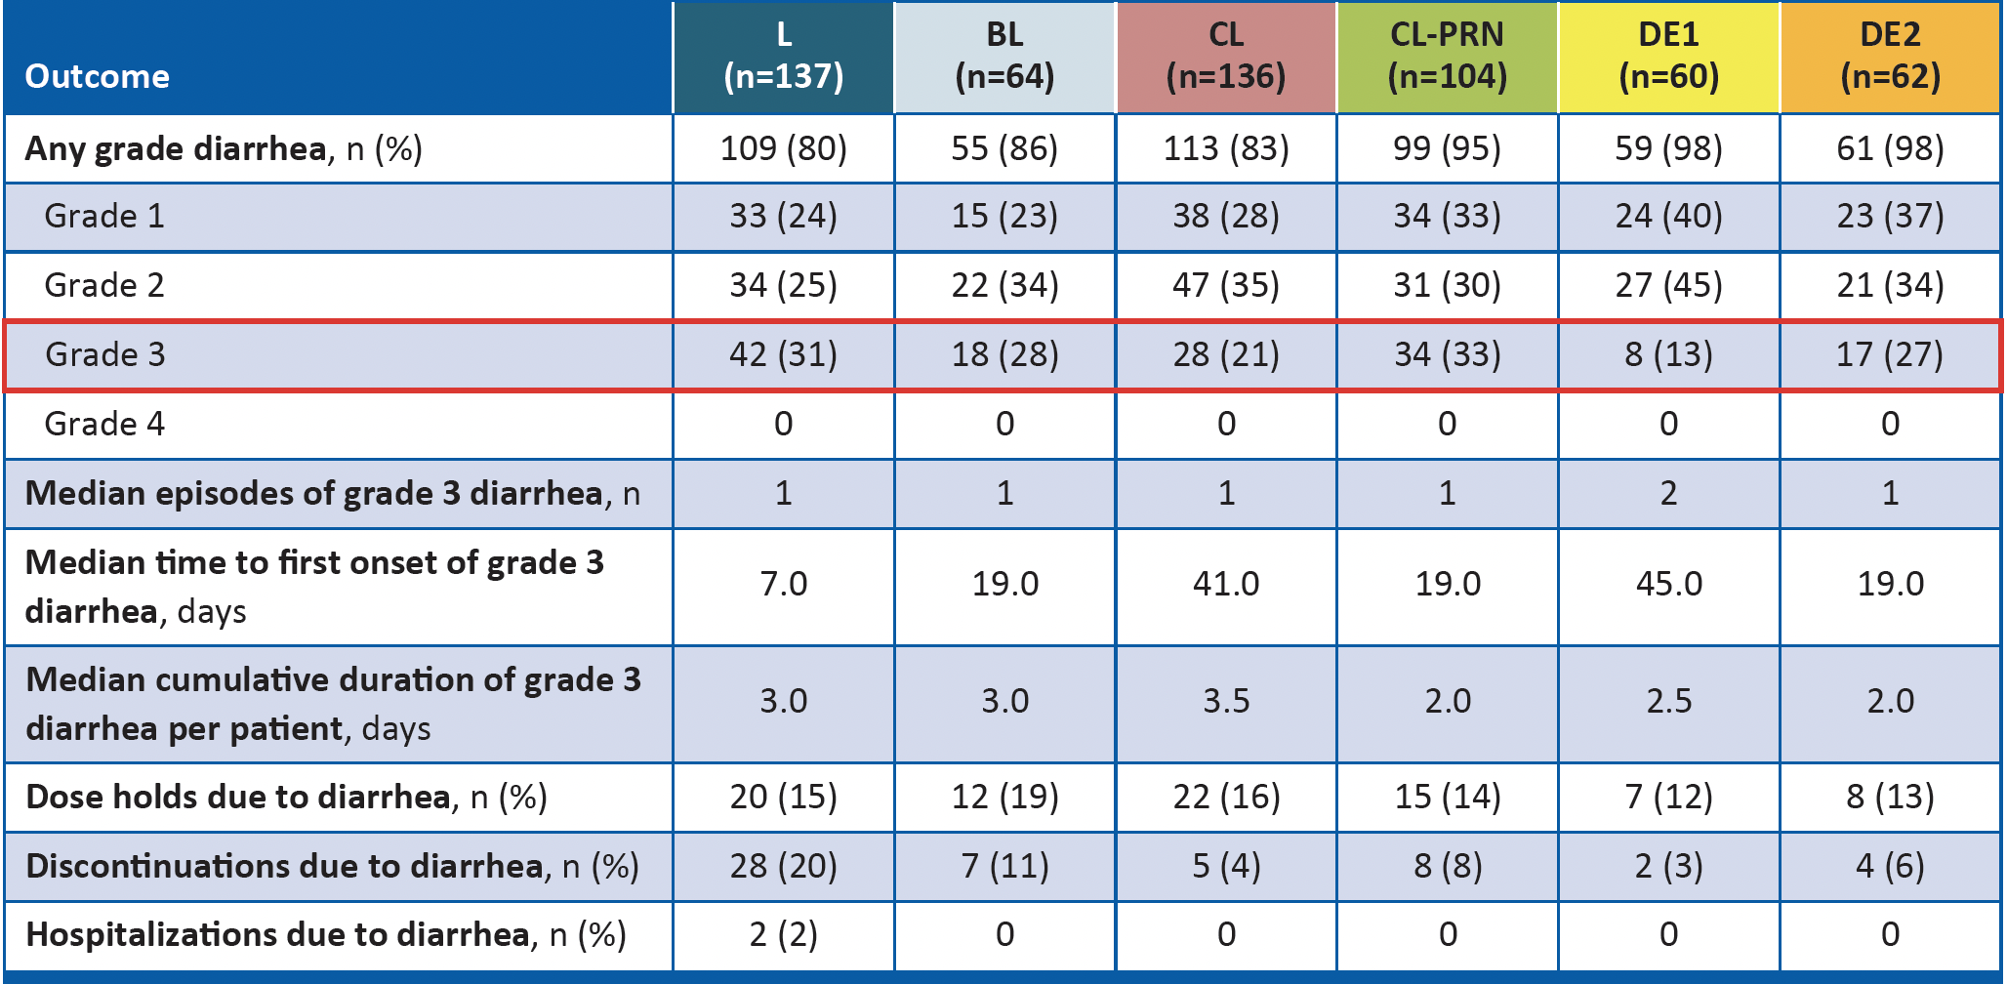
CONTROL: Diarrhea Profile
Chan A et al. ESMO Breast 2022;Abstract P73.

Slide 106
CONTROL: Conclusions
These final findings from the CONTROL study show improved tolerability of neratinib with all diarrhea prophylaxis and DE schedules. These results demonstrate that neratinib is well tolerated as extended-adjuvant treatment for patients with HER2-positive breast cancer after 1 year of trastuzumab.
Adoption of neratinib DE with loperamide PRN during the first 2 weeks of treatment (DE1 cohort) was associated with a lower rate of Grade 3 diarrhea compared to the CONTROL prophylaxis strategies, the DE2 strategy and the neratinib arm in the ExteNET trial.
The DE1 cohort also had the lowest rate of diarrhea-related discontinuations (3%) and dose holds (12%) compared to the other strategies investigated in the CONTROL trial and the neratinib arm in the ExteNET trial.
These findings suggest that several modalities, most notably neratinib DE1 with loperamide PRN, allow patients to stay on treatment longer and receive the full benefit of neratinib therapy.
The US package label for neratinib now includes both the mandatory loperamide prophylaxis regimen and the DE1 strategy from CONTROL as diarrhea-mitigation strategies.
Chan A et al. ESMO Breast 2022;Abstract P73.

Slide 107
HER2-Positive or HER2-Low Metastatic
Breast Cancer

Slide 108
FDA Grants Regular Approval to Fam-Trastuzumab Deruxtecan-nxki for Breast Cancer
Press Release – May 4, 2022
“The Food and Drug Administration approved fam-trastuzumab deruxtecan-nxki for adult patients with unresectable or metastatic HER2-positive breast cancer who have received a prior anti-HER2-based regimen either in the metastatic setting, or in the neoadjuvant or adjuvant setting and have developed disease recurrence during or within 6 months of completing therapy.
In December 2019, fam-trastuzumab deruxtecan-nxki received accelerated approval for adult patients with unresectable or metastatic HER2-positive breast cancer who have received two or more prior anti-HER2-based regimens in the metastatic setting. The following trial was the confirmatory trial for the accelerated approval.
Efficacy was based on DESTINY-Breast03 (NCT03529110), a multicenter, open-label, randomized trial that enrolled 524 patients with HER2-positive, unresectable, and/or metastatic breast cancer who received prior trastuzumab and taxane therapy for metastatic disease or developed disease recurrence during or within 6 months of completing neoadjuvant or adjuvant therapy.”
https://www.fda.gov/drugs/resources-information-approved-drugs/fda-grants-regular-approval-fam-trastuzumab-deruxtecan-nxki-breast-cancer

Slide 109
Trastuzumab Deruxtecan Granted FDA Approval for HER2-Low Breast Cancer
Press Release – August 5, 2022
“Today, the US Food and Drug Administration approved fam-trastuzumab-deruxtecan-nxki, an IV infusion for the treatment of patients with unresectable (unable to be removed) or metastatic (spread to other parts of the body) HER2-low breast cancer. This is the first approved therapy targeted to patients with the HER2-low breast cancer subtype, which is a newly defined subset of HER2-negative breast cancer.
Patients with HER2-low breast cancer are eligible for fam-trastuzumab-deruxtecan-nxki if they have received a prior chemotherapy in the metastatic setting, or their cancer returned during, or within 6 months of completing, adjuvant chemotherapy.
This approval is based on DESTINY-Breast04, a randomized, multicenter, open label clinical trial that enrolled 557 adult patients with unresectable or metastatic HER2-low breast cancer.”
https://www.fda.gov/news-events/press-announcements/fda-approves-first-targeted-therapy-her2-low-breast-cancer

Slide 110
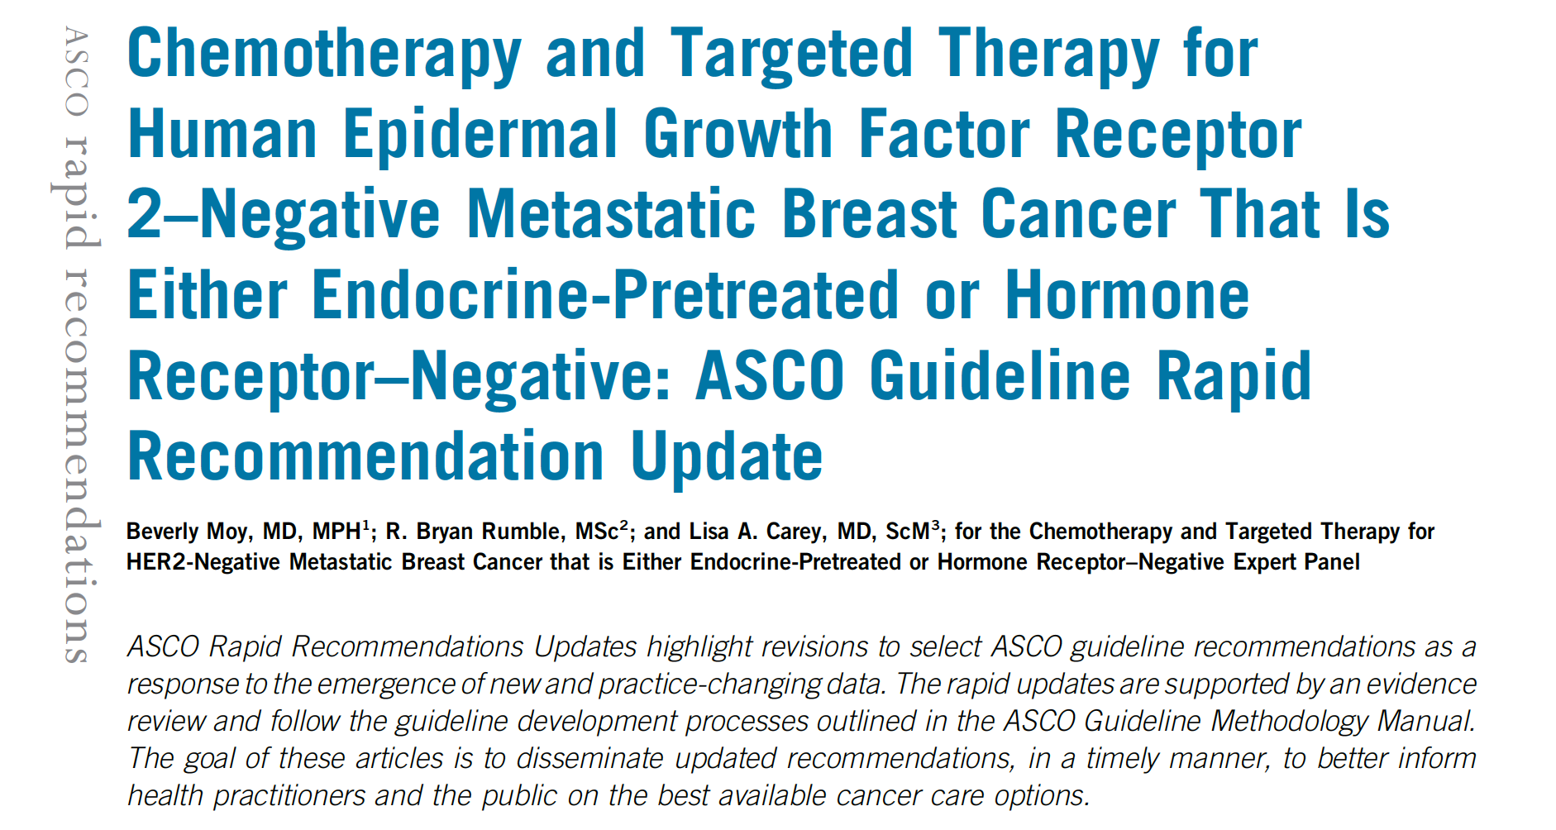
Updated Recommendation
Patients with HER2 IHC 1+ or 2+ and ISH-negative metastatic breast cancer who have received at least one prior chemotherapy for metastatic disease, and if hormone receptor–positive are refractory to endocrine therapy, should be offered treatment with trastuzumab deruxtecan
J Clin Oncol 2022 August 4;[Online ahead of print].

Slide 111
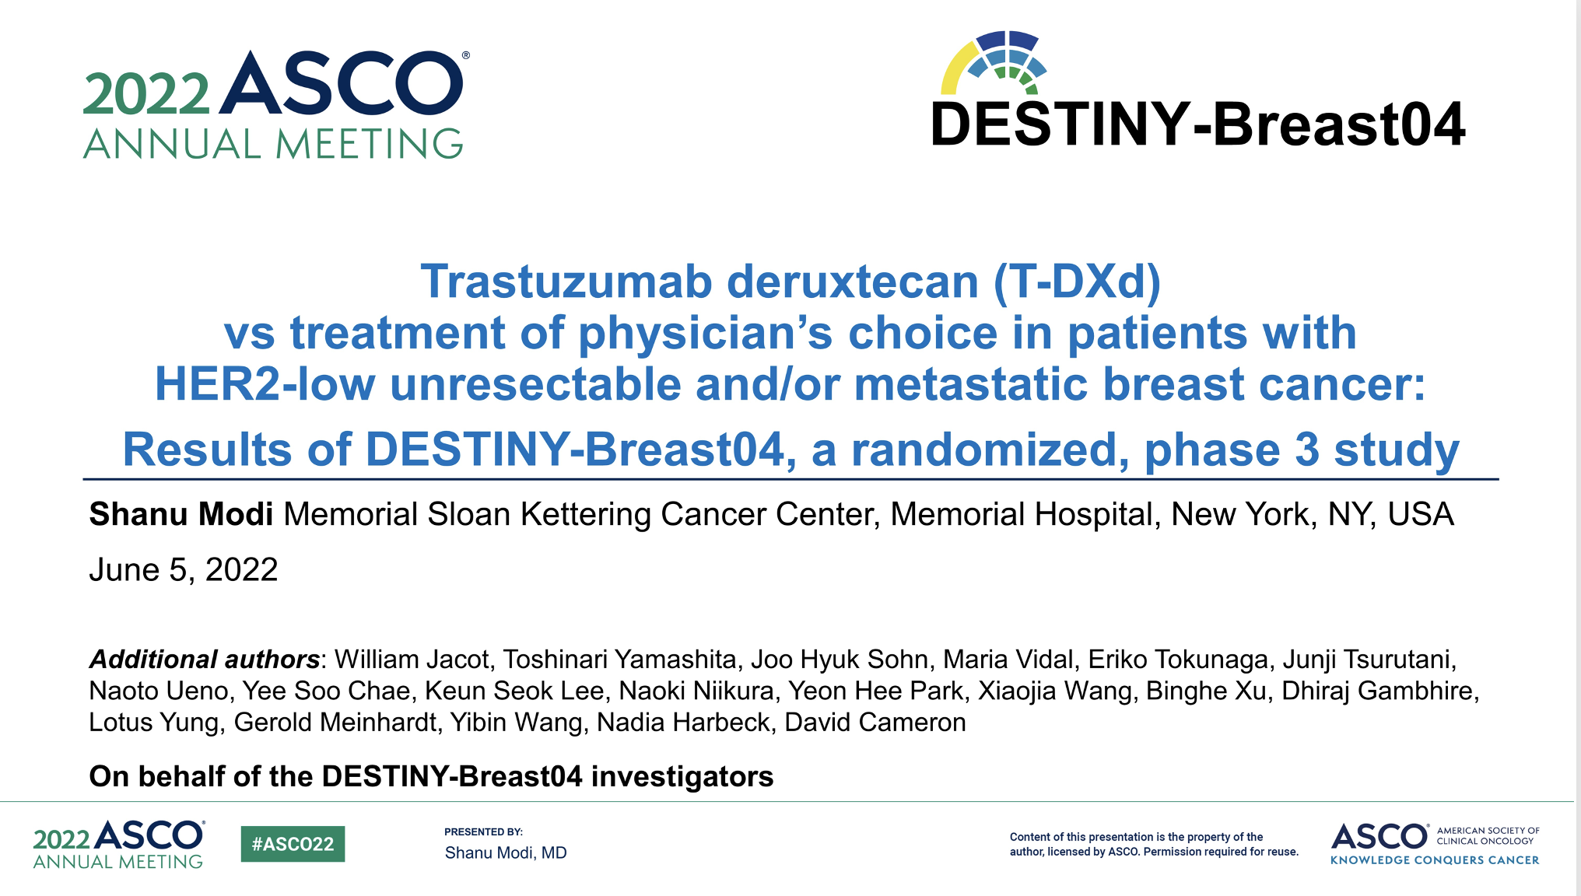
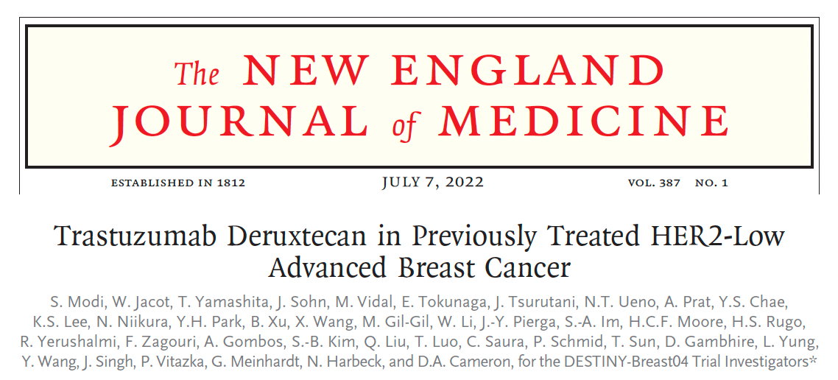
Abstract LBA3

Slide 112
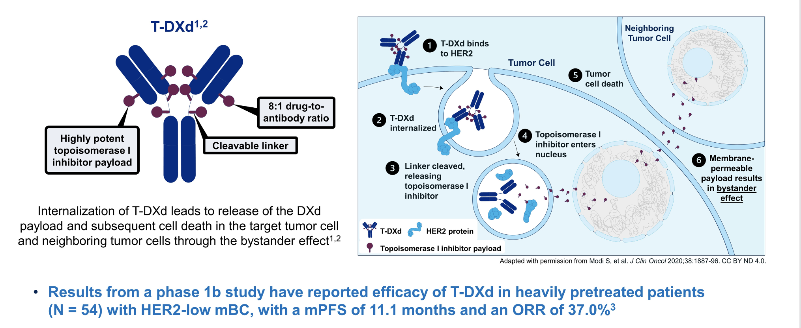
T-DXd Mechanism of Action, Bystander Effect and Rationale for Targeting HER2-Low Breast Cancer
ORR = objective response rate
Modi S et al. ASCO 2022;Abstract LBA3. Modi S et al. N Engl J Med 2022 July 7;387(1):9-20.

Slide 113
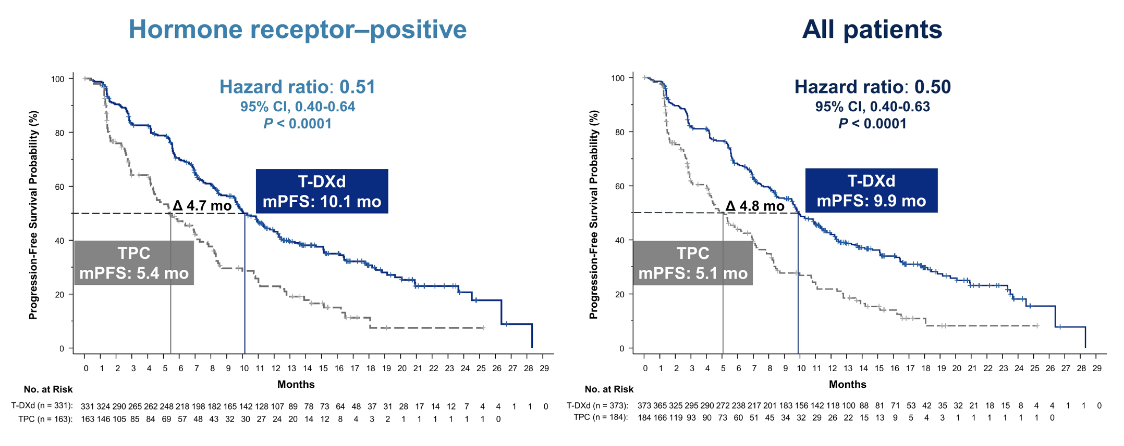
DESTINY-Breast04: PFS for HR-Positive (Primary Endpoint) and All Patients
mPFS = median progression-free survival
Modi S et al. ASCO 2022;Abstract LBA3. Modi S et al. N Engl J Med 2022 July 7;387(1):9-20.

Slide 114
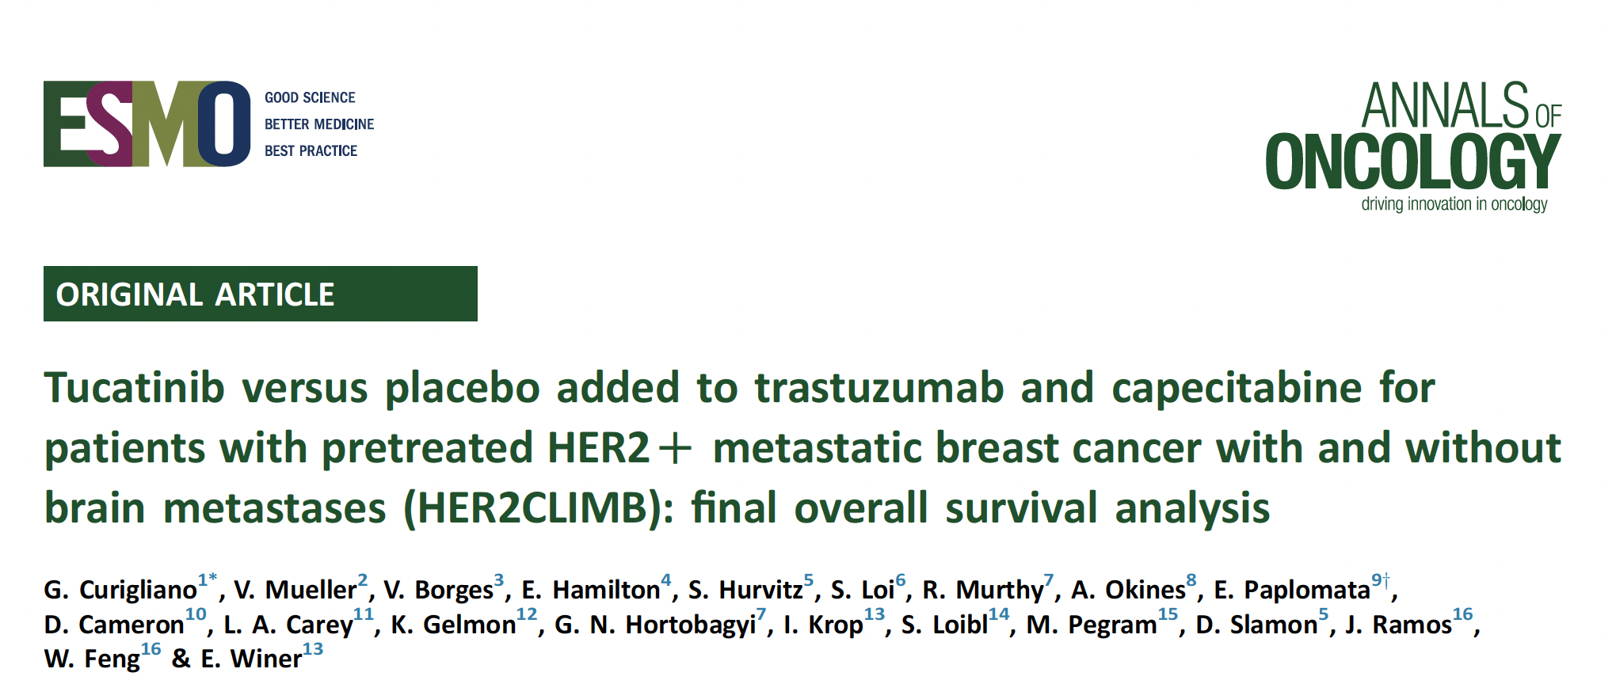
Ann Oncol 2022 March;33(3):321-9.

Slide 115
HER2CLIMB Trial Design
Key Eligibility Criteria
HER2+ metastatic breast cancer
Prior treatment with trastuzumab, pertuzumab, and T-DM1
ECOG performance status 0 or 1
Brain MRI at baseline
  Previously treated stable brain metastases
  Untreated brain metastases not needing immediate local therapy
  Previously treated progressing brain metastases not needing immediate local therapy
  No evidence of brain metastases
Tucatinib + Trastuzumab + Capecitabine
(21-day cycle)
Tucatinib 300 mg PO BID
+
Trastuzumab 6 mg/kg Q3W (loading dose 8 mg/kg C1D1)
+
Capecitabine 1000 mg/m² PO BID (Days 1-14)
N=410
R*
(2:1)
Placebo + Trastuzumab + Capecitabine
(21-day cycle)
Placebo
+
Trastuzumab 6 mg/kg Q3W (loading dose 8 mg/kg C1D1)
+
Capecitabine 1000 mg/m² PO BID (Days 1-14)
N=202
*Stratification factors: presence of brain metastases (yes/no), ECOG status (0 or 1), and region (US or Canada or rest of world)
https://clinicaltrials.gov/ct2/show/NCT02614794
Murthy RK et al. SABCS 2019;Abstract GS1-01.

Slide 116
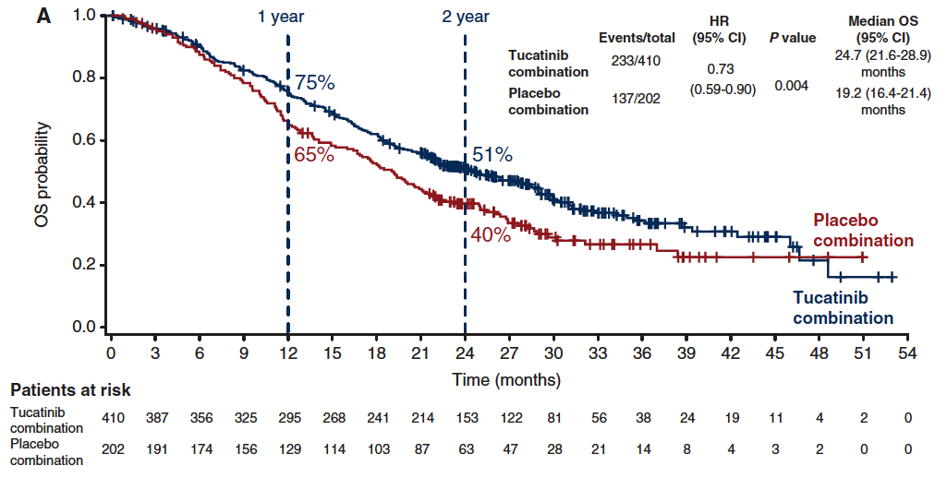
HER2CLIMB: Final Overall Survival (OS) Analysis
Curigliano G et al. Ann Oncol 2022;33(3):321-9.

Slide 117

HER2CLIMB: Adverse Events
Curigliano G et al. Ann Oncol 2022 March;33(3):321-9.

Slide 118

HER2CLIMB: Overall Survival and Intracranial Progression-Free Survival for Patients with Brain Metastases
OS
IPFS
Lin NU et al. JAMA Oncol 2023;9(2):197-205.

Slide 119

2022;28;1840-7.

Slide 120

TUXEDO-1: Response with Trastuzumab Deruxtecan by
RANO-BM Criteria
RANO-BM = Response assessment in neuro-oncology brain metastases
Bartsch R et al. Nature Med 2022;28;1840-7.

Slide 121
PARP Inhibitors

Slide 122
FDA Approves Olaparib as Adjuvant Treatment for HER2-Negative High-Risk Localized Breast Cancer with a Germline BRCA Mutation Previously Treated with Neoadjuvant or Adjuvant Chemotherapy
Press Release – March 11, 2022
“Olaparib has been approved by the US Food and Drug Administration (FDA) for the adjuvant treatment of adult patients with deleterious or suspected deleterious germline BRCA-mutated (gBRCAm), human epidermal growth factor receptor 2 (HER2)-negative high-risk early breast cancer who have been treated with neoadjuvant or adjuvant chemotherapy. Patients will be selected for therapy based on an FDA-approved companion diagnostic for olaparib.
The approval was based on results from the Phase 3 OlympiA trial, including data for the trial’s primary endpoint of invasive disease-free survival (IDFS), which were presented during the 2021 American Society of Clinical Oncology Annual Meeting and published in The New England Journal of Medicine, as well as overall survival (OS) data from a more recent interim analysis.”
https://finance.yahoo.com/news/fda-approves-lynparza-olaparib-adjuvant-005100263.html

Slide 123

Abstract VP1-2022

Slide 124

Tutt ANJ et al. ESMO Virtual Plenary 2022;Abstract VP1-2022.

Slide 125

OlympiA: Overall Survival
Tutt ANJ et al. ESMO Virtual Plenary 2022;Abstract VP1-2022.

Slide 126

OlympiA: Adverse Events of Any Grade in ≥10% of Patients
Tutt ANJ et al. ESMO Virtual Plenary 2022;Abstract VP1-2022.

Slide 127

Pivotal Phase III Trials Supporting the FDA Approvals of Olaparib and Talazoparib for Metastatic Breast Cancer with a Germline BRCA Mutation
Trial | Eligibility | Randomization | Primary endpoint
OlympiAD¹ (n = 302) | HER2-negative metastatic BC ER-positive and/or PR-positive or TNBC Deleterious or suspected deleterious gBRCA mutation Prior anthracycline and taxane ≤2 prior chemotherapy lines in metastatic setting | Olaparib Physician’s choice Capecitabine Eribulin Vinorelbine | PFS by blinded independent central review
EMBRACA² (n = 431) | HER2-negative locally advanced or metastatic BC Germline BRCA1 or BRCA2 mutation $\text{≤}$3 prior cytotoxic chemotherapy regimens Prior treatment with a taxane and/or anthracycline unless medically contraindicated | Talazoparib Physician’s choice Capecitabine Eribulin Gemcitabine Vinorelbine | PFS by blinded independent central review
¹ Robson M et al. N Engl J Med 2017;377(6):523-33. ² Litton JK et al. SABCS 2017;Abstract GS6-07; www.clinicaltrials.gov. Accessed August 2019.

Slide 128
OlympiAD and EMBRACA: Efficacy Summary
 | OlympiAD¹⁻³ | EMBRACA⁴⁻⁶
HR (PFS) | 0.58 | 0.54
HR (PFS) ER/PR-positive | 0.82 | 0.47
HR (PFS) TNBC | 0.43 | 0.60
HR (OS) | 0.84 | 0.76
ORR | 59.9% (vs 28.8% TPC) | 67.6% (vs 27.2% TPC)
TPC = treatment of physician’s choice
Cross-trial comparisons are challenging in terms of
determining the relative efficacy and tolerability of treatments
¹ Robson M et al. N Engl J Med 2017;377(6):523-33. ² Robson M et al. Ann Oncol 2019;30(4):558-66. ³ Robson M et al. San Antonio Breast Cancer Symposium 2019;Abstract PD4-03. ⁴ Litton JK et al. N Engl J Med 2018;379(8):753-63. ⁵ Litton JK et al. San Antonio Breast Cancer Symposium 2017;Abstract GS6-07. ⁶ Rugo HS et al. ASCO 2018;Abstract 1069.

Slide 129
OlympiAD and EMBRACA: Adverse Event (AE) and Quality of Life Summary
 | OlympiAD ^{1,2} | EMBRACA^{3,4}
Serious AEs Grade ≥3 | 36.6% (vs 50.5% TPC) | 25.5% (v. 25.4% TPC)
Anemia Grade ≥3 | 16.1% | 39.2%
Neutropenia Grade ≥3 | 9.3% | 20.9%
Thrombocytopenia Grade ≥3 | 2.4% | 14.7%
MDS/AML | 0 | 0
Nausea (any grade) | 58.0% | 48.6%
Alopecia (any grade) | 3.4% | 25.2%
Dose modification/reduction due to AE | 25.4% (vs 30.8% TPC) | 66% (vs 60% TPC)
Treatment discontinuation due to AE | 4.9% (vs 7.7% TPC) | 5.9% (vs 8.7% TPC)
Cross-trial comparisons are challenging in terms of
determining the relative efficacy and tolerability of treatments
¹ Robson M et al. N Engl J Med 2017;377(6):523-33. ² Robson M et al. Ann Oncol 2019;30(4):558-66. ³ Litton JK et al. N Engl J Med 2018;379(8):753-63. ⁴ Litton JK et al. San Antonio Breast Cancer Symposium 2017;Abstract GS6-07.

Slide 130
Immunotherapy

Slide 131

2022;386(6):556-67

Slide 132
KEYNOTE-522: Phase III Trial Schema
Schmid P et al. N Engl J Med 2020;382:810-21.

Slide 133

KEYNOTE-522: Event-Free Survival According to Treatment Group
(ITT Population)
Schmid P et al. N Engl J Med 2022;386(6):556-67.

Slide 134

KEYNOTE-355: Adverse Events
Cortes J et al. N Engl J Med 2022;387(3):217-26.

Slide 135

Symptoms of Immunotherapy Toxicity
Hypophysitis
(fatigue)
Thyroiditis
(over/underactive thyroid)
Adrenal Insufficiency (fatigue)
Diabetes Mellitus
(type I, II, fatigue, DKA)
Colitis
(diarrhea, abd pain)
Dermatitis
(rash, itch, blistering)
Pneumonitis
(dyspnea, cough)
Myocarditis
(chest pain, dyspnea)
Hepatitis
(abn LFTs, jaundice)
Pancreatitis
(abd pain)
Neurotoxicities
(MG, encephalitis)
Arthritis
(joint pain)

