Slide 1
Meet The Professor
Optimizing the Management of ER-Positive and Triple-Negative Breast Cancer
Komal Jhaveri, MD
Associate Attending Physician
Breast Medicine Service and Early Drug Development Service
Section Head, Endocrine Therapy Research Program
Clinical Director, Early Drug Development Service
Department of Medicine
Memorial Sloan Kettering Cancer Center
Assistant Professor of Medicine
Weill Cornell College of Medicine
New York, New York

Slide 2




Meet The Professor Program Participating Faculty
Harold J Burstein, MD, PhD
Institute Physician, Dana-Farber Cancer Institute
Professor of Medicine, Harvard Medical School
Boston, Massachusetts
Komal Jhaveri, MD
Associate Attending Physician
Breast Medicine Service and Early Drug Development Service
Section Head, Endocrine Therapy Research Program
Clinical Director, Early Drug Development Service
Department of Medicine
Memorial Sloan Kettering Cancer Center
Assistant Professor of Medicine
Weill Cornell College of Medicine
New York, New York
Sara A Hurvitz, MD
Professor of Medicine
Director, Breast Cancer Clinical Trials Program, Division of Hematology-Oncology
David Geffen School of Medicine at UCLA
Medical Director, Clinical Research Unit
Jonsson Comprehensive Cancer Center
Santa Monica, California
Ann Partridge, MD, MPH
Vice Chair of Medical Oncology
Director, Program for Young Women with Breast Cancer
Director, Adult Survivorship Program
Dana-Farber Cancer Institute
Professor of Medicine
Harvard Medical School
Boston, Massachusetts

Slide 3



Meet The Professor Program Participating Faculty
Laura Spring, MD
Breast Oncologist
Massachusetts General Hospital Cancer Center
Harvard Medical School
Boston, Massachusetts
MODERATOR
Neil Love, MD
Research To Practice
Miami, Florida
Sara M Tolaney, MD, MPH
Chief, Division of Breast Oncology
Associate Director, Susan F Smith Center
for Women's Cancers
Senior Physician
Dana-Farber Cancer Institute
Associate Professor of Medicine
Harvard Medical School
Boston, Massachusetts

Slide 4
Commercial Support
This activity is supported by educational grants from AstraZeneca Pharmaceuticals LP, Exact Sciences Corporation, Sanofi, and TerSera Therapeutics LLC.
Research To Practice CME Planning Committee Members,
Staff and Reviewers
Planners, scientific staff and independent reviewers for Research To Practice have no relevant conflicts of interest to disclose.

Slide 5
Dr Jhaveri — Disclosures
Consulting Agreements | AbbVie Inc, AstraZeneca Pharmaceuticals LP, Bristol-Myers Squibb Company, Daiichi Sankyo Inc, Eisai Inc, Genentech, a member of the Roche Group, Gilead Sciences Inc, Lilly, Loxo Oncology Inc, a wholly owned subsidiary of Eli Lilly & Company, Novartis, Pfizer Inc, Seagen Inc, Taiho Oncology Inc
Contracted Research | Gilead Sciences Inc, Merck, Puma Biotechnology Inc

Slide 6
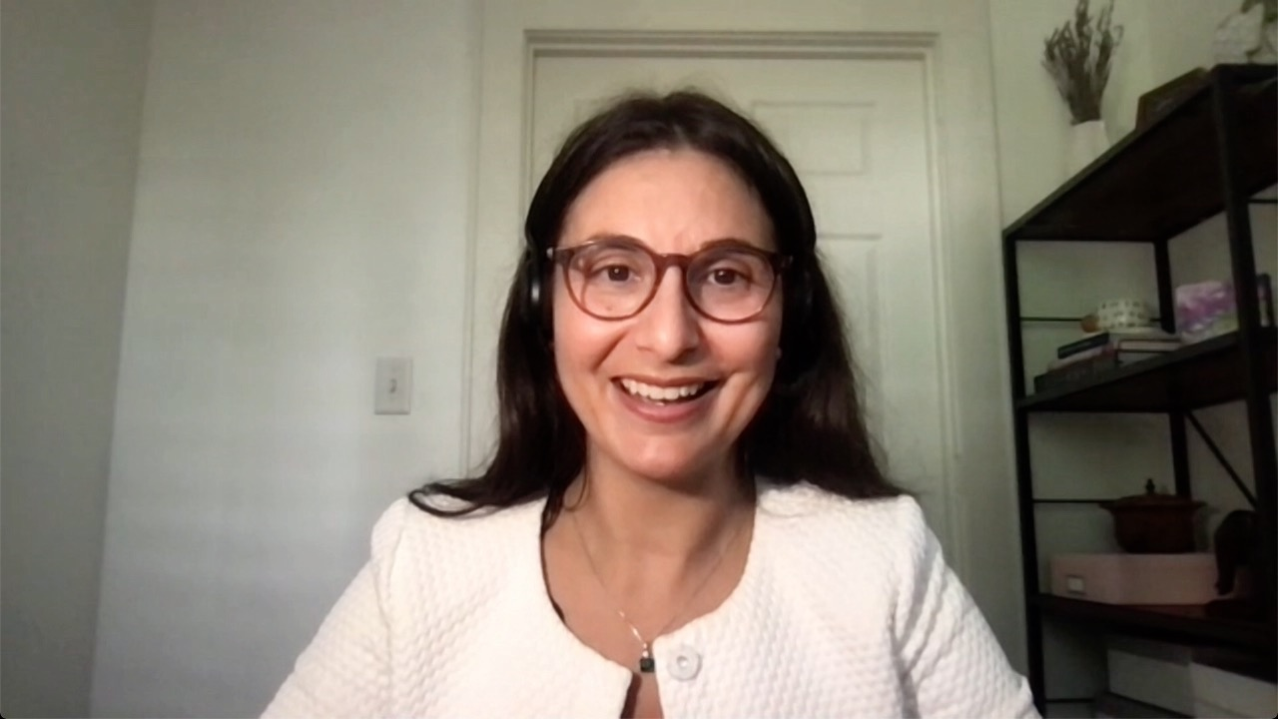

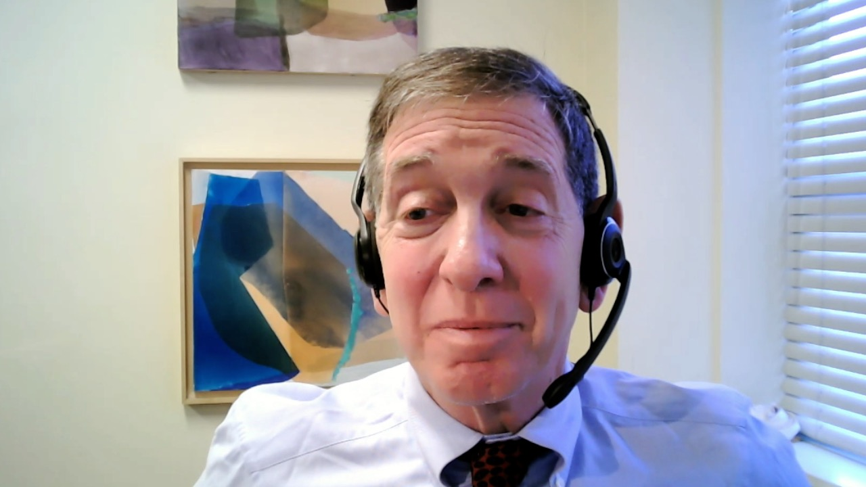
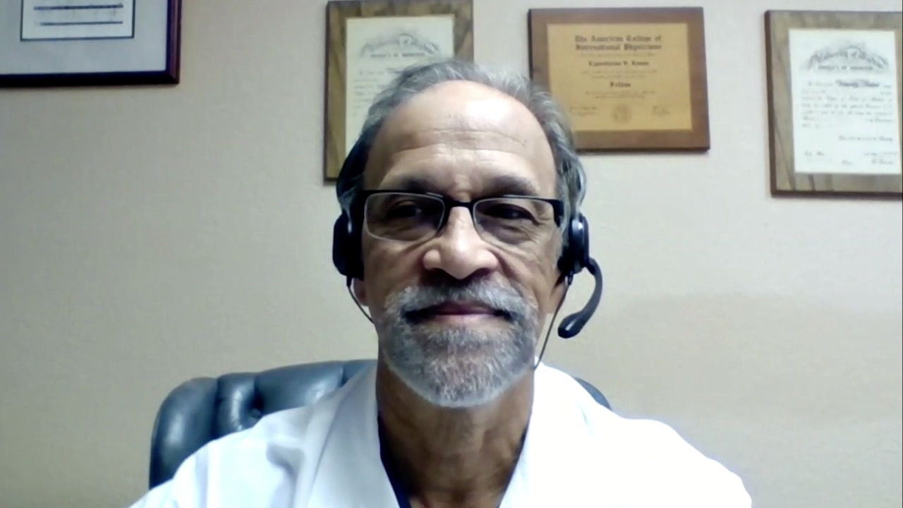
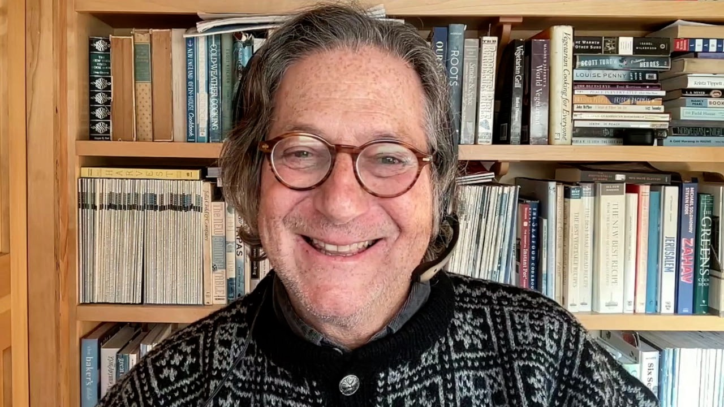

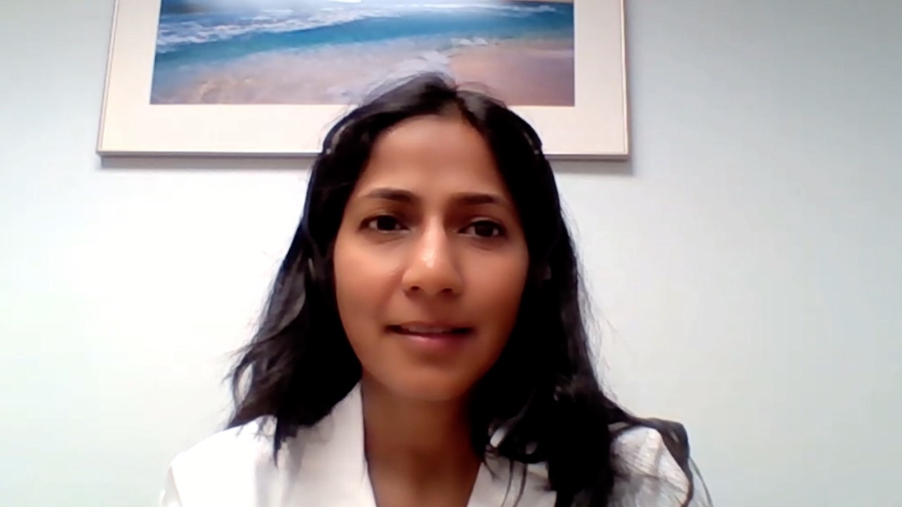
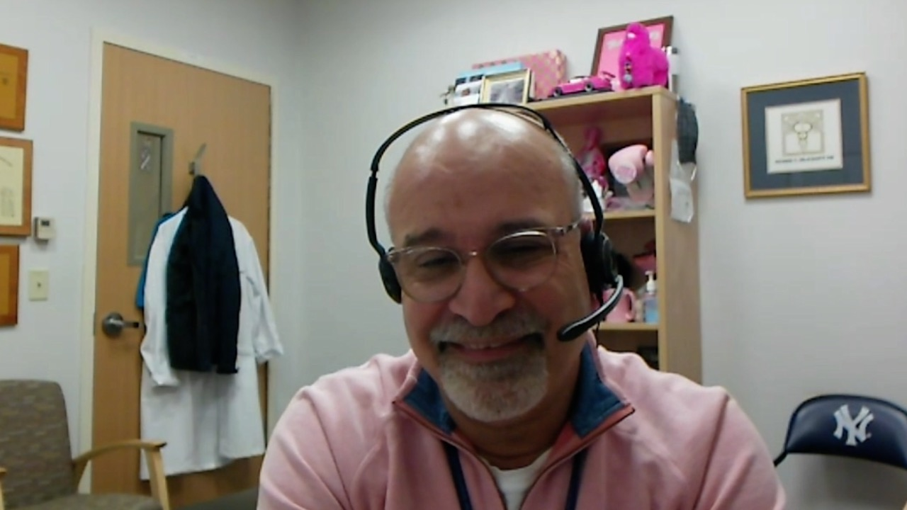
Laila Agrawal, MD
Norton Cancer Institute
Louisville, Kentucky
Arielle Heeke, MD
Levine Cancer Institute,
Atrium Health
Charlotte, North Carolina
Alan B Astrow, MD
New York-Presbyterian Brooklyn Methodist Hospital
Weill Cornell Medical College
Brooklyn, New York
Kapisthalam (KS) Kumar, MD
Florida Cancer Specialists
Trinity, Florida
Philip L Brooks, MD
Northern Light Eastern Maine
Medical Center and Lafayette
Family Cancer Institute
Initiative
Brewer, Maine
Zanetta S Lamar, MD
Florida Cancer Specialists and Research Institute Naples, Florida
Shaachi Gupta, MD, MPH
Florida Cancer Specialists
Lake Worth, Florida
Richard Zelkowitz, MD
Hartford HealthCare Cancer Institute
Bridgeport, Connecticut

Slide 7
Meet The Professor with Dr Jhaveri
Introduction
MODULE 1: Case Presentations
MODULE 2: Faculty Survey
MODULE 3: Journal Club with Dr Jhaveri
MODULE 4: Appendix

Slide 8
Meet The Professor with Dr Jhaveri
Introduction
MODULE 1: Case Presentations
MODULE 2: Faculty Survey
MODULE 3: Journal Club with Dr Jhaveri
MODULE 4: Appendix

Slide 9

Hormonal Therapy for the 1980s

Slide 10
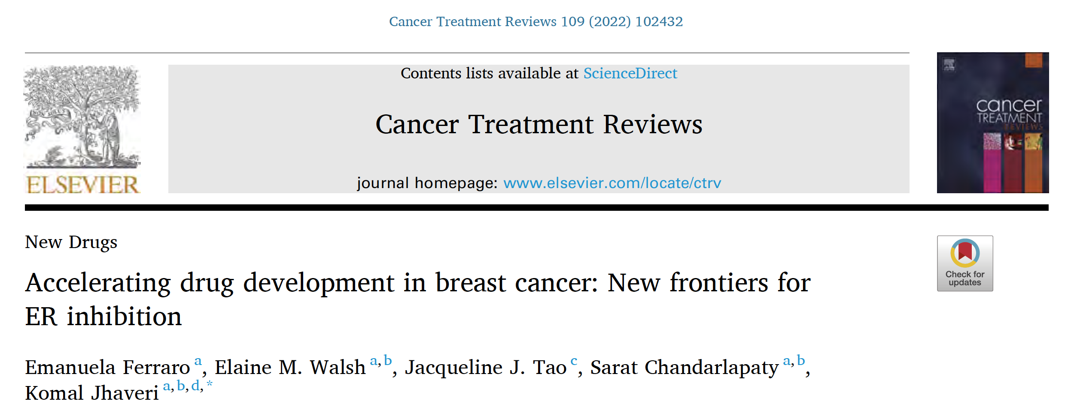


Slide 11
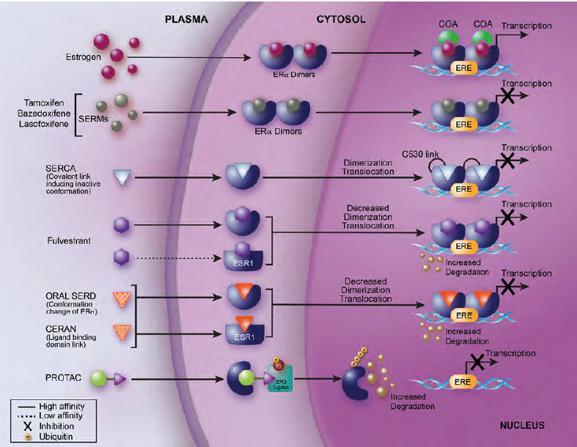
Interaction of New or Traditional ER Inhibitors with a Breast Cancer Cell
Ferraro E et al. Cancer Treat Rev 2022;109:102432.

Slide 12
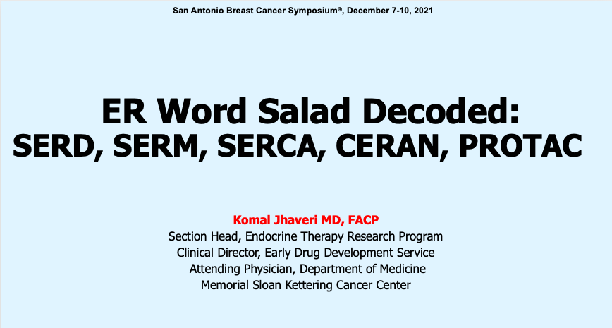
TF-1

Slide 13
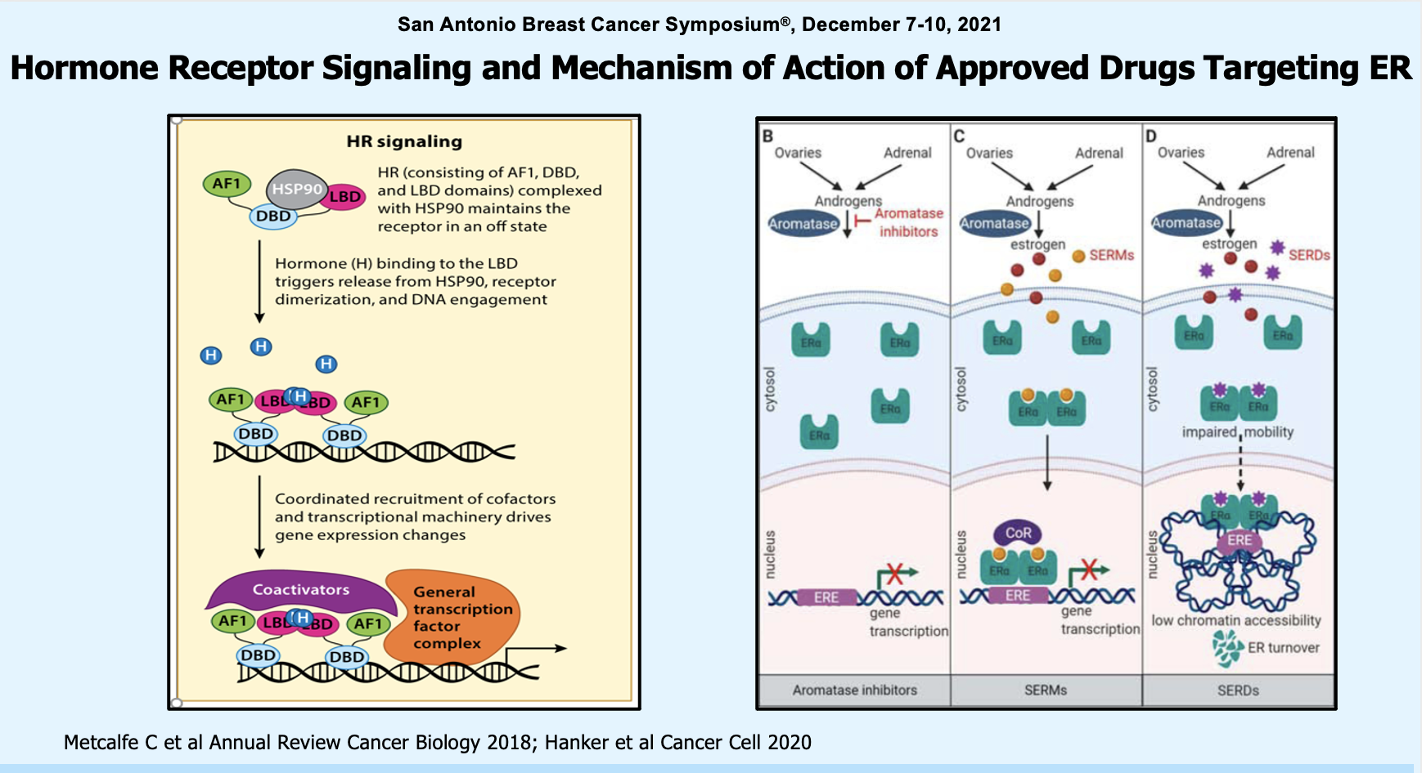
Jhaveri K et al. SABCS 2022;Abstract TF-1.

Slide 14
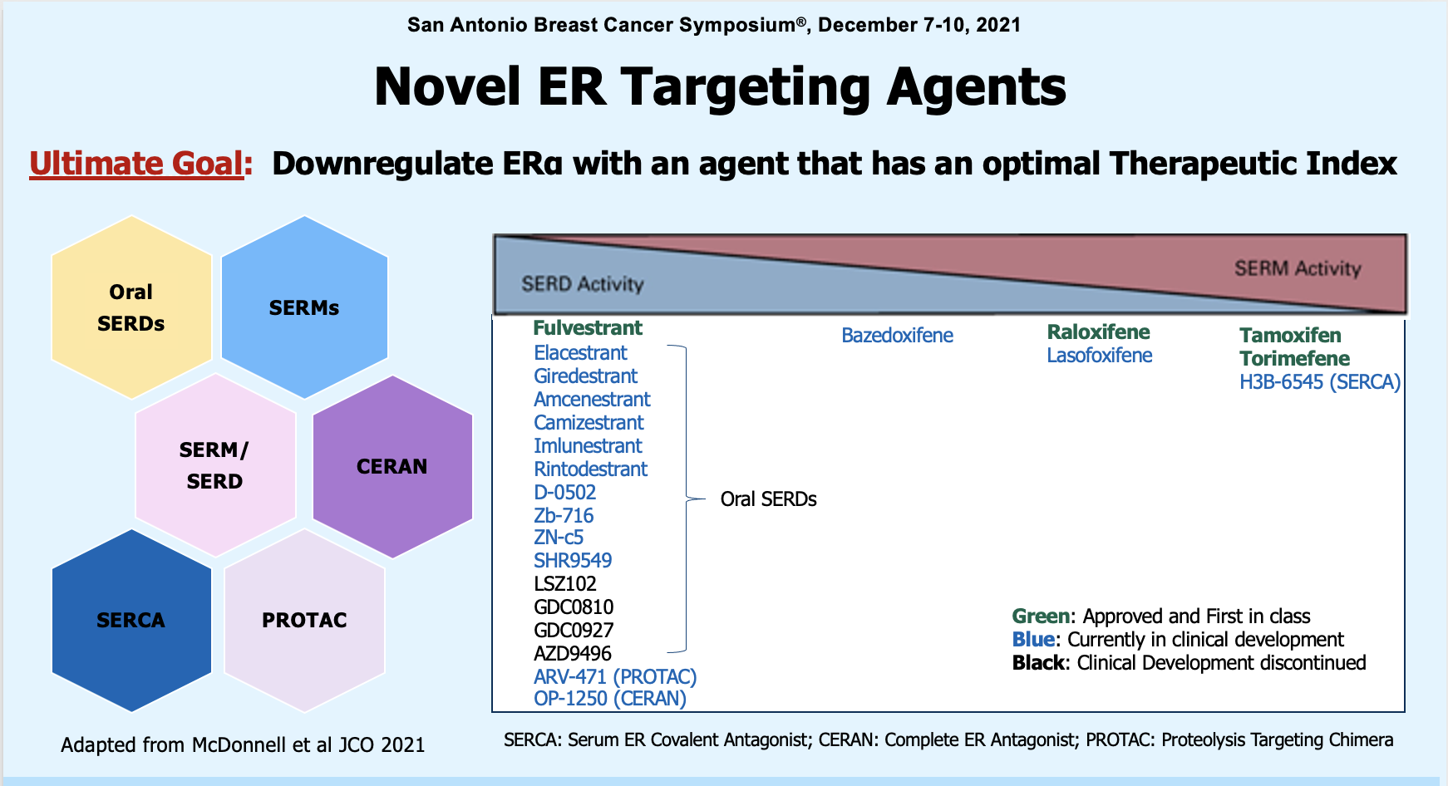
Jhaveri K et al. SABCS 2022;Abstract TF-1.

Slide 15
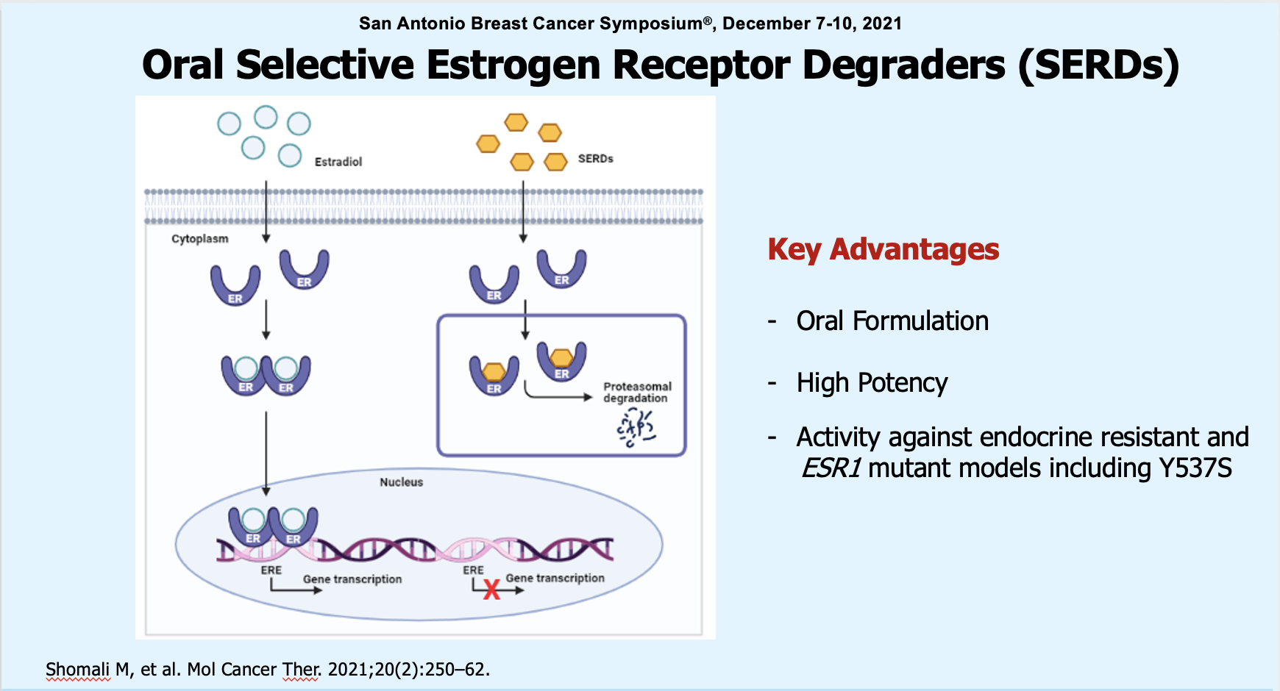
Jhaveri K et al. SABCS 2022;Abstract TF-1.

Slide 16
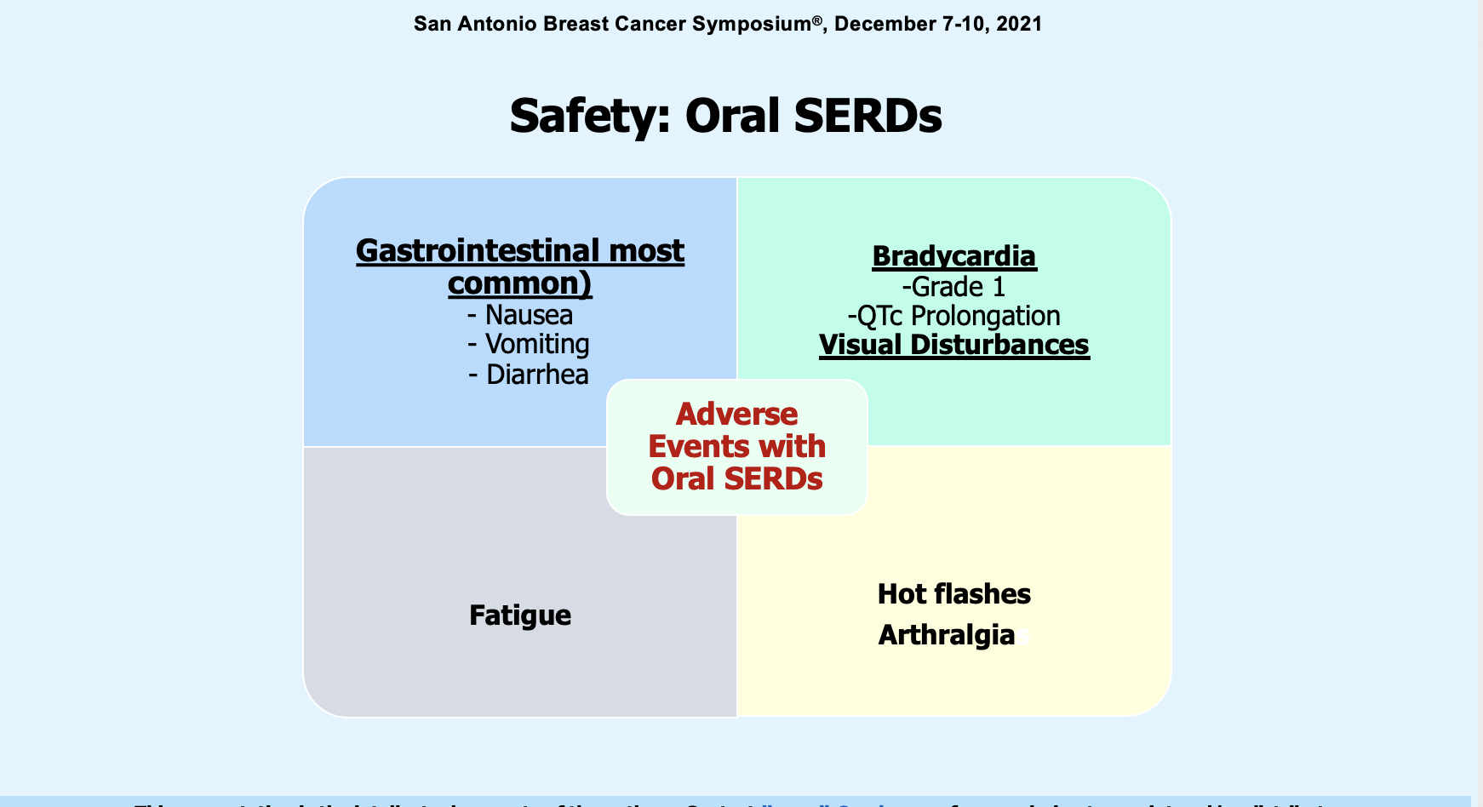
Jhaveri K et al. SABCS 2022;Abstract TF-1.

Slide 17
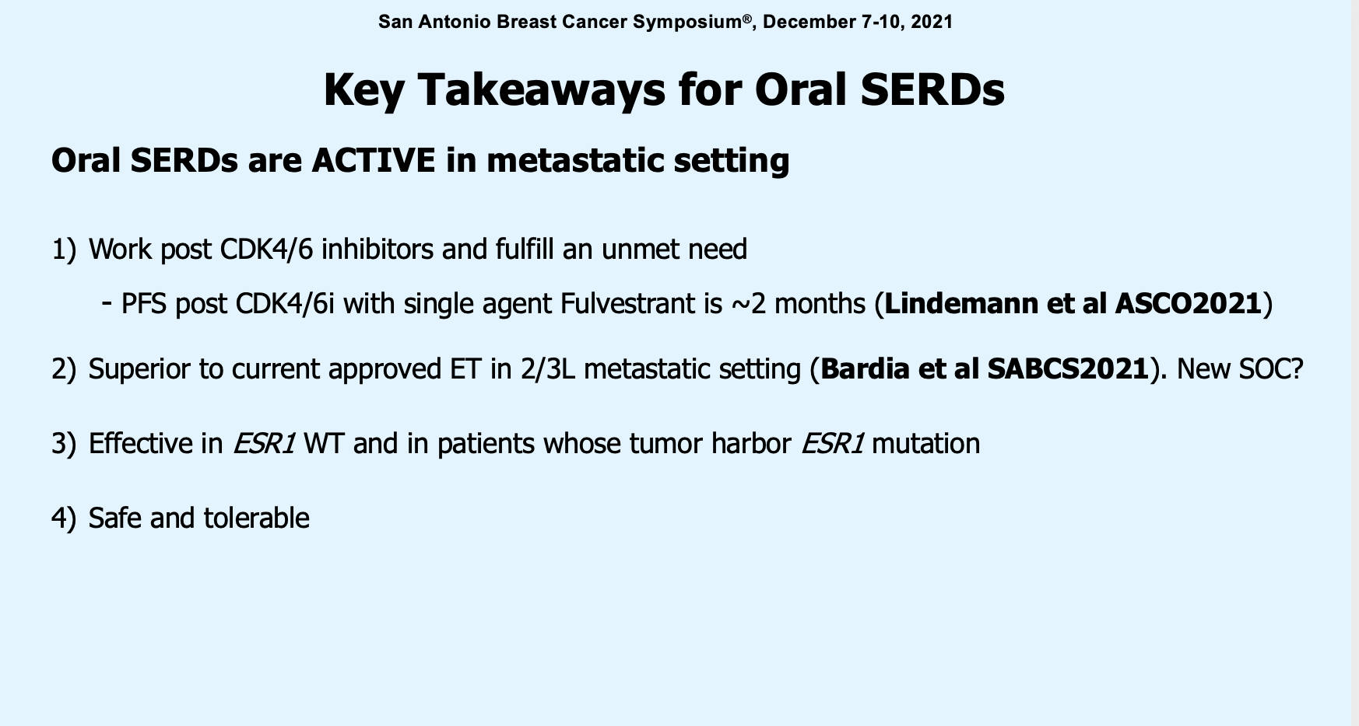
Jhaveri K et al. SABCS 2022;Abstract TF-1.

Slide 18
Meet The Professor with Dr Jhaveri
MODULE 1: Case Presentations
Dr Heeke: 40-year-old premenopausal woman with a 5.8-cm, ER/PR-positive, HER2-negative infiltrating lobular carcinoma and microscopic sentinel node involvement
Dr Astrow: 40-year-old premenopausal woman with a 3.1-cm ER/PR-positive, HER2-negative localized IDC and a Recurrence Score® of 18
Dr Gupta: 59-year-old woman with ER/PR-positive, HER2-negative, MSS, BRCA1/2 WT, PALB2-mutant metastatic IDC who receives palbociclib/letrozole and zoledronic acid
Dr Lamar: 60-year-old postmenopausal woman with de novo ER/PR-positive, HER2-low (IHC 1+) metastatic IDC, s/p PD on abemaciclib/letrozole and alpelisib/fulvestrant
Dr Agrawal: 35-year-old premenopausal woman with ER/PR-positive, HER2-negative IDC receiving neoadjuvant chemotherapy and goserelin, now with sexual dysfunction
Dr Brooks: 65-year-old woman with ER/PR-positive, HER2-low bone-only metastatic IDC on endocrine therapy alone since 2001, now experiencing asymptomatic disease progression — ESR1 variant, AKT1 mutation on liquid biopsy
Dr Zelkowitz: 46-year-old woman with a 3.7-cm axillary mass that proves to be triple-negative, BRCA1/2 WT, TxN1 IDC
Dr Kumar: 53-year-old woman, Jehovah’s Witness, with a 2-cm triple-negative IDC and primary biliary cirrhosis of the liver (Child-Pugh A) and scleroderma

Slide 19
Case Presentation: 40-year-old premenopausal woman with a 5.8-cm, ER/PR-positive, HER2-negative infiltrating lobular carcinoma and microscopic sentinel node involvement
Dr Arielle Heeke (Charlotte, North Carolina)

Slide 20
Case Presentation: 40-year-old premenopausal woman with a 3.1-cm ER/PR-positive, HER2-negative localized IDC and a Recurrence Score® of 18
Dr Alan Astrow (Brooklyn, New York)

Slide 21
ER+ EBC: Who benefits from chemotherapy?
Treatment decisions based on Oncotype DX after SABCS 2022
 | N0 |  |  |  |  |  | N+ 1-3LN |  |  | N ≥4LN
Premenopausal | 0-10 | 11-25 |  |  |  | >25 | 0-10 | 11-25 | >25 | CET
 | ET | 11-15 | 16-20 |  | 21-25 | CET | ET | CET | CET
 |  | ET | ET low risk |  | CET
 |  |  |  | CET high risk
Postmenopausal | 0-10 | 11-25 |  |  |  | >25 | 0-10 | 11-25 | >25 | CET
 | ET | ET |  |  |  | CET | ET | ET | CET
Courtesy, Professor Peter Schmid, 2023

Slide 22
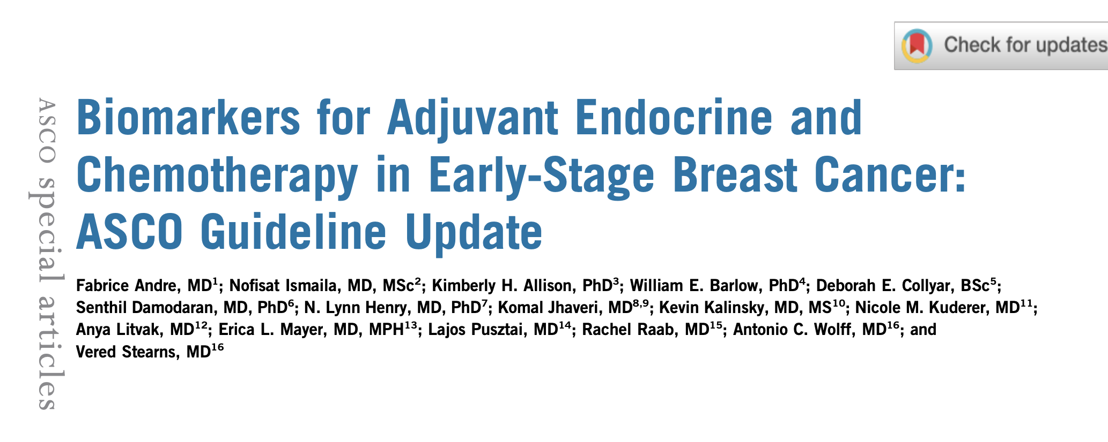
J Clin Oncol 2022;40(16):1816-37.
Notes:
Astrow

Slide 23
Case Presentation: 59-year-old woman with ER/PR-positive, HER2-negative, MSS, BRCA1/2 WT, PALB2-mutant metastatic IDC who receives palbociclib/letrozole and zoledronic acid
Dr Shaachi Gupta (Lake Worth, Florida)

Slide 24
Case Presentation: 60-year-old postmenopausal woman with de novo ER/PR-positive, HER2-low (IHC 1+) metastatic IDC, s/p PD on abemaciclib/letrozole and alpelisib/fulvestrant
Dr Zanetta Lamar (Naples, Florida)

Slide 25
Case Presentation: 35-year-old premenopausal woman with ER/PR-positive, HER2-negative IDC receiving neoadjuvant chemotherapy and goserelin, now with sexual dysfunction
Dr Laila Agrawal (Louisville, Kentucky)

Slide 26
Case Presentation: 35-year-old premenopausal woman with ER/PR-positive, HER2-negative IDC receiving neoadjuvant chemotherapy and goserelin, now with sexual dysfunction
(continued)
Dr Laila Agrawal (Louisville, Kentucky)

Slide 27
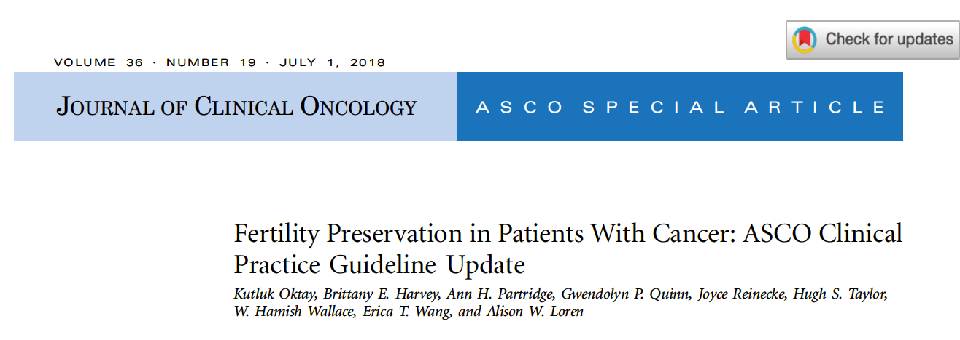
Sperm, oocyte, and embryo cryopreservation are considered standard practice and are widely available
There is conflicting evidence to recommend gonadotrophin-releasing hormone agonists (GnRHa) and other
means of ovarian suppression for fertility preservation
The Panel recognizes that, when proven fertility preservation methods are not feasible, and in the setting of
young women with breast cancer, GnRHa may be offered to patients in the hope of reducing the likelihood of
chemotherapy-induced ovarian insufficiency
GnRHa should not be used in place of proven fertility preservation methods

Slide 28
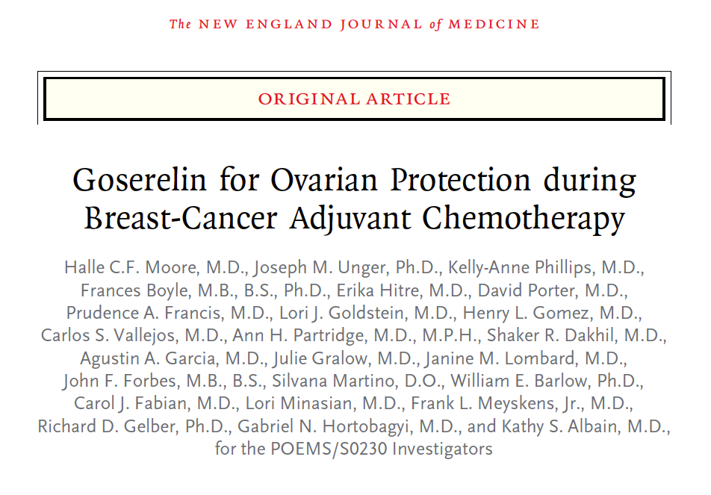
2015;372(10):923-32
Among 135 patients with complete primary endpoint data, the ovarian failure rate was 8% in the goserelin
group and 22% in the chemotherapy-alone group (odds ratio 0.30, two-sided p = 0.04)
Owing to missing primary endpoint data, sensitivity analyses were performed, and the results were
consistent with the main findings
Moore HCF et al. N Engl J Med 2015;372(10):923-32.

Slide 29
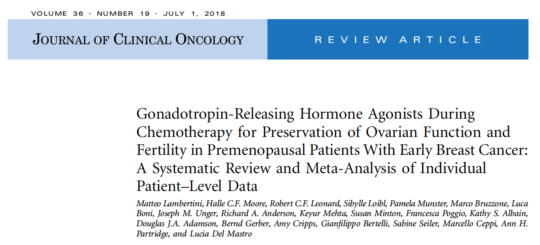

Slide 30
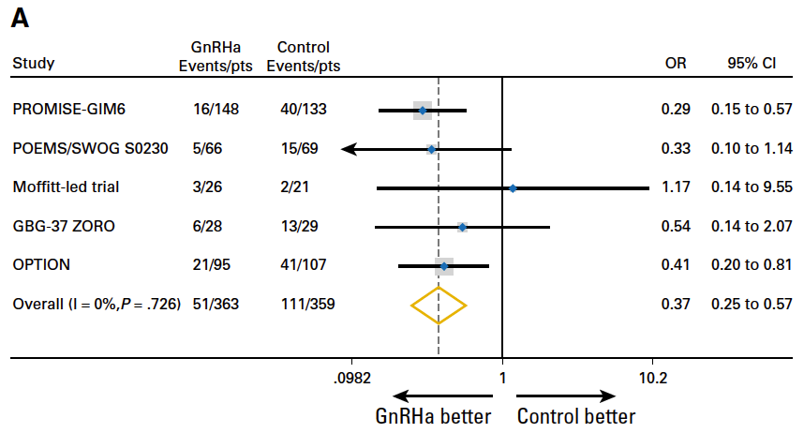
Meta-analysis of Gonadotropin-Releasing Hormone Analogues During Chemotherapy for Localized Breast Cancer: Premature Ovarian Insufficiency by Trial
873 randomized patients from 5 major trials were included in the meta-analysis
Lambertini M et al. J Clin Oncol 2018;36(19):1981-90.

Slide 31
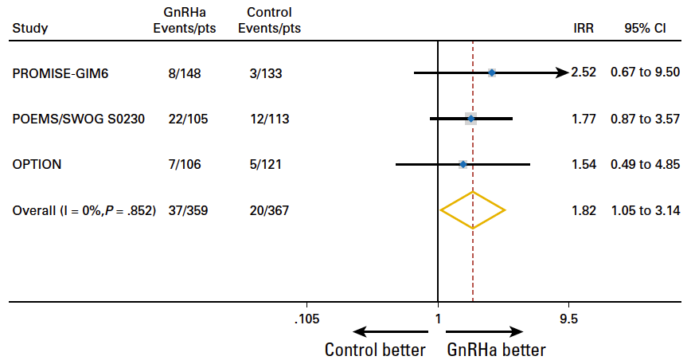
Meta-analysis of Gonadotropin-Releasing Hormone Analogues During Chemotherapy for Localized Breast Cancer: Post-treatment Pregnancies by Trial
Lambertini M et al. J Clin Oncol 2018;36(19):1981-90.

Slide 32
Case Presentation: 65-year-old woman with ER/PR-positive, HER2-low bone-only metastatic IDC on endocrine therapy alone since 2001, now experiencing asymptomatic disease progression — ESR1 variant, AKT1 mutation on liquid biopsy
Dr Philip Brooks (Brewer, Maine)

Slide 33
FDA Approval of Elacestrant for ER-Positive, HER2-Negative, ESR1-Mutated Advanced or Metastatic Breast Cancer
Press Release: January 27, 2023
“On January 27, 2023, the Food and Drug Administration approved elacestrant for postmenopausal women or adult men with ER-positive, HER2-negative, ESR1-mutated advanced or metastatic breast cancer with disease progression following at least one line of endocrine therapy.
FDA also approved the Guardant360 CDx assay as a companion diagnostic device to identify patients with breast cancer for treatment with elacestrant.
Efficacy was evaluated in EMERALD (NCT03778931), a randomized, open-label, active-controlled, multicenter trial that enrolled 478 postmenopausal women and men with ER-positive, HER2-negative advanced or metastatic breast cancer of which 228 patients had ESR1 mutations.
The recommended elacestrant dose is 345 mg taken orally with food once daily until disease progression or unacceptable toxicity.”
https://www.fda.gov/drugs/resources-information-approved-drugs/fda-approves-elacestrant-er-positive-her2-negative-esr1-mutated-advanced-or-metastatic-breast-cancer

Slide 34
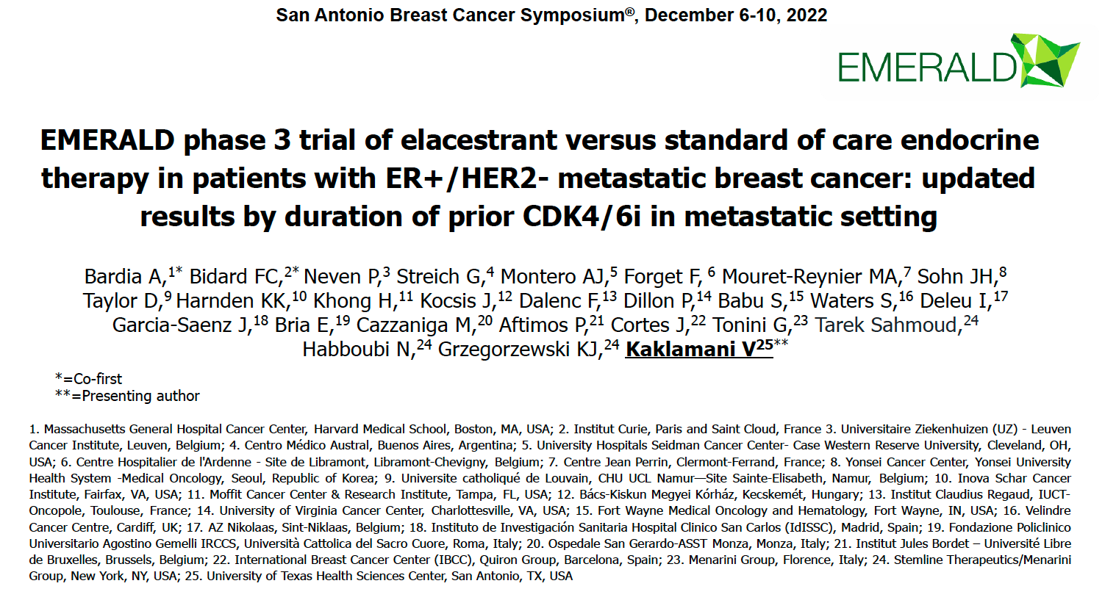
Abstract GS3-01

Slide 35
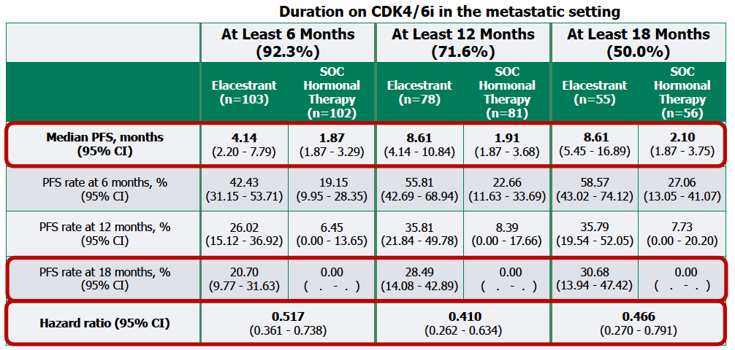
EMERALD PFS Analyses by CDK4/6 Inhibitor Duration: Patients with ESR1 Tumor Mutations
PFS = progression-free survival
Bardia A et al. SABCS 2022;Abstract GS3-01.

Slide 36
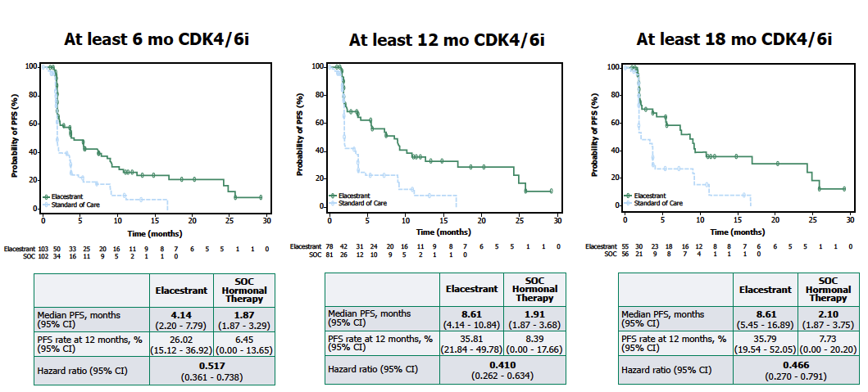
EMERALD PFS Analyses by CDK4/6i Duration: Patients with ESR1 Tumor Mutations
Bardia A et al. SABCS 2022;Abstract GS3-01.

Slide 37
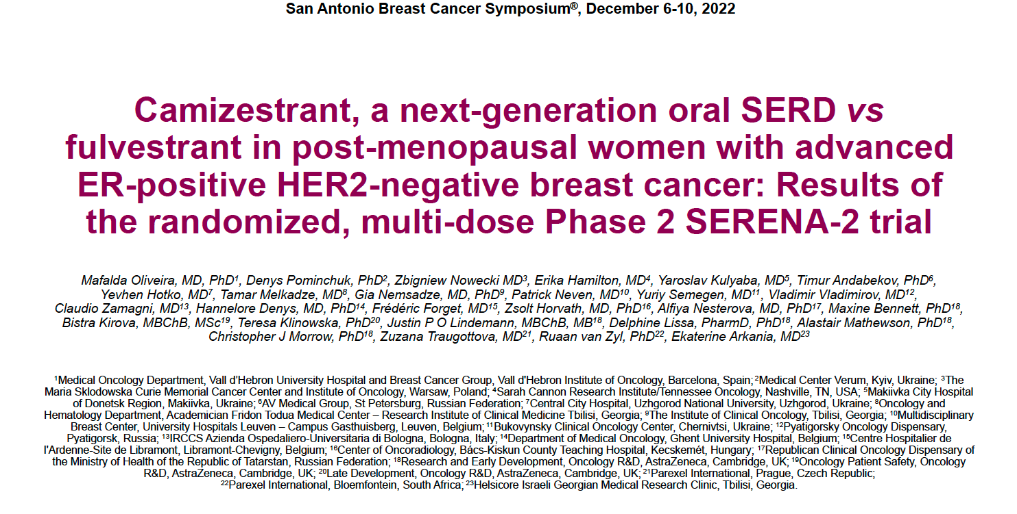
Abstract GS3-02

Slide 38
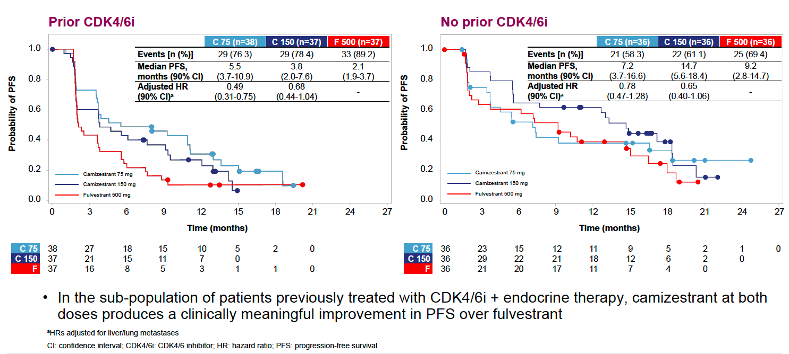
SERENA-2: PFS by Prior CDK4/6 Inhibitor Use
Oliveira M et al. SABCS 2022;Abstract GS3-02.

Slide 39
Select Ongoing Phase III Trials of Oral SERDs in Development for HR-Positive Advanced Breast Cancer (ABC)
Trial | N | Randomization | Setting | Est primary completion
SERENA-4 | 1,342 | Camizestrant + palbociclib Anastrozole + palbociclib | Untreated ABC | August 2026
persevERA | 978 | Giredestrant + palbociclib Letrozole + palbociclib | Untreated ABC | April 2024
SERENA-6 | 302 | Camizestrant + (palbociclib or abemaciclib) (Anastrozole or letrozole) + (palbociclib or abemaciclib) | Detectable ESR1 mutation w/o PD during 1st-line AI + CDK4/6i | Sept 2023
EMBER-3 | 860 | Imlunestrant Imlunestrant + abemaciclib Investigator’s choice of ET | ABC previously treated with ET + CDK4/6i | April 2024
evERA | 320 | Giredestrant + everolimus Exemestane + everolimus | ABC previously treated with ET + CDK4/6i | July 2024
heredERA | 812 | Giredestrant + pertuzumab/trastuzumab/hyaluronidase-zzxf Pertuzumab/trastuzumab/hyaluronidase-zzxf | Untreated ER+, HER2+ ABC after first-line pertuzumab/trastuzumab/ hyaluronidase-zzxf + taxane | August 2026
SERD = selective ER degrader
www.clinicaltrials.gov. Accessed November 2022.

Slide 40
Ongoing Phase III Trials of Adjuvant Oral SERDs for HR-Positive, HER2-Negative Localized Breast Cancer
Study | N | Setting | Randomization
lidERA | 4,100 | Node-negative or node-positive | Giredestrant +/- LHRH agonist ET of physician’s choice +/- LHRH agonist
EMBER-4 | 6,000 | Elevated risk of recurrence after definitive treatment Completion of at least 2 years and up to 5 years of ET Previous adjuvant CDK4/6i or PARPi allowed | Imlunestrant ET of physician’s choice
EORTC-2129-BCG | 220 | Elevated risk of recurrence after definitive treatment Completion of at least 2 years and up to 7 years of ET ctDNA-positive Previous adjuvant CDK4/6i or PARPi allowed | Elacestrant Tamoxifen or aromatase inhibitor at time of ctDNA detection
ctDNA = circulating tumor DNA
www.clinicaltrials.gov. Accessed January 2023.

Slide 41
Capivasertib and Fulvestrant for Patients with Aromatase Inhibitor-Resistant Hormone Receptor-Positive/Human Epidermal Growth Factor Receptor 2-
Negative Advanced Breast Cancer: Results from the Phase III CAPItello-291 Trial
Turner NC et al.
SABCS 2022;Abstract GS3-04.

Slide 42
CAPItello-291 Phase III Study Design
Secondary endpoints
Summary of Demographics
Median age ∼59
Asian 26%, Black 1%
Primary ET resistance ∼38%
Visceral metastases ∼68%
One line of prior ET for mBC ∼75%
Prior CDK4/6i for mBC ∼70%
Chemotherapy for ABC ∼18%
Turner NC et al. SABCS 2022;Abstract GS3-04.

Slide 43
CAPItello-291: Overall Response per Investigator Assessment
Turner NC et al. SABCS 2022;Abstract GS3-04.

Slide 44
CAPItello-291: Safety
Turner NC et al. SABCS 2022;Abstract GS3-04.

Slide 45
CAPItello-292 Phase III Study Design
Estimated enrollment (N = 700)
ER-positive, HER2-negative locally advanced unresectable or metastatic breast cancer Previous treatment with ET (tamoxifen or AI) as a single agent or in combination with Radiological evidence of breast cancer recurrence or PD while on or within 12 months of completing a neoadjuvant ET regimen OR Radiological evidence of PD while receiving the ET for locally advanced or metastatic breast cancer
Capivasertib + fulvestrant
+ palbociclib
R
Placebo + fulvestrant
+ palbociclib
Primary endpoint: Investigator-assessed PFS
Secondary endpoint: OS, PFS by subgroups, PFS2, objective response rate, duration of response, clinical benefit rate, quality of life, safety
www.clinicaltrials.gov. NCT04862663. Accessed November 2022.

Slide 46
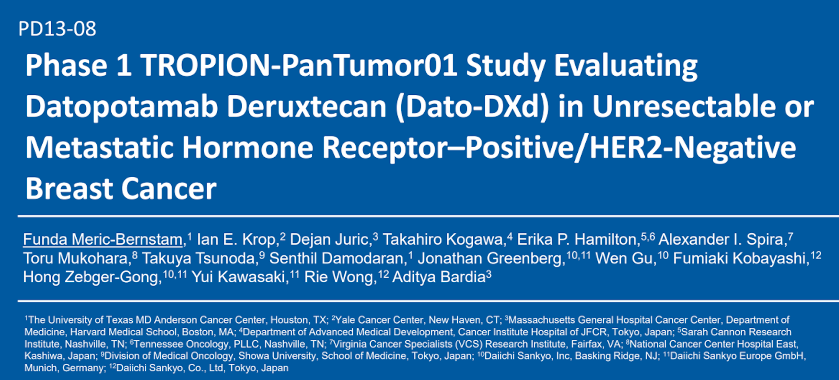
SABCS 2022

Slide 47
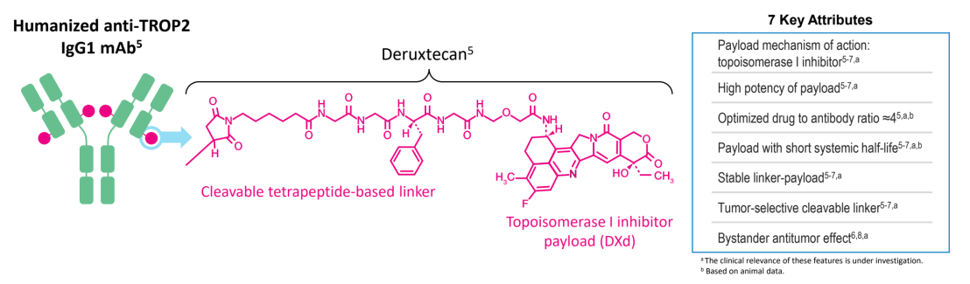
Datopotamab Deruxtecan Mechanism of Action
Meric-Bernstam F et al. SABCS 2022;Abstract PD13-08.

Slide 48
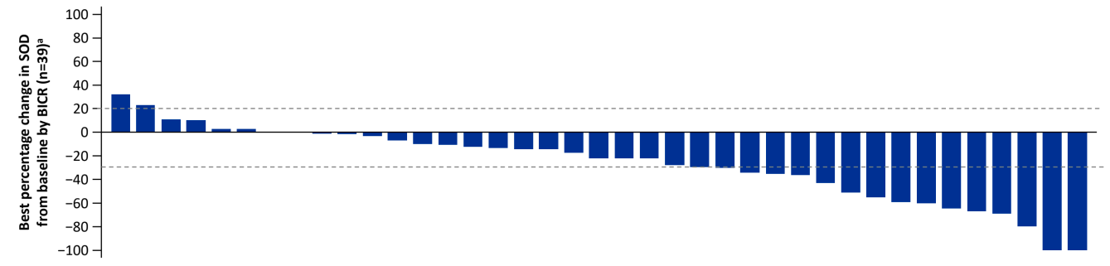
TROPION-PanTumor01: Datopotamab Deruxtecan for HR-Positive, HER2-Negative Metastatic Breast Cancer
Objective response rate: 27%
Median PFS: 8.3 mo
Meric-Bernstam F et al. SABCS 2022;Abstract PD13-08.

Slide 49
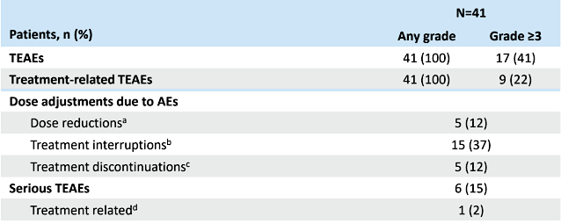
TROPION-PanTumor01: Safety Summary
Meric-Bernstam F et al. SABCS 2022;Abstract PD13-08.

Slide 50
TROPION-Breast01 Phase III Study Design
Estimated enrollment (N = 700) Estimated primary completion: August 2025
Eligibility HR-positive, HER2-negative locally advanced unresectable or metastatic breast cancer Disease progression on and ineligibility for ET per investigator assessment and treated with 1 to 2 lines of prior chemotherapy in the inoperable/metastatic setting. Participant must have documented progression on their most recent line of chemotherapy
Datopotamab deruxtecan
R
Investigator’s choice of
chemotherapy:
Capecitabine, gemcitabine, eribulin or vinorelbine
Coprimary endpoints: PFS by BICR, OS
Secondary endpoints: Objective response rate, duration of response, PFS (investigator), disease control rate, time to subsequent therapies, PFS2, others
www.clinicaltrials.gov. NCT05104866. Accessed November 2022.

Slide 51
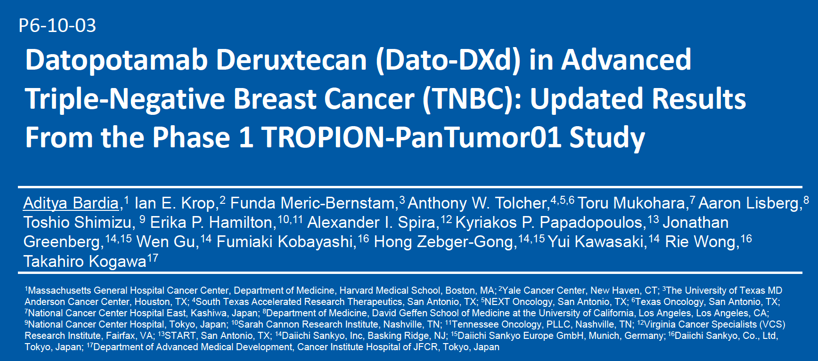
SABCS 2022

Slide 52
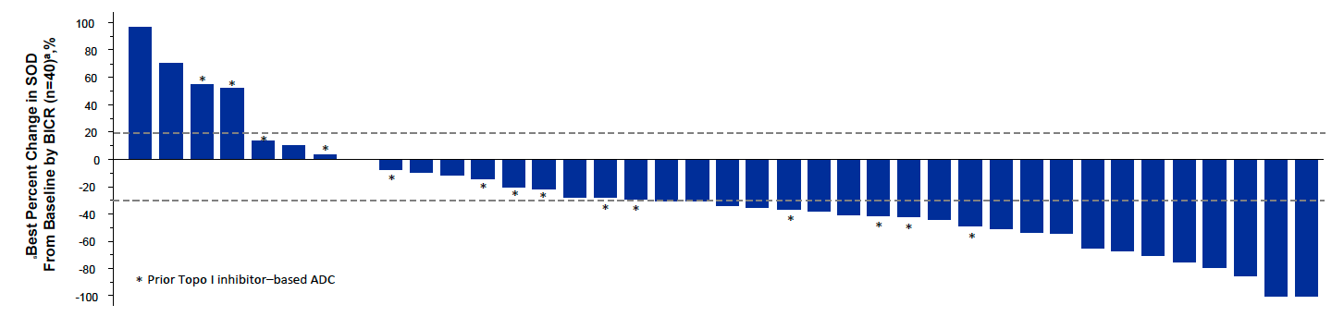
TROPION-PanTumor01: Response and Survival with Dato-DXd
Objective response rate (All): 32%
Objective response rate: Topo I inhibitor-naïve: 44%
 | All patients (N = 44) | Topo I inhibitor-naïve (N = 30)
Median PFS | 4.4 mo | 7.3 mo
Median OS | 13.5 mo | 14.3 mo
Bardia A et al. SABCS 2022;Abstract P6-10-03.

Slide 53
TROPION-Breast02 Phase III Study Design
Estimated enrollment (N = 600) Estimated primary completion: Dec 2025
Eligibility Previously untreated HR-negative, HER2-negative, locally advanced unresectable or metastatic TNBC PD-L1-negative or PD-L1-positive but relapsed after prior ICI for localized breast cancer, or comorbidities precluding ICI, or no regulatory access to pembrolizumab
Datopotamab deruxtecan
R
Investigator’s choice of chemotherapy (paclitaxel,
nab paclitaxel, carboplatin, capecitabine or eribulin)
Coprimary endpoints: PFS by BICR, OS
Secondary endpoints: Objective response rate, duration of response, PFS (investigator), disease control rate, time to subsequent therapies, PFS2, others
www.clinicaltrials.gov. NCT05374512. Accessed November 2022.

Slide 54
Case Presentation: 46-year-old woman with a 3.7-cm axillary mass that proves to be triple-negative, BRCA1/2 WT, TxN1 IDC
Dr Richard Zelkowitz (Bridgeport, Connecticut)

Slide 55
Case Presentation: 53-year-old woman, Jehovah’s Witness, with a 2-cm triple-negative IDC and primary biliary cirrhosis of the liver (Child-Pugh A) and scleroderma
Dr Kapisthalam Kumar (Trinity, Florida)

Slide 56
Meet The Professor with Dr Jhaveri
Introduction
MODULE 1: Case Presentations
MODULE 2: Faculty Survey
MODULE 3: Journal Club with Dr Jhaveri
MODULE 4: Appendix

Slide 57
Which adjuvant endocrine therapy (ET) would you most likely recommend for a 30-year-old premenopausal woman with node-negative, ER-positive, HER2-negative localized breast cancer and the Recurrence Score® (RS) below? Would you recommend adjuvant chemotherapy?
RS = 8
RS = 20
ET
Chemotherapy?
ET
Chemotherapy?
OFS/ablation + letrozole
No
OFS/ablation + letrozole
No
OFS/ablation + tamoxifen, or Tam alone if small tumor
No
OFS/ablation + tamoxifen
Yes, but OFS/ablation as alternative
Tamoxifen
No
OFS/ablation + tamoxifen or letrozole
Yes, but OFS/ablation as alternative
Tamoxifen +/-OFS/ablation
No
OFS/ablation + letrozole
Yes, but OFS/ablation as alternative
Tamoxifen
No
OFS/ablation + letrozole, or
Tamoxifen → OFS/tam → OFS/AI
Yes, but OFS/ablation as alternative
Tamoxifen
No
OFS/ablation + letrozole
Yes
OFS = ovarian function suppression; AI = aromatase inhibitor

Slide 58
Which adjuvant ET would you most likely recommend for a 30-year-old premenopausal woman with ER-positive, HER2-negative localized breast cancer with 1 positive node and the RS below? Would you recommend adjuvant chemotherapy?
RS = 8
RS = 20
ET
Chemotherapy?
ET
Chemotherapy?
OFS/ablation + letrozole
Yes, but OFS/ablation as alternative
OFS/ablation + letrozole
Yes, but OFS/ablation as alternative
OFS/ablation + tamoxifen
Yes, but OFS/ablation as alternative
OFS/ablation + anastrozole
Yes
OFS/ablation + tamoxifen or letrozole
Yes, but OFS/ablation as alternative
OFS/ablation + tamoxifen or letrozole
Yes
OFS/ablation + tamoxifen or + letrozole
Yes, but OFS/ablation as alternative
OFS/ablation + letrozole
Yes, but OFS/ablation as alternative
OFS/ablation + letrozole
Yes, but OFS/ablation as alternative
OFS/ablation + letrozole
Yes
OFS/ablation + letrozole
No
OFS/ablation + letrozole
Yes
OFS = ovarian function suppression

Slide 59
For premenopausal patients (age 40-50 years) with ER-positive, HER2-negative localized breast cancer who are about to receive adjuvant chemotherapy, do you generally offer the option of using OFS during chemotherapy in the following clinical scenarios?
For fertility preservation
For ovarian function preservation
Yes
Yes
Yes
Yes
No*
Yes
No
Yes
Yes
No
No
No
OFS = ovarian function suppression; *Fertility specialist discusses with patient

Slide 60
For premenopausal patients (age 40-50 years) with ER-positive, HER2-positive localized breast cancer who are about to receive adjuvant chemotherapy, do you generally offer the option of using OFS during chemotherapy in the following clinical scenarios?
For fertility preservation
For ovarian function preservation
Yes
Yes
Yes
Yes
No*
Yes
No
Yes
Yes
No
No
No
OFS = ovarian function suppression; *Fertility specialist discusses with patient

Slide 61
Regulatory and reimbursement issues aside, in general, what would you recommend as adjuvant therapy for a patient with TNBC, a germline BRCA mutation and a PD-L1 combined positive score (CPS) of 1 who has residual disease after neoadjuvant chemotherapy? Does level of PD-L1 expression have any bearing on your response?
Adjuvant therapy
PD-L1 expression a factor?
Olaparib for 1 year
No
Olaparib for 1 year*
No
Olaparib + pembrolizumab
No
Olaparib for 1 year + or
followed by pembrolizumab
No
Olaparib + pembrolizumab
for 1 year
No
Olaparib for 1 year*
No
*If patient received neoadjuvant pembrolizumab, I would complete pembrolizumab in combination with olaparib

Slide 62
Regulatory and reimbursement issues aside, have you attempted or would you attempt to access olaparib as part of adjuvant therapy for a patient with a germline PALB2 mutation and TNBC who has residual disease after neoadjuvant chemotherapy?
I have
I haven’t but would for the right patient
I haven’t but would for the right patient
I haven’t but would for the right patient
I haven’t but would for the right patient
I have

Slide 63
Regulatory and reimbursement issues aside, have you combined or would you combine olaparib with adjuvant pembrolizumab for a patient with a germline BRCA mutation and PD-L1-positive TNBC who has residual disease after neoadjuvant chemotherapy/pembrolizumab?
I have
I haven’t but would for the right patient
I have
I have
I have
I have

Slide 64
What would be your preferred treatment approach for a 60-year-old patient with a germline BRCA mutation and de novo metastatic TNBC and the following PD-L1 CPS?
PD-L1 CPS 0
PD-L1 CPS >10
Olaparib
Pembrolizumab/gem/carbo
Nonplatinum chemotherapy
Pembrolizumab/nab paclitaxel
Olaparib
Pembrolizumab/nab paclitaxel
Olaparib
Olaparib
Olaparib, or Talazoparib,
or Gem/carbo
Pembrolizumab/gem/carbo
Olaparib
Pembrolizumab/gem/carbo
CPS = combined positive score; gem/carbo = gemcitabine/carboplatin

Slide 65
A 45-year-old woman with an ER-negative, HER2-low (IHC 2+) IDC and a germline BRCA mutation receives neoadjuvant AC-T and adjuvant capecitabine for residual disease and now presents with low-volume metastases to the lung and bones (PD-L1 CPS = 0). Regulatory and reimbursement issues aside, what would likely be your next systemic therapy?
Trastuzumab
deruxtecan
Olaparib
Olaparib or talazoparib — coin flip
Olaparib or talazoparib — coin flip
Olaparib
Olaparib
IDC = infiltrating ductal carcinoma; CPS = combined positive score

Slide 66
In general, which CDK4/6 inhibitor do you recommend in combination with endocrine therapy as first-line treatment for women with ER-positive, HER2-negative metastatic breast cancer if they are…?
Postmenopausal
Premenopausal
Palbociclib
No preference
Ribociclib
Ribociclib
Ribociclib
Ribociclib
No preference
Ribociclib
Ribociclib
Ribociclib
Ribociclib
Ribociclib

Slide 67
A 65-year-old woman with ER-positive, HER2-negative breast cancer develops metastases 2 years after starting adjuvant anastrozole. In addition to a CDK4/6 inhibitor, which endocrine treatment would you most likely recommend?
Fulvestrant
Fulvestrant
Fulvestrant
Fulvestrant
Fulvestrant
Fulvestrant

Slide 68
A 65-year-old woman with ER-positive, HER2-negative breast cancer develops metastases 2 years after completing adjuvant anastrozole. In addition to a CDK4/6 inhibitor, which endocrine treatment would you most likely recommend?
Fulvestrant
Letrozole
Fulvestrant
Letrozole
Letrozole
Letrozole

Slide 69
Do you generally administer adjuvant pembrolizumab to patients with localized TNBC who receive neoadjuvant chemotherapy/ pembrolizumab and are found at surgery to have a pathologic complete response?
Yes, for select patients
Yes
Yes
Yes
Yes
Yes

Slide 70
Meet The Professor with Dr Jhaveri
Introduction
MODULE 1: Case Presentations
MODULE 2: Faculty Survey
MODULE 3: Journal Club with Dr Jhaveri
MODULE 4: Appendix

Slide 71
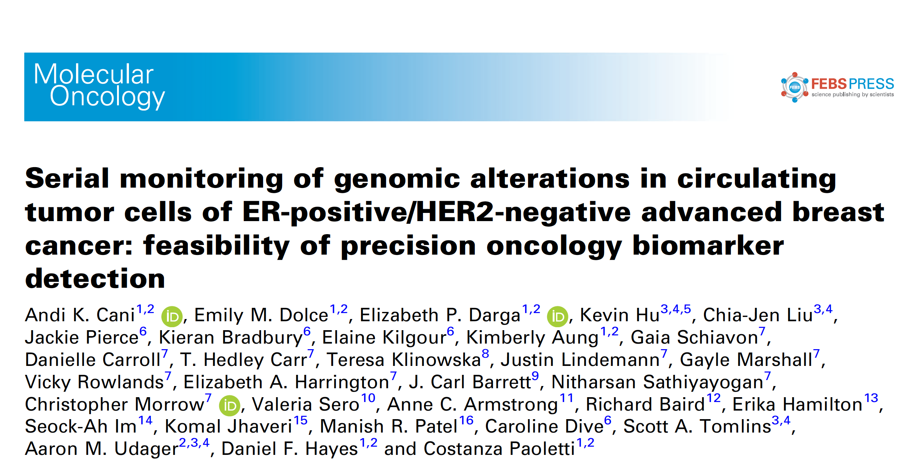
Mol Oncol 2022 May;16(10):1969-85.

Slide 72
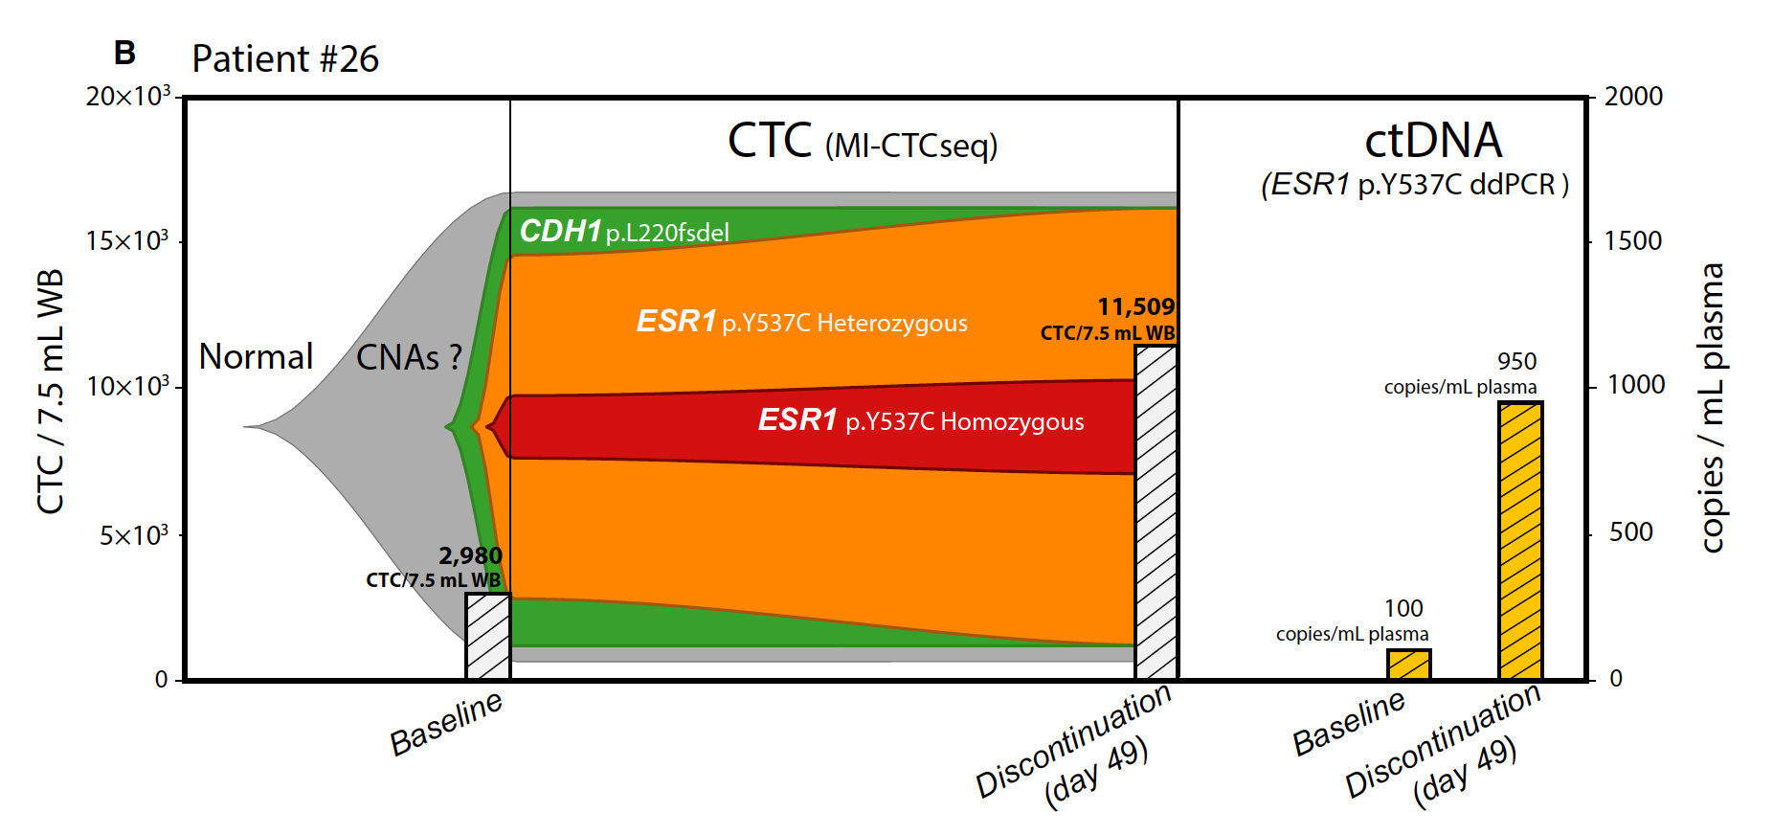
Comparison of Circulating Tumor Cell scNGS and ctDNA ddPCR Analysis for Patient #26
scNGS = single‐cell DNA next‐generation sequencing; ddPCR = digital droplet polymerase chain reaction
Cani AK et al. Mol Oncol 2022 May;16(10):1969-85.

Slide 73
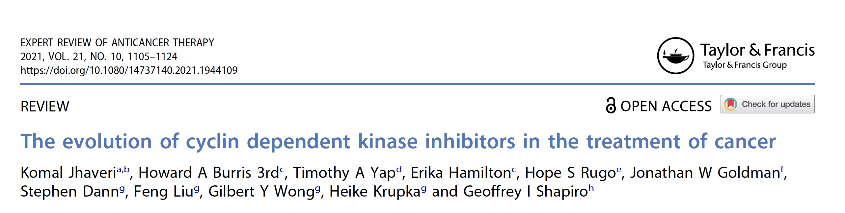

Slide 74
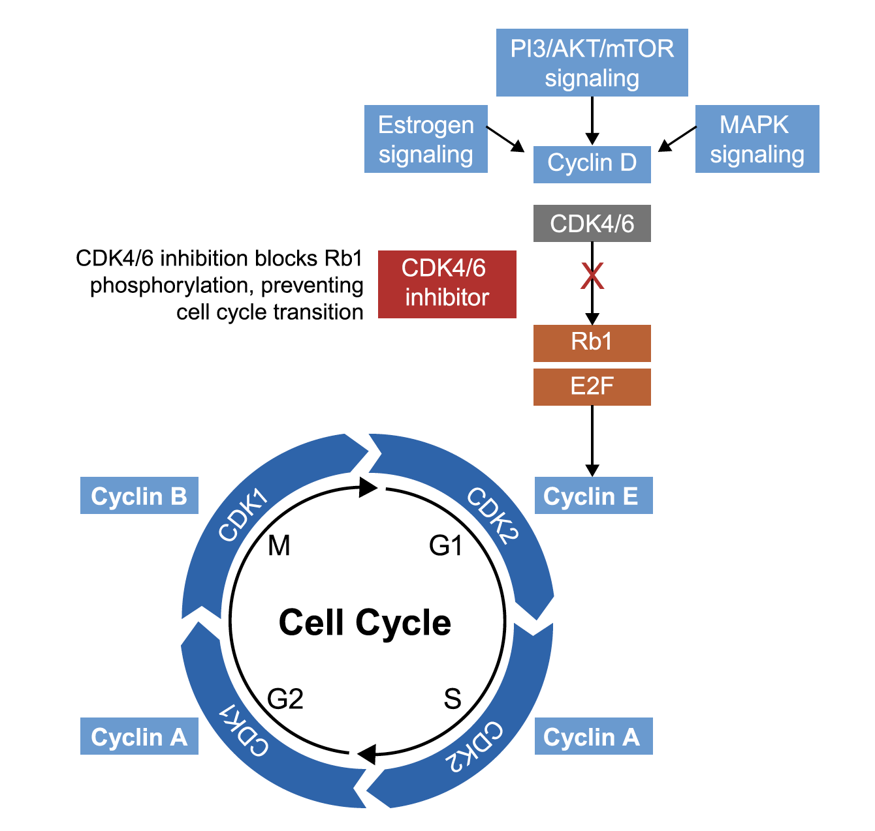
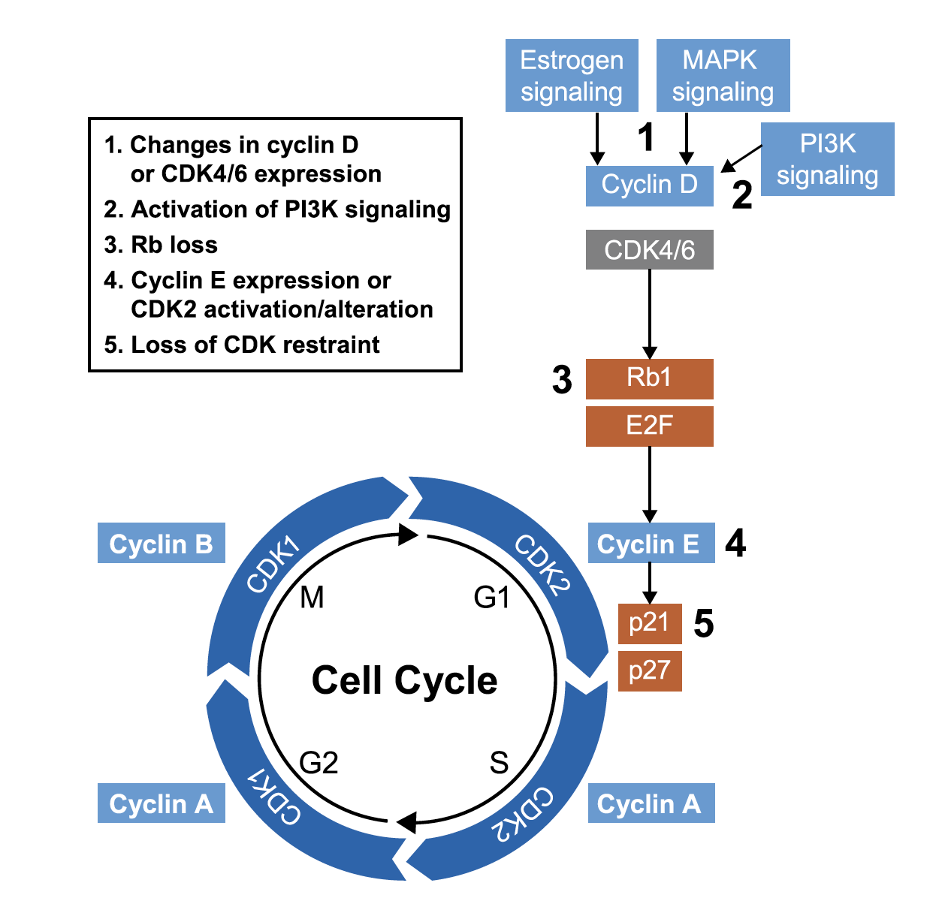
CDK4/6 Inhibition in the Cell Cycle and Possible Mechanisms of Resistance
Mechanisms of Resistance
Jhaveri K et al. Exp Rev Anticancer Ther 2021;21(10):1105-24.

Slide 75
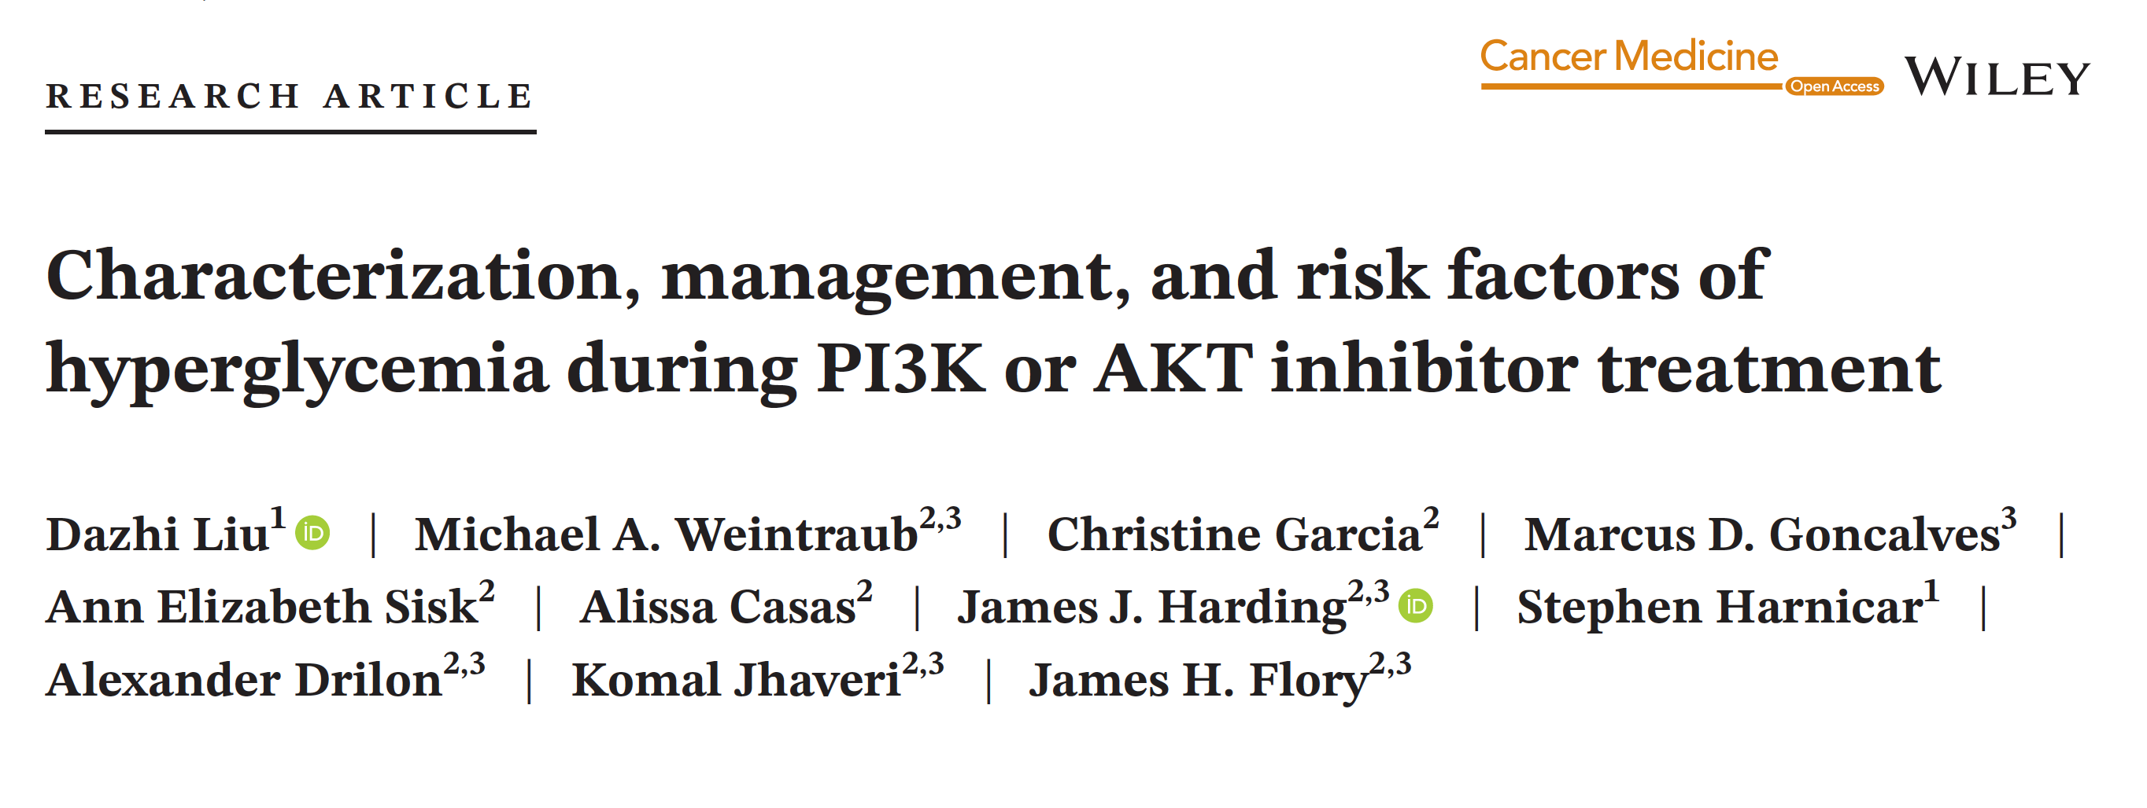
Cancer Med 2022 April;11(8):1796-804.

Slide 76
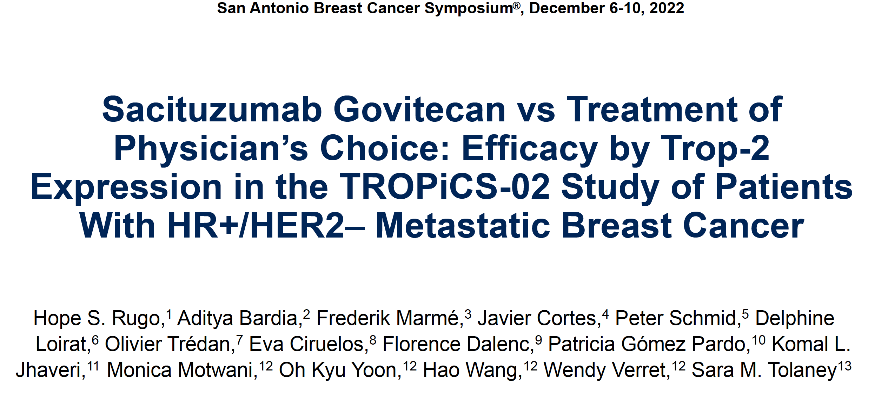
Abstract GS1-11

Slide 77
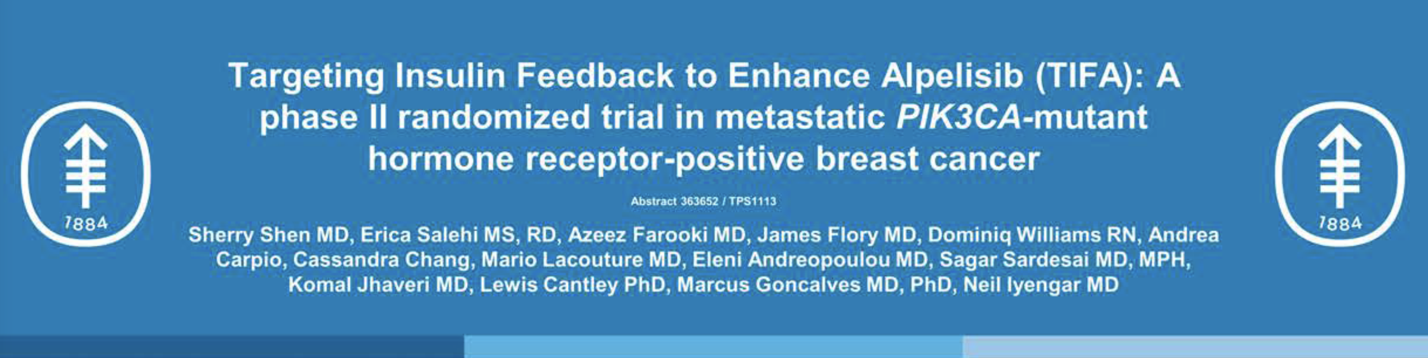
ASCO 2022;Abstract TPS1113.

Slide 78
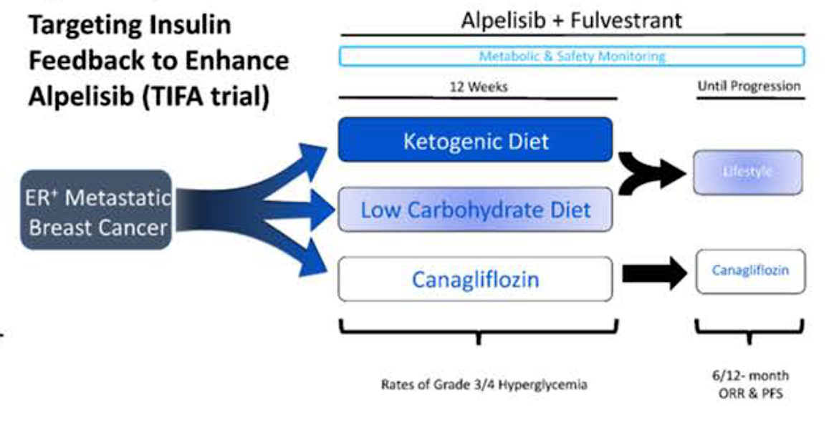
Multicenter Phase II Trial Design
Shen S et al. ASCO 2022;Abstract TPS1113.

Slide 79
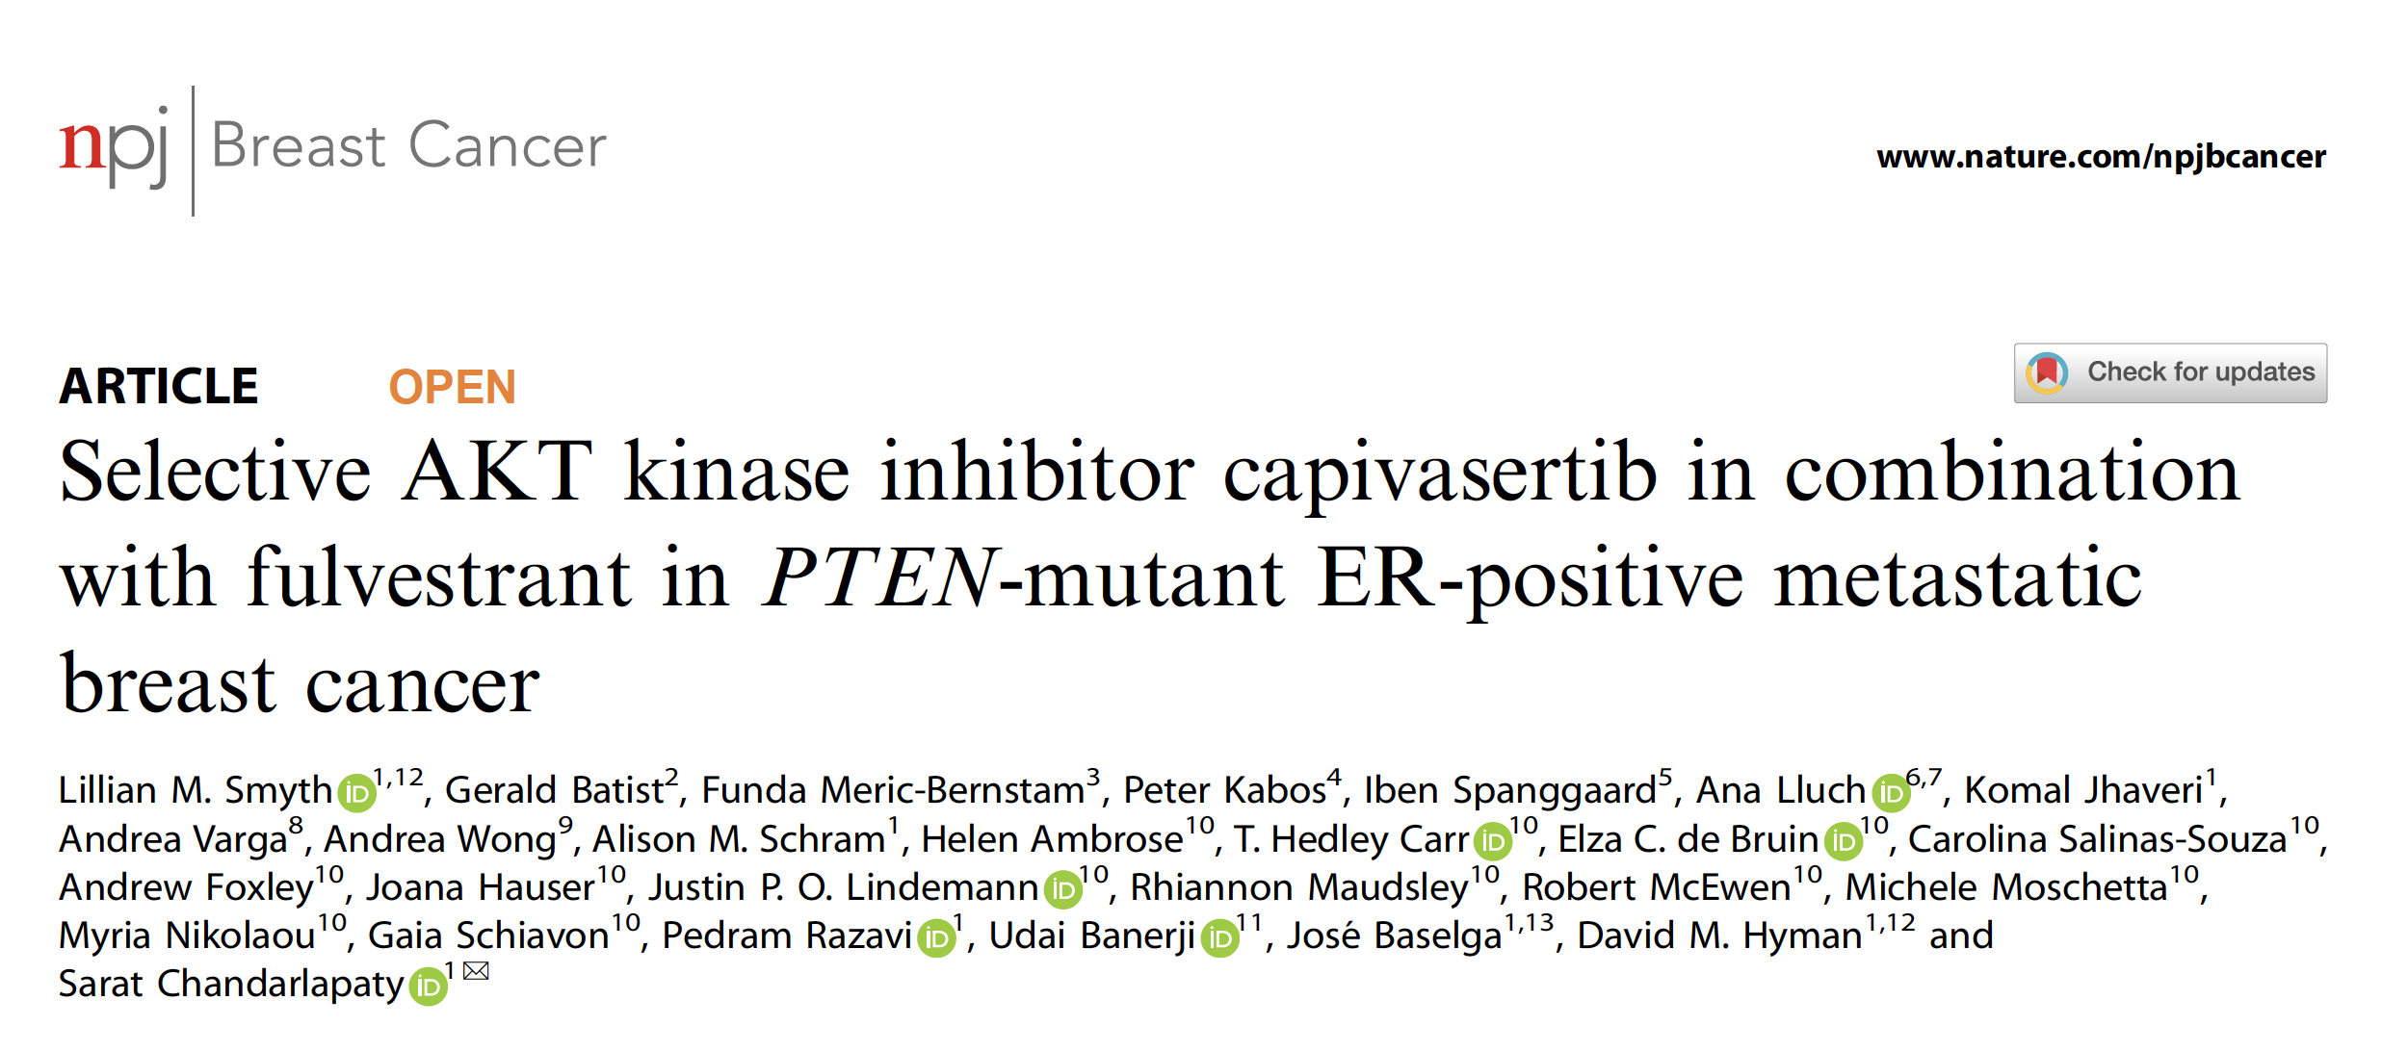
2021 April 16;7(1):44.

Slide 80
Meet The Professor with Dr Jhaveri
Introduction
MODULE 1: Case Presentations
MODULE 2: Faculty Survey
MODULE 3: Journal Club with Dr Jhaveri
MODULE 4: Appendix

Slide 81
HR-Positive Localized Breast Cancer

Slide 82
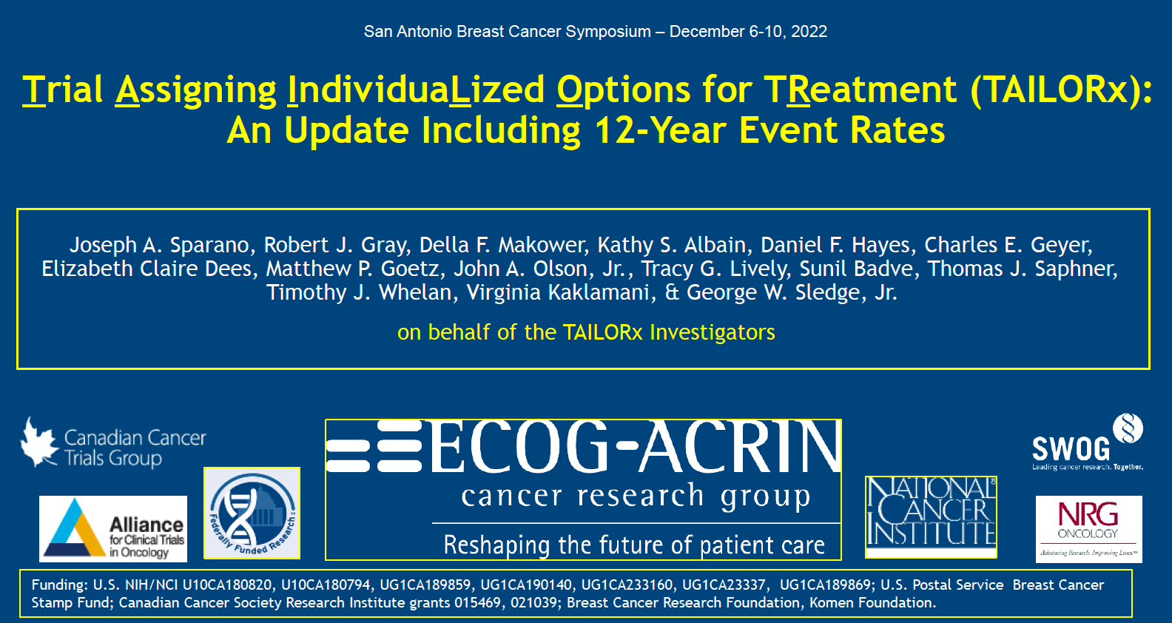
Abstract GS1-05

Slide 83
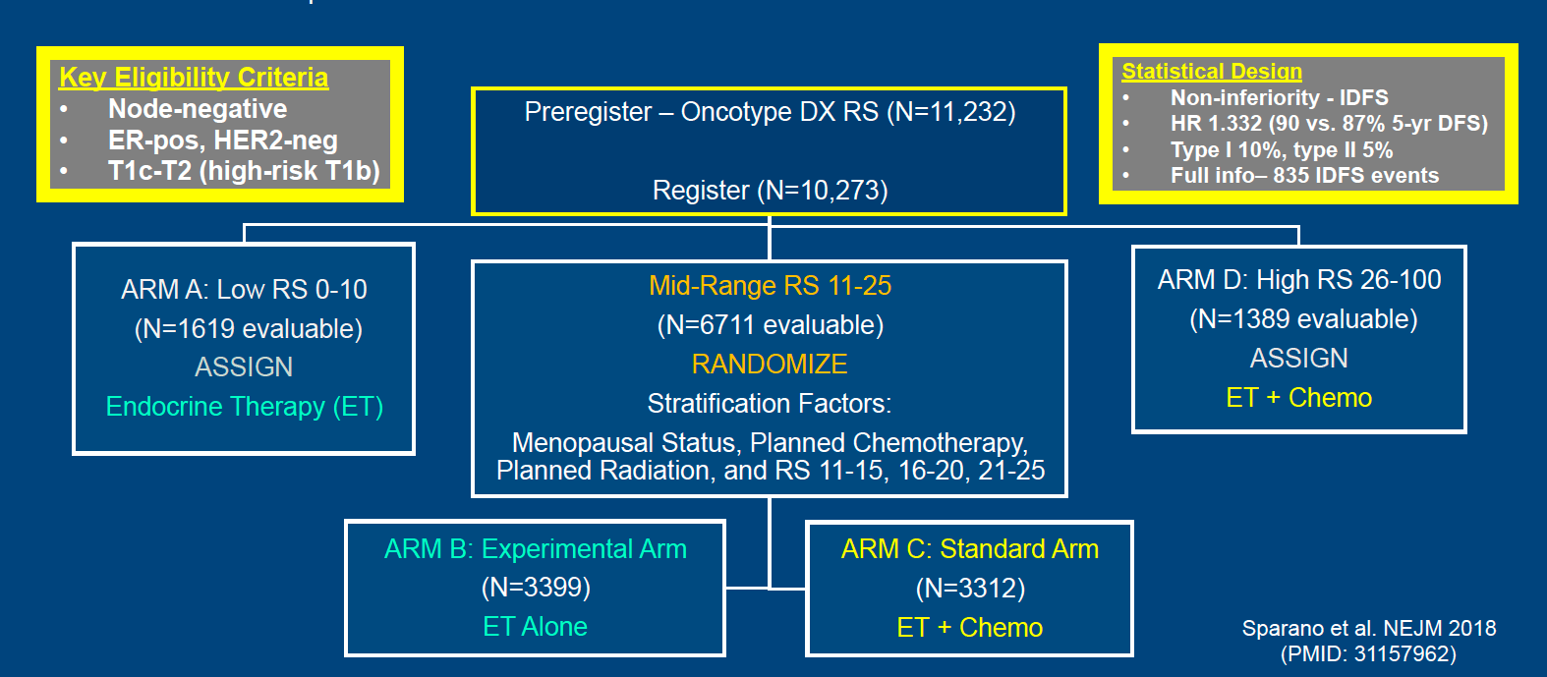
TAILORx Study Design: Treatment Assignment and Randomization
RS = Recurrence Score
Sparano JA et al. SABCS 2022;Abstract GS1-05.

Slide 84
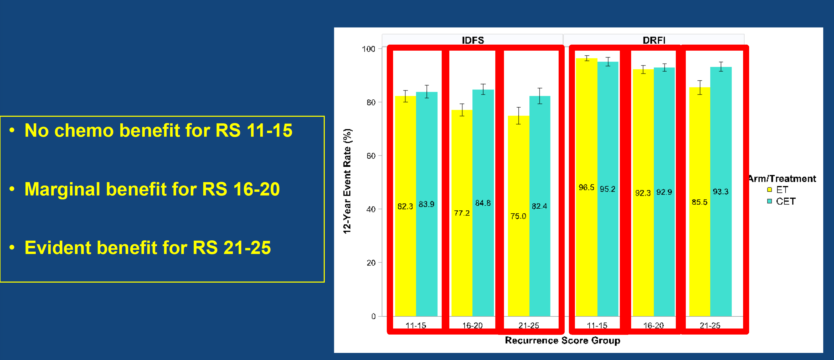
TAILORx Updated Analysis: Event Rates in RS 11-25 Arms and
Age ≤50 Years (ITT Population)
Sparano JA et al. SABCS 2022;Abstract GS1-05.

Slide 85
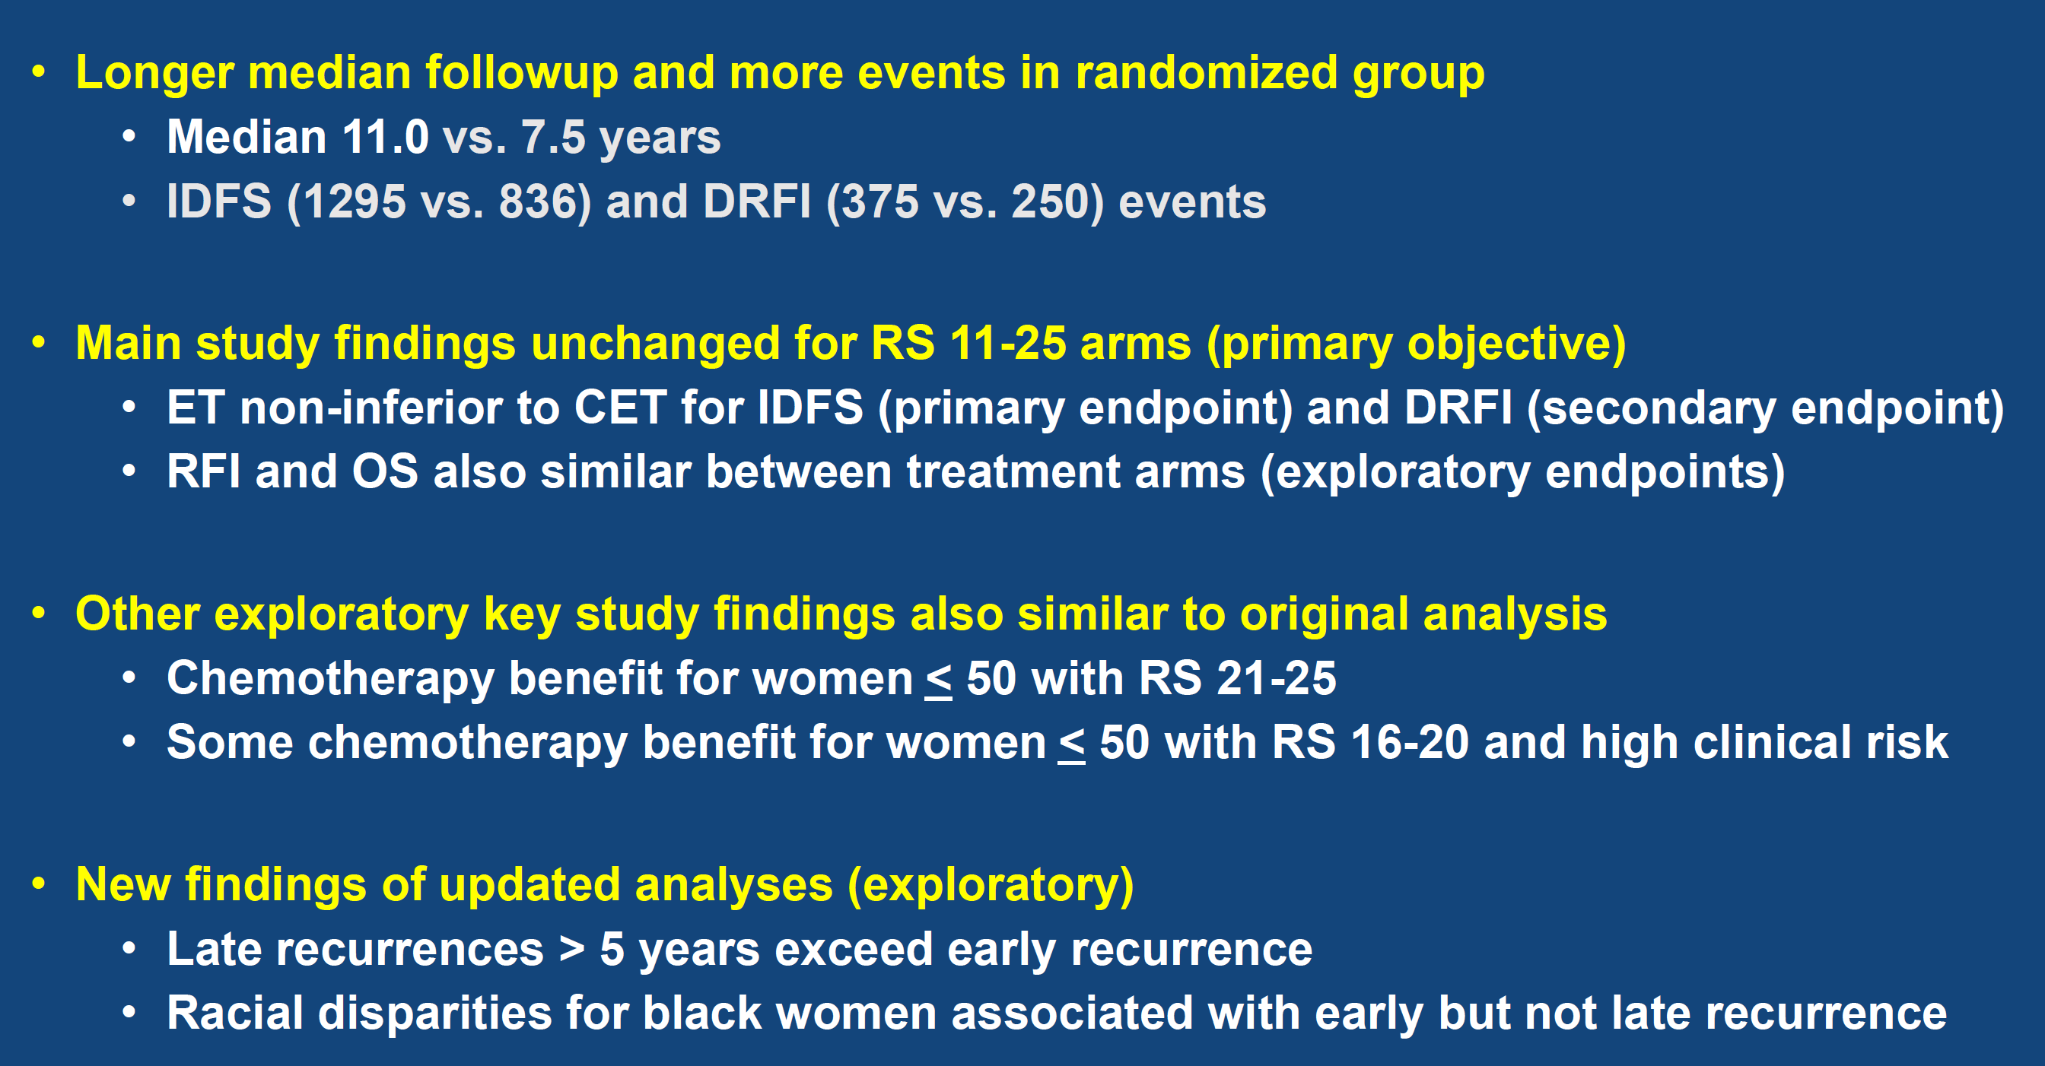
TAILORx Updated Analysis: Conclusions
Sparano JA et al. SABCS 2022;Abstract GS1-05.

Slide 86
HR-Positive Metastatic Breast Cancer

Slide 87
Trastuzumab Deruxtecan Granted FDA Approval for HER2-Low Breast Cancer
Press Release: August 5, 2022
“Today, the US Food and Drug Administration approved fam-trastuzumab-deruxtecan-nxki, an IV infusion for the treatment of patients with unresectable (unable to be removed) or metastatic (spread to other parts of the body) HER2-low breast cancer. This is the first approved therapy targeted to patients with the HER2-low breast cancer subtype, which is a newly defined subset of HER2-negative breast cancer.
Patients with HER2-low breast cancer are eligible for fam-trastuzumab-deruxtecan-nxki if they have received a prior chemotherapy in the metastatic setting, or their cancer returned during, or within 6 months of completing, adjuvant chemotherapy.
This approval is based on DESTINY-Breast04, a randomized, multicenter, open label clinical trial that enrolled 557 adult patients with unresectable or metastatic HER2-low breast cancer.”
https://www.fda.gov/news-events/press-announcements/fda-approves-first-targeted-therapy-her2-low-breast-cancer

Slide 88
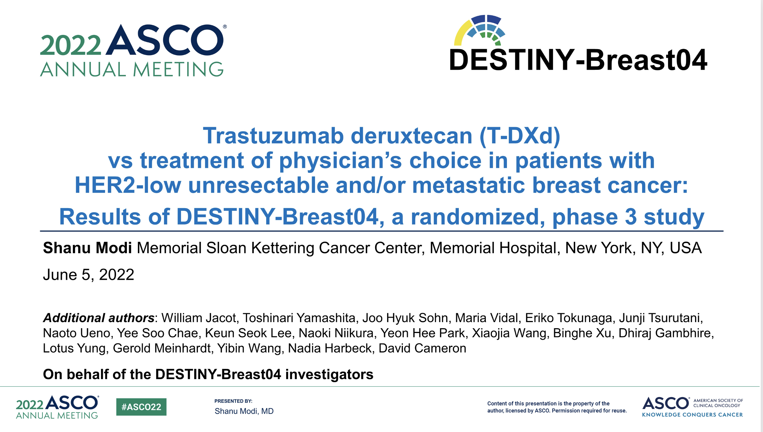
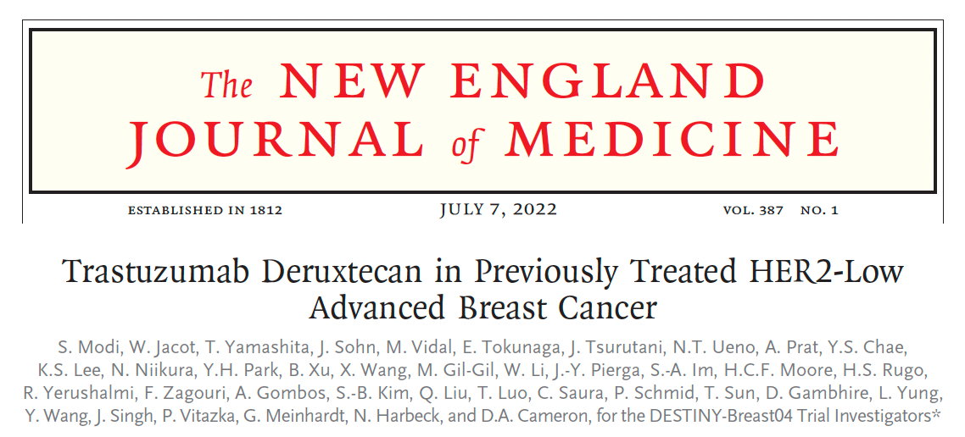
Abstract LBA3

Slide 89
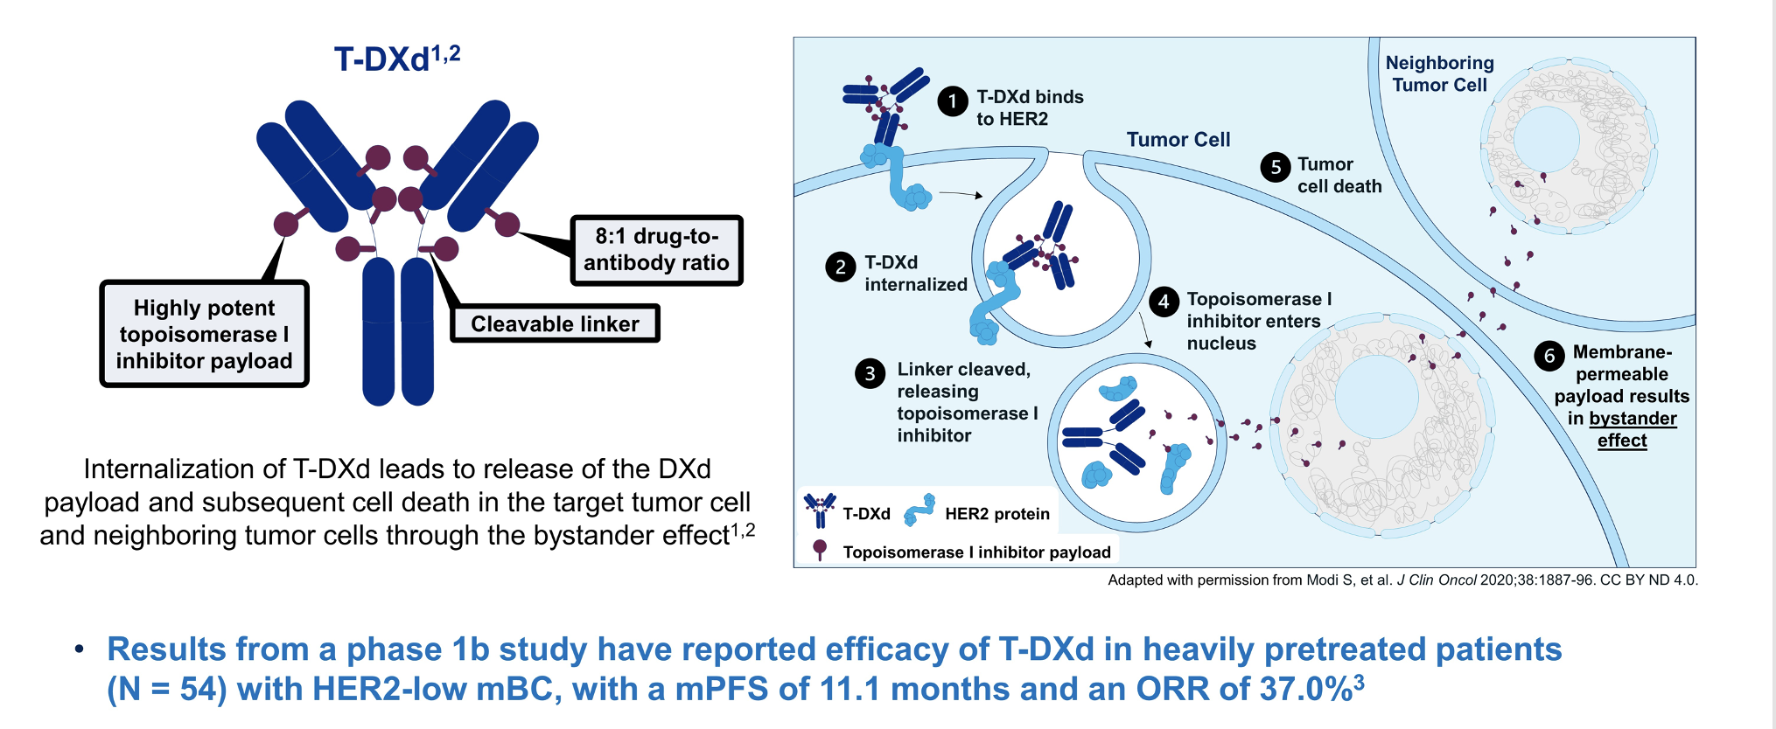
T-DXd Mechanism of Action, Bystander Effect and Rationale for Targeting HER2-Low Breast Cancer
ORR = objective response rate
Modi S et al. ASCO 2022;Abstract LBA3. Modi S et al. N Engl J Med 2022 July 7;387(1):9-20.

Slide 90
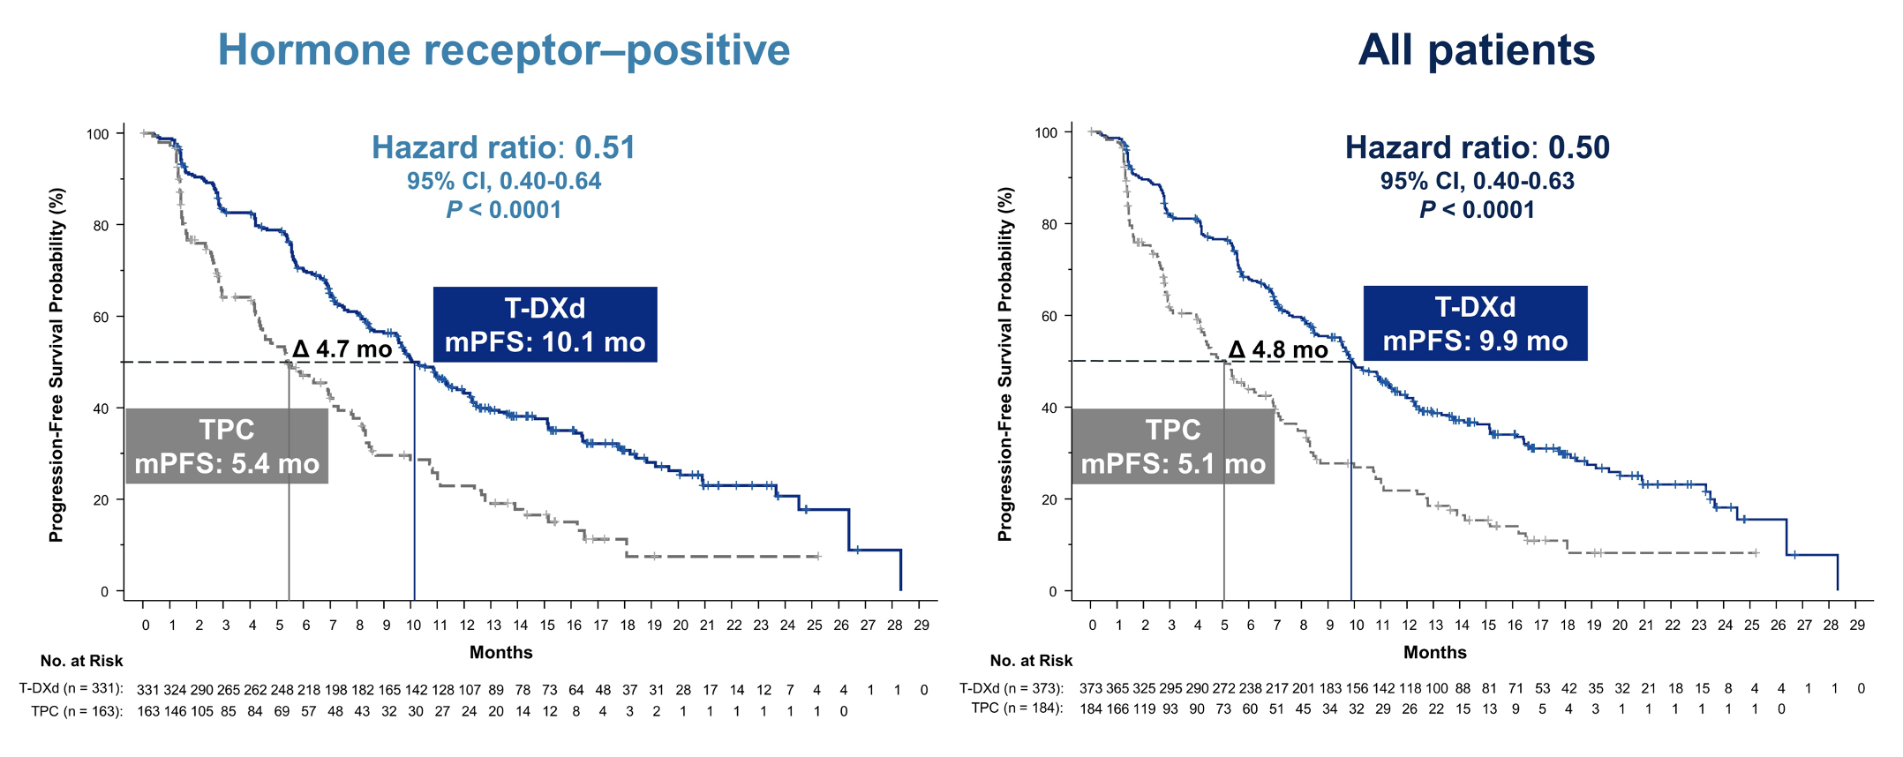
DESTINY-Breast04: PFS for HR-Positive (Primary Endpoint) and All Patients
mPFS = median progression-free survival
Modi S et al. ASCO 2022;Abstract LBA3. Modi S et al. N Engl J Med 2022 July 7;387(1):9-20.

Slide 91
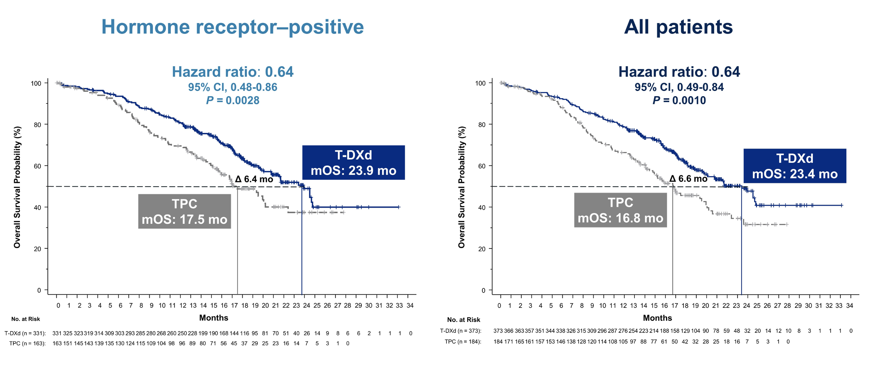
DESTINY-Breast04: OS for HR-Positive and All Patients
mOS = median overall survival
Modi S et al. ASCO 2022;Abstract LBA3. Modi S et al. N Engl J Med 2022 July 7;387(1):9-20.

Slide 92

DESTINY-Breast04: Confirmed Objective Response Rate
Modi S et al. ASCO 2022;Abstract LBA3. Modi S et al. N Engl J Med 2022 July 7;387(1):9-20.

