Slide 1
Inside the Issue — Exploring the Current Role of Ovarian Suppression in the Management of Breast Cancer
Wednesday, February 8, 2023
5:00 PM – 6:00 PM ET
Faculty
Kathy D Miller, MD Ann Partridge, MD, MPH
Moderator
Neil Love, MD

Slide 2
Faculty
Sara A Hurvitz, MD
Professor of Medicine
Director, Breast Cancer Clinical Trials Program, Division of Hematology-Oncology
David Geffen School of Medicine at UCLA
Medical Director, Clinical Research Unit
Jonsson Comprehensive Cancer Center
Santa Monica, California
Kathy D Miller, MD
Ballvé-Lantero Professor
Division of Hematology/Oncology
Associate Director for Clinical Research
The Indiana University Melvin and Bren Simon Cancer Center
Indianapolis, Indiana
Komal Jhaveri, MD
Associate Attending Physician
Breast Medicine Service and Early Drug Development Service
Section Head, Endocrine Therapy Research Program
Clinical Director, Early Drug Development Service
Department of Medicine
Memorial Sloan Kettering Cancer Center
Assistant Professor of Medicine
Weill Cornell College of Medicine
New York, New York
Ann Partridge, MD, MPH
Vice Chair of Medical Oncology
Director, Program for Young Women with Breast Cancer
Director, Adult Survivorship Program
Dana-Farber Cancer Institute
Professor of Medicine
Harvard Medical School
Boston, Massachusetts

Slide 3
Faculty
Melinda Telli, MD
Associate Professor of Medicine
Stanford University School of Medicine
Director, Breast Cancer Program
Stanford Cancer Institute
Stanford, California
Live Moderator
Neil Love, MD Research To Practice
Sara M Tolaney, MD, MPH
Chief, Division of Breast Oncology
Associate Director, Susan F Smith Center for Women's Cancers
Senior Physician
Dana-Farber Cancer Institute
Associate Professor of Medicine
Harvard Medical School
Boston, Massachusetts

Slide 4
Commercial Support
This activity is supported by an educational grant from TerSera Therapeutics LLC.
Research To Practice CME Planning Committee Members, Staff and Reviewers
Planners, scientific staff and independent reviewers for Research To Practice have no relevant conflicts of interest to disclose.

Slide 5
Dr Love — Disclosures
Dr Love is president and CEO of Research To Practice. Research To Practice receives funds in the form of educational grants to develop CME activities from the following companies: AbbVie Inc, Adaptive Biotechnologies Corporation, ADC Therapeutics, Agios Pharmaceuticals Inc, Alexion Pharmaceuticals, Amgen Inc, Array BioPharma Inc, a subsidiary of Pfizer Inc, Astellas, AstraZeneca Pharmaceuticals LP, Aveo Pharmaceuticals, Bayer HealthCare Pharmaceuticals, BeiGene Ltd, BeyondSpring Pharmaceuticals Inc, Blueprint Medicines, Boehringer Ingelheim Pharmaceuticals Inc, Bristol-Myers Squibb Company, Celgene Corporation, Clovis Oncology, Coherus BioSciences, CTI BioPharma Corp, Daiichi Sankyo Inc, Eisai Inc, Elevation Oncology Inc, EMD Serono Inc, Epizyme Inc, Exact Sciences Corporation, Exelixis Inc, Five Prime Therapeutics Inc, Foundation Medicine, G1 Therapeutics Inc, Genentech, a member of the Roche Group, Genmab, Gilead Sciences Inc, Grail Inc, GSK, Halozyme Inc, Helsinn Healthcare SA, ImmunoGen Inc, Incyte Corporation, Ipsen Biopharmaceuticals Inc, Janssen Biotech Inc, administered by Janssen Scientific Affairs LLC, Jazz Pharmaceuticals Inc, Karyopharm Therapeutics, Kite, A Gilead Company, Kronos Bio Inc, Lilly, Loxo Oncology Inc, a wholly owned subsidiary of Eli Lilly & Company, MEI Pharma Inc, Merck, Mersana Therapeutics Inc, Mirati Therapeutics Inc, Natera Inc, Novartis, Novartis Pharmaceuticals Corporation on behalf of Advanced Accelerator Applications, Novocure Inc, Oncopeptides, Pfizer Inc, Pharmacyclics LLC, an AbbVie Company, Puma Biotechnology Inc, Regeneron Pharmaceuticals Inc, Sanofi, Seagen Inc, Servier Pharmaceuticals LLC, SpringWorks Therapeutics Inc, Sumitomo Dainippon Pharma Oncology Inc, Taiho Oncology Inc, Takeda Pharmaceuticals USA Inc, TerSera Therapeutics LLC, Tesaro, A GSK Company, TG Therapeutics Inc, Turning Point Therapeutics Inc, Verastem Inc, and Zymeworks Inc.

Slide 6
Dr Miller — Disclosures
Contracted Research | Astex Pharmaceuticals, Pfizer Inc, Radiopharm Theranostics (not yet active)
Data and Safety Monitoring Board/Committee | AstraZeneca Pharmaceuticals LP, Celcuity, Genentech, a member of the Roche Group, Merck

Slide 7
Dr Partridge — Disclosures
No relevant conflicts of interest to disclose.

Slide 9
Agenda
Case Presentation: Dr Partridge
25-year-old woman with T1cN0M0, ER/PR-positive, HER2-negative breast cancer, Recurrence Score® (RS) = 26
Case Presentation: Dr Miller
28-year-old woman with a 2.8-cm ER/PR-positive, HER2-positive Grade III IDC
Case Presentation: Dr Partridge
35-year-old woman with a 3.5-cm ER/PR-negative, HER2-negative breast cancer with a BRCA2 mutation
Case Presentation: Dr Miller
32-year-old woman with ER/PR-positive, HER2-negative inflammatory breast cancer
Appendix

Slide 10
Common Questions from Community-Based Physicians
Who should receive ovarian function suppression (OFS)/ablation versus tamoxifen alone?
In what situations do you prefer oophorectomy to OFS?
When using OFS, what is your usual duration and dosing interval?
Does HER2 status affect your approach to endocrine therapy?
How do you approach OFS during chemotherapy for fertility preservation versus ovarian function preservation?
What is the optimal approach for interrupting endocrine therapy to allow for pregnancy?
How do you approach the management of side effects associated with OFS (hot flashes, vaginal dryness, etc)?

Slide 11
Agenda
Case Presentation: Dr Partridge
25-year-old woman with T1cN0M0, ER/PR-positive, HER2-negative breast cancer, RS = 26
Case Presentation: Dr Miller
28-year-old woman with a 2.8-cm ER/PR-positive, HER2-positive Grade III IDC
Case Presentation: Dr Partridge
35-year-old woman with a 3.5-cm ER/PR-negative, HER2-negative breast cancer with a BRCA2 mutation
Case Presentation: Dr Miller
32-year-old woman with ER/PR-positive, HER2-negative inflammatory breast cancer
Appendix

Slide 12
Which adjuvant endocrine treatment would you recommend for a 25-year-old premenopausal patient with T1cN0M0 ER/PR-positive, HER2-negative breast cancer and RS = 26?
1. Ovarian function suppression (OFS)/ablation
2. OFS/ablation + tamoxifen
3. OFS/ablation + anastrozole
4. OFS/ablation + letrozole
5. OFS/ablation + exemestane
6. Tamoxifen
7. Other

Slide 13
Hierarchy of Endocrine Therapy for Premenopausal Women
OFS/ablation + aromatase inhibitor
OFS/ablation + tamoxifen
OFS/ablation
Tamoxifen

Slide 14
Case 1: Dr Partridge – 25-year-old woman
25 yo woman who presents with a mass in her R breast and is diagnosed with T1cN0M0, ER+, PR+, HER2- breast ca, grade 3, Oncotype Dx 26
She receives 4 cycles of TC and sees you in follow-up for discussion of hormonal therapy
She is depressed and concerned about trying any further therapy at this time.

Slide 15
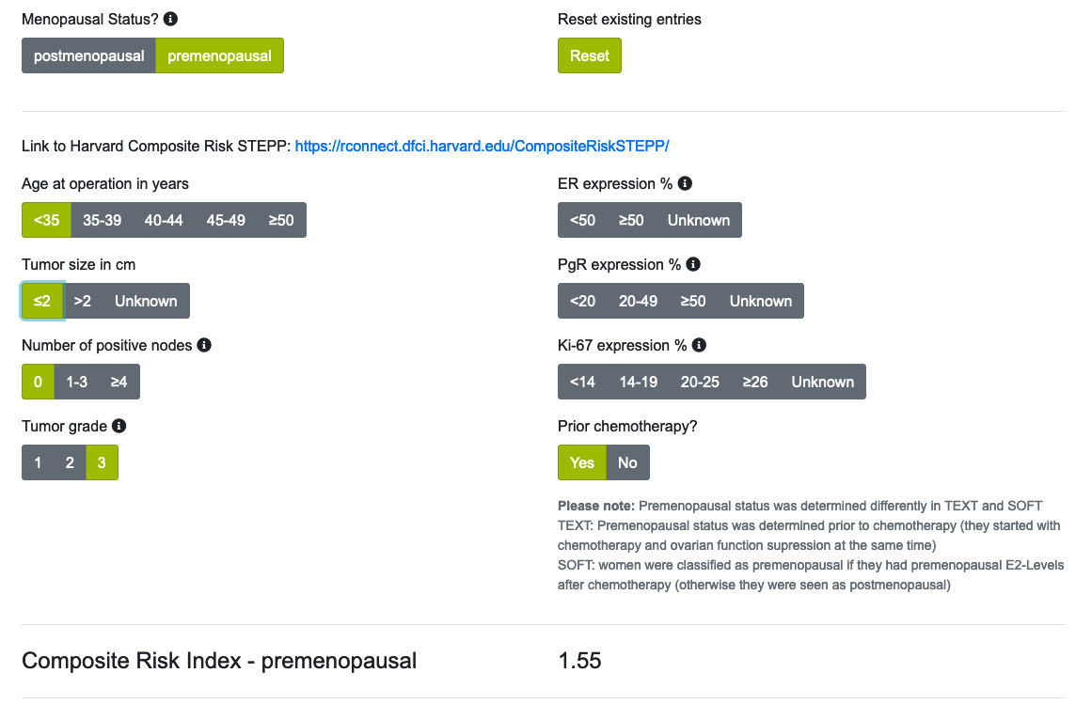
CRIB: Composite Risk Index Breast Cancer
https://crib-calculator.com/calculator.html

Slide 16
Ovarian suppression – monitoring schema
Leuprolide 3.75 mg monthly
Premenopausal women
Having periods
or
FSH/estradiol not postmenopausal
All ages
All stages
Prior chemo or not
Tamoxifen or AI
Starting OS or continuing OS
Monitoring ovarian suppression:
Check FSH and estradiol: Baseline, 3, 6, 12, 18, 24 mo
*Same schedule irrespective of age, oral ET (tam vs AI)
MD discretion / patient choice*
Leuprolide 11.25 mg q3 mo
Courtesy of Ann Partridge, MD, MPH

Slide 17
Ovarian suppression – dosing schema
Estradiol >20
Leuprolide 3.75 => 7.5
If AI, consider => Tam until suppressed
Repeat in 2 mo
If estradiol >10:
AI => Tam until suppressed
Leuprolide 3.75 => 7.5, or 7.5 => 11.25 if FSH not suppressed
Repeat estradiol in 2 mo
MONITORING
Leuprolide 3.75 mg monthly
Estradiol 10-20
If AI, consider => Tam until suppressed
Repeat in 2 mo
If estradiol <10:
Check in 3, 6, 12, 18, 24 mo
Estradiol <10
Continue on current therapy and monitoring plan
Estradiol >20
Q3 => Q1 mo, or 11.25 =>22.5
If AI, consider => Tam until suppressed
Repeat in 2 mo
If estradiol >10:
AI => Tam until suppressed
Q3 => Q1 dosing
Leuprolide 3.75 => 7.5, or 7.5 => 11.25 if FSH not suppressed
Repeat estradiol in 2 mo
MONITORING
Leuprolide 11.25 mg q3 mo
Estradiol 10-20
If AI, consider => Tam until suppressed
Repeat in 2 mo
If estradiol <10:
Check in 3, 6, 12, 18, 24 mo
Estradiol <10
Continue on current therapy and monitoring plan
Courtesy of Ann Partridge, MD, MPH
* Can use FSH to guide Leuprolide dose adjustment, but can be artificially suppressed by tam

Slide 18
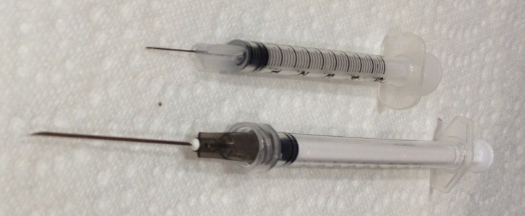
GnRHa Formulations
SOFT- used 3.75mg triptorelin monthly
EBCTCG overview
Only 1 of the included studies used leuprolide
Others used triptorelin and goserelin

Slide 19
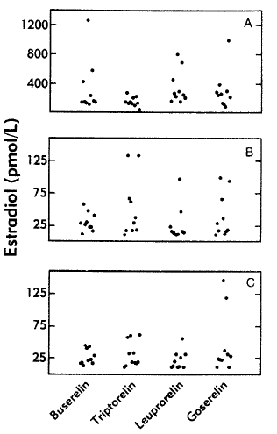
Filicori et al, J Clin Endocrinol Metab, 1992

Slide 20
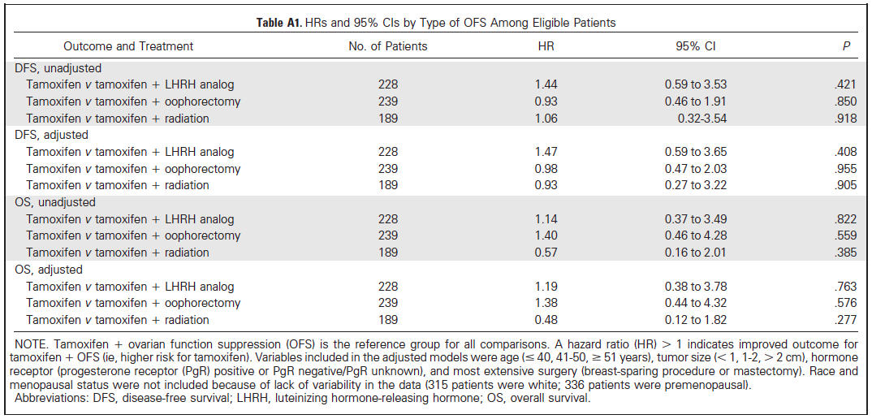
Tevaarwerk et al, J Clin Oncol, 2014

Slide 21
Randomized trials have demonstrated that GnRH agonists such as goserelin administered 0-14 days before initiating chemotherapy and then concurrently with adjuvant chemotherapy protect against ovarian failure and reduce the risk of early menopause.
Goserelin can be administered monthly or quarterly:
3.6 mg = every 28 days
10.8 mg = every 12 weeks
**Goserelin is the only FDA-approved GnRH agonist for premenopausal women with advanced breast cancer**

Slide 22
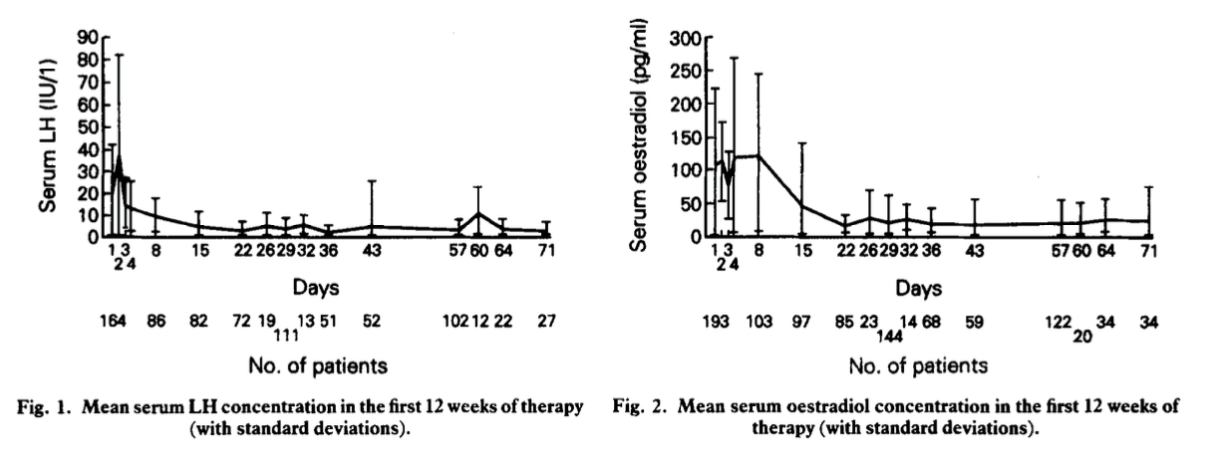
Goserelin 3.6 mg monthly
Blamey, Eur J Cancer, 1992

Slide 23
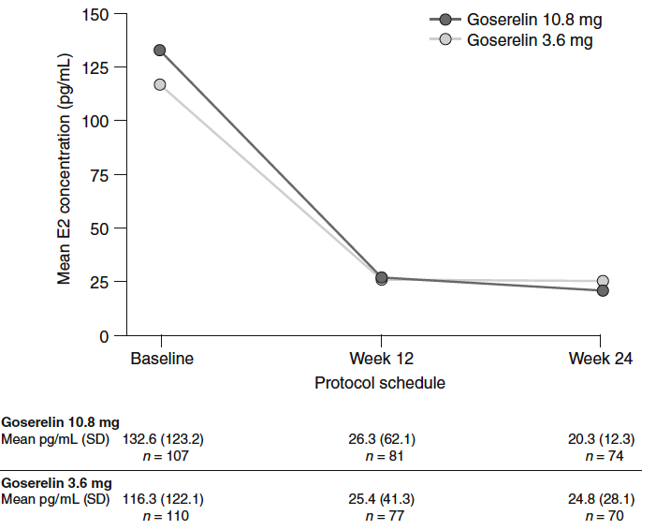
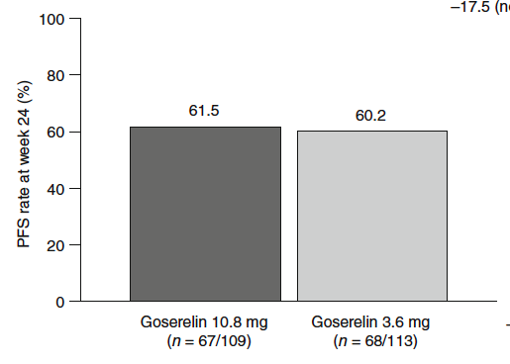
Goserelin: monthly vs quarterly
Mean serum E2 concentration
Monthly: 24.8 pg/ml
Q3 mo: 20.3 pg/ml
1. Noguchi et al, Breast Cancer, 2016

Slide 24
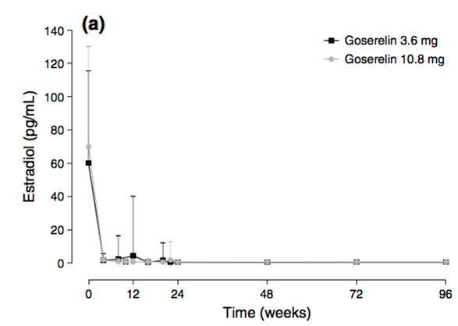
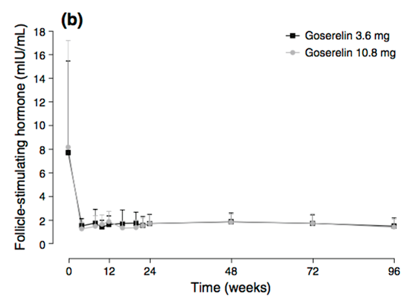
Goserelin: monthly vs quarterly
99% of pts in both arms had mean E2 <30 Breakthrough:
- Monthly: 4 pts (weeks 4, 8, 12, 20) - Q3 mo: 1 pt (week 22)
Courtesy of Ann Partridge, MD, MPH
1. Masuda et al, Breast Cancer Res Treat, 2013

Slide 25
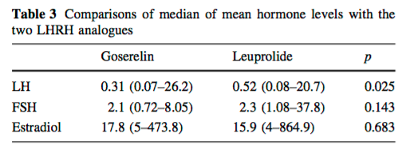
Goserelin monthly vs leuprolide quarterly
Leuprolide 11.25 mg q3 months
Goserelin 3.6 mg monthly
* Mean E2 >30 in 5/41 (12.2%) on leuprolide, 3/39 on goserelin (7.9%)
Courtesy of Ann Partridge, MD, MPH
1. Aydiner et al, Med Oncol, 2013

Slide 26
Which adjuvant treatment would you most likely recommend for a 30-year-old premenopausal woman with 0.5-cm ER-positive, HER2-negative, node-negative localized breast cancer and the Recurrence Score® (RS) below?
RS = 8 ET
RS = 20 ET
Tamoxifen*
Tamoxifen*
Tamoxifen
Tamoxifen
Tamoxifen
OFS/ablation and tamoxifen
Tamoxifen
Discuss tamoxifen vs OFS plus tamoxifen
Tamoxifen
Tamoxifen
Tamoxifen
Tamoxifen
ET = endocrine therapy; OFS = ovarian function suppression. * Low risk – T1 tumor, Grade <III, under age 40

Slide 27
Which adjuvant treatment would you most likely recommend for a 30-year-old premenopausal woman with 1-cm ER-positive, HER2-negative, node-negative localized breast cancer and the RS below?
RS = 8 ET
RS = 20 ET
OFS/ablation
OFS/ablation
Tamoxifen
OFS/ablation and letrozole
Tamoxifen
OFS/ablation and tamoxifen
Tamoxifen
Discuss OFS with tamoxifen/AI
Tamoxifen
OFS/ablation and exemestane
Tamoxifen
OFS/ablation and letrozole
AI = aromatase inhibitor

Slide 28
Which adjuvant treatment would you most likely recommend for a 30-year-old premenopausal woman with 1.5-cm ER-positive, HER2-negative, node-negative localized breast cancer and the RS below?
RS = 8 ET
RS = 20 ET
OFS/ablation
OFS/ablation
Tamoxifen
OFS/ablation and letrozole
Tamoxifen
OFS/ablation and tamoxifen
Tamoxifen
Discuss OFS with tamoxifen/AI
Tamoxifen
OFS/ablation and exemestane
Tamoxifen
OFS/ablation and exemestane
AI = aromatase inhibitor

Slide 29
Which adjuvant treatment would you most likely recommend for a 30-year-old premenopausal woman with 2-cm ER-positive, HER2-negative, node-negative localized breast cancer and the RS below?
RS = 8 ET
RS = 20 ET
OFS/ablation
OFS/ablation
OFS/ablation and letrozole
OFS/ablation and letrozole
OFS/ablation and tamoxifen
OFS/ablation and tamoxifen
Tamoxifen
Discuss OFS with tamoxifen/AI
Tamoxifen
OFS/ablation and exemestane
Tamoxifen
OFS/ablation and letrozole

Slide 30
Which adjuvant treatment would you most likely recommend for a 30-year-old premenopausal woman with 2.5-cm ER-positive, HER2-negative, node-negative localized breast cancer and the RS below?
RS = 8 ET
RS = 20 ET
OFS/ablation
OFS/ablation
OFS/ablation and letrozole
OFS/ablation and letrozole
OFS/ablation and tamoxifen
OFS/ablation and tamoxifen
Discuss OFS with tamoxifen/AI
OFS/ablation and AI
Tamoxifen
OFS/ablation and exemestane
Tamoxifen
OFS/ablation and letrozole

Slide 31
Which adjuvant ET would you most likely recommend for a 30-year-old premenopausal woman with ER-positive, HER2-negative localized breast cancer with 1 positive node and the RS below?
RS = 8
ET
RS = 20
ET
OFS/ablation and anastrozole
OFS/ablation and anastrozole
OFS/ablation + tamoxifen or + letrozole
OFS/ablation + letrozole
OFS/ablation + tamoxifen
OFS/ablation + anastrozole
OFS/ablation + tamoxifen or letrozole
OFS/ablation + tamoxifen or letrozole
OFS/ablation + exemestane
OFS/ablation + exemestane
OFS/ablation + letrozole
OFS/ablation + letrozole

Slide 32
For premenopausal patients with ER-positive localized breast cancer who wish to maintain fertility and to whom you are going to administer a GnRHa, when do you typically start it relative to chemotherapy?
Sequentially
Concurrently
Sequentially
Concurrently
Concurrently
Concurrently

Slide 33
For premenopausal patients with ER-positive localized breast cancer who are not interested in maintaining fertility but wish to preserve ovarian function and to whom you are going to administer a GnRHa, when do you typically start it relative to chemotherapy?
Sequentially
Concurrently
Sequentially
Concurrently
Concurrently
Concurrently

Slide 34
For premenopausal patients with ER-positive localized breast cancer who are not interested in maintaining fertility or preserving ovarian function and to whom you are going to administer a GnRHa, when do you typically start it relative to chemotherapy?
Concurrently
Concurrently
Sequentially
Sequentially
Sequentially
Sequentially

Slide 35
Agenda
Case Presentation: Dr Partridge
25-year-old woman with T1cN0M0, ER/PR-positive, HER2-negative breast cancer, RS = 26
Case Presentation: Dr Miller
28-year-old woman with a 2.8-cm ER/PR-positive, HER2-positive Grade III IDC
Case Presentation: Dr Partridge
35-year-old woman with a 3.5-cm ER/PR-negative, HER2-negative breast cancer with a BRCA2 mutation
Case Presentation: Dr Miller
32-year-old woman with ER/PR-positive, HER2-negative inflammatory breast cancer
Appendix

Slide 36
Case 2: Dr Miller – 28-year-old woman
Diagnosed at age 28 as part of an infertility evaluation
1 cm breast mass on exam
2.8 cm, normal LN on imaging -> Grade 3 IDC, ER 50%, PR 40%, HER2 3+
Expanded panel genetics -> no pathogenic mutation (VUS in NBN2)
Very interested in preserving fertility
Oocyte retrieval pre-chemo yielded 6 good quality eggs
Neoadjuvant THP with LHRH to preserve ovarian function
BCS with SNB – confirmed pCR
Completed RT and one-year HP
Continued LHRH as part of hormone Rx
Unacceptable toxicity with AI, tolerated tamoxifen well

Slide 37
Case 2: Dr Miller – 28-year-old woman (cont) 3 years later
Tired of menopausal effects
Wants to attempt pregnancy
She asks
When will menses resume if we stop the LHRH agonist?
What is the impact of stopping OFS sooner than 5 years?
Is it safe for me to get pregnant?

Slide 38
ASTRRA OFS + Tamoxifen versus Tamoxifen
N-1298
OFS given for 2 years
8-year DFS 85.4% vs. 80.2%
HR 0.67 (0.51-0.87)
8-year OS 96.5% vs 95.3% in the TAM-only group
HR 0.78 (0.49-1.25)
Baek et al, ASCO 2022
Courtesy of Kathy D Miller, MD

Slide 39
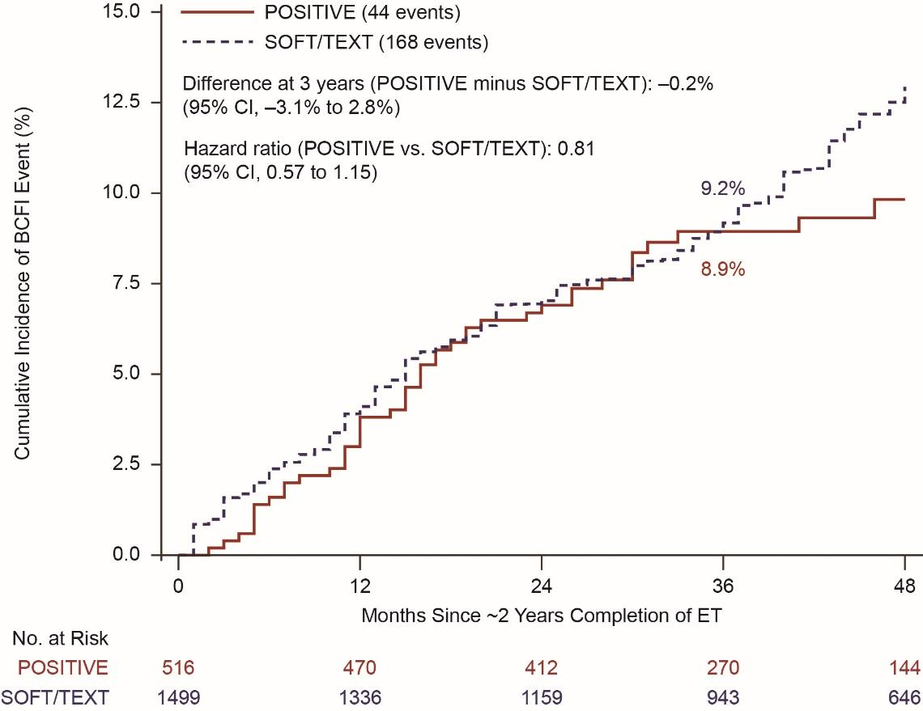
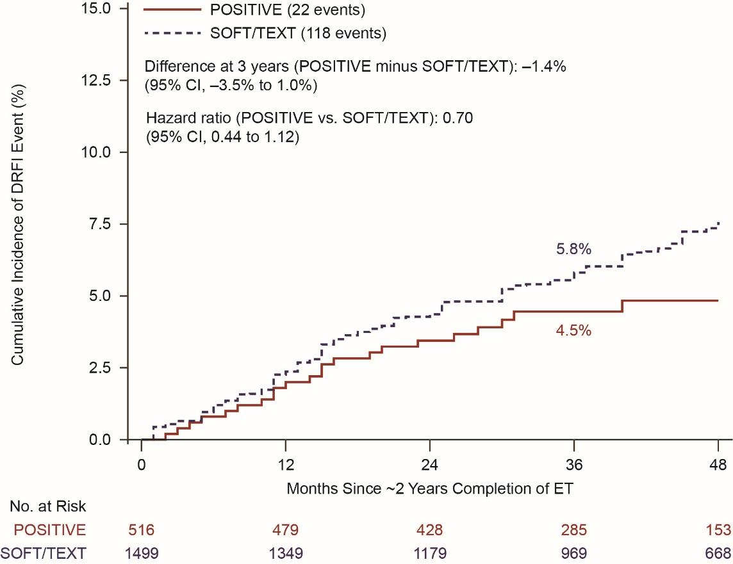
POSITIVE results for young patients IBCSG 48-14 / BIG 8-13 / Alliance A221405
Courtesy of Kathy D Miller, MD
Partridge et al, SABCS 2022

Slide 40
POSITIVE Pregnancy Outcomes
Delivery
Vaginal 66%
Cesarean section 34%
Pregnancy complications
11% of pregnancies
Most common: Hypertension/preeclampsia 3%, Diabetes 2%
62% of 317 women reported breast feeding
Courtesy of Kathy D Miller, MD
Partridge et al, SABCS 2022

Slide 41
A 28-year-old premenopausal woman with a 2.8-cm, ER/PR-positive, HER2-positive IDC who is interested in preserving fertility is going to receive neoadjuvant paclitaxel/trastuzumab/pertuzumab. When, if at all, would you initiate a GnRHa? Would your approach to the use of a GnRHa change if the patient experienced a pathologic complete response to neoadjuvant treatment?
Prior to neoadjuvant treatment; No
Concurrently with neoadjuvant treatment; Yes
Prior to neoadjuvant treatment; No
Prior to neoadjuvant treatment; No
Concurrently with neoadjuvant treatment; No
Concurrently with neoadjuvant treatment; No
IDC = infiltrating ductal carcinoma

Slide 42
Have you offered or would you offer the opportunity to discontinue hormonal therapy to a premenopausal patient with low-risk (node-negative) localized breast cancer who is receiving a GnRHa in combination with adjuvant endocrine treatment and wishes to become pregnant?
I have
I have
I have
I have
I have
I have

Slide 43
Have you offered or would you offer the opportunity to discontinue hormonal therapy to a premenopausal patient with high-risk (multiple positive nodes) localized breast cancer who is receiving a GnRHa in combination with adjuvant endocrine treatment and wishes to become pregnant?
I have
I have
I have not but would for the right patient
I have not but would for the right patient
I have
I have not but would for the right patient

Slide 44
In general, for a premenopausal patient with low-risk (node-negative) localized breast cancer who is receiving a GnRHa in combination with adjuvant endocrine treatment and wishes to become pregnant, what is the minimum duration of hormonal therapy that you would recommend before you would be comfortable discontinuing treatment?
I have proceeded to pregnancy with delayed hormone therapy in 2 patients
5 years
2 years
2 years
1 year
2 years

Slide 45
In general, for a premenopausal patient with high-risk (multiple positive nodes) localized breast cancer who is receiving a GnRHa in combination with adjuvant endocrine treatment and wishes to become pregnant, what is the minimum duration of hormonal therapy that you would recommend before you would be comfortable discontinuing treatment?
2 years
5 years
2 years
5 years
2 years
3-4 years

Slide 46
In general, for a premenopausal patient with low-risk (node-negative) localized breast cancer who is receiving a GnRHa in combination with adjuvant endocrine treatment and wishes to become pregnant, how long would you feel comfortable allowing her to remain off hormonal therapy?
2 years
2 years
2 years
2 years
3 years
2 years

Slide 47
In general, for a premenopausal patient with high-risk (multiple positive nodes) localized breast cancer who is receiving a GnRHa in combination with adjuvant endocrine treatment and wishes to become pregnant, how long would you feel comfortable allowing her to remain off hormonal therapy?
2 years
2 years
Maximum of 2 years
2 years
2 years
1 year

Slide 48
Agenda
Case Presentation: Dr Partridge
25-year-old woman with T1cN0M0, ER/PR-positive, HER2-negative breast cancer, RS = 26
Case Presentation: Dr Miller
28-year-old woman with a 2.8-cm ER/PR-positive, HER2-positive Grade III IDC
Case Presentation: Dr Partridge
35-year-old woman with a 3.5-cm ER/PR-negative, HER2-negative breast cancer with a BRCA2 mutation
Case Presentation: Dr Miller
32-year-old woman with ER/PR-positive, HER2-negative inflammatory breast cancer
Appendix

Slide 49
Case 3: Dr Partridge – 35-year-old woman (cT2N0 TNBC)
She has a 3cm mass palpable in her breast and ultrasound confirms 3.5 cm mass and reveals an enlarged axillary node; mammogram reveals dense breasts and MRI confirms L breast mass in upper outer breast without additional findings
Core needle biopsy reveals high grade triple negative (ER-/PR-/HER2-) invasive breast cancer; biopsy of the node reveals invasive carcinoma c/w breast primary
She undergoes rapid genetic testing and has a pathogenic BRCA2 variant (family hx of father with prostate in 50’s only)
She is a lawyer, married and had just started to try to get pregnant

Slide 50
Case 3: Dr Partridge – 35-year-old woman (cT2N0 TNBC)
(cont)
What would you offer her next?
Surgery considerations
Preoperative treatment options
Fertility preservation and future pregnancy considerations
Future surveillance and risk reduction recommendations

Slide 51
Case 3: Dr Partridge – 35-year-old woman (cT2N0 TNBC)
(cont)
The patient is recommended to receive preoperative KEYNOTE-522 chemotherapy.
She chooses to undergo 1 cycle of IVF prior to starting treatment which she does over a 3-week period
She banks 10 embryos and 8 oocytes with a plan to consider pre-implantation genetic diagnosis (PGD) in future
During treatment, she opts to receive leuprolide through chemotherapy to prevent premature menopause and potentially preserve fertility

Slide 52
Case 3: Dr Partridge – 35-year-old woman (cT2N0 TNBC)
(cont)
She tolerates chemotherapy well with excellent clinical response
At surgery (bilateral mastectomy with implant reconstruction), she is found to have negative sentinel node (0 of 3 nodes with disease, and evidence of treatment effect in the node with the clip) and 3 mm of residual grade 2 invasive ductal carcinoma in the breast.

Slide 53
Case 3: Dr Partridge – 35-year-old woman (cT2N0 TNBC)
(cont)
She sees you in follow-up after completing treatment and has a number of questions:
When can she get pregnant?
When does she have to get her ovaries out?
How will you know the treatment has worked?
How will you follow her?

Slide 54
Ovarian Suppression Through Chemotherapy
Premature-Ovarian Insufficiency Rate
Post-Treatment Pregnancy Rate
 | GnRHa group (n = 37) No. (%) | Control group (n = 20) No. (%)
Age distribution, years ≤ 40 ≥ 41 | 37 (100) 0 (0.0) | 20 (100) 0 (0.0)
Estrogen receptor status Positive Negative | 6 (16.2) 31 (83.8) | 2 (10.0) 18 (90.0)
30.9%
14.1%
IRR** 1.83 (95% CI 1.06-3.15)
p=0.030
GnRHa group
n=363
Control group
n=359
OR* 0.38 (95% CI 0.26-0.57)
p<0.001
DFS and OS the same!
*Odds ratio (OR) adjusted for age, estrogen receptor status, type and duration of chemotherapy administered
**Incidence risk ratio (IRR)
Courtesy of Ann Partridge, MD, MPH
Lambertini et al, JCO, 2018

Slide 55
PROMISE GIM-6: Long-term Outcomes of GnRHa to Preserve Ovarian Function
Courtesy of Ann Partridge, MD, MPH
Lambertini et al, JNCI, 2022

Slide 56
For a 35-year-old premenopausal woman with ER-positive, HER2-negative localized breast cancer and multiple positive nodes who is not interested in future childbearing and to whom you plan to administer an aromatase inhibitor, would you recommend oophorectomy or a gonadotropin-releasing hormone agonist (GnRHa) in addition to adjuvant endocrine therapy?
Patient preference — either option is acceptable
Patient preference — either option is acceptable
GnRHa, if not BRCA carrier
Patient preference — either option is acceptable
Patient preference — either option is acceptable
Patient preference — either option is acceptable

Slide 57
When administering a GnRHa in combination with adjuvant endocrine therapy for a 35-year-old woman with ER-positive localized breast cancer, what is your typical planned duration of OFS?
5 years
5 years
5 years
5 years
5 years
5 years

Slide 58
For premenopausal patients (age 20-40 years) with ER-positive, HER2-negative localized breast cancer who are about to receive adjuvant chemotherapy, do you generally offer the option of using OFS during chemotherapy in the following clinical scenarios?
For fertility preservation
For ovarian function preservation
Yes
No
Yes
Yes
Yes
Yes
No*
Yes
Yes
Yes
Yes
Yes
*Fertility specialist discusses with patient

Slide 59
For premenopausal patients (age 20-40 years) with ER-positive, HER2-positive localized breast cancer who are about to receive adjuvant chemotherapy, do you generally offer the option of using OFS during chemotherapy in the following clinical scenarios?
For fertility preservation
For ovarian function preservation
No
No
Yes
Yes
Yes
Yes
No*
Yes
Yes
Yes
Yes
Yes
*Fertility specialist discusses with patient

Slide 60
For premenopausal patients (age 20-40 years) with ER-negative, HER2-negative localized breast cancer who are about to receive adjuvant chemotherapy, do you generally offer the option of using OFS during chemotherapy in the following clinical scenarios?
For fertility preservation
For ovarian function preservation
Yes
Yes
Yes
Yes
Yes
Yes
No*
Yes
Yes
Yes
Yes
Yes
*Fertility specialist discusses with patient

Slide 61
Agenda
Case Presentation: Dr Partridge
25-year-old woman with T1cN0M0, ER/PR-positive, HER2-negative breast cancer, RS = 26
Case Presentation: Dr Miller
28-year-old woman with a 2.8-cm ER/PR-positive, HER2-positive Grade III IDC
Case Presentation: Dr Partridge
35-year-old woman with a 3.5-cm ER/PR-negative, HER2-negative breast cancer with a BRCA2 mutation
Case Presentation: Dr Miller
32-year-old woman with ER/PR-positive, HER2-negative inflammatory breast cancer
Appendix

Slide 62
Case 4: Dr Miller – 32-year-old woman
32-year-old presented with inflammatory breast cancer
ER 90%, PR 70%, HER2 0
Morbidly obese (BMI 36)
Irregular menses, suspected PCOS
Gaps of 3-6 months between cycles common
Adopted, family history unknown
Expanded panel genetics -> no pathogenic mutation
Systemic staging -> no mets
Identifies as lesbian, not interested in fertility preservation

Slide 63
Case 4: Dr Miller – 32-year-old woman (cont)
Neoadjuvant ddAC -> paclitaxel
Clinical complete response
Elected bilateral mastectomy for symmetry
Pathologic CR
PMRT/Olaparib on SWOG IBC trial
Light menses between C2 and 3, none since

Slide 64
Case 4: Dr Miller – 32-year-old woman (cont) Is she menopausal?
Menopause = No spontaneous menses for 12 months in the absence of interventions that may impact ovarian function
Predictors of chemotherapy related amenorrhea
Age
Lower pre-treatment AMH (?)
Could check hormone levels BUT
Ovarian function may vary over time
Tamoxifen therapy makes interpretation challenging
Decreased peripheral conversation -> decreased estradiol -> increased FSH/LH -> stimulate ovarian estradiol production -> resume menses
Up to ¼ of amenorrheic patients have pre-menopausal estradiol levels
Ruddy et al, BCRT 2014
Burstein et al, Clinical Breast Cancer 2006

Slide 65
Case 4: Dr Miller – 32-year-old woman (cont) Choice of hormone therapy
Uncomfortable with AI alone
Would require ongoing monitoring of ovarian function
Tamoxifen concerns
Less effective
Higher risk of thromboembolic events
Out of pocket cost for LHRH and more frequent clinic visits challenging
Elected BSO
Followed by AI

Slide 66
Do you or your practice employ any alternative approaches to manage symptoms associated with OFS (eg, exercise, complementary strategies)?
Yes — exercise, breathing exercises, SSRIs
Yes – exercise, acupuncture, gabapentin
Yes – exercise, CBT for menopausal symptoms
Yes
Yes – exercise, acupuncture
Yes – exercise, acupuncture
SSRIs = selective serotonin reuptake inhibitors; CBT = cognitive behavioral therapy

Slide 67
What is your typical strategy to ameliorate vaginal dryness/dyspareunia associated with OFS?
Vaginal lubricants and moisturizers, vaginal estrogen, topical pain relievers, pelvic floor therapy
Vaginal lubricants and moisturizers, vaginal estrogens
Vaginal lubricants and moisturizers
Vaginal lubricants and moisturizers, vaginal estrogen, pelvic floor therapy, CO2 laser treatment
Vaginal lubricants and moisturizers, topical pain relievers, pelvic floor therapy, CO2 laser treatment
Vaginal lubricants and moisturizers

Slide 68
Are there situations in which you recommend hormone replacement therapy to ameliorate side effects associated with OFS?
Yes — severe depression, suicidal, unresponsive to therapy
No
Yes – only in BRCA carrier previvors
No
No
No

Slide 69
Agenda
Case Presentation: Dr Partridge
25-year-old woman with T1cN0M0, ER/PR-positive, HER2-negative breast cancer, RS = 26
Case Presentation: Dr Miller
28-year-old woman with a 2.8-cm ER/PR-positive HER2-positive Grade III IDC
Case Presentation: Dr Partridge
35-year-old woman with a 3.5-cm ER/PR-negative, HER2-negative breast cancer and a BRCA2 mutation
Case Presentation: Dr Miller
32-year-old woman with ER/PR-positive, HER2-negative inflammatory breast cancer
Appendix

Slide 70
APPENDIX

Slide 71
Case: Dr Partridge – 32-year-old woman
A 32 yo woman sees you for a second opinion
She was diagnosed 18 months ago with high grade HR+, Her-2+ disease, clinically T2 (approximately 2.5 cm), N0.
She receives neoadjuvant THP chemotherapy (on clinical trial) and has a pCR and completes a year of HP and starts tamoxifen and OFS.
She wants to know optimal duration of hormonal therapy and when she can become pregnant

Slide 72
The POSITIVE Trial: ELIGIBILITY
Premenopausal women wishing to become pregnant
Age ≤42 years at study entry
At least 18 months and no more than 30 months of prior adjuvant ET for stage I-III HR+ BC
Prior neo/adjuvant chemotherapy ± fertility preservation allowed
No clinical evidence of recurrence
Courtesy of Ann Partridge, MD, MPH
Partridge et al, SABCS, 2022
4

Slide 73
POSITIVE TRIAL PROCEDURES
Planned ET interruption (within 1 month of trial enrollment):
Up to 2 years to attempt pregnancy, conceive, deliver, and breastfeed, including 3-months washout period
If no pregnancy by 1 year, fertility assessment strongly recommended
ET resumption strongly recommended after pregnancy to complete planned 5-10 yrs
Long-term follow-up
Courtesy of Ann Partridge, MD, MPH
Partridge et al, SABCS, 2022
5

Slide 74
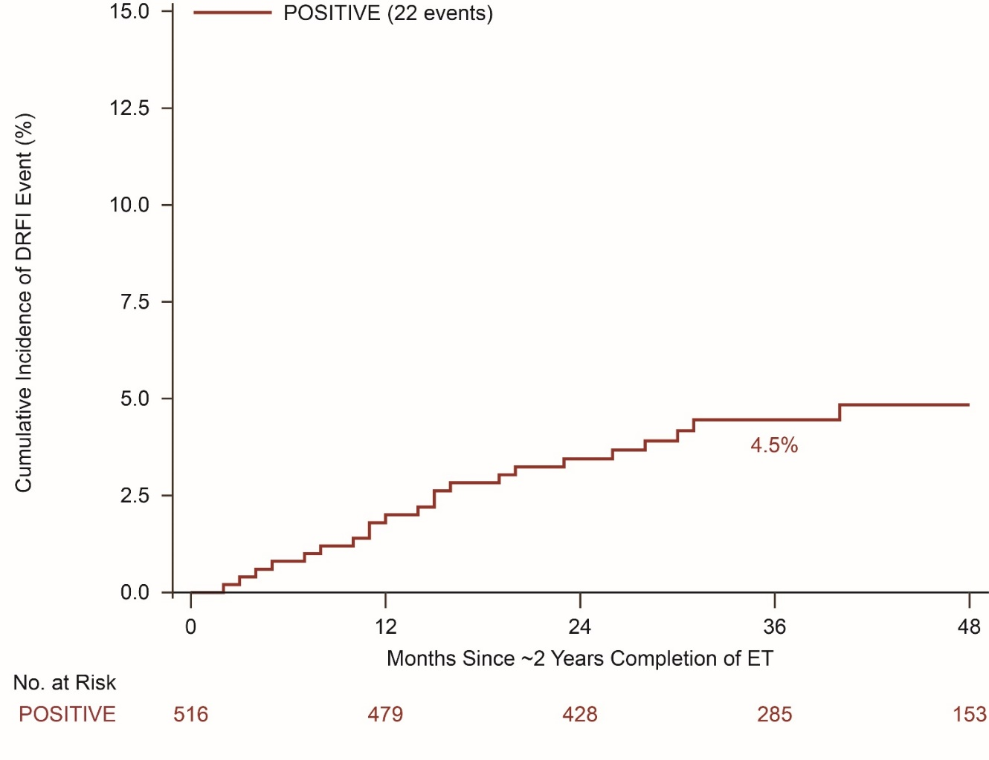
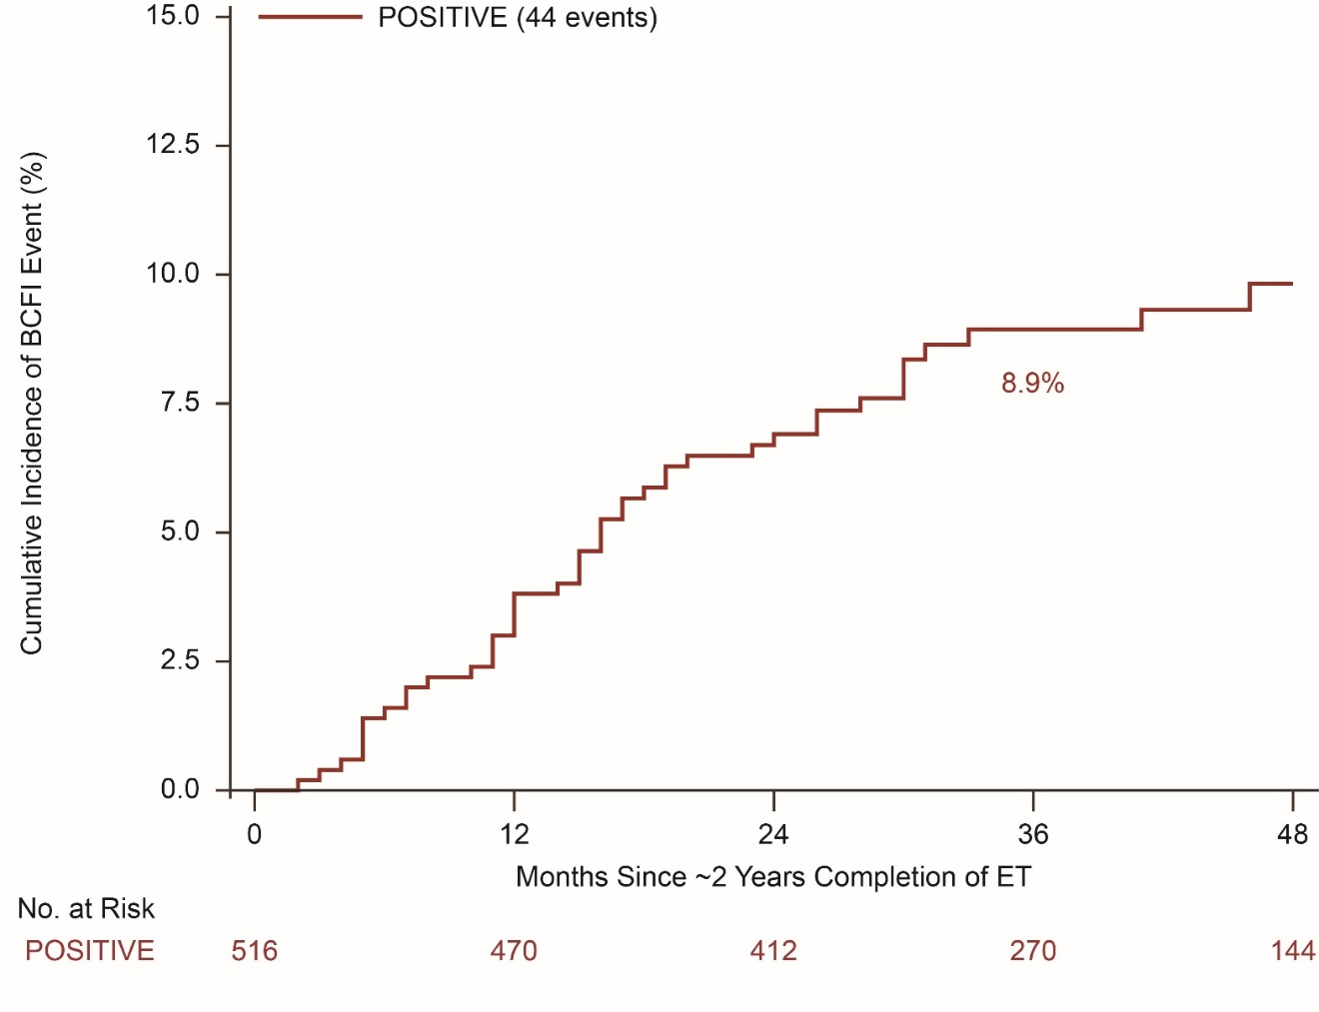
BREAST CANCER OUTCOMES – POSITIVE only
BCFI
DRFI
1638 patient-years of follow-up (41 months median follow-up)
Courtesy of Ann Partridge, MD, MPH
Partridge et al, SABCS, 2022
11

Slide 75
BREAST CANCER OUTCOMES – POSITIVE & SOFT/TEXT
BCFI
DRFI
Courtesy of Ann Partridge, MD, MPH
Partridge et al, SABCS, 2022
12

Slide 76
Case: Dr Miller – 32-year-old woman
32-year-old Black woman presented with breast mass 10 months after delivery of her third child.
Self-palpated 2 months earlier, assumed blocked duct from breast feeding
Came for evaluation when mass persisted (grew) despite weaning
Exam 4 cm mass with 1.5 cm ipsilateral LAN
Breast imaging -> biopsy -> Grade 3 IDC, ER 70%, PR 30%, HER2 1+, FISH –
Breast MR -> additional area in same breast -> biopsy DCIS
Systemic imaging -> no distant disease
Genetic testing -> pathogenic BRCA2 mutation

Slide 77
Case: Dr Miller – 32-year-old woman (cont)
No plans for future pregnancies
Not referred to reproductive endocrinology
No OFS during chemo
Neoadjuvant ddAC -> weekly paclitaxel
Tolerated well, excellent clinical response
Elected bilateral mastectomy
Residual 0.8 cm IDC, SLB negative x 3
No PMRT or nodal RT (on randomized trial)
Menses slightly irregular during chemo but persisted
Revisiting desire for future fertility

Slide 78
Case: Dr Miller – 32-year-old woman (cont) Options for HRx
Tamoxifen
OFS/oophorectomy
OFS/oophorectomy with tamoxifen
OFS/oophorectomy with an AI

Slide 79
Case: Dr Miller – 32-year-old woman (cont) Options for HRx
OFS with monthly LHRH agonist
Caution in using depot formulations
Added AI after OFS obtained

Slide 80
Ovarian suppression Powerful yet underutilized
SOFT-TEXT (n=4690)
SOFT (n=3047)
OS + exemestane vs OS + Tamoxifen
ITT population 12-year
DFS (4.6% absolute improvement, HR=0.79; 95%CI 0.70-0.90; P<0.001)
DRFI (1.8% absolute improvement, HR=0.83; 95%CI 0.70-0.98; P=0.03)
Overall survival (90.1% versus 89.1%, HR=0.93; 95%CI, 0.78-1.11)
Significant OS improvement in
women <35 years (4.0%)
Tumor >2 cm (4.5%)
Grade 3 tumor (5.5%).
Pagani et al, JCO 2022
Tamoxifen vs OS + Tam vs OS + AI
ITT population 12-year DFS
Tamoxifen 71.9%
OS + Tam 76.1%
OS + exemestane 79.0%
tamoxifen plus OFS versus tamoxifen (HR=0.82; 95%CI 0.69-0.98)
Overall survival
Tamoxifen 86.8%
OS + Tam 89.0%
OS + exemestane 89.4%
Francis et al, JCO 2022

Slide 81
Which adjuvant ET would you most likely recommend for a 30-year-old premenopausal woman with ER-positive, HER2-negative localized breast cancer with 3 positive nodes and the RS below?
RS = 8
ET
RS = 20
ET
OFS/ablation and anastrozole
OFS/ablation + anastrozole
OFS/ablation + letrozole
OFS/ablation + letrozole
OFS/ablation + anastrozole
OFS/ablation + anastrozole
OFS/ablation + tamoxifen or letrozole
OFS/ablation + tamoxifen or letrozole
OFS/ablation + exemestane
OFS/ablation + exemestane
OFS/ablation + letrozole
OFS/ablation + letrozole

Slide 82
Which adjuvant ET would you most likely recommend for a 45-year-old premenopausal woman with ER-positive, HER2-negative localized breast cancer with 1 positive node and the RS below?
RS = 8
ET
RS = 20
ET
OFS/ablation + anastrozole
OFS/ablation + anastrozole
OFS/ablation + letrozole
OFS/ablation + letrozole
OFS/ablation + anastrozole
OFS/ablation + anastrozole
OFS/ablation + tamoxifen or letrozole
OFS/ablation + tamoxifen or letrozole
OFS/ablation + exemestane
OFS/ablation + exemestane
OFS/ablation + letrozole
OFS/ablation + letrozole

Slide 83
Which adjuvant ET would you most likely recommend for a 45-year-old premenopausal woman with ER-positive, HER2-negative localized breast cancer with 3 positive nodes and the RS below?
RS = 8
ET
RS = 20
ET
OFS/ablation + anastrozole
OFS/ablation + anastrozole
OFS/ablation + letrozole
OFS/ablation + letrozole
OFS/ablation + anastrozole
OFS/ablation + anastrozole
OFS/ablation + tamoxifen or letrozole
OFS/ablation + tamoxifen or letrozole
OFS/ablation + exemestane
OFS/ablation + exemestane
OFS/ablation + letrozole
OFS/ablation + letrozole

