Slide 1
Inside the Issue: Current and Future Management of ER-Positive Metastatic Breast Cancer After
Disease Progression on a CDK4/6 Inhibitor
A CME/MOC-Accredited Live Webinar
Thursday, July 20, 2023
5:00 PM – 6:00 PM ET
Faculty
Aditya Bardia, MD, MPH
Erika Hamilton, MD
Moderator
Neil Love, MD

Slide 2



Faculty
Aditya Bardia, MD, MPH
Director, Breast Cancer Research Program
Associate Professor
Harvard Medical School
Attending Physician
Massachusetts General Hospital
Boston, Massachusetts
Moderator
Neil Love, MD
Research To Practice
Erika Hamilton, MD
Director, Breast Cancer Research Program
Sarah Cannon Research Institute/Tennessee Oncology
Nashville, Tennessee

Slide 3




Survey Participants
Harold J Burstein, MD, PhD
Institute Physician, Dana-Farber Cancer Institute
Professor of Medicine, Harvard Medical School
Boston, Massachusetts
Virginia Kaklamani, MD, DSc
Professor of Medicine
Ruth McLean Bowman Bowers Chair in Breast Cancer Research and Treatment
AB Alexander Distinguished Chair in Oncology
Leader, Breast Oncology Program
UT Health San Antonio MD Anderson Cancer Center
San Antonio, Texas
Matthew P Goetz, MD
Erivan K Haub Family Professor of Cancer Research Honoring Richard F Emslander, MD
Professor of Oncology and Pharmacology
Enterprise Deputy Director, Translational Research
Director, Mayo Clinic Breast Cancer SPORE
Mayo Clinic
Rochester, Minnesota
Ruth O’Regan, MD
Chair, Department of Medicine
Charles A Dewey Professor of Medicine
University of Rochester
Rochester, New York

Slide 4
Commercial Support
This activity is supported by educational grants from AstraZeneca Pharmaceuticals LP, Daiichi Sankyo Inc, and Gilead Sciences Inc.
Research To Practice CME Planning Committee Members,
Staff and Reviewers
Planners, scientific staff and independent reviewers for Research To Practice have no relevant conflicts of interest to disclose.

Slide 5
Dr Bardia — Disclosures
Consulting Agreements | AstraZeneca Pharmaceuticals LP, Daiichi Sankyo Inc, Foundation Medicine, Genentech, a member of the Roche Group, Gilead Sciences Inc, Lilly, Merck, Novartis, Pfizer Inc, Phillips HealthCare Services Ltd, Radius Health Inc, Sanofi
Contracted Research | AstraZeneca Pharmaceuticals LP, Daiichi Sankyo Inc, Genentech, a member of the Roche Group, Gilead Sciences Inc, Lilly, Merck, Novartis, Pfizer Inc, Radius Health Inc, Sanofi

Slide 6
Dr Hamilton — Disclosures
Advisory Committee and Consulting Agreements | AstraZeneca Pharmaceuticals LP, Daiichi Sankyo Inc, Ellipses Pharma, Genentech, a member of the Roche Group, Gilead Sciences Inc, Greenwich LifeSciences Inc, Janssen Biotech Inc, Jazz Pharmaceuticals Inc, Lilly, Loxo Oncology Inc, a wholly owned subsidiary of Eli Lilly & Company, Medical Pharma Services sro, Mersana Therapeutics Inc, Novartis, Olema Oncology, Orum Therapeutics, Pfizer Inc, Relay Therapeutics, Seagen Inc, Stemline Therapeutics Inc, Theratechnologies, Tubulis, Zentalis Pharmaceuticals
Contracted Research | AbbVie Inc, Acerta Pharma — A member of the AstraZeneca Group, Accutar Biotechnology Inc, ADC Therapeutics, Akesobio Australia Pty Ltd, Amgen Inc, Aravive Inc, ArQule Inc, Artios, Arvinas, AstraZeneca Pharmaceuticals LP, AtlasMedx Inc, BeiGene Ltd, Black Diamond Therapeutics Inc, Bliss Biopharmaceutical, Boehringer Ingelheim Pharmaceuticals Inc, Clovis Oncology, Compugen, Context Therapeutics, Cullinan Oncology, Curis Inc, CytomX Therapeutics, Daiichi Sankyo Inc, Dantari, Deciphera Pharmaceuticals Inc, Duality Biologics, eFFECTOR Therapeutics Inc, Ellipses Pharma, Elucida Oncology Inc, EMD Serono Inc, FUJIFILM Pharmaceuticals USA Inc, G1 Therapeutics Inc, Genentech, a member of the Roche Group, H3 Biomedicine, Harpoon Therapeutics, Hutchison MediPharma, ImmunoGen Inc, Incyte Corporation, Infinity Pharmaceuticals Inc, Inspirna, InventisBio, Jacobio Pharmaceuticals Group Co Ltd, Karyopharm Therapeutics, K-Group Beta, Kind Pharmaceuticals LLC, Leap Therapeutics Inc, Lilly, Loxo Oncology Inc, a wholly owned subsidiary of Eli Lilly & Company, Lycera, MacroGenics Inc, Marker Therapeutics Inc, Mersana Therapeutics Inc, Merus BV, Molecular Templates, Novartis, NuCana, Olema Oncology, OncoMed Pharmaceuticals Inc, Onconova Therapeutics Inc, Oncothyreon, ORIC Pharmaceuticals, Orinove Inc, Orum Therapeutics, Pfizer Inc, PharmaMar, Pieris Pharmaceuticals Inc, Pionyr Immunotherapeutics, Plexxikon Inc, Prelude Therapeutics, ProfoundBio, Radius Health Inc, Regeneron Pharmaceuticals Inc, Relay Therapeutics, Repertoire Immune Medicines, Seagen Inc, Sermonix Pharmaceuticals, Shattuck Labs, Stemcentrx, Sutro Biopharma, Syndax Pharmaceuticals Inc, Syros Pharmaceuticals Inc, Taiho Oncology Inc, Takeda Pharmaceuticals USA Inc, Tesaro, A GSK Company, Tolmar, Transcenta Holding Limited, Treadwell Therapeutics, Verastem Inc, Zenith Epigenetics, Zymeworks Inc
Nonrelevant Financial Relationship | Dana-Farber Cancer Institute, Verascity Science

Slide 7



Slide 8
Key Data Sets
Aditya Bardia, MD, MPH
Kalinsky K et al. Randomized phase II trial of endocrine therapy with or without ribociclib after progression on cyclin-dependent kinase 4/6 inhibition in hormone receptor-positive, human epidermal growth factor receptor 2-negative metastatic breast cancer: MAINTAIN trial. J Clin Oncol 2023 May 19;[Online ahead of print].
Mayer EL et al. Palbociclib after CDK4/6i and endocrine therapy (PACE): A randomized phase II study of fulvestrant, palbociclib, and avelumab for endocrine pre-treated ER+/HER2- metastatic breast cancer. SABCS 2022;Abstract GS3-06.
Bardia A et al. Phase I study of elacestrant (RAD1901), a novel selective estrogen receptor degrader, in ER-positive, HER2-negative advanced breast cancer. J Clin Oncol 2021 April 20;39(12):1360-70.
Bidard F-C et al. Elacestrant (oral selective estrogen receptor degrader) versus standard endocrine therapy for estrogen receptor-positive, human epidermal growth factor receptor 2-negative advanced breast cancer: Results from the randomized phase III EMERALD trial. J Clin Oncol 2022 October 1;40(28):3246-56.

Slide 9
Key Data Sets
Aditya Bardia, MD, MPH (continued)
Bardia A et al. EMERALD phase 3 trial of elacestrant versus standard of care endocrine therapy in patients with ER+/HER2- metastatic breast cancer: Updated results by duration of prior CDK4/6i in metastatic setting. SABCS 2022;Abstract GS3-01.
Kalinsky K et al. Sacituzumab govitecan in previously treated hormone receptor-positive/HER2-negative metastatic breast cancer: Final results from a phase I/II, single-arm, basket trial. Ann Oncol 2020 December;31(12):1709-18.
Rugo H et al. Sacituzumab govitecan in hormone receptor-positive/human epidermal growth factor receptor 2-negative metastatic breast cancer. J Clin Oncol 2022 October 10;40(29):3365-76.
Rugo HS et al. Overall survival (OS) results from the phase 3 TROPiCS-02 study of sacituzumab govitecan (SG) vs treatment of physician’s choice (TPC) in patients (pts) with HR+/HER2- metastatic breast cancer (MBC). ESMO 2022;Abstract LBA76.

Slide 10
Key Data Sets
Aditya Bardia, MD, MPH (continued)
Marmé F et al. Sacituzumab govitecan (SG) efficacy in hormone receptor-positive/human epidermal growth factor receptor 2-negative (HR+/HER2–) metastatic breast cancer (MBC) by HER2 immunohistochemistry (IHC) status in the phase 3 TROPiCS-02 study. Ann Oncol 2022;33(Suppl 7):S88-121.
Modi S et al. Trastuzumab deruxtecan (T-DXd) versus treatment of physician’s choice (TPC) in patients (pts) with HER2-low unresectable and/or metastatic breast cancer (mBC): Results of DESTINY-Breast04, a randomized, phase 3 study. ASCO 2022;Abstract LBA3.
Modi S et al. Trastuzumab deruxtecan in previously treated HER2-low advanced breast cancer. N Engl J Med 2022 July 7;387(1):9-20.

Slide 11
Key Data Sets
Erika Hamilton, MD
Bardia A et al. EMERALD phase 3 trial of elacestrant versus standard of care endocrine therapy in patients with ER+/HER2- metastatic breast cancer: Updated results by duration of prior CDK4/6i in metastatic setting. SABCS 2022;Abstract GS3-01.
Oliviera M et al. Camizestrant, a next generation oral SERD vs fulvestrant in post-menopausal women with advanced ER-positive HER2-negative breast cancer: Results of the randomized, multi-dose phase 2 SERENA-2 trial. SABCS 2022;Abstract GS3-02.
Martin M et al. Giredestrant (GDC-9545) vs physician choice of endocrine monotherapy (PCET) in patients (pts) with ER+, HER2- locally advanced/metastatic breast cancer (LA/MBC): Primary analysis of the phase 2 randomised, open-label acelERA BC study. ESMO 2022;Abstract 211MO.
Hamilton E et al. First-in-human safety and activity of ARV-471, a novel PROTAC estrogen receptor degrader, in ER+/HER2- locally advanced or metastatic breast cancer. SABCS 2021;Abstract PD13-08.

Slide 12
Key Data Sets
Erika Hamilton, MD (continued)
Hurvitz S et al. ARV-471, a PROTAC® estrogen receptor (ER) degrader in advanced ER-positive/human epidermal growth factor receptor 2 (HER2)-negative breast cancer: Phase 2 expansion (VERITAC) of a phase 1/2 study. SABCS 2022;Abstract 205P.
Turner NC et al. Capivasertib and fulvestrant for patients with aromatase inhibitor-resistant hormone receptor-positive/human epidermal growth factor receptor 2-negative advanced breast cancer: Results from the Phase III CAPItello-291 trial. SABCS 2022;Abstract GS3-04.
Oliveira M et al. Capivasertib and fulvestrant for patients with aromatase inhibitor-resistant HR+/HER2– advanced breast cancer: Subgroup analyses from the phase 3 CAPItello-291 trial. ESMO Breast 2023;Abstract 187O.
Krop I et al. Results from the phase 1/2 study of patritumab deruxtecan, a HER3-directed antibody-drug conjugate (ADC), in patients with HER3-expressing metastatic breast cancer (MBC). ASCO 2022;Abstract 1002.

Slide 13
Key Data Sets
Erika Hamilton, MD (continued)
Pistilli B et al. A phase 2 study of patritumab deruxtecan (HER3-DXd), in patients (pts) with advanced breast cancer (ABC), with biomarker analysis to characterize response to therapy (ICARUS-BREAST01). ESMO Breast 2023;Abstract 189O.
Hamilton E et al. A phase 2 study of HER3-DXd in patients (pts) with metastatic breast cancer (MBC). ASCO 2023;Abstract 1004.
Meric-Bernstram F et al. Phase 1 TROPION-PanTumor01 study evaluating datopotamab deruxtecan in unresectable or metastatic hormone receptor positive (HR positive), HER2 negative breast cancer. SABCS 2022;Abstract PD13-08.

Slide 14
Agenda
INTRODUCTION: Biopharmacology and Endocrinology of Breast Cancer
MODULE 1: Current Strategies for Previously Treated ER-Positive Metastatic Breast Cancer (mBC) — Dr Bardia
MODULE 2: Future Directions in the Management of ER-Positive mBC —
Dr Hamilton
MODULE 3: Clinical Investigator Survey

Slide 15
Agenda
INTRODUCTION: Biopharmacology and Endocrinology of Breast Cancer
MODULE 1: Current Strategies for Previously Treated ER-Positive Metastatic Breast Cancer (mBC) — Dr Bardia
MODULE 2: Future Directions in the Management of ER-Positive mBC —
Dr Hamilton
MODULE 3: Clinical Investigator Survey

Slide 16

Hormonal Therapy for the 1980s

Slide 17

Endocrine Therapy Resistance:
Potential Factors to Consider
Estrogen-Independent,
ER-Mediated Signaling
FGFR1
IGF1R
EGFR/HER2/HER3
P
P
P
P
P
P
SOS
PI3-K
RAS
RAF
Akt
MEK
p90^{RSK}
MAPK
ER
CDK 4/6
mTOR
P
P
P
P
Basal
Transcription
Machinery
Cytoplasm
ER
ER
p160
CBP
Tumor
Growth
ERE
ER Target Gene Transcription
Nucleus
  ER pathway is still active and disease progression due to estrogen-independent but estrogen-receptor mediated signaling...ESR1 mutations…
Courtesy of Aditya Bardia, MD, MPH
Johnston SR. J Natl Cancer Inst. 2015;107:djv212.

Slide 18
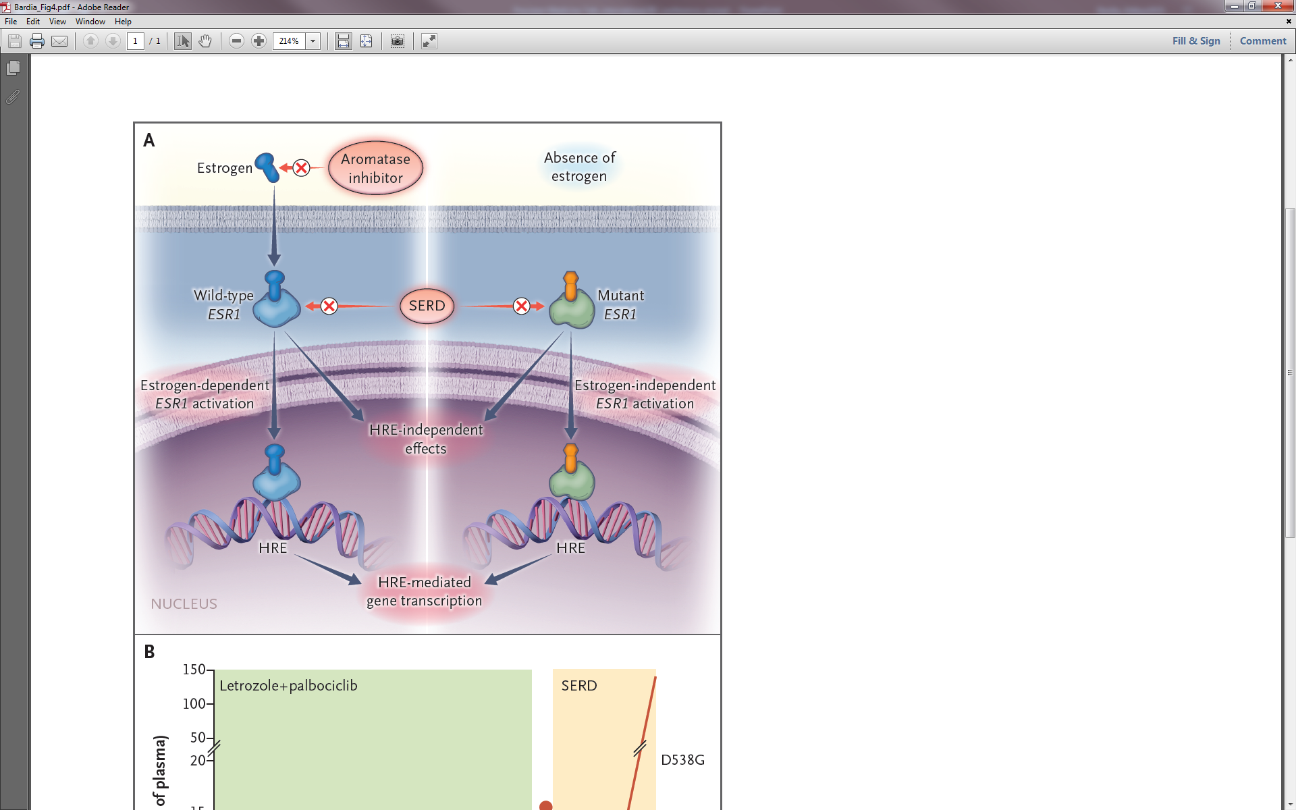
ESR1 (Acquired) Mutations:
Resistance to AI
Bardia A, et al. N Engl J Med. 2018;379:1946-1953.
Courtesy of Aditya Bardia, MD, MPH

Slide 19
SERM/SERD landscape in breast cancer
SERM Activity
SERD Activity
Fulvestrant
RU58668
ARV-471
DPC974
Bazedoxifene
Pipendoxifene
Acolbifene
Elacestrant
Raloxifene
Lasofoxifene
Arzoxifene
Tamoxifen
Toremifene
Endoxifen
H3-6545
Idoxifene
Droloxifene
D-0502
SHR9549
OP-1250
LSZ102
GDC810
AZD9694
GD0927
Camizestrant
Giresdestrant
Amcenestrant
ZN-c5
Rintodestrant
Imlunestrant
AC0682
Red: First in Class (clinically relevant)
Red: FDA approved
Blue: Currently in clinical development
Green: First in Class (development discontinued)
Black: Clinical development discontinued
Courtesy of Erika Hamilton, MD
Slide credit: D. McDonnell, SABCS 2021

Slide 20
Agenda
INTRODUCTION: Biopharmacology and Endocrinology of Breast Cancer
MODULE 1: Current Strategies for Previously Treated ER-Positive Metastatic Breast Cancer (mBC) — Dr Bardia
MODULE 2: Future Directions in the Management of ER-Positive mBC —
Dr Hamilton
MODULE 3: Clinical Investigator Survey

Slide 21



Current Strategies for Previously Treated ER-Positive Metastatic Breast Cancer
Aditya Bardia, MD, MPH, FASCO,
Director, Breast Cancer Research,
Associate Professor, Harvard Medical School,
Attending Physician, Mass General Cancer Center.
@DrAdityaBardia

Slide 22
Patient Story:
Endocrine Therapy for HR+ Cancer
65 yo female with:
2010: HR+/HER2- breast cancer (localized)
2015: Completed adjuvant exemestane
2021: Disease recurrence (bone); Started letrozole with CDK4/6i
2023: Disease progression (bone)
Which therapy would you consider next?
  Fulvestrant
  Fulvestrant + CDK 4/6i
  Exemestane + everolimus
  Need more information
Courtesy of Aditya Bardia, MD, MPH

Slide 23
CDK 4/6i after CDK 4/6i
Mixed Results:
MAINTAIN: Fulvestrant + Ribociclib demonstrated improvement in PFS
PACE: Fulvestrant + palbociclib demonstrated No improvement in PFS
postMONARCH: Fulvestrant vs fulvestrant + abemaciclib (NCT05169567): phase 3 trial
Kalinsky K et al. J Clin Oncol. 2023
Mayer E at al. SABCS 2022
Courtesy of Aditya Bardia, MD, MPH

Slide 24
Patient Story:
Endocrine Therapy for HR+ Cancer
1st line therapy:
- Endocrine Therapy + CDK 4/6 inhibitor
Which therapy would you consider next in 2nd line?
  Fulvestrant
  Fulvestrant + CDK 4/6i
  Exemestane + everolimus
  Need more information
  ctDNA analysis revealed ESR1 mutation
Courtesy of Aditya Bardia, MD, MPH

Slide 25
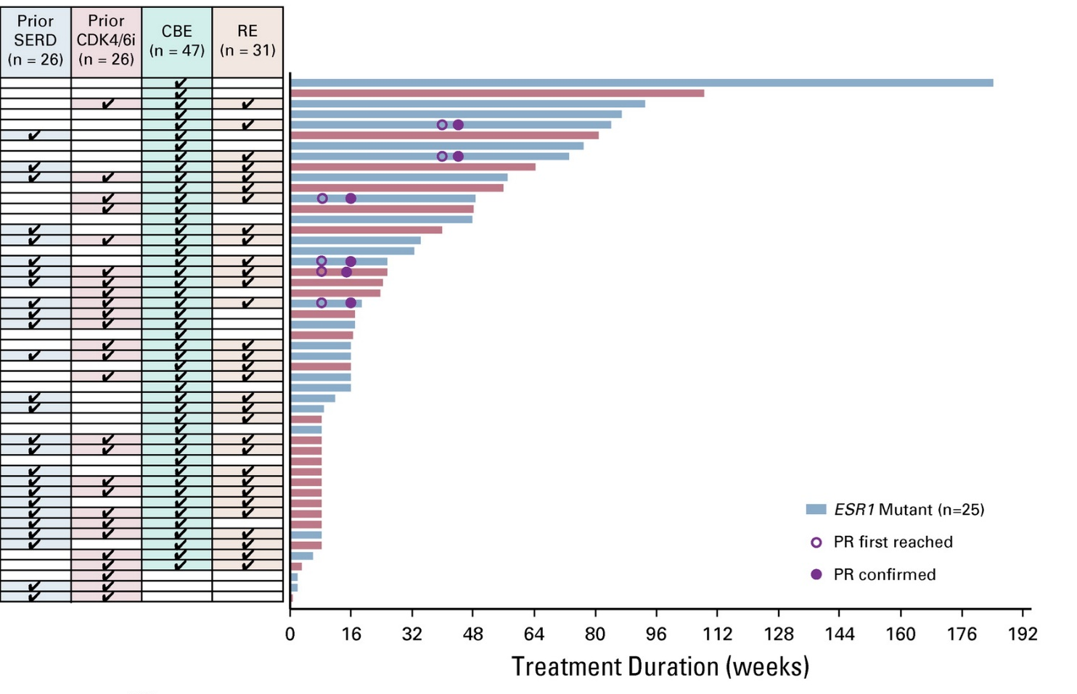
Elacestrant Clinical Activity:
CBR at 24 Weeks 42.6%
Median of 3 prior systemic therapies
  52% had previously received prior SERD
  52% had previously received CDK4/6i therapy
  50% had ESR1 mutation
CBE, clinical benefit–evaluable; CBR, clinical benefit rate; PR, partial response; RE, response-evaluable.
Bardia A, et al. J Clin Oncol. 2021;39:1360-1370.
Courtesy of Aditya Bardia, MD, MPH

Slide 26
Phase 3 EMERALD: Study Design
A multicenter, international, randomized, open-label, active-controlled phase 3 trial for postmenopausal patients with ER+/HER2- MBC
Key inclusion criteria
Advanced/metastatic ER+/HER2- breast cancer; progressed or relapsed on or after 1 or 2 lines of ET, 1 of which was given in combination with a CDK4/6 inhibitor, for advanced or MBC;
ECOG PS 0 or 1
Elacestrant (400 mg oral QD)
Investigator’s choice of fulvestrant, anastrozole, letrozole, exemestane
Objective: assess PFS in all patients and those with mESR1; OS, ORR, DOR, CBR, safety, PK, PRO
Study design considerations:
  planned sample size: 466 patients (randomized 1:1)
  planned number of countries/study sites: ~17/215
  planned study duration: ~30–33 months
  stratification factors: mESR1 status (detected by ctDNA), prior fulvestrant and presence of visceral disease
Courtesy of Aditya Bardia, MD, MPH
Bardia A, et al. SABCS 2021. Abstract GS2-02.

Slide 27
EMERALD: PFS Rate at 6 and 12 Months—
All Patients and mESR1 Group
All Patients
Patients With Tumors Harboring mESR1
 | Elacestrant | SOC
N | 239 | 238
Hazard ratio (95% CI) | 0.697 (0.552 – 0.880)
PFS rate at 6 months (95% CI) | 34.3% (27.2%-41.5%) | 20.4% (14.1%-26.7%)
PFS rate at 12 months (95% CI) | 22.3% (15.2%-29.4%) | 9.4% (4.0%-14.8%)
 | Elacestrant | SOC
N | 115 | 113
Hazard ratio (95% CI) | 0.546 (0.387 – 0.768)
PFS rate at 6 months (95% CI) | 40.8% (30.1%-51.4%) | 19.1% (14.1%-26.7%)
PFS rate at 12 months (95% CI) | 26.8% (16.2%-37.4%) | 8.2% (1.3%-15.1%)
100
PFS rate at 6 months was 34.32% with elacestrant vs 20.38% with SOC; PFS rate at 12 months was
22.23% with elacestrant vs
9.42% with SOC in all patients
100
90
80
80
70
70
60
60
50
50
Probability of PFS (%)
Probability of PFS (%)
40
40
30
30
20
20
10
Elacestrant
Standard of Care
10
Elacestrant
Standard of Care
0
0
1
2
3
4
5
6
7
8
9
10
11
12
13
14
15
16
17
18
19
20
21
22
23
24
25
0
Time (months)
0
1
2
3
4
5
6
7
8
9
10
11
12
13
14
15
16
17
18
19
20
21
22
23
24
25
Elacestrant
SOC
115
113
105
99
54
39
46
34
35
19
33
18
26
12
26
12
21
9
20
9
Time (months)
Elacestrant
SOC
239
238
223
206
106
84
89
68
60
39
57
38
42
25
40
25
34
16
33
15
27
7
24
4
19
3
13
3
11
2
8
2
7
1
6
0
6
2
2
2
2
1
0
16
4
14
1
11
1
9
1
7
0
5
5
4
4
1
1
1
1
1
0
Elacestrant demonstrated a higher PFS rate at 6 and 12 months versus SOC ET in patients with ER+/HER2- advanced/metastatic breast cancer following prior CDK4/6i therapy
Courtesy of Aditya Bardia, MD, MPH
Bidard F-C et al. J Clin Oncol 2022 Oct 1;40(28):3246–56; Bardia A, et al. SABCS 2021. Abstract GS2-02.

Slide 28
EMERALD:
PFS by duration of CDK 4/6i (ESR1m)
At least 6 mo CDK4/6i
At least 12 mo CDK4/6i
At least 18 mo CDK4/6i
100
100
100
80
80
80
60
60
60
Probability of PFS (%)
Probability of PFS (%)
Probability of PFS (%)
40
40
  40
20
20
20
0
Elacestrant
Standard of Care
0
Elacestrant
Standard of Care
0
Elacestrant
Standard of Care
0
5
10
15
20
25
30
0
5
10
15
20
25
30
0
5
10
15
20
25
30
Time (months)
Time (months)
Time (months)
Elacestrant
SOC
103
102
50
34
33
16
25
11
20
9
16
5
11
2
9
1
8
1
7
0
6
5
5
1
1
0
Elacestrant
SOC
78
81
42
26
31
12
24
10
20
9
16
5
11
2
9
1
8
1
7
0
6
5
5
1
1
0
Elacestrant
SOC
55
56
30
21
23
9
18
8
16
7
12
4
8
1
8
1
7
1
6
0
6
5
5
1
1
0
 | Elacestrant | SOC Hormonal Therapy
Median PFS, months (95% CI) | 4.14 (2.20 - 7.79) | 1.87 (1.87 - 3.29)
PFS rate at 12 months, % (95% CI) | 26.02 (15.12 - 36.92) | 6.45 (0.00 - 13.65)
Hazard ratio (95% CI) | 0.517 (0.361 - 0.738)
 | Elacestrant | SOC Hormonal Therapy
Median PFS, months (95% CI) | 8.61 (4.14 - 10.84) | 1.91 (1.87 - 3.68)
PFS rate at 12 months, % (95% CI) | 35.81 (21.84 - 49.78) | 8.39 (0.00 - 17.66)
Hazard ratio (95% CI) | 0.410 (0.262 - 0.634)
 | Elacestrant | SOC Hormonal Therapy
Median PFS, months (95% CI) | 8.61 (5.45 - 16.89) | 2.10 (1.87 - 3.75)
PFS rate at 12 months, % (95% CI) | 35.79 (19.54 - 52.05) | 7.73 (0.00 - 20.20)
Hazard ratio (95% CI) | 0.466 (0.270 - 0.791)
Courtesy of Aditya Bardia, MD, MPH
Bardia A et al, SABCS, 2022

Slide 29
Oral SERD in ER+ MBC:
Current Development Status
Drug name | Current Development Status
Elacestrant (RAD1901) | Phase 3
Giredestrant (GDC-9545) | Phase 2/3
Amcenestrant (SAR439859) | Phase 2/3
Imlunestrant | Phase 3
Camizestrant (AZD9833) | Phase 2/3
Need to be careful with cross-study comparisons –
Differences in prior lines of Rx, endocrine sensitivity, tumor biology
Courtesy of Aditya Bardia, MD, MPH

Slide 30
Patient Story:
Endocrine Therapy for HR+ Cancer
1st line therapy:
- Endocrine Therapy + CDK 4/6 inhibitor
Which therapy would you consider next in 2nd line?
  Fulvestrant
  Fulvestrant + CDK 4/6i
  Exemestane + everolimus
  Need more information
  ctDNA analysis revealed ESR1 mutation
  Pt started elacestrant. Currently doing well on therapy.
Courtesy of Aditya Bardia, MD, MPH

Slide 31
Case: 55F with HR+ MBC
55F with metastatic HR+ MBC (HER2 IHC = 0). Disease progression on various endocrine based therapy, and recently capecitabine and paclitaxel. PS = 1. No organ dysfunction. gBRCA = negative. PIK3CA and ESR1 WT. What therapy would you consider next?
  Eribulin
  Vinorelbine
  Sacituzumab Govitecan
  Trastuzumab Deruxtecan
Courtesy of Aditya Bardia, MD, MPH

Slide 32
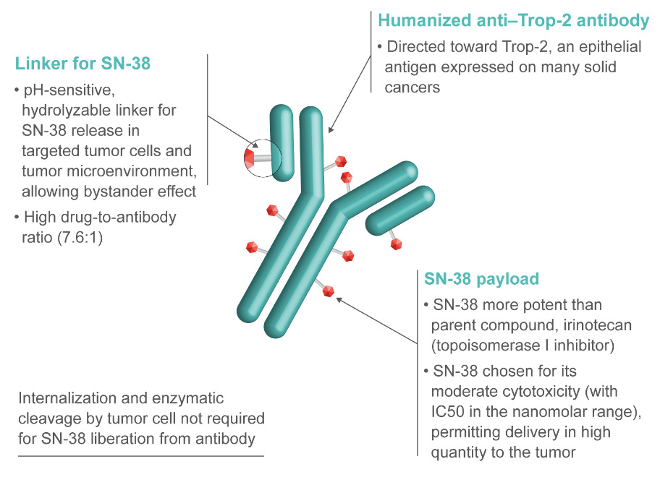
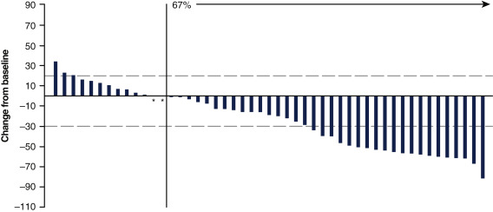
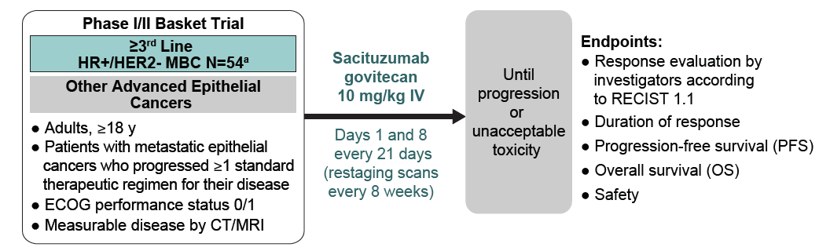
Trop2 ADC for HR+ MBC:
Sacituzumab Govitecan
Confirmed ORR = 31.5%
Courtesy of Aditya Bardia, MD, MPH
Kalinsky K et al. Ann Oncol. 2020

Slide 33
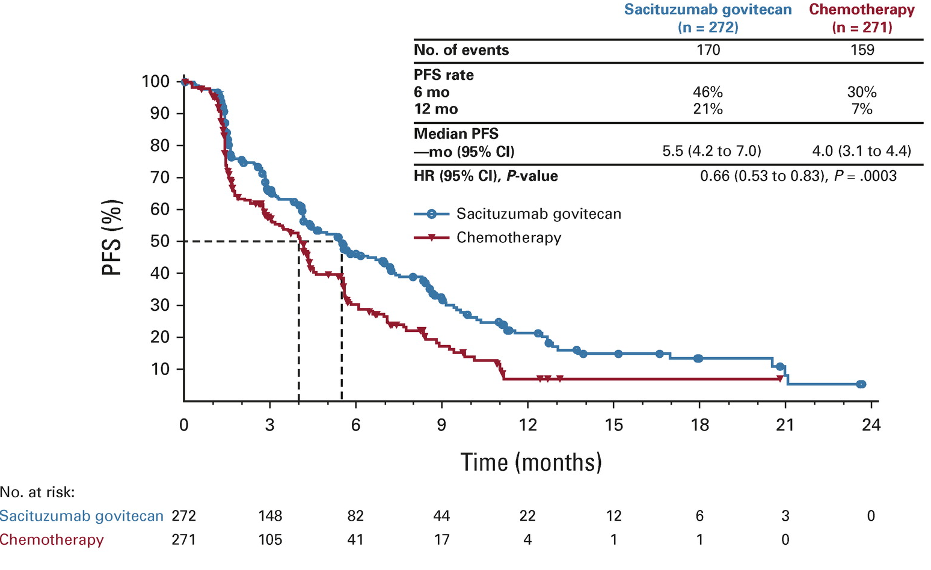
Sacituzumab Govitecan vs TPC:
PFS (HR+ MBC)
Courtesy of Aditya Bardia, MD, MPH
Rugo H and Bardia A et al. J Clin Oncol. 2022

Slide 34
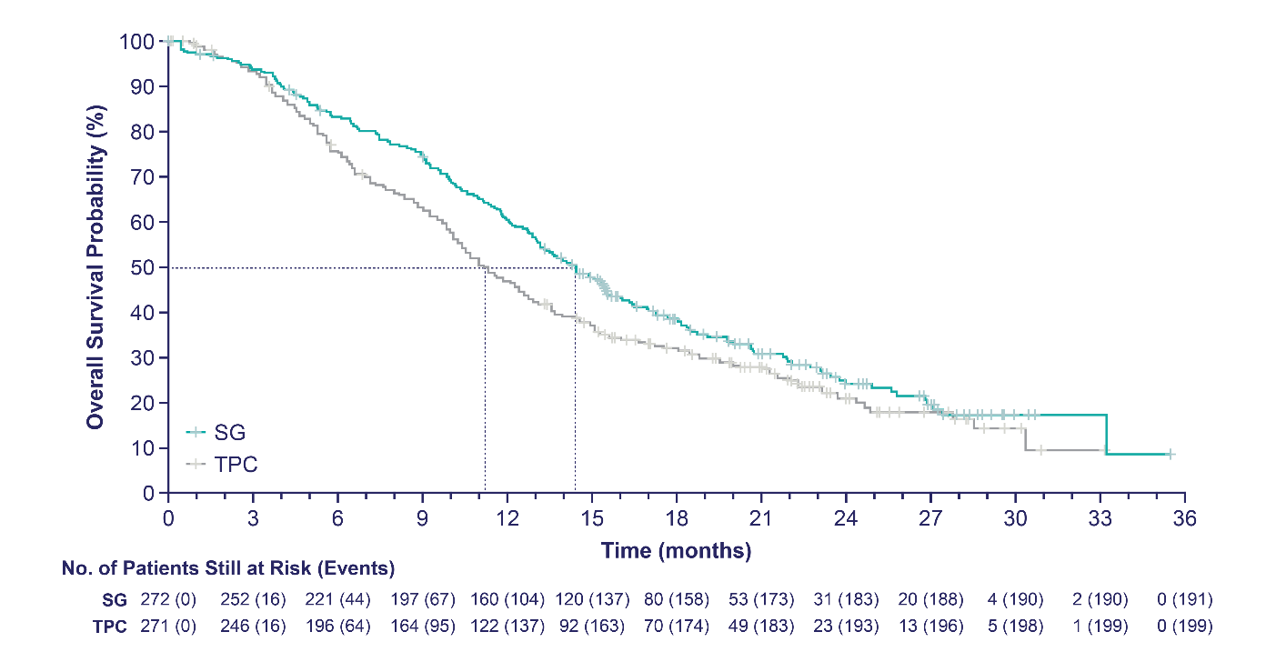
Sacituzumab Govitecan vs TPC:
OS (HR+ MBC)
12 months
 | SG (n=272) | TPC (n=271)
Number of events | 191 | 199
Median OS, mo (95% CI) | 14.4 (13.0–15.7) | 11.2 (10.1–12.7)
Stratified HR (95% CI) | 0.79 (0.65–0.96)
Stratified Log Rank P value | P=0.020
12-month OS rate, % (95% CI) | 61 (55–66) | 47 (41–53)
SG demonstrated a statistically significant improvement in OS vs TPC with 21% reduction in the risk of death; having met statistical significance, no further formal statistical testing of OS will occur
Patients who received SG survived a median of 3.2 months longer than those who received TPC
FDA Approved (Feb 2023)
Median follow-up was 12.5 months.
OS, overall survival; SG, sacituzumab govitecan; TPC, treatment of physician’s choice.
Presented by: Hope S. Rugo, MD
Courtesy of Aditya Bardia, MD, MPH

Slide 35
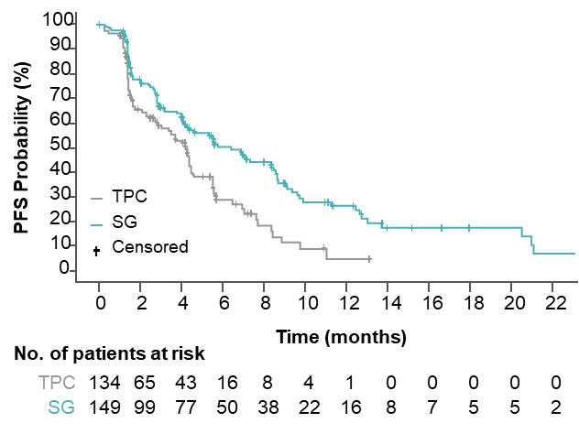
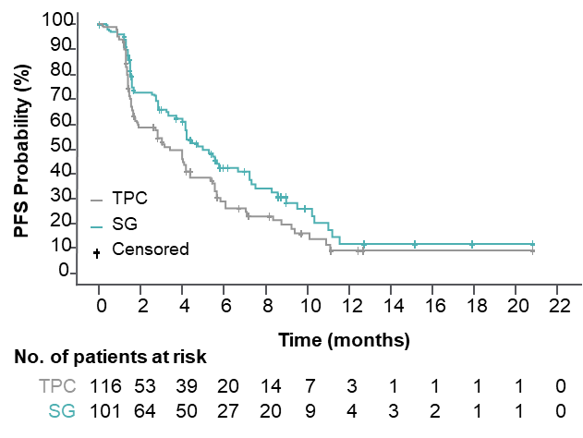
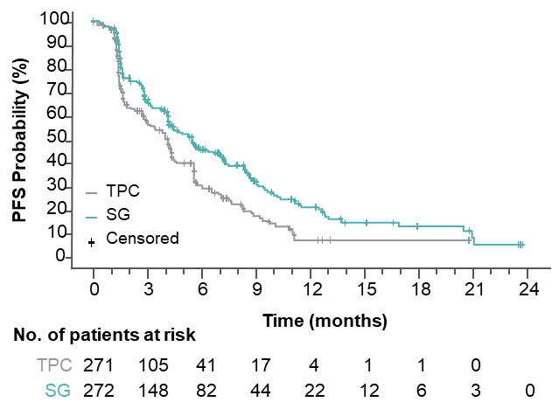
Sacituzumab Govitecan vs TPC:
Efficacy by HER2 status (TROPiCS-02)
HER2-Lowª
HER2 IHC0
ITT¹
 | SG (n=149) | TPC (n=134)
Median PFS, mo | 6.4 | 4.2
HR (95% CI) | 0.58 (0.42–0.79), P<0.001
 | SG (n=101) | TPC (n=116)
Median PFS, mo | 5.0 | 3.4
HR (95% CI) | 0.72 (0.51–1.00), P=0.05
 | SG (n=272) | TPC (n=271)
Median PFS, mo (95% CI) | 5.5 (4.2–7.0) | 4.0 (3.1–4.4)
HR (95% CI) | 0.66 (0.53–0.83), P=0.0003
Within the HER2-Low population, median PFS with SG vs TPC for the IHC1+ and IHC2+ subgroups was 7.0 vs 4.3 (HR, 0.57) and
5.6 vs 4.0 (HR, 0.58) months, respectively
The hazard ratio for median PFS in a sensitivity analysis of the HER2-Low subgroup (excluding ISH-unverified^{b}) was similar (HR, 0.53)
ªHER2-Low defined as IHC1+, or IHC2+ and ISH-negative/unverified.
^{b}39 patients with HER2 IHC2+ did not have ISH data documentation available for verification and were presumed to be HER2-low, consistent with the trial eligibility criteria to enroll HER2-negative patients.
HER2, human epidermal growth factor receptor 2; IHC, immunohistochemistry; ISH, in situ hybridization; PFS, progression-free survival; SG, sacituzumab govitecan; TPC, treatment of physician’s choice.
1. Rugo HS, et al. J Clin Oncol. 2022. doi: 10.1200/JCO.22.01002. (epub ahead of print). Adapted from Rugo HS, et al. Sacituzumab govitecan in hormone receptor-positive/human epidermal growth factor receptor 2-negative metastatic breast cancer. J Clin Oncol. 2022. doi: 10.1200/JCO.22.01002. Reprinted with permission from American Society of Clinical Oncology.
Presented by: Dr. Frederik Marmé
Courtesy of Aditya Bardia, MD, MPH

Slide 36
Case: 55F with HR+ MBC
55F with metastatic HR+ MBC (HER2 IHC = 1). Disease progression on various endocrine based therapy, and recently capecitabine and paclitaxel. PS = 1. No organ dysfunction. gBRCA = negative. PIK3CA and ESR1 WT. What therapy would you consider next?
  Eribulin
  Vinorelbine
  Sacituzumab Govitecan
  Trastuzumab Deruxtecan
Courtesy of Aditya Bardia, MD, MPH

Slide 37
HER2-Low Breast Cancer:
Current Definition
HER2 testing by validated IHC assay
Circumferential membrane staining that is complete, intense, and in >10% of tumor cells ➔ (IHC 3+)
Weak to moderate complete membrane staining in >10% of tumor cells ➔ (IHC 2+)
Incomplete membrane staining that is faint/barely perceptible and in >10% of tumor cells ➔ (IHC 1+)
No staining is observed HER2-null or membrane staining that is incomplete and is faint/barely perceptible and in <10% tumor cells ➔ (IHC 0)
HER2-Positive
(15%)
Reflex ISH test Positive
Reflex ISH test Negative
HER2-Low
(45-65%)
HER2-Negative/null
(30-40%)
Courtesy of Aditya Bardia, MD, MPH

Slide 38
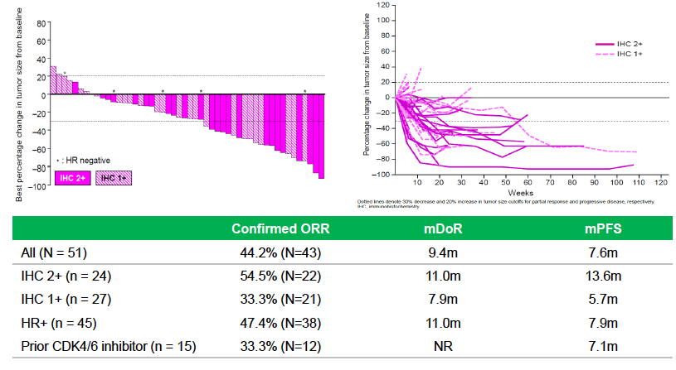
Trastuzumab Deruxtecan (T-DXd):
HER2 Low Tumors
Courtesy of Aditya Bardia, MD, MPH
Modi S et al. J Clin Oncol. 2020.

Slide 39
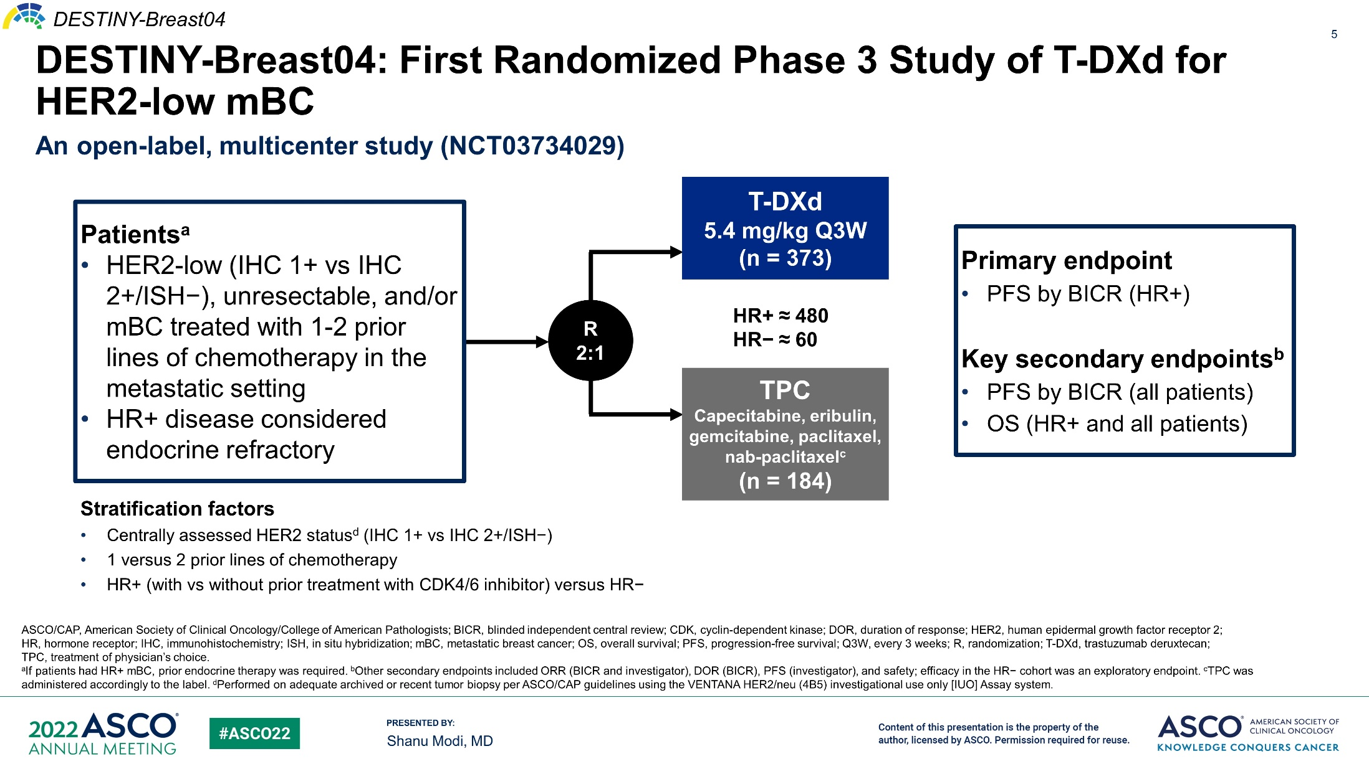
Slide 5
Trastuzumab Deruxtecan vs TPC:
Study Design (DESTINY-Breast04)
Courtesy of Aditya Bardia, MD, MPH

Slide 40
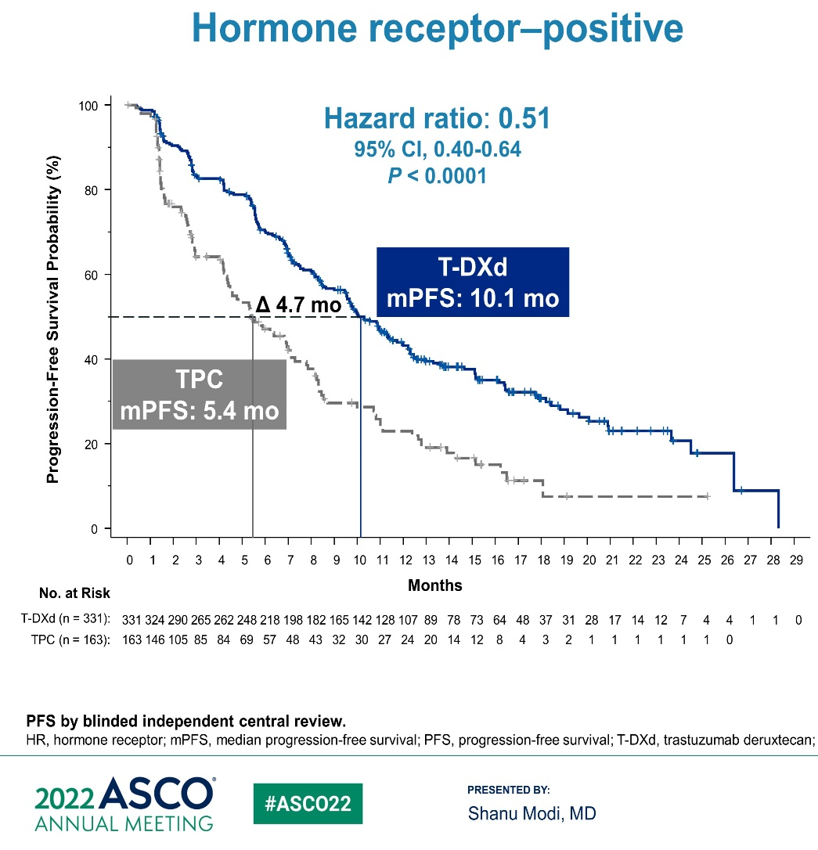
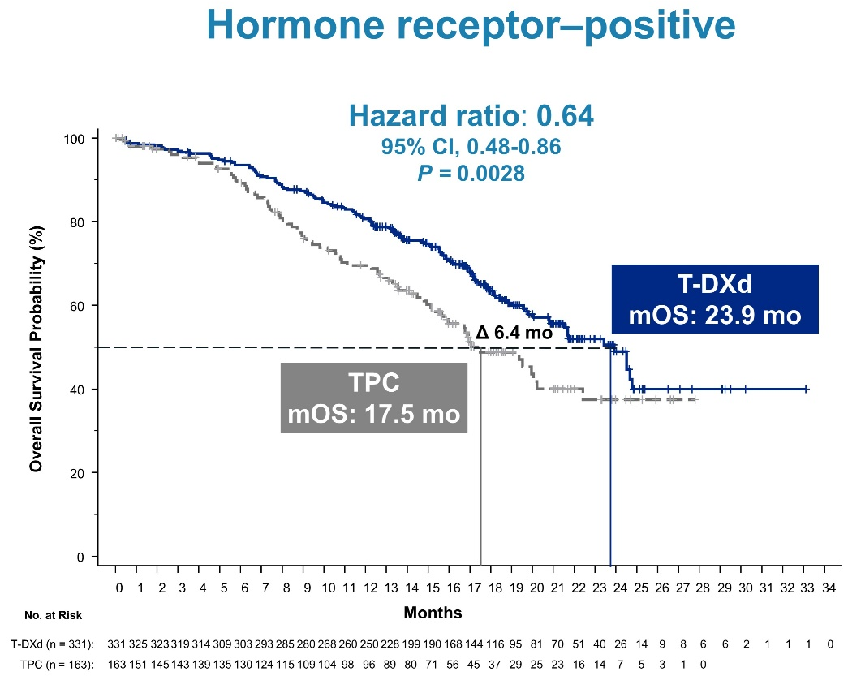
Slide 10
Trastuzumab Deruxtecan vs TPC:
PFS (HR+/HER2 Low BC)
Progression-Free Survival
Overall Survival
Courtesy of Aditya Bardia, MD, MPH
Modi S et al. ASCO 2022;Abstract LBA3. Modi S et al. N Engl J Med 2022;387(1):9-20.

Slide 41
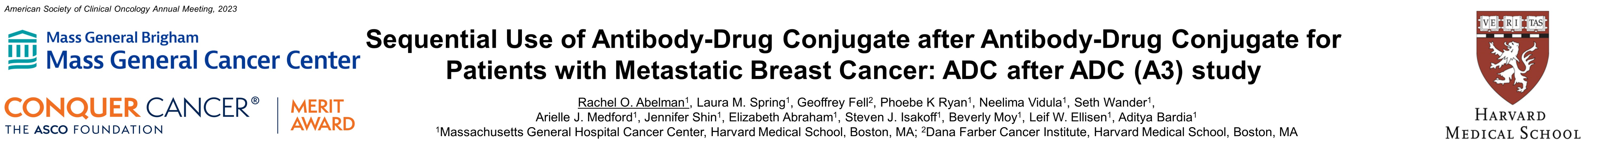
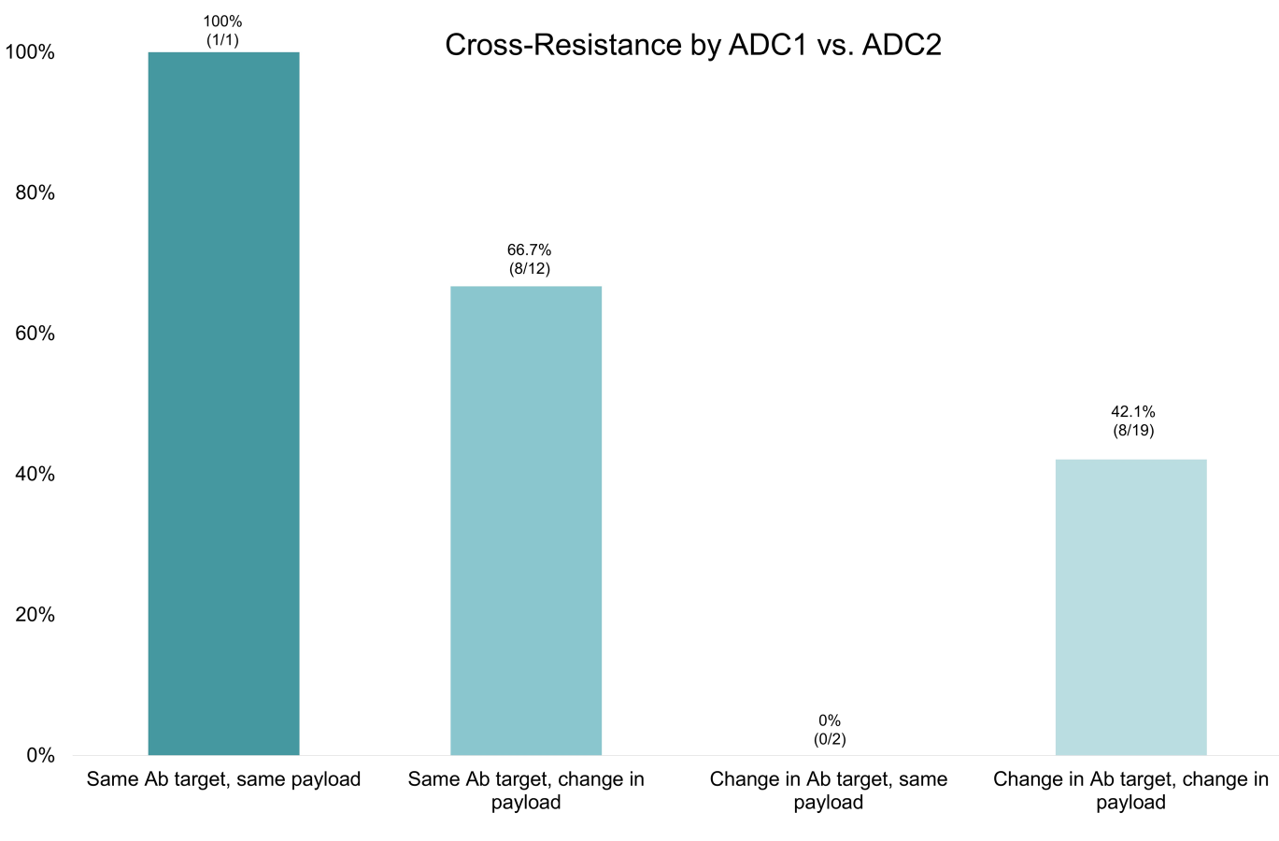
Target vs payload:
Implications for ADC Sequencing
Courtesy of Aditya Bardia, MD, MPH

Slide 42
Agenda
INTRODUCTION: Biopharmacology and Endocrinology of Breast Cancer
MODULE 1: Current Strategies for Previously Treated ER-Positive Metastatic Breast Cancer (mBC) — Dr Bardia
MODULE 2: Future Directions in the Management of ER-Positive mBC —
Dr Hamilton
MODULE 3: Clinical Investigator Survey

Slide 43
Future Directions in the Management of ER-Positive mBC
Erika Hamilton, MD
Director, Breast Cancer Research Program
Sarah Cannon Research Institute/ Tennessee Oncology
Nashville, TN

Slide 44
Oral SERDs
Courtesy of Erika Hamilton, MD

Slide 45
SERD: Selective estrogen receptor degrader
Key advantages
Oral formulation
Higher potency
Activity in ESR1 mutant MBC
Activity in post-ET and CDK4/6i treated pts
Courtesy of Erika Hamilton, MD

Slide 46
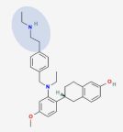

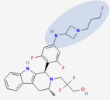
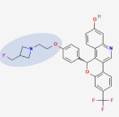
Comparison of oral SERDs in development
 | Elacestrant* | Camizestrant | Giredestrant | Imlunestrant
Structure
Sidechain | Basic | Basic | Basic | Basic
Class | SERM/SERD hybrid** | SERD | SERD | SERD
RP2D (monotherapy) | 400mg | 75mg | 30mg | 400mg
Adverse events >10% monotherapy | Nausea, fatigue, vomiting, decreased appetite, arthragias | Visual disturbances, bradycardia, nausea, fatigue, dizziness, vomiting, and asthenia | Fatigue, arthralgia, backpain, nausea, diarrhea, cough, constipation | Nausea, diarrhea, fatigue, arthralgia, urinary tract infection, constipation, headache
Median PFS (SERD vs ET in post CDK 4/6i) | 2.8 months vs 1.9 months (HR 0.70 p 0.0018) | 7.2 months vs 3.7 months (HR 0.58) statistically significant | 5.6 months vs 5.4 months (HR 0.81, p 0.1757) | NR
Activity in ESR1 mutant MBC | Yes | Yes | Yes | NR
* FDA approved
** lower doses-partial agonist;
higher doses - antagonist
As receptor occupancy increases,
degradation occurs
Courtesy of Erika Hamilton, MD
Bardia A et al JCO 2022; Oliviera M et al. SABCS 2022; Martin M et al. ESMO 2022

Slide 47
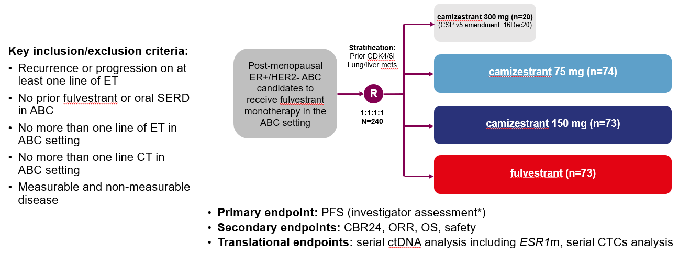

SERENA-2: Study design and patient population
Patient population
Lung/liver mets 58.1% 58.9% 58.9%
ESR1m detectable 29.7% 35.6% 47.9%
Adjuvant AI 40.5% 35.6% 31.5%
AI for MBC 55.4% 67.1% 67.1%
Prior CDK 4/6i 51.4% 50.7% 50.7%
Courtesy of Erika Hamilton, MD
Oliveira M et al. SABCS 2022, GS3-02

Slide 48
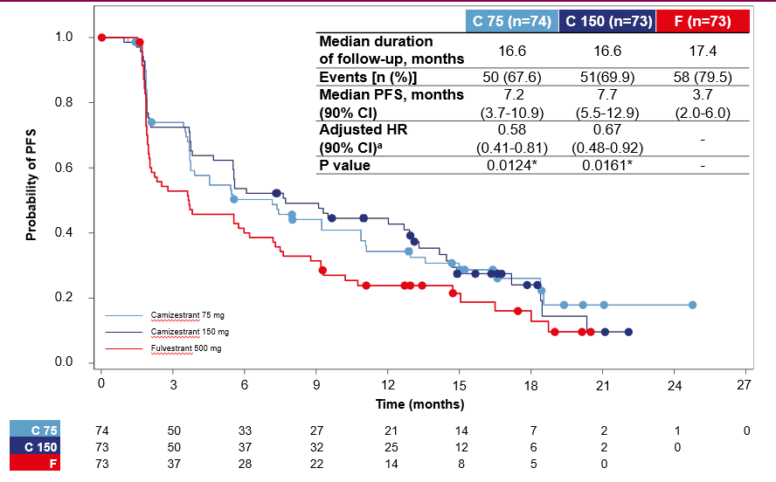
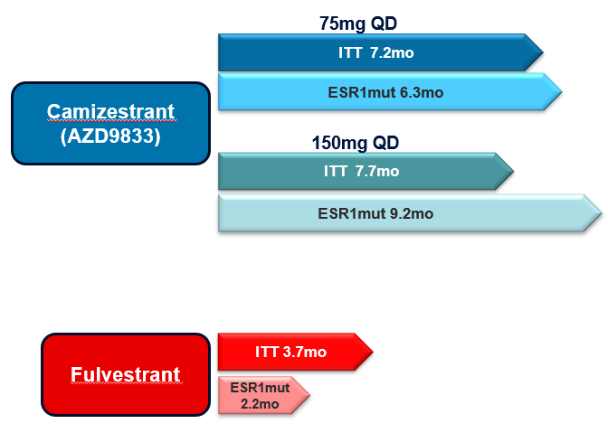
SERENA-2: Progression-free survival
PFS in overall patient population
PFS in pts based on detectable ESR1mut
Camizestrant improved PFS over fulvestrant in all patients including those with detectable ESR1 mutations
Courtesy of Erika Hamilton, MD
Oliveira M et al. SABCS 2022, GS3-02

Slide 49


Adverse events with oral SERDs
Gastrointestinal
Cardiac
General
Eye
Endocrine
- Nausea
- Vomiting
- Diarrhea
- G1 bradycardia
- QTc prolongation
- Fatigue
- Visual disturbances
Hot flashes
Courtesy of Erika Hamilton, MD

Slide 50
SERENA-4: Camizestrant + palbociclib as 1L therapy for HR+/HER2- MBC
NCT04711252
Pre/post menopausal women & male pts with ER+/HER2- MBC
No prior systemic therapy for metastatic disease
Recurrence from early stage disease:
-At least 24 months of an AI with a TFI > 12 months OR -At least 24 months of tamoxifen
Pts with de novo MBC allowed
Patients with bone only disease must have a lytic or mixed lytic lesion
N=1342
Camizestrant +
Palbociclib +
Anastrozole placebo
1:1
Camizestrant Placebo +
Palbociclib +
Anastrozole
Courtesy of Erika Hamilton, MD

Slide 51
EMBER-3: 1-2L trial for HR+/HER2- MBC with Imlunestrant
Imlunestrant is an oral SERD (Eli Lilly)
In a phase 1 trial, Imlunestrant monotherapy led to CBR of 48% in HR+/HER2- MBC
treated with fulvestrant and CDK 4/6i
NCT04975308
ER+/HER2- LA/MBC
Prior tx with an AI (with or without CDK 4/6i) in adjuvant /met setting
  Prior tx with CDK 4/6i expected if tx is approved and reimbursed
No other prior therapy for advanced disease
  No prior tx with SERD or chemo or PI3K/AKT/mTOR inhibitor
Measurable or non measurable bone only disease
Arm A: Imlunestrant
N ~ 800
1:1:1
Arm B: Fulvestrant or Exemestane
Arm C: Imlunestrant + Abemaciclib
Patients will be randomized 1:1:1 (A:B:C) until the target enrollment is met for either Arm B (n=250) or Arm C (n=180). At that point, the randomization will be 1:1 with Arm A and either Arm B or Arm C, whichever has not met target enrollment.
Courtesy of Erika Hamilton, MD

Slide 52
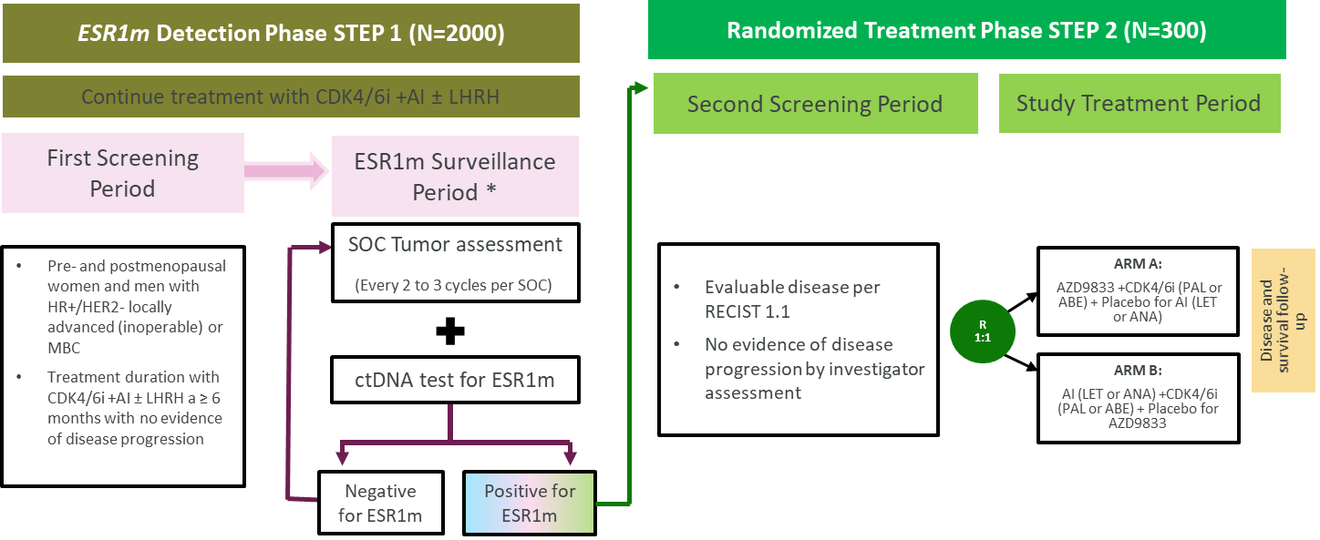
SERENA-6: Early switch strategy to oral SERD in ESR1-mutant ER+/HER2- MBC
NCT04964934
Courtesy of Erika Hamilton, MD

Slide 53
Other ER targeting agents
Courtesy of Erika Hamilton, MD

Slide 54
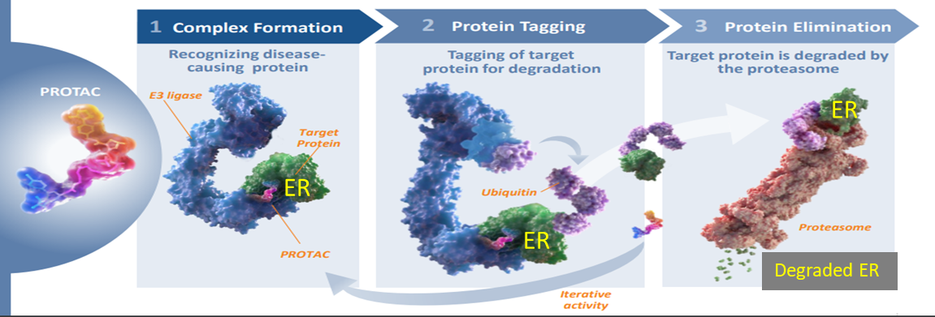
ARV-471: Proteolysis targeting chimera (PROTAC™)
ARV-471 is a PROTAC™ targeting the WT and ESR1 mutant estrogen receptor (ER)
In a phase 1 dose escalation study:
ARV-471 was well tolerated all doses with no DLTs
CBR was 40% (n=47 evaluable); 3 pts had confirmed PRs
Courtesy of Erika Hamilton, MD
Hamilton E. et al. SABCS 2021, PD13-08

Slide 55
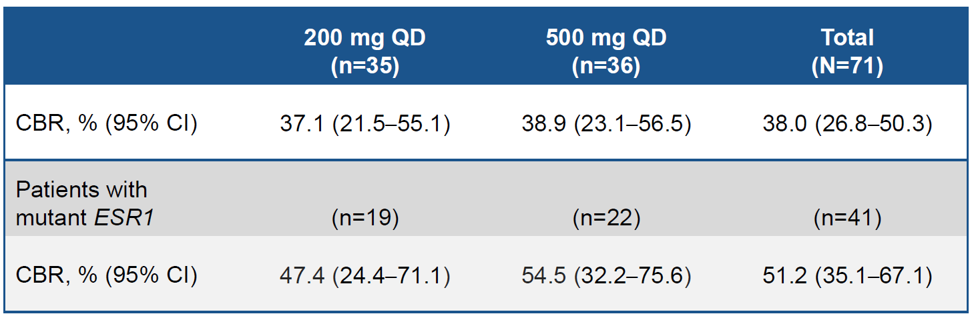
ARV-471: Phase 2 (VERITAC) cohort expansion
Schema
Primary Endpoint: Clinical benefit rate (CBR)
ER+/HER2- MBC
> 1 prior ET line for MBC
> 1 prior CDK 4/6i
0-1 prior chemo for MBC
Measurable disease per RECIST v1.1
ARV 471
200mg PO QD
(n=35)
ARV 471
500mg PO QD
(n=36)
Patient population:
Prior therapies for MBC
  CDK 4/6i 100%
  Fulvestrant 30%
  Chemotherapy 45%
BL ESR1 mutation 58%
PFS in ITT vs ESR1 mutant (200mg QD dose)
 | All patients |  | ESR1 mutant
 | 200mg QD (n=35) | Total (N=71) | 200mg QD (n=19) | Total (N=41)
Median PFS | 3.5 months | 3.7 months | 5.5 months | 5.7 months
Robust ER degradation was observed at both doses; mean ER degradation was 71%
CBR was higher with ARV-471 in ESR1 mutant subset at both doses tested
Fatigue and nausea were most common AEs, and most AEs were G1/2 events
200mg QD was selected as phase 3 dose
VERITAC-2: Phase 3 trial of ARV-471 vs fulvestrant in CDK 4/6i tx HR+/HER2- MBC is ongoing
Courtesy of Erika Hamilton, MD
Hurvitz SA et al. SABCS 2022

Slide 56
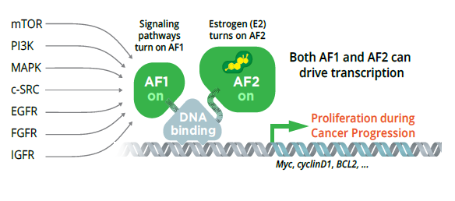
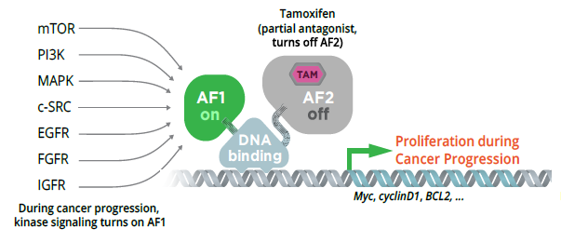
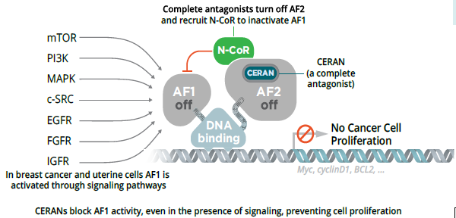
Complete ER antagonist (CERAN): MOA
CERAN shuts down both activation functions (AF1 and AF2) of the ER
OP1250 is a CERAN with activity in
WT & ESR1 mutant breast cancer xenografts
Brain mets xenograft model
Hodges-Gallaher L et al. ENA (EORTC NCI AACR) 2020
Hodges-Gallagher et al AACR 2021
Courtesy of Erika Hamilton, MD

Slide 57
OP-1250 monotherapy and palbociclib combination
Monotherapy
OP-1250 + palbociclib
ER/PR+ MBC treated at doses from 30mg to 120mg OP-1250 + 125 mg palbociclib (n=12)
>1 prior lines of therapy: 58%
Prior CDK 4/6i: 67%
Prior fulvestrant: 8%
Prior chemo: 25%
ER/PR+ MBC treated at doses from 30mg to 300mg (n=40)
>3 prior lines of therapy: 50%
Prior fulvestrant: 67.5%
Prior chemo: 75%
Prior CDK 4/6i: 92.5%
Efficacy
SD > 24 weeks : 2 pts and ongoing
8 pts on tx at data cut off; longest duration of tx was 31 weeks
Safety:
No DLTs observed, MTD not reached
Most TEAEs were G1 or G2
G3 AEs: Neutropenia (67%), fatigue (8%), WBC count decreased (8%)
PK analysis:
RP2D - 120mg OP-1250 in combo with 125mg palbociclib
No drug-drug interaction observed
Efficacy in anticipated RP2D range (60-120mg)
ORR: 8%
CBR: 38%
Safety:
No DLTs observed, MTD not reached
Most TEAEs were G1 or G2
Courtesy of Erika Hamilton, MD
Patel M et al. SABCS 2021 Abstract # P1-17-12
Chan A et al. SABCS 2022 Abstract # P2-24-07

Slide 58
Akt inhibition
Courtesy of Erika Hamilton, MD

Slide 59
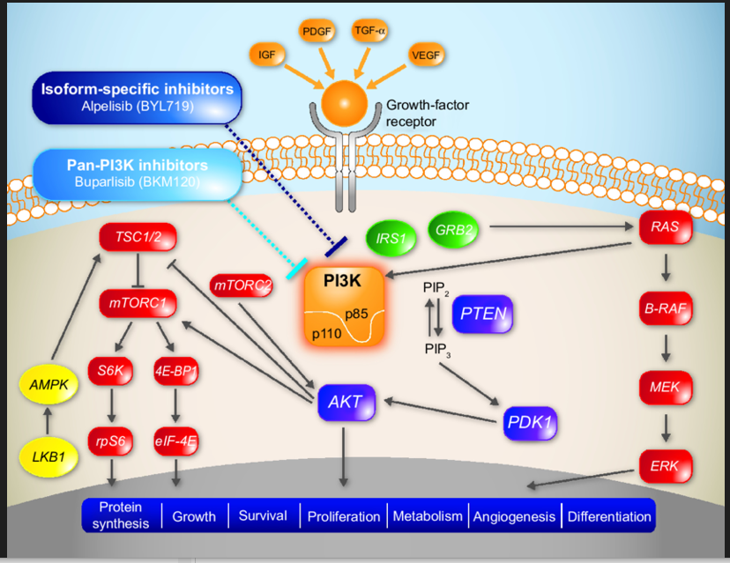
PI3K/AKT/mTOR pathway
Capivasertib, a pan-AKT inhibitor demonstrated synergistic
activity with fulvestrant in preclinical endocrine sensitive and
resistant models
Ipatasertib is also a pan-AKT inhibitor with demonstrated
antitumor activity in preclinical studies
In phase 1 trials
  Capivasertib + fulvestrant in AKT^{E17K} HR+ MBC –
  ORR of 20-36% and median PFS of 5-5.6 months
  depending on prior fulvestrant tx
  Ipatasertib + paclitaxel in HR+/HER2- MBC:
  2/15 patients had PR (one with H1047R PIK3CA
  mutation) and max PFS was 14.2 months in
  one pt with breast cancer
Phase 2 FAKTION trial
  Capivasertib + fulvestrant led to significant
  improvement in PFS vs placebo/fulv irrespective of
  PI3K/AKT/PTEN pathway activation status
AKT inhibitors
Capivasertib, Ipatasertib
mTOR inhibitor
Everolimus
@ErikaHamilton9
Smyth LM et al. 2020; Isakoff SJ et al. 2020
Jones RH et al. ASCO 2019
Courtesy of Erika Hamilton, MD

Slide 60

2023;388(22):2058-70.

Slide 61
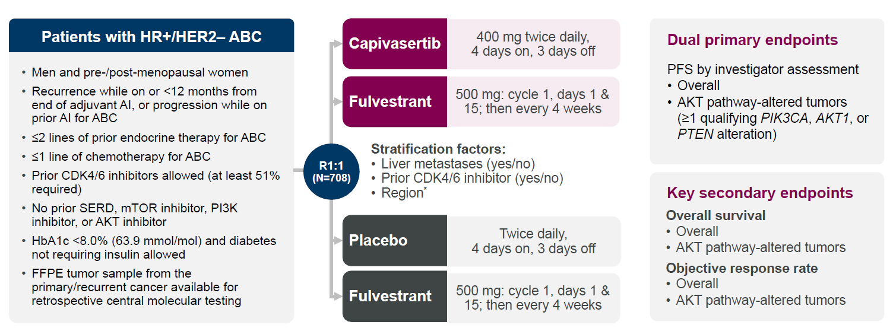
CAPItello-291: Phase 3 trial with an Akt inhibitor
Patient population
Visceral disease 66-73%
AKT pathway alterations 38-43%
Median priors for MBC 1
Prior CDK 4/6i 67-72%
Prior chemo for MBC 17-19%
Courtesy of Erika Hamilton, MD
Turner NC et al. SABCS 2022, GS3-04

Slide 62
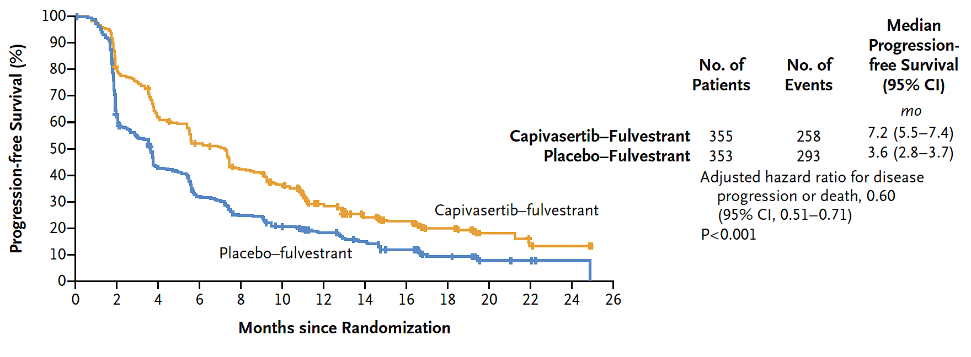
CAPItello-291: Progression-Free Survival in the Overall Population
Turner NC et al. N Engl J Med 2023;388(22):2058-70.

Slide 63
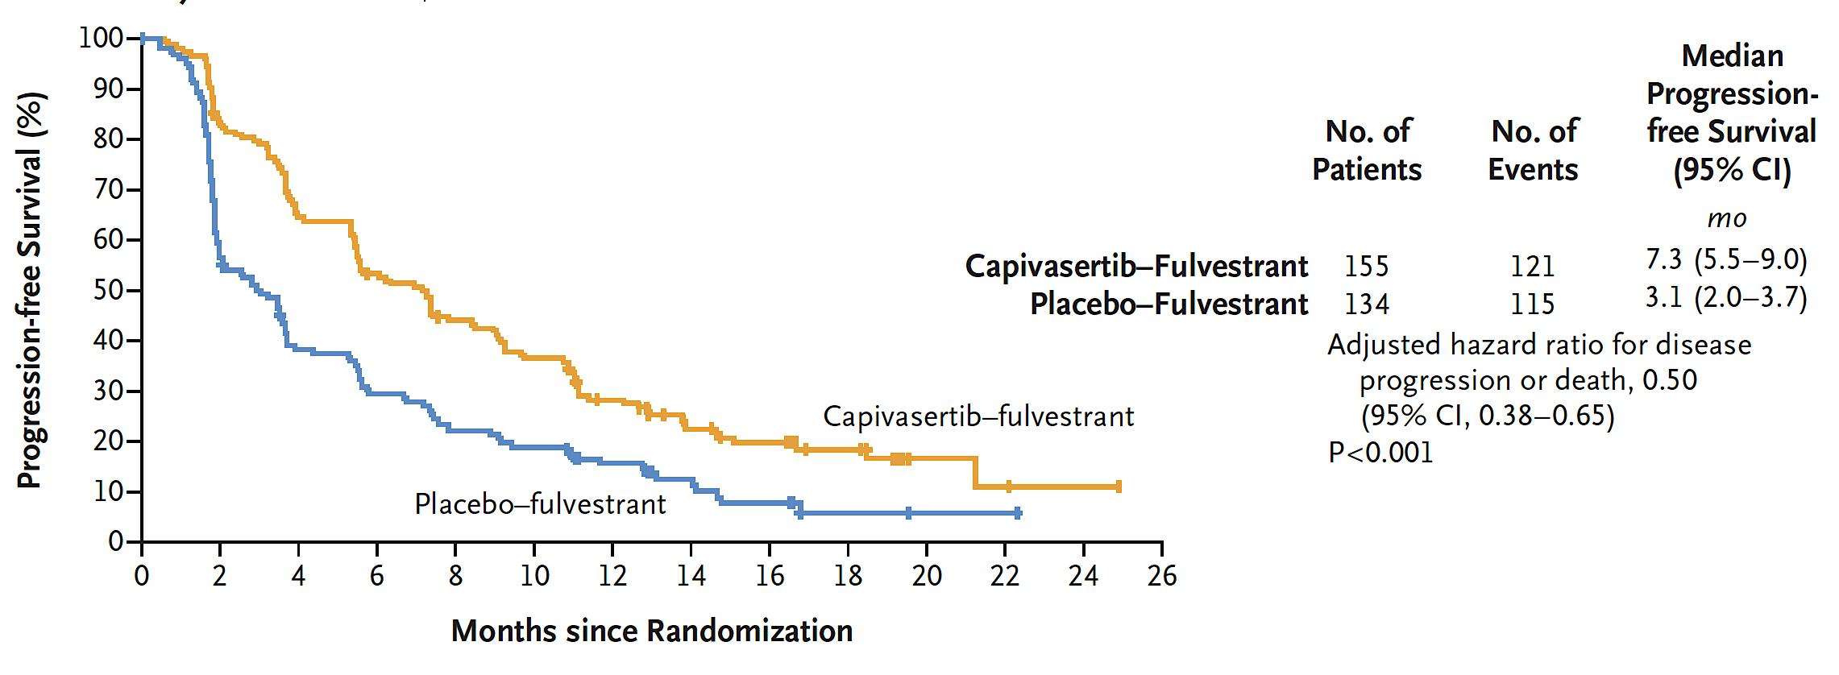
CAPItello-291: Progression-Free Survival for Patients with AKT Pathway-Altered Tumors
Turner NC et al. N Engl J Med 2023;388(22):2058-70.

Slide 64
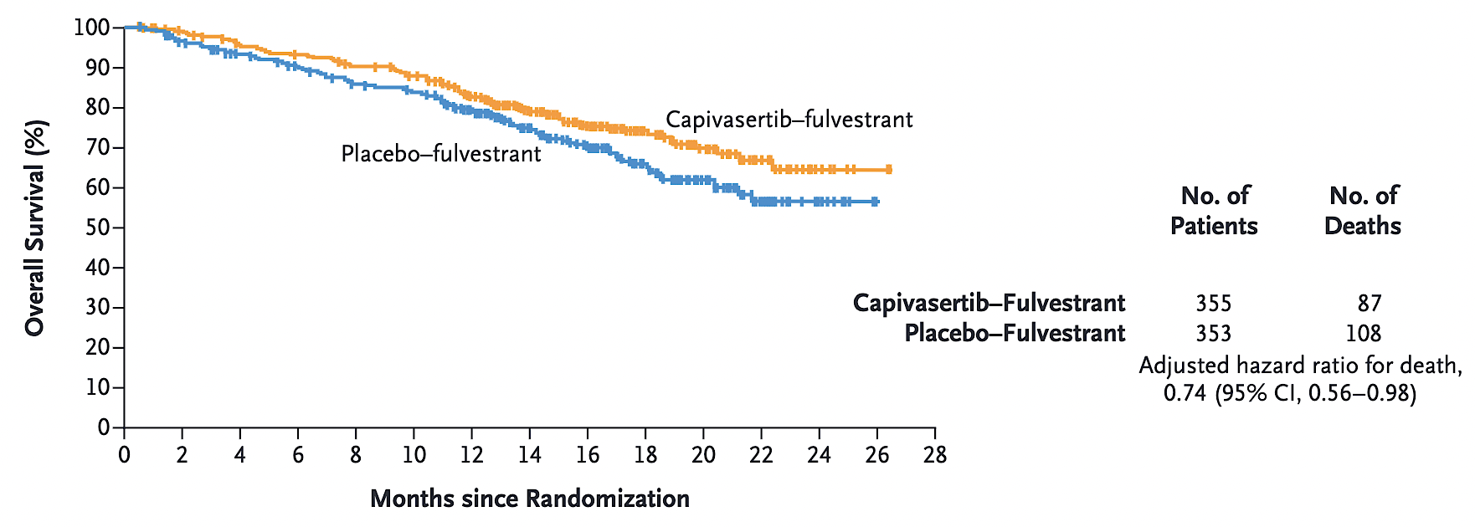
CAPItello-291: Overall Survival in the Overall Population
Turner NC et al. N Engl J Med 2023;388(22):2058-70.

Slide 65
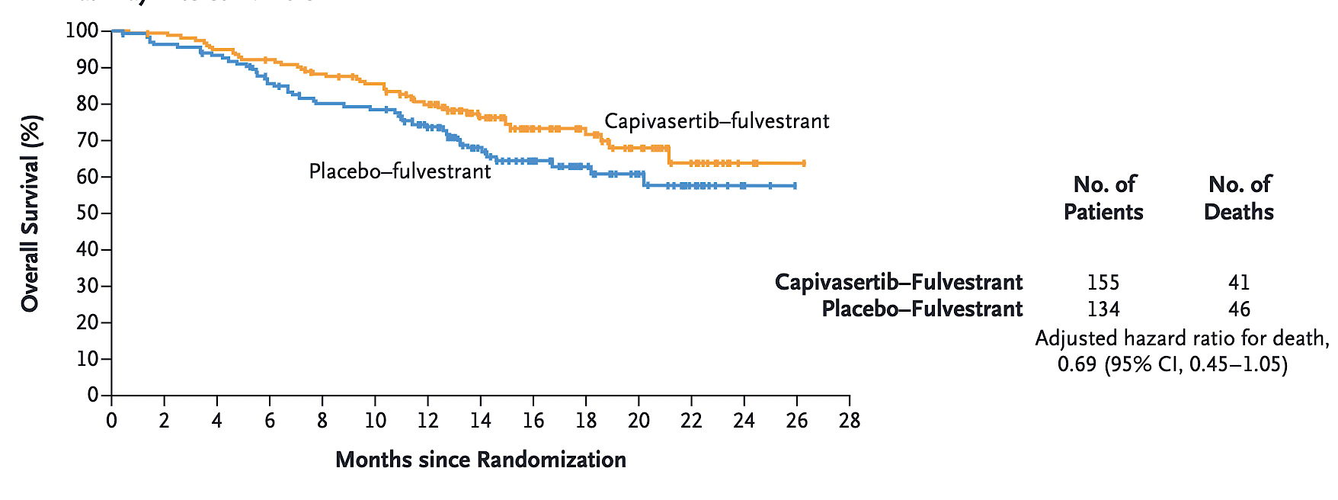
CAPItello-291: Overall Survival for Patients with AKT Pathway-Altered Tumors
Turner NC et al. N Engl J Med 2023;388(22):2058-70.

Slide 66
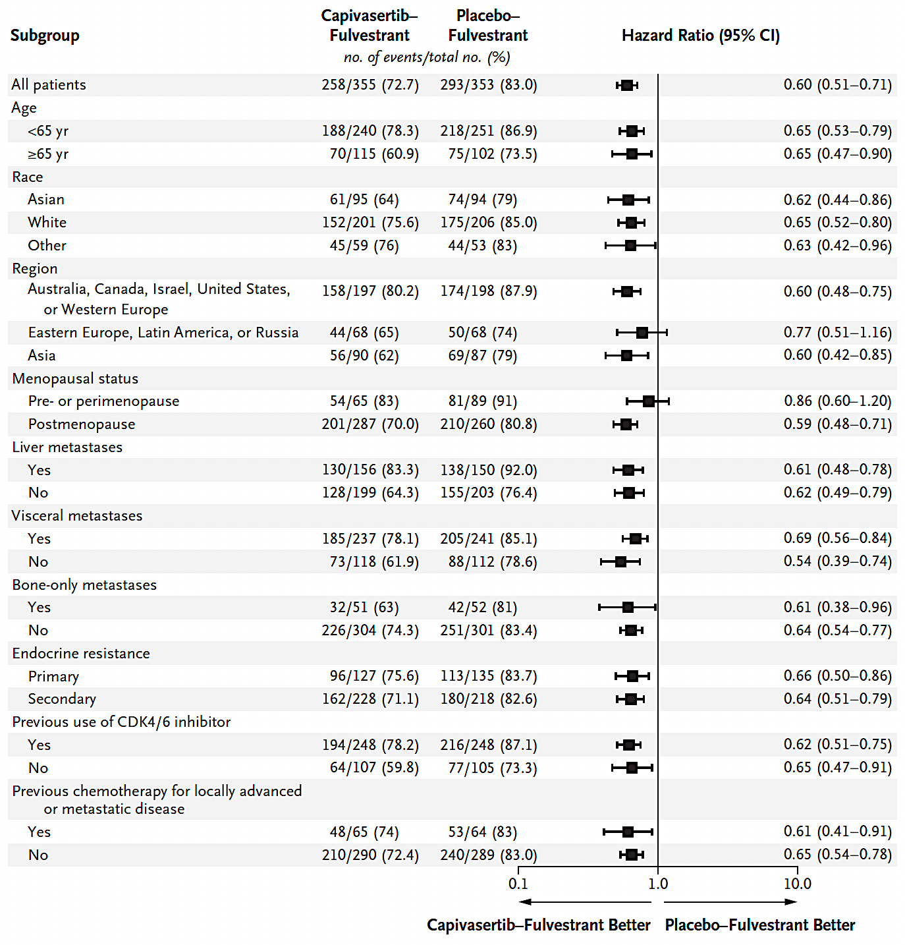
CAPItello-291: Subgroup Analysis
Turner NC et al. N Engl J Med 2023;388(22):2058-70.

Slide 67
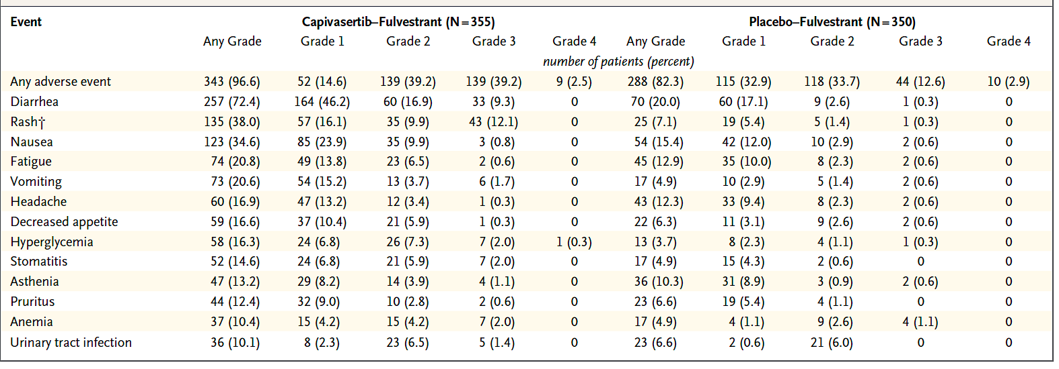
CAPItello-291: Most Frequent Adverse Events in the Overall Population (Safety Population)
Turner NC et al. N Engl J Med 2023;388(22):2058-70.

Slide 68
Novel ADCs
Courtesy of Erika Hamilton, MD

Slide 69
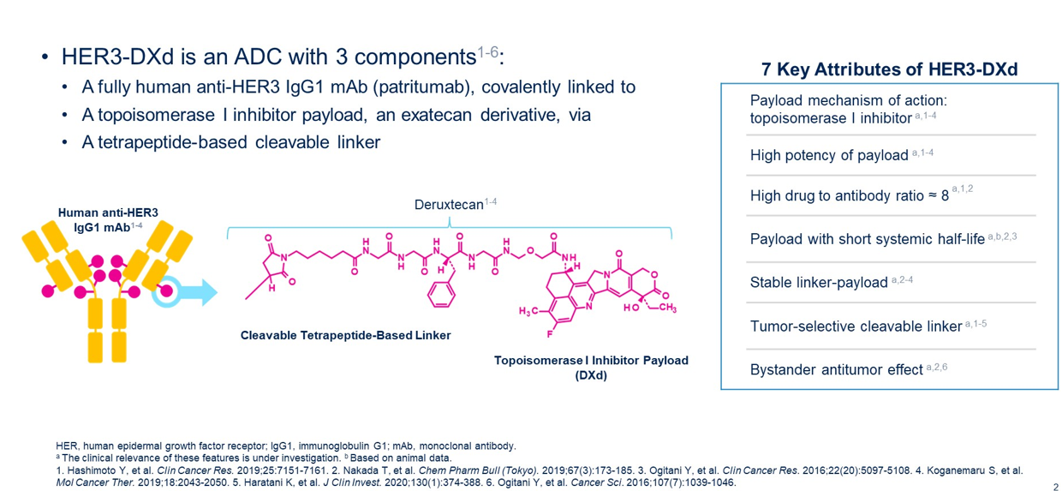
Patritumab deruxtecan (HER3-DXd)
Courtesy of Erika Hamilton, MD
Krop I et al. ASCO 2022, Abstract 1002

Slide 70
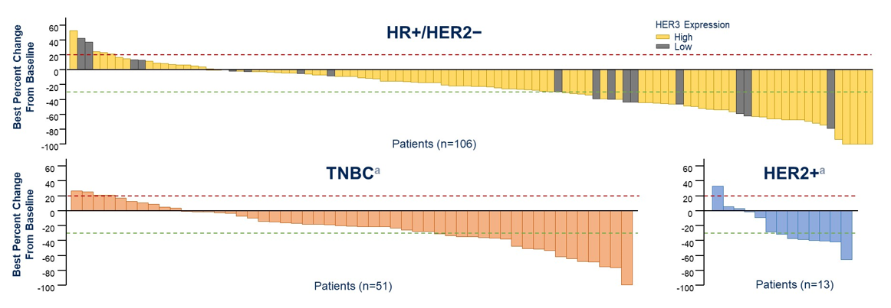
Patritumab deruxtecan: Activity in HER3-expressing MBC
  Phase 1/ 2 trial (expansion) in HER3 expressing MBC:
    Heavily pretreated patient population with median priors ranging from 2-6 depending on subtype
Change in tumor size from baseline
Subtype | ORR | Median DoR
HR+/HER2- | 30% | 7.2 mo
HER2+ | 23% | 5.9 mo
TNBC | 43% | 8.3 mo
Durable antitumor activity in all BC subtypes across the range of HER3 expression
Manageable safety profile with low rates of treatment discontinuation
Treatment related ILD (6.6%), mostly G1/2; one G5 event
Courtesy of Erika Hamilton, MD
Krop I et al. ASCO 2022, Abstract 1002

Slide 71
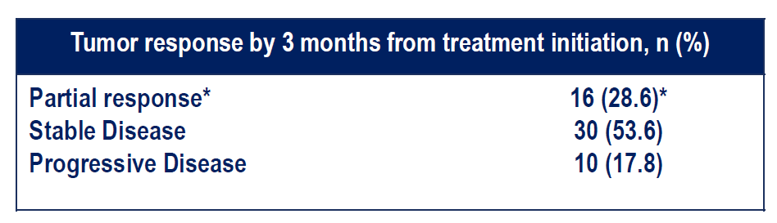
ICARUS-Breast01: Phase 2 trial of HER3-DXd in HR+/HER2- MBC
Prospective, multicenter, single-arm study with multiple biomarker analyses
LA/MBC
HR+/HER2- or HER2-low
PD on CDK 4/6i+ET
PD on 1 prior chemo for MBC
No prior T-DXd
Patient population:
Median prior regimens 2
Prior (neo)adj chemotherapy 65%
Prior everolimus 32%
BL HER3 expression (>75%) 51.8%
BL HER3 expression unknown 48.2%
N= 56
Patritumab deruxtecan
^{5.6mg/kg IV q 3 weeks}
Pre treatment, on tx and EOT biopsy and blood collected
*HER3-expression prescreening (75% of membrane positivity at 10x) was removed by amendment on April 21st, 2022
Courtesy of Erika Hamilton, MD
Pistilli B et al. ESMO Breast 2023

Slide 72
Phase 2 trial of HER3-DXd in HER2- MBC
LA/MBC
TNBC: 1-3 prior lines of chemo for MBC
HR+: Prior tx with CDK 4/6i +ET; no more than 2 prior chemo for MBC
Pre- and on-treatment biopsies
Patient population:
Median prior regimens 3
Prior chemotherapy 90%
Prior immunotherapy 20%
Prior Sacituzumab 8.3%
BL HER3 expression (>75%) 63.8%
BL HER3 expression (25-74%) 27.7%
N= 60
Patritumab deruxtecan
^{5.6mg/kg IV q 3 weeks}
Pre treatment* biopsy tissue analyzed for ER/PR/HER2 and HER3 expression
Membrane HER3 expression | ≥75% (N=30) | 25%- 74% (N=13) | <25% (N=4) | Unknown * (N=13) | Total (N=60) N (%)
ORR, n (%) | 10 (33.3) | 6 (46.2) | 2 (50.0) | 3 (23.1) | 21 (35.0)
CBR, n (%)** | 12 (40.0) | 7 (53.8) | 2 (50.0) | 5 (38.5) | 26 (43.3)
DoR ≥6 months, n (%)† | 4 (40.0) | 2 (33.3) | 2 (100) | 2 (66.7) | 10 (47.6)
*HER3 results available for 47 pts. Remaining 13 pts had tissue not available/testing result unevaluable
All-comer ORR was 35%, overall CBR was 43%, and DoR was at least 6 months in nearly half of all patients who responded
Courtesy of Erika Hamilton, MD
Hamilton E et al. ASCO 2023

Slide 73
Tumor shrinkage with HER3-DXd
Best Percent Change in Sum of Diameters from Baseline in Target Lesions
Percent Change from Baseline in Sum of Diameters
of Target Lesions HR+ vs TNBC
≥75% HER3 expression
25-74% HER3 expression
<25% HER3 expression
Hormone receptor+ (ER+ or PR+) (N=29) TNBC (N=19)
60
40
20
0
50
25
0
HER3 unknown
Hormone receptor+ (ER+ or PR+)
TNBC
Solid=ER+ Striped=TNBC
Best % Change in Sum of Diameters from Baseline
-20
-40
-60
-80
-100
-25
-50
-75
-100
% Change from Baseline in Sum of Diameters of Target Lesions
0.0 2.5 5.0 7.5 10.0 12.5
0.0 2.5 5.0 7.5 10.0 12.5
Time (months) from first dose of study drug
Assessment post-RECIST PD
PD response
Majority of the patients had tumor shrinkage with HER3-DXd treatment
Courtesy of Erika Hamilton, MD
Hamilton E et al. ASCO 2023

Slide 74
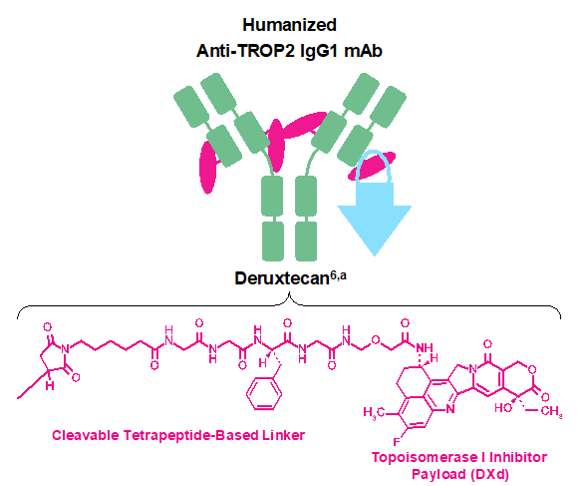
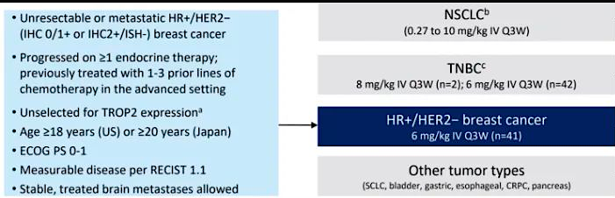
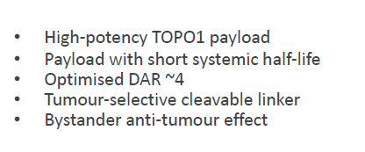
Datopotamab deruxtecan (Dato-DXd): Trop-2 directed ADC
TROPION-PanTumor01
N=41
ORR = 27%
Patient population (n=41)
Median prior chemo for MBC = 2 (1-6)
Prior CDK 4/6i = 95%
ORR= 27%
Median PFS = 8.3 months
Median OS = NR
Courtesy of Erika Hamilton, MD
Meric-Bernstram F et al. SABCS 2022; PD13-08

Slide 75
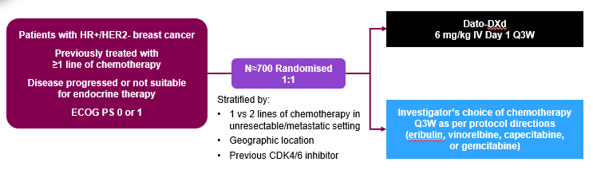
TROPION-Breast01: Phase 3 trial of Dato-DXd in HR+/HER2- MBC
NCT05104866
Trial has completed accrual
Courtesy of Erika Hamilton, MD

Slide 76
Case 1 Patient with ER+/HER2- MBC who received an investigational SERD
Diagnosis of ER+/HER2- BC in 2005
Lumpectomy- 2.2 cm IDC, G2, ER 100%, PR 80%, HER-2 IHC 0, 0/2 involved SLN
Adjuvant XRT
Adjuvant tamoxifen->letrozole for 2005-2013 (8 years)
Relapsed with lung metastases in 2017
Received palbociclib + letrozole 2017-2020
Enrolled on SERENA-2 randomized to camizestrant arm
Experienced G1 arthralgia and visual disturbances
Remains on therapy
Courtesy of Erika Hamilton, MD

Slide 77
Case 2 Patient with ER+/HER2- MBC who received capivasertib
Diagnosis of ER+/HER2- BC in 2003
5.5 cm IDC, grade 3, ER/PR 90%, HER-2 IHC 1+
Neoadjuvant chemotherapy AC->T followed lumpectomy
Bilateral mastectomies 2.2 cm residual IDC, 1+ SLN with 3 mm deposit, 3 additional neg nodes
Adjuvant exemestane/letrozole for 2004-2014 (10 years)
Relapsed with liver metastases in 2018
Received palbociclib + letrozole 2018-2020, needed 1 dose reduction on palbociclib
Progression - appearance of new bone lesions and new lung lesion
Molecular profiling revealed an AKT1 mutation
Patient enrolled on CAPItello-291
Experienced G2 diarrhea – controlled w/ 3 Imodium daily (2 in am, 1 at lunch)
G1 hyperglycemia
Courtesy of Erika Hamilton, MD

Slide 78
Case 3 Patient with ER+/HER2- MBC who received patritumab deruxtecan
Diagnosis of ER+/HER2- MBC in 2017 denovo with nodal and bone disease
Received palbociclib + letrozole 2017-2021
Exemestane + everolimus, progression at 4 months w/ new liver mets
Received capecitabine for 11 months w/ 1 dose reduction for hand/foot syndrome
Molecular profiling revealed an PIK3CA mutation
Patient received alpelisib + fulvestrant
Developed G2 hyperglycemia; discontinued alpelisib, continued fulvestrant until progression x 4 months
Received Sacituzumab govitecan for 4 months
At progression enrolled on clinical trial with patritumab deruxtecan, ongoing at 5 months
Courtesy of Erika Hamilton, MD

Slide 79
Agenda
INTRODUCTION: Biopharmacology and Endocrinology of Breast Cancer
MODULE 1: Current Strategies for Previously Treated ER-Positive Metastatic Breast Cancer (mBC) — Dr Bardia
MODULE 2: Future Directions in the Management of ER-Positive mBC —
Dr Hamilton
MODULE 3: Clinical Investigator Survey

Slide 80
In general, which CDK4/6 inhibitor are you most likely to recommend in combination with endocrine therapy for a patient with ER-positive, HER2-negative (IHC 0) metastatic breast cancer?
Premenopausal
Postmenopausal
Ribociclib
Ribociclib
Ribociclib
Ribociclib
Palbociclib
Palbociclib
Ribociclib
Ribociclib
Ribociclib
Ribociclib
Ribociclib
Ribociclib

Slide 81
A 65-year-old woman with ER-positive, HER2-negative (IHC 0), node-negative breast cancer has developed multiple minimally symptomatic bone metastases 2 years after starting adjuvant anastrozole. Which endocrine-based treatment would you most likely recommend?
Ribociclib + fulvestrant
Ribociclib + fulvestrant
Palbociclib + fulvestrant
Ribociclib + fulvestrant
Ribociclib + fulvestrant
Ribociclib + fulvestrant

Slide 82
A 65-year-old woman with ER-positive, HER2-negative (IHC 0), node-negative breast cancer has developed multiple minimally symptomatic bone metastases 2 years after starting adjuvant anastrozole. She receives a CDK4/6 inhibitor with fulvestrant and initially responds but then experiences disease progression 18 months later. Regulatory and reimbursement issues aside, what would be your most likely next treatment if biomarker evaluation revealed the following results?
ESR1-positive, PIK3CA-positive
ESR1-positive, PIK3CA-negative
ESR1-negative, PIK3CA-positive
ESR1-negative, PIK3CA-negative
Elacestrant
Elacestrant
Alpelisib/fulvestrant
Exemestane/
everolimus
Elacestrant or camizestrant
Elacestrant or camizestrant
Alpelisib/fulvestrant
Exemestane/
everolimus
Elacestrant
Elacestrant or capivasertib/fulvestrant
Capivasertib/
fulvestrant
Capivasertib/
fulvestrant
Alpelisib/fulvestrant
Cont fulvestrant, switch to abemaciclib
Alpelisib/fulvestrant
Exemestane/
everolimus
Elacestrant
Elacestrant
Alpelisib/
exemestane
Exemestane/
everolimus
Elacestrant
Elacestrant
Alpelisib/fulvestrant
Exemestane/
everolimus

Slide 83
Have you administered or would you administer a CDK4/6 inhibitor to a patient with ER-positive, HER2-negative (IHC 0) metastatic breast cancer who has experienced disease progression on a CDK4/6 inhibitor?
I have not but would for the right patient
I have not but would for the right patient
I have
I have
I have not but would for the right patient
I have

Slide 84
Should community-based oncologists routinely be testing for the following biomarkers in their patients with ER-positive metastatic breast cancer?
ESR1
PIK3CA
Yes
Yes
Yes
Yes
Yes
No
Yes
Yes
Yes
Yes
Yes
Yes

Slide 85
Have you administered or would you administer trastuzumab deruxtecan to a patient with ER-positive, HER2-negative (IHC 0) metastatic breast cancer?
I have not but would for the right patient
I have not but would for the right patient
I have
I have not but would for the right patient
I have not and would not
I have not and would not

Slide 86
Regulatory and reimbursement issues aside, would you offer trastuzumab deruxtecan to a patient with HER2-negative (IHC 0) metastatic breast cancer and a HER2 mutation?
Yes
Yes
Yes
Yes
Yes
No

Slide 87
A 65-year-old woman with ER-positive, HER2-negative (IHC 0) breast cancer experienced disease progression on various endocrine-based therapies and most recently on capecitabine/ paclitaxel. PS 1, no organ dysfunction. Regulatory and reimbursement issues aside what would be your most likely next treatment if biomarker evaluation revealed the following results?
ESR1-positive, PIK3CA-positive
ESR1-positive, PIK3CA-negative
ESR1-negative, PIK3CA-positive
ESR1-negative, PIK3CA-negative
Sacituzumab govitecan
Sacituzumab govitecan
Sacituzumab govitecan
Sacituzumab govitecan
Sacituzumab govitecan
Sacituzumab govitecan
Sacituzumab govitecan
Sacituzumab govitecan
Sacituzumab govitecan
Sacituzumab govitecan
Sacituzumab govitecan
Sacituzumab govitecan
Alpelisib/
fulvestrant
Sacituzumab govitecan
Alpelisib/
fulvestrant
Sacituzumab govitecan
Sacituzumab govitecan
Sacituzumab govitecan
Sacituzumab govitecan
Sacituzumab govitecan
Alpelisib/
fulvestrant
Elacestrant
Alpelisib/
fulvestrant
Exemestane/
everolimus

Slide 88
For a patient with metastatic breast cancer, regulatory and reimbursement issues aside, at what point would you like to use sacituzumab govitecan?
ER-positive, HER2-negative
ER-negative, HER2-negative
After 1 line of chemotherapy
After 1 line of chemotherapy
After 1 line of chemotherapy
After 1 line of chemotherapy
After 1 line of chemotherapy
After 1 line of chemotherapy
After 1 line of chemotherapy
After 1 line of chemotherapy
After 1 line of chemotherapy
After 1 line of chemotherapy
After 2 lines of endocrine therapy
After 1 line of chemotherapy

Slide 89
If camizestrant were to become available, for which patients with ER-positive, HER2-negative metastatic breast cancer would you prioritize its use?
First line as study in 1st-line setting (SERENA-4/6)
Chemo-naïve (both ESR1m and wt) w/ prior benefit from CDK4/6i
ESR1 mutation-positive
ESR1 mutation-positive
Depends on ESR1 approval
ESR1 mutation-positive
Wt = wild type; CDK4/6i = CDK4/6 inhibitor

Slide 90
If capivasertib were to become available, for which patients with ER-positive, HER2-negative metastatic breast cancer would you prioritize its use?
Second-line HR+/HER2- mBC, particularly with
PI3K/AKT pathway alteration
Fulvestrant-naïve with prior benefit from CDK4/6i
Prior CDK4/6i therapy
Disease progression on first-line endocrine therapy,
no ESR1 mutation
After progression on CDK4/6i assuming ESR1 wt
PI3K mutation, access as defined in FAKTION
CDK4/6i = CDK4/6 inhibitor; wt = wild type

Slide 91
If datopotamab deruxtecan were to become available, for which patients with
ER-positive metastatic breast cancer would you prioritize its use?
HER2-negative
HER2-positive
HR+/HER2- mBC, after 1 prior line
of chemotherapy
Unlikely in HER2+ setting w/o data. For HER2 low, after 1 prior line of chemotherapy
Endocrine-resistant disease
No evidence currently
Need more data
Need more data
After T-DXd and
sacituzumab govitecan
I would prioritize it for
later lines of therapy
After currently approved ADCs
After currently approved ADCs
After PD on 2 lines of therapy
After PD on 2 or 3 lines
of therapy
ADC = antibody-drug conjugate; PD = progressive disease

Slide 92
If patritumab deruxtecan were to become available, for which patients with
ER-positive metastatic breast cancer would you prioritize its use?
HER2-negative
HER2-positive
Tough to know without
pivotal Phase III trial
Tough to know without
pivotal Phase III trial
Endocrine-resistant disease
After THP and T-DXd,
likely concurrently
Need more data
Need more data
After T-DXd and
sacituzumab govitecan
After all standard HER2-based therapies
Depends on the Phase III data
Too early to tell
HER3-positive disease
HER3-positive disease
THP = docetaxel/trastuzumab/pertuzumab; T-DXd = trastuzumab deruxtecan

Slide 93
A 65-year-old woman with ER-positive, HER2-low (IHC 1) breast cancer experienced disease progression on various endocrine-based therapies and most recently on capecitabine/paclitaxel. PS 1, no organ dysfunction. Regulatory and reimbursement issues aside, what would be your most likely next treatment if biomarker evaluation revealed the following results?
ESR1-positive, PIK3CA-positive
ESR1-positive, PIK3CA-negative
ESR1-negative, PIK3CA-positive
ESR1-negative, PIK3CA-negative
T-DXd
T-DXd
T-DXd
T-DXd
T-DXd
T-DXd
T-DXd
T-DXd
Elacestrant or
T-DXd*
Elacestrant or
T-DXd*
T-DXd
T-DXd
T-DXd
T-DXd
T-DXd
T-DXd
T-DXd
T-DXd
T-DXd
T-DXd
Alpelisib/
fulvestrant
Elacestrant
Alpelisib/
fulvestrant
Exemestane/
everolimus
T-DXd = trastuzumab deruxtecan; * If not visceral disease, elacestrant

Slide 94
For a patient with metastatic breast cancer, regulatory and reimbursement issues aside, at what point would you like to use trastuzumab deruxtecan?
ER-positive, HER2-low (IHC 1)
ER-negative, HER2-low (IHC 1)
After 1 line of chemotherapy
After 2 lines of chemotherapy
(after SG)
After 1 line of chemotherapy
After 1 line of chemotherapy
After 1 line of chemotherapy
After 1 line of chemotherapy
After 1 line of chemotherapy
After 2 lines of chemotherapy
After 1 line of chemotherapy
After 2 lines of chemotherapy
After 2 lines of endocrine therapy
After 2 lines of chemotherapy
SG = sacituzumab govitecan

Slide 95
Would you recommend rechallenge with trastuzumab deruxtecan for a patient who previously developed pneumonitis on that treatment and has since recovered?
No
Yes, if Grade 1
Yes, if Grade 1
Yes, if Grade 1
Yes, if Grade 1
Yes, if Grade 1

Slide 96
Based on your personal clinical experience and knowledge of available data, please estimate the chance that a patient will experience toxicity requiring a dose hold during treatment with elacestrant. What is the primary toxicity that leads to withholding dosing?
Chance of dose hold
Primary toxicity
5%
Nausea
5%
Fatigue
75%
GI
20%
GI
5%
Nausea
<5%
GI

Slide 97
Based on your personal clinical experience and knowledge of available data, please estimate the chance that a patient will experience toxicity requiring a dose hold during treatment with camizestrant. What is the primary toxicity that leads to withholding dosing?
Chance of dose hold
Primary toxicity
10%
Visual toxicity
5%
Fatigue
75%
GI
20%
Fatigue
10%
Nausea
<5%
Vision issues

Slide 98
Based on your personal clinical experience and knowledge of available data, please estimate the chance that a patient will experience toxicity requiring a dose hold during treatment with giredestrant held. What is the primary toxicity that leads to withholding dosing?
Chance of dose hold
Primary toxicity
5%
Bradycardia
5% to 10%
GI
Not sure
Not sure
20%
GI
20%
Nausea
<5%
Hepatotoxicity

Slide 99
Based on your personal clinical experience and knowledge of available data, please estimate the chance that a patient will experience toxicity requiring a dose hold during treatment with imlunestrant. What is the primary toxicity that leads to withholding dosing?
Chance of dose hold
Primary toxicity
10%
Diarrhea
5%
Fatigue
75%
GI
20%
GI
10%
Nausea
<5%
GI

Slide 100
Based on your personal clinical experience and knowledge of available data, please estimate the chance that a patient will experience toxicity requiring a dose hold during treatment with capivasertib. What is the primary toxicity that leads to withholding dosing?
Chance of dose hold
Primary toxicity
20%
Diarrhea
25%
Diarrhea
50%
GI
30%
Diarrhea
20%
Diarrhea
10% to 15%
Rash

Slide 101
Based on your personal clinical experience and knowledge of available data, please estimate the chance that a patient will experience toxicity requiring a dose hold during treatment with alpelisib. What is the primary toxicity that leads to withholding dosing?
Chance of dose hold
Primary toxicity
25%
Rash, diarrhea
50%
Hyperglycemia, diarrhea
25%
Hyperglycemia
70%
Hyperglycemia
30%
Hyperglycemia
>10%
Hyperglycemia

Slide 102
Based on your personal clinical experience and knowledge of available data, please estimate the chance that a patient will experience toxicity requiring a dose hold during treatment with trastuzumab deruxtecan. What is the primary toxicity that leads to withholding dosing?
Chance of dose hold
Primary toxicity
30%
Pneumonitis
20%
Interstitial lung disease, nausea
50%
General fatigue
30%
Neutropenia
10%
Nausea
20%
Interstitial lung disease

Slide 103
Based on your personal clinical experience and knowledge of available data, please estimate the chance that a patient will experience toxicity requiring a dose hold during treatment with sacituzumab govitecan. What is the primary toxicity that leads to withholding dosing?
Chance of dose hold
Primary toxicity
30%
Myelosuppression
40%
Neutropenia
25%
Neutropenia
40%
Neutropenia
10%
Diarrhea
15%
Diarrhea

Slide 104
Based on your personal clinical experience and knowledge of available data, please estimate the chance that a patient will experience toxicity requiring a dose hold during treatment with datopotamab deruxtecan. What is the primary toxicity that leads to withholding dosing?
Chance of dose hold
Primary toxicity
15%
Mucositis
30%
Stomatitis
25%
General fatigue
30%
Nausea
10%
Nausea
10%
Anemia

Slide 105
Based on your personal clinical experience and knowledge of available data, please estimate the chance that a patient will experience toxicity requiring a dose hold during treatment with patritumab deruxtecan. What is the primary toxicity that leads to withholding dosing?
Chance of dose hold
Primary toxicity
Not sure
Not sure
15%
Nausea
Not sure
Not sure
I have not had enough
experience with this drug
I have not had enough
experience with this drug
10%
Nausea
10%
Hematologic

Slide 106
Based on your personal clinical experience and knowledge of available data, please estimate the chance that a patient will experience toxicity requiring a dose hold during treatment with olaparib. What is the primary toxicity that leads to withholding dosing?
Chance of dose hold
Primary toxicity
15%
Myelosuppression
~35%
GI, blood counts
50%
General fatigue
20%
Anemia
10%
Blood counts
10%
Anemia

Slide 107
Based on your personal clinical experience and knowledge of available data, please estimate the chance that a patient will experience toxicity requiring a dose hold during treatment with palbociclib. What is the primary toxicity that leads to withholding dosing?
Chance of dose hold
Primary toxicity
15%
Myelosuppression
70%
Transient neutropenia
75%
General fatigue
50%
Neutropenia
5%
Infections
10%
Neutropenia

Slide 108
Based on your personal clinical experience and knowledge of available data, please estimate the chance that a patient will experience toxicity requiring a dose hold during treatment with abemaciclib. What is the primary toxicity that leads to withholding dosing?
Chance of dose hold
Primary toxicity
20%
Diarrhea
50%
Diarrhea
50%
GI
50%
Diarrhea
20%
Diarrhea
10%
Diarrhea

Slide 109
Based on your personal clinical experience and knowledge of available data, please estimate the chance that a patient will experience toxicity requiring a dose hold during treatment with ribociclib. What is the primary toxicity that leads to withholding dosing?
Chance of dose hold
Primary toxicity
20%
LFT increase
70%
Transient neutropenia
75%
General fatigue
50%
Neutropenia
10%
Infections
10%
Neutropenia

Slide 110
Based on your personal clinical experience and knowledge of available data, should olaparib be offered to patients with ER-positive, HER2-negative breast cancer and either a somatic or germline BRCA mutation in the following situations?
Any number of positive nodes
Select patients with
node-negative disease
Yes
Yes
Yes
No
Yes
Yes
Yes
No
No
No
Yes
Yes

