Slide 1
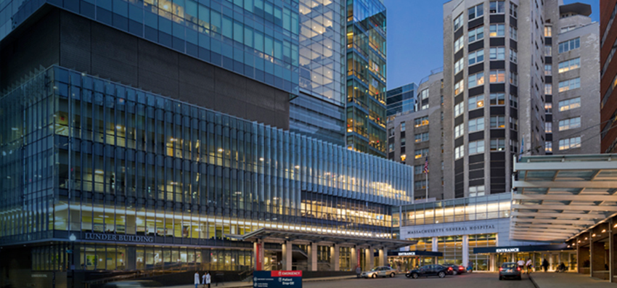
Second-generation ROS1 Inhibitors
Targeting MET
Rebecca S. Heist MD MPH
Associate Professor of Medicine
Harvard Medical School | Massachusetts General Hospital

Slide 2
Molecular landscape of NSCLC
May 6, 2020: FDA grants accelerated approval to capmatinib for metastatic NSCLC with METex14
Feb 3, 2021: FDA grants accelerated approval to tepotinib for metastatic NSCLC with METex14
Thai et al, Lancet 2021

Slide 3
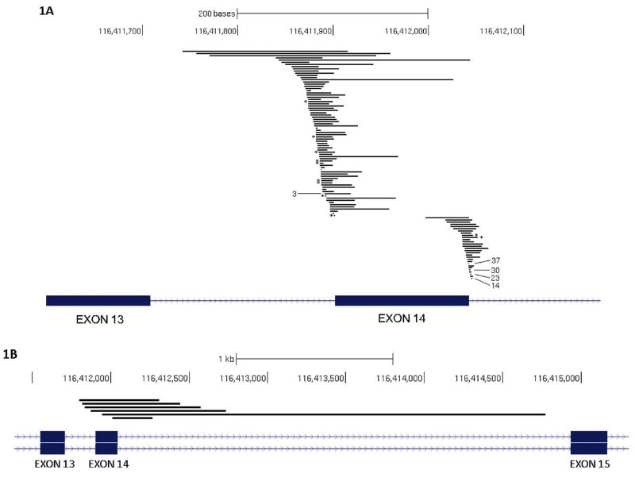
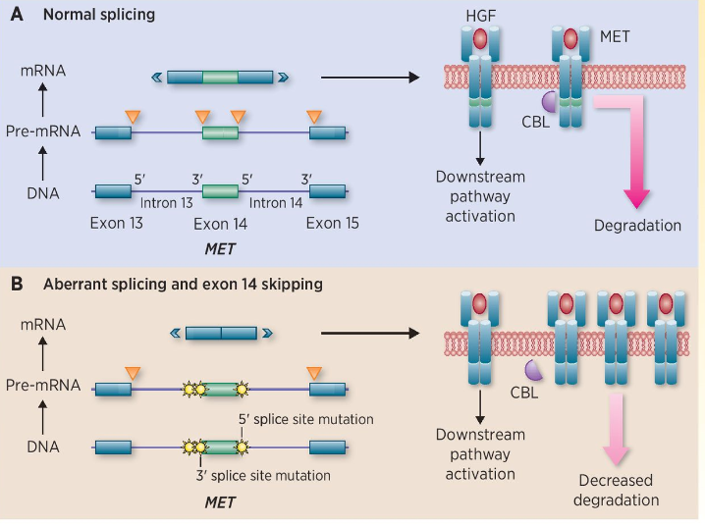
MET exon 14 skipping as a targetable alteration in lung cancer
Frampton et al Cancer Discovery 2015; Drilon CCR 2016;

Slide 4
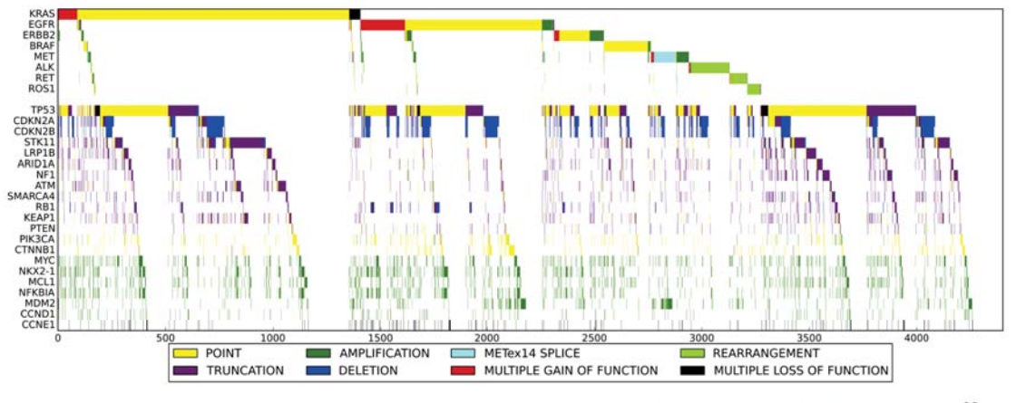
METex14 mutually exclusive from other driver alterations
Frampton et al, Cancer Discovery 2015

Slide 5
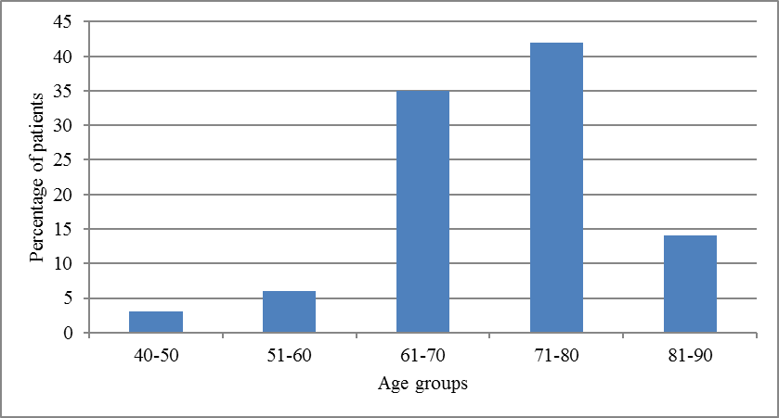
Characteristics of lung cancer patients with METex14
Smoking Status
Adapted from Awad et al, Lung Cancer 2019

Slide 6
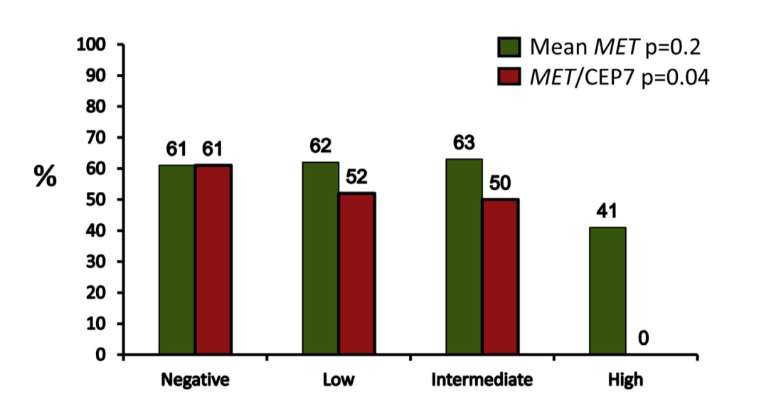
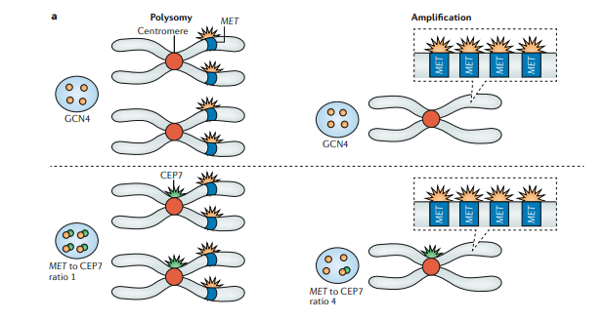
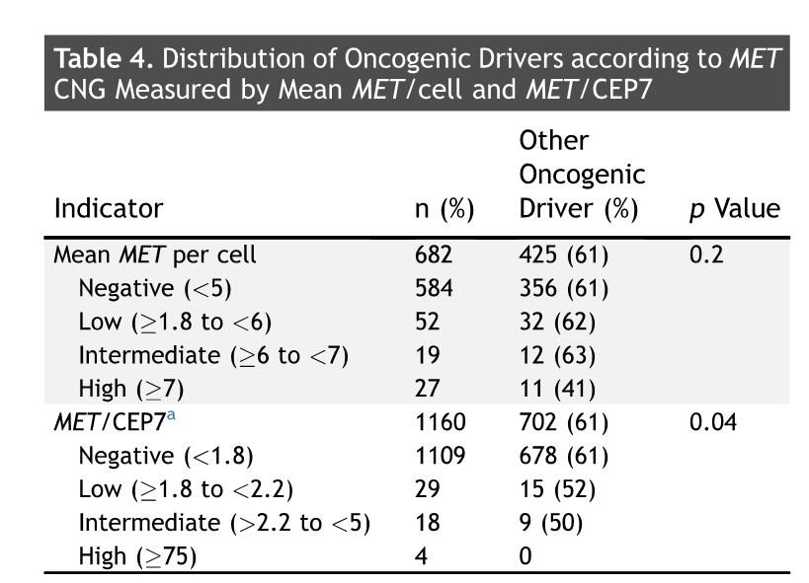
Gene Copy Number Increases: Polysomy v Focal Amplification

Slide 7
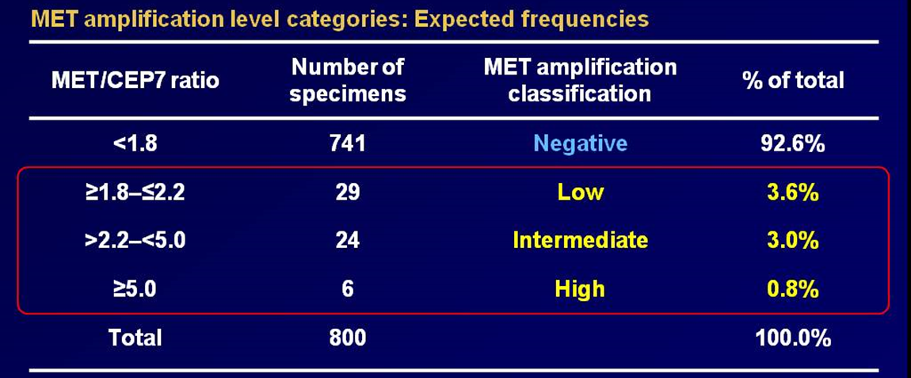
Frequency of high level MET amplification in lung cancer
Camidge et al, ASCO 2014

Slide 8
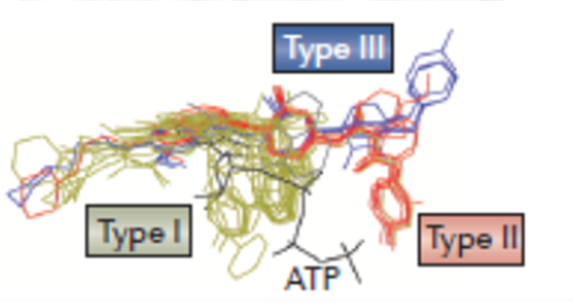
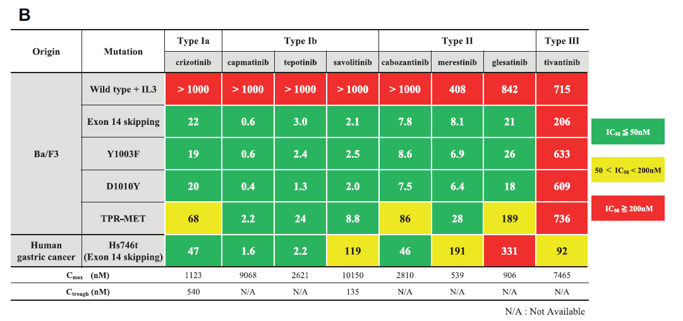
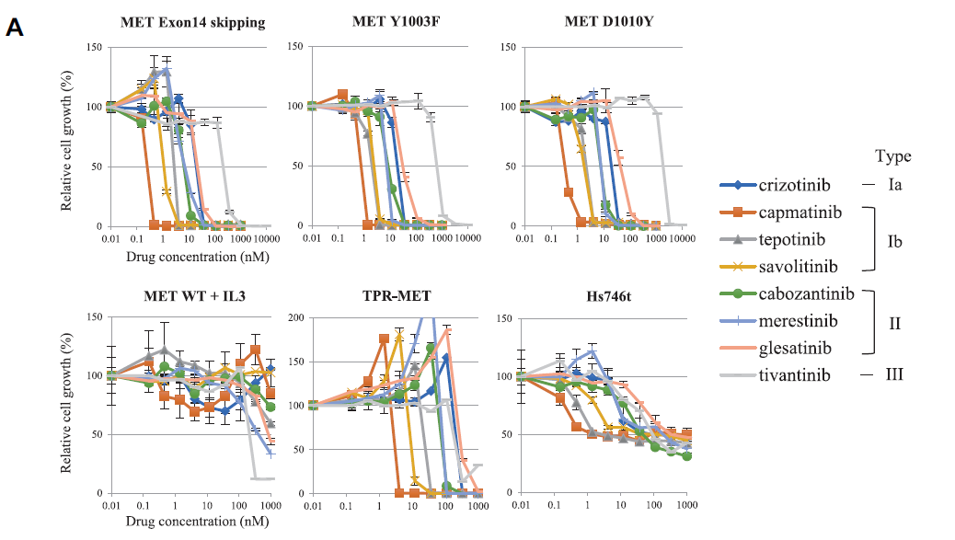
MET tyrosine kinase inhibitors
Gherardi et al Nature Reviews 2012; Fujino et al JTO 2019

Slide 9
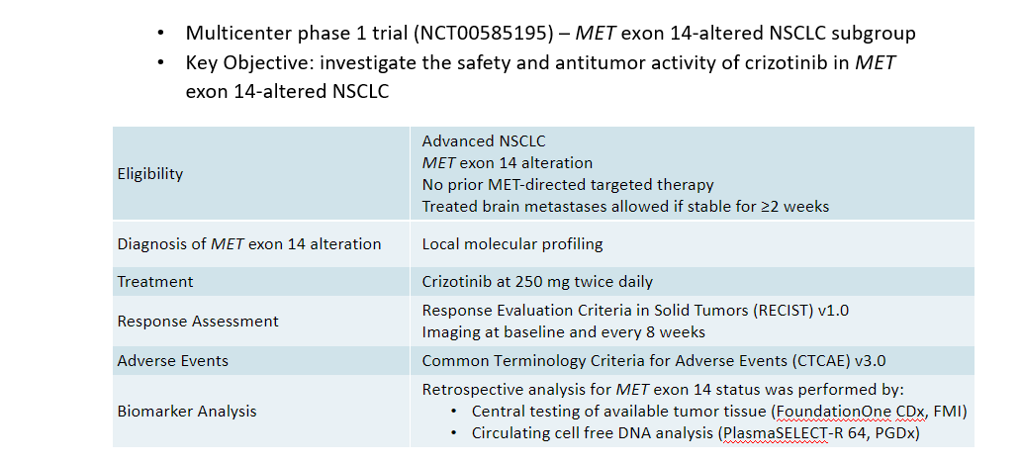
Crizotinib PROFILE 1001 Study Design
Drilon et al, WCLC 2018

Slide 10
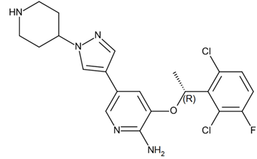
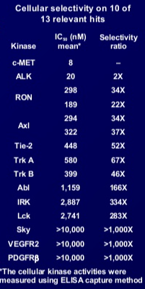
Crizotinib activity in METex14
ORR 32%
mPFS 7.3 mo
Bang et al ASCO 2010; Drilon et al, Nat Medicine 2019

Slide 11
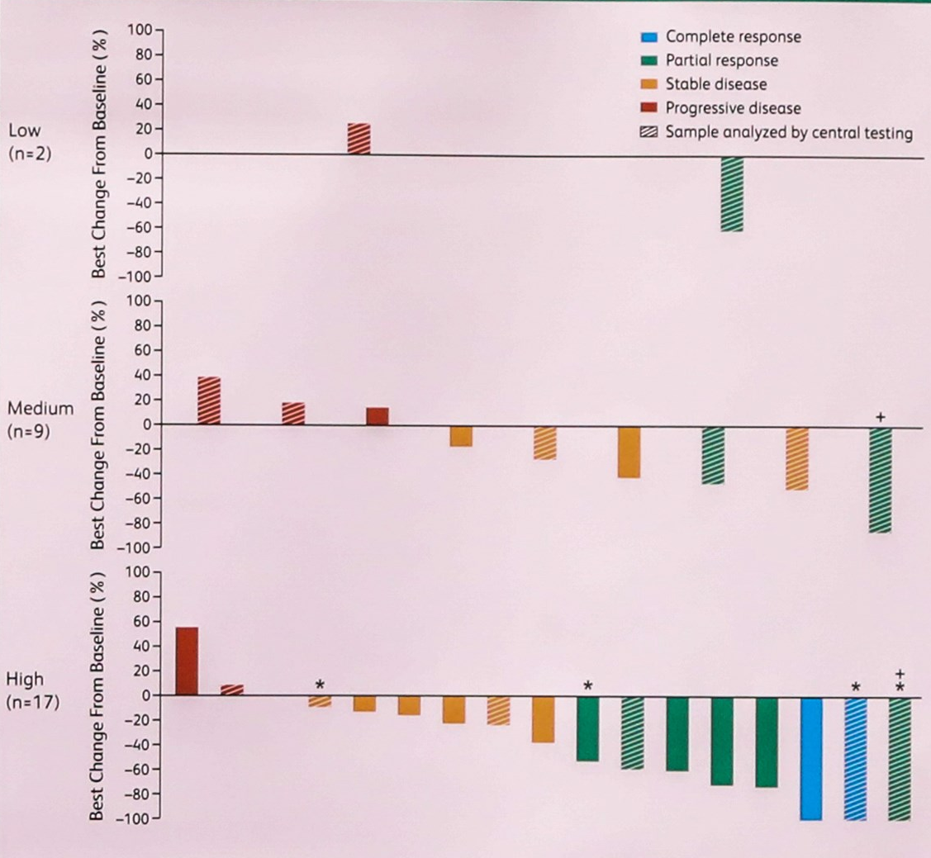
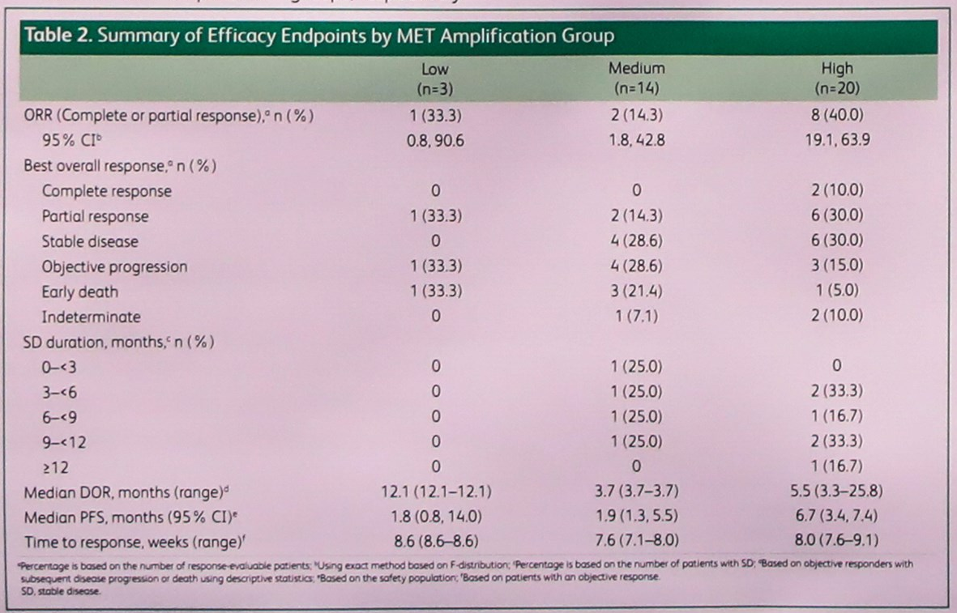
Crizotinib activity in MET amplified NSCLC
Camidge et al, ASCO 2018

Slide 12
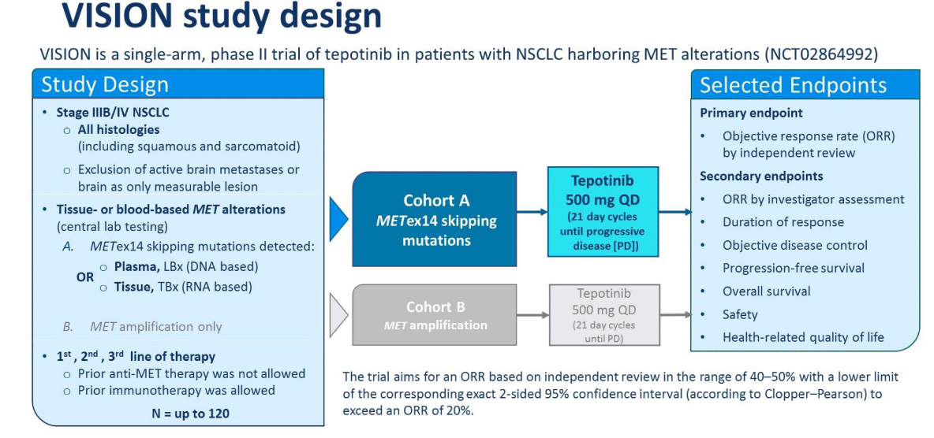
Tepotinib VISION study design
Paik et al ASCO 2019

Slide 13
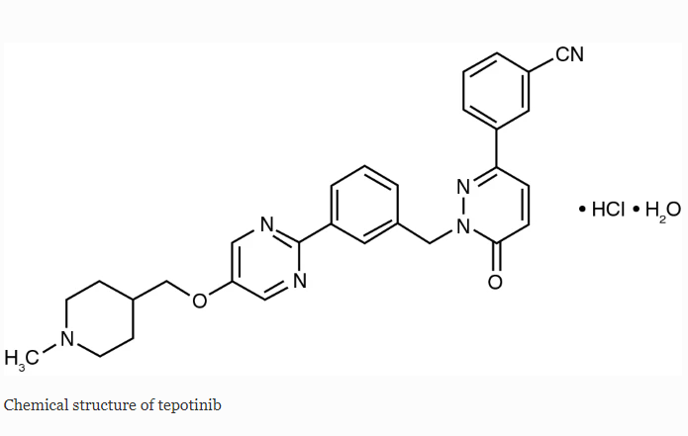
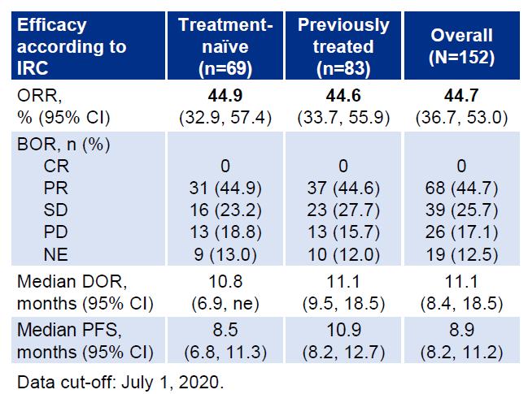
Tepotinib activity in METex14
ORR 46%
mPFS 8.5 mo
Bladt et al CCR 2013; Paik et al ASCO 2019; Paik et al NEJM 2020; Paik et al WCLC 2020

Slide 14
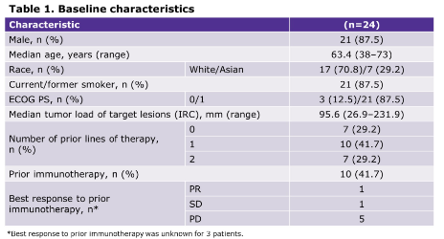
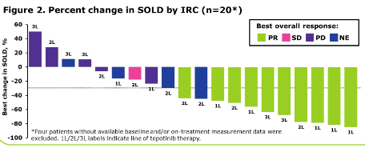
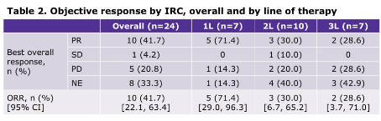
Tepotinib activity in MET amplified NSCLC
Le et al ASCO 2021

Slide 15
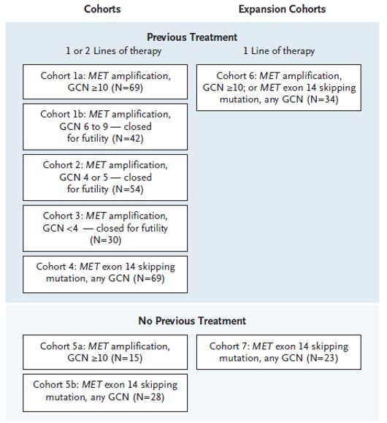
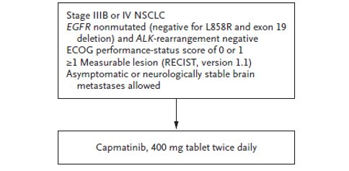
Capmatinib GEOMETRY mono-1 study design
Wolf et al NEJM 2020

Slide 16
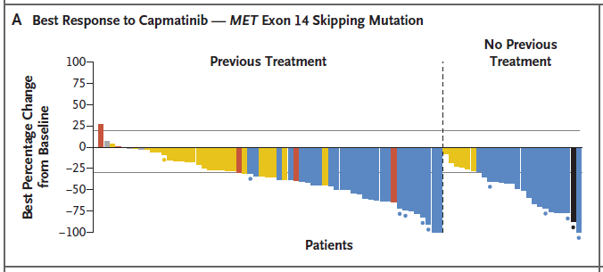
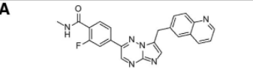
Capmatinib activity in METex14
ORR 41%
mPFS 5.4 mo
ORR 68%
mPFS 12.4 mo
Baltschukat et al CCR 2019; Wolf et al NEJM 2020

Slide 17
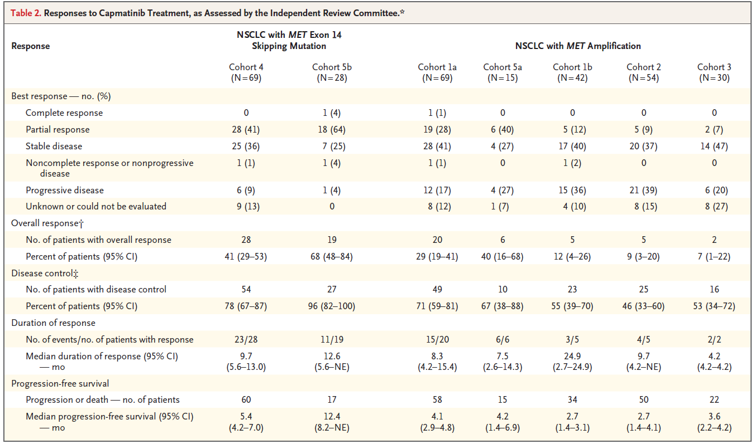
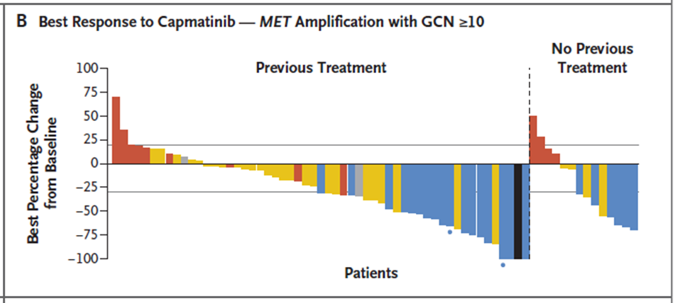
Capmatinib activity in GEOMETRY mono-1, in MET GCN cohorts
ORR 29%
ORR 40%
Wolf et al NEJM 2020

Slide 18
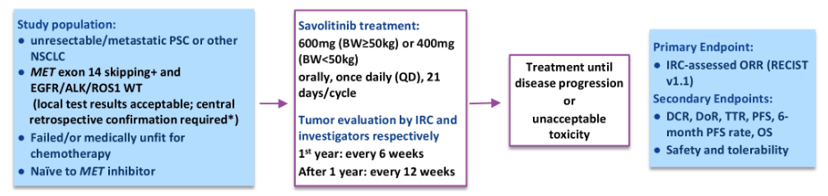
Savolitinib NCT02897479 study design
Lu et al, ASCO 2020

Slide 19
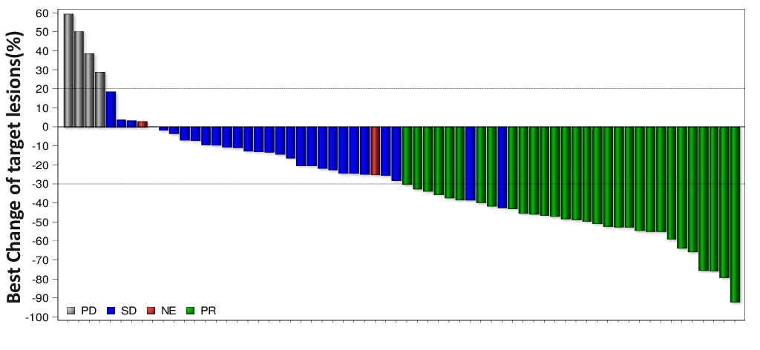
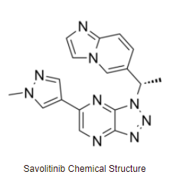
Savolitinib activity in METex14
ORR 43%
mPFS 6.9 mo

Slide 20
Type I MET TKIs in MET exon 14 skipping
 | Crizotinib n = 69 | Capmatinib n = 28 n = 69 |  | Tepotinib n = 69 n = 83 |  | Savolitinib n = 28 n = 42
 | Overall | 1L | Previously treated | 1L | Previously treated | 1L | Previously treated
Median Age | 72 | 71 | 71 | 74 | 73 | 69
RR | 32% | 68% | 41% | 45% | 45% | 46% | 41%
Median DOR (95% CI) | 9.1 mo | 12.6 mo (5.6, n.e.) | 9.7 mo (5.6, 13.0) | 10.8 mo (6.9, ne) | 11.1 mo (9.5, 18.5) | 6.8 mo (3.8, ne) | n.e. (6.9, n.e.)
Median PFS (95% CI) | 7.3 mo | 12.4 mo (8.2, n.e.) | 5.4 mo (4.2, 7.0) | 8.5 mo (6.8, 11.3) | 10.9 mo (8.2, 12.7) | 5.6 mo (2.8, 9.7) | 13.8 (4.1, ne)

Slide 21
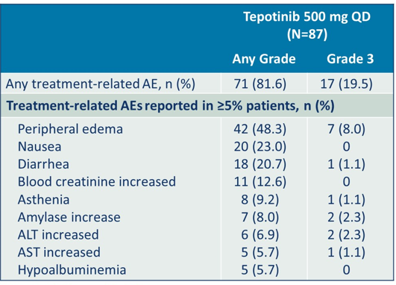
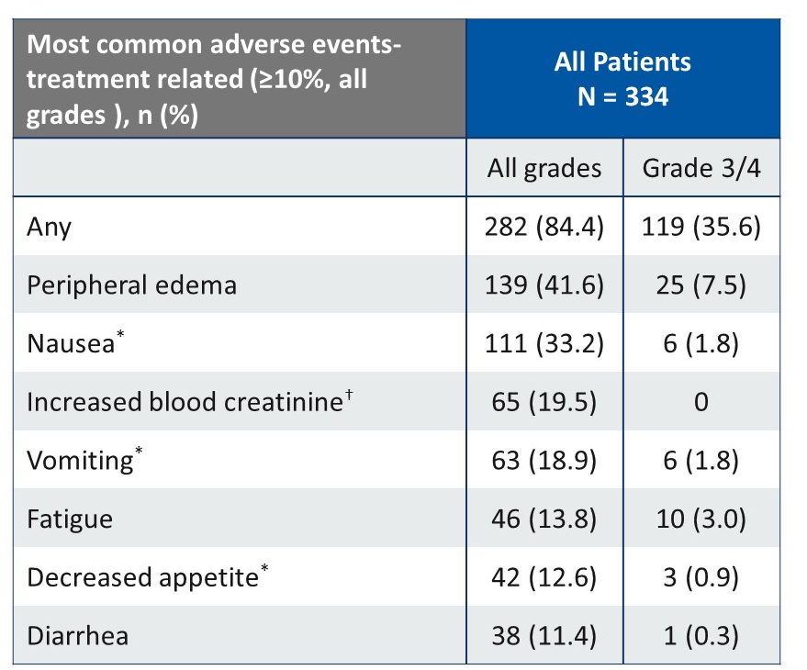
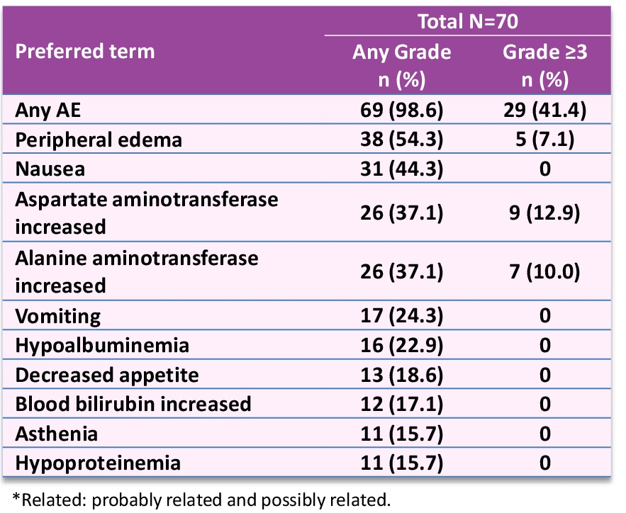
AE profiles of Type Ib MET TKIs
Tepotinib
Capmatinib
Savolitinib

Slide 22
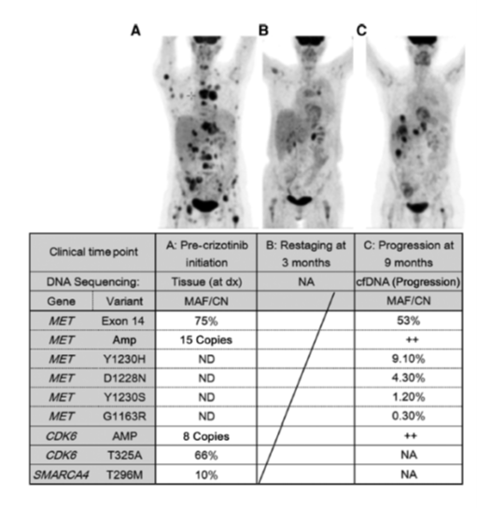
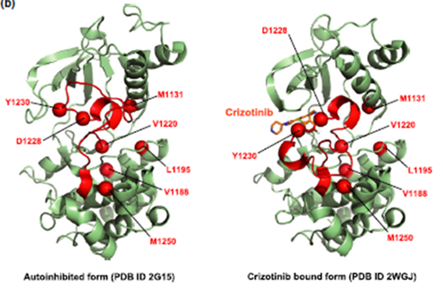
Resistance Mechanisms in METex14
Schrock et al, JTO 2017; Lu et al, Cancer Res 2017; Heist et al, JTO 2016; Ou et al, JTO 2016; Gherardi et al Nature Reviews 2012

Slide 23
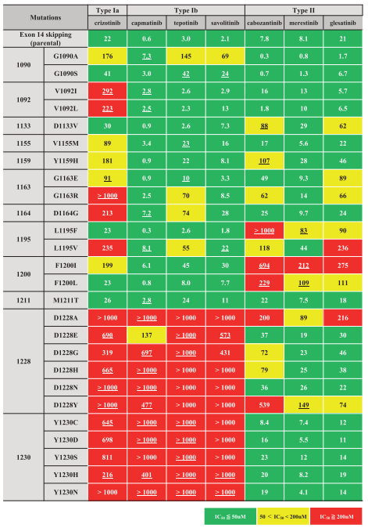
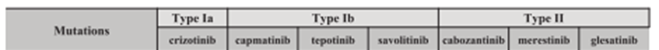
In vitro activity of MET TKIs to secondary mutations
Fujino et al JTO 2019

Slide 24
Resistance Mechanisms in METex14
Bahcall et al, CCR 2018; Recondo et al, CCR 2020

Slide 25
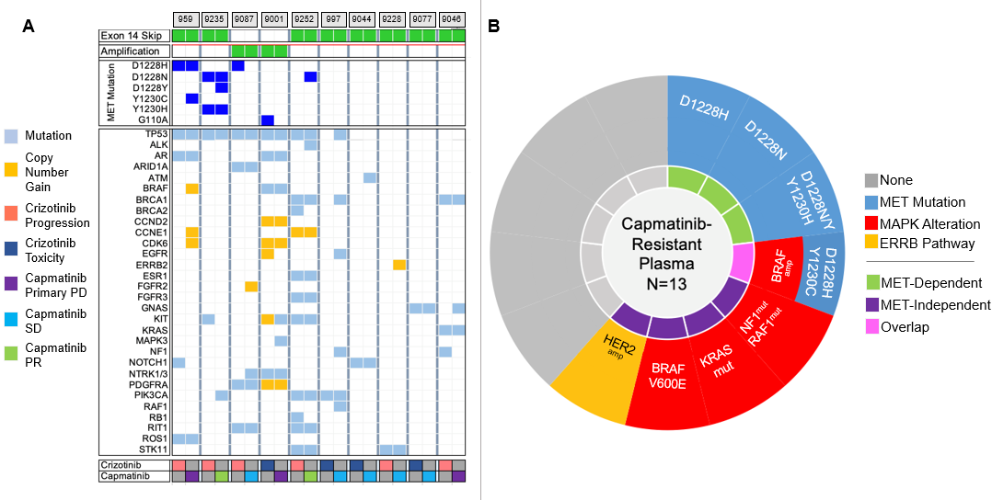
Pre- and post-capmatinib plasma specimens
Dagogo-Jack et al, JTO 2021

Slide 26
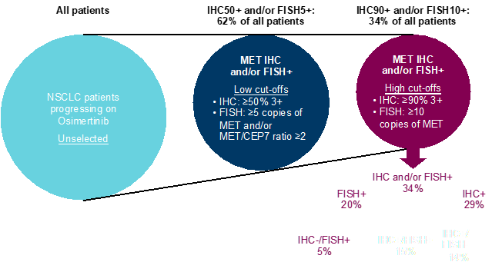
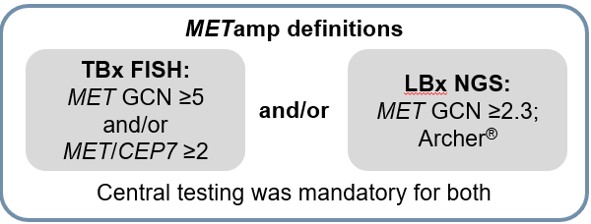
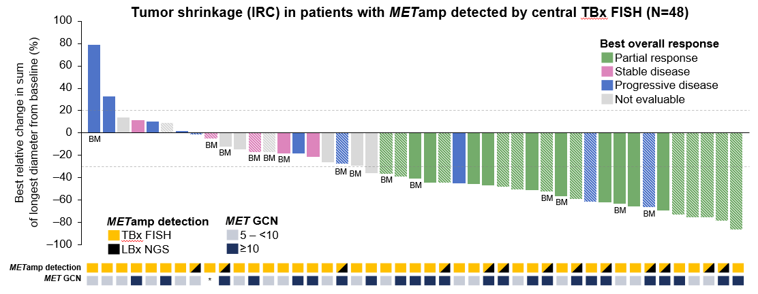
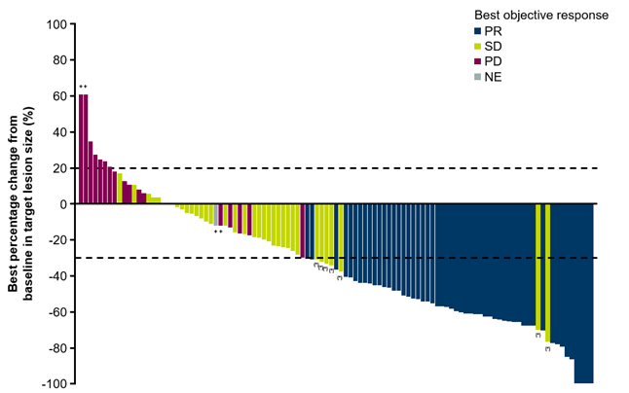
MET inhibitors in acquired resistance (e.g. EGFR)
INSIGHT 2
Osimertinib + Tepotinib
SAVANNAH
Osimertinib + Savolitinib
Mazieres et al ESMO 2022; Ahn et al WCLC 2022

Slide 27
Selected clinical trials of type I MET inhibitors
NCT | Drug | Setting
CNS metastases
NCT04739358 | Tepotinib | CNS mets
NCT05567055 | Capmatinib | CNS mets
EGFR combinations
NCT03940703 | Tepotinib + Osimertinib (INSIGHT) | EGFR acquired resistance
NCT01982955 | Tepotinib + Gefitinib (INSIGHT 2) | EGFR acquired resistance
NCT01911507 | Capmatinib + Erlotinib | EGFR acquired resistance
NCT01610336 | Capmatinib + Gefitinib | EGFR acquired resistance
NCT05261399 | Savolitinib + Osimertinib v platinum doublet chemotherapy (SAFFRON) | EGFR acquired resistance
NCT03778229 | Savolitinib + Osimertinib (SAVANNAH) | EGFR acquired resistance
Other
NCT05488314 | Capmatinib + amivantamab | METex14 and MET amp
NCT04926831 | Capmatinib | Neoadjuvant and adjuvant

Slide 28
Antibody and Antibody Drug Conjugates
NCT03859752 | TR1801 | MET ADC | I | NCT03859752
NCT03539536 | ABBV399 | MET ADC | II | NCT03539536
NCT04077099 | REGN5093 | MET bispecific Ab | I / II | NCT04077099
NCT04077463 | JNJ-61186372 | EGFR MET bispecific Ab | I | NCT04077463
NCT04169178 | HXL55 | MET Ab | I | NCT04169178
NCT02648724 | Sym015 | MET Ab | I / II | NCT02648724
Clinicaltrials.gov

Slide 29
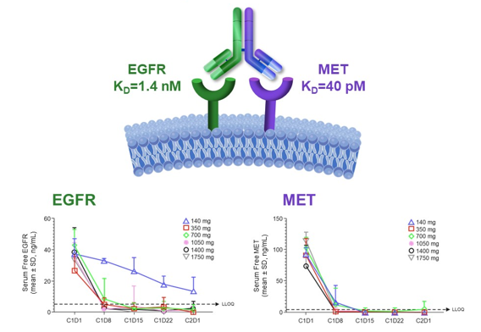
Amivantamab (JNJ-61186372): EGFR-MET bispecific antibody
Krebs et al, ASCO 2022

Slide 30
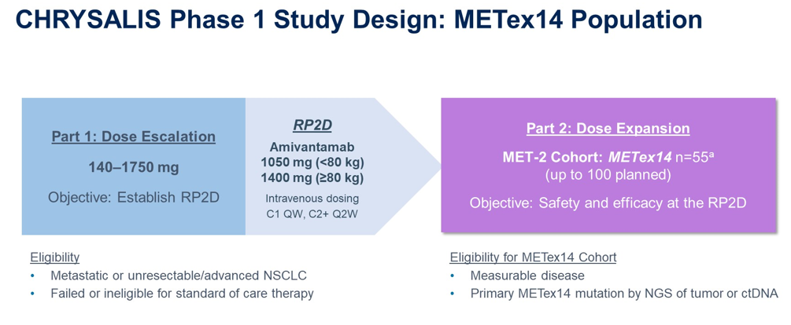
Amivantamab CHRYSALIS study design: METex14 cohort
Krebs et al, ASCO 2022

Slide 31
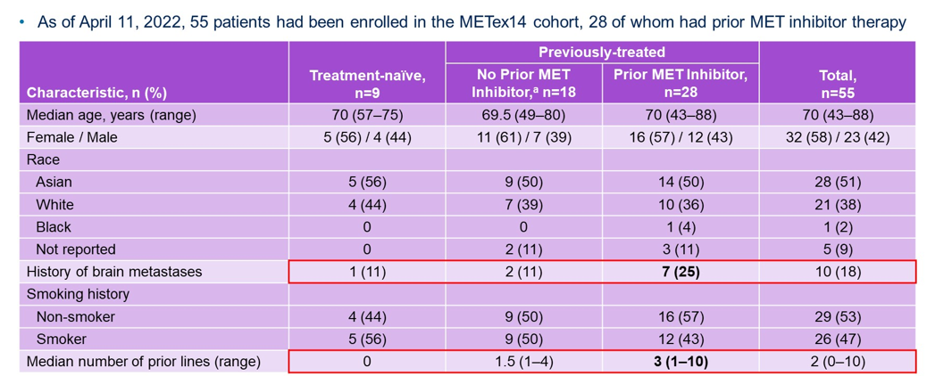
Amivantamab CHRYSALIS: METex14 population
Krebs et al, ASCO 2022

Slide 32
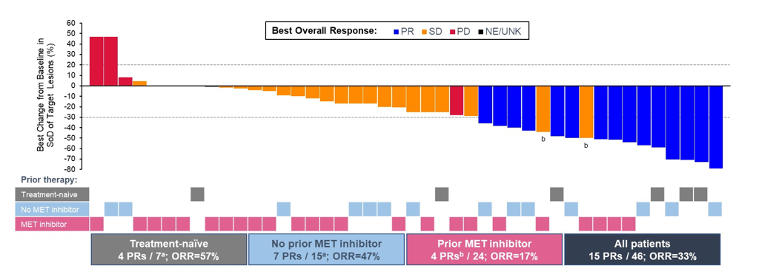
Amivantamab activity in METex14
Krebs et al, ASCO 2022

Slide 33
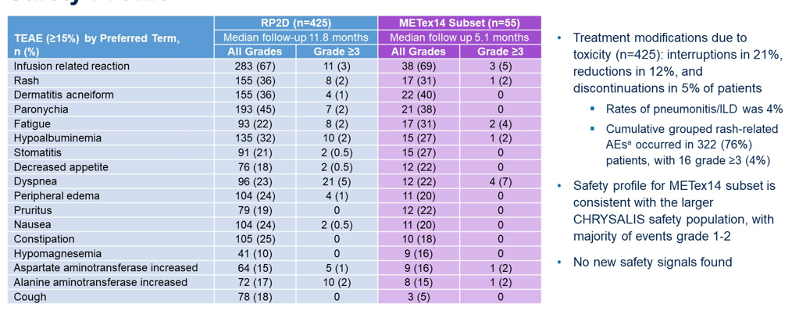
Amivantamab AEs
Krebs et al, ASCO 2022

Slide 34
Case 1
66 yo woman, neversmoker, presented with cough, chest pressure, and SOB
CTs showed lung mass with hilar, mediastinal, supraclavicular LAN
Found to have pericardial effusion with tamponade physiology
Pericardiocentesis performed; cytology confirmed adenocarcinoma
NGS revealed MET exon 14 skipping
Once discharged from hospitalization and medically stable, started on capmatinib on clinical trial

Slide 35
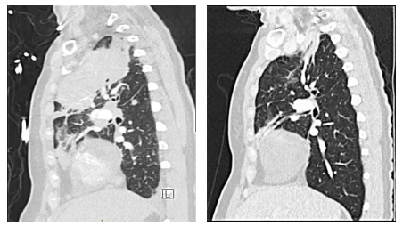
Case 1 cont’d
PR on first evaluation
Ongoing PR, currently 4+ years
Major AE: Grade 1-2 peripheral edema, managed with compression stockings

Slide 36
Case 2
77 yo woman who presented with a persistent cough. Was treated with antibiotics but cough persisted. Ultimately had chest CT in January 2013 that showed bilateral lung nodules and L pleural effusion.
  Thoracentesis showed malignant adenocarcinoma, and molecular testing showed EGFR L858R
Started erlotinib with good response until 2015
  Rebiopsy showed EGFR L858R and T790M
Started clinical trial AZD9291 (osimertinib) on 2/9/15 with good response until 7/2016
  Rebiopsy showed EGFR L858R and MET amplification (MET:CEP7 ratio > 25:1)
Started clinical trial AZD9291 (osimertinib) + AZD6094 (savolitinib) on 8/31/2016 with response
  Response lasted approximately 1 year
Started clinical trial erlotinib + ABBV-399 with good response for approximately 9 months
Ultimately at time of progression, PS further declined and she declined further therapy

Slide 37
Summary
METex14 is targetable alteration
MET amplification as target is dependent on level of amplification
Resistance mechanisms encompass on-target and off-target mechanisms
Clinical options
  Capmatinib and Tepotinib are FDA approved for METex14 NSCLC
  Crizotinib, savolitinib other type I inhibitors also have shown activity
  Cabozantinib and other type II inhibitors
  MET Abs and ADCs in development
  Activity of amivantamab

