Slide 1
Oncology Today:
Localized Non-Small Cell Lung Cancer
Heather Wakelee, MD, FASCO
Professor of Medicine, Oncology
Chief, Division of Medical Oncology
Interim Medical Director, Stanford Cancer Center
Stanford University School of Medicine
Deputy Director, Stanford Cancer Institute
President, International Association for the Study of Lung Cancer (IASLC)

Slide 2
Neo-Adjuvant IO Therapy

Slide 3
Neoadjuvant Nivolumab + Chemotherapy
CheckMate 816
Key eligibility criteria
Newly diagnosed, resectable, stage IB (≥ 4 cm)–IIIA NSCLC
(per TNM 7th edition)
ECOG PS 0–1
No known sensitizing EGFR mutations or ALK alterations
Stratified by
stage (IB/II vs IIIA),
PD-L1^{b} (≥ 1% vs < 1%^{c}), and sex
NIVO 360 mg Q3W
+
chemo^{d} Q3W (3 cycles)
Surgery
(within 6 weeks
post-treatment)
Optional adjuvant
chemo ± RT
N = 358
Radiologic
restaging
R
1:1
Follow-up
Chemo^{e} Q3W (3 cycles)
Primary endpoints
pCR by BIPR
EFS by BICR
Key secondary endpoints
MPR by BIPR
OS
Time to death or distant metastases
Key exploratory endpoints included
ORR by BICR
Feasibility of surgery; peri- and
post-operative surgery-related AEs
63% Stage IIIA
50% PD-L1 >1%
Spicer ASCO 2021 abstr: 8503

Slide 4
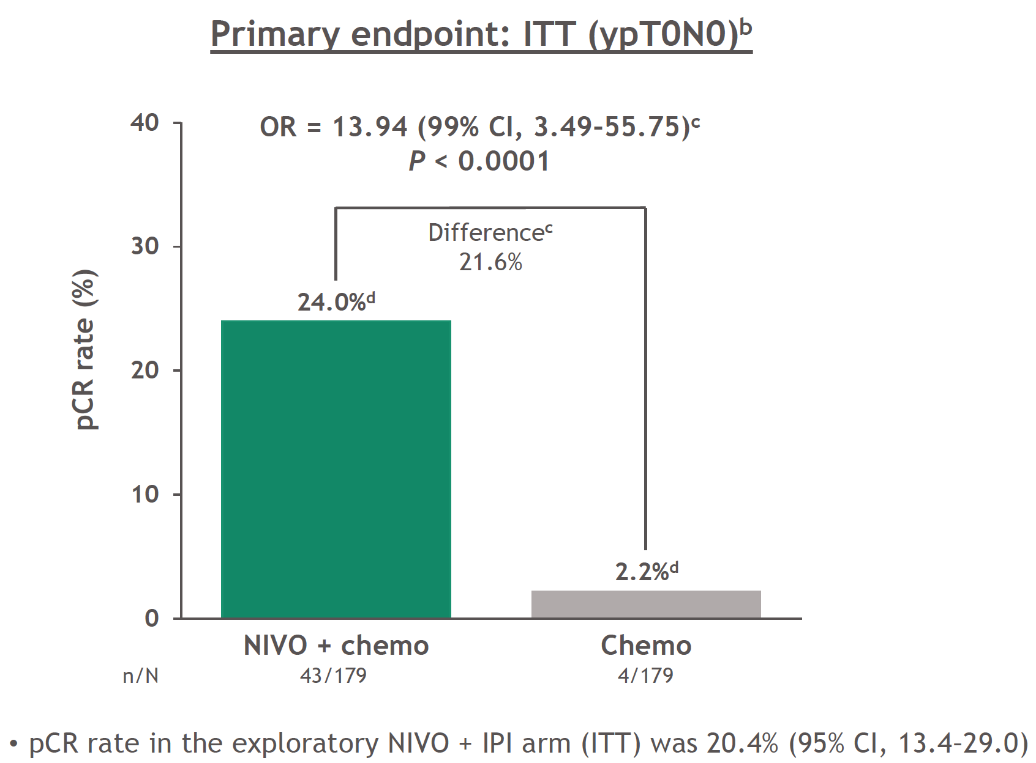
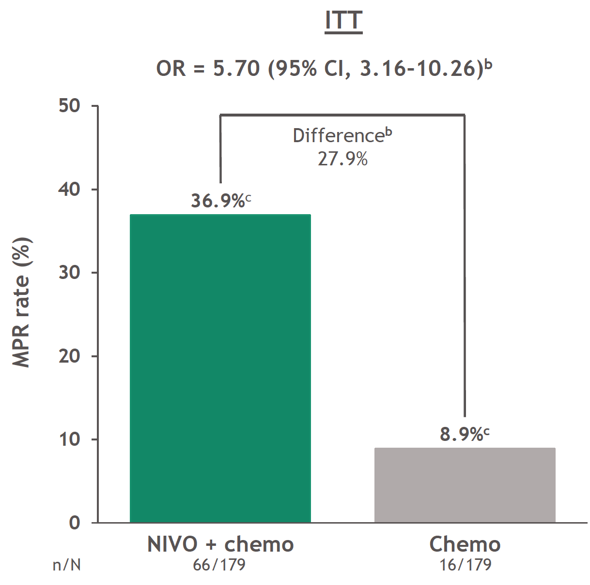
CM816 – pCR and MPR in ITT population
Forde CM816, AACR2021

Slide 5
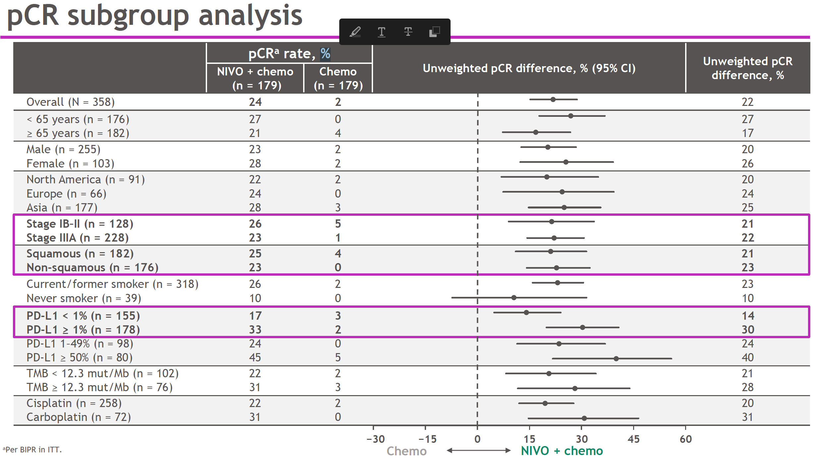
CM 816: PD-L1 and TMB data
Forde CM816 AACR 2021

Slide 6
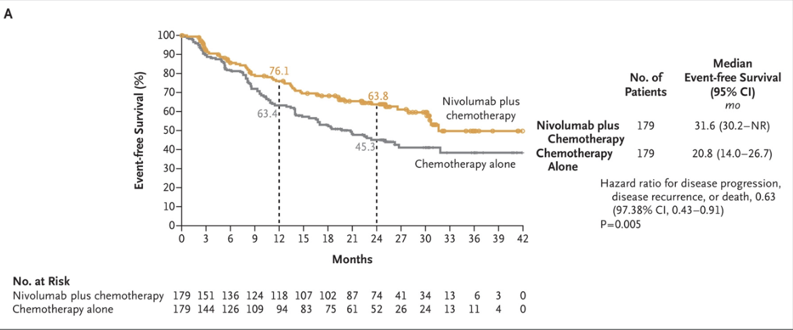
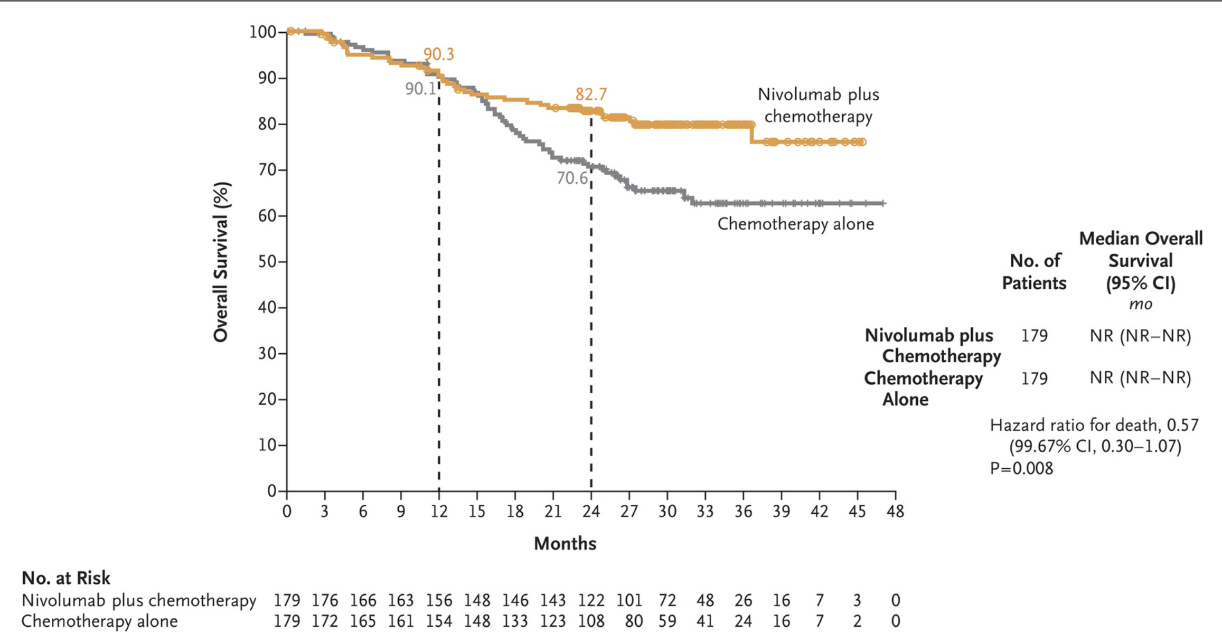
Neoadjuvant Nivolumab + Chemotherapy
CheckMate 816
EFS
OS
Forde NEJM 2022

Slide 7
Neoadjuvant Durvalumab + Chemotherapy
AEGEAN
Radiologic
restaging
Surgery
^{Durvalumab}
^{q 4 weeks}
^{X 12 cycles}
Key eligibility criteria
Newly diagnosed, resectable, stage IIA-IIIB NSCLC
ECOG PS 0–1
No known sensitizing EGFR mutations or ALK alterations
Durva 1500mg q 3 wk
+
chemo Q3W (4 cycles)
N =802
Radiologic
restaging
R
1:1
Placebo
+
Chemo Q3W (4 cycles)
Surgery
^{Placebo}
^{q 4 weeks}
^{X 12 cycles}
Primary endpoints
pCR
EFS
Key secondary endpoints
MPR
OS
Press Release 6/30/22
pCR significantly improved
MPR significantly improved
EFS remains blinded

Slide 8
Phase 3 Neo-Adjuvant PD-(L)1 IO trials
Drug | N | Stages | Description | Primary Endpoint
Nivo + platinum chemo (ipi/nivo closed) CM816 | 350 | Stage IB–IIIA, resectable NSCLC | Neo-adjuvant, no adjuvant | MPR / EFS
Atezo + platinum chemo Impower030 | 374 | Stage II–IIIB (T3N2), resectable NSCLC | Neo-adjuvant chemo-ICI, then adjuvant IO | MPR / RFS
Pembro + platinum chemo KN671 | 786 | Stage IIB–IIIA, resectable NSCLC | Neo-adjuvant chemo-ICI then adjuvant IO | RFS / OS
Durva + platinum chemo | 800 | Stage II–IIIA, resectable NSCLC | Neo-adjuvant chemo-ICI then adjuvant IO | pCR/EFS

Slide 9
Adjuvant IO Therapy

Slide 10
IMpower010: Phase III randomised trial of atezolizumab vs BSC in early-stage NSCLC
No crossover
Hierarchical statistical testing
of endpoints
Completely resected
stage IB-IIIAª NSCLC
Cisplatin + pemetrexed, gemcitabine, docetaxel or vinorelbine
1-4 cycles
N=1280
Atezolizumab
1200 mg q21d x 16 cycles or 1 year
DFS in PD-L1 TC ≥1%
stage II−IIIA population^{b}
Stage IB tumors ≥4 cm
ECOG 0-1
Lobectomy
Tumor tissue for
PD-L1 analysis
R 1:1
Survival
follow-up
If positive:
N = 1005
DFS in all-randomized
stage II−IIIA population^{b}
BSC
If positive:
DFS in ITT population (stage IB-IIIA)^{b}
Stratification factors
Sex | Stage | Histology | PD-L1 status
If positive:
OS in ITT population^{b}
Key exploratory endpoints
  OS biomarker analyses
Endpoint was met at DFS IA
Endpoint was not met at DFS IA and follow up is ongoing
Endpoint was not formally tested
Key secondary endpoints
  OS in ITT | Safety | Exploratory OS biomarker analyses
Clinical cutoff: 18 April 2022. Both arms included observation and regular scans for disease recurrence on the same schedule. ECOG, Eastern Cooperative Oncology Group, q21d, every 21 days.
ª Per UICC/AJCC staging system, 7th edition. ^{b} Two-sided α=0.05.
H. Wakelee ASCO 2021, abstr 8500:IMpower010 Interim Analysis; Felip Lancet 2021, Felip IASLC WCLC 2022

Slide 11
IMpower010: baseline characteristics
Characteristic | All patients (N=1005) | PD-L1 TC ≥1% (SP263) (stage II-IIIA) |  | All randomized (stage II-IIIA) |  | ITT (stage IB-IIIA)
 |  | Atezo (n=248) | BSC (n=228) | Atezo (n=442) | BSC (n=440) | Atezo (n=507) | BSC (n=498)
Median (range) age, | 62 (26-84) | 61 (34–82) | 62 (26–84) | 62 (33–82) | 62 (26–84) | 62 (33–83) | 62 (26–84)
Age ≥65 y, n (%) | 382 (38.0) | 92 (37.1) | 97 (42.5) | 161 (36.4) | 177 (40.2) | 184 (36.3) | 198 (39.8)
Sex, male, n (%) | 672 (66.9) | 171 (69.0) | 147 (64.5) | 295 (66.7) | 294 (66.8) | 337 (66.5) | 335 (67.3)
Race, n (%)
White | 738 (73.4) | 162 (65.3) | 166 (72.8) | 307 (69.5) | 324 (73.6) | 362 (71.4) | 376 (75.5)
Asian | 242 (24.1) | 78 (31.5) | 56 (24.6) | 121 (27.4) | 106 (24.1) | 130 (25.6) | 112 (22.5)
Other | 25 (2.5) | 8 (3.2) | 6 (2.6) | 14 (3.2) | 10 (2.3) | 15 (3.0) | 10 (2.0)
Histology, non-SQ | 659 (65.6) | 152 (61.3) | 143 (62.7) | 292 (66.1) | 296 (67.3) | 328 (64.7) | 331 (66.5)
Stage, n (%)
IB | 123 (12.2) | – | – | – | – | 65 (12.8) | 58 (11.6)
IIA | 295 (29.4) | 85 (34.3) | 76 (33.3) | 147 (33.3) | 148 (33.6) | 147 (29.0) | 148 (29.7)
IIB | 174 (17.3) | 46 (18.5) | 37 (16.2) | 90 (20.4) | 84 (19.1) | 90 (17.8) | 84 (16.9)
IIIA | 413 (41.1) | 117 (47.2) | 115 (50.4) | 205 (46.4) | 208 (47.3) | 205 (40.4) | 208 (41.8)
Tobacco use, n (%)
Never | 222 (22.1) | 51 (20.6) | 41 (18.0) | 100 (22.6) | 96 (21.8) | 114 (22.5) | 108 (21.7)
Current/previous | 783 (77.9) | 197 (79.4) | 187 (82.0) | 342 (77.4) | 344 (78.2) | 393 (77.5) | 390 (78.3)
PD-L1 by SP263, TC≥1%, n (%)ª | 535 (54.6) | 248 (100) | 228 (100) | 248 (57.8) | 228 (53.0) | 283 (57.4) | 252 (51.9)

Slide 12
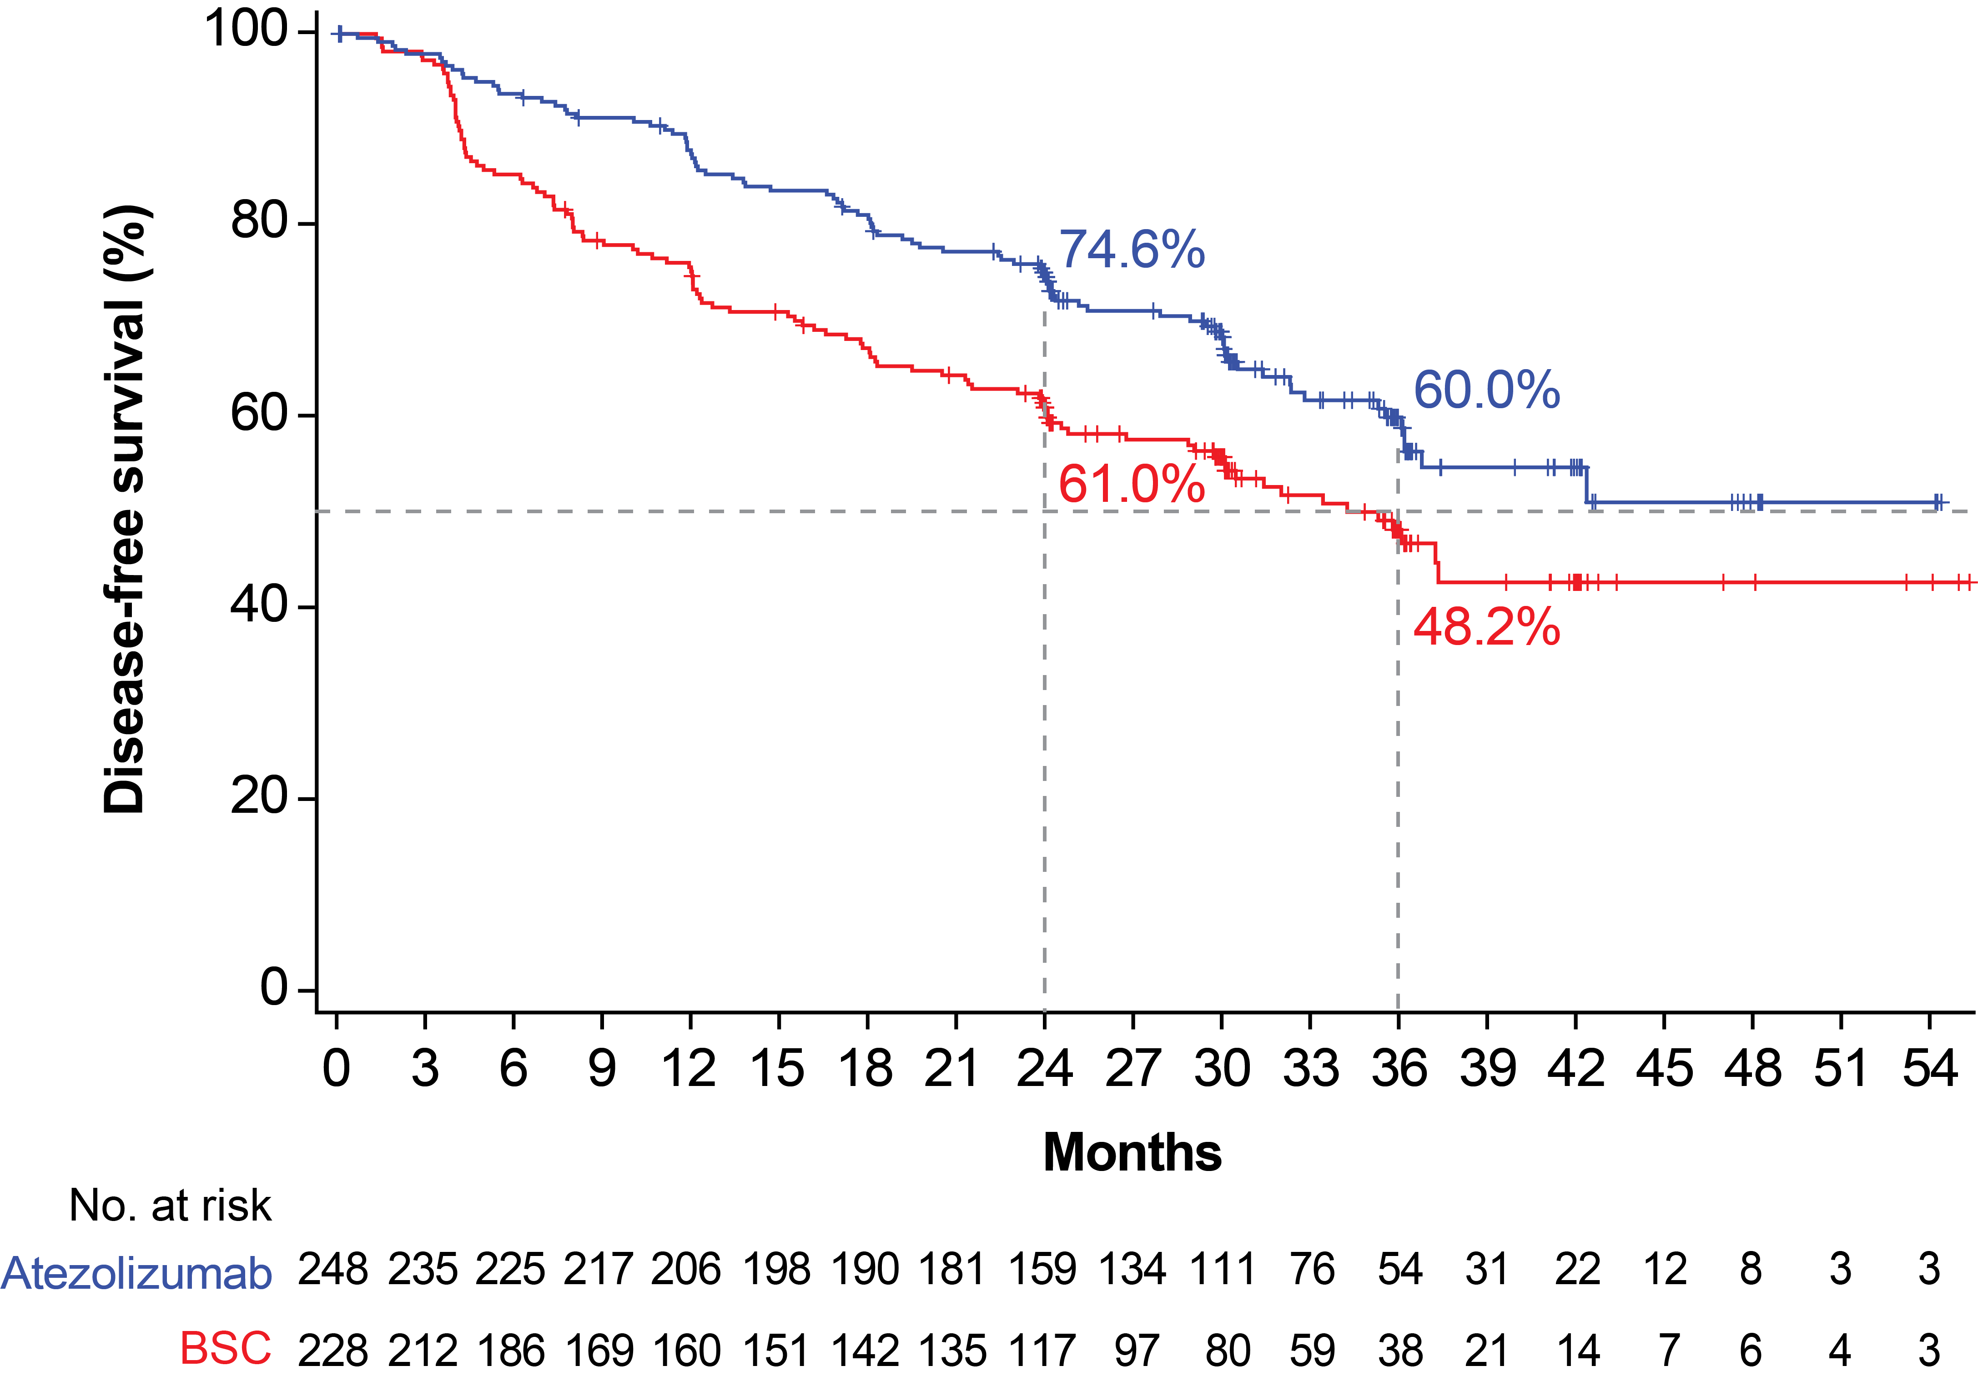
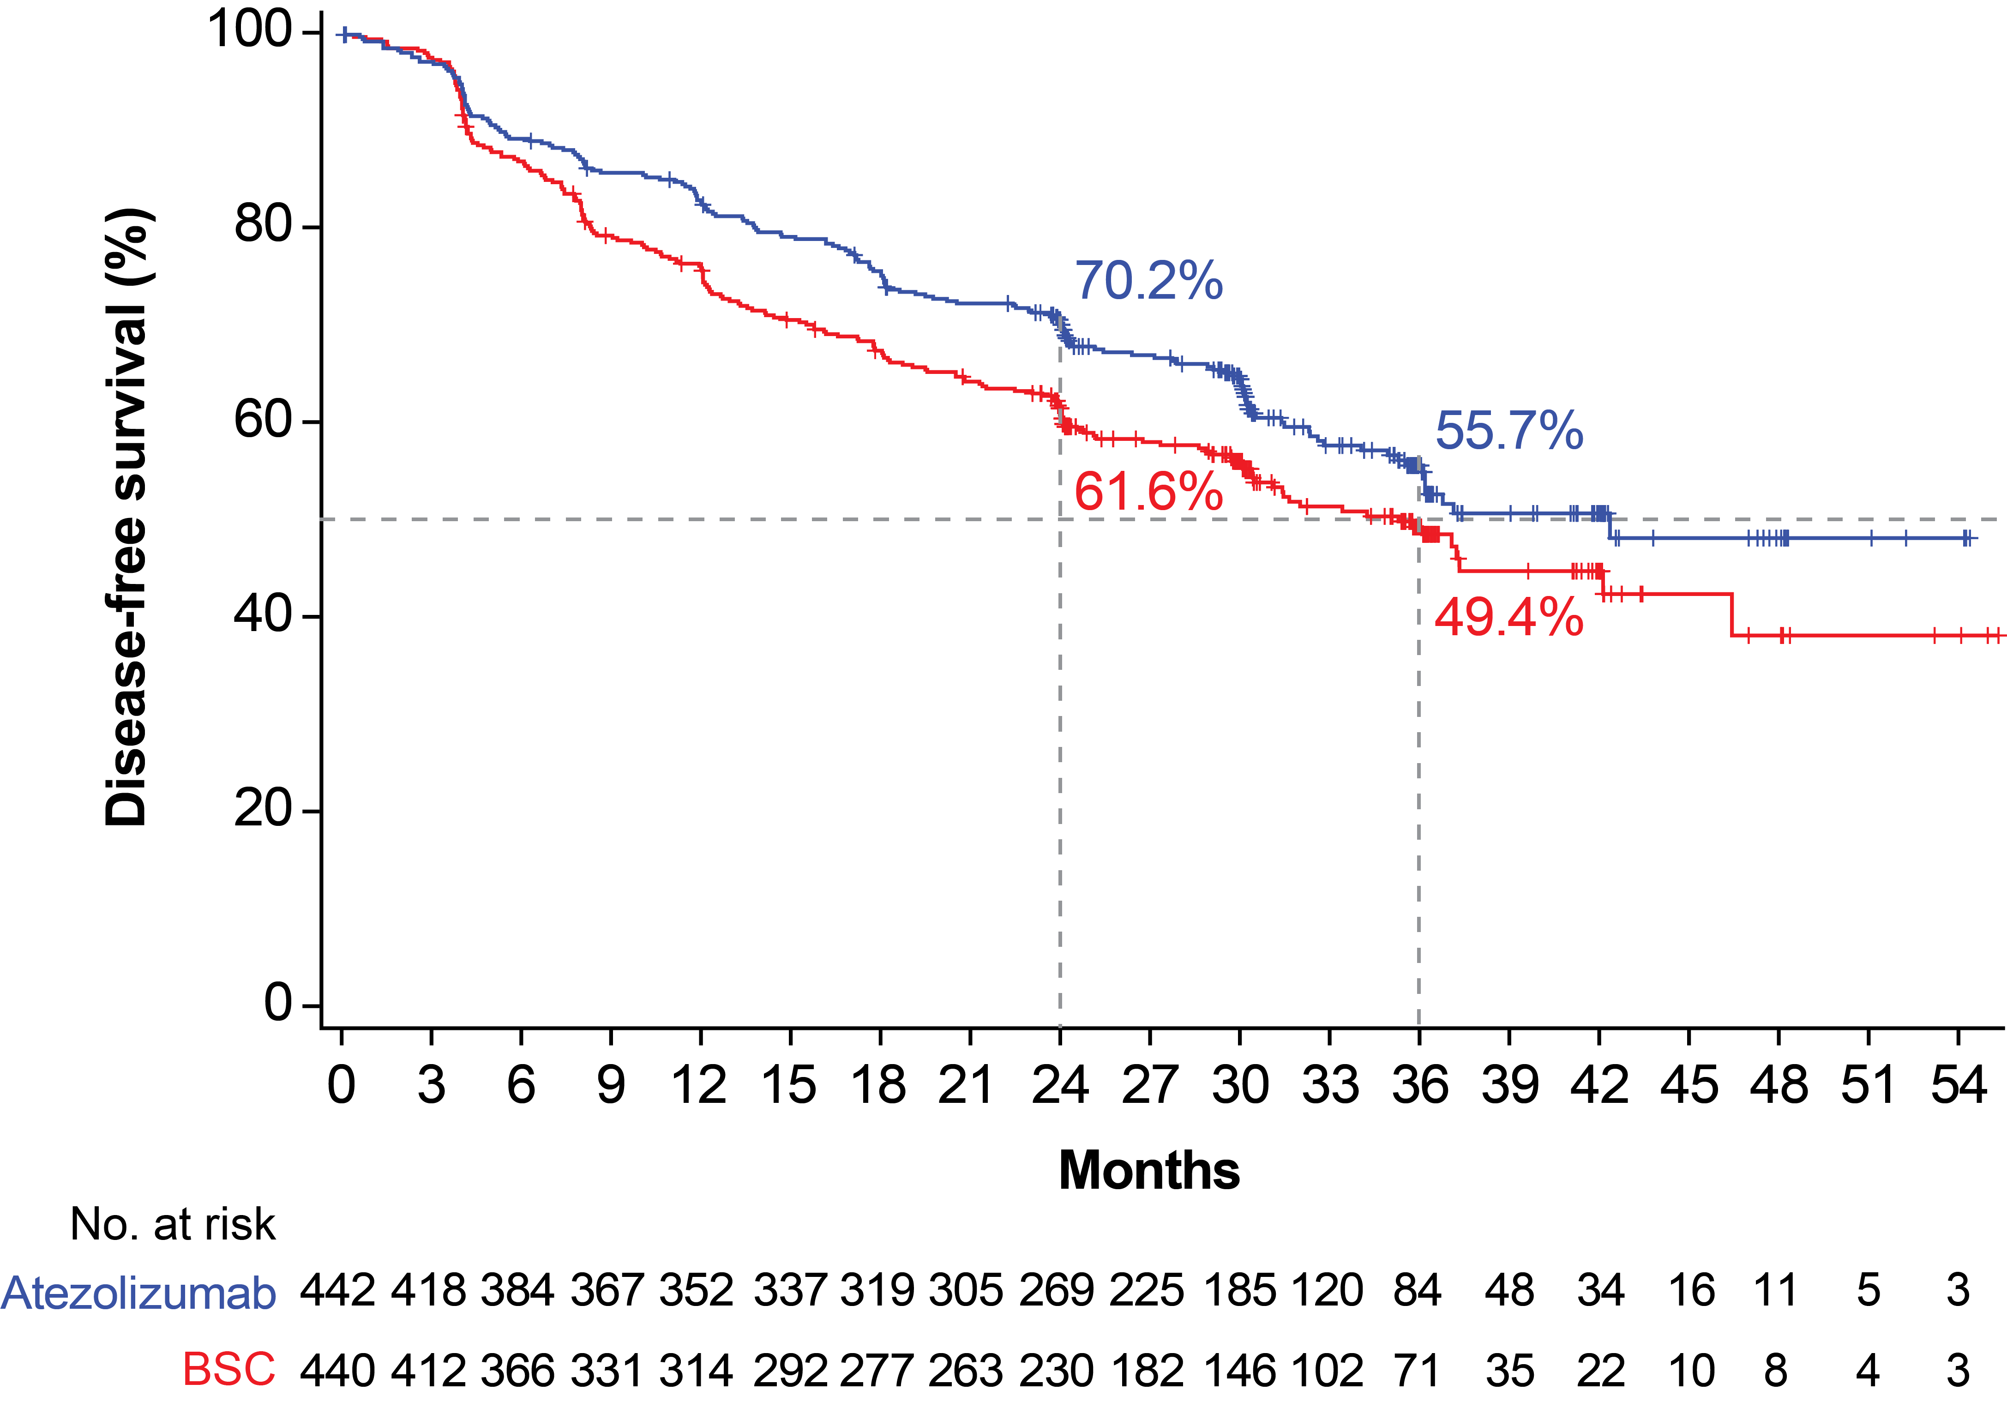
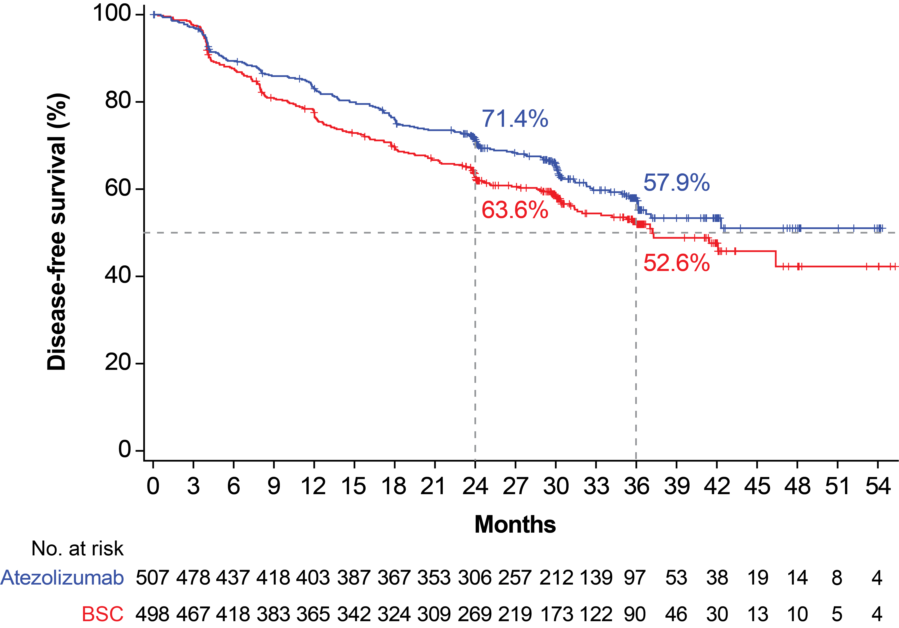
IMpower010: DFS in the PD-L1 TC ≥1%ª stage II-IIIA, all-randomized stage II-IIIA and ITT pop (primary endpoint)
US FDA approval Oct 15, 2021
PD-L1 TC ≥1%
stage II-IIIA population
All-randomized
stage II-IIIA population
ITT (randomized
stage IB-IIIA) population
Median follow-up:
32.8 mo (range, 0.1-57.5)
Median follow-up:
32.2 mo (range, 0-57.5)
Median follow-up:
32.2 mo (range, 0-58.8)
 | Atezolizumab (n=248) | BSC (n=228)
Median DFS (95% CI), mo | NE (36.1, NE) | 35.3 (29.0, NE)
Stratified HR (95% CI) | 0.66 (0.50, 0.88)
P value^{b} | 0.004^{c}
 | Atezolizumab (n=442) | BSC (n=440)
Median DFS (95% CI), mo | 42.3 (36.0, NE) | 35.3 (30.4, 46.4)
Stratified HR (95% CI) | 0.79 (0.64, 0.96)
P value^{b} | 0.02^{c}
 | Atezolizumab (n=507) | BSC (n=498)
Median DFS (95% CI), mo | NE (36.1, NE) | 37.2 (31.6, NE)
Stratified HR (95% CI) | 0.81 (0.67, 0.99)
P value^{b} | 0.04^{d}
Clinical cutoff: January 21, 2021. ª Per SP263 assay. ^{b} Stratified log-rank. ^{c} Crossed the significance boundary for DFS. ^{d} The statistical significance boundary for DFS was not crossed.
Wakelee ASCO 2021 abstr 8500; Felip Lancet 2021

Slide 13
IMpower010 DFS by PD-L1 statusª
All-randomised stage II-IIIA population (with and without known EGFR/ALK+ disease)
Subgroup (including EGFR/ALK+) | n |  | HR (95% CI)^{b,c}
PD-L1 status by SP263
TC <1% | 383 |  | 0.97 (0.72, 1.31)
TC ≥1% | 476 |  | 0.66 (0.50, 0.88)
TC 1-49% | 247 |  | 0.87 (0.60, 1.26)
TC ≥50% | 229 |  | 0.43 (0.27, 0.68)
All patients^{d} | 882 |  | 0.79 (0.64, 0.96)
Atezo best:
Stage IIIA
Non-Sq
Never-smoke
PD-L1>50%
HR
Atezolizumab better
BSC better
Felip ESMO2021

Slide 14
IMpower010: DFS in key subgroups of the
PD-L1 TC ≥1%ª stage II-IIIA population
Subgroup | N |  | HR (95% CI)^{b}
All patients | 476 |  | 0.66 (0.50, 0.88)
Age
<65 y | 287 |  | 0.67 (0.46, 0.96)
≥65 y | 189 |  | 0.64 (0.41, 1.01)
Sex
Male | 318 |  | 0.69 (0.48, 0.99)
Female | 158 |  | 0.61 (0.38, 0.97)
Race
White | 328 |  | 0.63 (0.45, 0.89)
Asian | 134 |  | 0.63 (0.37, 1.06)
ECOG PS
0 | 265 |  | 0.57 (0.40, 0.83)
1 | 209 |  | 0.79 (0.51, 1.23)
Tobacco use history
Never | 92 |  | 0.63 (0.37, 1.10)
Previous | 309 |  | 0.54 (0.37, 0.78)
Current | 75 |  | 1.24 (0.58, 2.64)
Histology
Squamous | 181 |  | 0.78 (0.47, 1.29)
Non-squamous | 295 |  | 0.60 (0.42, 0.84)
Subgroup | N |  | HR (95% CI)^{b}
All patients | 476 |  | 0.66 (0.50, 0.88)
Stage
IIA | 161 |  | 0.73 (0.43, 1.24)
IIB | 83 |  | 0.77 (0.35, 1.69)
IIIA | 232 |  | 0.62 (0.42, 0.90)
Regional LNstage (pN)
N0 | 106 |  | 0.88 (0.45, 1.74)
N1 | 194 |  | 0.59 (0.36, 0.97)
N2 | 176 |  | 0.66 (0.44, 0.99)
EGFR mutation status
Yes | 43 |  | 0.57 (0.26, 1.24)
No | 248 |  | 0.67 (0.45, 1.00)
Unknown^{c} | 185 |  | 0.61 (0.38, 0.98)
ALK rearrangement status
Yes | 23 |  | 1.05 (0.32, 3.45)
No | 254 |  | 0.64 (0.44, 0.93)
Unknown^{c} | 199 |  | 0.62 (0.39, 1.00)
HR
Atezolizumab better
HR
BSC better
Atezolizumab better
BSC better
Clinical cutoff: January 21, 2021. ª Per SP263 assay. ^{b} Stratified for all patients; unstratified for all other subgroups.
^{c} 89.2% and 80.7% of patients in the ITT population with unknown EGFR or ALK status, respectively, had squamous NSCLC and were not required to undergo local or central testing.
Dr. Heather A. Wakelee ASCO 2021, abstr 8500:IMpower010 Interim Analysis; https://bit.ly/33t6JJ; Felip Lancet 2021

Slide 15
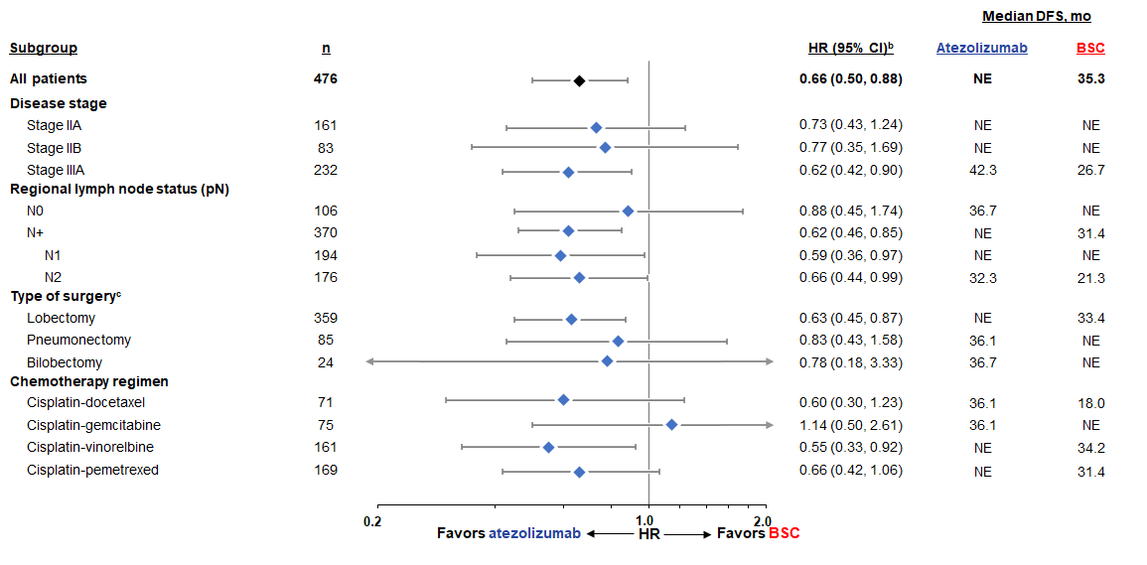
IMpower010: PD-L1 TC ≥1%ª stage II-IIIA population:
DFS by disease and treatment characteristics
Clinical cutoff: January 21, 2021. ª Per SP263 assay.
^{b} Stratified for all patients; unstratified for all other subgroups.
^{c} Subgroups with ≤10 patients are not shown.
Atezo best:
Stage IIIA
Non-Sq
Prev smoking history
PD-L1>50%
Altorki et al. IMpower010 Prior Therapies
https://bit.ly/36gV0j6
Altorki WCLC 2021

Slide 16
Recap of DFS and OS data from the DFS IA^{1,2}
(data cutoff: 21 Jan ‘21, median follow-up: 32 months)
DFS: PD-L1 TC ≥1%
stage II-IIIA population
DFS: All-randomised
stage II-IIIA population
DFS: ITT (randomised
stage IB-IIIA) population
DFS HR (95% CI)ª: 0.66 (0.50, 0.88)
P=0.0039^{b}
DFS HR (95% CI)ª: 0.79 (0.64, 0.96)
P=0.0205^{b}
DFS HR (95% CI)ª: 0.81 (0.67, 0.99)
P=0.0395^{c}
OS data not mature (event to patient ratio in ITT was 19% in atezolizumab arm, 18% in BSC arm)
PD-L1 TC ≥1% stage II-IIIA population: OS HR, 0.77 (95% CI: 0.51, 1.17)ª
    All-randomised stage II-IIIA population: OS HR, 0.99 (95% CI: 0.73, 1.33)ª
    ITT (randomised stage IB-IIIA) population: OS HR, 1.07 (95% CI: 0.80, 1.42)ª
Clinical cutoff: 21 Jan 2021. ª Stratified. ^{b} Statistical significance boundary for DFS crossed. ^{c} Statistical significance boundary for DFS not crossed.
1. Felip, E et al Lancet 2021; 938; 1344-1357; 2. Wakelee. HA et al ASCO 2021; abs #8500., Felip IASLC WCLC 2022 Presidential Plenary

Slide 17
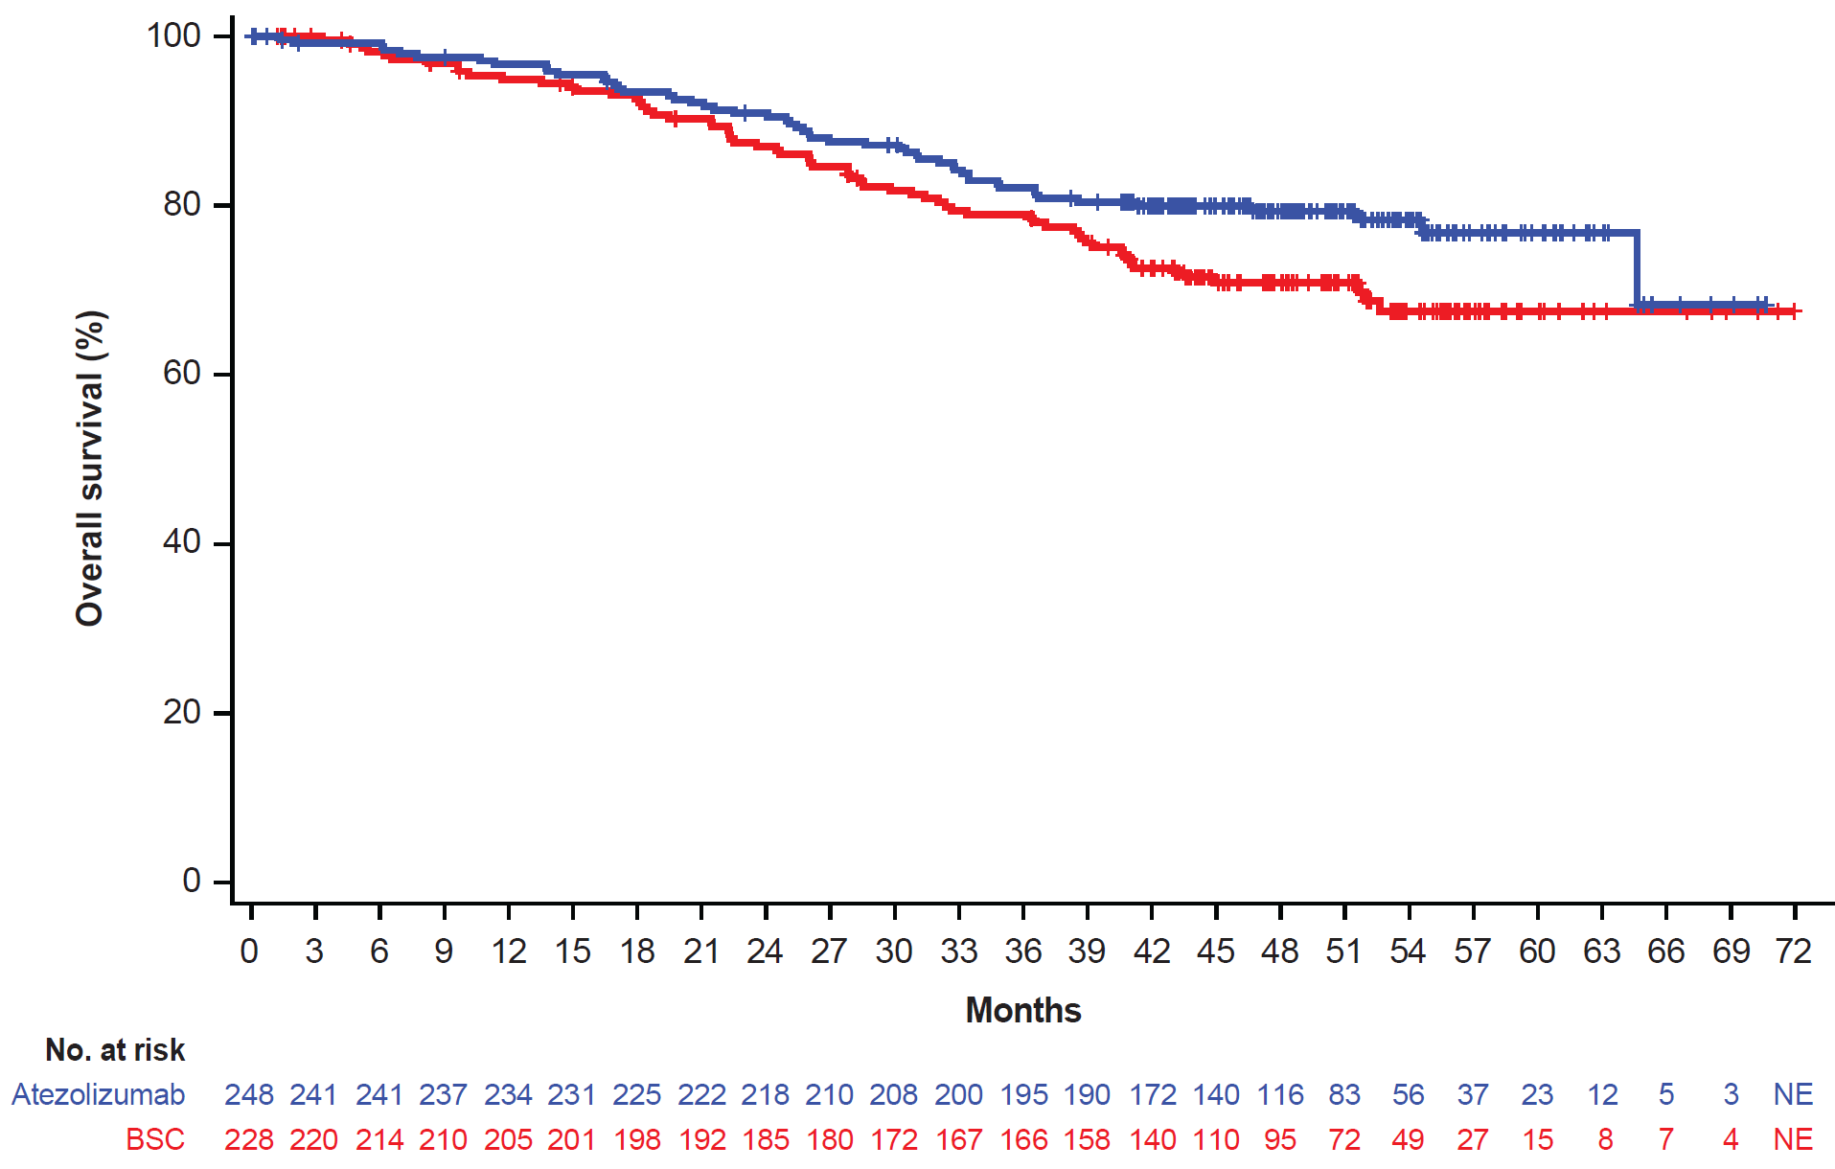
IMpower010: Results of OS IA(data cut 4/18/22: 46 mo med f/up)
PD-L1 TC ≥1%ª (stage II-IIIA)
82.1%
76.8%
78.9%
67.5%
 | Atezo (n=248) | BSC (n=228)
Events, n (%) | 52 (21.0%) | 64 (28.1%)
mOS (95% CI), mo | NR | NR
HR (95% CI)^{b} | 0.71 (0.49, 1.03)
Felip IASLC WCLC 2022 Presidential Plenary

Slide 18
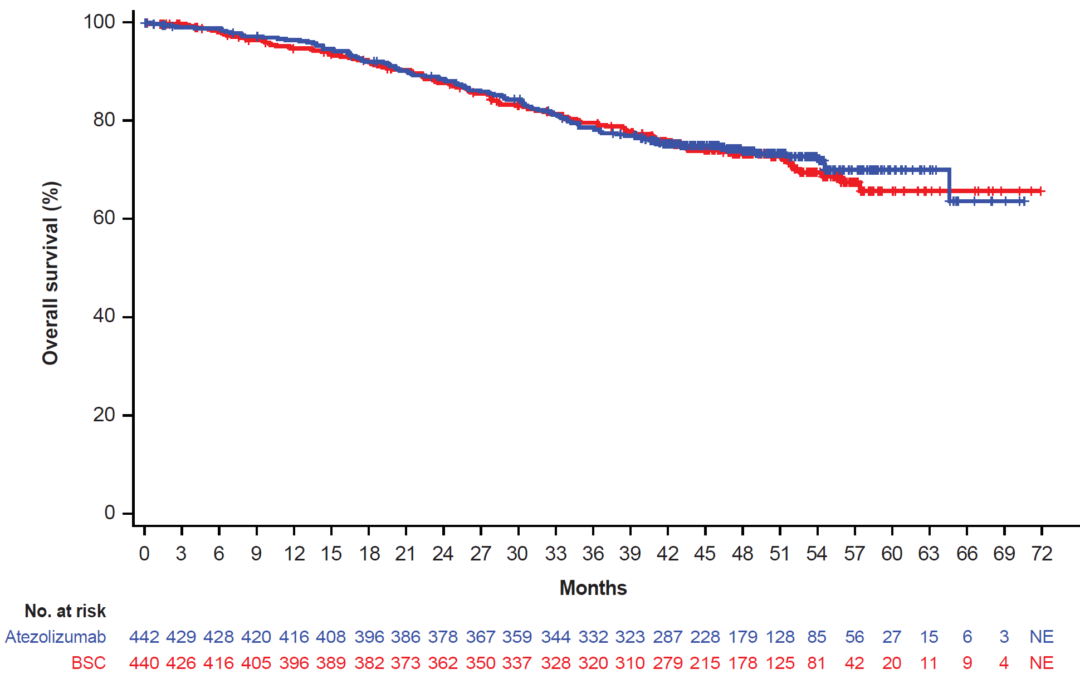
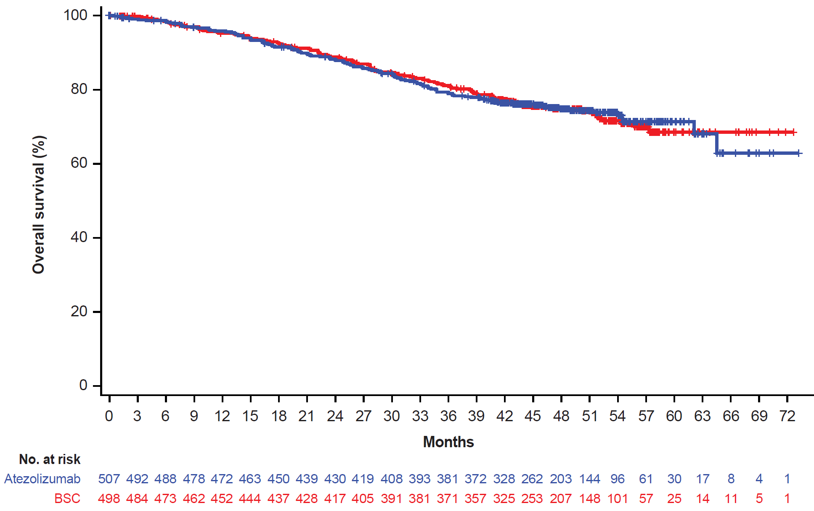
IMpower010: Results of OS IA (data cut 4/18/22: 46 mo med f/up)
Other primary populations
All randomised
(stage II-IIIA)
ITT
(randomised stage IB-IIIA)
 | Atezo (n=442) | BSC (n=440)
Events, n (%) | 115 (26.0%) | 116 (26.4%)
mOS (95% CI), mo | NR | NR
HR (95% CI)ª | 0.95 (0.74, 1.24)
 | Atezo (n=507) | BSC (n=498)
Events, n (%) | 127 (25.0%) | 124 (24.9%)
mOS (95% CI), mo | NR | NR
HR (95% CI)ª | 0.995 (0.78, 1.28)
P value^{b} | 0.9661^{c}
Clinical cutoff: 18 April 2022.ª Stratified.^{. b} No formal testing until statistical significance observed for DFS in the ITT population due to the prespecified testing hierarchy.
^{c} Descriptive purposes only.
Felip IASLC WCLC 2022 Presidential Plenary

Slide 19
Subgroup analysis of OS in PD-L1 TC ≥1%ª (stage II-IIIA)
(data cutoff: 18 Apr ‘22, median follow-up: 46 months)
Atezolizumab better
BSC better
Atezolizumab better
BSC better
Subgroup | N |  | HR (95% CI)
All patients^{b} | 476 |  | 0.71 (0.49, 1.03)
Age
<65 years | 287 |  | 0.65 (0.40, 1.07)
≥65 years | 189 |  | 0.78 (0.45, 1.35)
Sex
Male | 318 |  | 0.67 (0.43, 1.04)
Female | 158 |  | 0.73 (0.38, 1.40)
Race
White | 328 |  | 0.72 (0.48, 1.09)
Asian | 134 |  | 0.66 (0.27, 1.58)
ECOG PS
0 | 265 |  | 0.51 (0.30, 0.87)
1 | 209 |  | 0.96 (0.58, 1.59)
Tobacco use history
Never | 91 |  | 0.69 (0.29, 1.61)
Previous | 310 |  | 0.64 (0.40, 1.02)
Current | 75 |  | 1.01 (0.45, 2.25)
Histology
Squamous | 181 |  | 0.85 (0.48, 1.50)
Non-squamous | 295 |  | 0.61 (0.38, 0.99)
Stage
IIA | 161 |  | 0.75 (0.38, 1.51)
IIB | 83 |  | 0.64 (0.23, 1.77)
IIIA | 232 |  | 0.71 (0.44, 1.15)
HR
HR
Subgroup | N |  | HR (95% CI)
All patients^{b} | 476 |  | 0.71 (0.49, 1.03)
Regional lymph node stage (pN)
N0 | 106 |  | 0.70 (0.28, 1.72)
N1 | 194 |  | 0.57 (0.30, 1.08)
N2 | 176 |  | 0.84 (0.50, 1.40)
Type of surgery
Lobectomy | 358 |  | 0.63 (0.40, 0.99)
Bilobectomy | 24 |  | 0.29 (0.05, 1.74)
Pneumonectomy | 85 |  | 1.02 (0.52, 1.97)
Chemotherapy regimen
Cisplatin + docetaxel | 71 |  | 0.47 (0.21, 1.04)
Cisplatin + gemcitabine | 75 |  | 1.08 (0.43, 2.70)
Cisplatin + pemetrexed | 169 |  | 0.88 (0.45, 1.72)
Cisplatin + vinorelbine | 161 |  | 0.55 (0.28, 1.10)
EGFR mutation status
Yes | 43 |  | 0.77 (0.22, 2.67)
No | 248 |  | 0.71 (0.42, 1.21)
Unknown | 185 |  | 0.65 (0.37, 1.13)
ALK rearrangement status
Yes | 23 |  | 1.87 (0.17, 20.65)
No | 254 |  | 0.66 (0.40, 1.09)
Unknown^{c} | 199 |  | 0.71 (0.41, 1.24)
Clinical cutoff: 18 April 2022 (event to patient ratio, 25% [ITT]). ªBy SP263 assay. ^{b} Stratified.
Felip IASLC WCLC 2022 Presidential Plenary

Slide 20
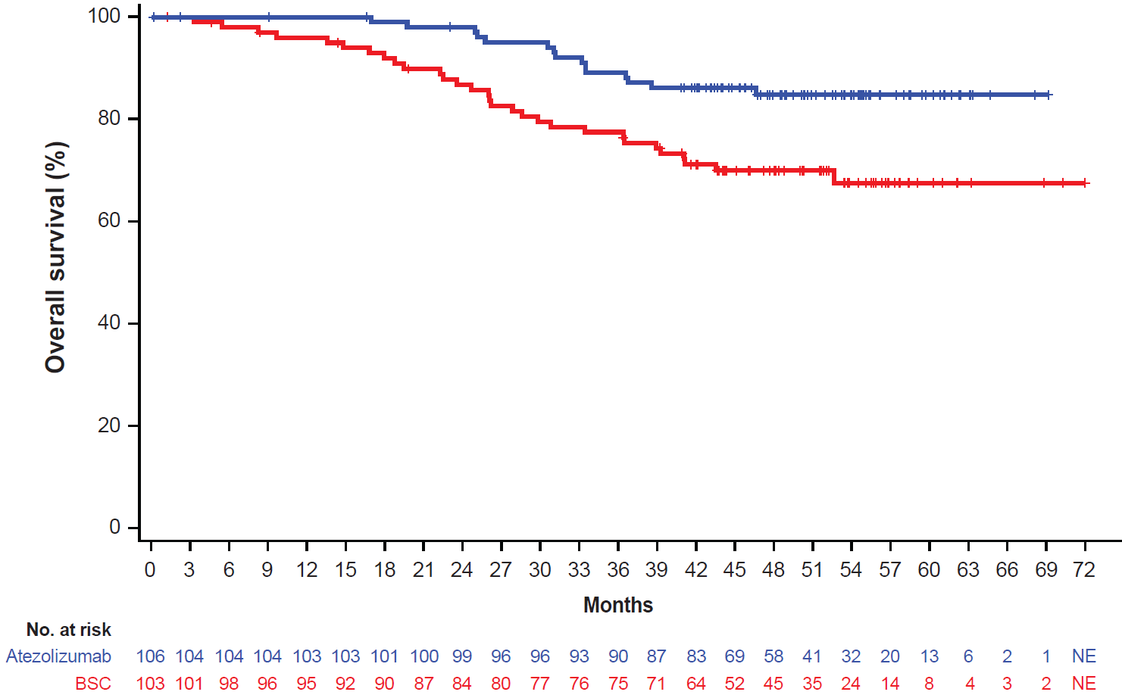
OS by Biomarkers (stage II-IIIA)
(data cutoff: 18 Apr ’22, 46 mo follow-up)
OS: PD-L1 TC ≥50% (stage II-IIIA)
excluding EGFR/ALK+
Atezo better
BSC better
HR
Subgroup (including EGFR/ALK+) | n |  | HR (95% CI)^{b}
PD-L1 status by SP263ª
TC ≥1% | 476 |  | 0.71 (0.49, 1.03)
TC ≥50% | 229 |  | 0.43 (0.24, 0.78)
TC 1-49% | 247 |  | 0.95 (0.59, 1.54)
TC <1% | 383 |  | 1.36 (0.93, 1.99)
 | Atezo (n=106) | BSC (n=103)
Events, n (%) | 15 (14.2%) | 30 (29.1%)
mOS (95% CI), mo | NR | NR
HR (95% CI)^{d} | 0.42 (0.23, 0.78)
Subgroup (excluding EGFR/ALK+) | n |  | HR (95% CI)^{d}
PD-L1 status by SP263^{c}
TC ≥1% | 410 |  | 0.67 (0.45, 0.98)
TC ≥50% | 209 |  | 0.42 (0.23, 0.78)
TC 1-49% | 201 |  | 0.93 (0.56, 1.56)
TC <1% | 312 |  | 1.21 (0.80, 1.85)
20
Felip IASLC WCLC 2022 Presidential Plenary

Slide 21
Safety summary
(data cutoff: 18 Apr ‘22)
Overall safety profile was consistent with previous analysis; no new safety signals were seen
 | IMpower010 DFS IA (21 Jan ‘21) | IMpower010 OS IA (18 Apr ‘22)
 | Atezo (n=495) | Atezo (n=495) | BSC (n=508)
All-grade AE | 92.7% | 92.5% | 70.9%
Treatment-related AE | 67.7% | 67.9% | 0%
Grade 3-4 AE | 21.8% | 22.0% | 11.5%
Treatment-related Grade 3-4 AE | 10.7% | 10.7% | 0%
Serious Adverse Event | 17.6% | 17.8% | 8.5%
Treatment-related SAE | 7.5% | 7.5% | 0%
Grade 5 AE | 1.6% | 1.8%ª | 0.6%
Treatment-related Grade 5 AE | 0.8% | 0.8% | 0%
AE leading to dose interruption of atezolizumab | 28.7% | 28.7% | 0%
AE leading to any treatment withdrawal | 18.2% | 18.2% | 0%
All-grade Atezo AESI^{b} | 51.7% | 52.1% | 9.5%
Grade 3-4 Atezo AESI | 7.9% | 7.9% | 0.6%
All-grade atezo AESI requiring use of corticosteroids | 12.1% | 12.3% | 0.8%
AESI, AE of special interest; SAE, serious AE. ª No new deaths due to AEs occurred since the DFS IA clinical cutoff date; a previous ‘other’ death was updated to a Grade 5 AE.
^{b} No new AESI medical concepts noted at OS IA vs DFS IA.
Felip IASLC WCLC 2022 Presidential Plenary

Slide 22
IMpower010 – Exploratory ctDNA results
In all ctDNA-evaluable stage II-IIIA patients, mDFS was NR (atezo) vs 31.4 months (BSC), with an HR of 0.69 (95% CI: 0.53, 0.89)
DFS in ctDNA-defined subgroups
(stage II-IIIA population)
1.0
0.9
0.8
0.7
0.6
ctDNA–
ctDNA– | Atezo (n=218) | BSC (n=204)
mDFS, mo | NR | NR
HR (95% CI) | 0.72 (0.52, 1.00)
DFS
0.5
0.4
0.3
0.2
ctDNA+
ctDNA+ | Atezo (n=53) | BSC (n=59)
mDFS, mo | 19.1 | 7.9
HR (95% CI) | 0.61 (0.39, 0.94)
0.1
0.0
0
3
6
9
12
15
18
21
24
27
30
33
36
39
42
45
48
51
54
57
No. at risk
Months
Atezo, ctDNA−
218
206
199
192
189
180
170
166
151
131
112
73
58
33
24
12
8
3
2
0
Atezo, ctDNA+
53
47
37
33
29
28
27
25
23
17
14
10
6
3
2
0
0
0
0
0
BSC, ctDNA−
204
193
176
167
158
152
143
137
124
106
88
62
44
19
9
3
3
0
0
0
BSC, ctDNA+
59
53
34
24
21
16
15
13
13
9
8
6
4
1
1
0
0
0
0
0
Zhou C et al, ESMO IO 2021

Slide 23
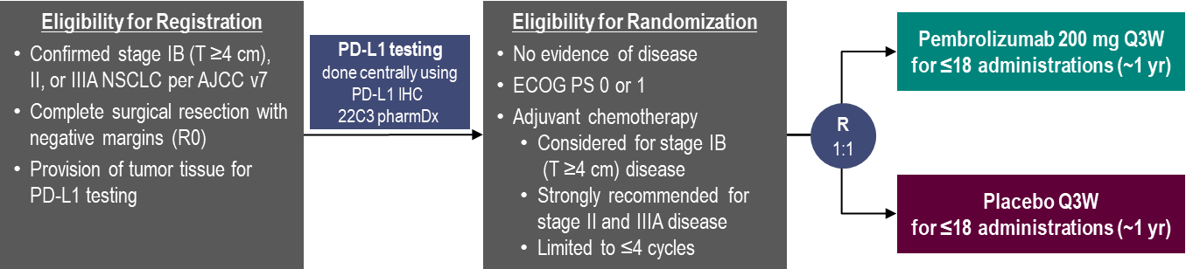
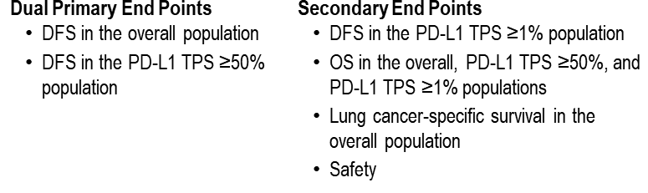
PEARLS/KEYNOTE-091 Study Design
Global, Randomized, Triple-Blind Phase 3 Study
Characteristic | Overall |  | PD-L1 TPS ≥50%
 | Pembro (N = 590) | Placebo (N = 587) | Pembro (N = 168) | Placebo (N = 165)
Age, median (range), y | 65.0 (31-87) | 65.0 (37-85) | 64.5 (38-82) | 65.0 (37-85)
Male sex | 68.0% | 68.7% | 72.0% | 70.3%
Geographic region
Asia | 18.0% | 17.9% | 17.3% | 17.6%
Eastern Europe | 19.7% | 19.3% | 18.5% | 18.2%
Western Europe | 51.4% | 51.3% | 53.6% | 53.9%
Rest of world | 11.0% | 11.6% | 10.7% | 10.3%
ECOG PS 1 | 35.6% | 41.6% | 31.0% | 38.8%
Characteristic | Overall |  | PD-L1 TPS ≥50%
 | Pembro (N = 590) | Placebo (N = 587) | Pembro (N = 168) | Placebo (N = 165)
Current/former smoker | 85.3% | 88.8% | 91.7% | 92.1%
Nonsquamous histology | 67.5% | 61.8% | 61.3% | 63.6%
Received adjuvant chemotherapy | 85.8% | 85.9% | 85.1% | 85.5%
Pathologic stageª
IB | 14.2% | 14.5% | 12.5% | 13.3%
II | 55.8% | 57.6% | 56.5% | 56.4%
IIIA | 30.0% | 27.6% | 31.0% | 30.3%
EGFR mutation^{b} | 6.6% | 5.8% | 3.6% | 3.0%
ALK translocation^{c} | 1.2% | 1.2% | 1.8% | 0.0%
Paz-Ares ESMO plenary 2022, O’Brien ASCO 2022

Slide 24
DFS, Overall Population
KN-091 DFS curves
DFS, PD-L1 TPS ≥50% Population
18-mo rate
73.4%
64.3%
18-mo rate
71.7%
70.2%
HR 0.76 (95% CI, 0.63-0.91)
P = 0.0014
HR 0.82 (95% CI, 0.57-1.18)
P = 0.14
 | Pts w/ Event | Median, mo (95% CI)
Pembrolizumab | 35.9% | 53.6 (39.2-NR)
Placebo | 44.3% | 42.0 (31.3-NR)
 | Pts w/ Event | Median, mo (95% CI)
Pembrolizumab | 32.1% | NR (44.3-NR)
Placebo | 38.2% | NR (35.8-NR)
Response assessed per RECIST v1.1 by investigator review.
Data cutoff date: September 20, 2021
IMpower010 DFS HR: all comer 0.81, PD-L1 >50% 0.43
Paz Ares – ESMO Virtual Plenary March 2022

Slide 25
KN-091 Results: DFS Related to Surgical Resection,
Disease Burden, and Use of Adjuvant Chemotherapy
O’Brien ASCO 2022

Slide 26
KN-091 DFS in Key Subgroups, Overall Population
Response assessed per RECIST v1.1 by investigator review.
Data cutoff date: September 20, 2021

Slide 27
KN-091 OS, Overall Population
 | Pts w/ Event | Median, mo (95% CI)
Pembrolizumab | 16.6% | NR (NR-NR)
Placebo | 18.9% | NR (NR-NR)
18-mo rate
91.7%
91.3%
HR 0.87 (95% CI, 0.67-1.15)
P = 0.17
Data cutoff date: September 20, 2021
Paz Ares – ESMO Virtual Plenary March 2022

Slide 28
Adjuvant PD-1/PD-L1 IO trials
Drug/Trial | Description | Stages entered | Description | Primary endpoint
Nivolumab ANVIL arm of ALCHEMIST | US, NCI (ECOG), Observational control | IB (4cm)-IIIA After Adj Chemo +/- radiation | Phase 3 Allows PD-L1 +/- | OS/DFS
Atezolizumab IMPOWER010 | Global, Placebo controlled | IB (4cm)-IIIA After Adj Chemo | Phase 3 Allows PD-L1 +/- | DFS
Durvalumab | Global, Placebo controlled | IB (4cm)-IIIA After Adj Chemo | Phase 3 Allows PD-L1 +/- | DFS
Pembrolizumab PEARLS KN-091 | ETOP/EORTC, Placebo Controlled | IB (4cm)-IIIA After Adj Chemo | Phase 3 Allows PD-L1 +/- | DFS

Slide 29
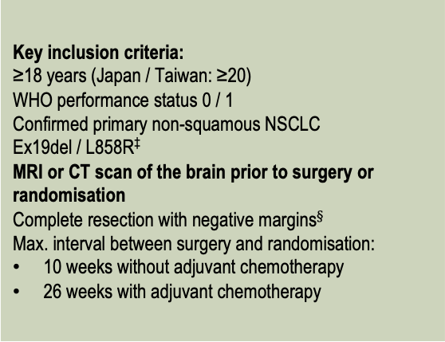
ADAURA: Phase III double-blind study design
Patients with completely resected
stage* IB, II, IIIA NSCLC, with or without adjuvant chemotherapy†
Planned treatment duration: 3 years
Treatment continued until:
Disease recurrence
Treatment completed
Discontinuation criterion met
Assessments:
For recurrence:
Weeks 12 and 24, then every 24 weeks to 5 years, then yearly (brain scans not mandated)
All sites of NSCLC and post-relapse cancer treatments were recorded at recurrence
Patients received regular CT scans,# with additional imaging as indicated by signs and symptoms
Osimertinib
80 mg, once daily
Key inclusion criteria:
≥18 years (Japan / Taiwan: ≥20)
WHO performance status 0 / 1
Confirmed primary non-squamous NSCLC
Ex19del / L858R‡
MRI or CT scan of the brain prior to surgery or randomisation
Complete resection with negative margins$§$
Max. interval between surgery and randomisation:
10 weeks without adjuvant chemotherapy
26 weeks with adjuvant chemotherapy
Stratification by:
stage (IB vs II vs IIIA)
EGFRm (Ex19del vs L858R)
race (Asian vs non-Asian)
Randomisation
1:1
(N=682)
Placebo,
once daily
The primary and key secondary endpoints of DFS¶ in stage II/IIIA patients and the overall population, respectively, have been reported previously¹
Here we report results from a pre-specified exploratory analysis of disease recurrence patterns in ADAURA, including CNS
CT, computed tomography; MRI, magnetic resonance imaging; WHO, World Heath Organization; ex19del, exon 19 deletion; *AJCC 7th edition; †Prior, post, or planned radiotherapy was not allowed;
‡Centrally confirmed in tissue; §Patients received a CT scan after resection and within 28 days prior to treatment; ¶ By investigator assessment; #CT scans of the chest and abdomen, including liver and adrenal glands.
1. Herbst et al. J Clin Oncol 2020;38:18_suppl.LBA5.
ADAURA data cut-off: 17 January, 2020

Slide 30
ADAURA: A positive breakthrough for some patients Osimertinib improves DFS in pts w resected EGFRmut NSCLC
Primary population: Stage II/IIIA
Overall population: Stage IB/II/IIIA
1.0
1.0
0.9
0.9
0.8
0.8
0.7
0.7
0.6
0.6
Probability of disease-free survival
Probability of disease-free survival
0.5
0.5
0.4
0.4
0.3
0.3
0.2
0.2
0.1
0.1
0.0
0.0
0
6
12
18
24
30
36
42
48
0
6
12
18
24
30
36
42
48
Time from randomisation (months)
Time from randomisation (months)
No. at risk
Osimertinib
233
219
189
137
97
52
18
2
0
339
313
272
208
138
74
27
5
0
237
190
127
82
51
27
9
1
0
343
287
207
148
88
53
20
3
1
Placebo
Median DFS, months (95% CI) |  | HR (99.06% CI)
– Osimertinib | NR (38.8, NC) | 0.17 (0.11, 0.26) P<0.0001
– Placebo | 19.6 (16.6, 24.5)
Median DFS, months (95% CI) |  | HR (99.12% CI)
– Osimertinib | NR (NC, NC) | 0.20 (0.14, 0.30) P<0.0001
– Placebo | 27.5 (22.0, 35.0)
CI, confidence interval; NC, not calculable; HR, hazard ratio; NR, not reached
ADAURA data cut-off: 17 January, 2020
Tsuboi ESMO 2020, Yu WCLC 2020, Wu NEJM 2020

Slide 31
Sites of disease recurrence
*Number of patients with disease recurrence regardless of pathology results of the tumour recurrence location;
†Includes CNS only (osimertinib n=4 [1%]; placebo n=25 [7%]) and CNS plus other locations (osimertinib n=1 [<1%]; placebo n=9 [3%]).
One patient in the osimertinib arm and one patient in the placebo arm had CNS metastases at baseline; therefore, these two patients were censored on Day 1 and excluded from the CNS DFS efficacy analysis;
‡Includes disease recurrence in liver, renal and adrenal systems and pancreas.
ADAURA data cut-off: 17 January, 2020
Tsuboi ESMO 2020

Slide 32
CNS DFS in the overall population
100%
98%
98%
Median CNS DFS, months (95% CI)
Osimertinib | NR (39, NC)
Placebo | 48.2 (NC, NC)
HR* (95% CI) | 0.18 (0.10, 0.33); p<0.0001
Maturity 7%: osimertinib 2%, placebo 11%
1.0
0.9
0.8
97%
85%
82%
0.7
0.6
0.5
Probability of CNS disease-free survival
0.4
0.3
0.2
0.1
0.0
0
6
12
18
24
30
36
42
48
No at risk
Time from randomisation (months)
Osimertinib
5
0
339
313
272
209
138
74
28
Placebo
3
343
288
208
149
88
53
20
1
Tsuboi ESMO 2020, Wu NEJM 2020
Median follow-up: osimertinib 22.1 months, placebo 16.6 months;
*A hazard ratio of <1 favours osimertinib.
ADAURA data cut-off: 17 January, 2020

Slide 33
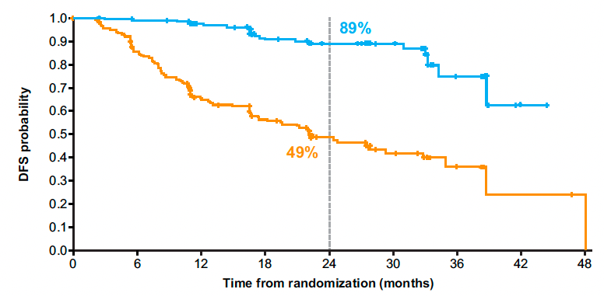
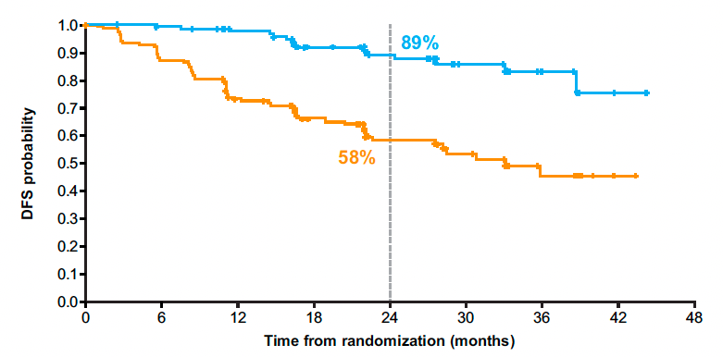
ADAURA: DFS with Adjuvant Osimertinib for Patients Receiving and Not Receiving Adjuvant Chemotherapy
With Adjuvant Chemotherapy
Without Adjuvant Chemotherapy
Wu YL et al. J Thorac Oncol 2022;17(3):423-33.

Slide 34
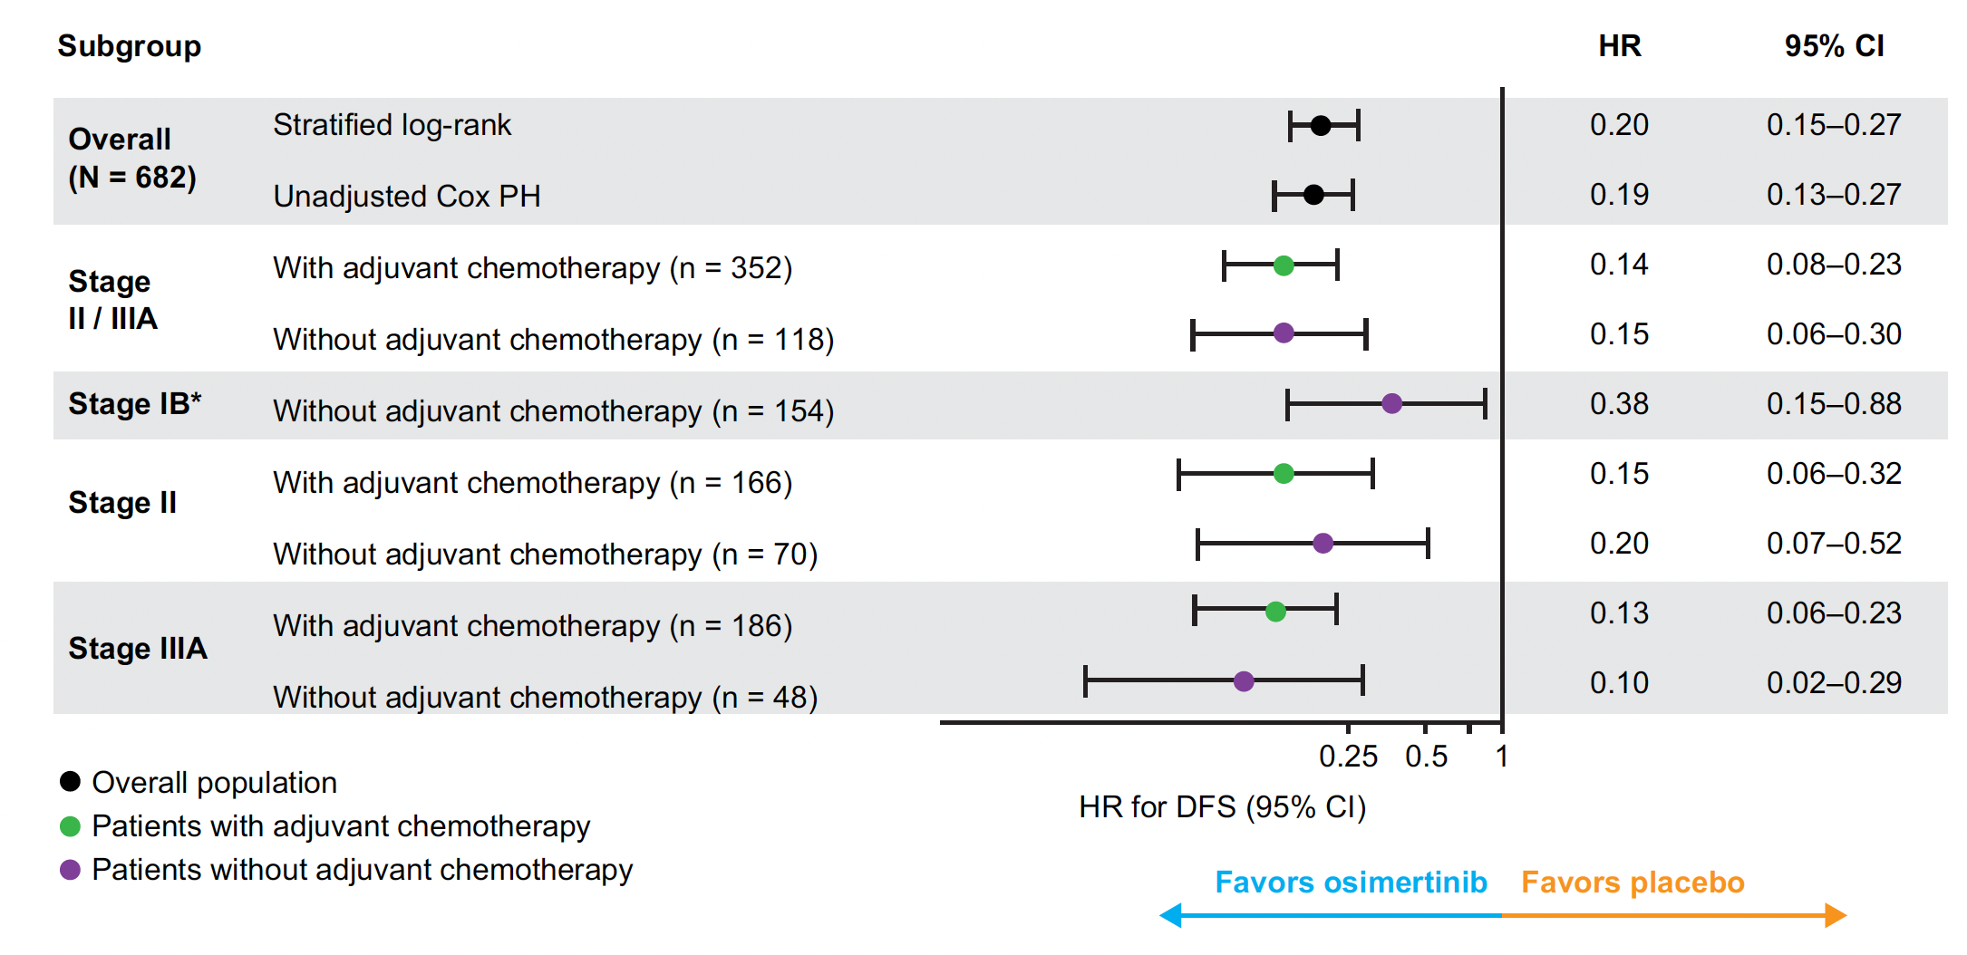
ADAURA: DFS with Adjuvant Osimertinib for Patients Receiving and Not Receiving Adjuvant Chemotherapy — Subgroups
Wu YL et al. J Thorac Oncol 2022;17(3):423-33.

Slide 35
Ongoing trials
Neoadjuvant and Adjuvant Tiragolumab Plus Atezolizumab, With or Without Platinum-Based Chemotherapy, in Participants With Previously Untreated Locally Advanced Resectable Stage II, IIIA, or Select IIIB Non-Small Cell Lung Cancer
Neo-ADAURA: Osimertinib in Treating Participants With Stage I-IIIA EGFR-mutant Non-small Cell Lung Cancer Before Surgery
ALCHEMIST: Adjuvant Crizotinib for ALK+ NSCLC
A Study of Multiple Therapies in Biomarker-Selected Patients With Resectable Stages IB-III Non-Small Cell Lung Cancer (Drugs: Alectinib Entrectinib; Vemurafenib; Cobimetinib; Pralsetinib; Atezolizumab)

Slide 36
Trials with updates coming at ESMO
A randomized, multicentric phase II study of preoperative nivolumab plus relatlimab or nivolumab in patients with resectable non-small-cell lung cancer (NEOpredict-Lung) – ESMO LBA 37 – Martin Schuler
Platform study of neoadjuvant durvalumab (D) alone or combined with novel agents in patients (pts) with resectable, early-stage non-small-cell lung cancer (NSCLC): pharmacodynamic correlates and circulating tumor DNA dynamics in the NeoCOAST study. - ESMO 929MO – Jonathan Spicer

Slide 37
Case 1
A 75 yo Chinese American woman without a smoking history
Presented with hip pain and pre-operative chest X-ray as part of work-up for hip replacement revealed a RUL mass
PET confirmed uptake in RUL 3 cm mass, right hilum only
Brain MRI negative
Biopsy revealed adenocarcinoma, EGFR exon19 del
She underwent RUL lobectomy with 3.1 cm mass, 2 hilar LN and level 7 with microscopic foci of adenocarcinoma, other mediastinal LN negative
Started on post-operative Osimertinib.
Doing well at 2.5 years

Slide 38
Case 2
A 60 yo Caucasian woman with a 40 pack yr smoking history
Presented with dyspnea and CXR revealed a 4 cm RLL lesion
PET confirmed uptake in RLL 4.4 cm mass, Right hilum and solitary paratracheal LN
Brain MRI negative
Biopsy revealed squamous cell carcinoma, PD-L1 10%
Treated with neo-adjuvant platinum/gemcitabine x 3 cycles
Complete resection of 3.5 cm mass, 1 hilar LN, 1+ paratracheal LN
Recurred after 18 months with right pleural effusion treated with carbo/paclitaxel/pembrolizumab with response but neuropathy and dermatomyositis developed

Slide 39
Case 3
A 55 yo Asian man with a 45 pack yr smoking history
Presented for screening CT and LUL mass identified
PET confirmed uptake in LUL 2.5 cm mass, left hilar uptake, rest negative
Brain MRI negative
Biopsy revealed adenocarcinoma carcinoma, no driver mutation
PD-L1 50%
Complete resection of 2.7 cm mass, 4 hilar LNs+, all N2 nodes negative
Completed 1 year of adjuvant atezolizumab
Had significant fatigue but was able to resume work 4 months after completion

