Slide 1
Year in Review: Clinical Investigator Perspectives on the Most Relevant New Data Sets and Advances in Oncology
Follicular Lymphoma
Tuesday, January 4, 2022
5:00 PM – 6:00 PM ET
Faculty
John P Leonard, MD
Laurie H Sehn, MD, MPH
Moderator
Neil Love, MD

Slide 2


YiR Follicular Lymphoma Faculty
John P Leonard, MD
Richard T Silver Distinguished Professor of Hematology and Medical Oncology
Senior Associate Dean for Innovation and Initiatives
Executive Vice Chair, Joan and Sanford I Weill Department of Medicine
Weill Cornell Medicine
New York, New York
Laurie H Sehn, MD, MPH
Chair, Lymphoma Tumour Group
BC Cancer Centre for Lymphoid Cancer
Clinical Professor of Medicine
Division of Medical Oncology
University of British Columbia
Associate Editor, Blood
Vancouver, British Columbia, Canada

Slide 3
Commercial Support
This activity is supported by educational grants from Bristol-Myers Squibb Company and Genentech, a member of the Roche Group.

Slide 4
Dr Love — Disclosures
Dr Love is president and CEO of Research To Practice. Research To Practice receives funds in the form of educational grants to develop CME activities from the following companies: AbbVie Inc, Adaptive Biotechnologies Corporation, ADC Therapeutics, Agios Pharmaceuticals Inc, Alexion Pharmaceuticals, Amgen Inc, Array BioPharma Inc, a subsidiary of Pfizer Inc, Astellas, AstraZeneca Pharmaceuticals LP, Aveo Pharmaceuticals, Bayer HealthCare Pharmaceuticals, BeiGene Ltd, BeyondSpring Pharmaceuticals Inc, Blueprint Medicines, Boehringer Ingelheim Pharmaceuticals Inc, Bristol-Myers Squibb Company, Celgene Corporation, Clovis Oncology, Coherus BioSciences, Daiichi Sankyo Inc, Eisai Inc, EMD Serono Inc, Epizyme Inc, Exact Sciences Inc, Exelixis Inc, Five Prime Therapeutics Inc, Foundation Medicine, G1 Therapeutics Inc, Genentech, a member of the Roche Group, Genmab, Gilead Sciences Inc, GlaxoSmithKline, Grail Inc, Halozyme Inc, Helsinn Healthcare SA, ImmunoGen Inc, Incyte Corporation, Ipsen Biopharmaceuticals Inc, Janssen Biotech Inc, administered by Janssen Scientific Affairs LLC, Jazz Pharmaceuticals Inc, Karyopharm Therapeutics, Kite, A Gilead Company, Lilly, Loxo Oncology Inc, a wholly owned subsidiary of Eli Lilly & Company, Merck, Mersana Therapeutics Inc, Natera Inc, Novartis, Novocure Inc, Oncopeptides, Pfizer Inc, Pharmacyclics LLC, an AbbVie Company, Puma Biotechnology Inc, Regeneron Pharmaceuticals Inc, Sanofi Genzyme, Seagen Inc, Servier Pharmaceuticals LLC, Sumitomo Dainippon Pharma Oncology Inc, Taiho Oncology Inc, Takeda Pharmaceuticals USA Inc, Tesaro, A GSK Company, TG Therapeutics Inc, Turning Point Therapeutics Inc, Verastem Inc and Zymeworks Inc.

Slide 5
Research To Practice CME Planning Committee Members,
Staff and Reviewers
Planners, scientific staff and independent reviewers for Research To Practice have no relevant conflicts of interest to disclose.

Slide 6
Dr Leonard — Disclosures
Consulting Agreements | AbbVie Inc, AstraZeneca Pharmaceuticals LP, Bayer HealthCare Pharmaceuticals, Bristol-Myers Squibb Company, Celgene Corporation, Epizyme Inc, Genentech, a member of the Roche Group, Genmab, Gilead Sciences Inc, Incyte Corporation, Janssen Biotech Inc, Karyopharm Therapeutics, Kite, A Gilead Company, Miltenyi Biotec, Mustang Bio, Regeneron Pharmaceuticals Inc, Second Genome, Sutro Biopharma
Contracted Research | Epizyme Inc, Genentech, a member of the Roche Group, Janssen Biotech Inc
Data and Safety Monitoring Board/Committee | AstraZeneca Pharmaceuticals LP, Bristol-Myers Squibb Company, Genentech, a member of the Roche Group

Slide 7
Dr Sehn — Disclosures
Advisory Committee and Consulting Agreements | AbbVie Inc, Acerta Pharma — A member of the AstraZeneca Group, Amgen Inc, Apobiologix, AstraZeneca Pharmaceuticals LP, Bristol-Myers Squibb Company, Celgene Corporation, Genentech, a member of the Roche Group, Gilead Sciences Inc, Incyte Corporation, Janssen Biotech Inc, Karyopharm Therapeutics, Kite, A Gilead Company, Lundbeck, Merck, MorphoSys, Novartis, Pfizer Inc, Roche Laboratories Inc, Sandoz Inc, a Novartis Division, Seagen Inc, Takeda Pharmaceuticals USA Inc, Teva Oncology, Verastem Inc
Contracted Research | Teva Oncology

Slide 8
Agenda
Introduction: Follicular Lymphoma in Clinical Practice
Module 1: First- and Second-Line Treatment — Chemotherapy, Anti-CD20 Antibodies and IMiDs
Module 2: Sequencing Third Line and Beyond — Bispecific Antibodies, PI3K Inhibitors, Tazemetostat
Module 3: CAR T-Cell Therapy

Slide 9
Agenda
Introduction: Follicular Lymphoma in Clinical Practice
Module 1: First- and Second-Line Treatment — Chemotherapy, Anti-CD20 Antibodies and IMiDs
Module 2: Sequencing Third Line and Beyond — Bispecific Antibodies, PI3K Inhibitors, Tazemetostat
Module 3: CAR T-Cell Therapy

Slide 10
In the past year approximately how many patients with follicular lymphoma (FL) did you care for clinically?
0
1-5
6-10
11-15
16-20
21-25
More than 25

Slide 11
In the past year approximately how many of your patients with FL died from their disease (including those with transformation)?
0
1
2-5
6-10
More than 10

Slide 12
Agenda
Introduction: Follicular Lymphoma in Clinical Practice
Module 1: First- and Second-Line Treatment — Chemotherapy, Anti-CD20 Antibodies and IMiDs
Module 2: Sequencing Third Line and Beyond — Bispecific Antibodies, PI3K Inhibitors, Tazemetostat
Module 3: CAR T-Cell Therapy

Slide 13
Module 1: First- and Second-Line Treatment — Chemotherapy, Anti-CD20 Antibodies and IMiDs
Key Topics
  Use and duration of anti-CD20 antibodies
    RESORT: Long-term follow-up comparing 2 different rituximab doses
      COVID-19 and vaccine considerations
  Lenalidomide
    RELEVANCE: Lenalidomide/rituximab (R²) for untreated FL
    MAGNIFY: R² → maintenance for relapsed/refractory disease

Slide 14
To what extent has the risk of COVID-19 affected your use of anti-CD20 antibodies?

Slide 15
When using the combination of lenalidomide and rituximab either up front or in the second line, what is the optimal total duration of treatment, including maintenance, for a patient with FL who achieves a CR in 3-4 months?

Slide 16
When using the combination of lenalidomide and rituximab either up front or in the second line, what is the optimal total duration of treatment, including maintenance, for a patient with FL who achieves a PR in 3-4 months?

Slide 17
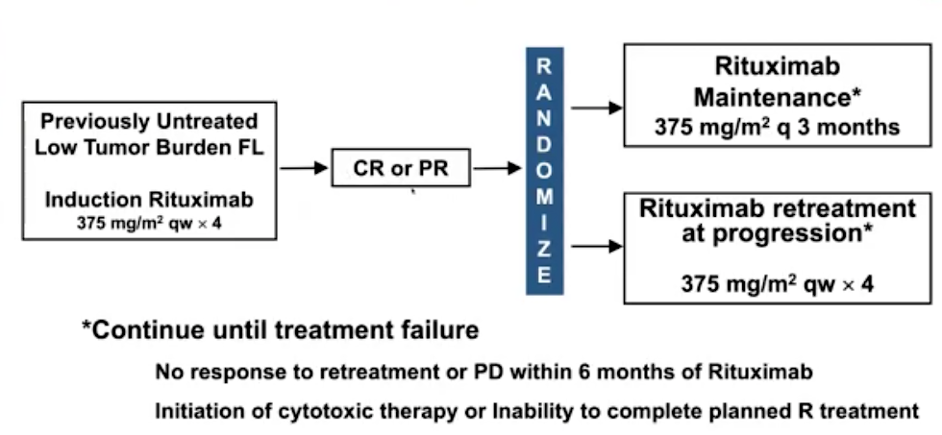
Long-Term Follow-Up of the RESORT Trial: A Phase III Study of 2 Different Rituximab Strategies in Low-Tumor-Burden FL
Courtesy of Laurie H Sehn, MD, MPH

Slide 18
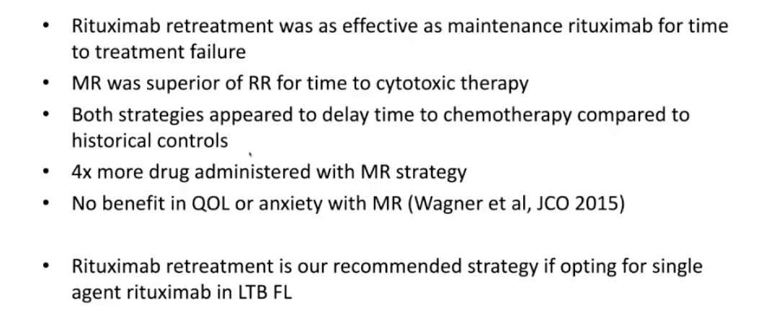
Long-Term Follow-Up of the RESORT Trial: A Phase III Study of 2 Different Rituximab Strategies in Low-Tumor-Burden FL
Original Conclusions: Kahl J Clin Oncol 2014
Courtesy of Laurie H Sehn, MD, MPH

Slide 19
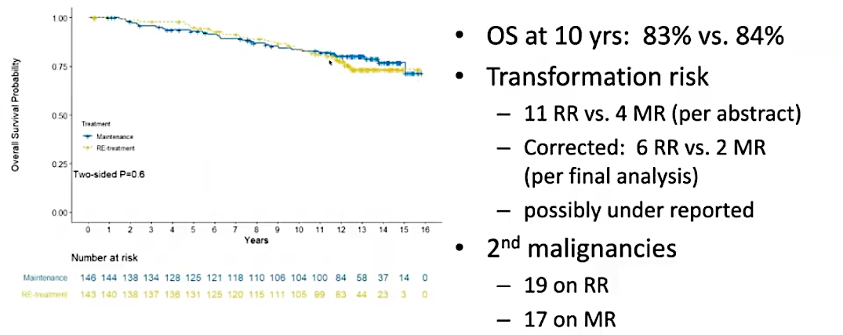
Long-Term Follow-Up of the RESORT Trial: A Phase III Study of 2 Different Rituximab Strategies in Low-Tumor-Burden FL
*Treatment of asymptomatic low-tumor-burden FL is currently not recommended due to COVID risk
Courtesy of Laurie H Sehn, MD, MPH

Slide 20
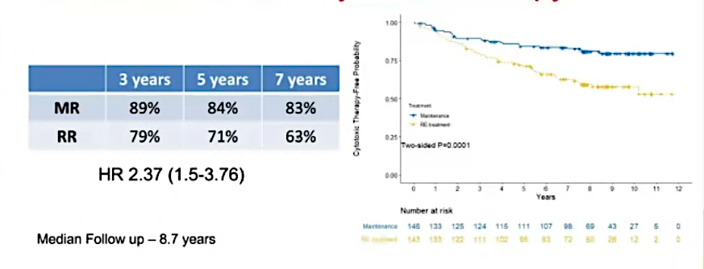
Long-Term Follow-Up of the RESORT Trial:
Freedom from First Cytotoxic Therapy
Kahl B et al. ASH 2021;Abstract 815.

Slide 21
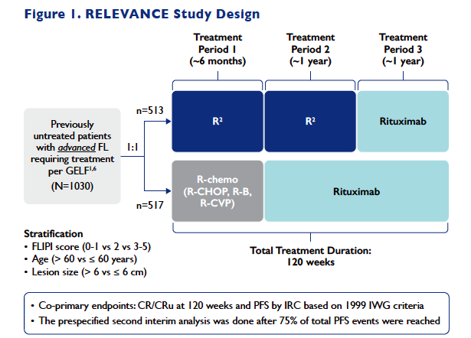
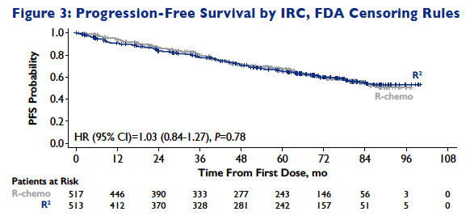
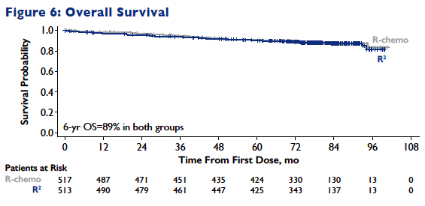
Six‑Year Results from the Phase III RELEVANCE Study: Similar Outcomes for Previously Untreated Follicular Lymphoma (FL) Receiving Lenalidomide with Rituximab (R²) versus R‑Chemotherapy Followed by Rituximab Maintenance
Morschhauser F, et al ASH 2021
Courtesy of Laurie H Sehn, MD, MPH

Slide 22
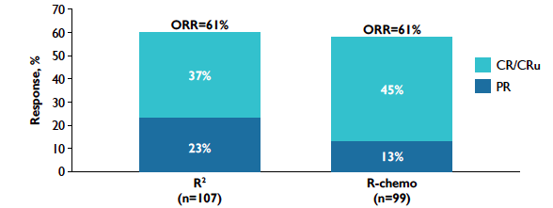
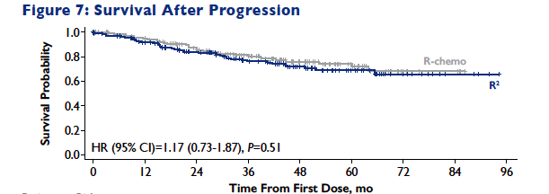
Six‑Year Results from the Phase III RELEVANCE Study:
Outcomes After Progression
Morschhauser F, et al ASH 2021
Courtesy of Laurie H Sehn, MD, MPH

Slide 23
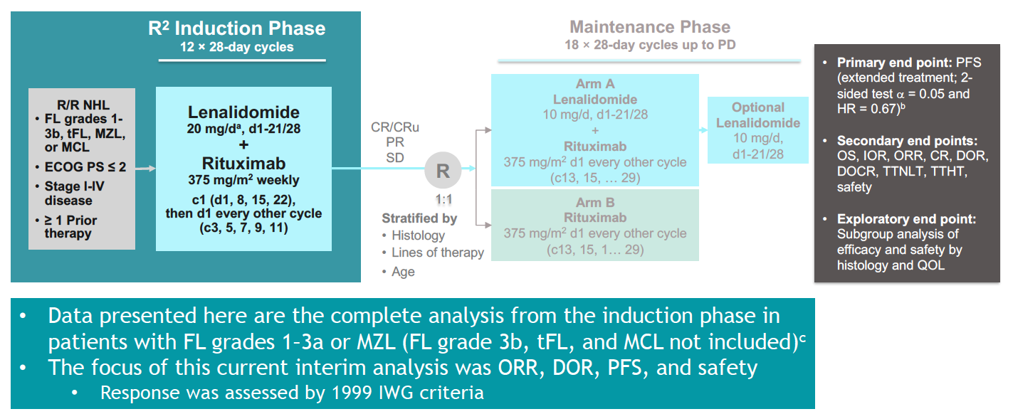
Completed Induction Analysis of MAGNIFY: A Phase IIIb Study of R² Followed by Maintenance for R/R iNHL
Courtesy of Laurie H Sehn, MD, MPH
Lansigan et al, ASH 2021

Slide 24
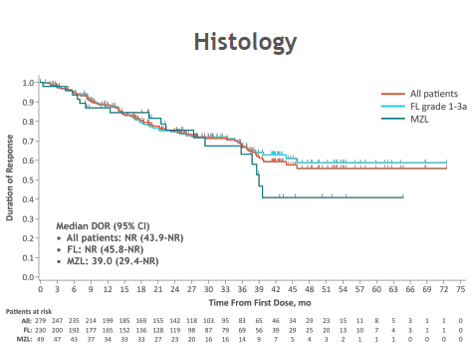
Completed Induction Analysis of MAGNIFY: A Phase IIIb Study of R² Followed by Maintenance for R/R Indolent NHL
Duration of Response
Confirms efficacy of R² seen in AUGMENT trial
Benefit seen in FL and MZL, rituximab-refractory, double-refractory, and early relapsers
No new safety findings
Randomized phase with test maintenance with R² vs rituximab
Courtesy of Laurie H Sehn, MD, MPH
Lansigan et al, ASH 2021

Slide 25
Agenda
Introduction: Follicular Lymphoma in Clinical Practice
Module 1: First- and Second-Line Treatment — Chemotherapy, Anti-CD20 Antibodies and IMiDs
Module 2: Sequencing Third Line and Beyond — Bispecific Antibodies, PI3K Inhibitors, Tazemetostat
Module 3: CAR T-Cell Therapy

Slide 26
Module 2: Sequencing Third Line and Beyond — Bispecific Antibodies, PI3K Inhibitors, Tazemetostat
Key Topics
  Bispecific antibodies: Efficacy and toxicity
    Mosunetuzumab as monotherapy or in combination with polatuzumab vedotin or lenalidomide
    Glofitamab as monotherapy or in combination with obinutuzumab
    Dose escalation of subcutaneous epcoritamab
  Selection of PI3K inhibitor; addition of anti-CD20 antibody
    CHRONOS: Copanlisib + rituximab for untreated and relapsed/refractory disease
    Umbralisib for relapsed/refractory indolent lymphoma
  Tazemetostat: EZH2 mutated and nonmutated

Slide 27
To approximately how many patients with FL have you administered a PI3K inhibitor?
0
1
2
3
More than 3

Slide 28
To approximately how many patients with FL have you administered tazemetostat?
0
1
2
3
More than 3

Slide 29
If the bispecific antibody mosunetuzumab was approved by the FDA for patients with FL after 2 lines of treatment, would you use it before a PI3K inhibitor or tazemetostat for a 60-year-old patient?
Yes
No
I’m not sure

Slide 30
If the bispecific antibody mosunetuzumab was approved by the FDA for patients with FL after 2 lines of treatment, would you use it before a PI3K inhibitor or tazemetostat for an 80-year-old patient?

Slide 31
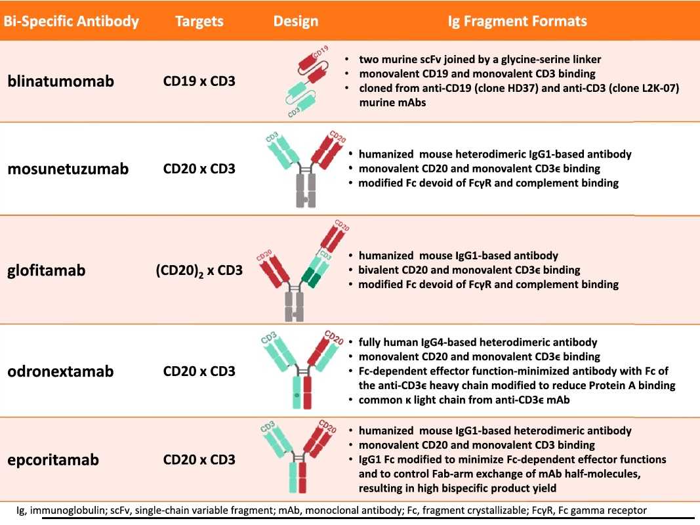
Structure of Selected Bispecific Antibodies
Anti-CD20/CD3 Bispecific Antibody
CD20
CD3
VH-A
VH-B
T-cell
Cancer
cell
VL-B
CH1
VL-B
CH1
CL
CL
CH2
CH2
CH3
CH3
Simultaneous binding of CD20 on malignant B cells and CD3 on cytotoxic T cells results in crosslinking of CD3, activation of T cells, and cancer cell killing
Schuster SJ. Hematol Oncol 2021;39(S1):113-16.
Courtesy of John P Leonard, MD

Slide 32
FDA Grants Breakthrough Therapy Designation for the CD20 x CD3 Bispecific Cancer Immunotherapy Mosunetuzumab for Follicular Lymphoma
Press Release — July 14, 2020
“[The] investigational CD20xCD3 T-cell engaging bispecific mosunetuzumab has been granted Breakthrough Therapy Designation (BTD) by the US Food and Drug Administration (FDA) for the treatment of adult patients with relapsed or refractory (R/R) follicular lymphoma who have received at least two prior systemic therapies.
This designation was granted based on encouraging efficacy results observed in the phase I/Ib GO29781 study [NCT02500407] investigating mosunetuzumab in R/R non-Hodgkin lymphoma (NHL). The safety profile of this T-cell engaging bispecific was consistent with its mechanism of action.”
www.roche.com/investors/updates/inv-update-2020-07-14b.htm
Courtesy of John P Leonard, MD

Slide 33
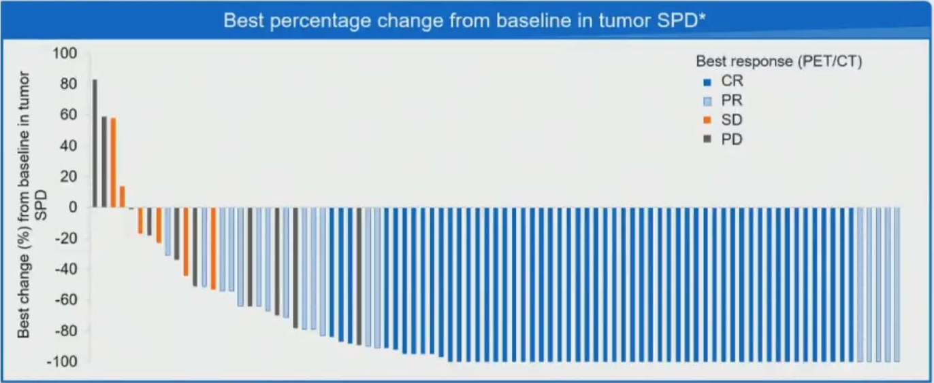
Phase I/II Study of Mosunetuzumab Monotherapy in Patients with R/R FL Who Have Received ≥2 Lines of Therapy
CR: 54 patients (60%)
ORR: 72 patients (80%)
Median DoR: 22.8 months
Median PFS: 17.9 months
Budde LE et al. ASH 2021;Abstract 127.
Courtesy of John P Leonard, MD

Slide 34
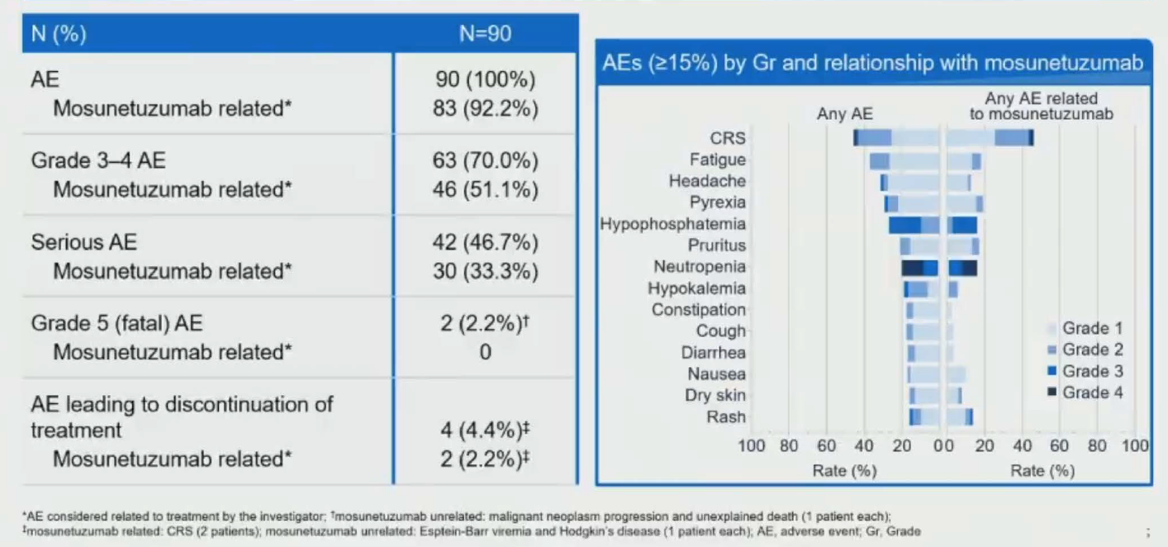
Safety Profile of Mosunetuzumab Monotherapy for Patients with R/R FL Who Have Received ≥2 Lines of Therapy: Adverse Events (AEs)
Budde LE et al. ASH 2021;Abstract 127.
Courtesy of John P Leonard, MD

Slide 35
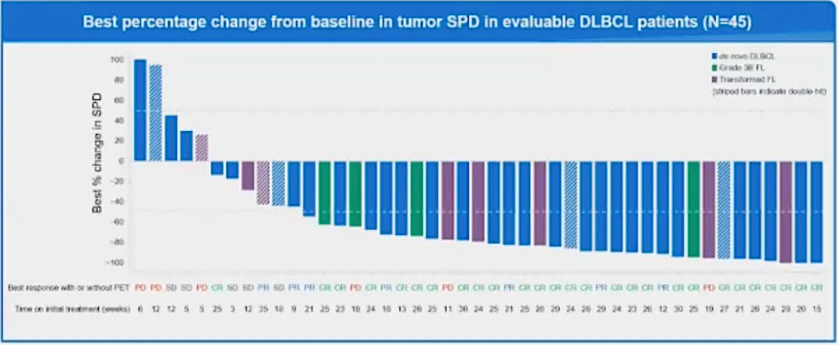
Phase Ib/II Study of Mosunetuzumab with Polatuzumab Vedotin for R/R Aggressive B-Cell NHL: Response
Response in pts receiving mosunetuzumab at the RP2D (N=46)
All (N=46) Prior CAR-T
ORR: 65.2% 65.0%
CR: 17.4% 20.0%
PR: 47.8% 45.0%
Budde LE et al. ASH 2021;Abstract 533.
Courtesy of John P Leonard, MD

Slide 36
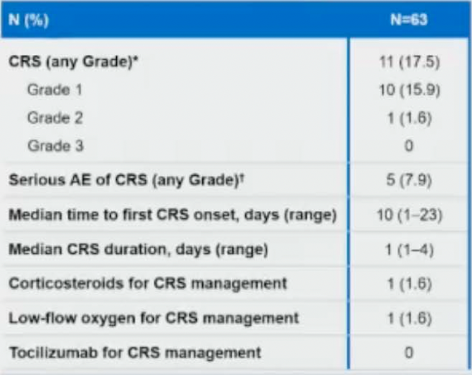
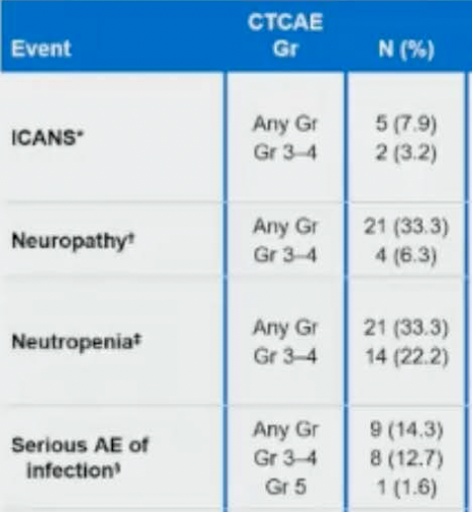
Mosunetuzumab with Polatuzumab Vedotin for R/R Aggressive
B-Cell NHL: CRS and Other AEs of Interest
Budde LE et al. ASH 2021;Abstract 533.
Courtesy of John P Leonard, MD

Slide 37
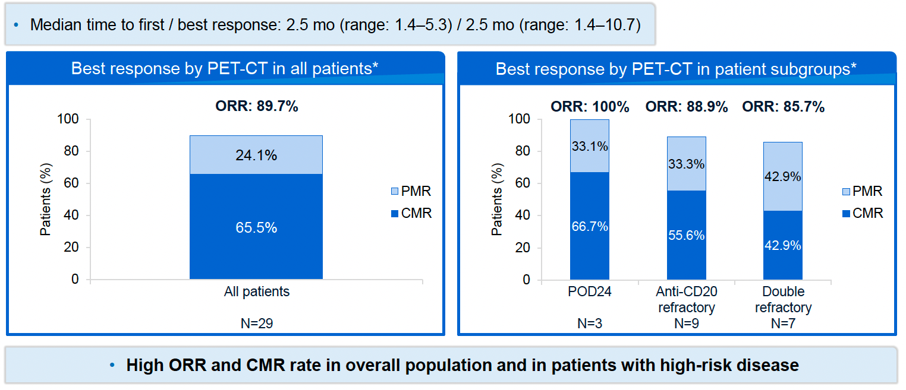
Stage Ib Study of Mosunetuzumab + Lenalidomide for R/R FL: Response
Morschhauser F et al. ASH 2021;Abstract 129.
Courtesy of John P Leonard, MD

Slide 38
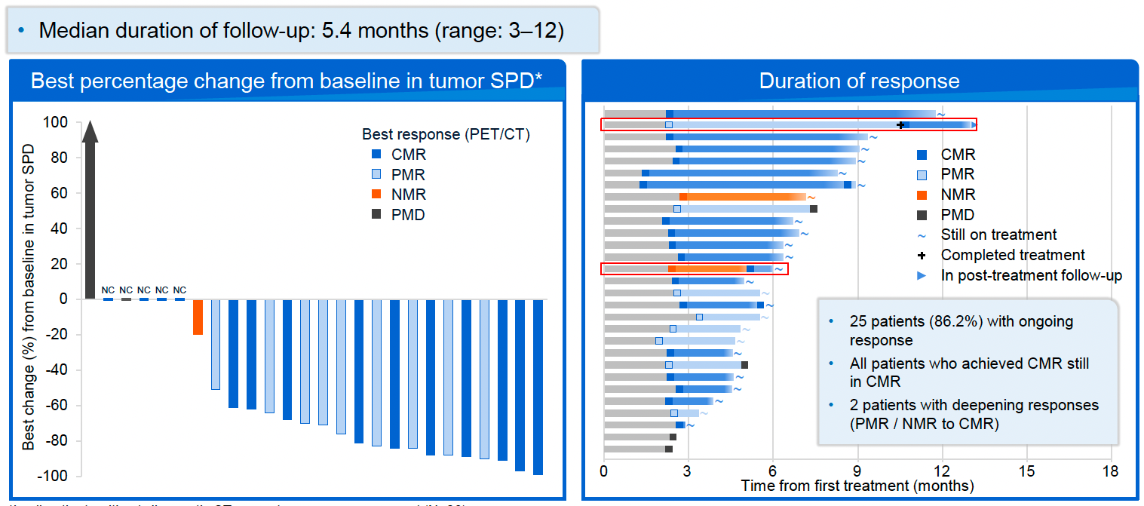
Mosunetuzumab + Lenalidomide for R/R FL: Change in Tumor Sum of Product Diameters and Duration of Response
Morschhauser F et al. ASH 2021;Abstract 129.
Courtesy of John P Leonard, MD

Slide 39
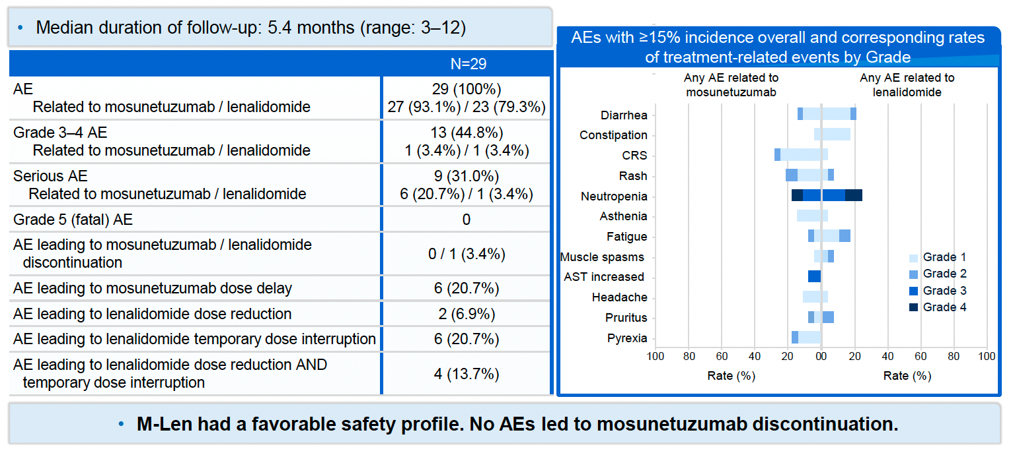
Mosunetuzumab + Lenalidomide for R/R FL: Summary of
Adverse Events
CRS Grade 3-4: 0% ICANS Grade 3-4: 0%
Neutropenia Grade 3-4: 24.1% Serious AE of infection Grade 3-4: 6.9%
Morschhauser F et al. ASH 2021;Abstract 129.
Courtesy of John P Leonard, MD

Slide 40
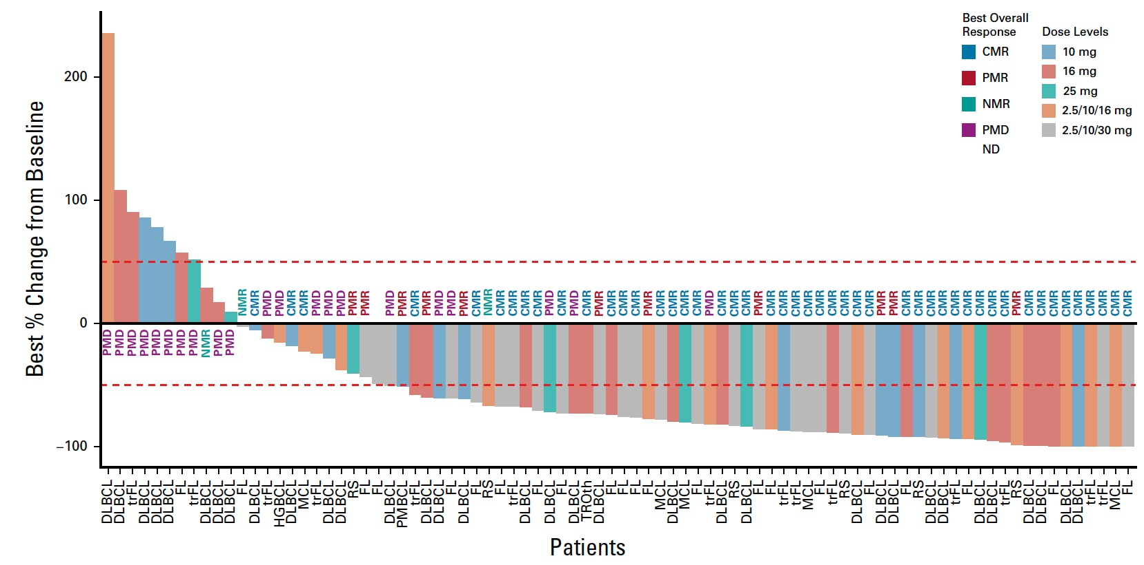
Phase I Study of Glofitamab in R/R B-Cell Lymphomas: Response
ORR (transformed FL, N = 29): 55.2%
ORR (Grade 1-3A FL, N = 44): 70.5%
Hutchings M et al. J Clin Oncol 2021;39:1959-70.
Courtesy of John P Leonard, MD

Slide 41
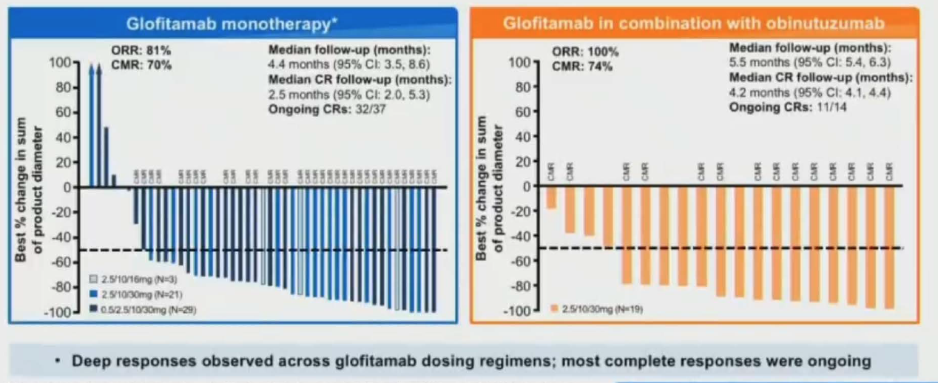
Phase I/II Study of Glofitamab as Monotherapy or in Combination with Obinutuzumab for R/R FL: Response
Myelosuppression was more common with the combination
CRS rates were high and comparable, and cases were mainly low grade
Morschhauser F et al. ASH 2021;Abstract 128.
Courtesy of John P Leonard, MD

Slide 42
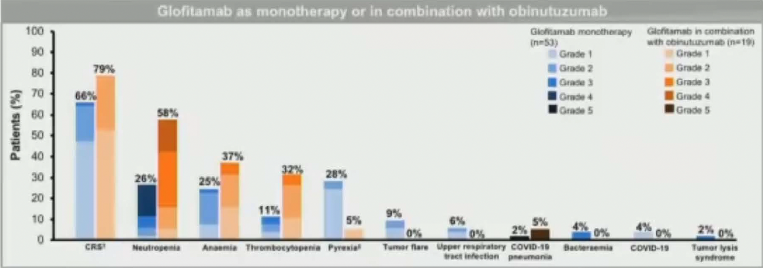
Glofitamab as Monotherapy or in Combination with Obinutuzumab for R/R FL: Common and Clinical AEs of Interest
Glofitamab as monotherapy or in combination with obinutuzumab
CRS
Neutropenia
Anemia
Thrombocytopenia
Pyrexia
Tumor flare
Upper
respiratory
tract infection
COVID-19
pneumonitis
Bacteremia
COVID-19
Tumor lysis
syndrome
Morschhauser F et al. ASH 2021;Abstract 128.
Courtesy of John P Leonard, MD

Slide 43
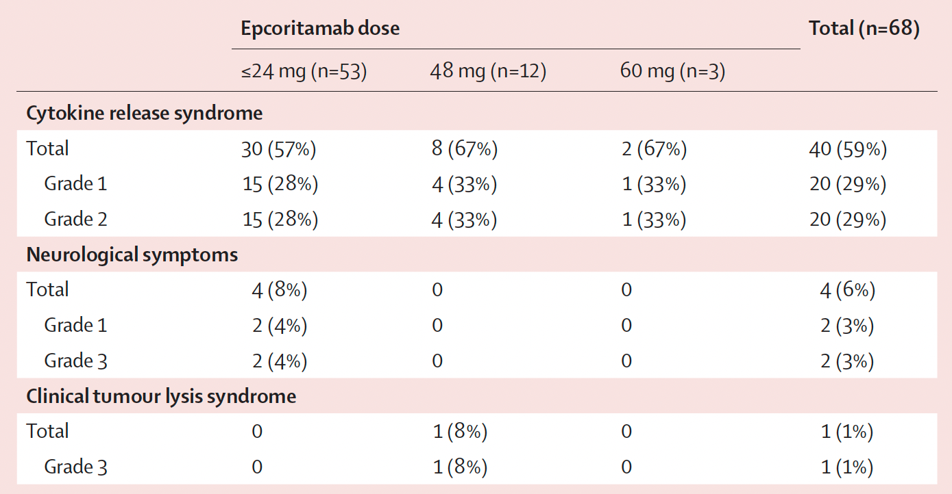
Phase I/II Dose Escalation of Subcutaneous Epcoritamab for R/R B-Cell NHL: Adverse Events of Special Interest
No treatment-related AEs led to discontinuation or death
Hutchings M et al. Lancet 2021;398:1157–69.
Courtesy of John P Leonard, MD

Slide 44
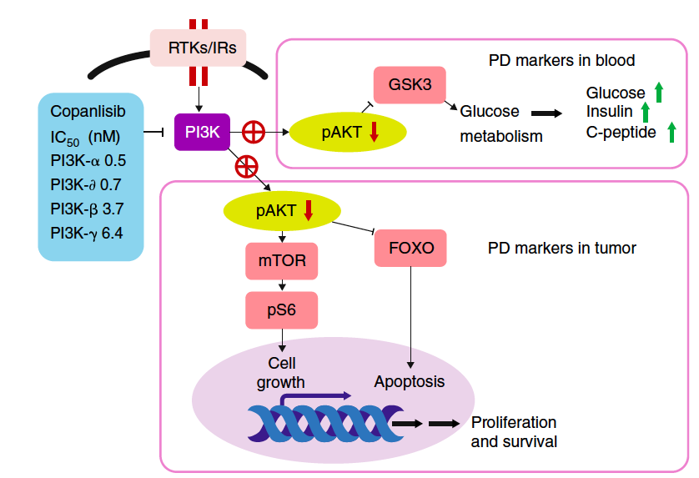
Copanlisib + Rituximab vs Placebo + Rituximab in Relapsed Indolent NHL: CHRONOS-3 Double-Blind Placebo Controlled Phase III Trial
Matasar et al, Lancet Oncol 2021
Pan-class I PI3K inhibitor
Relapsed indolent non-Hodgkin lymphoma (iNHL) >12 months since last anti-CD20 mAb therapy
Copanlisib 60 mg IV D1,8,15 of 28-day schedule until progression; rituximab D1,8,15,22 cycle 1, then D1 of cycles 3,5,7,9
Primary endpoint PFS
Courtesy of Laurie H Sehn, MD, MPH

Slide 45
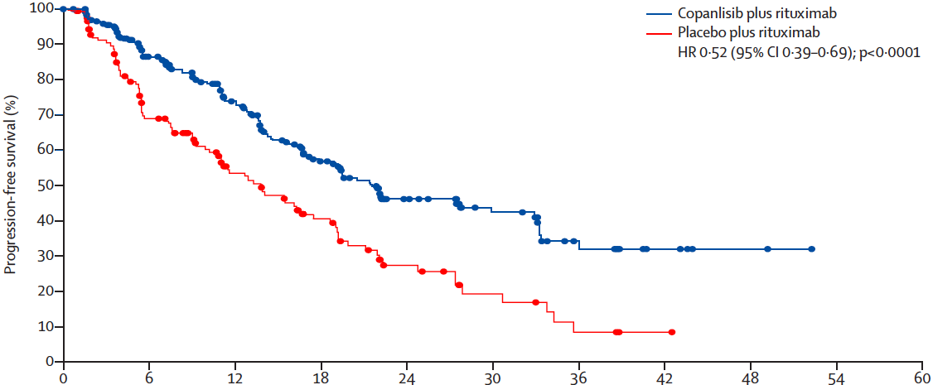
Copanlisib + Rituximab vs Placebo + Rituximab in Relapsed Indolent NHL: CHRONOS-3 Double-Blind Placebo Controlled Phase III Trial
Matasar et al, Lancet Oncol 2021
N=307
N=151
Median PFS: 21.5 m vs 13. 8 m,
Median follow-up: 19.2 mos
60% of patients had FL
Courtesy of Laurie H Sehn, MD, MPH

Slide 46
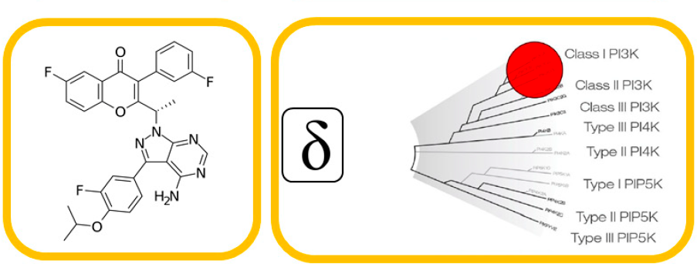
Umbralisib, a Dual PI3Kd/CK1ε Inhibitor, in Patients with Relapsed or Refractory Indolent Lymphoma
Fowler et al, J Clin Oncol 2021
Umbralisib exhibits improved selectivity for PI3Kd
Phase 2b study designed to assess the safety and efficacy of umbralisib for relapsed/refractory (R/R) indolent B-cell lymphoma
Umbralisib 800 mg po qd until progression or intolerance
FL n=117, median 3 prior lines of therapy (range 1-10)
Courtesy of Laurie H Sehn, MD, MPH

Slide 47
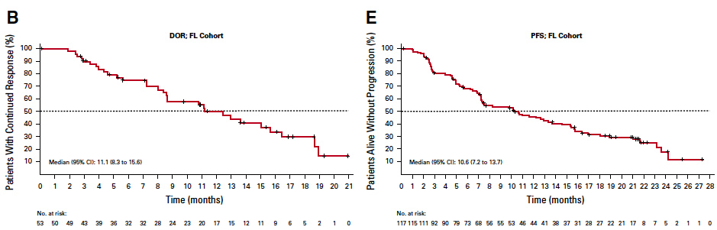
Umbralisib, a Dual PI3Kd/CK1ε Inhibitor in Patients with Relapsed or Refractory Indolent Lymphoma
Fowler et al, J Clin Oncol 2021
Overall response rate 45.3%, complete response rate 5%
Median follow-up: 27.7 months
Courtesy of Laurie H Sehn, MD, MPH

Slide 48
Agenda
Introduction: Follicular Lymphoma in Clinical Practice
Module 1: First- and Second-Line Treatment — Chemotherapy, Anti-CD20 Antibodies and IMiDs
Module 2: Sequencing Third Line and Beyond — Bispecific Antibodies, PI3K Inhibitors, Tazemetostat
Module 3: CAR T-Cell Therapy

Slide 49
Module 3: CAR T-Cell Therapy
Key Topics
  CAR T-cell therapy
    Efficacy and toxicity
    Clinical indications

Slide 50
For an otherwise healthy patient with FL with no comorbidities and no other feasible treatment options, what is the maximum age that you would recommend CAR T-cell therapy?

Slide 51
For an otherwise healthy patient with FL with no comorbidities and no other feasible treatment options, what is the maximum age that you would recommend autologous stem cell transplant?

Slide 52
ZUMA-5: A Phase II Study of Axicabtagene Ciloleucel (Axi-Cel) for R/R iNHL — Long-Term Follow-Up
Leukapheresis
Conditioning Chemotherapy
Fludarabine 30 mg/m² IV and
cyclophosphamide 500 mg/m² IV
on Days −5, −4, −3
Post-treatment assessment and
long-term
follow-up periods
R/R iNHL
(N=157)
Axi-Cel Infusion
2×10⁶ CAR+ cells/kg
on Day 0
Key ZUMA-5 Eligibility Criteria
R/R FL (Grades 1–3a) or MZL
(nodal or extranodal)ª
≥2 Prior lines of therapy that must have included an anti-CD20 mAb combined with an alkylating agent^{b}
Primary Endpoint
ORR (IRRC assessed per
the Lugano classification¹)
Key Secondary Endpoints
CR rate (IRRC assessed)
Investigator-assessed ORRª
DOR, PFS, OS
AEs
CAR T-cell and cytokine levels
Courtesy of Laurie H Sehn, MD, MPH

Slide 53
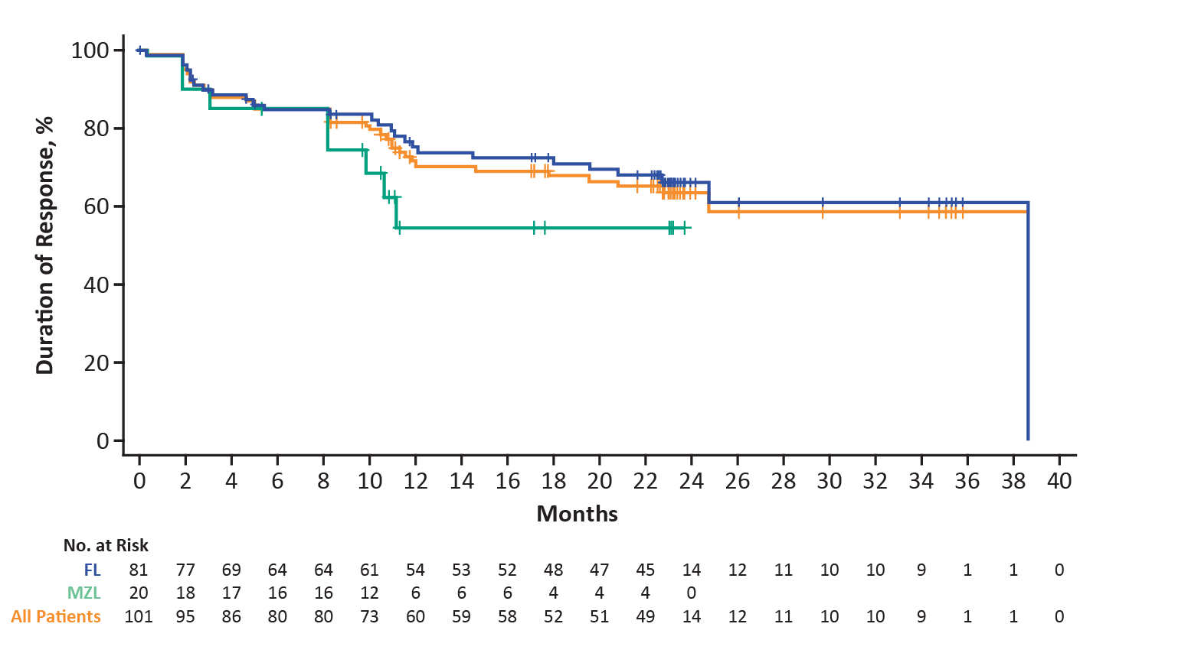
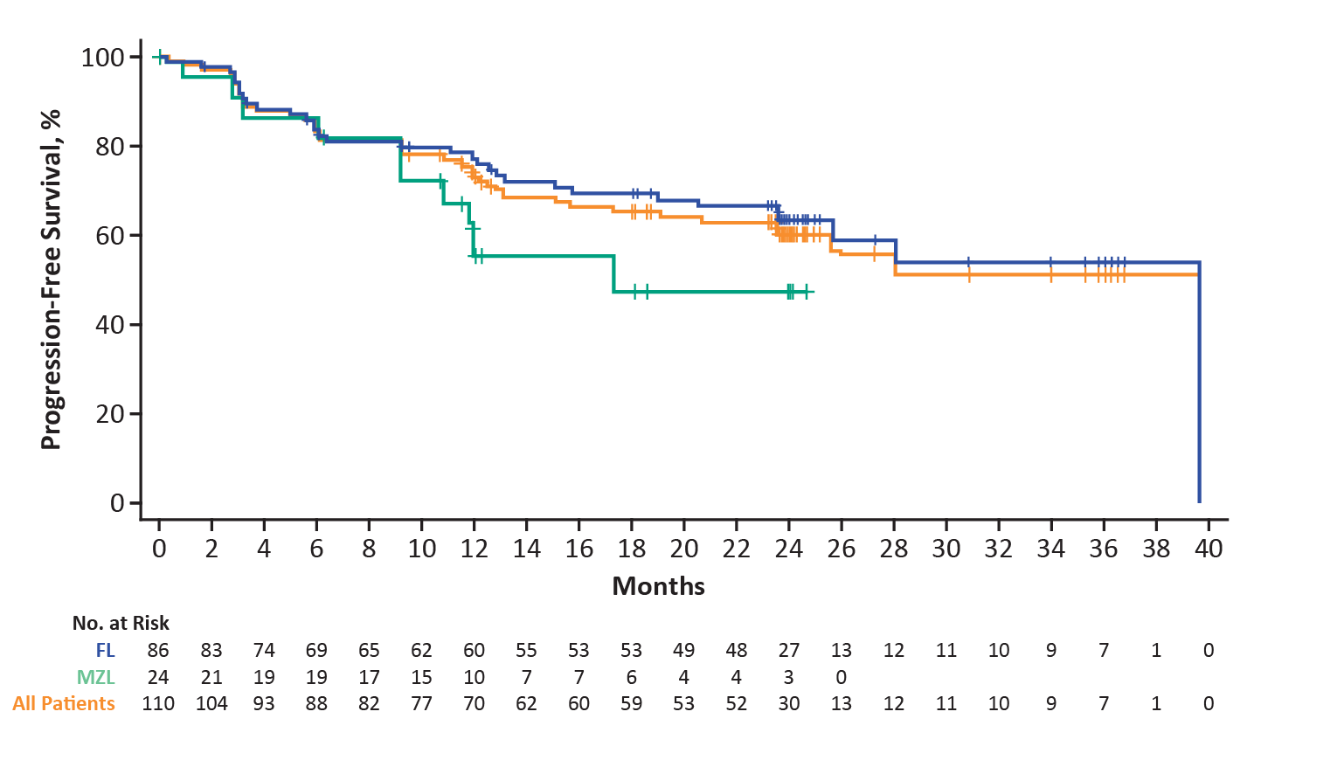
ZUMA-5: Duration of Response and PFS
Duration of Response
Progression-Free Survival
Estimated DOR | FL (n=86) | MZL (n=24) | All Patients (N=110)
Median (95% CI), mo | 38.6 (24.7–NE) | NR (8.2–NE) | 38.6 (24.7–NE)
24-mo rate (95% CI), % | 66.1 (53.9–75.8) | NR (NE–NE) | 63.5 (52.4–72.7)
Estimated PFS | FL (n=86) | MZL (n=24) | All Patients (N=110)
Median (95% CI), mo | 39.6 (25.7–NE) | 17.3 (9.2–NE) | 39.6 (23.6–NE)
24-mo rate (95% CI), % | 63.4 (51.6–73.0) | 47.4 (23.1–68.4) | 60.1 (49.4–69.2)
FL n=86
Updated analysis occurred when ≥80 treated patients with FL had ≥24 months of follow-up
ORR 94%, CR 79%
At data cutoff, 57% of efficacy-eligible patients with FL (49 of 86) had ongoing responses
Courtesy of Laurie H Sehn, MD, MPH

Slide 54
Appendix of Additional Data Slides

Slide 55
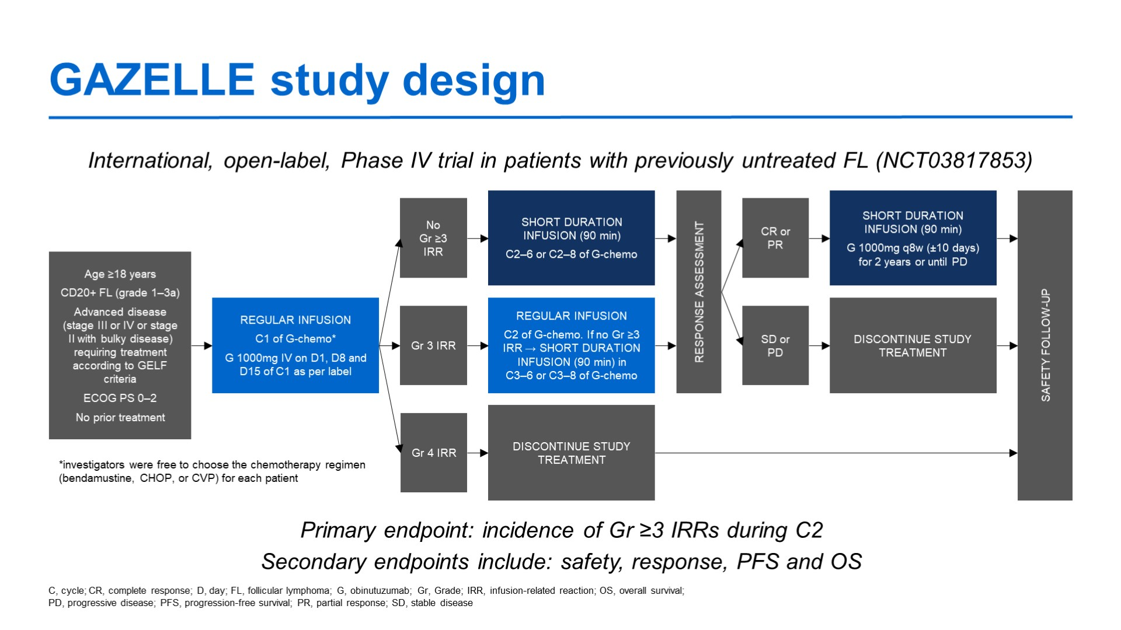
GAZELLE study design
Canales-Albendea MAA et al. ASCO 2021;Abstract 7545.
Courtesy of Laurie H Sehn, MD, MPH

Slide 56
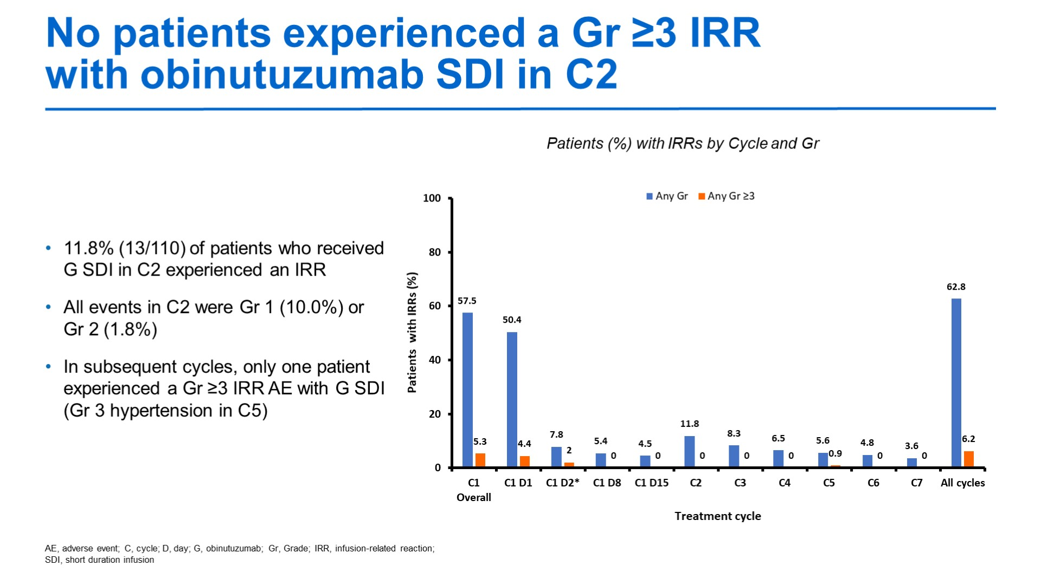
No patients experienced a Gr ≥3 IRR with obinutuzumab SDI in C2
GAZELLE: No patients experienced a Grade 3 or higher IRR with obinutuzumab SDI in C2
Content of this presentation is the property of the author, licensed by ASCO. Permission required for reuse.
Canales-Albendea MAA et al. ASCO 2021;Abstract 7545.
Courtesy of Laurie H Sehn, MD, MPH

Slide 57
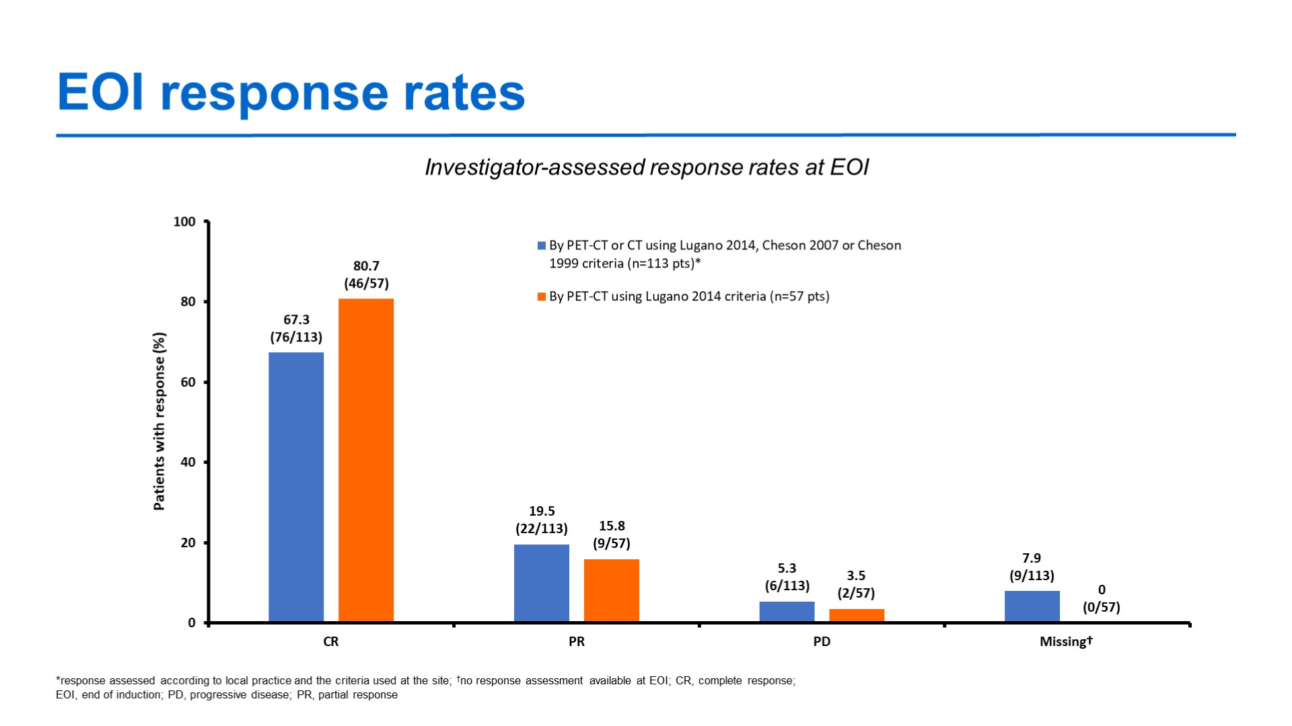
EOI response rates
GAZELLE: EOI response rates
Canales-Albendea MAA et al. ASCO 2021;Abstract 7545.
Content of this presentation is the property of the author, licensed by ASCO. Permission required for reuse.
Courtesy of Laurie H Sehn, MD, MPH

Slide 58
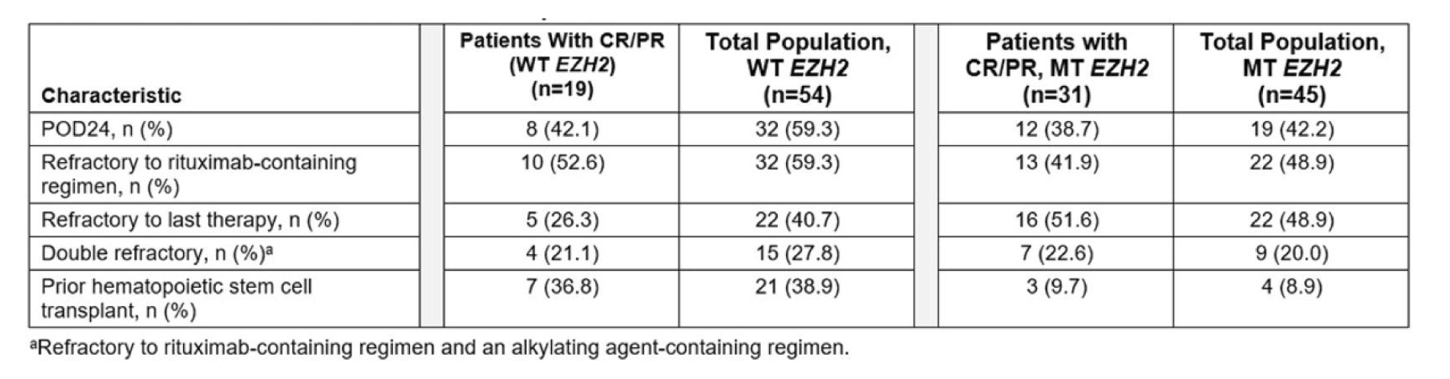
Characteristics of Patients Achieving Complete or Partial Response with Tazemetostat for Wild-Type (WT) R/R FL
Of 99 patients with WT EZH2 or EZH2 mutations, 19 patients with WT EZH2 who received a median of 3 prior lines of therapy responded (2 CR/17 PR)
Patients with refractoriness to last therapy represented 26.3% and 51.6% of WT and EZH2 mutation responders
Batlevi CL et al. ICML 2021;Abstract 109
Courtesy of Laurie H Sehn, MD, MPH

Slide 59
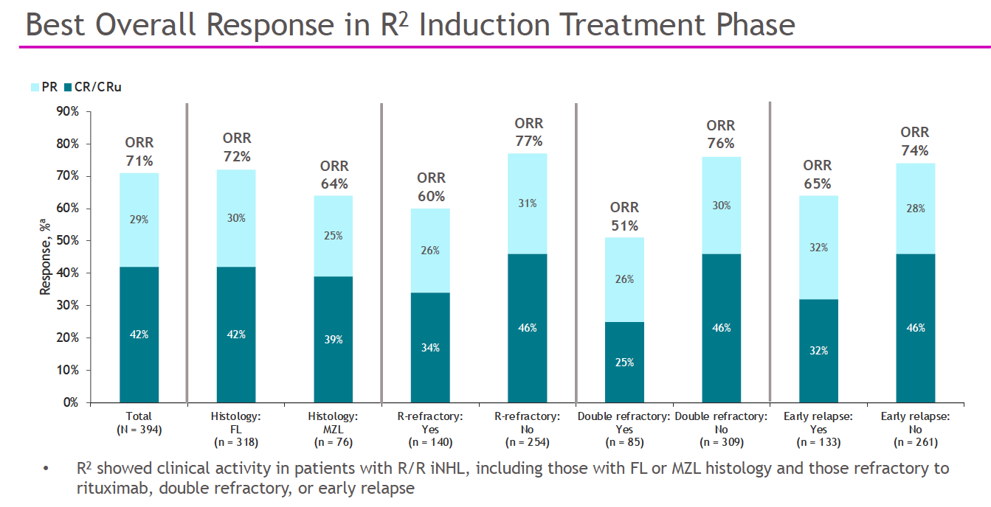
Completed Induction Analysis of MAGNIFY: Phase 3b study of R² followed by Maintenance in R/R Indolent NHL
Courtesy of Laurie H Sehn, MD, MPH
Lansigan et al, ASH 2021

Slide 60
DOR, PFS and OS in Patients with iNHL by POD24 Status
Courtesy of Laurie H Sehn, MD, MPH

Slide 61
CAR T-Cell Expansion and Key Pretreatment Serum Analytes in Patients with FL by POD24 Status
Courtesy of Laurie H Sehn, MD, MPH

Slide 62
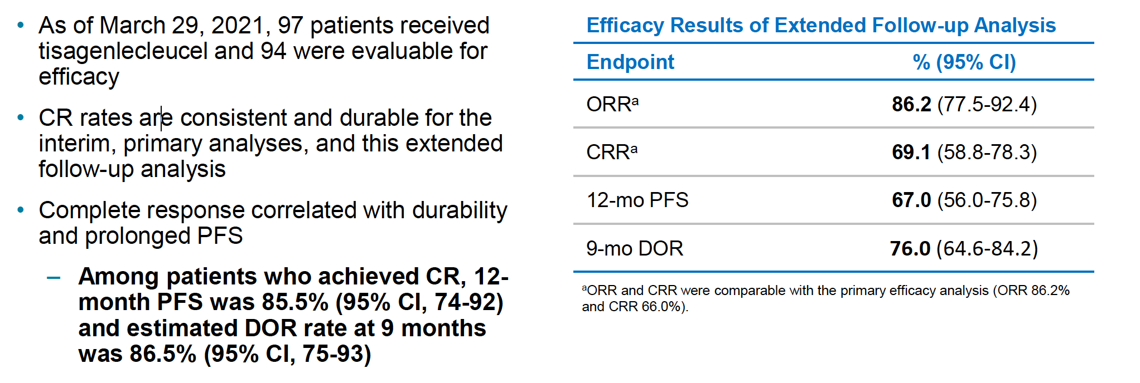
ELARA: Efficacy Analysis with Extended Follow-Up
Thieblemont C et al. ASH 2021;Abstract 131.
Courtesy of John P Leonard, MD

Slide 63
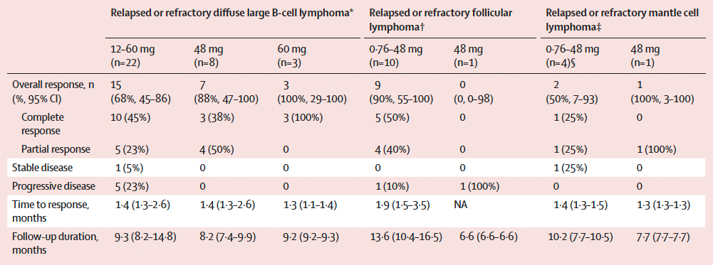
Subcutaneous Epcoritamab for R/R B-Cell NHL: Treatment Response by Diagnosis
The recommended Phase II dose was 48 mg across B-cell NHL histologies
Hutchings M et al. Lancet 2021;398:1157–69.
Courtesy of John P Leonard, MD

Slide 64
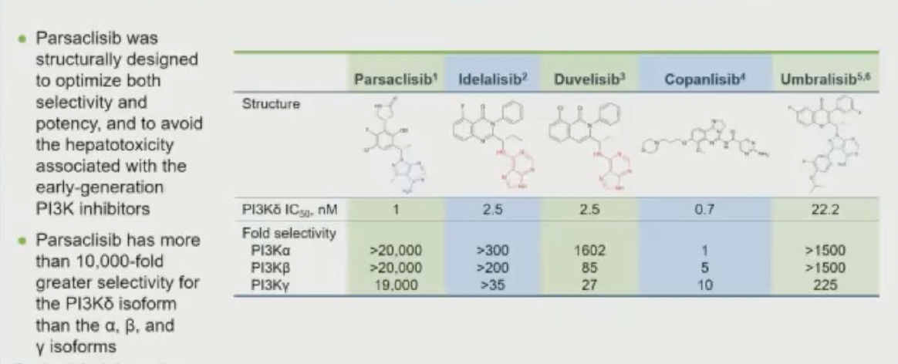
Comparative Potency and Isoform Selectivity of PI3K Inhibitors
Lynch RC et al. ASH 2021;Abstract 813.
Courtesy of John P Leonard, MD

Slide 65
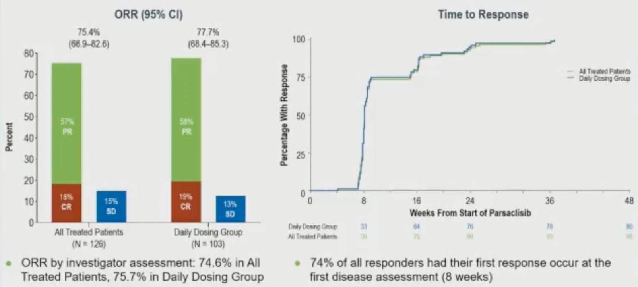
CITADEL-203 Phase II Study of the Next-Generation PI3K-Delta Inhibitor Parsaclisib in R/R FL: Objective Response by IRC
75.4%
77.7%
57%
PR
58%
PR
18%
CR
15%
SD
19%
CR
13%
SD
Lynch R et al. ASH 2021;Abstract 813.
Courtesy of John P Leonard, MD

Slide 66
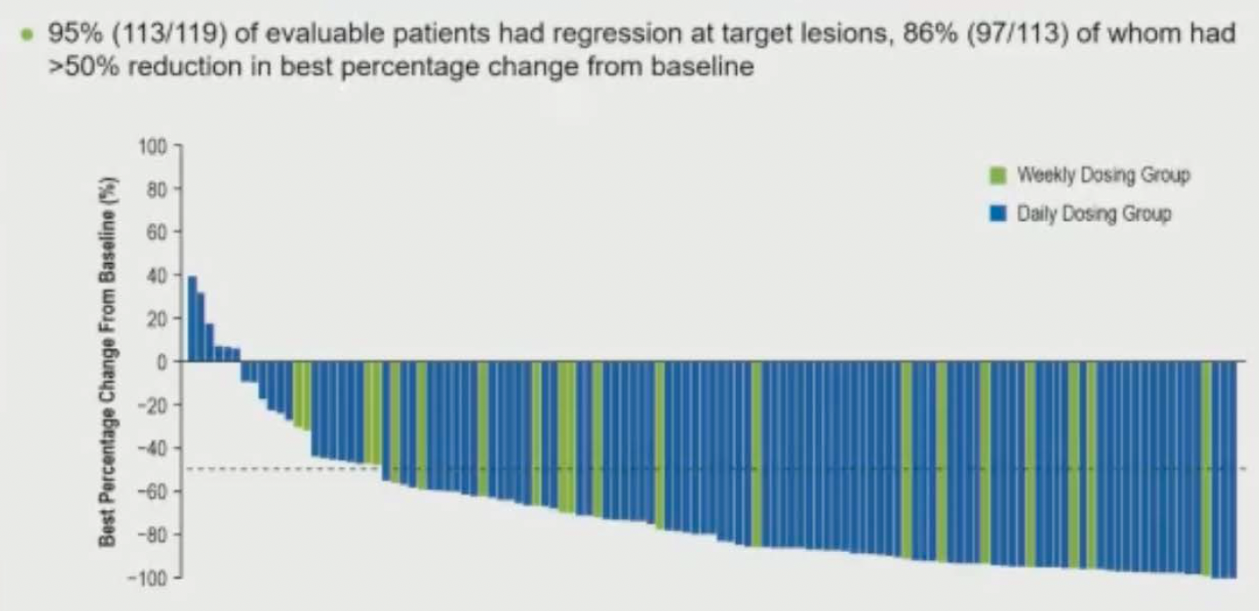
CITADEL-203 Phase II Study of the Next-Generation PI3K-Delta Inhibitor Parsaclisib in R/R FL: Change from Baseline in Target Lesion
Lynch R et al. ASH 2021;Abstract 813.
Courtesy of John P Leonard, MD

Slide 67
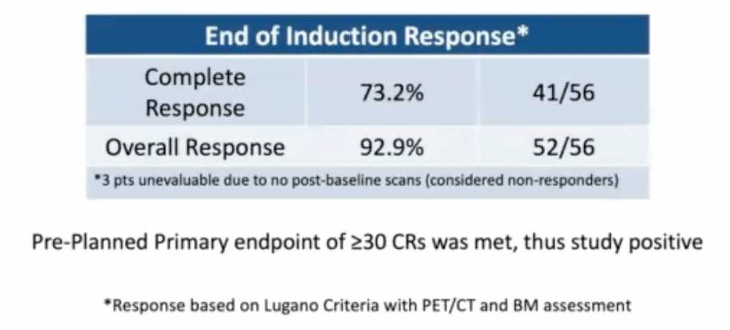
PrE0403 Phase II Study of Venetoclax + Obinutuzumab + Bendamustine as Front-Line Therapy for High Tumor Burden FL Primary Endpoint: CR at the End of Induction Therapy
Estimated 2-year OS: 94.4% Estimated 2-year PFS: 85.8%
Portell CA et al. ASH 2021;Abstract 814.
Courtesy of John P Leonard, MD

Slide 68
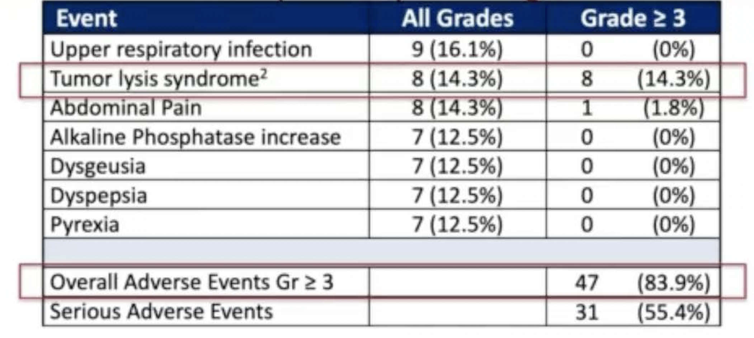
PrE0403: Venetoclax + Obinutuzumab + Bendamustine as
Front-Line Therapy for High Tumor Burden FL
Adverse Events
Portell CA et al. ASH 2021;Abstract 814.
Courtesy of John P Leonard, MD

Slide 69
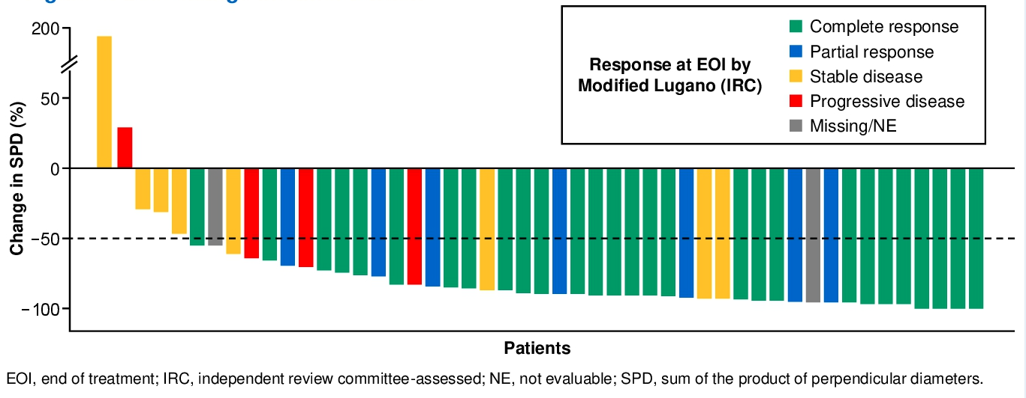
Phase Ib/II Study of Polatuzumab Vedotin + Obinutuzumab + Venetoclax for R/R Follicular Lymphoma: Response
Best change in tumor burden
*Overall response: 71%
*Complete response: 57%
*Modified Lugano 2014 response by IRC
Bannerji R et al. ASCO 2021;Abstract 7534.
Courtesy of John P Leonard, MD

Slide 70
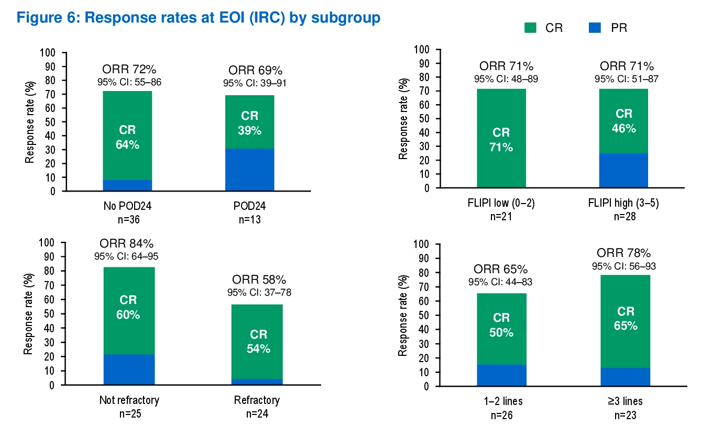

Polatuzumab Vedotin + Obinutuzumab + Venetoclax:
Response Rates at EOI by Subgroup
Bannerji R et al. ASCO 2021;Abstract 7534.
Courtesy of John P Leonard, MD

Slide 71
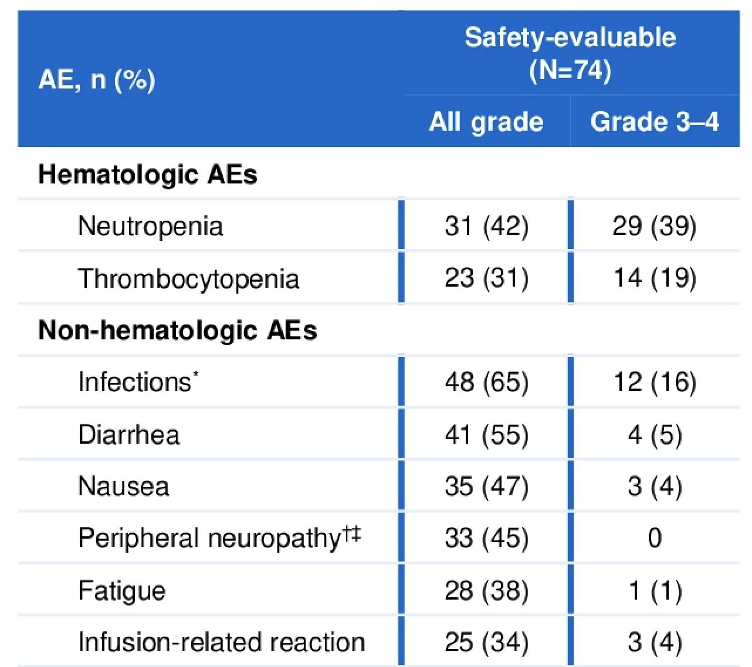
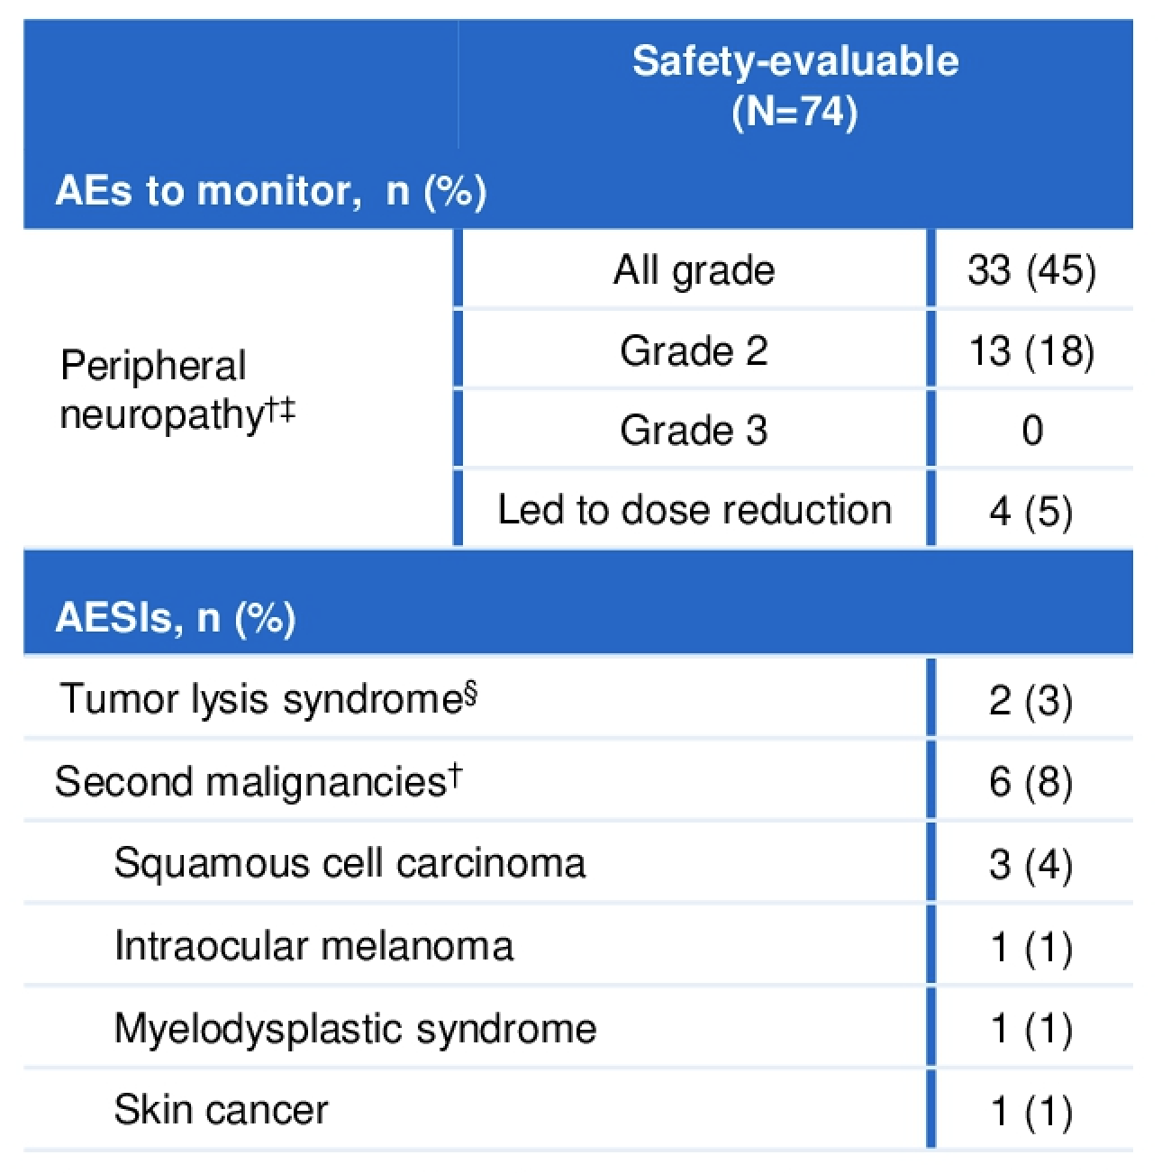
Polatuzumab Vedotin + Obinutuzumab + Venetoclax:
Adverse Events
Courtesy of John P Leonard, MD
Bannerji R et al. ASCO 2021;Abstract 7534.

Slide 72
Phase Ib/II Study of Obinutuzumab + Atezolizumab + Lenalidomide for R/R FL (N = 32): Efficacy
Efficacy endpoints | PET-CT (modified Lugano 2014) | CT-MRI (Lugano 2014)
Overall response rate | 78.1% | 81.3%
CR rate | 71.9% | 31.3%
CR rate (double-refractory) | 67.0% | Not reported
CR rate (POD24) | 50.0% | Not reported
PR rate | 6.3% | 50.0%
SD rate | 6.3% | 3.1%
PD rate | 9.4% | 12.5%
36-month PFS | 68.4%
36-month OS | 90.0%
Courtesy of John P Leonard, MD
Morschhauser F et al. Blood Cancer J 2021;11(8):147.

Slide 73
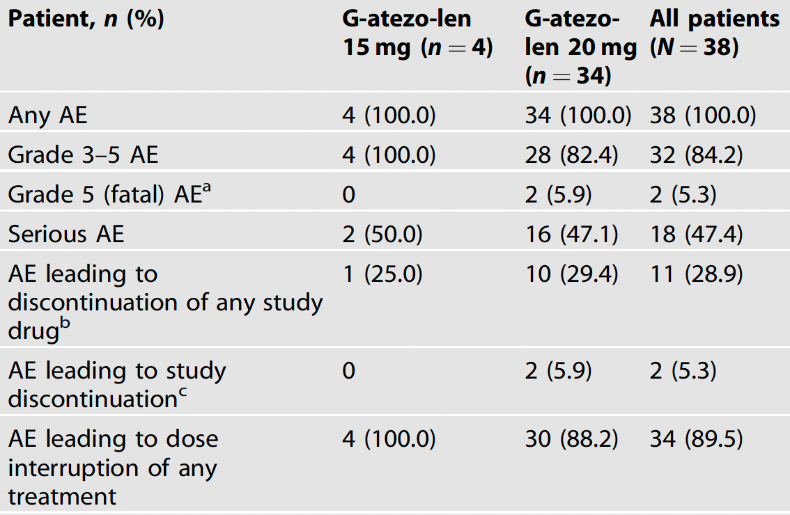
Obinutuzumab + Atezolizumab + Lenalidomide for R/R FL: Summary of Adverse Events
Courtesy of John P Leonard, MD
Morschhauser F et al. Blood Cancer J 2021;11(8):147.

