Slide 1
Year in Review: Acute Myeloid Leukemia and Myelodysplastic Syndromes Thursday, January 27, 2022 5:00 PM – 6:00 PM ET
Faculty
Daniel A Pollyea, MD, MS Gail J Roboz, MD
Moderator
Neil Love, MD

Slide 2
YiR Acute Myeloid Leukemia and Myelodysplastic Syndromes Faculty
Daniel A Pollyea, MD, MS Associate Professor of Medicine Clinical Director of Leukemia Services Robert H Allen, MD Chair in Hematology Research Division of Hematology University of Colorado School of Medicine Aurora, Colorado
Gail J Roboz, MD Director, Clinical and Translational Leukemia Programs Professor of Medicine Weill Cornell Medical College NewYork-Presbyterian Hospital New York, New York

Slide 3
Commercial Support
This activity is supported by educational grants from AbbVie Inc, Astellas and Genentech, a member of the Roche Group.

Slide 4
Dr Love — Disclosures
Dr Love is president and CEO of Research To Practice. Research To Practice receives funds in the form of educational grants to develop CME activities from the following companies: AbbVie Inc, Adaptive Biotechnologies Corporation, ADC Therapeutics, Agios Pharmaceuticals Inc, Alexion Pharmaceuticals, Amgen Inc, Array BioPharma Inc, a subsidiary of Pfizer Inc, Astellas, AstraZeneca Pharmaceuticals LP, Aveo Pharmaceuticals, Bayer HealthCare Pharmaceuticals, BeiGene Ltd, BeyondSpring Pharmaceuticals Inc, Blueprint Medicines, Boehringer Ingelheim Pharmaceuticals Inc, Bristol-Myers Squibb Company, Celgene Corporation, Clovis Oncology, Coherus BioSciences, CTI BioPharma Corp, Daiichi Sankyo Inc, Eisai Inc, EMD Serono Inc, Epizyme Inc, Exact Sciences Inc, Exelixis Inc, Five Prime Therapeutics Inc, Foundation Medicine, G1 Therapeutics Inc, Genentech, a member of the Roche Group, Genmab, Gilead Sciences Inc, GlaxoSmithKline, Grail Inc, Halozyme Inc, Helsinn Healthcare SA, ImmunoGen Inc, Incyte Corporation, Ipsen Biopharmaceuticals Inc, Janssen Biotech Inc, administered by Janssen Scientific Affairs LLC, Jazz Pharmaceuticals Inc, Karyopharm Therapeutics, Kite, A Gilead Company, Lilly, Loxo Oncology Inc, a wholly owned subsidiary of Eli Lilly & Company, Merck, Mersana Therapeutics Inc, Natera Inc, Novartis, Novocure Inc, Oncopeptides, Pfizer Inc, Pharmacyclics LLC, an AbbVie Company, Puma Biotechnology Inc, Regeneron Pharmaceuticals Inc, Sanofi Genzyme, Seagen Inc, Servier Pharmaceuticals LLC, Sumitomo Dainippon Pharma Oncology Inc, Taiho Oncology Inc, Takeda Pharmaceuticals USA Inc, Tesaro, A GSK Company, TG Therapeutics Inc, Turning Point Therapeutics Inc, Verastem Inc and Zymeworks Inc.

Slide 5
Research To Practice CME Planning Committee Members, Staff and Reviewers
Planners, scientific staff and independent reviewers for Research To Practice have no relevant conflicts of interest to disclose.

Slide 6
Dr Pollyea — Disclosures
Advisory Committee | AbbVie Inc, Amgen Inc, Aprea Therapeutics, Astellas, Bristol-Myers Squibb Company, Celgene Corporation, Foghorn Therapeutics, Genentech, a member of the Roche Group, Gilead Sciences Inc, GlycoMimetics Inc, Jazz Pharmaceuticals Inc, Kiadis Pharma, Novartis, Syndax Pharmaceuticals Inc, Syros Pharmaceuticals Inc, Takeda Pharmaceuticals USA Inc
Consulting Agreements | AbbVie Inc, Genentech, a member of the Roche Group, Gilead Sciences Inc, GlycoMimetics Inc, Novartis, Syros Pharmaceuticals Inc
Contracted Research | AbbVie Inc, Pfizer Inc, Teva Oncology
Data and Safety Monitoring Board/Committee | AbbVie Inc, GlycoMimetics Inc, Takeda Pharmaceuticals USA Inc

Slide 7
Dr Roboz — Disclosures
Consulting Agreements | AbbVie Inc, Actinium Pharmaceuticals Inc, Agios Pharmaceuticals Inc, Amgen Inc, Astellas, Astex Pharmaceuticals, AstraZeneca Pharmaceuticals LP, Bayer HealthCare Pharmaceuticals, Blueprint Medicines, Bristol-Myers Squibb Company, Celgene Corporation, Daiichi Sankyo Inc, Genentech, a member of the Roche Group, GlaxoSmithKline, Helsinn Healthcare SA, Janssen Biotech Inc, Jasper Therapeutics Inc, Jazz Pharmaceuticals Inc, MEI Pharma Inc (IDMC Chair), Mesoblast, Novartis, Otsuka America Pharmaceutical Inc, Pfizer Inc, Sandoz Inc, a Novartis Division, Takeda Pharmaceuticals USA Inc (IRC Chair)
Contracted Research | Janssen Biotech Inc
Data and Safety Monitoring Board/Committee | MEI Pharma Inc, Takeda Pharmaceuticals USA Inc

Slide 8
Agenda
Module 1: Acute Myeloid Leukemia – Dr Pollyea
Module 2: Myelodysplastic Syndromes – Dr Roboz

Slide 9
When did you finish your oncology fellowship/enter clinical practice?
Less than 5 years ago
5-10 years ago
11-20 years ago
21-30 years ago
31-40 years ago
More than 40 years ago

Slide 10
Richard M Stone, MD

Slide 11
Agenda
Module 1: Acute Myeloid Leukemia
Measurable residual disease response in VIALE-A
Venetoclax and intensive chemotherapy
Venetoclax/decitabine for high-risk younger patients
Venetoclax/hypomethylating agents/magrolimab
Future of venetoclax
FLT3 mutations
IDH1 versus IDH2 mutations
Combination therapy for IDH1/2
Module 2: Myelodysplastic Syndromes

Slide 12
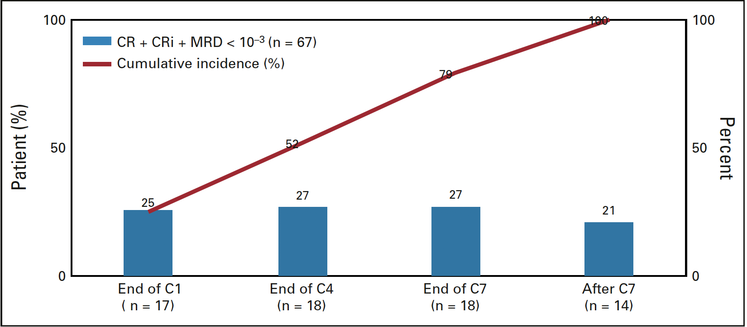
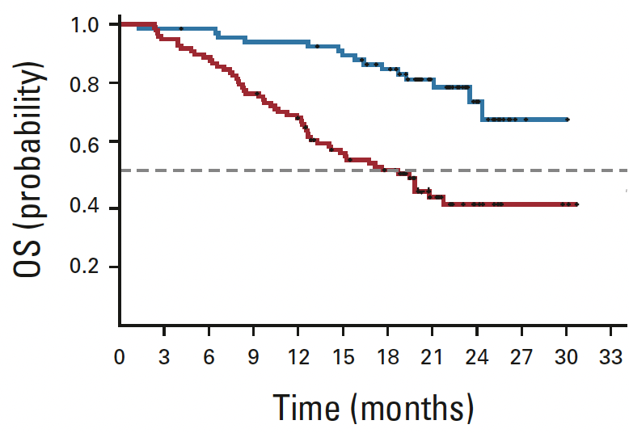
Can MRD Negativity be Achieved with a Lower Intensity Regimen?
41% of responding patients in VIALE-A were MRD<10⁻³
Higher rates in the NPM1+ group
Occurred early and late
Longer remission duration (not reached vs 9.7 mos)
Better event free survival (not reached vs 10.6 mos)
Better OS (not reached vs 18.7 mos)
Pratz et al, JCO 2021
Courtesy of Daniel A Pollyea, MD, MS

Slide 13
Measurable Residual Disease
Possible to get to MRD negative state with venetoclax
Important to understand/predict these patients so that we can apply transplantation more judiciously
Understanding the mechanism of a deep remission may help us treat those who have relatively poor responses
Courtesy of Daniel A Pollyea, MD, MS

Slide 14
Venetoclax + Intensive Chemotherapy
High response rates
High MRD negative rates
Will it be better than intensive chemotherapy alone?
Would it be better than venetoclax+HMA alone?
Courtesy of Daniel A Pollyea, MD, MS

Slide 15
Venetoclax + Decitabine for Younger Newly Diagnosed Patients with ELN Adverse Risk AML
Standard venetoclax/decitabine
If FLT3+ added sorafenib in some
Those who responded had 1-2 cycles of HIDAC followed by allo SCT
14 evaluable patients, compared to historical controls with 7+3
Chen S et al. ASH 2021 #35
Courtesy of Daniel A Pollyea, MD, MS

Slide 16
The End of Chemotherapy?
Ultimately will require randomized study
We are doing this with ven/aza and no HIDAC (Gutman et al, ASH 2020)
Preliminary results presented last year
8 patients
75% response rate
NCT03573024
Courtesy of Daniel A Pollyea, MD, MS

Slide 17
What Does it Mean to Be Adverse Risk?
Adverse risk factors all defined in relation to intensive chemotherapy
Do they still apply when you are using a novel regimen?
Courtesy of Daniel A Pollyea, MD, MS

Slide 18
Triple Combination of Venetoclax with a Non-Genomically Targeted Therapy
Courtesy of Daniel A Pollyea, MD, MS

Slide 19
Manufacturer Announces Partial Clinical Hold for Studies Evaluating Magrolimab in Combination With Azacitidine — January 25, 2022
“The U.S. Food and Drug Administration (FDA) has placed a partial clinical hold on studies evaluating the combination of magrolimab plus azacitidine due to an apparent imbalance in investigator-reported suspected unexpected serious adverse reactions (SUSARs) between study arms. While no clear trend in the adverse reactions or new safety signal has been identified at this time, the partial clinical hold is being implemented by the manufacturer across all ongoing magrolimab and azacitidine combination studies worldwide in the best interests of patients as additional data is gathered and analyzed to address the concerns raised by FDA.
During the partial clinical hold, screening and enrollment of new study participants will be paused in any study investigating the combination of magrolimab with azacitidine. Patients already enrolled in these clinical studies may continue to receive magrolimab and azacitidine, or placebo, and continue to be closely monitored according to the current study protocol. Other magrolimab studies, or cohorts, that are not studying the combination of magrolimab plus azacitidine, will continue without any impact by the partial clinical hold.”

Slide 20
Magrolimab with Ven/Aza
Randomized phase 3 study for up-front patients ongoing (ENHANCE-3)
Too soon to tell if it adds anything in the R/R setting
Will watch to see the signal in TP53+ patients
Courtesy of Daniel A Pollyea, MD, MS

Slide 21
Future for Venetoclax
Learning more about its mechanism
Re-assessing risk AML risk factors…adverse is not necessarily adverse!
Understanding who it doesn’t work for and overcoming this resistance
Courtesy of Daniel A Pollyea, MD, MS

Slide 22
Targeting FLT3
Based on the ADMIRAL trial, gilteritinib is approved for R/R AML due to its superiority compared with standard salvage chemotherapy
Similar findings from a Phase 3 study in Asians with 234 patients reported at ASH
Courtesy of Daniel A Pollyea, MD, MS

Slide 23
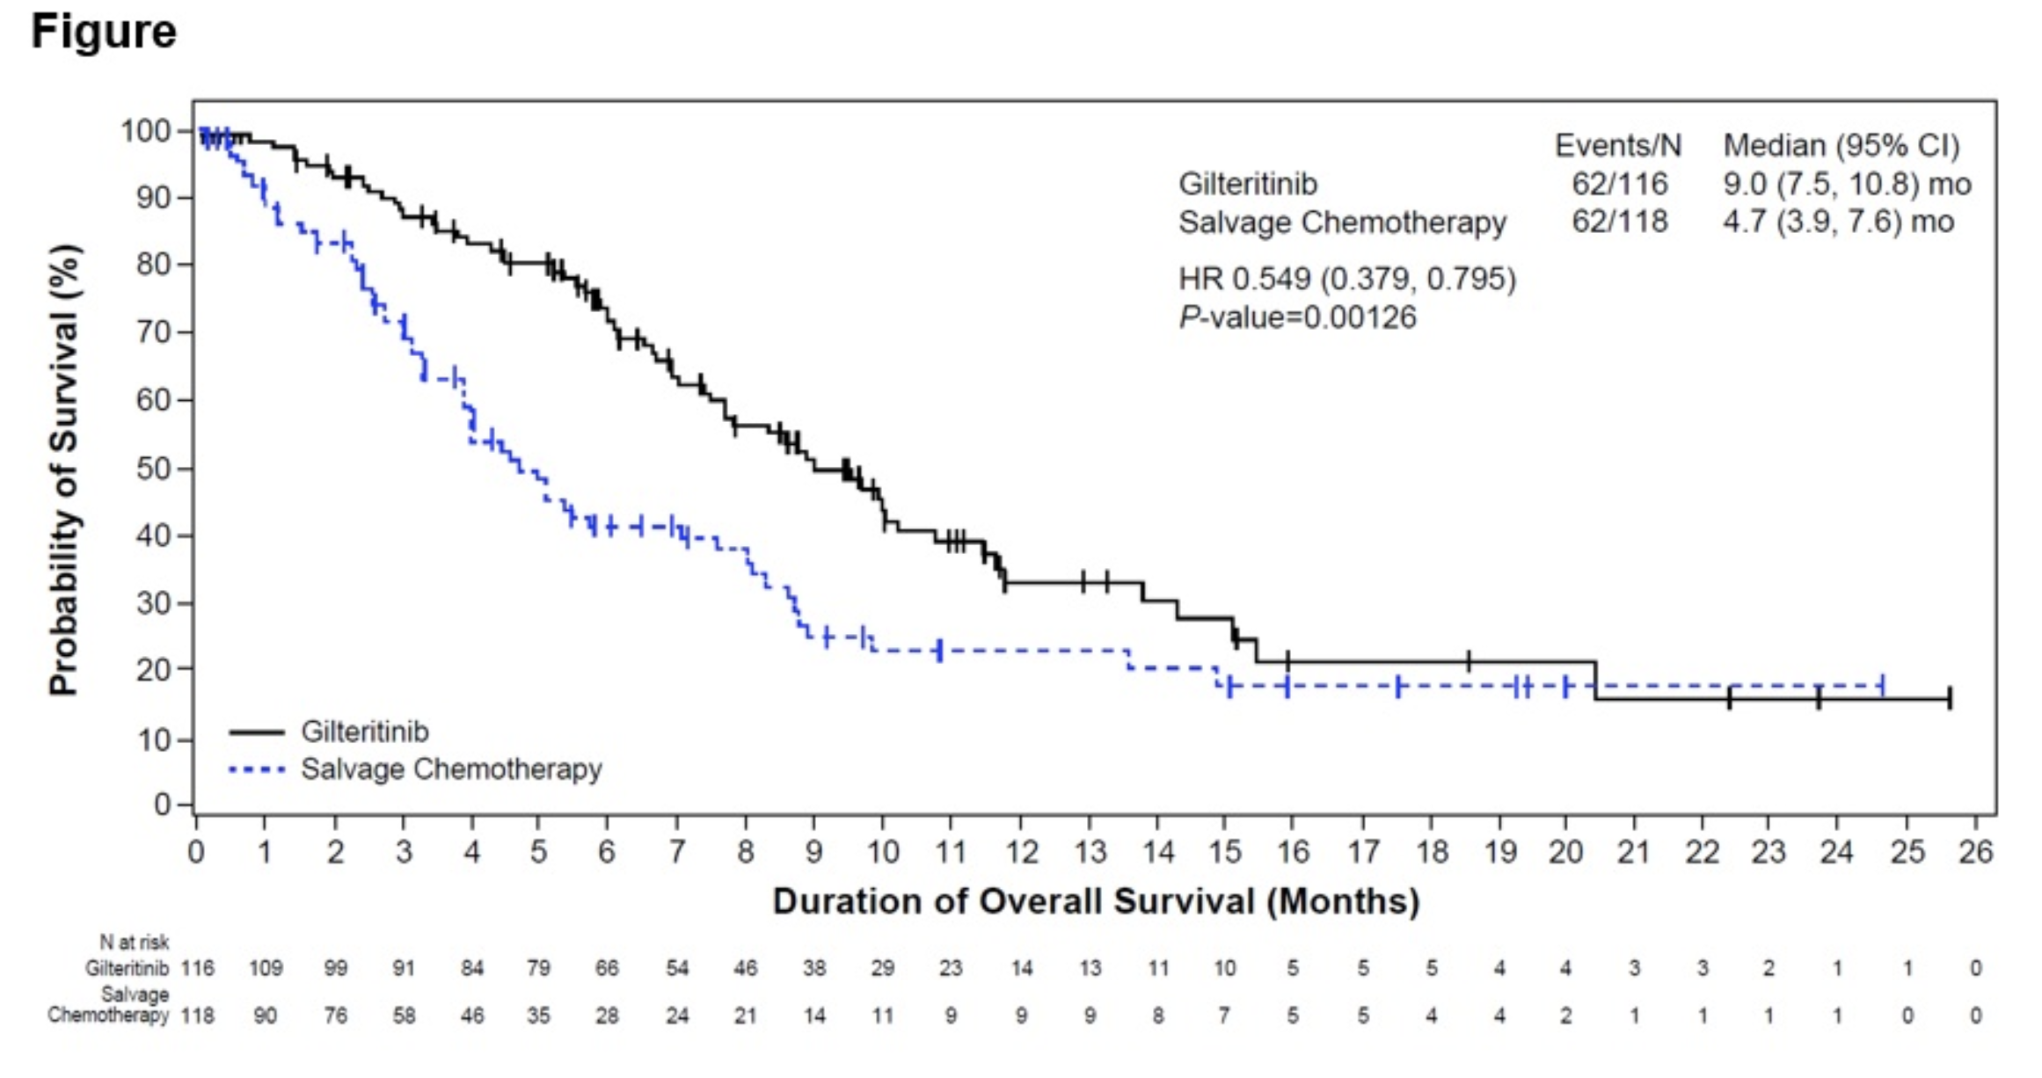
Wang J et al, ASH 2021 #695
Courtesy of Daniel A Pollyea, MD, MS

Slide 24
Do These Results Hold Up Over Time?
ASCO abstract from Perl et al updates the ADMIRAL study after 2 years
Courtesy of Daniel A Pollyea, MD, MS

Slide 25
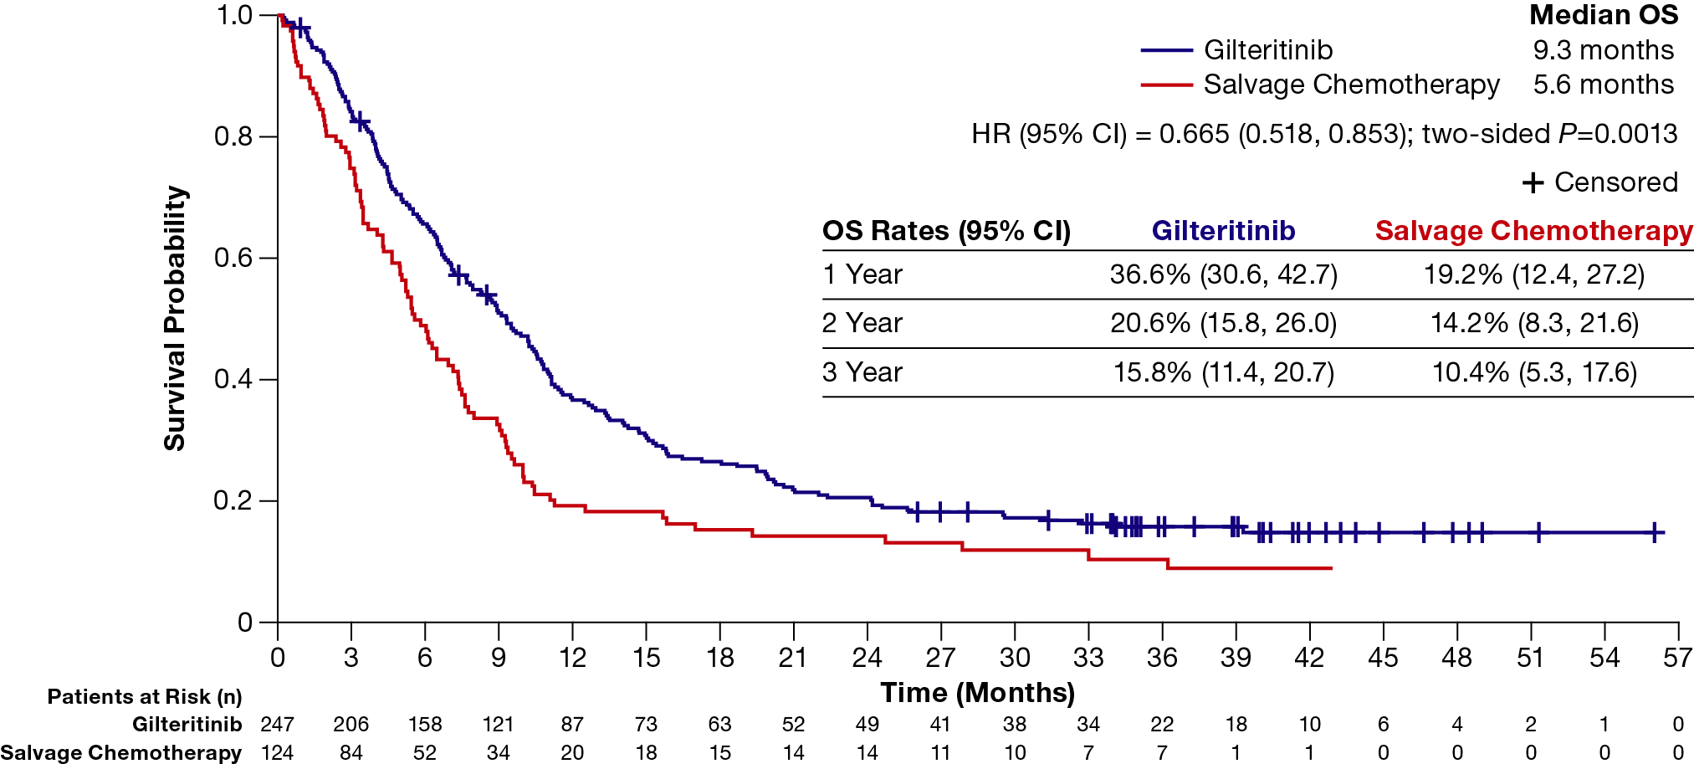
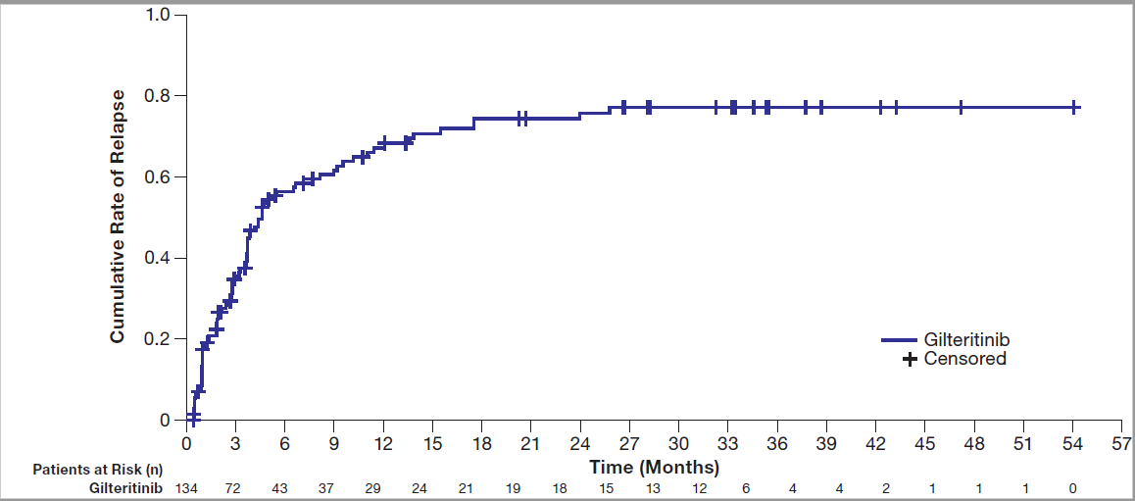
Overall Survival and Cumulative Relapse Rate
Overall Survival in R/R FLT3^{mut+} AML Patients (ITT Population; N=371)
Cumulative Incidence of Relapse in Patients Achieving CRc With Gilteritinib
With a median follow-up of 37.1 months, the median OS remained longer with gilteritinib than with salvage chemotherapy
Most relapses after CRc occurred within 12 months and rarely occurred after 18 months
Abbreviations: CI, confidence interval; CRc, composite complete remission; HR, hazard ratio; ITT, intention-to-treat.
Courtesy of Daniel A Pollyea, MD, MS

Slide 26
Take Aways
Gilteritinib is the standard of care for R/R FLT3 AML
Outcomes remain poor and better strategies are needed
How about adding to venetoclax?
Courtesy of Daniel A Pollyea, MD, MS

Slide 27
Aza+Ven+Gilteritinib in FLT3-mutated AML: Regimen
Consolidation
(up to 24 cycles)
Induction
Relapsed/refractory FLT3-mutated* AML or high-risk MDS or CMML
or
Newly diagnosed FLT3-mutated* AML unfit for intensive chemotherapy
Azacitidine
75 mg/m² IV/SC on D1-7
Venetoclax#
D1-28 (bone marrow on D14)%
Gilteritinib
80-120 mg on D1-28
Azacitidine
75 mg/m² IV/SC on D1-5
Venetoclax
400mg on D1-7
Gilteritinib
80-120 mg on D1-28
* FLT3-ITD or FLT3 D835 mutations allowed
# Venetoclax ramp-up during cycle 1:
100mg on D1, 200mg on D2, 400mg on D3+
% If <5% blasts or insufficient on C1D14, venetoclax held (both cohorts) and gilteritinib held (frontline only)
Primary endpoints: MTD of gilteritinib in combination (phase I), CR/CRi rate (phase II)
Secondary endpoints: CR rate, MRD negativity rate, duration of response, OS, safety
Courtesy of Daniel A Pollyea, MD, MS
Short et al, ASH 2021

Slide 28
Gilteritinib “Triple Combination”
In newly diagnosed patients, high response rate but do we need FLT3 inhibitors up-front with venetoclax?
Doesn’t contribute much to R/R who have had venetoclax
Toxicity must be managed
Courtesy of Daniel A Pollyea, MD, MS

Slide 29
Should FLT3 be Targeted in the Newly Diagnosed “Unfit” Setting?
Ven/HMA is standard of care here and better than HMA
What if you use gilteritinib+aza vs aza alone?
Courtesy of Daniel A Pollyea, MD, MS

Slide 30
LACEWING (NCT02752035) Study Design
Safety cohort
(N=15)
Administered over 28-day cycles
GIL
30-day follow-up, then every 3 months for up to 3 years^{c}
Newly diagnosed FLT3^{mut+} AML not eligible for intensive induction chemotherapy
Gilteritinib 120 mg PO daily on Days 1-28
Randomized
2:1ª
(N=145)
Gilteritinib 120 mg PO daily on Days 1-28, and
Azacitidine 75 mg/m² IV or SC daily on Days 1-7
GIL+AZA
Primary Endpoint
Overall survival (OS)
AZA
Azacitidine 75 mg/m² IV or SC daily on Days 1-7
Key secondary: Event-free survival (EFS)^{b}
Other secondary: Response, safety/tolerability
Exploratory: Pharmacokinetics
Additional Endpoints
Statistical analyses
Group sequential design prespecified with an interim and a final analysis
Time-to-event endpoints: Kaplan-Meier estimates
Response: Cochran-Mantel-Haenszel test
Pharmacokinetics parameters: standard noncompartmental analysis
ªRandomization (stratified by age, ≥75 years or <75 years) was initially 1:1:1 until the gilteritinib arm was removed due to preferred therapy changes.
^{b}EFS is time from date of randomization until date of documented relapse from CR, treatment failure (randomization date), or death from any cause. Treatment failure was failure to achieve CR after completing six cycles, permanent discontinuation of treatment without achieving CR prior to completing six cycles, or lack of post-baseline disease assessment. The randomization date was used as the treatment failure date.
^{c}Data from long-term follow-up ≤3 years were obtained, including subsequent AML therapy.
Abbreviations: AML, acute myeloid leukemia; AZA, azacitidine; CR, complete remission; EFS, event-free survival; FLT3, FMS-like tyrosine kinase; GIL, gilteritinib; IV, intravenous; OS, overall survival; PO, by mouth; SC, subcutaneous.
Courtesy of Daniel A Pollyea, MD, MS
Wang et al, ASH 2021

Slide 31
Take Aways
No change in OS despite higher response rates for gilteritinib
Maybe because aza alone patients more likely to be salvaged (10 vs 2 patients) or more patients in gilteritinib group with worse ECOG PS (47% vs 33%)
Even if positive this study would likely not have changed the standard of care
Courtesy of Daniel A Pollyea, MD, MS

Slide 32
Up-Front FLT3 Inhibitors in “Fit” Patients
Current standard of care is to use midostaurin with 7+3
Quizartinib is a more specific “next generation” FLT3 inhibitor
Only active against FLT3 ITD (not TKD)
Was not approved for R/R AML
Compared to 7+3 for FLT3+ newly diagnosed AML
Courtesy of Daniel A Pollyea, MD, MS

Slide 33
Future Landscape
Will quizartinib (or another FLT3 inhibitor) displace midostaurin in up-front AML?
Could either benefit newly diagnosed “unfit” patients with venetoclax?
Should triplet combinations be standard in R/R FLT3+ AML?
Courtesy of Daniel A Pollyea, MD, MS

Slide 34
Targeting IDH
Established strategy in the R/R setting as a single agent…or is it?
Can we do better with combinations?
Can we move it up-front?
Courtesy of Daniel A Pollyea, MD, MS

Slide 35
IDH Inhibitors in IDH+ R/R AML are Standard of Care
FDA approved
Listed in NCCN
Based on single arm uncontrolled studies
What would you see in a randomized study?
Courtesy of Daniel A Pollyea, MD, MS

Slide 36
Ivosidenib + Azacitidine for Newly Diagnosed “Unfit” AML
Ivo/aza clearly superior
How does this (or should it) impact the current treatment landscape with venetoclax?
Different finding than seen with IDH2…
Courtesy of Daniel A Pollyea, MD, MS

Slide 37
Different Outcomes for IDH1 and IDH2?
Ivosidenib and enasidenib seem equivalent in the R/R setting
Differences in salvage or crossover for the control arm of these two studies?
Courtesy of Daniel A Pollyea, MD, MS

Slide 38
Triple Combinations with IDH Inhibitors and Venetoclax
Ivosidenib + venetoclax + azacitidine
Newly diagnosed and R/R
Small numbers
Courtesy of Daniel A Pollyea, MD, MS

Slide 39
Agenda
Module 1: Acute Myeloid Leukemia
Module 2: Myelodysplastic Syndromes (MDS)
IPSS-M: New MDS prognostic score
PANTHER trial: Pevonedistat/azacitidine
ENHANCE trial: Magrolimab/azacitidine
Venetoclax/azacitidine for treatment naïve MDS
Venetoclax/hypomethylating agents (HMA) for higher-risk MDS
ASCERTAIN trial: Oral decitabine/cedazuridine
Sabatolimab/HMA for higher-risk MDS
IDH2 mutations
IDIOME trial: Ivosidenib for MDS with an IDH1 mutation

Slide 40
Courtesy of Gail J Roboz, MD

Slide 41
Development of IPSS-M: Conclusions
IPSS-M combines conventional parameters with mutations in 31 key genes to improve MDS risk stratification
Risk score is personalized as a continuous score, reproducible, and interpretable, as 1-unit increase in score doubles risk
6-category risk schema developed
Includes a strategy to handle missing data and a web calculator
Bernard. ASH 2021. Abstr 61.
Courtesy of Gail J Roboz, MD

Slide 42
PANTHER: Study Design
Global, multicenter, randomized, open-label phase III trial
Stratification into 4 groups by disease type (very high, high, int-risk MDS/CMML; AML)
Patients ≥18 yr with higher-risk MDS/CMML or AML with 20%-30% blasts, no previous HMAs, ineligible for alloSCT
(N = 454*)
Pevonedistat + Azacitidine
(n = 227)
Treatment until PD, relapse, unacceptable toxicity, transformation to AML, or death
Azacitidine
(n = 227)
*n = 324 with higher-risk MDS; n = 27 with CMML; n = 103 w/ low blast AML. Dosing in 28-day cycles: pevonedistat, 20 mg/m² IV on Days 1, 3, 5; azacitidine 75 mg/m² IV or SC on Days 1-5, 8, 9.
Primary endpoint: EFS (time from randomization to death or transformation to AML for patients with higher-risk MDS/CMML, or time to death for patients with AML)
Key secondary endpoint: OS
EFS and OS tested sequentially in higher-risk MDS cohort and ITT population using separate hierarchical testing procedures, with subsequent OS testing in AML cohort
Sekeres. ASH 2021. Abstr 242.
Courtesy of Gail J Roboz, MD

Slide 43
PANTHER: Conclusions
PANTHER did not meet the primary endpoint of EFS in patients with higher-risk MDS/CMML or AML with 20% to 30% blasts
Post-hoc analysis showed greater OS benefit with pevonedistat + azacitidine vs azacitidine alone in patients with higher-risk MDS who received >3 treatment cycles; benefit even more pronounced with >6 cycles
No new safety signals with pevonedistat + azacitidine; azacitidine dose intensity maintained in both arms
Investigators concluded that results underscore the importance of large, randomized controlled trials in heterogeneous myeloid diseases
Longitudinal clonal evolution studies ongoing to identify treatment effects on specific clones
Sekeres. ASH 2021. Abstr 242.
Courtesy of Gail J Roboz, MD

Slide 44
Courtesy of Gail J Roboz, MD

Slide 45
Courtesy of Gail J Roboz, MD

Slide 46
ENHANCE: Magrolimab + Azacitidine vs Placebo + Azacitidine in Treatment Naive Higher-risk MDS
Randomized, double-blind, phase III trial
Primary endpoints: CR, OS
Secondary endpoints: Duration of CR, ORR, DoR, RBC TI, PFS, EFS, MRD negative RR, time to transformation to AML, safety, PK
Magrolimab* +
+ Azacitidine 75 mg/m² days 1-7
Patients with untreated intermediate to very high risk MDS by IPSS-R, adequate PS (Planned N = 520)
Until disease progression, loss of benefit, unacceptable toxicity, or 5 yr
Placebo + Azacitidine 75 mg/m² days 1-7
*Cycle 1: 1mg/kg priming dose on D1, D4; 15 mg/kg on D8; 30 mg/kg on D11, 15, 22. Cycle 2: 30 mg/kg once weekly (D1, 8, 15, 22). Cycle ≥3: 30 mg/kg Q2W on D1, D15.
Garcia-Manero. ASCO 2021. Abstr TPS7055. NCT04313881.
Courtesy of Gail J Roboz, MD

Slide 47
Venetoclax/Azacitidine in Treatment-Naive HR-MDS: Background
The BCL-2 inhibitor venetoclax has shown synergy with hypomethylating agents such as azacitidine in preclinical studies and in clinical trials in patients with myeloid malignancies¹⁻⁴
Mechanism of action: Azacitidine targets BCL-X_{L} and MCL-1, and venetoclax targets BCL-2; all 3 targets are expressed on HR-MDS blast cells
Current study undertaken to evaluate combination of venetoclax and azacitidine in patients with treatment-naive HR-MDS⁵
1. Jin. Clin Cancer Res. 2020;26:3371. 2. Jilg. Exp Hematol Oncol. 2019;8:9. 3. DiNardo. Am J Hematol. 2018;93:4014. 4. DiNardo. NEJM. 2020;383:617. 5. Garcia. ASH 2021. Abstr 241.
Courtesy of Gail J Roboz, MD

Slide 48
Courtesy of Gail J Roboz, MD

Slide 49
Courtesy of Gail J Roboz, MD

Slide 50
Venetoclax/Azacitidine in Treatment-Naive HR-MDS (Phase Ib): Investigator Conclusions
In this phase Ib trial, venetoclax/azacitidine had an acceptable safety profile in patients with treatment-naive higher-risk MDS
RP2D venetoclax 400 mg on D1-14 + azacitidine 75 mg/m² induced rapid, durable responses and a high remission rate
Clinical and molecular responses were observed across mutational profiles, including in patients with poor prognostic mutations
Garcia. ASH 2021. Abstr 241.
Courtesy of Gail J Roboz, MD
Notes:
HR, higher-risk; MDS, myelodysplastic syndromes; RP2D, recommended phase II dose.

Slide 51
Courtesy of Gail J Roboz, MD

Slide 52
Venetoclax and HMA in Higher-Risk MDS: Conclusions
In this retrospective analysis, treatment with first-line HMA + venetoclax was associated with significantly higher CR rates vs HMA alone in patients with higher-risk MDS, including those with ASXL-1–mutant MDS
Investigators suggested promising clinical activity of first-line HMA + venetoclax in patients who proceed to AHSCT
Caveats: small population, short follow-up of combination therapy group
No adverse event or dose adjustment data available
Adding venetoclax to HMA after relapse may prolong OS
Prospective, randomized trial needed to confirm findings
Komrokji. ASH 2021. Abstr 536.
Courtesy of Gail J Roboz, MD

Slide 53
Courtesy of Gail J Roboz, MD

Slide 54
Courtesy of Gail J Roboz, MD

Slide 55
Courtesy of Gail J Roboz, MD

Slide 56
Courtesy of Gail J Roboz, MD

Slide 57
Courtesy of Gail J Roboz, MD

Slide 58
Sabatolimab + HMA for vHR/HR-MDS and ND-AML: Study Design
Multiarm, open-label phase Ib dose escalation and dose expansion study
Primary endpoints: MTD, recommended dose, safety, tolerability
Secondary endpoints: ORR, DoR
28-Day
Cycles
HMA
Patients with
vHR/HR-MDS (by IPSS-R) or
ND-AML who are unfit and ineligible for standard chemotherapy; prior HMA therapy excluded
(N = 101)
Decitabine Arm
20 mg/m² Days 1-5
(n = 41)
Sabatolimab Q2W
Day 8: 240 mg,
400 mg, or 800 mg
and
Day 22: 240 mg
or 400 mg
Azacitidine Arm
75 mg/m² Days 1-7
(n = 60)
Brunner. ASH 2021. Abstr 244.
Courtesy of Gail J Roboz, MD

Slide 59
Courtesy of Gail J Roboz, MD

Slide 60
Sabatolimab + HMA for vHR/HR-MDS and ND-AML: Conclusions
In patients with vHR/HR-MDS or newly diagnosed AML, sabatolimab in combination with HMA was generally well tolerated
Common AEs similar to HMA alone, immune-mediated AEs uncommon
Treatment resulted in durable clinical benefit, including in patients with adverse risk factors
vHR/HR-MDS: ORR, 56.9%; median DoR, 17.1 mo (95% CI: 6.7-NE)
ND-AML: ORR, 42.5%; median DoR, 12.6 mo (95% CI: 5.2-18.0)
Evaluation of sabatolimab-based therapy in patients with MDS and AML ongoing in phase II/III STIMULUS clinical trial program
Brunner. ASH 2021. Abstr 244.
Courtesy of Gail J Roboz, MD

Slide 61
Courtesy of Gail J Roboz, MD

Slide 62
Courtesy of Gail J Roboz, MD

Slide 63
Courtesy of Gail J Roboz, MD

Slide 64
Courtesy of Gail J Roboz, MD

