Slide 1
Challenging Cases from the Community:
Investigators Provide Perspectives on the Optimal Management of Diffuse Large B-Cell Lymphoma
A CME/MOC-Accredited Virtual Event
Tuesday, September 13, 2022
5:00 PM – 6:00 PM ET
Faculty
Jeremy Abramson, MD
Sonali M Smith, MD
Jason Westin, MD, MS
Moderator
Neil Love, MD

Slide 2
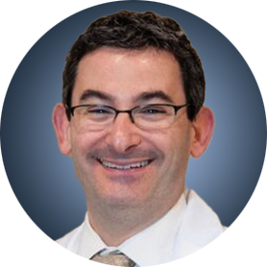
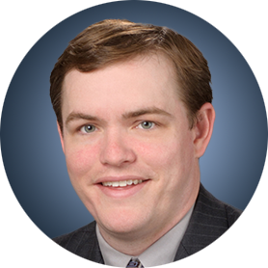

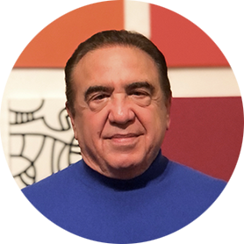
Faculty
Jeremy Abramson, MD
Director, Center for Lymphoma
Massachusetts General Hospital
Associate Professor of Medicine
Harvard Medical School
Boston, Massachusetts
Jason Westin, MD, MS
Director, Lymphoma Clinical Research
Section Chief, Aggressive Lymphoma
Department of Lymphoma and Myeloma
The University of Texas
MD Anderson Cancer Center
Houston, Texas
Sonali M Smith, MD
Elwood V Jensen Professor of Medicine
Chief, Section of Hematology/Oncology
Co-Leader, Cancer Service Line
Co-Director, Lymphoma Program
The University of Chicago
Chicago, Illinois
MODERATOR
Neil Love, MD
Research To Practice

Slide 3
Management of DLBCL
Where We Are, Where We’re Headed
PROLOGUE
MODULE 1: First-Line Treatment
MODULE 2: Bispecific Antibodies
MODULE 3: CAR T-Cell Therapy
MODULE 4: Sequencing of Novel Agents
MODULE 5: Appendix

Slide 4
Management of DLBCL
Where We Are, Where We’re Headed
Clinical Cases
Dr Morganstein: 43-year-old man with newly diagnosed GCB-subtype Stage III DLBCL
Dr Parsons: 59-year-old woman with Stage IV double-hit DLBCL and extensive bone involvement
Dr Choksi: 77-year-old symptomatic man with longstanding CLL and Richter’s transformation
Dr Ku: 66-year-old woman with newly diagnosed nonbulky Stage II DLBCL
Dr Morganstein: 75-year-old man with a history of severe CHF with a pulmonary nodule and regional adenopathy that on biopsy is proven to be DLBCL
Dr Yang: 73-year-old woman with rapid relapse after R-CHOP then R-ICE/ASCT achieves a CR with CAR T-cell therapy but experiences severe pancytopenia
Dr Mushtaq: 45-year-old man with R-CHOP-refractory DLBCL receives polatuzumab vedotin as bridging therapy → CAR T-cell therapy on protocol
Dr Gupta: 68-year-old man with cardiac comorbidities and relapsed DLBCL while on R-CHOP receives
second-line polatuzumab vedotin/BR

Slide 5
Accreditation Information
Target Audience
This activity is intended for hematologists, hematology-oncology fellows, medical oncologists, radiation oncologists and other healthcare providers involved in the treatment of diffuse large B-cell lymphoma.
Educational Objectives
Upon completion of this activity, participants should be able to
Apply available clinical research findings in the formulation of evidence-based therapeutic approaches for the treatment of newly diagnosed and relapsed/refractory (R/R) diffuse large B-cell lymphoma (DLBCL).
Appraise published Phase III clinical trial data documenting the benefit of CD79b-targeted therapy as a component of first-line treatment for patients with DLBCL, and consider the implications of these findings for current clinical management algorithms.
Appreciate long-term efficacy and safety data with FDA-approved chimeric antigen receptor (CAR) T-cell therapies directed at CD19, and identify patients with R/R DLBCL for whom this approach may be warranted.
Assess Phase III clinical trial data documenting the benefit of various CAR T-cell platforms as second-line therapy for patients with R/R DLBCL, and consider the potential application of these findings in routine clinical decision-making.
Review pivotal clinical trial findings leading to the FDA approval of other novel compounds with unique mechanisms of action for R/R DLBCL, and identify patients for whom treatment with these approaches would be appropriate.
Compare and contrast the side effects associated with available and emerging therapeutic strategies for DLBCL, and formulate supportive care plans to minimize and manage these toxicities.
Recall ongoing clinical research evaluating novel agents and strategies for DLBCL, and counsel appropriate patients regarding the potential benefits of trial participation.

Slide 6


Accreditation Information
    In support of improving patient care, this activity has been planned and implemented by Medical Learning Institute, Inc. and Research To Practice. Medical Learning Institute, Inc. is jointly accredited by the Accreditation Council for Continuing Medical Education (ACCME), the Accreditation Council for Pharmacy Education (ACPE), and the American Nurses Credentialing Center (ANCC), to provide continuing education for the healthcare team.
    Physician Continuing Medical Education
Medical Learning Institute, Inc. (MLI) designates this live activity for a maximum of 1.0 AMA PRA Category 1 CreditTM. Physicians should claim only the credit commensurate with the extent of their participation in the activity.
MOC Statement
Successful completion of this CME activity, which includes participation in the evaluation component,
enables the participant to earn up to 1.0 MOC point in the American Board of Internal Medicine’s (ABIM) Maintenance of Certification (MOC) program. It is the CME activity provider’s responsibility to submit participant completion information to ACCME for the purpose of granting ABIM MOC credit.
Participation information will be shared through the ACCME’s Program and Activity Reporting System (PARS).
Support Statement
This CE activity is supported through educational grants from Genentech, a member of the Roche Group,
and Kite, A Gilead Company.

Slide 7
Dr Abramson — Disclosures
Consulting Agreements | AbbVie Inc, AstraZeneca Pharmaceuticals LP, BeiGene Ltd, bluebird bio, Bristol-Myers Squibb Company, Caribou Biosciences Inc, Century Therapeutics, Epizyme Inc, Genentech, a member of the Roche Group, Genmab, Incyte Corporation, Janssen Biotech Inc, Kite, A Gilead Company, Kymera Therapeutics, Lilly, MorphoSys, Regeneron Pharmaceuticals Inc, Takeda Pharmaceuticals USA Inc
Contracted Research | AbbVie Inc, Bristol-Myers Squibb Company, Genentech, a member of the Roche Group, Seagen Inc

Slide 8
Dr Smith — Disclosures
Consulting Agreements | Adaptive Biotechnologies Corporation, ADC Therapeutics, Bantam, Bristol-Myers Squibb Company, Gamida Cell, Gilead Sciences Inc, Janssen Biotech Inc, Karyopharm Therapeutics, MorphoSys
Contracted Research | Acerta Pharma — A member of the AstraZeneca Group, Bristol-Myers Squibb Company, Celgene Corporation, Epizyme Inc, Forty Seven Inc, Genentech, a member of the Roche Group, Karyopharm Therapeutics, Pharmacyclics LLC, an AbbVie Company, Portola Pharmaceuticals Inc, TG Therapeutics Inc
Speaking Engagement | ADC Therapeutics ICML

Slide 9
Dr Westin — Disclosures
Advisory Committee and Consulting Agreements | AbbVie Inc, ADC Therapeutics, AstraZeneca Pharmaceuticals LP, Bristol-Myers Squibb Company, Calithera Biosciences, Genentech, a member of the Roche Group, Genmab, Incyte Corporation, Kite, A Gilead Company, Merck, Monte Rosa Therapeutics, MorphoSys, Novartis
Contracted Research | ADC Therapeutics, AstraZeneca Pharmaceuticals LP, Bristol-Myers Squibb Company, Calithera Biosciences, Genentech, a member of the Roche Group, Incyte Corporation, Kite, A Gilead Company, MorphoSys, Novartis

Slide 10
Planning Committee and Content/Peer Reviewers
The planners and content/peer reviewers from Medical Learning Institute, Inc., the accredited provider, and Research To Practice, our educational partner, do not have any relevant financial relationship(s) to disclose with ineligible companies.

Slide 11
Disclosure and Conflict of Interest Policy
Medical Learning Institute, Inc., is committed to providing high quality continuing education to healthcare professionals, as individuals and teams, with a protected space to learn, teach, and engage in scientific discourse free from influence from ineligible companies that may have an incentive to insert commercial bias into education. To that end, MLI requires faculty, presenters, planners, staff, and other individuals who are in a position to control the content of this CE activity to disclose all financial relationships they have had in the past 24 months with ineligible companies as defined by the ACCME, as related to the content of this CE activity, regardless of the amount or their view of the relevance to the education. All identified COI will be thoroughly vetted and mitigated according to MLI policy. These disclosures will be provided to learners prior to the start of the CE activity.

Slide 12
Disclosure of Unlabeled Use
This educational activity may contain discussions of published and/or investigational uses of agents that are not indicated by the FDA. The planners of this CE activity do not recommend the use of any agent outside of the labeled indications. The opinions expressed in the CE activity are those of the presenters and do not necessarily represent the views of the planners. Please refer to the official prescribing information for each product for discussion of approved indications, contraindications, and warnings.
Disclaimer
Participants have an implied responsibility to use the newly acquired information to enhance patient outcomes and their own professional development. The information presented in this CE activity is not meant to serve as a guideline for patient management. Any procedures, medications, or other courses of diagnosis or treatment discussed or suggested in this CE activity should not be used by clinicians without evaluation of their patient’s conditions and possible contraindications and/or dangers in use, review of any applicable manufacturer’s product information, and comparison with recommendations of other authorities.

Slide 13
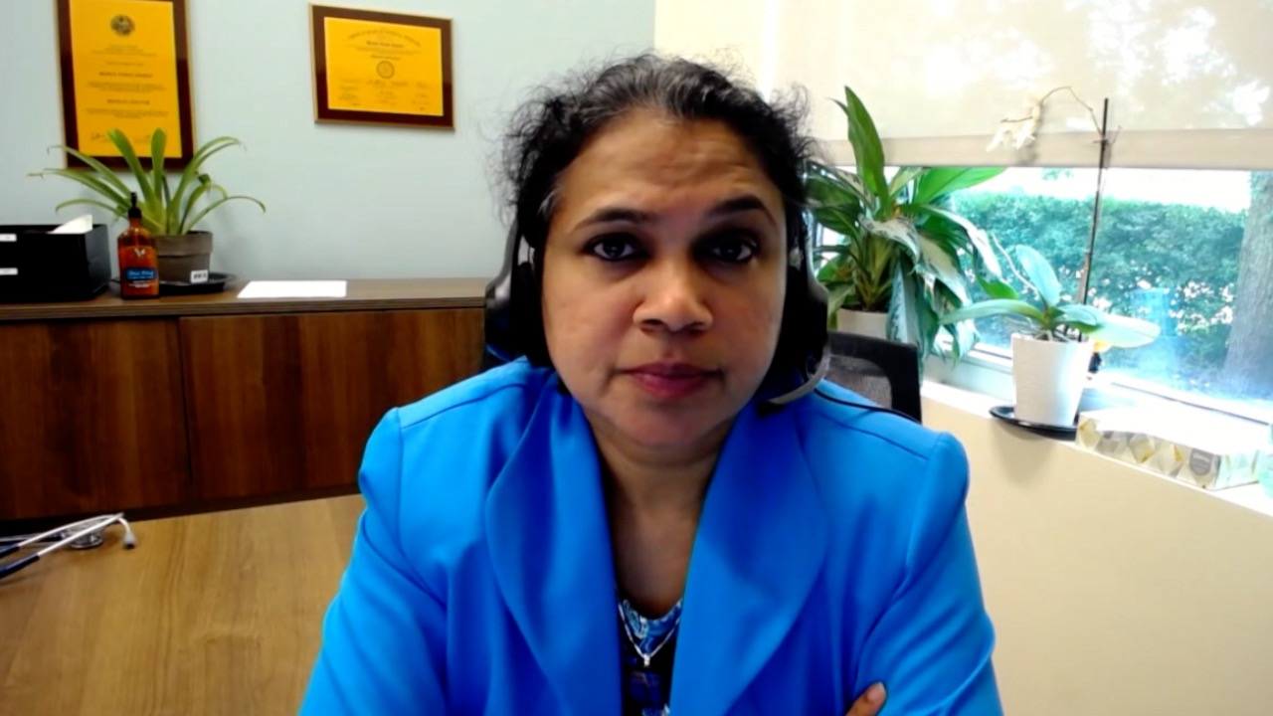
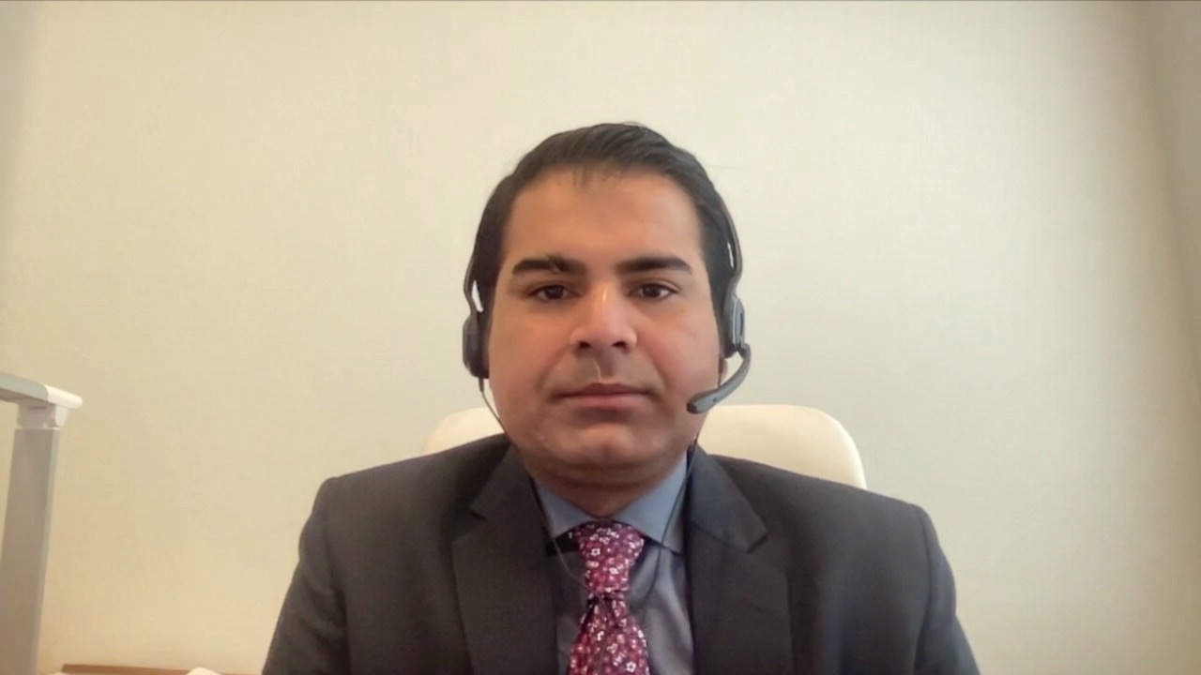
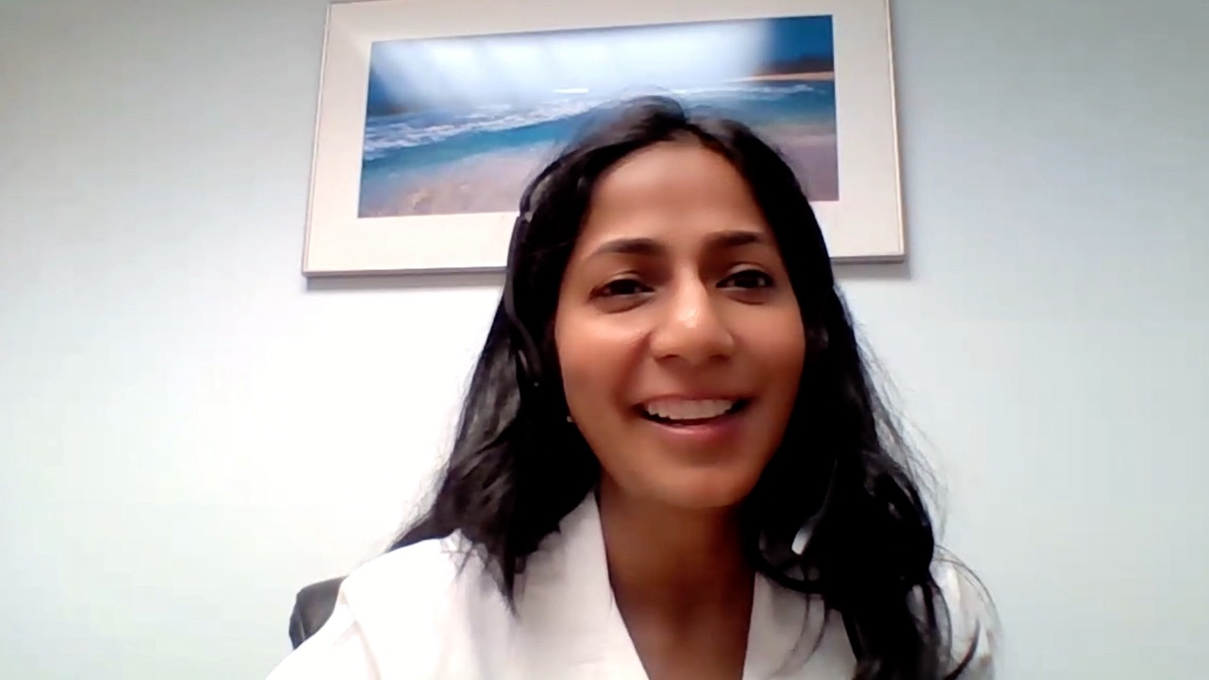
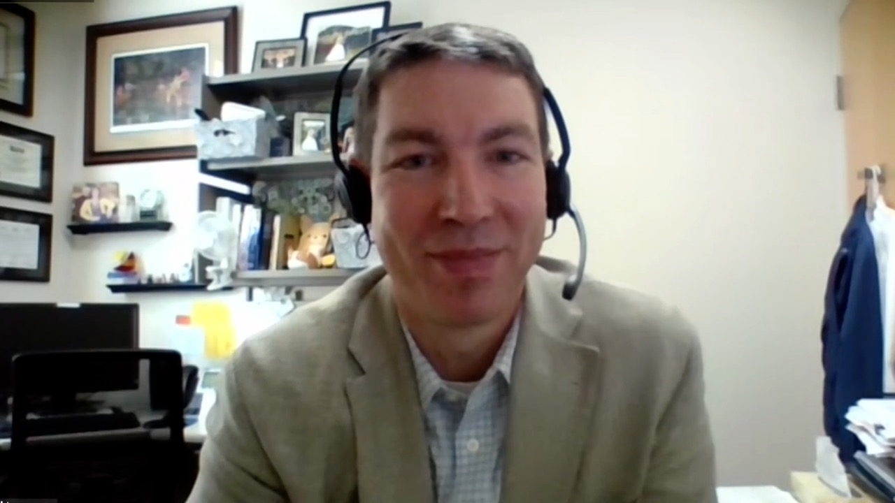
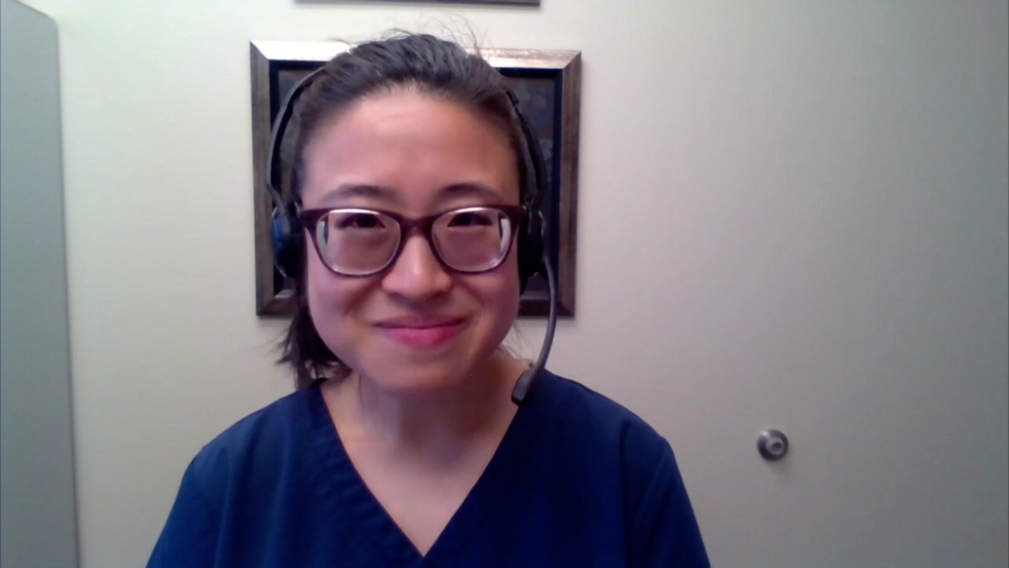
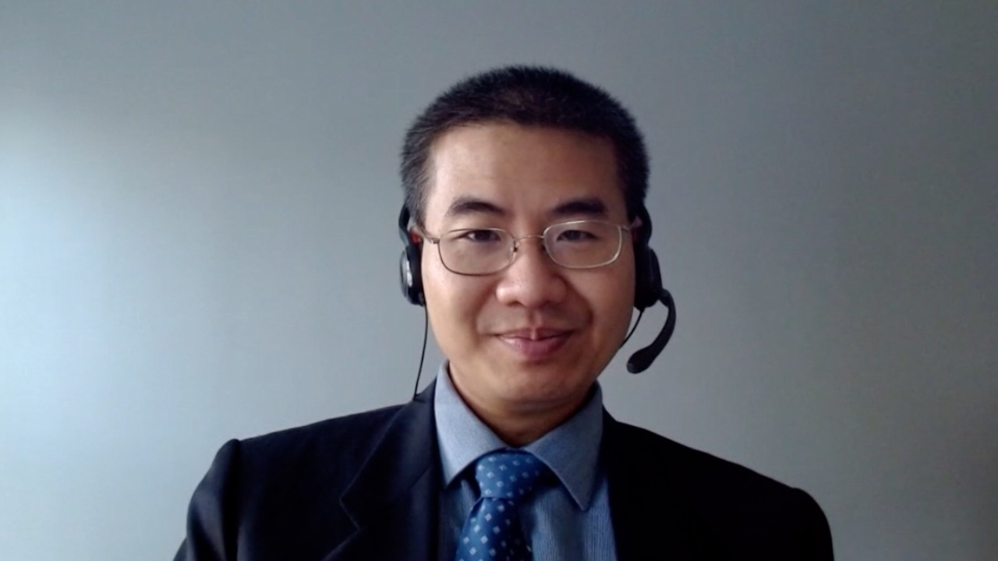
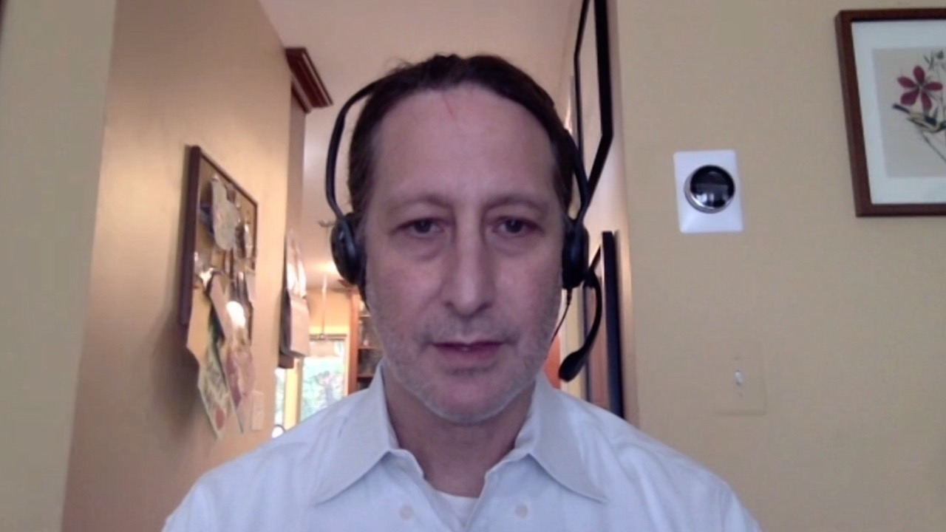
Mamta Choksi, MD
Florida Cancer Specialists
New Port Richey, Florida
Rao Mushtaq, MD
National Jewish Health
Thornton, Colorado
Shaachi Gupta, MD, MPH
Florida Cancer Specialists
Lake Worth, Florida
Benjamin Parsons, DO
Gundersen Health System
Madison, Wisconsin
Kimberly Ku, MD
Bloomington, Illinois
John Yang, MD
Fall River, Massachusetts
Neil Morganstein, MD
Atlantic Health System
Summit, New Jersey

Slide 14
Management of DLBCL
Where We Are, Where We’re Headed
PROLOGUE
MODULE 1: First-Line Treatment
MODULE 2: Bispecific Antibodies
MODULE 3: CAR T-Cell Therapy
MODULE 4: Sequencing of Novel Agents
MODULE 5: Appendix

Slide 15
Randomized Phase III Trials Against R-CHOP for DLBCL
Trial | Comparator arm | N | Study population | PFS (experimental vs standard)
R-CHOP | R-CHOP14 | 602 | 60-80 y, aaIPI≥1 | 60% vs 62% (3y)
GOYA | G-CHOP | 1,418 | ≥18 y, Stage II-IV | 70% vs 67% (3y)
PHOENIX | R-CHOP + ibrutinib | 838 | ≥18 y, Stage II-IV, non-GCB, IPI ≥2 | 71% vs 68% (3y)
ROBUST | R-CHOP + lenalidomide | 570 | ≥18 y, Stage II-IV, non-GCB, IPI ≥2 | 67% vs 64% (3y)
CALGB-50203 | DA-EPOCH-R | 524 | ≥18 y, Stage II-IV | 79% vs 76% (2y)
REMoDL-B | R-CHOP + bortezomib | 918 | ≥18 y | 75% vs 71% (2y)
Content Courtesy of Neha Mehta-Shah, MD, MSCI

Slide 16
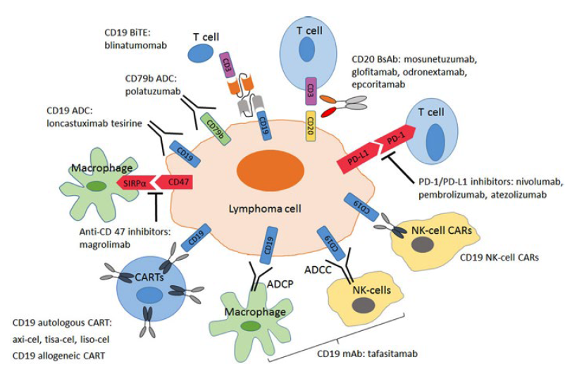
Evolving Landscape of Customized Engineered and Off-the-Shelf Immunotherapies for Aggressive B-Cell Non-Hodgkin Lymphoma
ADCC = antibody-dependent
cell cytotoxicity
ADCP = antibody-dependent cellular phagocytosis
BiTE = bispecific T-cell engager
PD-1 = programmed cell
death 1
PD-L1 = programmed cell death ligand 1
Karmali R. ASH 2021 Education Program.

Slide 17
Important Recent Developments in DLBCL
POLARIX Phase III Trial
  Polatuzumab vedotin
CAR T-Cell Therapy in the Second-Line Setting
  Axicabtagene ciloleucel
  Lisocabtagene maraleucel
  Tisagenlecleucel
Bispecific Antibodies
  Glofitamab
  Mosunetuzumab
  Epcoritamab
  Odronextamab

Slide 18
Management of DLBCL
Where We Are, Where We’re Headed
PROLOGUE
MODULE 1: First-Line Treatment
Dr Morganstein: 43-year-old man with newly diagnosed GCB-subtype Stage III DLBCL
Dr Parsons: 59-year-old woman with Stage IV double-hit DLBCL and extensive bone involvement
Dr Choksi: 77-year-old symptomatic man with longstanding CLL and Richter’s transformation
Dr Ku: 66-year-old woman with newly diagnosed nonbulky Stage II DLBCL
MODULE 2: Bispecific Antibodies
MODULE 3: CAR T-Cell Therapy
MODULE 4: Sequencing of Novel Agents
MODULE 5: Appendix

Slide 19
Case Presentation: 43-year-old man with newly diagnosed GCB-subtype Stage III DLBCL
Dr Neil Morganstein (Summit, New Jersey)

Slide 20
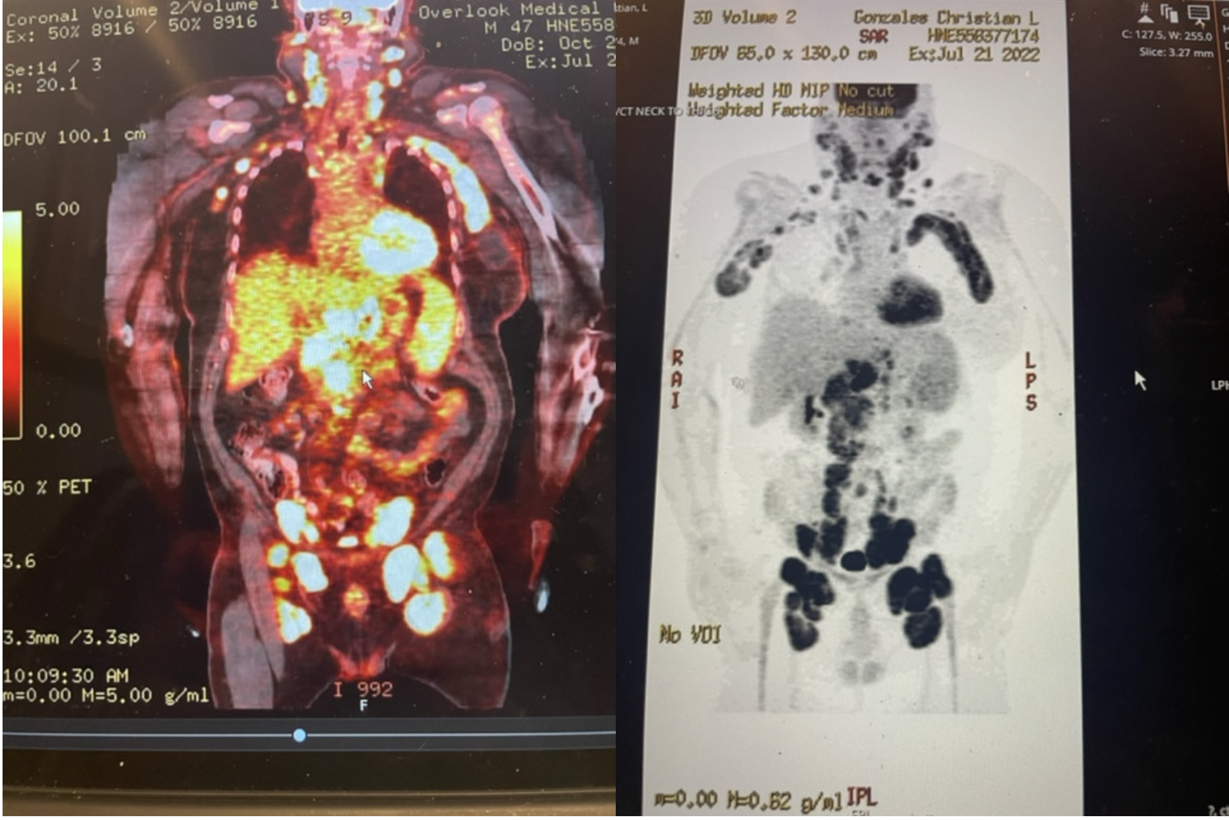

Slide 21
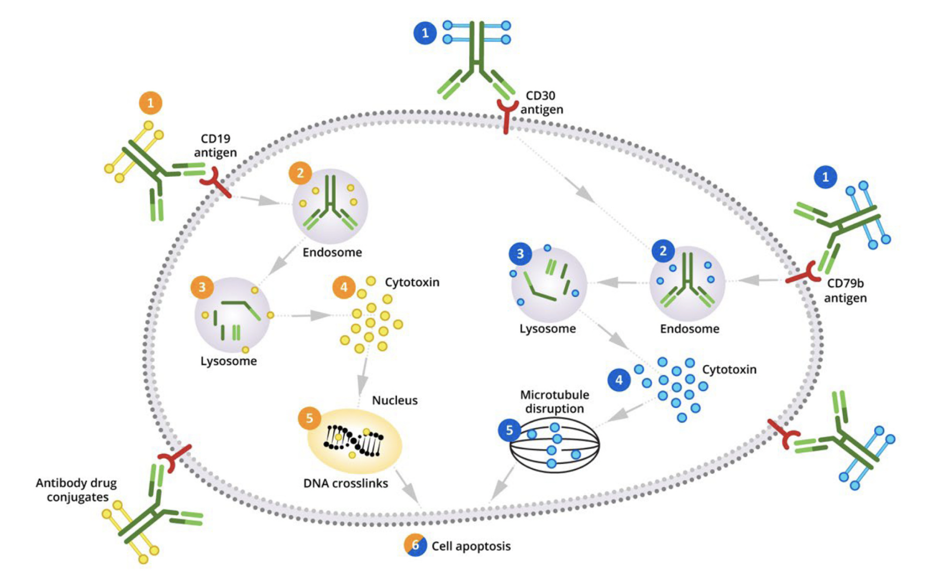
Antibody-Drug Conjugate Mechanism of Action in DLBCL
Alderuccio JP, Sharman JP. Blood Rev 2022;[Online ahead of print].

Slide 22
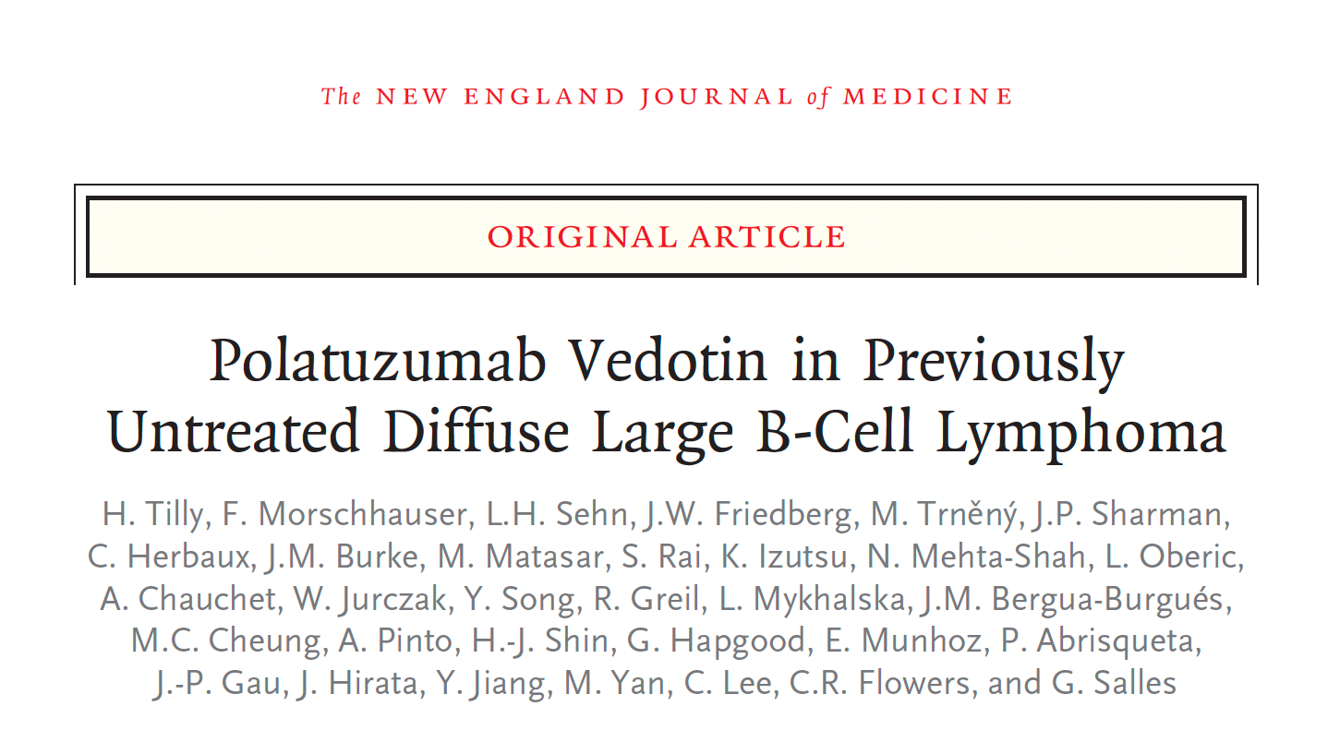
N Engl J Med 2022;386(4):351-63.

Slide 23
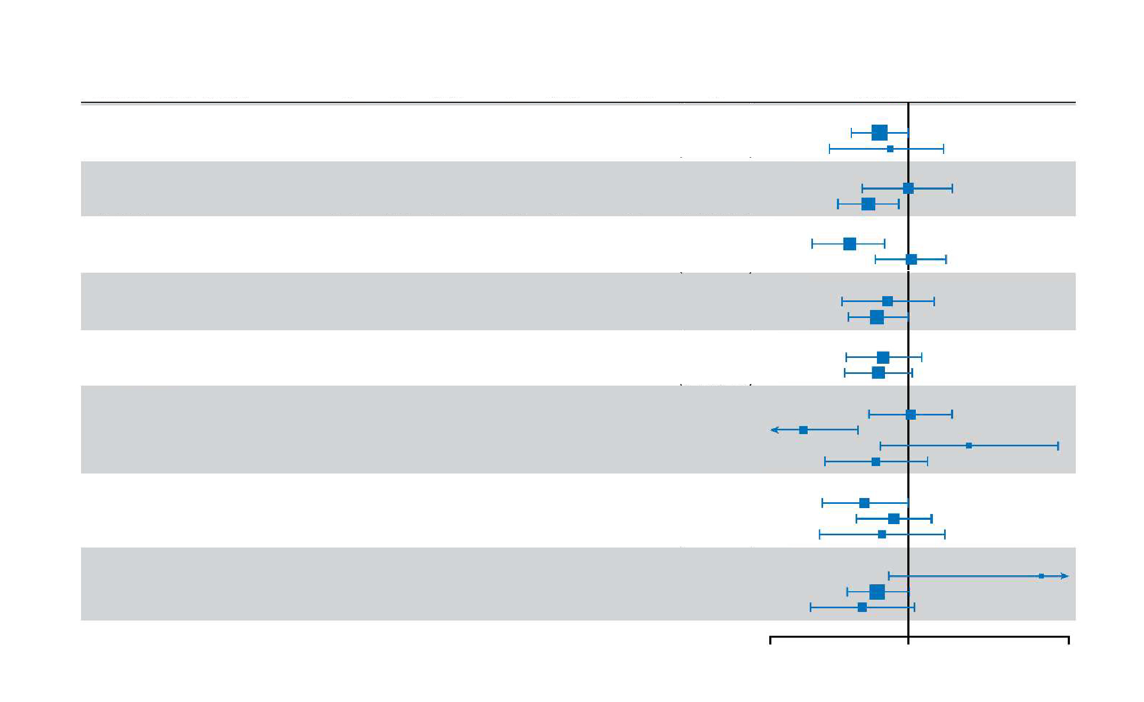
POLARIX: Subgroup Analysis
Pola-R-CHP
(N=440)
R-CHOP
(N=439)
Total
N
2-year
Rate
2-year
Rate
Hazard
Ratio
95% Wald
CI
Pola-R-CHP
Better
R-CHOP
Better
Baseline Risk Factors
n
n
ECOG PS
0-1
2
737
141
374
66
78.4
67.2
363
75
71.2
65.0
0.8
0.8
(0.6 to 1.0)
(0.5 to 1.4)
IPI score
IPI 2
IPI 3-5
334
545
167
273
79.3
75.2
167
272
78.5
65.1
1.0
0.7
(0.6 to 1.6)
(0.5 to 0.9)
Bulky disease
Absent
Present
494
385
247
193
82.7
69.0
247
192
70.7
69.7
0.6
1.0
(0.4 to 0.8)
(0.7 to 1.5)
Baseline LDH
≤ULN
>ULN
300
575
146
291
78.9
75.4
154
284
75.6
67.2
0.8
0.7
(0.5 to 1.3)
(0.5 to 1.0)
No. of extranodal sites
0-1
≥2
453
426
227
213
80.2
73.0
226
213
74.5
65.8
0.8
0.7
(0.5 to 1.1)
(0.5 to 1.0)
Cell-of-origin
GCB
ABC
Unclassified
Unkown
352
221
95
211
184
102
44
110
75.1
83.9
73.0
73.8
168
119
51
101
76.9
58.8
86.2
64.3
1.0
0.4
1.9
0.7
(0.7 to 1.5)
(0.2 to 0.6)
(0.8 to 4.5)
(0.4 to 1.2)
Double expressor by IHC
DEL
Non DEL
Unknown
290
438
151
139
223
78
75.5
77.7
76.0
151
215
73
63.1
75.7
69.8
0.6
0.9
0.8
(0.4 to 1.0)
(0.6 to 1.3)
(0.4 to 1.5)
Double- or triple-hit lymphoma
Yes
No
Unknown
45
620
214
26
305
109
69.0
76.8
78.5
19
315
105
889
70.3
66.4
3.8
0.7
0.6
(0.8 to 17.6)
(0.5 to 1.0)
(0.4 to 1.1)
0.25
1
5
Tilly H et al. N Engl J Med 2022;386(4):351-63.

Slide 24
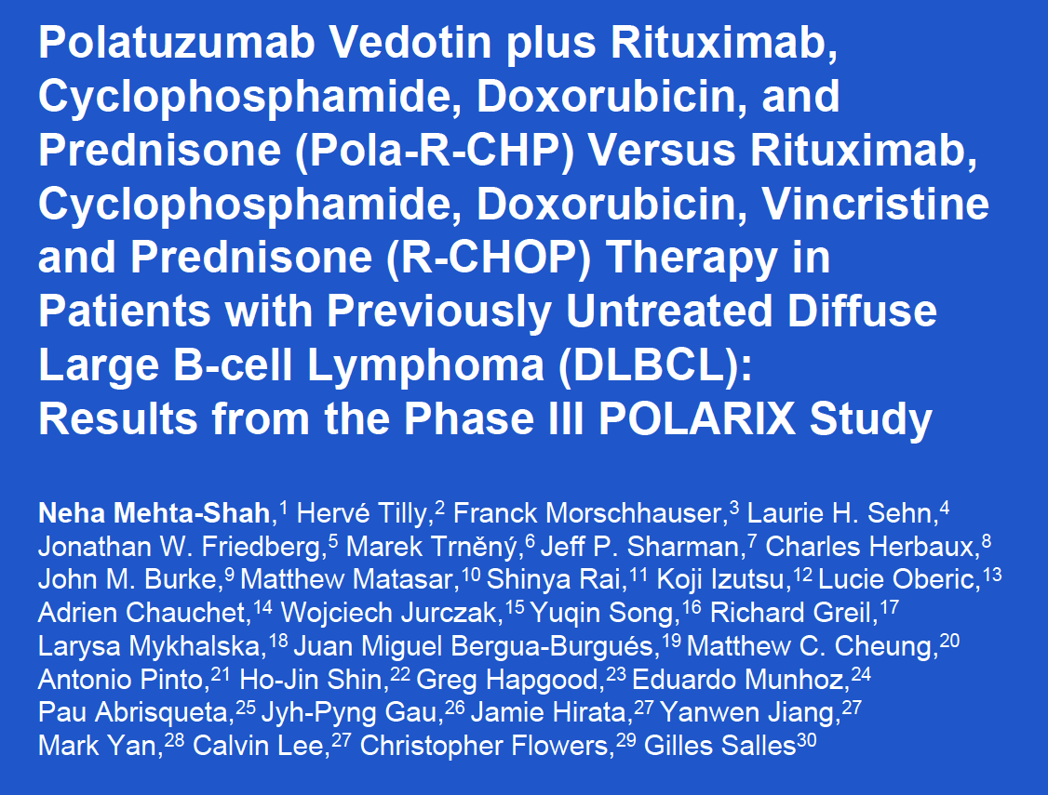
Pan Pacific Lymphoma Conference 2022

Slide 25
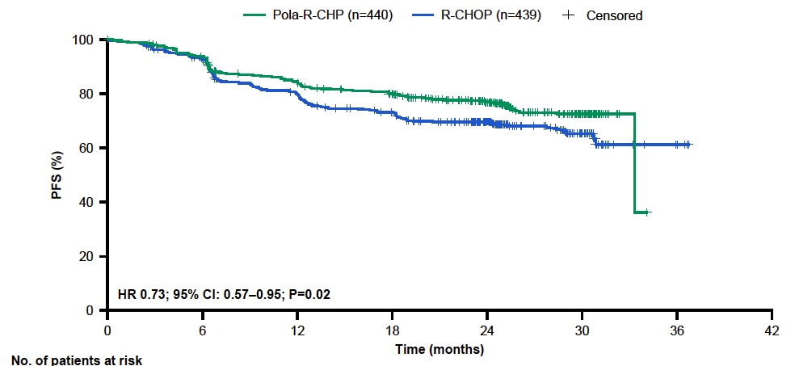
POLARIX: Investigator-Assessed Progression-Free Survival (PFS) — Primary Endpoint
Estimated 2-y PFS: 76.7% vs 70.2%
Mehta-Shah N et al. Pan Pacific Lymphoma Conference 2022.

Slide 26
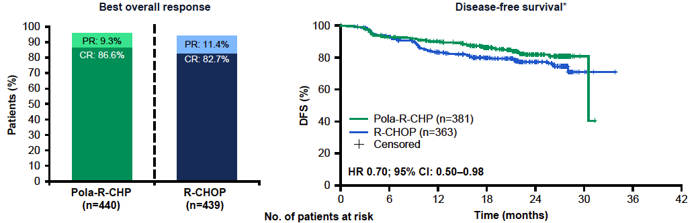
POLARIX: Key Secondary Endpoints
PR = partial response; CR = complete response
There was no difference in overall survival between treatment arms
Mehta-Shah N et al. Pan Pacific Lymphoma Conference 2022.

Slide 27
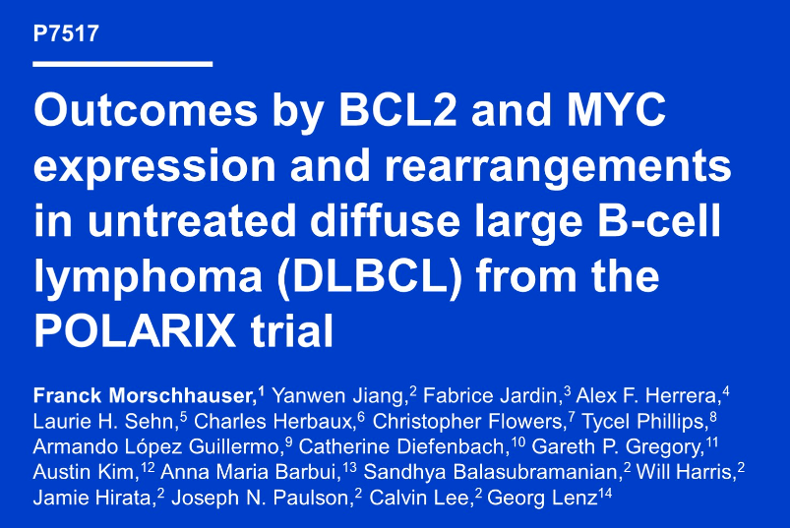
ASCO 2022

Slide 28
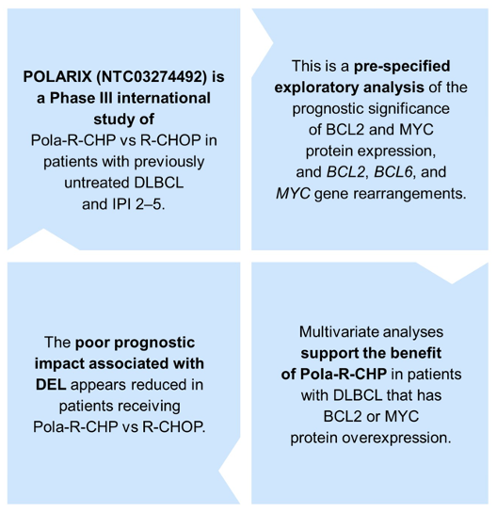
Summary
DEL,
double-expressor lymphoma
Morschhauser F et al. ASCO 2022;Abstract 7517.

Slide 29
POLAR BEAR Study Design: Adding Polatuzumab Vedotin to
R-Mini-CHOP as Initial Therapy for Older Patients with DLBCL
Previously untreated DLBCL
≥80 years, or frail ≥75 years
ECOG PS 0-3
N = 200
Arm A
Pola 1.8 mg/kg
R-mini-CHP + vincristine placebo
Q21D x 6 cycles
R
Primary endpoint: PFS​
Arm B
R-mini-CHOP + pola placebo
Q21D x 6 cycles

Slide 30
Case Presentation: 59-year-old woman with Stage IV double-hit DLBCL and extensive bone involvement
Dr Benjamin Parsons (Madison, Wisconsin)

Slide 31
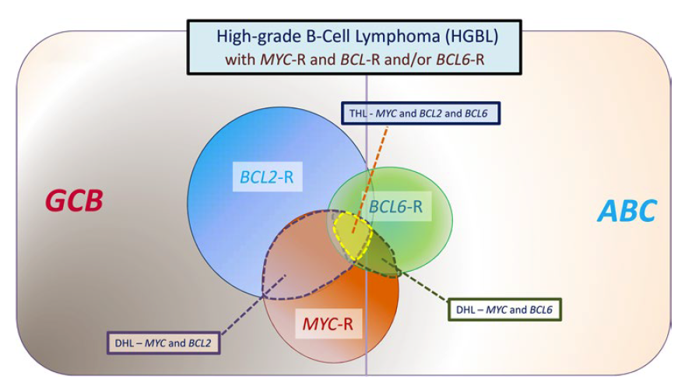
Categories of Aggressive B-Cell Lymphomas
Dunleavy K. ASH 2021 Education Program.

Slide 32
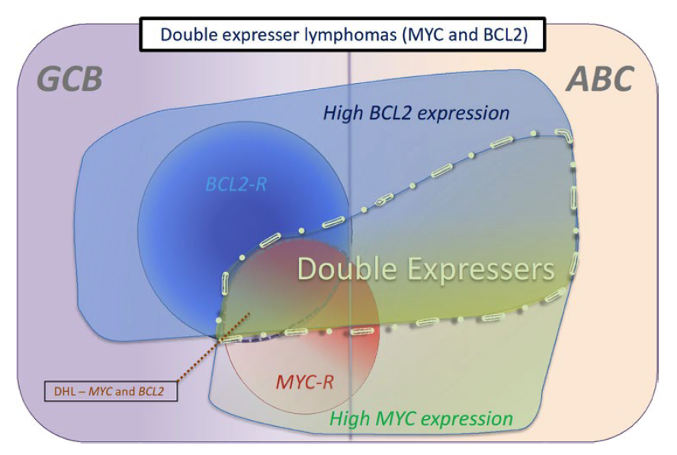
Categories of Double-Expressor Lymphomas
Dunleavy K. ASH 2021 Education Program.

Slide 33
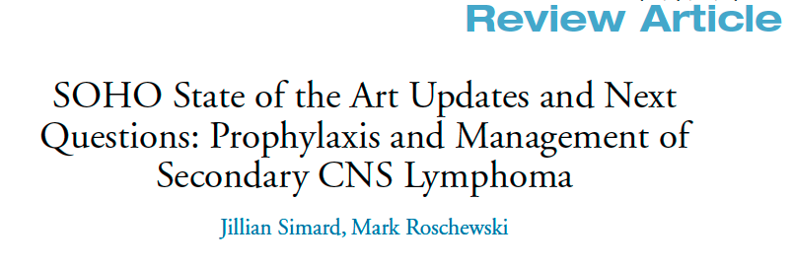
Clin Lymphoma Myeloma Leuk 2022;[Online ahead of print].

Slide 34
“The prevention of SCNSL remains an unmet clinical need and the standard approaches of delivering MTX either as intrathecal therapy or as HD-MTX during frontline therapy are largely ineffective.”
Simard J and Roschewski M. Clin Lymphoma Myeloma Leuk 2022;[Online ahead of print].

Slide 35
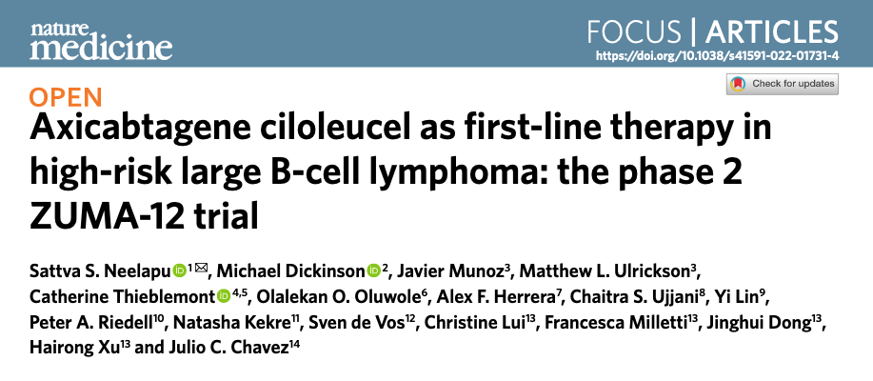
Nat Med 2022 April;28(4):735-42.

Slide 36
Multicenter Phase II ZUMA-12 Schema: First-Line Therapy
Eligibility criteria
Age ≥ 18 years
High-risk LBCL
  HGBCL, with MYC and BLCL2 and/or BCL6 translocations, or
  LBCL with IPI score ≥ 3 any time before enrollment
2 cycles of anti-CD20 plus anthracycline-containing regimen
Positive interim PET (DS 4 or 5)
ECOG PS score 0 or 1
Enrollment/leukapheresis
Optional nonchemotherapy bridging therapy
Primary endpoint
CR (complete response)
Key secondary endpoints
ORR (objective response rate)
DOR (duration of response)
EFS (event-free survival)
PFS
OS
Safety
CAR T cells in blood and cytokine levels in serum
Conditioning chemotherapy +
axi-cel infusion
Conditioning
Flu 30 mg/m² i.v. and Cy 500 mg/m² i.v. on Days −5, −4, and −3
Axi-cel
  Single i.v. infusion of 2 × 10⁶ CAR T cells/kg on Day 0
LBCL = large B-cell lymphoma; HGBCL = high-grade B-cell lymphoma
Neelapu SS et al. ASH 2020;Abstract 405.

Slide 37
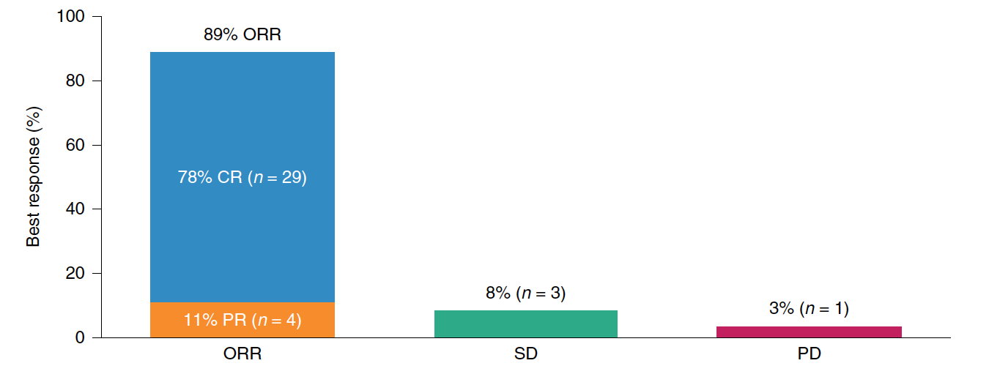
ZUMA-12: Efficacy Results with Axi-Cel as First-Line Treatment
ORR and CR in efficacy-evaluable patients (N = 37)
At median follow-up of 15.9 months, 73% of patients remained in objective response
Median DOR, EFS and PFS were not reached
ORR = objective response rate; CR = complete response; PR = partial response; SD = stable disease; PD = progressive disease; DOR = duration of response; EFS = event-free survival; PFS = progression-free survival
Neelapu SS et al. Nat Med 2022 April;28(4):735-42.

Slide 38
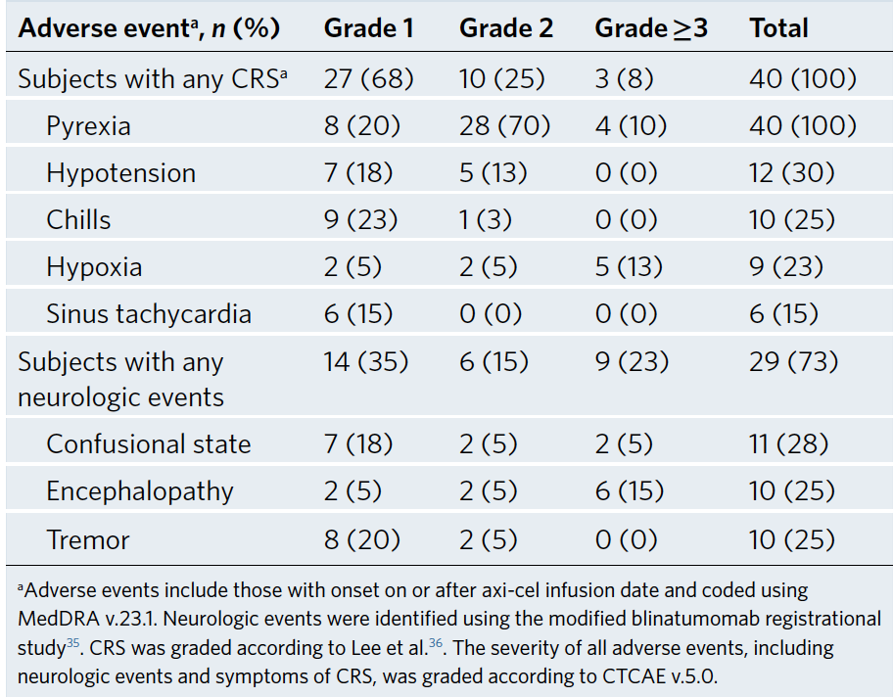
ZUMA-12: Adverse Events of Interest in ≥15% of Patients Receiving Treatment
Neelapu SS et al. Nat Med 2022 April;28(4):735-42.

Slide 39
Case Presentation: 77-year-old symptomatic man with longstanding CLL and Richter’s transformation
Dr Mamta Choksi (New Port Richey, Florida)

Slide 40
Case Presentation: 66-year-old woman with newly diagnosed nonbulky Stage II DLBCL
Dr Kimberly Ku (Bloomington, Illinois)

Slide 41
Management of DLBCL
Where We Are, Where We’re Headed
PROLOGUE
MODULE 1: First-Line Treatment
MODULE 2: Bispecific Antibodies
Dr Morganstein: 75-year-old man with a history of severe CHF with a pulmonary nodule and regional adenopathy that on biopsy is proven to be DLBCL
MODULE 3: CAR T-Cell Therapy
MODULE 4: Sequencing of Novel Agents
MODULE 5: Appendix

Slide 42
Case Presentation: 75-year-old man with a history of severe CHF with a pulmonary nodule and regional adenopathy that on biopsy is proven to be DLBCL
Dr Neil Morganstein (Summit, New Jersey)

Slide 43
Evolving Landscape of Customized Engineered and Off-the-Shelf Immunotherapies for Aggressive B-Cell Non-Hodgkin Lymphoma
ADCC = antibody-dependent
cell cytotoxicity
ADCP = antibody-dependent cellular phagocytosis
BiTE = bispecific T-cell engager
PD-1 = programmed cell
death 1
PD-L1 = programmed cell death ligand 1
Karmali R. ASH 2021 Education Program.

Slide 44
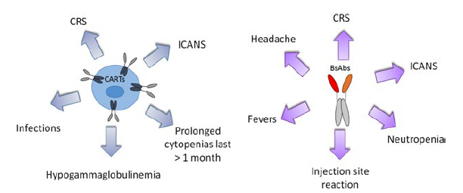
CAR T or Bispecific T-Cell-Engaging Antibody Treatment-Related Adverse Effects of Interest with an Incidence of ≥10% or ≥5%
BsAb = Bispecific T-cell-engaging antibody
Karmali R. ASH 2021 Education Program.

Slide 45
Emerging Bispecific Antibodies for DLBCL
Bispecific antibody | Construct | Administration
Glofitamab | CD3 (Fab) x CD20 (Fab x 2) Fc | IV
Mosunetuzumab | CD3 x CD20 Knobs-into-holes Fc | IV, SC
Epcoritamab | DuoBody®-CD3 x CD20 | SC
Odronextamab | CD3 x CD20 common LC Fc | IV
IV = intravenous; SC = subcutaneous; LC = light chain
Content Courtesy of Jeremy Abramson, MD - adapted

Slide 46
Glofitamab in Patients with Relapsed/Refractory (R/R) Diffuse Large B-Cell Lymphoma (DLBCL) and ≥ 2 Prior Therapies: Pivotal Phase II Expansion Results
Dickinson M et al.
ASCO 2022;Abstract 7500.

Slide 47
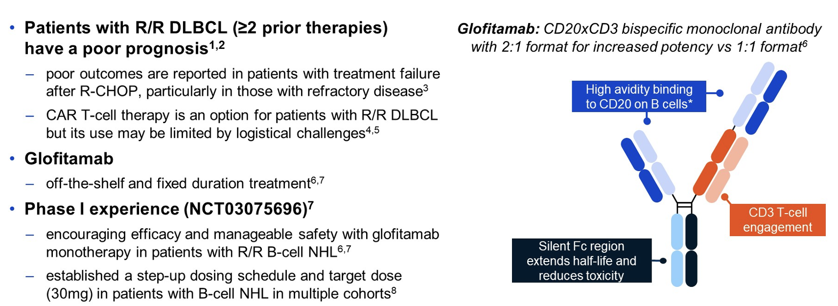
Glofitamab: Background and Mechanism of Action
Dickinson M et al. ASCO 2022;Abstract 7500. Dickinson M et al. EHA 2022;Abstract S220.

Slide 48
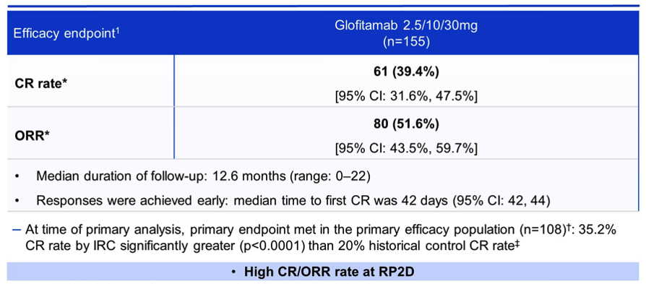
Response Rates with Glofitamab in Patients with R/R DLBCL (≥2 Prior Therapies)
Efficacy endpoint
CR rate
ORR
At time of primary analysis, primary endpoint met in the primary efficacy population (n=108; 35.2%
CR rate by IRC significantly greater (p<0.0001) than 20% historical control CR rate
Dickinson M et al. ASCO 2022;Abstract 7500. Dickinson M et al. EHA 2022;Abstract S220.

Slide 49
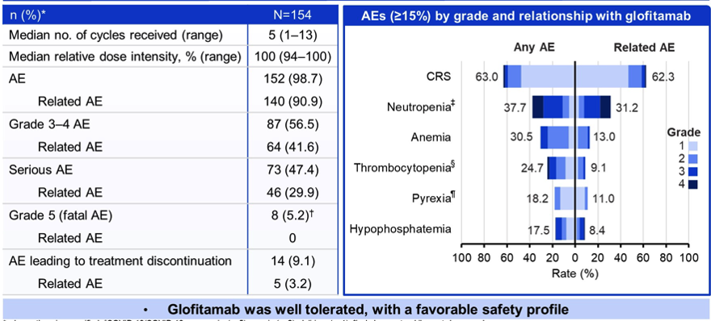
Safety Profile of Glofitamab in Patients with R/R DLBCL (≥2 Prior Therapies)
n (%)
Neutropenia
Thrombocytopenia
Pyrexia
8 (5.2)
Dickinson M et al. ASCO 2022;Abstract 7500. Dickinson M et al. EHA 2022;Abstract S220.

Slide 50
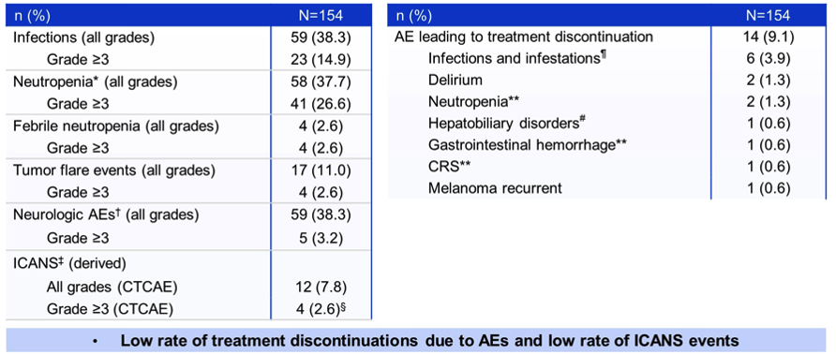
Safety Profile of Glofitamab in Patients with R/R DLBCL (≥2 Prior Therapies) — Continued
Infections and infestations
Neutropenia (all grades)
Neutropenia
Hepatobiliary disorders
Gastrointestinal hemorrhage
CRS
Neurologic AEs (all grades)
ICANS (derived)
4 (2.6)
Dickinson M et al. ASCO 2022;Abstract 7500. Dickinson M et al. EHA 2022;Abstract S220.

Slide 51
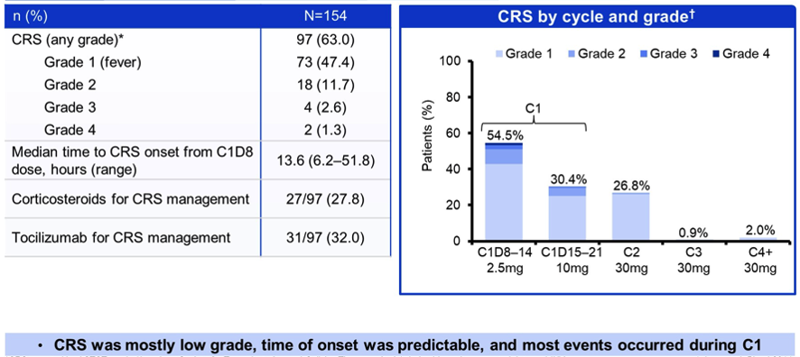
Incidence of Cytokine Release Syndrome with Glofitamab in Patients with R/R DLBCL (≥2 Prior Therapies)
CRS by cycle and grade
CRS (any grade)
Dickinson M et al. ASCO 2022;Abstract 7500. Dickinson M et al. EHA 2022;Abstract S220.

Slide 52
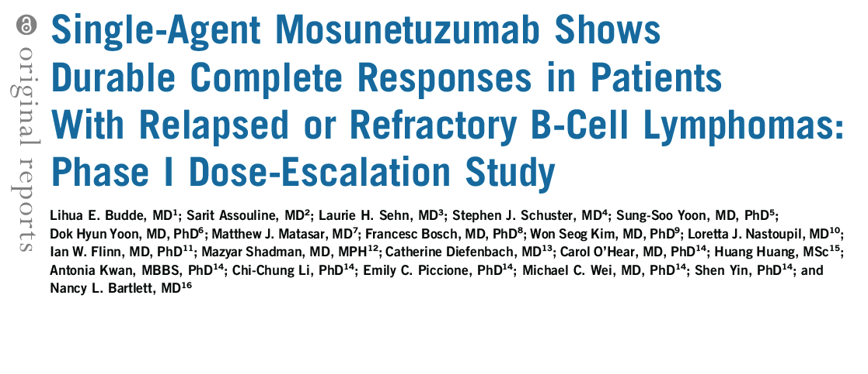
J Clin Oncol 2022 February 10;40(5):481-91.

Slide 53
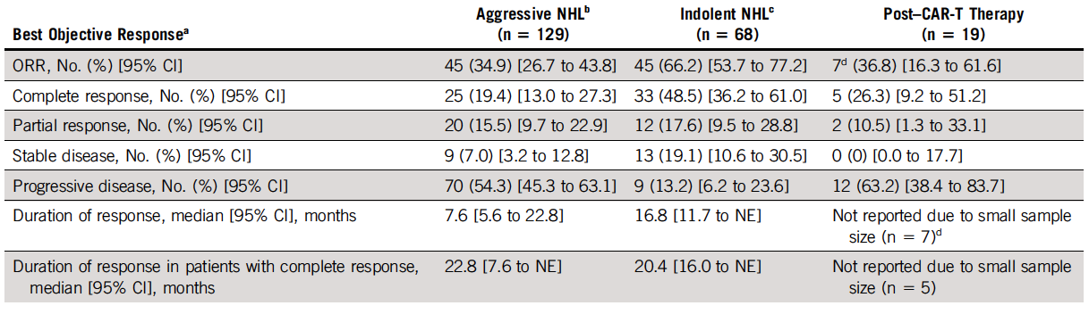
Efficacy of Single-Agent Mosunetuzumab for Relapsed/Refractory B-Cell Lymphomas
ª Response by computed tomography with or without ﬂuorodeoxyglucose positron emission tomography. At data cutoff, among patients who had at least one tumor assessment, 86% had at least one positron emission tomography scan performed.
^{b} Includes patients with DLBCL (n = 82), transformed follicular lymphoma (FL; n = 26), mantle cell lymphoma (MCL; n = 13), Richter’s transformation (n = 5), FL Grade IIIb (n = 1), transformed marginal zone lymphoma (MZL; n = 1) and mixed DLBCL and MCL (n = 1).
^{c} Includes patients with FL (Grade I-IIIa; n = 68), MZL (n = 2) and small lymphocytic lymphoma (n = 1).
Budde LE et al. J Clin Oncol 2022 February 10;40(5):481-91.

Slide 54
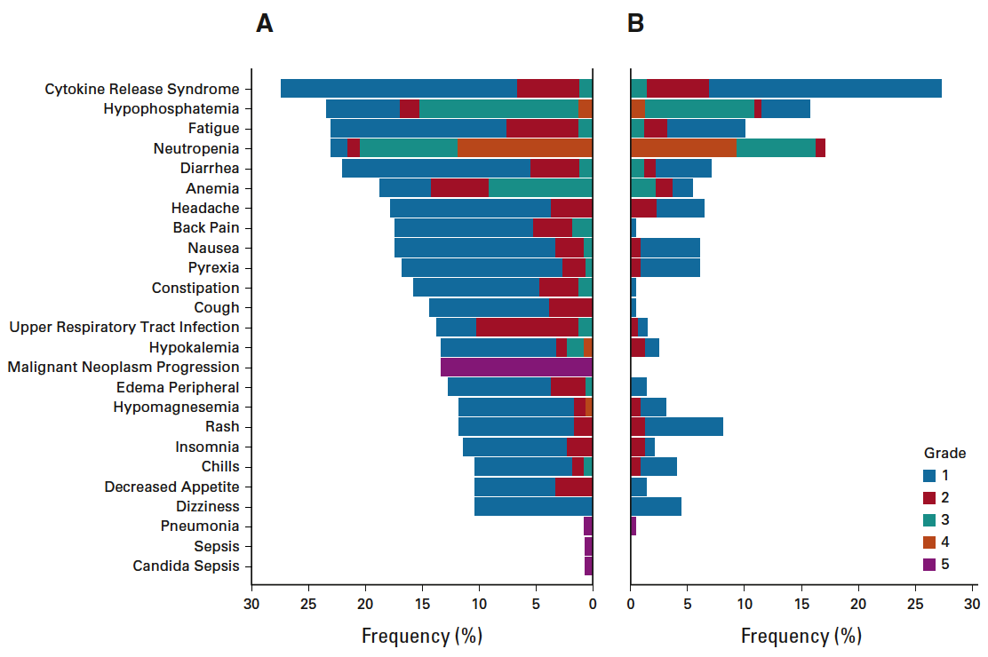
Adverse Events (AEs) with Incidence of Greater than 10% or National Cancer Institute-Common Terminology Criteria for AEs Grade
All AEs AEs related to
mosunetuzumab
Budde LE et al. J Clin Oncol 2022 February 10;40(5):481-91.

Slide 55
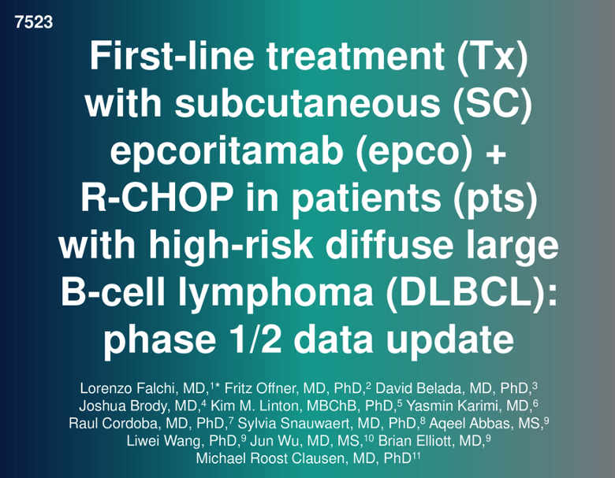
ASCO 2022

Slide 56
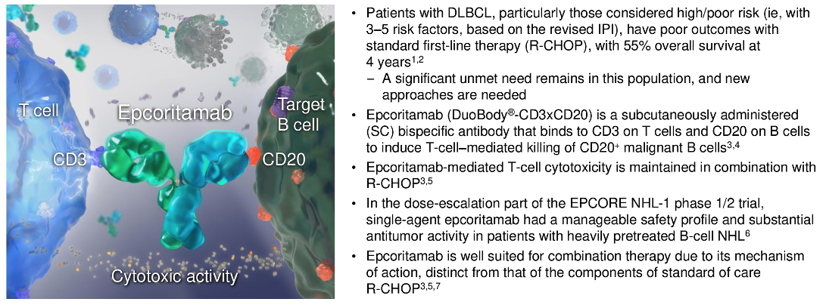
Epcoritamab: Background and Mechanism of Action
Falchi L et al. ASCO 2022;Abstract 7523.

Slide 57
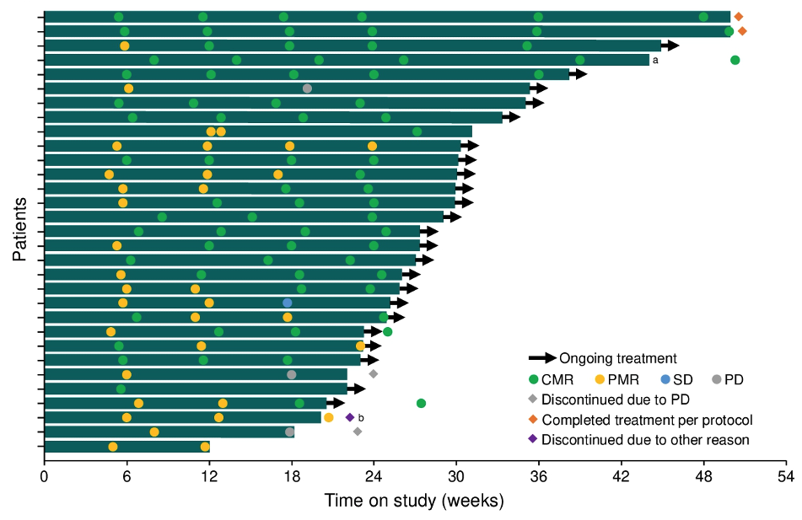
EPCORE NHL-2: Response Profile
ORR = 100%
Falchi L et al. ASCO 2022;Abstract 7523.

Slide 58
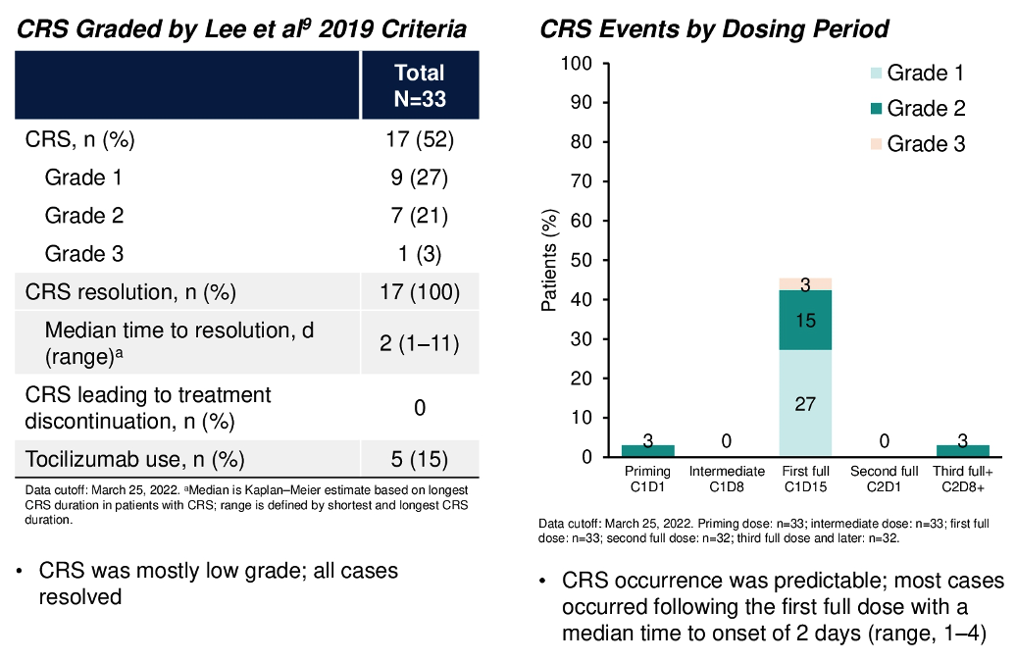
EPCORE NHL-2: Cytokine Release Syndrome (CRS)
Falchi L et al. ASCO 2022;Abstract 7523.

Slide 59
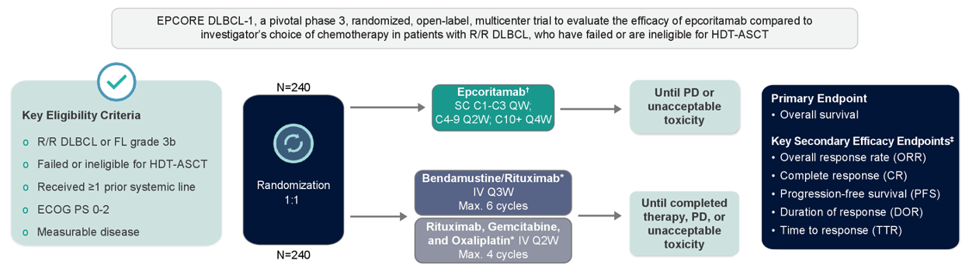
EPCORE DLBCL-1: Phase III Study Design
Thieblemont C et al. ASCO 2021;Abstract TPS7569.

Slide 60
Management of DLBCL
Where We Are, Where We’re Headed
PROLOGUE
MODULE 1: First-Line Treatment
MODULE 2: Bispecific Antibodies
MODULE 3: CAR T-Cell Therapy
Dr Yang: 73-year-old woman with rapid relapse after R-CHOP then R-ICE/ASCT achieves a CR with
CAR T-cell therapy but experiences severe pancytopenia
Dr Mushtaq: 45-year-old man with R-CHOP-refractory DLBCL receives polatuzumab vedotin as bridging therapy → CAR T-cell therapy on protocol
MODULE 4: Sequencing of Novel Agents
MODULE 5: Appendix

Slide 61
Case Presentation: 73-year-old woman with rapid relapse after R-CHOP then R-ICE/ASCT achieves a CR with CAR T-cell therapy but experiences severe pancytopenia
Dr John Yang (Fall River, Massachusetts)

Slide 62
Notable CAR T-Cell Therapy-Associated Toxicities
Cytokine Release Syndrome
Neurologic Toxicity
  CAR T-cell associated encephalopathy syndrome
  ICANS (immune effector cell associated neurotoxicity syndrome
Prolonged Cytopenias
B-Cell Aplasia
Hypogammaglobulinemia
Content Courtesy of Jeremy Abramson, MD - adapted

Slide 63
Case Presentation: 45-year-old man with R-CHOP-refractory DLBCL receives polatuzumab vedotin as bridging therapy → CAR T-cell therapy on protocol
Dr Rao Mushtaq (Thornton, Colorado)

Slide 64
Key Issues in CAR T-Cell Therapy Selection
Turnaround Time for Manufacturing
Bridging for Symptomatic or Progressive Disease
  Radiation therapy
  Polatuzumab vedotin
Referral to Center for CAR T-Cell Therapy
  Early referral is optimal – after first treatment failure before initiating salvage therapy
Content Courtesy of Jeremy Abramson, MD - adapted

Slide 65
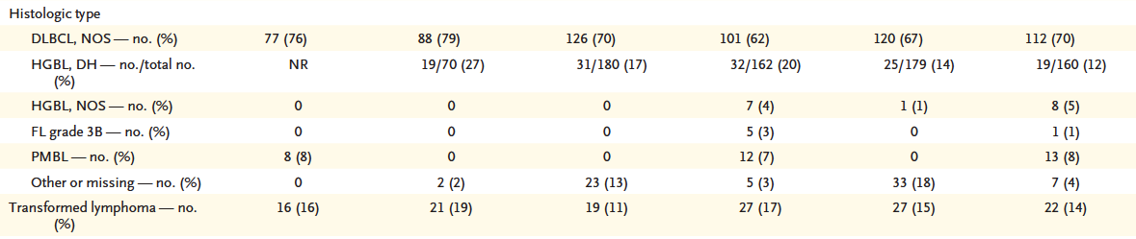
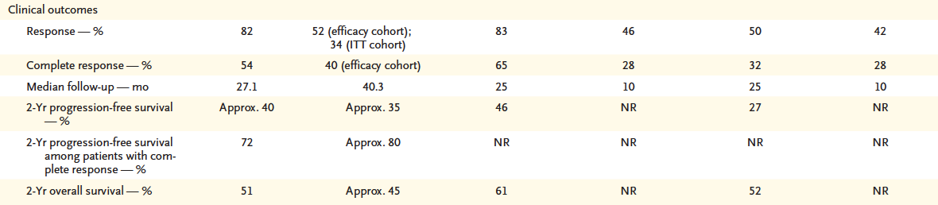
Characteristics of Pivotal Trials of Axi-cel and Tisagenlecleucel
Roschewski M et al. N Engl J Med 2022;386(7):692-96.

Slide 66
Recent FDA Approvals of CAR (Chimeric Antigen Receptor) T-Cell Therapy as Second-Line Treatment for Large B-Cell Lymphoma
June 24, 2022: “The FDA approved lisocabtagene maraleucel for adult patients with large B-cell lymphoma (LBCL) who have refractory disease to first-line chemoimmunotherapy or relapse within 12 months of first-line chemoimmunotherapy; or refractory disease to first-line chemoimmunotherapy or relapse after first-line chemoimmunotherapy and are not eligible for hematopoietic stem cell transplantation (HSCT) due to comorbidities or age. It is not indicated for the treatment of patients with primary central nervous system lymphoma.” Based on the TRANSFORM study
April 1, 2022: “The FDA approved axicabtagene ciloleucel for adult patients with large B-cell lymphoma (LBCL) that is refractory to first-line chemoimmunotherapy or relapses within 12 months of first-line chemoimmunotherapy. It is not indicated for the treatment of patients with primary central nervous system lymphoma.” Based on the ZUMA-7 study
www.fda.gov/drugs/resources-information-approved-drugs/fda-approves-lisocabtagene-maraleucel-second-line-treatment-large-b-cell-lymphoma
www.fda.gov/drugs/resources-information-approved-drugs/fda-approves-axicabtagene-ciloleucel-second-line-treatment-large-b-cell-lymphoma

Slide 67
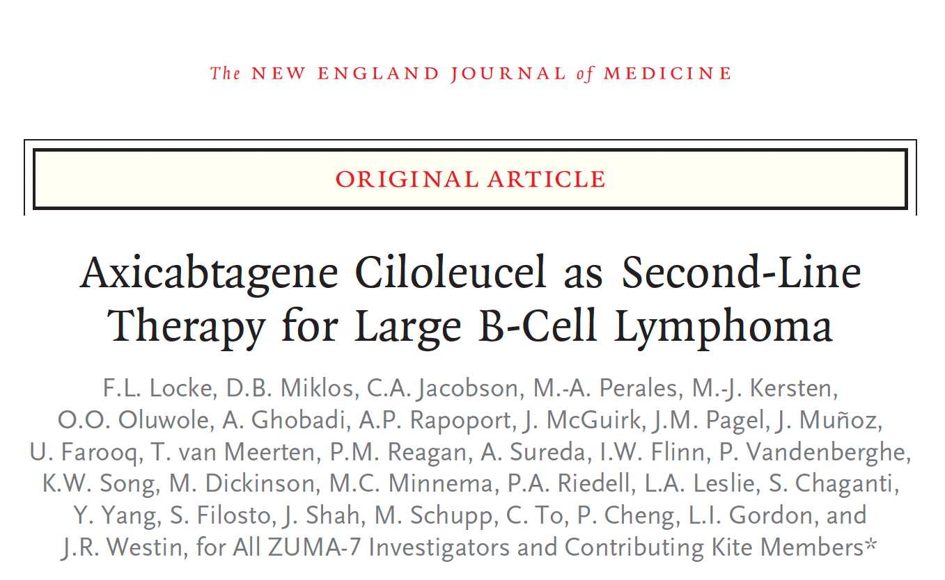
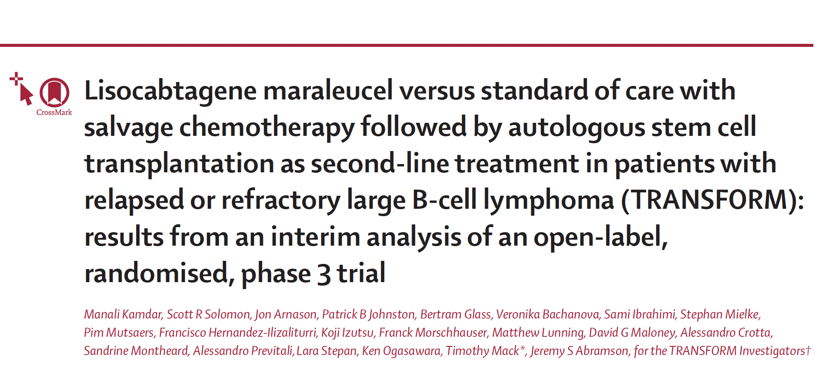
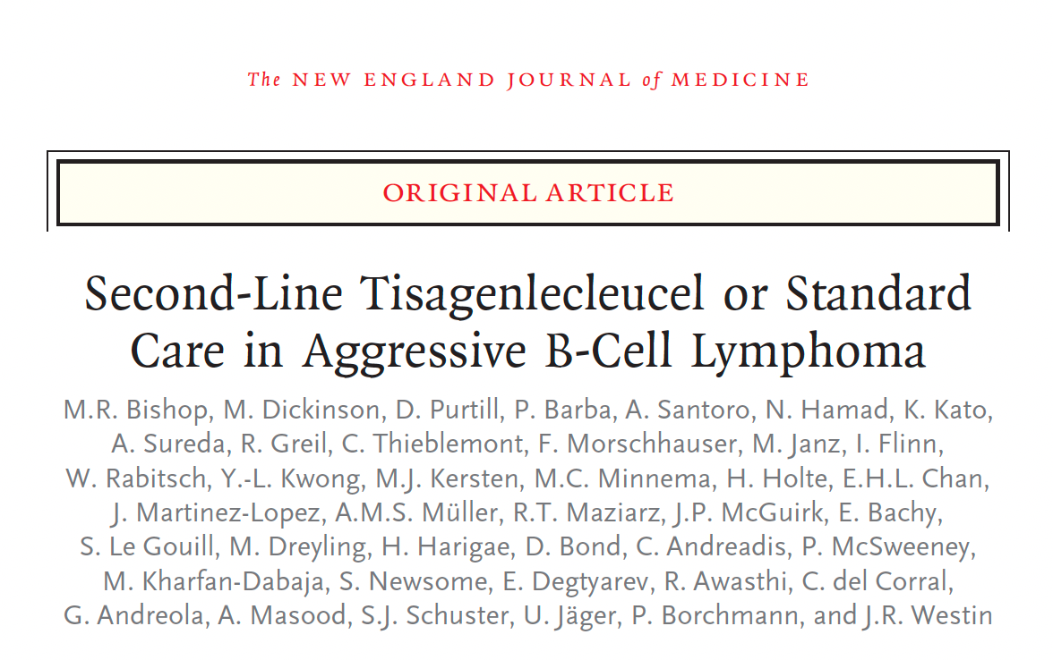
N Engl J Med 2022;386(7):640-54.
Lancet 2022;399:2294-308.
N Engl J Med 2022;386(7):629-39.

Slide 68
Randomized Trials Comparing Second-Line CAR T-Cell to Standard Therapy for Patients with Transplant-Eligible DLBCL with Primary Refractory Disease or Relapse within 1 Year of First-Line Therapy
 | ZUMA-7 | TRANSFORM | BELINDA
CAR T-cell therapy | Axicabtagene ciloleucel | Lisocabtagene maraleucel | Tisagenlecleucel
n | 359 | 184 | 322
Patients infused in CAR arm | 94% | 98% | 96%
Median EFS | 8.3 mo vs 2 mo | 10.1 mo vs 2.3 mo | 3 mo vs 3 mo
Hazard ratio | 0.398 (p < 0.0001) | 0.349 (p < 0.0001) | 1.07 (p = 0.69)
Median follow-up | 25 mo | 6 mo | 10 mo
CR rate | 65% vs 32% | 66% vs 39% | 28% vs 28%
Grade ≥3 CRS/NT | 6%/21% | 1%/4% | 5%/3%
 | Locke et al. ASH 2021;Abstract 2. | Kamdar et al. ASH 2021;Abstract 91. | Bishop et al. ASH 2021;Abstract LBA-6.
Content Courtesy of Jeremy Abramson, MD

Slide 69
N Engl J Med 2022;386(7):640-54.

Slide 70
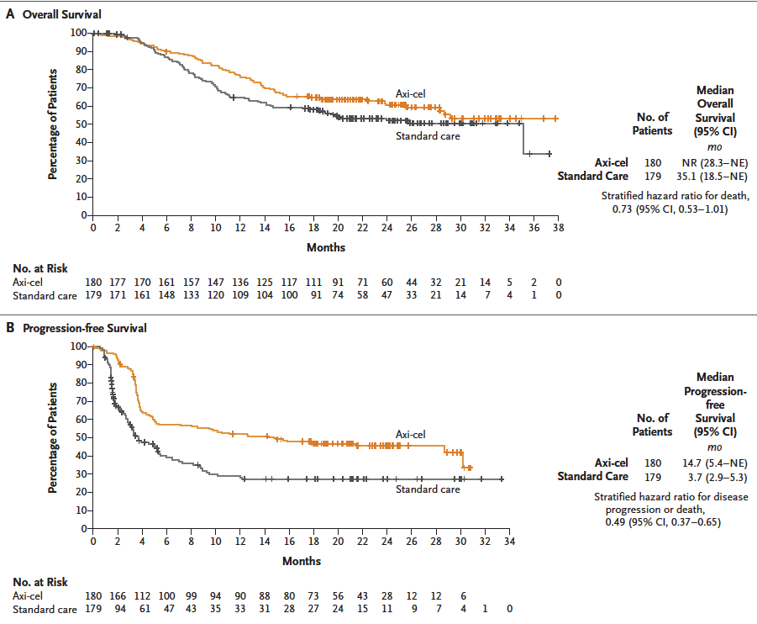
ZUMA-7: Overall and Progression-Free Survival
Locke FL et al. N Engl J Med 2022;386(7):640-54.

Slide 71
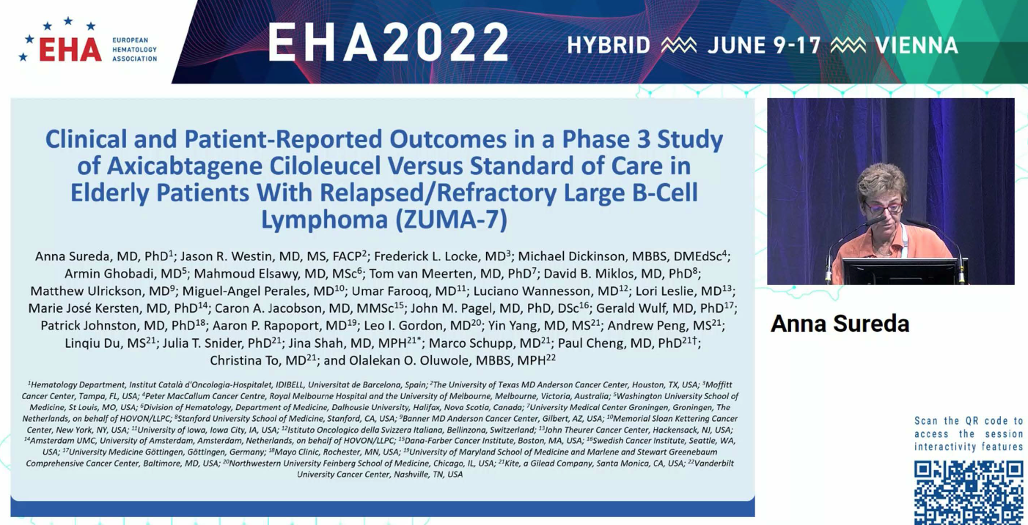
Abstract S211

Slide 72
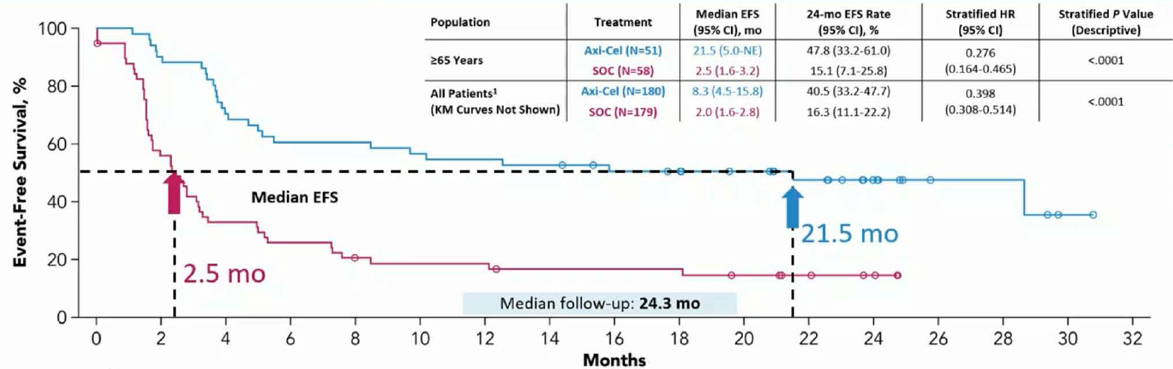
ZUMA-7: Event-Free Survival per Blinded Central Review in Patients Aged ≥65 Years
Sureda A et al. EHA 2022;Abstract S211.

Slide 73
ZUMA-7: Select Grade ≥3 Adverse Events
Adverse event | Axi-cel (N = 170) | SOC (N = 168)
Pyrexia | 9% | 1%
Neutropenia | 69% | 41%
Fatigue | 6% | 2%
Anemia | 30% | 39%
Thrombocytopenia | 15% | 57%
Febrile neutropenia | 2% | 27%
Cytokine release syndrome | 6% | 0
Neurologic event | 21% | 1%
Vomiting | 0 | 1%
SOC = standard of care
Sureda A et al. EHA 2022;Abstract S211.

Slide 74
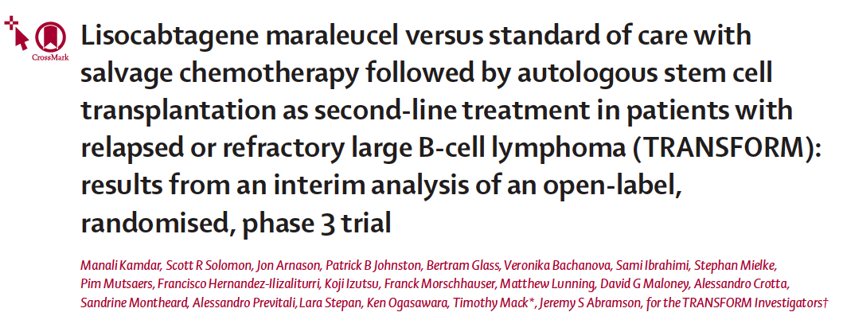


Slide 75
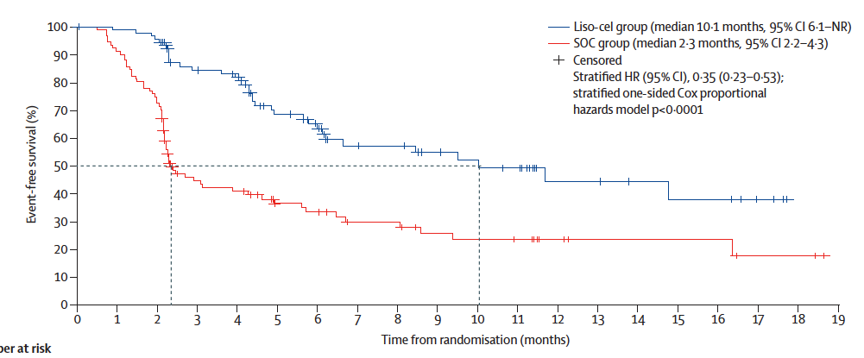
TRANSFORM: Event-Free Survival (ITT Population, Primary Endpoint)
Kamdar M et al. Lancet 2022;399:2294-308.

Slide 76
N Engl J Med 2022;386(7):629-39.

Slide 77

BELINDA: Event-Free Survival (Primary Endpoint)
Bishop MR et al. N Engl J Med 2022;386(7):629-39.

Slide 78

Lancet Oncology 2022;August;23(8):1066-77.

Slide 79


PILOT: Progression-Free and Overall Survival
Sehgal A et al. Lancet Oncology 2022;August;23(8):1066-77.

Slide 80
PILOT: Best Response by Independent Review Committee Assessment in the Efficacy Analysis Set
Overall response rate 80%
(95% CI 68–89); p <0.0001
(n = 49)
Complete response
rate 54%
(95% CI 41–67)
Partial response
rate 26%
(95% CI 16–39)
(n = 33)
15%
(n = 9)
5%
(n = 3)
(n = 16)
Sehgal A et al. Lancet Oncology 2022;August;23(8):1066-77.

Slide 81
PILOT: Patients Who Received Lisocabtagene Maraleucel (n = 61)
Transplantation not intended criteria
Cytokine release syndrome | 30 (49%)
Any grade | 23 (38%)
Grade 1 | 11 (18%)
Grade 2 | 11 (18%)
Grade 3 | 1 (2%)
Grade 4 or 5 | 0
Time to onset,* days | 4 (3-7)
Time to resolution,† days | 4 (2-5)
Tocilizumab, corticosteroids, or both for cytokine release syndrome | 16 (26%)
Tocilizumab only | 6 (10%)
Tocilizumab and corticosteroids | 10 (16%)
Corticosteroids only | 0
* Time to onset was calculated from the lisocabtagene maraleucel infusion date to the first onset of cytokine release syndrome or a neurological event. Any cytokine release syndrome or a neurological event that started and stopped within 7 days was considered as a single episode.
† Time to resolution of cytokine release syndrome or a neurological event was defined as the number of days from onset to when the last event of the first episode ended. Patients with an unresolved event in the first episode were excluded from the summary.
Sehgal A et al. Lancet Oncology 2022;August;23(8):1066-77.

Slide 82
Long-Term (4- and 5-Year) Overall Survival in ZUMA-1, the Pivotal Study of Axicabtagene Ciloleucel (Axi-Cel) in Patients with Refractory Large B-Cell Lymphoma (LBCL)
Jacobson C et al.
ASH 2021;Abstract 1764.

Slide 83

ZUMA-1: Five-Year Update
5-y OS rate: 42.6%
5-y OS rate in complete responders: 64.4%
Median time to next cancer therapy: 8.7 months
Safety findings were similar to those in previous reports
Jacobson C et al. ASH 2021;Abstract 1764.

Slide 84
Management of DLBCL
Where We Are, Where We’re Headed
PROLOGUE
MODULE 1: First-Line Treatment
MODULE 2: Bispecific Antibodies
MODULE 3: CAR T-Cell Therapy
MODULE 4: Sequencing of Novel Agents
Dr Gupta: 68-year-old man with cardiac comorbidities and relapsed DLBCL while on R-CHOP receives second-line polatuzumab vedotin/BR
MODULE 5: Appendix

Slide 85
Case Presentation: 68-year-old man with cardiac comorbidities and relapsed DLBCL while on R-CHOP receives second-line polatuzumab vedotin/BR
Dr Shaachi Gupta (Lake Worth, Florida)

Slide 86
Novel Agents Recently Approved for Relapsed/Refractory DLBCL
 | Pola-BR | Selinexor | Tafasitamab/ lenalidomide | Loncastuximab tesirine
Mechanism of action | Anti-CD79b ADC | XPO-1 inhibitor | Anti-CD19 MAb/immunomodulator | Anti-CD19 ADC
ORR | 45% | 28% | 58% | 48%
CR rate | 40% | 10% | 40% | 24%
PFS | 9.2 mo | 2.6 mo | 11.6 mo | 4.9 mo
DOR | 12.6 mo | 9.3 mo | 43.9 mo | 10.3 mo
OS | 12.4 mo | NR | 33.5 mo | 9.9 mo
MAb = monoclonal antibody; ADC = antibody-drug conjugate
Content Courtesy of Laurie H Sehn MD, MPH

Slide 87

Tafasitamab (MOR208)
Tafasitamab
Lenalidomide enhances NK function with enhanced ADCC in vitro
Tafasitamab
Salles G et al. Lancet Oncol 2020;21(7):978-88.

Slide 88

Lancet Oncol 2020;21(7):978-88.
As a result of the L-MIND trial, tafasitamab in combination with lenalidomide was FDA approved for patients with relapsed or refractory DLBCL not otherwise specified, including DLBCL arising from low-grade lymphoma, who are not eligible for autologous stem cell transplant.

Slide 89

L-MIND: Best Objective Response According to Independent Radiology Committee or Clinical Review Committee
Salles G et al. Lancet Oncol 2020;21(7):978-88.

Slide 90
L-MIND: Select Adverse Events and Incidence of Infusion-Related Reactions
 | Grade 1-2 | Grade 3-4
Neutropenia | 1 (1%) | 39 (49%)
Anemia | 22 (27%) | 6 (7%)
Thrombocytopenia | 11 (14%) | 14 (18%)
Febrile neutropenia | 0 | 10 (13%)
Pneumonia | 1 (1%) | 5 (6%)
Pulmonary embolism | 0 | 4 (5%)
Treatment-emergent adverse events that led to discontinuation of tafasitamab included pneumonia, bronchitis, deep vein thrombosis and allergic dermatitis.
Infusion-related reactions (all Grade 1) were observed in 5 (6%) patients. All occurred once during the first infusion and no discontinuation of infusion was required.
Salles G et al. Lancet Oncol 2020;21(7):978-88.

Slide 91

frontMIND: Phase III Trial Design for Newly Diagnosed DLBCL
Stratification: IPI 3/aaIPI 2 vs IPI 4-5/aaIPI 3, region
Experimental arm
Tafa 12 mg/kg d 1, 8, and 15 of each cycle +
Len 25 mg/d (d1-d10) +
R-CHOP x 6 cycles
Q21D (n = 440)
Previously untreated DLBCL and HGBL
Aged 18-80 y
IPI 3-5 + aaIPI 2-3
ECOG PS 3-5
Diagnosis to treatment interval ≤28 days
Candidate for
R-CHOP
Screening
End of treatment
Follow-up
End of study
R
1:1
Control arm
Tafa placebo d 1, 8, and 15 of each cycle +
Len placebo (d1-d10) +
R-CHOP x 6 cycles
Q21D (n = 440)
www.clinicaltrials.gov. NCT04824092. Accessed August 2022.

Slide 92

Lancet Oncol 2021;22(6):790-800.
As a result of the LOTIS-2 trial, loncastuximab tesirine was FDA approved for patients with relapsed or refractory large B-cell lymphoma after 2 or more lines of systemic therapy, including DLBCL not otherwise specified, DLBCL arising from low-grade lymphoma and high-grade B-cell lymphoma.

Slide 93

Mechanism of Action of Loncastuximab Tesirine
Hamadani M et al. ASCO 2021;
Abstract TPS7574.

Slide 94
LOTIS-2: Response and Survival with Loncastuximab Tesirine for R/R DLBCL
Response | As-treated population (N = 145)
Overall response rate | 70/145 (48.3%)
Complete response rate | 35/145 (24.1%)
Complete response | 35 (24%)
Partial response | 35 (24%)
Stable disease | 22 (15%)
Progressive disease | 30 (21%)
Not evaluable | 23 (16%)
Survival | As-treated population (N = 145)
Median progression-free survival | 4.9 months
Median overall survival | 9.9 months
Caimi PF et al. Lancet Oncol 2021;22(6):790-800.

Slide 95
LOTIS-2: Select Treatment-Emergent Adverse Events (AEs)
Treatment-emergent AEs | Grade 1-2 | Grade 3-4
Peripheral edema* | 19% | 1%
Anemia | 16% | 10%
Thrombocytopenia | 15% | 18%
Neutropenia | 14% | 26%
Pleural effusion* | 8% | 2%
Leukopenia | 6% | 9%
* Treatment-emergent AEs considered likely to be related to the the agent’s payload included edema or effusion, symptoms in the skin or nails and liver enzyme abnormalities
Caimi PF et al. Lancet Oncol 2021;22(6):790-800.

Slide 96

Blood Adv 2022;6(2):533-43.

Slide 97

Polatuzumab Vedotin with BR for Transplant-Ineligible R/R DLBCL: Overall Survival
Sehn LH et al. J Clin Oncol 2020;38(2):155-65.

Slide 98
Management of DLBCL
Where We Are, Where We’re Headed
PROLOGUE
MODULE 1: First-Line Treatment
MODULE 2: Bispecific Antibodies
MODULE 3: CAR T-Cell Therapy
MODULE 4: Sequencing of Novel Agents
MODULE 5: Appendix

Slide 99
Overview of DLBCL

Slide 100
DLBCL Is the Most Common Non-Hodgkin
Lymphoma (NHL) Subtype
NHL prevalence in the US
United States patients with DLBCL
Newly diagnosed ~28,000 per year
Relapsed/refractory ~11,000 per year
DLBCL
Follicular lymphoma
All other subtypes

Slide 101
DLBCL Incidence Increases with Age
Average patient at diagnosis is 60-65 years of age (median age = 69 years), and most are not fit for high-dose chemotherapy/autologous stem cell transplant¹⁻⁴
1. https://seer.cancer.gov/statfacts/html/dlbcl.html; 2. https://www.leukaemia.org.au/wp-content/uploads/2011/11/Factsheet-Lymphoma-
DLBCL.pdf; 3. Martelli M et al. Crit Rev Oncol Hematol 2013;87(2):146-71; 4. Broccoli A et al. Oncologist 2019;24(9):1246-52.

Slide 102


DLBCL: Prognosis
5-year overall survival
  Germinal center: 76%
  Nongerminal center: 56%
  “Double expressor”: 54%
    Overexpression of c-MYC and BCL2 or BCL6
  Double hit: ~35%
    Translocation of c-MYC and BCL2
GCB vs non-GCB
Double expressor
Double hit
Hans et al. Blood 2004;103:275-82; Scott et al. JCO 2015; Green et al. JCO 2012.

Slide 103

ASH 2021 Education Program.

Slide 104

Outline for Workup and Management of Aggressive B-Cell Lymphomas
Dunleavy K. ASH 2021 Education Program.

Slide 105
R-CHOP Became the Standard Treatment >20 Years Ago
Three large randomized trials (n ≈ 2,000) in advanced-stage DLBCL for patients
≥60 years old show improved OS with R-CHOP versus CHOP:
  At 3 years: 70% versus 57%
  At 5 years: 58% versus 45%
  At 10 years: 44% versus 28%
Similar trial in advanced-stage DLBCL for patients <60 years old showed improved OS with R-CHOP versus CHOP (n = 824):
  At 3 years: 93% versus 84%
  At 5 years: 90% versus 80%
Content Courtesy of Neha Mehta-Shah, MD, MSCI

Slide 106
Bispecific Antibodies

Slide 107

ASH 2021 Education Program.

Slide 108

Algorithm for Preferred and Alternative Treatment Options for R/R DLBCL
Karmali R. ASH 2021 Education Program.

Slide 109
ASCO 2022

Slide 110

EPCORE NHL-2 Arm 1 Study Design
Falchi L et al. ASCO 2022;Abstract 7523.

Slide 111

EPCORE NHL-2: Treatment-Emergent Adverse Events
Falchi L et al. ASCO 2022;Abstract 7523.

Slide 112
CAR T-Cell Therapy

Slide 114

TRANSFORM: Summary of Primary and Key Secondary Endpoints
Kamdar M et al. Lancet 2022;399:2294-308.

Slide 115

TRANSFORM: Select Adverse Events
Kamdar M et al. Lancet 2022;399:2294-308.

Slide 116
N Engl J Med 2022;386(7):629-39.

Slide 117
BELINDA: Select Grade ≥3 Adverse Events
Adverse event | Tisagenlecleucel (N = 162) | SOC (N = 160)
Anemia | 33.3% | 57.5%
Nausea | 1.2% | 6.3%
Thrombocytopenia | 32.1% | 47.5%
Neutropenia | 40.1% | 39.4%
Cytokine release syndrome | 4.9% | 0
Hypokalemia | 4.9% | 8.8%
Diarrhea | 1.9% | 3.8%
Pyrexia | 0 | 1.9%
Vomiting | 0.6% | 1.9%
Bishop MR et al. N Engl J Med 2022;386(7):629-39.

Slide 118
CAR T-Cell Therapy-Associated Cytokine Release Syndrome (CRS)
CRS — May be mild or life-threatening
Occurs with CART19 activation and expansion
Dramatic cytokine elevations (IL-6, IL10, IFNɤ, CRP, ferritin)
Fevers initially (can be quite high: 105˚F)
Myalgias, fatigue, nausea/anorexia
Capillary leak, headache, hypoxia and hypotension
CRS-related mortality 3% to 10%
Varadarajan I, Lee DW. Cancer J 2019;25(3):223‐30.
Abramson JS et al. ASCO 2019 Education Book.

Slide 119
Cytokine Release Syndrome (CRS): Common Symptoms
CRS
High fevers
Rigors
Myalgia/
arthralgias
Nausea/vomiting/
anorexia
Hypotension
Dyspnea/ tachypnea/ hypoxia
Fatigue
Headache
Escalating fevers
Based on CAR T-cell experience
Diagnosis based on clinical symptoms and events

Slide 120
CAR T-Cell Therapy-Associated Neurologic Toxicity
Neurologic toxicity — May be mild or life-threatening
Mechanism unclear, referred to as immune effector cell-associated neurotoxicity syndrome (ICANS)
Encephalopathy
Seizures
Delirium, confusion, aphasia, agitation, sedation, coma
Varadarajan I, Lee DW. Cancer J 2019;25(3):223‐30.
Abramson JS et al. ASCO 2019 Education Book.

Slide 121

Example of Handwriting Deterioration Associated with Neurotoxicity from CAR T-Cell Therapy

Slide 122
Sequencing of Novel Agents

Slide 123


L-MIND: Phase II Study Design
  Sample size suitable to detect ≥15% absolute increase in ORR for tafasitamab/LEN combination versus LEN monotherapy at 85% power,
  2-sided alpha of 5%
  Mature data: Primary endpoint analysis with data cutoff 30 Nov 2018; minimum follow-up 12 months, median follow-up 17.3 months
ORR = objective response rate; PFS = progression-free survival; DoR = duration of response; OS = overall survival
Salles G et al. Lancet Oncol 2020;21(7):978-88.

Slide 124

LOTIS-2: Phase II Trial Design
ORR = overall response rate; Lonca = loncastuximab tesirine
Caimi PF et al. Lancet Oncol 2021;22(6):790-800.

Slide 125
GO29365: Phase Ib/II Study Design
Inclusion: transplant-ineligible DLBCL, ≥1 line of therapy
Exclusion: prior allo-SCT, history of transformation, current Grade >1 peripheral neuropathy
Main study
Phase Ib: Safety run-in Pola + BR
Pola + BR (n = 6)
R/R DLBCL
Pooled
pola + BR
cohorts
(N = 152)
Phase II: Randomization
Pola + BR vs BR
BR (n = 40)
R/R DLBCL
Randomized
Median follow-up: 48.9 months
Pola + BR (n = 40)
Extension
cohort
Phase II: Extension Pola + BR
R/R DLBCL
Pola + BR (n = 106)
Median follow-up: 15.2 months
Pola = polatuzumab vedotin; BR = bendamustine/rituximab; R/R = relapsed/refractory
Pola 1.8 mg/kg on day 1 of each cycle of BR; up to 6 cycles at 3-weekly interval
Sehn LH et al. Blood Adv 2022;6(2):533-43.

Slide 126
GO29365: PFS and OS in Randomized and Extension Cohorts
Randomized
Extension cohort
100
Median PFS
100
Median PFS
80
Pola + BR (N = 40): 9.2 months
80
Pola + BR (N = 106): 6.6 months
60
BR (N = 40): 3.7 months
60
PFS (%)
PFS (%)
40
40
20
20
0
0
0
2
4
6
8
10
12
14
16
18
20
22
24
26
28
30
32
34
36
38
40
42
44
46
48
50
52
54
0
2
4
6
8
10
12
14
16
18
20
22
24
26
28
Time (months)
Time (months)
Pola+BR
100
Median OS
100
Median OS
80
Pola + BR (N = 40): 12.4 months
80
Pola + BR (N = 106): 12.5 months
60
BR (N = 40): 4.7 months
60
OS (%)
OS (%)
40
40
20
20
0
0
0
2
4
6
8
10
12
14
16
18
20
22
24
26
28
30
32
34
36
38
40
42
44
46
48
50
52
54
0
2
4
6
8
10
12
14
16
18
20
22
24
26
28
Time (months)
Time (months)
Randomized cohort:
Survival benefit persists with longer follow-up
2-y PFS 28.4%, 2-y OS 38.2%
Pooled cohort
Non-primary refractory:
Median PFS 13.4 mo, median OS 32 mo
Sehn LH et al. Blood Adv 2022;6(2):533-43.

Slide 127

GO29365: Median PFS and OS in the Pooled Pola + BR Cohort
According to Line of Therapy and Refractory Status
Sehn LH et al. Blood Adv 2022;6(2):533-43.

