Slide 1
American Society of Hematology December 2021 Annual Meeting: Multiple Myeloma Updates
Ajai Chari, MD
Professor of Medicine
Director of Clinical Research, Multiple Myeloma Program
Icahn School of Medicine at Mount Sinai

Slide 2
Currently Available Anti-Myeloma Agents in 2022
Steroids | Conventional Chemo | ImIDs | Proteasome Inhibitors | Immunologic approaches | XPO inhibitor
Prednisone | Melphalan | Thalidomide | Bortezomib | Daratumumab (anti-CD38) | Selinexor
Dexamethasone | Cyclophosphamide | Lenalidomide | Carfilzomib | Isatuximab (anti-CD38)
 | Doxorubicin | Pomalidomide | Ixazomib | Elotuzumab (anti-CS1)
 | DCEP/D-PACE |  |  | Belantamab (anti-BCMA + MMAF)
 | METRO28 |  |  | idecabtagene vicleucel: anti-BCMA CART
 | Carmustine
 | Bendamustine

Slide 3
ASH 2021 : Multiple Myeloma Updates
Newly Diagnosed MM
  SCT Ineligible:
    Front line vs 2nd Line Dara
  SCT eligible
    Griffin: DVRd vs VRd
    GMMG-HD7: IsaVRd to VRd
    Cassiopeia: DVTd vs VTd
    Master: DKRd
Relapsed MM
CAR-T
Bispecifics
Notes:
Fonseca R et al. First-Line Use of Daratumumab, Lenalidomide, and Dexamethasone Confers Survival Benefit Compared with Second-Line Use of Daratumumab-Based Regimens in Transplant-Ineligible Patients with Multiple Myeloma: Analysis of Different Clinical Scenarios. ASH 2021;Abstract 118.
Goldschmidt H et al. Addition of Isatuximab to Lenalidomide, Bortezomib and Dexamethasone As Induction Therapy for Newly-Diagnosed, Transplant-Eligible Multiple Myeloma Patients: The Phase III GMMG-HD7 Trial. ASH 2021;Abstract 463.

Slide 4
An 80 year old male with a history of HTN, DM, stable CAD, CKd (Cr Cl 45 ml/min) presents with new anemia (hg 10.5 from baseline 12.5 g/dl) and is found to have an IgA m spike 2.5 g/dl, lambda FLC 200 mg/L, bone marrow biopsy with 40% lambda restricted plasma cells, nl FISH, ISS2, LDH normal.
What would you treat this patient with?
1. RVd
2. RVd lite
3. Daratumumab VMP
4. Daratumumab Rd
5. Ixazomib Rd

Slide 5
Summary: NDMM without SCT
HR (95% CI) | 0.74 (0.59–0.93) | N/A | 0.42 (0.34 - 0.51) | 0.53 (0.43- 0.66) | 0.83 (0.68–1.02)
41
NR
36
35.3
34
29
35.1
19
21.8
Median PFS (mos)
 | SWOGG 777 VRd vs Rd | RVd-lite | ALYCYONE Dara VMP vs VMP | MAIA DaraRD vs Rd | TOURMALINE-MM2 Ixazomib-Rd vs Rd
Total N | 225 vs 235 | 50 | 350 vs 356 | 368 vs 369 | 351 vs 354
Median age | 63 | 73 | 71 | 73 | 73
mFU (months) | 84 | 30 | 40 | 56 | 54
 | V for 6 mos (biw q21 d * 8 cycles) | V for 17 mos (qwk:35d *9, q2wk:28d *6) | V for 12 mos (6 wk cycles, biw *1, qwk * 8)
Duriet et al Blood Cancer J 2020. 10: 53
O’Donnell. Br J Haematol. 2018;182:222
Mateos MV, et al. NEJM. 2018;378:518-528.
Mateos MV, et al Lancet 2020:395:132-141
Dimopolous et al. ASH 2018
Facon et al. NEJM 2019; 380:2104-15
Facon et al EHA 2021
Kumar et al. ASH 2020. Abstract 2276.
Facon et al. SOHO 2020.
Facon et al. ASH 2020.
OS HR | 0.71 (0.54-0.93) | N/A | 0.60 (0.46-0.80) | 0.68 (0.53-0.86) | 0.998 (0.790-1.261)
Age > 65 HR 0.77 (0.52, 1.14)
Notes:
Results
737 patients (D-Rd, 368; Rd, 369) were enrolled in this study. Baseline characteristics were well balanced between arms. The median age was 73 (range, 45-90) years. After a median follow-up of almost 5 years (56.2 months), a significant 32% reduction in the risk of death was observed with D-Rd versus Rd; median OS was not reached (NR) in either arm (hazard ratio [HR], 0.68; 95% confidence interval [CI], 0.53-0.86; P=0.0013 [crossing the prespecified stopping boundary of P=0.0414]). The estimated 5-year OS rate was 66.3% with D-Rd and 53.1% with Rd (Figure A). The updated median PFS was NR with D-Rd versus 34.4 months with Rd (HR, 0.53; 95% CI, 0.43-0.66; P<0.0001; Figure B). The estimated 5-year PFS rate was 52.5% with D-Rd and 28.7% with Rd. The updated ORR was 92.9% with D-Rd versus 81.6% with Rd (P<0.0001). No new safety signals were identified with longer follow-up. The most common (in >15% of patients in either arm) grade 3/4 treatment-emergent adverse events for the D-Rd/Rd arms were neutropenia (54.1%/37.0%, respectively), pneumonia (19.2%/10.7%), anemia (16.8%/21.6%), and lymphopenia (16.5%/11.2%).
Conclusion
After almost 5 years of follow-up, a significant and clinically meaningful OS improvement was demonstrated with the use of D-Rd versus Rd in patients with NDMM who are transplant ineligible, representing a 32% reduction in the risk of death. The significant PFS benefit of D-Rd versus Rd from the primary analysis (median follow-up, 28 months) was maintained, with a 47% reduction in risk of disease progression or death and a median PFS for D-Rd NR. The favorable benefit-risk profile observed supports the use of D-Rd in transplant-ineligible patients with NDMM. These results, together with the OS benefit observed in ALCYONE, support the use of frontline DARA-based combination regimens to maximize PFS for optimal long-term outcomes.

Slide 6
Initial Treatment is Best Chance For Deep and Durable Remissions
Attrition
% of Patients Able to Get Nth Line of Therapy
Diminishing Returns
Median Duration of Nth Line of Therapy
% of Patients
Months
Line of therapy
Line of therapy
In spite of 7 Classes of anti-MM agents, no plateau in MM OS curves
Attrition: high risk & frail elderly patients in particular will not live to Nth relapse
Response rates and duration diminish with each successive line of therapy
Early use of efficacious regimens to achieve and sustain remissions critical
Yong et al. British Journal of Haematology, 2016, 175, 252–264
Notes:
LOT DOT % Patients 1 13 95 2 7 61 3 6 38 4 5 15 5 4 10

Slide 7
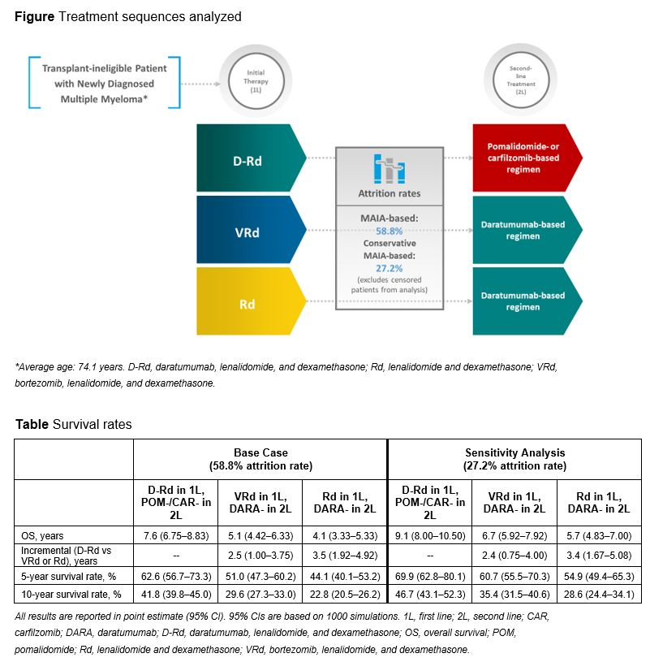
First-Line Use of Dara Rd vs Second-Line Use of Daratumumab-Based Regimens in Transplant-Ineligible Patients with Multiple Myeloma: Analysis of Different Clinical Scenarios
Fonseca et al, ASH 2021, Abs 118

Slide 8
A 60 year old female presents with hypercalcemia, FDG avid lytic lesions, IgG m spike 2.4 g/dl, kappa FLC 750 mg/L, bone marrow 25% kappa restricted plasma cells, +1q. ISS2, LDH inc.
What would you pick for each of the following components
Induction: VRd, KRd, DVRd, DKRd?
SCT or not?
If SCT consolidation or not?
Maintenance: R, R+dara, R+Ixa, R+bort, R+ carf?

Slide 9
Summary: NDMM with SCT
Attal et al. NEJM . 2017; Perrot ASH 2020
Gay et al ASCO 2019, ASH 2020
Moreau et al. Lancet 2019; Avet Loiseau ASH 2021, Abs 82
Laubach et al ASH 2021, Abs 79
Costa et al JCO 2021, ASH 2021. Abs 481
Goldschmidt et al, ASH 2021, Abs 463
HR (95% CI) | 0.65 (0.53-0.80) | 0.64 (0.44-0.94) | 0.58 (0.47-0.72) | 0.46 (0.21-1.01)
NR
57
NR
50
52
36
89%
@ 3y
81%
@3y
87%
@ 2y
Median PFS (mos)
 | IFM 2009 RVd-SCT vs RVd | FORTE KRd-SCT vs KRd | Cassiopeia- all SCT Dara VTd vs VTd | Griffin – all SCT DaraVRd vs VRd | MASTER DaraKRd SCT | GMMG_HD7 – all SCT; VRD +/- Isa
Total N | 350 vs 350 | 158 vs 157 | 543 vs 542 | 104 vs 103 | 123 | 331 vs 329
# days (28 day cycles) chemo induction to post consolidation | 105 (3.75) vs 168 (6) | 224 (8) vs 336 (12) | 168 (6) | 126 (4.5) | 112 -336 (4-12) | 126 (4.5)
SCH mobilization | Cy 3 gm/m2 | Cy 2 gm/m2 | Cy 3 gm/m2 | Plerixafor | NR | NR
ORR (%) | N/A | N/A | 93 vs 81 | 99 vs 91.8 | 98% | 90 vs 84%
≥VGPR(%) | 78 vs 69 | 89 vs 87 | 83.4 vs 78 | 95 vs 91 | 98% | 77 vs 61%
sCR (%) | N/A | 44 vs 43 | 28.9 vs 20.3 | 42.4 vs 32 | 84% | NR
mFU (months) | 44 | 45 | 45 | 38.6 | 25 | NR

Slide 10
Avet Loiseau ASH 2021, Abs 82

Slide 11
CASSIOPEIA: Rates of ≥ CR + MRD Negativity
Avet Loiseau ASH 2021, Abs 82

Slide 12
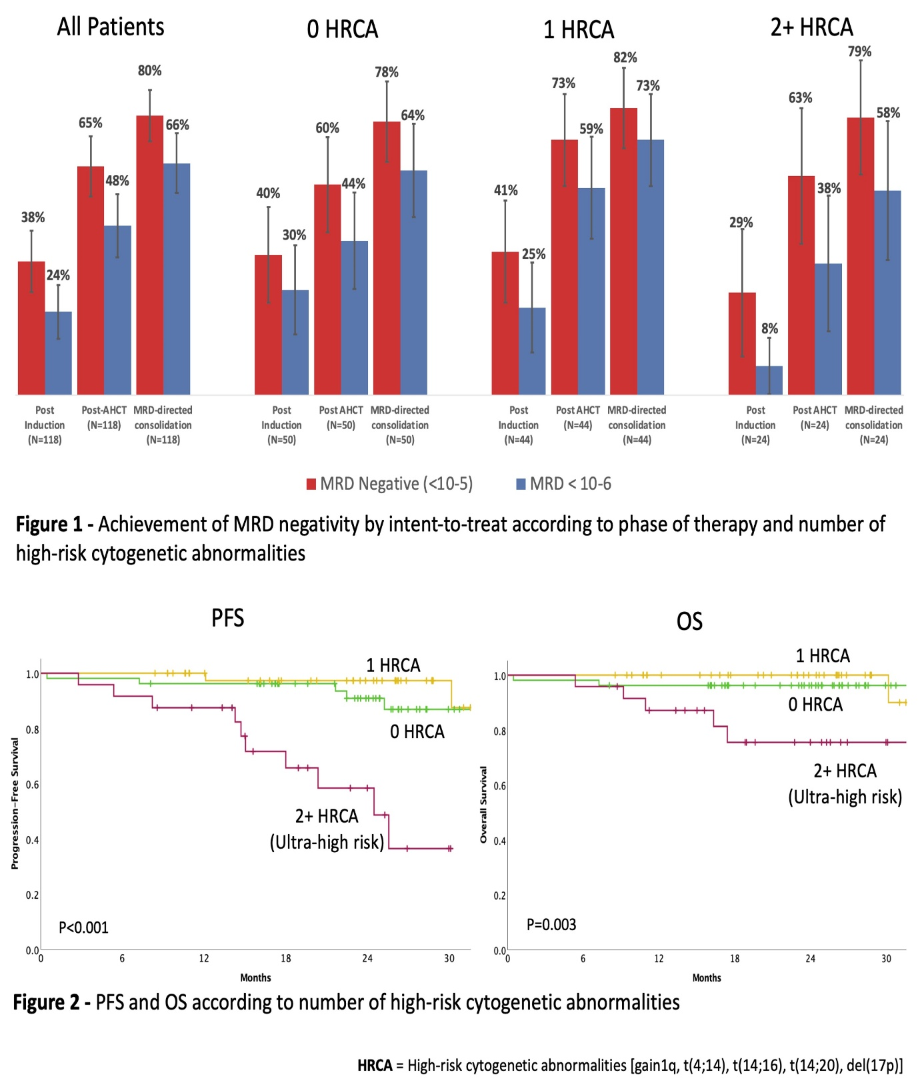
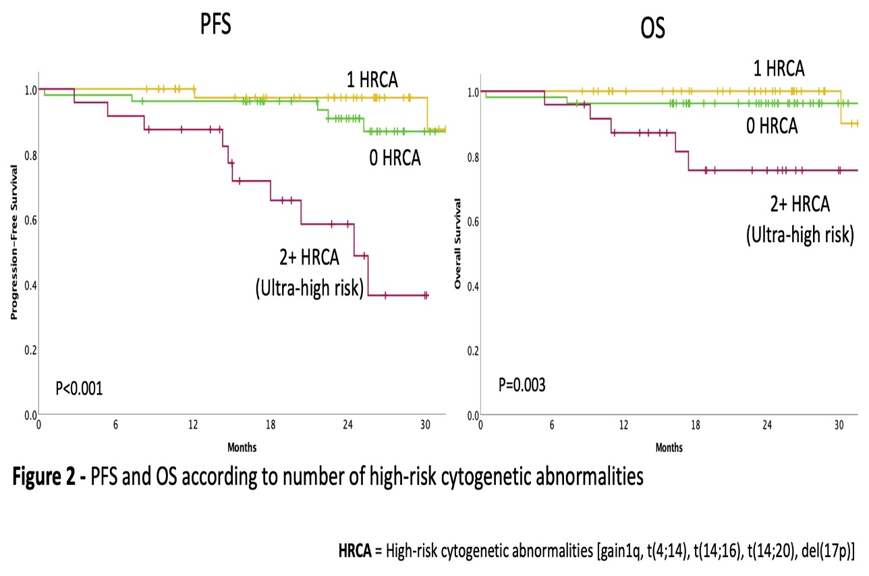
MASTER (DKRd-SCT- MRD guided DKRd consolidation):
MRD negativity and PFS/OS
Costa et al JCO 2021, ASH 2021. Abs 481

Slide 13
GMMG-HD7 (IsaVRd vs VRd): MRD negativity
Goldschmidt et al, ASH 2021, Abs 463

Slide 14
ASH 2021 : Multiple Myeloma Updates
Newly Diagnosed MM
Relapsed MM
  Selinexor post dara
  Bellini – Bortezomib Dex +/- Venetoclax
CAR-T
Bispecifics
Notes:
Fonseca R et al. First-Line Use of Daratumumab, Lenalidomide, and Dexamethasone Confers Survival Benefit Compared with Second-Line Use of Daratumumab-Based Regimens in Transplant-Ineligible Patients with Multiple Myeloma: Analysis of Different Clinical Scenarios. ASH 2021;Abstract 118.
Goldschmidt H et al. Addition of Isatuximab to Lenalidomide, Bortezomib and Dexamethasone As Induction Therapy for Newly-Diagnosed, Transplant-Eligible Multiple Myeloma Patients: The Phase III GMMG-HD7 Trial. ASH 2021;Abstract 463.

Slide 15
A 63 year old female presents with hypercalcemia, anemia, FDG avid lytic lesions
with soft tissue extension, IgG m spike 5.4 g/dl, kappa FLC 1320 mg/L, bone marrow
biopsy with 65% kappa restricted plasma cells, FISH -17p 65%, +1q. ISS3, LDH inc.
Treatment course
Dara VRd induction, mel 200 mg/m2 SCT, dara-len maintenance with PD after 1.5 years.
Carfilzomib Pom dex with rapid PD after 4 mos. Severe back pain with multifocal
disease on PET-CT ANC 1.2 Hg 8.3 plt 78k, Cr 1.5
Assuming all these options available, all of the following would be reasonable options except
Selinexor, belantamab, or iberdomide based triplet
96 hour infusional chemo
2nd autologous stem cell transplant
Bispecific clinical trial
Anti-BCMA CART

Slide 16
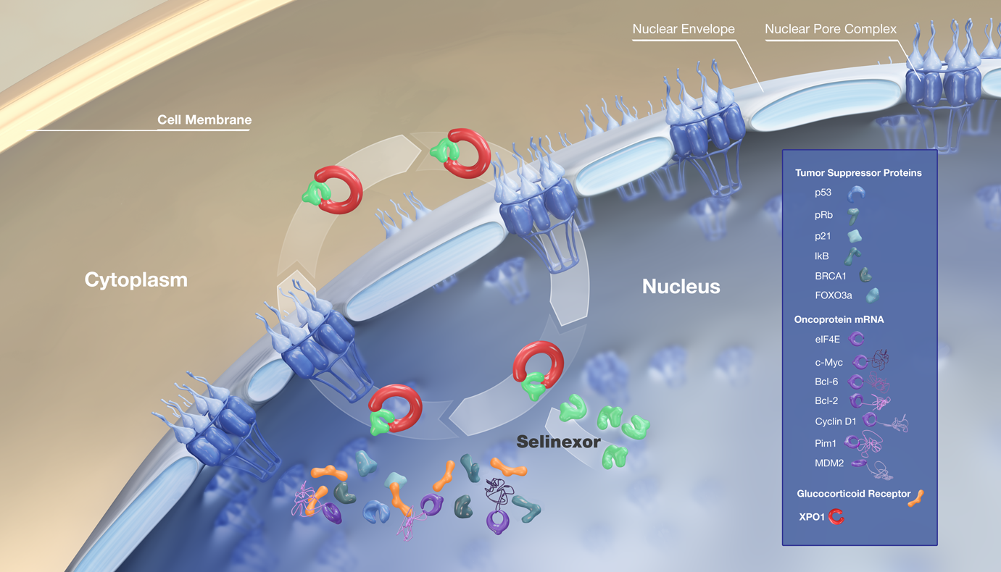
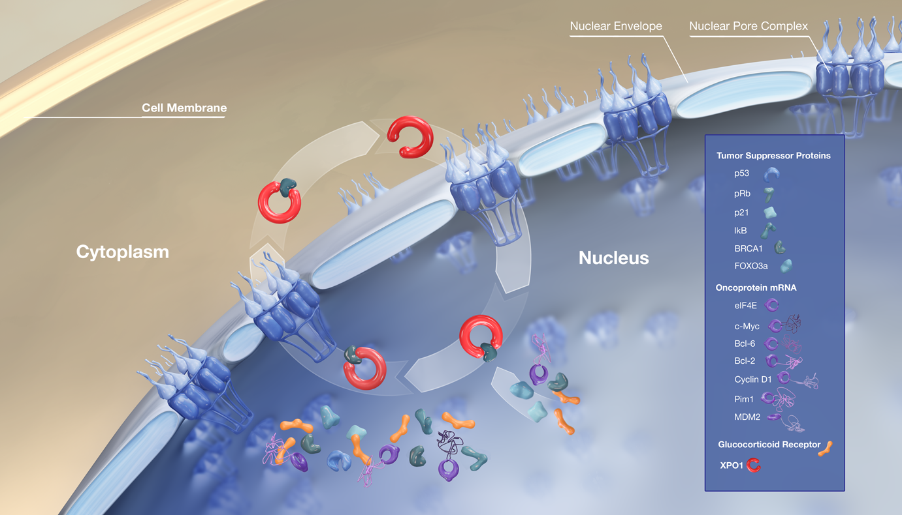
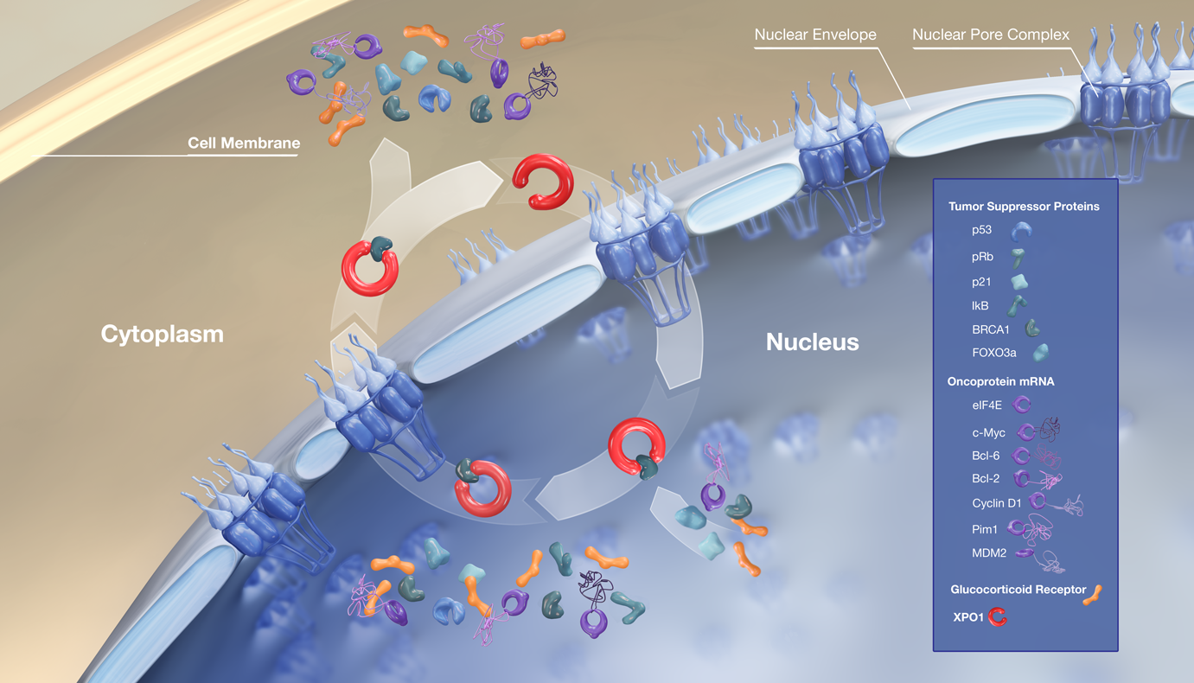
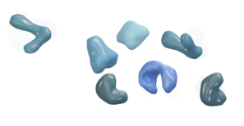





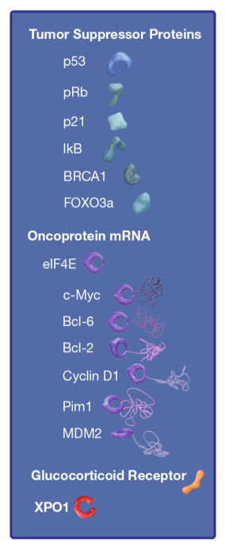

Selinexor: A First-in-Class, Oral Selective Inhibitor of Nuclear Export (SINE) Compound: Mechanism of Action
Selinexor
  Inhibits XPO1 through reversible covalent modification
Selinexor Mechanisms of Action
Nuclear retention/activation of tumor suppressor proteins and glucocorticoid receptor
Reduction of oncoproteins through nuclear retention of their mRNAs
With
Without Selinexor
p53 Localization
Control
Selinexor-Treated
XPO expression increased in MM vs normal plasma cells /MGUS/SMM
also, increased with bortezomib resistance
correlates with increased lytic bone and shorter survival.
Tai et al Leukemia 2014.
Schmidt et al Leukemia 2013.

Slide 17
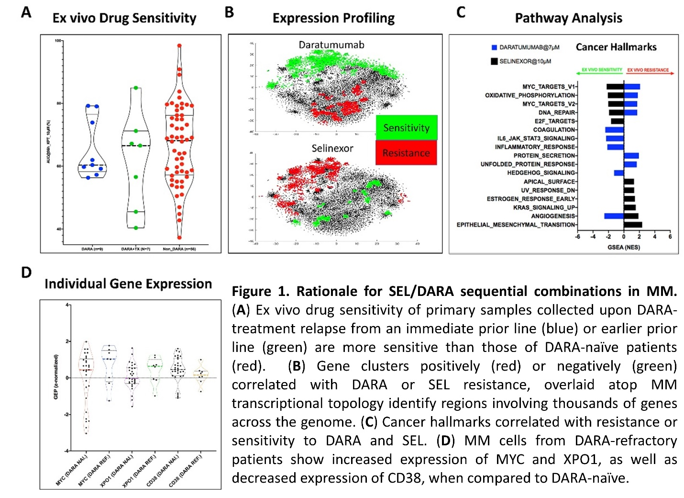
Rationale for Selinexor Treatment in Daratumumab-Refractory Multiple Myeloma Patients Identified by Paired Ex Vivo Drug Sensitivity and RNA-Seq.
Sudalagunta et al, ASH 2021, Abs 893

Slide 18
Proteasome Inhibitor Backbone Phase 3 Trials in RRMM
HR (95% CI) P value | 0.61 (0.49−0.77) | 0.70 (NA) | 0.31 (0.24−0.39) | 0.53 (0.44−0.65) | 0.58 (0.43-0.78)
18.7
23.4
16.7
13.9
11.2
11.4
9.5
9.4
7.1
7.1
Median PFS (mos)
 | OPTIMISMM¹ PVd vs Vd | BOSTON² SVd vs Vd | CASTOR³ DVd vs Vd | ENDEAVOR⁴ Kd vs Vd | BELLINI⁵ VenVd vs Vd
N | 281 vs 278 | 195 vs 207 | 251 vs 247 | 464 vs 465 | 194 vs 97
No. prior lines | 2 | NA | 2 | 2 | 1-2
Len refractory (%) | 71.2 vs 68.7 | NA | 23.9 vs 32.8 | 24.4 vs 26.2 | 20 vs 28
mFU (months) | 15.9 | 13.2 vs 16.5 | 50.2 | 11.9 vs 11.1 | 45.6
≥CR (%) | 4.0 | 10.5 | 9.8 | 6 | 7
15.6 vs
16.9 vs
30.0 vs
13 vs
29 vs
OS HR | NR | NR | NR | 0.79 (0.65-0.96) | 1.19 (0.80-1.77)
1. Richardson PG et al. Lancet Oncol. 2019;20:781; 2. Dimopoulos MA et al. J Clin Oncol. 2020;38: Abstract 8501; 3. Weisel K et al. Blood. 2019;134: Abstract 3192; 4. Dimopoulos MA et al. Lancet Oncol. 2016;17:27; 5 Kumar et al. Lancet Oncol. 2020;21:1630-1642). Kumar SK et al ASH 2021, Abs 84
Notes:
PFS benefit can translate into OS benefit with adequate follow up though toxicity (eg in high risk/low Bcl2 with venetoclax) and drug access at relapse confounding Issues.

Slide 19
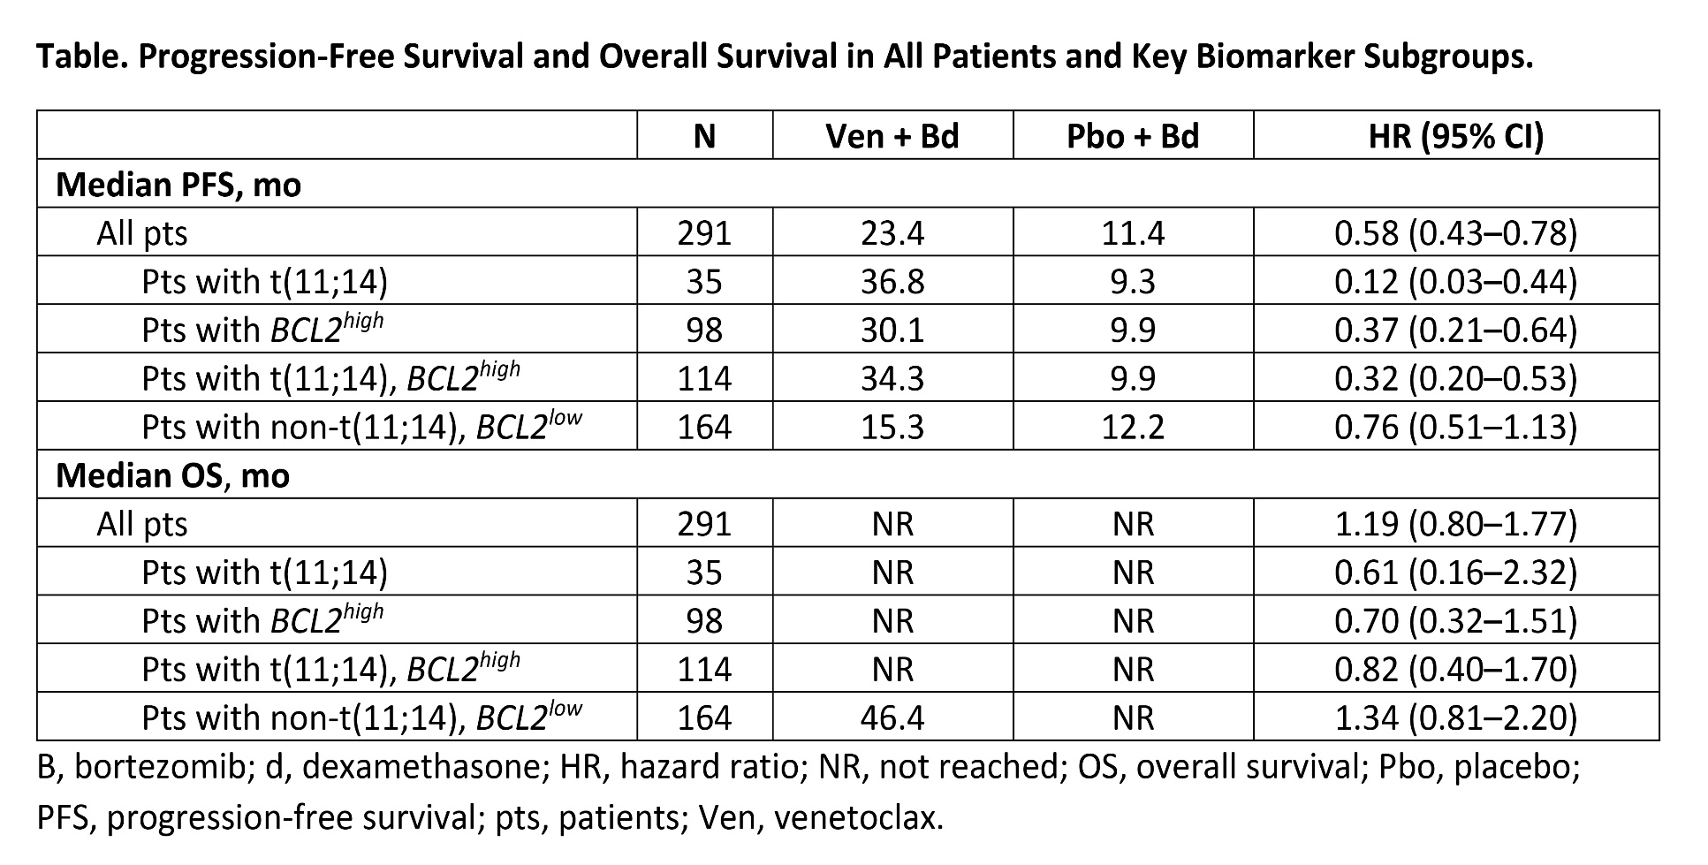
Bellini Final Overall Survival Analysis
Kumar SK et al ASH 2021, Abs 84

Slide 20
BCMA Antibody Drug Conjugates
Study | DREAMM-1 | DREAMM-2 | DREAMM-4 | DREAMM-6 | ALGONQUIN
Phase | I | II | I/II | I/II | I
Treatment (All IV q 3wk) | Belamaf dose esc/ exp 3.4 mg/kg | Belamaf 2.5 or 3.4 mg/kg | Belamaf 2.5 or 3.4 mg/kg + pembro | Belamaf 2.5 mg/kg + bortezomib-dex | Bela 2.5 mg/kg(split D1/8) q4wk+ pom 4/dex 40
Patients | n=35 | n=196 | n=13 | n=18 | n=20
Median prior lines | 5 | 6-7 | 8/ 5 | 3 | 2.5
Triple-class refractory | 37% | 100% | NR | NR | ~48% (but all pom naïve)
Trudel, et al. Blood Cancer J 2019; Lonial, et al. Lancet Oncol 2019/ASH 2020; Nooka, et al. Hematology Reports 2020;; Popat, et al. ASH 2020; Trudel ASH 2021
Notes:
Usually pt reports blurred vision, dry eyes, or decline in visual acuity, but not always symptomatic- requires regular optho exam
Predominant optho finding is microcyst-like epithelial changes (MECs) seen on slit lamp exam;
72% in DREAMM-2 (49% grade 3/4 on KVA- keratopathy and visual acuity scale)
Median onset 37 days (most within 4 doses); median time to resolution 86 days
Accounted for 47% of dose delays and 25% of dose reductions in DREAMM-2
Majority (~80%) resolve with dose modifications and time
REMS program: belamaf dose modifications based on eye examination findings per the KVA

Slide 21
BCMA Antibody Drug Conjugates
Study | DREAMM-1 | DREAMM-2 | DREAMM-4 | DREAMM-6 | ALGONQUIN
Phase | I | II | I/II | I/II | I
Treatment (All IV q 3wk) | Belamaf dose esc/ exp 3.4 mg/kg | Belamaf 2.5 or 3.4 mg/kg | Belamaf 2.5 or 3.4 mg/kg + pembro | Belamaf 2.5 mg/kg + bortezomib-dex | Bela 2.5 mg/kg(split D1/8) q4wk+ pom 4/dex 40
Patients | n=35 | n=196 | n=13 | n=18 | n=20
Median prior lines | 5 | 6-7 | 8/ 5 | 3 | 2.5
Triple-class refractory | 37% | 100% | NR | NR | ~48% (but all pom naïve)
ORR % | 60% (38.5% if prior dara exposure) | 31% / 34% | 67% / 14% | 78% | 95%
PFS | 12 mos (6.8 mos if prior dara) | 2.8 / 4.9 mos Median DOR 11.0 mos | NR | NR | 25.3 mos
AEs- All (Gr 3+) Keratopathy Dec plts Anemia Infusion reaction Other | 52% (3%) 63% (35%) 28% (17%) 12% (3%) | 71 (29%)/ 75%(21%) 24% (19%)/58% (34%) 27% (21%) /37% (25%) 21% (3%) /16% (1%) | 67% (33%) / 57% (0%) 50%(0)/14% (0) | 100% (56%) 67% (61%) 17% (0%) | 100 (75%) 45%(25%)
REMS
program:
Trudel, et al. Blood Cancer J 2019; Lonial, et al. Lancet Oncol 2019/ASH 2020; Nooka, et al. Hematology Reports 2020;; Popat, et al. ASH 2020; Trudel ASH 2021
Notes:
Usually pt reports blurred vision, dry eyes, or decline in visual acuity, but not always symptomatic- requires regular optho exam
Predominant optho finding is microcyst-like epithelial changes (MECs) seen on slit lamp exam;
72% in DREAMM-2 (49% grade 3/4 on KVA- keratopathy and visual acuity scale)
Median onset 37 days (most within 4 doses); median time to resolution 86 days
Accounted for 47% of dose delays and 25% of dose reductions in DREAMM-2
Majority (~80%) resolve with dose modifications and time
REMS program: belamaf dose modifications based on eye examination findings per the KVA

Slide 22
ASH 2021 : Multiple Myeloma Updates
Newly Diagnosed MM
Relapsed MM
CAR-T
Bispecifics
Notes:
Fonseca R et al. First-Line Use of Daratumumab, Lenalidomide, and Dexamethasone Confers Survival Benefit Compared with Second-Line Use of Daratumumab-Based Regimens in Transplant-Ineligible Patients with Multiple Myeloma: Analysis of Different Clinical Scenarios. ASH 2021;Abstract 118.
Goldschmidt H et al. Addition of Isatuximab to Lenalidomide, Bortezomib and Dexamethasone As Induction Therapy for Newly-Diagnosed, Transplant-Eligible Multiple Myeloma Patients: The Phase III GMMG-HD7 Trial. ASH 2021;Abstract 463.

Slide 23
Novel Agent Anti-MM Activity
Needed for Approval/Use
1961-2013: 129 drugs studied in 228 early phase studies with 7,421 pts
Threshold response rate needed for regulatory approval and widespread clinical use: best ORR > 20%
Single agent response rates diminish with increasing relapses/refractoriness
Attaining ORR 20% in 2021 isn’t easy!
1.0
0.8
Not triple-refractory
(ie, double-refractory) (N=57)
Median OS 11.2 mos
0.6
Proportion Surviving
0.4
Triple-refractory and quad-refractory (N=148)
Median OS 9.2 mos
0.2
P=0.002
Penta-refractory (N=70)
Median OS 5.6 mos
0.0
0
10
20
30
40
50
Months
Kortuem KM et al. Clin Lymphoma Myeloma. 2014;14:284.
Gandhi UH et al. Leukemia. 2019;33:2266.
Notes:
RedMedEd Fact-Check:
Bullet 1: OK per abstract, Kortuem
Bullet 2: OK per abstract, Kortuem
Bullet 3 and 4: Kortuem
Image taken directly from Gandhi et al Figure 1A, page 10 (of PDF version); med OS from page 4, results
**Permission Required** $2995 cost; convert to table for enduring

Slide 24
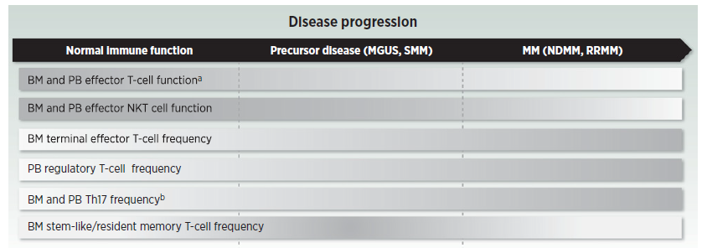
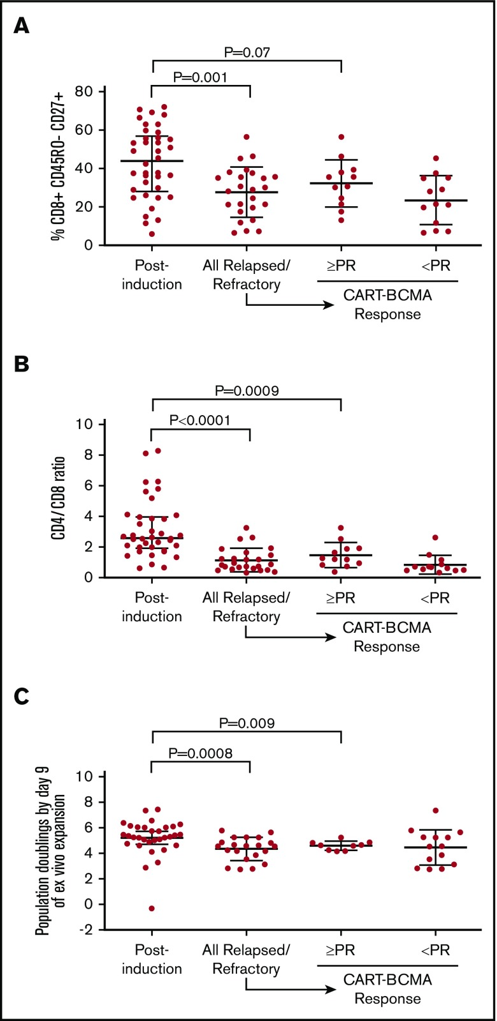
Changes in the T-cell Health in Plasma Cell Neoplasia
Memory T cell
phenotype
CD4:CD8 ratio
Garfall AL et al. Blood Adv. 2019;3:2812–2815
Cohen et al. Clin Cancer Res; 26(7) April 1, 2020.
Notes:
Terminal effector =- destined to die
T reg suppress immune response
Th17 pro inflammatory

Slide 25
Yet in Phase 1 studies of RRMM patients with a median of ~6 lines of therapy, T Cell Engagers are yielding Overall Response Rates ~60-100% with median PFS of 9+ months?

Slide 26
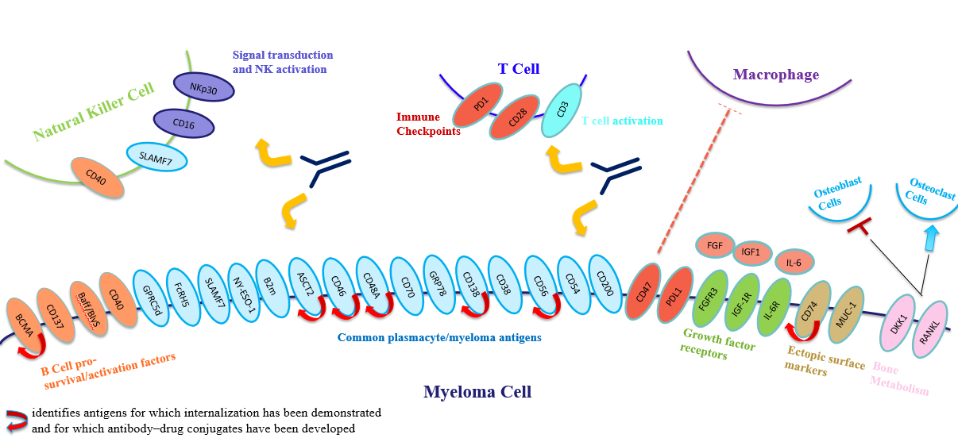
Immunotherapeutic Targets in Multiple Myeloma

Slide 27
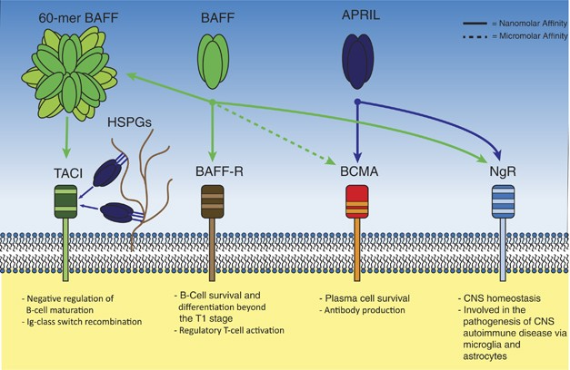
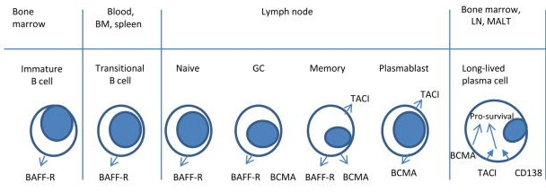
BCMA (B-cell maturation antigen)
Receptor for BAFF and APRIL
Expressed on mature B cell subsets, PC’s, and plasmacytoid DC’s
Maintains plasma cell homeostasis
  BCMA-/- mice have normal B cell #s, impaired PC survival
Hengeveld et al Bl Cancer J 2015 ; Maus, June, Clin Can Res 2013

Slide 28
Anti-BCMA Car-T Therapies
 | CARTITUDE-1¹ Cilta-cel Phase 1 | CRB-401² Ide-cel Phase 1 | CRB-402³ Bb21217 Phase 1 | LUMMICAR-2⁴ CT053 Phase 1b | PRIME⁵ BCMA-101 Phase 1/2 | CT103A⁶ Phase 1
Patients | 97 | 128 | 72 | 20 | 55 | 79
Median prior LOT | 6 | 6 | 6 | 5 | 8 | 5
Triple refractory, % | 88% | 84% | 69% | 85% | 60% | 17%
CAR-T dose | 0.75×10⁶ (0.5–1.0×10⁶) | 50, 150, 450 and 800 x 10⁶ | 150, 300, 450 x10⁶ + PI3 kinase inhibitor (bb007) | 1.5-1.8/2.5-3.0 x10⁸ | 0.75-15 x10⁶ | RP2D 1.0x10⁶
Vector | lentivirus | lentivirus | lentivirus | lentivirus | transposome | lentivirus
Binding Domain | llama (2 HC Abs) | murine (scFv) | murine (scFv) | human (scFv) | human (centyrin) | human (scFv)
ORR/ CR | 98%/83% | 73%/33% | 69%/36% | 94%/77% | 67%^{b/}NR | 95%/58%
Median PFS months | 2 yr- PFS 61% | 8.6 | NR |  |  | 25.3
Median OS months | 2-yr OS 74% | 24.8 | NR |  |  | NR
CRS, all/ Gr 3+ | 95%/4% | 84%/5.4% | 75%/4% | 15%, 17%^{c}/ | 17%/0% | 95%/2%
Neurotoxicity, all/Gr 3+ | 21%/9% | 18%/3% | 15%/4% | 15%, 17%^{c}/8%, 0% | 3.8%/3.8% | 1%/0%
1. Martin T, ASH 2021, abstract 549.; 2Anderson LD. ASCO 2021. Poster 8016. ; 3. Raje NS, et al. ASH 2021, abstract 548; 4. Kumar et al., ASH 2020: Abstract 133 ; 5. Costello et al., ASH 2020: Abstract 134 ; 6 L i C, et al. ASH 2021, abstract 547.
Notes:
79
5
16.5%
RP2D 1.0x10⁶
95%, 58%
NR
25.3
at mFUP of 25.3 mo
NR
95%/2%
1%/0%

Slide 29
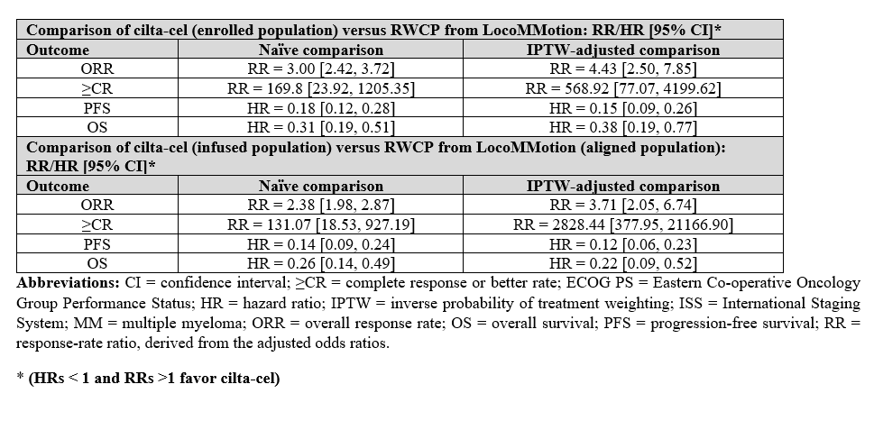
Ciltacabtagene Autoleucel for Triple-Class Exposed Multiple Myeloma: Adjusted Comparisons of CARTITUDE-1 Patient Outcomes Versus Therapies from Real-World Clinical Practice from the LocoMMotion Prospective Study
Mateos et al, ASH 2021; Abstract 550

Slide 30
Anti-BCMA Car-T Therapies
 | CARTITUDE-1¹ Cilta-cel Phase 1 | CARTITUDE-2 Cilta-cel Phase 2
Patients | 97 | 20
Median prior LOT | 6 | 2
Triple refractory, % | 88% | 40%
CAR-T dose | 0.75×10⁶ (0.5–1.0×10⁶) | 0.75×10⁶
Vector | lentivirus | lentivirus
Binding Domain | llama (2 HC Abs) | llama (2 HC Abs)
median f/u | ~24 mos | 9.7 mos
ORR/ CR | 98%/83% | 95%/85%
PFS | 2 yr- PFS 61% | 6 mo PFS 90%
OS | 2-yr OS 74% | 24.8
CRS, all/ Gr 3+ | 95%/4% | 95%/10%
Neurotoxicity, all/Gr 3+ | 21%/9% | 20%/0%
1. Martin T, ASH 2021, abstract 549.; 2 Cohen Y, ASH 2021, abstract 3866

Slide 31
ASH 2021 : Multiple Myeloma Updates
Newly Diagnosed MM
Relapsed MM
CAR-T
Bispecifics
Notes:
Fonseca R et al. First-Line Use of Daratumumab, Lenalidomide, and Dexamethasone Confers Survival Benefit Compared with Second-Line Use of Daratumumab-Based Regimens in Transplant-Ineligible Patients with Multiple Myeloma: Analysis of Different Clinical Scenarios. ASH 2021;Abstract 118.
Goldschmidt H et al. Addition of Isatuximab to Lenalidomide, Bortezomib and Dexamethasone As Induction Therapy for Newly-Diagnosed, Transplant-Eligible Multiple Myeloma Patients: The Phase III GMMG-HD7 Trial. ASH 2021;Abstract 463.

Slide 32
Bispecific Antibodies- BCMAxCD3
Bispecific Antibody | AMG-701 | CC-93269 | Elranatamab | REGN5458 | Teclistamab | TNB-383B
Treatment | Weekly IV | Weekly IV | Weekly SC | Weekly IV | Weekly SC | IV q3w
Patients | n= 85 | n= 19 | n=55 | n=73 | n= 165 | n= 118
Median prior lines | 6 | 6 | 6 | 5 | 5 | 5
Triple-class refractory | 62% | IMiD/PI/Dara 84%/90%/89% | 50%; 22% prior BCMA-directed | 19% | 78% | 61%
Harrison, et al. ASH 2020; Costa, et al. ASH 2019; Sebag M, et al. ASH 2021;Abstract 895; Zonder et al ASH 2021; Moreau P, et al. ASH 2021;Abstract 896. Kumar S, et al. ASH 2021

Slide 33
Bispecific Antibodies- BCMAxCD3
Bispecific Antibody | AMG-701 | CC-93269 | Elranatamab | REGN5458 | Teclistamab | TNB-383B
Treatment | Weekly IV | Weekly IV | Weekly SC | Weekly IV | Weekly SC | IV q3w
Patients | n= 85 | n= 19 | n=55 | n=73 | n= 165 | n= 118
Median prior lines | 6 | 6 | 6 | 5 | 5 | 5
Triple-class refractory | 62% | IMiD/PI/Dara 84%/90%/89% | 50%; 22% prior BCMA-directed | 19% | 78% | 61%
ORR @ therapeutic dose | 26% all patients 5/6 (83%) most recent cohort | 10/12 (83%) ≥ 6mg IV | 9/13 (69%) 1000 μg/kg SC | 22/37 (75%) 200-800 mg IV | 93/150 (62%) 1500ug/kg SC (RP2D) | 60% in > 40 40-60 mg IV
Duration of Response | 17/21 (81%) ongoing at median 5.6 months | NR | NR | 90% @ median 8 months | 91% > 6 mos | NR
Harrison, et al. ASH 2020; Costa, et al. ASH 2019; Sebag M, et al. ASH 2021;Abstract 895; Zonder et al ASH 2021; Moreau P, et al. ASH 2021;Abstract 896. Kumar S, et al. ASH 2021

Slide 34
Bispecific Antibodies- BCMAxCD3
Bispecific Antibody | AMG-701 | CC-93269 | Elranatamab | REGN5458 | Teclistamab | TNB-383B
Treatment | Weekly IV | Weekly IV | Weekly SC | Weekly IV | Weekly SC | IV q3w
Patients | n= 85 | n= 19 | n=55 | n=73 | n= 165 | n= 118
Median prior lines | 6 | 6 | 6 | 5 | 5 | 5
Triple-class refractory | 62% | IMiD/PI/Dara 84%/90%/89% | 50%; 22% prior BCMA-directed | 19% | 78% | 61%
ORR @ therapeutic dose | 26% all patients 5/6 (83%) most recent cohort | 10/12 (83%) ≥ 6mg IV | 9/13 (69%) 1000 μg/kg SC | 22/37 (75%) 200-800 mg IV | 93/150 (62%) 1500ug/kg SC (RP2D) | 60% in > 40 40-60 mg IV
Duration of Response | 17/21 (81%) ongoing at median 5.6 months | NR | NR | 90% @ median 8 months | 91% > 6 mos | NR
AEs, (All/(Gr 3+) CRS Infections Neutropenia Anemia Thrombocytopenia Deaths Other | 64% (9%) (17%) 25% 42% 21% 4 (5%) Neurotoxicity 8% (0%) | 90% (5%) NR (26%) NR (53%) NR (42%) NR (21%) 1 (5%) | 87% (0%) NR 71% (67%) 32% (23%) 21% (13%) 5 (7%) ISR 56% (0%) | 38% (0%) NR 23% (22%) 32% (23%) 21% (13%) 5 (7%) | 72% (1%) 63% (35%) 66% (57%) 49% (35%) 38% (22%) 9, 7 COVID ISR 35% (0%) Hypogamma 72% | 54% (3%) 32% (17%) 27% ( 22%) 25% (14%) 22% (11%) 6, 3 COVID
Harrison, et al. ASH 2020; Costa, et al. ASH 2019; Sebag M, et al. ASH 2021;Abstract 895; Zonder et al ASH 2021; Moreau P, et al. ASH 2021;Abstract 896. Kumar S, et al. ASH 2021

Slide 35
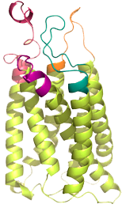
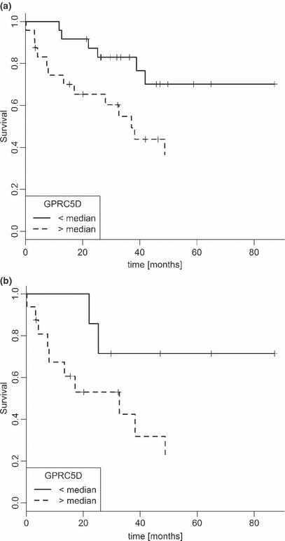
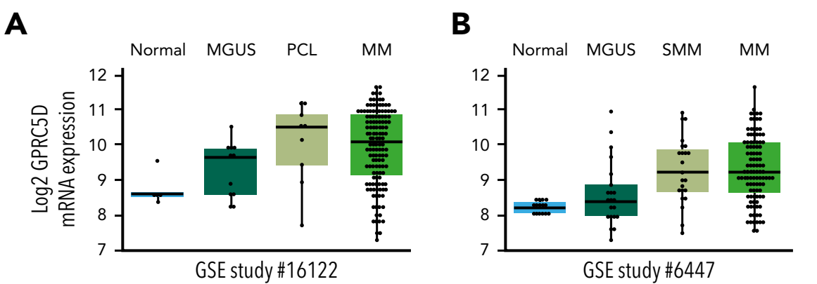
GPRC 5d Expression and Prognosis
G-protein–coupled receptor class 5 member D (GPRC5D) is a type-C 7-pass transmembrane receptor protein
  Orphan receptor - ligand and signaling mechanism unknown
  No known shed peptides or extracellular domain shedding (reduced risk for sink effect)
Predominantly expressed in cells with a plasma-cell phenotype, including the majority of malignant plasma cells from patients with MM
High GPRC5D expression associated with poor prognosis
Loop-3
Loop-1
Loop-4
Loop-2
GPRC mRNA expression
Pillarisetti K et al. Blood 2020;135(15):1232-1243
Atamaniuk J et al. Eur J Clinical Invest 2012;42(9):953-60
Notes:
GPRC5D is selectively expressed on the surface of MM cells. (A-B) A bioinformatic analysis of 2 NCI public data sets shows upregulation of GPRC5D mRNA expression on MM patient CD138⁺ cells as well as SMM and plasma-cell leukemia samples (PCL). mRNA expression was plotted on log2 scale on the y-axis. (C) GPRC5D cell-surface protein expression on MM cells (AMO-1, EJM, H929, MM.1R, MOLP-8, and OPM2), B cells (Daudi), and myeloid cells (KG-1 and MOLM-13) was labeled using an anti-GPRC5D antibody (red line; 571961 clone; R&D Systems) or an isotype control antibody (gray line; IC0041A clone; R&D Systems) for 30 minutes at 4°C and analyzed by flow cytometry.

Slide 36
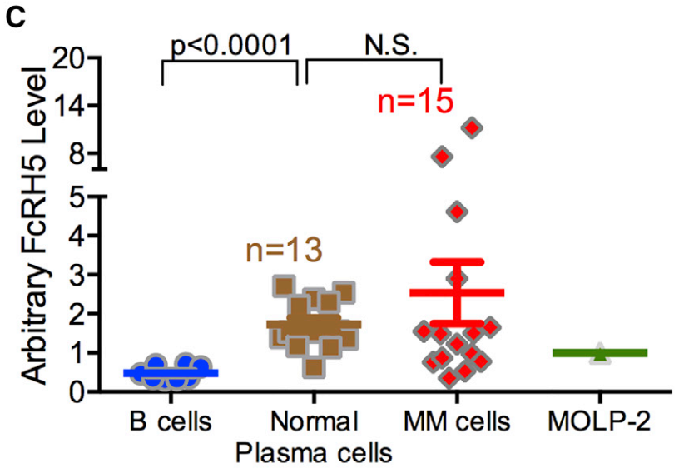
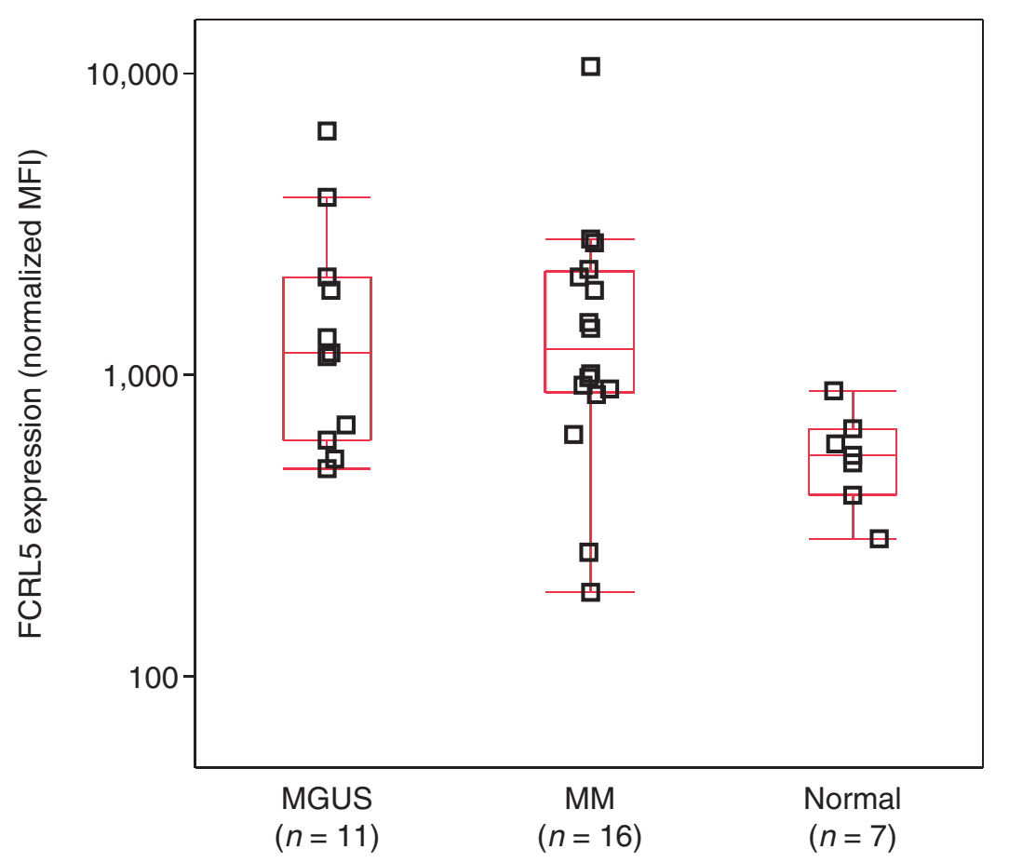
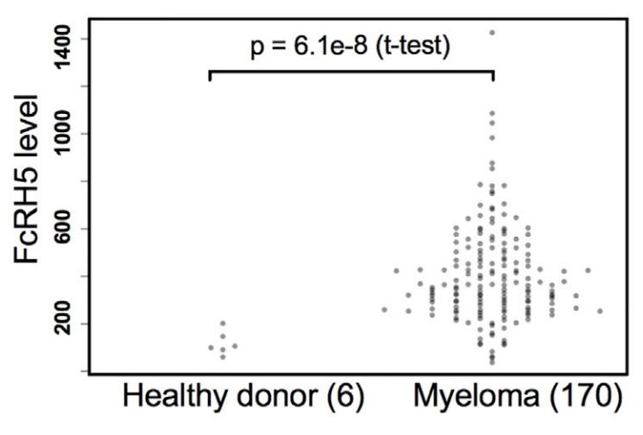
Fc receptor-homolog 5 (FcRH5) Protein and mRNA expression
Surface protein in immunoglobulin superfamily, closely related to Fc receptors
Ligand(s) for FcRH5 are unknown, but implicated in proliferation and isotype expression in the development of antigen-primed B cells
FcRH5 protein and mRNA over-expressed in malignant plasma cells
FcRH5 protein expression
by flow cytometry
FcRH5 protein expression
by flow cytometry
FcRH5 mRNA expression
in CD138+ plasma cells
MGUS, monoclonal gammopathy of undetermined significance
Li J et al. Cancer Cell 2017;31(3):383-395
Elkins K et al. Mol Cancer Ther 2012;11(10):2222-32
Li J et al. Cancer Cell 2017;31(3):383-395
Notes:
C) FcRH5 protein expression in primary multiple myeloma tumor cells and healthy donor peripheral B cells and bone marrow plasma cells. FcRH5 expression was analyzed by flow cytometry normalized to expression in MOLP-2 internal and assay control. Data are represented as the mean ± SEM.
(D) FcRH5 mRNA expression in anti-CD138 purified plasma cells from newly diagnosed non-treated multiple myeloma patients measured using Affymetrix GeneChip Human Exon 1.0 ST.
(E) qRT-PCR analysis of FcRH5 mRNA level in bone marrow biopsies from patient myeloma samples with or without 1q21 gain. mRNA expression level was calculated by the delta Ct (dCt) method. Statistical analysis was performed using a Mann-Whitney U test. The box represents the 25th to 75th percentiles and median. Whiskers represent the range of minimum and maximum values.

Slide 37
Non-BCMA-Targeted Bispecific Antibodies
Bispecific Antibody | Anti-GPRC5d Talquetamab^{[a]} Phase 1 MonumenTAL-1 Study |  | Anti-GPRC5d Talquetamab + Daratumumab Phase 1b TRIMM 2 Study ^{[b]} | Anti-FcRH5 Cevostamab^{[c]} Phase 1
Treatment | 405 µg/kg SC QW (RP2D) | 800 µg/kg SC QW | 400 qwk & 800 ug/kg q2wk | IV q3w
Patients | n=30 | n=25 | n=29 | n=161
Median prior lines | 6 | 5 | 6 | 6
Prior BCMA therapy | 27% | 16% | 55% | 33%
Triple-class refractory | 100% | 92% | 79% | 85%
Penta-drug refractory | 80% | 68% | 66% | 68%
ORR at therapeutic dose | 21/30 (70%) | 14/21 (67%) | 17/21 (81%) | 132-198 mg: (56.7%)
AEs, (All/(Gr 3+) CRS Infections Neutropenia Anemia Thrombocytopenia Deaths Dysgeusia Other | 77% (3%) 67% (60%) 60% (27%) 37% (23%) 60% (N/A) | 72% (0%) 44% (36%) 36% (8%) 20% (8%) 36% (N/A) | 55% (0%) 35% (10%) 41% (31%) 31% (21%) 35% (21%) 0 48% (N/A) Skin & nail 65% G3 rash 10% | 80% (2%) 43% (19%) 18% (16%) 32% (22%) % not reported 6 (3.7%) Diarrhea 26% (1%)
33% (5%)
0%
Skin-related and nail disorders 75%
G3 rash 7.5%
a. Krishnan A, et al. ASH 2021, abstract 158; b.Chari et al ASH 2021, abstract 161, c Trudel S, et al. ASH 2021, abstract 157.

Slide 38
Conclusions: Treatment Selection for Penta-Refractory Multiple Myeloma
GOC/Pt preferences
Previous Rx w/therapies approved for TCR MM
Rapid Progression
Near academic center
Bispecific
Other Studies
Eg. CelMod
Adequate organ function
(CBC, Cr Cl, EF)
Indolent Progression
Able to tolerate CRS/Neurotox
Far from academic center
CART study
Yes
Yes
Study Eligible & Interested
Measureable disease
No
Ide-Cel
Low ANC/plts
due to MM & fit
No
Yes
t (11;14)
Venetoclax + bortezomib + dex +/- dara
Salvage
Auto SCT
(stem cells
remaining)
96h infusional
chemo
Not cachectic
17p deletion, CrCl 20-30
Qwk selinexor based triplet: (if cytopenia CD38/PI; all po - IMID)
Willing and able to do
ocular monitoring
Belantamab

Slide 39

Acknowledgements: Multiple Myeloma Team at Mount Sinai
Patients and Caregivers
NPs
  Bell, Frances
  Cuccurullo, Carmela
  Fetahi, Esmeralda
  Giacoia, Leora
  Lee Yaw, Shawn
  Lyn, Michelle
  Nimo, Gloria
  Ray, Chloe
  Verina, Daniel
RNs
  Ogunfowora Joy, Adedayo
  Divya, Reddy
  Dlugach, Emily
  Kats, Valerie
  Lacson, Klara
  Onyekelu-eze, Ugoeze
  Pantchenko, Kristine
  Reddy, Divya
  Spencer, Patrick
  Stevens, Nadege
  Taylor, Lisa
  West, Jeremy
  Wong, Tiffany
  Yum, Moon-Hee
Clinical Research
  Williams, Schantel
  Catamero, Donna (NP)
  Dhadwal, Amishi
  Aronson, Liz (NP)
  Aponte, Annel (RN)
  Corry, Skye
  - Myrus, Elizabeth
  Dardac, Alexandra
  DeVito, Nicole
  Dominguez, Armando
  Escalon, Juliet (NP)
  Lieberman-Cribbin, Alex
  Lurie, Alaina
  Louw, Karen (NP)
  Mancia, Ines Stefania (NP)
  Myrus, Elizabeth
  Onatonye, Abolade
  Purcell, Kiah (NP)
  Riley, Jazmine
  Strumolo, Gina
  Thomas, Joanne (RN)
  Tamarin, Benjamin
  Zhang, Jianwen
Laboratory Research
  Agte, Sarita
  Aleman, Adolfo
  Bekri, Selma
  Elnaggar, Muhammad
  Ghodke, Yogita
  Huang, Yuanhui
  Kappes, Katerina
  Lagana, Alessandro
  Mei, Anna
  Melnekoff, David
  Restrepo, Paula
  Lenshchenko, Violetta
  Serebryakova, Kseniya
  Upadhyaya, Bhaskar
  Van Oekelen, Oliver
  Zajdman, Ariel Kogan
Physicians
  Jagannath, Sundar
  Chari, Ajai
  Cho, Hearn J.
  Parekh, Samir
  Richard, Shambavi
  Richter, Josh
  Rodriguez, Cesar
  Rossi, Adriana
  Sanchez, Larysa
Fellows
  Lancman, Guido
  Mouhieddine, Tarek
  Pan, Darren
  Thibaud, Santiago
PAs
  Heinerich, Jermey
  Patel, Dhara
  Perrault, James
  Reinhart, Jennifer
SCT/CART RNs
  Castaneda, Ericka
  Creutz, Amanda
  Steele, Anne
  Williams-Solomon, Cathrine
Social Workers
  Adams, Rachel
  Hilaire, Sonchelove
  Kreitman, Jessica
  Song, Yu Mee
  Vu, Mary
Administration
  Hughes, Jordan
  Chen, Lupita
  Davilmar, Sherley
  Denmark, Jessica
  Harewood, Janelle
  Jaihin, Salma
  Morales, Chastity
  Roman, Rochelle
  Rosa, Gladys
  Thompson, Jeanette
Pharmacists
  Rattu, Mohammad
  Tam, Lowena
Dietician
  Reiser, Abby

Slide 40
Supplemental

Slide 41
Hypothetical Randomized Control Trial of CART vs BITE
Manufacturing
And
Bridging Chemo
Flu-Cy
& ? Inpt
CAR-T infusion
Heme& ID
supportive care
Apheresis
Pre-screen
Consent
Enroll and
Randomize
? Inpt Priming
Bispecific Treatment to Progression
Potential for throughput failure esp for rapidly progressive MM- impact on ITT analysis?
To date sig pt selection for limited/competitive CART slots
To date no other
RRMM study allows bridging chemo - ? Impact on PFS
Short term OS: CART with deep/durable responses ORR
yet deaths < 1 year?
PFS2/OS- impact of flu cy on salvage with TCE
QOL?
AE: Neurotox/infection

