Slide 1
Key Presentations from the 63rd American Society of Hematology (ASH) Annual Meeting:
Acute Myeloid Leukemia and Myelodysplastic Syndromes Edition
Andrew Brunner, MD
Assistant Professor
Harvard Medical School
Massachusetts General Hospital

Slide 2
Select Abstracts in AML

Slide 3

Management of AML in 2022
“Fit,” younger patients
Initial Treatment
Relapsed/Refractory
FLT3
7+3+midostaurin
FLT3i ± Reinduction
Fav Cyto
7+3+GO
Reinduction
Int Cyto
7+3 → HCT
HMA+IDHi
sAML
CPX-351 → HCT
TP53
HMA+Ven
“Frail,” older patients
DAC 10d → ?HCT
TP53
HMA+Ven
GO monotherapy
FLT3
HMA + FLT3i
FLT3i
”Other”
HMA+Ven
Low Intensity/Palliative
IDH1/2
GO monotherapy
Enasidenib/Ivosidenib
Enasidenib/Ivosidenib
HMA monotherapy
HMA monotherapy

Slide 4
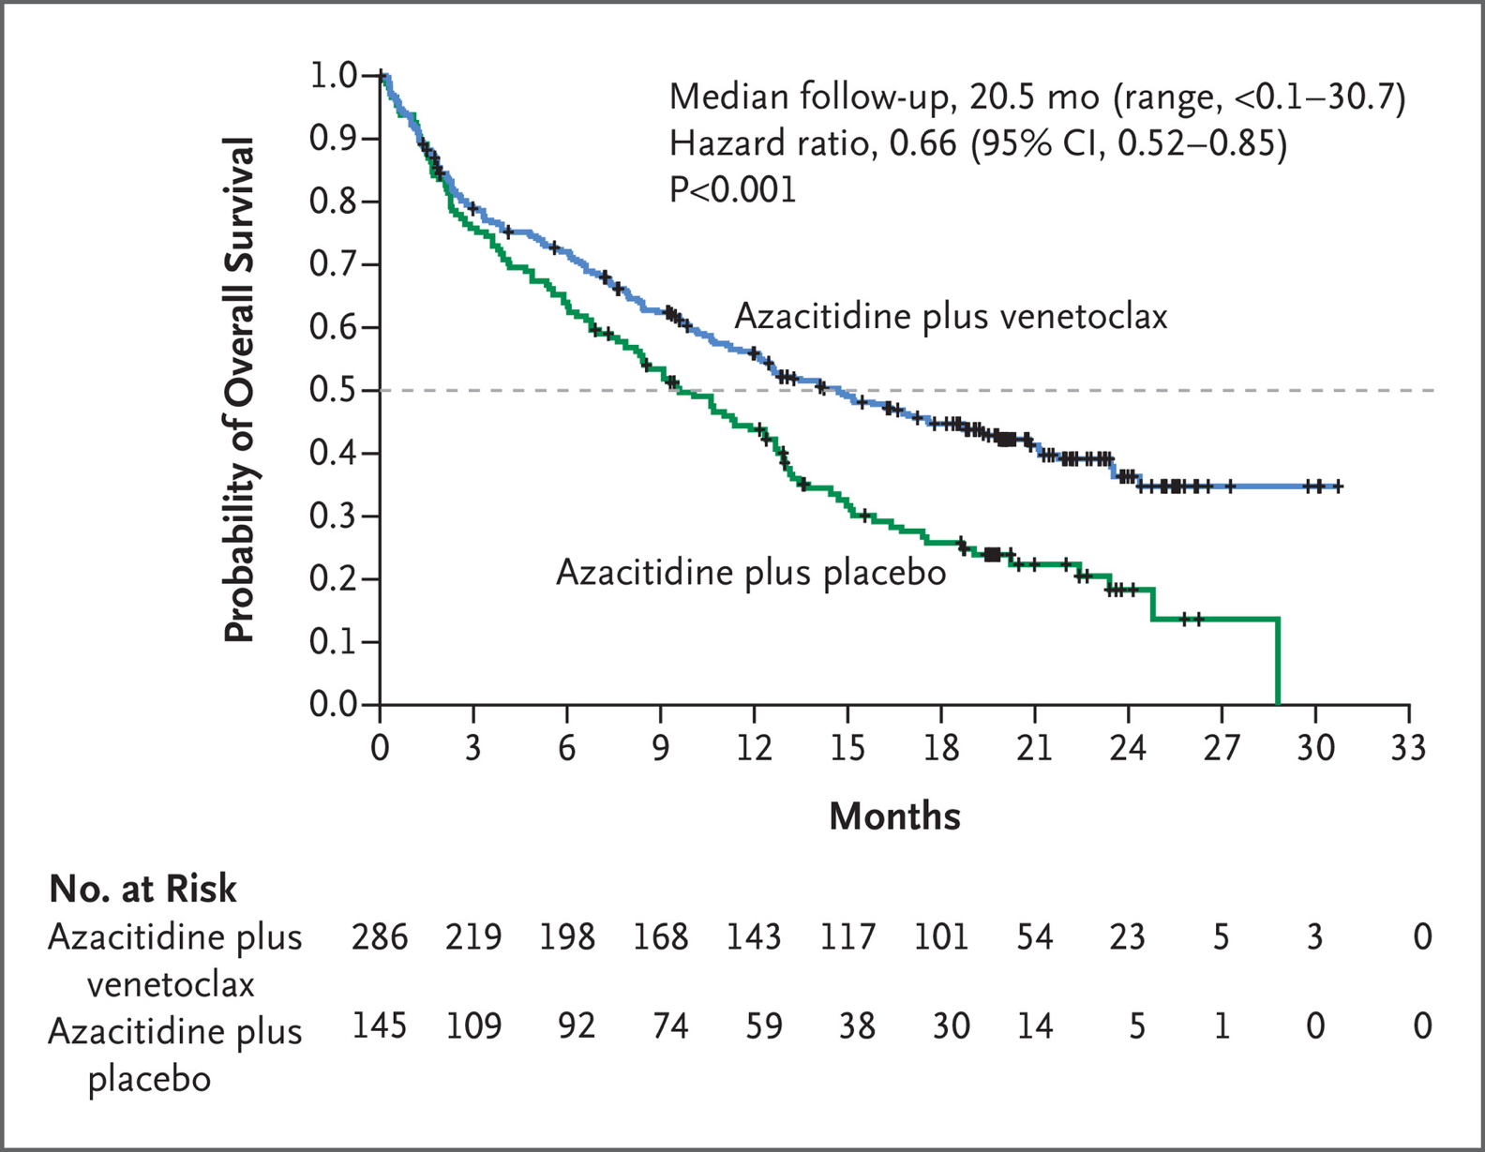
HMA+Venetoclax in AML
ASH 2022 Asking the next question:
How does this compare to other regimens?
Do all patients benefit the same?
What about patients not included in this study (”fit”)
How can we improve upon this regimen?
Dinardo et al NEJM 2020

Slide 5
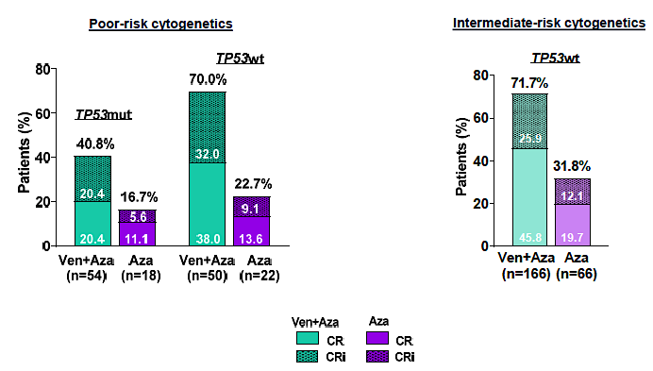
Outcomes in Patients with Poor-Risk Cytogenetics with or without TP53 Mutations Treated with Venetoclax Combined with Hypomethylating Agents
Pooled analysis of patients with poor and int risk cytogenetics
  VIALE-A and Ph1b trial of patients with NCCN int/poor risk (n=232/144)
Pollyea D et al. ASH Annual Meeting 2021, Atlanta GA. Abstract 224

Slide 6
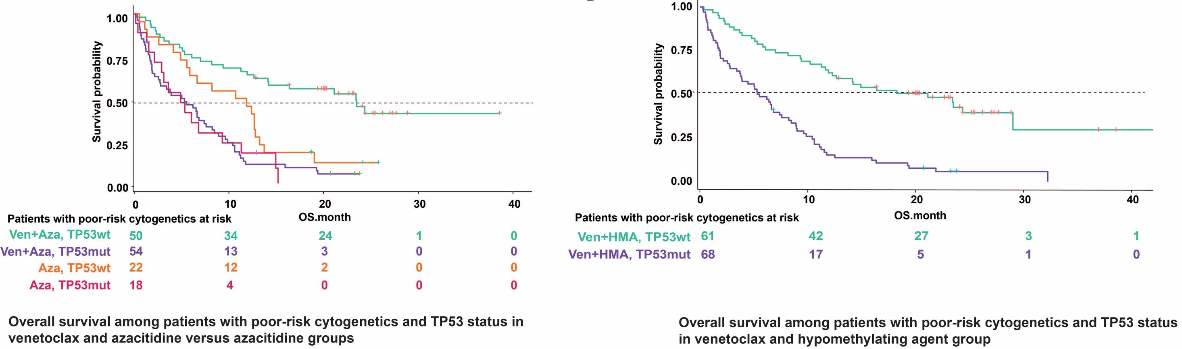
Outcomes in Patients with Poor-Risk Cytogenetics with or without TP53 Mutations Treated with Venetoclax Combined with Hypomethylating Agents
Pollyea D et al. ASH Annual Meeting 2021, Atlanta GA. Abstract 224

Slide 7
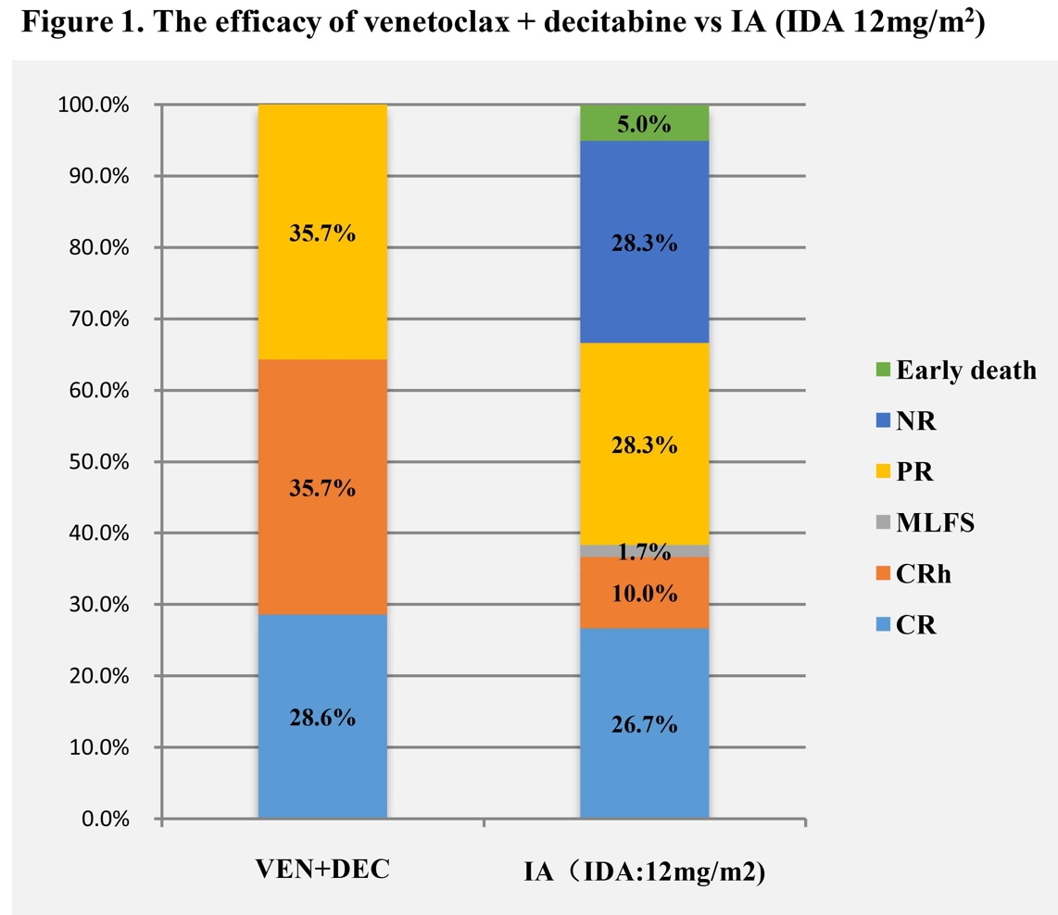
Venetoclax Plus Decitabine for Young Adults with Newly Diagnosed ELN Adverse-Risk Acute Myeloid Leukemia: Interim Analysis of a Prospective, Multicenter, Single-Arm, Phase 2 Trial
Patients 18-59 with newly diagnosed ELN Adverse Risk AML
  Decitabine 20mg/m² d1-5, Venetoclax 100, 200, 400 continued through 28d
  Patients with FLT3-ITD received Decitabine+Venetoclax +/- Sorafenib
Primary endpoint: superiority of composite remission vs. historic 7+3
N=14
N=60
Chen S et al. ASH Annual Meeting 2021, Atlanta GA. Abstract 35

Slide 8
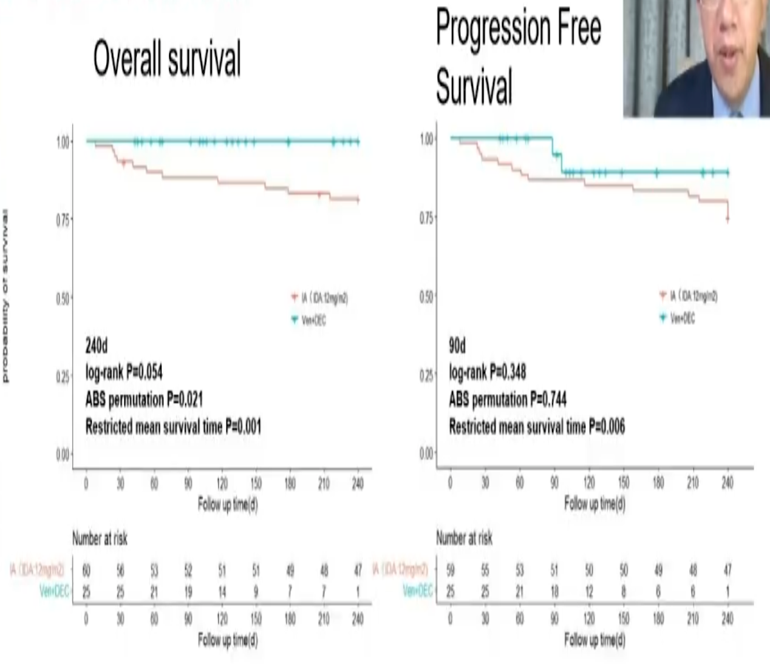
Venetoclax Plus Decitabine for Young Adults with Newly Diagnosed ELN Adverse-Risk Acute Myeloid Leukemia: Interim Analysis of a Prospective, Multicenter, Single-Arm, Phase 2 Trial
Chen S et al. ASH Annual Meeting 2021, Atlanta GA. Abstract 35

Slide 9
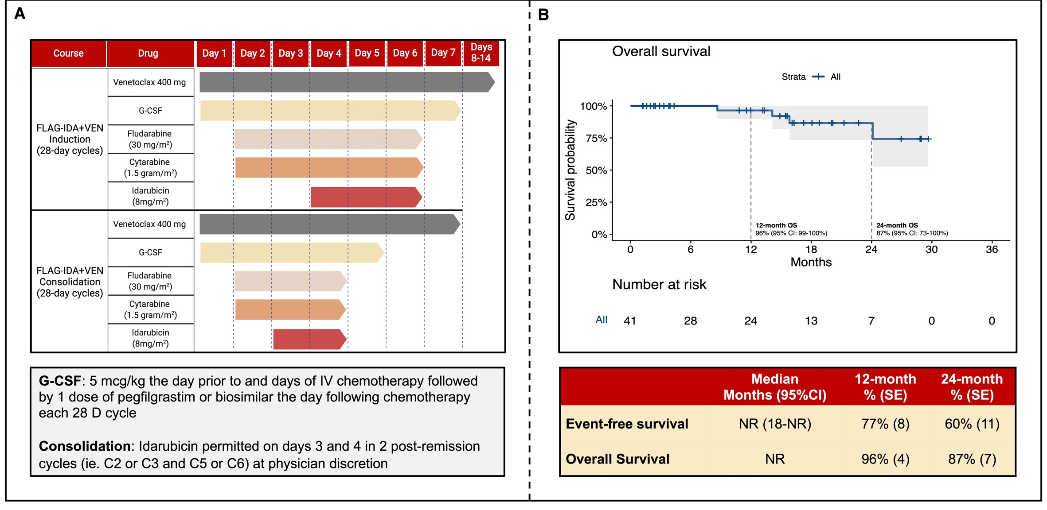
Venetoclax Combined with FLAG-IDA Induction and Consolidation in Newly Diagnosed Acute Myeloid Leukemia
Lachowiez C et al. ASH Annual Meeting 2021, Atlanta GA. Abstract 701

Slide 10
Comparing Outcomes between Liposomal Daunorubicin/Cytarabine (CPX-351) and HMA+Venetoclax As Frontline Therapy in Acute Myeloid Leukemia
Retrospective study from 4 academic centers of patients treated with CPX-351 or HMA+Ven
 | CPX-351 (n=211) | HMA+Ven (n=226)
CR | 98 (46%) | 62 (27%)
CRi | 24 (11%) | 66 (29%)
RFS | 33.7mo | 15.8mo
OS | 17.3mo | 11.1mo
Grenet J et al. ASH Annual Meeting 2021, Atlanta GA. Abstract 32

Slide 11
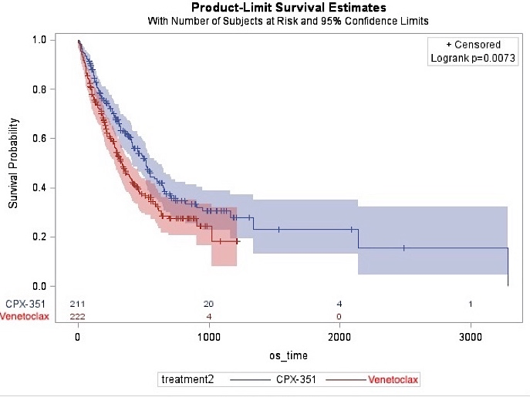
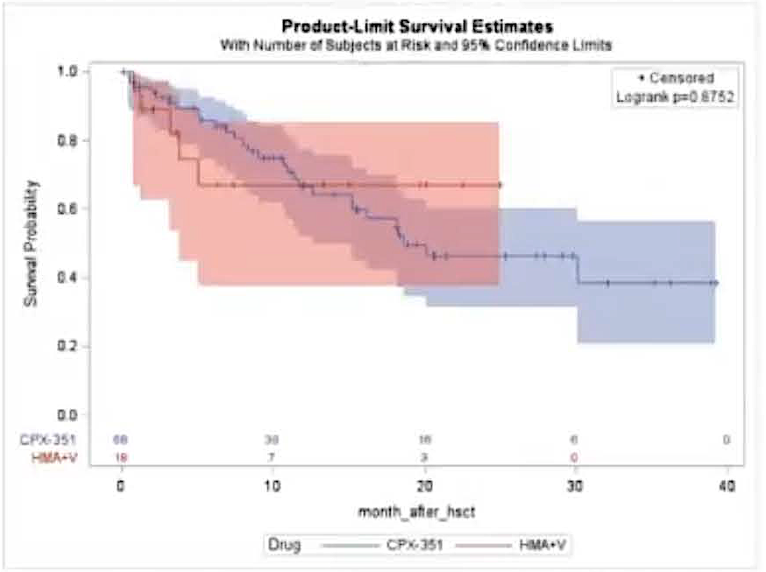
Comparing Outcomes between Liposomal Daunorubicin/Cytarabine (CPX-351) and HMA+Venetoclax As Frontline Therapy in Acute Myeloid Leukemia
Overall population – survival improved with CPX-351, but without as clear a benefit in the 60-75yo subgroup (HR 0.8, 0.57-1.13)
No clear significant post-HCT survival difference in 60-75yo
(CPX-351 n=72, HMA+Ven n=19)
Grenet J et al. ASH Annual Meeting 2021, Atlanta GA. Abstract 32

Slide 12
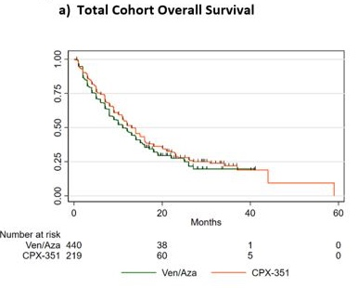
Real World Survival Outcomes of CPX-351 Versus Venetoclax and Azacitadine for Initial Therapy in Adult Acute Myeloid Leukemia
HUP and Flatiron HER
CPX-351 (n=219)
Aza+Ven (n=440)
Overall survival similar at 13mo (CPX-351) vs 11mo (AzaVen) (p=0.18)
Higher rates of F&N with CPX351
Matthews A et al. ASH Annual Meeting 2021, Atlanta GA. Abstract 795

Slide 13
Targeted Therapies in AML

Slide 14
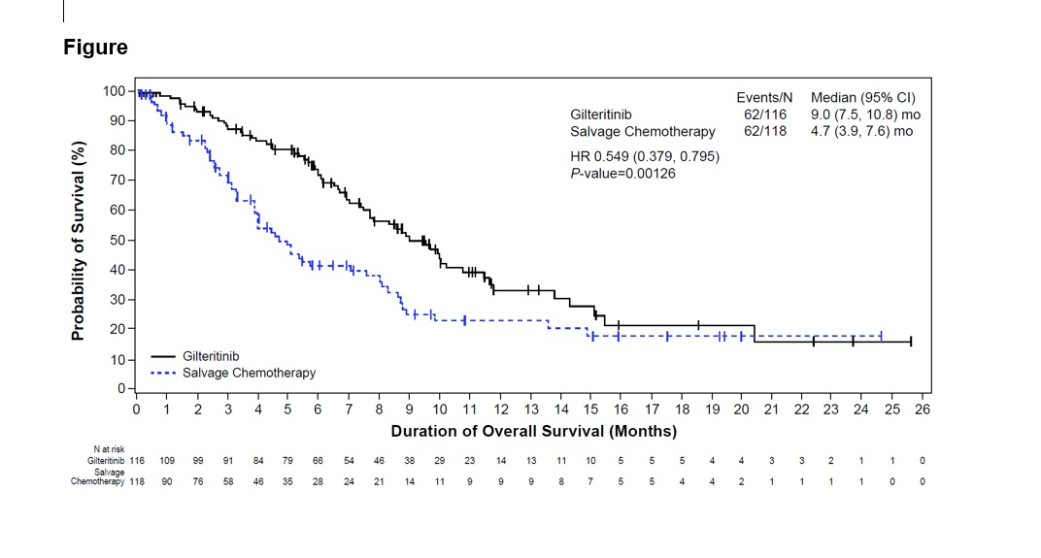
Gilteritinib Versus Salvage Chemotherapy for Relapsed/Refractory FLT3-Mutated Acute Myeloid Leukemia: A Phase 3, Randomized, Multicenter, Open-Label Trial in Asia
Gilteritinib
CRc 50% (58/116) CR=16%
R/R FLT3 ITD or TKD AML
1:1
LoDAC
MEC
FLAG
CRc 20% (24/118) CR=10%
Wang J et al. ASH Annual Meeting 2021, Atlanta GA. Abstract 695

Slide 15
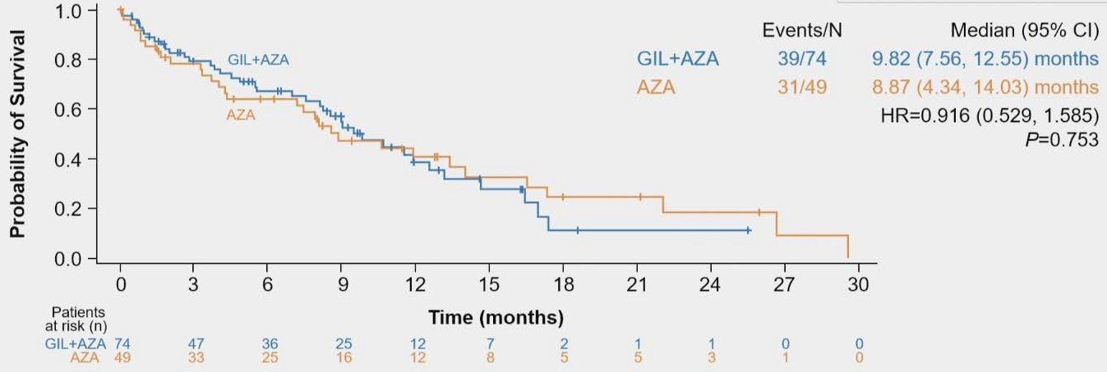
Phase 3, Open-Label, Randomized Study of Gilteritinib and Azacitidine Vs Azacitidine for Newly Diagnosed FLT3-Mutated Acute Myeloid Leukemia in Patients Ineligible for Intensive Induction Chemotherapy
Gilteritinib
Azacitidine
N=49
ND FLT3 ITD or TKD AML
2:1
Gilteritinib + Azacitidine
N=74
Wang ES et al. ASH Annual Meeting 2021, Atlanta GA. Abstract 700

Slide 16
Phase 3, Open-Label, Randomized Study of Gilteritinib and Azacitidine Vs Azacitidine for Newly Diagnosed FLT3-Mutated Acute Myeloid Leukemia in Patients Ineligible for Intensive Induction Chemotherapy
 | Gilteritinib + Azacitidine (n=74) | Azacitidine (n=49)
Any subsequent therapy | 15 (20%) | 22 (45%)
FLT3i-containing regimen | 3 (4%) | 14 (29%)
No survival difference in subgroup analysis (ELN risk, FLT3 mutation type, ITD allelic ratio)
Wang ES et al. ASH Annual Meeting 2021, Atlanta GA. Abstract 700

Slide 17
AGILE: A Global, Randomized, Double-Blind, Phase 3 Study of Ivosidenib + Azacitidine Versus Placebo + Azacitidine in Patients with Newly Diagnosed Acute Myeloid Leukemia with an IDH1 Mutation
Randomize 1:1 Aza+Ivosidenib vs Aza+Placebo
  Aza 75mg/m² d1-7 of 28, Ivo 500mg d1-28
Toxicities balanced; fewer infections in the AZA+IVO arm
HRQoL favored AZA+IVO
 | Azacitidine+Ivosidenib (n=72) | Azacitidine (n=74)
CR | 34 (47%) | 11 (15%)
CR+CRh | 38 (53%) | 13 (18%)
ORR | 45 (63%) | 14 (19%)
Montesinos P et al. ASH Annual Meeting 2021, Atlanta GA. Abstract 697

Slide 18
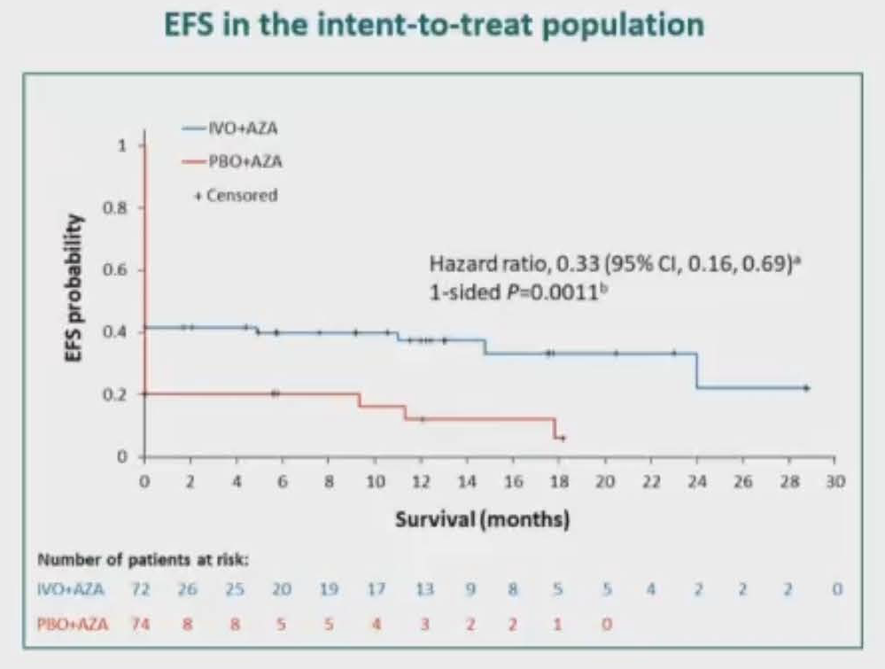
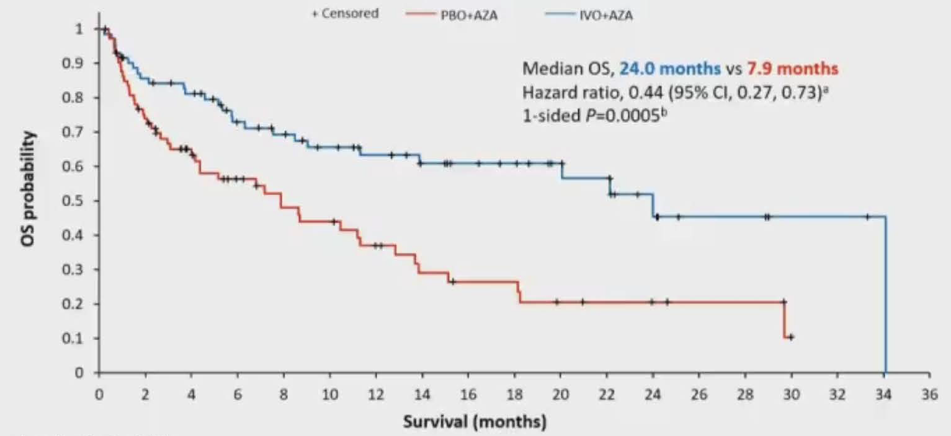
AGILE: A Global, Randomized, Double-Blind, Phase 3 Study of Ivosidenib + Azacitidine Versus Placebo + Azacitidine in Patients with Newly Diagnosed Acute Myeloid Leukemia with an IDH1 Mutation
Montesinos P et al. ASH Annual Meeting 2021, Atlanta GA. Abstract 697

Slide 19
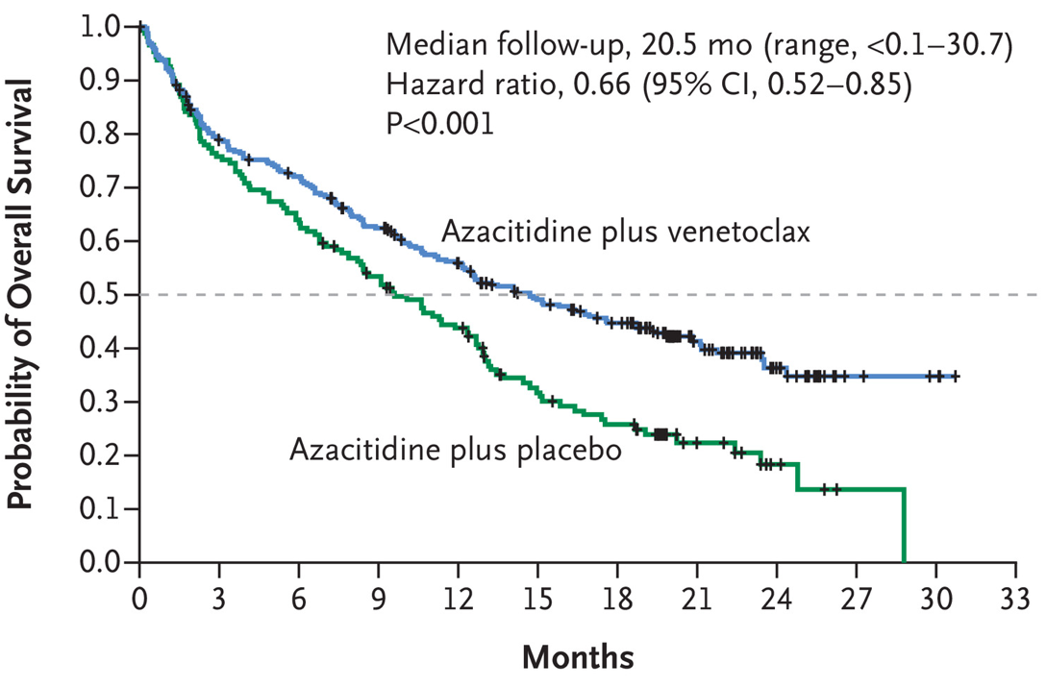
The rise of triplets: what will be their role?
”7+3” +/- GO
sAML – CPX vs “7+3”
“Unfit” – Aza vs Aza+Ven
Castaigne S et al. Lancet 2012
Lancet et al. JCO 2018
DiNardo et al NEJM 2020

Slide 20
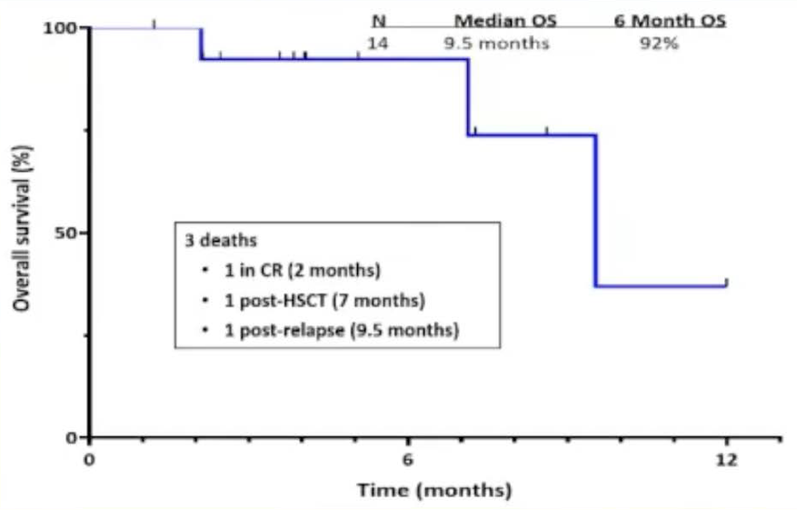
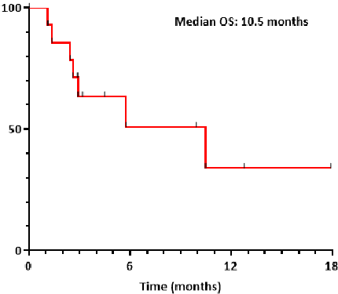
A Triplet Combination of Azacitidine, Venetoclax and Gilteritinib for Patients with FLT3-Mutated Acute Myeloid Leukemia: Results from a Phase I/II Study
R/R FLT3 AML (n=14), HR-MDS/CMML (n=1), and ND FLT3 AML (n=11)
Myelosuppression (MLFS) at Gilt 120 -> Gilt 80mg used in PhII
Aza 75mg/m² d1-7
Ven 400mg d1-28
Gilt 80-120mg d1-28
BM Bx day 14
Aza 75mg/m² d1-5
Ven 400mg d1-7
Gilt 80-120mg d1-28
 | Frontline (n=14) | R/R (n=16)
CR | 13 | 11
CRi | 0 | 2
MLFS | 1 | 6
PR | 0 | 1
No Response | 0 | 4
Newly Diagnosed
R/R
Short N et al. ASH Annual Meeting 2021, Atlanta GA. Abstract 696

Slide 21
Quizartinib (Quiz) with Decitabine (DAC) and Venetoclax (VEN) Is Highly Active in Patients (pts) with FLT3-ITD Mutated Acute Myeloid Leukemia (AML) – RAS/MAPK Mutations Continue to Drive Primary and Secondary Resistance
R/R FLT3 AML (n=23), or ND FLT3 AML (n=5)
G4 Myelosuppression at Quizartinib 40 -> Quiz 30mg used in PhII
Decitabine 20mg/m² d1-10
Ven 400mg d1-21
Quiz 30-40mg d1-28
BM Bx day 14
Decitabine 20mg/m² d1-5
Ven 400mg d1-14
Quiz 30-40mg d1-14 to 28
 | Frontline (n=5) | R/R (n=23)
CR | 2 | 3
CRi | 3 | 5
MLFS | 0 | 10
Bridge to Allo | 3 | 8
Median OS | 14.5 mo | 7.6 mo
Yilmaz M et al. ASH Annual Meeting 2021, Atlanta GA. Abstract 370

Slide 22
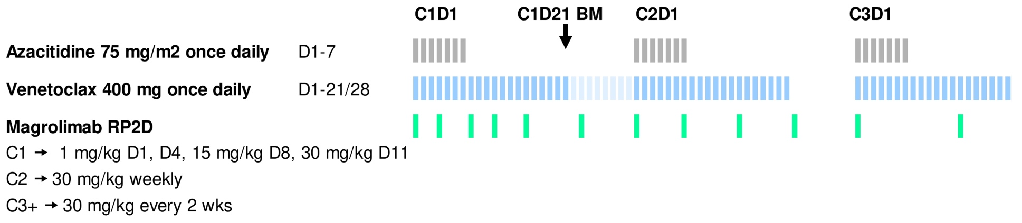
Phase I/II Study of Azacitidine (AZA) with Venetoclax (VEN) and Magrolimab (Magro) in Patients (pts) with Newly Diagnosed Older/Unfit or High-Risk Acute Myeloid Leukemia (AML) and Relapsed/Refractory (R/R) AML
 | Frontline TP53mut (n=14) | Frontline TP53wt (n=11) | RR Ven Naïve (n=8) | RR Prior Ven (n=15)
ORR | 12 | 11 | 75 | 3
CR | 9 | 7 | 3 | 0
CRi | 0 | 3 | 2 | 3
MLFS | 3 | 1 | 1 | 0
MRD negative | 5/9 | 4/9 | 2/6 | 0
CCyR | 4/9 | 5/6 | 3/5 | 1/2
Daver N et al. ASH Annual Meeting 2021, Atlanta GA. Abstract 371

Slide 23
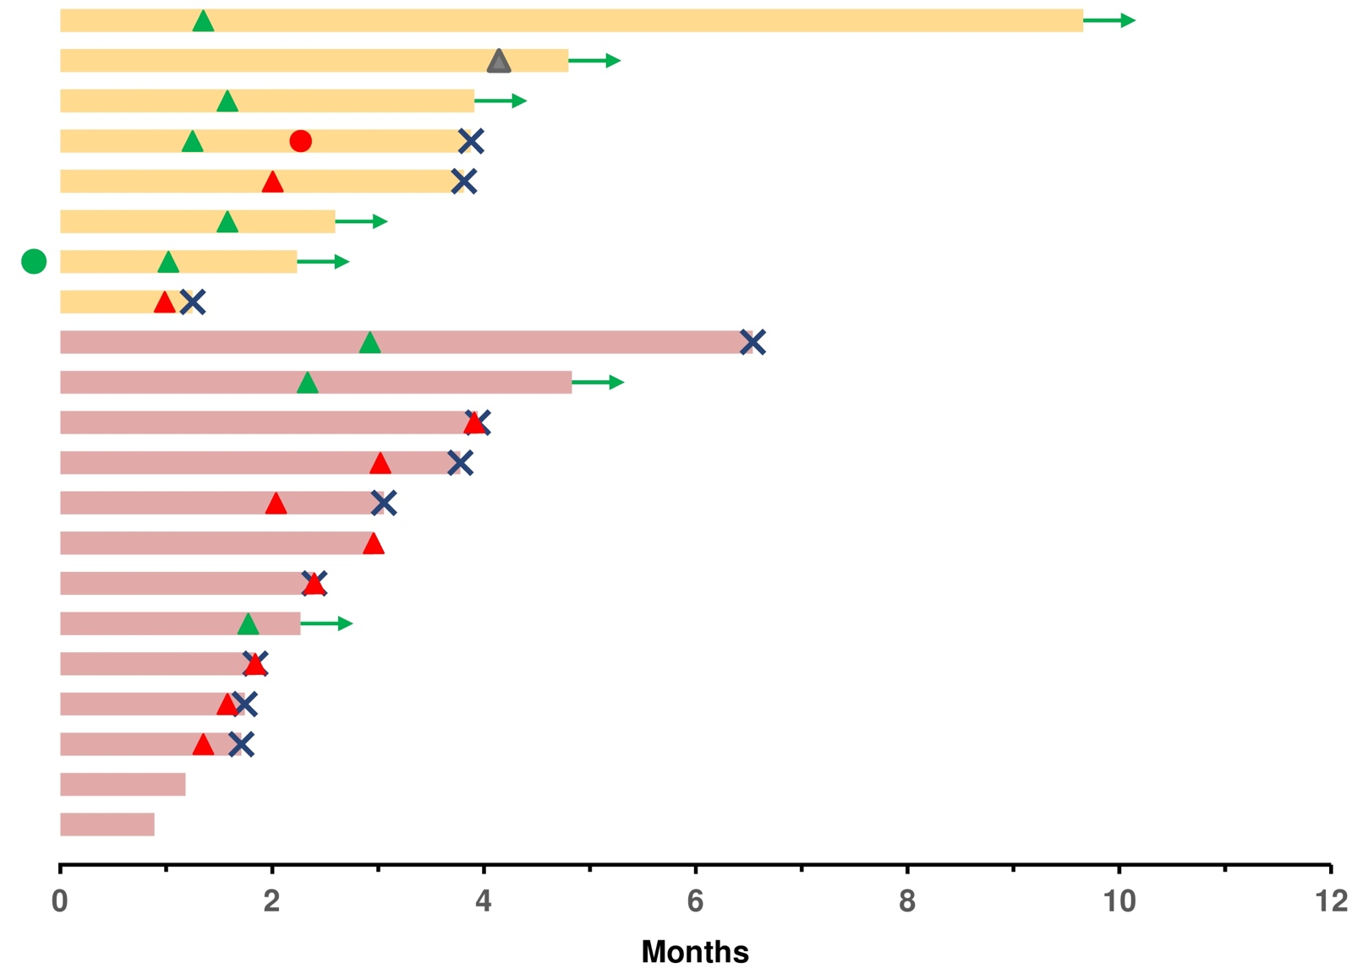
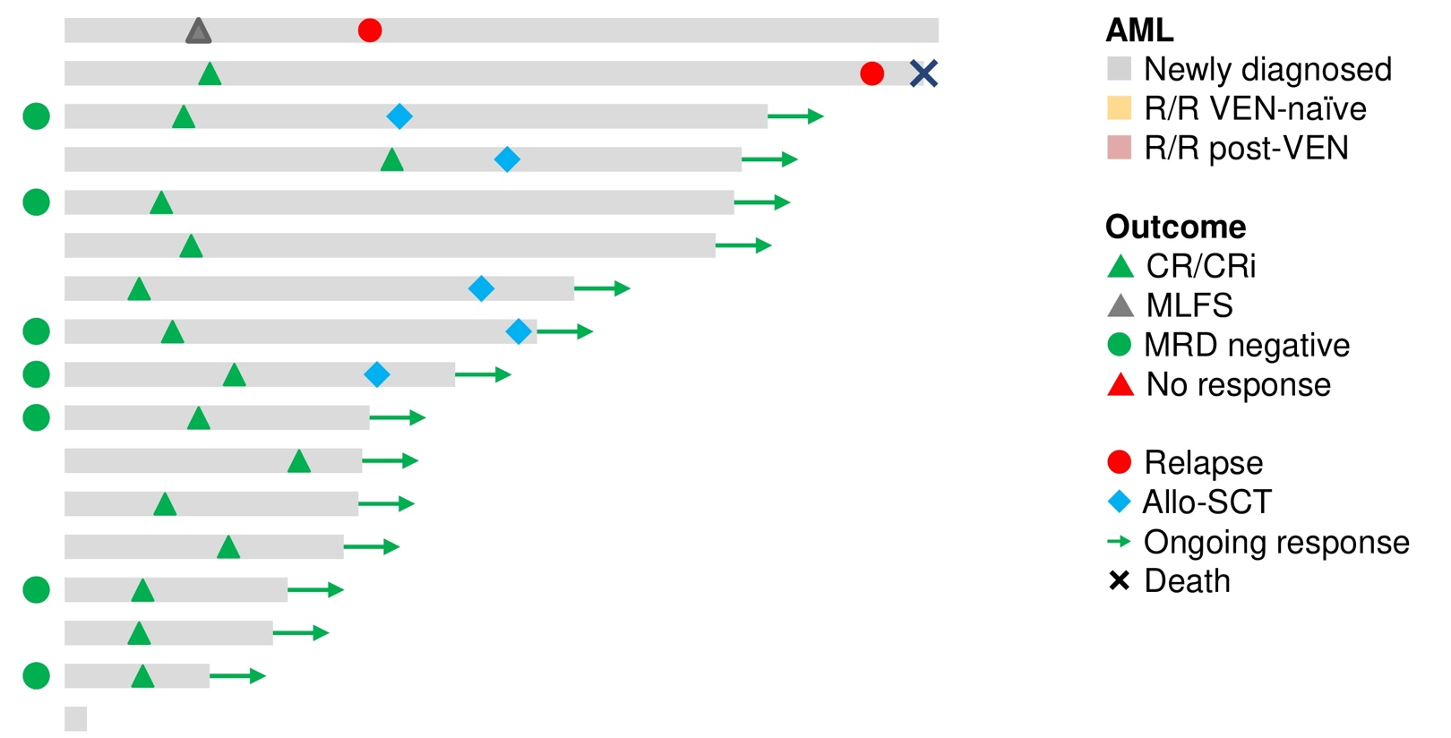
Phase I/II Study of Azacitidine (AZA) with Venetoclax (VEN) and Magrolimab (Magro) in Patients (pts) with Newly Diagnosed Older/Unfit or High-Risk Acute Myeloid Leukemia (AML) and Relapsed/Refractory (R/R) AML
Daver N et al. ASH Annual Meeting 2021, Atlanta GA. Abstract 371

Slide 24
Conclusions for AML from ASH 2022
There are a number of active regimens in the front line but direct comparisons are lacking
The sequencing of agents – particularly targeted therapies or agents active in relapse – are unanswered questions
Triplet therapies are being explored and can be administered
  Are they an improvement over sequential therapy?

Slide 25
Select Abstracts in MDS

Slide 26
Defining MDS Risk
Goal: Identify patients whose disease, left untreated, is high risk of:
Death (most often from infection/bleed/cardiac disease) or
Leukemic progression
within months (generally <18 months)
*
IPSS
IPSS-R
Disease History
Molecular
INT-2 Risk
High Risk
Score > 3.5
Intermediate
High
Very High
Progression after prior therapies e.g. formerly low risk
TP53
EZH2, RUNX1, ASXL1
“AML-like” mutations

Slide 27
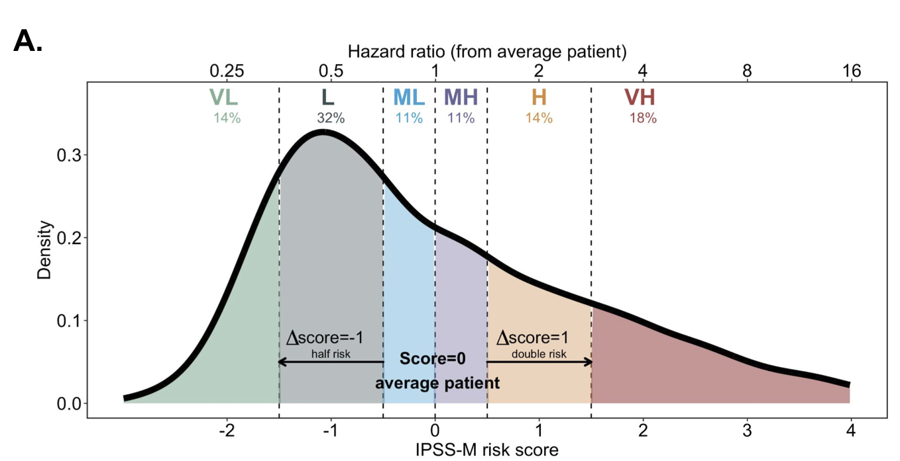
Molecular International Prognosis Scoring System for Myelodysplastic Syndromes
Diagnostic samples from 2,957 patients with MDS (<20% blasts, WBC< 13)
Profiling for 156 genes in the discovery cohort
  94% with at least 1 cytogenetic/molecular alteration
Validation cohort from Japan
Patient characteristics:
  Median 72 yo (39-88)
  8% had tMDS, and 30% received disease modifying therapy
  Median follow up of 3.8 years
Bernard E et al. ASH Annual Meeting 2021, Atlanta GA. Abstract 61

Slide 28
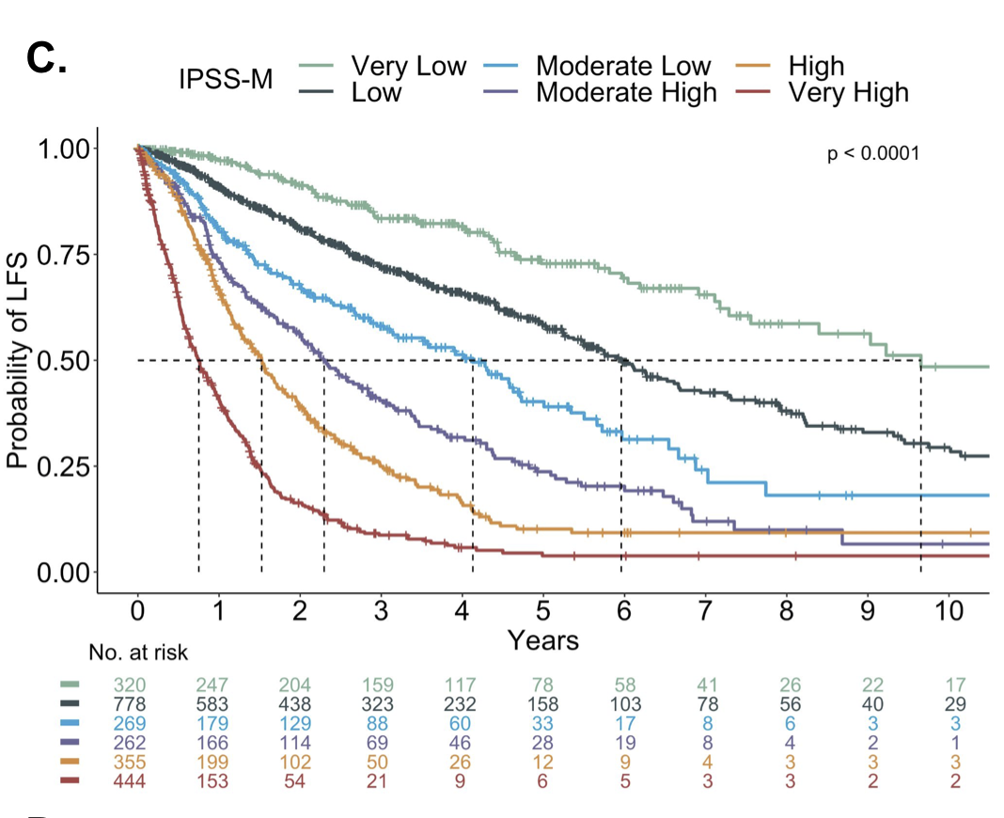
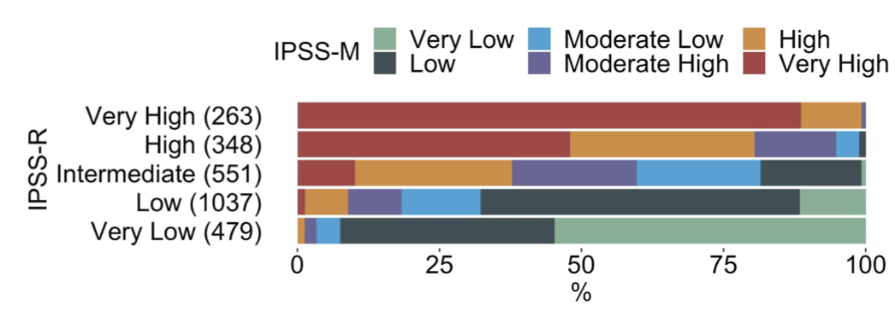
Molecular International Prognosis Scoring System for Myelodysplastic Syndromes
Poor LFS, OS, and AML transformation:
TP53 multi-hit mutations (7%)
MLL PTD (2.5%)
FLT3 mutations (1%)
More favorable clinical course:
SF3B1, depending on comutations
Bernard E et al. ASH Annual Meeting 2021, Atlanta GA. Abstract 61

Slide 29
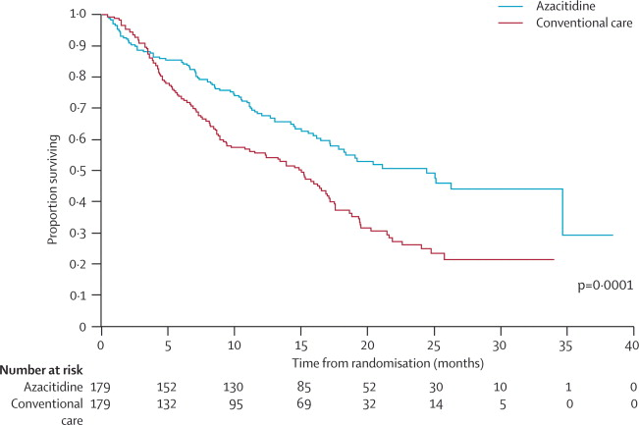
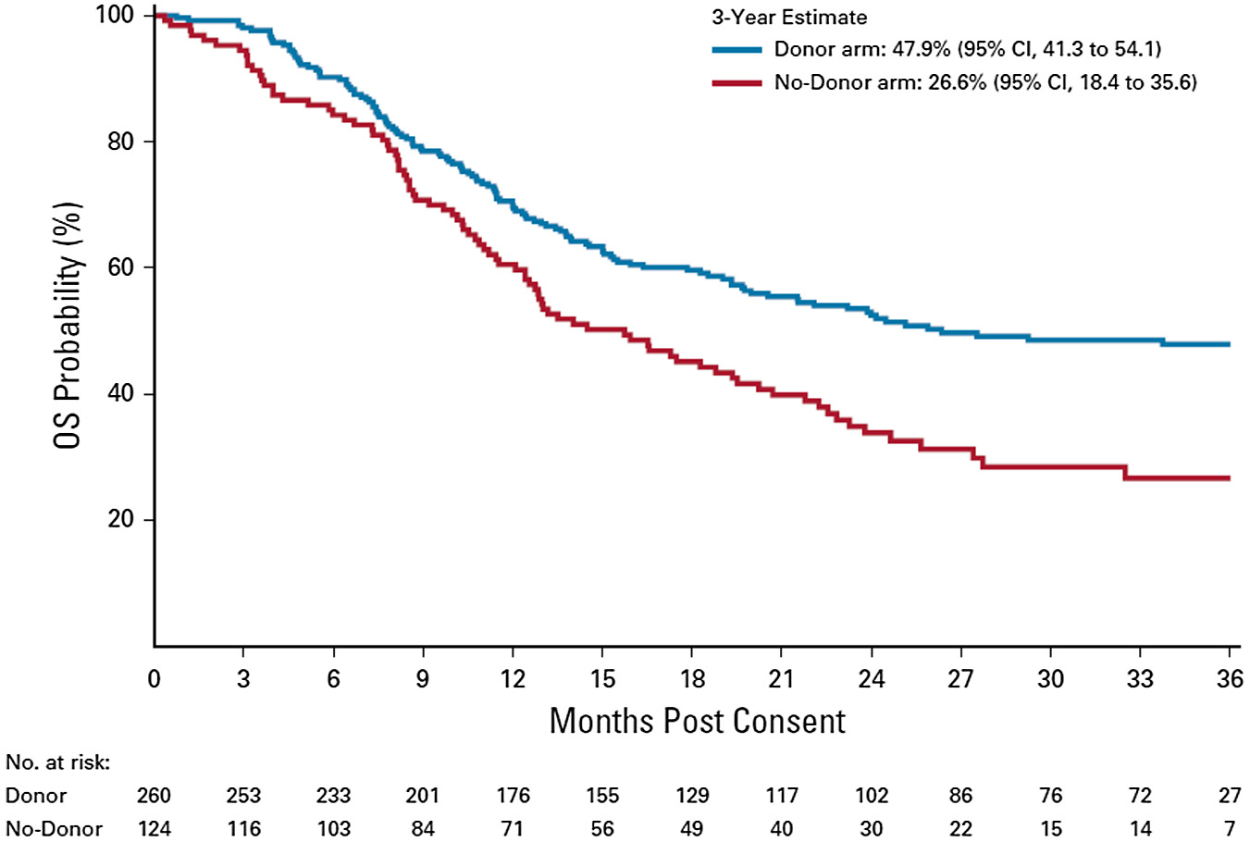
Managing Higher Risk MDS
OS 21.1 mo (AZA) vs. 15.0 mo (Conventional Care)
Fenaux et al. The Lancet Oncology, 2009;10(3):223-232
Nakamura et al. J Clin Oncol. Published online June 09, 2021.

Slide 30
Trials with HMA Backbones
Can we improve upon:
Frequency of responses
Quality of responses
Duration of those responses and patient survival?

Slide 31
Pevonedistat (PEV) + Azacitidine (AZA) Versus AZA Alone As First-Line Treatment for Patients with Higher-Risk Myelodysplastic Syndromes (MDS)/Chronic Myelomonocytic Leukemia (CMML) or Acute Myeloid Leukemia (AML) with 20–30% Marrow Blasts: The Randomized Phase 3 PANTHER Trial (NCT03268954)
Randomized patients with HR-MDS/CMML or AML with 20-30% blasts 1:1 to Pevonedistat+Azacitidine (n=227) or Azacitidine alone (n=227)
  HR MDS n=324, CMML n=27, LB AML n=103
  Pevonedistat 20mg/m² days 1, 3, 5, Aza 75mg/m² days 1-7 of 28d cycle
Primary Endpoint: EFS (death or transformation to AML)
Secondary Endpoint: OS
Balanced risk groups and mutations; most frequent MDS mutations include TP53 (n=74/270 total), TET2, ASXL1, RUNX1, SRSF2, DNMT3A
Sekeres M et al. ASH Annual Meeting 2021, Atlanta GA. Abstract 242

Slide 32
Pevonedistat (PEV) + Azacitidine (AZA) Versus AZA Alone As First-Line Treatment for Patients with Higher-Risk Myelodysplastic Syndromes (MDS)/Chronic Myelomonocytic Leukemia (CMML) or Acute Myeloid Leukemia (AML) with 20–30% Marrow Blasts: The Randomized Phase 3 PANTHER Trial (NCT03268954)
 | Pevonedistat+Azacitidine | Azacitidine | P-value
ORR (CR+CRi+PR) | 28% | 32% | NS
CR+CRi | 28% | 31% | NS
EFS | 17.7 mo | 15.7 mo | 0.56
OS | 20.3 mo | 16.8 mo | 0.18
No differences seen among subgroups of interest:
HR MDS
HR CMML
LB AML
Azacitidine dose intensity >95% in each arm
Sekeres M et al. ASH Annual Meeting 2021, Atlanta GA. Abstract 242

Slide 33
Approaching Higher Risk MDS
Transplant Candidate?
Goal for HCT
HCT Ineligible/Not immediate
Targetable Mutation
Disease Optimization
AML-like approach?
Emerging Targeted Therapies?
Duration and Quality of Response

Slide 34
A Pilot Study of CPX-351 for Transplant Eligible, Higher Risk Patients with Myelodysplastic Syndrome
Goal for HCT
Induction Dose Level 1: (daunorubicin 29 mg/m² and 65 mg/m² cytarabine) liposome on days 1, 3, 5
Induction Dose Level 2: (daunorubicin 44 mg/m² and 100 mg/m² cytarabine) liposome on days 1, 3, 5.
Patients proceeding to transplant:
Received allo HCT: 75%
Pending allo HCT: 15%
Death: 5% (1/20; progression to AML)
Poor PS: 5% (1/20)
Jacoby M et al. ASH Annual Meeting 2021, Atlanta GA. Abstract 540

Slide 35
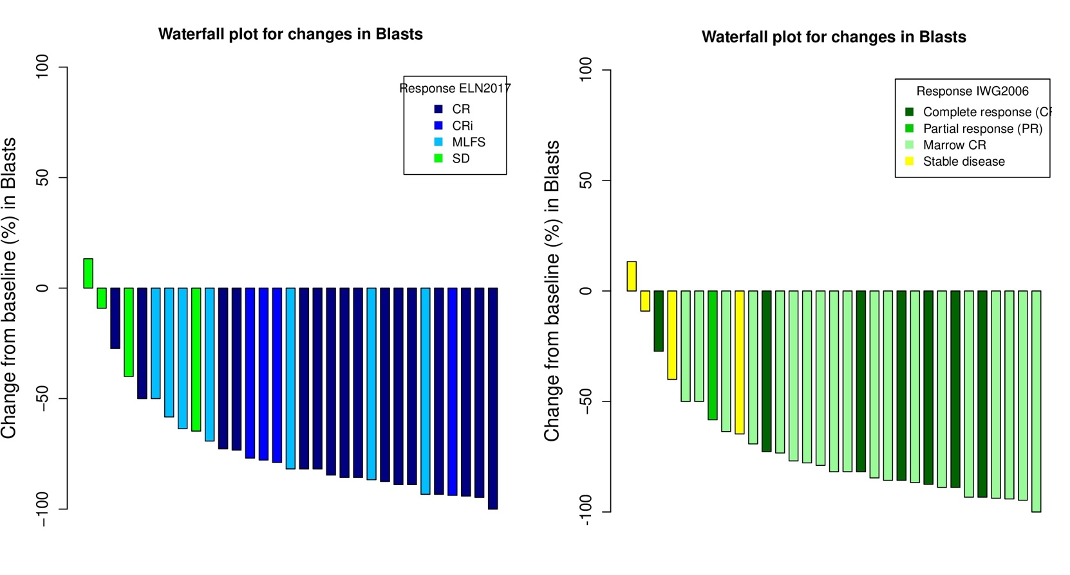
CPX-351 As First Line Treatment in Higher Risk MDS. A Phase II Trial By the GFM
Goal for HCT
CPX-351 induction days 1, 3 and 5 (AML dosing). Second induction allowed if no PR
Consolidation cycles (same daily dose for one day) up to 4 cycles. Allo SCT could follow after 1 to 4 consolidation cycles.
Responses Per Criteria Used
Peterlin P et al. ASH Annual Meeting 2021, Atlanta GA. Abstract 243

Slide 36
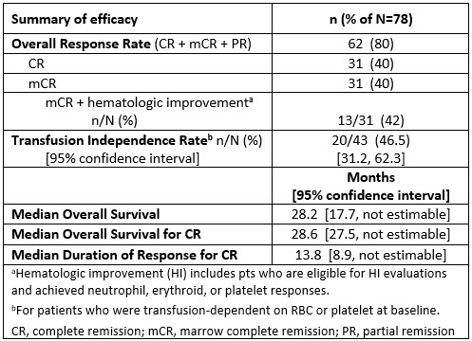
Azacitidine and Venetoclax in HR-MDS
Goal for HCT
mCR +HI:
24%
mORR:ª
84%
EHA Library. Wei A. 06/09/21; 325675; EP917
Garcia J et al. ASH Annual Meeting 2021, Atlanta GA. Abstract 241

Slide 37
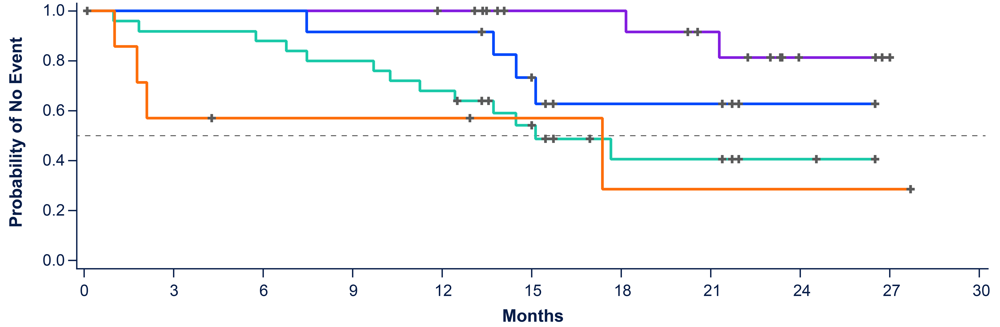
Azacitidine and Venetoclax in HR-MDS
Goal for HCT
Garcia J et al. ASH Annual Meeting 2021, Atlanta GA. Abstract 241

Slide 38
Azacitidine and Venetoclax in HR-MDS
Goal for HCT
ORR Across Baseline Mutations
mORR
85%
82%
75%
100%
100%
86%
71%
69%
55%
100%
29%
43%
100%
100%
100%
43%
100%
75%
75%
75%
50%
83%
40%
71%
57%
80%
80%
75%
25%
57%
50%
75%
15%
27%
25%
43%
60%
50%
14%
17%
20%
20%
25%
25%
Garcia J et al. ASH Annual Meeting 2021, Atlanta GA. Abstract 241

Slide 39
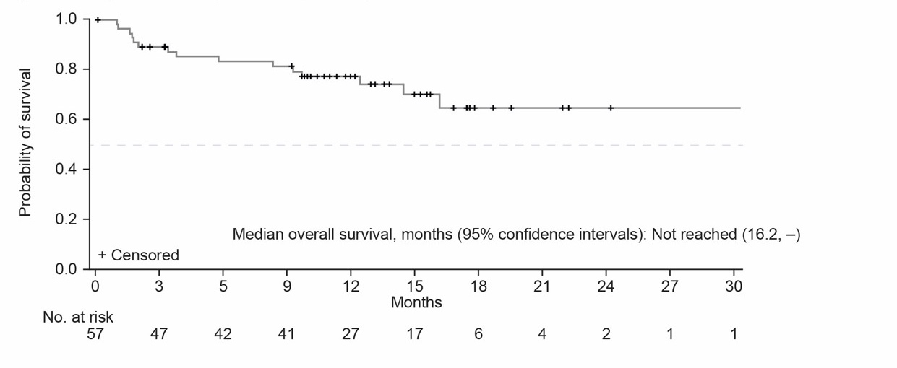
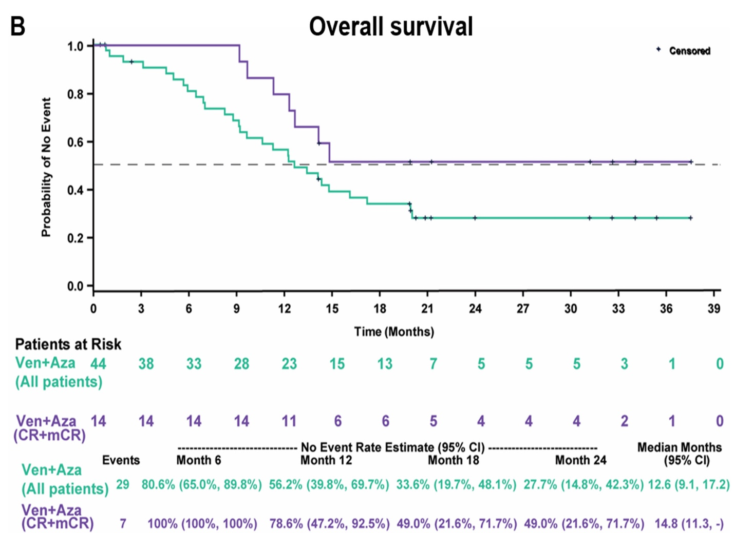
Sequencing Chemotherapy in MDS:
The Case of Venetoclax
Duration and Quality of Response
Frontline therapy
Salvage therapy
CR + mCR
All Patients
Garcia et al ASH 2020, Abstract 656
Zeidan et al, ASH 2021, Abstract 537

Slide 40
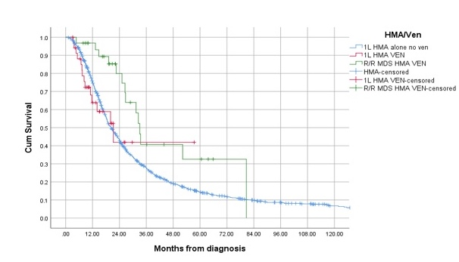
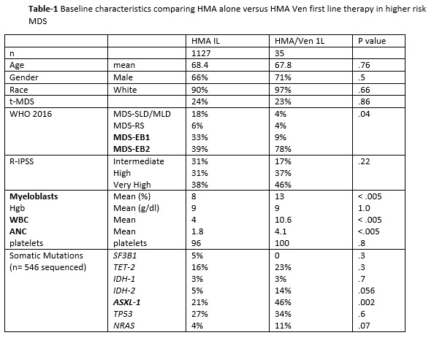
Assessing the Role of Venetoclax in Combination with Hypomethylating Agents in Higher Risk Myelodysplastic Syndromes
Duration and Quality of Response
Higher risk MDS at Moffitt Cancer Center (INT, H, VH)
Compare: first line single agent HMA, first line HMA/Ven combination, HMA, but add Ven after HMA failure (R/R MDS HMA/Ven)
HMA and add VEN later
Komrokji R et al. ASH Annual Meeting 2021, Atlanta GA. Abstract 536

Slide 41



Efficacy and Safety of Sabatolimab (MBG453) in Combination with Hypomethylating Agents (HMAs) in Patients (Pts) with Very High/High-Risk Myelodysplastic Syndrome (vHR/HR-MDS) and Acute Myeloid Leukemia (AML): Final Analysis from a Phase Ib Study
Duration and Quality of Response
Response Rate
(evaluable patientsª)
Durability Assessments
100
ORR 56.9% (29/51)
17.1
mo
Median DOR [CR / mCR / PR] (95% CI, 6.7-NE)
Estimated 12-mo PFS rate
(95% CI, 33.0%-71.0%)
54.0%
80
Response Rate, %
60
SD w/HI 9.8
Median Duration of Response (mDOR) by response category
mDOR for mCR and PR could not be estimated
PR 3.9
40
mCR
23.5
mCR w/HI 11.8
mDOR (mCR w/HI) = 7.9 mo (95% CI, 3.0-NE)
20
mCR w/HI
CR 19.6
CR
mDOR (CR) = 19.3 mo (95% CI, 12.1-NE)
0
0 5 10 15
20
25
Duration of Response, mo
Brunner AM et al. ASH Annual Meeting 2021, Atlanta GA. Abstract 244

Slide 42


Efficacy and Safety of Sabatolimab (MBG453) in Combination with Hypomethylating Agents (HMAs) in Patients (Pts) with Very High/High-Risk Myelodysplastic Syndrome (vHR/HR-MDS) and Acute Myeloid Leukemia (AML): Final Analysis from a Phase Ib Study
Duration and Quality of Response
vHR/HR-MDS ND-AML
100
ORRª 71.4% (10/14)
ORRª 65.6% (21/32)
100
ORRª 40% (2/5)
ORRª 53.8% (7/13)
Response Rate, %
80
80
60
SD w/HI 21.4
SD w/HI 12.5
60
PR 7.1
PR 6.3
PR 7.7
40
mCR w/HI 14.3
mCR
mCR w/HI 18.8
40
CRi 7.7
21.9
CRi 20
20
20
CR 38.5
CR 28.6
CR 25
CR 20
0
At least one ELN adverse- risk mutation^{1,b}
0
TP53
At least one ELN adverse- risk mutation^{1,b}
TP53
Median duration of response | 21.5 mo 95% CI, 6.7-NE Events, 3/7^{c} | 16.1 mo 95% CI, 6.7-NE Events, 7/17^{c} | 6.4 mo 95% CI, 4.2-NE Events, 2/2^{c} | 12.6 mo 95% CI, 1.3-NE Events, 5/7^{c}
Brunner AM et al. ASH Annual Meeting 2021, Atlanta GA. Abstract 244

Slide 43
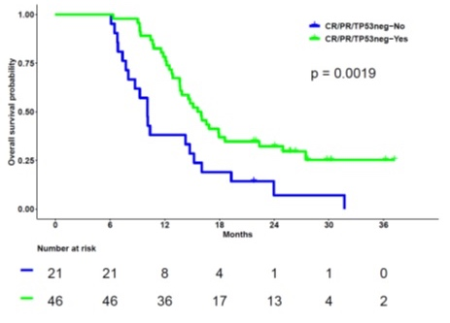
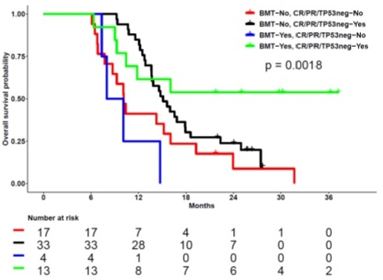
Long Term Follow-up and Combined Phase 2 Results of Eprenetapopt (APR-246) and Azacitidine (AZA) in Patients with TP53 mutant Myelodysplastic Syndromes (MDS) and Oligoblastic Acute Myeloid Leukemia (AML)
Emerging Targeted Therapies
74 pts with MDS, 22 AML-MRC and 4 CMML/MDS-MPN
ORR: 69% with 43 CR, 1 PR, 10 marrow CR (mCR)+HI, 9 HI, and 6 mCR
Sallman D et al. ASH Annual Meeting 2021, Atlanta GA. Abstract 246

Slide 44
Emerging Targets in MDS
Exploring molecular profiles of interest

Slide 45
Ivosidenib Monotherapy Is Effective in Patients with IDH1 Mutated Myelodysplastic Syndrome (MDS): The Idiome Phase 2 Study By the GFM Group
Emerging Targeted Therapies
Ivosidenib 500mg Daily
Cohort A: HR-MDS without response to AZA after 6 cycles
MDS (up to 29% blasts)
IDH1 Mutation
Cohort B: HR-MDS without prior AZA/Decitabine
Could add AZA d1-7 if no response after 3 cycles
Cohort C: LR-MDS
Anemia post ESA
Sébert M et al. ASH Annual Meeting 2021, Atlanta GA. Abstract 62

Slide 46
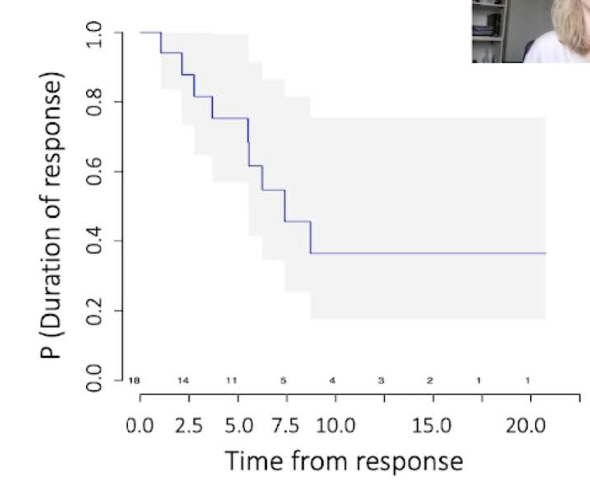
Ivosidenib Monotherapy Is Effective in Patients with IDH1 Mutated Myelodysplastic Syndrome (MDS): The Idiome Phase 2 Study By the GFM Group
Emerging Targeted Therapies
Sébert M et al. ASH Annual Meeting 2021, Atlanta GA. Abstract 62

Slide 47
Enasidenib (ENA) Is Effective in Patients with IDH2 Mutated Myelodysplastic Syndrome (MDS) : The IDEAL Phase 2 Study By the GFM Group
Emerging Targeted Therapies
Enasidenib 100mg Daily
Cohort A: HR-MDS without response to AZA after 6 cycles
MDS (up to 29% blasts)
IDH2 Mutation
Cohort B: HR-MDS without prior AZA/Decitabine
Could add AZA d1-7 if no response after 3 cycles
Cohort C: LR-MDS
Anemia post ESA
Adès L et al. ASH Annual Meeting 2021, Atlanta GA. Abstract 63

Slide 48
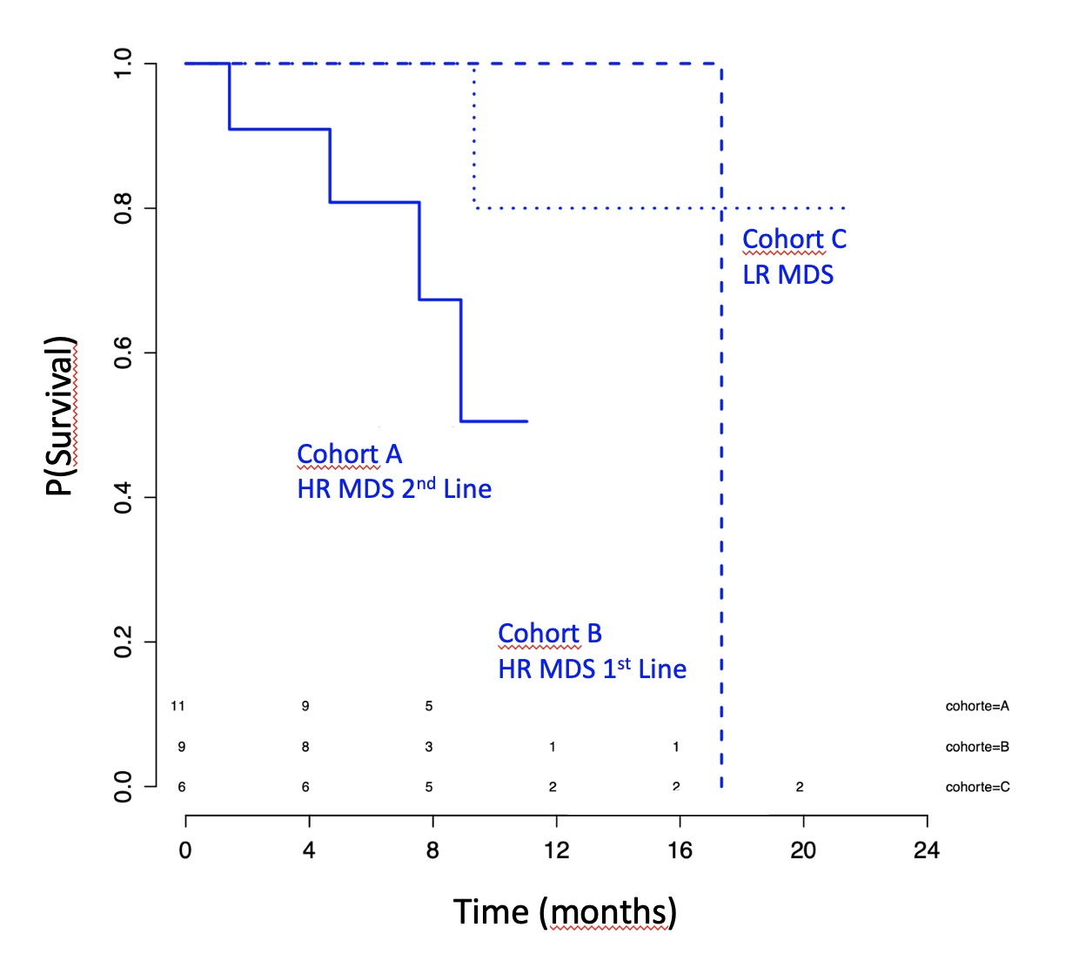
Enasidenib (ENA) Is Effective in Patients with IDH2 Mutated Myelodysplastic Syndrome (MDS) : The IDEAL Phase 2 Study By the GFM Group
Emerging Targeted Therapies
Adès L et al. ASH Annual Meeting 2021, Atlanta GA. Abstract 63

Slide 49
Oral Decitabine/Cedazuridine in Patients with Lower Risk Myelodysplastic Syndrome: A Longer-Term Follow-up of from the Ascertain Study
69 patients with a diagnosis of lower-risk MDS (93% Int-1, 7% LR)
Enrolled on ASCERTAIN
Decitabine eligible MDS, CMML, AML
C1: oral ASTX727
D1-5
C2: IV decitabine
D1-5
Randomized 1:1
Oral ASTX727
D1-5
C1: IV decitabine
D1-5
C2: oral ASTX727
D1-5
Garcia Manero G et al. ASH Annual Meeting 2021, Atlanta GA. Abstract 66

Slide 50
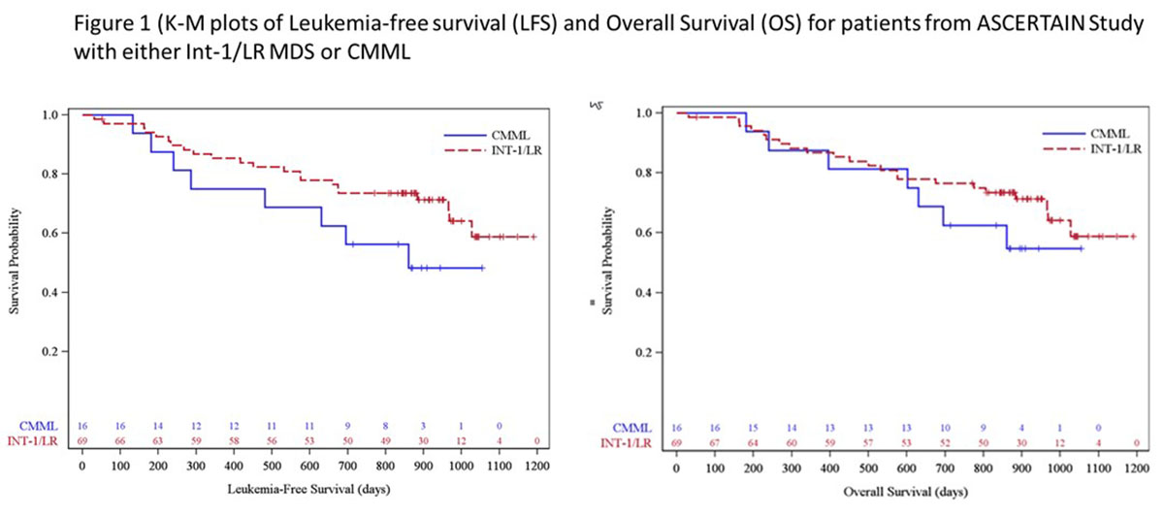
Oral Decitabine/Cedazuridine in Patients with Lower Risk Myelodysplastic Syndrome: A Longer-Term Follow-up of from the Ascertain Study
 | Total LR MDS (n=69)
CR | 16 (23%)
PR | 0
mCR | 18 (26%)
mCR with HI | 9 (13%)
HI | 5 (7%)
HI-E | 1 (1%)
HI-N | 0
HI-P | 4 (6%)
Of those RBC or plt TD at baseline, 13/27 (48%) became RBC TI and 4/6 (67%) became plt TI.
Garcia Manero G et al. ASH Annual Meeting 2021, Atlanta GA. Abstract 66

Slide 51
Conclusions for MDS from ASH 2022
Molecular characterization of disease and response increasingly important
HMA combination studies are ongoing
  Importance of overall treatment goals – transplant, sequencing
Novel targeted therapies have a role in MDS but as of yet only apply to subsets of patients

Slide 52
Thank you
Questions: abrunner@mgh.harvard.edu

