Slide 1


Evolving Therapy of
MPNs 2022
Ruben A. Mesa, MD
Executive Director, Mays Cancer Center
Mays Family Foundation Distinguished University Presidential Chair
mesar@uthscsa.edu
Twitter: @mpdrc
Notes:
RC to do

Slide 2
JAK Inhibitor Landscape 2022
Approved
Seeking Approval
Inactive
NCT04173494
Ruxolitinib
1L – MF, 2L PV
Momelotinib
MF
XL-019
Fedratinib
MF-1L
Ruxolitinib Combinations
BMS-911543
NS - 018
MF
AZD-1480
Pacritinib
MF (Low PLT)
LY-2784544
NOW Approved

Slide 3
Ruxolitinib FDA Approved (MF)
November 16, 2011

Slide 4
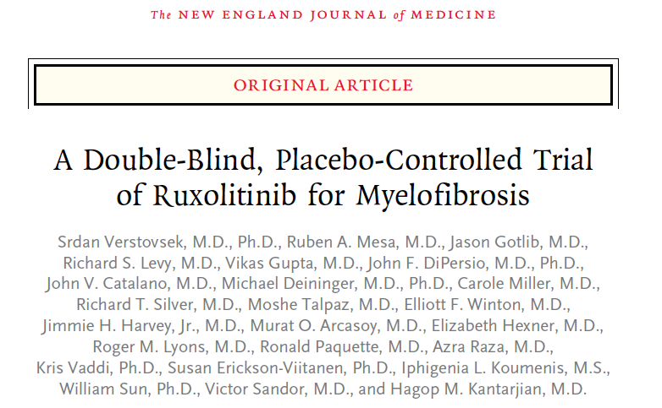
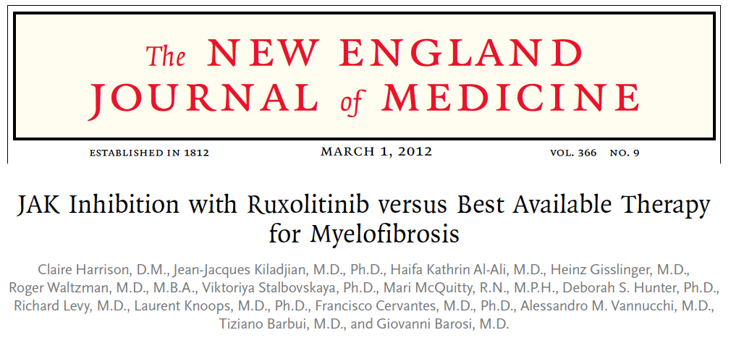
Ruxolitinib phase III trials (COMFORT I & II)
INC424 (oral)
15 mg BID or
20 mg BID
Patients
with MF
(N = 309)
Randomised
1:1
Placebo (oral)
BID
INC424 (oral)
15 mg BID
or 20 mg BID
Patients
with MF
(N = 219)
Randomised
2:1
Best available therapy
BID, twice daily; MF, myelofibrosis.
1. Verstovsek S, et al. NEJM 2012;366:799–807; 2.Harrison C, et al. NEJM 2012;366:787–798.

Slide 5
Results: OS ~ ruxolitinib
MF survival ~ last decade
1.0
 | N | Ev | Med OS
≤ 2010, RUX | 117 | 76 | 98 (78–118)
> 2010, RUX | 241 | 90 | 91 (73–109)
> 2010, NO RUX | 565 | 171 | 57 (47–67)
≤ 2010, NO RUX | 423 | 323 | 34 (27–41)
0.8
0.6
Yes RUX
2010–2020
Cumulative survival
OS without and with RUX ~ years 2010
≤Year 2010, p<0.001, HR 0.46, 95% CI 0.35–0.59
>Year 2010, p=0.001, HR 0.66, 95% CI 0.51–0.85
0.4
Yes RUX
≤2010
No RUX
2010–2020
0.2
No RUX
≤2010
0.0
0
50
100
150
200
250
300
Time (months)
CI, confidence interval; Ev, event; HR, hazard ratio; MF, myelofibrosis; OS, overall survival; RUX, ruxolitinib.
Masarova L et. al. ASH Annual Meeting and Exposition. Abstract 2995. December 5–8 2020.

Slide 6
Fedratinib FDA Approved (MF)
August 16, 2019

Slide 7
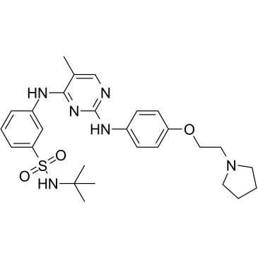
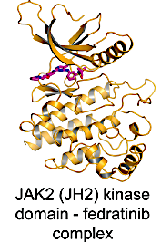
Fedratinib
Oral, selective inhibitor of JAK2¹
FDA approved for the treatment of intermediate-2 or high-risk primary or secondary (post-polycythemia vera or post-essential thrombocythemia) myelofibrosis and platelet counts ≥50 × 10⁹ /L based on outcomes from the phase III JAKARTA trial for JAK-inhibitor-naïve patients and the phase 2 JAKARTA2 trial for patients previously treated with ruxolitinib¹
Fedratinib has higher inhibitory activity for JAK2 over JAK1, JAK3, and TYK24²
Both JAKARTA and JAKARTA2 allowed enrollment of patients with platelet counts of ≥50 × 10⁹/L at study entry^{3,4}
FEDRATINIB⁵
JAK2 KINASE DOMAIN – Fedratinib Complex⁶
1. Harrison CN et al. Br J Haematol 2022;198(2):317-27. 2. Wernig G et al. Cancer Cell 2008;13(4):311-20. 3. Pardanani et al. JAMA
Oncol 2015;1(5):643-51. 4. Harrison CN et al. Lancet Haematol 2017;4(7):e317-e24. 5. Harrison et al. Lancet Haematol 2017;4:e317-24.
6. Hantschel O. ACS Chem Biol 2015;10(1):234-45.

Slide 8
Pacritinib FDA Approved (MF)
February 28th, 2022

Slide 9
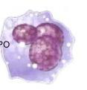
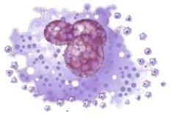

Pacritinib (PAC): A Selective Inhibitor of JAK2 and IRAK1
JAK1i
JAK and FLT3 Kinases IC₅₀ (nM)
Kinase | Pacritinib | Ruxolitinib | Fedratinib
JAK1 | 1280 | 3.4 | 18
JAK2 | 6.0 | 0.0 | 1.1
JAK2 V617F | 9.4 | NR | NR
JAK3 | 18.3 | 2.0 | 74
FLT3 | 14.8 | >3000 | 13
Immature
Megakaryocyte
Mature
Megakaryocyte
Blood
Platelets
JAK1/2i
Non-Tyrosine Kinases of Interest IC₅₀ (nM)
Kinase | Pacritinib | Ruxolitinib | Fedratinib
CSF1R | 39.5 | >3000 | 220
IRAK1 | 13.6 | 290 | 620
JAK1/2 inhibitors impair megakaryopoiesis while preserving thrombopoiesis, whereas JAK1 inhibition impairs both megakaryopoiesis and platelet release in vitro and can exacerbate thrombocytopenia in MF.ª
Minimal JAK1 inhibition uniquely positions pacritinib for use in thrombocytopenic MF patients.
Only pacritinib is a potent inhibitor of IRAK1
Eurofins “KINOMEscan” for RUX and FED
J Exp Pharm publication for PAC
Leukemia publication for PAC (JAK1)
IC₅₀, half-maximal inhibitory concentration; JAK, Janus kinase; TYK, tyrosine kinase; FLT, FMS-like tyrosine kinase; ITD, internal tandem duplication; CSF1R, colony stimulating factor 1 receptor; IRAK, interleukin-1 receptor-associated kinase
ªJadwiga J, et. al. Blood (2018) 132 (Supplement 1): 2559. Mascarenhas JO, et. al. Haematologica. 2017; 102(2):327.
Singer et al. ASH, 2014, Abstract 1874.
Notes:
IRAK1 is critical in inflammasome signaling. Inhibition of IRAK1 suppresses IL-1, TNFalpha, IL-6, IL17 and TGF beta among other inflammatory cytokines

Slide 10
Momelotinib
Seeking Approval

Slide 11
MOMENTUM: Phase 3 Randomized Study of Momelotinib (MMB) versus Danazol (DAN) in Symptomatic and Anemic Myelofibrosis (MF) Patients Previously Treated with a JAK Inhibitor
Ruben Mesa¹, Aaron T. Gerds², Alessandro Vannucchi³, Haifa Kathrin Al-Ali⁴, David Lavie⁵, Andrew Kuykendall⁶, Sebastian Grosicki⁷, Alessandra Iurlo⁸, Yeow Tee Goh⁹, Mihaela Lazaroiu¹⁰, Miklos Egyed¹¹, Maria Laura Fox¹², Donal McLornan¹³, Andrew Perkins¹⁴, Sung-Soo Yoon¹⁵, Vikas Gupta¹⁶, Jean-Jacques Kiladjian¹⁷, Rafe Donahue¹⁸, Jun Kawashima¹⁸, Srdan Verstovsek¹⁹
¹Mays Cancer Center at UT Health San Antonio MD Anderson, San Antonio, TX; ²Cleveland Clinic Taussig Cancer Institute, Cleveland, OH; ³University of Florence and AOU Careggi, Florence, Italy; ⁴University Hospital of Halle, Halle, Germany; ⁵Hadassah-Hebrew University Medical Center, Jerusalem, Israel; ⁶Moffitt Cancer Center, Tampa, FL; ⁷Medical University of Silesia, Katowice, Poland; ⁸Foundation IRCCS Ca' Granda Ospedale Maggiore Policlinico, Milan, Italy; ⁹Singapore General Hospital, Singapore; ¹⁰Policlinica de Diagnostic Rapid Brasov, Romania; ¹¹Somogy County Mór Kaposi General Hospital, Kaposvár, Hungary; ¹²Vall d’Hebron Institute of Oncology, University Hospital Vall d’Hebron, Barcelona, Spain; ¹³Guy's and St Thomas' NHS Foundation Trust, London, United Kingdom; ¹⁴Monash University, Melbourne, Australia; ¹⁵Seoul National University Hospital, Seoul, South Korea; ¹⁶Princess Margaret Cancer Centre, Toronto, Ontario; ¹⁷Université de Paris, AP-HP, Hôpital Saint-Louis, Centre d’Investigations Cliniques, INSERM, CIC1427, Paris, France; ¹⁸Sierra Oncology Inc., San Mateo, CA; ¹⁹The University of Texas MD Anderson Cancer Center, Houston, TX
Ruben Mesa, MD, FACP
Director, Mays Cancer Center at UT Health San Antonio MD Anderson

Slide 12









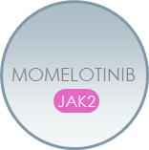


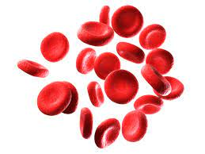


Momelotinib Inhibits JAK1, JAK2 and ACVR1 to Address MF Symptoms, Spleen, and Anemia
Interleukins
Interferons
Ligand
BMP2, BMP6
Cytokine
Receptors
EPOR/MPL
ACVR1
Hepatocyte
cellular membrane
JAK2
JAK2
JAK2
Serum Iron,
Hemoglobin,
Erythropoiesis
JAK1
Hepcidin
JAK2
Inhibition
STAT
P
STAT
P
SMAD1,5
P
Dysregulated JAK-STAT signaling in MF drives overproduction of inflammatory cytokines, bone marrow fibrosis, systemic symptoms, and clonal proliferation resulting in extramedullary hematopoiesis and splenomegaly.^{1,2}
Chronic inflammation also drives hyperactivation of ACVR1, elevated hepcidin, dysregulated iron metabolism, and anemia of MF.^{3,4}
ACVR1=activin A receptor type 1; BMP=bone morphogenic protein; EPOR=erythropoietin receptor; JAK=Janus kinase; MMB=momelotinib; MPL=myeloproliferative leukemia protein;
STAT=signal transducer and activator of transcription.
1. Chifotides HT, et al. J Hematol Oncol. 2022;15(1):7; 2. Verstovsek S, et al. Future Oncol. 2021;17(12):1449-1458; 3. Asshoff M, et al. Blood. 2017;129(13):1823-1830; 4. Oh S, et al. Blood Adv. 2020;4(18):4282-4291.
Ruben Mesa, MD, FACP
Director, Mays Cancer Center at UT Health San Antonio MD Anderson

Slide 13
Momelotinib: Prior Evidence of Clinical Benefit in Completed Trials
SIMPLIFY-1:
Splenic Response
SIMPLIFY-1:
Transfusion Requirement
SIMPLIFY-1 and -2:
Total Symptom Score Response
JAKi-Naïve
(SIMPLIFY-1)
Momelotinib
Post-RUX, No Washout
(SIMPLIFY-2)
Momelotinib
150
Momelotinib
Ruxolitinib
6
Ruxolitinib
150
100
Momelotinib
28% TSS
Response Rate
(60/211)
250
26% TSS
Response Rate
(27/103)
26.5% Splenic
Response Rate
(57/215)
29.0% Splenic
Response Rate
(63/217)
4
100
200
50
50
150
Change in Spleen Volume From Baseline (%)
Number of Units
Change in TSS From Baseline (%)
100
0
2
0
50
–50
35% decrease
–50
0
Individual Patients
50% decrease
–50
50% decrease
–100
0
0
4
8
12
16
20
24
–100
–100
Proportion difference of 0.09 (95% CI, 0.02 to 0.16)
P = 0.011
Week
Individual Patients
Individual Patients
Phase 3 SIMPLIFY studies in JAKi-naïve and post-RUX patients with MF demonstrated momelotinib benefits on symptoms, spleen, and anemia.
Mesa R, et al. J Clin Oncol. 2017;35(34):3844–3850.; Harrison CN, et al. Lancet Haematol. 2018;5(2):e73–e81. Mesa R, et al. Leuk Lymphoma. 2022; Mar 7:1–5.
Ruben Mesa, MD, FACP
Director, Mays Cancer Center at UT Health San Antonio MD Anderson

Slide 14
MOMENTUM Study Design
Long Term
Follow-up
Double-Blind Treatment
Open Label/Crossover
Previously Treated
with JAK inhibitor
Symptomatic (TSS ≥10) and Anemic
(hemoglobin <10 g/dL)
Patients
N=195
Momelotinib (MMB) 200 mg daily
+ Placebo
Momelotinib (MMB)
200 mg daily
Early crossover if confirmed progression
2:1 randomization
JAKi taper/washout
≥21 days
Danazol (DAN)* 600 mg daily
+ Placebo
Stratification:
Total symptom score
Palpable spleen length
Transfused units in prior 8 wks
Study site
Planned enrollment: 180
FPE April 2020
LPE June 2021
Database lock Dec 2021
Primary Endpoint
Day 1
Week 24
Primary Endpoint
Key Secondary Endpoints
Total symptom score (TSS) response rate at Week 24
Transfusion independence (TI) rate at Week 24
Splenic response rate (SRR) at Week 24
ClinicalTrials.gov: NCT04173494
*Danazol was selected as an appropriate comparator given its use to ameliorate anemia in MF patients, as recommended by NCCN, ESMO guidelines.
TSS response defined as achieving ≥50% reduction in TSS over the 28 days immediately prior to the end of week 24 compared to baseline.
TI defined as not requiring red blood cell transfusion in the last 12 weeks of the 24-week randomized period, with all hemoglobin levels during the 12-week interval of ≥8 g/dL.
SRR defined as achieving a ≥25% or ≥35% reduction in spleen volume from baseline.
Ruben Mesa, MD, FACP
Director, Mays Cancer Center at UT Health San Antonio MD Anderson

Slide 15
MFSAF Total Symptom Score Response Rate* at W24
120
100
 | MFSAF TSS Response Rate at Week 24* no. (%) [95% CI) | P Value (Superior)
Momelotinib (N=130) | 32 (24.6) [17.49–32.94] | 0.0095
Danazol (N=65) | 6 (9.2) [3.46–19.02] | 67.7
80
60
40
20
Change in MFSAF TSS from Baseline at Week 24 (%)
0
–20
–40
50% decrease
–60
–80
≤
–100
Individual Patients
*Defined as the proportion of patients who achieve ≥50% reduction in TSS over the 28 days immediately prior to the end of Week 24 compared to baseline.
Ruben Mesa, MD, FACP
Director, Mays Cancer Center at UT Health San Antonio MD Anderson

Slide 16
Spleen Response Rate* at Week 24
100
 | Spleen response rate at Week 24* no. (%) [95% CI]
 | 25% reduction | 35% reduction
Momelotinib (N=130) | 52 (40.0) [31.51–48.95] | 30 (23.1) [16.14–31.28]
Danazol (N=65) | 4 (6.2) [1.70–15.01] | 2 (3.1) [0.37–10.68]
 | P<0.0001 (Superior) | P=0.0006 (Superior)
80
60
40
20
Change in Spleen Volume from Baseline at Week 24 (%)
0
–20
25% Decrease
–40
35% Decrease
–60
–80
–100
Individual Patients
*Defined as the proportion of patients who have a reduction in spleen volume of ≥25% or ≥35% from baseline.
Ruben Mesa, MD, FACP
Director, Mays Cancer Center at UT Health San Antonio MD Anderson

Slide 17
Transfusion Independence* Rate at W24 and Mean Hemoglobin Over Time
P=0.0064 (Noninferior)
Double-blind Randomization Period
Open-label Period
35
11.0
31%
Momelotinib
Momelotinib
30
Danazol
Danazol → Momelotinib
25
10.0
20%
20
Mean Hemoglobin Levels (g/dL)
Transfusion Independence Rate (%)
15%
9.0
15
13%
10
8.0
5
BL
4
8
12
16
20
24
28
32
36
40
44
48
0
No. of Patients
Weeks since Randomization
Baseline
Week 24
Baseline
Week 24
Momelotinib
129
105
112
93
87
88
83
67
56
44
42
36
28
Momelotinib (N=130)
Danazol (N=65)
Danazol
65
54
50
38
36
36
29
31
21
19
18
13
7
*Defined as not requiring red blood cell transfusion in the terminal 12 weeks of the 24-week randomized period, with all hemoglobin levels during the 12-week interval of ≥8 g/dL.
Ruben Mesa, MD, FACP
Director, Mays Cancer Center at UT Health San Antonio MD Anderson

Slide 18
Step 1 for MF Management: Optimize JAK Inhibition
FDA Approval
Pending
Momelotinib
Momelotinib
Momelotinib
Momelotinib
Pacritinib
Pacritinib
Pacritinib
Pacritinib
FDA Approved
Dose Opt FEDR
Dose Opt FEDR
Dose Opt FEDR
Dose Opt FEDR
Dose Opt RUX
Dose Opt RUX
Dose Opt RUX
Clinical Spectrum of MF requiring Therapy (> Symptomatic Low Risk)
Proliferative 1L
Proliferative 2L
Cytopenic MF
AP/BP MF

Slide 19
A selection of novel agents/targets being developed in MPN particularly MF
Cell-cycle Checkpoint
Apoptosis/MDM2/BCL
Imetelstat | Telomerase Inhibitor
KRT-232
Idasanutlin / RG7388
Alisertib | Aurora Kinase Inhibitor
Anti-fibrotic
Navitoclax | BCL2 inhibition
PRM-151 | Pentraxin-2
Immuno-modulator / CPI
Receptor Ab / ADC
Pegasys | IFN-α2a
Ropeg-IFN-α2b
Nivolumab / Pembrolizumab | PD-1
SL-401 | CD123-toxin
Signaling / TKI
+/- Ruxolitinib
Glasdegib | Hedgehog
Sonidegib | Hedgehog
INCB’465 | PI3Ki
LCL1 I SMAC/IAP
HDAC / Epigenetic
Azacitidine | HMA
Panobinostat | HDAC
Givinostat I HDAC
IMG-7289 | LSD1
CPI-0610 | BETi
PU-H71 | HSP90i
Next-gen JAKi
Fedratinib | JAK2
Pacritinib | JAK2/FLT3
Momelotinib | JAK2/1/ACVR1
Itacitinib | JAK1
Slide Courtesy of Prof Claire Harrison

Slide 20
Strategies for Non JAKi MOA in MF
Dual Therapy w/ Single Agent
Different MOA
Combination RX
Optimized JAK Inhibition
Add on of Single Agent
Different MOA
SubOpt JAKI
ADD-ON
Optimized JAK Inhibition
Optimized JAK Inhibition
2L Single Agent
Different MOA
JAKI Fail

Slide 21
BET Inhibitor Pelabresib (CPI-0610) Combined With Ruxolitinib in Patients With Myelofibrosis — JAK Inhibitor-Naïve or With
Suboptimal Response to Ruxolitinib
Preliminary Data From the MANIFEST Study
John Mascarenhas,¹ Marina Kremyanskaya,¹ Andrea Patriarca,² Claire Harrison,³ Prithviraj Bose,⁴ Raajit K Rampal,⁵ Francesca Palandri,⁶ Timothy Devos,⁷ Francesco Passamonti,⁸ Gabriela Hobbs,⁹ Moshe Talpaz,¹⁰ Alessandro Vannucchi,¹¹ Jean-Jacques Kiladjian,¹² Srdan Verstovsek,¹³ Ron Hoffman,¹ Mohamed E Salama,¹³ Dong Chen,¹⁴ Pietro Taverna,¹⁵ Alex Chang,¹⁵ Gozde Colak,¹⁵ Sandra Klein,¹⁵ Vikas Gupta¹⁶
¹Tisch Cancer Institute, Icahn School of Medicine at Mount Sinai, New York, NY, USA; ²Hematology Unit, Department of Translational Medicine, University of Eastern Piedmont and AOU Maggiore della Carità, Novara, Italy; ³Guy's and St Thomas' NHS Foundation Trust, London, UK; ⁴MD Anderson Cancer Center, Houston, TX, USA; ⁵Memorial Sloan-Kettering Cancer Center, New York, NY, USA; ⁶IRCCS Azienda Ospedaliero-Universitaria di Bologna, Istituto di Ematologia “Seràgnoli”, Bologna, Italy; ⁷University Hospitals Leuven and Laboratory of Molecular Immunology (Rega Institute), KU Leuven, Leuven, Belgium; ⁸University of Insubria, Varese, Italy; ⁹Division of Hematology/Oncology, Massachusetts General Hospital, Harvard Medical School, Boston, MA, USA; ¹⁰University of Michigan Comprehensive Cancer Center, Ann Arbor, MI, USA; ¹¹Azienda Ospedaliero-Universitaria Careggi, University of Florence, Florence, Italy; ¹²Hôpital Saint-Louis, Université de Paris, Paris, France; ¹³Leukemia Department, University of Texas MD Anderson Cancer Center, Houston, TX, USA; ¹⁴Mayo Clinic, Rochester, MN, USA; ¹⁵Constellation Pharmaceuticals Inc. a MorphoSys Company, Boston, MA, USA; ¹⁶Princess Margaret Cancer Centre, University of Toronto, Toronto, Canada.

Slide 22
Courtesy Constellation Pharma

Slide 23
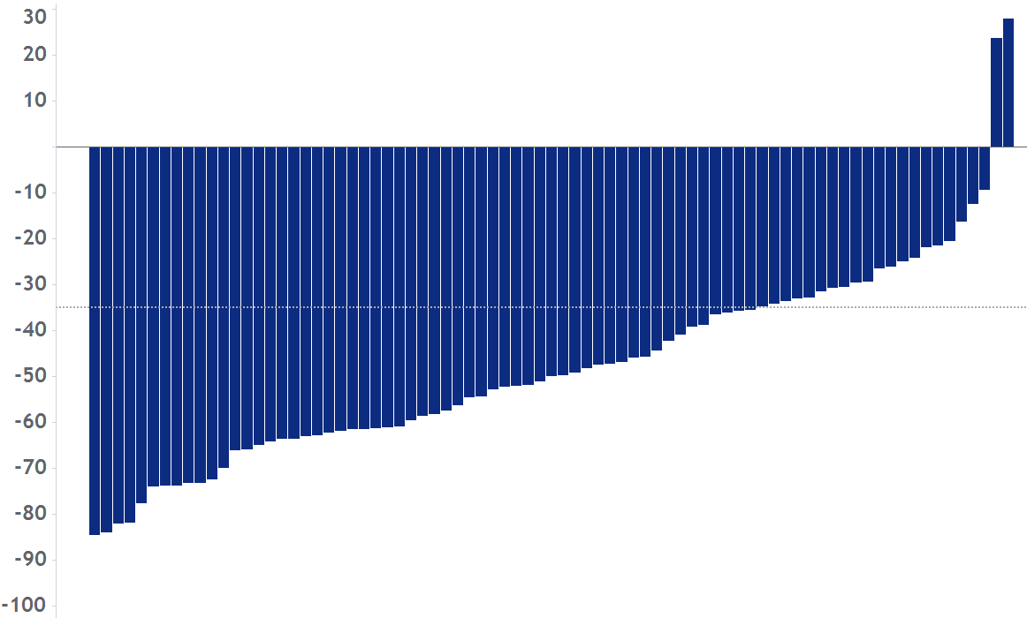
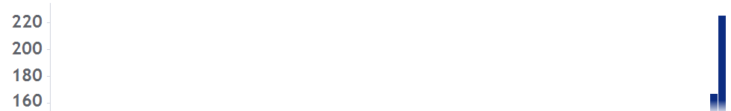
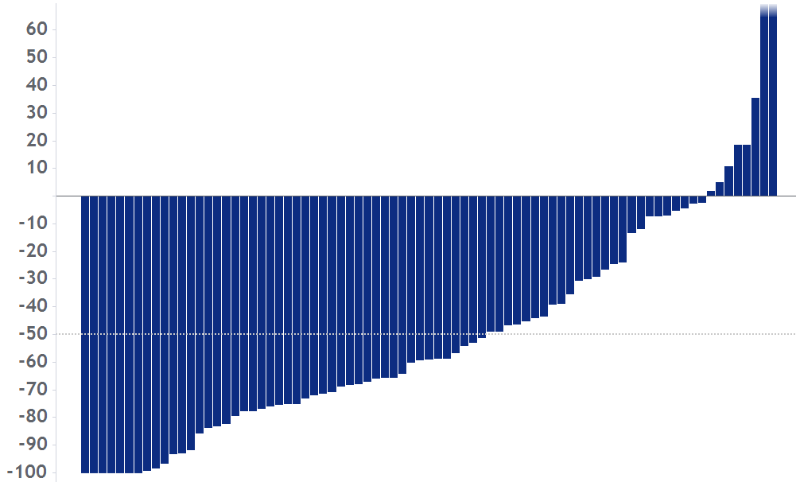
Arm 3: JAKi-naïve MF patients — Reduction of spleen volume and total symptom score in majority of the patients
SVR35 at Wk 24: 68% (57/84), 95% CI 57–78
SVR35 at any time: 80% (67/84, range: 10–51 wks)
Median SVR: –50%
58 pts (69%) with SVR35 maintained response at the time of data cut-off
Median follow-up* for SVR35 response: 37 wks
220
TSS50 at Wk 24: 56% (46/82†), 95% CI 45–67
Median TSS % change: –59%
30
200
180
20
160
10
60
50
40
-10
30
-20
20
10
-30
% change from baseline
% change from baseline
-10
-40
-20
-50
-30
-60
-40
-50
-70
-60
-80
-70
-90
-80
Local vs central review concordance in a subset of 55 pts is 86%
-90
-100
-100
SVR per local radiology review; central radiology review is ongoing.
Patients are evaluable for SVR35 or TSS50 at Wk 24 if they have had Wk 24 assessment by the data cut-off date or discontinued without Wk 24 assessment at any time.
*Reverse Kaplan–Meier estimate of median duration of follow-up for SVR35 response.
†Two ongoing patients were nonevaluable for TSS50 at Wk 24; n=1 due to missing baseline, n=1 due to baseline TSS=0.
CI, confidence interval; JAKi, Janus kinase inhibitor; MF, myelofibrosis; pts, patients; SVR, spleen volume reduction; SVR35, ≥35% reduction in spleen volume from baseline; TSS, total symptom score; TSS50, ≥50% reduction in total symptom score from baseline; wk, week.

Slide 24
Navitoclax Plus Ruxolitinib in JAK Inhibitor-Naïve Patients With Myelofibrosis:
Preliminary Safety and Efficacy in a Multicenter, Open-label Phase 2 Study
Title of Presentation, Title Case
Francesco Passamonti¹, James Foran², Anand Tandra³, Valerio De Stefano⁴,⁵, Maria Laura Fox⁶, Ahmad Mattour⁷, Mary Frances McMullin⁸, Andrew C. Perkins⁹, Gabriela Rodriguez-Macías¹⁰, Hassan Sibai¹¹, Qin Qin¹², Avijeet Chopra¹², Jalaja Potluri¹², Jonathan How¹³
¹Department of Medicine and Surgery, University of Insubria, Varese, Italy; ²Mayo Clinic, Jacksonville, FL, USA; ³Indiana Blood and Marrow Transplant, Indianapolis, IN, USA; ⁴Section of Hematology, Department of Radiological and Hematological Sciences, Catholic University, Rome, Italy; ⁵Fondazione Policlinico Universitario Agostino Gemelli IRCCS, Rome, Italy; ⁶Department of Hematology, Hospital Universitari Vall d’Hebron, Experimental Hematology, Vall d’Hebron Institute of Oncology (VHIO), Vall d’Hebron Hospital Campus, Barcelona, Spain; ⁷Henry Ford Hospital, Detroit, MI, USA; ⁸Centre for Medical Education, Queenʼs University Belfast, Belfast, UK; ⁹Australian Centre for Blood Diseases, Monash University and The Alfred Hospital, Melbourne, Australia; ¹⁰Department of Hematology, Hospital General Universitario Gregorio Marañón, Madrid, Spain; ¹¹Medical Oncology and Hematology, Princess Margaret Cancer Centre, University of Toronto, Toronto, Canada; ¹²AbbVie Inc., North Chicago, IL, USA; ¹³Division of Hematology, McGill University Health Center; Montreal, Canada
European Hematology Association Congress, June 11, 2022, Vienna, Austria

Slide 25

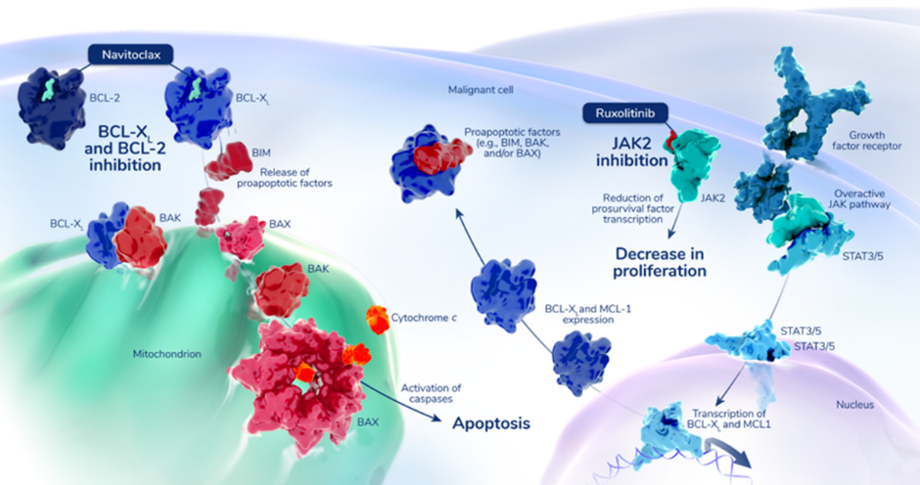
  Navitoclax is an oral BCL-X_{L} inhibitor with synergistic effect when combined with JAK inhibitors to enhance malignant cell death in myelofibrosis
Myelofibrosis (MF) is a rare myeloproliferative neoplasm associated with bone marrow fibrosis, cytopenia, and symptom burden that impairs quality of life
  Ruxolitinib, a Janus kinase (JAK) 1/2 inhibitor, is the current standard of care for patients with MF that improves disease symptoms in approximately 40% of patients with limited impact on disease biology, and responses are typically limited in duration (3-5 years)¹
  Navitoclax is an oral small-molecule BH3 mimetic that binds with high affinity to pro-survival proteins (BCL-2, BCL-X_{L}, and BCL-W) promoting release of pro-apoptotic factors such as BIM, which promotes apoptosis of malignant MPN cells²
  The synergistic effect of ruxolitinib and navitoclax can promote apoptosis of malignant cells by suppressing the expression of MCL-1, BCL-2, and BCL-X_{L}³
¹ Tse et al., Cancer Res, 2008; ²Chen at al., Mol. Cancer Ther, 2011; ³Waibel et al., Cell Rep; 2013
MPN, myeloproliferative neoplasm
Notes:
MF is driven by constitutive activation of JAK/STAT signaling pathway. Increased expression of pro-survival proteins, such as BCL-X_{L}, enables MF cells to evade apoptosis
This Phase 2 REFINE study is evaluating navitoclax and ruxolitinib combination in patients with MF who are either naïve and/or exposed to ruxolitinib. Previous results in patients with persistent or progressive myeloﬁbrosis showed that the addition of navitoclax to ruxolitinib resulted in durable SVR₃₅, improved TSS₅₀, hemoglobin response, and BMF reduction.

Slide 26

  Patients treated with navitoclax and ruxolitinib achieved spleen volume reductions
  All patients experienced reduction in spleen volumes; 20/32 (63%) achieved spleen volume reduction of at least 35% (SVR₃₅ ) at week 24
  SVR₃₅ obtained anytime during the post-baseline period was observed in 25/32 (78%) patients
  Median time to first SVR₃₅ was 12.3 weeks (range, 11.1 to 47.3)
  Estimated rate of maintaining SVR₃₅ at 12 months was 92.9% (95% CI, 59.1 to 99.0)
Spleen volume was measured by MRI/CT
Three patients discontinued the study prior to week 24, and 2 patients received new anti MF therapy before week 24

Slide 27

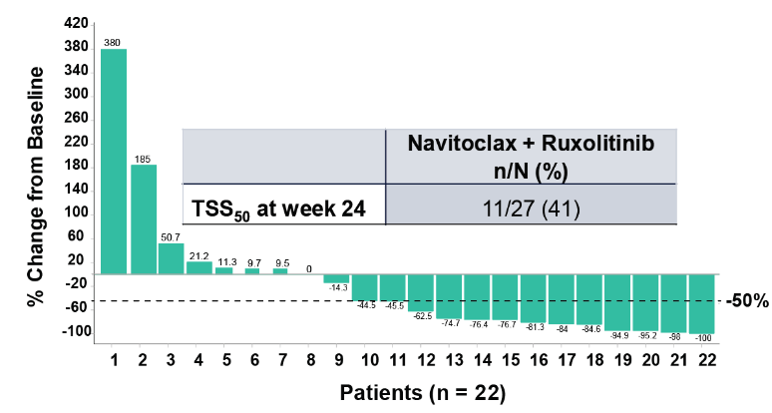
  Patients treated with navitoclax and ruxolitinib reported reduction in disease symptom burden
Total symptom score reduction of at least 50% (TSS₅₀) at anytime during the post-baseline period was observed in 18/27 (67%) patients
Median time to first TSS₅₀ from baseline was 3.2 weeks (95% CI, 0.3 to 16.3)
Total symptom score (TSS) was measured by Myelofibrosis Symptom Assessment Form v.4.0.; 5 patients had baseline TSS ≤ 0 or had missing values for baseline TSS; 5 patients had missing post-baseline TSS at week 24 and were considered as non-responders

Slide 28
Add-on Parsaclisib in Patients With Myelofibrosis and Suboptimal Response to Ruxolitinib
Abdulraheem Yacoub,¹ Uma Borate,² Raajit Rampal,³ Haris Ali,⁴ Eunice Wang,⁵ Aaron Gerds,⁶ Gabriela Hobbs,⁷
Marina Kremyanskaya,⁸ Elliott Winton,⁹ Casey O’Connell,¹⁰ Swati Goel,¹¹ Stephen Oh,¹² Gary Schiller,¹³ Albert Assad,¹⁴ Sue Erickson-Viitanen,¹⁴ Feng Zhou,¹⁴ Naval Daver¹⁵
¹University of Kansas Cancer Center, Westwood, KS, USA; ²Oregon Health & Science University, Portland, OR, USA; ³Memorial Sloan Kettering Cancer Center, New York, NY, USA; ⁴City of Hope National Medical Center, Duarte, CA, USA; ⁵Roswell Park Comprehensive Cancer Center, Buffalo, NY, USA; ⁶Cleveland Clinic, Cleveland, OH, USA; ⁷Massachusetts General Hospital, Boston, MA, USA; ⁸Icahn School of Medicine at Mount Sinai, New York, NY, USA; ⁹Emory University, Atlanta, GA, USA; ¹⁰University of Southern California, Los Angeles, CA, USA; ¹¹Montefiore Medical Center, Bronx, NY, USA; ¹²Washington University School of Medicine, St. Louis, MO, USA; ¹³David Geffen School of Medicine, University of California Los Angeles, Los Angeles, CA, USA; ¹⁴Incyte Corporation, Wilmington, DE, USA; ¹⁵University of Texas MD Anderson Cancer Center, Houston, TX, USA

Slide 29
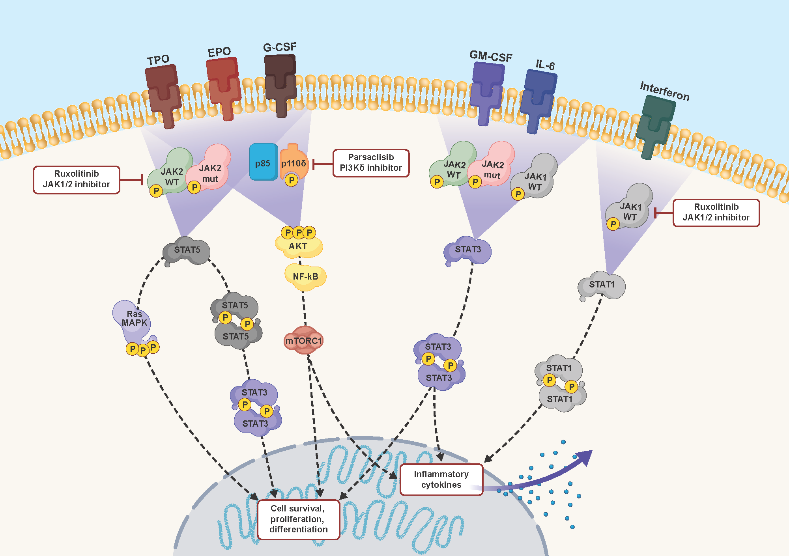
JAK1/2 and PI3K Pathways in Myelofibrosis
Ruxolitinib, a JAK1/2 inhibitor, improves symptoms and prolongs survival in patients with intermediate- or high-risk MF¹⁻³
  Some patients may experience suboptimal or declining responses despite continued JAK inhibition
  Additionally, patients with low platelets are more difficult to treat with JAK inhibitors, which are associated with thrombocytopenia
Parsaclisib is a potent, highly selective, next-generation PI3Kδ inhibitor that exhibits favorable pharmacokinetics for once-daily dosing⁴
Combined inhibition of signaling via the JAK1/2 and PI3K pathways may improve outcomes in patients with MF

Slide 30
Phase 2 Study of the JAK 1/2 Inhibitor, Ruxolitinib, and Add-on PI3Kδ Inhibitor, Parsaclisib (NCT02718300)
8-week treatment
Treatment thereafter
Patients enrolled
N=67
Ruxolitinib +
parsaclisib 10 mg QD
Ruxolitinib +
parsaclisib 10 mg QW*
Daily/weekly
dosing
n=32
Part 1
Safety run-in
n=10
Ruxolitinib +
parsaclisib 20 mg QD
Ruxolitinib +
parsaclisib 20 mg QW*
Parts 2-4
Randomized portion
n=57
Ruxolitinib +
parsaclisib 5 mg QD
All daily
dosing
n=35
Ruxolitinib +
parsaclisib 5 mg QD
Ruxolitinib +
parsaclisib 20 mg QD
As of the data cutoff for the interim analysis (August 27, 2020), median (range) duration of treatment was 30.4 (0.6-147.6) weeks

Slide 31
Percentage Change in Spleen Volume and Response Categories of All Enrolled Patients*
Daily/weekly parsaclisib dosing
All daily parsaclisib dosing
12 Weeks
24 Weeks
†
Response Category, n (%) | Daily/Weekly Dosing | All Daily Dosing
Week 12 | n=29 | n=27
≥10% reduction | 9 (31) | 15 (56)
≥25% reduction | 1 (3) | 4 (15)
≥35% reduction | 0 | 1 (4)
Response Category, n (%) | Daily/Weekly Dosing | All Daily Dosing
Week 24 | n=29 | n=23
≥10% reduction | 6 (21) | 13 (57)
≥25% reduction | 4 (14) | 7 (30)
≥35% reduction | 1 (3) | 2 (9)
*Evaluable patients were those receiving ≥1 dose of study drug, had spleen volume baseline assessment with a non-zero value, and met ≥1 of the following criteria: (1) had an assessment at the study follow-up week; (2) had discontinued treatment before the study follow-up assessment; or (3) had been on treatment for ≥12 or 24 weeks but no 12- or 24-week assessment, respectively. †Patient had best percentage change from baseline to >100%. Dotted lines represent target reductions of 10%, 25%, and 35%.

Slide 32
Percentage Change in MFSAF-TSS of All Enrolled Patients*
Daily/weekly parsaclisib dosing
All daily parsaclisib dosing
12 Weeks
24 Weeks
†
†
†
†
Response Category, n (%) | Daily/Weekly Dosing | All Daily Dosing
Week 12 | n=27 | n=23
0 to <25% reduction | 5 (19) | 4 (17)
≥25 to <50% reduction | 3 (11) | 3 (13)
≥50% reduction | 4 (15) | 7 (30)
Response Category, n (%) | Daily/Weekly Dosing | All Daily Dosing
Week 24 | n=27 | n=21
0 to <25% reduction | 3 (11) | 3 (14)
≥25 to <50% reduction | 4 (15) | 3 (14)
≥50% reduction | 3 (11) | 4 (19)

Slide 33
Most Common Nonhematologic, Serious, and Fatal TEAEs Among All Treated Patients
Nonhematologic TEAEs (≥15% of Patients)
Event, n (%) | Daily/Weekly Dosing (n=32) |  | All Daily Dosing (n=35)
 | All Grades | Grade ≥3 | All Grades | Grade ≥3
Diarrhea | 11 (34) | 1 (3) | 6 (17) | 0
Nausea | 10 (31) | 1 (3) | 5 (14) | 0
Fall | 9 (28) | 2 (6) | 4 (11) | 0
Abdominal pain | 8 (25) | 1 (3) | 5 (14) | 0
Cough | 7 (22) | 0 | 6 (17) | 0
Fatigue | 9 (28) | 1 (3) | 3 (9) | 1 (3)
Pruritus | 6 (19) | 1 (3) | 4 (11) | 0
Dizziness | 4 (13) | 0 | 6 (17) | 0
Dyspnea | 5 (16) | 0 | 5 (14) | 2 (6)
Serious TEAEs occurring in ≥2 patients:
  Urinary tract infection and pyrexia (n=3 each)
  Pneumonia and fall (n=2 each)
TEAEs with fatal outcome occurred in:
  6 patients receiving daily/weekly dosing
  1 patient receiving all daily dosing
  None were deemed treatment related

Slide 34
MF Treatment in 3-5 Years (Where Transplant Not Selected)
FRONT LINE
2nd or More LINE
Low Risk
No
Sx
OBS/ PEG INF/ TRIAL
Move to INT/High Approach
Yes
SX
RUXO/ TRIAL
PT
<75
PAC
PAC/ Trial
PT
<50
Inter/High Risk
HB
<8.5
MOM/ RUXO + LUS/ ?RUXO PLUS PELA/ PAC
2nd JAKi (FEDR) or COMBO
SPL
STD
MF
RUXO/ FEDR
MOM/ JAKi + ESA-IMID-AND/COMBO JAKI
HB
<8
Inc
Risk
RUXO + (PELA, NAVITO, PARS)
IMETEL/ JAKi + PELA/PARS/NAVITO/NAVT
Inc
Risk
Yes
BMT
ENHANCED INDUCTION
Trial/ Supp Care
AP/Blast Phase
No
BMT
RUXO + TARGET (IDH1/2, DNMTi, BCL2i)
RUXO PLUS HMA
No
Sx

Slide 35
Case 1 – Worsening Anemia in MF
72 Male Presented with MF in 2018 (Primary MF, DIPSS Int 2, MPN10 25/100).
  4 years (IWG spleen response, anemia (Hb 9-10 g/dL), IWG symptom response) (rux started 15 BID but quickly to 10mg in am and 5mg in pm)
June 2022
  Spleen now 10 cm BLCM, MPN10 36, Hb of 7.5 g/dL, platelets 110 x 10(9)/L
  Rux dose 5mg BID
Options
  Off study – Fedr? PAC?
  Evolving rx – Momelotinib? Combination?

Slide 36
Case 2 – Up front MF
68 Male Presenting with post PV MF 4 years
  Spleen 18cm BLCM
  Symptoms (MPN 10 score 46)
  MIPSS high risk – JAK2 mutated, DNMT3a, ASXL1
  Hb 10.2 g/dL, 2 % blasts, WBC of 29 x 10(9)/L, Platelets of 170 x 10(9)/L
  Marrow 2-3+ fibrosis, Karyotype del 13(q)
Options
  Off study – RUX, FEDR?
  Evolving rx – Rux plus pelabresib (MANIFEST II)? Plus parsaclisib? Plus navitoclax?

Slide 37
Case 3 – Suboptimal response to JAKi
64 female Presented with post pv MF in 2021
  Baseline spleen 15 cm BLCM
  Baseline symptoms MPN10 34.
  Hb 12.8 g/dL, platelets 460 x 10(9)/L, wbc 22 x 10(9)/L
  Rux 20mg BID
Sep 2022
  Spleen now 10 cm BLCM, MPN10 26
  Hb of 10.9 g/dL, platelets 220 x 10(9)/L
  Rux dose 20 BID
Options
  Off study – Fedr?
  Evolving rx – “Add on” strategy? + navitoclax? Or + pelabresib? Other?

Slide 38
Appendix

Slide 39
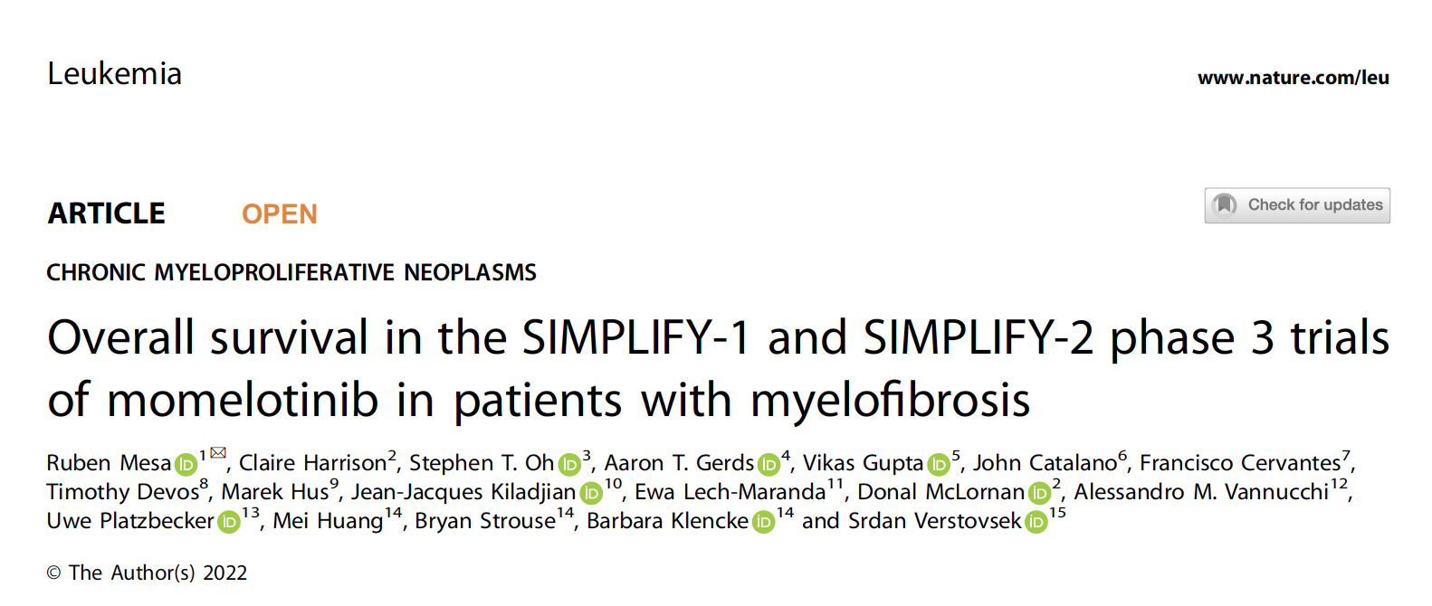
Mesa R et al. Leukemia 2022;36(9):2261-8.

Slide 40
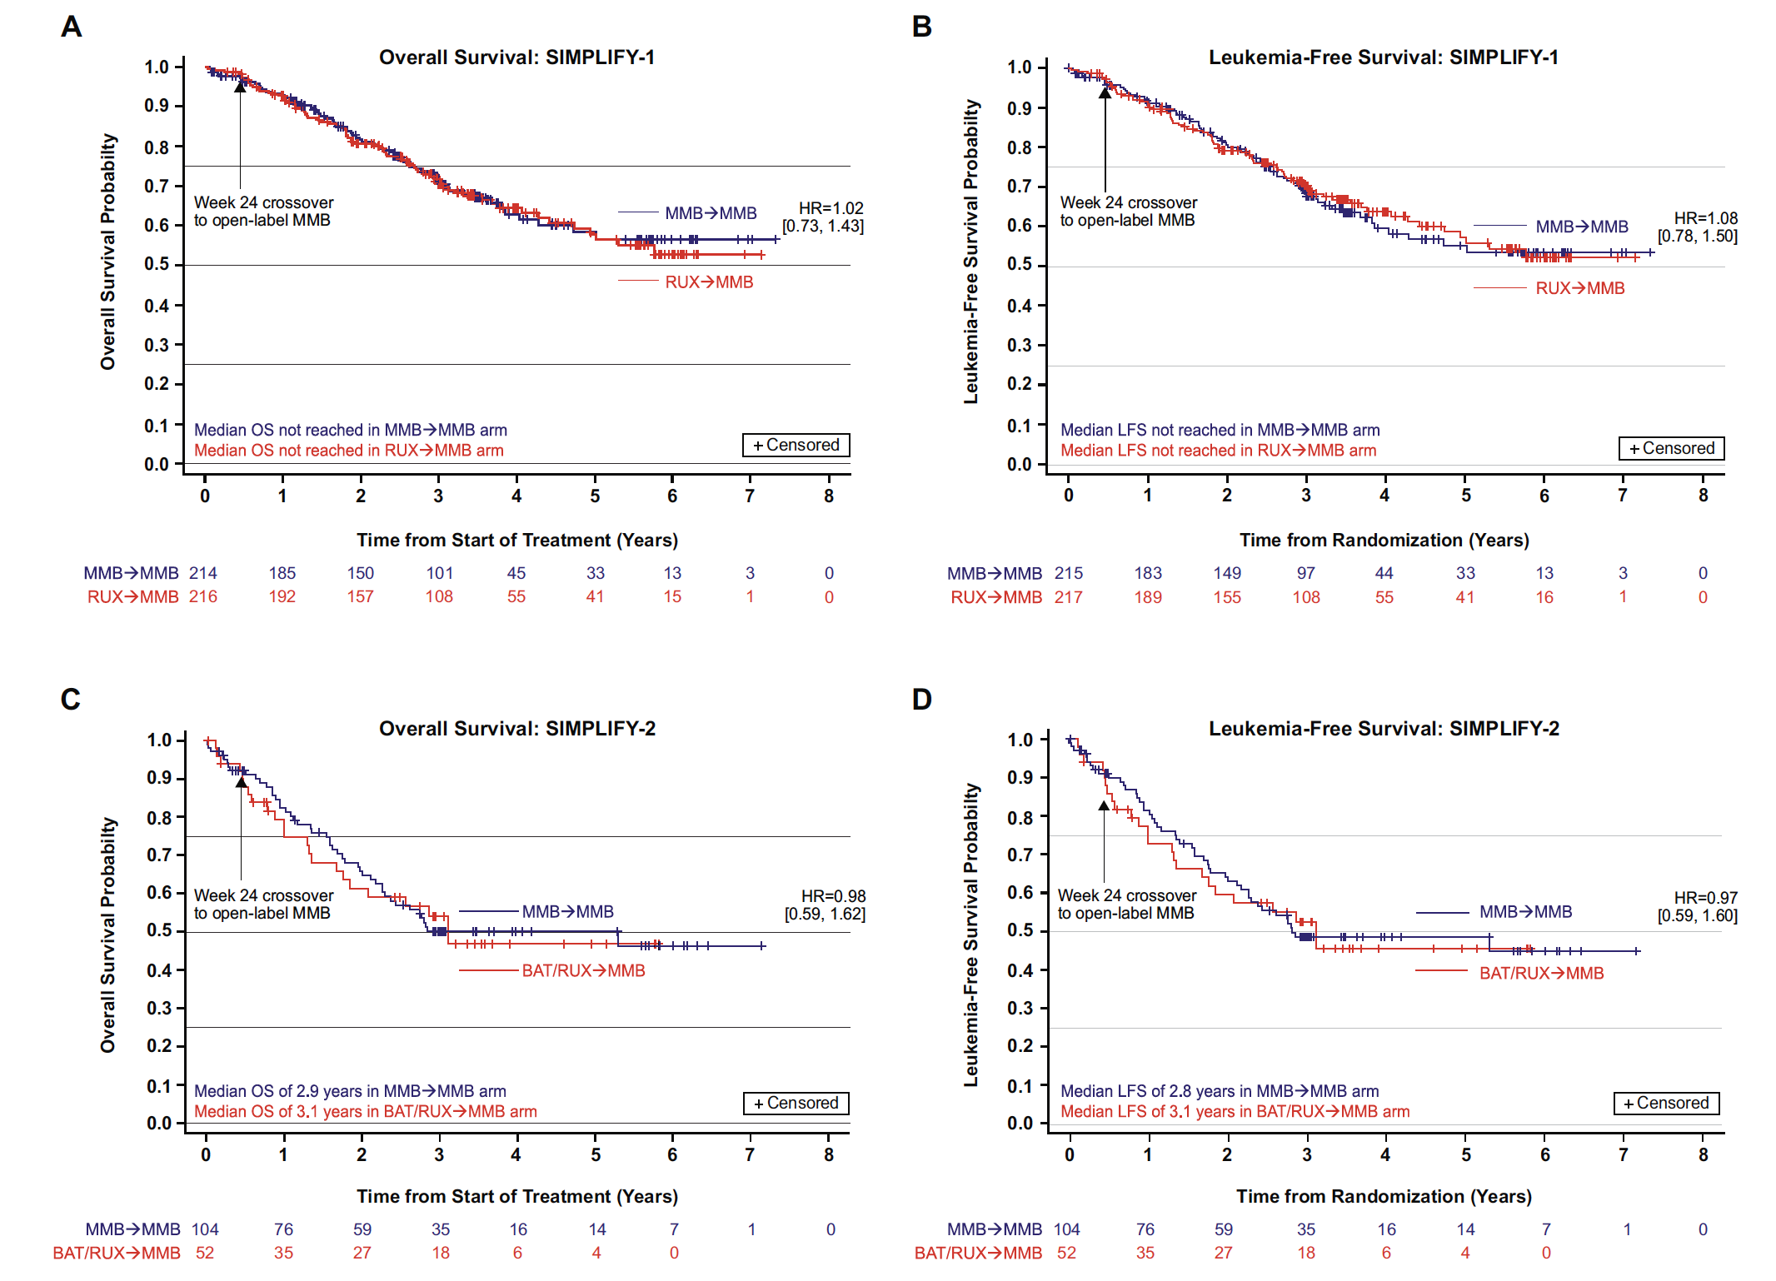
SIMPLIFY-1/2: Leukemia-Free Survival
Mesa R et al. Leukemia 2022;36(9):2261-8.

Slide 41
SIMPLIFY-1/2: Overall Survival
Mesa R et al. Leukemia 2022;36(9):2261-8.

Slide 42
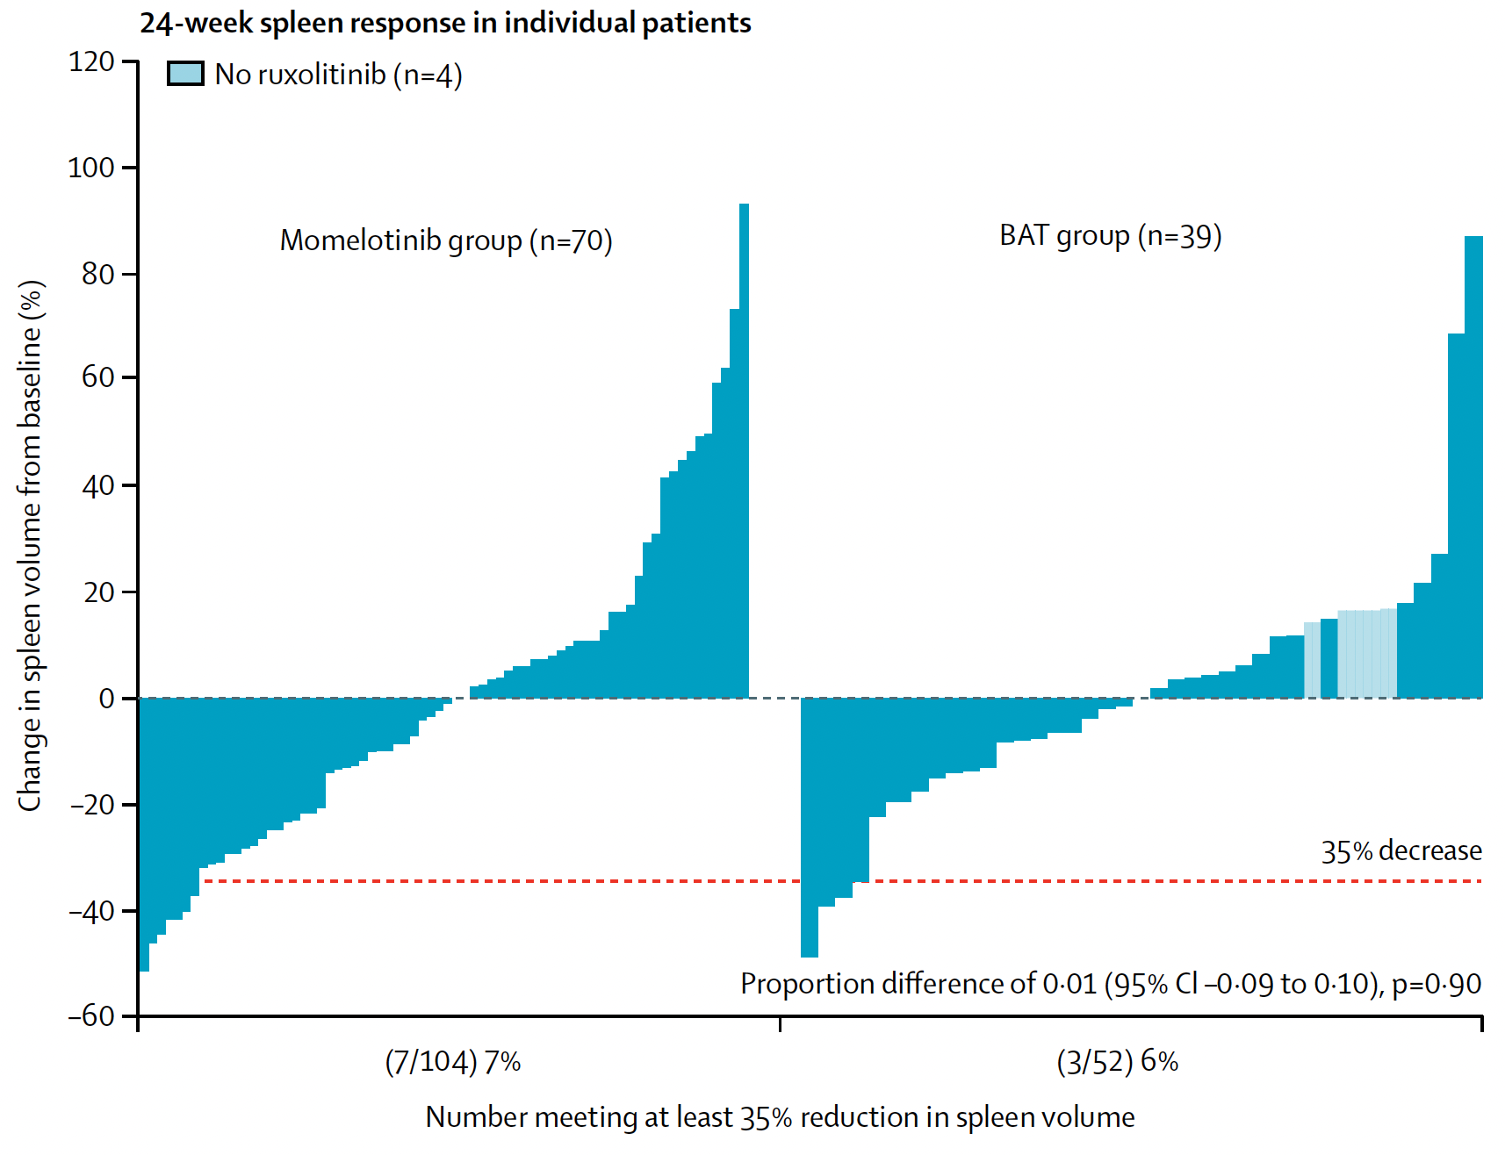
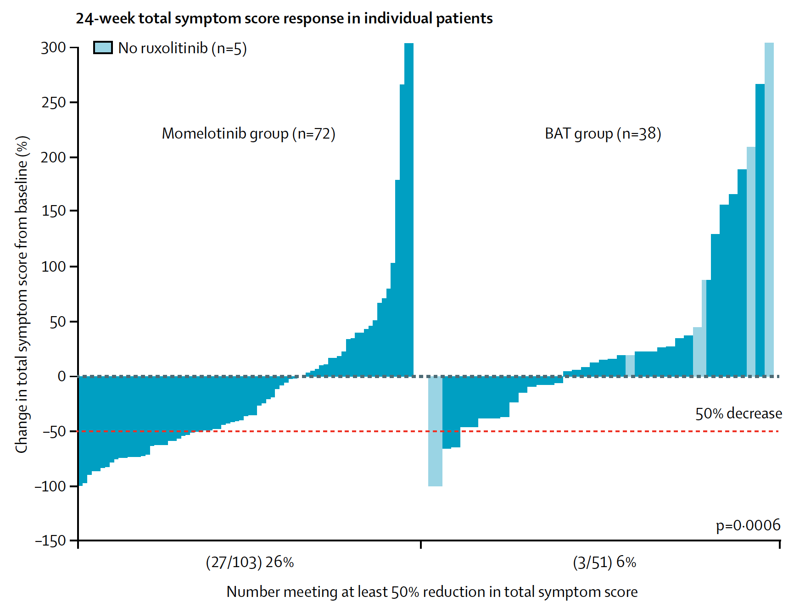
SIMPLIFY-2: Spleen Response and Total Symptom Score
Change in spleen volume/spleen response
Change in TSS from baseline to week 24 and TSS response
Harrison CN et al. Lancet Haematol 2018;5(2):e73-81.

Slide 43
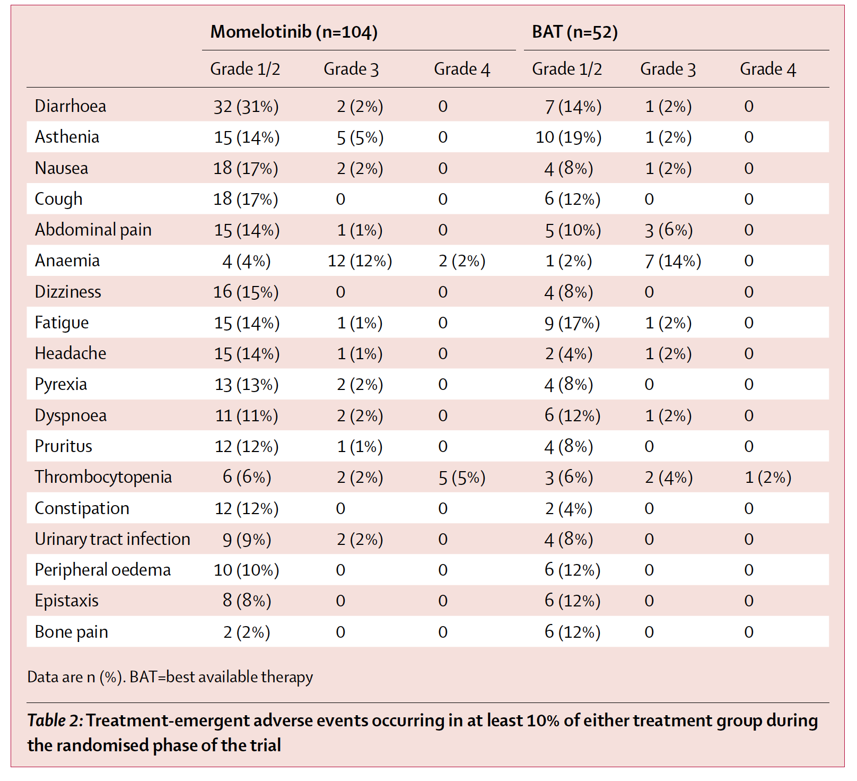
SIMPLIFY-2: Treatment-Emergent Adverse Events
Harrison CN et al. Lancet Haematol 2018;5(2):e73-81.

