Slide 1
AL Amyloidosis:
Diagnosis, Staging, and the
Shifting Treatment Paradigm
Jeffrey A. Zonder, MD
Professor of Oncology, Wayne State University
Leader, Multiple Myeloma & Amyloidosis MDT
Co-Leader, Molecular Therapeutics Program
Karmanos Cancer Institute

Slide 2
Agenda
Making the Diagnosis
Staging AL Amyloidosis
Initial Therapy
  ANDROMEDA Trial
  ASCT (very briefly!)
Indications for Initiating Second-Line Rx (and Which One?)
Emerging Protein-Directed Therapies

Slide 3

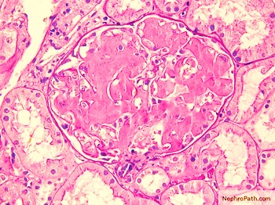
Amyloid Typing is Essential
AL = “Amyloid” “Light Chain”
ATTR = “Amyloid” “Transthyretin”
AA = “Amyloid” “(Apo)serum Amyloid A”
Tandem Mass Spectrometry¹
1. Nelson L, et al. Blood 2012 120:3206-3213; doi:10.1182/blood-2012-03-413682

Slide 4
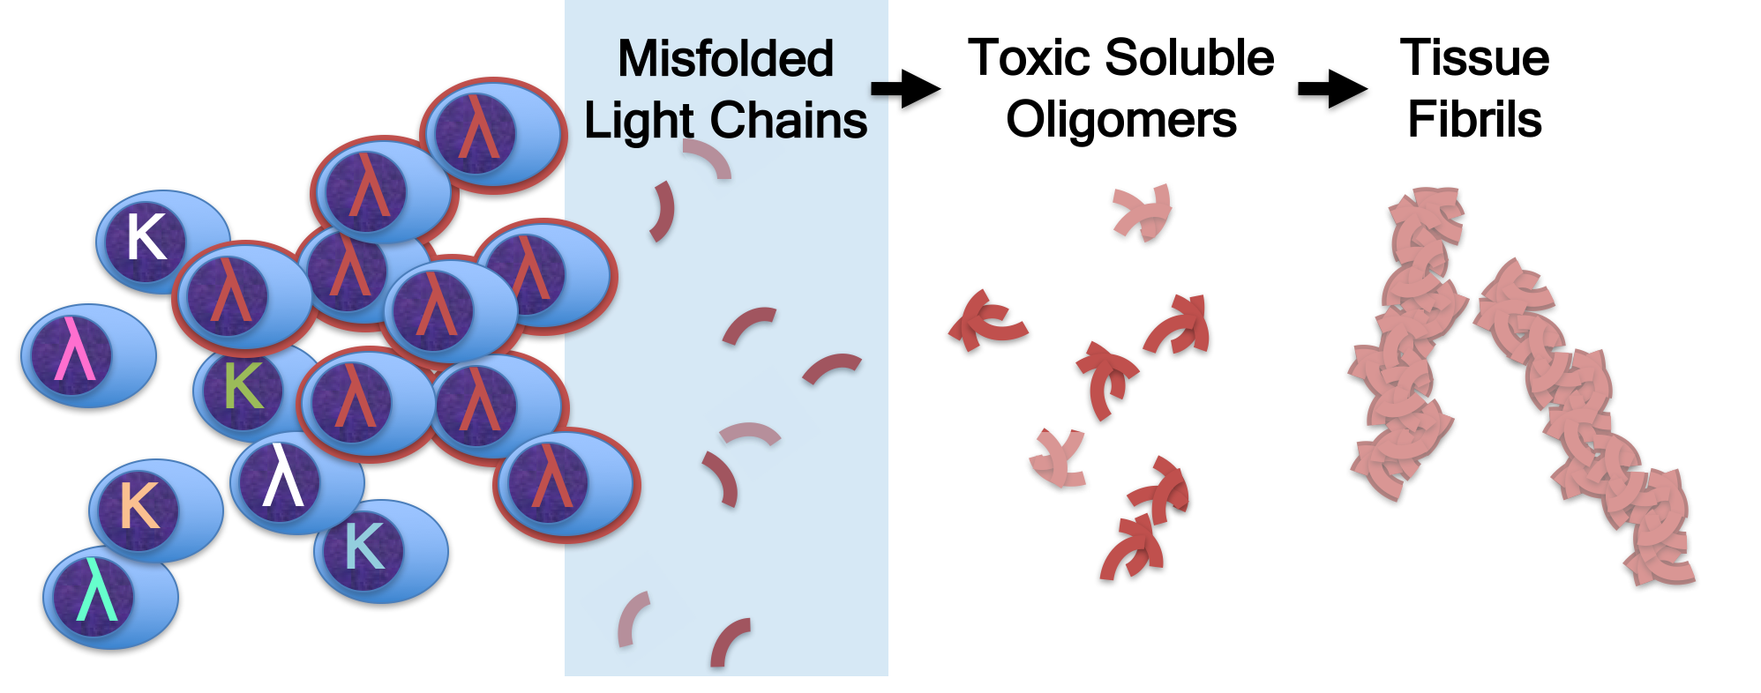
AL Amyloidosis is a Clonal Plasma Cell Disease

Slide 5
Like Myeloma, AL Amyloidosis Arises from MGUS
AL
Remember the
epidemiology of
MGUS and ATTR!
Bone Marrow Plasmacytosis
5%
5%
10%
10%
30%
MGUS
SMM
MM
100%
Likelihood of Myeloma-Related Symptoms
0%
Landgren O, et al. Blood. 2009;113:5412

Slide 6
Case #1: Newly-Diagnosed Cardiac Amyloidosis
79-yo African American male presents with CHF, minor PN
Echocardiogram: LVEF 55%, IVSd 1.8 cm, GLS (-8)
Cardiac MRI: late gadolinium enhancement
Labs: NTproBNP 4500, SPEP1.0 g/dL IgGk, KFLC 18mg/dL
BMBx: 7% kappa-restricted PCs, (+) Congo red stain
Mass Spec: ATTR (!)
PYP-scan (+), genetic testing (+), PET/CT: (-)
Diagnosis: Cardiac hATTR and MGUS!

Slide 7
Time is of the Essence
Prognosis is in part determined by cardiac and renal events which have been set in motion before the time of diagnosis.

Slide 8
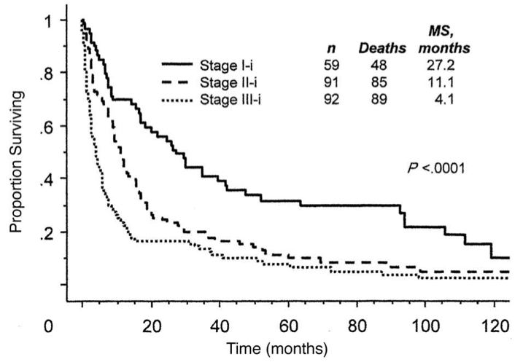
Cardiac Stage & Survival
cTnT >0.035 ng/mL
  cTnI >0.1 ng/mL
NT-proBNP > 332 pg/mL
Dispenzieri A., et al. J Clin Oncol. 2004;22:3751
Dispenzieri A., et al. Blood. 2004;104:1881

Slide 9
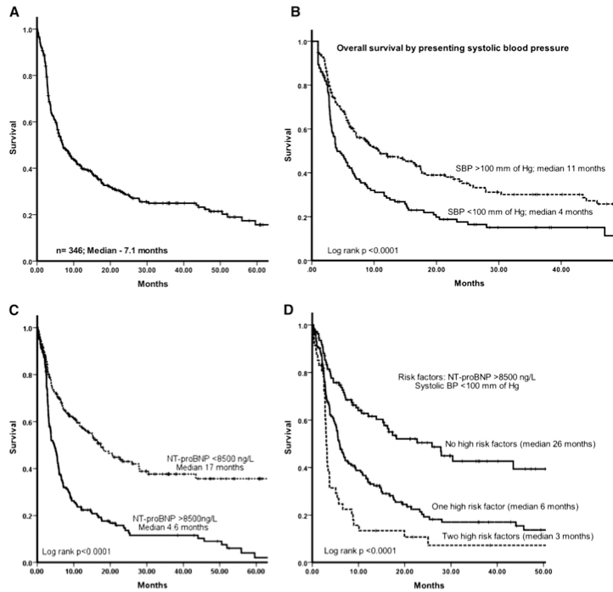
Cardiac Stage III: Not All the Same
343 AL pts, Stage III, Original Mayo Criteria
RISK FACTORS:
NT-proBNP > 8500 ng/L
Systolic BP < 100 mm Hg
NEITHER (med 26 mos)
IIIb
IIIa
EITHER (med 6 mos)
BOTH (med 3 mos)
Wechalekar AD, et al. Blood. 2013;121:3420

Slide 10
What is the Goal of Treatment?
Rapid, deep, sustained amyloidogenic light chain reduction
  Halt/slow fibril deposition
  Ameliorate LC-mediated organ toxicity
Supportive management of symptoms from organ dysfunction
  Congestive heart failure and edema
  Low blood pressure
  Malabsorption and diarrhea

Slide 11
Hematologic and Organ Response Criteria
Hematologic Responses
Response Category | AL Amyloidosis | Multiple Myeloma
Partial Response | dFLC* decreased by >50% | M-spike decreased by >50%
Very Good Partial Response | dFLC < 4 mg/dL | M-spike decreased by >90%
Complete Response | LC normalized & no M-spike | M-spike disappeared
Do not focus
on FLC ratio:
dFLC = (iFLC –uFLC)
Organ Responses
Response Category | Laboratory Criteria
Heart Response | NT-pro-BNP down by >30%
Renal Response | Proteinuria down by >30%
Liver Response | Alk Phos down by >50%
These may lag behind hematologic response by months or years

Slide 12
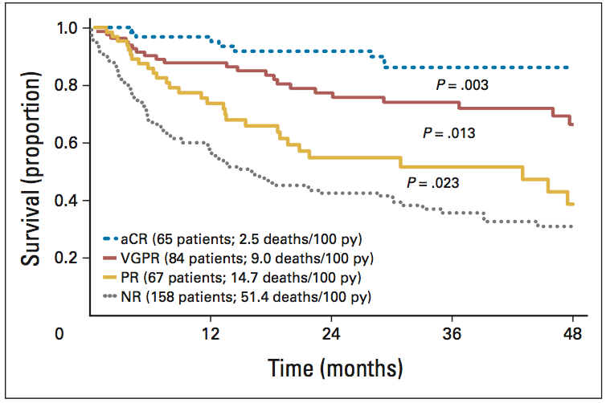
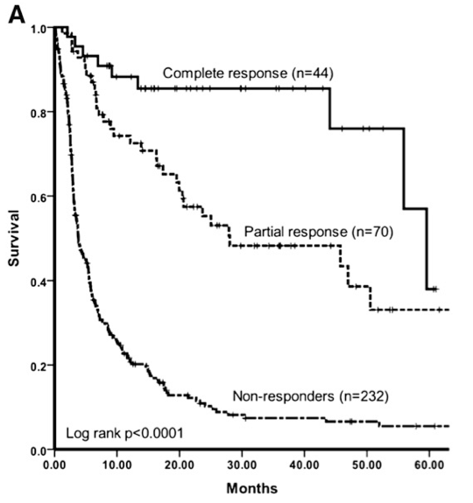
Response Matters (Landmark Analysis)
Palladini G., et al. J Clin Oncol. 2012;30:4541
Wechalekar AD, et al. Blood. 2013;121:3420

Slide 13
AL Treatment Algorithm 2020 (Not That Long Ago…)
Is this AL type Amyloidosis?
N
Y
Non-chemo treatment appropriate for the specific type of amyloidosis
Is the patient a potential candidate for stem cell transplant?
N
Y
?
Chemotherapy
High dose melphalan & stem cell transplant
FDA Approved Therapies
for ATTR:
Patisiran (RNAi)
Inotersen (RNAi)
Tafamidis (stabilizer)
Adequate light chain response?
N
Y
Consider additional therapy
(daratumumab)
Monitor closely
OR
Anti-fibril Rx trial

Slide 14
Background: CyBorD as Frontline Therapy (AL)
Mayo Case Series¹
(17 patients)
94% Response Rate
71% CR
EU Case Series²
(201 patients)
62% Response Rate
43% >VGPR
More than half of pts have an inadequate response!
REFS:
1. Mikhael JR, et al. Blood 2012 119:4391-4394
2. Palladini G, et al. Blood 2015 126:612-615
Notes:
Even Mayo’s ”Real World” data isn’t quite average: pts seen at Mayo were healthy enough and/or had the family support to get to mayo and had the financial means to get to mayo – average patient may not have both.

Slide 15

ANDROMEDA: CyBorD (VCd) +/- Dara for AL
ORR: 96% (CR: 54%)
No Late Toxicity
Newly-diagnosed AL¹
(safety run-in)
CyBorD + SubQ Daratumumab
Dara Maintenance
PD
>1 cycle
2yr
n=28
Stratification:
Mayo Stage 1,2,3a
ASCT availability
CrCl >/<60 mL/min
CyBorD + SubQ Daratumumab
Dara Maintenance
Newly-diagnosed AL²
(non-ASCT)
1:1
6 cycles
PD
CyBorD
n=388
Patients enrolled at 109 sites in 22 countries from May 2018 through August 2019
1. Palladini G, et al., Blood. 2020 Jul 2;136(1):71-80
2. Kastritis E, et al. N Engl J Med 2021;385:46-58

Slide 16
ANDROMEDA: Endpoints
Primary endpoint: complete hematologic response (cHR)
  iFLC < ULN with negative serum/urine immunofixation
  Normalization of FLC ratio not required
  Confirmed by IRC member blinded to treatment allocation
Key secondary endpoints:
  Major Organ Deterioration (MOD)-PFS
    Cardiac transplant, LVAD, IABP
    ESRD requiring HD or renal transplant
    Death or hematologic progression
  Organ Progression
  VGPR+
  Overall Survival
  cHR at 6 months
  Time to/duration of hematologic response
  Time to next treatment (TTNT)
Kastritis E, et al. N Engl J Med 2021;385:46-58

Slide 17
ANDROMEDA: cHR (primary endpoint)
Dose Reductions:
CTX: 17.6%
BTZ: 25.9%
DEX: 27.5%
Med DOT: 9.6 mos
2 no Rx
82%
72%
n=195
CyBorD + SubQ Daratumumab
Dara Maintenance
cHR: 53.3%
RRR: 2.9
OR: 5.1
p<0.001 (both)
6 cycles
PD
n=193
CyBorD
cHR: 18.1%
5 no Rx
64%
Dose Reductions:
CTX: 13.8%
BTZ: 19.7%
DEX: 27.7%
Med DOT: 5.3 mos
Kastritis E, et al. N Engl J Med 2021;385:46-58

Slide 18
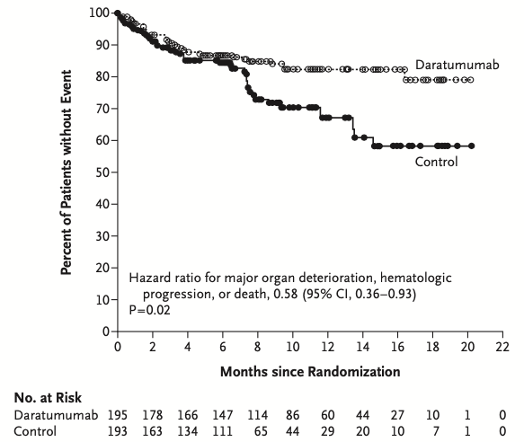
ANDROMEDA: Key Secondary Endpoints
Heme Progression: 8 pts
Death: 27 pts (13 in first 60 days)
MOD-PFS
Rx Change: 19 (13 ASCT)
n=195
CyBorD + SubQ Daratumumab
Dara Maintenance
6 cycles
PD
HR=0.58
p=0.02
n=193
CyBorD
Heme Progression: 25 pts
Death: 29 pts (13 in first 60 days)
Rx Change: 79 (48 IV dara; 20 ASCT)
HR=0.39
Kastritis E, et al. N Engl J Med 2021;385:46-58

Slide 19
What We Did and Did Not Learn from ANDROMEDA
What we learned:
  Addition of Dara to induction improves cHR rate
  Dara does not improve early (cardiac) mortality
  Adding Dara doubled the cardiac and renal response rates
What we did not learn:
  Is Dara maintenance needed if cHR obtained with induction?
  What is optimal duration of Dara maintenance?
  Will long-term survival be improved by adding Dara?
  Can this regimen be safely given with IIIb, IV pts?

Slide 20
ASCT as Initial Therapy for AL Amyloidosis
Only appropriate for a subset of patients
  Not patients with advanced cardiac AL or multi-organ dz
  Gut involvement may predispose pts to GI tox from melphalan
MEL dose often needs reduction (GI, renal AL)
Transplant can induce very durable responses
  Cardiac Stage I pts with hCR have >8 yr med PFS…w/o maintenance
Increasingly being deferred to second-line Rx

Slide 21
Updated AL Treatment Algorithm: 2022
Is this AL type Amyloidosis?
N
Y
Non-chemo treatment appropriate for the specific type of amyloidosis
Start Dara-CyBorD (CAEL-101 or BIRT trial?)
Hematologic Deep Response?
N
Y
ASCT Candidate?
Maintenance Dara
N
?
Y
Other Therapy
(IMiDs,Venetoclax)
High dose melphalan & stem cell transplant
Notes:
Notes re 2nd line RX: no consensus on timing. Don’t wait til organ prog. Re-use old regimen occ? IMIDs hard to tolerate (HEART). Venetoclax useful in 30-50% (t(11;14)

Slide 22
Therapy for AL Amyloidosis 2022
Antibodies (Plasma Cells) | Alkylating Agents | Proteasome Inhibitors | Steroids | IMiDs | Novel Agents | Fibril-Directed Agents
Daratumumab | Oral Melphalan | Bortezomib | Prednisone | Thalidomide | Venetoclax | Birtamimab (NEOD001)
Isatuximab | IV Melphalan (Transplant) | Ixazomib | Dexamethasone | Lenalidomide | CART Cells | Anselamimab (CAEL-101)
Elotuzumab | Cyclophosphamide | Carfilzomib |  | Pomalidomide | Bispecific Abs (BiTEs) | AT-02 (PAR-IgG)
Belantamab | Bendamustine |  |  |  |  | AT-03 (PAR-SAP)
 |  |  |  |  |  | Light Chain Stabilizers

Slide 23
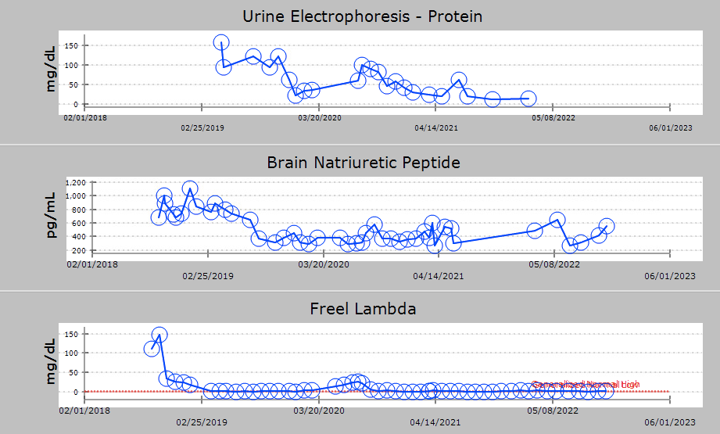
Case Report #2: Relapsed AL
78 y.o. woman relapsed LLC AL
Renal, heart involvement
1st line: CyBorD with only PR
2nd line: Dara-BorD, Dara maint
Rd-Elo (clinical trial 8/2020)
  Hematologic CR
Renal Response: YES
Cardiac Response: NO

Slide 24


Other Monoclonal Antibody Approaches
Daratumumab
Isatuximab
Misfolded Light Chains
Toxic Soluble Oligomers
Tissue Fibrils
λ
λ
κ
Birtamimab
(NEOD001)
λ
λ
λ
λ
λ
κ
λ
λ
λ
λ
κ
κ
λ
Elotuzumab
CAEL-101

Slide 25
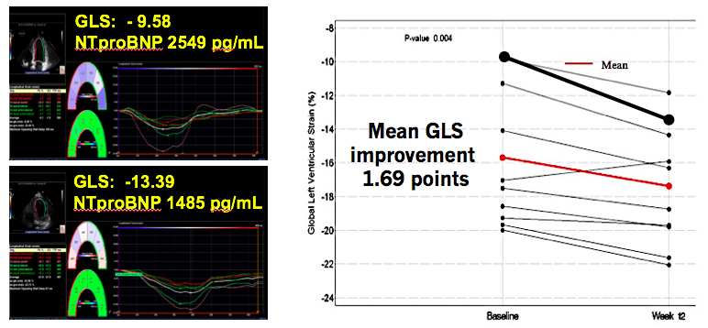
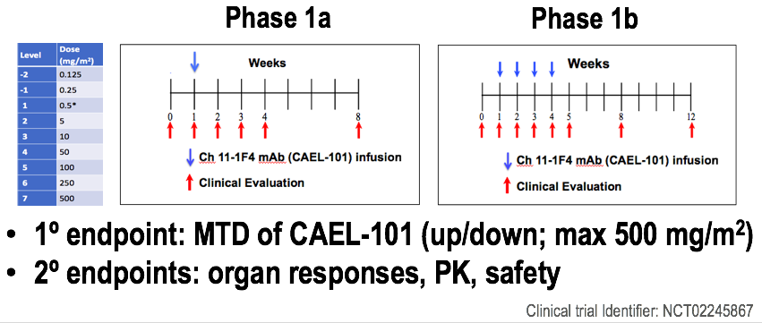
CAEL-101 Anti-fibril MoAb
Clinical Trial Identifier: NCT02245867
Bhutani D., et al. Abstract # 958, ASH 2018

Slide 26
Case Report #3: Relapsed Cardiac AL
62 y.o. man, relapsed LLC AL (Heart, Renal, Gut)
Prior Rx: CyBorD then ASCT in 2017
2020: slight rise in LLC, major rise in NTproBNP
CyBorD + Dara + CAEL101 (September 2020)
  Hematologic CR
  Cardiac Response (68% reduction in NTproBNP)
  Renal Response
Ongoing Dara q mo + CAEL101 q 2 wk maint

Slide 27
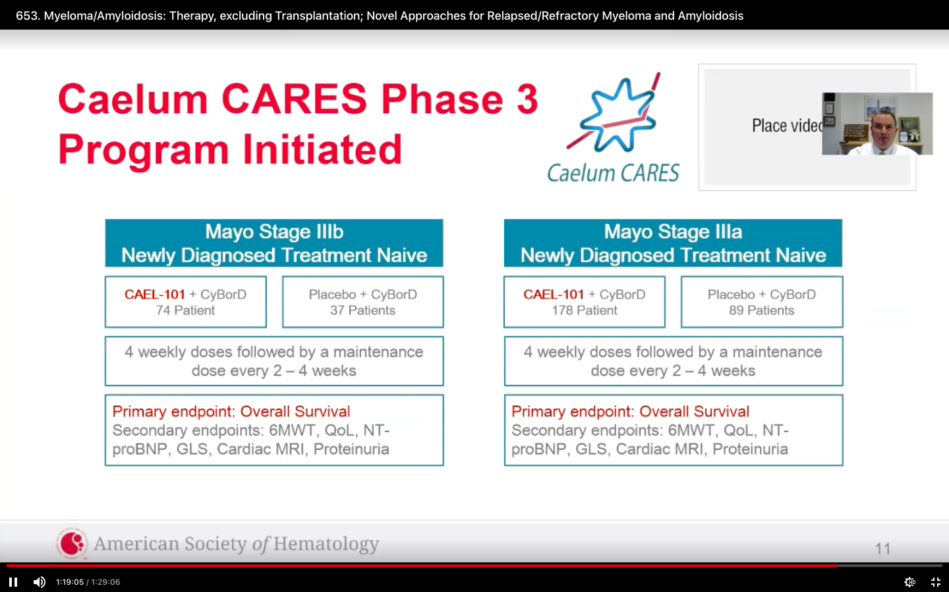
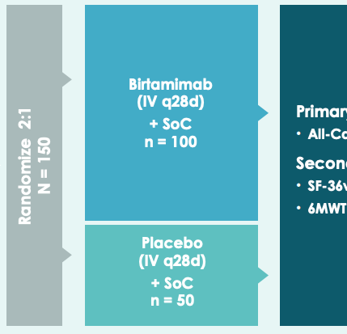
Current Trials of Anti-Fibril Antibodies
CAEL-101 (IIIa)
CAEL-101 (IIIb)
Birtamimab (IV)
IMPORTANT TRIALS!
Mayo IIIb and IV pts were
excluded from
ANDROMEDA
Primary Outcome:
All-Cause Mortality
n=267 (2:1)
n=111 (2:1)
n=150 (2:1)
Clinical Trial Identifier:
NCT04512235
Clinical Trial Identifier:
NCT04504825
Clinical Trial Identifier:
NCT04973137

Slide 28
Take Home Points
Prompt recognition of amyloidosis and correct typing essential
As in MM, adding anti-CD38 Ab improves heme responses
Early cardiac mortality remains a major clinical issue
Anti-fibril Abs to address this are in clinical trials
IMiDs and Venetoclax currently reserved for relapsed AL
  IMiDs harder to use in AL than in MM
  VEN may have more utility in AL than MM, given high freq of t(11;14)

Slide 29
Appendix

Slide 30
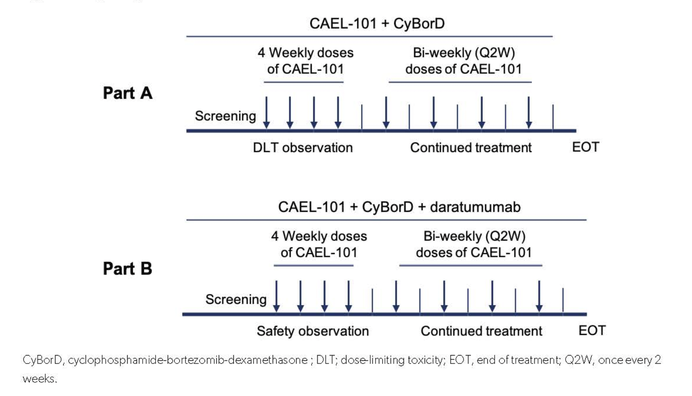
Phase II Trial of CAEL-101 with Anti-Plasma Cell Dyscrasia Therapy for Patients with AL Amyloidosis: 1-Year Results
Valent J et al. ASH 2021;Abstract 653.

Slide 31
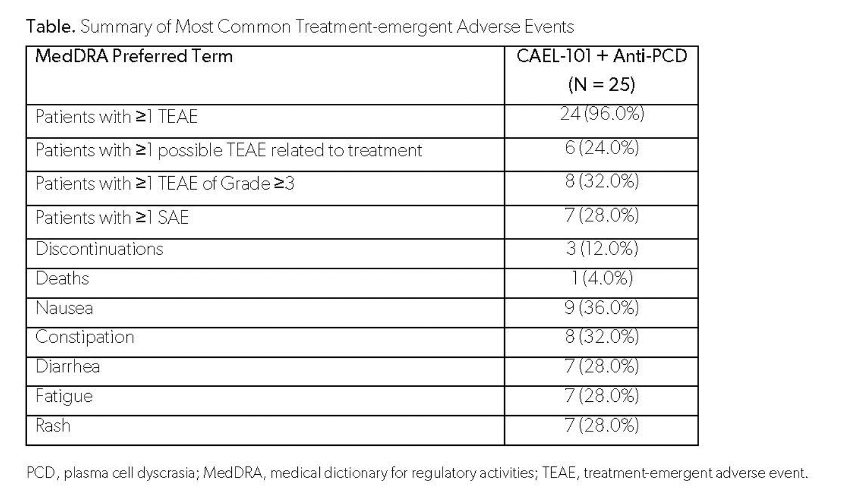
Phase II Trial of CAEL-101 with Anti-Plasma Cell Dyscrasia Therapy for Patients with AL Amyloidosis: 1-Year Results
Valent J et al. ASH 2021;Abstract 653.

Slide 32
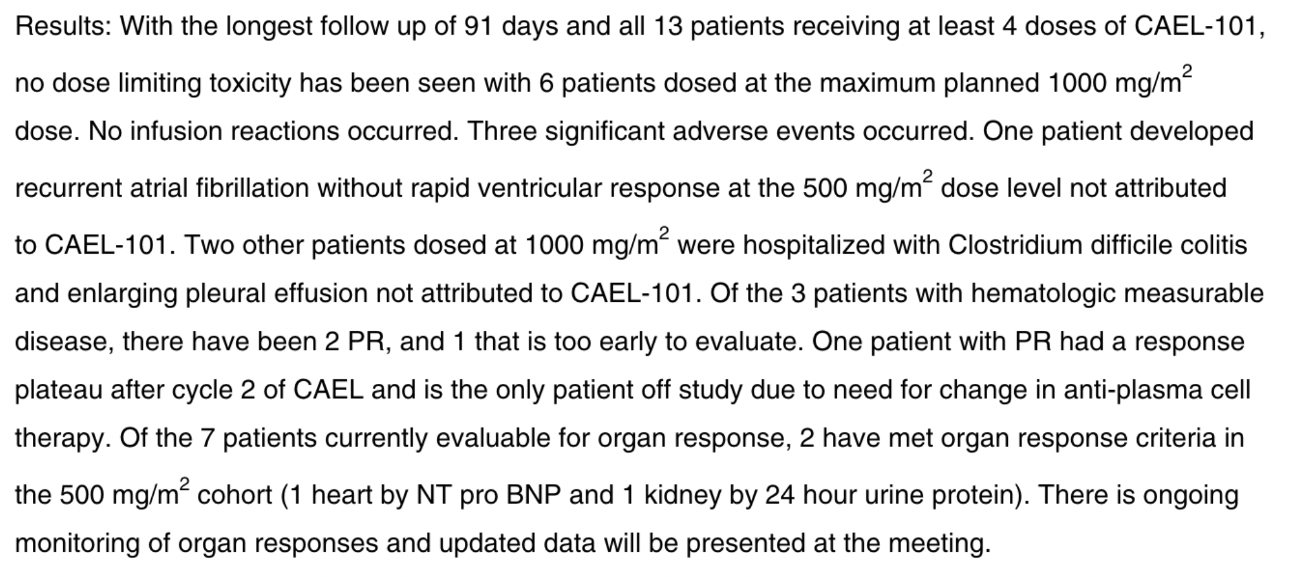
Phase II Dose Selection Study: Safety, Tolerability and Efficacy of CAEL-101 in Patients with AL Amyloidosis
Khouri J et al. Blood 2020;136(1):21.

