Slide 1
Meet The Professor Optimizing the Clinical Management of Hodgkin and Non-Hodgkin Lymphomas
Sonali M Smith, MD
Elwood V Jensen Professor of Medicine
Chief, Section of Hematology/Oncology
Co-Leader, Cancer Service Line
Co-Director, Lymphoma Program
The University of Chicago
Chicago, Illinois

Slide 2
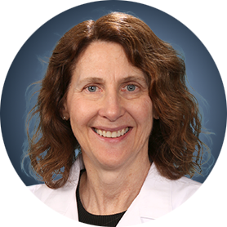
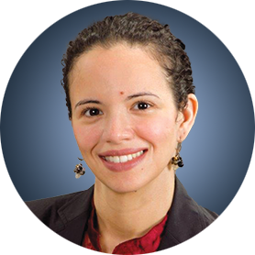
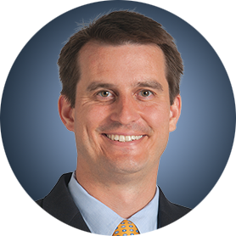
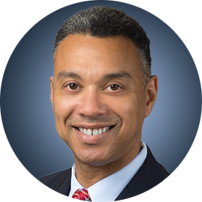
Meet The Professor Program Participating Faculty
Nancy L Bartlett, MD
Professor of Medicine
Koman Chair in Medical Oncology
Washington University School of Medicine
St Louis, Missouri
Jonathan W Friedberg, MD, MMSc
Samuel E Durand Professor of Medicine
Director, James P Wilmot Cancer Institute
University of Rochester
Rochester, New York
Carla Casulo, MD
Associate Professor of Medicine
Division of Hematology/Oncology
Director, Hematology/Oncology Fellowship Program
University of Rochester
Wilmot Cancer Institute Rochester, New York
Brian T Hill, MD, PhD
Director, Lymphoid Malignancy Program
Cleveland Clinic Taussig Cancer Institute
Cleveland, Ohio
Christopher R Flowers, MD, MS
Chair, Professor
Department of Lymphoma/Myeloma
The University of Texas MD Anderson Cancer Center
Houston, Texas
Brad S Kahl, MD
Professor of Medicine
Washington University School of Medicine
Director, Lymphoma Program
Siteman Cancer Center
St Louis, Missouri

Slide 3
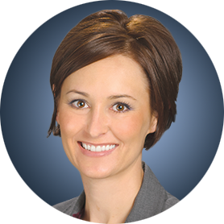
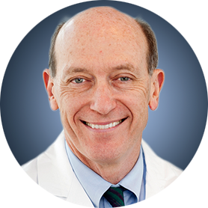
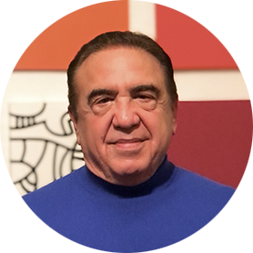
Meet The Professor Program Participating Faculty
Loretta J Nastoupil, MD
Associate Professor
Section Chief, Indolent Lymphoma
Section Chief, New Drug Development
Department of Lymphoma/Myeloma
The University of Texas MD Anderson Cancer Center
Houston, Texas
Michael E Williams, MD, ScM
Byrd S Leavell Professor of Medicine
Chief, Hematology/Oncology Division
Physician Lead, Cancer Service Line
University of Virginia School of Medicine
Charlottesville, Virginia
Sonali M Smith, MD
Elwood V Jensen Professor of Medicine
Chief, Section of Hematology/Oncology
Co-Leader, Cancer Service Line
Co-Director, Lymphoma Program
The University of Chicago
Chicago, Illinois
Moderator Neil Love, MD Research To Practice Miami, Florida

Slide 4
Commercial Support
This activity is supported by educational grants from ADC Therapeutics, Bayer HealthCare Pharmaceuticals, Bristol-Myers Squibb Company, Genentech, a member of the Roche Group, Novartis and Seagen Inc.
Research To Practice CME Planning Committee Members, Staff and Reviewers
Planners, scientific staff and independent reviewers for Research To Practice have no relevant conflicts of interest to disclose.

Slide 5
Dr Smith — Disclosures
Consulting Agreements | Adaptive Biotechnologies Corporation, ADC Therapeutics, Bantam, Bristol-Myers Squibb Company, Gamida Cell, Gilead Sciences Inc, Janssen Biotech Inc, Karyopharm Therapeutics, MorphoSys
Contracted Research | Acerta Pharma — A member of the AstraZeneca Group, Bristol-Myers Squibb Company, Celgene Corporation, Epizyme Inc, Forty Seven Inc, Genentech, a member of the Roche Group, Karyopharm Therapeutics, Pharmacyclics LLC, an AbbVie Company, Portola Pharmaceuticals Inc, TG Therapeutics Inc
Speaking Engagement | ADC Therapeutics ICML

Slide 6
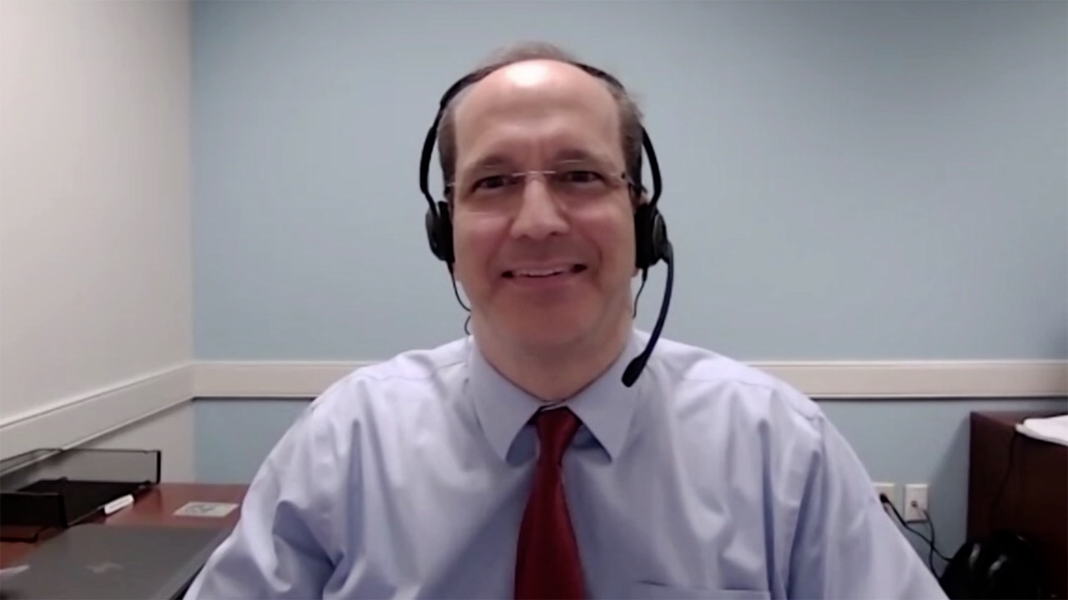
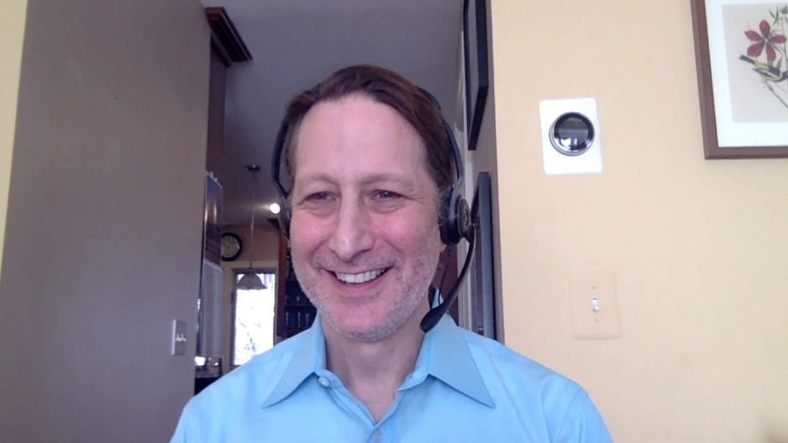
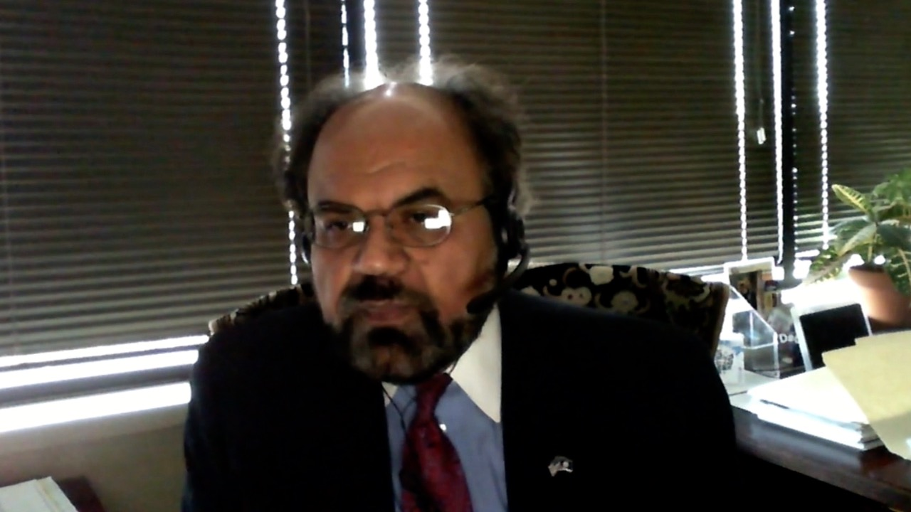
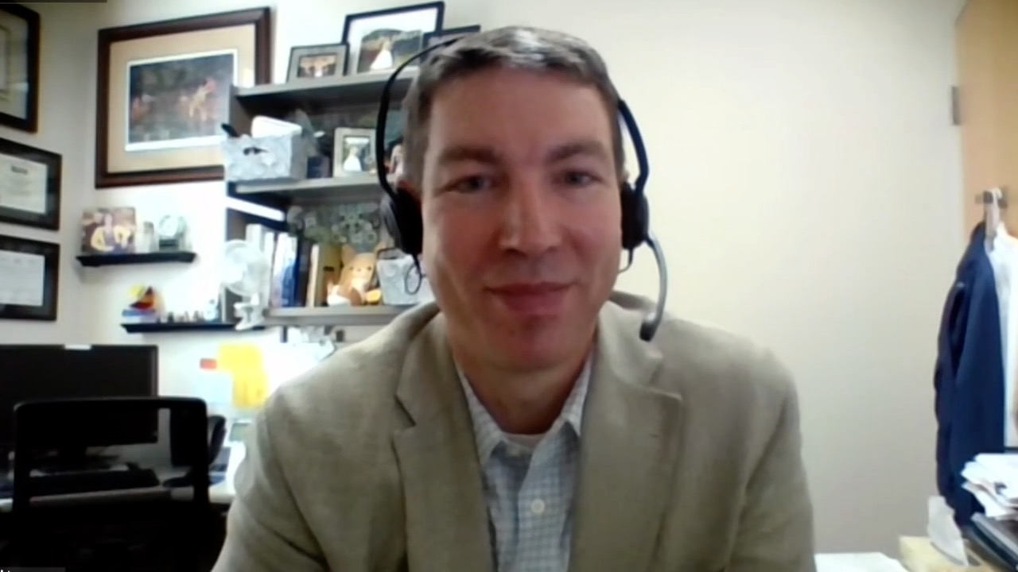
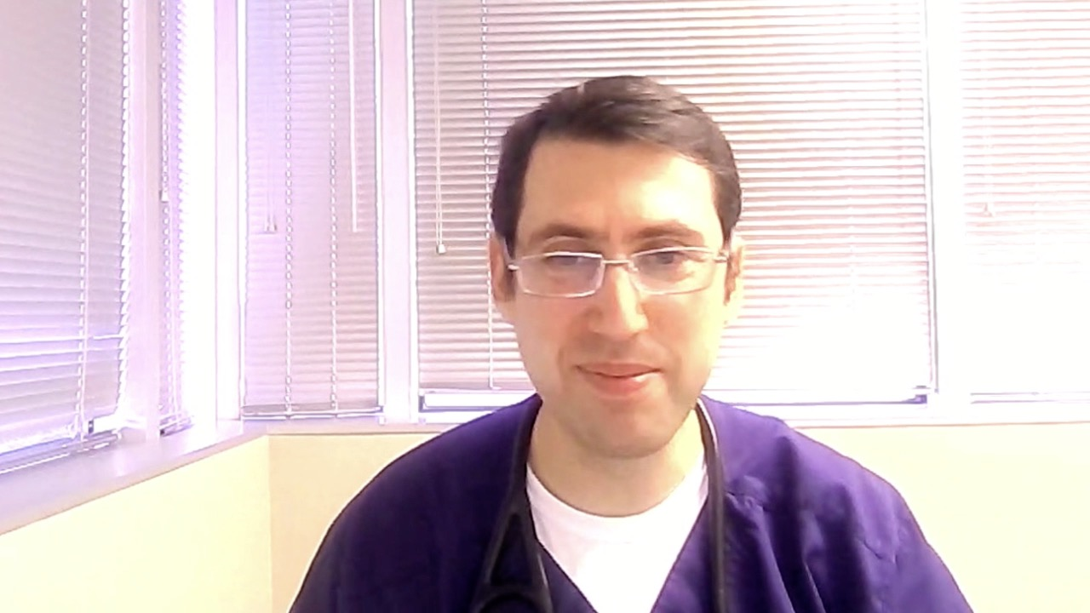
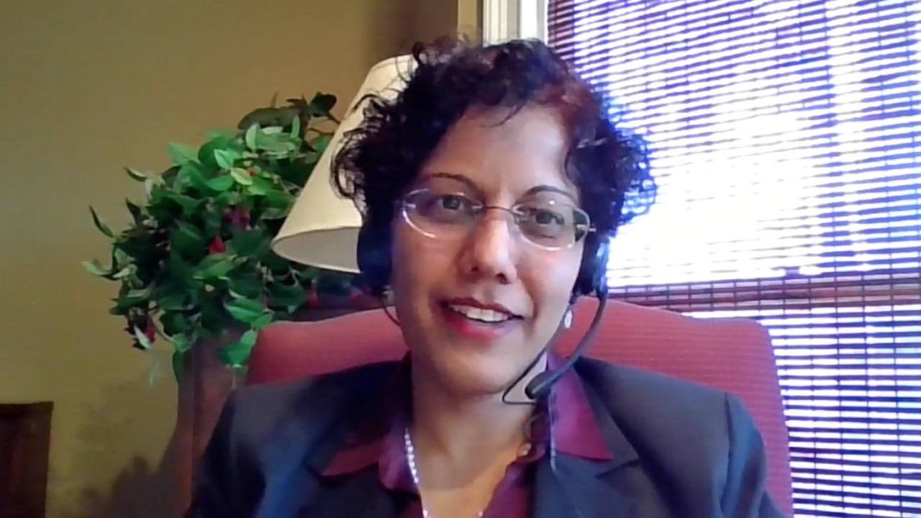
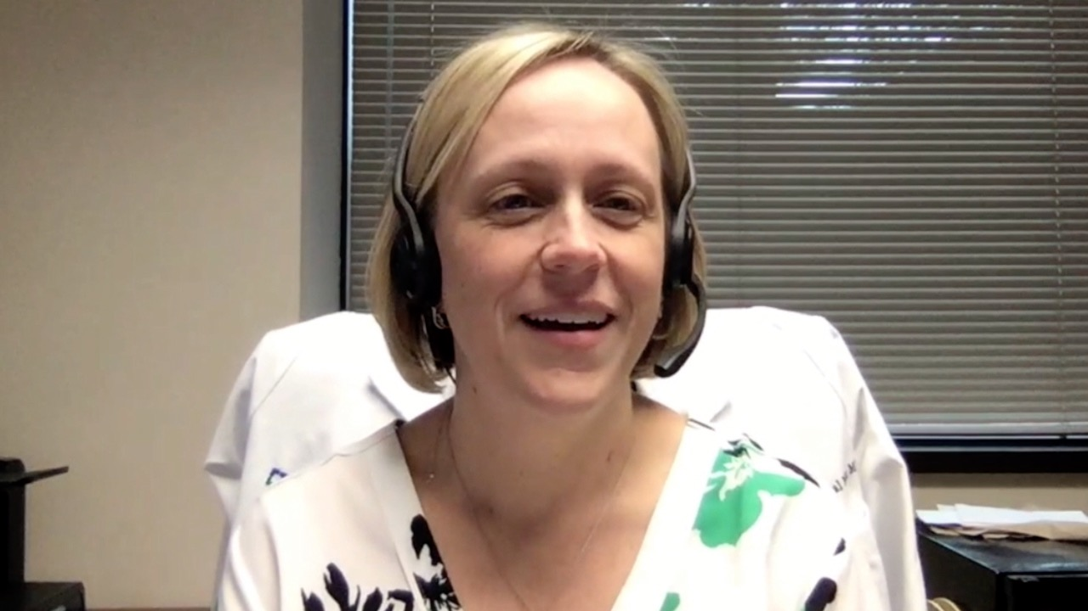
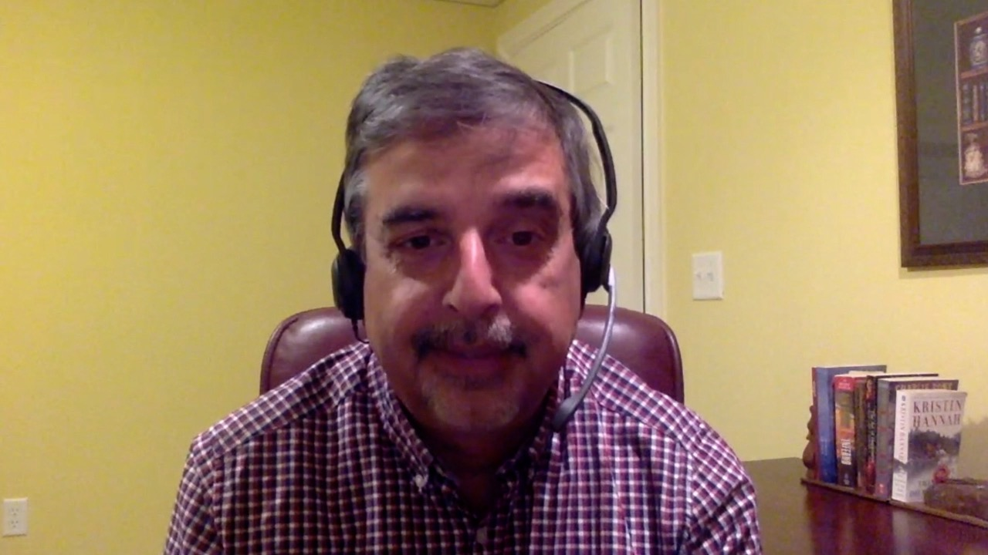
Justin Peter Favaro, MD, PhD
Oncology Specialists of Charlotte
Charlotte, North Carolina
Neil Morganstein, MD
Atlantic Health System
Summit, New Jersey
Khuda Dad Khan, MD, PhD
Norton Cancer Institute
Prospect, Kentucky
Benjamin Parsons, DO
Gundersen Health System
Madison, Wisconsin
Pavel A Levin, MD, PhD
Texas Oncology-Pearland
Houston, Texas
Priya Rudolph, MD, PhD
Georgia Cancer Specialists
Athens, Georgia
Laurie Matt-Amaral, MD, MPH
Cleveland Clinic Akron General
Akron, Ohio
Raman Sood, MD
Brooks Memorial Hospital
Dunkirk, New York

Slide 7
Meet The Professor with Dr Smith
Introduction
MODULE 1: Case Presentations – Diffuse Large B-Cell Lymphoma (DLBCL), Mantle Cell Lymphoma (MCL)
Dr Rudolph: A 78-year-old woman with DLBCL receiving tafasitamab/lenalidomide
Dr Morganstein: A 54-year-old man with DLBCL transformed from follicular lymphoma
Dr Matt-Amaral: A 51-year-old man with intense abdominal pain is diagnosed with DLBCL
Dr Parsons: An 83-year-old woman with relapsed MCL
Dr Favaro: A 53-year-old man with MCL, blastoid variant
MODULE 2: Case Presentations – Follicular Lymphoma (FL), Hodgkin Lymphoma (HL)
Dr Khan: A 75-year-old man with newly diagnosed FL
Dr Levin: A 36-year-old man with newly diagnosed Grade I FL with a high proliferative index
Dr Morganstein: A 38-year-old woman with Stage II lymphocyte-predominant HL
Dr Sood: A 60-year-old woman with recurrent HL
MODULE 3: Faculty Survey Results
MODULE 4: Journal Club with Dr Smith
MODULE 5: Appendix of Key Data Sets

Slide 8
Phase II AMEERA Study of the Oral SERD Amcenestrant in ER-Positive, HER2-Negative Advanced or Metastatic Breast Cancer Fails to Meet PFS Endpoint Press Release – March 14, 2022
“The Phase 2 AMEERA-3 clinical trial evaluating amcenestrant, an investigational optimized oral selective estrogen receptor degrader (SERD), did not meet its primary endpoint of improving progression-free survival (PFS) as assessed by an independent central review. The trial evaluated amcenestrant as monotherapy compared to endocrine treatment of physician’s choice in patients with locally advanced or metastatic estrogen receptor-positive (ER+)/human epidermal growth factor receptor 2-negative (HER2-) breast cancer who progressed on or after hormonal therapies. No new safety signals were identified and the safety profile of amcenestrant in AMEERA-3 was consistent with earlier studies.”
https://www.sanofi.com/en/media-room/press-releases/2022/2022-03-14-07-00-00-2402216#

Slide 9
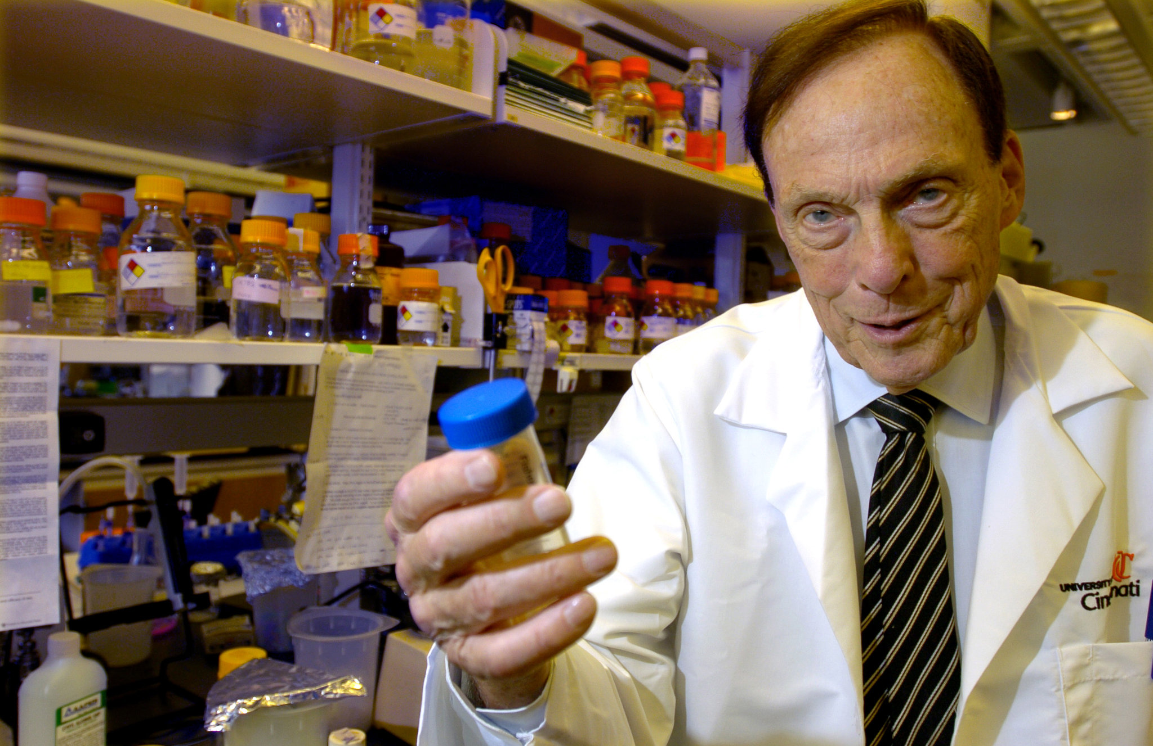
Elwood V Jensen

Slide 10
Meet The Professor with Dr Smith
Introduction
MODULE 1: Case Presentations – Diffuse Large B-Cell Lymphoma (DLBCL), Mantle Cell Lymphoma (MCL)
Dr Rudolph: A 78-year-old woman with DLBCL receiving tafasitamab/lenalidomide
Dr Morganstein: A 54-year-old man with DLBCL transformed from follicular lymphoma
Dr Matt-Amaral: A 51-year-old man with intense abdominal pain is diagnosed with DLBCL
Dr Parsons: An 83-year-old woman with relapsed MCL
Dr Favaro: A 53-year-old man with MCL, blastoid variant
MODULE 2: Case Presentations – Follicular Lymphoma (FL), Hodgkin Lymphoma (HL)
Dr Khan: A 75-year-old man with newly diagnosed FL
Dr Levin: A 36-year-old man with newly diagnosed Grade I FL with a high proliferative index
Dr Morganstein: A 38-year-old woman with Stage II lymphocyte-predominant HL
Dr Sood: A 60-year-old woman with recurrent HL
MODULE 3: Faculty Survey Results
MODULE 4: Journal Club with Dr Smith
MODULE 5: Appendix of Key Data Sets

Slide 12
S1918: A Phase II/III Randomized Study of R-Minichop with or without Oral Azacitidine (CC-486) in Participants Age 75 Years or Older with Newly Diagnosed Diffuse Large B Cell Lymphoma, Grade IIIb Follicular Lymphoma, Transformed Lymphoma, and High-Grade B-Cell Lymphomas with MYC and BCL2 and/or BCL6 Rearrangements
Brem EA et al. ASH 2021;Abstract 3565.

Slide 13
Journal of Clinical Oncology 2021;39(11):1193-5.

Slide 14
Meet The Professor with Dr Smith
Introduction
MODULE 1: Case Presentations – Diffuse Large B-Cell Lymphoma (DLBCL), Mantle Cell Lymphoma (MCL)
Dr Rudolph: A 78-year-old woman with DLBCL receiving tafasitamab/lenalidomide
Dr Morganstein: A 54-year-old man with DLBCL transformed from follicular lymphoma
Dr Matt-Amaral: A 51-year-old man with intense abdominal pain is diagnosed with DLBCL
Dr Parsons: An 83-year-old woman with relapsed MCL
Dr Favaro: A 53-year-old man with MCL, blastoid variant
MODULE 2: Case Presentations – Follicular Lymphoma (FL), Hodgkin Lymphoma (HL)
Dr Khan: A 75-year-old man with newly diagnosed FL
Dr Levin: A 36-year-old man with newly diagnosed Grade I FL with a high proliferative index
Dr Morganstein: A 38-year-old woman with Stage II lymphocyte-predominant HL
Dr Sood: A 60-year-old woman with recurrent HL
MODULE 3: Faculty Survey Results
MODULE 4: Journal Club with Dr Smith
MODULE 5: Appendix of Key Data Sets

Slide 15
Case Presentation: A 78-year-old woman with DLBCL receiving tafasitamab/lenalidomide
Dr Priya Rudolph (Athens, Georgia)

Slide 16
Case Presentation: A 78-year-old woman with DLBCL receiving tafasitamab/lenalidomide (continued)
Dr Priya Rudolph (Athens, Georgia)

Slide 17
Case Presentation: A 54-year-old man with DLBCL transformed from FL
Dr Neil Morganstein (Summit, New Jersey)

Slide 18
Case Presentation: A 51-year-old man with intense abdominal pain is diagnosed with DLBCL
Dr Laurie Matt-Amaral (Akron, Ohio)

Slide 19
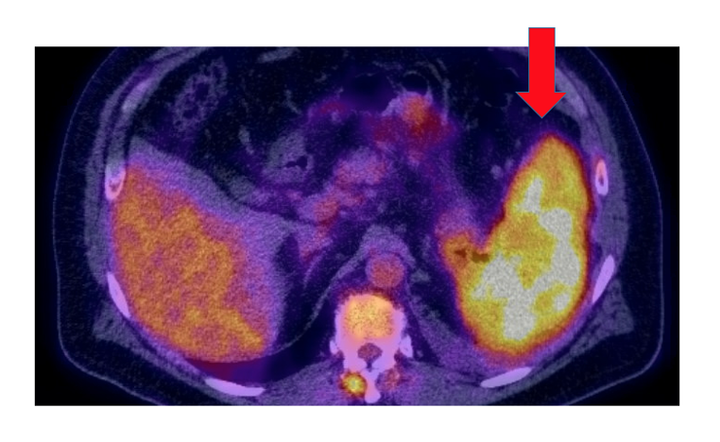
Case Presentation: A 51-year-old man with intense abdominal pain is diagnosed with DLBCL (continued)
PET at Diagnosis

Slide 20
Case Presentation: An 83-year-old woman with relapsed MCL
Dr Benjamin Parsons (Madison, Wisconsin)

Slide 21
Case Presentation: A 53-year-old man with MCL, blastoid variant
Dr Justin Favaro (Charlotte, North Carolina)

Slide 22
Meet The Professor with Dr Smith
Introduction
MODULE 1: Case Presentations – Diffuse Large B-Cell Lymphoma (DLBCL), Mantle Cell Lymphoma (MCL)
Dr Rudolph: A 78-year-old woman with DLBCL receiving tafasitamab/lenalidomide
Dr Morganstein: A 54-year-old man with DLBCL transformed from follicular lymphoma
Dr Matt-Amaral: A 51-year-old man with intense abdominal pain is diagnosed with DLBCL
Dr Parsons: An 83-year-old woman with relapsed MCL
Dr Favaro: A 53-year-old man with MCL, blastoid variant
MODULE 2: Case Presentations – Follicular Lymphoma (FL), Hodgkin Lymphoma (HL)
Dr Khan: A 75-year-old man with newly diagnosed FL
Dr Levin: A 36-year-old man with newly diagnosed Grade I FL with a high proliferative index
Dr Morganstein: A 38-year-old woman with Stage II lymphocyte-predominant HL
Dr Sood: A 60-year-old woman with recurrent HL
MODULE 3: Faculty Survey Results
MODULE 4: Journal Club with Dr Smith
MODULE 5: Appendix of Key Data Sets

Slide 23
Case Presentation: A 75-year-old man with newly diagnosed FL
Dr Khuda Dad Khan (Prospect, Kentucky)

Slide 24
Case Presentation: A 36-year-old man with newly diagnosed Grade I FL with a high proliferative index
Dr Pavel Levin (Houston, Texas)

Slide 25
Case Presentation: A 38-year-old woman with Stage II lymphocyte-predominant HL
Dr Neil Morganstein (Summit, New Jersey)

Slide 26
Case Presentation: A 60-year-old woman with recurrent HL
Dr Raman Sood (Dunkirk, New York)

Slide 27
Meet The Professor with Dr Smith
Introduction
MODULE 1: Case Presentations – Diffuse Large B-Cell Lymphoma (DLBCL), Mantle Cell Lymphoma (MCL)
Dr Rudolph: A 78-year-old woman with DLBCL receiving tafasitamab/lenalidomide
Dr Morganstein: A 54-year-old man with DLBCL transformed from follicular lymphoma
Dr Matt-Amaral: A 51-year-old man with intense abdominal pain is diagnosed with DLBCL
Dr Parsons: An 83-year-old woman with relapsed MCL
Dr Favaro: A 53-year-old man with MCL, blastoid variant
MODULE 2: Case Presentations – Follicular Lymphoma (FL), Hodgkin Lymphoma (HL)
Dr Khan: A 75-year-old man with newly diagnosed FL
Dr Levin: A 36-year-old man with newly diagnosed Grade I FL with a high proliferative index
Dr Morganstein: A 38-year-old woman with Stage II lymphocyte-predominant HL
Dr Sood: A 60-year-old woman with recurrent HL
MODULE 3: Faculty Survey Results
MODULE 4: Journal Club with Dr Smith
MODULE 5: Appendix of Key Data Sets

Slide 28
If future data continue not to demonstrate an overall survival advantage with polatuzumab vedotin in combination with R-CHP over R-CHOP when used as up-front therapy for DLBCL, do you think the clinical benefit with this regimen is greater than the risk?
Yes
17
No
3
Survey of Lymphoma Clinical Investigators

Slide 29
Based on available evidence and your own experience, how would you compare the global tolerability/toxicity of polatuzumab vedotin in combination with R-CHP to that of R-CHOP when used as up-front therapy for DLBCL?
17
About the same
R-CHOP has less toxicity
3
Survey of Lymphoma Clinical Investigators

Slide 30
Regulatory and reimbursement issues aside, which first-line therapy would you generally recommend for an otherwise healthy 65-year-old patient with Stage IV activated B-cell (ABC)-type DLBCL?
18
R-CHP + polatuzumab vedotin
R-CHOP
1
Lenalidomide
1
Survey of Lymphoma Clinical Investigators

Slide 31
Regulatory and reimbursement issues aside, which first-line therapy would you generally recommend for an otherwise healthy 65-year-old patient with Stage IV germinal center B-cell (GCB)-type DLBCL?
R-CHOP
11
R-CHP + polatuzumab vedotin
8
Survey of Lymphoma Clinical Investigators

Slide 32
Regulatory and reimbursement issues aside, which second-line therapy would you recommend for a younger, transplant-eligible patient with DLBCL who experiences disease relapse 12 months after R-CHOP?
17
CAR T-cell therapy
Autologous stem cell transplant (ASCT)
2
Either ASCT or CAR T-cell therapy — coin flip
1
Survey of Lymphoma Clinical Investigators

Slide 33
Which therapy would you generally recommend first for a patient with DLBCL who experiences disease progression on front-line R-CHOP and is not eligible for high-dose therapy or CAR T-cell therapy?
Tafasitamab/lenalidomide
13
Polatuzumab vedotin/BR
6
I’m not sure
1
Survey of Lymphoma Clinical Investigators

Slide 34
Meet The Professor with Dr Smith
Introduction
MODULE 1: Case Presentations – Diffuse Large B-Cell Lymphoma (DLBCL), Mantle Cell Lymphoma (MCL)
Dr Rudolph: A 78-year-old woman with DLBCL receiving tafasitamab/lenalidomide
Dr Morganstein: A 54-year-old man with DLBCL transformed from follicular lymphoma
Dr Matt-Amaral: A 51-year-old man with intense abdominal pain is diagnosed with DLBCL
Dr Parsons: An 83-year-old woman with relapsed MCL
Dr Favaro: A 53-year-old man with MCL, blastoid variant
MODULE 2: Case Presentations – Follicular Lymphoma (FL), Hodgkin Lymphoma (HL)
Dr Khan: A 75-year-old man with newly diagnosed FL
Dr Levin: A 36-year-old man with newly diagnosed Grade I FL with a high proliferative index
Dr Morganstein: A 38-year-old woman with Stage II lymphocyte-predominant HL
Dr Sood: A 60-year-old woman with recurrent HL
MODULE 3: Faculty Survey Results
MODULE 4: Journal Club with Dr Smith
MODULE 5: Appendix of Key Data Sets

Slide 35
Leukemia & Lymphoma 2021;62(6):1497-501.

Slide 36
2022;36(2):97-106

Slide 37
Cahill KE, Smith SM. Oncology 2022;36(2):97-106

Slide 38
Cahill KE, Smith SM. Oncology 2022;36(2):97-106

Slide 39
Cahill KE, Smith SM. Oncology 2022;36(2):97-106

Slide 40
“Since maintenance rituximab has yet to offer cure or improved overall survival after chemoimmunotherapy induction, it seems more appropriate to identify the minimum number of doses rather than trying to expand or extend treatment.”
Smith SM. Haematologica 2022;107(2):353-4.

Slide 42
Clin Adv Hematol Oncol 2021;19(11):698-709.

Slide 44
ASTCT, CIBMTR, and EBMT Clinical Practice Recommendations for Transplant and Cellular Therapies in Mantle Cell Lymphoma
Estimated number of newly diagnosed lymphoma patients seen by individual member annually
>75 | 23 (69.7%)
51-75 | 6 (18.2%)
26-50 | 3 (9.1%)
≤25 | 1 (3.0%)
Estimated number of mantle cell lymphoma patients seen by individual member annually
>40 | 6 (18.2%)
31-40 | 3 (9.1%)
21-30 | 14 (42.4%)
≤20 | 10 (30.3%)
Estimated annual CAR T-cell therapies performed at respective centers for lymphoma (on or off clinical trial)
>20 | 21 (63.6%)
16-20 | 3 (9.1%)
11-15 | 5 (15.2%)
≤10 | 4 (12.1%)
Munshi PN et al. Bone Marrow Transplant 2021;56(12):2911-21.

Slide 45
Blood 2022;139(3):413-23.

Slide 46
Blood Cancer J 2022;12(2):33.

Slide 47
Management of Limited-Stage Diffuse Large B-Cell Lymphoma (DLBCL)
Rojek AE, Smith SM. Blood Cancer J 2022;12(2):33.

Slide 48
Efficacy Comparison of Tisagenlecleucel versus Standard of Care in Patients with Relapsed or Refractory Follicular Lymphoma
Salles G et al.
ASH 2021;Abstract 3528.

Slide 49
Clin Adv Hematol Oncol 2021;19(10):624-6.

Slide 50
A Multicenter, Single-Arm, Phase I/II Dose Finding and Efficacy Study of Venetoclax, CC-486, and Obinutuzumab in Minimally- Pretreated Follicular Lymphoma
Cahill KE et al. ASH 2021;Abstract 2420.

Slide 51
Meet The Professor with Dr Smith
Introduction
MODULE 1: Case Presentations – Diffuse Large B-Cell Lymphoma (DLBCL), Mantle Cell Lymphoma (MCL)
Dr Rudolph: A 78-year-old woman with DLBCL receiving tafasitamab/lenalidomide
Dr Morganstein: A 54-year-old man with DLBCL transformed from follicular lymphoma
Dr Matt-Amaral: A 51-year-old man with intense abdominal pain is diagnosed with DLBCL
Dr Parsons: An 83-year-old woman with relapsed MCL
Dr Favaro: A 53-year-old man with MCL, blastoid variant
MODULE 2: Case Presentations – Follicular Lymphoma (FL), Hodgkin Lymphoma (HL)
Dr Khan: A 75-year-old man with newly diagnosed FL
Dr Levin: A 36-year-old man with newly diagnosed Grade I FL with a high proliferative index
Dr Morganstein: A 38-year-old woman with Stage II lymphocyte-predominant HL
Dr Sood: A 60-year-old woman with recurrent HL
MODULE 3: Faculty Survey Results
MODULE 4: Journal Club with Dr Smith
MODULE 5: Appendix of Key Data Sets

Slide 52
Diffuse Large B-Cell Lymphoma

Slide 53
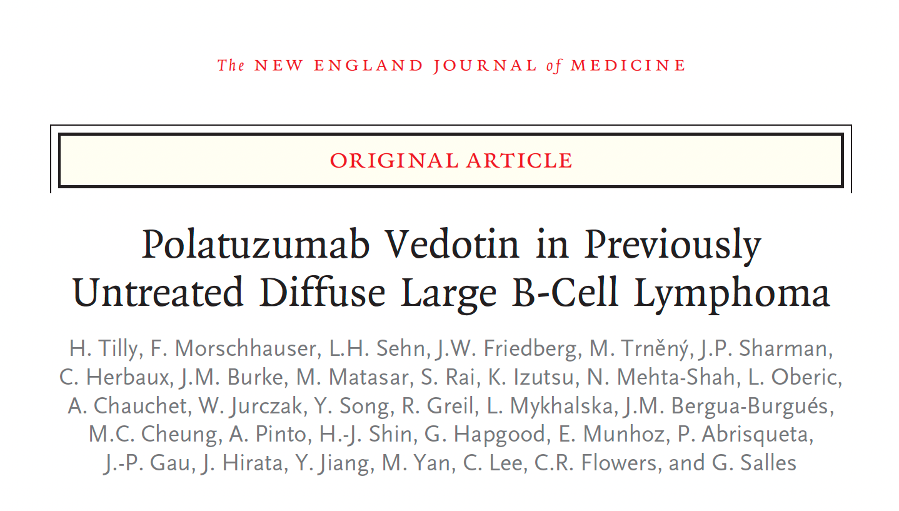
N Engl J Med 2021;[Online ahead of print].
Tilly H et al. ASH 2021;LBA-1

Slide 54
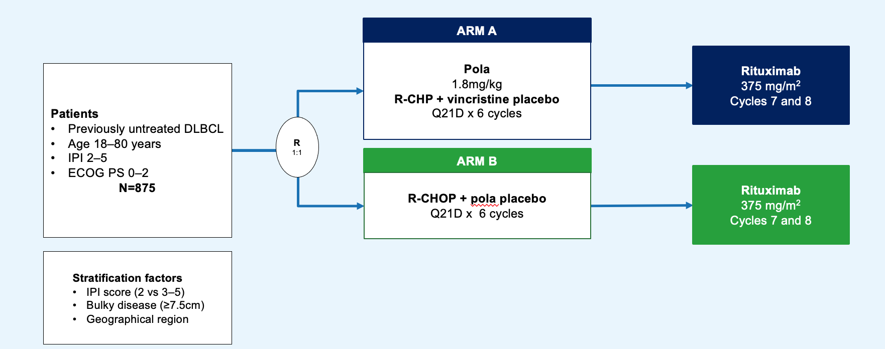
POLARIX Phase III Trial Design
Courtesy of Gilles Salles MD, PhD

Slide 55
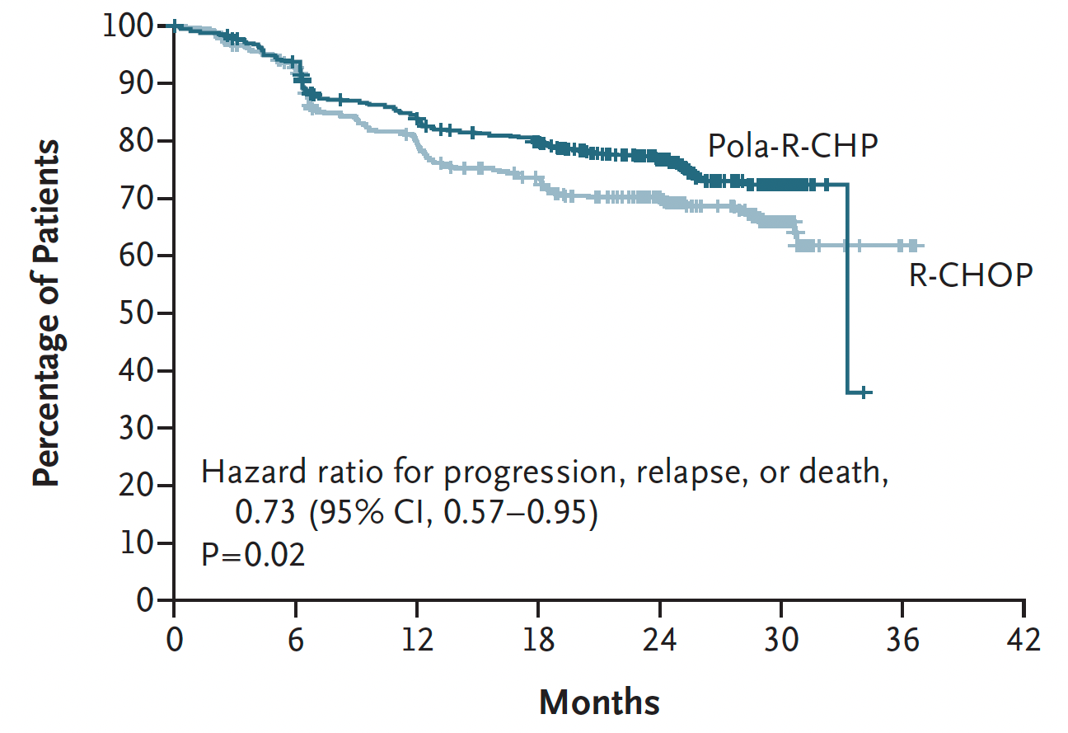
POLARIX: Investigator-Assessed Progression-Free Survival (Primary Endpoint)
Estimated 2-yrs PFS: 76.7% vs 70.2%
Tilly H et al. N Engl J Med 2021;[Online ahead of print].

Slide 56
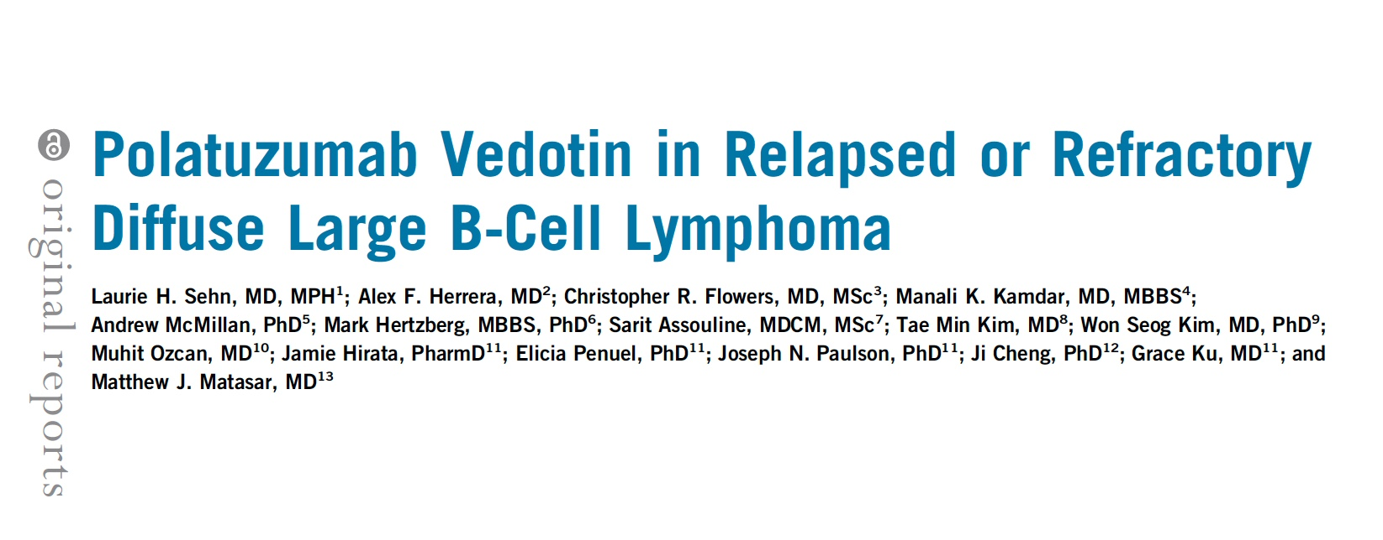
J Clin Oncol 2020;38(2):155-65.

Slide 57
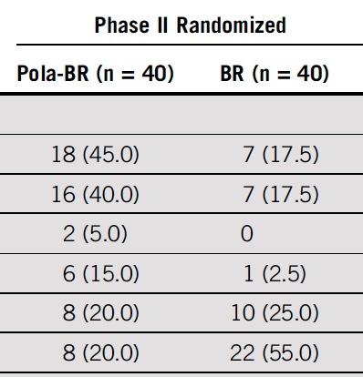
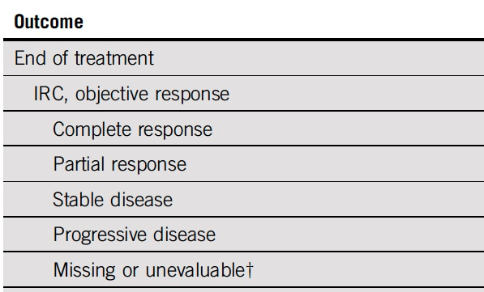
Polatuzumab Vedotin with Bendamustine/Rituximab for Transplant-Ineligible R/R DLBCL: End-of-Treatment CR Rate
Sehn LH et al. J Clin Oncol 2020;38(2):155-65.

Slide 58
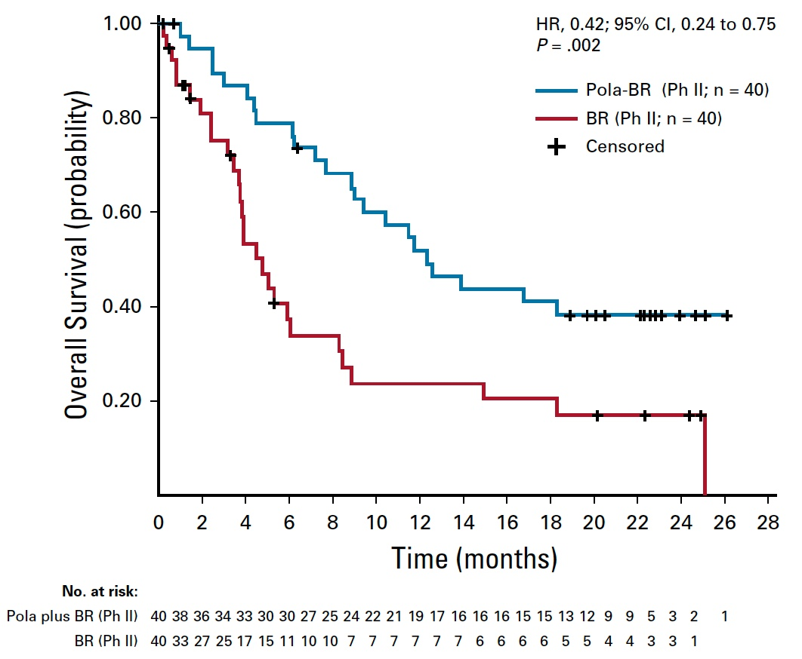
Polatuzumab Vedotin with Bendamustine/Rituximab for Transplant-Ineligible R/R DLBCL: Overall Survival
Sehn LH et al. J Clin Oncol 2020;38(2):155-65.

Slide 59
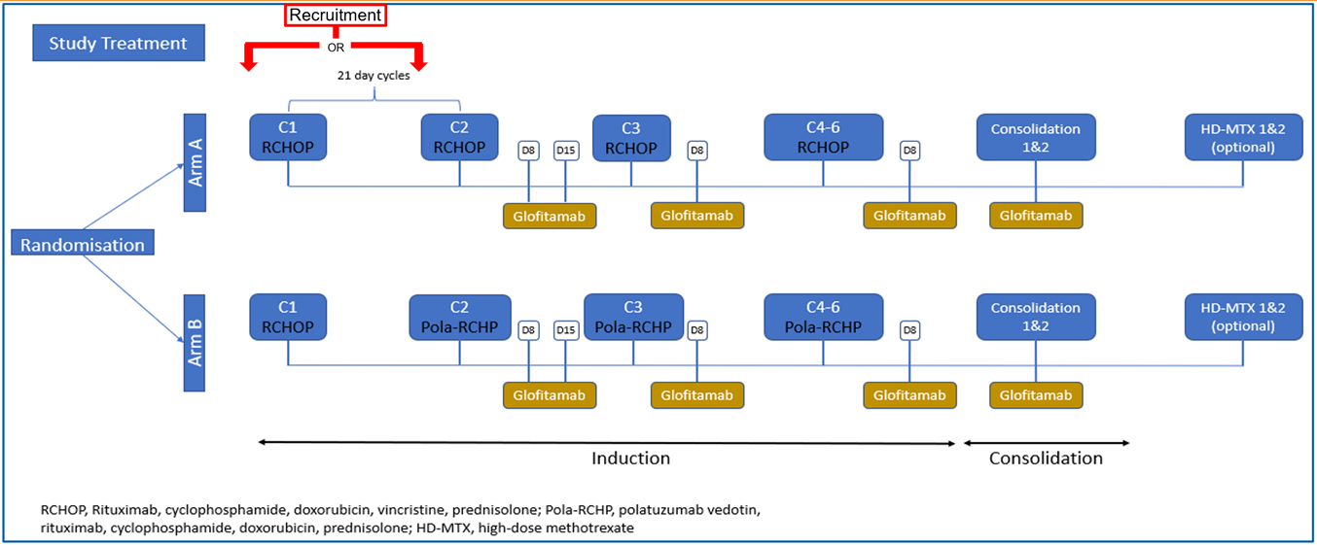
Trial in Progress: A Multicentre, Parallel Arm, Open-Label Trial of Frontline R-CHOP/Polatuzumab Vedotin-RCHP and Glofitamab in Younger Patients with Higher Risk Diffuse Large B Cell Lymphoma (COALITION)
Minson A et Al, ASH 2021
Courtesy of Grzegorz Nowakowski, MD

Slide 60
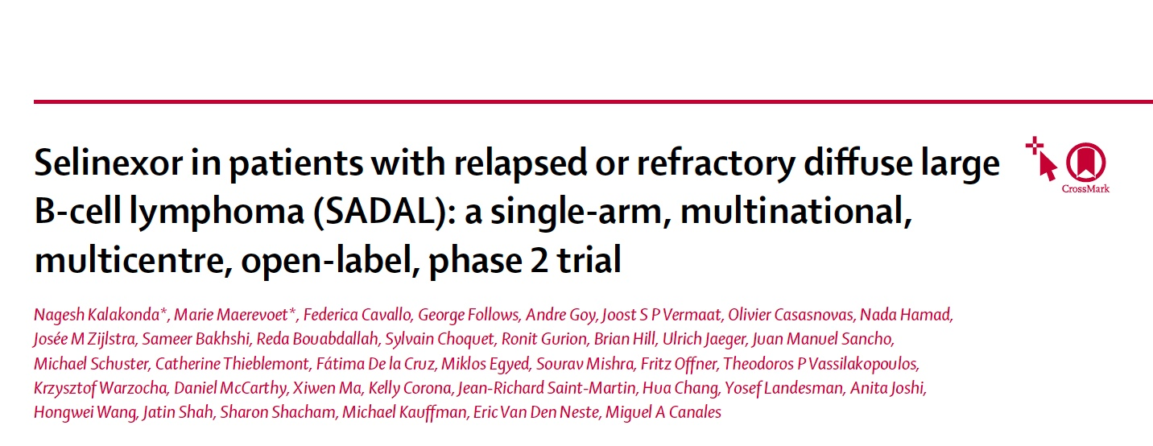
Lancet Haematol 2020;7:e511-22.

Slide 61
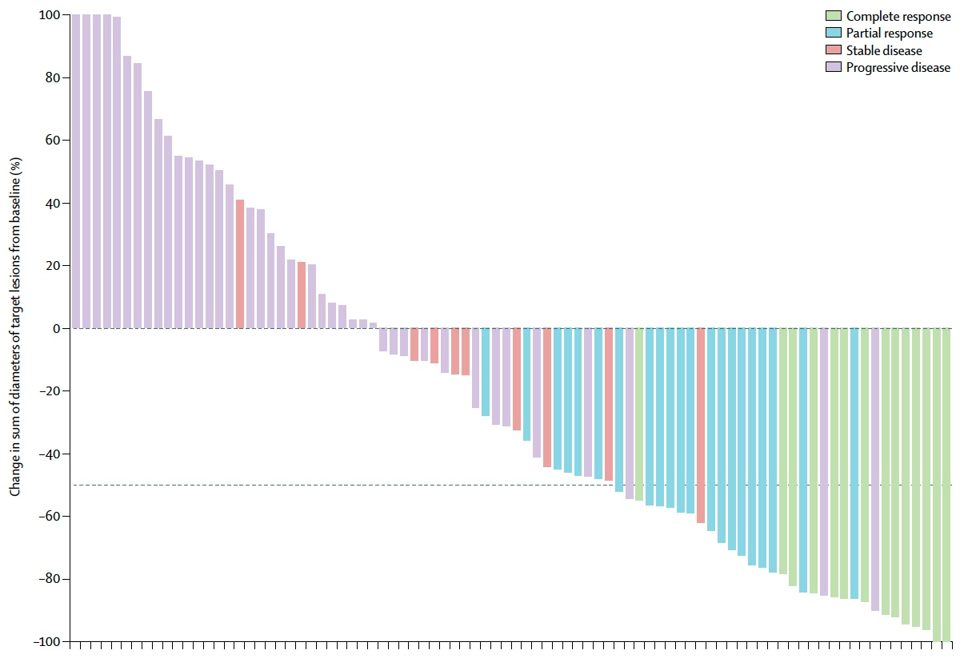
SADAL: Efficacy and Safety of Selinexor for R/R DLBCL After at Least 2 Previous Lines of Chemoimmunotherapy
 | ORR | CRR
All patients | 36/127 (28%) | 15/127 (12%)
GCB subtype | 20/59 (34%) | 8/59 (14%)
Non-GCB subtype | 13/63 (21%) | 6/63 (10%)
Unclassified | 3/5 (60%) | 1/5 (20%)
 | Gr 1-2 | Gr 3 | Gr 4
Thrombocytopenia | 16% | 31% | 15%
Anemia | 21% | 21% | 1%
Neutropenia | 6% | 16% | 9%
Kalakonda N et al. Lancet Haematol 2020;7:e511-22.

Slide 62
FDA Grants Accelerated Approval to Tafasitamab-cxix for DLBCL Press Release – July 31, 2020
“The Food and Drug Administration granted accelerated approval to tafasitamab-cxix, a CD19-directed cytolytic antibody, indicated in combination with lenalidomide for adult patients with relapsed or refractory diffuse large B-cell lymphoma (DLBCL) not otherwise specified, including DLBCL arising from low grade lymphoma, and who are not eligible for autologous stem cell transplant.
The efficacy of tafasitamab-cxix with lenalidomide was evaluated in L-MIND (NCT02399085), an open label, multicenter single-arm trial in 81 patients. Patients received tafasitamab-cxix 12 mg/kg intravenously with lenalidomide (25 mg orally on days 1 to 21 of each 28-day cycle) for maximum of 12 cycles, followed by tafasitamab-cxix as monotherapy.”
www.fda.gov/drugs/resources-information-approved-drugs/fda-grants-accelerated-approval-tafasitamab-cxix-diffuse-large-b-cell-lymphoma

Slide 63
Lancet Oncol 2020;21:978-88

Slide 64
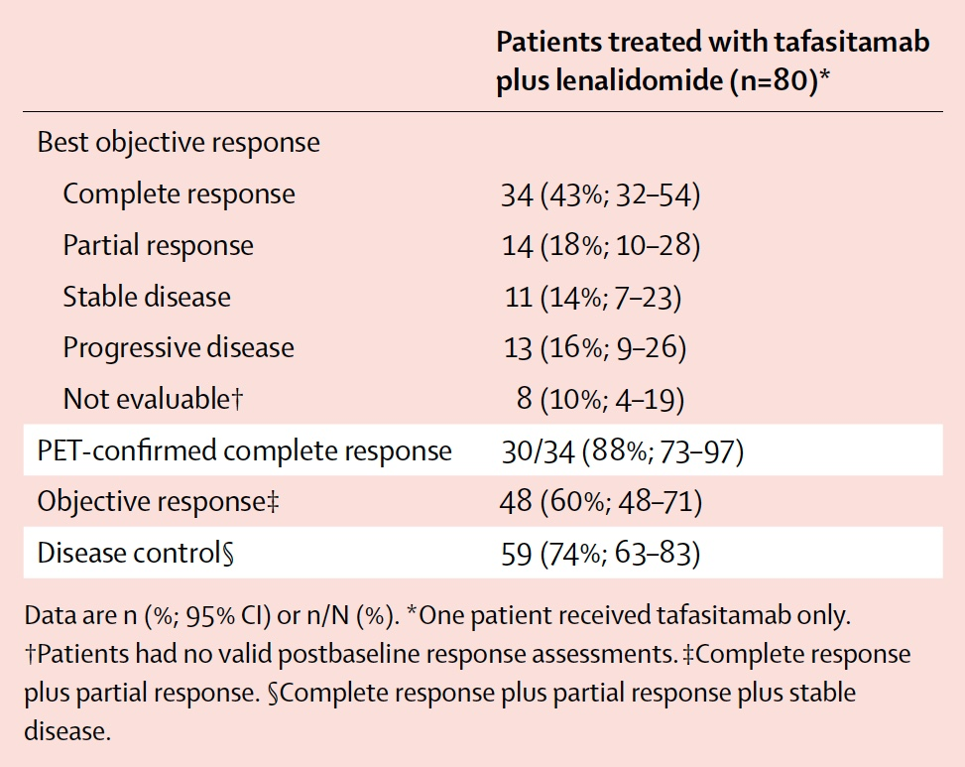
L-MIND: Best Objective Response According to Independent Radiology Committee or Clinical Review Committee
Salles G et al. Lancet Oncol 2020;21:978-88.

Slide 65
FDA Grants Accelerated Approval to Loncastuximab Tesirine-lpyl for Large B-Cell Lymphoma Press Release – April 23, 2021
“The Food and Drug Administration granted accelerated approval to loncastuximab tesirine-lpyl, a CD19-directed antibody and alkylating agent conjugate, for adult patients with relapsed or refractory large B-cell lymphoma after two or more lines of systemic therapy, including diffuse large B-cell lymphoma (DLBCL) not otherwise specified, DLBCL arising from low grade lymphoma, and high-grade B-cell lymphoma.
Approval was based on LOTIS-2 (NCT03589469), an open-label, single-arm trial in 145 adult patients with relapsed or refractory DLBCL or high-grade B-cell lymphoma after at least two prior systemic regimens. Patients received loncastuximab tesirine-lpyl 0.15 mg/kg every 3 weeks for 2 cycles, then 0.075 mg/kg every 3 weeks for subsequent cycles. Patients received treatment until progressive disease or unacceptable toxicity.”
www.fda.gov/drugs/resources-information-approved-drugs/fda-grants-accelerated-approval-loncastuximab-tesirine-lpyl-large-b-cell-lymphoma

Slide 66
Lancet Oncol 2021;22:790-800

Slide 67
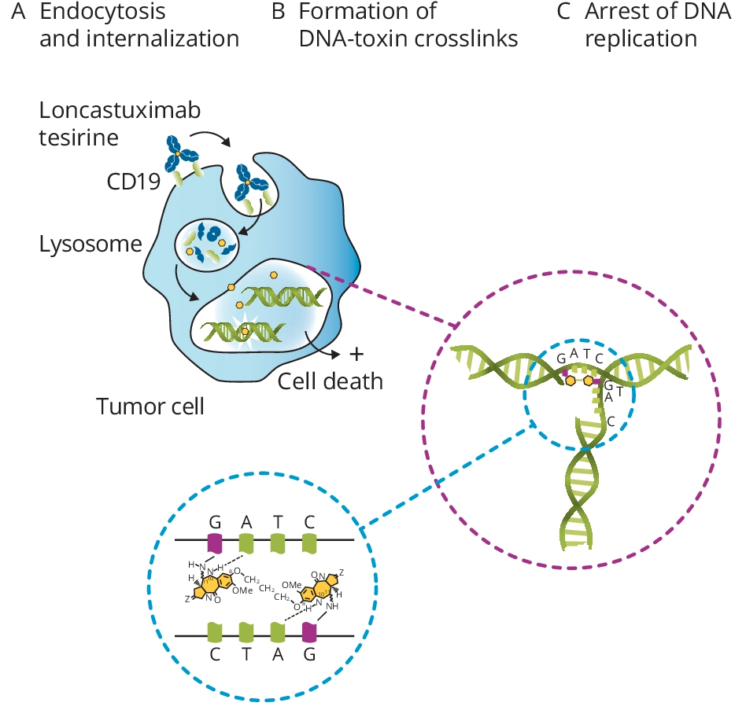
Mechanism of Action of Loncastuximab Tesirine
Hamadani M et al. ASCO 2021;
Abstract TPS7574.

Slide 68
LOTIS-2: Response and Survival with Loncastuximab Tesirine for R/R DLBCL
Response | As-treated population (N = 145)
Overall response rate | 70/145 (48.3%)
Complete response rate | 35/145 (24.1%)
Complete response | 35 (24%)
Partial response | 35 (24%)
Stable disease | 22 (15%)
Progressive disease | 30 (21%)
Not evaluable | 23 (16%)
Survival | As-treated population (N = 145)
Median progression-free survival | 4.9 months
Median overall survival | 9.9 months
Caimi PF et al. Lancet Oncol 2021;22:790-800.

Slide 69
LOTIS-2: Common Treatment-Emergent Adverse Events
Treatment-Emergent AEs | Grade 1-2 | Grade 3-4
Anemia | 16% | 10%
Thrombocytopenia | 15% | 18%
Neutropenia | 14% | 26%
Leukopenia | 6% | 9%
Caimi PF et al. Lancet Oncol 2021;22:790-800.

Slide 70
ASH 2021;Abstract 54

Slide 71
LOTIS-3: Phase II Study of Loncastuximab Tesirine with Ibrutinib for Advanced DLBCL
Safety data were consistent with those reported previously
Carlo-Stella C et al. ASH 2021;Abstract 54.

Slide 72
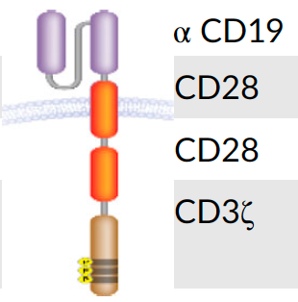
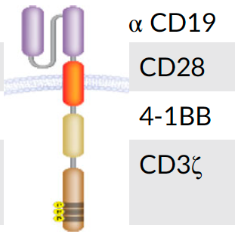
Summary of CAR T-Cell Pivotal Studies in DLBCL
 | Axi-cel ZUMA-1 (N = 108 infused) | Tisagenlecleucel JULIET (N = 108 infused) | Liso-cel TRANSCEND (N = 294 infused)
CAR
Transmembrane domain
Co-stimulatory doman
T-cell activation domain
Leukapheresis | Fresh product | Cryopreserved product | Fresh product
Outpatient administration | Not allowed | Allowed | Allowed
Bridging therapy, % | Not allowed | 92% | 59%
Lymphodepletion chemotherapy | Cy/Flu 500/30 mg/m² × 3d | Cy/Flu 250/25 mg/m² x 3d Bendamustine 90 mg/m² x 2d | Cy/Flu 300/30 mg/m² x 3d
Westin JR et al. Am J Hematol 2021;[Online ahead of print].

Slide 73
Long-Term (4- and 5-Year) Overall Survival in ZUMA-1, the Pivotal Study of Axicabtagene Ciloleucel (Axi-Cel) in Patients with Refractory Large B-Cell Lymphoma (LBCL)
Jacobson C et al. ASH 2021;Abstract 1764.

Slide 74
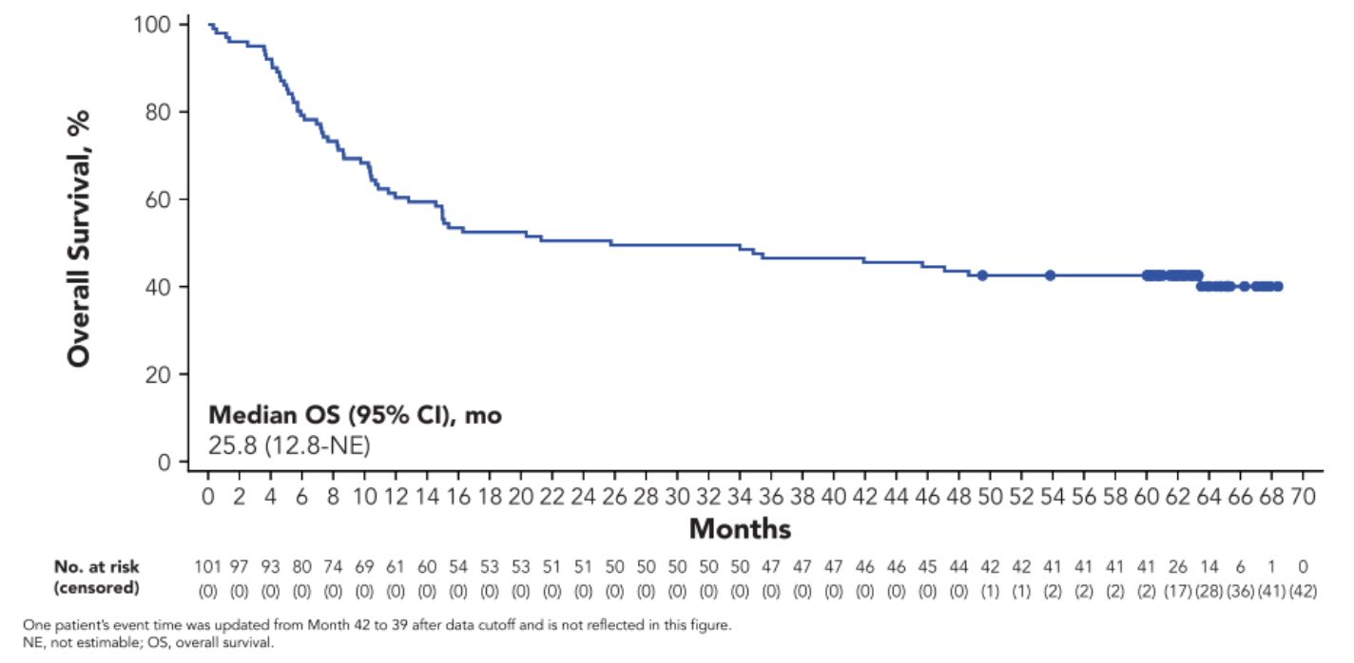
ZUMA-1: Five-Year Update
5-Yr OS Rate: 42.6%
5-Yr OS Rate in Complete Responders: 64.4%
Median time to next cancer therapy: 8.7 months
Safety findings were similar to those in previous reports
Jacobson C et al. ASH 2021;Abstract 1764.

Slide 75
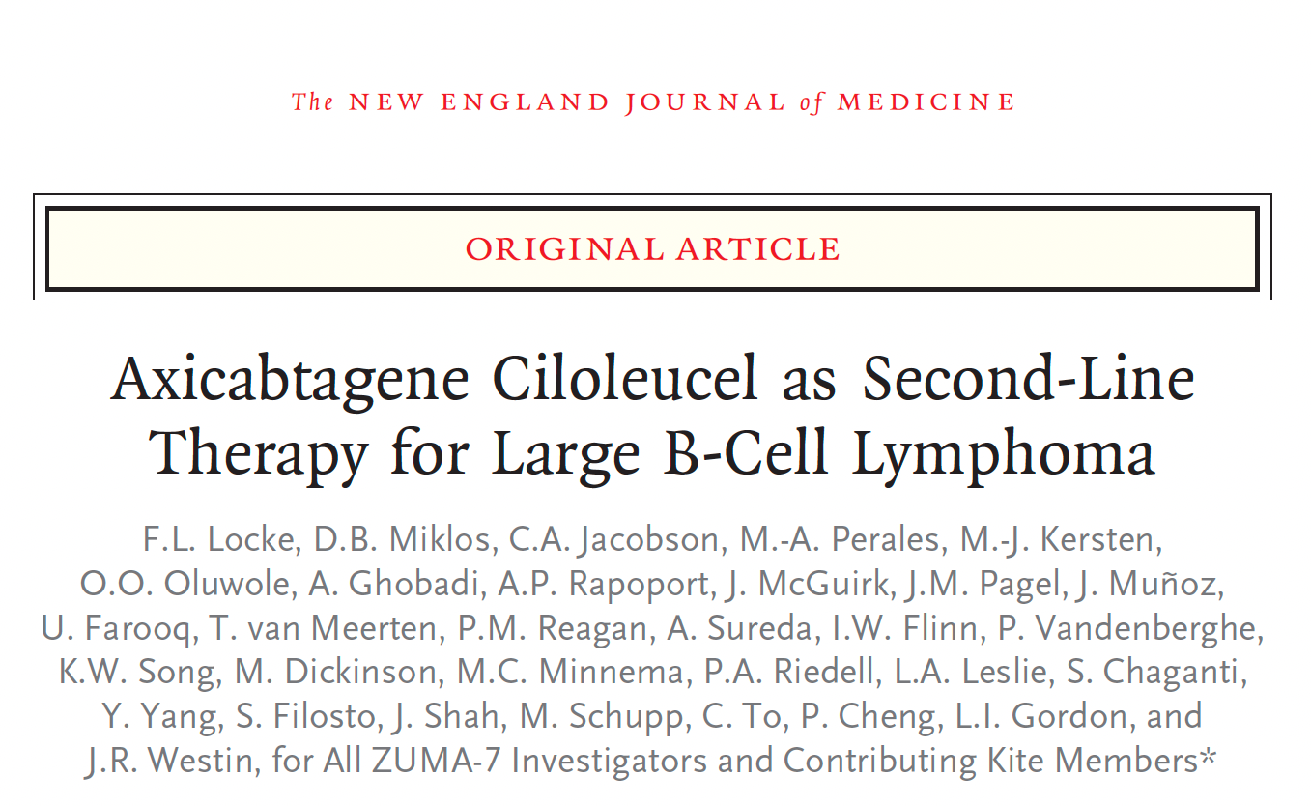
N Engl J Med 2021;[Online ahead of print].
Locke FL et al. ASH 2021;Abstract 2.

Slide 76
ZUMA-7: Event-Free Survival
Locke FL et al. N Engl J Med 2021;[Online ahead of print].

Slide 77
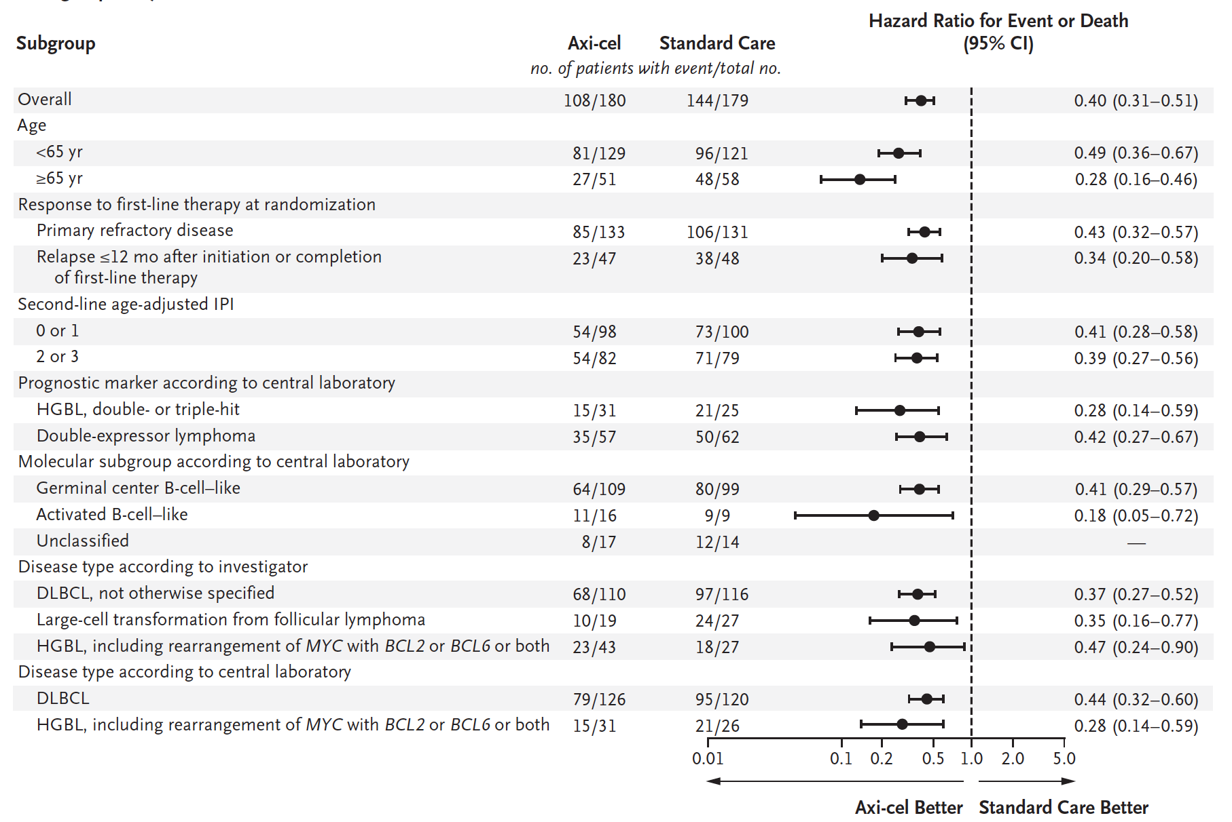
ZUMA-7: Event-Free Survival Subgroup Analysis
Tilly H et al. N Engl J Med 2021;[Online ahead of print].

Slide 78
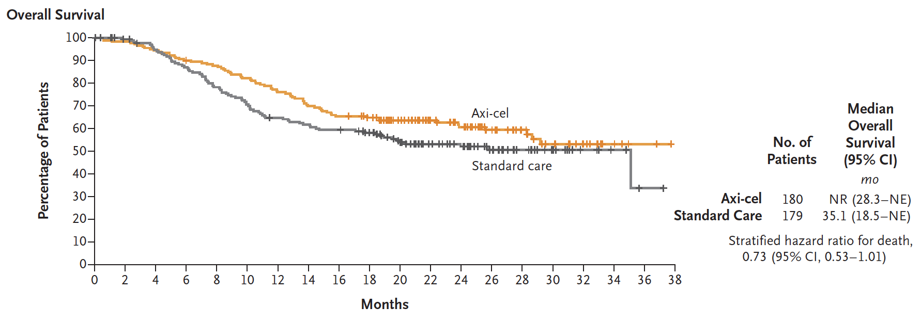
ZUMA-7: Overall Survival
Tilly H et al. N Engl J Med 2021;[Online ahead of print].

Slide 79
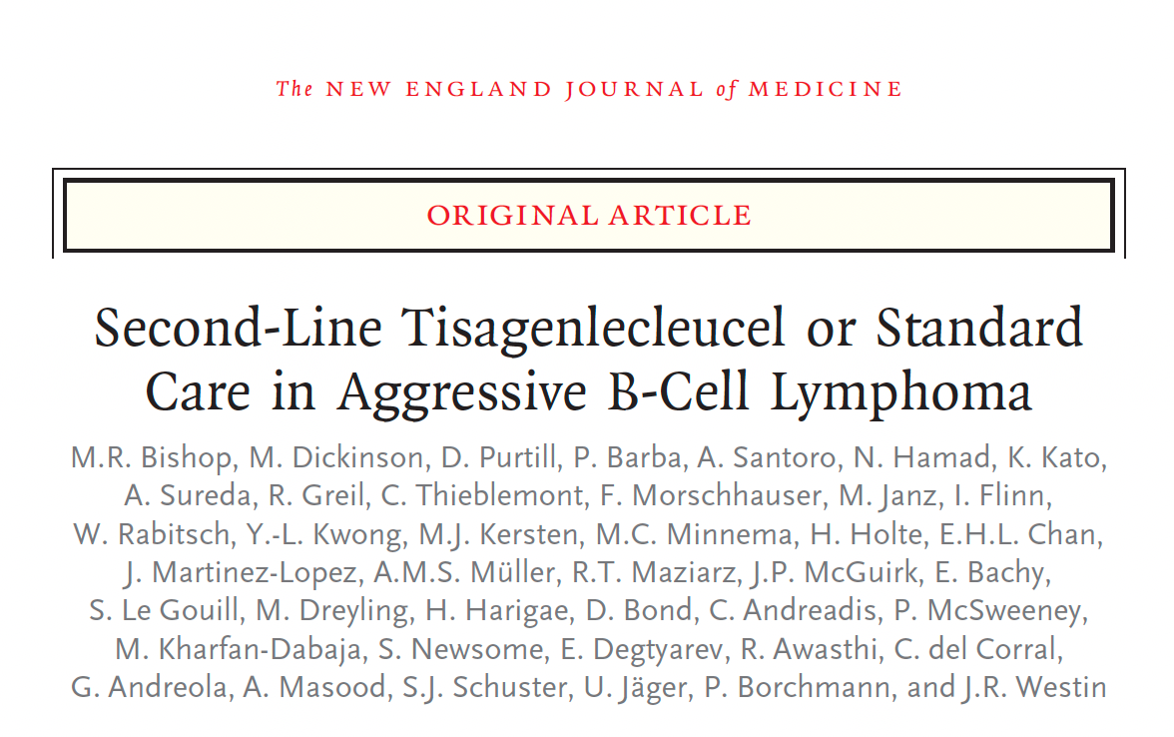
N Engl J Med 2021;[Online ahead of print].
Bishop MR et al. ASH 2021;Abstract LBA-6.

Slide 80
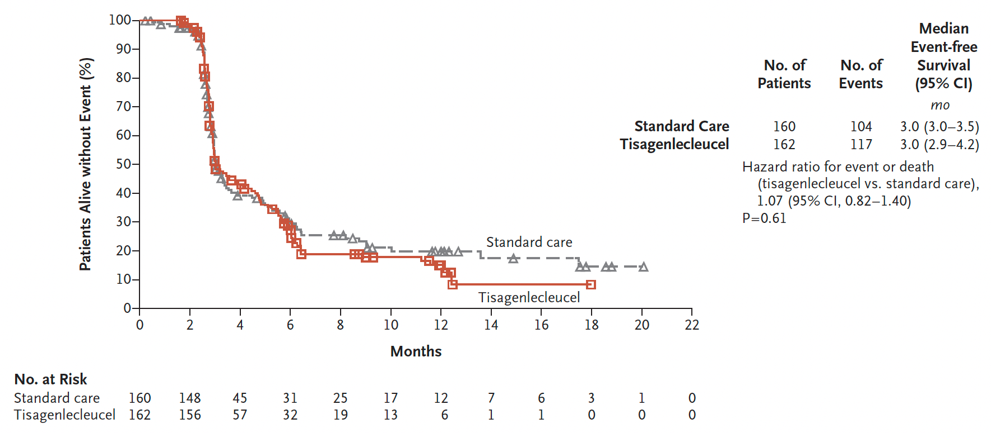
BELINDA: Event-Free Survival (Primary Endpoint)
Bishop MR et al. N Engl J Med 2021;[Epub ahead of print].

Slide 82
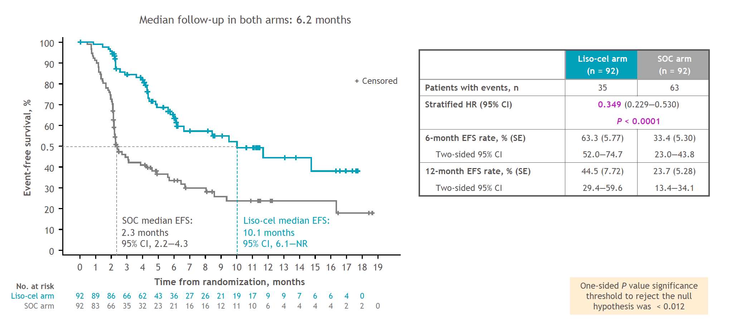
TRANSFORM: Event-Free Survival per Independent Review Committee (ITT, Primary Endpoint)
Kamdar M et al. ASH 2021;Abstract 91.

Slide 83
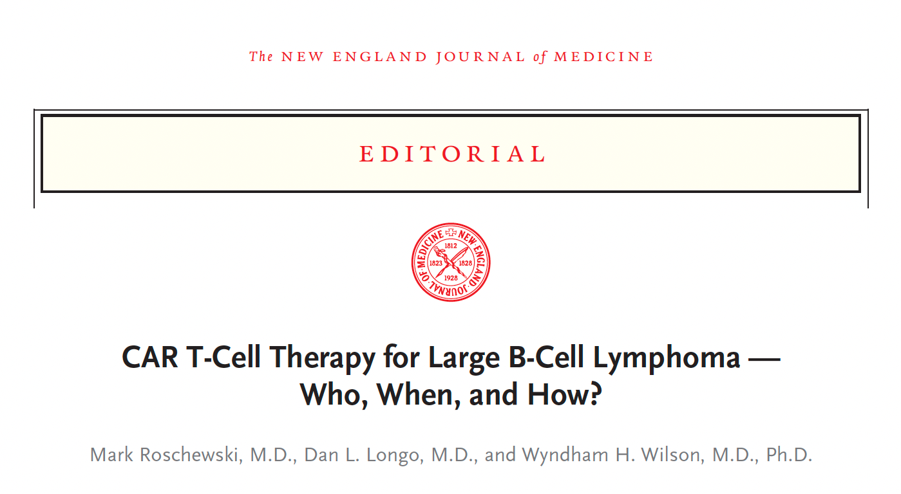
N Engl J Med 2021;[Online ahead of print].

Slide 84
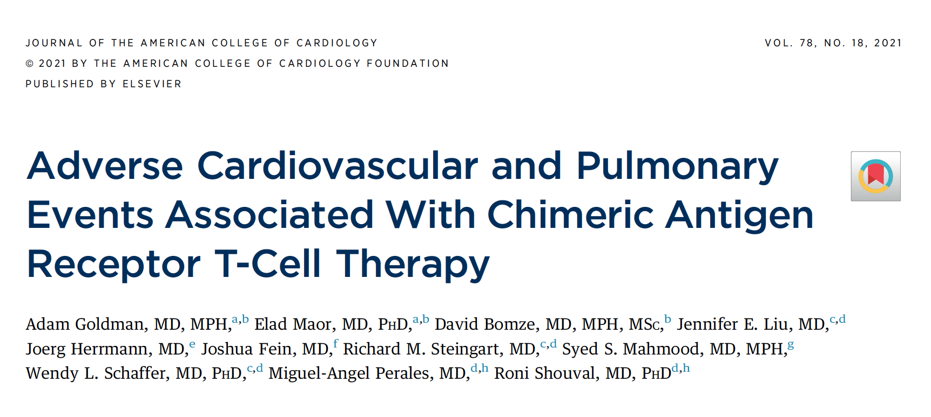

Slide 85
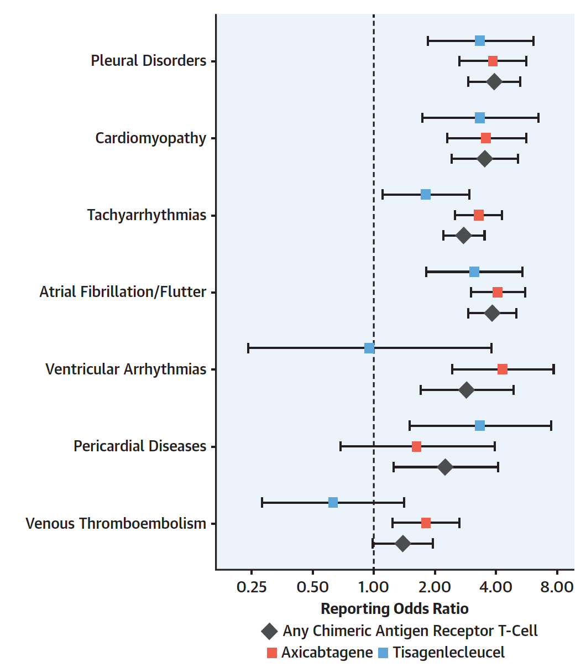
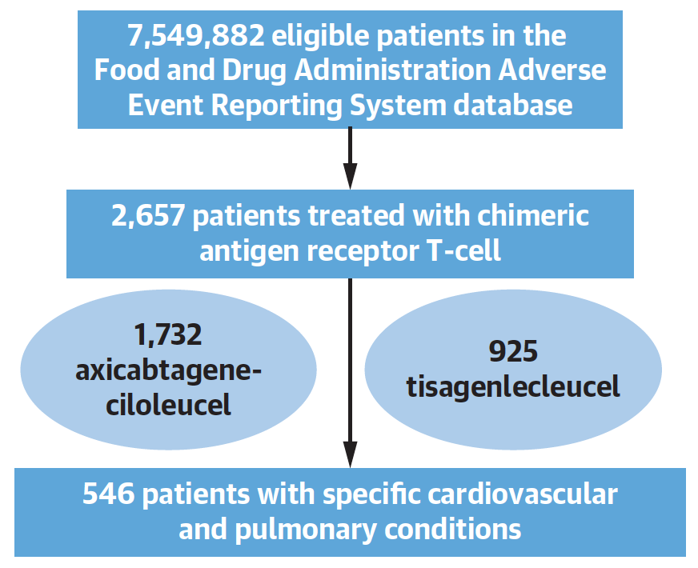
Cardiovascular and Pulmonary Toxicities of CAR T-Cell Therapy
Goldman A et al. J Am Coll Cardiol 2021;78(18):1800-13.

Slide 86
Summary of Efficacy Outcomes in Pivotal Studies of CAR T-Cell Therapy for DLBCL
 | Axi-cel ZUMA-1 (N = 108 infused) | Tisagenlecleucel JULIET (N = 115 infused) | Liso-cel TRANSCEND (N = 294 infused)
Overall response rate | 74% | 52% | 73%
Complete response rate | 54% | 40% | 53%
24-month OS rate | 50.5% | 40.0% | 44.9%
Indication | DLBCL, High grade, PMBCL, tFL | DLBCL, High grade, tFL | DLBCL, HGBCL, PMBCL, tFL, tIND
Westin JR et al. Am J Hematol 2021;[Online ahead of print].

Slide 87
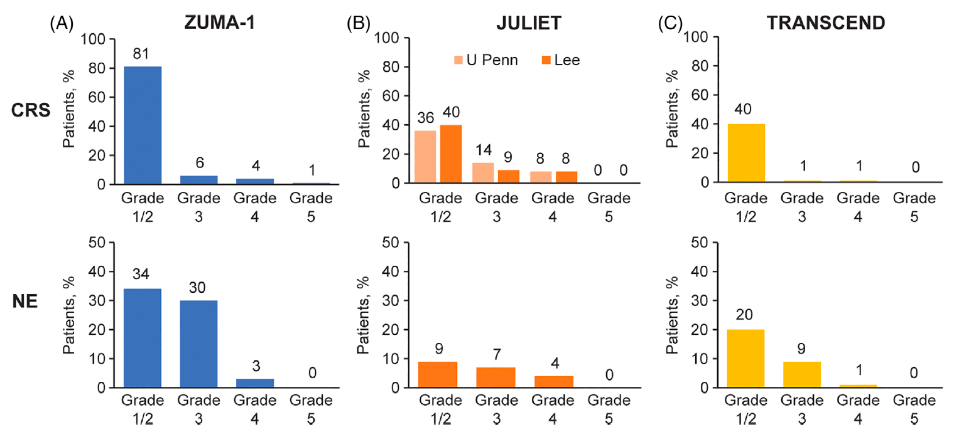
Cytokine Release Syndrome and Neurologic Events in Pivotal Studies of CAR T-Cell Therapy for DLBCL
Westin JR et al. Am J Hematol 2021;[Online ahead of print].

Slide 88
CAR-T-Associated Cytokine Release Syndrome (CRS) and Neurologic Toxicity
CRS — May be mild or life-threatening
Occurs with CART19 activation and expansion
Dramatic cytokine elevations (IL-6, IL10, IFNɤ, CRP, ferritin)
Fevers initially (can be quite high: 105˚F)
Myalgias, fatigue, nausea/anorexia
Capillary leak, headache, hypoxia and hypotension
CRS-related mortality 3% to 10%
Neurologic toxicity — May be mild or life-threatening
Mechanism unclear, referred to as immune effector cell-associated neurotoxicity syndrome (ICANS)
Encephalopathy
Seizures
Delirium, confusion, aphasia, agitation, sedation, coma
Varadarajan I, Lee DW. Cancer J 2019;25(3):223‐30.
Abramson JS et al. ASCO 2019 Education Book.

Slide 89
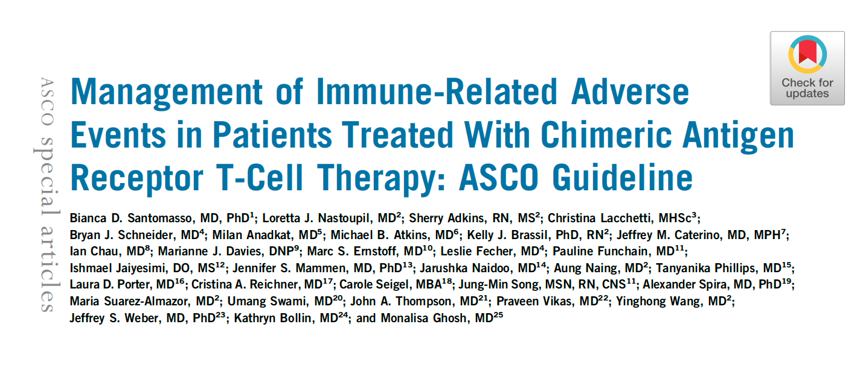
J Clin Oncol 2021;39:3978-92

Slide 90
ASH 2021;Abstract 525.

Slide 91
Phase Ib/II Study of Glofitamab Combined with Polatuzumab Vedotin for R/R DLBCL
Response rate (%)
Safety profile of the combination was consistent with that of the individual drugs
Majority of CRS events were Gr 1 and occurred after first dose of glofitamab (no Gr 3/4 cases)
One Gr 1 ICANS AE was reported
Hutchings M et al. ASH 2021;Abstract 525.

Slide 92
Hodgkin Lymphoma

Slide 93
Regulatory and reimbursement issues aside, in general, what would be your preferred bridge to transplant for a patient with HL who is experiencing disease relapse after up-front ABVD?
Ifosfamide/ carboplatin/etoposide
Ifosfamide/ carboplatin/etoposide
Brentuximab vedotin + nivolumab
Ifosfamide/ carboplatin/etoposide
Ifosfamide/ carboplatin/etoposide
Pembrolizumab + GVD
Brentuximab vedotin + nivolumab
Brentuximab vedotin + nivolumab
GND = gemcitabine/vinorelbine/liposomal doxorubicin

Slide 94
What initial treatment would you recommend for a 26-year-old patient with classical Hodgkin lymphoma (HL) with anemia, diffuse adenopathy, hepatosplenomegaly and diffuse bone marrow involvement?
Brentuximab vedotin + AVD
ABVD
Brentuximab vedotin + AVD
Brentuximab vedotin + AVD
Brentuximab vedotin + AVD
Brentuximab vedotin + AVD
Brentuximab vedotin + AVD
Brentuximab vedotin + AVD
A = doxorubicin; V = vinblastine; D = dacarbazine; B = bleomycin

Slide 95
An 85-year-old frail patient with advanced-stage symptomatic HL is not a candidate for aggressive chemotherapy but is seeking active treatment. Regulatory and reimbursement issues aside, what would you recommend?
Brentuximab vedotin + nivolumab
Brentuximab vedotin
Brentuximab vedotin/ dacarbazine
Pembrolizumab
Brentuximab vedotin + nivolumab
Brentuximab vedotin + nivolumab
Brentuximab vedotin + nivolumab
Brentuximab vedotin

Slide 96
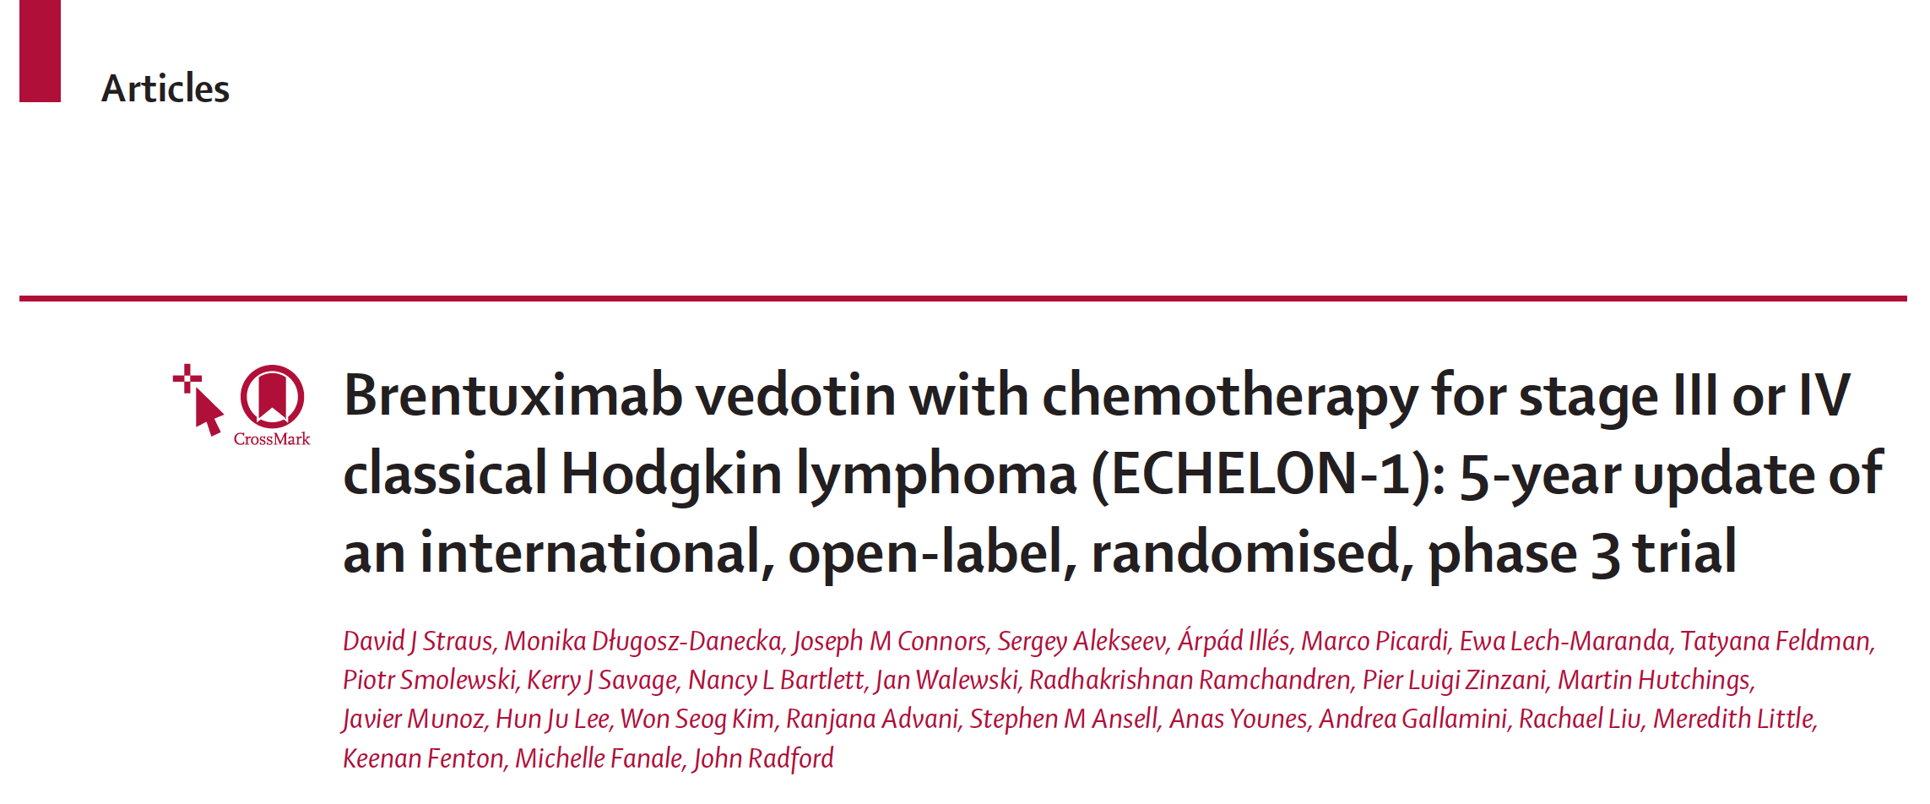
Lancet Haematol 2021;8(6):e410-21

Slide 97
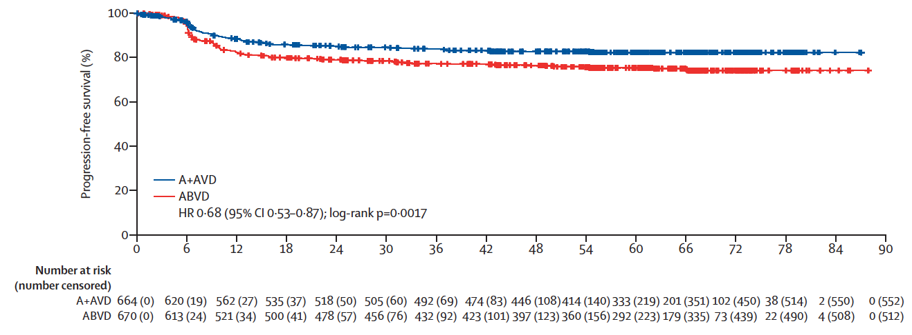
ECHELON-1: Five-Year Update
5-Yr PFS Rate
A + AVD 82.2%
ABVD 75.3%
Five-year PFS was higher with A + AVD than with ABVD for both PET-2-negative and positive patients
Peripheral neuropathy continued to improve or resolve over time with both A + AVD and ABVD; more patients had ongoing peripheral neuropathy in the A + AVD group than in the ABVD group (19% vs 9%).
Straus DJ et al. Lancet Haematol 2021;8(6):e410-21.

Slide 98
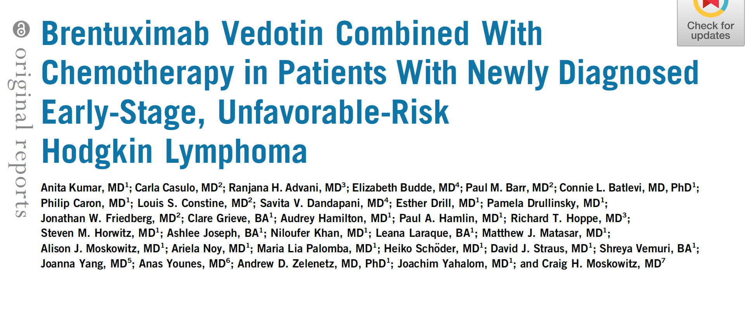
J Clin Oncol 2021;[Online ahead of print].

Slide 99
Multicenter Pilot Study of BV + AVD with or without Consolidative Radiation Therapy for Early-Stage, Unfavorable-Risk Hodgkin Lymphoma
Patients who achieved a negative end-of-therapy (EOT) PET-4 scan after 4 cycles of BV + AVD were studied with de-escalating radiation dose and field
Clinical endpoint | Cohort 1 30-Gy ISRT (n = 29) | Cohort 2 20-Gy ISRT (n = 29) | Cohort 3 30-Gy CVRT (n = 29) | Cohort 4 No radiation (n = 29) | All patients (n = 114)
EOT CR rate | 27 (93%) | 29 (100%) | 27 (93%) | 28 (97%) | 111 (96%)
2-year PFS rate | 93.1% | 96.6% | 89.7% | 96.6% | 94%
“BV + AVD x four cycles is a highly active and well-tolerated treatment program for ES, unfavorable-risk Hodgkin lymphoma, including bulky disease. The efficacy of BV + AVD supports the safe reduction or elimination of consolidative radiation among PET-4–negative patients.”
Kumar A et al. J Clin Oncol 2021;[Online ahead of print].

Slide 100
Frontline Brentuximab Vedotin as Monotherapy or in Combination for Older Hodgkin Lymphoma Patients
Yasenchak CA et al. ASH 2020;Abstract 471.

Slide 101
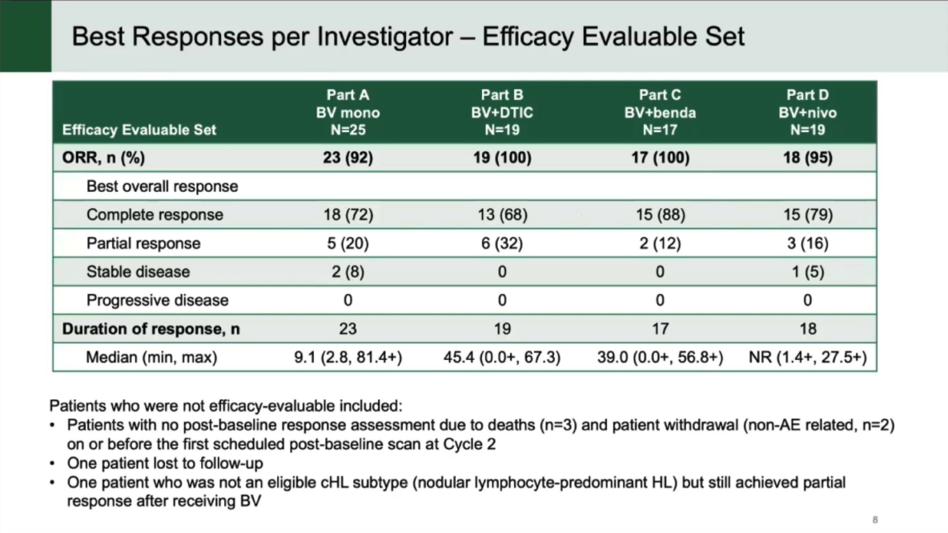
Yasenchak CA et al. ASH 2020;Abstract 471.

Slide 102
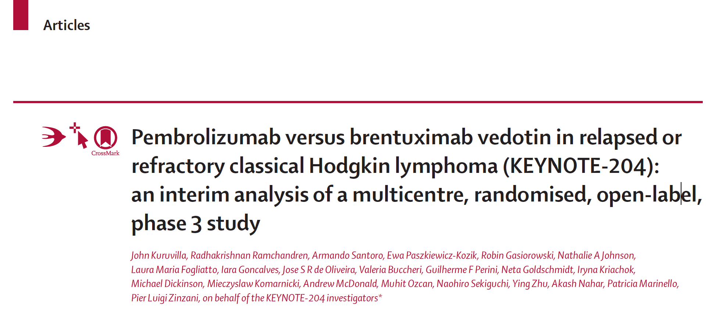
Lancet Oncol 2021;22(4):512-24.

Slide 103
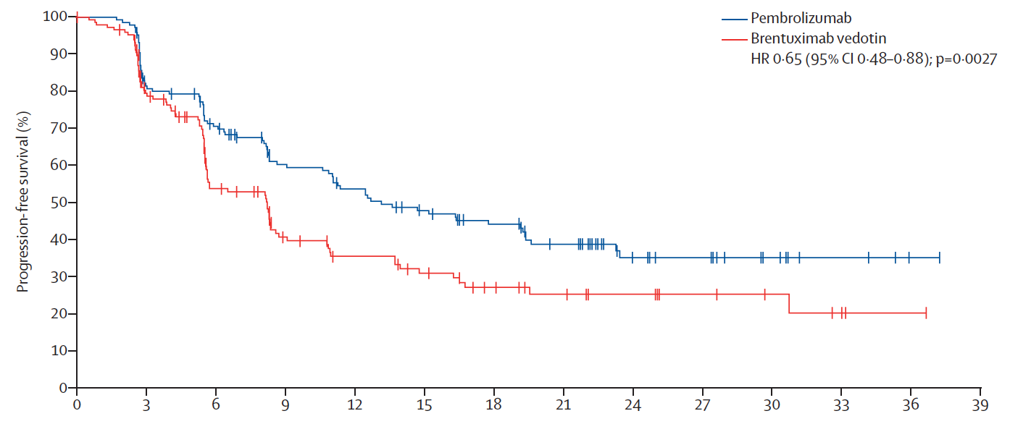
KEYNOTE-204: Interim Analysis
(n=151)
(n=153)
Median PFS: 13.2 mo
Median PFS: 8.3 mo
The most common Grade 3-5 TRAEs in the pembrolizumab and brentuximab vedotin study arms included pneumonitis (4% vs 1%), neutropenia (2% vs 7%), and peripheral neuropathy (1% vs 3%).
Serious TRAEs occurred in 16% of patients receiving pembrolizumab and 11% of patients receiving brentuximab vedotin.
Kuruvilla J et al. Lancet Oncol 2021;22(4):512-24.

Slide 104
J Clin Oncol 2020;38(32):3794-804.
and

Slide 105
Anti-CD30 CAR T-Cell Therapy After Lymphodepletion Regimens for R/R Hodgkin Lymphoma (HL)
Two parallel Phase I/II studies (NCT02690545 and NCT02917083) at 2 independent centers involving patients with relapsed or refractory HL
Anti-CD30 CAR T cells were administered after lymphodepletion with either bendamustine alone, bendamustine and fludarabine or cyclophosphamide and fludarabine
Cytokine release syndrome was observed in 10 patients, all of which were Grade 1. No neurologic toxicity was observed
Ramos CA et al. J Clin Oncol 2020;38(32):3794-804.

Slide 106
Preliminary Results of a Phase 2 Study of Camidanlumab Tesirine (Cami), a Novel Pyrrolobenzodiazepine-Based Antibody-Drug Conjugate, in Patients with Relapsed or Refractory Hodgkin Lymphoma
Herrera AF et al.
ASH 2020;Abstract 2020.

Slide 107
Response to Camidanlumab Tesirine in Patients with R/R Classical Hodgkin Lymphoma
Herrera AF et al. ASH 2020;Abstract 2020.

Slide 108
Follicular Lymphoma

Slide 109
What treatment do you generally recommend for an otherwise healthy 65-year-old patient with symptomatic FL requiring treatment?
Bendamustine/ rituximab (BR)
BR
BR
BR
BR
BR
BR
BR

Slide 110
Regulatory and reimbursement issues aside, what is your usual second-line therapy for a 65-year-old patient with FL who achieves a complete response to 6 cycles of bendamustine/rituximab (BR) but then experiences disease relapse 4 years later?
Lenalidomide/ rituximab
Lenalidomide/rituximabor rituximab alone
Lenalidomide/ rituximab
or R alone
Lenalidomide/ rituximab
Lenalidomide/ rituximab
Lenalidomide/ rituximab
Lenalidomide/ obinutuzumab
Lenalidomide/ rituximab

Slide 111
What is your usual third- and fourth-line treatment for a patient with FL (EZH2 wild type) who receives first-line BR, second-line lenalidomide/rituximab and then develops disease progression?
Duvelisib → tazemetostat
Tazemetostat → umbralisib
Clin trial → tazemetostat
Tazemetostat → umbralisib
Tazemetostat → umbralisib
Umbralisib → axi-cel
Umbralisib → tazemetostat
Umbralisib → tazemetostat

Slide 112
What is your usual third- and fourth-line treatment for a patient with FL with an EZH2 mutation who receives first-line BR, second-line lenalidomide/rituximab and then develops disease progression?
Duvelisib → tazemetostat
Tazemetostat → umbralisib
Tazemetostat → umbralisib
Tazemetostat → axi-cel
Tazemetostat → umbralisib
Tazemetostat → umbralisib
Tazemetostat → umbralisib

Slide 113
Approved PI3K Inhibitors for FL: Indication and Dosing
 | Idelalisib¹ | Copanlisib² | Duvelisib³ | Umbralisib⁴
Mechanism of action | Selective PI3Kδ inhibitor | Dual inhibitor of PI3Kδ,α | Dual inhibitor of PI3Kδ,γ | Dual inhibitor of PI3Kδ and casein kinase CK1ε
Indication | Relapsed FL after at least 2 prior systemic therapies | Relapsed FL after at least 2 prior systemic therapies | R/R FL after at least 2 prior systemic therapies | R/R FL after at least 3 prior systemic therapies
Dosing | 150 mg orally, twice daily | 60 mg as a 1-hour IV infusion weekly (3 weeks on, 1 week off) | 25 mg orally, twice daily | 800 mg orally, once daily
¹ Gopal AK et al. N Engl J Med 2014;370(11):1008-18; Idelalisib package insert, January 2018.
² Dreyling M et al. J Clin Oncol 2017;35(35):3898-905; Copanlisib package insert, September 2017.
³ Flinn IW et al. J Clin Oncol 2019;[Epub ahead of print]; Zinzani PL et al. EHA 2017;Abstract S777; Duvelisib package insert, September 2018. ⁴ Umbralisib package insert, February 2021.

Slide 114
Lancet Oncol 2021;22:678-89

Slide 115
CHRONOS-3: Progression-Free Survival in R/R Indolent NHL
 | Copanlisib + rituximab | Placebo + rituximab | HR | p-value
Median PFS | 21.5 mo | 13.8 mo | 0.52 | <0.0001
Matasar MJ et al. Lancet Oncol 2021;22:678-89.

Slide 116
FDA Grants Accelerated Approval to Umbralisib for Marginal Zone Lymphoma and Follicular Lymphoma Press Release – February 5, 2021
“The Food and Drug Administration granted accelerated approval to umbralisib, a kinase inhibitor including PI3K-delta and casein kinase CK1-epsilon, for the following indications:
Adult patients with relapsed or refractory marginal zone lymphoma (MZL) who have received at least one prior anti-CD20-based regimen;
Adult patients with relapsed or refractory follicular lymphoma (FL) who have received at least three prior lines of systemic therapy.
Approval was based on two single-arm cohorts of an open-label, multi-center, multi-cohort trial, UTX-TGR-205 (NCT02793583), in 69 patients with MZL who received at least one prior therapy, including an anti-CD20 containing regimen, and in 117 patients with FL after at least 2 prior systemic therapies. Patients received umbralisib 800 mg orally once daily until disease progression or unacceptable toxicity.”
www.fda.gov/drugs/resources-information-approved-drugs/fda-grants-accelerated-approval-umbralisib-marginal-zone-lymphoma-and-follicular-lymphoma

Slide 117
J Clin Oncol 2021;39:1609-18

Slide 118
Umbralisib for Heavily Pretreated R/R Indolent NHL
ORR (FL cohort; N = 117): 45.3%
Median PFS (FL cohort): 10.6 mo
Fowler NH et al. J Clin Oncol 2021;39:1609-18.

Slide 119
Lancet Oncol 2020;21:1433-42

Slide 120
Response to Tazemetostat in Patients with R/R FL and EZH2- Mutated or EZH2 Wild-Type Tumors
EZH2^{mut}
ORR: 69%
EZH2^{WT}
ORR: 35%
Morschhauser F et al. Lancet Oncol 2020;21:1433-42.

Slide 121
Structure of Selected Bispecific Antibodies
Schuster SJ. Hematol Oncol 2021;39(S1):113-16.

Slide 122
FDA Grants Breakthrough Therapy Designation for the CD20 x CD3 Bispecific Cancer Immunotherapy Mosunetuzumab for Follicular Lymphoma Press Release — July 14, 2020
“[The] investigational CD20xCD3 T-cell engaging bispecific mosunetuzumab has been granted Breakthrough Therapy Designation (BTD) by the US Food and Drug Administration (FDA) for the treatment of adult patients with relapsed or refractory (R/R) follicular lymphoma who have received at least two prior systemic therapies.
This designation was granted based on encouraging efficacy results observed in the phase I/Ib GO29781 study [NCT02500407] investigating mosunetuzumab in R/R non-Hodgkin lymphoma (NHL). The safety profile of this T-cell engaging bispecific was consistent with its mechanism of action.”
www.roche.com/investors/updates/inv-update-2020-07-14b.htm

Slide 123
ASH 2021;Abstract 127.

Slide 124
Response to Mosunetuzumab Monotherapy in Patients with R/R FL Who Have Received ≥2 Lines of Therapy
CR: 54 patients (60%)
ORR: 72 patients (80%)
Median DoR: 22.8 months
Median PFS: 17.9 months
Budde EL et al. ASH 2021;Abstract 127.

Slide 125
Safety Profile of Mosunetuzumab Monotherapy for Patients with R/R FL Who Have Received ≥2 Lines of Therapy
Budde EL et al. ASH 2021;Abstract 127.

Slide 126
J Clin Oncol 2021;39:1959-70.

Slide 127
Response to Glofitamab in Patients with R/R B-Cell Lymphomas
ORR (transformed FL, N = 29): 55.2%
ORR (Grade 1-3A FL, N = 44): 70.5%
Hutchings M et al. J Clin Oncol 2021;39:1959-70.

Slide 128
ASH 2021;Abstract 128.

Slide 129
Phase I/II Study of Glofitamab as Monotherapy or in Combination with Obinutuzumab for R/R FL
Myelosuppression was more common with the combination
CRS rates were high and comparable, and cases were mainly low grade
Morschhauser F et al. ASH 2021;Abstract 128.

Slide 130
FDA Grants Accelerated Approval to Axicabtagene Ciloleucel for Relapsed or Refractory Follicular Lymphoma Press Release – March 5, 2021
“The Food and Drug Administration granted accelerated approval to axicabtagene ciloleucel for adult patients with relapsed or refractory follicular lymphoma (FL) after two or more lines of systemic therapy.
Approval in FL was based on a single-arm, open-label, multicenter trial (ZUMA-5; NCT03105336) that evaluated axicabtagene ciloleucel, a CD19-directed chimeric antigen receptor (CAR) T cell therapy, in adult patients with relapsed or refractory FL after two or more lines of systemic therapy, including the combination of an anti-CD20 monoclonal antibody and an alkylating agent. Following lymphodepleting chemotherapy, axicabtagene ciloleucel was administered as a single intravenous infusion.”
www.fda.gov/drugs/resources-information-approved-drugs/fda-grants-accelerated-approval-axicabtagene-ciloleucel-relapsed-or-refractory-follicular-lymphoma

Slide 131
ASH 2021;Abstract 93.

Slide 132
ZUMA-5: ORR by Central Review
Neelapu SS et al. ASH 2021;Abstract 93.

Slide 133
ZUMA-5: Progression-Free and Overall Survival
Neelapu SS et al. ASH 2021;Abstract 93.

Slide 134
ZUMA-5: AEs with First Occurrence After Primary Analysis Data Cutoff
Neelapu SS et al. ASH 2021;Abstract 93.

Slide 135
Thieblemont C et al. ASH 2021;Abstract 131.

Slide 136
ELARA: Efficacy Analysis with Extended Follow-Up
Thieblemont C et al. ASH 2021;Abstract 131.

Slide 137
Mantle Cell Lymphoma

Slide 138
Multicenter Phase II ZUMA-12 Schema: First-Line Therapy
Eligibility criteria
Age ≥ 18 years
High-risk LBCL
HGBCL, with MYC and BLCL2 and/or BCL6 translocations, or
LBCL with IPI score ≥ 3 any time before enrollment
2 cycles of anti-CD20 plus anthracycline-containing regimen
Positive interim PET (DS 4 or 5)
ECOG PS score 0 or 1
Enrollment/leukapheresis
Optional nonchemotherapy bridging therapyª
Primary endpoint
CR^{b}
Key secondary endpoints
ORR
DOR
EFS
PFS
OS
Safety
CAR T cells in blood and cytokine levels in serum
Conditioning chemotherapy +
axi-cel infusion
Conditioning
Flu 30 mg/m² i.v. and Cy 500 mg/m² i.v. on Days −5, −4, and −3
Axi-cel
Single i.v. infusion of 2 × 10⁶ CAR T cells/kg on Day 0
Neelapu SS et al. ASH 2020;Abstract 405.

Slide 139
ZUMA-12: Interim Safety and Efficacy Results with Axi-cel as First-Line Treatment
ORR and CR in response-evaluable cohort (N = 27)
Safety | CRS (N = 32) | Neurologic events (N = 32)
Any grade, n (%) | 32 (100%) | 22 (69%)
Grade ≥3, n (%) | 3 (9%) | 8 (25%)
Grade 4, n (%) | 0 | 2 (6%)
Grade 5, n (%) | 0 | 0
Most common any-grade symptoms, n (%) | Pyrexia: 32 (100%) Chills: 8 (25%) Hypotension: 8 (25%) | Encephalopathy: 10 (31%) Confusional state: 9 (28%)
Neelapu SS et al. ASH 2020;Abstract 405.

Slide 140
FDA Approves Brexucabtagene Autoleucel for Relapsed or Refractory Mantle Cell Lymphoma Press Release – July 24, 2020
“The Food and Drug Administration granted accelerated approval to brexucabtagene autoleucel, a CD19-directed genetically modified autologous T cell immunotherapy, for the treatment of adult patients with relapsed or refractory mantle cell lymphoma (MCL). Approval was based on ZUMA-2 (NCT02601313), an open-label, multicenter, single-arm trial of 74 patients with relapsed or refractory MCL who had previously received anthracycline- or bendamustine-containing chemotherapy, an anti-CD20 antibody, and a Bruton tyrosine kinase inhibitor. Patients received a single infusion of brexucabtagene autoleucel following completion of lymphodepleting chemotherapy. The primary efficacy outcome measure was objective response rate (ORR) per Lugano [2014] criteria as assessed by an independent review committee.”
www.fda.gov/drugs/resources-information-approved-drugs/fda-approves-brexucabtagene-autoleucel-relapsed-or-refractory-mantle-cell-lymphoma

Slide 141
N Engl J Med 2020;382(14):1331-42

Slide 142
ZUMA-2: Response Rates, Survival and Select Safety Outcomes with Brexucabtagene Autoleucel for Mantle Cell Lymphoma
Survival and Safety Outcomes
12-mos PFS | 61%
12-mos OS | 83%
≥Grade 3 CRS | 15%
≥Grade 3 Neurologic events | 31%
Wang M et al. N Engl J Med 2020;382(14):1331-42.

