Slide 1
Meet The Professor Current and Future Management of Chronic Lymphocytic Leukemia
Peter Hillmen, MB ChB, PhD Professor of Experimental Haematology University of Leeds Honorary Consultant Haematologist Leeds Teaching Hospitals NHS Trust Leeds, United Kingdom

Slide 2
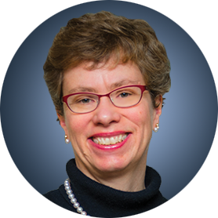
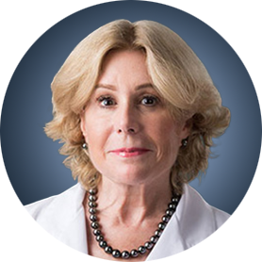
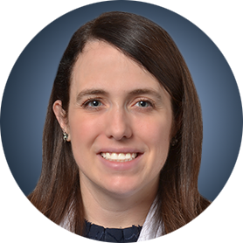
Meet The Professor Program Participating Faculty
Jennifer R Brown, MD, PhD CLL Center Director and Institute Physician Dana-Farber Cancer Institute Worthington and Margaret Collette Professor of Medicine in the Field of Hematologic Oncology Harvard Medical School Boston, Massachusetts
Susan O’Brien, MD Professor, Division of Hematology/Oncology School of Medicine UCI Chao Family Comprehensive Cancer Center Orange, California
Peter Hillmen, MB ChB, PhD Professor of Experimental Haematology University of Leeds Honorary Consultant Haematologist Leeds Teaching Hospitals NHS Trust Leeds, United Kingdom
Kerry Rogers, MD Assistant Professor in the Division of Hematology The Ohio State University Columbus, Ohio

Slide 3
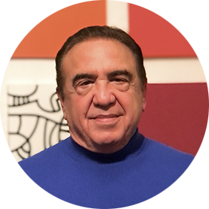
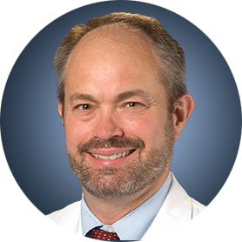
Meet The Professor Program Participating Faculty
Jeff Sharman, MD
Medical Director of Hematology Research
US Oncology Network
Willamette Valley Cancer Institute and Research Center
Eugene, Oregon
Moderator
Neil Love, MD Research To Practice
William G Wierda, MD, PhD DB Lane Cancer Research Distinguished Professor Section Chief, Chronic Lymphocytic Leukemia Center Medical Director Department of Leukemia, Division of Cancer Medicine Executive Medical Director, Inpatient Medical Services The University of Texas MD Anderson Cancer Center Houston, Texas

Slide 4
Commercial Support
This activity is supported by educational grants from AstraZeneca Pharmaceuticals LP, Genentech, a member of the Roche Group, and Pharmacyclics LLC, an AbbVie Company and Janssen Biotech Inc, administered by Janssen Scientific Affairs LLC.
Research To Practice CME Planning Committee Members, Staff and Reviewers
Planners, scientific staff and independent reviewers for Research To Practice have no relevant conflicts of interest to disclose.

Slide 5
Prof Hillmen — Disclosures
Advisory Committee | AbbVie Inc, Apellis, AstraZeneca Pharmaceuticals LP, BeiGene Ltd, Janssen Biotech Inc, Sobi
Consulting Agreements | AbbVie Inc, Apellis, AstraZeneca Pharmaceuticals LP, Janssen Biotech Inc, Sobi
Contracted Research | AbbVie Inc, Apellis, Janssen Biotech Inc, Pharmacyclics LLC, an AbbVie Company, Roche Laboratories Inc
Speakers Bureau | AbbVie Inc, Apellis, AstraZeneca Pharmaceuticals LP, BeiGene Ltd, Janssen Biotech Inc, Roche Laboratories Inc, Sobi

Slide 6
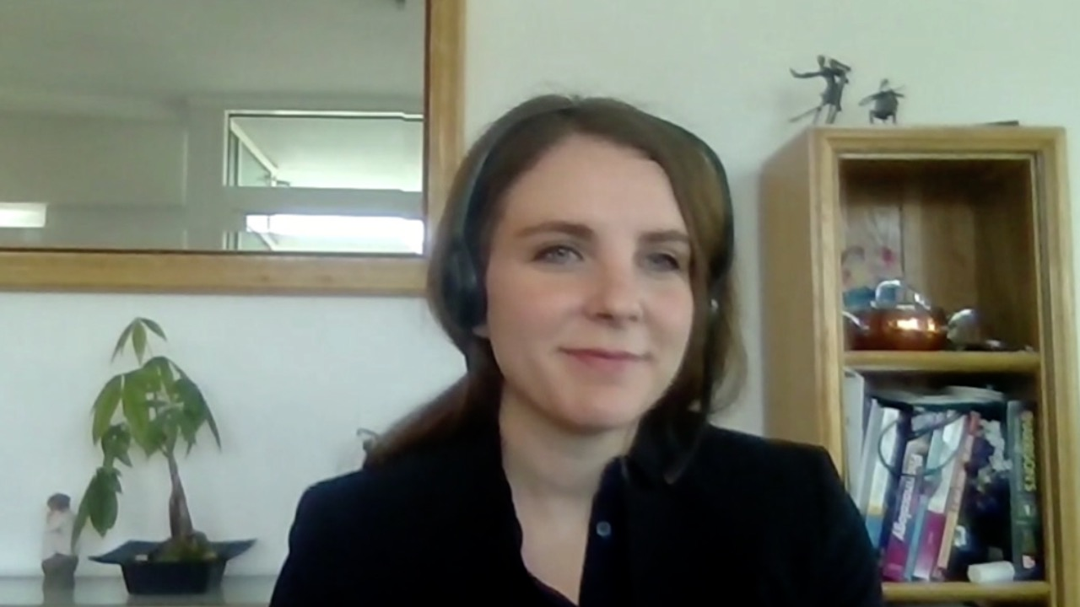
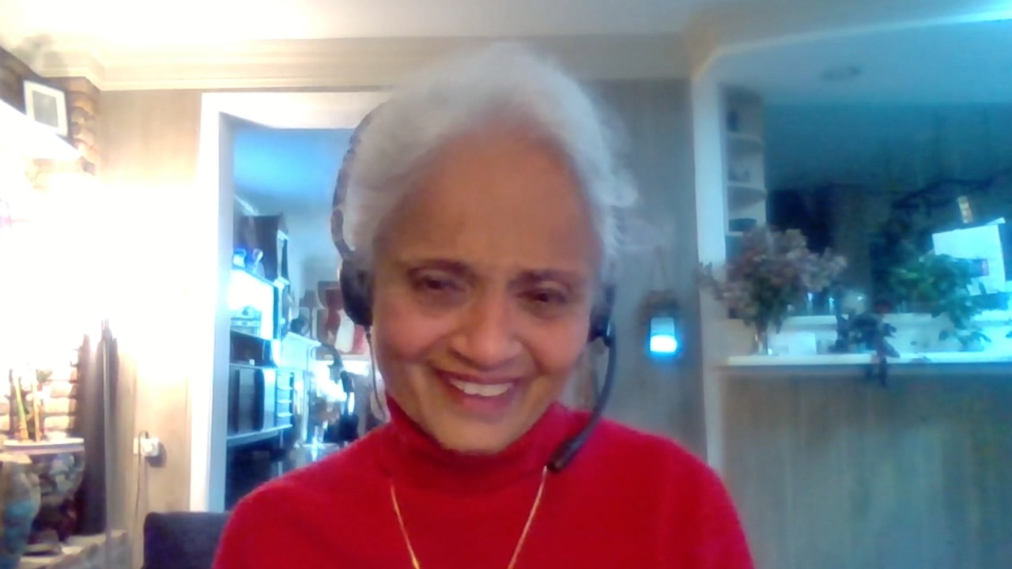
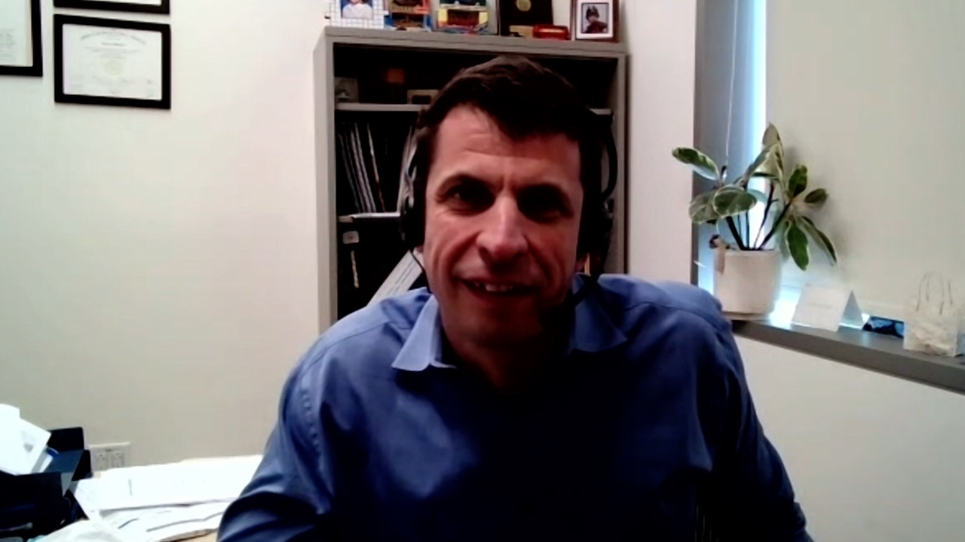
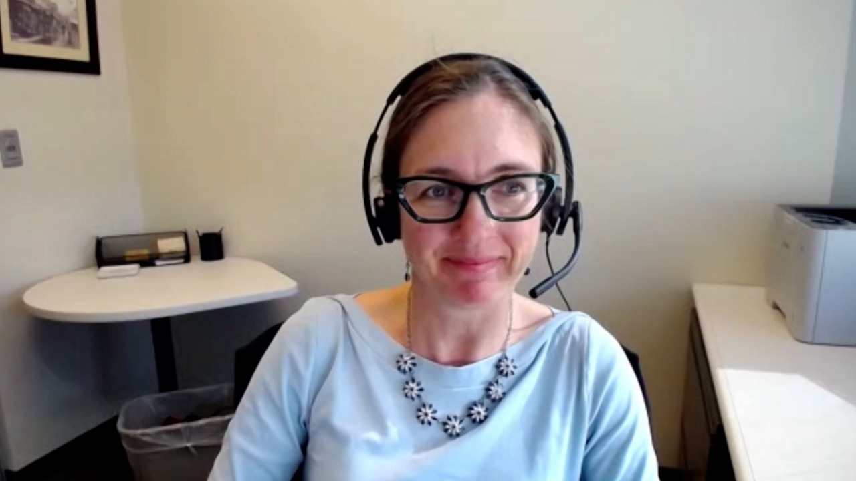
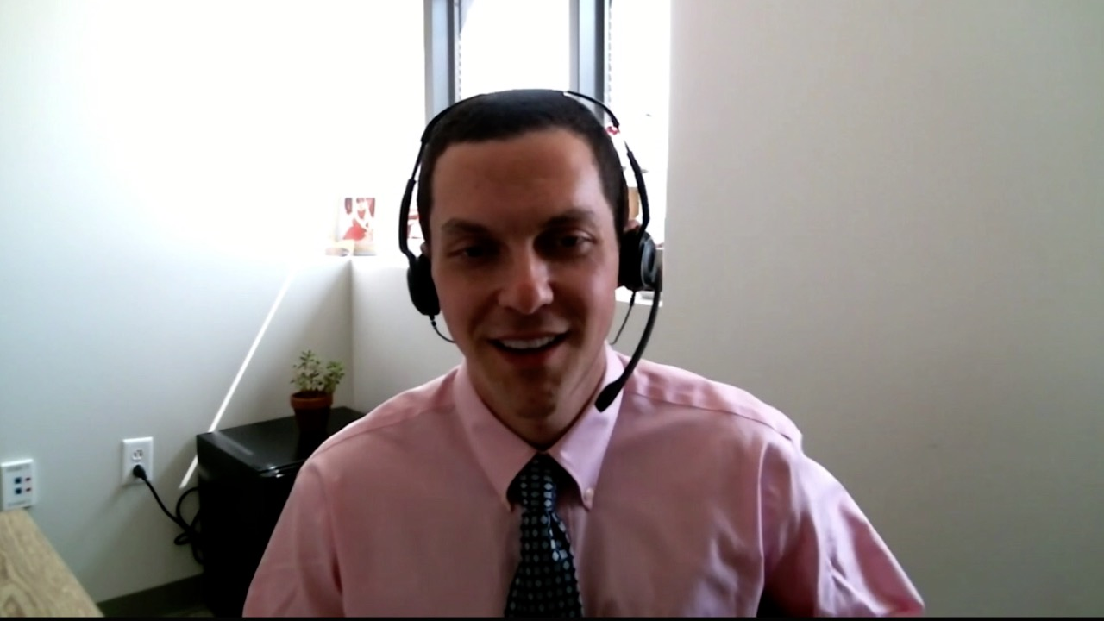
Amanda Blackmon, DO, MS
University of California, Irvine
Irvine, California
Rajalaxmi McKenna
Southwest Medical Consultants SC
Willowbrook, Illinois
Alexey V Danilov, MD, PhD
City of Hope National Medical Center
Duarte, California
Jeanne Palmer, MD
Mayo Clinic
Phoenix, Arizona
Jeremy Lorber, MD
Cedars-Sinai Medical Center
Beverly Hills, California

Slide 7
Meet The Professor with Prof Hillmen
Introduction
MODULE 1: Case Presentations
Dr Blackmon: A 60-year-old man with CLL and Richter’s transformation to Hodgkin lymphoma
Dr Palmer: A 76-year-old man with relapsed CLL after 3 years of second-line ibrutinib
Dr Danilov: A 52-year-old man with newly diagnosed IGHV-unmutated CLL — Del(17p), TP53 mutation
Dr McKenna: A 53-year-old woman who presents with persistent lymphocytosis
Dr Blackmon: A 58-year-old man with CLL who receives FCR and remains in complete remission 5 years later
Dr Danilov: A 71-year-old man with relapsed CLL who is concerned about contracting COVID-19
MODULE 2: Journal Club with Prof Hillmen
MODULE 3: Faculty Survey
MODULE 4: Key Recent Data Sets

Slide 8
Meet The Professor with Prof Hillmen
Introduction
MODULE 1: Case Presentations
Dr Blackmon: A 60-year-old man with CLL and Richter’s transformation to Hodgkin lymphoma
Dr Palmer: A 76-year-old man with relapsed CLL after 3 years of second-line ibrutinib
Dr Danilov: A 52-year-old man with newly diagnosed IGHV-unmutated CLL — Del(17p), TP53 mutation
Dr McKenna: A 53-year-old woman who presents with persistent lymphocytosis
Dr Blackmon: A 58-year-old man with CLL who receives FCR and remains in complete remission 5 years later
Dr Danilov: A 71-year-old man with relapsed CLL who is concerned about contracting COVID-19
MODULE 2: Journal Club with Prof Hillmen
MODULE 3: Faculty Survey
MODULE 4: Key Recent Data Sets

Slide 10
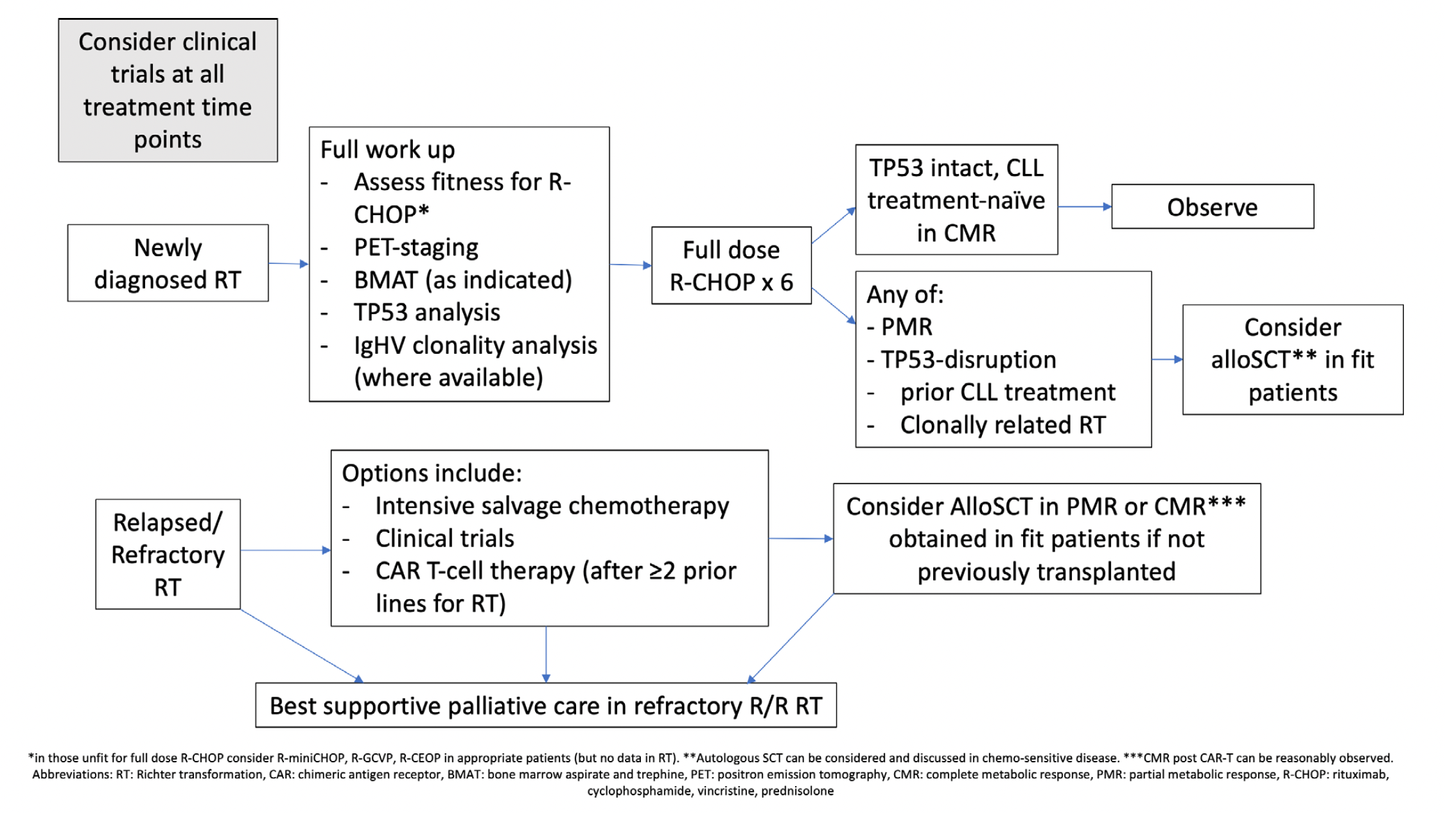
Richter's Transformation of CLL
Eyre et al British Journal of Haematology 2022;196:864-70.

Slide 11
Meet The Professor with Prof Hillmen
Introduction
MODULE 1: Case Presentations
Dr Blackmon: A 60-year-old man with CLL and Richter’s transformation to Hodgkin lymphoma
Dr Palmer: A 76-year-old man with relapsed CLL after 3 years of second-line ibrutinib
Dr Danilov: A 52-year-old man with newly diagnosed IGHV-unmutated CLL — Del(17p), TP53 mutation
Dr McKenna: A 53-year-old woman who presents with persistent lymphocytosis
Dr Blackmon: A 58-year-old man with CLL who receives FCR and remains in complete remission 5 years later
Dr Danilov: A 71-year-old man with relapsed CLL who is concerned about contracting COVID-19
MODULE 2: Journal Club with Prof Hillmen
MODULE 3: Faculty Survey
MODULE 4: Key Recent Data Sets

Slide 12
Case Presentation: A 60-year-old man with CLL and Richter’s transformation to Hodgkin lymphoma
Dr Amanda Blackmon (Irvine, California)

Slide 13
Case Presentation: A 76-year-old man with relapsed CLL after 3 years of second-line ibrutinib
Dr Jeanne Palmer (Phoenix, Arizona)

Slide 14
Venetoclax/obinutuzumab in younger patients
Dr Jeremy Lorber (Beverly Hills, California)

Slide 15
Case Presentation: A 52-year-old man with newly diagnosed IGHV-unmutated CLL — Del(17p), TP53 mutation
Dr Alexey Danilov (Duarte, California)

Slide 16
Case Presentation: A 52-year-old man with newly diagnosed IGHV-unmutated CLL — Del(17p), TP53 mutation (continued)
Dr Alexey Danilov (Duarte, California)

Slide 17
Case Presentation: A 53-year-old woman who presents with persistent lymphocytosis
Dr Rajalaxmi McKenna (Willowbrook, Illinois)

Slide 18
Case Presentation: A 58-year-old man with CLL who receives FCR and remains in complete remission 5 years later
Dr Amanda Blackmon (Irvine, California)

Slide 19
Clinical experience with ibrutinib combined with venetoclax
Dr Alexey Danilov (Duarte, California)

Slide 20
Case Presentation: A 71-year-old man with relapsed CLL who is concerned about contracting COVID-19
Dr Alexey Danilov (Duarte, California)

Slide 21
Case Presentation: A 71-year-old man with relapsed CLL who is concerned about contracting COVID-19 (continued)
Dr Alexey Danilov (Duarte, California)

Slide 22
Approach to COVID-19 vaccinations for patients with CLL who are on active treatment
Dr Alexey Danilov (Duarte, California)

Slide 23
Meet The Professor with Prof Hillmen
Introduction
MODULE 1: Case Presentations
Dr Blackmon: A 60-year-old man with CLL and Richter’s transformation to Hodgkin lymphoma
Dr Palmer: A 76-year-old man with relapsed CLL after 3 years of second-line ibrutinib
Dr Danilov: A 52-year-old man with newly diagnosed IGHV-unmutated CLL — Del(17p), TP53 mutation
Dr McKenna: A 53-year-old woman who presents with persistent lymphocytosis
Dr Blackmon: A 58-year-old man with CLL who receives FCR and remains in complete remission 5 years later
Dr Danilov: A 71-year-old man with relapsed CLL who is concerned about contracting COVID-19
MODULE 2: Journal Club with Prof Hillmen
MODULE 3: Faculty Survey
MODULE 4: Key Recent Data Sets

Slide 24
Am J Hematol 2022;1-4.
Allsup DJ and Zucchetto A

Slide 29
Journal of The Ferrata-Storti Foundation
10.3324/haematol.2021;278901.

Slide 30
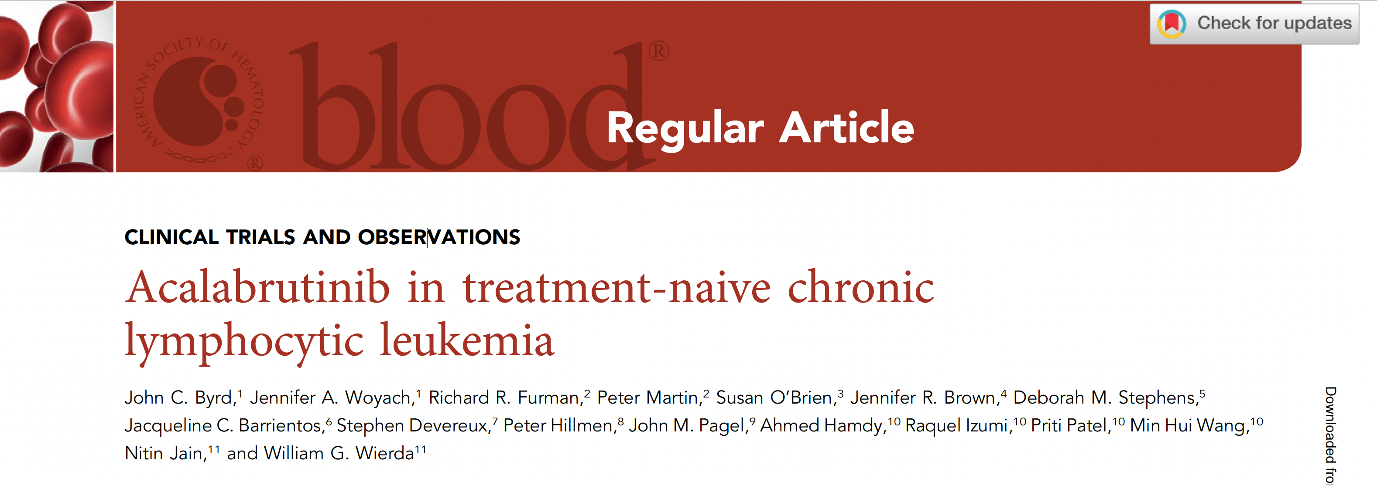
2021;137(24):3327-38.

Slide 31
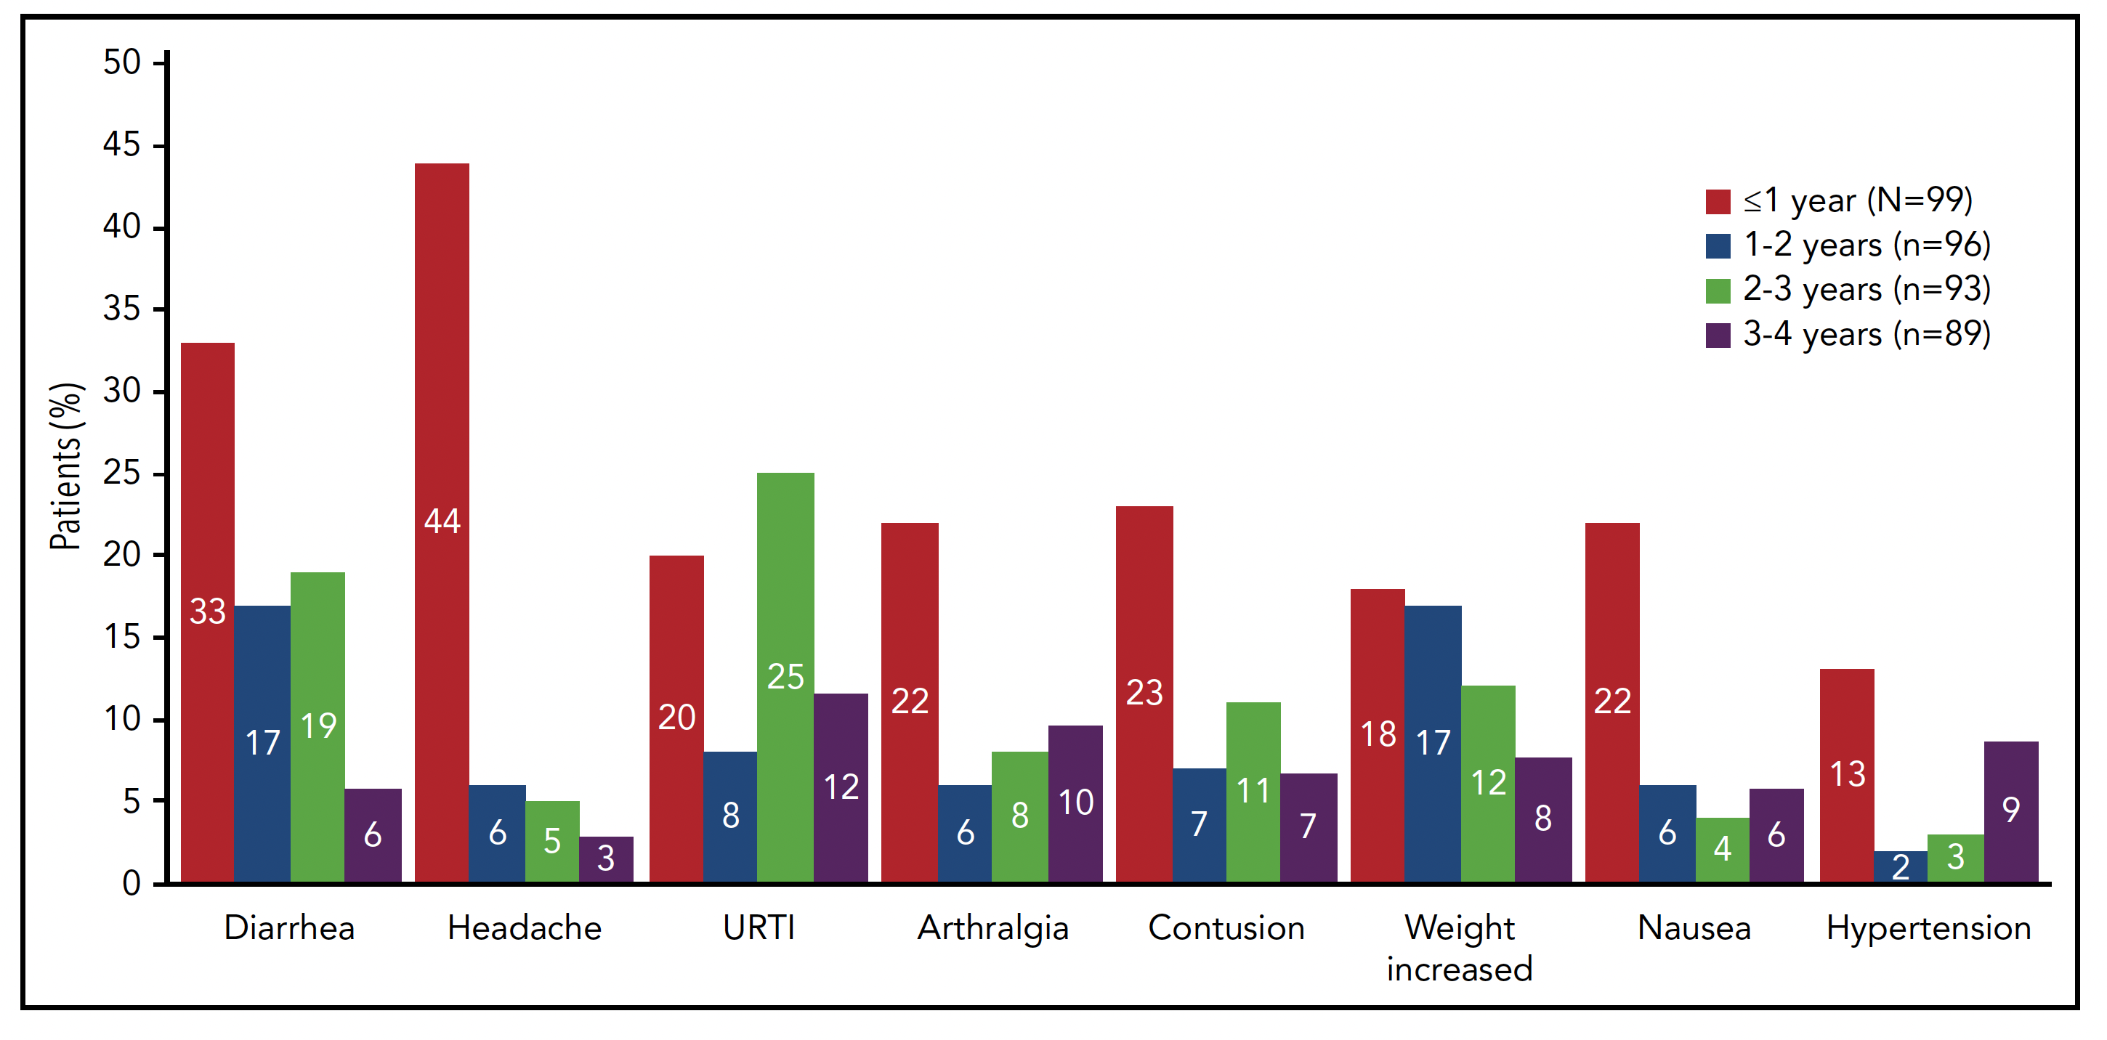
Incidence of Select Treatment-Emergent Adverse Events by Yearly Intervals
Byrd JC et al. Blood 2021;137(24):3327-38.

Slide 32
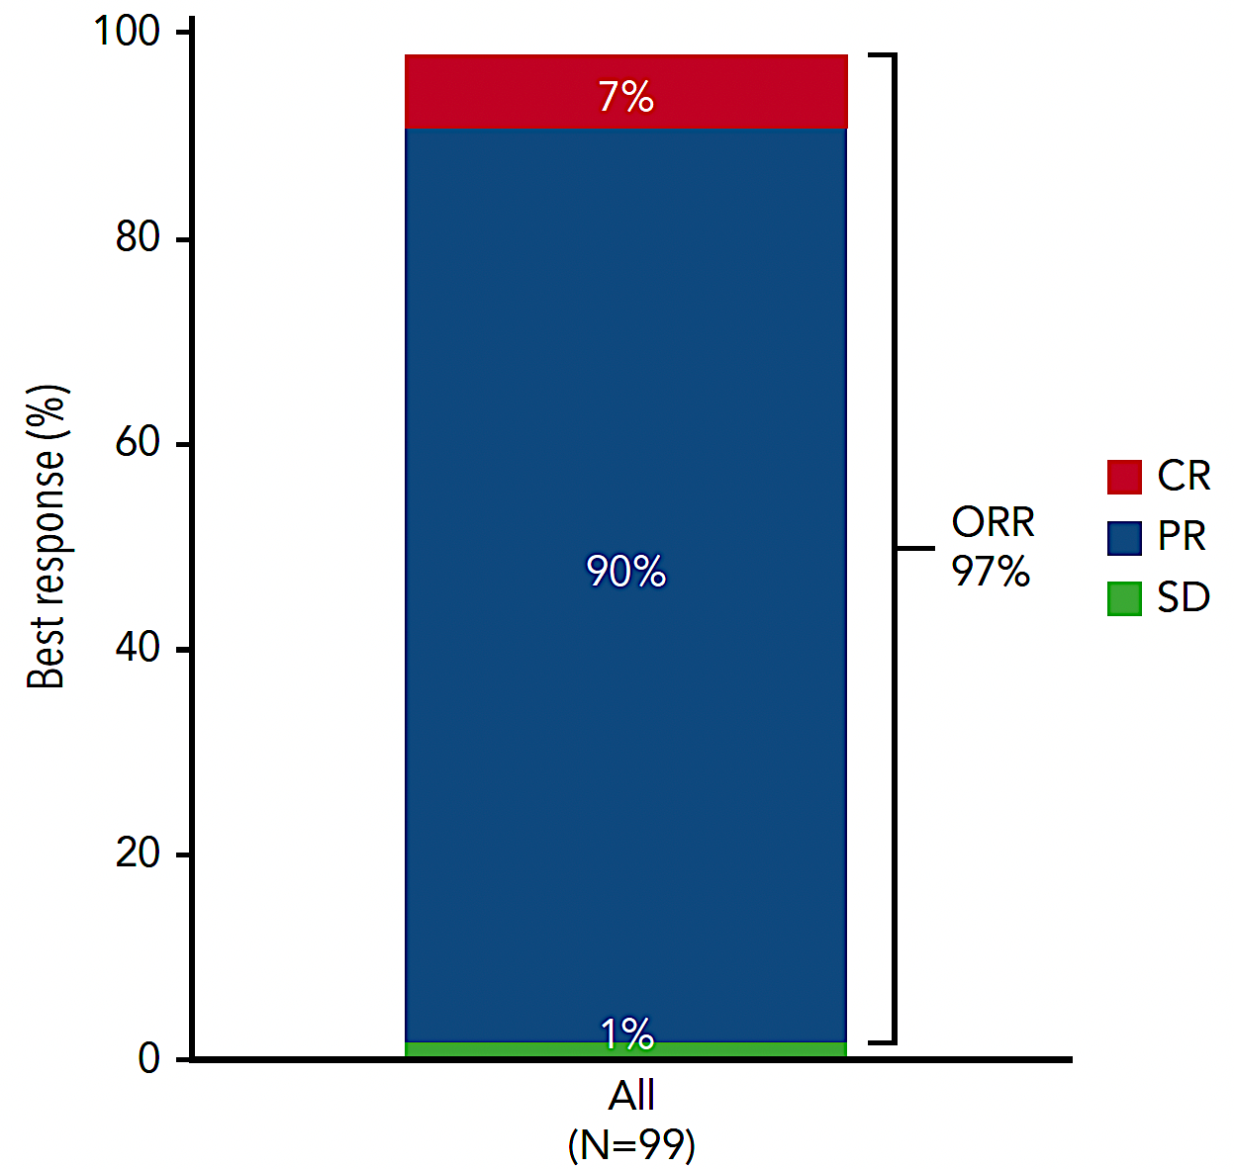
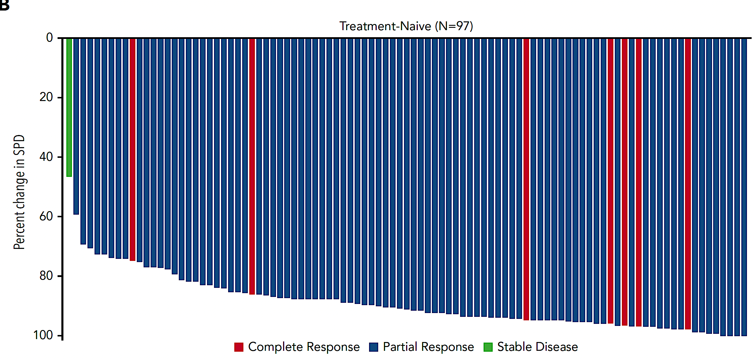
Response to Acalabrutinib and Best Change in Tumor Size
Byrd JC et al. Blood 2021;137(24):3327-38.

Slide 33
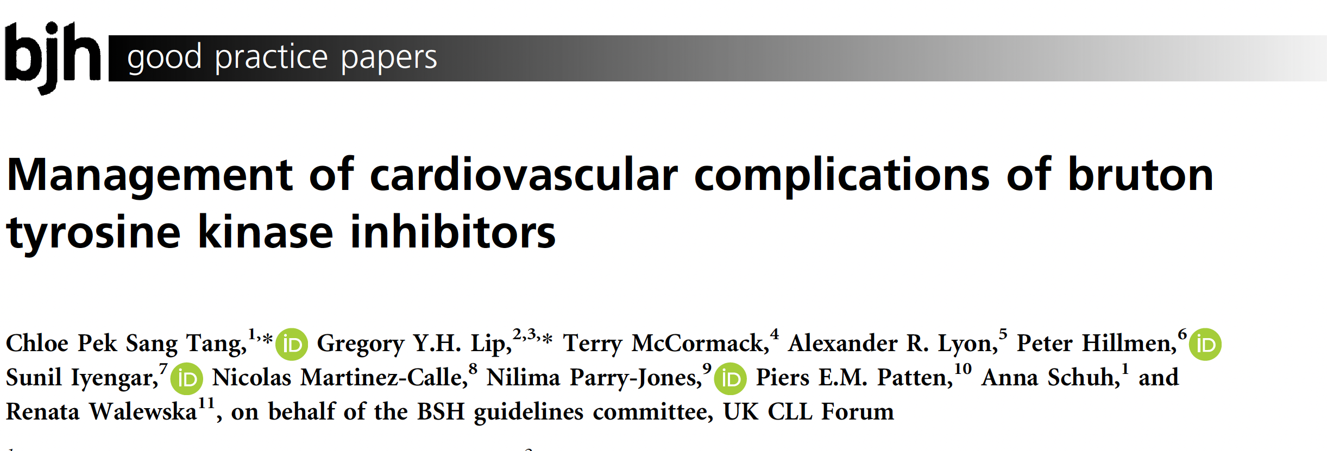
British Journal of Haematology 2022;196:70-8.

Slide 34
ASH 2021

Slide 35
Sudden or Cardiac Deaths on Ibrutinib-Based Therapy Were Associated with a Prior History of Hypertension or Cardiac Disease and the Use of ACE-Inhibitors at Study Entry: Analysis from the Phase III NCRI FLAIR Trial
Munir T et al.
ASH 2021;Abstract 2636.

Slide 36
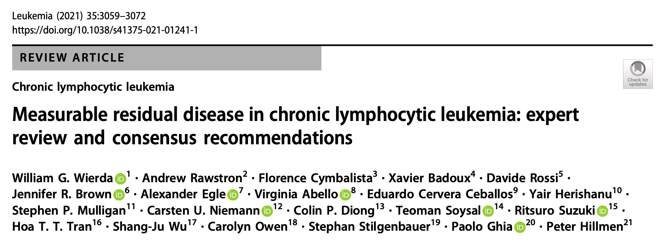

Slide 38
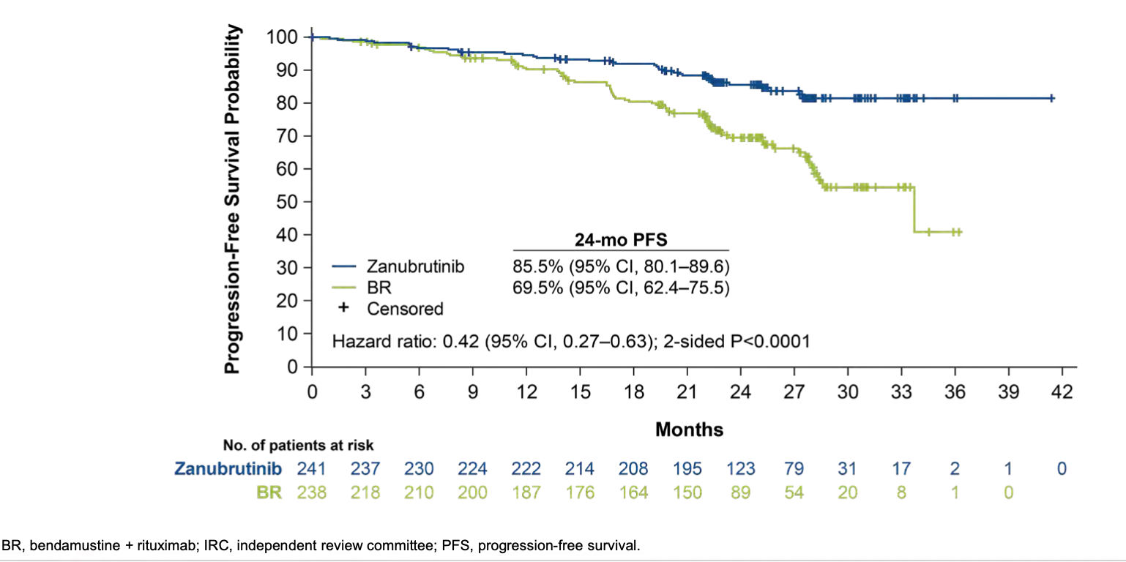
SEQUOIA: Progression-Free Survival per IRC Assessment
Tam CS et al. ASH 2021;Abstract 396.

Slide 39
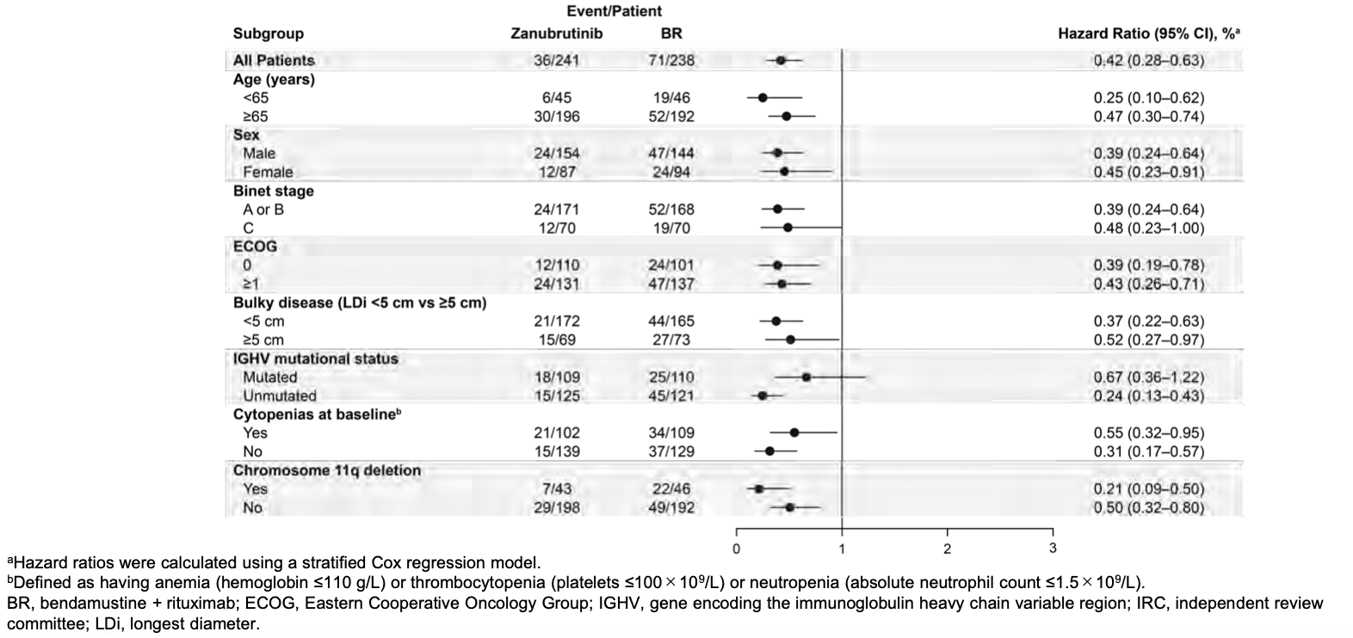
SEQUOIA: Progression-Free Survival per IRC Assessment by Key Patient Subgroup
Tam CS et al. ASH 2021;Abstract 396.

Slide 40
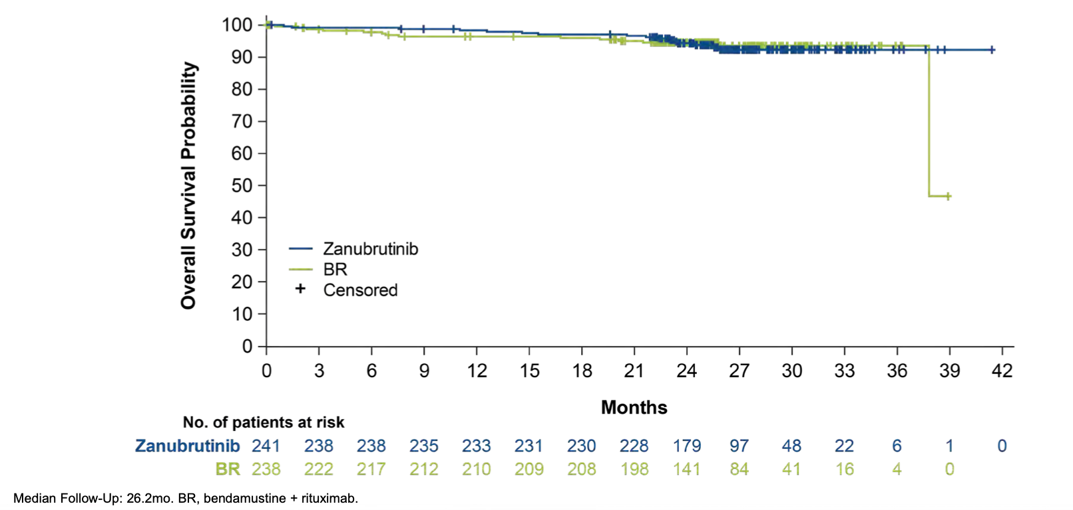
SEQUOIA: Overall Survival
Tam CS et al. ASH 2021;Abstract 396.

Slide 41
SEQUOIA: Adverse Event Summary
Tam CS et al. ASH 2021;Abstract 396.

Slide 42
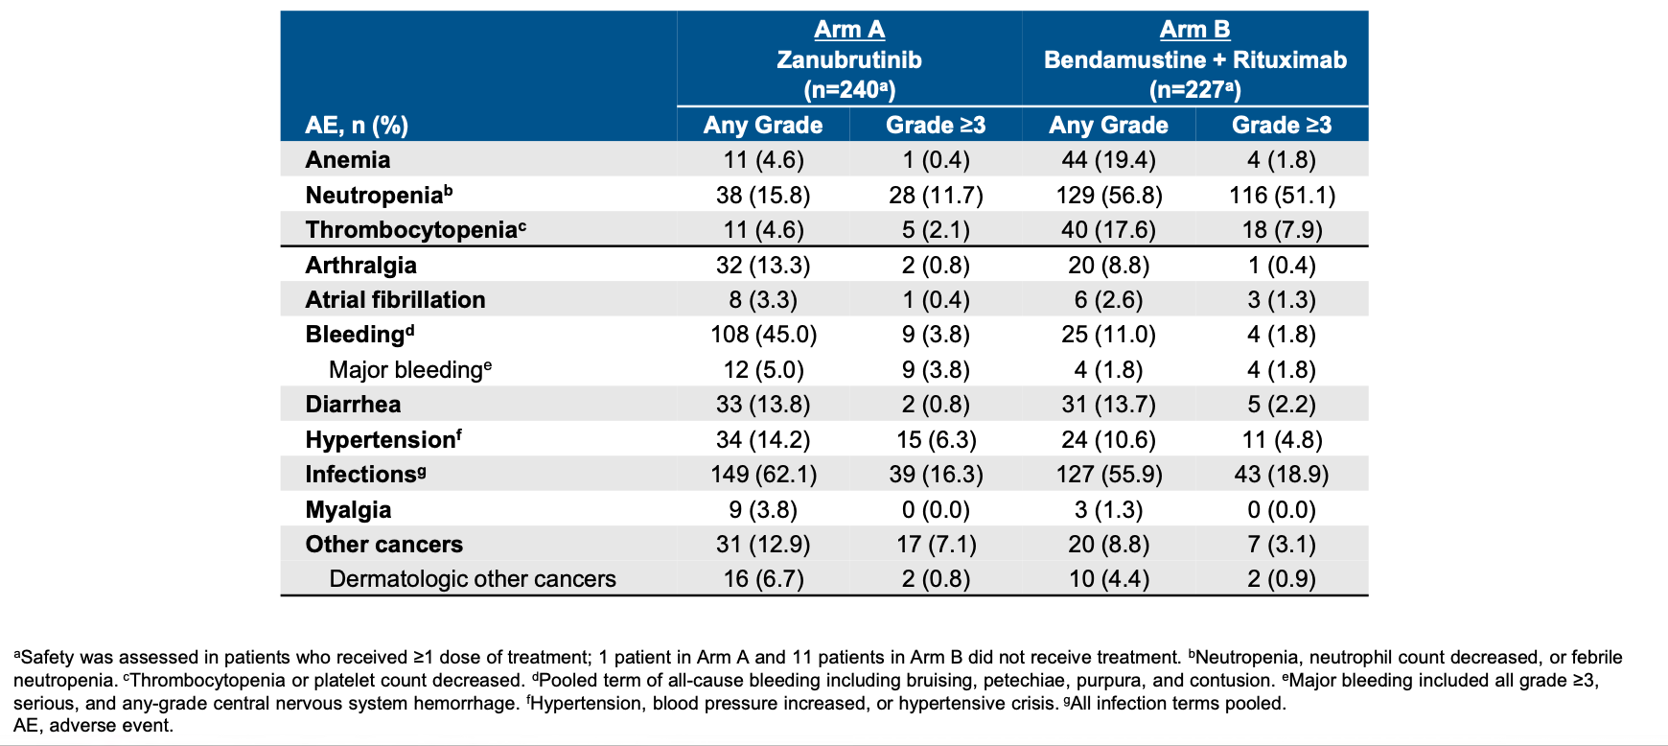
SEQUOIA: Adverse Events of Interest
Tam CS et al. ASH 2021;Abstract 396.

Slide 44
Meet The Professor with Prof Hillmen
Introduction
MODULE 1: Case Presentations
Dr Blackmon: A 60-year-old man with CLL and Richter’s transformation to Hodgkin lymphoma
Dr Palmer: A 76-year-old man with relapsed CLL after 3 years of second-line ibrutinib
Dr Danilov: A 52-year-old man with newly diagnosed IGHV-unmutated CLL — Del(17p), TP53 mutation
Dr McKenna: A 53-year-old woman who presents with persistent lymphocytosis
Dr Blackmon: A 58-year-old man with CLL who receives FCR and remains in complete remission 5 years later
Dr Danilov: A 71-year-old man with relapsed CLL who is concerned about contracting COVID-19
MODULE 2: Journal Club with Prof Hillmen
MODULE 3: Faculty Survey
MODULE 4: Key Recent Data Sets

Slide 45
In general, how if at all has the COVID-19 pandemic affected your selection of first-line therapy for patients with chronic lymphocytic leukemia (CLL) who require treatment?
I have used a BTK inhibitor more
I have used a BTK inhibitor more
It has had little to no effect
I have used a BTK inhibitor more
I have used a BTK inhibitor more
BTK = Bruton tyrosine kinase

Slide 46
For which patients with CLL are you using Evusheld™ (tixagevimab copackaged with cilgavimab) as pre-exposure prophylaxis for COVID-19?
Not available in United Kingdom
Any patient on tx in last 24 mo if neg Ab titer
All patients with CLL
All who are on tx or received tx within past year
Anyone with CLL/SLL
SLL = small lymphocytic lymphoma

Slide 47
For patients with CLL who are receiving a BTK inhibitor and contract an asymptomatic COVID-19 infection, should the BTK inhibitor generally be continued or held?
BTK inhibitor should be continued
BTK inhibitor should be held
I’m not sure

Slide 48
For patients with CLL who are receiving a BTK inhibitor and contract an asymptomatic COVID-19 infection, do you generally continue or hold the BTK inhibitor?
Continue the BTK inhibitor
Hold the BTK inhibitor
Continue the BTK inhibitor
Continue the BTK inhibitor
Continue the BTK inhibitor

Slide 49
For patients with CLL who are receiving obinutuzumab/venetoclax and contract an asymptomatic COVID-19 infection, do you generally continue or hold the treatment?
Hold obinutuzumab but continue venetoclax
Hold
Hold obinutuzumab but continue venetoclax
Continue
Hold obinutuzumab but continue venetoclax

Slide 50
What is your usual preferred initial regimen for a 60-year-old patient with CLL with IGHV mutation but no del(17p) or TP53 mutation who requires treatment?
FCR
BR (bendamustine/rituximab)
Ibrutinib
Ibrutinib + anti-CD20 antibody
Acalabrutinib
Acalabrutinib + obinutuzumab
Venetoclax + obinutuzumab
Other

Slide 51
What is your usual preferred initial regimen for a 60-year-old patient with CLL with IGHV mutation but no del(17p) or TP53 mutation who requires treatment?
Venetoclax/ obinutuzumab
Venetoclax/ obinutuzumab
Venetoclax/ obinutuzumab
Venetoclax/ obinutuzumab
Acalabrutinib or Venetoclax/ obinutuzumab

Slide 52
Regulatory and reimbursement issues aside, what is your usual preferred initial regimen for a 60-year-old patient with CLL, unmutated IGHV and no del(17p) or TP53 mutation who requires treatment?
Ibrutinib
Ibrutinib + anti-CD20 antibody
Acalabrutinib
Acalabrutinib + obinutuzumab
Zanubrutinib
Venetoclax + obinutuzumab
Venetoclax + ibrutinib
Other

Slide 53
Regulatory and reimbursement issues aside, what would be your preferred initial regimen for a 60-year-old patient with CLL, unmutated IGHV and no del(17p) or TP53 mutation who required treatment?
Venetoclax/ibrutinib
Venetoclax/ obinutuzumab
Venetoclax/ibrutinib
Venetoclax/ibrutinib
Acalabrutinib or Venetoclax/ obinutuzumab

Slide 54
What is your usual preferred initial regimen for a 60-year-old patient with CLL, IGHV mutation and del(17p) or TP53 mutation who requires treatment?
FCR
BR
Ibrutinib
Ibrutinib + anti-CD20 antibody
Acalabrutinib
Acalabrutinib + obinutuzumab
Venetoclax + obinutuzumab
Other

Slide 55
What is your usual preferred initial regimen for a 60-year-old patient with CLL and IGHV mutation and del(17p) or TP53 mutation who requires treatment?
Acalabrutinib
Acalabrutinib
Acalabrutinib
Acalabrutinib
Acalabrutinib

Slide 56
Which second-line systemic therapy would you recommend for a 60-year-old patient with CLL and unmutated IGHV without del(17p) or TP53 mutation who responds to venetoclax/obinutuzumab and then experiences disease progression 3 years after completing treatment?
Ibrutinib
Ibrutinib + anti-CD20 antibody
Acalabrutinib
Acalabrutinib + obinutuzumab
Idelalisib
Duvelisib
Venetoclax + rituximab
Other

Slide 57
Which second-line systemic therapy would you recommend for a 60-year-old patient with CLL and unmutated IGHV without del(17p) or TP53 mutation who responds to venetoclax/obinutuzumab and then experiences disease progression 3 years after completing treatment?
Acalabrutinib
Acalabrutinib
Venetoclax + rituximab
Acalabrutinib
Acalabrutinib + obinutuzumab
Re-treat with venetoclax + obinutuzumab

Slide 58
For patients with CLL who are receiving obinutuzumab/venetoclax as initial therapy, do you generally order a minimal residual disease (MRD) assay at the end of 12 months?
Yes
No

Slide 59
For patients with CLL who are receiving obinutuzumab/venetoclax as initial therapy, do you generally order a minimal residual disease (MRD) assay at the end of 12 months?
Yes
No
Yes
Yes
Yes

Slide 60
What would be your most likely approach for a patient with newly diagnosed CLL to whom you decide to administer up-front venetoclax/obinutuzumab who has detectable MRD after completing 1 year of treatment?
Continue treatment
Discontinue treatment

Slide 61
What would be your most likely approach for a patient with newly diagnosed CLL to whom you decide to administer up-front venetoclax/obinutuzumab who has detectable MRD after completing 1 year of treatment?
Discontinue treatment
Discontinue treatment
Continue treatment
Continue treatment
Discontinue treatment

Slide 62
Should community-based medical oncologists/hematologists be ordering MRD assessment in any CLL clinical situations?
Yes
No

Slide 63
Should community-based medical oncologists/hematologists be ordering MRD assessment for patients with CLL in any clinical situations?
No
No
No
Yes
Yes

Slide 64
Meet The Professor with Prof Hillmen
Introduction
MODULE 1: Case Presentations
Dr Blackmon: A 60-year-old man with CLL and Richter’s transformation to Hodgkin lymphoma
Dr Palmer: A 76-year-old man with relapsed CLL after 3 years of second-line ibrutinib
Dr Danilov: A 52-year-old man with newly diagnosed IGHV-unmutated CLL — Del(17p), TP53 mutation
Dr McKenna: A 53-year-old woman who presents with persistent lymphocytosis
Dr Blackmon: A 58-year-old man with CLL who receives FCR and remains in complete remission 5 years later
Dr Danilov: A 71-year-old man with relapsed CLL who is concerned about contracting COVID-19
MODULE 2: Journal Club with Prof Hillmen
MODULE 3: Faculty Survey
MODULE 4: Key Recent Data Sets

Slide 65
Minimal Residual Disease

Slide 66
Currently Applied Methods for MRD Assessment
Method | Sensitivity | Features | Advantages | Disadvantages
Flow cytometry
4-color flow | 10⁻⁴ | Detection of surface markers by established antibody panels | ERIC consensus guidelines available, widely accessible, relatively affordable, quantitative results relatively quick | Fresh (<48 h) PB or BM samples necessary, sufficient number of cells required to achieve sensitivity
≥6-color flow | 10⁻⁵
8-color flow | 10⁻⁶
10-color flow | 10⁻⁵
Polymerase chain reaction (PCR)
ASO PCR | 10⁻⁵ | Quantification based on allele- and pt-specific primers for hypervariable CDR3 of IgH | Good sensitivity, use of DNA (instead of fresh material), quantitative results | Pt-specific primers required, baseline reference sample necessary, relatively time and labor intensive
Next-generation sequencing
ClonoSEQ® | 10⁻⁶ | Measurement of CLL-specific IgH sequences based on consensus primers | High sensitivity, use of DNA, tracking of clones possible, quantitative results | Relatively expensive, baseline reference sample necessary, not widely used yet
Al-Sawaf O et al. Hematol Oncol Clin N Am 2021;35(4):775-91. Wierda WG et al. Leukemia 2021;35:3059-72.

Slide 67
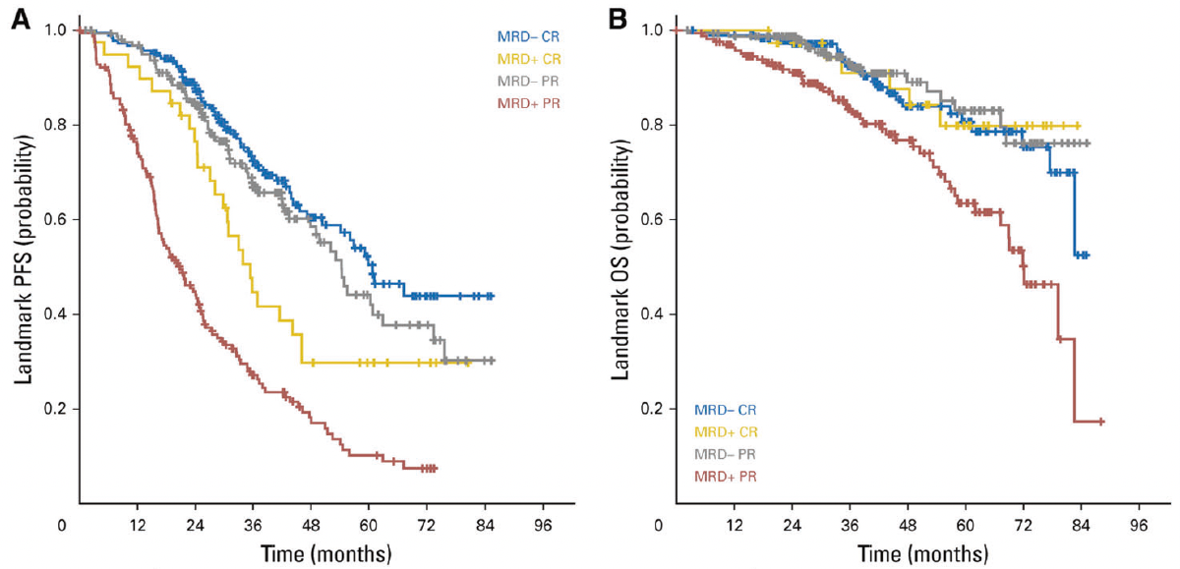
Landmark Analysis in the CLL8 and CLL10 Trials of Chemoimmunotherapy for CLL: Survival According to MRD Status
Wierda WG et al. Leukemia 2021;35:3059-72.

Slide 68
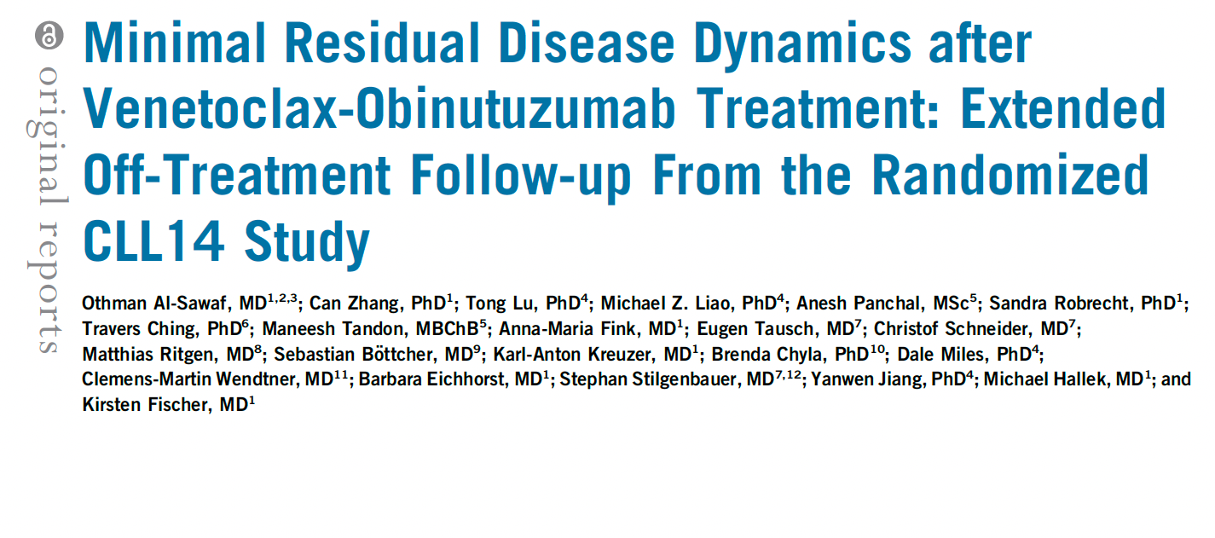
J Clin Oncol 2021;39(36):4049-60.

Slide 69
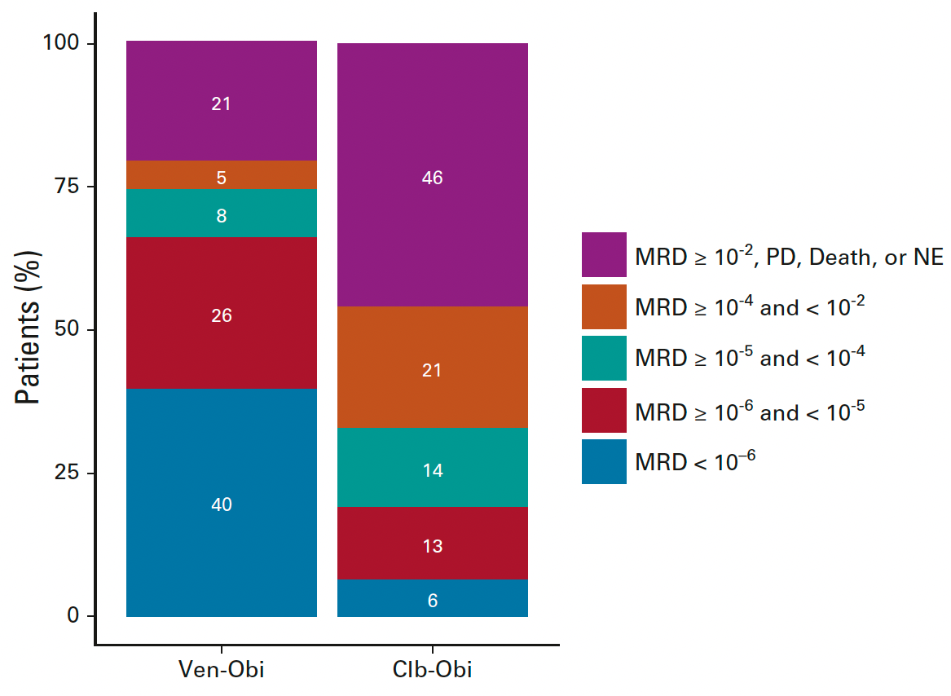
CLL14 Update: Minimum Residual Disease (MRD) Status by Next-Generation Sequencing 2 Months After Completion of Treatment
Al-Sawaf O et al. J Clin Oncol 2021;39(36):4049-60.

Slide 70
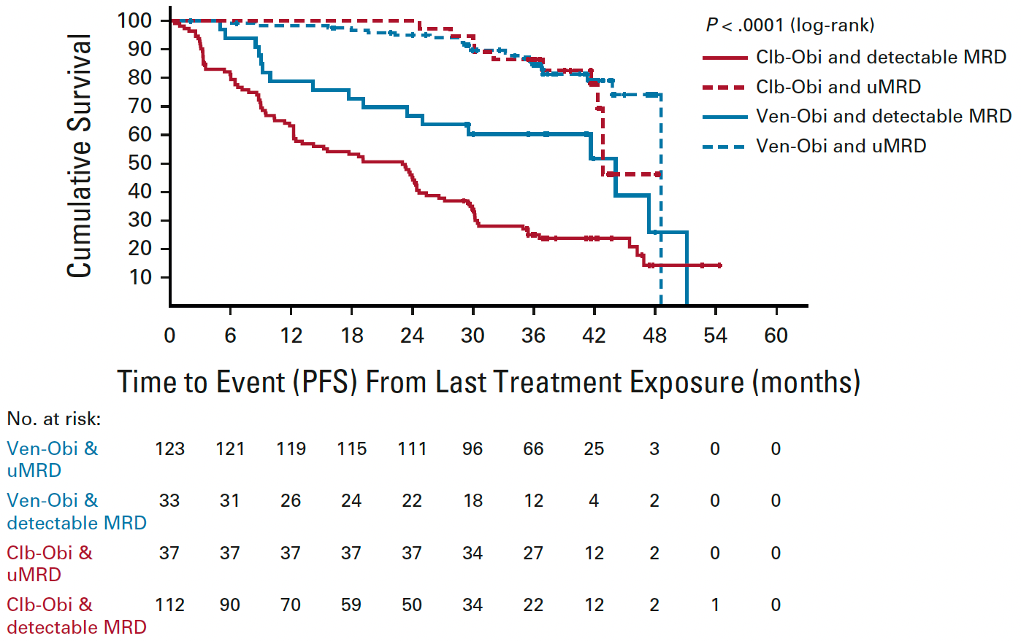
CLL14: PFS According to Bone Marrow MRD Status, from Last Treatment Exposure
Al-Sawaf O et al. J Clin Oncol 2021;39(36):4049-60.

Slide 71
Current Approach to First-Line Treatment

Slide 72
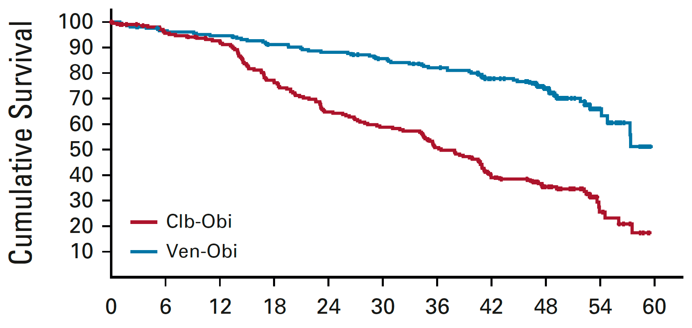
CLL14 Update: Progression-Free Survival
Median F/U: 52.4 months
PFS significantly longer for Ven-Obi in patients with TP53 aberrations and for those with and without IGHV mutations
 | Ven-Obi (n = 216) | Clb-Obi (n = 216)
Median PFS | Not reached | 36.4 mo
 | HR: 0.33, p < 0.0001
Time in Months from Randomization
Al-Sawaf O et al. J Clin Oncol 2021;39(36):4049-60.

Slide 73
Long-Term Results of Alliance A041202 Show Continued Advantage of Ibrutinib-Based Regimens Compared with Bendamustine Plus Rituximab (BR) Chemoimmunotherapy
Woyach JA et al.
ASH 2021;Abstract 639.

Slide 74
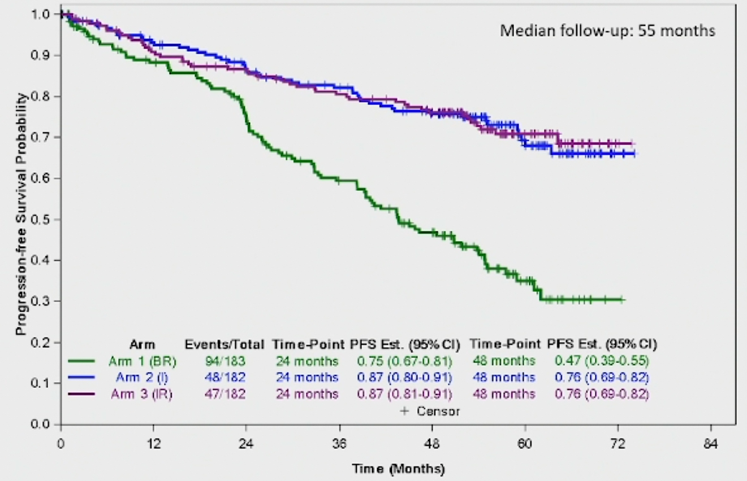
Alliance A041202: Progression-Free Survival
Pairwise comparisons | Hazard ratio | p-value
I vs BR | 0.36 | <0.0001
IR vs BR | 0.36 | <0.001
IR vs I | 0.99 | 0.96
Woyach JA et al. ASH 2021;Abstract 639.

Slide 75
Ibrutinib and Rituximab Provides Superior Clinical Outcome Compared to FCR in Younger Patients with Chronic Lymphocytic Leukemia (CLL): Extended Follow-Up from the E1912 Trial
Shanafelt TD et al. ASH 2019;Abstract 33.

Slide 76
Phase III ECOG-ACRIN E1912 Study Design
Ibrutinib + rituximab (IR)
→ ibrutinib until PD
Eligibility
Previously untreated CLL requiring treatment Ability to tolerate FCR-based therapy Age ≤70 years
R
(2:1; N = 529)
FCR
Primary endpoint: PFS
Secondary endpoints: OS, ORR, Toxicity and Tolerability
ECOG-ACRIN E1912 Physician Fact Sheet, version 01/15/16;
www.clinicaltrials.gov (NCT02048813); Shanafelt TD et al. ASH 2018;Abstract LBA-4.

Slide 77
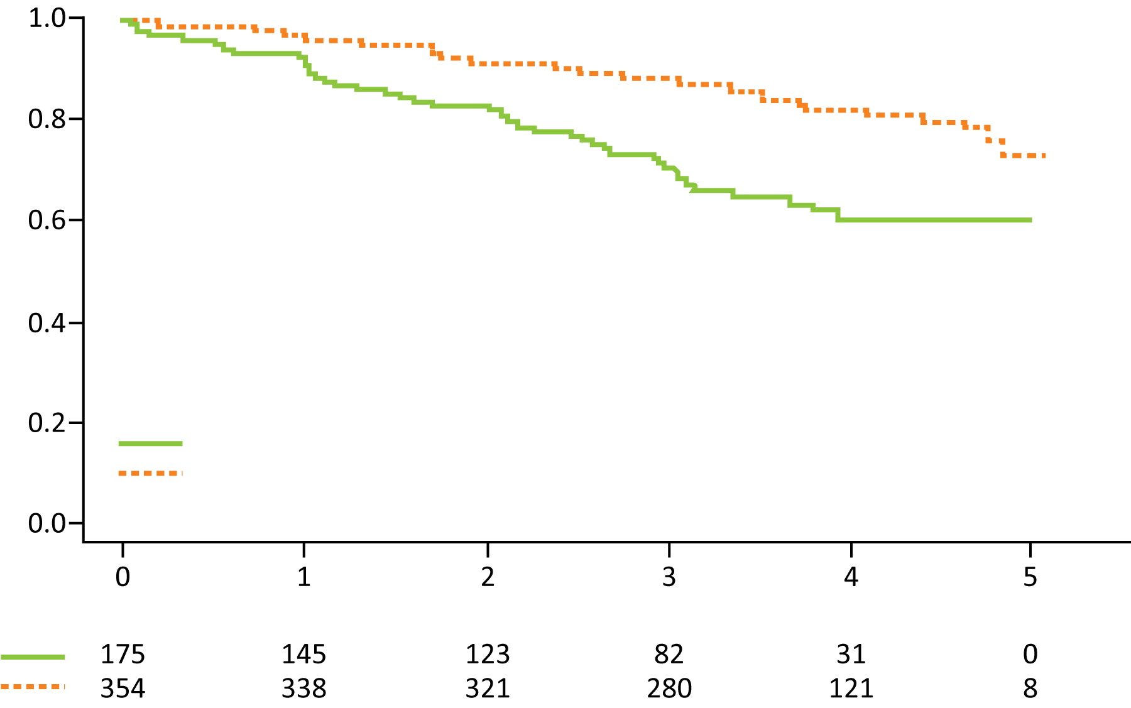
ECOG-ACRIN E1912 Extended Follow-Up: Up-Front IR Compared to FCR for Younger Patients with CLL
PFS
Probability
HR = 0.39 p < 0.0001
3-year rates: 89%, 71%
FCR (52 events/175 cases)
IR (58 events/354 cases)
Years
Number at risk
Grade ≥3 treatment-related AEs were reported in 70% of patients receiving IR and 80% of patients receiving FCR (odds ratio = 0.56; p = 0.013).
Among the 95 patients who discontinued ibrutinib, the most common cause was AE or complication.
Shanafelt TD et al. ASH 2019;Abstract 33.

Slide 78
Ibrutinib plus Rituximab Is Superior to FCR in Previously Untreated CLL: Results of the Phase III NCRI FLAIR Trial
Hillmen P et al.
ASH 2021;Abstract 642.

Slide 79
NCRI FLAIR Study Design
Hillmen P et al. ASH 2021;Abstract 642.

Slide 80
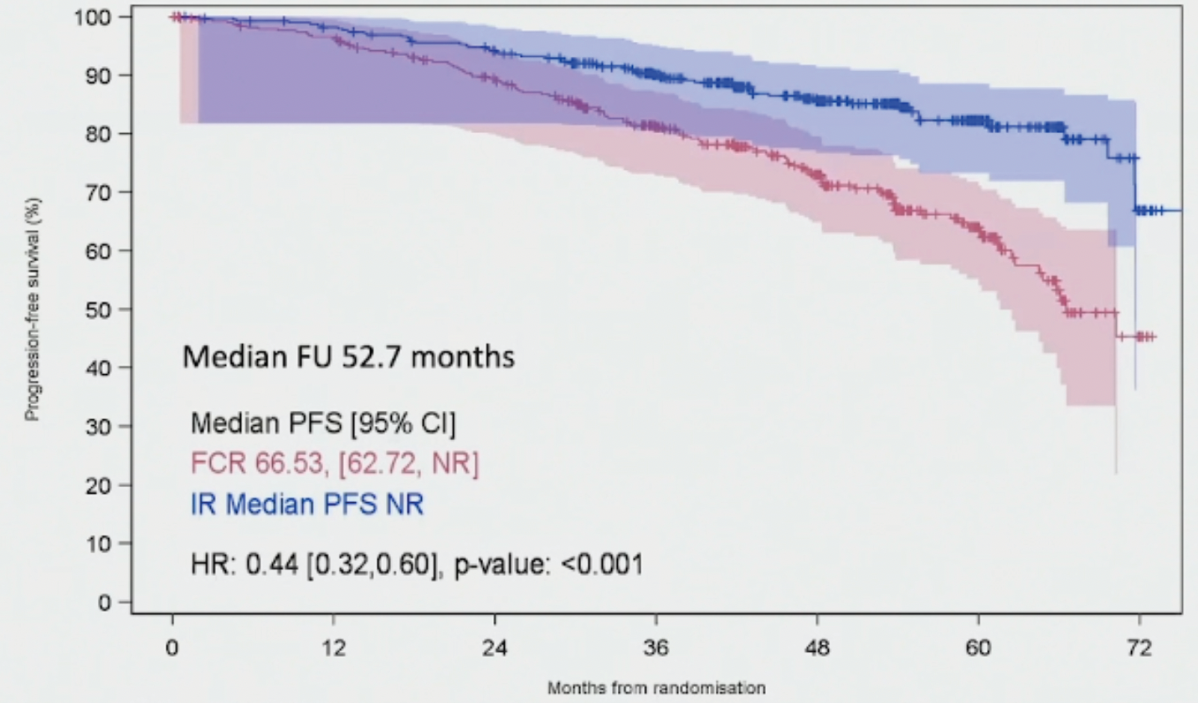
NCRI FLAIR: Progression-Free Survival
(N = 385)
(N = 386)
Hillmen P et al. ASH 2021;Abstract 642.

Slide 81
Leukemia 2022;[Online ahead of print].

Slide 82
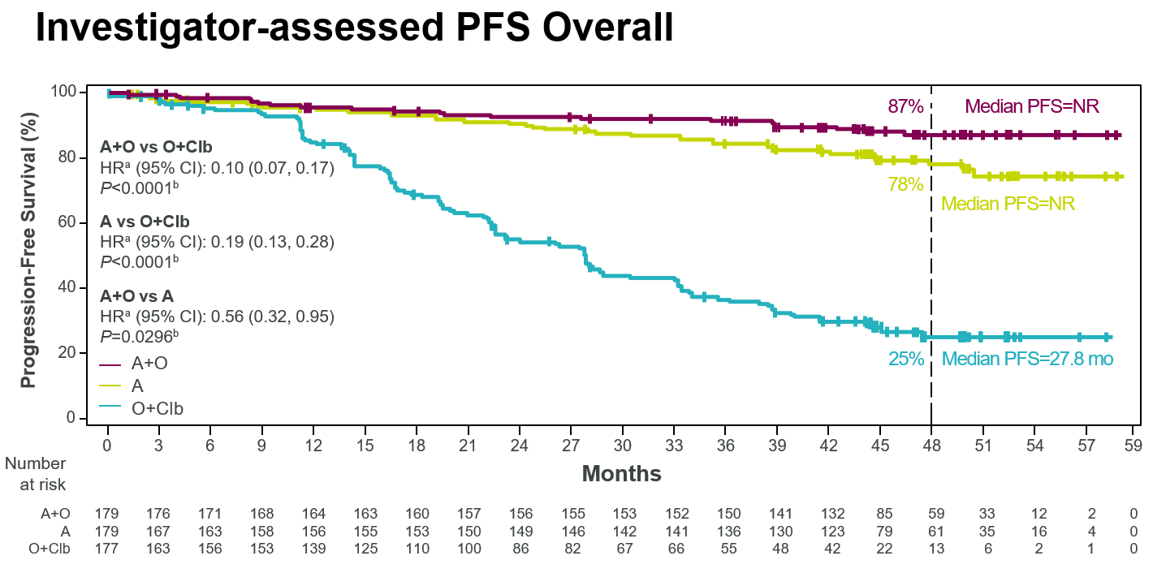
ELEVATE-TN: Investigator-Assessed PFS (Overall)
4-Year Follow-Up
Sharman JP et al. Leukemia 2022;[Online ahead of print].

Slide 84
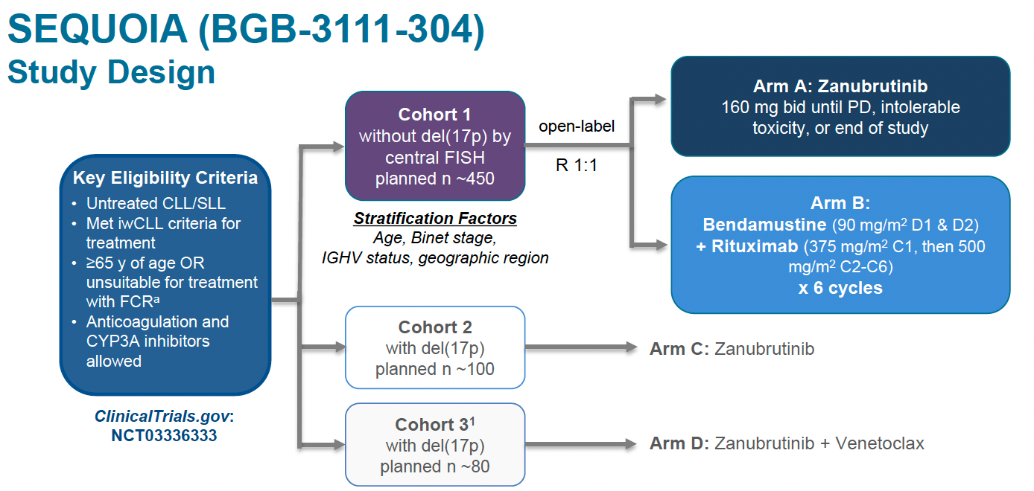
SEQUOIA Phase III Study Design
Tam CS et al. ASH 2021;Abstract 396.

Slide 85
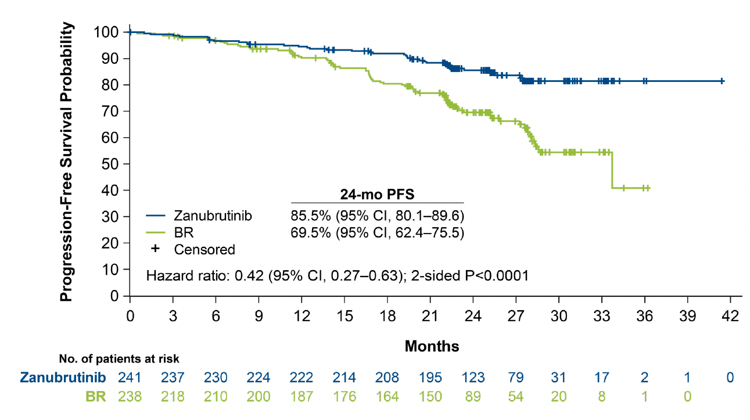
SEQUOIA: Progression-Free Survival by IRC
Tam CS et al. ASH 2021;Abstract 396.

Slide 86
SEQUOIA: Progression-Free Survival by Subgroups
Tam CS et al. ASH 2021;Abstract 396.

Slide 87
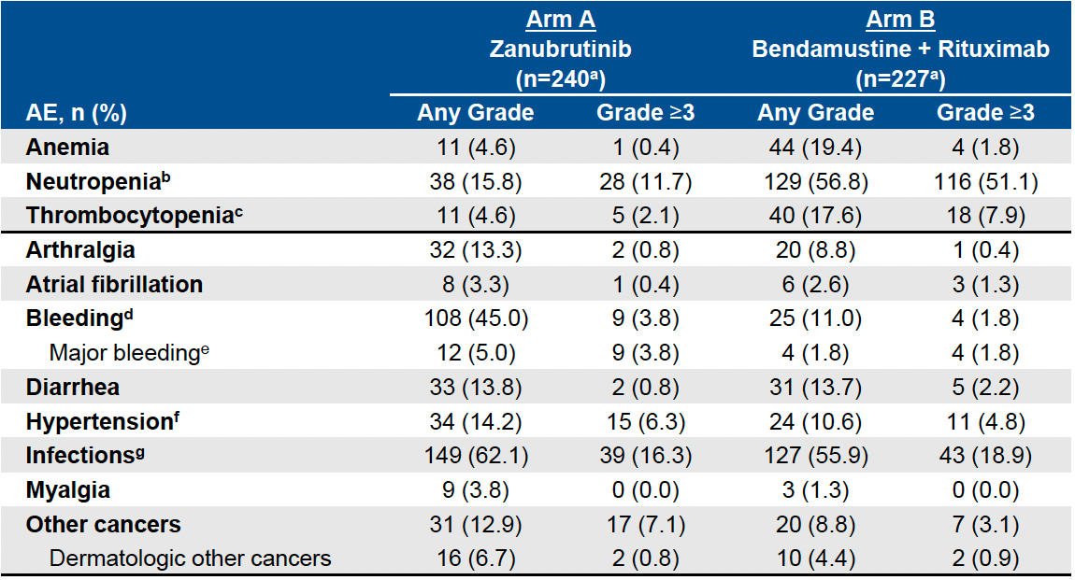
SEQUOIA: Adverse Events of Interest
Tam CS et al. ASH 2021;Abstract 396.

Slide 88
Venetoclax Combination Regimens

Slide 89
A Randomized Phase III Study of Venetoclax-Based Time-Limited Combination Treatments (RVe, GVe, GIVe) vs Standard Chemoimmunotherapy (CIT: FCR/BR) in Frontline Chronic Lymphocytic Leukemia (CLL) of Fit Patients: First Co-Primary Endpoint Analysis of the International Intergroup GAIA (CLL13) Trial
Eichhorst B et al.
ASH 2021;Abstract 71.

Slide 90
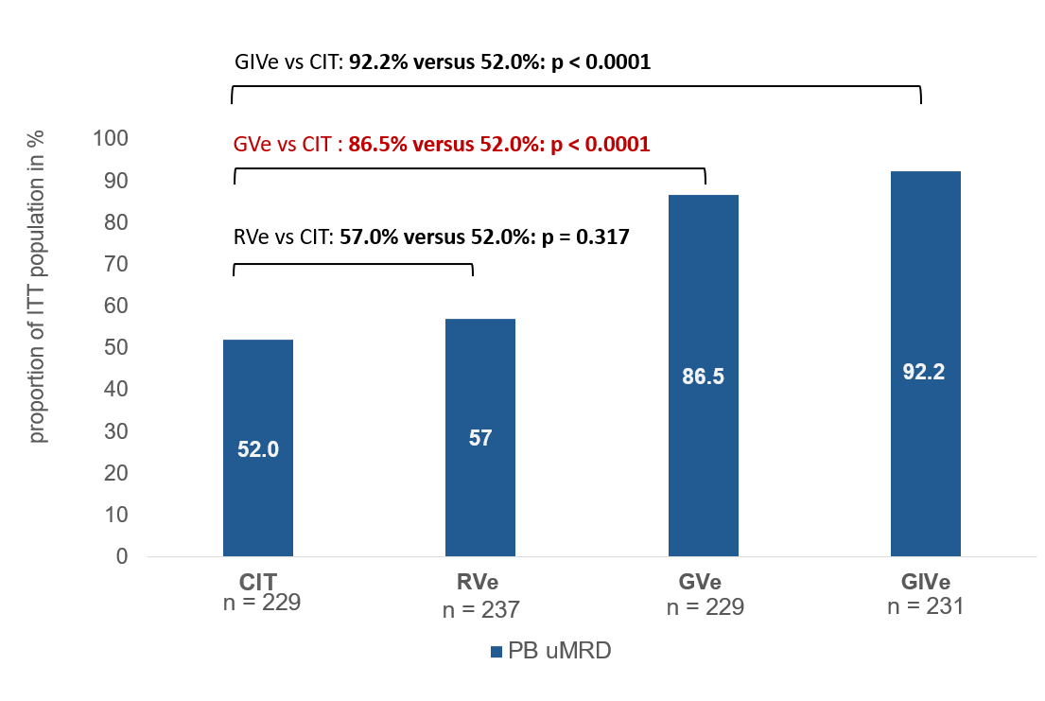
GAIA/CLL13 Coprimary Endpoint: Undetectable MRD (uMRD) (<10⁻⁴) at Month 15 in Peripheral Blood by 4-Color Flow
CIT
BR >65
≤FCR 65
RVe
Rituximab/venetoclax
GVe
Obinutuzumab/venetoclax
GIVe
Obinutuzumab/ibrutinib/venetoclax
Eichhorst B et al. ASH 2021;Abstract 71.

Slide 91
ASCO 2021;Abstract 7501

Slide 92
CAPTIVATE Study Design
Ghia P et al. ASCO 2021;Abstract 7051.

Slide 93
CAPTIVATE: Response
Ghia P et al. ASCO 2021;Abstract 7051.

Slide 94
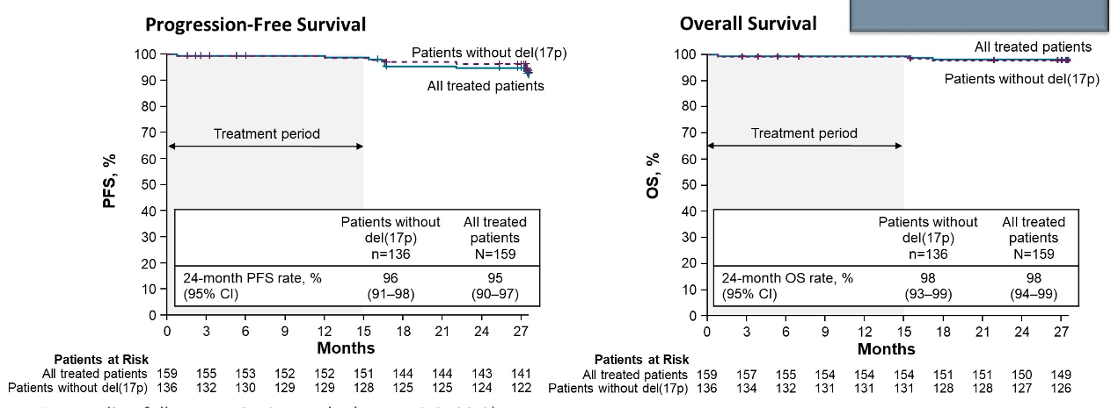
CAPTIVATE: Progression-Free and Overall Survival
Ghia P et al. ASCO 2021;Abstract 7051.

Slide 95
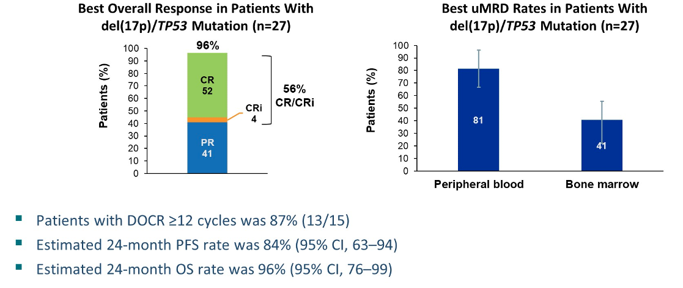
CAPTIVATE: Efficacy Outcomes for Patients with Del(17p)/TP53 Mutation
Ghia P et al. ASCO 2021;Abstract 7051.

Slide 96
First-Line Treatment with Ibrutinib (Ibr) plus Venetoclax (Ven) for Chronic Lymphocytic Leukemia (CLL): 2-Year Post-Randomization Disease-Free Survival (DFS) Results from the Minimal Residual Disease (MRD) Cohort of the Phase 2 Captivate Study
Ghia P et al.
ASH 2021;Abstract 68.

Slide 97
CAPTIVATE MRD Cohort: DFS Events in Patients with Confirmed uMRD
Ghia P et al. ASH 2021;Abstract 68.

Slide 98
CAPTIVATE MRD Cohort: Three-Year PFS Rates
Ghia P et al. ASH 2021;Abstract 68.

Slide 99
CAPTIVATE MRD Cohort: CR Rates with 24 Months Postrandomization Follow-Up
Ghia P et al. ASH 2021;Abstract 68.

Slide 100
ASH 2021;Abstract 70.

Slide 101
GLOW: Independent Review Committee (IRC)-Assessed PFS
30-month PFS: 80.5% for Ibr+Ven vs 35.8% for Clb+O
Munir T et al. ASH 2021;Abstract 70.

Slide 102
GLOW: uMRD <10⁻⁴ Rate
Munir T et al. ASH 2021;Abstract 70.

Slide 103
Fixed-Duration Ibrutinib and Venetoclax (I + V) versus Chlorambucil plus Obinutuzumab (Clb + O) for First-Line (1L) Chronic Lymphocytic Leukemia (CLL): Primary Analysis of the Phase 3 GLOW Study
Kater A et al. EHA 2021;Abstract LB1902.

Slide 104
GLOW: Study Design and Endpoints
Kater A et al. EHA 2021;Abstract LB1902.

Slide 105
GLOW: Progression-Free Survival
Kater A et al. EHA 2021;Abstract LB1902.

Slide 106
GLOW: Undetectable MRD Rate
Kater A et al. EHA 2021;Abstract LB1902.

Slide 107
GLOW: Safety
Kater A et al. EHA 2021;Abstract LB1902.

Slide 109
VISION H0141 Study Schema
Niemann CU et al. ASH 2021;Abstract 69.

Slide 110
VISION H0141: Progression-Free Survival

Slide 111
Selection of BTK Inhibitor

Slide 112
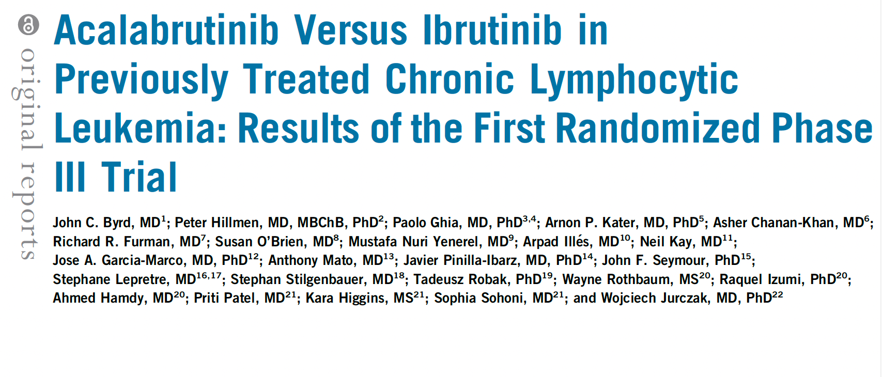
J Clin Oncol 2021;39(31):3441-52.

Slide 113
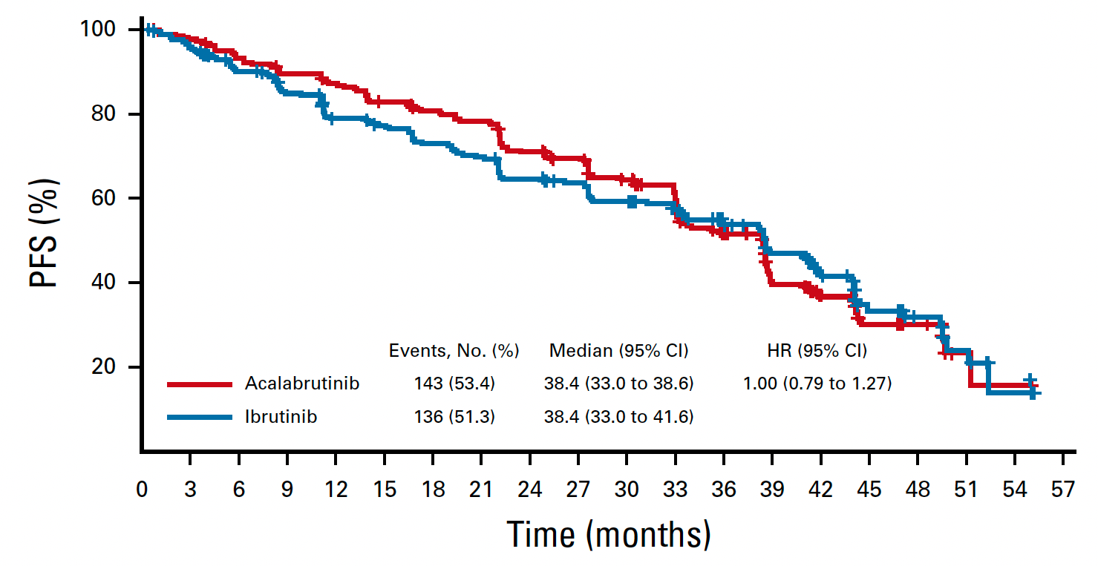
ELEVATE-RR: Independent Review Committee-Assessed PFS
Byrd JC et al. J Clin Oncol 2021;39(31):3441-52.

Slide 114
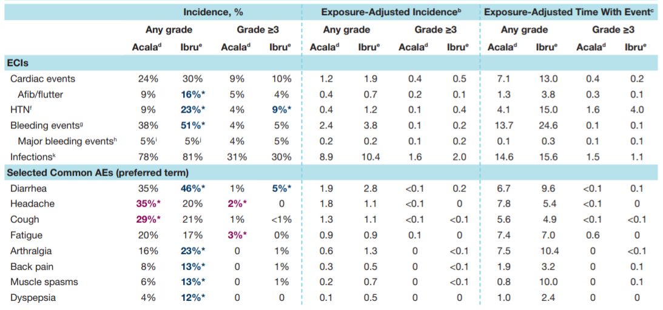
ELEVATE-RR: Characterization of Adverse Events with Acalabrutinib versus Ibrutinib
Seymour JF et al. ASH 2021;Abstract 3721.

Slide 115
New Acalabrutinib Formulation Enables Co-Administration with Proton Pump Inhibitors and Dosing in Patients Unable to Swallow Capsules (ELEVATE-PLUS)
Sharma S et al. ASH 2021;Abstract 4365.
Author Conclusions: Acalabrutinib maleate, administered as a tablet or suspension, is safe and well tolerated. Based on the PK (and associated variability), BTK-TO, and established exposure-efficacy/safety relationship, AMT clinical effect is expected to be comparable to acalabrutinib capsules at the approved 100-mg BID dosing, regardless of use of PPIs and ingestion of food. Additionally, AMT improves swallowing ability given the film coating and a 50% reduced volume compared with the capsule, and can be easily suspended in a small amount of water to allow dosing in patients unable to swallow tablets.

Slide 116
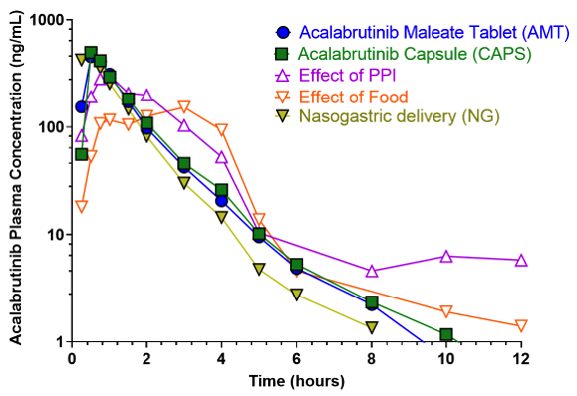
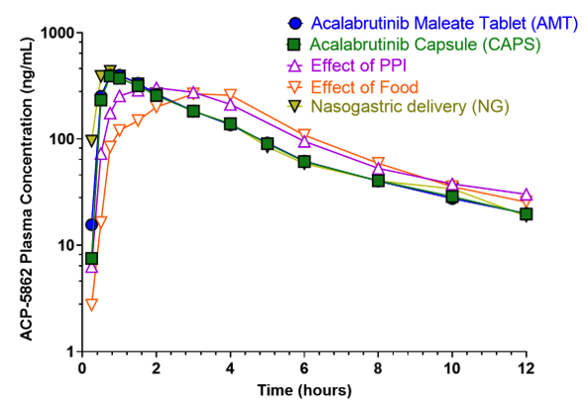
ELEVATE-PLUS: Pharmacokinetic Profiles of Acalabrutinib and Its Major Pharmacologically Active Metabolite Across 3 Clinical Trials
Sharma S et al. ASH 2021;Abstract 4365.

Slide 117
First Interim Analysis of ALPINE Study: Results of a Phase 3 Randomized Study of Zanubrutinib vs Ibrutinib in Patients with Relapsed/Refractory Chronic Lymphocytic Leukemia/Small Lymphocytic Lymphoma
Hillmen P et al.
EHA 2021;Abstract LBA1900.

Slide 118
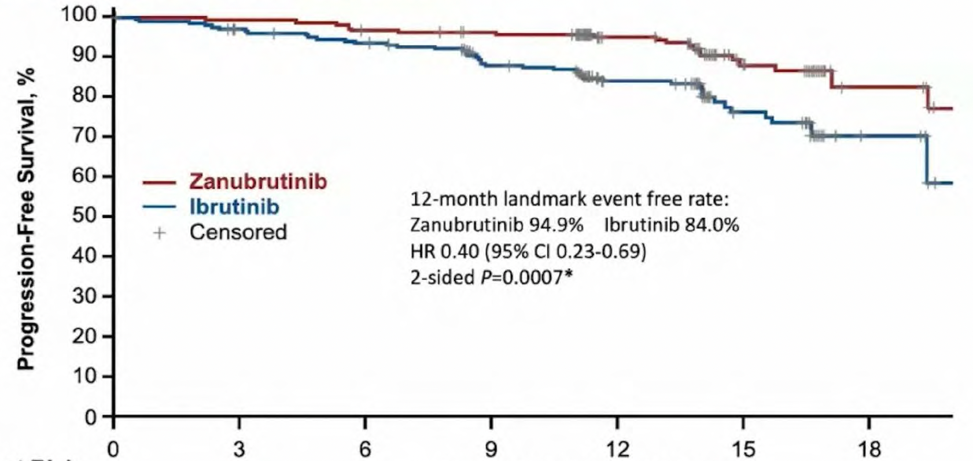
ALPINE: Response and Investigator-Assessed PFS
 | Zanubrutinib (n = 207) | Ibrutinib (n = 208)
12-month event-free rate | 94.9% | 84.0%
 | HR: 0.40, p = 0.0007
ORR | 78.3% | 62.5%
ORR for del(17p) | 83.3% | 53.8%
Months from Randomization
Hillmen P et al. EHA 2021;Abstract LBA1900.

Slide 119
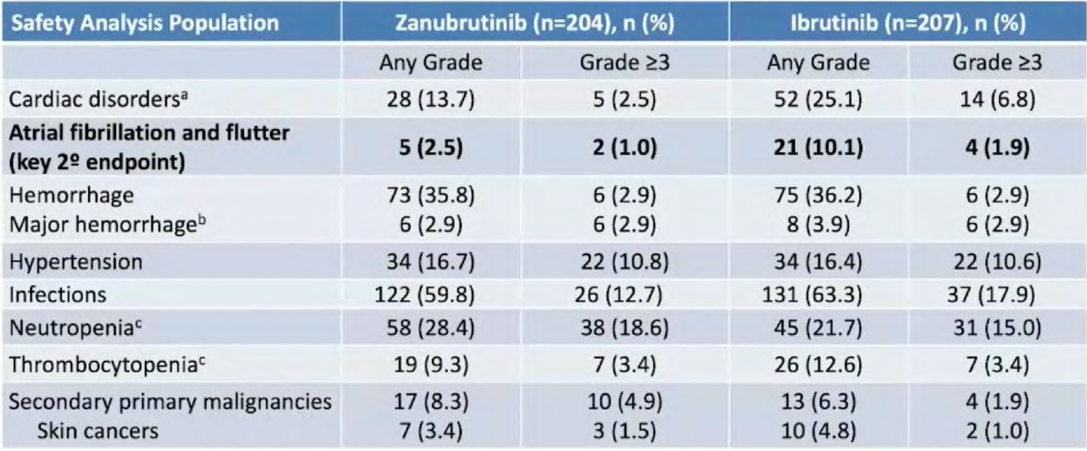
ALPINE: Adverse Events of Special Interest
Hillmen P et al. EHA 2021;Abstract LBA1900.

Slide 120
Relapsed/Refractory CLL

Slide 121
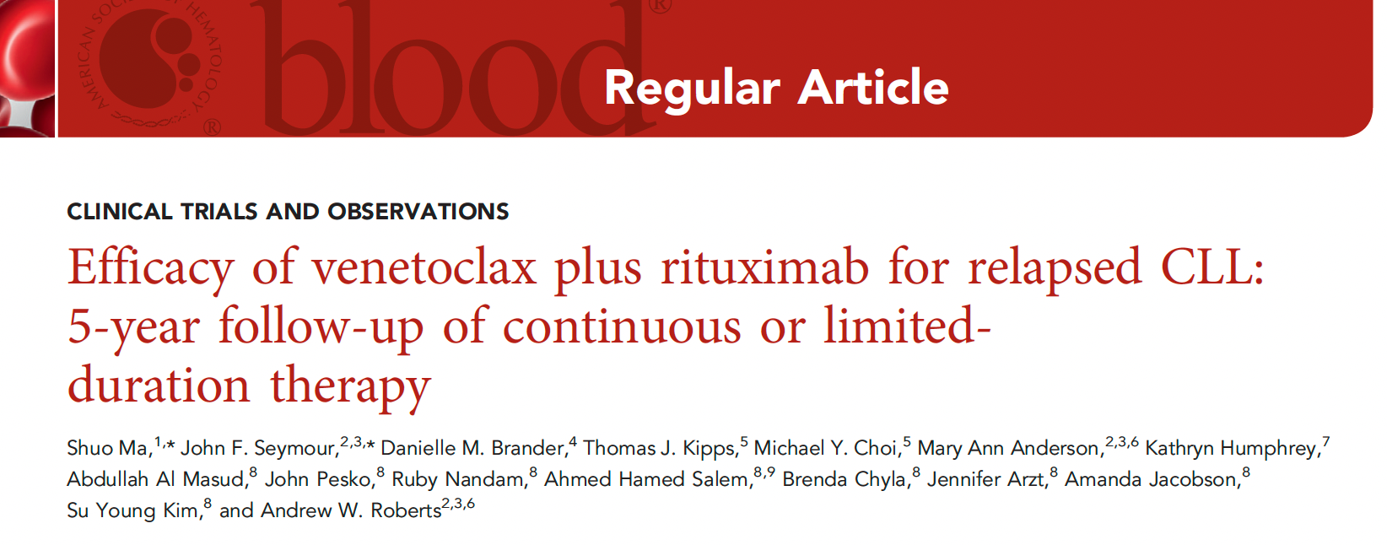
Blood 2021;138(10):836-46.

Slide 122
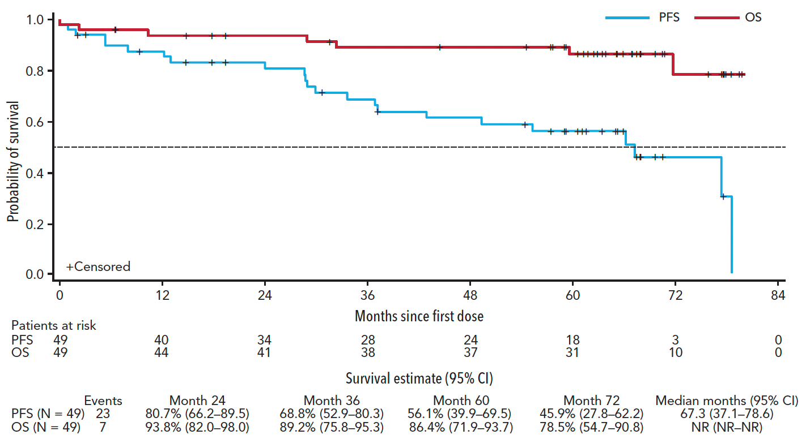
MURANO 5-Year Follow-Up: Overall and Progression-Free Survival (All Patients)
Ma S et al. Blood 2021;138(10):836-46.

Slide 123
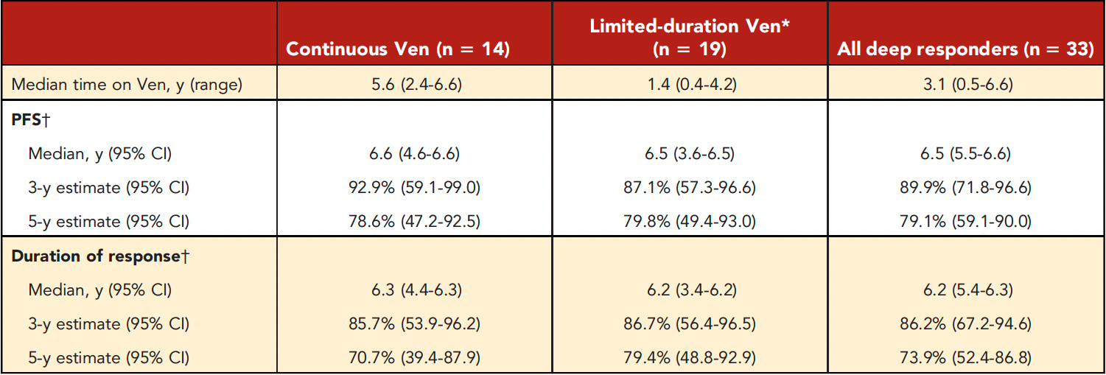
MURANO 5-Year Follow-Up: Durability of Benefit in Deep Responders (CR or uMRD Response)
CR = complete response; uMRD = undetectable minimal residual disease
Ma S et al. Blood 2021;138(10):836-46.

Slide 124
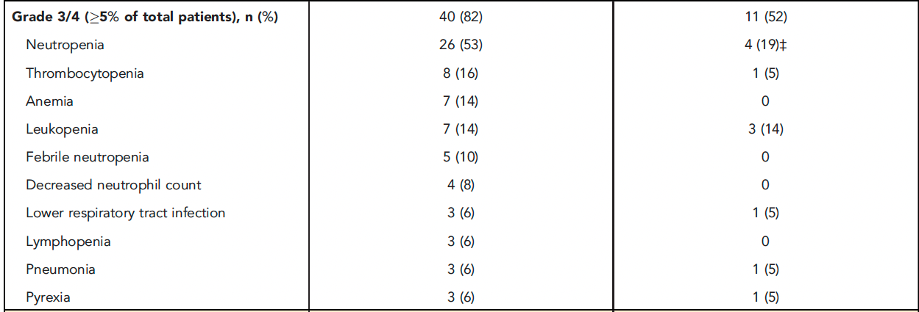
MURANO: Grade 3 or 4 Treatment-Emergent Adverse Events (AEs) Within and Beyond 2 Years of Treatment
Ma S et al. Blood 2021;138(10):836-46.

Slide 125
MURANO: Serious AEs Within and Beyond 2 Years of Treatment
Ma S et al. Blood 2021;138(10):836-46.

Slide 126
Novel Strategies Under Investigation

Slide 127
Pirtobrutinib, a Next Generation, Highly Selective, Non-Covalent BTK Inhibitor in Previously Treated CLL/SLL: Updated Results from the Phase 1/2 BRUIN Study
Mato AR et al.
ASH 2021;Abstract 391.

Slide 128
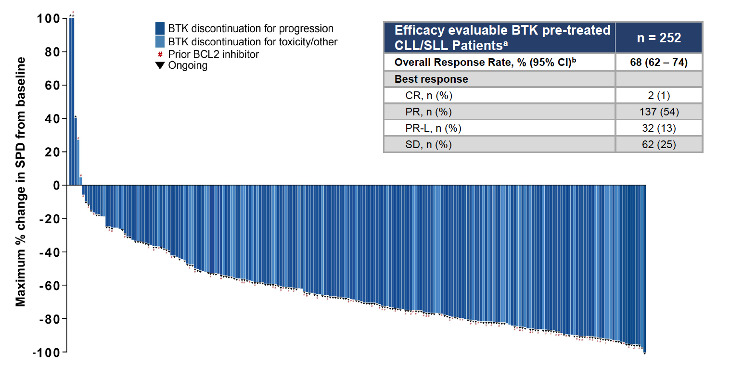
BRUIN: Pirtobrutinib Efficacy in Patients with BTK-Pretreated CLL or Small Lymphocytic Lymphoma (SLL)
Mato AR et al. ASH 2021;Abstract 391.

Slide 129
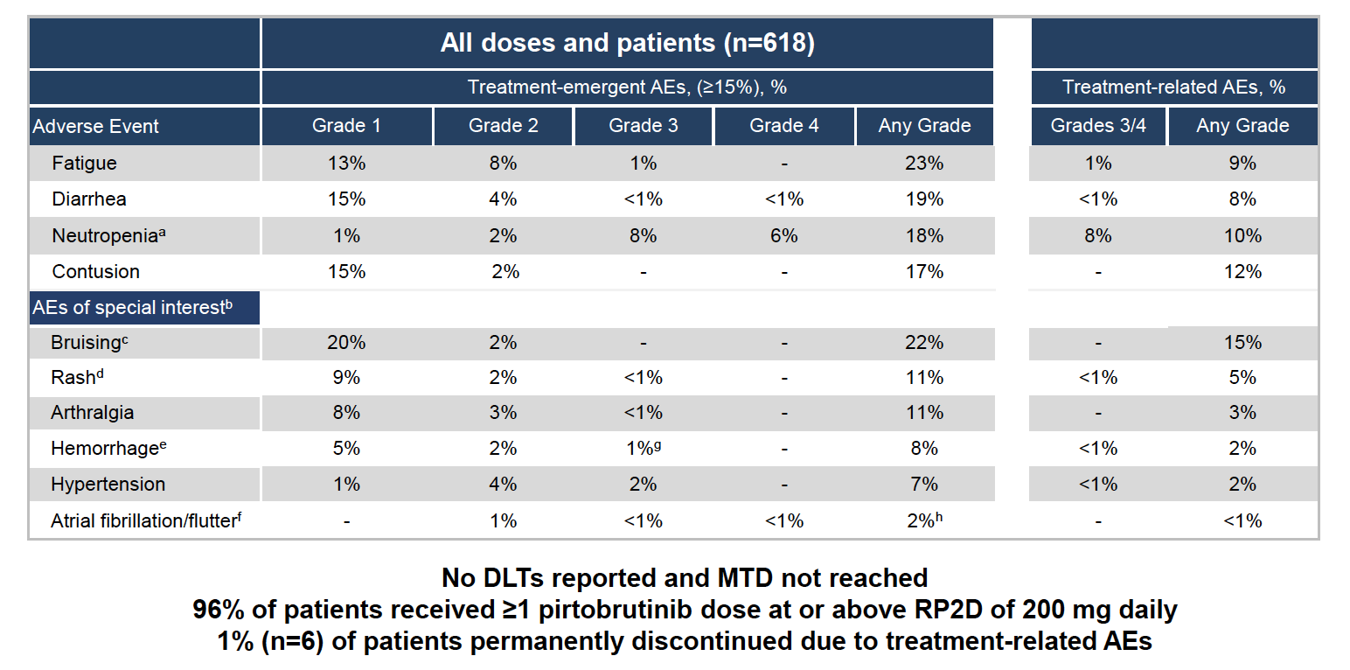
BRUIN: Pirtobrutinib Safety Profile
Mato AR et al. ASH 2021;Abstract 391.

Slide 130
FDA Has Placed a Partial Clinical Hold on Some Combination Candidate Studies for Leukemia and Lymphoma Press Release – January 27, 2022
The FDA placed partial holds on studies of the U2 combination umbralisib and ublituximab for chronic lymphocytic leukemia (CLL) and non-Hodgkin lymphoma (NHL).
The updated overall survival (OS) preliminary results from the UNITY-CLL study showed improvement. The OS hazard ratio was 1.23, and, including COVID-19-related deaths, the ratio reached 1.04.
An OS hazard ratio above 1.00 implies a risk that the investigational therapy might be causing harm.
No new patients can be enrolled in some CLL and NHL trials, but those deriving a benefit may continue with consent.
https://www.yahoo.com/now/tg-therapeutics-falls-30-ceo-173034141.html

Slide 131
Efficacy and Safety of Ublituximab in Combination with Umbralisib (U2) in Patients with Chronic Lymphocytic Leukemia (CLL) By Treatment Status: A Sub-Analysis of the Phase 3 Unity-CLL Study
Jacobs R et al.
ASH 2021;Abstract 3726.

Slide 132
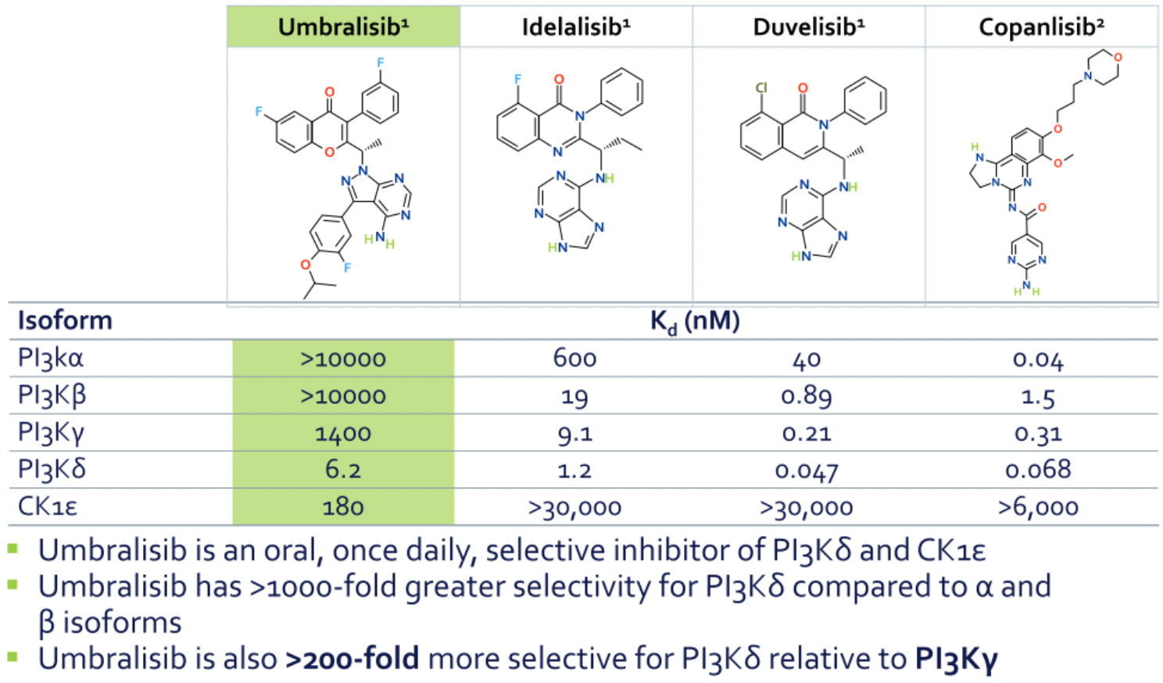
Umbralisib: A Selective Inhibitor of PI3Kδ and CK1ε
Jacobs R et al. ASH 2021;Abstract 3726.

Slide 133
Ublituximab: A Novel Glycoengineered Anti-CD20 Monoclonal Antibody
Jacobs R et al. ASH 2021;Abstract 3726.

Slide 134
UNITY-CLL: IRC-Assessed PFS by Treatment Status
Jacobs R et al. ASH 2021;Abstract 3726.

Slide 135
UNITY-CLL: Adverse Events (AEs) of Clinical Interest
Jacobs R et al. ASH 2021;Abstract 3726.

Slide 136
Lancet Haematol 2021;8:e254-66.

Slide 137
GENUINE: Progression-Free Survival (All Patients)
Time since randomization (months)
Sharman JP et al. Lancet Haematol 2021;8:e254-56.

Slide 138
GENUINE: Progression-Free Survival in Subgroups
Patients with 17p deletion, TP mutation, or both
Patients with 11q deletion
Time since randomization (months)
Time since randomization (months)
Sharman JP et al. Lancet Haematol 2021;8:e254-56.

Slide 139
Nature 2022;[Online ahead of print].

Slide 140
Analysis of CD3+ CAR+ T Cells Using CyTOF Across Multiple Time Points
“Here we studied long-lasting CD19-redirected chimeric antigen
receptor (CAR) T cells in two patients with chronic lymphocytic leukaemia who achieved a complete remission in 2010.
CAR T cells remained detectable more than ten years after infusion, with sustained remission in both patients. Notably, a highly activated CD4+ population emerged in both patients, dominating the CAR T cell population at the later time points…
…Our identification and characterization of these unexpected
CAR T cell populations provide novel insight into the CAR T cell characteristics associated with anti-cancer response and long-term remission in leukaemia.”
Melenhorst JJ et al. Nature 2022;[Online ahead of print].

Slide 141
Blood 2021;[Online ahead of print].

Slide 142
TRANSCEND CLL 004: Rates of Cytokine Release Syndrome (CRS), Neurologic Events (NE) and Rehospitalization After Liso-cel Infusion
 | All patients (N = 23) | Dose level 1 50 x 10⁶ (n = 9) | Dose level 2 100 x 10⁶ (n = 14)
CRS any grade | 17 (74%) | 7 (78%) | 10 (71%)
CRS Grade ≥3 | 2 (9%) | 0 | 2 (14%)
NE any grade | 9 (39%) | 2 (22%) | 7 (50%)
NE Grade ≥3 | 5 (21%) | 2 (22%) | 2 (14%)
Reasons for patient rehospitalization
Adverse events | 11 (48%) | 3 (33%) | 8 (57%)
CRS and/or NE | 5 (22%) | 1 (11%) | 4 (29%)
CRS and NE | 2 (9%) | 0 | 2 (14%)
NE only | 3 (13%) | 1 (11%) | 2 (14%)
Siddiqi T et al. Blood 2021;[Online ahead of print].

Slide 143
TRANSCEND CLL 004: Response and uMRD (10⁻⁴) Rates
Siddiqi T et al. Blood 2021;[Online ahead of print].

Slide 144
TRANSCEND CLL 004: Swim Lane Plot, Duration of Response and PFS
Siddiqi T et al. Blood 2021;[Online ahead of print].

