Slide 1
Exploring the Current and Future Role of B-Cell Maturation Antigen-Directed Therapy in the Management of Multiple Myeloma
Monday, February 7, 2022
5:00 PM – 6:00 PM ET
Faculty
Jesús G Berdeja, MD
Noopur Raje, MD
Moderator
Neil Love, MD

Slide 2
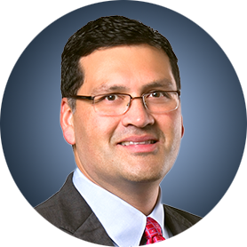
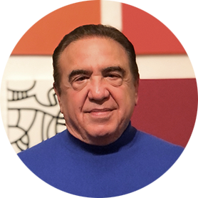

Faculty
Jesús G Berdeja, MD
Director of Multiple Myeloma Research
Sarah Cannon Research Institute
Tennessee Oncology
Sarah Cannon Center for Blood Cancer
Nashville, Tennessee
Moderator
Neil Love, MD
Research To Practice
Miami, Florida
Noopur Raje, MD
Director, Center for Multiple Myeloma
Massachusetts General Hospital Cancer Center
Professor of Medicine
Harvard Medical School
Boston, Massachusetts

Slide 3
Commercial Support
This activity is supported by educational grants from GlaxoSmithKline and Pfizer Inc.

Slide 4
Dr Love — Disclosures
Dr Love is president and CEO of Research To Practice. Research To Practice receives funds in the form of educational grants to develop CME activities from the following companies: AbbVie Inc, Adaptive Biotechnologies Corporation, ADC Therapeutics, Agios Pharmaceuticals Inc, Alexion Pharmaceuticals, Amgen Inc, Array BioPharma Inc, a subsidiary of Pfizer Inc, Astellas, AstraZeneca Pharmaceuticals LP, Aveo Pharmaceuticals, Bayer HealthCare Pharmaceuticals, BeiGene Ltd, BeyondSpring Pharmaceuticals Inc, Blueprint Medicines, Boehringer Ingelheim Pharmaceuticals Inc, Bristol-Myers Squibb Company, Celgene Corporation, Clovis Oncology, Coherus BioSciences, CTI BioPharma Corp, Daiichi Sankyo Inc, Eisai Inc, Epizyme Inc, Exact Sciences Inc, Exelixis Inc, Five Prime Therapeutics Inc, Foundation Medicine, G1 Therapeutics Inc, Genentech, a member of the Roche Group, Genmab, Gilead Sciences Inc, GlaxoSmithKline, Grail Inc, Halozyme Inc, Helsinn Healthcare SA, ImmunoGen Inc, Incyte Corporation, Ipsen Biopharmaceuticals Inc, Janssen Biotech Inc, administered by Janssen Scientific Affairs LLC, Jazz Pharmaceuticals Inc, Karyopharm Therapeutics, Kite, A Gilead Company, Lilly, Loxo Oncology Inc, a wholly owned subsidiary of Eli Lilly & Company, Merck, Natera Inc, Novartis, Novocure Inc, Oncopeptides, Pfizer Inc, Pharmacyclics LLC, an AbbVie Company, Puma Biotechnology Inc, Regeneron Pharmaceuticals Inc, Sanofi Genzyme, Seagen Inc, Servier Pharmaceuticals LLC, Sumitomo Dainippon Pharma Oncology Inc, Taiho Oncology Inc, Takeda Pharmaceuticals USA Inc, Tesaro, A GSK Company, TG Therapeutics Inc, Turning Point Therapeutics Inc, Verastem Inc and Zymeworks Inc.

Slide 5
Research To Practice CME Planning Committee Members,
Staff and Reviewers
Planners, scientific staff and independent reviewers for Research To Practice have no relevant conflicts of interest to disclose.

Slide 6
Dr Berdeja — Disclosures
Consulting Agreements | bluebird bio, Bristol-Myers Squibb Company, Celgene Corporation, CRISPR Therapeutics, Janssen Biotech Inc, Kite, A Gilead Company, Legend Biotech, Secura Bio, Takeda Pharmaceuticals USA Inc
Contracted Research | AbbVie Inc, Amgen Inc, Astex Pharmaceuticals, bluebird bio, Bristol-Myers Squibb Company, Celator Pharmaceuticals Inc, Celgene Corporation, Celularity, CRISPR Therapeutics, Curis Inc, EMD Serono Inc, Genentech, a member of the Roche Group, GlaxoSmithKline, Ichnos Sciences, Incyte Corporation, Janssen Biotech Inc, Juno Therapeutics, a Celgene Company, Kesios Therapeutics Ltd, Lilly, Novartis, Onyx Pharmaceuticals, an Amgen subsidiary, Pharmacyclics LLC, an AbbVie Company, Poseida Therapeutics, Sanofi Genzyme, Takeda Pharmaceuticals USA Inc, Vivolux

Slide 7
Dr Raje — Disclosures
Advisory Committee | Amgen Inc, bluebird bio, Bristol-Myers Squibb Company, Caribou Biosciences Inc, GlaxoSmithKline, Immuneel Therapeutics, Janssen Biotech Inc

Slide 8
Agenda
Introduction: Monday Night with Research To Practice
MODULE 1: Targeting BCMA
MODULE 2: CAR T-Cell Therapy
MODULE 3: Bispecific Antibodies
MODULE 4: Belantamab Mafodotin

Slide 9
Agenda
Introduction: Monday Night with Research To Practice
MODULE 1: Targeting BCMA
MODULE 2: CAR T-Cell Therapy
MODULE 3: Bispecific Antibodies
MODULE 4: Belantamab Mafodotin

Slide 10
What were you doing in 2010?
High school or earlier
College
Medical school
Fellowship/residency
In practice less than 10 years
In practice 10-25 years
In practice for more than 25 years
Retired

Slide 11
Exploring the Current and Changing Paradigm for the Management of Newly Diagnosed
Diffuse Large B-Cell Lymphoma
Wednesday, February 2, 2022
5:00 PM – 6:15 PM ET
Faculty
Christopher R Flowers, MD, MS
Neha Mehta-Shah, MD, MSCI
Grzegorz Nowakowski, MD
Moderator
Neil Love, MD

Slide 12
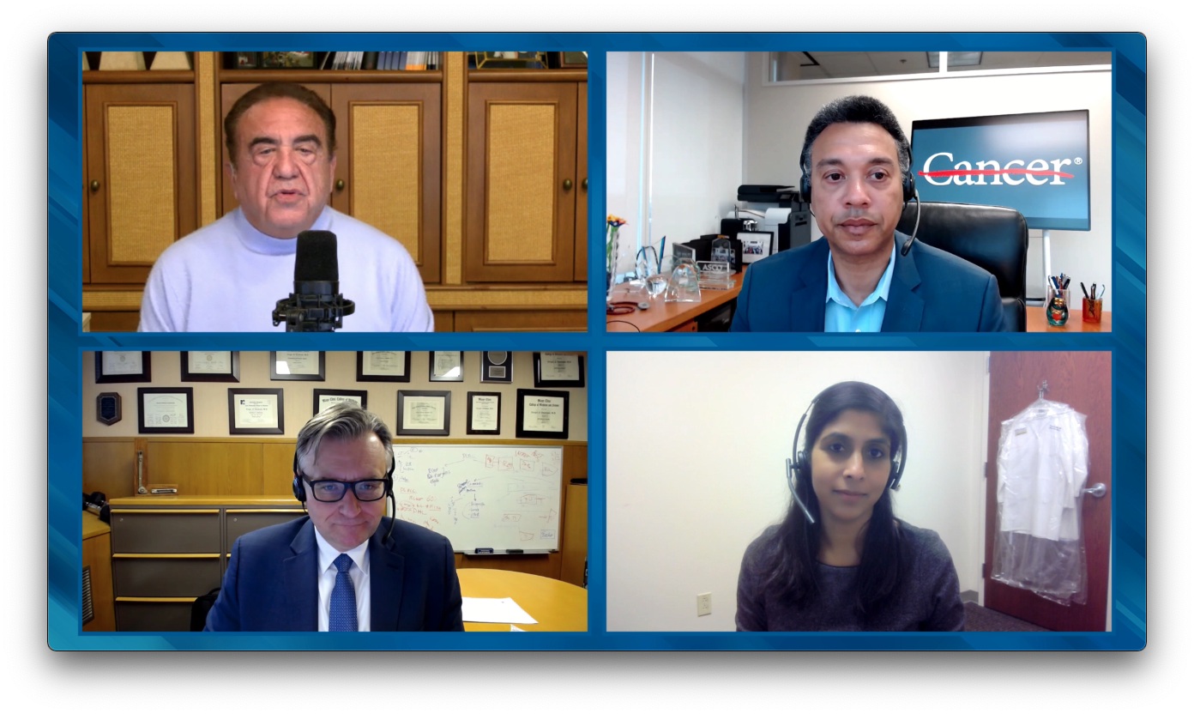

Slide 13
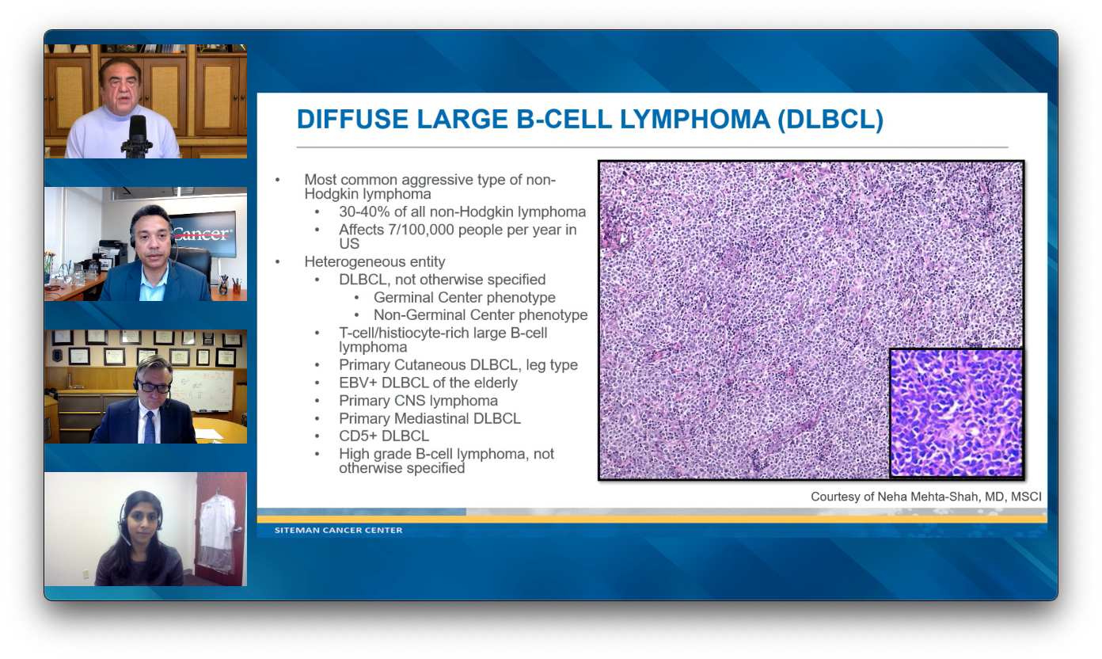

Slide 14


Slide 15
Agenda
Introduction: Monday Night with Research To Practice
MODULE 1: Targeting BCMA
MODULE 2: CAR T-Cell Therapy
MODULE 3: Bispecific Antibodies
MODULE 4: Belantamab Mafodotin

Slide 16
Myeloma Drugs Approved Since 2000
Daratumumab
Ixazomib
Elotuzumab
Bortezomib
Liposomal doxorubicin
Pomalidomide
Selinexor
Daratumumab SC
Zoledronic acid
Thalidomide
Lenalidomide
Carfilzomib
Panobinostat
Denosumab
Isatuximab
2000
2005
2010
2015
2020
2021
Belantamab mafodotin
Idecabtagene vicleucel
Courtesy of Jesús G Berdeja, MD

Slide 17
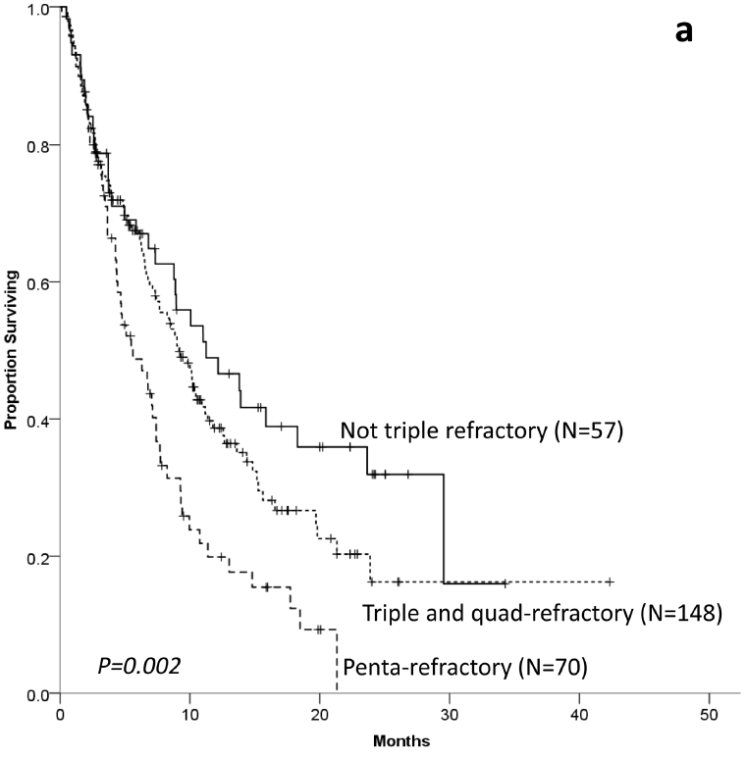
Despite Progress in MM There Remains Need for New Tx
The MAMMOTH study
Retrospective study of 275 patients from 14 academic centers in the US who had MM refractory to anti-CD38 monoclonal antibodies (MoAB)
Median number of prior therapies = 4 (range 1–16)
Prior autologous stem cell transplantation = 72%
Efficacy
mOS from T₀ for the entire cohort:
8.6 months (95% CI 7.5–9.9)
At least one subsequent treatment regimen was given post T₀ in 249 (90%) patients
  ORR to first regimen after T₀ = 31%
  mPFS = 3.4 months
  mOS = 9.3 months
1.0
OS of patients who are refractory to CD38 MoAB according to refractoriness to different immuno-modulatory agents or proteasome inhibitors
0.8
0.6
Proportion Surviving
0.4
Med OS 11.2 mos
0.2
Med OS 9.2 mos
Med OS 5.6 mos
0.0
0
10
20
30
40
50
Months
Gandhi UH, et al. Leukemia. 2019;33(9):2266–2275.
Courtesy of Jesús G Berdeja, MD

Slide 18
BCMA as a Target in Myeloma Treatment
BM
LN
BM, LN
BCMA
Short-lived PC
Immunoglobulin
Pro-B
Pre-B
Transitional
Naive
GC-B
Memory
Plasmablast
PC
Long-lived PC
MM
BCMA
BAFF-R
BCMA: antigen expressed specifically on PCs and myeloma cells
Higher expression on myeloma cells than normal PCs
Not expressed in other tissues
Cell-surface receptor in TNF superfamily
Receptor for APRIL and BAFF
Key role in B-cell maturation and differentiation
Promotes myeloma cell growth, chemotherapy resistance, immunosuppression in bone marrow microenvironment
BCMA
APRIL
BAFF
sBCMA
γ-secretase
Cell membrane
Cho. Front Immunol. 2018;9:1821. Moreaux. Blood. 2004;103:3148. Sanchez. Br J Haematol. 2012;158:727.
Courtesy of Jesús G Berdeja, MD

Slide 19
BCMA-Targeted Immunotherapy in MM
bb2121, LCAR-B38M,
P-BCMA-101
BCMA-T Bi Ab
TNB-383B, PF-06863135,
JNJ-64007957, EM801
BCMA
CAR T
BCMA CAR T
T
bb21217
JCARH125
MCARH171
FCARH143
CT053
BCMA-CART
Descartes-08
AMG 420; AMG 701
MM
BCMA-BiTE
Apoptotic
MM cells
MM
cell lysis
GSK2857916, MEDI2228
BCMA
BCMA-ADC
CD3
AMG 224
Mφ
Cytotoxic granule
(perforin,
granzyme B)
NK ,
Monocyte
Courtesy of Noopur Raje, MD

Slide 20
BCMA-Targeted Therapies for Multiple Myeloma
*Now approved for adults with R/R multiple myeloma after ≥4 prior lines of therapy, including an immunomodulatory agent, a proteasome inhibitor, and an anti-CD38 monoclonal Ab (August 2020)
Antibody–Drug Conjugates
Belantamab mafodotin*
MEDI2228
CC-99712
Bispecific Antibody Therapies
AMG 701
CC-93269
REGN5458
JNJ-64007957 (Teclistamab)
PF-06863135 (Elranatamab)
TNB-383B
BCMA
CAR T-Cell Therapies
Idecabtagene vicleucel*
Ciltacabtagene autoleucel
P-BCMA-101
bb21217
ALLO-715
*Now approved for adults with R/R multiple myeloma after ≥4 prior lines of therapy, including an immunomodulatory agent, a proteasome inhibitor, and an anti-CD38 monoclonal Ab (March 2021)
Myeloma
cell
Courtesy of Jesús G Berdeja, MD

Slide 21
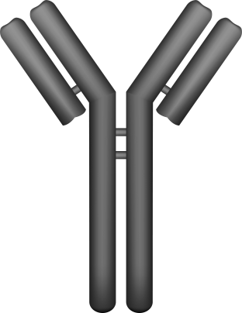
Types of Antibodies
Naked
Antibody Drug Conjugates (ADC)
Bispecific Antibodies (BsAbs)
CD3
T cell
δ
ε
Target antigen
(CD33, CD19, etc)
MM
Cell
Nothing is attached
A toxin or radioactive isotope
is attached
Engineered so that one end binds to MM cell, the other end binds to T cell
Courtesy of Noopur Raje, MD

Slide 22
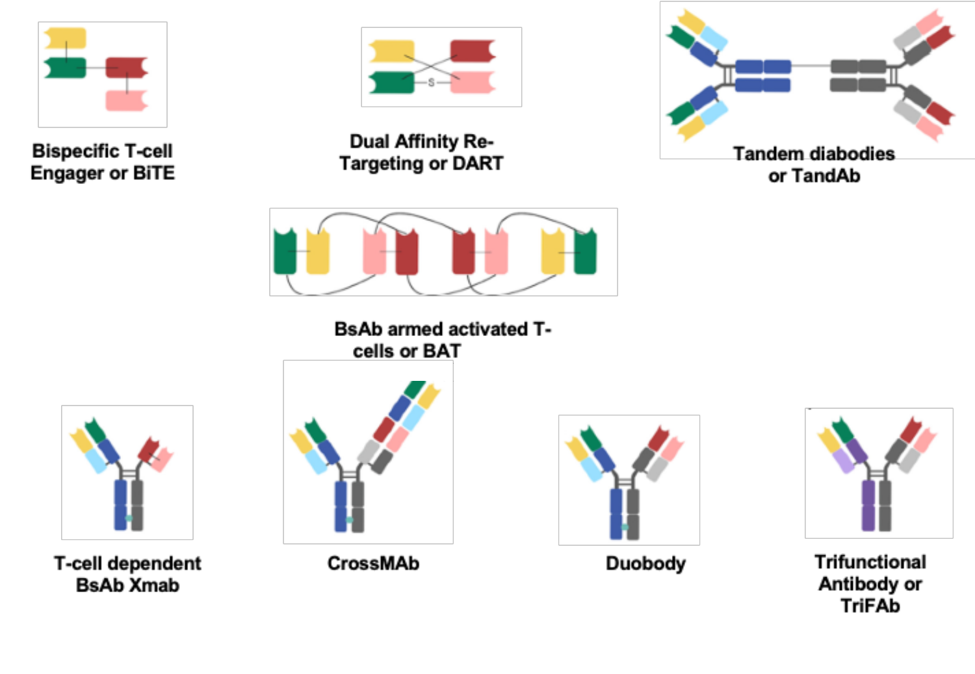
BsAbs – Many Different Platforms
Adapted from Lejeune M et al. Front Immunol 2020 11:762.
Courtesy of Noopur Raje, MD

Slide 23
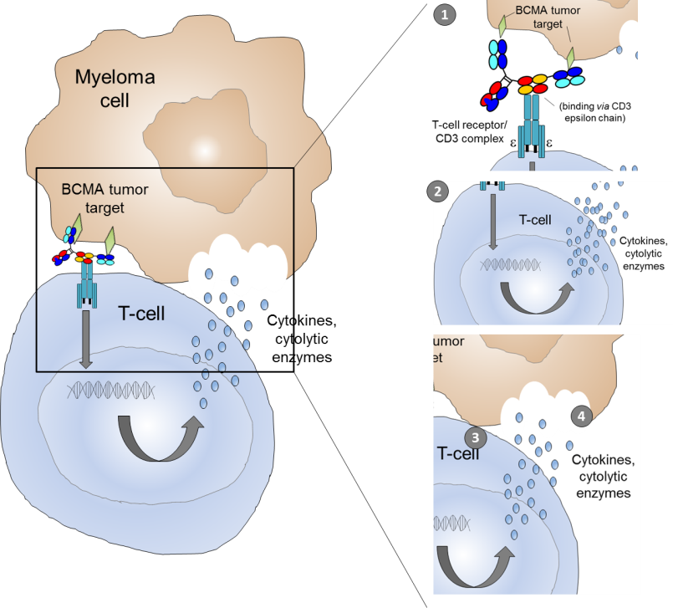
BCMA bispecific antibodies in myeloma
Potential to overcome the limitations of immunosuppressive tumor microenvironment by redirecting T cells to kill tumor target cells
BCMA (B-cell maturation antigen, CD269)
IgG-like bispecific antibody (long serum half-life,
retain Fc function):^{1–3}
  Anti-BCMAxCD3⁴
  Ab-957¹
  CC-93269^{2,3}
  Bi-Fab⁵
Non-IgG like BiTE® (better tissue penetrance, access to epitopes):
  BI 836909⁶
Mechanism of action of CC-93269 BCMA-TCB
α-BCMA: bivalent high affinity binding
α-CD3ε chain: monovalent low affinity binding
BCMA, B cell maturation antigen; CTL, cytotoxic T cell; Ig, immunoglobulin;
TCB, T-cell bispecific.
1.Pillarisetti K, et al. Abstract 2116; Presented at ASH 2016; San Diego, California; 2. Seckinger A, et al. Cancer Cell 2017;31:396–410; 3. Cho S-F, et al. Front Immunol 2018;9:1821; 4 Panowski SH, et al. Abstract 383; Presented at ASH 2016; San Diego, California; 5. Ramadoss NS, et al. J Am Chem Soc 2015;137:5288–91; 6. Hipp S, et al. Leukemia 2017;31:1743–51.
Courtesy of Noopur Raje, MD
Notes:
Panowski. 2016. para 3
Pillarisetti. 2016. para 1
Moreno. 2016. para 1
Hipp. 2017. 3-Abstract
Need ramadoss red
Not sure where this image came from

Slide 24
Agenda
Introduction: Monday Night with Research To Practice
MODULE 1: Targeting BCMA
MODULE 2: CAR T-Cell Therapy
MODULE 3: Bispecific Antibodies
MODULE 4: Belantamab Mafodotin

Slide 25
Case Presentation – Dr Raje: A 74-year-old man with multiregimen-relapsed MM who receives CAR T-cell therapy
A 74-year-old male who presented with kappa light chain MM.
Received RVD followed by ASCT.
Relapsed and was treated with Dara PD — developed rapidly progressive disease with EMD.
Received 3 cycles of DCEP and came for further evaluation.
Was offered CAR T cells against BCMA on clinical trial.
Was treated in the interim with Dara KPd.
Received CAR T cells-BB 21217.
Remains in remission with MRD-negative disease for 22 months.

Slide 26
Case Presentation – Dr Berdeja: A 67-year-old man with multiregimen-relapsed MM who receives CAR T-cell therapy
67-yr-old man diagnosed with R-ISS II IgGK multiple myeloma with standard- risk cytogenetics
Initial treatment: RVd therapy; achieved a VGPR and subsequently received HDM and autograft
After 24 mos of maintenance therapy, his M spike increased consistent with PD
Treated with daratumumab, bortezomib, dex; achieved a VGPR, lasting 12 mos
Treated with elotuzumab, pomalidomide, dex; achieved a PR, lasting 10 mos

Slide 27
Case Presentation – Dr Berdeja: A 67-year-old man with multiregimen-relapsed MM who receives CAR T-cell therapy (continued)
Treated with carfilzomib, pomalidomide, dex; achieved a PR
6 mos later, patient presents with increasing back pain and found to have a new pathological fracture with an increase in M protein to 1 g/dL HPI
He was referred for CAR T-cell trial with ide-cel
Baseline bone marrow with 70% plasmacytosis, FISH+ for Dup(1q) and t(4;14)
He underwent leukapheresis for T-cell collection successfully
During CAR T manufacturing he underwent an abbreviated cycle of dara/btz/dex with SD
He received fludarabine and cyclophosphamide LP chemo

Slide 28
Case Presentation – Dr Berdeja: A 67-year-old man with multiregimen-relapsed MM who receives CAR T-cell therapy (continued)
He was admitted to the hospital and received ide-cel
On D +1 he developed fever and hypotension responsive to fluids. He was felt to have Grade 2 CRS and given tocilizumab x 1 with prompt resolution. He did well thereafter and was discharged home
Main issue post CART was persistent cytopenias requiring intermittent
transfusions and GCSF prn but eventually resolved
D30 response assessment was VGPR, MRD- 10⁻⁶ by 6 mos
Response lasted 20 months

Slide 29
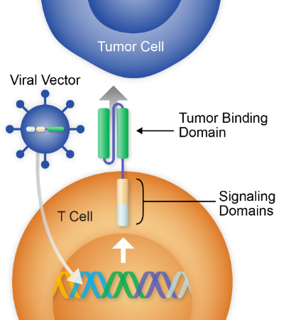
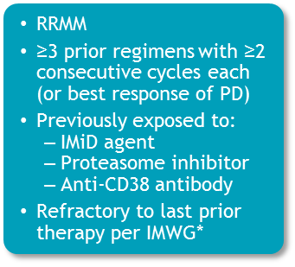
Phase II KarMMa: Idecabtagene Vicleucel (Ide-cel) in RRMM
Screened N=158
Leukapheresed
N=140
Treated N=128
(Target Dose CAR+ T cells)
150 × 10⁶ n=4
300 × 10⁶ n=70
450 × 10⁶ n=54
Endpoints
Primary: ORR (null hypothesis ≤50%)
Secondary: CRR (key secondary;
null hypothesis ≤10%), Safety, DOR, PFS, OS,
PK, MRD‡, QOL, HEOR
Exploratory: Immunogenicity,
BCMA expression/loss, cytokines,
T cell immunophenotype, GEP in BM
ide-cel CAR design
MND
SP
Anti-BCMA scFv
4-1BB
CD3ζ
Median Follow-up (mo)
CD8
150 × 10⁶ 18.0
300 × 10⁶ 15.8
450 × 10⁶ 12.4
Total 24.8
Promoter
Linker
Tumor-binding domain
Signaling domains
Munshi et al. NEJM 2021;384:705-16.
Courtesy of Jesús G Berdeja, MD
Notes:
KarMMa es un estudio de fase 2 de ide-cel en pacientes con mieloma múltiple refractario.
Ide-cel es un CAR estándar con un fragmento de variable de cadena única como dominio de enlace a BCMA, un dominio de coestimulación 41BB y un dominio de activación de células t CD3Z
los pacientes que tenían 3 líneas previas de tratamiento, incluyendo un IMID, un inibior proteosoma y un anticuerpo anti-CD38 fueron elegibles. El objetivo principal era la tasa de respuesta global.
158 pacientes fueron examinados, 128 pacientes fueron tratados. El seguimiento medio fue de 13.3 meses.

Slide 30
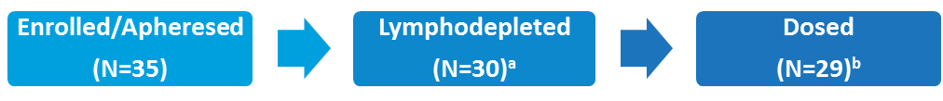
CARTITUDE-1: A phase 1b/2 study of cilta-cel in RRMM
Binding domains
Key Eligibility Criteria
Progressive MM per IMWG criteria
Received ≥3 prior therapies or double refractory
Prior PI, IMiD, anti-CD38 therapy
VHH
VHH
Primary Objectives
Phase 1b: Characterize safety and confirm recommended phase 2 dose
Phase 2: Evaluate efficacy of cilta-cel
4-1BB
CD3ζ
(N=113)
(N=101)
(N=97)
Cilta-cel
Target JNJ-4528 Infusion: 0.75x106 (0.5 – 1.0x106) CAR+ viable T cells/kg
Median administered dose = 0.71x10⁶ (0.51 – 0.95x10⁶) CAR+ viable T cells/kg
Special Features
Ciltacabtagene autoleucel (cilta-cel; JNJ-68284528) contains
2 BCMA-targeting single chain antibodies designed to confer avidity
Identical to the CAR construct used in the LEGEND-2 study
Berdeja et al. Lancet 2021; 398(10297):314-324.
Courtesy of Jesús G Berdeja, MD

Slide 31
CAR T-Associated Toxicities
Acute phase (D0-30)
Cytokine Release Syndrome (CRS)
Immune effector cell–associated neurotoxicity syndrome (ICANS)
Cytopenias
  MAS or HLH is a very rare and severe form
  DIC
B-cell aplasia and hypogammaglobulinemia
Life threatening if not managed by expert multidisciplinary team
Tumor lysis is rare and likely varies by disease and disease burden
Courtesy of Jesús G Berdeja, MD

Slide 32
CAR T-Associated Toxicities
Late phase (D30+)
Persistent cytopenias
B-cell aplasia and hypogammaglobulinemia
  ?IVIG replacement
T-cell deficiency
  PJP and VZV prophylaxis, other?
Infection prophylaxis
Residual effects of acute toxicity
Delayed CRS and neurotoxicity are rare but can occur
Impairment to QOL – fatigue, memory issues, not yet well described
Courtesy of Jesús G Berdeja, MD

Slide 33
Agenda
Introduction: Monday Night with Research To Practice
MODULE 1: Targeting BCMA
MODULE 2: CAR T-Cell Therapy
MODULE 3: Bispecific Antibodies
MODULE 4: Belantamab Mafodotin

Slide 34
Case Presentation – Dr Raje: A 62-year-old woman with multiregimen-relapsed MM who receives a bispecific antibody
A 62-year-old African American who was diagnosed with IgA kappa multiple myeloma approximately 4 years back when she presented with an acetabular fracture.
Had a RT THR.
Was treated with RVD followed by rev maintenance—had stem cells collected but refused a transplant.
Relapsed after 18 months. Was treated with dara pom dex. Achieved a PR and then had progressive disease.
Was treated with carfilzomib and cyclophosphamide. Progressed after 6 months. Was offered anti BCMA (Elranatamab) with lenalidomide on trial.
Has been on therapy for >1 year.
Is in MRD-negative disease state.
Courtesy of Noopur Raje, MD

Slide 35
BCMA x CD3 Bispecific Antibodies: Summary
Therapy | Characteristics | N | Population | Safety | Response | DOR/PFS
Teclistamab¹ | Bispecific IV/SC (RP2D: 1500μg/kg SC) Weekly and every other week in f/u | 157 | At SC cohorts: Median of 5PL 79% triple refractory 38% penta refractory | At RP2D: CRS 70% G1-2 Neurotox 1% (G1) Infections 50% | At RP2D, ORR: 65% with 40% sCR/CR | No mature data
AMG701² | BiTE modified IV Weekly | 82 | Median of 6PL 62% triple refractory | CRS 55%, G3-4: 9% No ICANS 20% cytopenias | 83% ORR at the top dose level and 50% VGPR | No mature data
REGN5458³ | Bispecific IV Weekly and every other week C4-> | 49 | Median of 5PL 100% triple refractory 57% penta refractory | CRS 39%, no G3-4 ICANS 12% cytopenias 47% and infections 18% | 62.5% at 96 mg and 95% of responders were VGPR. Some CR in lower dose levels | Preliminary median DOR: 6m
TNB-383B⁴ | Triple chain anti-BCMA bispecific IV fixed doses Every 3 weeks | 58 | Median of 6PL 64% triple refractory 34% penta refractory | CRS 45% and no G3-4 No ICANS Cytopenias 21% and infections 14% | 80% (13% CR) at the dose levels 40-60 mg | No mature data
Elranatamab (PF-3135⁵) | Bispecific SC and weekly RP2D: 1000 μg/kg | 30 | Median of 8PL 87% triple refractory 23% prior BCMA-based therapy | CRS 73% and no G3-4 ICANS 20% ISR 50% | 83% ORR at RP2D | No mature data
1. Usmani SZ et al. Lancet 2021. 2. Harrison SJ, et al. Presented at ASH 2020. Abstract 181. 3. Madduri D, et al. Presented at ASH 2020. Abstract 291. 4. Rodriguez C, et al. Presented at ASH 2020. Abstract 293.5. Bahlis NJ, et al. Presented at ASCO 2021. Abstract 8006.
Courtesy of Noopur Raje, MD

Slide 36
Novel Non-BCMA Bispecific Antibodies
Therapy | Characteristics | N | Population | Safety | Response | DOR/PFS
Talquetamab¹ | G protein-coupled receptor family C group 5 member D (GPRC5D) x CD3 bispecific antibody IV or SC admin | 184, 30 at RP2D (405 𝛍g/kg)) | Median of 6PL (6PL at RP2D) 76% triple refractory 28% penta refractory | Infections in 37% of SC and RP2D patients; G3-4 3% at RP2D Neurotoxicity in 4 SC patients; 2 (7%) at RP2D CRS 73%, G3-4 2% at RP2D | At RP2D: 70% ORR with ≥ VGPR 60% | No mature data
Cevostamab (BFCR4350A)² | FcRH5/CD3 bispecific T-cell engager Q3W IV infusions | 53 | Median of 6PL 72% triple refractory 45% penta refractory | Thrombocytopenia 32%, G3-4 25% CRS 76%, G3-4 2% Neurotoxicity 28%, no G3-4 | ORR in ≥3.6/20-mg cohorts: 53% (18/34) in all pts 63% (5/8) in pts with prior anti-BCMA | No mature data
1. Berdeja JG, et al. ASCO 2021. Abstract 8008. 2. Cohen A, et al. ASH 2020. Abstract 292.
Courtesy of Noopur Raje, MD

Slide 37
Phase 1 First-in-Human Study of Teclistamab in Patients With RRMM: Study Design and Patients
Teclistamab is a B-cell Maturation Antigen (BCMA) x CD3 bispecific antibody
Patient Characteristics |  | SC Total (N=73) | RP2D (n=40)
Median age (range), years |  | 64 (39–84) | 62.5 (39–84)
Extramedullary plasmacytomas ≥1, n (%) |  | 11 (15) | 8 (20)
Median time since diagnosis (range), years |  | 5.9 (0.8–23.5) | 5.7 (0.8–17.4)
High-risk cytogenetics,^{d} n (%) |  | 16 (30) | 10 (37)
Prior transplantation, n (%) |  | 63 (86) | 34 (85)
Median prior lines of therapy (range), n |  | 5 (2–14) | 5 (2–11)
Triple-class exposed,^{e} n (%) |  | 71 (97) | 40 (100)
Penta-drug exposed,^{f} n (%) |  | 50 (68) | 26 (65)
Refractory status, n (%) | Carfilzomib | 49 (67) | 27 (68)
 | Pomalidomide | 55 (75) | 28 (70)
 | Anti-CD38 antibody | 68 (93) | 39 (98)
 | Triple-class | 58 (79) | 33 (83)
 | Penta-drug | 28 (38) | 15 (38)
Refractory to last line of therapy, n (%) |  | 64 (88) | 33 (83)
Key eligibility criteria
RR or intolerant to established MM therapies
No prior BCMA-targeted therapy
Dosing Overview
Premedicationsª were limited to step-up dosing and first full dose
  No steroid requirement after first full dose
Step-up dose^{b}: week -1
Initial Q2W IV dosing switched to weekly IV or SC ± step-up dosing
IV Teclistamab (N=84)
0.3-720 µg/kg
(+ step-up dosing^{b})
SC Teclistamab (N=73)
80-3000 µg/kg
RP2D: 1500 µg/kg^{c}
Key objectives: RP2D (Part 1), RP2D safety/tolerability (Part 2)
Antitumor activity, PK, PD
ªGlucocorticoid, antihistamine, and antipyretic. ^{b}1-3 step-up doses given within 1 week before a full dose. ^{c}With 60 and 300 µg/kg step-up doses given within 1 week before a full dose.
^{d}Defined as del(17p), t(4;14), t(14;16), t(14;20).^{e}PI, IMiD, and anti-CD38, ^{f}2 PIs, 2 IMiDs, and anti-CD38., PK, pharmacokinetics; q2w, once every 2 weeks; RP2D, recommended phase 2 dose.
Usmani SZ. Lancet 2021
Courtesy of Noopur Raje, MD

Slide 38
Phase 1 First-in-Human Study of Teclistamab in Patients With RRMM: Efficacy
ORRª: 65%
≥CR: 40%
≥VGPR: 58%
ORRª: 59%
≥CR: 34%
≥VGPR: 59%
RP2D mF/U: 6.1 months (range: 1.2-12.2)
  Median time to first response: 1.0 month (range: 0.2-3.1)
  ORR in 33 triple-class refractory patients: 61%
Of 6 evaluable patients in RP2D cohort, all achieved MRD-negative CR/sCR at 10⁻⁶ (n=5) and 10⁻⁵ (n=1)
Median DOR was not reached
RP2D^{b}
n=40
Other SC doses
n=32
ª Investigator assessment of evaluable patients who had ≥1 postbaseline disease evaluation per 2011 IMWG response criteria, includes unconfirmed response
^{b} 1500 µg/kg SC QW, with step-up doses of 60 and 300 µg/kg
Usmani SZ et al. Lancet 2021
CR, complete response; DOR, duration of response; MRD, minimal residual disease; mF/U, median follow up; ORR, overall response rate; PR, partial response; RP2D, recommended phase 2 dose; sCR, stringent complete response; VGPR, very good partial response
Courtesy of Noopur Raje, MD

Slide 39
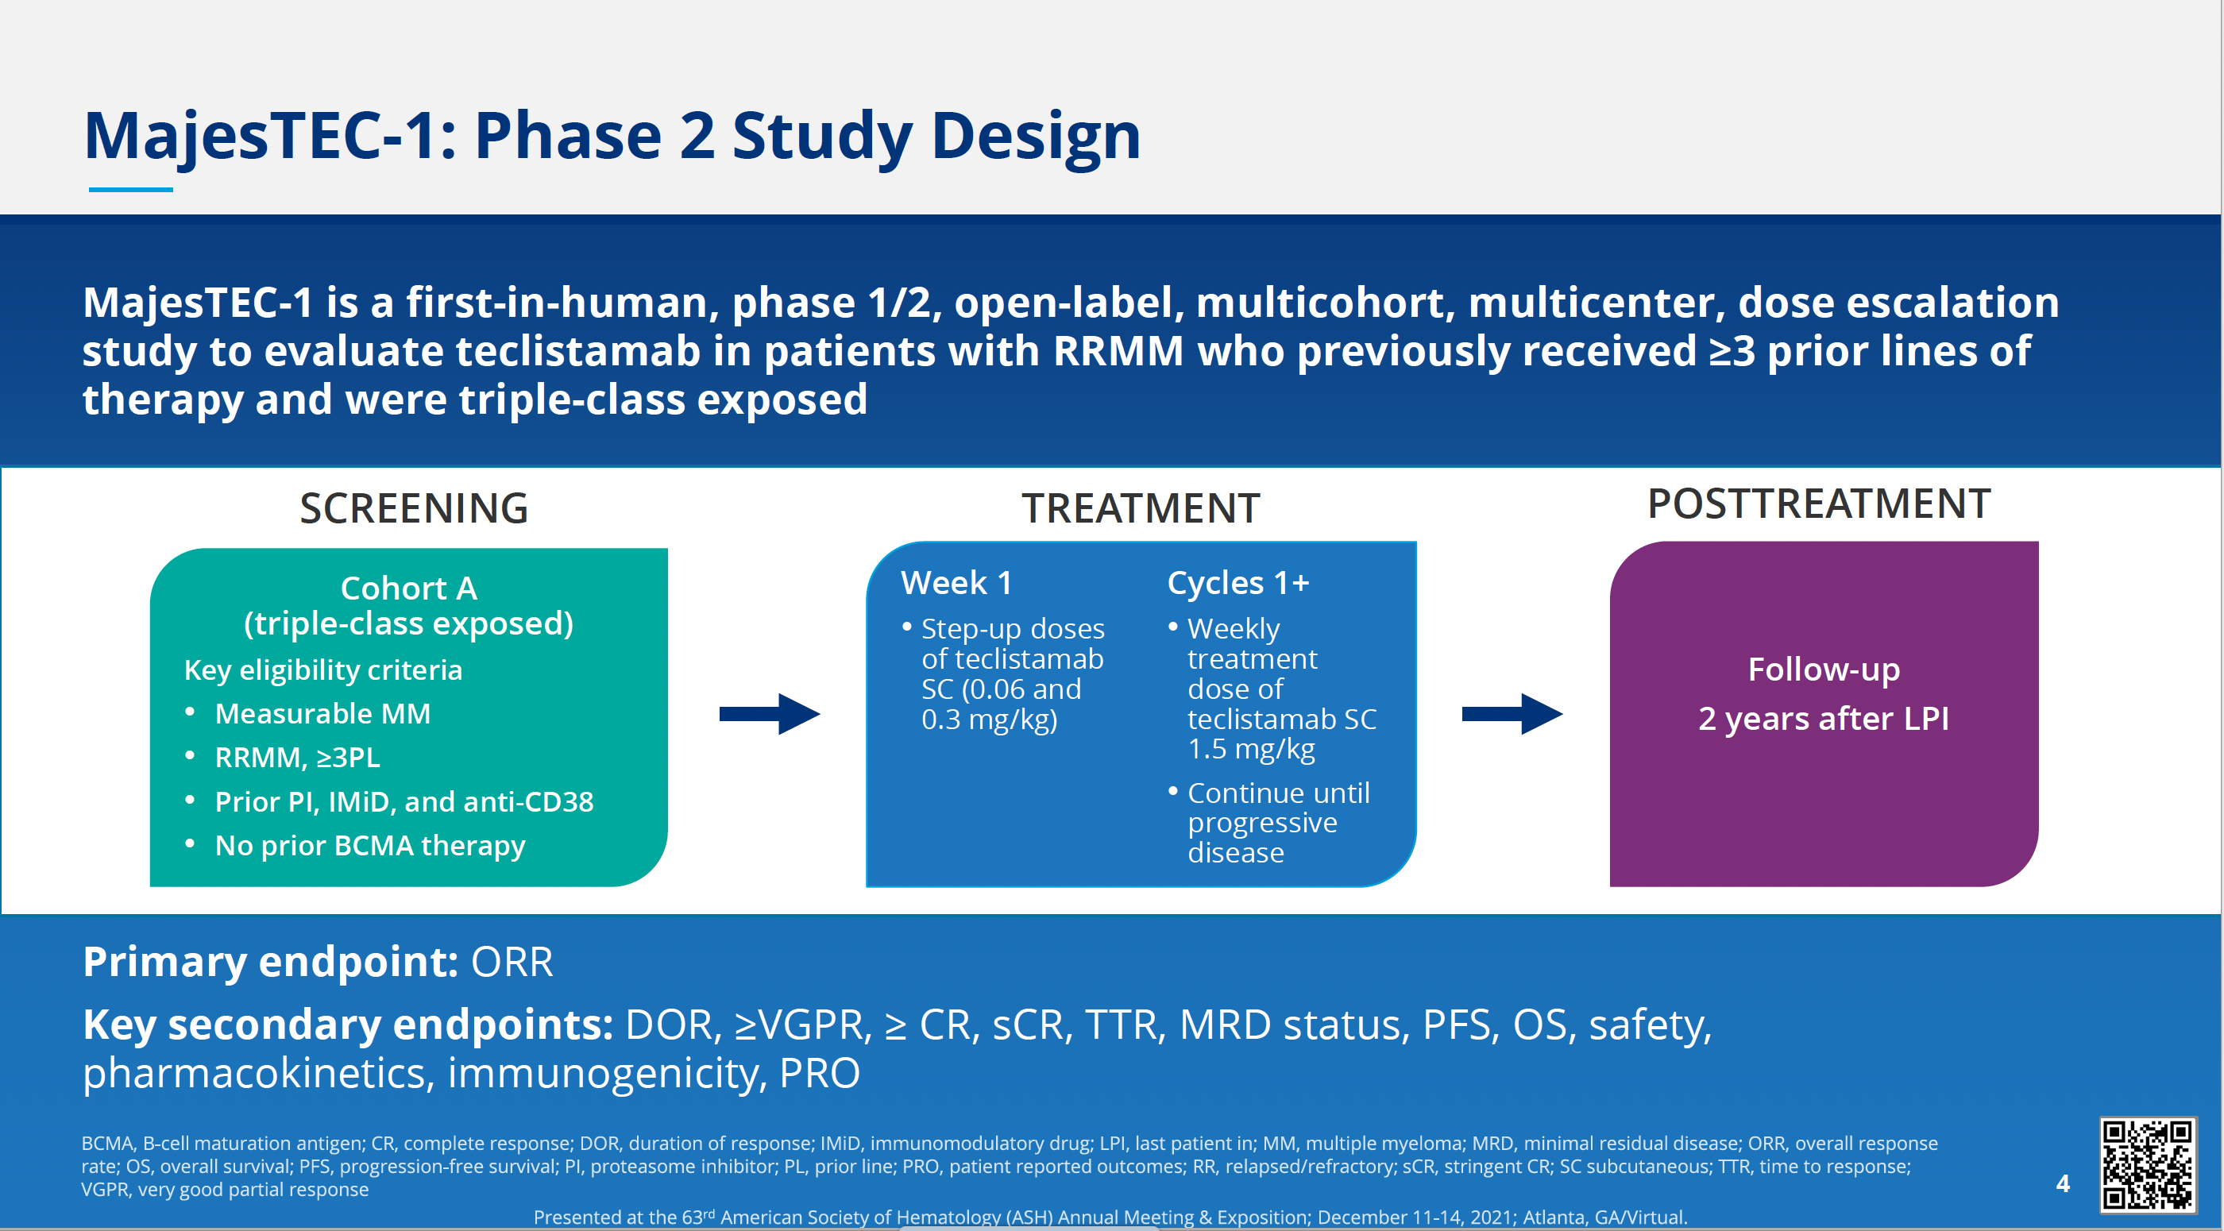
Moreau et al, ASH 2021, Abstract 896

Slide 40
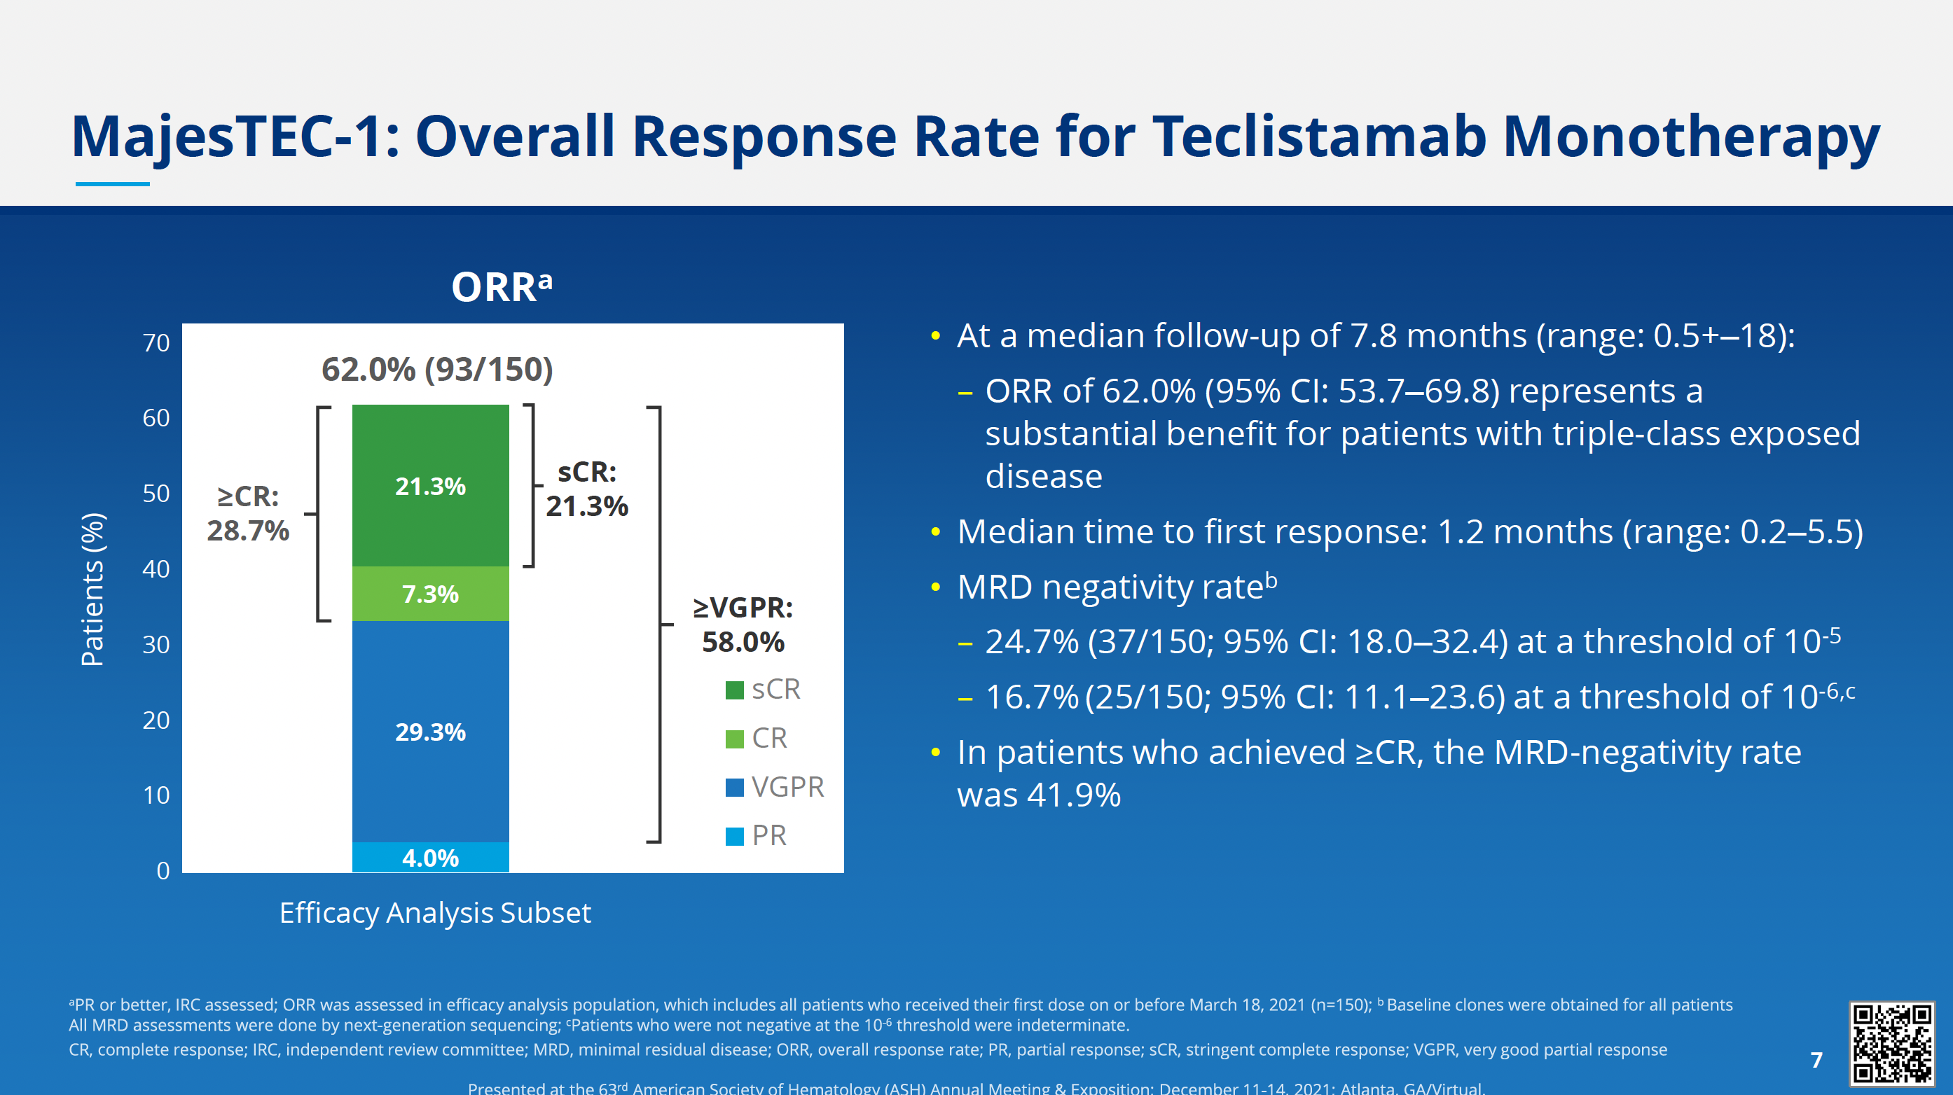
Moreau et al, ASH 2021, Abstract 896

Slide 41
MagnetisMM-1: Phase 1 Study of Elranatamab (PF-06863135), a BCMA-targeted CD3-Engaging Bispecific Molecule, for Patients with RRMM
Prior treatments
Study design
 | N=55
Number of prior therapies, median (range) | 6.0 (2-15)
Triple-class exposed, n (%) | 54 (98)
Triple-class refractory,ª n (%) | 50 (91)
Prior BCMA-targeted therapy, n (%) Anti-BCMA ADC CAR-T | 12 (22) 7 (13) 5 (9)
ªRefractory to ≥1 PI, 1 IMiD, and 1 anti-CD38 mAb
1000 (N=6)
600 (N=6)
Dose escalation
(Part 1, N=30), μg/kg
360 (N=4)
215 (N=4)
130 (N=4)
80 (N=6)
Priming cohorts (Part 1.1, N=20)
Priming dose 600 μg/kg → 1000 μg/kg (Q1W or Q2W)
Efficacy summary
Elranatamab 1000 μg/kg Q2W achieved exposure associated with anti-myeloma efficacy
Confirmed ORR was 69% (9/13) at the recommended dose of 1000 μg/kg Q1W
70% (7/10) of patients with prior BCMA-directed therapy achieved response
Expansion (Part 2A, N=15)
Priming dose 44 mg → 76 mg (Q1W) Pre-medicationª
Heavily pretreated population
Good efficacy rates
Small study population
Data cut-off: July 26, 2021
Sebag M, et al. ASH 2021;Abstract 895
Courtesy of Noopur Raje, MD

Slide 42
MagnetisMM-1: Phase 1 Study of Elranatamab (PF-06863135), a BCMA-targeted CD3-Engaging Bispecific Molecule, for Patients with RRMM
Treatment-emergent AEs
Effect of priming and pre-medication on CRS
AE, n (%) | Grade 1 | Grade 2 | Grade 3 | Grade 4 | Total
Hematologic Neutropenia Anemia Lymphopenia Thrombocytopenia Leukopenia | 0 2 (3.6) 0 6 (10.9) 2 (3.6) | 2 (3.6) 8 (14.5) 0 6 (10.9) 4 (7.3) | 13 (23.6) 25 (45.5) 3 (5.5) 5 (9.1) 9 (16.4) | 24 (43.6) 1 (1.8) 25 (45.5) 10 (18.2) 4 (7.3) | 39 (70.9) 36 (65.5) 28 (50.9) 27 (49.1) 19 (34.5)
Non-hematologic CRS Injection site reactions Fatigue Diarrhea Hypophosphatemia Decreased appetite Dry skin | 28 (50.9) 27 (49.1) 6 (10.9) 11 (20.0) 0 12 (21.8) 17 (30.9) | 20 (36.4) 4 (7.3) 12 (21.8) 7 (12.7) 6 (10.9) 6 (10.9) 2 (3.6) | 0 0 3 (5.5) 2 (3.6) 13 (23.6) 1 (1.8) 0 | 0 0 0 0 1 (1.8) 0 0 | 48 (87.3) 31 (56.4) 21 (38.2) 20 (36.4) 20 (36.4) 19 (34.5) 19 (34.5)
Occurring in ≥33% of patients
 | Elranatamab SC at recommended monotherapy dose
 | Dose escalation Part 1 (N=6) | Priming cohorts Part 1.1 (N=20) | Expansion Part 2A (N=15)
Priming/Pre-medication | No / No | Yes / No | Yes / Yes
Overall incidence of CRS, n (%) Grade 1 Grade 2 | 6 (100) 4 (66.7) 2 (33.3) | 20 (100) 10 (50) 10 (50) | 10 (66.7) 5 (33.3) 5 (33.3)
Duration, days, median (range) | 4.0 (1–10) | 3.0 (2–7) | 3.0 (1–4)
Sebag M, et al. ASH 2021;Abstract 895
Courtesy of Noopur Raje, MD

Slide 43
MagnetisMM-1: Phase 1 Study of Elranatamab (PF-06863135), a BCMA-targeted CD3-Engaging Bispecific Molecule, for Patients with RRMM
Sebag et al.ASH 2021
Courtesy of Noopur Raje, MD

Slide 44
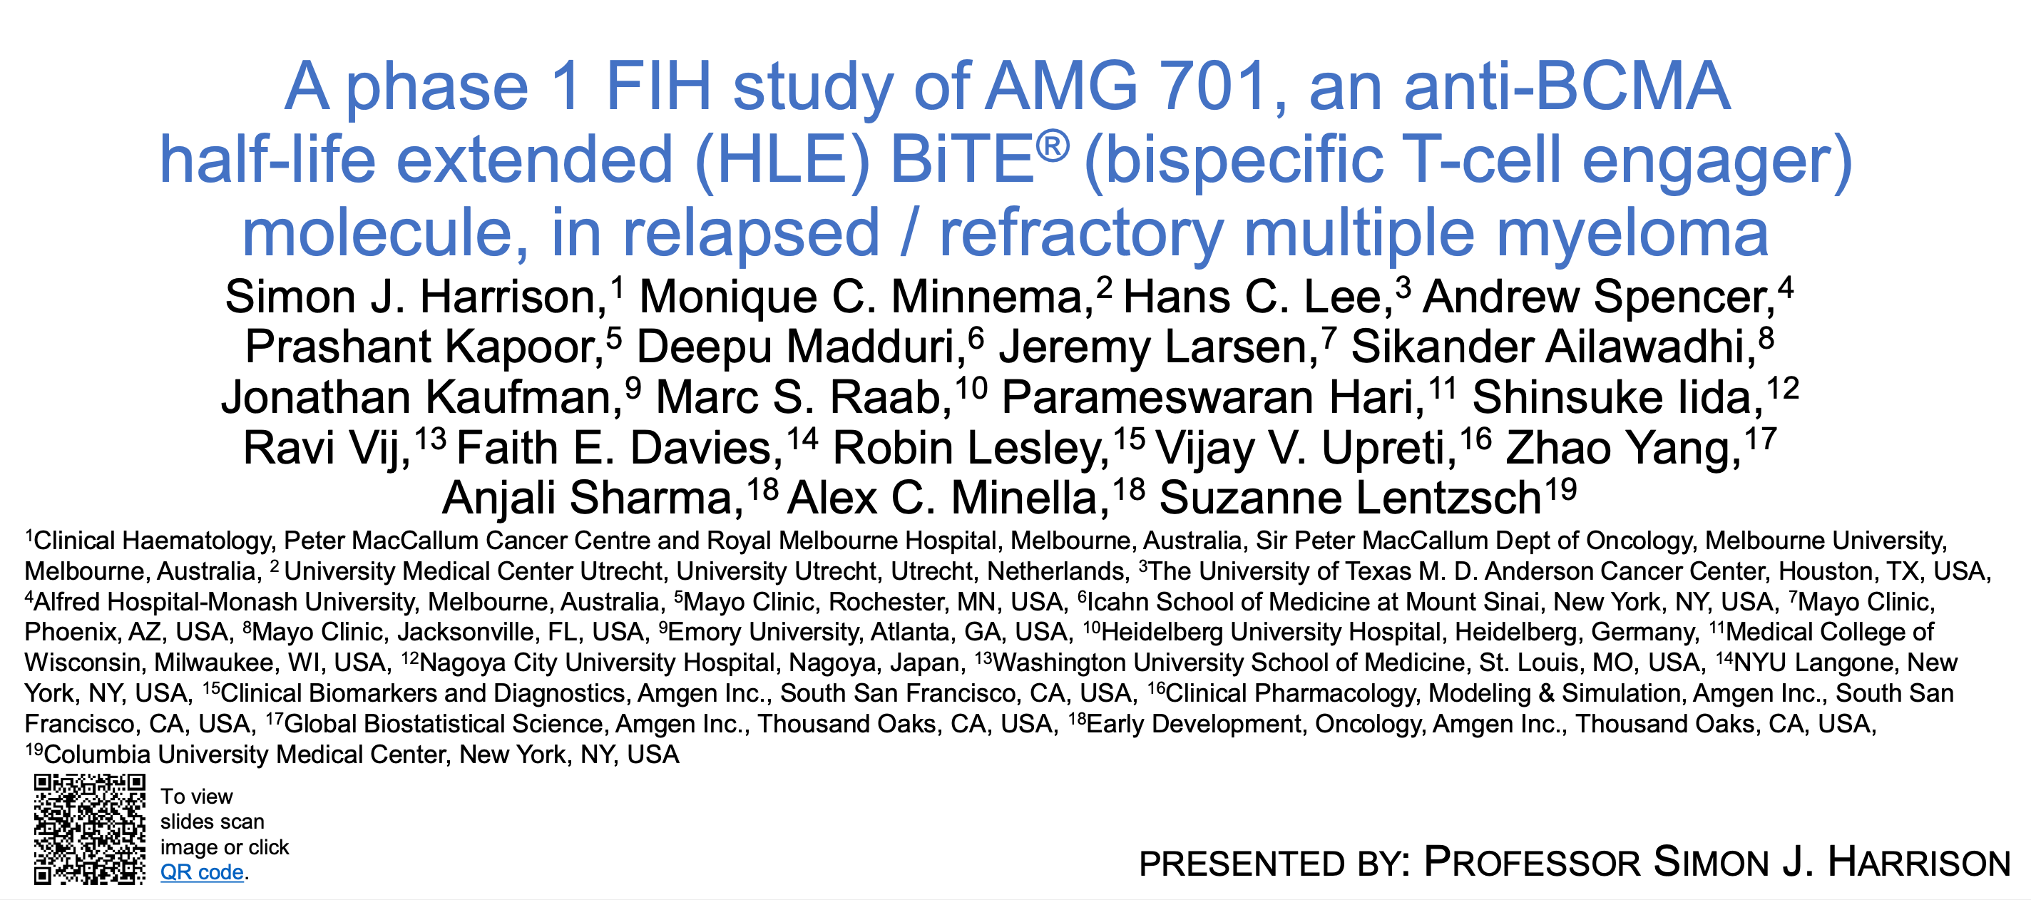
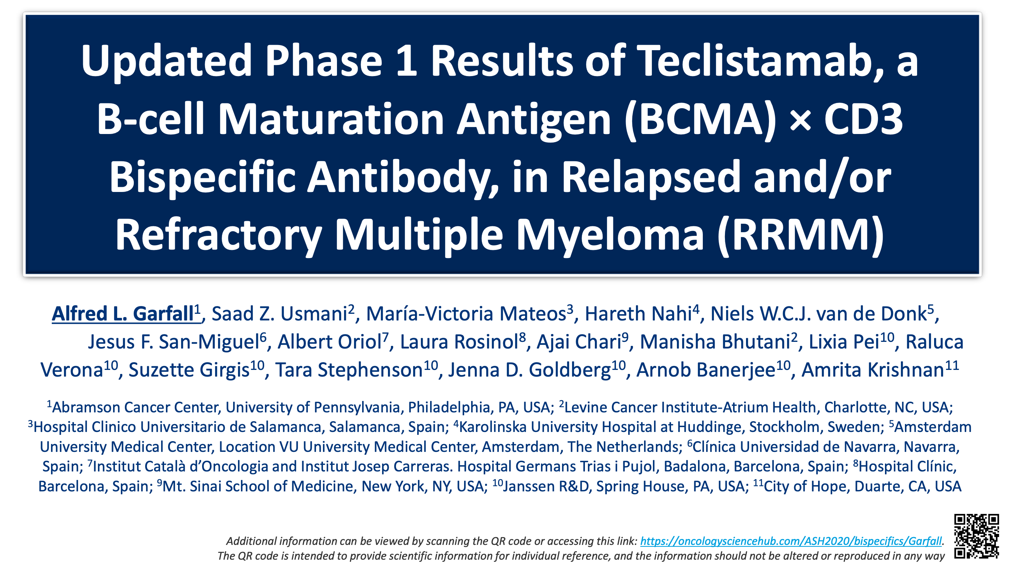
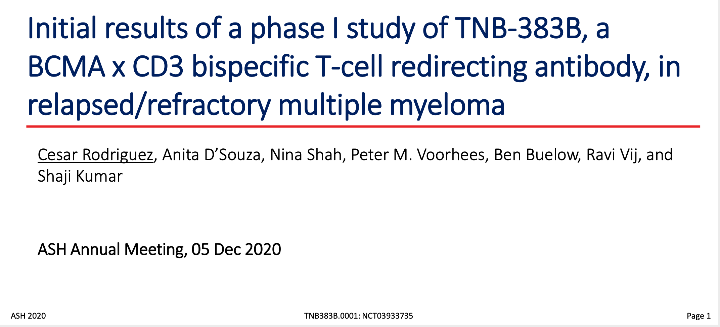
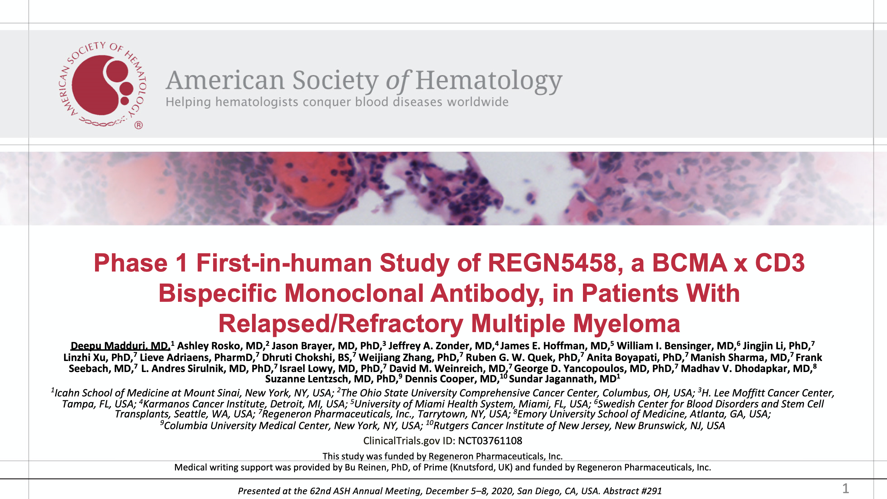
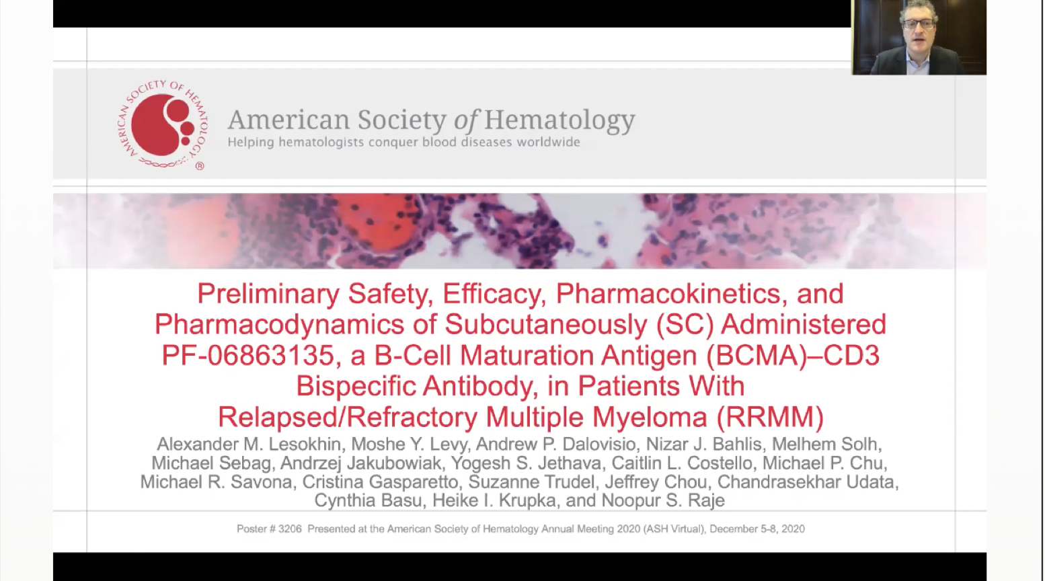
Five anti-BCMA bispecific antibodies presented at ASH 2020
Courtesy of Noopur Raje, MD

Slide 45
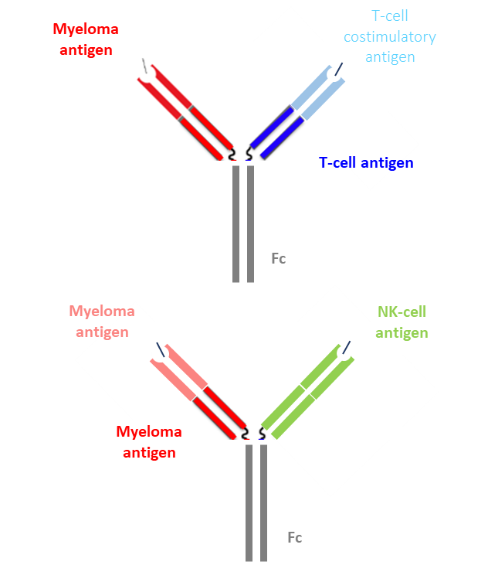
The Future: Trispecific Antibodies
Still in pre-clinical stages of development
With bispecifics, in absence of T cell co-stimulation higher likelihood of anergy, leading to a suboptimal anti-tumor response
Wu, et al. recently demonstrated a trispecific T cell engager targeting CD38, CD3, and CD28 (co-stimulatory protein on T-cells) very potent killing of CD38+ MM cell lines, 3- to 4-log higher than daratumumab
Also suppressed MM growth in mice and promoted proliferation of memory and effector T-cells and downregulation of regulatory T-cells in primates
Trispecific NK cell engagers also being developed, targeting CD16A on NK cell as well as the MM antigens BCMA and CD200
Lancman, et al. ASH 2020
Wu, et al. Nature Cancer 2019
Courtesy of Noopur Raje, MD
Slide Courtesy of Dr. Ajai Chair

Slide 46
Current Understanding and Future Directions
The immune system is important across the spectrum of myeloma
BCMA is a validated target
Antibody drug conjugates, bispecific T-cell engagers, and cellular products all show efficacy
Future will be to define how to combine/sequence these
Next generation approaches will focus on improving efficacy and DOR
Courtesy of Noopur Raje, MD

Slide 47
Agenda
Introduction: Monday Night with Research To Practice
MODULE 1: Targeting BCMA
MODULE 2: CAR T-Cell Therapy
MODULE 3: Bispecific Antibodies
MODULE 4: Belantamab Mafodotin

Slide 48
Case Presentation – Dr Berdeja: A 78-year-old man with multiregimen-relapsed MM who receives belantamab mafodotin
78-yr-old male diagnosed with ISS/R-ISS stage II multiple myeloma with standard-risk cytogenetics
Initial treatment: lenalidomide/dexamethasone; achieved a VGPR
After 24 mos, his M spike increased consistent with PD. At this time, he was also noted to have a Cr 2.5.
Treated with cyclophosphamide/bortezomib/dex; achieved a PR, lasting 12 mos
Treated with daratumumab/bortezomib/dexamethasone; achieved VGPR, lasting 12 mos
Treated with elotuzumab, pomalidomide, dex; achieved a PR
Courtesy of Jesús G Berdeja, MD

Slide 49
Case Presentation – Dr Berdeja: A 78-year-old man with multiregimen-relapsed MM who receives belantamab mafodotin (continued)
8 mos later, patient presents with increasing back pain and found to have a new pathological fracture with an increase in M protein to 1 g/dL.
Given his age and renal insufficiency, he was not felt to be a CART candidate.
He underwent treatment with belantamab mafodotin 2.5 mg/kg IV q 3 wks.
He achieved VGPR after 3 cycles. Tolerated therapy well except for mild eye irritation.
Prior to cycle 4 he was found to have G3 keratopathy on ophtho exam but no changes in visual acuity. Dose was held for 2 mos. Repeat evaluation revealed G1 keratopathy. Cycle 4 proceeded with dose reduction to 1.9 mg/kg IV. Tolerated well.
Courtesy of Jesús G Berdeja, MD

Slide 50
Belantamab mafodotin (GSK2857916)
Antibody
  Humanized, afucosylated IgG1
Antibody-Target
  BCMA
Payload
  MMAF (monomethyl auristatin-F)
Four mechanisms of action:
ADC mechanism
ADCC mechanism
Immunogenic cell death
BCMA receptor signaling inhibition
Background
1
ADC
2
ADCC
BCMA
Fc
receptor
3
Lysosome
Effector cell
BCMA
BCMA
4
BCMA
x
Malignant
plasma
cell
Cell death
¹Tai YT, et al. Blood 2014;123(20):3128-38.
Trudel et al. The Lancet Oncology. 2018 Dec 1;19(12):1641-53.
ADC, antibody-drug conjugate; ADCC, antibody-dependent cell-mediated cytotoxicity;
BCMA, B-cell maturation antigen; IgG, immunoglobulin G; MMAF, monomethyl auristatin-F
Courtesy of Jesús G Berdeja, MD

Slide 51
Belantamab mafodotin
FDA-approved August 2020 (this guideline published July 2020, so not included) for R/R MM after >4 prior therapies, including anti-CD38, PI, and IMiD
Trial | Phase | Patient population | N | Treatment arm(s) | ORR | Median PFS
DREAMM-1 | 1 | R/R MM after ASCT, alkylators, PI, and IMiD | 35 | 3.4 mg/kg belantamab mafodotin Q3W | 60% | 12 months
DREAMM-2 | 2 | R/R MM after IMiD, PI, and anti-CD38 | 196 | 2.5 mg/kg belantamab mafodotin Q3W | 31% | 2.9 months
 |  |  |  | 3.4 mg/kg belantamab mafodotin Q3W | 34% | 4.9 months
Trudel, Blood Cancer J 2019; Lonial, Lancet Oncol 2019.
Courtesy of Jesús G Berdeja, MD

Slide 52
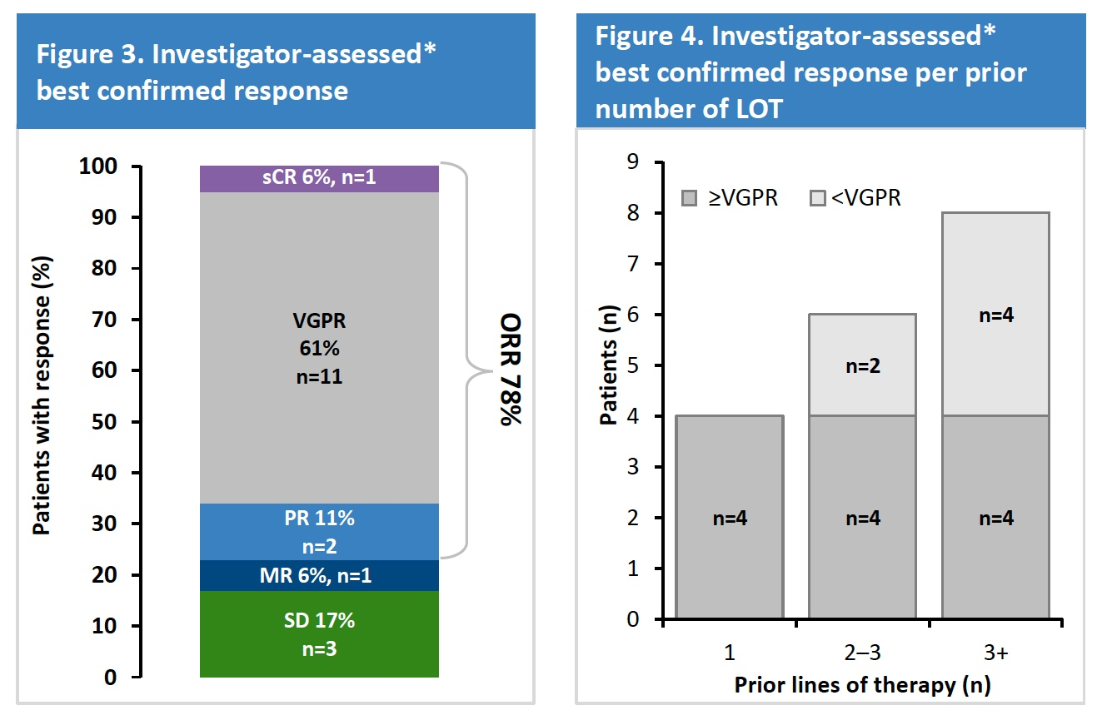
DREAMM-6: Investigator-Assessed Best Confirmed Response for Belantamab Mafodotin + Vd
Popat R et al. ASH 2020;Abstract 1419.

Slide 53
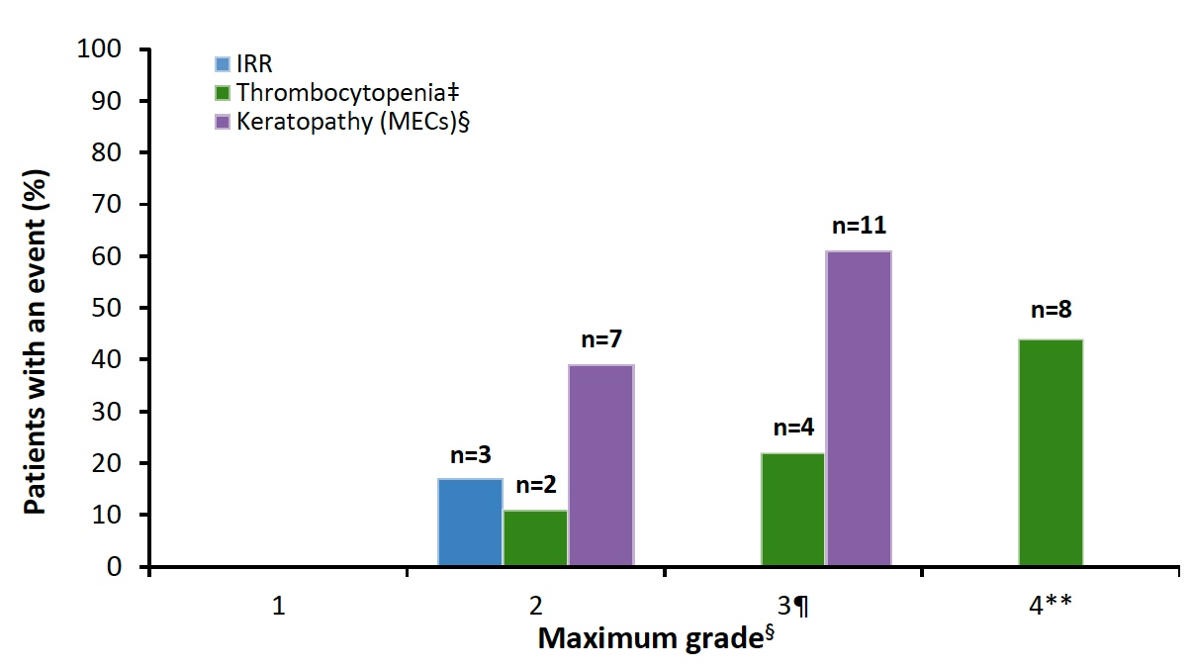
DREAMM-6: Adverse Events of Special Interest
Thrombocytopenia and corneal events were managed with dose modifications
Popat R et al. ASH 2020;Abstract 1419.

Slide 54
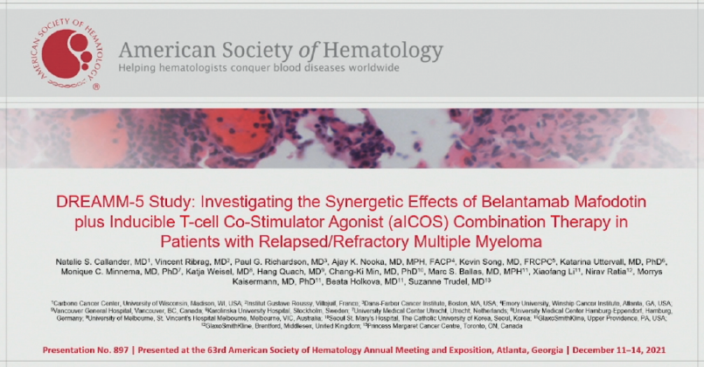

Slide 55
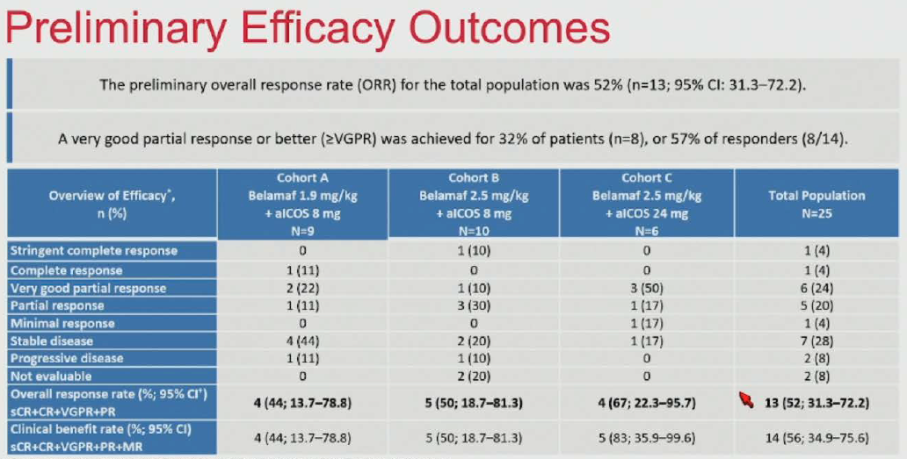
Callander NS et. al, ASH 2021, Abstract 897

Slide 56
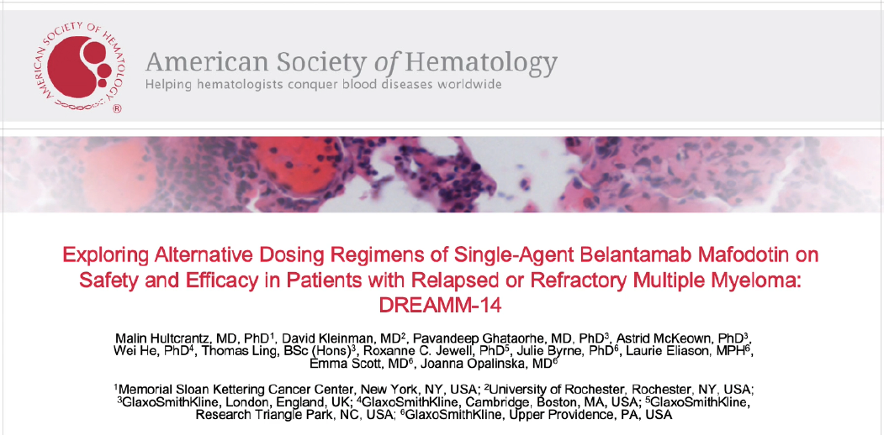

Slide 57
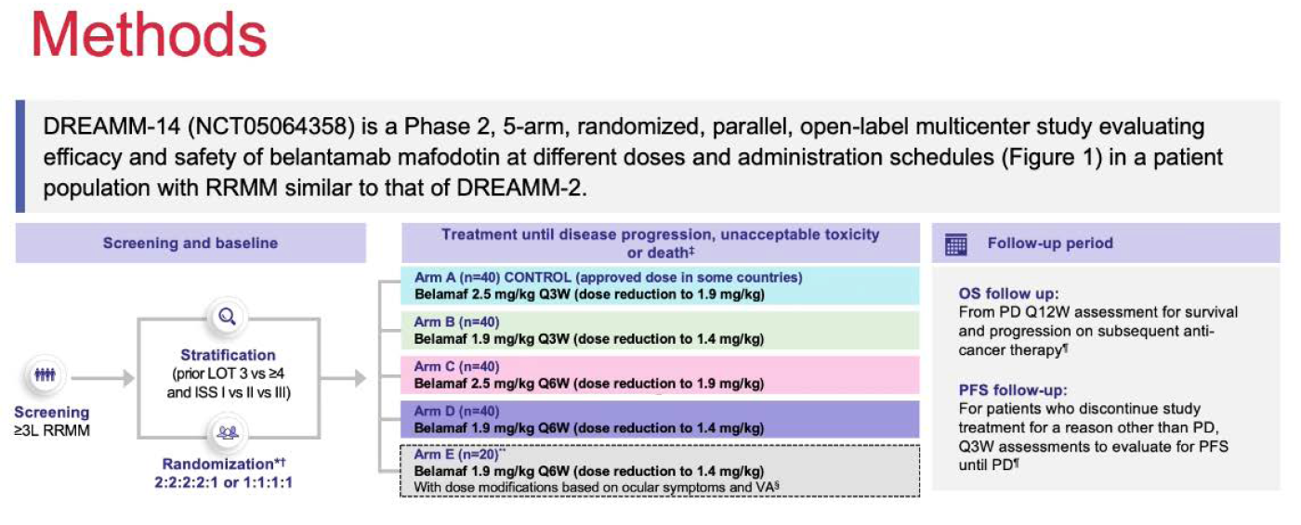
Hultcrantz M et al, SH 2021, Abstract 1645

Slide 58
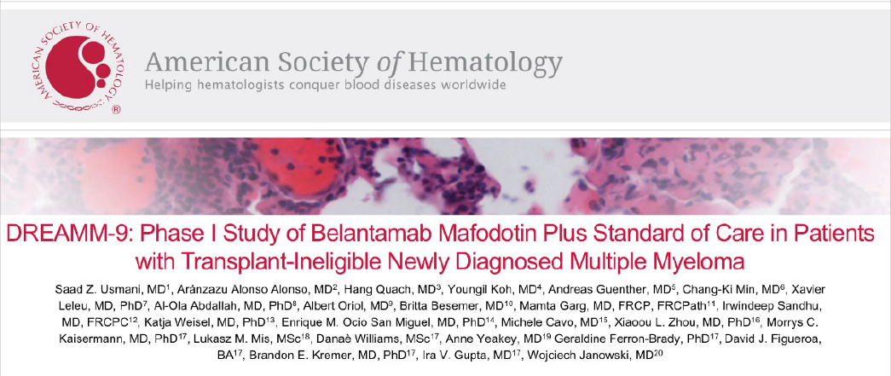

Slide 59
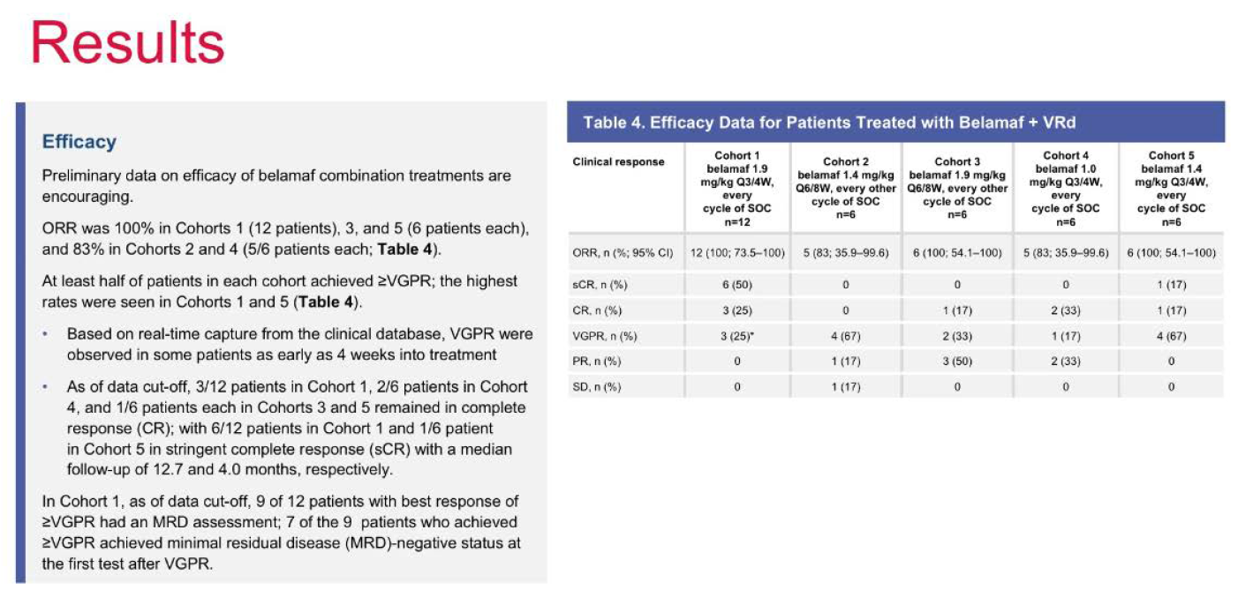
Usmani SZ et al, ASH 2021, Abstract 2738

Slide 60
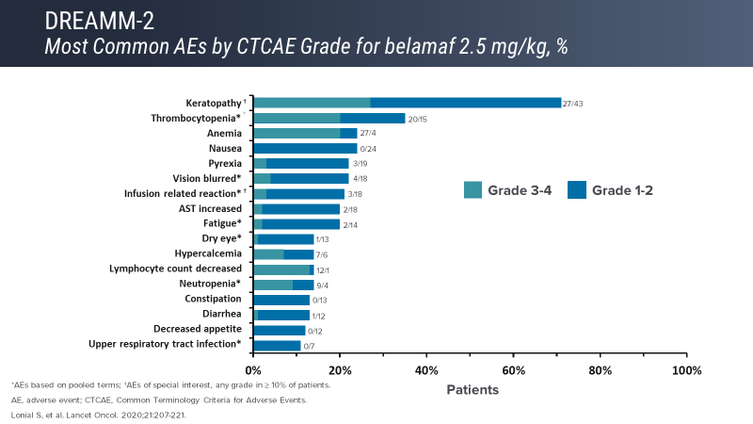
Belantamab mafodotin toxicity
Courtesy of Jesús G Berdeja, MD

Slide 61
Ocular toxicities of belantamab mafodotin
Patients should receive pre-treatment eye exam
Symptoms may include dry eyes, blurred vision, changes in vision, and exam findings
72% of patients on trials had keratopathy on exam
Around 50% of patients on clinical trials reported significantly worsening vision symptoms
Management approaches:
  Belantamab mafodotin dose reductions
  Supportive care, like lubricating eye drops
Popat, ASH 2020 #2278; Lonial, ASH 2020 #3224
Courtesy of Jesús G Berdeja, MD
Notes:
Could also discuss the controversy around steroid eye drops on this slide.
Also could mention improvements in QoL.
https://www.ncbi.nlm.nih.gov/pmc/articles/PMC7193475/
https://ash.confex.com/ash/2020/webprogram/Paper139698.html
https://ash.confex.com/ash/2020/webprogram/Paper140013.html

Slide 62
Belantamab mafodotin development
Approved in RRMM with at least 4 prior LOT including PI/IMID/antiCD38
DREAMM studies underway in various combinations in earlier lines of therapy and frontline settings
  DREAMM 9 BelaMaf +VRD in TI NDMM early results – feasible¹
Canadian Myeloma Research Group²
  Belantamab in combination with pomalidomide and dexamethasone in pts with ≥ 1 LOT
  Various BM dosing cohorts
    1.92 or 2.5 mg/kg IV on D1 q 4wks and 2.5 or 3.4 split dosing IV on D1 and D8 q 4 wks
    MTD BM 2.5mg/kg D1 or split over D1 and D8 (2.5mg/kg total) IV Q4wks – DLTs were Gr 3 keratopathy
    Promising early efficacy: ORR 88% all 34 pts, ORR 100% in 11 pts with triple refractory disease
Courtesy of Jesús G Berdeja, MD

Slide 63
Targeting BCMA may be is a new standard
 | Antibody drug conjugate | Bispecific antibody | CAR T-cell
Approved product | Belantamab mafodotin (August 2020) | Several in phase II | Ide-cel (March 2021)
Efficacy | ++ (as single agent; higher in combinations) | +++ | ++++
How given | IV, q3 weeks, until progression | IV or SC, weekly or q2 weeks until progression | One-and-done
Where given | Community | Academic medical centers | Academic medical centers
Notable adverse events | Ocular (corneal) | CRS and neurotoxicity | CRS and neurotoxicity
CRS | Not seen | ++ | +++
Neurotoxicity | Not seen | + | ++
Availability | Off-the-shelf; after ophthalmology evaluation | Off-the-shelf | Wait time for manufacturing
Courtesy of Noopur Raje, MD

