Slide 1
Exploring the Current and Changing Paradigm for the Management of Newly Diagnosed
Diffuse Large B-Cell Lymphoma
Wednesday, February 2, 2022
5:00 PM – 6:15 PM ET
Faculty
Christopher R Flowers, MD, MS
Neha Mehta-Shah, MD, MSCI
Grzegorz Nowakowski, MD
Moderator
Neil Love, MD

Slide 2
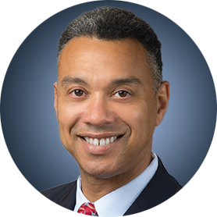

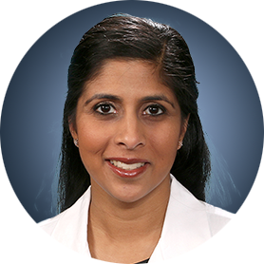
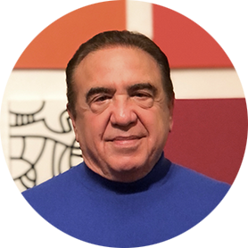
Faculty
Christopher R Flowers, MD, MS
Chair, Professor
Department of Lymphoma/Myeloma
The University of Texas
MD Anderson Cancer Center
Houston, Texas
Grzegorz Nowakowski, MD
Professor of Oncology and Medicine
Vice Chair, Lymphoma Disease Group
Chair for Education
Division of Hematology
Mayo Clinic
Rochester, Minnesota
Neha Mehta-Shah, MD, MSCI
Associate Professor of Medicine
Division of Oncology, Department of Medicine
Washington University School of Medicine
St Louis, Missouri
Moderator
Neil Love, MD
Research To Practice
Miami, Florida

Slide 3
Commercial Support
This activity is supported by an educational grant from Genentech, a member of the Roche Group.

Slide 4
Dr Love — Disclosures
Dr Love is president and CEO of Research To Practice. Research To Practice receives funds in the form of educational grants to develop CME activities from the following companies: AbbVie Inc, Adaptive Biotechnologies Corporation, ADC Therapeutics, Agios Pharmaceuticals Inc, Alexion Pharmaceuticals, Amgen Inc, Array BioPharma Inc, a subsidiary of Pfizer Inc, Astellas, AstraZeneca Pharmaceuticals LP, Aveo Pharmaceuticals, Bayer HealthCare Pharmaceuticals, BeiGene Ltd, BeyondSpring Pharmaceuticals Inc, Blueprint Medicines, Boehringer Ingelheim Pharmaceuticals Inc, Bristol-Myers Squibb Company, Celgene Corporation, Clovis Oncology, Coherus BioSciences, CTI BioPharma Corp, Daiichi Sankyo Inc, Eisai Inc, Epizyme Inc, Exact Sciences Inc, Exelixis Inc, Five Prime Therapeutics Inc, Foundation Medicine, G1 Therapeutics Inc, Genentech, a member of the Roche Group, Genmab, Gilead Sciences Inc, GlaxoSmithKline, Grail Inc, Halozyme Inc, Helsinn Healthcare SA, ImmunoGen Inc, Incyte Corporation, Ipsen Biopharmaceuticals Inc, Janssen Biotech Inc, administered by Janssen Scientific Affairs LLC, Jazz Pharmaceuticals Inc, Karyopharm Therapeutics, Kite, A Gilead Company, Lilly, Loxo Oncology Inc, a wholly owned subsidiary of Eli Lilly & Company, Merck, Natera Inc, Novartis, Novocure Inc, Oncopeptides, Pfizer Inc, Pharmacyclics LLC, an AbbVie Company, Puma Biotechnology Inc, Regeneron Pharmaceuticals Inc, Sanofi Genzyme, Seagen Inc, Servier Pharmaceuticals LLC, Sumitomo Dainippon Pharma Oncology Inc, Taiho Oncology Inc, Takeda Pharmaceuticals USA Inc, Tesaro, A GSK Company, TG Therapeutics Inc, Turning Point Therapeutics Inc, Verastem Inc and Zymeworks Inc.

Slide 5
Research To Practice CME Planning Committee Members,
Staff and Reviewers
Planners, scientific staff and independent reviewers for Research To Practice have no relevant conflicts of interest to disclose.

Slide 6
Dr Flowers — Disclosures
Consulting Agreements | AbbVie Inc, Bayer HealthCare Pharmaceuticals, BeiGene Ltd, Celgene Corporation, Denovo Biopharma, Epizyme Inc, Genentech, a member of the Roche Group, Genmab, Gilead Sciences Inc, Janssen Biotech Inc, Karyopharm Therapeutics, Pharmacyclics LLC, an AbbVie Company, Seagen Inc, Spectrum Pharmaceuticals Inc
Contracted Research | 4D Pharma PLC, AbbVie Inc, Acerta Pharma — A member of the AstraZeneca Group, Adaptimmune, Allogene Therapeutics, Amgen Inc, Bayer HealthCare Pharmaceuticals, Burroughs Wellcome Fund, Cancer Prevention and Research Institute of Texas (CPRIT Scholar in Cancer Research), Celgene Corporation, Cellectis, Eastern Cooperative Oncology Group, EMD Serono Inc, Genentech, a member of the Roche Group, Gilead Sciences Inc, Guardant Health, Iovance Biotherapeutics, Janssen Biotech Inc, Kite, A Gilead Company, MorphoSys, National Cancer Institute, Nektar, Novartis, Pfizer Inc, Pharmacyclics LLC, an AbbVie Company, Sanofi Genzyme, Takeda Pharmaceuticals USA Inc, TG Therapeutics Inc, Xencor, ZIOPHARM Oncology Inc
Data and Safety Monitoring Board/Committee | Denovo Biopharma

Slide 7
Dr Mehta-Shah — Disclosures
Consulting Agreements | C4 Therapeutics, Daiichi Sankyo Inc, Karyopharm Therapeutics, Kyowa Kirin Co Ltd, Ono Pharmaceutical Co Ltd, Secura Bio
Contracted Research | AstraZeneca Pharmaceuticals LP, Bristol-Myers Squibb Company, Celgene Corporation, Corvus Pharmaceuticals, Daiichi Sankyo Inc, Genentech, a member of the Roche Group, Innate Pharma, Secura Bio, Verastem Inc

Slide 8
Prof Nowakowski — Disclosures
Consulting Agreements | AbbVie Inc, Bristol-Myers Squibb Company, Celgene Corporation, Daiichi Sankyo Inc, Incyte Corporation, Kite, A Gilead Company, MorphoSys, Roche Laboratories Inc, Seagen Inc
Contracted Research | Incyte Corporation, MorphoSys, Roche Laboratories Inc, Seagen Inc

Slide 9
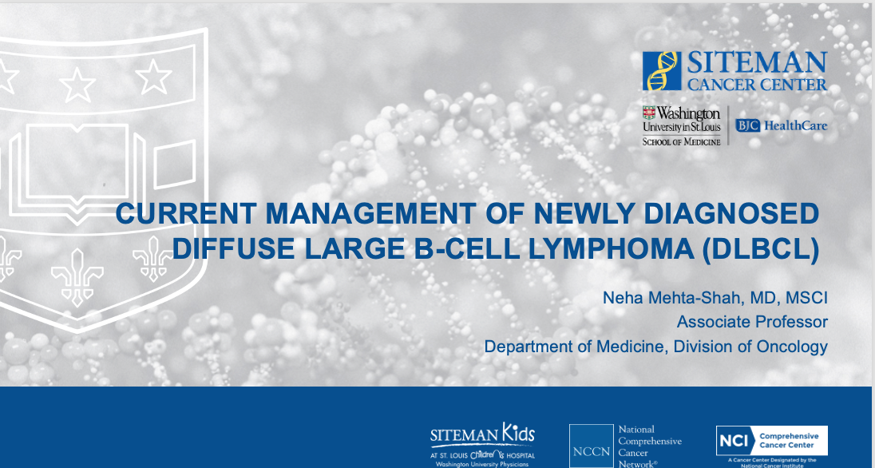
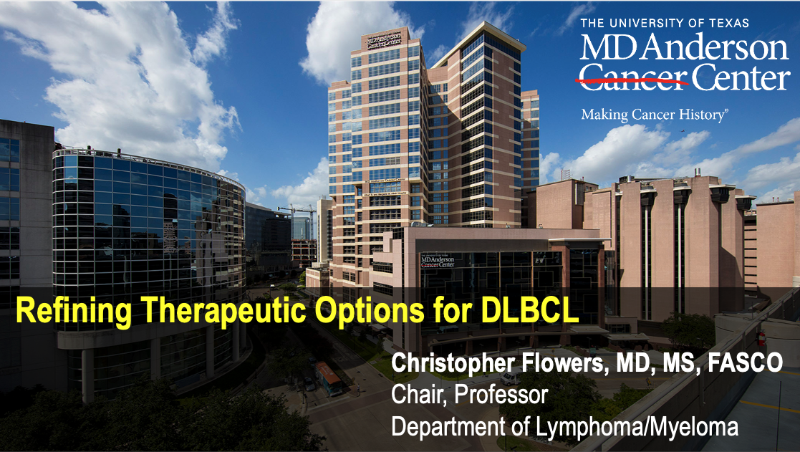
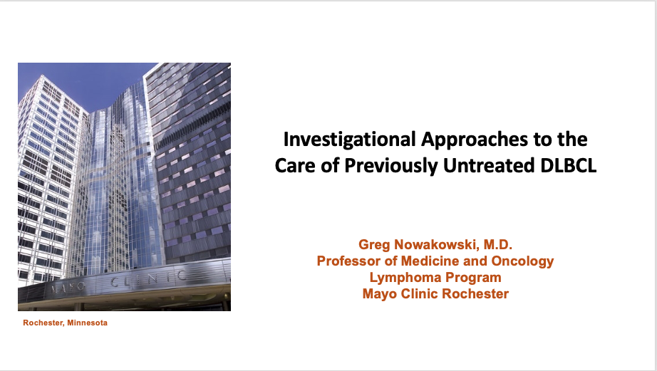

Slide 10
DLBCL Survey Respondents
January 26 - January 31, 2022
Jeremy Abramson, MD
James Armitage, MD
Ian W Flinn, MD, PhD
Christopher R Flowers, MD, MS
Steven M Horwitz, MD
Eric D Jacobsen, MD
Brad S Kahl, MD
Ann S LaCasce, MD, MMSc
Neha Mehta-Shah, MD, MSCI
Craig Moskowitz, MD
Grzegorz Nowakowski, MD
Daniel O Persky, MD
Gilles Salles, MD, PhD
Laurie H Sehn, MD, MPH
Jeff Sharman, MD
Mitchell R Smith, MD, PhD
Sonali M Smith, MD
Julie M Vose, MD, MBA
Michael E Williams, MD, ScM
Andrew D Zelenetz, MD, PhD

Slide 11
Agenda
Introduction: Overview of Diffuse Large B-Cell Lymphoma (DLBCL)
MODULE 1: The POLARIX Trial – Dr Flowers
MODULE 2: Clinical Investigator Survey
MODULE 3: Ongoing Trials in DLBCL – Prof Nowakowski
MODULE 4: Up-Front Treatment for Older Patients with DLBCL – Dr Mehta-Shah

Slide 12
Agenda
Introduction: Overview of Diffuse Large B-Cell Lymphoma (DLBCL)
MODULE 1: The POLARIX Trial – Dr Flowers
MODULE 2: Clinical Investigator Survey
MODULE 3: Ongoing Trials in DLBCL – Prof Nowakowski
MODULE 4: Up-Front Treatment for Older Patients with DLBCL – Dr Mehta-Shah

Slide 13
CASE Presentation – DR MEHTA-SHAH: A 33-YEAR-OLD WOMAN with
Germinal center B-cell-like dlbcl
33 yo woman with no significant past medical history with a 6 week history of an enlarging left supraclavicular LN (doubled in size over 3 weeks). She is otherwise asymptomatic. No fevers, chills, night sweats, weight loss, abdominal pain, nausea, vomiting.
US showed 2.8 x 2.8 x 1.3-cm supraclavicular LN
Labs:
  Normal CBC (WBC 8.5, Hgb 13.1, Plts 294)
  LDH 246 (ULN 250)
  Normal Chemistries
Courtesy of Neha Mehta-Shah, MD, MSCI

Slide 14

CASE Presentation – DR MEHTA-SHAH: A 33-YEAR-OLD WOMAN with
Germinal center B-cell-like dlbcl (continued)
US guided biopsy shows diffuse large B-cell lymphoma, germinal center
  IHC positive for: CD20, CD10, BCL6, PAX 5
  IHC negative for: MUM1, cMYC, EBER, CyclinD1, CD30
  FISH negative for MYC, BCL2, BCL6
PET/CT left supraclavicular, right cervical, mediastinal, bilateral hilar adenopathy. Adnexal and liver involvement
Courtesy of Neha Mehta-Shah, MD, MSCI

Slide 15
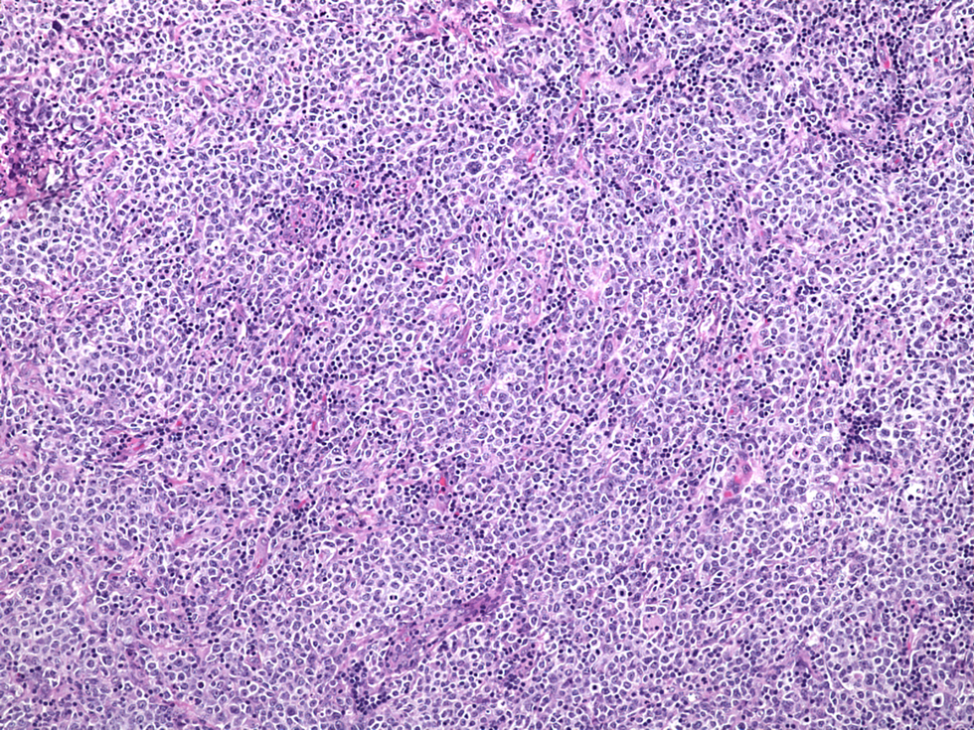
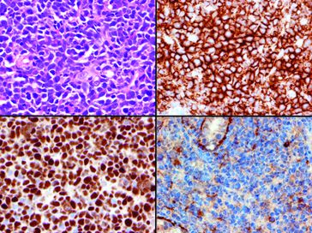
Diffuse Large B-cell Lymphoma (DLBCL)
Most common aggressive type of non-Hodgkin lymphoma
  30-40% of all non-Hodgkin lymphoma
  Affects 7/100,000 people per year in US
Heterogeneous entity
  DLBCL, not otherwise specified
    Germinal Center phenotype
    Non-Germinal Center phenotype
  T-cell/histiocyte-rich large B-cell lymphoma
  Primary Cutaneous DLBCL, leg type
  EBV+ DLBCL of the elderly
  Primary CNS lymphoma
  Primary Mediastinal DLBCL
  CD5+ DLBCL
  High grade B-cell lymphoma, not otherwise specified
Courtesy of Neha Mehta-Shah, MD, MSCI

Slide 16
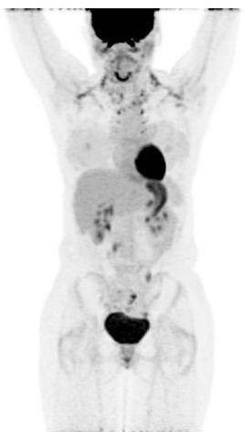
CASE Presentation – DR MEHTA-SHAH: A 33-YEAR-OLD WOMAN with
Germinal center B-cell-like dlbcl (continued)
Baseline
Post R-CHOP x 6
She underwent oocyte preservation and then R-CHOP x 6 cycles
End of Treatment PET/CT showed a complete metabolic response
She remains clinically in complete remission
Courtesy of Neha Mehta-Shah, MD, MSCI

Slide 17
DLBCL is the Most Common NHL Subtype
NHL prevalence in the US⁵
United States patients with DLBCL¹⁻³
Newly diagnosed ~28,000 per year
Relapsed/Refractory ~11,000 per year
DLBCL
Follicular lymphoma
All other subtypes
Courtesy of Christopher R Flowers, MD, MS

Slide 18
DLBCL Incidence Increases With Age
Average patient at diagnosis is 60-65 years of age (median age = 69 years), where most are not fit for HDC/ASCT¹⁻⁴
1. https://seer.cancer.gov/statfacts/html/dlbcl.html; 2; 3. . https://www.leukaemia.org.au/wp-content/uploads/2011/11/Factsheet-Lymphoma-DLBCL.pdfMartelli M et al. Crit Rev Oncol Hematol. 2013;87(2):146-171; 4. Broccoli A et al. Oncologist. 2019;24(9):1246-1252.
Courtesy of Christopher R Flowers, MD, MS

Slide 19
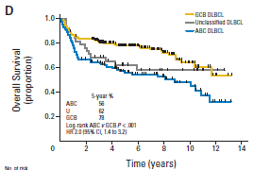
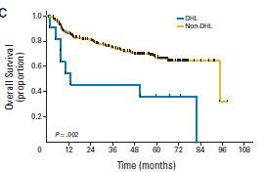
DLBCL Prognosis
5-Year Overall Survival:
  Germinal Center: 76%
  Non-Germinal Center: 56%
  “Double Expressor” : 54%
    Over expression of c-MYC + BCL2 or BCL6
  Double Hit: ~35%
    Translocation of c-MYC and BCL2
GCB vs non-GCB
Double Expressor
Double Hit
Hans et al. Blood 2004;103:275-282; Scott et al. JCO 2015; Green et al JCO 2012
Courtesy of Neha Mehta-Shah, MD, MSCI

Slide 20
Agenda
Introduction: Overview of Diffuse Large B-Cell Lymphoma (DLBCL)
MODULE 1: The POLARIX Trial – Dr Flowers
MODULE 2: Clinical Investigator Survey
MODULE 3: Ongoing Trials in DLBCL – Prof Nowakowski
MODULE 4: Up-Front Treatment for Older Patients with DLBCL – Dr Mehta-Shah

Slide 21
Case Presentation – Dr Flowers: A 71-year-old with
Stage IV DLBCL
71-year old woman diagnosed with stage IV DLBCL
  PET/CT scan shows involvement of R axillary, mediastinal, supraclavicular, mesenteric, and inguinal LNs, largest 7 cm, SUVmax = 14
  Axillary LN Bx: diffuse large B-cell lymphoma, non-GCB subtype by Hans algorithm (CD10-)
  MYC -, BCL2-, BCL6- by IHC and FISH
  Bone marrow biopsy +
  Fatigue, 8 pound weight loss
  HTN, CAD x 3v (EF >50%), obesity, DM-2, heavy smoker x 60 py
Courtesy of Christopher R Flowers, MD, MS

Slide 22
Case Presentation – Dr Flowers: A 71-year-old with
Stage IV DLBCL (continued)
Patient achieved CR with polatuzumab-R-CHP.
Developed grade 2 nausea, prolonged grade 3 neutropenia without infection during therapy around cycle 3
Hand and finger burning/tingling by cycle 5 (grade 1 peripheral neuropathy)
All resolved at post-treatment follow-up
Courtesy of Christopher R Flowers, MD, MS

Slide 23
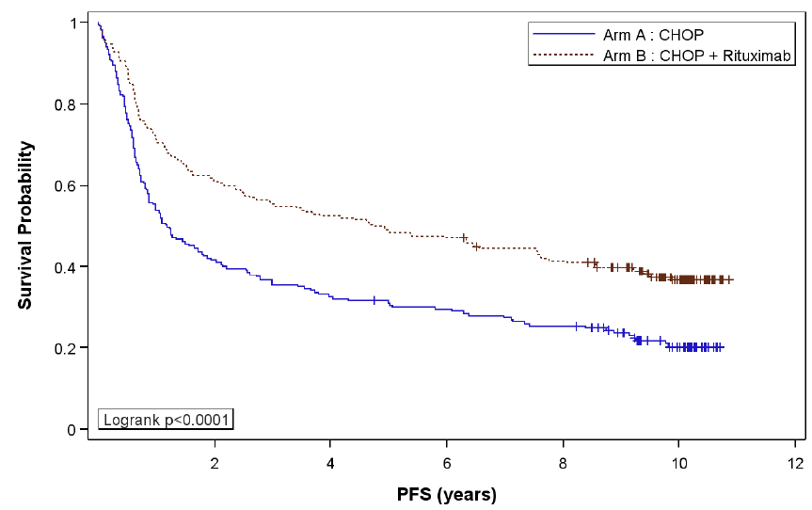
DLBCL: Strategies to Improve Beyond R-CHOP-21
Intensification over
R-CHOP-21?
1.0
.8
.6
Better predict/evaluate
quality of response?
.4
.2
0.0
Logrank P<.0001
2
4
6
8
10
12
Take into consideration
biological diversity of DLBCL
Different efficacy of Treatment
Focus on: GCB/non-GCB/DHIT
PFS, Years
Age>60 years
PS>2
Stage III-IV
Extranodal sites >2
LDH>Nml
IPI
Courtesy of Christopher R Flowers, MD, MS

Slide 24
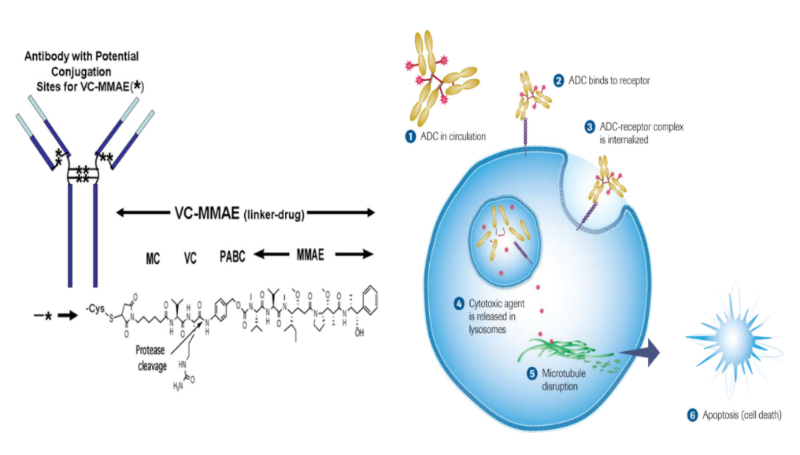
Polatuzumab vedotin is an ADC targeting CD79b
CD79b is ubiquitously expressed on DLBCL cells^{1–3}
Polatuzumab vedotin
Binds to CD79b and is then internalized
Apoptosis
Microtubule
disruption
1. Dornan D, et al. Blood 2009;114:2721–9; 2. Polson AG, et al. Expert Opin Invest Drugs 2011;20:75–85;
3. Doronina SO, et al. Nat Biotechnol 2003;21:778–84; 4. Tilly H, et al. Lancet Oncol 2019;20:998–1010.
Courtesy of Christopher R Flowers, MD, MS

Slide 25
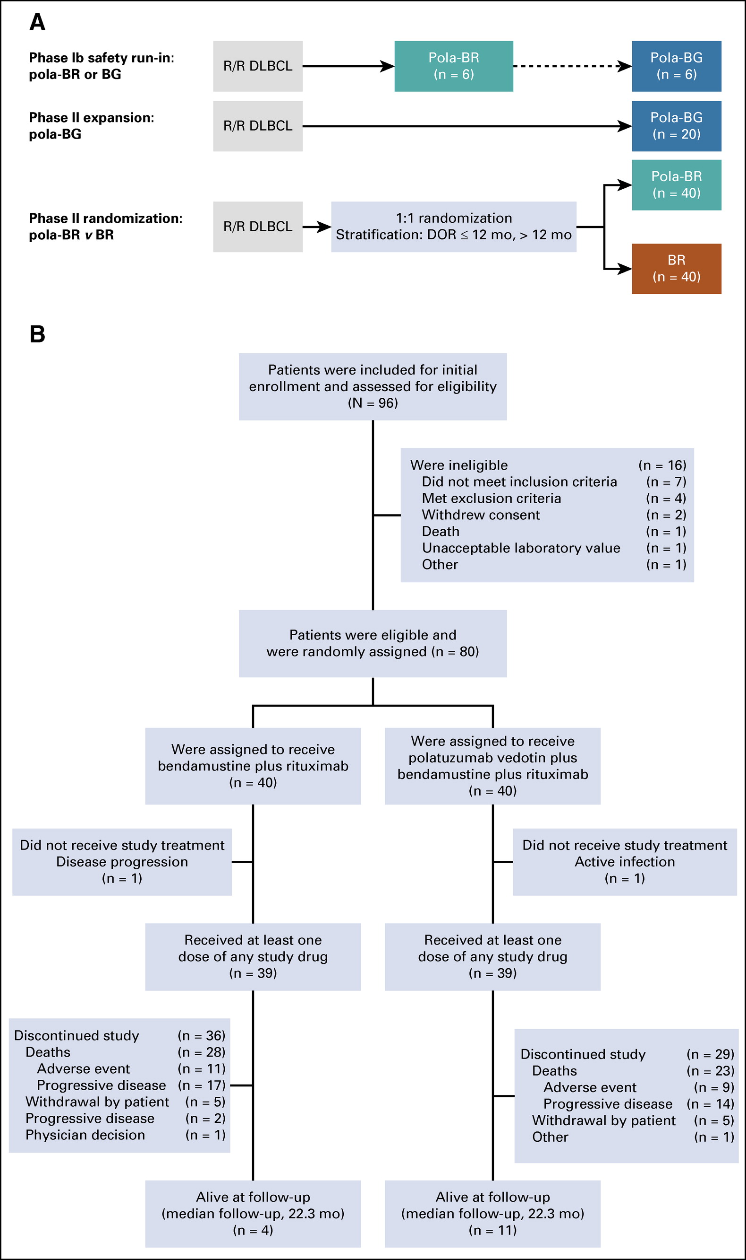
Targeting CD79b: BR + Polatuzumab
Sehn LH et al. J Clin Oncol. 2020;38(2):155-165.
Courtesy of Christopher R Flowers, MD, MS

Slide 26
R-Benda vs R-Benda + Pola: Response Rates
Outcome (IRC) | Pola-BR (n = 40) | BR (n = 40)
End of treatment
Objective response | 45.0% | 17.5%
Complete response | 40.0% | 17.5%
Best Response
Objective response | 62.5% | 25.0%
Complete response | 50.0% | 22.5%
Median duration response | 12.6 months | 7.7 months
Sehn LH et al. J Clin Oncol. 2020;38(2):155-165.
Courtesy of Christopher R Flowers, MD, MS

Slide 27
POLARIX Study: Polatuzumab Vedotin with Rituximab, Cyclophosphamide, Doxorubicin, and Prednisone (Pola-R-CHP) Versus Rituximab, Cyclophosphamide, Doxorubicin, Vincristine and Prednisone (R-CHOP) Therapy in Patients with Previously Untreated Diffuse Large B-Cell Lymphoma
Hervé Tilly, Franck Morschhauser, Laurie H. Sehn, Jonathan W. Friedberg, Marek Trněný, Jeff P. Sharman, Charles Herbaux, John M. Burke, Matthew Matasar, Shinya Rai, Koji Izutsu, Neha Mehta-Shah, Lucie Oberic, Adrien Chauchet, Wojciech Jurczak, Yuqin Song, Richard Greil, Larysa Mykhalska, Juan Miguel Bergua Burgués, Matthew C. Cheung, Antonio Pinto, Ho-Jin Shin, Greg Hapgood, Eduardo Munhoz, Pau Abrisqueta, Jyh-Pyng Gau, Jamie Hirata, Yanwen Jiang, Mark Yan, Calvin Lee, Christopher Flowers, Gilles Salles
Courtesy of Christopher R Flowers, MD, MS

Slide 28
Pola+R/G-CHP demonstrated activity in 1L DLBCL
11%
100
12%
80
Pola+R/G-CHP (N=66)
60
PFS (%)
77%
40
20
0
0
3
6
9
12
15
18
21
24
27
30
33
Time (months)
ADC, antibody–drug conjugate; G, obinutuzumab.
1. Dornan D, et al. Blood 2009;114:2721–9; 2. Polson AG, et al. Expert Opin Invest Drugs 2011;20:75–85;
3. Doronina SO, et al. Nat Biotechnol 2003;21:778–84; 4. Tilly H, et al. Lancet Oncol 2019;20:998–1010.
Courtesy of Christopher R Flowers, MD, MS

Slide 29
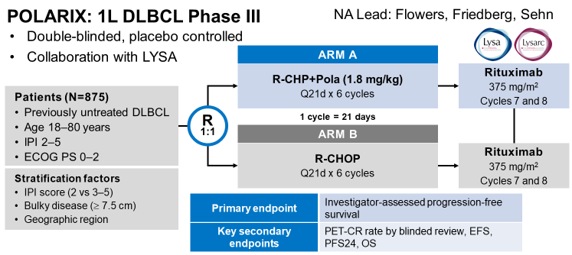
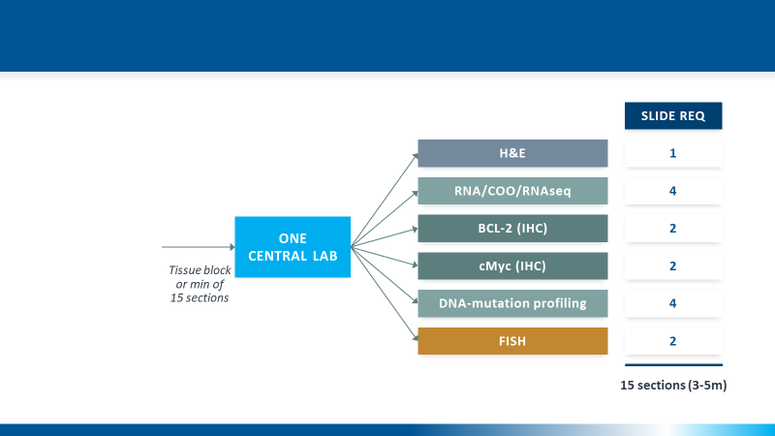
POLARIX: A randomized double-blinded study
Courtesy of Christopher R Flowers, MD, MS

Slide 30
POLARIX: Key endpoints and analysis timing
Key endpoints
Primary endpoint | Progression-free survival (Investigator-assessed)
Secondary endpoints | Event-free survival Complete response rate at end of treatment (PET/CT, IRC-assessed) Disease-free survival Overall survival
Safety endpoints | Incidence, nature, and severity of adverse events
Statistical design and timing of primary analysis:
875 patients, all on study for ≥24 months with approximately 228 PFS events, were required for the primary analysis. This occurred on June 28, 2021 (clinical cut-off date)
Median follow up at the primary analysis was 28.2 months
Tilly H et al. ASH 2021;Abstract LBA1.
Courtesy of Christopher R Flowers, MD, MS

Slide 31
POLARIX: Baseline characteristics
ITT population |  | Pola-R-CHP (N=440) | R-CHOP (N=439)
Age | Median (range), years | 65.0 (19–80) | 66.0 (19–80)
Sex, n (%) | Male | 239 (54) | 234 (53)
ECOG PS, n (%) | 0–1 2 | 374 (85) 66 (15) | 363 (83) 75 (17)
Bulky disease (≥7.5cm), n (%) | Present | 193 (44) | 192 (44)
Elevated LDH, n (%) | Yes | 291 (66) | 284 (65)
Time from diagnosis to treatment initiation | Median, days | 26 | 27
Ann Arbor Stage, n (%) | III–IV | 393 (89) | 387 (88)
Extranodal sites, n (%) | ≥2 | 213 (48) | 213 (49)
IPI score, n (%) | 2 3–5 | 167 (38) 273 (62) | 167 (38) 272 (62)
Cell-of-origin, (%)* | ABC GCB Unclassified | 102 (31) 184 (56) 44 (13) | 119 (35) 168 (50) 51 (15)
MYC/BCL2 expression, n (%)* | Double expression | 139 (38) | 151 (41)
MYC/BCL2/BCL6 rearrangement, n (%)* | Double-/triple-hit | 26 (8) | 19 (6)
*In the Pola-R-CHP and R-CHOP groups, respectively, the numbers of patients evaluable for cell-of-origin were 330 and 338, with IHC for MYC/BCL2 expression were 362 and 366, and with FISH for MYC/BCL2/BCL6 rearrangements were 331 and 334.
ABC, activated B-cell; FISH, fluorescence in situ hybridization; GCB, germinal center B-cell; LDH, lactate dehydrogenase.
Tilly H et al. ASH 2021;Abstract LBA1.
Courtesy of Christopher R Flowers, MD, MS

Slide 32
POLARIX: Primary endpoint: Progression-free survival
Pola-R-CHP significantly improved PFS versus R-CHOP
100
Pola-R-CHP (N=440)
R-CHOP (N=439)
80
Censored
HR 0.73 (P<0.02)
95% CI: 0.57, 0.95
60
Pola-R-CHP demonstrated a 27% reduction in the relative risk of disease progression, relapse,
or death versus R-CHOP
24-month PFS:
76.7% with Pola-R-CHP versus 70.2% with R-CHOP (∆=6.5%)
PFS (%)
40
20
0
0
6
12
18
24
30
36
42
Time (months)
No. of patients at risk
Pola-R-CHP | 440 | 404 | 353 | 327 | 246 | 78 | NE | NE
R-CHOP | 439 | 389 | 330 | 296 | 220 | 78 | 3 | NE
Tilly H et al. N Engl J Med 2022;386(4):351-63; ASH 2021;Abstract LBA1.
Courtesy of Christopher R Flowers, MD, MS

Slide 33
POLARIX: Event-free survival
100
Pola-R-CHP (N=440)
R-CHOP (N=439)
80
Censored
HR 0.75 (P=0.02)
95% CI: 0.58, 0.96
60
EFS (%)
40
20
0
0
6
12
18
24
30
36
42
Time (months)
No. of patients at risk
Pola-R-CHP | 440 | 402 | 348 | 323 | 243 | 78 | NE | NE
R-CHOP | 439 | 386 | 327 | 294 | 218 | 78 | 3 | NE
Tilly H et al. N Engl J Med 2022;386(4):351-63; ASH 2021;Abstract LBA1.
Courtesy of Christopher R Flowers, MD, MS

Slide 34
POLARIX: Response rates and disease-free survival
Best overall response
Disease-free survival
100
80
60
Patients (%)
DFS (%)
40
Pola-R-CHP (N=381)
R-CHOP (N=363)
Censored
20
HR (95% CI): 0.70 (0.50, 0.98)
0
Pola-R-CHP
(N=440)
R-CHOP
(N=439)
0
6
12
18
24
30
36
42
Time (months)
No. of patients at risk
Pola-R-CHP | 381 | 342 | 322 | 266 | 106 | 2 | NE | NE
R-CHOP | 363 | 326 | 282 | 238 | 96 | 5 | NE | NE
Tilly H et al. ASH 2021;Abstract LBA1.
Courtesy of Christopher R Flowers, MD, MS

Slide 35
POLARIX: Overall survival
100
80
60
Pola-R-CHP (N=440)
R-CHOP (N=439)
OS (%)
Censored
40
20
HR 0.94 (95% CI 0.65, 1.37); P=0.75
0
0
6
12
18
24
30
36
42
Time (months)
No. of patients at risk
Pola-R-CHP | 440 | 423 | 397 | 384 | 362 | 140 | 15 | 1
R-CHOP | 439 | 414 | 401 | 376 | 355 | 132 | 20 | 1
Tilly H et al. N Engl J Med 2022;386(4):351-63; ASH 2021;Abstract LBA1.
Courtesy of Christopher R Flowers, MD, MS

Slide 36
POLARIX: Patients receiving subsequent treatments
n=99
n=133
n=41
n=57
n=75
n=103
n=17
n=31
n=9
n=16
†
Data cut-off: June 28, 2021. *Subsequent lymphoma treatment was defined as non-protocol anti-lymphoma therapy; †Includes any monotherapy, multi-drug, or cell-based regimen.
CAR-T, chimeric antigen receptor T-cell therapy; SCT, stem cell transplant.
Tilly H et al. ASH 2021;Abstract LBA1.
Courtesy of Christopher R Flowers, MD, MS

Slide 37

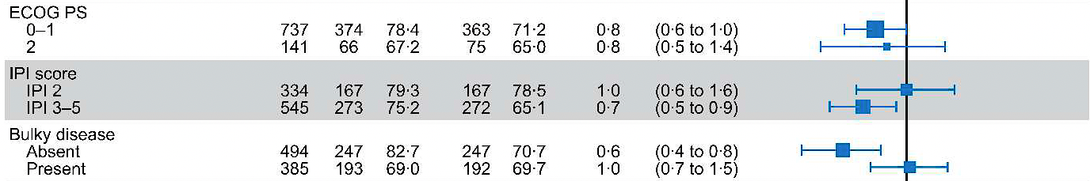
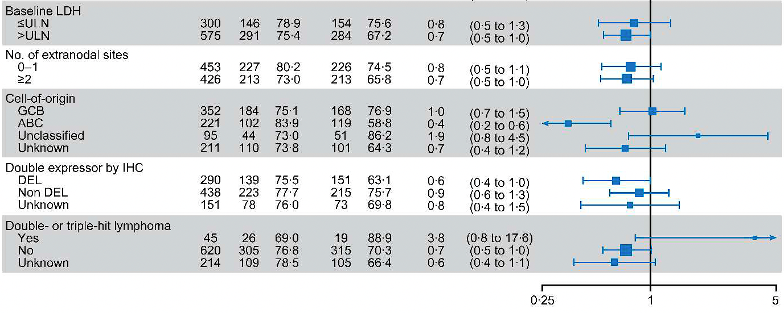
POLARIX: Subgroup Analysis
n=99
n=133
n=41
n=57
n=75
n=103
n=17
n=31
n=9
n=16
†
Tilly H et al. N Engl J Med 2022;386(4):351-63.
Courtesy of Christopher R Flowers, MD, MS

Slide 38
POLARIX: Common adverse events
Pola-R-CHP
R-CHOP
Peripheral neuropathy*
Grade
Nausea
1
Diarrhea
2
Neutropenia
3
Anemia
4
Constipation
Fatigue
Alopecia
Decreased appetite
Pyrexia
Vomiting
Febrile neutropenia
Cough
Headache
Decreased weight
Asthenia
Dysgeusia
Frequency (%)
Tilly H et al. ASH 2021;Abstract LBA1.
Courtesy of Christopher R Flowers, MD, MS

Slide 39
Next Steps in Firstline DLBCL Trial Design
Improve eligibility assessment and enrollment strategies to reduce DTI
Incorporate Novel Agents in SMART Start trials
  Polatuzumab
  Mosunetuzumab
  Tafasitamab
cfDNA Surrogate for response at imaging-paired time points for validation/comparison
Integrate understanding of biological subsets into trial design
  Ibrutinib
  Lenalidomide
Courtesy of Christopher R Flowers, MD, MS

Slide 40
Agenda
Introduction: Overview of Diffuse Large B-Cell Lymphoma (DLBCL)
MODULE 1: The POLARIX Trial – Dr Flowers
MODULE 2: Clinical Investigator Survey
MODULE 3: Ongoing Trials in DLBCL – Prof Nowakowski
MODULE 4: Up-Front Treatment for Older Patients with DLBCL – Dr Mehta-Shah

Slide 41
DLBCL Clinical Investigator Survey “Top Ten”
How quickly does treatment need to be initiated?
Perspectives on the POLARIX trial
First-line treatment of DLBCL
First-line treatment for older patients with DLBCL
First-line treatment for patients with higher-risk DLBCL
First-line treatment of DLBCL in patients with comorbidities
Transformed follicular lymphoma and chronic lymphocytic leukemia
CNS prophylaxis
Chimeric antigen receptor (CAR) T-cell therapy
Newly approved agents in relapsed disease

Slide 42
DLBCL Clinical Investigator Survey “Top Ten”
How quickly does treatment need to be initiated?
Perspectives on the POLARIX trial
First-line treatment of DLBCL
First-line treatment for older patients with DLBCL
First-line treatment for patients with higher-risk DLBCL
First-line treatment of DLBCL in patients with comorbidities
Transformed follicular lymphoma and chronic lymphocytic leukemia
CNS prophylaxis
Chimeric antigen receptor (CAR) T-cell therapy
Newly approved agents in relapsed disease

Slide 43




For a patient who is clinically stable with newly diagnosed advanced-stage diffuse large B-cell lymphoma (DLBCL), within what time period should treatment be initiated?
ASAP
2
Within 5 to 7 days
12
Within 2 to 3 weeks
4
Within 30 days
1
Survey of Lymphoma Clinical Investigators

Slide 44
DLBCL Clinical Investigator Survey “Top Ten”
How quickly does treatment need to be initiated?
Perspectives on the POLARIX trial
First-line treatment of DLBCL
First-line treatment for older patients with DLBCL
First-line treatment for patients with higher-risk DLBCL
First-line treatment of DLBCL in patients with comorbidities
Transformed follicular lymphoma and chronic lymphocytic leukemia
CNS prophylaxis
Chimeric antigen receptor (CAR) T-cell therapy
Newly approved agents in relapsed disease

Slide 45

If future data continue not to demonstrate an overall survival advantage with polatuzumab vedotin in combination with R-CHP over R-CHOP when used as up-front therapy for DLBCL, do you think the clinical benefit with this regimen is greater than the risk?
Yes
17
No
3
Survey of Lymphoma Clinical Investigators

Slide 46
Based on available evidence and your own experience, how would you compare the global tolerability/toxicity of polatuzumab vedotin in combination with R-CHP to that of R-CHOP when used as up-front therapy for DLBCL?
17
About the same
R-CHOP has less toxicity
3
Survey of Lymphoma Clinical Investigators

Slide 47
The peripheral neuropathy associated with polatuzumab vedotin is generally reversible in the majority of patients.
17
Agree
I don’t know
3
Survey of Lymphoma Clinical Investigators

Slide 48
DLBCL Clinical Investigator Survey “Top Ten”
How quickly does treatment need to be initiated?
Perspectives on the POLARIX trial
First-line treatment of DLBCL
First-line treatment for older patients with DLBCL
First-line treatment for patients with higher-risk DLBCL
First-line treatment of DLBCL in patients with comorbidities
Transformed follicular lymphoma and chronic lymphocytic leukemia
CNS prophylaxis
Chimeric antigen receptor (CAR) T-cell therapy
Newly approved agents in relapsed disease

Slide 49
Regulatory and reimbursement issues aside, which first-line therapy would you generally recommend for an otherwise healthy 65-year-old patient with Stage IV activated B-cell (ABC)-type DLBCL?
18
R-CHP + polatuzumab vedotin
R-CHOP
1
Lenalidomide
1
Survey of Lymphoma Clinical Investigators

Slide 50
Regulatory and reimbursement issues aside, which first-line therapy would you generally recommend for an otherwise healthy 65-year-old patient with Stage IV germinal center B-cell (GCB)-type DLBCL?
R-CHOP
11
R-CHP + polatuzumab vedotin
8
Survey of Lymphoma Clinical Investigators

Slide 51
DLBCL Clinical Investigator Survey “Top Ten”
How quickly does treatment need to be initiated?
Perspectives on the POLARIX trial
First-line treatment of DLBCL
First-line treatment for older patients with DLBCL
First-line treatment for patients with higher-risk DLBCL
First-line treatment of DLBCL in patients with comorbidities
Transformed follicular lymphoma and chronic lymphocytic leukemia
CNS prophylaxis
Chimeric antigen receptor (CAR) T-cell therapy
Newly approved agents in relapsed disease

Slide 52

Regulatory and reimbursement issues aside, which first-line therapy would you generally recommend for an otherwise healthy 80-year-old patient with Stage IV ABC-type DLBCL?
R-mini-CHP + polatuzumab vedotin
6
R-mini-CHOP
5
R-CHP + polatuzumab vedotin
5
R-CHOP
2
R-CHOP + lenalidomide
1
Dose-adjusted R-CHOP
1
Survey of Lymphoma Clinical Investigators

Slide 53
Regulatory and reimbursement issues aside, which first-line therapy would you generally recommend for an otherwise healthy 80-year-old patient with Stage IV GCB-type DLBCL?
R-mini-CHOP
10
R-CHOP
5
R-mini-CHP + polatuzumab vedotin
2
R-CHP + polatuzumab vedotin
2
Dose-adjusted R-CHOP
1
Survey of Lymphoma Clinical Investigators

Slide 54
DLBCL Clinical Investigator Survey “Top Ten”
How quickly does treatment need to be initiated?
Perspectives on the POLARIX trial
First-line treatment of DLBCL
First-line treatment for older patients with DLBCL
First-line treatment for patients with higher-risk DLBCL
First-line treatment of DLBCL in patients with comorbidities
Transformed follicular lymphoma and chronic lymphocytic leukemia
CNS prophylaxis
Chimeric antigen receptor (CAR) T-cell therapy
Newly approved agents in relapsed disease

Slide 55
Regulatory and reimbursement issues aside, which first-line therapy would you generally recommend for an otherwise healthy 65-year-old patient with Stage IV double-expressor DLBCL?
16
R-CHP + polatuzumab vedotin
R-CHOP
3
Dose-adjusted R-EPOCH
1
Survey of Lymphoma Clinical Investigators

Slide 56
Regulatory and reimbursement issues aside, which first-line therapy would you generally recommend for an otherwise healthy 65-year-old patient with Stage IV double-hit DLBCL?
18
Dose-adjusted R-EPOCH
R-CHP + polatuzumab vedotin
2
Survey of Lymphoma Clinical Investigators

Slide 57
ZUMA-12 Study Demonstrates 78% Complete Response Rate as Part of First-Line Treatment in Newly Diagnosed High-Risk Large B-Cell Lymphoma
December 13, 2021
“Primary results were announced from ZUMA-12, a global, multicenter, single-arm, open-label Phase 2 study evaluating axicabtagene ciloleucel as part of first-line treatment in patients with high-risk large B-cell lymphoma (LBCL). This is the first study to evaluate CAR T-cell therapy as part of first-line therapy in high-risk LBCL. The study is based on the desire to utilize potential curative treatment as quickly as possible and the hypothesis that earlier use of CAR T-cell therapy when T cells are healthier may produce better outcomes. The data were presented in an oral session during the 63rd American Society of Hematology (ASH) Annual Meeting & Exposition (Abstract #739).
After a single infusion of axicabtagene ciloleucel, 89% of evaluable patients achieved a response (ORR) (n=37 evaluable for efficacy), including 78% of patients with a complete response (CR) at a median follow-up of 15.9 months. CR rate was consistent among key subgroups. Among evaluable patients, median time to response was one month. At time of data cut-off, 73% of evaluable patients had ongoing responses. Medians for duration of response (DOR), event-free survival (EFS), and progression-free survival (PFS) were not yet reached, with 12-month estimates of 81%, 73%, and 75%, respectively, and an estimated 12-month OS rate of 91%.”
https://www.gilead.com/news-and-press/press-room/press-releases/2021/12/yescarta-zuma12-study-demonstrates-78-complete-response-rate-as-part-of-firstline-treatment-in-newly-diagnosed-highrisk-large-bcell-lymphoma

Slide 58
ZUMA-12: A Phase II Study Evaluating Axicabtagene Ciloleucel as Part of First-Line Treatment for Patients with High-Risk Large B-Cell Lymphoma
Variable | N = 40 (median age 61) 25% DH/TH Median F/U = 15.9 months
DS 4/5 at PET-2 | 48%/53%
Complete Response | 78%
Median PFS | NR
G3 CRS | 8%
G3 ICANS | 23%
Neelapu et al. ASH 2021 Abs # 739

Slide 59
DLBCL Clinical Investigator Survey “Top Ten”
How quickly does treatment need to be initiated?
Perspectives on the POLARIX trial
First-line treatment of DLBCL
First-line treatment for older patients with DLBCL
First-line treatment for patients with higher-risk DLBCL
First-line treatment of DLBCL in patients with comorbidities
Transformed follicular lymphoma and chronic lymphocytic leukemia
CNS prophylaxis
Chimeric antigen receptor (CAR) T-cell therapy
Newly approved agents in relapsed disease

Slide 60
A 65-year-old patient with a history of smoking, mild COPD and hypertension presents with Stage IV GCB-type DLBCL. Which initial therapy would you most likely recommend?
R-CHOP
11
R-CHP + polatuzumab vedotin
8
R-mini-CHOP with dose escalation
1
Survey of Lymphoma Clinical Investigators

Slide 61
A 65-year-old woman with a history of congestive heart failure and a left ventricular ejection fraction (LVEF) of 45% presents with Stage IV GCB-type DLBCL. Which initial therapy would you most likely recommend?
R-CEOP
8
R-CHP + polatuzumab vedotin
3
Dose-adjusted R-EPOCH
3
R-GCVP
3
R-CHOP
2
R-CHOP + doxorubicin
1
Survey of Lymphoma Clinical Investigators

Slide 62
A 65-year-old woman with a history of congestive heart failure and an LVEF of 30% presents with Stage IV GCB-type DLBCL. Which initial therapy would you most likely recommend?
R-CEOP
10
R-GCVP
9
Bispecific antibody
1
Survey of Lymphoma Clinical Investigators

Slide 63
A 65-year-old patient with a history of poorly controlled diabetes mellitus and sensory diabetic peripheral neuropathy presents with Stage IV GCB-type DLBCL. Which initial therapy would you most likely recommend?
R-CHP + polatuzumab vedotin
7
R-CHOP
6
R-CHP
4
R-mini-CHOP
1
Dose-adjusted R-EPOCH
1
R-EPOCH
1
Survey of Lymphoma Clinical Investigators

Slide 64
DLBCL Clinical Investigator Survey “Top Ten”
How quickly does treatment need to be initiated?
Perspectives on the POLARIX trial
First-line treatment of DLBCL
First-line treatment for older patients with DLBCL
First-line treatment for patients with higher-risk DLBCL
First-line treatment of DLBCL in patients with comorbidities
Transformed follicular lymphoma and chronic lymphocytic leukemia
CNS prophylaxis
Chimeric antigen receptor (CAR) T-cell therapy
Newly approved agents in relapsed disease

Slide 65
A 65-year-old otherwise healthy patient with a history of chronic lymphocytic leukemia treated with ibrutinib presents with Richter’s transformation. What would you recommend?
R-CHOP
11
R-CHP + polatuzumab vedotin
3
Dose-adjusted R-EPOCH
3
Anti-PD-1/anti-PD-L1 antibody
1
Dose-adjusted R-EPOCH + venetoclax
1
R-CHOP + venetoclax
1
Survey of Lymphoma Clinical Investigators

Slide 66
A 65-year-old otherwise healthy patient with a history of follicular lymphoma (FL) treated with first-line bendamustine/rituximab (BR) presents with histologic transformation to DLBCL without double hit. What would you recommend?
R-CHOP
13
R-CHP + polatuzumab vedotin
6
Dose-adjusted R-EPOCH
1
Survey of Lymphoma Clinical Investigators

Slide 67
DLBCL Clinical Investigator Survey “Top Ten”
How quickly does treatment need to be initiated?
Perspectives on the POLARIX trial
First-line treatment of DLBCL
First-line treatment for older patients with DLBCL
First-line treatment for patients with higher-risk DLBCL
First-line treatment of DLBCL in patients with comorbidities
Transformed follicular lymphoma and chronic lymphocytic leukemia
CNS prophylaxis
Chimeric antigen receptor (CAR) T-cell therapy
Newly approved agents in relapsed disease

Slide 68
A 65-year-old man presents with fatigue and right testicular swelling. Biopsy confirms GCB-type DLBCL, and a PET scan is negative for distant disease with no marrow involvement. Would you recommend CNS prophylaxis?
16
Yes, high-dose
methotrexate with R-CHOP
No
2
Yes, intrathecal methotrexate
1
Yes, intrathecal and
systemic methotrexate
1
Survey of Lymphoma Clinical Investigators

Slide 69
A 65-year-old man presents with fatigue, night sweats and palpable lymphadenopathy. Biopsy confirms GCB-type DLBCL. LDH is 300 U/L and a PET scan reveals diffuse bone marrow involvement. Would you recommend CNS prophylaxis?
16
No
Yes, intrathecal methotrexate
2
Yes, high-dose methotrexate with R-CHOP
1
Yes, high-dose methotrexate post-R-CHOP + polatuzumab
1
Survey of Lymphoma Clinical Investigators

Slide 70
DLBCL Clinical Investigator Survey “Top Ten”
How quickly does treatment need to be initiated?
Perspectives on the POLARIX trial
First-line treatment of DLBCL
First-line treatment for older patients with DLBCL
First-line treatment for patients with higher-risk DLBCL
First-line treatment of DLBCL in patients with comorbidities
Transformed follicular lymphoma and chronic lymphocytic leukemia
CNS prophylaxis
Chimeric antigen receptor (CAR) T-cell therapy
Newly approved agents in relapsed disease

Slide 71
Which therapy would you generally recommend first for a 65-year-old patient with DLBCL who responds to R-CHOP and then R-DHAP followed by transplant on relapse but subsequently experiences disease progression?
20
CAR T-cell therapy
Survey of Lymphoma Clinical Investigators

Slide 72
Regulatory and reimbursement issues aside, which second-line therapy would you recommend for a younger, transplant-eligible patient with DLBCL who experiences disease relapse 12 months after R-CHOP?
17
CAR T-cell therapy
Autologous stem cell
transplant (ASCT)
2
Either ASCT or CAR
T-cell therapy — coin flip
1
Survey of Lymphoma Clinical Investigators

Slide 73
Which therapy would you generally recommend first for a patient with DLBCL who experiences disease progression on front-line R-CHOP and is not eligible for high-dose therapy or CAR T-cell therapy?
Tafasitamab/lenalidomide
13
Polatuzumab vedotin/BR
6
I’m not sure
1
Survey of Lymphoma Clinical Investigators

Slide 74
DLBCL Clinical Investigator Survey “Top Ten”
How quickly does treatment need to be initiated?
Perspectives on the POLARIX trial
First-line treatment of DLBCL
First-line treatment for older patients with DLBCL
First-line treatment for patients with higher-risk DLBCL
First-line treatment of DLBCL in patients with comorbidities
Transformed follicular lymphoma and chronic lymphocytic leukemia
CNS prophylaxis
Chimeric antigen receptor (CAR) T-cell therapy
Newly approved agents in relapsed disease

Slide 75
Is it reasonable to offer a patient who has experienced disease progression on or after CD19-directed CAR T-cell therapy treatment with tafasitamab/lenalidomide or loncastuximab tesirine and vice versa?
18
Yes
I’m not sure
2
Survey of Lymphoma Clinical Investigators

Slide 76
Agenda
Introduction: Overview of Diffuse Large B-Cell Lymphoma (DLBCL)
MODULE 1: The POLARIX Trial – Dr Flowers
MODULE 2: Clinical Investigator Survey
MODULE 3: Ongoing Trials in DLBCL – Prof Nowakowski
MODULE 4: Up-Front Treatment for Older Patients with DLBCL – Dr Mehta-Shah

Slide 77
Case Presentation – Prof Nowakowski: A 22-year-old man with non-germinal center B-cell-like DLBCL
22 yo male with several months' history of dry cough and night sweats, weight loss of >10 lbs
No significant PMH
No family history of immunodeficiency, lymphoma or cancer
Unremarkable physical examination apart from mass protruding from anterior chest
CXR – large intrathoracic masses
CBC – anemia Hb 9.9, chemistries unremarkable; LDH 550 (ULN 220) HIV-/Hepatitis B-/C-
Courtesy of Grzegorz Nowakowski, MD

Slide 78
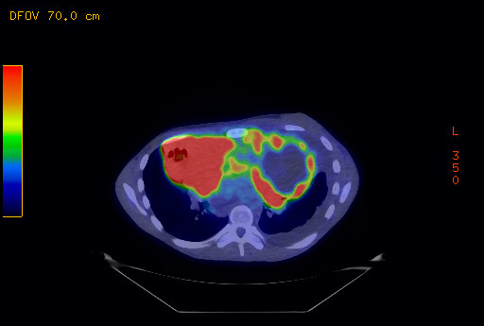
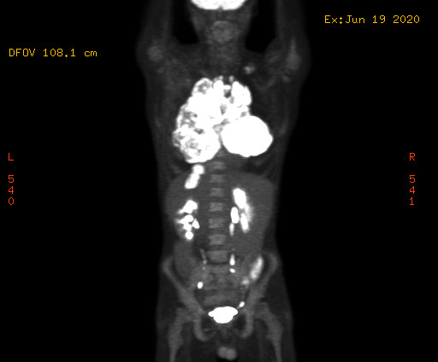
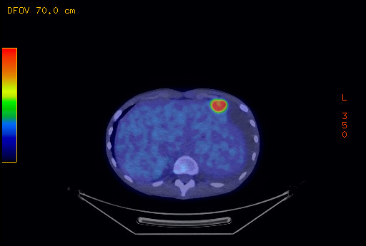
Staging PET Scan
Courtesy of Grzegorz Nowakowski, MD

Slide 79
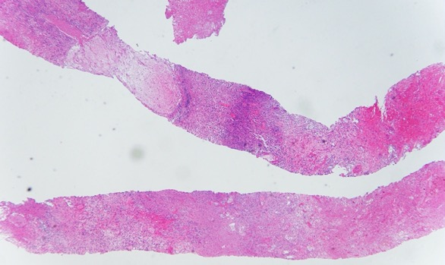
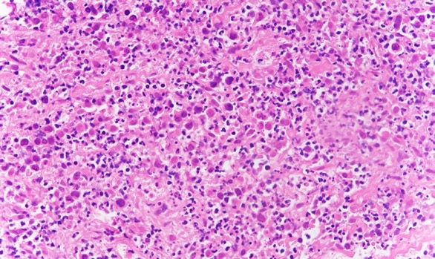
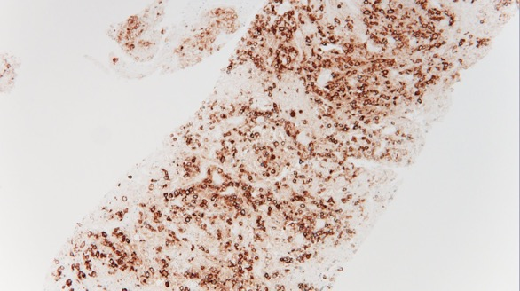
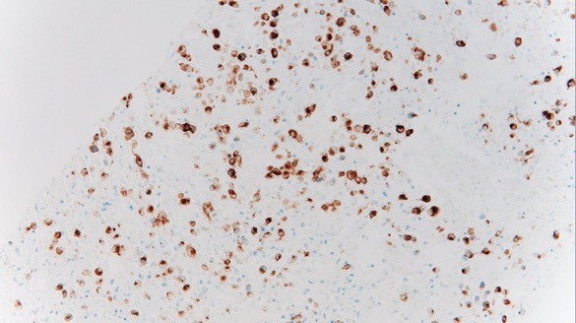
Pathology CT-Guided Core Biopsy
Positive: CD20, PAX5, EBV-LMP1, EBER (in intact viable cells), MUM1 (>30%).
Negative: CD10 (<30%), BCL6 (<30%), BCL2, BCL6 (<50%), and MYC (<40%), CD30.
Non-GCB by Hans
FISH: MYC-/BCL2-
CD20
EBV-LMP1
Courtesy of Grzegorz Nowakowski, MD

Slide 80
Lymph3Cx Assay, Distinction of PMLBCL and Cell-of-Origin for DLBCL, mRNA Gene Expression, NanoString
Molecular classification assay for the distinction of PMBCL from DLBCL subtypes as well as the “cell-of origin” subtypes of DLBCL based on gene expression in formalin-fixed, paraffin-embedded tissue
Utilizes the NanoString Technology and consists of probes for 58 target genes (discriminatory and housekeeping genes)
PMBCL Call is based upon PMBCL probability:
≥ 0.90 is PMBCL
≤ 0.10 is DLBCL
All other DLBCL with unclear gene expression pattern
If DLBCL is called per above, then COO is determined by DLBCL probability:
≤ 0.10 is Germinal Center B-cell (GCB).
≥ 0.90 Activated B-cell (ABC).
All other results are Unclassifiable.
Patient: Non PMBCL - ABC DLBCL
Courtesy of Grzegorz Nowakowski, MD
Mottok A et al. Blood. 2018;132(22):2401–2405.

Slide 81
Case Presentation – Prof Nowakowski: A 66-year-old woman with germinal center B-cell-like DLBCL
66 yo woman presented with progressive dysphagia, neck pain and weight loss. Neck CT showing a 4.5-cm mass at the base of tongue with intact airway
Biopsy – DLBCL, GCB subtype, FISH for myc negative
LDH 2 x ULN
PETCT showed base of tongue mass, and non-bulky bilateral cervical, left supraclavicular and superior mediastinal nodes – Deauville 5
The initiatives on 2 cycles of chemotherapy showed partial shrinkage of mass and lymphadenopathy but with persistent uptake -
Deauville 4
Courtesy of Grzegorz Nowakowski, MD

Slide 82
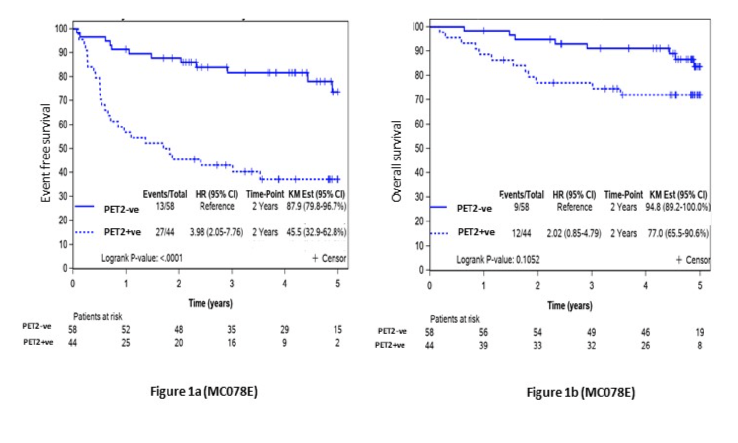
PET 2 in R-CHOP Treated DLBCL Patients
Desai et al. ASH 2021: 2508
Courtesy of Grzegorz Nowakowski, MD

Slide 83
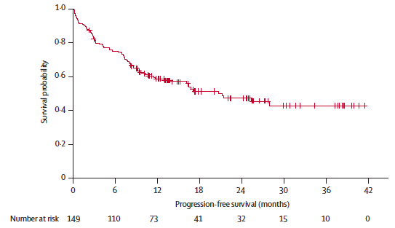
R-mini-CHOP
Regimen
  Rituximab 375 mg/m² day 1
  Cyclophosphamide 400 mg/m² day 1
  Doxorubicin 25 mg/m2 day 1
  Vincristine 1 mg flat dose day 1
  Prednisone 40 mg/m2 days 1-5
Median age 83 y (range 80–95)
Median dose intensity 98%
ORR 74%, CRR 63%
Progression-free survival
2y PFS 47%
2y OS 59%
Peyrade F et al. Lancet Oncol. 2011;12(5):460-468.
Courtesy of Grzegorz Nowakowski, MD

Slide 84
POLAR BEAR Study - Adding Polatuzumab Vedotin to Mini R-CHOP
Previously untreated DLBCL
≥80 Years, or Frail ≥75 Years
ECOG PS 0-3
N = 200
Arm A
Pola 1.8 mg/kg
Mini R-CHP + vincristine placebo
Q21D x 6 cycles
R
Primary endpoint: PFS​
Arm B
Mini-R-CHOP + pola placebo
Q21D x 6 cycles
Courtesy of Grzegorz Nowakowski, MD

Slide 85
Bispecific Antibodies (1L DLBCL) Key Trial Results
Molecule | Trial Design | Patient Population | Outcomes | Safety
Epcoritamab | Ph 1b/2 First-in-human Dose escalation | N=24 Age 30-82 years Median age=65 | Among modified response-evaluable population (n=11), ORR=100%; CMR=73%; PMR=27% All 11 patients remain on study treatment with ongoing responses | No dose-limiting toxicities for Epcoritamab Most common TEAEs: CRS, anemia, infections No Grade ≥3 CRS, ICANS, or cases of febrile neutropenia 1 TLS event
Glofitamab | Ph 1b Dose escalation and safety run-in | N=26 (1L DLBCL safety run-in population) Age 26-84 years Median age=68 | 9 of 26 patients reached end-of-treatment assessment ORR=100%; CMR=88.9%; PMR=11.1% mDoR not reached | Grade 1 CRS: 1 patient Grade ≥3 AEs related to glofitamab: 4 patients No ICANS or AEs leading to discontinuation
Belada D.et al ASH 2021; Minson A et Al, ASH 2021
Courtesy of Grzegorz Nowakowski, MD

Slide 86
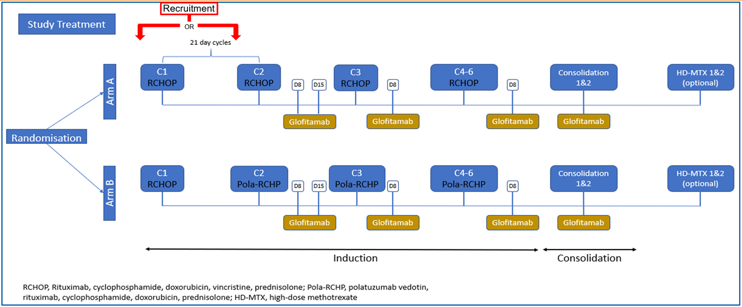
Trial in Progress: A Multicentre, Parallel Arm, Open-Label Trial of Frontline R-CHOP/Polatuzumab Vedotin-RCHP and Glofitamab in Younger Patients with Higher Risk Diffuse Large B Cell Lymphoma (COALITION)
Minson A et Al, ASH 2021
Courtesy of Grzegorz Nowakowski, MD

Slide 87
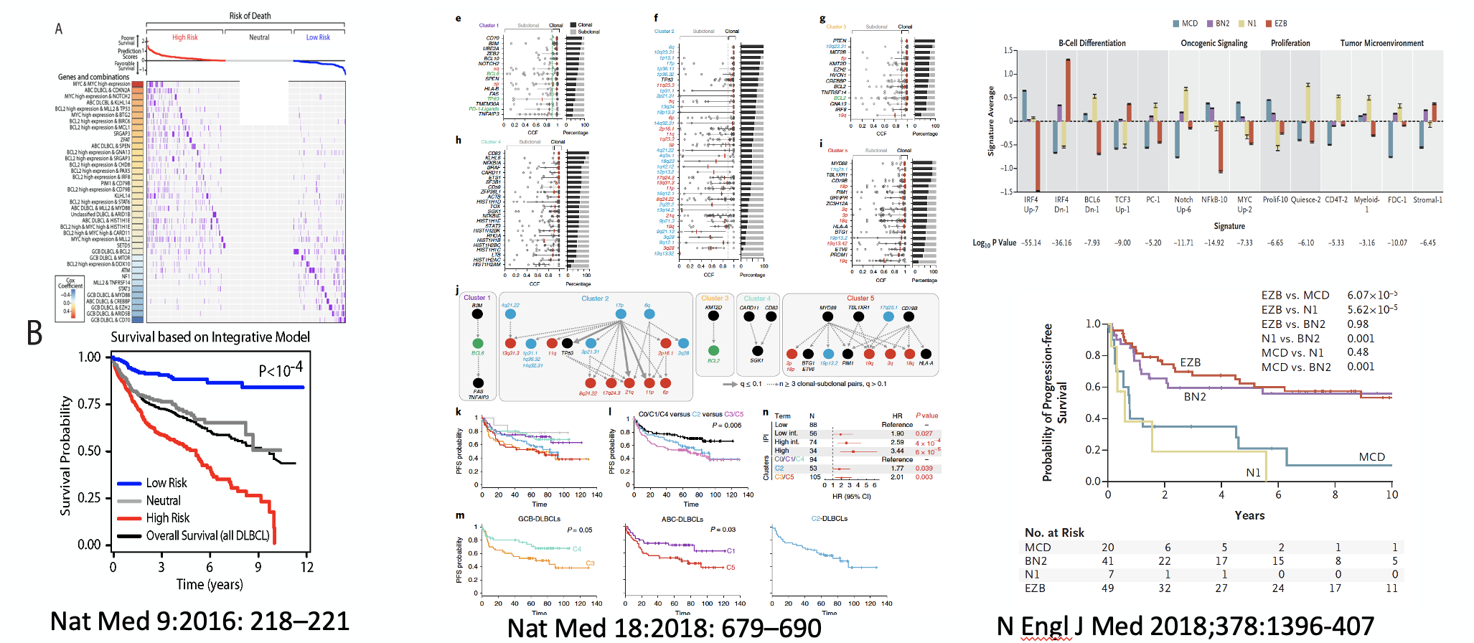
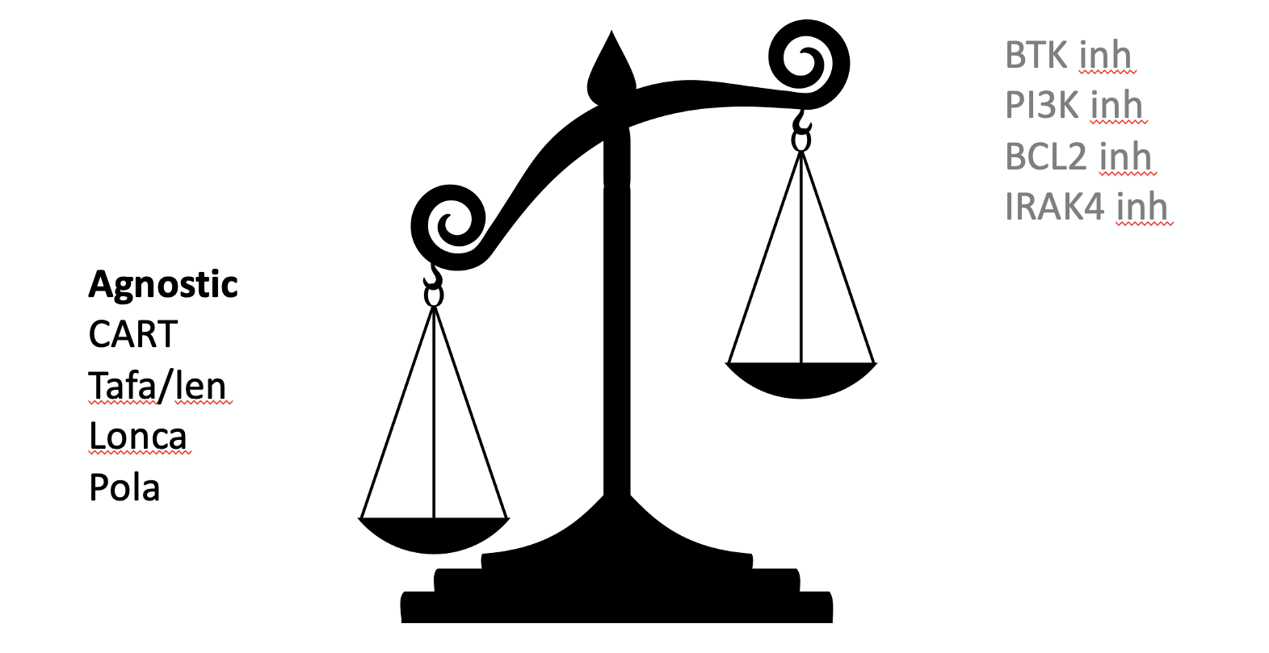
Next waive of R-CHOP “plus”
Bispecific antibodies plus R-CHOP/R-CHP/Pola
R²-CHOP plus Tafa
Lonca plus R-CHOP
Others in development
Courtesy of Grzegorz Nowakowski, MD

Slide 88
Agenda
Introduction: Overview of Diffuse Large B-Cell Lymphoma (DLBCL)
MODULE 1: The POLARIX Trial – Dr Flowers
MODULE 2: Clinical Investigator Survey
MODULE 3: Ongoing Trials in DLBCL – Prof Nowakowski
MODULE 4: Up-Front Treatment for Older Patients with DLBCL – Dr Mehta-Shah

Slide 89
CASE Presentation – dr Mehta-shah: an 87-year-old man with non-Germinal center B-cell-like dlbcl
87 yo man with CAD sp stents to the LAD and total occlusion of the RCA with most recent echo showing EF 70% (2014), AAA, prostate cancer s/p robotic prostatectomy who presented with 15 lbs weight loss.
Patient notes early satiety without nausea, vomiting, abdominal pain.
Exam notable for splenomegaly
CT A/P showed heterogenous enhancing mass involving the spleen and his stable 6-cm AAA (grafted)
Courtesy of Neha Mehta-Shah, MD, MSCI

Slide 90
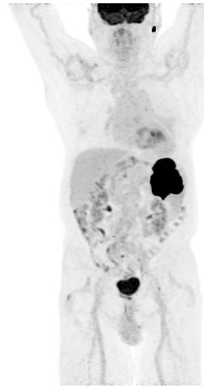
CASE Presentation – dr Mehta-shah: an 87-year-old man with non-Germinal center B-cell-like dlbcl (continued)
Core biopsy of the spleen performed 3/21/19: diffuse large B-cell lymphoma, non-germinal B-cell type
  IHC positive for: CD20, MUM1 (40-50%), BCL6, PAX 5, cMYC (60-70%)
  IHC negative for: CD10, CD30, BCl2, CD5, EBER, CyclinD1
  FISH negative for MYC, BCL2, and positive for BCL6
Labs
  Normal CBC (WBC 5.9, Hgb 13.5, Plts 205)
  LDH 643 (ULN 250)
  Cr 1.79, BUN 26, Calcium 12.6, normal LFTs
PET/CT with 10 x 7-cm splenic mass with SUV 44.4 with extrasplenic extension, multiple mildly FDG avid para-aortic, perihepatic and right axillary lymph nodes with SUV 5 and some calcification
Courtesy of Neha Mehta-Shah, MD, MSCI

Slide 91
Treating the Elderly/Less Fit
Assessing frailty
Treatment related mortality
  Treatment related mortality 18% in cycle 1 in patients >80 years old
Courtesy of Neha Mehta-Shah, MD, MSCI

Slide 92
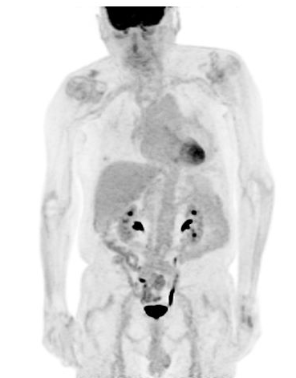
CASE Presentation – dr Mehta-shah: an 87-year-old man with non-Germinal center B-cell-like dlbcl (continued)
Admitted for cycle 1 and given prednisone, IV fluids with improvement of calcium to 11.0 in 24 hours
Repeat echocardiogram showed EF 73%
Received pre-phase steroids for three days while awaiting PET and echo
Received R-mini-CHOP x 6
Remains in a complete remission
Baseline
Post R-miniCHOP x 6
Courtesy of Neha Mehta-Shah, MD, MSCI

