Slide 1
PARP Inhibition in the Management of
Prostate Cancer — Where We Are and Where We’re Headed
Thursday, June 23, 2022
5:00 PM – 6:00 PM ET
Faculty
Johann S de Bono, MB ChB, MSc, PhD, FMedSci
Fred Saad, MD
Moderator
Neil Love, MD

Slide 2


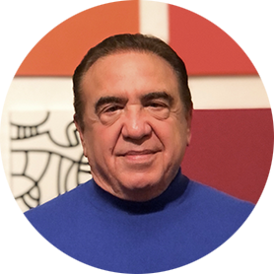
Faculty
Johann S de Bono, MB ChB, MSc, PhD, FMedSci
Regius Professor of Cancer Research
Professor of Experimental Cancer Medicine and Honorary Consultant in Medical Oncology
Head of Clinical Studies Division
Director of Drug Development Unit
Head of the Prostate Cancer Targeted Therapy Group
The Institute of Cancer Research and
The Royal Marsden NHS Foundation Trust
London, United Kingdom
Fred Saad, MD
Professor and Chief of Urology
Director of GU Oncology
Raymond Garneau Chair in Prostate Cancer
University of Montreal Hospital Center (CHUM)
Director, Prostate Cancer Research
Montreal Cancer Institute/CRCHUM
Montréal, Québec, Canada
MODERATOR
Neil Love, MD
Research To Practice

Slide 3
Commercial Support
This activity is supported by educational grants from AstraZeneca Pharmaceuticals LP and Merck.
Research To Practice CME Planning Committee Members,
Staff and Reviewers
Planners, scientific staff and independent reviewers for Research To Practice have no relevant conflicts of interest to disclose.

Slide 4
Prof de Bono — Disclosures
No relevant conflicts of interest to disclose

Slide 5
Dr Saad — Disclosures
Advisory Committee and Consulting Agreements | Astellas, AstraZeneca Pharmaceuticals LP, Bayer HealthCare Pharmaceuticals, Janssen Biotech Inc, Myovant Sciences, Novartis, Pfizer Inc, Sanofi Genzyme
Contracted Research | Astellas, AstraZeneca Pharmaceuticals LP, Bayer HealthCare Pharmaceuticals, Bristol-Myers Squibb Company, Janssen Biotech Inc, Merck, Myovant Sciences, Novartis, Pfizer Inc, Sanofi Genzyme

Slide 6
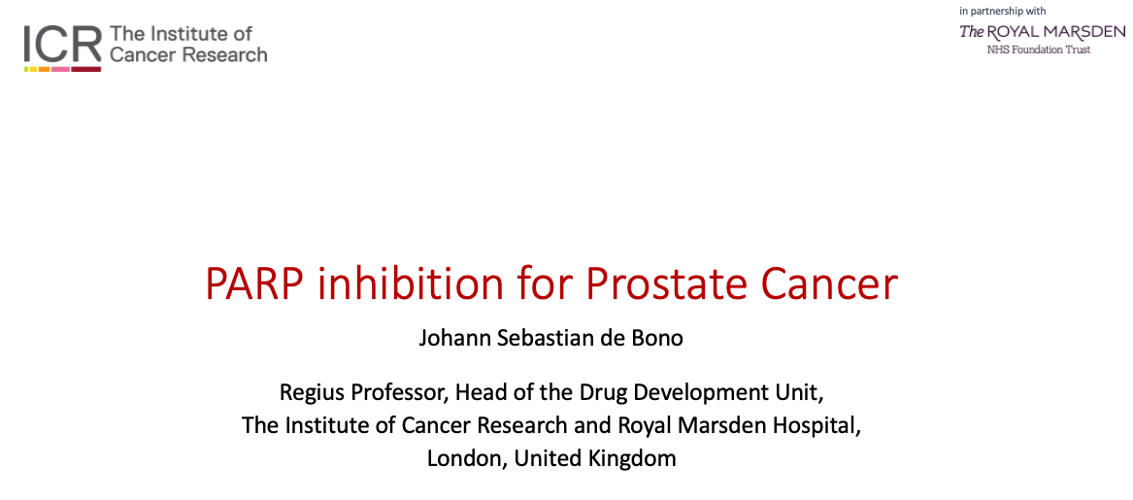
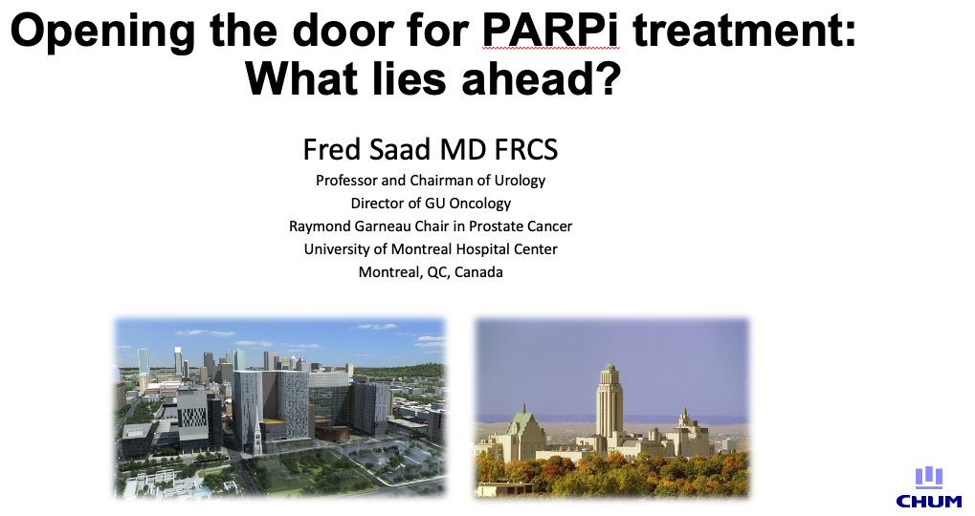

Slide 7
Dabrafenib/Trametinib Combination Granted Accelerated Approval for a Tumor-Agnostic Indication for Solid Tumors with BRAF V600E Mutations
Press Release – June 23, 2022
“…the US Food and Drug Administration (FDA) granted accelerated approval for dabrafenib + trametinib for the treatment of adult and pediatric patients 6 years of age and older with unresectable or metastatic solid tumors with BRAF V600E mutation who have progressed following prior treatment and have no satisfactory alternative treatment options. In accordance with the Accelerated Approval Program, continued approval for this indication may be contingent upon verification and description of clinical benefit in a confirmatory trial(s).
The FDA approval was based on clinical efficacy and safety demonstrated in three clinical trials. In the Phase II ROAR (Rare Oncology Agnostic Research) basket study and the NCI-MATCH Subprotocol H study, dabrafenib + trametinib resulted in overall response rates of up to 80% in patients with BRAF V600E solid tumors, including high- and low-grade glioma, biliary tract cancer and certain gynecological and gastrointestinal cancers. An additional study (Study X2101) demonstrated the clinical benefit and acceptable safety profile of dabrafenib + trametinib in pediatric patients.
The safety profile of dabrafenib + trametinib observed in these studies was consistent with the known safety profile in other approved indications.”
https://www.novartis.com/news/media-releases/novartis-tafinlar-mekinist-receives-fda-approval-first-tumor-agnostic-indication-braf-v600e-solid-tumors

Slide 8
Agenda
Introduction: This Week on RTP
MODULE 1: PARP Inhibitors in Prostate Cancer – Top 10 List
MODULE 2: Optimal Integration of PARP Inhibitor Monotherapy into the Management of Metastatic Castration-Resistant Prostate Cancer (mCRPC) – Prof de Bono
MODULE 3: Available Data with, Ongoing Investigation of and Potential Future Role for PARP Inhibitor-Based Combination Strategies – Dr Saad

Slide 9
Agenda
Introduction: This Week on RTP
MODULE 1: PARP Inhibitors in Prostate Cancer – Top 10 List
MODULE 2: Optimal Integration of PARP Inhibitor Monotherapy into the Management of Metastatic Castration-Resistant Prostate Cancer (mCRPC) – Prof de Bono
MODULE 3: Available Data with, Ongoing Investigation of and Potential Future Role for PARP Inhibitor-Based Combination Strategies – Dr Saad

Slide 10
Meet The Professor
Optimizing the Management of Ovarian Cancer
Shannon N Westin, MD, MPH
Associate Professor
Director, Early Drug Development
Department of Gynecologic Oncology and Reproductive Medicine
The University of Texas MD Anderson Cancer Center
Houston, Texas

Slide 11
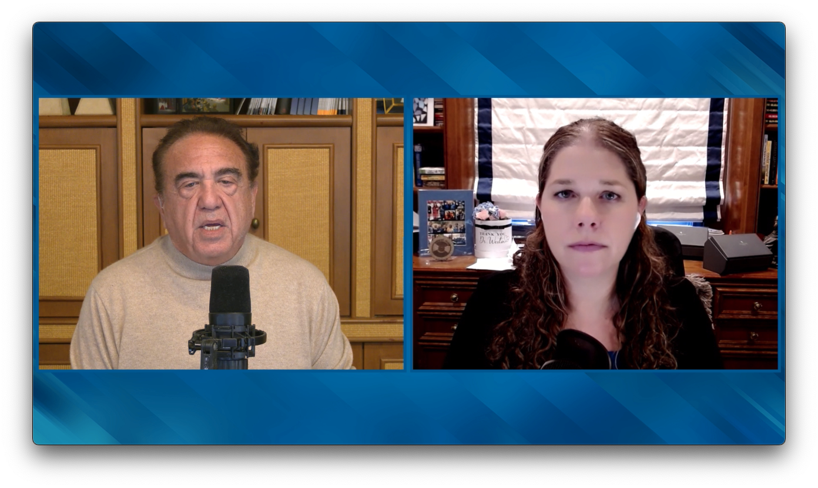

Slide 12
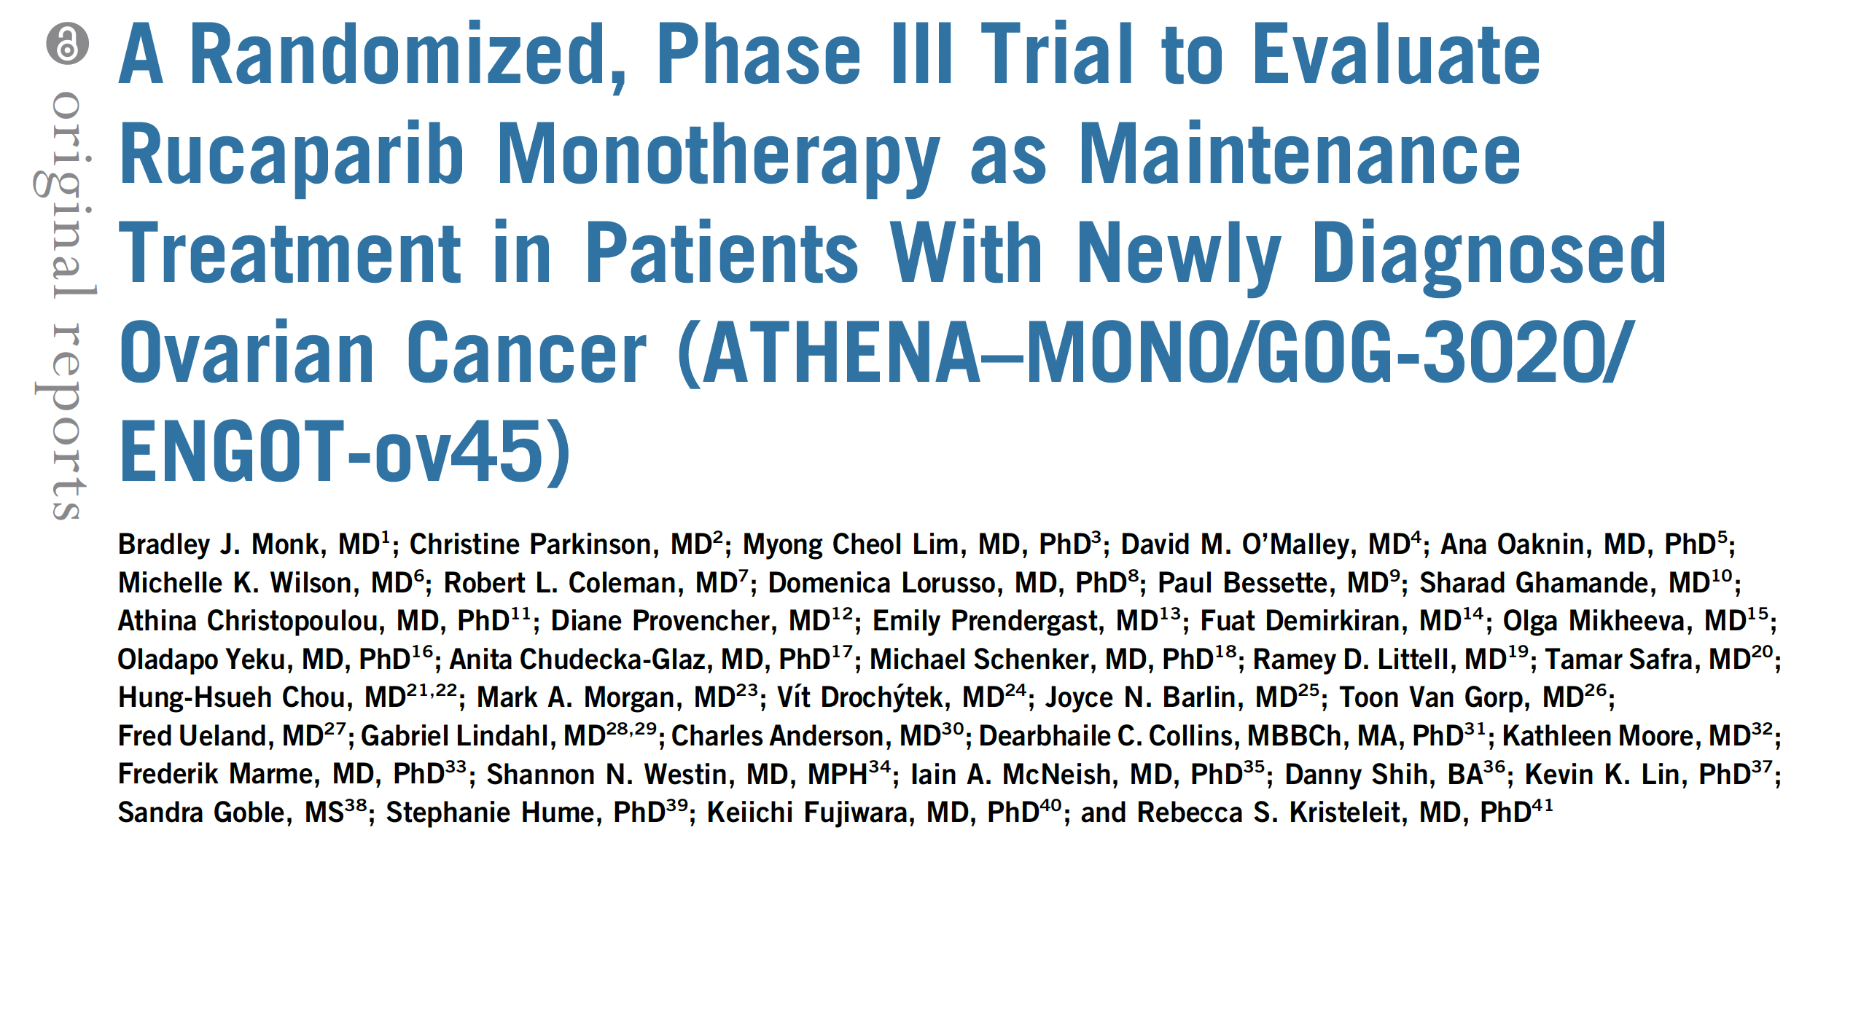

J Clin Oncol 2022;[Online ahead of print].

Slide 13
FDA Advises Manufacturer Not to Submit First-Line Maintenance sNDA for Rucaparib Until OS Survival Data from the ATHENA-MONO Trial Are More Mature
June 17, 2022
“In consultation with the FDA, [the manufacturer of rucaparib] recently was advised not to file a supplemental new drug application based on data from a cohort of the Phase III ATHENA study until the study’s overall survival data mature.
In the 8-K, [the manufacturer] said the FDA has accepted a request for a pre-NDA meeting and noted that the ATHENA-MONO portion of the Phase III study has met its primary endpoint of progression-free survival compared to placebo. OS is a secondary endpoint for ATHENA-MONO and the data are approximately 25% mature at present. [The manufacturer] said the FDA urged it to hold off filing for supplemental approval until the OS data reach 50% maturity, and indicated an advisory committee review would likely be necessary if the data were filed earlier than that point.
In a statement to Scrip, the firm said that although it cannot anticipate the outcome of the pre-NDA meeting, ‘we are encouraged that the FDA is willing to have a dialogue.’ [They] estimate the ATHENA-MONO OS data will reach 50% maturity in approximately two years.”
https://scrip.pharmaintelligence.informa.com/SC146575/Clovis-Withdraws-Rubraca-Ovarian-Cancer-Indication-Due-To-Survival-Imbalance?vid=Pharma

Slide 14
Meet The Professor
Optimizing the Management of
Gastroesophageal Cancers
Eric Van Cutsem, MD, PhD
Professor of Medicine
Digestive Oncology
University Hospitals Leuven
Leuven, Belgium

Slide 15
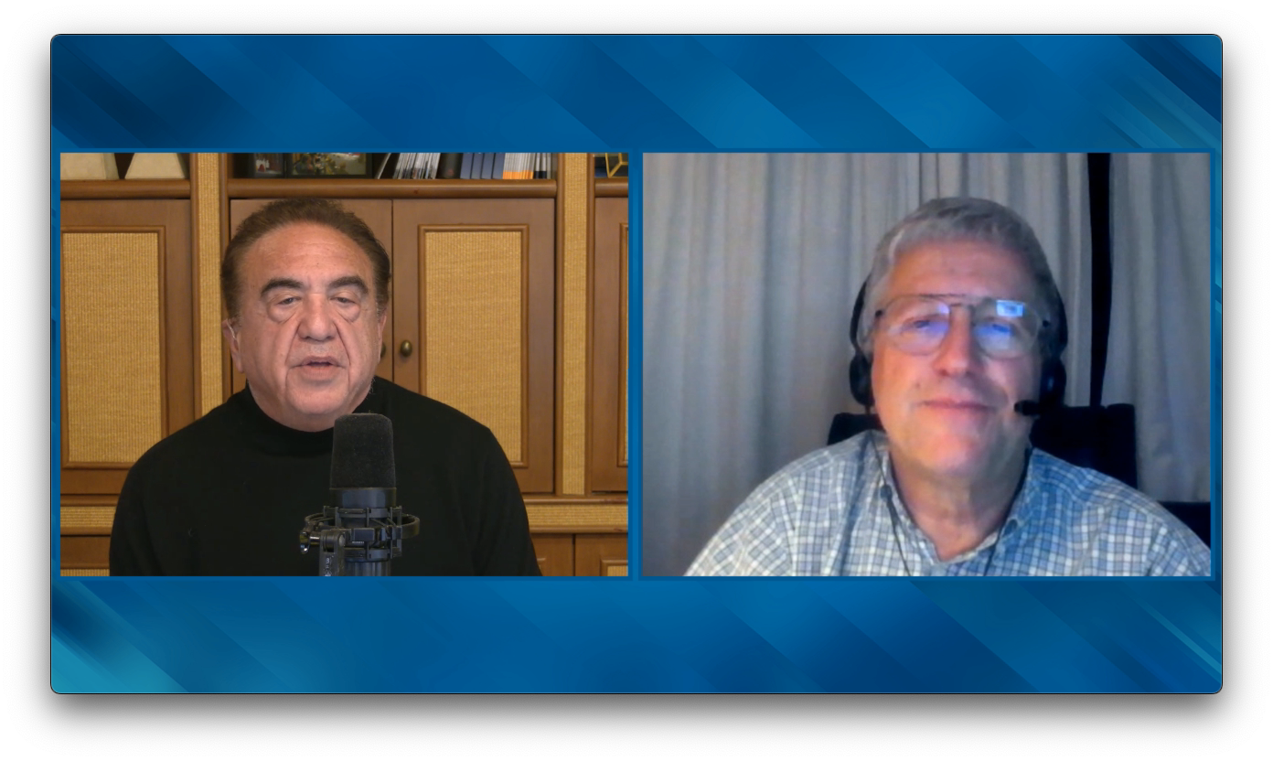

Slide 16
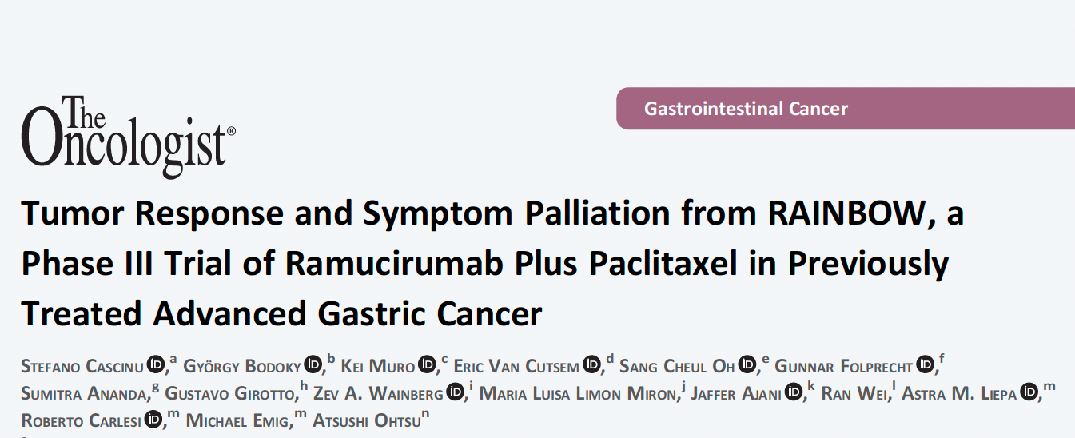
Oncologist 2021;26(3):e414-24.

Slide 17
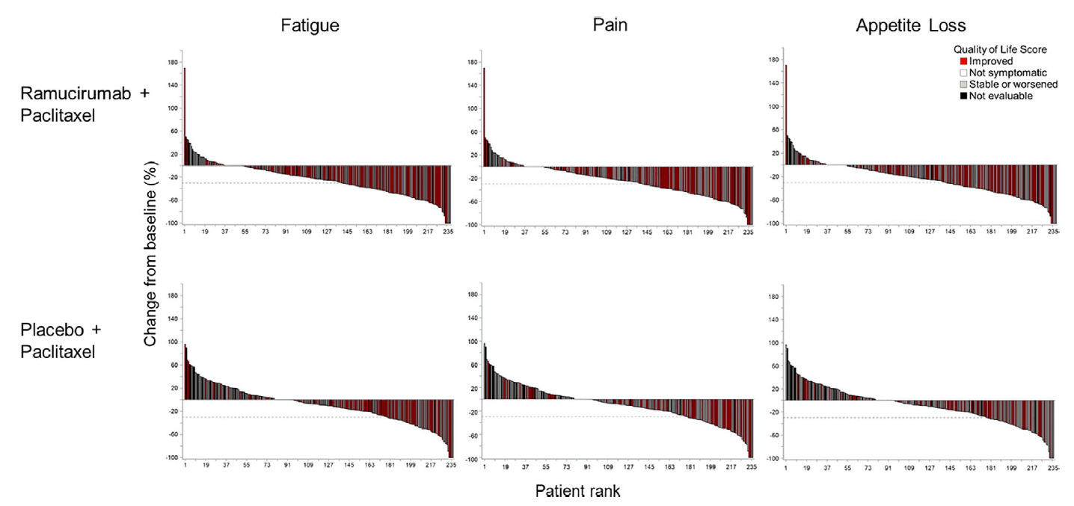
Association of Best Percent Change in Tumor Size with Best Improvement in Selected Symptoms
Cascinu S et al. Oncologist 2021;26(3):e414-24.

Slide 18
Agenda
Introduction: This Week on RTP
MODULE 1: PARP Inhibitors in Prostate Cancer – Top 10 List
MODULE 2: Optimal Integration of PARP Inhibitor Monotherapy into the Management of Metastatic Castration-Resistant Prostate Cancer (mCRPC) – Prof de Bono
MODULE 3: Available Data with, Ongoing Investigation of and Potential Future Role for PARP Inhibitor-Based Combination Strategies – Dr Saad

Slide 19
Consider how you felt when you got up this morning (eg, energy level, acute or chronic health issues) and compare that to how you generally felt 2 months ago on scale of 1 to 10, with 1 being much worse today and 10 being much better today.
1 – much worse
2
3
4
5 – status quo
6
7
8
9
10 – much better

Slide 20
PARP Inhibitors in Prostate Cancer
Top Ten List
Genomic workup: Metastatic disease?
Role of liquid biopsy?
BRCA 1 vs BRCA 2? Other germline mutations?
Somatic mutations?
LOH, HRD scores?
Use of platinum agents
PARP inhibitors: First-line therapy for mCRPC (PROPEL, MAGNITUDE)
PARP inhibitors: Second-line and beyond
Prevention and management of toxicity/side effects
Resistance mechanisms; PARP inhibitor rechallange

Slide 21
Last but not least in light of the PROpel and MAGNITUDE trials:
Is there any rationale for PARPi to work in Pca without DDR?
My opinion:
Does PARPi block AR signaling?
  If it did PSA falls would have been seen in non-DDR Pca pts.
Does AR blockade downregulate HRD and sensitize to PARPi?
  If it did Abi/enza would hugely increase PARPi RR
Is there some other MOA?
  Possibly; suggestions of an impact on immune response? STING?
  Clearance of emerging neuroendocrine clones (RB1/RNASEH2B/BRCA2 lost)
  Off target effects?
Courtesy of Johann S de Bono, MB ChB, MSc, PhD, FMedSci

Slide 22
Rationale for combining PARP inhibitors and NHAs
Olaparib + NHA^{10–13}
PARP inhibition reported to increase activity of NHA via
AR-dependent transcription^{10,11}
NHA reported to induce HRR deficiency and increase susceptibility to PARP inhibition^{11‒13}
Combined effect
Anti-tumor activity in HRRm and non-HRRm prostate cancer^{10–13}
1. Mateo J, et al. N Engl J Med 2015;373:1697–1708; 2. Schiewer MJ, et al Cancer Discov 2012;2:1134–1149; 3. Polkinghorn WR, et al. Cancer Discov 2013;3:1245–1153; 4. Asim M, et al. Nat Commun 2017;8:374
Courtesy of Fred Saad, MD

Slide 23
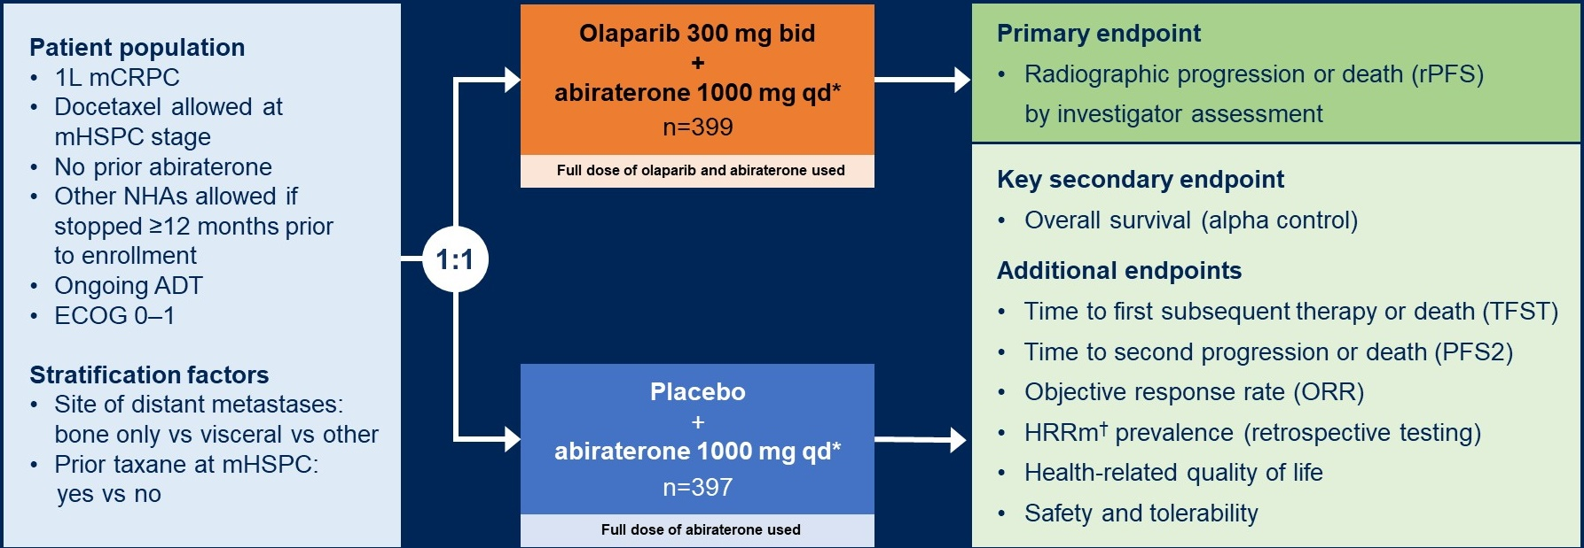
PROpel
Randomized, double-blind, placebo-controlled Phase III trial
Baseline demographics: HRRm status
Courtesy of Fred Saad, MD

Slide 24
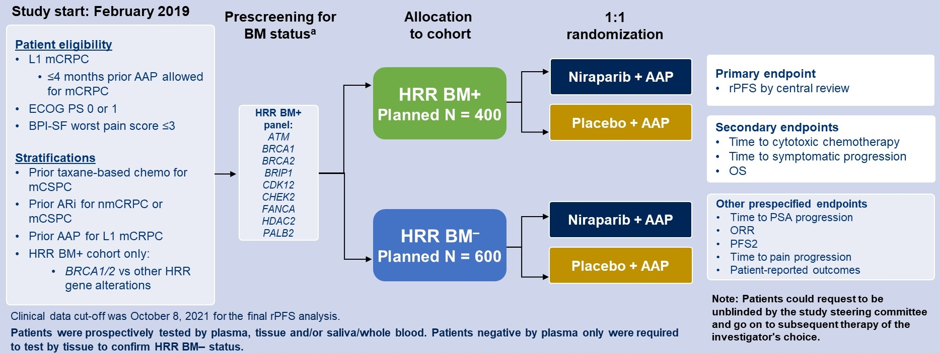
MAGNITUDE
Randomized, double-blind, placebo-controlled Phase III trial
Courtesy of Fred Saad, MD

Slide 25
PARP Inhibitors in Prostate Cancer
Top Ten List
Genomic workup: Metastatic disease?
Role of liquid biopsy?
BRCA 1 vs BRCA 2? Other germline mutations?
Somatic mutations?
LOH, HRD scores?
Use of platinum agents
PARP inhibitors: First-line therapy for mCRPC (PROPEL, MAGNITUDE)
PARP inhibitors: Second-line and beyond
Prevention and management of toxicity/side effects
Resistance mechanisms; PARP inhibitor rechallange

Slide 26
Agenda
Introduction: This Week on RTP
MODULE 1: PARP Inhibitors in Prostate Cancer – Top 10 List
MODULE 2: Optimal Integration of PARP Inhibitor Monotherapy into the Management of Metastatic Castration-Resistant Prostate Cancer (mCRPC) – Prof de Bono
MODULE 3: Available Data with, Ongoing Investigation of and Potential Future Role for PARP Inhibitor-Based Combination Strategies – Dr Saad

Slide 27


PARP inhibition for Prostate Cancer
in partnership with
Johann Sebastian de Bono
Regius Professor, Head of the Drug Development Unit,
The Institute of Cancer Research and Royal Marsden Hospital,
London, United Kingdom
June 2022

Slide 28
Conclusions
Synthetic lethality strategies can change prostate cancer care
  PARP inhibitors and platinum cross-resistant
Germline DDR testing now a standard of care
  And family cascade testing
  Please remember to take a family history
Increasingly complex predictive biomarkers
  Biallelic loss necessary to sensitize to PARPi/platinum
  BRCA2 homozygous deletions result in longer responses than BRCA2 mutations
  ATM loss does sensitize to PARPi
  MMRd and PD-1/PD-L1 targeting ICI
Beware risks of plasma ctDNA NGS
  Median tumour fraction 10-30% (ie 70-90% of DNA not tumor DNA)
  Can miss (BRCA2) HOMDELs (super responders)
  Can also mistake clonal hemopoietic (CHIP) mutations for tumor mutations
Courtesy of Johann S de Bono, MB ChB, MSc, PhD, FMedSci

Slide 29
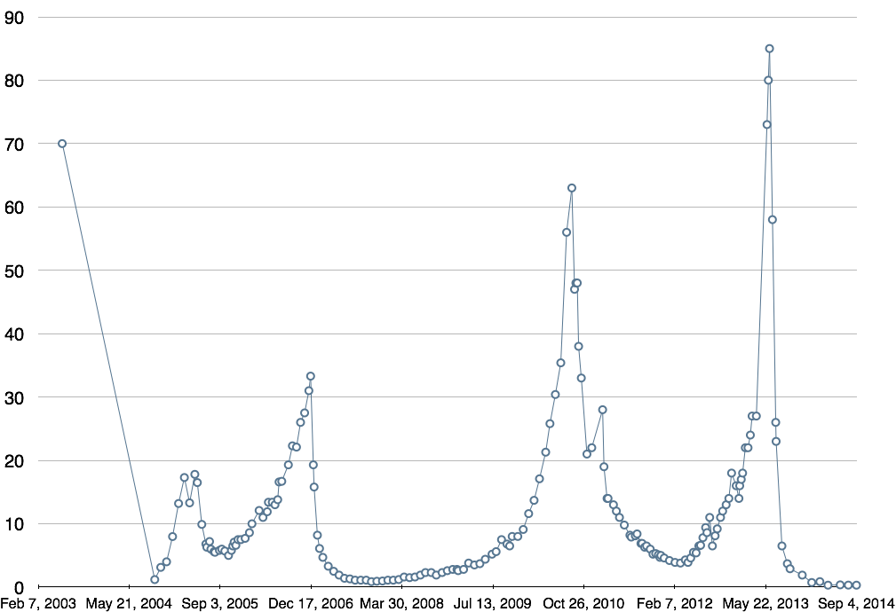
PSA
Case Presentation – Prof de Bono: 65-year-old man
Radiotherapy to prostate,
pelvic nodes, and large left iliac bone met
We have reported on
cross-sensitivity/
cross-resistance of PARPi with carboplatin (Fong et al, JCO 2010)
Diagnosed with
metastatic CRPC
Multiple bone mets
FH identified:
BRCA2 germline mt
Identified: Olaparib
Goserelin and bicalutamide
----31 months----
CRPC after 1 year
Multiple bone mets
‘Go home to die’
New met in left iliac bone,
enlarged retroperitoneal nodes
Abiraterone
Docetaxel and
figitumumab
Radium 223
Good response to
Abiraterone (36m)
Eribulin
Courtesy of Johann S de Bono, MB ChB, MSc, PhD, FMedSci
Time ➔

Slide 30
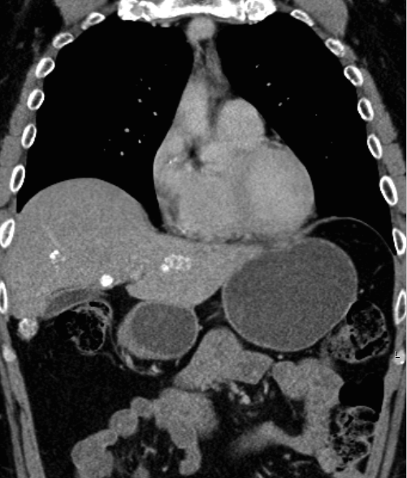
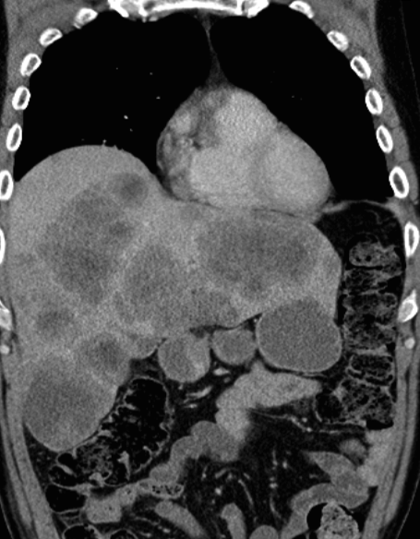
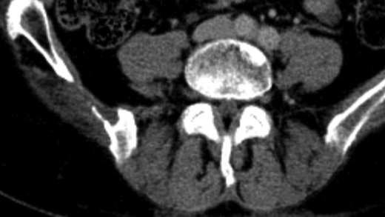
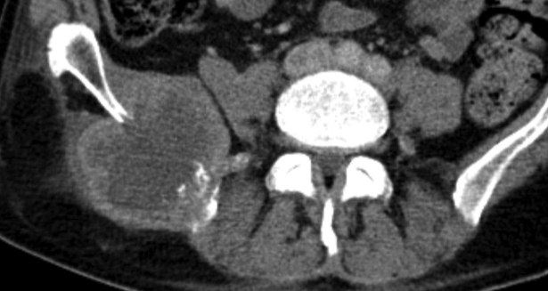
Almost complete resolution of liver metastases with residuum calcified abnormality
Case Presentation – Prof de Bono
HRD and carboplatin response
Treatment?
Dying man.
Age 44
Strong FH.
LFTs⇡
Referred post-abi,
enza,
docetaxel,
cabazitaxel
Healing lytic
Bone metastasis
Courtesy of Johann S de Bono, MB ChB, MSc, PhD, FMedSci
March 2015

Slide 31
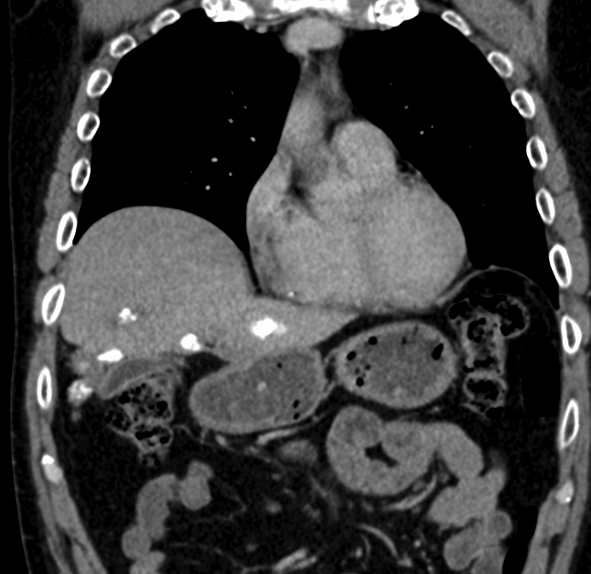
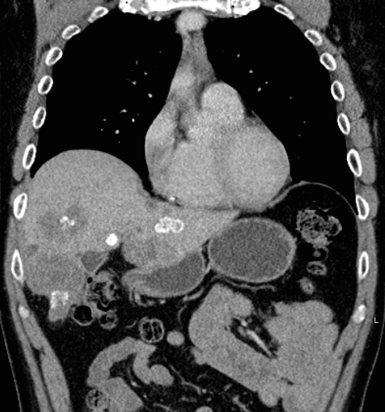
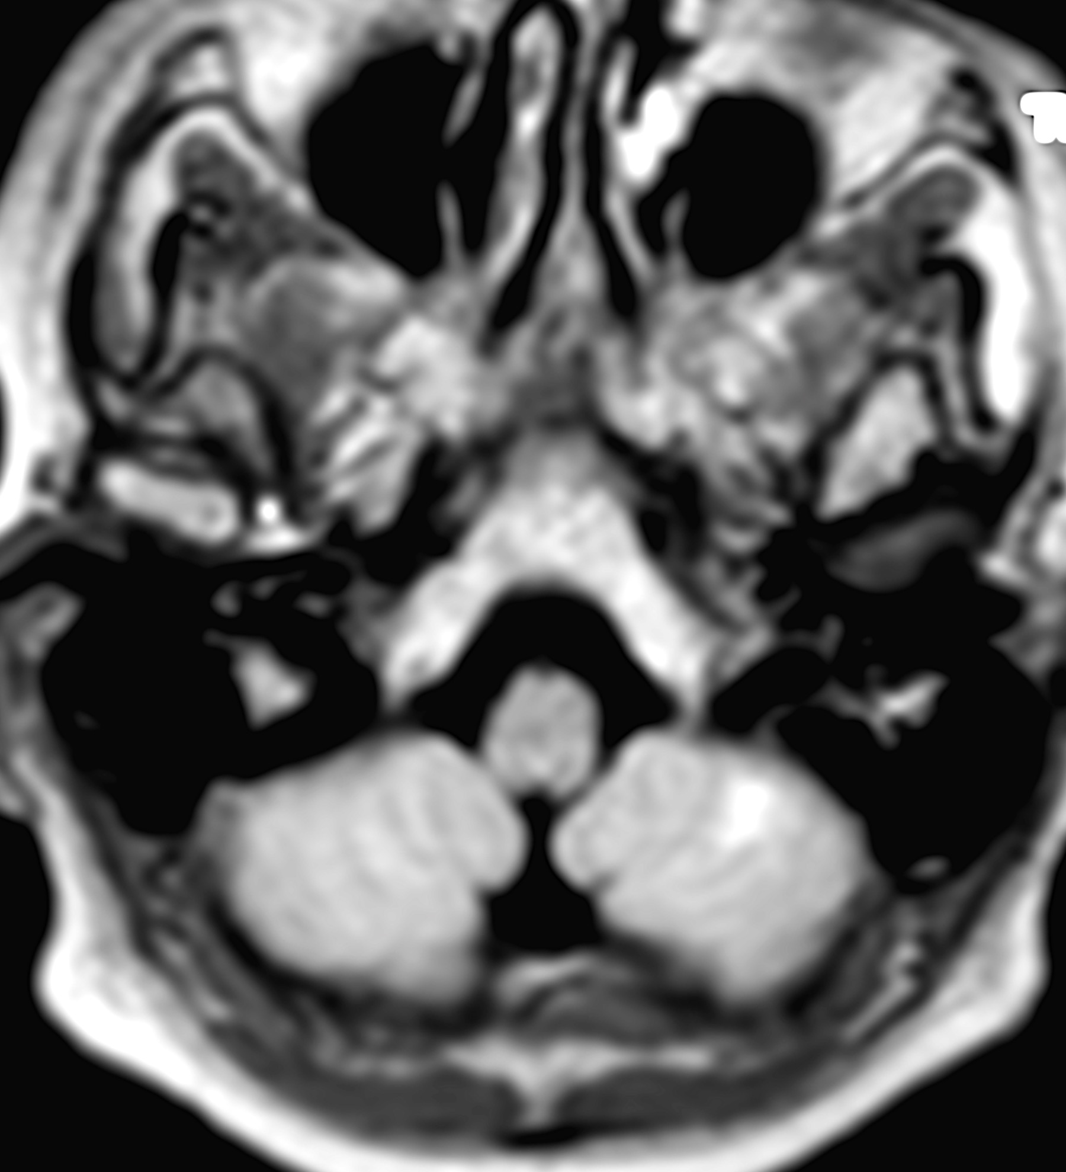
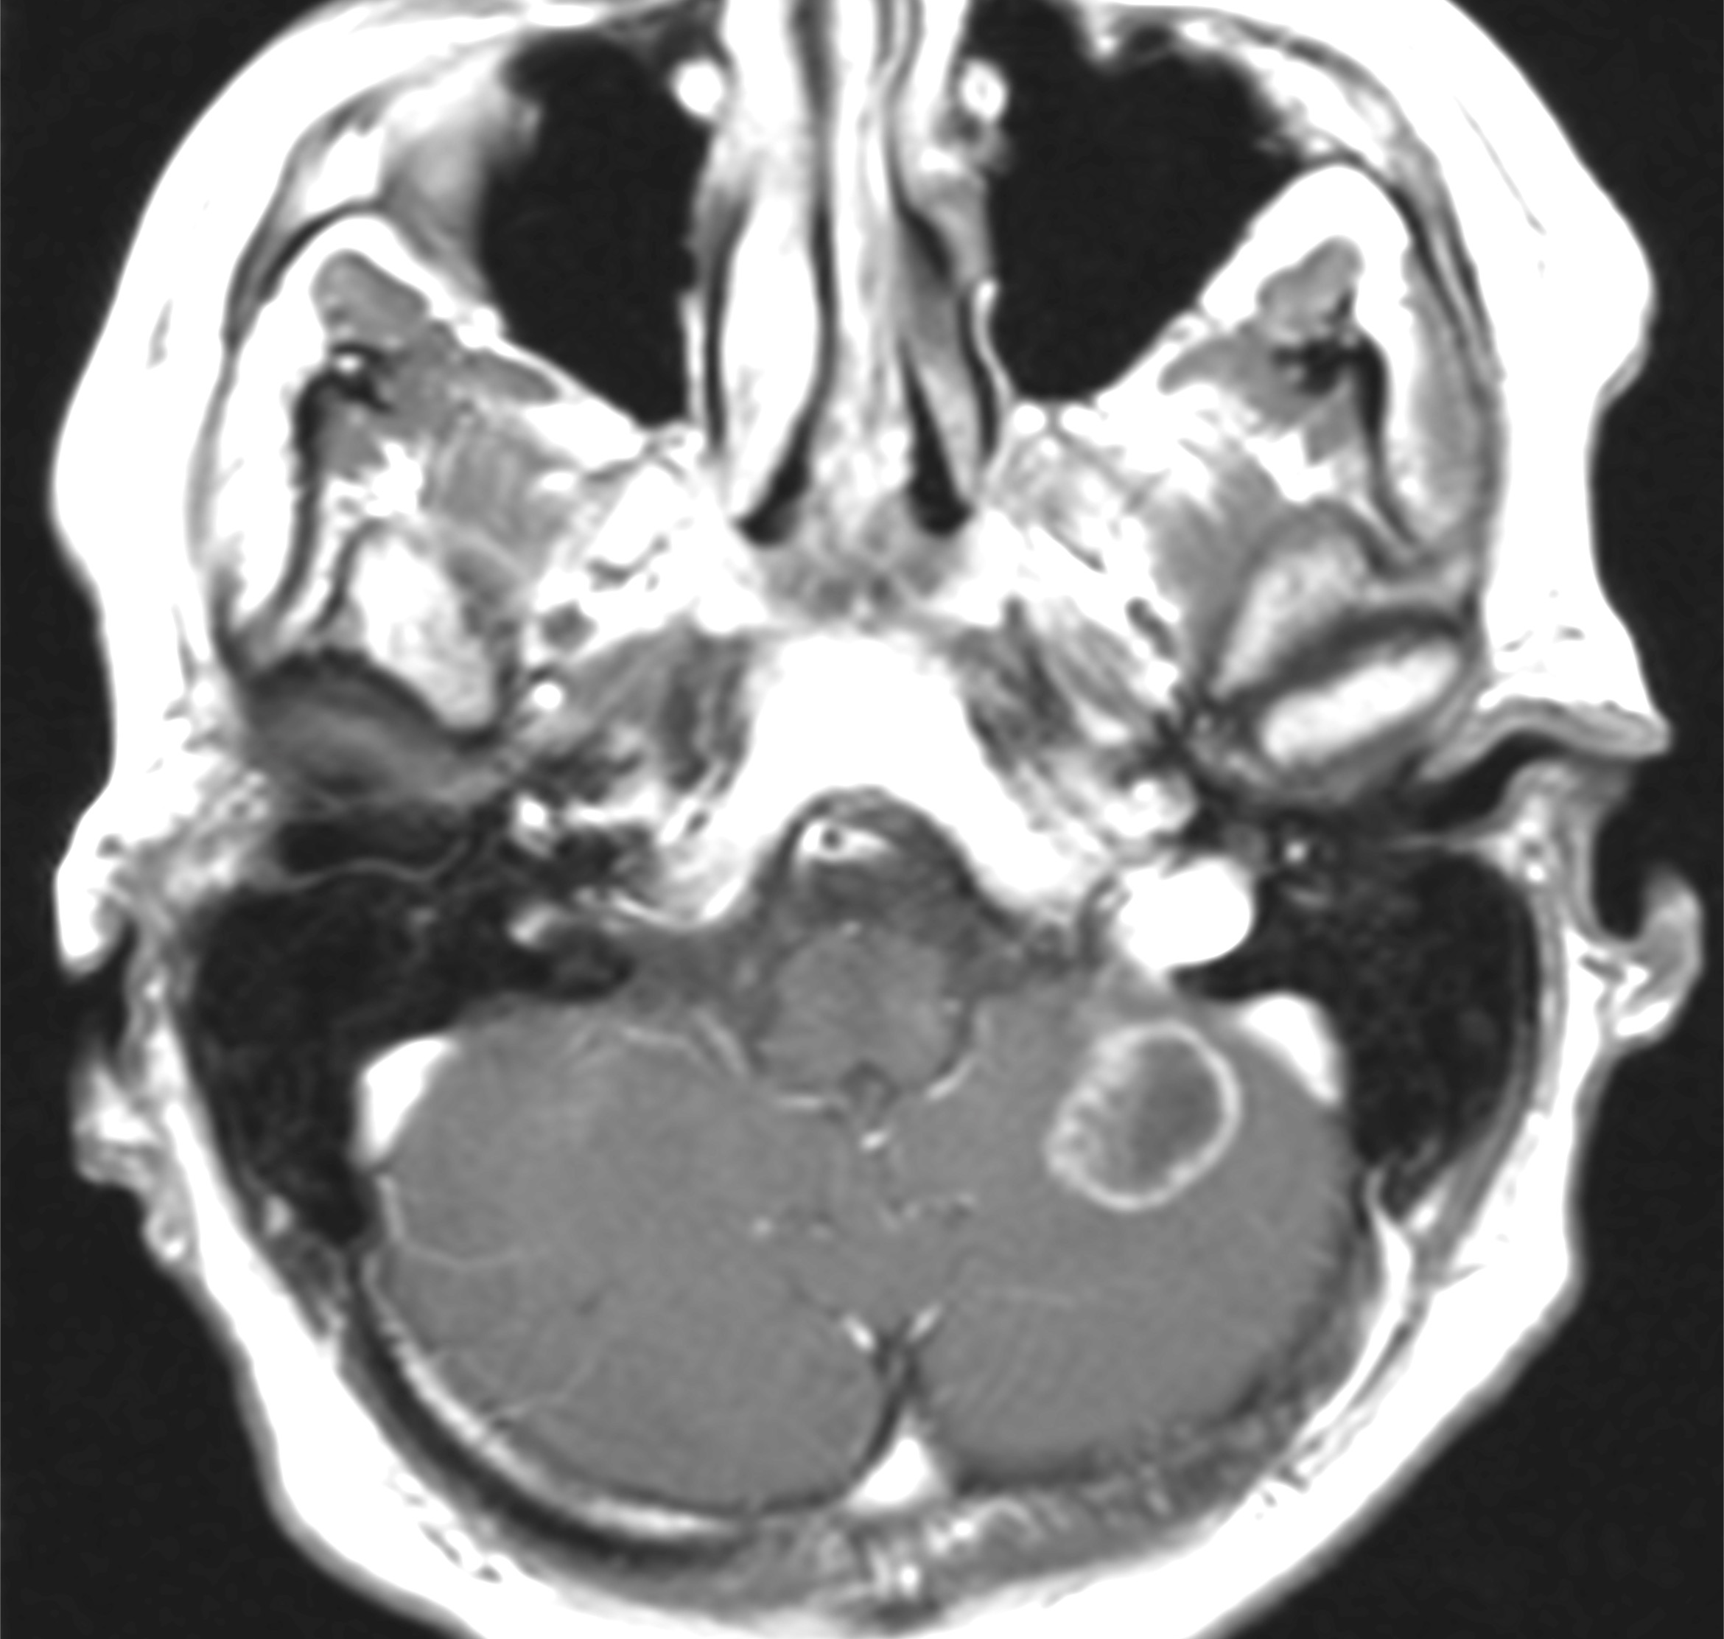
February 2017
Retreated with carbo AUC6
Almost complete resolution of liver metastases with residuum calcified abnormality
Courtesy of Johann S de Bono, MB ChB, MSc, PhD, FMedSci
Relapse after 8 months
Carboplatin AUc6 q21d
Dying man.
M1 at diagnosis
Strong FH.
Referred post-abi, enza,
docetaxel,
cabazitaxel. LFTs⇡
Healing lytic
Bone metastasis
Cyberknife planning MRI
Very high HRD score
on exome NGS
4-year long remission!
New solitary cerebellar metastasis
March 2015

Slide 32
PALB2 altered mCRPC responding patient on TOPARP-B
Baseline Best response
Coronal and Axial Contrast Enhanced CT images at baseline and during treatment: Complete response (PR) of left supraclavicular lymphadenopathy (arrows). Patient also had very good response at the sites of small volume lymphadenopathy. This response lasted > 1 year in late stage mCRPC.
Patient had bi-allelic PALB2 loss.
29.05.18 29.07.19
Courtesy of Johann S de Bono, MB ChB, MSc, PhD, FMedSci

Slide 33
Agenda
Introduction: This Week on RTP
MODULE 1: PARP Inhibitors in Prostate Cancer – Top 10 List
MODULE 2: Optimal Integration of PARP Inhibitor Monotherapy into the Management of Metastatic Castration-Resistant Prostate Cancer (mCRPC) – Prof de Bono
MODULE 3: Available Data with, Ongoing Investigation of and Potential Future Role for PARP Inhibitor-Based Combination Strategies – Dr Saad

Slide 34
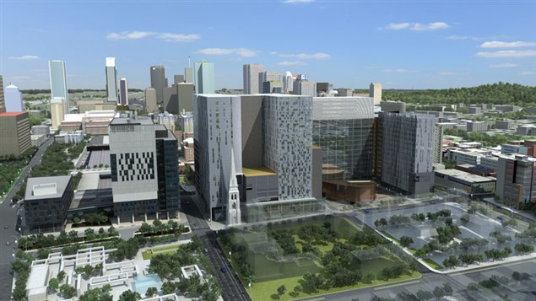

Opening the door for PARPi treatment:
What lies ahead?
Fred Saad MD FRCS
Professor and Chairman of Urology
Director of GU Oncology
Raymond Garneau Chair in Prostate Cancer
University of Montreal Hospital Center
Montreal, QC, Canada

Slide 35
Conclusion
Survival of men with mCRPC in the real world remains a problem
Good first line options but early resistance/progression is a challenge
Second line options are available but many patients do not get more than 1 line of effective therapy in the real world
Less than half the men with prostate cancer will receive chemotherapy before dying from prostate cancer
Building on effective first line options for mCRPC is critically needed
PARP/NHT combination fulfills an unmet need of effective and tolerable first line combinations
  In all patients? Only in HRR mutated?
Courtesy of Fred Saad, MD

Slide 36
Successful phase 3 trials in mCRPC
Study | Agents | N | Indication | HR | ∆OS (mo)
TAX-327¹ | DOC / P vs mito / P | 1006 | mCRPC, symptomatic or not | 0.76 | +2.9
COU-AA-302² | ABI / P vs P | 1088 | mCRPC (pre-DOC), mild / no symptoms No visceral metastases | 0.81 | +4.4
COU-AA-301³ | ABI / P vs P | 1195 | mCRPC (post-DOC) | 0.74 | +4.6
PREVAIL⁴ | ENZ vs PBO | 1717 | mCRPC (pre-DOC), mild / no symptoms | 0.77 | +4.0
AFFIRM⁵ | ENZ vs PBO (or P) | 1199 | mCRPC (post-DOC) | 0.63 | +4.8
TROPIC⁶ | CABA / P vs mito / P | 755 | mCRPC (post-DOC) | 0.70 | +2.4
ALSYMPCA⁷ | Radium-223 vs PBO | 921 | mCRPC (post-DOC or unfit for DOC) | 0.70 | +3.6
PROfound⁸ | Olaparib vs NHT | 245 | mCRPC post-NHT (with HRRm) | 0.69 | +4.4
VISION⁹ | Lu-PSMA vs NHT | 831 | mCRPC post-NHT (with PSMA+) and chemo | 0.62 | +4.0
All studies had a non life-prolonging control arm
Courtesy of Fred Saad, MD
ABI, abiraterone; CABA, cabazitaxel; chemo, chemotherapy; DOC, docetaxel; ENZ, enzalutamide; HR, hazard ratio; HRRm, homologous recombination repair gene mutation; Lu-PSMA, Lutetium-177 prostate-specific membrane antigen;
mCRPC, metastatic castration-resistant prostate cancer; mito, mitoxantrone; mo, months; NHT, neoadjuvant hormonal therapy; OS, overall survival; P, prednisone; PBO, placebo
1. Tannock IF, et al. N Engl J Med 2004;351:1502–1512; 2. Ryan CJ, et al. Lancet Oncol 2015;16:152–160; 3. Rathkopf DE, et al. Eur Urol 2014;66:815–825; 4. Beer TM, et al. Eur Urol 2017;71:151–154; 5. Armstrong AJ, et al. Cancer 2017;123:2303–2311;
6. de Bono JS, et al. Lancet 2010;376:1147–1154; 7. Hoskin P, et al. Lancet Oncol 2014;15:1397–1406; 8. Hussain M, et al. N Engl J Med 2020;383:2345–2357; 9. Sartor O, et al. Online ahead of print. N Engl J Med 2021

Slide 37
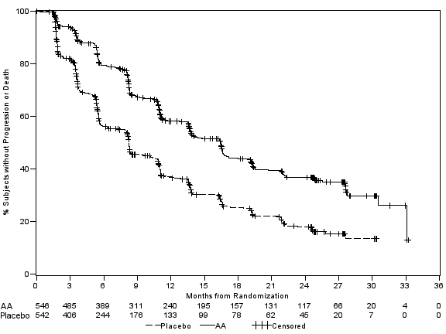
Standard of care Abiraterone: rPFS
Abiraterone + Prednisone:
16.46 months (95% CI 13.77, 16.76)
HR: 0.525; p value: <0.0001
Prednisone + Placebo:
8.25 months (95% CI 8.02, 9.43)
Courtesy of Fred Saad, MD
Notes:
37

Slide 38
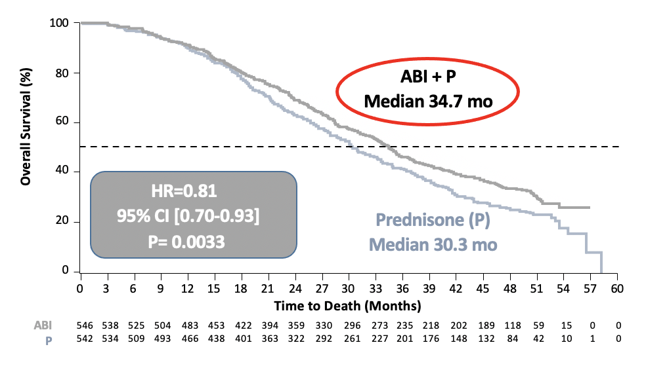
Abiraterone First Line – Overall Survival
Ryan CJ et al. Lancet Oncol. 2015;16: 152-60
Courtesy of Fred Saad, MD

Slide 39
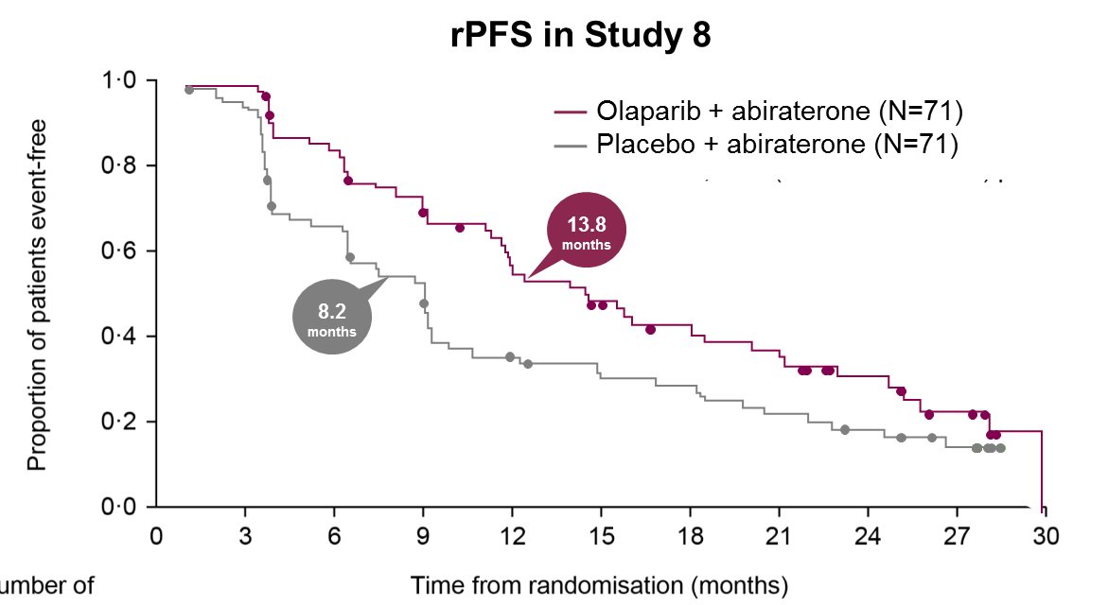
Phase 2 study
Olaparib + abiraterone significantly prolonged rPFS vs. placebo + abiraterone in patients irrespective of HRRm status^{1,2}
A 35% decrease in the risk of disease progression or death was seen in the olaparib + abiraterone arm¹
Investigator-assessed rPFS¹
 | Olaparib + abiraterone (n=71) | Placebo + abiraterone (n=71)
Events, n (%) | 46 (65%) | 54 (76%)
 | HR = 0.65 95 % CI (0.44– 0.97) p=0.034
rPFS by HRRm subgroup^{2*}
HRRm
n=23 (16%)
0.62
HRRm partially characterized
n=46 (32%)
0.95
Non-HRRm
n=73 (51%)
0.54
0.25
0.50
1.00
2.00
HR (95% CI)
*Dashed line and shaded area show HR and 95% CI, respectively, for the intent to treat population
CI=confidence interval; HR=hazard ratio; HR=hazard ratio; HRRm=homologous recombination repair gene mutation; rPFS=radiographic progression free survival
1. Clarke N. et al. Lancet Oncol 2018;19(7):975–986; 2. Carr TH, et al. Cancers 2021;13(22):5830.
Courtesy of Fred Saad, MD

Slide 40
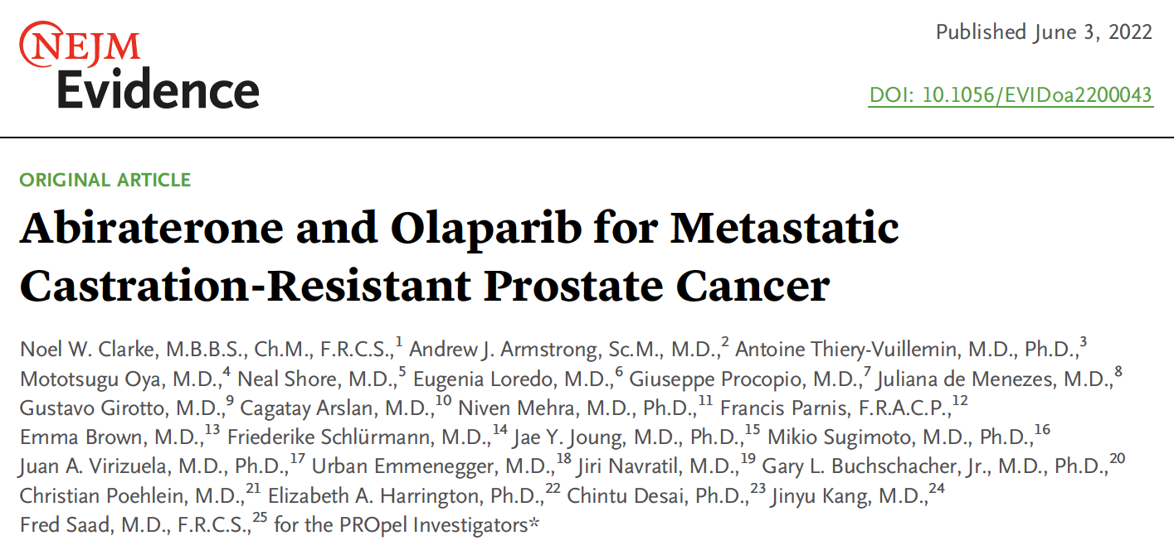

Slide 41
PROpel
Randomized, double-blind, placebo-controlled Phase III trial
Baseline demographics: HRRm status
Courtesy of Fred Saad, MD

Slide 42
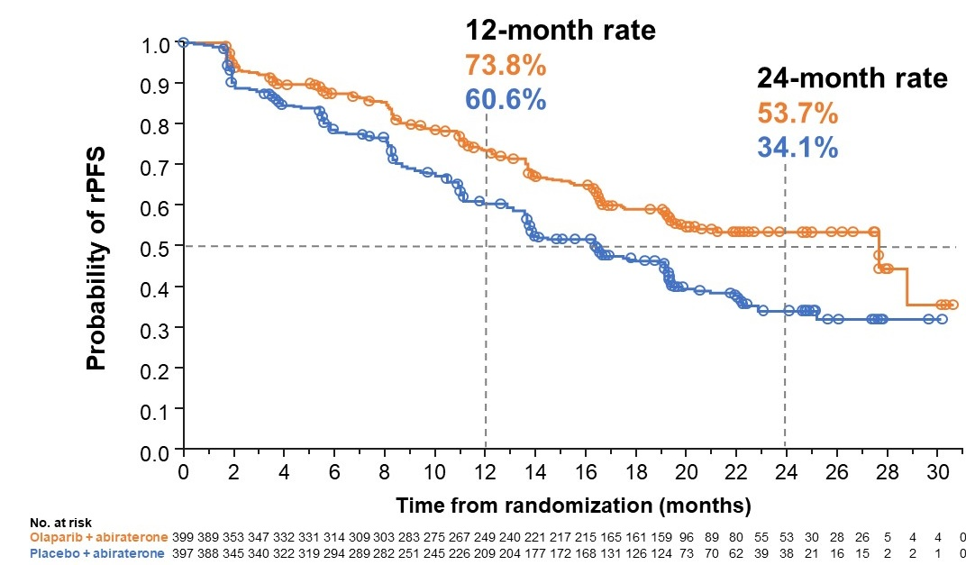
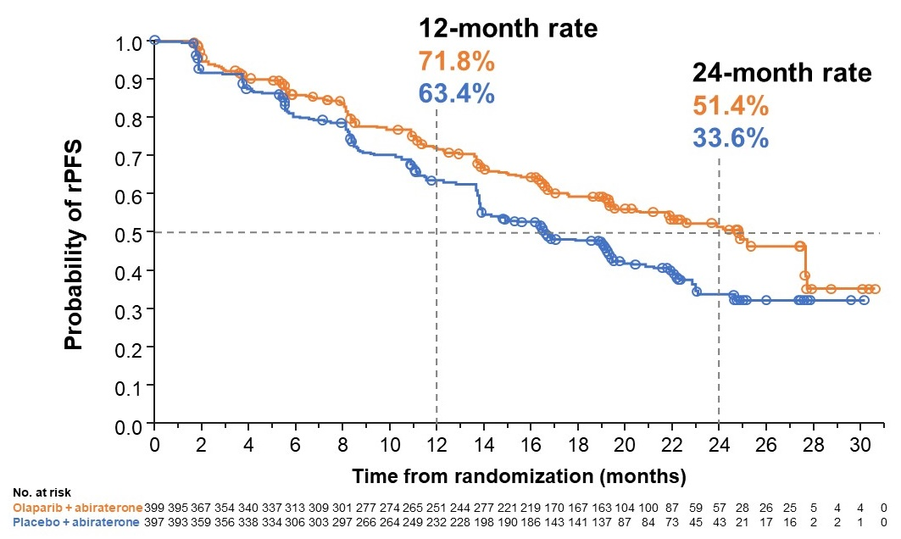
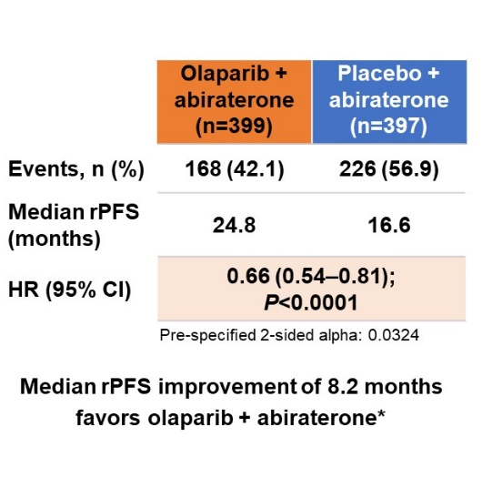
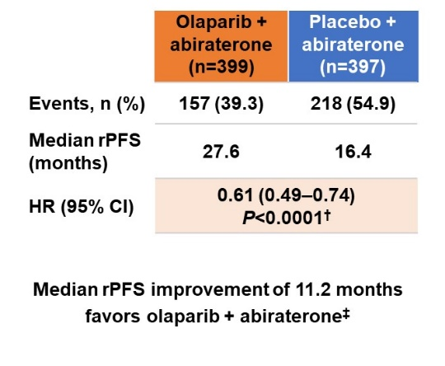
PROpel
Primary endpoint
rPFS by investigator assessment
rPFS by blinded independent central review^
  34% risk reduction for progression or death with olaparib + abiraterone (HR 0.66; 95% CI 0.54–0.81; P<0.0001)
Saad F, et al. Oral presentation at the 2022 ASCO GU Symposium; Feb 17, 2022; Abstract #11
Courtesy of Fred Saad, MD

Slide 43
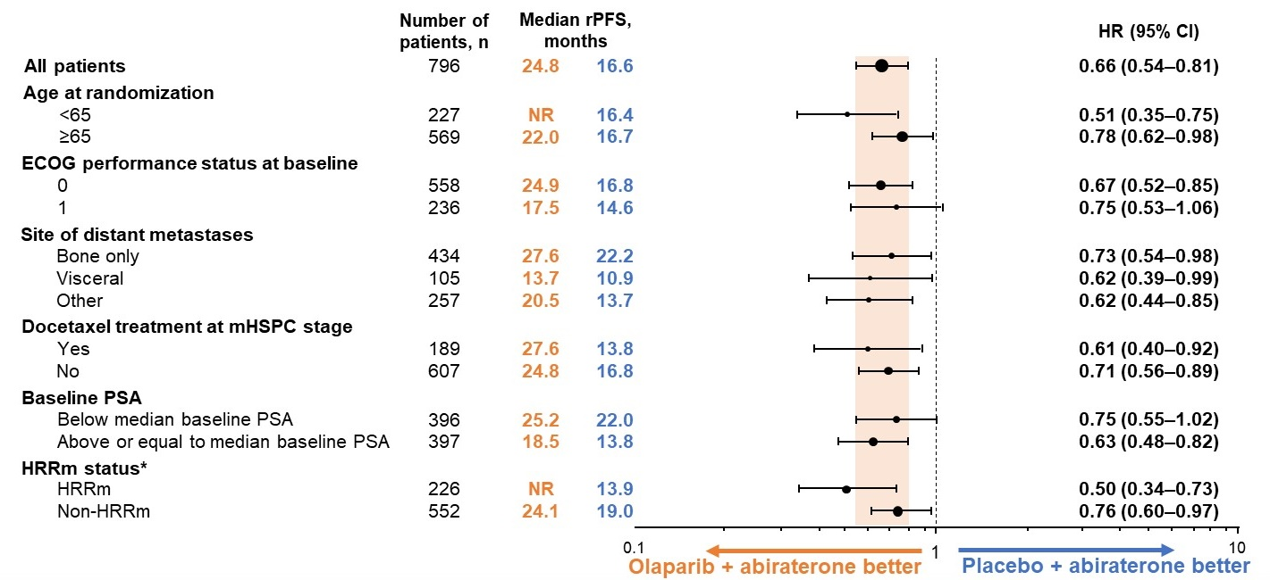
PROpel rPFS subgroup analysis
  rPFS benefit observed across all pre-specified subgroups
Saad F, et al. Oral presentation at the 2022 ASCO GU Symposium; Feb 17, 2022; Abstract #11
Courtesy of Fred Saad, MD

Slide 44
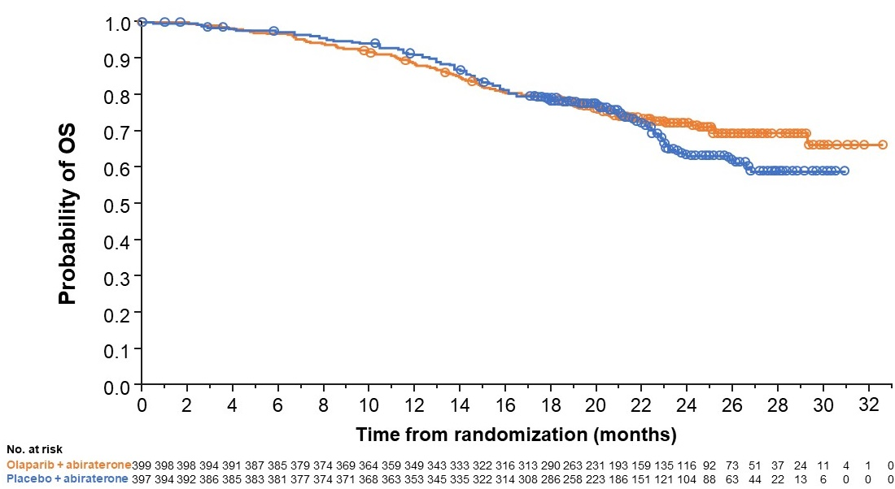
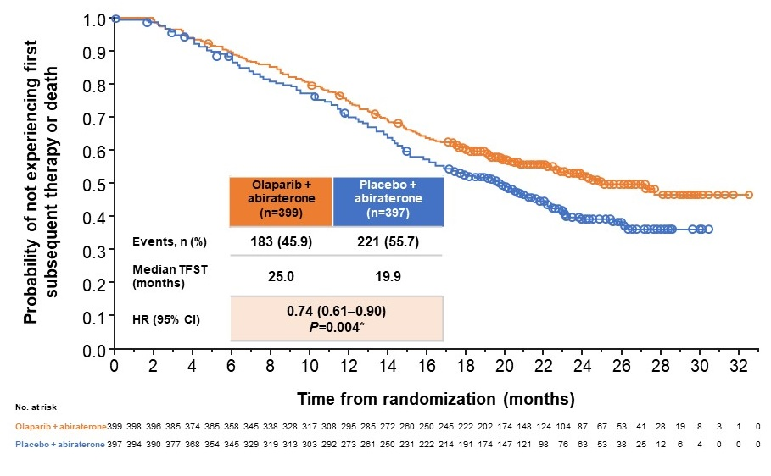
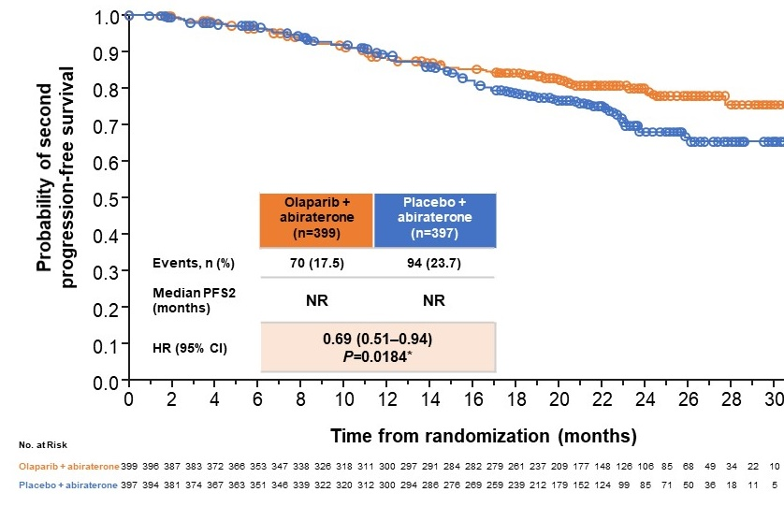
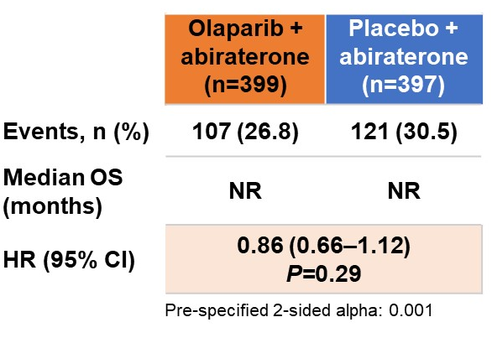
PROpel
Key secondary endpoints
Overall survival
Time to first subsequent therapy or death (TFST)
Time to second progression or death (PFS2)
  OS data immature, but trend towards improved OS with olaparib + abiraterone
  TFST (HR 0.74; 95% CI 0.61–0.90) and PFS2 (HR 0.69; 95% CI 0.51–0.94) supportive of long-term benefits
Saad F, et al. Oral presentation at the 2022 ASCO GU Symposium; Feb 17, 2022; Abstract #11
Courtesy of Fred Saad, MD

Slide 45
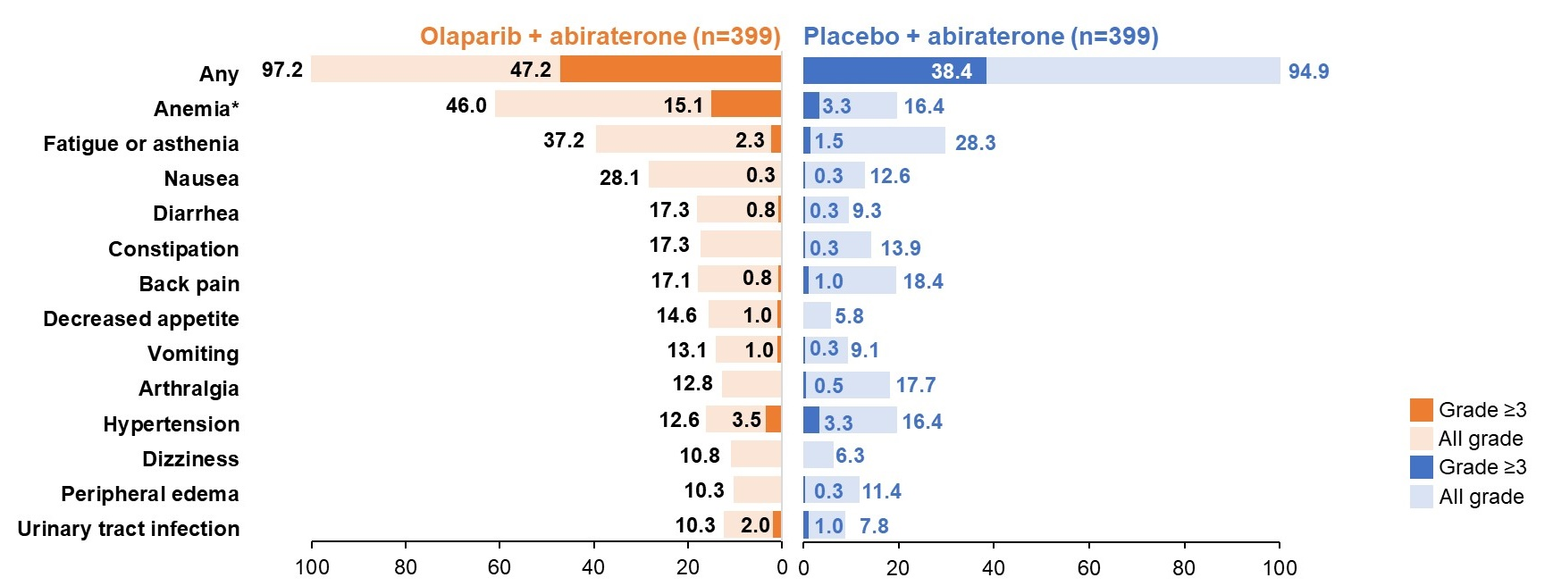
PROpel
Safety data
  Safety and tolerability profile consistent with the known safety profiles of individual drugs
  The most common grade ≥3 AE was anemia (15.1% vs 3.3%)
*Anemia category includes anemia, decreased hemoglobin level, decreased red-cell count, decreased hematocrit level, erythropenia, macrocytic anemia, normochromic anemia, normochromic normocytic anemia, and normocytic anemia.
AE, adverse event; CTCAE, Common Terminology Criteria for Adverse Events v4.03.
Saad F, et al. Oral presentation at the 2022 ASCO GU Symposium; Feb 17, 2022; Abstract #11
Courtesy of Fred Saad, MD

Slide 46
MAGNITUDE
Randomized, double-blind, placebo-controlled Phase III trial
Courtesy of Fred Saad, MD

Slide 47
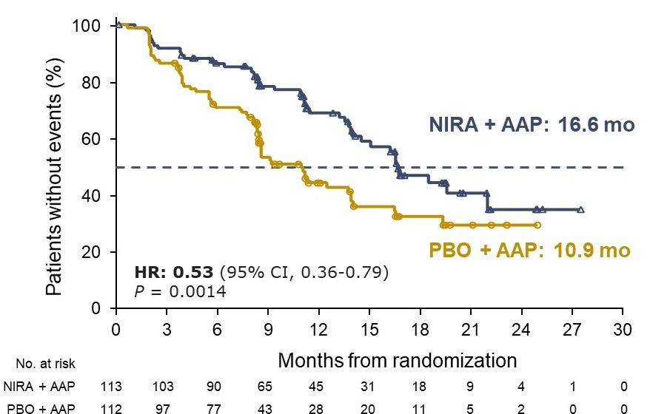
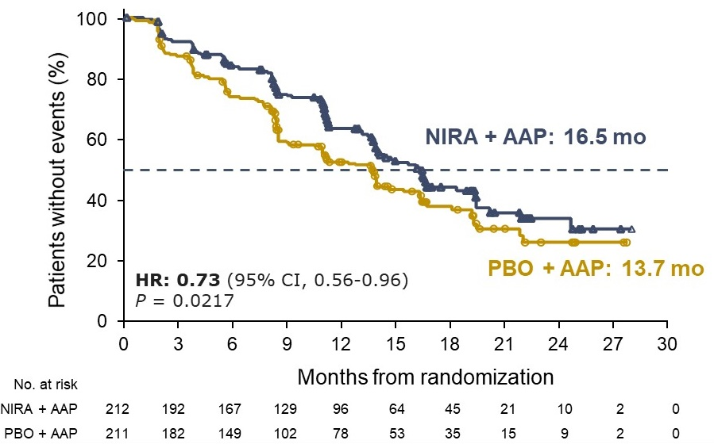
MAGNITUDE
Primary endpoint: rPFS by central review
BRCA1/2-mutated
All HRR BM+
47% improvement in rPFS in patients with BRCA1/2 alterations (HR 0.53; 95% CI 0.36–0.79; P=0.0014)
27% improvement in rPFS across all HRR BM+ patients (HR 0.73; 95% CI 0.56–0.96; P=0.0217)
Chi KN, et al. Oral presentation at the 2022 ASCO GU Symposium; Feb 17, 2022; Abstract #12
Courtesy of Fred Saad, MD

Slide 48
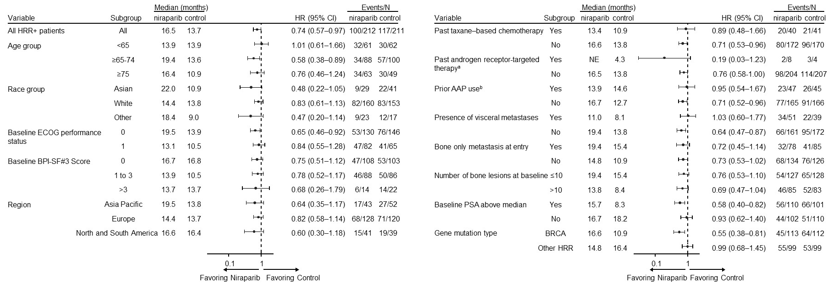
MAGNITUDE rPFS subgroup analysis: All HRR BM+
Chi KN, et al. Oral presentation at the 2022 ASCO GU Symposium; Feb 17, 2022; Abstract #12
Courtesy of Fred Saad, MD

Slide 49
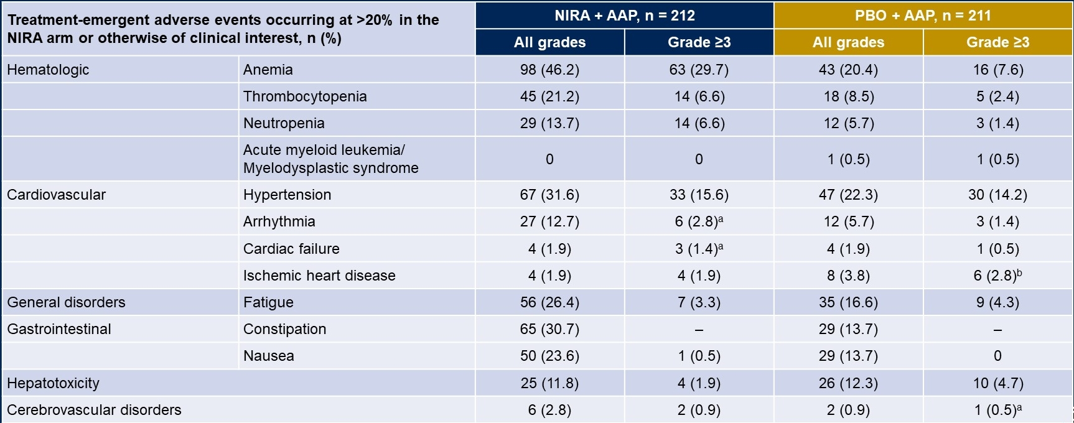
MAGNITUDE
Safety data: HRR BM+
Courtesy of Fred Saad, MD

Slide 50
Ongoing trials investigating PARPi in advanced PC
Primary
Adjuvant
Biochemical Recurrence (BCR)
mHSPC
(incl de novo)
1L mCRPC
2L mCRPC
3L mCRPC
nmCRPC
PROfound¹*
Olaparib mono, BRCA / ATM and other HRRm, post-NHA
PROpel²
Olaparib + abi
all-comers
TALAPRO-3³
Talazoparib + enza
All Comers / HRRm
TALAPRO-2⁴
Talazoparib + enza
All Comers / HRRm
TALAPRO-1⁵ (PII)
Talazoparib mono, HRRm / BRCAm
Post-NHA, post-taxane
Prostate Specific Antigen
AMPLITUDE⁶
Niraparib + abi
HRRm
MAGNITUDE⁷
Niraparib + abi
Primary endpoint: HRRm
GALAHAD⁸ (PII)
Niraparib mono, HRRm / BRCAm
Post-NHA, post-taxane
CASPAR⁴
Rucaparib + enza
All Comers / HRRm
TRITON-3¹⁰
Rucaparib mono,
Post-NHA, BRCAm / ATM
TRITON-2¹¹ (PII)
Rucaparib mono
HRRm / BRCAm†
Post-NHA, post-taxane
Met
Time
Non-metastatic
Metastatic
Hormone-sensitive
Castration-resistant
Asymptomatic
Symptomatic
Courtesy of Fred Saad, MD

Slide 51
Case Presentation – Dr Saad: 61-year-old patient
Presented with moderate LUTS
No relevant past medical history
PSA 132 with suspicious T3 disease on DRE
Biopsy reveals 9/12 cores with Gleason 4 + 4 adenocarcinoma
Bone scan:
  Multiple metastases in the hip, lumbar spine, and 8th left rib
Abdominal/thoracic CT scan:
  Suspicious retroperitoneal lymph nodes between and lung metastases
Courtesy of Fred Saad, MD

Slide 52
Case Presentation – Dr Saad: 61-year-old patient (continued)
Patient received ADT + 6 cycles of docetaxel
PSA nadir of 0.9 after 12 months
6 months later: PSA rises to 1.6
6 months later: PSA 3.4
Slight discomfort lumber spine
Imaging reveals progression of lymph nodes, stable otherwise
Courtesy of Fred Saad, MD

Slide 53
Case Presentation – Dr Saad: 61-year-old patient (continued)
Began PROpel study of abiraterone +/- olaparib in February 2019
Well tolerated except for slight fatigue and decline in hemoglobin from 13.3 to 10.5 after 3 months
Rise in Hb after 8 months to 12.5 and remains stable
PSA < 0.02 after 6 months
Imaging: CR of all measurable lesions and no change on bone scan
Continues to be seen monthly and remains in complete response
Courtesy of Fred Saad, MD

Slide 54
Case Presentation – Dr Saad: 75-year-old patient
History of well controlled hypertension
Known family history of breast and ovarian cancer
Patient known to be germline BRCA2 carrier
Patient found to have metastatic prostate cancer at diagnosis
Became mCRPC 2 years after start of ADT
Started on enzalutamide 4 years ago
PSA declines from 16 to 6
Courtesy of Fred Saad, MD

Slide 55
Case Presentation – Dr Saad: 75-year-old patient (continued)
PSA rises to 10 and radiographic progression 15 months later
  Bone scan: metastases hip and lumbar spine
  Abdominal/thoracic CT scan: multiple retroperitoneal lymph nodes up to 3 cm
Patient started on olaparib
  Well tolerated with minor fatigue
  PSA declines to 0.2
  Imaging: lymph nodes all below 1 cm, reduced intensity on bone scan
Patient remained without progression for 18 months
Courtesy of Fred Saad, MD

Slide 56
Case Presentation – Dr Saad: 75-year-old patient (continued)
PSA began to rise and progression of metastases on imaging with eventual progression of pain
Patient went on to receive docetaxel
Some relief of pain and PSA reduction after 4 cycles
Progression of PSA, imaging and symptoms after 8 cycles
Patient allowed early access to ¹⁷⁷Lu-PSMA-617
Presently stable after 2 cycles and tolerating well
Courtesy of Fred Saad, MD

Slide 57
Consider how prepared you feel right now to administer a PARP inhibitor to a patient with mCRPC compared to how prepared you felt before this webinar. How would you rate your current preparedness on a scale of 1 to 10, with
1 being much less prepared now and 10 being much more prepared now?
1 – much less prepared
2
3
4
5 – status quo
6
7
8
9
10 – much more prepared

Slide 58
Backup Slides

Slide 59
Case Presentation – Dr Saad: 74-year-old patient
Long history of prostate cancer
Diagnosed with metastatic disease 5 years prior to referral
Received ADT at diagnosis, then received treatment for mCRPC
  Abiraterone
  Docetaxel
  Cabazitaxel
Referred in desperation for clinical trial
  ECOG PS 2 with chest tubes for pleural effusion
  Multiple bone, lymph node and lung metastases
  PSA 4,222
Courtesy of Fred Saad, MD

Slide 60
Case Presentation – Dr Saad: 74-year-old patient (continued)
Patient eligible for GALAHAD trial IF found to have HRRm
Patient tested and was positive for BRCA2
Started open label niraparib monotherapy
After 1 month patient started to feel better and breathing improved
After 4 months pleural effusion had stopped and chest tubes could be removed
PSA declined to 1,230, patient resumed all his previous activities and continued to drive 3 hours every month for his visits
Remained responsive for 22 months even with PSA rising up to 5,100
Courtesy of Fred Saad, MD

Slide 61
Case Presentation – Dr Saad: 74-year-old patient (continued)
Referred for clinical trial following progressive mCRPC
Had received ADT for de novo metastatic prostate cancer diagnosed 3 years prior
After rapid progression to mCRPC had received docetaxel followed by enzalutamide
Rapid progression of disease on enzalutamide
Patient ECOG PS 0-1 with pain requiring narcotics, otherwise active
Patient accepted open label phase 1 study of niraparib + abiraterone
Courtesy of Fred Saad, MD

Slide 62
Case Presentation – Dr Saad: 74-year-old patient (continued)
Full dose niraparib and abiraterone started on study
Patient had some relief of pain but developed grade 3 anemia and thrombocytopenia
Niraparib held, patient transfused
  Anemia and thrombocytopenia returned to grade 1
Resumed niraparib at reduced dose of 200 mg BID
Tolerated drug but again experienced grade 3 thrombocytopenia
Treatment stopped but disease progressed shortly after
Patient started on cabazitaxel with little success
Courtesy of Fred Saad, MD

