Slide 1
GU Abstracts ASCO 2022
Sandy Srinivas, MD
Stanford University

Slide 2
Prostate Abstracts 2022

Slide 3
Phase II, double-blind, randomized study of salvage radiation therapy (SRT) plus enzalutamide or placebo for high-risk PSA-recurrent prostate cancer after radical prostatectomy: The SALV-ENZA Trial. Abstract 5012.
Addition of ADT to radiation in the primary setting well established
Duration of ADT 4-6 months for intermediate risk and 18-24 months for high risk
The role of ADT in the salvage setting unclear
Enzalutamide is an AR antagonist which does not alter testosterone levels

Slide 4
Phase II, double-blind, randomized study of salvage radiation therapy (SRT) plus enzalutamide or placebo for high-risk PSA-recurrent prostate cancer after radical prostatectomy: The SALV-ENZA Trial. Abstract 5012.
BCR PC after RP
Randomized to placebo or Enzalutamide 160mg/d x 6 months, prostate bed RT
86 men were enrolled; 43/arm
Median follow up 34 mos
Powered for a HR 0.44
FFPP improved with enza vs placebo HR-0.42 ).19-.92) P=.031
AE’s grade 1-2 fatigue 65% vs 53%

Slide 5
The SALV-ENZA Trial: Conclusions/Takeaways
Non-ADT option in the salvage setting very promising
Promising!! Await the randomized RADICALS-HD trial

Slide 6
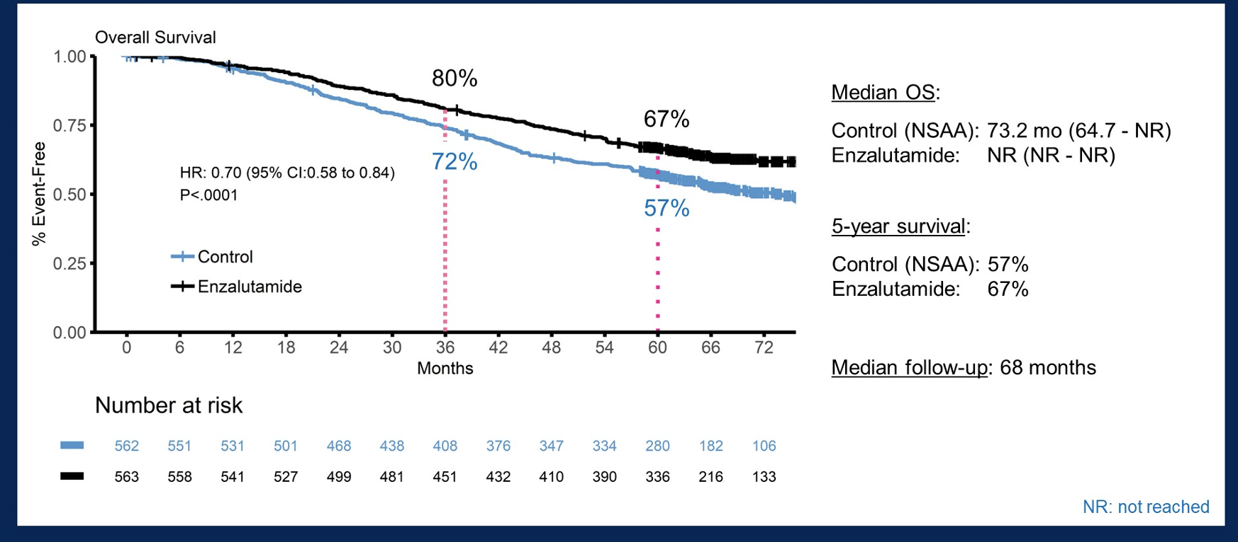
Updated overall survival outcomes in ENZAMET (ANZUP 1304), an international, cooperative group trial of enzalutamide in metastatic hormone-sensitive prostate cancer (mHSPC).Abstract LBA5004.

Slide 7
Conclusions/Takeaways
Enzalutamide +ADT superior to ADT alone with longer follow up
This trial was not best suited to ask the question of docetaxel (triplet)
That is already known from PEACE1 and ARASENS
The question of docetaxel in this trial was not prospective and is a subset
None of the 3 trials address the question of the added value of docetaxel
ADT + ARAT +/- docetaxel is the optimum trial design that is unlikely to happen

Slide 8
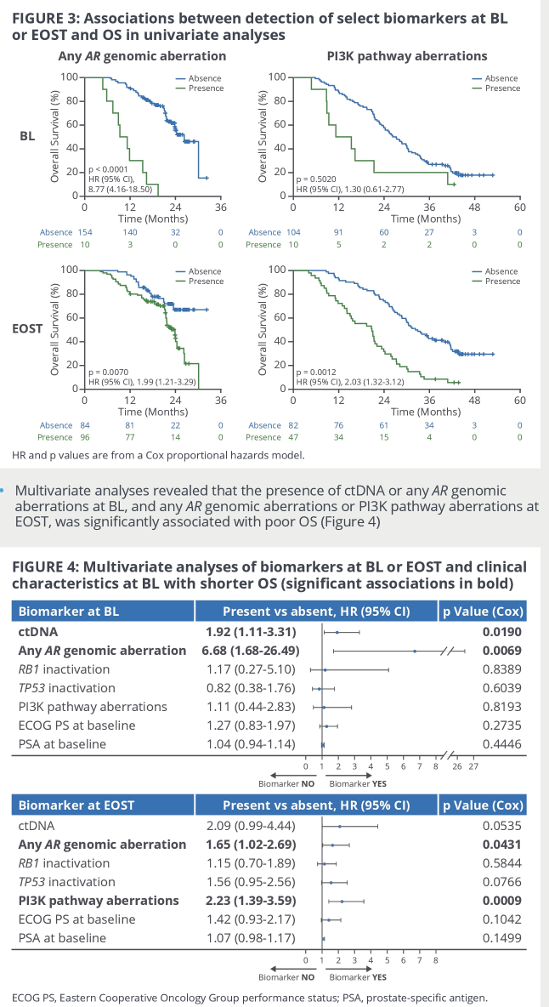
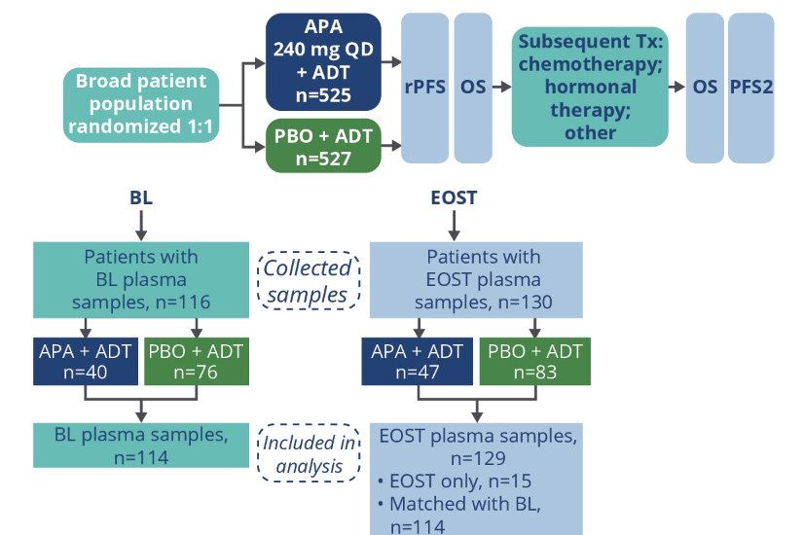
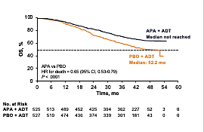
Genomic aberrations associated with overall survival (OS) in metastatic castration-sensitive prostate cancer (mCSPC) treated with apalutamide (APA) or placebo (PBO) plus androgen deprivation therapy (ADT) in TITAN. ASCO 2022;Abstract 5066.
Presence of ctDNA and AR genomic aberration at baseline had worse outcomes
Presence of any AR genomic aberration and PI3K pathway aberrations at end of study had worse outcomes

Slide 9
TheraP: 177Lu-PSMA-617 (LuPSMA) versus cabazitaxel in metastatic castration-resistant prostate cancer (mCRPC) progressing after docetaxel—Overall survival after median follow-up of 3 years (ANZUP 1603). ASCO 2022;Abstract 5000.

Slide 10
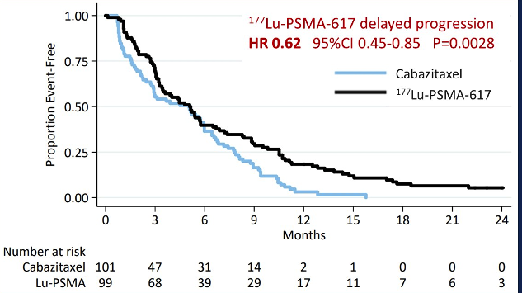
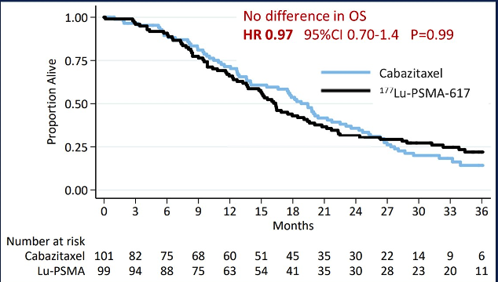
RESULTS: PFS/OS
Too much to ask out of phase 2
Not powered to detect a survival benefit
Cross overs, drop outs, subsequent Rx all affect OS
Both drugs have level 1 for mCRPC

Slide 11
Phase III PROpel trial. ASCO 2022;Abstract 5019.
Saad GU ASCO 2022

Slide 12
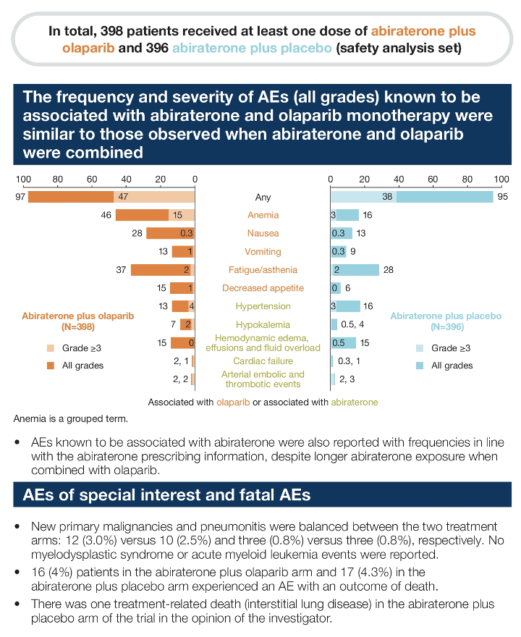
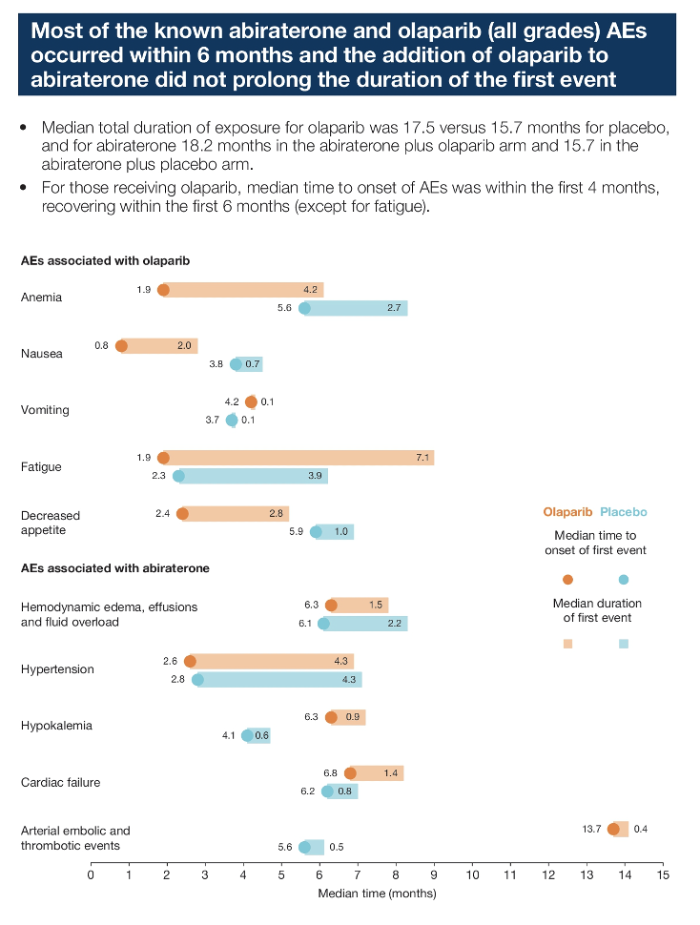
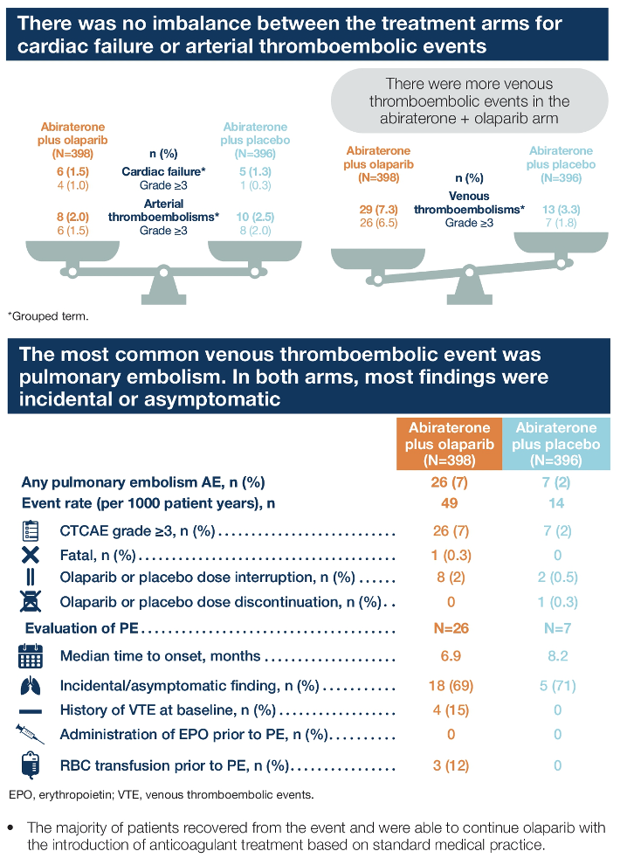
Tolerability of abiraterone (abi) combined with olaparib (ola) in patients (pts) with metastatic castration-resistant prostate cancer (mCRPC): Further results from the phase III PROpel trial. ASCO 2022;Abstract 5019.

Slide 13
Gene-by-gene analysis in the MAGNITUDE study of niraparib (NIRA) with abiraterone acetate and prednisone (AAP) in patients (pts) with metastatic castration-resistant prostate cancer (mCRPC) and homologous recombination repair (HRR) gene alterations. Abstract 5020.

Slide 14
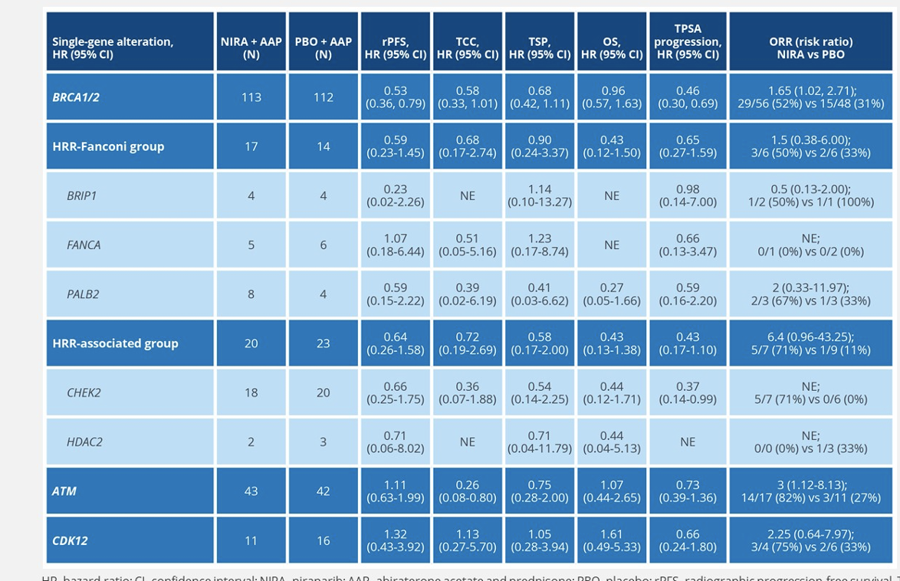
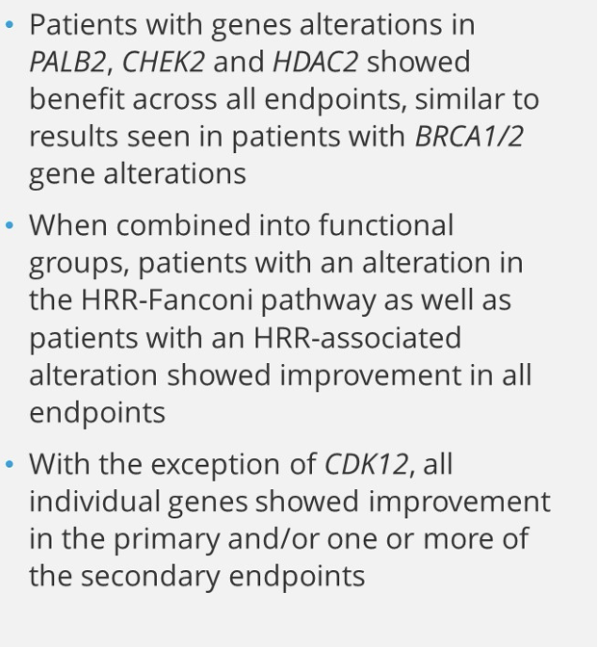
Results:
Secondary endpoints
Patients with gene alterations in

Slide 15
Gene-by-gene analysis in the MAGNITUDE study of niraparib (NIRA) with abiraterone acetate and prednisone (AAP) in patients (pts) with metastatic castration-resistant prostate cancer (mCRPC) and homologous recombination repair (HRR) gene alterations.
Conclusions/Takeaways
HRR negative patients did not benefit from abiraterone/niraparib
HRR + cohort: BRCA positive patients had the highest benefit
No benefit in CDK12 patients
Other genes had some benefit

Slide 16
Bladder Abstracts 2022

Slide 17
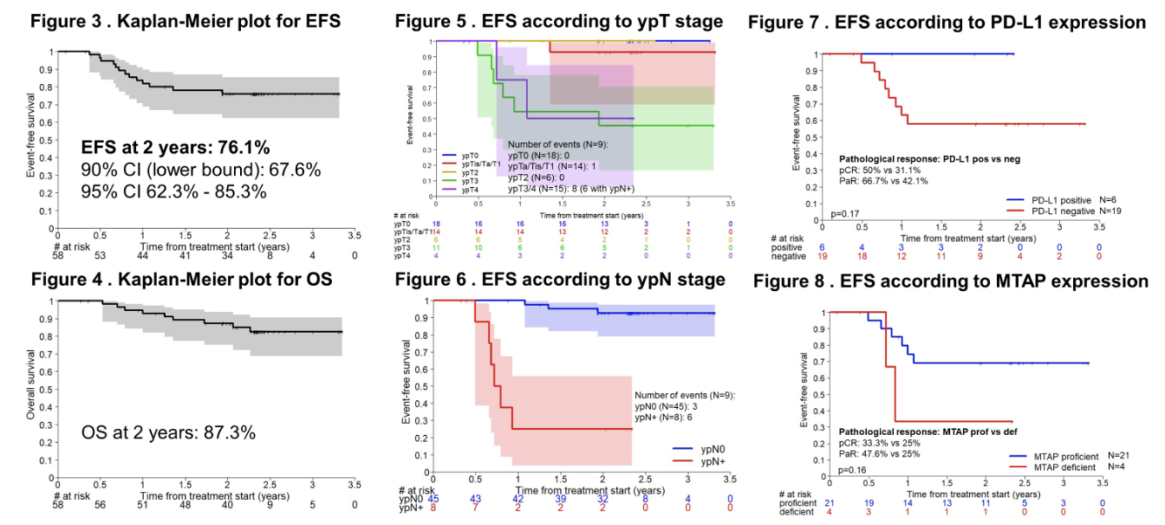
Perioperative chemoimmunotherapy with durvalumab for operable muscle-invasive urothelial carcinoma (MIUC): Primary analysis of the single arm phase II trial SAKK 06/17. ASCO 2022;Abstract 4515.

Slide 18
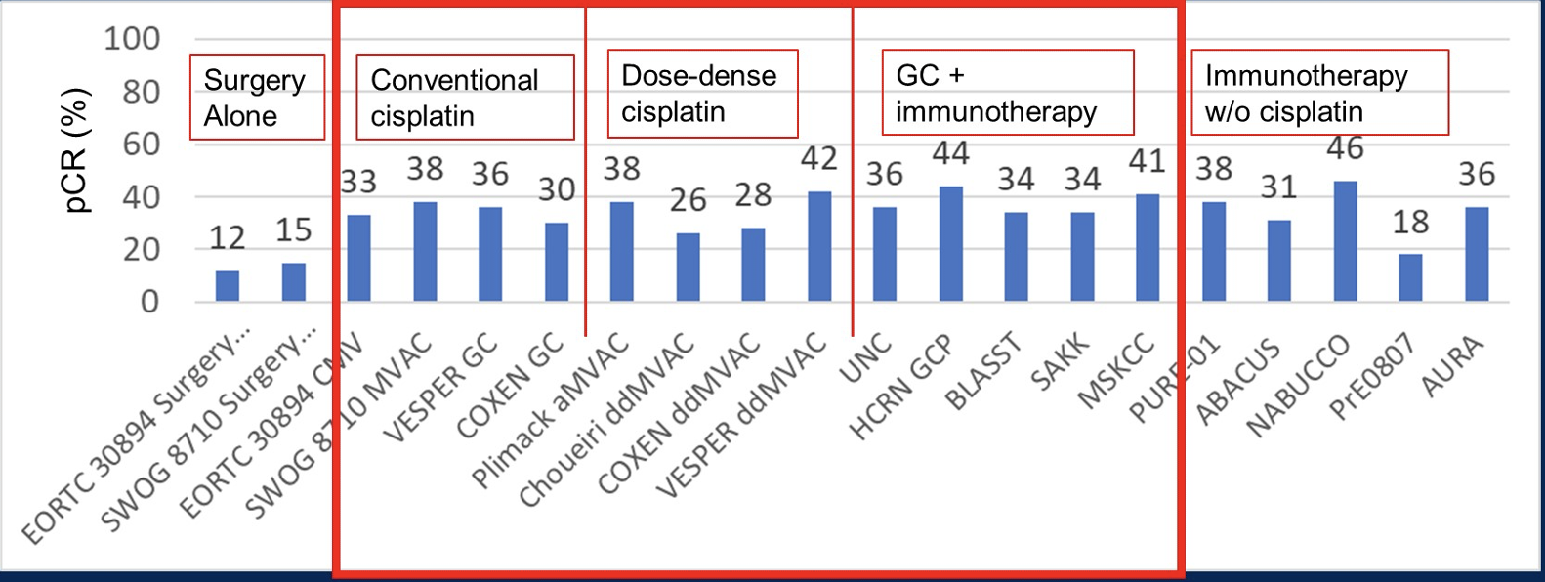
Is chemo-IO needed in MIBC?
Milowsky ASCO 2022

Slide 19
Long-term outcomes in EV-301: 24-month findings from the phase 3 trial of enfortumab vedotin versus chemotherapy in patients with previously treated advanced urothelial carcinoma. Abstract 4516.

Slide 20
Preliminary results of a phase Ib/II combination study of RC48-ADC, a novel humanized anti-HER2 antibody-drug conjugate (ADC) with toripalimab, a humanized IgG4 mAb against programmed death-1 (PD-1) in patients with locally advanced UC. Abstract 451.

Slide 21
RC 48 Mono Rx

Slide 22
. Cabozantinib (C) in combination with atezolizumab (A) in urothelial carcinoma (UC): Results from cohorts 3, 4, 5 of the COSMIC-021 study. ASCO 2022;Abstract 4504.

Slide 23
Renal Abstracts 2022

Slide 24
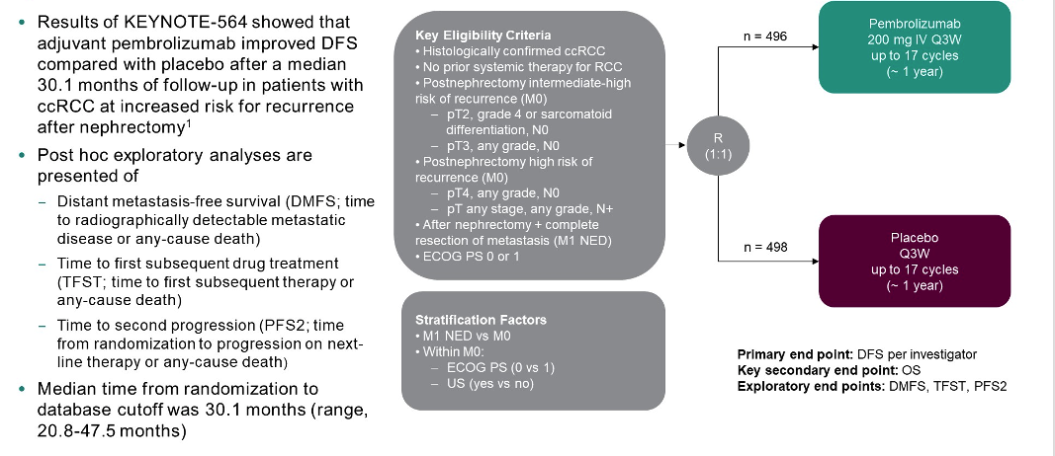
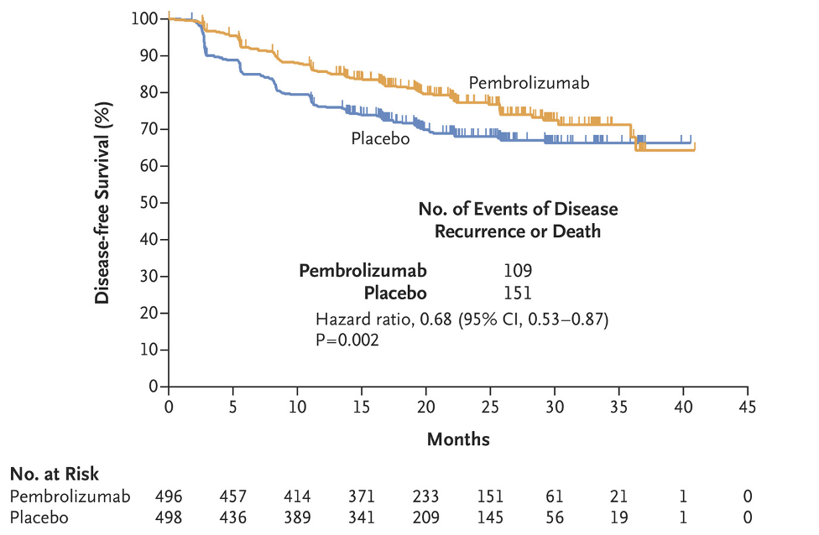
Adjuvant pembrolizumab for post-nephrectomy renal cell carcinoma (RCC): Expanded efficacy analyses from KEYNOTE-564. ASCO 2022;Abstract 4512.
Choueiri NEJM 2021

Slide 25
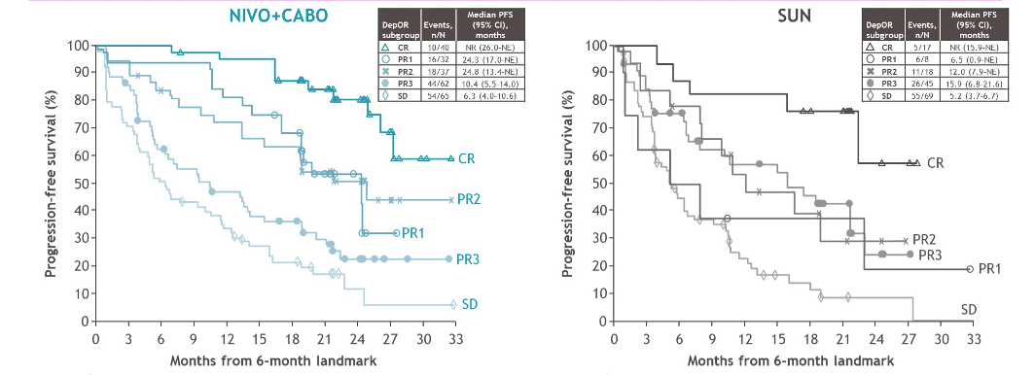
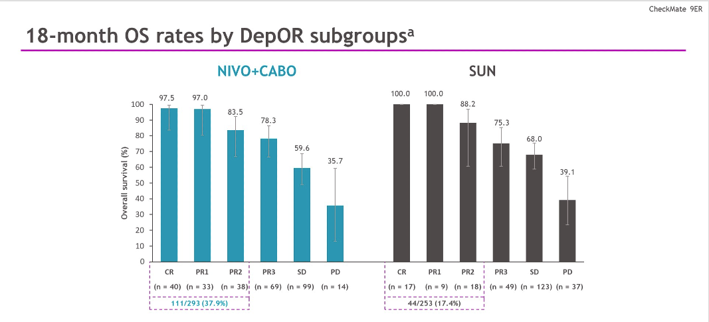
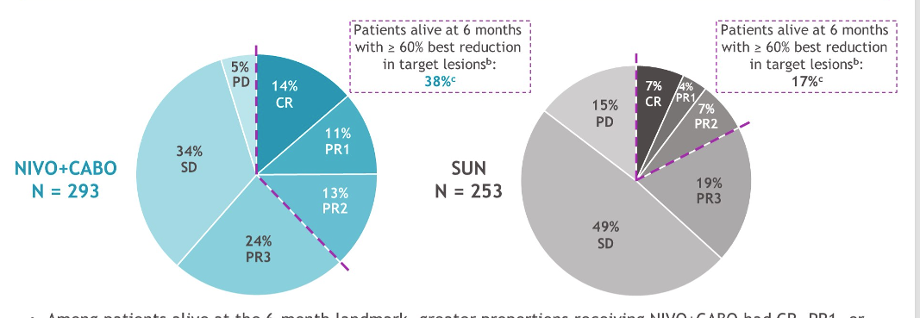
Association between depth of response (DepOR) and clinical outcomes: Exploratory analysis in patients with previously untreated advanced renal cell carcinoma (aRCC) in CheckMate 9ER. ASCO 2022;Abstract 4501.
 | CheckMate 9ER (Cabo/Nivo)³ (n=323 vs n=328)
HR OS median | 0.70 37.7 vs 34.3
HR PFS median | 0.56 16.6 vs 8.3
ORR (%) | 56 vs 28
CR (%) | 12 vs 5
Med FU | 32.9
PD | 6
OS@ 2yrs | 39%

Slide 26
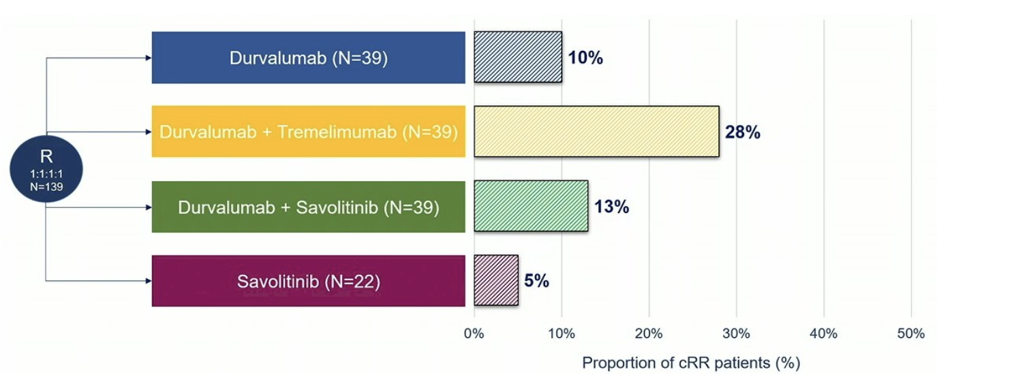
CALYPSO: A three-arm randomized phase II study of durvalumab alone or with savolitinib or tremelimumab in previously treated advanced clear cell renal cancer. ASCO 2022;Abstract LBA4503.

Slide 27
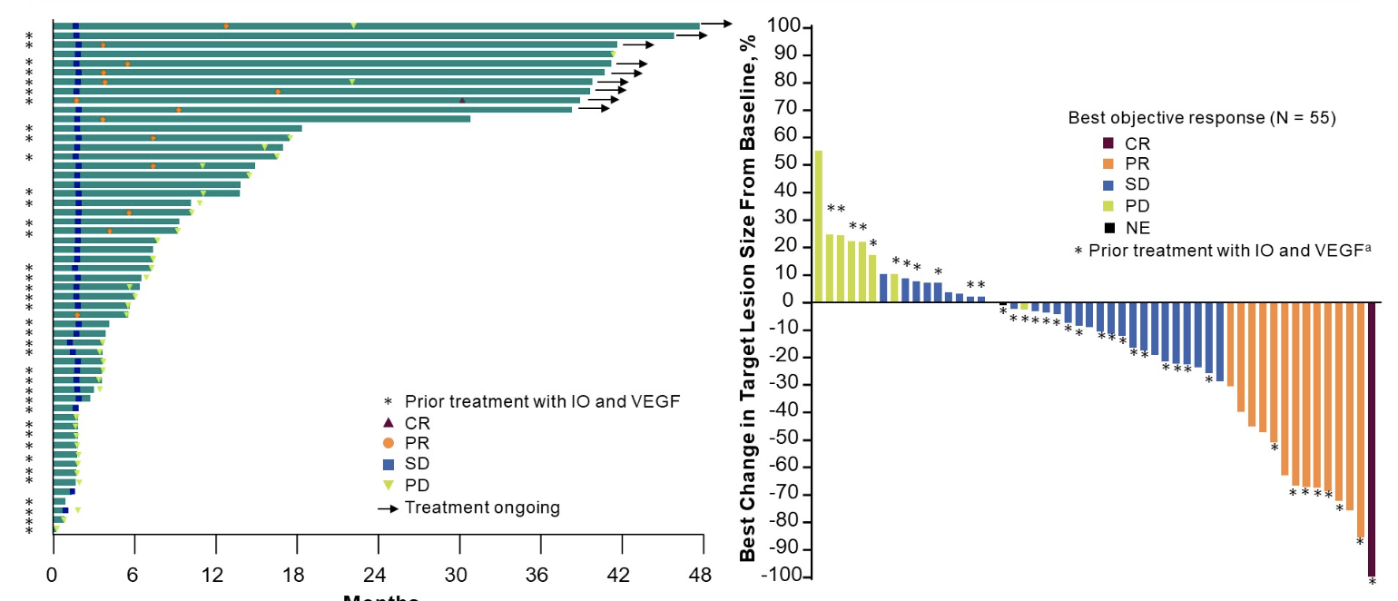
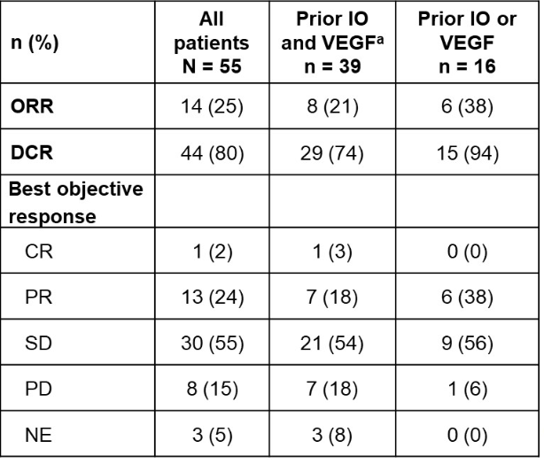
Phase 1 LITESPARK-001 (MK-6482-001) study of belzutifan in advanced solid tumors: Update of the clear cell renal cell carcinoma (ccRCC) cohort with more than 3 years of total follow-up. Abstract 4509.

Slide 28
Other Belzutifan studies in RCC
A Study of Pembrolizumab (MK-3475) in Combination With Belzutifan (MK-6482) and Lenvatinib (MK-7902), or Pembrolizumab/Quavonlimab (MK-1308A) in Combination With Lenvatinib, Versus Pembrolizumab and Lenvatinib, for Treatment of Advanced Clear Cell Renal Cell Carcinoma (MK-6482-012)
A Study of Belzutifan (MK-6482) Plus Pembrolizumab (MK-3475) Versus Placebo Plus Pembrolizumab in Participants With Clear Cell Renal Cell Carcinoma Post Nephrectomy (MK-6482-022)

Slide 29
Maturation of overall survival (OS) in TIVO-3 with long-term follow-up. ASCO 2022;Abstract 4557.
On March 10, 2021, the FDA approved tivozanib, a kinase inhibitor, for adult patients with relapsed or refractory advanced renal cell carcinoma following two or more prior systemic therapies.

Slide 30
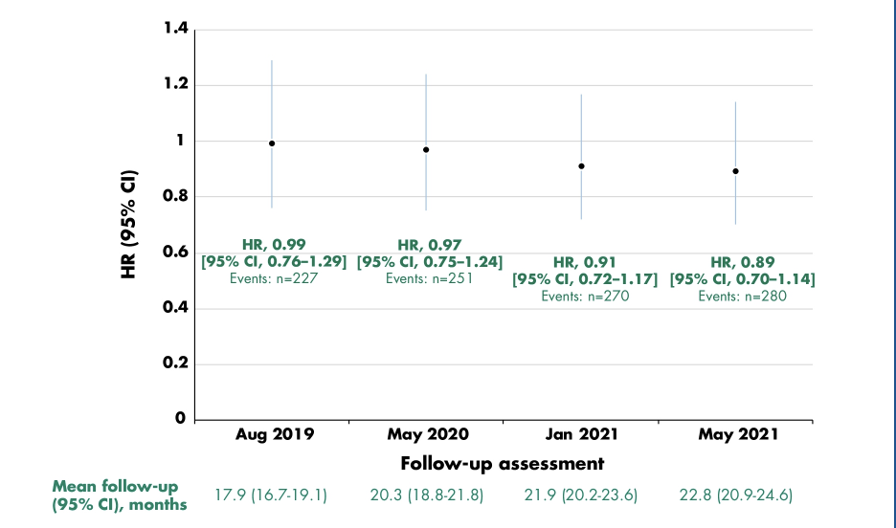
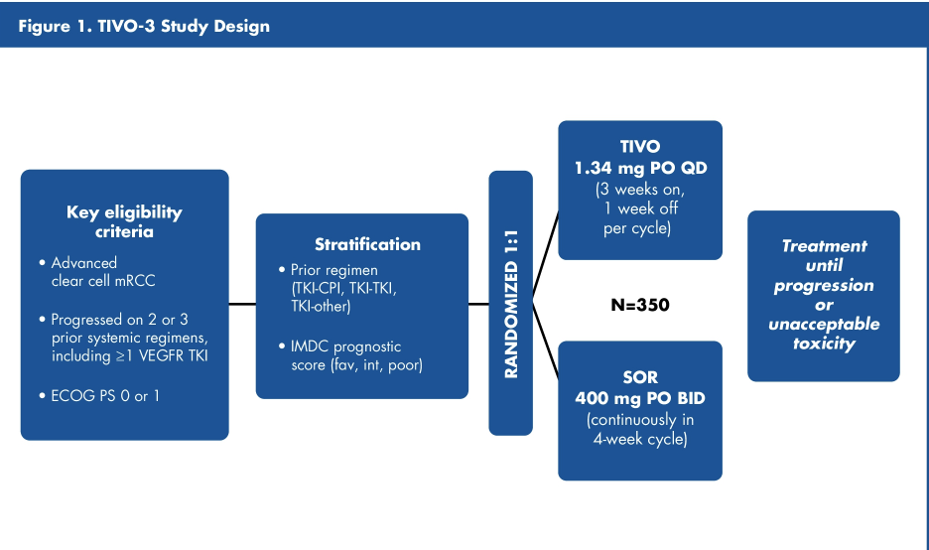
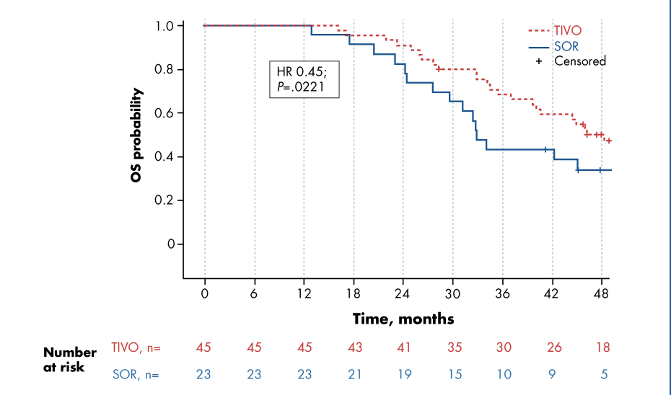
Maturation of overall survival (OS) in TIVO-3 with long-term follow-up. ASCO 2022;Abstract 4557.
*
*Patients had PFS of ≥12 months

Slide 31
Additional Presentations of Interest
Resistance Mechanisms and Combinatorial Approaches to Enhance PSMA-Based Radioligand Responses- Hoffman
EVEREST: Everolimus for renal cancer ensuing surgical therapy—A phase III study (SWOG S0931, NCT01120249).-Ryan

