Slide 1
Oncology Today:
Management of Nonmetastatic Bladder Cancer
Sia Daneshmand, M.D.
Professor of Urology and Medicine (Oncology) — Clinical Scholar Director of Urologic Oncology
Director of Clinical Research

Slide 2
Discuss
Mechanism of antitumor activity of TAR-200; proposed method of improved drug delivery relative to intravesical chemotherapy
Early data with the use of TAR-200 in patients with muscle-invasive bladder cancer (MIBC)
Ongoing studies of TAR-200 with and without the anti-PD-1 antibody cetrelimab in non-muscle-invasive bladder cancer (NMIBC) (eg, SunRISe-1) and MIBC (eg, SunRISe-2, SunRISe-4)
Long-term findings from the KEYNOTE-057 trial supporting the FDA approval of pembrolizumab monotherapy for high-risk NMIBC unresponsive or refractory to BCG therapy
Rates of pathologic complete response and other clinically relevant endpoints achieved in early trials evaluating neoadjuvant anti-PD-1/PD-L1 antibody therapy for resectable MIBC
Key data from the Phase III CheckMate 274 trial comparing nivolumab to placebo after radical surgery for high-risk MIBC
Other promising novel agents and strategies for patients with NMIBC or MIBC

Slide 3
TARIS® System Allows Controlled Drug Delivery
Example of Delivery: Osmotic Engine
Dose Delivered Over Time
Semi-permeable polymer
(silicone) tube
Instillation
(Current SOC)
Orifice
Solid drug core
TARIS
IC₉₀
Water permeation
Day 1
Day 2
Day 3
Day 4
Day 5
Day 6
Day 7
Osmotic pump modulates drug release from internal reservoir
Dose and duration tailored to specific disease states
Rational dosing maximizes intracellular drug potency
Time of Drug Exposure >IC90
>1 Week
<1 Hr
Instillation
TARIS System

Slide 4
TAR-200 Bladder Cancer Clinical Development History
TAR-200-101
TAR-200-102
TAR-200-103
TAR-200-104
Initial Proof-of-Principle: MIBC Neoadjuvant to Cystectomy
Intermediate Risk NMIBC: Marker Lesion Study
MIBC patients unfit for curative intent
Collaboration study: TAR-200 + Nivolumab
MIBC Neoadjuvant to Cystectomy
(2016)
(2016)
(2017)
(2018)
40%
ORR
ORR
50%
ORR
42%
ORR
46%
67%
DCR

Slide 5
TAR-200-101: Arm 1 Data
Unresected tumor (≥3cm), two 7-day cycles of TAR-200 (Days 0-7, 21-28)
RC @ Day 28
Subject ID | Sex | Age | Tumor Stage at Diagnosis | Stage on Final Histopathology | Nodal Involvement @ Cystectomy
01-006 | M | 66 | cT2 | pT0 | N0
01-001 | M | 76 | cT2 | pTis | N0
01-003 | M | 88 | cT2 | pTis | N0
01-008 | M | 73 | cT2 | pT1 | N0
05-001 | M | 69 | cT2 | PT2b | N0
01-002 | M | 75 | cT2 | PT3a | N0
01-007 | M | 73 | cT2 | PT3a | N0
05-003 | F | 53 | cT2 | PT3a | N0
02-001 | F | 72 | cT3 | PT3a | N0
05-002 | M | 74 | cT3 | PT3b | N3
Absence of MIBC:
40%

Slide 6
TAR-200-101: Arm 2 Data
Tumor fully resected as feasible, two 7-day cycles of TAR-200 (Days 0-7, 21-28)
CT Imaging prior to cystectomy
RC @ Day 42 (histopathologic staging)
Subject ID | Sex | Age | Tumor Stage at Diagnosis | Stage on Final Histopathology | Nodal Involvement @ Cystectomy
01-012 | M | 71 | cT2 | pT0 | N0
07-002 | M | 69 | cT2 | pT0 | N0
07-003 | M | 76 | cT2 | pT0 | N2
02-002 | M | 59 | cT2 | pTis | N0
05-004 | M | 63 | cT2 | pTis | N0
01-014 | F | 69 | cT2 | pT1 | N0
01-011 | M | 75 | cT2 | PT2b | N0
01-016 | M | 65 | cT2 | pT2b | N0
01-013 | M | 70 | cT2 | PT3a | N2
07-001 | M | 56 | cT2 | pT3a | N1
Absence of MIBC:
60%

Slide 7

Phase 2b – TAR-200 + Cetrelimab │
NMIBC BCG Un-responsive [BLC2001]
Primary Endpoint
Complete Response [CR] Rate in CIS patients at any time point
  Assessment via Cystoscopy, Urine Cytology, and Bladder Biopsy
Secondary Endpoints
Duration of CR from Achievement of CR
Overall Survival [OS] measured as time from cohort assignment to death
TAR-200 [225 mg Gemcitabine]
Q3W [24 wks.], Quarterly → 2 years
+ CETRELIMAB
for 18 Months
Key Eligibility Criteria
BCG Unresponsive Carcinoma In Situ [CIS]
Patients Ineligible for or Refusing Radical Cystectomy
COHORT 1
[N~100]
TAR-200 Alone
[225 mg Gemcitabine]
Q3W [24 wks.], Quarterly → 2 years
COHORT
2
[N~50]
Randomization [2:1:1; N~200]
Stratification
Presence or absence of concomitant papillary disease
CETRELIMAB Alone [360 mg]
for 18 Months
COHORT
3
[N~50]

Slide 8

Phase 3 – TAR-200 + Cetrelimab │
MIBC [BLC3001]
-2
Key Eligibility Criteria
Patients with muscle‑invasive urothelial carcinoma of the bladder [cT2-cT4a N0 M0]
Not Receiving Radical Cystectomy
TAR-200
[225 mg Gemcitabine] Q3W [18 wks.], Quarterly → 3 years
+ CETRELIMAB
for [18 months]
Primary Endpoint
Bladder Intact Event-Free Survival [BI-EFS] – any MIBC, +N, or M+ disease
Secondary Endpoints
Metastasis Free Survival
Overall Survival
Objective Response Rate at Week 18
QoL Outcomes Comparing Acute and Long-term Toxicity/Side Effects
Arm 1
[N~275]
Randomization [1:1; N~550]
Stratification
Tumor Stage at Randomization [T0, Ta/T1/Tis, or T2-T4a]
Presence or Absence of Visible Residual Disease
Chemoradiotherapy
- Cisplatin or Gemcitabine AND
- 55 or 64 Gy External Beam Radiation
Arm 2
[N~275]
~ 4.5 – 6 Weeks
Janssen Research & Development, LLC

Slide 9
Phase 2 – TAR-200 + Cetrelimab │
MIBC Neoadjuvant [BLC2002]
Key Eligibility Criteria
Patients with MIBC who are Scheduled for RC [cT2-cT4a N0 M0]
Patients Ineligible for or Refusing Platinum-Based Neoadjuvant Chemotherapy
TAR-200
[225 mg Gemcitabine] Q3W [12 wks.]
+ CETRELIMAB [360 mg]
for [3 Months]
Primary Endpoint
Assessment of Pathologic Complete Response [pCR] Rate at RC
Secondary Endpoints
Evaluation of the Safety and Tolerability of TAR-200 in Combination with Cetrelimab
Compare Recurrence Free Survival [RFS]
Arm 1
[N~100]
Randomization [5:3; N~160]
Stratification
T stage: T2-T4a
Completeness of TURBT: Complete vs. Incomplete <3cm
CETRELIMAB Alone [360 mg]
for [3 Months]
Arm 2
[N~60]
“Window of Opportunity” Study to Demonstrate the Activity of Cetrelimab Alone and Cetrelimab in Combination with TAR-200 with respect to pCR Rates at RC and the Potential Subsequent Correlation with Post-Surgical Metastasis-Free Survival

Slide 10
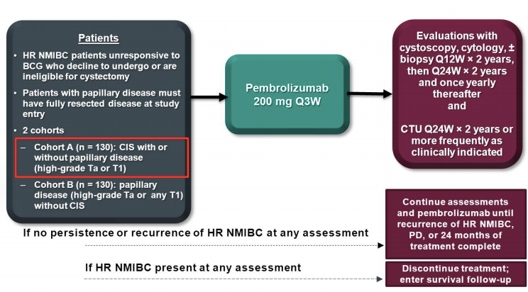
KEYNOTE-057
Single-arm, open-label phase II study
Primary endpoint
  CRR

Slide 11
Updated results
96 patients BCG unresponsive CIS +/- papillary tumor
  CR 41%
  Median response duration 16 months
  46% of responders had durable CR at 12 months
    24% RFS
Balar AV et al. Lancet Oncol 2021;22(7):919-930.
Notes:
HR is T1, HG Ta, CIS, anything recurrent

Slide 12
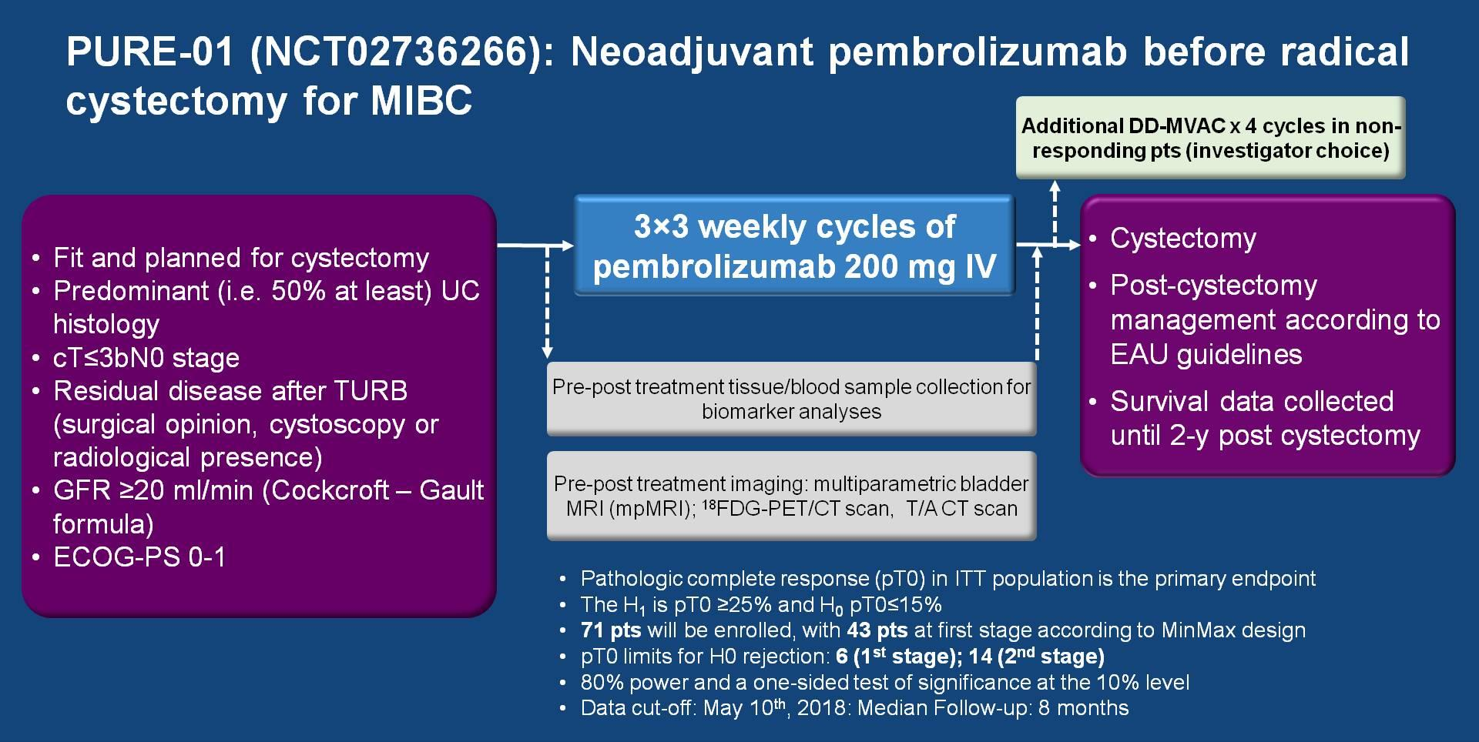
Nechhi A, et al. J Clin Oncol. 2018;36: Abs 4507.

Slide 13
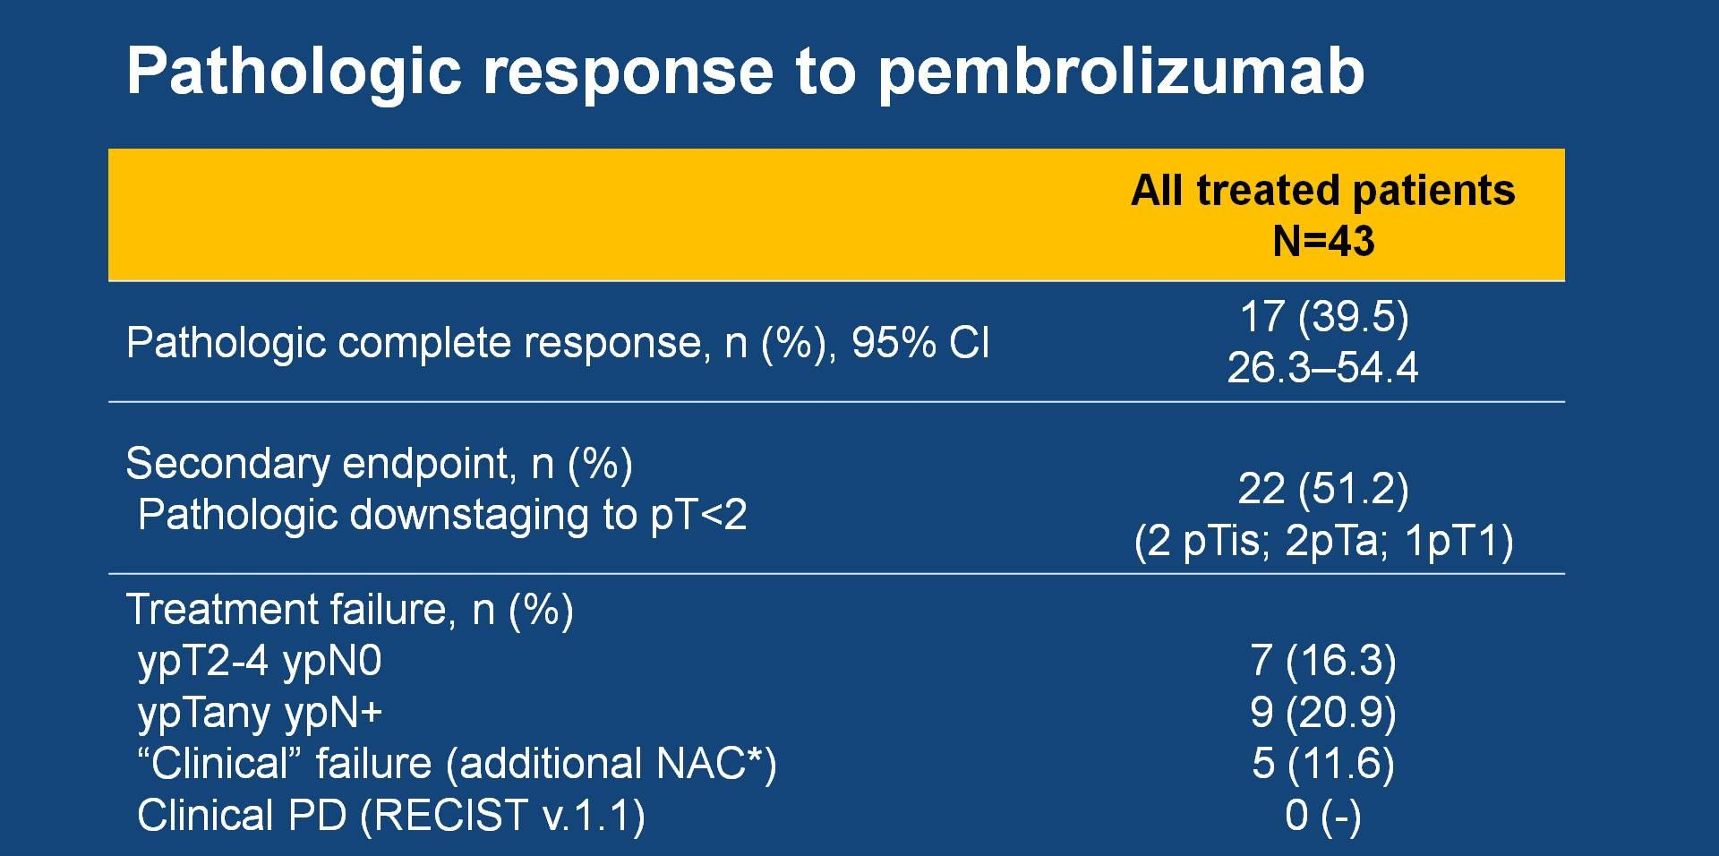
Nechhi A, et al. J Clin Oncol. 2018;36: Abs 4507.

Slide 14
Select Ongoing Neoadjuvant Trials in Bladder Cancer
NCT Number/Name | Drugs | Title | Phase
NCT02717156 | Pembrolizumab sEphB4-HSA | A Phase II trial of sEphB4-HSA in combination with anti PD1 antibody pembrolizumab (MK-3475) for solid tumors | II
NCT03558087 | GC+ Nivolumab | Neoadjuvant Gemcitabine, Cisplatin, Plus Nivolumab in Patients With Muscle-invasive Bladder Cancer With Selective Bladder Sparing | II
NCT02887248 | Nab-Paclitaxel Gemcitabine | Nab-paclitaxel Plus Gemcitabine as First-line Therapy for Cisplatin-ineligible or Cisplatin-incurable Advanced Urothelial Carcinoma. | II
NCT02767921 | sEphB4-HSA | sEphB4-HSA Before Surgery in Treating Patients with Bladder Cancer, Prostate Cancer, or Kidney Cancer | II
NCT03518320 | Nivolumab | Safety and Tolerability of TAR-200 and Nivolumab in Subjects with Muscle-Invasive Bladder Cancer | II
NCT03529890 (RACE IT) | Nivolumab | Radio-Immunotherapy Before Cystectomy in Locally Advanced Urothelial Carcinoma of the Bladder | II
NCT02812420 | Durvalumab Tremelimumab | Durvalumab and Tremelimumab in Treating Patients with Muscle-Invasive, High-Risk Urothelial Cancer That Cannot Be Treated with Cisplatin-Based Therapy Before Surgery | II
NCT03674424 (AURA) | Avelumab | Avelumab as Neoadjuvant Therapy in Subjects with Urothelial Muscle Invasive Bladder Cancers | II
NCT02845323 | Nivolumab urelumab | Neoadjuvant Nivolumab with and without Urelumab in Patients with Cisplatin-Ineligible Muscle-Invasive Urothelial Carcinoma of the Bladder | II
NCT02365766 | Pembrolizumab Gemcitabine | Neoadjuvant Pembrolizumab in Combination with Gemcitabine Therapy in Cis-eligible/Ineligible UC Subjects | II
NCT02451423 | Atezolizumab | Neoadjuvant Atezolizumab in Localized Bladder Cancer | II

Slide 15
Select Ongoing Neoadjuvant Trials in Bladder Cancer
NCT Number/Name | Drugs | Title | Phase
NCT04073160 (TRIO) | Durvalumab Tremelimumab | A Phase Ib Study of Durvalumab (MEDI 4736) Plus Tremelimumab Followed by Concurrent Durvalumab Plus Bladder Radiation, Based on Molecular Subtypes in Muscle-Invasive Bladder Cancer | Ib
NCT03387761 (NABUCCO) | Nivolumab Ipilimumab | Neo-Adjuvant Bladder Urothelial Carcinoma COmbination-immunotherapy (NABUCCO) | Ib
NCT03520491 | Nivolumab Ipilimumab | A Study to Test the Safety of Immunotherapy with Nivolumab Alone or with Ipilimumab Before Surgery for Bladder Cancer Patients Who Are Not Suitable for Chemotherapy | II
NCT03832673 (PECULIAR) | Pembrolizumab Epacadostat | Pembrolizumab-Epacadostat Combination to Treat Muscle-invasive Bladder UrotheLIAl canceR | II
NCT03534492 (NEODURVARIB) | Durvalumab Olaparib | Durvalumab Plus Olaparib Administered Prior to Surgery of Resectable Urothelial Bladder Cancer | II
NCT02365766 (HCRN-GU-188) | Pembrolizumab Gemcitabine | Neoadjuvant Pembrolizumab in Combination with Gemcitabine Therapy in Cis-eligible/Ineligible UC Subjects | Ib/II
NCT03773666 (BLASST-2) | Durvalumab Oleclumab | A Feasibility Study of Durvalumab +/- Oleclumab as Neoadjuvant Therapy for Muscle-invasive Bladder Cancer | I
NCT03747419 | Avelumab Radiation | Avelumab and Radiation in Muscle-Invasive Bladder Cancer | II
NCT03702179 (IMMUNOPRESERVE) | Durvalumab Tremelimumab Radiation | Durvalumab Plus Tremelimumab with Concurrent Radiotherapy for Localized Muscle Invasive Bladder Cancer Treated with a Selective Bladder Preservation Approach | II
NCT03472274 (DUTRENEO) | Durvalumab Tremelimumab | DUrvalumab (MEDI4736) and TREmelimumab in NEOadjuvant Bladder Cancer Patients | II
NCT03844256 (CRIMI) | Mitomycin-C Capecitabine | A Study of Mitomycin-C/ Capecitabine ChemoRadiotherapy Combined With Nivolumab Monotherapy or Ipilumimab and Nivolumab, as Bladder Sparing Curative Treatment for Muscle Invasive Bladder Cancer | I

Slide 16
Checkmate 274: A Phase 3 Randomized, Double-blind, Multi-center Study of Adjuvant Nivolumab Versus Placebo in Subjects With High-Risk Invasive Urothelial Carcinoma
Enrollment
Treatment
Endpoints
Invasive urothelial cancer at high risk of recurrence
Radical surgical resection performed within the last 120 days
Disease free status determined by imaging < 4 weeks of dosing
Tumor tissue must be provided for biomarker analysis
If no prior neoadjuvant cisplatin chemotherapy must be ineligible for or refuse cisplatin-based adjuvant chemotherapy
N=709
Primary endpoint:
DFS by investigator (PD-L1>1% and All)
Nivolumab 240mg IV Q2W x 1 year
Secondary endpoints
R
1:1
OS
Non-Urothelial Tract RFS
DSS
Placebo Q2W x 1 year

Slide 17
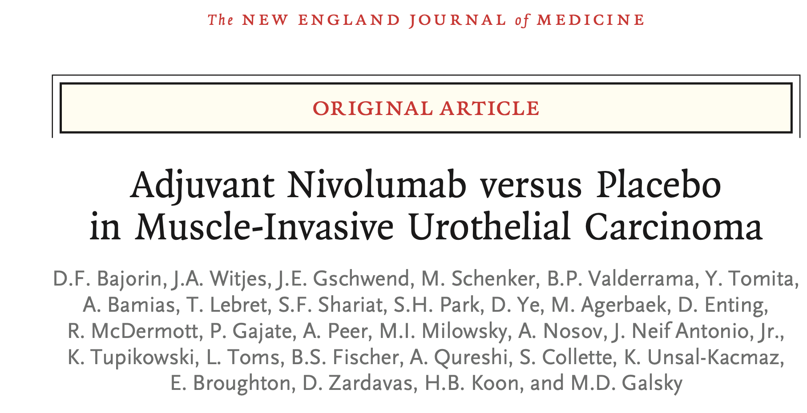
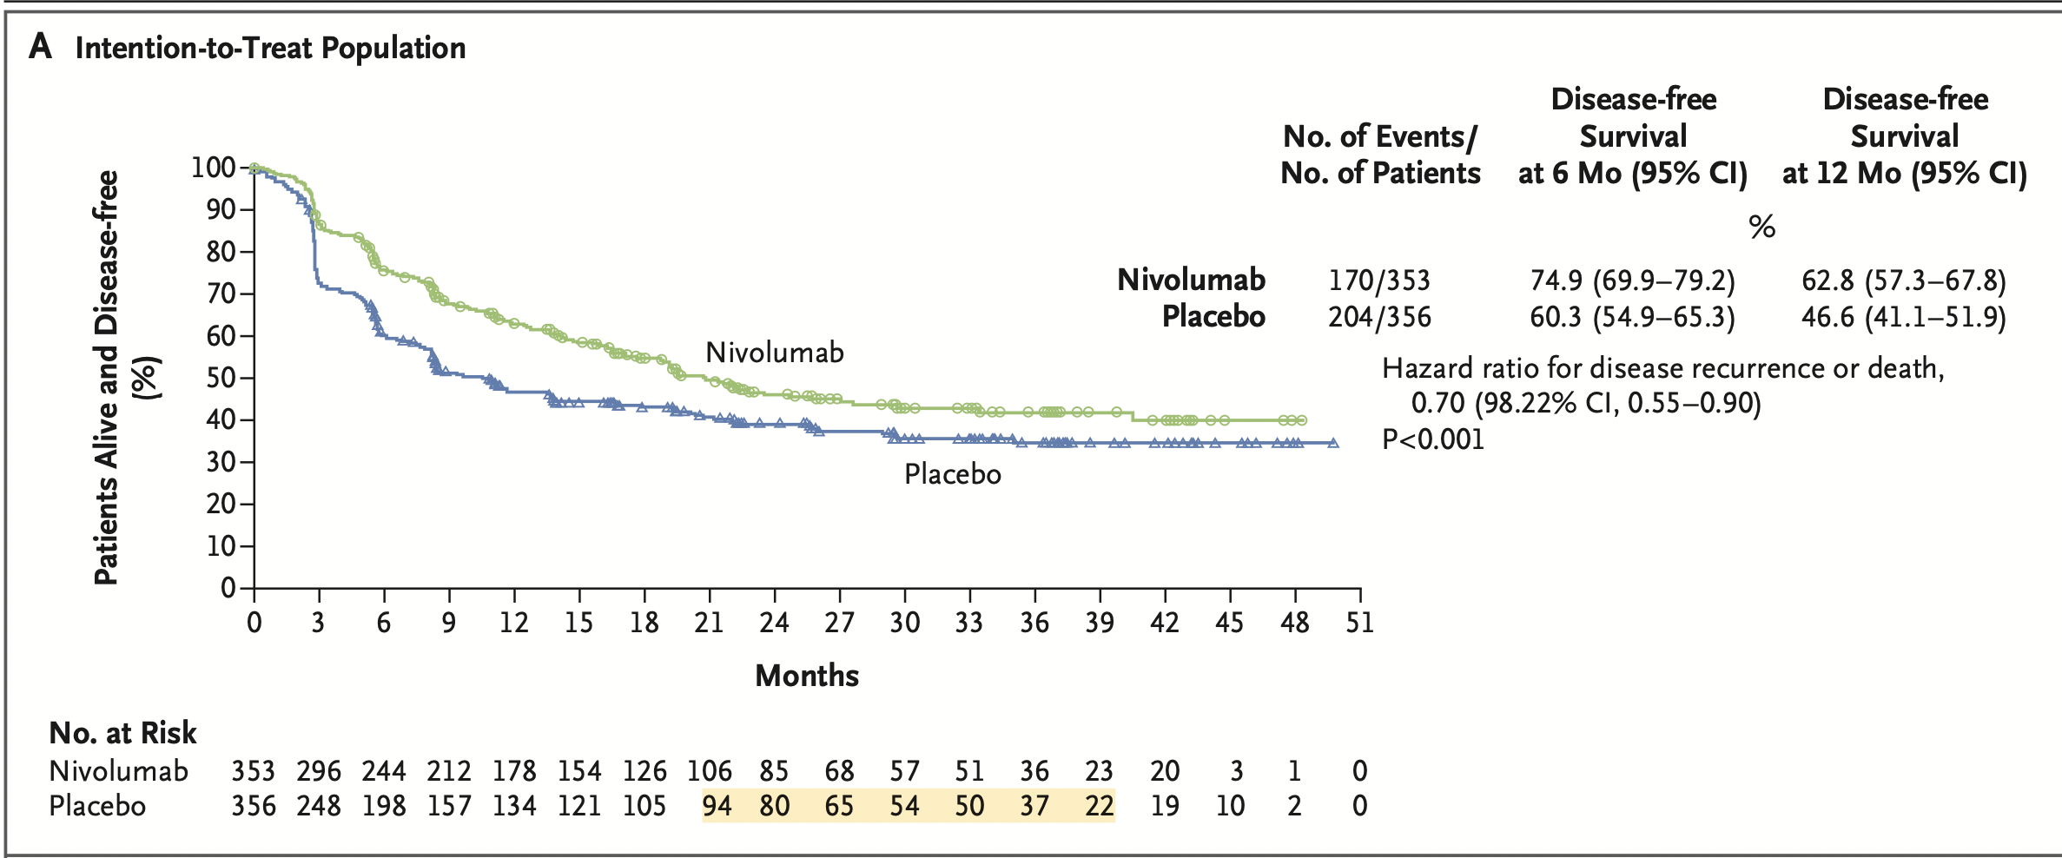
N Engl J Med 384;22 nejm.org June 3, 2021

Slide 18
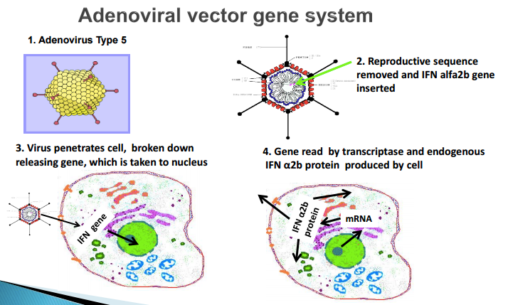
Nadofaragene firadenovec - Adstiladrin

Slide 19
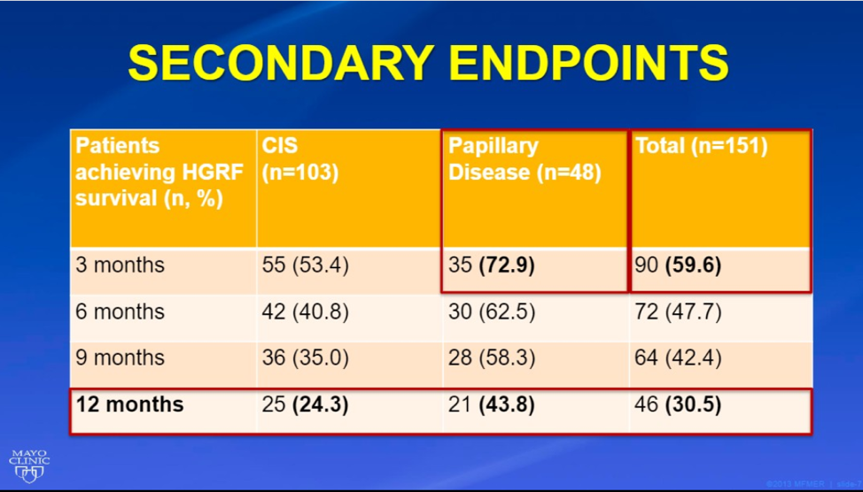
Instilladrin
Notes:
53% of patients with CIS had a CR and all were at 3 months, 43% of the responders had a durable response which lead to a 24% RF survival
Collin Dinney:
Less than 5% progressed
Cx free survival at 2 years was 65%
Only 12% had upstaging at Cx
44% had upstaging when went to Cx straight from BCG unresponsive

Slide 20
Adstiladrin
70% with AE
  Serious AE in 3 patients (1.9%)
CIS: 53% CR, 45.5% durable at 12 months
  24% RFS
*Keynote 057
  CR 41%, 46% durable at 12 months, median duration 16 months. 24% RFS at 12 months
Notes:
International phase 3 clinical trial, powered for equivalence– original goal for 100 patients, 500 each arm but had to decrease goal to 412 per

Slide 21
276 patients (9 discontinued)
Median Follow-up 22.9 mos
High grade RFS 60% and 46% at 1 & 2 yrs
3.6% disease progression
15.6% cystectomy

Slide 22
Steinberg RL et al. J Urol 2020;203(5):902-909.

Slide 23
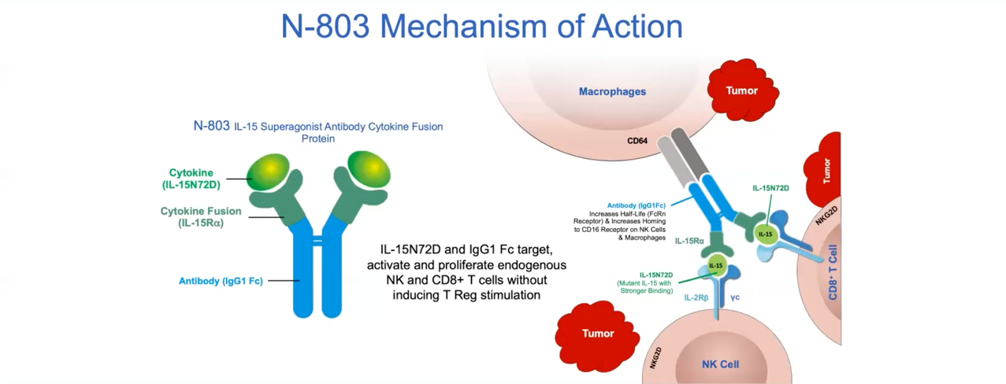
Novel IL-15 Superagonist Fusion Protein Upregulates NK and T Cells
Notes:
N-803 (Anktiva), is a mutant IL-15-based immunostimulatory fusion protein complex (IL-15RαFc) that promotes proliferation and activation of natural killer (NK) cells and CD8+ T cells, but not regulatory T cells.

Slide 24
QUILT 3.032
Multicenter Phase II/III study
Intravesical BCG plus N-803
Patients with BCG-unresponsive HG NMIBC
Primary Endpoint
  CR at 12 mo
Secondary Endpoint
  CR duration, Cystectomy avoidance

Slide 25
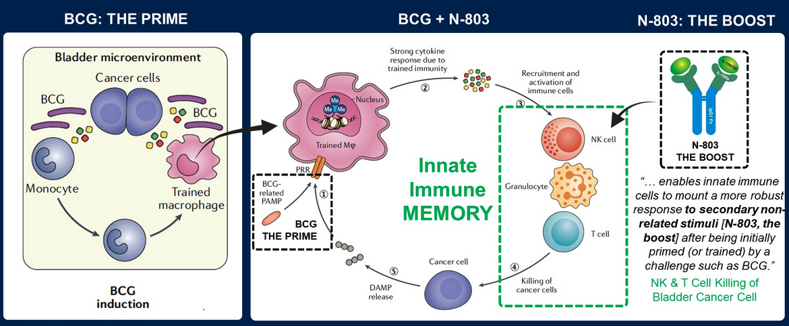
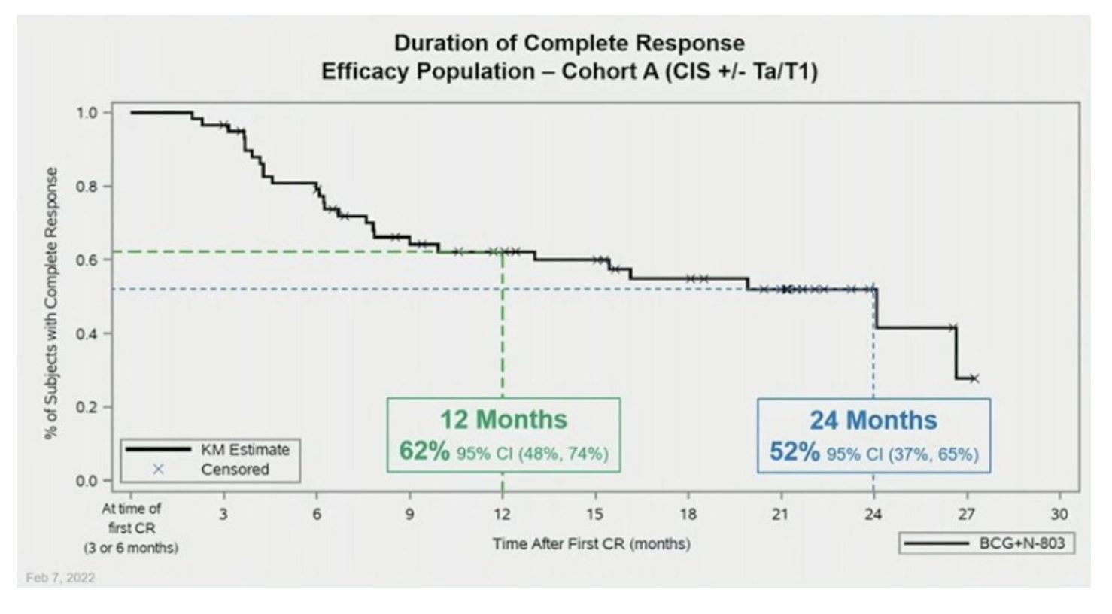
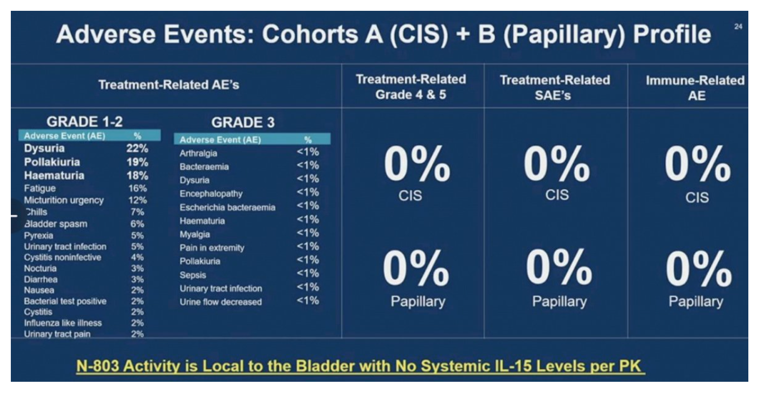
ASCO GU 2022: Positive Efficacy and Safety Phase 3 Results in Both CIS and
Papillary Cohorts BCG-Unresponsive NMIBC After IL-15RαFc Superagonist
N-803 and BCG Infusion
Chang SS et al. ASCO GU 2022;Abstract 431.

Slide 26
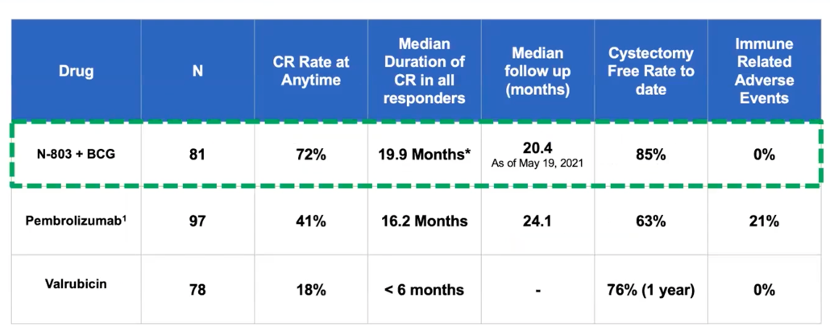
QUILT 3.032

Slide 27
CASE 1
76 y.o. male hx arthritis, hearing loss, morbid obesity
HGT1 bladder cancer s/p BCG X 6
Cysto 3 mos disease free
Cysto 6 mos → recurrence HGTa
2nd induction course of BCG (6 weeks)
Surveillance cystoscopy CIS

Slide 28
CASE 2
82 y.o. male hx COPD, CAD, CKD, ECOG 1
HGT2 MIBC
Management options?

Slide 29
Case 3
58 y.o. healthy female with focal HGT2 urothelial carcinoma completely resected strongly desires bladder sparing treatment

