Slide 1
Bladder Cancer Saturday, April 30, 2022 12:15 PM – 1:45 PM PT
What I Tell My Patients: New Treatments and Clinical Trial Options
An NCPD Hybrid Symposium Series Held During the 47th Annual ONS Congress
Faculty
Monica Averia, MSN, AOCNP, NP-C Shilpa Gupta, MD Brenda Martone, MSN, NP-BC, AOCNP Sumanta Kumar Pal, MD
Moderator
Neil Love, MD

Slide 2
Faculty
Monica Averia, MSN, AOCNP, NP-C
Oncology Nurse Practitioner
USC Norris Cancer Center
Los Angeles, California
Sumanta Kumar Pal, MD
Professor, Department of Medical Oncology and Therapeutics Research
City of Hope
Duarte, California
Shilpa Gupta, MD
Associate Professor
Director, Genitourinary Oncology Program
Taussig Cancer Institute, Cleveland Clinic
Cleveland, Ohio
Moderator Neil Love, MD Research To Practice Miami, Florida
Brenda Martone, MSN, NP-BC, AOCNP
Northwestern Medicine
Northwestern Memorial Hospital
Chicago, Illinois

Slide 3
Ms Averia — Disclosures
No relevant conflicts of interest to disclose

Slide 4
Dr Gupta — Disclosures
Advisory Committee | Aveo Pharmaceuticals, EMD Serono Inc, Gilead Sciences Inc, Lilly, Pfizer Inc
Consulting Agreements | Aveo Pharmaceuticals, Bristol-Myers Squibb Company, EMD Serono Inc, Gilead Sciences Inc, Janssen Biotech Inc, Lilly, Pfizer Inc
Ownership Interest | Nektar
Speakers Bureau | Bristol-Myers Squibb Company, Gilead Sciences Inc, Janssen Biotech Inc, Seagen Inc

Slide 5
Ms Martone — Disclosures
No relevant conflicts of interest to disclose

Slide 6
Dr Pal — Disclosures
No relevant conflicts of interest to disclose

Slide 7
Commercial Support
This activity is supported by educational grants from Astellas and Seagen Inc and Janssen Biotech Inc, administered by Janssen Scientific Affairs LLC.
Research To Practice CME Planning Committee Members, Staff and Reviewers
Planners, scientific staff and independent reviewers for Research To Practice have no relevant conflicts of interest to disclose.

Slide 8
Ten years from now, what will the death rate from cancer be compared to today?
Increased
Decreased modestly (<20% reduction)
Decreased substantially (20%-50% reduction)
Eliminated (>90% reduction)

Slide 9
Agenda
Module 1 – Management of Localized Urothelial Bladder Cancer (UBC): Adjuvant Treatment, TAR-200
Module 2 – Management of Metastatic UBC: Antibody-Drug Conjugates, Checkpoint Inhibitors
Module 3 – Management of FGFR-Mutant UBC
Module 4 – Oncology/UBC 2032 and Crystal Ball: Part 2

Slide 10
Agenda
Module 1 – Management of Localized Urothelial Bladder Cancer (UBC): Adjuvant Treatment, TAR-200
Module 2 – Management of Metastatic UBC: Antibody-Drug Conjugates, Checkpoint Inhibitors
Module 3 – Management of FGFR-Mutant UBC
Module 4 – Oncology/UBC 2032 and Crystal Ball: Part 2

Slide 11
Usual initial treatment for non-muscle invasive bladder cancer is…
Observation
Bacillus Calmette-Guérin (BCG)
Cystectomy
Immune checkpoint inhibitor
I don’t know

Slide 12
What is the mechanism of action of TAR-200?
Antibody-drug conjugate
FGFR inhibitor
PD-1/PD-L1 inhibitor
Intravesicular gemcitabine
I don’t know

Slide 13
Most patients with muscle-invasive bladder cancer are initially treated with cystectomy followed by adjuvant therapy.
Agree
Disagree
I don’t know

Slide 14
Which of the following is FDA approved as adjuvant therapy for bladder cancer?
Enfortumab vedotin
Erdafitinib
Pembrolizumab
Nivolumab
I don’t know

Slide 15
Overview of Bladder Cancer
Patient profile
Median age at diagnosis: 73 years
76% male
Smoking is the most well-established risk factor (47% of all cases in the US)
Natural history
Non-muscle-invasive
Muscle-invasive
Metastatic
Cystectomy and ileal conduit/stoma management
Neoadjuvant and adjuvant chemotherapy
ACS Cancer Facts & Figures 2020; www.cancer.org.

Slide 16
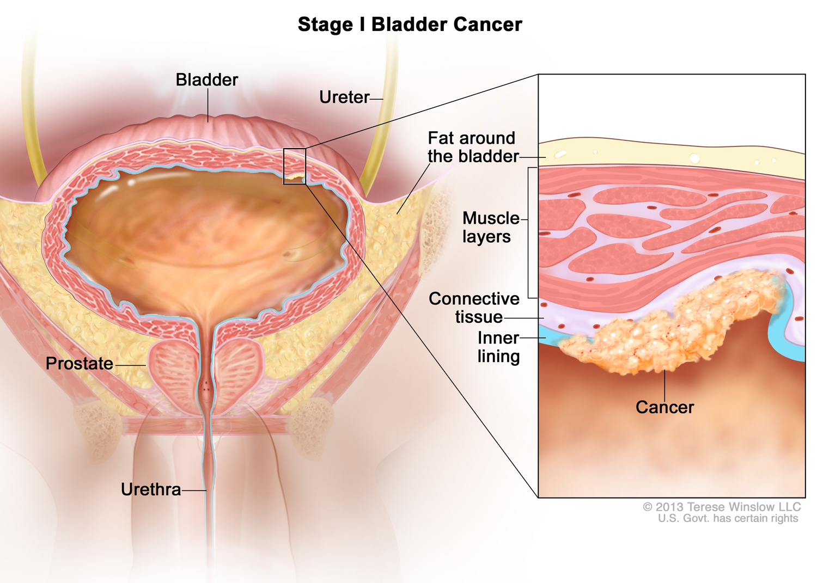
With permission from Terese Winslow LLC

Slide 17
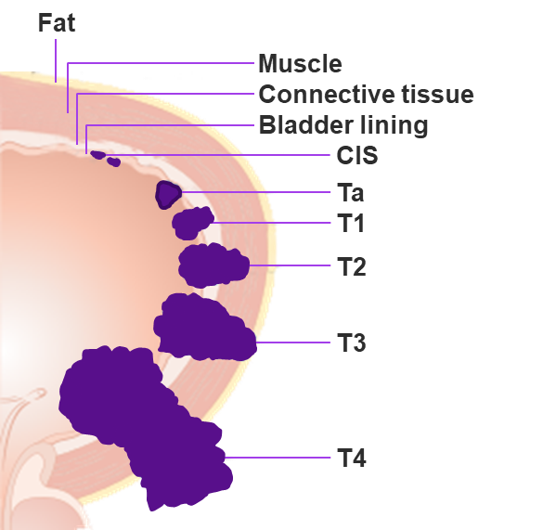
High-Risk Non‒Muscle-Invasive BC
High-risk (HR) NMIBC is defined as any carcinoma in situ (CIS), T1 tumor, and/or high-grade Ta tumor
Standard-of-care therapy for HR NMIBC is TURBT and intravesical Bacillus Calmette-Guérin (BCG)
Although there is a high rate of complete response (70%) to initial therapy, most patients with high-risk disease do not maintain response
30% of patients experience recurrence within 1 year
40% of patients at high risk progress to muscle-invasive disease
20%-30% of patients progress to metastatic disease
BCG unresponsive disease – standard of care is cystectomy
With the lack of a suitable comparator, single-arm designs testing novel agents are thought to be acceptable in the BCG-unresponsive population
World-wide BCG shortage
Cumberbatch MGK et al. Eur Urol. 2018;74:784-795. National Comprehensive Cancer Network. NCCN clinical practice guidelines in oncology (NCCN guidelines):
bladder cancer (Version 1.2019). https://www.nccn.org/professionals/physician_gls/pdf/bladder.pdf. Accessed January 7, 2019. Hemdan T et al. J Urol. 2014;191:1244. Herr HW et al. Urol Oncol. 2015;33:108.e1-4. 5. Anastasiadis A et al. Ther Adv Urol. 2012;4:13-32. US Department of Health and Human Services. BCG-unresponsive nonmuscle invasive bladder cancer: developing drugs and biologics for treatment—Guidance for industry. February 2018. https://www.fda.gov/ucm/groups/fdagov-public/@fdagov-drugs-gen/documents/document/ucm529600.pdf. Accessed February 5, 2019. Babjuk M et al. Eur Urol. 2017;71:447-461.
Courtesy of Arjun V. Balar, MD

Slide 18
Lancet Oncol 2021;22(7):919-30.

Slide 19
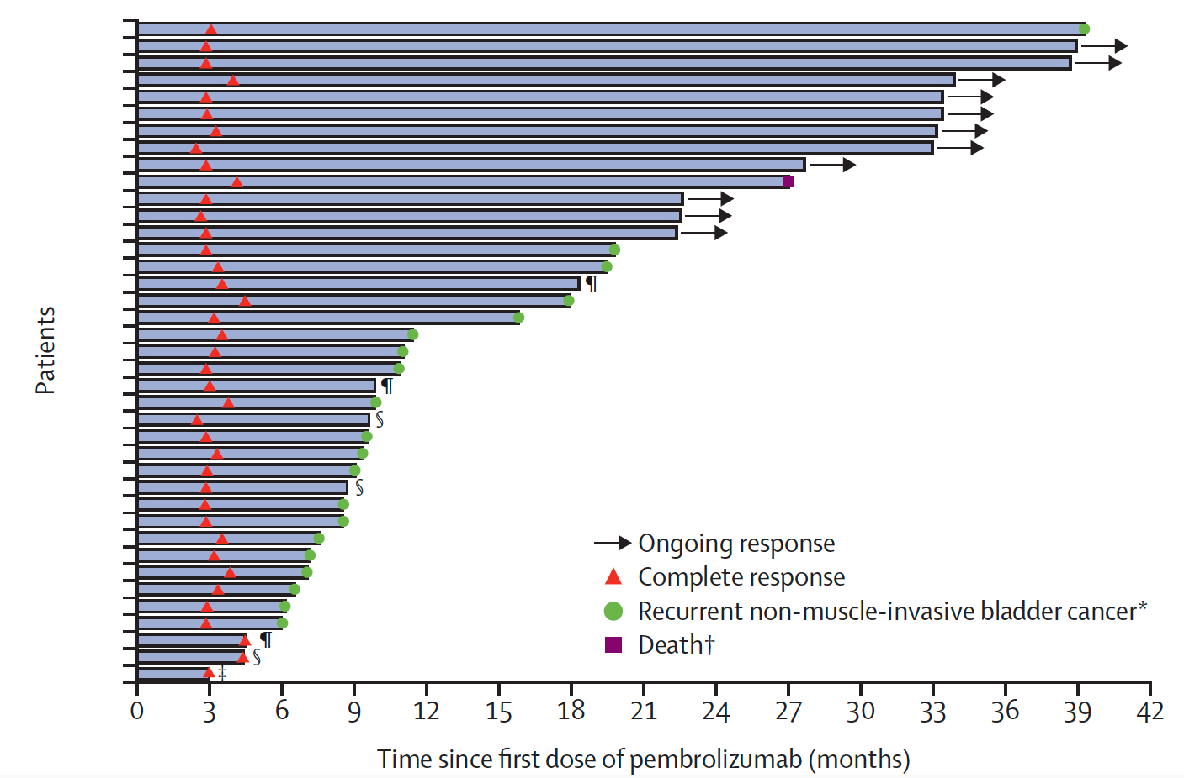
KEYNOTE-057: Pembrolizumab for High-Risk NMIBC Response, Duration of Response and Summary of Adverse Events
Serious AEs: 8%
AEs leading to treatment interruption: 13%
IRAEs: 22%
Grade 3/4 IRAEs: 3%
CR at 3 months: 41%
Median duration of CR: 16.2 mo
Balar AV et al. Lancet Oncol 2021;22(7):919-30.

Slide 20
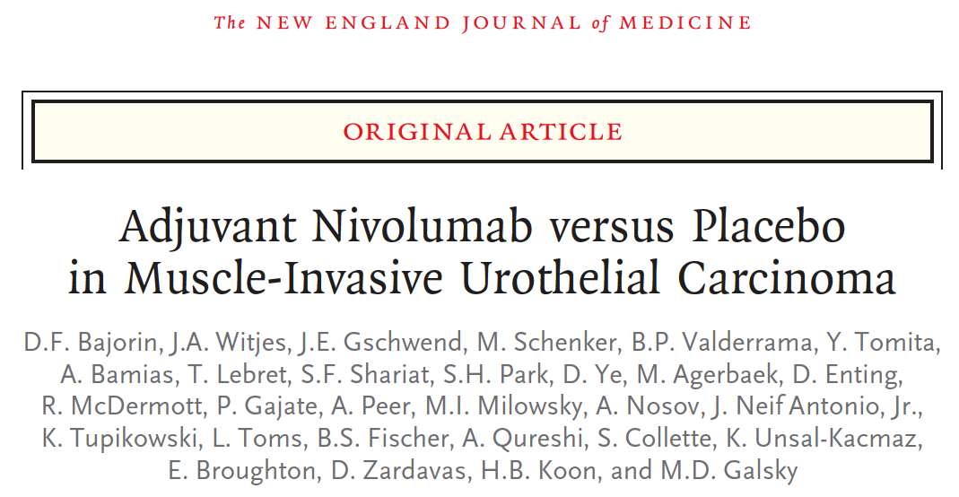
N Engl J Med 2021;384(22):2102-14.

Slide 21
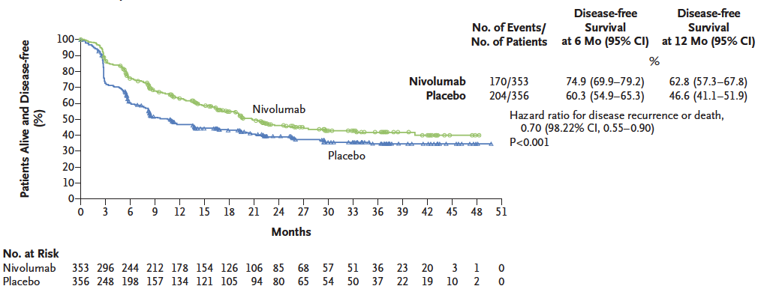
CheckMate 274: Adjuvant Nivolumab for High-Risk MIBC Disease-Free Survival in the Intent-to-Treat Population
Bajorin DF et al. N Engl J Med 2021;384(22):2102-14.

Slide 22
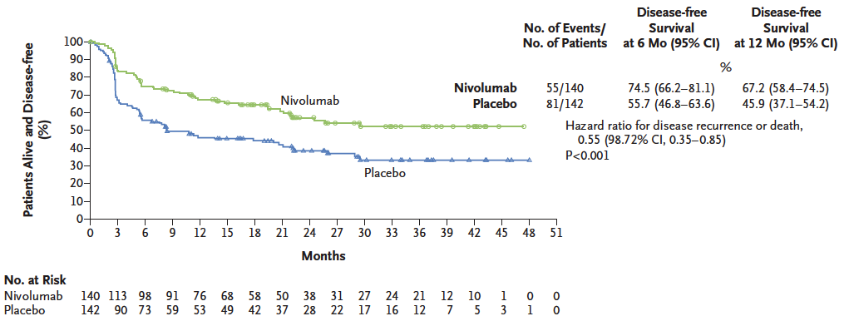
CheckMate 274: Adjuvant Nivolumab for High-Risk MIBC Disease-Free Survival in Patients with PD-L1 Expression Level of 1% or More
Bajorin DF et al. N Engl J Med 2021;384(22):2102-14.

Slide 23
Paradigm Shift: Delivery systems enter the room…
Courtesy of Stephen B Williams, MD

Slide 24
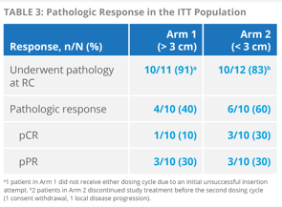
Paradigm Shift: Delivery systems enter the room…
TAR-200
TAR-200 is safe, well tolerated, 50% pCR or pPR
Courtesy of Stephen B Williams, MD

Slide 25
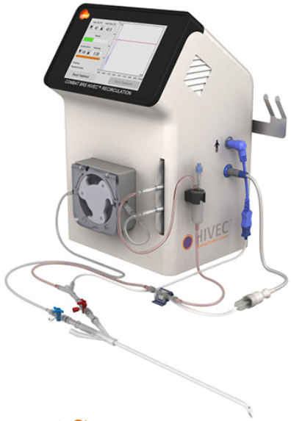
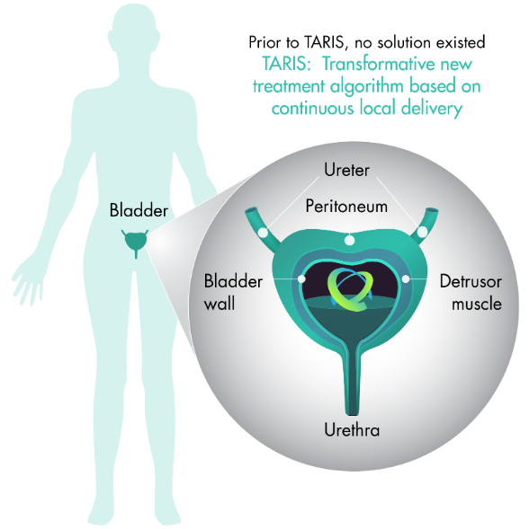
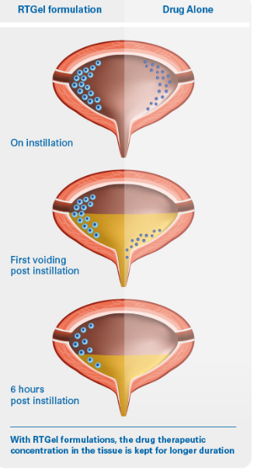
TAR-200
Prior to TAR-200, no solution existed
Transformative new treatment algorithm based on continuous local delivery
Courtesy of Ashish M Kamat, MD

Slide 26
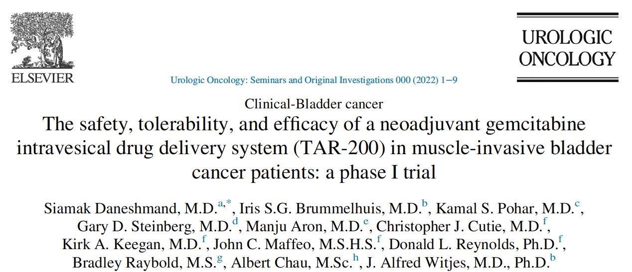
Urol Oncol 2022;[Online ahead of print].

Slide 27
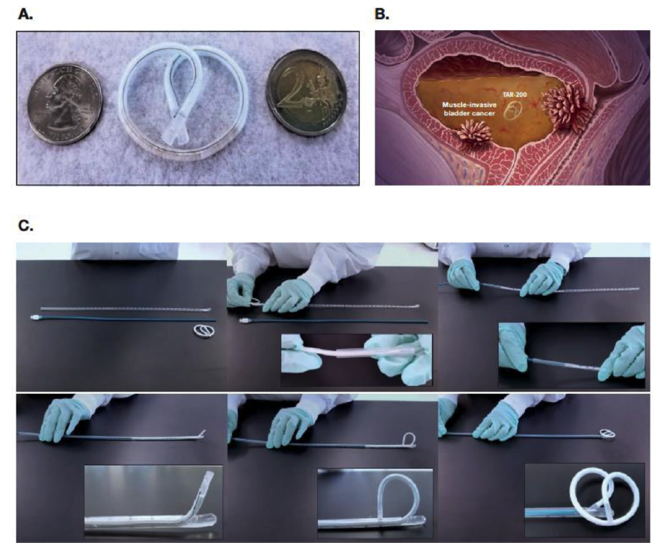
Components of TAR-200
TAR-200, a gemcitabine-releasing intravesical system, is formed into a “pretzel”-like configuration within the bladder.
TAR-200:
A. Consists of a small, flexible silicone tube filled with gemcitabine
B. Is designed to release drug directly inside the bladder over the indwelling period
C. Is inserted using a TARIS urinary placement catheter
Daneshmand S et al. Urol Oncol 2022;[Online ahead of print].

Slide 28
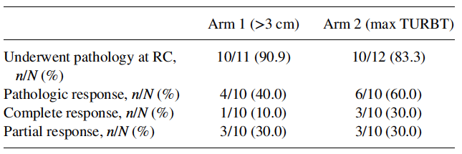
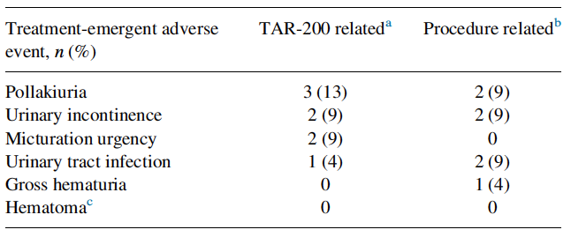
TAR-200-101: Study Design and Outcomes
Response
Daneshmand S et al. Urol Oncol 2022;[Online ahead of print].

Slide 29
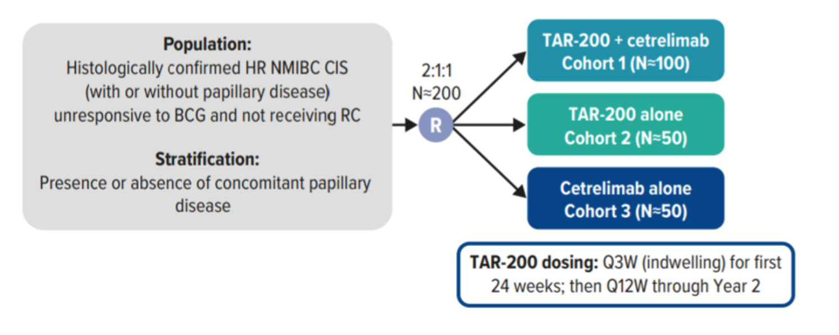
SunRISe-1: Ongoing Phase IIb Trial of TAR-200 Alone, Cetrelimab Alone, or the Combination for BCG-Unresponsive, High-Risk Non-Muscle-Invasive Bladder Cancer
Clinical Trial Identifier: NCT04640623
Primary Endpoint: Overall clinical response rate
Van der Heijden SB et al. ESMO 2021;Abstract 719TiP.

Slide 30
Patients with non-muscle-invasive bladder cancer (NMIBC)
Questions — Shilpa Gupta, MD
How is NMIBC typically diagnosed and managed?
How do you explain to patients how the available therapies for NMIBC work?

Slide 31
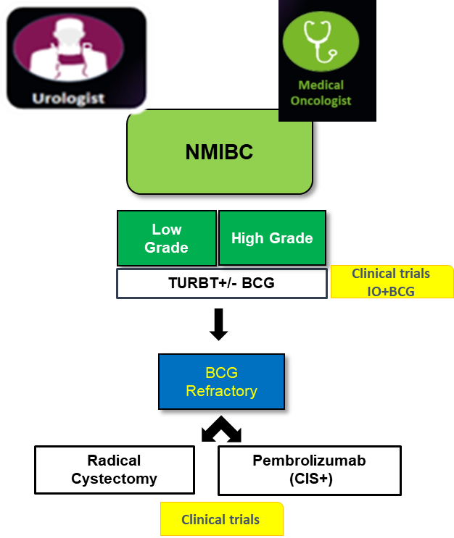
Patients with non-muscle-invasive bladder cancer (NMIBC)
Commentary — Shilpa Gupta, MD
Multidisciplinary Care in NMIBC
Presentation:
Hematuria, frequent/painful urination, pain
Diagnosis:
Need timely referral to Urology
Urine cytology, Imaging, Cystoscopy, TURBT
Treatment:
TURBT +/- Intravesical BCG
Immunotherapy in select cases
Novel intravesical therapy/immunotherapy trials
Radical cystectomy
Patients prefer bladder preservation approaches

Slide 32
Patients with non-muscle-invasive bladder cancer (NMIBC)
Questions — Monica Averia, MSN, AOCNP, NP-C
What are some of the clinical and support issues that arise for patients undergoing cystectomy and urinary diversion?
What are some of the clinical and support issues that arise for patients who have received chemoradiation and are now eligible for surgery?
What are some of the psychosocial issues that arise in these situations?

Slide 33
Patients with non-muscle-invasive bladder cancer (NMIBC)
Commentary — Monica Averia, MSN, AOCNP, NP-C
What are some of the clinical and support issues that arise for pts undergoing cystectomy and urinary diversion?
RC and UD pts require tremendous support.
Preoperative period
Self-care challenges
Postoperative period

Slide 34
Commentary — Monica Averia, MSN, AOCNP, NP-C
What are some of the clinical and support issues that arise for pts who have received chemoradiation and are now eligible for surgery?
Chemoradiation patients tend to have already gone through the SE profile of both regimens:
Fatigue, nausea, vomiting, diarrhea, neuropathy, decreased counts, and reduced QOL.
Presenting surgery as an option in some pts can be viewed as:
A. Welcomed option
B. Challenging option

Slide 35
Commentary — Monica Averia, MSN, AOCNP, NP-C
Cite brief instructive examples of actual clinical experiences with pts in your practice.
Med onc
Post op pts referred for adjuvant Tx
Fear, uncertainty, and knowledge deficit
Empower pts with correct info to help them decide on life changing treatment options
What are some of the PSYCHOSOCIAL issues that arise in these situations?
Radical cystectomy and urinary diversion
Often associated with permanent alteration of body image and function
Poses a serious threat to the patient's psychological well-being

Slide 36
Commentary — Monica Averia, MSN, AOCNP, NP-C
Life after cystectomy and urinary diversion:
1. Body function changes
2. Financial impact
3. Loss of independence and control
4. Lifestyle changes
5. Effects on sexuality and intimacy
6. Feelings of anxiety and depression over cancer recurrence
7. Pain management

Slide 37
Agenda
Module 1 – Management of Localized Urothelial Bladder Cancer (UBC): Adjuvant Treatment, TAR-200
Module 2 – Management of Metastatic UBC: Antibody-Drug Conjugates, Checkpoint Inhibitors
Module 3 – Management of FGFR-Mutant UBC
Module 4 – Oncology/UBC 2032 and Crystal Ball: Part 2

Slide 38
Patients with metastatic urothelial bladder cancer (mUBC) may be designated as “platinum-ineligible” due to…
Renal dysfunction
Poor performance status
Peripheral neuropathy
All of the above
Only 1 and 2
Only 2 and 3
Only 1 and 3
I don’t know

Slide 39
Platinum Ineligibility
Eastern Cooperative Oncology Group PS 2
CrCl , 60 mL/min
Grade ≥2 hearing loss
Grade ≥2 neuropathy
New York Heart Association Class III heart failure
Probability of cisplatin ineligibility increases with age. More than 40% of patients with MIBC age ≥70 years are ineligible.
Relief of ureteric obstruction and hydronephrosis using a stent or nephrostomy may convert cisplatin-ineligible patients to cisplatin-eligible.

Slide 40
What is the mechanism of action of enfortumab vedotin?
Antibody-drug conjugate
FGFR inhibitor
PD-1/PD-L1 inhibitor
Intravesicular gemcitabine
I don’t know

Slide 41
Enfortumab vedotin is showing encouraging results in the initial treatment of mUBC when combined with…
Erdafitinib
Chemotherapy
Anti-PD-1/PD-L1 agents
Trastuzumab deruxtecan
I don’t know

Slide 42
2022;Abstract 487

Slide 43
JAVELIN-100 Study Design
Powles T et al. Genitourinary Cancers Symposium 2022;Abstract 487.

Slide 44
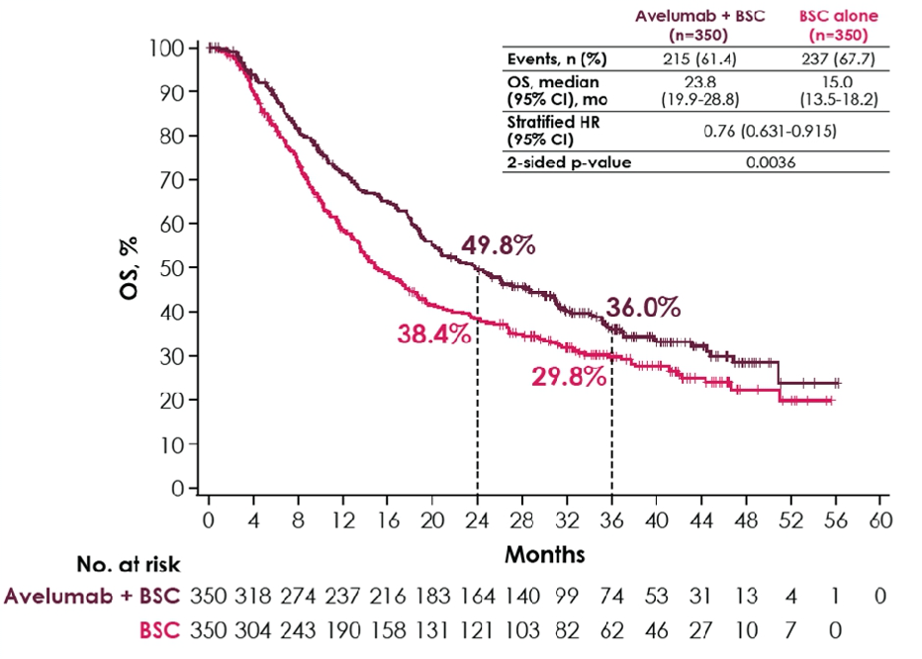
JAVELIN-100: Long-Term Overall Survival (OS)
Powles T et al. Genitourinary Cancers Symposium 2022;Abstract 487.

Slide 45
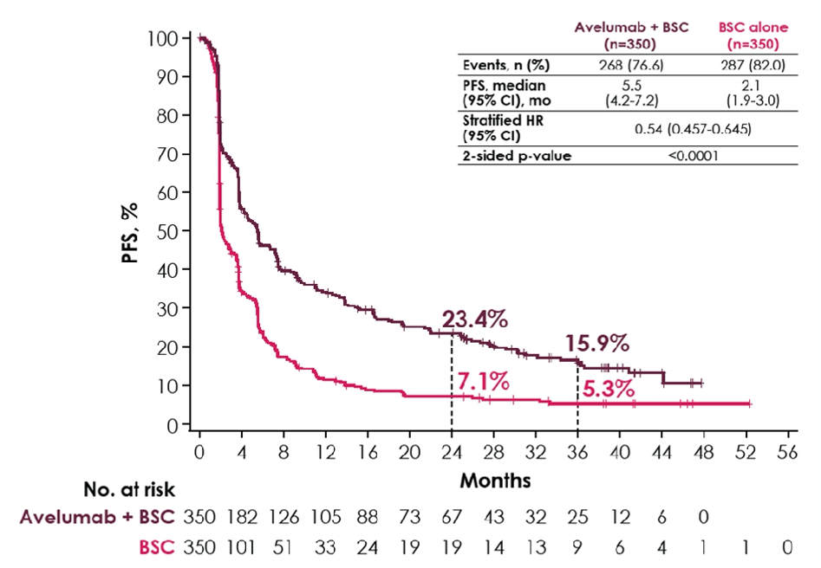
JAVELIN-100: Investigator-Assessed Progression-Free Survival (PFS)
Powles T et al. Genitourinary Cancers Symposium 2022;Abstract 487.

Slide 46
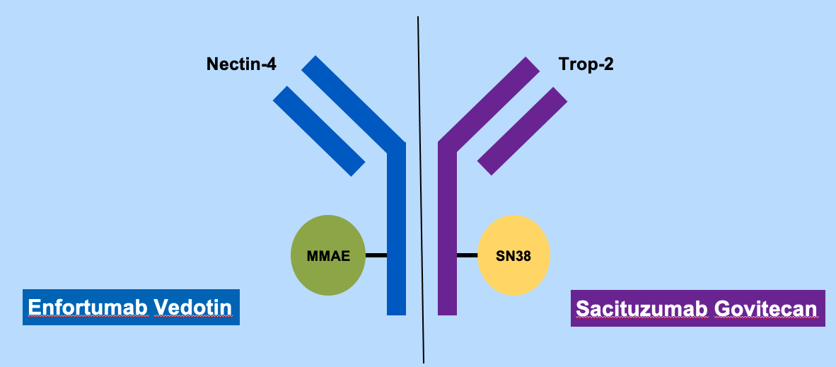
Antibody-Drug Conjugates in UBC
Courtesy of Matthew Galsky, MD

Slide 47
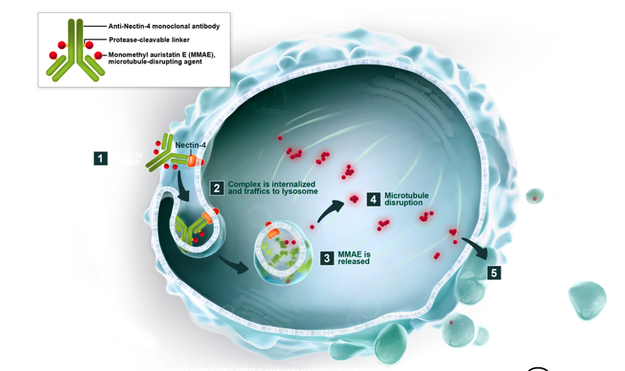
Enfortumab Vedotin: Nectin-4 Targeted Therapy
Anti-Nectin-4 monoclonal antibody
Protease-cleavable linker
Monomethyl auristatin E (MMAE), microtubule-disrupting agent
Courtesy of Jonathan Rosenberg, MD

Slide 48
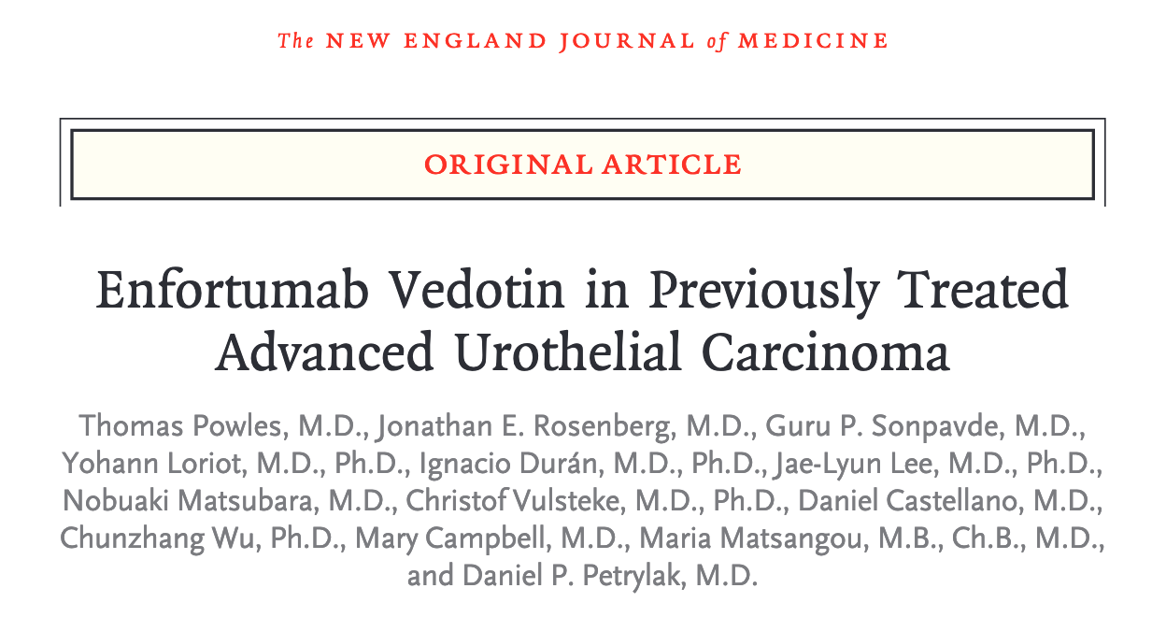
N Engl J Med 2021;384(12):1125-35.

Slide 49
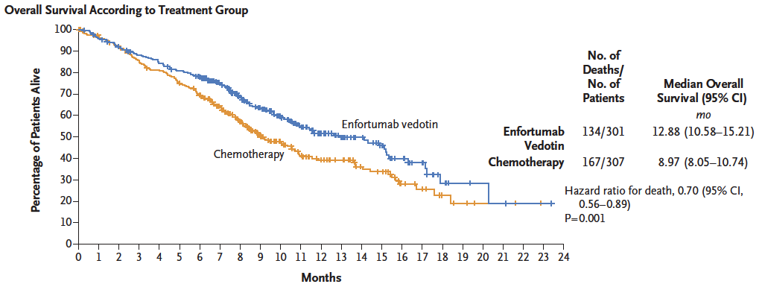
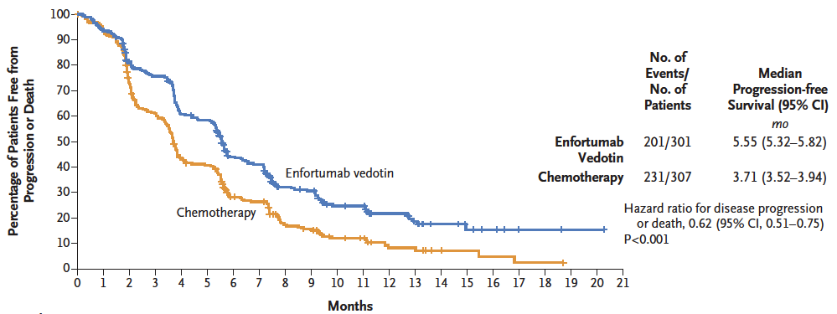
EV-301: Enfortumab Vedotin for Previously-Treated Advanced UC Survival Analyses
Overall Survival
HR: 0.70
P = 0.001
Progression-Free Survival
HR: 0.62
P = 0.001
Powles T et al. N Engl J Med 2021;384(12):1125-35.

Slide 50
EV-301: Antitumor Response
 | EV (n = 288) | Chemo (n = 296) | P-value
Overall response | 40.6% | 17.9% | <0.001
Complete response (CR) | 49% | 2.7%
Partial response (PR) | 35.8% | 15.2%
Stable disease (SD) | 31.3% | 35.5%
Disease control rate* | 71.9% | 53.4% | <0.001
Duration of response at 12 months | 27.7% | 19.8%
Time to response, median | 1.87 mo | 1.91 mo
*Disease control rate: CR + PR + SD at least 7 weeks
Powles T et al. N Engl J Med 2021;384(12):1125-35.

Slide 51
EV-301: Treatment-Related Adverse Events of Special Interest
Treatment-related adverse event (TRAE) | Enfortumab Vedotin (n = 296) |  | Chemotherapy (n = 291)
 | Any grade | Grade ≥3 | Any grade | Grade ≥3
Skin reactions | 47% | 33% | 16% | <1%
Peripheral neuropathy | 46% | 5% | 31% | <1%
Ocular disorders | 19% | <1% | 5% | <1%
Infusion-related reactions | 9% | 1% | 5% | 0
Hyperglycemia | 6% | 4% | <1% | 0
TRAE summary | Any grade |  | Any grade
Leading to dose reduction | 32% |  | 28%
Leading to dose interruption | 51% |  | 19%
Leading to dose withdrawal | 14% |  | 11%
Powles T et al. N Engl J Med 2021;384(12):1125-35.

Slide 52
Lancet Oncol 2021;22(6):872-82.

Slide 53
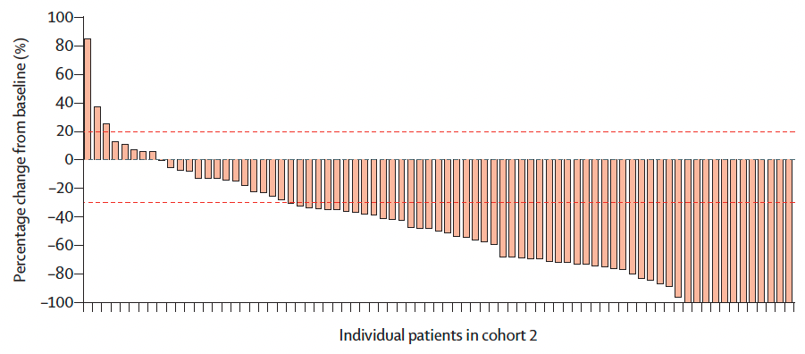
EV-201: Enfortumab Vedotin for Cisplatin-Ineligible Patients with Advanced UC Previously Treated with PD-1 or PD-L1 Therapy
ORR per BICR: 52%
Median DoR: 10.9 months
Median PFS: 5.8 months
Cohort 2 included adults (aged ≥18 years) with an ECOG PS score of 2 or less who were considered ineligible for cisplatin at enrolment and who had not received platinum-containing chemotherapy in the locally advanced or metastatic setting
Yu EY et al. Lancet Oncol 2021;22(6):872-82.

Slide 54
Study EV-103: Update on Durability Results and Long Term Outcome of Enfortumab Vedotin + Pembrolizumab in First Line Locally Advanced or Metastatic Urothelial Carcinoma (la/mUC)
Friedlander TW et al. ASCO 2021;Abstract 4528.

Slide 55
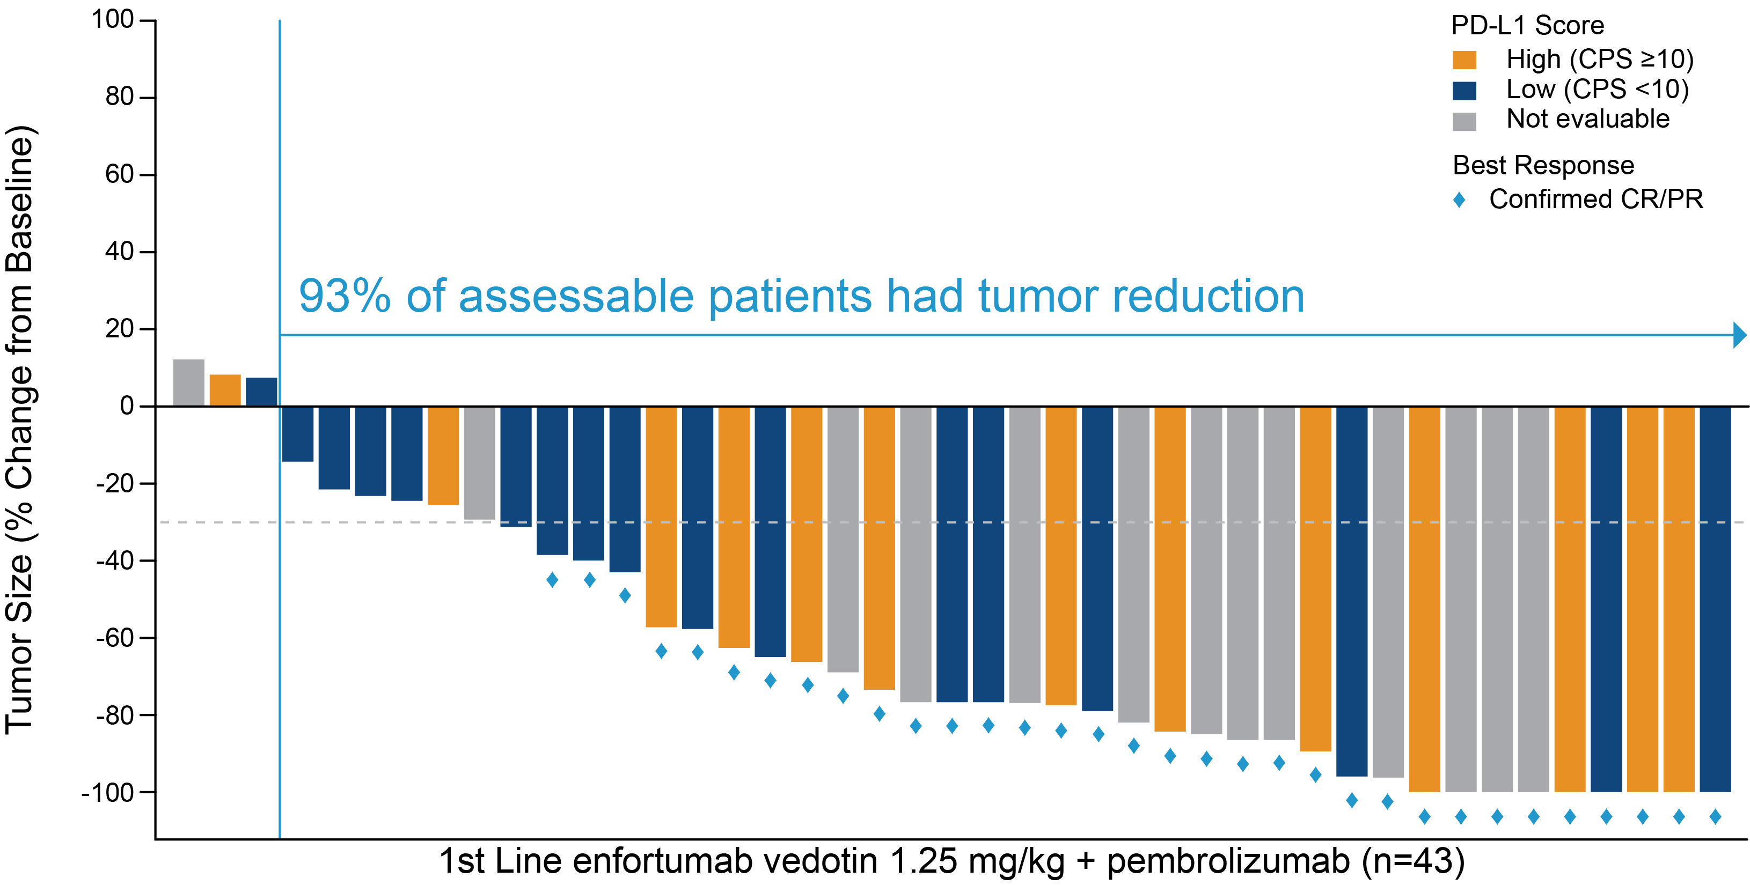
EV-103: Enfortumab Vedotin with Pembrolizumab as First-Line Therapy for Locally Advanced or Metastatic Urothelial Carcinoma
Friedlander TW et al. ASCO 2021;Abstract 4528.

Slide 56
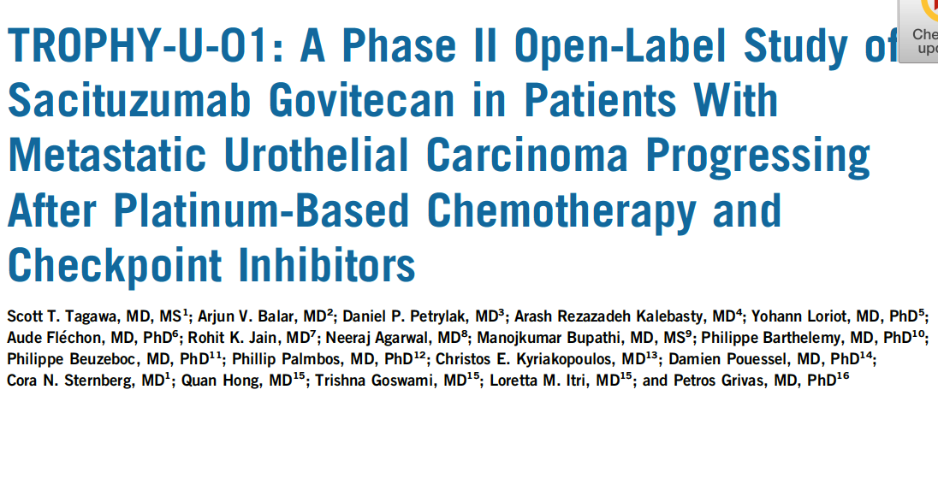
of
J Clin Oncol 2021;39(22):2474-85.

Slide 57
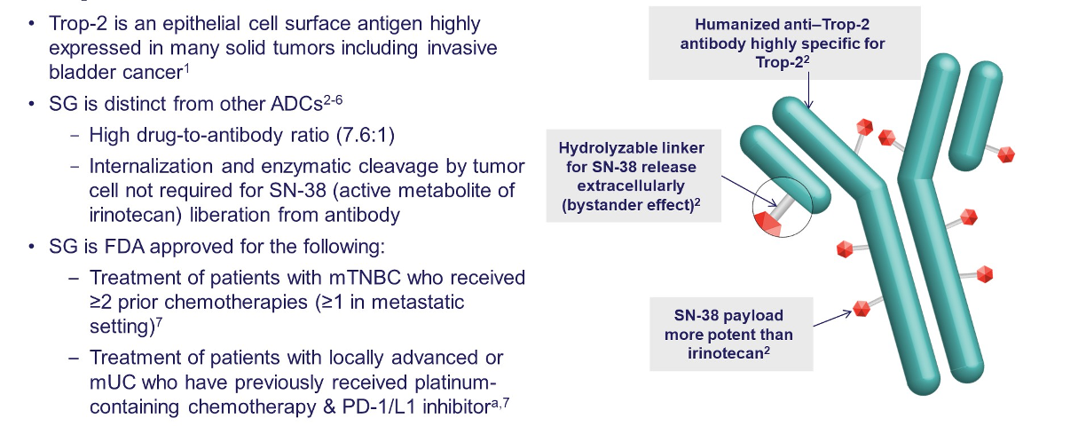
Sacituzumab Govitecan: A First-in-Class TROP2-Directed Antibody-Drug Conjugate
Grivas P et al. Genitourinary Cancers Symposium 2022;Abstract 434.

Slide 58
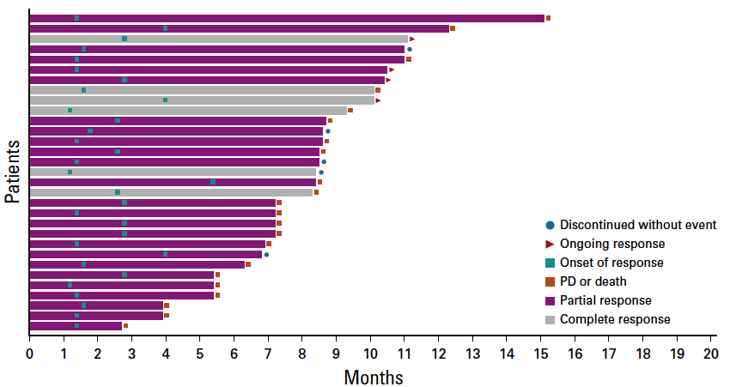
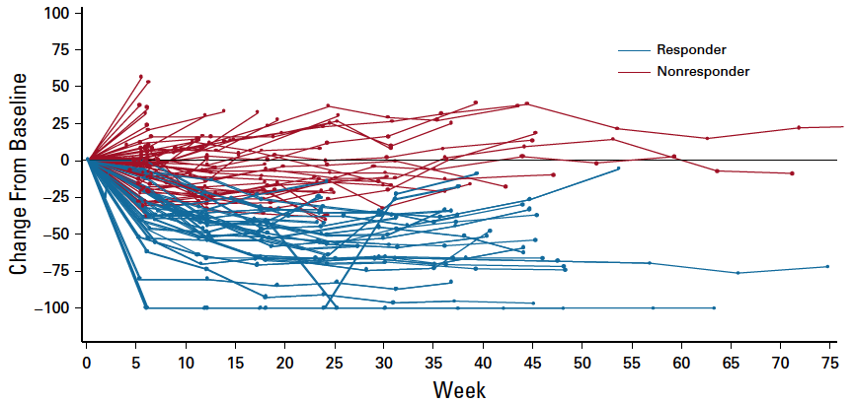
TROPHY U-01 (Cohort 1): ORR, Duration of Response and Survival
Median DOR: 7.2 mo
Median time to onset of response: 1.6 mo
ORR: 27% (31/113)
Median PFS: 5.4 mo Median OS: 10.9 mo
Tagawa ST et al. J Clin Oncol 2021;39(22):2474-85; Loriot Y et al. ESMO 2020;Abstract LBA24.

Slide 59
2022;Abstract 434

Slide 60
Patients with FGFR wild-type metastatic urothelial bladder cancer (FGFR-WT UBC)
Questions — Sumanta Kumar Pal, MD
What are the common clinical histories of patients with mUBC?
What are the usual first- and second-line systemic treatments administered to patient with FGFR-WT UBC?
How do you explain to patients the mechanism of action enfortumab vedotin and its potential benefits?

Slide 61
Patients with FGFR wild-type metastatic urothelial bladder cancer (FGFR-WT UBC)
Commentary — Sumanta Kumar Pal, MD
Cisplatin-based neoadjuvant chemotherapy remains a gold-standard for those patients with muscle-invasive bladder cancer who are cisplatin-eligible
Adjuvant nivolumab is a consideration for patients with ypT2-ypT4a or ypN+ didsease or pT3-pT4a or pN+ disease
Adjuvant FGFR3-directed therapy with infigratinib is being explored in clinical trials, as is adjuvant atezolizumab based on ctDNA
Cisplatin-based chemotherapy followed by maintenance avelumab is a gold standard front-line approach for patients with metastatic urothelial cancer

Slide 62
Commentary — Sumanta Kumar Pal, MD
Carboplatin-based chemotherapy followed by maintenance avelumab is a gold standard for patients with metastatic urothelial cancer who are cisplatin-ineligible, but immunotherapy can be considered in selected circumstances
Enfortumab has demonstrated level 1 evidence following platinum-based chemotherapy and checkpoint inhibitor for metastatic urothelial cancer
FGFR3 mutations should be assessed early in the course of treatment to determine eligibility for agents such as erdafitinib
Sacituzumab has shown compelling response rates in patients with prior platinum-based chemotherapy and immunotherapy

Slide 63
Patients with FGFR wild-type metastatic urothelial bladder cancer (FGFR-WT UBC)
Questions — Brenda Martone, MSN, NP-BC, AOCNP
What do you say to patients who are about to receive enfortumab vedotin in terms of what they should expect with this treatment?
What are some of the psychosocial issues that arise in this situation?

Slide 64
Patients with FGFR wild-type metastatic urothelial bladder cancer (FGFR-WT UBC)
Commentary —Brenda Martone, MSN, NP-BC, AOCNP
Explain how Enfortumab vedotin is different from their previous treatments.
Conjugated antibody that attaches to protein receptors on the surface bladder cancer cells, and then inserts the medication directly into the bladder cancer cells.
It can also cause harm to normal cells
What you can expect while on treatment. These side effects are somewhat unique to this treatment.
Peripheral neuropathies
Skin rash
Changes in the sense of smell
Dry eyes
Elevated glucose readings

Slide 65
Commentary —Brenda Martone, MSN, NP-BC, AOCNP
Actual patient cases
49 y/o female with metastatic bladder cancer and a history of spina bifida. S/p 7 cycles of treatment with persistence of bothersome rash despite dose reduction and interventions. Coming for treatment created anxiety and worsening of her baseline depression. FYI, her last treatment was May 2021 and she remains in CR.
68 y/o male s/p 7 cycles who developed grade 2-3 peripheral neuropathies. Currently remodeling a house in Wisconsin with plans to move there.
Psychosocial issues to consider during treatment
Anxiety
Changes to physical appearance
Impact of side effects on ADLs
Treatment schedule
Access to transportation: cost of parking in downtown Chicago

Slide 66
Agenda
Module 1 – Management of Localized Urothelial Bladder Cancer (UBC): Adjuvant Treatment, TAR-200
Module 2 – Management of Metastatic UBC: Antibody-Drug Conjugates, Checkpoint Inhibitors
Module 3 – Management of FGFR-Mutant UBC
Module 4 – Oncology/UBC 2032 and Crystal Ball: Part 2

Slide 67
What is the mechanism of action of erdafitinib?
Antibody-drug conjugate
Tyrosine kinase inhibitor
PD-1/PD-L1 inhibitor
Intravesicular gemcitabine
I don’t know

Slide 68
Erdafitinib targets…
FGFR2
Nectin-4
TROP2
I don’t know

Slide 69
Which of the following is a potential unique side effect of erdafitinib that requires monitoring?
Atrial fibrillation
Ocular disorders
Peripheral neuropathy
I don’t know

Slide 70
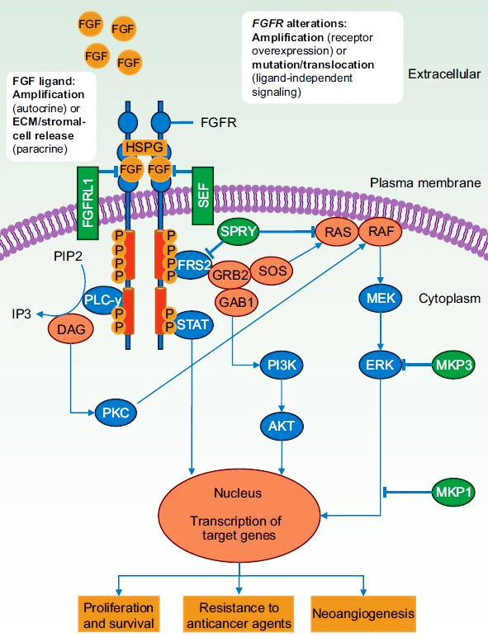
Rationale for Targeting FGFR in Urothelial Carcinoma (UC)^{1,2}
FGFR Signaling Pathway³
FGFR is altered in 15%-20% of advanced UC⁴
Mutated FGFR3 is present in 37% of upper-tract UC⁵
FGFR alterations: Amplification (receptor overexpression) or mutation/translocation (ligand-independent signaling)
FGF ligand: Amplification (autocrine), or ECM/stromal cell release (paracrine)
Cancer Type | Frequency of FGFR Alterations¹
Metastatic UC | 15%-20%
NMIBC | 40%-70%
Cholangiocarcinoma | 14%-22%
NSCLC | 4%
HCC (FGF19 amp by FISH) | 21%
Glioblastoma | 23%
Breast cancer | 3%-5%
Ovarian cancer | 7%
Head and neck cancer | 9%-17%
1. The Cancer Genome Atlas (TCGA) genomic alteration database: https://tcga-data.nci.nih.gov/docs/publications/tcga/. Accessed February 6, 2020. 2. Genomics Evidence Neoplasia Information Exchange (GENIE) genomic alteration database: https://www.aacr.org/Research/Research/pages/aacr-project-genie.aspx. Accessed February 6, 2020. 3. Touat M et al. Clin Cancer Res. 2015;21:2684-2694. 4. Rodriguez-Vida A et al. J Hematol Oncol. 2015;8:119. 5. Li Q et al. Curr Urol Rep. 2016;17:12.

Slide 71
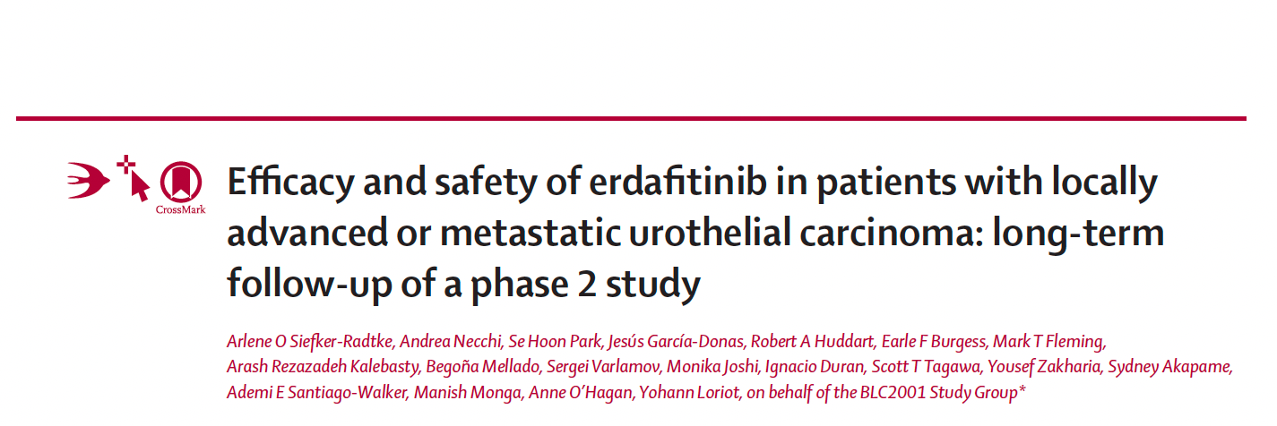
Lancet Oncol 2022;23(2):248-58.

Slide 72
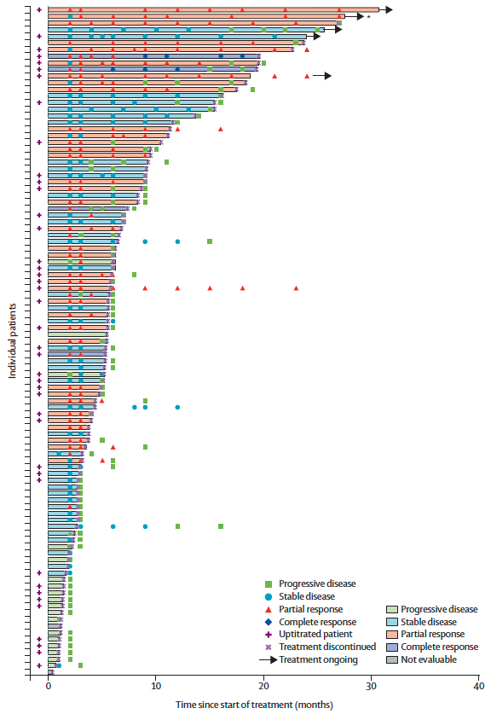
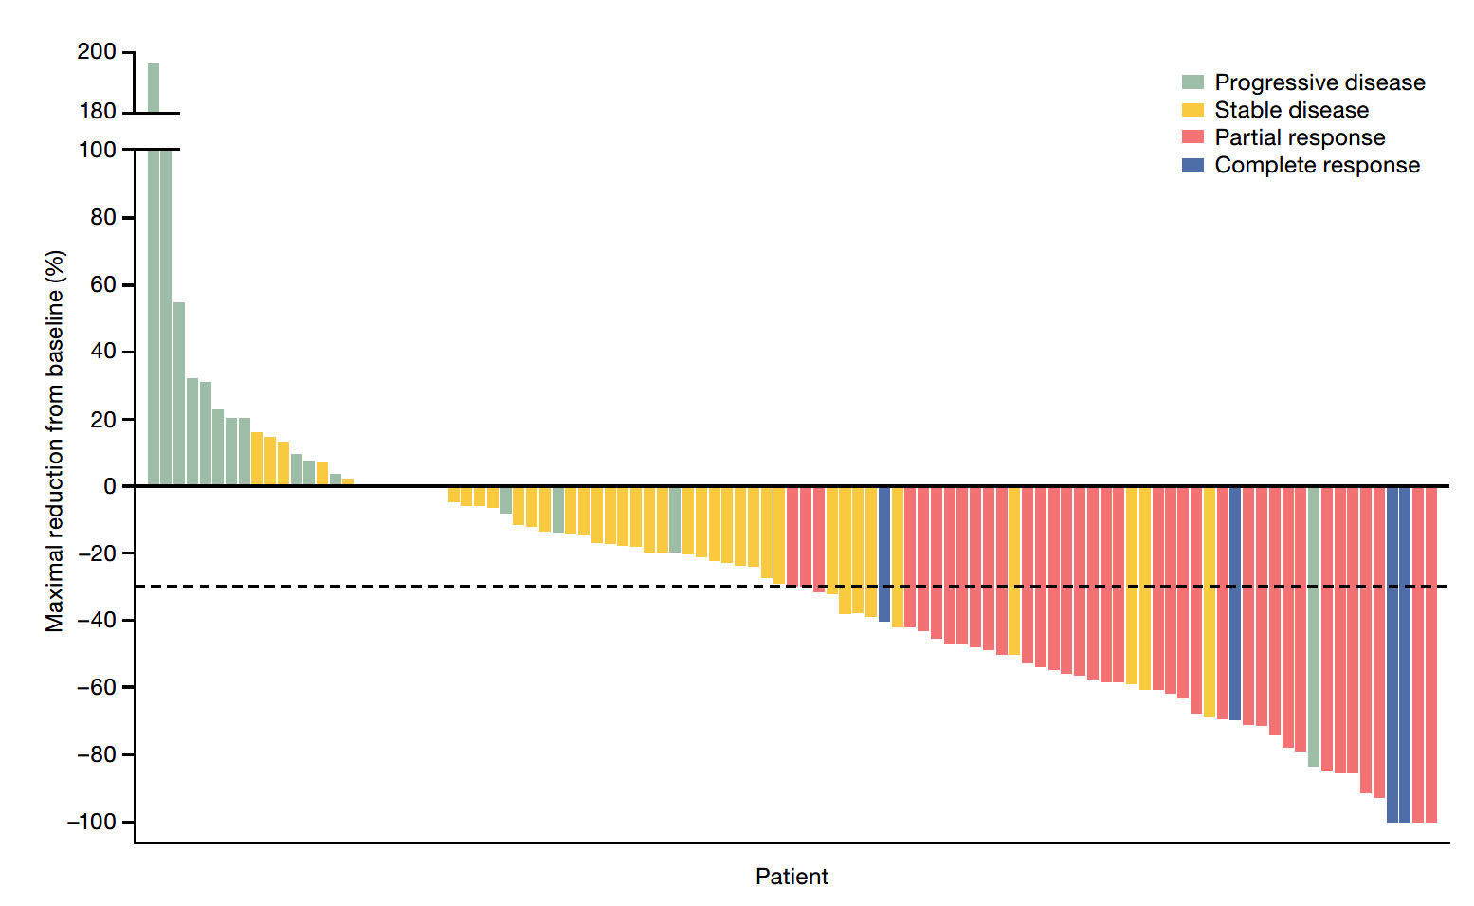
BLC2001: Erdafitinib for Locally Advanced or Metastatic UBC Responses in Patients Treated with the Selected 8 mg/day Erdafitinib UpT Regimen
ORR: 40%
Siefker-Radtke A et al. Lancet Oncol 2022;23(2):248-58.

Slide 73
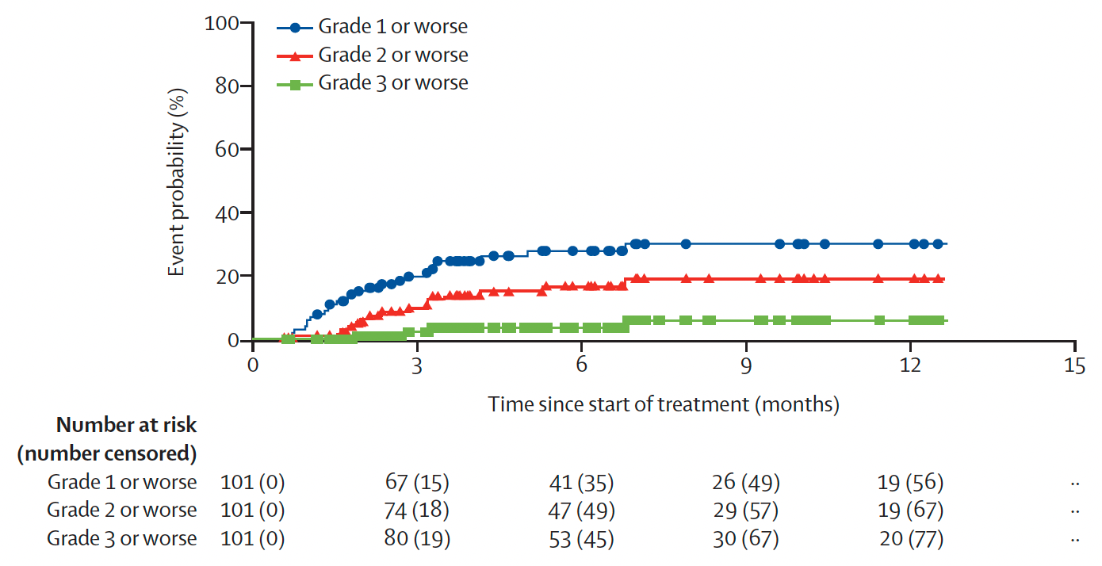
BLC2001: Post Hoc Analysis of the Cumulative Incidence of First-Onset Central Serous Retinopathy Events by Grade
Siefker-Radtke A et al. Lancet Oncol 2022;23(2):248-58.

Slide 74
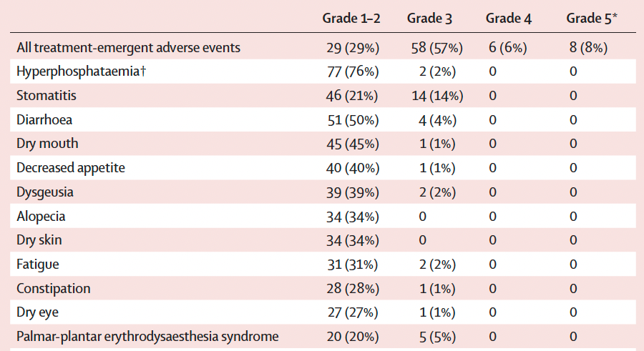
BLC2001: Select Treatment-Emergent Adverse Events
Siefker-Radtke A et al. Lancet Oncol 2022;23(2):248-58.

Slide 75
Patients with mUBC and an FGFR mutation
Questions — Shilpa Gupta, MD
How do you explain FGFR mutations and how erdafitinib works to patients?
What are the potential benefits with this treatment?

Slide 76
Patients with mUBC and an FGFR mutation
Commentary — Shilpa Gupta, MD
FGFR mutations occur in ~ 20% mUBC patients
Erdafitinib is an oral targeted therapy that inhibits FGFR pathway to block cancer growth
It results in tumor shrinkage in ~ 40% patients and median overall survival ~ 11 months
Significant toxicity, needs monitoring
Skin and nail toxicity
Eye toxicity- regular ophthalmologic evals
Hyperphosphatemia- regular lab monitoring
Knowles MA et al. Nat Rev Cancer. 2015, Loriot Y et al. NEJM 2019

Slide 77
Patients with mUBC and an FGFR mutation
Questions — Monica Averia, MSN, AOCNP, NP-C
What do you say to patients who are about to receive erdafitinib in terms of what they should expect with this treatment?
What are some of the psychosocial issues that arise in this situation?

Slide 78
Patients with mUBC and an FGFR mutation
Commentary — Monica Averia, MSN, AOCNP, NP-C
What do you say to pts who are abt to receive Erdafitinib in terms of what to EXPECT with the treatment?
Erdafitinib is used to treat patients with metastatic urothelial carcinoma
FGFR gene alterations
Decreased the tumors of some patients whose cancers did not respond to other treatments
Common side effects:
Fatigue, Nausea, Vomiting, Diarrhea, Dry mouth, Changes to nails, Hand-foot syndrome

Slide 79
Commentary — Monica Averia, MSN, AOCNP, NP-C
Cite brief instructive examples of actual clinical experiences with pts in your practice
65 y/o male from Guatemala case study
ddMVAC chemo
Radical cystectomy with ileal conduit
>1 yr: DP with new LN met, Bx proven
Option: immunotherapy or chemo. Cisplatin/Gemcitabine chemo
COVID-19: intubated, hospitalized, lost to follow-up
Presented with DP: liver, lungs, LN
Tumor Profiling: FGFR gene alteration
Cycle 1: CT showed dec in lesions. Cycle 2: CT pending

Slide 80
Commentary — Monica Averia, MSN, AOCNP, NP-C
What are some of the psychosocial issues that arise in this situation?
Side effects experienced:
Self limiting
Reinforce ways to manage SE profile of the medication

Slide 81
Agenda
Module 1 – Management of Localized Urothelial Bladder Cancer (UBC): Adjuvant Treatment, TAR-200
Module 2 – Management of Metastatic UBC: Antibody-Drug Conjugates, Checkpoint Inhibitors
Module 3 – Management of FGFR-Mutant UBC
Module 4 – Oncology/UBC 2032 and Crystal Ball: Part 2

Slide 82
Fantasies for the future… Oncology 2032?
Questions — Sumanta Kumar Pal, MD
UBC now has immunotherapy, chemotherapy, antibody-drug conjugates and targeted treatment options approved. How do you see these treatment modalities and others being incorporated into the next generation of therapies?

Slide 83
Antibody Drug Conjugates to Trop-2
Future Vision:
Could drugs such as enfortumab vedotin or sacituzumab govitecan be used in the neoadjuvant/adjuvant setting?
Could targeted therapies advance forward into NMIBC and MIBC?
Antibody Drug Conjugates to Nectin-4
Non-Muscle Invasive Bladder Cancer
Muscle Invasive Bladder Cancer
Metastatic Bladder Cancer
Checkpoint Inhibitors
Targeted Therapies (FGFR, HER2)

Slide 84
Fantasies for the future… Oncology 2032?
Questions — Brenda Martone, MSN, NP-BC, AOCNP
What is your vision for oncology nursing in 2032?
How can advances in technology be harnessed to provide better patient care?

Slide 85
Fantasies for the future… Oncology 2032?
Commentary —Brenda Martone, MSN, NP-BC, AOCNP
Oncology nurses and APP’s will practice at the top of their license.
Better understanding and appreciation of the role of all oncology nurses
All oncology nurses will hold OCN or AOCN
Advances to in technology to be harnessed
Detection of NMIBC and multifocal bladder cancer by imaging
Non-invasive screening for patients globally.
Circulating tumor DNA for cancer monitoring

Slide 86
Appendix of Recent Data Sets

Slide 87
FGFR3 Genomic Alterations in Muscle-Invasive Bladder Cancer
Genomics of MIBC: TCGA
In muscle-invasive disease, FGFR3 mutations in ~20% of tumors, but protein and/or gene overexpression in ~50%.
Activating mutations of FGFR3 in ~75% of low-grade papillary bladder tumors.
FGFR3-TACC3 fusions enriched in young, Asian, non-smokers, upper tract tumors (invasive, high grade)
Preclinical evidence for activity of FGFR inhibitors in selected cells with FGFR alterations
Robertson AG et al. Cell 2017;171(3):540-56; Cappellen D et al. Nat Genet 1999;23:18-20; Nassar A et al. JCO Precis Oncol 2018; Gust KM et al. Mol Cancer Ther 2013;12:1245-54; Grünewald S et al. Int J Cancer 2019; Sfakianos JP Eur Urol 2015;68(6):970-7.

Slide 88
of
J Clin Oncol 2021;39(22):2474-85.

Slide 89
TROPHY-U-01: Overall Response and Best Change from Baseline in Tumor Size
Grivas P et al. Genitourinary Cancers Symposium 2022;Abstract 434.

Slide 90
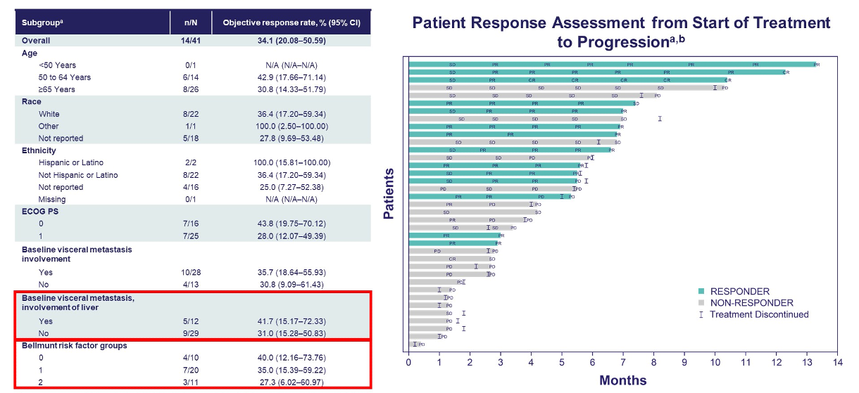
TROPHY-U-01: ORR by Subgroup and Individual Response Assessment
Grivas P et al. Genitourinary Cancers Symposium 2022;Abstract 434.

Slide 91
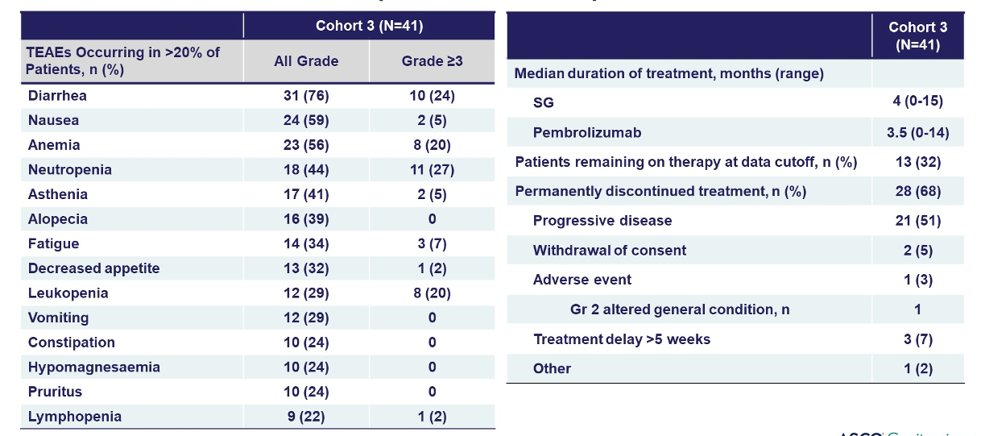
TROPHY-U-01: Most Common Treatment-Emergent Adverse Events (TEAEs) for All Patients
Grivas P et al. Genitourinary Cancers Symposium 2022;Abstract 434.

Slide 92
TROPHY-U-01: Most Common Treatment-Related Adverse Events (TRAEs) for All Patients
Grivas P et al. Genitourinary Cancers Symposium 2022;Abstract 434.

