Slide 1
Friday, May 13, 2022
8:00 AM – 10:00 AM CT (9:00 AM – 11:00 AM ET)
Cases from the Community: Urologic Oncology Investigators Provide Perspectives on the Optimal Management of Prostate Cancer
Part 1 of a 2-Part CME Satellite Symposium Series in
Conjunction with the AUA 2022 Annual Meeting
Faculty
Raoul S Concepcion, MD
Fred Saad, MD
Matthew R Smith, MD, PhD
Moderator
Emmanuel S Antonarakis, MD

Slide 2




Faculty
Raoul S Concepcion, MD
Chief Science Officer
US Urology Partners
Nashville, Tennessee
Matthew R Smith, MD, PhD
Claire and John Bertucci Endowed Chair in Genitourinary Cancers
Professor of Medicine, Harvard Medical School
Director, Genitourinary Malignancies Program
Massachusetts General Hospital Cancer Center
Boston, Massachusetts
Fred Saad, MD
Professor and Chief of Urology
Director of GU Oncology
Raymond Garneau Chair in Prostate Cancer
University of Montreal Hospital Center (CHUM)
Director, Prostate Cancer Research
Montreal Cancer Institute/CRCHUM
Montréal, Québec, Canada
Moderator
Emmanuel S Antonarakis, MD
Clark Endowed Professor of Medicine
Division of Hematology, Oncology and Transplantation
University of Minnesota
Minneapolis, Minnesota

Slide 3
Commercial Support
This activity is supported by educational grants from Astellas and Pfizer Inc, AstraZeneca Pharmaceuticals LP, Bayer HealthCare Pharmaceuticals, Janssen Biotech Inc, administered by Janssen Scientific Affairs LLC, Merck, and Pfizer Inc.
Research To Practice CME Planning Committee Members,
Staff and Reviewers
Planners, scientific staff and independent reviewers for Research To Practice have no relevant conflicts of interest to disclose.

Slide 4
Dr Antonarakis — Disclosures
Advisory Committee | AIkido Pharma Inc, Amgen Inc, AstraZeneca Pharmaceuticals LP, Bayer HealthCare Pharmaceuticals, Blue Earth Diagnostics, Bristol-Myers Squibb Company, Constellation Pharmaceuticals, Curium Pharma, Exact Sciences, Foundation Medicine, Invitae, Ismar Healthcare NV, Merck, Orion Corporation, Tempus
Consulting Agreements | EcoR1 Capital LLC, KeyQuest Health
Contracted Research | AstraZeneca Pharmaceuticals LP, Celgene Corporation, Clovis Oncology
Other | QIAGEN: licenser of technology

Slide 5
Dr Concepcion — Disclosures
No relevant conflicts of interest to disclose

Slide 6
Dr Saad — Disclosures
Advisory Committee and Consulting Agreements | Astellas, AstraZeneca Pharmaceuticals LP, Bayer HealthCare Pharmaceuticals, Janssen Biotech Inc, Myovant Sciences, Novartis, Pfizer Inc, Sanofi Genzyme
Contracted Research | Astellas, AstraZeneca Pharmaceuticals LP, Bayer HealthCare Pharmaceuticals, Bristol-Myers Squibb Company, Janssen Biotech Inc, Merck, Myovant Sciences, Novartis, Pfizer Inc, Sanofi Genzyme

Slide 7
Dr Smith — Disclosures
Advisory Committee, Consulting Agreements and Contracted Research | Bayer HealthCare Pharmaceuticals, Janssen Biotech Inc, Lilly, Pfizer Inc

Slide 8
Agenda
MODULE 1: Management Approaches for Nonmetastatic Prostate Cancer
— Dr Concepcion
MODULE 2: Role of Treatment Intensification in Metastatic Hormone-Sensitive Prostate Cancer (mHSPC) — Dr Smith
MODULE 3: Selection and Sequencing of Therapy for Metastatic CRPC (mCRPC)
— Dr Antonarakis
MODULE 4: Current and Future Integration of PARP Inhibitors in the Management of Prostate Cancer — Dr Saad

Slide 9


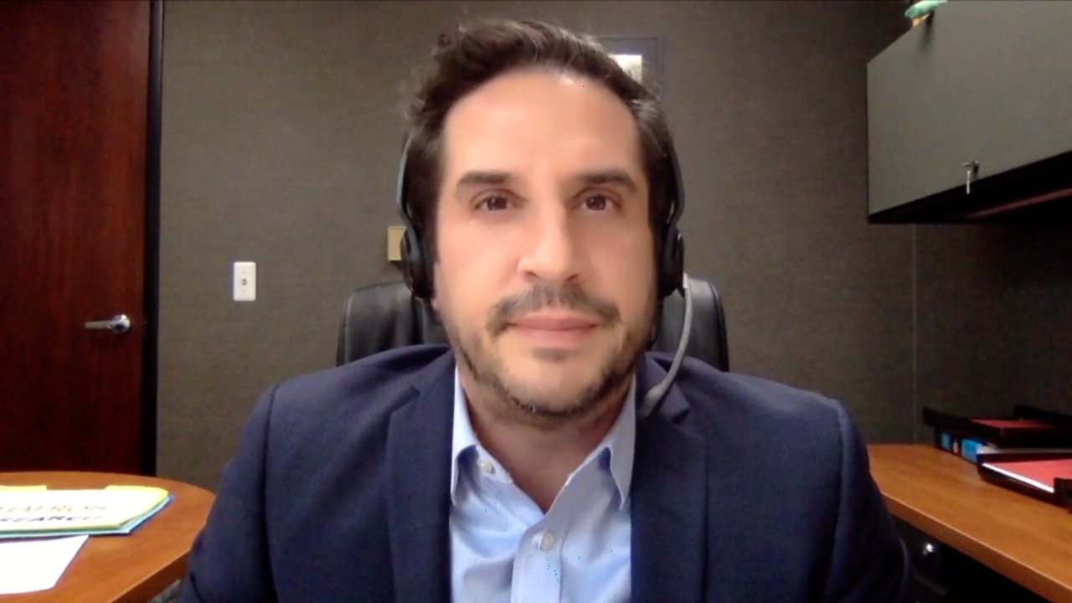
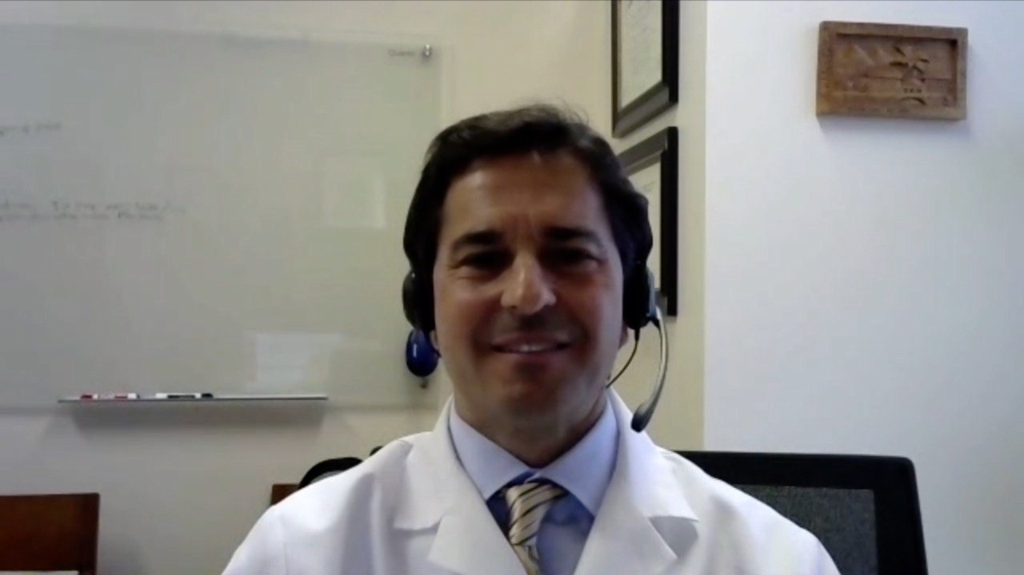

Laura Bukavina, MD, MPH Fox Chase Cancer Center
Philadelphia, Pennsylvania
David S Morris, MD
Urology Associates
Nashville, Tennessee
Jason Hafron, MD
Oakland University William Beaumont School of Medicine
West Bloomfield, Michigan
David A Taub, MD, MBA
Lynn Cancer Institute
Baptist Health South Florida Boca Raton, Florida
Paul Markowski, MD
Atlantic Health System
Summit, New Jersey

Slide 10
MODULE 1: Management Approaches
for Nonmetastatic Prostate Cancer

Slide 11
For your patients with high-risk biochemical (M0) recurrence after primary radiation therapy, in general, if you could access a PSMA PET scan, would you?
Yes
No

Slide 12
Case Presentation: A 70-year-old man with M0 HSPC
Dr Laura Bukavina (Philadelphia, Pennsylvania)

Slide 13
What form of ADT would you most likely recommend for a 53-year-old man with high-risk, node-positive prostate cancer at prostatectomy?
Relugolix
Leuprolide
Goserelin
Other

Slide 14
Case Presentation: A 53-year-old man with high-risk M0 HSPC and a slowly rising PSA
Dr David Morris (Nashville, Tennessee)

Slide 15
Management Approaches for Nonmetastatic Prostate Cancer
Raoul S. Concepcion, MD, FACS
Chief Science Officer
Nashville TN

Slide 16
Clinical Challenges
Detection of clinically significant disease
Management of HG/HR disease, non-metastatic
How will molecular imaging change the current landscape
Optimizing therapeutic choices and SE profiles, nmCRPC

Slide 17
Semantics
Localized Prostate Cancer
  Very Low Risk
  Low Risk
  Favorable Intermediate
  High Risk
  Very High Risk
Advanced Prostate Cancer
  What defines?
Metastatic Disease: Yes/No
Continuous Hormonal Status: Yes/No
CNPC/CSPC
CRPC

Slide 18
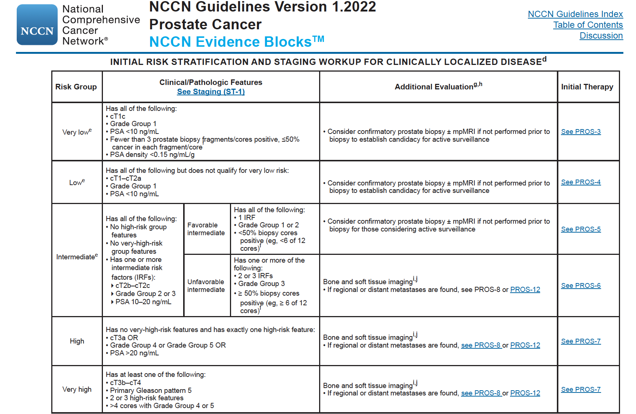
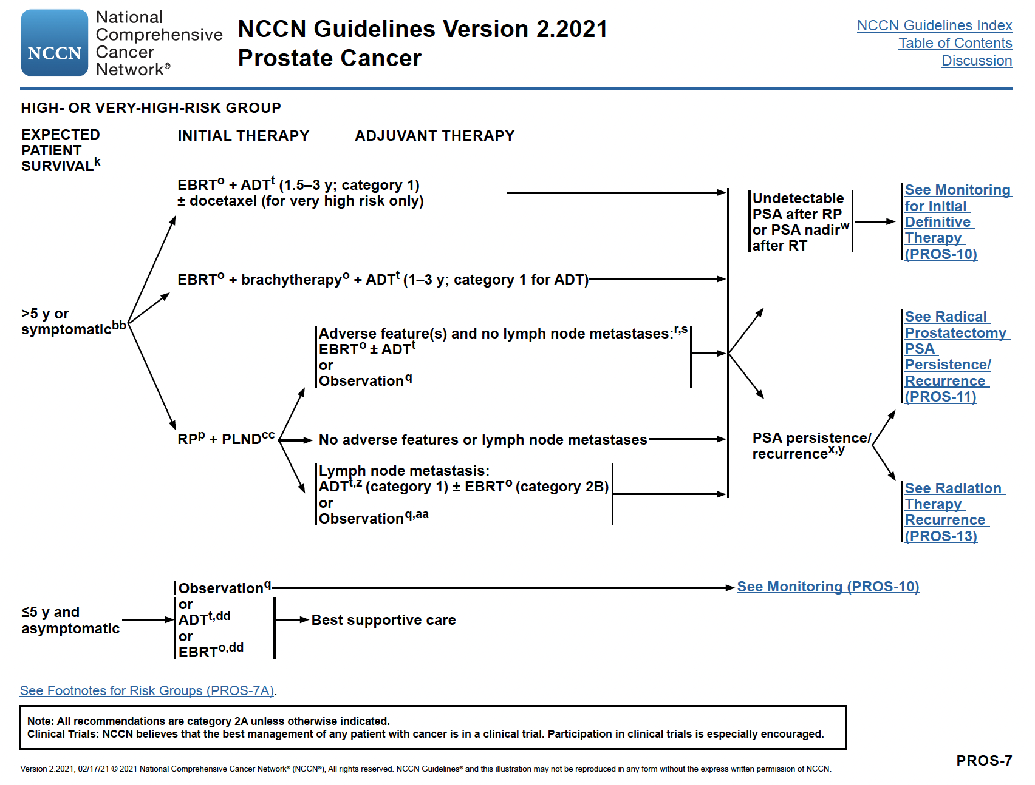

Slide 19
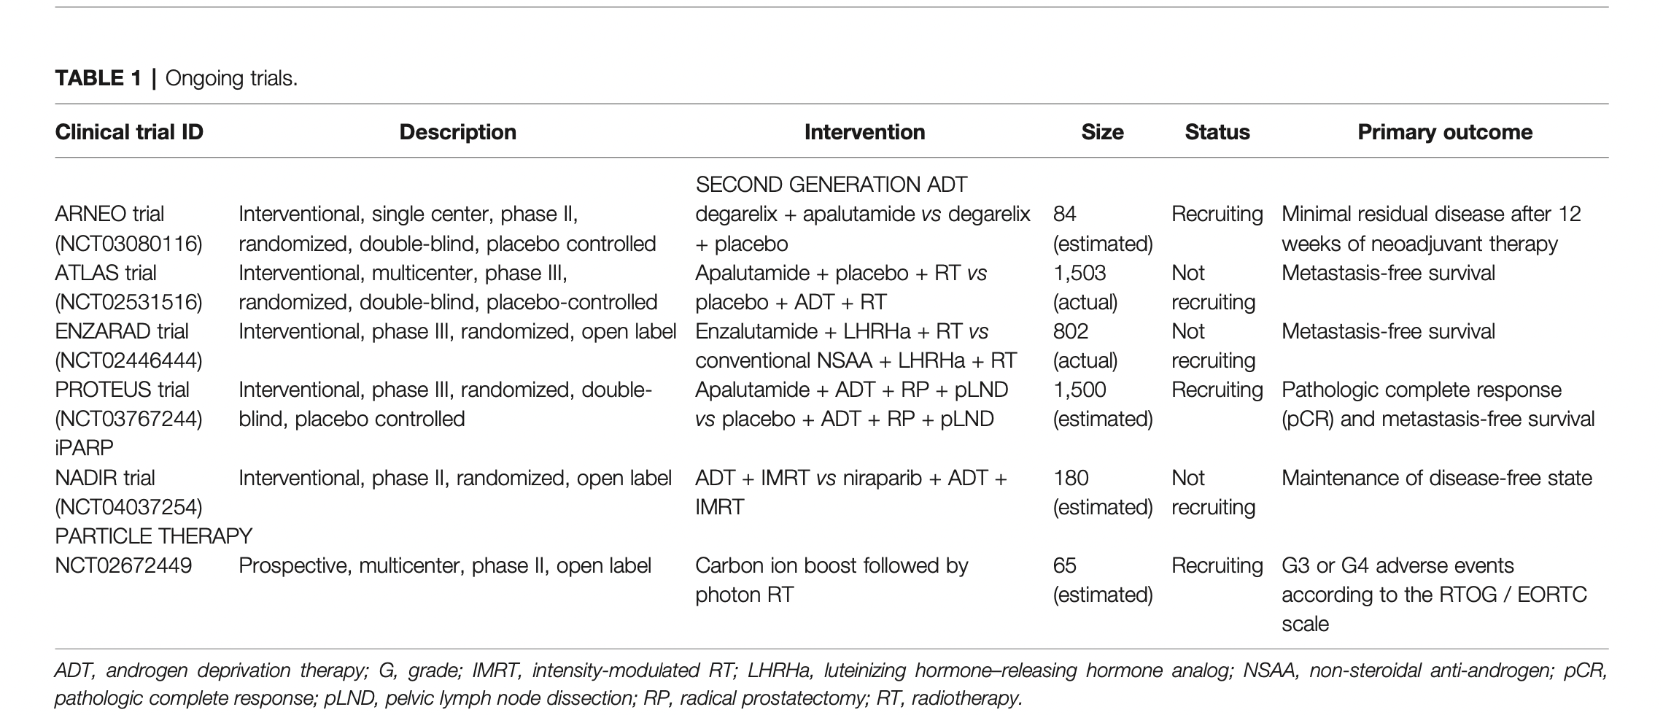
Ongoing Phase II & III Trials in High-Risk Prostate Cancer
Marvaso G et al. Front Oncol 2021;11:732766.

Slide 20
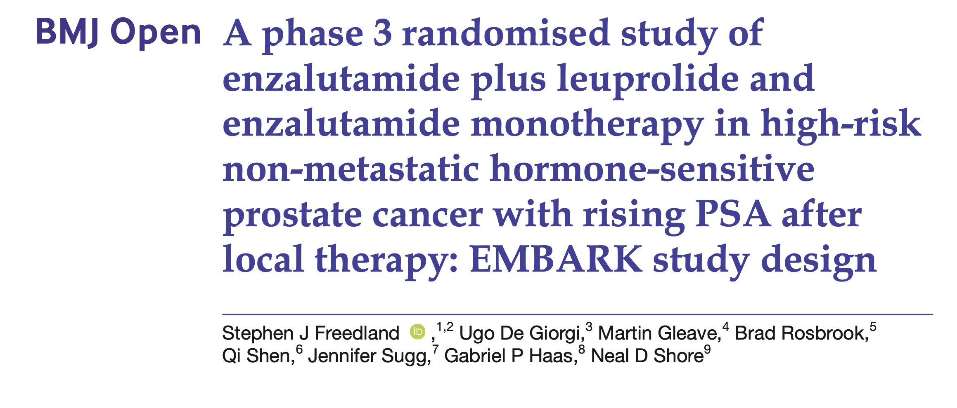

Slide 21
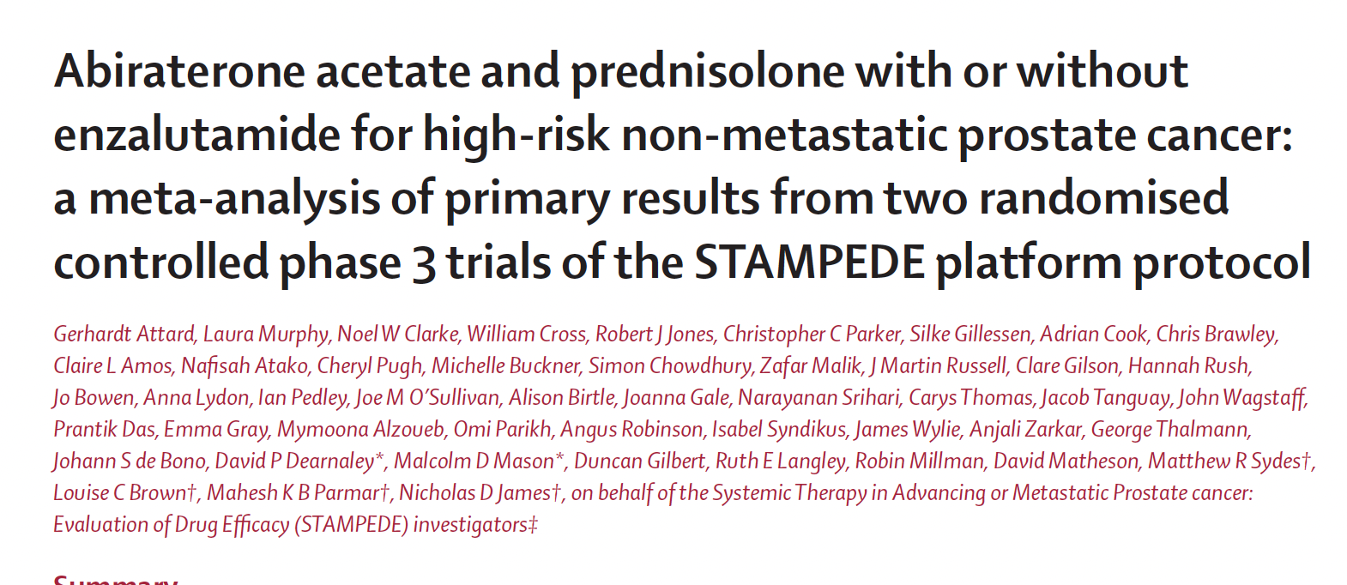

Slide 22
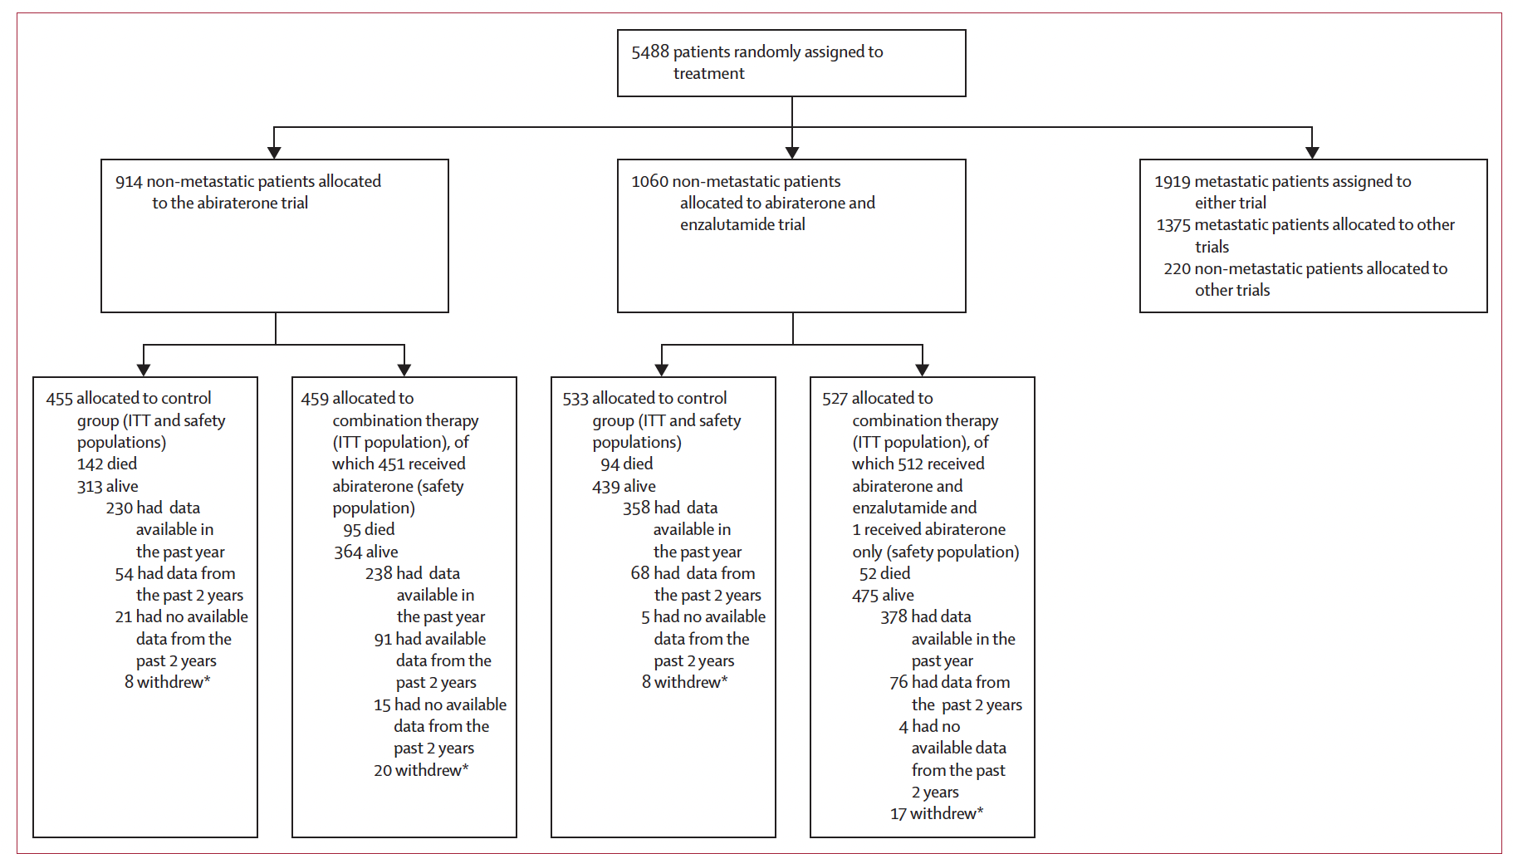
Attard G et al. Lancet 2022;399:447-60

Slide 23
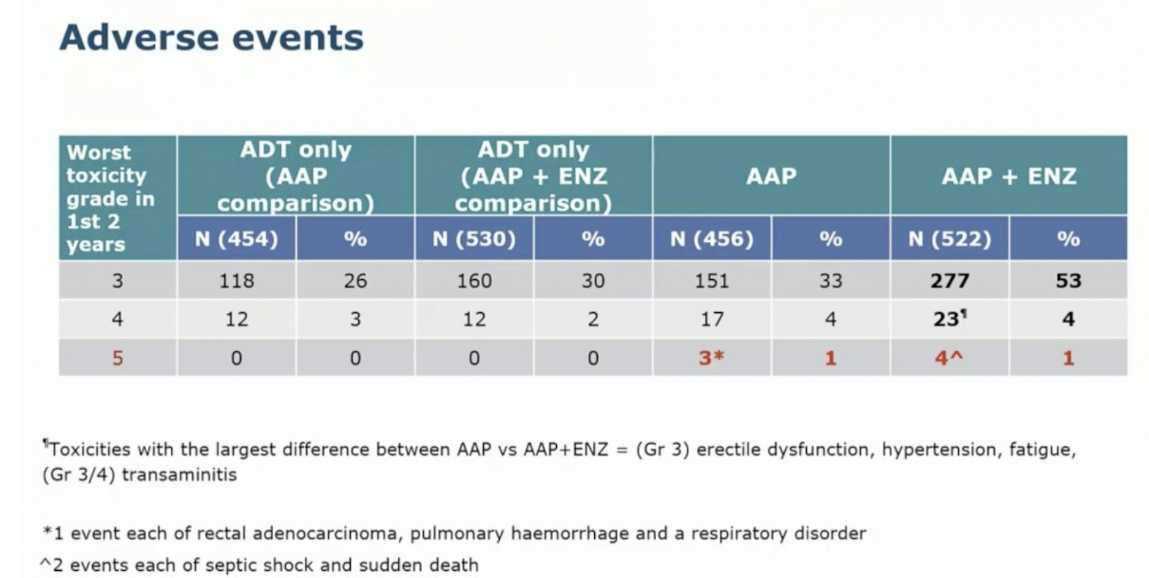
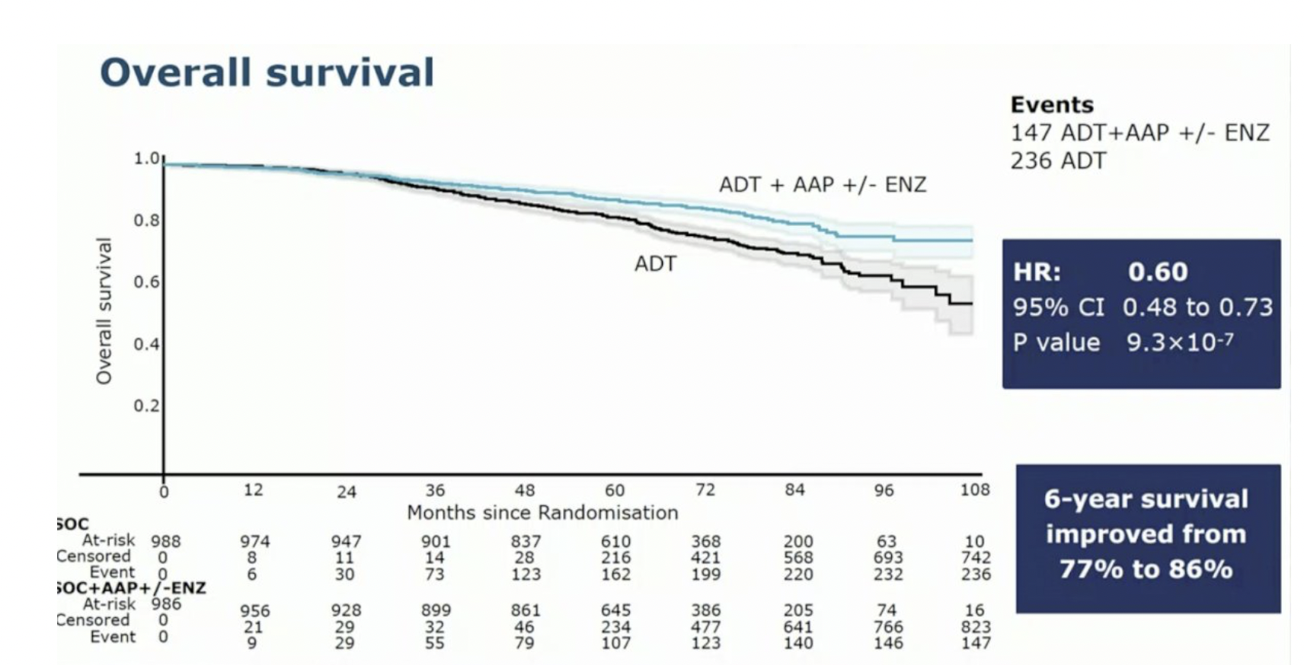
Attard G et al. Lancet 2022;399:447-60; Attard G et al. ESMO 2021;Abstract LBA4_PR.

Slide 24
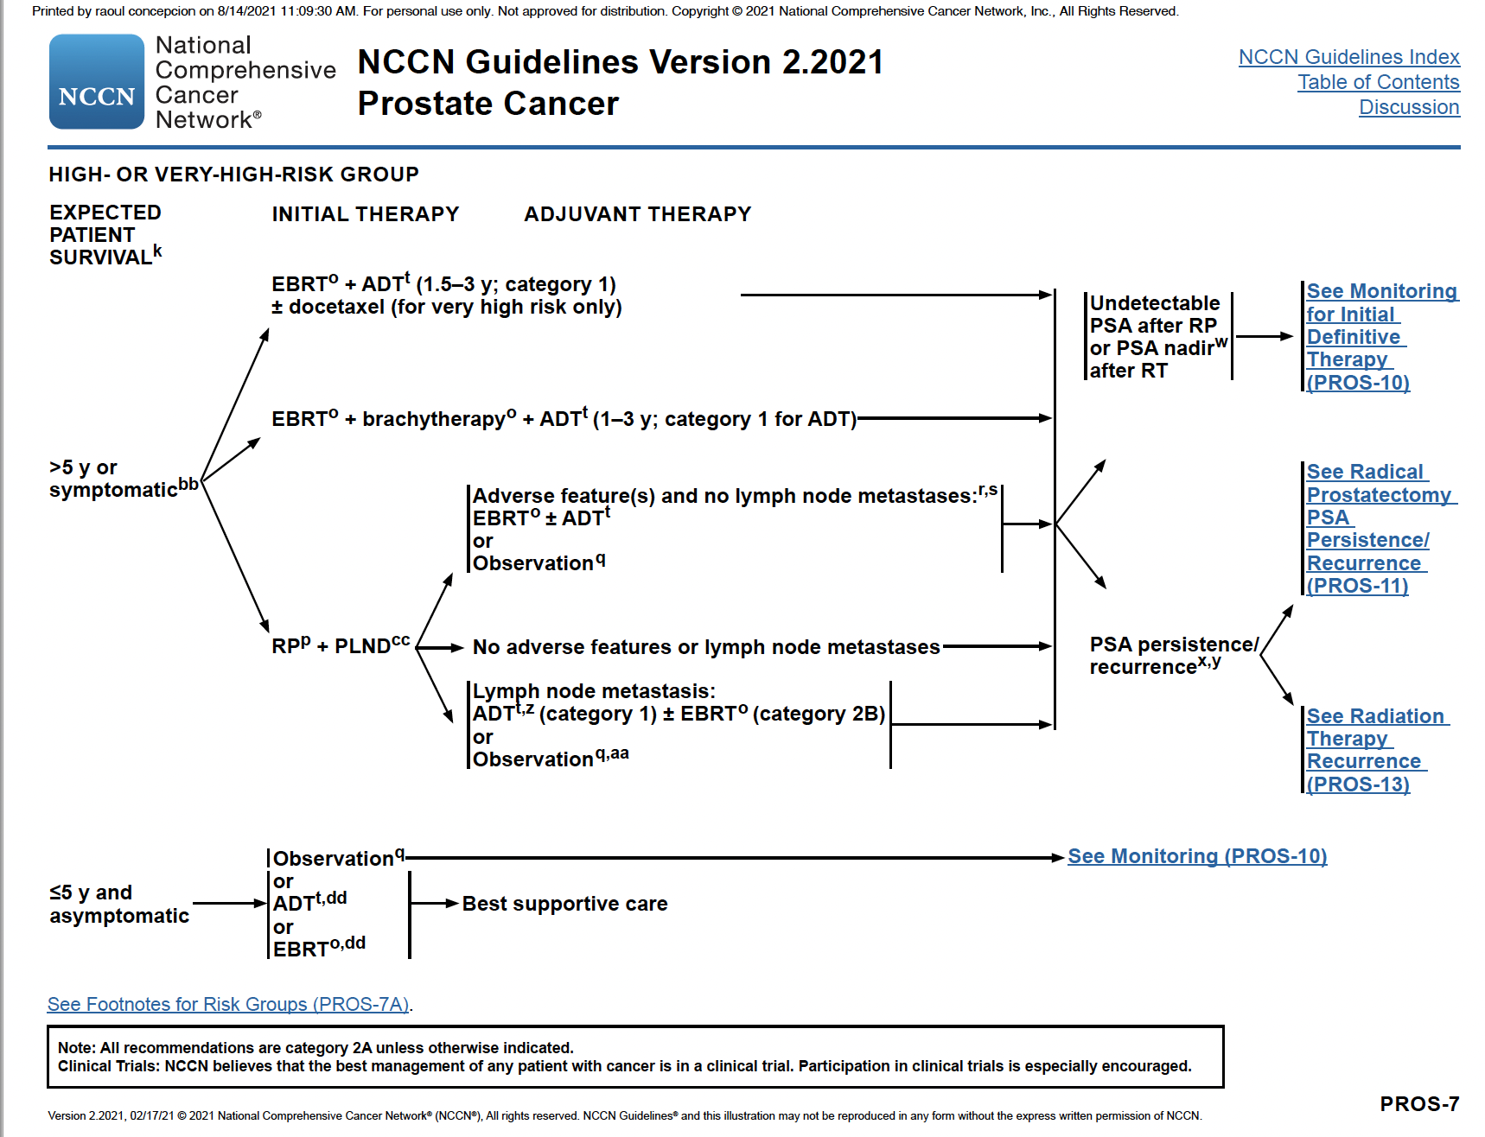
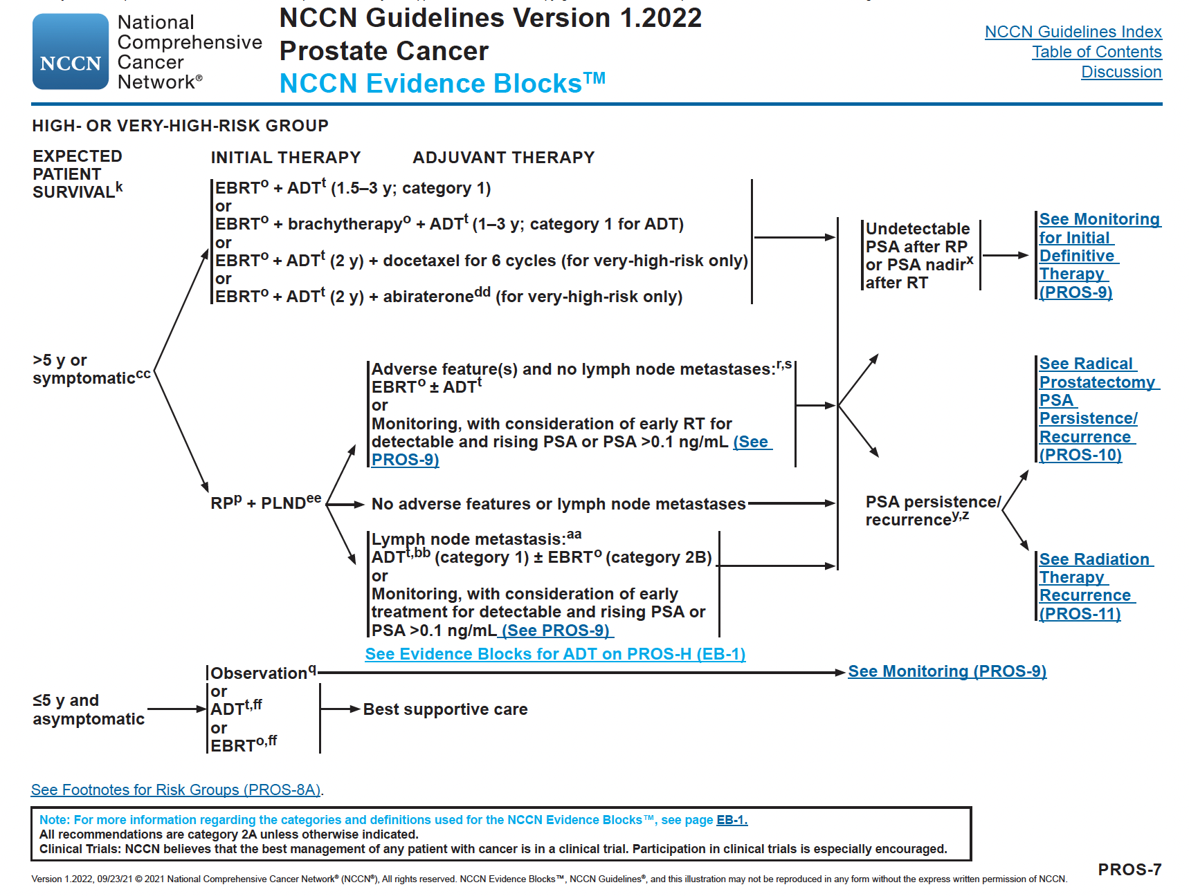

Slide 25
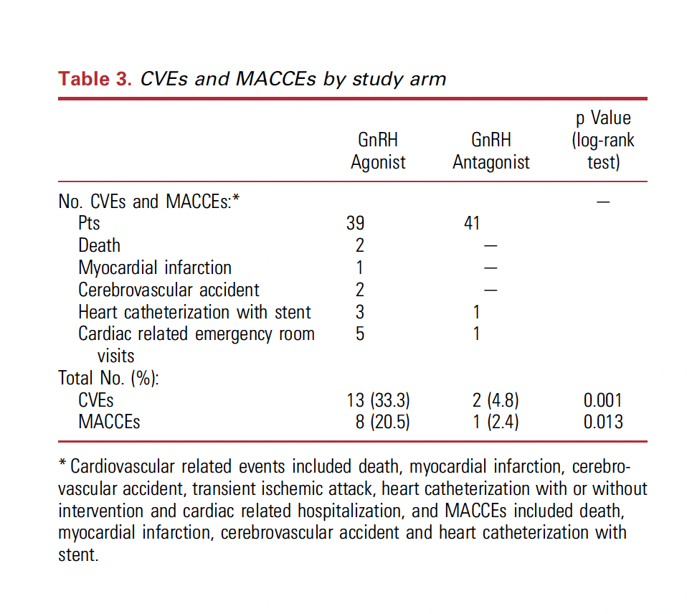
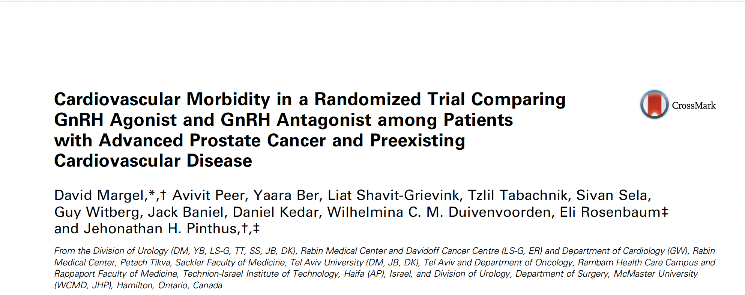

Slide 26
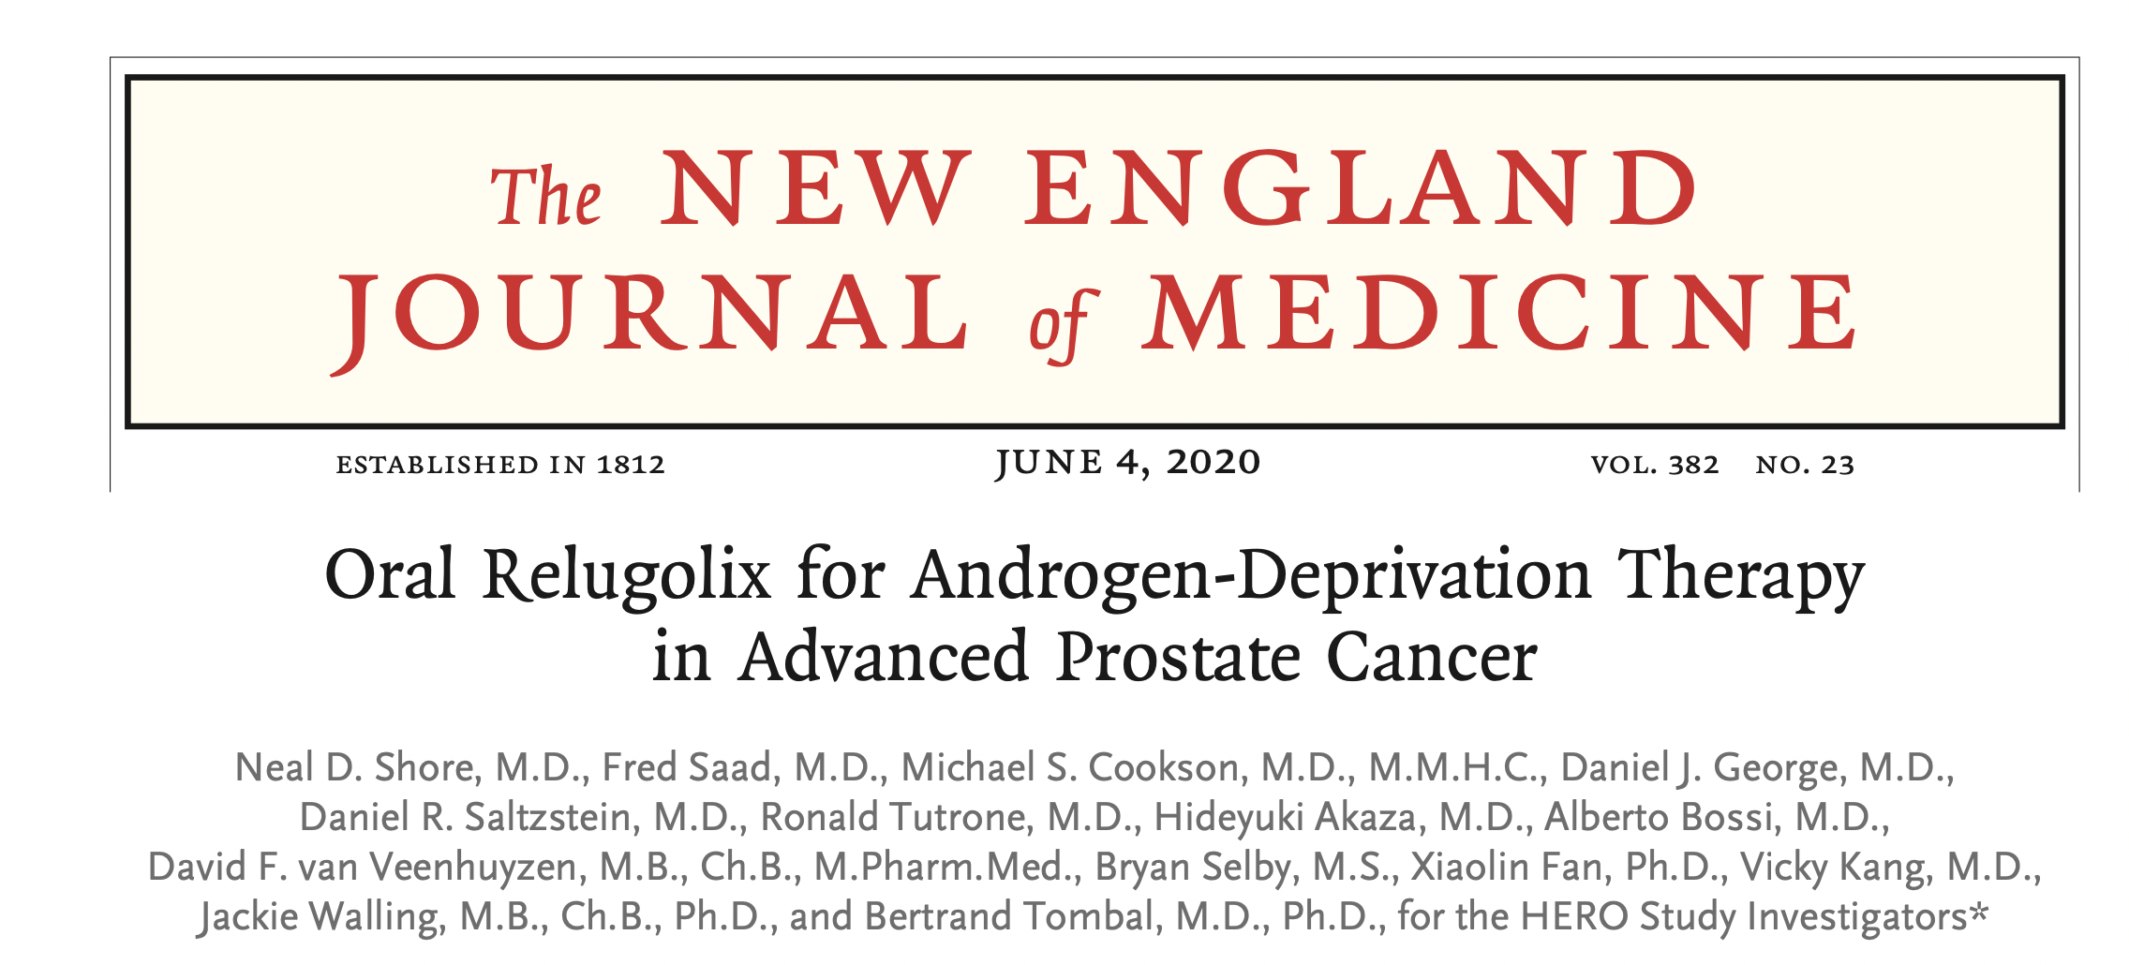

Slide 27
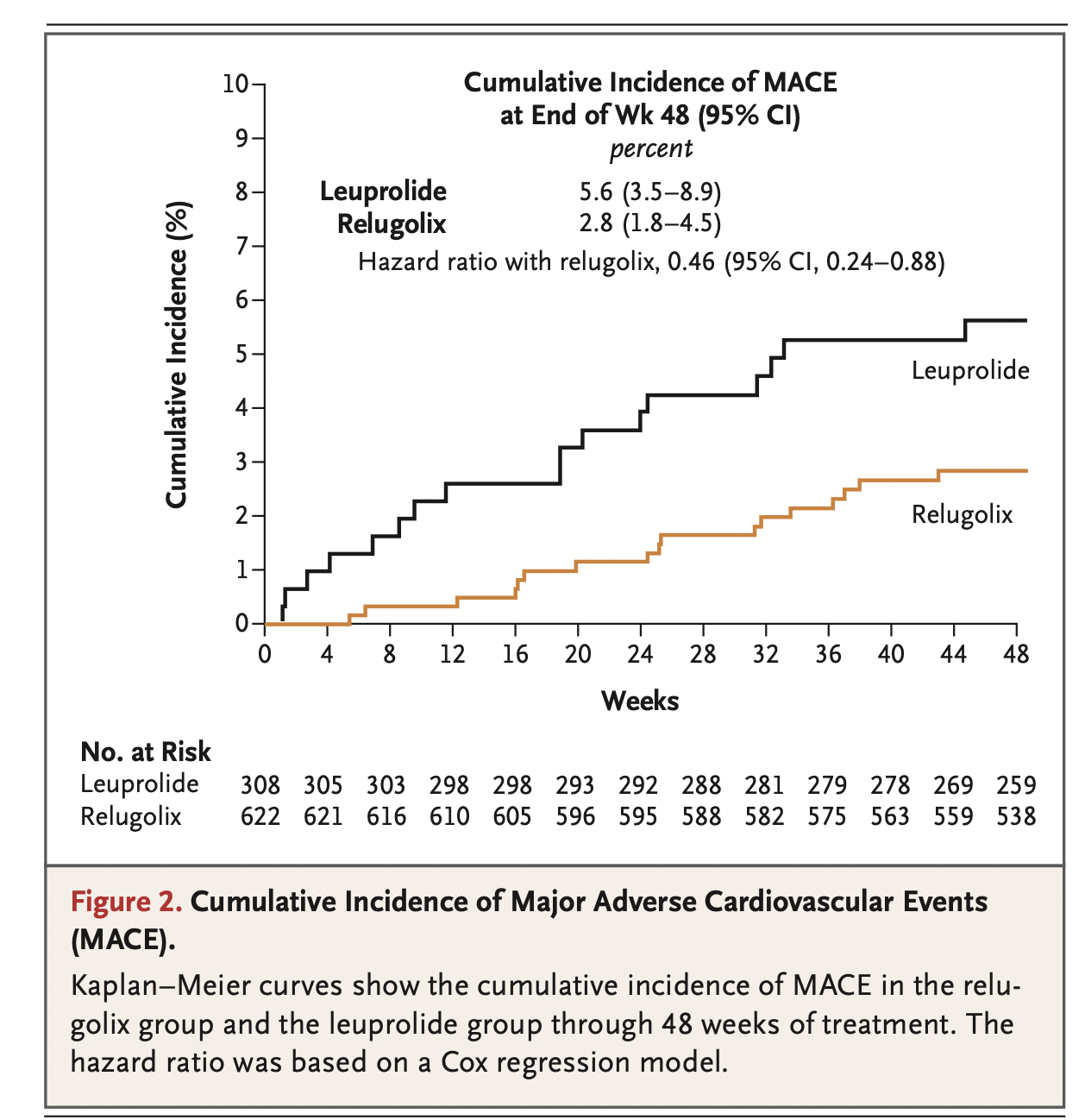
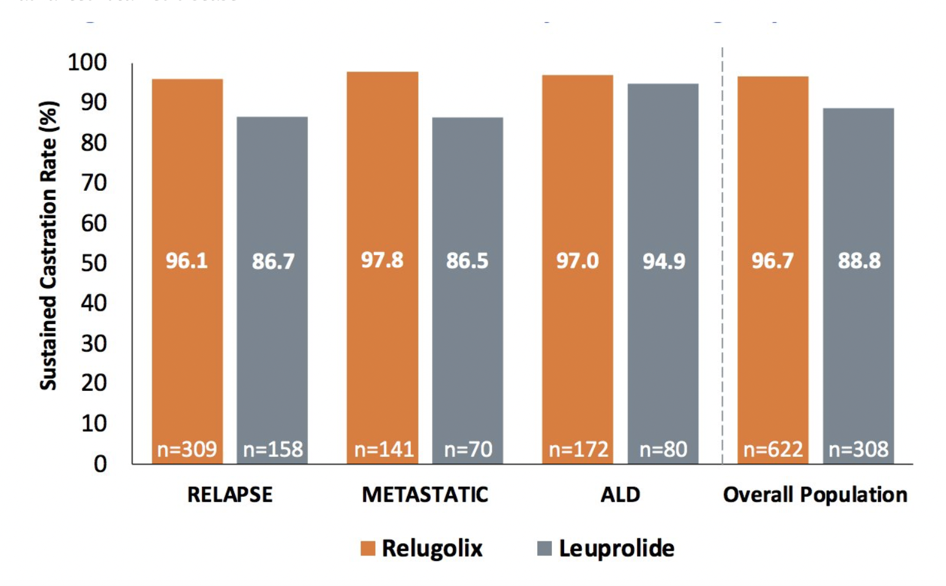
HERO Study: Sustained Castration Rates by Clinical Subgroups
Tombal B et al. ESMO 2021;Abstract 621P; Shore ND et al. N Engl J Med 2020;382(23):2187-2196.

Slide 28
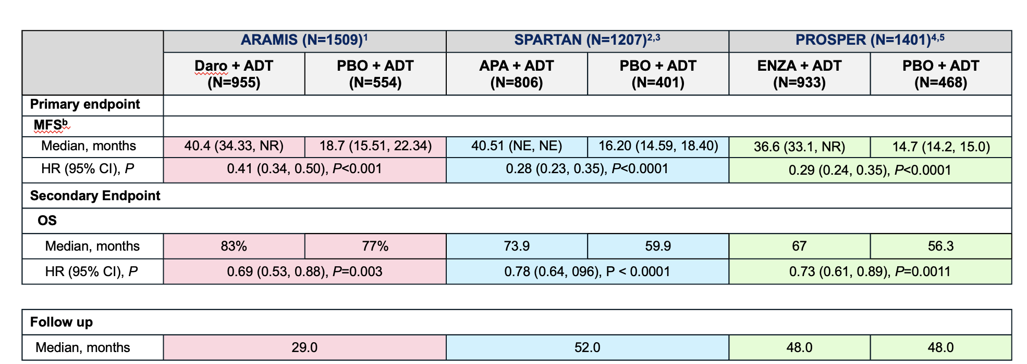
Efficacy Outcomes with Darolutamide, Apalutamide, Enzalutamide for nmCRPC
1. Fizazi K et al. N Engl J Med 2020;383:1040-9. 2. Smith MR et al. N Engl J Med 2019;378:1408-18. 3. Smith MR et al. Eur Urol 2021;79(1):150-8.
4. Hussain M et al. N Engl J Med 2018;378:2465-74. 5. Sternberg CN et al. N Engl J Med 2020;382:2192-206.

Slide 29
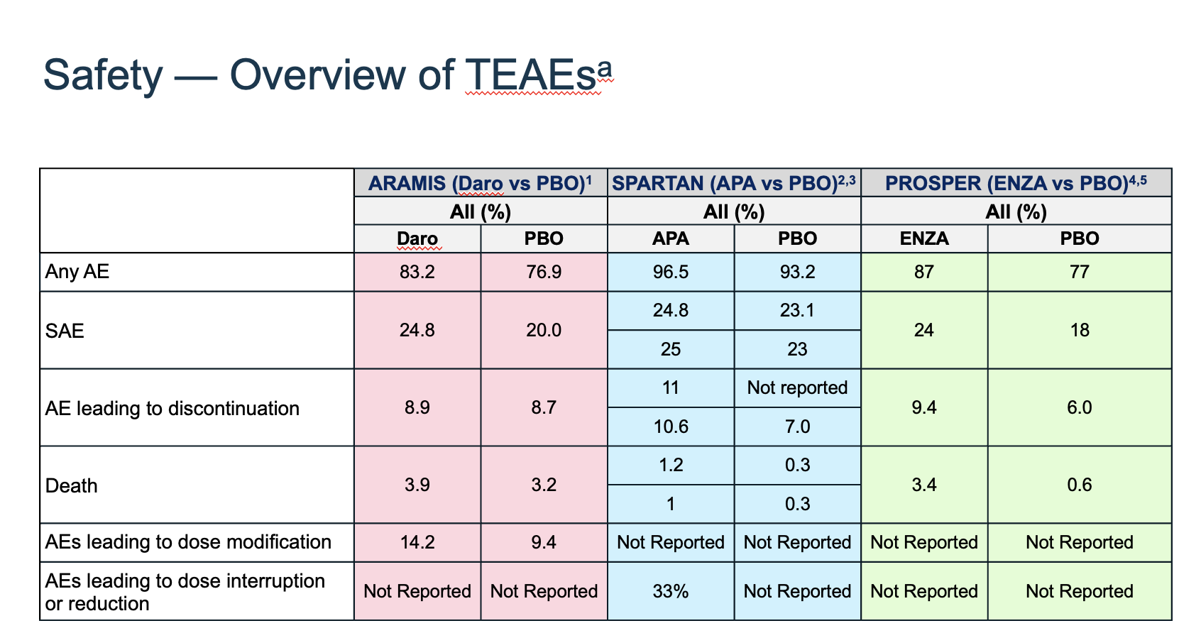
1. Fizazi K et al. N Engl J Med 2019;380:1235-46. Smith MR et al. N Engl J Med 2019;378:1408-18. 3. Smith MR et al. Eur Urol 2021;79(1):150-8.
4. Hussain M et al. N Engl J Med 2018;378:2465-74. 5. Sternberg CN et al. N Engl J Med 2020;382:2192-206.

Slide 30
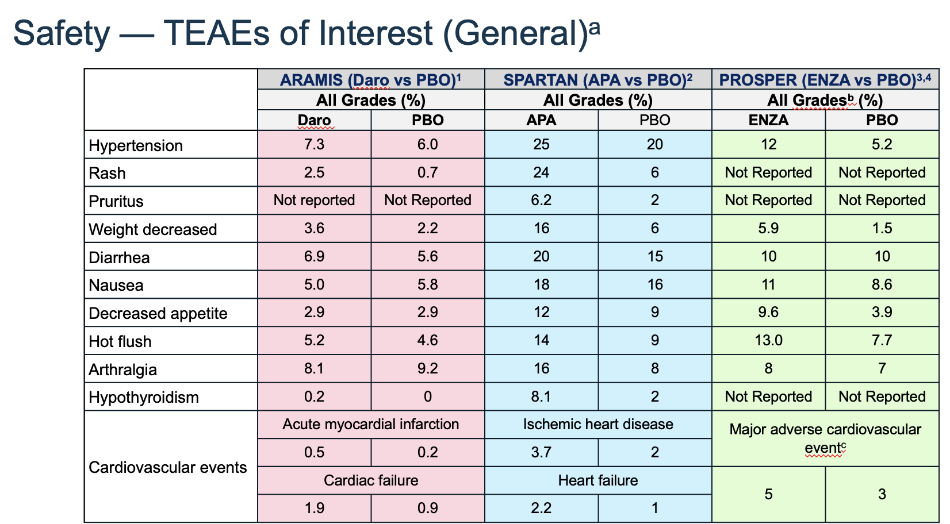
1. Fizazi K et al. N Engl J Med 2019;380:1235-46. 2. Smith MR et al. N Engl J Med 2019;378:1408-18.
3. Hussain M et al. N Engl J Med 2018;378:2465-74. 4. Sternberg CN et al. N Engl J Med 2020;382:2192-206.

Slide 31
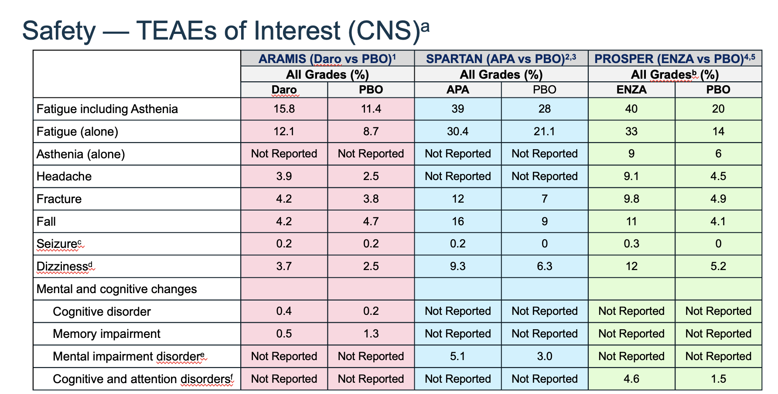
1. Fizazi K et al. N Engl J Med 2019;380:1235-46. 2. Smith MR et al. N Engl J Med 2019;378:1408-18. 3. Smith MR et al. Eur Urol 2021;79(1):150-8.
4. Hussain M et al. N Engl J Med 2018;378:2465-74. 5. Sternberg CN et al. N Engl J Med 2020;382:2192-206.

Slide 32
MODULE 2: Role of Treatment Intensification in Metastatic Hormone-Sensitive Prostate Cancer

Slide 33
Regulatory and reimbursement issues aside, what systemic therapy would you typically employ for a 59-year-old man presenting with bulky, high-volume metastatic hormone-sensitive prostate cancer (mHSPC)?
ADT alone
ADT and abiraterone
ADT and apalutamide
ADT and enzalutamide
ADT and darolutamide
ADT and docetaxel
ADT with docetaxel and secondary hormonal therapy
Other

Slide 34
A 59-year-old man with metastatic HSPC
Dr Paul Markowski
Summit, New Jersey
A 57-year-old man with metastatic
HSPC – germline BRCA2 mutation
Dr David Morris
Nashville, Tennessee

Slide 35
Regulatory and reimbursement issues aside, what systemic therapy would you typically employ for a 49-year-old man presenting with low-volume mHSPC?
ADT alone
ADT and abiraterone
ADT and apalutamide
ADT and enzalutamide
ADT and darolutamide
ADT and docetaxel
ADT with docetaxel and secondary hormonal therapy
Other

Slide 36
Case Presentation: A 49-year-old man with regionally advanced HSPC
Dr David Taub (Boca Raton, Florida)

Slide 37



Role of Treatment Intensification for Patients with Metastatic Hormone-Sensitive Prostate Cancer (mHSPC)
Matthew R. Smith, M.D.,Ph.D.
Professor of Medicine, Harvard Medical School
Director, MGH Genitourinary Malignancies Program
Notes:
37

Slide 38
Context
Men receiving androgen deprivation therapy (ADT) alone for metastatic prostate cancer have poor clinical outcomes
Survival is related to location and extent of disease
Treatment intensification by early addition of either docetaxel or an androgen receptor pathway inhibitor (ARPI) to ADT significantly improves overall survival
The addition of darolutamide or abiraterone to ADT and docetaxel improves overall survival

Slide 39
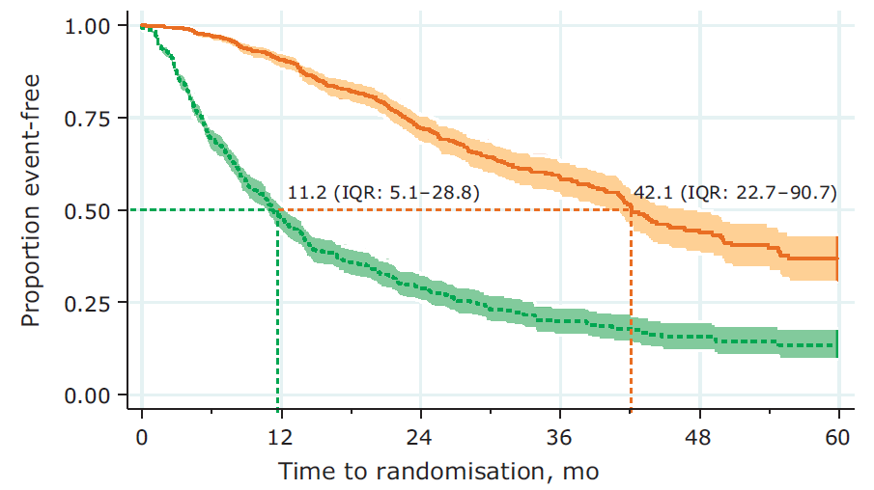
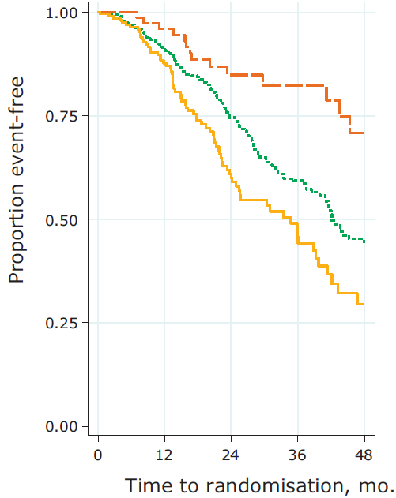
Clinical Outcomes in Metastatic Prostate Cancer:
STAMPEDE Experience with ADT
Death
Soft tissue only
Bone only
Bone and soft tissue
Failure event
(PSA progression, local progression, distant metastases, or death)
STAMPEDE Control Arm
metastatic disease
accrued 10/2005-1/2014
N=917
James ND et al (2015) Eur Urol 67: 1028-1038
Notes:
Figure 1 Kaplan–Meier Estimates of Radiographic Progression-free Survival and Overall Survival. Shown are data for the coprimary end points of radiographic progression-free survival (Panel A) and overall survival (Panel B). The dashed horizontal lines indicate medians. Hazard ratios are based on unstratified Cox regression models with treatment as the only covariate, with values of less than 1.00 favoring enzalutamide.

Slide 40
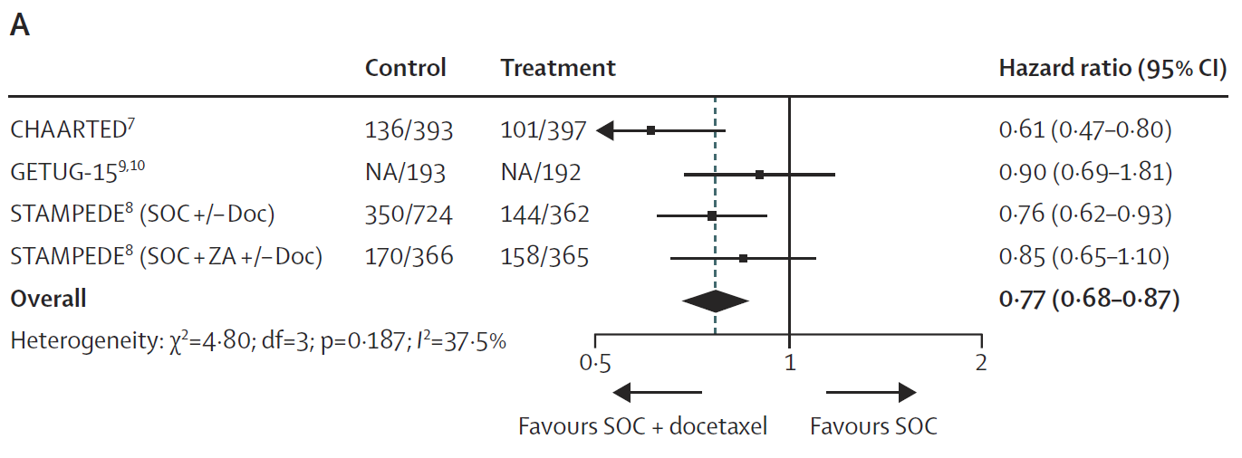
Meta-Analysis of RCTs of Docetaxel in mHSPC
Overall Survival
Results based on 2992 men/2204 events
9% absolute improvement in survival at 4 years
Vale et al. Lancet Oncol 2016; 17(2):243-56

Slide 41
CHAARTED: Docetaxel for mHSPC
SPARTAN ─ Overall Study Design
Phase 3 Placebo-Controlled, Randomized International Study
Sweeney et al (2015) N Engl J Med 373: 737-46

Slide 42
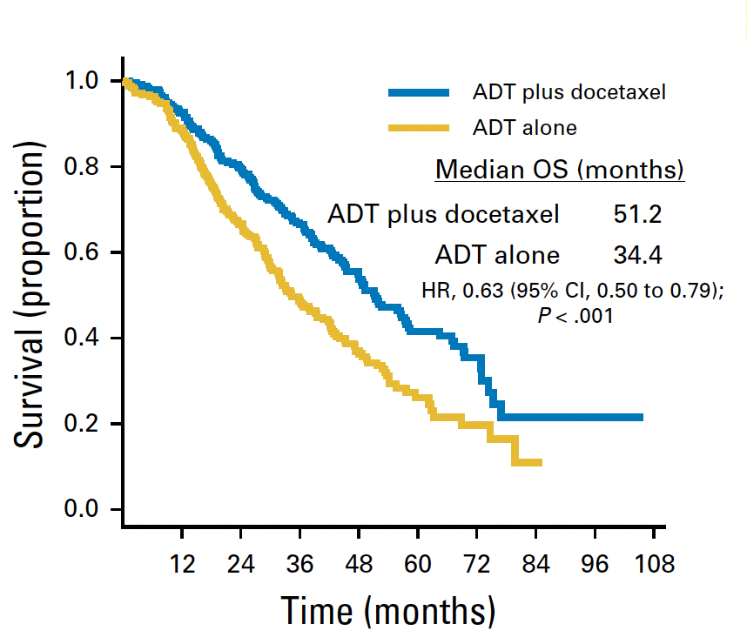
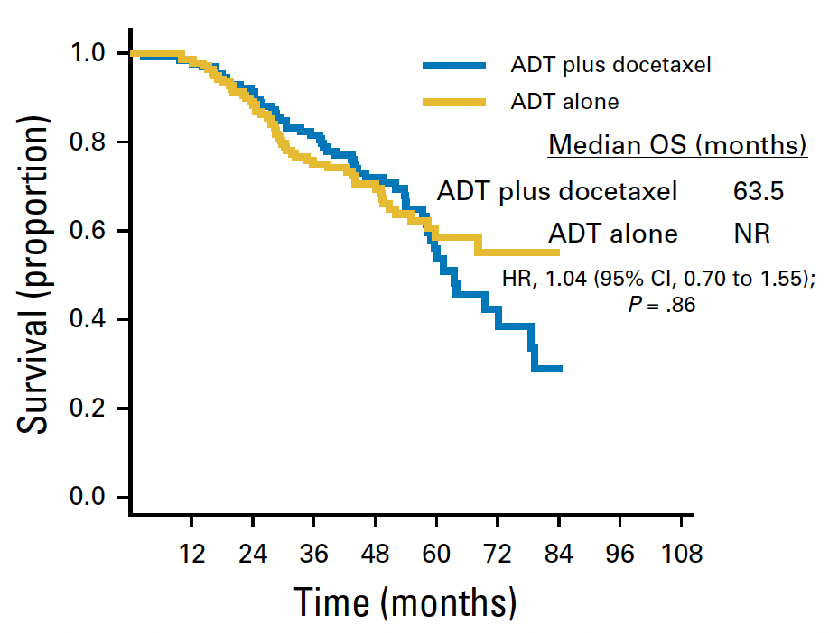
CHAARTED: OS for High vs Low Volume Disease
High Volume Low Volume
Kyriakopoulos et al (2018) J Clin Oncol 36: 1080-0187

Slide 43
LATITUDE: Abiraterone Acetate for mHSPC
SPARTAN ─ Overall Study Design
Phase 3 Placebo-Controlled, Randomized International Study
Radiographic Progression-Free Survival Overall Survival
Fizazi et al (2017) N Engl J Med 377: 352-60

Slide 44
STAMPEDE: Docetaxel vs Abiraterone Comparison
SPARTAN ─ Overall Study Design
Phase 3 Placebo-Controlled, Randomized International Study
Sydes et al (2018) Annals of Oncology 29:1235-1248

Slide 45
STAMPEDE: Docetaxel vs Abiraterone Comparison
SPARTAN ─ Overall Study Design
Phase 3 Placebo-Controlled, Randomized International Study
Overall Survival
Sydes et al (2018) Annals of Oncology 29:1235-1248

Slide 46
TITAN: Apalutamide for mHSPC
SPARTAN ─ Overall Study Design
Phase 3 Placebo-Controlled, Randomized International Study
Radiographic Progression-Free Survival Overall Survival
HR 0.48, P<0.001 HR 0.67, P=0.005
Chi et al (2019) N Engl J Med 381: 13-24

Slide 47
Overall Survival
SPARTAN ─ Overall Study Design
Phase 3 Placebo-Controlled, Randomized International Study
TITAN Subgroup Analyses
Chi et al (2019) N Engl J Med 381: 13-24

Slide 48
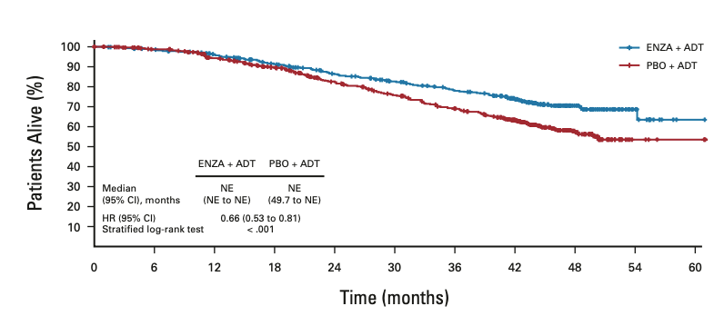
ARCHES: Enzalutamide for mHSPC
SPARTAN ─ Overall Study Design
Phase 3 Placebo-Controlled, Randomized International Study
rPFS
OS
Armstrong et al (2019) J Clin Oncol 37: 2974-2986; Armstrong et al (2022) J Clin Oncol DOI: 10.1200/JCO.22.00193

Slide 49
ENZAMET: Enzalutamide for mHSPC
Clinical Progression-Free Survival Overall Survival
Davis et al (2019) N Engl J Med 381: 121-131

Slide 50
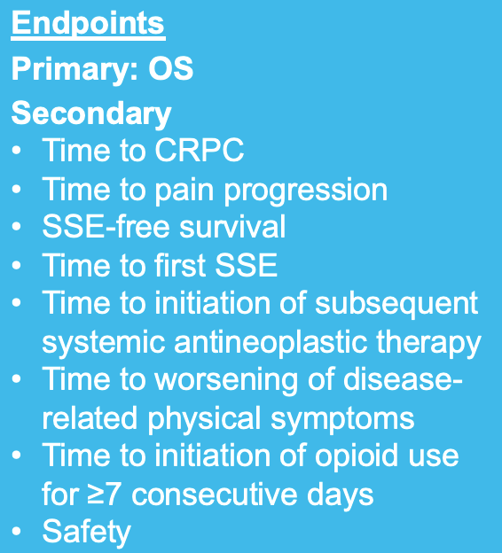
50
ARASENS Study Design
Global, randomized, double-blind, placebo-controlled phase III study (NCT02799602)
Docetaxel × 6
Endpoints
Primary: OS
Secondary
Time to CRPC
Time to pain progression
SSE-free survival
Time to first SSE
Time to initiation of subsequent systemic antineoplastic therapy
Time to worsening of disease-related physical symptoms
Time to initiation of opioid use for ≥7 consecutive days
Safety
Patients (N=1306)
mHSPC
ECOG PS 0 or 1
Candidates for ADT and docetaxel
Stratification
Extent of disease: M1a vs M1b vs M1c
ALP < vs ≥ ULN
Darolutamide 600 mg twice daily + ADT
1:1
randomization
(N=1305*)
Primary analysis
Placebo twice daily + ADT
Docetaxel × 6
FPFV: Nov 2016
LPFV: June 2018
Data cut-off
Oct 25, 2021
The primary analysis was planned to occur after ~509 deaths
Secondary efficacy endpoints were tested hierarchically
*One enrolled patient was excluded from all analysis sets because of Good Clinical Practice violations. ALP, alkaline phosphatase; CRPC, castration-resistant prostate cancer; ECOG PS, Eastern Cooperative Oncology Group performance status; FPFV, first patient first visit; LPFV, last patient first visit; M1a, nonregional lymph node metastases only; M1b, bone metastases ± lymph node metastases; M1c, visceral metastases ± lymph node or bone metastases; Q3W, every 3 weeks; SSE, symptomatic skeletal event; ULN, upper limit of normal.
Smith et al (2022) N Engl J Med DOI: 10.1056/NEJMoa2119115

Slide 51
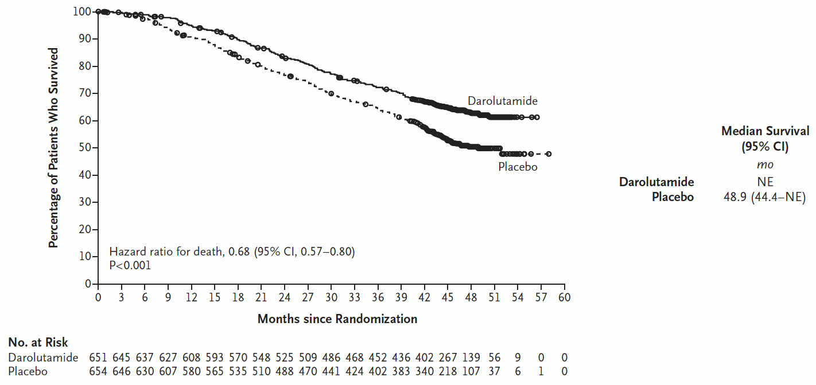
ARASENS Primary Endpoint: Overall Survival
Smith et al (2022) N Engl J Med DOI: 10.1056/NEJMoa2119115

Slide 52
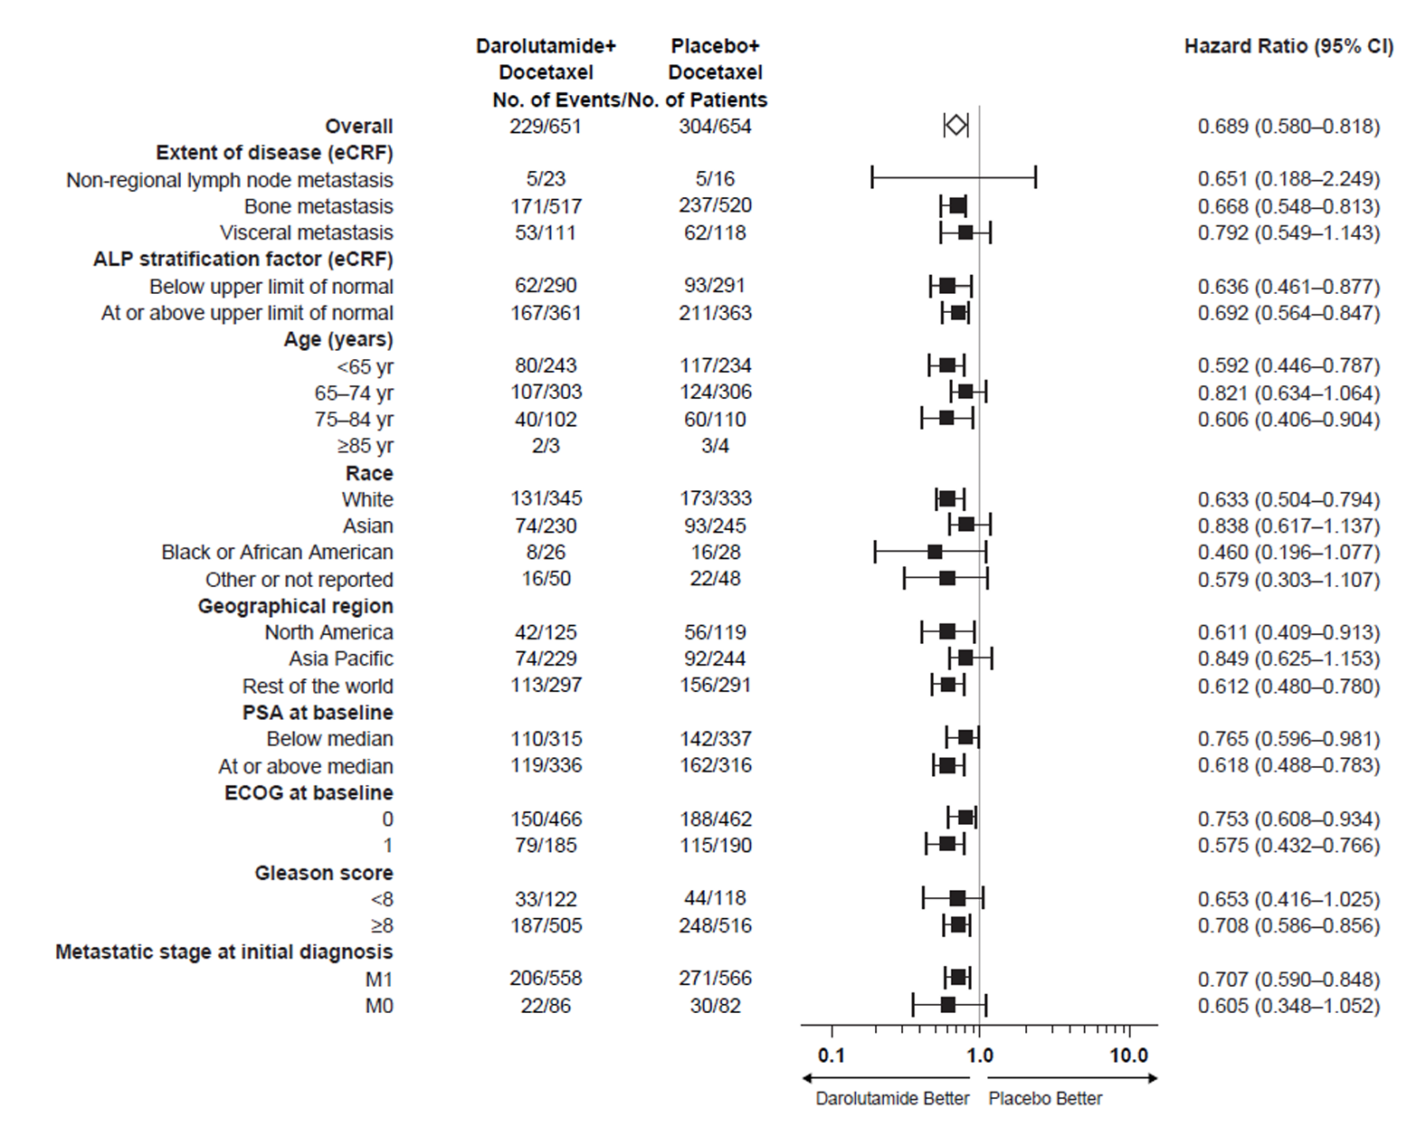
ARASENS: Subgroup Analyses for Overall Survival
Smith et al (2022) N Engl J Med DOI: 10.1056/NEJMoa2119115

Slide 53
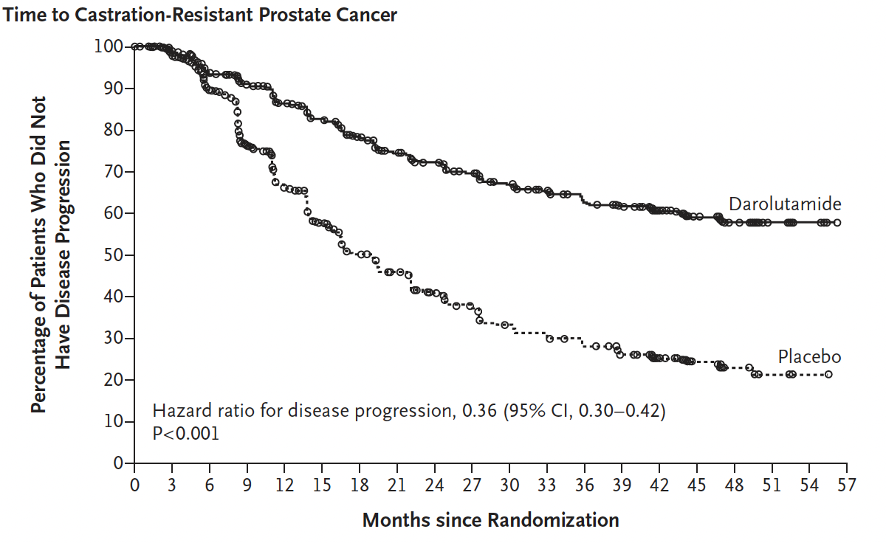
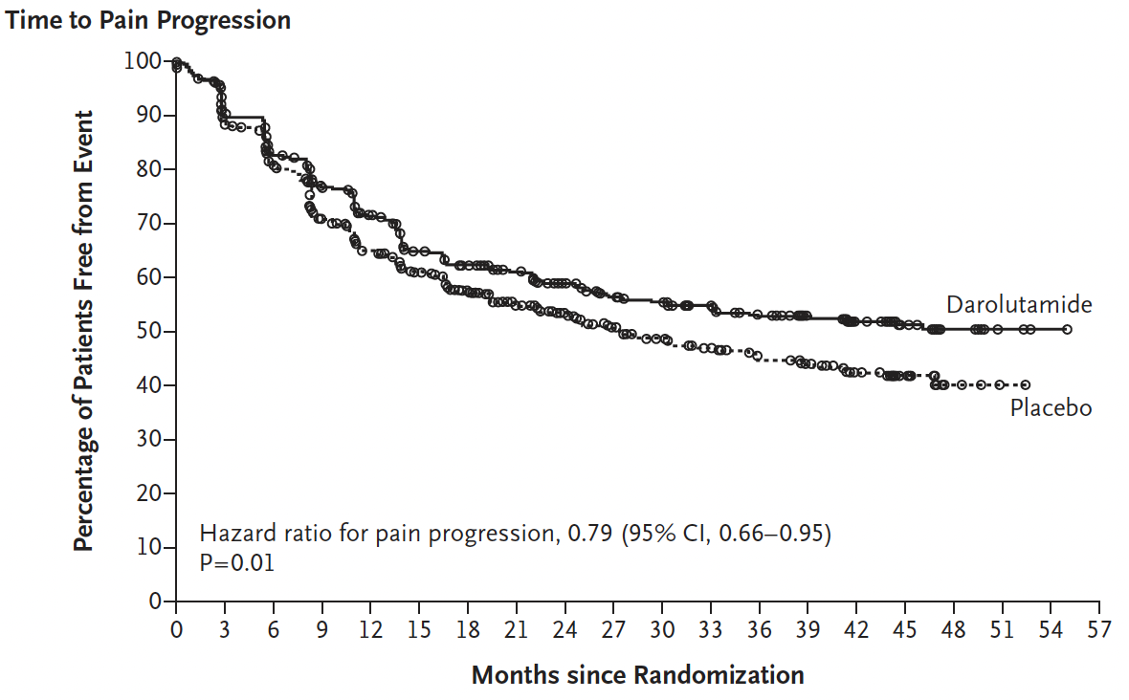
ARASENS: Key Secondary Endpoints
Time to Castration-Resistant Prostate Cancer Time to Pain Progression
Smith et al (2022) N Engl J Med DOI: 10.1056/NEJMoa2119115

Slide 54
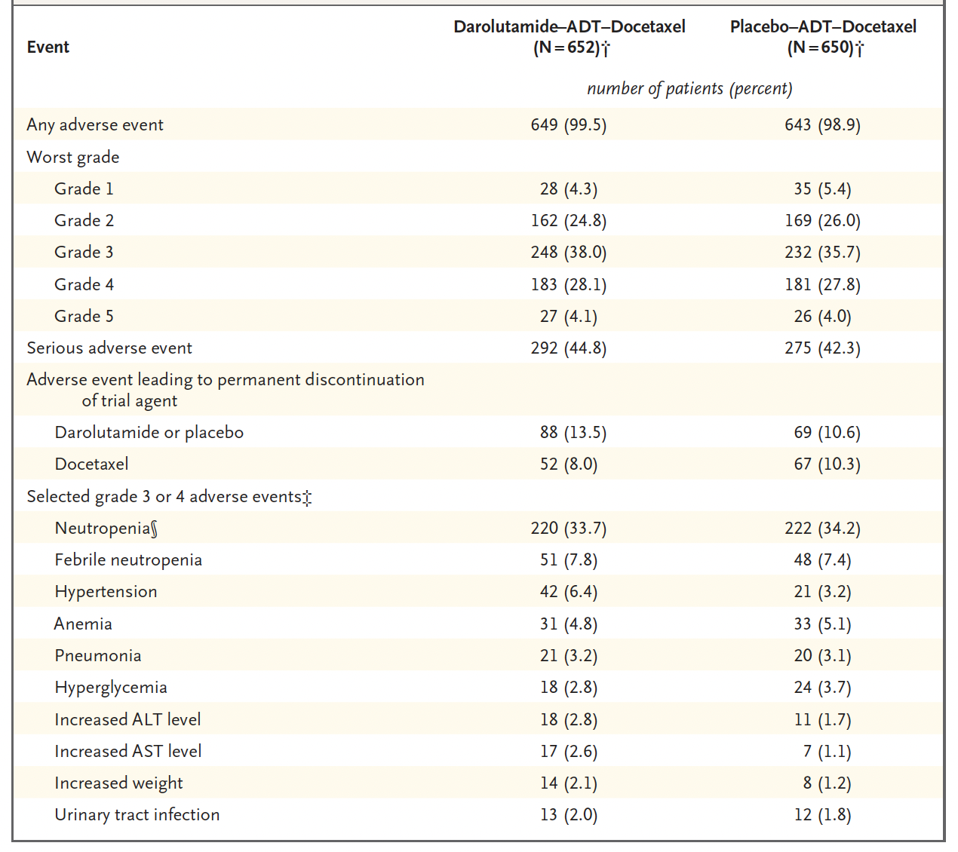
ARASENS: Safety
Smith et al (2022) N Engl J Med DOI: 10.1056/NEJMoa2119115

Slide 55
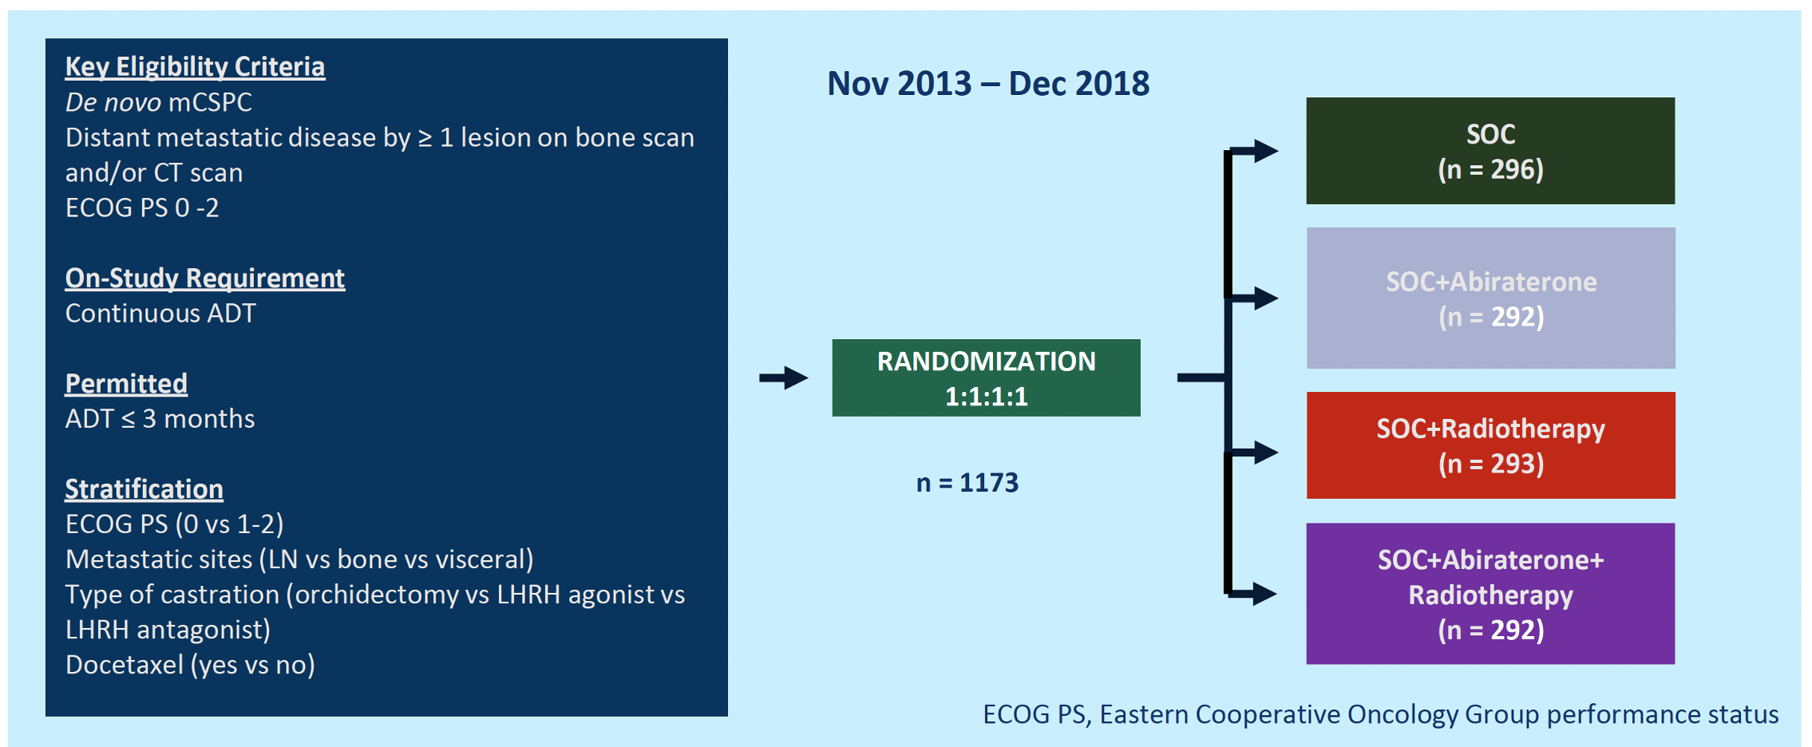

PEACE-1 Study Design

Slide 56
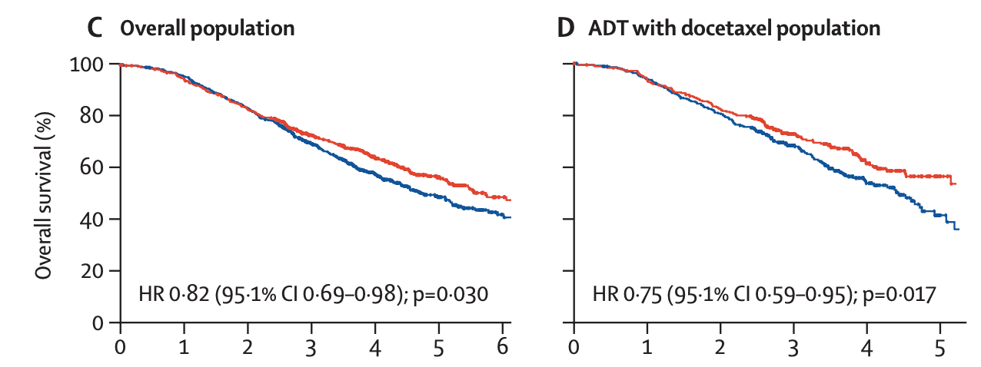
PEACE-1: Overall Survival
Fizazi et al (2022) Lancet https://doi.org/10.1016/ S0140-6736(22)00367-1

Slide 57
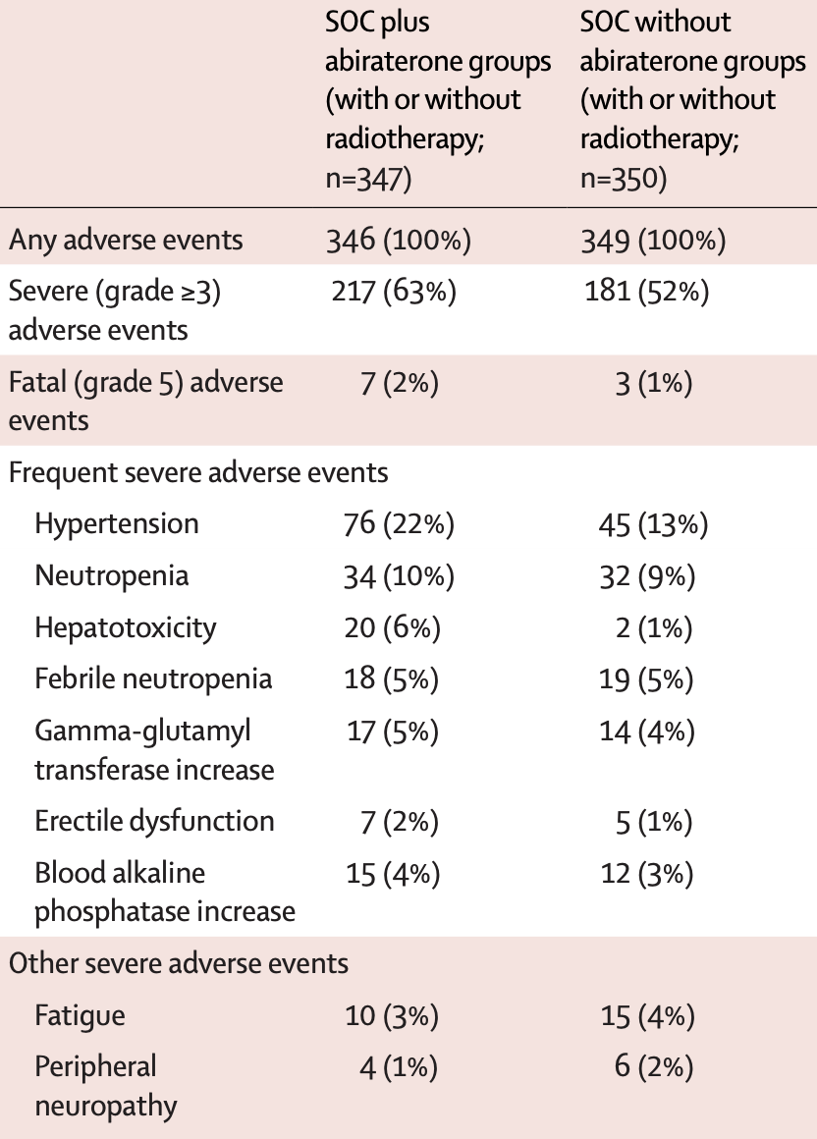
PEACE-1: Safety in Docetaxel Subgroup
Fizazi et al (2022) Lancet https://doi.org/10.1016/ S0140-6736(22)00367-1

Slide 58
Conclusions
ADT alone is no longer a standard of care for most patients with mHSPC
Treatment intensification improves overall survival in mHSPC
  ADT + docetaxel > ADT alone
  ADT + ARPI >ADT alone
  ADT + docetaxel + darolutamide > ADT + docetaxel
  ADT + docetaxel + abiraterone > ADT + docetaxel
Most/all patients with mHSPC should receive an ARPI:
  ADT +ARPI
  ADT + docetaxel + ARPI (darolutamide or abiraterone)

Slide 59
MODULE 3: Selection and Sequencing of Therapy for Metastatic CRPC

Slide 60
An 83-year-old man with metastatic castration-resistant prostate cancer (mCRPC) to the bone who previously received ADT + enzalutamide prefers not to receive chemotherapy at this time. Regulatory and reimbursements issues aside, what systemic treatment would you most likely recommend?
Abiraterone
Sipuleucel-T
Radium-223
¹⁷⁷Lu-PSMA-617
Abiraterone + olaparib
Other

Slide 61
An 83-year-old man with metastatic CRPC –
CHEK2, AR and APC gene mutations
Dr Jason Hafron
West Bloomfield, Michigan
A 67-year-old man with metastatic CRPC who received ¹⁷⁷Lu-PSMA-617
Dr Jason Hafron
West Bloomfield, Michigan

Slide 62
In general, do you offer sipuleucel-T to patients with asymptomatic mCRPC?
Yes
Yes, in select patients
No

Slide 63
An 81-year-old man with metastatic CRPC and disease progression on multiple therapies
Dr Paul Markowski
Summit, New Jersey
A 62-year-old man with metastatic CRPC and asymptomatic bone metastases
Dr Paul Markowski
Summit, New Jersey

Slide 64
Sequencing of Therapy for Metastatic CRPC (mCRPC)
Emmanuel S. Antonarakis, M.D.
Clark Endowed Professor of Medicine
Division of Hematology/Oncology and Transplantation
University of Minnesota, Masonic Cancer Center
Minneapolis, MN

Slide 65
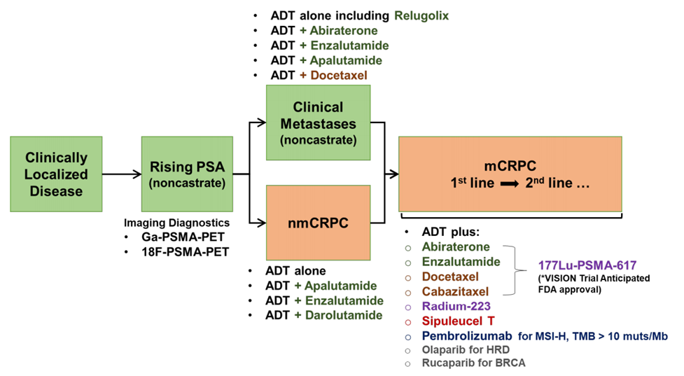
Treatment Landscape for mCRPC
PARPi for BRCA1/2
Pembro for MSI-hi
Positive PSMA-PET

Slide 66
Selection and Sequencing of Therapy

Slide 67

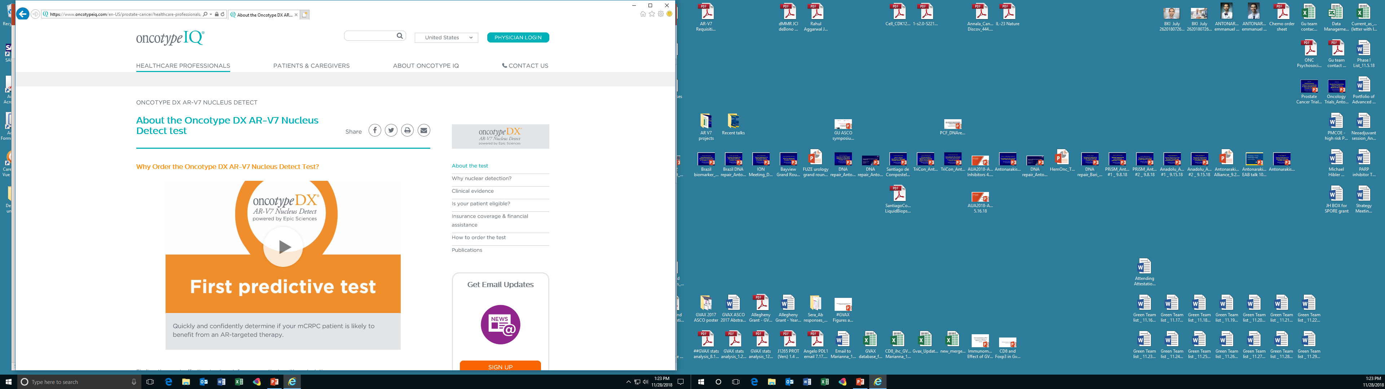
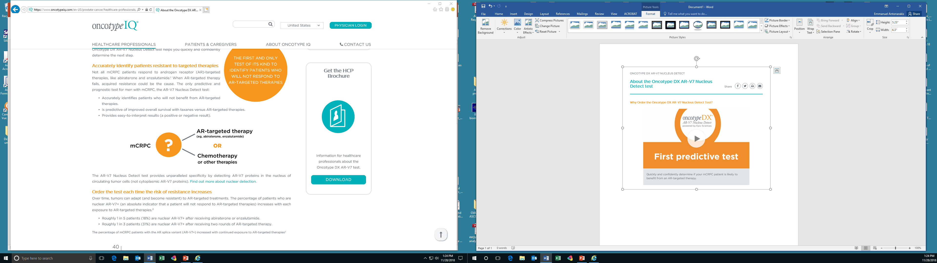
AR-V7

Slide 68
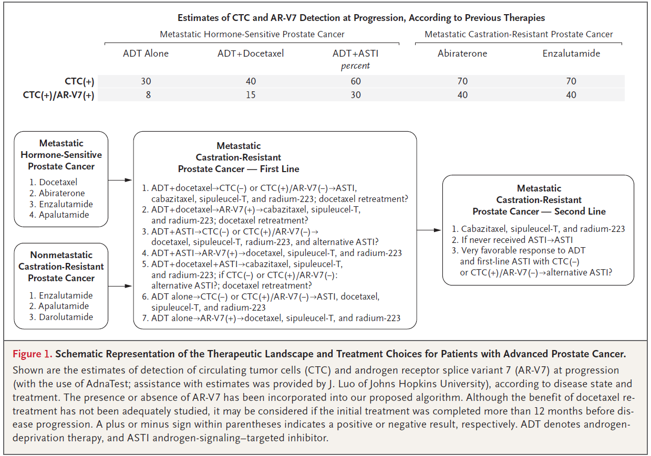
Therapy Sequencing in mCRPC …. Complicated!
Eisenberger MA, Antonarakis ES. NEJM 2019; 381: 2564-2566.

Slide 69
Abi → Enza vs Enza → Abi

Slide 70
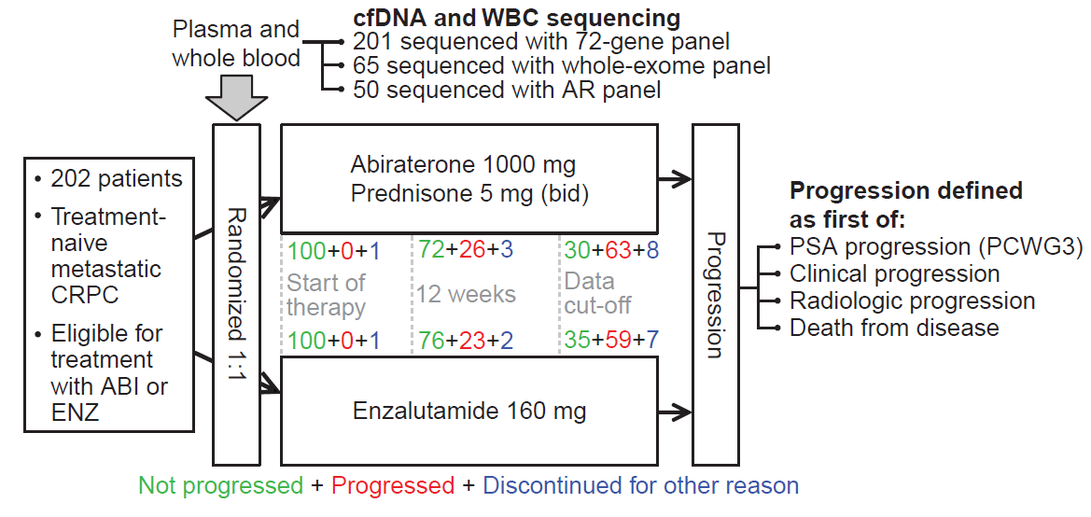
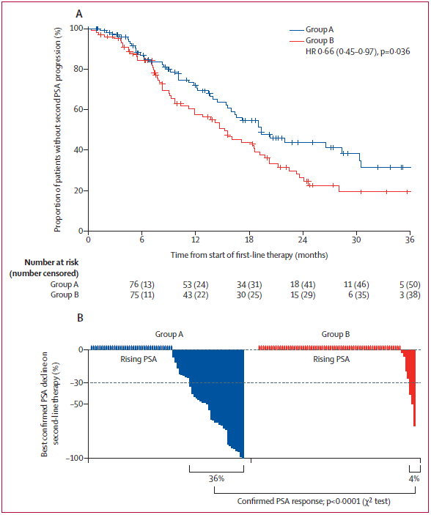
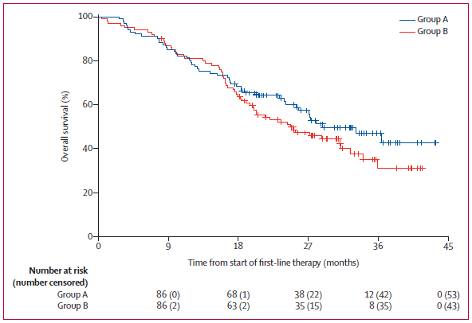
GUTG-001 Study
PFS2
Abi –> Enza
Enza –> Abi
OS
Abi –> Enza
Abi –> Enza
Enza –> Abi
Enza –> Abi
Khalaf DJ, et al. Lancet Oncol 2019; 20: 1730-39.

Slide 71
The CARD trial

Slide 72
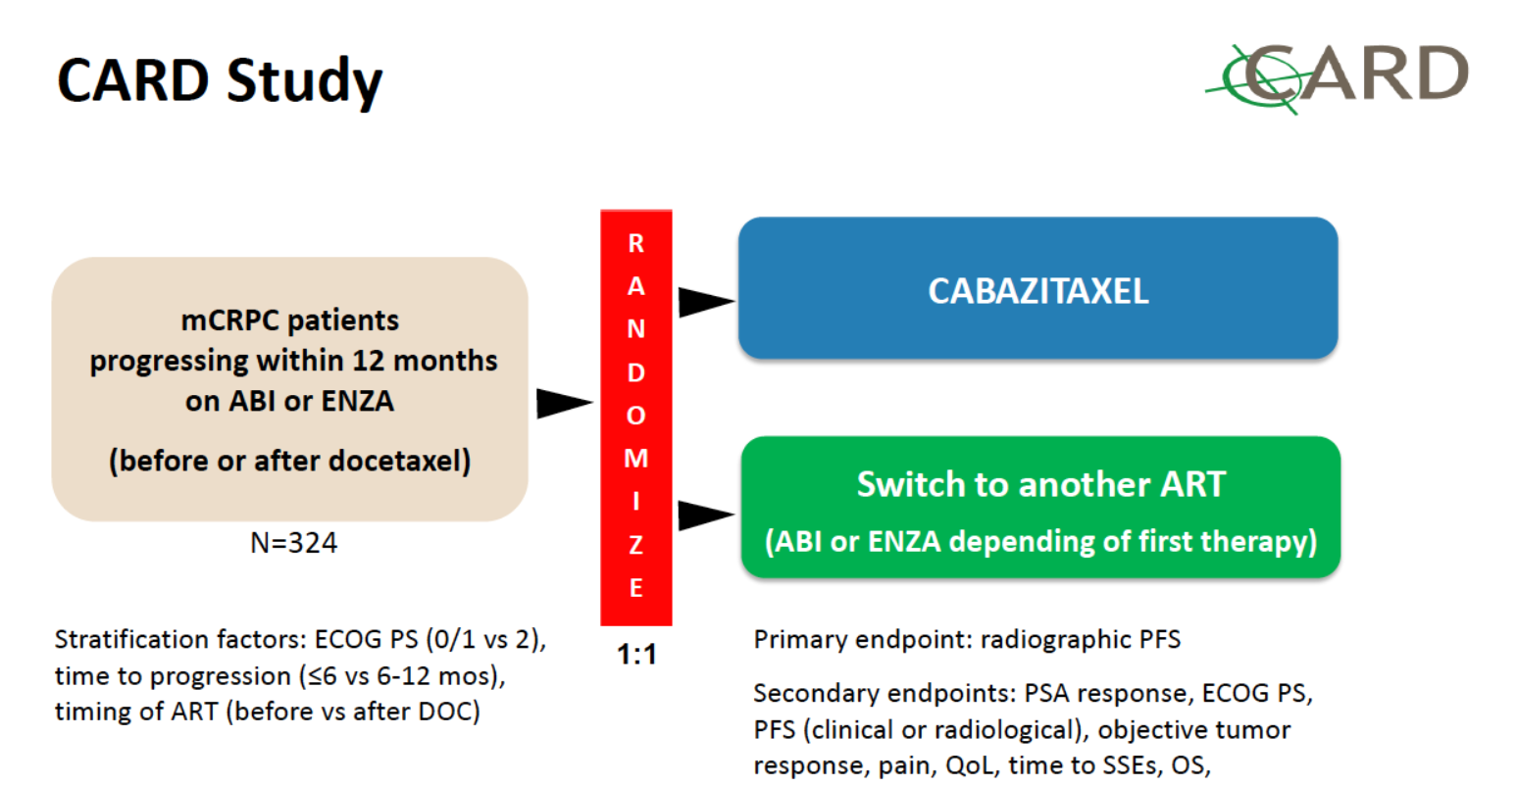
N = 255
on first therapy)
de Wit R, et al. NEJM 2019; 381: 2506-2518.

Slide 73
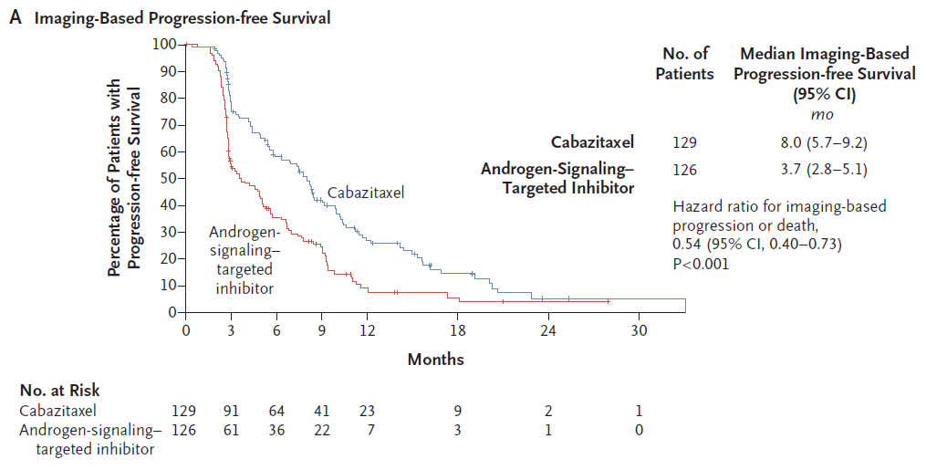
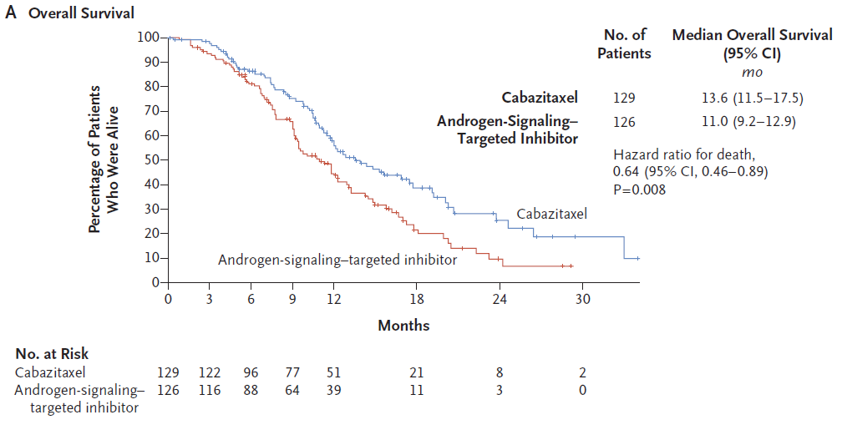
The CARD trial
de Wit R, et al. NEJM 2019; 381: 2506-2518.

Slide 74
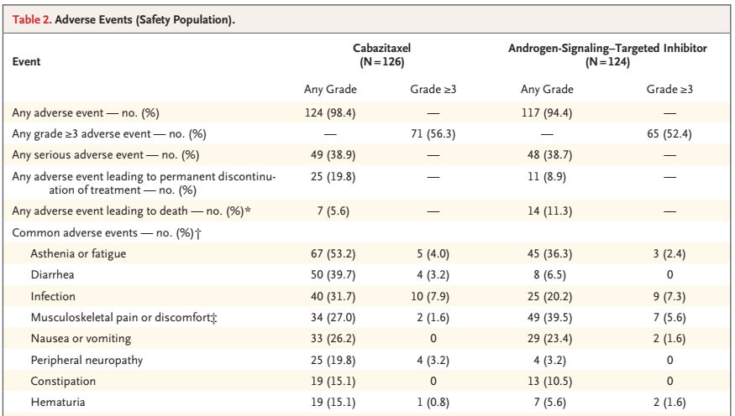
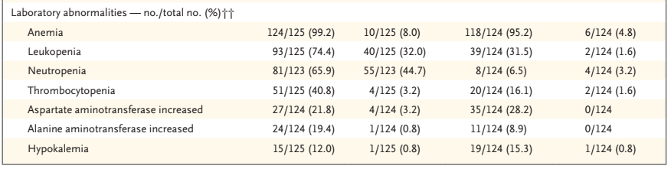
de Wit R, et al. NEJM 2019; 381: 2506-2518.

Slide 75
The Canadian (OZM-054) trial

Slide 76
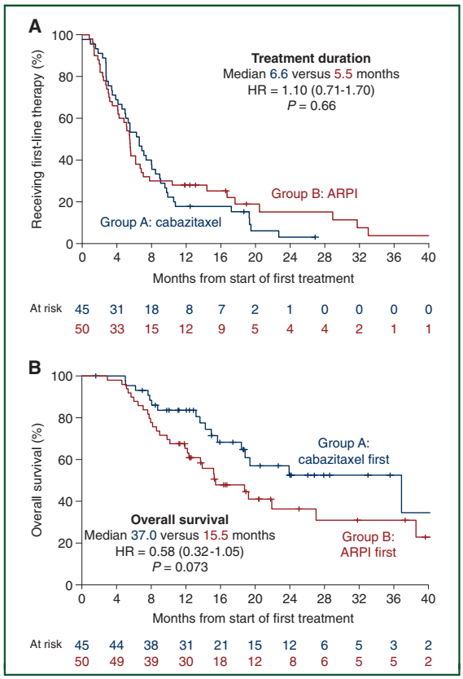
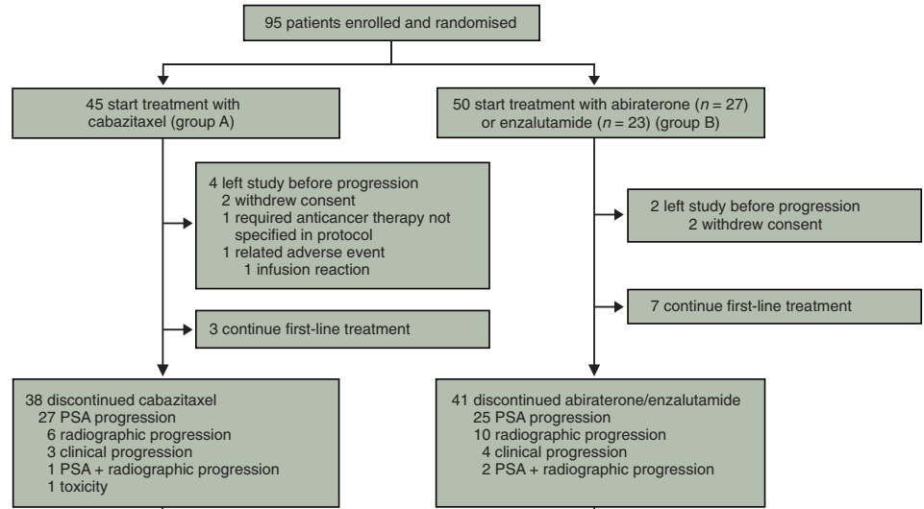
The OZM-054 trial
Poor prognosis:
liver mets,
CRPC <12 months,
or >3 of 6 (LDH, ECOG, visceral, albumin, ALP, <36 mo from Dx)
Annala M, et al. Ann Oncol 2021; 32: 896-905.

Slide 77


Biomarkers of differential response?
Annala M, et al. Ann Oncol 2021; 32: 896-905.

Slide 78
Optimal integration of radium-223

Slide 79


Radium-223: the ALSYMPCA trial
Parker C, et al. N Engl J Med 2013; 369: 213-223.

Slide 80
Ideal patient for Radium-223 treatment
mCRPC with symptomatic bone metastases
Mild bone pain (1-4/10), but not severe bone pain (≥5/10)
Few bone metastases (5-10), but not too many (≥20)
No impending pathologic fracture or cord compression
Adequate bone marrow function (Hgb ≥9, ANC ≥1000, Plt ≥100K)
No visceral mets (≥10 mm) or bulky nodal mets (≥30 mm)
No concurrent Abi; use Denosumab with concurrent Enza
ECOG 0-1; avoid if ECOG 2-4

Slide 81
The PEACE-3 (EORTC-1333) trial

Slide 82


ERA-223 study: A cautionary note
60% of patients did not receive a bone-protecting agent
Smith MR, et al. Lancet Oncol 2019; 20: 408-419.

Slide 83

Tombal B, et al. ASCO 2019; Abstract 5007.

Slide 84

Gillessen S, et al. ASCO 2021; Abstract 5002.

Slide 85

Gillessen S, et al. ASCO 2021; Abstract 5002.

Slide 86

Gillessen S, et al. ASCO 2021; Abstract 5002.

Slide 87
¹⁷⁷Lutetium–PSMA–617

Slide 88

PSMA: Target for imaging and therapy
Evans JC, et al. Br J Pharmacol 2016; 173: 3041-79.

Slide 89

¹⁷⁷Lu-PSMA-617 Radioligand therapy
Morris MJ, et al. J Clin Oncol 39; 2021 (ASCO abstract LBA4).

Slide 90

VISION trial for patients with PSMA⁺ mCRPC
Morris MJ, et al. J Clin Oncol 39; 2021 (ASCO abstract LBA4). Sartor O, et al. NEJM 2021.

Slide 91


VISION trial: rPFS and OS
Percent of Patients Alive
Morris MJ, et al. J Clin Oncol 39; 2021 (ASCO abstract LBA4) . Sartor O, et al. NEJM 2021.

Slide 92
VISION trial: rPFS forest plot
Morris MJ, et al. J Clin Oncol 39; 2021 (ASCO abstract LBA4) . Sartor O, et al. NEJM 2021.

Slide 93

VISION trial: Adverse Events
Morris MJ, et al. J Clin Oncol 39; 2021 (ASCO abstract LBA4) . Sartor O, et al. NEJM 2021.

Slide 94

¹⁷⁷Lutetium–PSMA–617: FDA Approval!

Slide 95
Novel strategies for mCRPC

Slide 96
Cabozantinib + Atezo: Rationale
Agarwal N, et al. ASCO GU 2021; Abstract TPS190.

Slide 97
COSMIC-021: ORR and PSA response
ORR
PSA₅₀ Response
Agarwal N, et al. ESMO 2021; Abstract LBA24.

Slide 98
CONTACT-02: Phase III Trial Schema
Primary Endpoints:
• PFS per RECIST v1.1 by BIRC
• OS
Secondary Endpoint:
• ORR per RECIST v1.1 by BIRC
Agarwal N, et al. ASCO GU Symposium 2021; Abstract TPS190.

Slide 99


ARV-110: AR-directed PROTAC
Gao X, et al. ASCO GU 2022; Abstract 17.

Slide 100


ODM-208:
CYP11A1 inhibitor
Fizazi K, et al. ASCO GU 2022; Abstract 18.

Slide 101
MODULE 4: Current and Future Integration
of PARP Inhibitors in the Management
of Prostate Cancer

Slide 102
Regulatory and reimbursement issues aside, which of the following patients with prostate cancer and no relevant family history should undergo germline genetic testing?
Patients with locally advanced disease who are going to receive radiation therapy and hormonal therapy
Patients with previously untreated metastatic disease
Patients with metastatic disease after progression on first-line therapy
All of the above
a and b only
a and c only
b and c only

Slide 103
Germline mutation testing; selection of PARP inhibitor therapy
Dr Jason Hafron (West Bloomfield, Michigan)

Slide 104
Regulatory and reimbursement issues aside, for which patients with mCRPC who are about to begin secondary hormonal therapy would you generally add a PARP inhibitor as well?
Patients with a germline BRCA mutation
Patients with a somatic BRCA mutation
Patient without HRR gene mutations
All of the above
a and b only
a and c only
b and c only

Slide 105
Case Presentation: A 73-year-old man with metastatic CRPC – germline BRCA2 mutation
Dr David Morris (Nashville, Tennessee)

Slide 106


Current and Future Integration of PARP Inhibitors in the Management of Prostate Cancer
Fred Saad MD FRCS
Professor and Chairman of Urology
Director of GU Oncology
Raymond Garneau Chair in Prostate Cancer
University of Montreal Hospital Center
Montreal, QC, Canada

Slide 107

Metastatic prostate cancer is biologically heterogeneous
Multiple pathways have been identified with genomic alterations in association with advanced prostate cancer¹
Approximately 25% of patients with mCRPC have alterations associated with DNA repair pathways*²
PI3K
Cell cycle
Epigenetic
DNA repair
WNT
MAP kinase
AR
ETS
TP53
PTEN
RB1
PIK3CA
KMT2C
FOXA1
KMT2D
BRCA2
APC
CDK12
ATM
SPOP
CDKN1B
CTNNB1
ZBTB16
RNF43
CDKN2A
PIK3R1
KMT2A
KDM6A
PIK3CB
FANCA
BRAF
BRCA1
AKT1
KRAS
HRAS
0
10
20
30
40
50
60
Alteration frequency
Homologous recombination repair (HRR) is a key mechanism for DNA repair^{3,4}
Tumour/
germline
exomes
~23% of mutations were identified in
DNA repair pathways¹
Mutation
Deep deletion
Amplification
Fusion
*A multi-institutional study profiling N=444 tumours from 429 mCRPC patients
AR=androgen receptor; DDR=DNA damage repair; mCRPC=metastatic castration-resistant prostate cancer; PI3K=phosphoinositide 3-kinase; WNT=wingless integration
1. Robinson D, et al. Cell. 2015;161:1215–1228; 2. Abida W, et al. PNAS 2019;116:11428-436 ; 3. Lord CJ and Ashworth A. Nature. 2012;481:287–293; 4. O’Connor MJ. Mol Cell. 2015;60:547–560.

Slide 108

> 1 in 10 Men with mCRPC have Germline Mutations
Distribution of presumed pathogenic
germline mutations
Inherited germline DDR mutations
  mCRPC: 11.8% (82/692)
  Localized disease: 4.6% (23/499)
RAD51C 1%
MSH6 1%
MRE11A 1%
MSH2 1%
BRIP1 1%
Presumed pathogenic germline mutations in metastatic cases (N = 692) | Presumed pathogenic germline mutations in metastatic cases (N = 692)
Gene | No. of Mutations | % of Men
BRCA2 | 37 | 5.35
ATM | 11 | 1.59
CHEK2* | 10 | 1.87
BRCA1 | 6 | 0.87
GEN1 2%
FAM175A 1%
PMS2 2%
NBN 2%
ATR 2%
RAD51D 4%
PALB2 4%
BRCA2 44%
BRCA1 7%
CHEK2 12%
ATM 13%
*n = 534; data censored for metastatic cases with inadequate sequencing
Using germline testing alone
~50% of patients with a BRCA1/2, or ATM mutation will be missed

Slide 109


Patients with HRRm including BRCA2m are more likely to have poor outcomes on standard of care therapies¹⁻³
Patients with germline HRRm including BRCA2m are more likely to have poor outcomes on standard of care therapies^{1,2}
Poor responses to standard therapy also seen for tumour HRRm³
Cancer specific survival in mCRPC patients
with gBRCA2m¹
Time to progression in mCRPC patients
with HRRm³
Group | Median CSS (95% CI)
Non-carriers | 33.2 months (29.0–37.4)
BRCA2m | 17.4 months (10.7–24.2)
Log-rank test p=0.0266
HRR defect
Yes
No
ctDNA unquantifiable
Cause specific survival (%)
Progression-free survival
Months
Months
1. Castro E, et al. J Clin Oncol. 2019;6:490–503; 2. Annala M, et al. Eur Urol. 2017;72:34–42; 3. Annala M, et al. Cancer Discovery. 2018;doi:10.1158/2159-8290.CD-17-0937

Slide 110
PARP Inhibitor Trials and approvals in mCRPC
Q1 2017¹
PROfound study initiated
Q4 2019²
PROfound study results presented
Q2 2020³
FDA approval of olaparib
Q4 2020¹¹
Health Canada approval of olaparib
2015 | 2016 | 2017 | 2018 | 2019 | 2020 | 2021 | 2022
Q4 2015⁴
TOPARP-A data published
Q4 2019⁵
TOPARP-B data published
Q1 2017⁶
TRITON2 P2 rucaparib study initiated
Q2 2017⁷
TRITON3 P3 rucaparib study initiated
Q3 2020⁶
TRITON2 P2 rucaparib study due to read out
Q2 2020⁸
FDA approval of rucaparib
Q1 2022⁷
TRITON3 rucaparib study due to read out
Q2 2017⁹
TALAPRO-1 P2 talazoparib study initiated
Q2 2020⁹
TALAPRO-1 P2 talazoparib study due to read out
Q3 2016¹⁰
GALAHAD P2 niraparib study initiated
Q3 2020¹⁰
GALAHAD P2 niraparib study due to read out
HLR, high level results; HRRm, homologous recombination repair; mCRPC, metastatic castration-resistant prostate cancer; PARP, poly(ADP-ribose) polymerase; P, phase
1. de Bono J et al. NEJM 2020;382:2091-102; 2. AstraZeneca press release, 7 August 2019; 3. https://www.fda.gov/drugs/drug-approvals-and-databases/fda-approves-olaparib-hrr-gene-mutated-metastatic-castration-resistant-prostate-cancer; 4. Mateo J et al. NEJM 2015; 373:1697-708; 5. Mateo J et al. J Clin Oncol 2019;37:Abstr 5005; 6. https://clinicaltrials.gov/ct2/show/NCT02952534;
7. https://clinicaltrials.gov/ct2/show/NCT02975934; 8. https://www.fda.gov/drugs/fda-grants-accelerated-approval-rucaparib-brca-mutated-metastatic-castration-resistant-prostate;
9. https://clinicaltrials.gov/ct2/show/NCT03148795; 10. https://clinicaltrials.gov/ct2/show/NCT02854436; 11. Lynparza (olaparib) Canadian Product Monograph.

Slide 111
TOPARP-A: PFS and OS by Presence of DDR Defects
Radiographic PFS
OS
OS
1.00
1.00
P = .05 by log-rank test
P < .001 by log-rank test
0.75
Biomarker positive,
median: 13.8 mos
0.75
Biomarker positive,
median: 9.8 mos
0.50
0.50
Proportion of Pts
Proportion of Pts
Biomarker negative,
median: 7.5 mos
Biomarker negative,
median: 2.7 mos
0.25
0.25
0
0
0
1
2
3
4
5
6
7
8
9
10
11
12
13
14
15
16
17
18
19
20
0
1
2
3
4
5
6
7
8
9
10
11
12
13
14
15
16
17
18
19
20
Mos Since Trial Entry
Mos Since Trial Entry
DDR, DNA damage response; OS, overall survival; PFS, progression-free survival
Mateo J et al. NEJM 2015;373:1697-708.

Slide 112


GALAHAD: Niraparib Monotherapy
Results for BRCA vs Non-BRCA
Measurable Response
PSA response

Slide 113



TALAPRO-1: Efficacy of Talazoparib Monotherapy

Slide 114


TRITON 2: Efficacy of Rucaparib Monotherapy in mCRPC with BRCA1 or BRCA2
Abida W. et al. J Clin Oncol . 2020 Nov 10;38(32):3763-3772

Slide 115
PROfound: First Phase 3 RCT of a PARP Inhibitor in mCRPC (Olaparib vs Enzalutamide or Abiraterone)
Randomised, open-label phase 3 study
Olaparib (tablets)
N=162
COHORT A
N=245
BRCA1/2 or ATM
Key eligibility criteria
mCRPC with disease progression on prior NHA eg abiraterone or enzalutamide
Alterations in ≥1 of any qualifying gene with a direct or indirect role in HRR
2:1
Physician’s choice of enzalutamide or abiraterone N=83
Optional olaparib
upon progression at time of BICR
Open-label
Olaparib (tablets)
N=94
COHORT B
N=142
Other HRR mutations*
2:1
Physician’s choice of enzalutamide or abiraterone N=48
Optional olaparib
upon progression at time of BIRC
Primary endpoint: Radiographic PFS by BICR using RECIST 1.1 (soft tissue) and PCWG3 (bone) criteria (cohort A)
Key secondary endpoints:
Cohort A: Confirmed ORR, time to pain progression, overall survival
Cohort A + B: radiographic PFS
*Cohort B included patients with BARD1, BRIP1, CDK12, CHEK1, CHEK2, FANCL, PALB2, PPP2R2A, RAD51B, RAD51C, RAD51D, or RAD54L mutations. ARAT, ARAT, androgen receptor-axis-targeted therapies; BICR, blinded independent central review; EGOC, Eastern Cooperative Oncology Group; HRR, homologous recombination repair; mCRPC, metastatic castrate resistant prostate cancer; mPC, metastatic prostate cancer; ORR, objective response rate; PARP, poly(ADP-ribose) polymerase; PFS, progression-free survival. de Bono JS et al. NEJM 2020;382:2091-102.

Slide 116
PROfound Primary Endpoint: Significant Improvement in rPFS in mCRPC with BRCA1/2 or ATM Mutations (Cohort A)
66% reduction in risk of progression or death with olaparib vs. physician’s choice
Confirmed ORR in Cohort A
1.0
HR=0.34 95% CI (0.25, 0.47)
P<0.001
0.9
0.8
0.7
0.6
7.39
Probability of rPFS
0.5
0.4
3.55
0.3
Odds ratio: 20.86
(95% CI 4.18, 379.18)
P<0.001
0.2
0.1
0.0
0
1
2
3
4
5
6
7
8
9
10
11
12
13
14
15
16
17
18
19
20
21
No. at risk
Time from randomisation (months)
Olaparib
162
149
126
116
102
101
82
77
56
53
42
37
26
24
18
11
11
3
2
0
0
0
Physician's choice
83
79
47
44
22
20
13
12
7
6
3
3
3
2
2
1
1
1
1
0
0
0
de Bono JS et al. NEJM 2020;382:2091-102.

Slide 117
PROfound Secondary Endpoint: Significant Improvement in OS in mCRPC with BRCA1/2 or ATM Mutations (Cohort A)
31% Reduction in Risk Of Death with Olaparib vs. Physician’s Choice
Cohort A
Cohort A with adjustment for crossover*
100
100
HR=0.69 (95% CI 0.50, 0.97)
Median OS: 19.1 vs. 14.7 months; P=0.02
HR=0.42 (95% CI 0.19, 0.91)
Crossover rate: 67% (56/83)
80
80
60
60
Overall survival (%)
Overall survival (%)
40
40
20
20
0
0
0
2
4
6
8
10
12
14
16
18
20
22
24
26
28
30
32
34
0
2
4
6
8
10
12
14
16
18
20
22
24
26
28
30
32
34
No. at risk
Time from randomisation (months)
No. at risk
Time from randomisation (months)
Olaparib
Physician’s
choice
155
79
44
15
Olaparib
Physician’s
choice
155
79
44
0
162
83
150
74
142
69
136
64
124
58
107
50
101
43
91
37
71
27
56
18
30
11
18
9
6
6
2
3
1
1
0
0
162
83
150
73
142
67
136
56
124
47
107
29
101
15
91
9
71
3
56
0
30
0
18
0
6
0
2
0
1
0
0
0
Median follow-up duration for censored patients : olaparib, 21.9 months; control, 21.0 months. *Re-censored; conducted using rank-preserving structural failure time model (RPSFTM) to demonstrate the impact on OS of crossover of patients from the control arm to receive olaparib as a first subsequent anticancer therapy. CI, confidence interval; HR, hazard ratio; OS, overall survival. 1. Hussain M, et al. NEJM 2020;Online: doi10.1056/NEJMoa2022485

Slide 118

Findings suggest that sequential use of an NHA may be of limited benefit
Saad F., et al. AUA 2021

Slide 119
Tolerability profile
Grade
All Severe
Olaparib
Control
median duration of treatment was
7.6 mo. in the olaparib arm and 3.9 mo. in the control arm

Slide 120

PROfound Secondary Endpoints: Improvements in Multiple Clinical and Patient-reported Endpoints in mCRPC With BRCA1/2 or ATM Mutations (Cohort A)
Olaparib
Physician’s choice
Improvement in patient reported HR-QoL
Time to pain progression in Cohort A
1.0
0.8
0.6
Probability event free
0.4
Median NR vs 9.92 months
HR = 0.44 (95% CI 0.22, 0.91)
P=0.0192
0.2
0.0
0
2
4
6
8
10
12
14
16
18
20
Time from randomization (months)
de Bono JS et al. NEJM 2020;382:2091-102.

Slide 121
The Future
Earlier introduction? Combination trials?
In all-comers?

Slide 122
Rationale for combining PARP inhibitors and NHAs
Olaparib + NHA^{10–13}
PARP inhibition reported to increase activity of NHA via
AR-dependent transcription^{10,11}
NHA reported to induce HRR deficiency and increase susceptibility to PARP inhibition^{11‒13}
Combined effect
Anti-tumor activity in HRRm and non-HRRm prostate cancer^{10–13}
phase 2 olaparib + NHA combination study showed benefit in all patients
1. Mateo J, et al. N Engl J Med 2015;373:1697–1708; 2. Schiewer MJ, et al Cancer Discov 2012;2:1134–1149; 3. Polkinghorn WR, et al. Cancer Discov 2013;3:1245–1153; 4. Asim M, et al. Nat Commun 2017;8:374

Slide 123

PROpel
Randomized, double-blind, placebo-controlled Phase III trial
Baseline demographics: HRRm status

Slide 124




PROpel
Primary endpoint
rPFS by investigator assessment
rPFS by blinded independent central review
  34% risk reduction for progression or death with olaparib + abiraterone (HR 0.66; 95% CI 0.54–0.81; P<0.0001)
Saad F, et al. Oral presentation at the 2022 ASCO GU Symposium; Feb 17, 2022; Abstract #11

Slide 125

PROpel rPFS subgroup analysis
  rPFS benefit observed across all pre-specified subgroups
Saad F, et al. Oral presentation at the 2022 ASCO GU Symposium; Feb 17, 2022; Abstract #11

Slide 126




PROpel
Key secondary endpoints
Overall survival
Time to first subsequent therapy or death (TFST)
Time to second progression or death (PFS2)
  OS data immature, but trend towards improved OS with olaparib + abiraterone
  TFST (HR 0.74; 95% CI 0.61–0.90) and PFS2 (HR 0.69; 95% CI 0.51–0.94) supportive of long-term benefits
Saad F, et al. Oral presentation at the 2022 ASCO GU Symposium; Feb 17, 2022; Abstract #11

Slide 127


PROpel
Safety data
  Safety and tolerability profile consistent with the known safety profiles of individual drugs
  The most common grade ≥3 AE was anemia (15.1% vs 3.3%)
*Anemia category includes anemia, decreased hemoglobin level, decreased red-cell count, decreased hematocrit level, erythropenia, macrocytic anemia, normochromic anemia, normochromic normocytic anemia, and normocytic anemia.
AE, adverse event; CTCAE, Common Terminology Criteria for Adverse Events v4.03.
Saad F, et al. Oral presentation at the 2022 ASCO GU Symposium; Feb 17, 2022; Abstract #11

Slide 128

MAGNITUDE
Randomized, double-blind, placebo-controlled Phase III trial

Slide 129


MAGNITUDE
Pre-specified futility analysis: HRR BM–
  No benefit of adding NIRA to AAP in the pre-specified composite endpoint (HR, 1.09; 95% CI 0.75–1.59)
Chi KN, et al. Oral presentation at the 2022 ASCO GU Symposium; Feb 17, 2022; Abstract #12

Slide 130


MAGNITUDE
Primary endpoint: rPFS by central review
BRCA1/2-mutated
All HRR BM+
47% improvement in rPFS in patients with BRCA1/2 alterations (HR 0.53; 95% CI 0.36–0.79; P=0.0014)
27% improvement in rPFS across all HRR BM+ patients (HR 0.73; 95% CI 0.56–0.96; P=0.0217)
Chi KN, et al. Oral presentation at the 2022 ASCO GU Symposium; Feb 17, 2022; Abstract #12

Slide 131

MAGNITUDE rPFS subgroup analysis: All HRR BM+
Chi KN, et al. Oral presentation at the 2022 ASCO GU Symposium; Feb 17, 2022; Abstract #12

Slide 132


MAGNITUDE
Safety data: HRR BM+
Most common AEs leading to dose reduction with NIRA + AAP: anemia (13.2%), thrombocytopenia (2.8%)
Median relative dose intensity in the NIRA + AAP group: 99%
TEAEs consistent with known safety profile for each individual therapy

Slide 133
Ongoing trials investigating PARPi in advanced PC
Primary
Adjuvant
Biochemical Recurrence (BCR)
mHSPC
(incl de novo)
1L mCRPC
2L mCRPC
3L mCRPC
nmCRPC
PROfound¹*
Olaparib mono, BRCA / ATM and other HRRm, post-NHA
PROpel²
Olaparib + abi
all-comers
TALAPRO-3³
Talazoparib + enza
All Comers / HRRm
TALAPRO-2⁴
Talazoparib + enza
All Comers / HRRm
TALAPRO-1⁵ (PII)
Talazoparib mono, HRRm / BRCAm
Post-NHA, post-taxane
Prostate Specific Antigen
AMPLITUDE⁶
Niraparib + abi
HRRm
MAGNITUDE⁷
Niraparib + abi
Primary endpoint: HRRm
GALAHAD⁸ (PII)
Niraparib mono, HRRm / BRCAm
Post-NHA, post-taxane
CASPAR⁴
Rucaparib + enza
All Comers / HRRm
TRITON-3¹⁰
Rucaparib mono,
Post-NHA, BRCAm / ATM
TRITON-2¹¹ (PII)
Rucaparib mono
HRRm / BRCAm†
Post-NHA, post-taxane
Met
Time
Non-metastatic
Metastatic
Hormone-sensitive
Castration-resistant
Asymptomatic
Symptomatic
Please see slide notes for references
*As a result of the data from PROfound, olaparib monotherapy was approved for treatment of mCRPC in patients with HRRm (FDA approval) or for patients with mutations in only BRCA1/2 (EMA approval) after progression on a NHA^{12,13}
†As a result of the data from TRITON2, rucaparib monotherapy was approved by the FDA only for the treatment of mCRPC in patients with a BRCA1/2m who have disease progression after treatment with prior AR-directed therapy and prior taxane¹⁴
Abi=abiraterone; BCR=biochemical recurrence; enza=enzalutamide; FDA=US Food and Drug Administration; HRRm=homologous recombination repair mutation; mCRPC=metastatic castration-resistant prostate cancer; met=metastasis; mono=monotherapy; mHSPC=metastatic hormone-sensitive prostate cancer; NHA=new hormonal agent; nmCRPC=non-metastatic castration-resistant prostate cancer; P2=Phase II; P3=Phase III.

Slide 134
Conclusion
Patients in the mCRPC state live less than 3 years even with the best available treatments
A significant proportion of men destined to die of prostate cancer harbor HRR mutations
  Treatment improves progression free survival and overall survival
  Strategies to identify patients are challenging but critically important
Future will likely include earlier introduction of PARPi and possibly treatment beyond patients with HRR/DDR mutations

