Slide 1
Cases from the Community: Urologic Oncology Investigators Provide Perspectives on the Optimal Management of Urothelial Bladder Cancer
Part 2 of a 2-Part CME Satellite Symposium Series in
Conjunction with the AUA 2022 Annual Meeting
Friday, May 13, 2022
6:00 PM – 8:00 PM CT (7:00 PM – 9:00 PM ET)
Faculty
Matthew D Galsky, MD
Ashish M Kamat, MD, MBBS
Stephen B Williams, MD, MS
Moderator
Sumanta Kumar Pal, MD

Slide 2




Faculty
Matthew D Galsky, MD
Professor of Medicine
Icahn School of Medicine at Mount Sinai
Co-Leader, Bladder Cancer Center of Excellence
Associate Director, Translational Research
The Tisch Cancer Institute
New York, New York
Stephen B Williams, MD, MS
Medical Director, High Value Care
UTMB Health System
Chief, Division of Urology
Professor (Tenured), Urology and Radiology
Robert Earl Cone Professorship
Director of Urologic Oncology
Director of Urologic Research
Co-Director of the Surgical Outcomes Research Division
The University of Texas Medical Branch
Galveston, Texas
Ashish M Kamat, MD, MBBS
Professor of Urologic Oncology (Surgery)
Wayne B Duddlesten Professor of Cancer Research
Department of Urology
Division of Surgery
The University of Texas
MD Anderson Cancer Center
Houston, Texas
Moderator
Sumanta Kumar Pal, MD
Professor, Department of Medical Oncology and Therapeutics Research
City of Hope
Duarte, California

Slide 3
Commercial Support
This activity is supported by educational grants from Astellas and Seagen Inc, AstraZeneca Pharmaceuticals LP, Gilead Sciences Inc, and Janssen Biotech Inc, administered by Janssen Scientific Affairs LLC.
Research To Practice CME Planning Committee Members,
Staff and Reviewers
Planners, scientific staff and independent reviewers for Research To Practice have no relevant conflicts of interest to disclose.

Slide 4
Dr Galsky — Disclosures
Advisory Committee | Aileron Therapeutics Inc, Alligator Bioscience, Astellas, AstraZeneca Pharmaceuticals LP, Basilea Pharmaceutica Ltd, BioMotiv, Bristol-Myers Squibb Company, Dendreon Pharmaceuticals Inc, Dracen Pharmaceuticals, Dragonfly Therapeutics, EMD Serono Inc, Genentech, a member of the Roche Group, Gilead Sciences Inc, GlaxoSmithKline, Incyte Corporation, Infinity Pharmaceuticals Inc, Inovio Pharmaceuticals Inc, Janssen Biotech Inc, Lilly, Merck, Novartis, Numab, Pfizer Inc, Seagen Inc, UroGen Pharma
Contracted Research | AstraZeneca Pharmaceuticals LP, Bristol-Myers Squibb Company, Genentech, a member of the Roche Group, Merck

Slide 5
Dr Kamat — Disclosures
No relevant conflicts of interest to disclose

Slide 6
Dr Pal — Disclosures
No relevant conflicts of interest to disclose

Slide 7
Dr Williams — Disclosures
No relevant conflicts of interest to disclose

Slide 8
Agenda
MODULE 1: Available Data with and Ongoing Investigation of Novel Agents and Strategies for Non-Muscle-Invasive Bladder Cancer (NMIBC) — Dr Kamat
MODULE 2: Novel Therapeutic Approaches for Muscle-Invasive Bladder Cancer (MIBC) — Dr Williams
MODULE 3: Current and Future Front-Line Management of Metastatic Urothelial Bladder Carcinoma (mUBC) — Dr Galsky
MODULE 4: Selection and Sequencing of Therapy for Relapsed/Refractory mUBC — Dr Pal

Slide 9
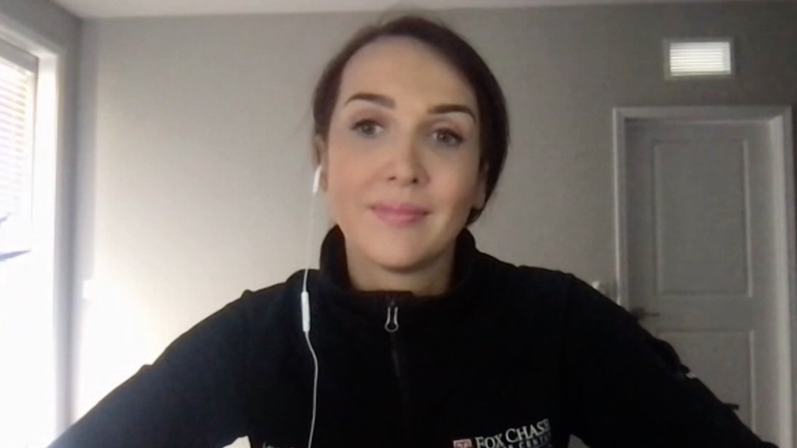

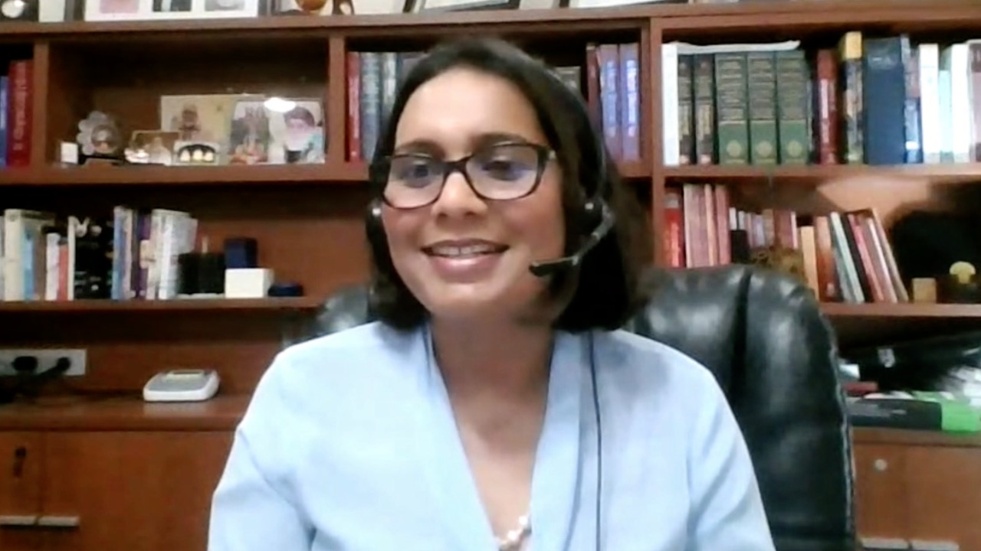
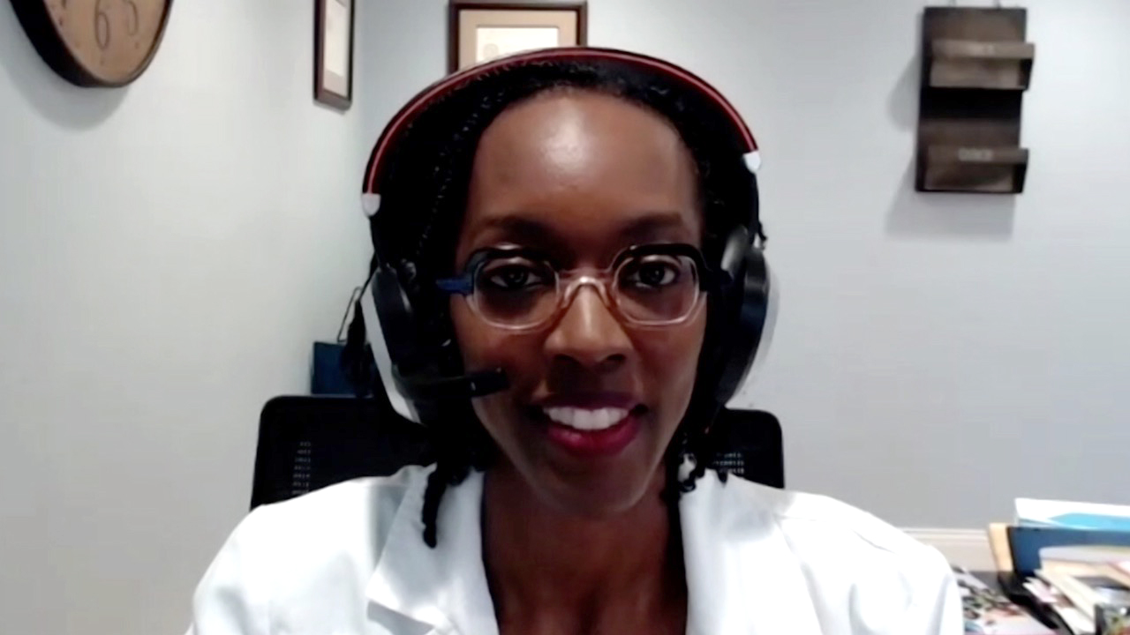
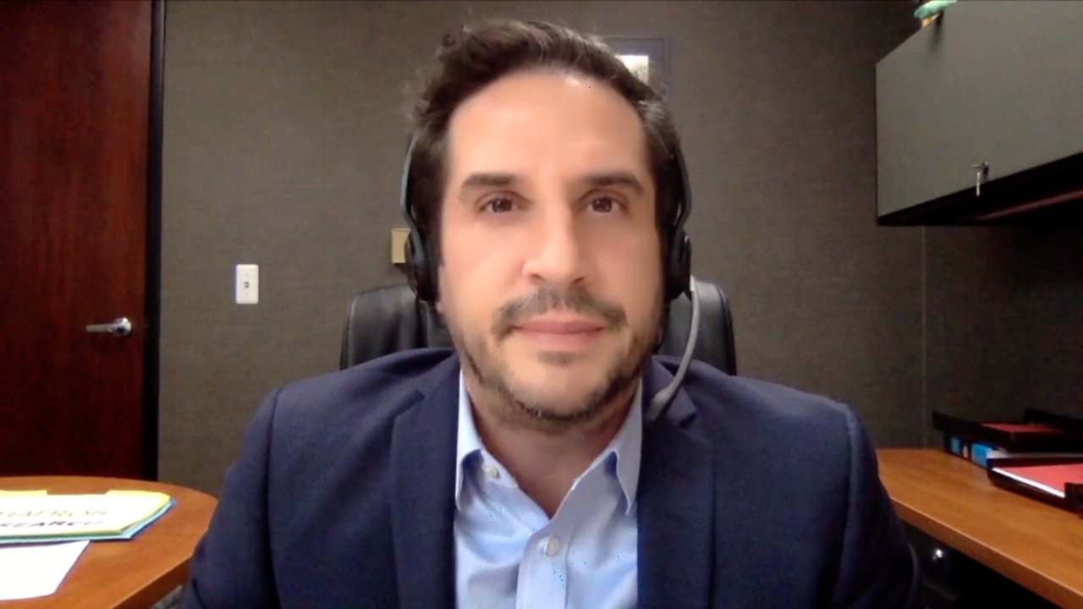
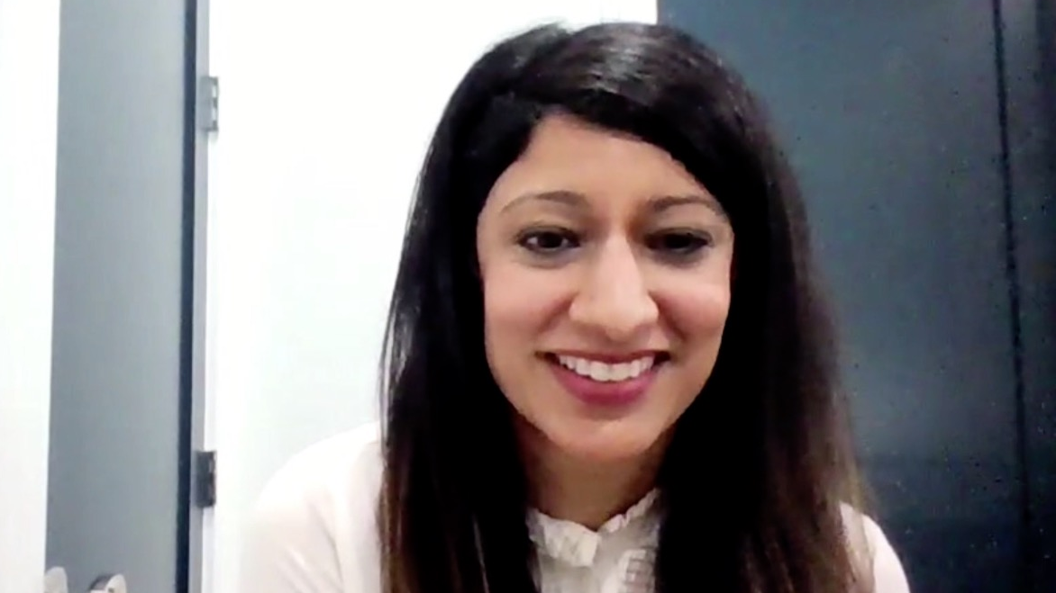
Laura Bukavina, MD, MPH
Fox Chase Cancer Center
Philadelphia, Pennsylvania
Sulfi Ibrahim, MD
Reid Health
Richmond, Indiana
Ranju Gupta, MD
LVPG Hematology Oncology Associates
Lehigh Valley Health Network
Bethlehem, Pennsylvania
Zanetta S Lamar, MD
Florida Cancer Specialists
Naples, Florida
Jason Hafron, MD
Oakland University William Beaumont School of Medicine
West Bloomfield, Michigan
Henna Malik, MD
Texas Oncology
Houston, Texas

Slide 10
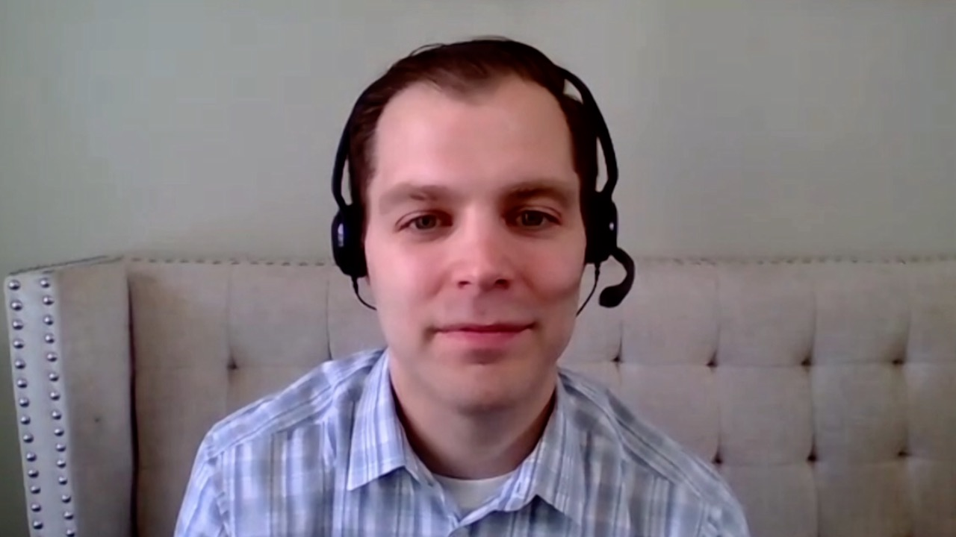
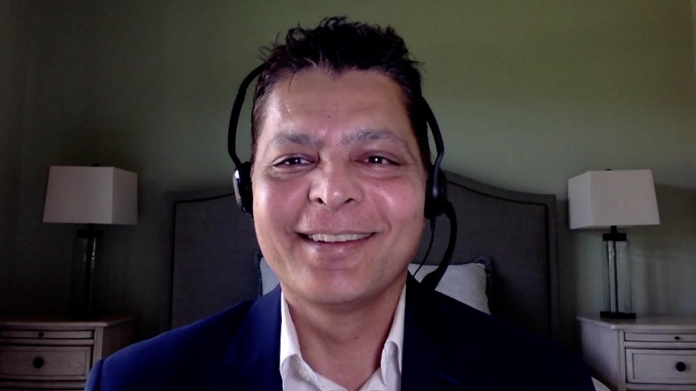
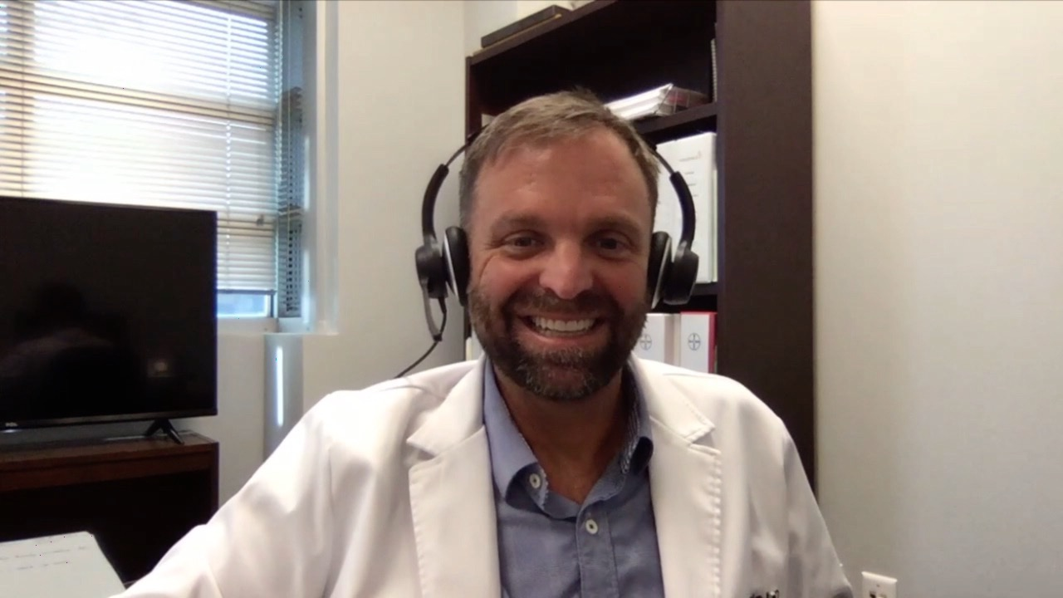
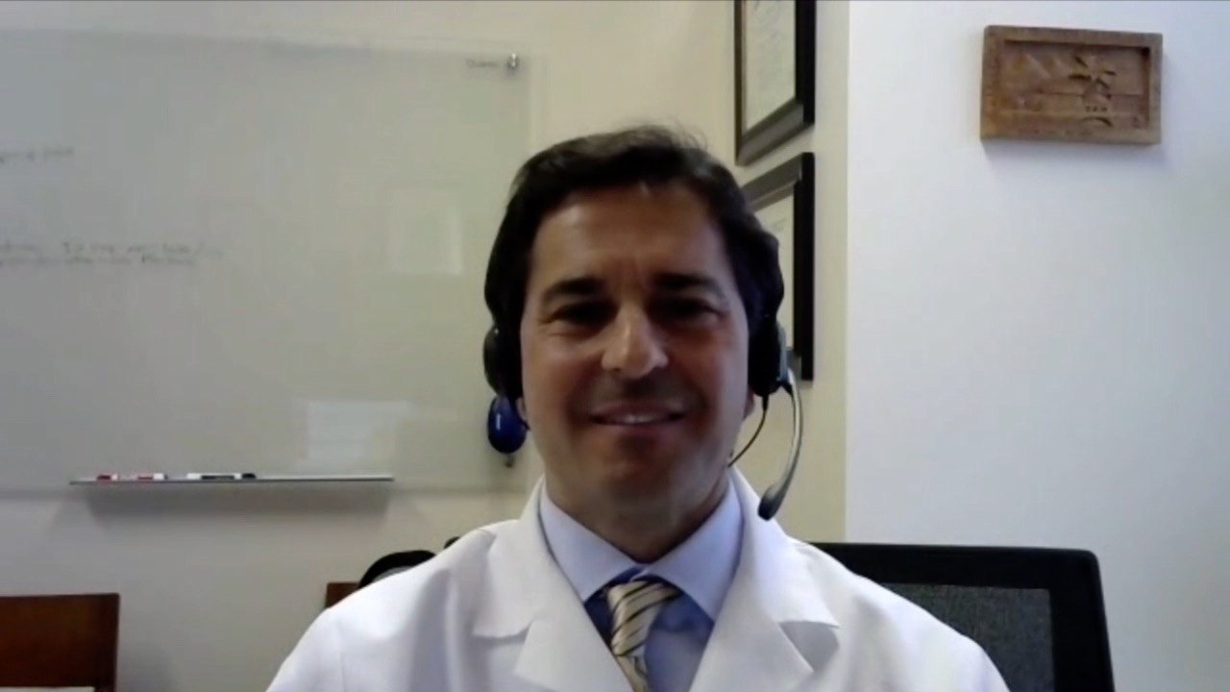
Paul Markowski, MD
Atlantic Health System
Summit, New Jersey
Chris Prakash, MD
Texas Oncology
Paris, Texas
David S Morris, MD
Urology Associates
Nashville, Tennessee
David A Taub, MD, MBA
Lynn Cancer Institute
Baptist Health South Florida Boca Raton, Florida

Slide 11
MODULE 1: Available Data with and Ongoing Investigation of Novel Agents and Strategies
for Non-Muscle-Invasive Bladder Cancer

Slide 12
How many patients in your practice with non-muscle-invasive bladder cancer (NMIBC) have been treated with an anti-PD-1/PD-L1 antibody such as pembrolizumab?
0
1
2-5
More than 5

Slide 13
A 72-year-old man with persistent NMIBC after multiple therapies
Dr Laura Bukavina
Philadelphia, Pennsylvania
An 82-year-old woman with high-grade NMIBC
Dr David Taub
Boca Raton, Florida
A 70-year-old woman with multiple recurrences
of NMIBC involving the ureter – PD-L1: 5%
Dr Paul Markowski
Summit, New Jersey

Slide 14
What is the age of the oldest patient in your practice who has undergone cystectomy?
Younger than 60
60-70
71-80
81-85
86-90
91-95
96-100
Older than 100

Slide 15
An 88-year-old man with multiple recurrences of FGFR3-positive NMIBC who receives erdafitinib on a clinical trial
Dr David Morris
Nashville, Tennessee
TAR-200: Gemcitabine-releasing intravesicle system
Dr David Morris
Nashville, Tennessee

Slide 16
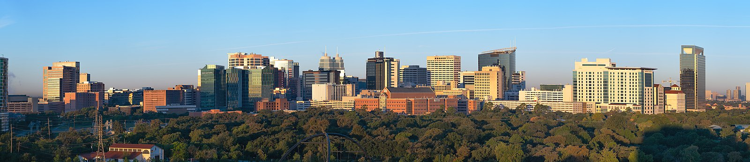

Novel Agents and Strategies for Non-
Muscle-Invasive Bladder Cancer (NMIBC)
Ashish M. Kamat, MD, MBBS
Professor of Urologic Oncology
Wayne B. Duddlesten Professor of Cancer Research
President, International Bladder Cancer Group (IBCG)
Co-President, International Bladder Cancer Network (IBCN)

Slide 17
Evolution of Therapy for Urothelial Cancer
^{BCG}
^{Valrubicin}
^{Pembrolizumab}
Paclitaxel (Ph II)²
Docetaxel (Ph II)⁴
Vinflunine (Ph III)⁹
Atezolizumab (Ph II)¹³
Durvalumab (Ph I/II)¹⁴
Gemcitabine
+ Cisplatin (Ph III)⁵
Gemcitabine
+ Carboplatin
/ MCaVi (Ph III)¹¹
Avelumab (Ph I)¹⁷
Publication
Nivolumab (Ph II)¹⁸
HD-MVAC (Ph III)⁶
Pembrolizumab (Ph I/II)¹⁹
Gemcitabine
+ Cisplatin
+ Paclitaxel (Ph III)¹²
MVAC (Ph II)¹
Gemcitabine
+ Paclitaxel (Ph II)⁷
1989
1990
1993
1997
1998
2001
2005
2009
2013
2016 2017 2020
Gemcitabine
authorisation in UK
(Oct 26, '95)³
Durvalumab
FDA breakthrough
designation
(Feb 17, '16)¹⁵
Atezolizumab
FDA approval
(May 18, '16)¹⁶
Agency Action
Gemcitabine
EMA harmonisation
(Sep 23, '08)⁸
Vinflunine
EMA approval
(Sep 21, '09)¹⁰
¹Sternberg CN, et al. Cancer. 1989; ²Roth BJ, et al. J Clin Oncol. 1994; ³Eli Lilly. SmPC Gemzar® 01-Jul-2014 (www.medicined.org.uk); ⁴McCaffrey JA, et al. J Clin Oncol. 1997; ⁵Von der Maase H, et al. J Clin Oncol. 2000; ⁶Sternberg CN, et al. J Clin Oncol. 2001; ⁷Meluch AA, et al. J Clin Oncol. 2001; ⁸EMA. EMEA/CHMP/512295/2008; 24.09.2018 (www.ema.europa.eu); ⁹Bellmunt J, et al. J Clin Oncol. 2009; ¹⁰EMA. EMEA/H/C/000983; 2012 (www.ema.europa.eu); ¹¹De Santis M, et al. J Clin Oncol. 2009; ¹²Bellmunt J, et al. J Clin Oncol. 2012; ¹³Rosenberg JE, et al. Lancet. 2016; ¹⁴Massard C et al. ASCO 2016: abstract #4502 and oral presentation; ¹⁵AstraZeneca. Press Release 17.02.2016 (access: www.astrazeneca.com); ¹⁶FDA. Press Release 18.05.2016 (access: www.fda.gov); ¹⁷Apolo AB, et al. J Clin Oncol. 2016; ¹⁸Galsky MD, et al. ESMO 2016: abstract #LBA31_PR; ¹⁹Balar A, et al. Ann Oncol. 2016.

Slide 18

Valrubicin
FDA approved in 1998 for BCG-refractory CIS in those who are not candidates for cystectomy
CR at 6 months in 18% of patients
2-year DFS only 4%
Steinberg et al, J Urol, 1998; Dinney et al, Urol Onc, 2013.
Notes:
and was placed on the FDA Drug Shortages List. The impurities issue was resolved and VALSTAR® was approved by the FDA on ___________.

Slide 19
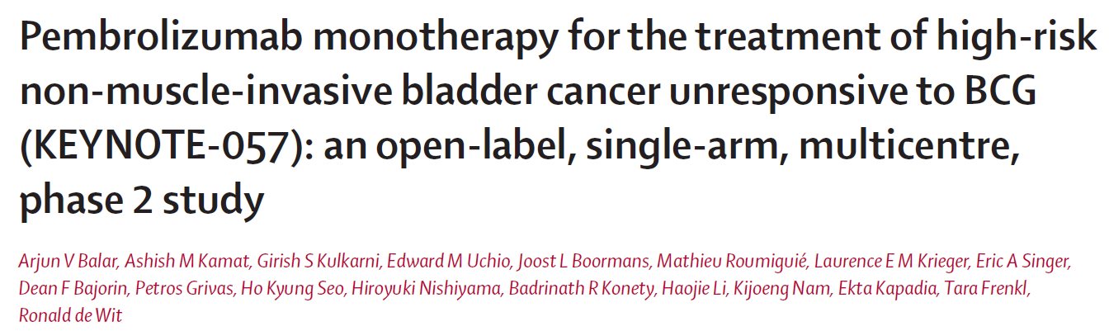
January 8, 2020
Pembrolizumab is approved for the treatment of patients with BCG-unresponsive, high-risk, NMIBC with carcinoma in situ (CIS) with or without papillary tumors who are ineligible for, or who have elected not to undergo, cystectomy
Lancet Oncology, May 25, 2021

Slide 20
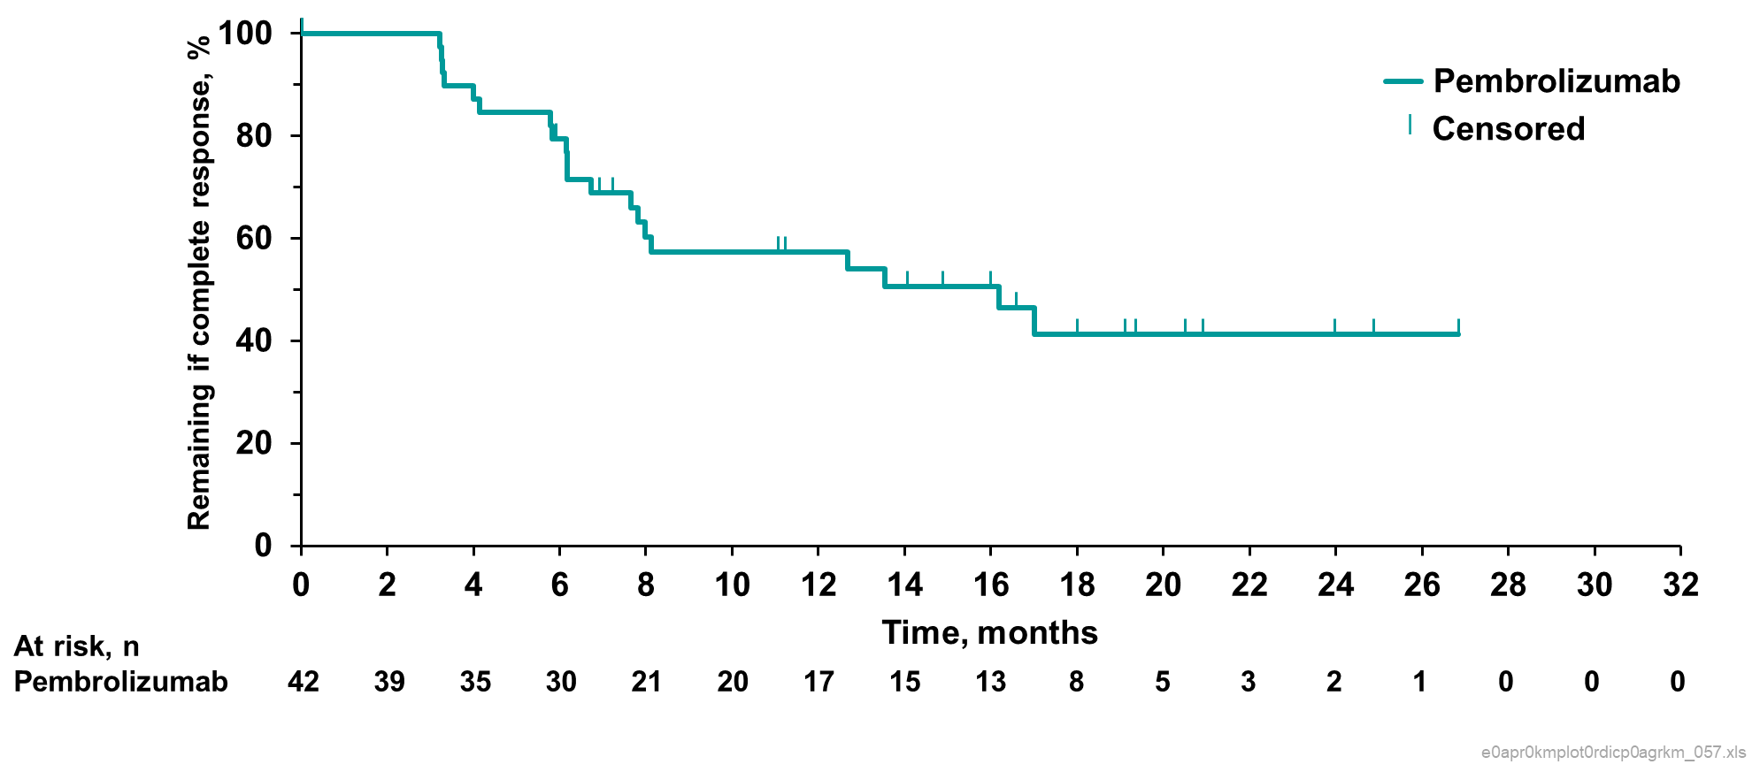
KEYNOTE-057:
BCG Unresponsive CIS Patients Achieving CR with Pembrolizumab
 | N=96
Best response | n (%) | 95% CI
CR | 39 (40.6) | 30.7, 51.1
Non-CR | 58 (56.9) | 46.7, 66.6
Persistent | 41 (40.2) | 30.6, 50.4
Recurrent | 7 (6.9) | 2.8, 13.6
NMIBC stage progression | 9 (8.8) | 4.1, 16.1
Progression to T2 | 0 | NA, NA
Extravesical diseaseª | 1 (1.0) | 0.0, 5.3
Non-evaluable (NE) | 2 (2.0) | 0.2, 6.9
Median CR duration, mo (range) | 16.2 (0.0+ - 36.2+)
Updated 2021
CR, complete response. ª1 month = 30.4367 days. ^{b}Month 0 = time point when initial CR was achieved.
.

Slide 21
Key Baseline Characteristics KN057
Characteristic | N=96
Median age, years (range) | 73 (44-92)
<65 | 30 (31.3)
≥65 to <75 | 24 (25.0)
≥75 to <85 | 33 (34.4)
≥85 | 9 (9.3)
Male, n (%) | 81 (84.4)
Female, n (%) | 15 (15.6)
Race, n (%)
White | 64 (66.7)
Asian | 26 (27.1)
Missing | 6 (6.3)
ECOG PS, n (%)
0 | 70 (72.9)
1 | 26 (27.1)
Characteristic | N=97
Median prior BCG instillations, n (range) | 12.0 (7.0-45.0)
Tumor pattern at study entry, n (%)
CIS with T1 | 12 (12.5)
CIS with high-grade Ta | 24 (25.0)
CIS alone | 60 (62.5)
PD-L1 status, n (%)
CPS ≥10 | 35 (36.5)
CPS <10 | 56 (58.3)
Not evaluable | 5 (5.2)
Reason prior cystectomy not performed, n (%)
Declined | 91 (94.8)
Ineligible | 5 (5.2)

Slide 22
Immune-mediated AEs
Any Grade and Corresponding Grade 3 or 4ª Events
Incidence of any-grade immune-mediated AEs, n (%) | N=102
Any | 21 (20.6)
Hypothyroidism | 8 (7.8)
Hyperthyroidism | 5 (4.9)
Pneumonitis | 3 (2.9)
Hypophysitis | 1 (1.0)
Colitis | 1 (1.0)
Adrenal insufficiency | 1 (1.0)
Nephritis | 1 (1.0)
Severe skin reaction | 1 (1.0)
Type 1 diabetes mellitus | 1 (1.0)
Uveitis | 1 (1.0)
Hepatitis | 1 (1.0)
Incidence of grades 3 or 4 immune-mediated AEs, n (%) | N=102
Any | 3 (2.9)
Hypothyroidism | 0 (0.0)
Hyperthyroidism | 0 (0.0)
Pneumonitis | 0 (0.0)
Hypophysitis | 0 (0.0)
Colitis | 0 (0.0)
Adrenal insufficiency | 1 (1.0)
Nephritis | 0 (0.0)
Severe skin reaction | 1 (1.0)
Type 1 diabetes mellitus | 1 (1.0)
Uveitis | 0 (0.0)
Hepatitis | 0 (0.0)
From Balar et al, 2021

Slide 23
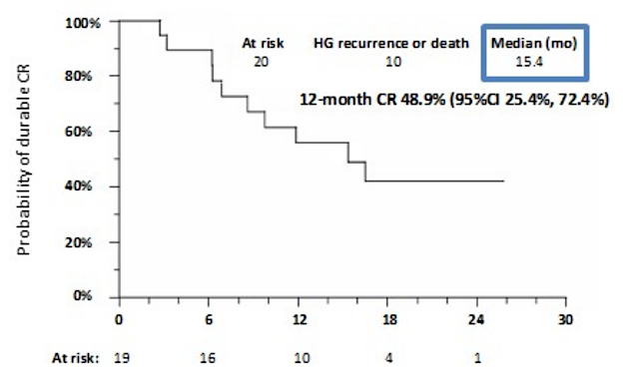
SWOG-S1605: Atezolizumab in BCG Unresponsive High Risk NMIBC
  CR rate at 6 mos: 27% (20/74 patients with CIS)
  KM estimate in patients with 6 month CR
    12 months = 48.9% (95% CI 25.4%, 72.4%)
    18 months = 17% (90% CI: 9%, 25%)
    median duration of response was 15.4 months
PI: Black, Singh: ASCO 2021

Slide 24
What’s next: Immune Checkpoint Inhibitors for Earlier NMIBC
BCG “Exposed”
BCG Naïve
KEYNOTE-676
POTOMAC
Similar Trials:
Checkmate 7G8 with nivolumab
ADAPT-Bladder durvalumab + RT
Similar Trials:
ALBAN with atezolizumab
CREST with sasanlimab (subq)
SITC Webinar, 101, Aug 2021 (Slide P. Black)

Slide 25
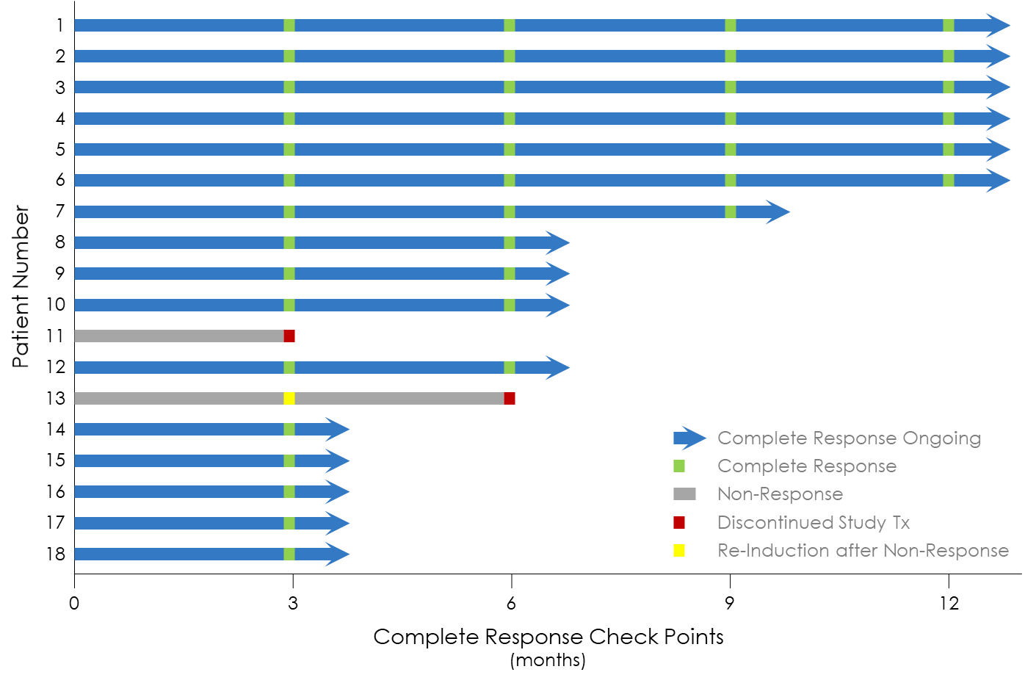
CORE1: CG0070 + Pembrolizumab Study
Preliminary Results of Combination Therapy in BCG-Unresponsive
Authors: Roger Li, Gary D. Steinberg, Ed Uchio, Paras Shah, Donald Lamm, Trinity Bivalacqua, Vignesh T. Packiam, Ashish M. Kamat, Michael Chisamore, John McAdory, Paola Grandi, Jee-Hyun Kim, and James Burke.
Overall CR Rate: 88.9% (16/18)
CR at 12 Months: 75% (6/8)
Safety profile: consistent with single agent experience for both agents
Primary data readout: 3 mos data all 35 patients August 2022, 12 month May 2023
AACR 2022

Slide 26
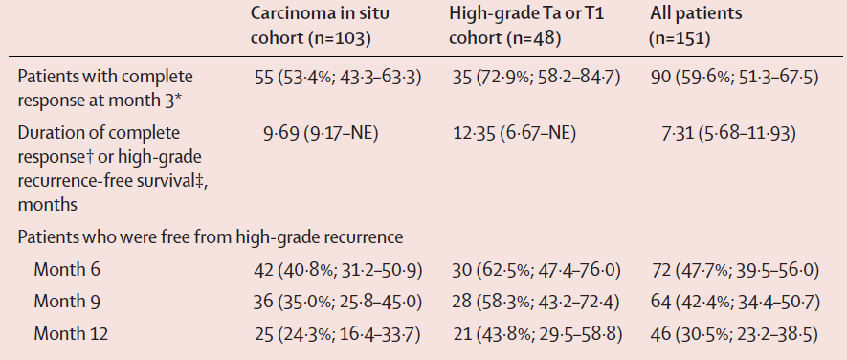
Nadofaragene Firadenovec: Phase 3, Multi-Center, Open-Label Study
  Median duration of HG-RFS was 12.35 months (95% CI: 6.67, NE) in patients with papillary disease
  Progression to ≥ MIBC in 8 (5.3%) patients
Boorjian SA, Lancet Oncology, 2021

Slide 27
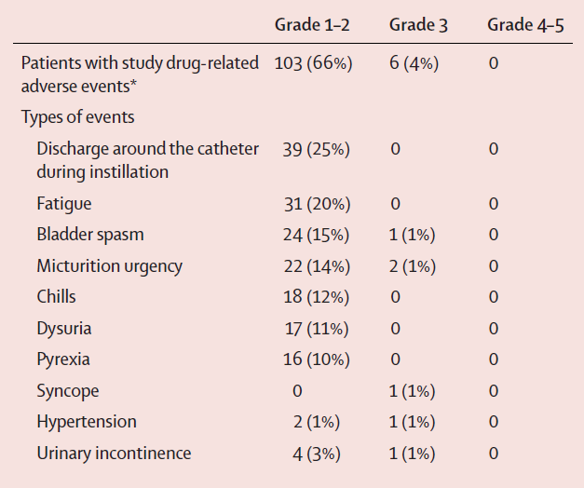
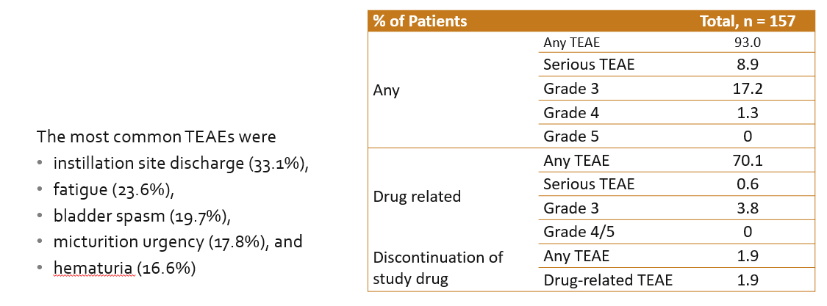
Nadofaragene Firadenovec
Boorjan SA, Lancet Oncology, 2021

Slide 28
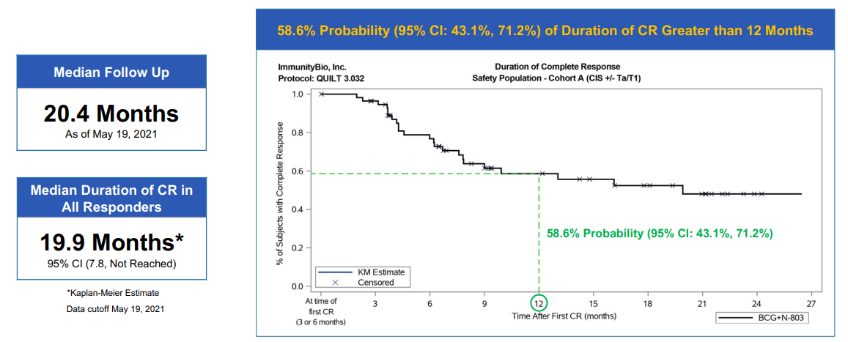
QUILT 3.032: N-803 (IL-15 Superagonist Fusion Protein) + BCG
N=81, 58 patients (72%0 with biopsy confirmed CR at 3 or 6 mos
Chamie, AUA 2021

Slide 29

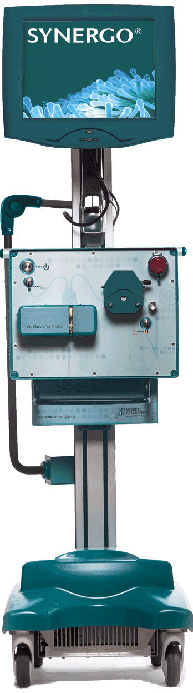

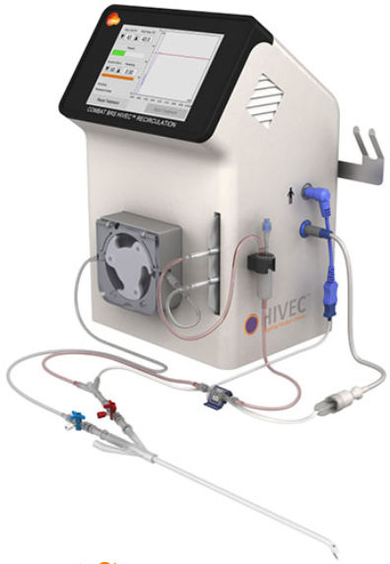
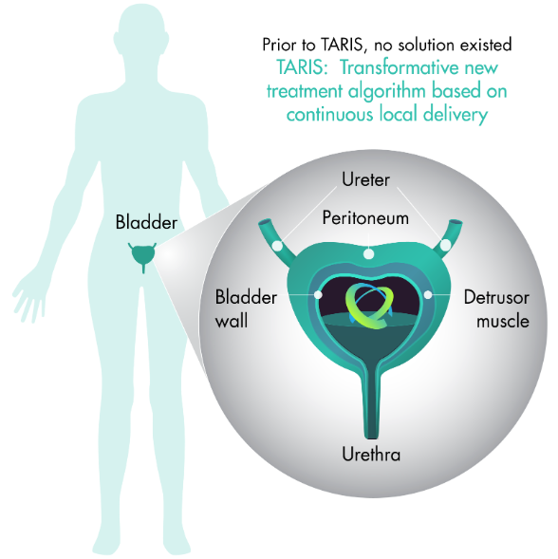
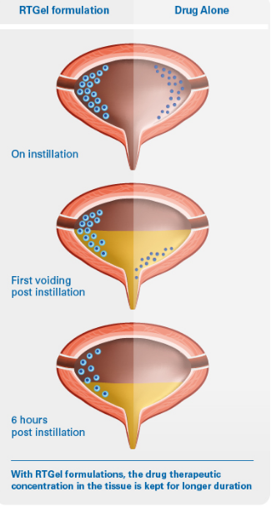
TAR-200
Prior to TAR-200, no solution existed
Transformative new treatment algorithm based on continuous
local delivery

Slide 30

Phase 2b – TAR-200 + Cetrelimab │
NMIBC BCG Un-responsive [BLC2001]
Primary Endpoint
Complete Response [CR] Rate in CIS patients at any time point
  Assessment via Cystoscopy, Urine Cytology, and Bladder Biopsy
Secondary Endpoints
Durability of CR at 12 months from Achievement of CR
Overall Survival [OS] measured as time from cohort assignment to death
TAR-200 [225 mg Gemcitabine]
Q3W [24 wks.], Quarterly → 2 years
+ CETRELIMAB
18 Months
Key Eligibility Criteria
BCG Unresponsive Carcinoma In Situ [CIS]
Patients Ineligible for or Refusing Radical Cystectomy
COHORT 1
[N~100]
TAR-200 Alone
[225 mg Gemcitabine]
2 years
COHORT
2
[N~50]
Randomization [2:1:1; N~200]
Stratification
Presence or absence of concomitant papillary disease
CETRELIMAB Alone
for 18 Months
COHORT
3
[N~50]

Slide 31
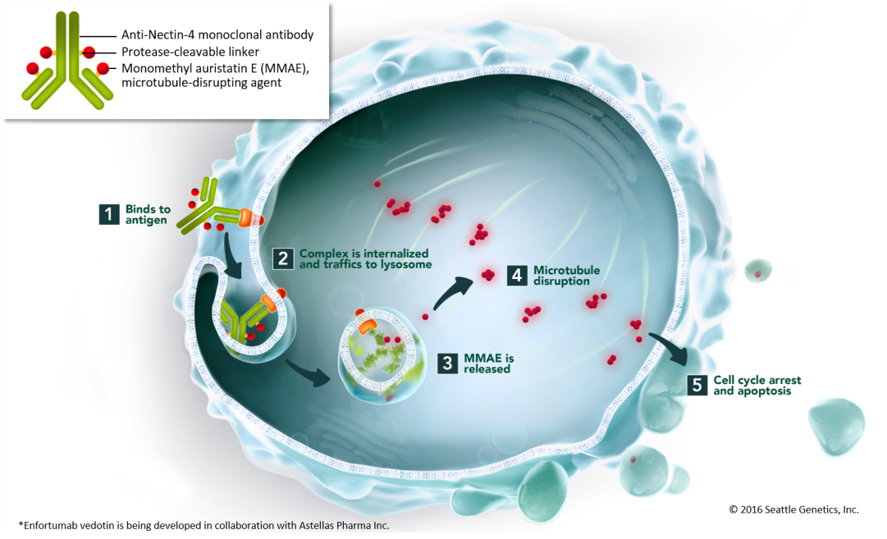
Enfortumab Vedotin: Proposed MOA and Target
Nectin – 4
Transmembrane adhesion molecule expressed on skin, urothelium, salivary gland ducts, breast, stomach, esophagus
Expressed in 83% of UC TMA samples

Slide 32
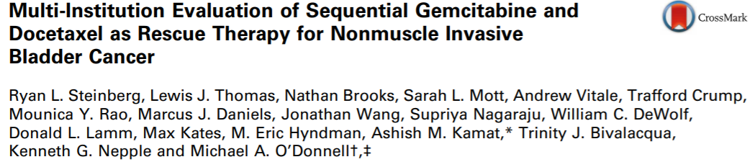
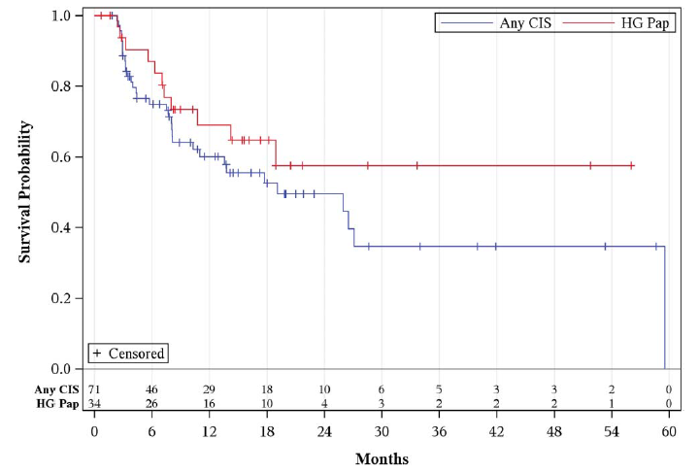
High grade bladder recurrence-free survival for BCG unresponsive cases
276 patients
HG RFS: 65% and 52%, at 1 and 2 yr
RFS: 60% and 46%, at 1 and 2 yr
Cystectomy: 15.6%
4.0% progression to muscle invasion
Papillary alone: 58% HG-RFS at 2 years
Any CIS: 50% HG-RFS at 2 years
Steinberg, Kamat, O’Donnell et al, J Urol, May 2020

Slide 33




Optimal Management of Bladder Cancer Requires a Multidisciplinary Approach
“Providing the best management for patients with bladder neoplasia relies on close cooperation and teamwork among urologists, oncologists, radiologists, and pathologists”
  —2nd International Consultation on Bladder Cancer
“Multidisciplinary input via tumor board discussions and/or directed consultations is critical to the optimal management of patients with bladder cancer”
  —ASCO Clinical Practice Guideline Endorsement
Pharmacist
Urologist
Oncology
Nurse
Urologist
Multidisciplinary Team
Radiation Oncologist
Medical Oncologist
Amin MB, et al. Eur Urol. 2013; Milowsky MI, et al. J Clin Oncol. 2016

Slide 34
MODULE 2: Novel Therapeutic Approaches
for Muscle-Invasive Bladder Cancer

Slide 35
In the past month, approximately how many patients did you see whose primary diagnosis was NMIBC?
0
1
2-5
More than 5

Slide 36
Administration and tolerability of TAR-200
Dr Jason Hafron
West Bloomfield, Michigan
A 76-year-old man with T2 muscle-invasive bladder cancer (MIBC) who discontinues neoadjuvant gemcitabine/cisplatin after acute renal failure
Dr Jason Hafron
West Bloomfield, Michigan

Slide 37
Regulatory and reimbursement issues aside, would you generally include a checkpoint inhibitor in the initial management of a 66-year-old man with muscle-invasive bladder cancer (MIBC) who is not a candidate for bladder resection due to cardiovascular issues?
Yes
No

Slide 38
A 66-year-old man with MIBC, PD-L1 >1% and an extensive history of cardiac disease
Dr Paul Markowski
Summit, New Jersey
A 62-year-old man with high-grade, cT3 FGFR3-positive MIBC
Dr David Morris
Nashville, Tennessee

Slide 39
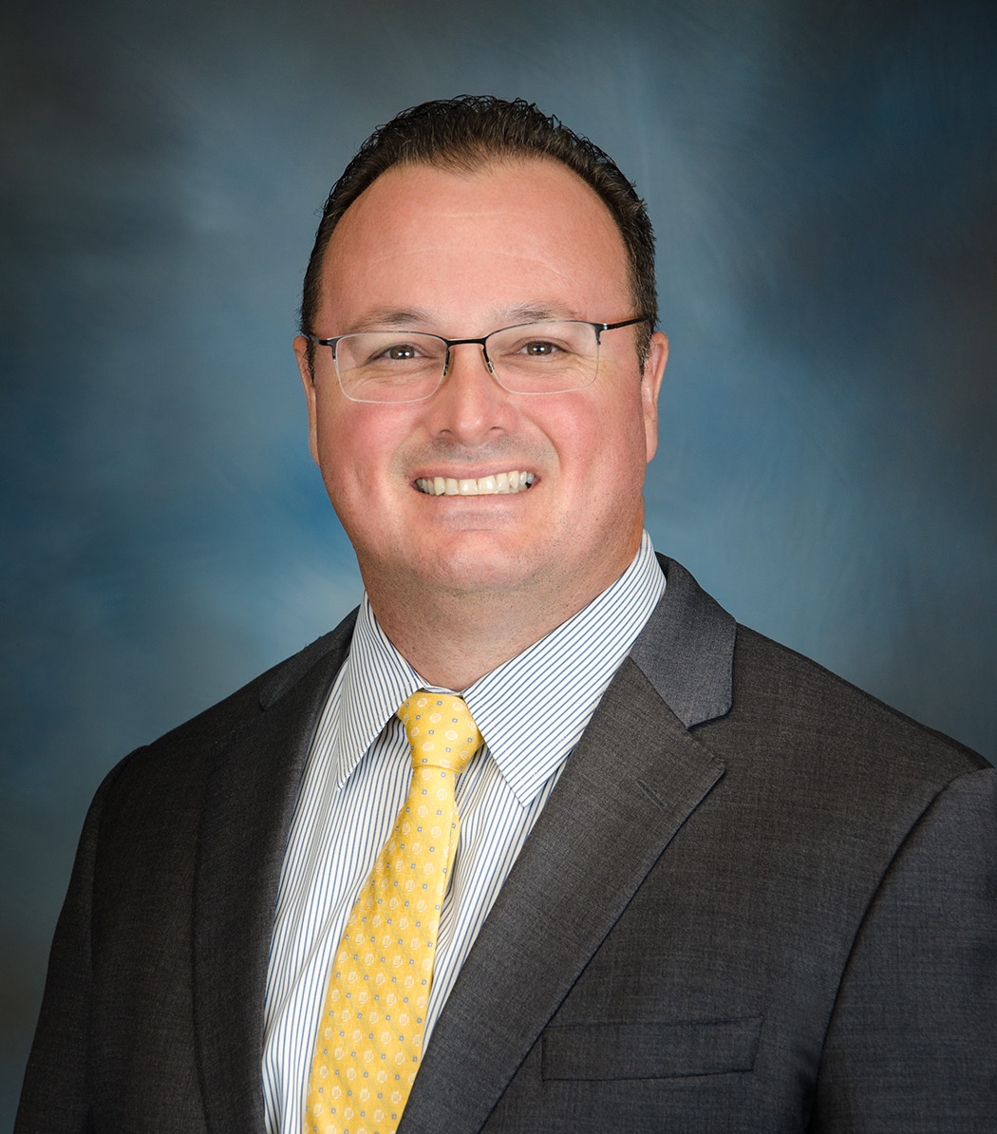
Novel Therapeutic Approaches for Muscle-Invasive Bladder Cancer (MIBC)
Stephen B. Williams, MD, MBA, MS, FACS
Medical Director for High Value Care, UTMB Health System
Professor (Tenured)
Chief, Division of Urology
The Robert Earl Cone Professorship in Urology
Director of Urologic Oncology
Director of Urologic Research
Co-Director, Surgical Outcomes Research Program
The University of Texas Medical Branch in Galveston, TX

Slide 40
Disease / Treatment Settings
Ta, Tis, T1
organ-confined
Locally advanced
NMIBC
MIBC
Cystectomy/PLND
Metastatic/recurrent
Bladder preservation
TURBT(s)
intravesical Tx (BCG, chemoTx)
RC/PLND
pembrolizumab
Neoadjuvant cisplatin-based chemoTx in fit pts
Adjuvant Therapy
1st line therapy
(cisplatin-eligible or ineligible)
2nd line therapy & beyond

Slide 41
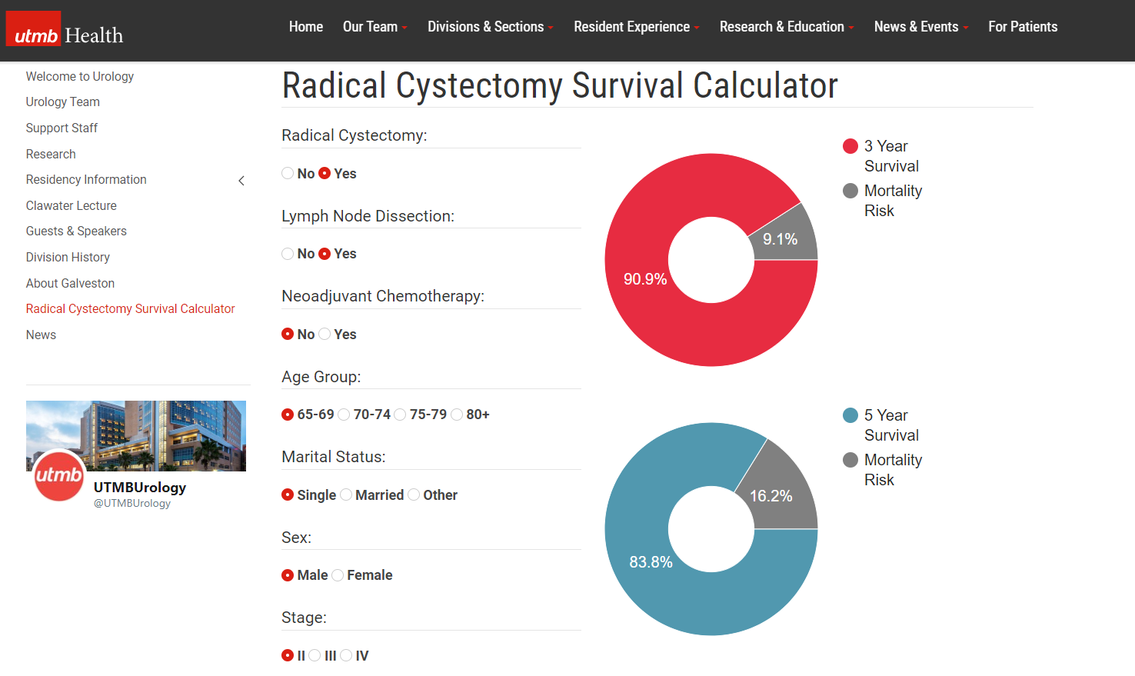
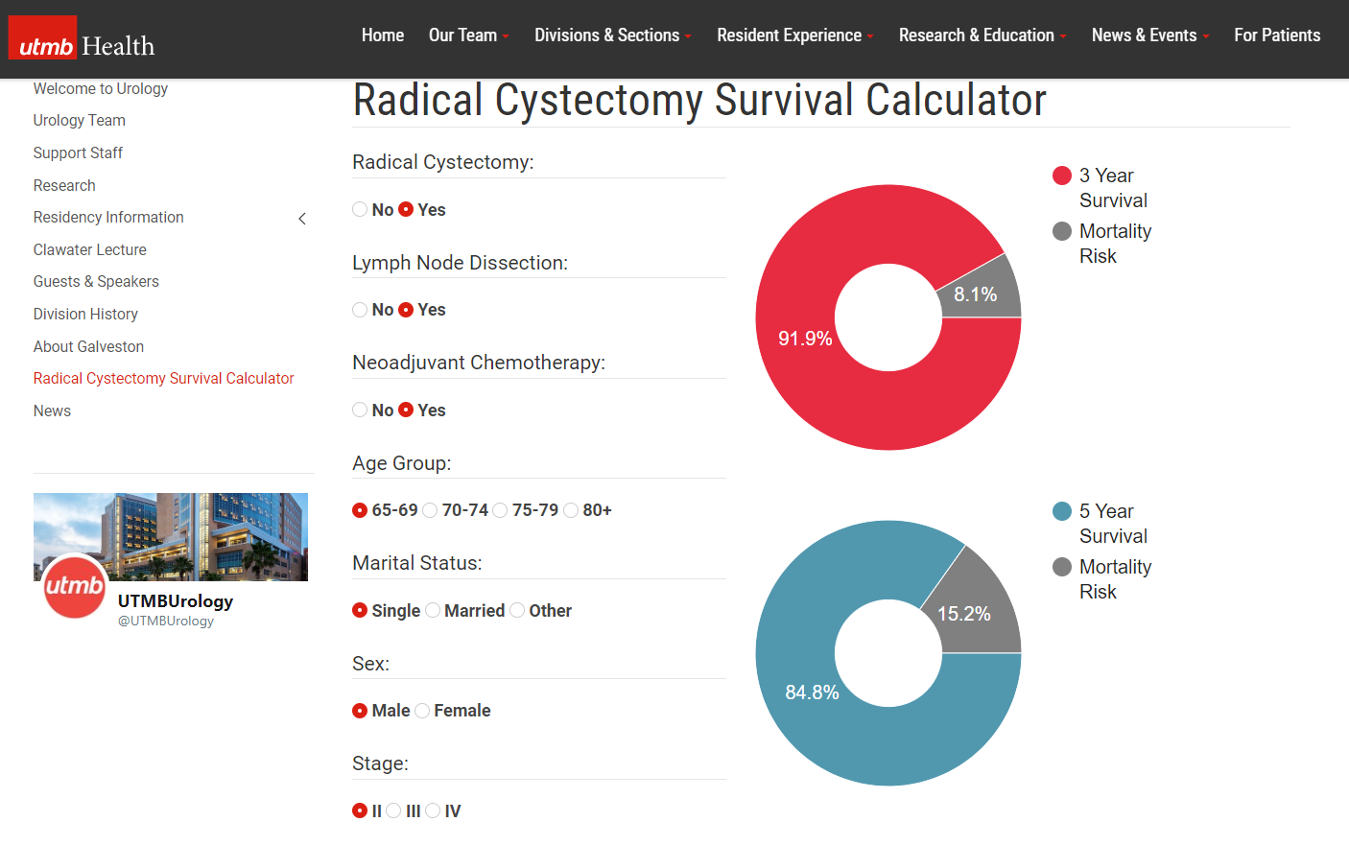

NAC: Need to move the needle…
https://www.utmb.edu/surgery/divisions-and-sections/urology/radical-cystectomy-survival-calculator

Slide 42
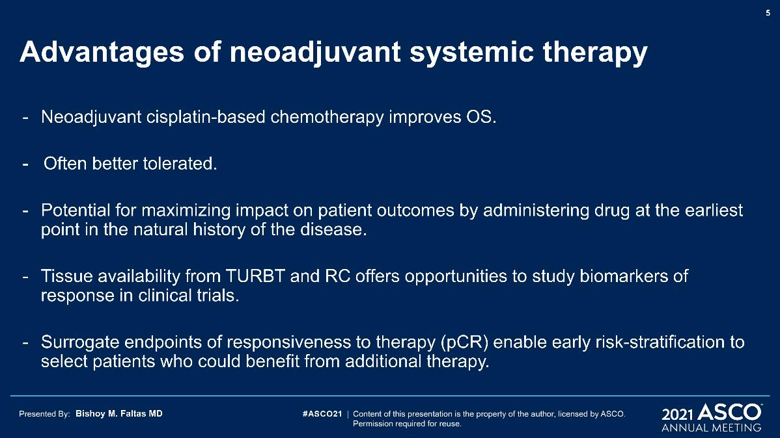
Advantages of neoadjuvant systemic therapy

Slide 43
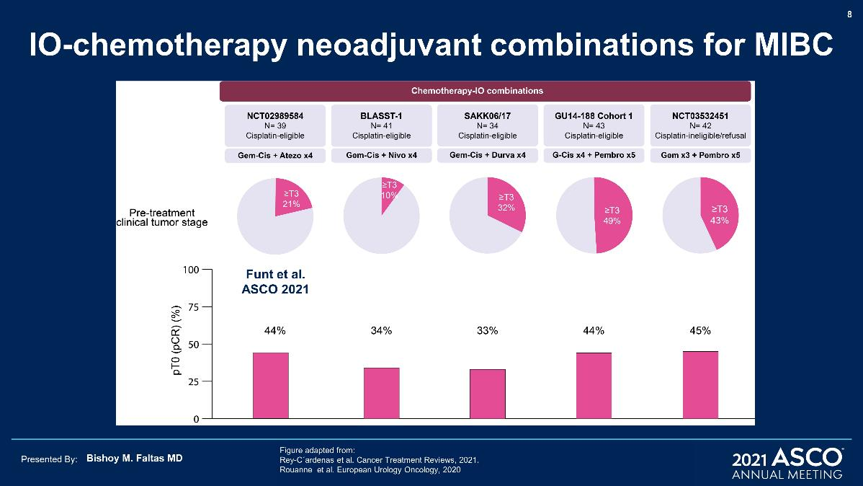
IO-chemotherapy neoadjuvant combinations for MIBC

Slide 44
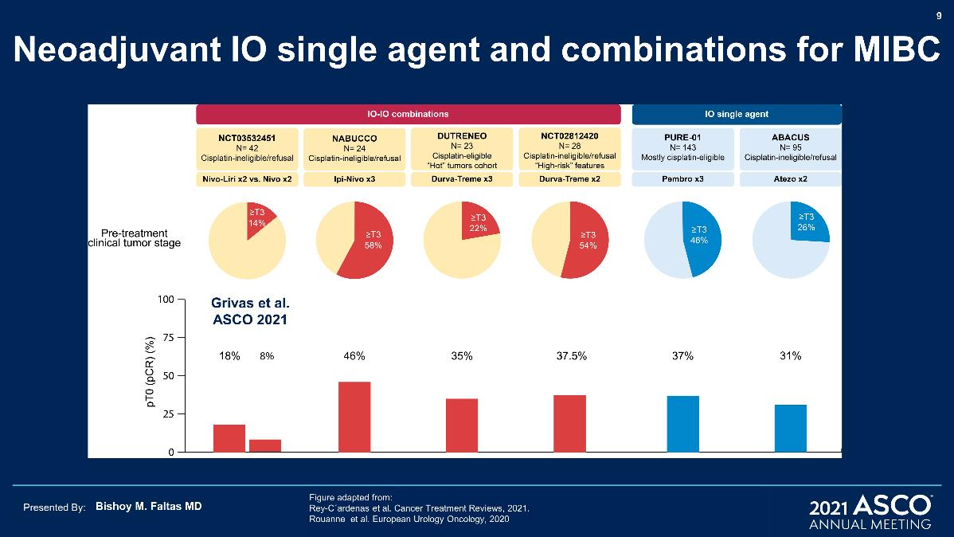
Neoadjuvant IO single agent and combinations for MIBC

Slide 45
Phase 2 studies exploring neoadjuvant IO
 | PURE-01 | ABACUS | NABUCCO |  |  | DUTRENEO | MDACC | PrE0807 | MSKCC
 | Pembro | Atezo | Ipi > Ipi/Nivo > Nivo | Ipi3-Nivo1 | Ipi1-Nivo3 | Durva + Treme | Durva + Treme | Nivo+ Liri | Nivo3 | Ipi3- Nivo1
N | 143 | 88 | 24 | 15 | 15 | 23 | 28 | 30 | 15 | 15
cT2 | 49% | 73% | 0 | 0 | 0 | 78% | 43% | 87% | 54% | 46%
cN1-3 | 0 | 0 | 42% | 47% | 53% | 9% | 0 | 3% | 0 | 0
pT0N0 | 39% | 31% | 46% | 43% | 7% | 35% | 38% | 18% | 13% | 7%
p≤T1 | 56% |  | 58% | 57% | 29% | 57% | 58% | 29% | 26% | 20%
1-yr RFS | 87% | 79% | 92% | NA | NA | NA | 83% | NA | 77% | 68%

Slide 46
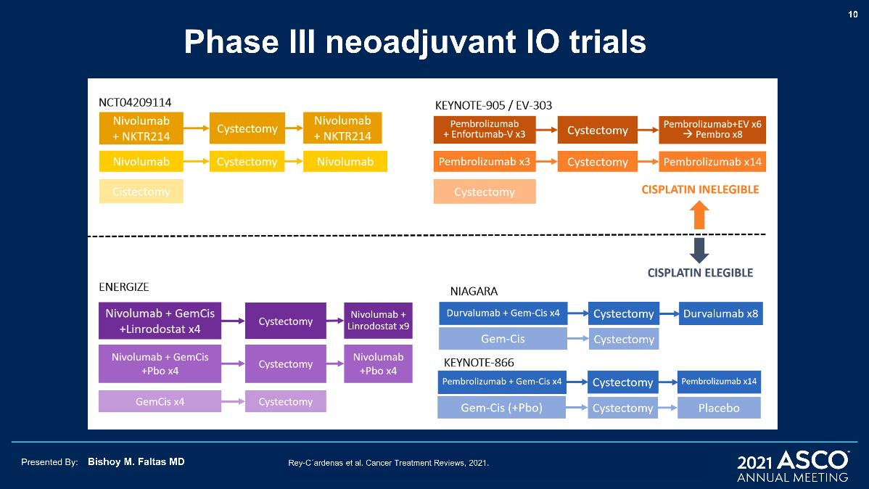
Phase III neoadjuvant IO trials

Slide 47
3 trials integrating IO into neoadjuvant regimens
Cisplatin Ineligible
Pembrolizumab → Cyst* Pembro + Enfortumab vedotin → Cyst* | Cyst | T2-4aN0M0 | KEYNOTE-905/EV-303 NCT03924895
Nivolumab → Cyst* Nivolumab + NKTR-214 → Cyst* | Cyst | T2-4aN0M0 | NCT04209114
Cisplatin Eligible
Gem/Cis + pembrolizumab → Cyst* | Gem/Cis → Cyst | T2-4aN0M0 | KEYNOTE-866 NCT03924856
Gem/Cis + durvalumab → Cyst* | Gem/Cis → Cyst | T2-4aN0M0 | NIAGARA NCT03732677
Gem/Cis + nivolumab → Cyst* Gem/Cis + nivolumab ± BMS-986205 → Cyst* | Gem/Cis → Cyst | T2-4aN0M0 | ENERGIZE NCT03661320
Pembro + Enfortumab vedotin → Cyst* | Gem/Cis → Cyst | T2-4aN0M0 | KEYNOTE-B15 NCT03661320
*regimen continued in the adjuvant setting

Slide 48
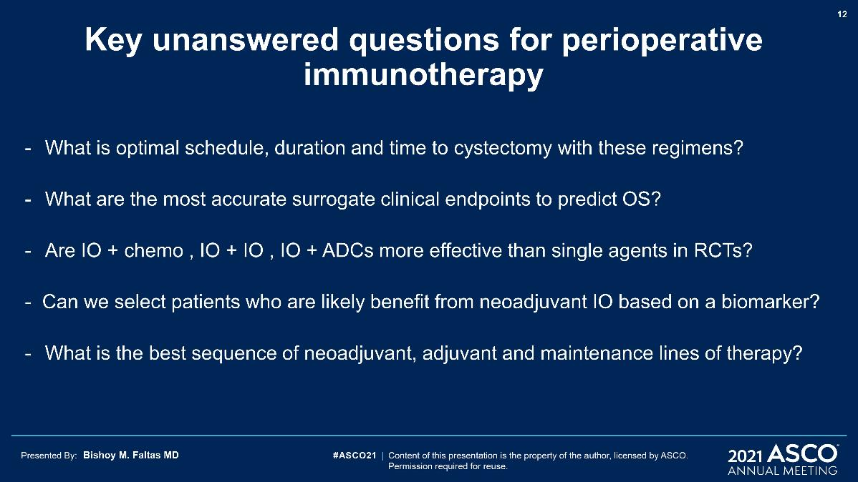
Key unanswered questions for perioperative immunotherapy
Can we select patients who will likely benefit from neoadjuvant IO based on a biomarker?

Slide 49
Disease / Treatment Settings
Ta, Tis, T1
organ-confined
Locally advanced
NMIBC
MIBC
Cystectomy/PLND
Metastatic/recurrent
Bladder preservation
TURBT(s)
intravesical Tx (BCG, chemoTx)
RC/PLND
pembrolizumab
Neoadjuvant cisplatin-based chemoTx in fit pts
Adjuvant Therapy
1st line therapy
(cisplatin-eligible or ineligible)
2nd line therapy & beyond

Slide 50
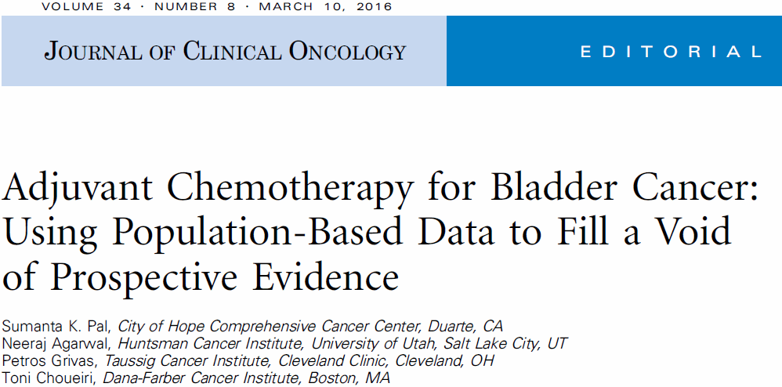

Slide 51
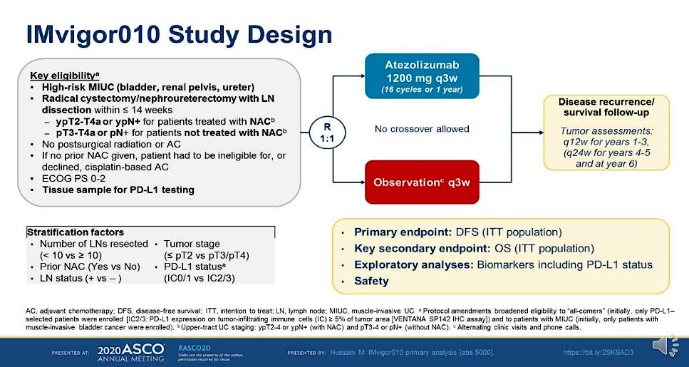
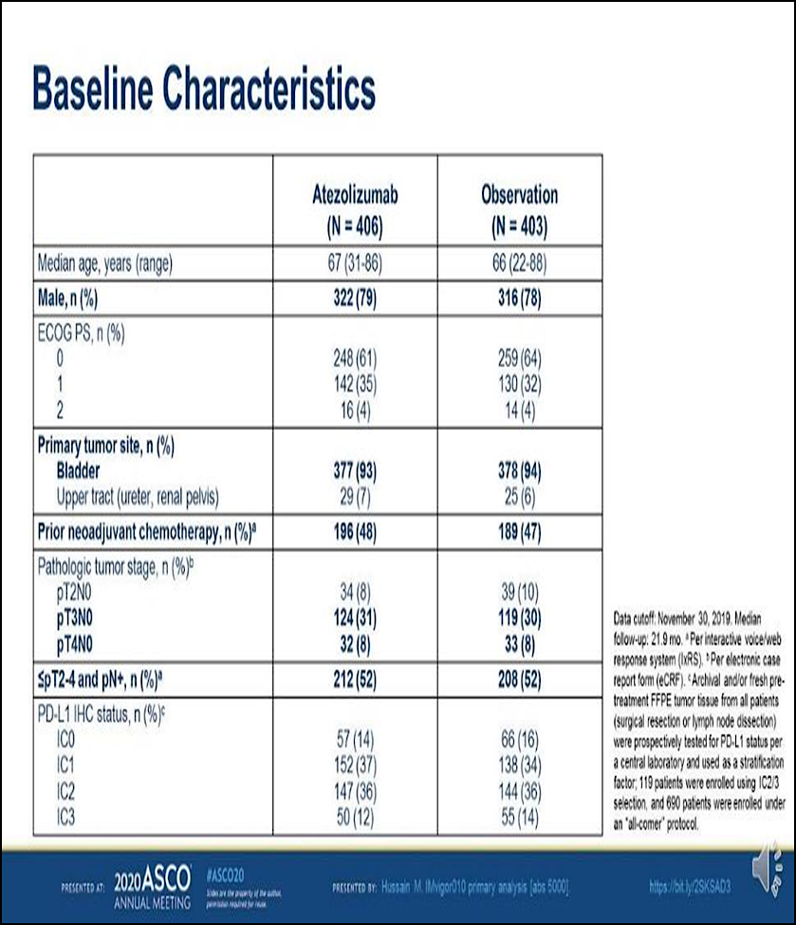
Presented by Maha Hussain at TBD

Slide 52
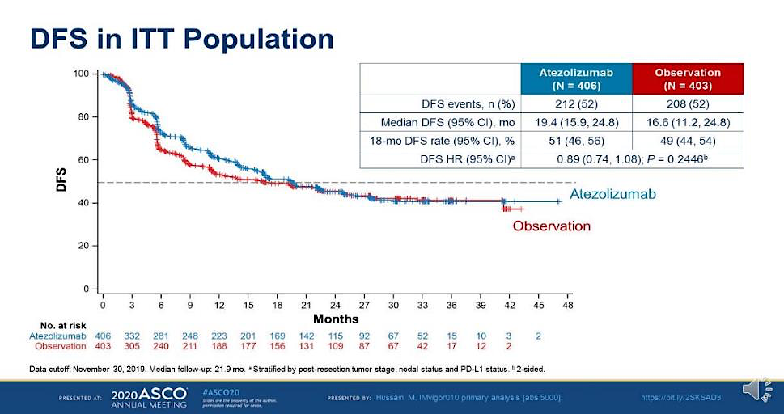
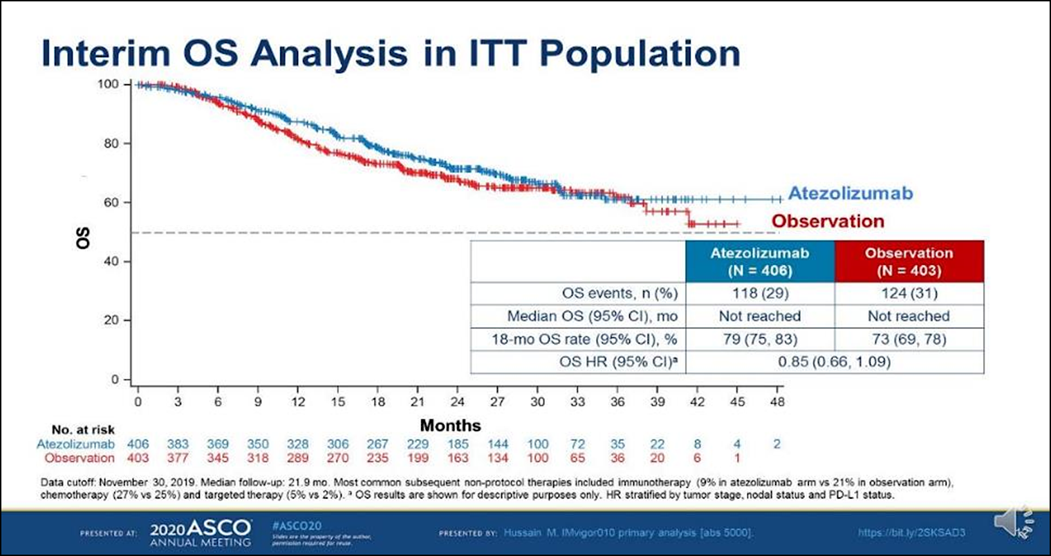
Presented by Maha Hussain at TBD

Slide 53
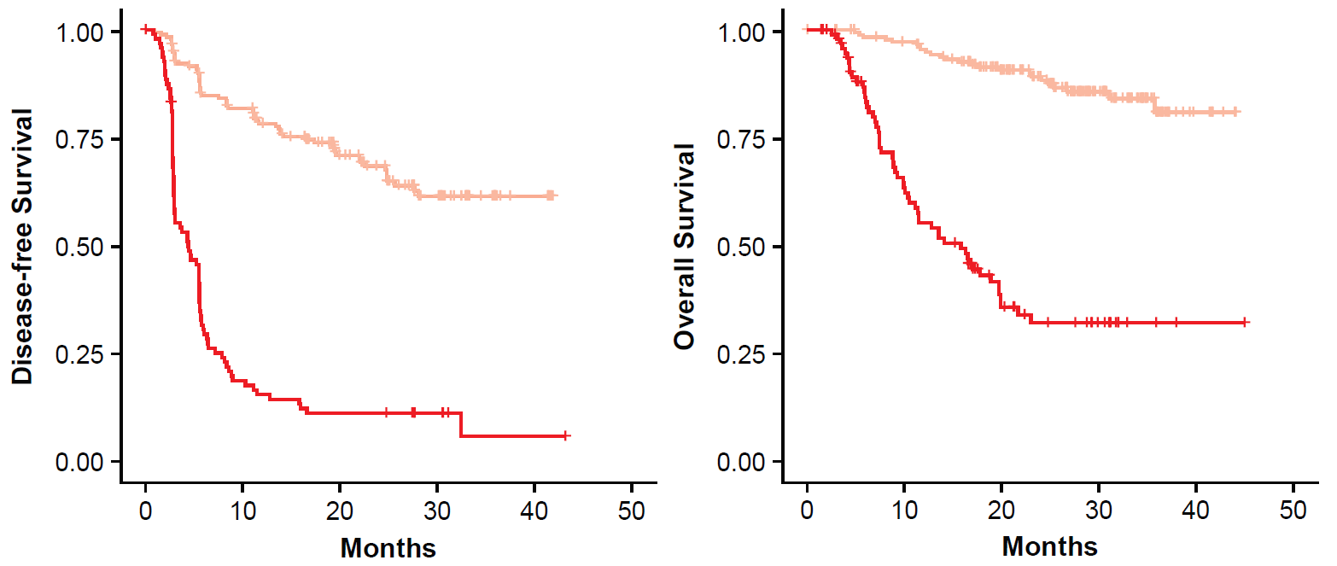
ctDNA(+) portends poor prognosis
Observation arm
Observation arm
— ctDNA(–) (n=183)
— ctDNA(+) (n=98)
— ctDNA(–) (n=183)
— ctDNA(+) (n=98)
OS HR, 8.00 (95% CI: 4.92, 12.99)
P<0.0001
Disease-free survival
DFS HR, 6.30 (95% CI: 4.45, 8.92)
P<0.0001
Overall survival
Months
Months
IMvigor010 confirmed the prognostic value of ctDNA status
Powles et al. ESMO IO, 2020
Powles et al. Nature, 2021

Slide 54
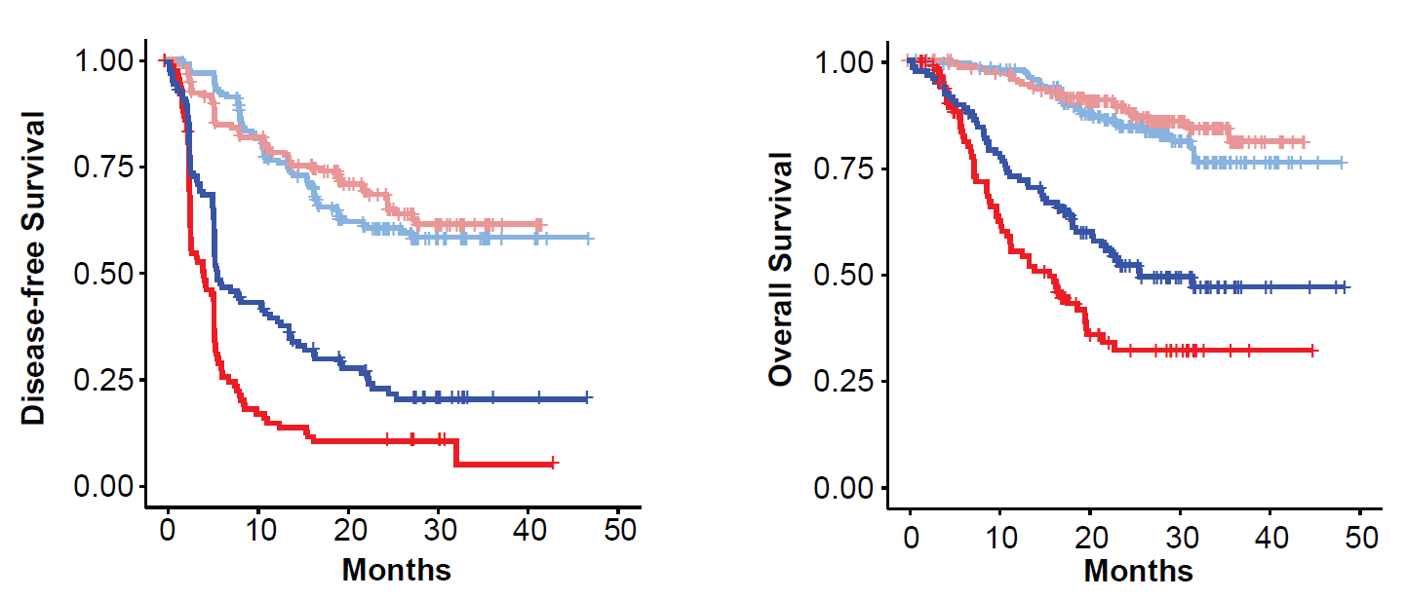
ctDNA(+) associated with improved DFS and OS with atezolizumab vs observation
ctDNA(+) ctDNA(-)
▬ ▬ Atezolizumab
▬ ▬ Observation
ctDNA(−): 63%
HR, 1.31 (95% CI: 0.77, 2.23)
P=0.32
ctDNA(+): 37%
HR, 0.59 (95% CI: 0.41, 0.86)
P=0.0059
ctDNA(−): 63%
HR, 1.14 (95% CI: 0.81, 1.62)
P=0.45
ctDNA(+): 37%
HR, 0.58 (95% CI: 0.43, 0.79)
P=0.0005
Disease-free survival
Overall survival
— n=116
— n=98
— n=184
— n=183
— n=116
— n=98
— n=184
— n=183
Months
Months
Powles et al. ESMO IO, 2020
Powles et al. Nature, 2021

Slide 55
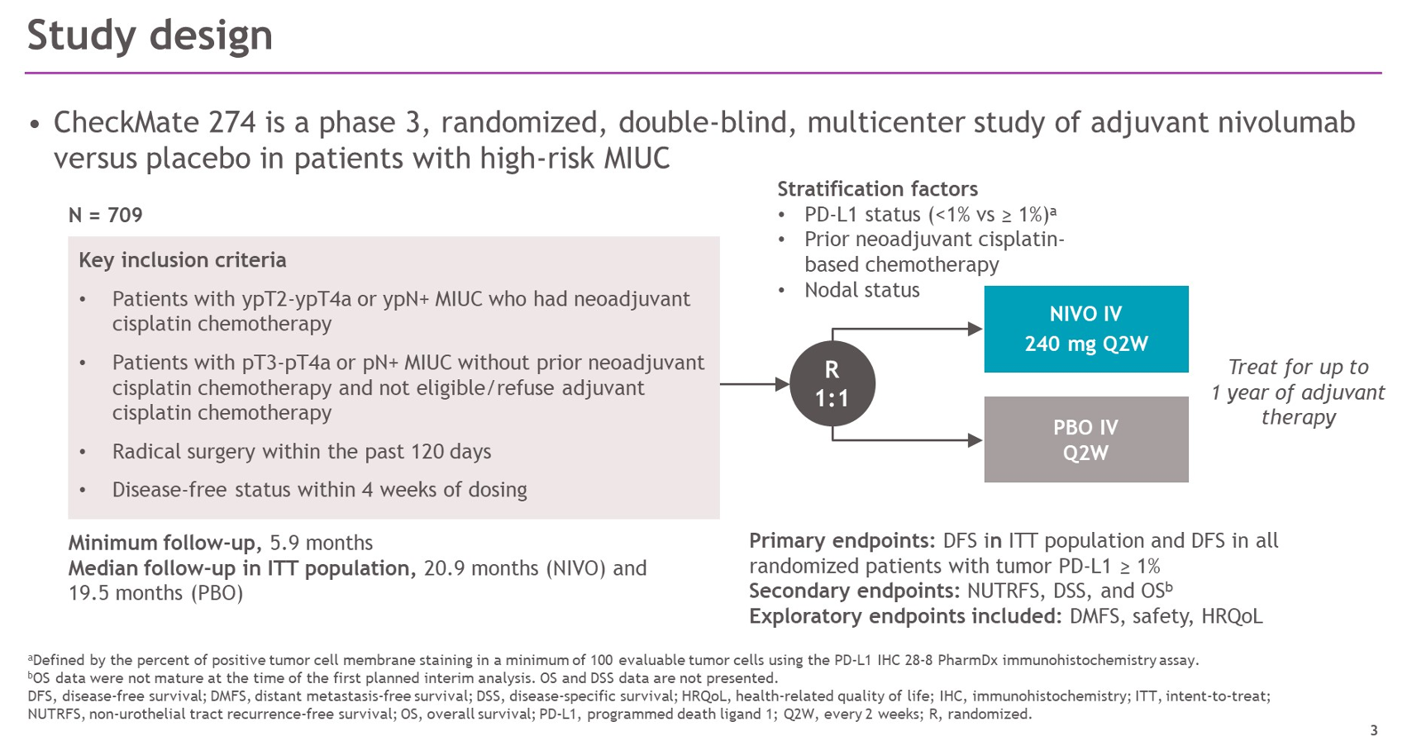
Bajorin DF et al. N Engl J Med 2021;384:2102-114.

Slide 56
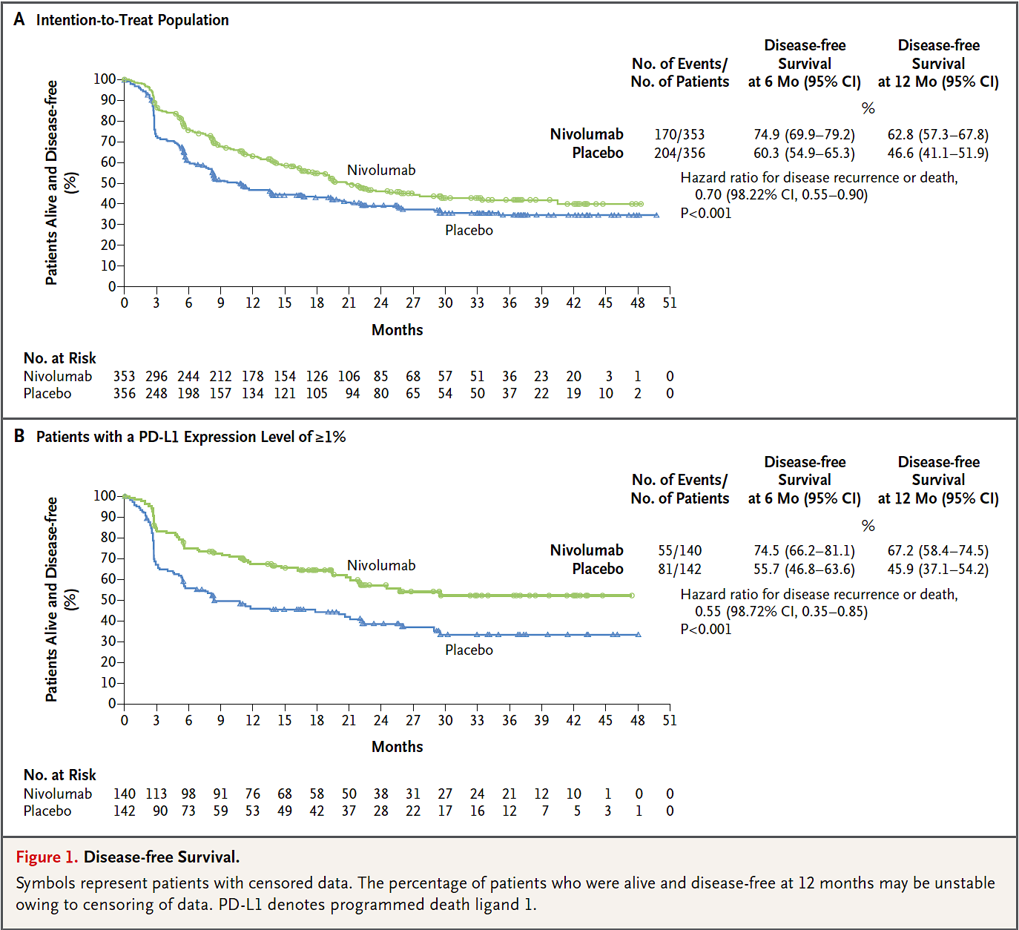
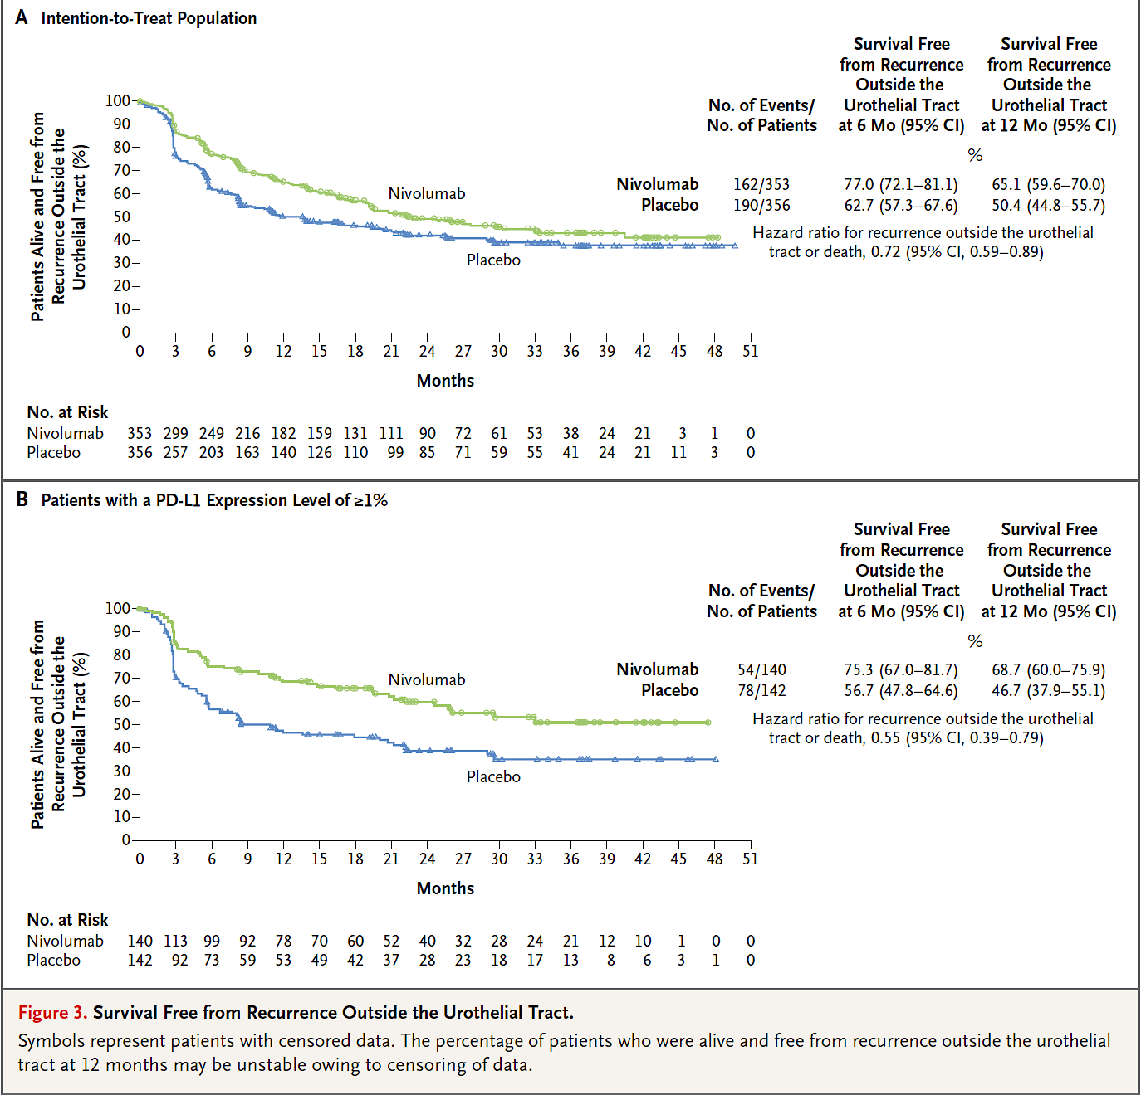
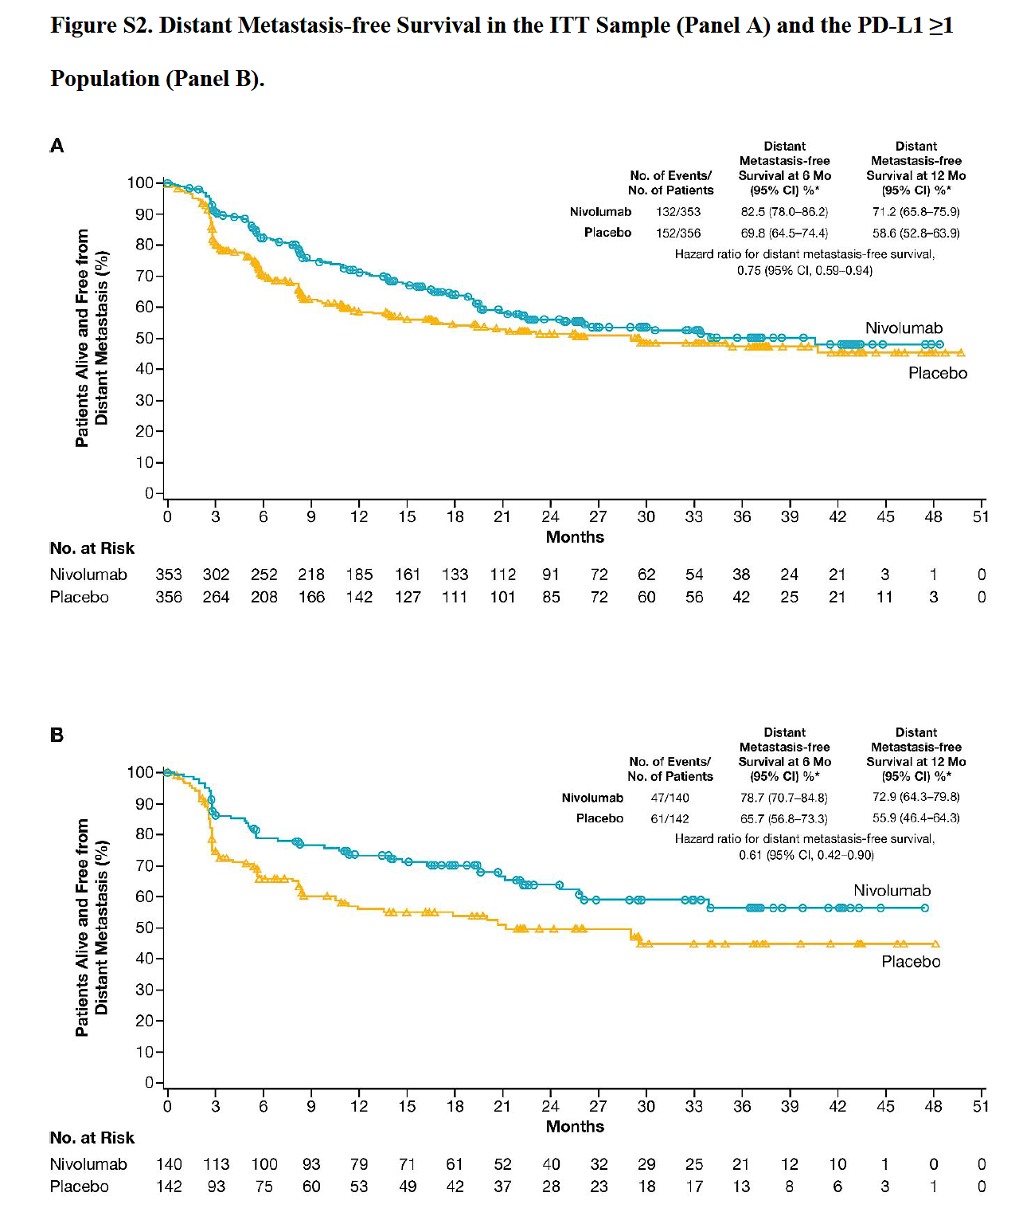
DISEASE-FREE SURVIVAL
SURVIVAL FREE FROM RECURRENCE OUTSIDE THE UROTHELIAL TRACT
DISTANT METASTASIS-FREE SURVIVAL
ITT POPULATION
PD-L1 ≥ 1
Bajorin DF et al. N Engl J Med 2021;384:2102-114.

Slide 57
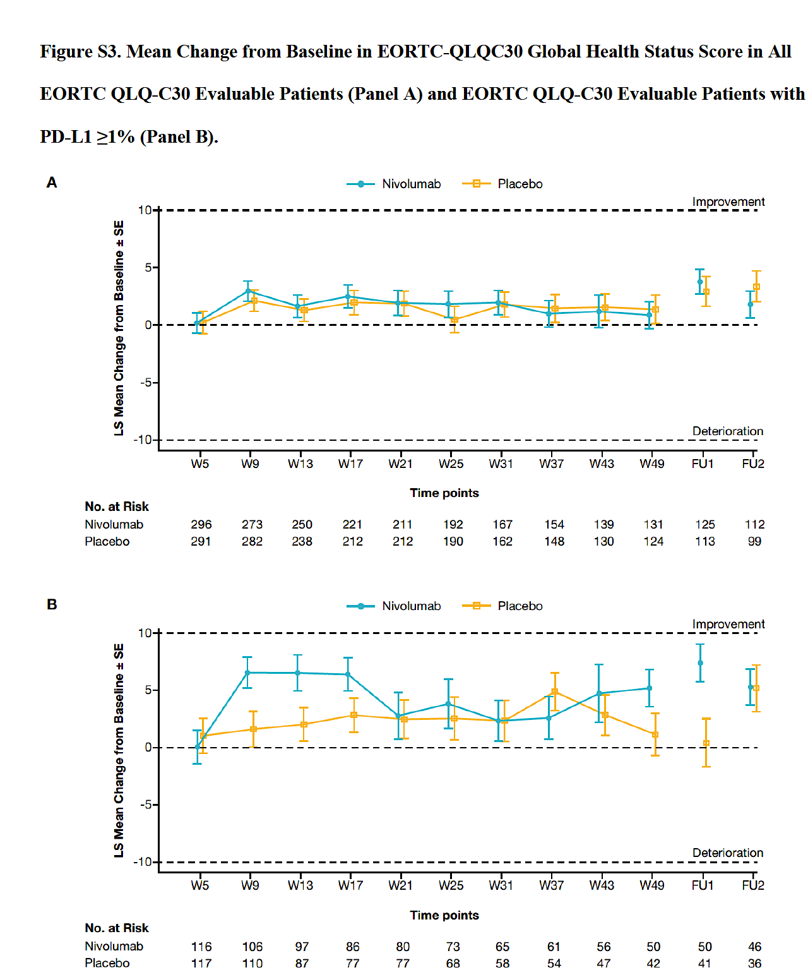
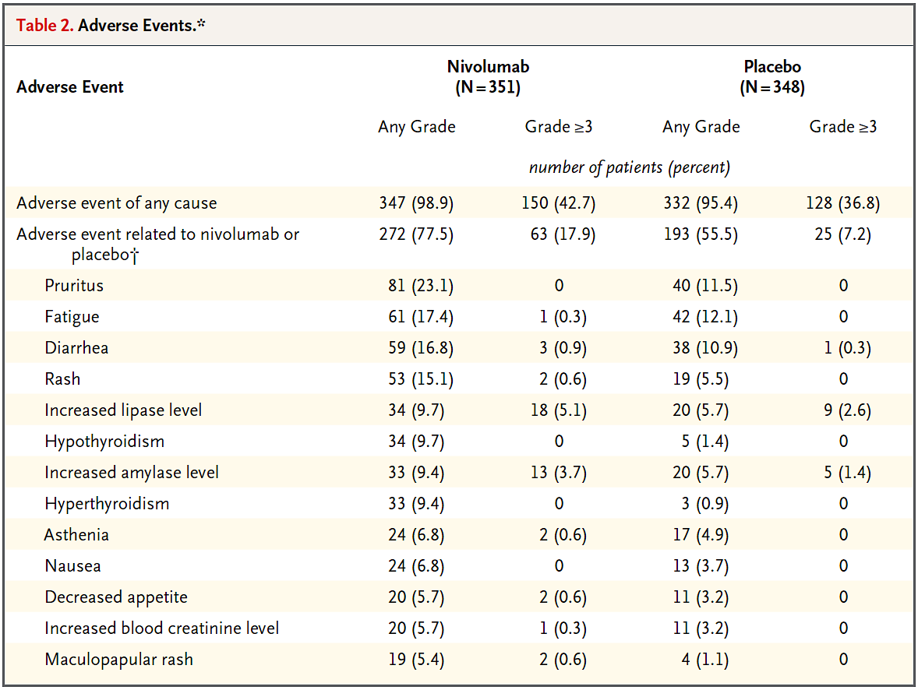
Bajorin DF et al. N Engl J Med 2021;384:2102-114.

Slide 58
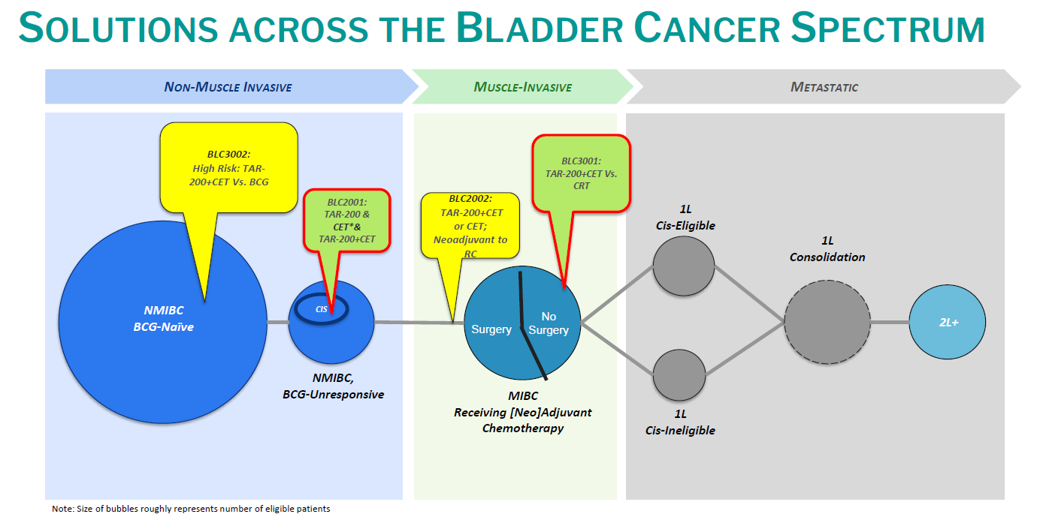
Paradigm Shift: Delivery systems enter the room…

Slide 59
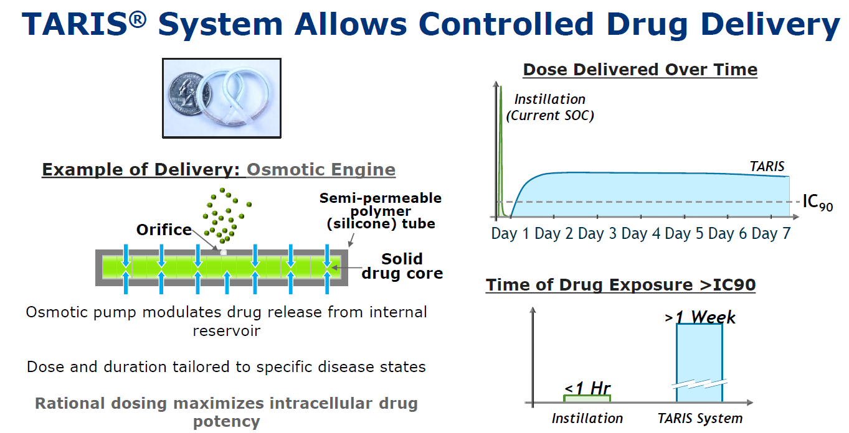
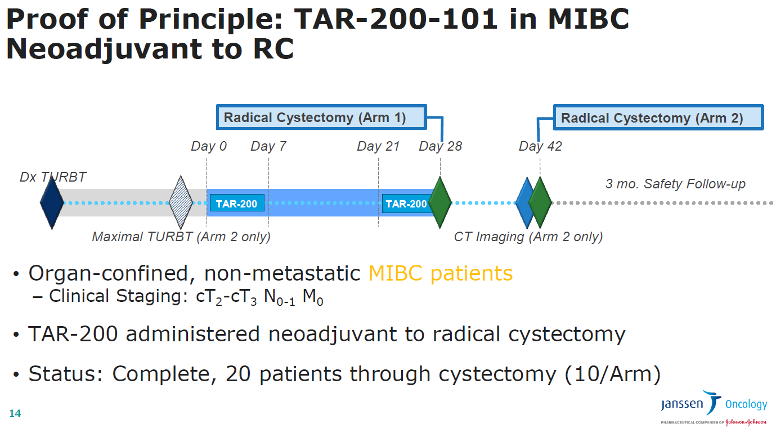
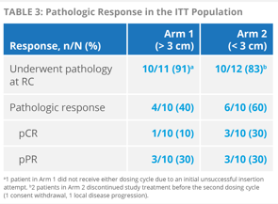
Paradigm Shift: Delivery systems enter the room…
TAR-200 was safe, well tolerated, 50% pCR or pPR
Daneshmand S et al. Urol Oncol 2022;[Online ahead of print].

Slide 60


Slide 61

with TAR-200 with respect

Slide 62


Enfortumab vedotin (EV) is an antibody-drug conjugate directed to Nectin-4
Cohort H of the EV-103 phase 1b/2 trial (NCT03288545):
- cis-ineligible cT2-T4aN0M0 MIBC RC + PLND eligible.
- 3 cycles of neoadjuvant EV (1.25 mg/kg) on Days 1 and 8 of every 3-week cycle prior to RC+PLND.

Slide 63
Results: 22 pts were treated->21 underwent RC+PLND, and 1 had a partial cystectomy.
-36.4% pCR-> 50% pPR-> well tolerated-> no delay to surgery.
Supports ongoing Phase II and III programs evaluating EV in MIBC.

Slide 64

Tomorrowland No More: Novel Therapeutic Approaches for MIBC

Slide 65
MODULE 3: Current and Future Front-Line Management of Metastatic Urothelial
Bladder Carcinoma

Slide 66
For a patient with responding/stable disease after first-line chemotherapy for metastatic urothelial bladder cancer (mUBC), would you generally recommend maintenance therapy with a checkpoint inhibitor?
Yes
Yes, if PD-L1-positive
No

Slide 67
A 75-year-old man with metastatic urothelial bladder cancer (mUBC) who required bilateral percutaneous nephrostomies
Dr David Taub
Boca Raton, Florida
A 69-year-old man with mUBC and peritoneal carcinomatosis
Dr Jason Hafron
West Bloomfield, Michigan

Slide 68
The key antitumor mechanism of most antibody-drug conjugates is…
Immune-based
Antiapoptotic
Cytotoxic
Kinase inhibition
I don’t know

Slide 69
A 73-year-old man with mUBC and recurrence in the bladder while receiving pembrolizumab
Dr Laura Bukavina
Philadelphia, Pennsylvania
Sequencing immunotherapy and enfortumab vedotin
Dr Sulfi Ibrahim
Richmond, Indiana

Slide 70

Current and Future Front-Line Management of Metastatic Urothelial Bladder Carcinoma (mUBC)
Matthew D. Galsky, MD
Professor of Medicine
Icahn School of Medicine at Mount Sinai
Associate Director, Translational Research
Co-Leader, Cancer Clinical Investigation Program
Tisch Cancer Institute
@MattGalsky
Notes:
Last updated: 28 April 2016

Slide 71
Immune Checkpoint Inhibitors for
Locally Advanced and Metastatic UC
Agent | Ab Inhibits | Schedule | Post Platinum | Front-line Cis-Ineligible
Atezolizumab | PD-L1 | Q3W | Accelerated | Accelerated
Nivolumab | PD-1 | Q2W | Accelerated | --
Durvalumab | PD-L1 | Q2W | Accelerated | --
Avelumab | PD-L1 | Q2W | Accelerated | --
Pembrolizumab | PD-1 | Q3W | Level 1 | Accelerated

Slide 72
Approximately 50% of patients are “cisplatin-ineligible”
ECOG PS = 2
Creatinine clearance < 60 mL/min
Grade ≥ 2 hearing loss
Grade ≥ 2 neuropathy
New York Heart Association Class III CHF
Galsky et al, Lancet Oncology, 2011

Slide 73
Immune Checkpoint Inhibitors for
1st line treatment of Cisplatin-ineligible patients with Metastatic UC
Studyª
Patients, no.
Study arm
Key inclusion criteria
ORR (%)
IMvigor210¹ Atezolizumab Phase 2 – Cohort 1
119
Atezolizumab 1200 mg IV q3w
Inoperable la/mUC No prior treatment for mUC ECOG PS ≤2 Cisplatin ineligible
23
KEYNOTE-052² Pembrolizumab Phase 2
370
Pembrolizumab 200 mg IV q3w
Inoperable la/mUC No prior chemotherapy for mUC ECOG PS ≤2 Cisplatin ineligible
29
1. Balar AV, et al. Lancet. 2017;389(10064):67-76. 2. Vuky J, et al. J Clin Oncol. 2020;38(23):2658-2666.

Slide 74
A series of randomized clinical trials has recently refined first-line treatment for metastatic urothelial CA
DANUBE
Is there a role for chemo + IO?
Is there a role for IO alone upfront?
Is there a role for biomarker selection for IO?
Is there a role for “switch maintenance” IO?
Is there a role for IO doublet therapy?
KEYNOTE 361
IMvigor 130
Javelin-100
Checkmate 901

Slide 75
A series of randomized clinical trials has recently refined first-line treatment for metastatic urothelial CA
DANUBE
Is there a role for chemo + IO?
Is there a role for IO alone upfront?
Is there a role for biomarker selection for IO?
Is there a role for “switch maintenance” IO?
Is there a role for IO doublet therapy?
KEYNOTE 361
IMvigor 130
Javelin-100
Checkmate 901

Slide 76
“Switch Maintenance” PD-1/PD-L1 blockade improves outcomes in metastatic UC
HCRN 14-182 Randomized Phase 2
Javelin Bladder-100 Randomized Phase 3
Javelin Bladder-100 Overall Survival
Galsky et al, JCO, 2020
Powles, NEJM, 2020

Slide 77

Long term follow-up of Javelin Bladder 100
(≥ 2 year follow up)
Powles et al, ASCO GU 2022 # A487

Slide 78
What is optimal first-line treatment for metastatic UC?
PD-1/PD-L1
PD-1/PD-L1
Metastatic UC
Cisplatin eligible or ineligible
Metastatic UC
Cisplatin eligible or ineligible
R
    Chemo + PD-1/PD-L1
R
    PD-1/PD-L1 + CTLA4
Chemo
Chemo
IMvigor 130✓
Keynote 361✓
Checkmate 901 (substudy)
NILE
DANUBE✓
Checkmate 901 (main study)
NILE (sort of…)

Slide 79

Platinum-based chemo + anti-PD-1/PD-L1 leads to
non-significant improvements in OS in ITT
IMvigor 130
Keynote 361
Galsky et al, Lancet, 2020
Alva et al, ESMO, 2020

Slide 80

Platinum-based chemo vs anti-PD-1/PD-L1 in ITT populations
DANUBE
Keynote 361
IMVIGOR 130
Galsky et al, Lancet, 2020
Alva et al, ESMO, 2020
Powles, Lancet Oncol, 2020

Slide 81
PD-L1 testing…clear as mud?
Drug | Biomarker | Scoring
Pembrolizumab | 22C3 | TC + IC
Atezolizumab | SP142 | IC
Nivolumab | 28-8 | TC
Durvalumab | SP263 | TC + IC
Avelumab | 73-10 | TC + IC
TC, tumor cell; IC, immune cell

Slide 82

Platinum-based chemo vs anti-PD-1/PD-L1 in PD-L1+ populations
DANUBE
Keynote 361
IMVIGOR 130
Galsky et al, Lancet, 2020
Alva et al, ESMO, 2020
Powles, Lancet Oncol, 2020

Slide 83
Platinum-based chemo vs anti-PD-1/PD-L1 in PD-L1+ populations
DANUBE
Keynote 361
PD-L1+ (SP263) = 60%
PD-L1+ (22C3) = 51%
IMVIGOR 130
Galsky et al, Lancet, 2020
Alva et al, ESMO, 2020
Powles, Lancet Oncol, 2020
PD-L1+ (SP142) = 24%

Slide 84


What about the current label (ie, cisplatin ineligible + PD-L1 ”high”)?
PD-L1 IC0/1
PD-L1 IC2/3
OS (%)
OS (%)
11.2 mo
(9.9, 15.0)
11.2 mo
(6.9, 15.0)
10.0 mo
(7.4, 19.1)
18.6
(13.1, NE)
Months
Months
No. at risk
No. at risk
Atezolizumab
140
103
83
71
60
39
21
14
7
NE
NE
NE
Atezolizumab
50
42
40
37
28
22
14
8
2
NE
NE
NE
Placebo+plt/gem
55
38
26
12
8
2
NE
NE
Placebo+plt/gem
140
124
105
80
43
36
26
21
17
12
6
4
1
NE
NE
NE
 | Atezolizumab (Arm B) (n=140) | Placebo + plt/gem (Arm C) (n=140)
OS events | 85 | 85
OS HR (95% CI) | 1.11 (0.82, 1.51)
ORR (95% CI), %ª | 16 (10, 23) | 42 (34, 51)
 | Atezolizumab (Arm B) (n=50) | Placebo + plt/gem (Arm C) (n=43)
OS events | 21 | 26
OS HR (95% CI) | 0.53 (0.30, 0.94)
ORR (95% CI), % | 38 (25, 53) | 33 (19, 49)
Galsky et al, ASCO GU 21

Slide 85
A series of randomized clinical trials has recently refined first-line treatment for metastatic urothelial CA
DANUBE
Is there a role for chemo + IO?
Is there a role for IO alone upfront?
Is there a role for biomarker selection for IO?
Is there a role for “switch maintenance” IO?
Is there a role for IO doublet therapy?
KEYNOTE 361
IMvigor 130
Javelin-100
Checkmate 901

Slide 86

CheckMate 032: Phase 1/2 Trial of Nivolumab + Ipilimumab
Pretreated patients with la/mUC (or refused chemotherapy)
Progressive disease after ≥1 prior platinum-based chemotherapy
Best Tumor Change From Baseline in Target Lesion per Investigator¹
 | NIVO1 + IPI3 (n=92)
ORR 95% CI | 35 (38.0%) (28.1, 48.8)
Complete response | 6 (6.5%)
Partial response | 29 (31.5%)
NIVO3 (n=78)
NIVO3 + IPI1 (n=104)
NIVO1 + IPI3 (n=92)
Nivolumab 1 mg/kg + ipilimumab 3 mg/kg
every 3 weeks x4 doses
followed by nivolumab maintenance
Sharma et al, JCO, 2019

Slide 87
Can anti-CTLA4 + PD-L1 ↑ ORR enough to compete with chemo?
DANUBE (PD-L1+)
DANUBE (ITT)
Powles, Lancet Oncol, 2020

Slide 88

Checkmate 901 Trial

Slide 89
How can we further improve PD-1/PD-L1 blockade?
Move treatment earlier
Combination regimens
Biomarkers

Slide 90
Antibody-drug conjugates are changing UC treatment landscape
Antigen
Payload
Linker

Slide 91
Enfortumab Vedotin
Target: Nectin-4, a type 1 transmembrane cell adhesion molecule overexpressed in epithelial cancers
Linker: Protease cleavable
Payload: MMAE

Slide 92

EV + Pembrolizumab in cisplatin-ineligible patients with metastatic urothelial cancer
EV 1.25 mg/kg days 1 and 8
of a 3-week cycle
+
Pembrolizumab 200 mg on day 1
of a 3-week cycle
Confirmed ORR 95% CI | 73.3% (33/45) (58.1, 85.4)
Complete response | 15.6%
Partial response | 57.8%
Median DOR =25.6 mo
Friedlander, ASCO 2021

Slide 93
FGFR3 mutations in urothelial cancer
Hotspot mutations in 15-25% invasive
Enriched in upper tract disease
Not definitively associated with ICB resistance
Small molecule TKIs with ORR ~40%

Slide 94


FGFR3 inhibition plus PD-1/PD-L1 blockade
Erdafitinib plus cetrelimab
Rogaratinib in combination with atezolizumab
ORR 55%
ORR 58%
Phase 2 NORSE trial at ESMO 2021 (n=19)
ORR 68%
Siefker-Radke, ESMO, 2020; Rosenberg, ASCO, 2021; Powles, ESMO, 2021

Slide 95
MODULE 4: Selection and Sequencing
of Therapy for Relapsed/Refractory
Urothelial Bladder Carcinoma

Slide 96
Current first-line treatment of metastatic disease frequently involves the use of chemotherapy in combination with a checkpoint inhibitor in which of the following tumor types?
Non-small cell lung cancer
Head and neck cancer
Esophageal cancer
Cervical cancer
Triple-negative breast cancer
All of the above
I don’t know

Slide 97
A 68-year-old man with mUBC whose disease progressed after 4 years of nivolumab/ipilimumab
Dr Zanetta Lamar
Naples, Florida
A 70-year-old woman with mUBC and PD-L1 30% with enfortumab vedotin-associated dermatologic toxicity
Dr Sulfi Ibrahim
Richmond, Indiana

Slide 98
What would you generally recommend as second-line therapy for a patient with mUBC with an FGFR somatic mutation whose disease progresses while he is receiving avelumab maintenance after first-line chemotherapy?
Enfortumab vedotin
Erdafitinib
Sacituzumab govitecan
Other

Slide 99
A 58-year-old man with mUBC and an FGFR mutation
Dr Chris Prakash
Paris, Texas
An 84-year-old woman with NMIBC and an
FGFR2 mutation
Dr Henna Malik
Houston, Texas
A 67-year-old man with mUBC who receives sacituzumab govitecan
Dr Ranju Gupta
Bethlehem, Pennsylvania

Slide 100
Selection and Sequencing of Therapy for Relapsed/Refractory mUBC
Sumanta Kumar Pal, MD
Professor, Department of Medical Oncology and Therapeutics Research
City of Hope
Duarte, California

Slide 101

Balar, Arjun V., Ashish M. Kamat, Girish S. Kulkarni, Edward M. Uchio, Joost L. Boormans, Mathieu Roumiguié, Laurence E. M. Krieger, et al. “Pembrolizumab Monotherapy for the Treatment of High-Risk Non-Muscle-Invasive Bladder Cancer Unresponsive to BCG (KEYNOTE-057): An Open-Label, Single-Arm, Multicentre, Phase 2 Study.” The Lancet Oncology 22, no. 7 (July 1, 2021): 919–30. https://doi.org/10.1016/S1470-2045(21)00147-9.

Slide 102


Slide 103


Slide 104


Slide 105


Slide 106


Slide 107


Slide 108


Slide 109


Slide 110


Slide 111


Slide 112


Slide 113

Erdafitinib in locally advanced or metastatic urothelial carcinoma (mUC): Long-term outcomes in BLC2001.
Siefker-Radtke et al ASCO 2020 (Abstr 5015)

Slide 114

Siefker-Radtke et al ASCO 2020 (Abstr 5015)

Slide 115





Siefker-Radtke et al ASCO 2020 (Abstr 5015)

Slide 116

Pal, Sumanta K., Jonathan E. Rosenberg, Jean H. Hoffman-Censits, Raanan Berger, David I. Quinn, Matthew D. Galsky, Juergen Wolf, et al. “Efficacy of BGJ398, a Fibroblast Growth Factor Receptor 1-3 Inhibitor, in Patients with Previously Treated Advanced Urothelial Carcinoma with FGFR3 Alterations.” Cancer Discovery 8, no. 7 (July 2018): 812–21. https://doi.org/10.1158/2159-8290.CD-18-0229.

Slide 117

Pal, Sumanta K., Siamak Daneshmand, Surena F. Matin, Yohann Loriot, Srikala S. Sridhar, Petros Grivas, Shilpa Gupta, et al. “PROOF 302: A Randomized, Double-Blind, Placebo-Controlled, Phase III Trial of Infigratinib as Adjuvant Therapy in Patients with Invasive Urothelial Carcinoma Harboring FGFR3 Alterations.” Journal of Clinical Oncology 38, no. 6_suppl (February 20, 2020): TPS600–TPS600. https://doi.org/10.1200/JCO.2020.38.6_suppl.TPS600.

Slide 118

Pal, Sumanta K., Siamak Daneshmand, Surena F. Matin, Yohann Loriot, Srikala S. Sridhar, Petros Grivas, Shilpa Gupta, et al. “PROOF 302: A Randomized, Double-Blind, Placebo-Controlled, Phase III Trial of Infigratinib as Adjuvant Therapy in Patients with Invasive Urothelial Carcinoma Harboring FGFR3 Alterations.” Journal of Clinical Oncology 38, no. 6_suppl (February 20, 2020): TPS600–TPS600. https://doi.org/10.1200/JCO.2020.38.6_suppl.TPS600.

Slide 119


Slide 120



Tagawa et al JCO 2021

Slide 121

Tagawa et al JCO 2021

Slide 122



Tagawa et al JCO 2021

Slide 123


Slide 124


Slide 125


Slide 126


Slide 127


Slide 128


Slide 129


Slide 130


Slide 131


